Slide 1
Newton’s 3rd Law of Motion
Slides Version 2
This version includes:
Slides with screenshot images from the video.
The video narration in the slide notes.
A blank template slide with the same background and font as the video.
Slides with some basic graphics from this video for you to use however you like.
Feel free to add, delete and edit slides to make your own presentation. You can use these slides in class or share them with your students, but please do not share them with anyone else.
If you have any feedback, suggestions or questions about these slides please email me at chris@physicslab.app or send me a message on Discord @physicslab.
physicslab.app

Slide 2
Heading
Text

Slide 3
Heading
Text

Slide 4



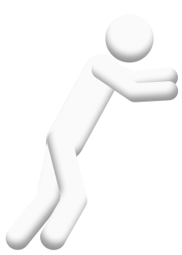




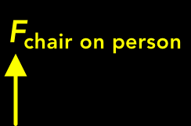
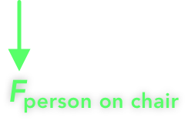





Slide 5














Slide 6











Slide 7

























Slide 8





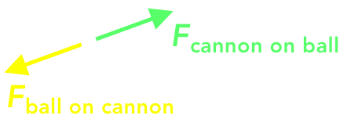





Slide 9









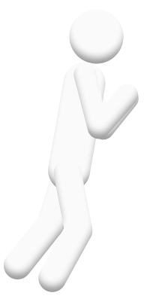
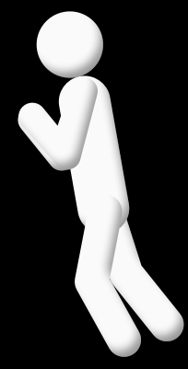



Slide 10
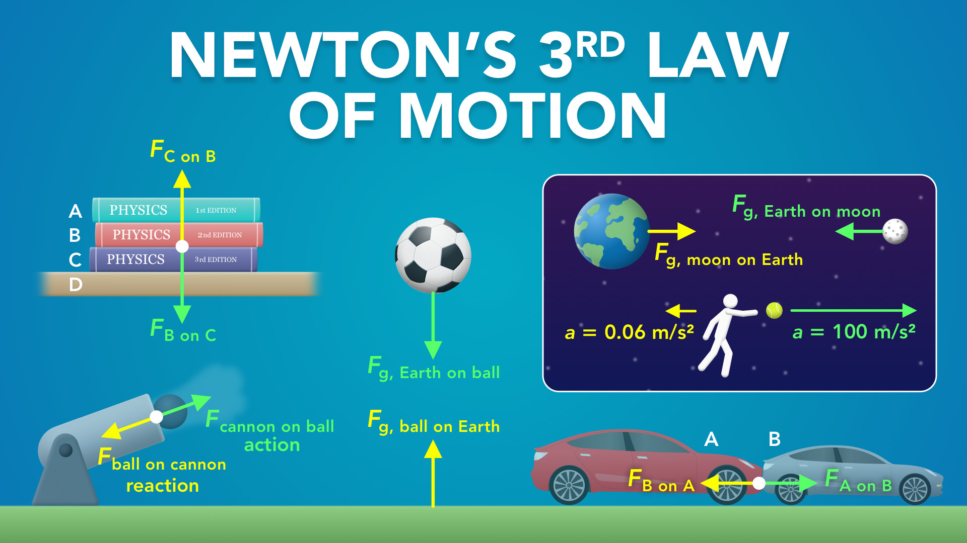
Notes:
Newton’s 3rd Law of Motion
physicslab.app
If you have any questions, suggestions or feedback about these slides please email me at chris@physicslab.app or send me a message on Discord @physicslab.

Slide 11
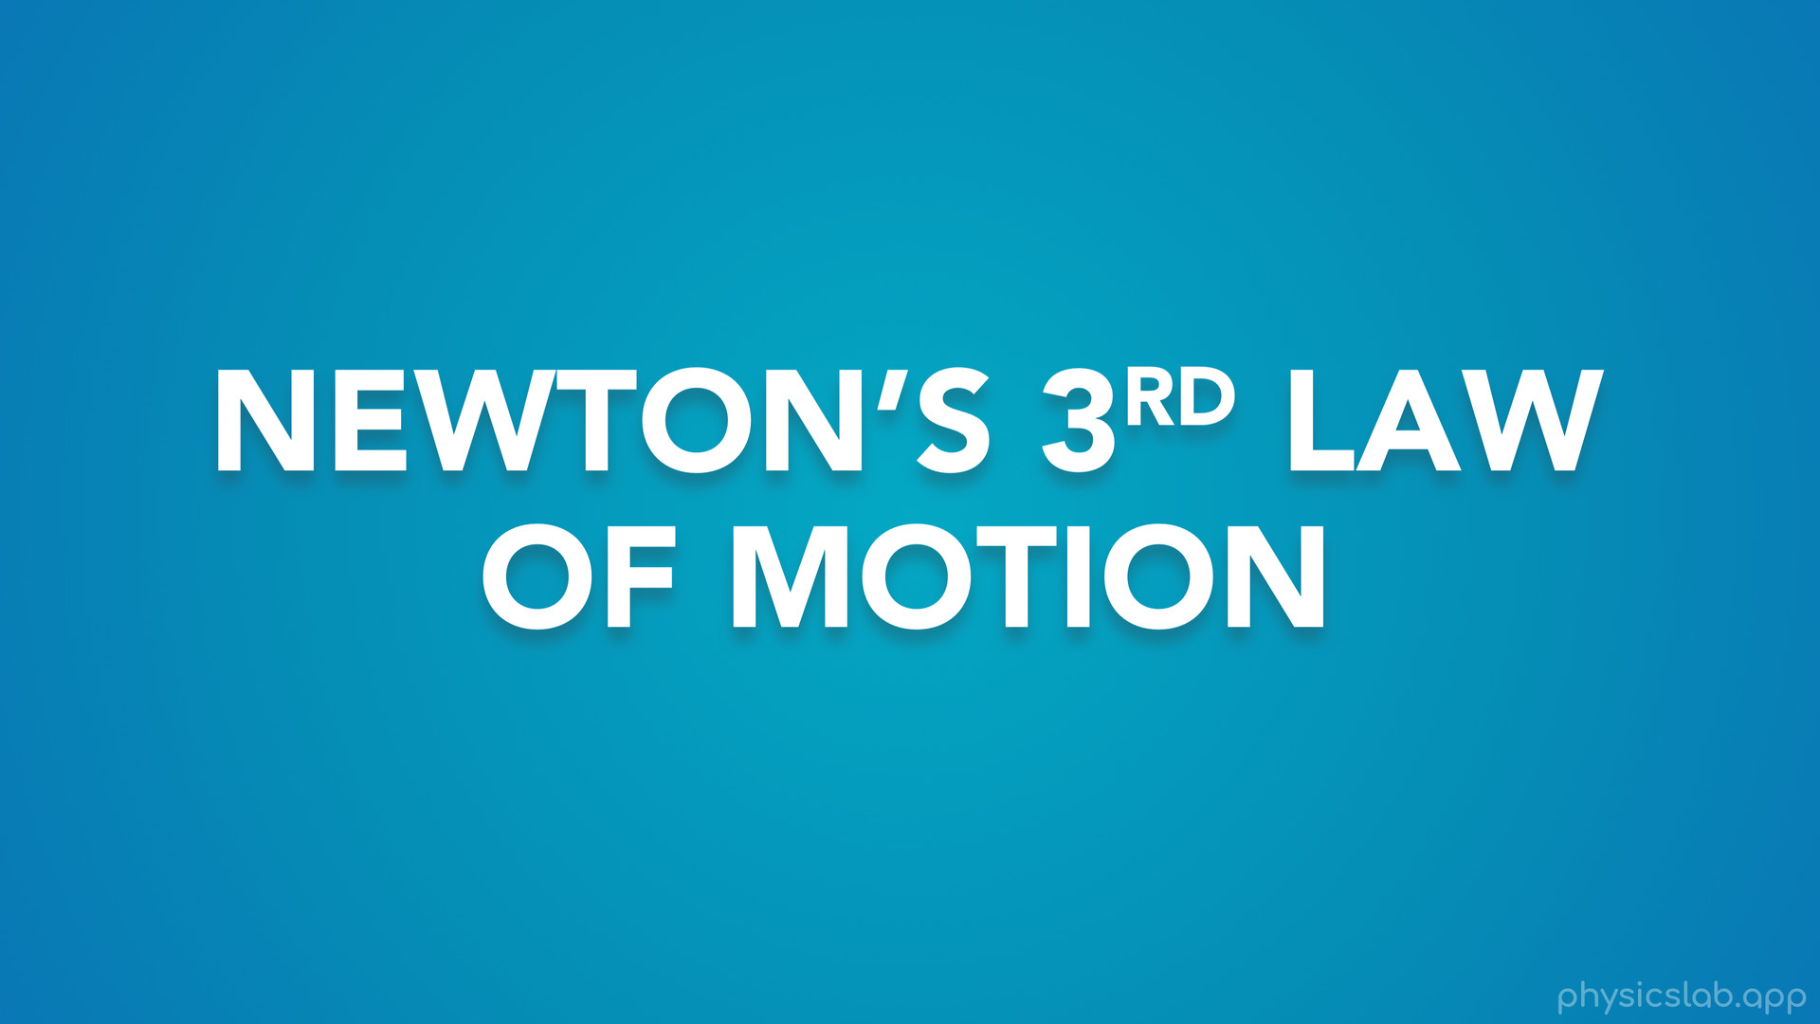
Notes:
• Hey everyone! In this video we’re going to learn about Newton’s 3rd law of motion.

Slide 12
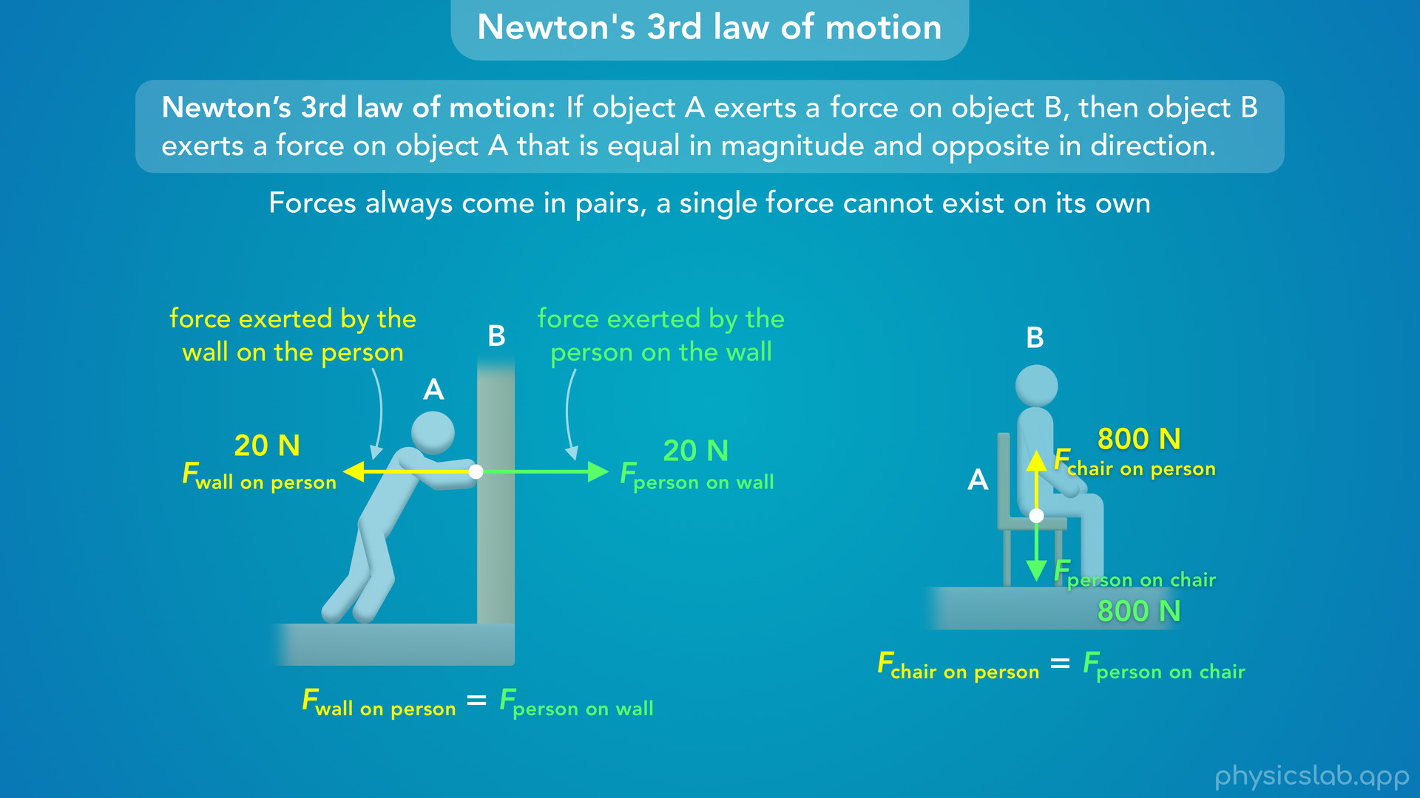
Notes:
• There’s a few different ways to write this law so we’ll start by explaining what the law actually means.

Slide 13
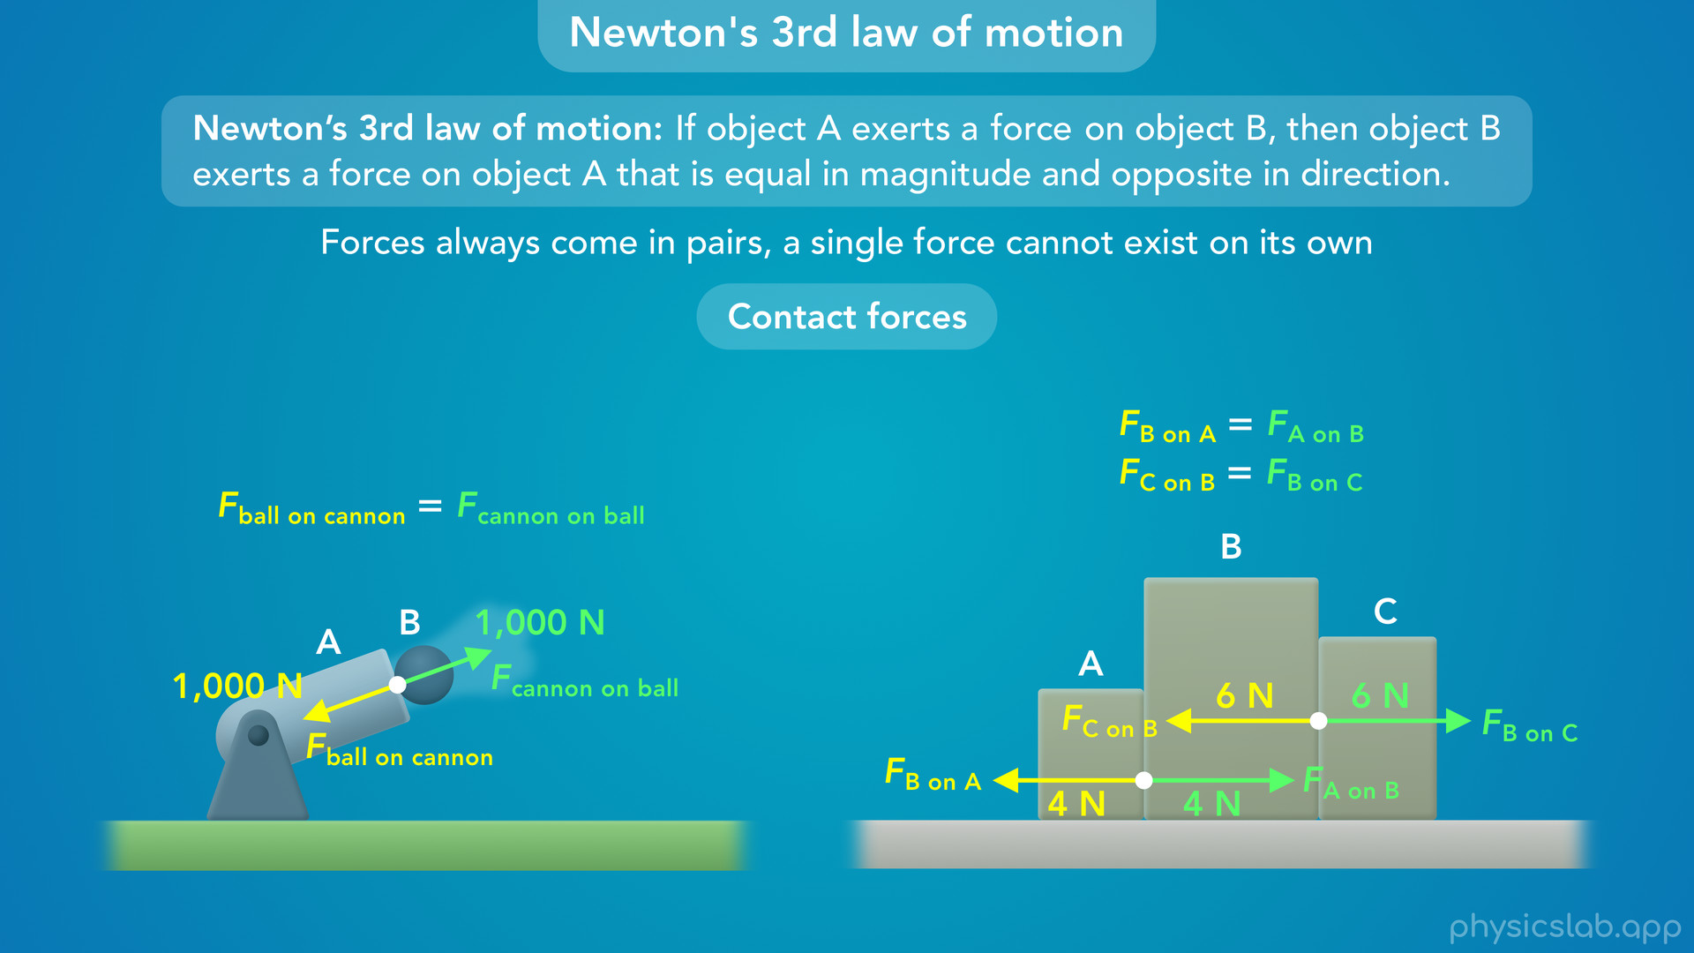
Notes:
• Then, we’ll look at some examples that involve pairs of contact forces.

Slide 14
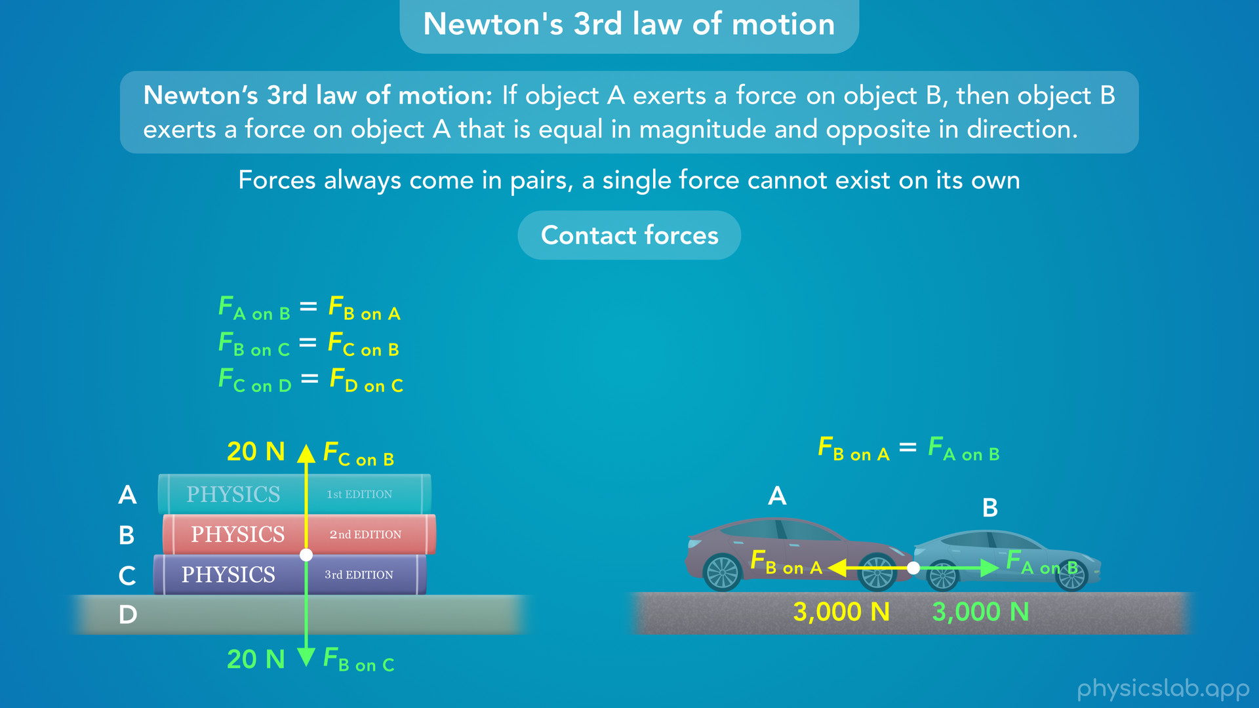

Slide 15
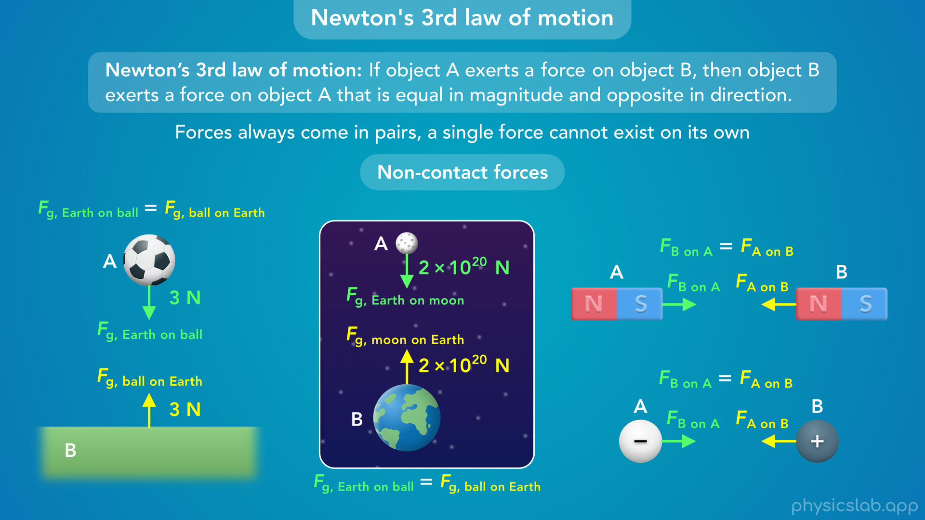
Notes:
• We’ll also look at examples with non-contact forces.

Slide 16
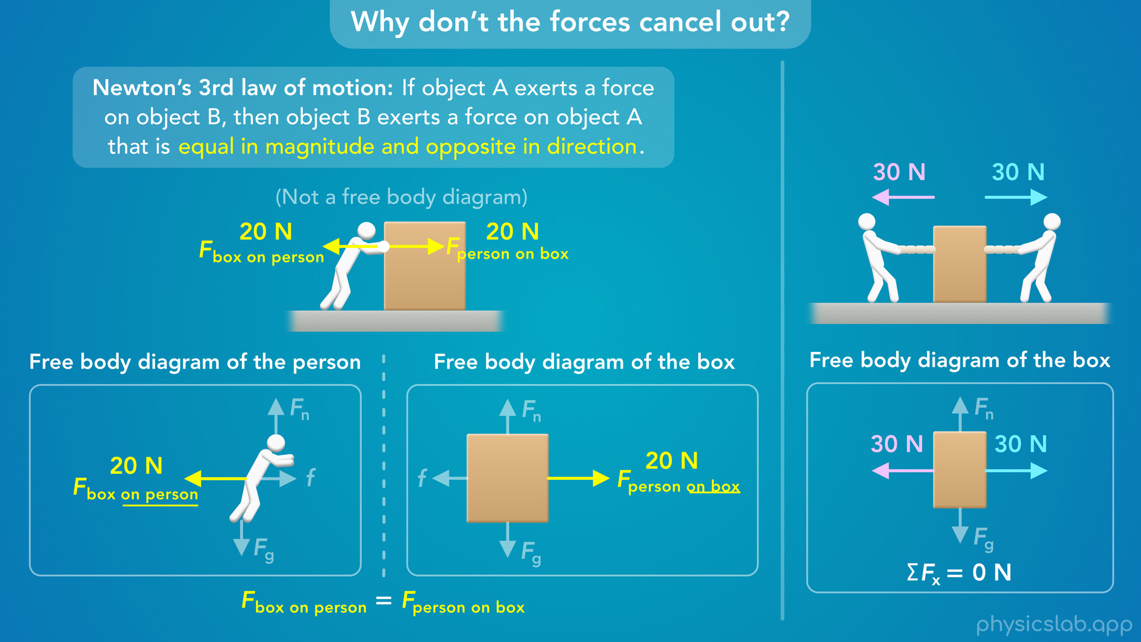
Notes:
• After that, we’ll address some common points of confusion, like where do we draw the forces and why don’t they cancel out...

Slide 17
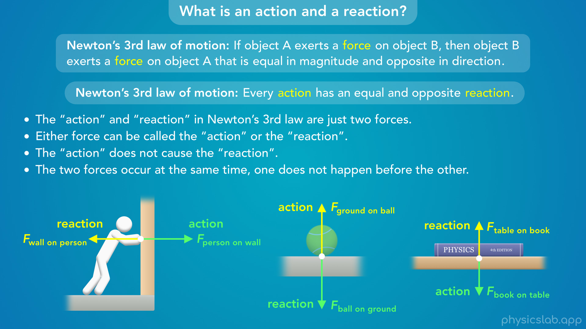
Notes:
• … what do the words “action” and “reaction” mean...

Slide 18
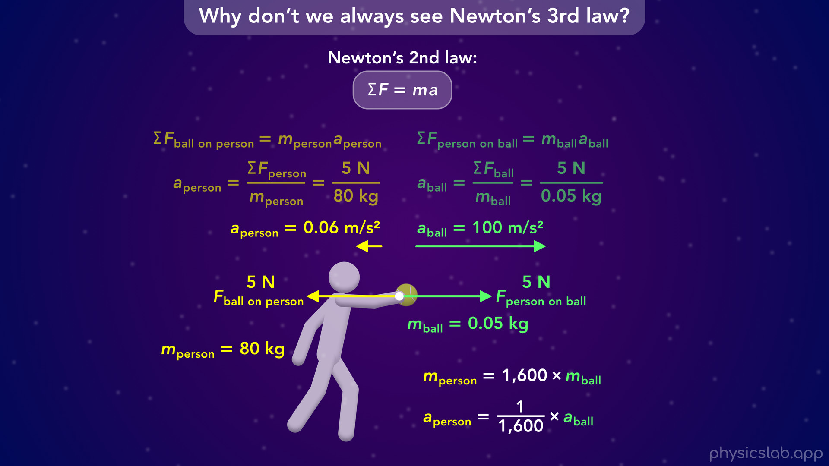
Notes:
• … and why don’t we always see the effects of Newton’s 3rd law.

Slide 19
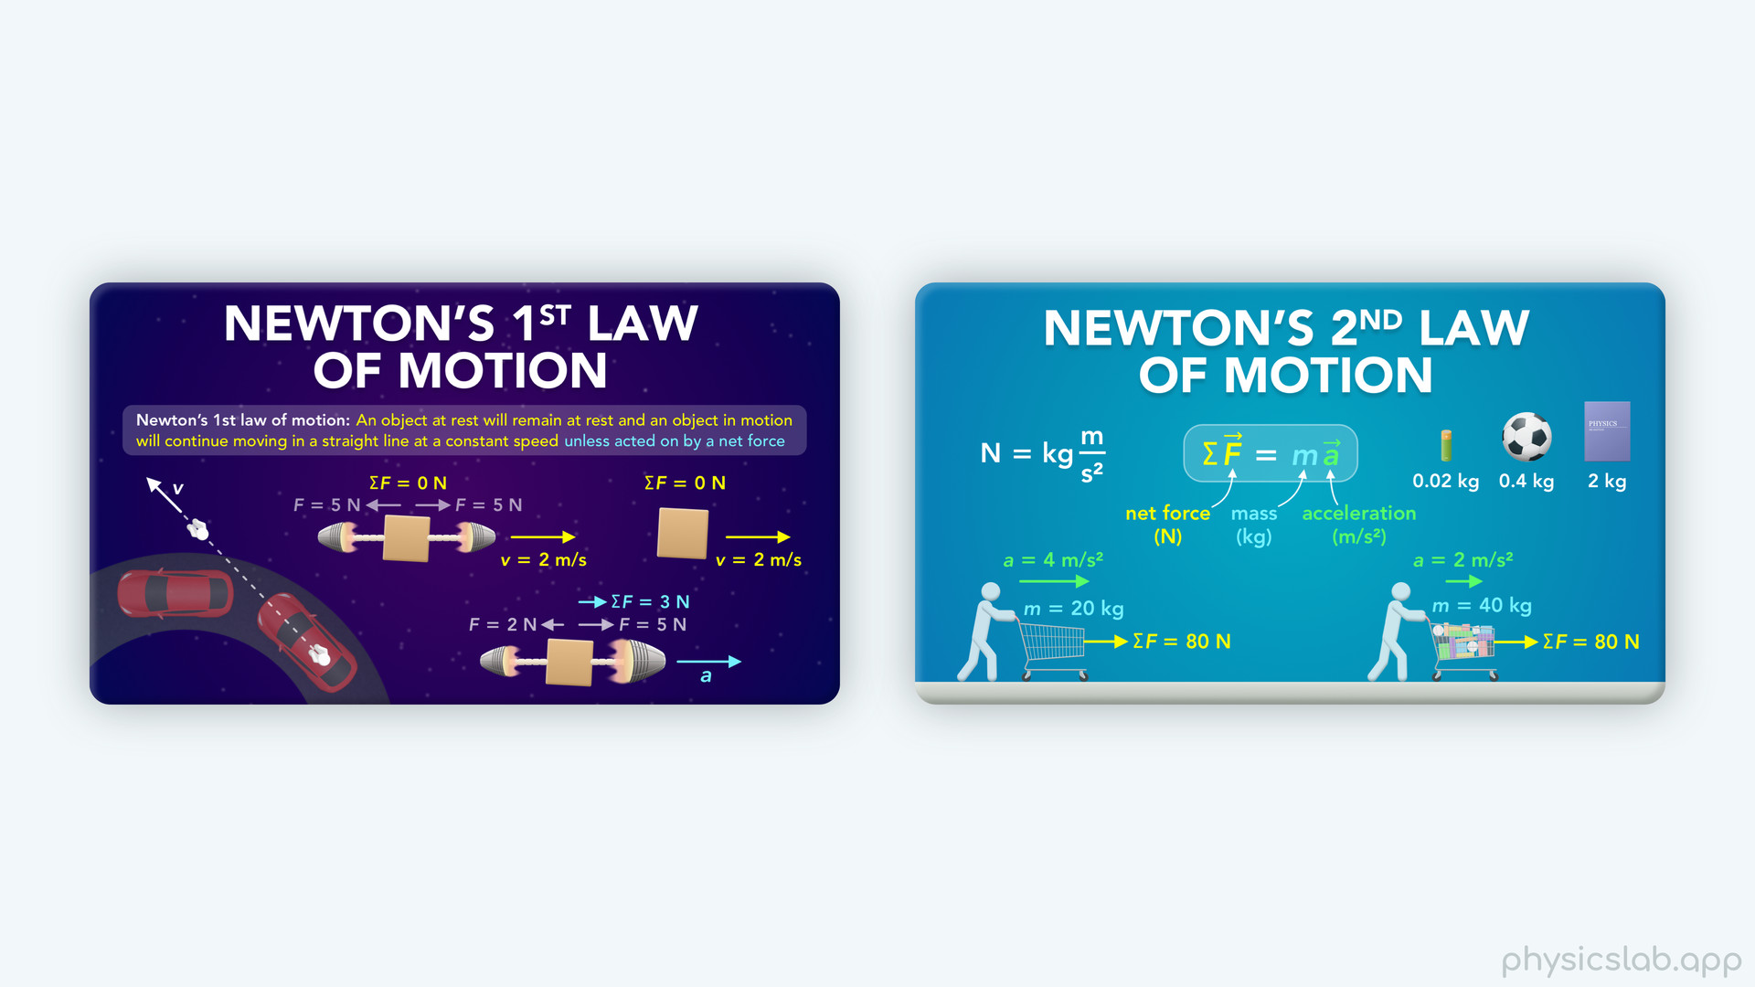
Notes:
• We covered Newton’s 1st and 2nd laws in previous lessons...

Slide 20
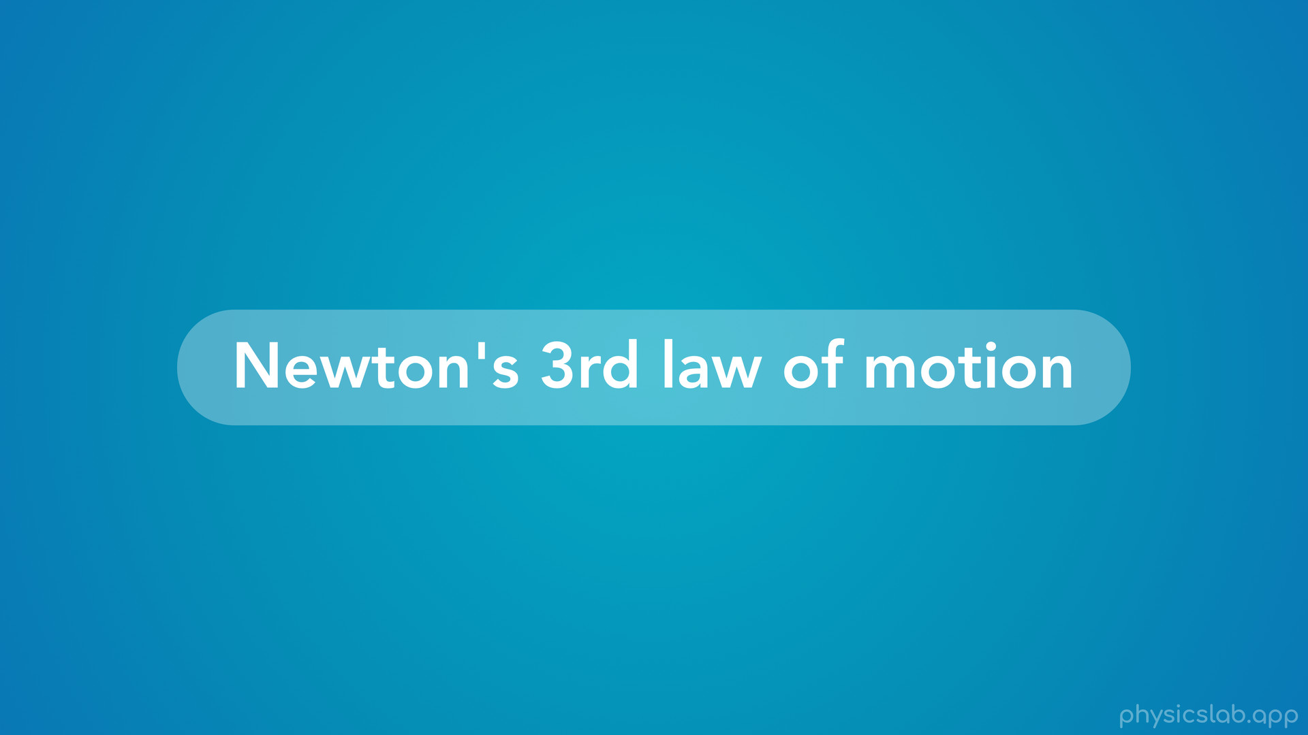
Notes:
• …so now let’s learn about Newton’s 3rd and final law of motion.

Slide 21
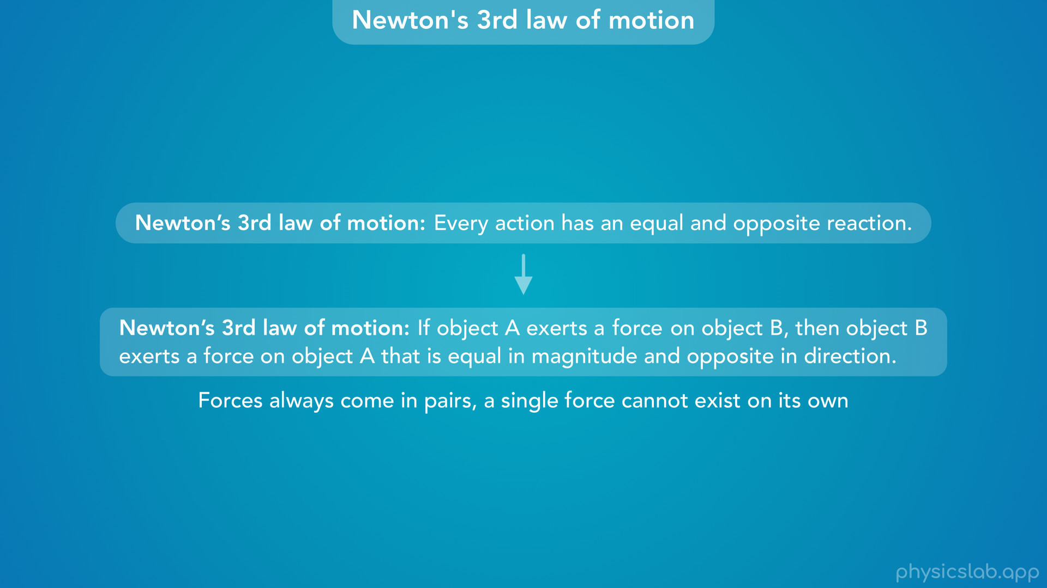
Notes:
• It’s common to see Newton’s 3rd law stated like this: every action has an equal and opposite reaction.
• But this can be confusing, and we’ll come back to that later, but let’s rewrite Newton’s 3rd law like this:
• If object A exerts a force on object B, then object B exerts a force on object A that is equal in magnitude and opposite in direction.
• This means that forces always come in pairs, and a single force cannot exist on its own.

Slide 22
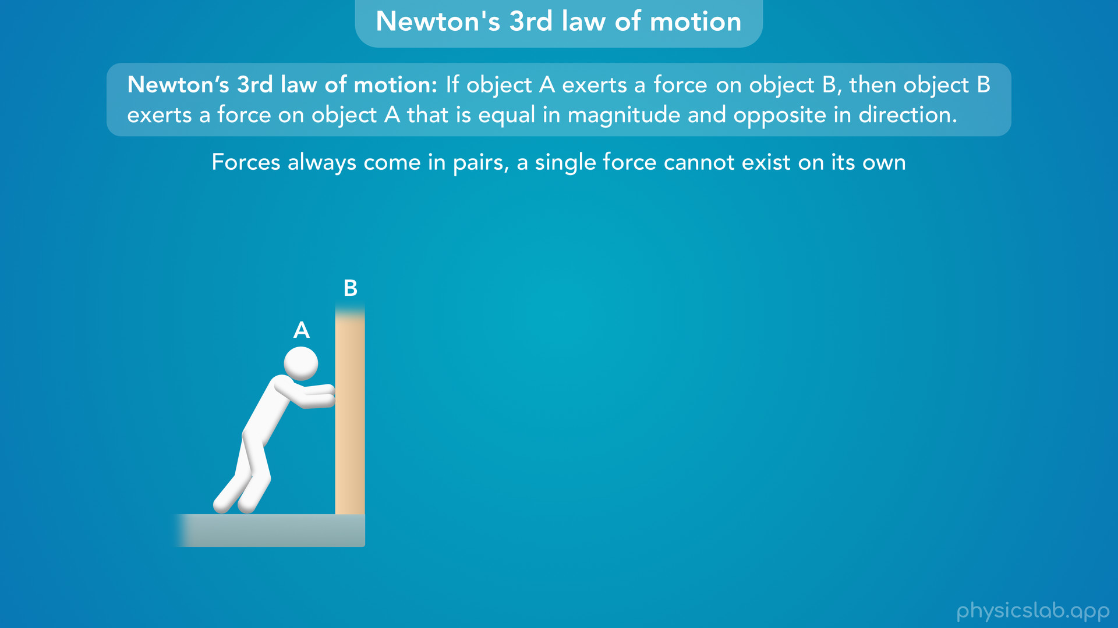
Notes:
• So what does this look like?
• Let’s say you’re leaning against a wall. We’ll call you object A and the wall object B.

Slide 23

Notes:
• If you’re applying or exerting a force on the wall

Slide 24
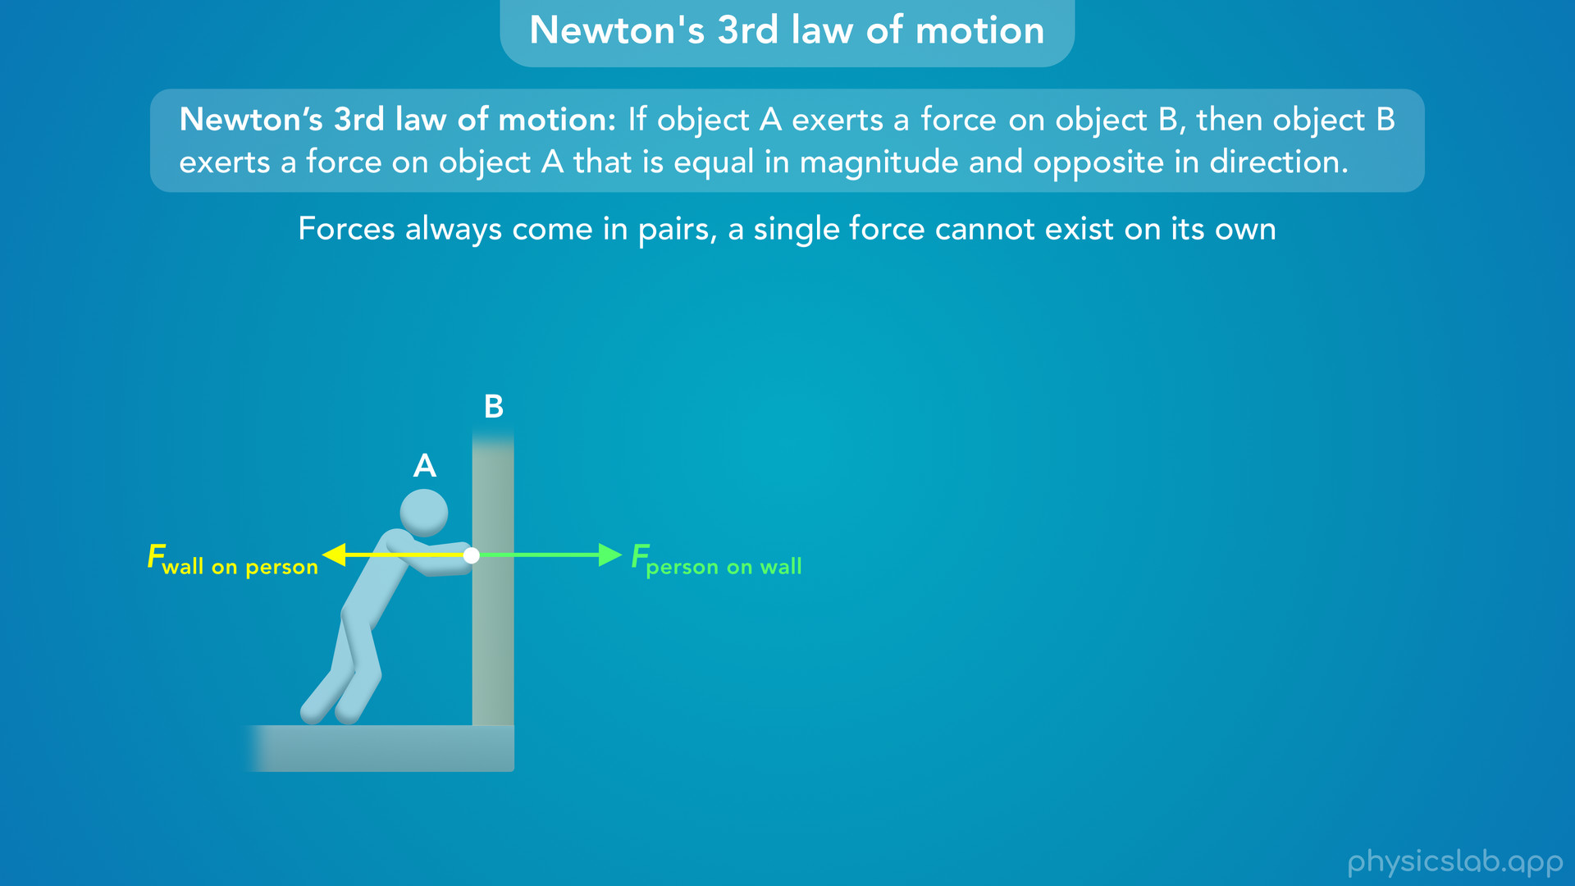
Notes:
then Newton’s 3rd law says that the wall must also be exerting a force back on you with the same magnitude and the opposite direction.

Slide 25
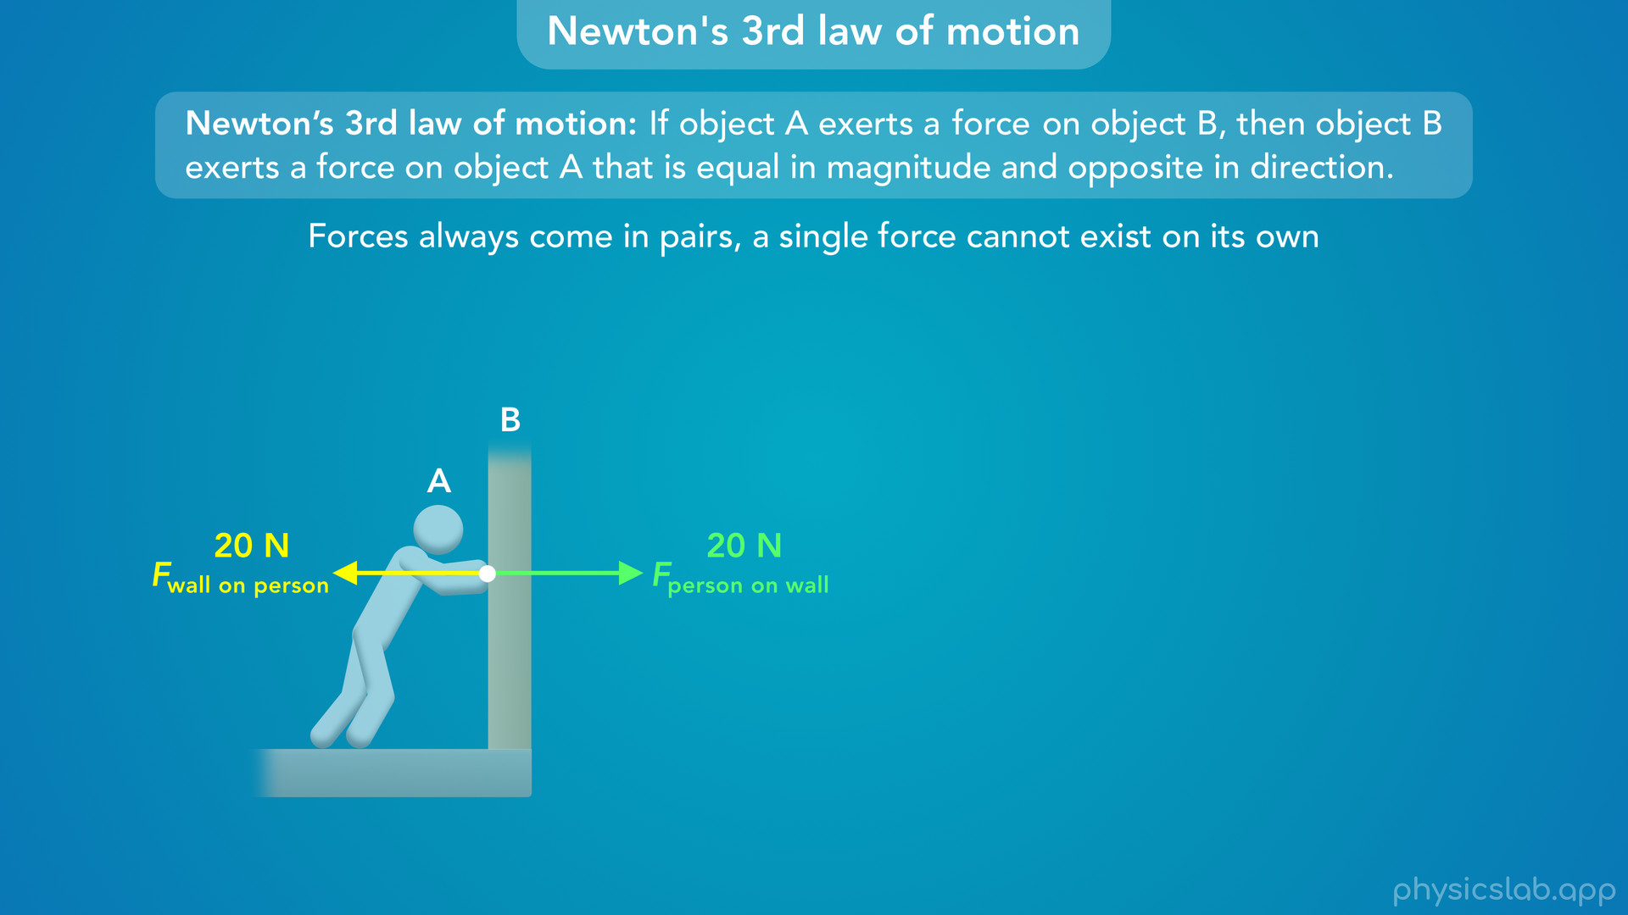
Notes:
• So if you’re pushing on the wall with 20 N of force to the right, then the wall is also pushing on you with 20 N of force to the left.

Slide 26
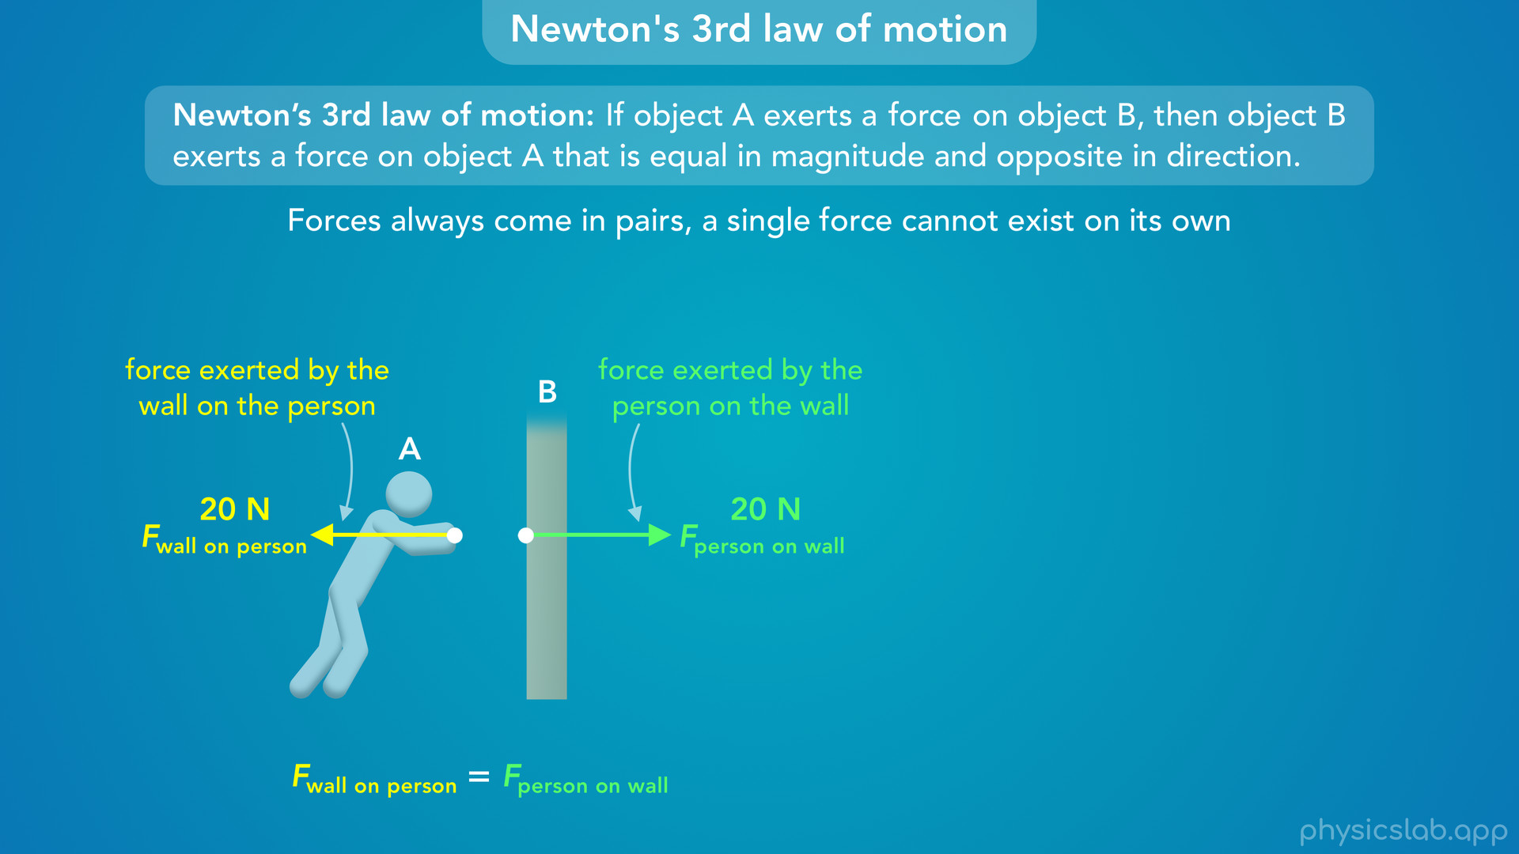
Notes:
• So, we have a pair of forces. One force is acting on the wall, and the other force is acting on you.
• The two forces are equal in magnitude and opposite in direction.

Slide 27
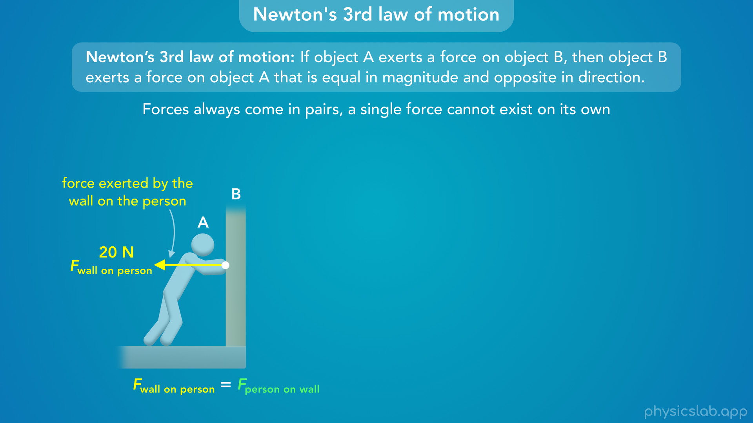
Notes:
• It might be weird to think that the wall is pushing on you

Slide 28
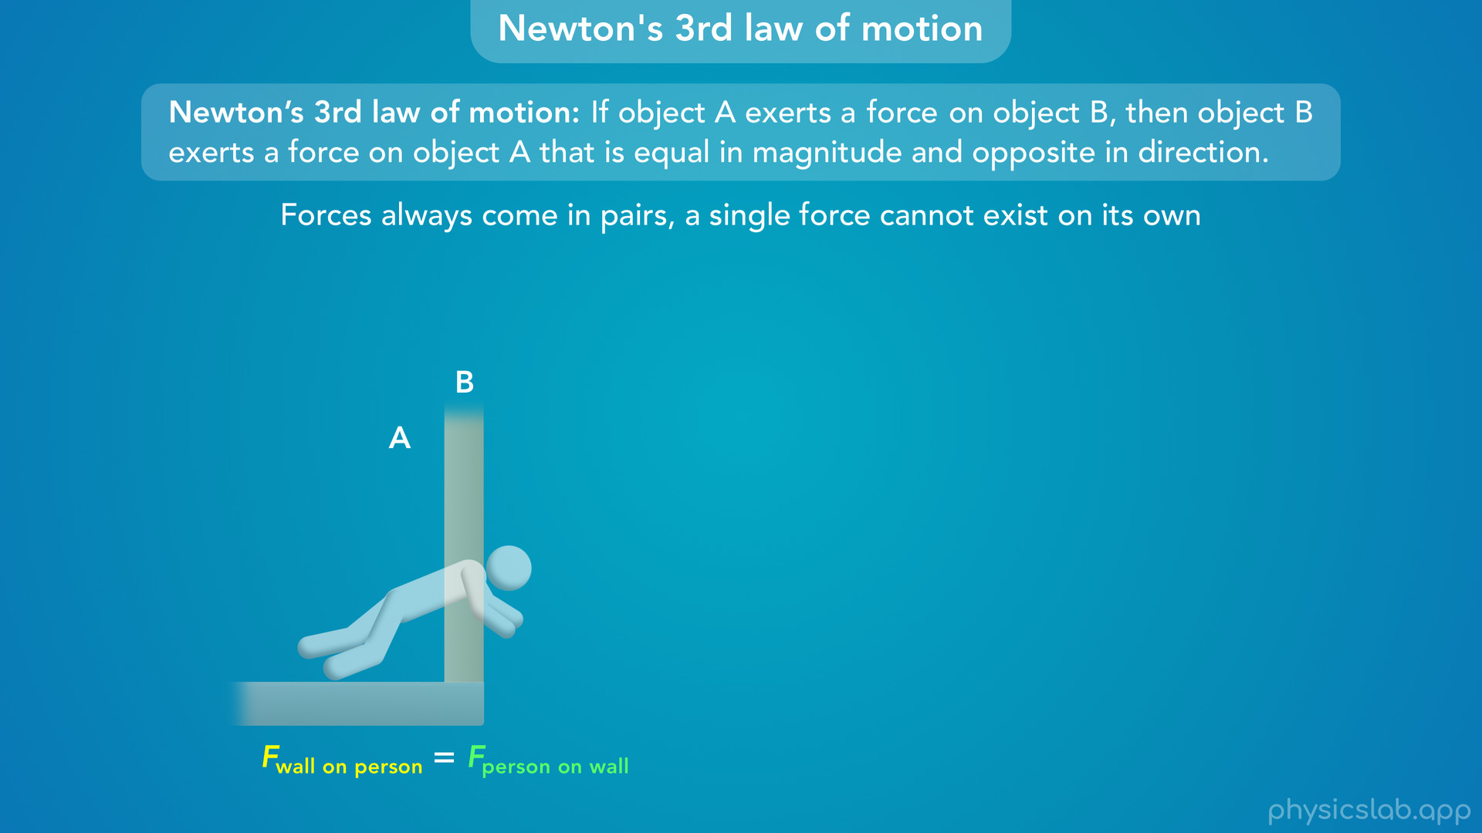
Notes:
but if that force didn’t exist, you would fall right through the wall.

Slide 29
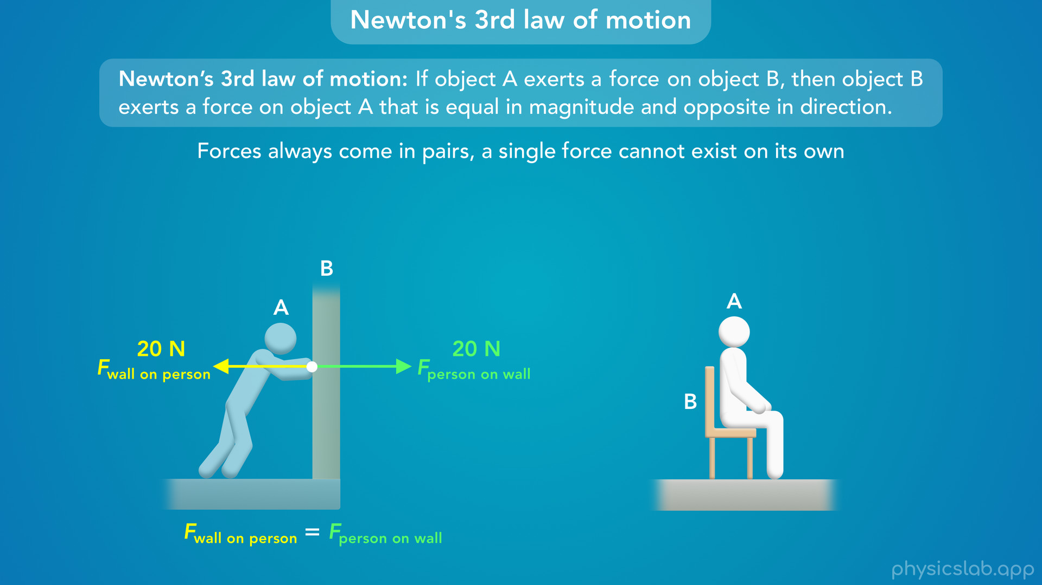
Notes:
• Here’s another example.
• When you’re sitting in a chair

Slide 30
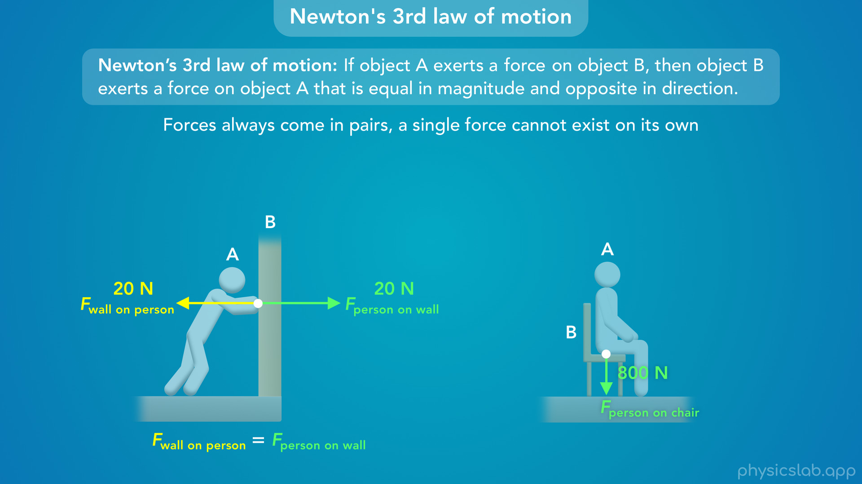
Notes:
you’re exerting a downwards force on the chair

Slide 31
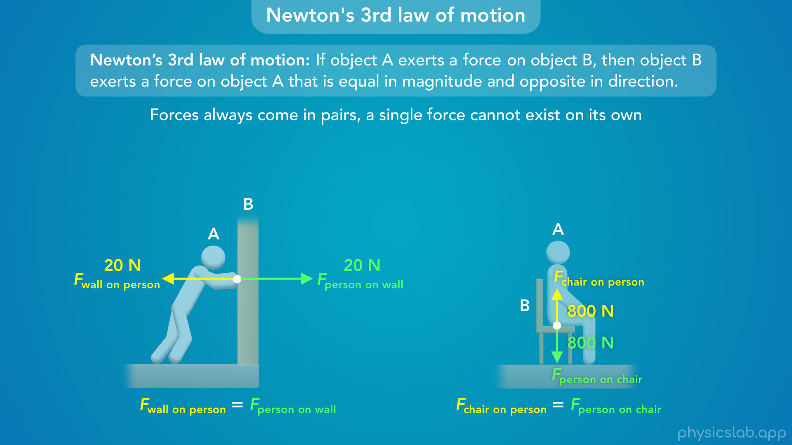
Notes:
and the chair is exerting an upwards force on you with the same magnitude. Again, if that force didn’t exist, you would fall through the chair.

Slide 32
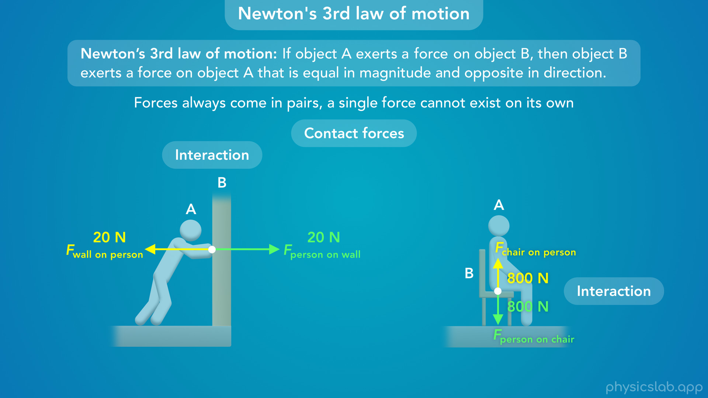
Notes:
• These are examples of contact forces which exist when two objects are in contact with each other.
• Also, these pairs of forces only exist during the interaction between you and the wall or between you and the chair.

Slide 33
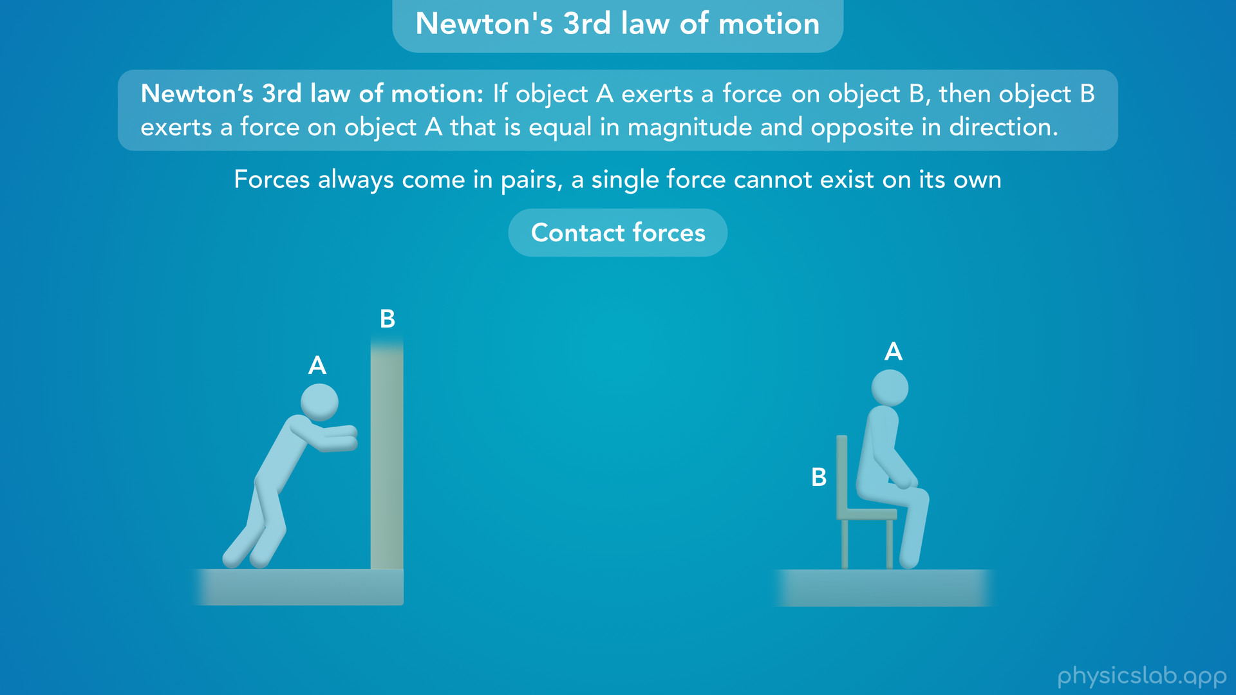
Notes:
• As soon as you lose contact, there’s no longer an interaction so these forces disappear...

Slide 34
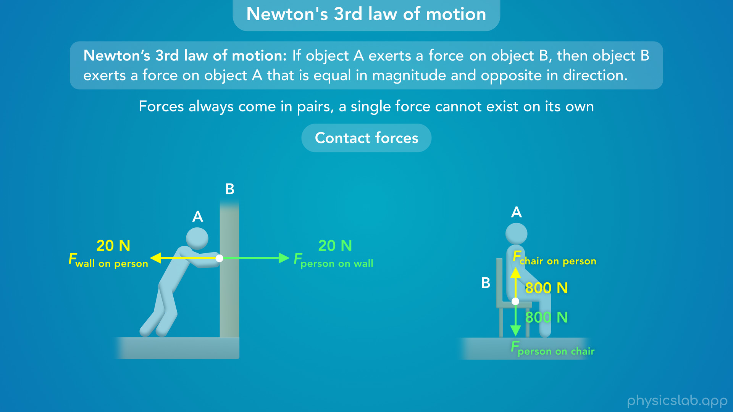
Notes:
• …and they reappear the moment you’re in contact again.

Slide 35
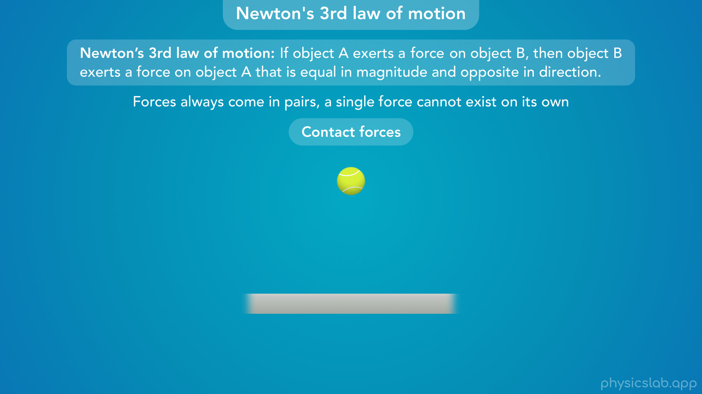
Notes:
• Let’s look at some more examples of contact forces.

Slide 36
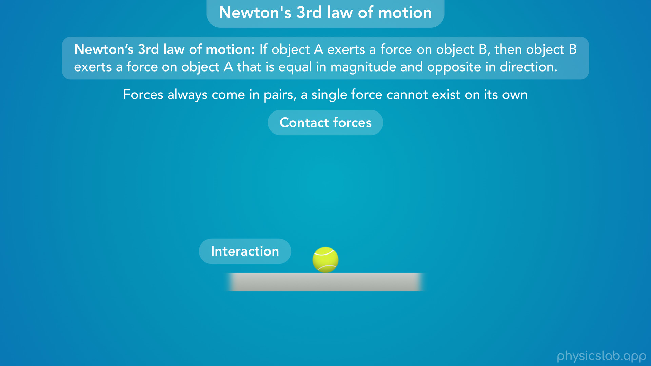
Notes:
• Every time this ball hits the ground there’s an interaction.

Slide 37
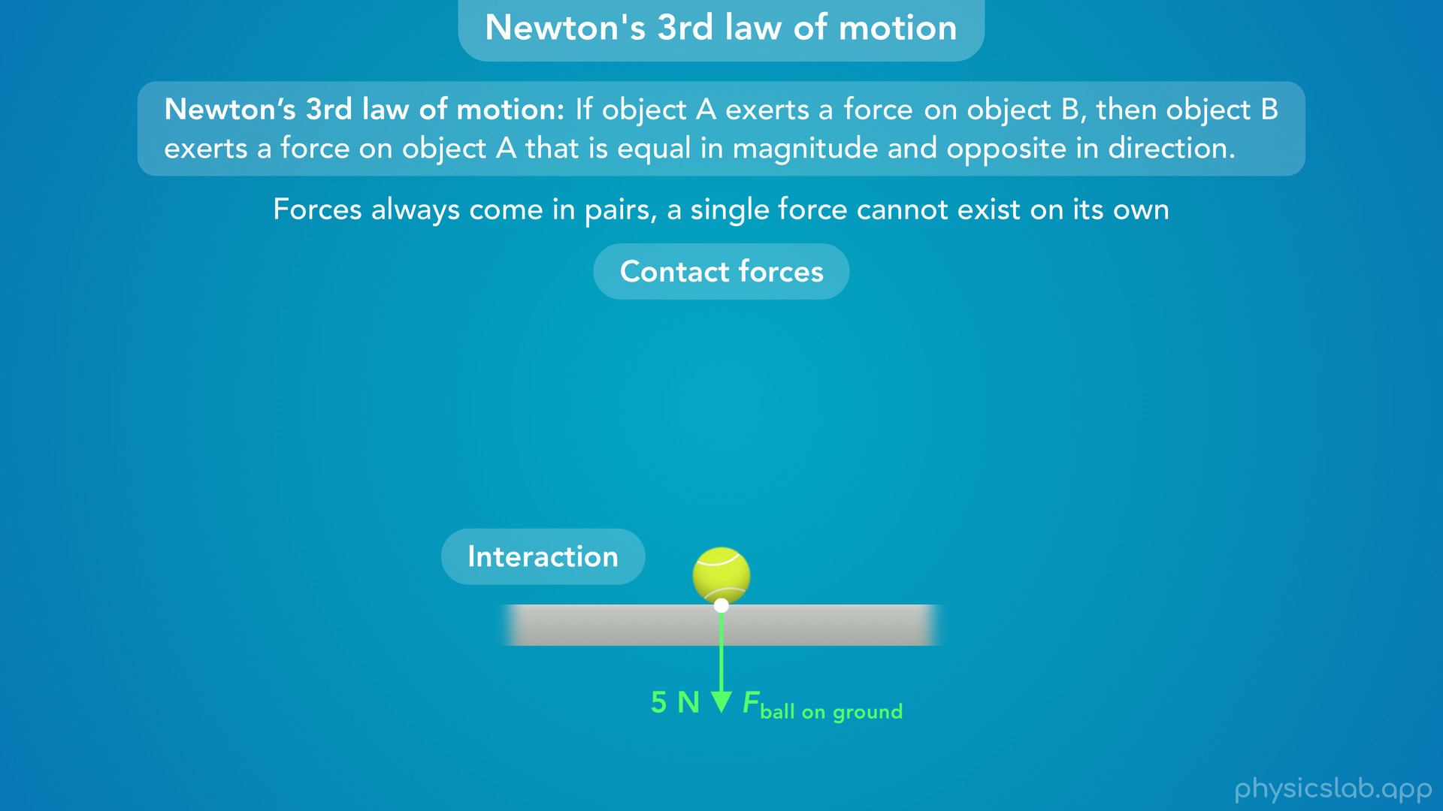
Notes:
• The ball exerts a downwards force on the ground...

Slide 38
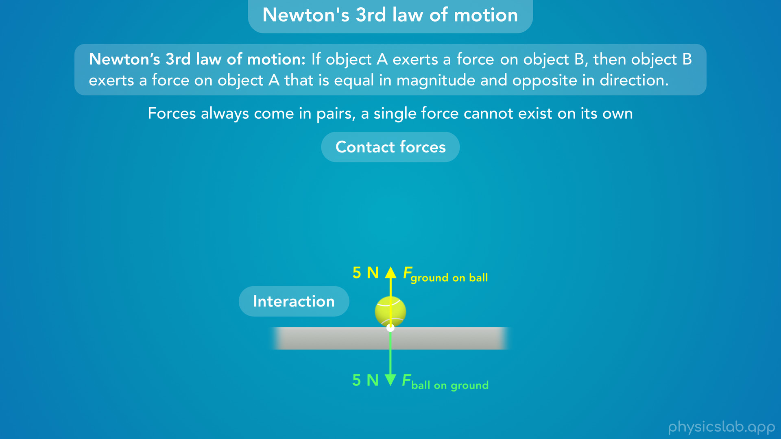
Notes:
• …and the ground exerts an upwards force on the ball with the same magnitude.
• Again, this pair of forces only exists during the interaction between the ball and the ground

Slide 39
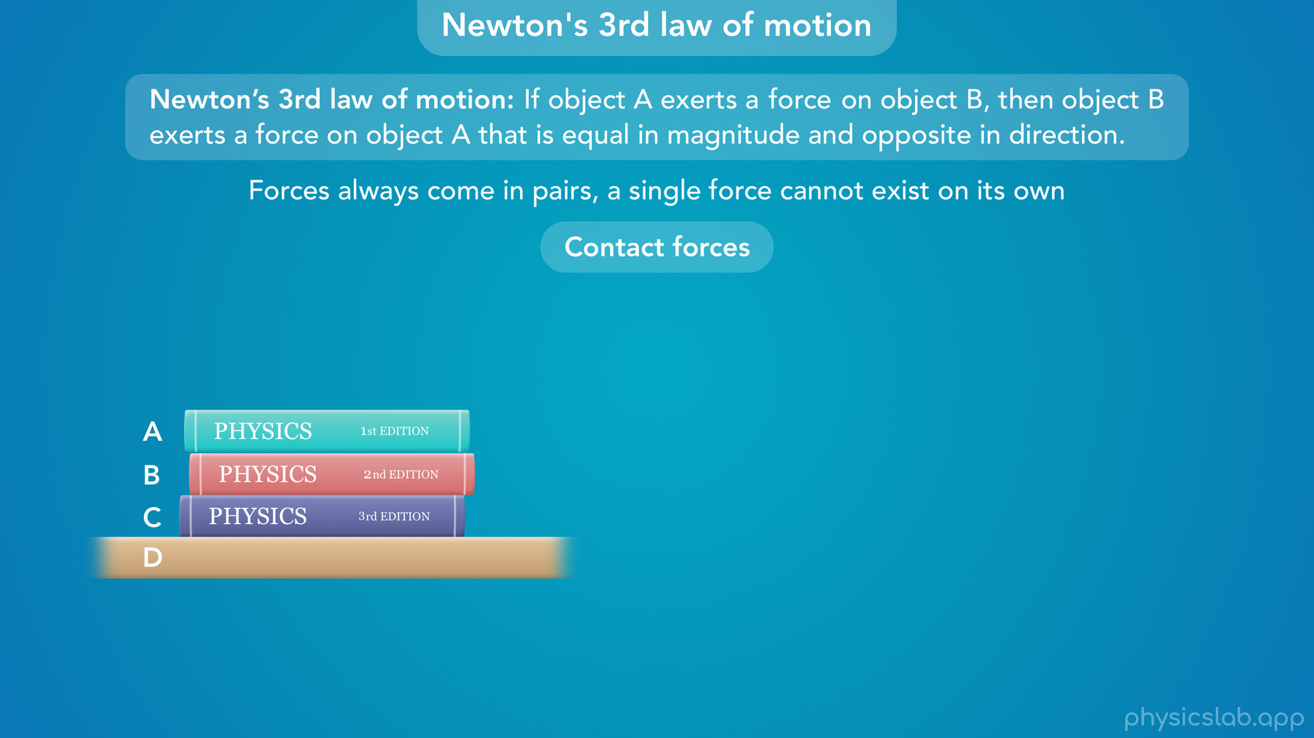
Notes:
• If we have a stack of books on a table, there’s an interaction between each pair of objects that are in contact with each other.

Slide 40
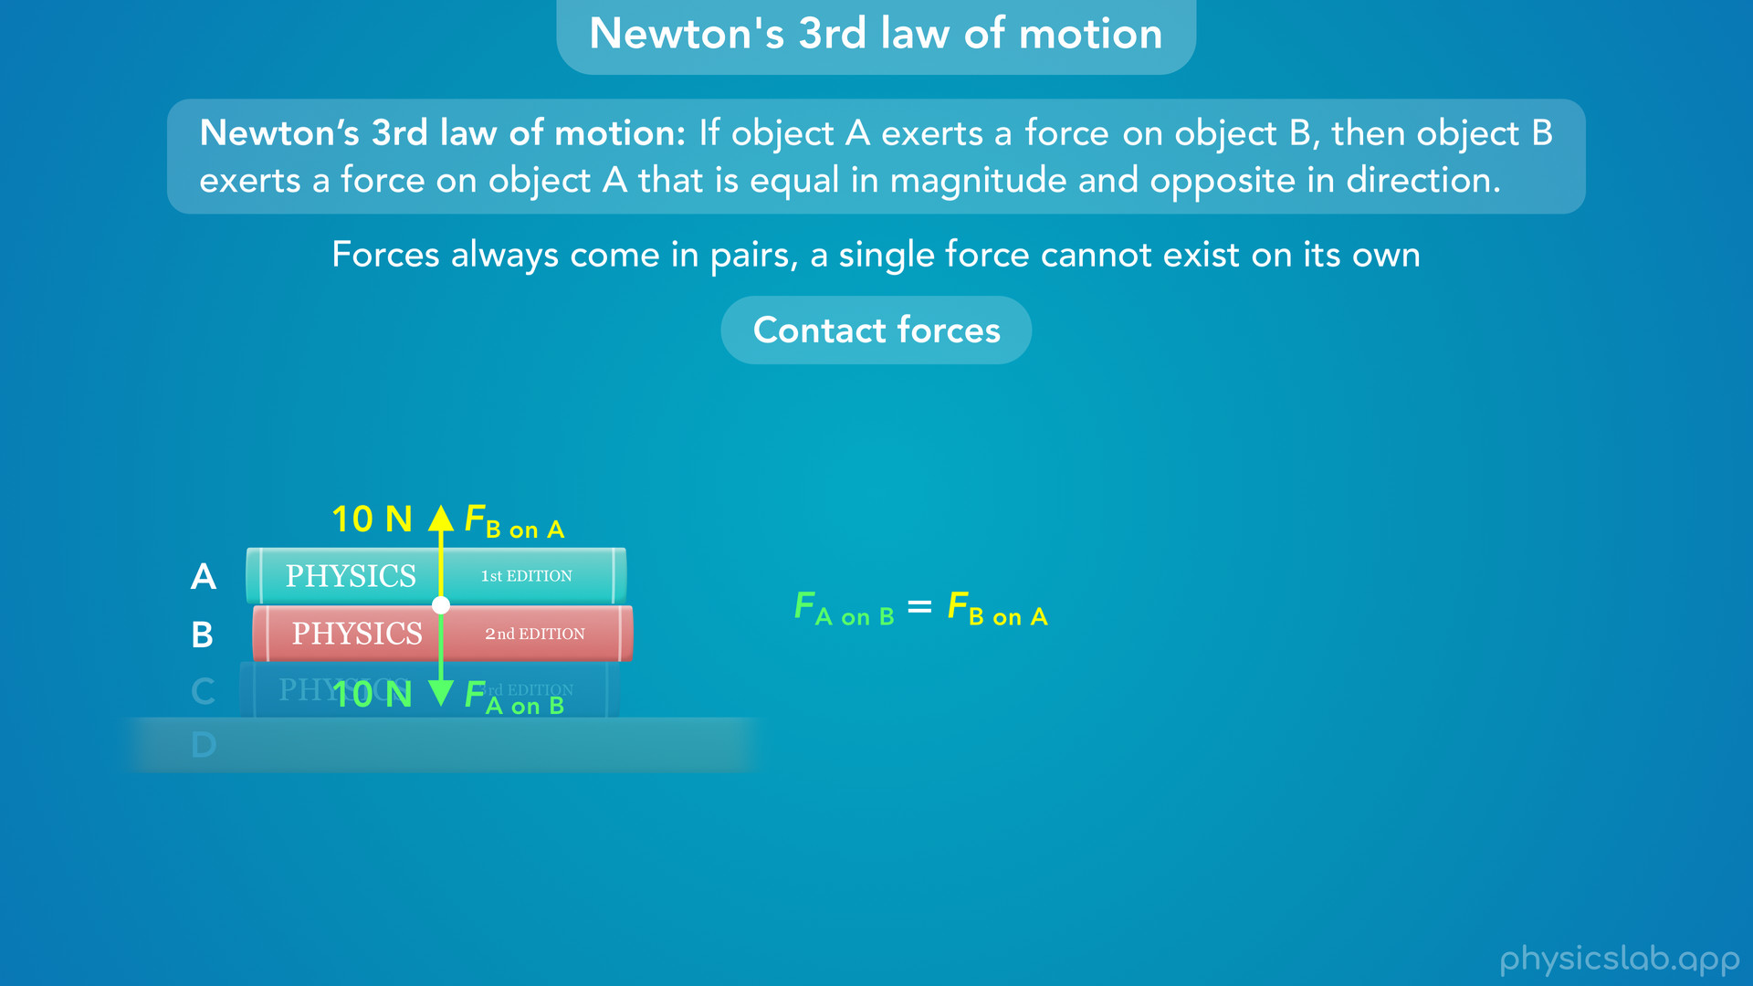
Notes:
• The force exerted by object A on object B is equal and opposite to the force exerted by object B on object A.

Slide 41
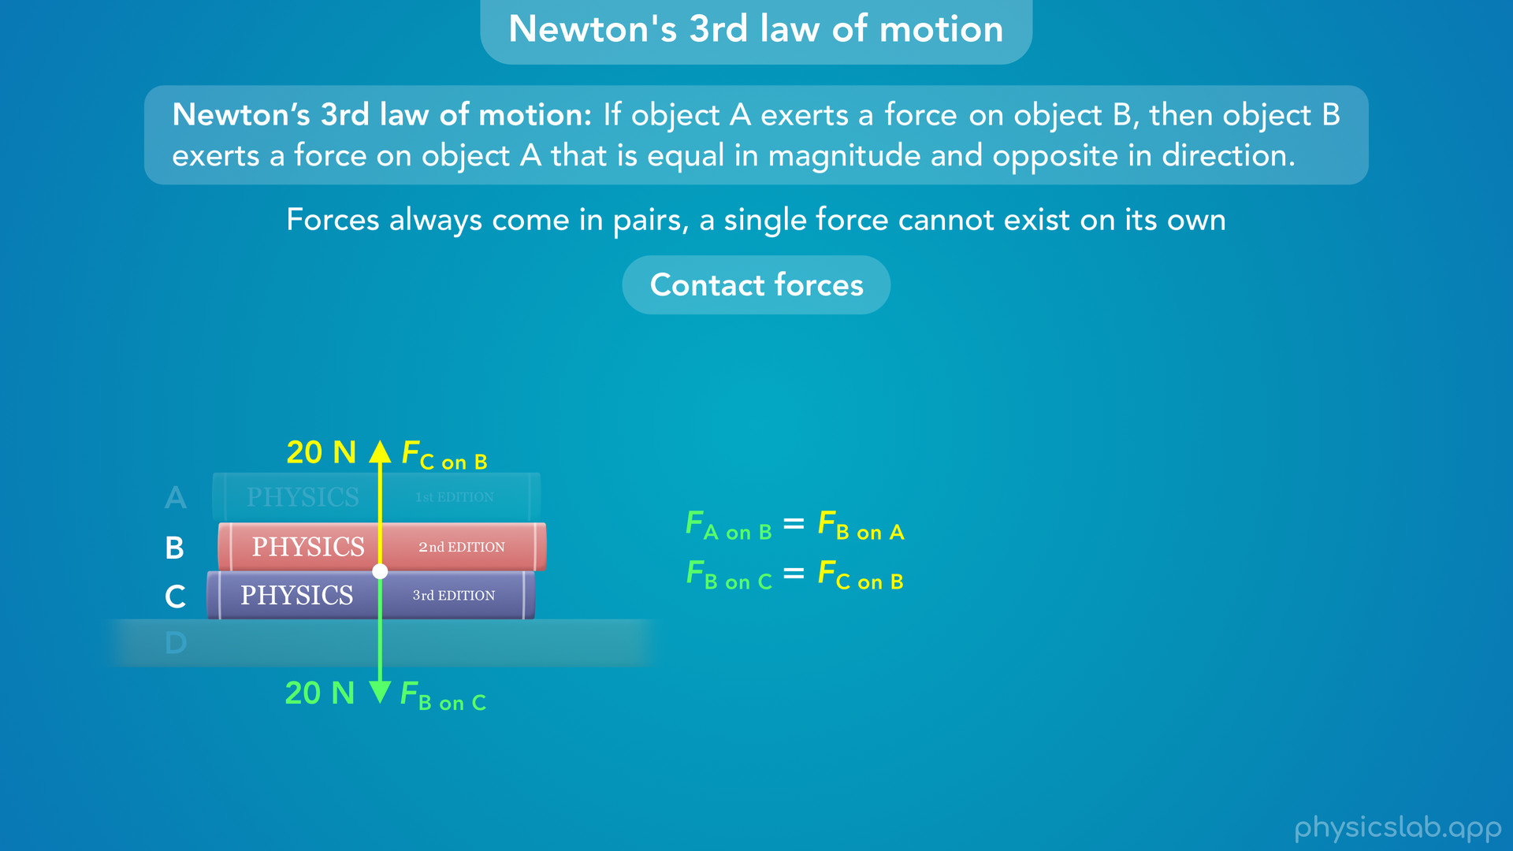
Notes:
• Separately, there are equal and opposite forces between objects B and C

Slide 42
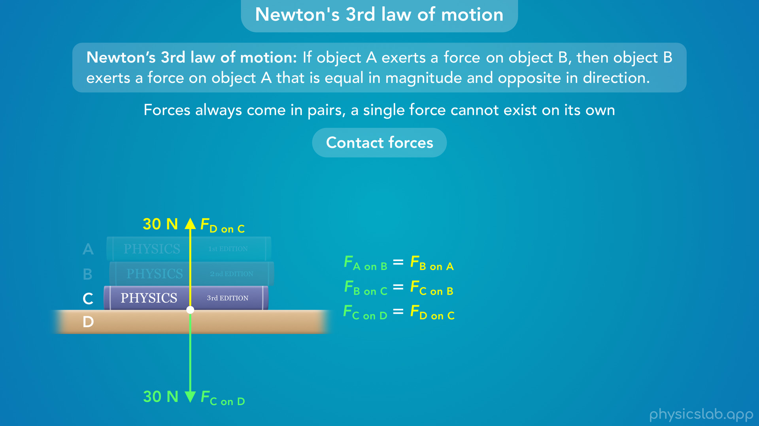
Notes:
and between objects C and D.

Slide 43
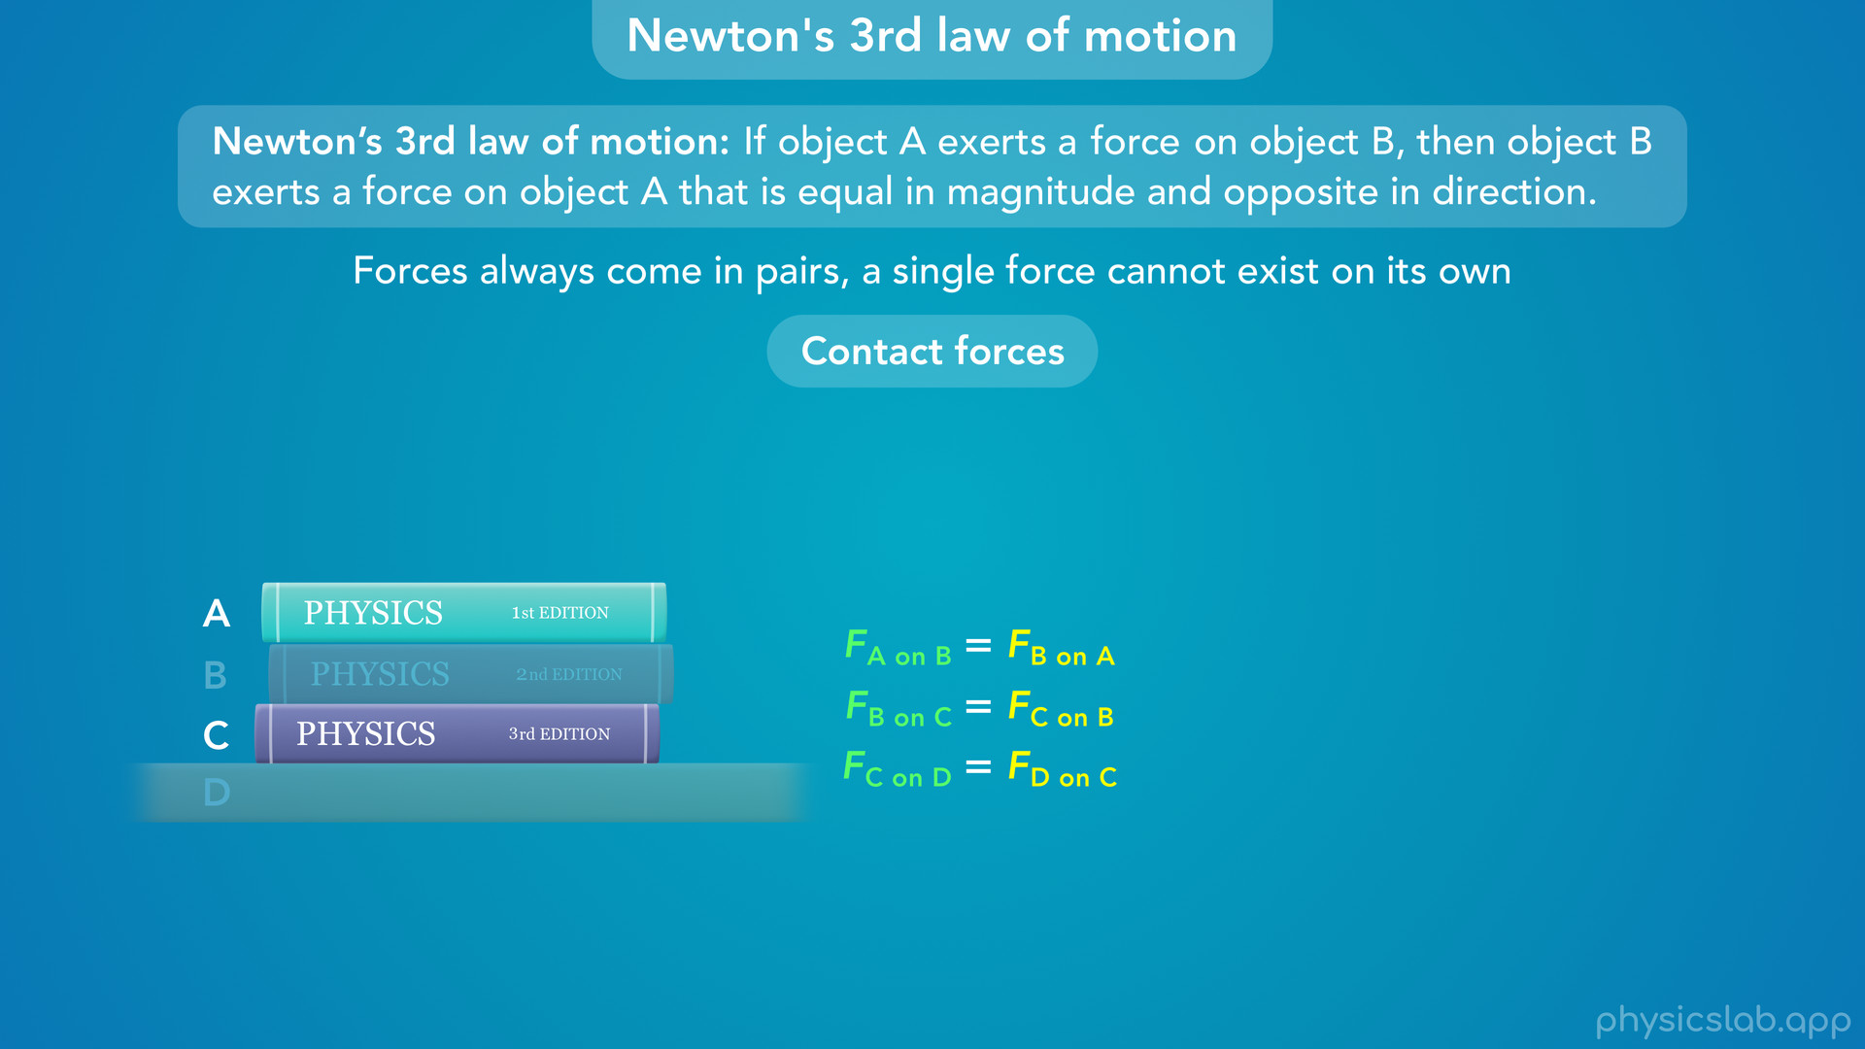
Notes:
• But there’s no forces between objects A and C for example, because they’re not in direct contact.

Slide 44
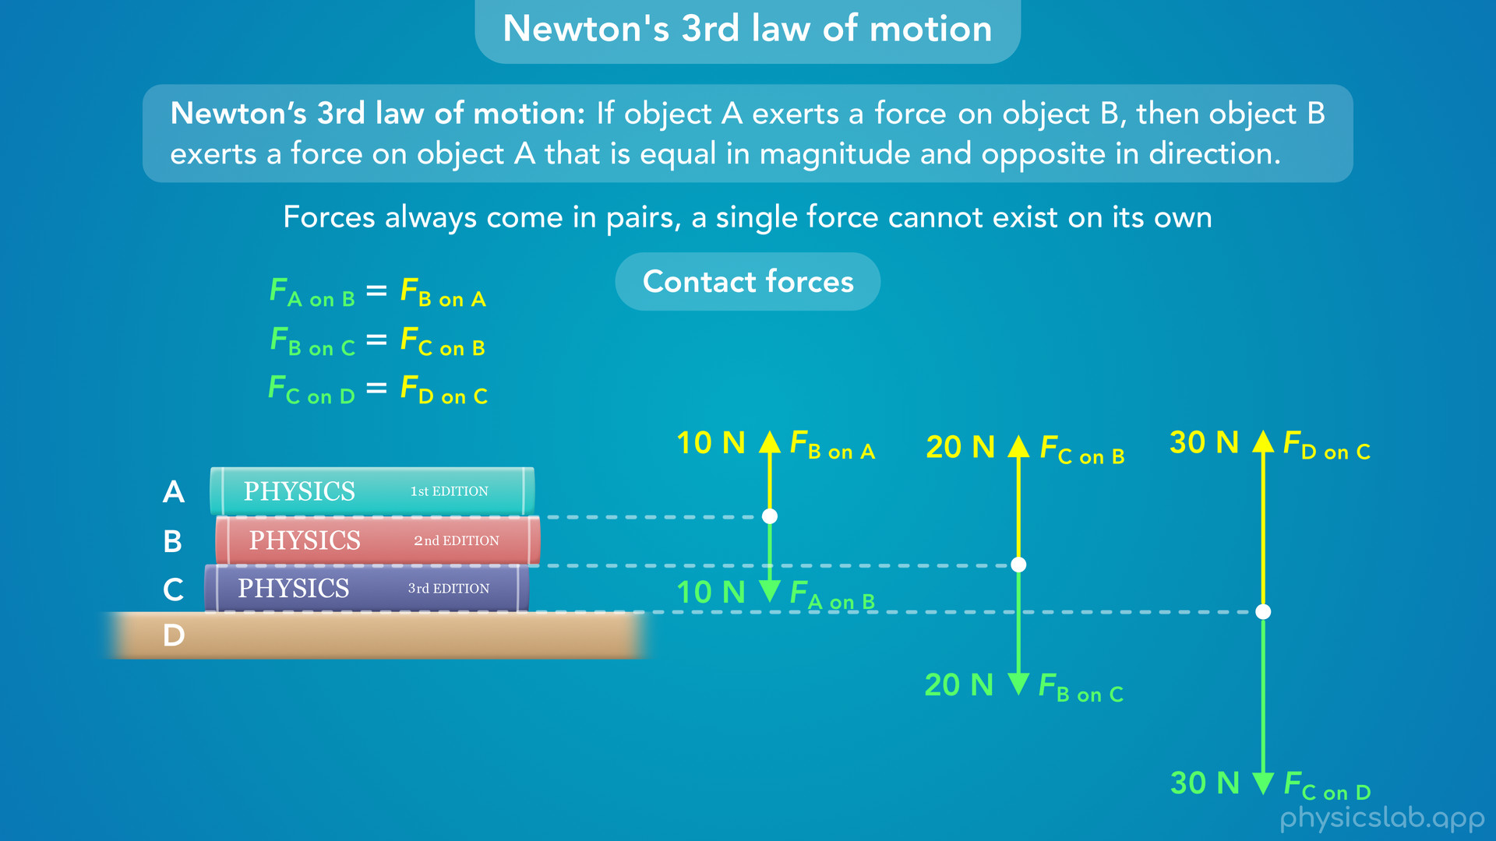
Notes:
• So we have 4 objects and 3 different pairs of forces.

Slide 45
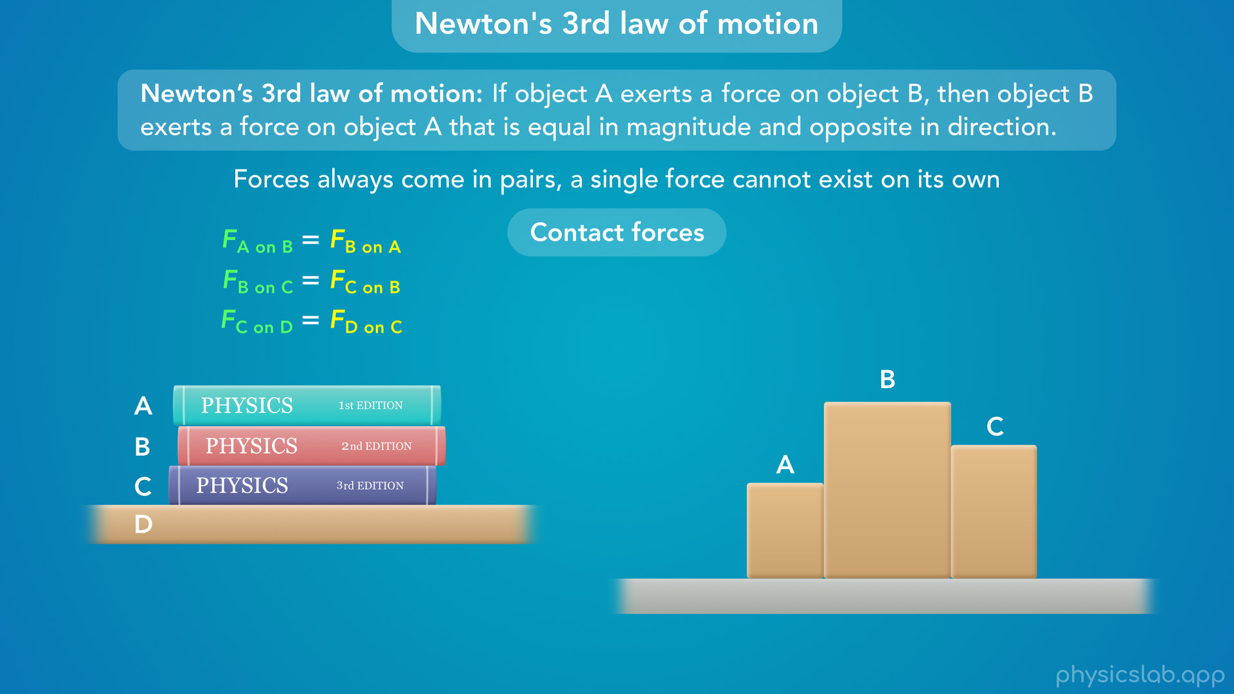
Notes:
• If we had a group of blocks that were pushed together

Slide 46
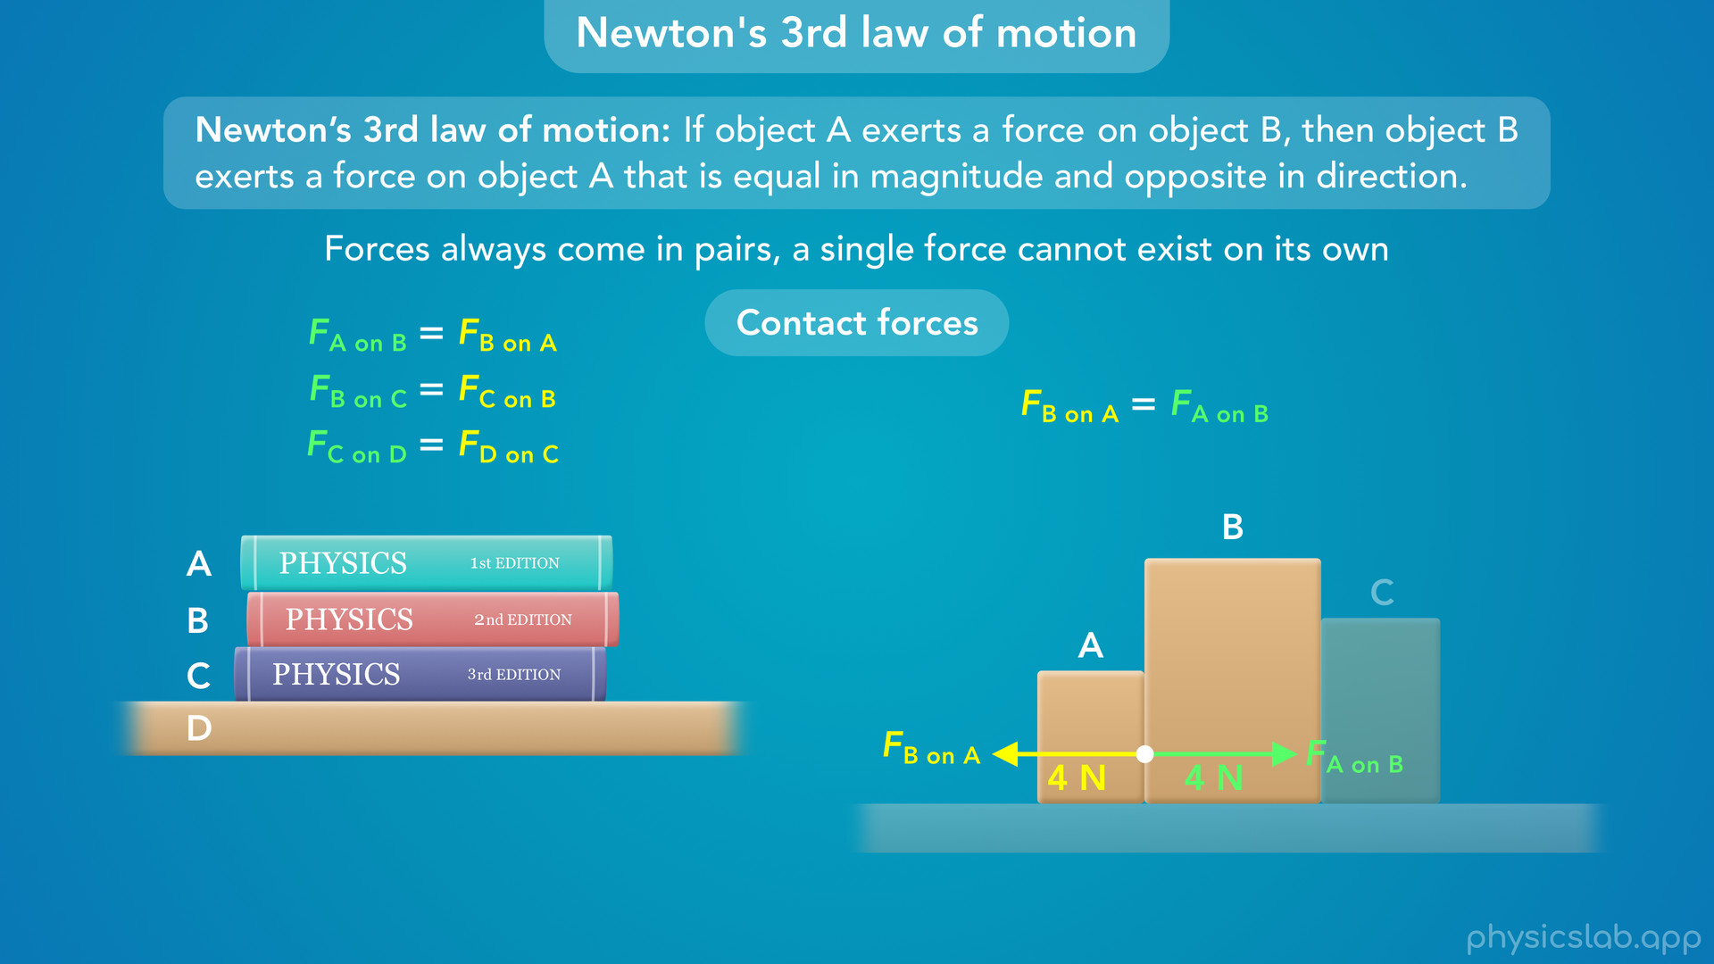
Notes:
blocks A and B would exert equal and opposite forces on each other.

Slide 47
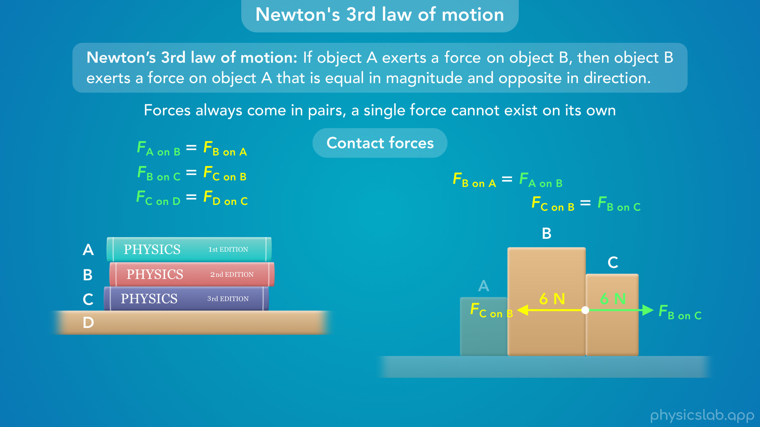
Notes:
• And separately, blocks B and C would exert equal and opposite forces on each other.

Slide 48
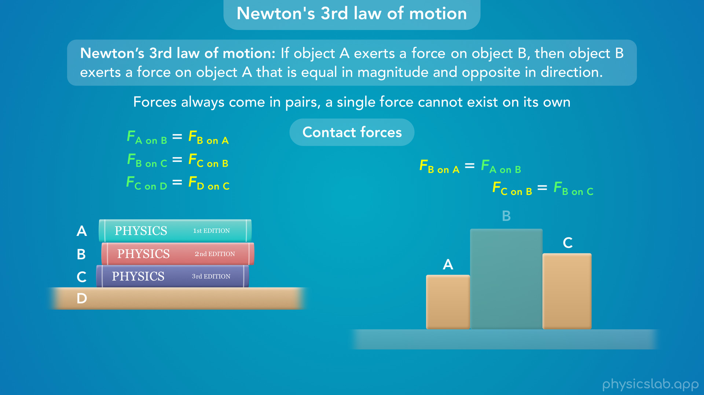
Notes:
• But blocks A and C do not exert forces on each other.

Slide 49
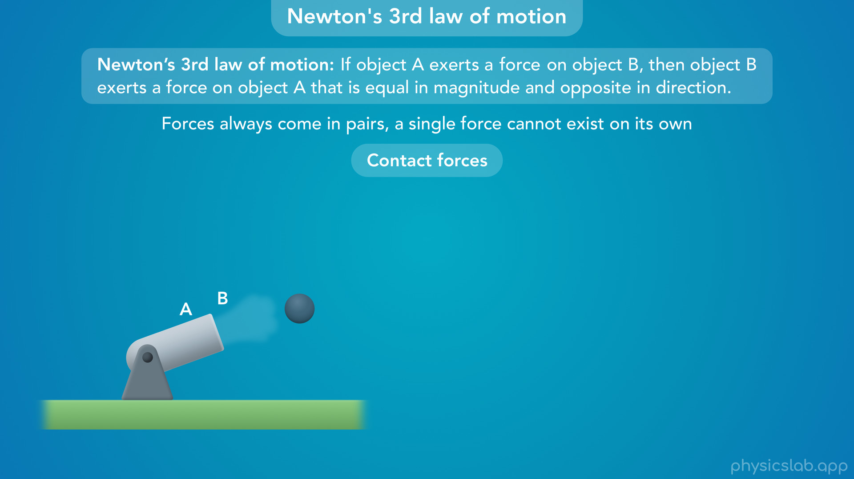
Notes:
• When a cannonball is fired out of a cannon

Slide 50
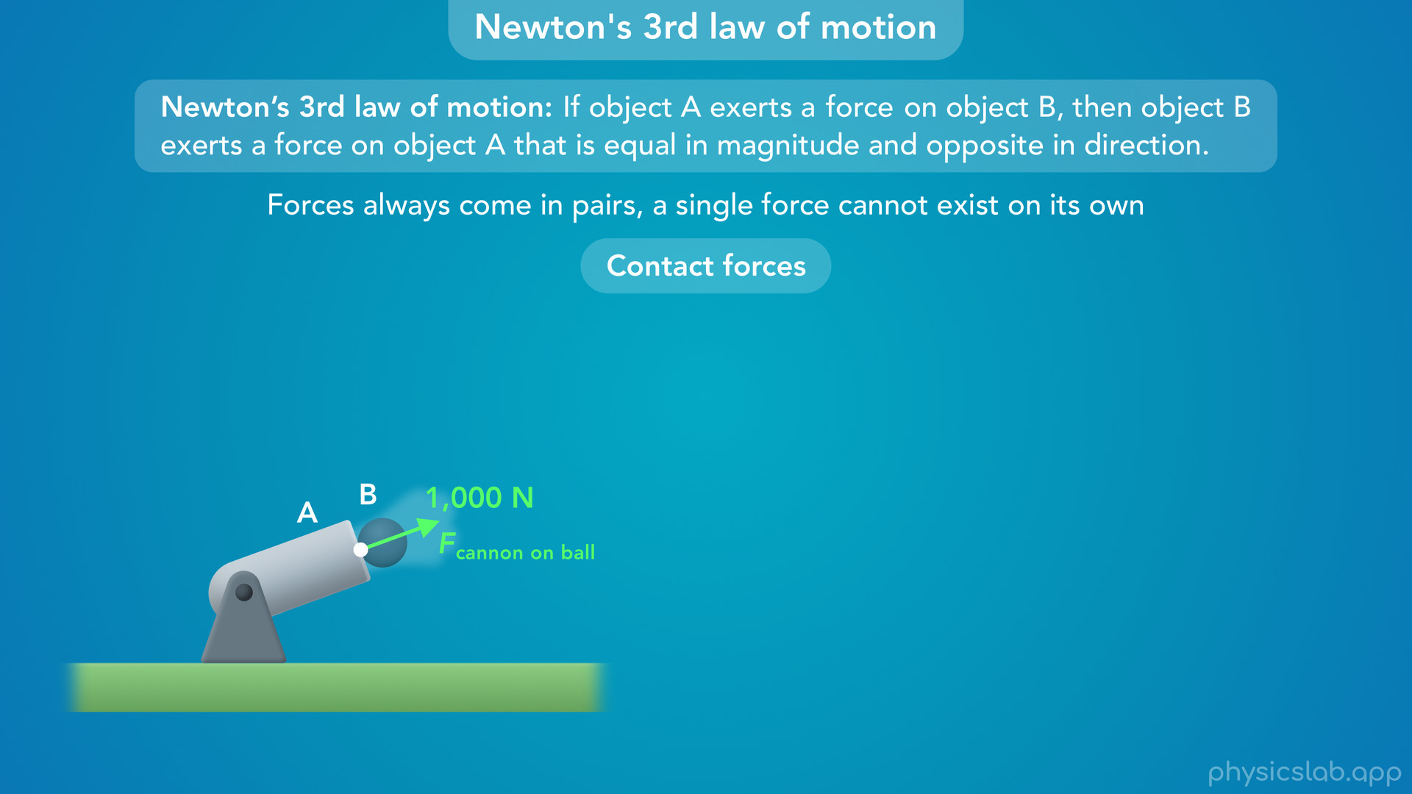
Notes:
the the cannon exerts a force on the ball

Slide 51
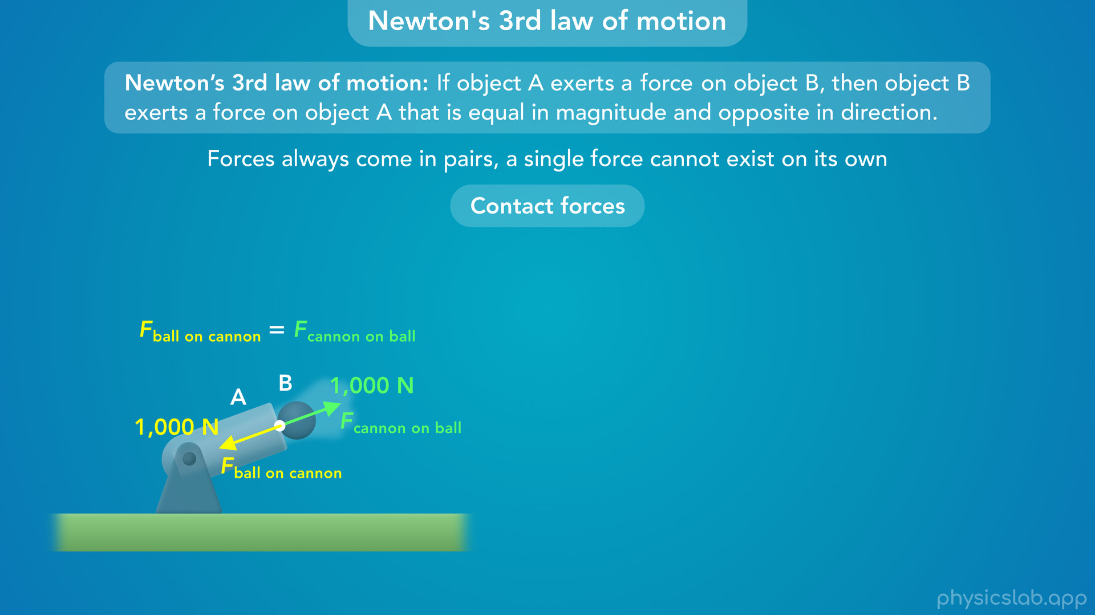
Notes:
but the ball also exerts and equal and opposite force on the cannon.

Slide 52
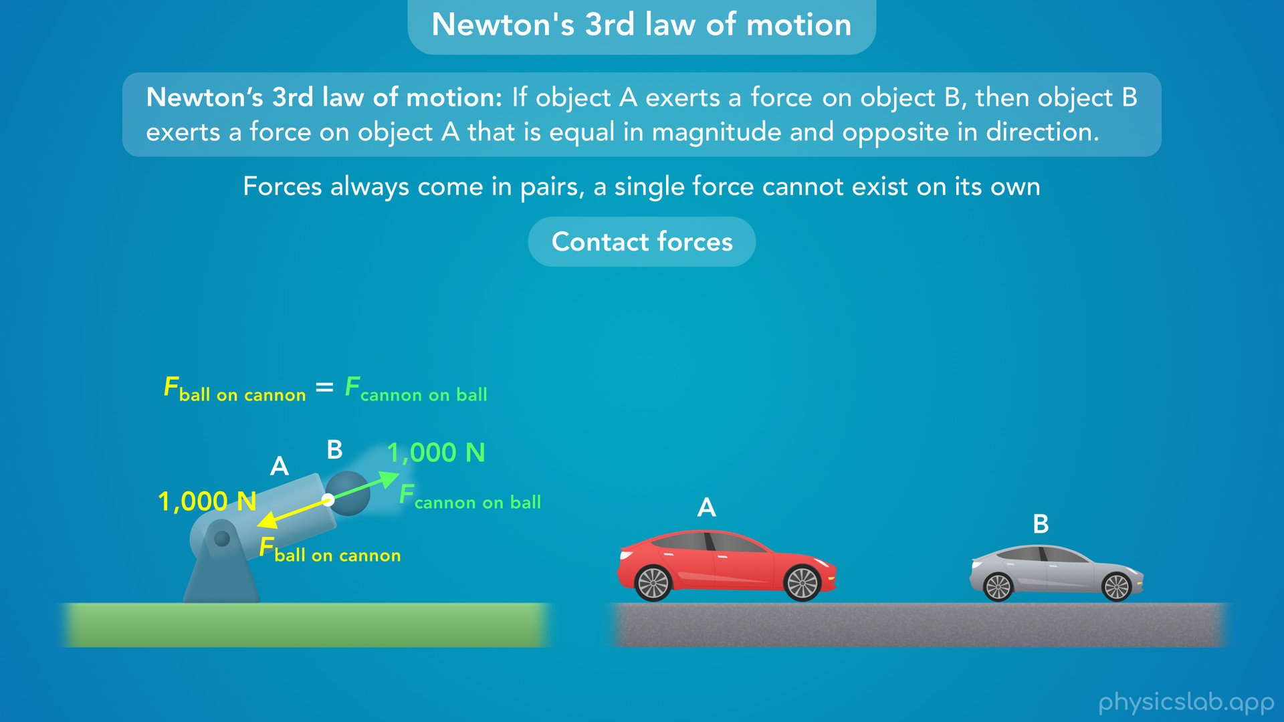
Notes:
• And when two cars collide with each other

Slide 53
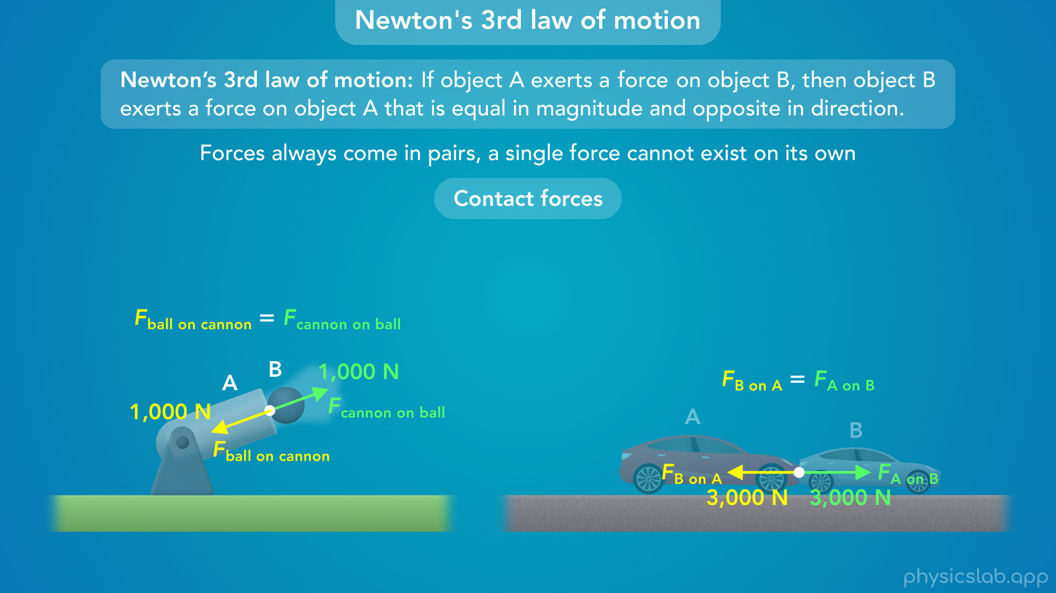
Notes:
they each exert equal and opposite forces on the other car.
• It doesn’t matter how the cars were moving or if one car is bigger.
• Newton’s 3rd law says that these two forces must be equal in magnitude.

Slide 54

Notes:
• Newton’s 3rd law also applies to non-contact forces, like gravitational, magnetic and electric forces.
• This is when two objects exert forces on each other when they’re some distance apart.

Slide 55
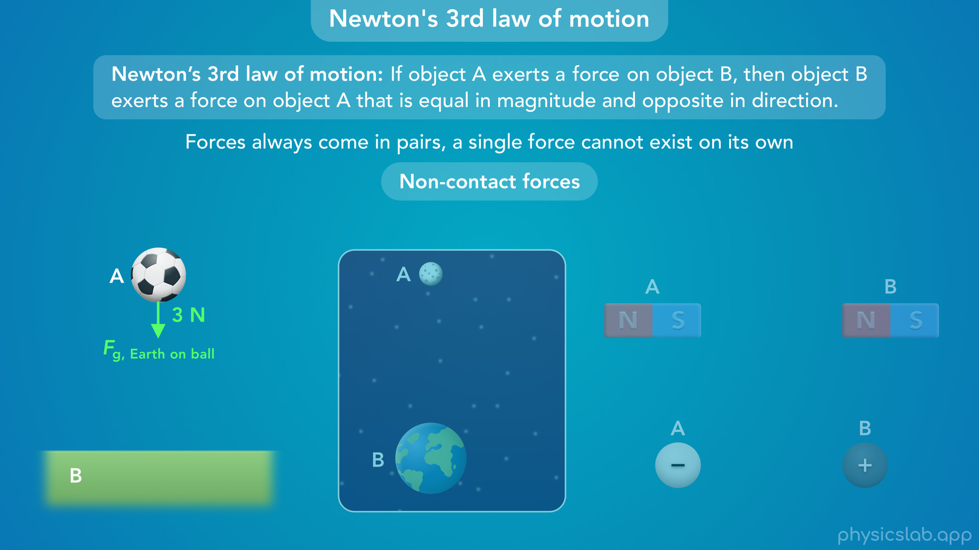
Notes:
• We’ll cover this more in another lesson, but what we experience as gravity is the earth pulling down on an object with a gravitational force.

Slide 56

Notes:
• But Newton’s 3rd law says that this ball is also pulling up on the earth with an equal and opposite force.
• Like we said, forces always come in pairs and a single force cannot exist on its own.

Slide 57

Notes:
• The same thing is true for the earth and the moon.
• The earth exerts a gravitational force on the moon which keeps the moon in orbit.

Slide 58

Notes:
• But the moon also exerts an equal gravitational force on the earth, and that’s what causes the ocean’s tides.

Slide 59

Notes:
• Two magnets exert equal and opposite magnetic forces on each other.

Slide 60

Notes:
• And two charged particles exert equal and opposite electric forces on each other.
• We said that forces occur because of the interaction between two objects.
• Since these are non-contact forces, we could say these objects are always interacting with each other, they don’t need to be in contact.

Slide 61

Notes:
• But there still needs to be two objects for the forces to exist.
• If there’s only one object, there are no forces.

Slide 62

Notes:
• In a previous video, we listed different types of forces.
• According to Newton’s 3rd law, all of these forces must exist in pairs.

Slide 63

Notes:
• So this table exerts a normal force on this book, and the book exerts and equal and opposite normal force on the table.

Slide 64

Notes:
• If this table exerts a friction force on this book, the book also exerts a friction force on the table.

Slide 65

Notes:
• And this is true for every other type of force.
• So if you’re ever working on a problem and you can’t figure out which two forces are equal and opposite according to Newton’s 3rd law, keep in mind that the pair of forces must be the same type of force, because they’re caused by the same interaction.

Slide 66

Notes:
• So that’s Newton’s 3rd law of motion.
• Now let’s address some things that people usually get confused about.

Slide 67

Notes:
• First, if the two forces from Newton’s 3rd law are equal and opposite, why don’t they cancel each other out?
• Wouldn’t the net force always be zero?
• The key thing is that these two forces are acting on two different objects, and they can’t be added together.

Slide 68

Notes:
• So if this person is applying a 20 N force on the box to the right

Slide 69

Notes:
then the box must be applying a 20 N force on the person to the left.

Slide 70

Notes:
• But this picture is not a free body diagram.
• Like we mentioned in a previous video, a free body diagram only includes a single object and the forces acting on that object.

Slide 71

Notes:
• So if we draw a free body diagram of the person and a free body diagram of the box, only one force goes in each diagram, the force that is acting on that object.
• The person and the box have other forces acting on them, but the equal and opposite pair of forces from Newton’s 3rd law are split up between the two free body diagrams of the two objects. Only one of the forces goes in each diagram.
• Then you can find the net force on each object.
• In most cases we’re only focused on the forces that are acting on one object, like the box.
• But if you’re ever wondering where’s the other force from Newton’s 3rd law, it’s in a free body diagram for a different object.

Slide 72

Notes:
• Next, let’s talk about equal and opposite forces.
• When we’re talking about Newton’s 3rd law of motion, this is referring to the pair of forces that exists between two objects, the forces are equal in magnitude and opposite in direction.
• In this case the 2 objects are the person and the box. Let’s make these the same color to show that they’re a pair of forces from Newton’s 3rd law.

Slide 73

Notes:
• But here’s a different scenario, where two people are pulling on a box in opposite directions with the same amount of force.
• We might say that those two forces are equal and opposite, so the net horizontal force acting on the box is zero.
• But in that example, there are 3 objects: 2 people and a box.
• These two forces are acting on the same object, the box, so they both show up in the free body diagram of the box and we can add them together.
• The difference is that the 2 forces in the left example are a pair of forces from Newton’s 3rd law that act on 2 different objects, so they must have the same magnitude, in this case 20 N.
• In the right example, it’s just a coincidence that these 2 forces are both 30 N and they act in opposite directions. They have nothing to do with Newton’s 3rd law, and they’re not a pair of forces.

Slide 74

Notes:
• Next, let’s look at the commonly used version of Newton’s 3rd law, which says that every action has an equal and opposite reaction.
• First, the action and reaction are just two forces, the pair of forces that two objects exert on each other.
• They’re not referring to the motion of the objects, just these two forces.
• Either force can be called the action or the reaction.
• The action does not cause the reaction.
• And the two forces occur at the same time, one does not happen before the other.
• So the pair of forces from Newton’s 3rd law are equivalent, it’s not like one force is more important than the other.
• It might feel more natural to say that this person is doing the action and the wall is doing the reaction, because people move and do stuff and the wall is an inanimate object. But we can also swap these and it’s still correct.
• One force does not cause the other force, they both happen simultaneously when the two objects are in contact for whatever reason.

Slide 75


Slide 76

Notes:
• Now let’s talk about one more thing.
• If two objects exert the same force on eachother, why don’t we always see that?

Slide 77

Notes:
• A cannon obviously exerts a force on a cannon ball

Slide 78

Notes:
but if the ball exerts the same force back on the cannon, why doesn’t the cannon move?

Slide 79

Notes:
• Or, if a person throws a ball

Slide 80

Notes:
and the ball exerts a force on the person why doesn’t the person move backwards?

Slide 81

Notes:
• Well, the first reason is that there are other forces acting on the person and the cannon, like friction forces from the ground.

Slide 82

Notes:
• To see the effects of Newton’s 3rd law without friction and other forces, let’s see what happens when someone throws a ball while they’re floating in outer space.

Slide 83


Slide 84

Notes:
• Now we can see the person does move backwards, but not as fast as the ball. So why is that?

Slide 85

Notes:
• It has to do with Newton’s 2nd law of motion.
• The force on the person and the ball is the same, 5 N.
• But the person has a lot more mass than the ball, maybe 80 kg vs 0.05 kg.

Slide 86

Notes:
• If we use Newton’s 2nd law to calculate the acceleration of each object

Slide 87

Notes:
the ball has a much greater acceleration than the person.

Slide 88

Notes:
• If the person’s mass is 1600 times the ball’s mass, then the person’s acceleration is only 1/1600th the ball’s acceleration.
• The force on each object is the same, but the person has much more inertia than the ball, so they accelerate less during the throw.

Slide 89


Slide 90


Slide 91

Notes:
• But what would happen if the person pushed on another person with the same mass?

Slide 92

Notes:
• The force on each person is the same, but now the accelerations are the same.

Slide 93


Slide 94


Slide 95


Slide 96

Notes:
• So Newton’s 3rd law says that these forces must be equal

Slide 97

Notes:
and Newton’s 2nd law says that an object with more mass will have a smaller acceleration.

Slide 98

Notes:
• So that’s Newton’s 3rd law of motion.
• When two objects interact, they exert equal and opposite forces on each other.

Slide 99

Notes:
• In the next video, we’ll learn about normal forces, which might be the most common use of Newton’s 3rd law.
• We’ll talk about how these forces behave, how to calculate them, and what the word normal actually means.

