Slide 1
Tension in Accelerating Systems
Slides Version 1
This version includes:
Slides with screenshot images from the video.
The video narration in the slide notes.
A blank template slide with the same background and font as the video.
Slides with some basic graphics from this video for you to use however you like.
Feel free to add, delete and edit slides to make your own presentation. You can use these slides in class or share them with your students, but please do not share them with anyone else.
If you have any feedback, suggestions or questions about these slides please email me at chris@physicslab.app or send me a message on Discord @physicslab.
physicslab.app

Slide 2
Heading
Text

Slide 3
































Free body diagram

Slide 4
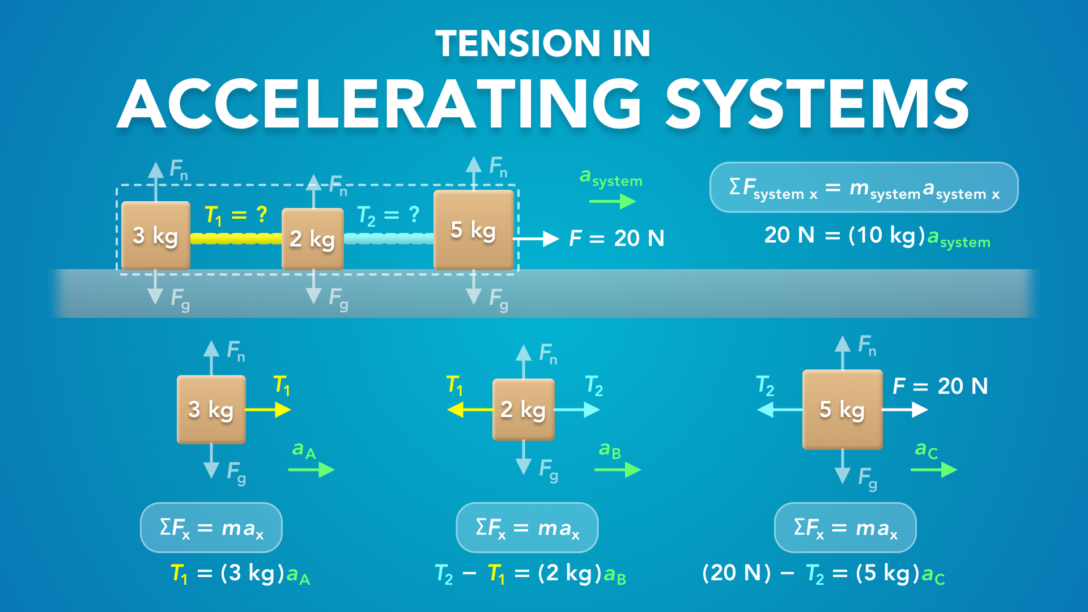
Notes:
Tension in Accelerating Systems
physicslab.app
If you have any questions, suggestions or feedback about these slides please email me at chris@physicslab.app or send me a message on Discord @physicslab.

Slide 5
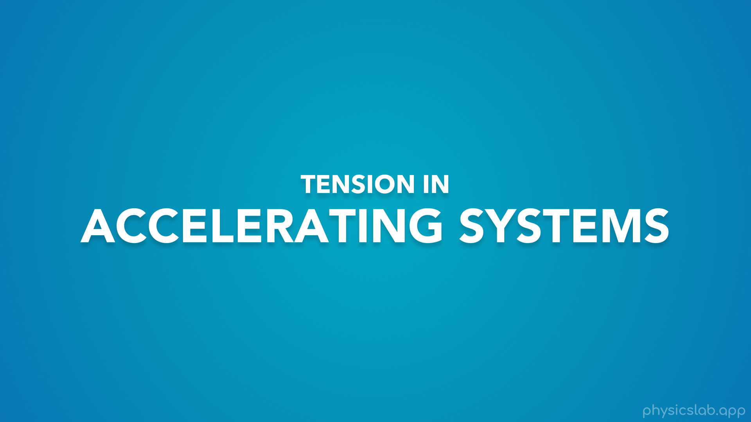
Notes:
In this video we’re gonna learn about tension in accelerating systems.

Slide 6
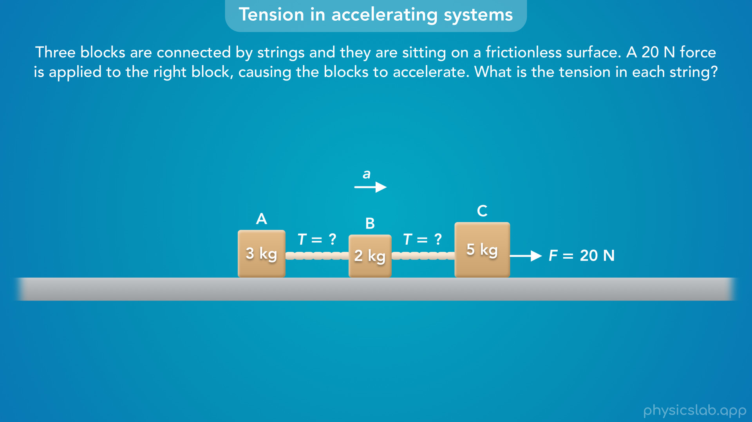
Notes:
• We’ll use this example throughout the video.
• If we have several blocks that are accelerating, how do we find the tension in each string?

Slide 7
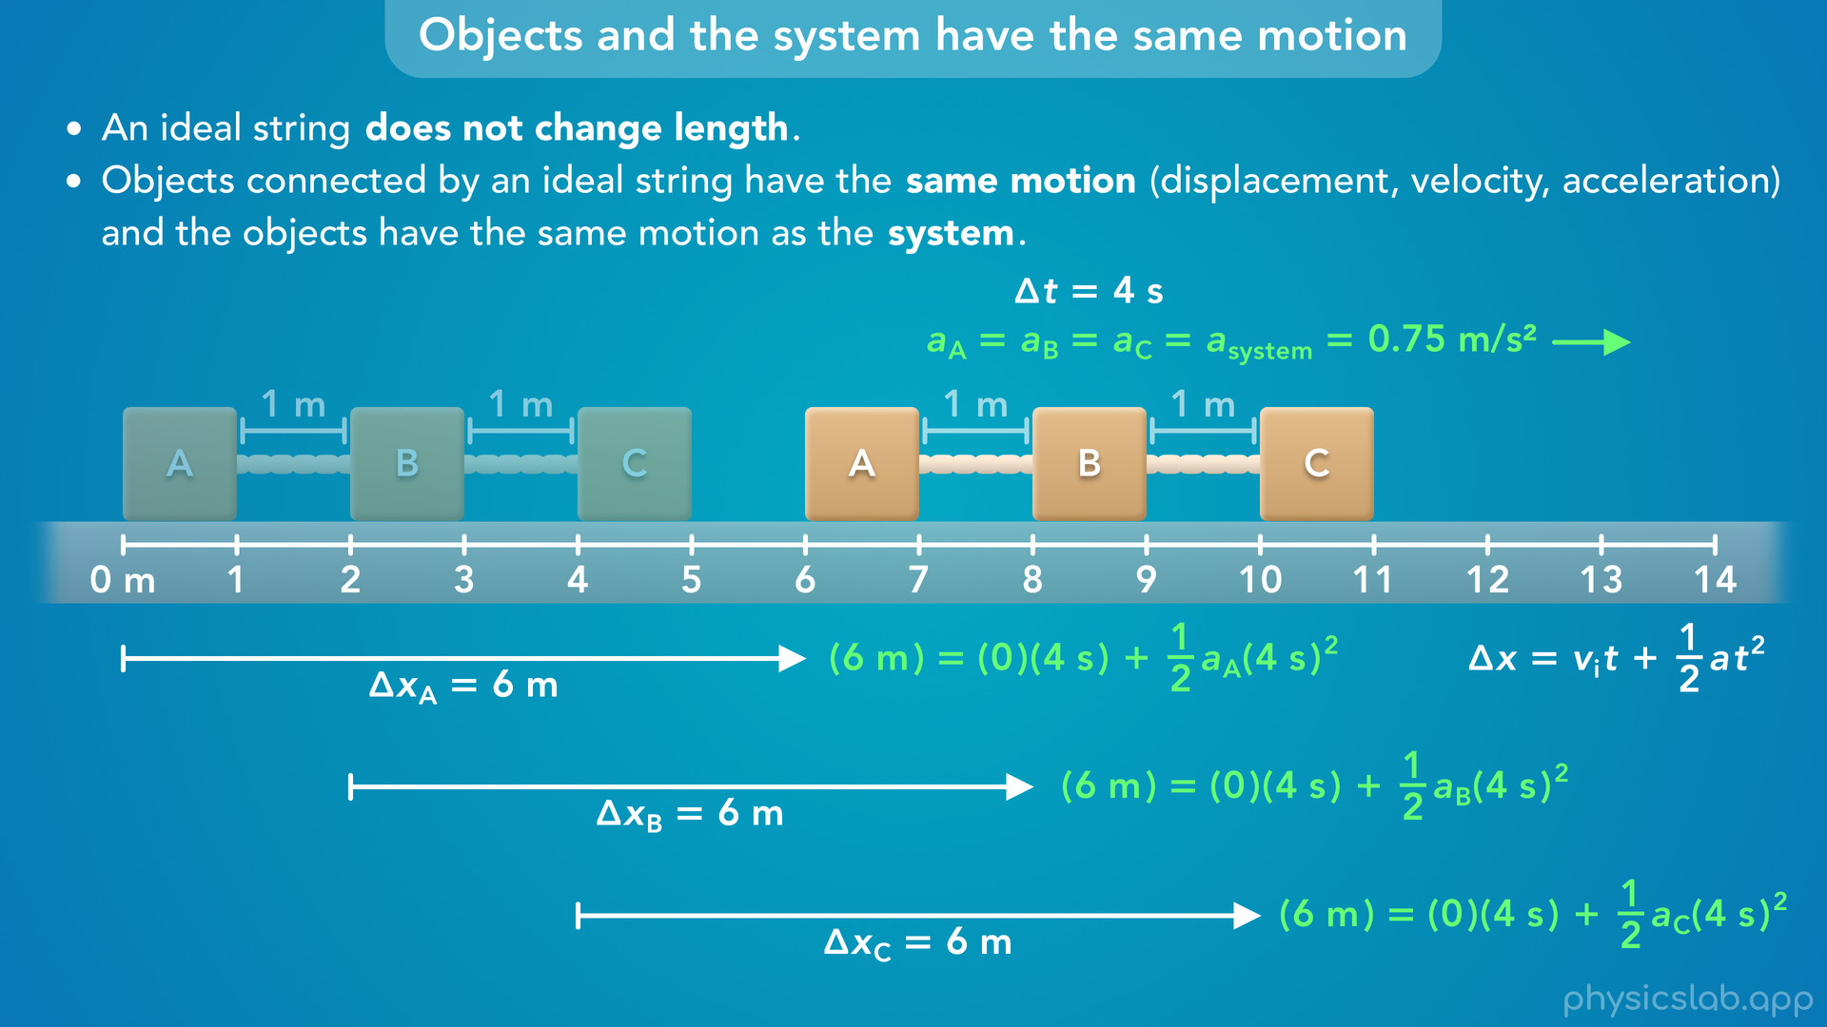
Notes:
• One of the important concepts is that the objects and the system have the same motion.
• We’ll explain why that is, and how we can use that information to solve the problem.

Slide 8
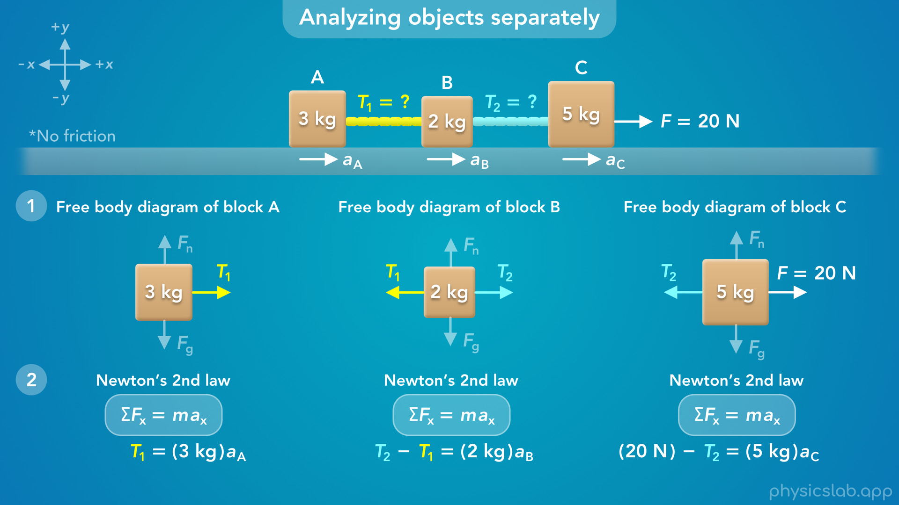
Notes:
• Then we’ll walk through the free body diagram and Newton’s 2nd law for each block.
• And we’ll use substitution to solve for the tension in each string.

Slide 9
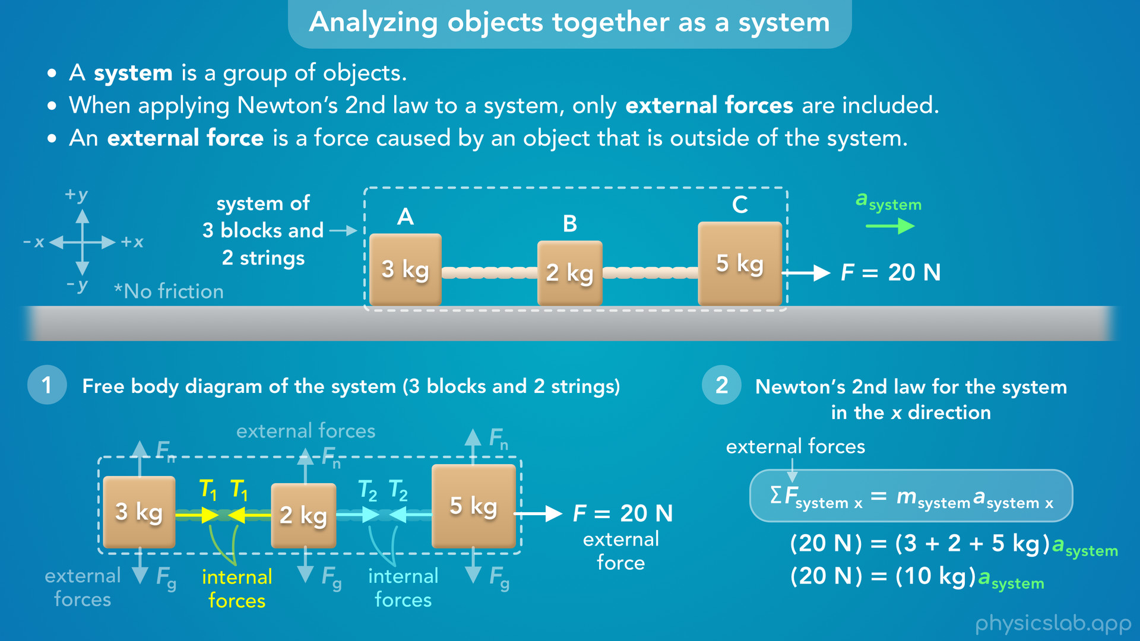
Notes:
• We’ll also analyze the 3 blocks together as a system to find the acceleration, and then use that to find the tensions.

Slide 10
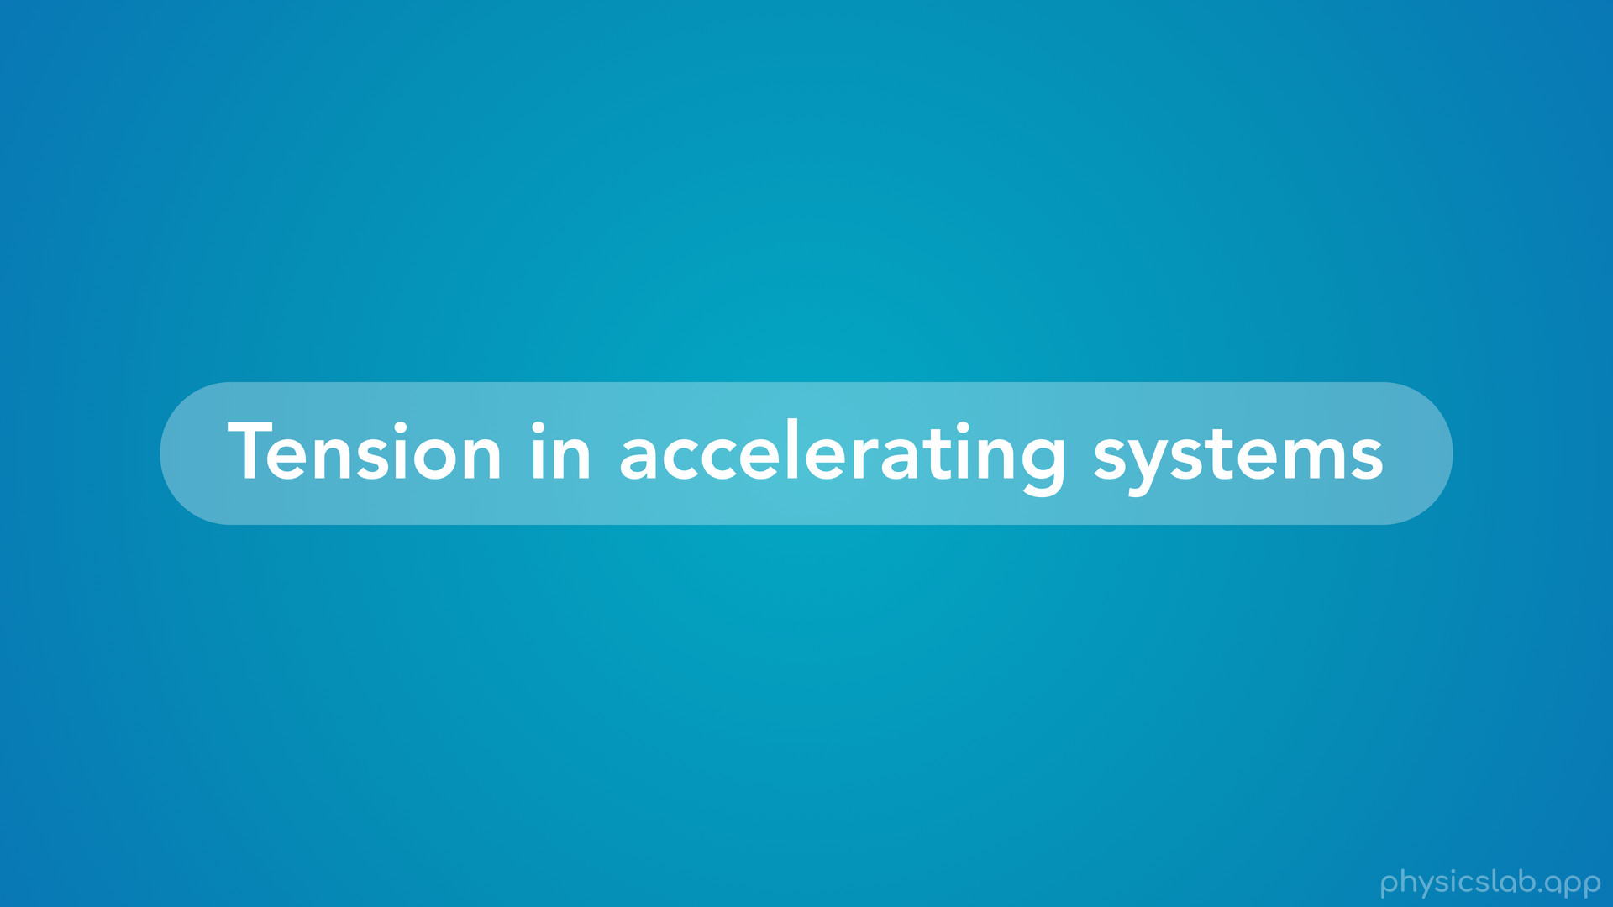
Notes:
• So let’s learn how to work with tension in accelerating systems.

Slide 11
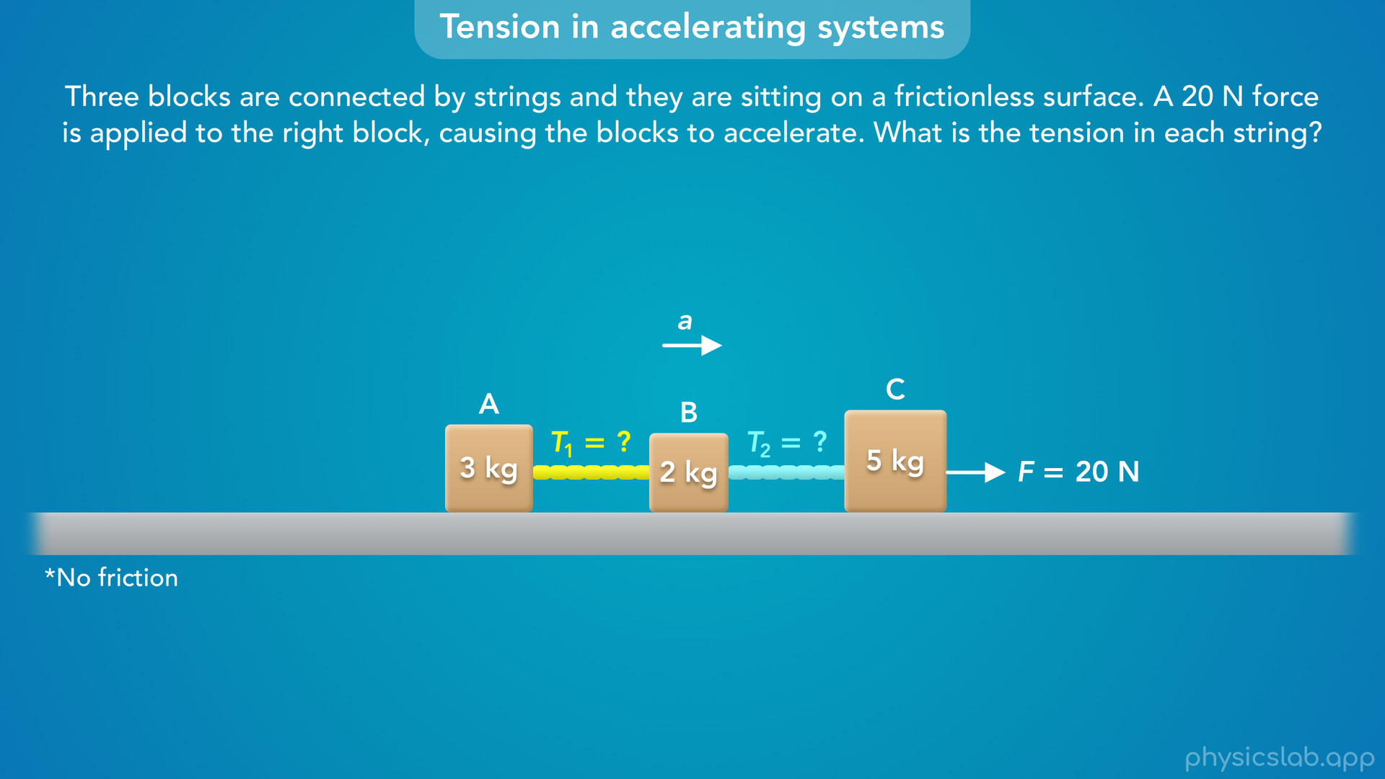
Notes:
• Here’s the example that we’re gonna use.
• Three blocks are connected by strings, and they are sitting on a frictionless surface. A 20 N force is applied to the right block, causing the blocks to accelerate. What is the tension in each string?
• In this example, we’re dealing with two different strings, so we’ll label the tension in the left string as T1 and the tension in the right string as T2.
• So how do we find the tensions?

Slide 12
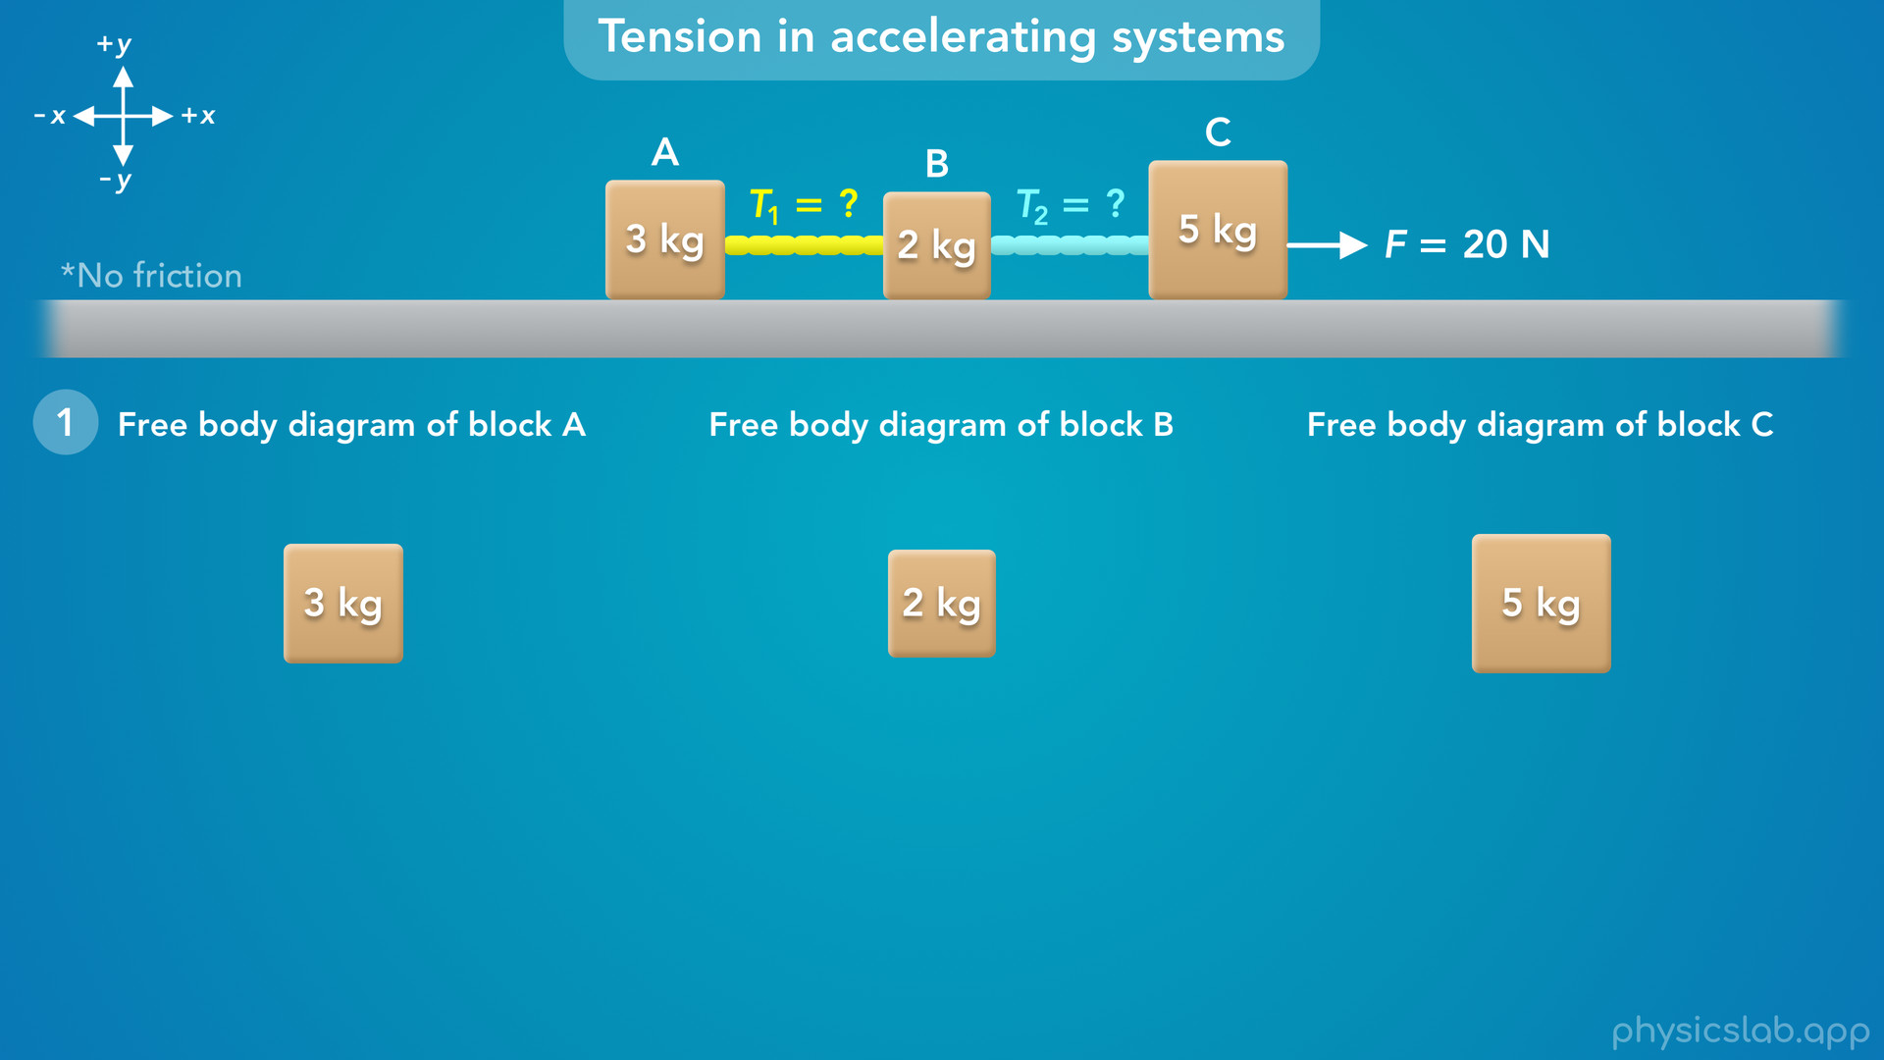
Notes:
• Like we covered in the previous videos, the first step is to draw free body diagrams and the coordinate system, the x and y axes.
• We’re gonna draw a diagram for each block so we can see all of the forces that are involved.

Slide 13
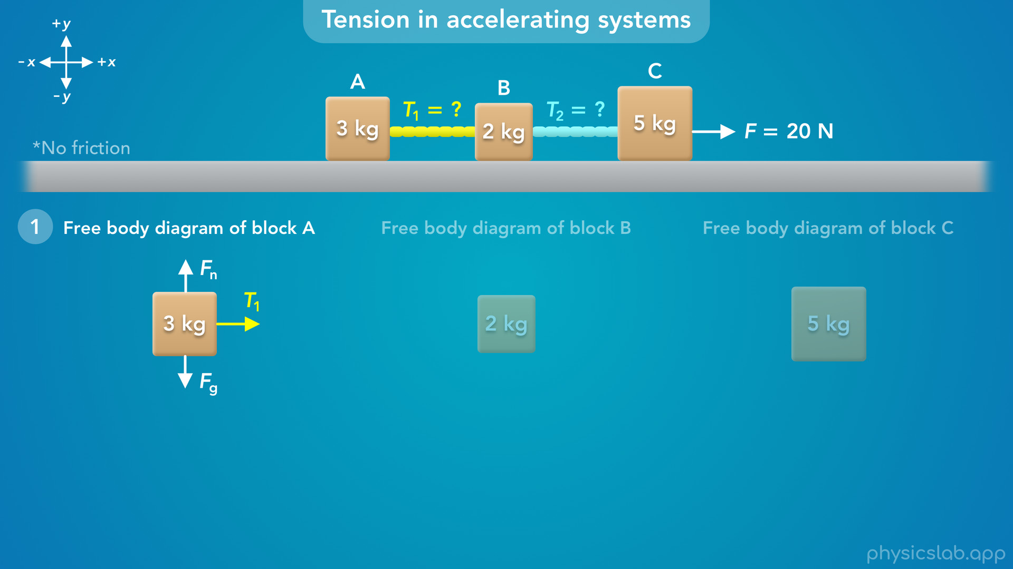
Notes:
• So what forces are acting on block A?
• We know there’s a downwards gravitational force from the earth… and there would be an upwards normal force from the ground.
• Block A is attached to string 1, so there’s a tension force, T1 acting on block A that points to the right.
• Remember, tension is always a pulling force that acts in the same direction as the string.
• The question said this is a frictionless surface, so there’s no friction force.

Slide 14
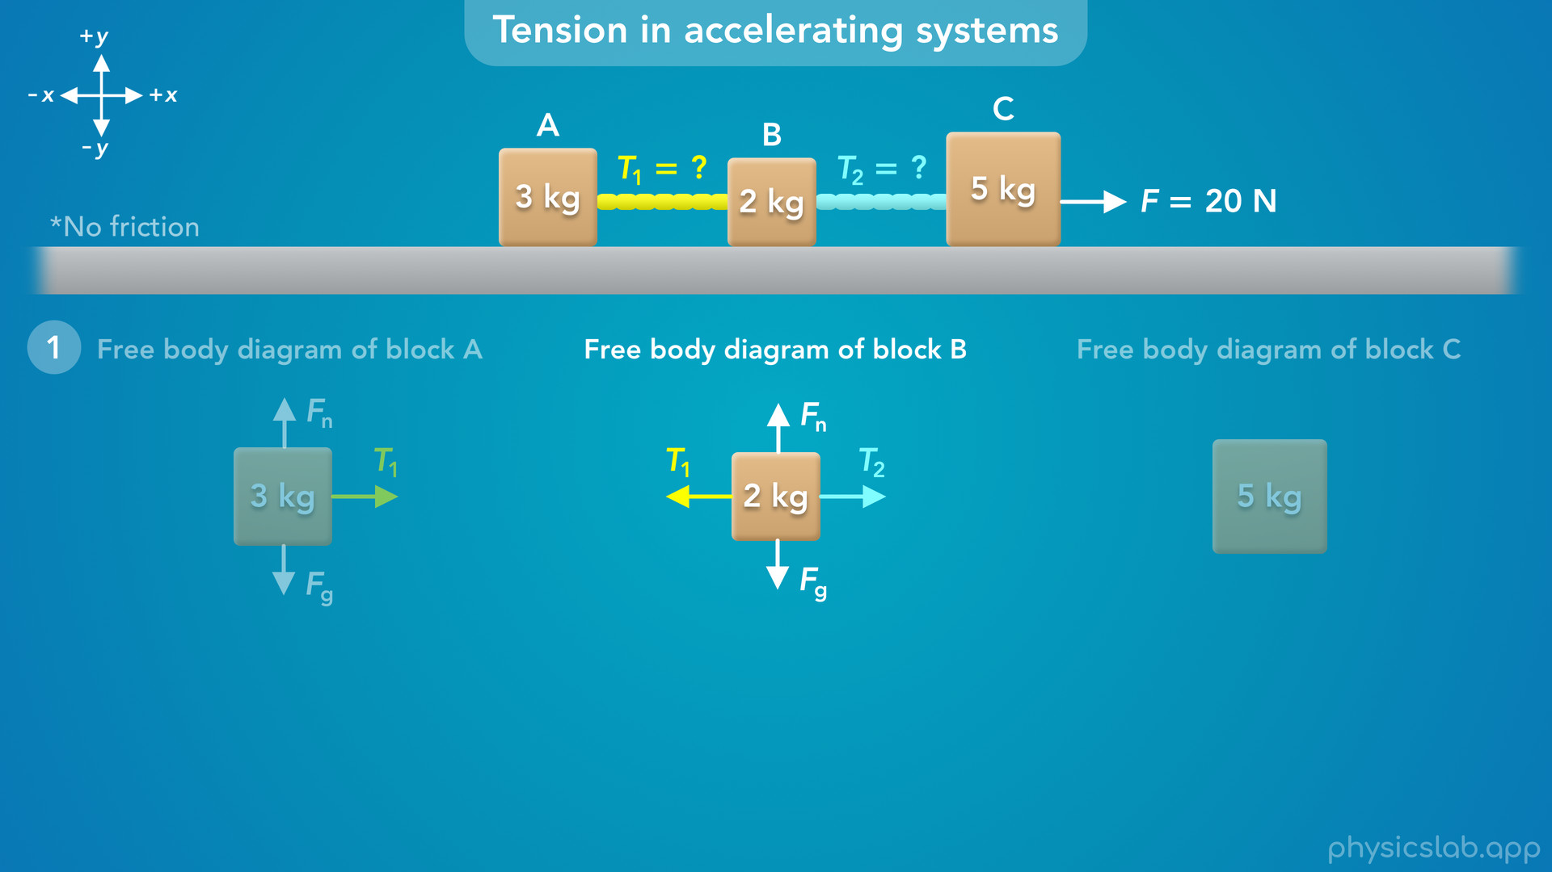
Notes:
• Next, what forces are acting on block B?
• Again, there’s a gravitational force and a normal force.
• Block B is attached to string 1, so there’s a tension force T1 acting to the left, towards string 1.
• Block B is also attached to string 2, so there’s another tension force T2 acting to the right, towards string 2.

Slide 15
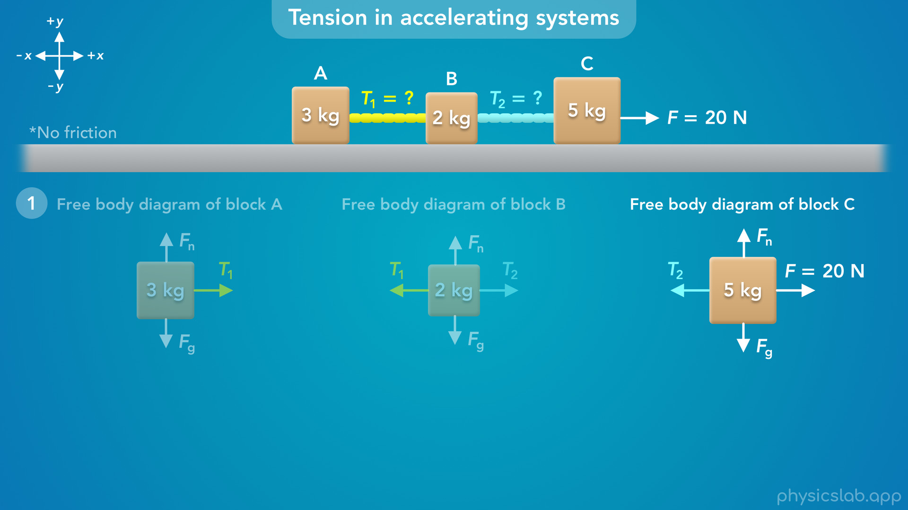
Notes:
• What about block C?
• There’s a gravitational force and a normal force.
• And we have this 20 N force acting to the right.
• Block C is attached to string 2, so there’s a tension force T2 acting to the left.

Slide 16
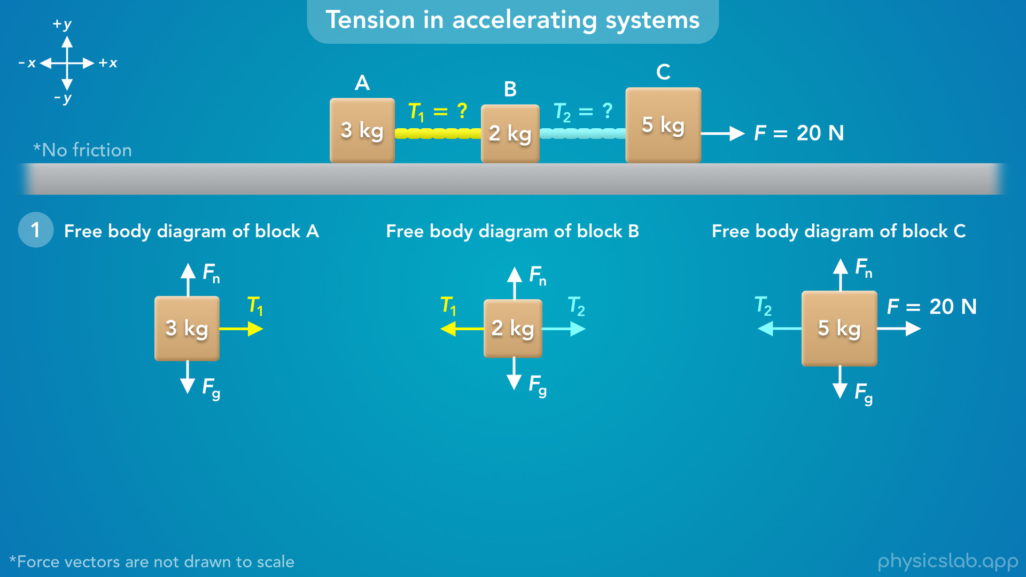
Notes:
• There’s a few things to note here.
• First, we don’t know the magnitudes of the tension forces, so the length of these force vectors are not drawn to scale.
• Second, notice that the 20 N force is acting on block C, so we do not include that force in the free body diagram for block A or block B.

Slide 17
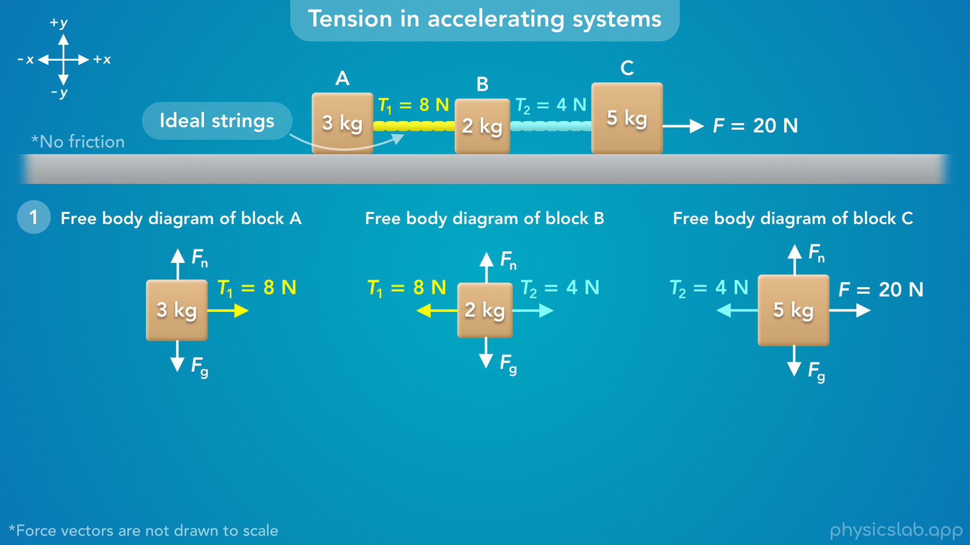
Notes:
• And third, we’re assuming these are ideal strings.
• So they have no mass, and they exert the same amount of force on the blocks that they’re attached to.
• For example, if the tension in string 1 was 8 N, then string 1 is exerting an 8 N force on block A and block B.
• If the tension in string 2 was 4 N, then string 2 is exerting a 4 N force on block B and block C.
• So to find the tension in the strings, we need to find at least one of these tension forces for each string.
• So how do we do that?

Slide 18
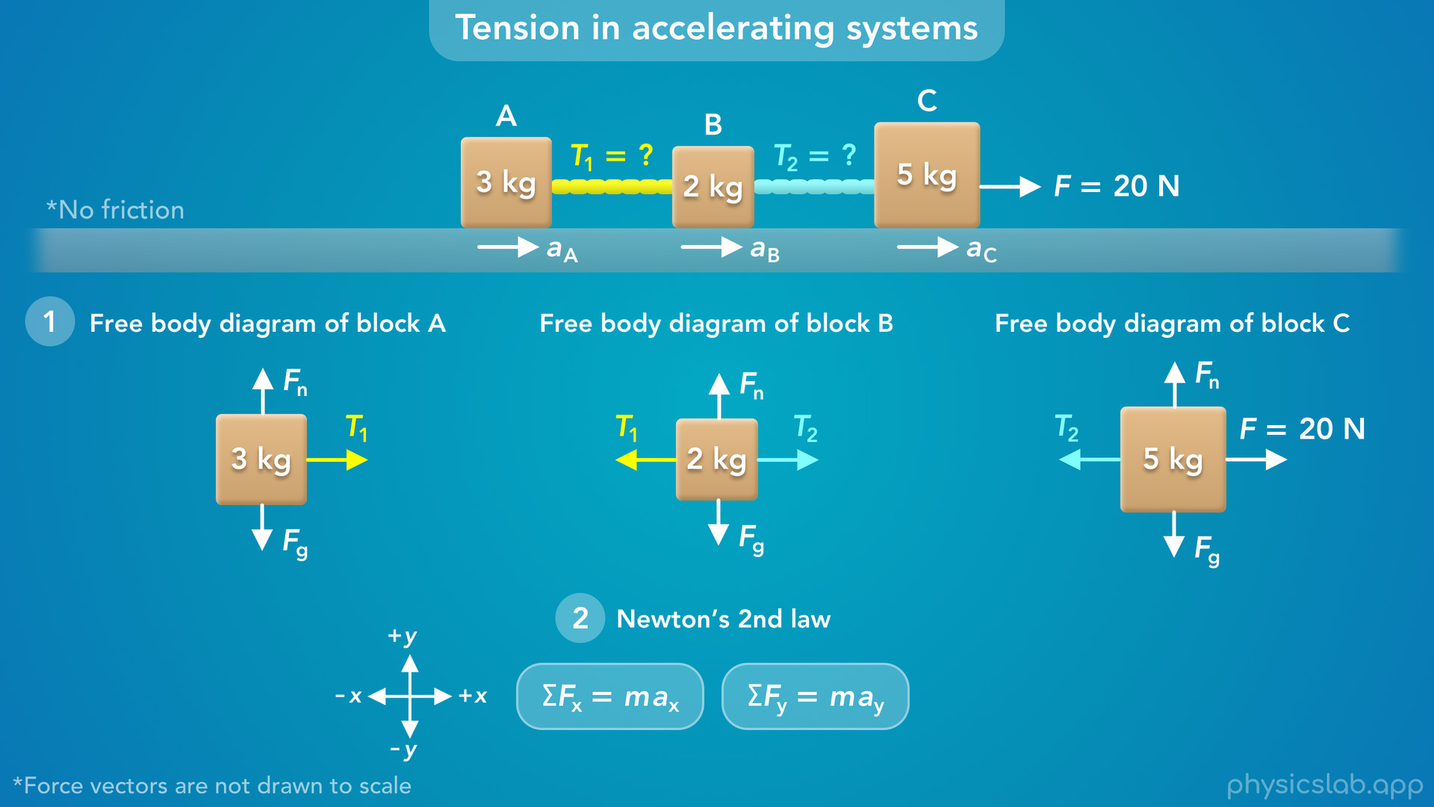
Notes:
• The second step is to apply Newton’s 2nd law, the net force on an object is equal to its mass times its acceleration.
• We use this equation in the x direction and the y direction.

Slide 19
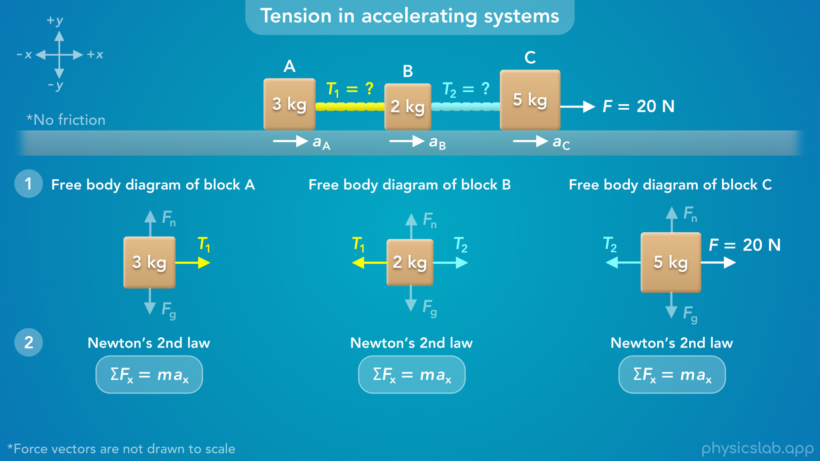
Notes:
• But for this example, the blocks are not accelerating up or down, so the net force in the y direction is zero for each block.
• Also, the tension forces that we’re trying to find are in the x direction.
• So we’re just going to use Newton’s 2nd law in the x direction, and we can do this for each block.

Slide 20
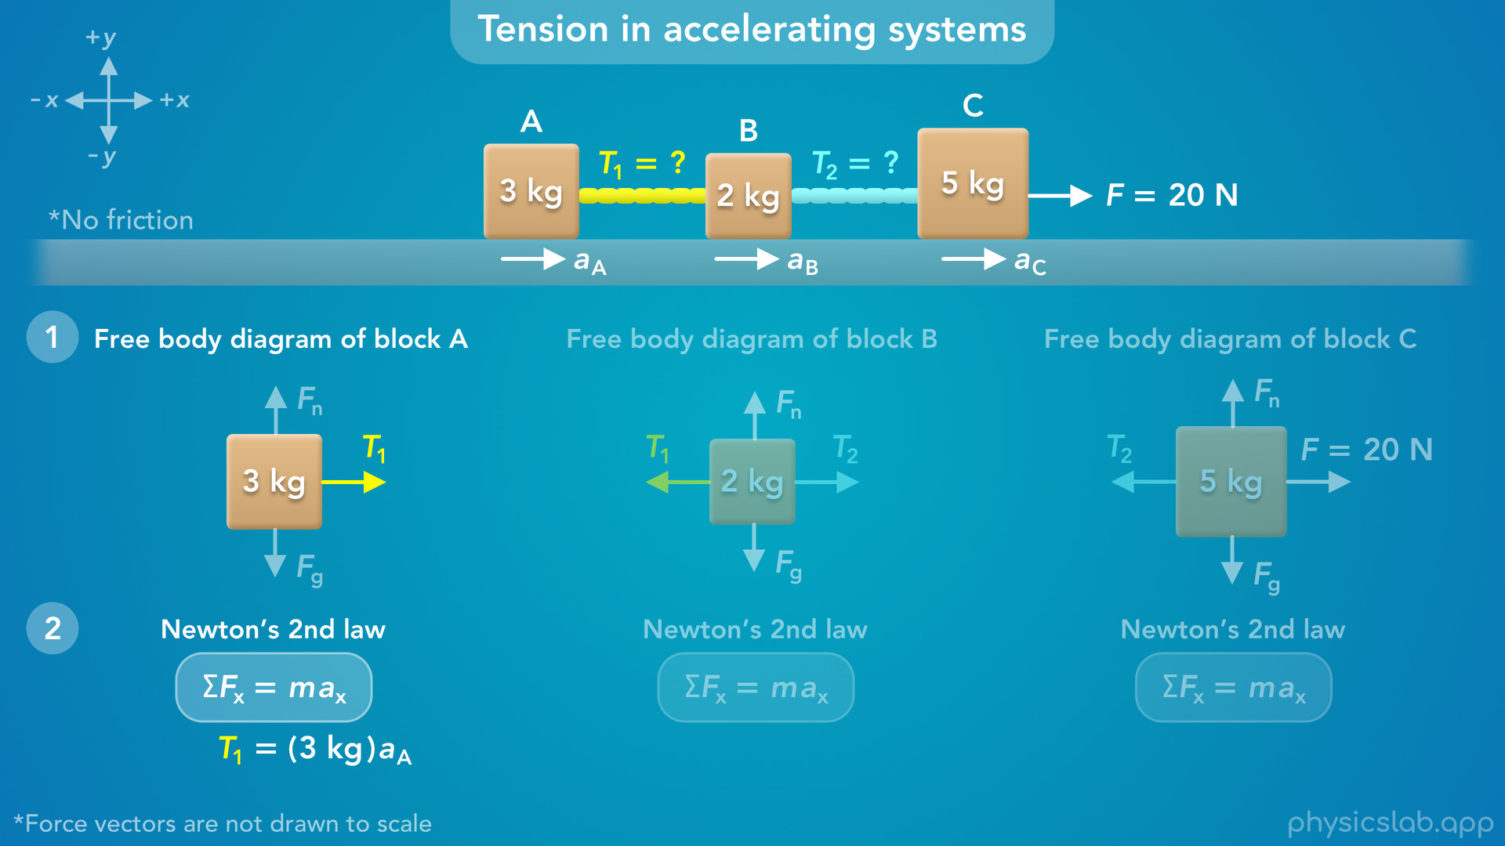
Notes:
• For block A, there’s only one force in the positive x direction, so the net force would just be T1.
• The mass of block A is 3 kg, but we don’t know the acceleration of block A, so we’ll leave that for now.

Slide 21
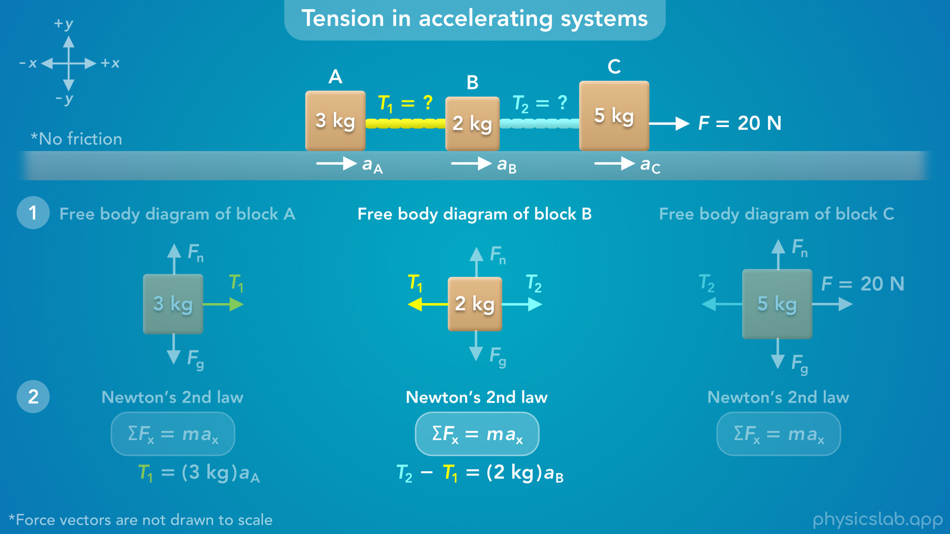
Notes:
• For block B, T2 is acting in the positive x direction and T1 is acting in the negative x direction, so the net force is T2 minus T1.
• The mass of block B is 2 kg, but we don’t know the acceleration.

Slide 22
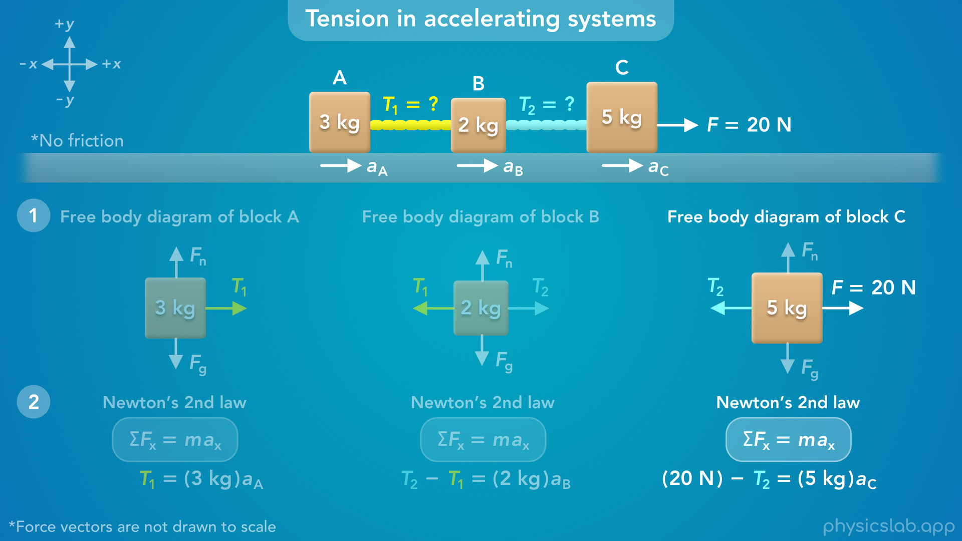
Notes:
• For block C, the net force is 20 N minus T2.
• The mass is 5 kg, and we don’t know the acceleration.

Slide 23
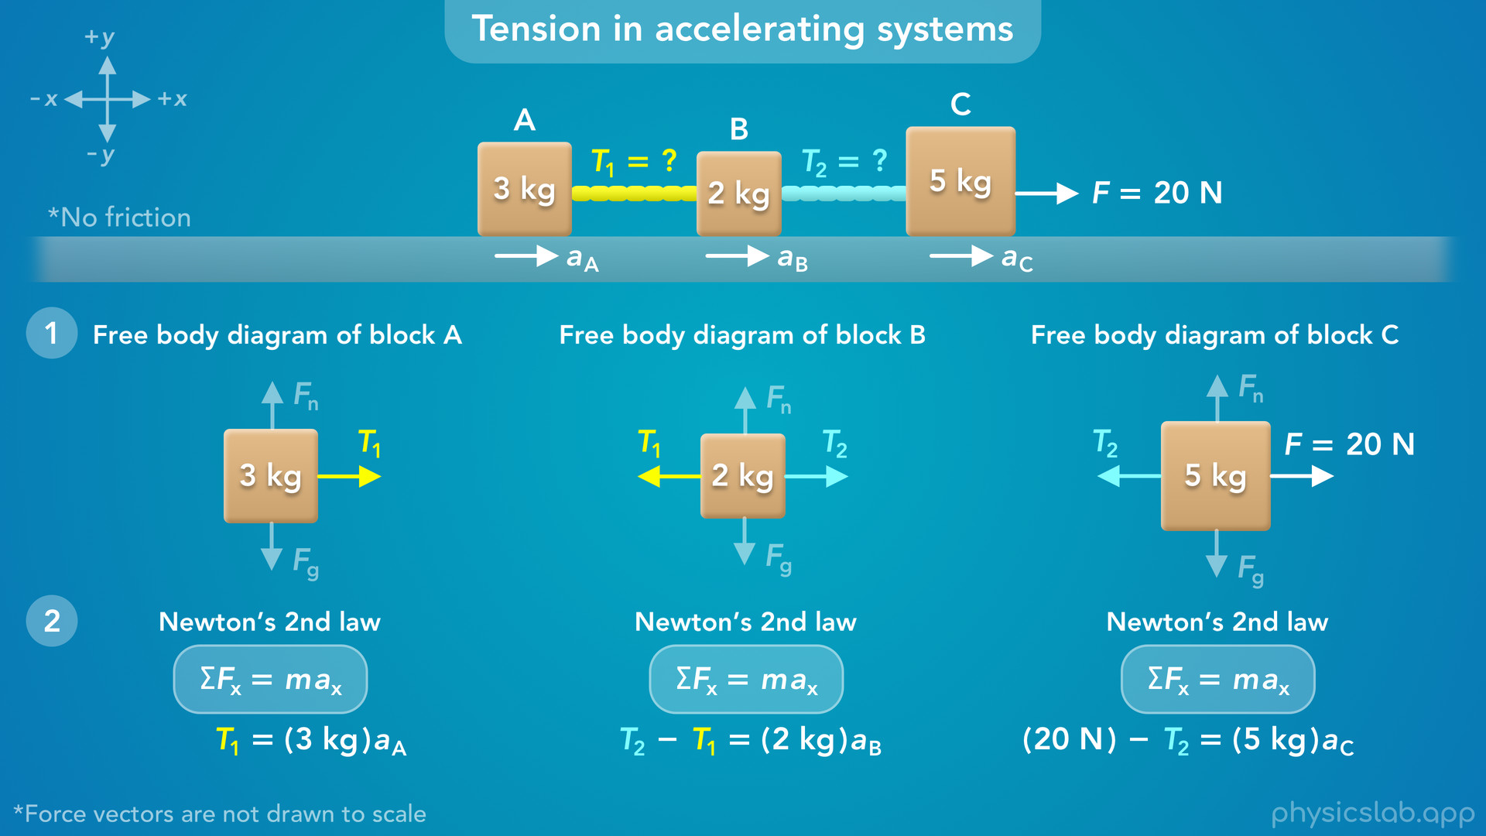
Notes:
• Alright, so now we have 3 equations and 5 unknown variables, 2 tensions and 3 accelerations.
• So what do we do next?
• If we want to find the tensions, we need to know the accelerations.
• There are two different ways we can solve this, and they both use an important concept that we need to cover…

Slide 24
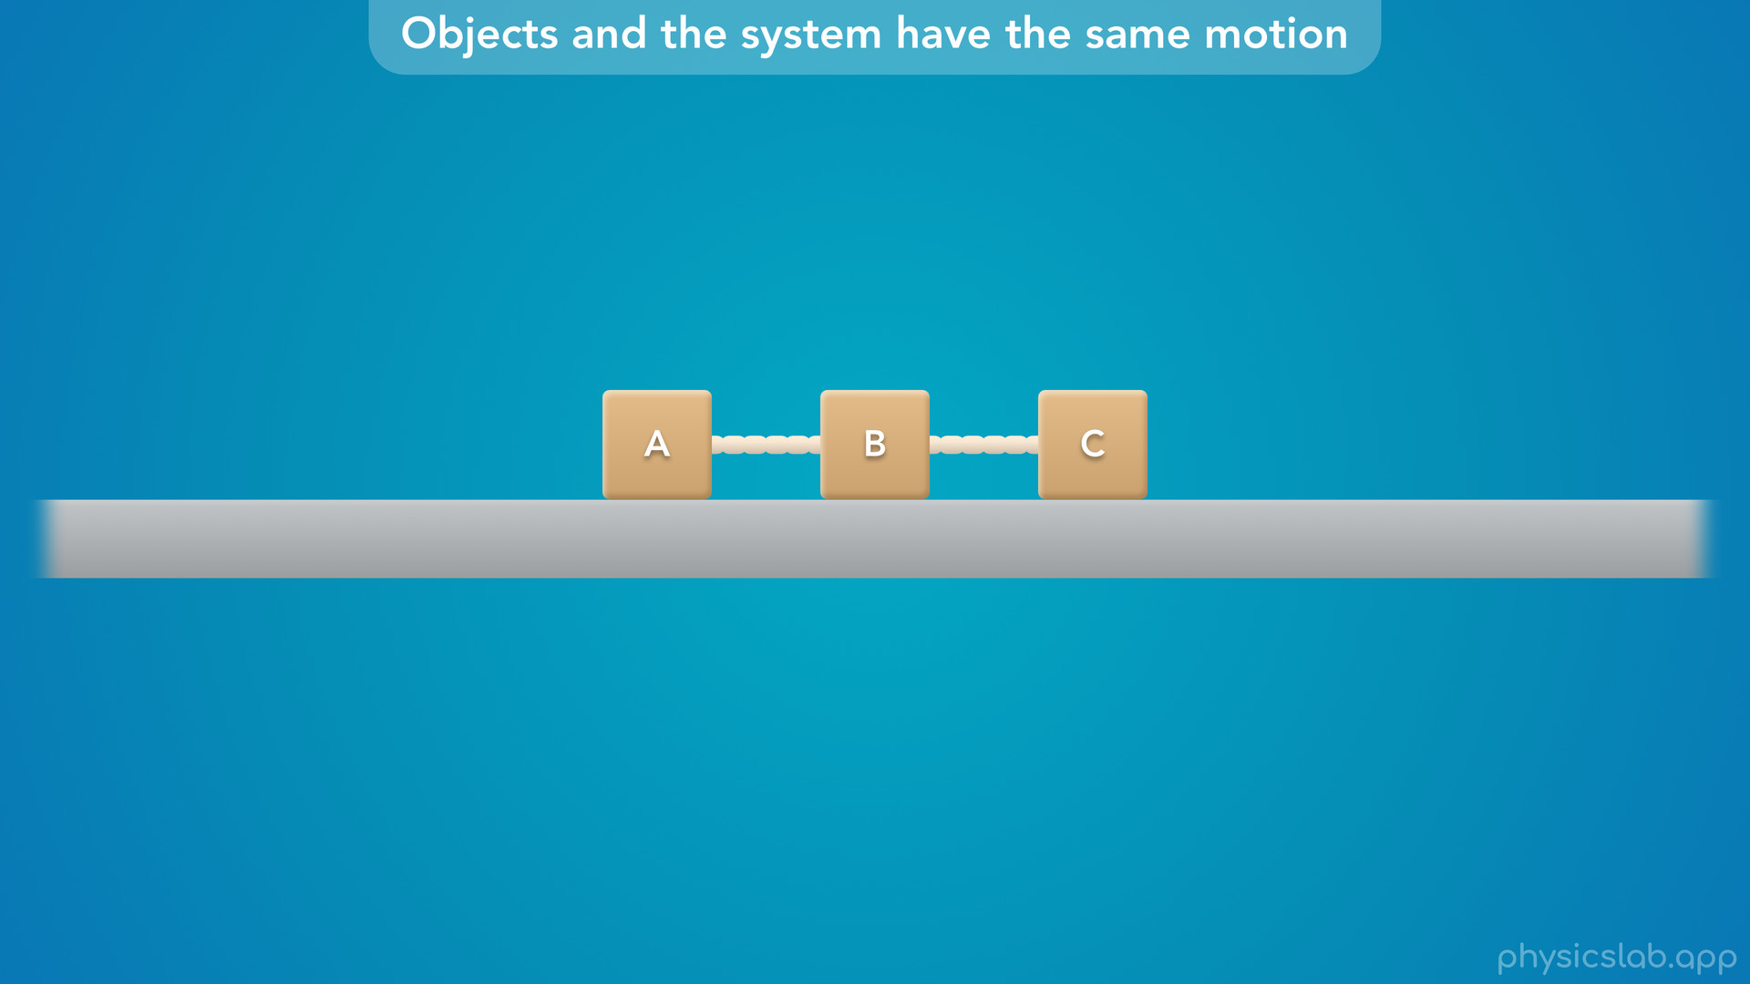
Notes:
• Objects and the system have the same motion.

Slide 25
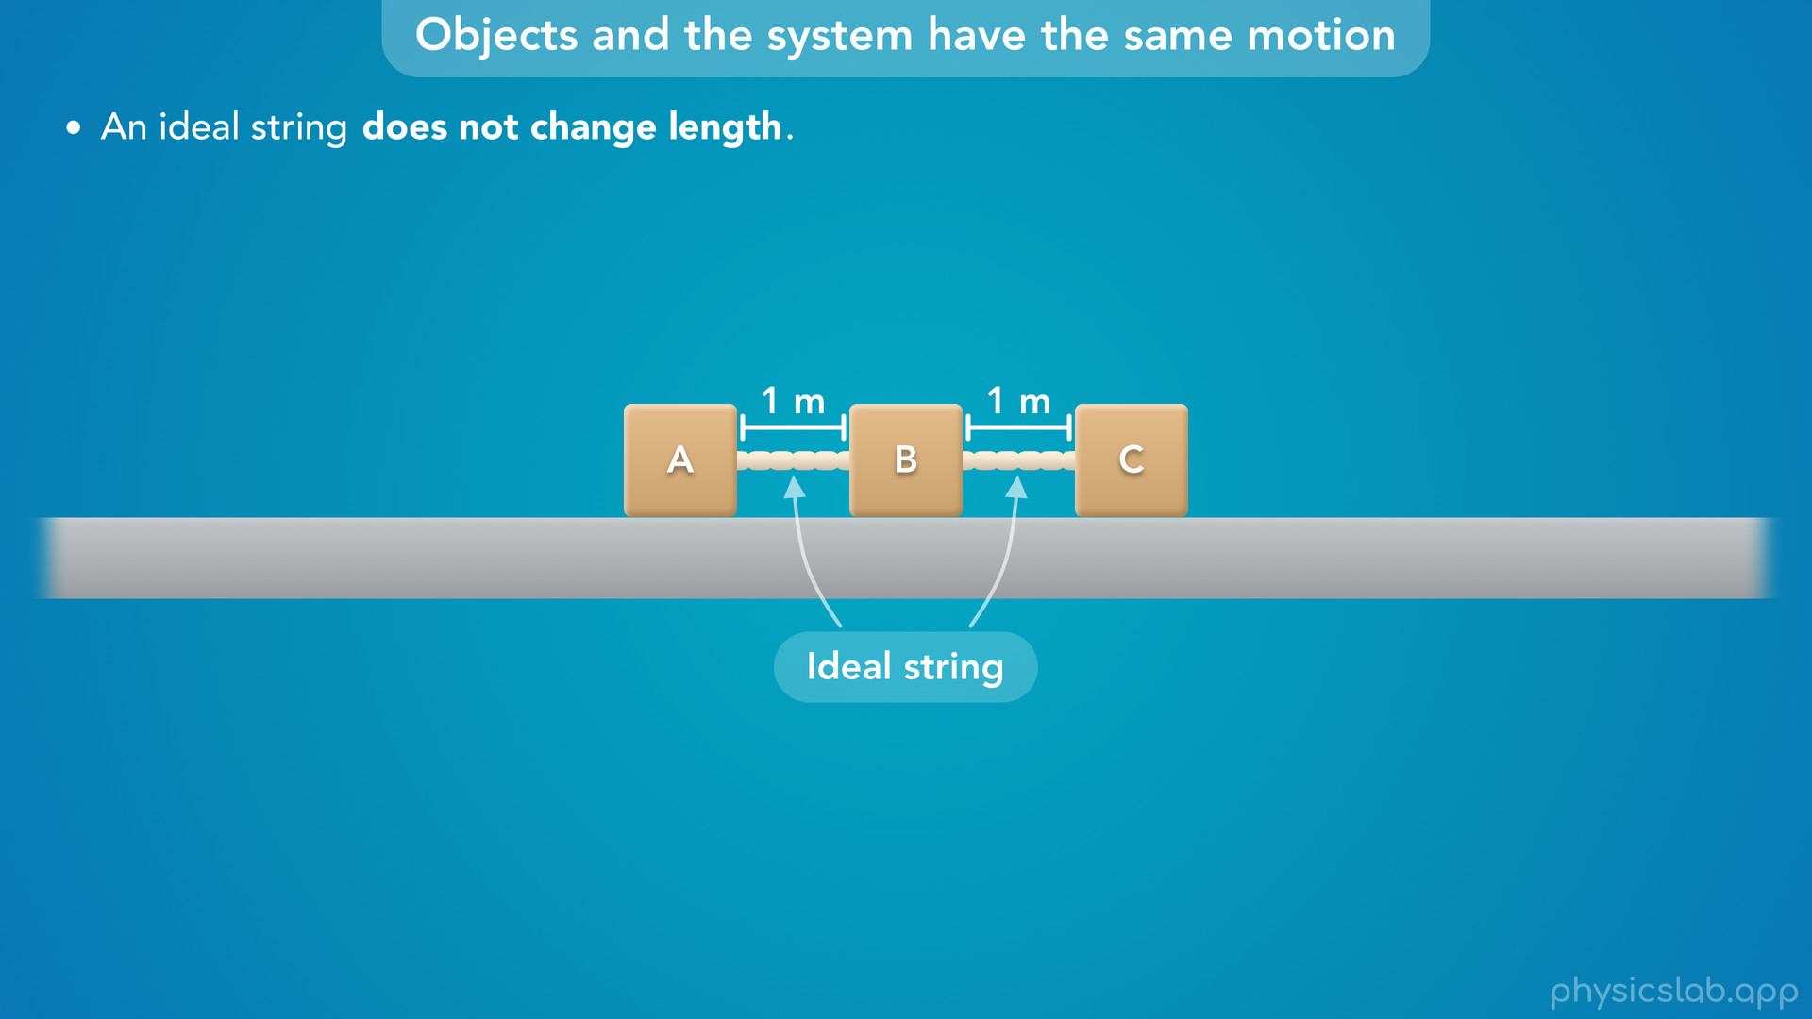
Notes:
• We’re assuming that these are ideal strings, and we learned that an ideal string does not change length.
• For example, let’s say that these strings are always 1 m long, so the distance between each block is always 1 m.

Slide 26
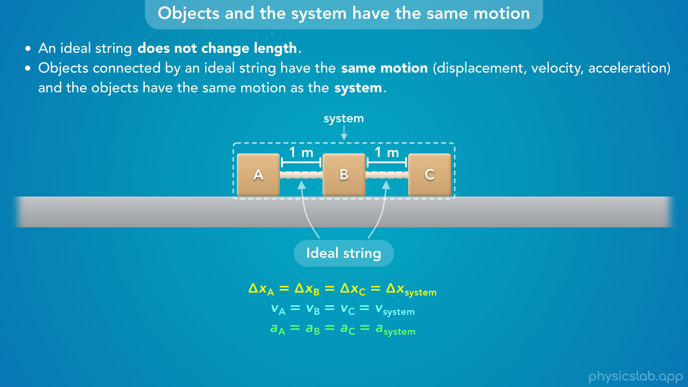
Notes:
• This means that objects connected by an ideal string have the same motion, the same displacement, velocity and acceleration, and the objects have the same motion as the system.
• So these 3 blocks will move together as a group, which we call a system.
• If the blocks were connected by solid metal rods, it might be easier to imagine how they move together as a group.
• We could also think of them as a single object.
• If this already makes sense, you can skip to the next part of the video.

Slide 27
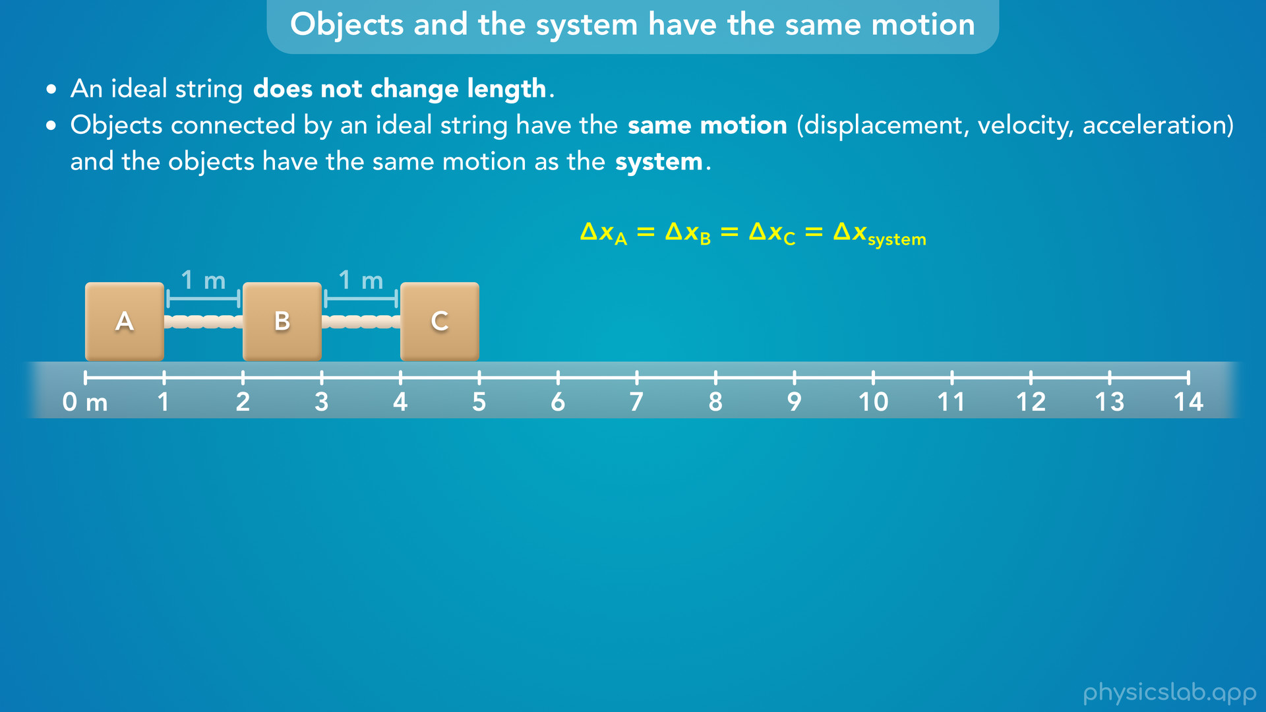
Notes:
• But we can also explore this a little further, starting with the displacements.
• If the blocks start here…

Slide 28
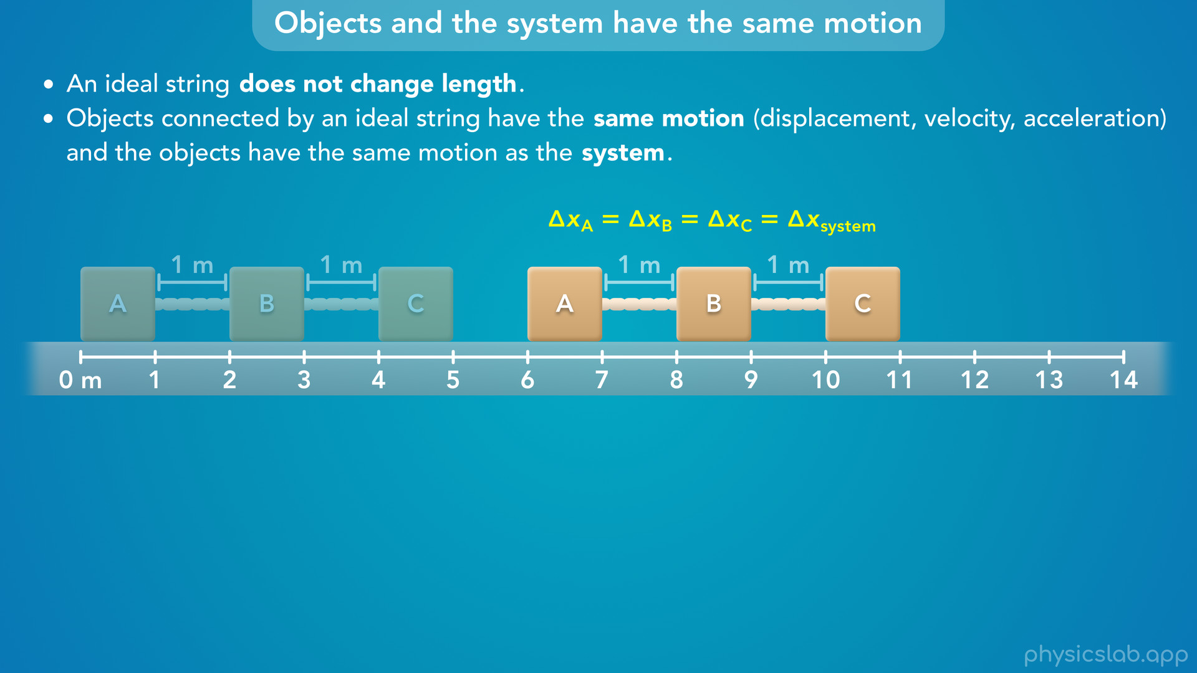
Notes:
…and some time later the blocks are here, each block will have the same displacement, delta x.

Slide 29
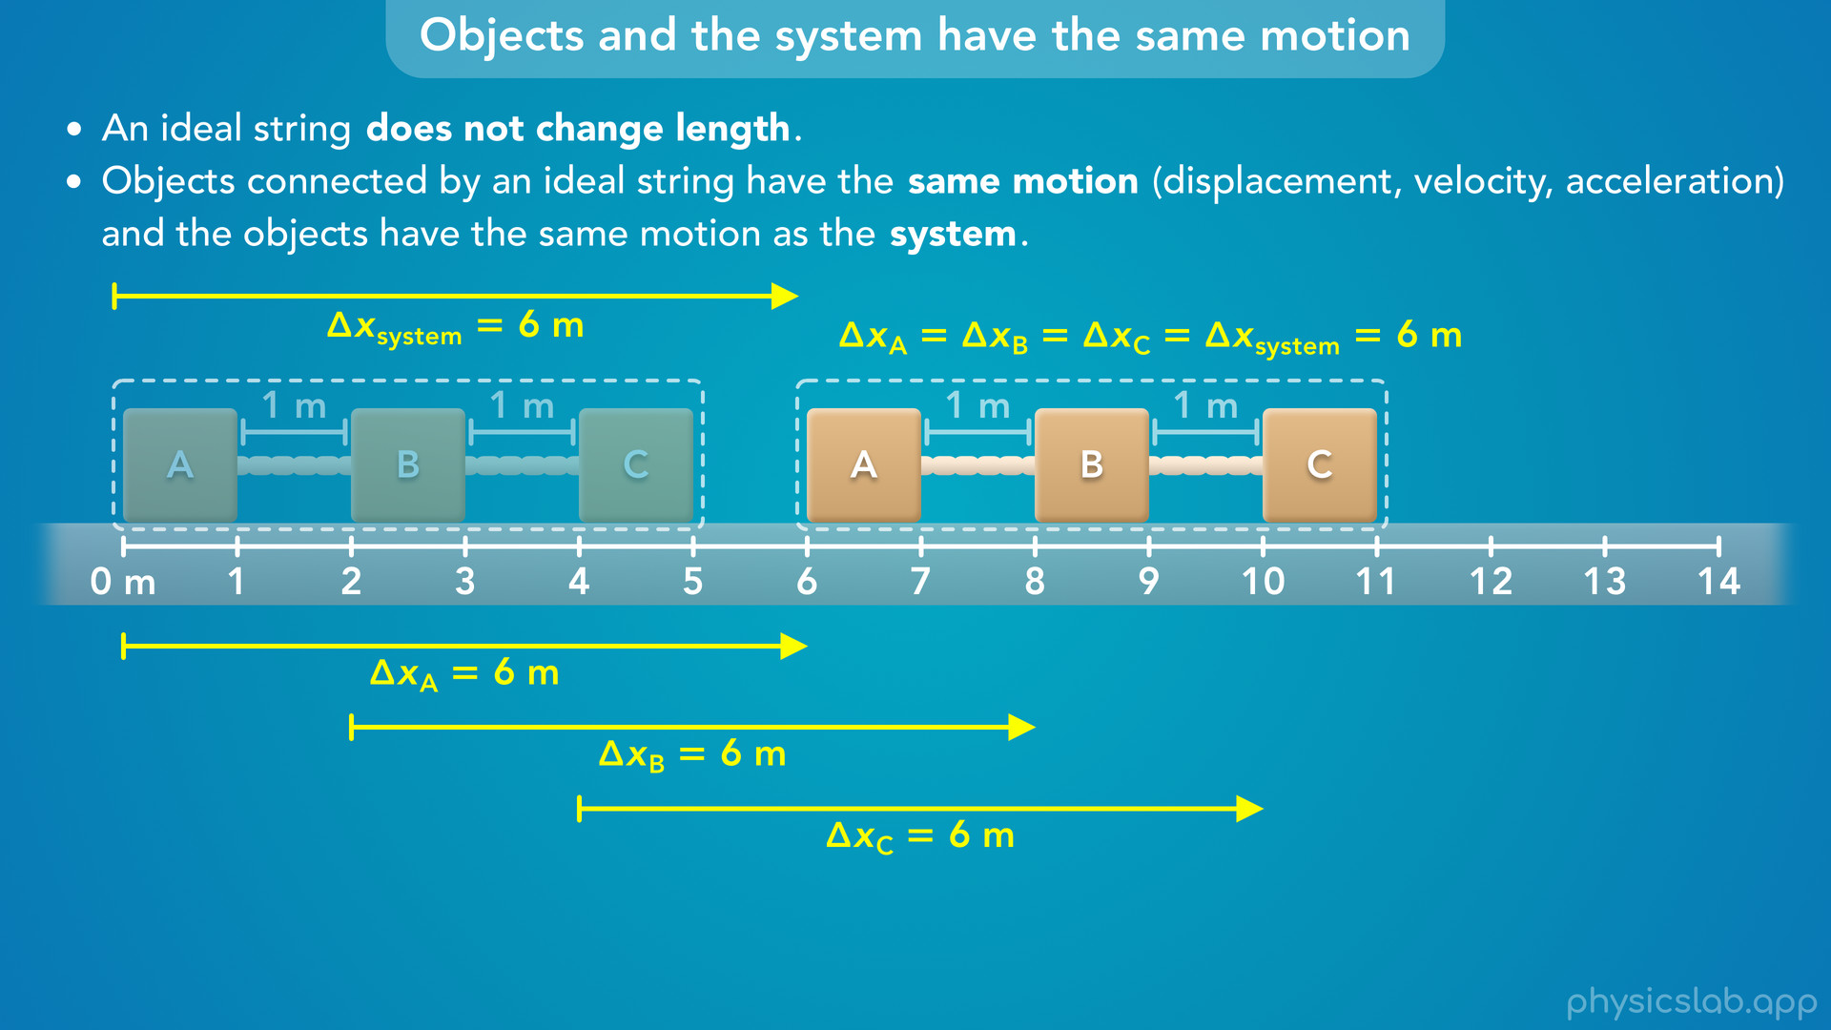
Notes:
• Block A moved 6 m to the right, block B moved 6 m to the right, and block C moved 6 m to the right.
• And we could say the system as a whole moved 6 m to the right.

Slide 30
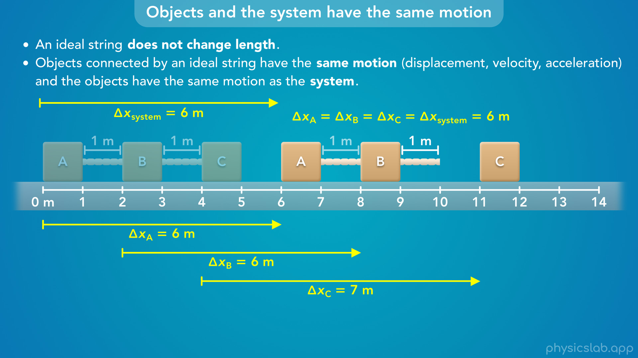
Notes:
• If one block moved a different amount, the strings would have to get longer or shorter.
• For example, if block C moved 7 m, it would now be 2 m away from block B.
• So the right string would either have to break… or stretch and become 2 m long.
• But we assume the strings don’t break and they don’t stretch, so the blocks have the same displacements.

Slide 31
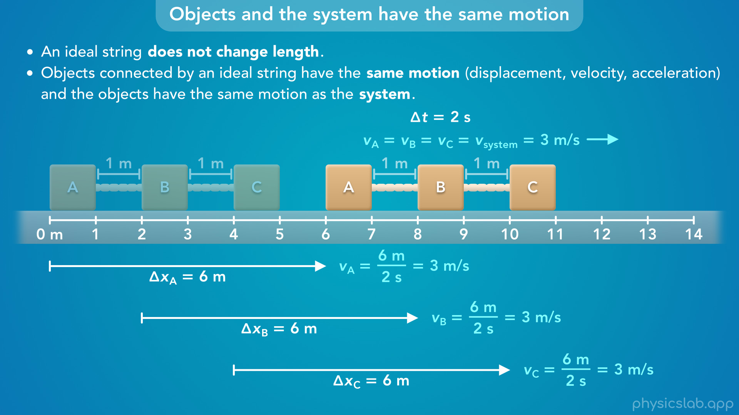
Notes:
• What about the velocities?
• Let’s say each block moved 6 m over a period of 2 seconds at a constant velocity.
• The velocity of each block would be 3 m/s.
• The blocks moved the same displacement in the same amount of time, so they had the same velocity.

Slide 32
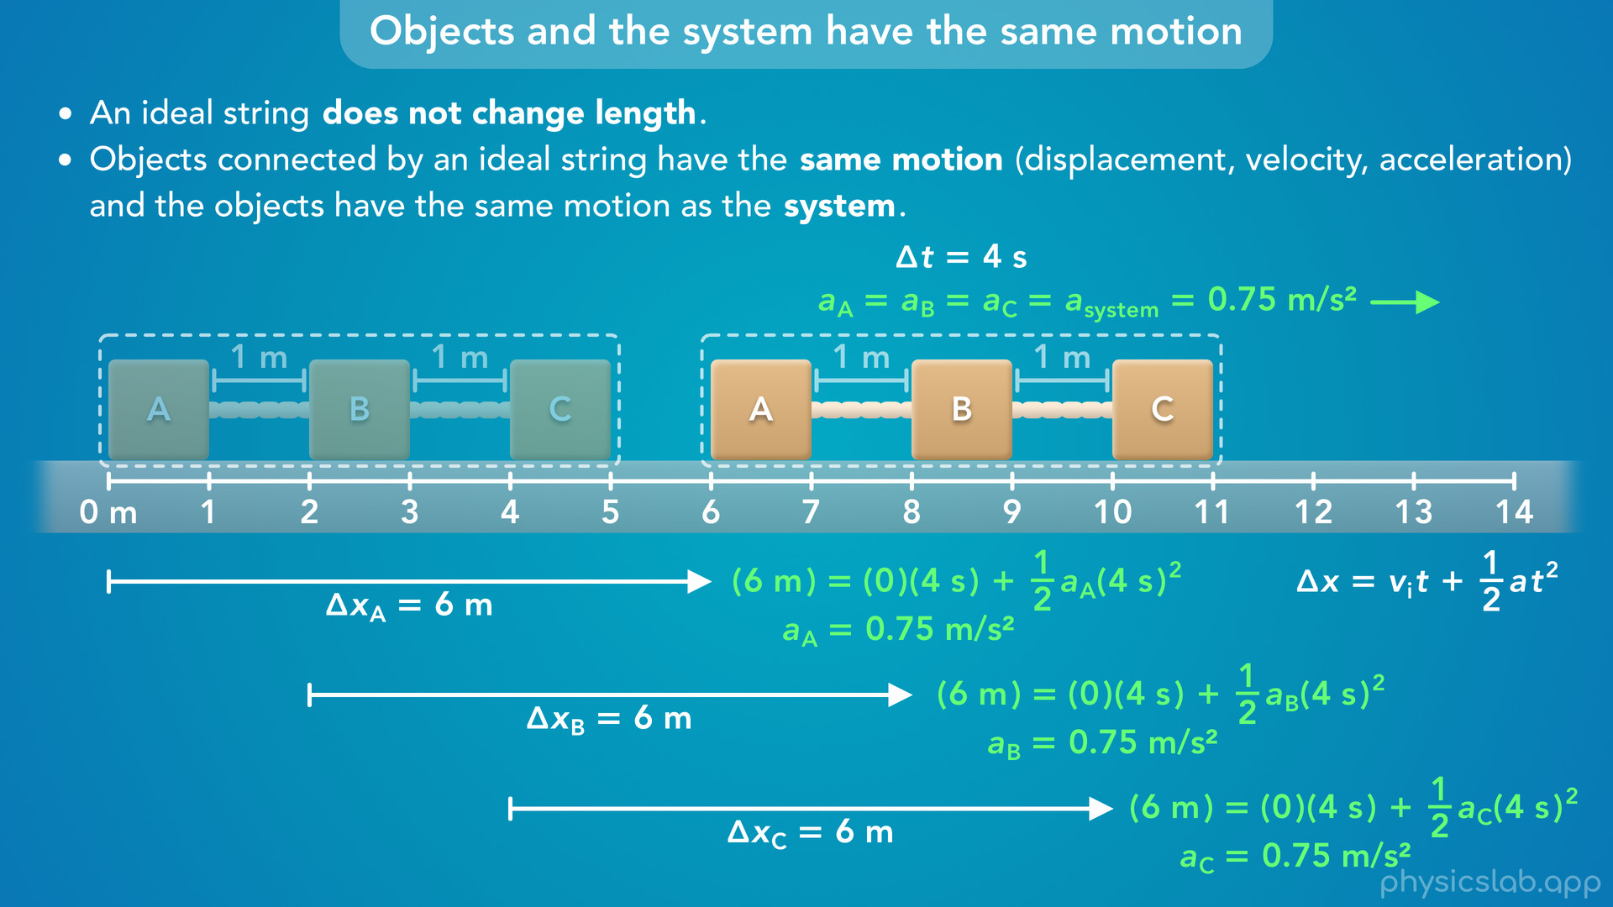
Notes:
• Now let’s say the blocks start at rest, they accelerate to the right, and they move 6 m over a period of 4 seconds.
• We can use this kinematic equation to calculate the acceleration.
• Each block moved the same displacement in the same amount of time, so they have the same acceleration, which is 0.75 m/s².
• This is also the acceleration of the system as a whole.

Slide 33
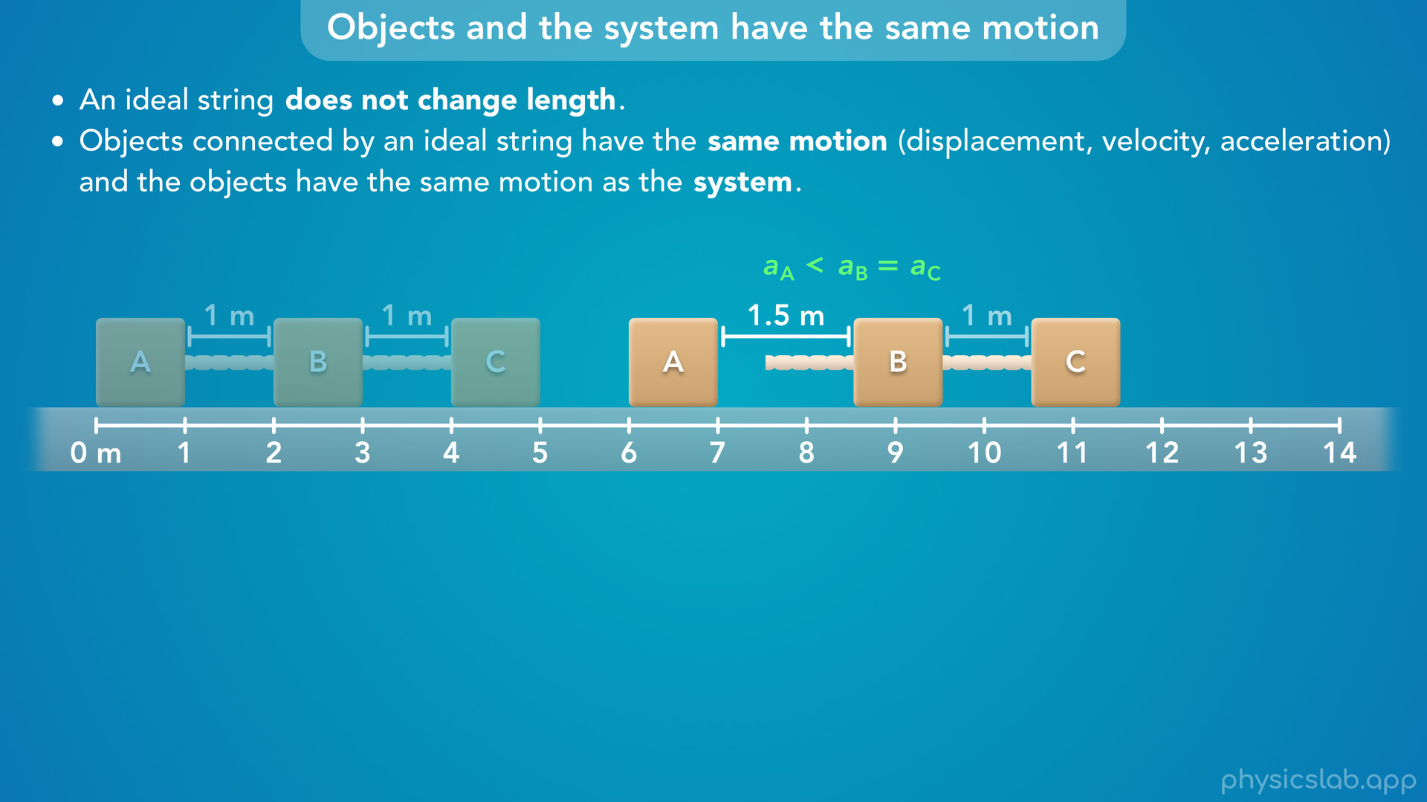
Notes:
• If one block had a different acceleration, the strings would have to get longer or shorter.
• For example, let’s say blocks B and C have a greater acceleration than block A.
• Over the same period of time, blocks B and C would travel a greater distance than block A, so blocks A and B would get farther apart.
• But the strings don’t break or stretch, so this can’t happen.

Slide 34
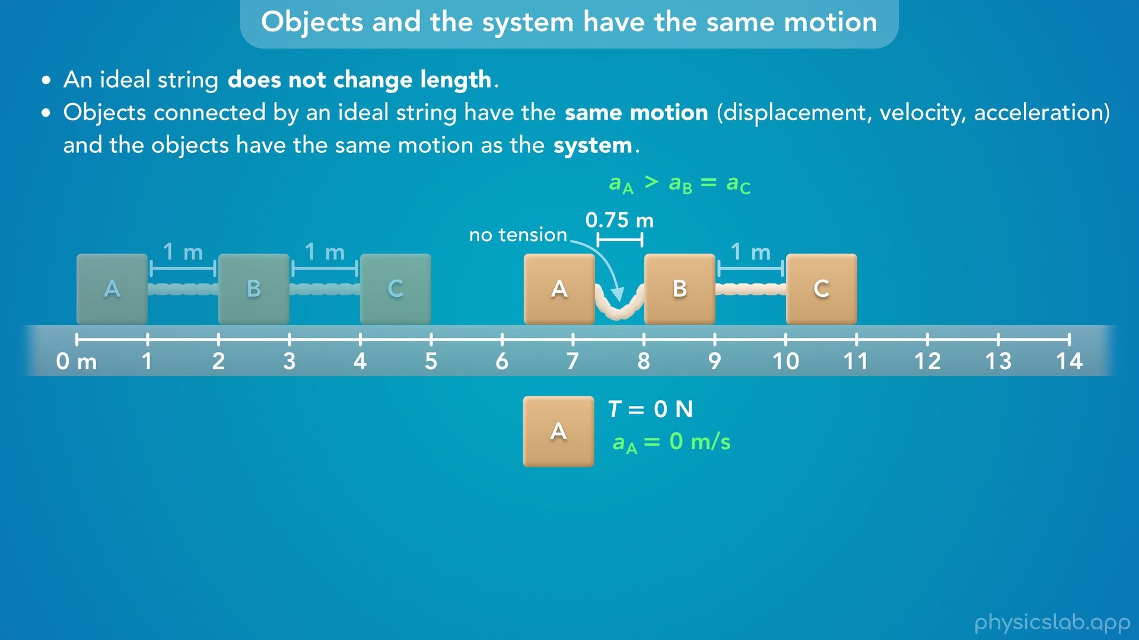
Notes:
• What if block A had a greater acceleration, it get closer to block B.
• The strings can’t get shorter, so this string would collapse.
• As soon as that happens, there is no tension in that string, which means there is no longer a tension *force* causing block A to accelerate, and the acceleration of block A goes to zero.
• So block A cannot have a greater acceleration than block B.

Slide 35
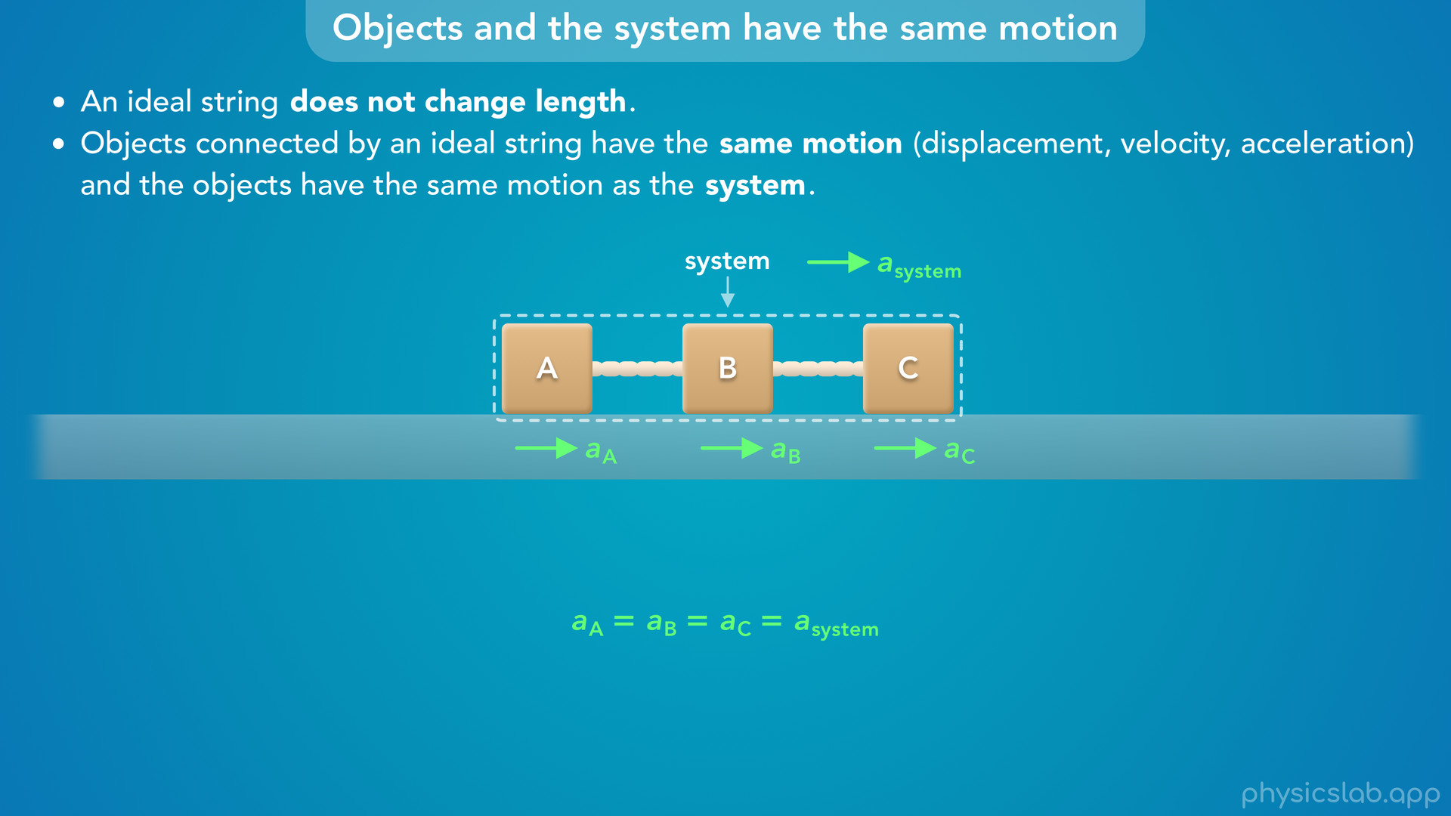
Notes:
• So these blocks and the system have the same motion.
• And now that we know the accelerations are the same, there are two ways we can use this information to solve for the tensions in the example problem.

Slide 36
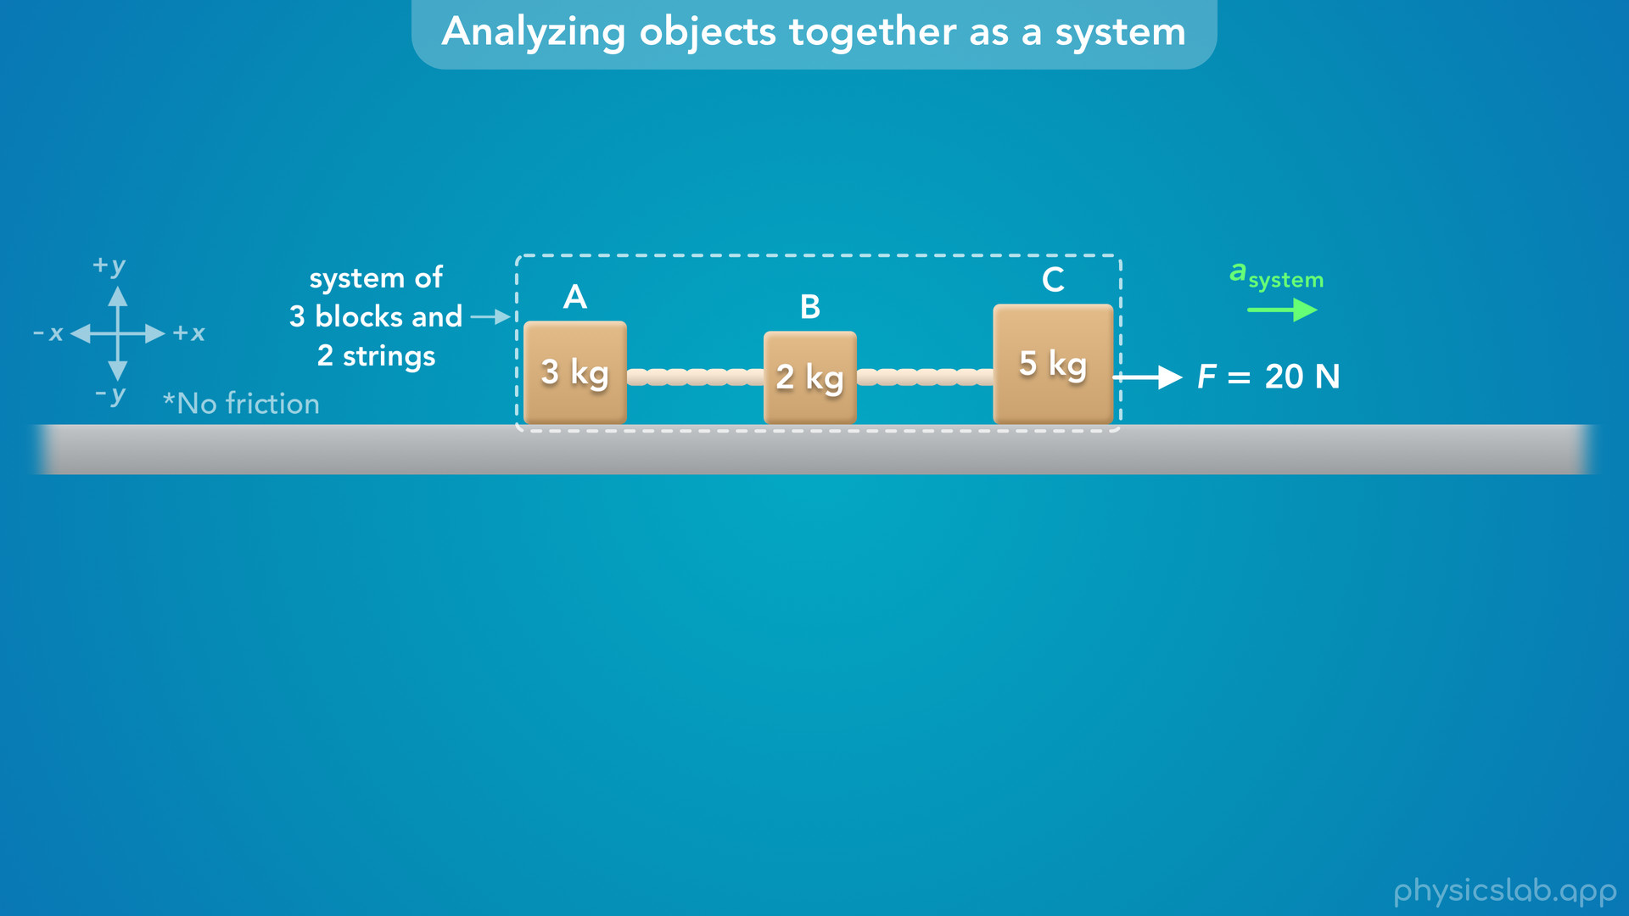
Notes:
• The first way to solve this is by analyzing the objects together as a system to find the acceleration.

Slide 37
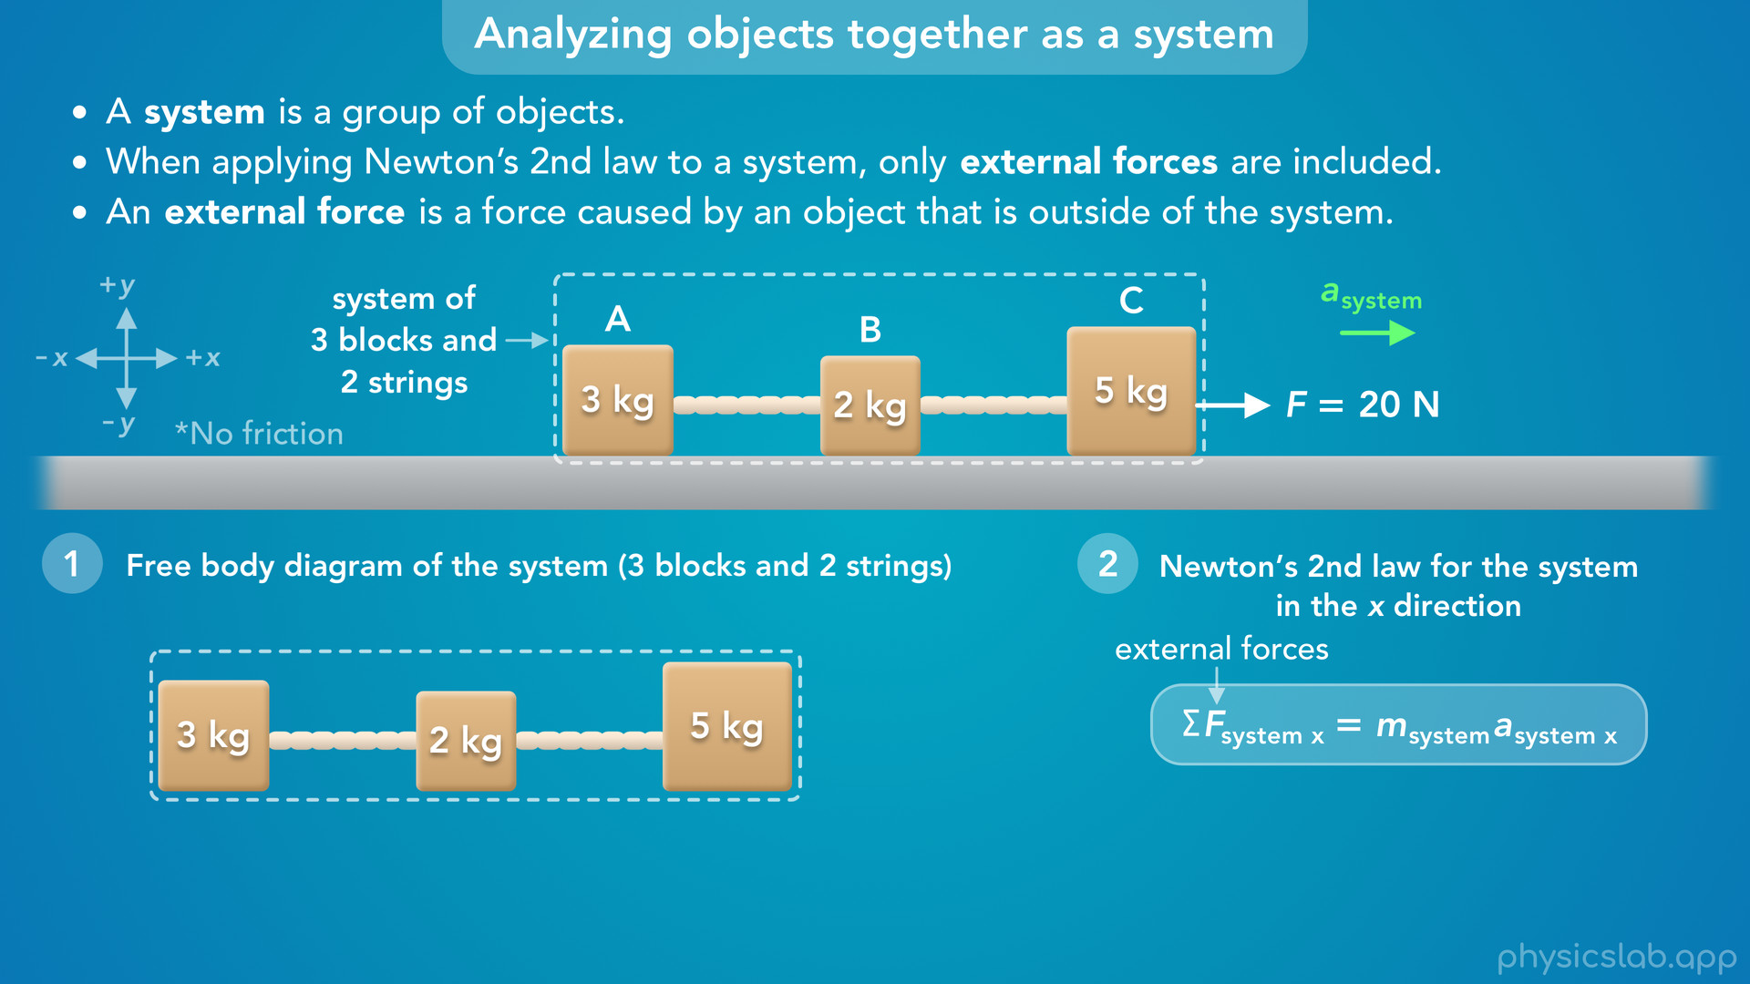
Notes:
• Remember that a system is just a group of objects, and right now we’re choosing to include the 3 blocks and the 2 strings inside the system. That means the ground and everything else is outside the system.
• Now we can draw a free body diagram and apply Newton’s 2nd law to the overall system.
• But remember, when we apply Newton’s 2nd law to a system, only external forces are included.
• And an external force is a force caused by an object that is outside of the system.
• So what are the external forces acting on this system?

Slide 38
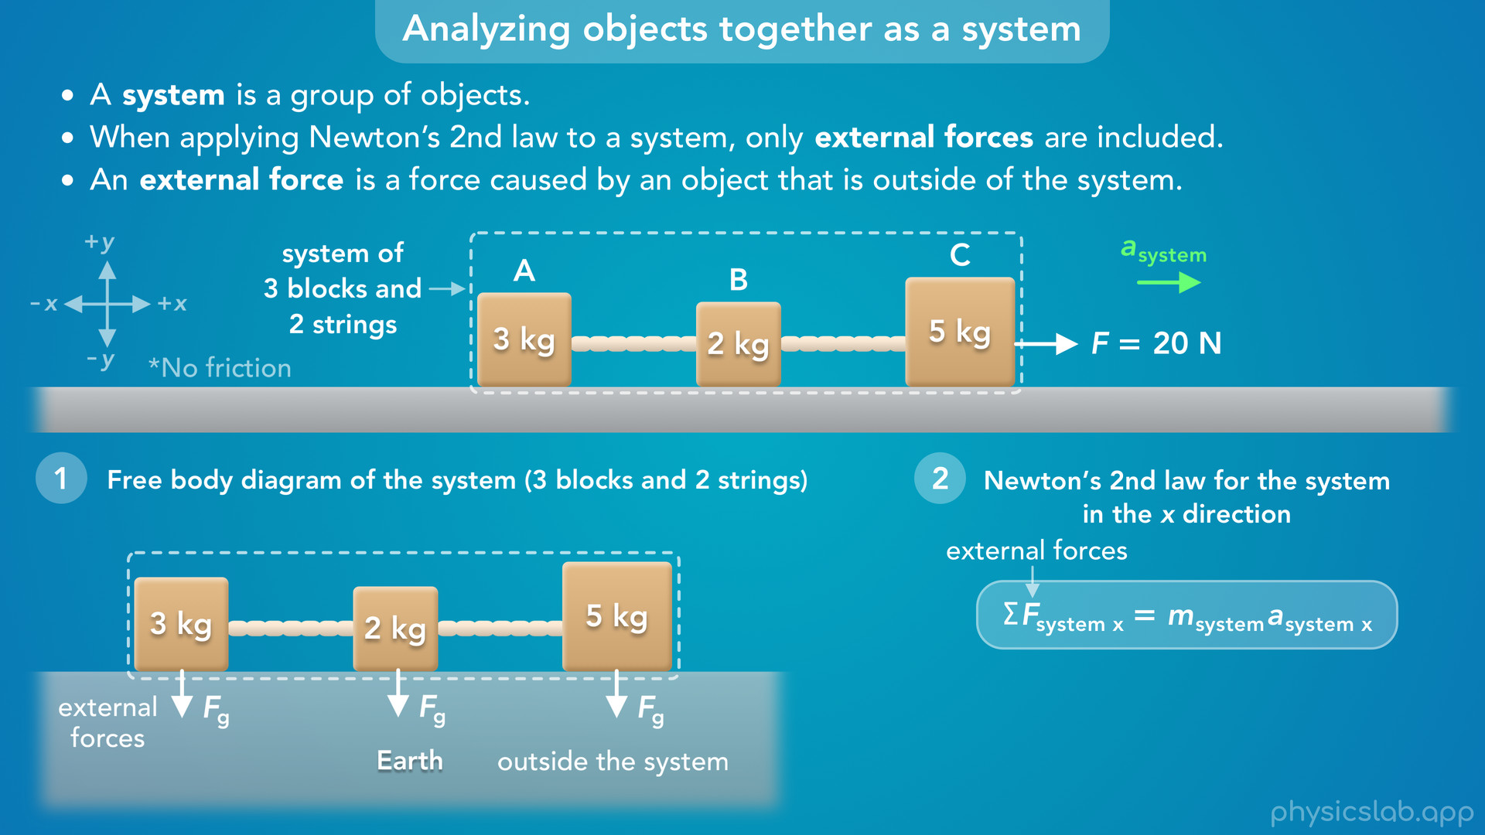
Notes:
• There’s a downwards gravitational force on each block caused by the earth.
• These are external forces because the earth is outside of this system.

Slide 39
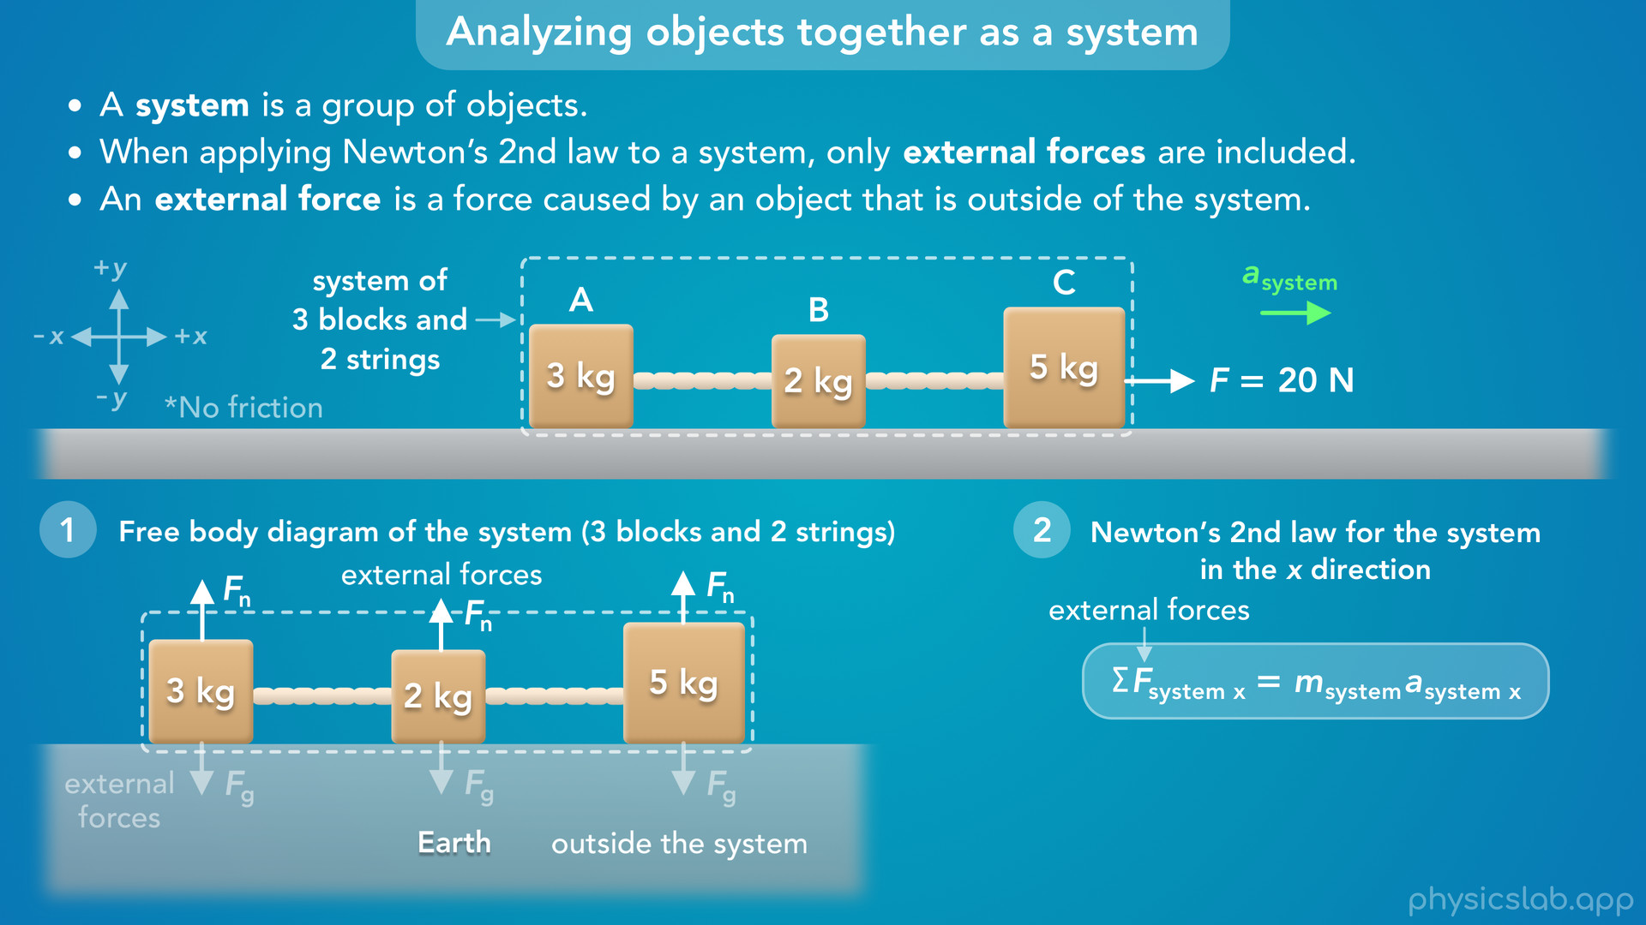
Notes:
• There’s also an upwards normal force on each block caused by the surface of the ground.
• These are also external forces because the ground is outside of the system.

Slide 40
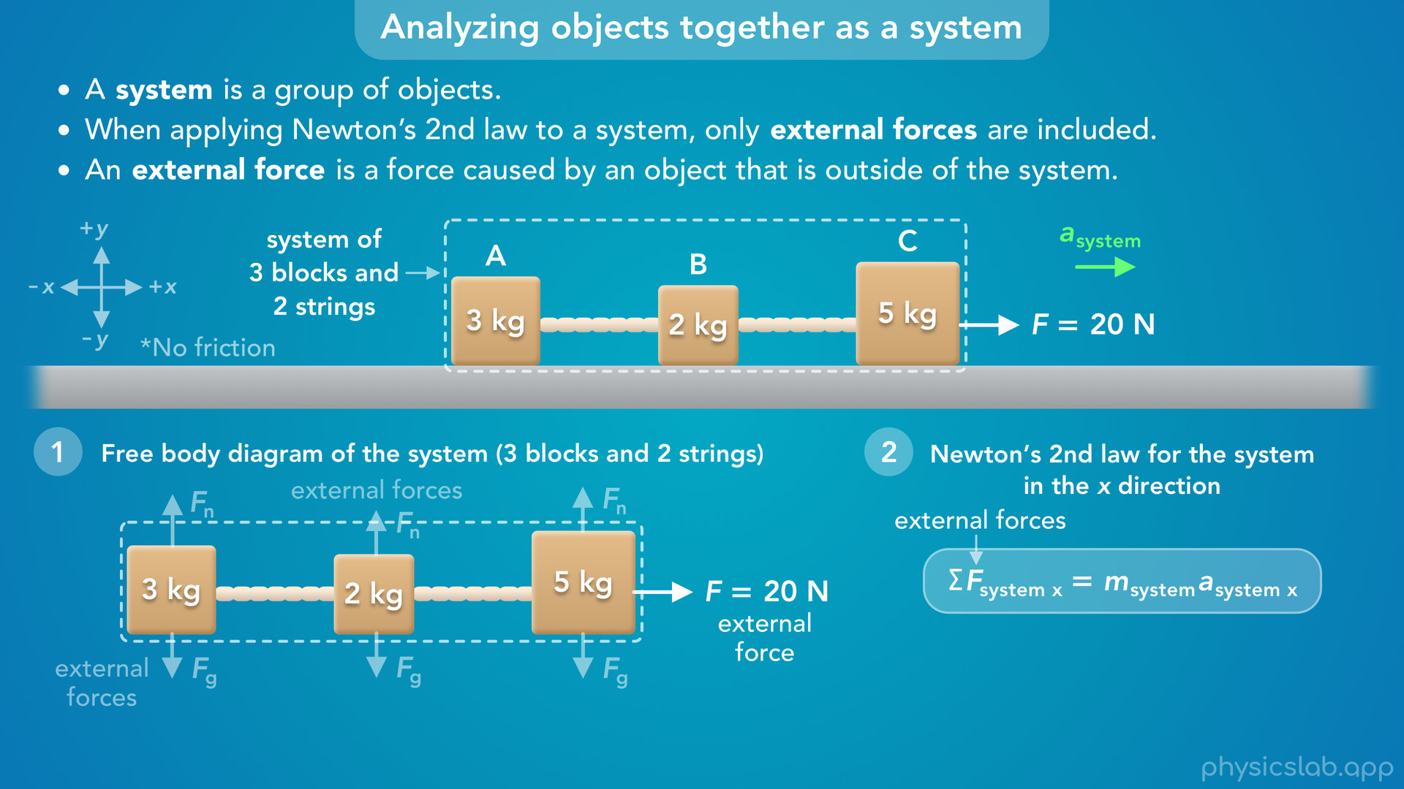
Notes:
• This 20 N force would also be an external force.
• We don’t know what’s causing this force, maybe a person is pulling on block C.
• But whatever is causing this force is outside of the system.

Slide 41

Notes:
• What about the tension forces, T1 and T2?
• These forces are caused by the strings which are inside the system, so these would be internal forces.
• When we apply Newton’s 2nd law to the system, we only include the external forces, so we’re going to ignore T1 and T2.

Slide 42
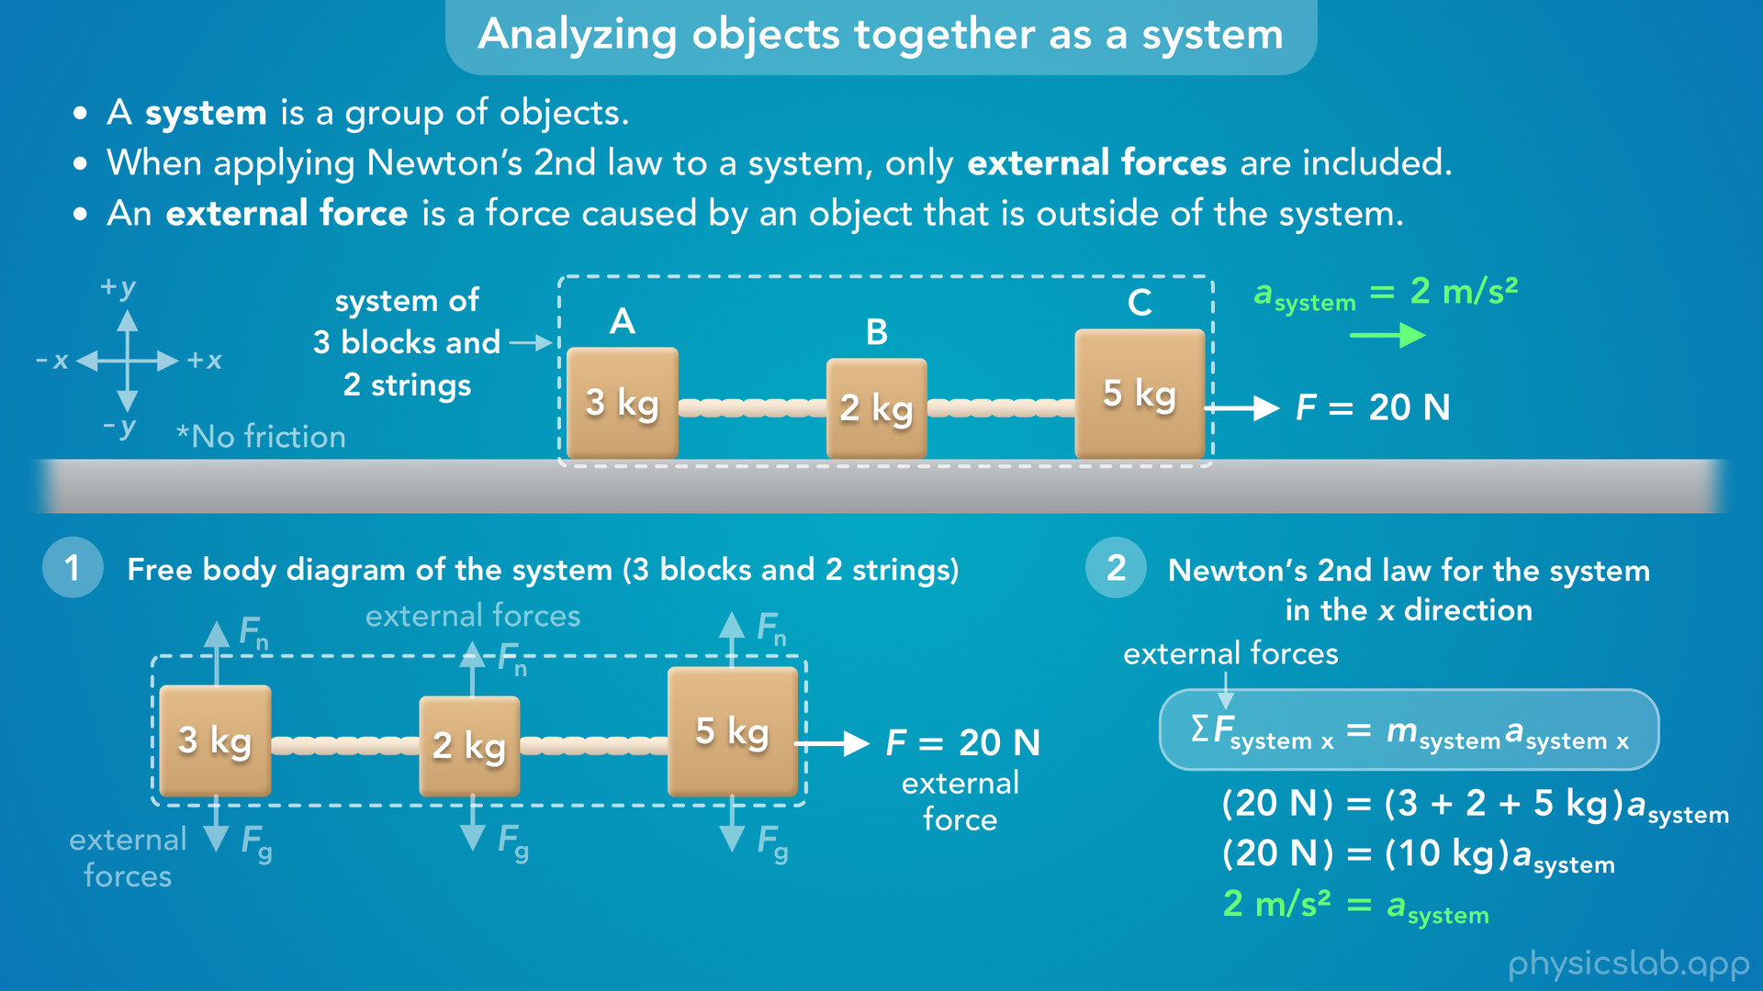
Notes:
• In the x direction, the net external force acting on the sytem would just be the 20 N force to the right.
• There are no other external forces in the x direction.
• For the mass, we use the total mass of the system, so we add the mass of the blocks together to get 10 kg.
• Remember, we assume the strings have no mass.
• When we divide 20 N by 10 kg, we get 2 m/s² for the acceleration of the system.

Slide 43
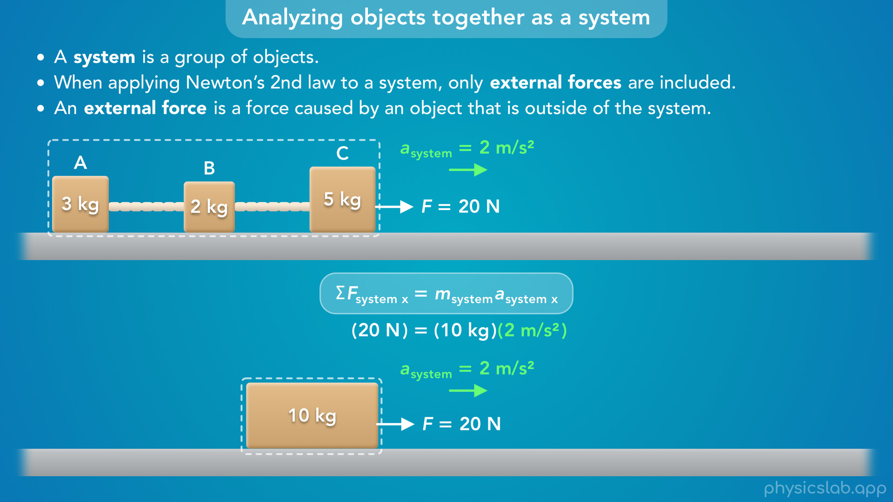
Notes:
• So this 20 N force is causing the system to accelerate at 2 m/s².
• This would be the same thing as applying a 20 N force to a 10 kg block.
• Both systems have the same external force, the same mass, and they both accelerate at 2 m/s².

Slide 44
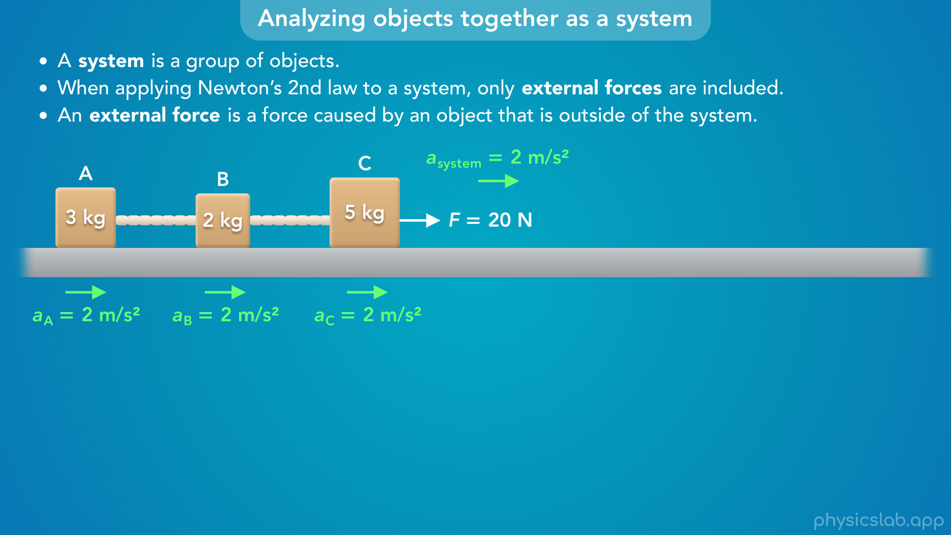
Notes:
• So that’s the acceleration of the system, and it’s also the acceleration of each block, because the blocks move together.

Slide 45
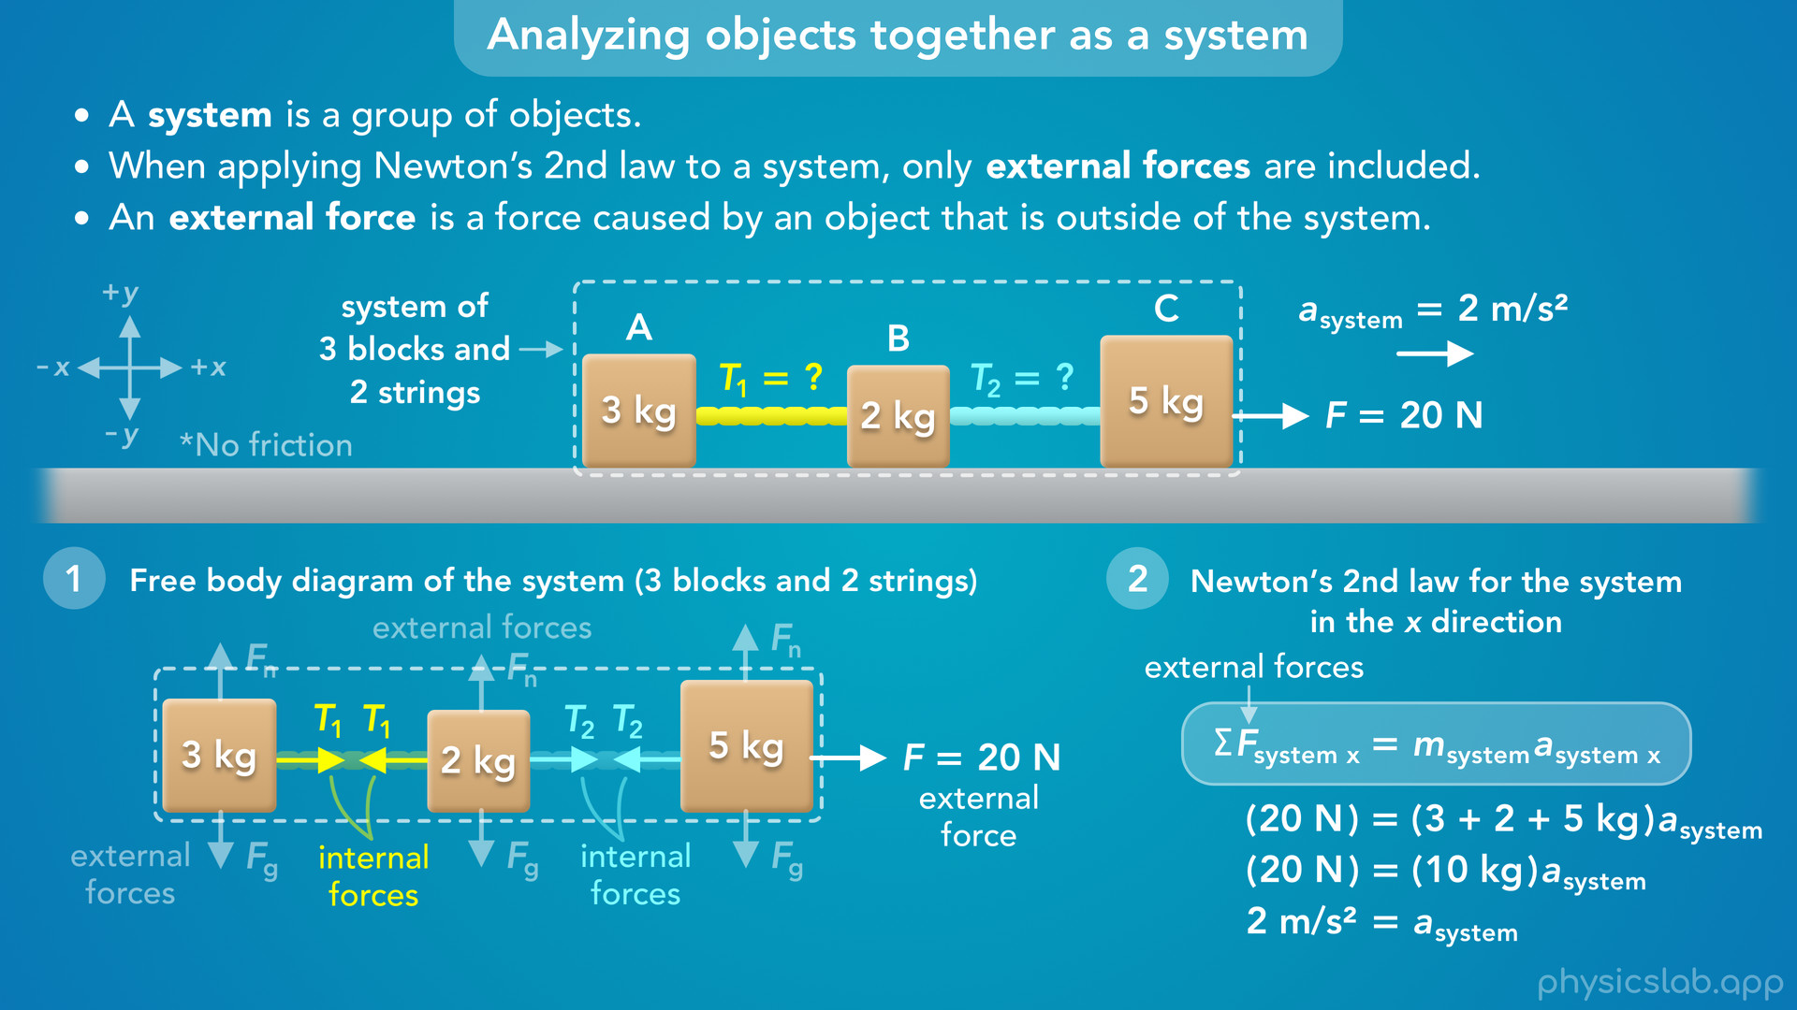
Notes:
• But, we’re still trying to find the tension in each string, T1 and T2.
• And we cannot solve for those forces by analyzing this system, because T1 and T2 would be internal forces.
• So what do we do next?

Slide 46
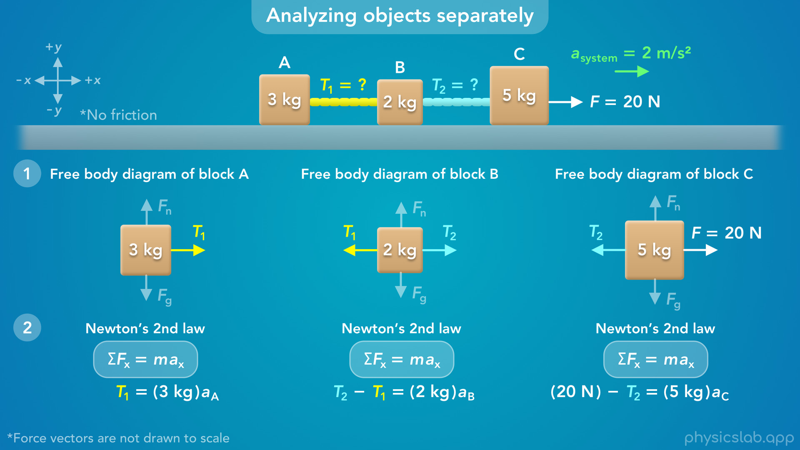
Notes:
• We have to go back to analyzing the blocks separately.
• This way, T1 and T2 show up in the free body diagrams and Newton’s 2nd law for each block.

Slide 47
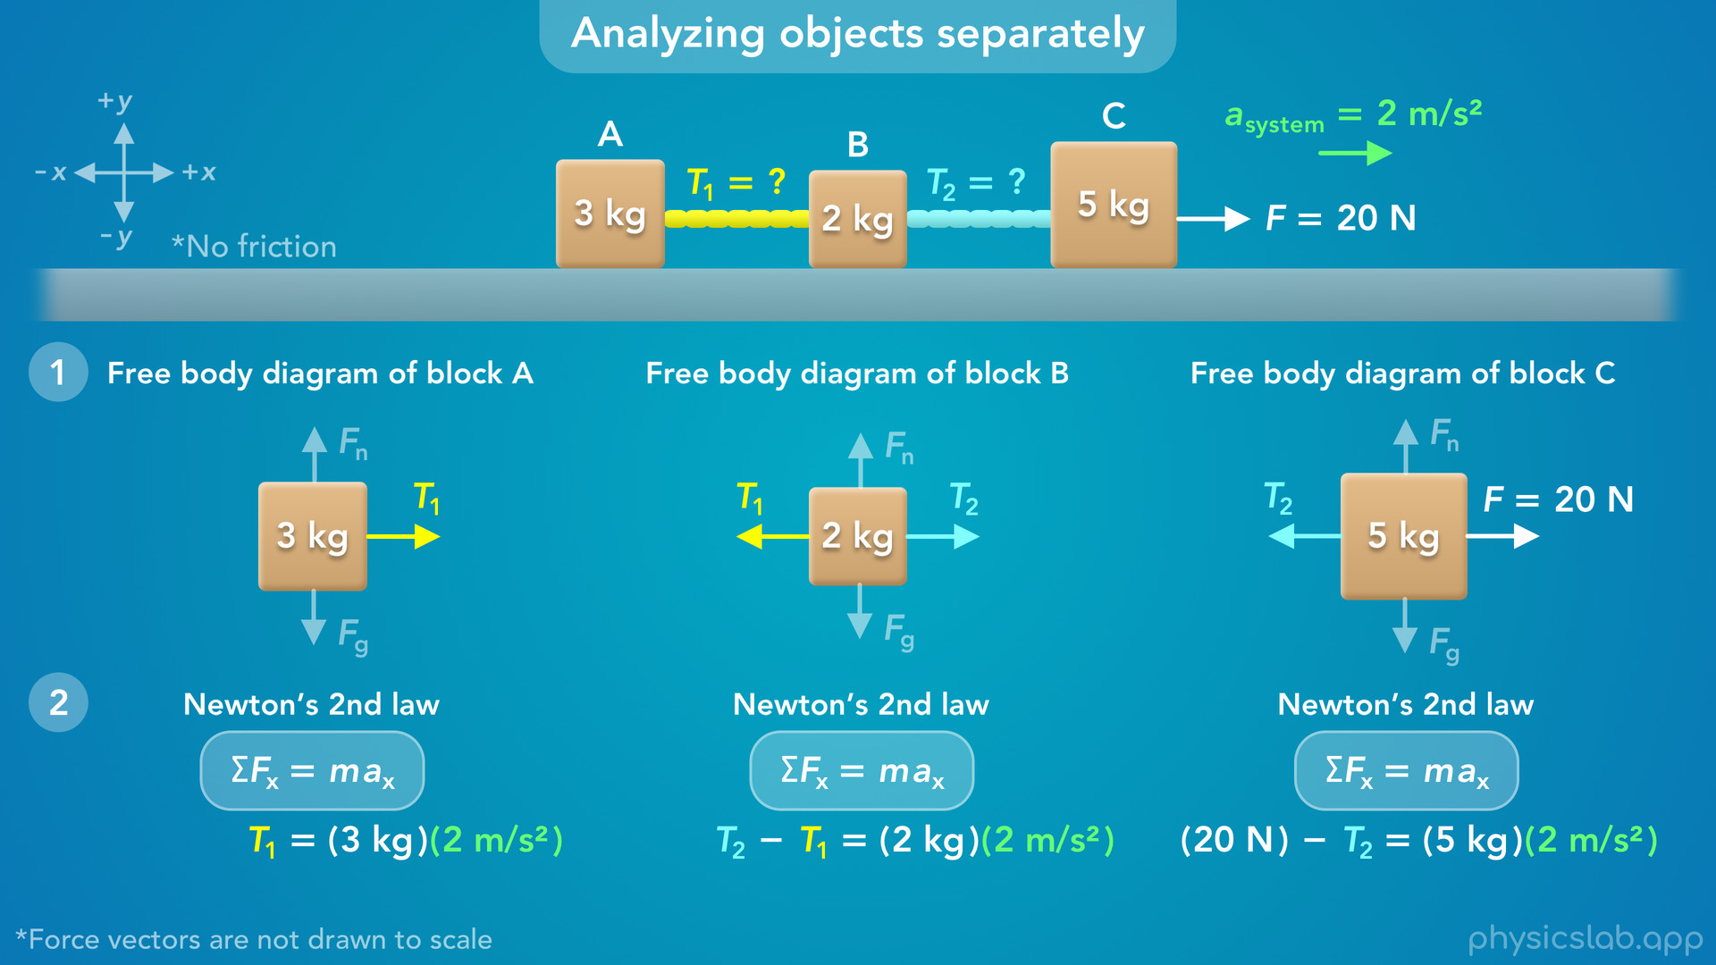
Notes:
• But now, we know the acceleration of each block is 2 m/s², so we can plug that in to these equations.

Slide 48
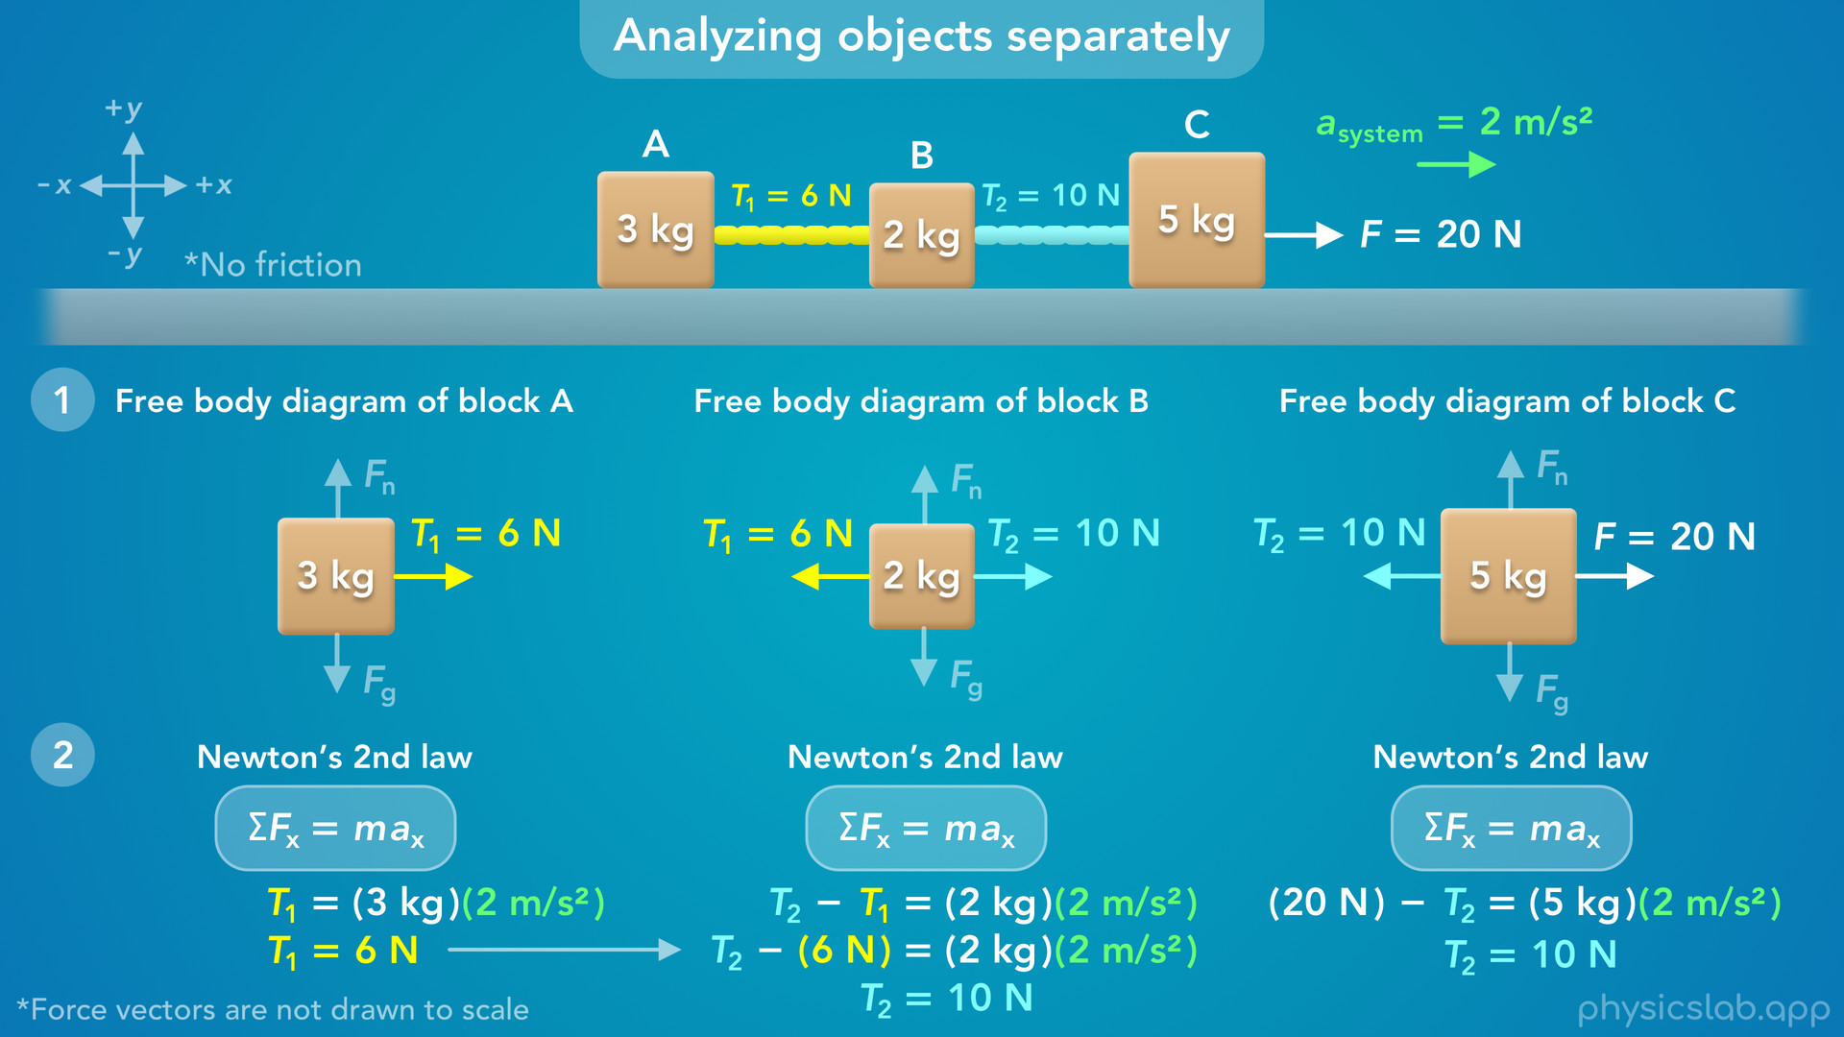
Notes:
• For block A, T1 is the only force causing the block to accelerate, so T1 would be 6 N.
• That means the left tension force on block B is also 6 N, these forces are caused by the same string.
• So we can plug in 6 N for T1 in this equation, and when we calculate that, we get 10 N for T2.
• We could also solve for T2 using block C.
• We know the acceleration, so the only unknown variable is T2.
• When we solve that, we get 10 N.
• So using this method, we found the acceleration by analyzing the system as a whole.
• For block A, there’s only 1 force, so we could solve for T1.
• For block C, there’s only 1 unknown force, so we could solve for T2.
• Block B had two unknown forces, so we need to find either T1 or T2 using another block, and then substitute that into this equation.

Slide 49
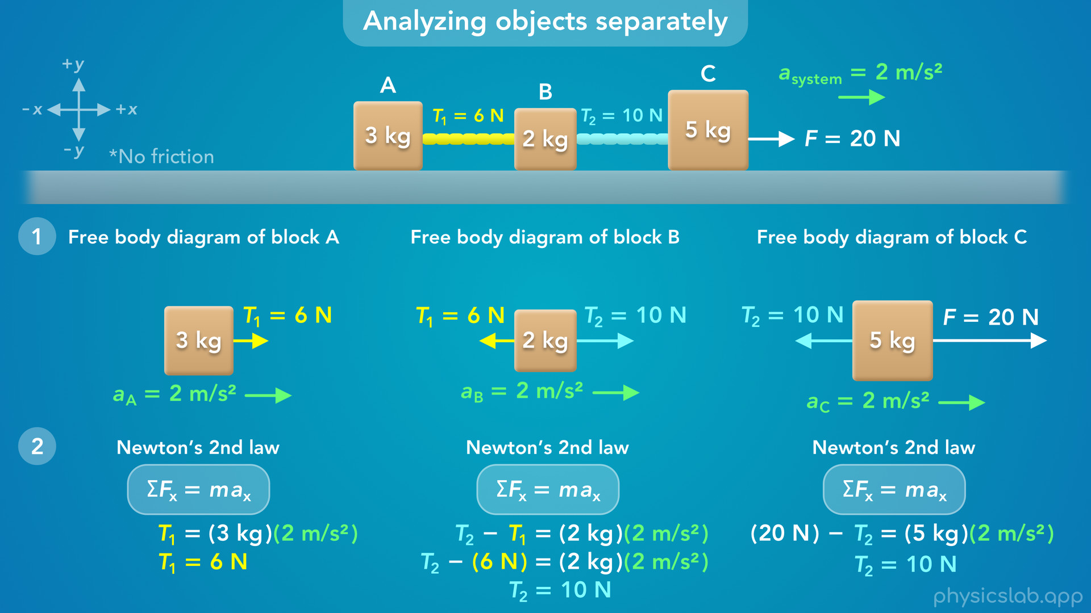
Notes:
• Like we mentioned at the beginning, these force vectors are not drawn to scale.
• So here’s what they look like with the correct magnitudes.
• For each block, there is a net force acting to the right, which causes that block to accelerate to the right.
• The blocks experience different net forces, but they also have different masses, and their accelerations are the same.
• So that’s one way to solve for the tensions.

Slide 50
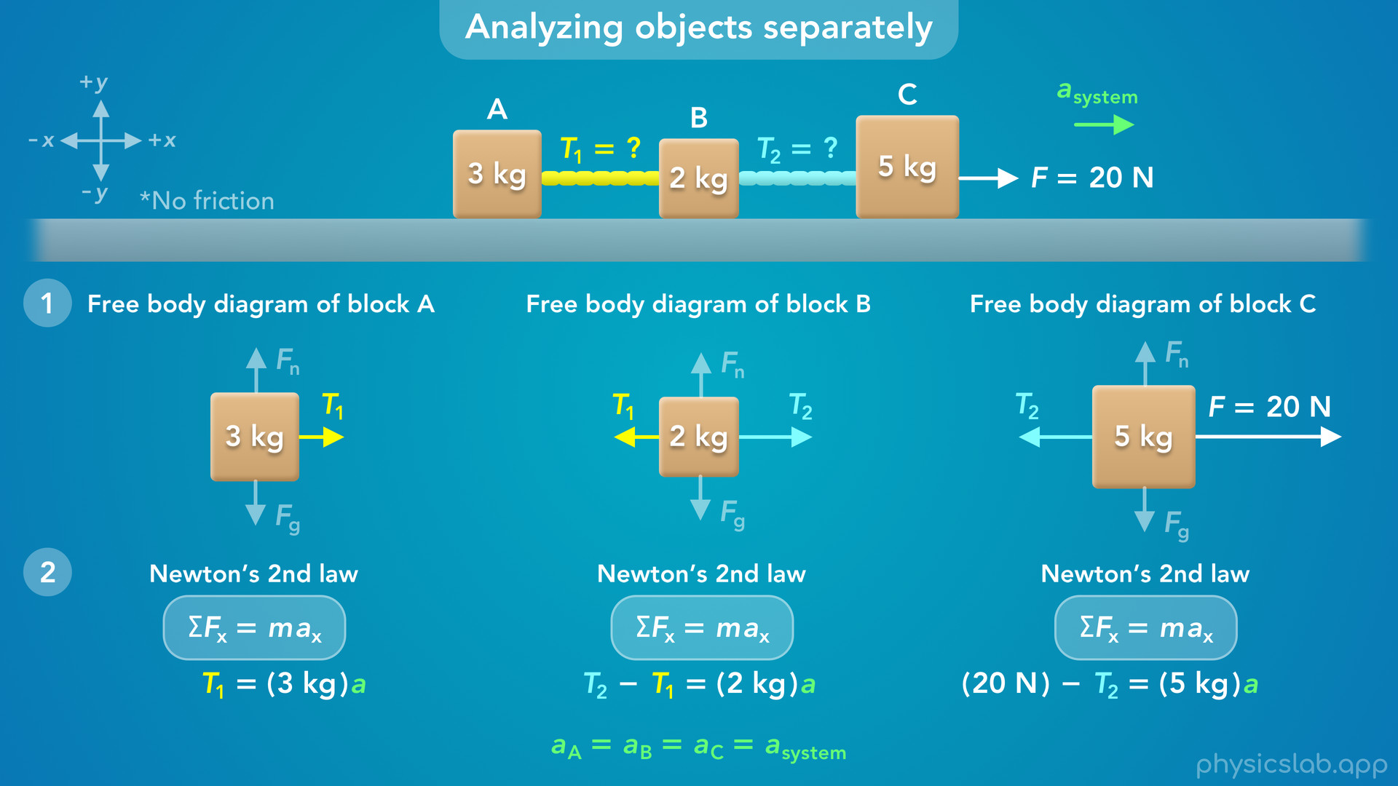
Notes:
• But we could have solved this another way.
• We know that the acceleration is the same for each block.
• But instead of plugging in 2 m/s², we could just use the same variable in the equation for each block.
• We could call this the acceleration of the system, but we’ll just use the variable a.
• Now, we have 3 equations with 3 unknown variables: T1, T2, and a.
• So we can solve for each one by doing some algebra.

Slide 51
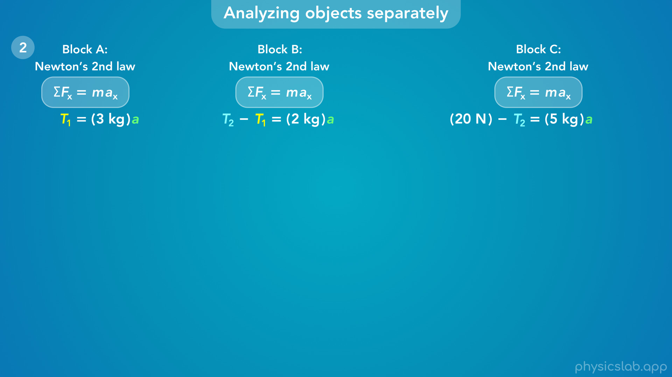
Notes:
• You could work through this in a different order, but here’s one way we could do it.

Slide 52
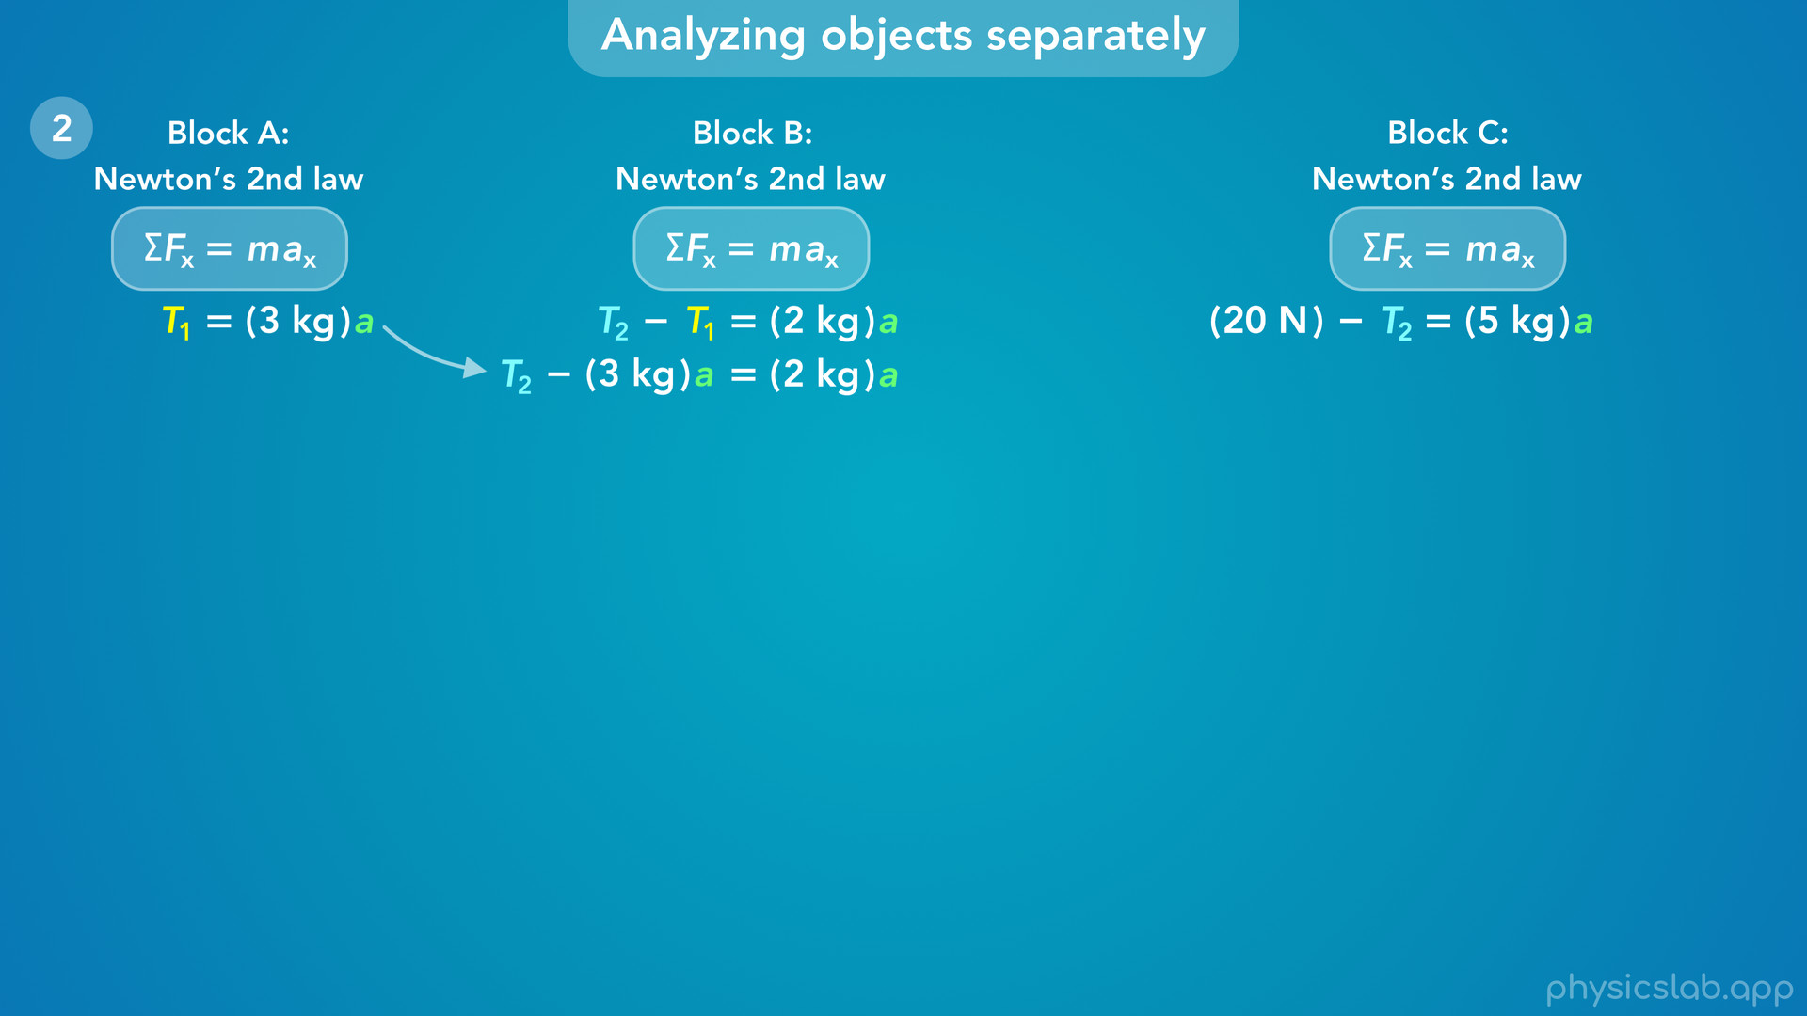
Notes:
• From block A, we know that T1 is equal to 3 kg times a.
• So we can substitute that in place of T1 in the equation for block B.

Slide 53
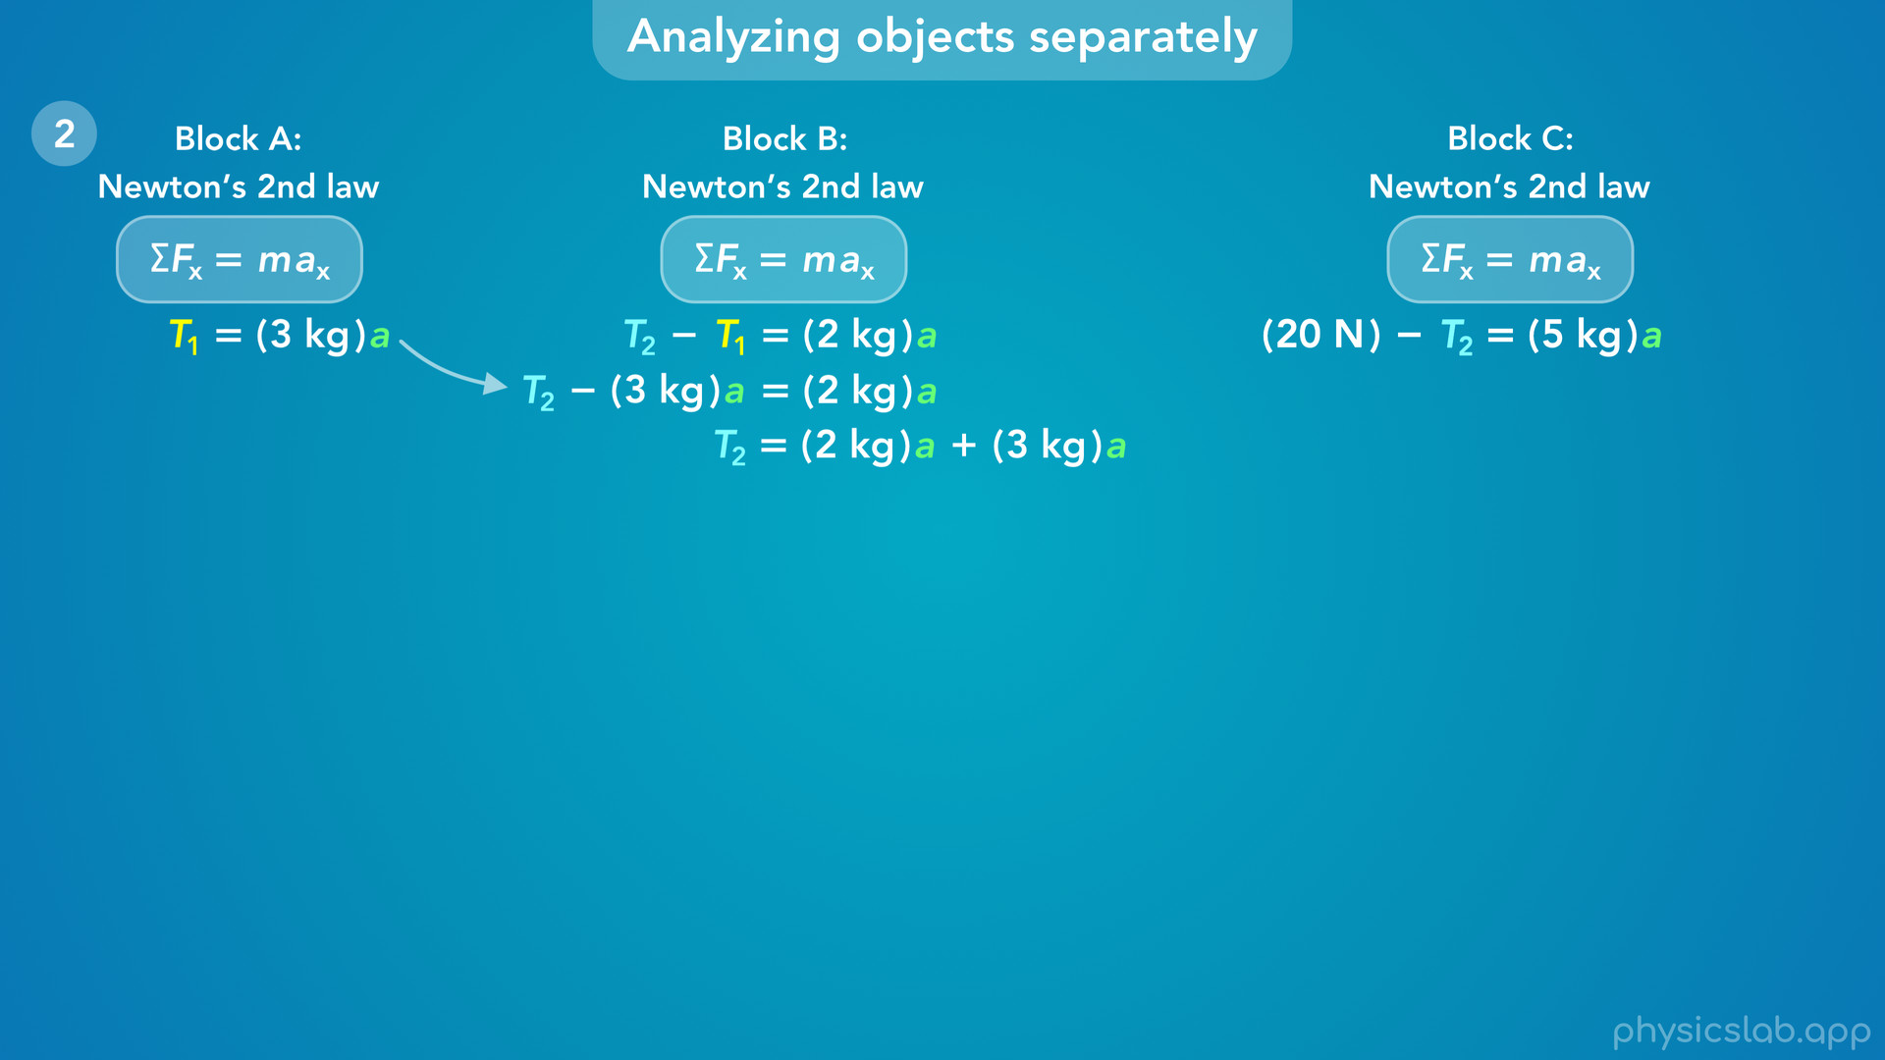
Notes:
• Then we can add that to both sides

Slide 54

Notes:
add these terms together, and we get an equation for T2 in terms of a.

Slide 55
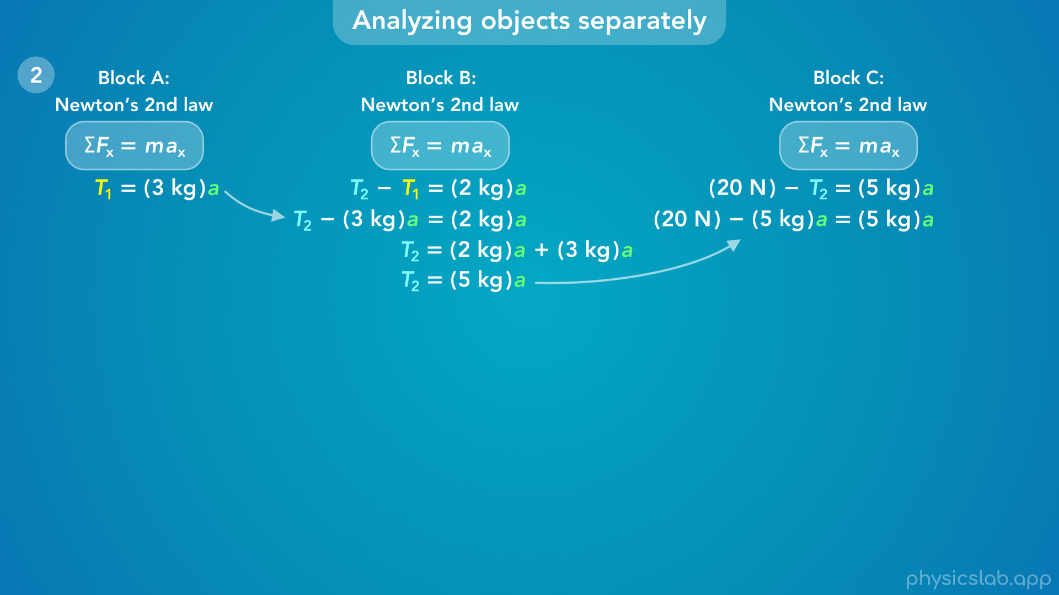
Notes:
• Now we can substitute that in place of T2 in the equation for block C.

Slide 56

Notes:
• Then we can add that to both sides

Slide 57

Notes:
add these terms together

Slide 58

Notes:
divide both sides by 10 kg, and we get 2 m/s² for the acceleration.
• That’s the same value that we got before when we analyzed the system.

Slide 59

Notes:
• Now we can take that value and plug it for a in the equations for block A and block B.

Slide 60

Notes:
• When we do that, we get 6 N for T1 and 10 N for T2.

Slide 61

Notes:
• So that’s another way we can find the tensions.

Slide 62

Notes:
• Let’s do a quick recap.
• We have 3 blocks connected by strings and they’re accelerating to the right because of this 20 N force.
• And we wanted to find the tension in each string.
• To do that, we needed to find the magnitude of the tension *forces* acting on the blocks.

Slide 63

Notes:
• When we work with forces, we usually need to draw a free body diagram and apply Newton’s 2nd law.
• We can do this for individual objects… or we can group the objects together and do this for the overall system.

Slide 64

Notes:
• If the strings are inside the system, then T1 and T2 are internal forces and they do not show up in Newton’s 2nd law for the system.

Slide 65

Notes:
• So we need to draw free body diagrams and apply Newton’s 2nd law to the individual blocks.
• That gives us three equations that include the tension forces, but we don’t know the accelerations.

Slide 66

Notes:
• One option is to find the acceleration by analyzing the system.
• Then we can plug that in for the acceleration of each block, and we can solve for the tension forces.

Slide 67

Notes:
• The other option is to use same variable for the acceleration of each block, and solve these equations together using substitution.
• That gives us the tension forces and the acceleration.

Slide 68

Notes:
• So that’s an example of working with tension in a system that’s accelerating.
• If we only need to find the acceleration, it’s easier to analyze the system, because the objects move together with the same acceleration.
• Otherwise, it’s a good idea to draw a free body diagram and apply Newton’s 2nd law to each object.
• That gives us a better picture of how everything is related, and it gives us more ways to solve a problem.

