Slide 1
Weight
Slides Version 2
This version includes:
Slides with screenshot images from the video.
The video narration in the slide notes.
A blank template slide with the same background and font as the video.
Slides with some basic graphics from this video for you to use however you like.
Feel free to add, delete and edit slides to make your own presentation. You can use these slides in class or share them with your students, but please do not share them with anyone else.
If you have any feedback, suggestions or questions about these slides please email me at chris@physicslab.app or send me a message on Discord @physicslab.
physicslab.app

Slide 2
Heading
Text

Slide 3
Heading
Text

Slide 4


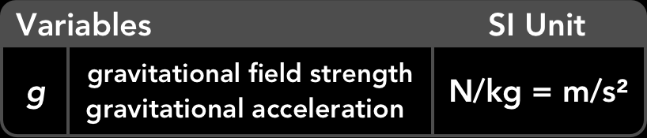
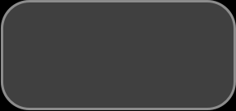
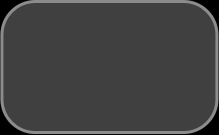
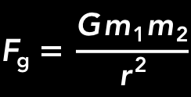
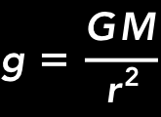
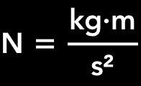
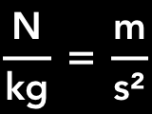
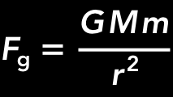



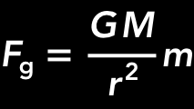
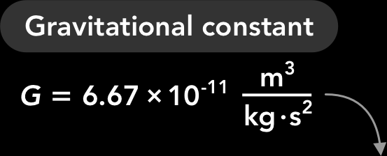
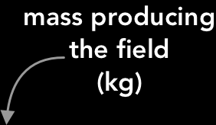

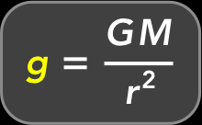
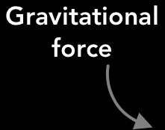


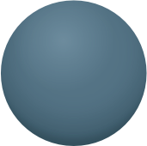
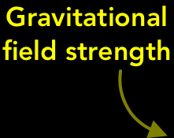




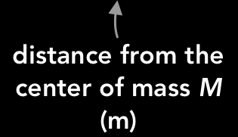


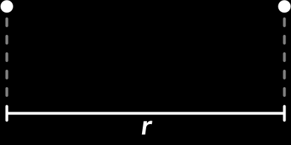



Slide 5

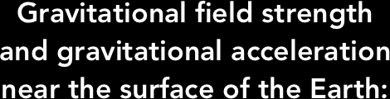








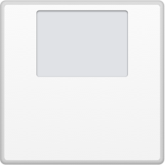


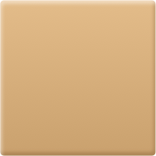
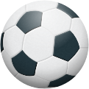


Slide 6


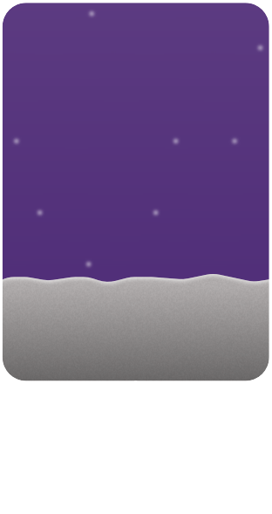
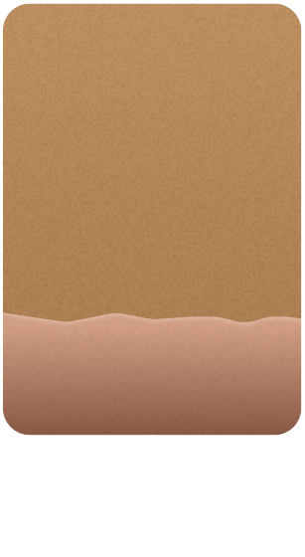
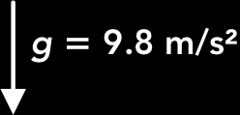










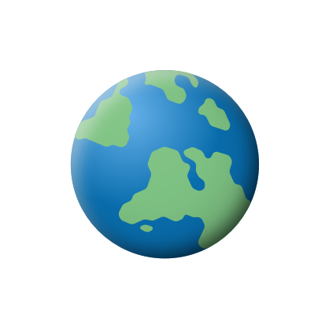
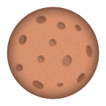





Slide 7
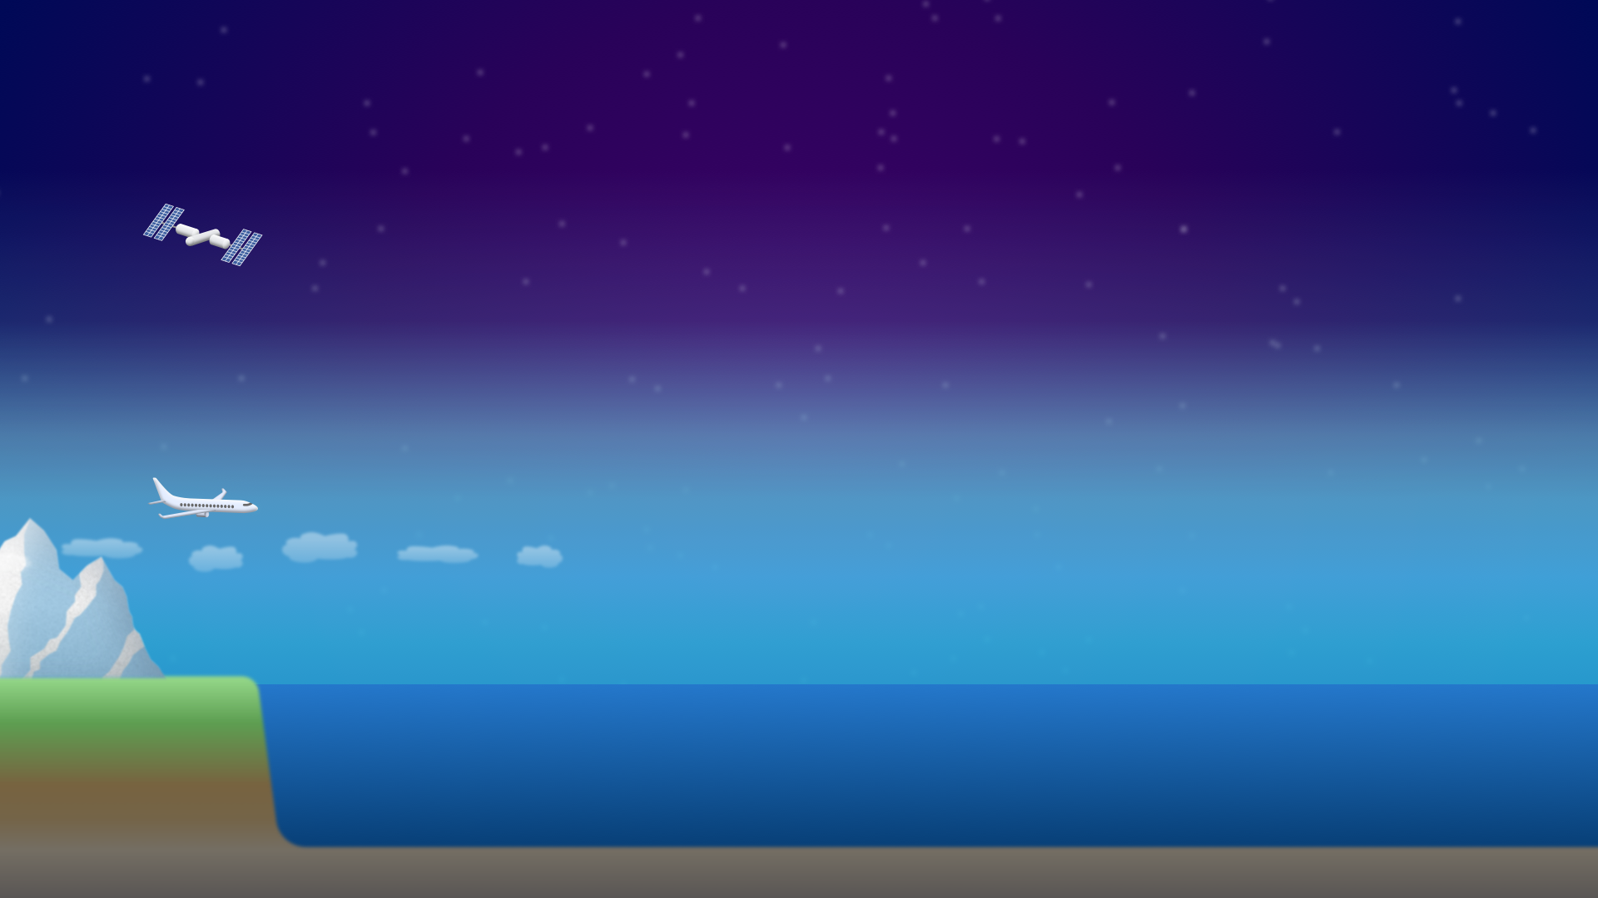





Slide 8
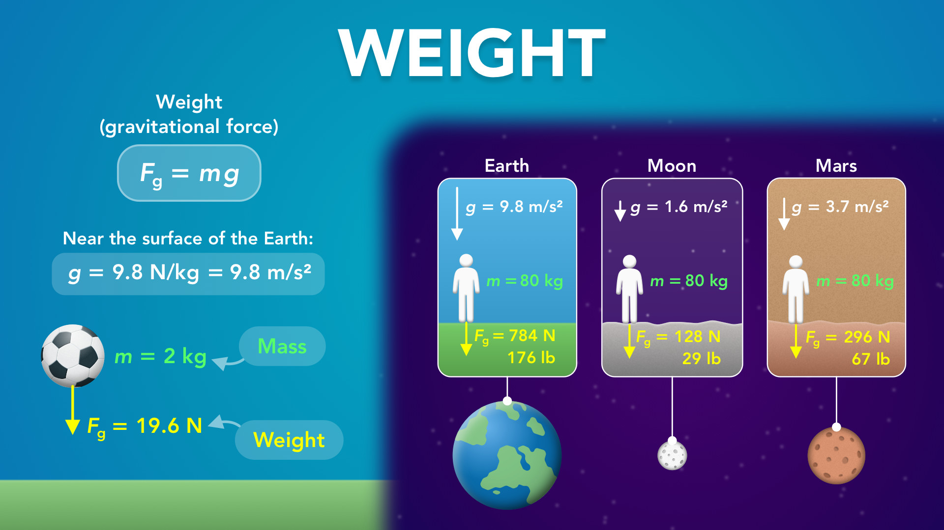
Notes:
Weight
physicslab.app
If you have any questions, suggestions or feedback about these slides please email me at chris@physicslab.app or send me a message on Discord @physicslab.

Slide 9
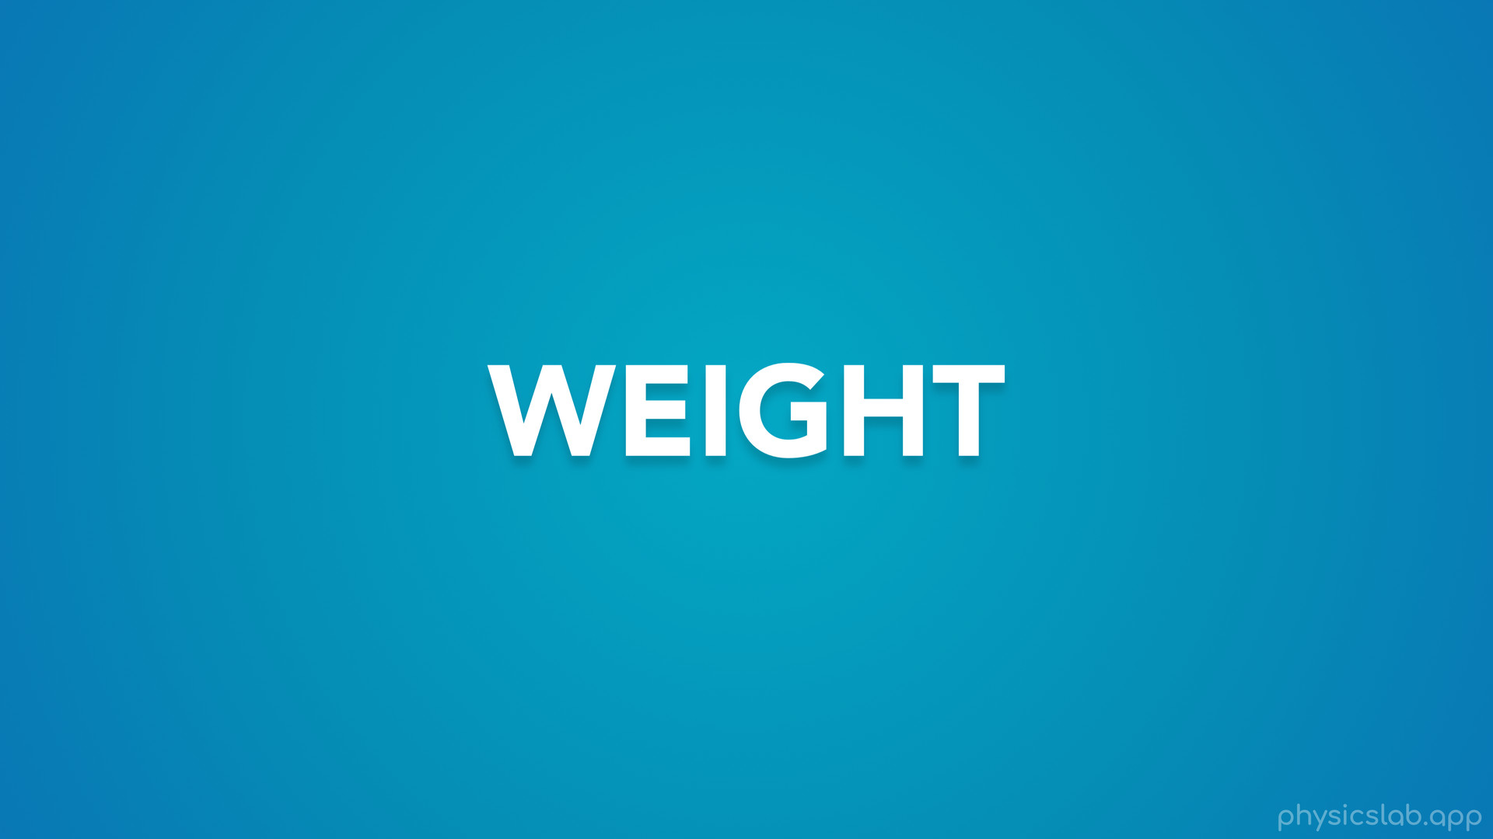
Notes:
• Hey everyone, in this video we’re gonna learn about weight.

Slide 10
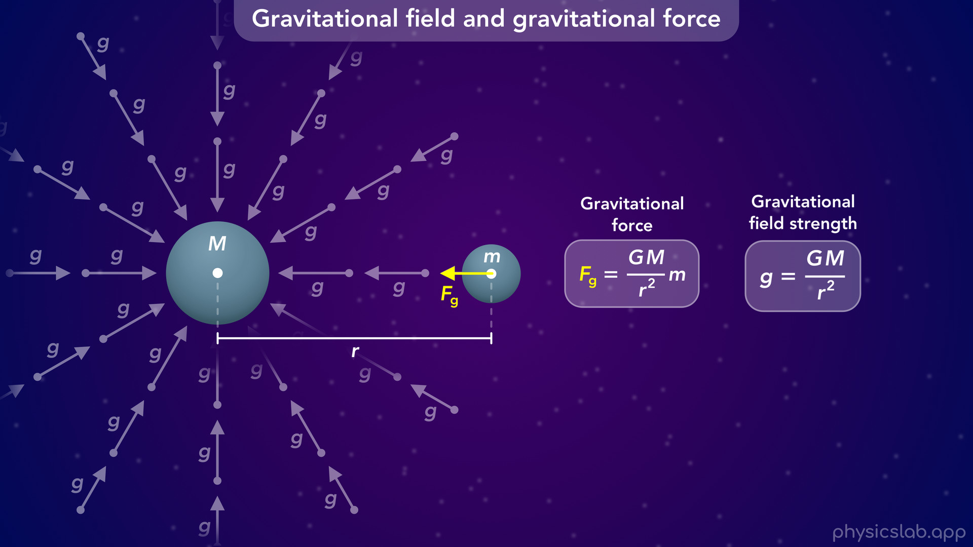
Notes:
• We talked about weight in the last 2 videos, so we’ll start with a quick summary of where weight comes from.

Slide 11
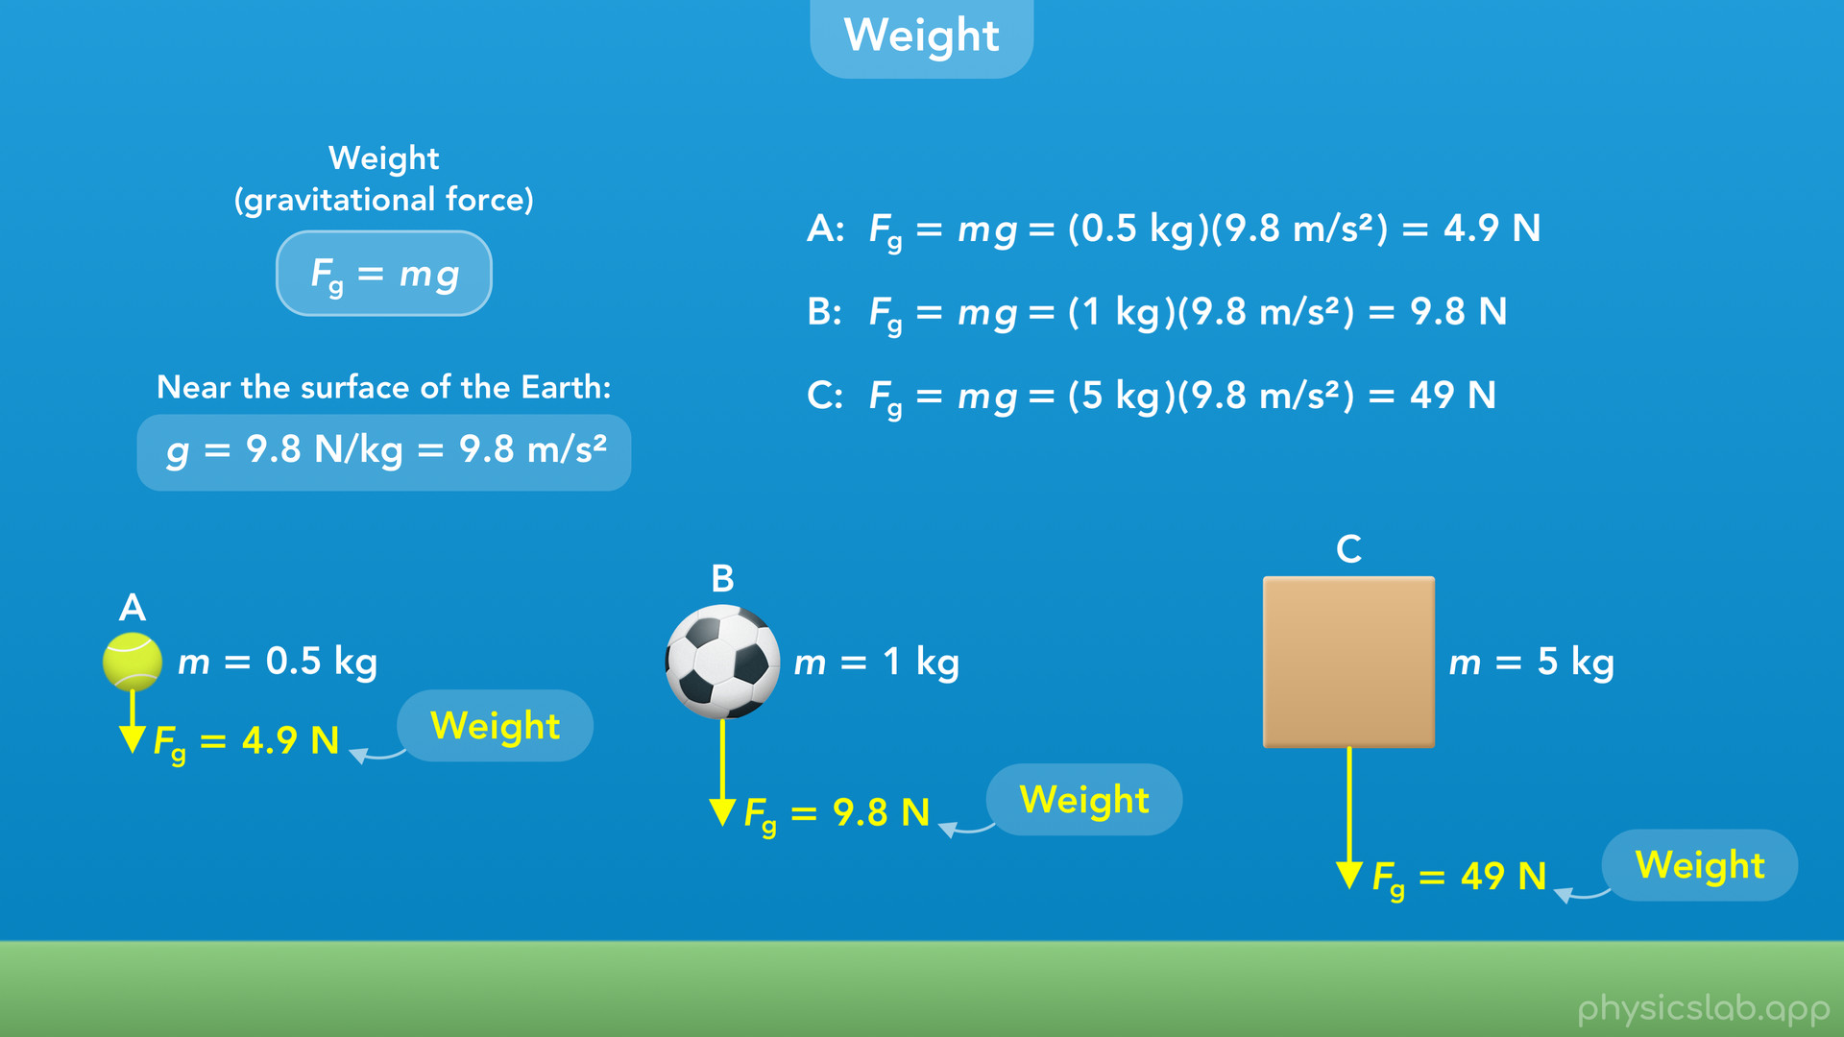
Notes:
• Then we’ll learn how to use the equation for weight.

Slide 12
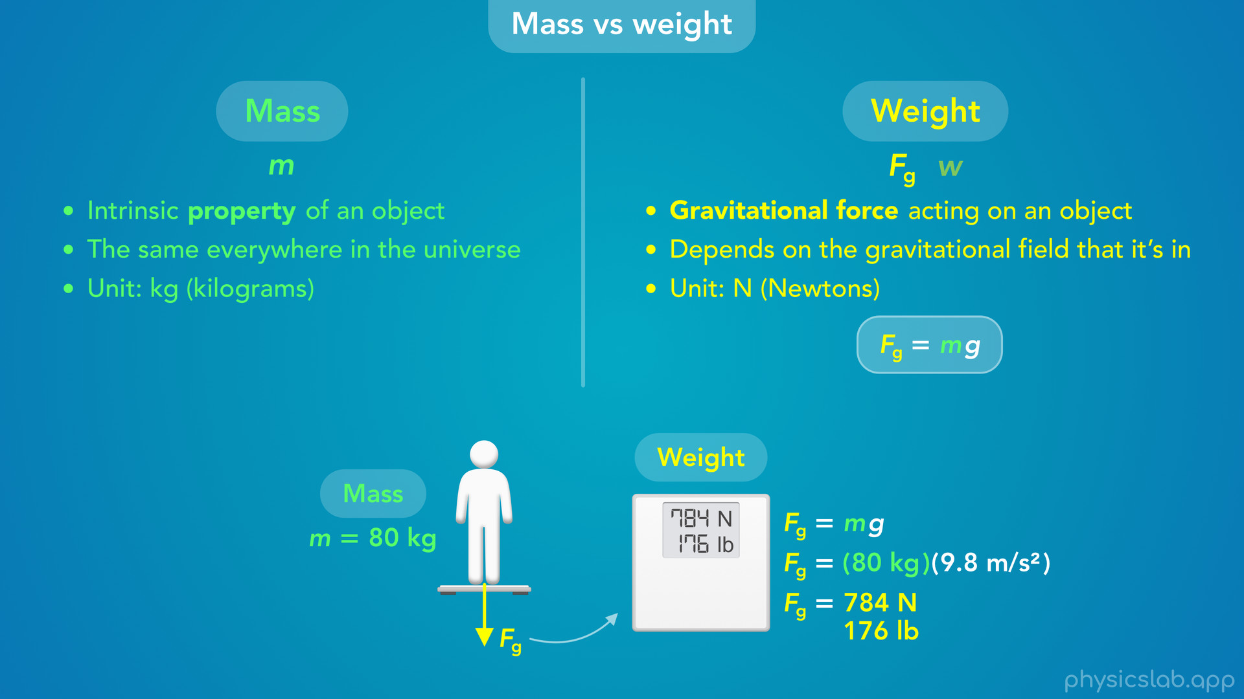
Notes:
• We’ll talk about the difference between mass and weight...

Slide 13
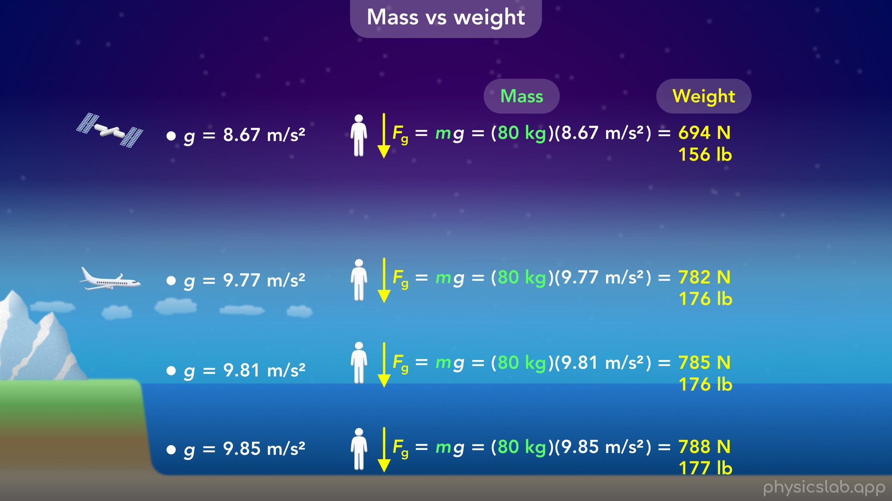
Notes:
• …and how your weight would change at different points on earth...

Slide 14
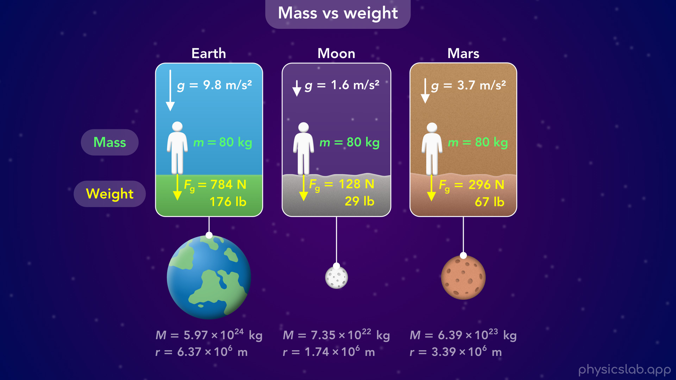
Notes:
• … and how it would change on the moon and on mars.

Slide 15
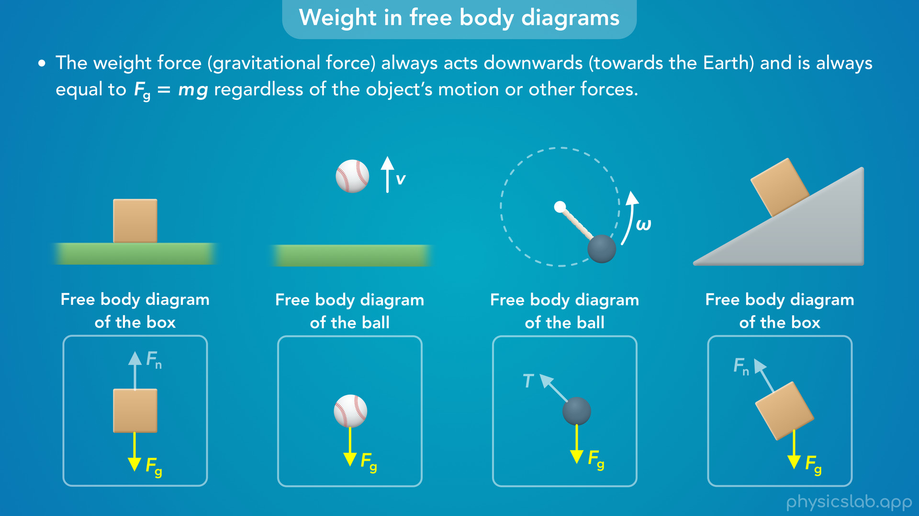
Notes:
• Then we’ll cover how and when to draw a weight force in a free body diagram…

Slide 16
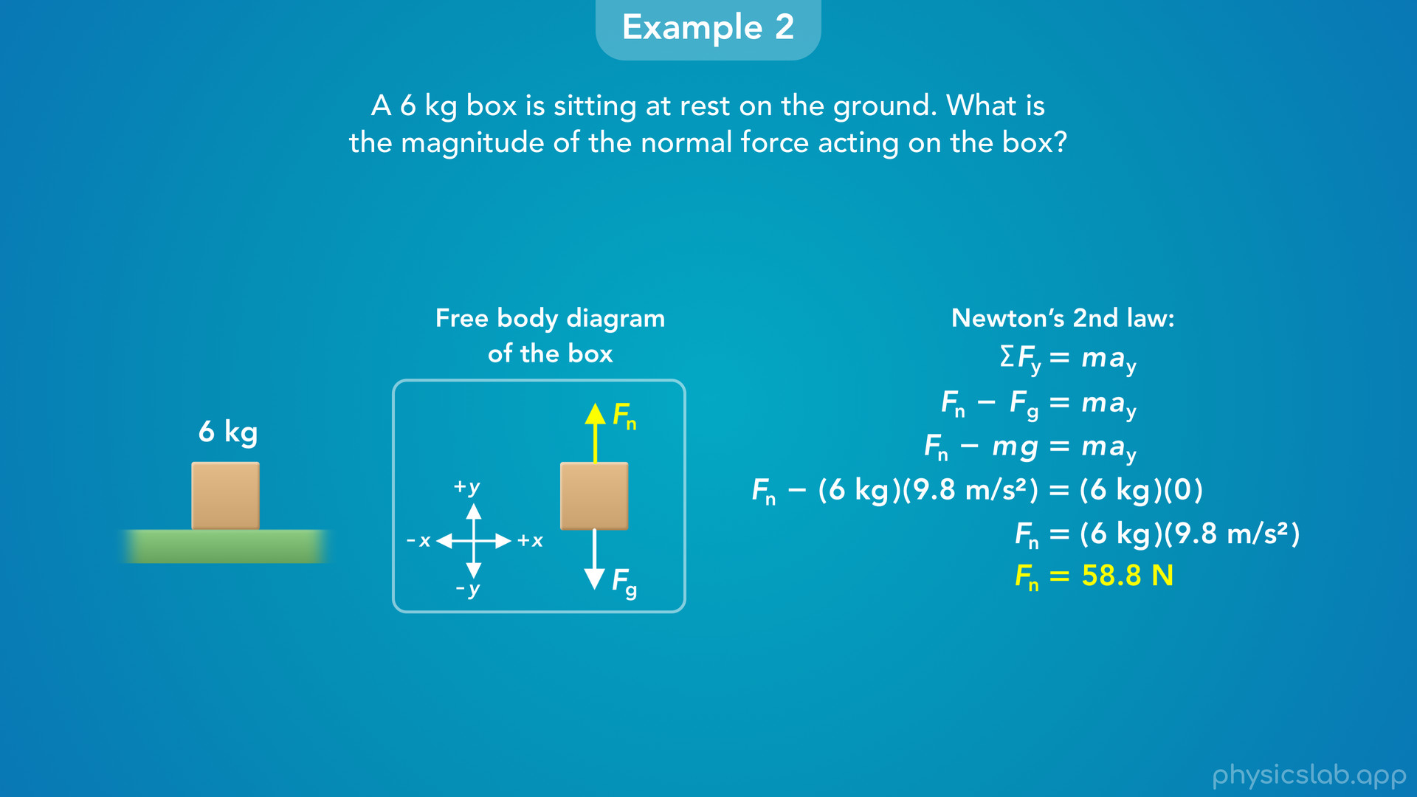
Notes:
• … and we’ll look 3 examples that involve weight.

Slide 17
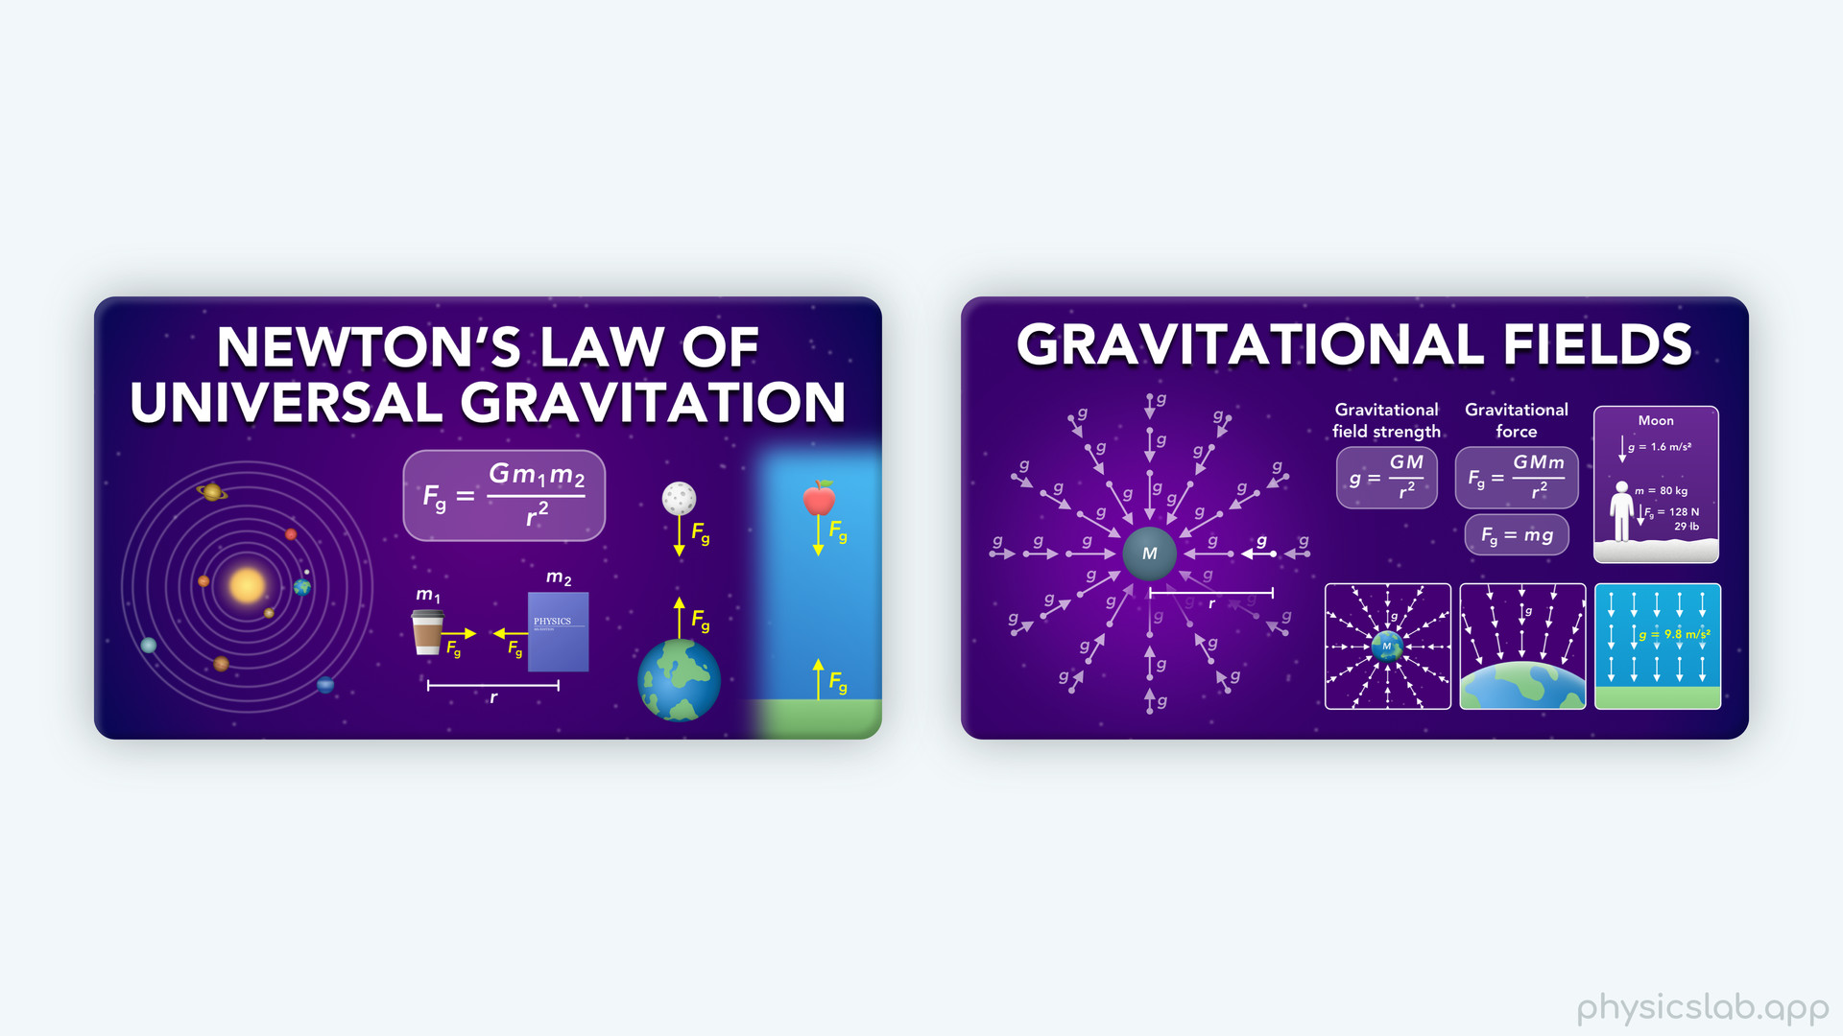
Notes:
• If you really want to understand weight, it’ll help if you watch the previous 2 videos first.

Slide 18
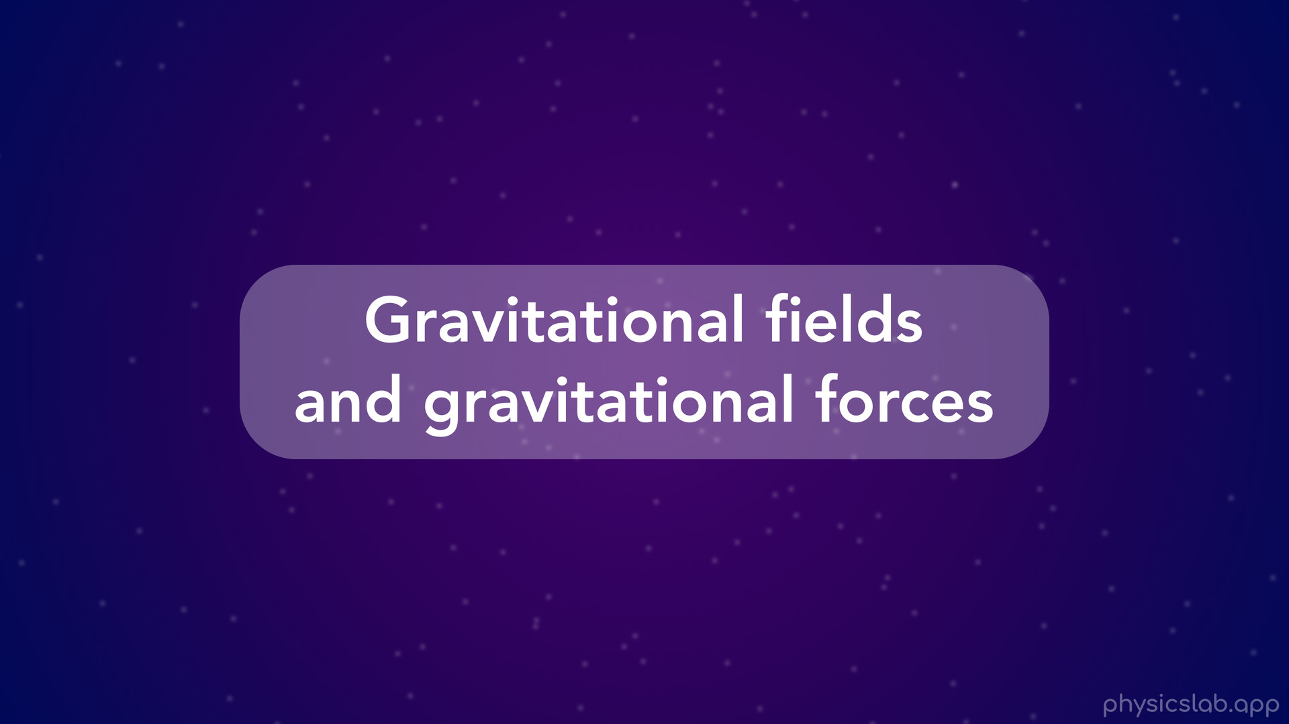
Notes:
• But here’s a quick summary of gravitational fields and gravitational forces.

Slide 19
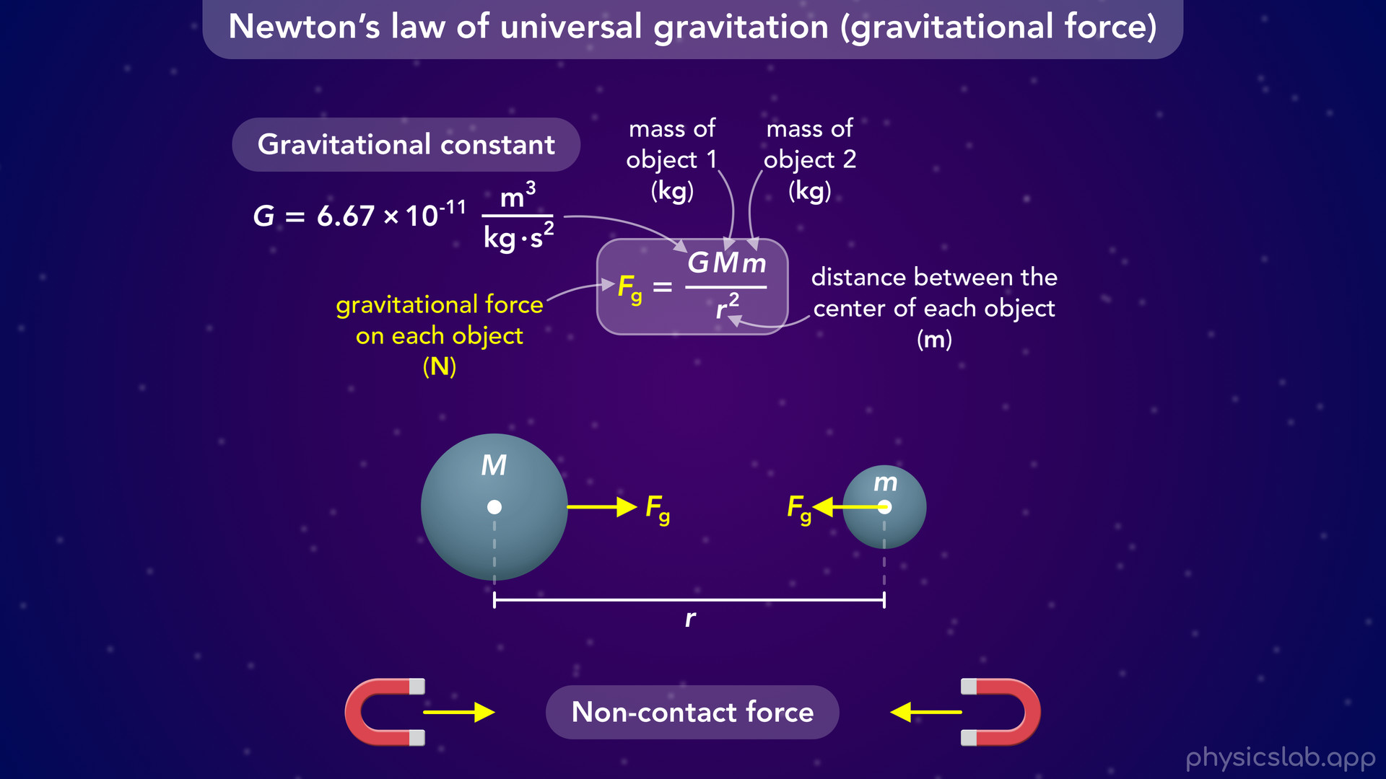
Notes:
• Newton’s law of universal gravitation says that any two objects in the universe attract each other with a pair of gravitational forces, Fg.
• This is a non-contact force, and the two objects pull on each other from a distance, similar to how two magnets attract each other without being in contact.
• We can use this equation to calculate the gravitational force on each object, which depends on the mass of each object and the distance between their centers.

Slide 20
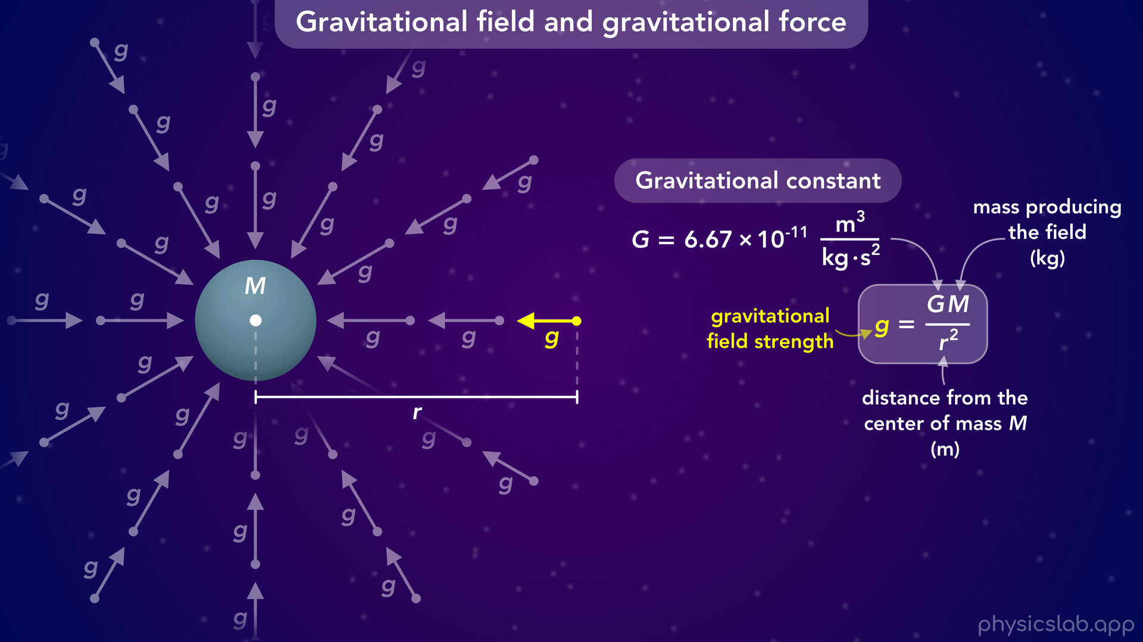
Notes:
• Another way to think about gravity is with fields.
• A gravitational field exists around every mass, and it has a magnitude and direction at each point.
• The field vectors always point towards the center of the mass, and we can use this equation to calculate the strength of the gravitational field, lowercase g, at any point around the mass.

Slide 21
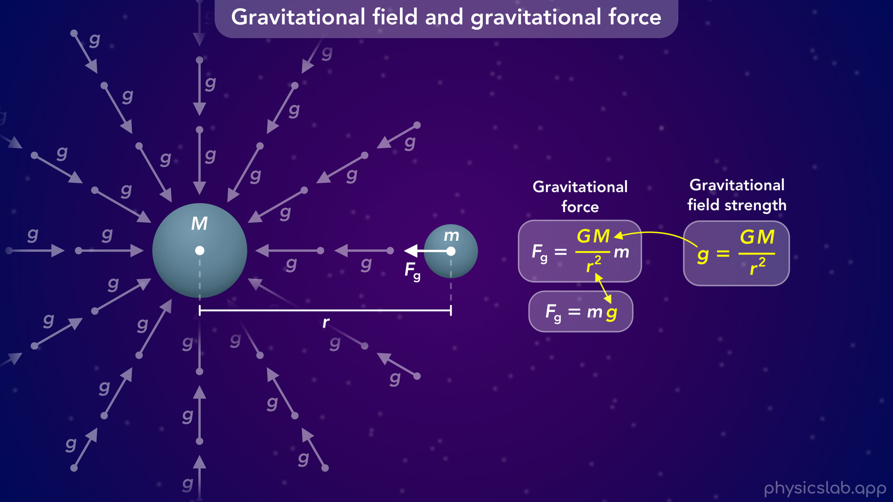
Notes:
• If a second mass is in that gravitational field, the second mass experiences a gravitational force caused by the field from the first mass.
• If we take the equation for gravitational force and replace this fraction with lowercase g, we get this simplified equation for gravitational force.

Slide 22
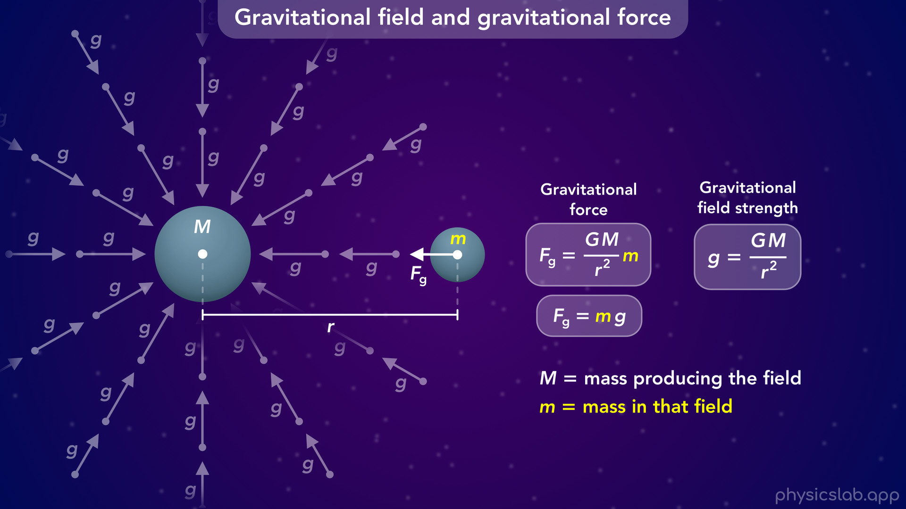
Notes:
• Capital M is the mass producing the field, and lowercase m is the mass that’s in the field and experiencing a gravitational force.

Slide 23
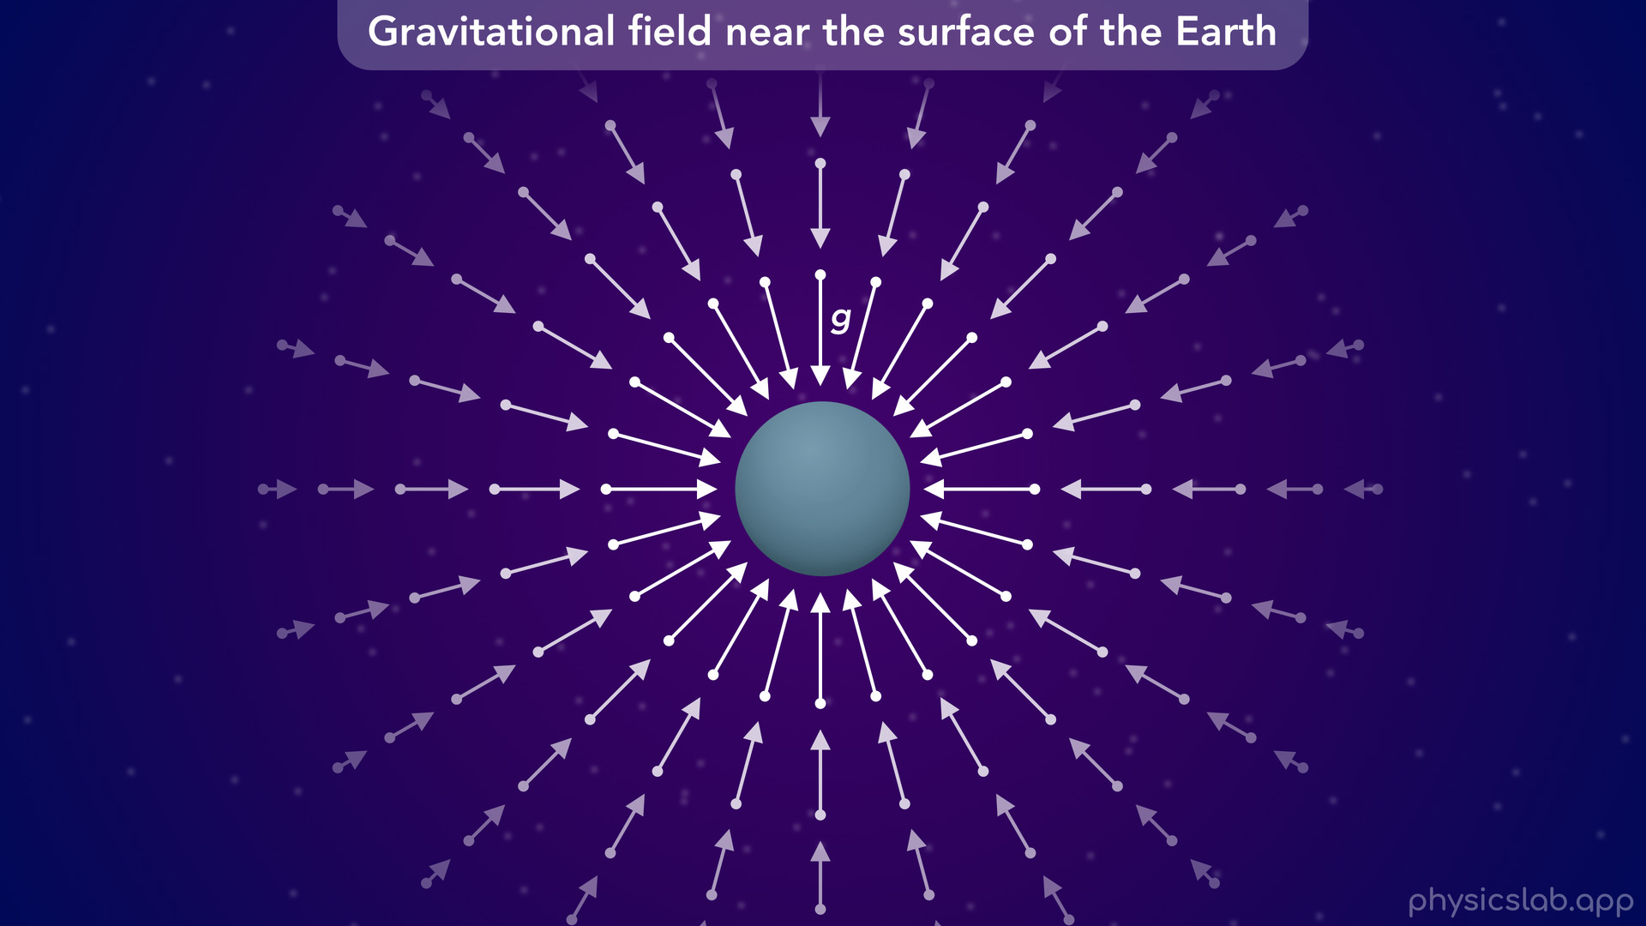
Notes:
• The strength and direction of the gravitational field is different at every point around the mass.

Slide 24
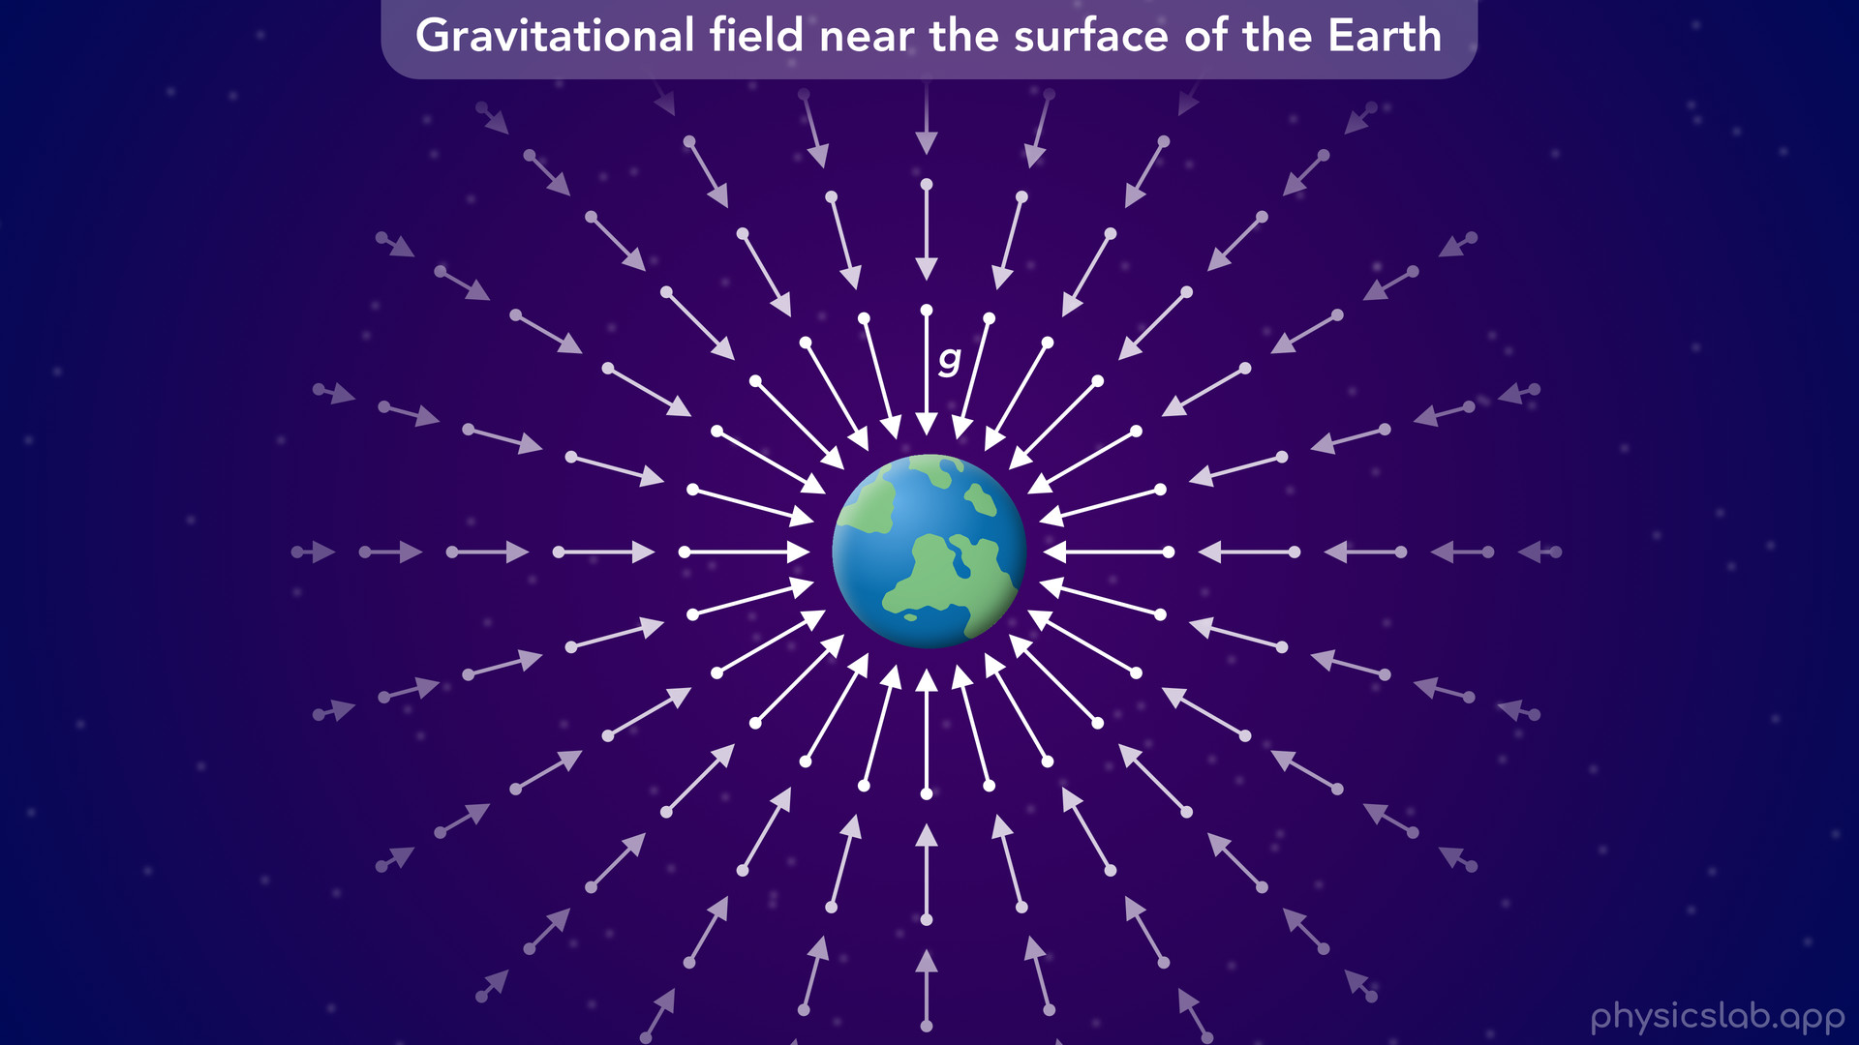
Notes:
• But if that mass is a planet and we zoom in closer to the surface...

Slide 25
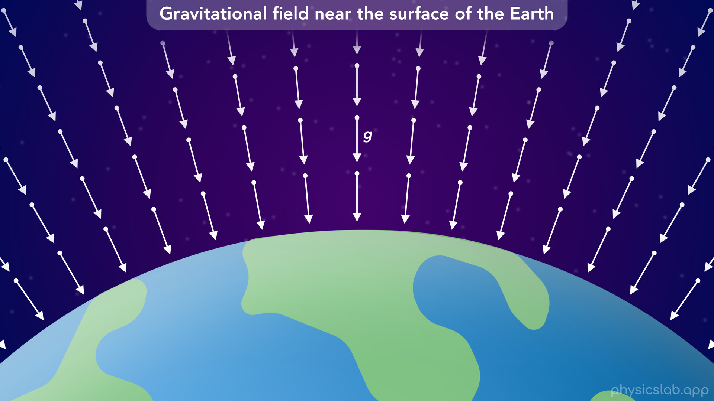
Notes:
• … the strength and direction of the field doesn’t seem to vary as much in this view.

Slide 26
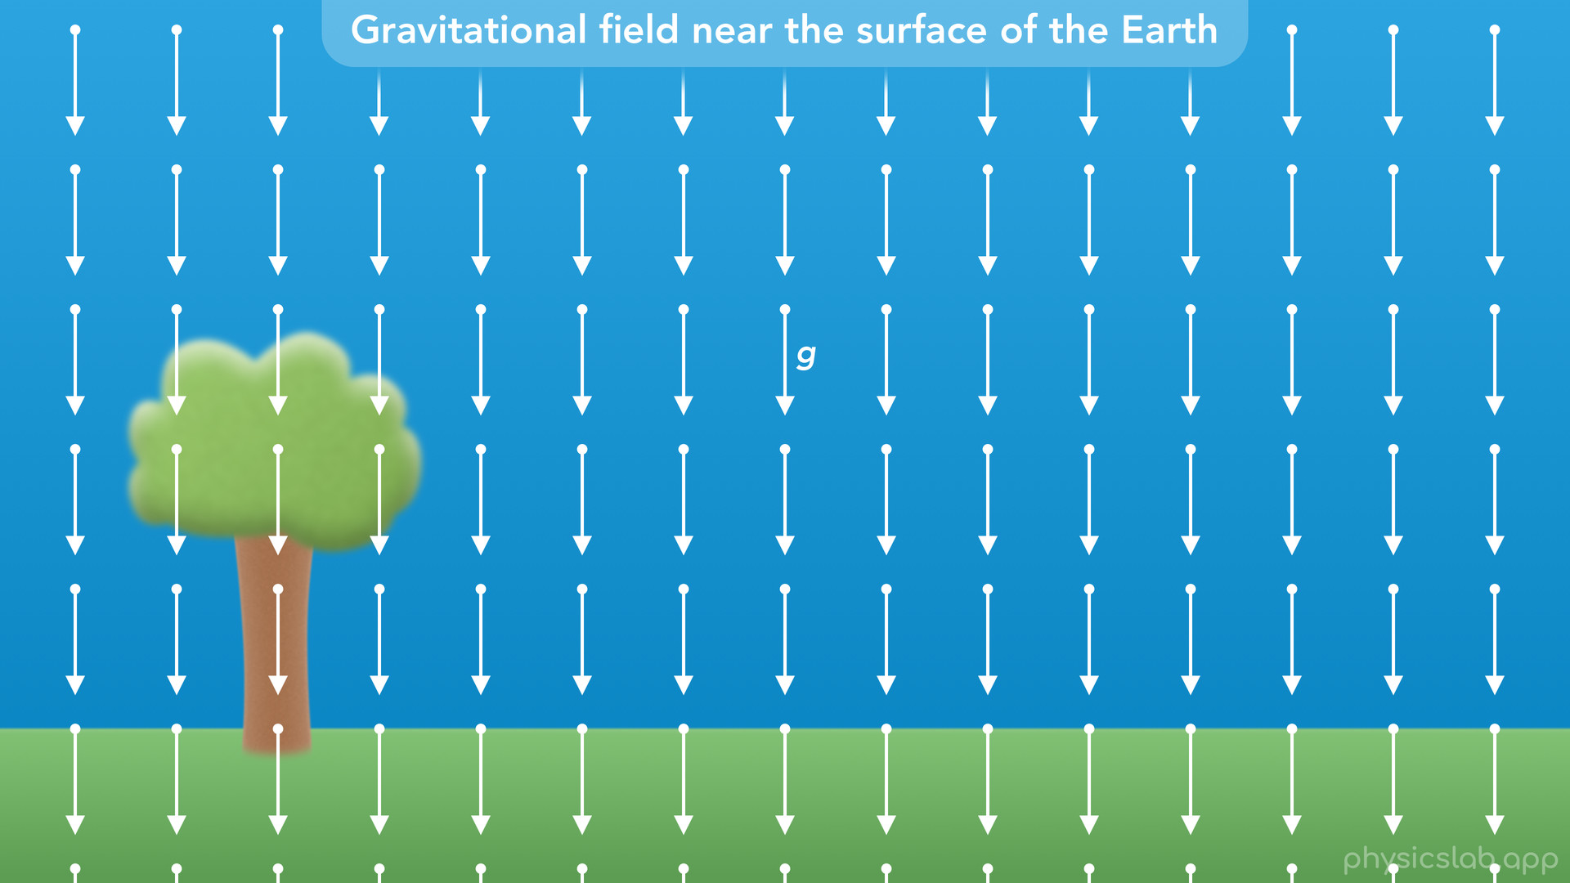
Notes:
• If we keep zooming in, the gravitational field vectors appear to be the same at each point in space...

Slide 27
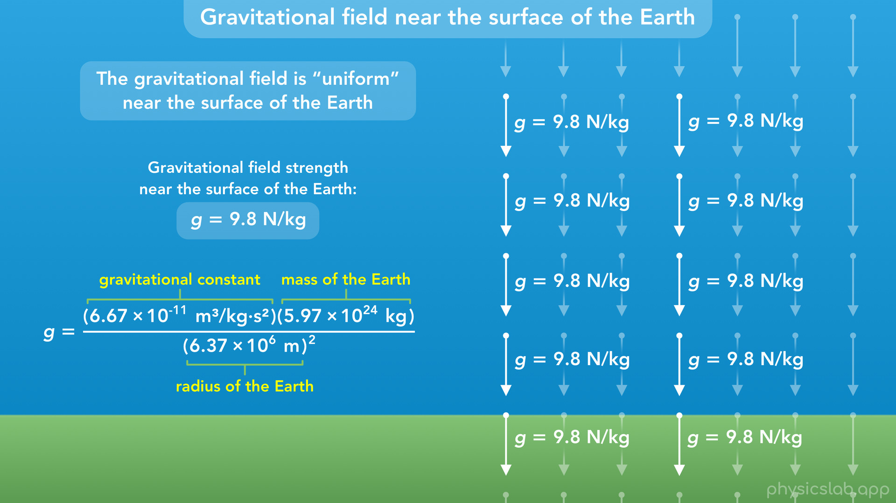
Notes:
• … and we say that “the gravitational field is uniform near the surface of the earth”, or any other planet.
• If we plug in the mass of the earth and the radius of the earth, we get 9.8 N/kg for the strength of the gravitational field near the surface of the earth.

Slide 28
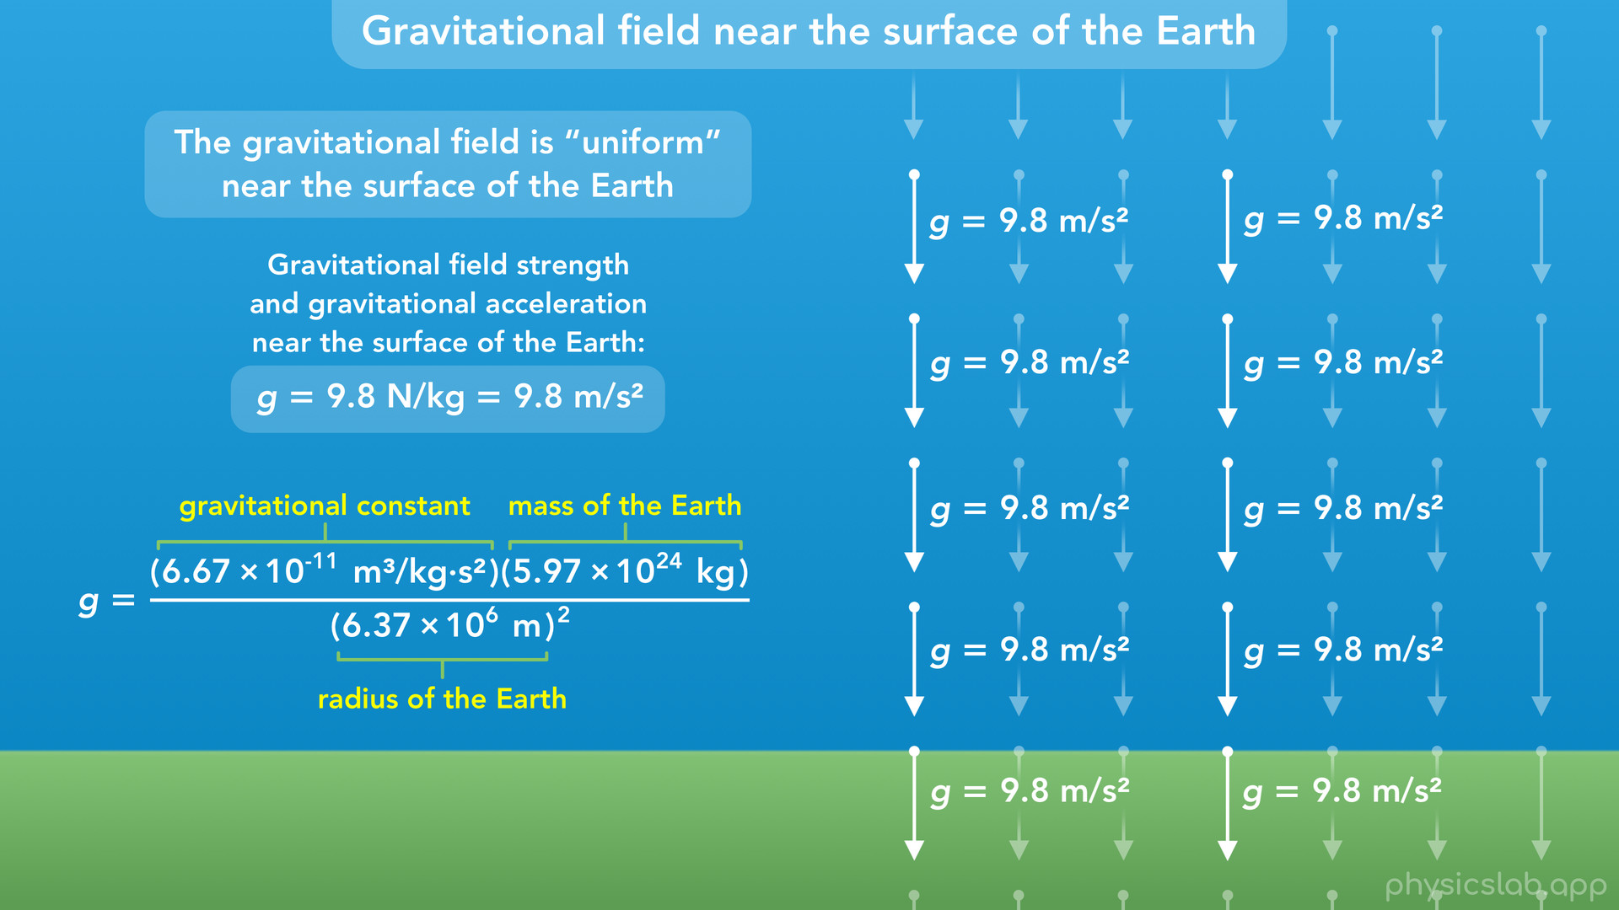
Notes:
• This means that the acceleration due to gravity is 9.8 m/s^2, and it always points downwards, towards the center of the earth.

Slide 29
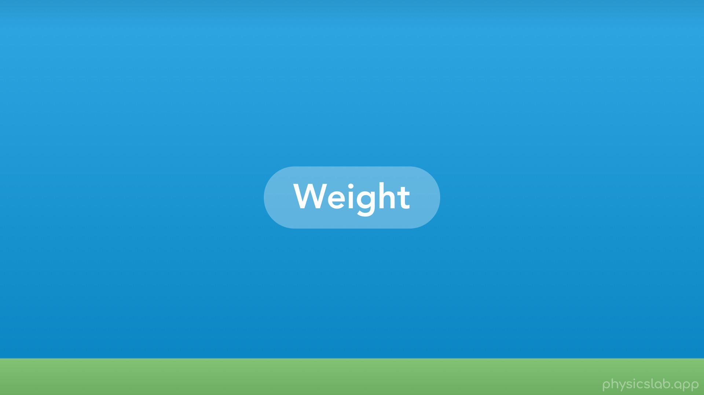
Notes:
• And that brings us to weight.

Slide 30
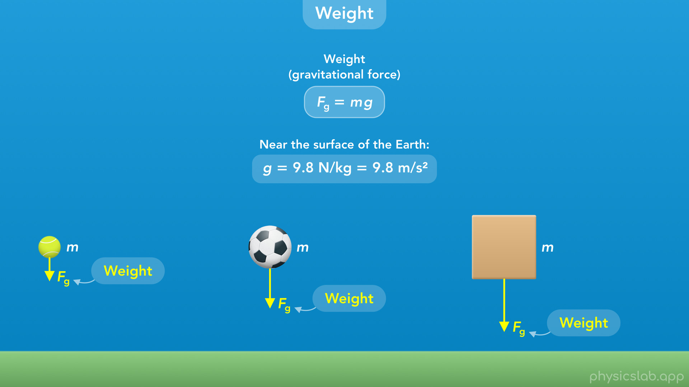
Notes:
• Weight is just the gravitational force that is acting on an object when it’s near a large body like the earth or another planet.
• The equation for weight is the equation we just mentioned for the gravitational force acting on a mass in a gravitational field.
• So the weight is just the object’s mass multiplied by lowercase g.
• If we’re near the surface of the earth, we use 9.8 N/kg or 9.8 m/s² for lowercase g.
• And and unless we’re in space or we’re given a different value for g, we’re always going to assume it’s 9.8.

Slide 31

Notes:
• So if the mass of this ball is 0.5 kg, then the weight of the ball is 0.5 kg times 9.8 m/s^2, which equals 4.9 N.

Slide 32

Notes:
• If the mass of this ball is 1 kg, then it has a weight of 9.8 N.

Slide 33
Notes:
• And if this box has a mass of 5 kg, it has a weight of 49 N.

Slide 34

Notes:
• So a weight force is not a new type of force.
• Weight is just a label for the gravitational force acting on a small object caused by the gravitational field of a large body like the earth, the moon, or another planet.
• So if this ball was near the surface of the moon, the gravitational force on the ball from the moon would also be called the weight.

Slide 35

Notes:
• And we learned that these forces come in pairs. The ball is also exerting a gravitational force on the earth and the moon.
• But we would not call that force a weight force, only the force on the small object.

Slide 36

Notes:
• And we would not use the term weight to refer to the gravitational forces between two large bodies, like the earth and the moon.

Slide 37

Notes:
• Sometimes people get confused about the difference between mass and weight, so let’s explain that.

Slide 38

Notes:
• We use the variable m for mass and Fg for weight, although you might also see weight as lowercase w, but we won’t use that in this course.

Slide 39

Notes:
• Mass is an intrinsic property of an object, and an object’s mass is the same everywhere in the universe.
• An object’s weight is the gravitational force acting on an object from a large body like the earth, and the weight depends on the strength of the gravitational field that the object is in.

Slide 40

Notes:
• The SI unit for mass is kilograms, and the SI unit for weight is Newton’s, the same as every other force.

Slide 41

Notes:
• The weight of an object, Fg, is equal to its mass multiplied by the strength of the gravitational field that its in.
• So an object’s weight is proportional to its mass, which is why these are often used to mean the same thing. But in physics they’re completely different.

Slide 42

Notes:
• If the mass of this ball is 2 kg, and the strength of the gravitational field is 9.8 m/s², then the weight of the ball, Fg, is 2 kg times 9.8 m/s^2, which is 19.6 N.

Slide 43
Notes:
• As another example, if a person has a mass of 80 kg and they stand on a scale, the scale will read 784 N or 176 lb.
• The scale is measuring the weight of the person, not the mass.
• A pound is actually a unit of force, not mass.
• If you ever use a scale that tells you the mass of an object in kg or grams, the scale is physically measuring the weight and then it’s dividing that by 9.8 to get the mass.
• So your weight depends on your mass, but it also depends on the value of g.

Slide 44

Notes:
• So what would your weight be at different points on earth?
• Your mass is always the same, but the value of g depends on the distance from the center of the earth.

Slide 45

Notes:
• If you’re at sea level, near the surface of the earth, g would 9.81 using two decimal places, so your weight would be 785 N or 176 lb.

Slide 46

Notes:
• At the lowest point in the ocean, g would greater, 9.85, so your weight would be greater, 788 N.

Slide 47

Notes:
• If you’re at the top of mount Everest or you’re in a plane, g would be less, about 9.77, so your weight would be less, 782 N.

Slide 48
Notes:
• And if you were an astronaut in the international space station, g would be 8.67 and your weight would be 694 N.
• You may feel weightless in the space station, which we’ll cover in another video, but your weight would still be about 90% of your weight on the ground.

Slide 49

Notes:
• What would be your weight on surface of the moon and the surface of mars?
• The mass and the radius of the moon and mars are different than the earth, so the strength of their gravity is different.

Slide 50

Notes:
• On the moon, the value of g is 1.6 m/s^2, which is about 16% of earths gravity, so your weight on the moon would be 128 N or 29 lb.

Slide 51
Notes:
• On mars, g would be 3.7 m/s^2, about a third of earth’s gravity, so your weight would be 296 N or 67 lb.
• So an object’s mass is the same everywhere in the universe.
• But it’s weight depends on g, the strength of the gravitational field.

Slide 52

Notes:
• So now that we know what a weight force is, how and when do we draw one in a free body diagram?

Slide 53

Notes:
• Let’s say we have a box sitting at rest on the ground.
• If we’re draw a free body diagram of the box, how do we draw the weight?

Slide 54

Notes:
• The weight force (which is just the gravitational force) always acts downwards (towards the earth) and is always equal to mg regardless of the object’s motion or other forces.
• So the weight force on the box is the gravitational force from the earth, which points downwards.

Slide 55

Notes:
• There would also be an upwards normal force on this box from the ground.

Slide 56

Notes:
• What if we had a ball in the air that was moving upwards?

Slide 57

Notes:
• The weight force on the ball would still point downwards towards the earth, and it doesn’t matter how the ball is moving.

Slide 58

Notes:
• What if we had a ball attached to a string swinging in a vertical circle?

Slide 59

Notes:
• Again, the weight force points downwards towards the earth, regardless of the motion.

Slide 60

Notes:
And this ball would also have a tension force pointing in the direction of the string.

Slide 61

Notes:
• And finally, what if we had a box on a ramp?

Slide 62

Notes:
The weight force still points vertically downwards towards the earth, it has nothing to do with the ramp.

Slide 63

Notes:
• The normal force on this box would be perpendicular to the ramp, but the weight is downwards.
• So we always draw a weight force in a free body diagram if the object is near the earth, the moon or another planet.

Slide 64

Notes:
• Now let’s do a few examples that involve weight.

Slide 65

Notes:
• A 2 kg ball is thrown into the air. When the ball is moving upwards at 5 m/s, what is the weight of the ball?
• Pause the video and see if you can solve it first.

Slide 66

Notes:
• Let’s draw a free body diagram of the ball.

Slide 67

Notes:
• It’s in the air, so the only force acting on the ball is the weight force pointing downwards.

Slide 68

Notes:
• To calculate the weight, we just use this equation.

Slide 69

Notes:
• We plug in the mass of the ball, 2 kg, and we assume that we’re near the surface of the earth so g is 9.8 m/s².

Slide 70

Notes:
• that gives us 19.6 N for the weight of the ball.
• So it doesn’t matter that the ball is moving, it’s weight is always the same if it’s near the surface of the earth.

Slide 71

Notes:
• Next, a 6kg box is sitting at rest on the ground. What is the magnitude of the normal force acting on the box?
• Pause the video and try solving it first.

Slide 72

Notes:
• If we draw a free body diagram of the box

Slide 73

Notes:
there’s a downwards weight force from the earth, Fg

Slide 74

Notes:
and there’s an upwards normal force from the ground, which we covered in a previous lesson.

Slide 75

Notes:
• Let’s also draw our coordinate system, and say that up is the positive y direction.
• So how do we find the normal force?

Slide 76

Notes:
• We would start by writing the equation for Newton’s 2nd law in the y direction: the net force on the box is equal to its mass times its acceleration.

Slide 77

Notes:
• We said up is positive, so the net force would be the normal minus the weight force.

Slide 78

Notes:
• Now that we know the equation for the weight force, we can replace Fg with m times g.

Slide 79

Notes:
• Next, we can plug in the values that we know: 6 kg for the mass, 9.8 m/s² for g, and since the box is at rest, its acceleration is 0 and the net force is zero.
• Remember, g is the acceleration due to gravity if the object is in free fall, but this box is at rest so its acceleration, a, is zero.

Slide 80

Notes:
• If we add mg to both sides, then the normal force is equal to the weight force, 6 times 9.8.

Slide 81

Notes:
• That gives us 58.8 N for the normal force.
• So in this example, we used the weight force to find the normal force, which happens a lot.
• But remember that they’re only equal because the box is not accelerating and the net force is zero.

Slide 82

Notes:
• For the last example, a 3 kg ball is dropped on the surface of a planet where the gravitational field near the surface is twice as strong as the gravitational field near the surface of the earth. What is the weight of the ball on this planet?
• Pause the video and see if you can figure it out.

Slide 83

Notes:
• So a free body diagram of the ball would only have the weight force.

Slide 84

Notes:
• We still use this equation for the weight, and we know the mass is 3 kg, but what value do we use for g?

Slide 85

Notes:
• The question said the gravitational field on this planet is twice as strong as it is on the earth.
• So if g on earth is 9.8 m/s², then g on this planet would be 2 times 9.8, or 19.6 m/s².

Slide 86

Notes:
• So we plug in 3 kg for the mass of the ball, and 19.6 m/s² for g

Slide 87

Notes:
and we get 58.8 N for the weight of the ball on this planet.

