Slide 1
Linear Motion 2 - Kinematic Equations, Scalars vs Vectors, and Average Speed
Slides Version 2
This version includes:
Slides with screenshot images from the video.
The video narration in the slide notes.
A blank template slide with the same background and font as the video.
Slides with some basic graphics from this video for you to use however you like.
Feel free to add, delete and edit slides to make your own presentation. You can use these slides in class or share them with your students, but please do not post them online.
If you have any feedback, suggestions or questions about these slides please email me at chris@physicslab.app or send me a message on Discord @physicslab.
physicslab.app

Slide 2
Heading
Text

Slide 3














Slide 4

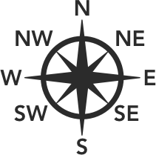




Slide 5
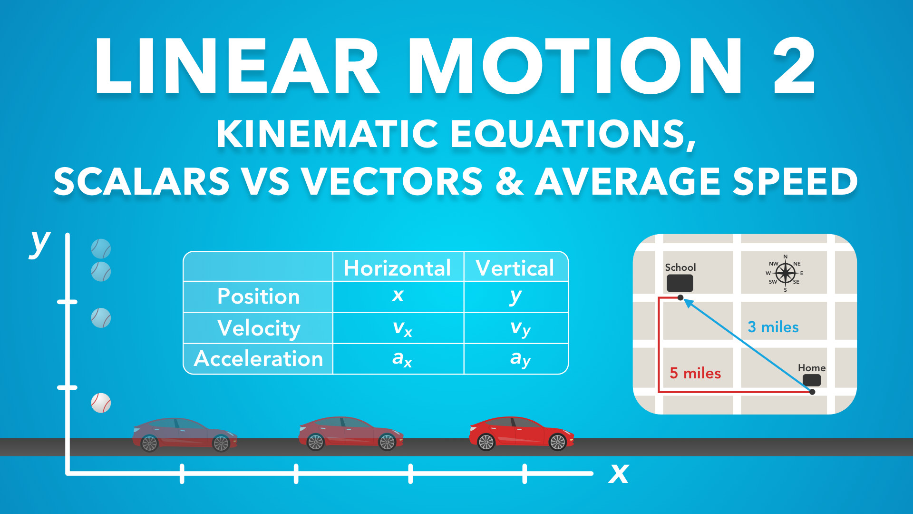
Notes:
Linear Motion 2 - Kinematic Equations, Scalars vs Vectors & Average Speed
Slides Version 1
physicslab.app
These slides include screenshots from the video. Want more slides? Less slides? Different material on the slides or a different format? If you have any questions, suggestions or feedback about these slides please email me at chris@physicslab.app or send me a message on Discord @physicslab.

Slide 6
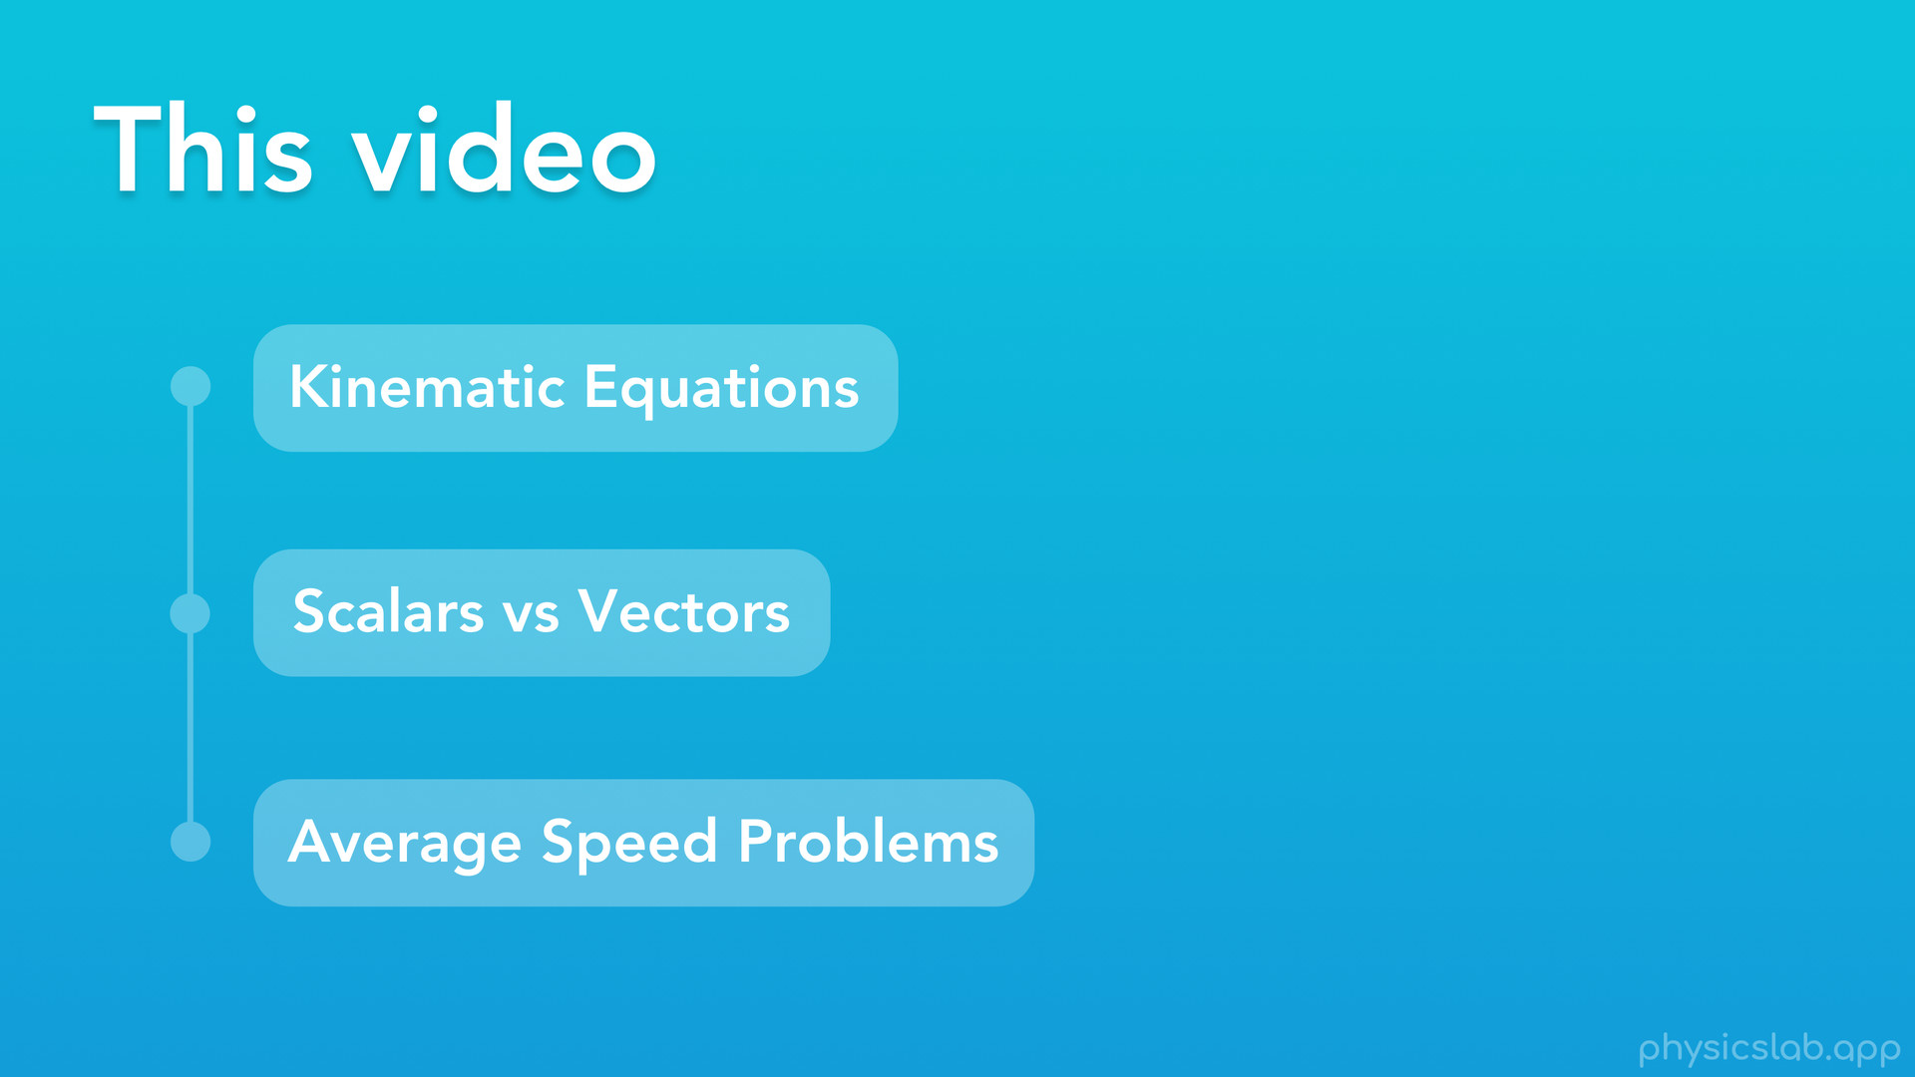
Notes:
Hey everyone, welcome to the second video on linear motion. We’ll pick up where we left off in the last video and learn a few more things.
In this video:
We’ll learn the last 2 kinematic equations that we’ll need for linear motion, and we’ll talk about equations for horizontal and vertical motion
We’ll also cover the difference between scalars and vectors
And we’ll talk a little bit about physics problems involving average speed

Slide 7

Notes:
First up, let’s cover the last 2 kinematic equations that we’ll need when we’re studying the linear motion of objects, and see how we can apply them to both horizontal and vertical motion.

Slide 8
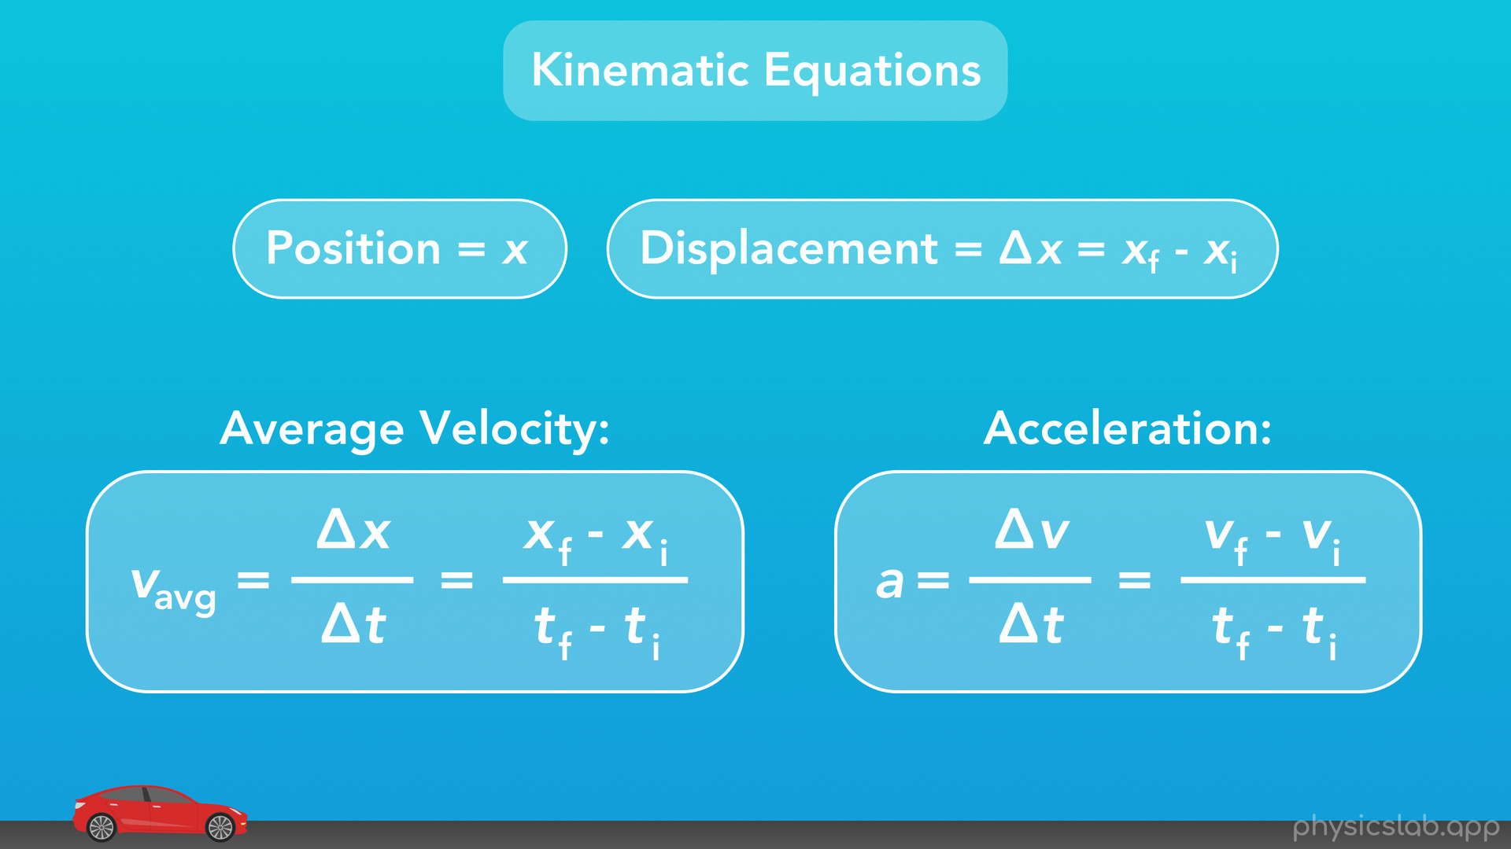
Notes:
Just as a quick reminder, here are the kinematic equations for position, displacement, velocity and acceleration that we learned in the last video. These equations are what we might call “the definitions” of position, velocity and acceleration. The next equations that we’ll learn are really useful and they combine all 3 of these.

Slide 9
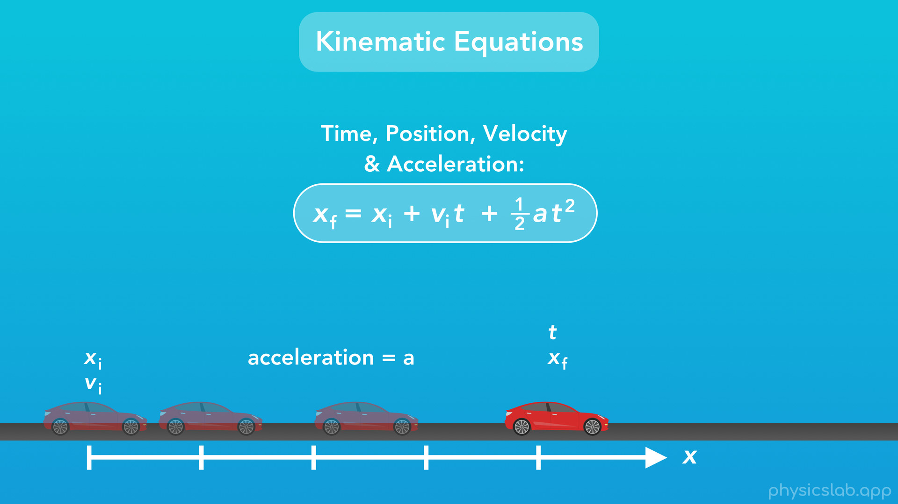
Notes:
So this first equation includes the variables for time, position, velocity and acceleration. And for an object that’s accelerating, this equation helps us find the object’s position at any point in time by using the initial position, the initial velocity, the acceleration, and how long it’s been accelerating for.

Slide 10
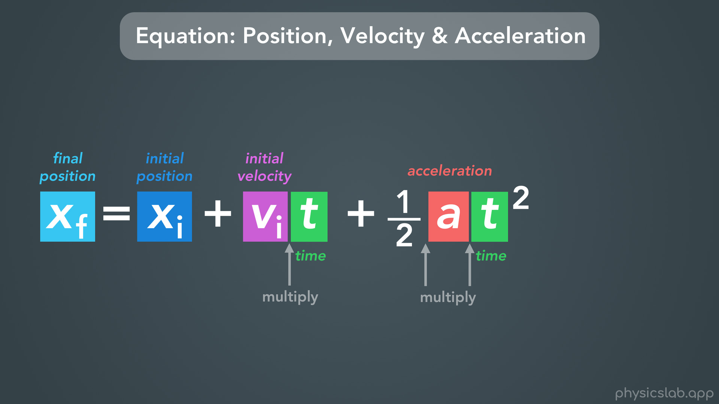
Notes:
Let’s take a closer look.
“xf” is the final position, “xi” is the initial position, “vi” is the initial velocity, “t” is the time, and “a” is the acceleration.
Something to note here, which we covered in one of the basics videos, is that when we have two variables next to each other with nothing in between them, it means we have to multiply them together. So here we have initial velocity times time, and we have ½ times acceleration times time squared.

Slide 11
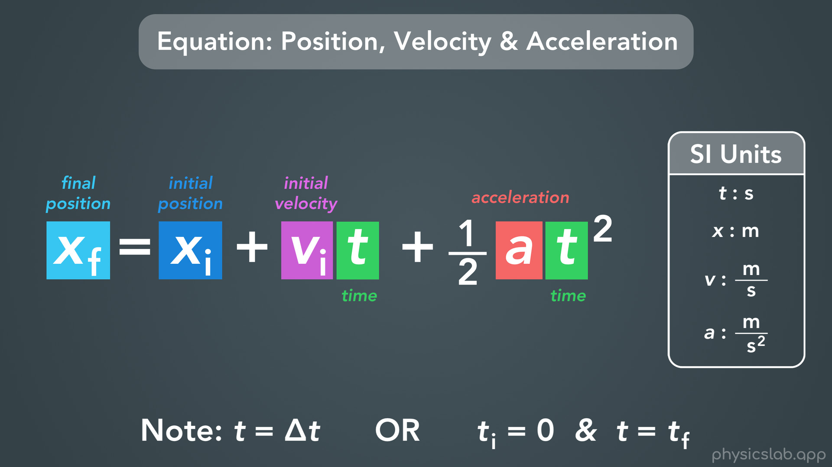
Notes:
Another important thing to point out is that this equation only has the variable “t” for time. It doesn’t have a delta “t” for change in time, or an initial time and final time. The thing to remember is this: for equations that only have a “t” by itself, that “t” really means “delta t” or change in time. Or we could think of it this way: we assume the initial time is just 0, and “t” is equal to the final time, which is the time point that we care about, the time point we’re plugging in to find the object’s position.
So, all together this equation is saying that the final position of an object is equal to the initial position, plus the initial velocity times time, plus ½ times the acceleration times the time squared. And here are the SI units we use in this equation: time is in seconds, position is in meters, velocity is m/s, and acceleration is m/s^2.

Slide 12
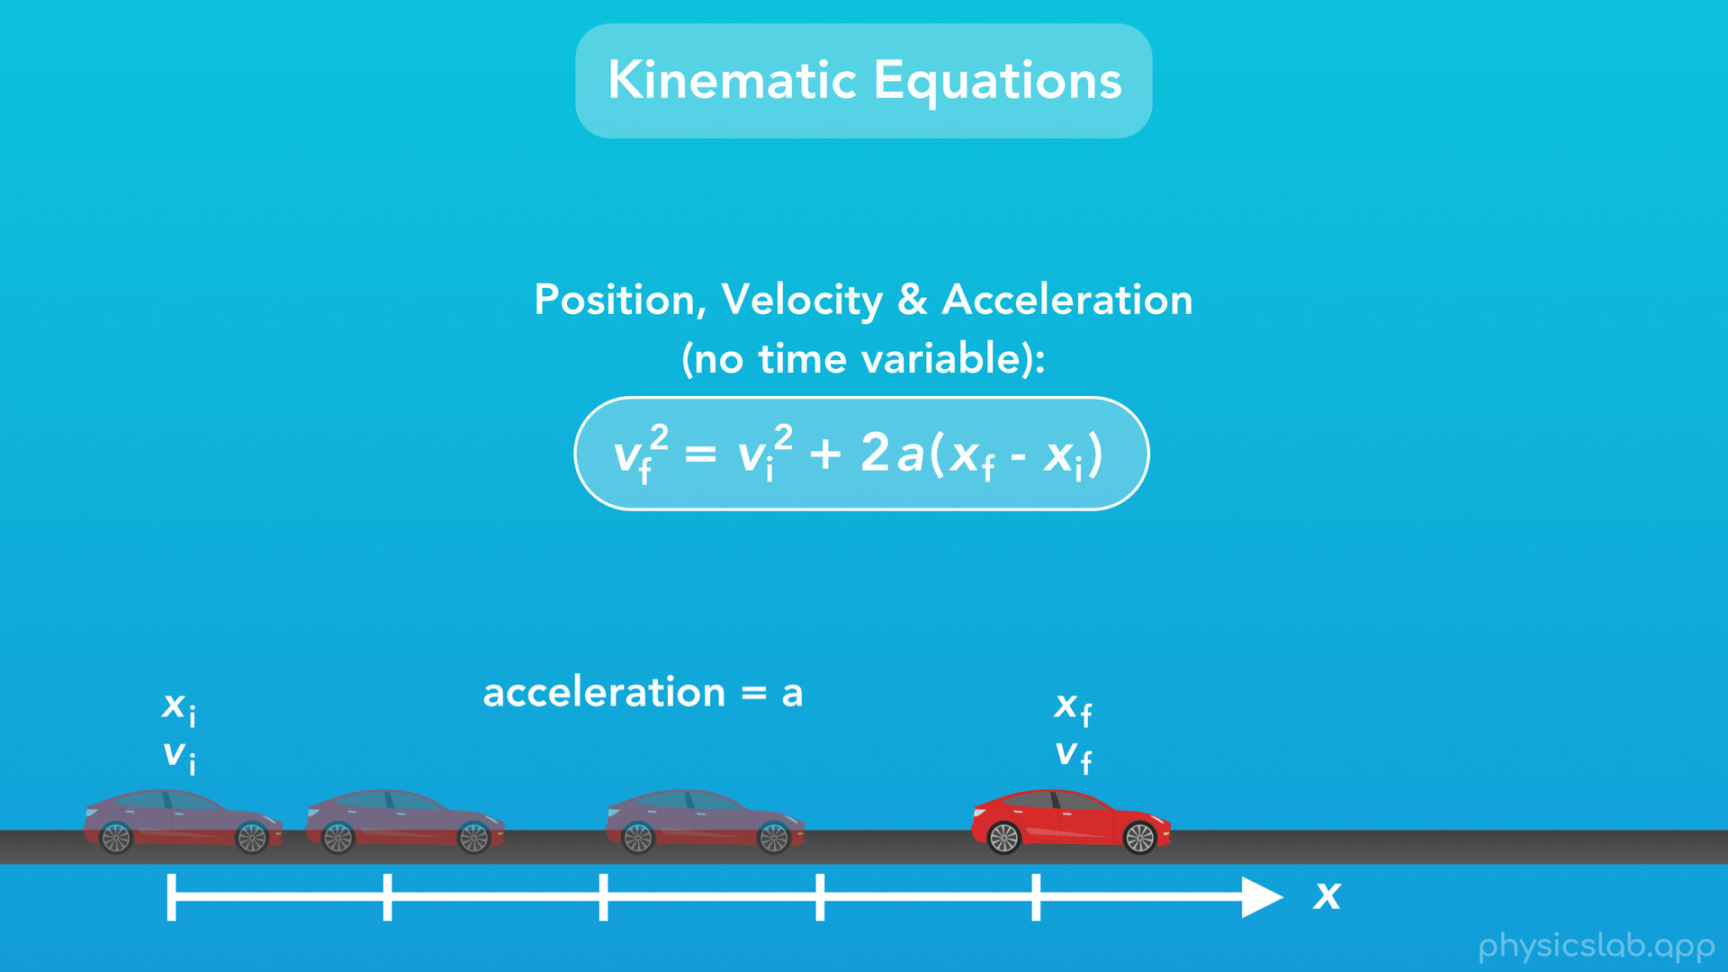
Notes:
Alright now the last kinematic equation that we’ll learn for linear motion is this one. This equation relates the position, velocity and acceleration of an object. But it doesn’t include the variable for time, which is pretty interesting, because time is a fundamental part of kinematics. This equation is actually made by combining and rearranging a few other equations in order to get rid of the variable for time, which makes it really useful for certain problems where we don’t know anything about time.
So, for an object that is accelerating, like this car, this equation will help us find the final velocity of the object based on its initial velocity, its acceleration, and its change in position.

Slide 13
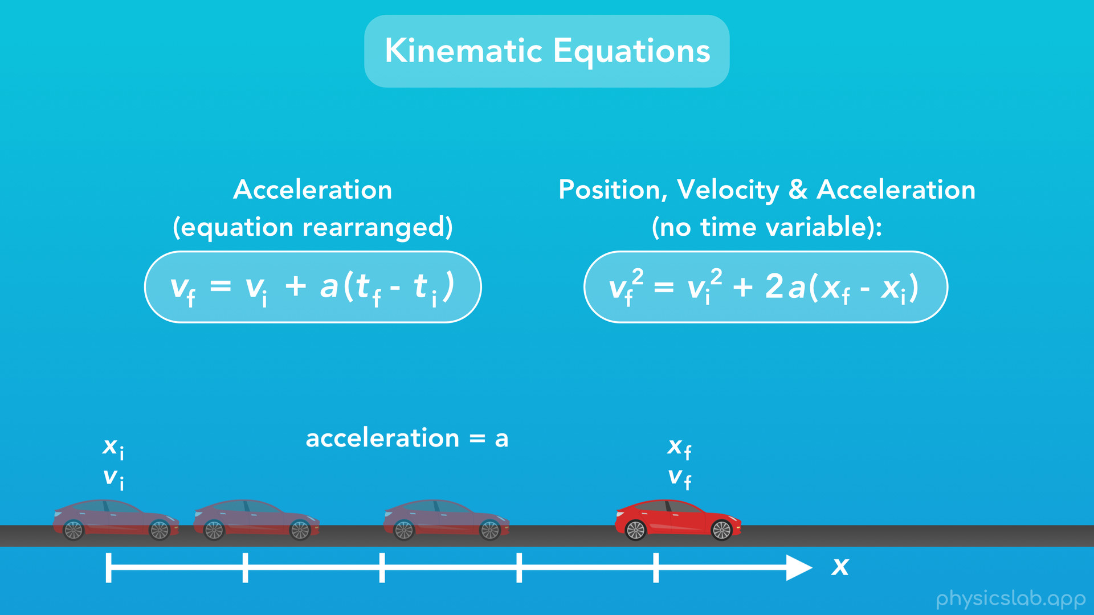
Notes:
This looks very similar to the equation we learned for acceleration, if we rearrange the variables like we mentioned in the last video. Using this equation on the left, we’re using the change in time, which is the part in parentheses, and with this new equation on right, we’re using the change in position. To put that into words: the left equation can tell us the car’s velocity based on how much time the car has been accelerating for, for example “I’ve been holding down the gas pedal for 4 seconds, so how fast am I going now?”. And the right equation can tell us the car’s velocity based on how much distance the car has been accelerating over, so “I’ve been holding down the gas pedal and I’ve traveled 500 feet, so how fast am I going now?”.

Slide 14
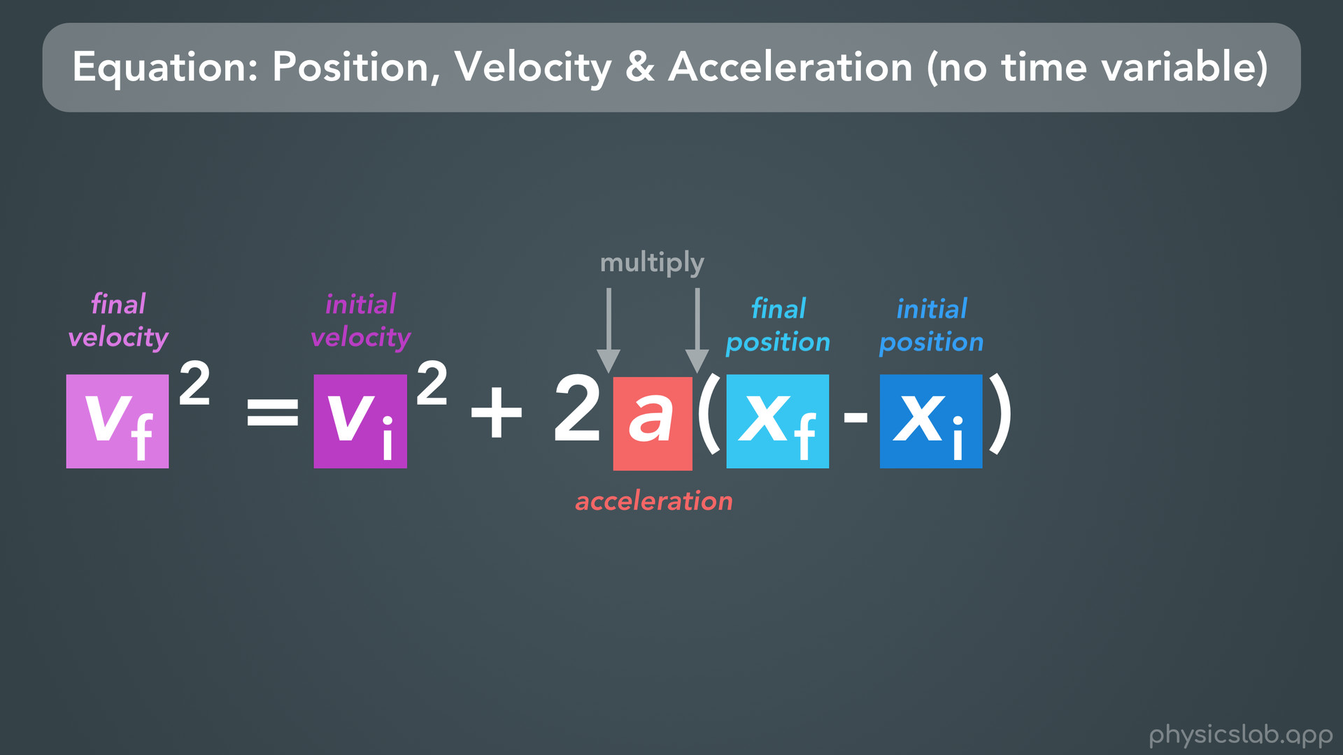
Notes:
So, let’s take a closer look at the variables in this new equation.
“vf” is final velocity, “vi” is initial velocity, “a” is acceleration”, “xf” is final position, and “xi” is initial position. And don’t forget, multiplication is implied in these two spots. As a whole, this equation says that, for an object, the final velocity squared is equal to the initial velocity squared plus 2 times the acceleration times the change in position, or the final position minus the initial position.

Slide 15
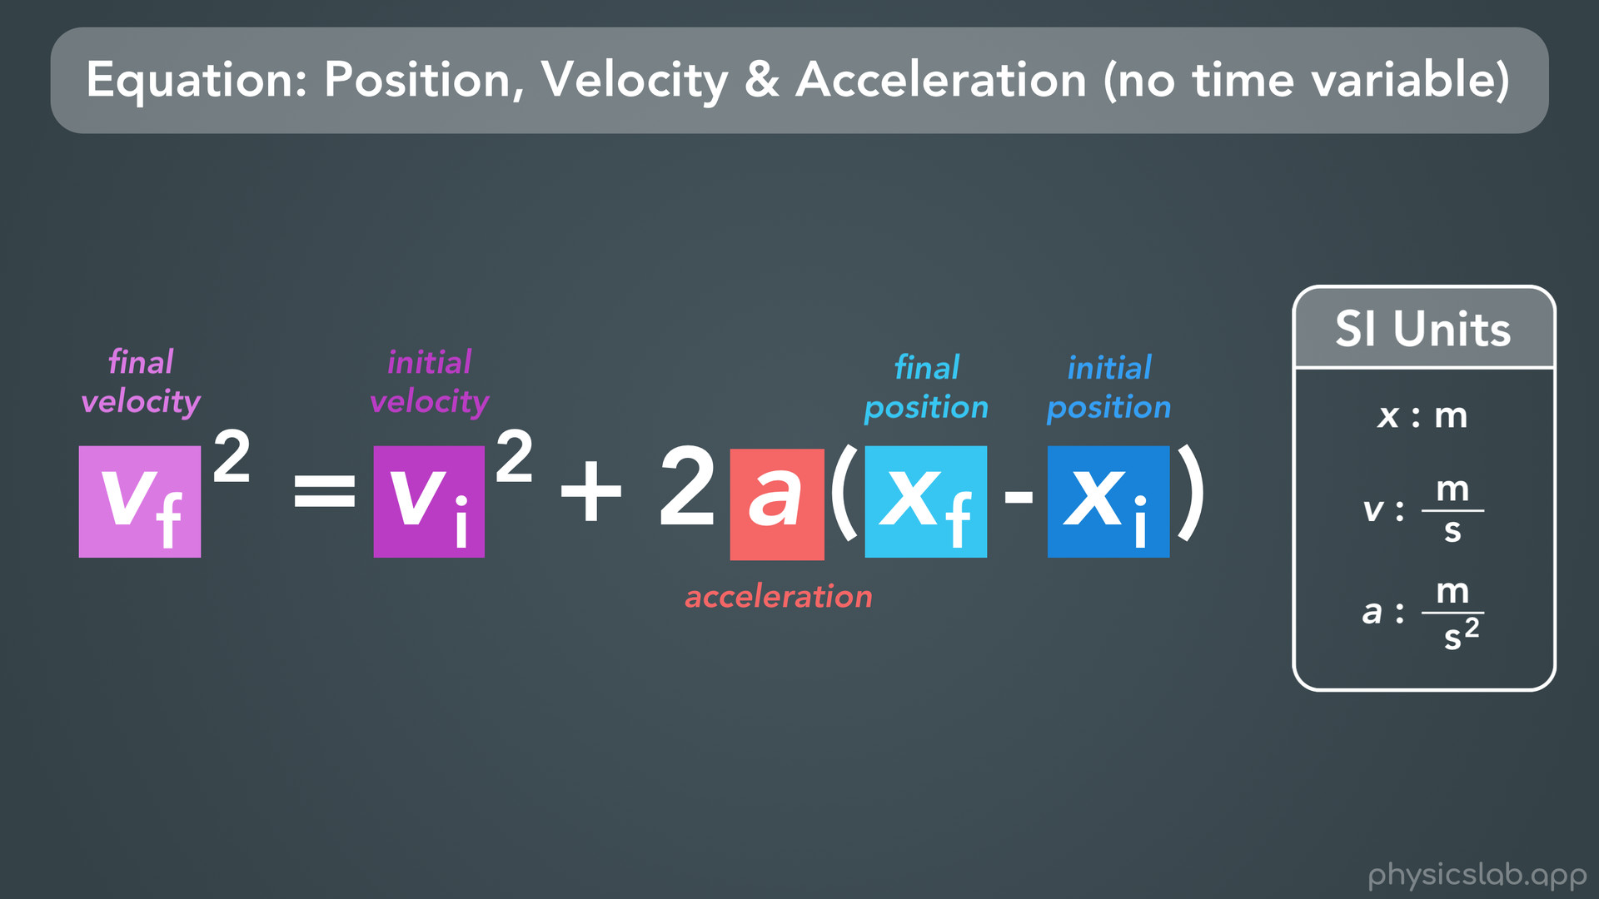
Notes:
And, here are the SI units for the variables in this equation.

Slide 16
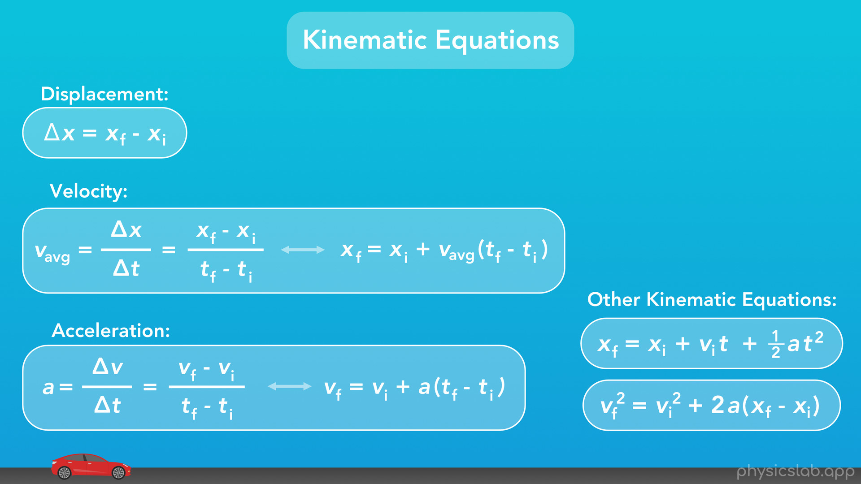
Notes:
Now we have a nice list of kinematic equations that we can use to solve problems, which we’ll work through in later videos. And don’t worry if this seems like a lot here, you don’t have to memorize it. All of these are on your equation sheet, and the variables are defined so you know what they all mean.

Slide 17
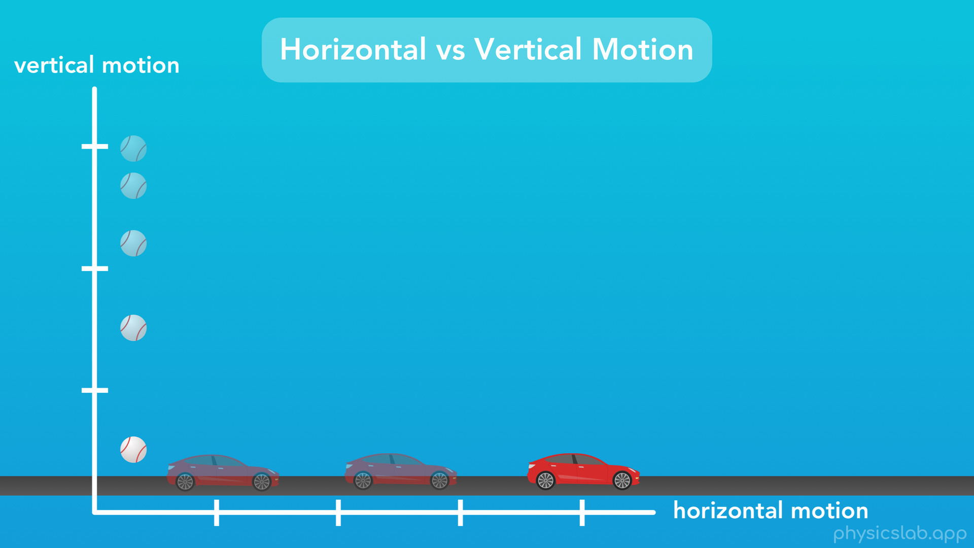
Notes:
Now before we wrap up with kinematic equations, there’s one more thing we need to cover, and that’s the variables we use for horizontal and vertical motion. So we’re learning about linear motion, or motion along a straight line, and mostly we’ve talked about a car driving along a road, which is horizontal motion. But we can also have vertical motion, like if we dropped a ball from some height and let it fall. Both of these are examples of linear motion, but they’re in different directions.

Slide 18
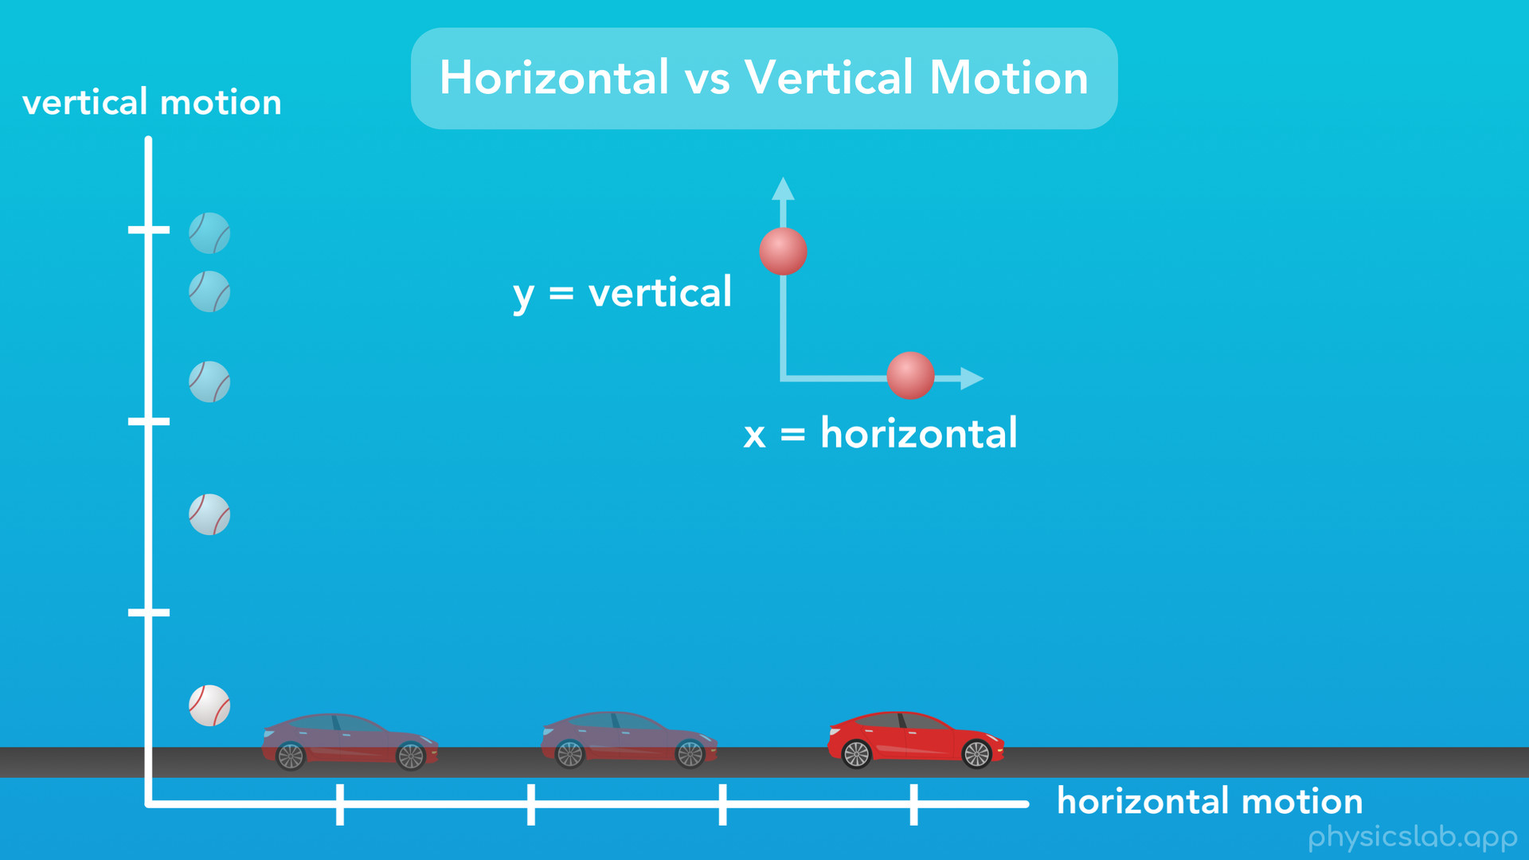
Notes:
In physics, we typically use “x” to represent horizontal motion, and we use “y” to represent vertical motion.

Slide 19
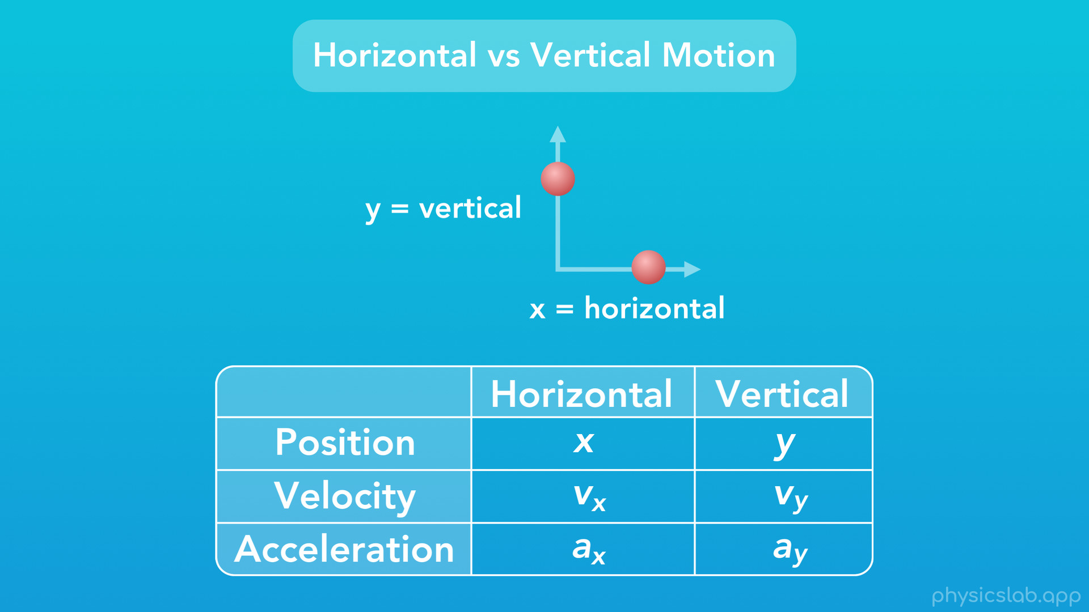
Notes:
So, just like we’ve been using “x” to represent horizontal position, we’re going to use “y” to represent vertical position, or the height of an object. And sometimes, we’ll also use x and y as subscripts, to label the direction of something. We can use v with x as a subscript to mean velocity in the horizontal direction, or v with y as a subscript to mean velocity in the vertical direction. Likewise, “ax” would mean acceleration in the horizontal direction, and “ay” would mean acceleration in the vertical direction.

Slide 20
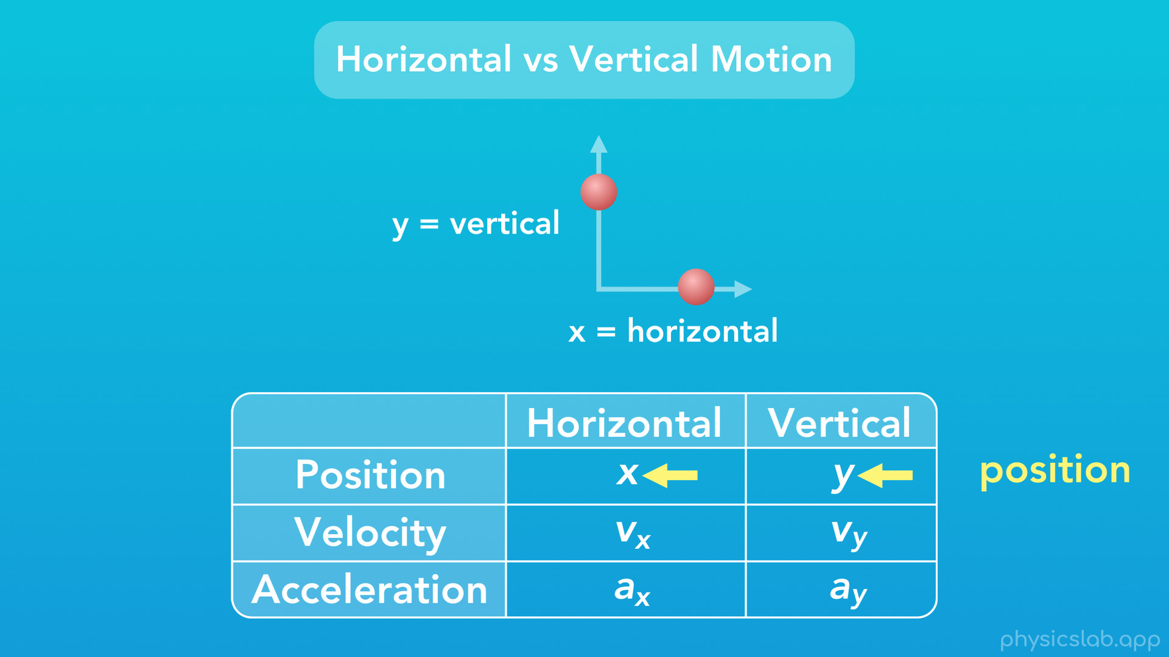
Notes:
Now, when you look at it organized this way, it kinda feels like position should have its own variable, like p, and then use x and y as subscripts, just like velocity and acceleration do. Well the variable “p” is already taken, but actually you’ll find in some places that people use the variable “s” to represent position. But in most cases, I’ve seen everyone use x and y to represent position, so that’s what we’ll do in this course.
The takeaway here is that, when they’re the actual variables, x and y mean horizontal and vertical position.

Slide 21
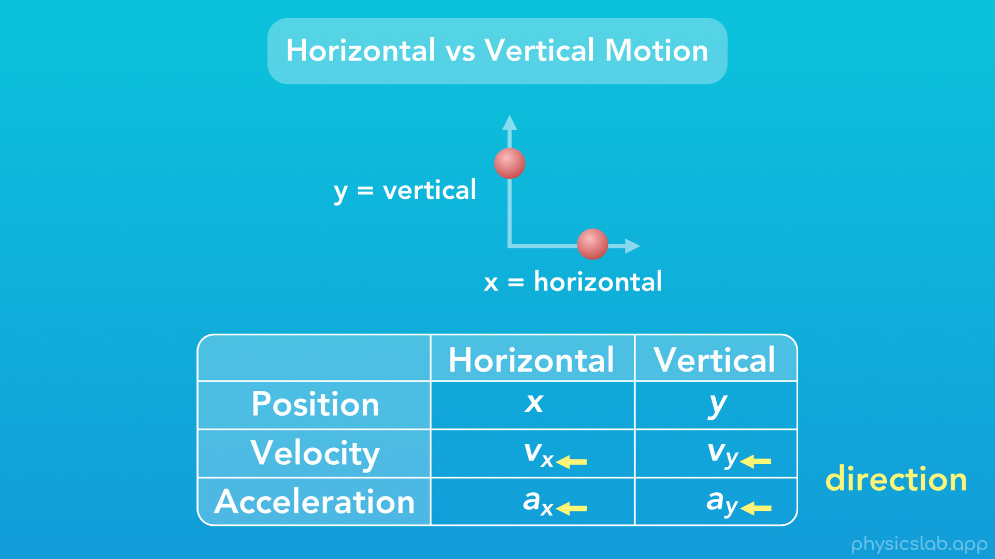
Notes:
And when they’re subscripts, x and y are telling us the direction of that thing, like velocity and acceleration.

Slide 22
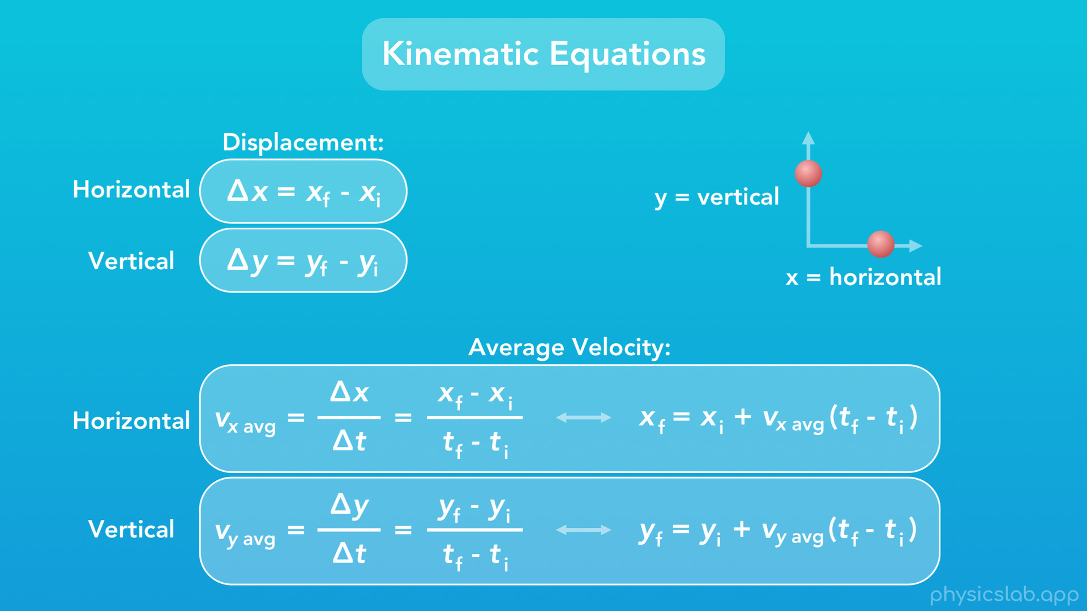
Notes:
So, what does this mean for our list of kinematic equations that we’ve put together? It means we actually know twice as many equations as before, without even learning them. Every equation can be applied to either horizontal or vertical motion, just by using x or y.
The equation we learned for displacement uses “x”, for horizontal displacement. But if we use “y” instead of “x”, now we have an equation for vertical displacement.
Here’s our equation for average velocity that uses “x”. And again if we use “y” instead of “x”, we have an equation for vertical average velocity. Notice how we’ve added x and y as subscripts for the average velocity variables, to label them as average velocity in the horizontal and vertical directions.

Slide 23
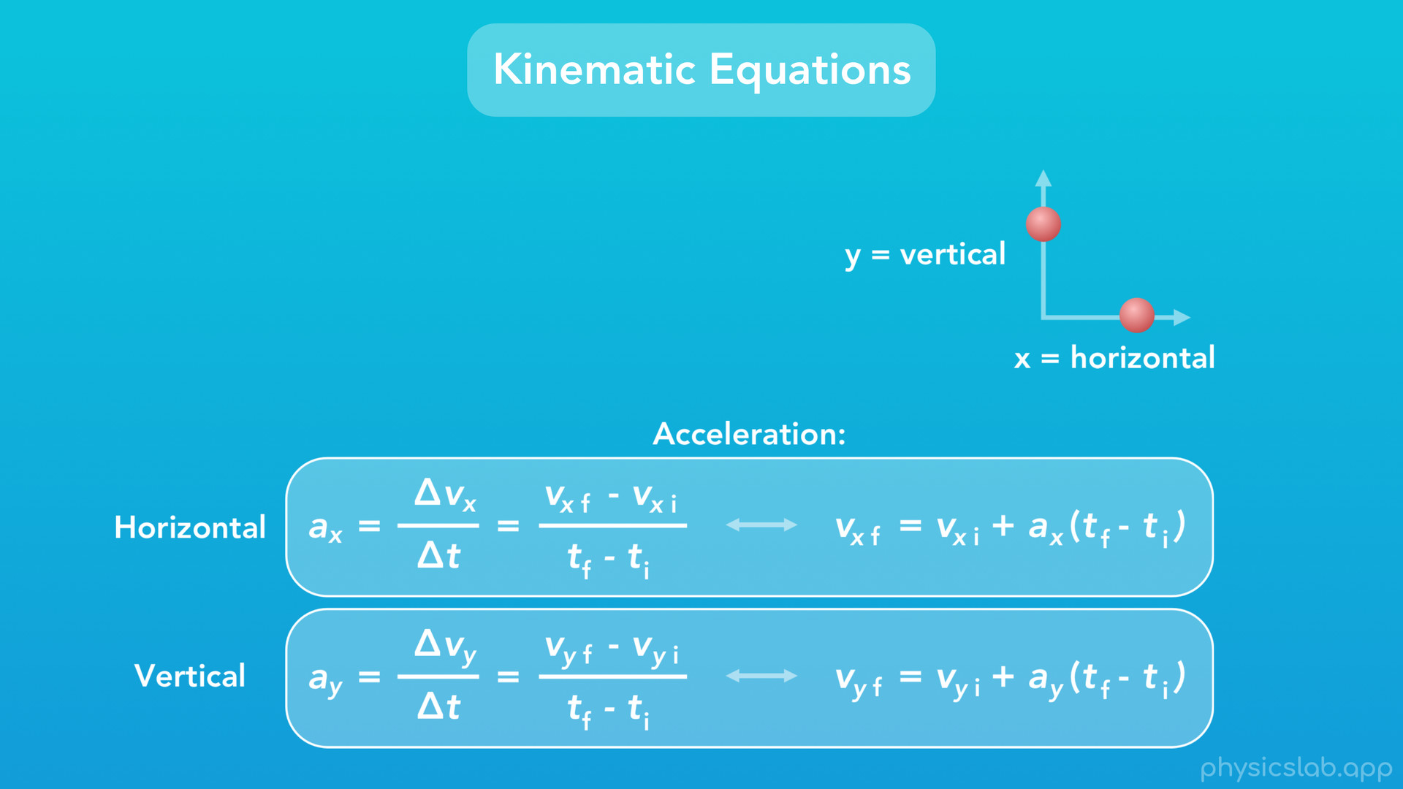
Notes:
We can do the same thing for our equation for acceleration. Here, all the variables for velocity and acceleration get their own subscript, x or y, to label their direction. However, the variable t, for time, doesn’t get an x or y subscript, because time applies to all motion, time can’t be horizontal or vertical.

Slide 24
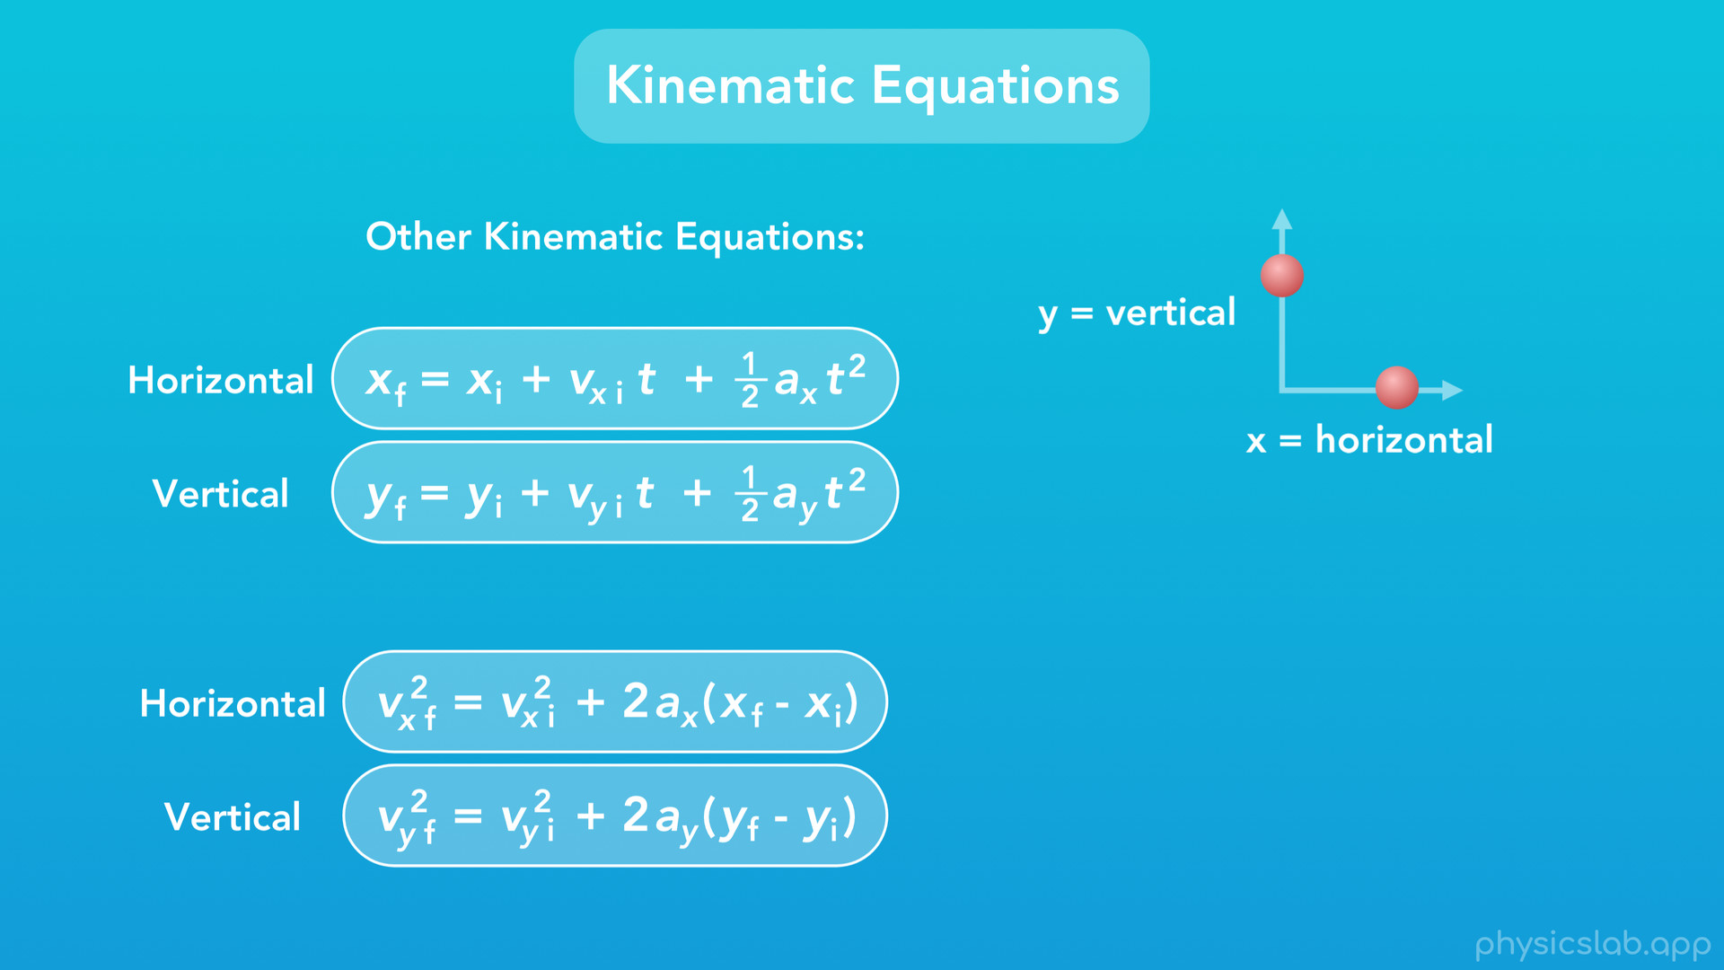
Notes:
And finally, here are the last 2 kinematic equations we learned, and each one has a version for horizontal or vertical motion, by using either x or y.

Slide 25
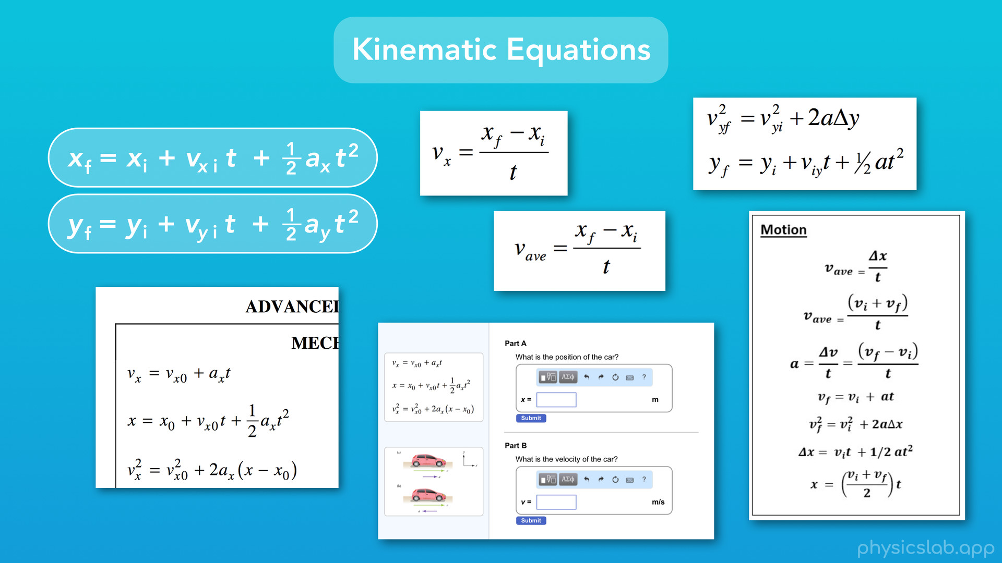
Notes:
Different physics equations are going to show up in this course, in your class, in other online videos, maybe on a website where you do your homework, or wherever. And all of those equations might look just slightly different from each other. They might have different subscripts, or they might just be rearranged. It can definitely be annoying, especially when you’re learning these for the first time.
But, don’t worry about all of that. All you need to know is what each variable means, and what each subscript means. That way, you’ll understand how to use any equation, even one that you haven’t seen before.

Slide 26
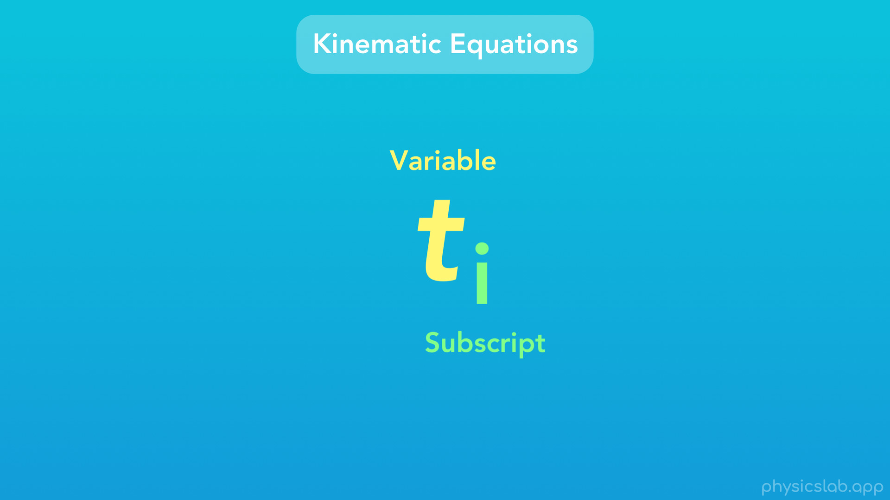
Notes:
So just to reiterate, the variables in an equation are the large letters, and the subscripts are the smaller letters at the bottom right of a variable. We can think of a subscript as a label, and a variable can also have more than one subscript.

Slide 27
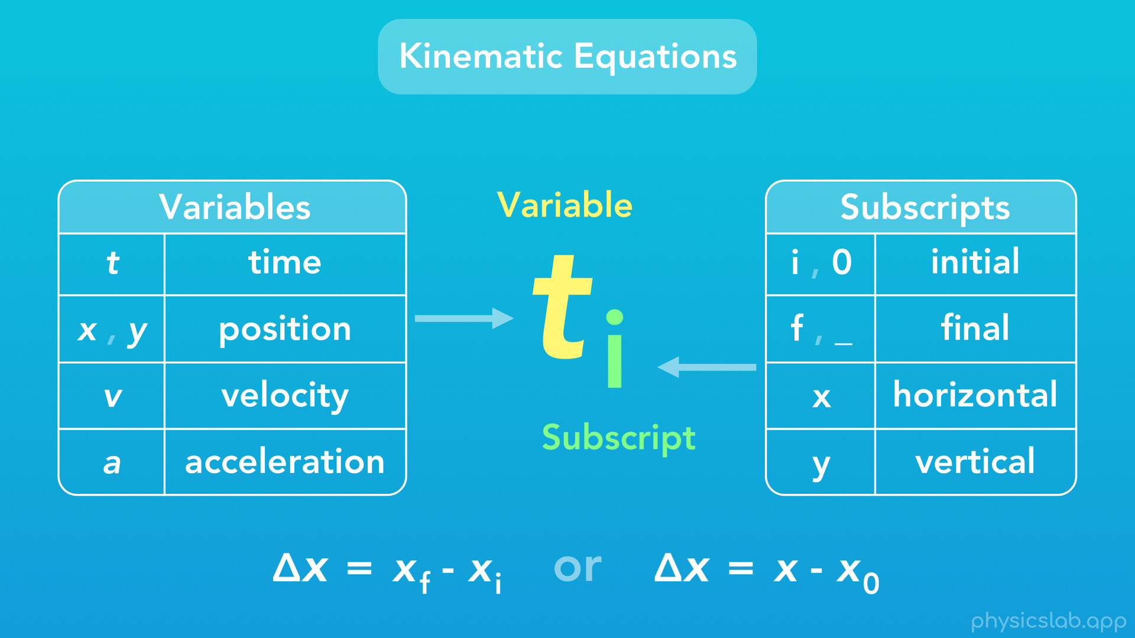
Notes:
So for the kinematic equations, here are the variables we’ll use. “t” is time, as variables “x” and “y” mean position, “v” means velocity, and “a” means acceleration. And for the subscripts, “i” means initial, or instead you might see a “zero” which means time zero, sometimes called “nought”. “i” and “zero” both mean the same thing. “f” means final, and if there is no subscript it will also mean “final”. You would see variables with the subscripts i and f in an equation, OR instead you would see variables with the subscript 0, and one with no subscript. These are sort of paired together. “x” as a subscript means the horizontal direction, and “y” as a subscript means the vertical direction.

Slide 28
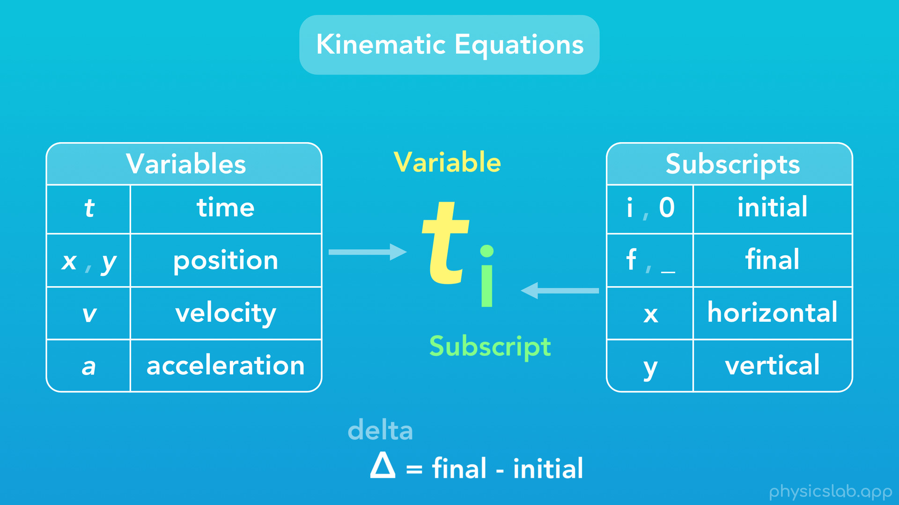
Notes:
And last, it’s not a variable or subscript, but remember that this little triangle is “delta”, and it means the final value minus the initial value, or the change in that value.
And again this might seem like a lot to remember, but don’t worry, the equation sheet for this course will have everything on it. This video is meant to introduce these equations, but we’ll get more comfortable with them as we start doing practice problems.

Slide 29

Notes:
So next up, let’s talk about scalars and vectors.

Slide 30
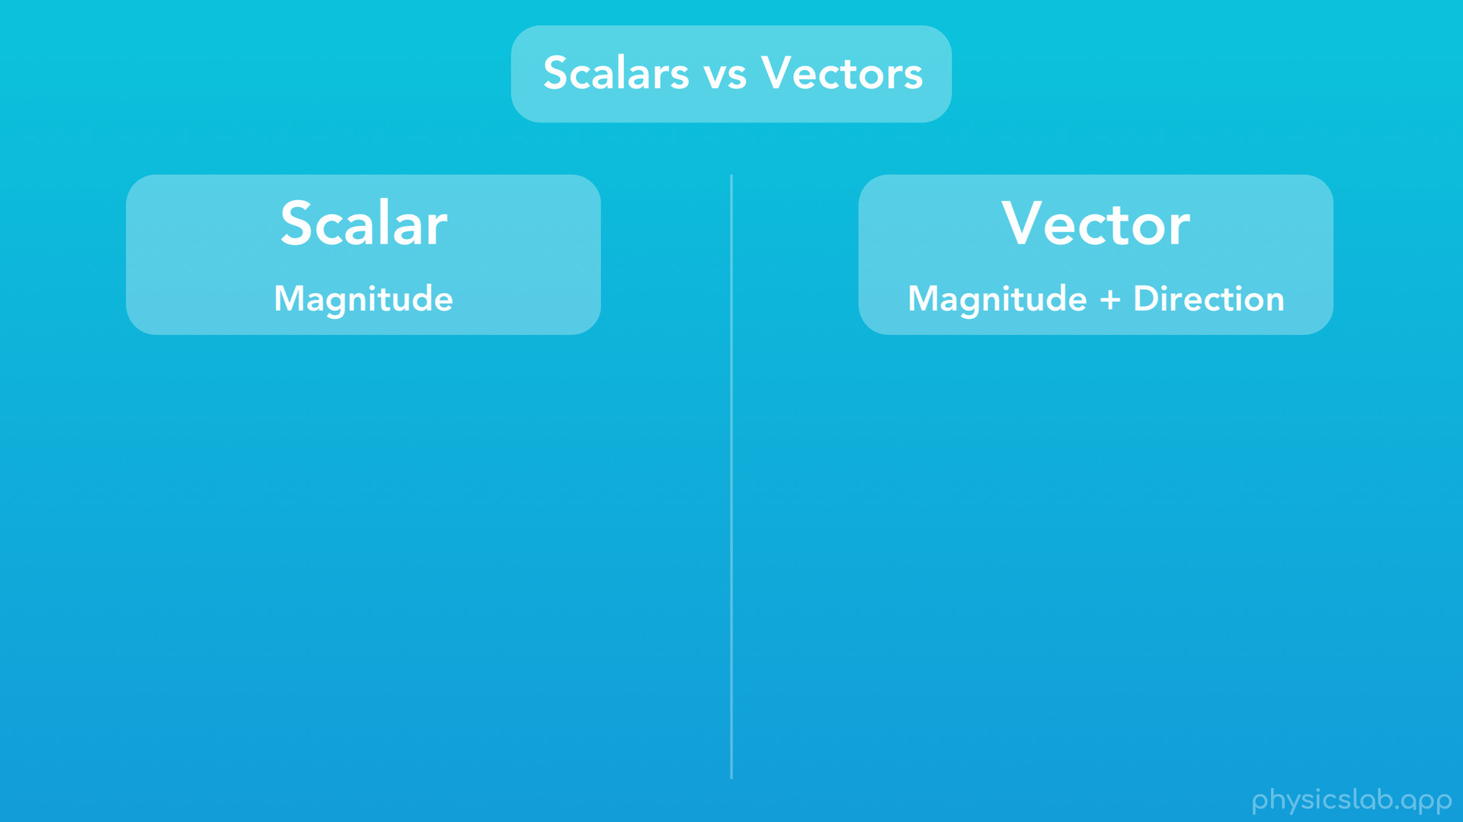
Notes:
A scalar is a quantity that only tells you the magnitude. And a vector is a quantity that tells you both the magnitude and direction.

Slide 31
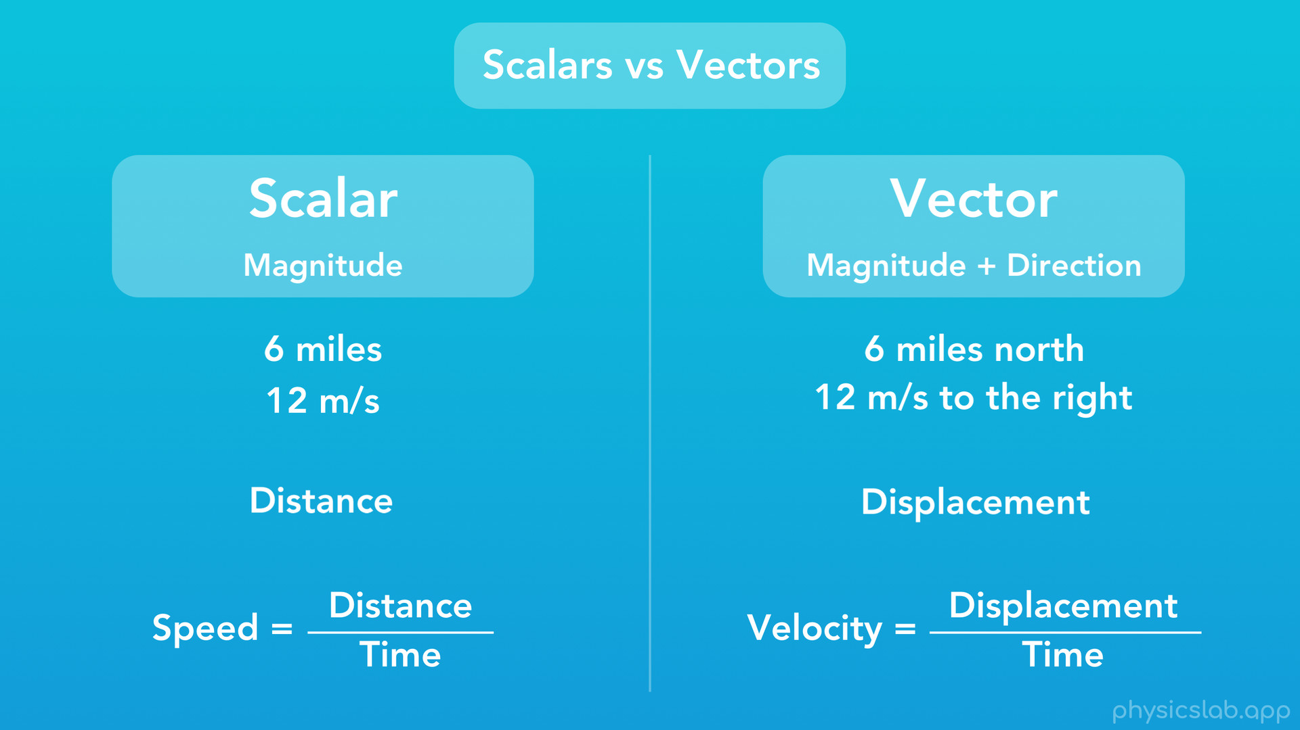
Notes:
So what does that mean? Well scalars are what we’re mostly used to. For example, 6 miles is a scalar quantity, and 12 m/s is a scalar quantity. On the other hand, 6 miles north would be a vector, and 12 m/s to the right would also be a vector. That’s because they tell us the magnitude, like 6 miles, as well as a direction, like north. If you take a scalar quantity, and add a direction to it, you turn it into a vector.
Also, we’ve mentioned the words “distance” and “displacement”. The difference between them is that distance is a scalar, and displacement is a vector. And it turns out, this is the difference between speed and velocity. Speed equals distance over time, which makes it a scalar, while velocity equals displacement over time, so it’s a vector.

Slide 32
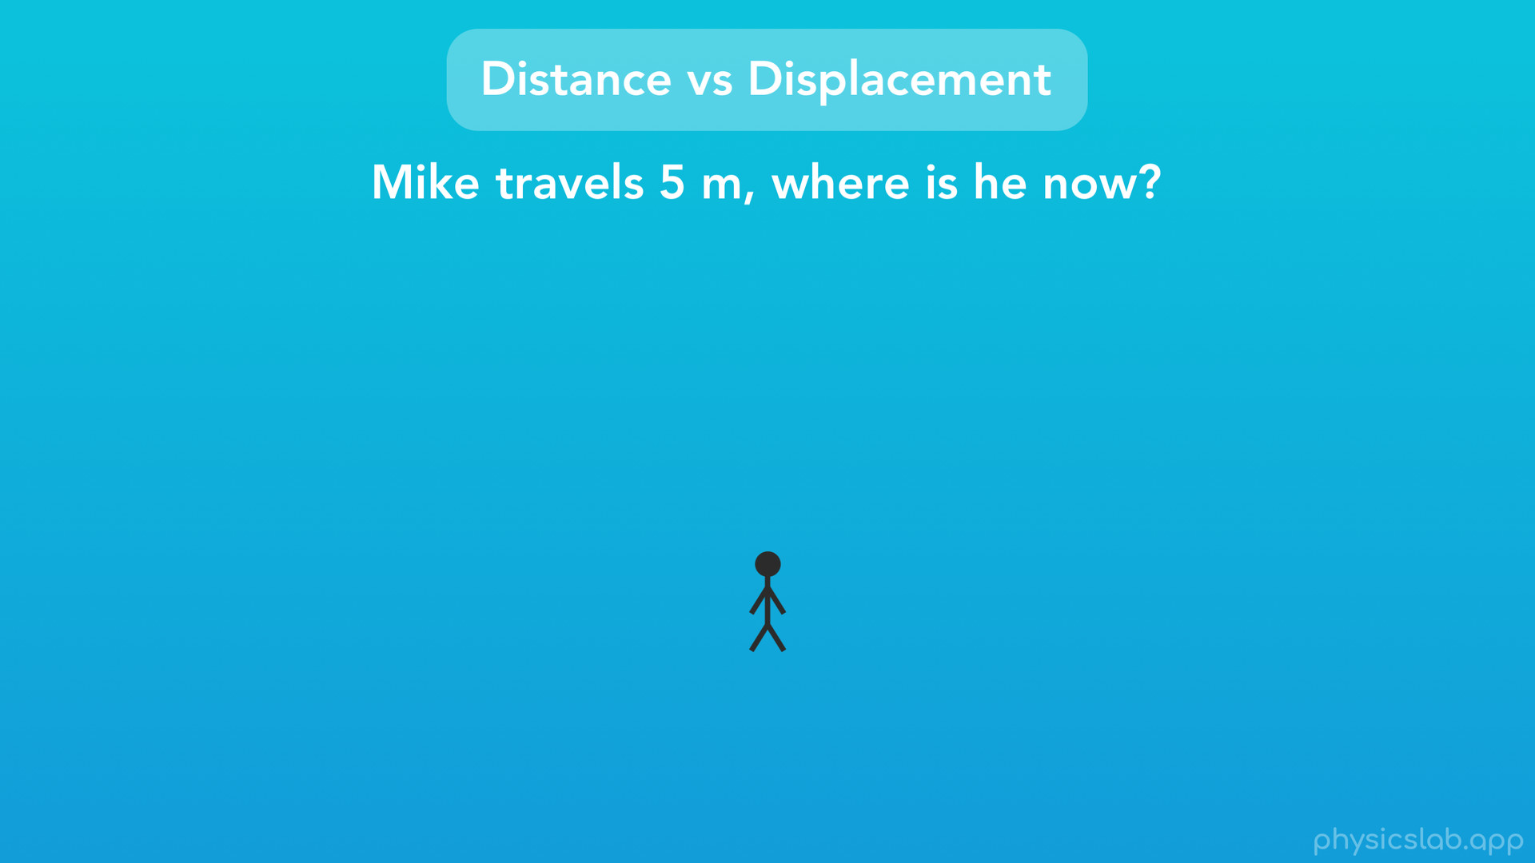
Notes:
Let’s take a look at the difference between distance and displacement. Here’s our friend Mike. If Mike starts here, and he travels 5 meters, then where is he now?

Slide 33
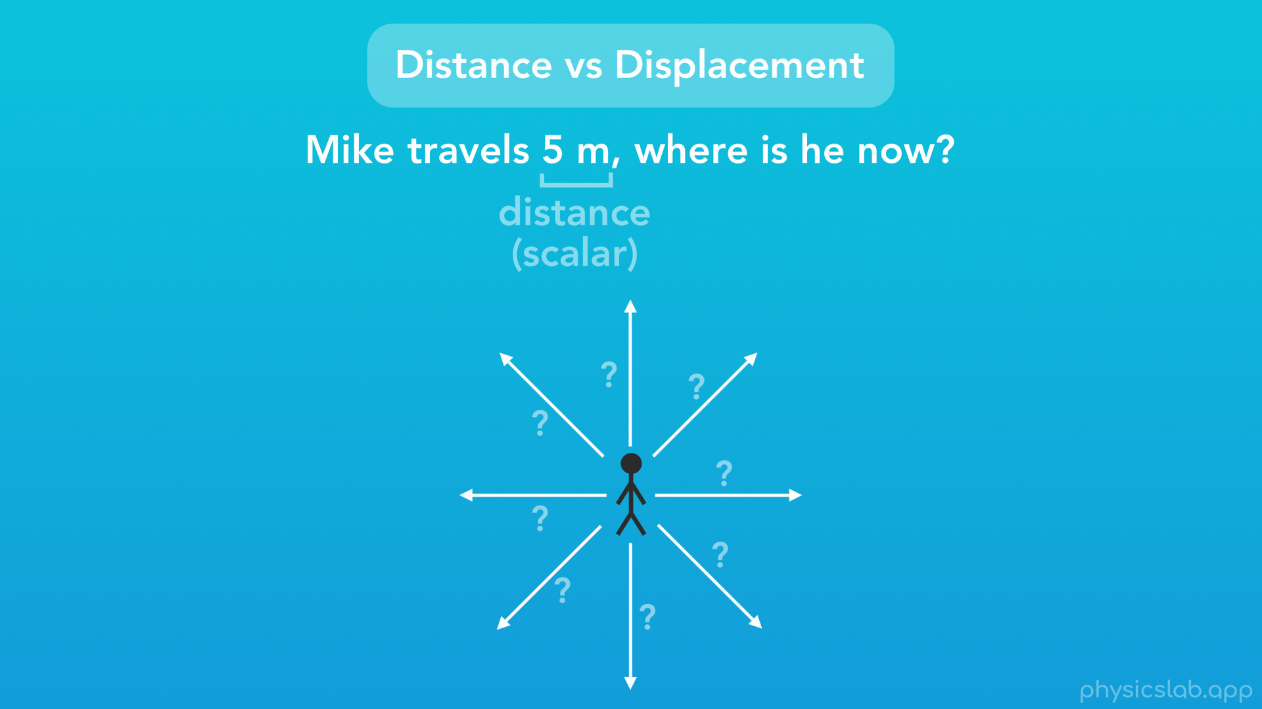
Notes:
Well, it’s not possible for us to know, because we weren’t given a direction. We were given a distance, which is a scalar.

Slide 34
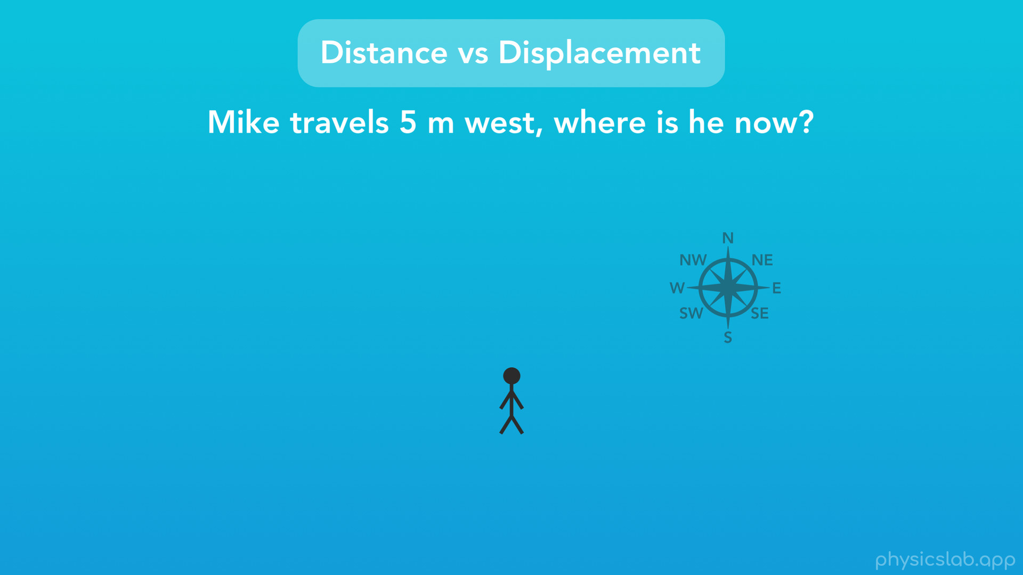
Notes:
Now instead, say have a compass and we’re told Mike travels 5 meters west

Slide 35
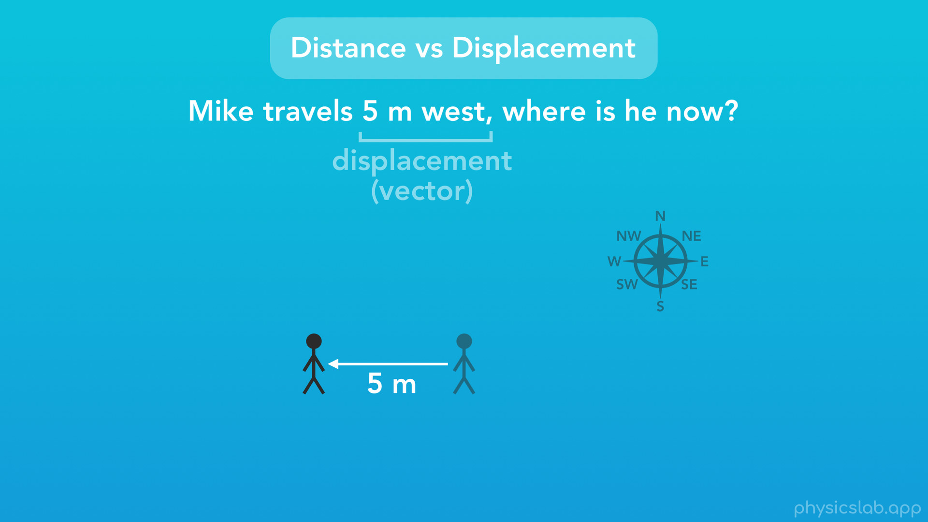
Notes:
we know exactly where he is now. Here, we were given a displacement, which is a vector, and it includes both the magnitude and the direction. Think of it as taking a distance value, and adding on a direction.

Slide 36
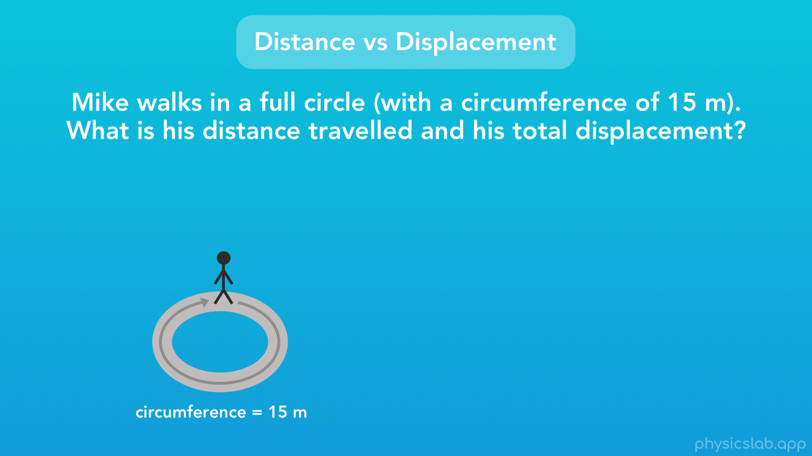
Notes:
Here’s another important distinction between distance and displacement. Here’s Mike again. Let’s say that Mike walks in a full circle (with a circumference of 15 meters), and ends up right where he started. What is his distance travelled, and what is his total displacement?

Slide 37
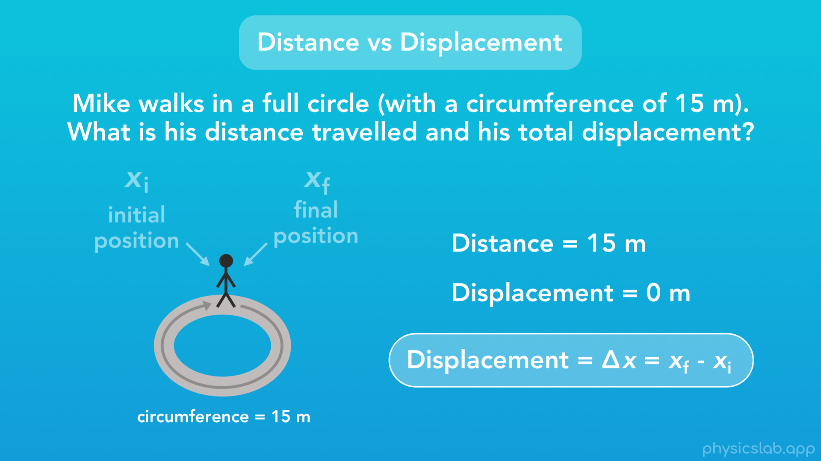
Notes:
Well his distance travelled, which is the actual path that he covered while he was walking, is 15 meters. That’s the circumference of this circle, or the length of his path.
However, his total displacement during this journey is 0 meters. Why is that? We’ll remember our equation for displacement is the difference between the final position and the initial position. Well for this journey, Mike started and ended in the same place, so his final position and initial position are the same, and we find the displacement equals 0.

Slide 38
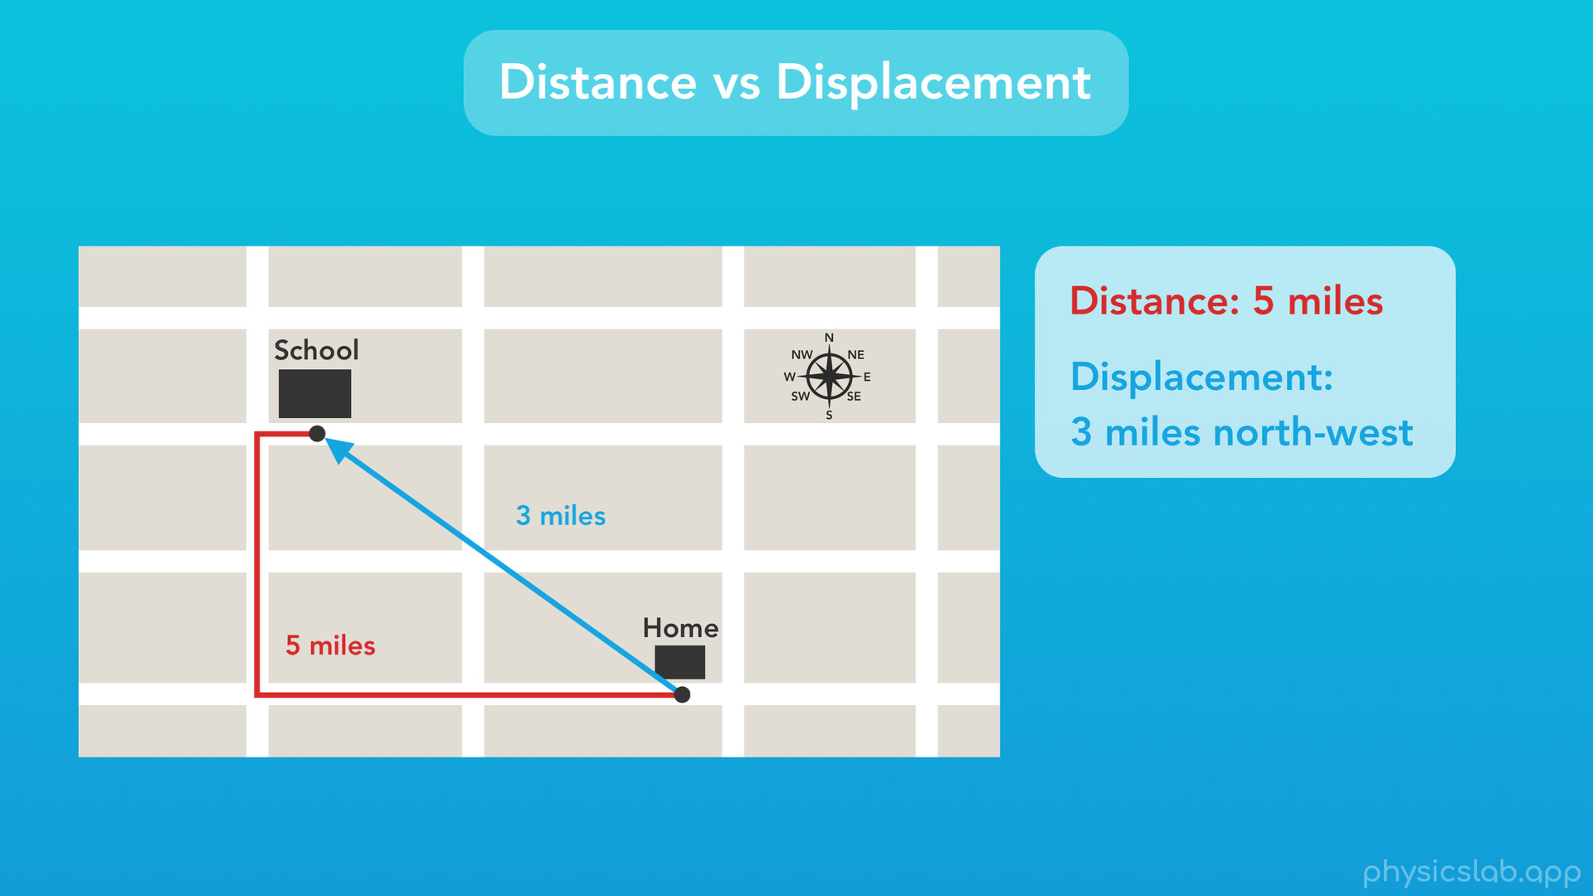
Notes:
Let’s look at this another way. Let’s say you’re driving from your home to your school, and we look at it from a bird’s eye view. There’s different paths you could take, but let’s say you drove to school like this. The distance you travelled, let’s say, is 5 miles. What would be your displacement? Well the displacement is the direct difference between your initial and final points, and we can think of it as an arrow going from our starting point to our ending point. Here, our displacement is 3 miles north-west. Remember distance is a scalar, and it only has a magnitude. But displacement is a vector, so it has both a magnitude (3 miles) and a direction (north-west).

Slide 39
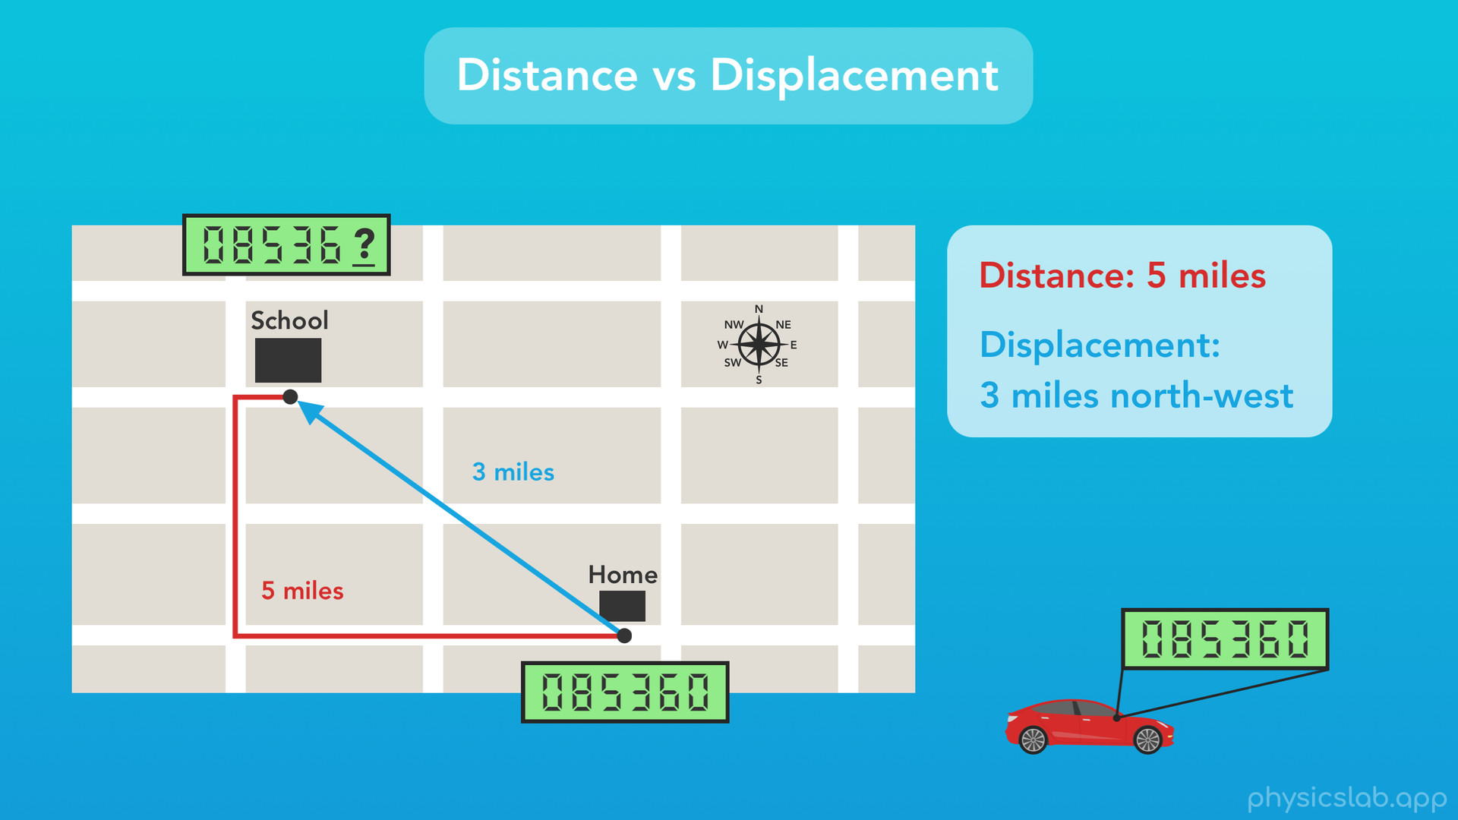
Notes:
So here’s a question for you. Every car has something called an odometer, which measures the number of miles driven in your car. If we checked the odometer at home and then checked it again when we got to school, would the odometer increase by 5 miles, or would it increase by 3 miles. Does the odometer track our distance, or our displacement?

Slide 40
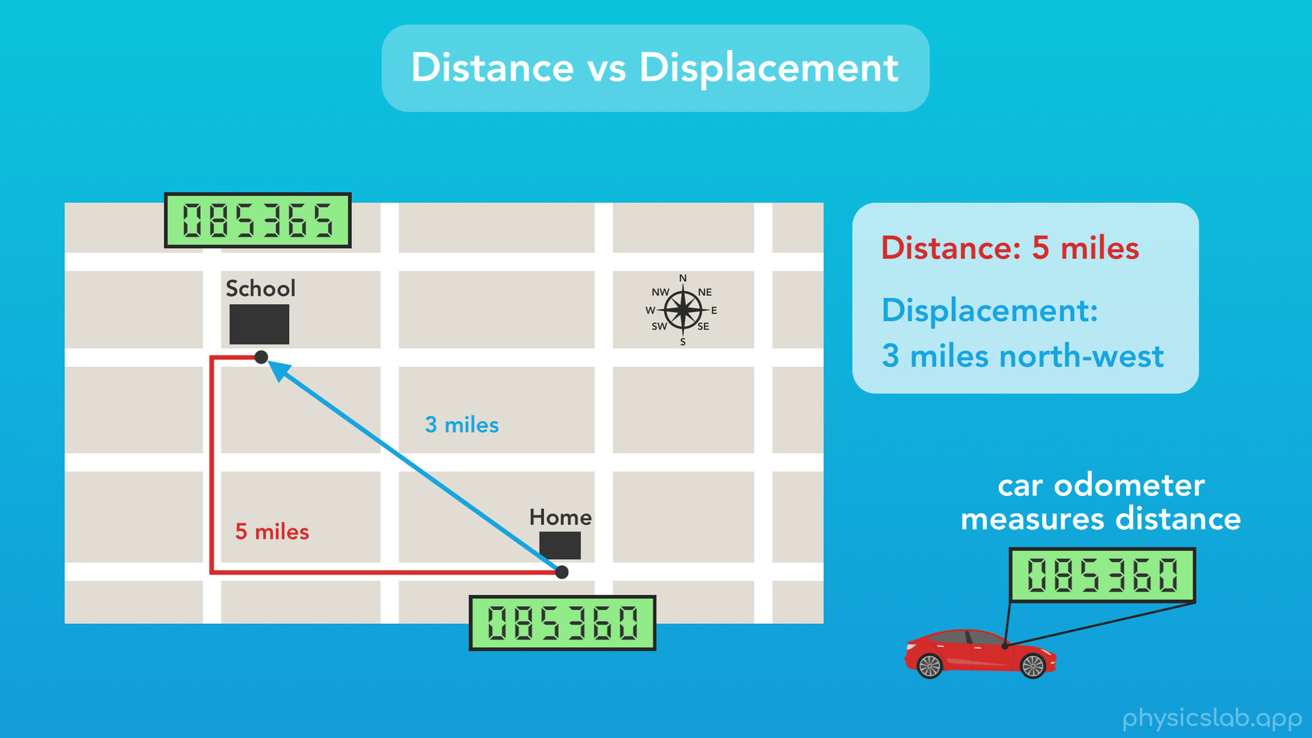
Notes:
The answer is, the odometer would go up by 5 miles, because measures distance, it measures the actual path that the car takes. So that’s another way to think about the difference between distance and displacement.

Slide 41
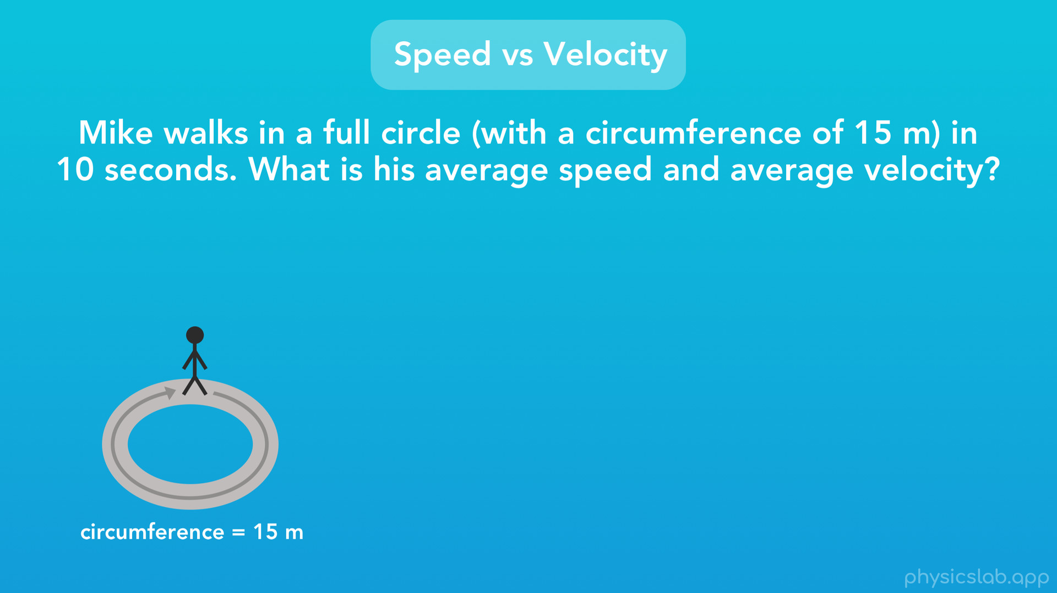
Notes:
Next, we can use the same examples to compare speed and velocity. Again, Mike walks in a full circle (with a circumference of 15 m), but now we’re given that it takes him 10 seconds. What is his average speed and his average velocity?

Slide 42
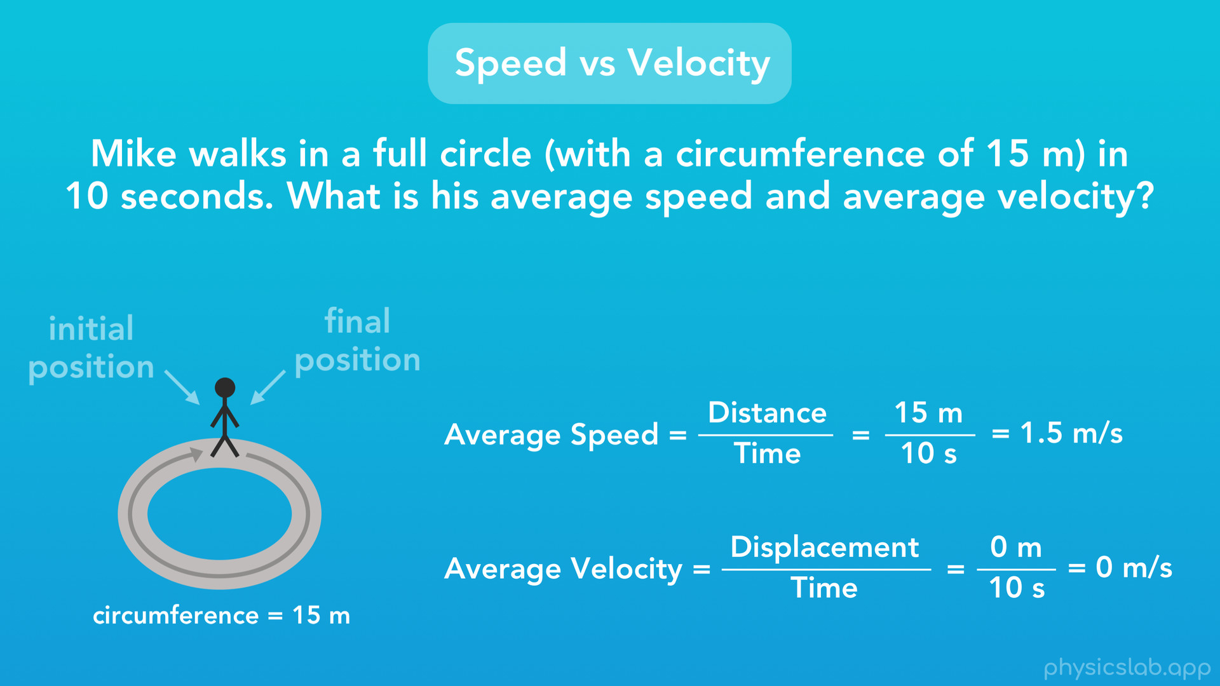
Notes:
Well speed is equal to distance over time. His distance travelled is 15 meters, and it takes him 10 seconds, so his average speed is 15 divided by 10, or 1.5 m/s. But velocity uses displacement over time, not distance over time. We learned last time his displacement is 0 m, since there’s no difference between his initial and final position. So Mike’s average velocity is 0 meters divided by 10 seconds, or 0 m/s. That seems kinda strange, because we know Mike was moving as he walked around the circle. But, this is how we define average velocity, and in this case it’s 0.

Slide 43
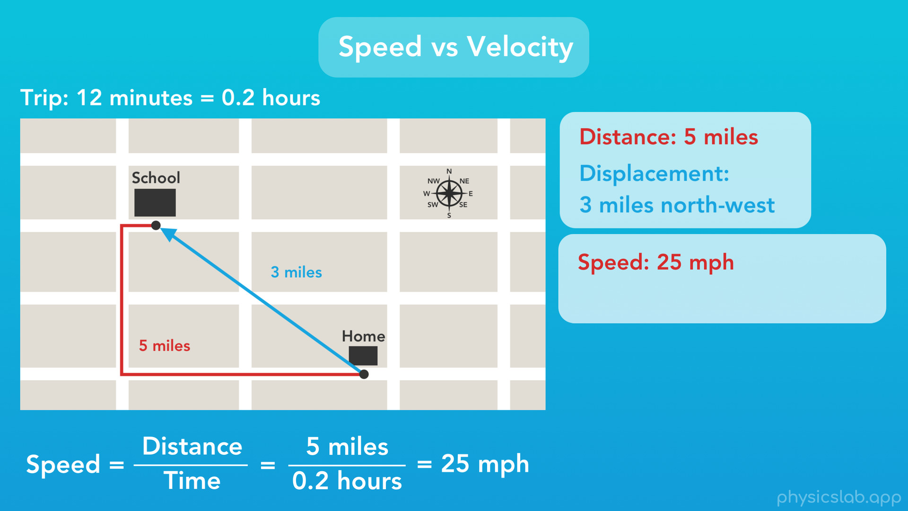
Notes:
What about our driving example? We already found the distance and displacement of our car. And let’s say that the trip takes us 12 minutes, which equals 0.2 hours. So what would be our average speed and average velocity for this trip?
Well speed is distance over time, which would be 5 miles divided by 0.2 hours, and we get 25 mph. So that’s our average speed.

Slide 44
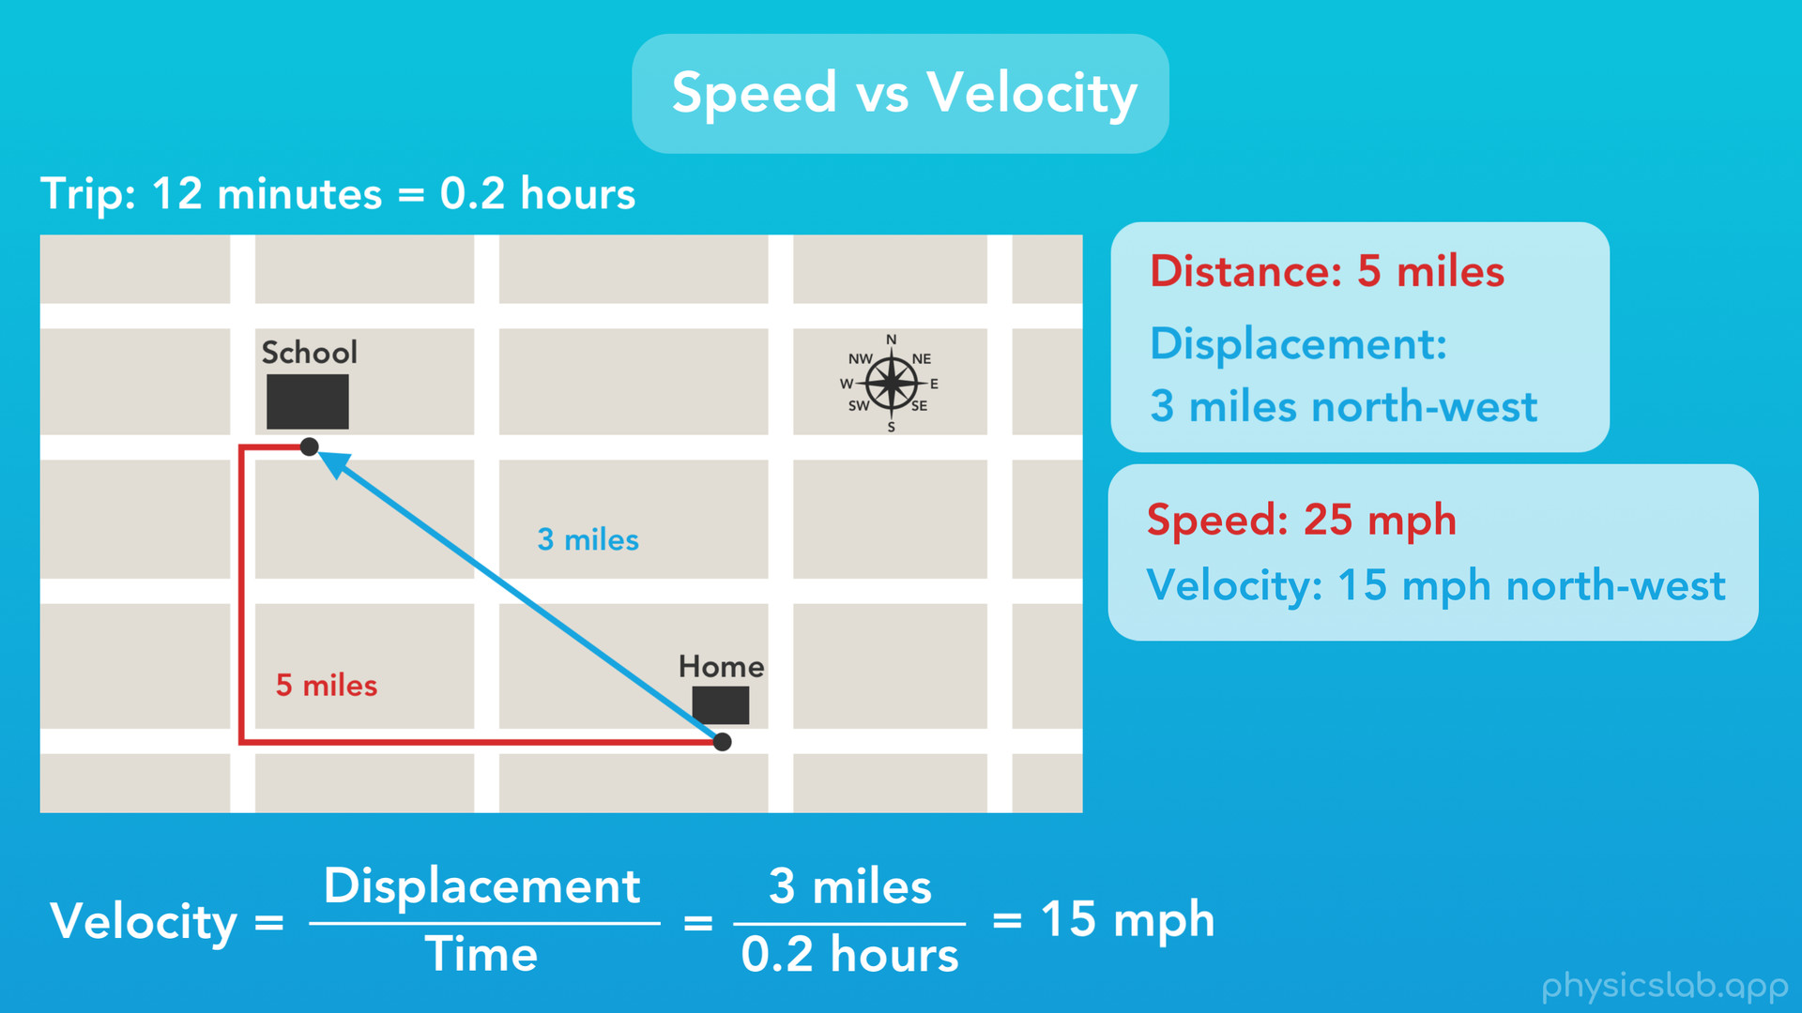
Notes:
Next, velocity is displacement over time, so to find the magnitude, we do 3 miles divided by 0.2 hours, which gives us 15 mph. But, velocity is a vector, so we need to include the direction. So our average velocity would be 15 mph north-west. It has the same direction as our displacement.

Slide 45
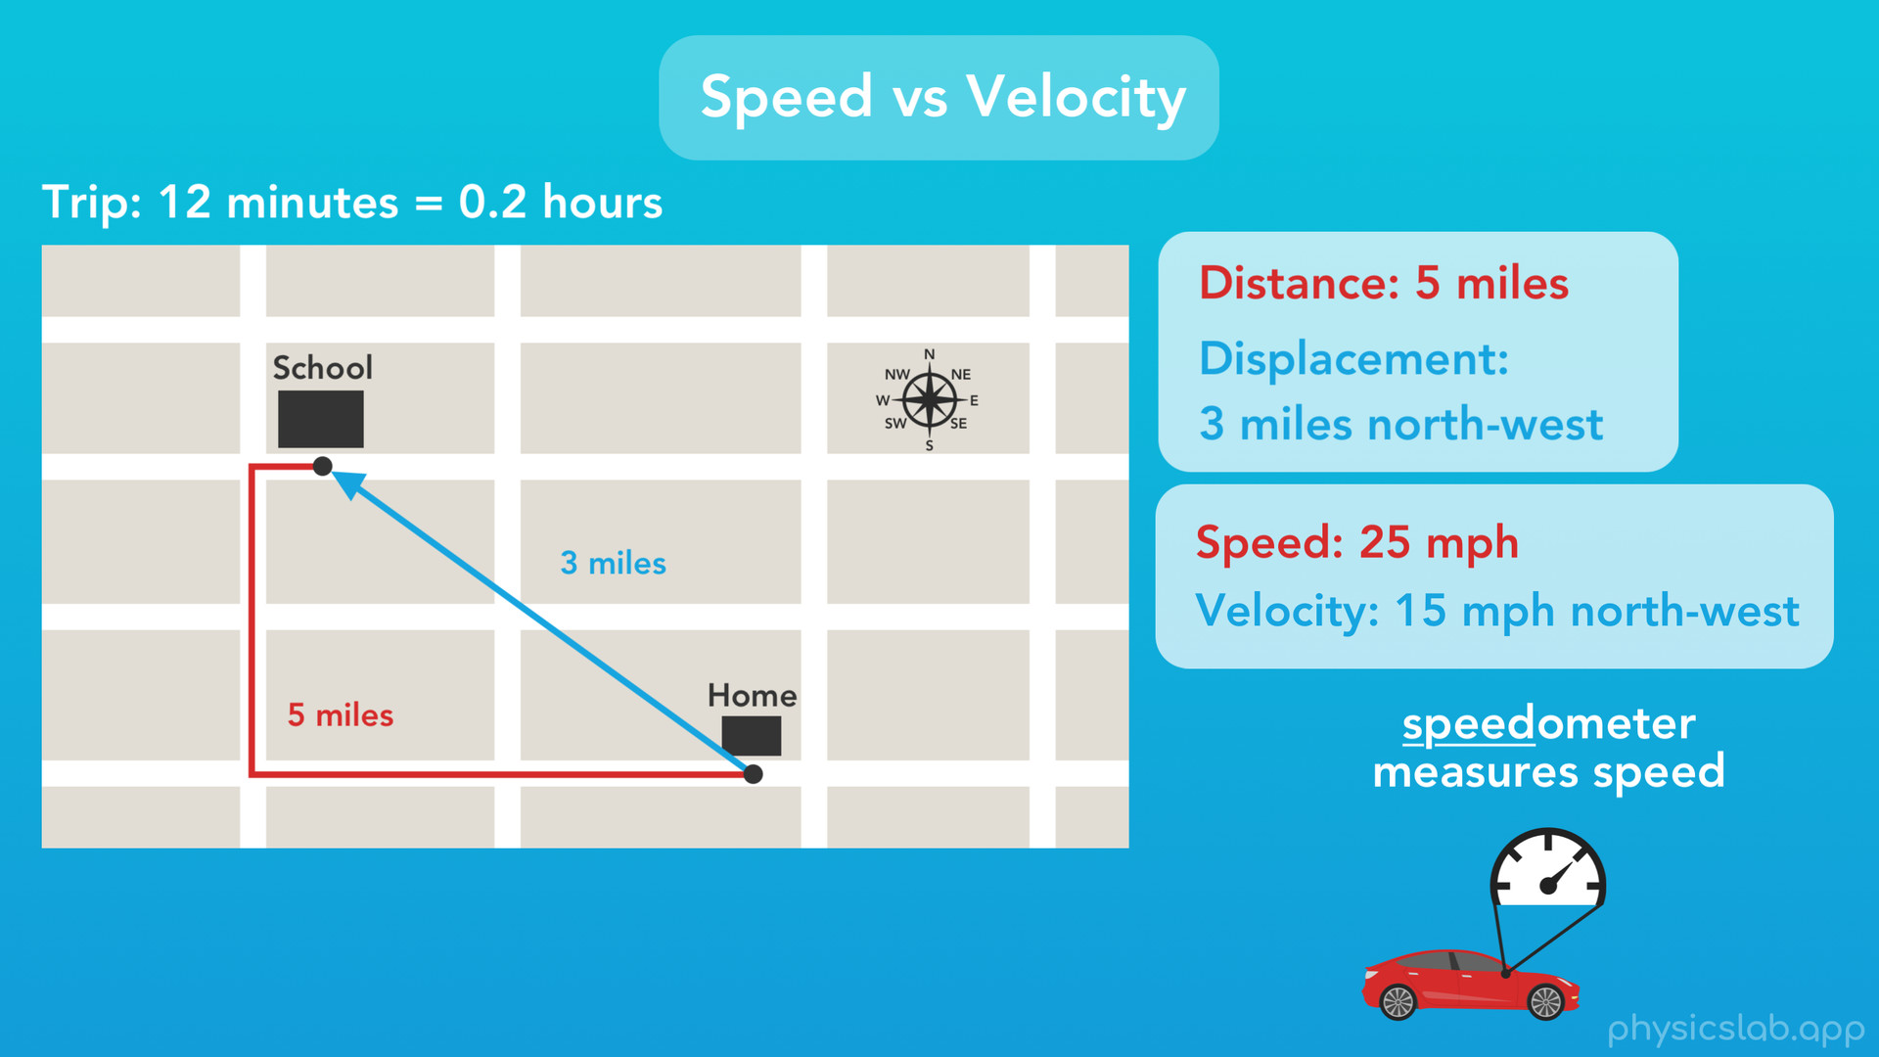
Notes:
And, similar to last time, every car has what we call a speedometer. That’s the thing that tells us how fast we’re going. Now, does the speedometer tell us the speed or the velocity of the car? The name kinda gives it away, but a speedometer tells us the car’s speed. The speedometer only knows we’re driving forward, but not which direction we’re traveling. But, if your car has a built in compass, you could think of combining your speed and your compass direction together to give you your car’s velocity, which is a vector.

Slide 46

Notes:
Alright, the last thing we’ll cover in this video is physics problems involving average speed.

Slide 47
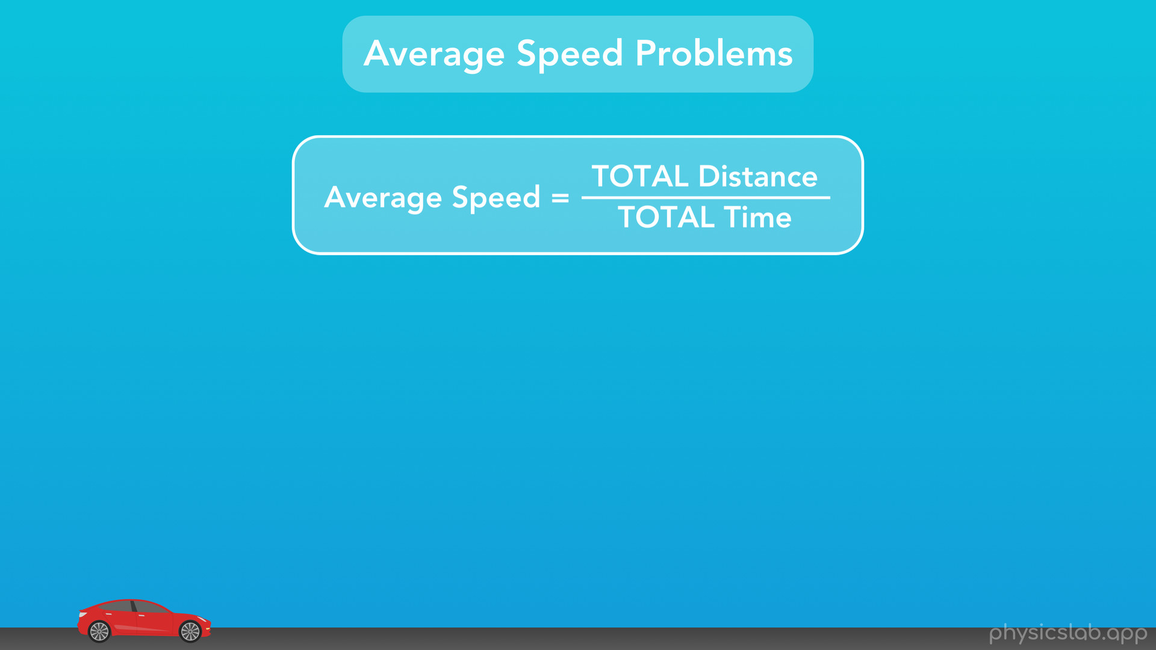
Notes:
So here’s our equation for average speed: average speed equals the total distance travelled divided by the total time it took to travel that distance. I emphasized “total” because it’s an important part of finding average speed.

Slide 48
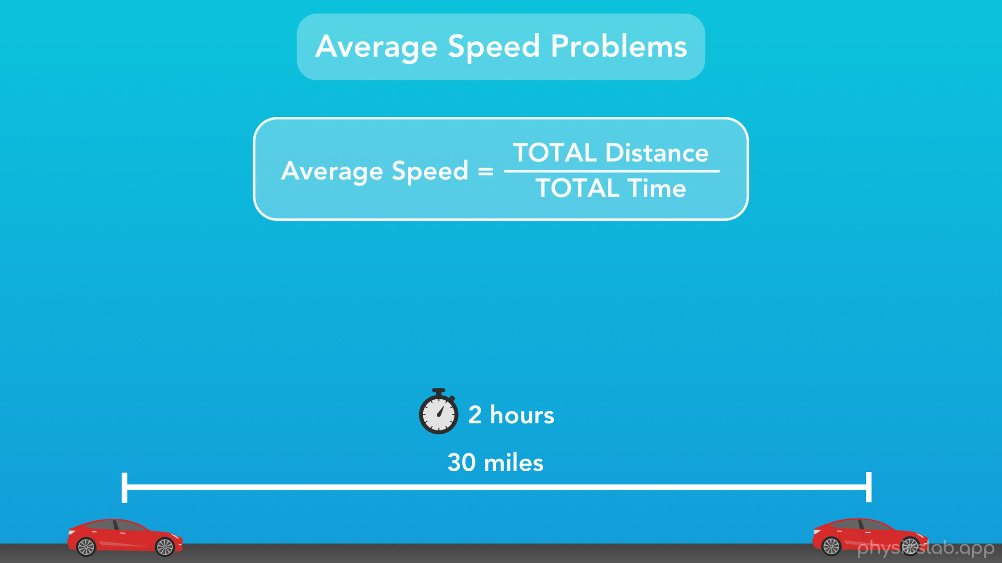
Notes:
For example, if we said that this car travelled 30 miles and it took 2 hours, then the average speed of the car for that period is 30 miles divided by 2 hours, or 15 miles per hour.

Slide 49
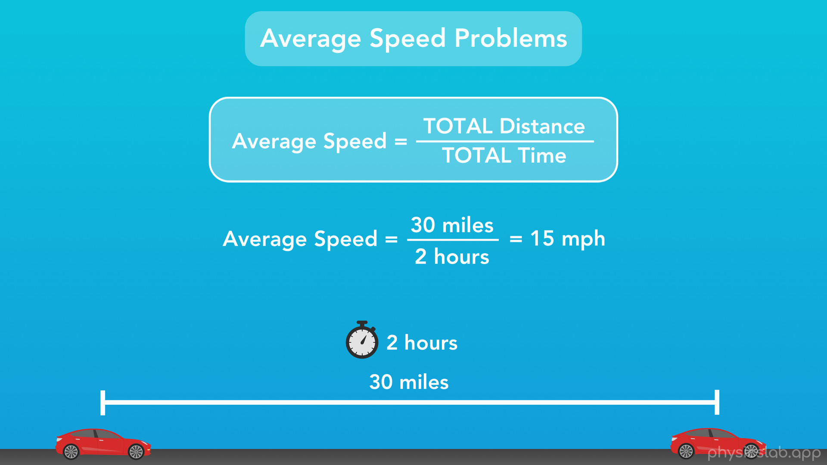
Notes:
Seems pretty straightforward right? But, sometimes physics problems can trip us up, because the information we get isn’t this easy. And we might forget that “average speed” is defined as the TOTAL distance over the TOTAL time. If the problem wants us to find average speed, this is how we have to calculate it.

Slide 50
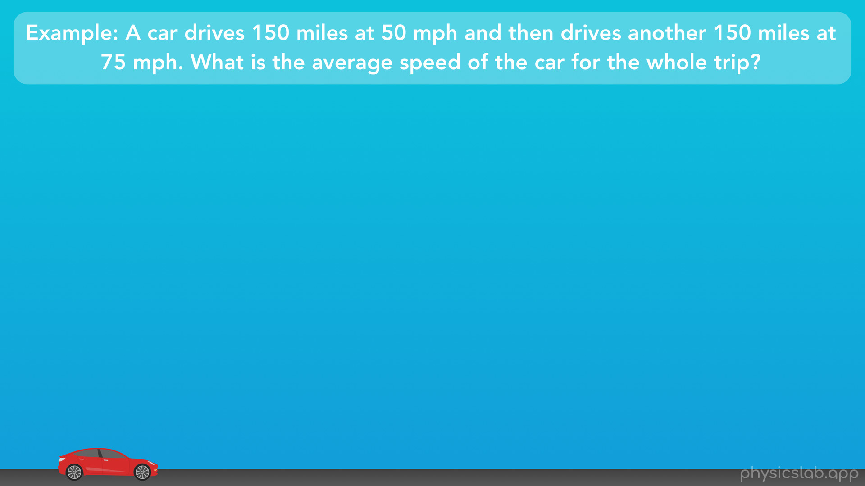
Notes:
Take a look at this example. A car drives 150 miles at 50 mph and then drives for another 150 miles at 75 mph. What is the average speed of the car for the whole trip?

Slide 51
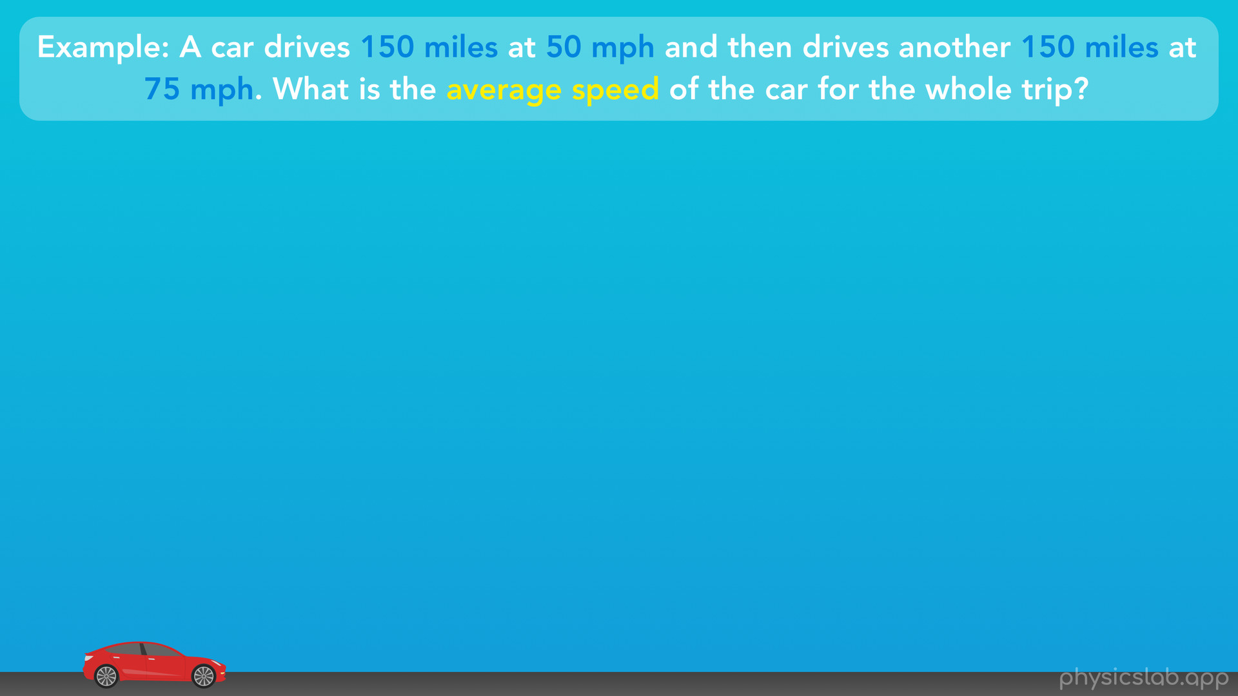
Notes:
So what are the important pieces of information in this word problem? We’re given some numbers, the car drives 150 miles at 50 mph and 150 miles at 75 mph, and we’re being asked to find the average speed.

Slide 52
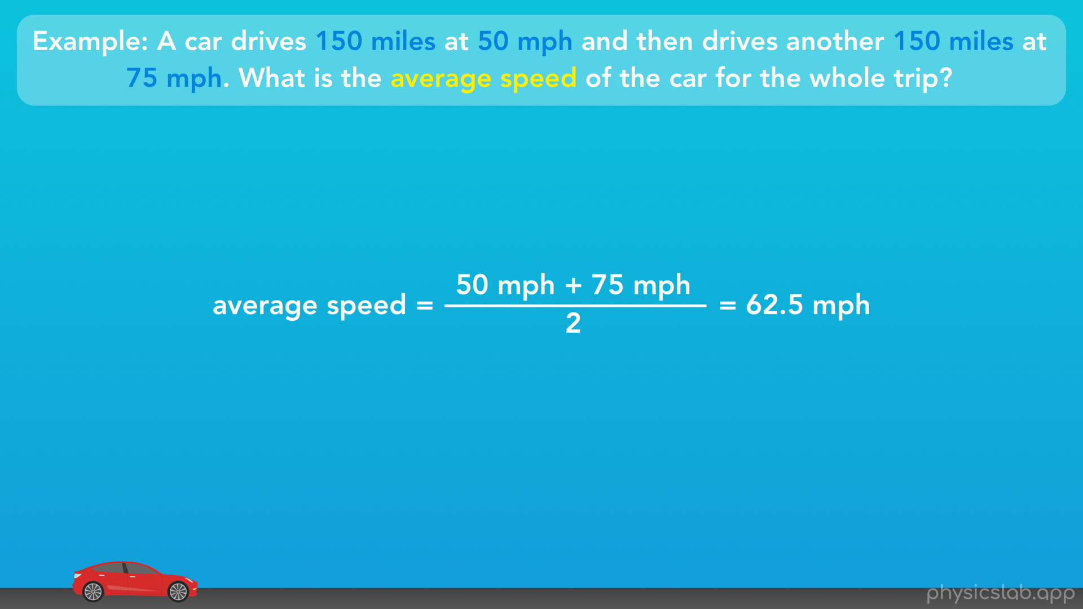
Notes:
So we see the word “average”. We know what average means. We know how to take a group of numbers and find the average, right? So to find the average speed, can we just find the average of 50 mph and 75 mph? That would be 50 mph plus 75 mph divided by 2, which gives us 62.5 mph. That seems logical, right?

Slide 53
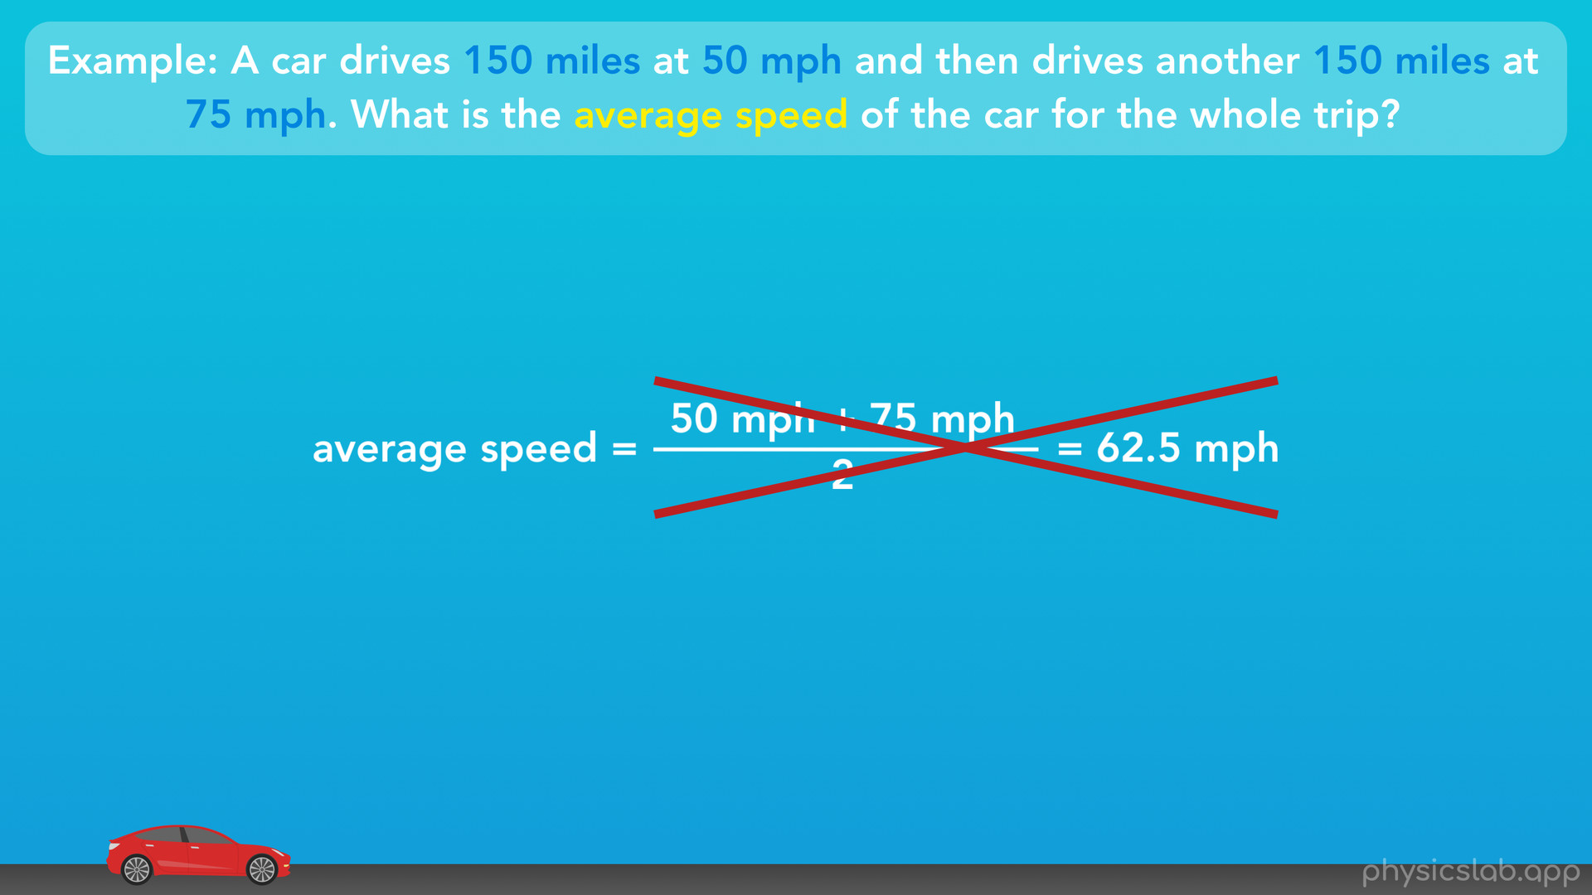
Notes:
Well, this is actually not the average speed.

Slide 54
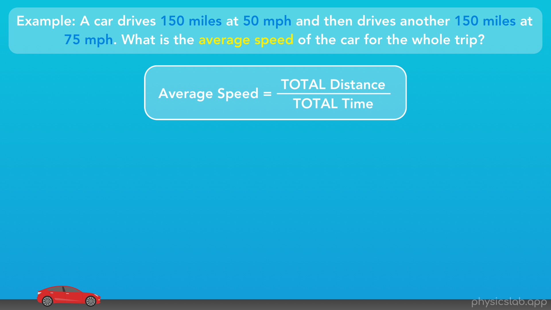
Notes:
Remember, this is how we define it: the average speed equals the total distance divided by the total time.

Slide 55
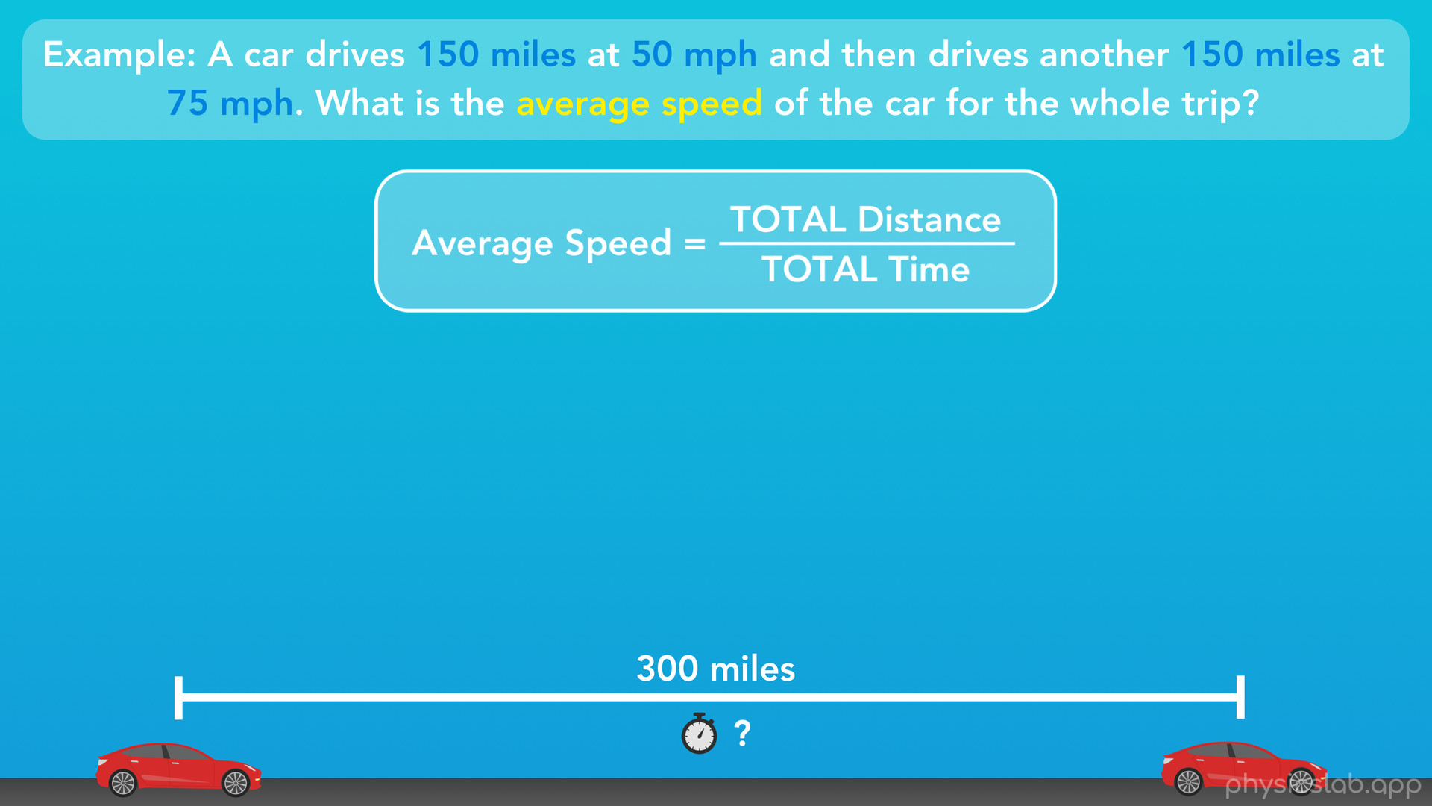
Notes:
Well, we know the total distance, 150 miles plus 150 miles which is 300 miles. But we don’t know the total time. How can we find it?

Slide 56
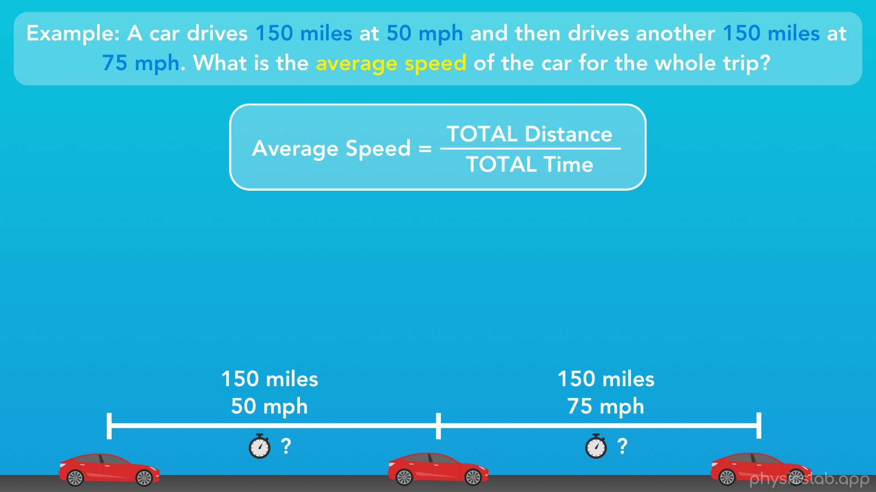
Notes:
Well, we know the distance and the speed of the car for each part of this trip. So what we can do is find the amount of time the car travelled for each part of the trip, then add them together to get the total time.

Slide 57

Notes:
So speed equals distance divided by time, but we want to rearrange this equation so we can find time. If we multiply both sides by “time” we get speed times time equals distance. Then if we divide both sides by “speed” we get time equals distance divided by speed. Quick side note: we just rearranged our equation so time is by itself on one side, and next we’re going to plug in numbers to solve for time. We could have also plugged in the numbers first, and then rearranged the equation for time, I just chose to do it this way.

Slide 58

Notes:
Ok, so for the first part of the trip, we have 150 miles divided by 50 mph, which equals 3 hours. For the second part of the trip, we have 150 miles divided by 75 mph, which equals 2 hours.

Slide 59

Notes:
So the total time for the entire trip is 3 plus 2, or 5 hours.

Slide 60

Notes:
Now we can calculate the average speed of the car for the entire trip. Average speed equals the total distance (300 miles) divided by the total time (5 hours), which equals 60 mph. So that is the actual average speed that this problem is asking us to find.

Slide 61

Notes:
So why is this answer correct, and why is it different than the one we got before? Let’s explore this for a minute. You won’t need to remember this, but I think it would be nice to clear things up.
So this first method of finding the average speed feels right, doesn’t it? 62.5 is halfway between 50 and 75, which is how we’re used to finding the average of 2 numbers. But the correct average speed (60) is less than that, it’s closer to 50 than it is to 75. So why is that? The car even drove the exact same distance at each of these 2 speeds, so it feels like each speed is equally important, like if you imagined a balance, each speed would have equal weight.

Slide 62

Notes:
Now, if instead the car had driven 50 mph for 1000 miles, and 75 mph for only 1 mile, then it would feel like the 50 mph would hold more weight, and the average should be closer to 50. But, the distances are actually the same.

Slide 63

Notes:
However, the “times” are not the same. We found that the car was driving 50 mph for 3 hours, and 75 mph for only 2 hours. Since the car was driving at 50 mph for a longer time, the 50 has more weight to it, so the average speed is closer to 50 than 75.

Slide 64

Notes:
So really, when we say “average speed” in physics, you could think of it as the “time-weighted average speed” as opposed to the “distance-weighted-average speed”. When an object like a car travels at different speeds over its journey, we’re averaging the speeds based on their times, and not on their distances.
The nice thing is, all you need is this equation. If a problem asks you to find the average speed, just divide the total distance by the total time, and you’ll be good to go.

Slide 65

Notes:
Alright, let’s do a recap of what we learned in this video.

Slide 66

Notes:
First off, we learned the last 2 kinematic equations for linear motion, which both apply to an object that’s accelerating.

Slide 67

Notes:
Next, we learned that we describe horizontal motion using the variable or the subscript “x”, and we describe vertical motion using the variable or the subscript “y”. And, that let us use each of our kinematic equations for either horizontal or vertical motion, by using x or y.

Slide 68

Notes:
We also learned that all we need to know is what each variable and each subscript means, and we don’t need to memorize any equations.

Slide 69

Notes:
Next, we learned the difference between scalars and vectors, where scalars have only a magnitude, but vectors have both a magnitude and a direction. And we covered a few examples showing the difference between distance and displacement, and speed and velocity.

Slide 70

Notes:
And finally, we talked about how average speed can be thought of as the “time-weighted” average speed. But when we’re solving problems like these, all we need to do is simply use this equation for average speed, using the total distance and the total time.

