Slide 1
2D Position, Coordinates & Displacement Vectors
Slides Version 2
This version includes:
Slides with screenshot images from the video.
The video narration in the slide notes.
A blank template slide with the same background and font as the video.
Slides with some basic graphics from this video for you to use however you like.
Feel free to add, delete and edit slides to make your own presentation. You can use these slides in class or share them with your students, but please do not post them online.
If you have any feedback, suggestions or questions about these slides please email me at chris@physicslab.app or send me a message on Discord @physicslab.
physicslab.app

Slide 2
Heading
Text

Slide 3
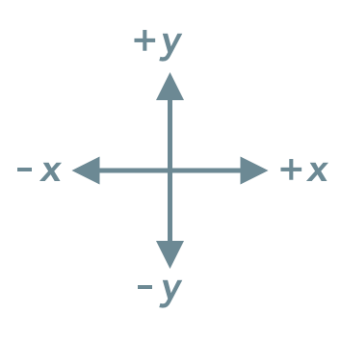
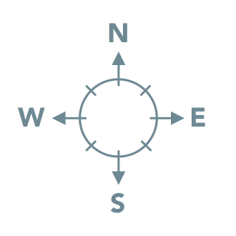
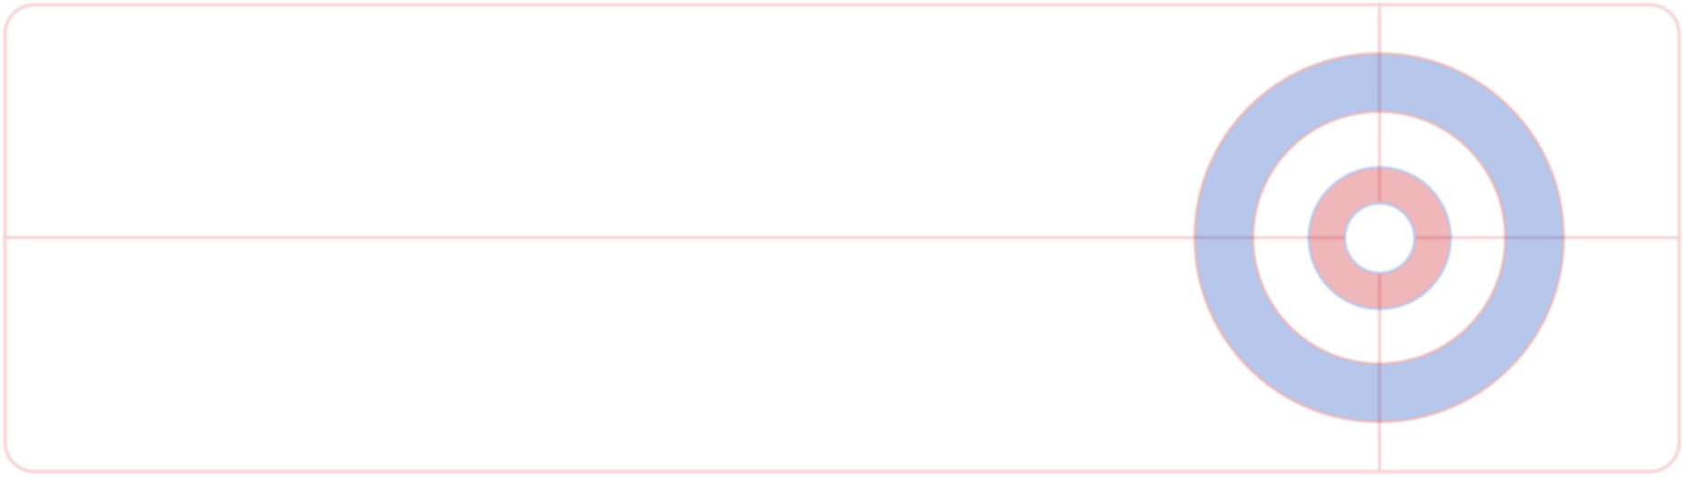




Slide 4
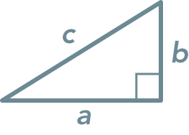
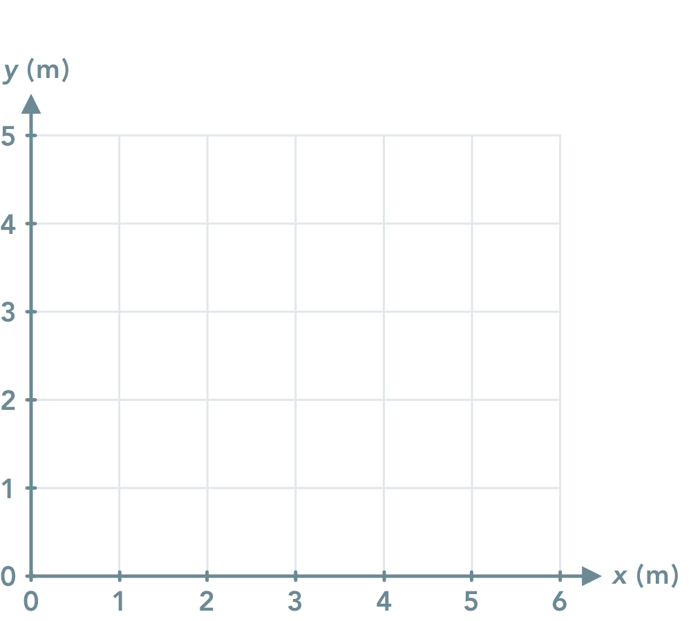


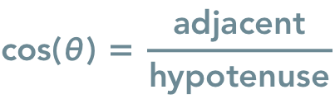
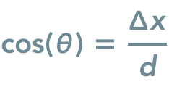


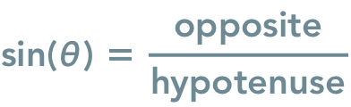
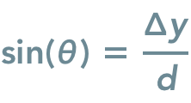


Slide 5
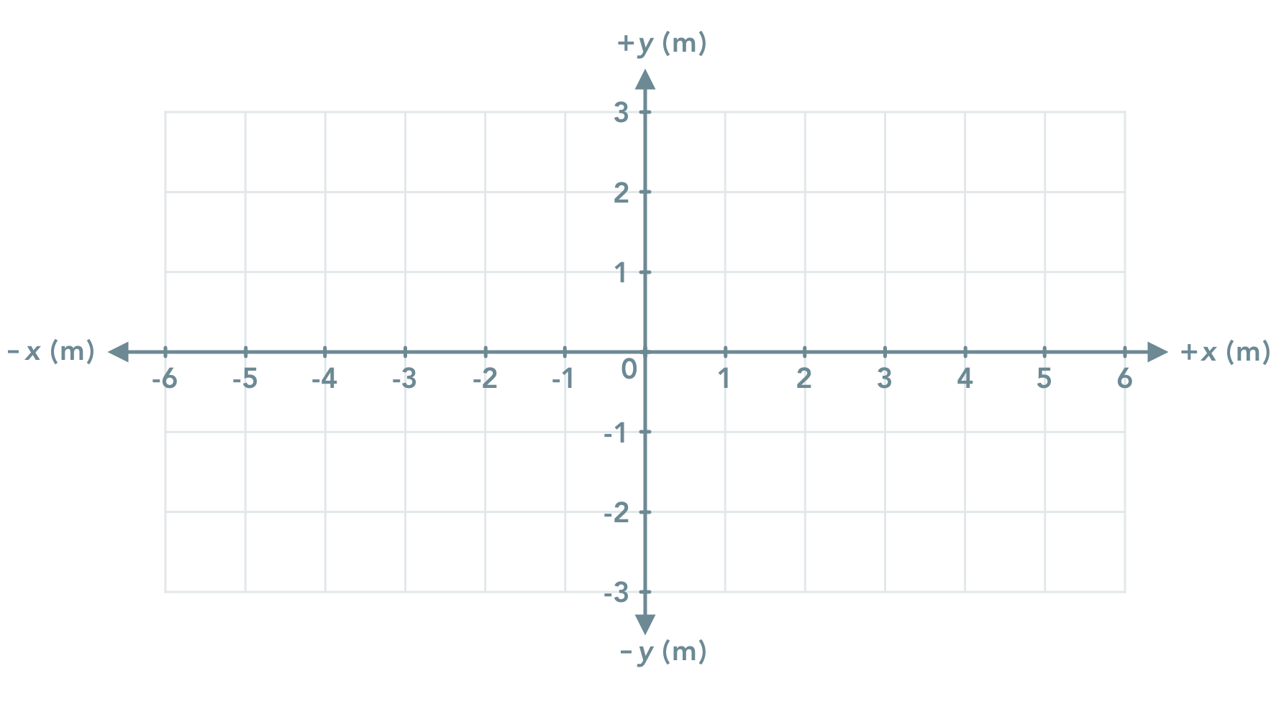

Slide 6
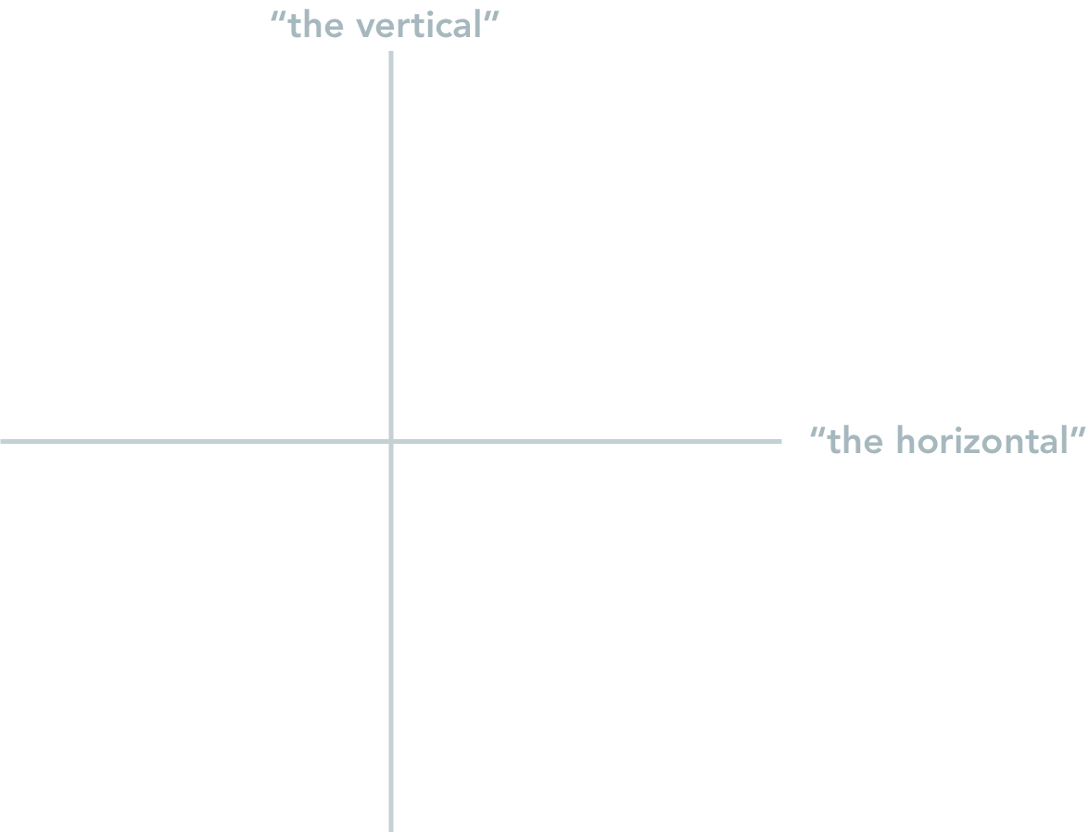
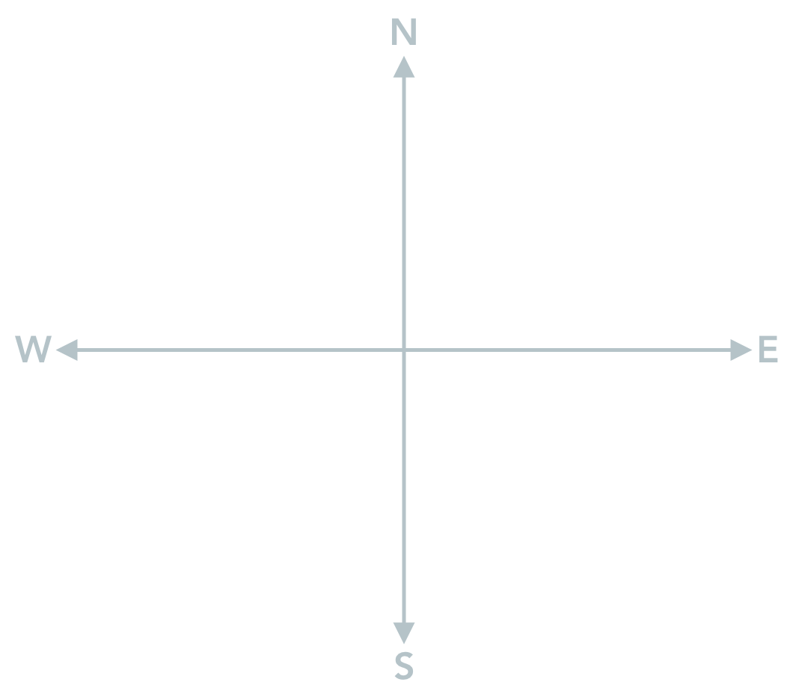
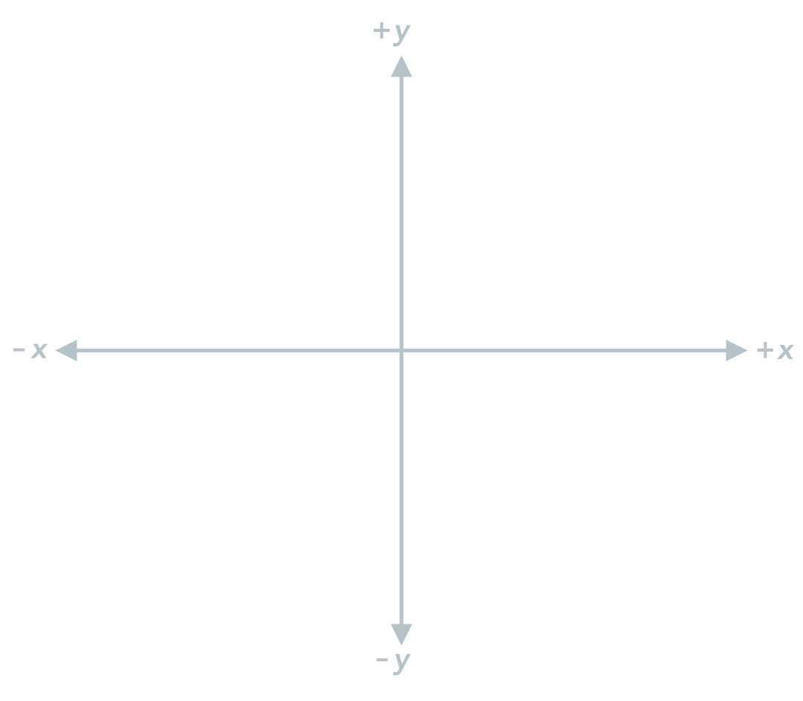
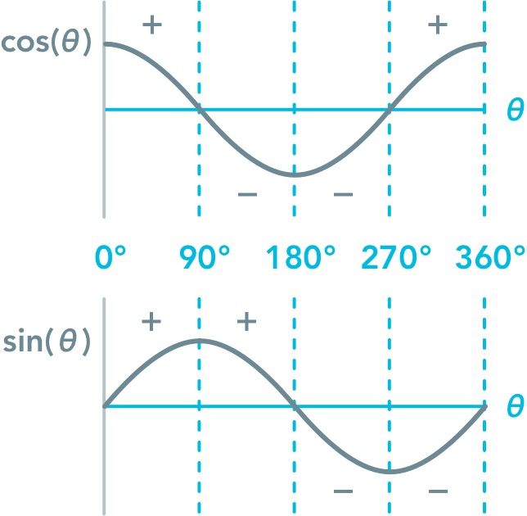

Slide 7
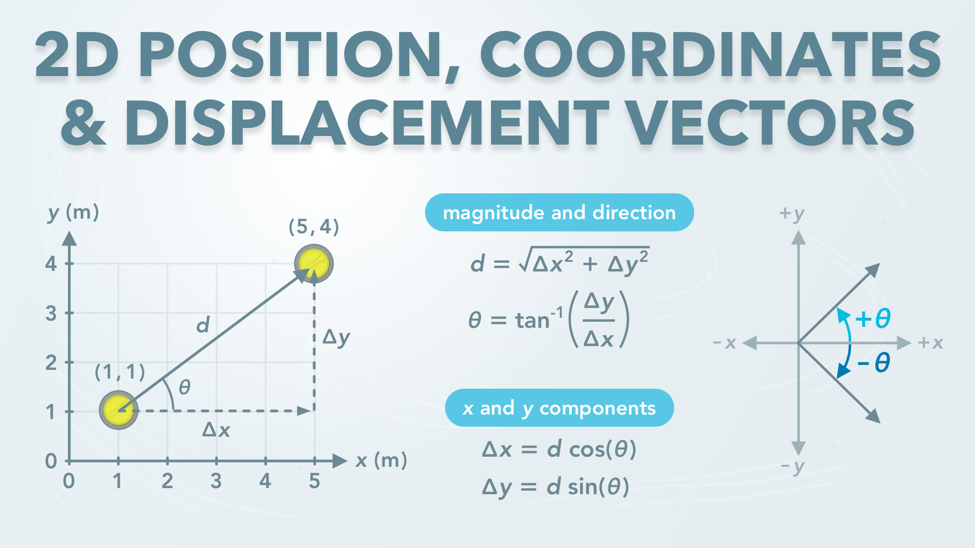
Notes:
2D Position, Coordinates & Displacement Vectors
physicslab.app
If you have any questions, suggestions or feedback about these slides please email me at chris@physicslab.app or send me a message on Discord @physicslab.

Slide 8
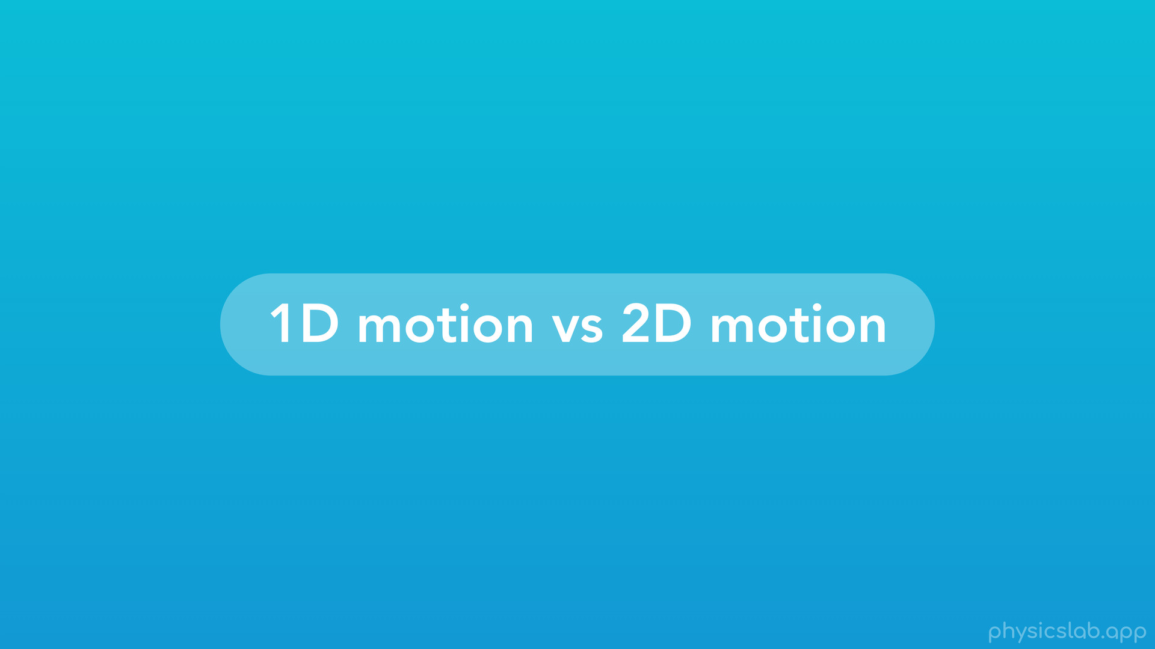
Notes:
• Hey everyone, in this video we’re going to introduce two dimensional motion.
• First, we’ll talk about the difference between 1 dimensional and 2 dimensional motion.
• Then we’ll learn how to use coordinates to describe position in two dimensions.
• Next, we’ll cover how to use vectors to describe displacement, and how to find the magnitude, angle, and components of a vector.
• After that, we’ll talk about negative vector components.
• Finally, we’ll explain the different ways to describe the angle of a vector and which method is best.
• So what’s the difference between 1 dimensional and 2 dimensional motion?

Slide 9
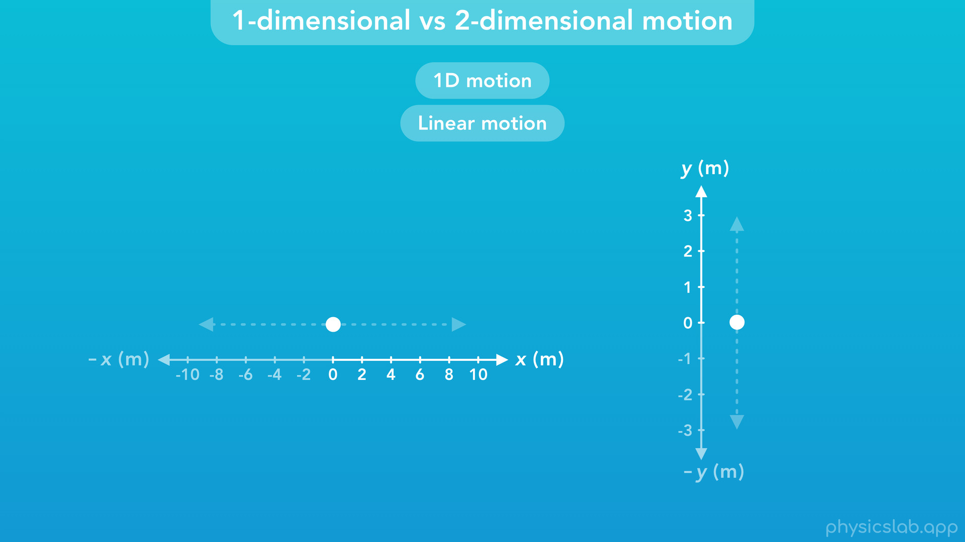
Notes:
• We already learned about 1-dimensional or 1D motion, also known as linear motion. If an object is in 1D motion, only the x position changes, or only the y position changes.

Slide 10
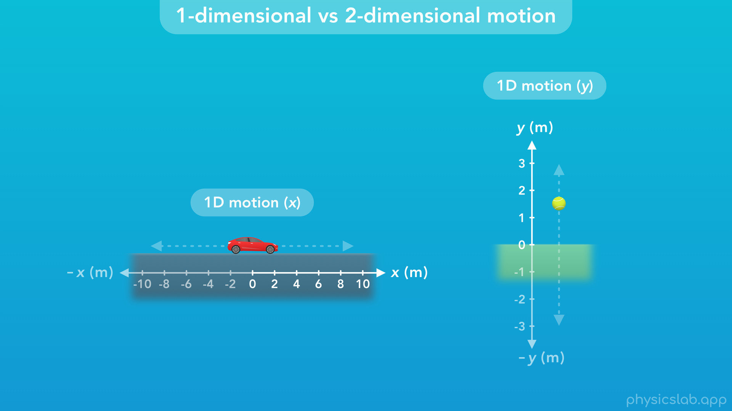
Notes:
• If this car only moves left and right, then its motion is 1 dimensional in the x direction. If this ball only moves up and down, then its motion is 1 dimensional in the y direction.

Slide 11
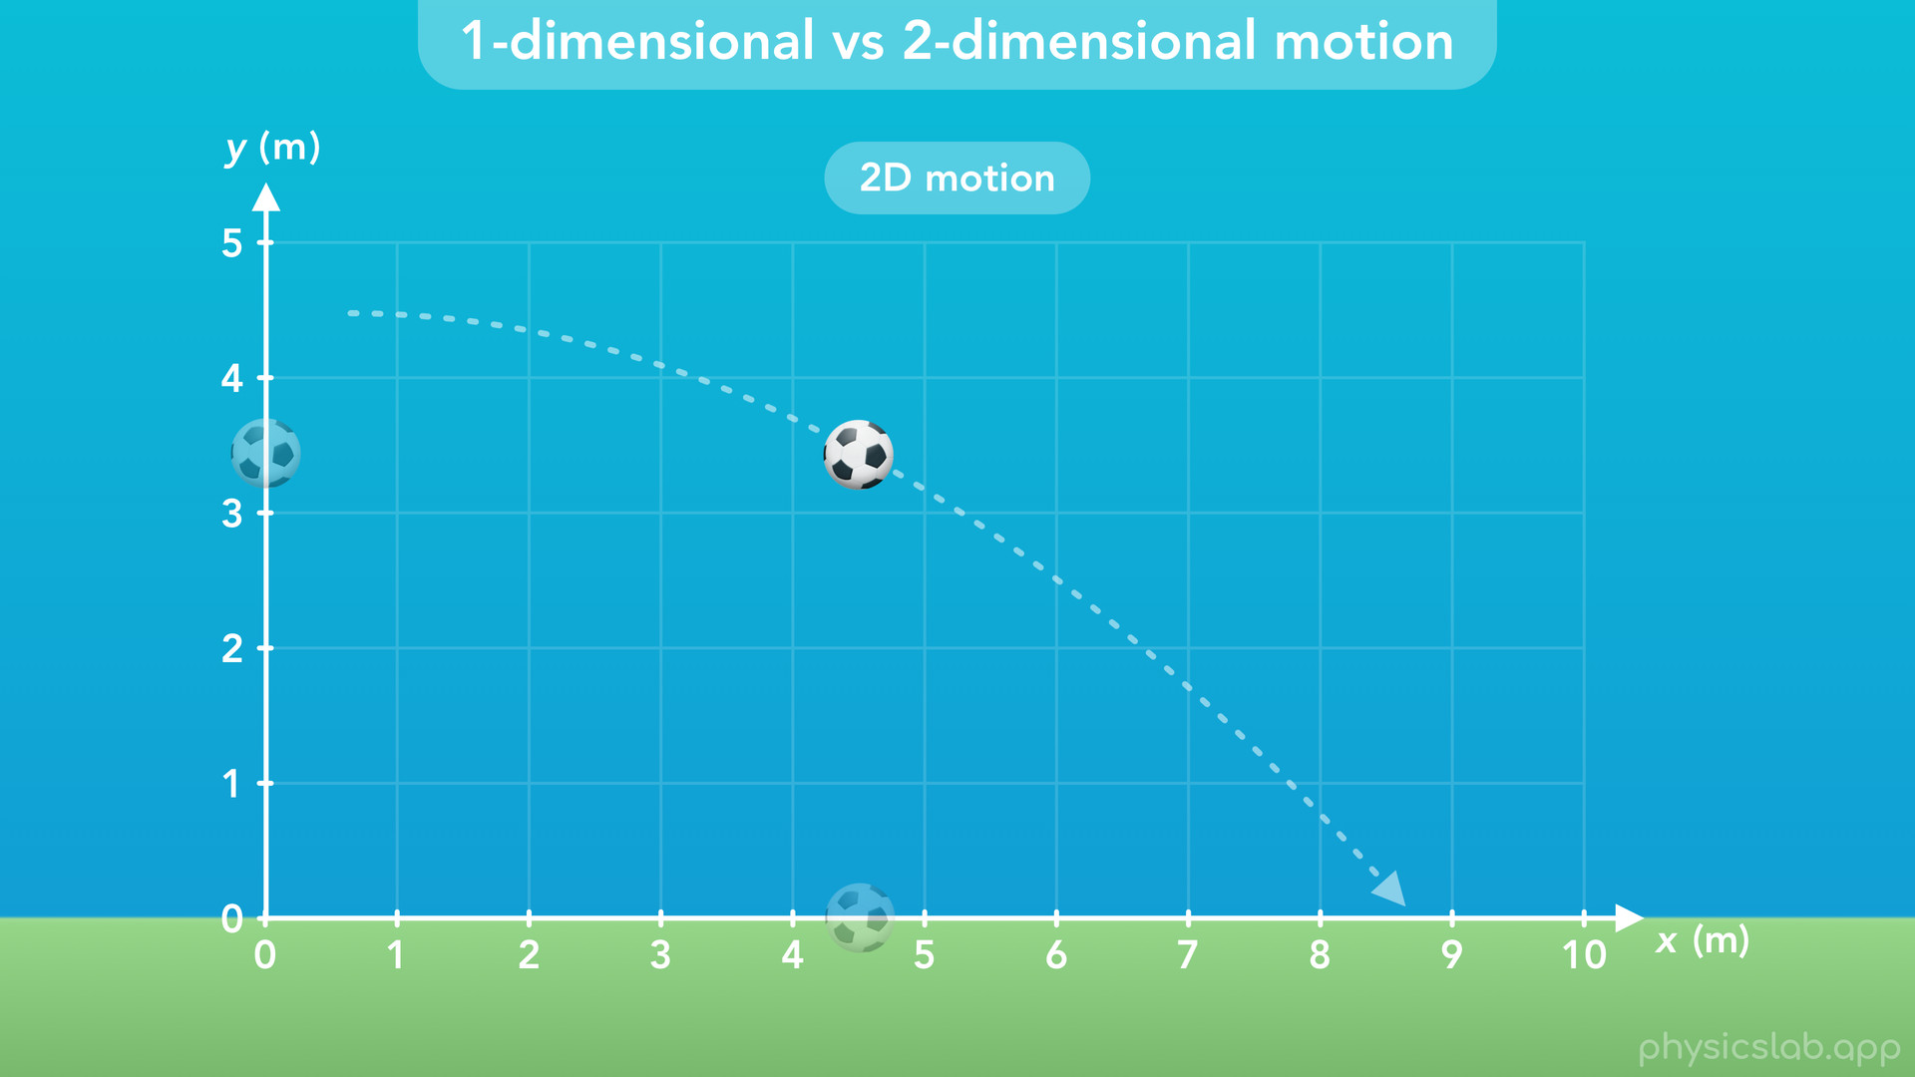
Notes:
• But if an object is in 2-dimensional motion, or 2D motion, then its position on the x axis and the y axis are changing at the same time. But 2D motion doesn’t have to be a combination of horizonal and vertical motion.

Slide 12
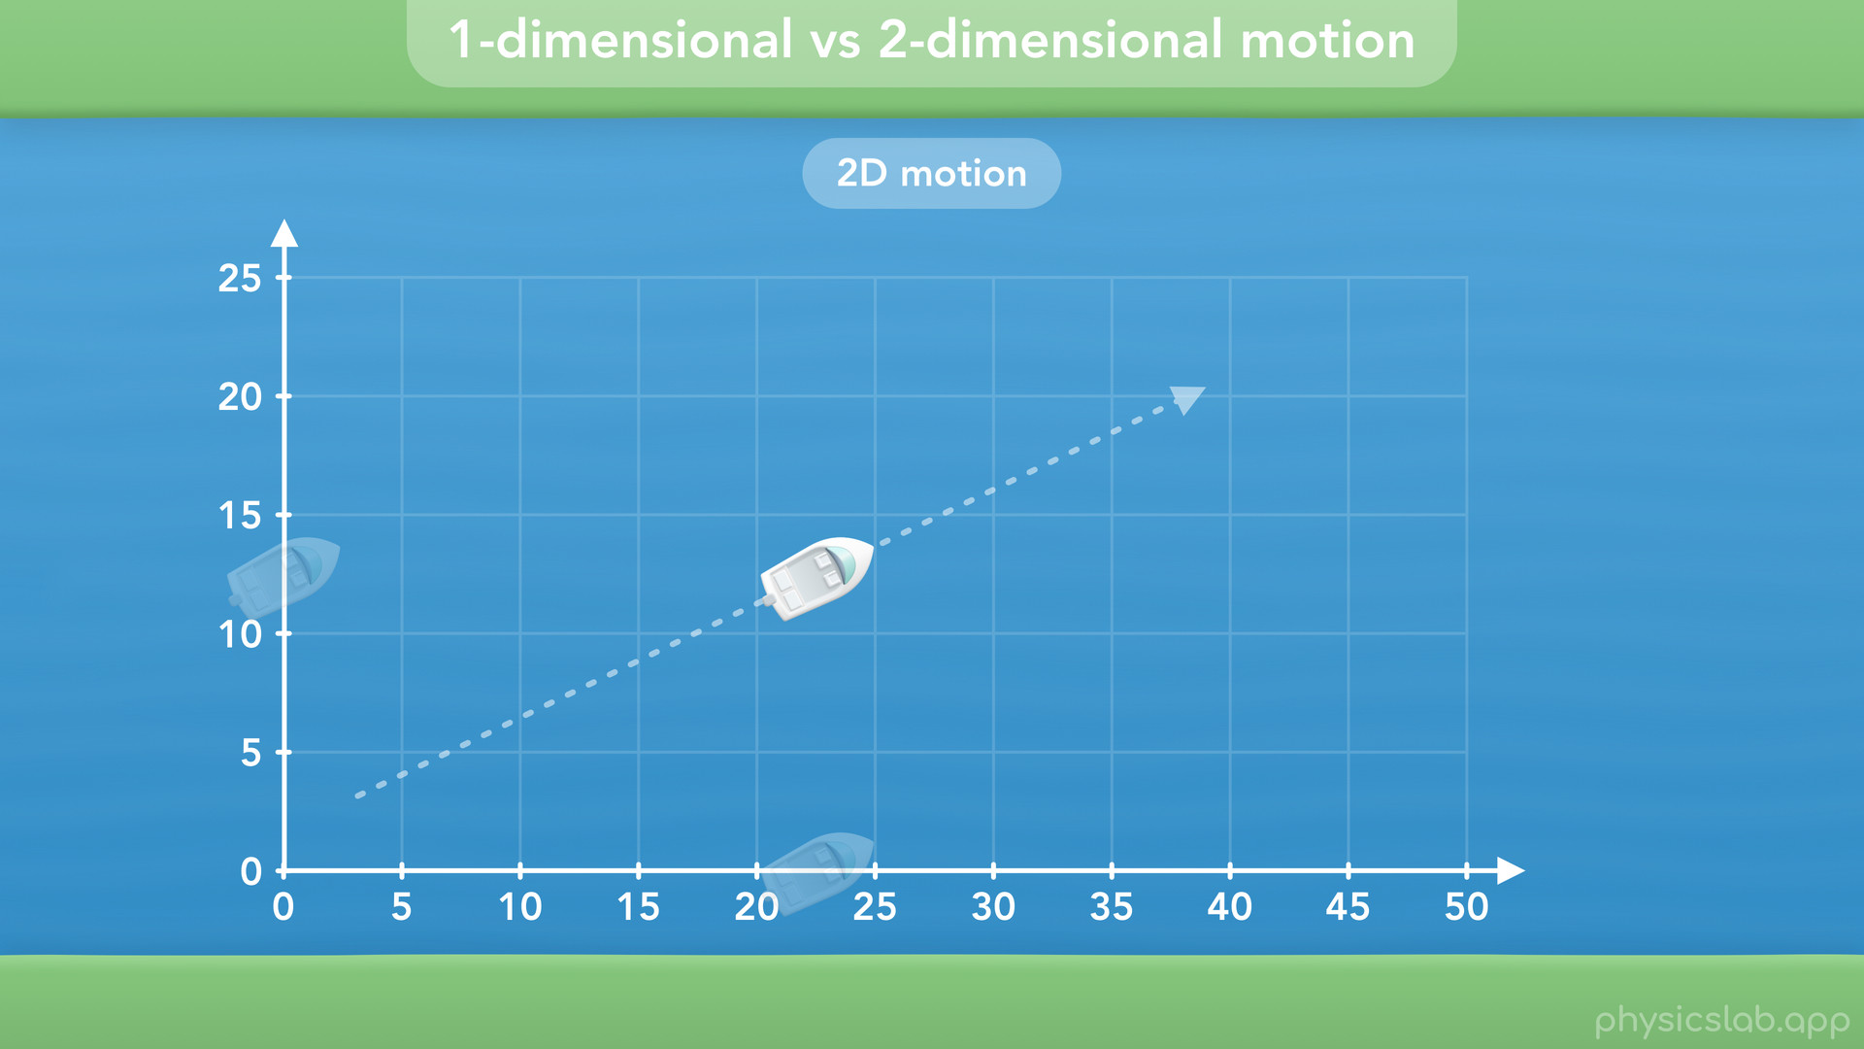
Notes:
• This boat crossing a river is an example of 2D motion on a horizontal plane. It’s two dimensional motion because it’s position is changing along two different axes.

Slide 13
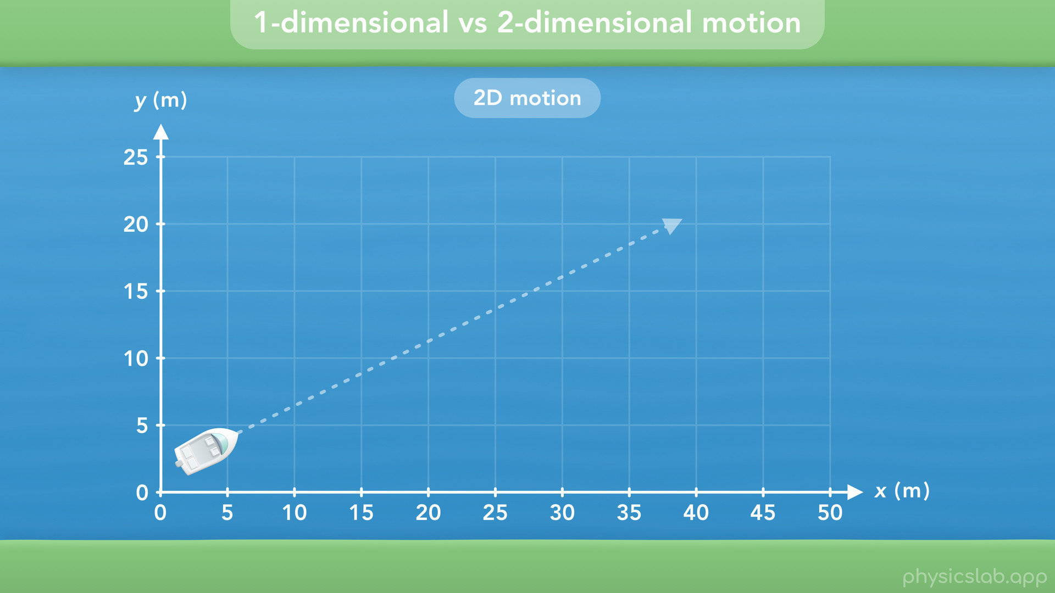
Notes:
Even though both axes, both directions, are horizontal relative to the ground, we can still use the x axis for the left and right direction, and the y axis for the up and down direction from this point of view. If using the y axis is confusing, we could use the z axis instead.

Slide 14
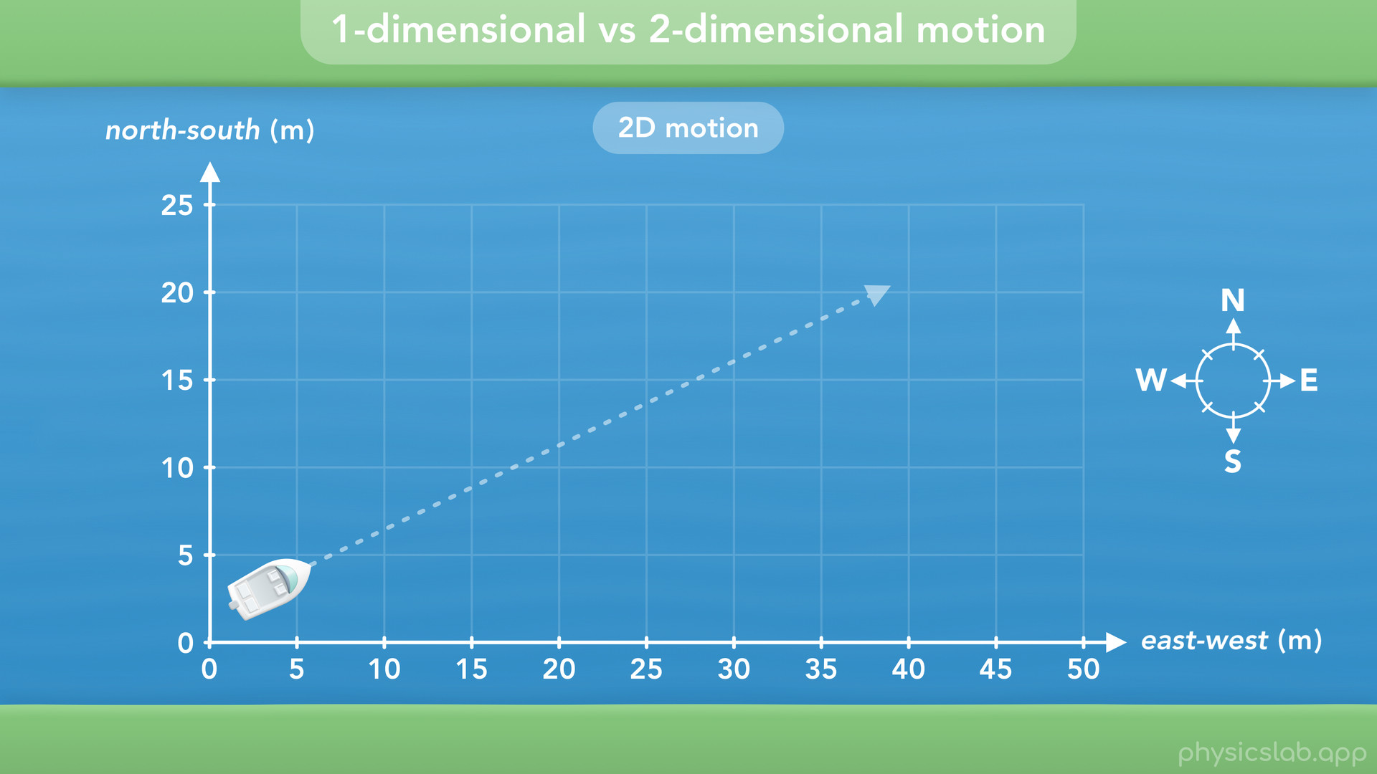
Notes:
Or if we used a compass, this could be the east/west axis, and this would be north/south axis. The point is, if we establish two axes like we see here, then this boat’s position is changing along both axes at the same time. From this point of view, it’s moving to the right, and it’s moving up. In most 2D motion examples, we’re going to label the axes as x and y regardless of the point of view.

Slide 15
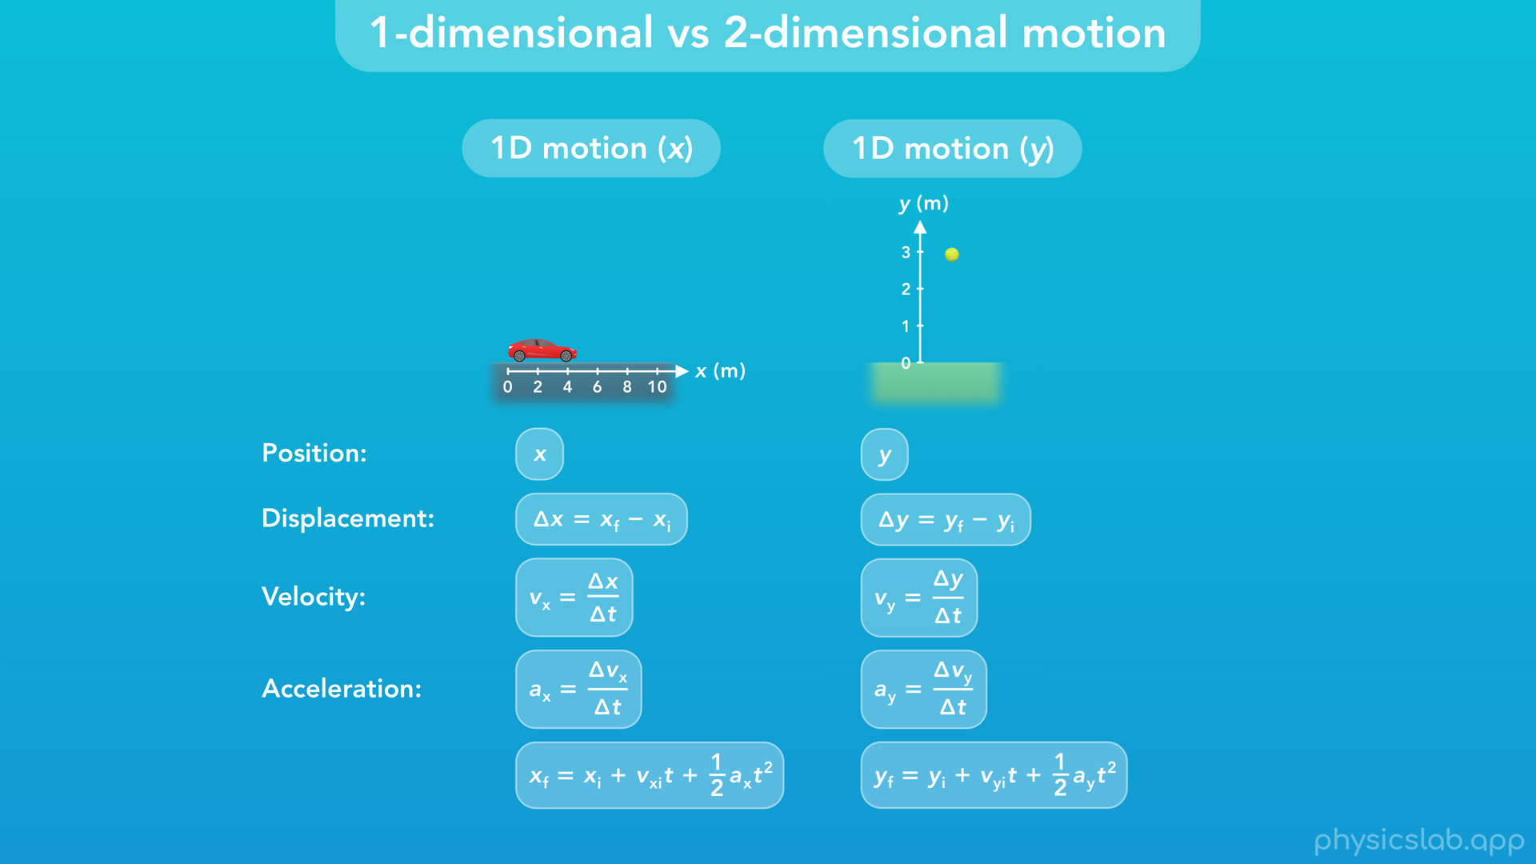
Notes:
• For one dimensional motion, we use x for horizontal motion and y for vertical motion, although the equations are the same.

Slide 16
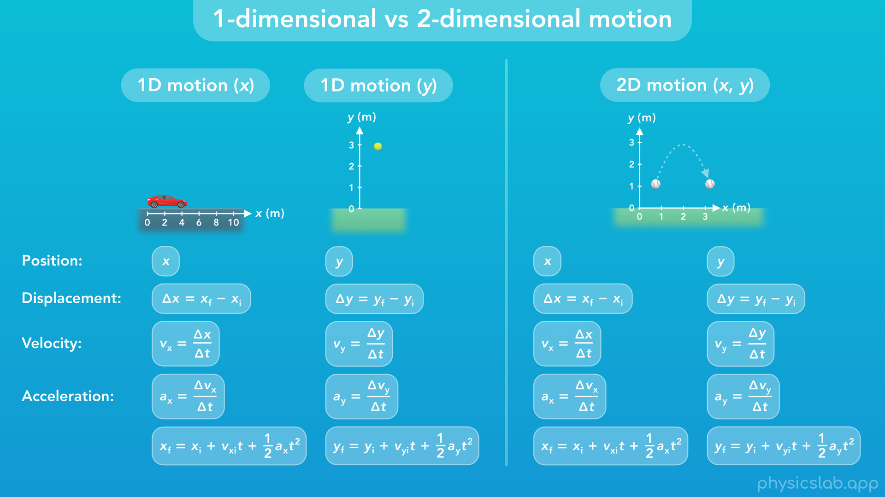
Notes:
• But if an object is in 2-dimensional motion, then it has motion in the x direction and the y direction at the same time. So we need both variables and both sets of equations to describe the motion of the object.
• So that’s a quick introduction. Now let’s learn about two dimensional motion.

Slide 17
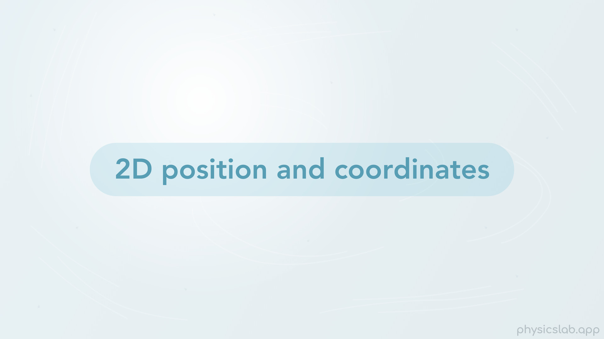
Notes:
• First up is two-dimensional position and coordinates.

Slide 18
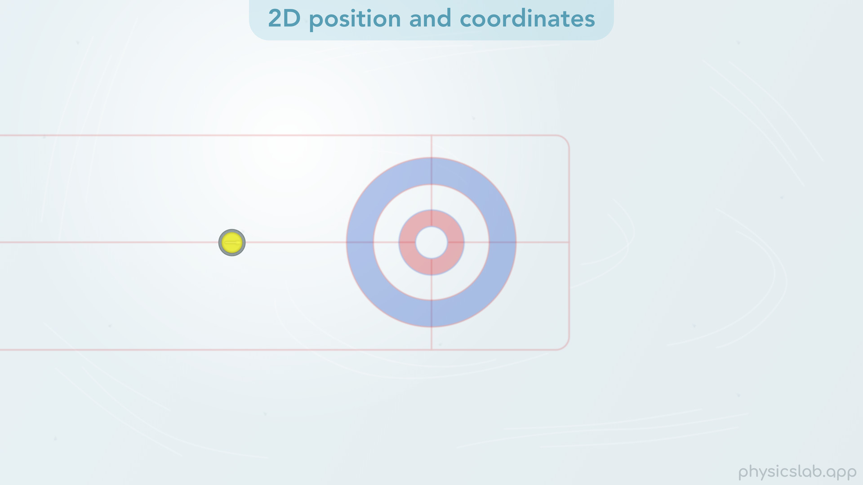
Notes:
• For this video, we’re gonna use a birds-eye-view of a curling stone sliding on ice.

Slide 19
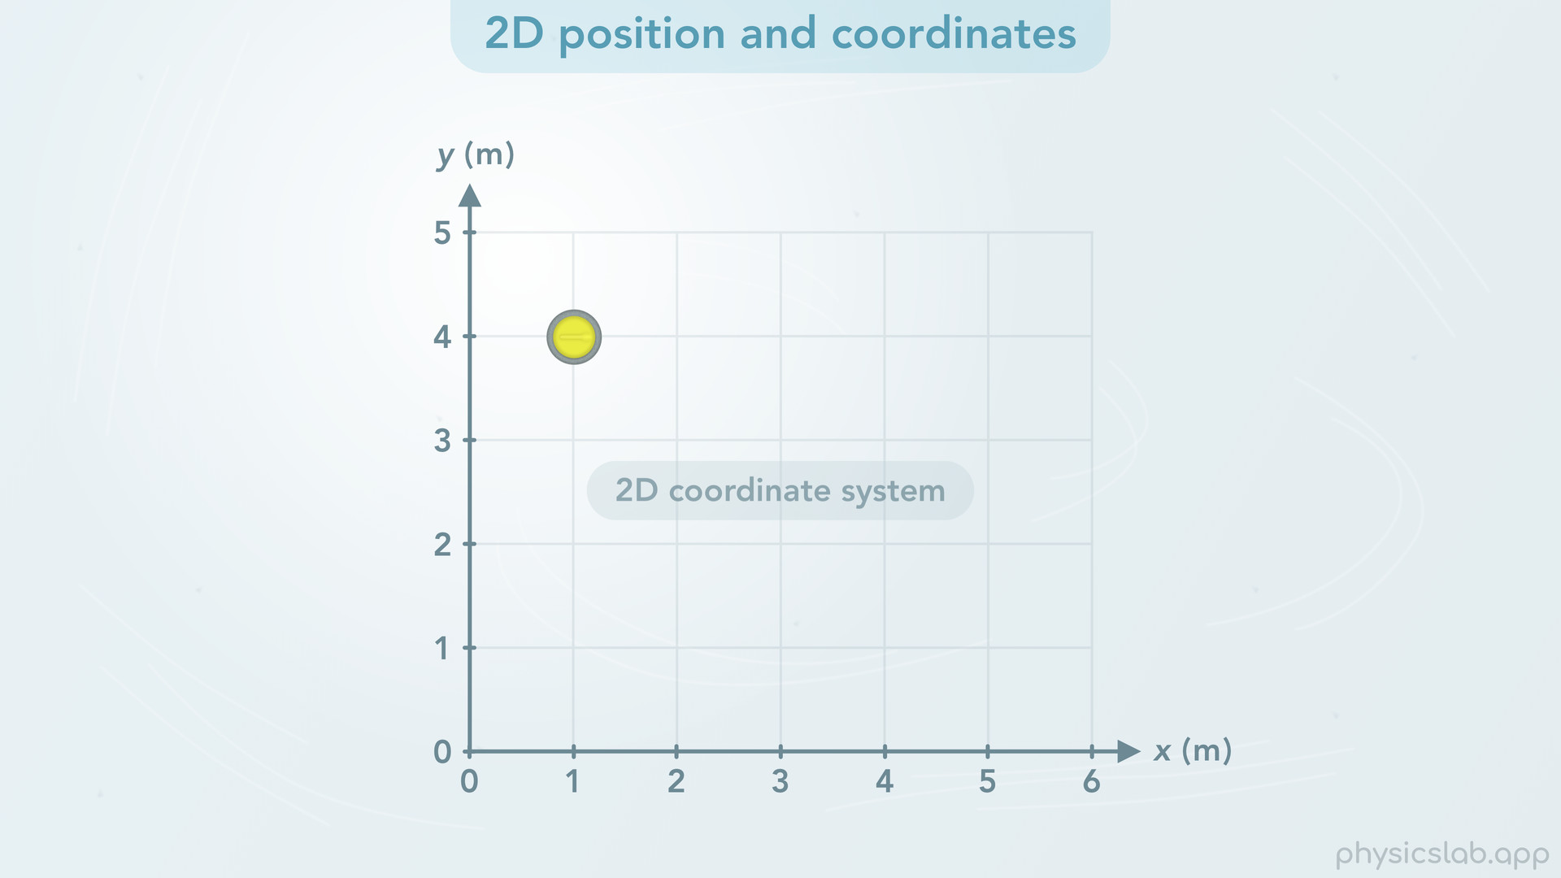
Notes:
• This is an example of 2D motion on a horizontal plane. We’re gonna use the x and y axes, but keep in mind that we’re looking at the motion from above, so both axes are horizontal along on the ground. Together, the x and y axes form a 2D coordinate system, which we can use to describe the position of an object at any point in 2D space.
• So how do we do that?

Slide 20
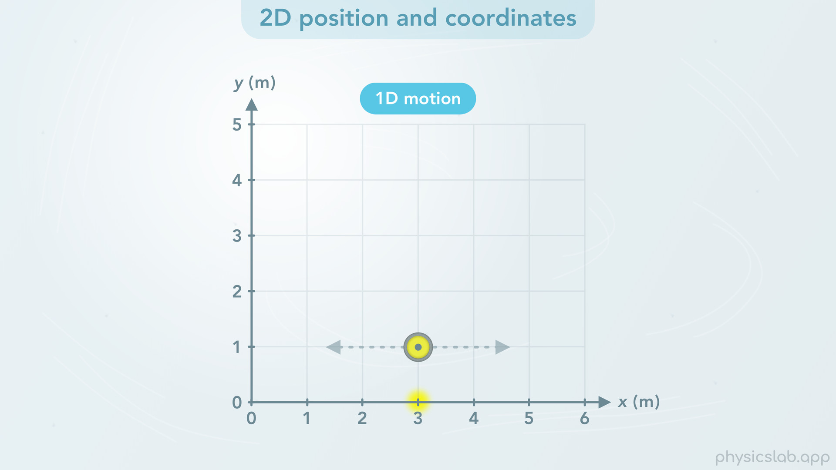
Notes:
• First, when we talk about the position of an object, keep in mind that we’re talking about the center of the object.
• If this curling stone only moves left and right, we can describe its position using a single number on the x axis.

Slide 21
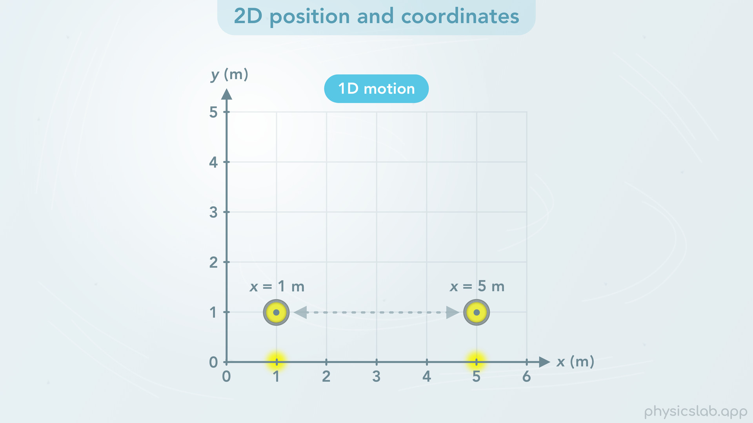
Notes:
At this position, x = 1 m, and at this position, x = 5 m.

Slide 22
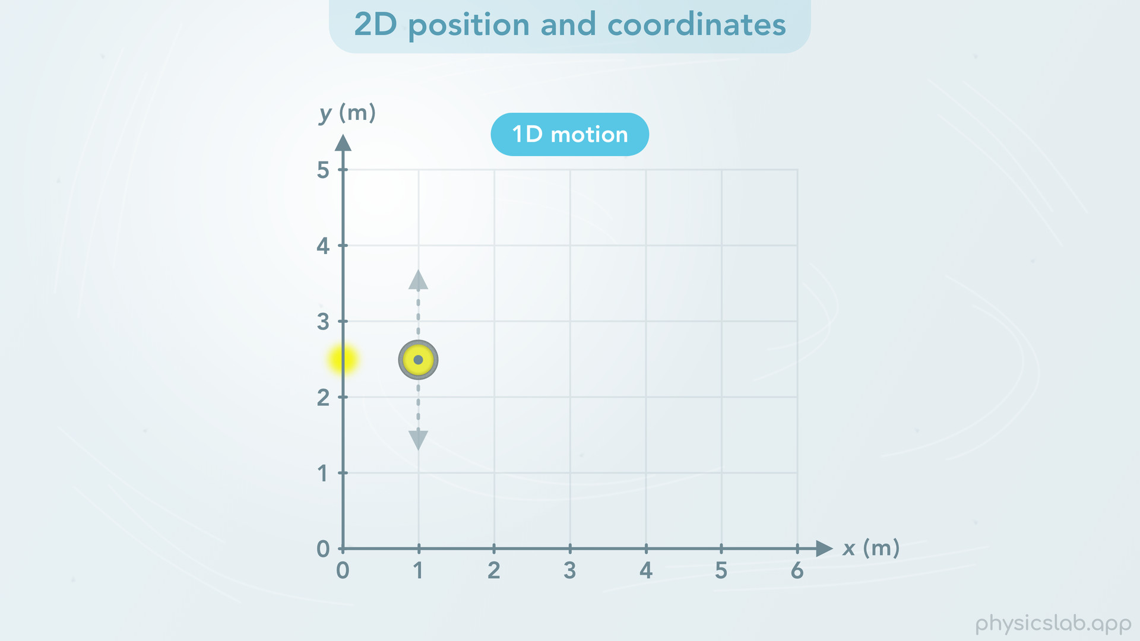
Notes:
• If the stone only moves up and down, we can do the same thing using a single number on the y axis.

Slide 23
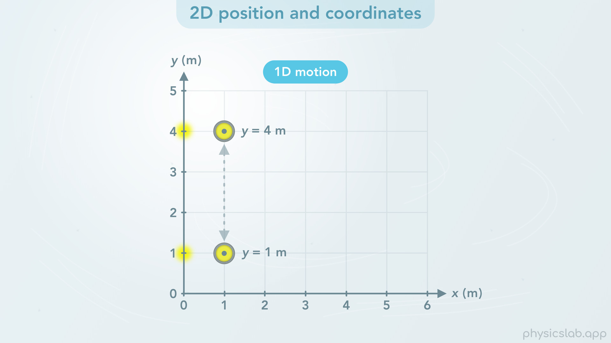
Notes:
At this position y = 1 m, and at this position, y = 4 m.

Slide 24
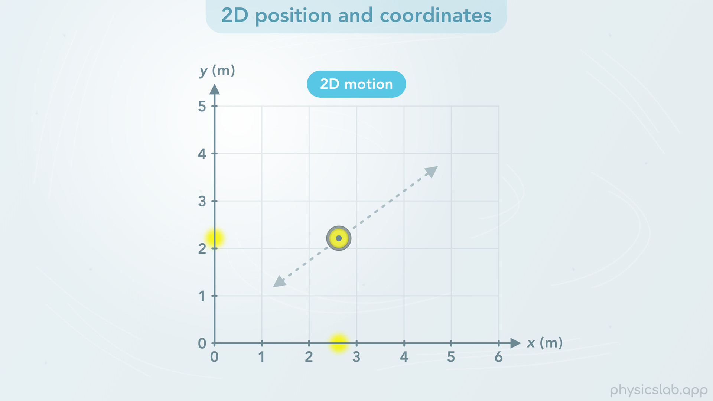
Notes:
• But when the stone moves in 2 dimensions, we need to include the x position and the y position.

Slide 25
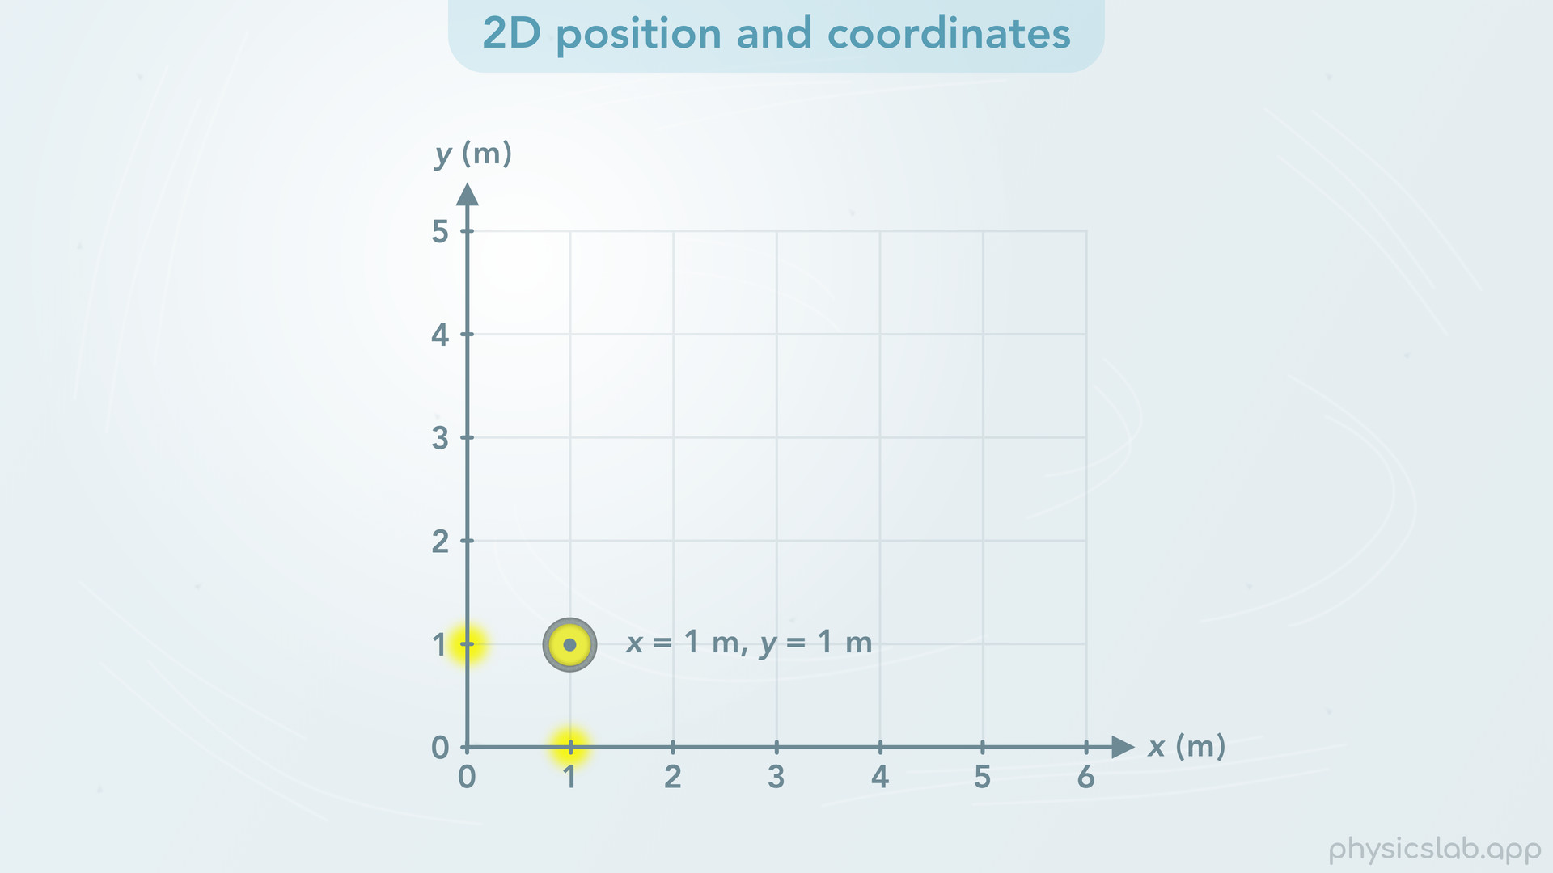
Notes:
When the stone is here, x = 1 m and y = 1 m.

Slide 26
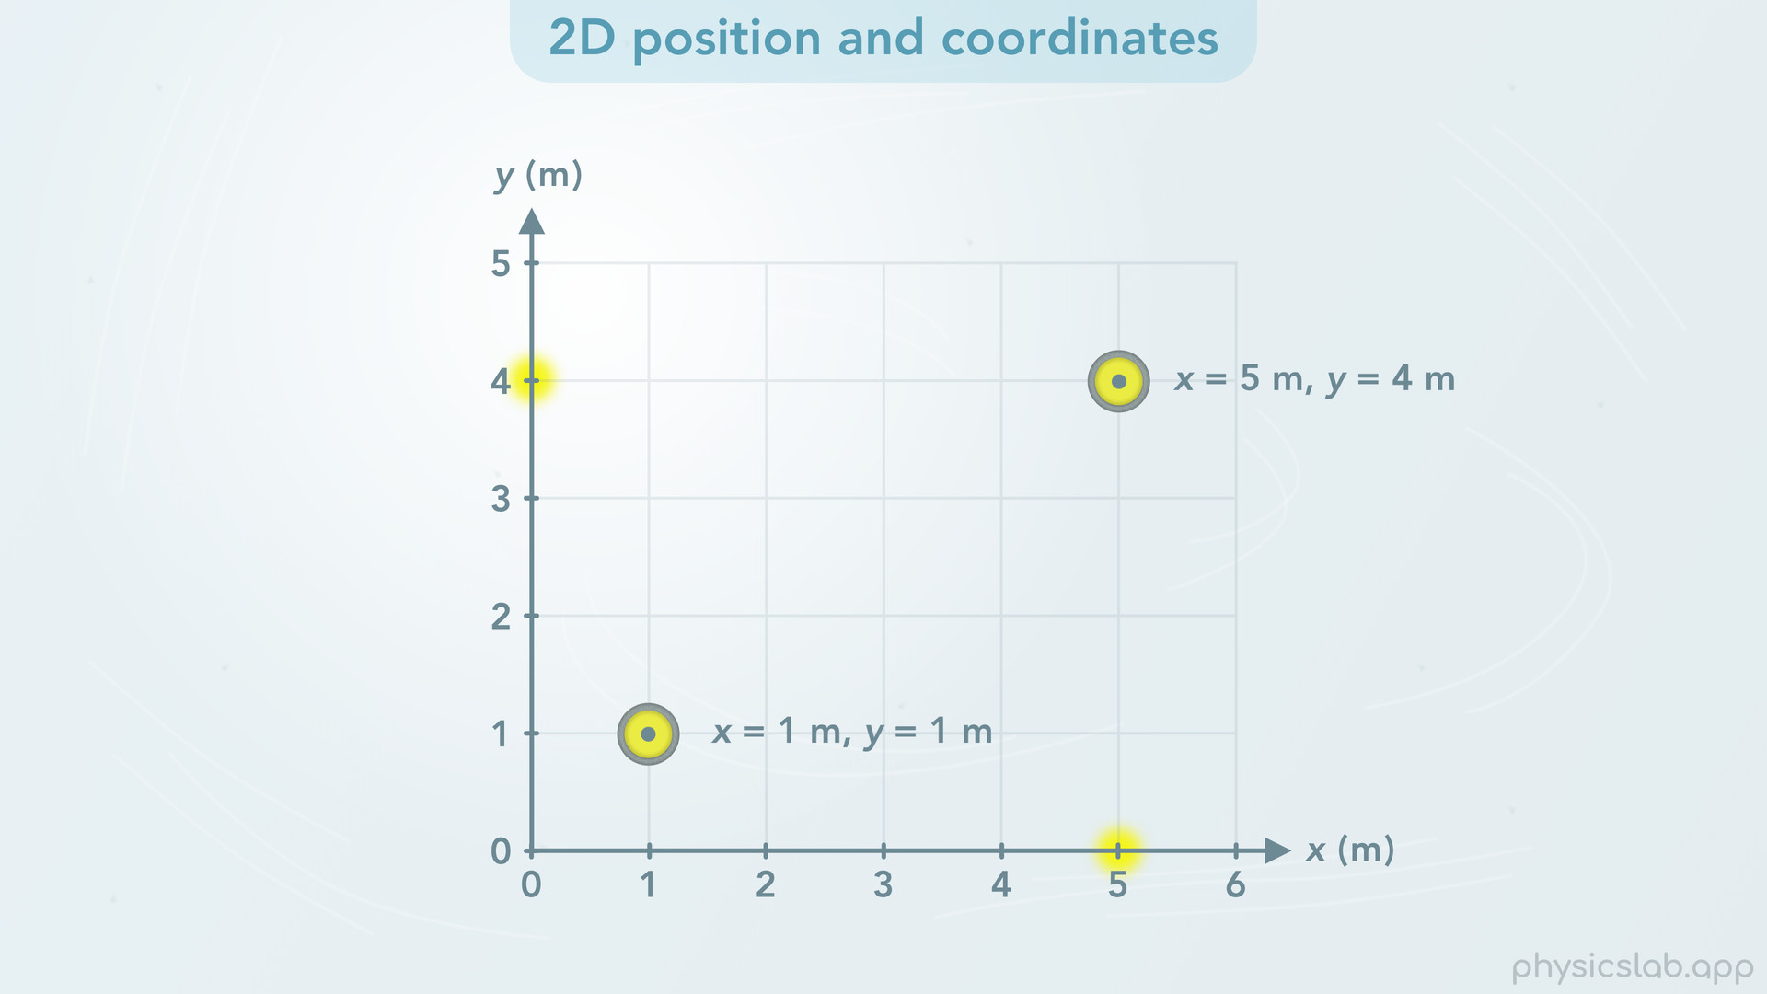
Notes:
And at this position, x = 5 m, and y = 4 m.

Slide 27
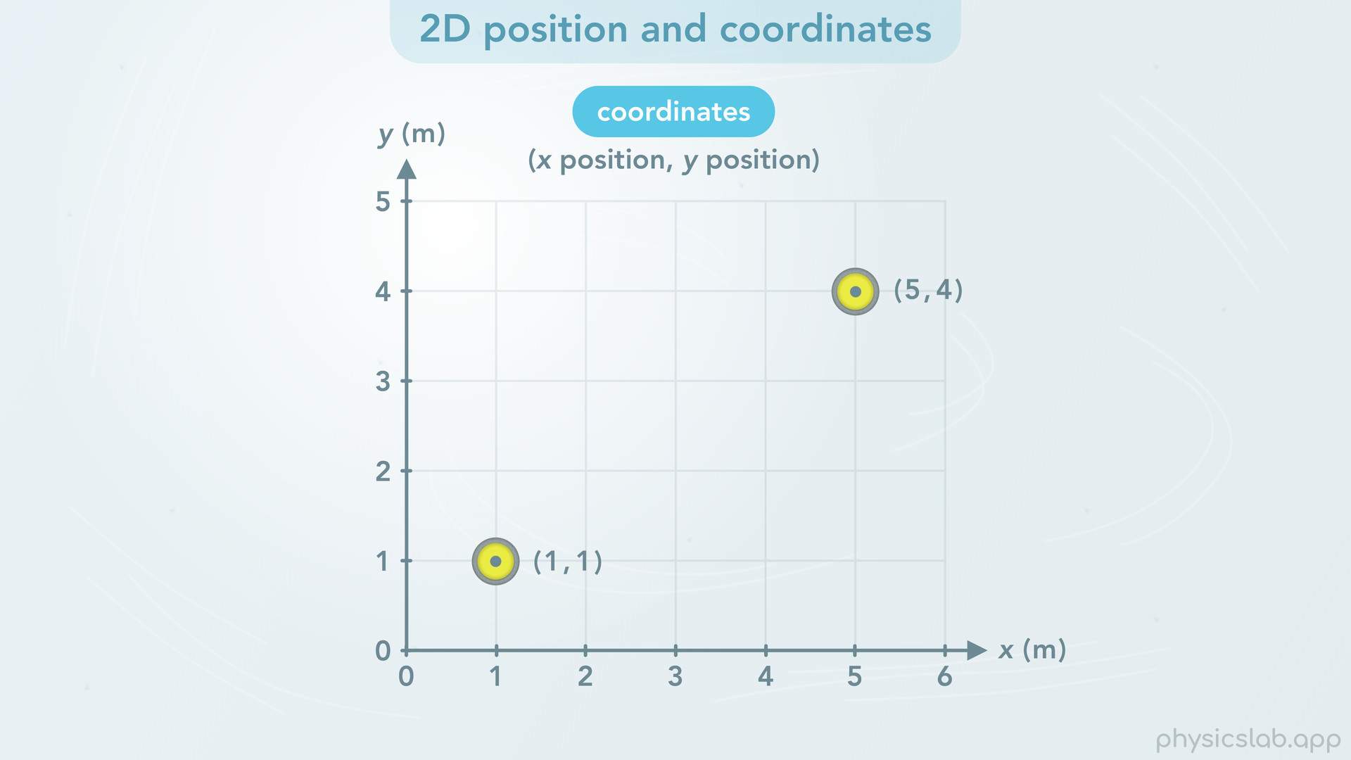
Notes:
• Instead of writing out x = and y =, we can use coordinates. Coordinates are a set of numbers in parentheses separated by a comma. For a 2D coordinate system, the first number is the x position, and the second number is the y position.

Slide 28
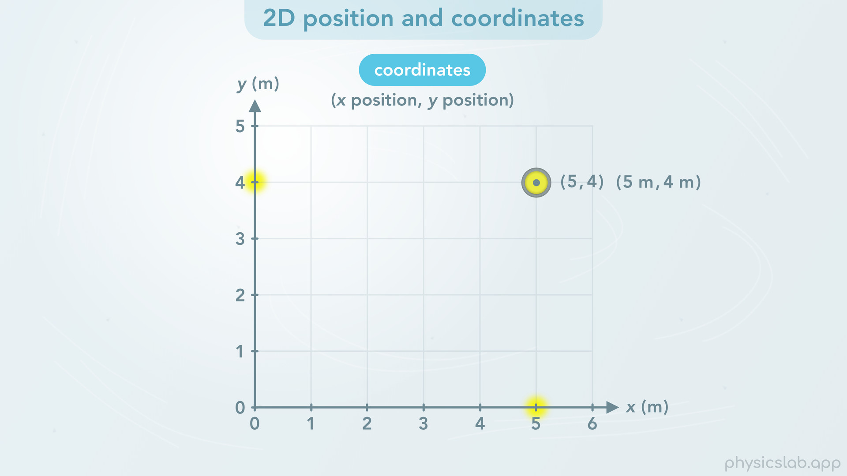
Notes:
So when the stone is here, its coordinates would be “5 4”.
Most of the time the coordinates won’t include the unit. Just know that the unit for a set of coordinates would be the same as the unit for position.

Slide 29
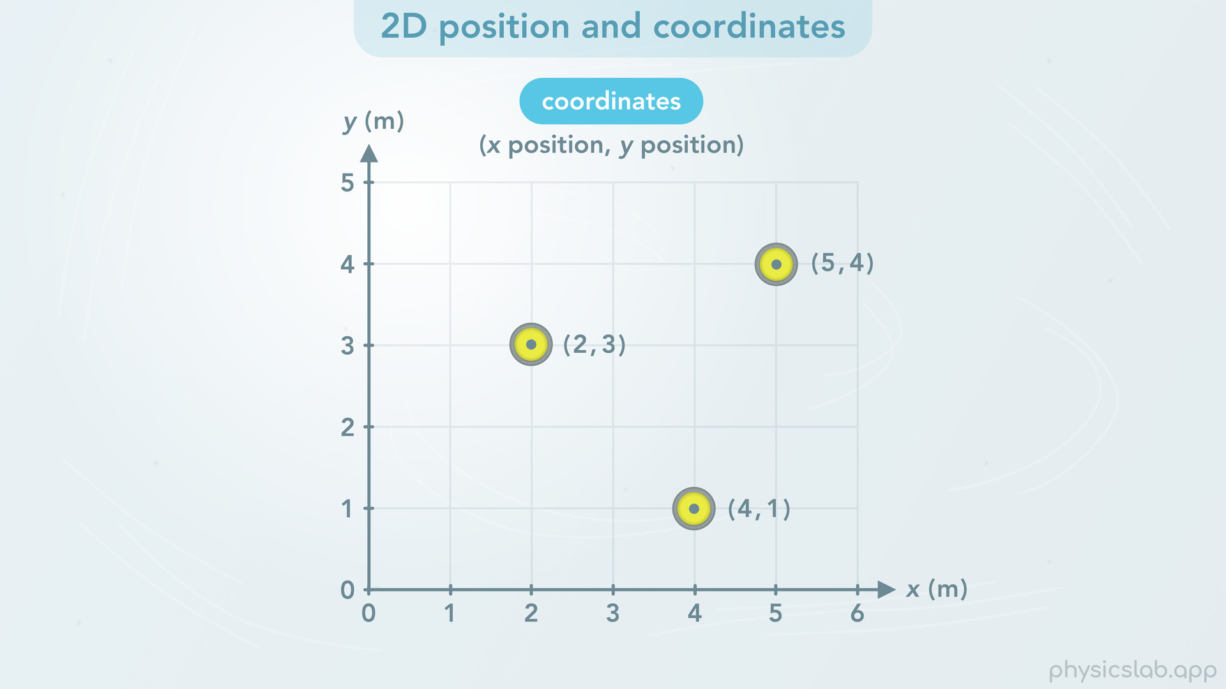
Notes:
• Let’s see a few more examples. The coordinates for this position would be (2,3). And here, they would be (4,1).

Slide 30
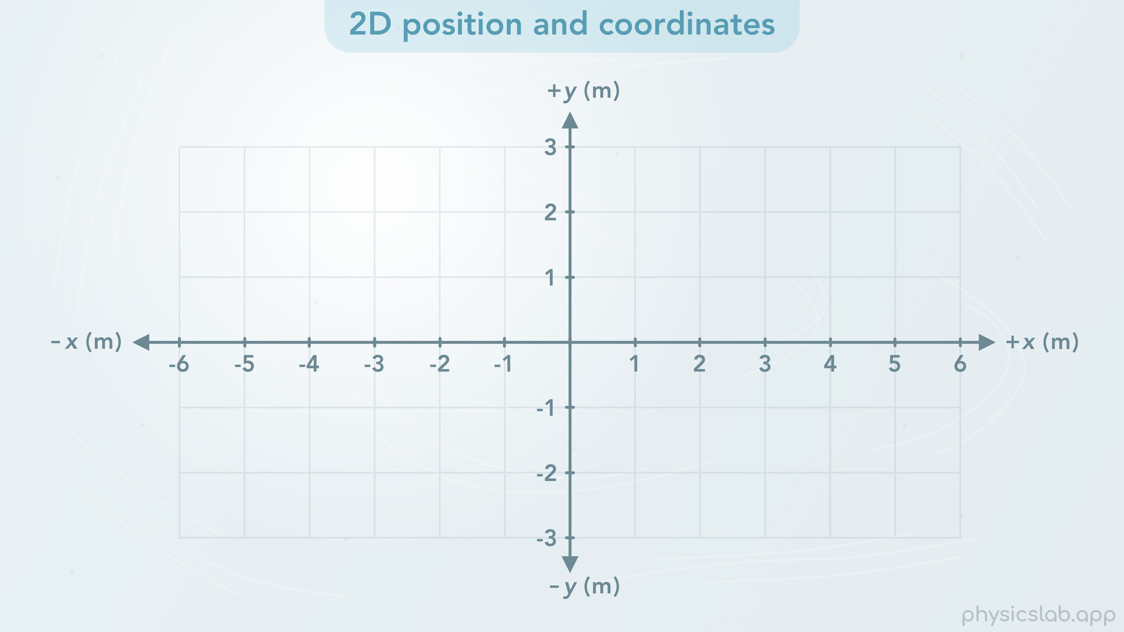
Notes:
• We’ve been looking at the positive x and y axes, but coordinates can also have negative values. Once we establish the origin, which is where x and y equal zero, then an object can have positive or negative positions.

Slide 31
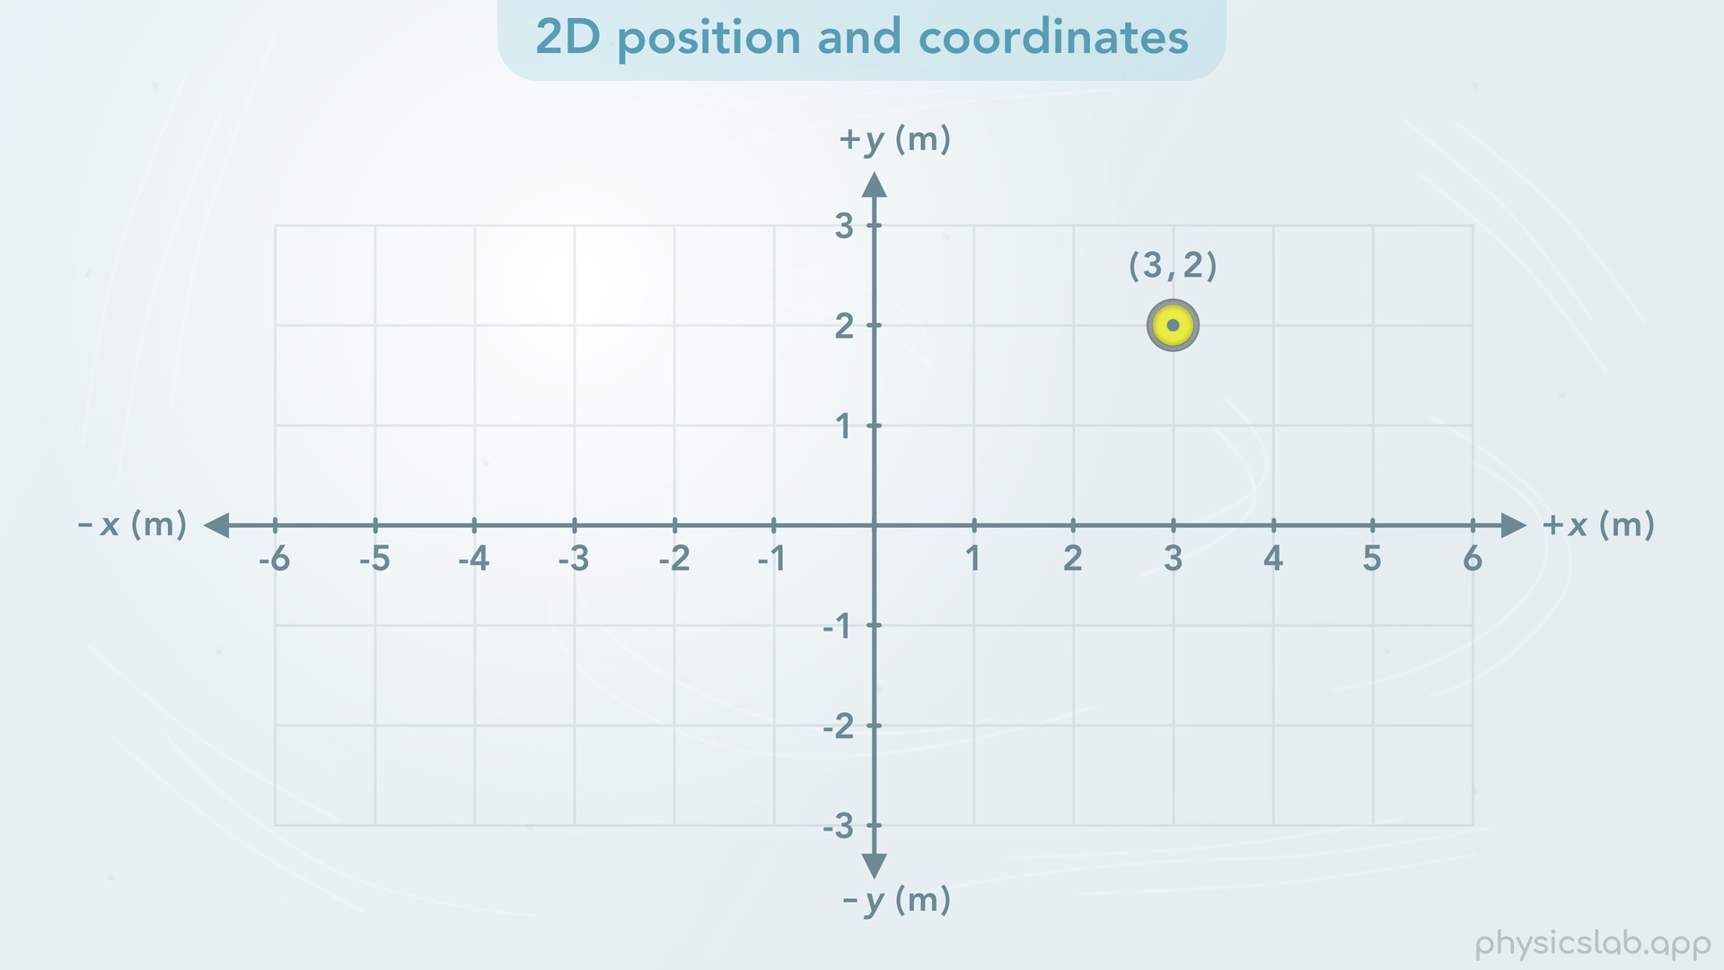
Notes:
Here, the coordinates would be (3, 2).

Slide 32
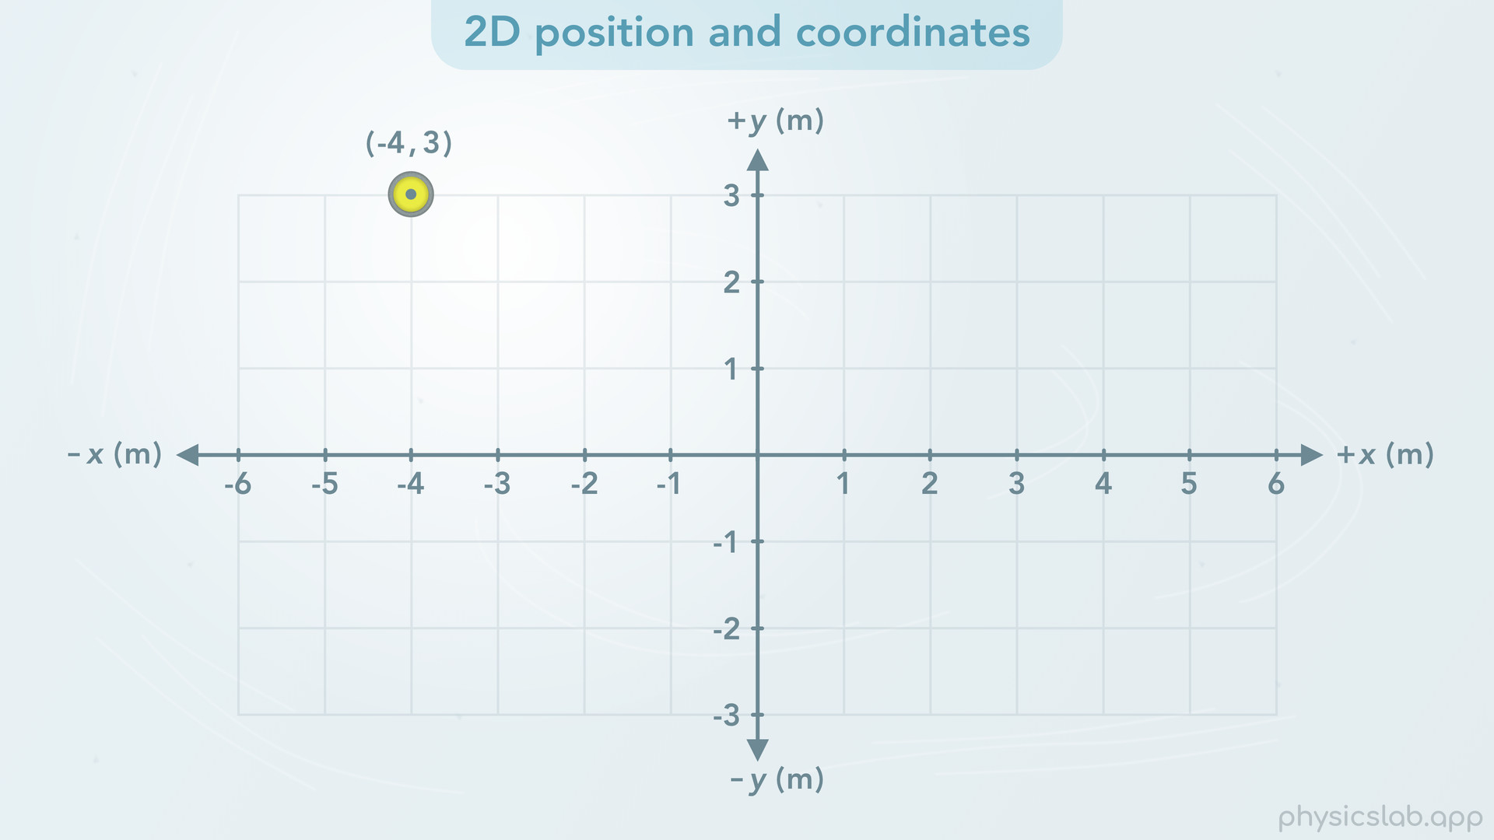
Notes:
And here, they would be (-4, 3) because the x position is negative 4 and the y position is positive 3.

Slide 33
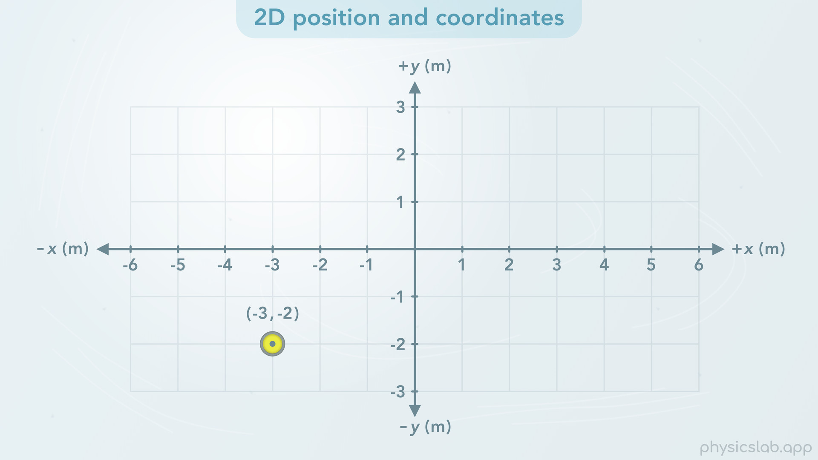
Notes:
Here, they would be (-3, -2).

Slide 34
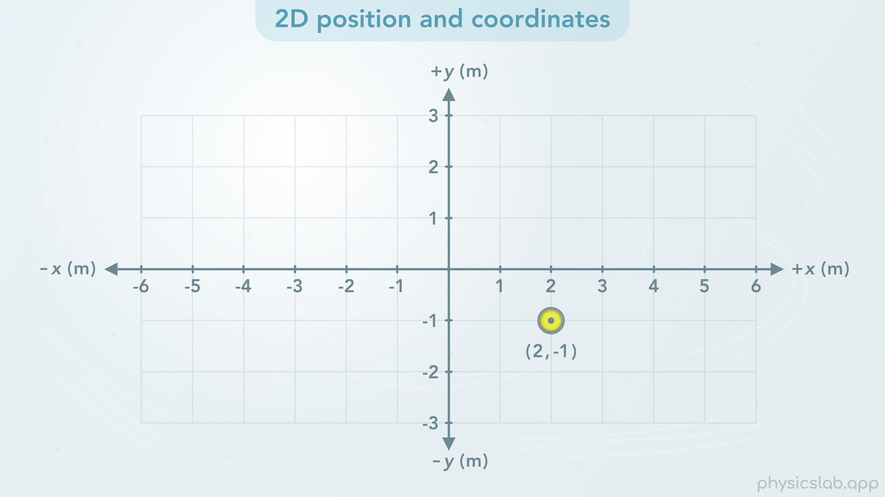
Notes:
And here, they would be (2, -1).
So that’s how we describe the position of an object in two dimensions. It has an x position and a y position at every moment in time.

Slide 35
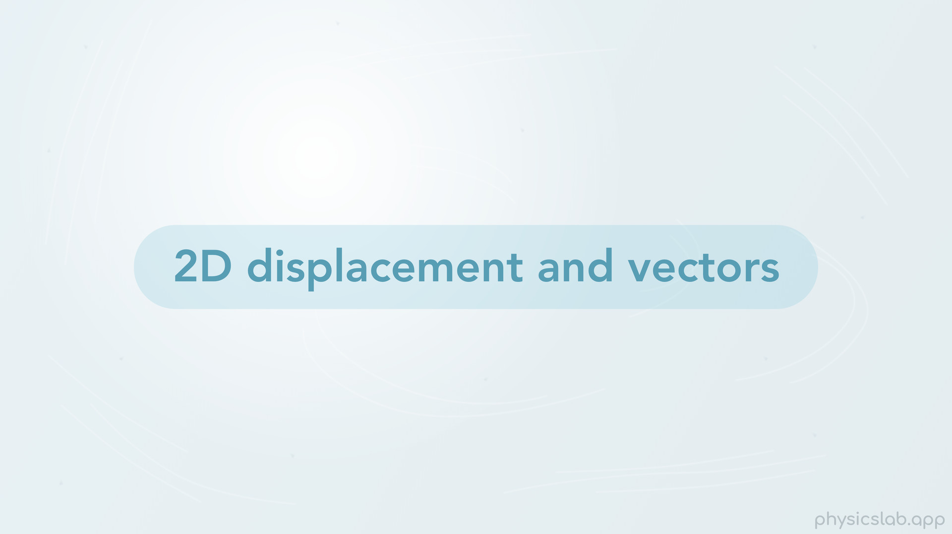
Notes:
• Now let’s talk about two dimensional displacement and vectors.

Slide 36
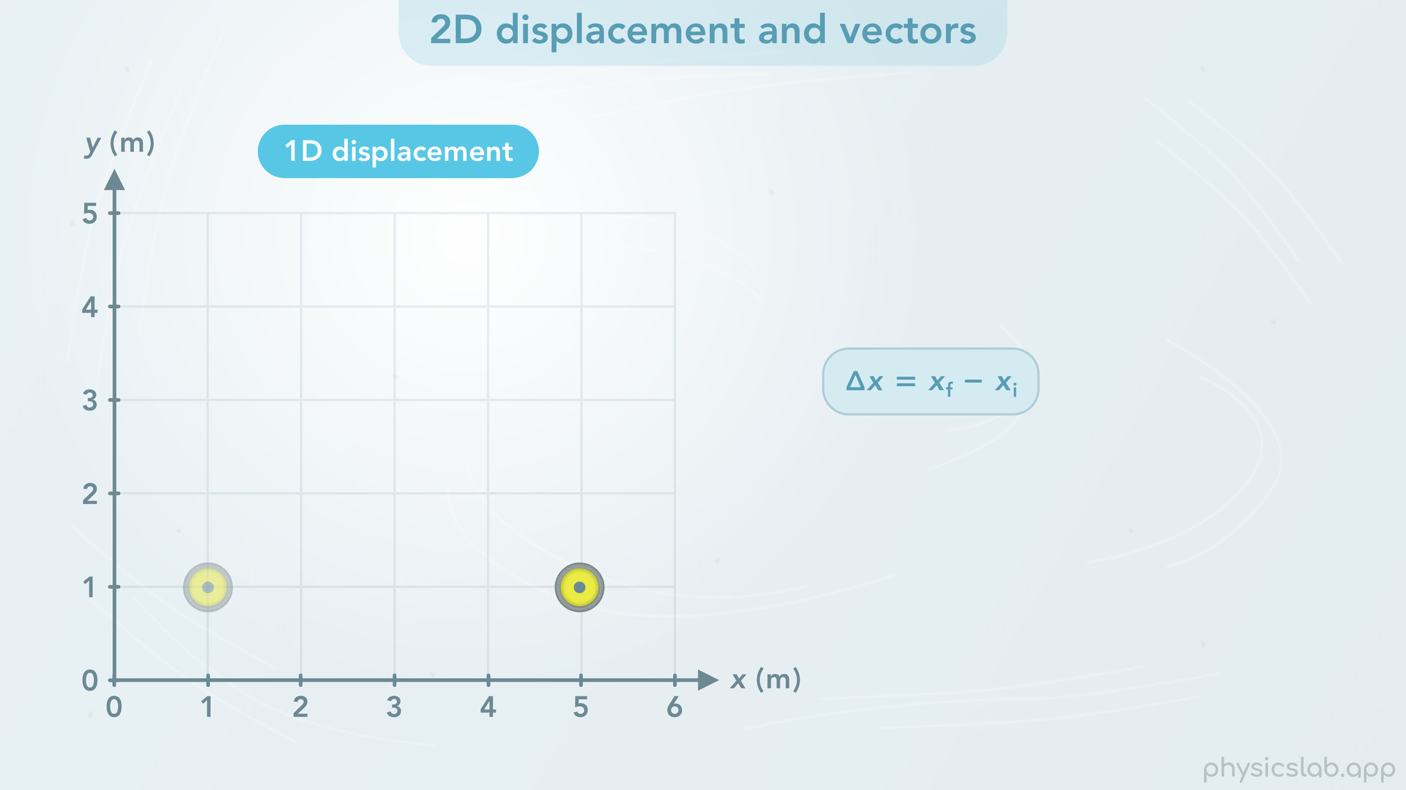
Notes:
• We already know that the displacement in one dimension is the change in position, or the final position minus the initial position.

Slide 37
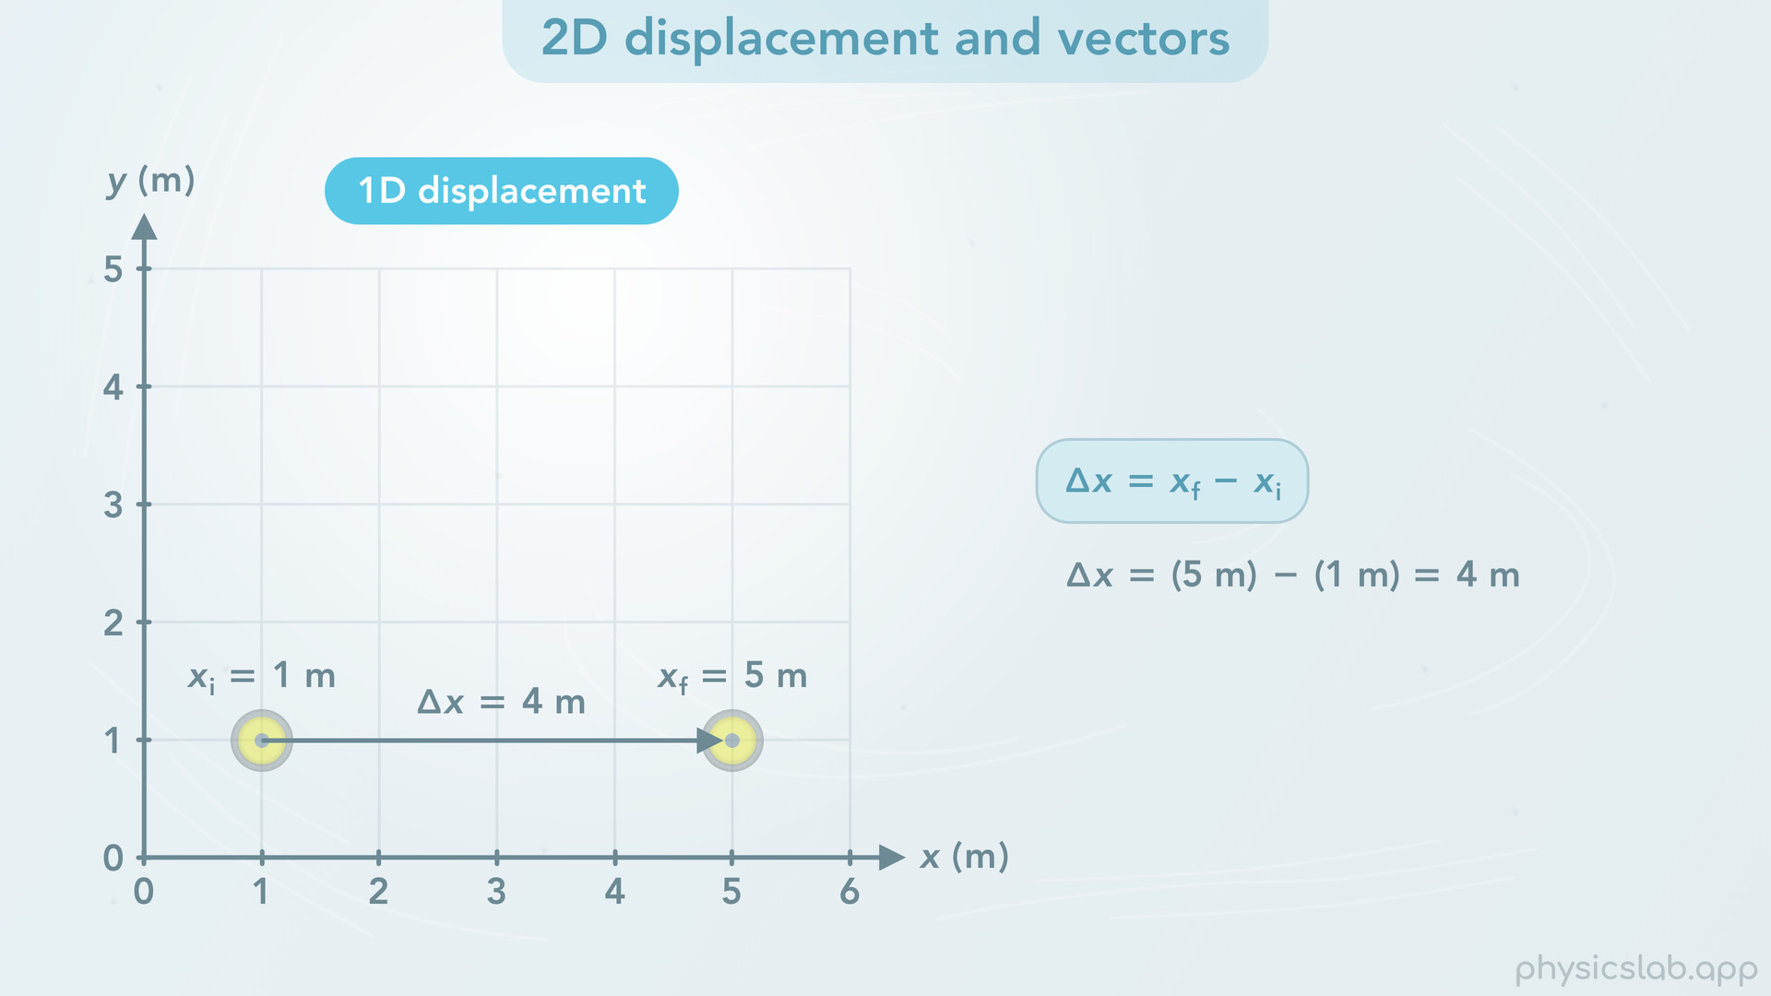
Notes:
• If this stone moves in the x direction and the initial position is 1 m and the final position is 5 m, then the displacement, delta x, is 5 minus 1, or 4 m.

Slide 38
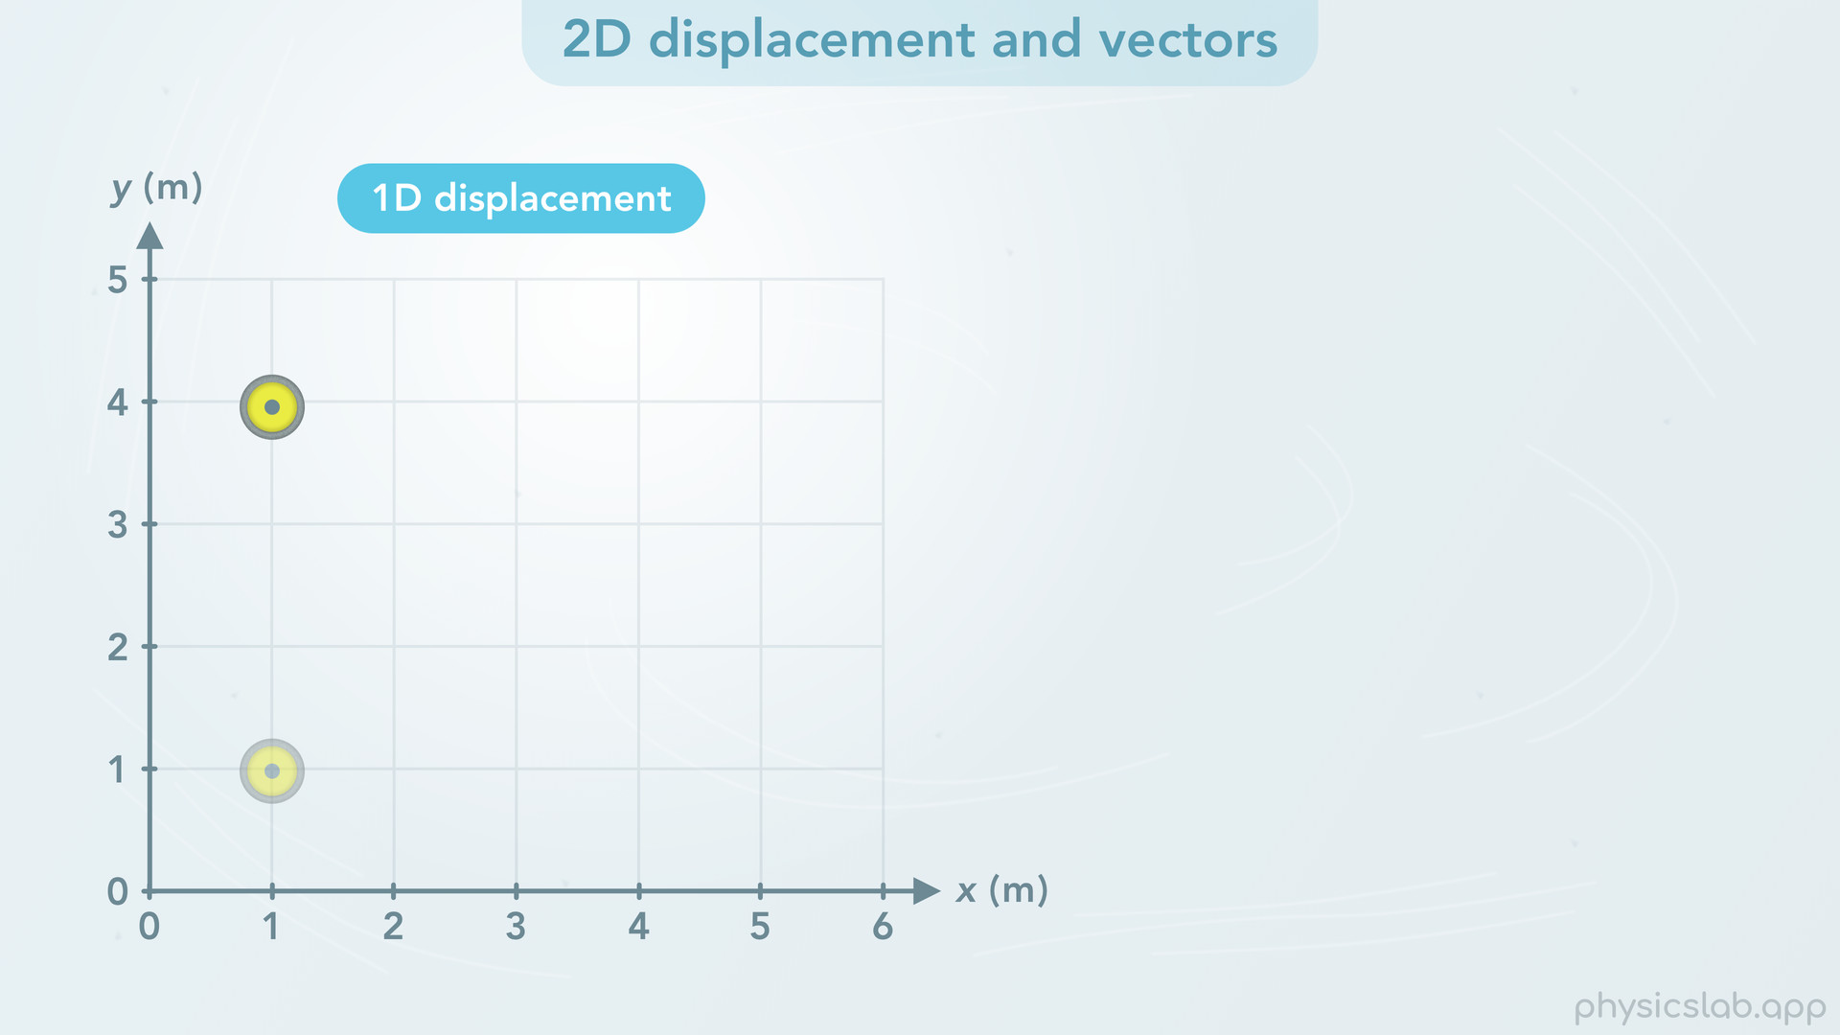
Notes:
• If the stone moves in the y direction, and the initial position is 1 m and the final position is 4 m

Slide 39
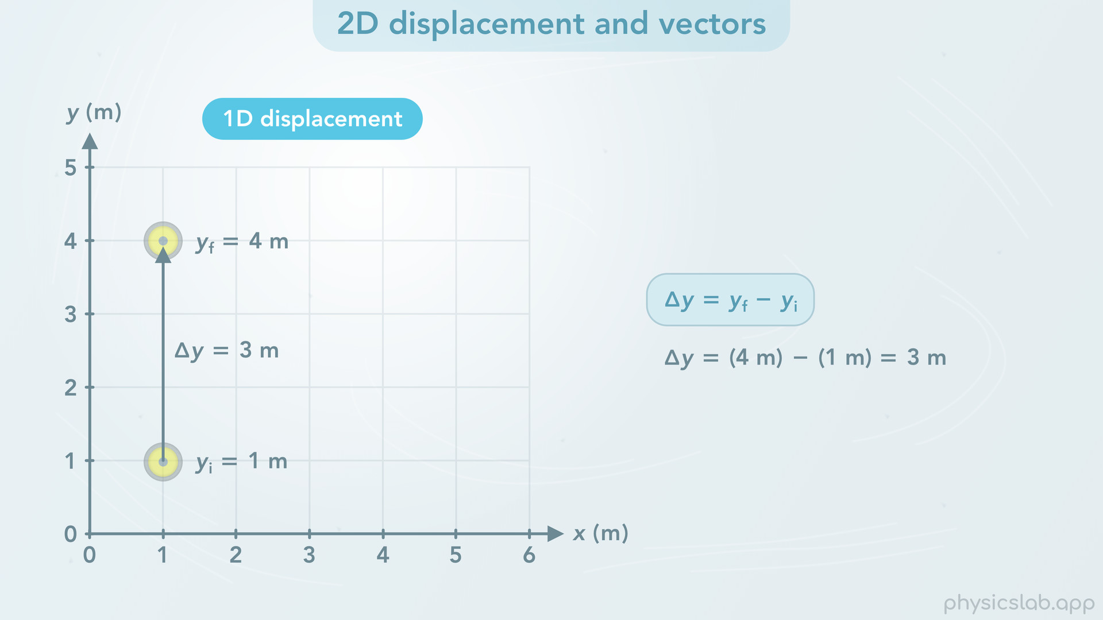
Notes:
the displacement, delta y, would be 4 minus 1, or 3 m.
Those are both one dimensional displacements.

Slide 40
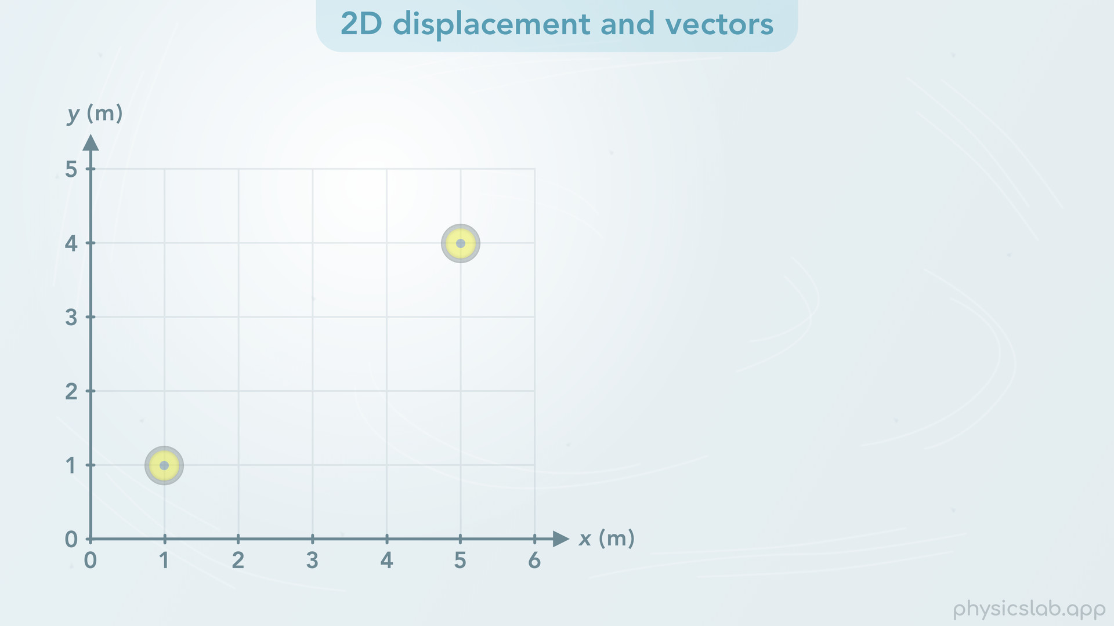
Notes:
• But if the stone moves in two dimensions, it moves in the x and y directions at the same time.

Slide 41
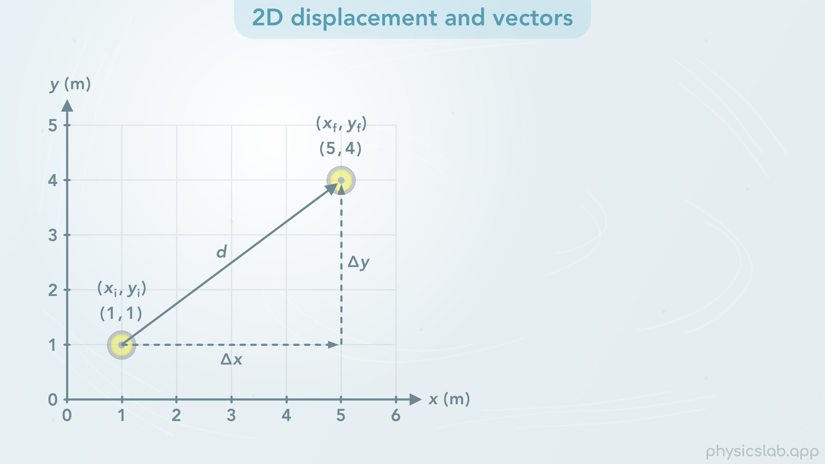
Notes:
If it moves from an initial position of (1, 1) to a final position of (5, 4), how do we describe the displacement? We’re going to use a 2D displacement vector, labeled “d”.
The first way that we can describe this displacement vector is by using the x and y displacements, delta x and delta y. Even though the stone moved in a straight line from the initial point to the final point, we can see that the stone moved some amount in the x direction and it moved some amount in the y direction, so we can find delta x and delta y.

Slide 42
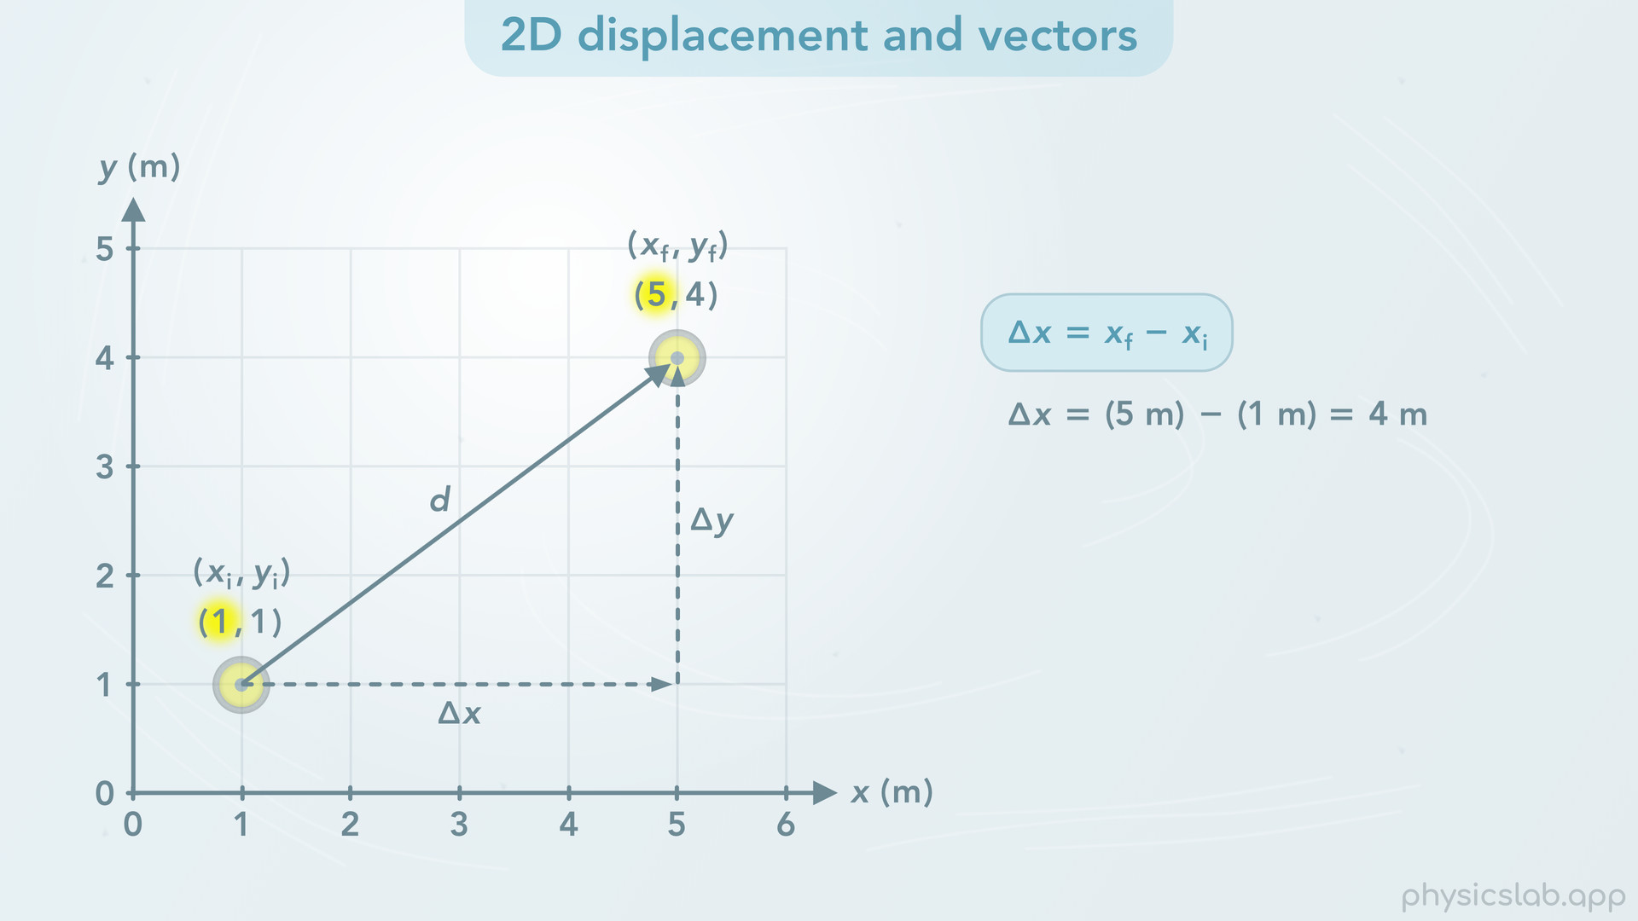
Notes:
• So what is delta x? Delta x is the final x position minus the initial x position, which would be 5 m minus 1 m, which is 4 m.

Slide 43

Notes:
And delta y is the final y position minus the initial y position, which is 4 m minus 1 m, or 3 m. So for this displacement vector, delta x is 4 m and delta y is 3 m.

Slide 44

Notes:
• Delta x and delta y are what we call the components of the vector. Delta x is the x component, which is how far the displacement vector points in the x direction. And delta y is the y component, which is how far the vector points in the y direction.

Slide 45

Notes:
• We can draw the components on either side of the vector, as long as the x component is parallel to the x axis and the y component is parallel to the y axis. But, as we’ll see in a minute, it might be useful to draw the components so they form a right triangle with the vector.

Slide 46

Notes:
• So the components are one way to describe the displacement of the stone, and we calculated them using the initial and final coordinates.

Slide 47

Notes:
• The other way to describe the displacement vector is how far the stone moved in a straight line, and what direction it moved as an angle. In this case, the stone’s displacement is 5 m at an angle of 36.9 degrees relative to the x axis. 5 m is what we call the magnitude of the displacement, and it’s the straight line distance between the initial and final points. It’s also the length of the vector. 36.9 degrees is the angle, which we represent with the Greek letter theta, and this angle tells us the direction of the vector.

Slide 48

Notes:
• So those are the two methods we can use to describe the displacement vector of the stone when it moved from the initial position to the final position. We can use the x and y components, where delta x is 4 m and delta y is 3 m.

Slide 49

Notes:
Or we can use the magnitude and direction, which is 5 m at an angle of 36.9 degrees.
• Depending on the situation, one description might be more useful than the other, and we’re going to have to convert between them. If we’re given the magnitude and angle, how can we find the x and y components? Or if we’re given the components, what’s the magnitude and the angle?

Slide 50

Notes:
• This is where geometry and the trig functions come in. This applies to every type of vector, including velocity, acceleration, force and momentum vectors, and we’re gonna use this a lot in physics.
• First, let’s say we know the magnitude and direction of the displacement, and we wanna find the x and y components.

Slide 51

Notes:
A vector and its two components form a right triangle. The vector is the hypotenuse and the magnitude of the vector is the length of the hypotenuse, which in this case is 5 m. The x and y components are the two legs of the triangle. If we know the length of the hypotenuse and we have one of the angles, we can use the sine and cosine functions to find the other two sides, which are the components.

Slide 52

Notes:
• Cosine of theta equals the adjacent side divided by the hypotenuse. The hypotenuse is d, and if we use this angle, the adjacent side is the x component, delta x. If we rearrange that equation, then delta x equals d times the cosine of theta. If we plug in 5 m for d and 36.9 degrees for theta, then the x component is 4 m. That’s the length of that side of the triangle. And don’t forget to check that your calculator is using degrees instead of radians.

Slide 53

Notes:
• We also know that the sine of theta equals the opposite side divided by the hypotenuse. The opposite side would be the y component, delta y. So delta y equals d times the sine of theta. If we plug in 5 m for d and 36.9 degrees for theta then the y component is 3 m.
• Keep in mind that in this example, the y component uses sine because the y component is opposite from the angle, and the x component uses cosine because it’s adjacent to the angle. If we used the other angle, then x would use sine and y would use cosine.
• So that’s how we convert from the vector’s magnitude and direction to the x and y components.

Slide 54

Notes:
• Now let’s say we’re given the components and we wanna find the magnitude and direction of the vector.

Slide 55

Notes:
• To find the magnitude, we can use the Pythagorean theorem. For a right triangle where c is the hypotenuse and a and b are the other two sides, c squared equals a squared plus b squared. If we apply that to this vector, d is the hypotenuse (c) and the components are the other two sides (a and b). So d squared equals delta x squared plus delta y squared. If we take the square root of both sides of the equation, then we just have d on the left. We plug in 4 m for delta x and 3 m for delta y, and we find that d is 5 m. That’s the length of the hypotenuse and the it’s magnitude of the vector.

Slide 56

Notes:
• Now, in order to find the angle, theta, we need to use one of the inverse trig functions. Once we know the hypotenuse, we could use inverse sine or inverse cosine. But it’s probably easier to just use the inverse tangent function because we’re given the components. So theta equals the inverse tangent of the opposite side divided by the adjacent side. If we’re finding this angle, then the opposite side is delta y and the adjacent side is delta x. Remember if we wanted to find the other angle, x and y would be flipped. Now we plug in 3 m for delta y and 4 m for delta x, and we find that this angle, theta, is 36.9 degrees. So we were given the components and we found that the displacement of the stone was 5 m at an angle of 36.9 degrees.

Slide 57

Notes:
• And that’s how we convert between a vector’s magnitude and direction and the x and y components.
• In this example, both components are positive.

Slide 58

Notes:
• But what if the stone moves from a position of (1,4) to a position of (5,1)?

Slide 59

Notes:
This would be the displacement vector. But what would the x and y components be?

Slide 60

Notes:
• Delta x is 5 m minus 1 m, which is 4 m. But delta y would be 1 m minus 4 m, which is negative 3 m. Remember, displacement is the final position minus the initial position. So delta y is negative.

Slide 61

Notes:
• Notice how all the positions have positive values. But, the direction of a component determines whether it’s positive or negative. It doesn’t matter where the object is. If up is the positive y direction, then down is the negative y direction. The y component is pointing down, so it’s negative.
• It’s kind of like using a compass. If the positive y direction is north, then the negative y direction is south. Even though the positions are positive, the y component is pointing south, which is negative. The stone moved in the negative y direction.
• The magnitude of the displacement vector is still positive 5 m, because magnitude is always positive. If someone asks “how far did the stone move” we would say 5 m, not negative 5 m.

Slide 62

Notes:
• What if the stone moved from a position of (5,4) to a position of (1,1)? The y component, delta y, would still be -3 m. But now the x component, delta x, would be 1 m minus 5 m which is negative 4 m. If right or east is the positive x direction, then left would be the negative x direction. And again, the magnitude would still be positive 5 m.
• In these examples, the coordinates and the math kept track of the positive and negative signs for us. 1 minus 5 is negative 4, and 1 minus 4 is negative 3. But what if we don’t have the coordinates, and we’re only given the magnitude and the angle. How do we find the components and whether they’re positive or negative?

Slide 63

Notes:
• Let’s talk about the different ways to describe vector angles and how to keep track of positive and negative components.

Slide 64

Notes:
• It’s important to note that we always measure the angle at the start of the vector, not at the end of the vector.

Slide 65

Notes:
• In some cases, a problem might describe an angle above or below the horizontal, or right or left of the vertical, which are just horizontal and vertical lines passing through the start of the vector. If we’re using an x y coordinate system, these might align with the x and y axes, and the horizontal might align with the ground, but it depends on the problem. If we’re told that a vector is “at an angle of 60 deg above the horizontal”, the vector could look like this.

Slide 66

Notes:
• But, the vector could also look like this and point to the left. If the left and right directions are important to the problem, like if the left direction is negative, then 60 degrees above the horizontal is not enough information. So if we see an angle described like this, it probably means we’re only working with positive components and positive reference angles.

Slide 67

Notes:
• A better way to describe angles is to specify the positive or negative axes. If a problem says a vector is “at an angle of 60 degrees above the positive x axis” then we must be working with an x y coordinate system, and this is the only possible direction for the vector.

Slide 68

Notes:
This other vector would have an angle of 60 degrees above the negative x axis.

Slide 69

Notes:
• We might also see vectors described using compass directions, north south east and west. In that case the directions are still fully defined, similar to the positive and negative x and y directions. If the direction of a vector is described as east, then the vector points in the east direction.

Slide 70

Notes:
If a vector is at an angle of 60 degrees north of east, the vector would look like this. It’s like saying this vector would be east, and this vector would point 60 degrees north of east. The vector starts in the east direction and rotates towards the north direction. This vector could also be described as 30 degrees east of north.
So these ways of describing angles are more accurate, but they still use a lot of words.

Slide 71

Notes:
• The last method is the conventional way to describe angles. Positive angles are counterclockwise from the positive x axis. And negative angles are clockwise from the positive x axis. Using this method, we only need a single value to describe the angle.

Slide 72

Notes:
• So if a problem says a vector has an angle of 60 degrees, with no other information, then this would be the direction of the vector. We can think of it as the vector starting on the positive x axis and rotating counterclockwise 60 degrees.

Slide 73

Notes:
• Negative 60 degrees would mean the vector rotates clockwise from the positive x axis and ends up here.

Slide 74

Notes:
• What if the vector points in this direction? Now the vector is has an angle of 120 degrees. But we could also describe this direction as -240 degrees, because negative angles are measured clockwise from the positive x axis. There’s 360 degrees in a circle, so 360 minus 120 would be 240.

Slide 75

Notes:
• The positive y direction is 90 degrees or negative 270 degrees

Slide 76

Notes:
• The negative x direction is 180 degrees or negative 180 degrees

Slide 77

Notes:
• The negative y direction is 270 degrees or negative 90 degrees

Slide 78

Notes:
• And the positive x direction is 0 degrees.

Slide 79

Notes:
• So that’s how we describe the angle. What about the components?
• Let’s use this vector which has an angle of 120 degrees.

Slide 80

Notes:
Remember, the vector and components form a right triangle, so we use the trig functions to find the components. But what angle do we plug into sine and cosine? There’s two ways to do this.

Slide 81

Notes:
• First, if we wanna use the angle that’s inside the right triangle, then we subtract 180 degrees minus 120 to get 60 degrees. This is what we call a reference angle. The reference angle will always be a positive, acute angle between 0 and 90 degrees.

Slide 82

Notes:
• The x component would be d, 10 m, times the cosine of 60 degrees, which gives us 5 m. This gives us the length of a side of the triangle. But now, we need to realize that the x component is pointing to the left, in the negative x direction. So we have to change the x component to negative 5 m.
• The y component is d times the sine of 60 degrees, which gives us 8.7 m. It’s pointing in the positive y direction, so we leave delta y as positive. We’ll see why it’s important to keep track of positive and negative components when we learn how to add vectors.

Slide 83

Notes:
• The second way we can find the components is by using the conventional angle counterclockwise from the positive x axis
• If we plug 120 degrees into the cosine function, we actually get negative 5 m for delta x, and we get positive 8.7 m for delta y.
• So by plugging in this angle, the sine and cosine functions keep track of the positive and negative signs.

Slide 84

Notes:
It might seem weird using the right triangle trig functions with an angle that’s outside of the triangle, but this is how the functions work. If you graph the sine and cosine functions, we can see where the output is positive and negative.
If the angle is between 0 and 90 degrees, sine and cosine are both positive, and we can see the components point in the positive x and positive y directions.

Slide 85

Notes:
• Between 90 and 180 degrees, cosine and the x component are negative, while sine and the y component are positive.

Slide 86

Notes:
• Between 180 and 270 degrees, cosine and the x component are negative, and sine and the y component are also negative.

Slide 87

Notes:
• And between 270 and 360 degrees, cosine and the x component are positive, and sine and the y component are negative.
• The sine and cosine graphs extend in both directions, so if we used negative angles going clockwise then the functions gives us the same thing.

Slide 88

Notes:
• One important thing to note here, is that the sine and cosine functions give us the positive and negative components. But if we’re trying to find the angle using the inverse tangent function, it’s going to give us a reference angle and not the angle that’s counterclockwise from the positive x axis.
• For example, if we plug in 8.7 for delta y and -5 for delta x, the inverse tangent function gives us negative 60 degrees. The absolute value of that , positive 60 degrees, is the reference angle inside the triangle.
Negative 60 degrees would be the conventional angle for this vector, 60 degrees clockwise from the positive x axis. The function doesn’t know if it’s delta x or delta y that’s negative. And if we look at the graph of the function, it’s only gonna give us an angle between -90 and positive 90 degrees.

Slide 89

Notes:
• So the point is, we can just plug in positive values for the components, the opposite side and the adjacent side, and it’ll give us a positive reference angle inside the triangle.

Slide 90

Notes:
Then we can figure out the angle counterclockwise from the positive x axis if we need to.

Slide 91

Notes:
• So that’s everything we’re gonna cover in this video, let’s do a summary of the main points.

Slide 92

Notes:
• If an object is in two dimensional motion, it has an x position and a y position at every point in time, and we can use coordinates as an easy way to write the x and y positions.

Slide 93

Notes:
• When an object moves in two dimensions, we can describe its displacement using a displacement vector. The x and y components are just the x displacement and y displacement, which we can calculate using the coordinates of the initial and final positions.

Slide 94

Notes:
• A vector and its two components form a right triangle. So if we’re given the magnitude and angle of the vector, we can find the x and y components using the cosine and sine functions.

Slide 95

Notes:
• Or if we’re given the components, we can find the magnitude using the Pythagorean theorem and the find the angle with the inverse tangent function.

Slide 96

Notes:
• A component is positive if it points in the positive direction, and it’s negative if it points in the negative direction. If we know the coordinates, the math will take care of the positive and negative signs. But if we don’t have coordinates, we need to figure out if a component is positive or negative based on its direction.

Slide 97

Notes:
• There’s a few ways we can describe the angle of a vector, but the conventional method is to measure positive angles counterclockwise from the positive x axis, and negative angles as clockwise.

Slide 98

Notes:
• If we want, we can also use a reference angle, which is an angle inside the right triangle and it’s always positive.

Slide 99

Notes:
• If we use the conventional angle, the sine and cosine functions will tell us which components are positive and negative.

Slide 100

Notes:
• And we can plug positive components into the inverse tangent function to get a reference angle inside the right triangle.

