Slide 1
Apparent Weight
Slides Version 2
This version includes:
Slides with screenshot images from the video.
The video narration in the slide notes.
A blank template slide with the same background and font as the video.
Slides with some basic graphics from this video for you to use however you like.
Feel free to add, delete and edit slides to make your own presentation. You can use these slides in class or share them with your students, but please do not share them with anyone else.
If you have any feedback, suggestions or questions about these slides please email me at chris@physicslab.app or send me a message on Discord @physicslab.
physicslab.app

Slide 2
Heading
Text

Slide 3
Heading
Text

Slide 4




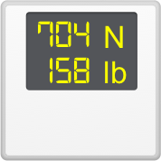








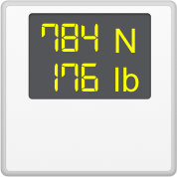









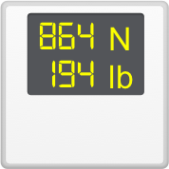






Slide 5












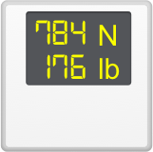
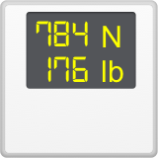
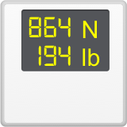
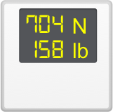










Slide 6








Slide 7






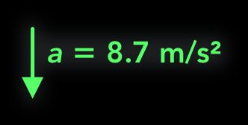


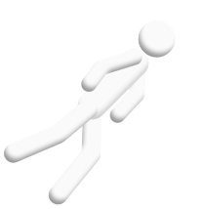
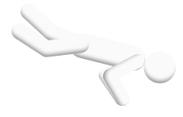






Slide 8
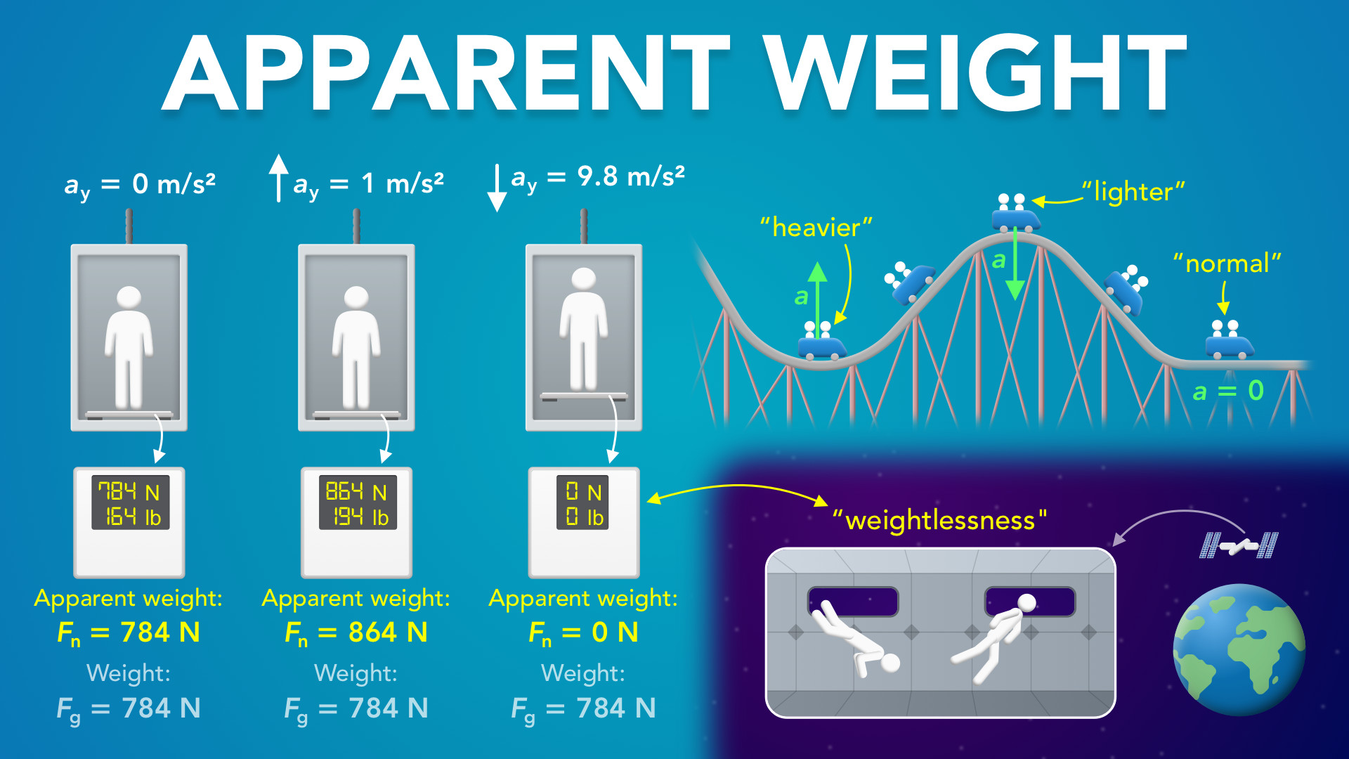
Notes:
Apparent Weight
physicslab.app
If you have any questions, suggestions or feedback about these slides please email me at chris@physicslab.app or send me a message on Discord @physicslab.

Slide 9
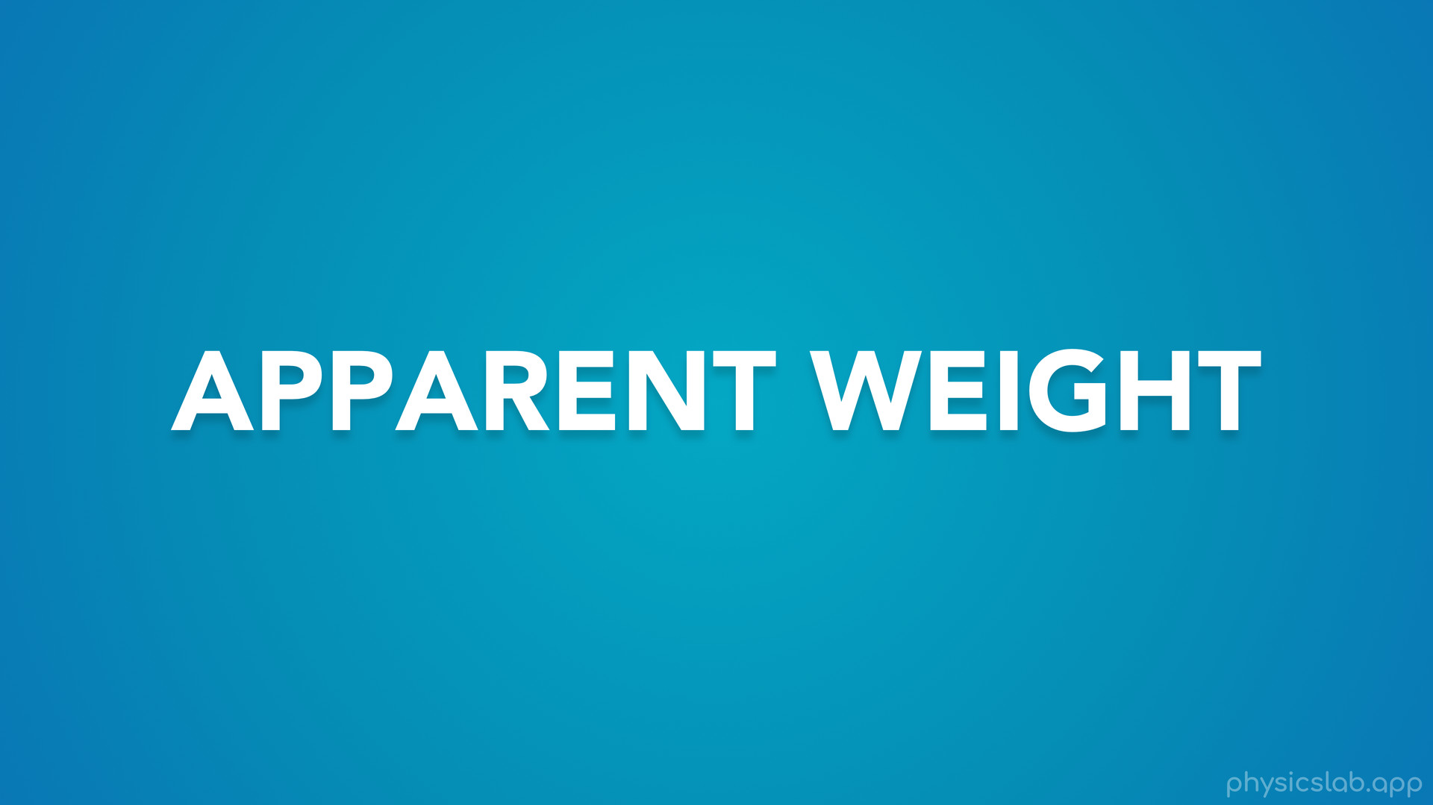
Notes:
• Hey everyone! In this video we’re gonna learn about apparent weight.

Slide 10
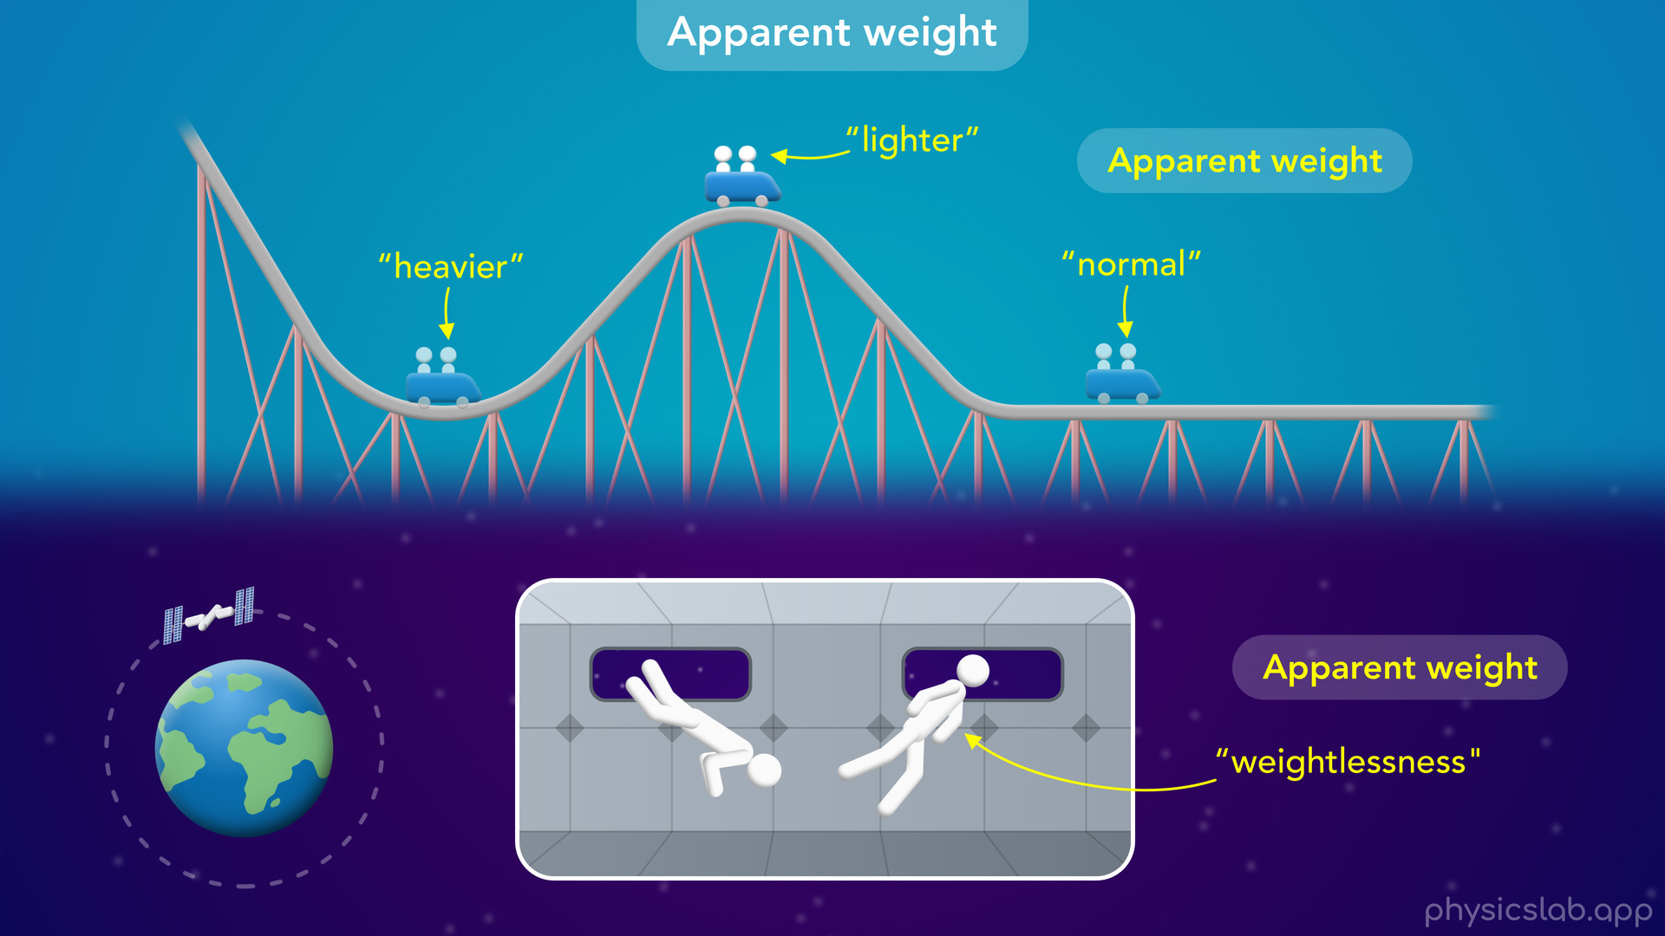
Notes:
• We’ll talk about what apparent weight feels like conceptually...

Slide 11
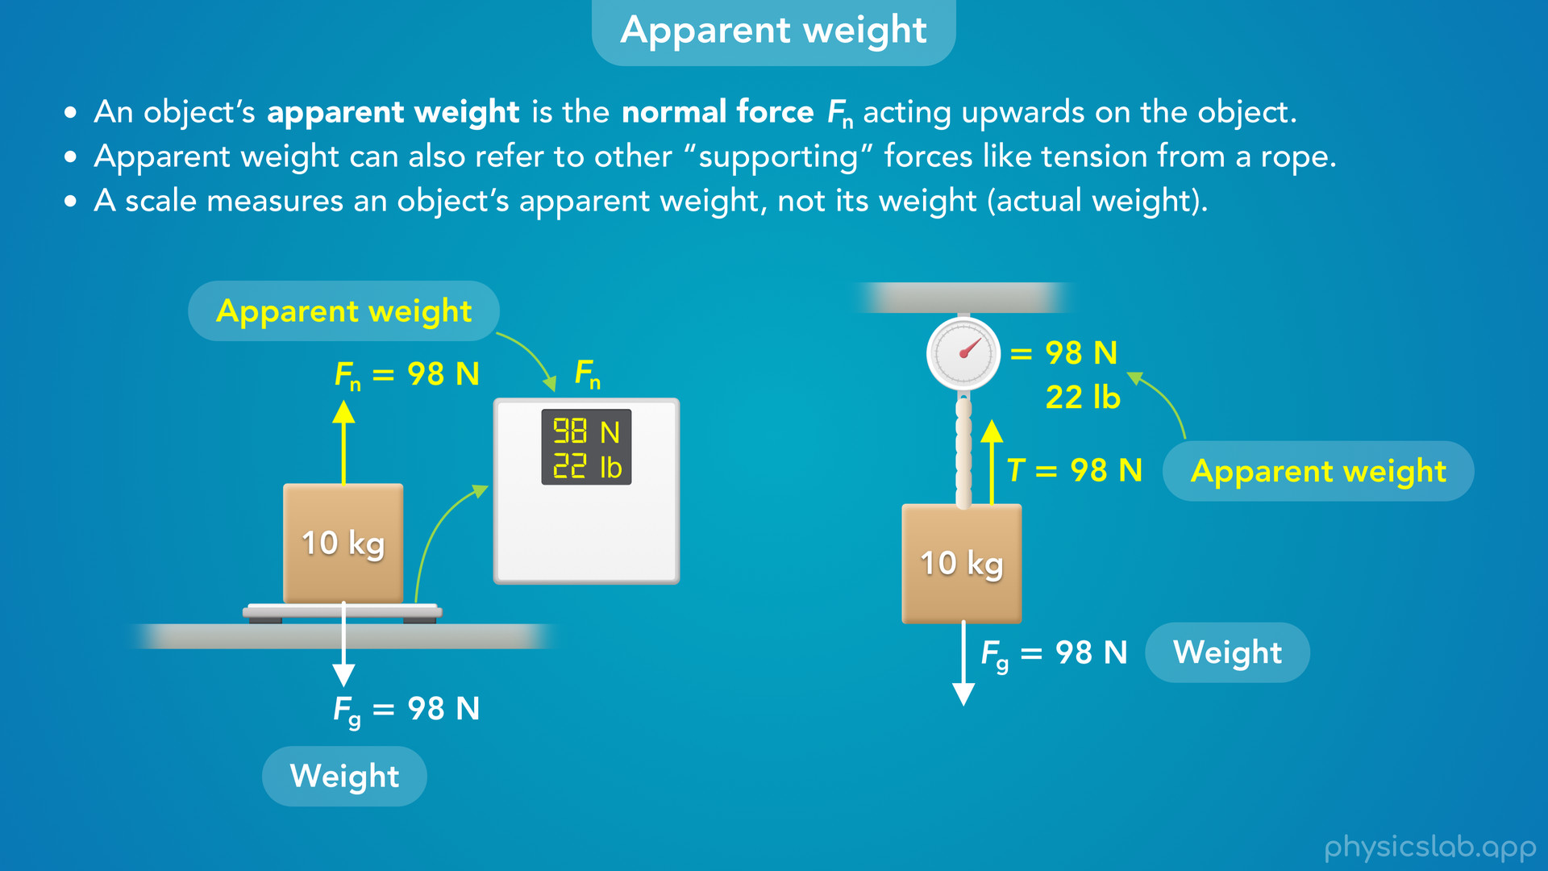
Notes:
• … and then we’ll cover it in more detail.

Slide 12
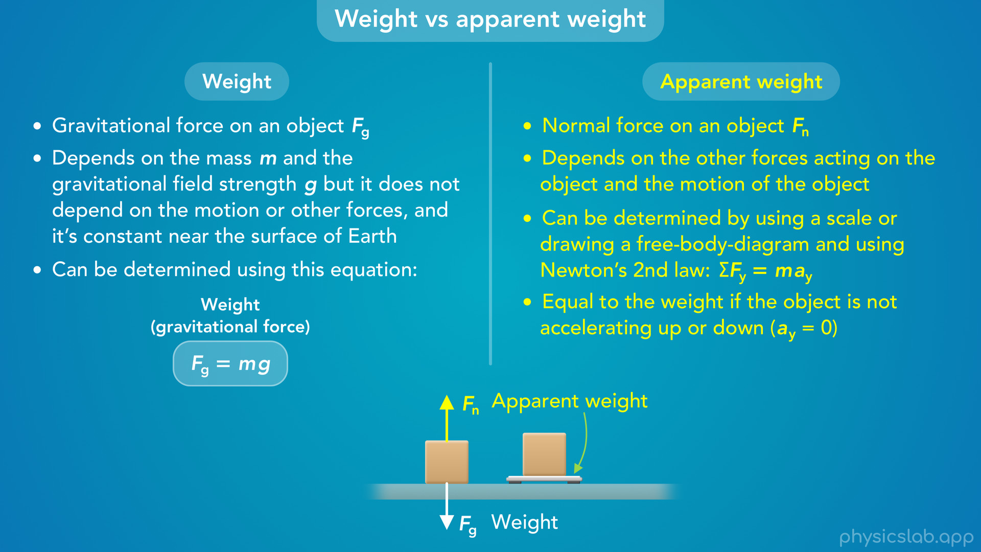
Notes:
• After that, we’ll explain the difference between weight and apparent weight.

Slide 13
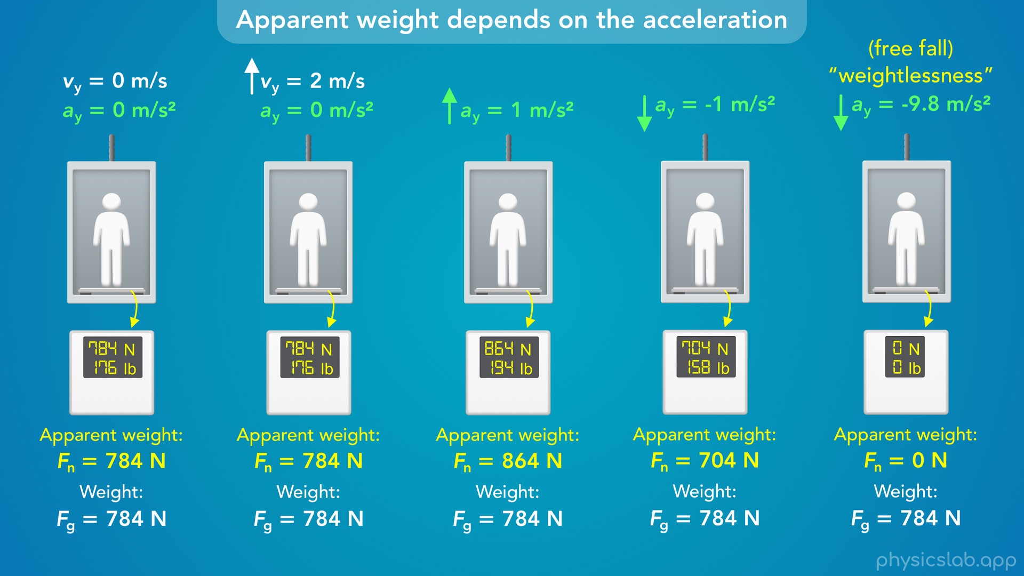
Notes:
• And we’ll calculate the apparent weight of a person in an elevator for 5 different scenarios.

Slide 14
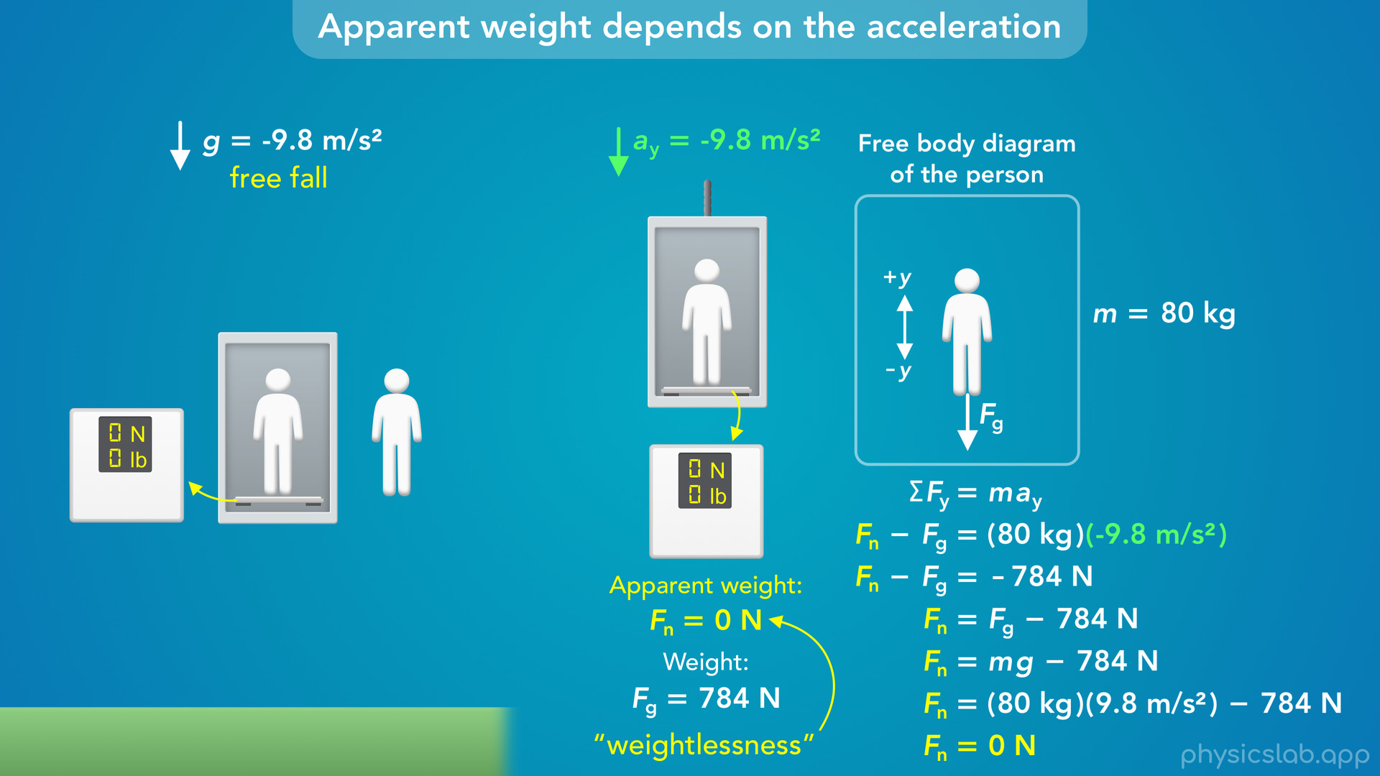
Notes:
• In the last scenario, we’ll talk about weightlessness and how a person or any object can have zero apparent weight.

Slide 15
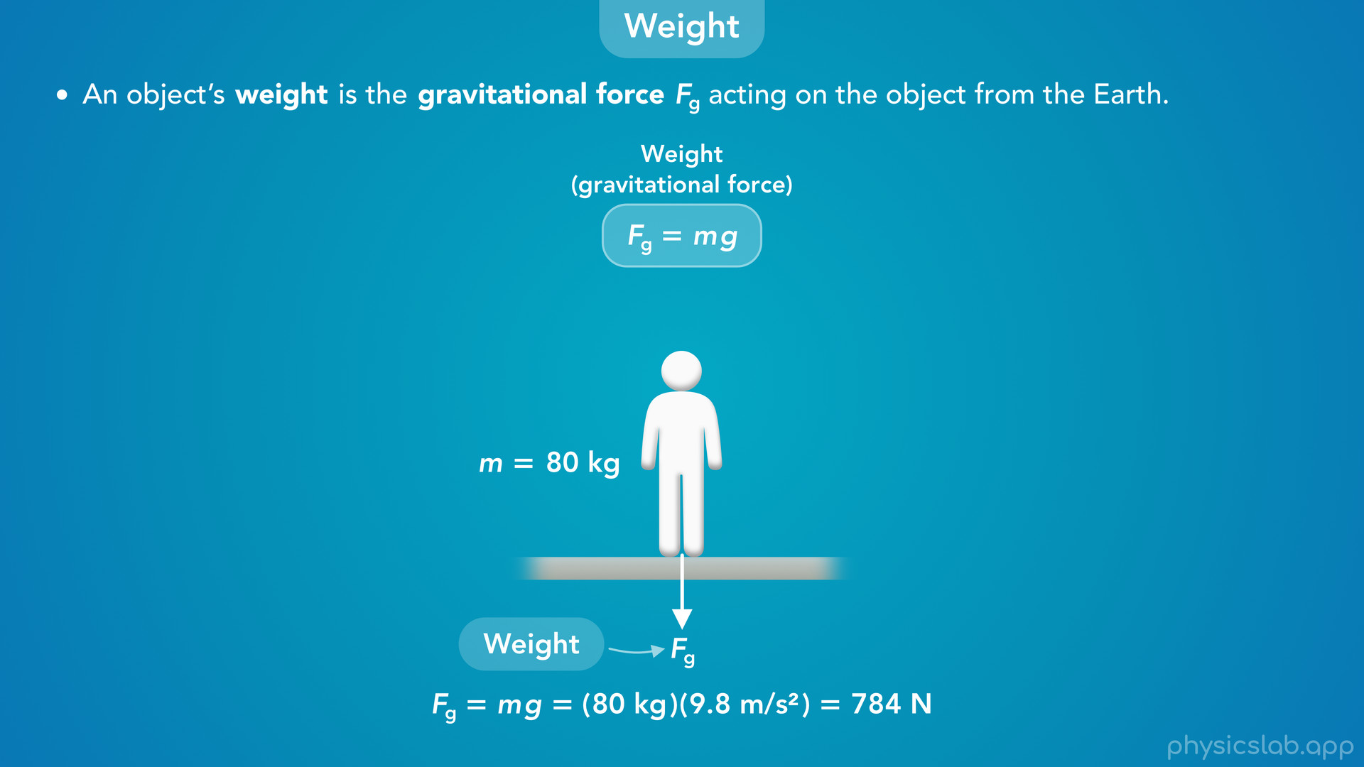
Notes:
• We already learned that an object’s weight is the gravitational force, Fg, acting on the object from the Earth.
• We aways use this equation to calculate the weight, which is the object’s mass multiplied by g, the acceleration due to gravity or the strength of the gravitational field.
• So if you have a mass of 80 kg, then your weight, the gravitaitonal force, is 80 kg times 9.8 m/s² which is 784 N.

Slide 16
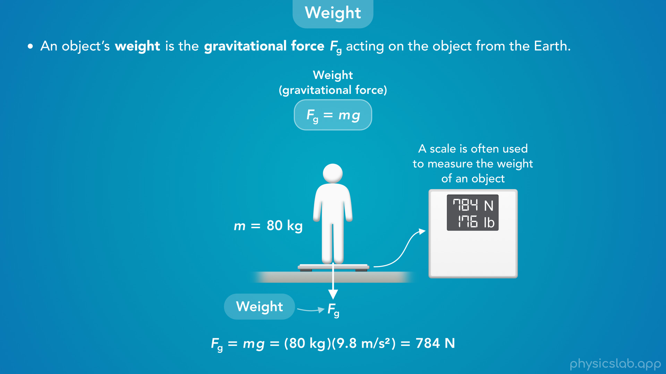
Notes:
• And a scale is often used to measure the weight of an object.
• So if you stand on a scale on the ground, the scale would read 784 N or 176 lb.
• That is your actual weight.

Slide 17
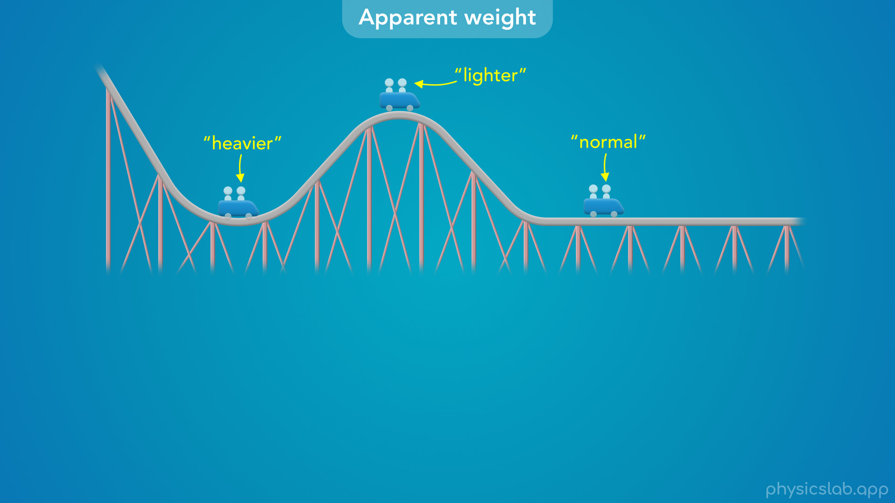
Notes:
• But in some situations, like if you’re riding a roller coaster, you might feel like your weight is changing at different points in the ride.
• When you go through the bottom of a curve you actually feel heavier.
• When you go over the top of a curve you feel lighter.
• And if you’re on a flat part of the ride, your weight would feel normal.

Slide 18
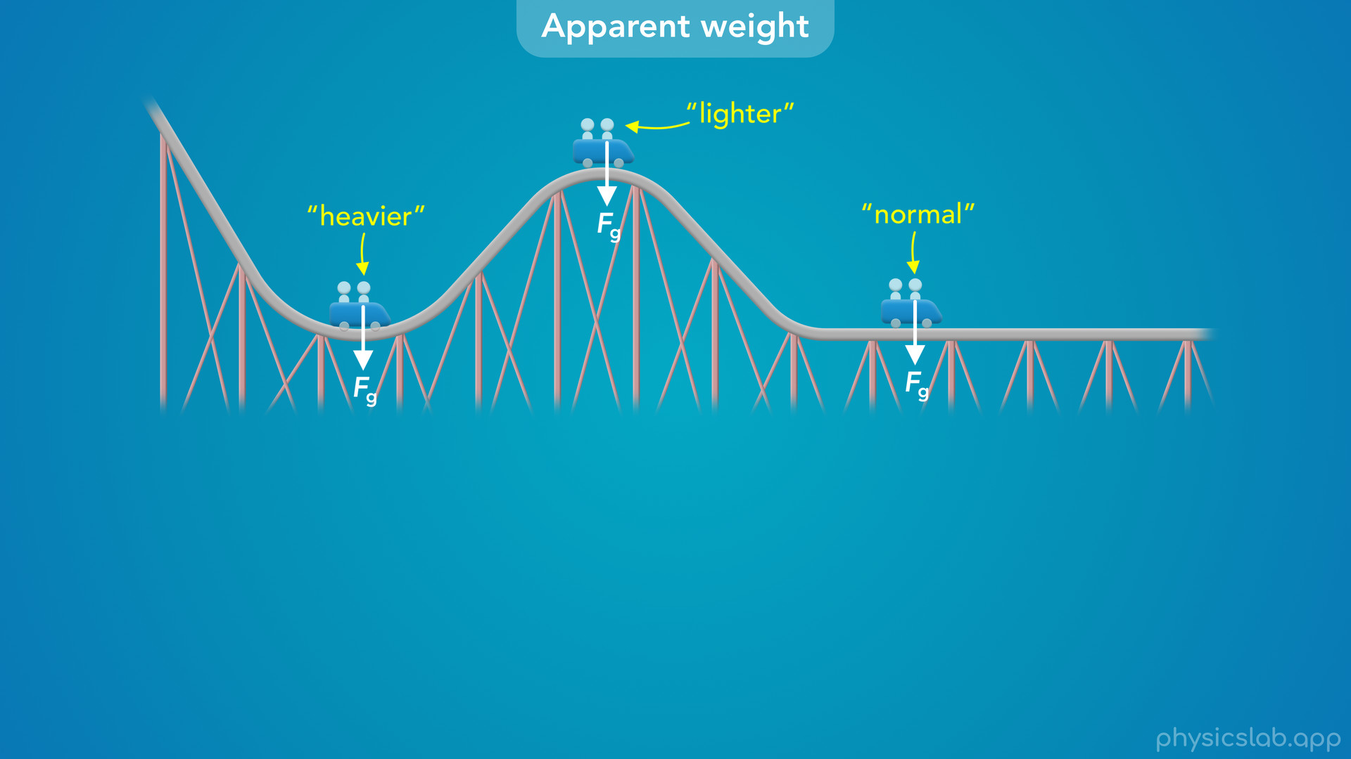
Notes:
• Your actual weight, the gravitational force, is not changing.

Slide 19
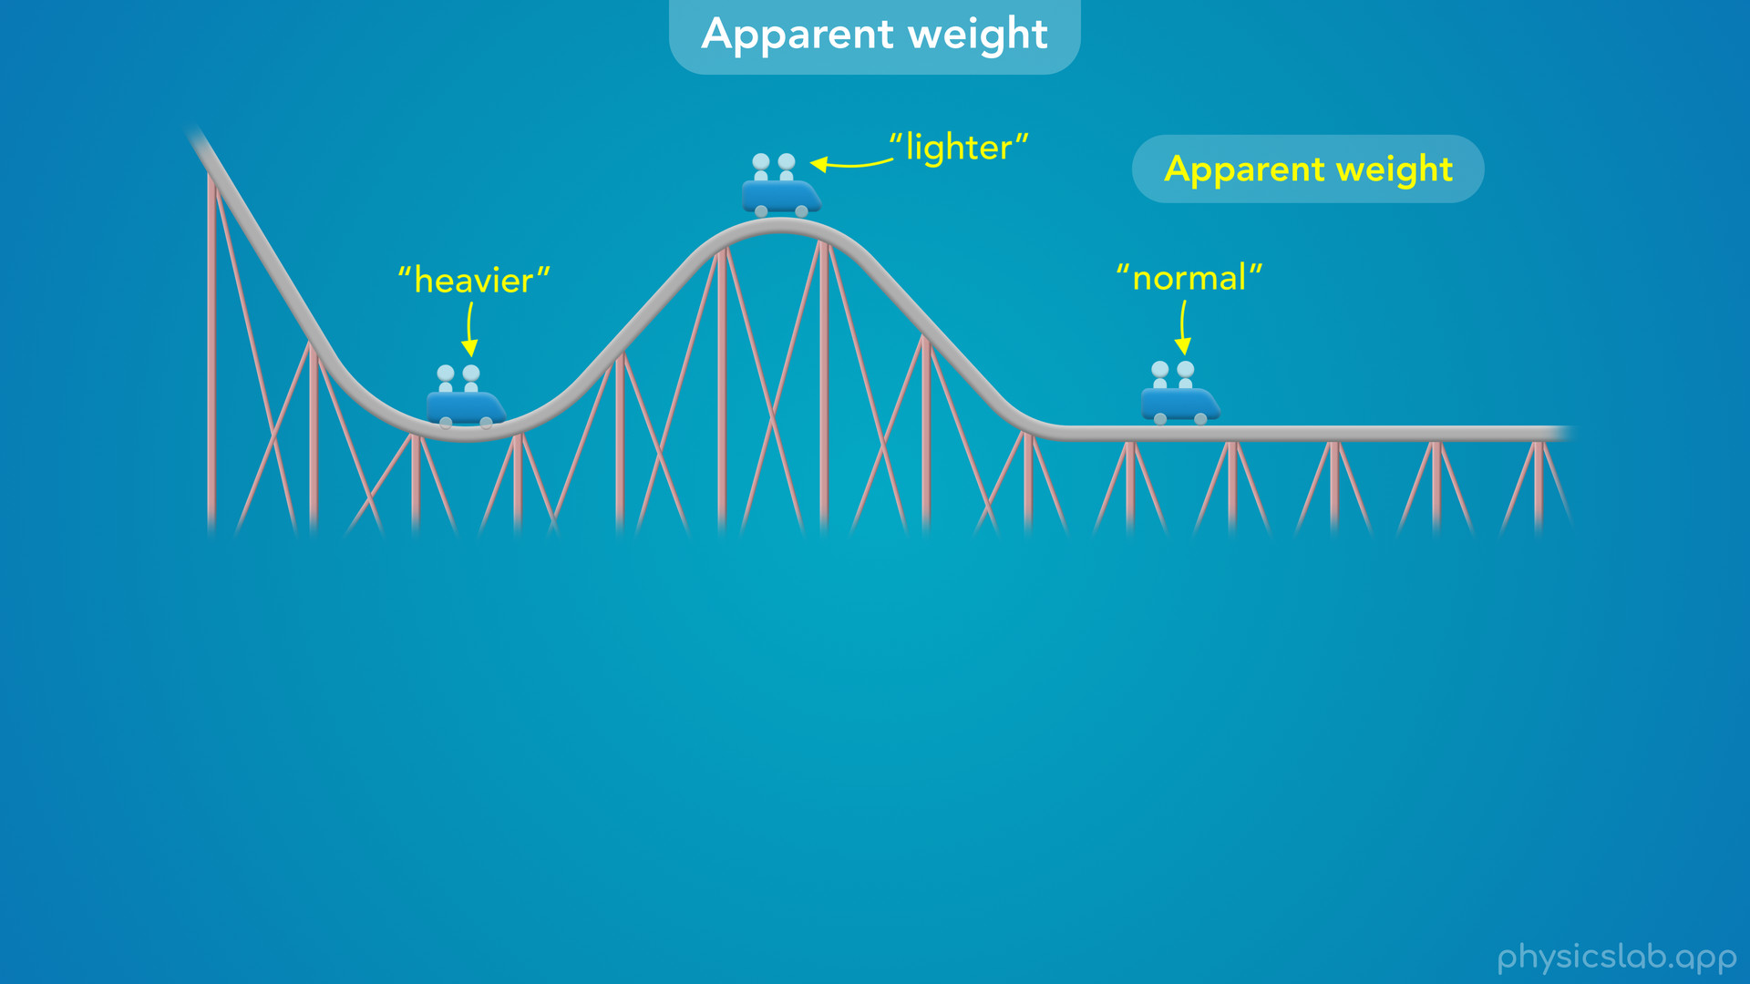
Notes:
• The thing that is changing is what we call your apparent weight.
• When you feel heavier at the bottom of a curve and you feel like you’re being pushed down into your seat, your apparent weight is greater than your actual weight.
• And when you feel lighter at the top of a curve and you feel like you’re lifting out of your seat, your apparent weight is less than your actual weight.
• But when you’re on the flat part of the track and you’re not moving up or down, your apparent weight is the same as your actual weight.
• So it seems like your apparent weight might be affected by your motion.

Slide 20
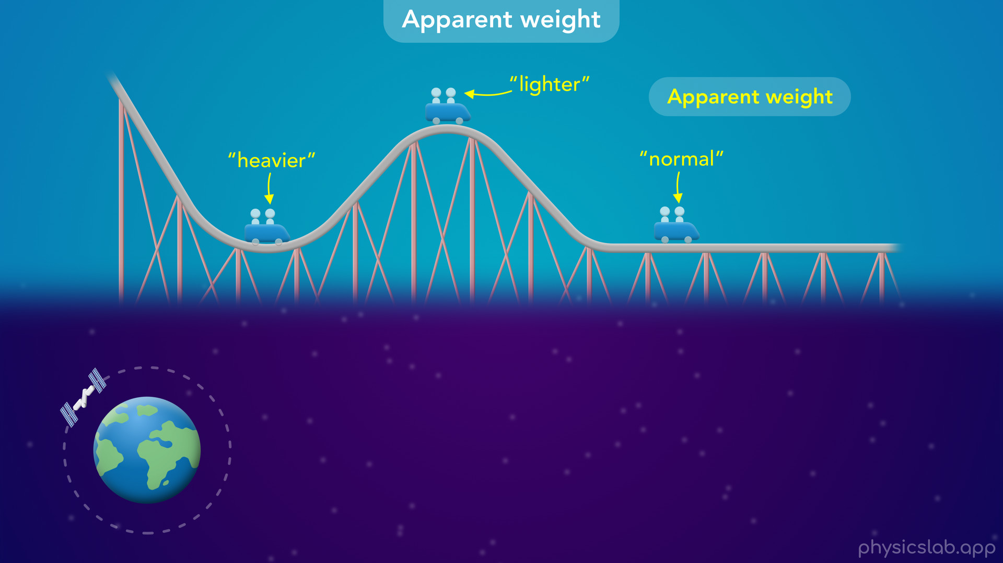

Slide 21
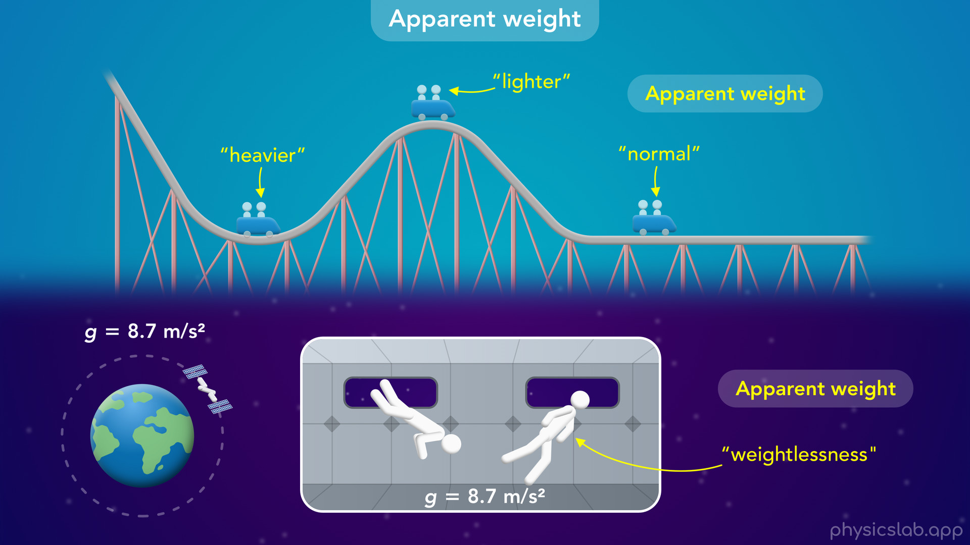
Notes:
• Here’s another scenario.
• The international space station is in orbit around the earth.
• The astronauts in the space station have zero apparent weight, which we refer to as weightlessness.
• So they feel like there’s no gravity and they can float around inside the space station.
• You might think this is because there’s no gravity in space, but we learned in the last few videos that the strength of the Earths gravitational field at the height of the space station is still 8.7 m/s^2, almost 90% of the gravity that we feel on the ground.
• So why do the astronauts feel weightless? We’ll come back to that later.

Slide 22
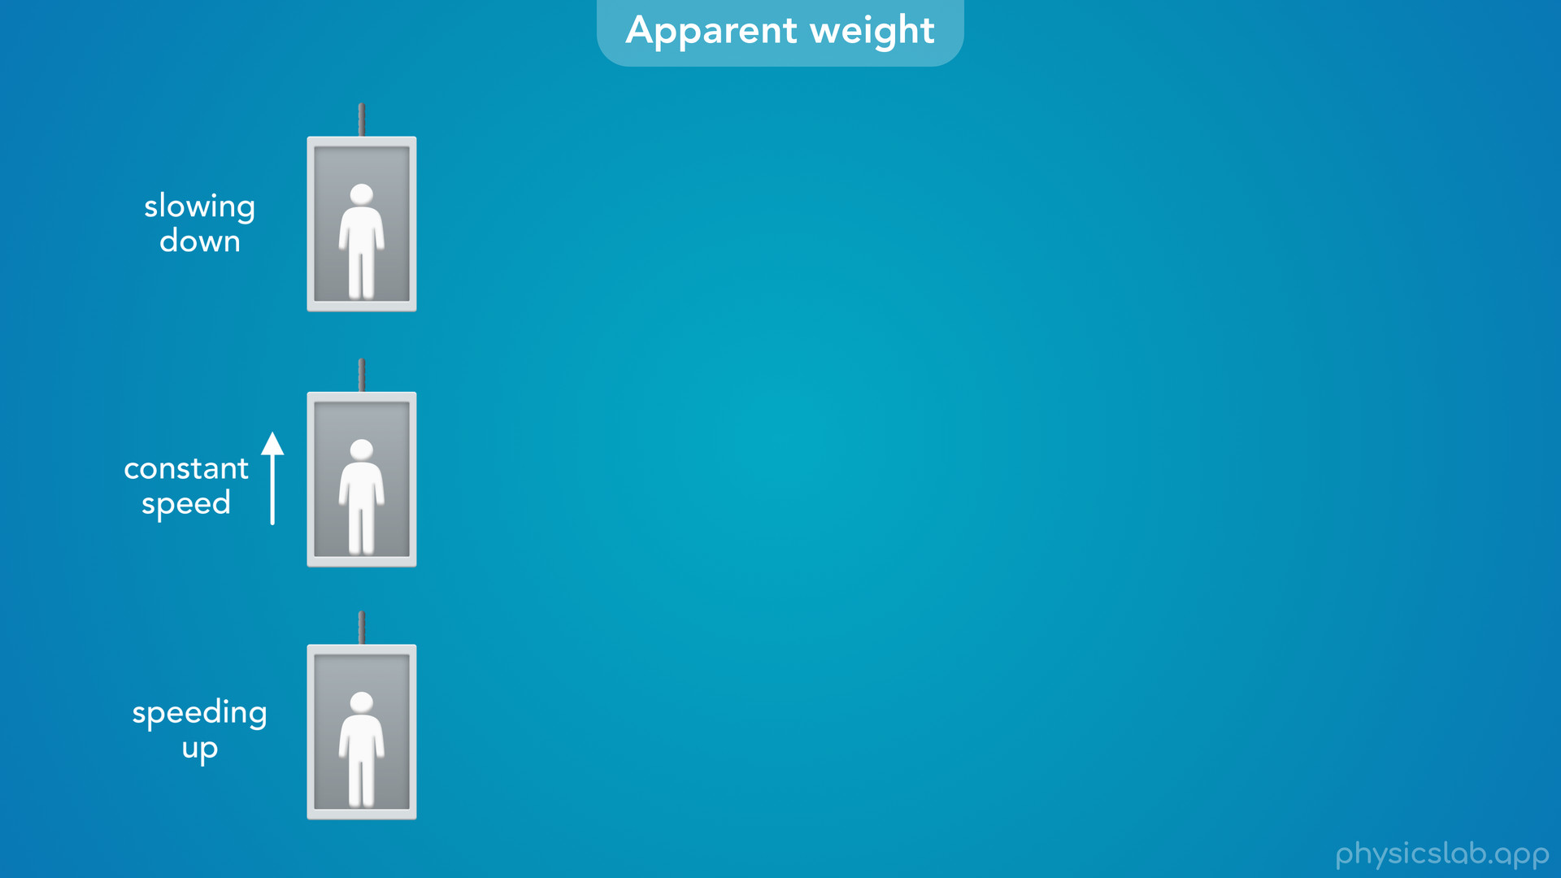
Notes:
• A simpler and more common scenario would be a person riding in an elevator.
• Let’s say it’s moving upwards.

Slide 23
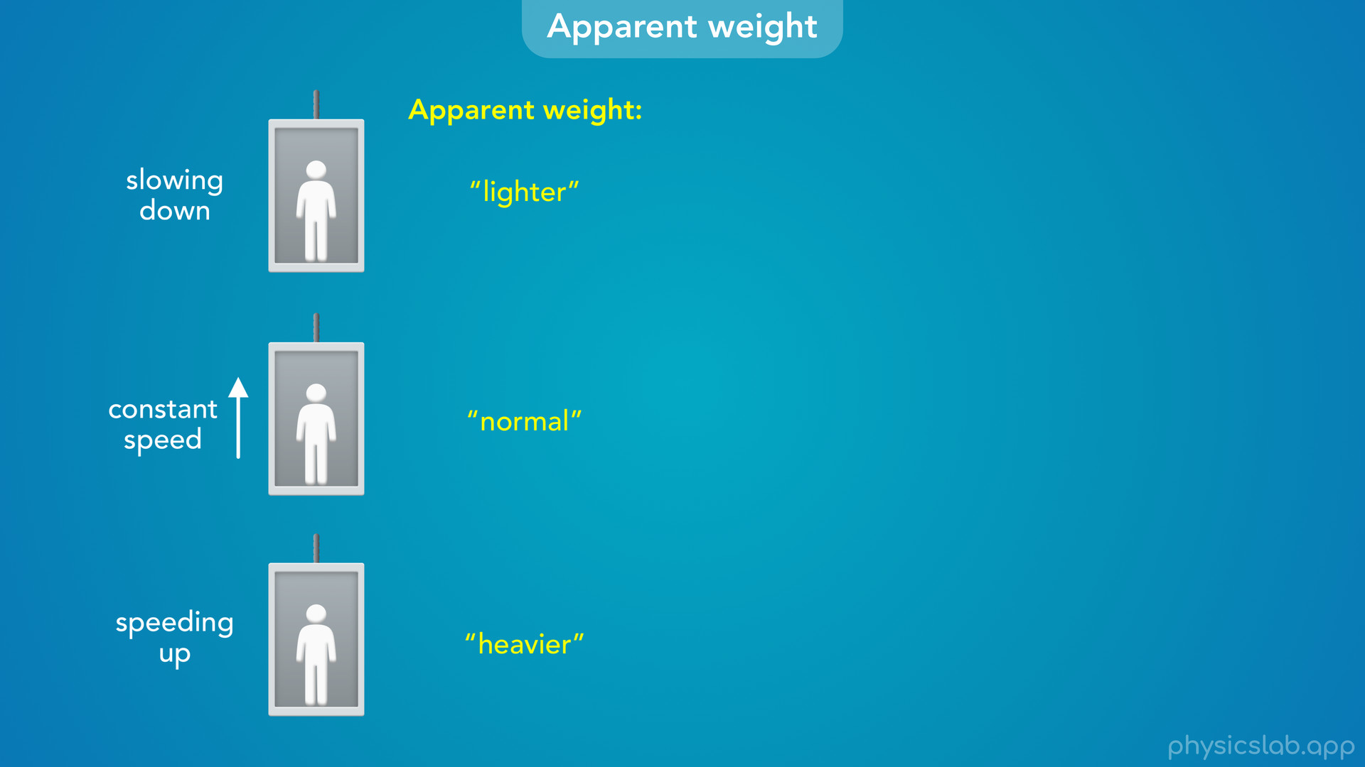
Notes:
• When the elevator is speeding up, you would actually feel heavier.
• When you’re moving at a constant speed for most of the ride, you would feel normal.
• And when the elevator is slowing down, you would feel lighter.
• But what’s causing you to feel heavier and lighter?
• Is something physically happening or is it just an illusion?

Slide 24
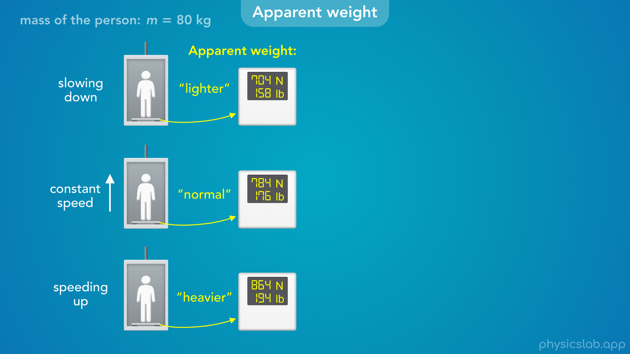
Notes:
• Well, if you were standing on a scale in the elevator, you would actually see the number on the scale change.
• The number would be bigger when you’re speeding up, and it would be smaller when you’re slowing down.
• So it turns out that a scale does not measure your actual weight, it measures your apparent weight, and your apparent weight is changing.

Slide 25
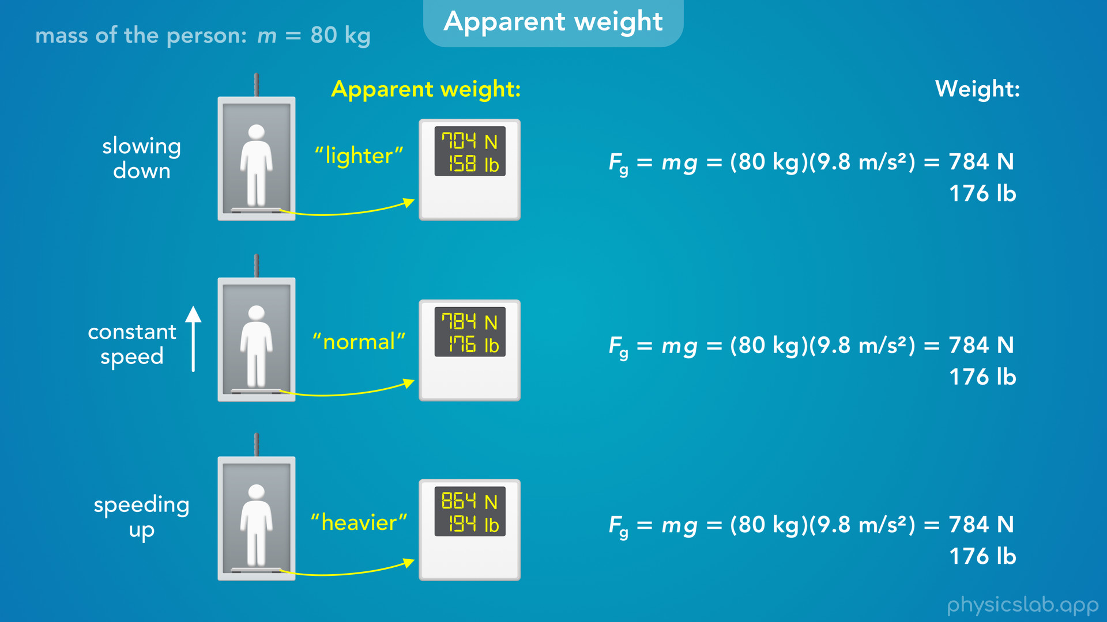
Notes:
• Your actual weight is always the same, m times g, which is 784 N.

Slide 26
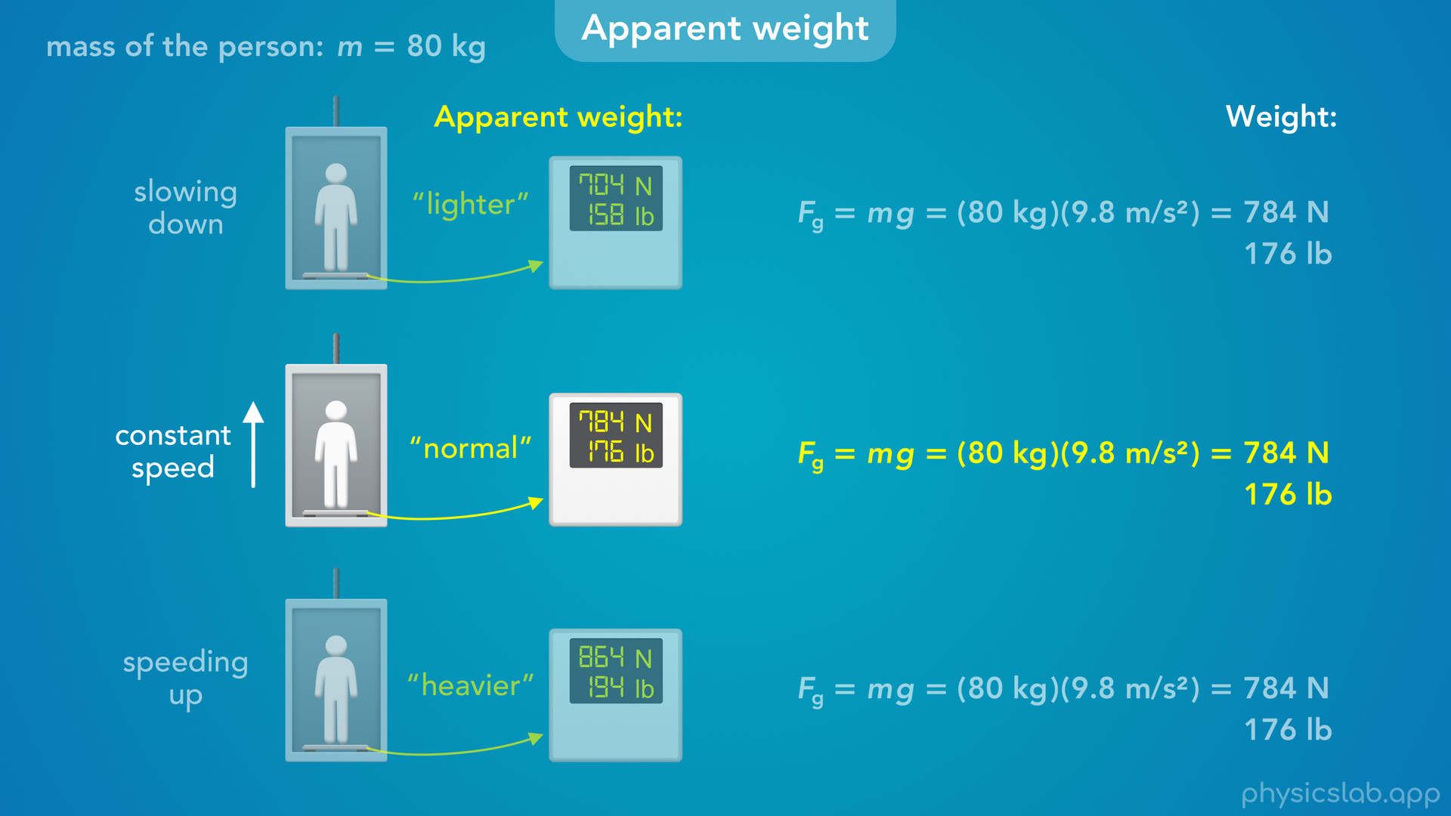
Notes:
• And when you’re moving at a constant speed, for most of the ride, your apparent weight is the same as your actual weight.

Slide 27
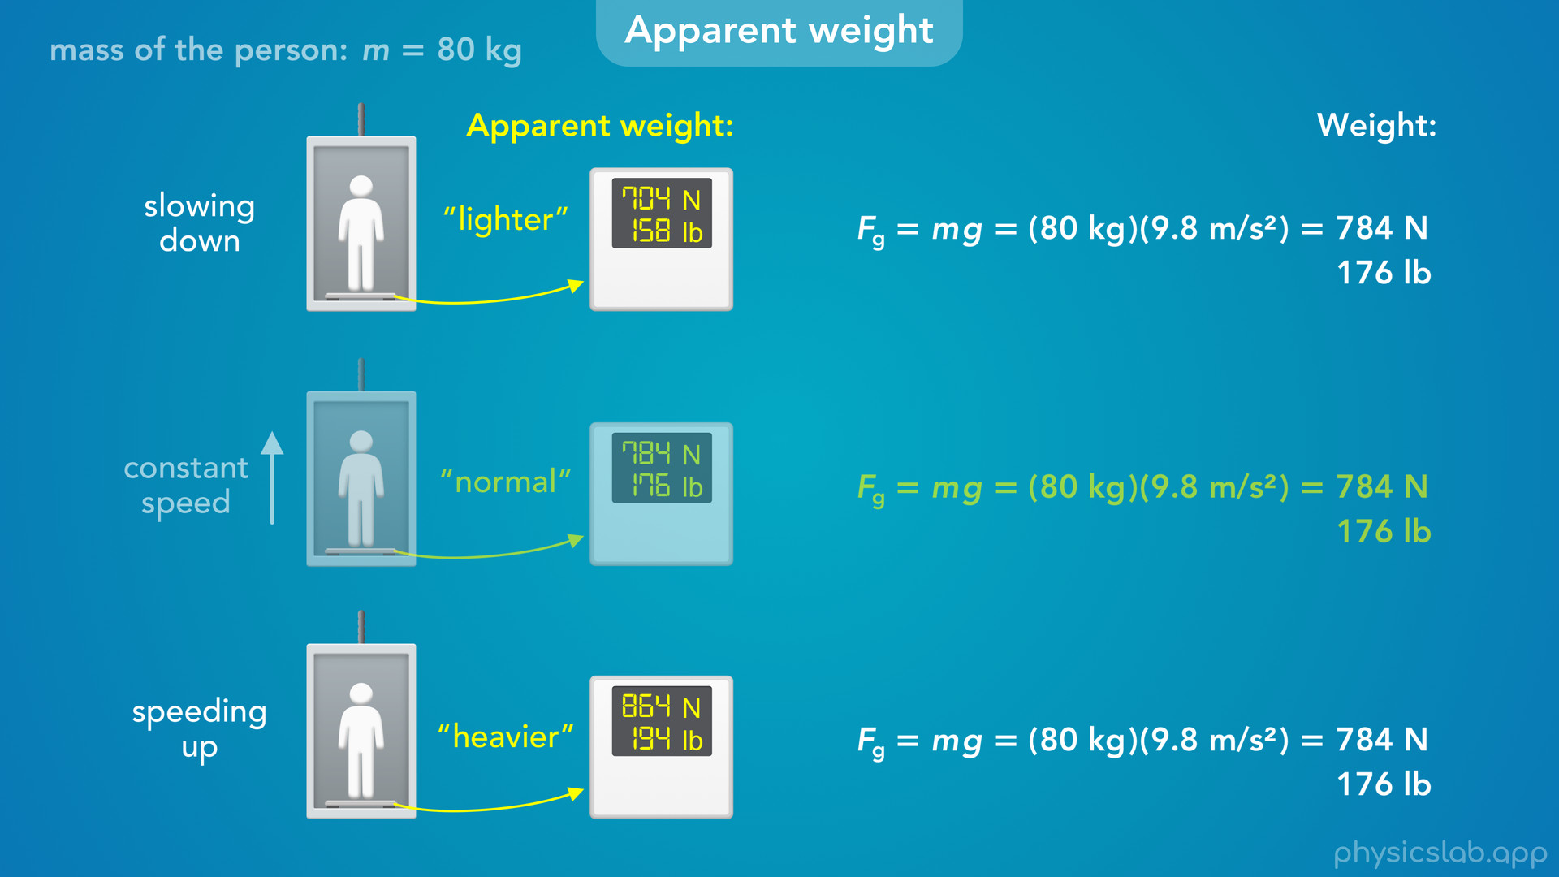
Notes:
• But when you’re speeding up and slowing down, your apparent weight changes.
• So what’s causing you to feel heavier or lighter?
• Gravity is the same in each case.

Slide 28
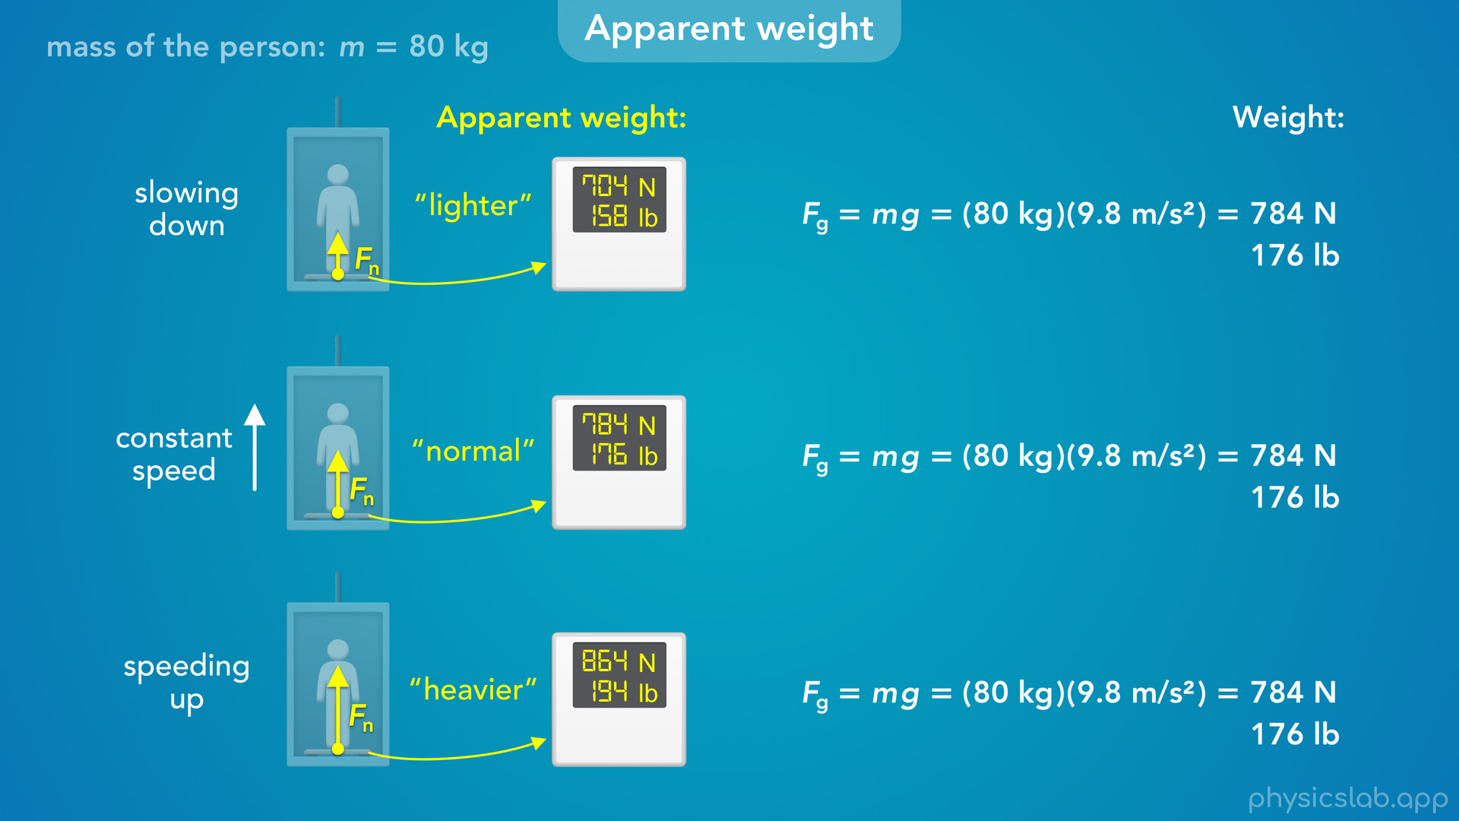
Notes:
• And the only other force that’s acting on you is a force from the floor, pushing upwards against your feet, and we call that a normal force.
• That’s the force that you feel, and that’s what’s changing.

Slide 29
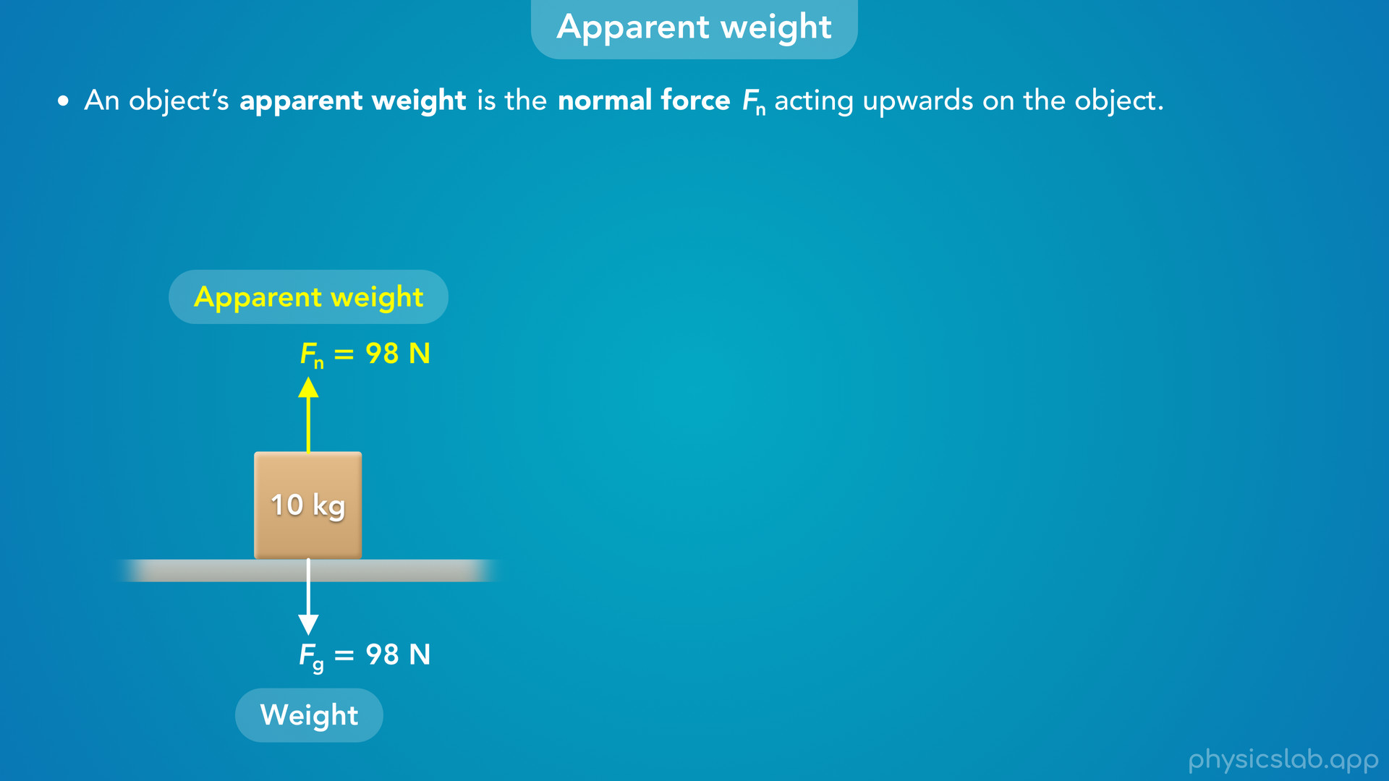
Notes:
• So, an object’s apparent weight is the normal force, Fn, acting upwards on the object.
• For example, this 10 kg box is sitting on the ground.
• There is a downwards gravitational force from the earth, which we call the weight, and there’s an upwards normal force because the box is in contact with the ground.
• That normal force is the apparent weight of the box. This is just a label for the normal force, and in this case the apparent weight is equal to the actual weight, 98 N.

Slide 30
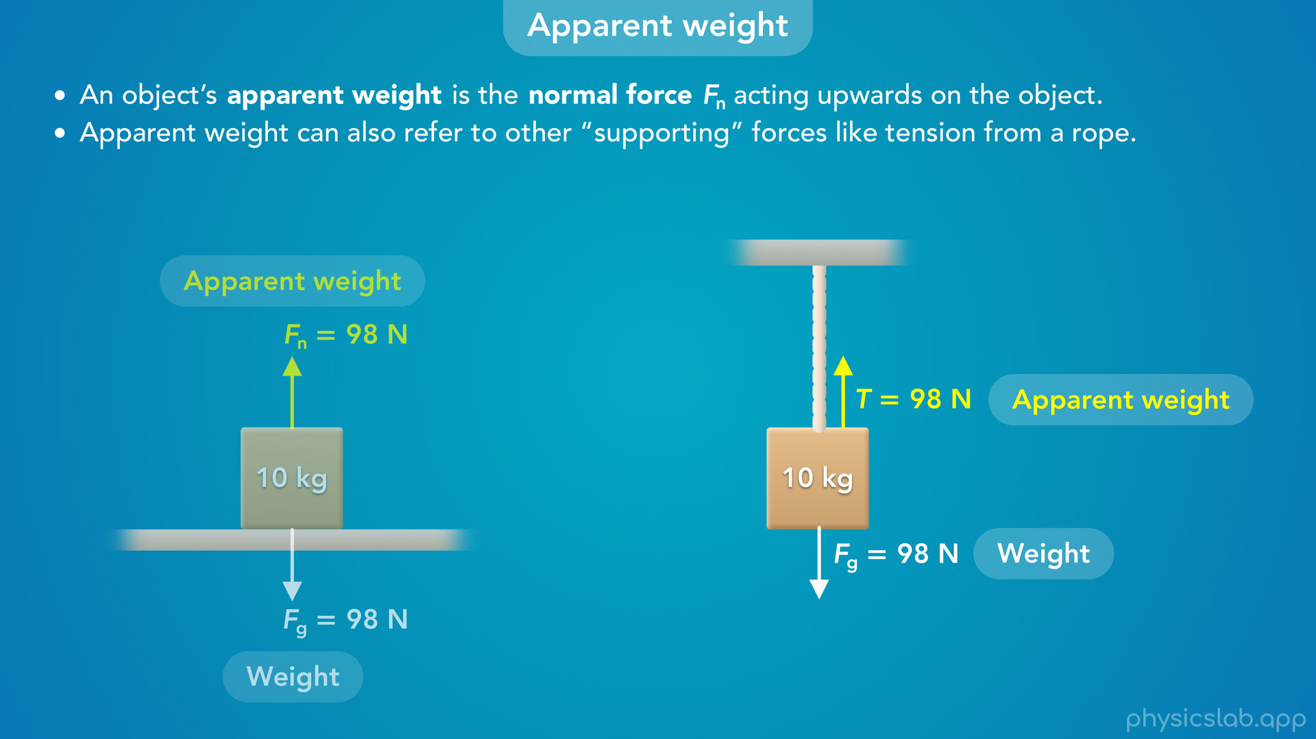
Notes:
• Apparent weight can also refer to other supporting forces like tension from a rope.
• Here the box is hanging from a rope and there’s no normal force, so the apparent weight might refer to this upwards tension force.
• But most of the time, apparent weight means the normal force, and a question will probably tell you if it means something else.

Slide 31
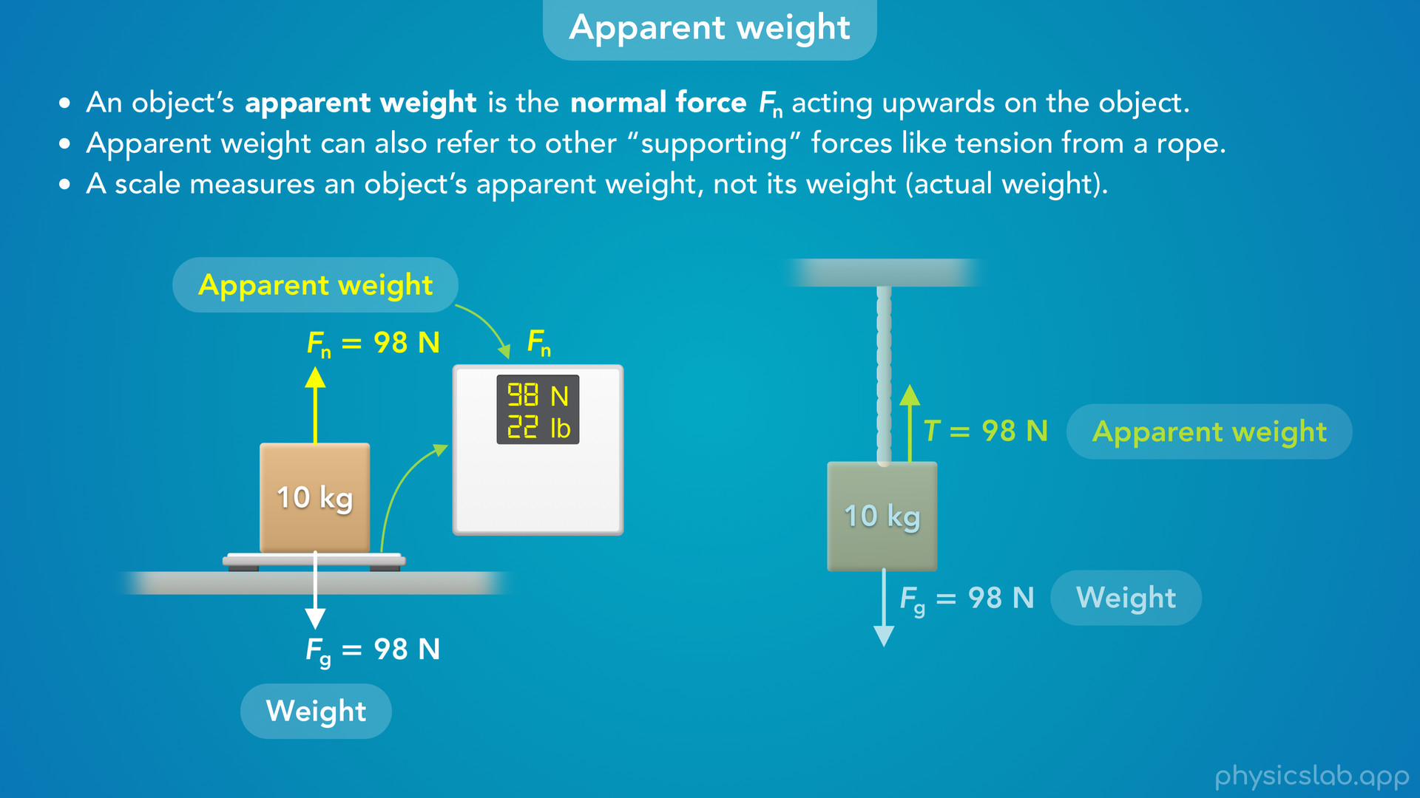
Notes:
• We learned in another video that a scale measures the normal force on an object, and the apparent weight is the normal force, so a scale measure’s an object’s apparent weight, not its weight or its actual weight.

Slide 32

Notes:
• Or if we attached a hanging scale to this rope, the scale would measure the tension force in the rope, which would tell us the apparent weight of the box.
• So why do we usually think that a scale measures an object’s weight?

Slide 33
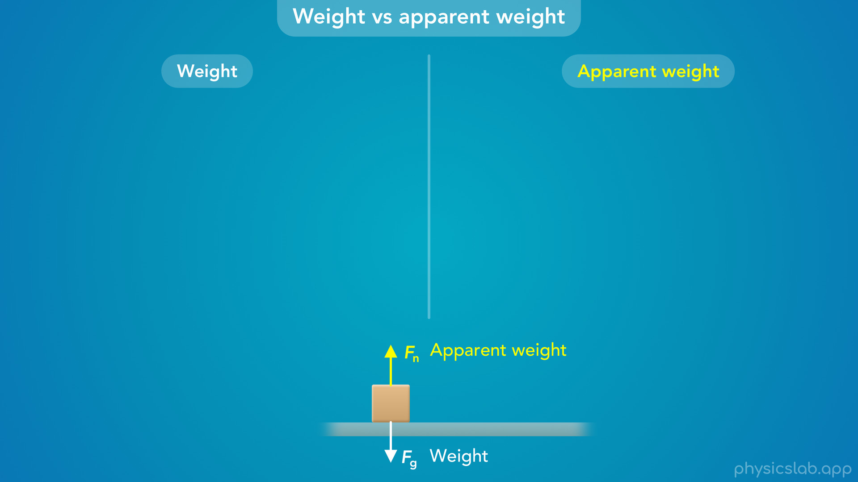
Notes:
• Let’s review the difference between weight and apparent weight, and then we’ll see when they’re equal and when they’re different.

Slide 34
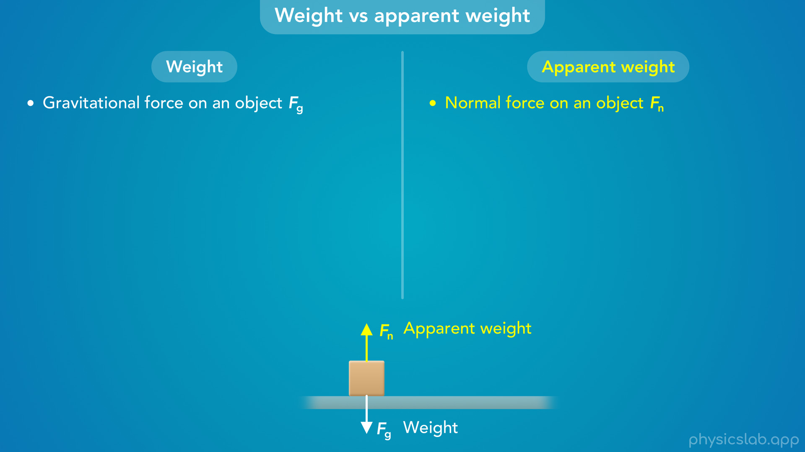
Notes:
• Weight is the gravitational force on an object, Fg
• And apparent weight is the normal force on an object, Fn. Or like we said, it could be another force like tension.

Slide 35
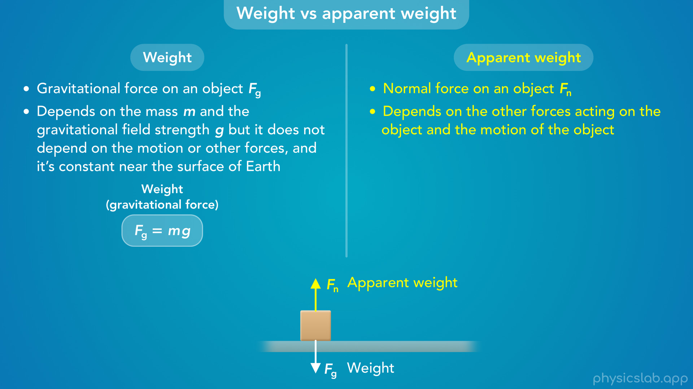
Notes:
• An object’s weight depends on its mass m and the gravitational field strength g, which is also the accelerating due to gravity, but it does not depend on the object’s motion or other forces, and we assume an object’s weight is constant near the surface of the earth, because we assume g is constant.
• An object’s apparent weight depends on the other forces acting on the object and it depends on the motion of the object, which we’ll see in a minute.

Slide 36
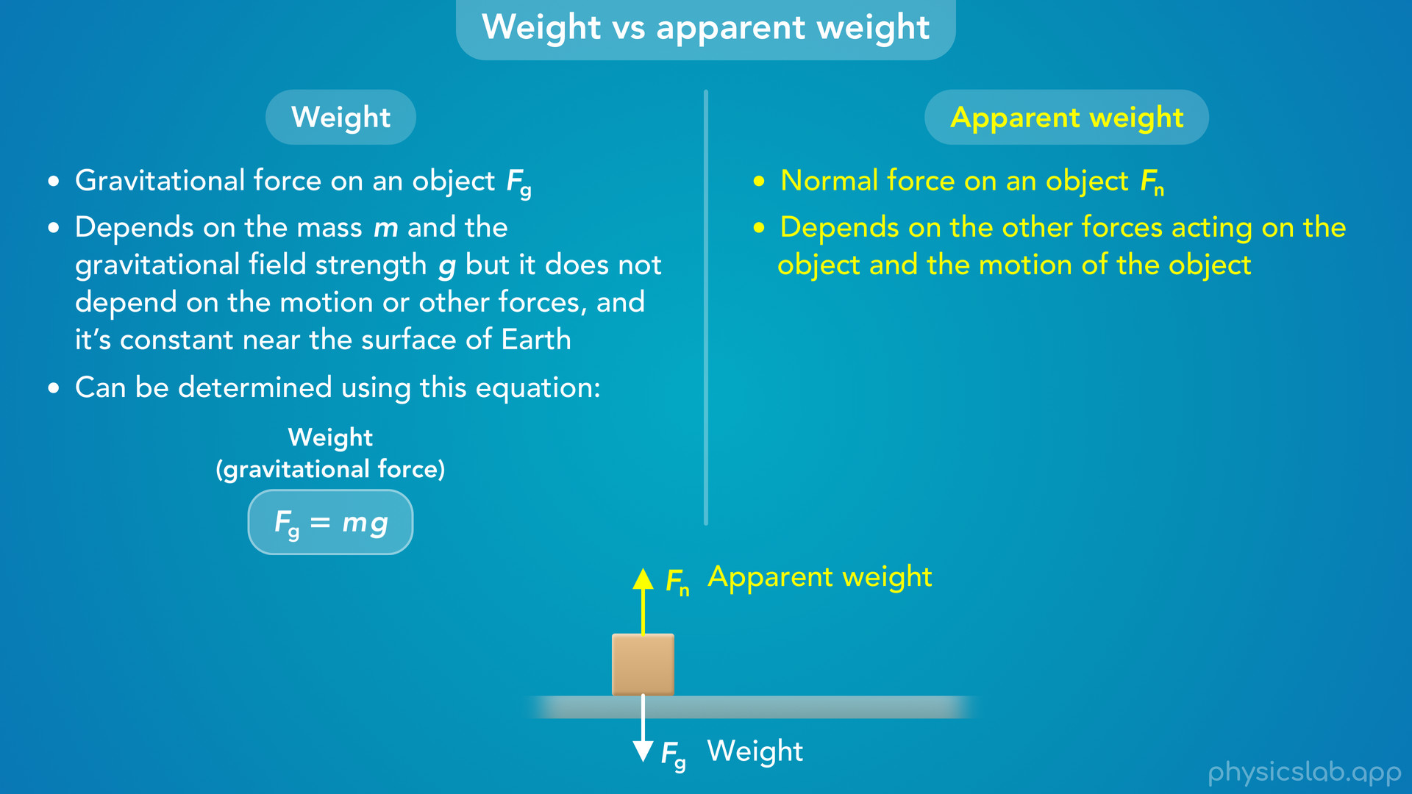
Notes:
• An object’s weight can be determined using this equation, and it’s always equal to mg.

Slide 37
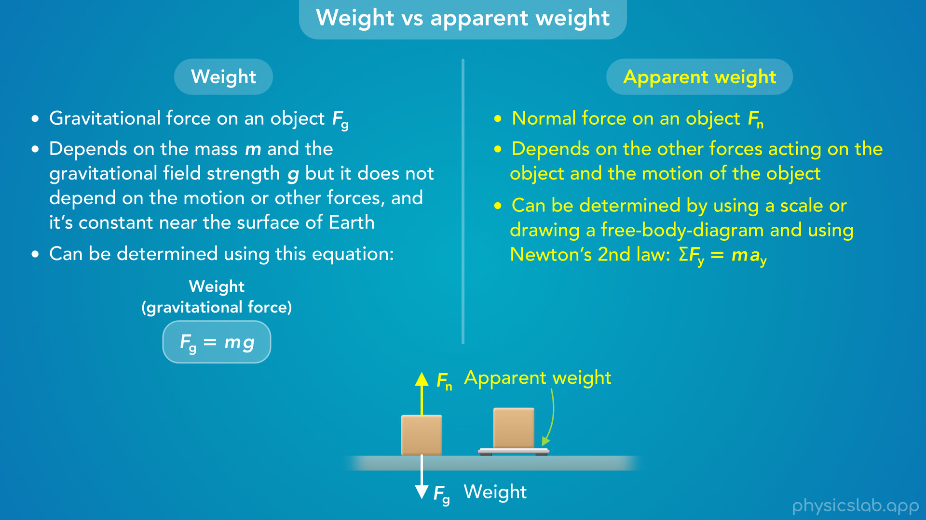
Notes:
• An object’s apparent weight can be determined using a scale like we just mentioned, or by drawing a free body diagram and using Newton’s 2nd law, usually in the y direction.

Slide 38

Notes:
• And finally, an object’s apparent weight will be equal to its actual weight if the object is not accelerating up or down, and ay is 0.
• This is true if the object is sitting at rest, like this box, or if it’s moving at a constant speed.

Slide 39
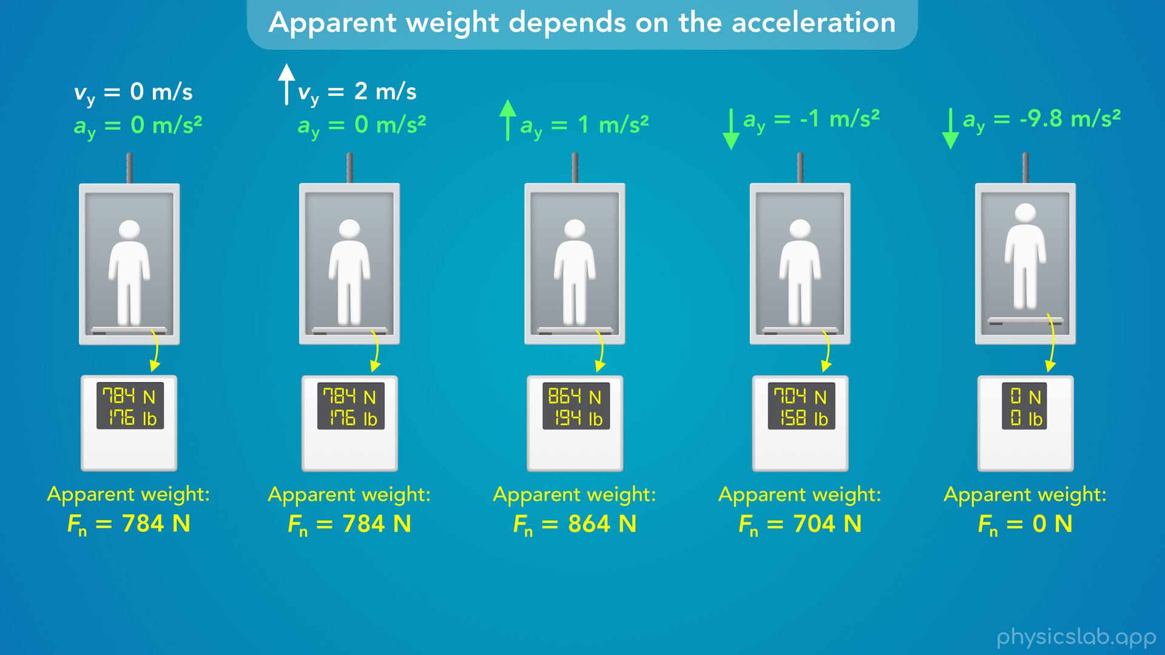
Notes:
• Let’s explore that last point and walk through some examples of finding a person’s apparent weight in an elevator.

Slide 40
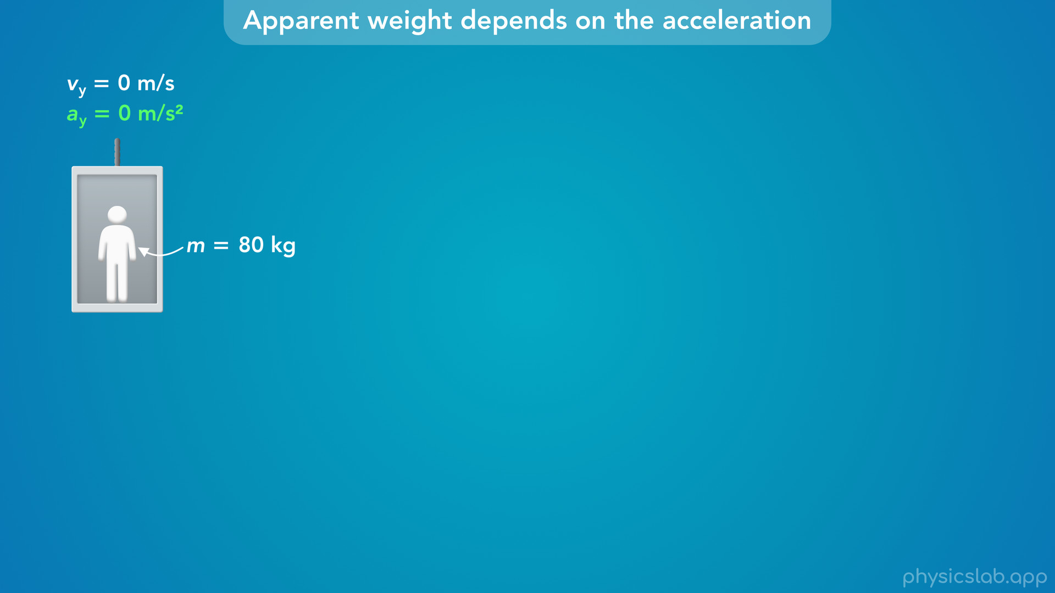
Notes:
• In this first scenario, the elevator is not moving so it’s velocity is zero, and its acceleration is zero.

Slide 41
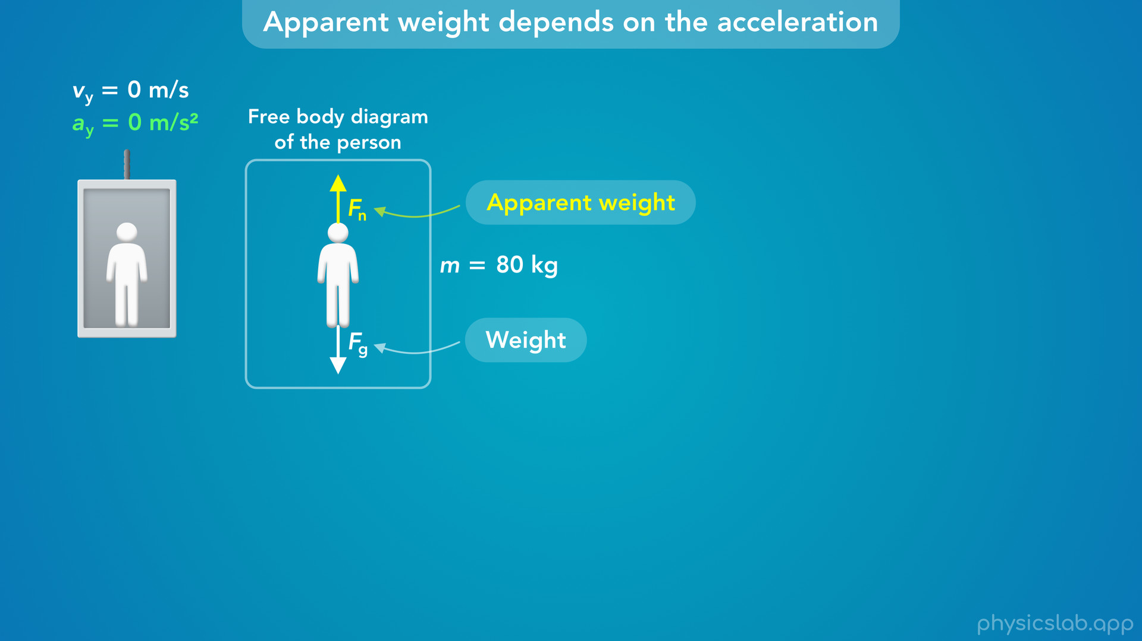
Notes:
• If we draw a free body diagram of the person, there’s a downwards gravitational force, which is the weight, and an upwards normal force from the floor, which is the apparent weight.

Slide 42
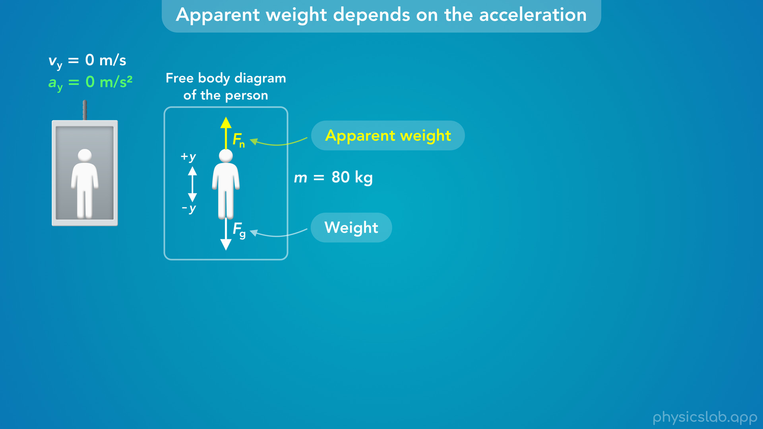

Slide 43
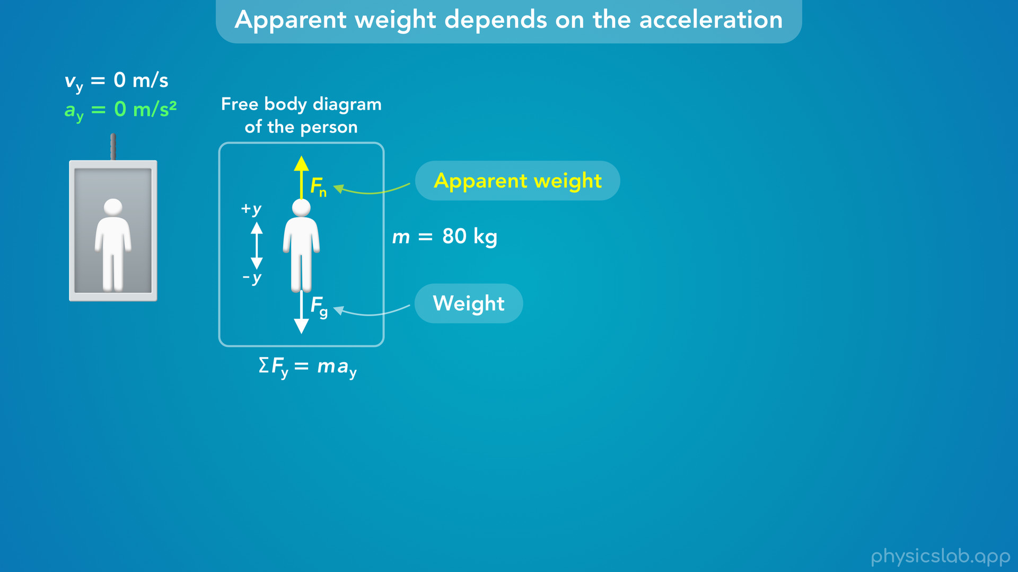
Notes:
• And let’s say up is the positive y direction.
• We can find the weight using the weight equation, but to find the apparent weight we need to use Newton’s 2nd law in the y direction.

Slide 44
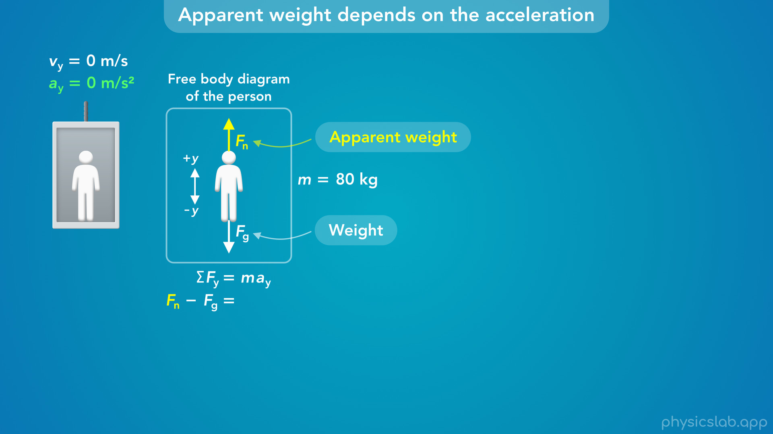
Notes:
• The net force is the normal force minus the weight force because we said up is positive.

Slide 45
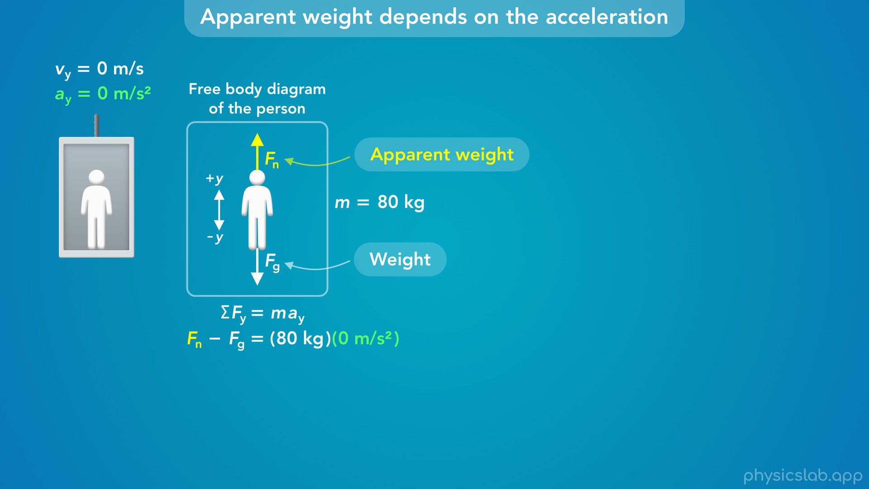
Notes:
• We plug in 80 kg for the mass of the person, and 0 m/s^2 for their acceleration.

Slide 46
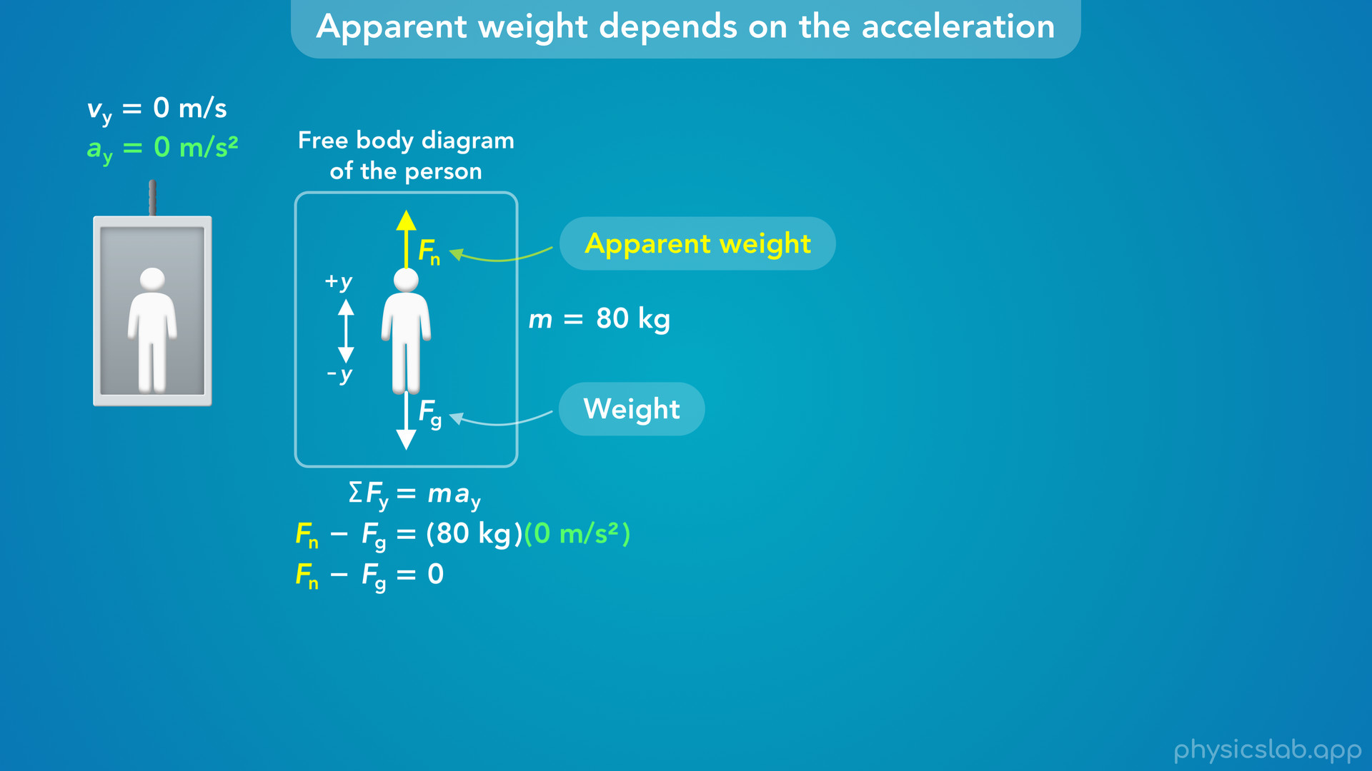
Notes:
• The right side of this equation just becomes zero,

Slide 47

Notes:
which means the normal force is equal to the weight force.

Slide 48
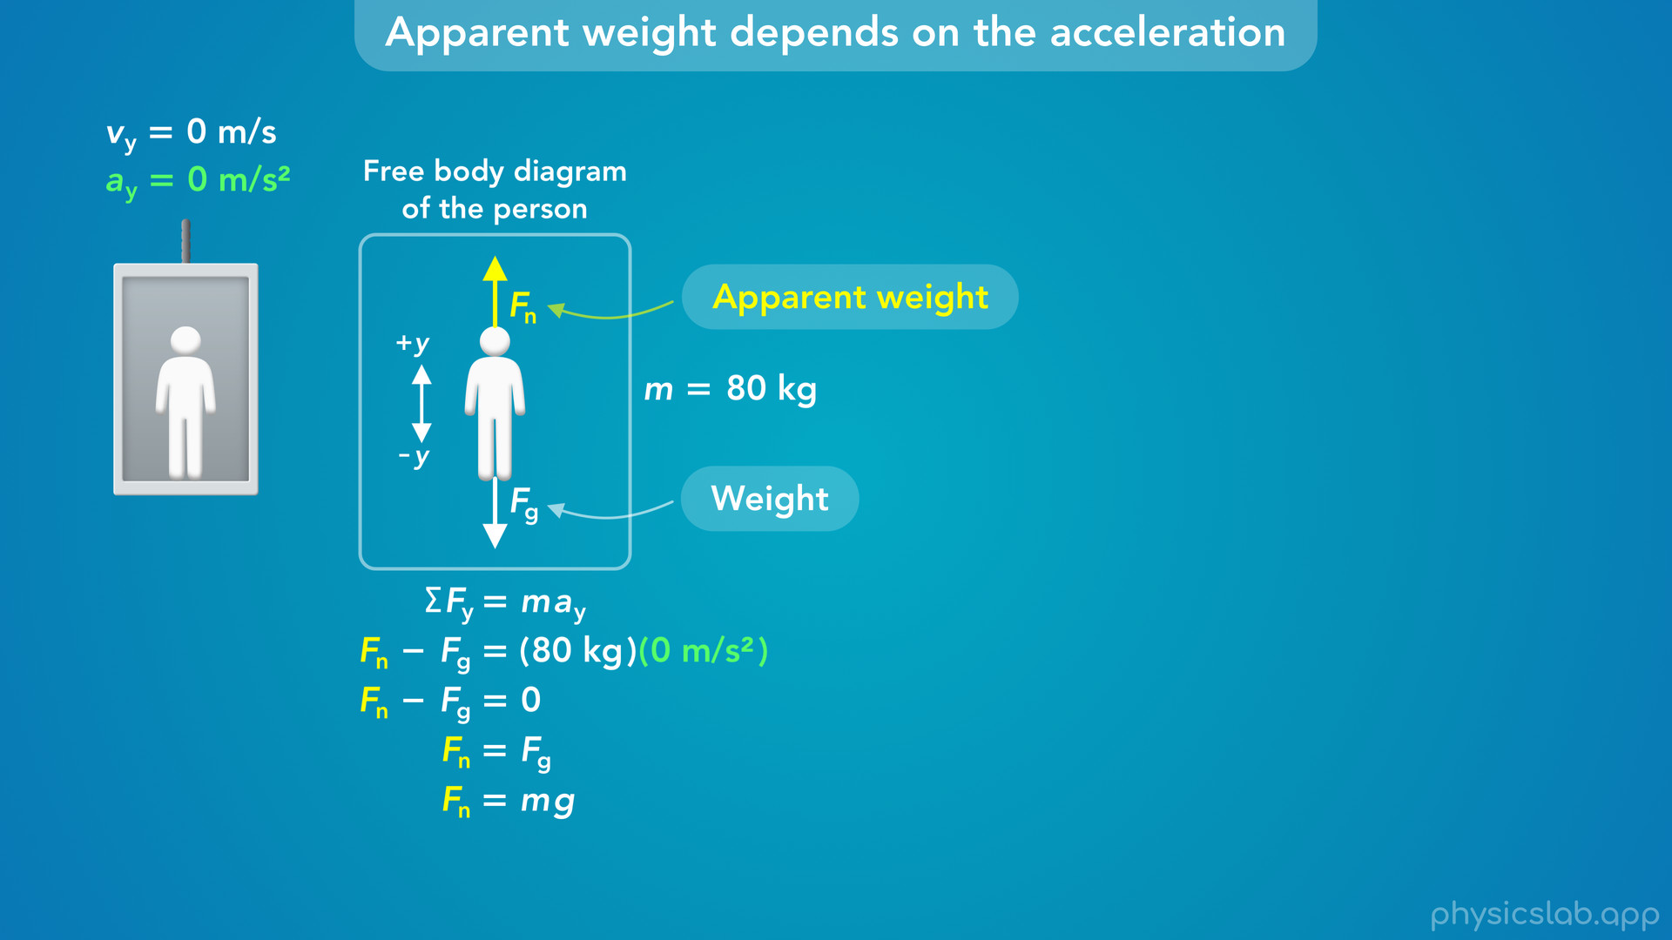
Notes:
• We can replace the weight force with mg

Slide 49
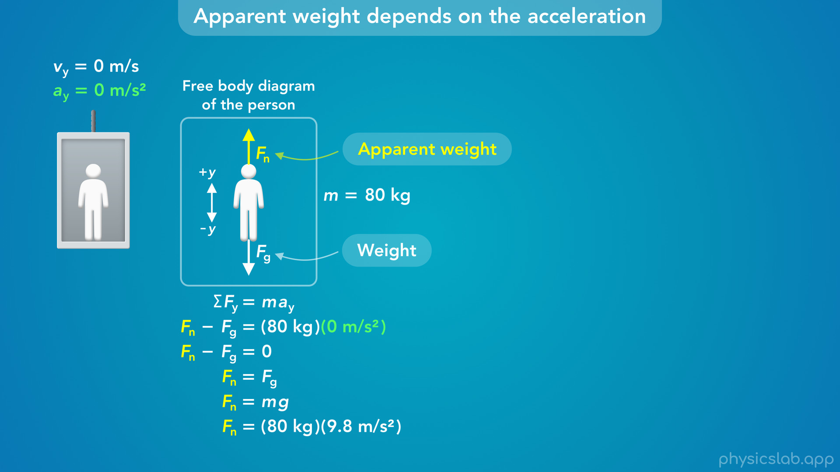
Notes:
and plug in 80 kg for the mass and 9.8 m/s^2 for g.

Slide 50
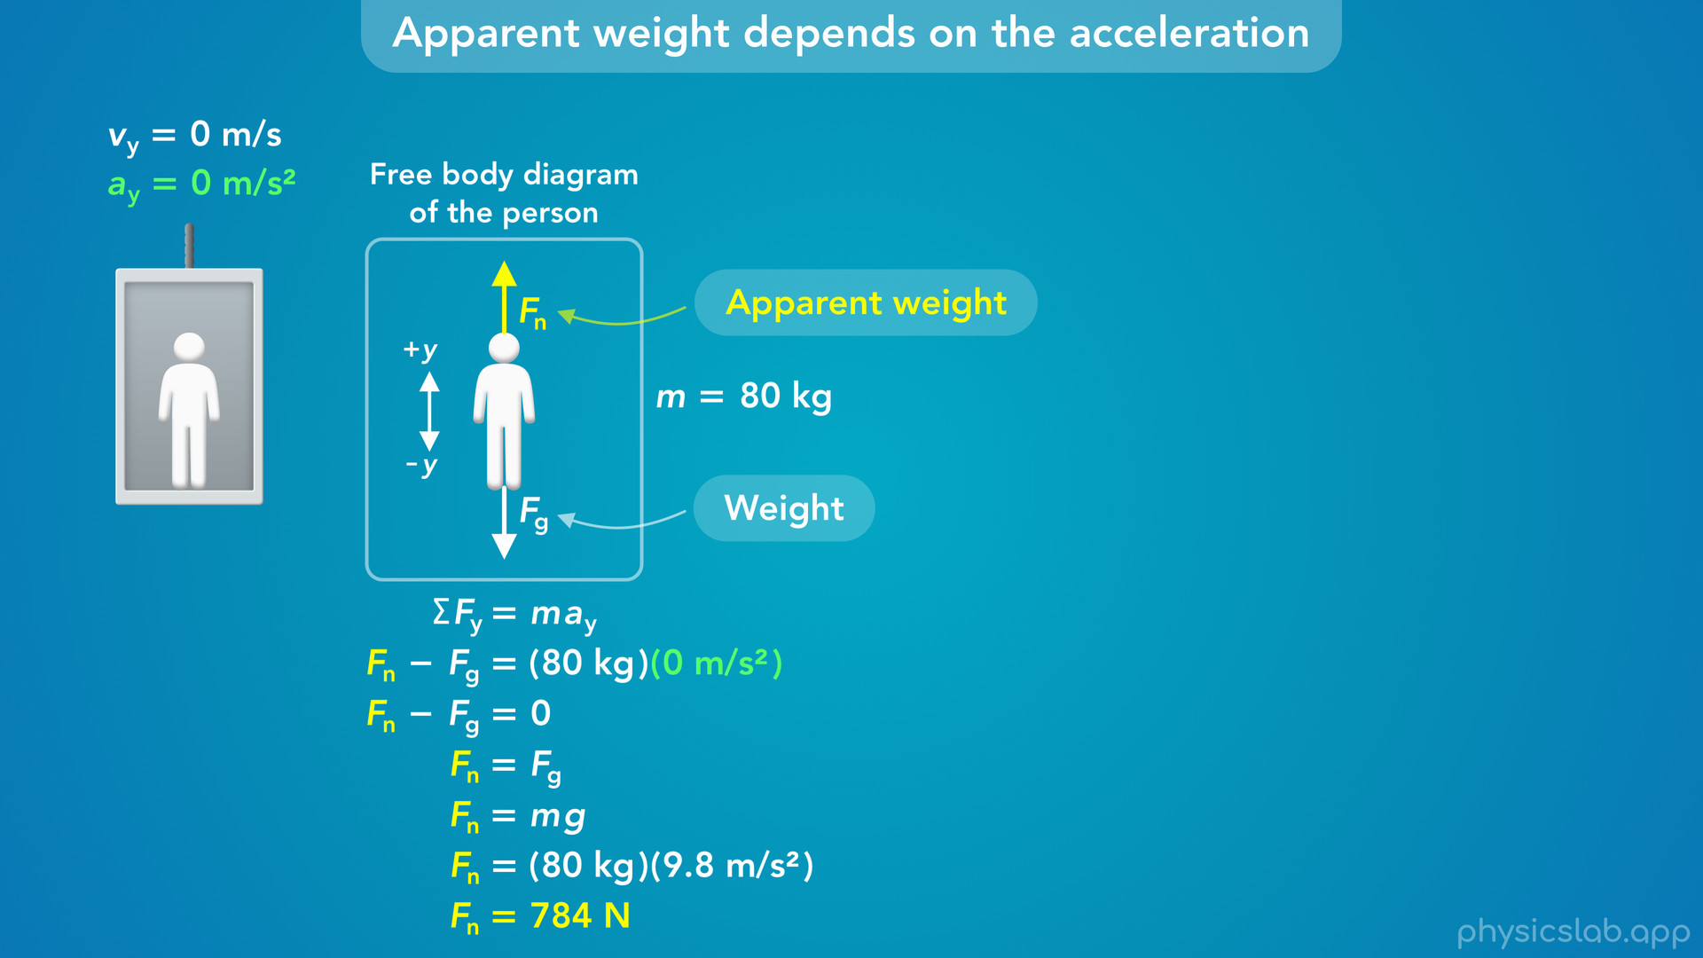
Notes:
• That gives us 784 N for the normal force acting on the person, and that’s their apparent weight.

Slide 51

Notes:
• If we have the person stand on a scale in the elevator, the scale would measure the apparent weight.
• But notice that in this case, the person’s apparent weight is equal to their actual weight, and they would feel normal, like they’re standing on the ground.

Slide 52

Notes:
• That’s because the person is not accelerating up or down, so the net force on the person must be zero.
• These are the only 2 vertical forces on the person, so they must be equal to each other.

Slide 53

Notes:
• In the next scenario, the elevator is moving upwards with a constant velocity of 2 m/s.
• But it’s not accelerating, so a is still zero.

Slide 54

Notes:
• That means that the forces and the equation for Newton’s 2nd law is the same as the last scenario.
• Remember that forces are related to an object’s acceleration, not the velocity.
• So it doesn’t matter that this elevator is moving at a velocity of 2 m/s.
• The person’s apparent weight is still equal to their weight.

Slide 55

Notes:
• The elevator could also be moving downwards at 2 m/s

Slide 56

Notes:
or even 100 m/s.
• As long as the velocity is constant so the acceleration is 0, their apparent weight is equal to their actual weight.
• If you were in this elevator, moving at a constant velocity of 100 m/s, you wouldn’t actually be able to tell that you’re moving, except for maybe some noise and vibrations.
• You would feel the elevator accelerate and get up to that speed, but once you’re moving at a constant velocity, it would feel the same as the elevator that’s not moving.

Slide 57

Notes:
• So what if there is acceleration?
• In the next scenario, let’s say the elevator is accelerating upwards at 1 m/s^2.

Slide 58

Notes:
• Now when we write out Newton’s 2nd law, we would plug in positive 1 m/s^2 for the acceleration, because we said up is the positive y direction.

Slide 59

Notes:
• The right side of the equation simplifies to 80 N, not 0

Slide 60

Notes:
so now the normal force is equal to the weight force plus 80 N.

Slide 61

Notes:
• If we replace the weight with mg and plug in those values

Slide 62

Notes:
we get 864 N for the normal force and the apparent weight.

Slide 63

Notes:
• So now, the apparent weight is greater than the actual weight.
• The person is accelerating upwards, so the net force must be upwards, so the normal force must be greater than the weight force.
• And remember that acceleration is a change in velocity, which is a vector.
• This elevator could be moving upwards and speeding up, or it could be moving downwards and slowing down.
• The acceleration is upwards in both cases.
• So if you’re in an elevator, you would feel heavier any time it’s accelerating upwards, either at the beginning or the end of the ride.

Slide 64

Notes:
• What if the elevator was accelerating downwards at 1 m/s^2?

Slide 65

Notes:
• Now, we would plug in negative 1 for a, because we said down is the negative y direction.

Slide 66

Notes:
• This means that the normal force is equal to the weight force minus 80 N.

Slide 67

Notes:
• That’s going to give us 704 N for the normal force.

Slide 68

Notes:
• So when the person is accelerating downwards, the net force is downwards, so their apparent weight is less than their actual weight and they feel lighter.
• Again, this could happen at the beginning or the end of the ride, depending on whether you’re going up or down.

Slide 69

Notes:
• Finally, what would be the person’s apparent weight if the elevator was accelerating downwards at 9.8 m/s^2?

Slide 70

Notes:
• We would plug that value in for a in Newton’s 2nd law.

Slide 71

Notes:
• When we solve for the normal force, we get 0 N.

Slide 72

Notes:
• So there’s actually no normal force acting on this person and they have zero apparent weight, which we refer to as “weightlessness”.
• Their actual weight is still 784 N, but their apparent weight is zero.

Slide 73

Notes:
• This might seem weird at first, but we know that 9.8 m/s^2 is the acceleration due to gravity.
• So if the elevator and the person are both accelerating downwards at that rate, then they’re just falling, or we could say they’re in free fall.

Slide 74

Notes:
• This would be like dropping the elevator at some height above the ground.
• And the person’s motion would be the same even without the elevator.
• All objects in free fall accelerate downwards at 9.8 m/s^2, so the elevator, the person, and the scale all accelerate together, so there are no normal forces or contact forces between them, and the scale would read 0 N.
• The only force acting on the person is the gravitational force, so they feel weightless.
• But this is only true if their acceleration is equal to g.

Slide 75


Slide 76


Slide 77


Slide 78

Notes:
• So to recap, an object’s apparent weight is the normal force acting on it, so it depends on the vertical acceleration of the object.

Slide 79

Notes:
• If the acceleration is zero, the apparent weight is equal to the actual weight, even if it’s moving at some constant velocity up or down.

Slide 80

Notes:
• If the object is accelerating upwards, the apparent weight must be greater.

Slide 81

Notes:
• And if it’s accelerating downwards, the apparent weight must be smaller.

Slide 82

Notes:
• And if an object is accelerating downwards at g, 9.8 m/s^2, the object is in free fall so it has no normal force, no apparent weight, and we say the object is experiencing weightlessness.

Slide 83

Notes:
• So now that we know more about apparent weight, why do you feel heavier and lighter at different points on a roller coaster?

Slide 84

Notes:
• We’re gonna learn more about this in the lesson on centripetal force.
• But basically, when you’re going around a curve your net force and acceleration point towards the center of the curve.
• So when you’re at the bottom of a curve, the acceleration and net force is upwards, so the normal force is greater than the weight force, and your apparent weight is greater than your actual weight and you feel heavier.
• At the top of a curve, the acceleration and net force is downwards, so the normal force is less than the weight force, and your apparent weight is less than your actual weight, so you feel lighter.
• And if you’re not accelerating up or down, your apparent weight is equal to your actual weight and you feel normal.

Slide 85

Notes:
• And finally, why do astronauts feel weightless, and how can they float around inside the space station?

Slide 86

Notes:
• The value of g at the height of the space station is 8.7 m/s^2.
• So there’s still plenty of gravity and each person’s actual weight is still about 90% of their weight on the ground.

Slide 87

Notes:
• But we just learned that a person has zero apparent weight when they’re in free fall - when they’re accelerating towards the earth at the same rate as g.
• So the astronauts feel weightless because the space station and the astronauts are actually in free fall.
• The only force acting on them is the gravitational force, so they accelerate towards the earth at 8.7 m/s^2, the value of g at that height.

Slide 88

Notes:
• Another way to think about this, is that a person in the space station is basically the same as a person in a falling elevator.
• The astronauts and the space station are both falling at the same rate.
• So the astronauts have zero apparent weight and they can move around the space station as it falls.
• If they had scales in the space station, they would also float around and they wouldn’t be very useful.

Slide 89


Slide 90


Slide 91


Slide 92

Notes:
• So the space station is in free fall, and it’s accelerating towards the earth at 8.7 m/s^2.
• But obviously, it doesn’t just fall and crash into the earth.

Slide 93

Notes:
• That’s because it’s also moving sideways extremely fast, over 7000 m/s, so it never hits the earth and we say it’s in orbit.
• Its own inertia keeps it from falling straight down, and we’ll learn more about that in the lesson on orbital motion.
• But orbital motion is technically the same as projectile motion.
• The space station may be moving sideways at constant speed, but it’s acceleration is always towards the earth at the same rate as g.
• So there’s still gravity in space, but the astronauts are in free fall so they have no apparent weight.

Slide 94


Slide 95


Slide 96


