Slide 1
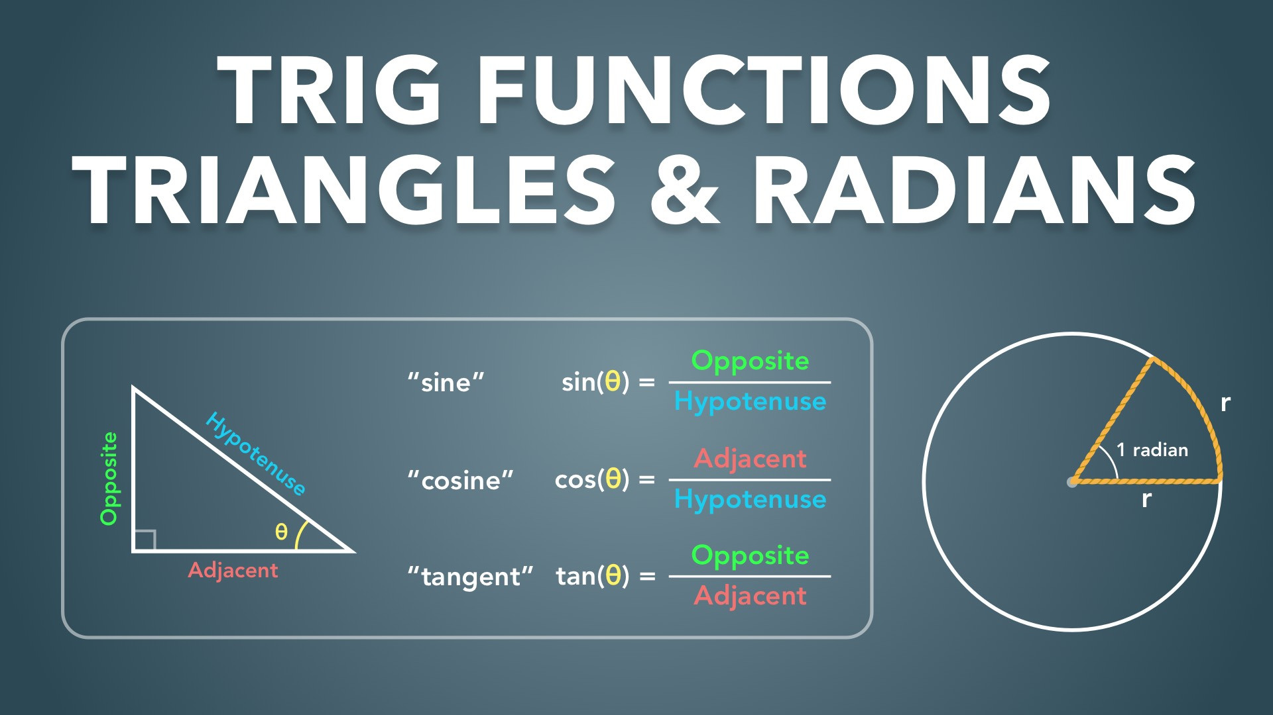
Notes:
Trig Functions, Triangles & Radians
Slides Version 1
physicslab.app
These slides include screenshots from the video. Want more slides? Less slides? Different material on the slides or a different format? If you have any questions, suggestions or feedback about these slides please email me at chris@physicslab.app or send me a message on Discord @physicslab.

Slide 2
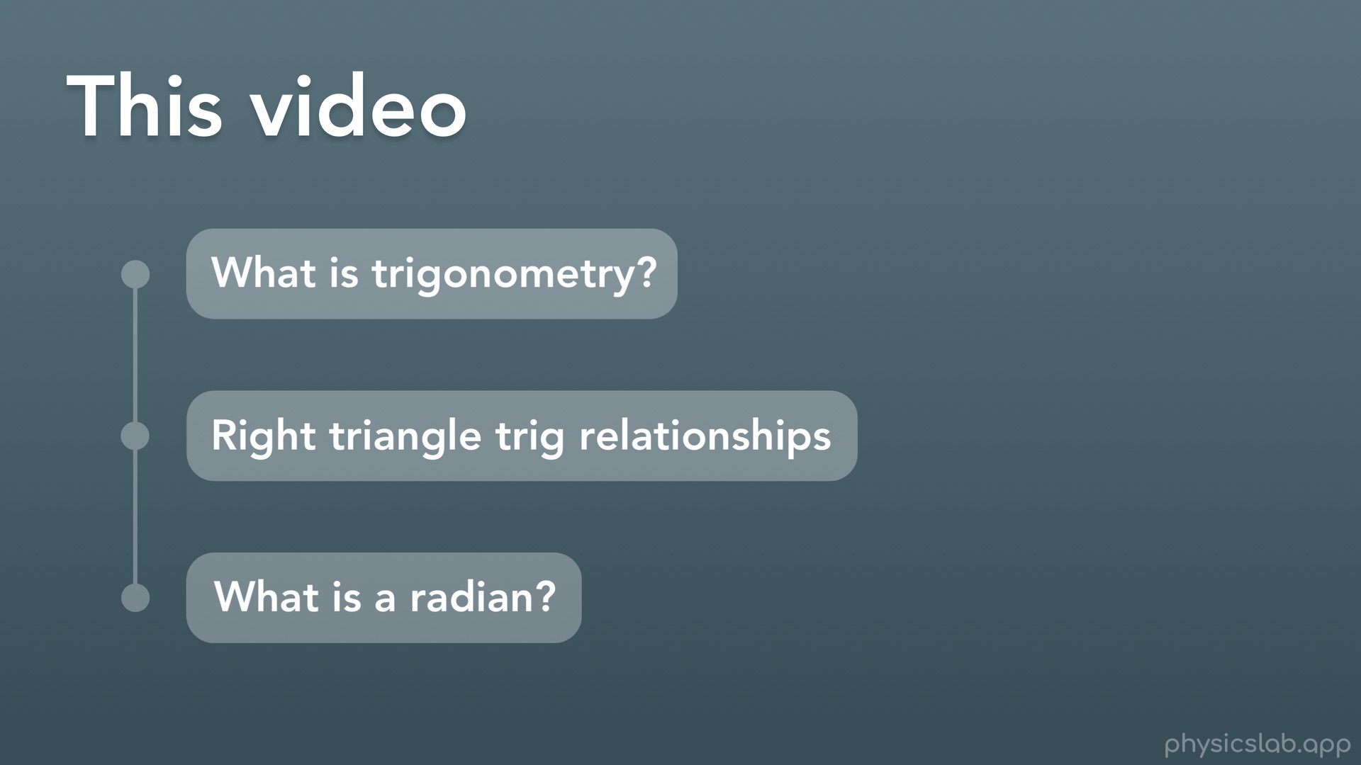
Notes:
Hey everyone, welcome to this Basics video on trigonometry and radians. Like I’ve said in the last videos, this might just be a refresher for some people but you definitely want to have a good understanding of it so I’d recommend watching it even if you’ve already learned it before.
So in this video we’ll answer the question what is trigonometry, or trig? We’ll cover the right triangle trig relationships, like sine cosine and tangent. And last we’ll talk about radians and how they’re different from degrees.

Slide 3
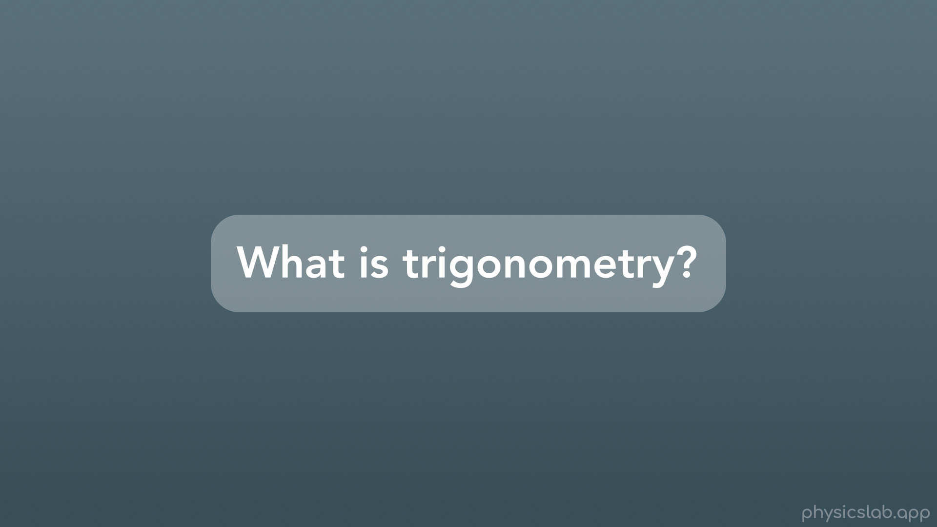

Slide 4
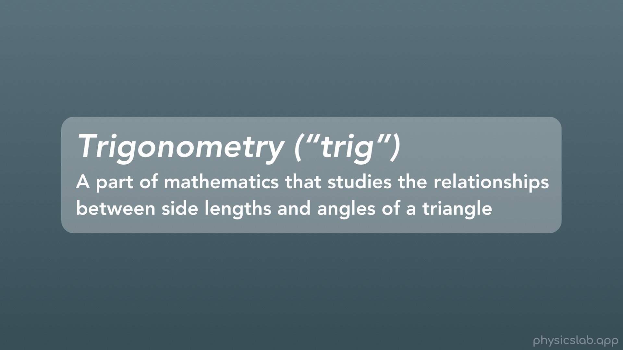
Notes:
So trigonometry, or “trig” for short, is a part of mathematics that studies the relationships between the side lengths and the angles of triangles. It’s going to help us out a lot in physics, and we’ll see why later on.

Slide 5
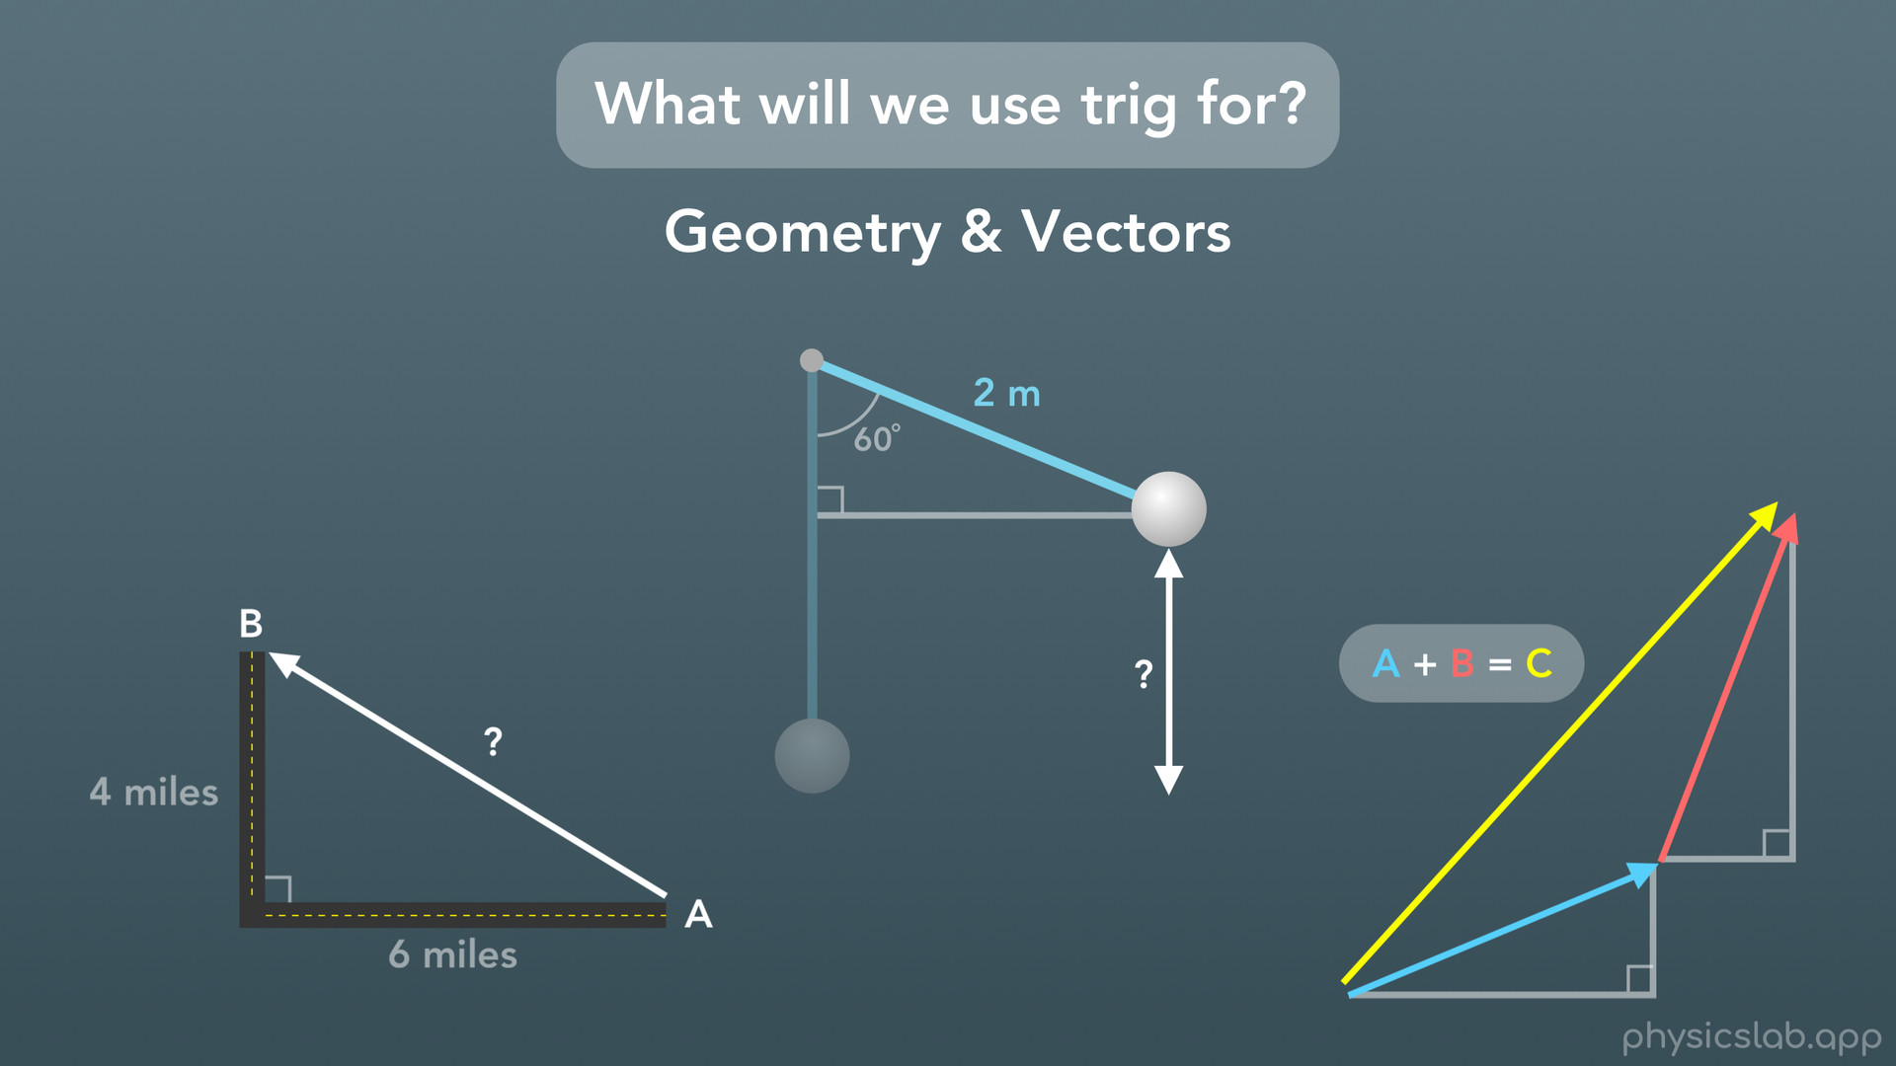
Notes:
So what will we use trig for? In short, we’ll use it for physics problems that involve geometry or what we call vectors. Here’s a few examples. If you travel 6 miles west and then 4 miles north, what is the straight line distance from your starting point to your ending point? Here we’ve formed a triangle, and it would be nice to know how the side lengths are related to each other. If you have a 2m long pendulum that swings 60 degrees, how high is the pendulum weight at that point? Just like before, we want to use triangles to help us figure it out. And when we start doing things like adding vectors together, we’ll turn each vector into a triangle to make it easier to add up the sides.

Slide 6
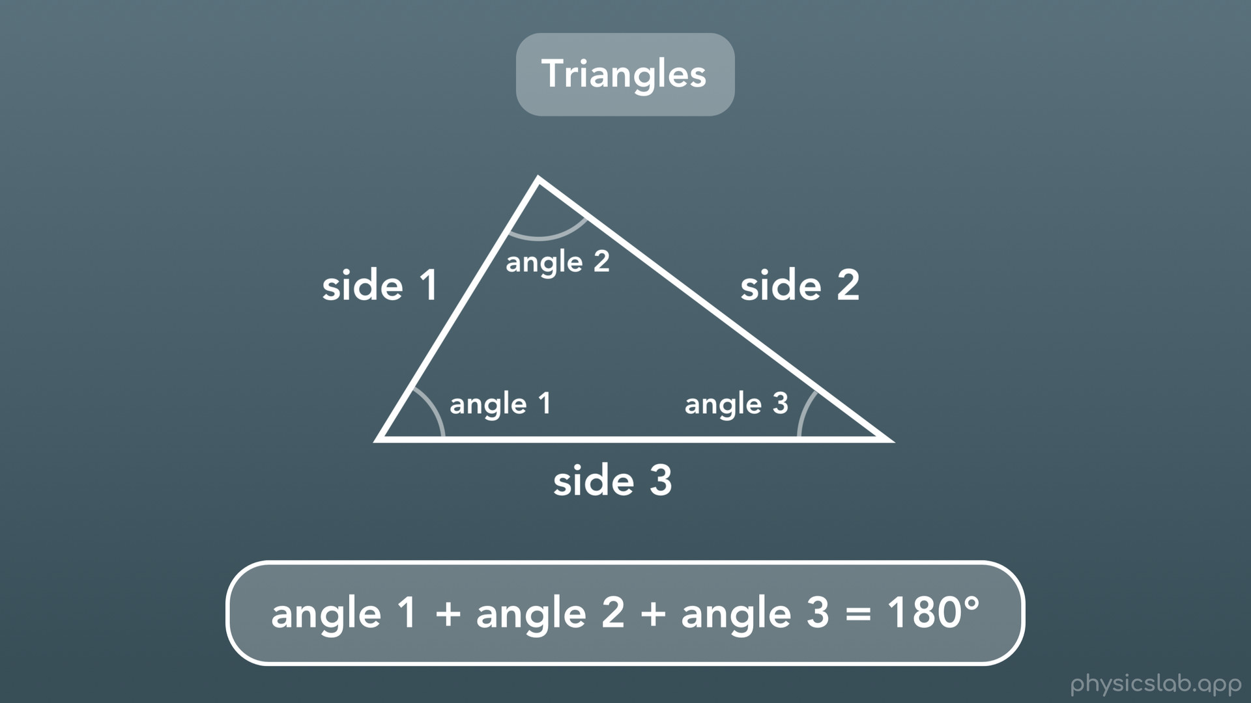
Notes:
Before we get into the trig relationships, let’s get some basic stuff about triangles out of the way. Every triangle, no matter what shape or size, has 3 sides and 3 angles that those sides form with each other. A rule about all triangles that we’ll need to remember is that if you add up the 3 angles of a triangle you will always get 180 degrees.

Slide 7
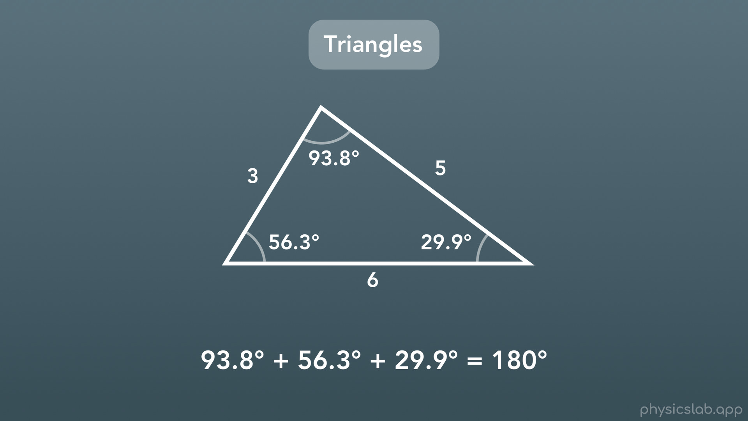
Notes:
Here’s a triangle with everything labeled. Keep in mind that when you see a number on one side of a triangle, that number represents the length of that side of the triangle. You could think of it as having units of inches or centimeters, so like this triangle has sides that are 3in, 5in, and 6in long. And when you see a number near the angle of a triangle, that number usually represents the angle in units of degrees. And just like we mentioned, if you add up all 3 of the angles of a triangle, they equal 180 degrees.

Slide 8
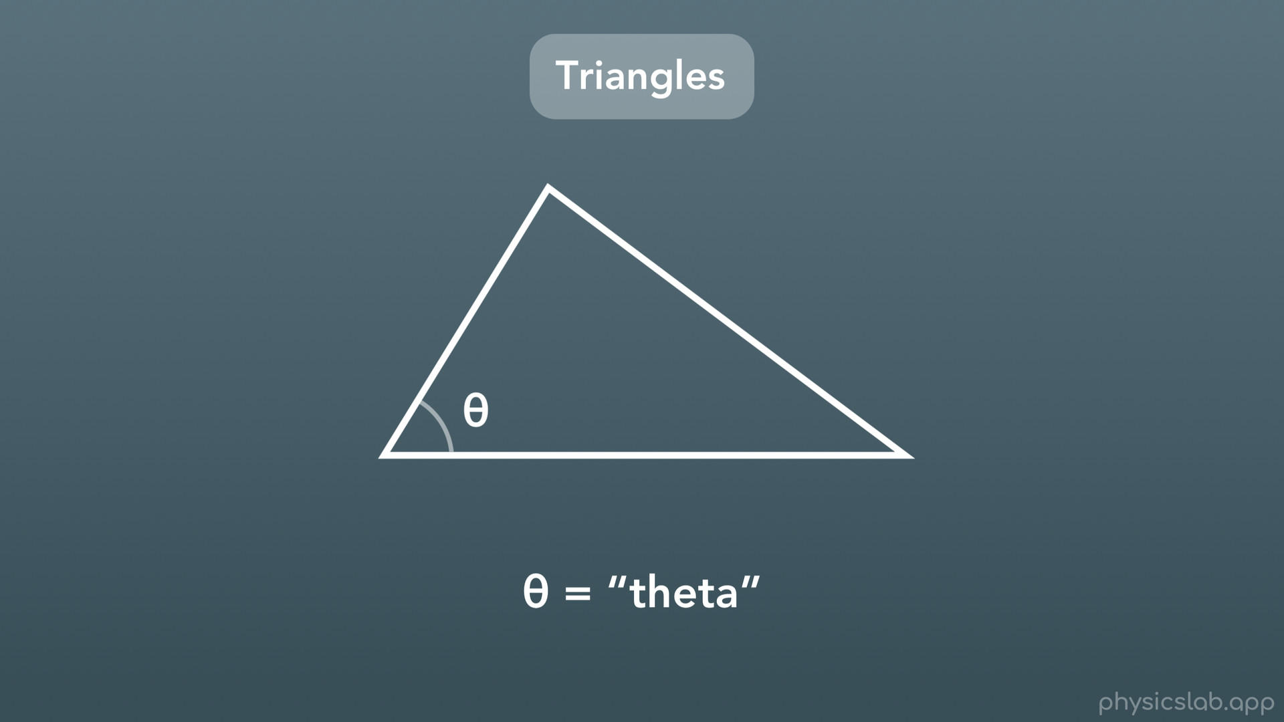
Notes:
Also, just like with algebra and equations, we sometimes put a variable in place of something that we don’t know. When we are working with an angle that we don’t know, a lot of times we’ll use this variable here, called “theta”. We can use a letter of the alphabet if we want, but you’ll see theta used a lot.

Slide 9
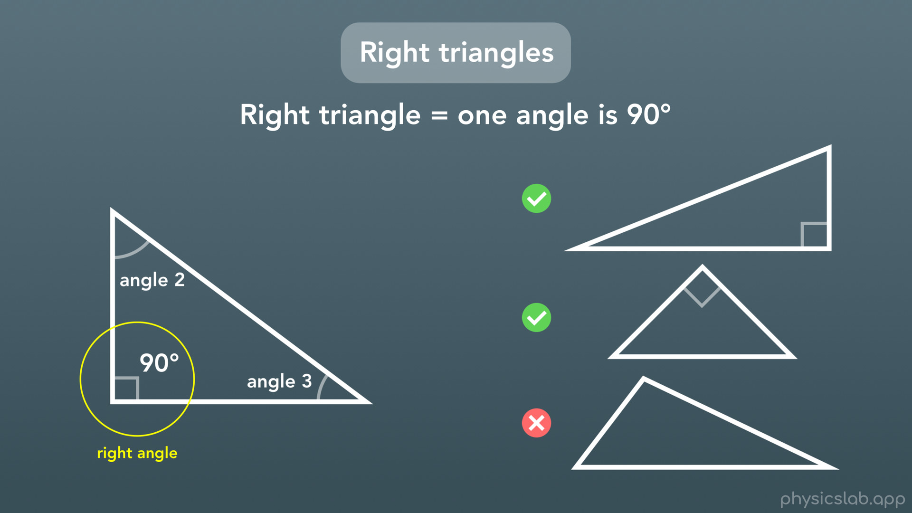
Notes:
In trig, most of the rules that we get to use only apply to right triangles. A right triangle is a triangle where one of the angles is 90 degrees, also known as a right angle. And we use this little box to show that an angle is a right angle, or 90 degrees. It doesn’t matter which angle is 90 degrees or which way it’s facing. For example, these first 2 triangles are right triangles, but the last one isn’t, because none of the angles are exactly 90 degrees.

Slide 10
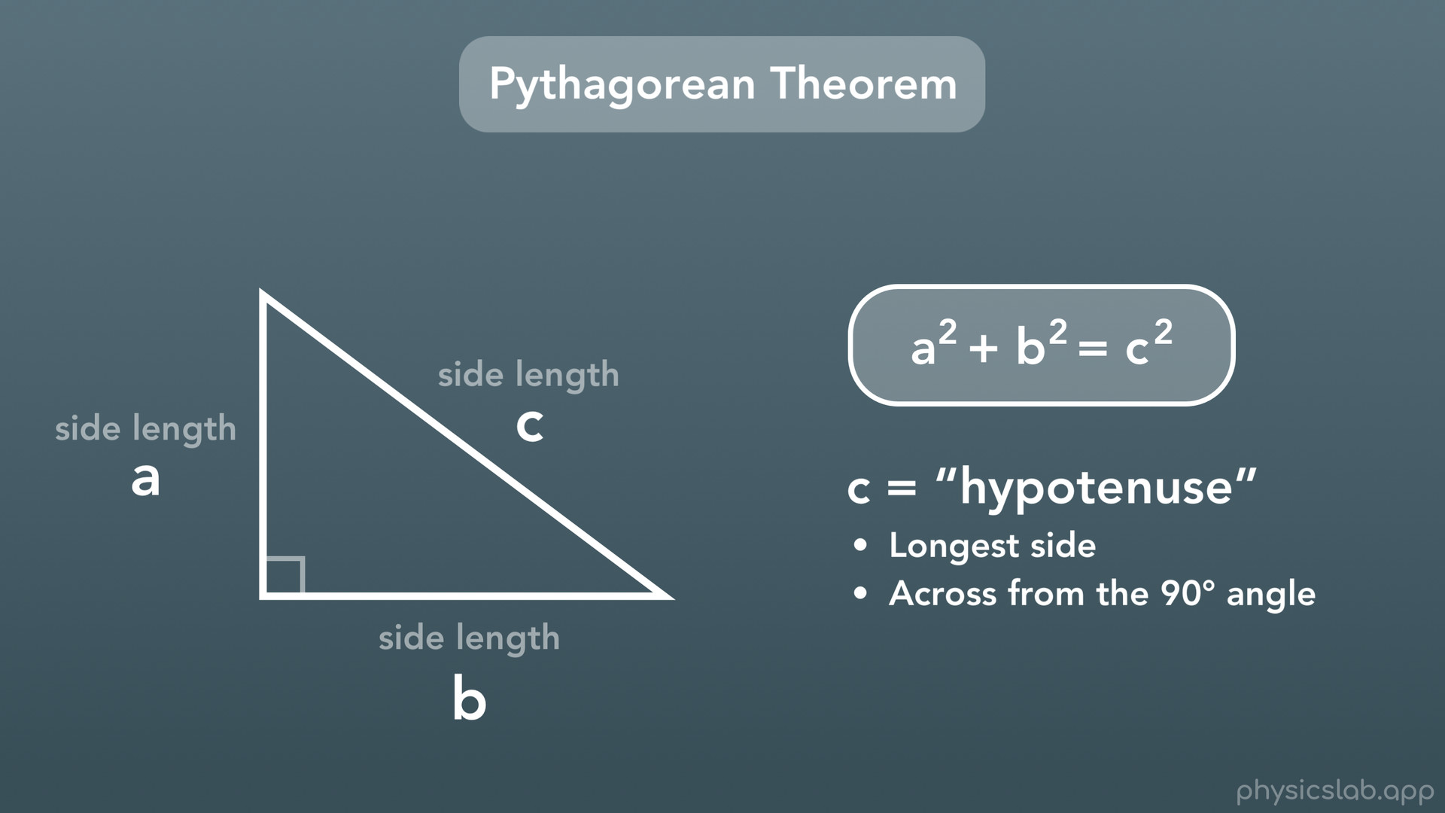
Notes:
The first rule about right triangles that we’ll be using is called the Pythagorean Theorem. If we have a right triangle and we call the 2 shorter side lengths a and b, and the longest side length c, then we get this rule: a^2 + b^2 = c^2. Also, we call c the hypotenuse. This is the longest side of the triangle, and it’s also the side that’s across from the 90 degree angle. Now when we use this equation, don’t forget that a and b are the 2 shorter sides, and c is the longest side, or the hypotenuse, otherwise the equation won’t work. Alright cool, so the Pythagorean theorem helps us with sides of a right triangle, but it doesn’t tell us anything about angles. For that we’ll need some more rules.

Slide 11
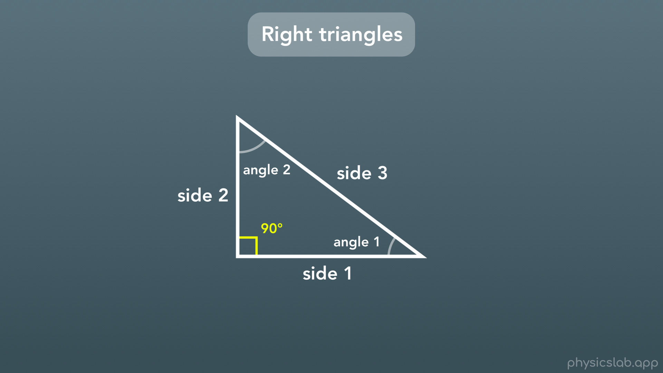
Notes:
Well, right triangles are special because, unlike regular triangles, we already know one angle. And it turns out that we only need 2 other numbers in order to figure out what every side length and angle in our triangle are.

Slide 12
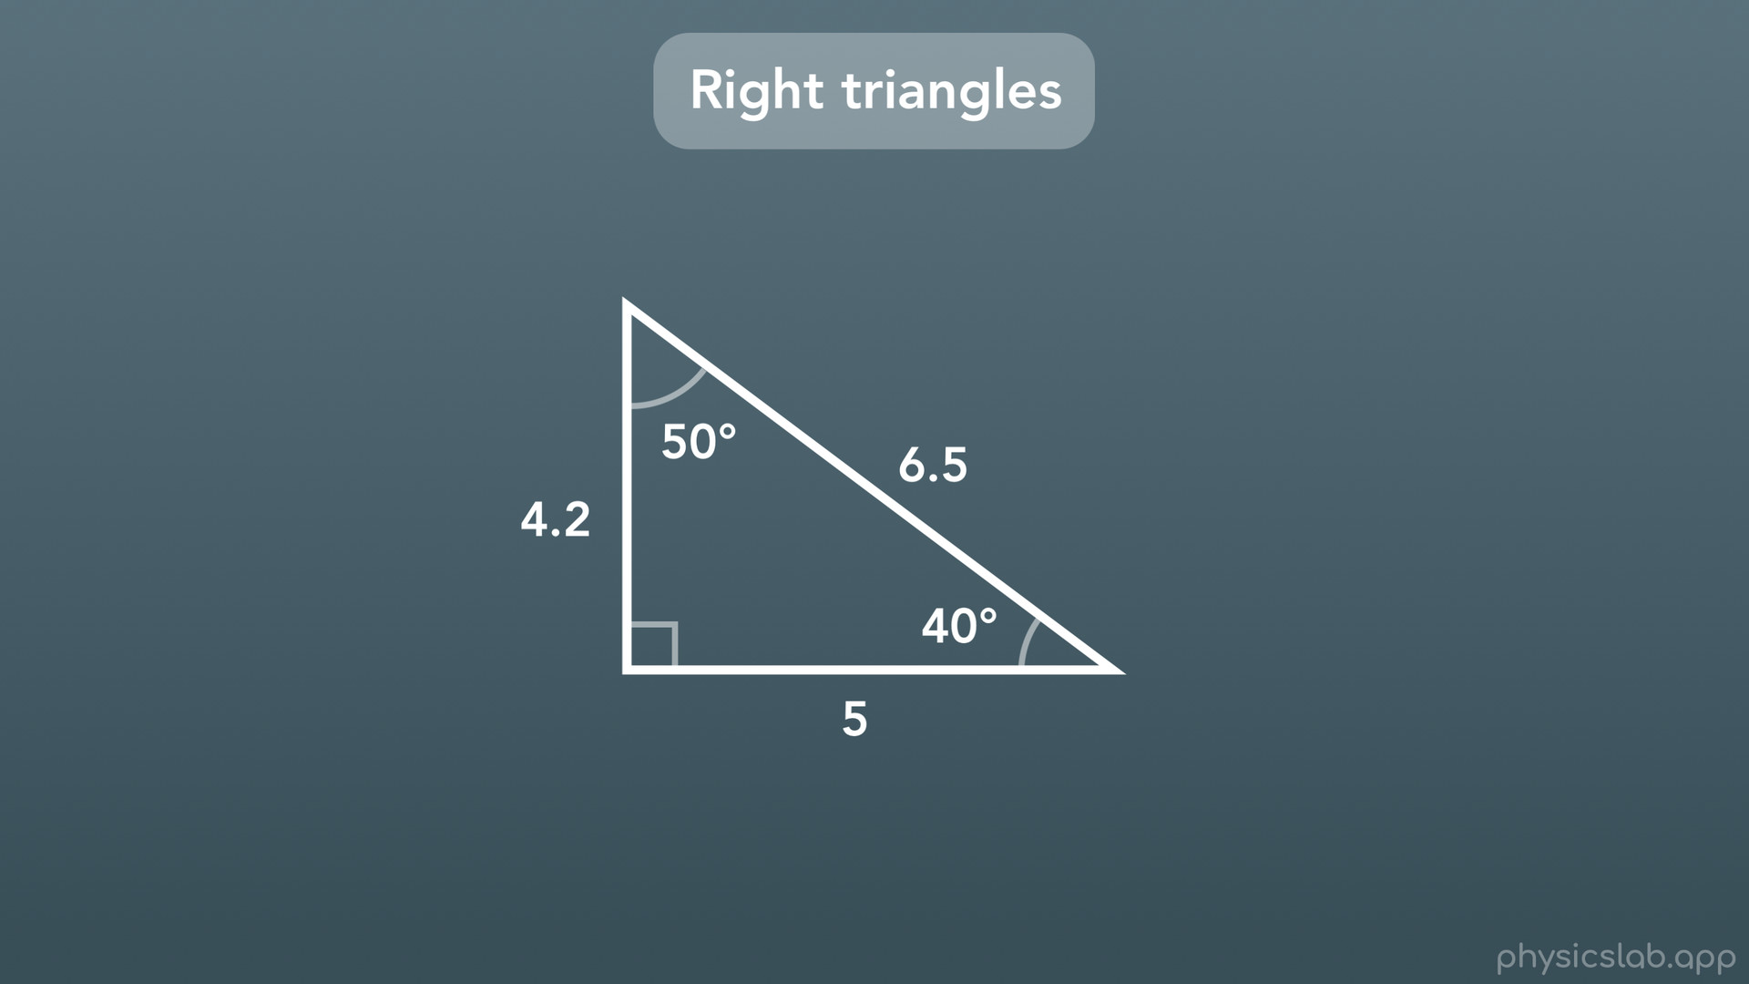
Notes:
For example, if we have a right triangle, and we’re given just one side length and one angle, we can actually figure out what the other angle and side lengths are. How can we do that?

Slide 13
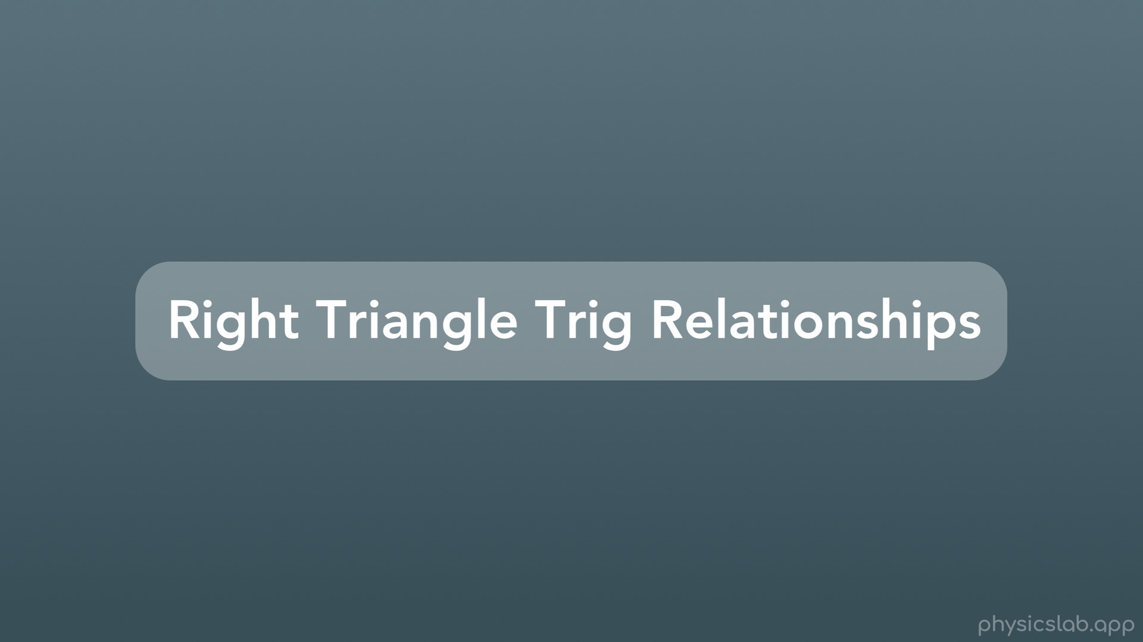
Notes:
This is probably the most important thing in the video, and what we use all of the time. These are the right triangle trig relationships: sine, cosine and tangent. Let’s walk through it.

Slide 14
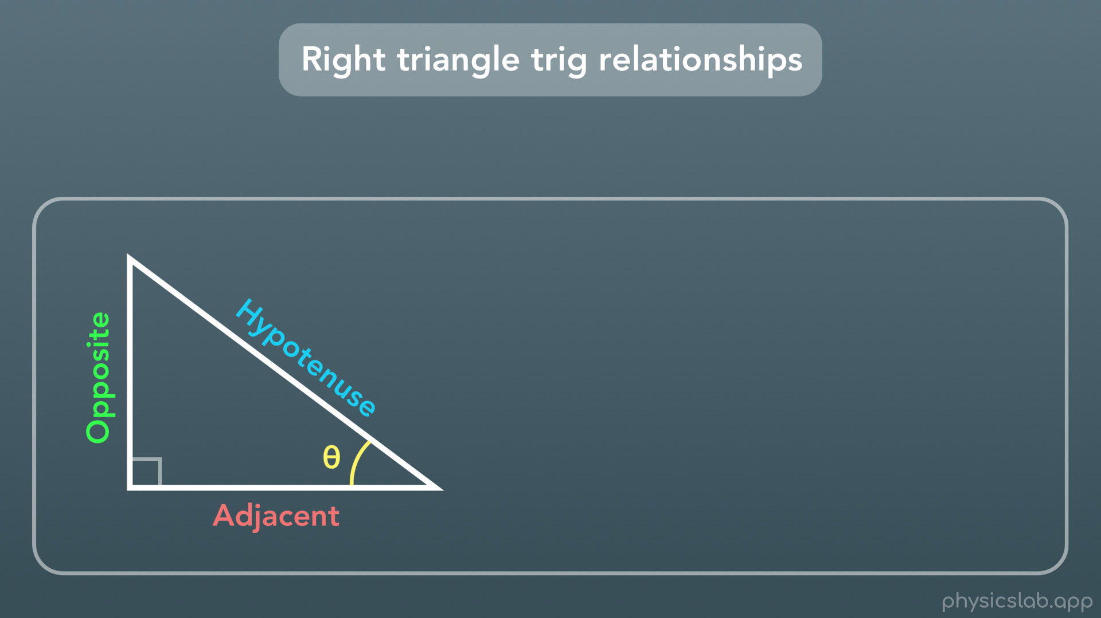
Notes:
First we start with a right triangle, where one angle is 90 degrees, labeled with that little right angle box thing.
We learned that the longest side of the triangle, which is across from the 90 degree angle, is called the hypotenuse.
We’re going to label one of the 2 remaining angles with the variable we call theta. We don’t know what this angle is, it could be 25 degrees, 40 degrees, we don’t know, which is why we’re using a variable. Now, we’re going to call the short side that is next to the angle “adjacent”, which literally means “next to”. And we’re going to call the side that is opposite from this angle “opposite”.
Now that we’ve labeled this triangle, let’s look at the relationships between the side lengths and this angle theta.

Slide 15
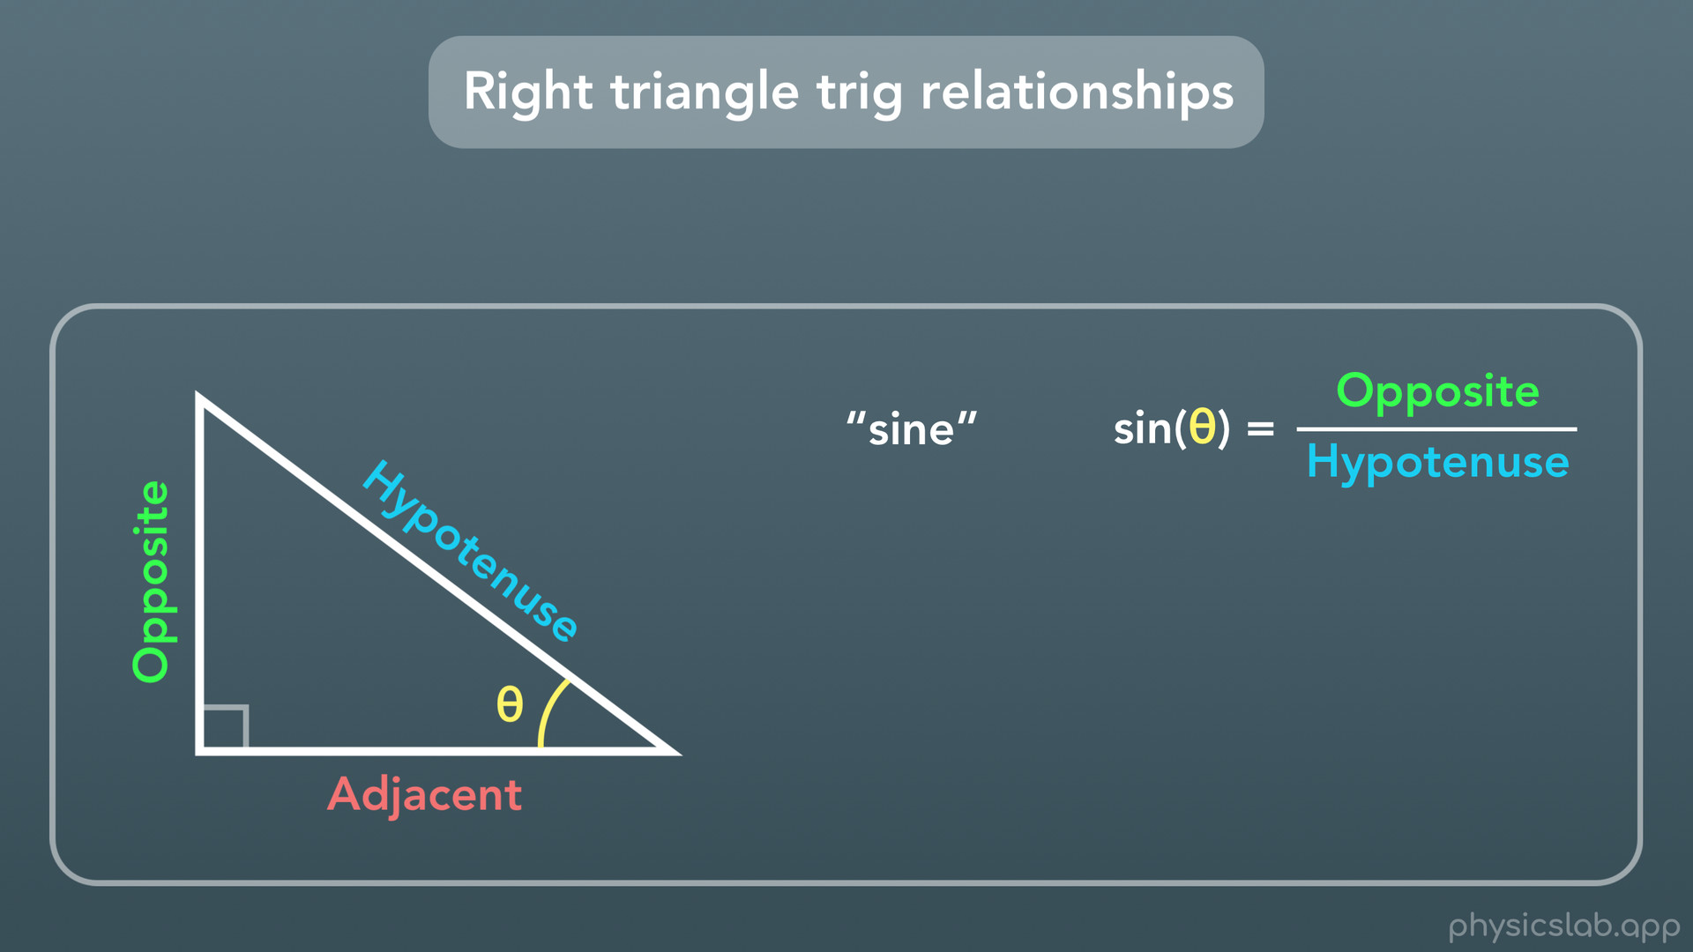
Notes:
The first is called “sine”, written as s-i-n. Sine of theta is equal to the opposite side length divided by the hypotenuse side length.

Slide 16
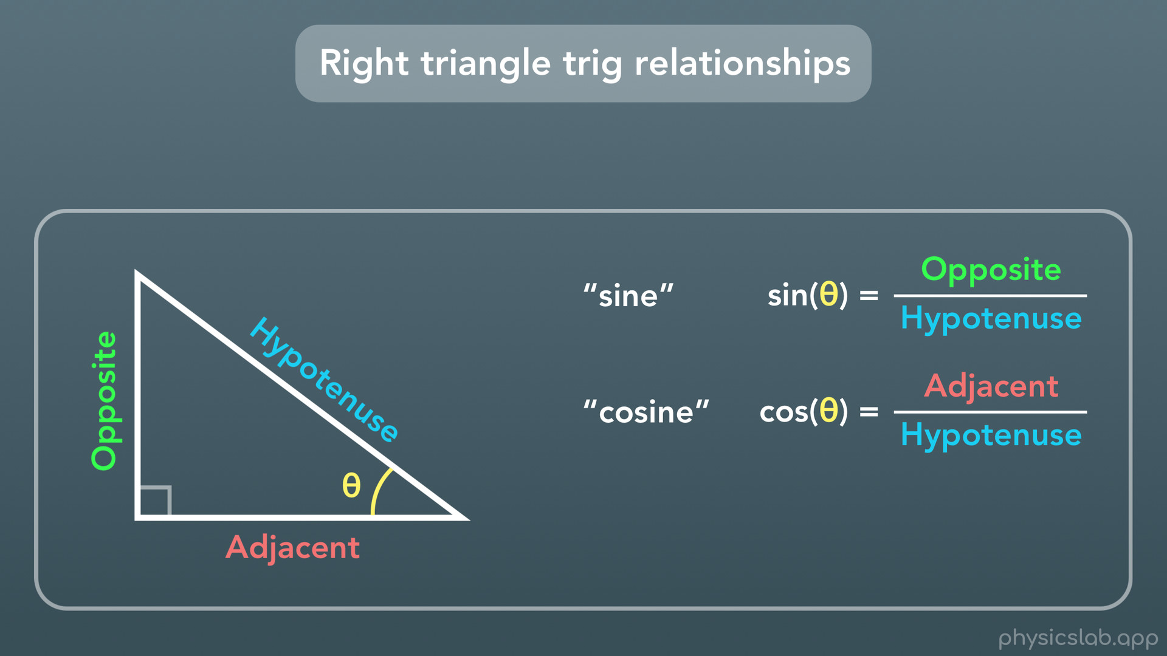
Notes:
Next, is “cosine”, written as c-o-s. Cosine of theta is equal to the adjacent side length divided by the hypotenuse side length.

Slide 17
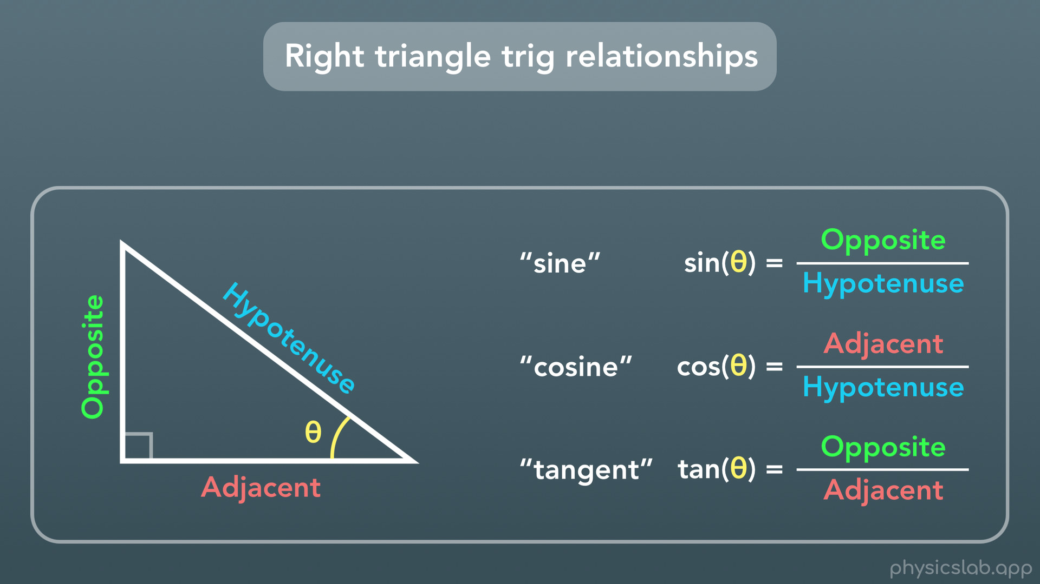
Notes:
And finally, we have “tangent” written as t-a-n. Tangent of theta is equal to the opposite side length divided by the adjacent side length.

Slide 18
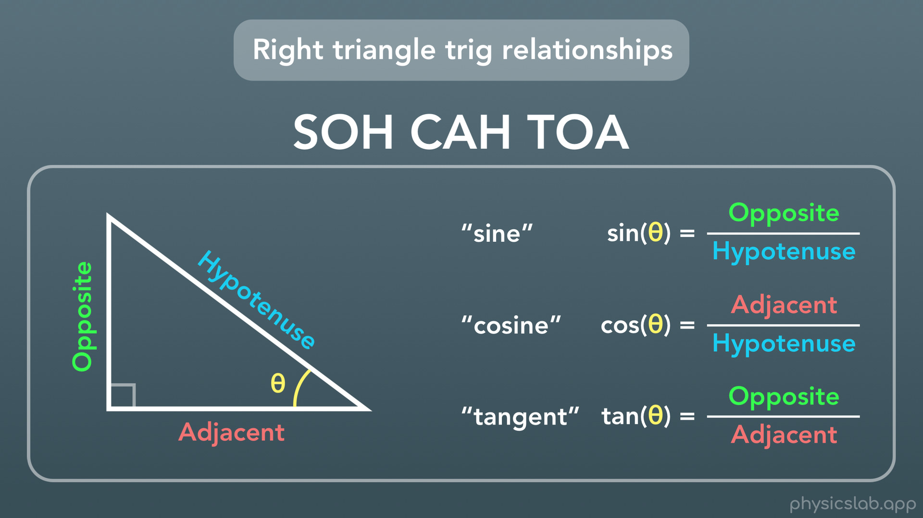
Notes:
And the way that we can remember these 3 relationships is with the phrase SOH CAH TOA. The letters stand for sine is opposite over hypotenuse, cosine is adjacent of hypotenuse, and tangent is opposite over adjacent.

Slide 19
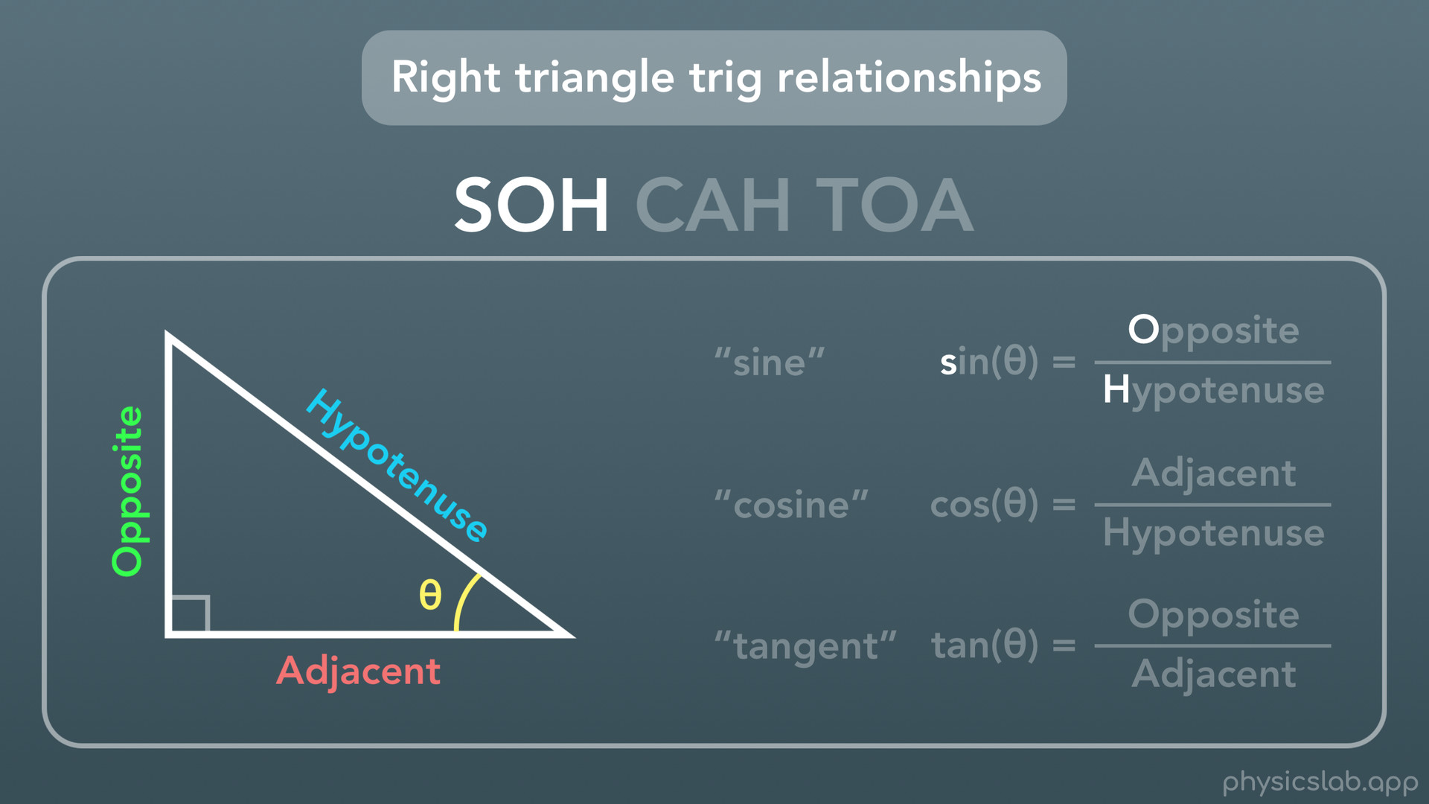

Slide 20
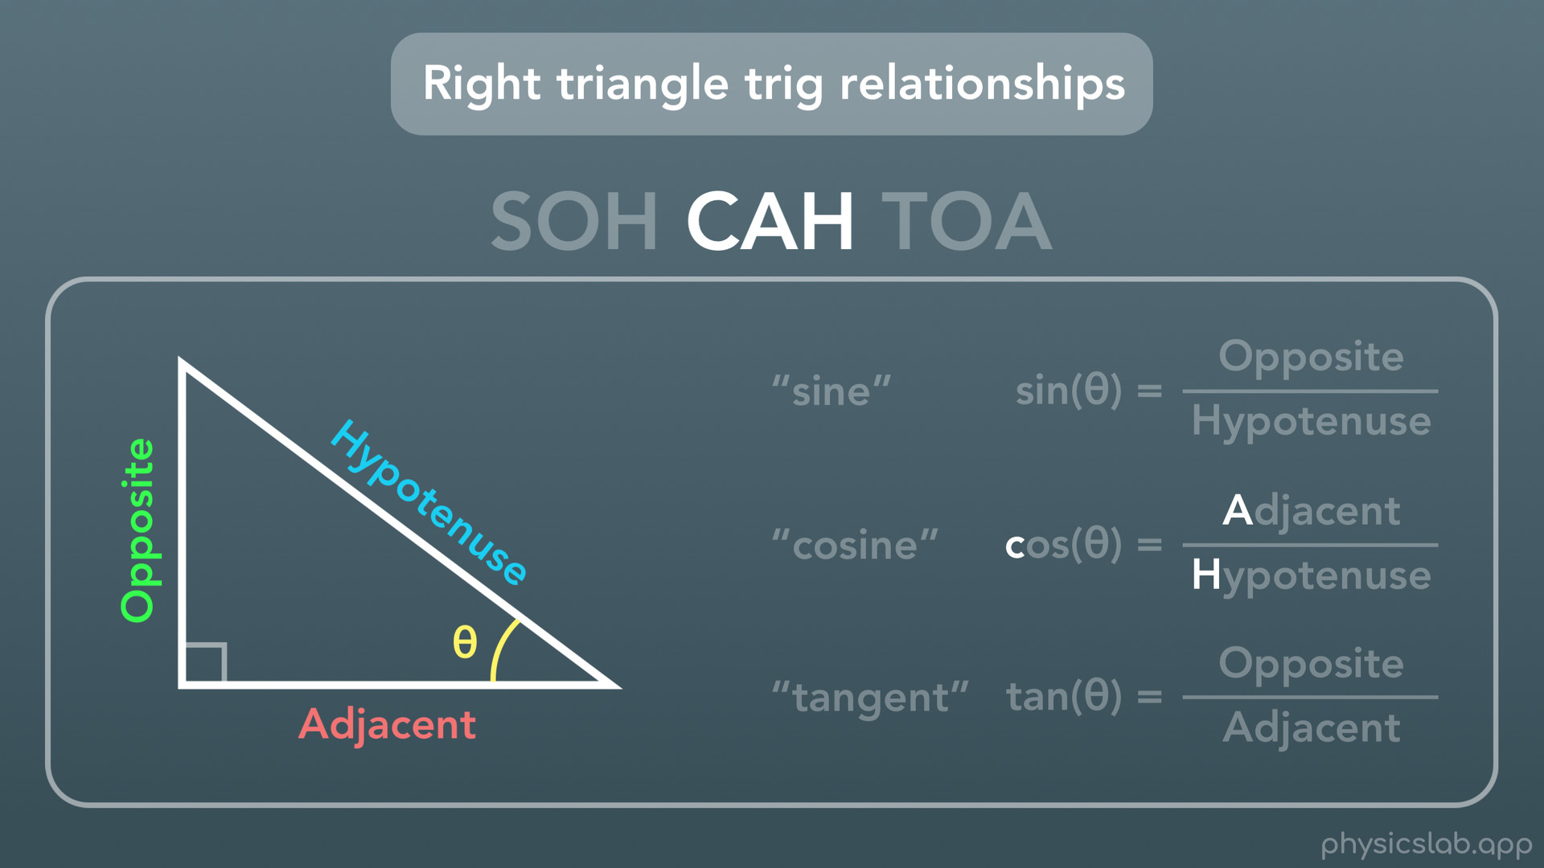

Slide 21
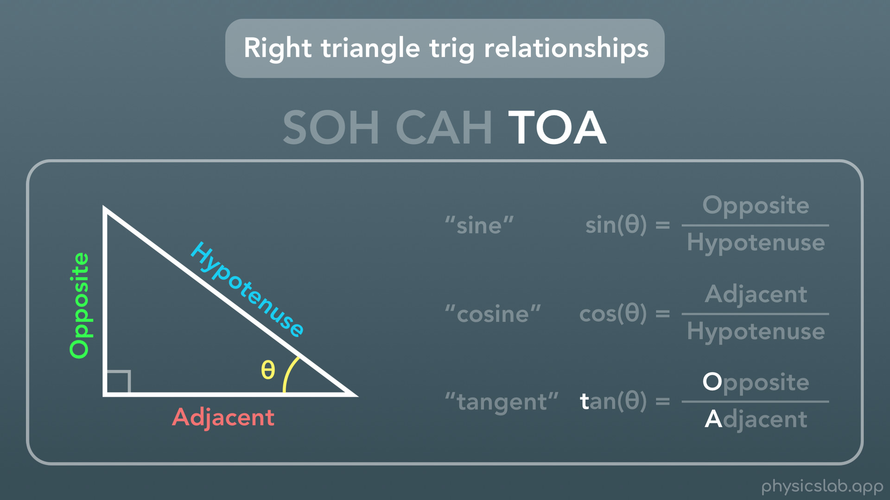

Slide 22
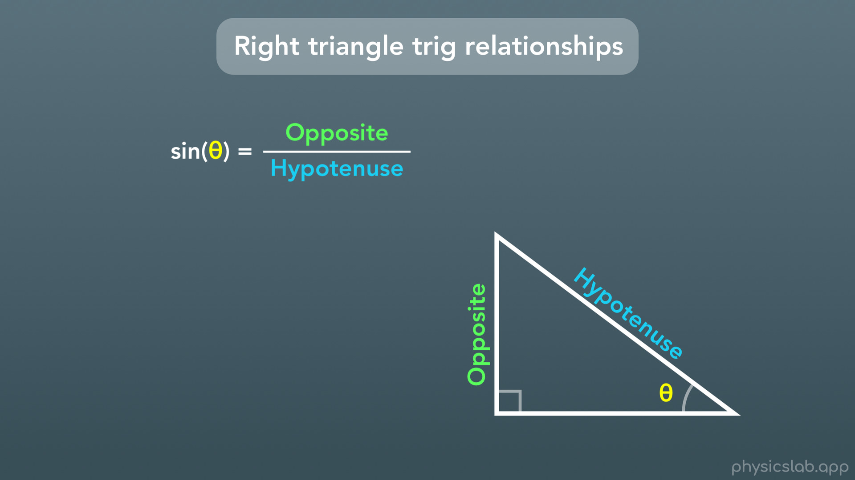
Notes:
Let’s check out an example using sine. We just learned that sine of theta is equal to the opposite side length divided by the hypotenuse side length. But what the heck does “sine of theta” mean?

Slide 23
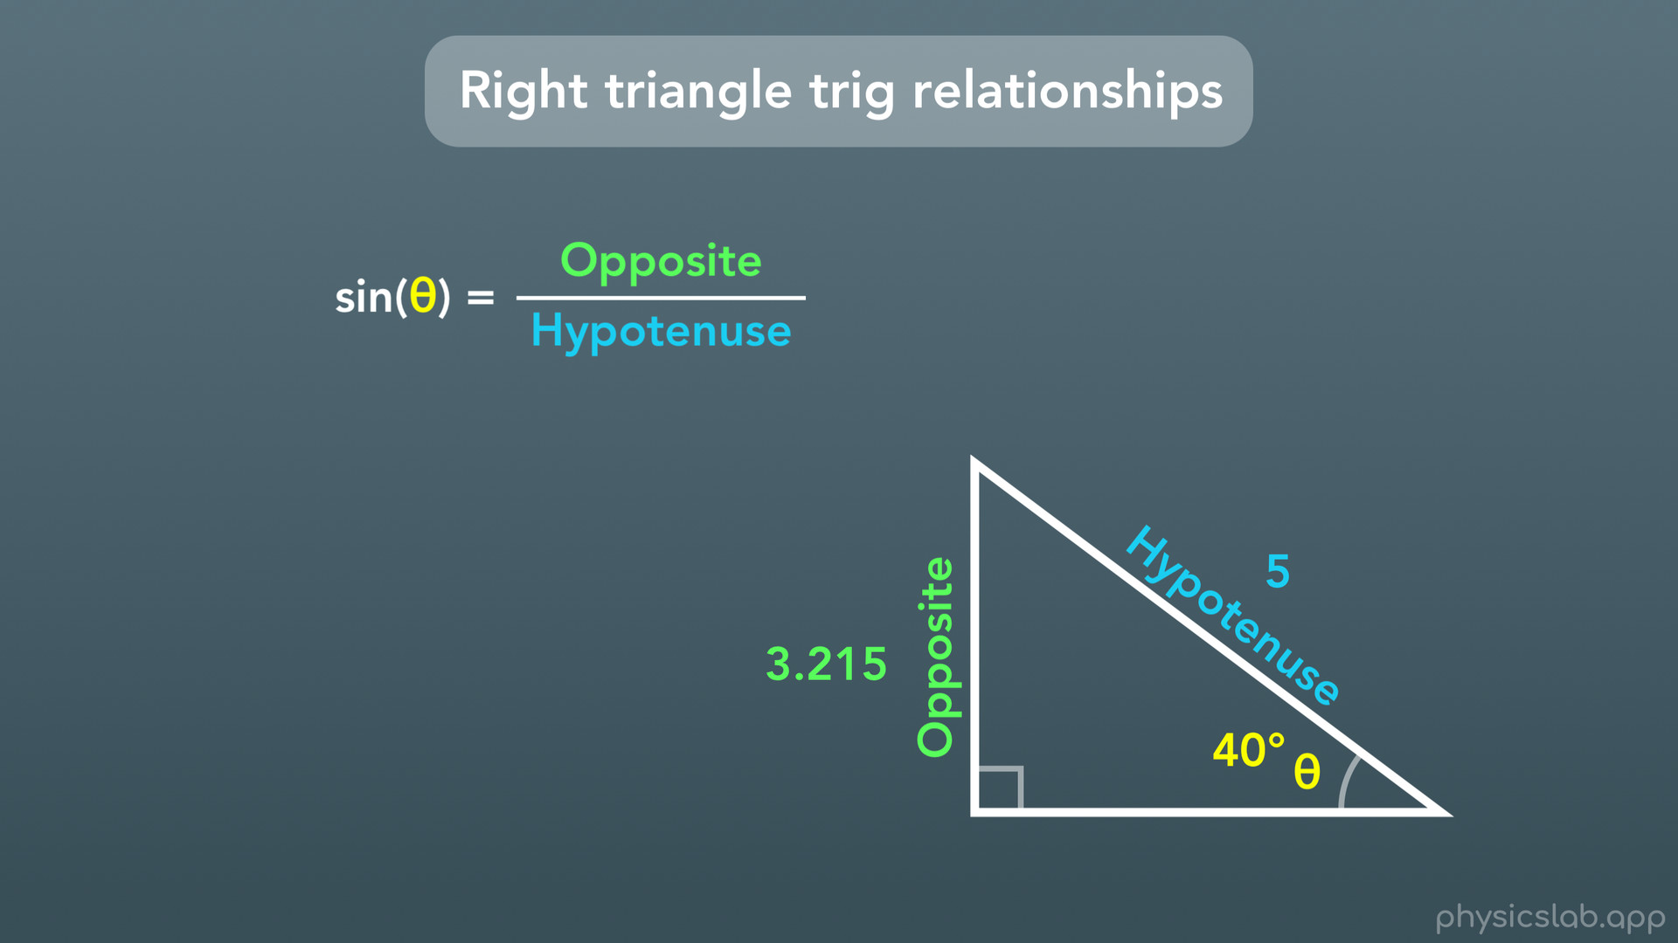
Notes:
Let’s say we’re given that theta is equal to 40 degrees, and we’re given the lengths of these 2 sides, 3.215 and 5.

Slide 24
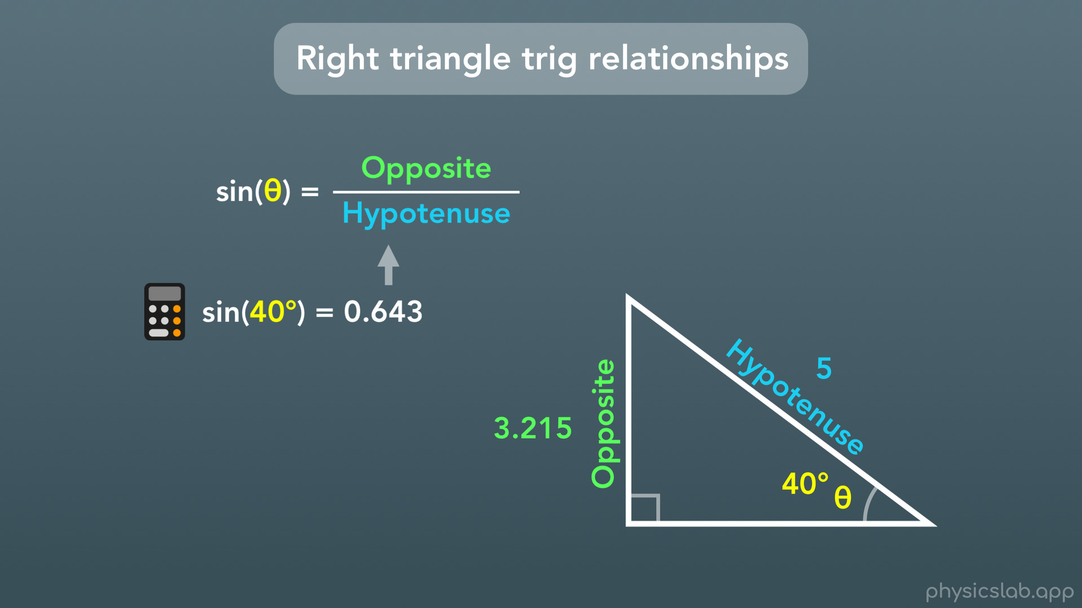
Notes:
Well sine is what we call a function, and is something that’s built into your calculator. So if you type in “sin(40deg)” into your calculator it will give you 0.643 (rounded to 3 decimal places).

Slide 25
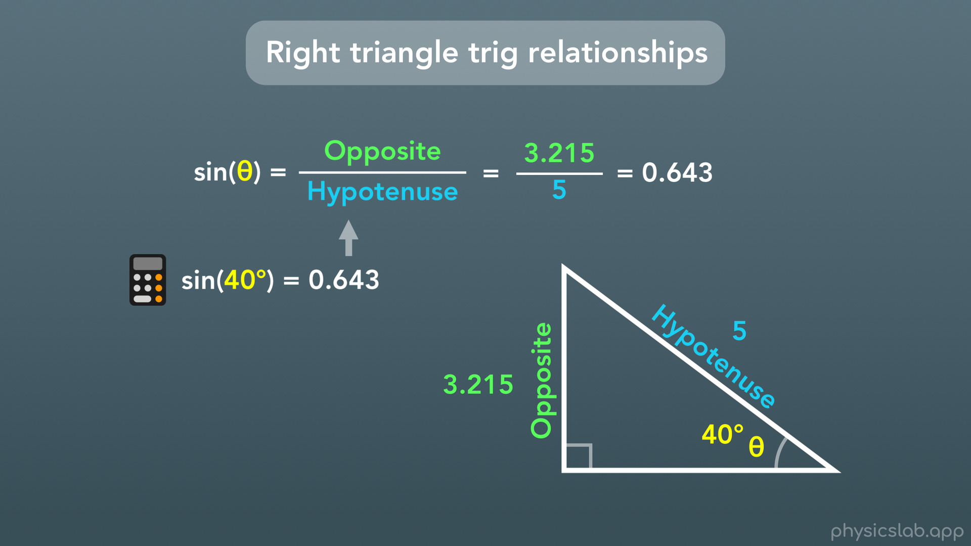
Notes:
It might seem random, but this number is equal to the ratio of these 2 side lengths, opposite divided by hypotenuse. So if we do the opposite side divided by the hypotenuse, which is 3.215 divided by 5, we get the exact same number: 0.643. And that’s what this relationship means: sine of theta equals the opposite side length divided by the hypotenuse side length. Or in this case, sine of 40 degrees equals the sides 3.215 divided by 5, which both equal 0.643.This is how cosine and tangent work too, except using different sides.

Slide 26
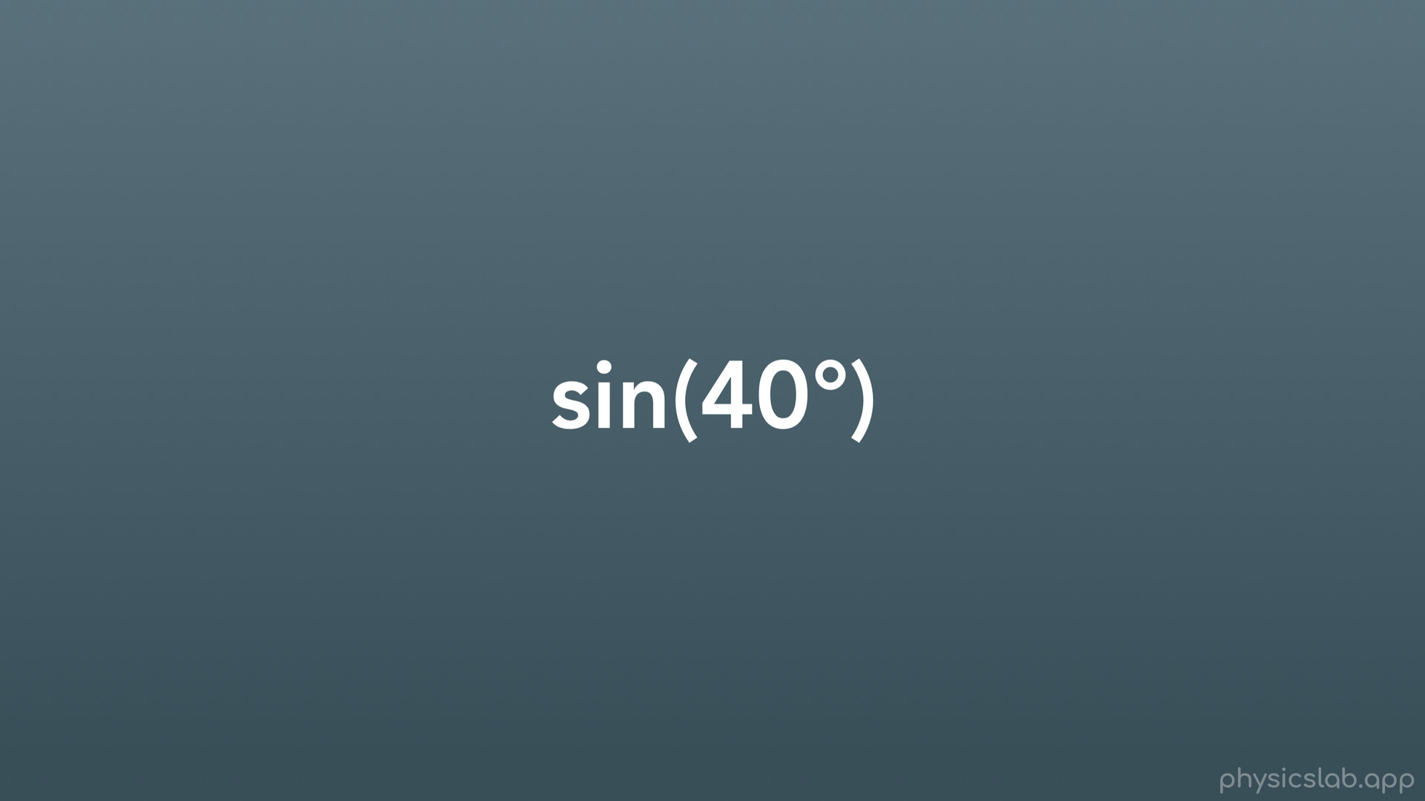
Notes:
Real quick, let’s talk about the way trig functions are written because it looks kind of confusing.

Slide 27
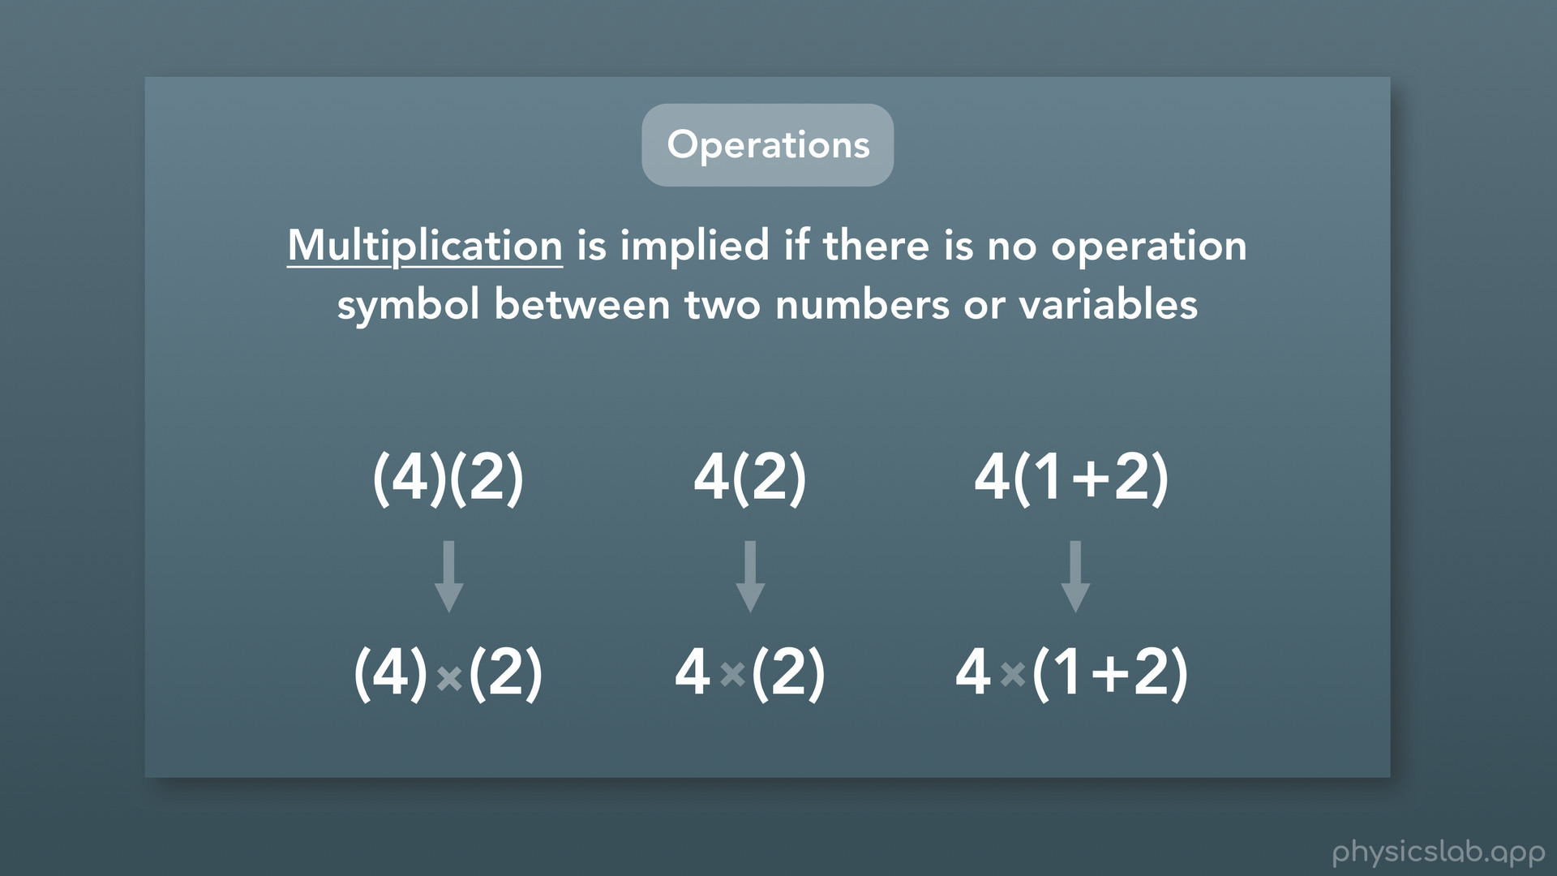
Notes:
We learned in another video that when two things are next to each other with no mathematical operation symbol between them, and one is in parentheses, that means to multiply them together.

Slide 28
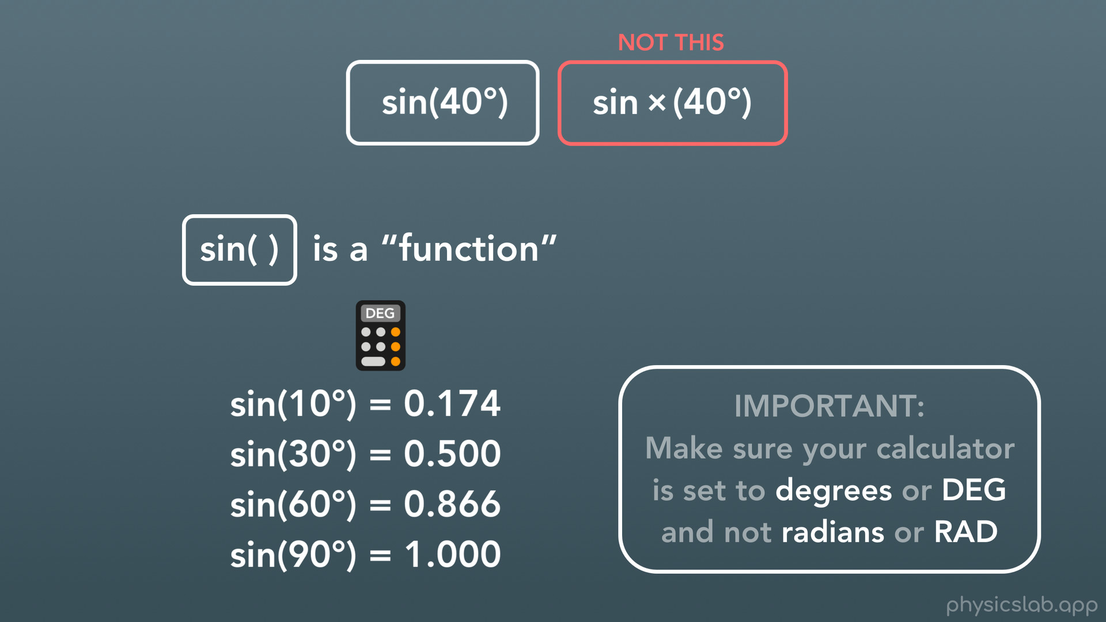
Notes:
But that is NOT what we’re doing here. We’re not multiplying something called “sine” by 40 degrees. Sine is what we call a function. That means you can use a calculator to plug in any number you want into the sine function, and it will give you a different number like you see here. All you need to remember is that when we write down trig functions like this, we are NOT MULTIPLYING. The whole thing is a single package.
Here’s one more really important thing that comes up a lot. If you find that your calculator isn’t giving you these numbers here, it might be because the calculator is using units of “radians” instead of degrees. We’ll talk about radians later in this video, but for now, keep in mind that IF you’re working with degrees like we are here, make sure your calculator is set to degrees or DEG and not radians or RAD.

Slide 29
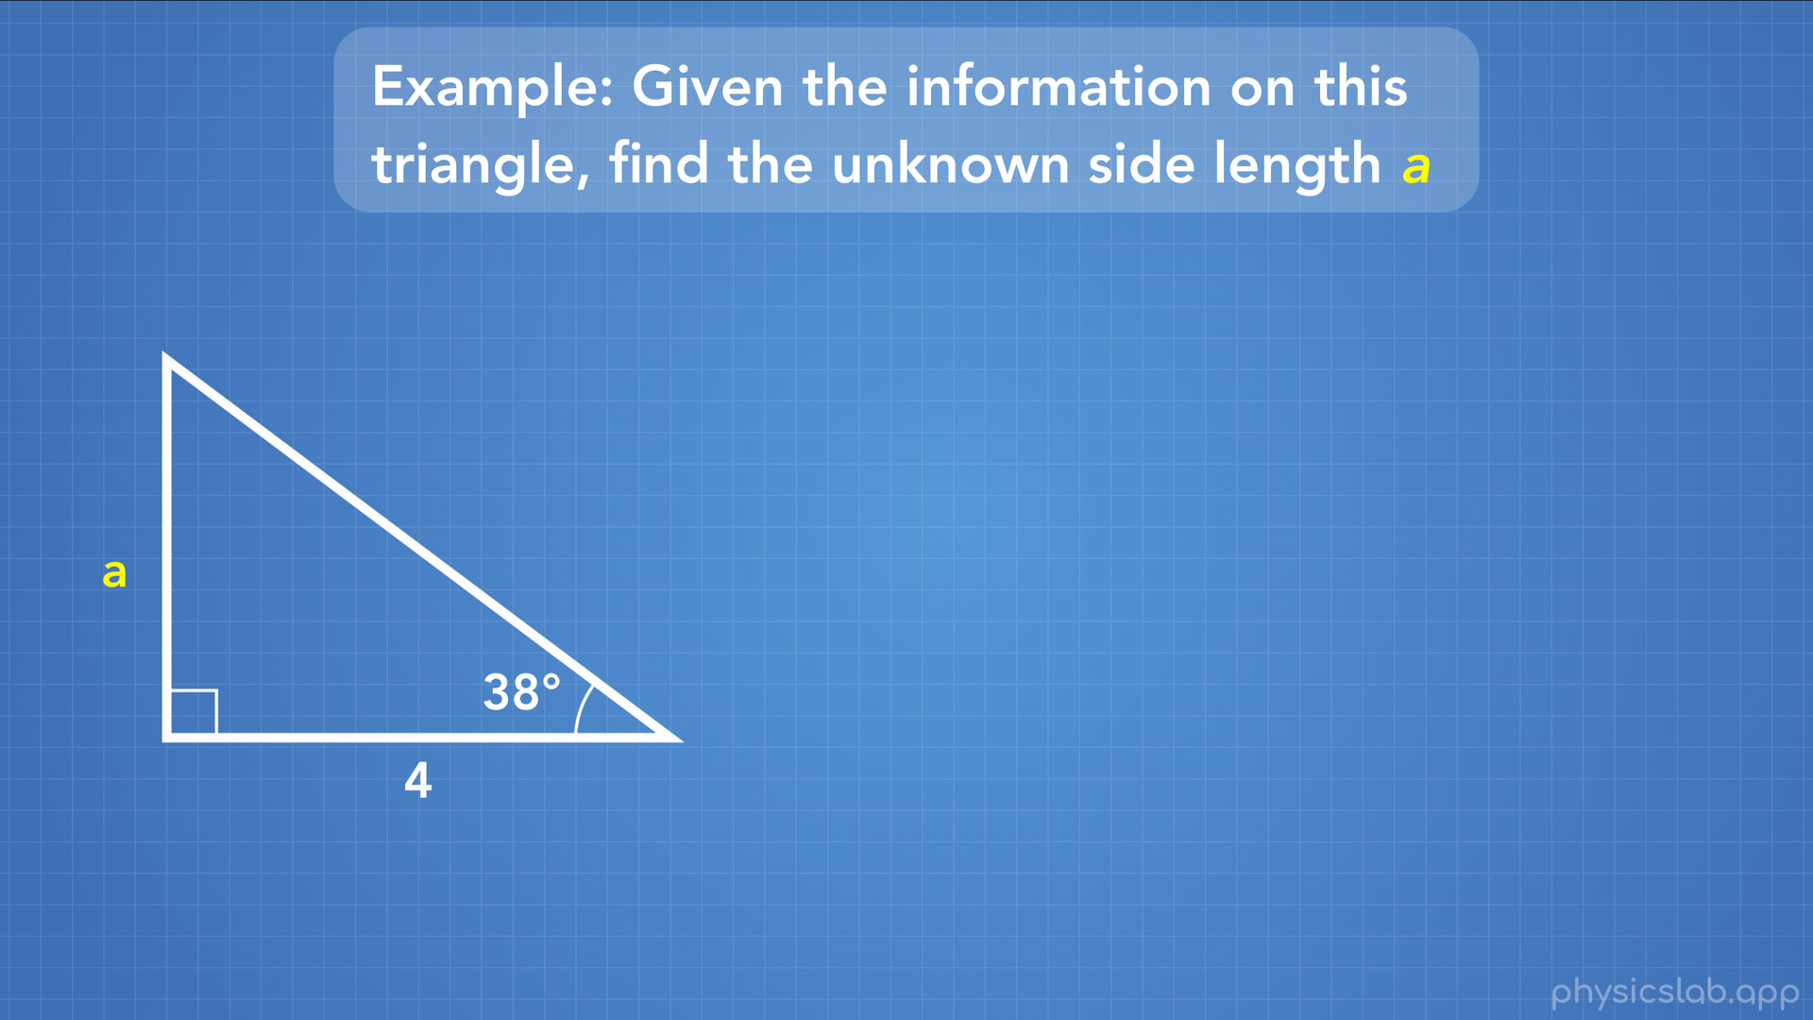
Notes:
Let’s use the trig relationships to solve an actual problem. Given the information on this triangle, find the unknown side length “a”.
Ok so here we have a right triangle, so we can use our right triangle trig relationships. We’re given one side length, 4, and one angle, 38 degrees. And it’s asking us to find the length of this side, labeled with the variable a.

Slide 30
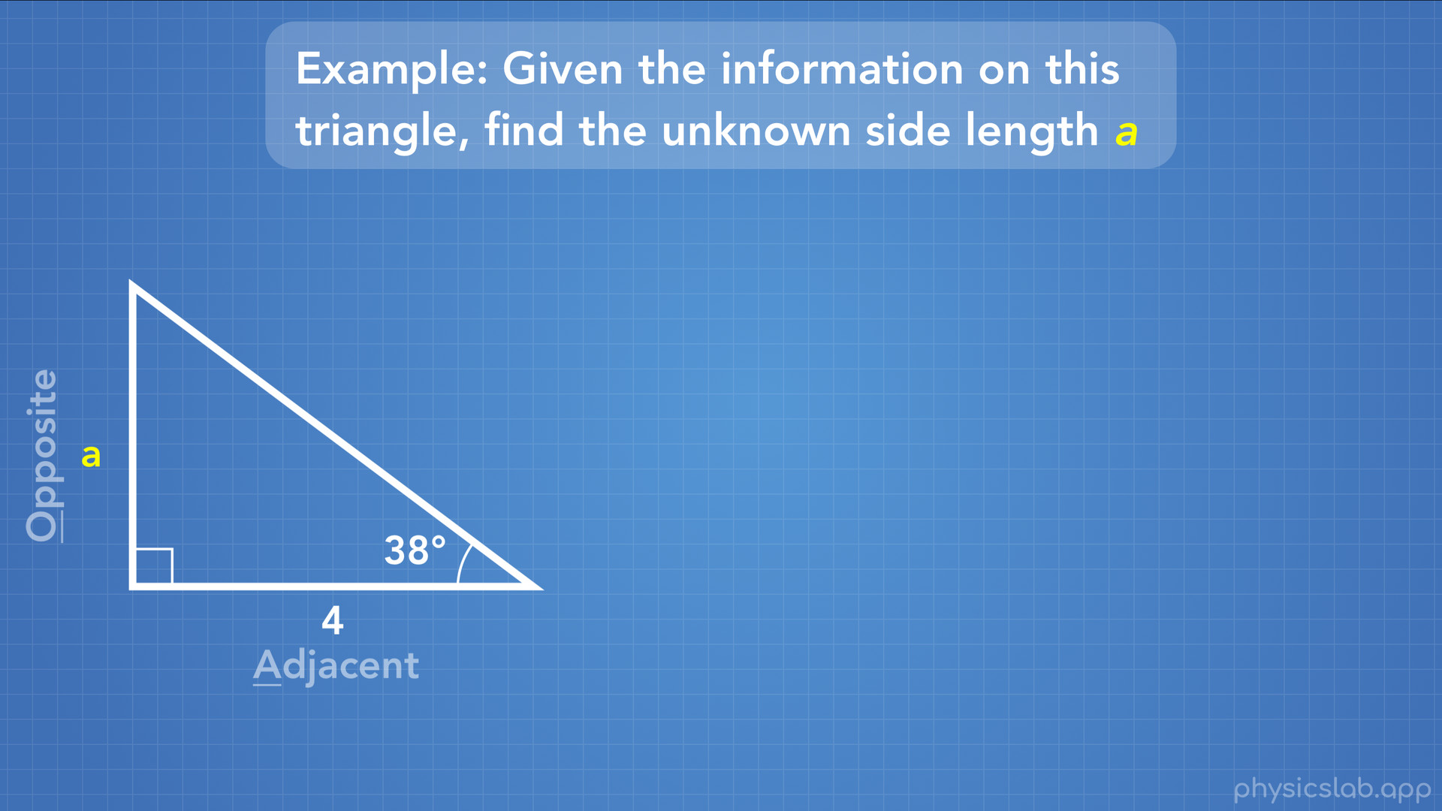
Notes:
So what do we do? Well first we’ll label this triangle so we know what sides we have and which trig function to use. The side length that we’re given is next to the angle, so that’s the adjacent side. The side that we want to find is opposite from the angle, so that’s the opposite side. The third side is the hypotenuse, but we don’t know it’s length and we’re not trying to find it.

Slide 31
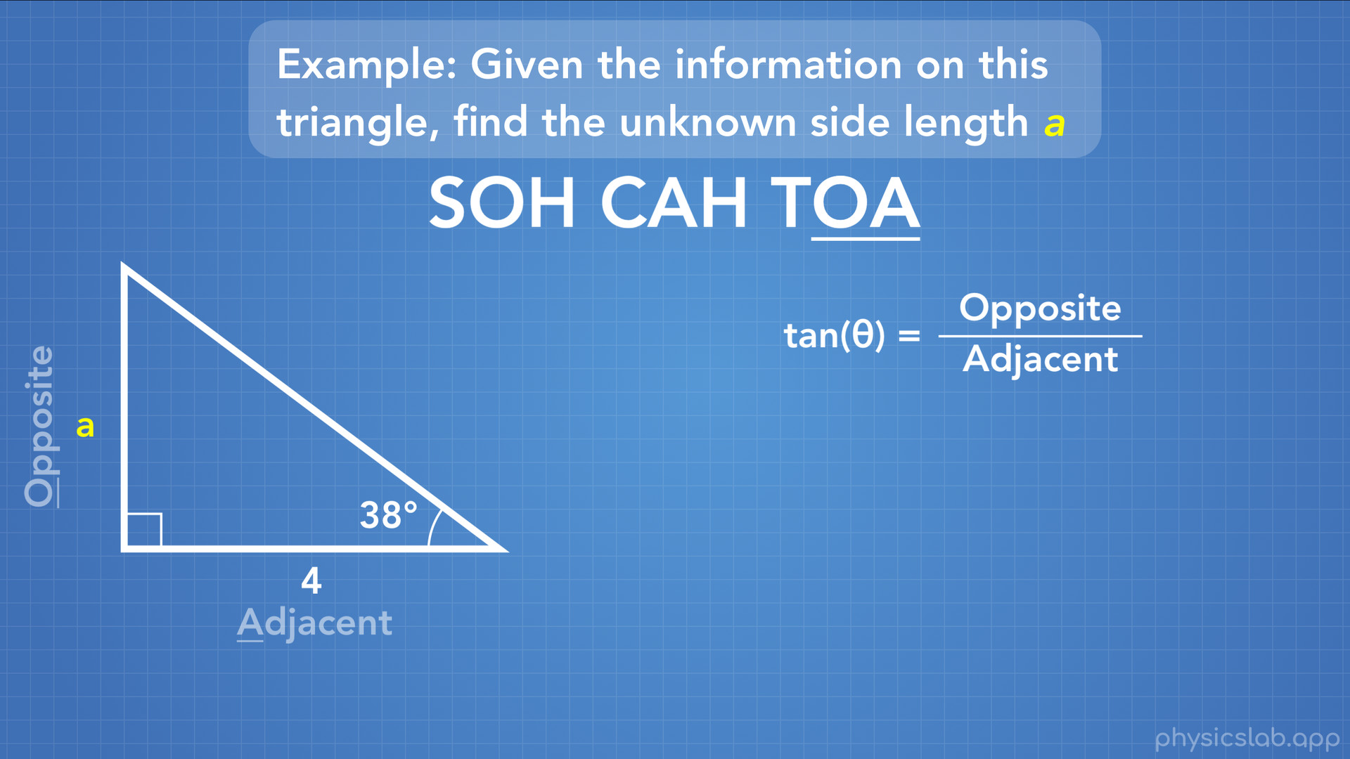
Notes:
So we know the adjacent side, and we want to find the opposite side. What trig relationship uses opposite and adjacent? We can either check our reference sheet at the 3 trig relationships, or we might remember SOH CAH TOA. The last part, TOA, uses opposite and adjacent, which we know from the letters O and A. So that means we’re going to be using the tangent trig function.

Slide 32
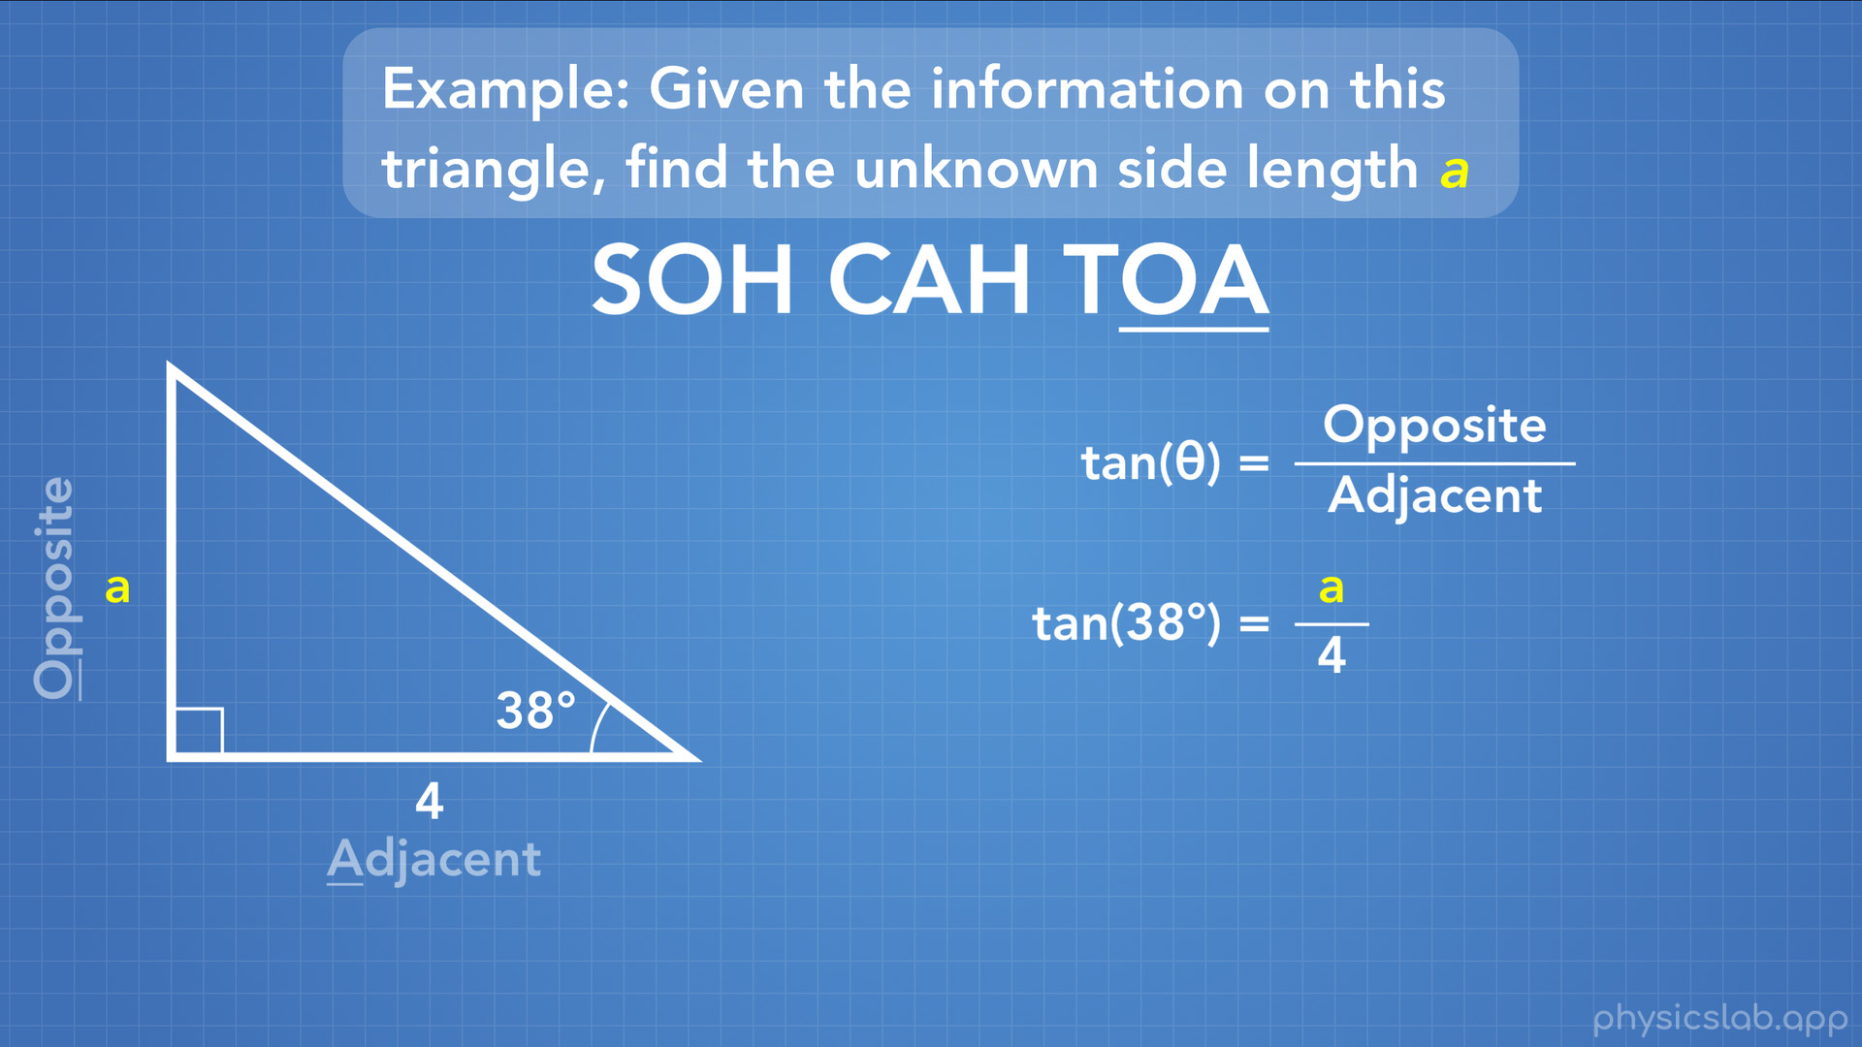
Notes:
So tangent of the angle theta equals the opposite side divided by the adjacent side. In our case, tangent of 38 degrees equals a (the opposite side) divided by 4 (the adjacent side). Now we have an equation with one variable that we want to find, a.

Slide 33
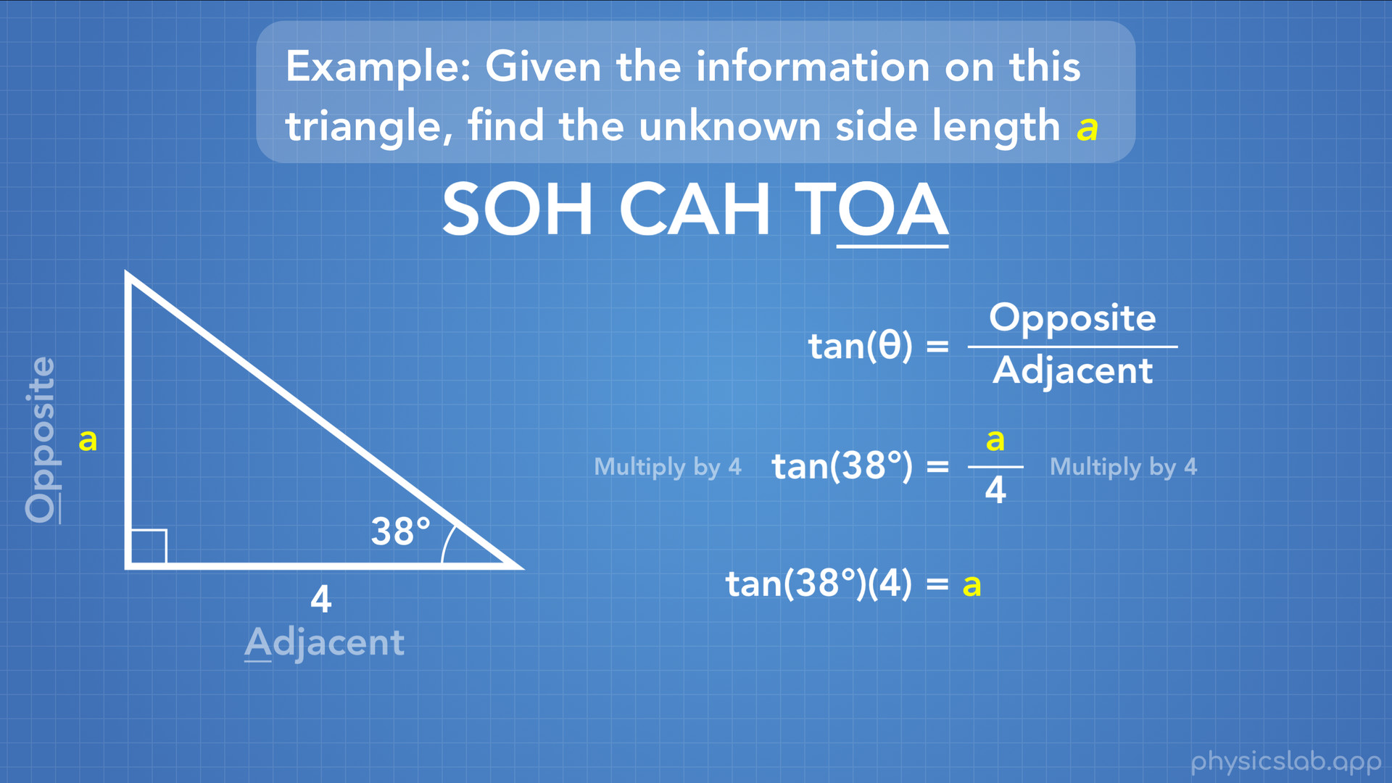
Notes:
What we can do is rearrange the equation to make it simpler to solve for a. If we multiply both sides of the equation by 4 we now have tan(38deg) times 4 = a. Remember that this expression is NOT tan times 38deg times 4. Tan OF 38degrees is a single package.

Slide 34
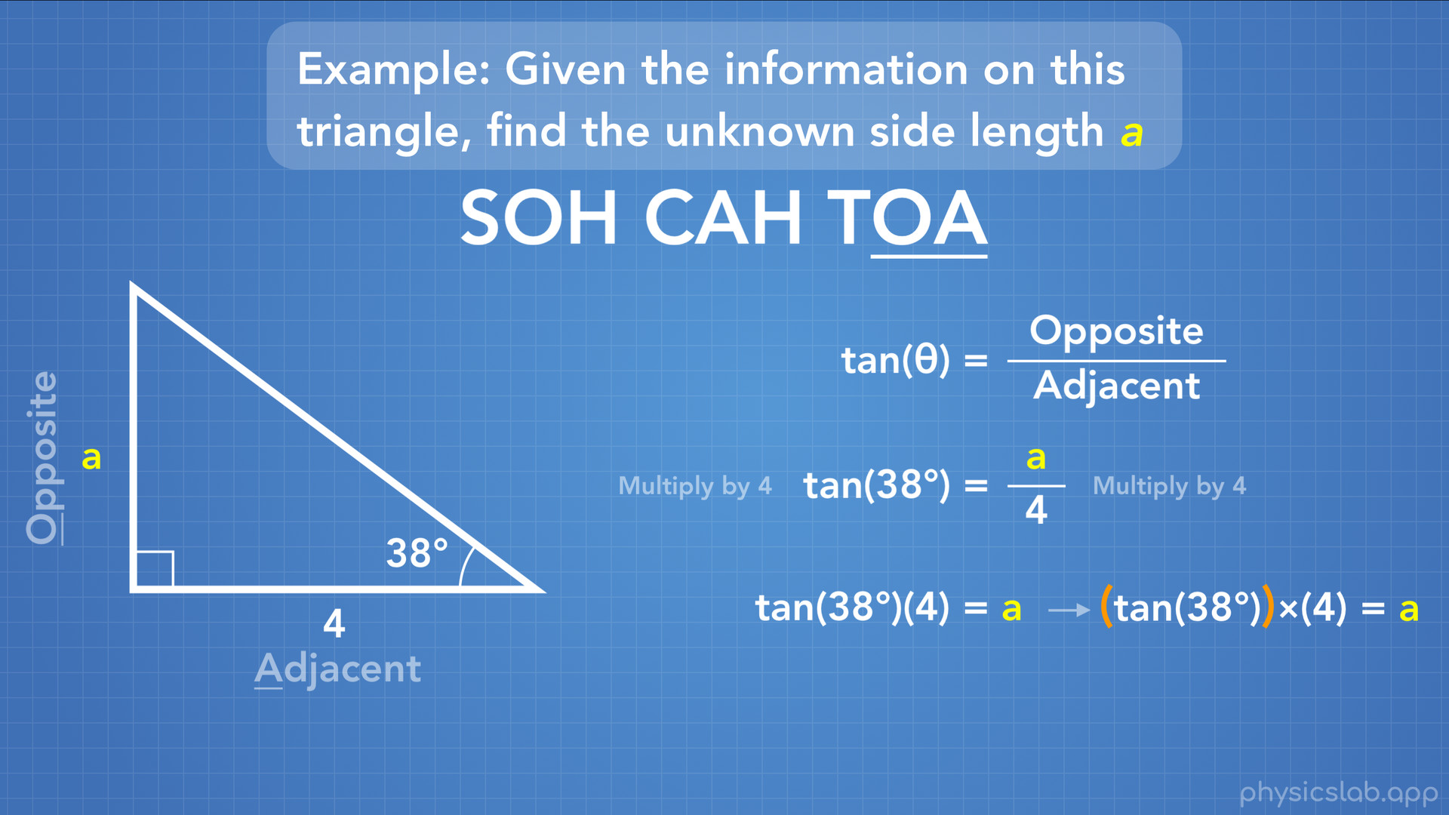
Notes:
If it helps, you can write tan(38deg) in another set of parentheses, or write the symbol for multiplication.

Slide 35
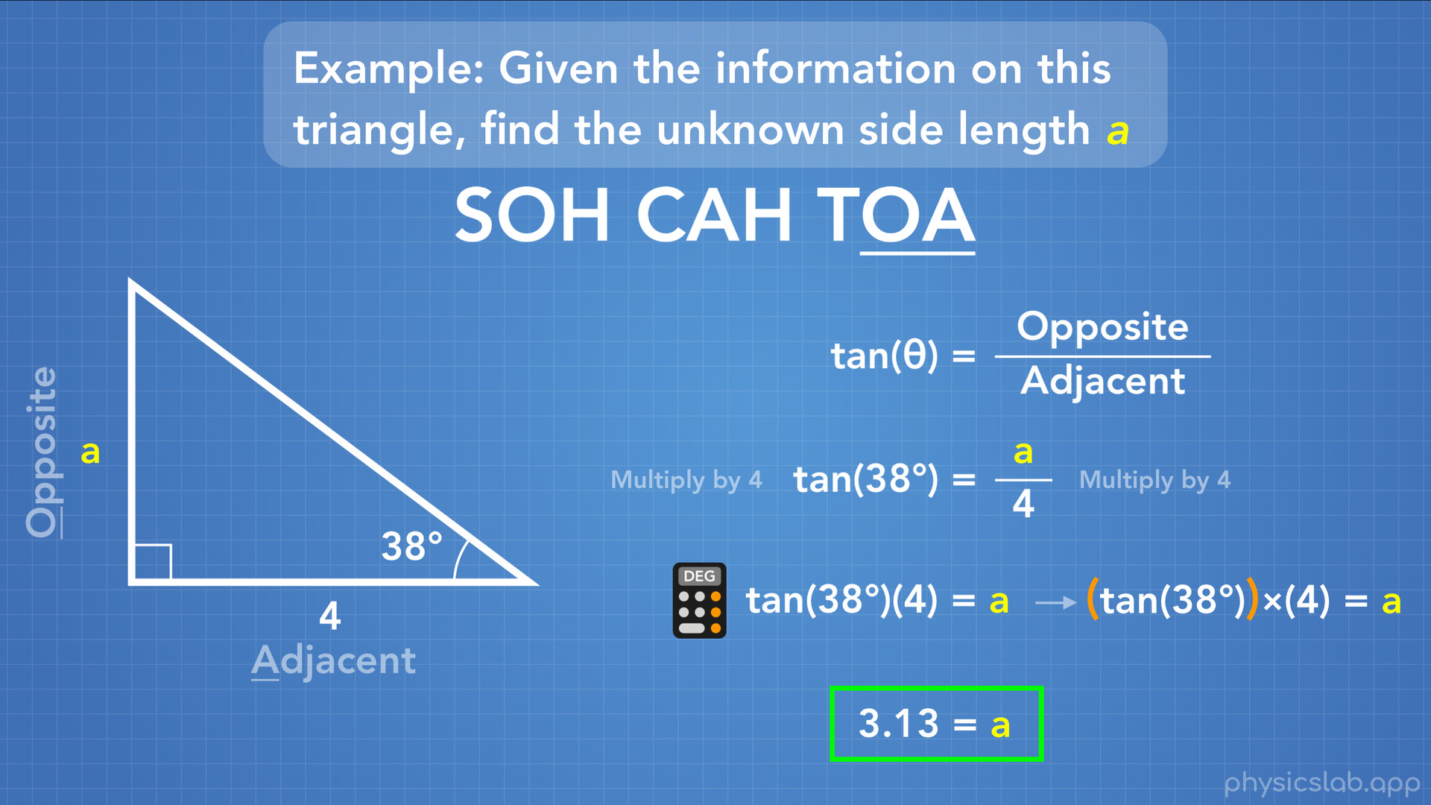
Notes:
So now we just plug this in to our calculator, remember to set your calculator to degrees, and we get tan(38deg) times 4 = 3.13. And that’s our answer. Using one side length, one angle and a trig function, we found the unknown side length a = 3.13.

Slide 36
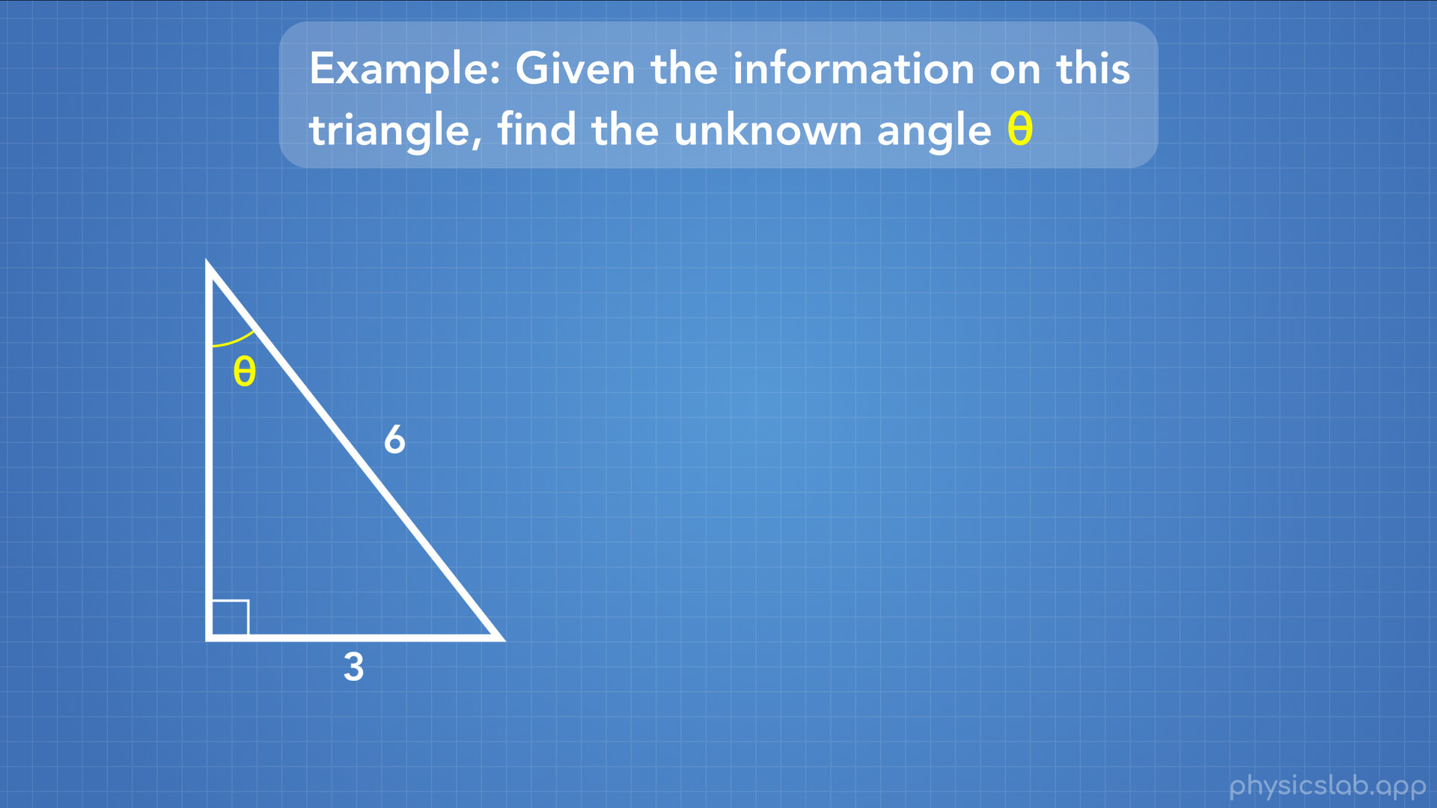
Notes:
Let’s try a different example.
So we have a right triangle, with 2 known side lengths 3 and 6, and an angle that we want to find.

Slide 37
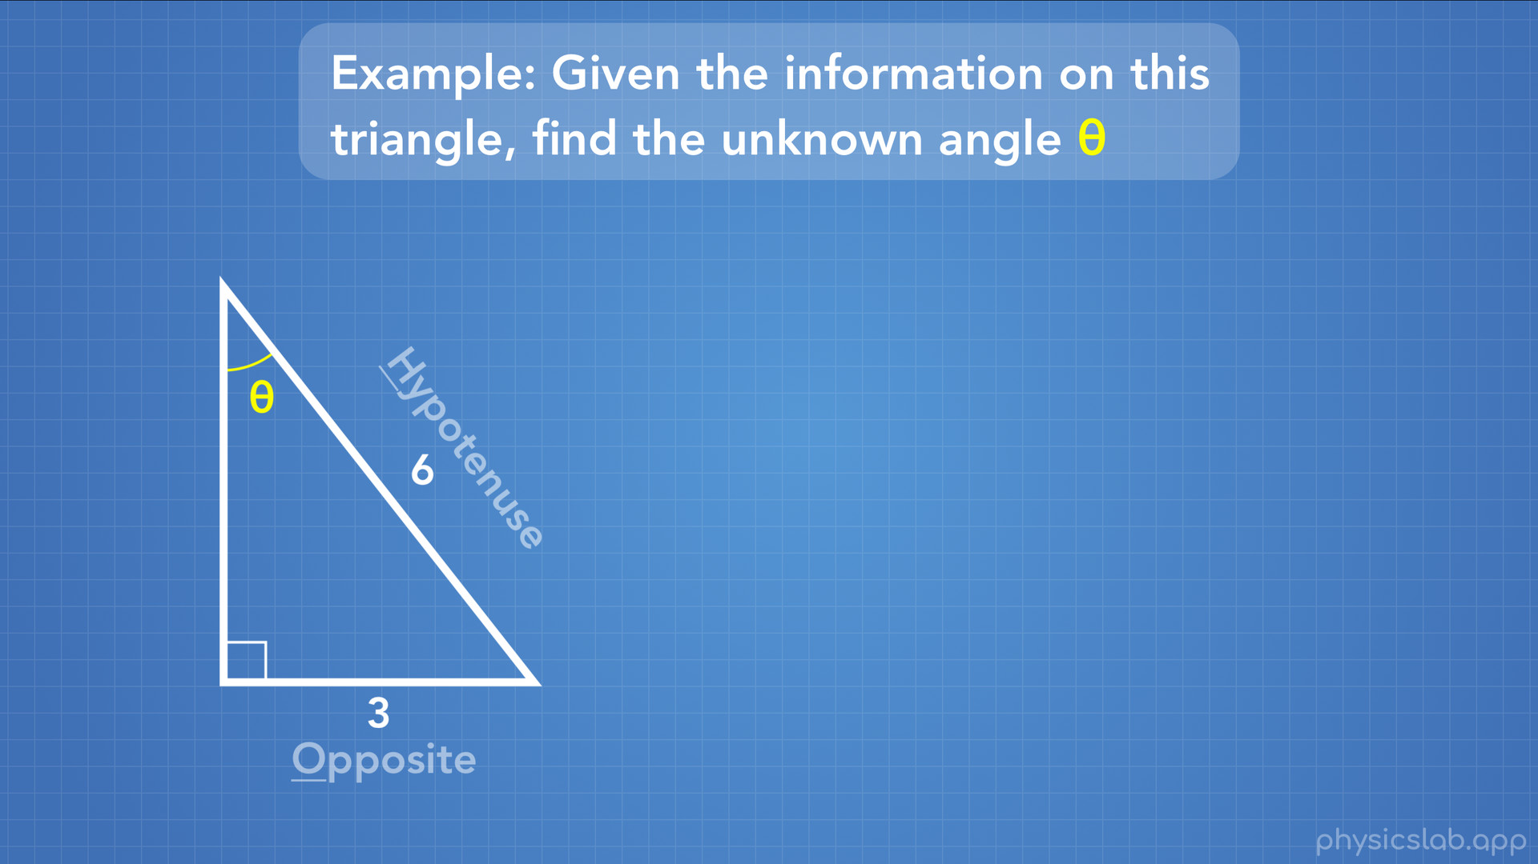
Notes:
Just like last time we’ll start by labeling the sides that we’re dealing with. One side that we’re given is the hypotenuse, which we know because it’s the side across from the 90 degree angle. The other side we’re given is the side that’s opposite from the angle theta, so that’s the opposite side.
So which trig function uses opposite and hypotenuse?

Slide 38
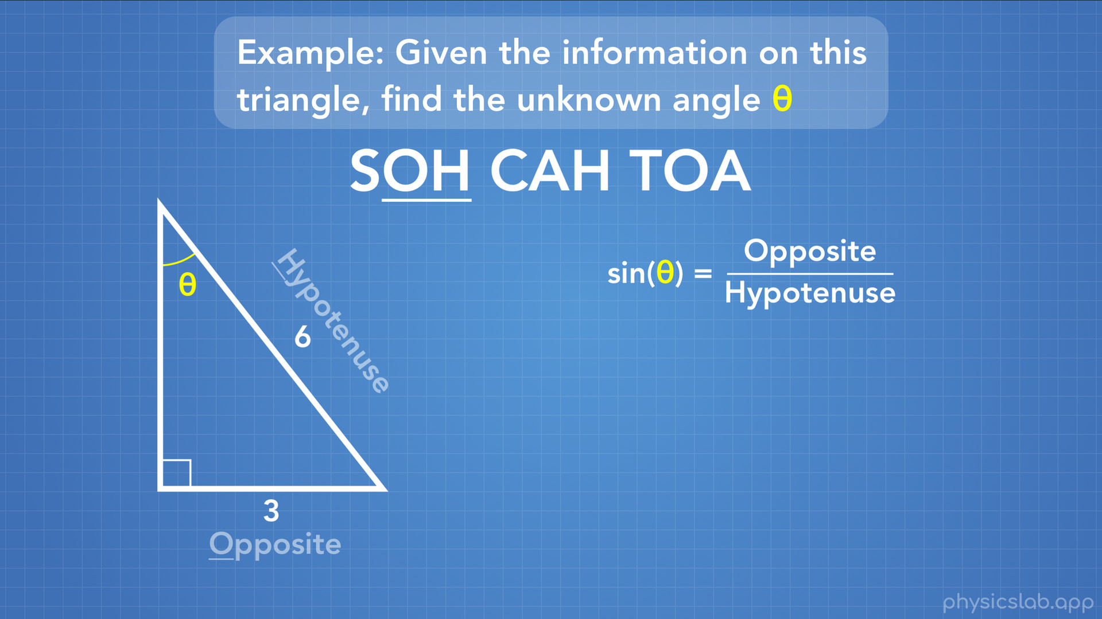
Notes:
Again we can check our reference sheet or remember SOH CAH TOA. And we find that the first part has O and H for opposite and hypotenuse.
Ok, so we’ll be using the sine function for this.

Slide 39
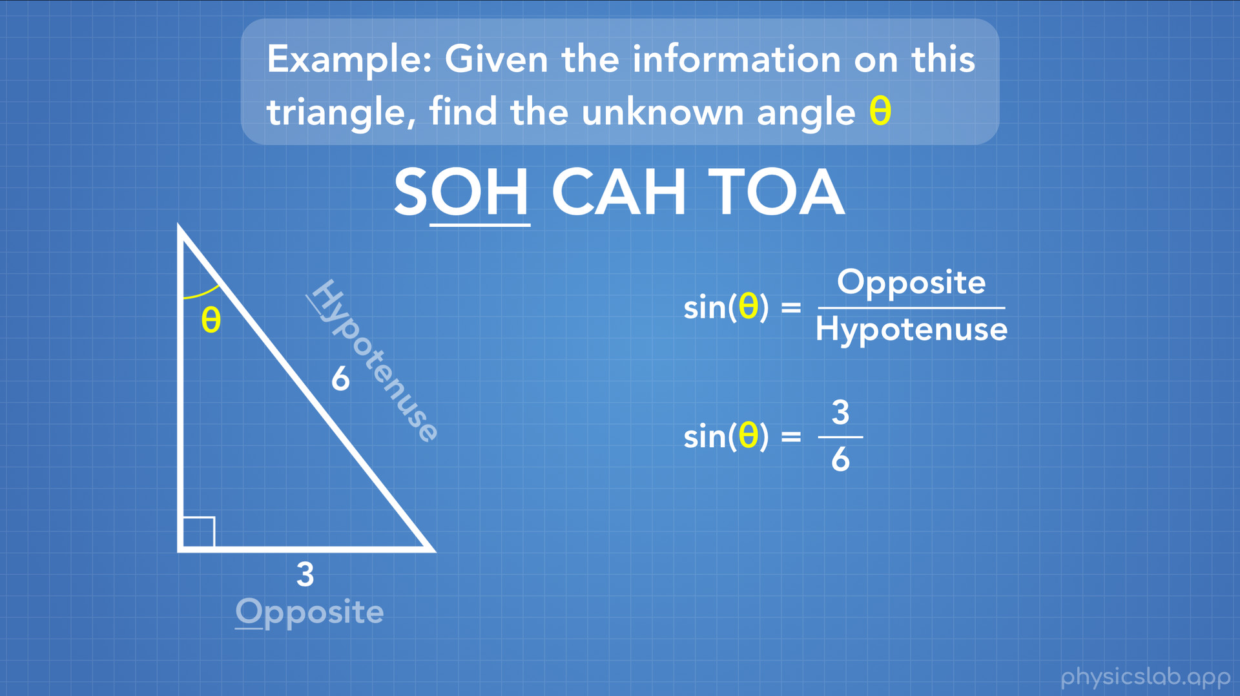
Notes:
We know that sine of theta equals the opposite side length divided by the hypotenuse side length. So sine of theta equals 3 divided by 6. And we want to find what theta is.

Slide 40

Notes:
Hmm… now what? We can’t use this regular trig relationship to find out what the angle is.

Slide 41
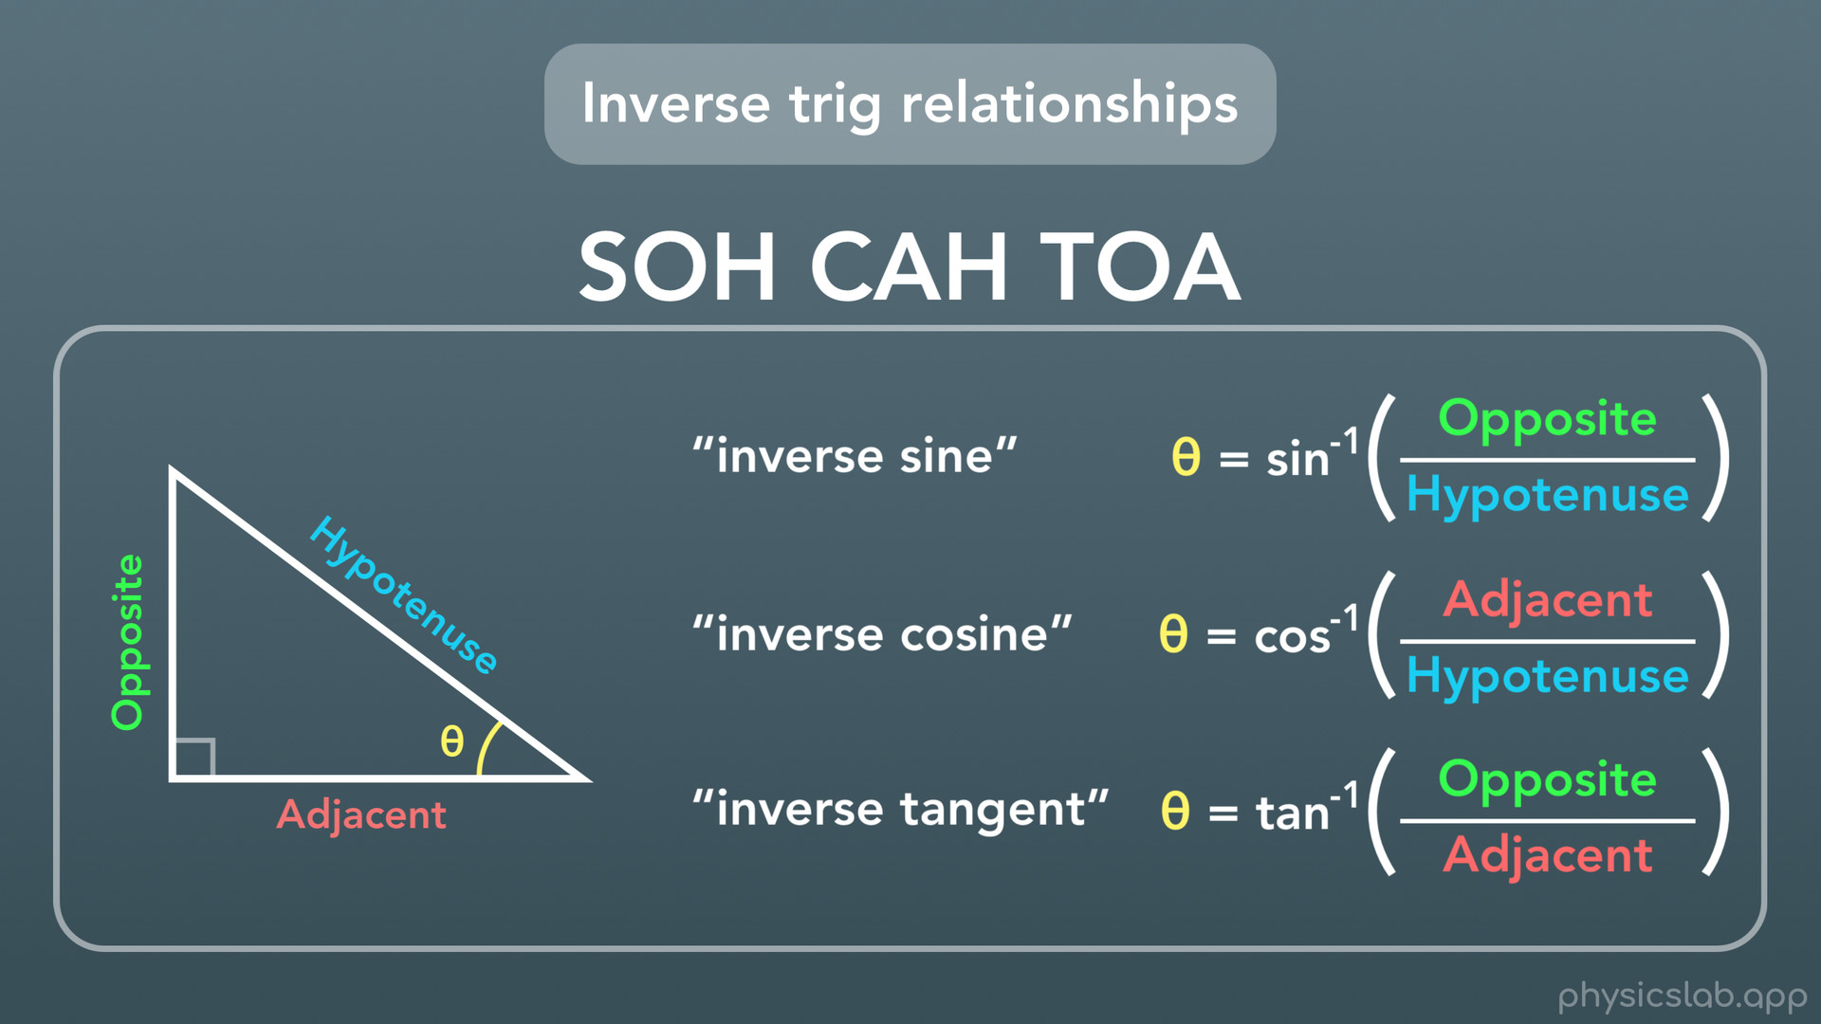
Notes:
For that, we need one more set of trig relationships, which we call the inverse trig relationships. These are inverse sine, inverse cosine, and inverse tangent. These are really similar to the regular trig functions, except instead of plugging in an ANGLE into the trig function in our calculator, we’re plugging in the ration of the 2 side lengths, and we’re calculating the angle. Note that SOH CAH TOA still works, because each function still uses the same side lengths.
One way to write these functions is the way we see here. For example, we call the first one “inverse sine” and we write the function as s-i-n with a -1 above it. Note that this is not a real exponent like we use for doing math, this is just the way it’s written.

Slide 42
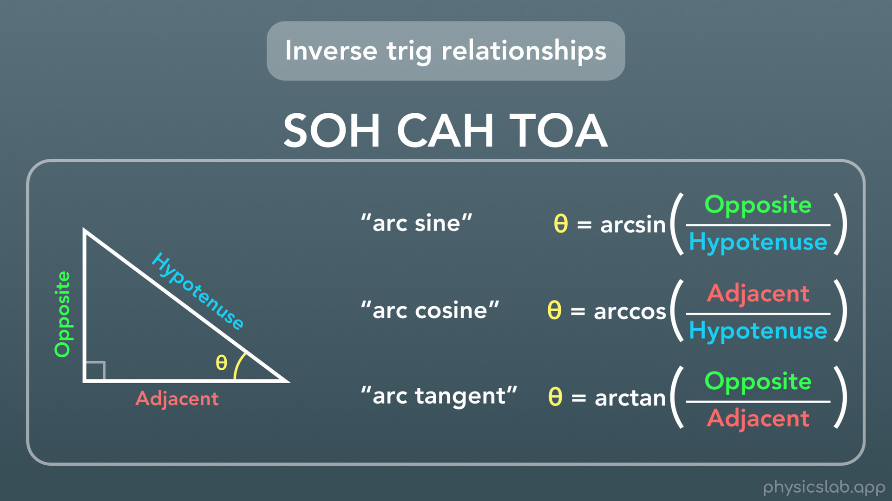
Notes:
The other way you might see these written is like this: arc sine, arc cosine and arc tangent. If we write it out this way, we write arc and we don’t include the little negative 1 above the function.
So two different ways to write them, but they’re the same function.

Slide 43
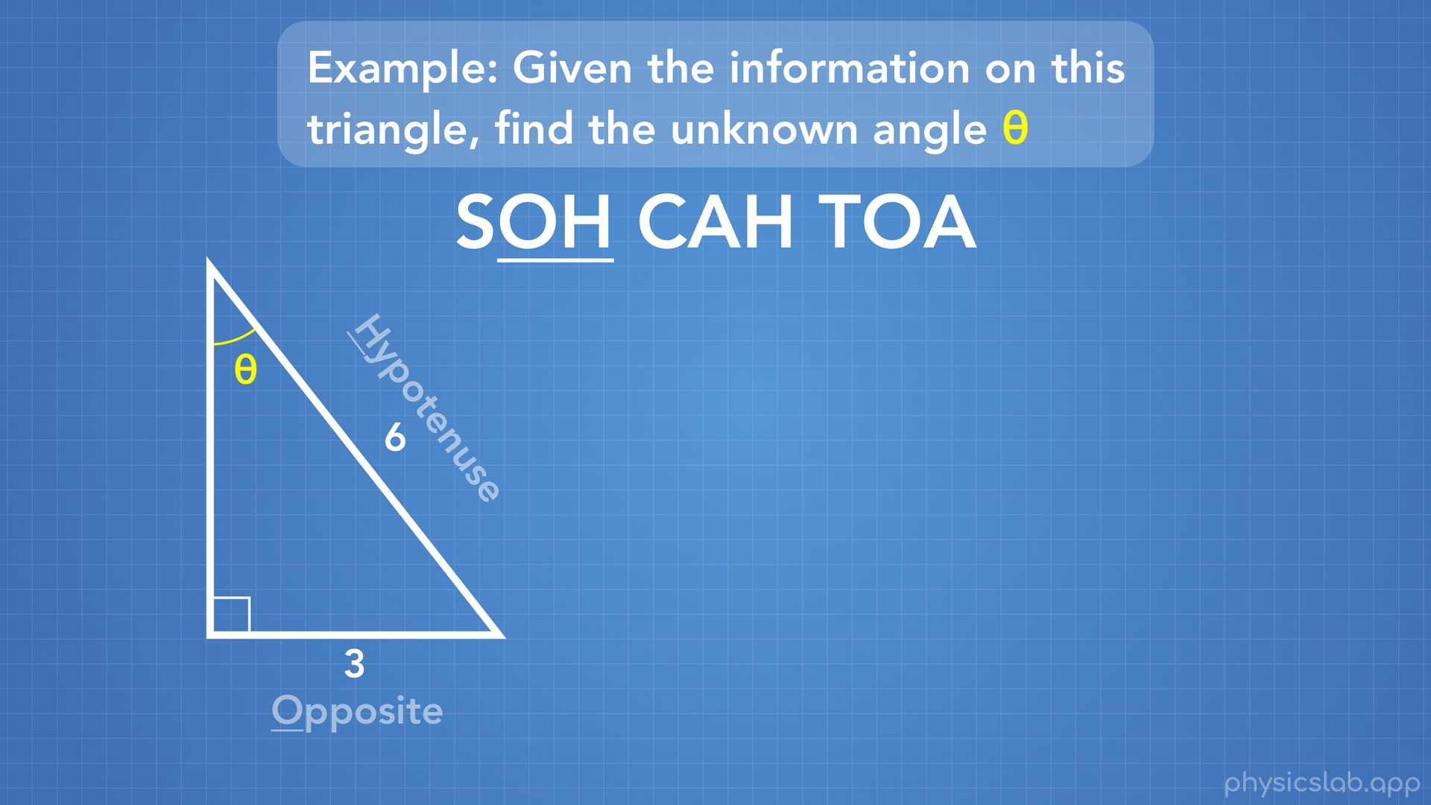
Notes:
Now we can finish our problem.

Slide 44
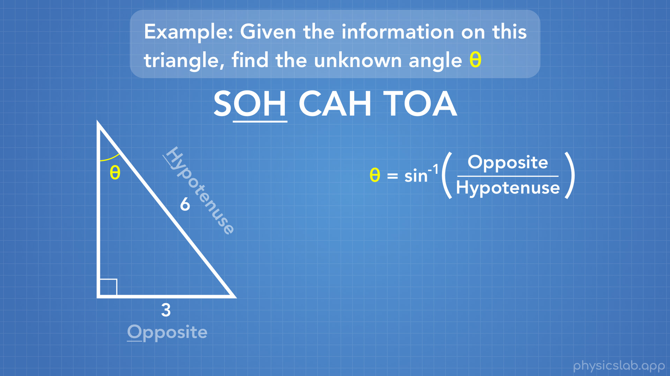
Notes:
We’re still dealing with sine, but since we want to find an angle, we’re going to use the inverse sine function.

Slide 45
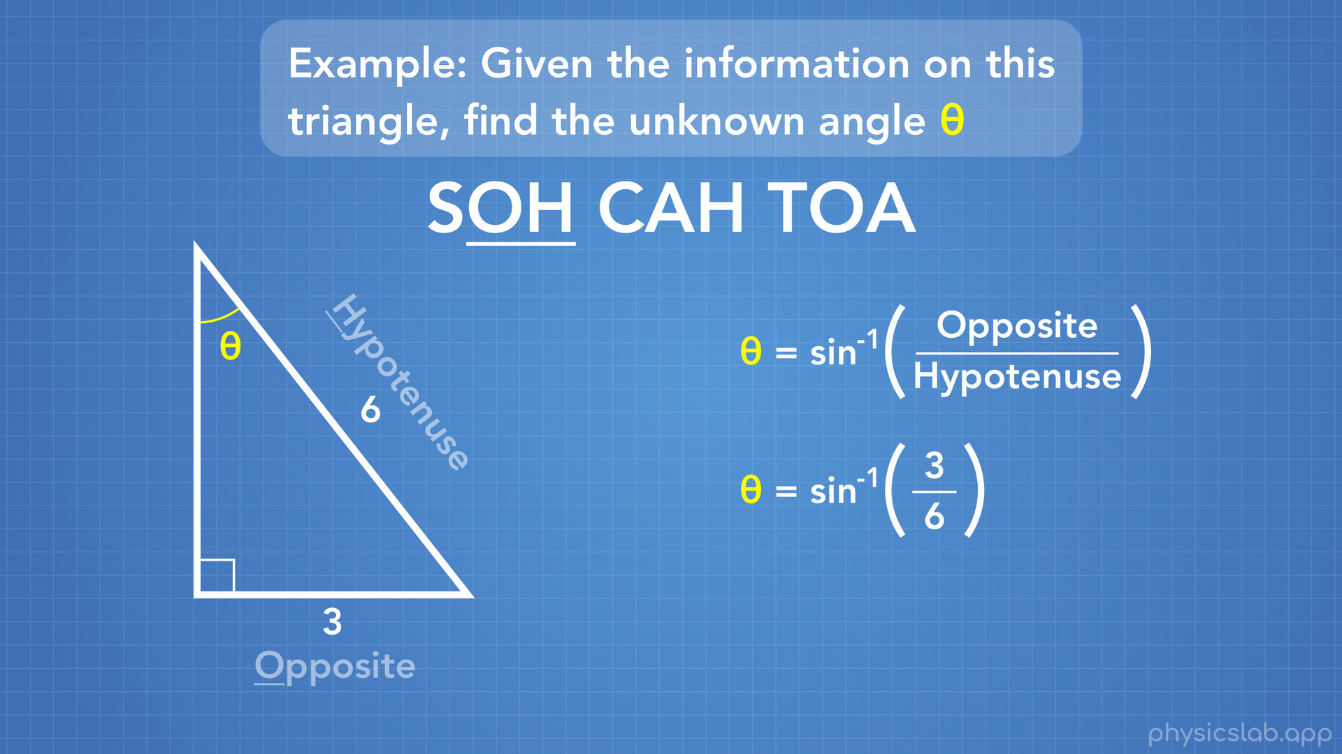
Notes:
In this case we plug in 3, for the opposite side length, and 6, for the hypotenuse side length.

Slide 46
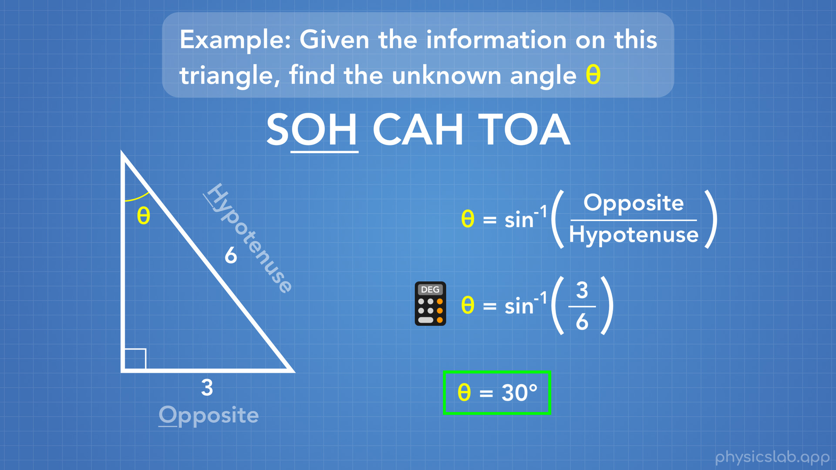
Notes:
Next we just plug this into our calculator, and we find that theta equals 30 degrees. Don’t forget to make sure your calculator is set to degrees.
Now we have everything we need to find the side lengths and angles of any right triangle.

Slide 47
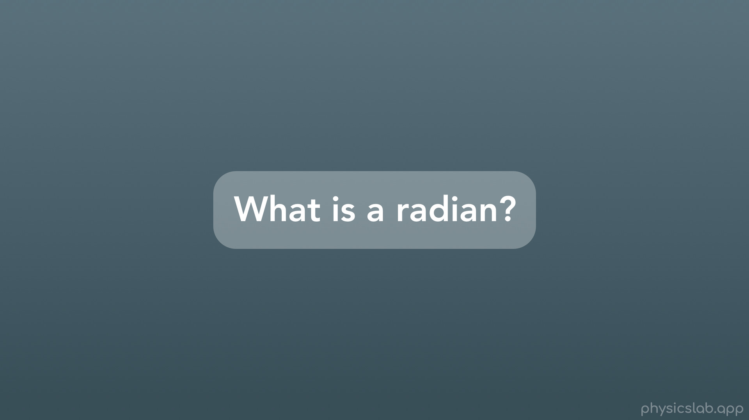
Notes:
Onto the last part of this video: what is a radian?

Slide 48
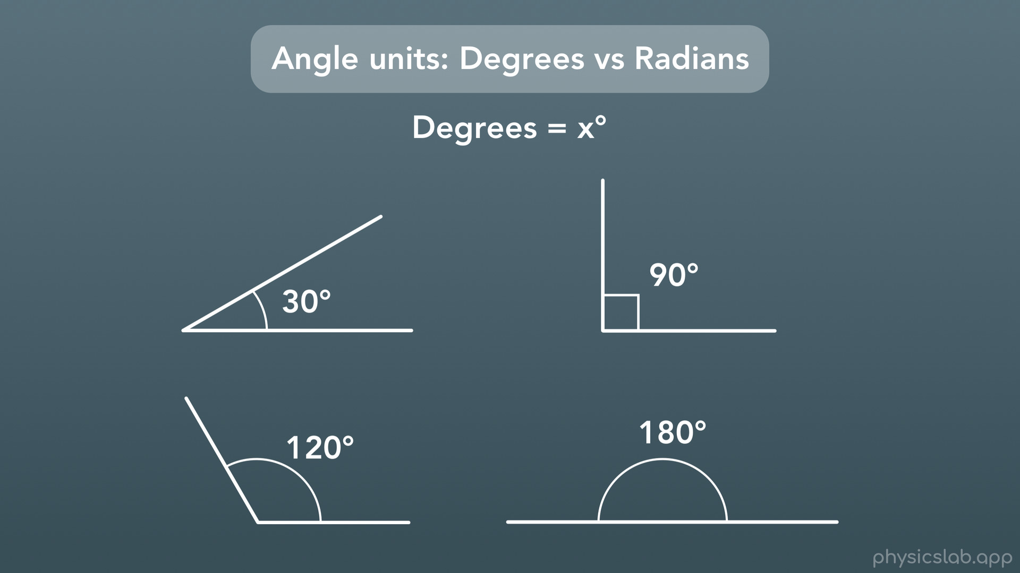
Notes:
Well in our everyday lives, and in this video, we’ve described angles using the unit of degrees, which has the little circle symbol above the number. Here are some angles measured in degrees.

Slide 49
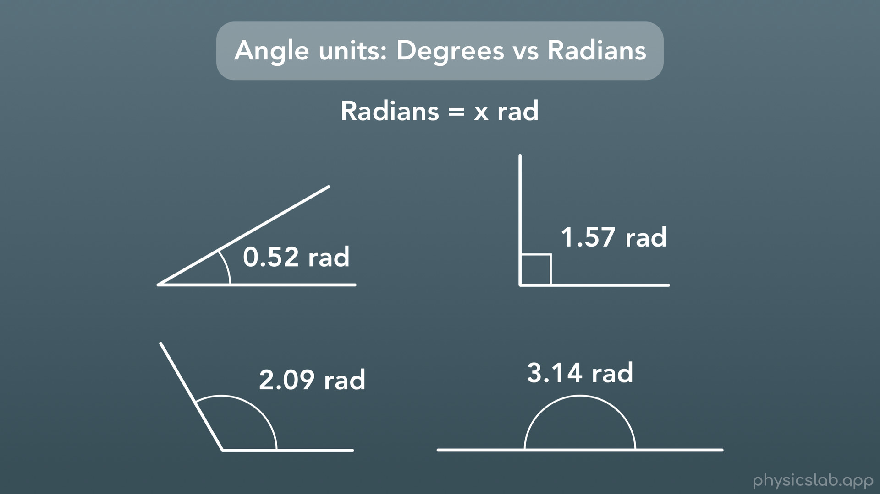
Notes:
But in physics, we sometimes use the unit for angles known as radians, which we write as r-a-d. Here are those same angles measured in units of radians. These numbers look a little weird, although that last one might look familiar to some of you…

Slide 50
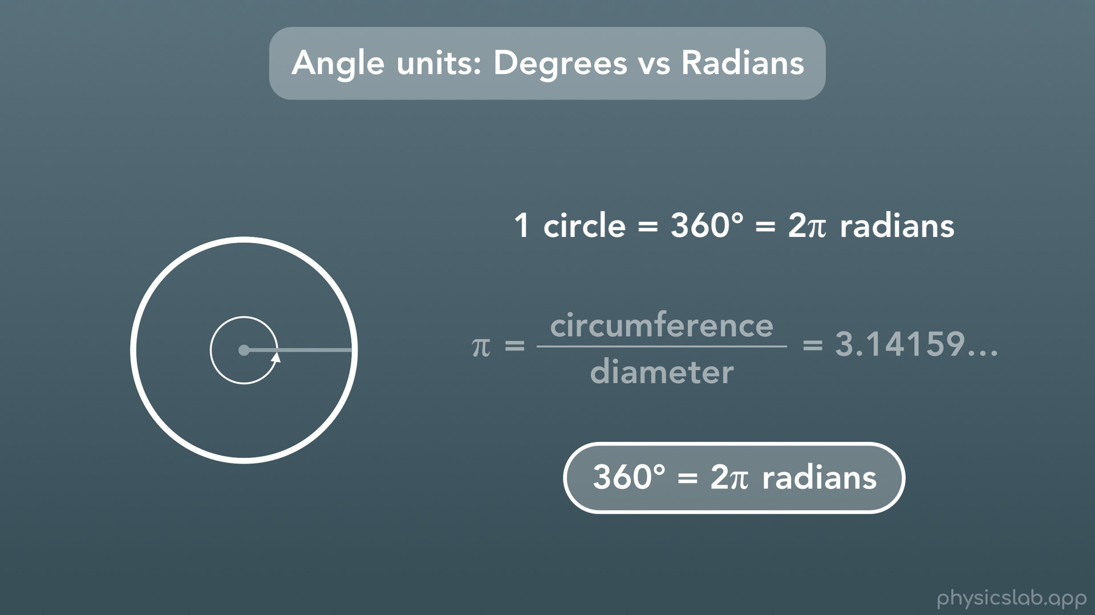
Notes:
What’s the relationship between between degrees and radians? How would we convert between the two? Well they’re both based on the number of degrees in a circle. One full circle, if you make one full revolution, has 360 degrees. It also has 2 pi radians, where pi (if you remember) is the circumference of a circle divided by its diameter. So here’s our conversion, 360 degrees equals 2 pi radians. Ok but what is a radian? Why are there 2 pi radians in one circle?

Slide 51
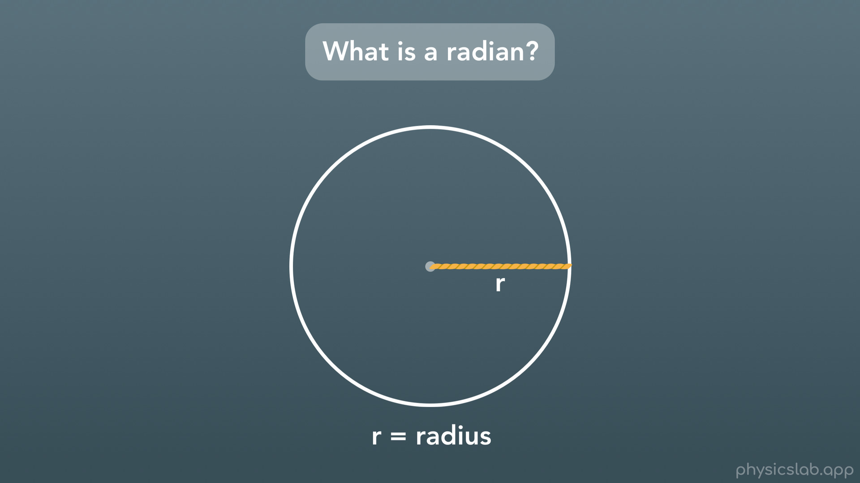
Notes:
Let’s take a look. Let’s say we have a circle and the radius is some number that we’ll represent with the variable r.

Slide 52

Notes:
Now we take the length of that radius r, we bring it outside the circle

Slide 53

Notes:
and we bend it or wrap it along the circumference of the circle.

Slide 54


Slide 55

Notes:
If we draw a line from the center to where that new length ends

Slide 56

Notes:
we form an angle inside the circle.

Slide 57

Notes:
The value of that angle is 1 radian. For reference, that’s about 57.3 degrees.

Slide 58

Notes:
Pretty interesting. So when we count the number of radians in a circle, that’s how we end up with 2 pi radians, which is about 6.28 radians. You might notice the similarity to the equation for the circumference of a circle: circumference equals 2 pi times the radius, because they’re pretty related.

Slide 59

Notes:
Let’s do a quick example of converting between degrees and radians. Here, we want to convert 68 degrees to units of radians.

Slide 60

Notes:
Well we know from before, and from our reference sheet, that 360 degrees equals 2 pi radians.

Slide 61

Notes:
And we’ll use the same method that we learned before for converting between units. We write our starting amount, which is 68 degrees.

Slide 62

Notes:
Then we write our equal amounts, in this case there’s 2 pi radians per 360 degrees.

Slide 63

Notes:
Since we wrote our fraction with degrees on the bottom, we can cross out degrees on the top and bottom, and we’re just left with units of radians.

Slide 64

Notes:
We do the math: 68 times 2 pi, divided by 360, and we get 1.19 radians.

Slide 65

Notes:
Let’s recap what we covered in this video.

Slide 66

Notes:
We learned that the three angles in a triangle add up to 180 degrees. And this is true for any triangle, not just right triangles.

Slide 67

Notes:
We learned about right triangles, where one angle is 90 degrees, and the pythagorean theorem: a^2+b^2=c^2, where c is the hypotenuse.

Slide 68
Notes:
Next we covered the 3 right triangle trig functions: sine cosine and tangent, which we can use to find the side lengths of a triangle, and SOH CAH TOA, which is a way to remember which side lengths go with which trig function.

Slide 69
Notes:
We also learned the inverse trig functions, which we can use to solve for the angles in a triangle.

Slide 70
Notes:
And last, we learned what a radian is, and how to convert from units of degrees to units of radians.

Slide 71


