Slide 1
Gravitational Fields
Slides Version 2
This version includes:
Slides with screenshot images from the video.
The video narration in the slide notes.
A blank template slide with the same background and font as the video.
Slides with some basic graphics from this video for you to use however you like.
Feel free to add, delete and edit slides to make your own presentation. You can use these slides in class or share them with your students, but please do not share them with anyone else.
If you have any feedback, suggestions or questions about these slides please email me at chris@physicslab.app or send me a message on Discord @physicslab.
physicslab.app

Slide 2
Heading
Text

Slide 3
Heading
Text

Slide 4

















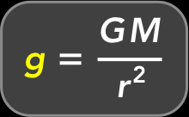



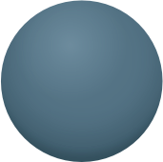
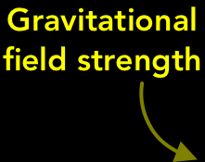











Slide 5



Slide 6

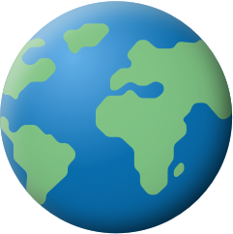
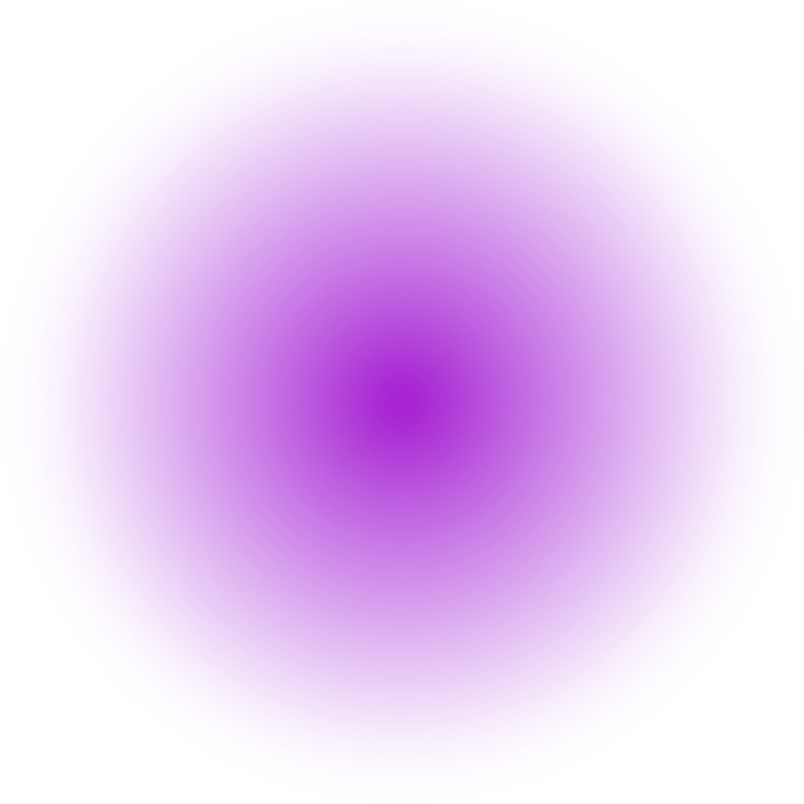



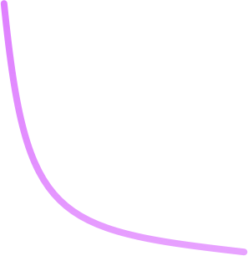

Slide 7


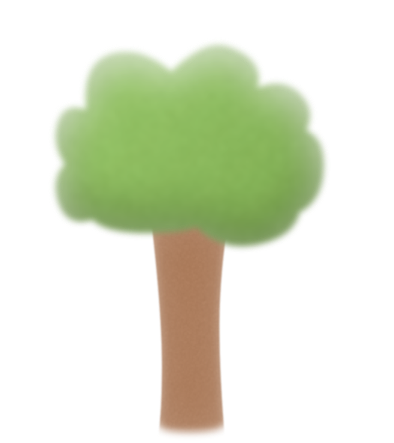


Slide 8


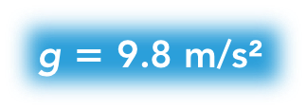







Slide 9






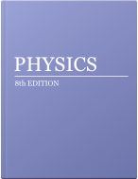





Slide 10
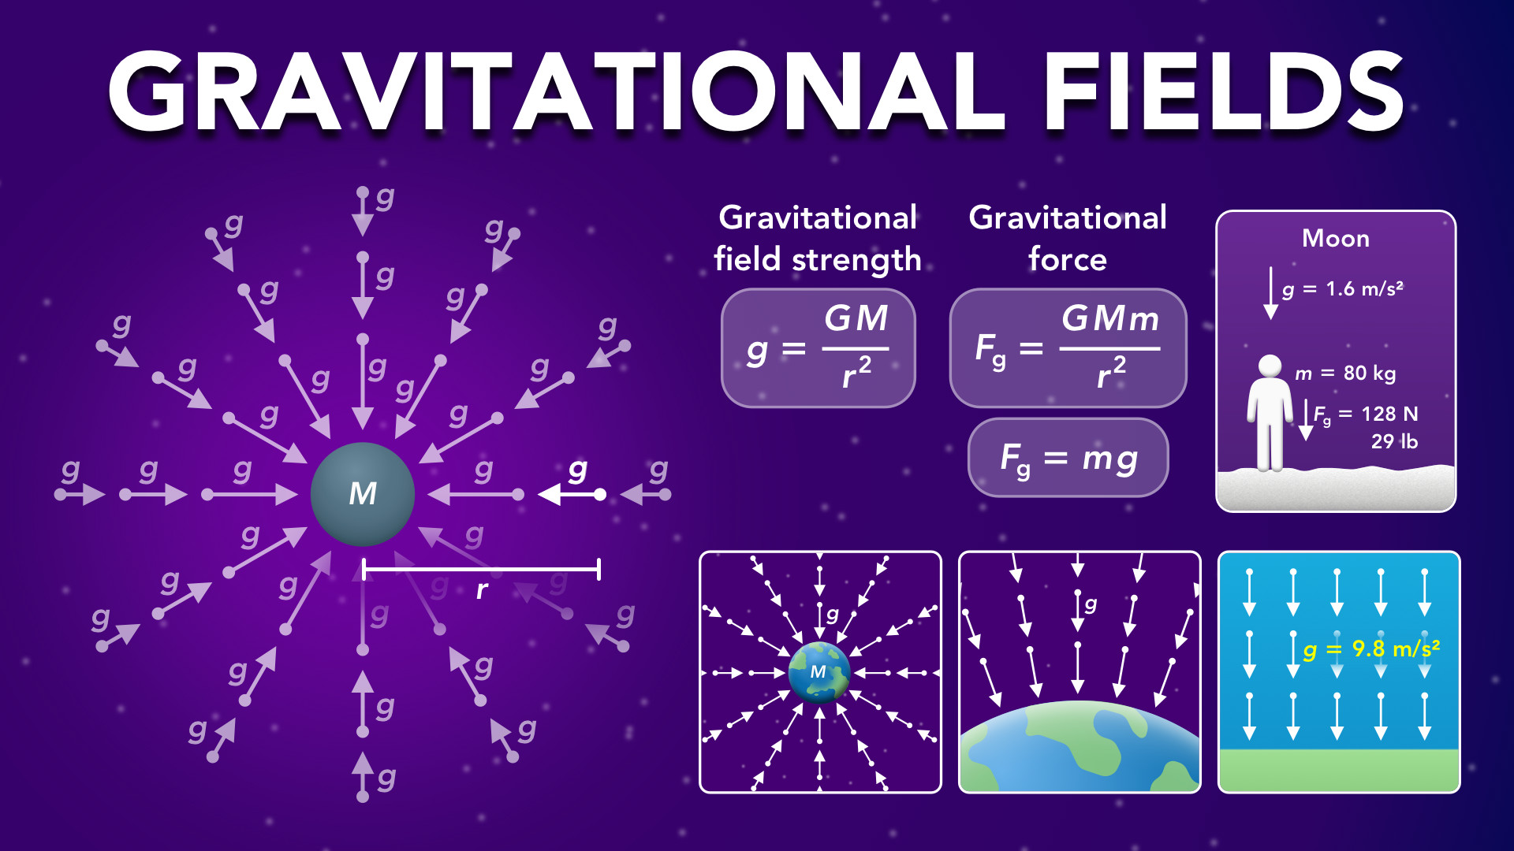
Notes:
Gravitational Fields
physicslab.app
If you have any questions, suggestions or feedback about these slides please email me at chris@physicslab.app or send me a message on Discord @physicslab.

Slide 11
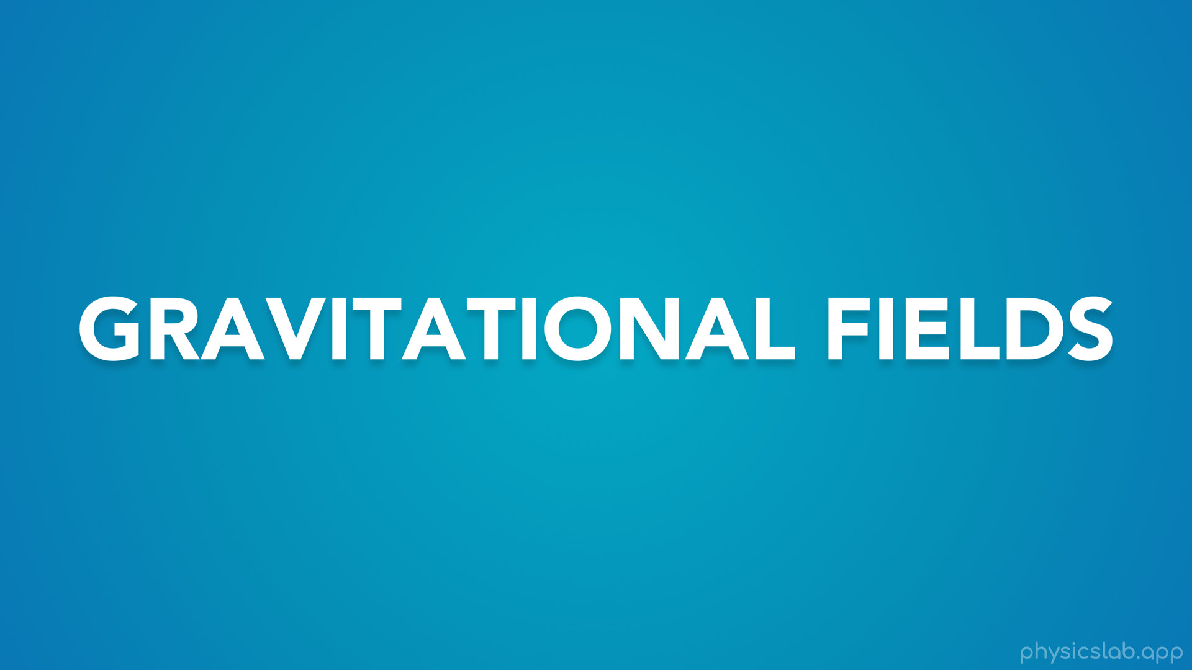
Notes:
• Hey everyone, in this video we’re gonna learn about gravitational fields!

Slide 12
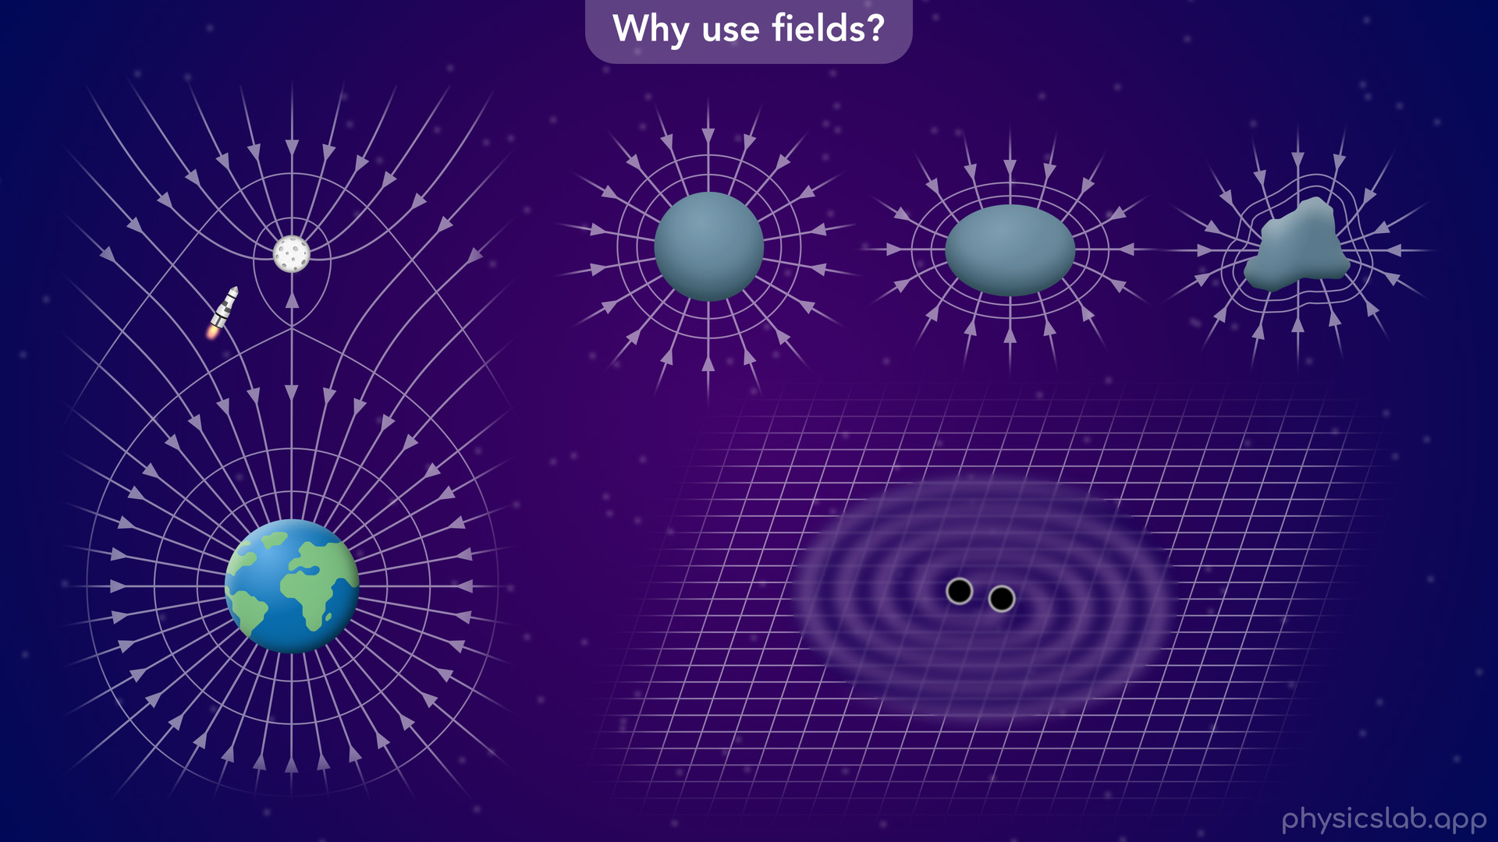
Notes:
• We’ll start with a quick introduction to fields and why they’re useful.

Slide 13
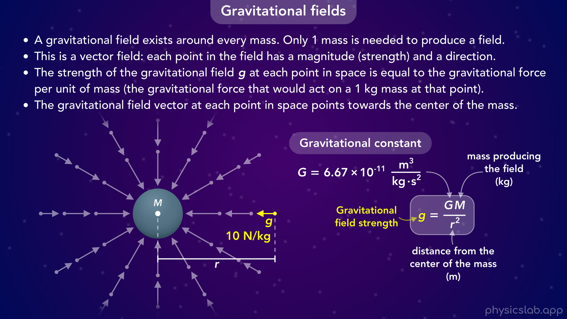
Notes:
• Then we’ll learn about gravitation fields and the equation for gravitational field strength.

Slide 14
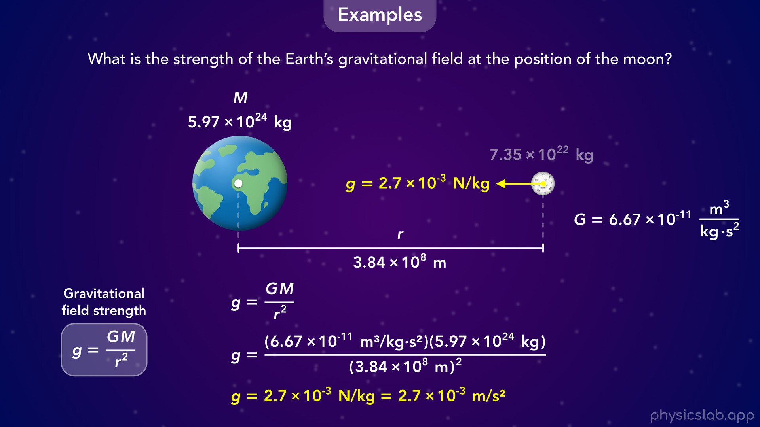
Notes:
• We’ll walk through an example of calculating the gravitational field at a point in space, and how to calculate a gravitational force using that field.

Slide 15
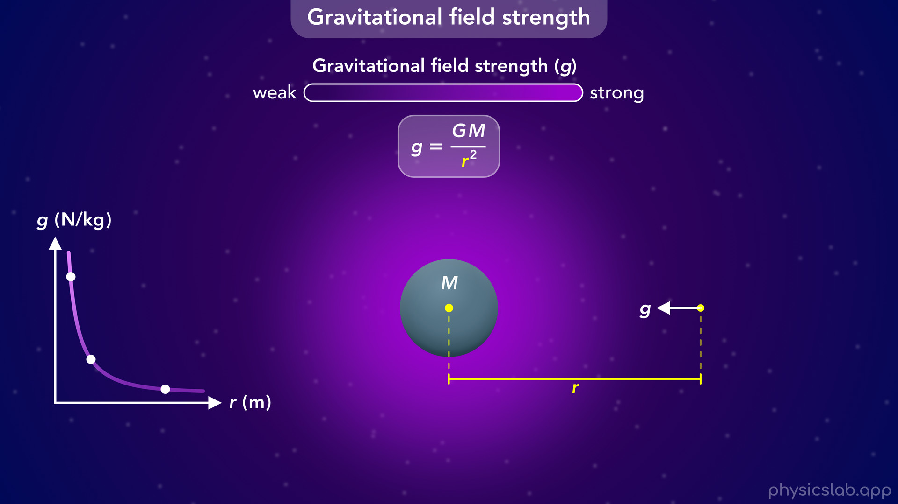
Notes:
• We’ll also explore how the field strength changes with each variable.

Slide 16
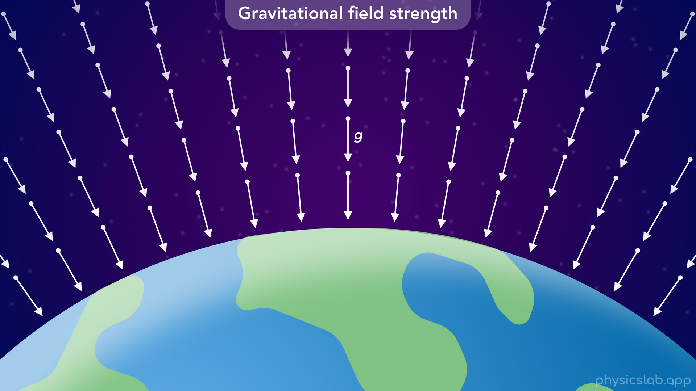
Notes:
• Then, we’ll look at the gravitational field around the earth.

Slide 17
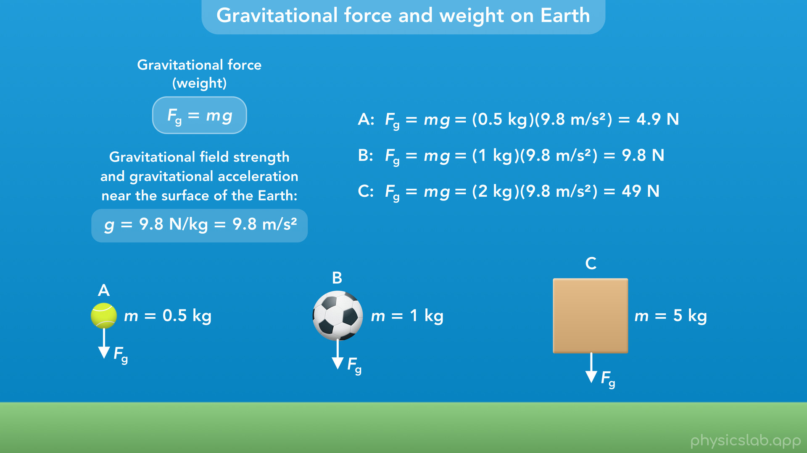
Notes:
• We’ll learn where the free fall acceleration of 9.8 m/s² comes from, and how to calculate the weight of an object.

Slide 18
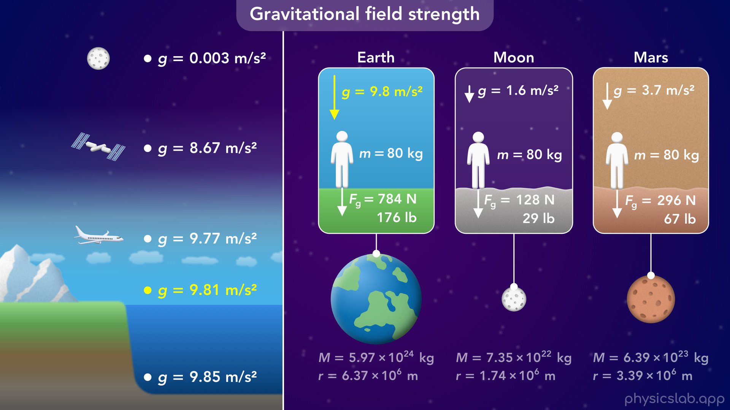
Notes:
• At the end, we’ll see how the value of g varies on earth and on different planets.

Slide 19
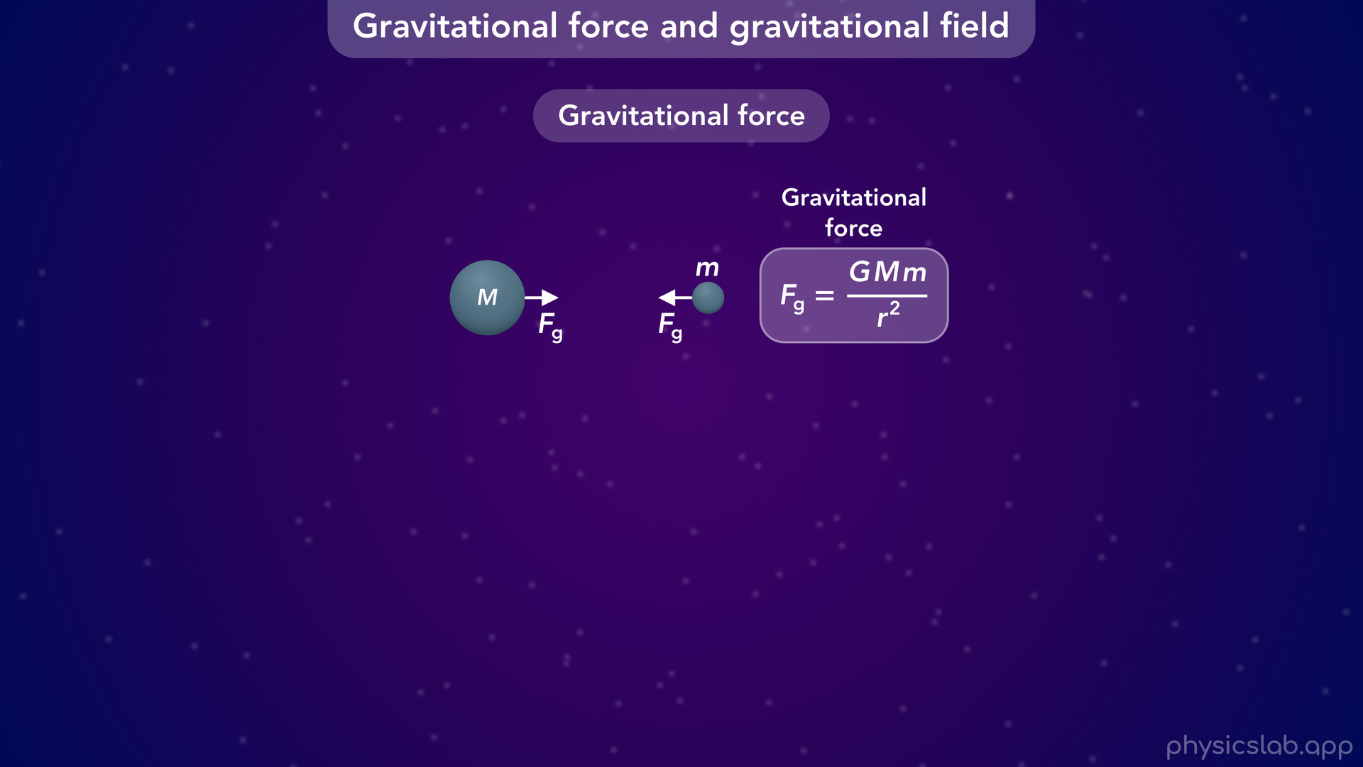
Notes:
• In the last video, we learned how to find the gravitational force between two masses using this equation.

Slide 20
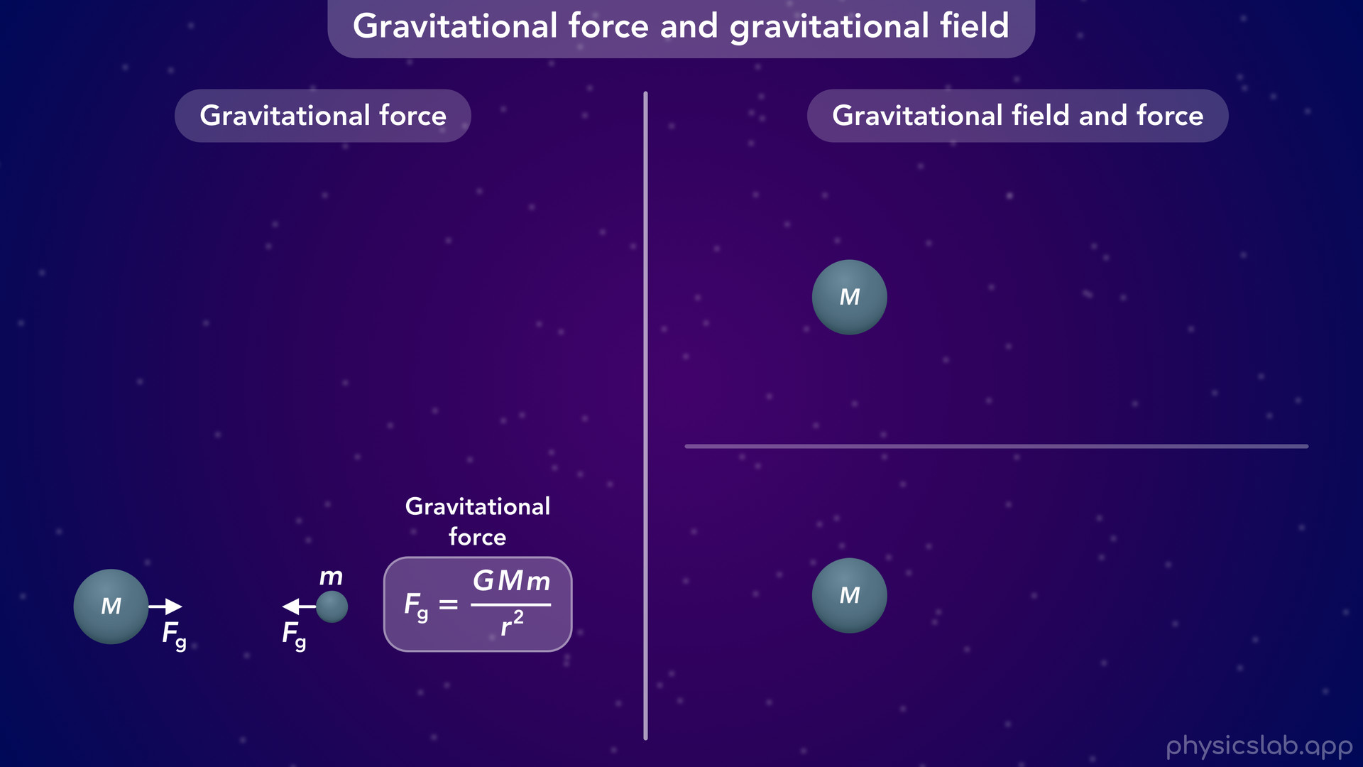
Notes:
• But there’s another way to think about gravity, using fields.
• There’s a gravitational field around every mass that points towards the mass.
• We can find the field strength at each point in space using this equation.
• And then, If a second mass is in that field, it experiences a gravitational force, which we can find using this new equation.
• You might be wondering, what’s the point of using a field if we can just find the gravitational force in one step with the equation on the left?

Slide 21
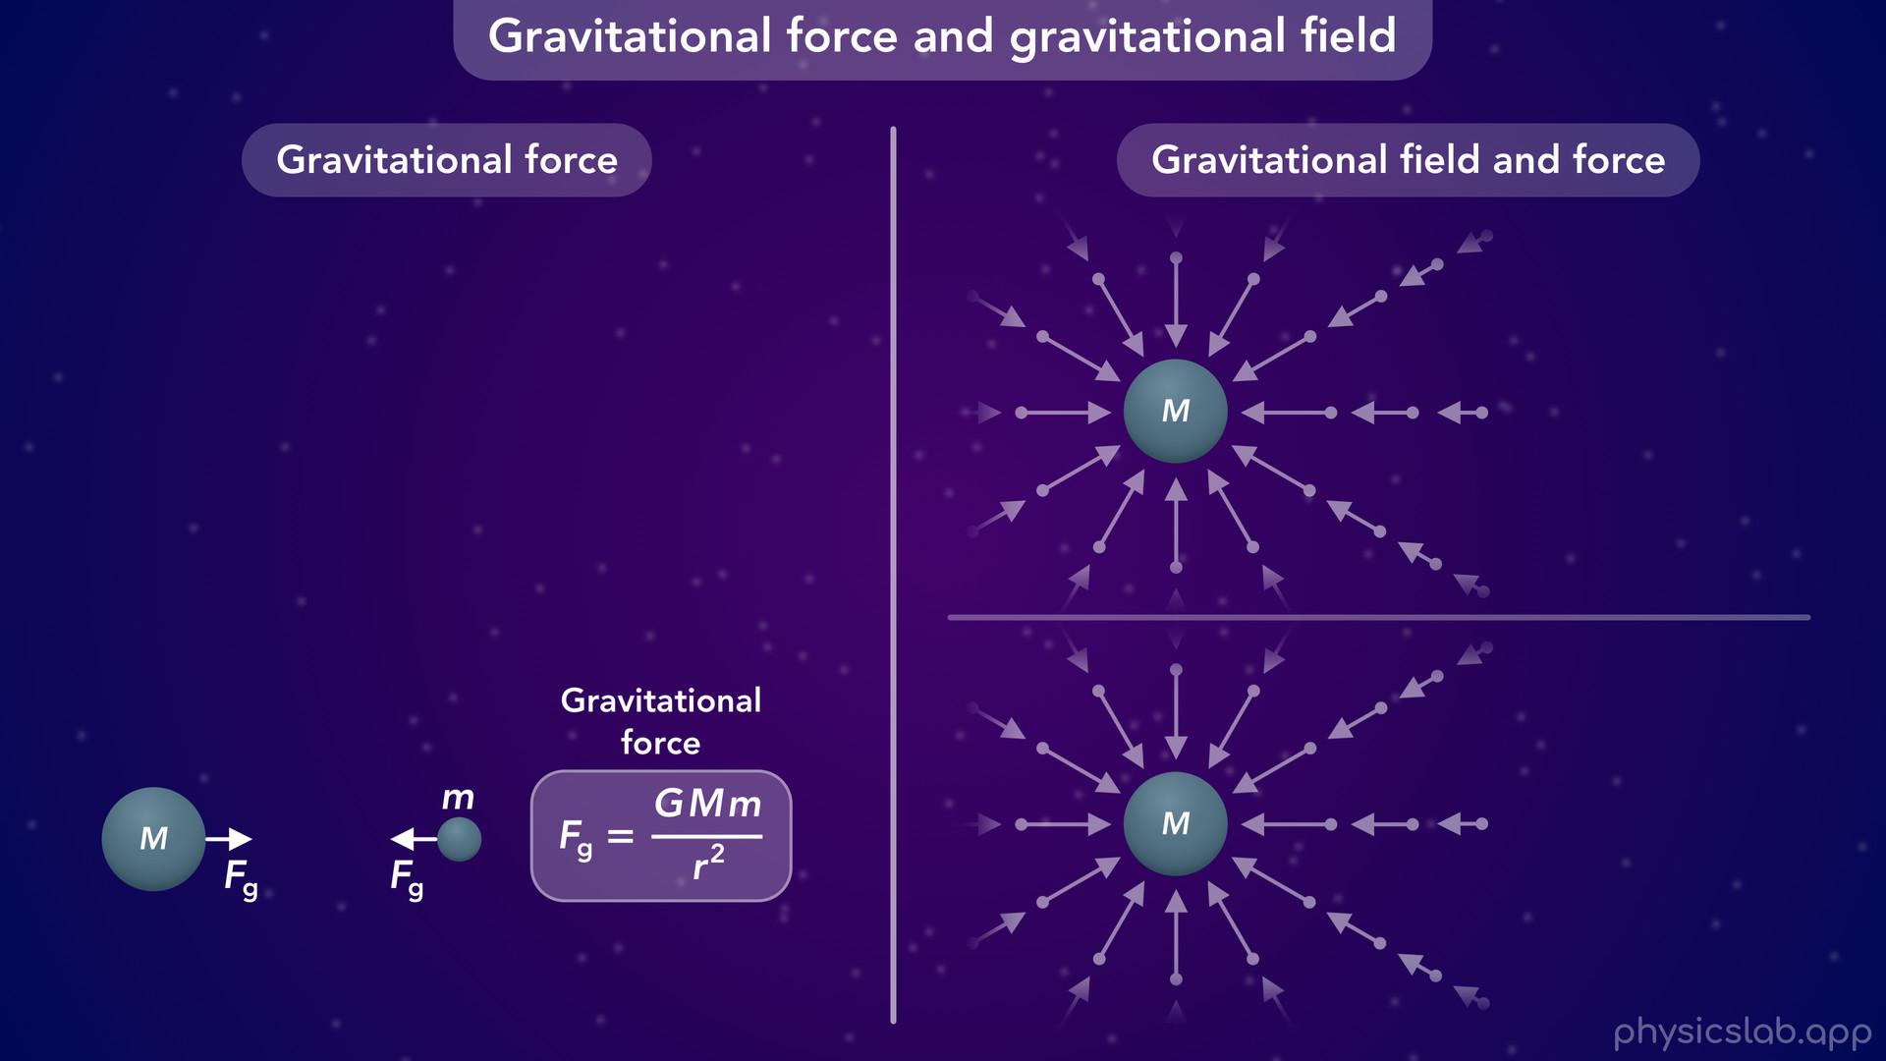
Notes:
• But there’s another way to think about gravity, using fields.
• There’s a gravitational field around every mass that points towards the mass.

Slide 22
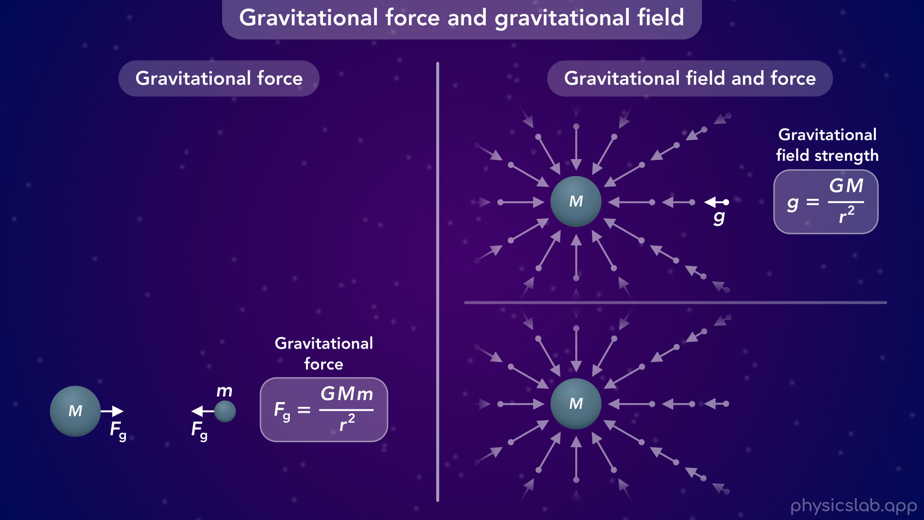
Notes:
• We can find the field strength at each point in space using this equation.

Slide 23
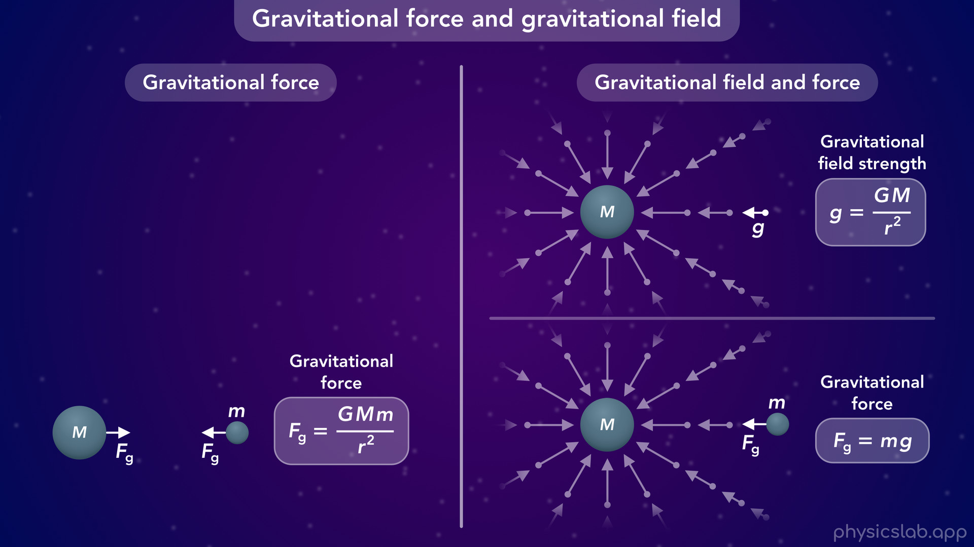
Notes:
• And then, If a second mass is in that field, it experiences a gravitational force, which we can find using this new equation.
• You might be wondering, what’s the point of using a field if we can just find the gravitational force in one step with the equation on the left?

Slide 24
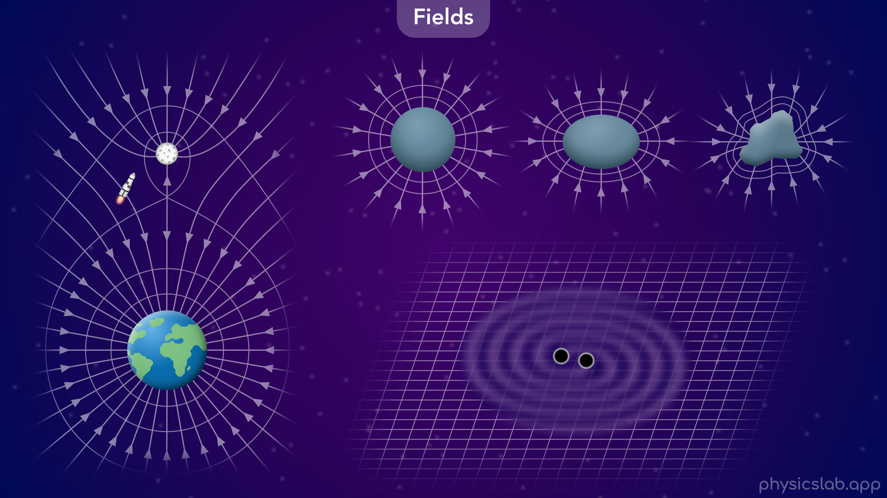
Notes:
• There’s a lot of reasons why gravitational fields are useful.
• We can combine the separate gravitational fields from two bodies, like the earth and the moon, to figure out the best way to navigate something through space.
• We’re only gonna look at spherical objects, but planets are not perfect spheres and many objects have an irregular shape. In those cases, we can’t use the equation that we learned for gravitational force.
• And sometimes we’re only interested in the gravitational field itself.
• Einstein predicted the existence of gravitational waves, which are waves in a gravitational field.
• And in 2015, we detected gravitational waves for the first time, which were caused by two black holes orbiting each other about 1.3 billion light years away.

Slide 25
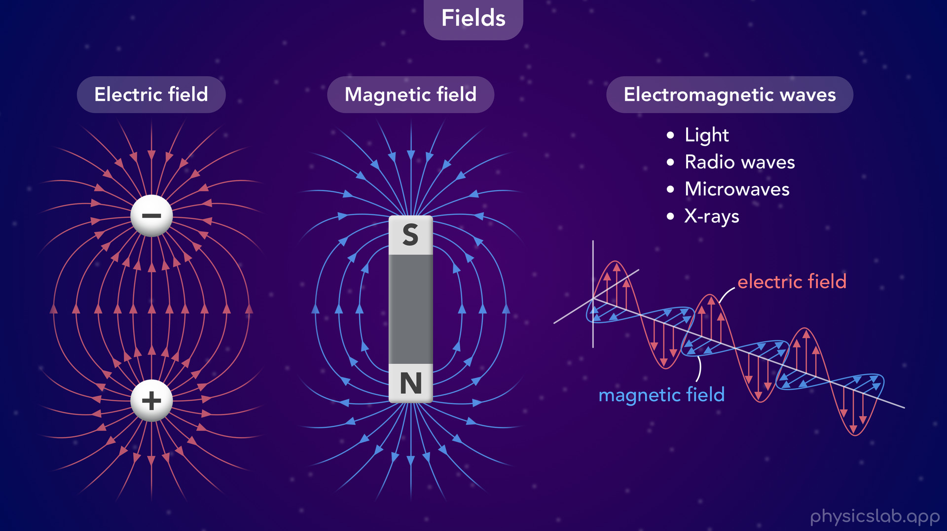
Notes:
• Although we’re not covering these in this course, there’s also electric fields around charged objects and magnetic fields around magnetic objects.
• Gravitational waves may see weird, but we experience electrogmagnetic waves every day.
• Light, radio waves, microwaves, x rays, and everything on electromagnetic spectrum are just waves that travel through the electric and magnetic fields on their own.
• So in many cases, it’s the field itself that care about.

Slide 26
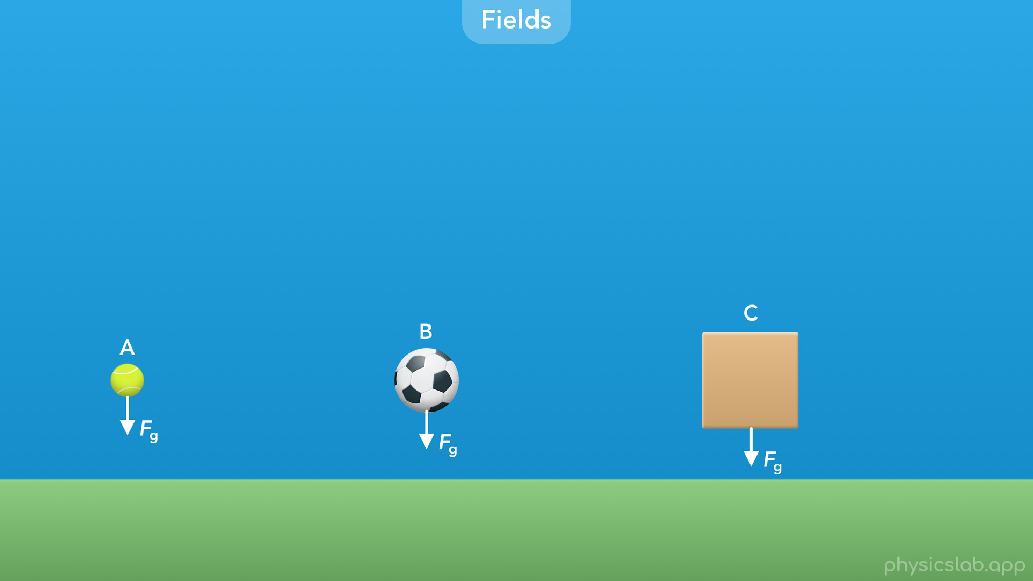
Notes:
• Even though we’re not gonna learn about complex gravitational fields, using a field can still make things easier for us.
• It might seem like an extra step for finding the gravitational force, but think about this scenario.
• Let’s say we want to calculate the gravitational force on 3 different objects from the Earth.

Slide 27
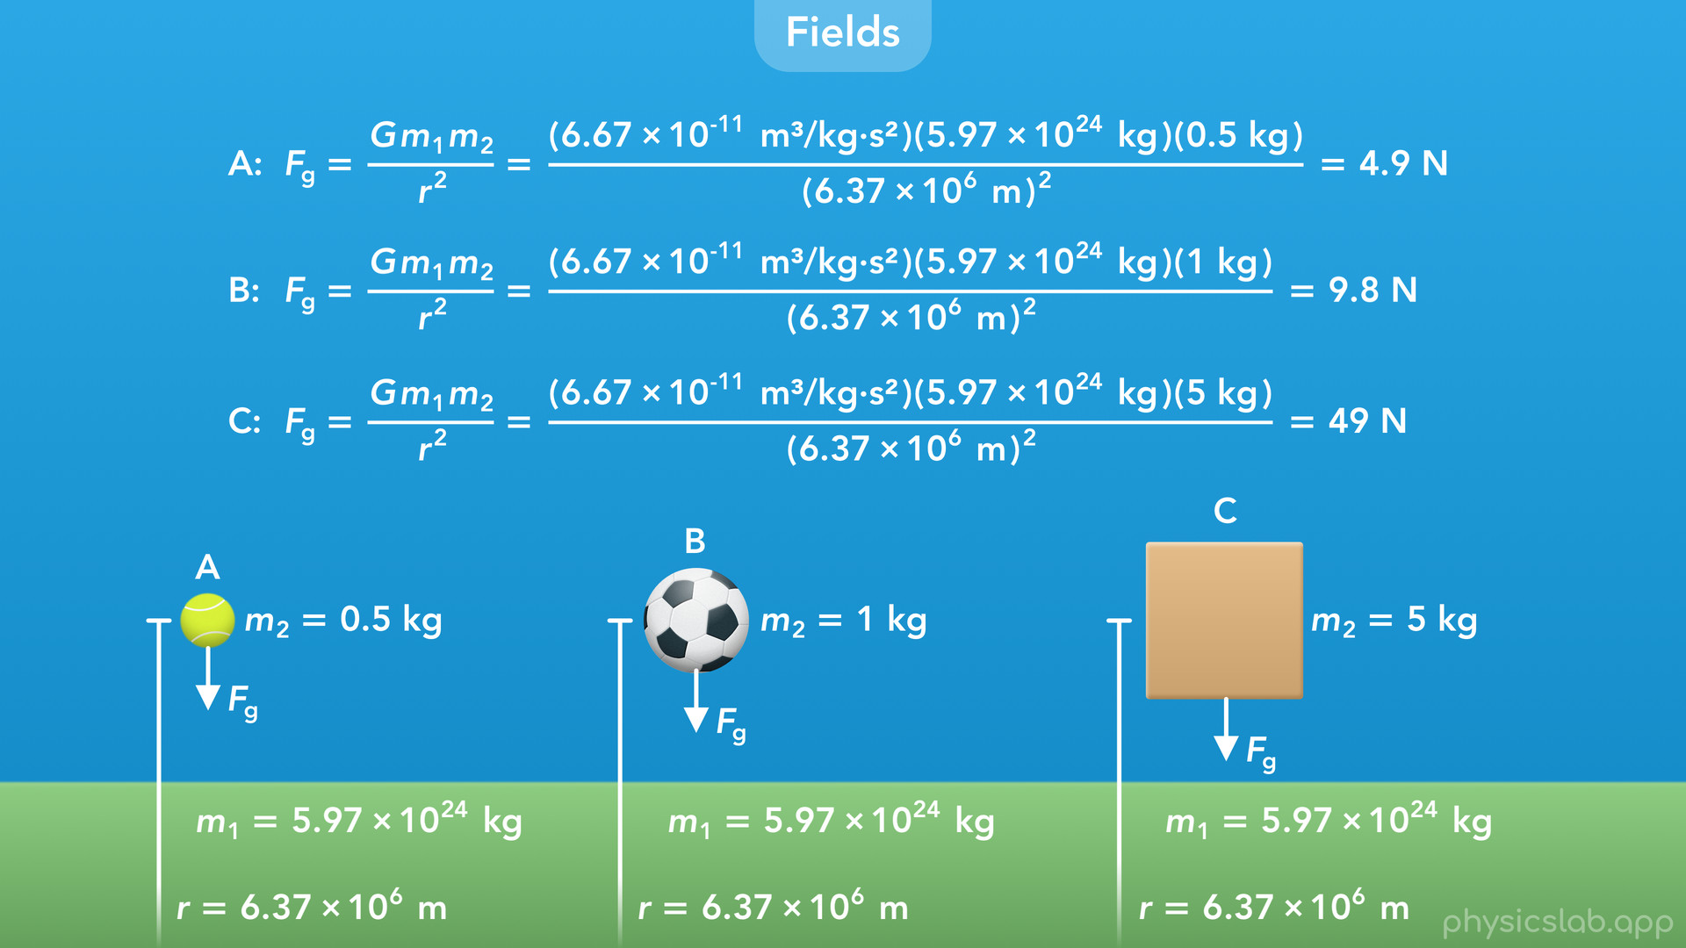
Notes:
• If we use the equation we learned for gravitational force, we have to plug in the gravitational constant, capital G, the mass of the earth, the mass of the object and the radius of the earth.

Slide 28
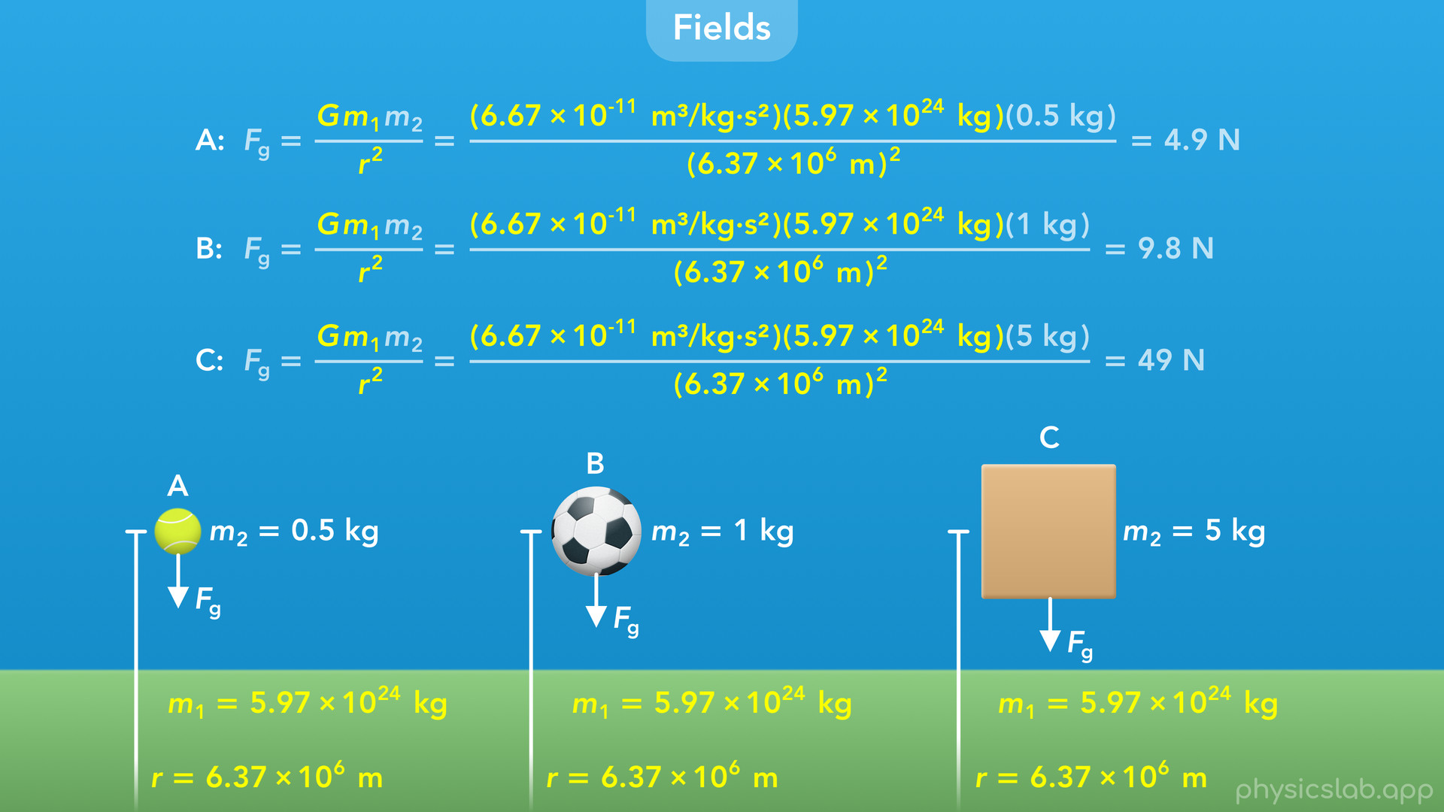
Notes:
• That’s a lot of stuff to write.
• And notice that G, m1 and r have the same value in each case.
• The only difference is m2, the mass of the object.

Slide 29
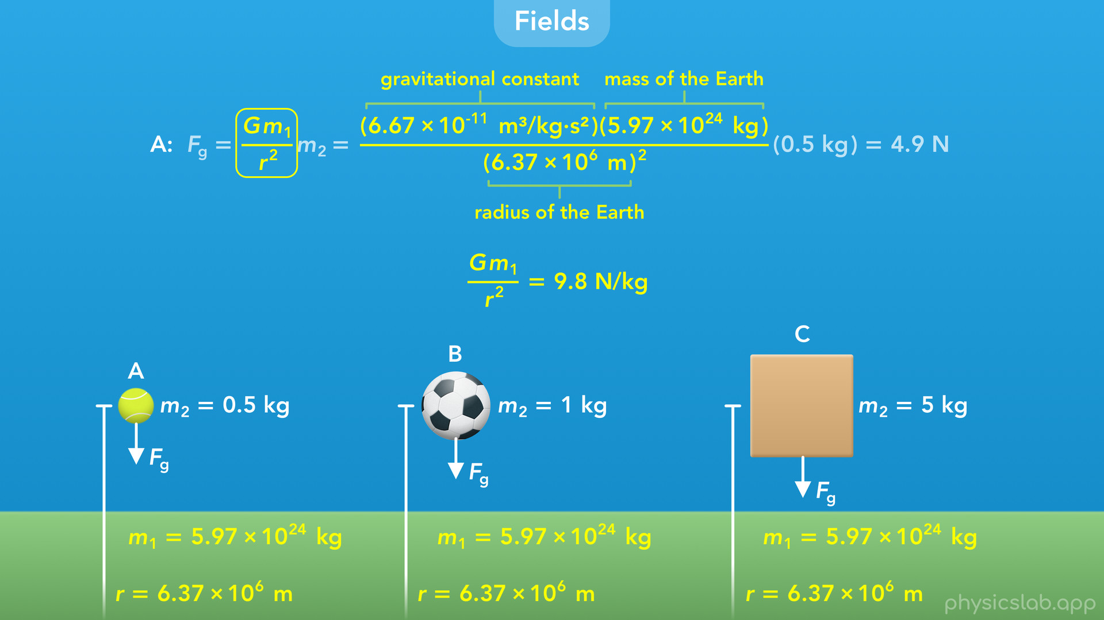
Notes:
• If we write this equation a little differently, we’re basically multiplying this fraction by the mass of the object.
• And this fraction always has the same 3 values if an object is near the surface of the Earth: the gravitational constant, the mass of the earth and the radius of the earth.
• So why don’t we just calculate this fraction by itself and use that number in each example.
• If we do that using these values, we get 9.8 N/kg.

Slide 30
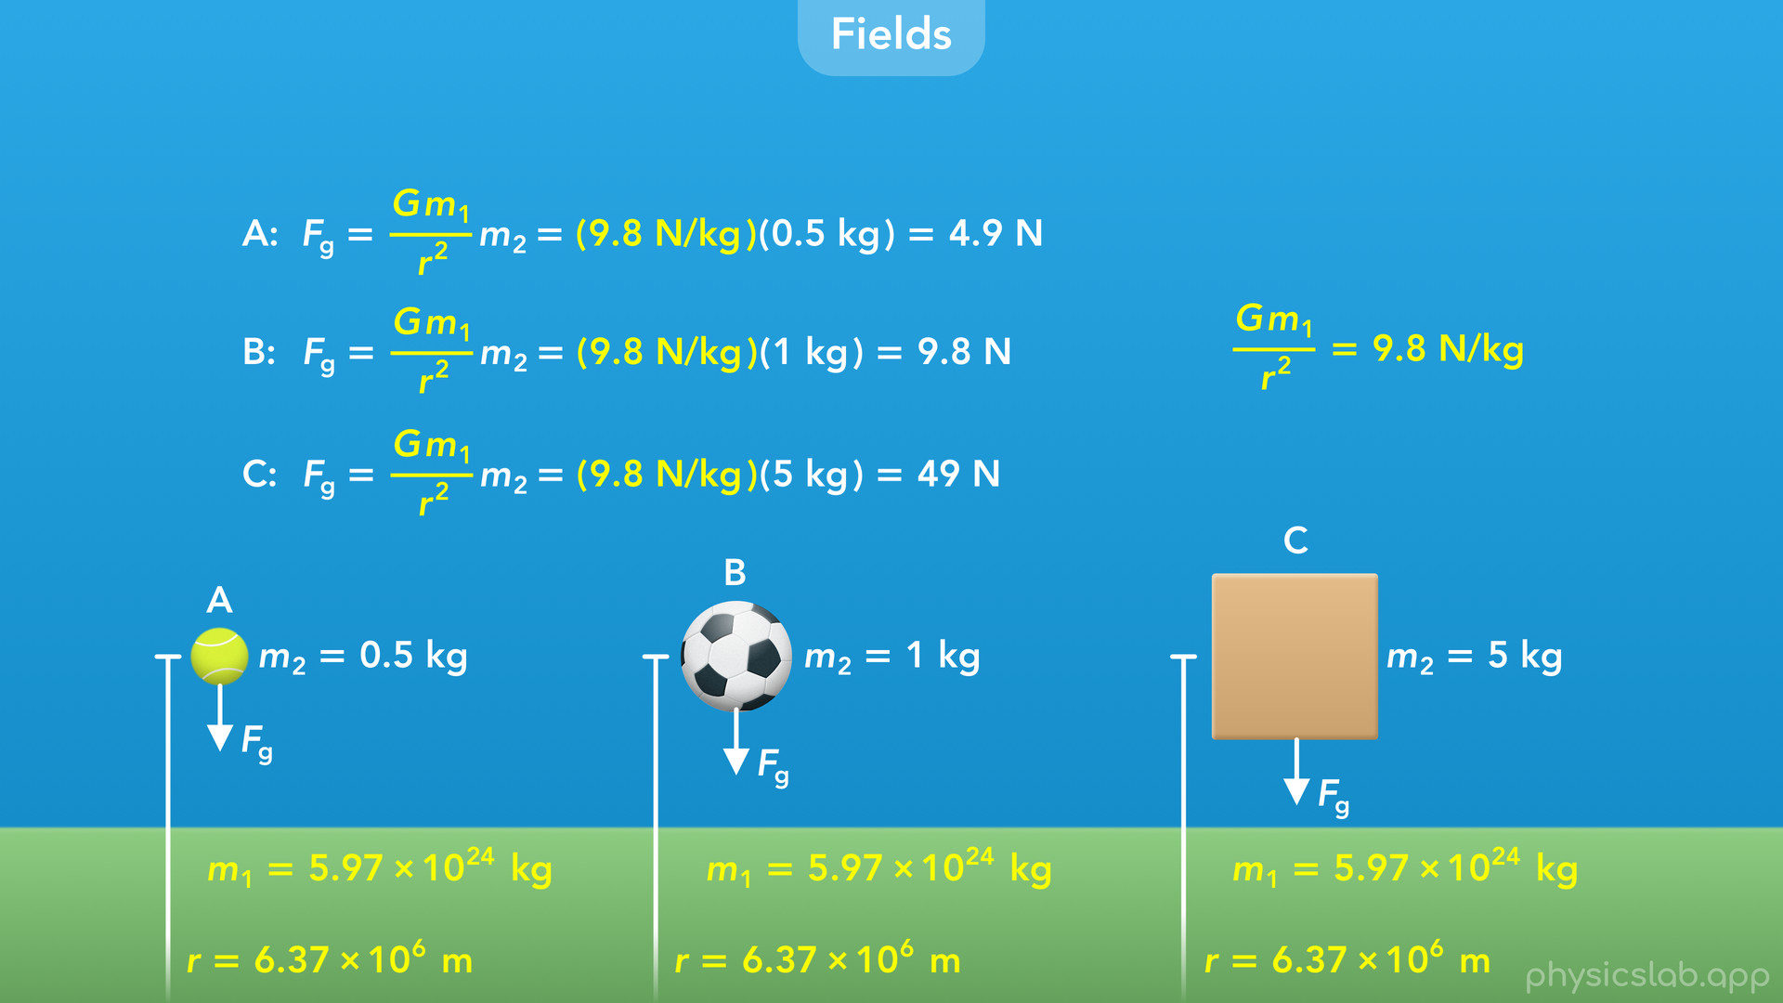
Notes:
• So instead of this fraction, we multiply 9.8 N/kg times the mass of an object to get the gravitational force on that object.
• And we can do this for any object near the surface of the Earth, which makes things a lot easier.
• It turns out that we have a name for this fraction and this number.

Slide 31
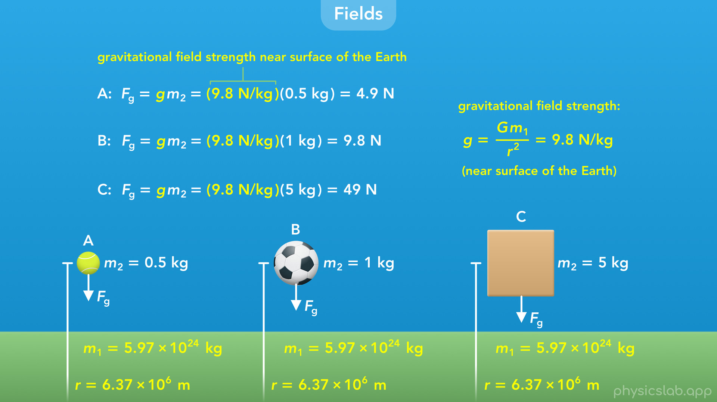
Notes:
• We call it the gravitational field strength and we represent it with lowercase g.
• This might look familiar, and we’ll get to that later.

Slide 32
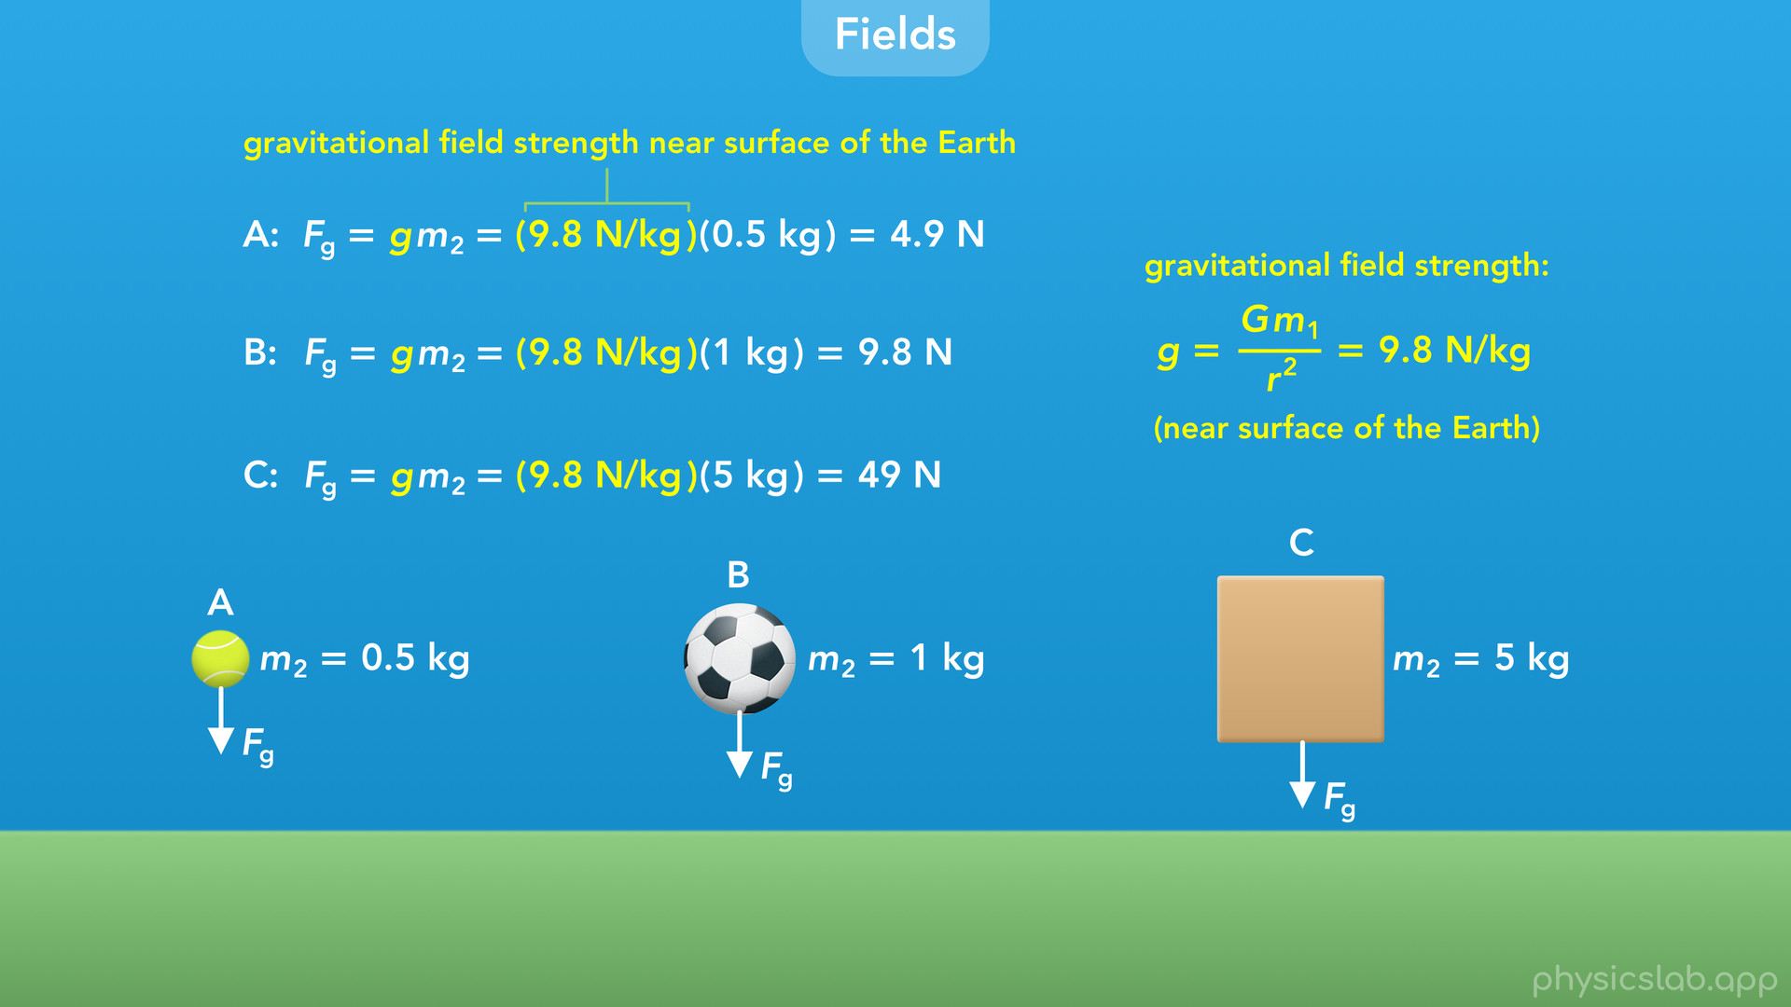
Notes:
• So if we already know the gravitational field strength, we can just multiply that times the mass of an object to get the gravitational force on that object.

Slide 33
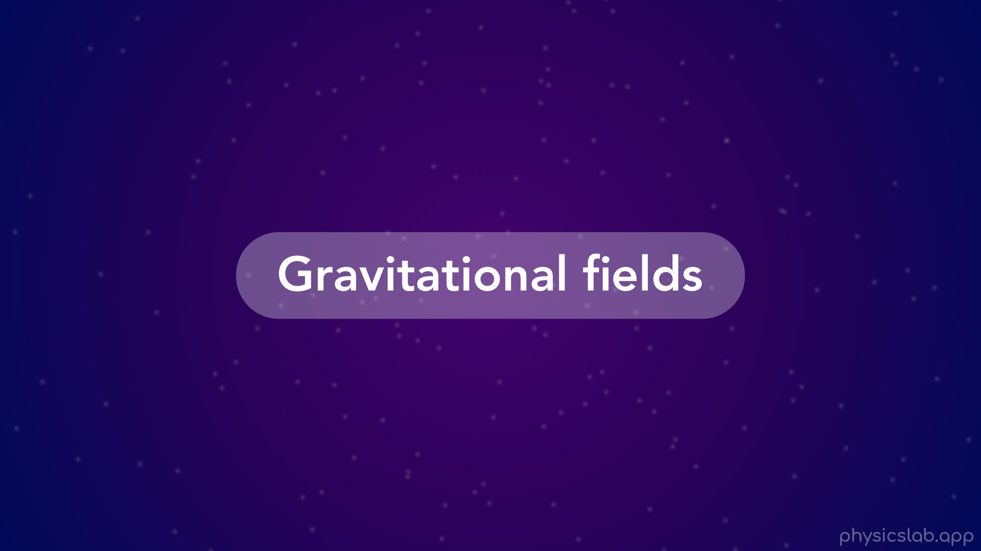
Notes:
• But what actually is the gravitational field strength, and what’s a gravitational field?

Slide 34
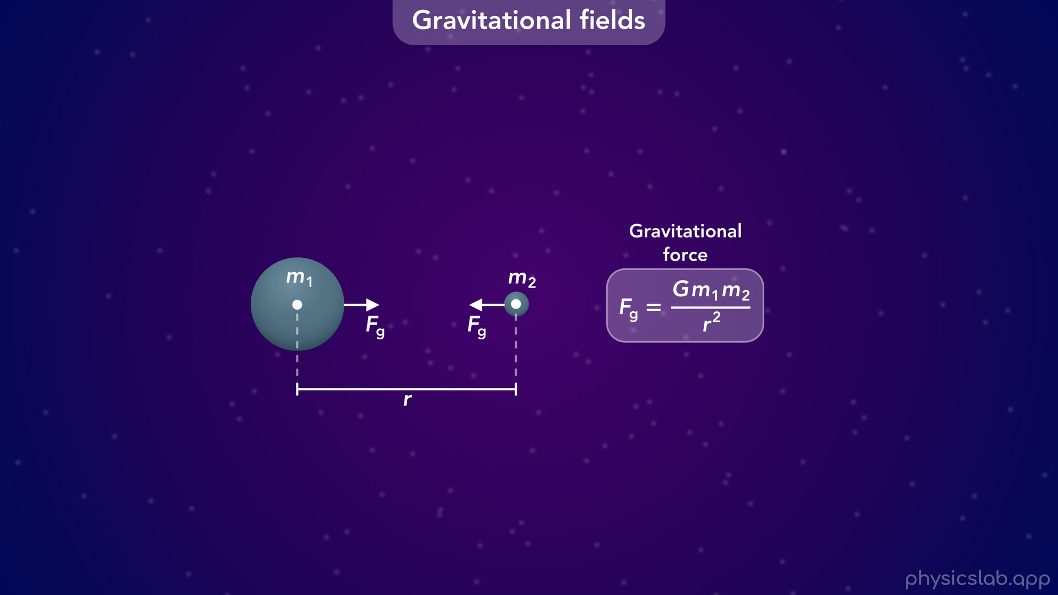
Notes:
• Gravitational fields, like many types of fields, are actually based on a gravitational force.
• We learned in the last video that two masses attract each other with equal and opposite gravitational forces, Fg.
• And we can use this equation to calculate the gravitational force, which depends on the two masses and the distance between their centers.

Slide 35
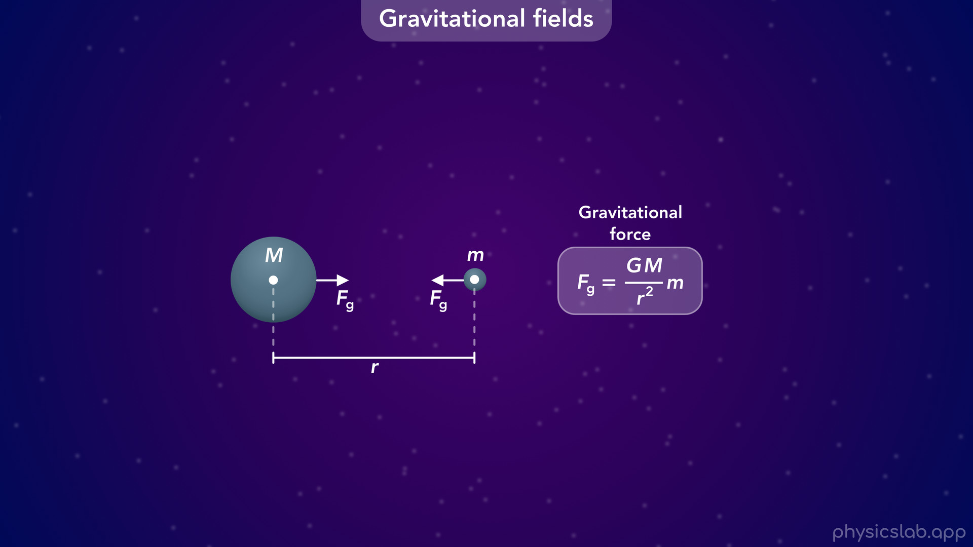
Notes:
• Instead of using m1 and m2 for the masses, we’re gonna replace them with capital M and lower case m… and we’ll write it like this so lowercase m is multiplied by this fraction.

Slide 36
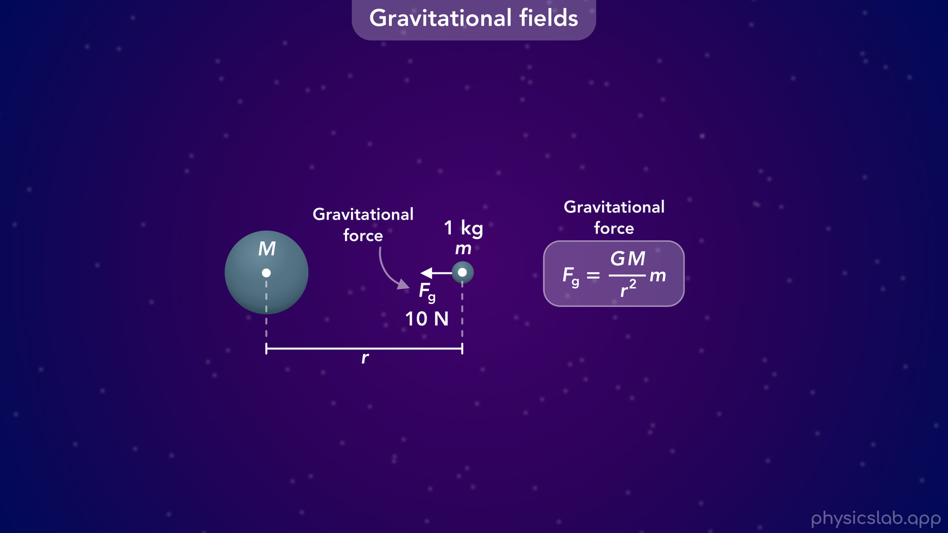
Notes:
• Fg is the gravitational force acting on each mass, but let’s just focus on the force that’s acting on the right mass.
• As an example, let’s say the mass is 1 kg and the gravitational force acting on it is 10 N.
• That is the gravitational force on that mass at that point in space.

Slide 37
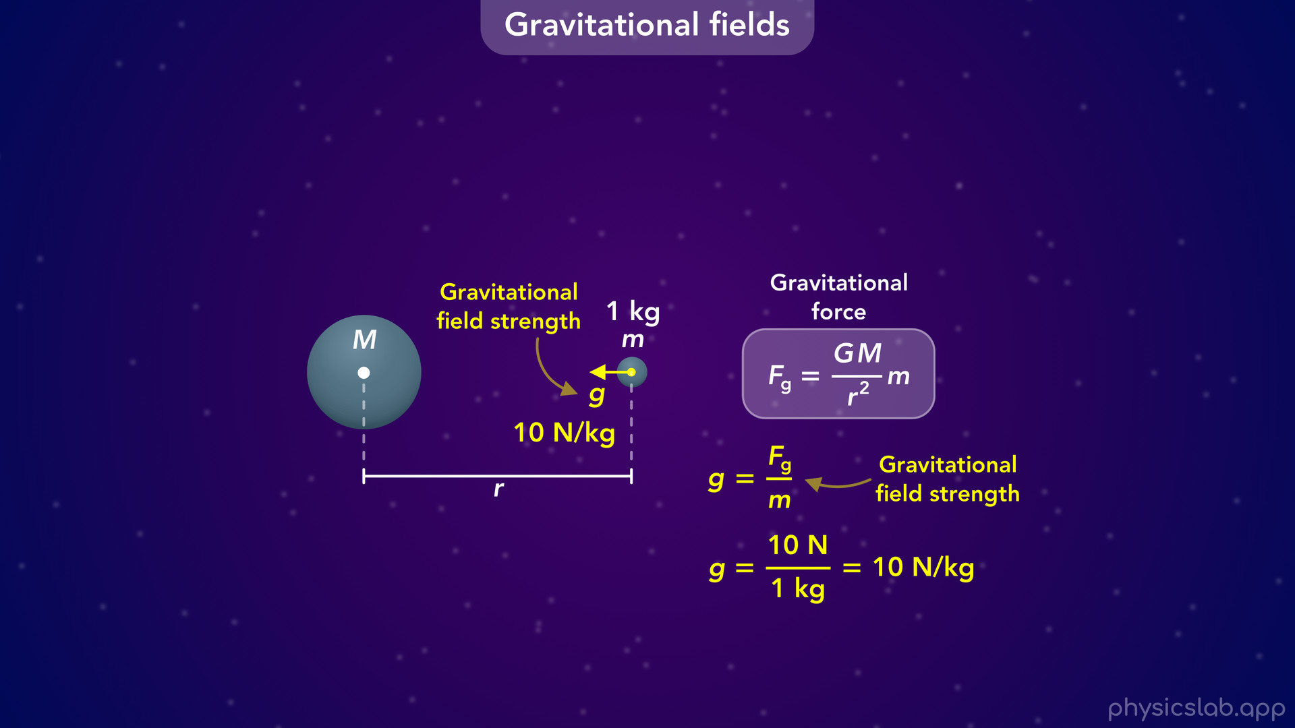
Notes:
• The strength of the gravitational field at that point in space, which we represent with lowercase g, is the gravitational force divided by the mass.
• In this example, that would be the 10 N force divided by the 1 kg mass, so the gravitational field strength at that point is 10 N/kg.
• And to get the equation for field strength, we just take the equation for gravitational force and divide it by lowercase m, the mass of the object on the right.

Slide 38
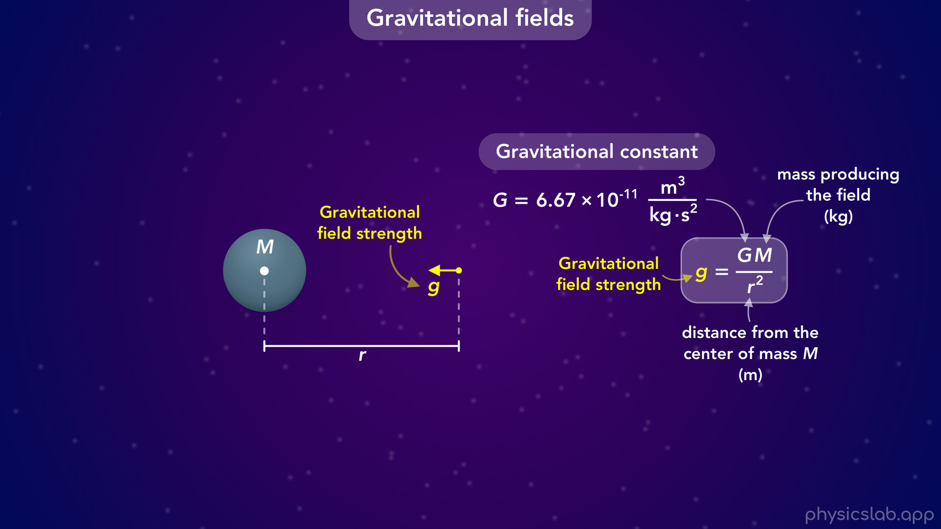
Notes:
• So the gravitational field strength, lowercase g, is equal to the gravitational constant, capital G, times the mass of the object on the left, capital M, divided by r squared, where r is the distance from the center of the mass on the left.
• So lowercase g and capital G are two different things.
• Notice that the mass of the object on the right, lowercase m, is no longer in this equation.
• Lowercase g is the strength of the gravitational field around the left mass, and it has nothing to do with the right mass.

Slide 39
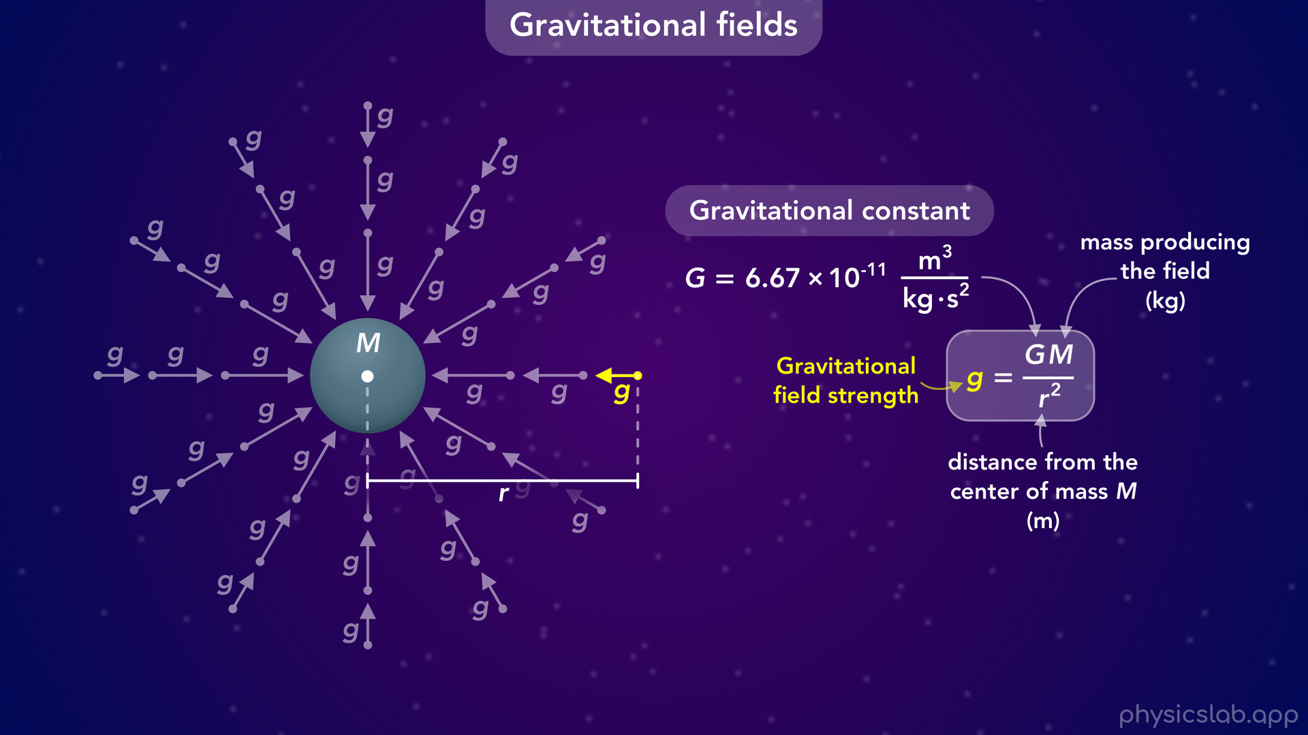
Notes:
• If we draw the gravitational field at other points around this mass, it would look something like this.
• So what actually is a field?

Slide 40

Notes:
• First, a gravitational field exists around every mass. Only 1 mass is needed to produce a field, which we can see in this equation.
• This is a vector field. We know that vectors have a magnitude and a direction, so each each point in the field has a magnitude, which we call the strength, and a direction.
• The strength of the gravitational field, lower case g, at each point in space is equal to the gravitational force per unit of mass, which is the gravitational force that would act on a 1 kg mass at that point.
• We use this equation for the field strength, which depends on the mass and the distance from its center.
• For the direction, the gravitational field vector at each point in space points towards the center of the mass that is producing the field.
• A field is a little bit conceptual.
• These vectors aren’t real tangible things that exist in space, this is just one way to visualize the strength and direction of the field at different points in space.
• The strength is lower as we get farther from the mass so the vectors get shorter. But they always point towards the center of the mass.

Slide 41
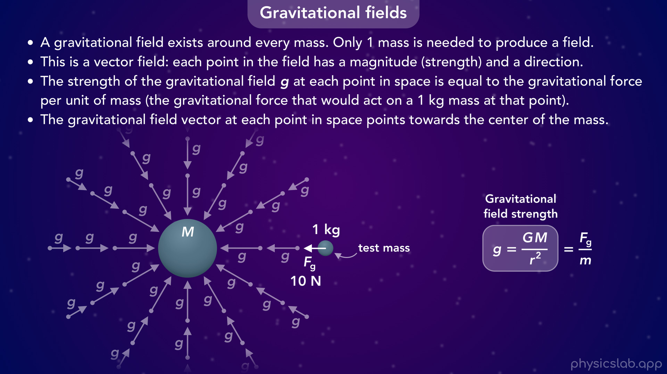
Notes:
• One way to think about the gravitational field around a mass, is to imagine placing a second mass, sometimes called a test mass, into that field at different points.
• If the test mass is 1 kg, then the strength of the field at that point is the same value as the force that would act on the test mass.
• So if a 1 kg mass would feel a 10 N force at this point in the field

Slide 42

Notes:
then the strength of the field at that point is 10 N/kg.

Slide 43
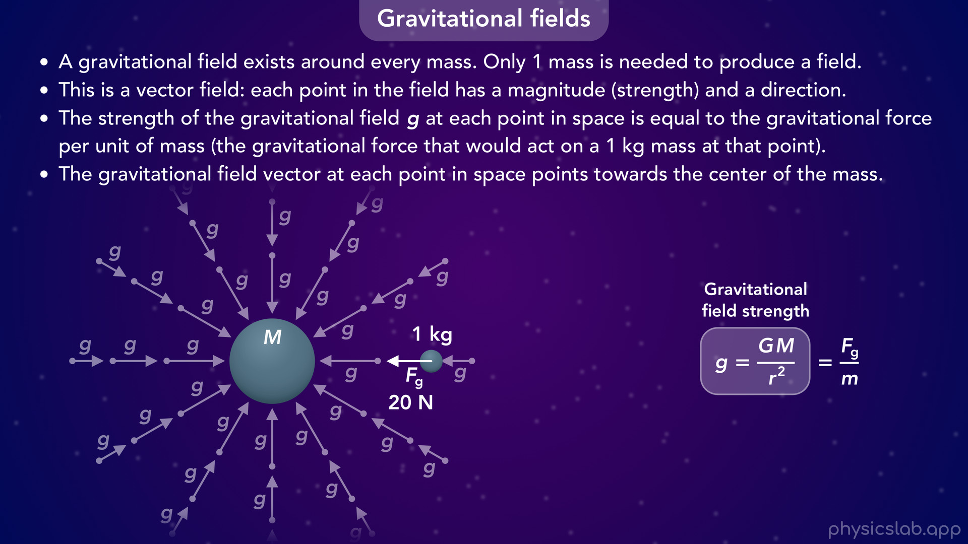
Notes:
• If the 1 kg mass was here and it felt 20 N of force

Slide 44

Notes:
the field strength would be 20 N/kg at that point.

Slide 45
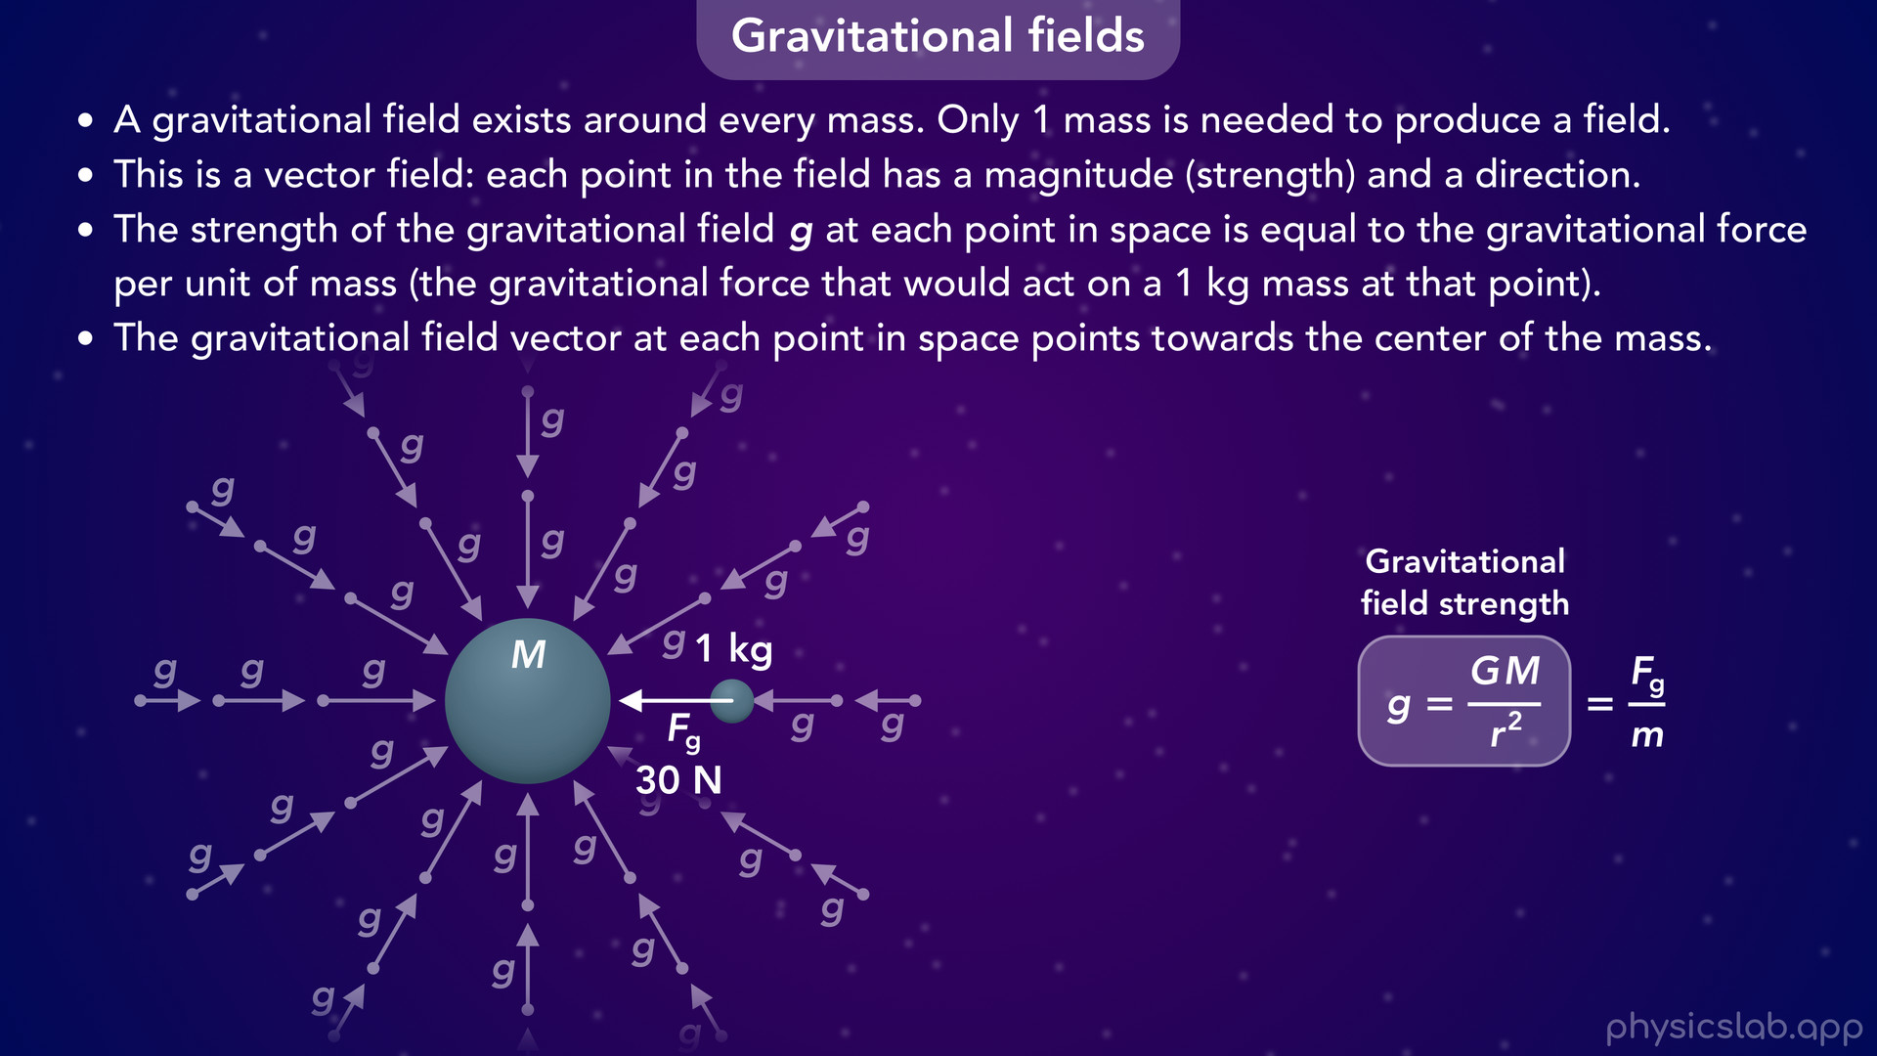
Notes:
• And if the force was 30 N here

Slide 46

Notes:
the field strength would be 30 N/kg at that point.

Slide 47
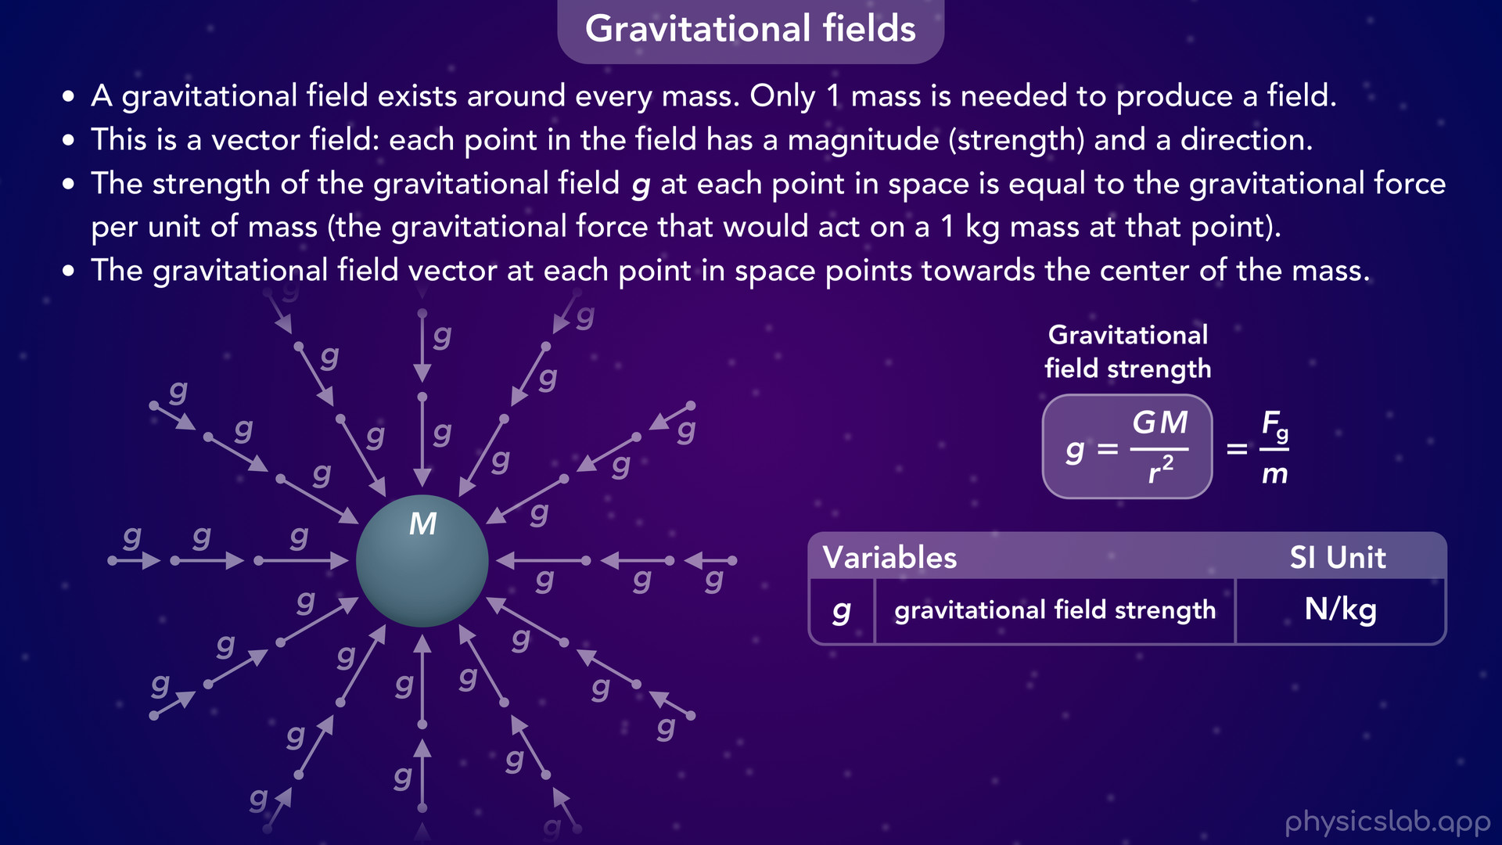
Notes:
• So lowercase g is a variable, it has a different value at different points in the field.

Slide 48
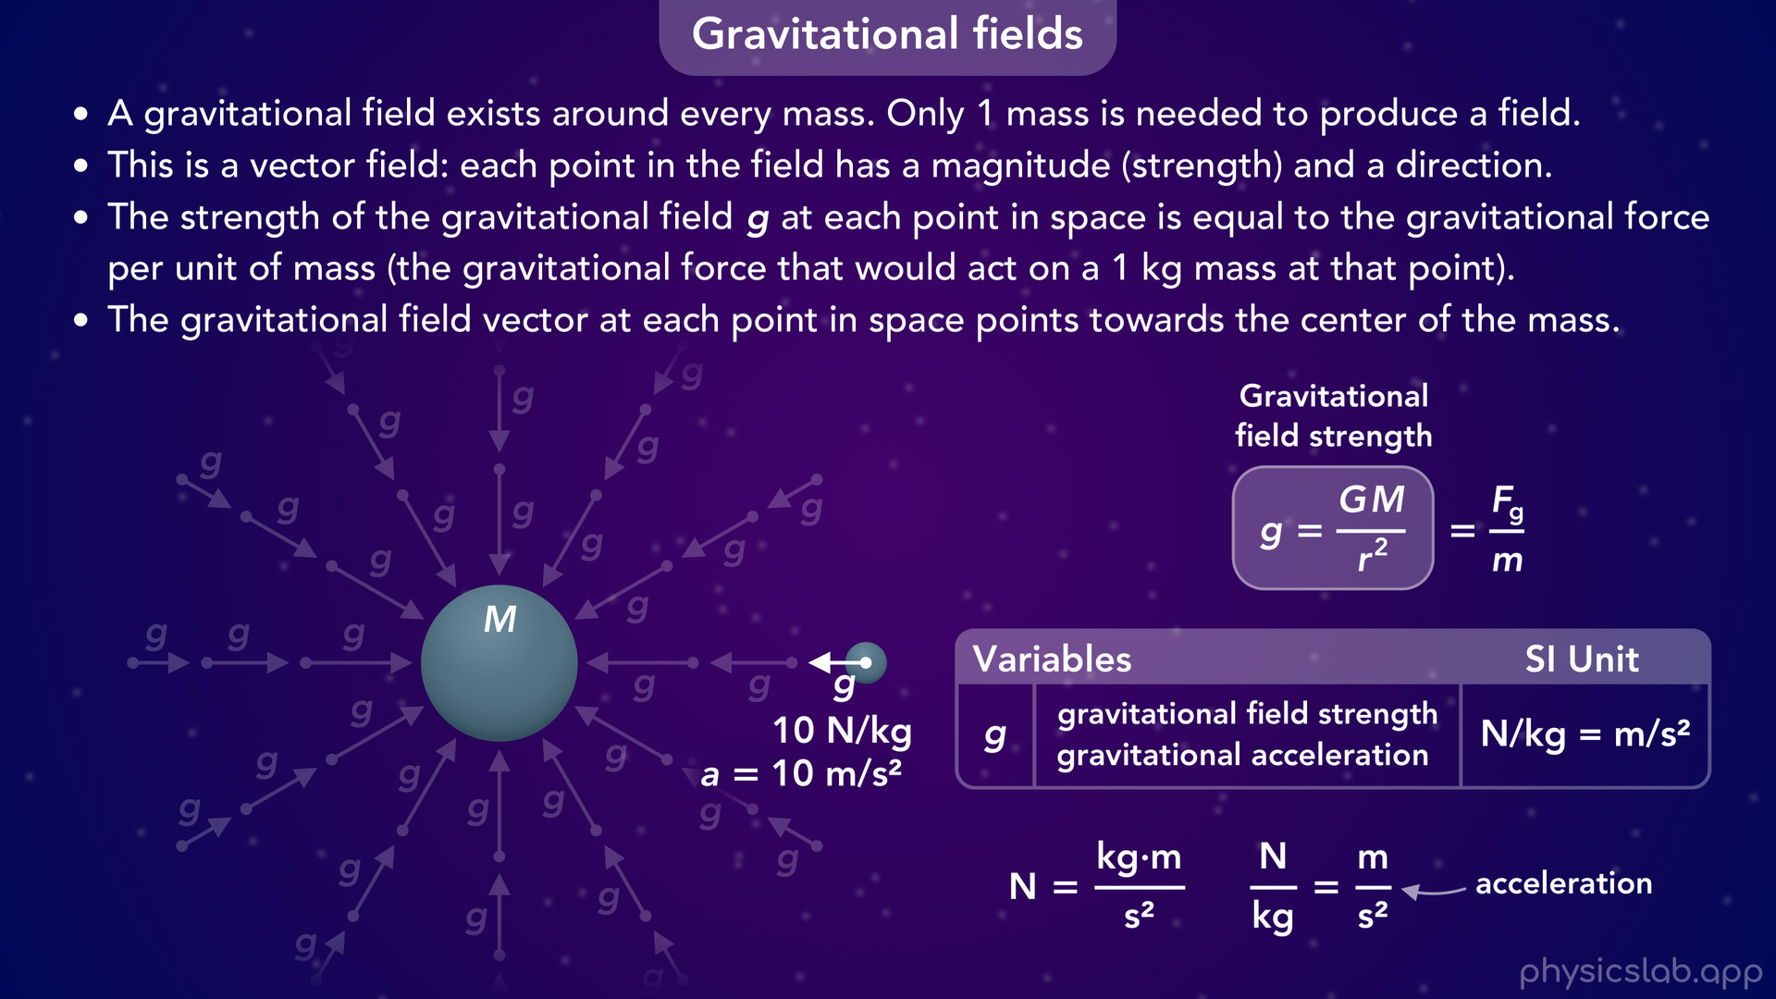
Notes:
• It also has some interesting units.
• So far we’ve been using the unit of N/kg, the units of force divided by mass.
• But remember that a N is a derived unit equal to kg m /s^2.
• So if we divide N by kg, we’re left with m/s^2. You might recognize that as the unit for acceleration.
• So g is the strength of the gravitational field, but it’s also the acceleration due to gravity.
• If a second object is in that field and the only force acting on it is the gravitational force, it will accelerate at that rate when it’s at that point.
• We’ll come back to that later.

Slide 49
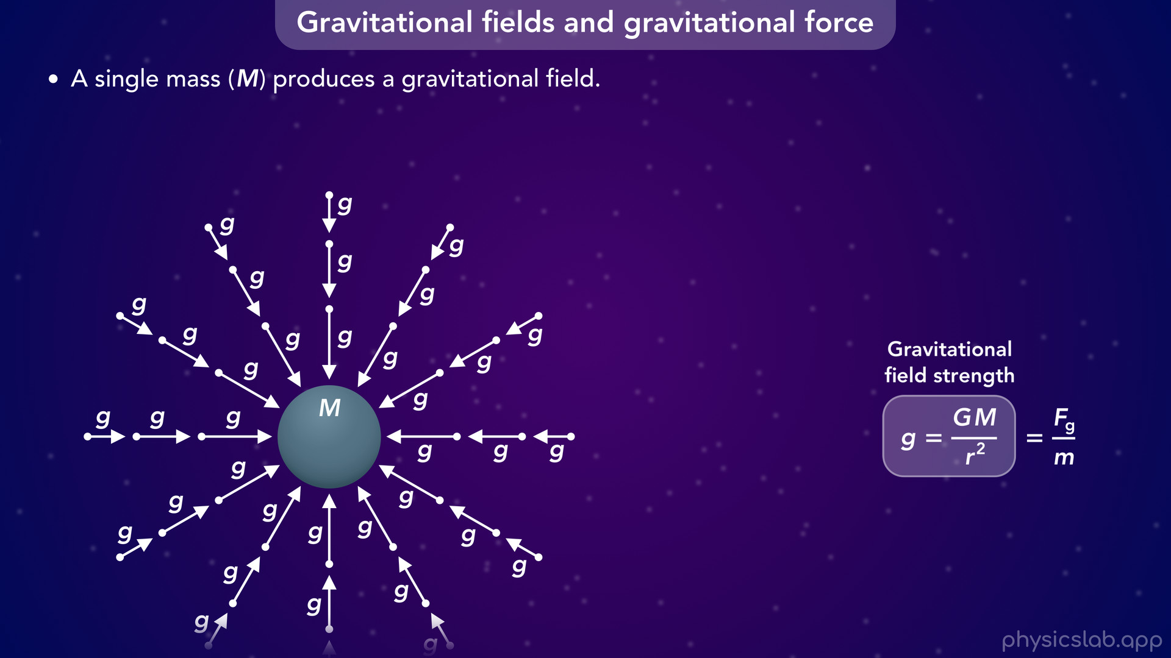
Notes:
• So a single mass, capital M, produces a gravitational field.

Slide 50
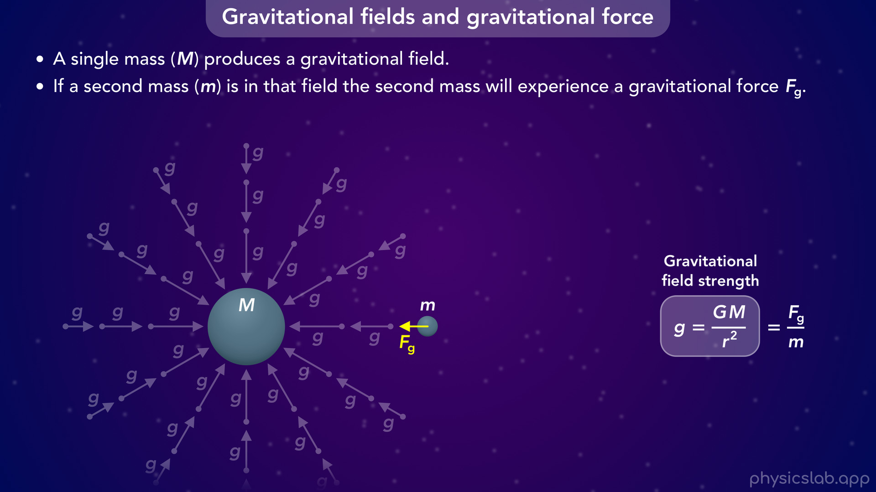
Notes:
• If a second mass, lowercase m, is in that field the second mass will experience a gravitational force Fg caused by the field.

Slide 51
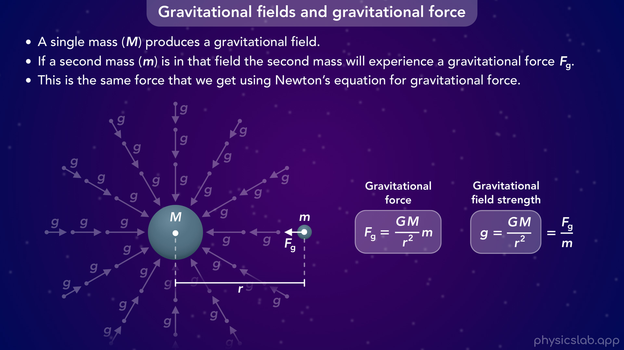
Notes:
• This is the same force that we get using Newton’s equation for gravitational force, we’re just thinking about it in a different way.

Slide 52
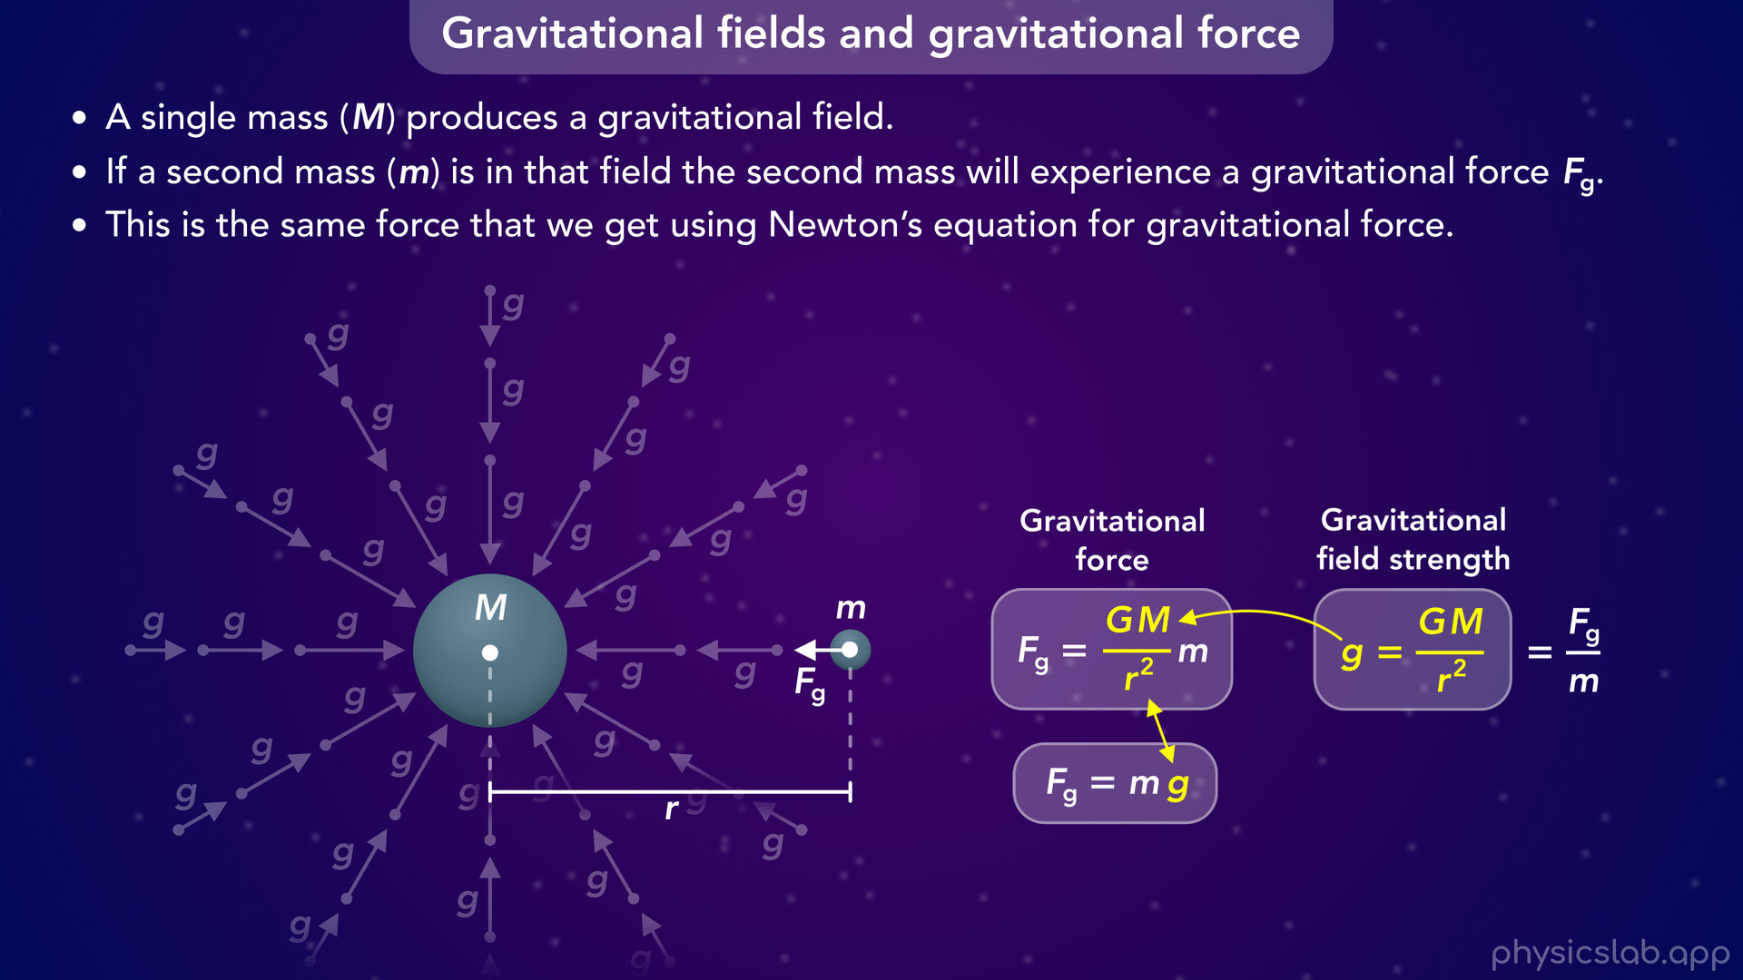
Notes:
• But notice that this fraction in the force equation is the same as the field strength, like me mentioned before.
• So we can replace this fraction with lowercase g to get a simplified equation for gravitational force.
• Although we usually write it like this.

Slide 53
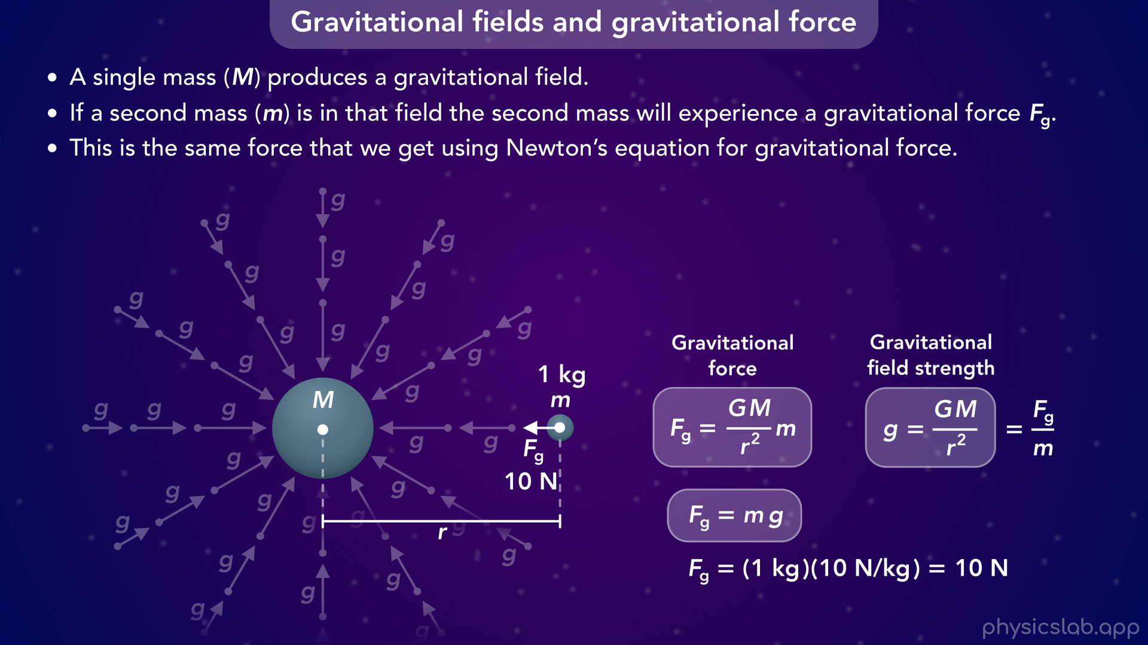
Notes:
• So the gravitational force acting on an object is equal to its mass multiplied by the strength of the gravitational field at that point in space.

Slide 54
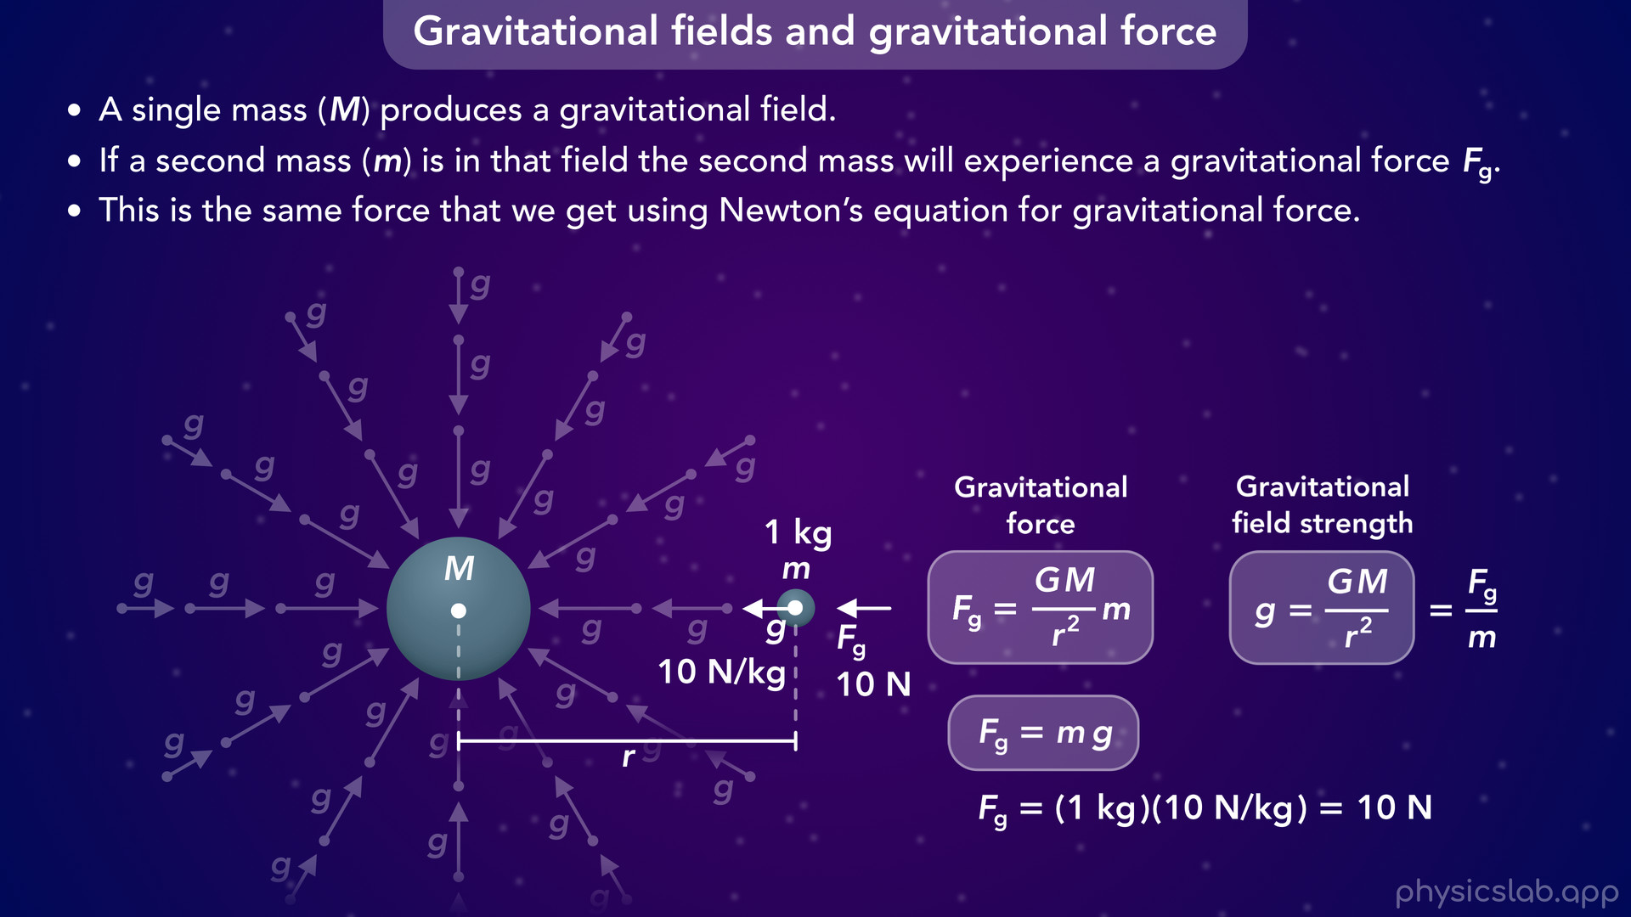
Notes:
• These two force equations are the same and they give us the same force.
• But the second one is easier to use if we already know the value of the field strength, lowercase g.

Slide 55

Notes:
• So this is the force acting on the right mass, lowercase m.
• But we know that gravitational forces come in pairs, so what about the force acting on the left mass, capital M.

Slide 56

Notes:
• One important thing to remember is that a mass does not experience a gravitational force from its own field.
• So what’s causing the gravitational force on the left mass?

Slide 57

Notes:
• Well, the right mass also produces its own gravitational field, and the left mass is in that field.
• So if we wanted to find the force on the left mass, we would swap capital M and lowercase m.
• These variables have nothing to do with the size of the masses.
• We always use capital M for the mass producing the field and lowercase m for mass that is somewhere in that field, experiencing a force.

Slide 58

Notes:
• It might seem like we would get a completely different value for this force, but it turns out to be the same.
• The field around the smaller mass is weaker, but now we’re multiplying the field by a larger mass and we get the same force.
• In most cases we only care about the field around one object, so we’re not gonna draw both fields.
• But again, these two force equations are the same. One uses the concept of a field, and the other doesn’t.

Slide 59

Notes:
• Let’s walk through an example to get some practice with these equations.

Slide 60

Notes:
• What is the strength of the Earth’s gravitational field at the position of the moon?

Slide 61

Notes:
• Here’s the mass of the earth, the mass of the moon, the distance between their centers, and the gravitational constant capital G.
• Pause the video and see if you can figure it out.

Slide 62

Notes:
• So we’re using this equation for the gravitational field strength.
• But which mass do we use for capital M?
• The question is asking for the strength of the Earth’s gravitational field, so we use the earth’s mass in this equation.
• Remember, it’s not because the earth’s mass is bigger.
• We plug 6.67 x 10 ^ -11 for capital G, 5.97 x 10^24 kg for the mass of the earth, and 3.84 x 10 ^8 m for r. •And remember that r is squared in this equation.
• When we calculate that, we get 2.7 x 10 ^ -3 N/kg for the strength of the gravitational field at that distance.
• We can also use the unit of m/s^2.

Slide 63

Notes:
• Now let’s find the magnitude of the gravitational force acting on the moon from the earth.
• Pause and the video and try solving this first.

Slide 64

Notes:
• Now we have two equations for gravitational force.
• Let’s try this one first, the one we learned in the last video.
• We would plug in the value for capital G, the mass of the earth, the mass of the moon, and the distance between their centers.
• That gives us 1.98 x 10^20 N for the gravitational force acting on the moon. It’s also the force acting on the earth.

Slide 65

Notes:
• But since we already found the strength of the earth’s gravitational field at the position of the moon, we can also use this equation to find the gravitational force on the moon.

Slide 66

Notes:
• We would just plug in the mass of the moon, and 2.7 x 10^-3 N/kg for lowercase g, the gravitational field strength.
• That gives us 1.98 x 10^20 N, which is the same value we got with the other equation.
• So that’s how we can calculate a gravitational field and a gravitational force.

Slide 67

Notes:
• Now let’s explore this equation for gravitational field strength, and see how it depends on each variable.

Slide 68

Notes:
• Instead of using a bunch of vectors, we’ll visualize the field strength using color.
• Capital G is the gravitational constant which is always the same, it’s not a variable.
• The mass of the object, capital M, is in the numerator of this fraction, so the field strength is directly proportional to the mass.

Slide 69

Notes:
• If we double the mass but keep the distance the same, the gravitational field strength also doubles.
• The field is stronger around larger masses.

Slide 70

Notes:
• And if we divide the mass by 2, the field strength is also divided by 2.
• So the field is weaker around smaller masses.

Slide 71

Notes:
• Next, the distance from the center of the mass, r, is in the denominator of this fraction, and it’s squared.
• If we keep the mass the same and we double r, then the strength of the gravitational field is divided by 4.
• So the field is weaker when you’re farther from the mass.

Slide 72

Notes:
• And if we divide r by 2, then the field strength is multiplied by 4.
• The gravitational field is stronger as you get closer to the mass.

Slide 73

Notes:
• Another way to visualize this is with a graph.
• The vertical axis is the gravitational field strength and the horizontal axis is r, the distance from the center of the mass.

Slide 74

Notes:
• Again, the field is stronger when you’re closer to the mass

Slide 75

Notes:
and it gets weaker as you move away from the mass.
• No matter how far away you are, there is still some gravitational field from this mass.
• Even if it’s very small, it’s never zero.

Slide 76

Notes:
• Now let’s take a closer look at the gravitational field around the earth.

Slide 77

Notes:
• When we view it at this scale, we can see that it varies in strength and direction at different points.
• The vectors are shorter as they get farther from the earth, and the field gets weaker.
• They always point towards the center of the earth, so they’re at different angles at different points.
• But what does the field look like if we zoom in on the surface.

Slide 78

Notes:
• Now that we’re closer and looking at a smaller window of space, the vectors are a little more parallel to each other.
• And they’re closer in length, so the gravitational field doesn’t vary as much in this view.

Slide 79

Notes:
• If we keep zooming and we get close to the surface of the earth, now the vectors seem to be parallel and they all have the same direction.
• They’re still pointing towards the center of the earth, but at this scale they just appear to be pointing downwards.
• And they look like they have the same length, but is that actually true?

Slide 80

Notes:
• Let’s calculate the strength of the gravitational field at a point on the ground.

Slide 81

Notes:
• We would plug in the gravitational constant, the mass of the earth, and the distance from the ground to the center of the earth, which is the radius of the earth. That’s about 6,370,000 m.
• If we calculate that, we get 9.8 N/kg for the field strength at this point.

Slide 82


Slide 83

Notes:
• What would be the field strength at this point? Let’s say it’s 10 m above the ground.
• The only difference is the value of r, but at this scale, 10 m doesn’t really make a difference.
• If we’re using a value of r with 2 decimal places, that 10 m doesn’t affect it, and we still get 9.8 N/kg.
• Even if this point was 1000 m above the ground, we would still get 9.8 using this level of precision.

Slide 84

Notes:
• So technically, the gravitational field does change at different heights.
• But at this scale, we usually say the gravitational field is uniform near the surface of the earth.
• It has a value of 9.8 N/kg at every point, and it always points downwards.

Slide 85

Notes:
• And remember that the field strength is also the gravitational acceleration.
• So the acceleration due to gravity at any point near the surface of the earth, is 9.8 m/s² downwards.
• This is why we used that value in kinematics.
• It’s the strength of the Earth’s gravitational field near the surface of the earth.

Slide 86

Notes:
• So if we drop any object, regardless of its mass, it will accelerate downwards at 9.8 m/s².

Slide 87

Notes:
• And like we mentioned before, now that we know g, the strength of the gravitational field at this point, we can use this equation to calculate the gravitational force on an object near the surface of the earth.
• We just multiply the mass times the gravitational field strength, or the acceleration due to gravity.
• Again, we call this the weight force, or the weight of the object.
• And look what happens if we apply the equation from Newton’s 2nd law.
• If the object is in free fall, the only force acting on the object is this gravitational force, and that net force is equal to the mass times the acceleration.
• The gravitational force is equal to mg, and if we divide both sides by the mass, then the acceleration is equal to g, 9.8 m/s².

Slide 88

Notes:
• For example, if the mass is 2 kg then the gravitational force, Fg, is 19.6 N.
• But then we divide that force by the mass of 2 kg to get the acceleration, 9.8 m/s².

Slide 89

Notes:
• So if we want to calculate the gravitational force on an object from the Earth, we can use this equation and plug in capital G, the mass of the earth, the mass of object, and the radius of the earth.

Slide 90

Notes:
• But if we’re near the surface of the earth, then we can just use this equation to find the gravitational force, or weight of an object.
• We just plug in the mass of the object and lowercase g, which is 9.8 m/s² if we’re near the surface of the earth.

Slide 91

Notes:
• But if we’re not near the surface of the earth?
• What’s the value of g at different heights? Here’s a few examples.

Slide 92

Notes:
• At sea level, which is near the surface of the earth, g would be 9.81 m/s^2 using 2 decimal places.
• At the deepest point in the ocean, g would be 9.85.
• At the top of mount Everest and the altitude of planes, g would be 9.77 So still pretty close to the value at sea level.
• At the orbital height of the International space station, g would be 8.67 m/s^2. So it’s getting smaller, but there’s still plenty of gravity in space, and we’ll explain why astronauts feel zero gravity in another video.
• And at the distance of the moon, earths gravitational field strength is 0.003 m/s^2. So pretty small, but still enough to keep the moon in orbit around the earth.

Slide 93

Notes:
• And just for comparison, here’s the strength of gravity on the surface of the moon and mars due to their own gravity.
• On the moon’s surface, its own value of g is 1.6 m/s^2.
• And on mars, its 3.7 m/s^2.

Slide 94

Notes:
• So you would feel lighter on the moon and on mars because their gravity at the surface is weaker than it is on earth.
• Your mass is always the same, but your weight, which is the gravitational force, will be different. And we’ll talk more about that in the next video.

