Slide 1
Transition Between Static and Kinetic Friction
Slides Version 2
This version includes:
Slides with screenshot images from the video.
The video narration in the slide notes.
A blank template slide with the same background and font as the video.
Slides with some basic graphics from this video for you to use however you like.
Feel free to add, delete and edit slides to make your own presentation. You can use these slides in class or share them with your students, but please do not share them with anyone else.
If you have any feedback, suggestions or questions about these slides please email me at chris@physicslab.app or send me a message on Discord @physicslab.
physicslab.app

Slide 2
Heading
Text

Slide 3






















Slide 4





















Slide 5
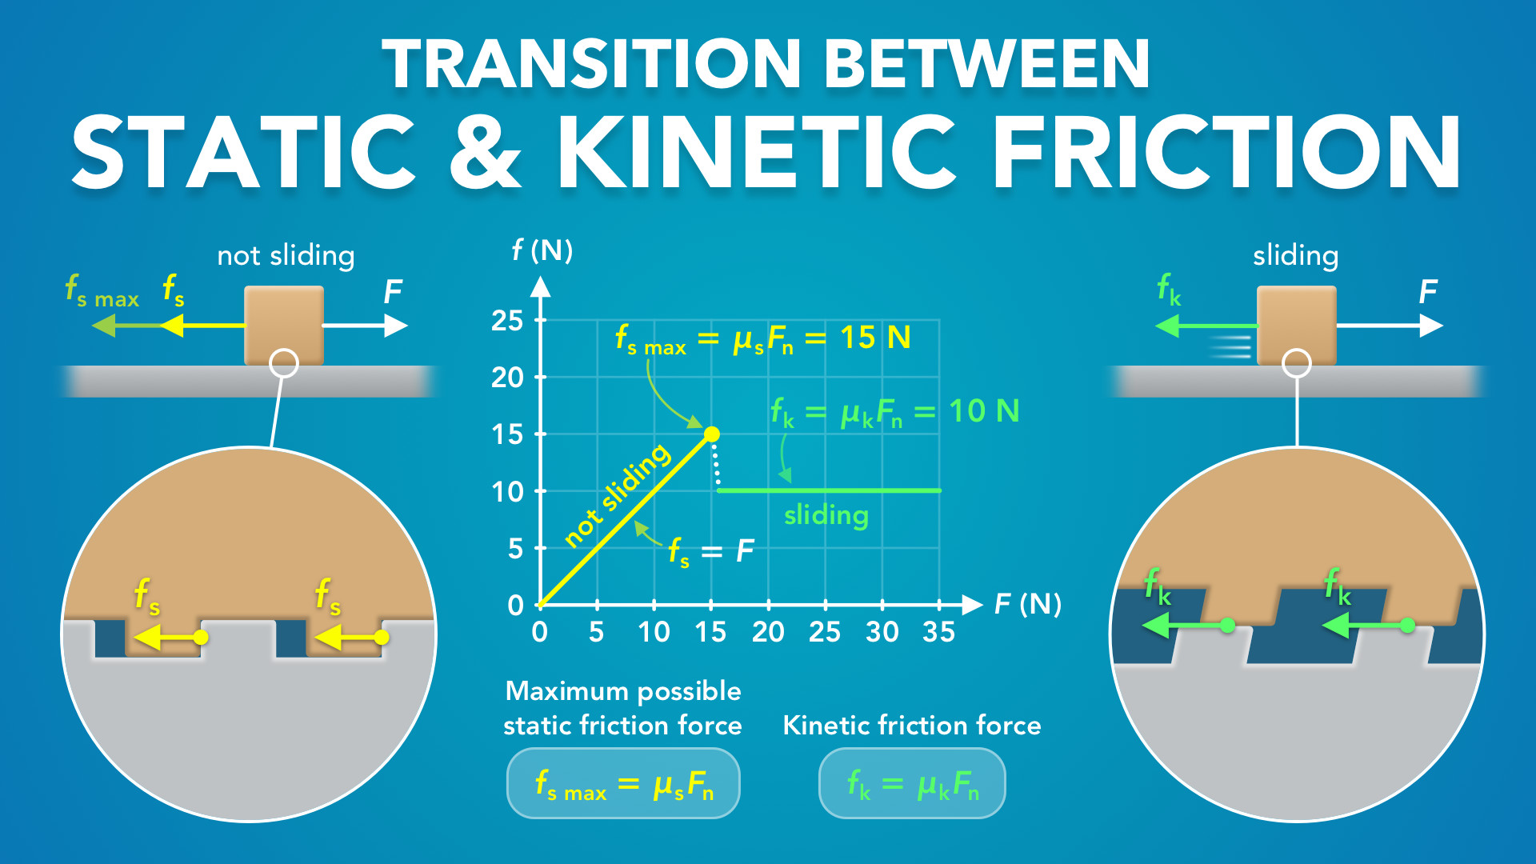
Notes:
Transition Between Static and Kinetic Friction
physicslab.app
If you have any questions, suggestions or feedback about these slides please email me at chris@physicslab.app or send me a message on Discord @physicslab.

Slide 6
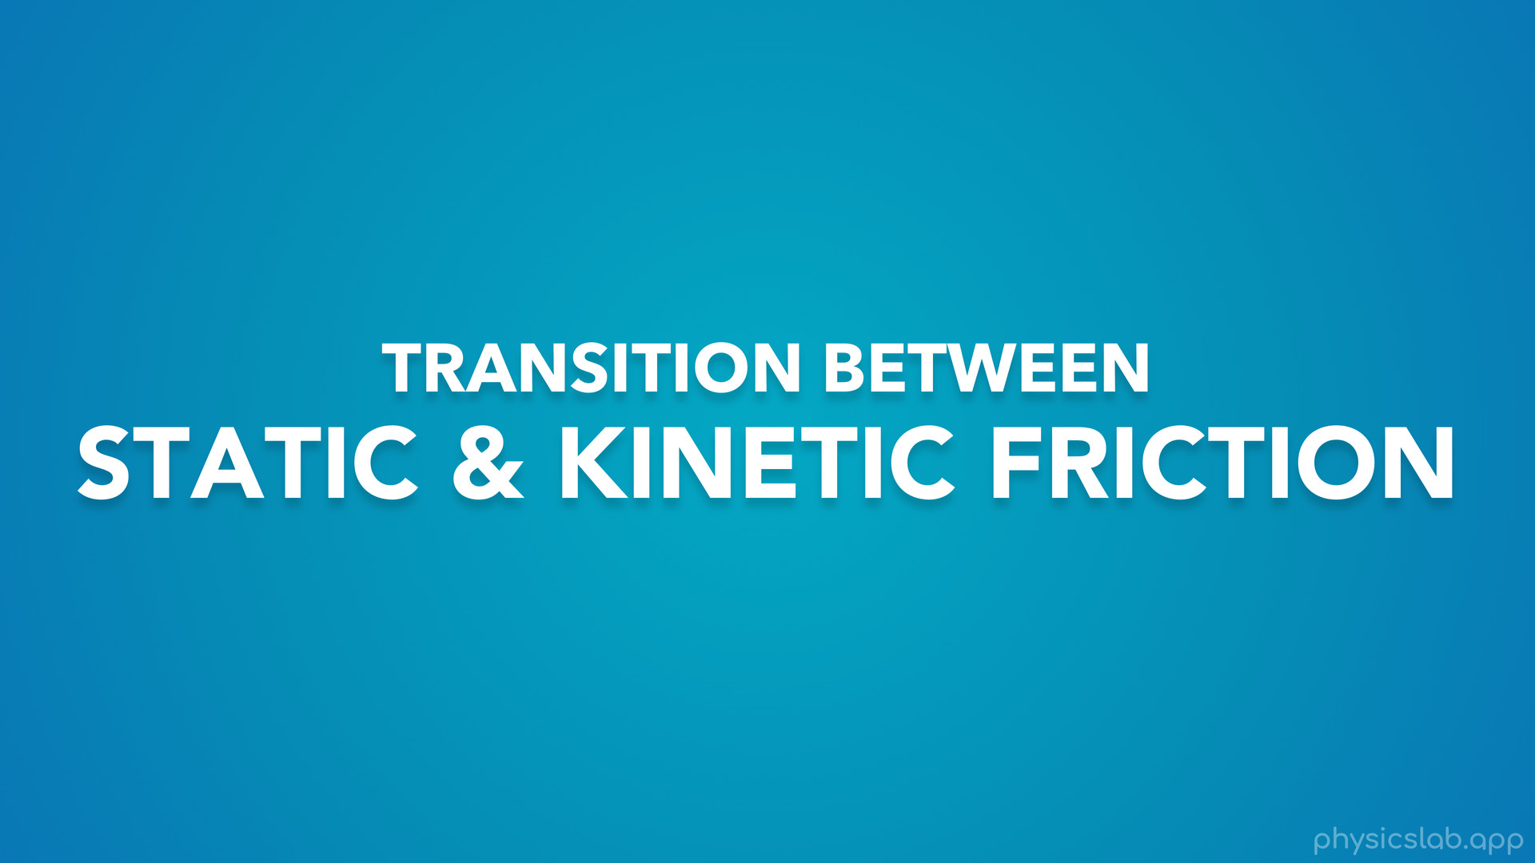
Notes:
• Hey everyone! In this video we’re gonna talk about the transition between static and kinetic friction.

Slide 7
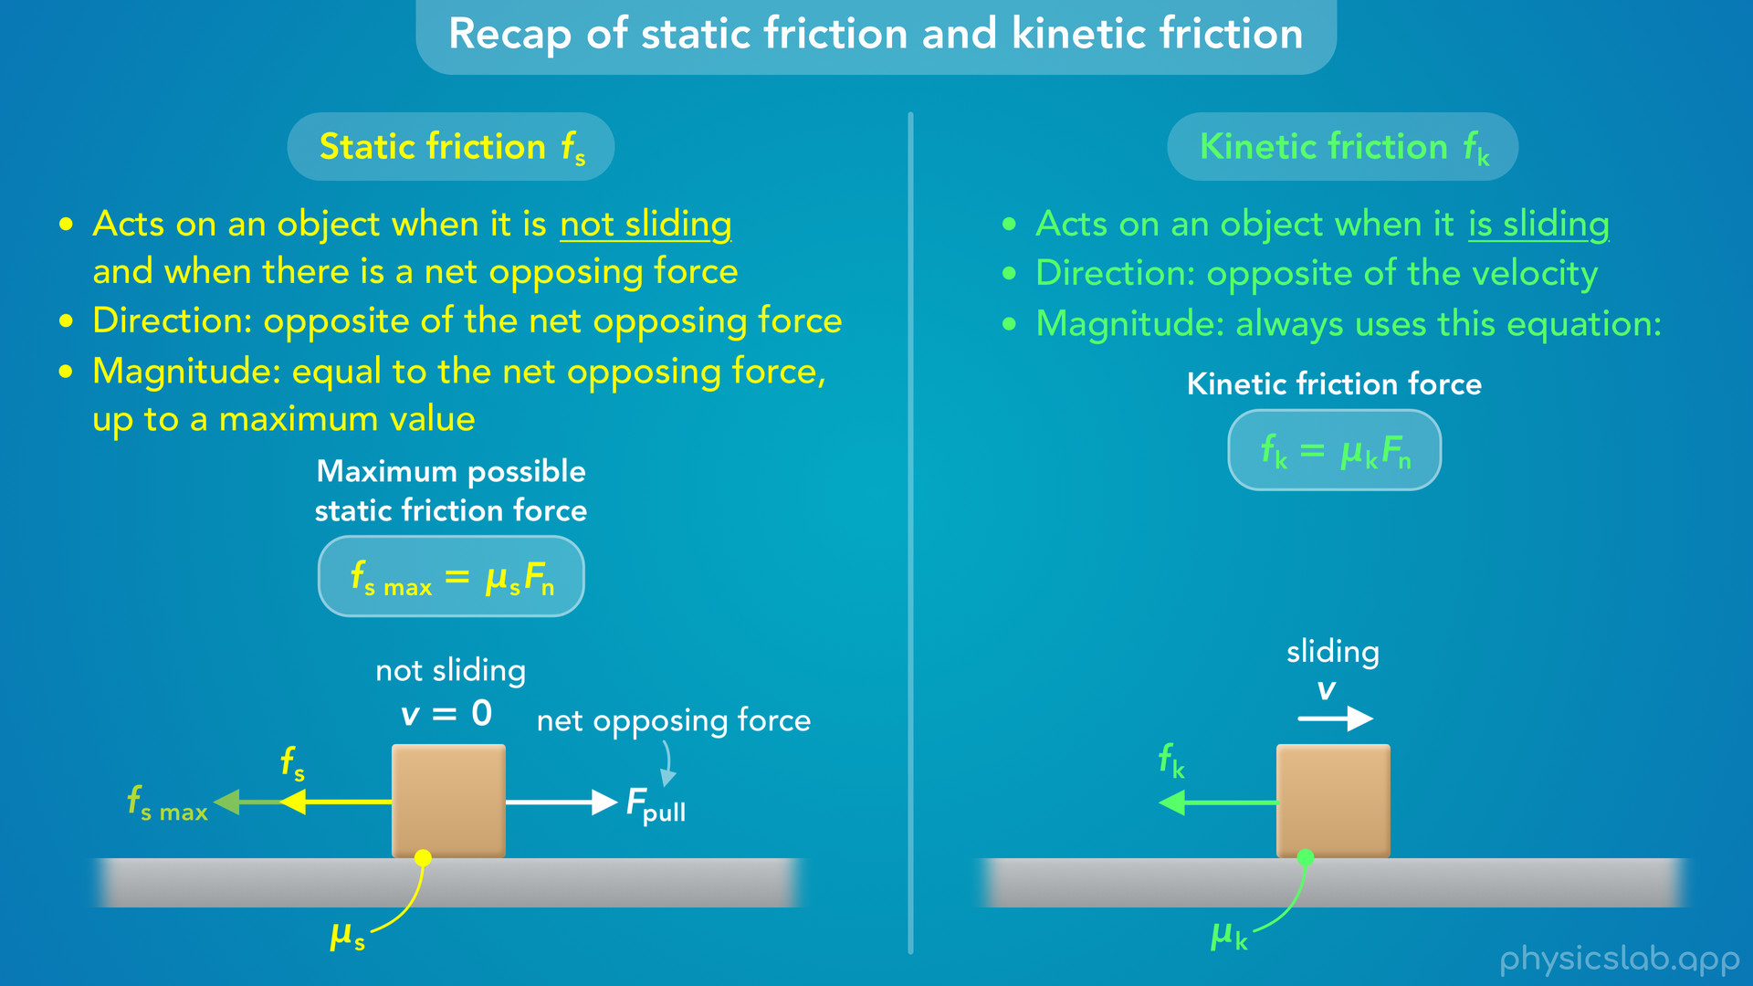
Notes:
• Make sure you watch the previous videos first, but we’ll start this video with a recap of static and kinetic friction.

Slide 8
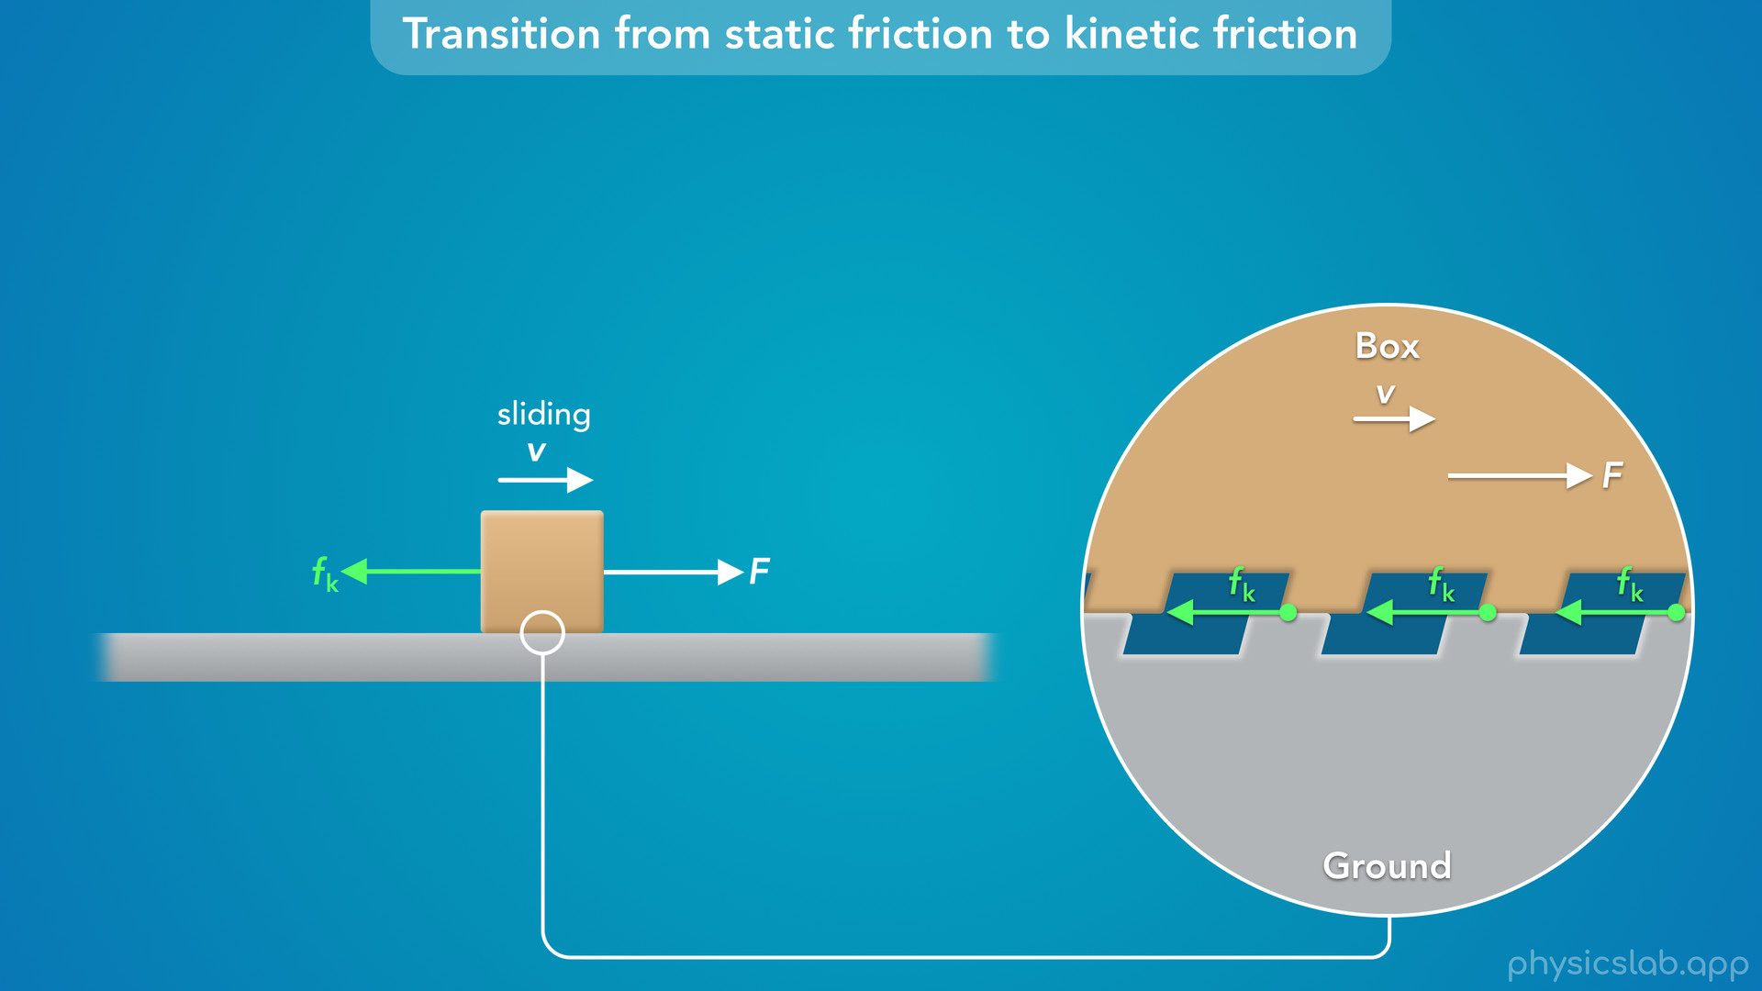
Notes:
• We’ll look at the interaction between the two surfaces and explain how a friction force transitions from static to kinetic, and why the kinetic friction is always less than the static friction.

Slide 9
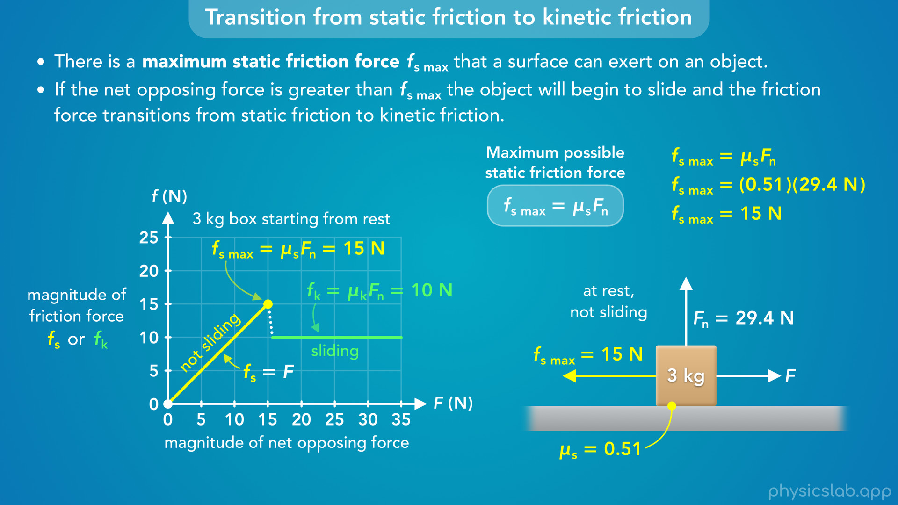
Notes:
• Then we’ll graph the transition from static friction to kinetic friction, and we’ll talk about different points on the graph.

Slide 10
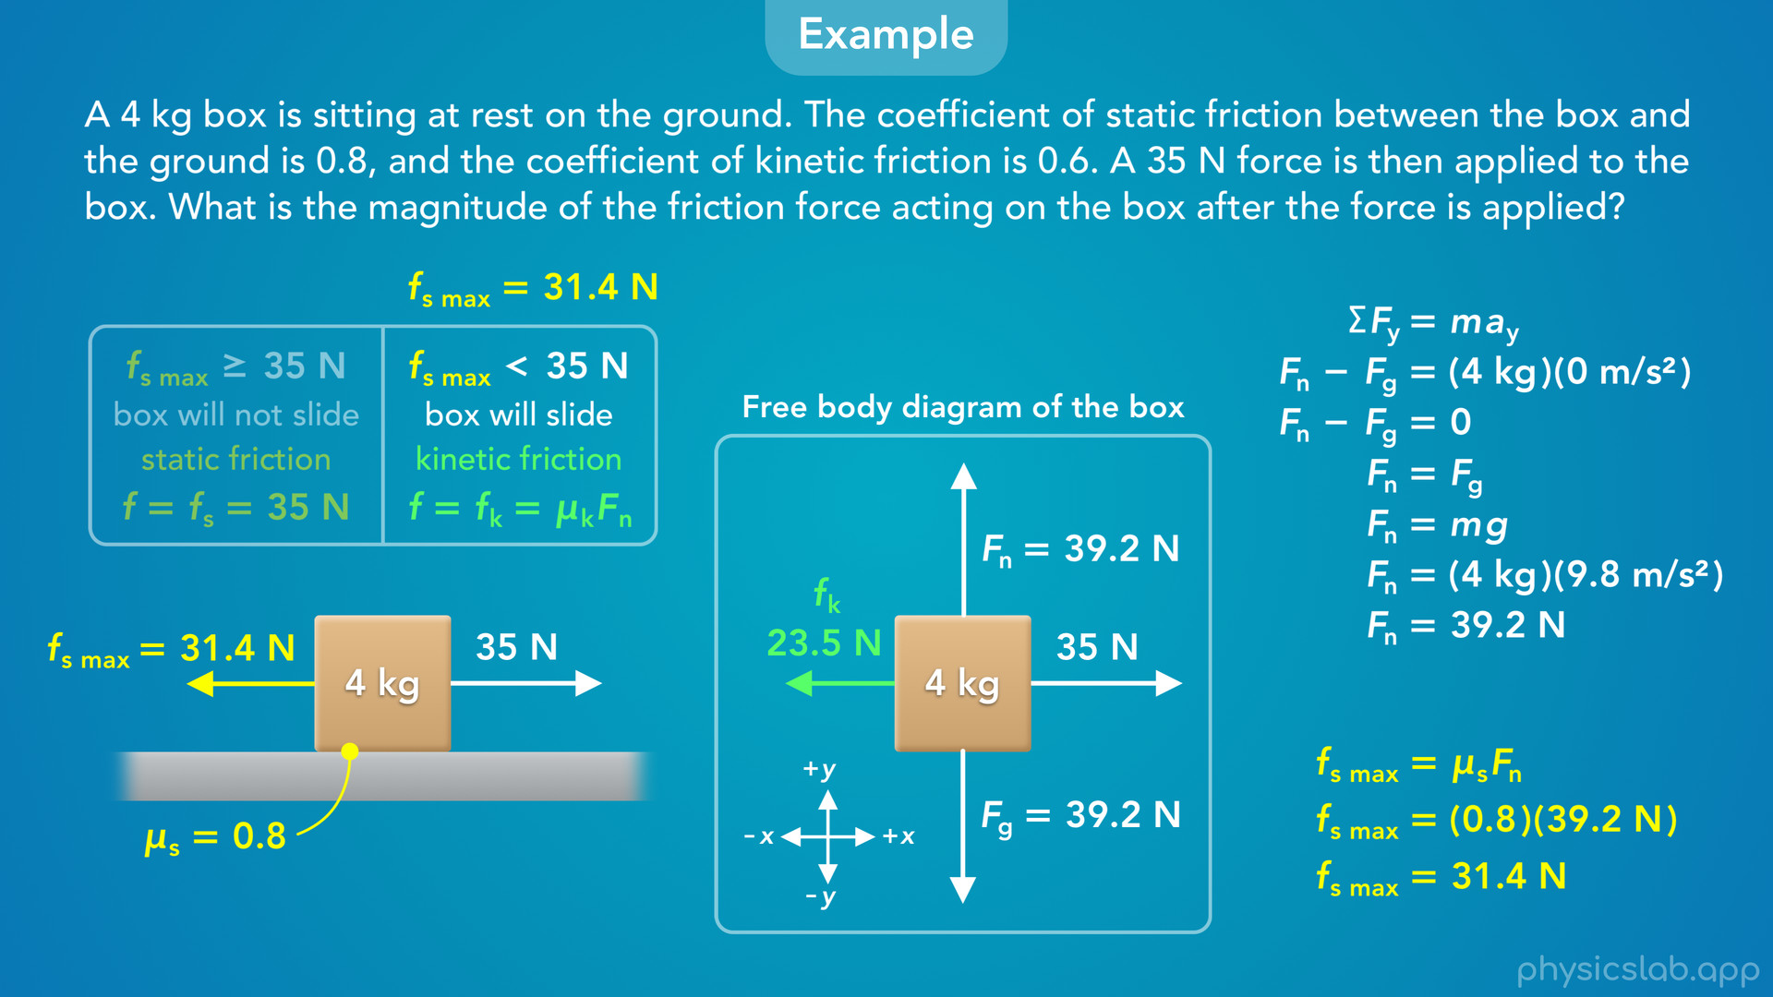
Notes:
• At the end, we’ll walk through an example problem that combines everything we learned about friction.

Slide 11
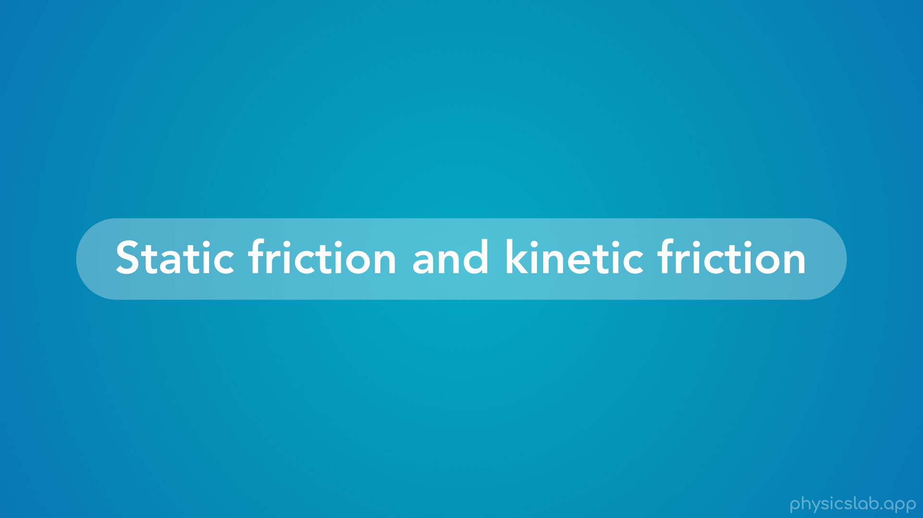
Notes:
• So let’s review static and kinetic friction, and then we’ll learn about this transition.

Slide 12

Notes:
• Static friction, fs, acts on object when it is not sliding and when there is a net opposing force.
• The direction of a static friction force is opposite of the net opposing force.
• And the magnitude is always equal to the net opposing force, up to a maximum value.
• A kinetic friction force, fk, acts on an object when it is sliding.
• The direction of a kinetic friction force is always opposite of the velocity.
• And the magnitude always uses this equation: a kinetic friction force is always equal to the coefficient of kinetic friction, mu k, times the normal force, Fn.
• So these are two different types of friction that behave in different ways.
• But in many situations, we need to consider both.
• We might have to figure out which type to use, and sometimes there’s static and kinetic friction in the same problem.

Slide 13
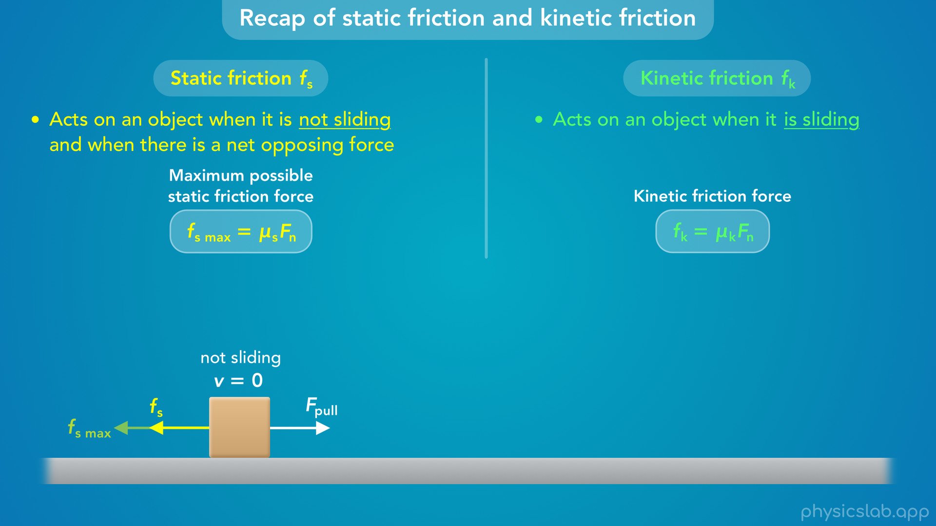
Notes:
• If this pulling force is less than the maximum possible static friction force, then the box is doesn’t slide, we know that we’re dealing with static friction, it’s magnitude is equal to the net opposing force, and it points to the left.

Slide 14
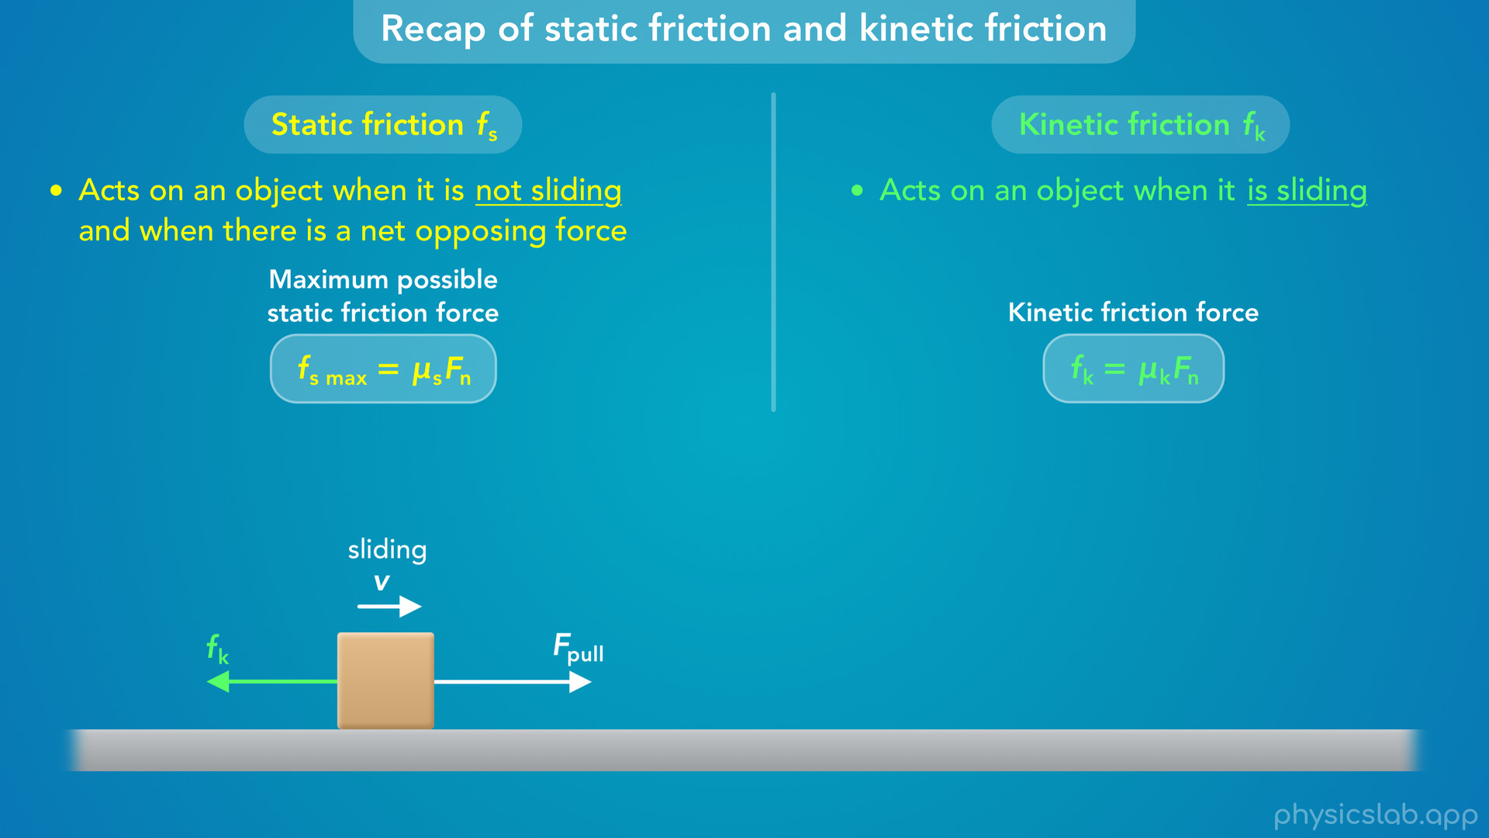
Notes:
• But if the pulling force increases until it’s greater than the maximum static friction force, the box begins to slide, the friction transitions to kinetic friction, it’s magnitude is equal to uk times Fn, and it points in the opposite direction as the velocity.

Slide 15
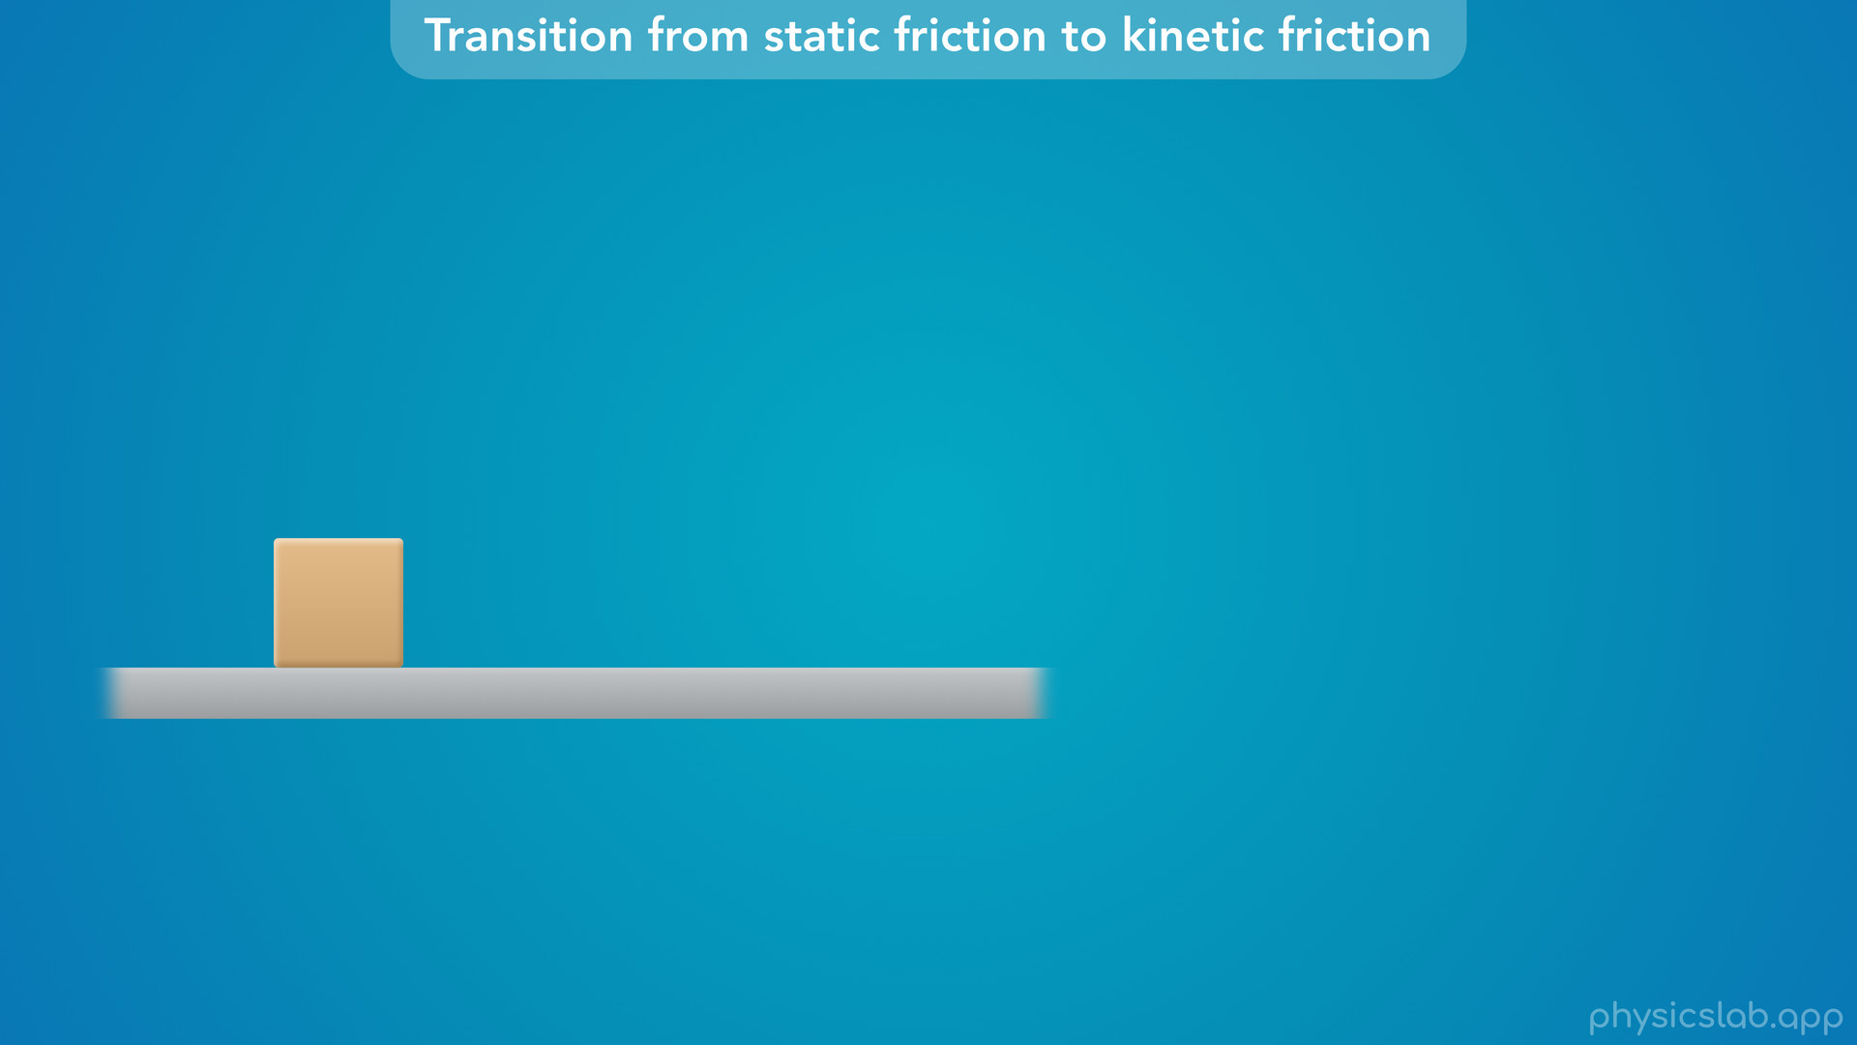
Notes:
• So how does this transition happen?
• Let’s look at this box sitting on the ground.

Slide 16
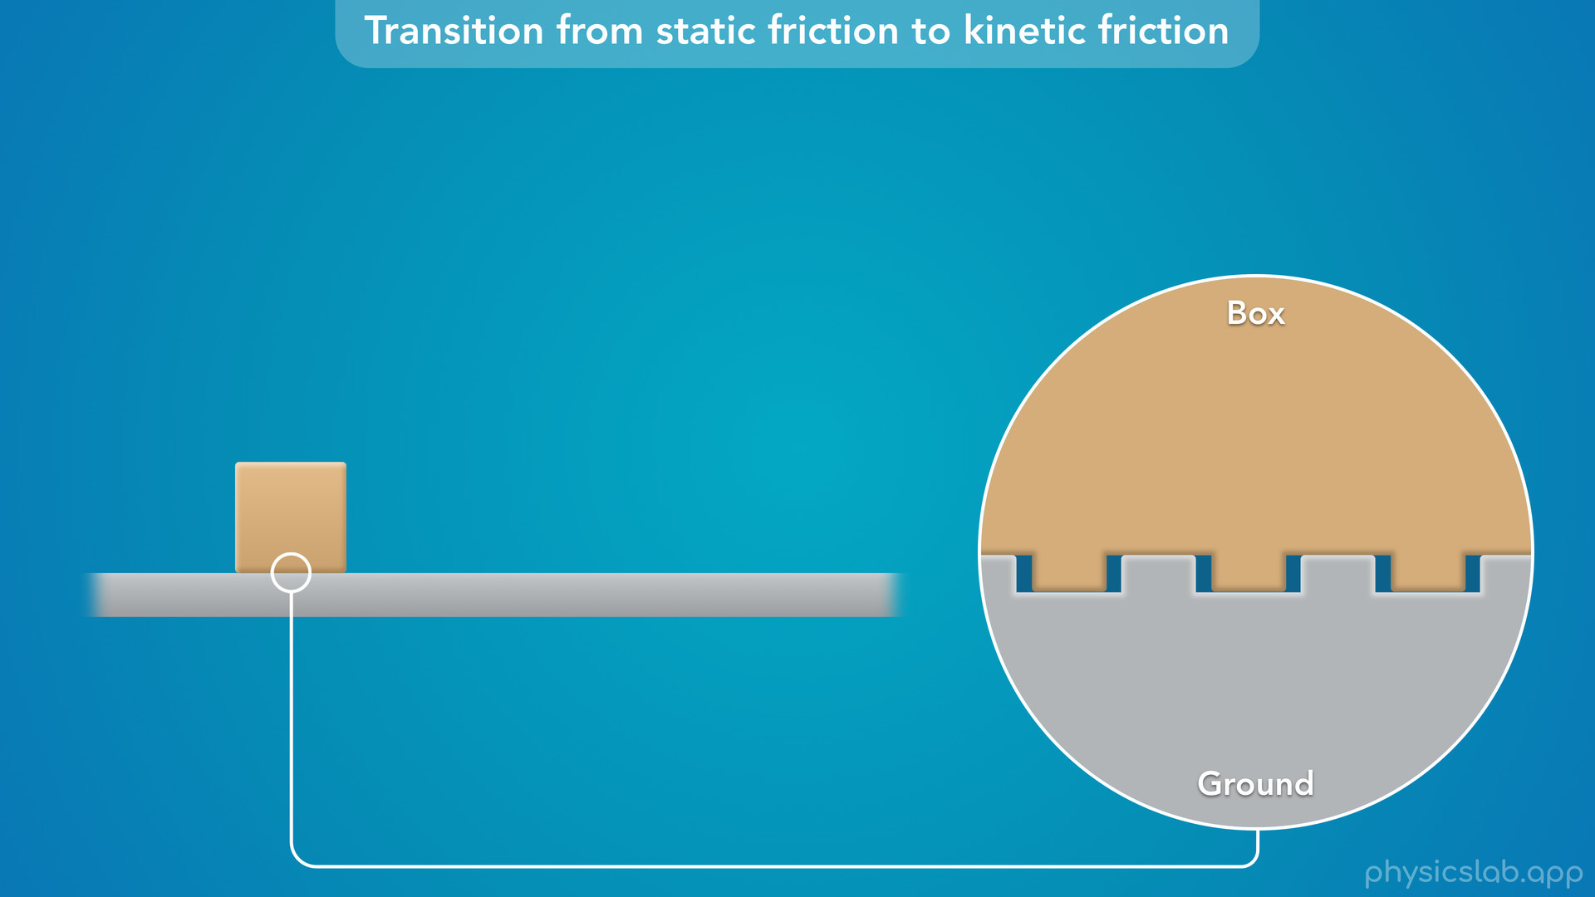
Notes:
• If we zoom in closely and look at the surfaces of the box and the ground, we can see they’re not perfectly smooth.
• They’re each covered in a bunch of small bumps that sort of fit together.
• In the real world, this physical interaction is a lot more complicated, but this picture can help understand how friction behaves.
• If the box is sitting on the ground and there’s no sideways force trying to move it, then there’s no friction force.

Slide 17

Notes:
• If we apply a force F that tries to pull the box to the right, the bumps on the box will get stuck against the bumps on the ground.

Slide 18
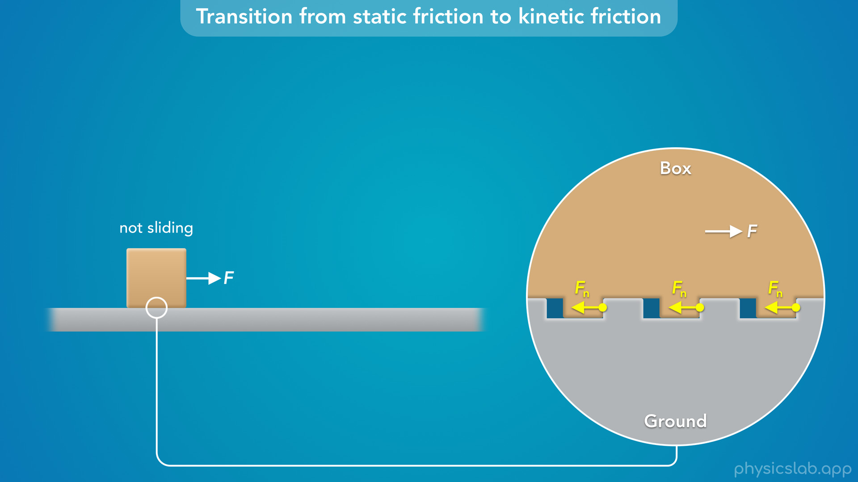
Notes:
• We can think of the ground as exerting a bunch of small sideways normal forces on the box which prevent it from sliding.

Slide 19

Notes:
• All of these sideways forces added together are the total static friction force on the box.
• Since the box is not sliding, the static friction force is equal and opposite to the pulling force, F.

Slide 20

Notes:
• As we increase the pulling force, the static friction force also increases.
• This is similar to how a normal force reacts to other forces.
• But what happens if we keep increasing this force?

Slide 21


Slide 22


Slide 23


Slide 24
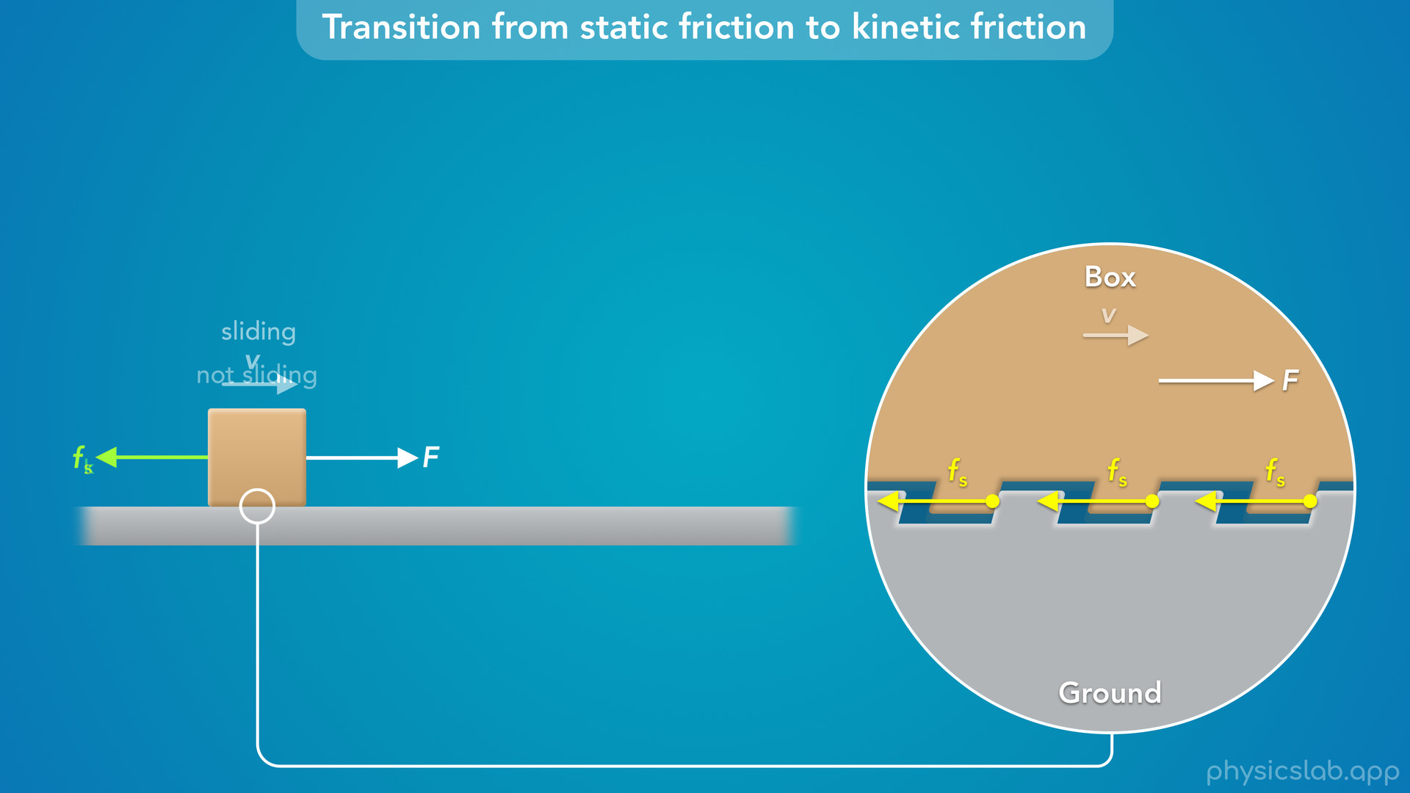

Slide 25
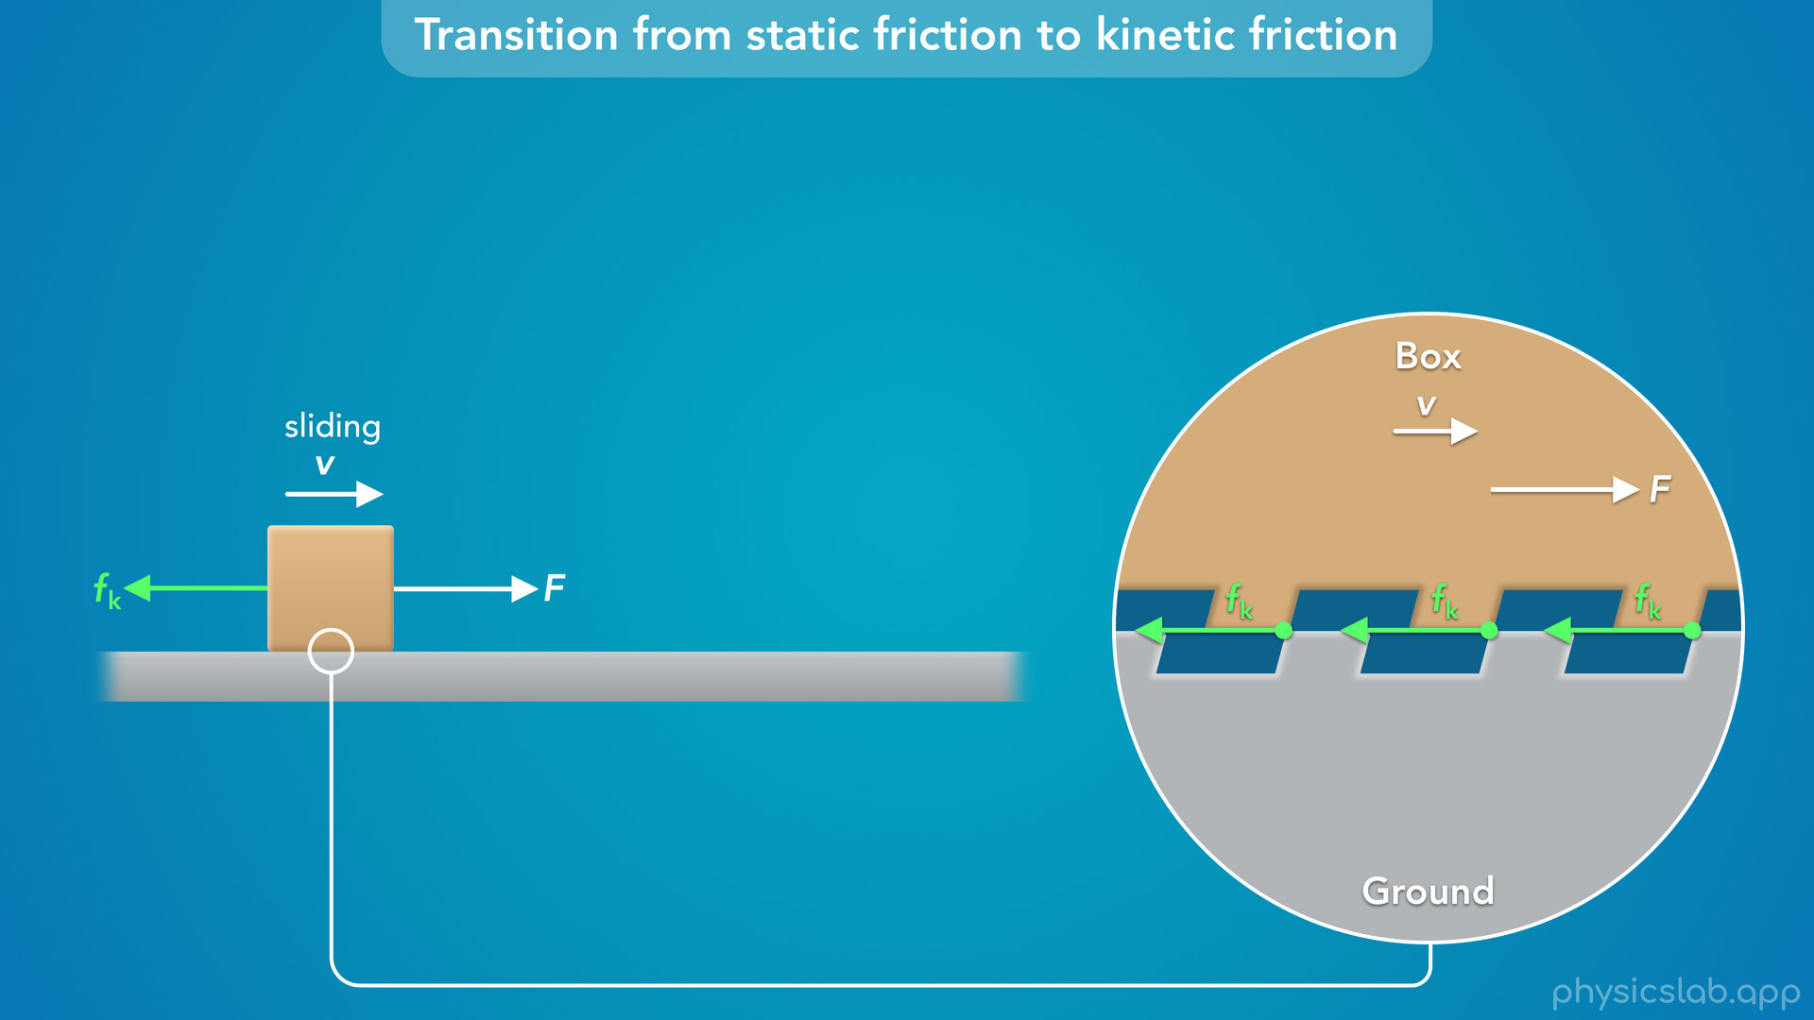
Notes:
• The ground can’t provide an infinite amount of static friction.
• So eventually it won’t be able to hold on to the box and the box will start to slide.
• At that moment, the friction force transitions from static to kinetic.
• We can imagine that the bumps on the box and the ground eventually stretch or deform and they slip past each other.

Slide 26
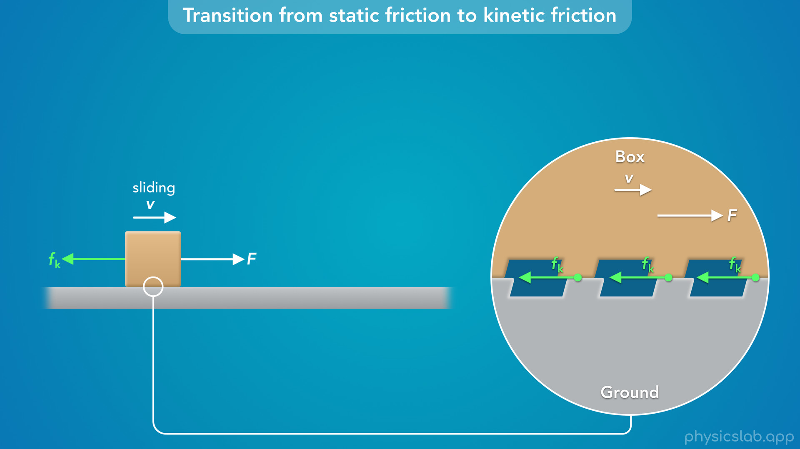

Slide 27
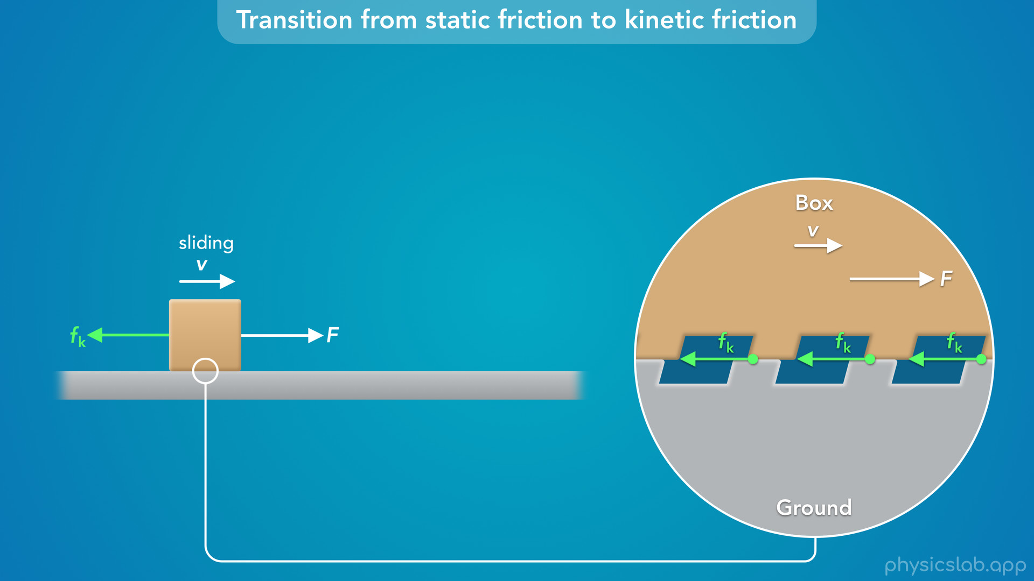

Slide 28
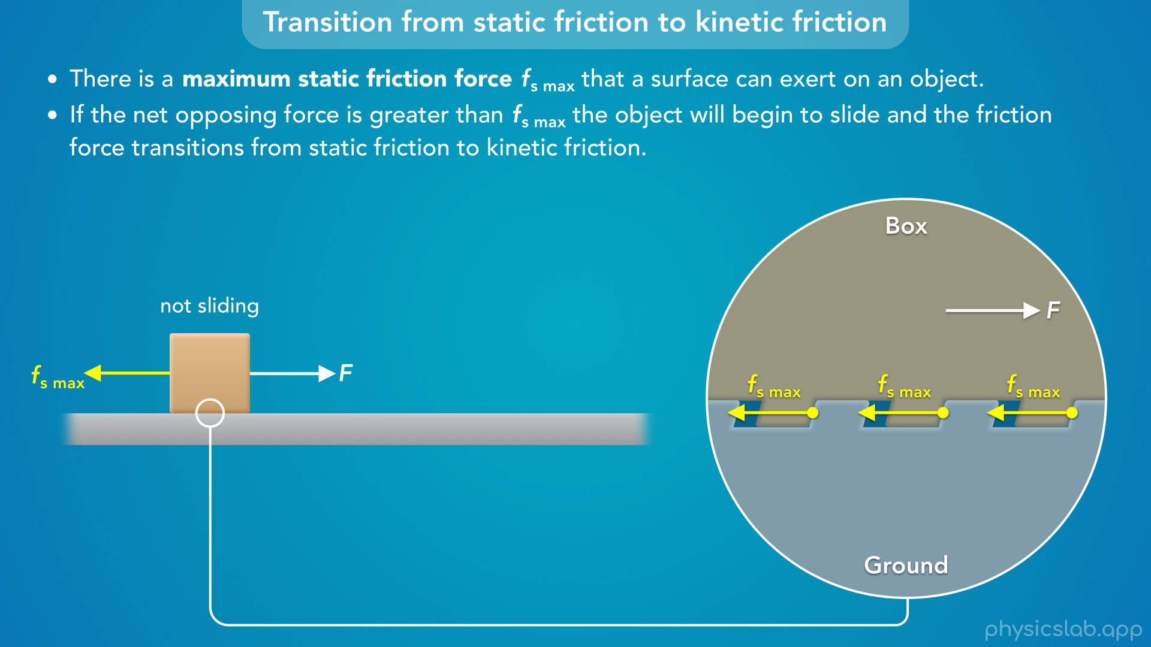
Notes:
• So “there is a maximum static friction force that a surface can exert on an object”.
• “If the net opposing force is greater than that, the object will begin to slide and the friction force transitions from static friction to kinetic friction".

Slide 29
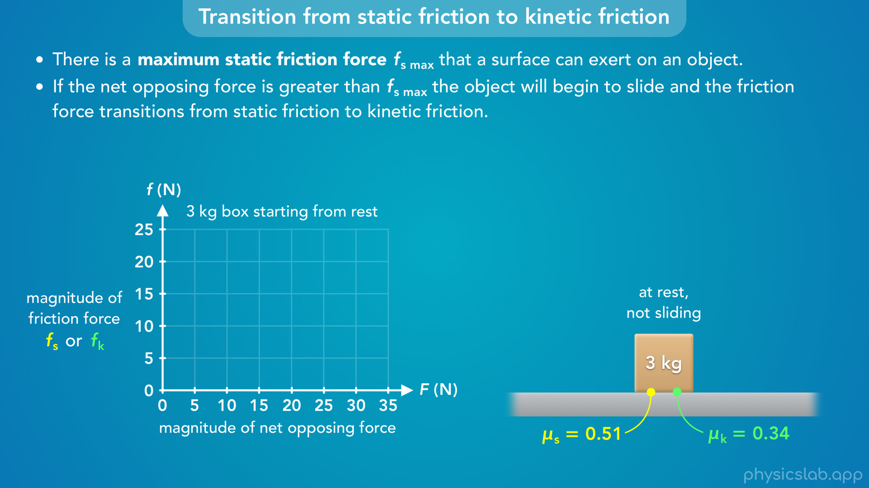
Notes:
• So what does this transition look like in a friction force graph?
• Let’s say we have a 3 kg box sitting at rest, the coefficient of static friction is 0.51 and the coefficient of kinetic friction is 0.34.
• Notice that they have different values.

Slide 30

Notes:
• If we apply this force F to the right, there’s going to be a static or kinetic friction force to the left, depending on whether it slides.

Slide 31
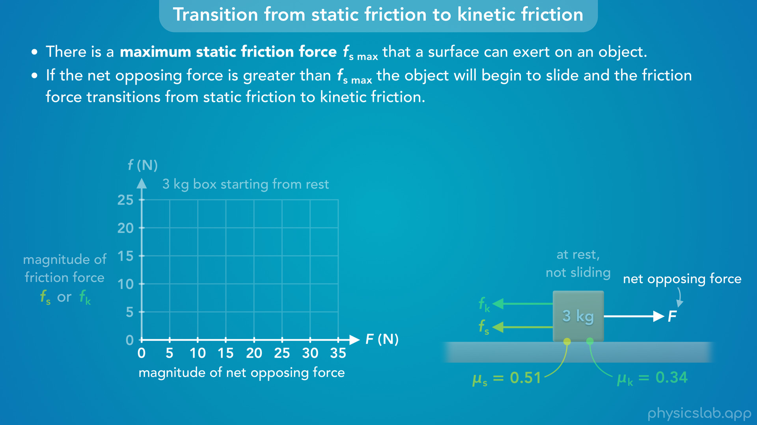
Notes:
• For this graph, the horizontal axis is the magnitude of the net opposing force, which is the force F to the right

Slide 32
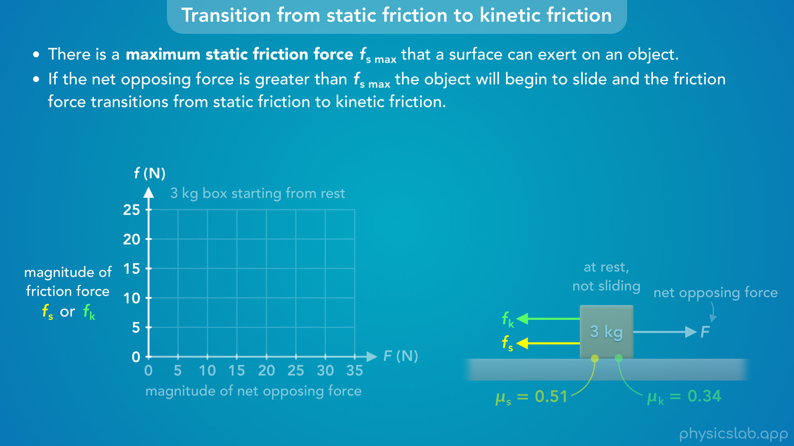
Notes:
and the vertical axis is the magnitude of the friction force on the box acting to the left, which can be static or kinetic.

Slide 33

Notes:
• What we wanna do is create a graph that shows how the friction force changes as we increase the opposing force, F.
• Pause the video and see if you can draw this graph before we walk through it. Or at least think about what it could look like.

Slide 34
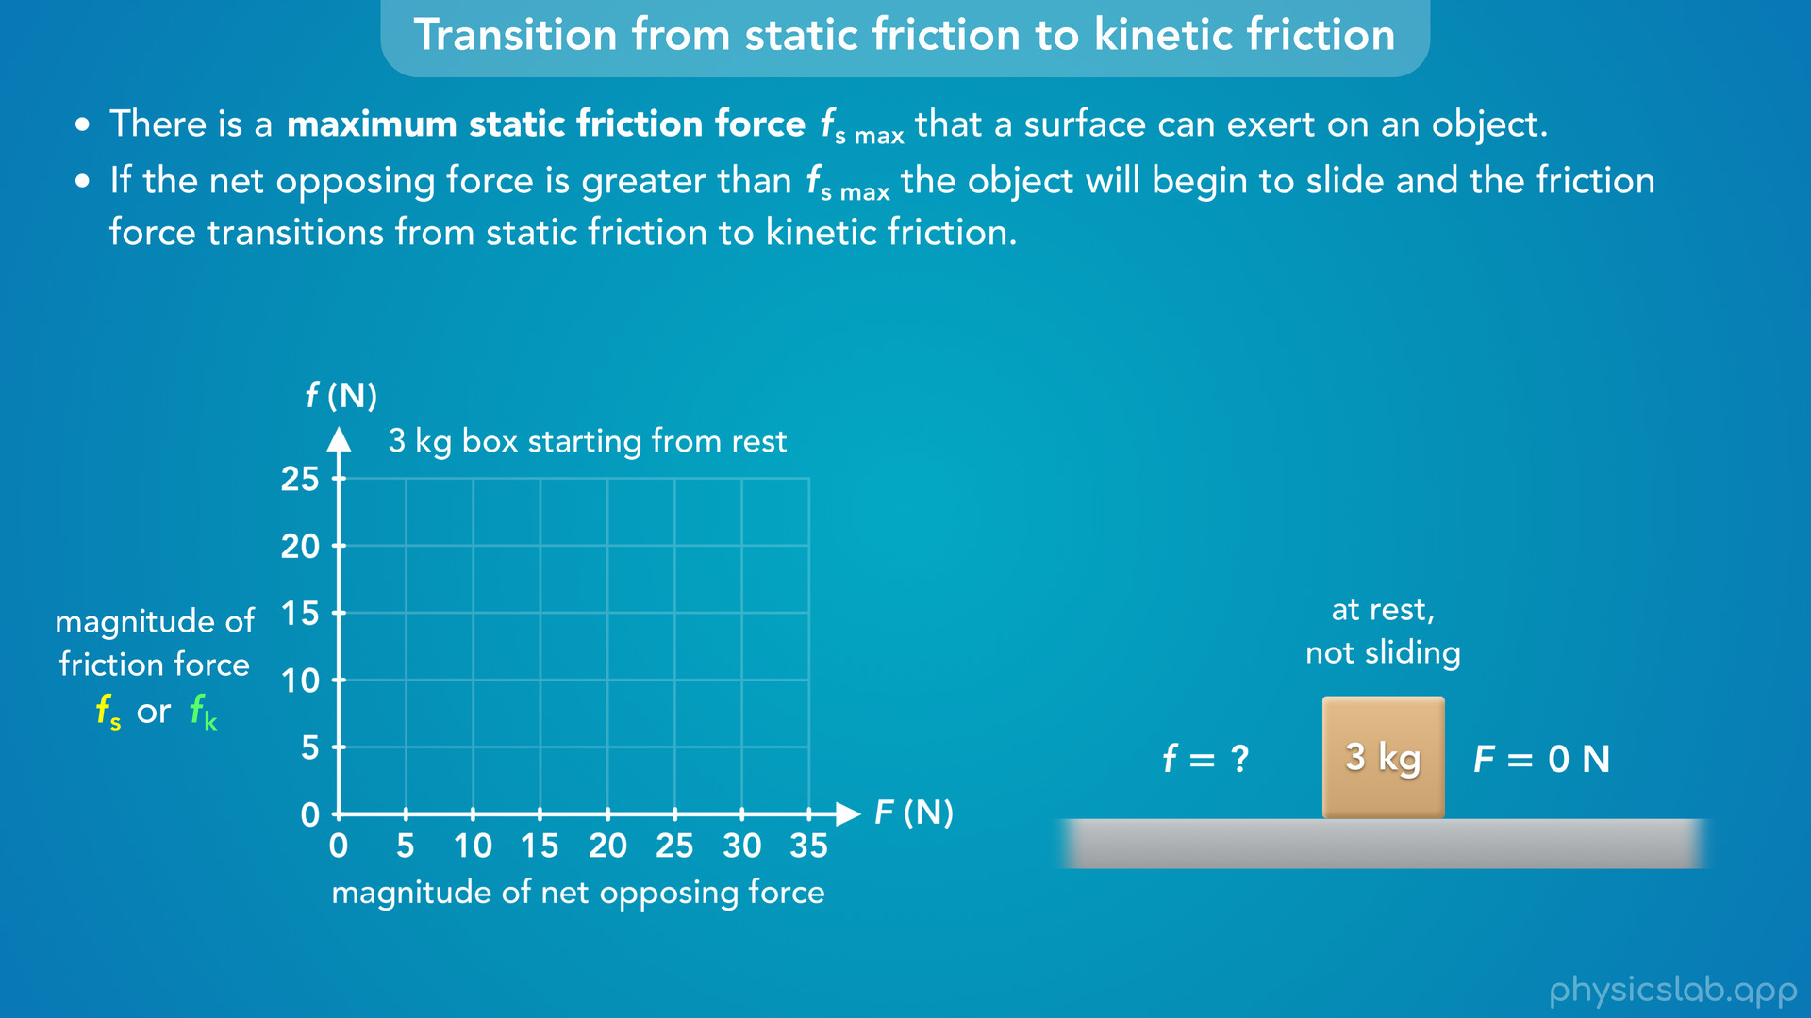
Notes:
• So which type of friction should we graph first?
• If we start at the beginning, what is the magnitude of the friction force if the opposing force is 0?

Slide 35

Notes:
• In that case, there’s no friction force because the box is not sliding and there’s no force to oppose.
• So we have our first point on the graph.
• If F = 0, the friction force is zero.

Slide 36

Notes:
• What happens if start to pull on this box to the right?
• The box is initially at rest, so the first type of friction force that’s going to act on the box is static friction.
• And we learned that the magnitude of the static friction force is equal to the net opposing force.

Slide 37

Notes:
• So if F is 5 N, the static friction force is also 5 N.

Slide 38
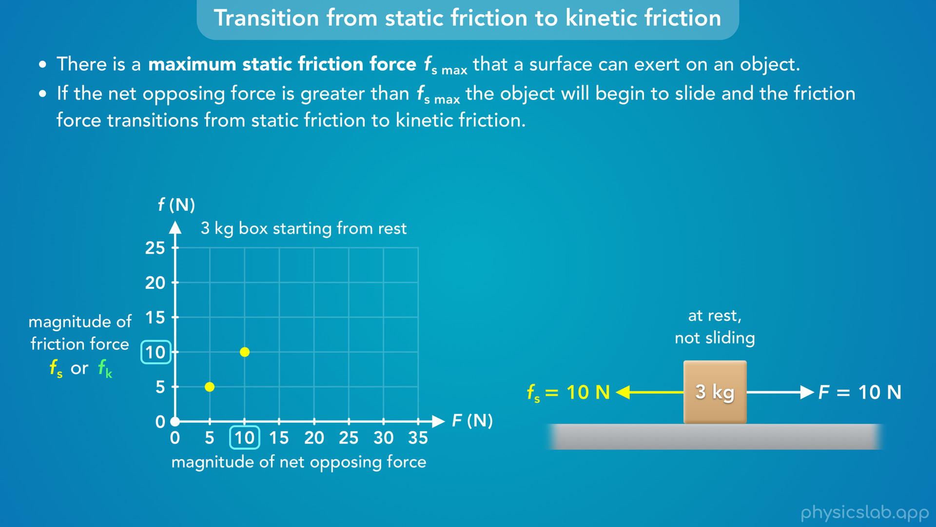
Notes:
• If F is 10 N, the static friction force is 10 N.

Slide 39
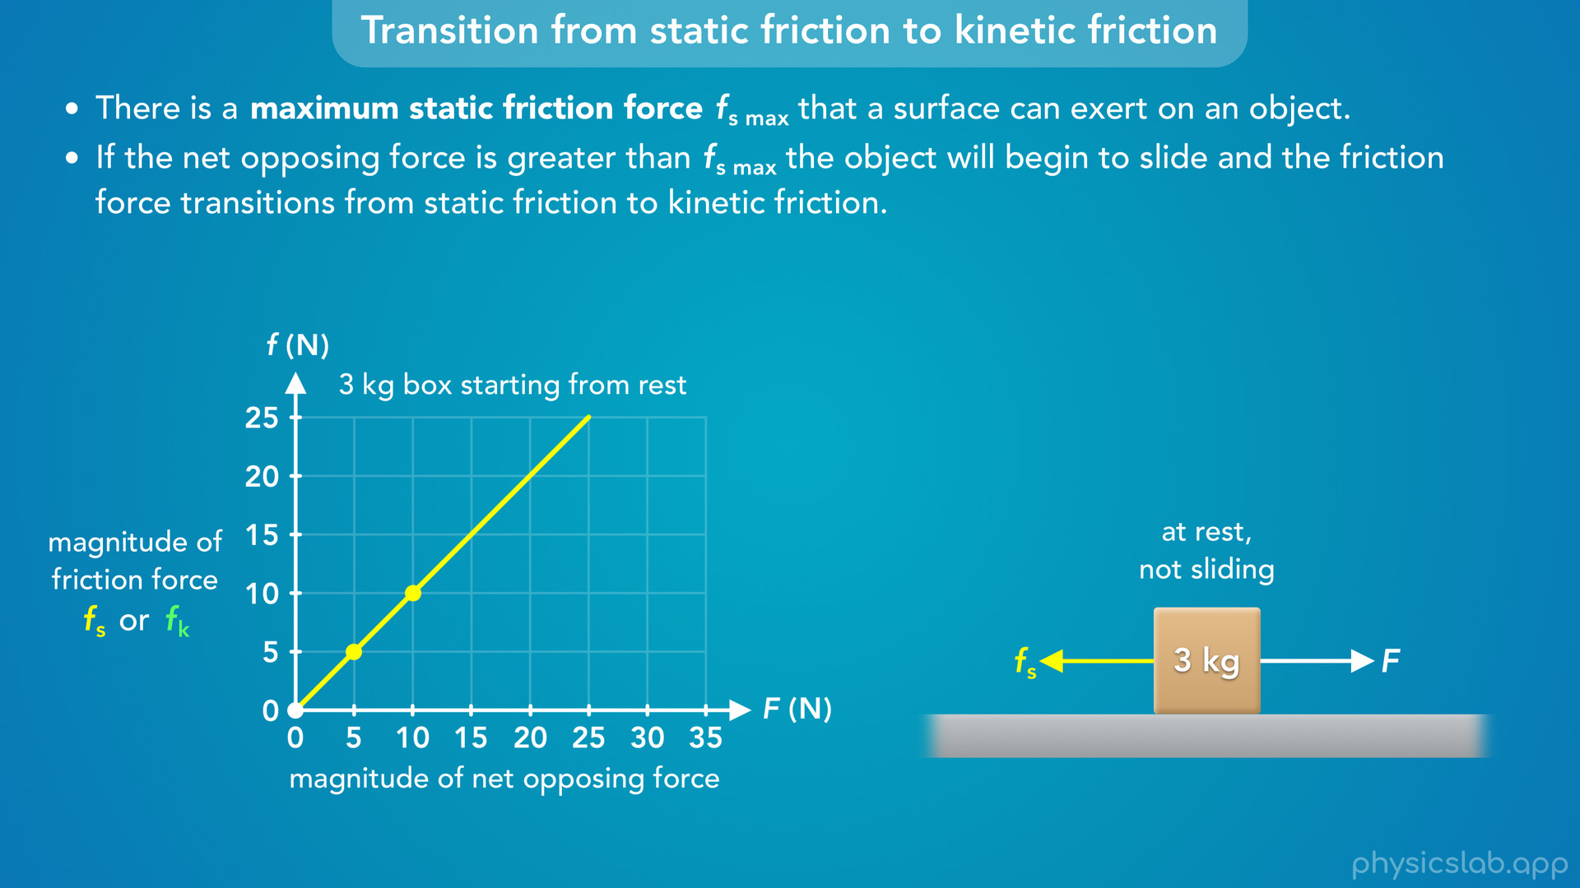
Notes:
• So the graph of the static friction friction force is a line with a slope of 1.

Slide 40
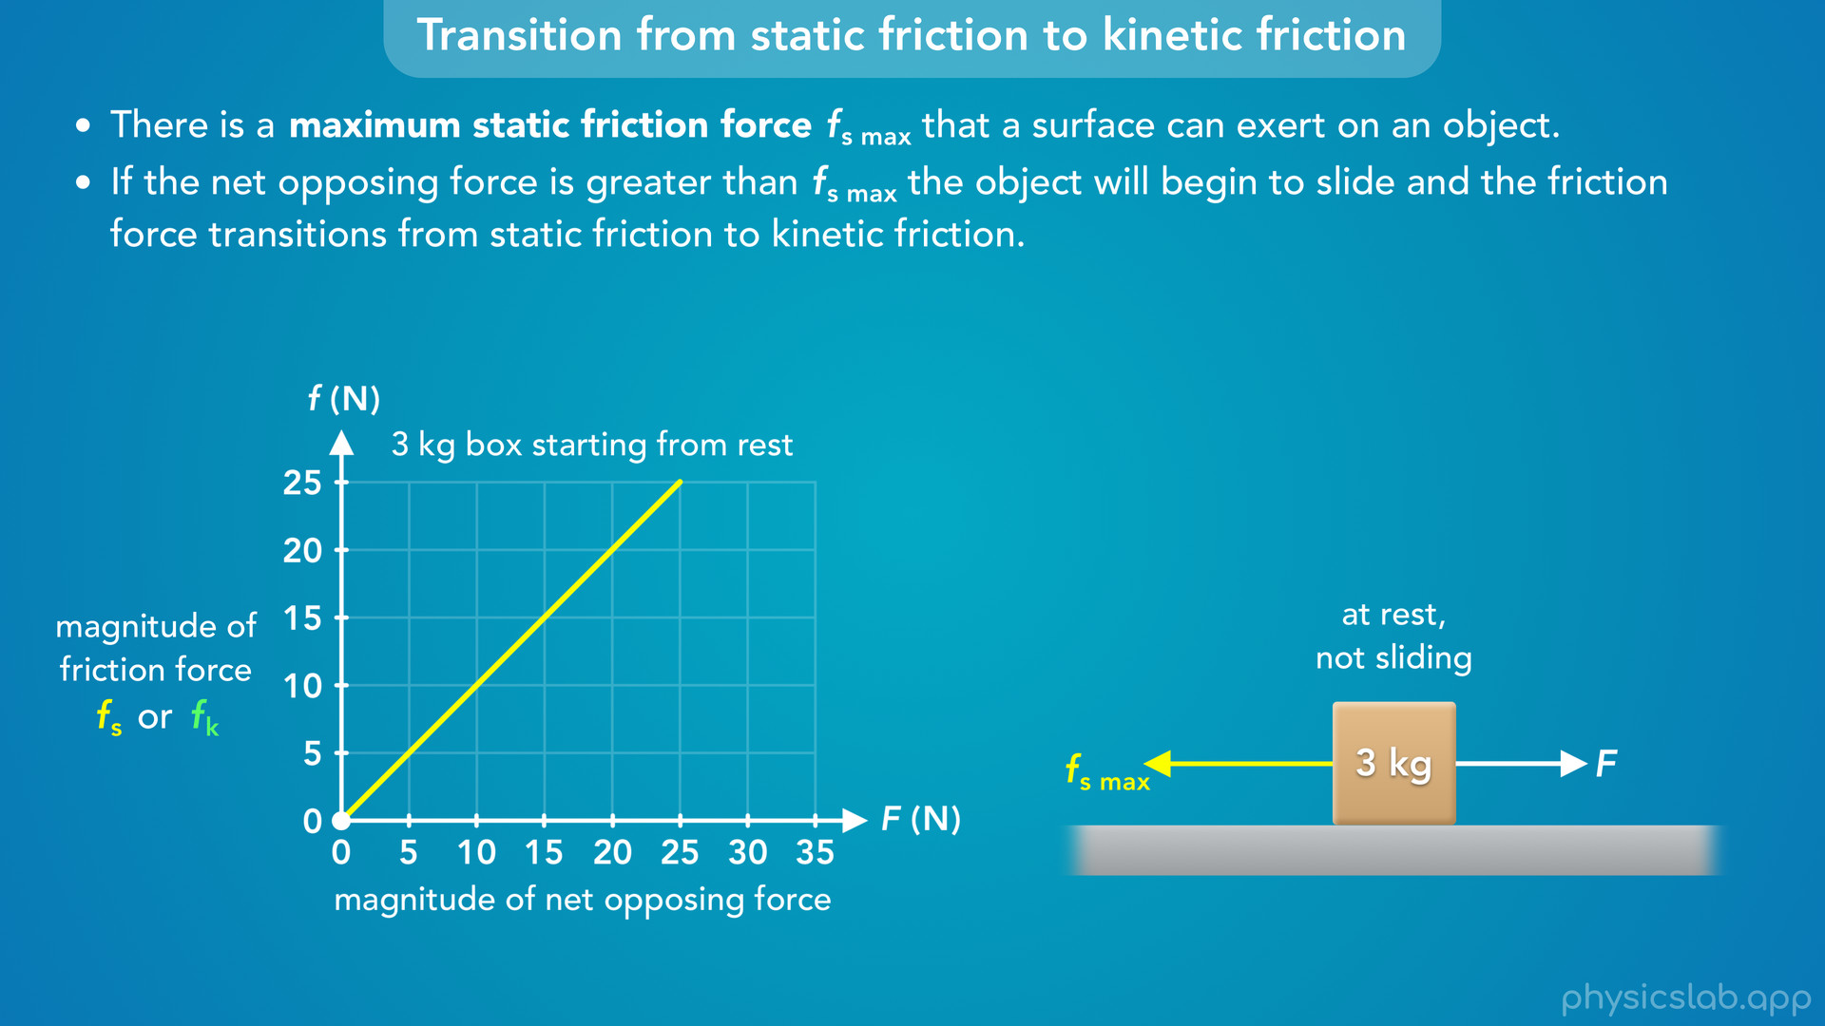
Notes:
• But, we know this line doesn’t extend forever. There’s a maximum static friction force.
• So what would that be for this 3 kg box?

Slide 41
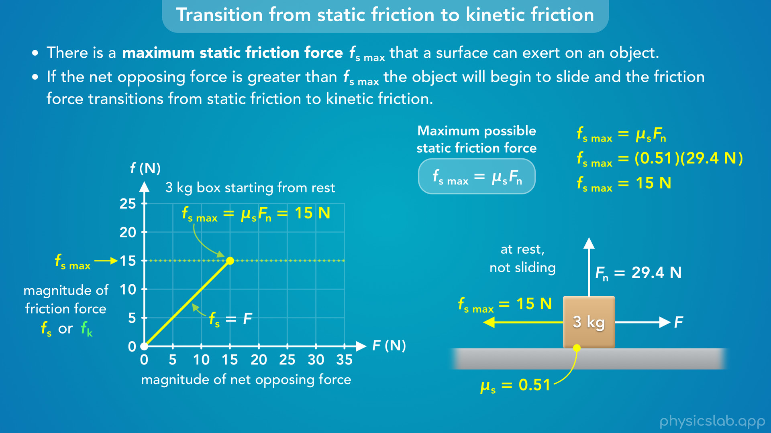
Notes:
• We can calculate it using this equation.
• The coefficient of static friction is 0.51.
• And using Newton’s 2nd law in the vertical direction, we would find that the normal force on the box is 29.4 N.
• Multiplying those together, we get 15 N for the maximum static friction force.
• So the graph of the static friction is going to end at 15 N.
• The static friction force is only equal to the opposing force if it’s less than or equal to 15 N.
• So what happens after this point?

Slide 42
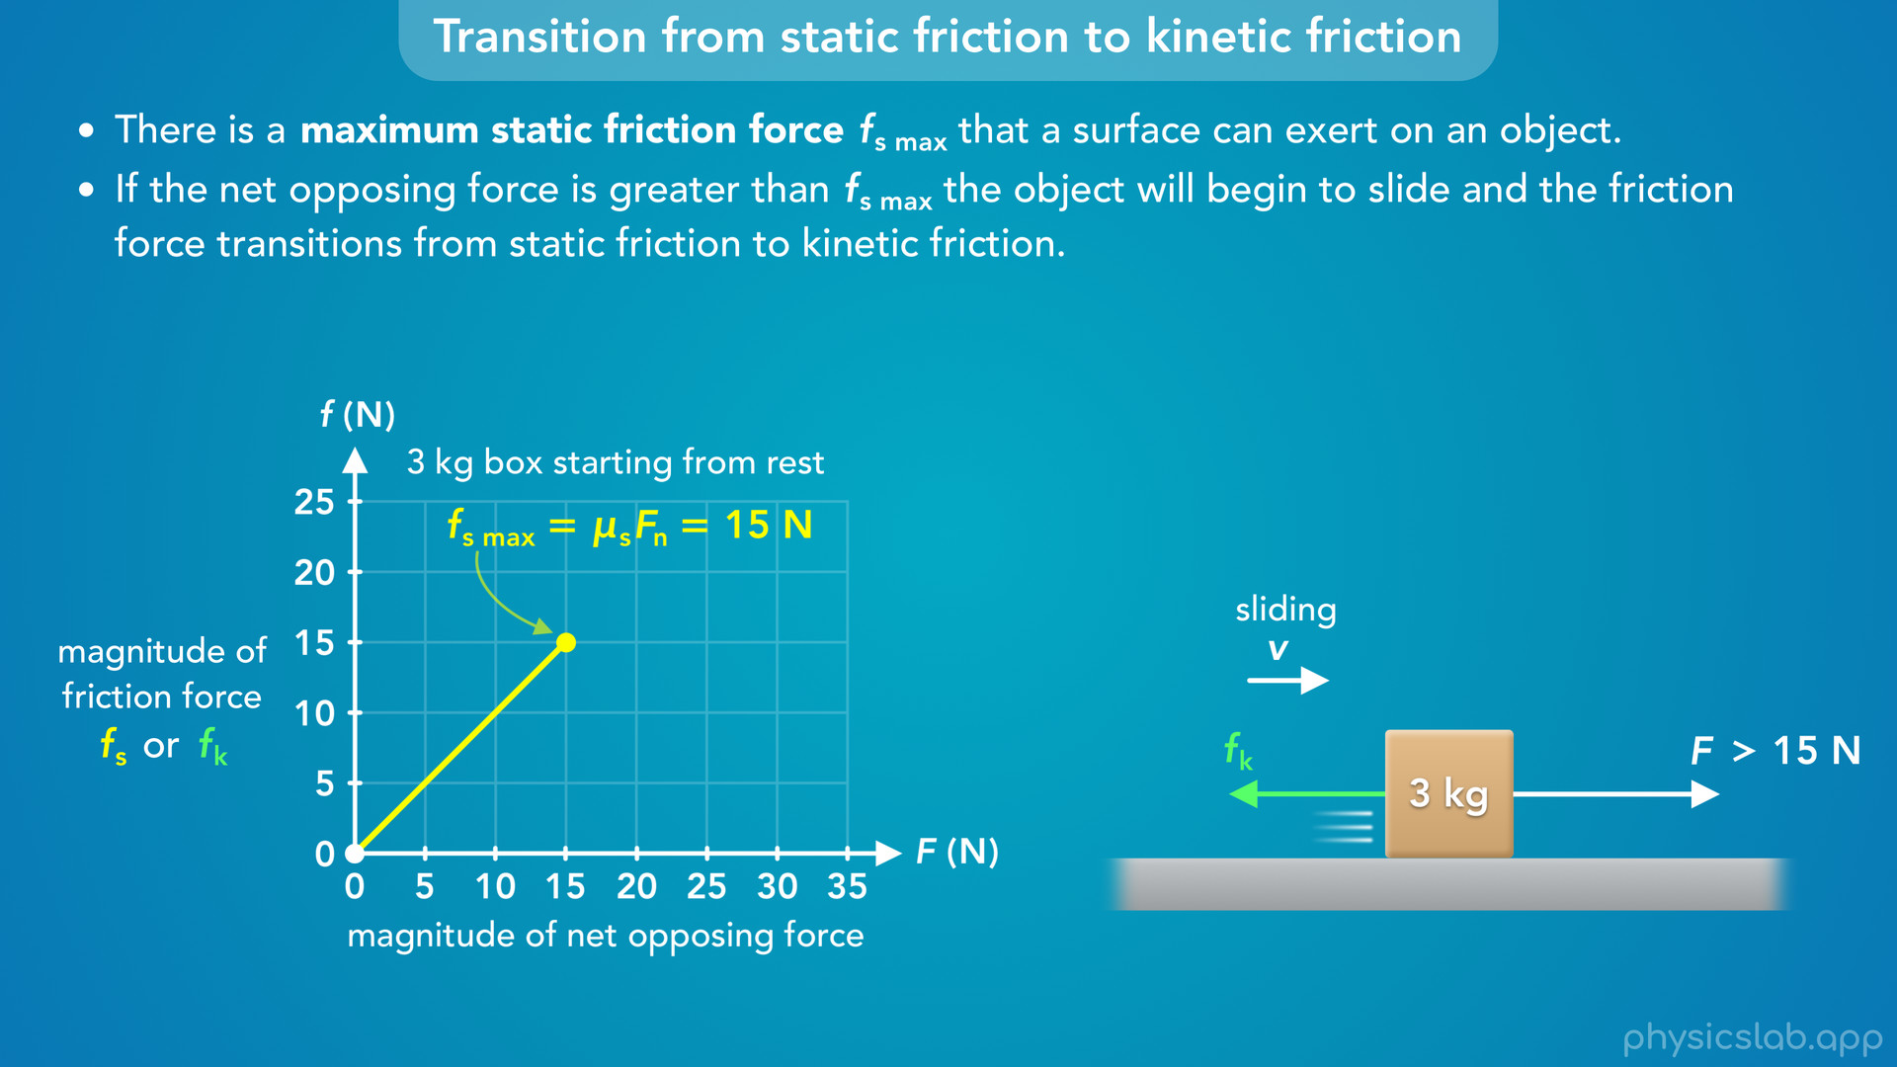
Notes:
• If the opposing force F is greater than the maximum static friction force, the box begins sliding and we switch to kinetic friction.

Slide 43
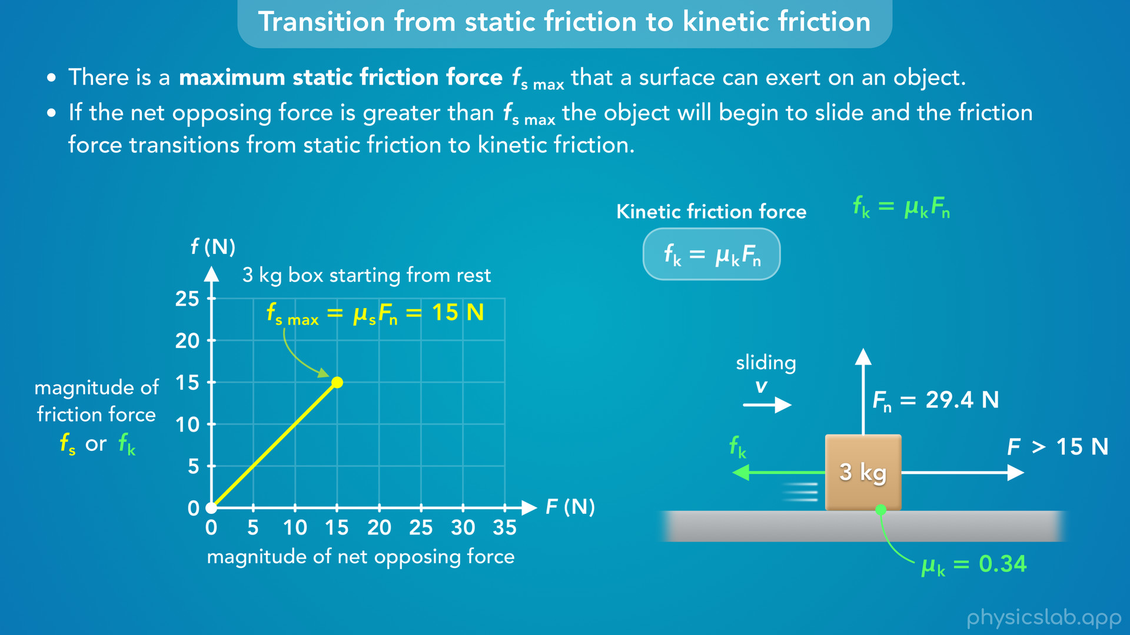
Notes:
• And we use this equation to find the magnitude of the kinetic friction force.

Slide 44
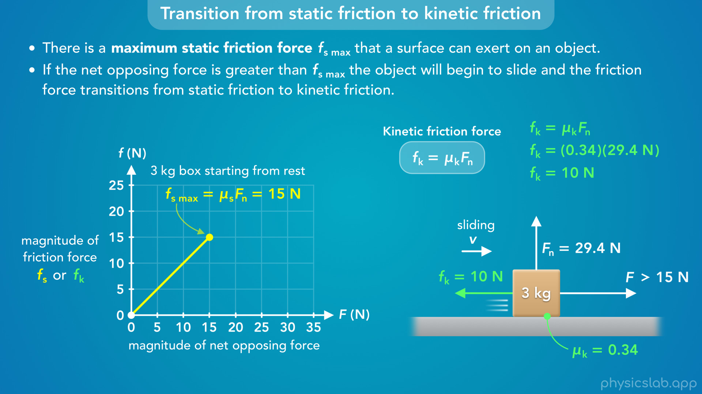
Notes:
• This time we plug in 0.34 for the coefficient of kinetic friction, but we still plug in 29.4 N for the normal force.
• That gives us 10 N for the magnitude of the kinetic friction force.
• But how do we graph this?

Slide 45
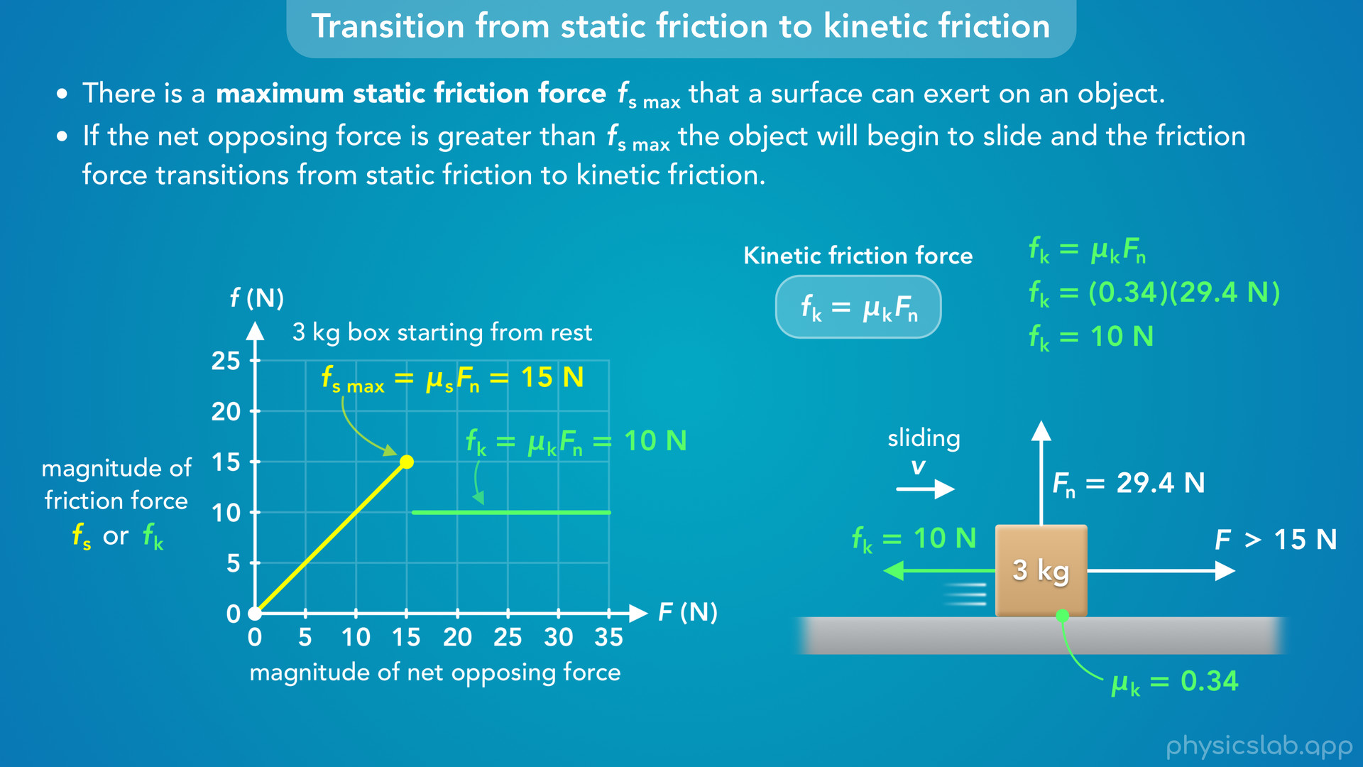
Notes:
• The kinetic friction force does not depend on the opposing force F. It’s always equal to mu k times Fn.
• So the graph of the kinetic friction starts immediately after the maximum static friction force, and it’s always 10 N for this box.
• Again, the value of the kinetic friction does not depend on the opposing force, so it’s not very useful to graph it on it’s own, it’s just a horizontal line.
• But together with the static friction graph it gives us another way to see this transition.

Slide 46
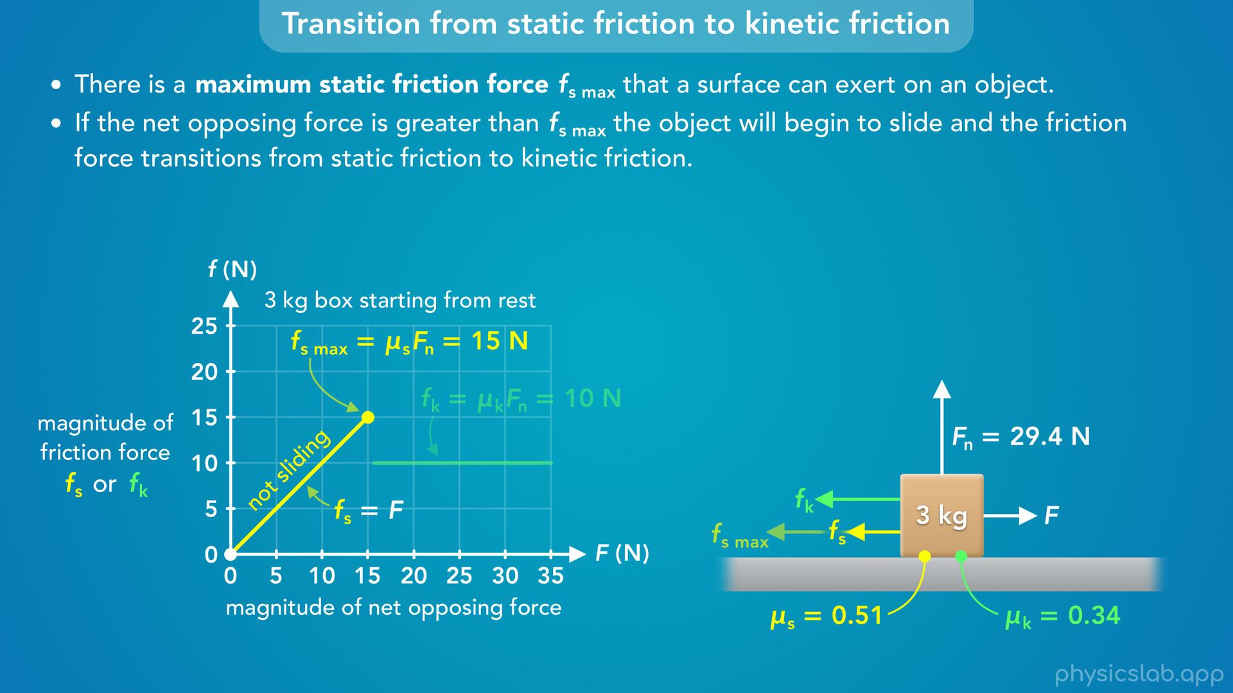
Notes:
• The line on the left is static friction which is always equal to the opposing force.
• There’s a maximum value for the static friction which is equal to mu s times Fn.
• During this part, and at the maximum value, the object is not sliding.

Slide 47

Notes:
• The line on the right is kinetic friction which is always equal to mu k times Fn.
• During that part, the object is sliding.

Slide 48
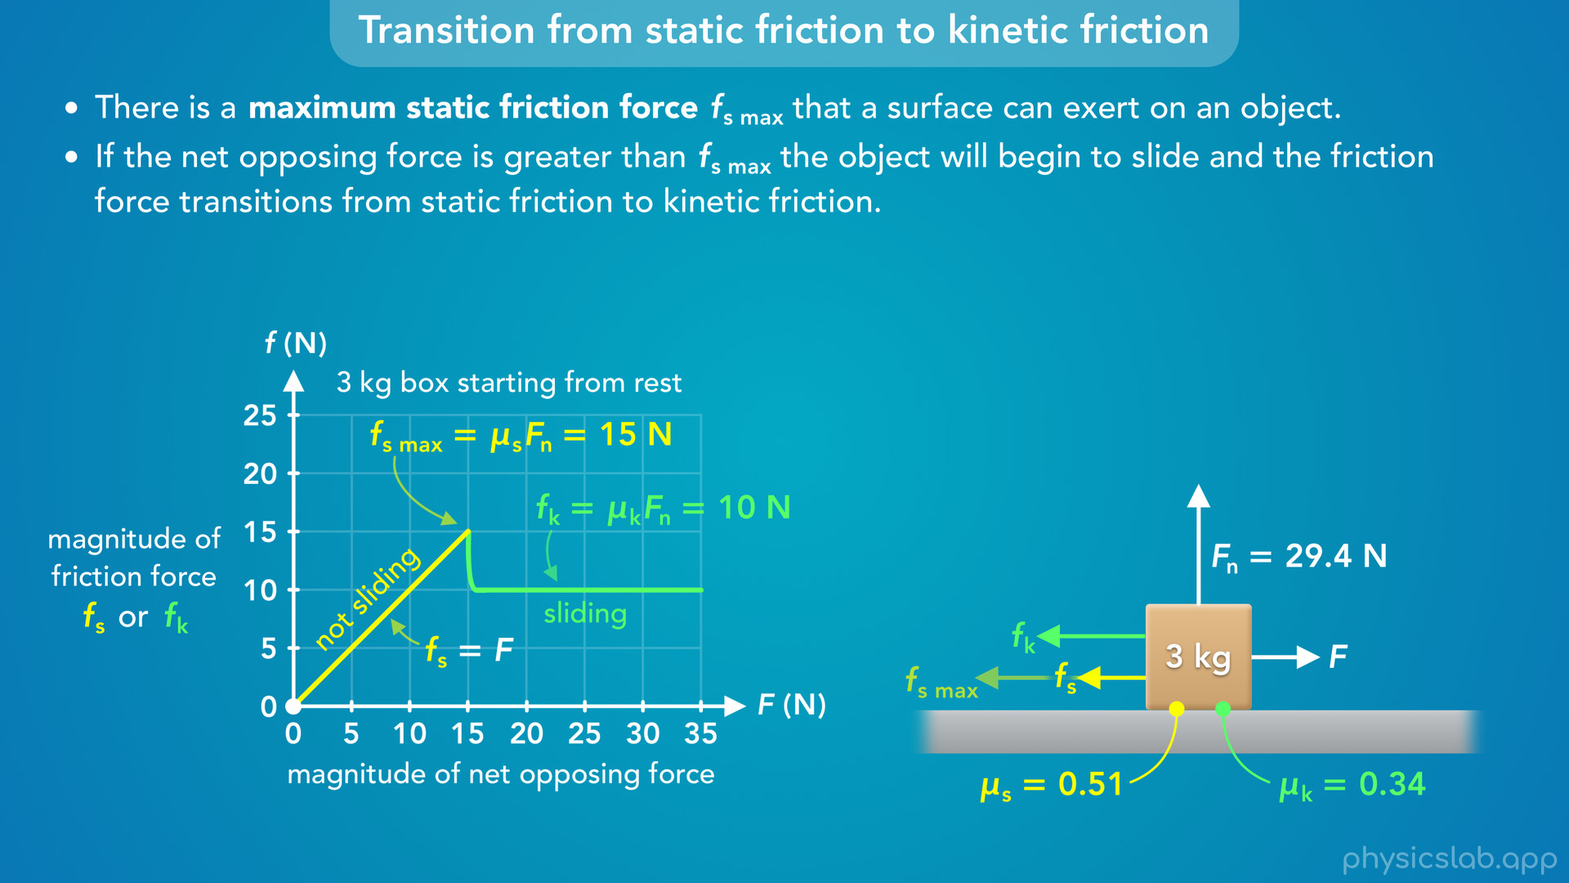
Notes:
• But what’s happening between these two lines?
• Technically, this should be one continuous line.
• After the maximum value, the friction becomes kinetic friction and it immediately changes to 10 N.

Slide 49

Notes:
• But we don’t care about this part of the graph, so we’re just going to draw it as a dotted line to show the transition.

Slide 50
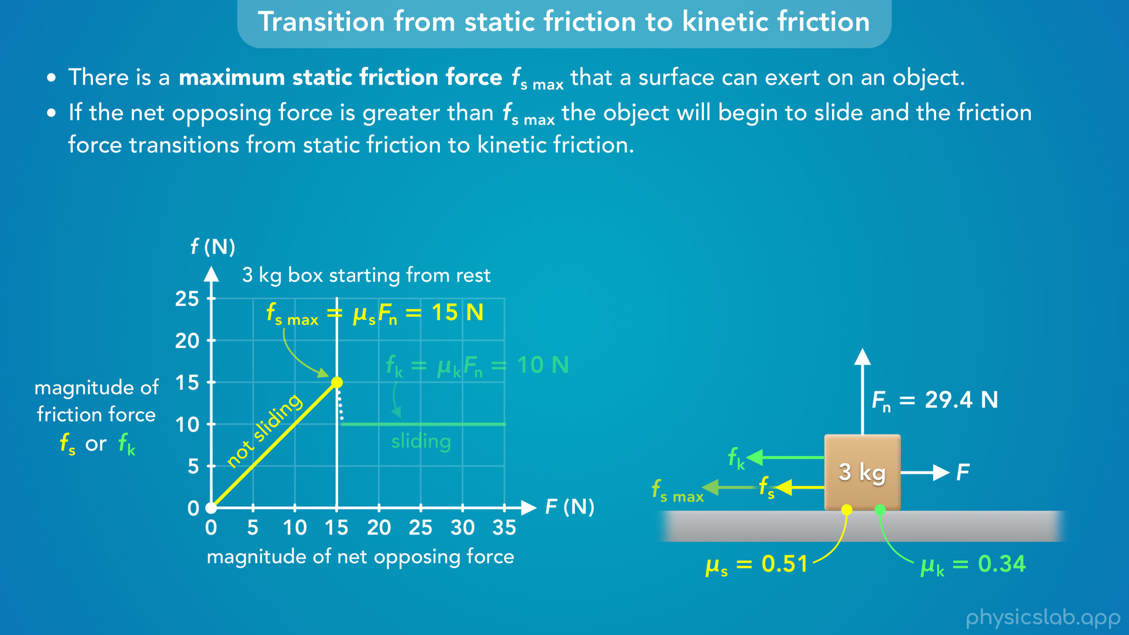
Notes:
• If the opposing force is exactly equal to the maximum static friction force, the friction force is static and has a magnitude of 15 N.

Slide 51
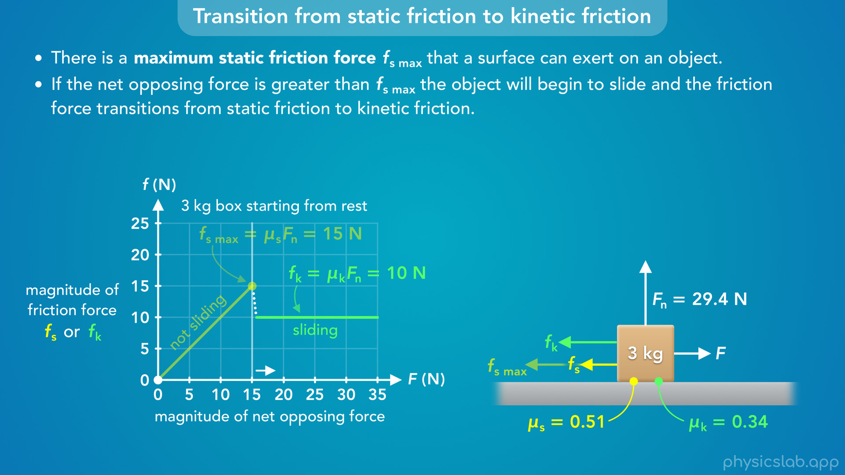
Notes:
• If the opposing force is any value greater than the maximum static friction, then the friction force is kinetic and has magnitude of 10 N.

Slide 52
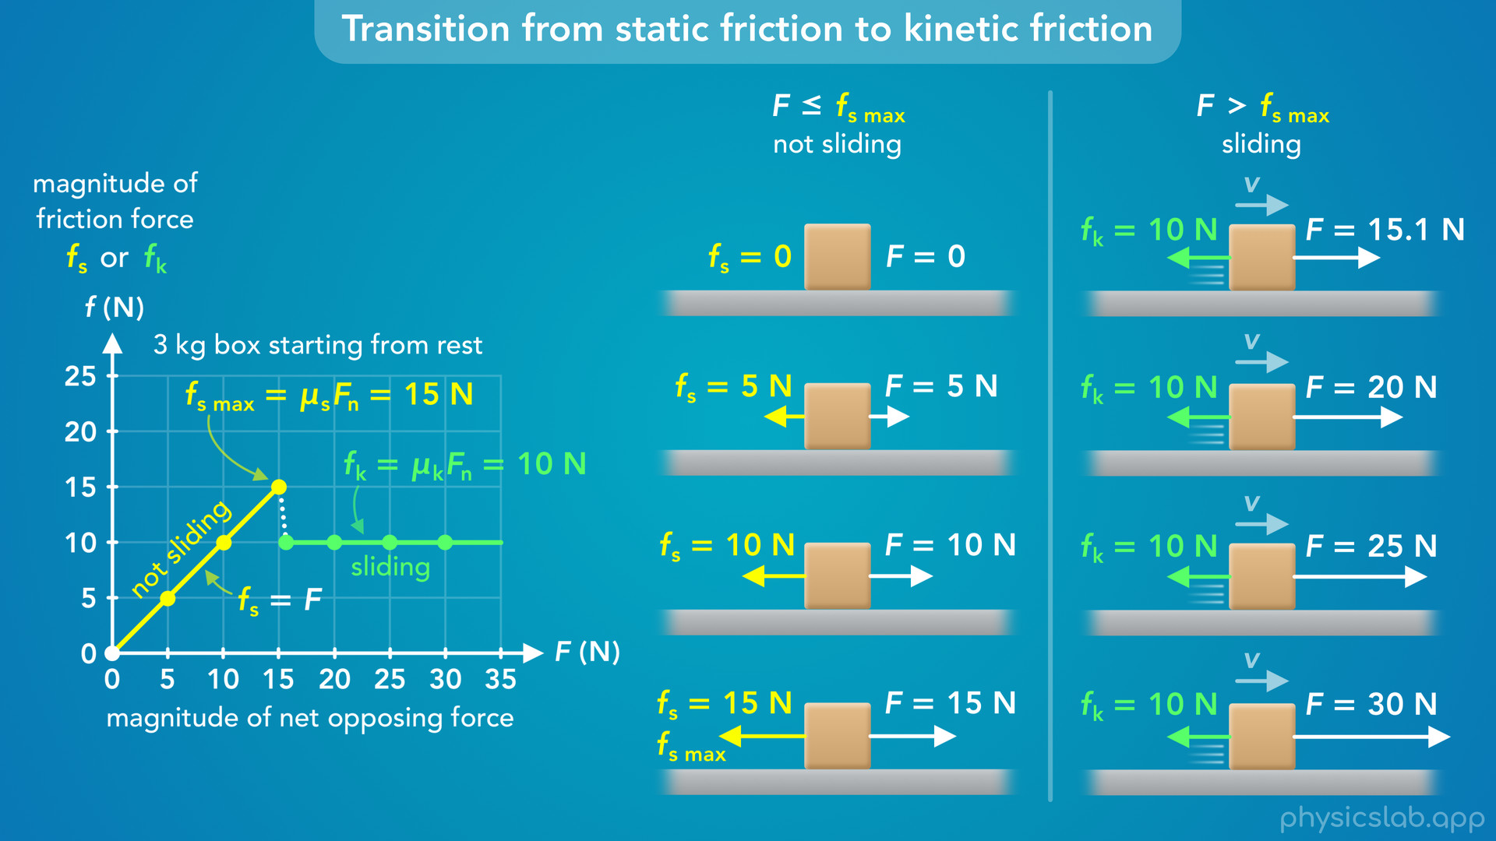
Notes:
• So if we’re given a graph like this, we can use it to determine the type and the magnitude of the friction force acting on an object, and whether it’s going to slide.

Slide 53
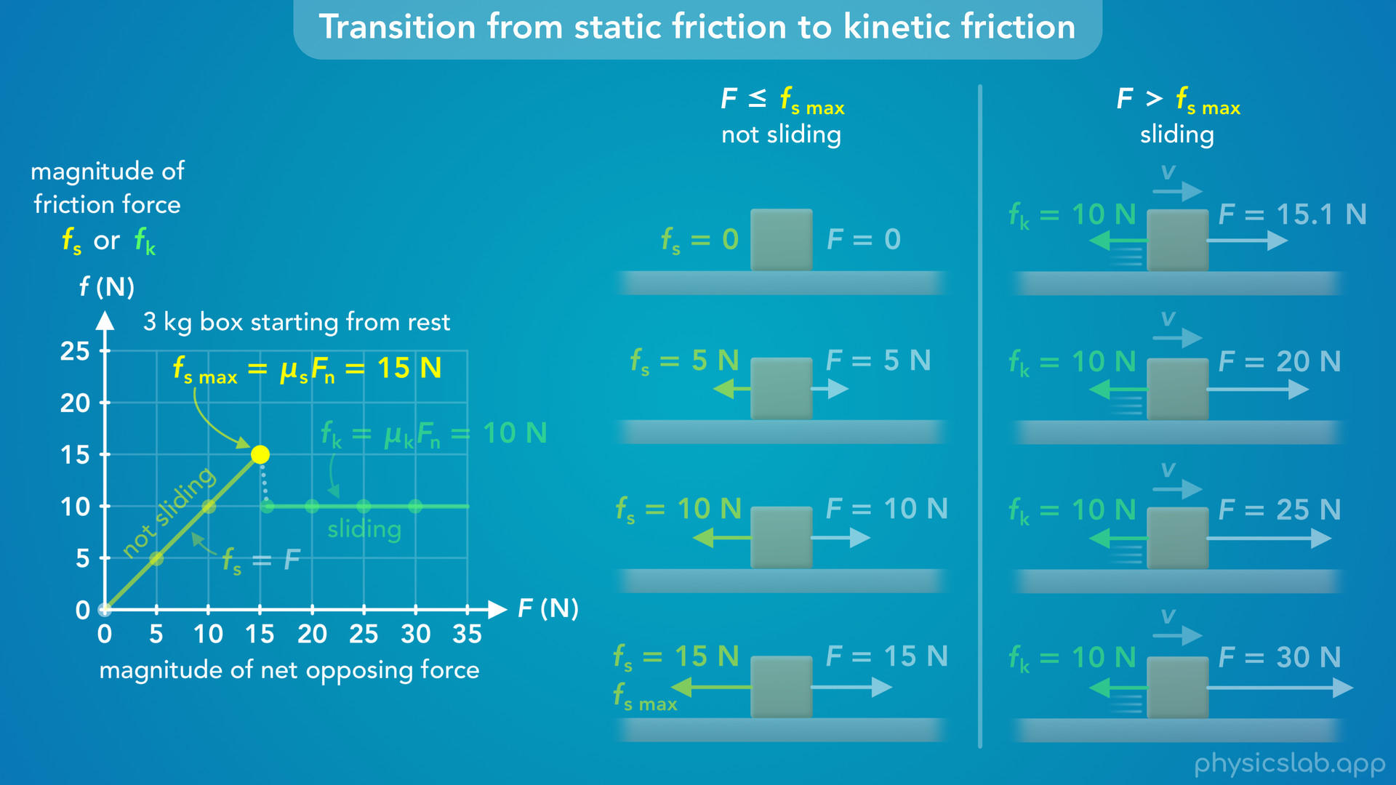
Notes:
• The key point is the maximum static friction force.

Slide 54
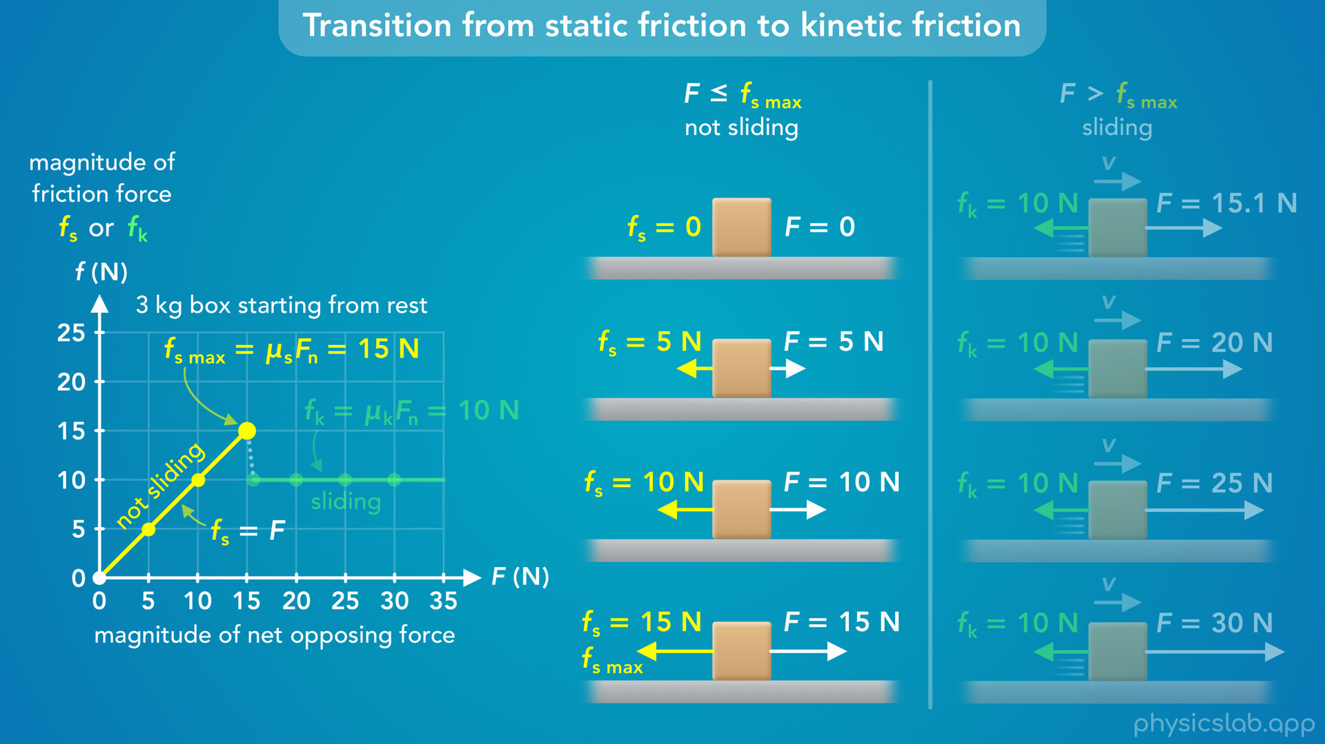
Notes:
• If the net opposing force is less than or equal to that value, then the friction is static, it’s equal to the net opposing force, and the object does not slide.

Slide 55
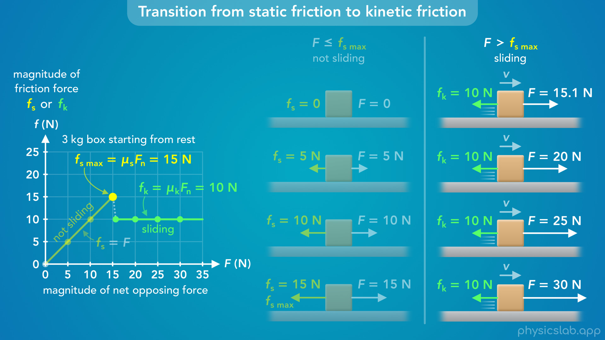
Notes:
• If the net opposing force is greater than that value, then the friction is kinetic, it’s equal to mu k times Fn, and the object will slide.

Slide 56
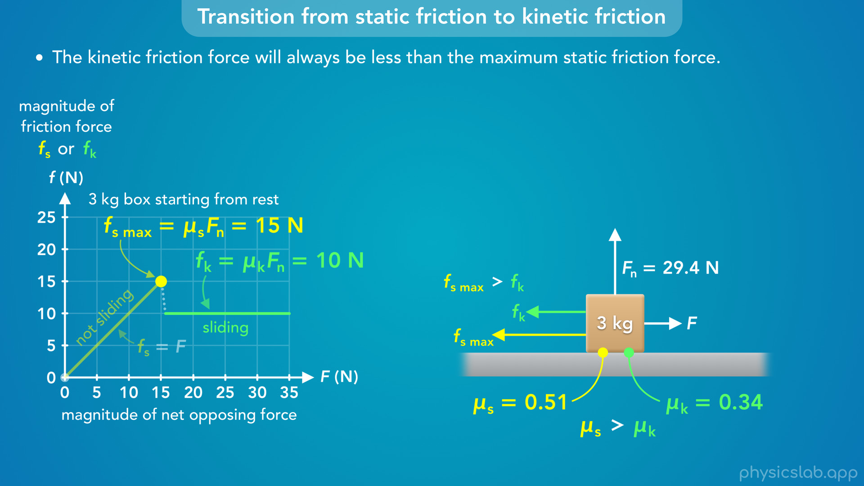
Notes:
• The last important thing to notice is that the kinetic friction force will always be less than the maximum static friction force for a given object and surface.
• Why is that? Why doesn’t the friction increase when the object starts sliding?
• Well, the forces depend on the coefficients of static and kinetic friction, and the coefficient of kinetic friction will always be less than the coefficient of static friction.
• But that doesn’t really answer the question.

Slide 57
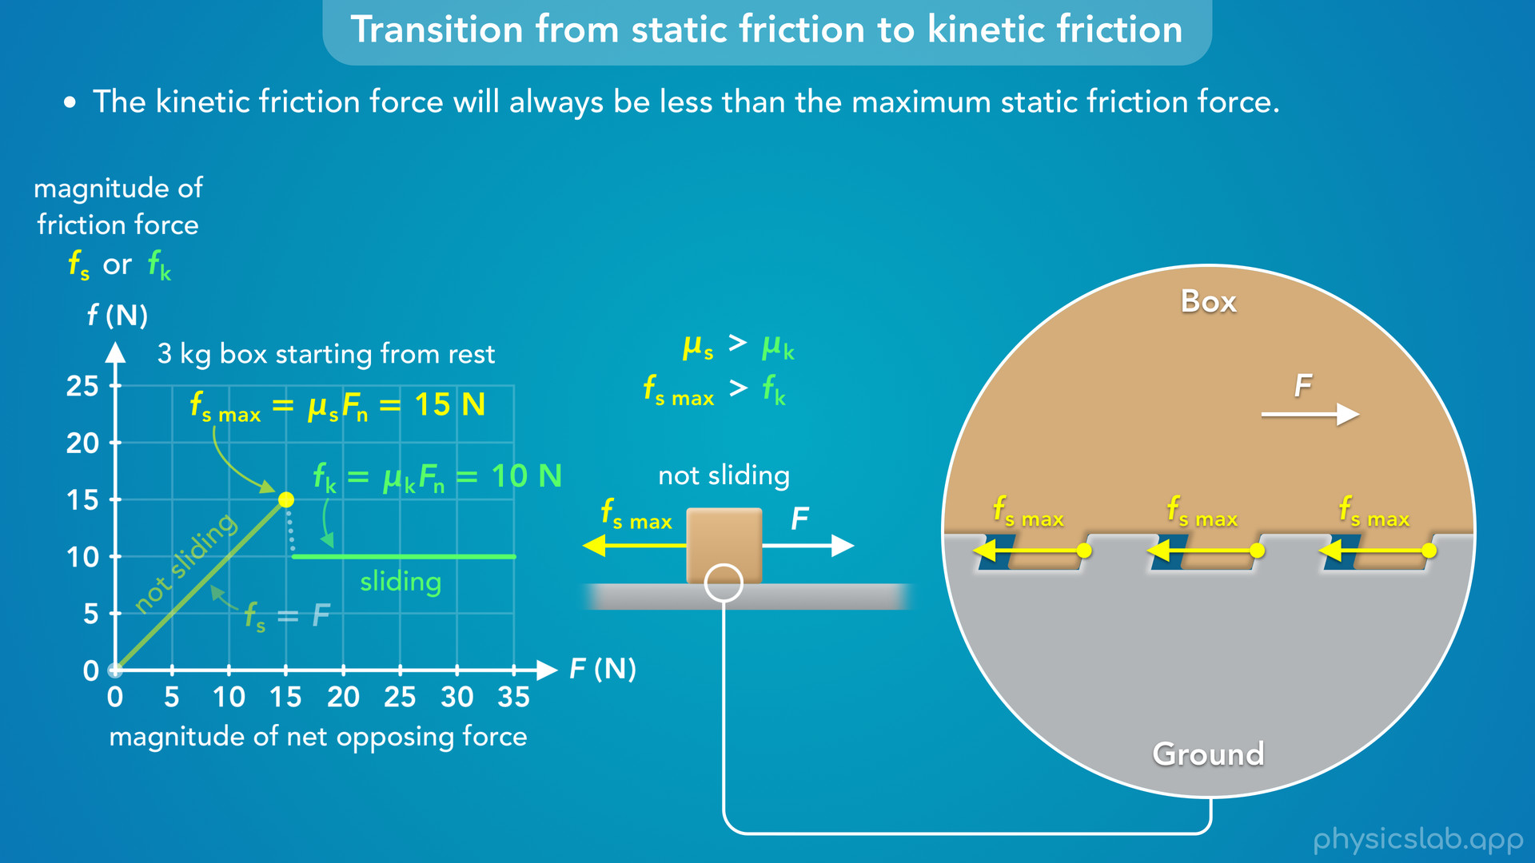
Notes:
• The real answer is a little more complicated because friction depends on the intermolecular forces between each surface.
• But using the picture from before, we could say the maximum static friction force is greater because the bumps on the box are stuck against the bumps on the ground, so the ground can provide more sideways force on the box.

Slide 58
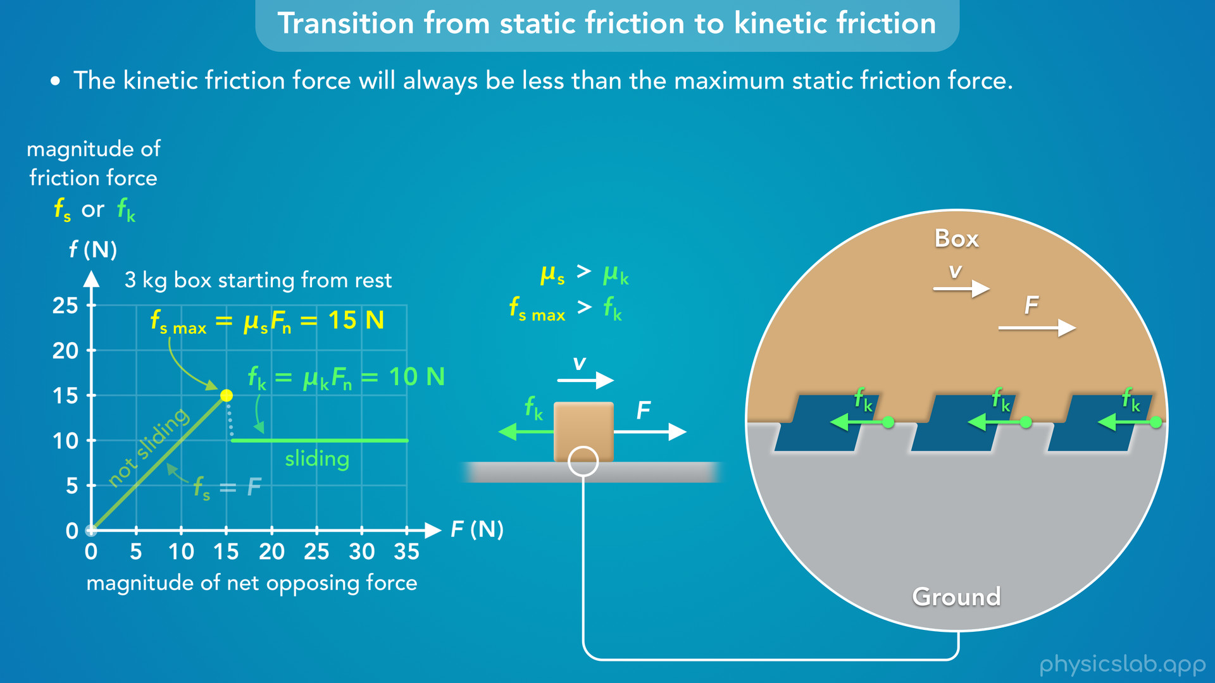
Notes:
• But when the box is sliding, there’s not enough time for the bumps on the box to fall into the holes in the ground so they don’t get stuck, they just slide along the top.
• There’s still some friction from rubbing against the top, but the sides of the bumps aren’t hitting each other, so there’s less friction.

Slide 59
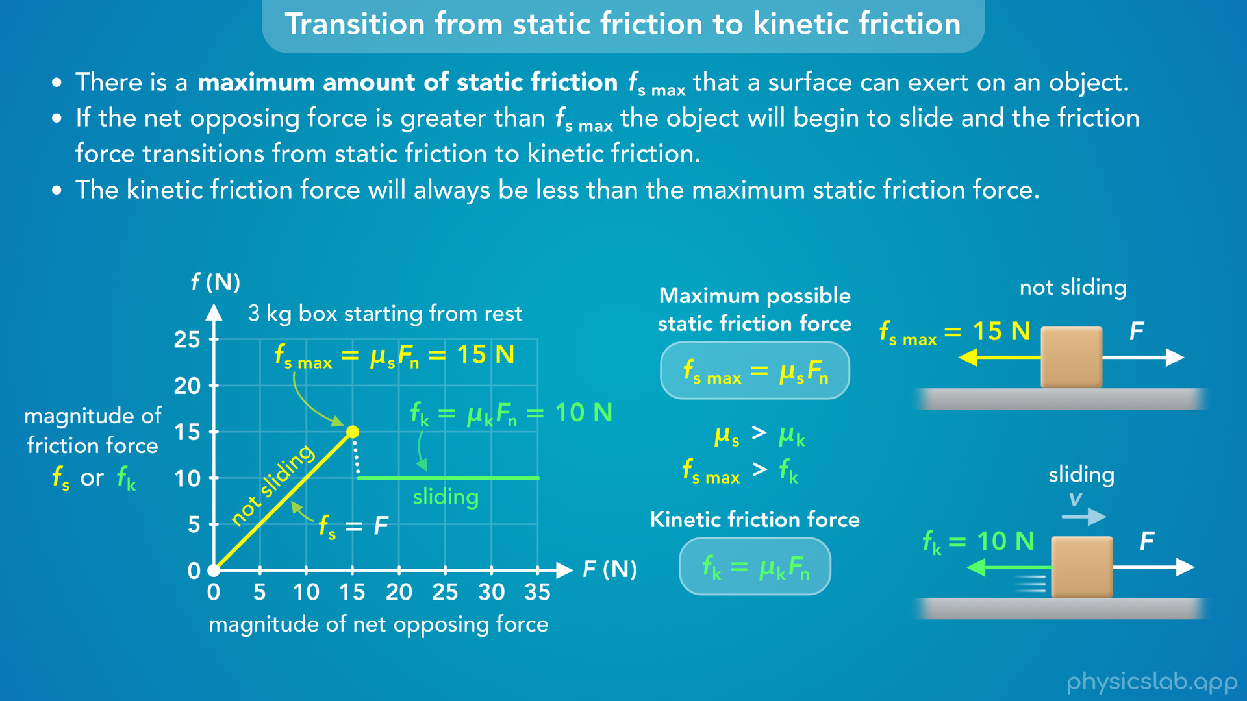
Notes:
• So that’s what it looks like when a friction force transitions from static friction to kinetic friction.

Slide 60
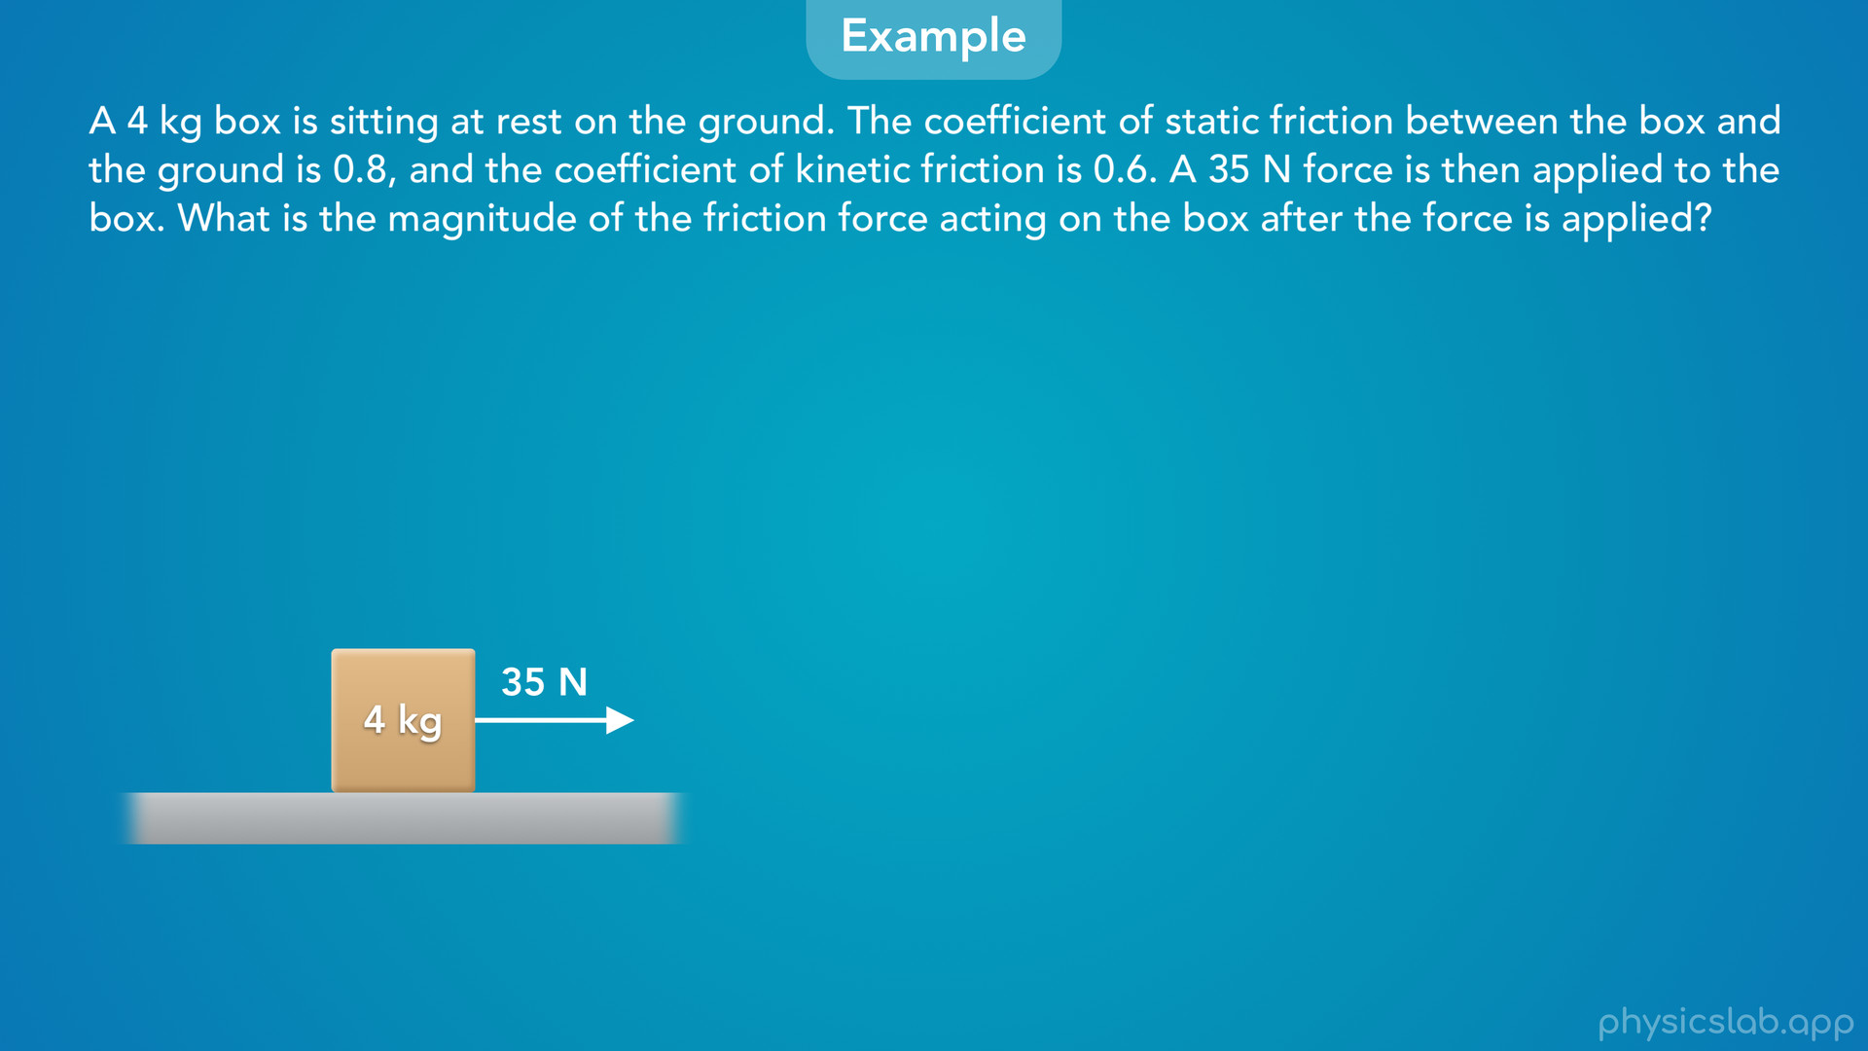
Notes:
• Let’s walk through an example and see how we can apply this to a problem.
• A 4 kg box is sitting at rest on the ground. The coefficient of static friction between the box and the ground is 0.8, and the coefficient of kinetic friction is 0.6. A 35 N force is then applied to the box. What is the magnitude of the friction force acting on the box after the force is applied?
• Pause the video and try solving this first.

Slide 61
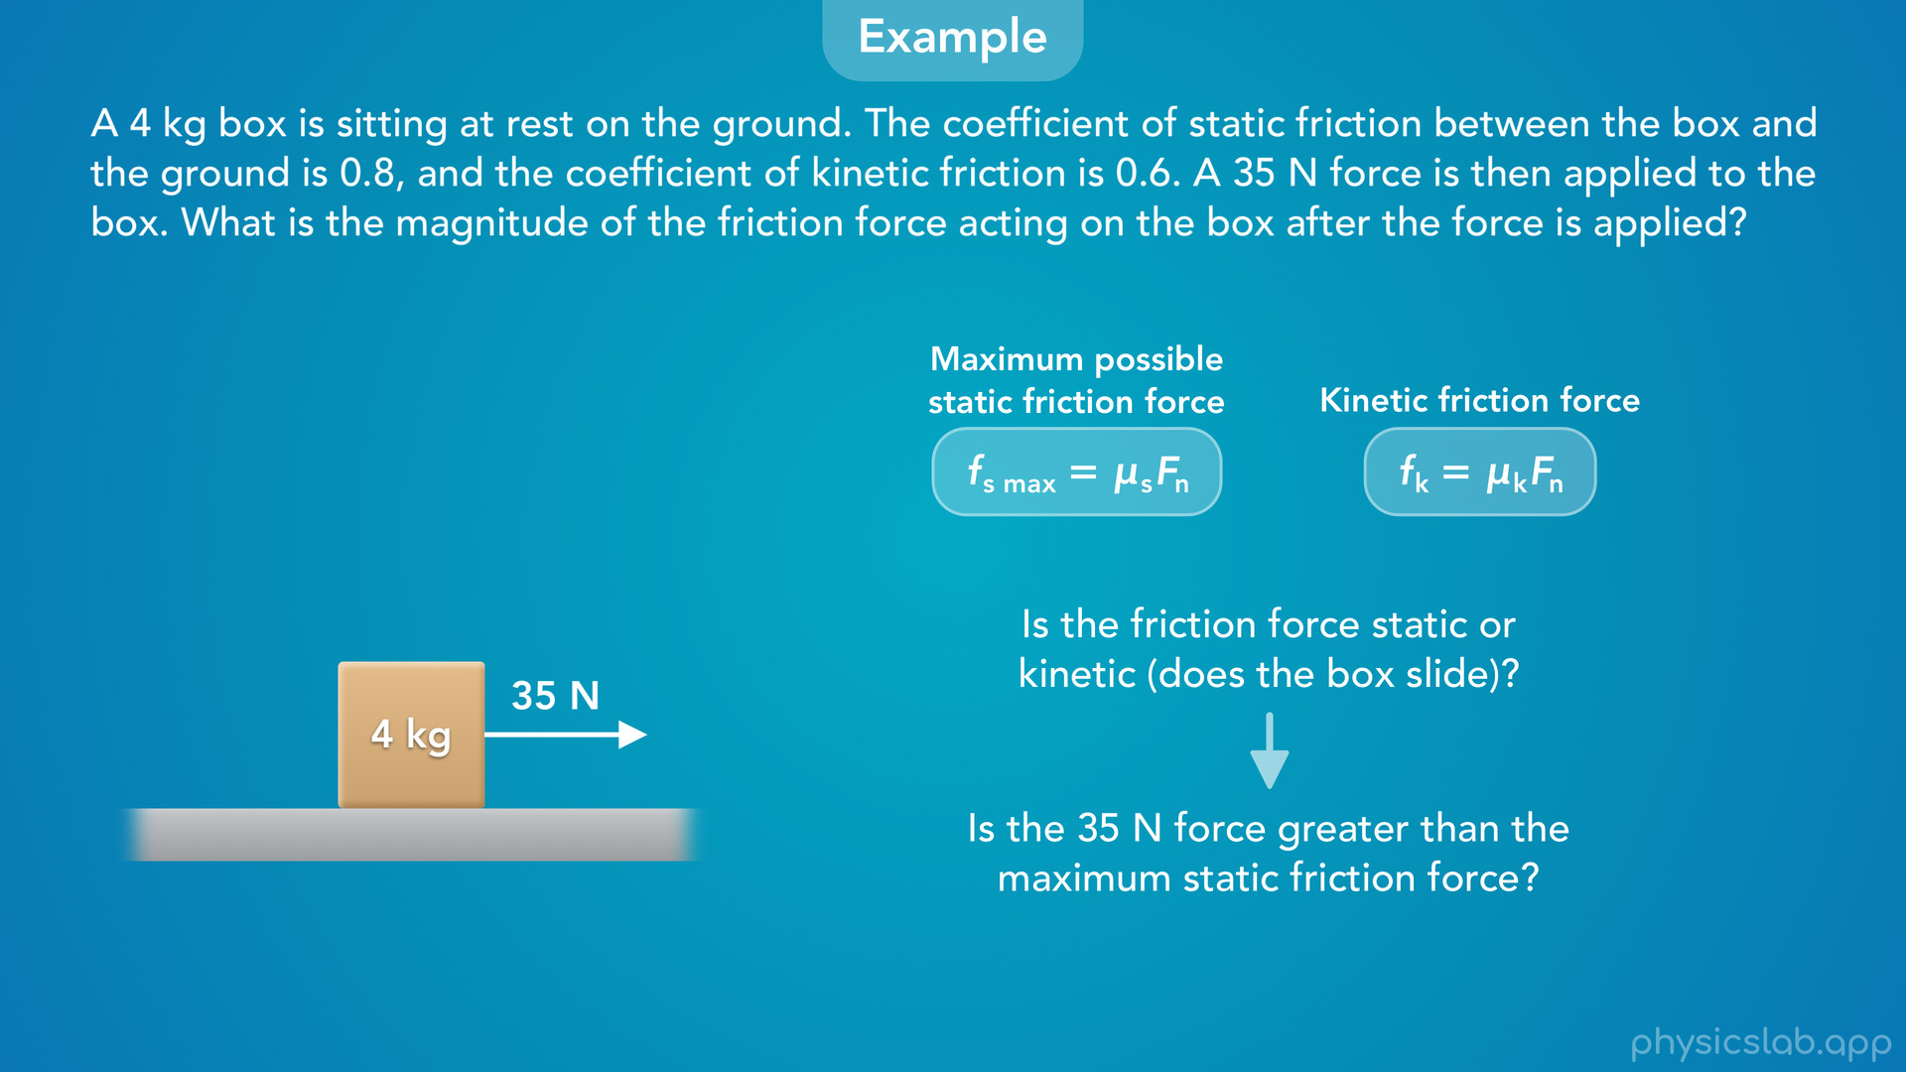
Notes:
• So how do we find the magnitude of the friction force?
• Well, we find the magnitudes of static and kinetic friction in different ways, so the first thing we need to do is figure out if the friction is static or kinetic, so does the box slide?
• To do that, we need to figure out if the 35 N force is greater than the maximum static friction force, which we can find using this equation.

Slide 62
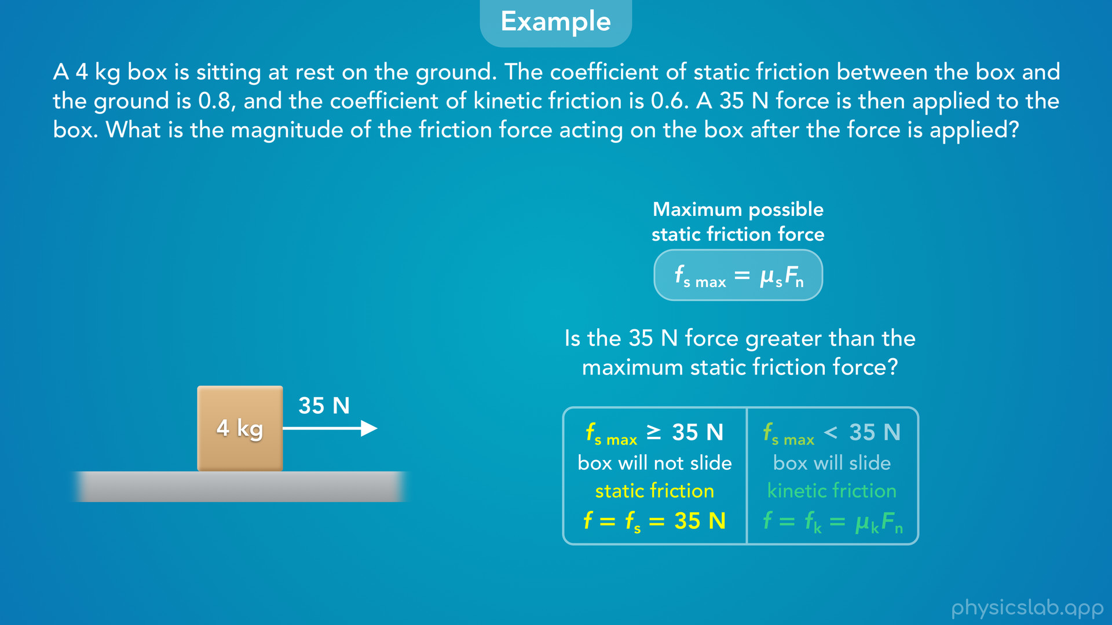
Notes:
• If the 35 N force is less than or equal to the maximum static friction, the box will not slide, the friction is static friction and it’s equal to 35 N.

Slide 63
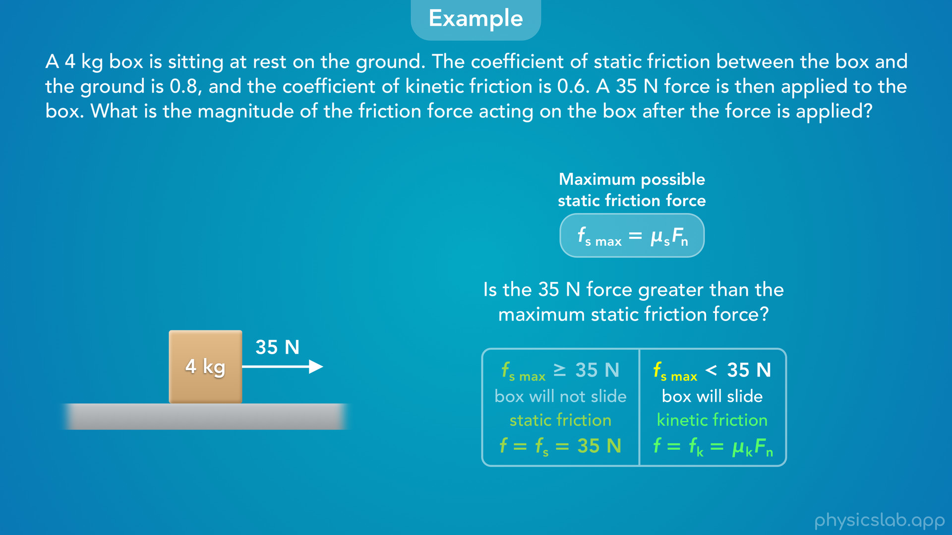
Notes:
• If the 35 N force is greater than the maximum static friction, the box will slide, the friction is kinetic friction and it’s equal to the coefficient of kinetic friction times the normal force.

Slide 64
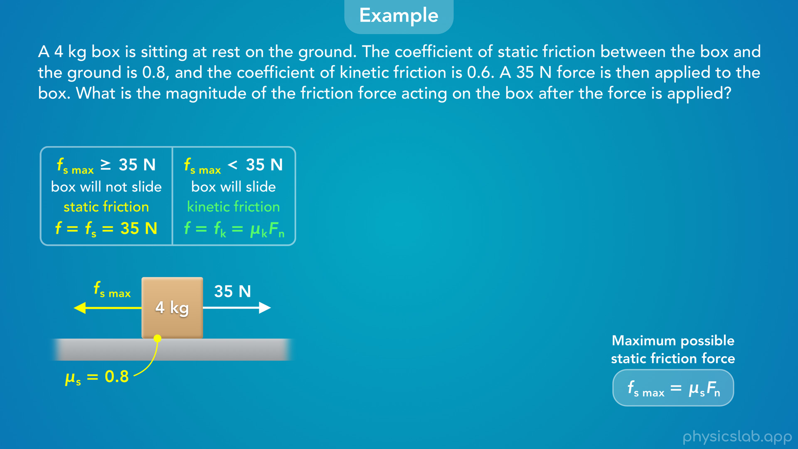
Notes:
• So let’s start by finding the maximum static friction force.
• We have the coefficient of static friction, but we need the normal force.

Slide 65
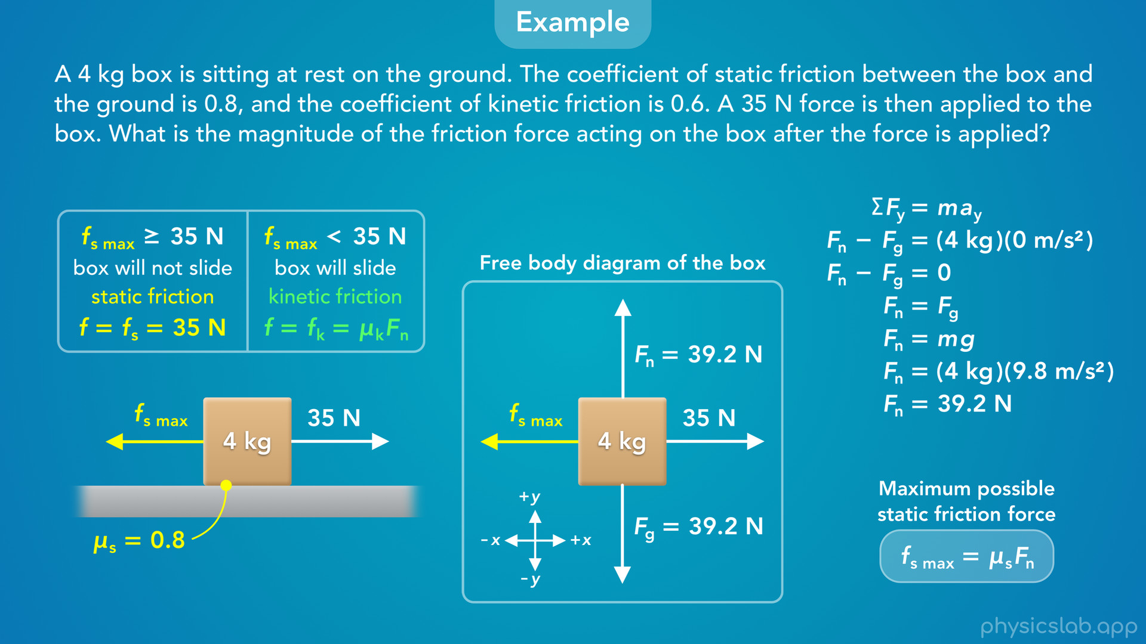
Notes:
• Like we’ve done before, we can draw a free body diagram of the box and apply Newton’s 2nd law in the y direction.
• The box is not accelerating up or down, so the normal force is equal to the gravitational force, which is 39.2 N.

Slide 66
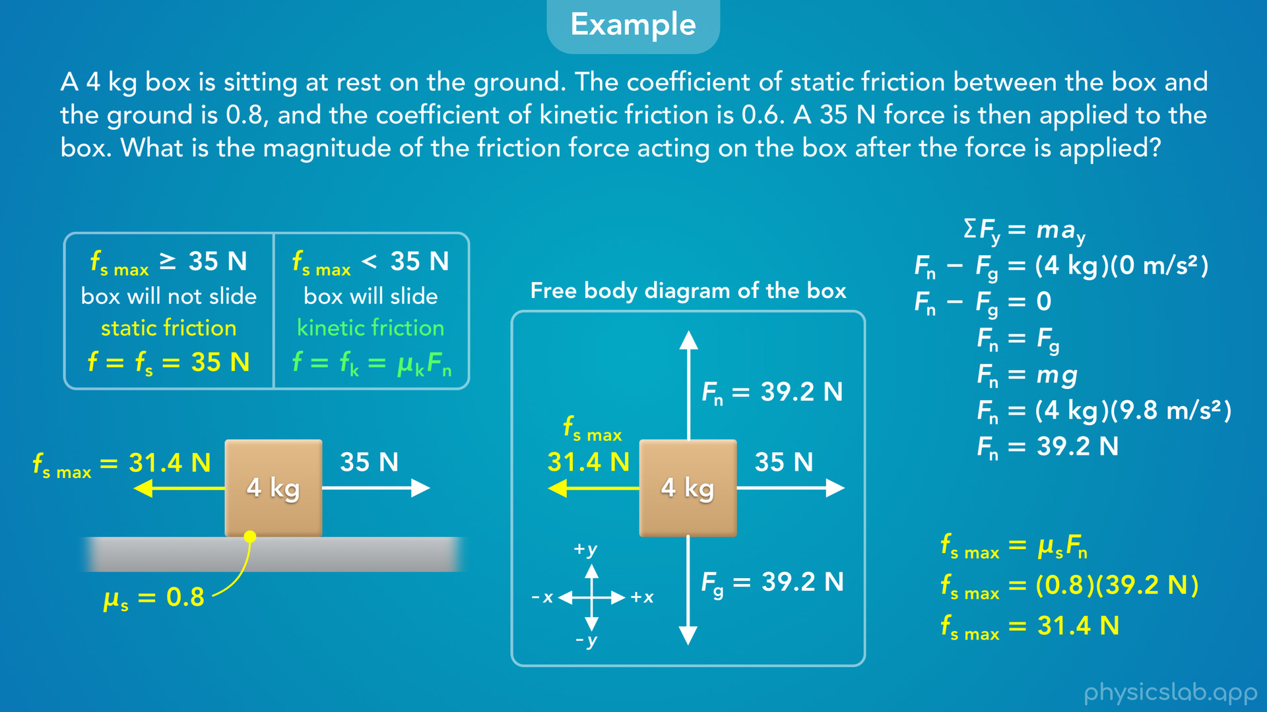
Notes:
• Using this equation, we can plug in 0.8 for the coefficient of static friction and 39.2 N for the normal force.
• That gives us 31.4 N for the maximum static friction force.

Slide 67
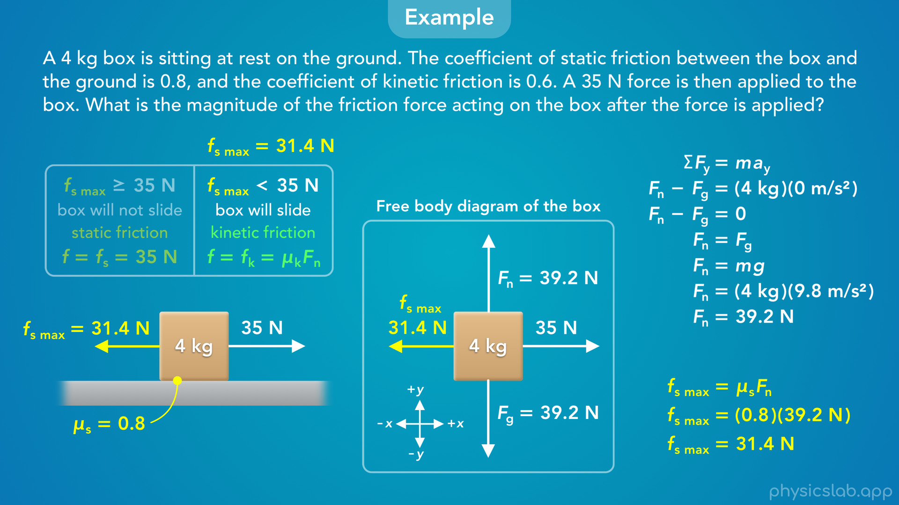
Notes:
• That value is less than the 35 N force that’s trying to pull the box to the right.
• So the box will slide, and the friction will be kinetic friction.

Slide 68
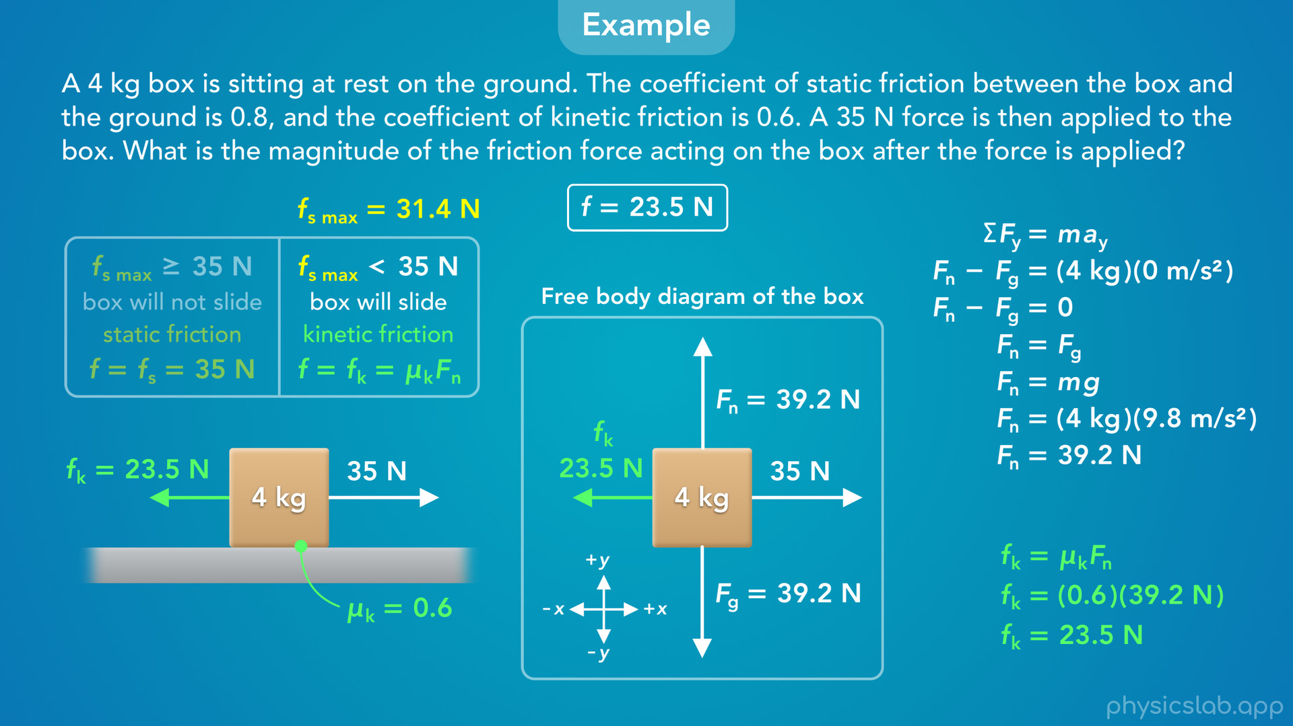
Notes:
• Now we can use this equation to find the magnitude of the kinetic friction force.
• We plug in 0.6 for the coefficient of kinetic friction, which is different than the coefficient of static friction.
• We already found the normal force, which is 39.2 N.
• That gives us 23.5 N for the kinetic friction force.
• So to answer the question, the magnitude of the friction force acting on the box is 23.5 N.
• The question didn’t tell us which type of friction is acting on the box.
• We had to figure that out by finding the maximum static friction force and comparing it to the opposing force of 35 N.
• Notice that we did not compare the kinetic friction force to the 35 N force.
• That will not tell us whether the box will slide.
• We need to find the maximum possible static friction force and compare that to the opposing force.
• In this case the opposing force is greater, so we know the friction is kinetic, and we use this equation to find the kinetic friction.

Slide 69

Notes:
• What if we changed the question, and it instead of a 35 N force, it was a 30 N force?
• Pause the video and figure out the magnitude of the friction force in this case.

Slide 70

Notes:
• The maximum static friction force is still 31.4 N, it only depends on the coefficient of static friction and the normal force.

Slide 71

Notes:
• But now, the 30 N force is less than or equal to the maximum static friction, so the box does not slide, the friction is static friction, which is always equal to the net opposing force, which is 30 N.
• Remember, this equation gives us the maximum value, but the actual value of the static friction force is always equal to the net opposing force.
• So for this question, the magnitude of the friction force acting on the box is 30 N, and it happens to be static friction.

