Slide 1
Computer Networks Devices and Services
Dr. Mohammad Adly

Slide 2
Computer Networks Devices
Network Interface Card (NIC)
Hub
Switch
Access Point (AP)
Router

Slide 3
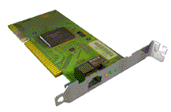
Network Interface Card (NIC)
Network adapter
Interface between PC and the network cable
Resides in the motherboard of PC
Communicate with PC through the device driver
Contain transmitter/receiver (transceiver)
Wired or wireless (via antenna)

Slide 4
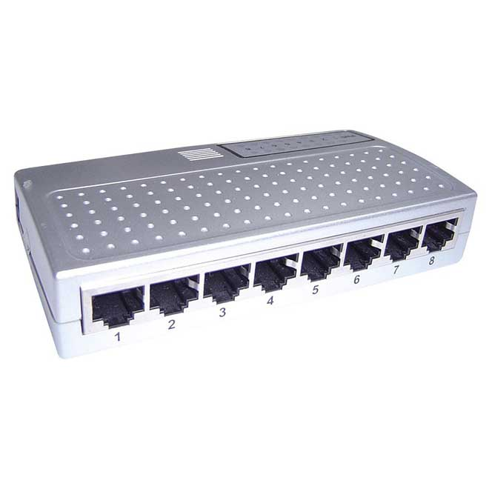
HUB
Shares frames between machines
Number of ports to connect several machines
Work with full duplex communication
Mixture of speeds (10M, 100M, 1G,…)
Allows collisions

Slide 5

Collisions
Hub is one collision domain
Hub is one broadcast domain.
Collisions make the network slow and congested

Slide 6
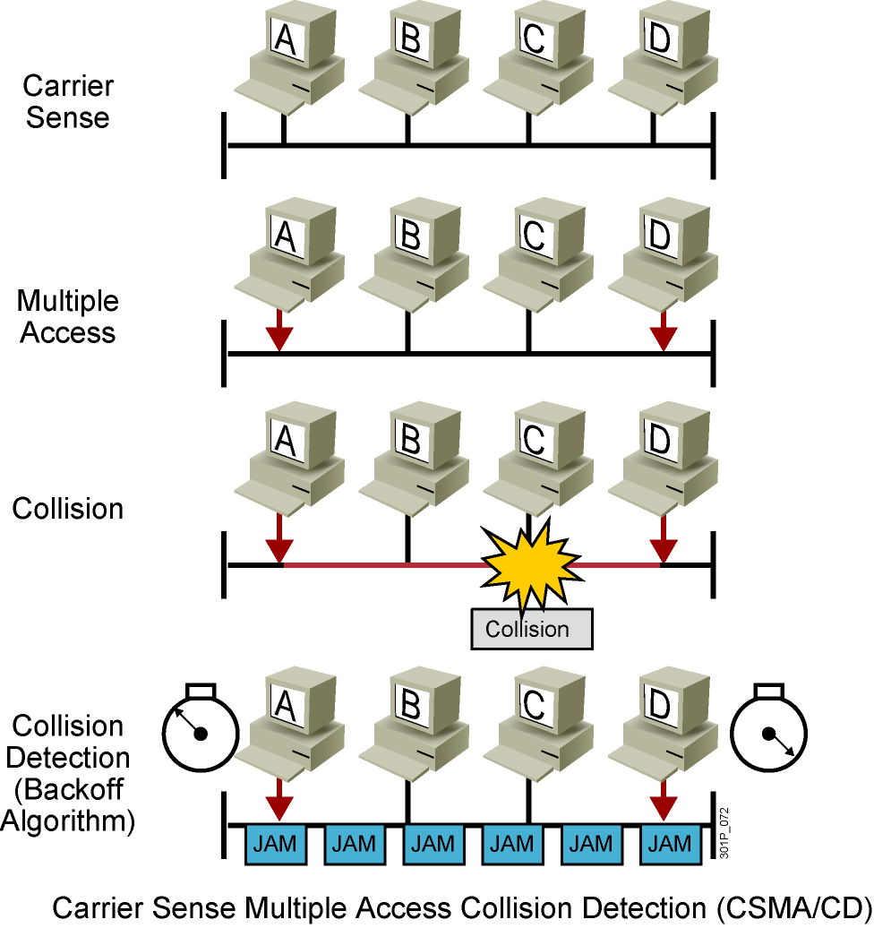
CSMA/CD

Slide 7
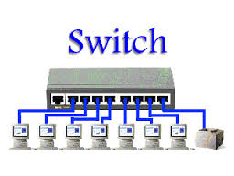
Switch
Forward and filter frames
Work with full duplex communication
Mixture of speeds
One broadcast domain
Each port is a separate collision domain
No collisions
No Sniffing

Slide 8
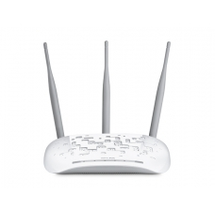
Access Point (AP)
Connects machines wirelessly in LAN
Transmits frames in the air media
Links wireless part to wired infrastructure
One broadcast domain
One collision domain
Carrier Sense Multiple Access/Collision Avoidance (CSMA/CA)

Slide 9
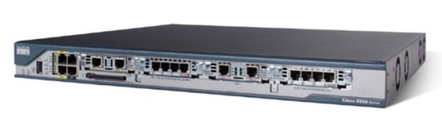
Router
Redirects packets between networks
Works based on a routing table
Divides network into broadcast domains
Divides network into collision domains

Slide 10
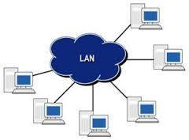
Computer Network (LAN) Services
Software Resources Centralization
  Files
  Databases
  Applications
Hardware Peripheral Sharing
  Printer
  Scanner
  Processor
  Storage

Slide 11

Computer Network (WAN) Services
Web Services
  Web Browsing
  Web Searching
  Social Media
E-mail Exchanging
File Transfer
Voice Calls
Video Conferencing

Slide 12
Thank you

