Slide 1
Deriving Centripetal Acceleration
Slides Version 1
This version includes:
Slides with screenshot images from the video.
The video narration in the slide notes.
A blank template slide with the same background and font as the video.
Slides with some basic graphics from this video for you to use however you like.
Feel free to add, delete and edit slides to make your own presentation. You can use these slides in class or share them with your students, but please do not share them with anyone else.
If you have any feedback, suggestions or questions about these slides please email me at chris@physicslab.app or send me a message on Discord @physicslab.
physicslab.app

Slide 2
Heading
Text

Slide 3








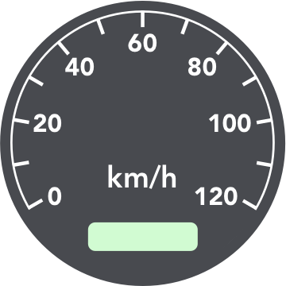











Slide 4
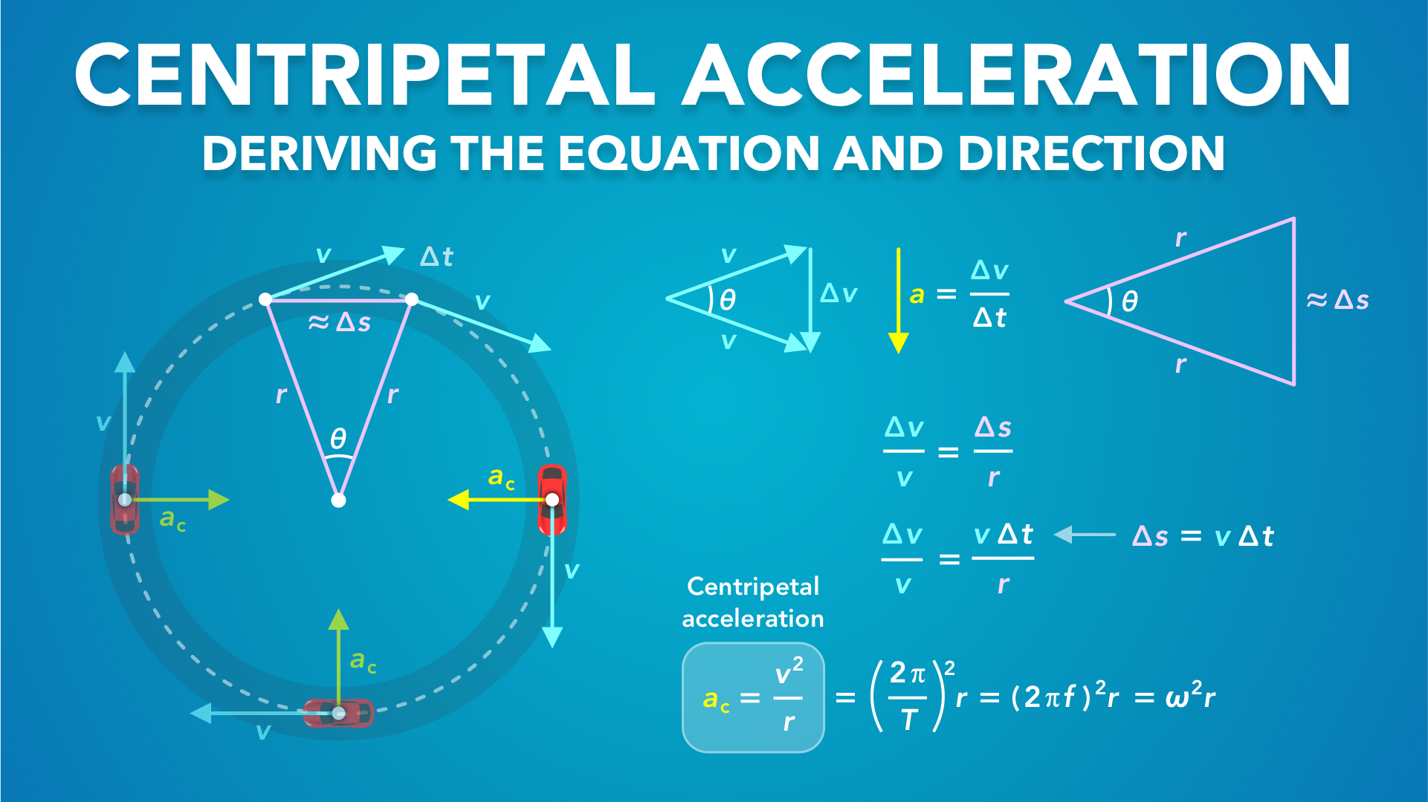
Notes:
Deriving Centripetal Acceleration
physicslab.app
If you have any questions, suggestions or feedback about these slides please email me at chris@physicslab.app or send me a message on Discord @physicslab.

Slide 5
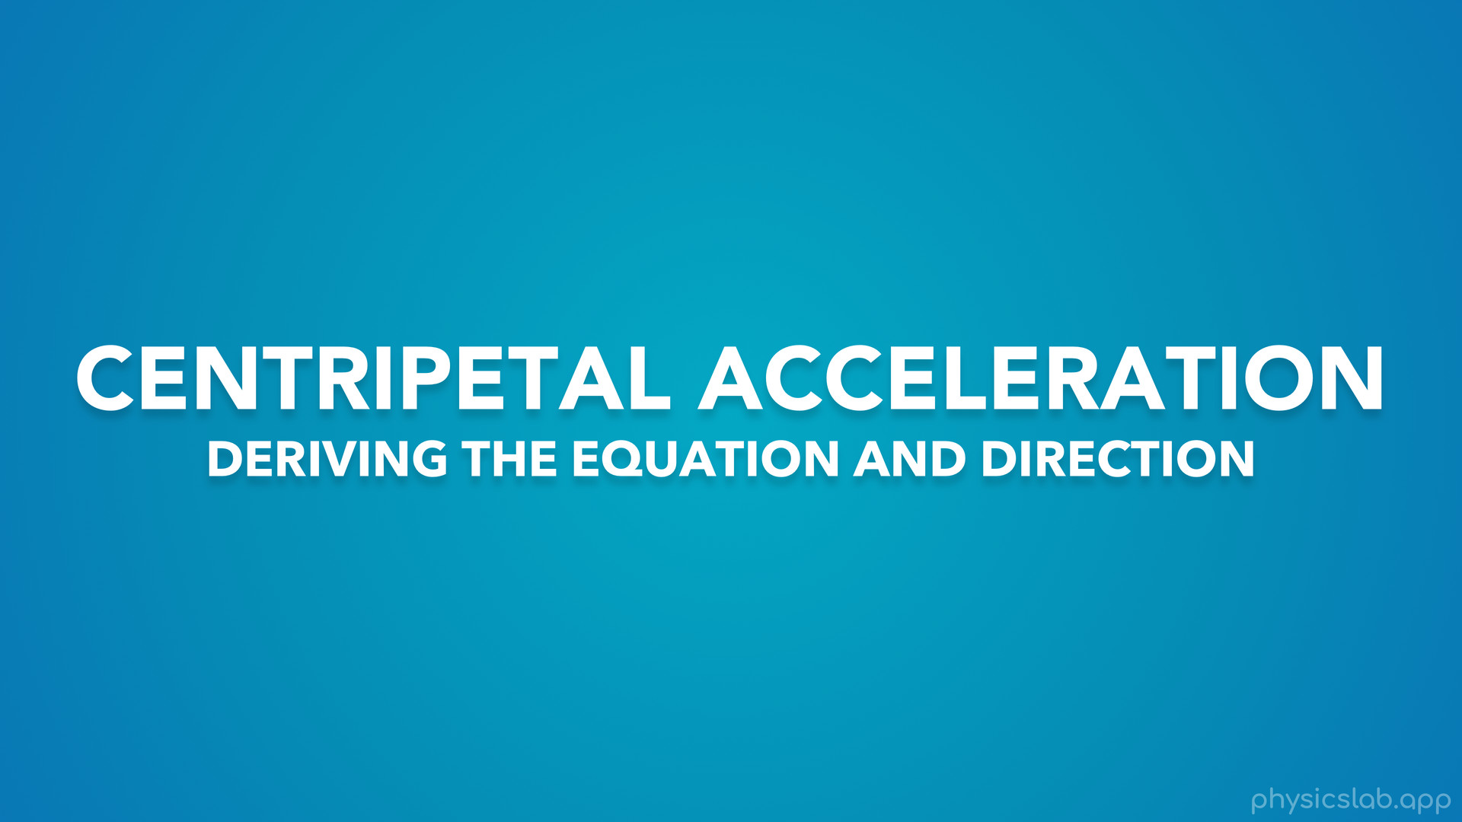
Notes:
• Hey everyone! In this video we’re gonna learn about centripetal acceleration.

Slide 6
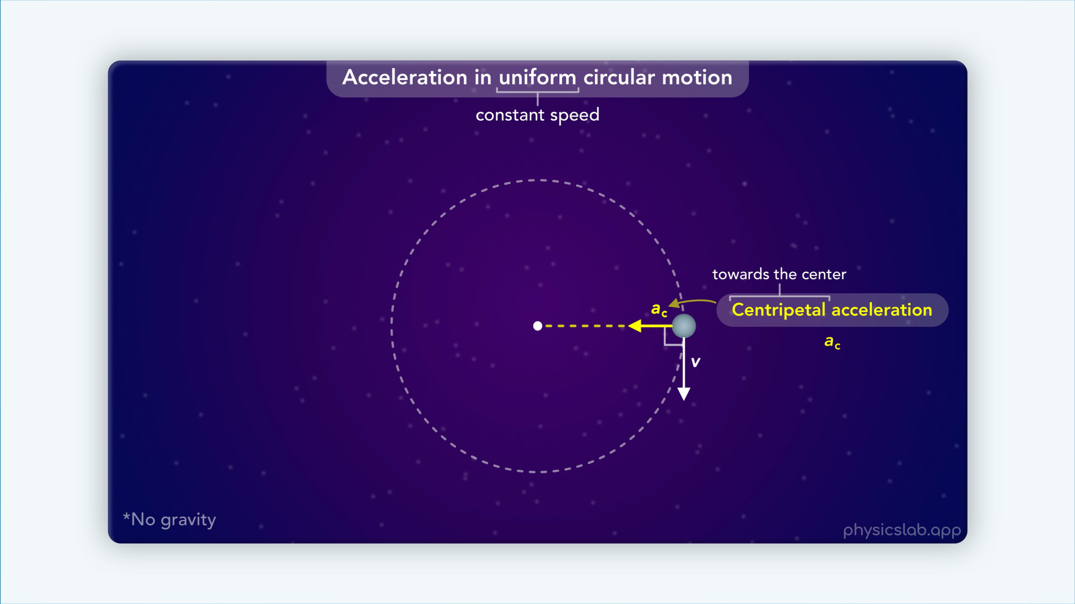
Notes:
• We introduced centripetal acceleration in the last video, so make sure you watch that first.

Slide 7
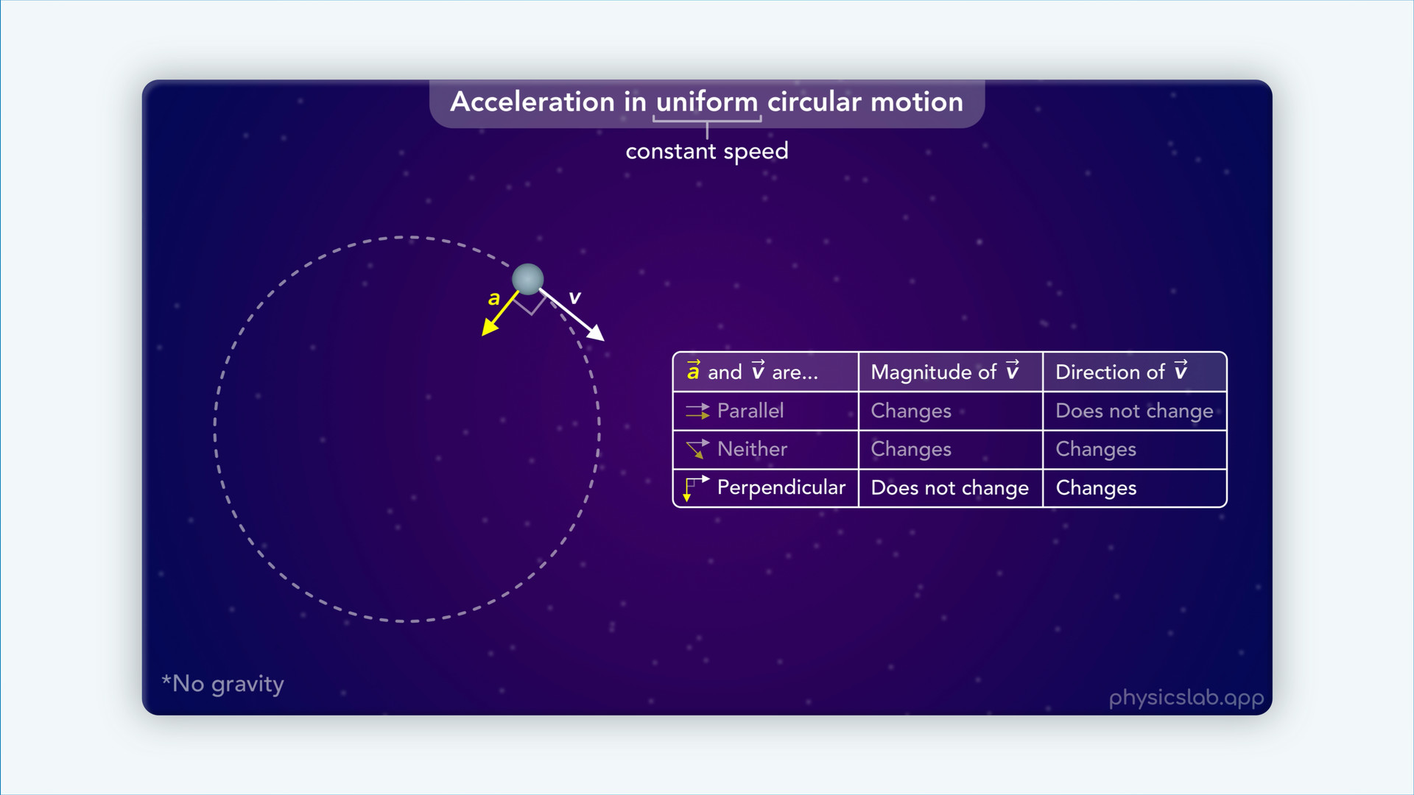
Notes:
• In that video, we saw what happens when the acceleration and velocity vectors are parallel, perpendicular, or neither.

Slide 8
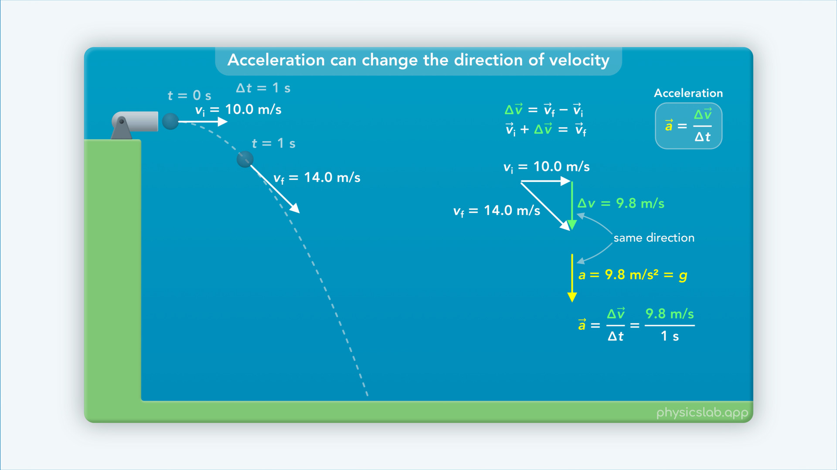
Notes:
• We also reviewed how to find the acceleration vector using the tip to tail method.

Slide 9
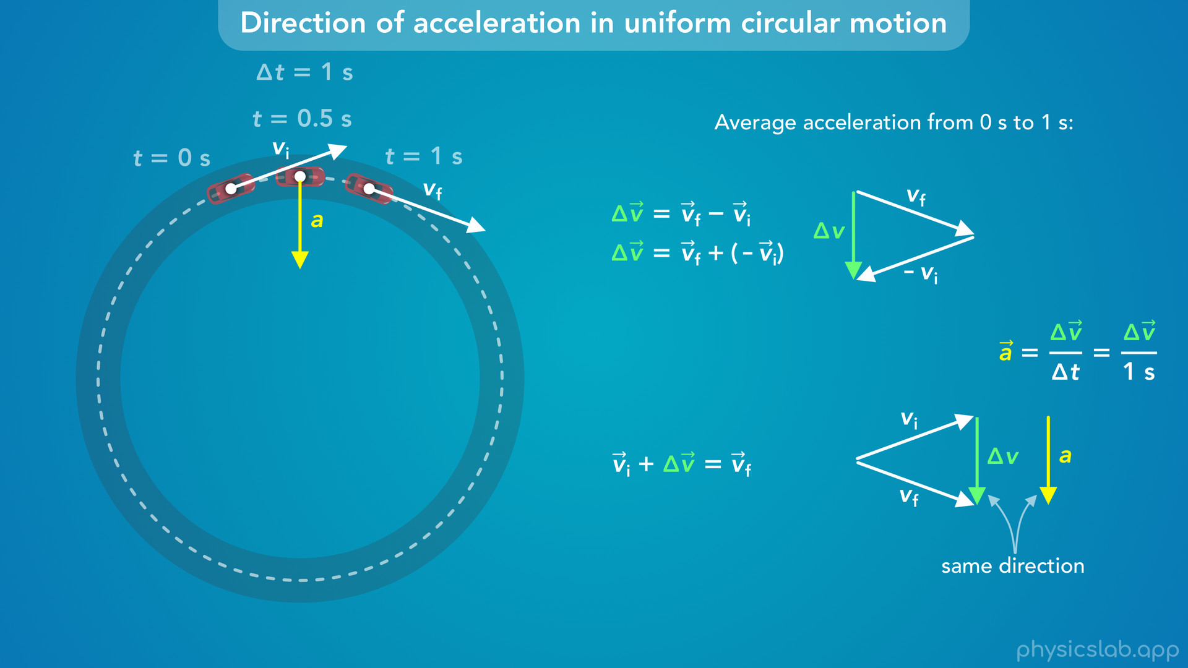
Notes:
• In this video, we’re gonna use the same method to find the centripetal acceleration vector.
• First, we’ll figure out the direction…

Slide 10
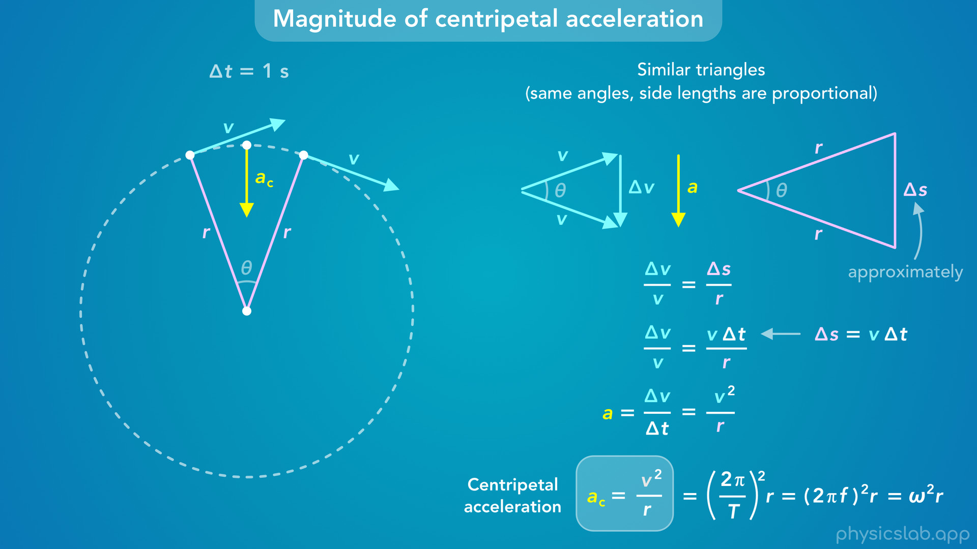
Notes:
• … and then we’ll derive the equation for the magnitude of the centripetal acceleration.
• This will help us understand where centripetal acceleration actually comes from.

Slide 11
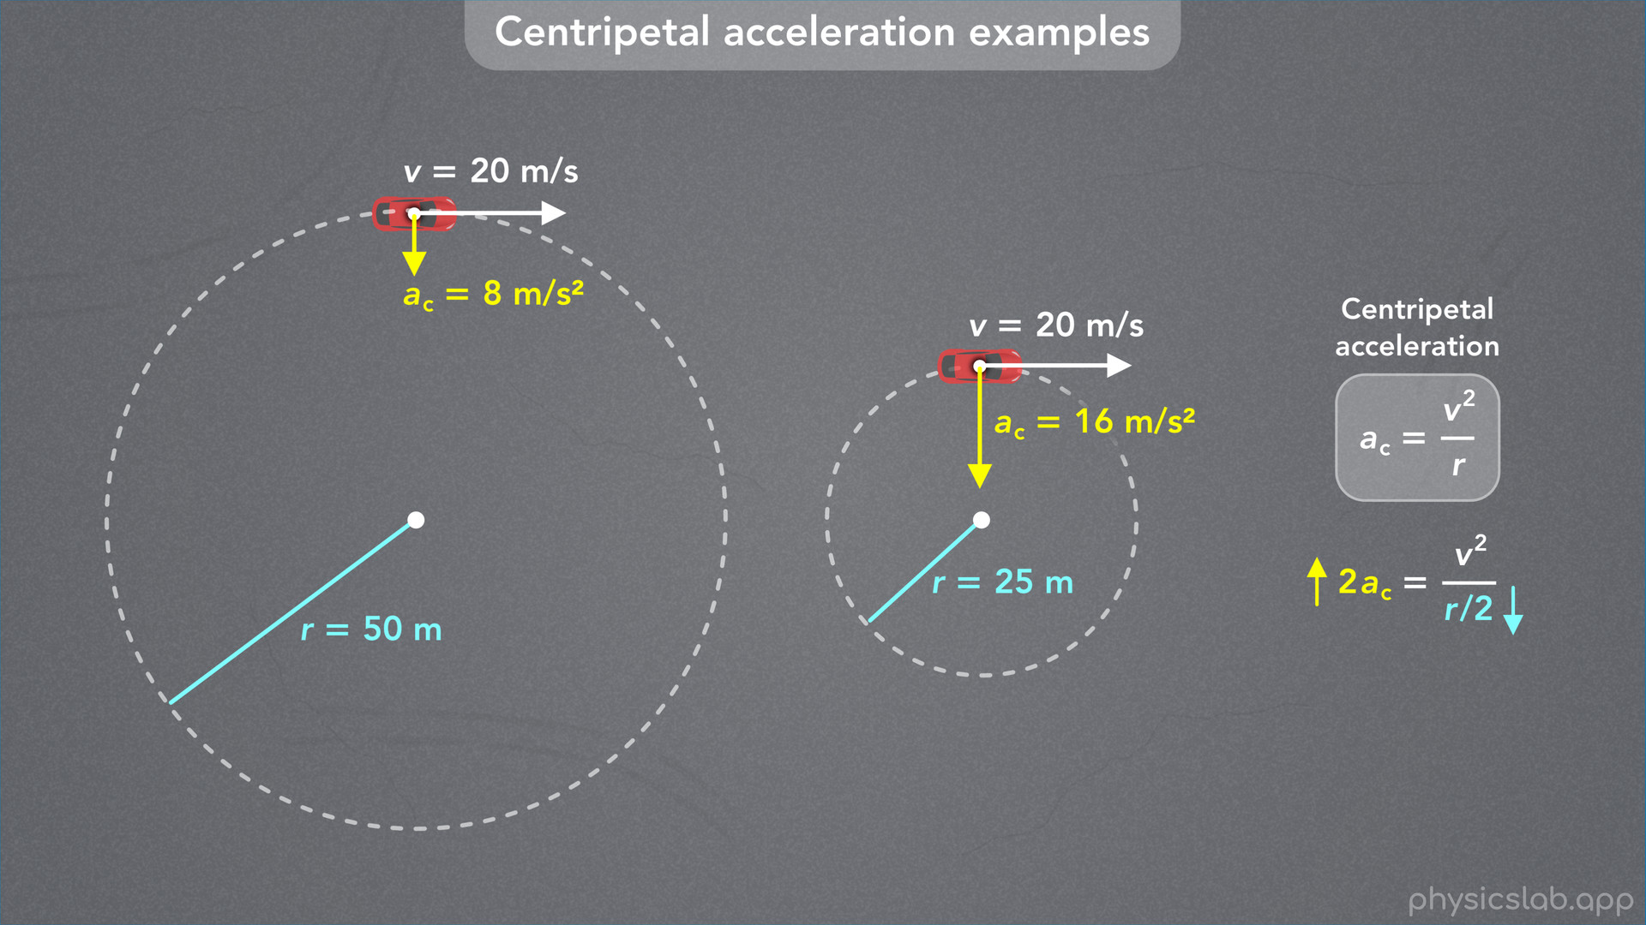
Notes:
• We’re gonna derive the equation in this video, and then we’ll go through some examples in the next video.

Slide 12
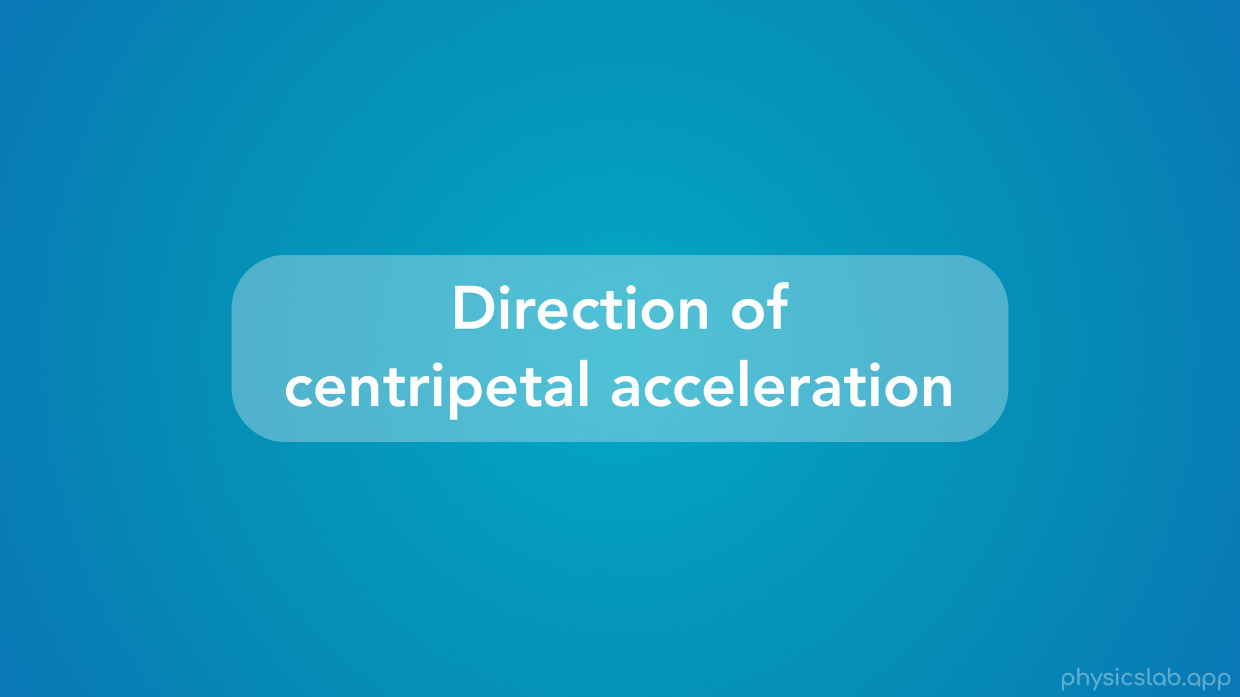
Notes:
• So what is centripetal acceleration, and how can we figure out its direction by using vectors?

Slide 13
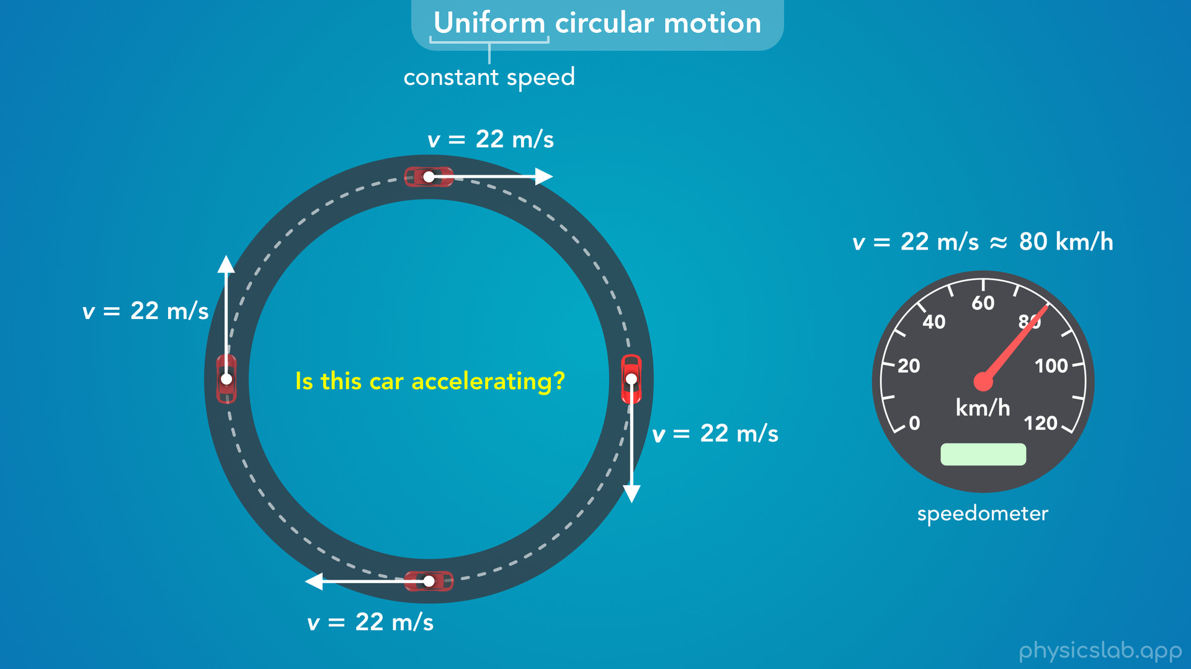
Notes:
• We learned that uniform circular motion is when an object travels around a circular path at a constant speed.
• In this example, a car is driving around a circular road with a constant speed of 22 m/s, which is about 80 km/h.
• Here’s the question we asked in the previous video: if this car is not speeding up or slowing down, is this car accelerating?
• If the speed is constant, it might seem like there’s no acceleration.
• But we learned in the last video that the answer is yes, this car is accelerating.
• So how can we figure out the magnitude and direction of the acceleration?

Slide 14
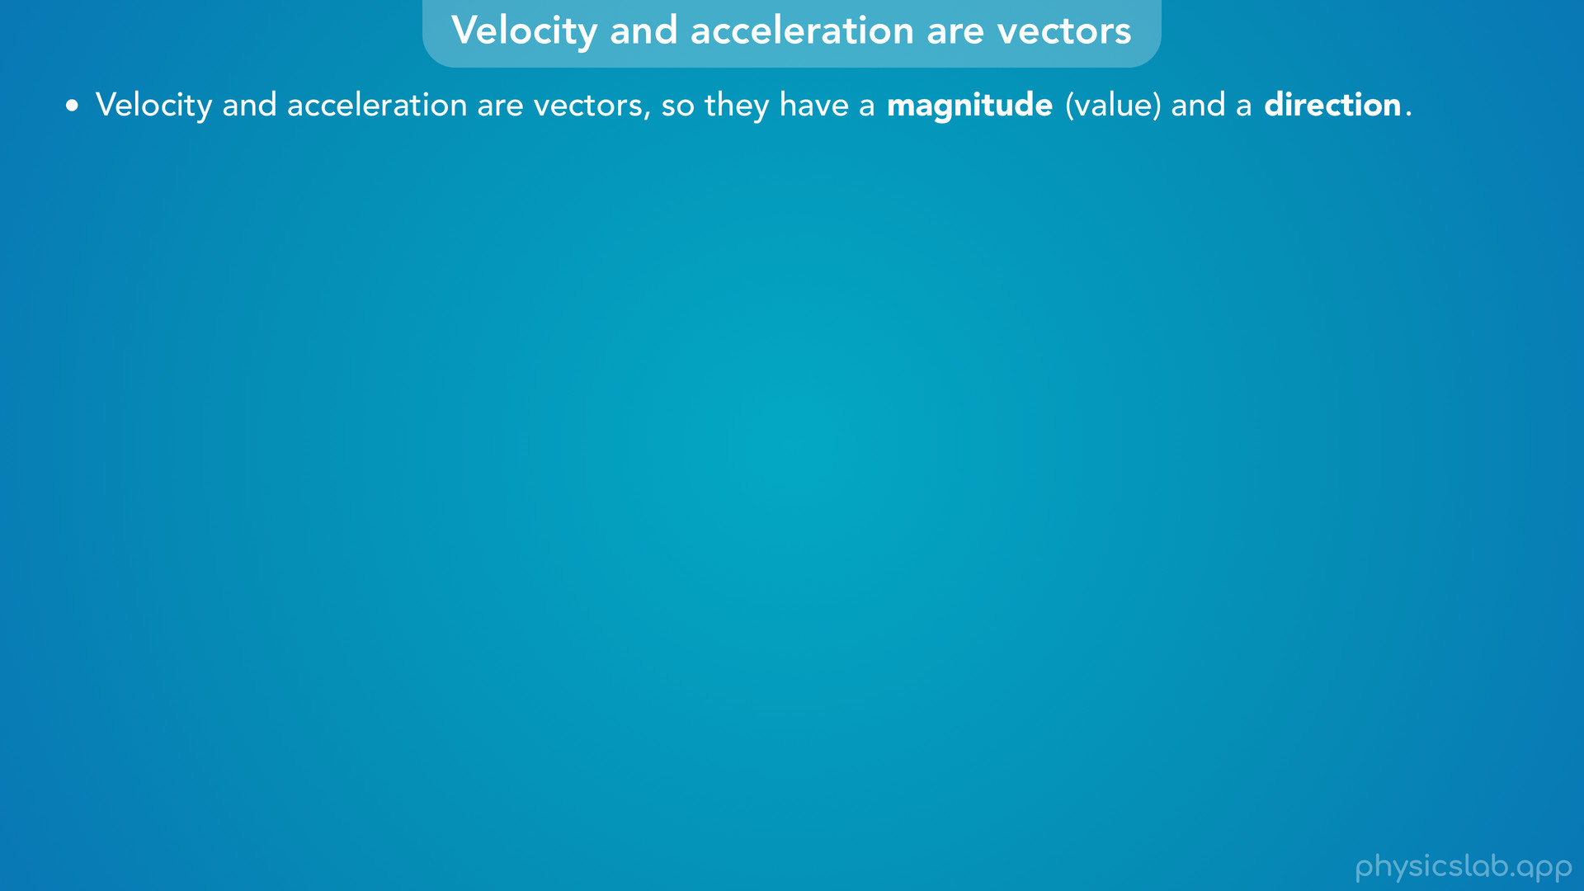
Notes:
• Remember, velocity and acceleration are vectors, so they have a magnitude, or a value, and a direction.

Slide 15
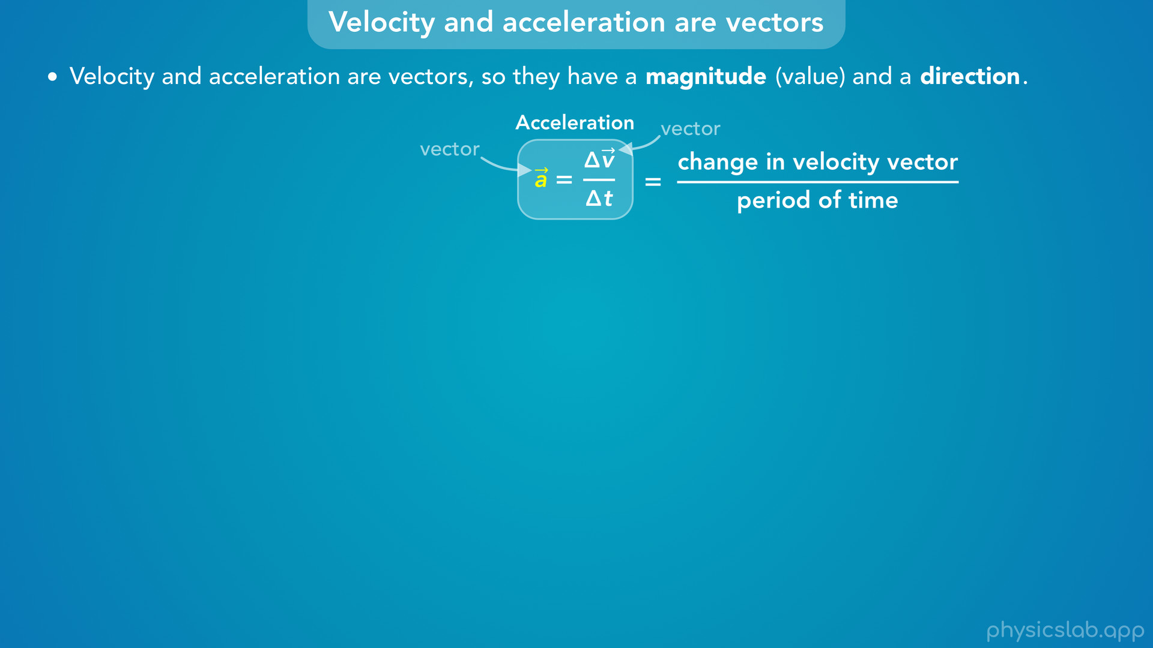
Notes:
• Acceleration is the change in the velocity vector divided by the period of time.

Slide 16
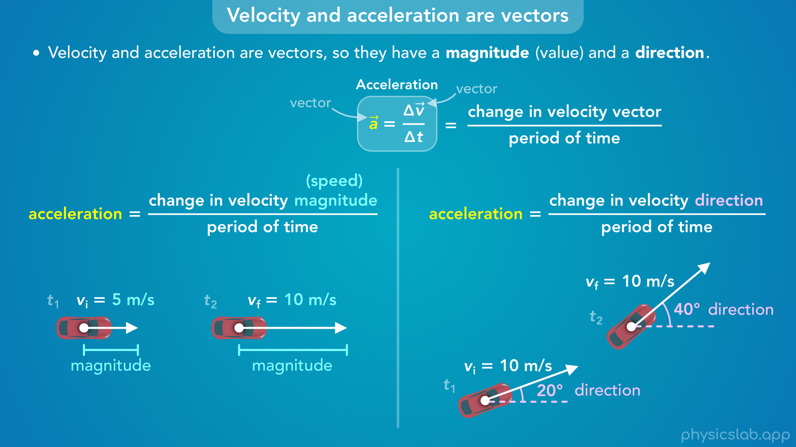
Notes:
• That means acceleration can be a change in the velocity magnitude (which we call the speed)… or acceleration can be a change in the velocity direction.
• In the two snapshots on the left, the car is speeding up.
• The magnitude of the velocity is changing, which is represented by the length of the velocity vectors.
• So this car is accelerating.
• In the two snapshots on the right, the car is turning.
• The direction of the velocity is changing, which we can see by their angles.
• So even if the speed of this car is constant, the direction of the velocity is changing, so this car is accelerating.

Slide 17
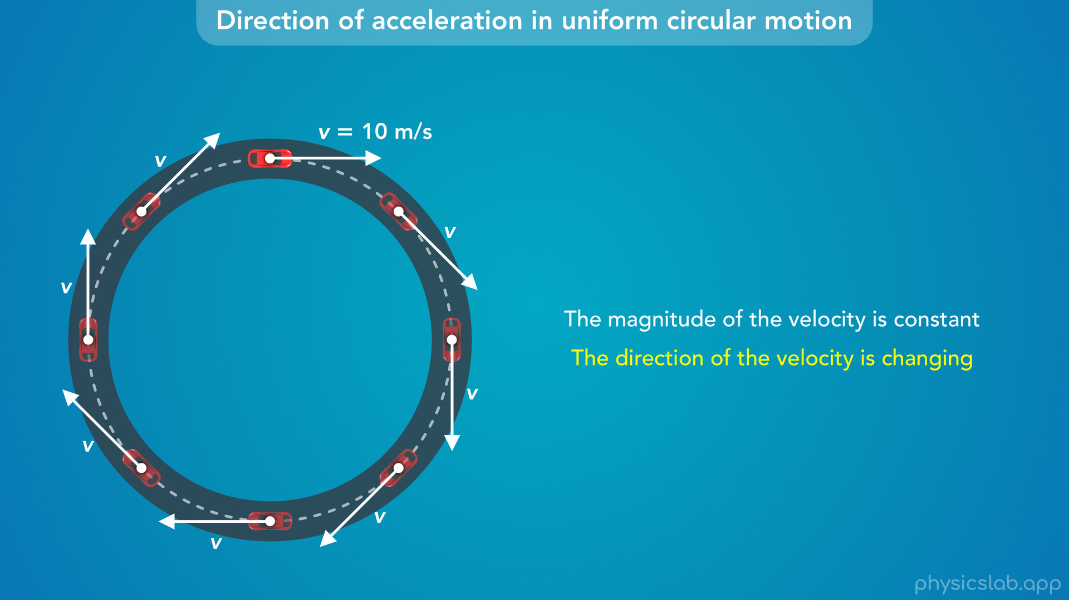
Notes:
• So when an object is in uniform circular motion, the magnitude of the velocity is constant, but the direction of the velocity is always changing.

Slide 18
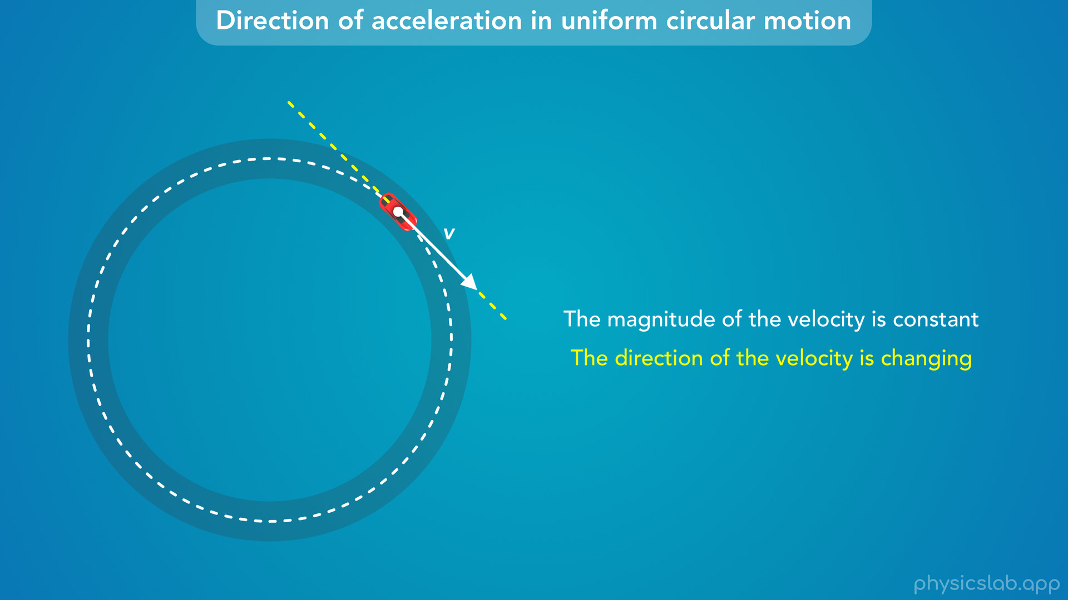
Notes:
• The velocity vector is always tangent to the circle, and it’s turning or rotating as the object goes around.
• So how do we find the acceleration from this change in direction?

Slide 19
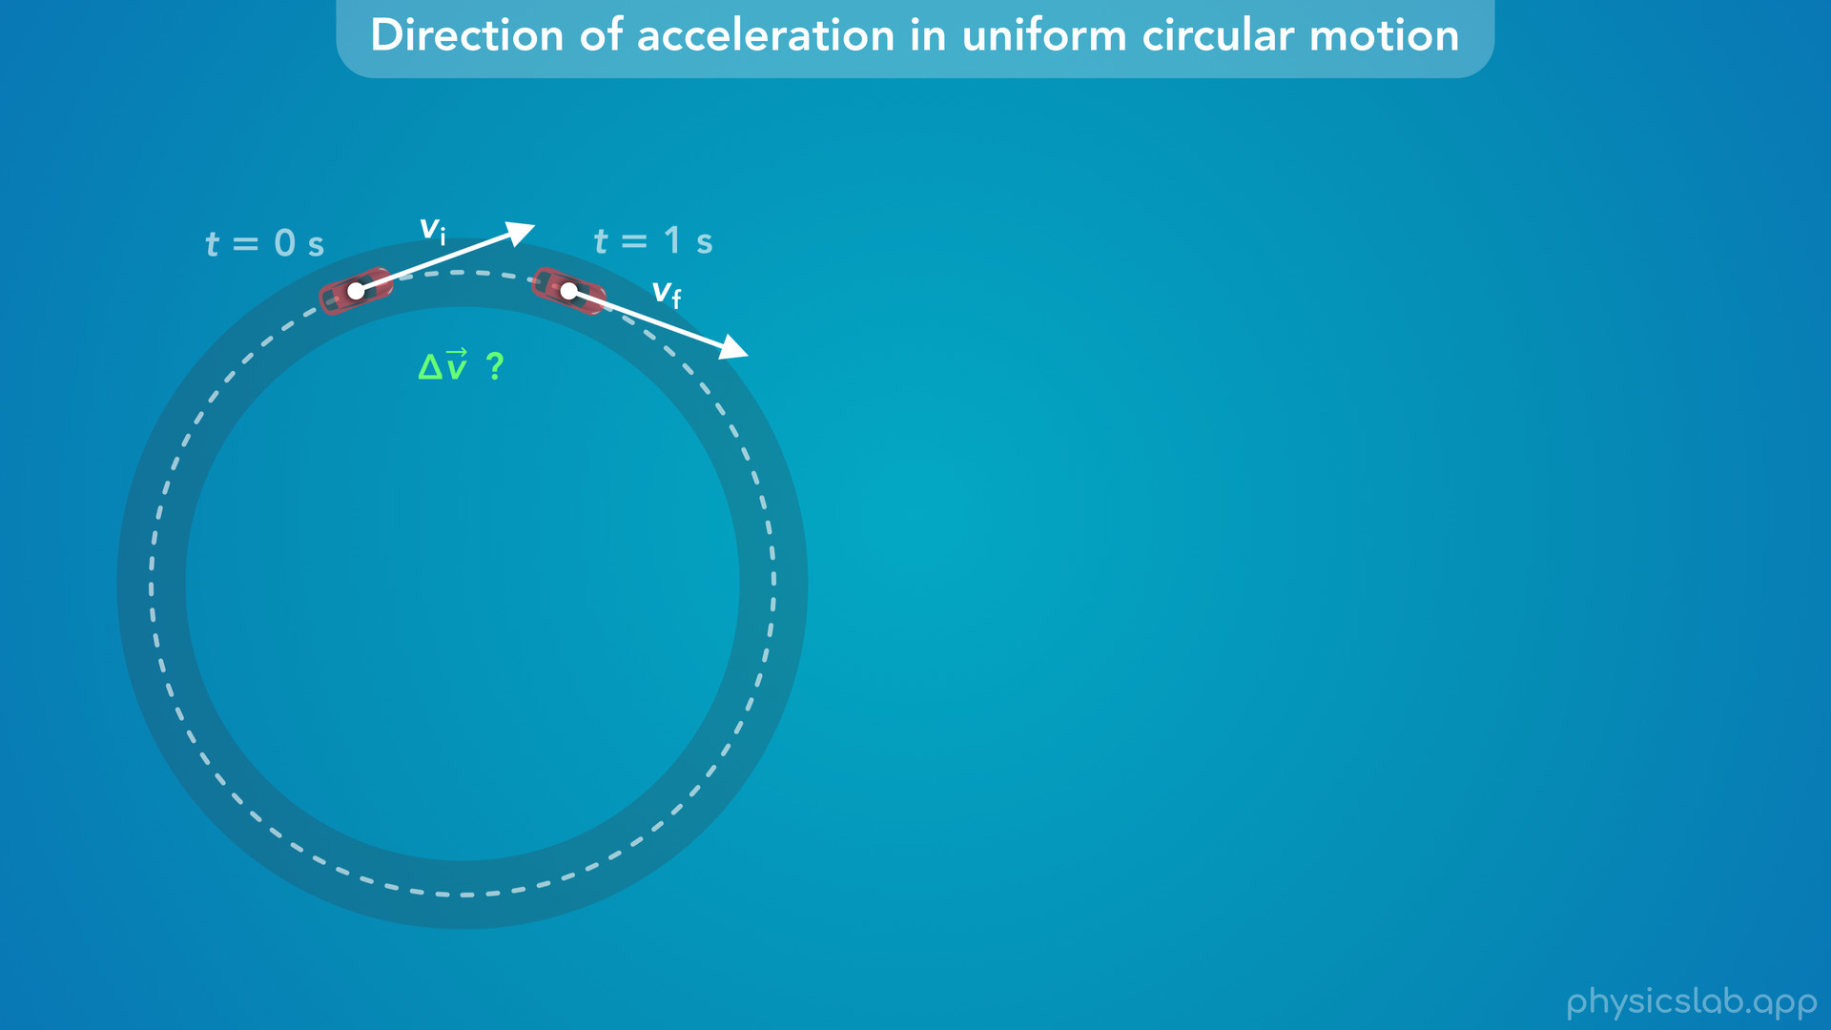
Notes:
• Let’s look at the velocity vector at two moments in time.
• We’ll call the first one the initial velocity vector at 0 seconds, and we’ll call the second one the final velocity vector, which is one second later.
• Given these two velocity vectors, how would we draw delta v, the change in velocity vector?

Slide 20
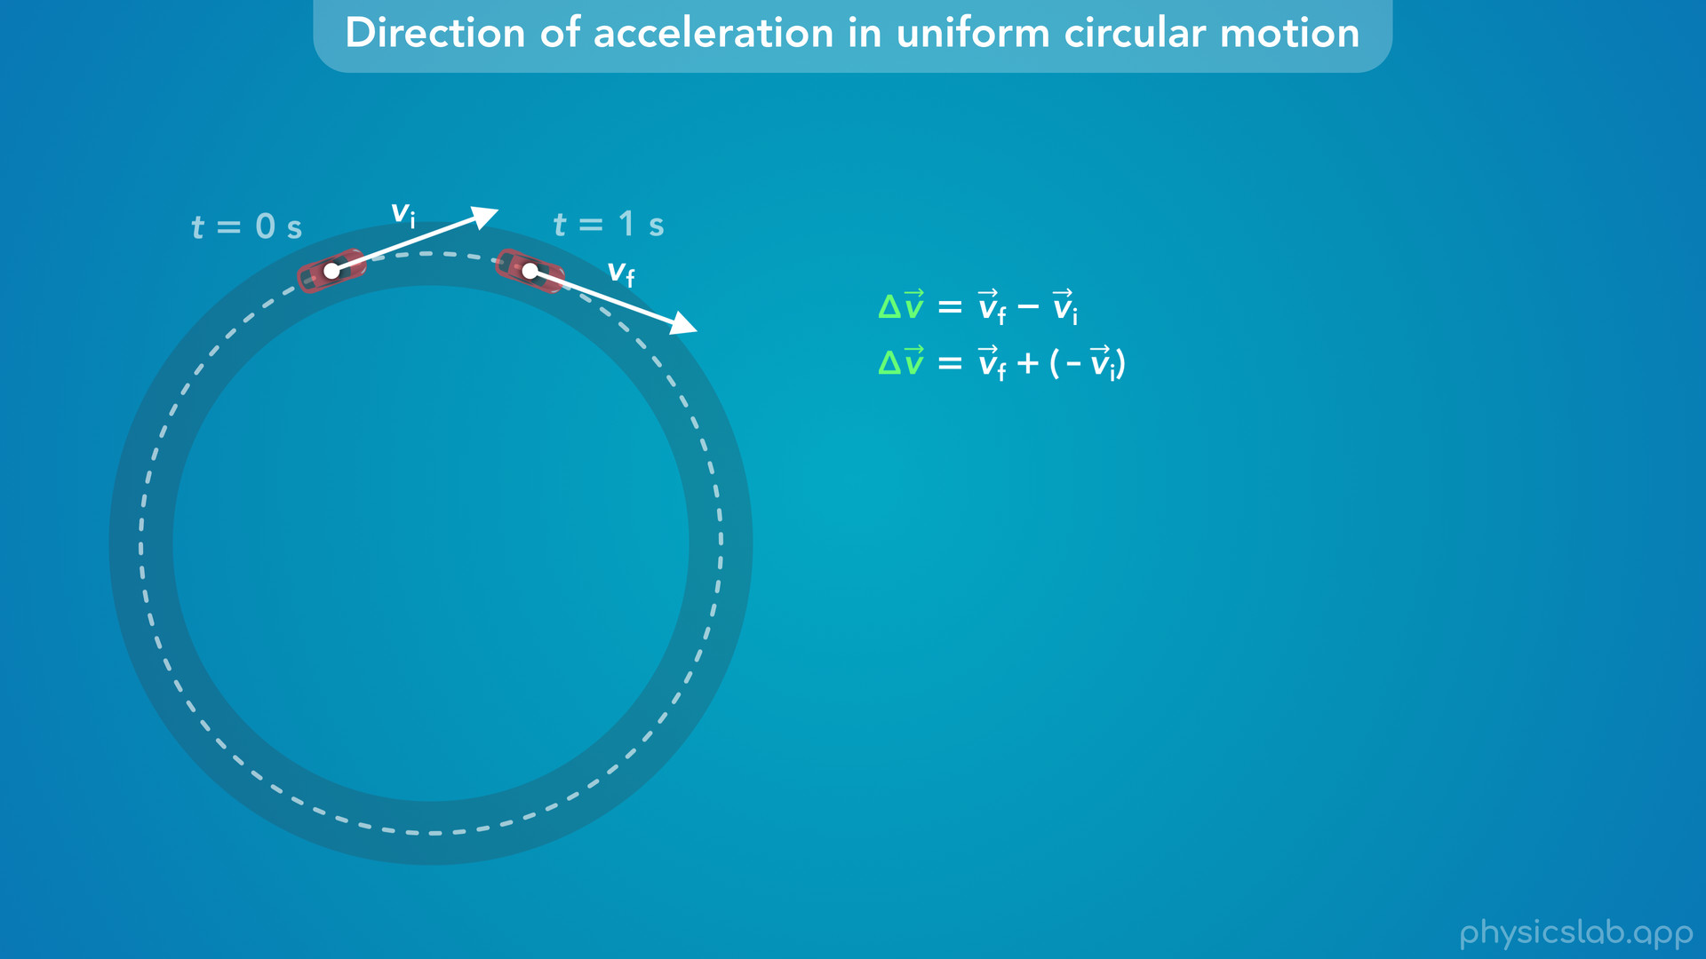
Notes:
• Like we covered in the last video, the change in velocity vector is equal to the final velocity vector minus the initial velocity vector.
• We can also write this as the final velocity vector plus the negative of the initial velocity vector.
• So we can find delta v using vector addition and the tip to tail method.

Slide 21
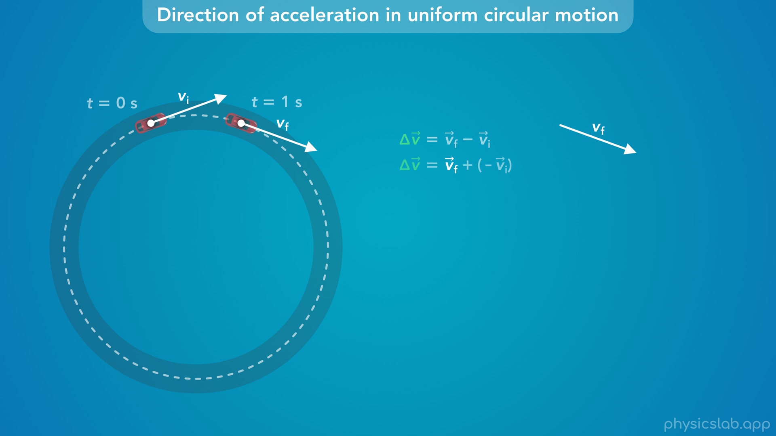
Notes:
• We draw the first vector, which is v final

Slide 22
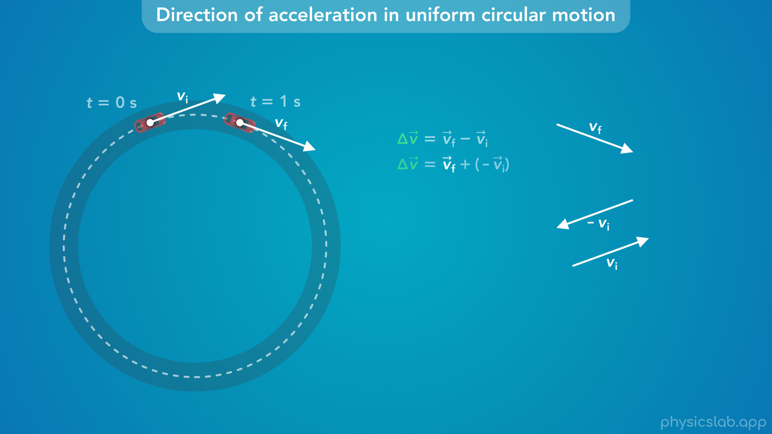
Notes:
and then we take v initial and flip it to get negative v initial

Slide 23
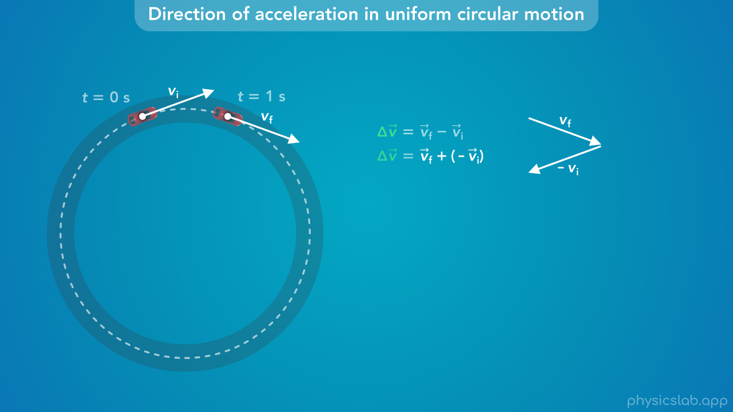
Notes:
and then we add that to the first vector.

Slide 24
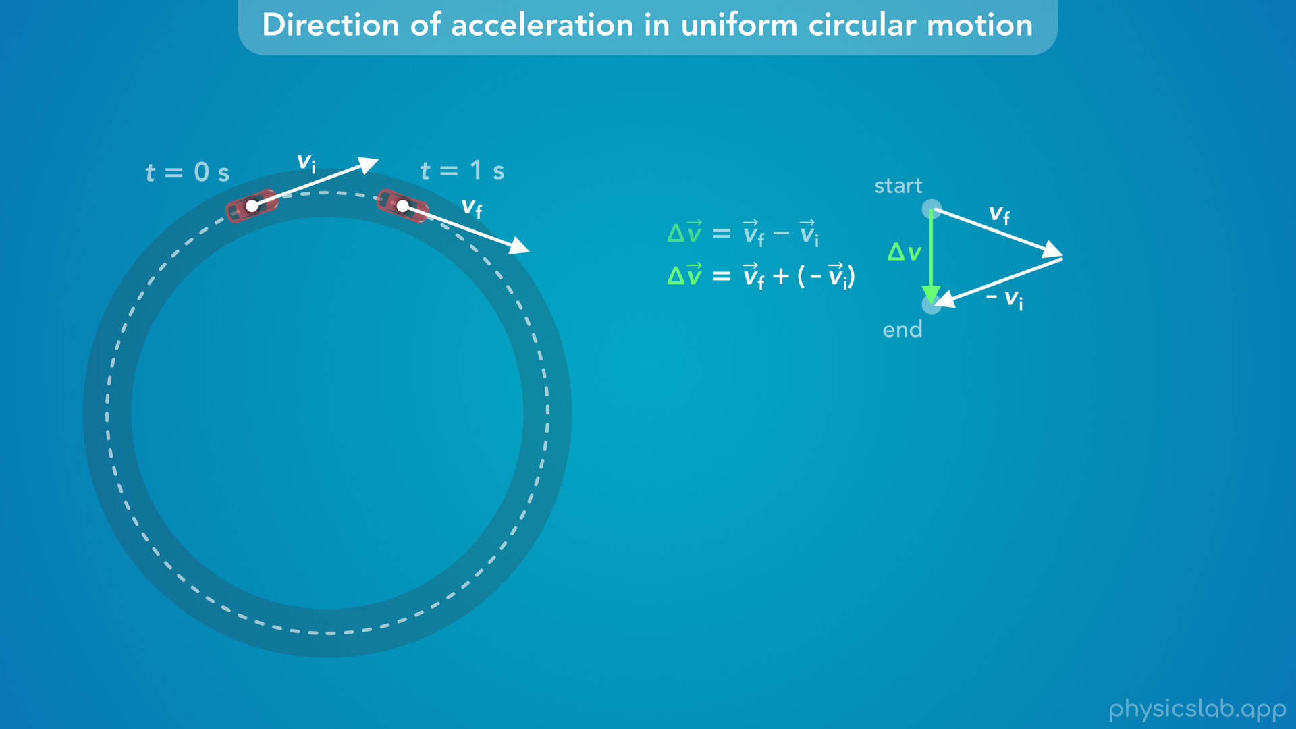
Notes:
• Now, delta v is the sum of these two vectors.
• It starts at the start of the first vector, and ends at the end of the last vector.
• So delta v, the change in velocity vector, looks like this.

Slide 25
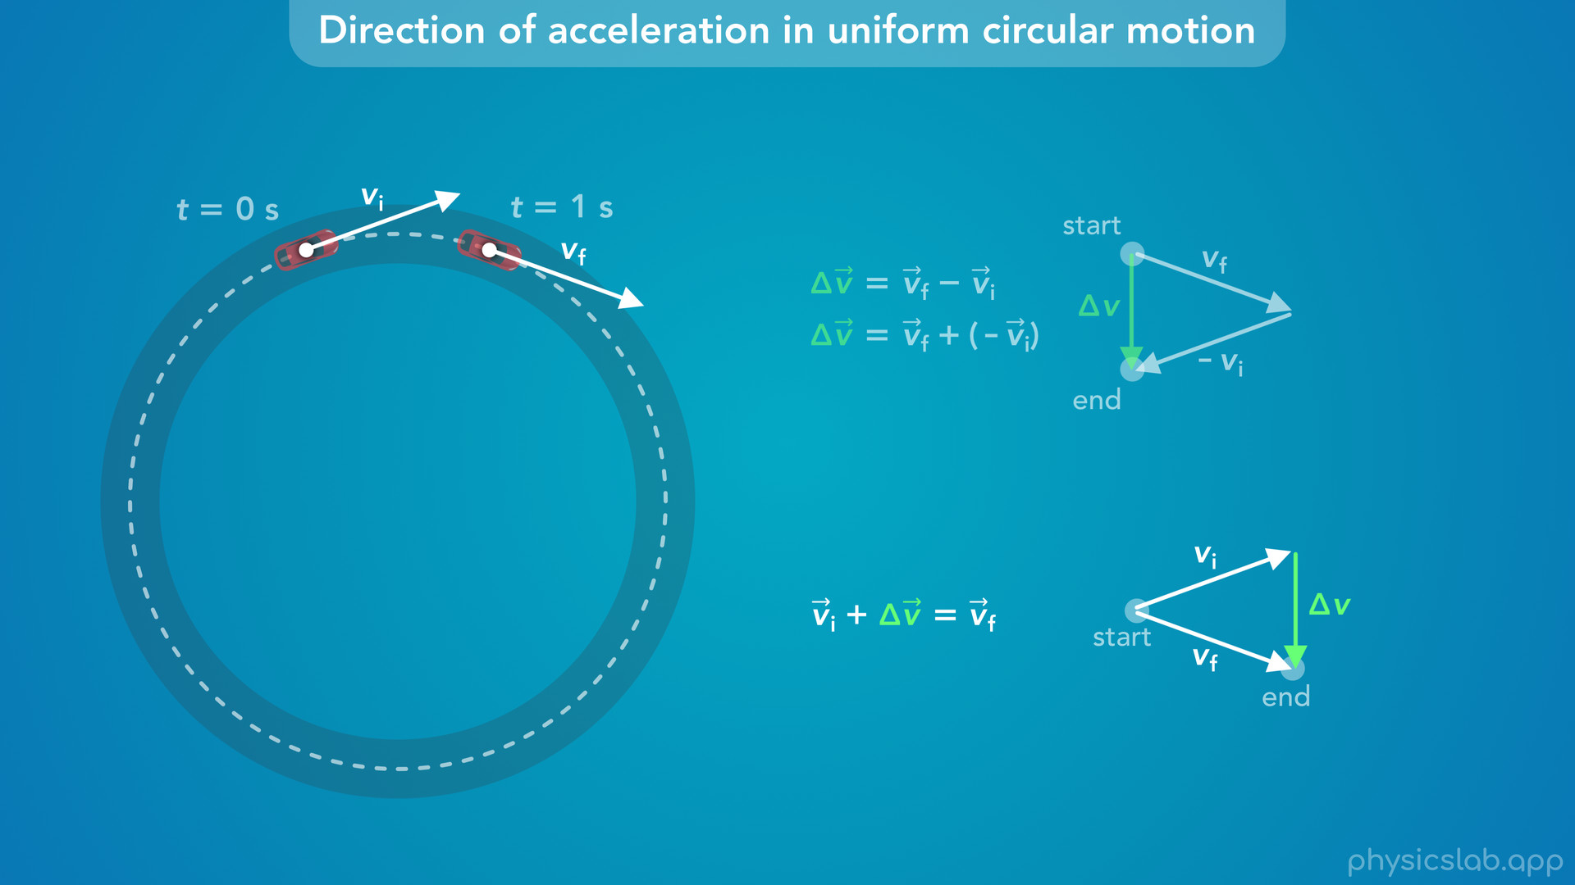
Notes:
• Another way to think about this, is that the initial velocity… plus the change in velocity… equals the final velocity.

Slide 26
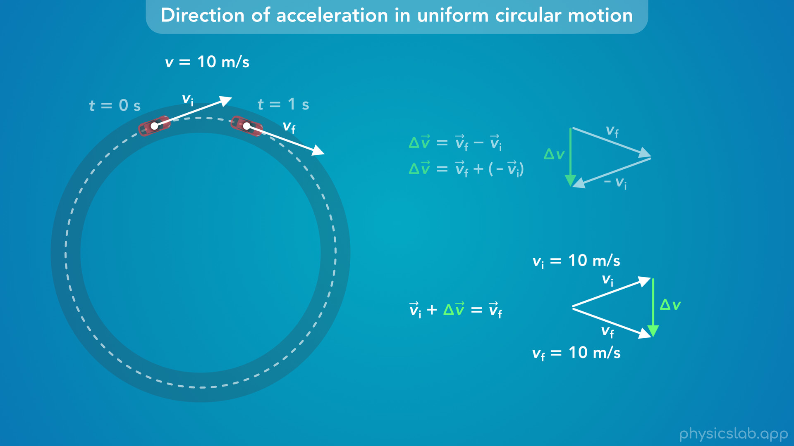
Notes:
• Even though the initial and final velocities have the same magnitude, they have different directions, and delta v is showing us the change in the velocity’s direction, which in this case is downwards.

Slide 27

Notes:
• So now, how do we draw the acceleration vector?

Slide 28
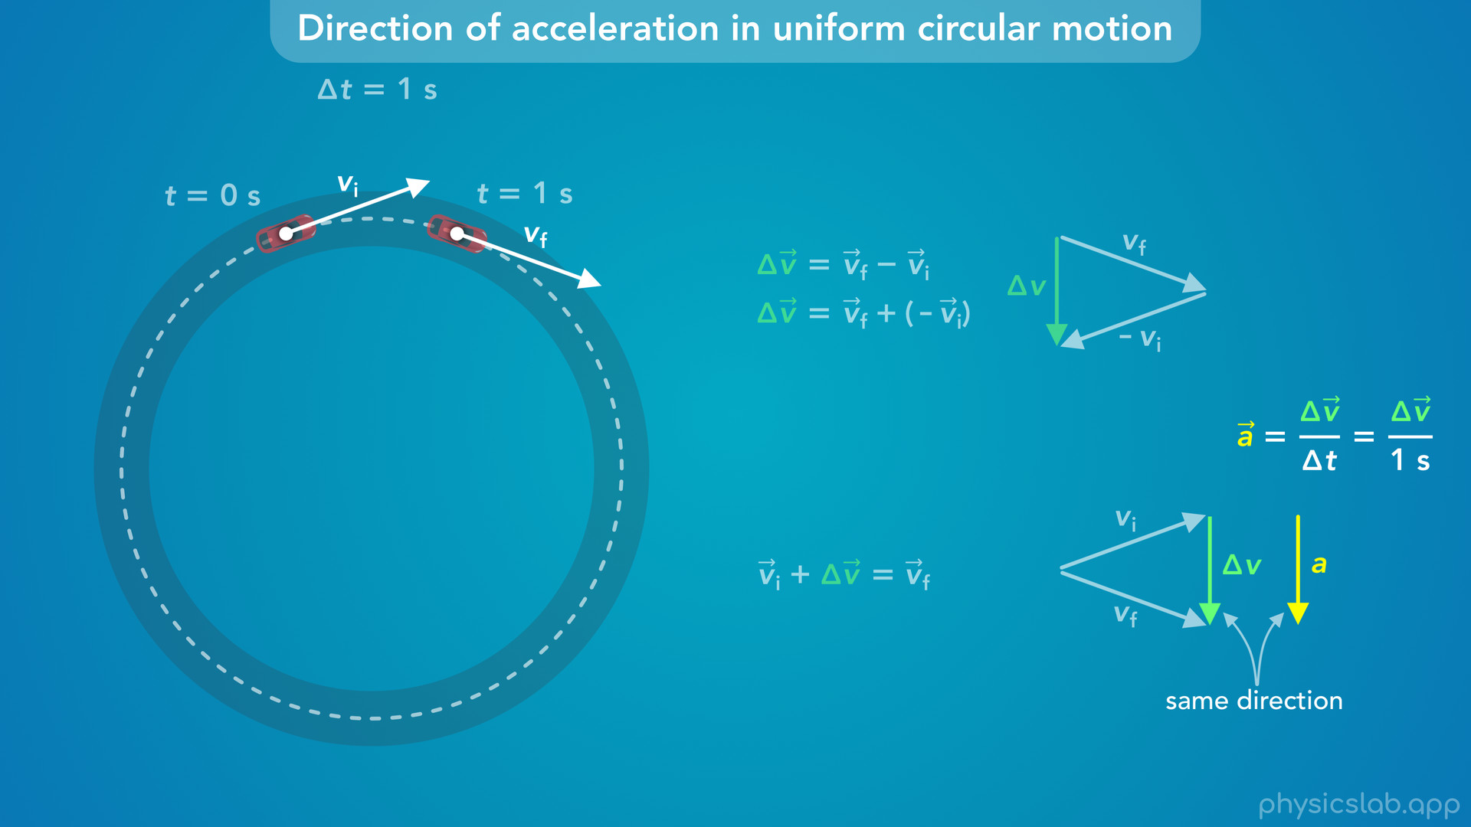
Notes:
• Acceleration is the change in velocity vector, delta v, divided by the period of time between the initial and final velocities, which in this case is 1 second.
• The time is a scalar value, and when we multiply or divide a vector by a scalar value, it changes the length of the vector but not the direction.
• In this case we’re dividing by 1, so the length doesn’t actually change.
• *This means that the acceleration vector has the same length as delta v, and it points in the same direction.*
• Now, where do we put this acceleration vector in the diagram?
• Is this the acceleration of the car at 0 seconds? Is it the acceleration at 1 second?

Slide 29
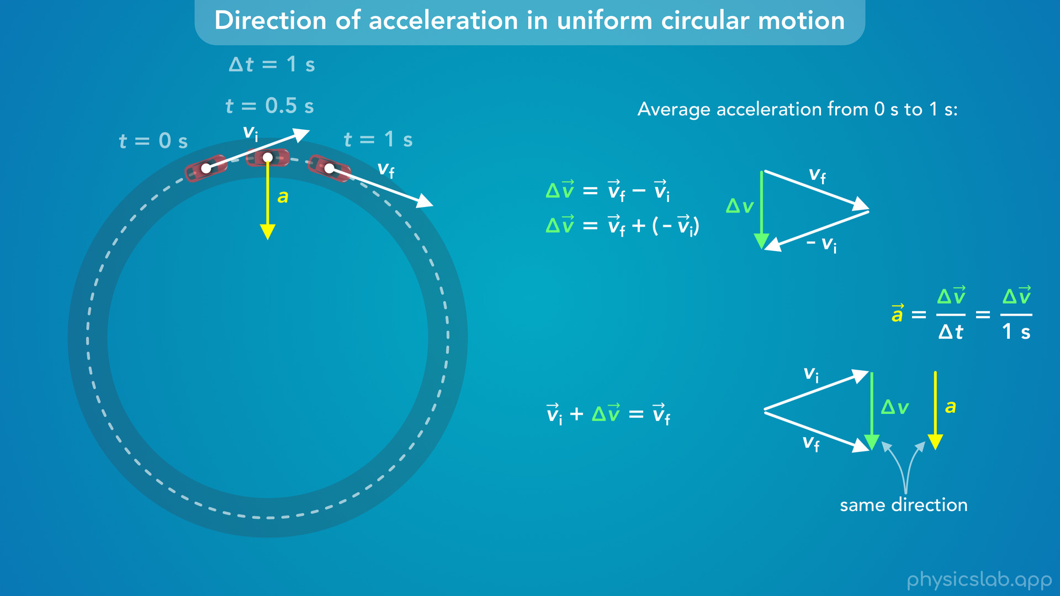
Notes:
• One thing we didn’t mention in the previous video, is that this is the *average* acceleration vector from 0 seconds to 1 second, because we found it using the initial and final velocities over a period of time.
• This is the average acceleration vector, so we can draw it on the car when it’s in the average position during this period, which is halfway between the initial and final positions.
• So at 0.5 seconds, the car’s acceleration vector is pointing down.

Slide 30

Notes:
• Let’s also include the velocity vector at that time, which points to the right, tangent to the circle.
• So during this period of time, the acceleration is causing the direction of the velocity to turn.

Slide 31
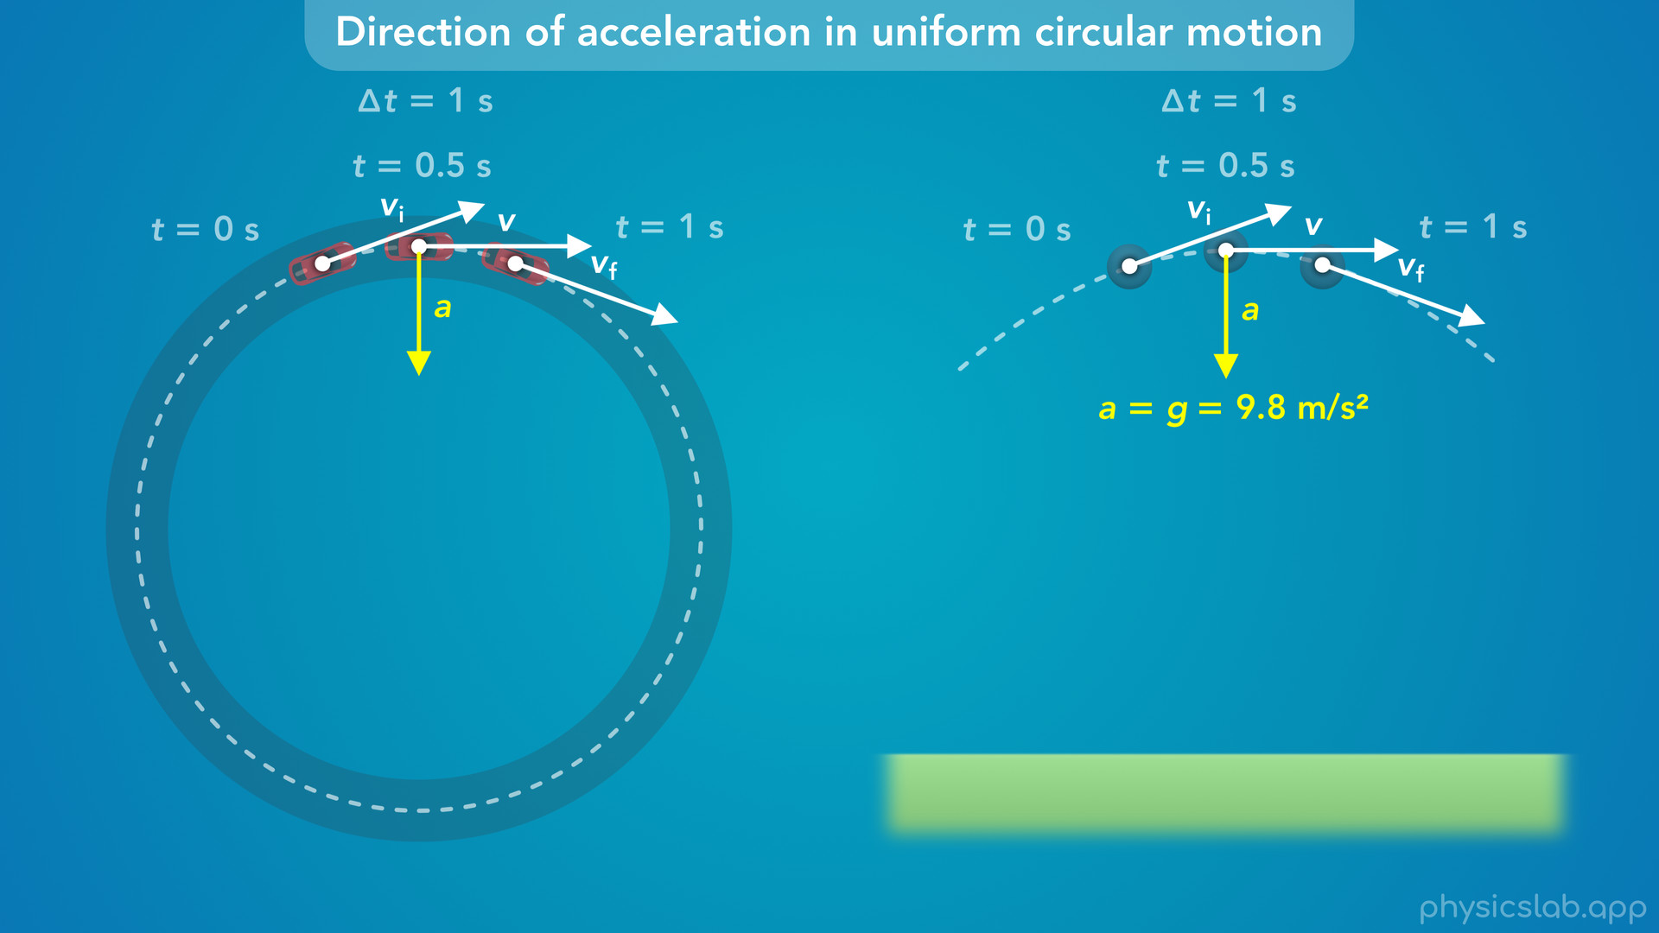
Notes:
• This picture is similar to the top of a trajectory in projectile motion.
• In that case, the acceleration due to gravity is downwards, and it causes the direction of the velocity to change.
• The initial velocity is pointing up, and the final velocity is pointing down.

Slide 32
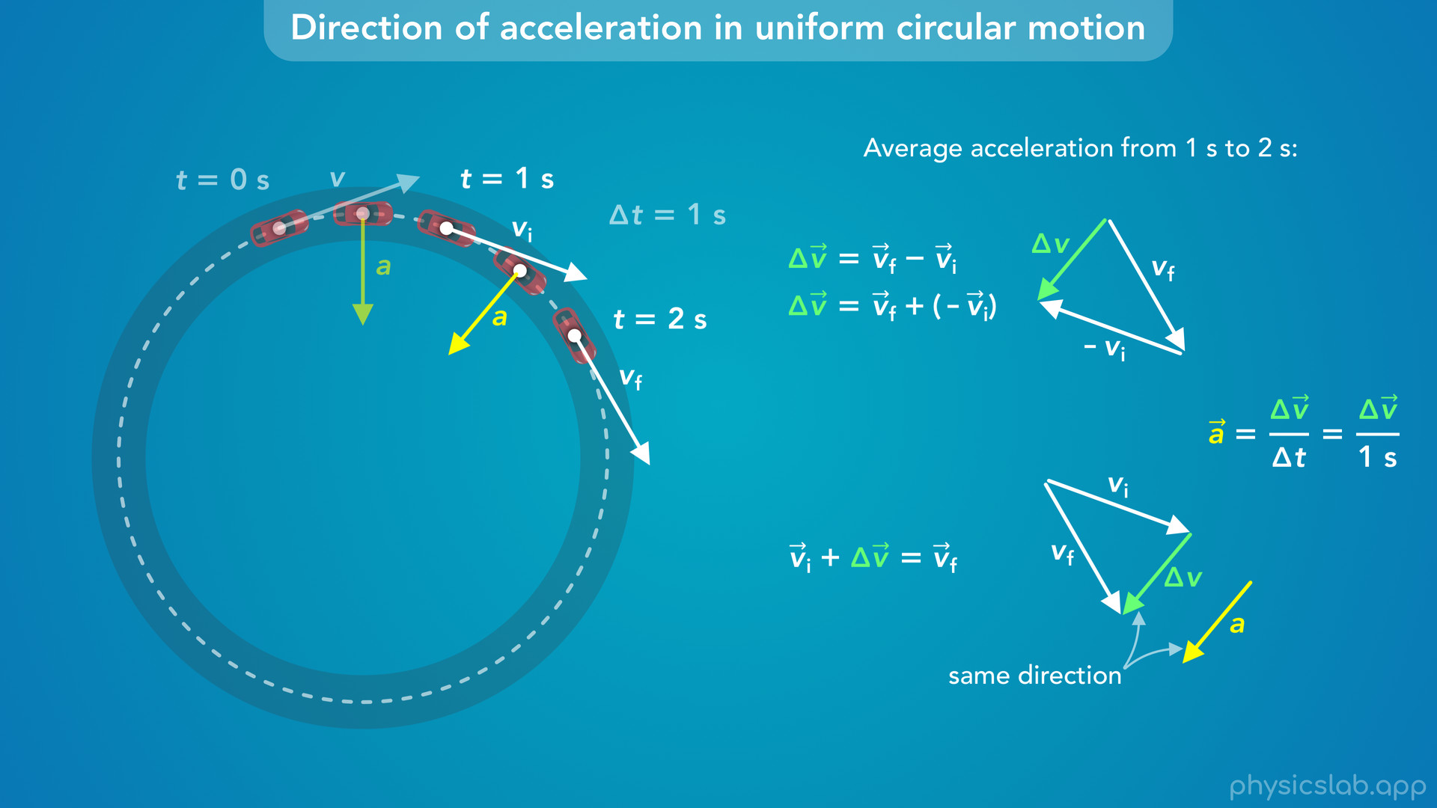
Notes:
• But that’s just the acceleration during one period of time.
• What if we use the velocity vectors at 1 second and 2 seconds?
• In that case, the average acceleration vector looks like this.
• And again, we can draw it on the car when it’s halfway between the initial and final positions.

Slide 33
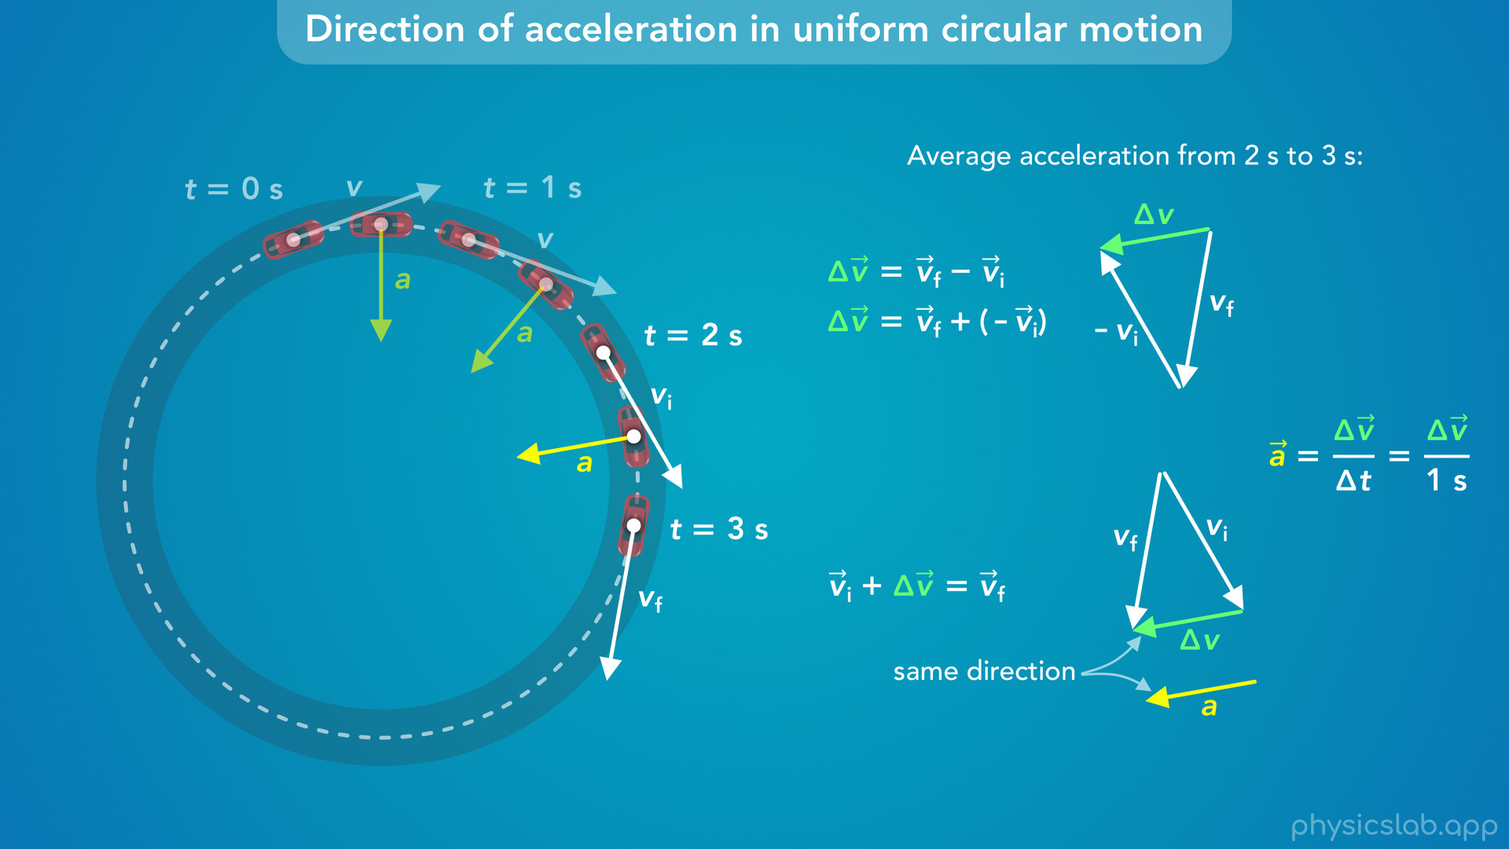
Notes:
• Between 2 seconds and 3 seconds, the acceleration vector looks like this.

Slide 34
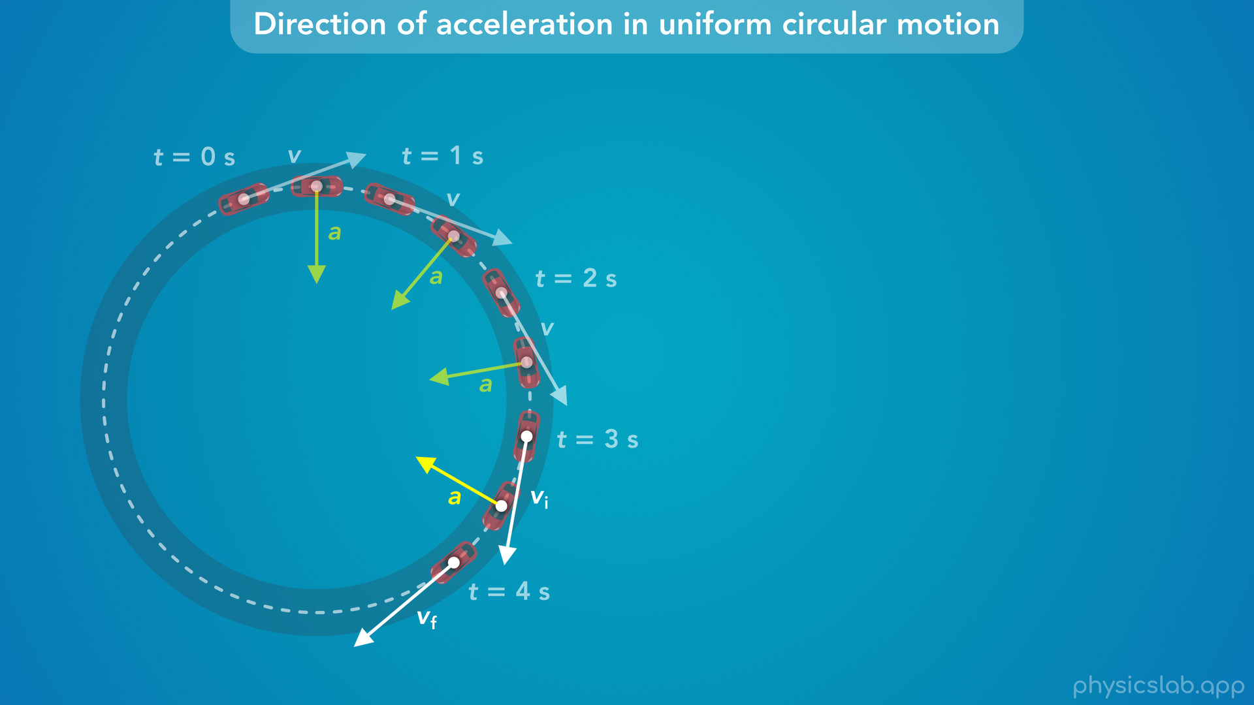
Notes:
• And if we draw the acceleration vector during every 1 second interval, this is what they look like.

Slide 35
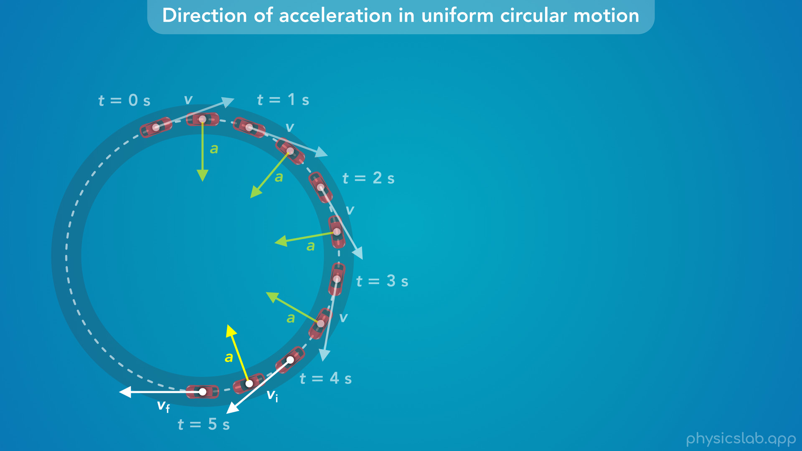

Slide 36
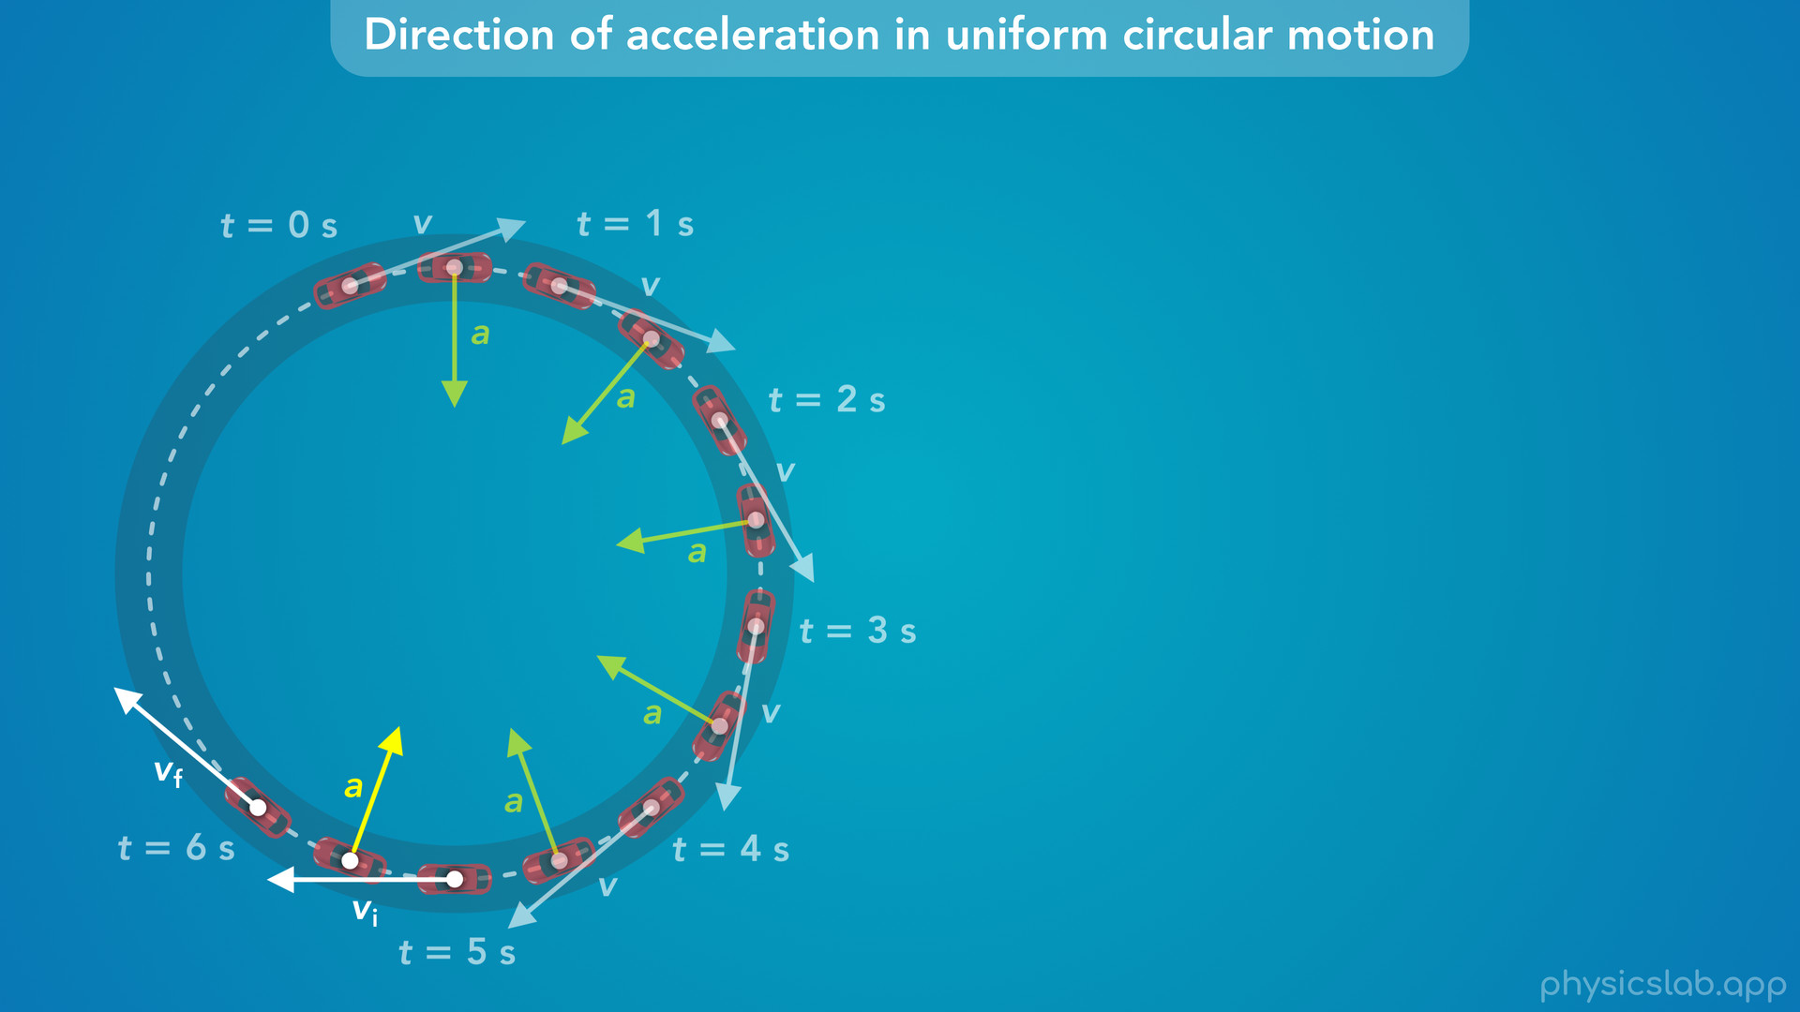

Slide 37
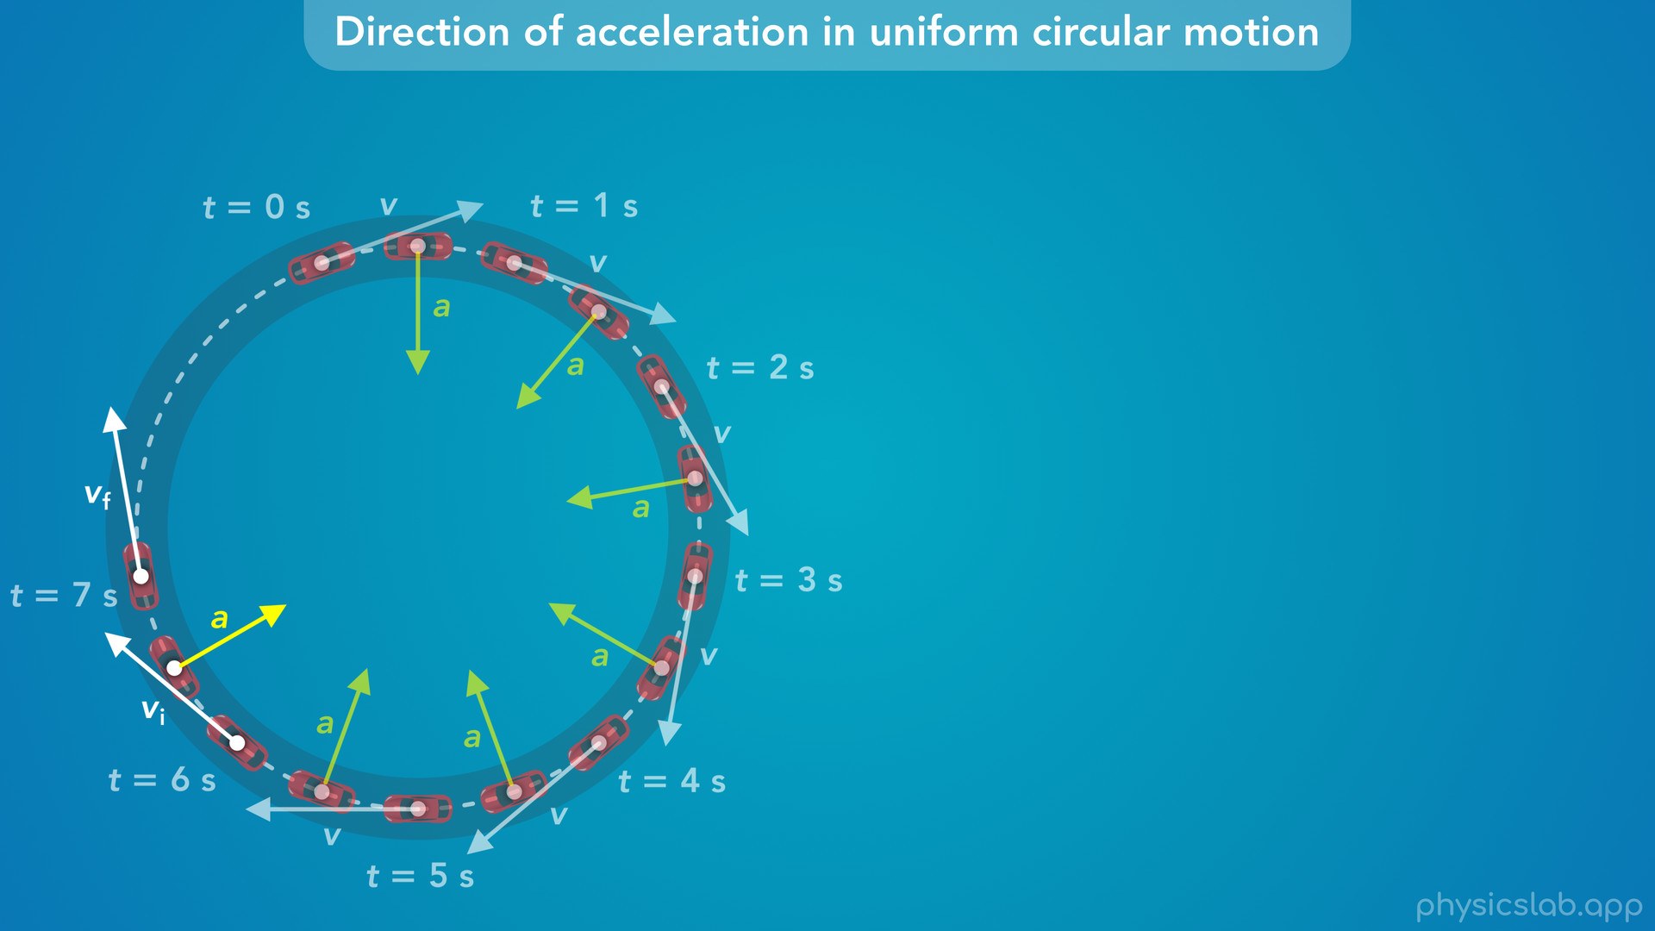

Slide 38
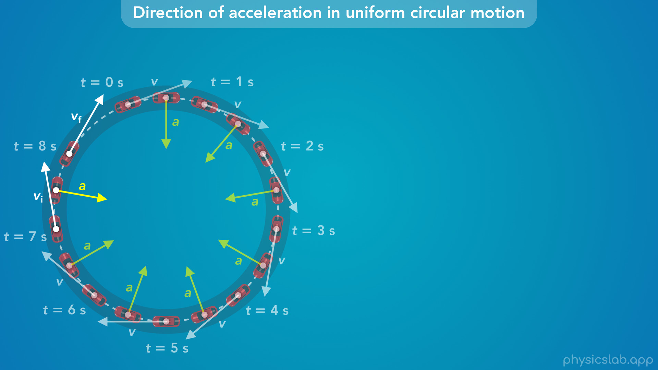

Slide 39
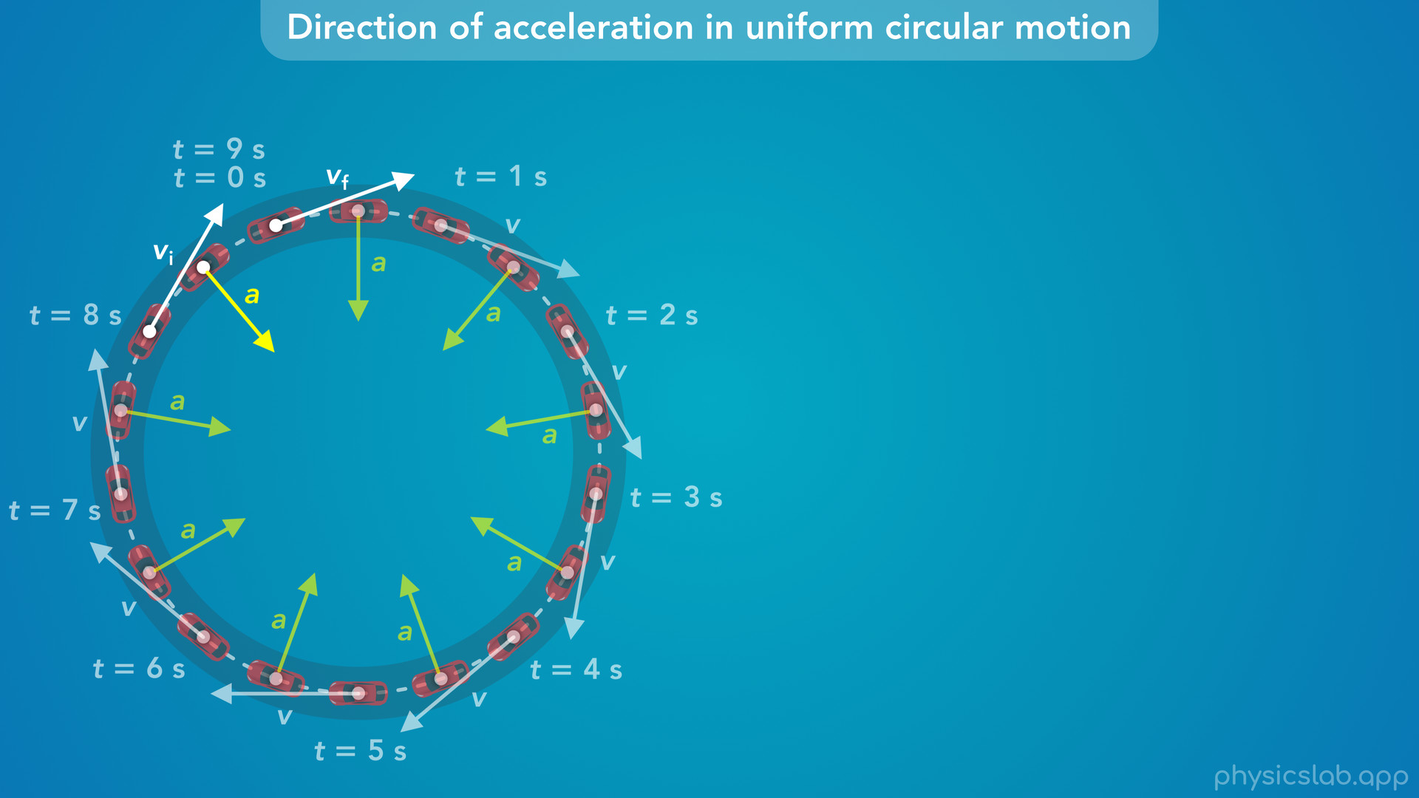

Slide 40
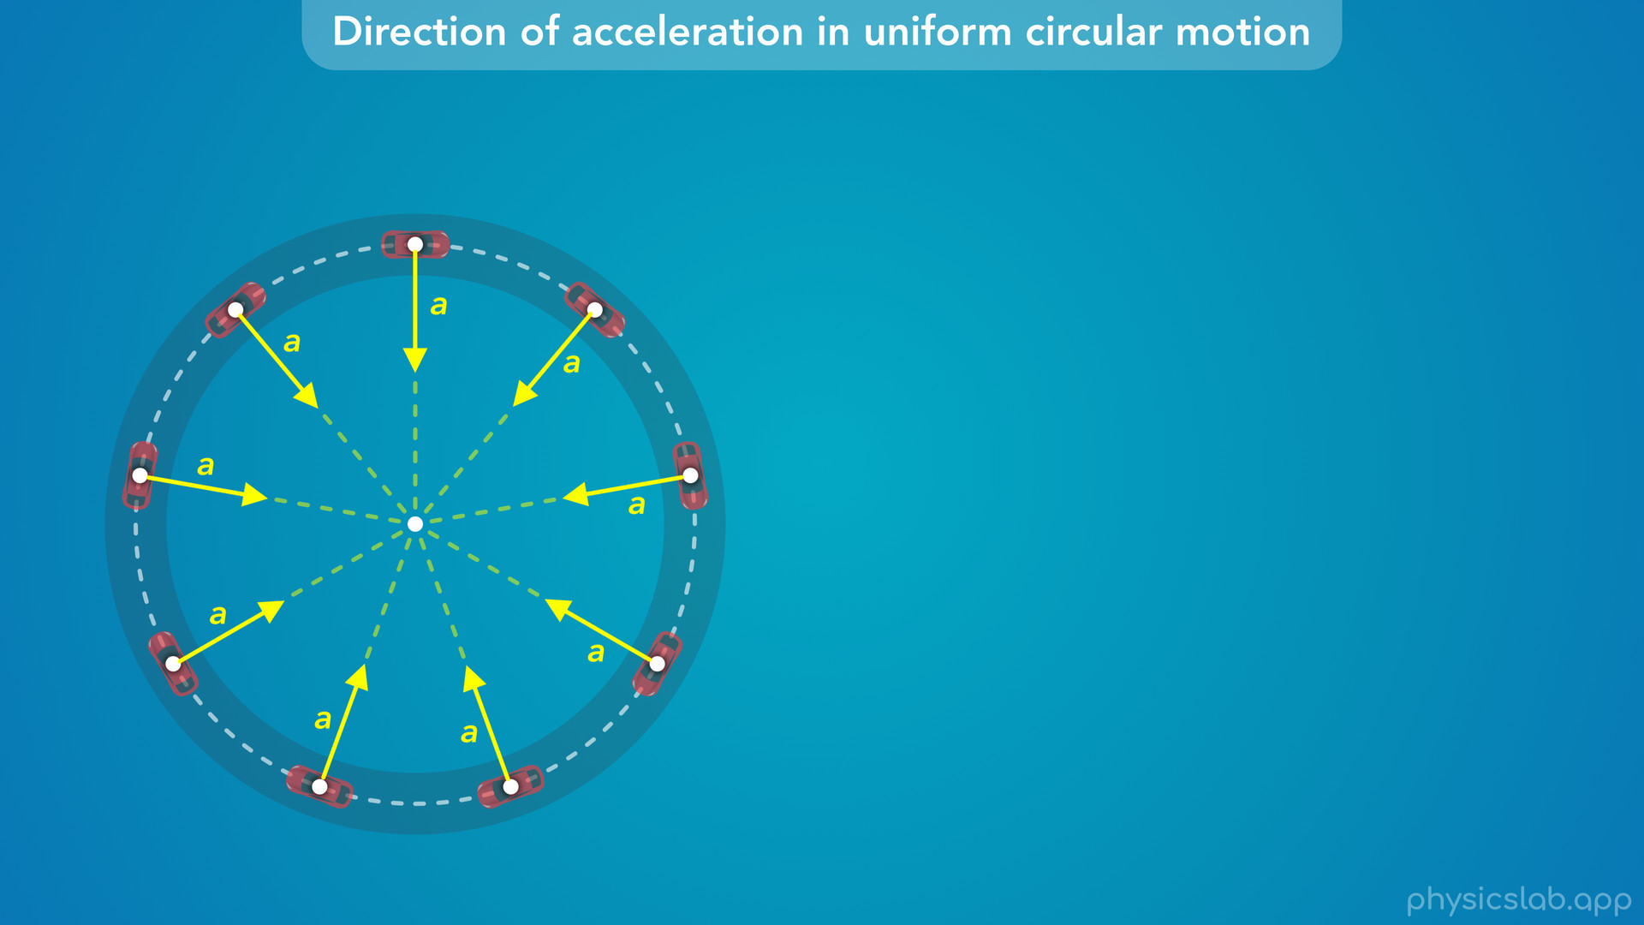
Notes:
• Notice that all of the acceleration vectors are pointing towards the center of the circular path.

Slide 41
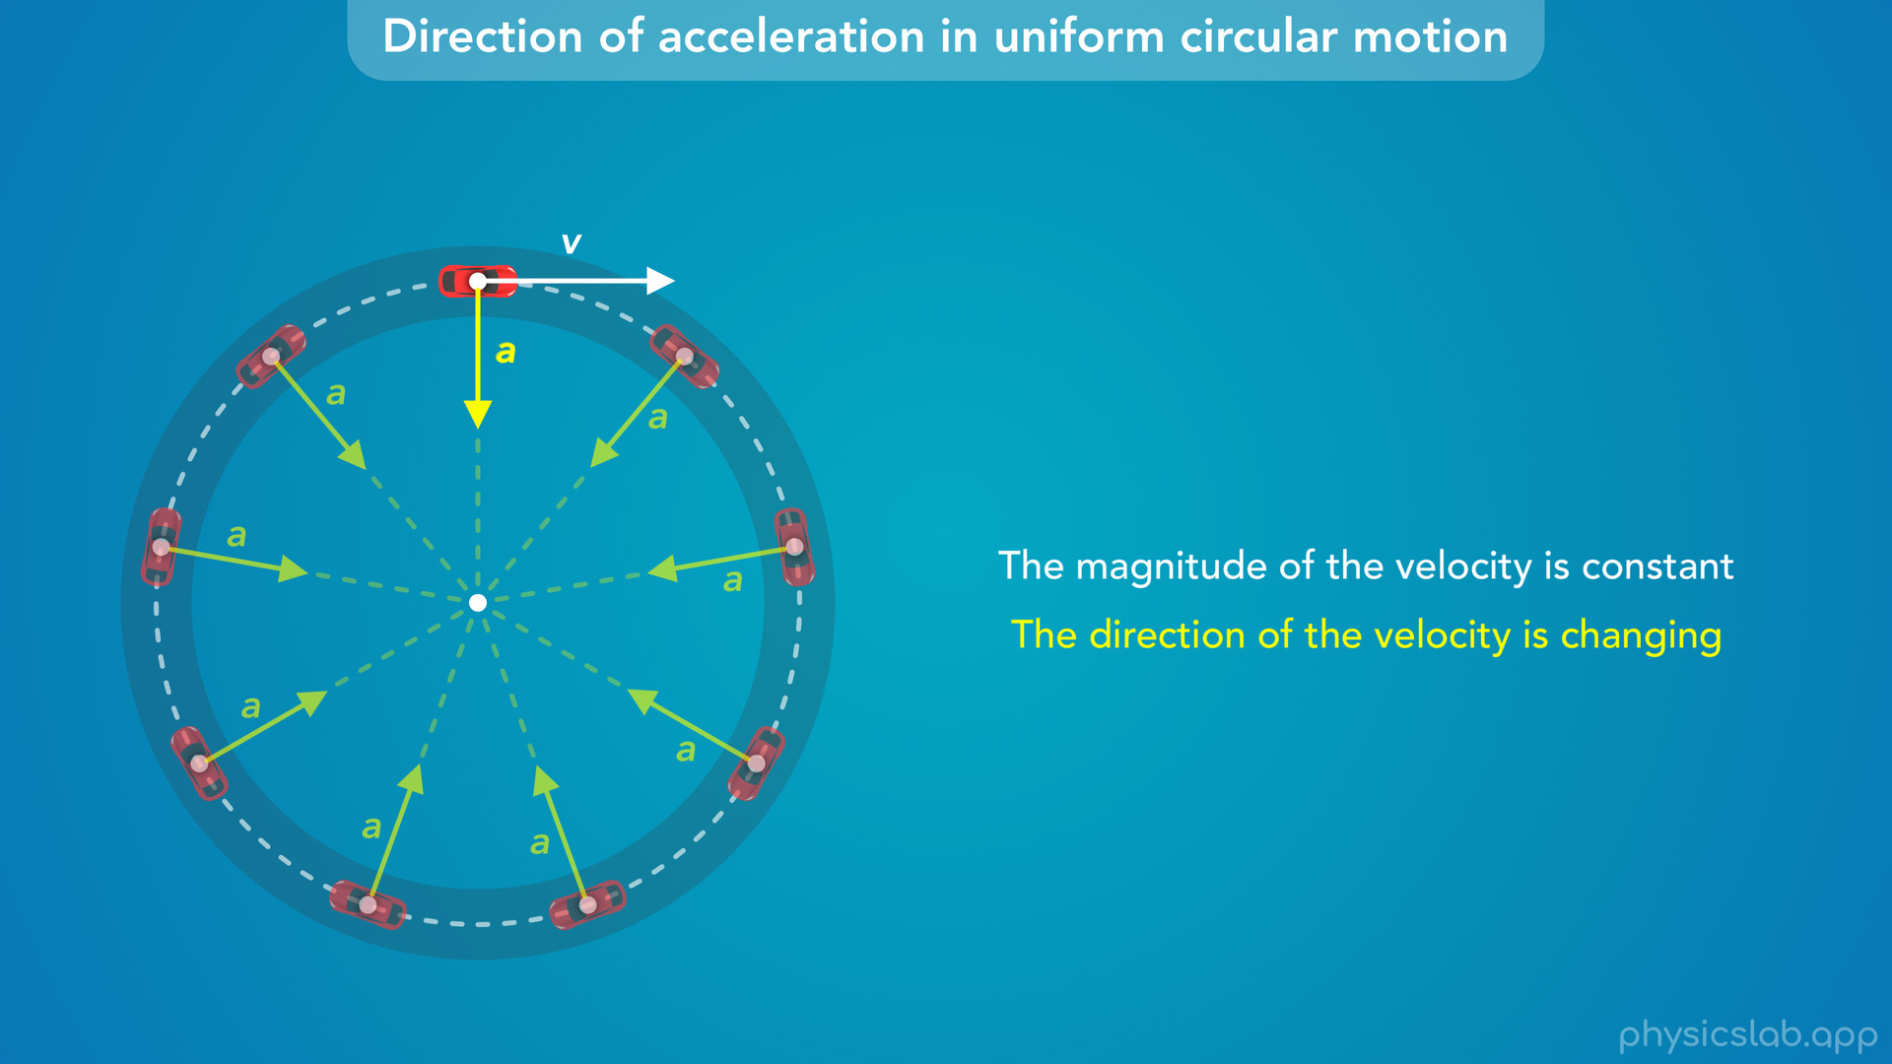
Notes:
• So, as the car drives around, the velocity vector is always tangent to the circle.
• The magnitude of the velocity is constant, but the direction of the velocity is changing, and the car is always accelerating towards the center of the circle.

Slide 42
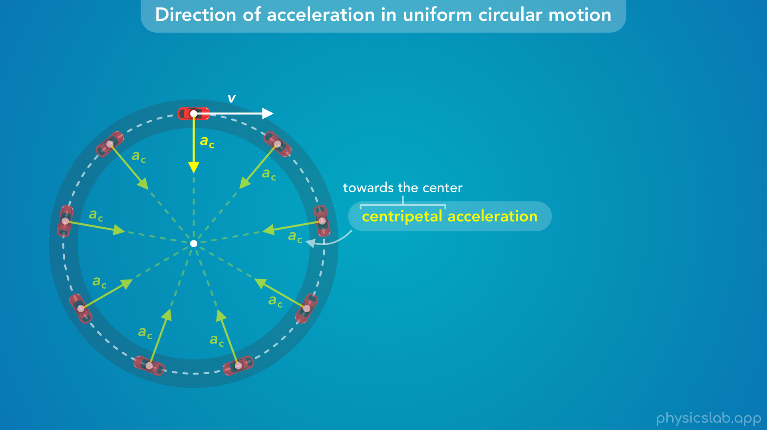
Notes:
• We call this centripetal acceleration, because the word centripetal means “towards the center”, and we use the subscript c for centripetal.
• This is not a new type of acceleration, this is just a label.
• When an object is in circular motion, its acceleration points towards the center, and we call it centripetal acceleration.

Slide 43
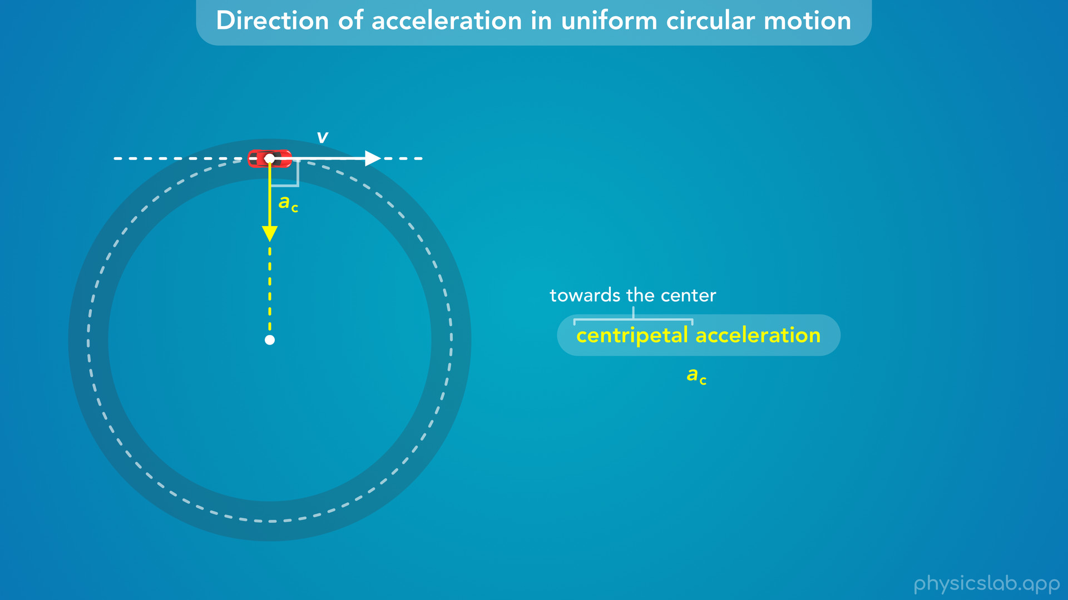
Notes:
• Also notice, that if the velocity is tangent to the circle, and the acceleration points towards the center, then the velocity and acceleration vectors are always perpendicular, the angle between the vectors is 90 degrees.

Slide 44
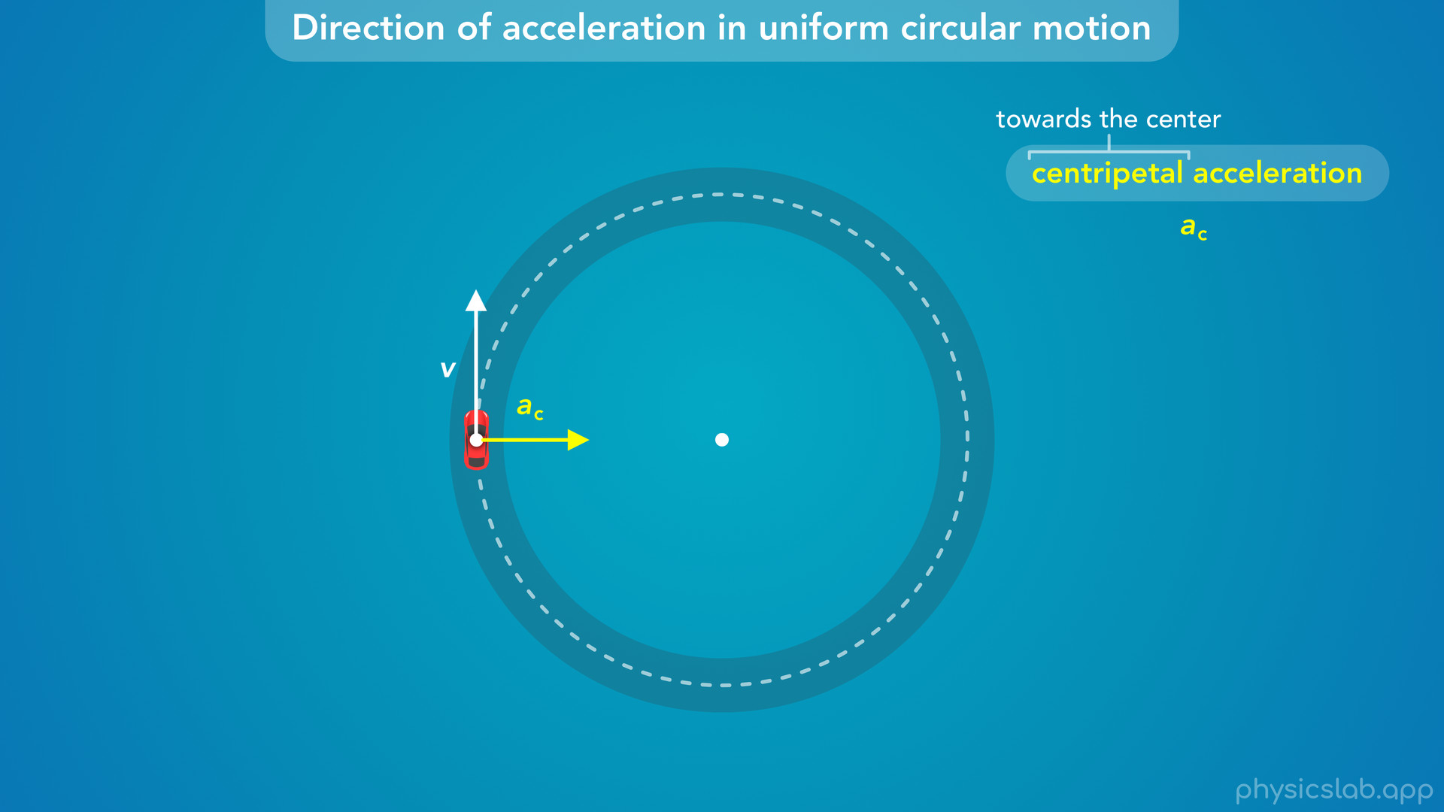
Notes:
• Any object in circular motion is experiencing centripetal acceleration.

Slide 45
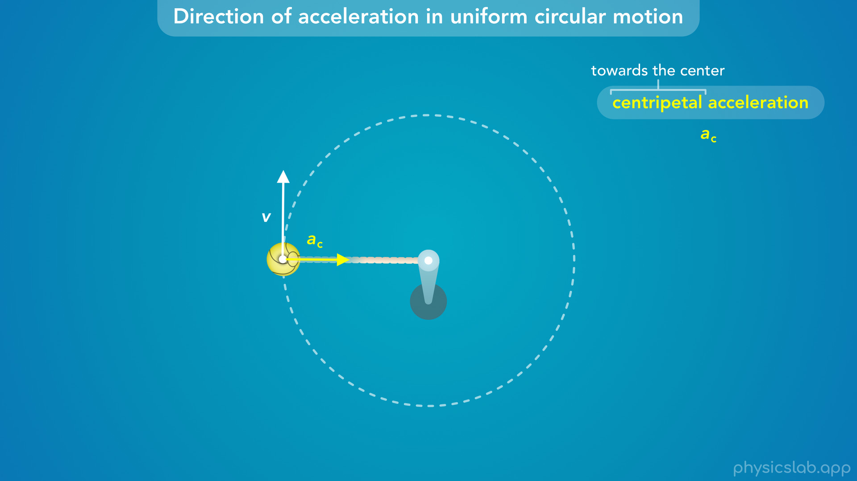
Notes:
• When a tetherball is swinging around a pole, the ball is always accelerating towards the center of the circular path.

Slide 46
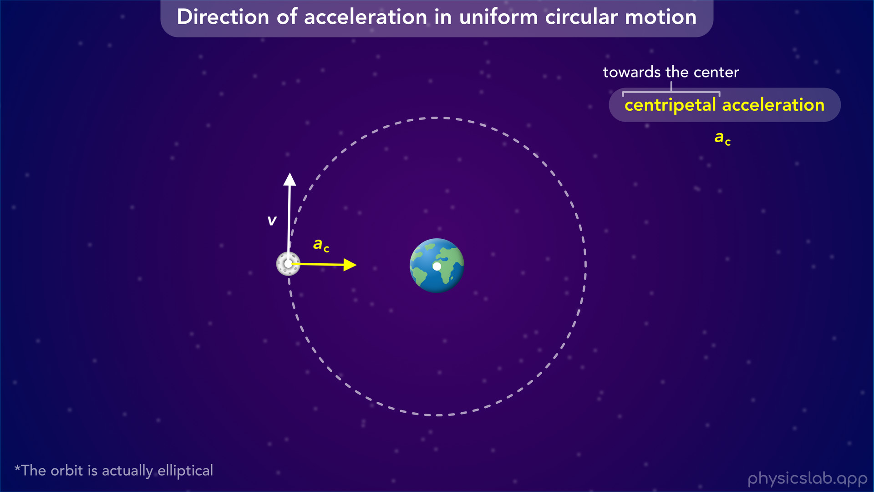
Notes:
• When an object is in a circular orbit, it’s always accelerating towards the center of the circle, which is also the center of the object that it’s orbiting.

Slide 47
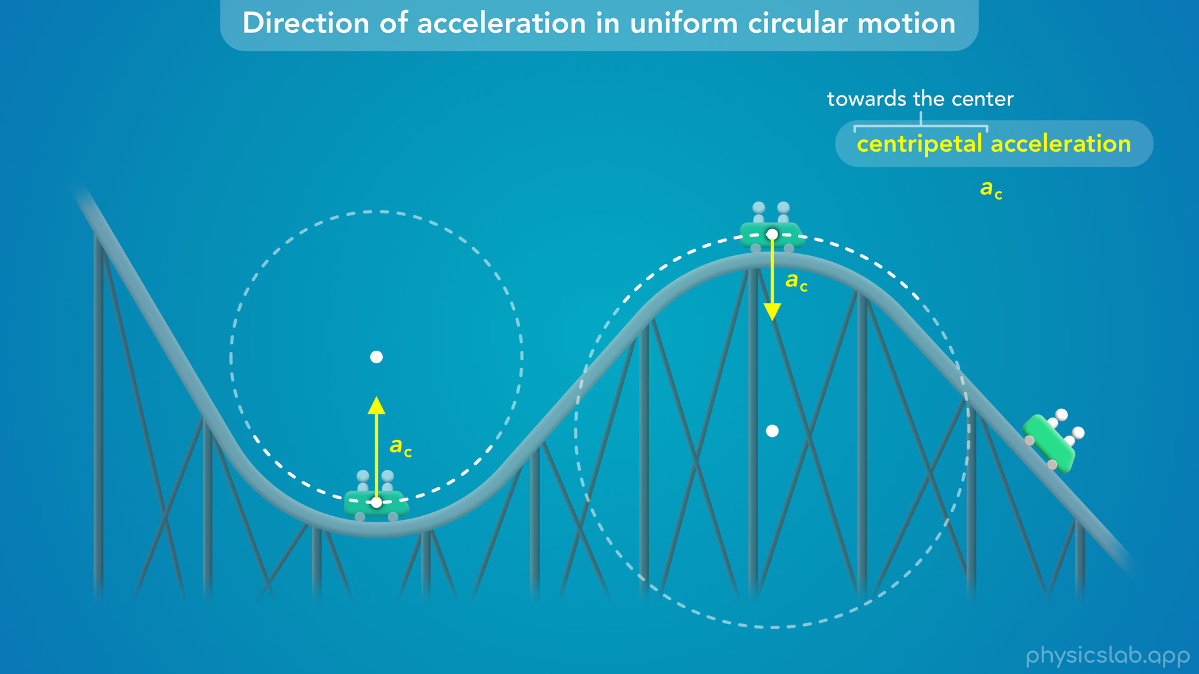
Notes:
• Even if an object moves along part of a circle, there is still centripetal acceleration.
• When you’re going through a curve on a roller coaster, you’re accelerating towards the center of the circular path.

Slide 48
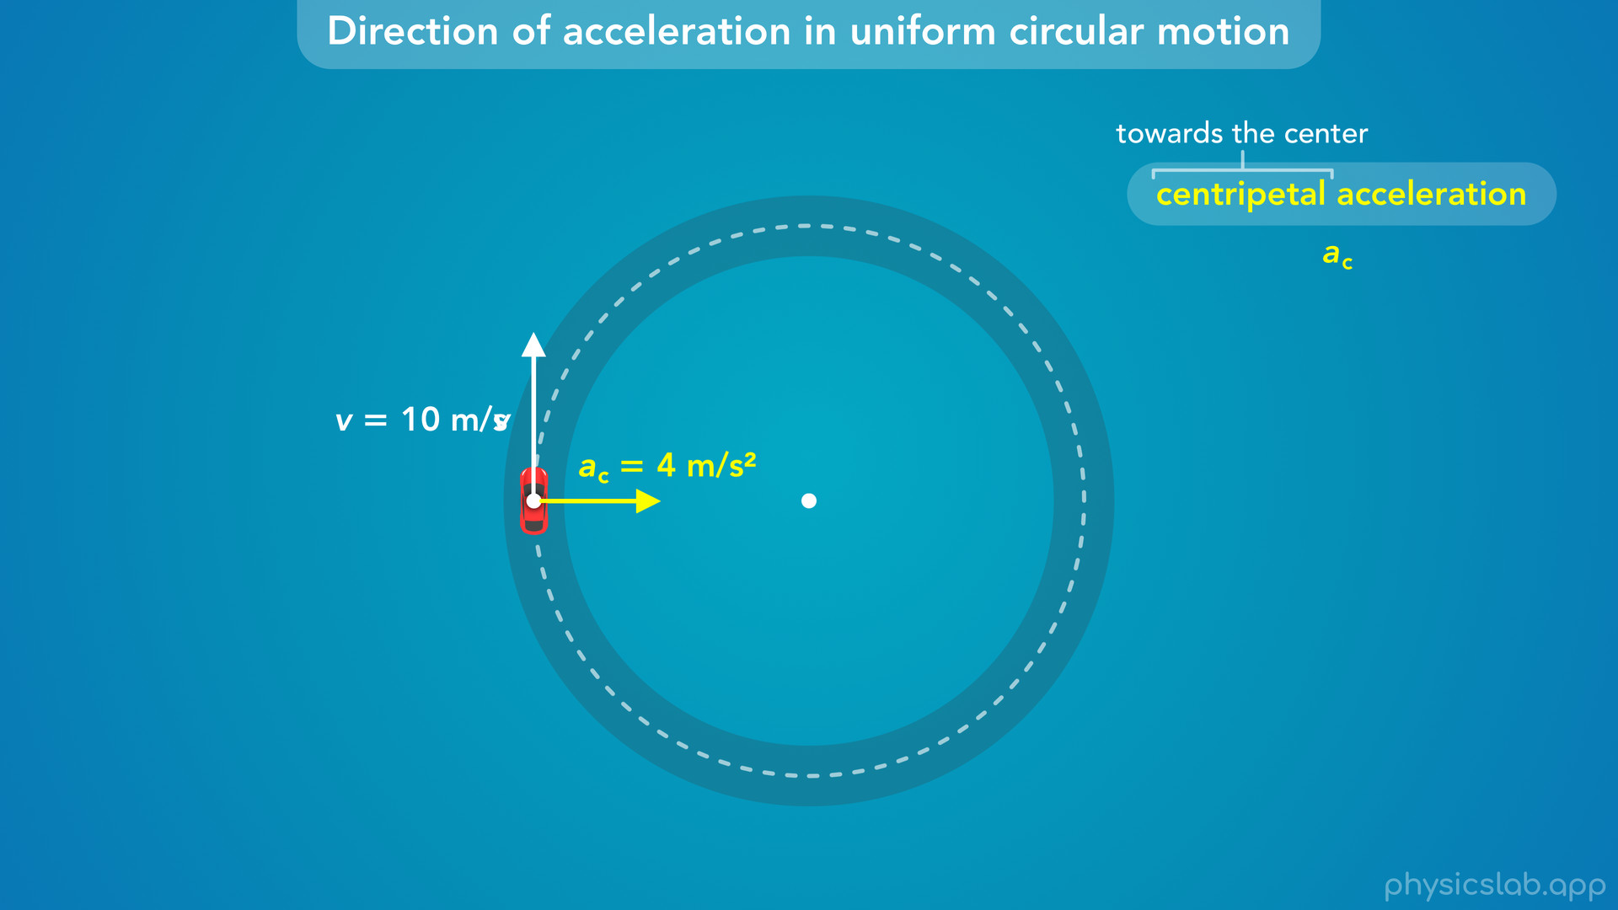
Notes:
• So that’s the direction of centripetal acceleration.
• But this is a vector, so it also has a magnitude or a value.
• For example, the speed of this car is a constant 10 m/s.
• And the centripetal acceleration is 4 m/s^2.
• So where does that number come from?

Slide 49
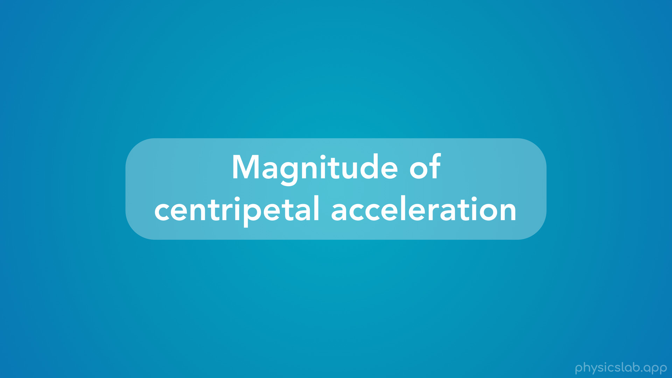
Notes:
• Let’s learn about the equation for the magnitude of centripetal acceleration.

Slide 50
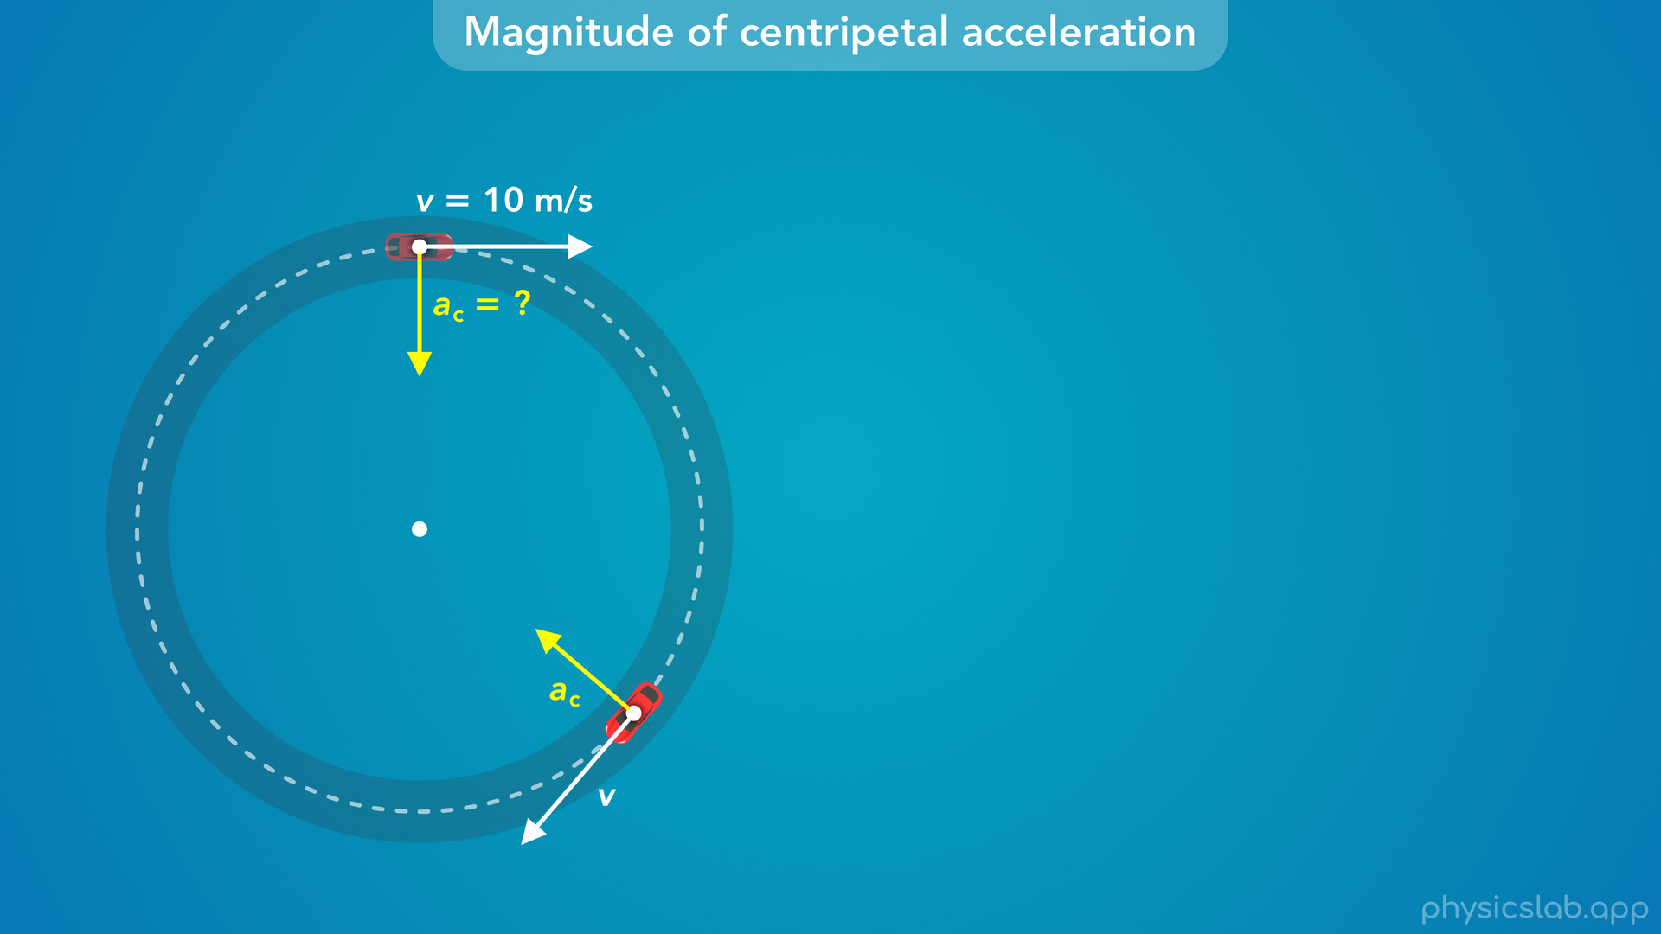
Notes:
• Here we have a car driving around with a constant speed of 10 m/s.
• How can we find the magnitude of the centripetal acceleration?
• We’re going to derive the equation, and you won’t need to know how to do this yourself, but it’s important to see where this equation comes from.

Slide 51
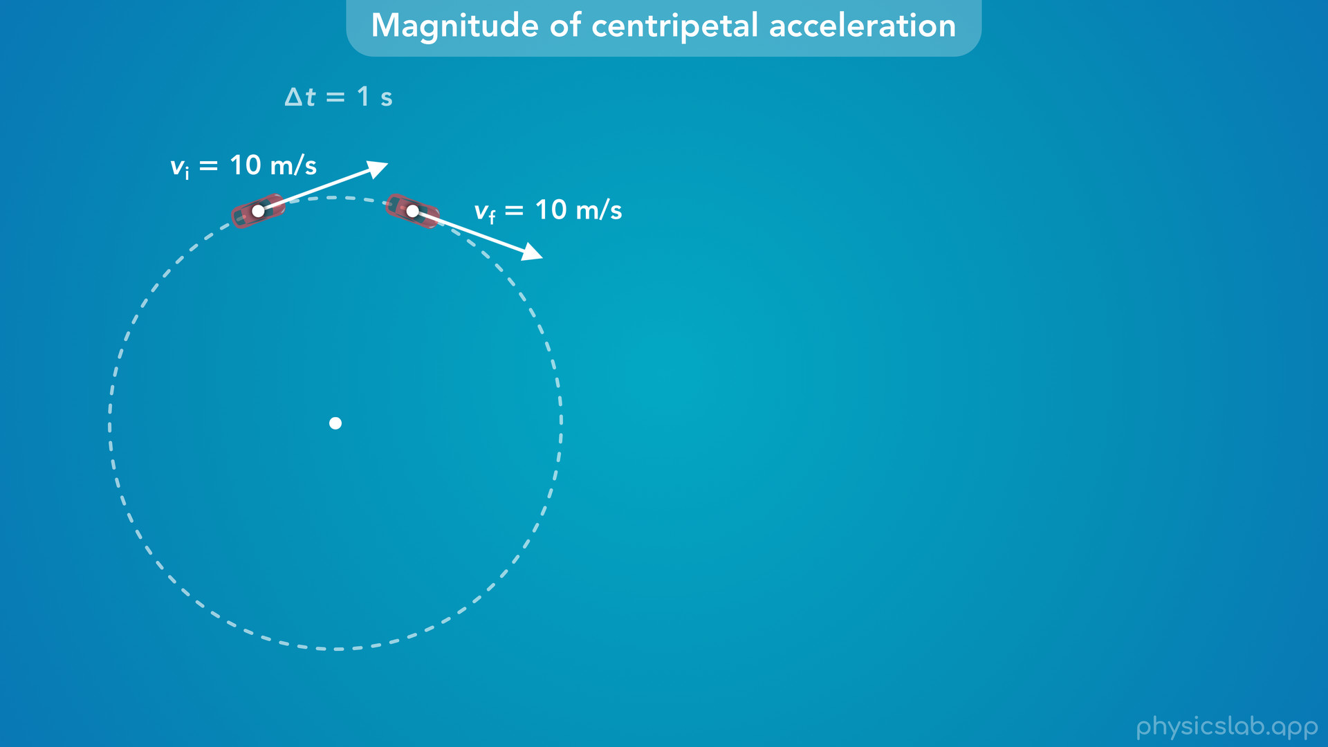
Notes:
• Just like before, let’s look at the velocity vectors at two moments in time that are 1 second apart.

Slide 52
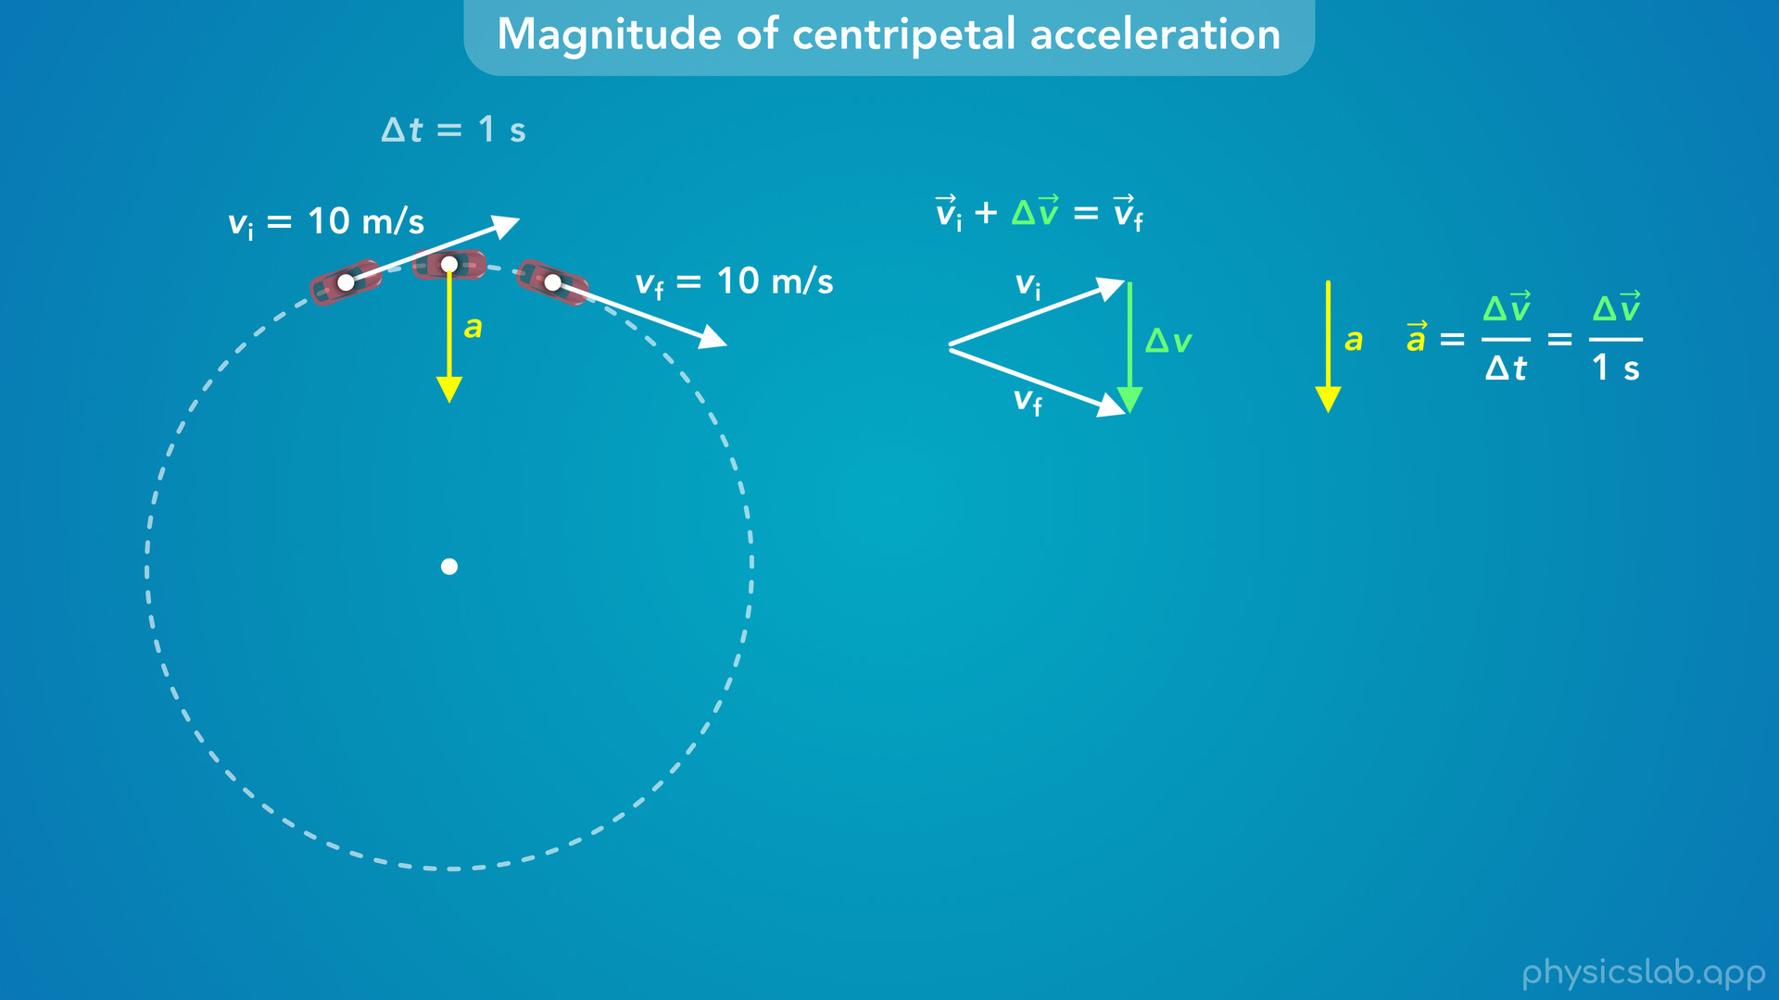
Notes:
• We already found the acceleration vector using the tip to tail method.
• But instead of focusing on its direction, now we want to find its magnitude.
• We know that the acceleration vector is equal to the change in velocity vector divided by the period of time, which is 1 second.
• So what is the magnitude of delta v?

Slide 53
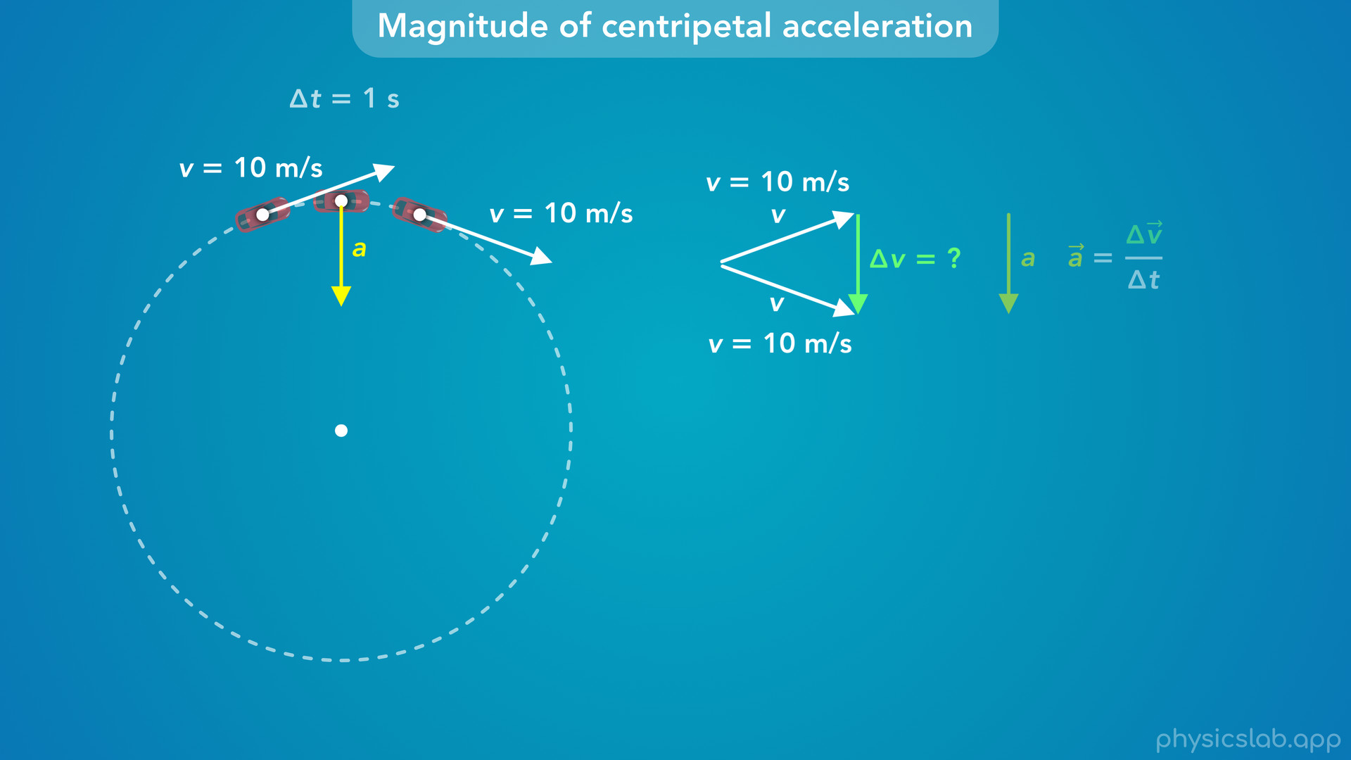
Notes:
• We know the initial and final velocities are both 10 m/s.
• This is uniform circular motion so the velocities have the same magnitude.
• So to simplify things, let’s just use v to represent the length of the initial and final velocity vectors.
• Now, how do we find the length of delta v?

Slide 54
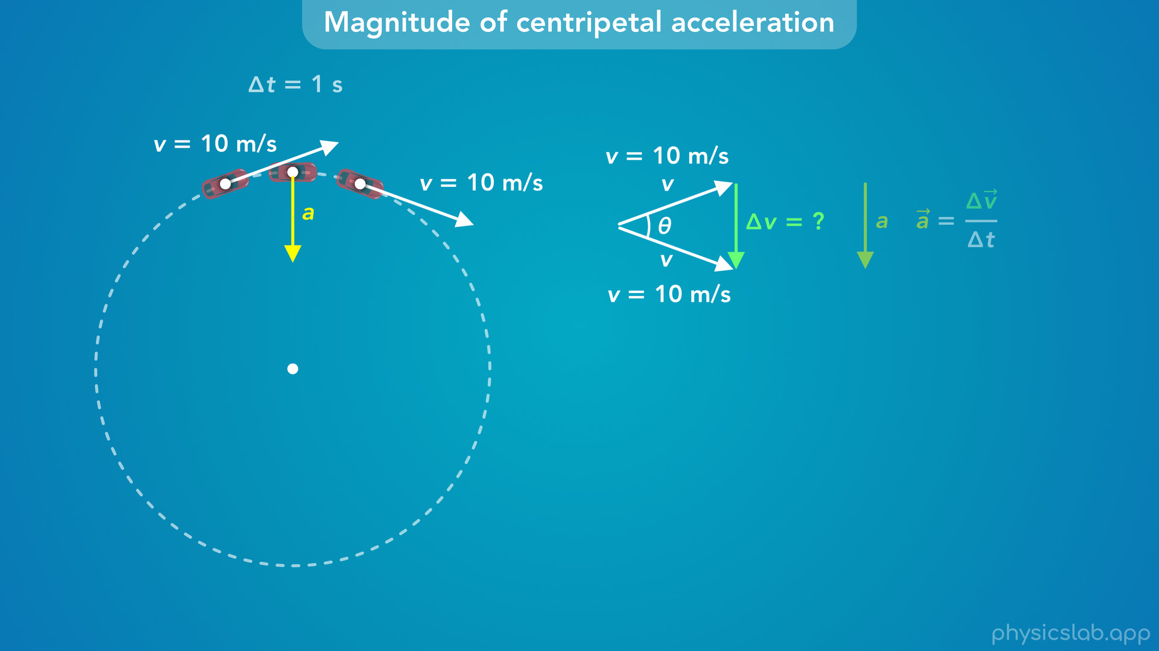
Notes:
• This comes down to geometry.
• If we knew this angle inside this triangle, we could find the length of the right side, delta v.
• So what is this angle?

Slide 55

Notes:
• It turns out that if we draw a line from the center of the circle to each of these points, the angle between these lines is the same as the angle between the initial and final velocity vectors, which we’re calling theta.
• As this point moves around the circle, the radius line and the velocity vector both rotate the same angle, theta.
• Now, if we draw a line connecting these points, we get a triangle, where the length of these two sides is the radius of the circle, r.

Slide 56

Notes:
• This triangle, and the triangle formed by the velocity vectors, are similar triangles.
• They have the same angles and the side lengths are proportional.
• This new triangle is a scaled up version of the velocity triangle.
• So to find the length of delta v, we don’t need this angle, we can just use the relationship between the side lengths.

Slide 57

Notes:
• If side v is proportional to side r, then delta v is proportional to the length of this right side.
• So what is that length?

Slide 58

Notes:
• If we look at the circle, there’s an arc length between these two points which we’ll call delta s.

Slide 59

Notes:
• That’s the distance the car travels during this one second, the distance from the initial position to the final position.
• The velocity of the car is equal to that distance divided by the period of time.
• If we rearrange that, delta s is equal to the velocity times the period of time.

Slide 60

Notes:
• Notice, that the length of this side of the triangle is approximately equal to that arc length, delta s.

Slide 61

Notes:
• They’re not exactly the same, but it’s a good approximation, and it gets more accurate if we use shorter periods of time between the two points.

Slide 62

Notes:
• So, we’re going to say that this side of the triangle is approximately equal to the arc length, delta s.

Slide 63

Notes:
• Now, since these are similar triangles, the ratio of delta v divided by v is equal to the ratio of delta s divided by r.

Slide 64

Notes:
• And we can substitute the velocity times the period of time in place of delta s.

Slide 65

Notes:
• Now we can divide both sides by delta t… and then multiply both sides by v, and v times v is v squared.
• Notice that left side is the change in velocity divided by the period of time.

Slide 66

Notes:
• That’s the equation for acceleration.

Slide 67

Notes:
• So, the magnitude of the acceleration vector is equal to the velocity squared divided by the radius of the circle.

Slide 68

Notes:
• And that’s our equation for centripetal acceleration, v squared over r.

Slide 69

Notes:
• This is true for any velocity and any radius.
• These triangles will just scale up and down, but the proportions stay the same.

Slide 70

Notes:
• To use some numbers, the velocity is 10 m/s and let’s say the radius of the circle is 25 m.
• Delta s would be the velocity times the period of time, 10 m/s times 1 second, which is 10 m.
• So the ratio of 10 m divided by 25 m, is equal to the ratio of delta v divided by 10 m/s.

Slide 71

Notes:
• That means delta v is 4 m/s.

Slide 72

Notes:
• Then, the acceleration is delta v divided by delta t, 4 m/s divided by 1 second, which is 4 m/s^2.

Slide 73

Notes:
• That’s the length of the acceleration vector, which is the magnitude of the centripetal acceleration of this car.

Slide 74

Notes:
• And if we use this new equation, we plug in 10 m/s for the velocity and 25 m for the radius.
• That gives us the same thing, 4 m/s^2.

Slide 75

Notes:
• Again, you won’t need to derive this equation yourself.
• The point of walking through this is to show that this equation comes from geometry.
• We haven’t mentioned any forces or physical laws, and it doesn’t matter what the object is.
• If a point is following a circular path, the velocity vector is changing direction so that point is accelerating.
• And the acceleration points towards the center of the circle.
• We call this centripetal acceleration, but this is not a new type of acceleration, this is still the change in the velocity vector over time.
• It just happens to be the case that in circular motion, we get another equation, the acceleration is also equal to the velocity squared divided by the radius.
• And again, this equation comes from vectors and geometry.
• When we work on centripetal acceleration problems, and when we learn about centripetal force, this concept will help us think about those scenarios in the right way.

Slide 76

Notes:
• So to summarize, when an object is in circular motion, there is an acceleration that acts towards the center of the circle called the centripetal acceleration.
• The magnitude of the acceleration is equal to the magnitude of the velocity squared, or we could say the speed squared, divided by the radius of the circular path.

Slide 77

Notes:
• We use the subscript c for centripetal acceleration, and the SI unit is m/s^2, this is just acceleration.
• In this equation, the unit for velocity is m/s and the unit for the radius is meters, and if we simplify that, we get m/s^2.

Slide 78

Notes:
• So if we’re told that the speed is 10 m/s and the radius is 25 m, we can plug those into this equation and get 4 m/s^2 for the centripetal acceleration.

Slide 79

Notes:
• But since this is circular motion, we might be given other values instead of the velocity.
• For example, maybe we know the period, which is the time it takes to complete one circle.
• We learned in a previous video that the velocity in uniform circular motion is equal to 2 pi r over T, the circumference divided by the period.
• So we can replace the velocity with 2 pi r over T, and if we simplify that, we get 2 pi over the period (squared) multiplied by the radius.
• So if we know the period and the radius, we can find the centripetal acceleration.

Slide 80

Notes:
• Or maybe we know the frequency instead of the period.
• The frequency is just the inverse of the period, and the period is the inverse of the frequency.
• So we can replace the period with one divided by the frequency, and we get another equation for the centripetal acceleration using the frequency and the radius.

Slide 81

Notes:
• And finally, maybe we know the angular velocity, omega, in rad/s.
• In that case, this tangential velocity is equal to the radius times the angular velocity.
• So can replace v with r times omega, and if we simplify that, the centripetal acceleration is equal to the angular velocity squared times the radius.

Slide 82

Notes:
• So the centripetal acceleration points towards the center of the circle, and its magnitude is equal to v^2 over r.
• And if we don’t know the velocity, we can find it using the period, frequency or the angular velocity.

Slide 83
Notes:
• In the next video, we’ll look at some examples and learn more about how to use this equation for centripetal acceleration.

