Slide 1
Tension in Static Systems - Analyzing Objects and Systems
Slides Version 1
This version includes:
Slides with screenshot images from the video.
The video narration in the slide notes.
A blank template slide with the same background and font as the video.
Slides with some basic graphics from this video for you to use however you like.
Feel free to add, delete and edit slides to make your own presentation. You can use these slides in class or share them with your students, but please do not share them with anyone else.
If you have any feedback, suggestions or questions about these slides please email me at chris@physicslab.app or send me a message on Discord @physicslab.
physicslab.app

Slide 2
Heading
Text

Slide 3




















Free body diagram

Slide 4
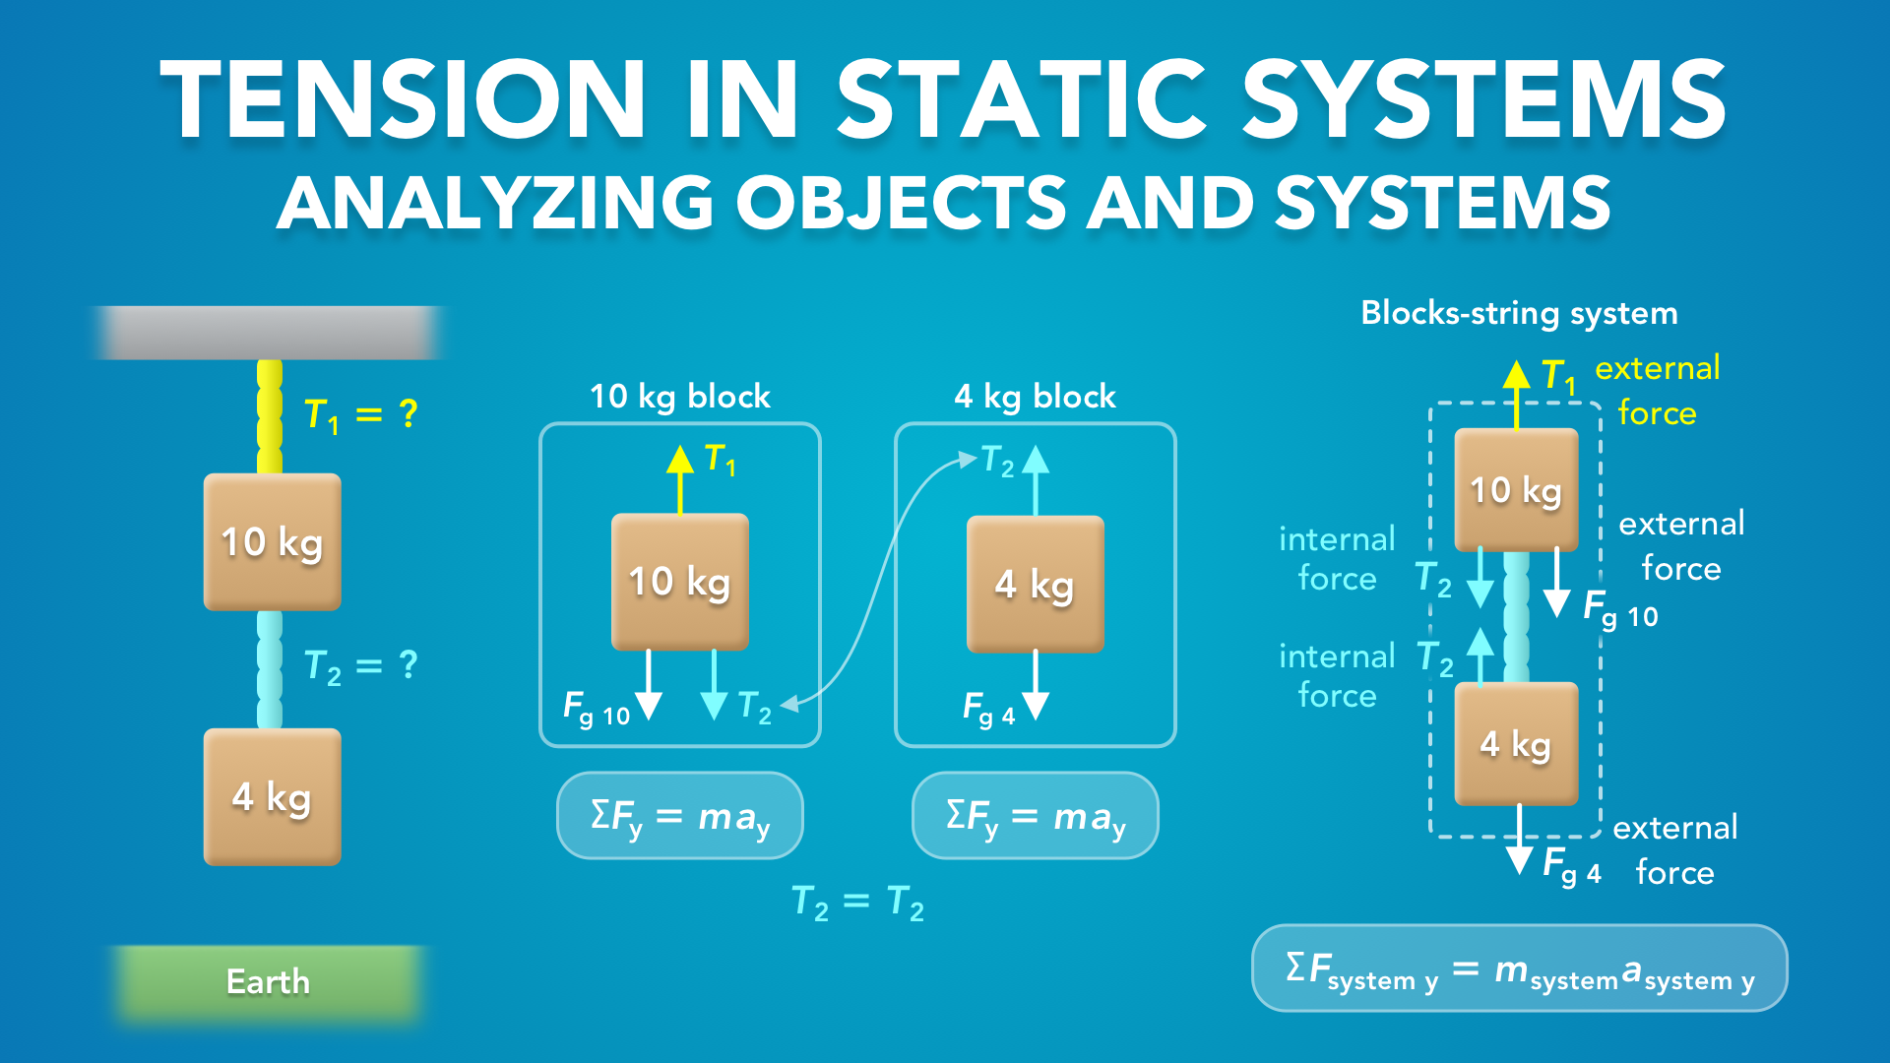
Notes:
Tension in Static Systems - Analyzing Objects and Systems
physicslab.app
If you have any questions, suggestions or feedback about these slides please email me at chris@physicslab.app or send me a message on Discord @physicslab.

Slide 5
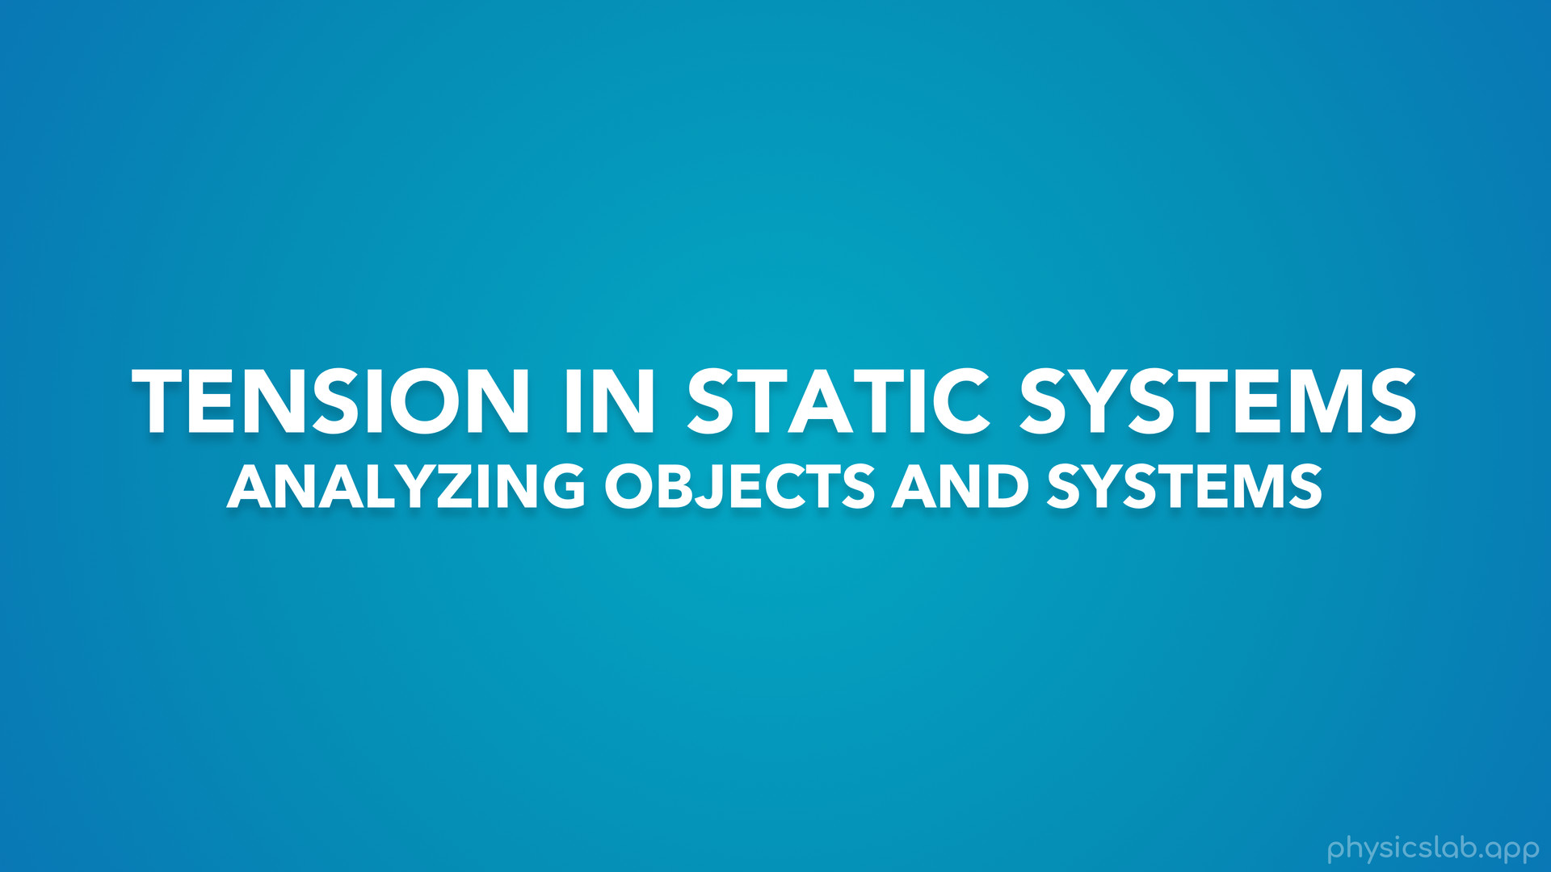
Notes:
In this video we’re gonna learn about analyzing objects and systems involving tension.

Slide 6
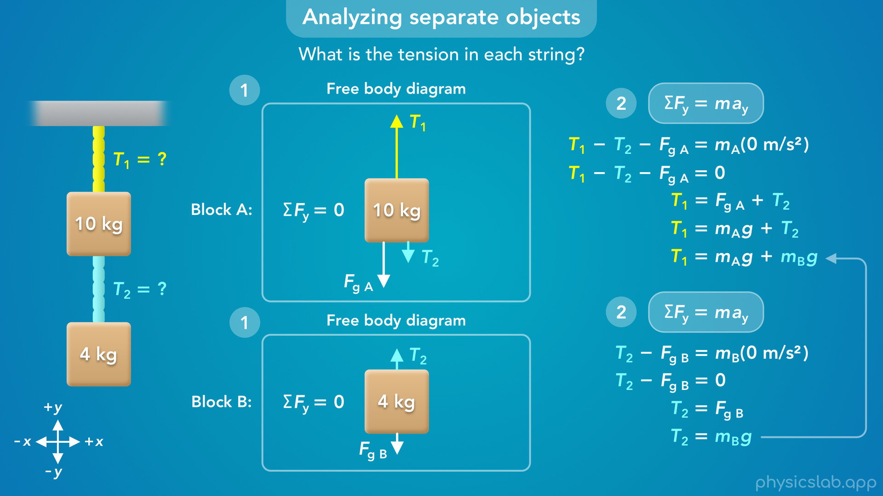
Notes:
• We’ll start by drawing a free body diagram and applying newton’s 2nd law to separate objects.
• And we’ll see how we can connect the equations together to solve for two different tensions.

Slide 7
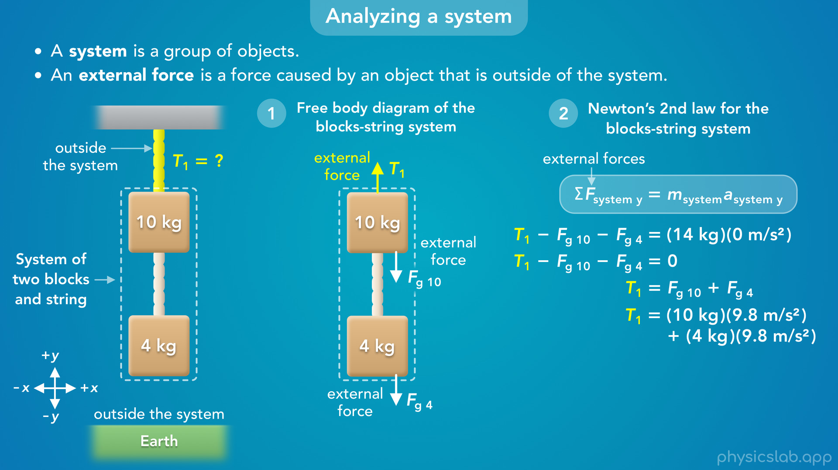
Notes:
• Then we’ll look at the same example, but we’ll analyze the objects together as a system.
• This simplifies things if we’re trying to find an external force.

Slide 8
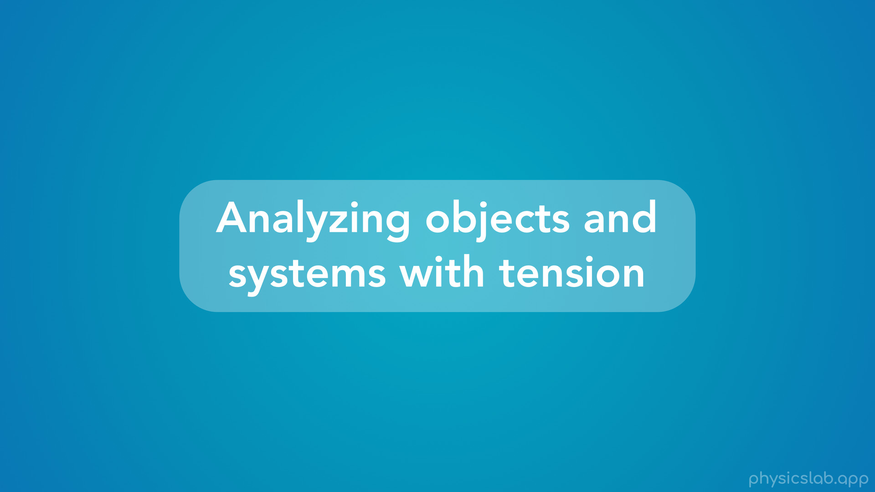
Notes:
• So how do we analyze objects and systems with tension?

Slide 9
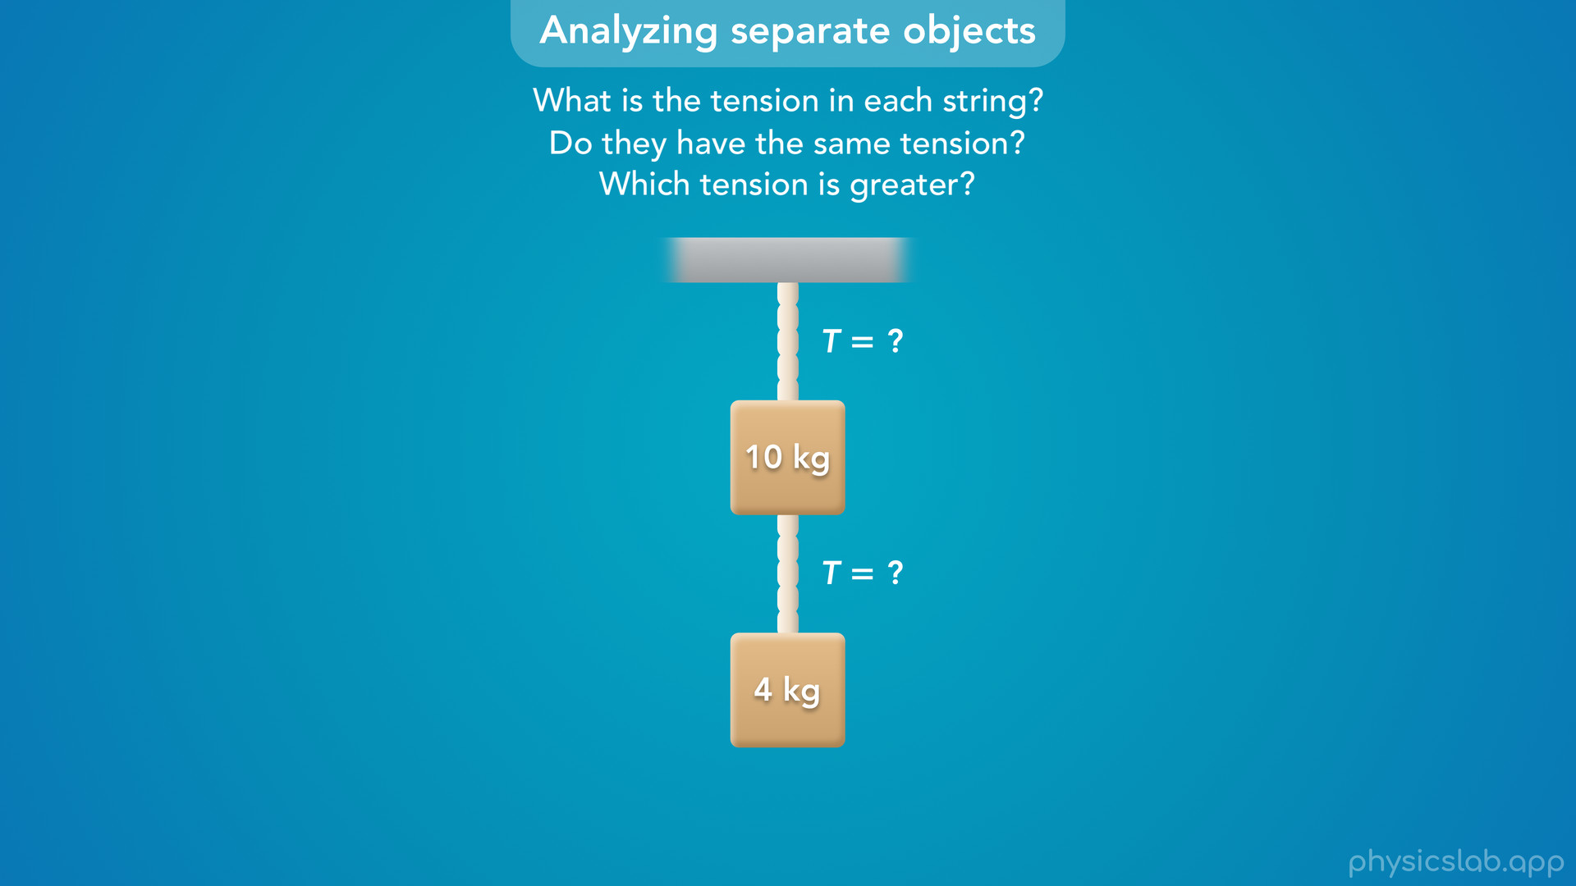
Notes:
• Here we have two blocks suspended by two strings.
• What is the tension is each string?
• Do you think they have the same tension? And if not, which tension is greater?

Slide 10
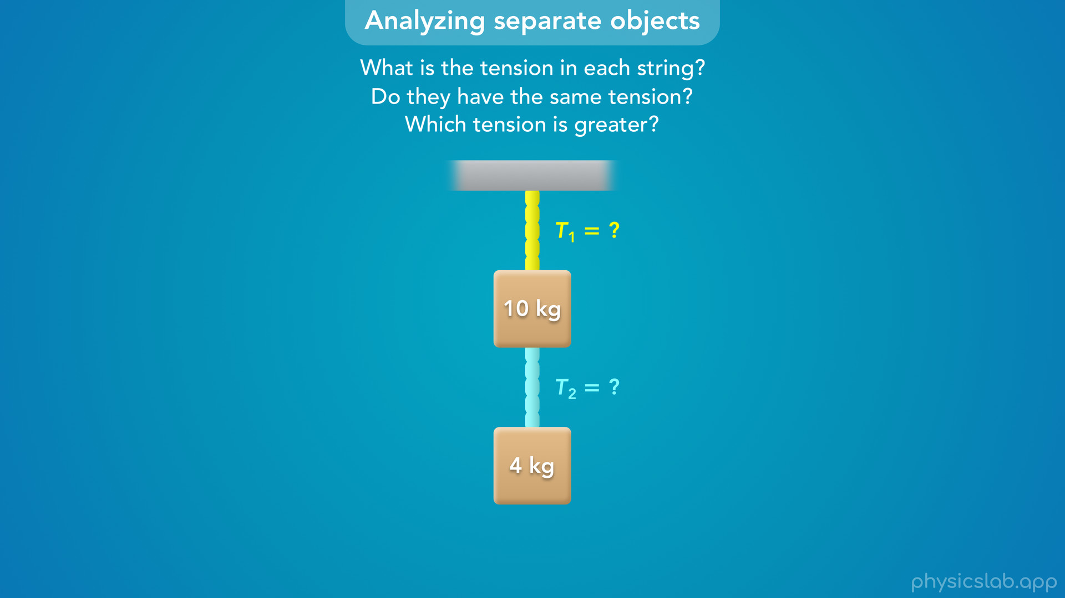
Notes:
• So we have two separate strings that can have different tensions, so we’re going to label the tension in each string as T1 and T2.

Slide 11
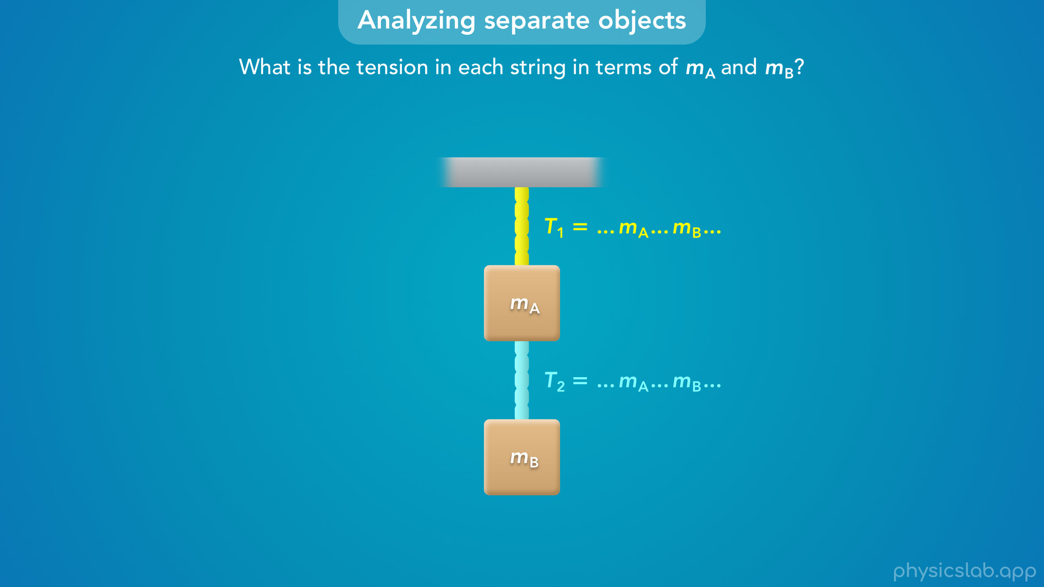
Notes:
• For this example, let’s try working through the problem using variables first, and then plug in numbers at the end.
• So for now, we’ll say the top block has a mass of mA, and the bottom block has a mass of mB, and we want to find the tension in each string in terms of mass A and mass B.
• So instead of finding the value of T1 and T2, we want to derive an equation for each one that could include mass a and mass b.
• Then we can plug in numbers for each mass to get the tensions.

Slide 12
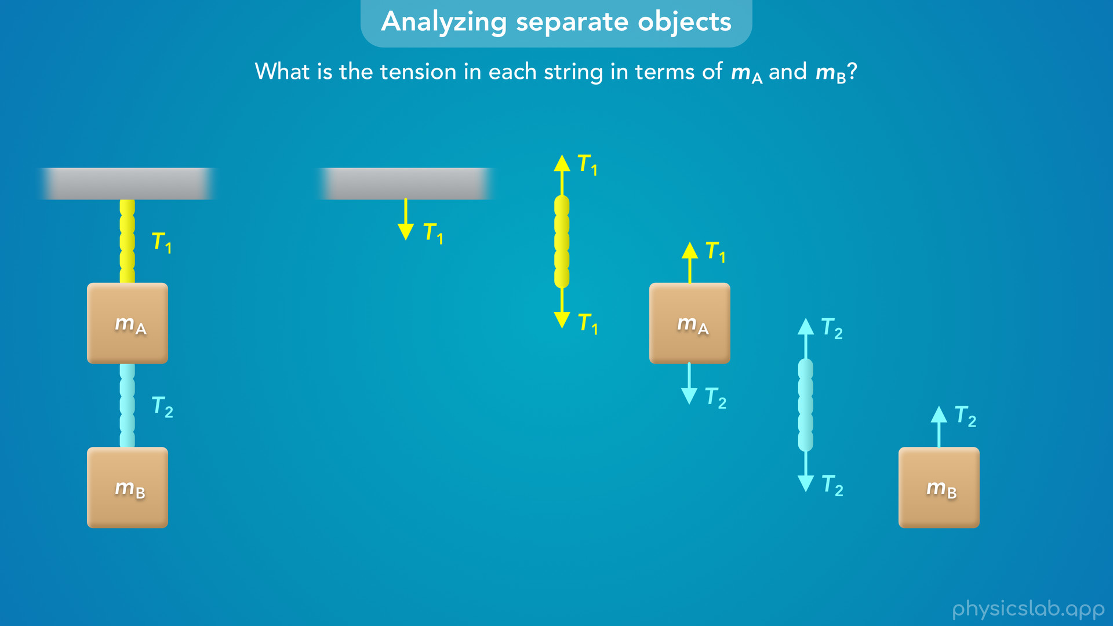
Notes:
• Here’s what the tension forces look like in this scenario.
• String 1 is pulling down on the ceiling and pulling up on block A with the same amount of force, T1.
• String 2 is pulling down on block A and pulling up on block B with the same amount of force, T2.

Slide 13
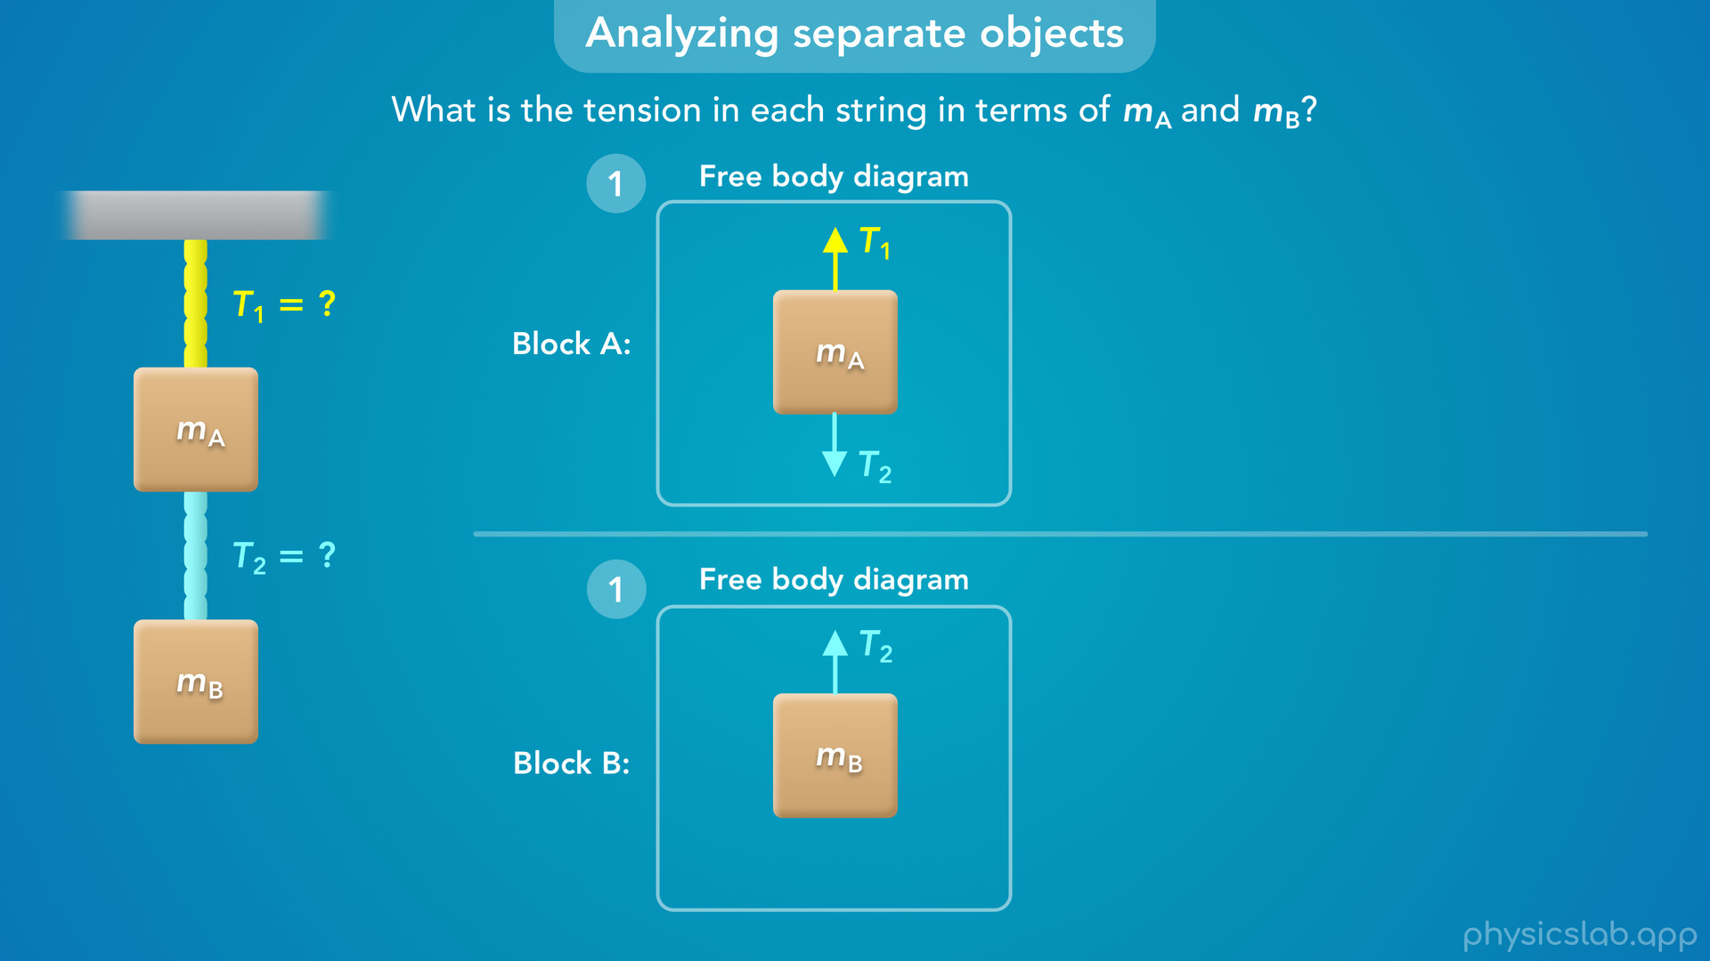
Notes:
• Like we covered in the last video, the first step is to draw a free body diagram, and we’re going to draw one for each block.
• At this point, we don’t know if we’ll need both to solve the problem, but either way, it always helps to draw free body diagrams so we have a better picture of what’s going on.

Slide 14
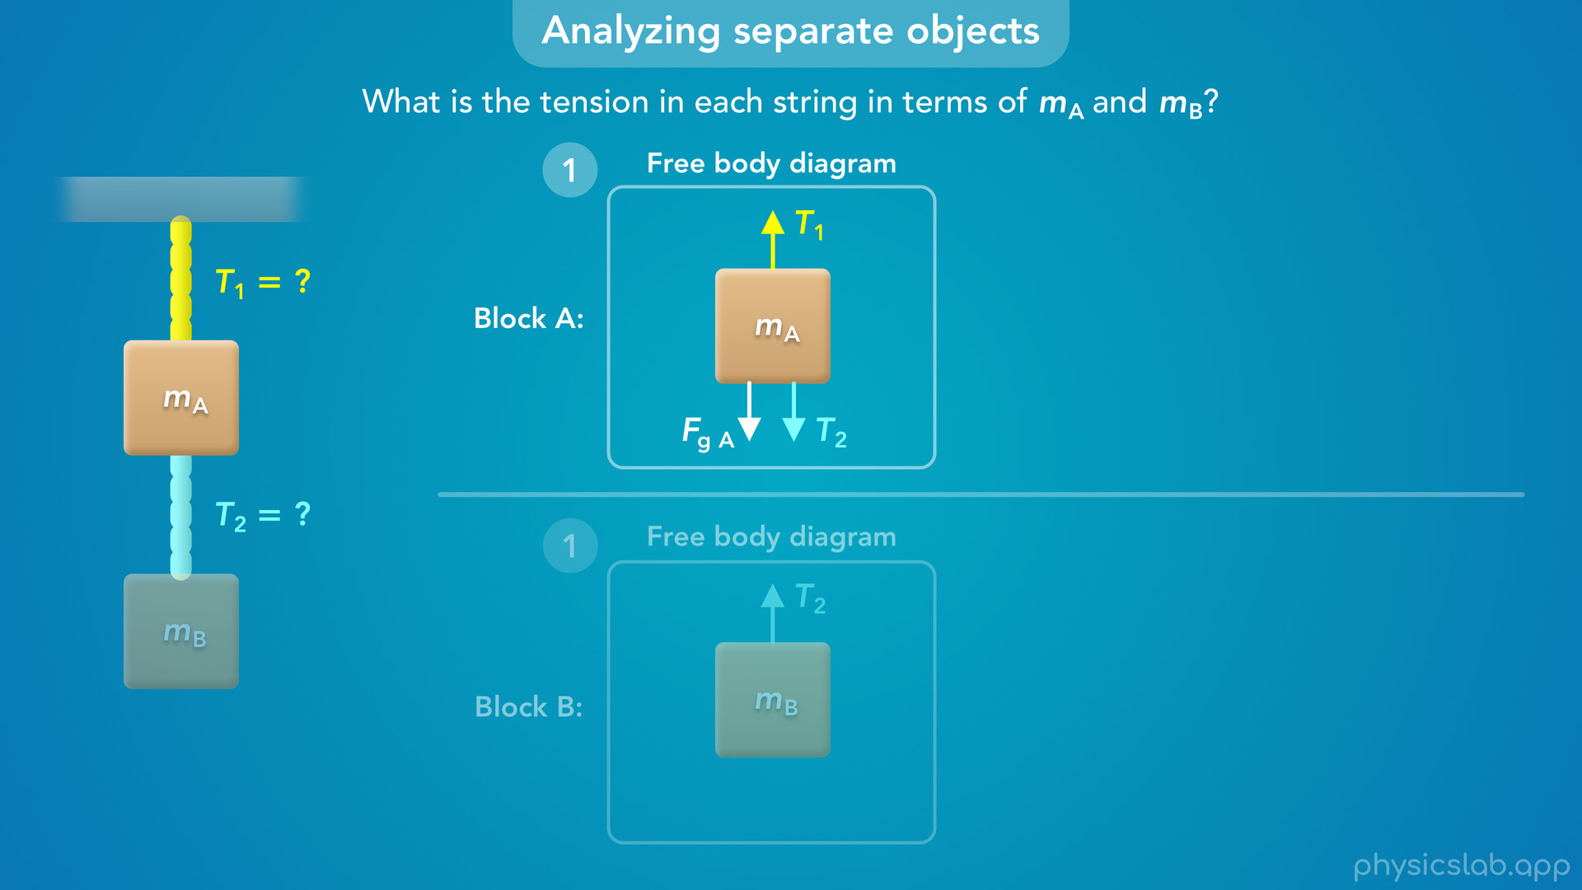
Notes:
• Block A has an upwards tension force T1, and a downwards tension force T2.
• It also has a downwards gravitational force, which we’ll call Fg A.

Slide 15
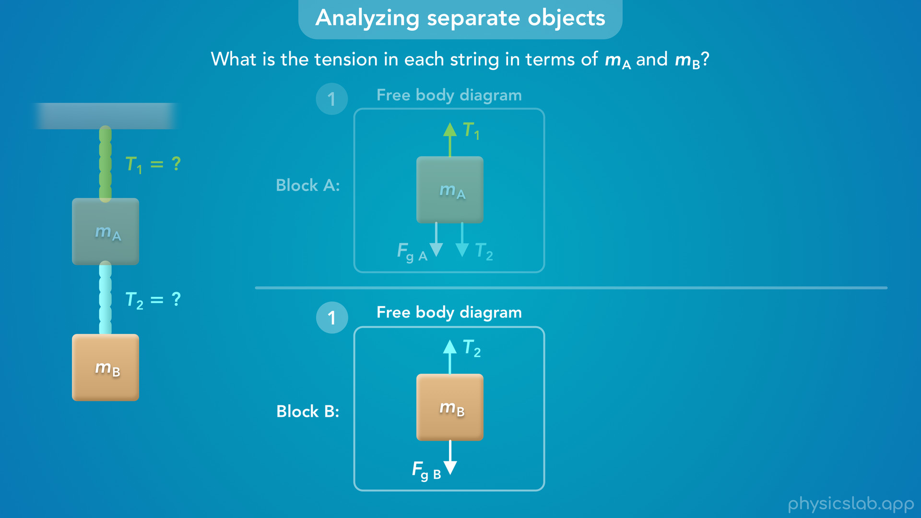
Notes:
• Block B has an upwards tension force T2, and a downwards gravitational force, Fg B.

Slide 16
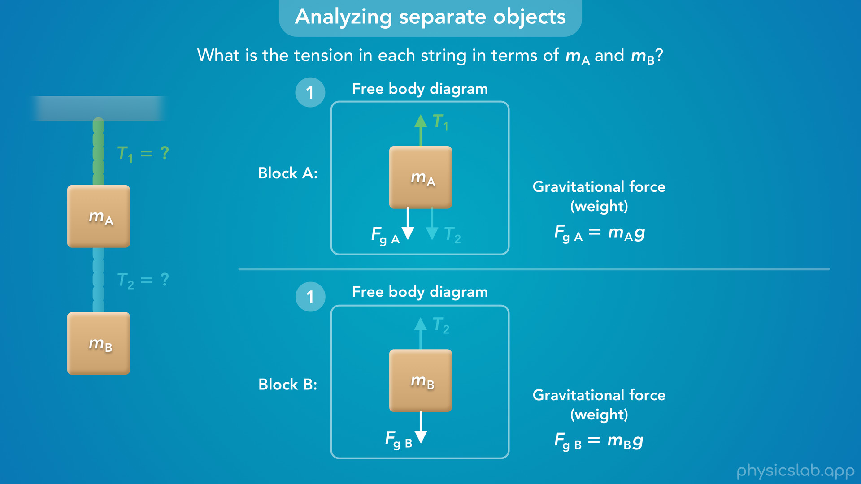
Notes:
• Keep in mind that Fg A and Fg B are the weights of each block.
• They’re not related, and they do not depend on the tension forces, or the other block.
• Also, we dont know the magnitudes of the forces, so the length of these vectors are not drawn to scale.

Slide 17
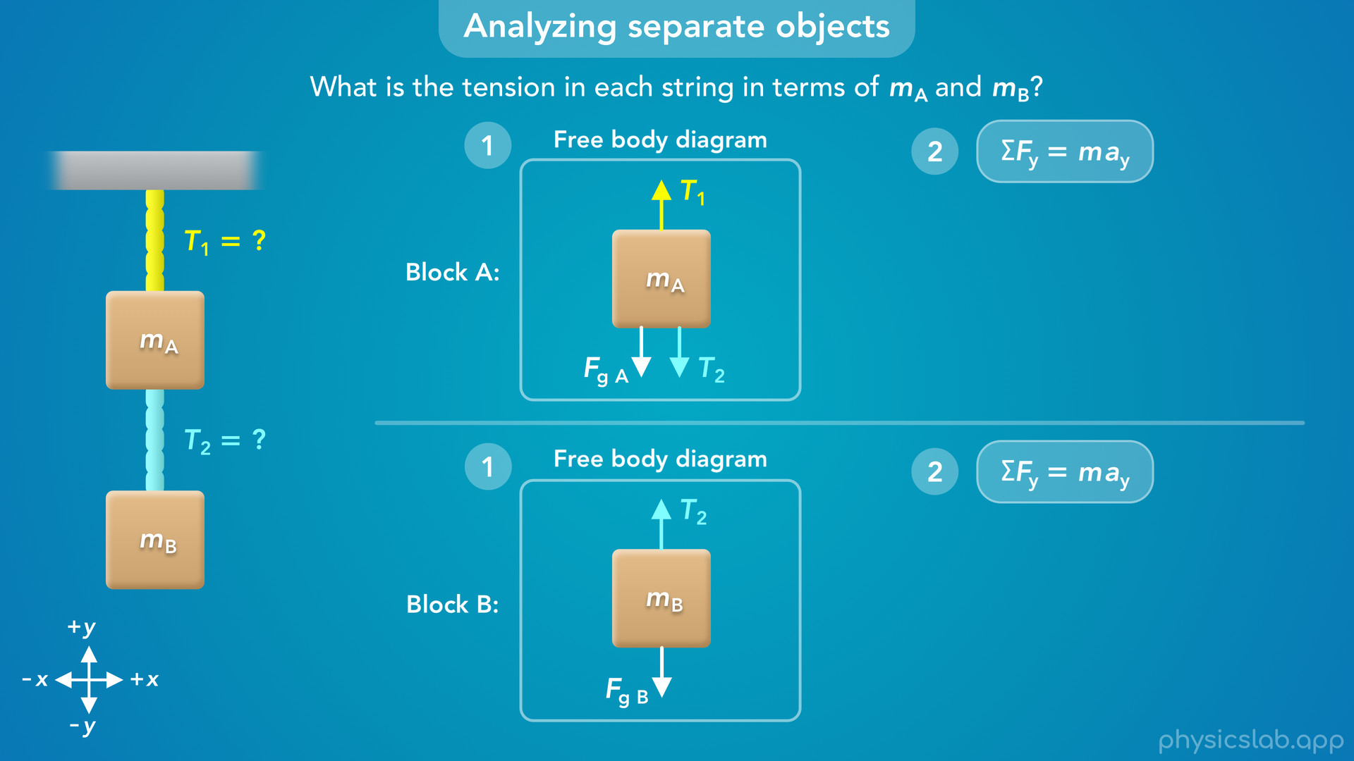
Notes:
• Alright so we have our free body diagrams.
• If we set up our coordinate system like this, we only have forces in the y direction.
• So the second step is to apply newton’s 2nd law in the y direction. And we’re going to do this for each block.

Slide 18
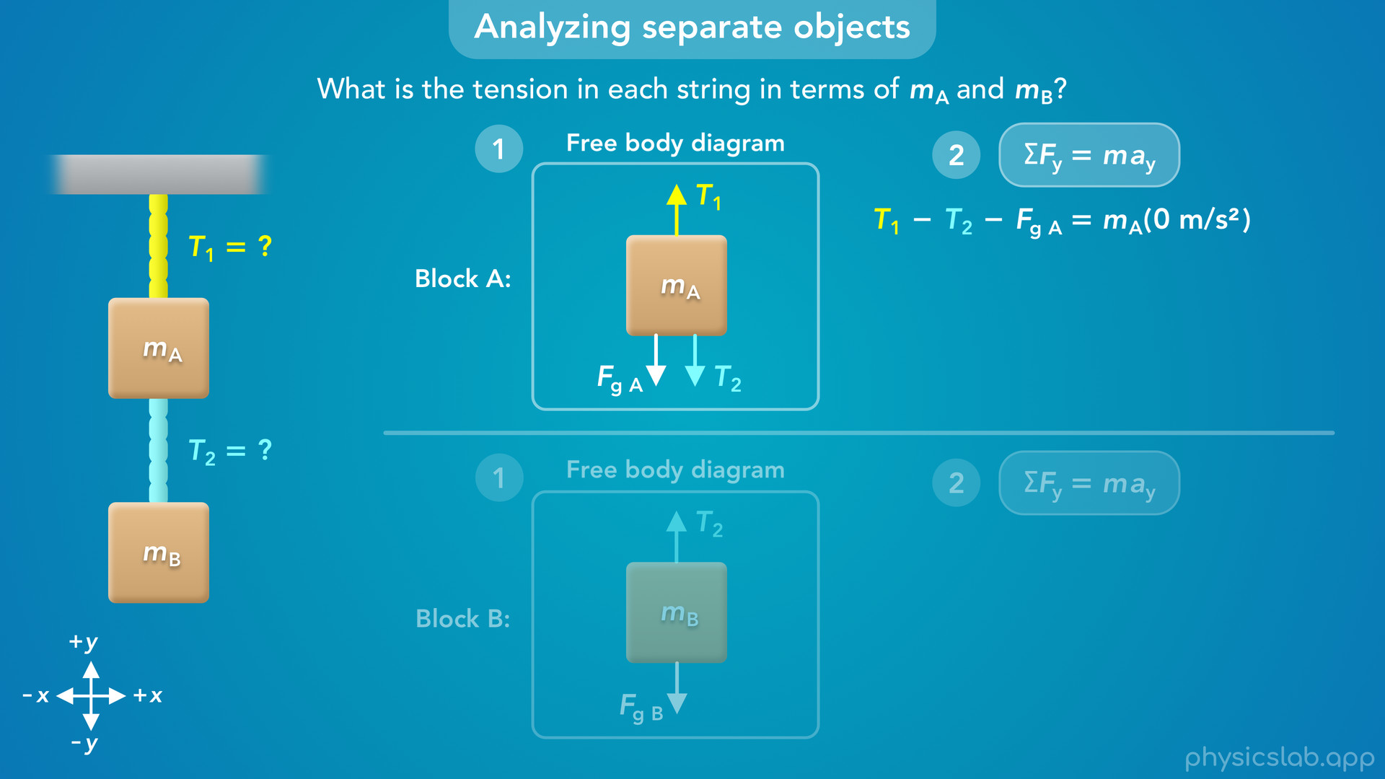
Notes:
• For block A, the net force would be T1 minus T2 minus FgA.
• The mass of block A is mA, but we can assume block A is at rest. It’s not moving, so the acceleration is zero.

Slide 19
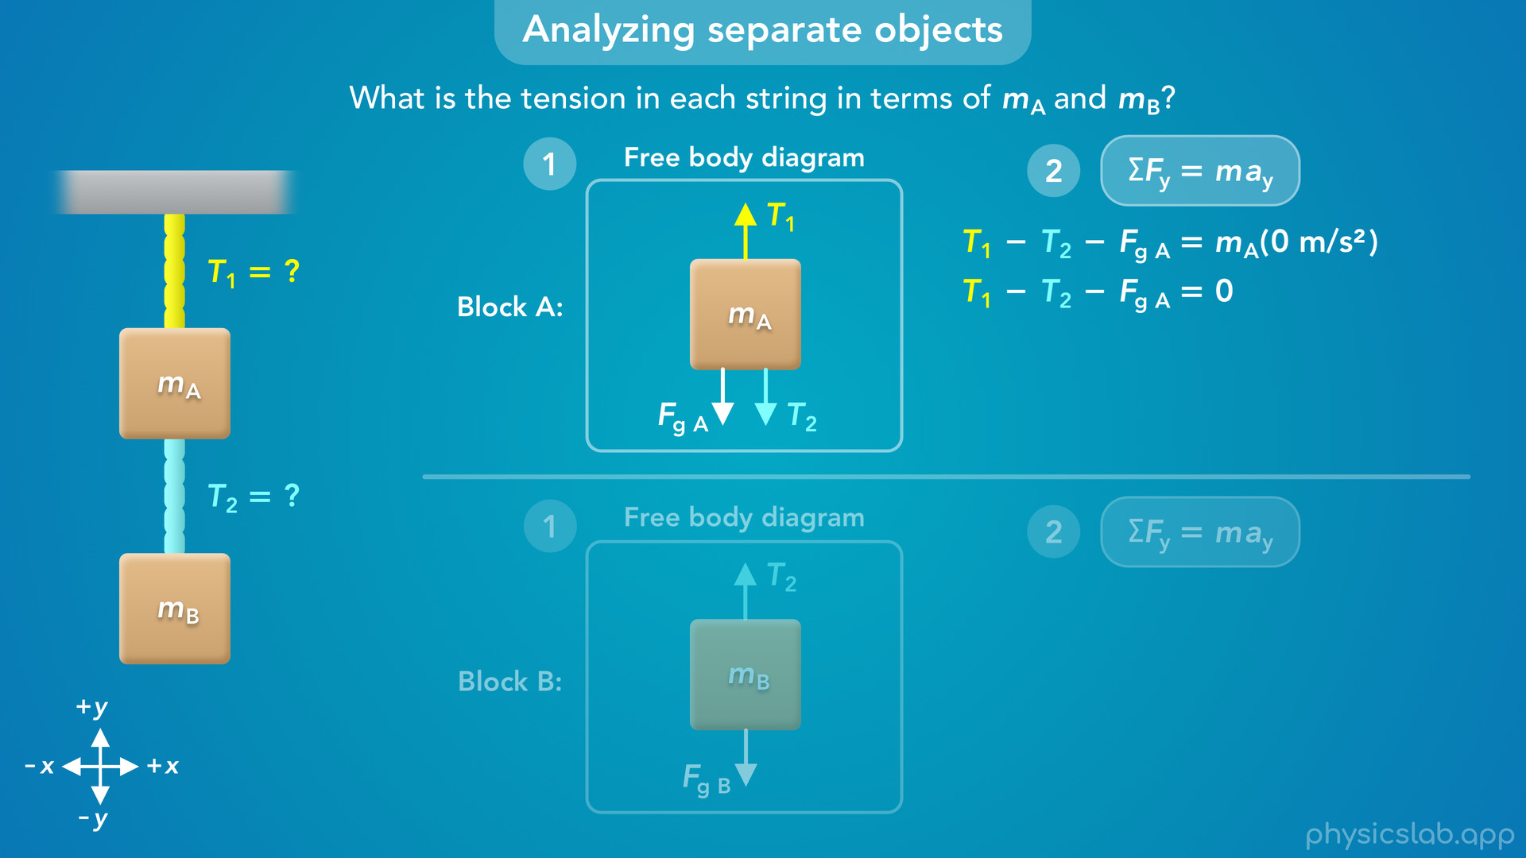
Notes:
• The right side becomes zero, and the net force on block A is zero.

Slide 20
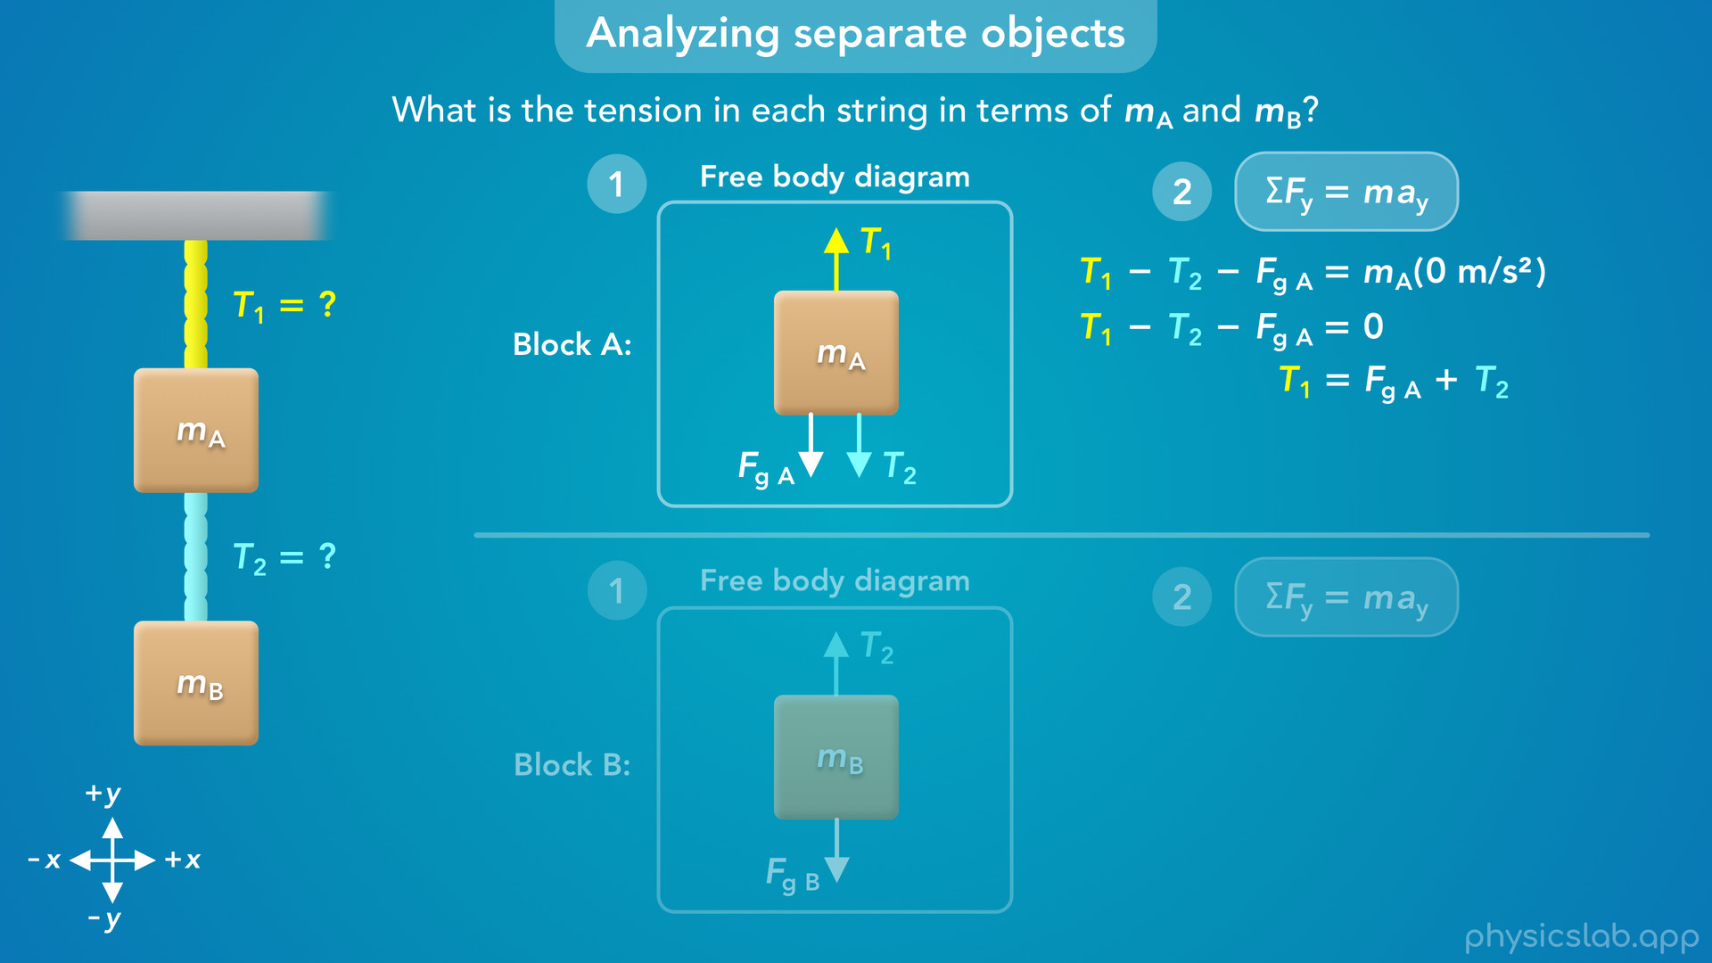
Notes:
• Next, let’s rearrange the equation so we only have T1 on the left.
• Now we can see that the upwards tension force T1 is equal to the downwards weight force plus the downwards tension force T2.
• Block A is at rest, so there is no net force, these forces are balanced.

Slide 21
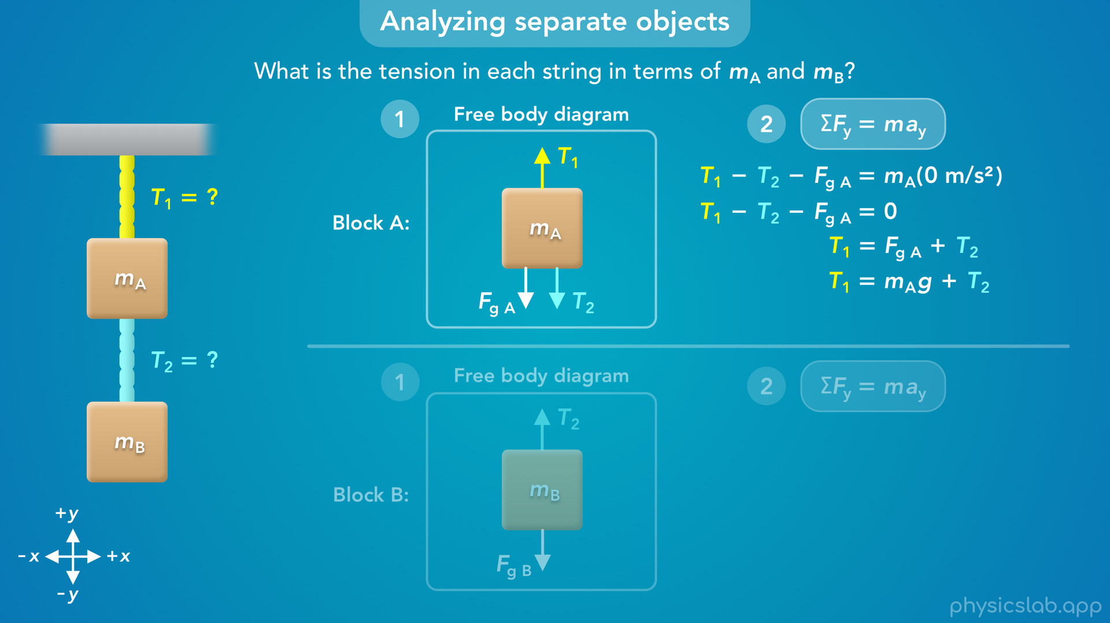
Notes:
• Next, can replace Fg A with mass A times g.
• But now, we have one equation with two unknown variables that we want to solve for, T1 and T2.
• So if we were given the masses, we still can’t solve for both tensions using this equation by itself.
• That means we have to apply Newton’s 2nd law to block B to get another equation.

Slide 22
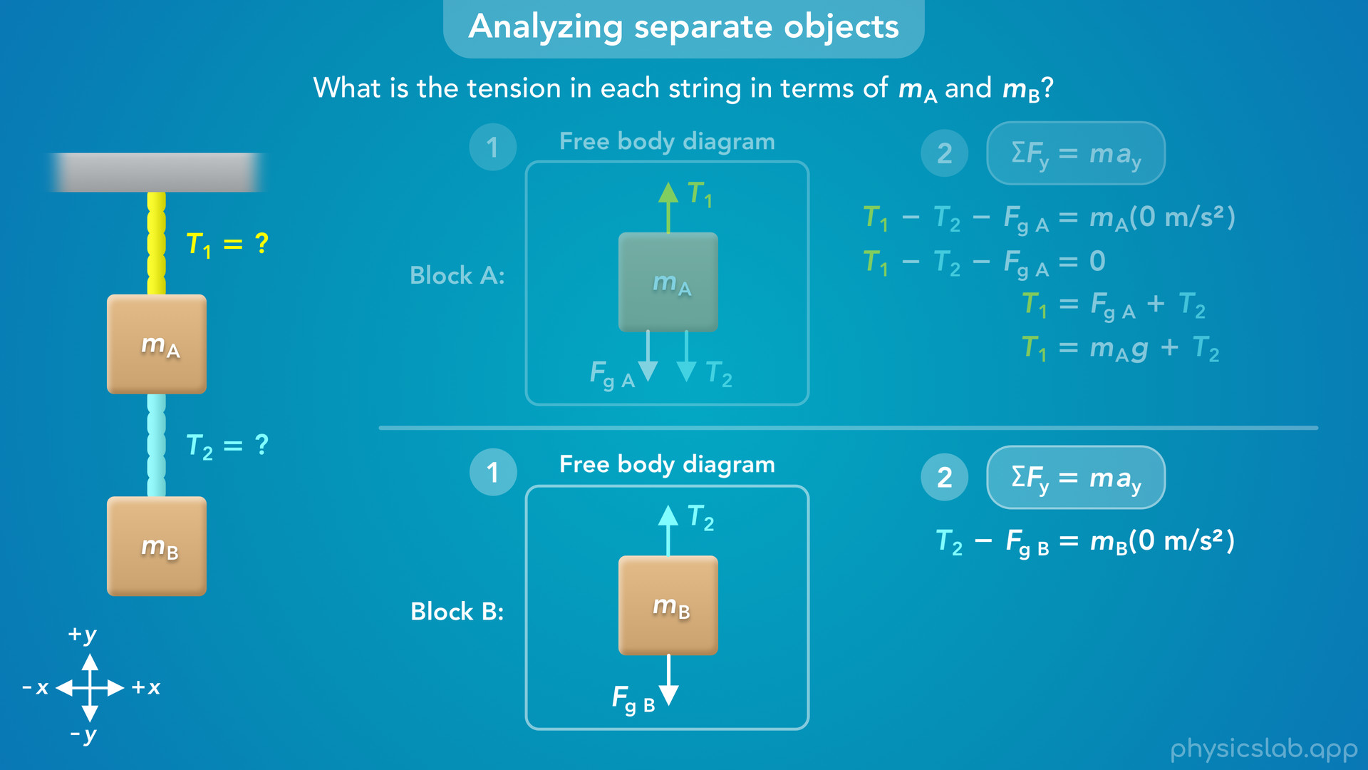
Notes:
• For block B, the net force is T2 minus Fg B, and we also assume block B is at rest so the acceleration is zero.

Slide 23
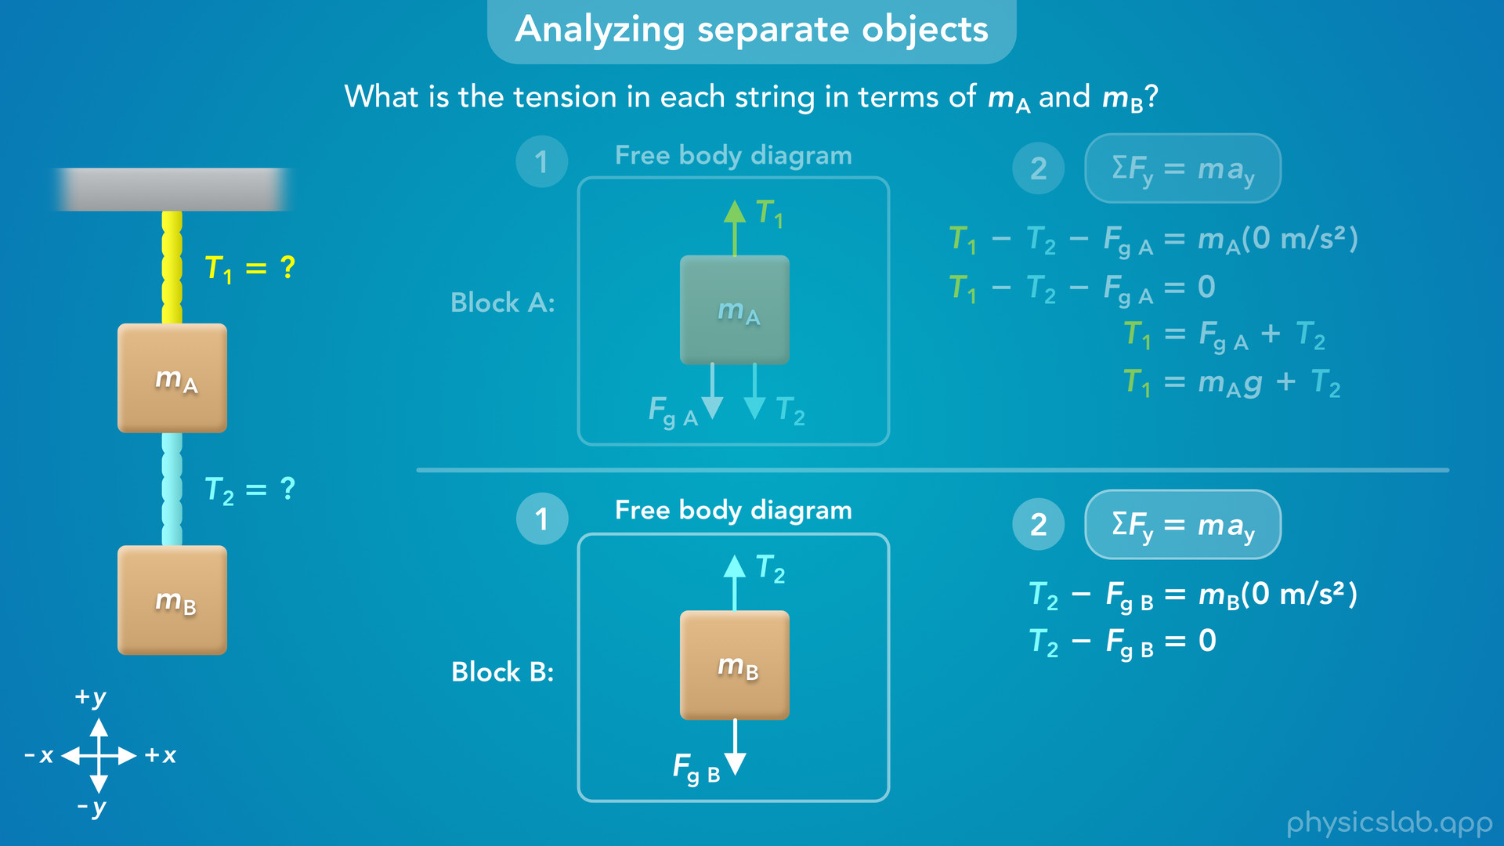

Slide 24

Notes:
• That means the upwards tension force T2 is equal in magnitude to the weight of block B, and these forces are balanced.

Slide 25
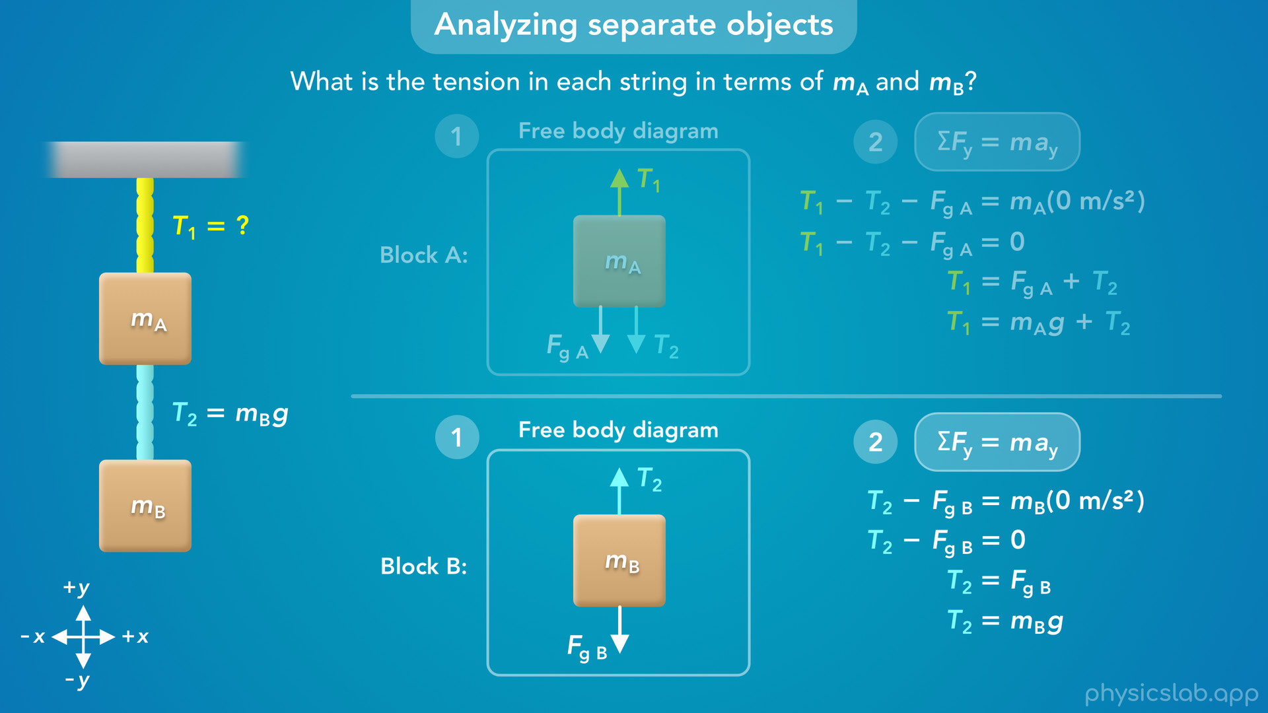
Notes:
• Now we can replace Fg B with mass B times g, and that’s our equation for the tension in string 2 in terms of the masses.
• Tension 2 only depends on the mass of block B, not block A.

Slide 26
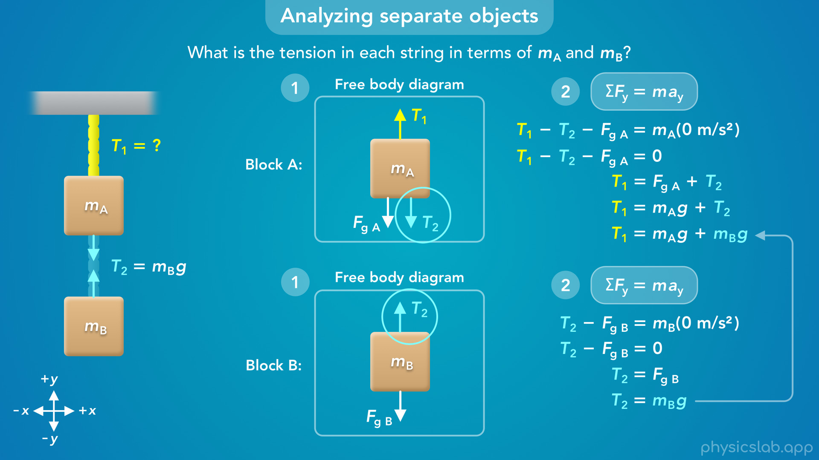
Notes:
• But what about the equation for T1?
• Now that we know T2 is equal to mass B times g, we can substitute *this* in place of T2 in this first equation.
• Why can we do that?
• Well, we’re assuming these are ideal strings, and string 2 is pulling on block A and block B with the same amount of force.
• So T2 has the same value for block A and block B, and we can substitute for T2 between these equations.

Slide 27

Notes:
• So, now we have equations for T1 and T2 in terms of mass A and mass B.
• These are the relationships between the tension in each string and the mass of each block.

Slide 28
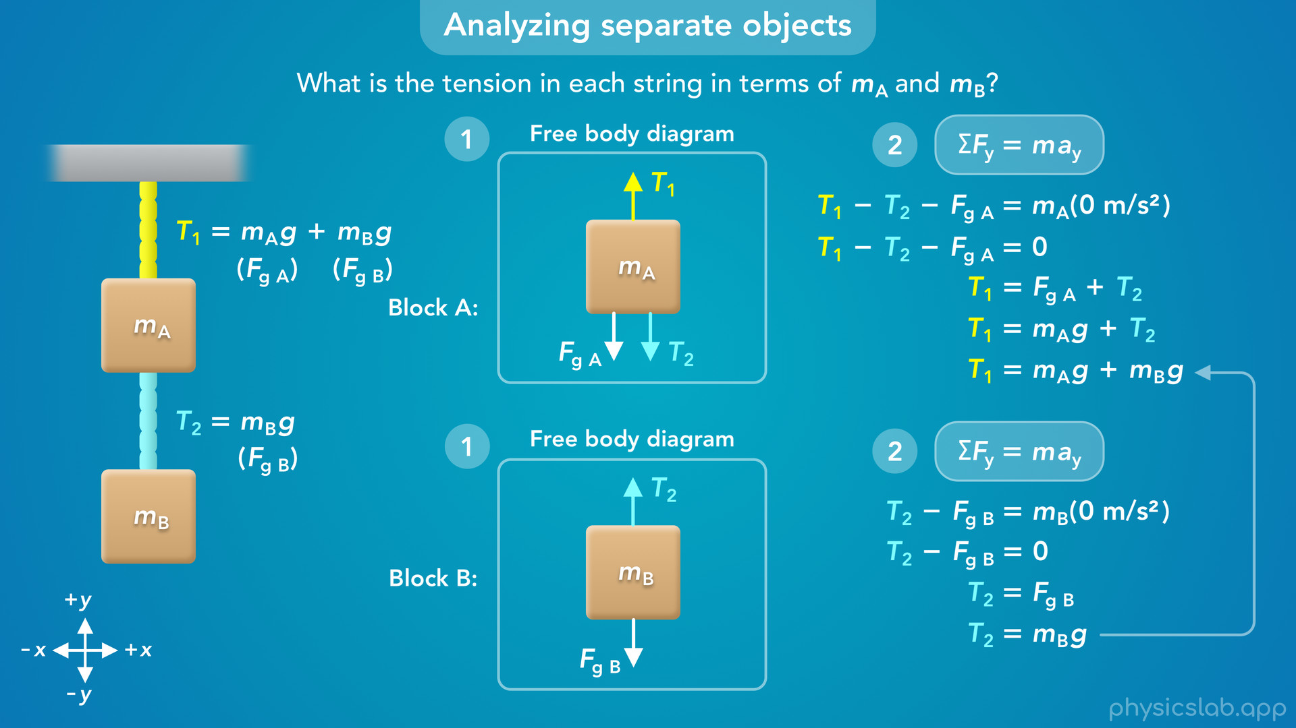
Notes:
• Notice that the tension in the bottom string, T2, is equal to the weight of block B.
• The bottom string only needs to support the weight of the block below it.
• But the top string needs to support the weight of both blocks, so T1, is equal to the weight of block A plus the weight of block B.

Slide 29
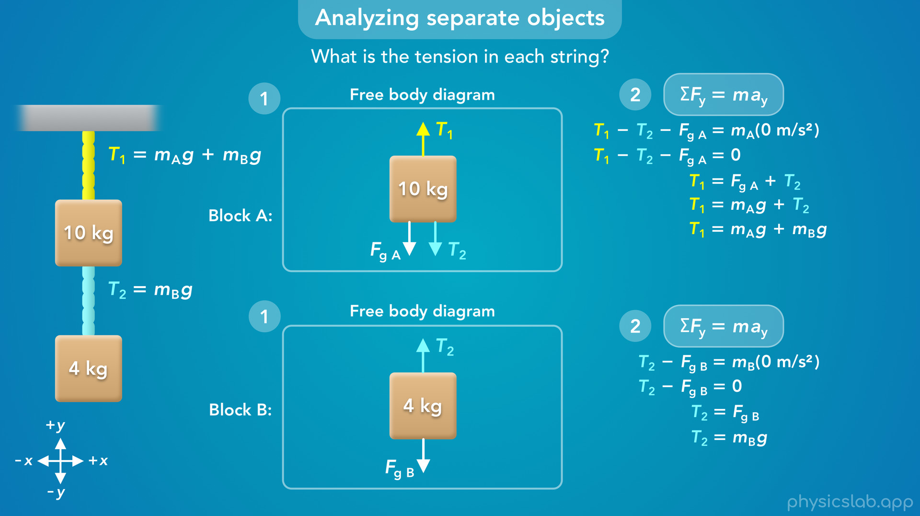
Notes:
• So now let’s plug in some numbers.
• If we’re told that block A has a mass of 10 kg and block B has a mass of 4 kg, we can plug those in to the equations we just found.

Slide 30
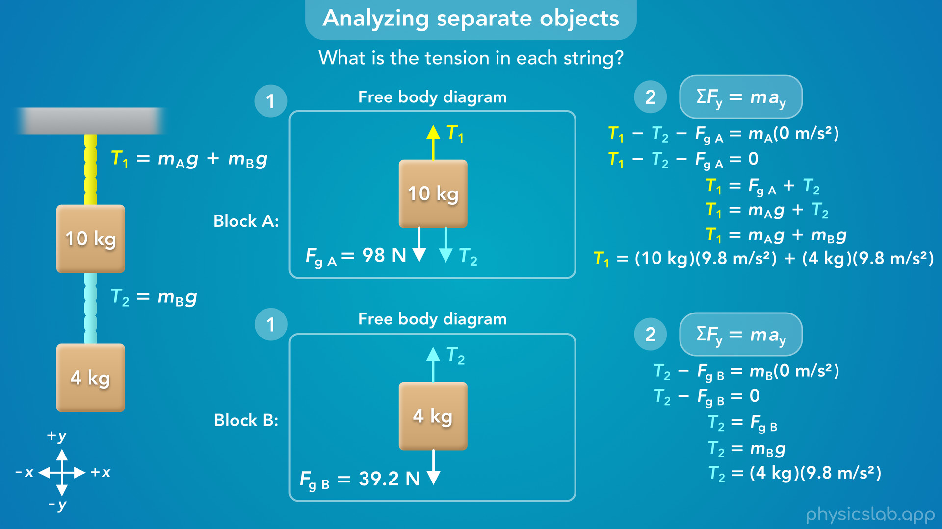

Slide 31
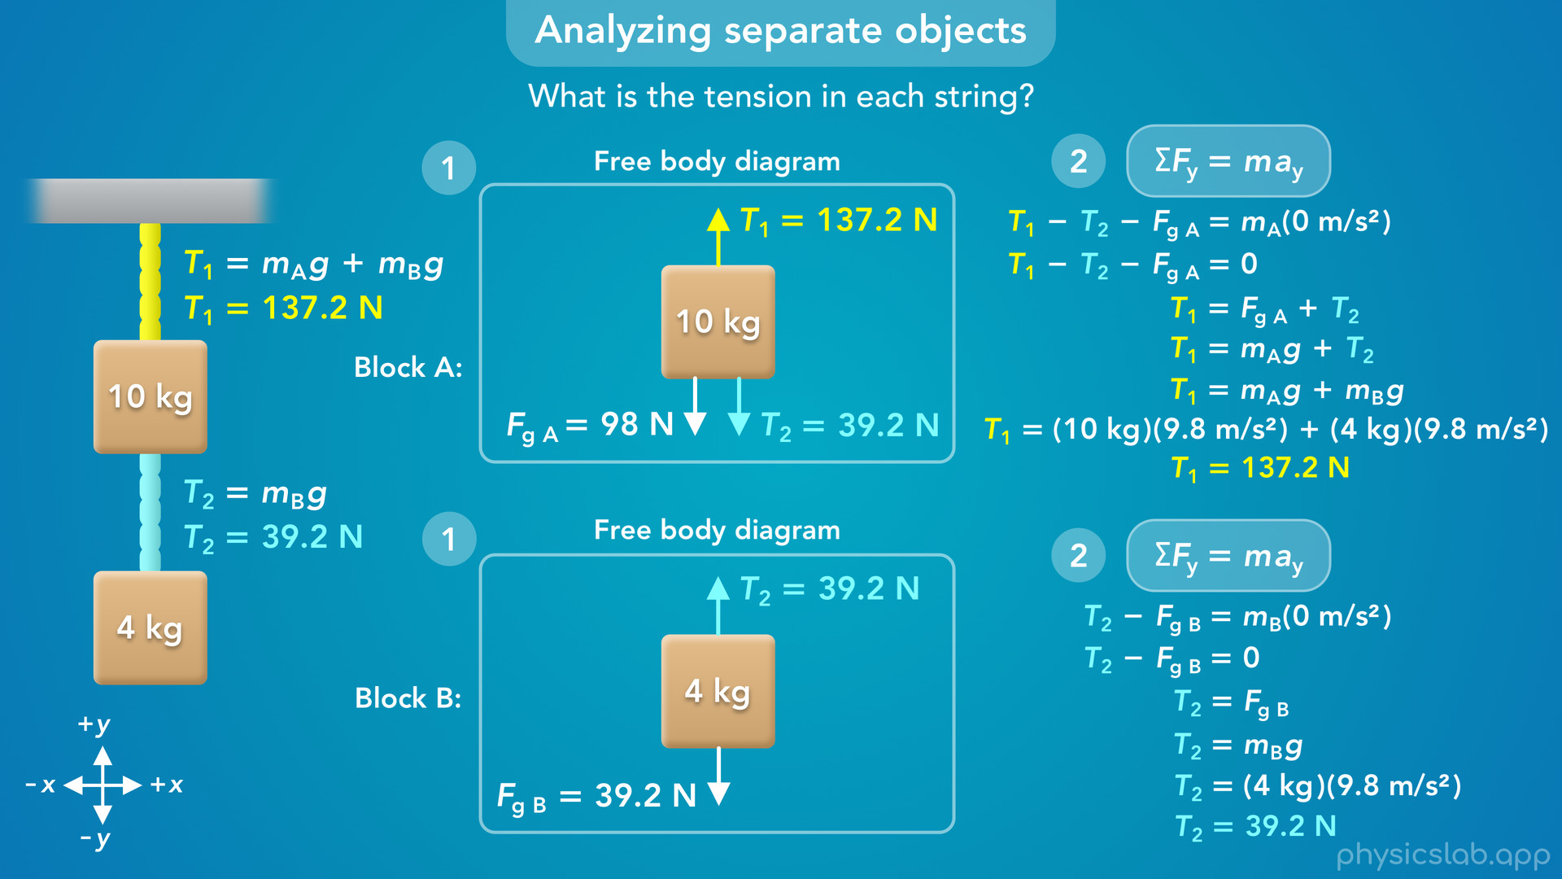
Notes:
• Tension 1 would be 137.2 N… and tension 2 would be 39.2 N.
• The weight of the 10 kg block would be 98 N, and the weight of the 4 kg block would be 39.2 N.

Slide 32
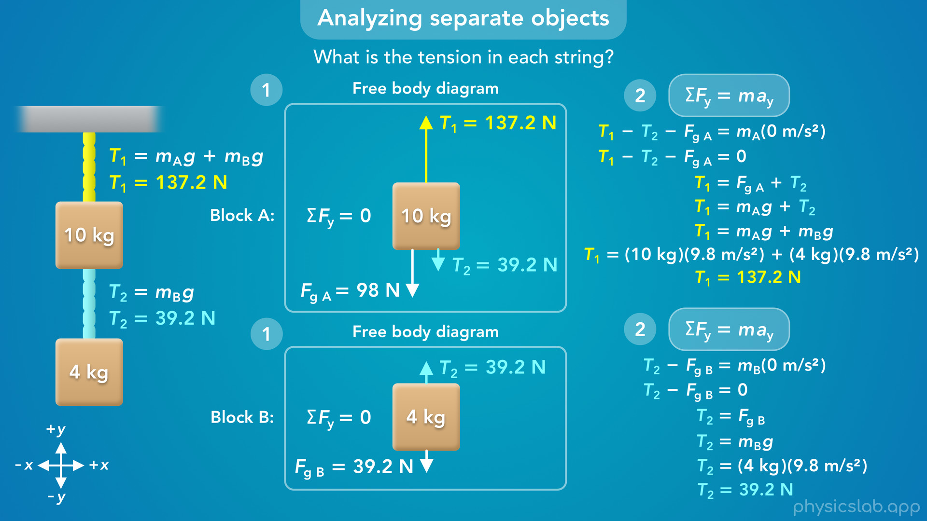
Notes:
• If we drew the length of the force vectors to scale, they would actually look like this.
• Let’s take another look at how the forces are related.
• Each block is at rest so the net force on each block is zero.
• Tension 2 is equal to the weight of the bottom block… and that same amount force is pulling down on the top block, because they’re connected by an ideal string.
• The top block also has its own weight, so tension 1 needs to balance the weight of the top block plus tension 2.
• That means tension 1 is supporting the weight of both blocks. It would also have to support the weight of the bottom string if it had mass, but we’re assuming these are ideal strings with no mass.

Slide 33
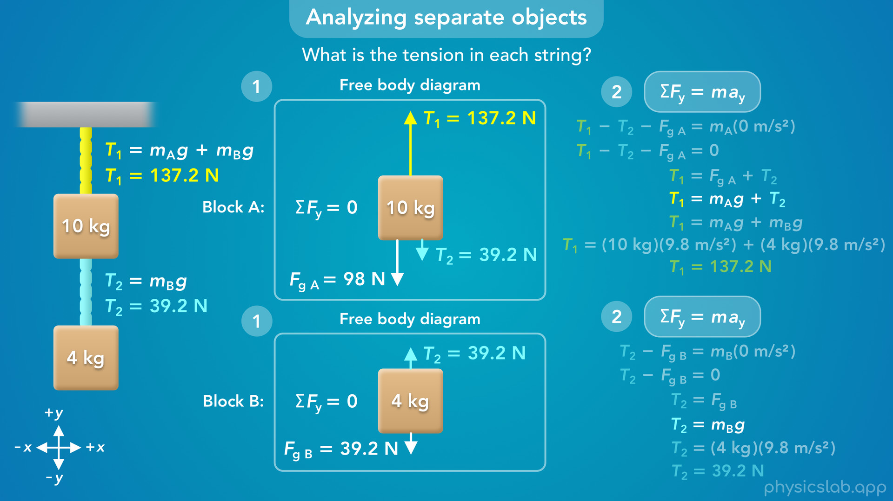
Notes:
• So to recap, the question asked us to find the tension in each string.
• We drew a free body diagram and applied Newton’s 2nd law to each block separately.
• Since there were two unknown variables, T1 and T2, we needed two equations to be able to solve for them.

Slide 34
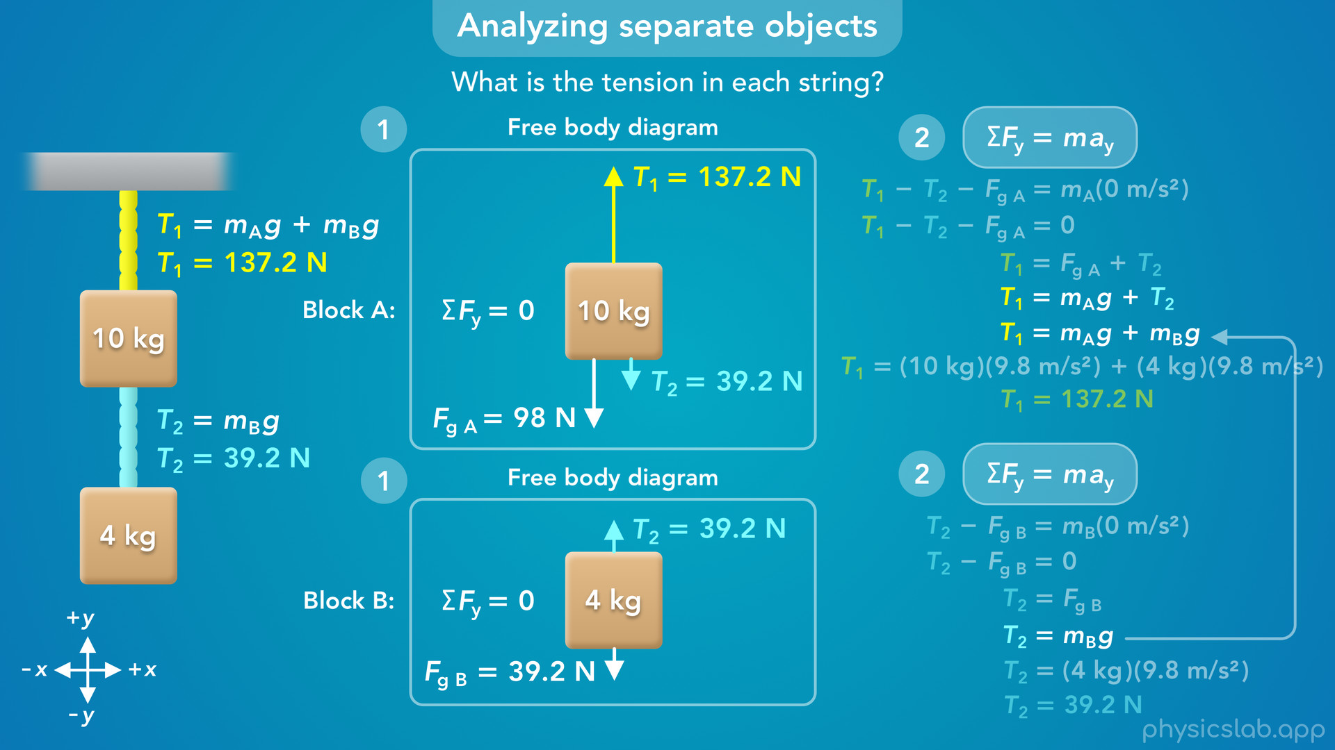
Notes:
• Even though Newton’s 2nd law applies to each block independently, string 2 is applying the same amount of tension force to both blocks, so we could take the equation for T2 from the bottom block, and substitute that in place of T2 for the top block.

Slide 35
Notes:
• That let us solve for the tension in each string.

Slide 36

Notes:
• But what if the question only asked us to find the tension in the top string, T1.
• Would we solve it the same way?
• We could, but maybe there’s a way to simplify things.

Slide 37
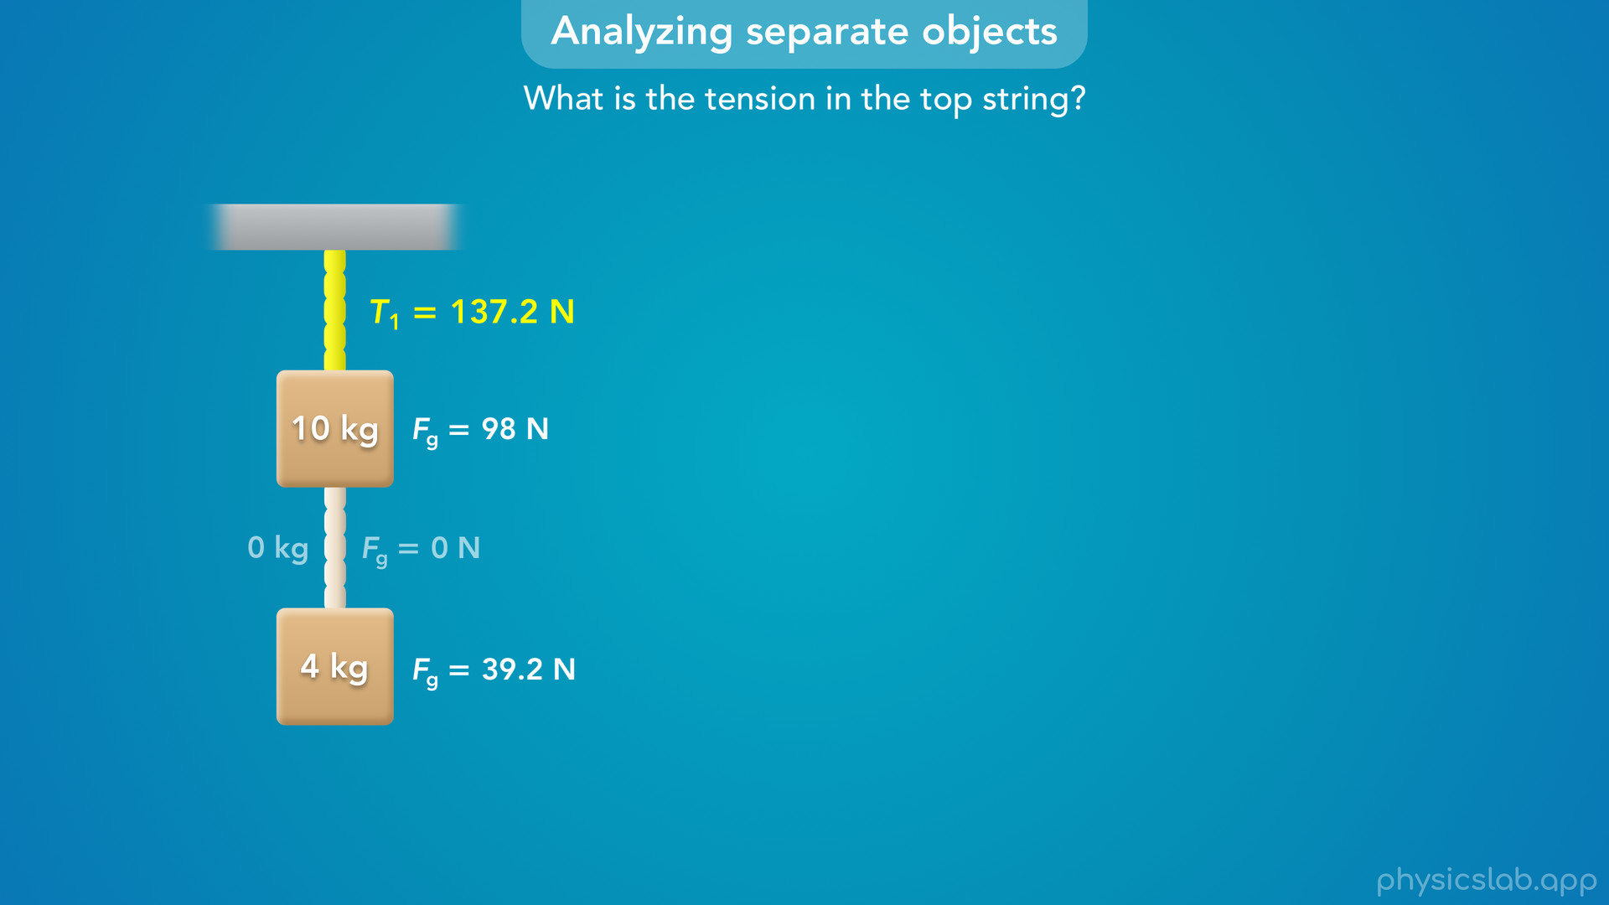
Notes:
• Remember that we said the tension in the top string needs to hold up the weight of both blocks.
• But does it matter that the blocks are connected by another string?

Slide 38
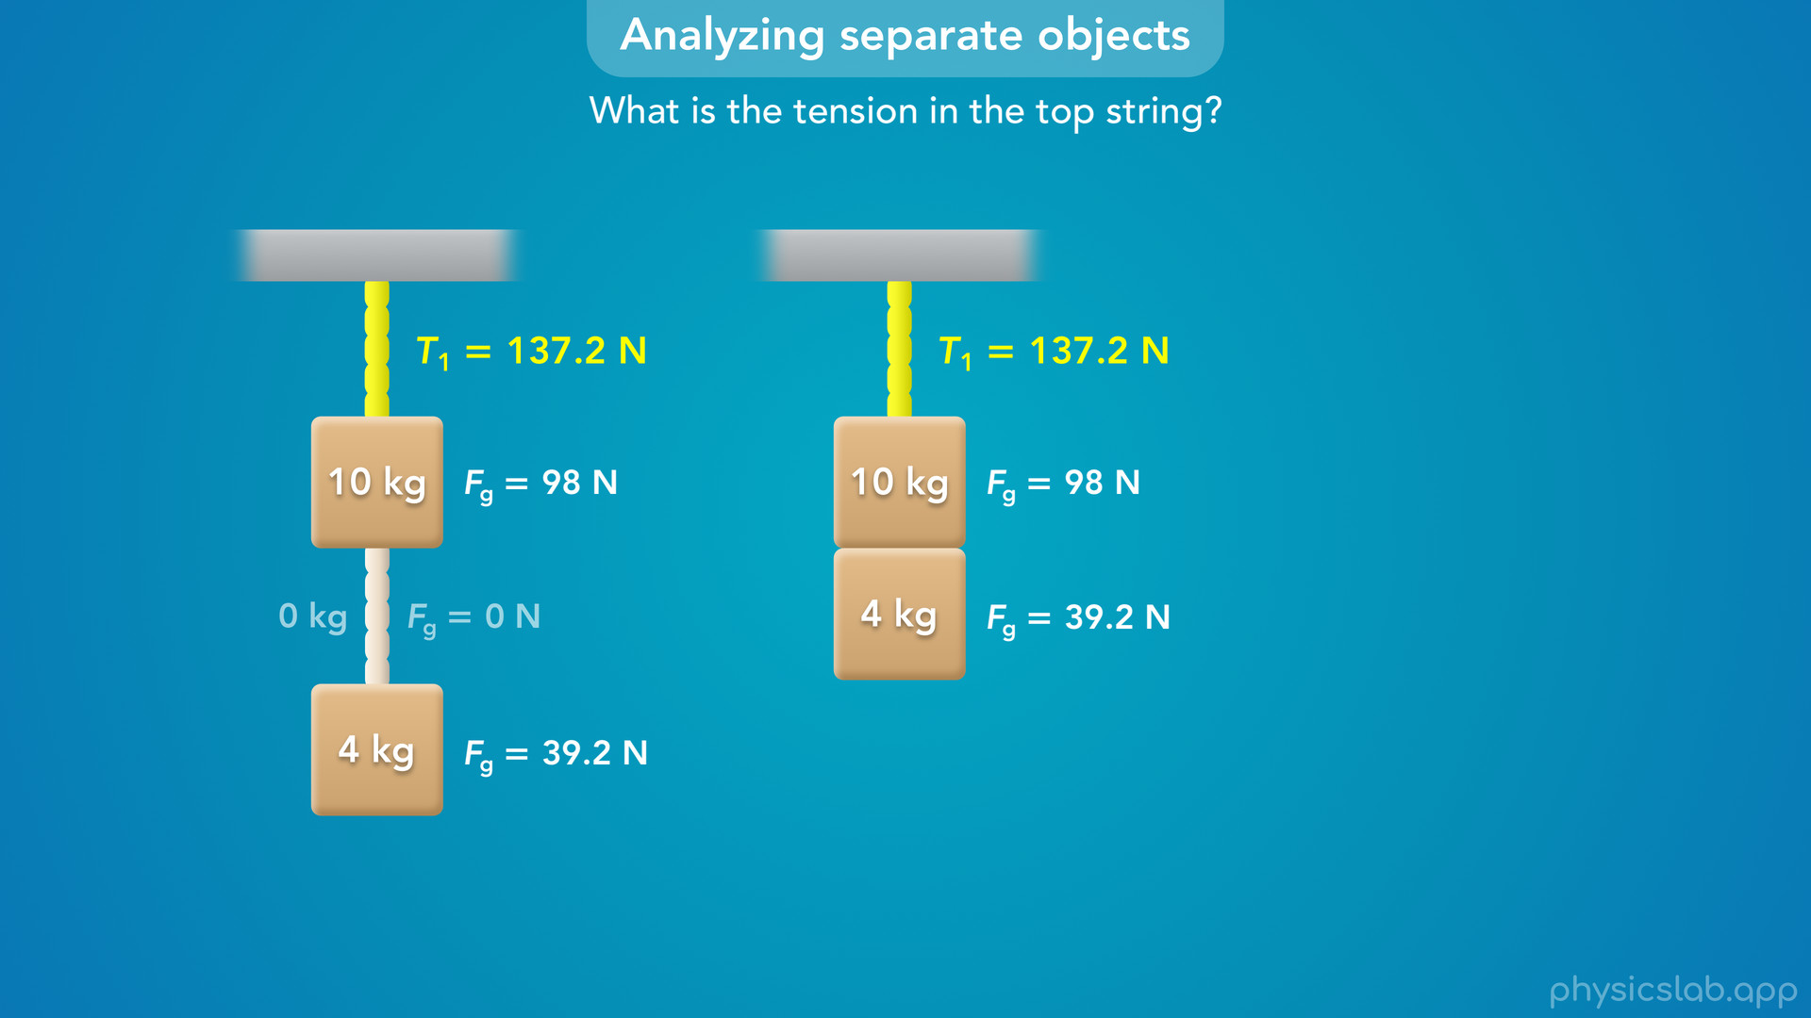
Notes:
• If the blocks were just glued together, the tension in the top string would still be the same, because it’s still holding up the same amount of weight.

Slide 39
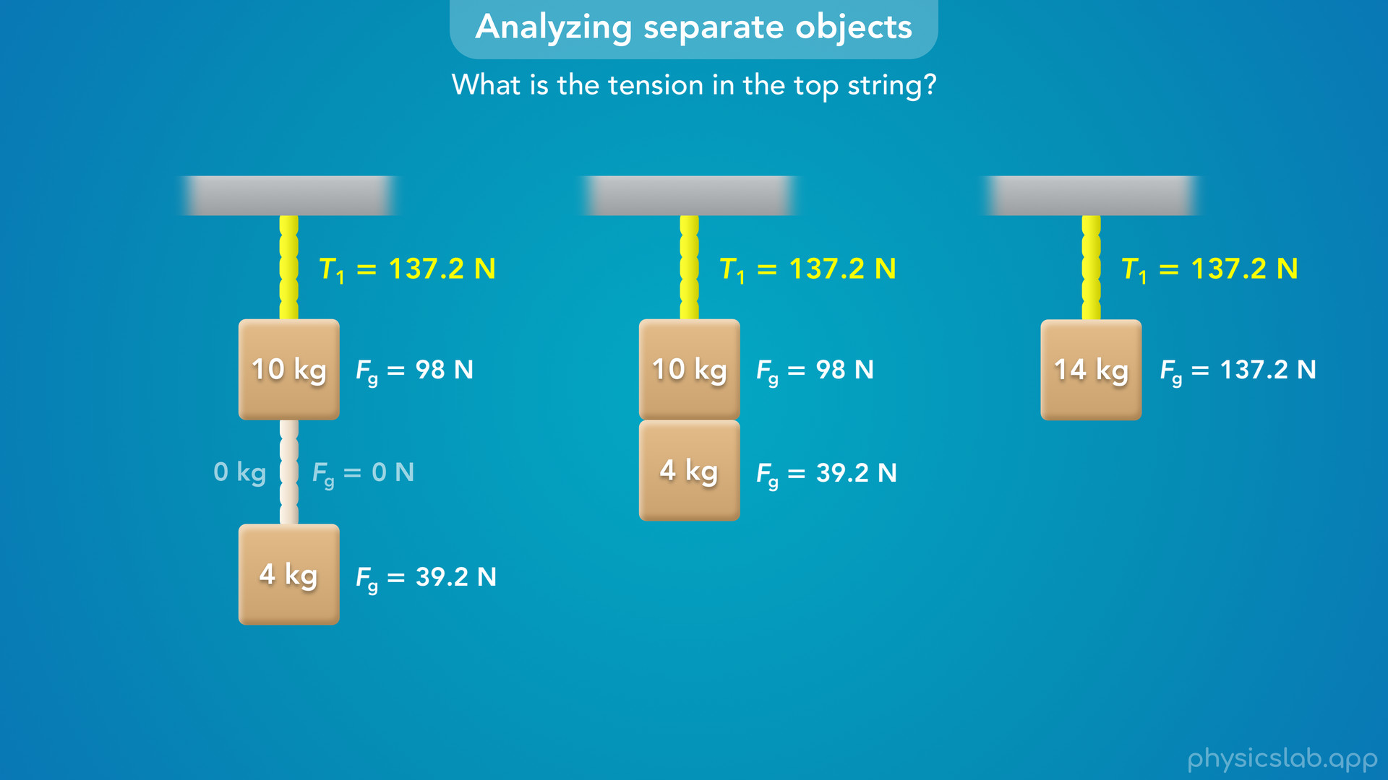
Notes:
• What if we only had one block with the same total mass of 14 kg?
• The tension would still be the same, because it still has to hold up the same amount of weight.

Slide 40
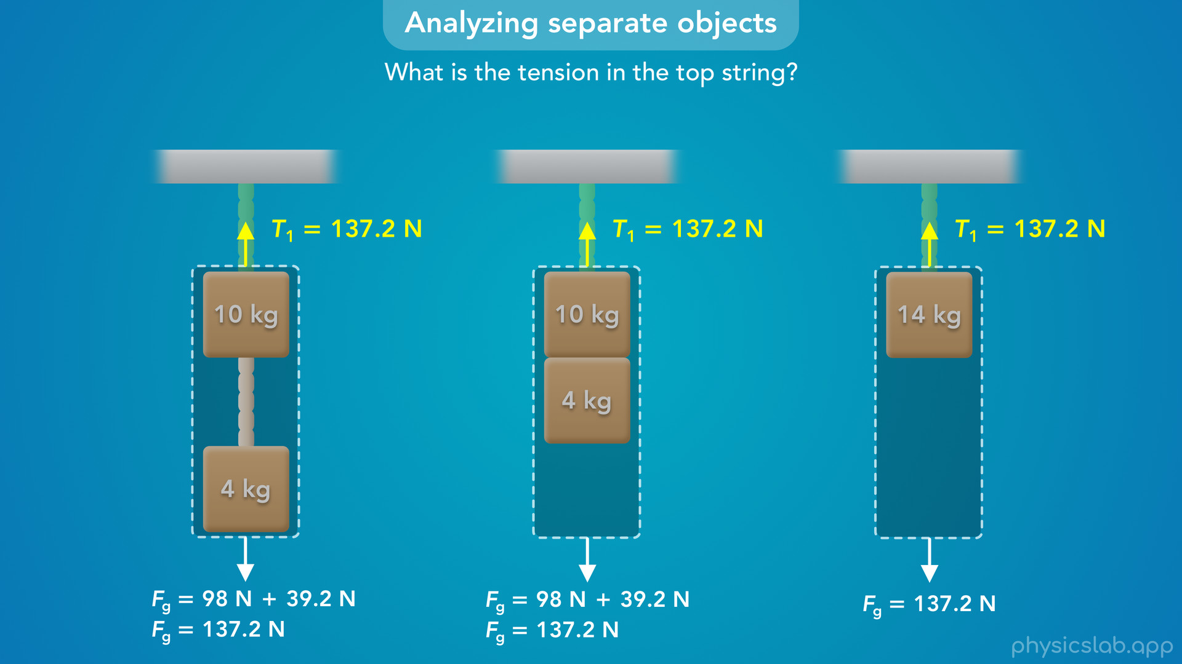
Notes:
• The top string doesn’t really know what it’s holding up, it only feels a downwards weight force from the total amount of mass that’s attached to it.
• And if the blocks are not moving, then the upwards tension force from the top string must be equal to the *total* downwards weight force from the blocks.

Slide 41
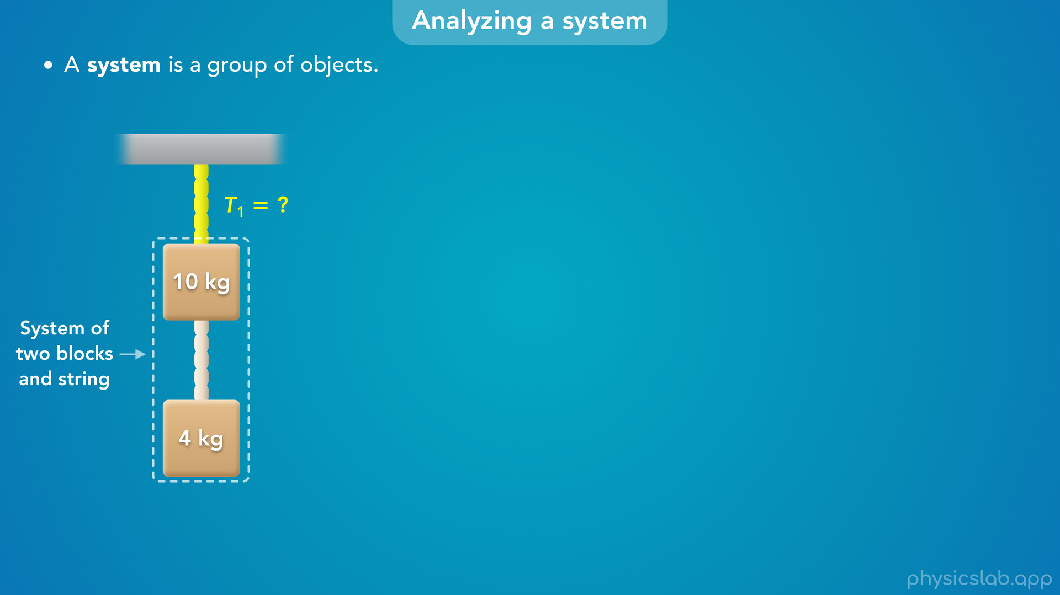
Notes:
• So instead of analyzing each block separately, we’re going to analyze the system of the two blocks and the bottom string.
• A system is just a group of objects, and we can represent it with this boundary line.

Slide 42
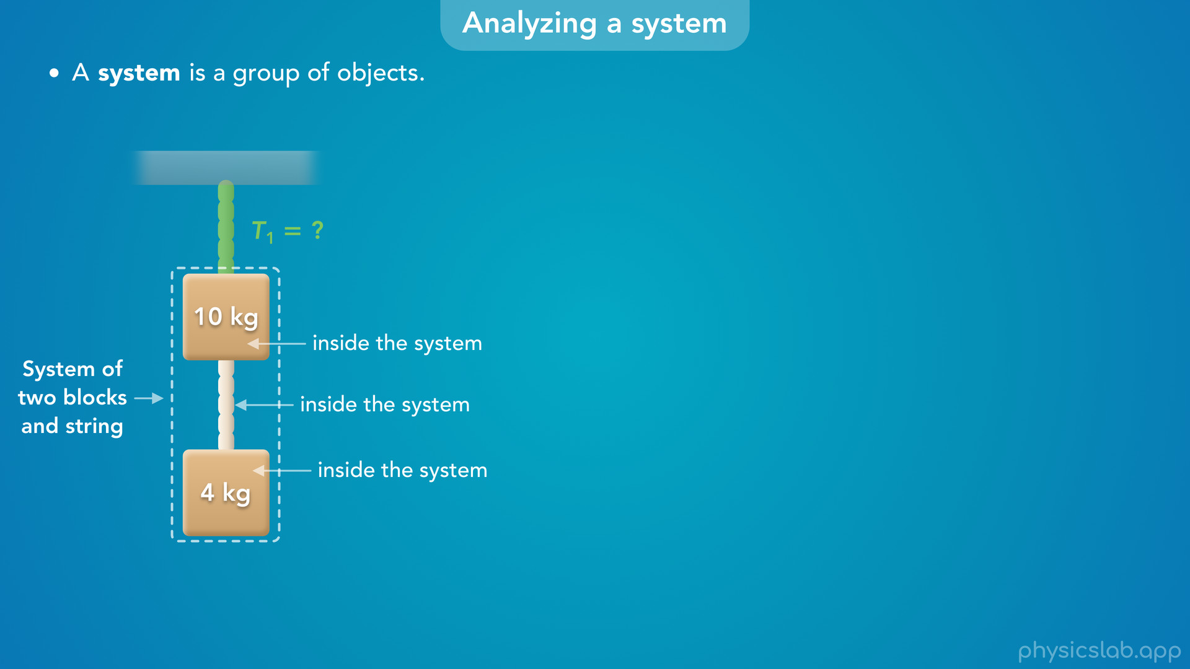
Notes:
• We’re deciding that the 10 kg block, the bottom string and the 4 kg block are inside the system.

Slide 43
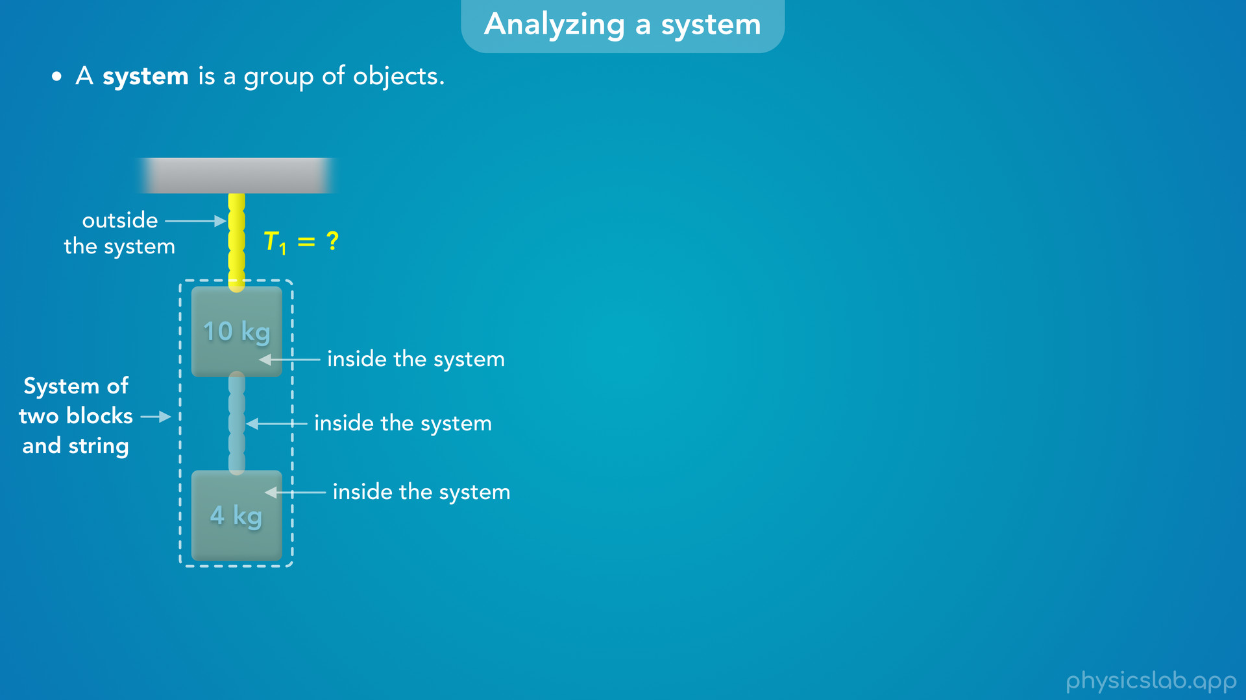
Notes:
• That means the top string, and everything else, is outside the system.

Slide 44
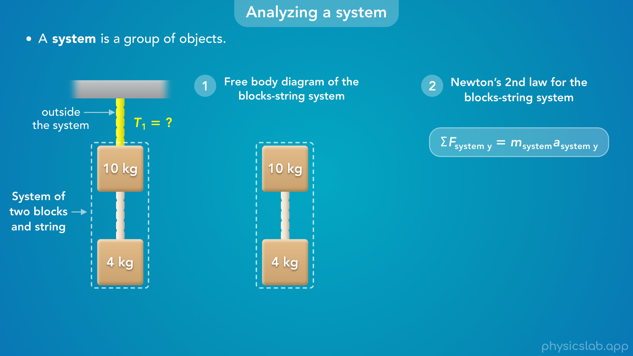
Notes:
• Now, we can draw a free body diagram of the system… and we can apply Newton’s 2nd law to the system as a whole.
• So what forces are acting on this system?

Slide 45

Notes:
• There’s an upwards tension force T1 from the top string… there’s a downwards gravitational force on the 10 kg block, which we’ll call Fg 10… and a downwards gravitational force on the 4 kg block, Fg 4.

Slide 46
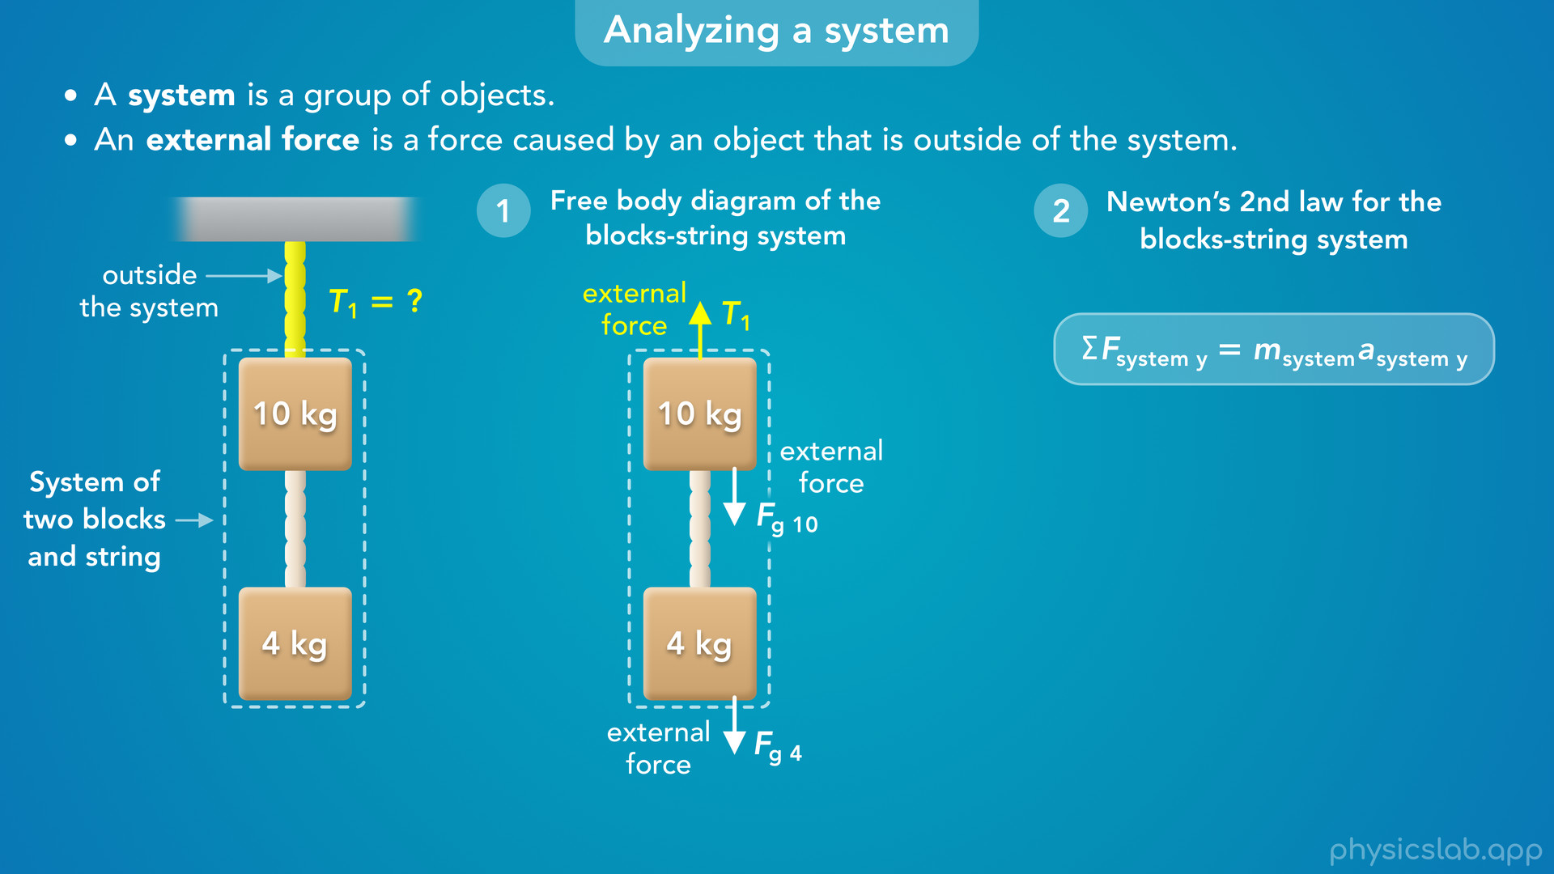
Notes:
• These are the only external forces that are acting *on* this system.
• An external force is a force caused by an object that outside of the system.

Slide 47
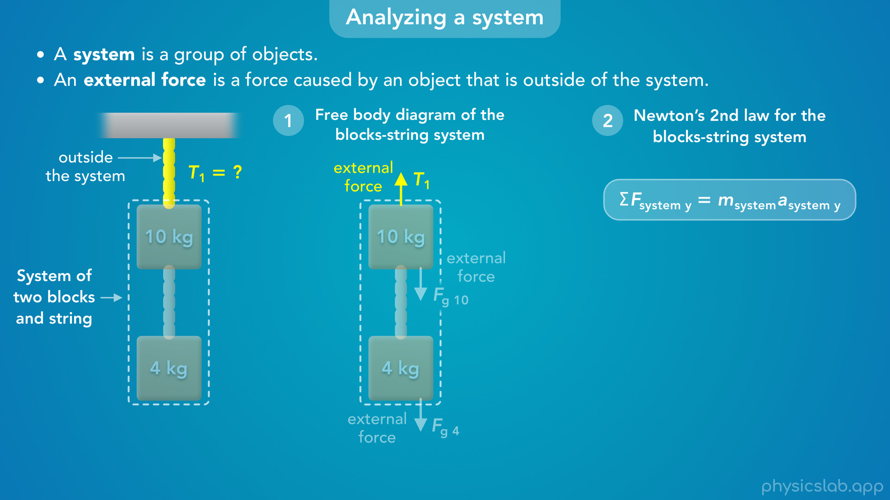
Notes:
• The top string is outside the system, so T1 is an external force that’s being exerted on this system.

Slide 48
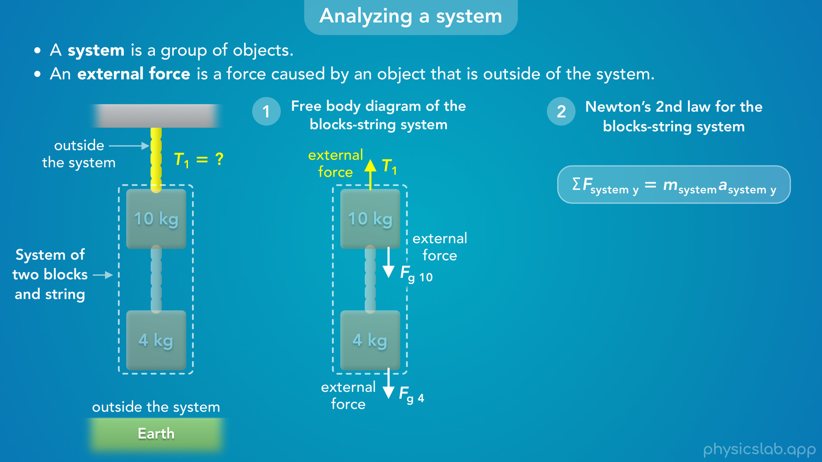
Notes:
• The gravitational forces are caused by the earth, which is also outside the system, so these are external forces.

Slide 49
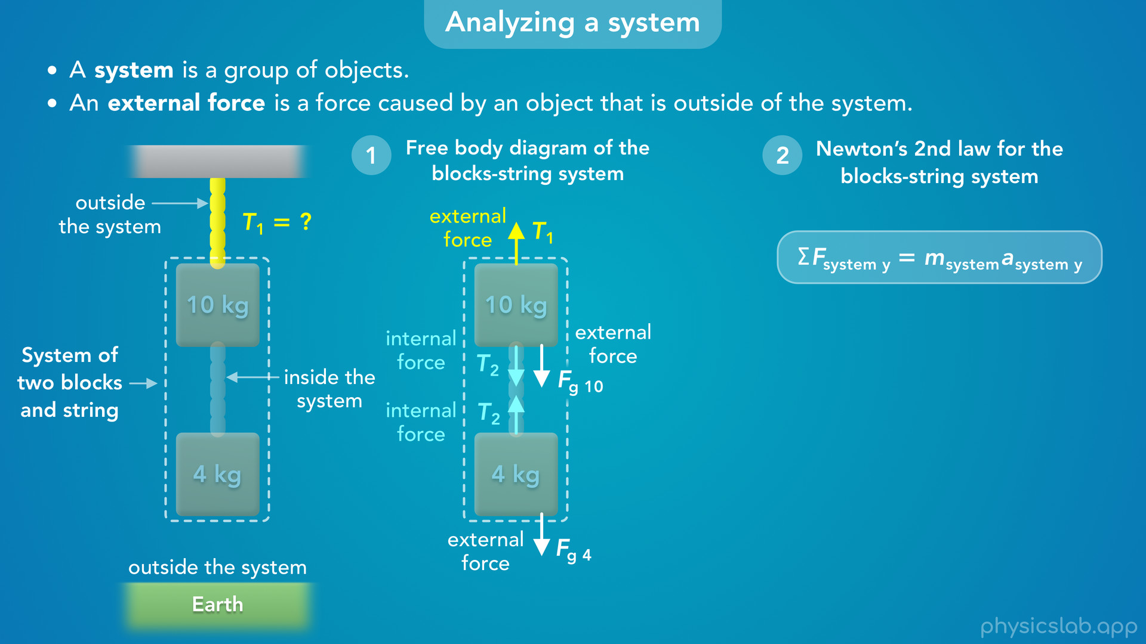
Notes:
• But what about T2, the tension forces acting on the blocks from the bottom string?
• Well, the bottom string is inside the system, so these would be internal forces.

Slide 50
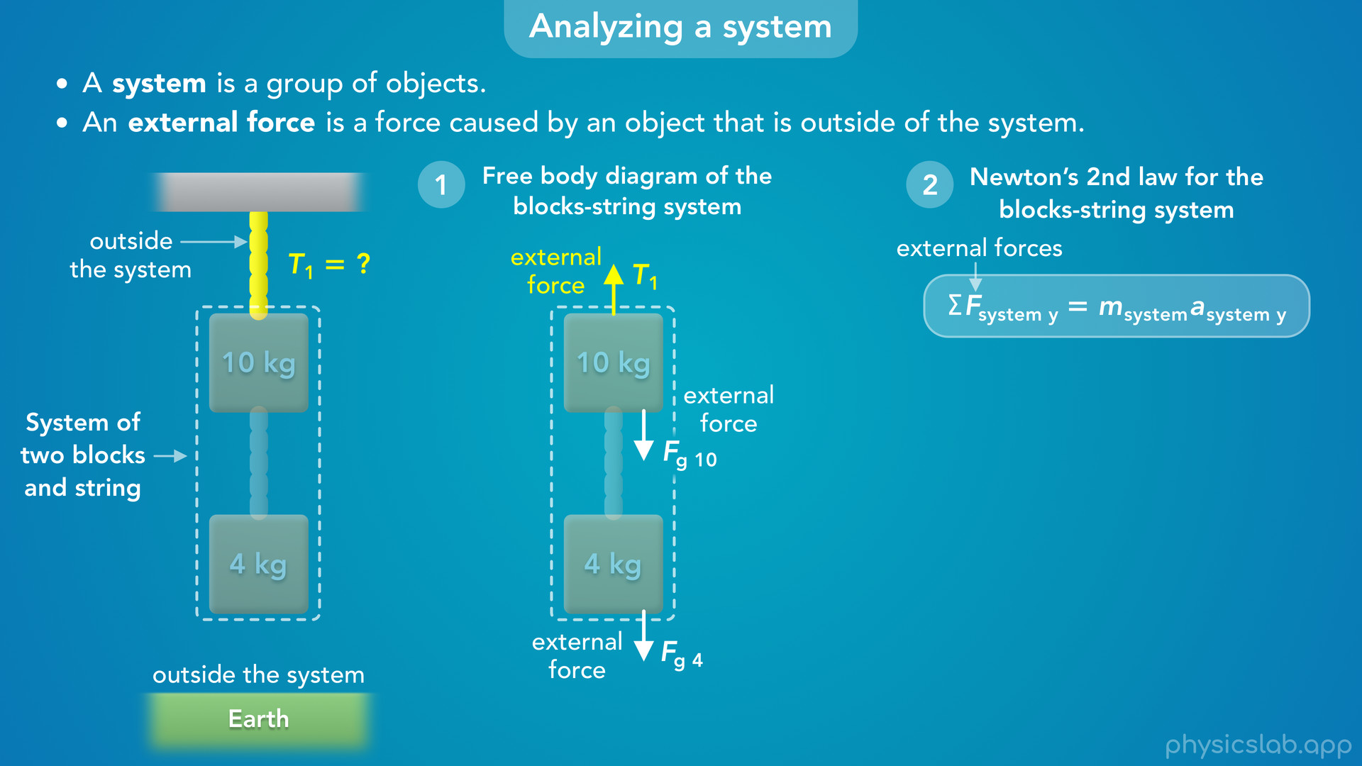
Notes:
• Now, when we apply Newton’s 2nd law to a system, the net force only includes the external forces acting *on* the system, so we’re going to ignore the internal forces, and T2 will not show up in Newton’s 2nd law.

Slide 51
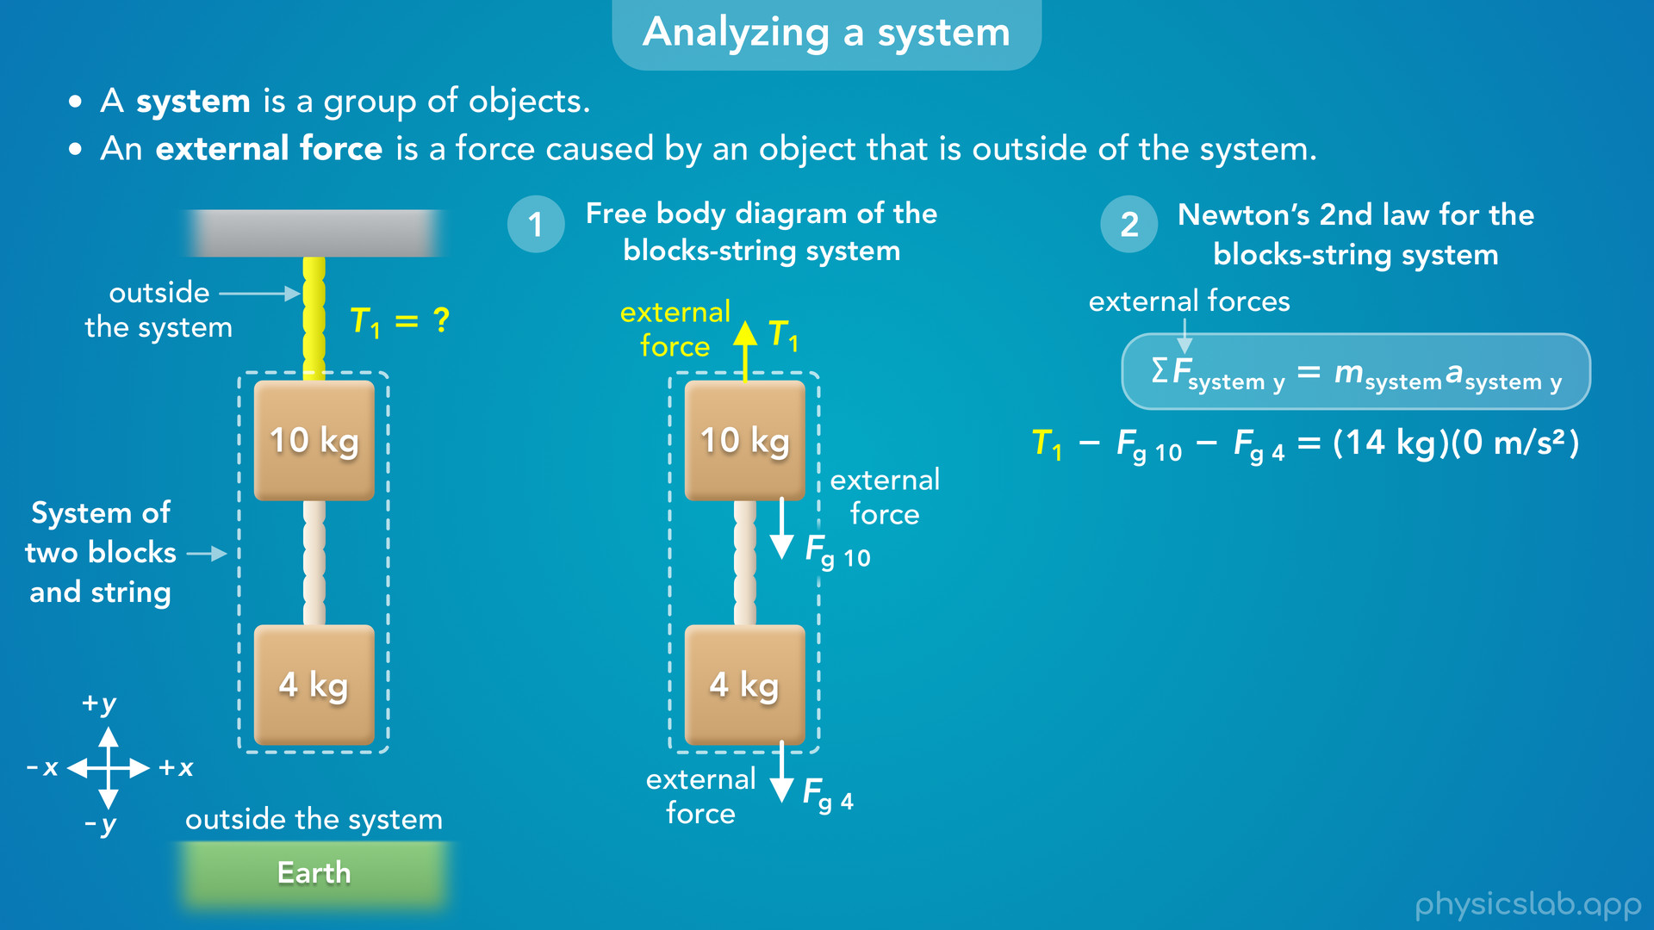
Notes:
• So, if up is the positive direction, then the net external force acting on the system would be T1 minus the weight of the 10 kg block, minus the weight of the 4 kg block.
• For the mass, we use the total mass of the system which is 14 kg. Remember the strings don’t have mass.
• And a is the acceleration of the system. Since everything is at rest, the acceleration of the system is zero.

Slide 52
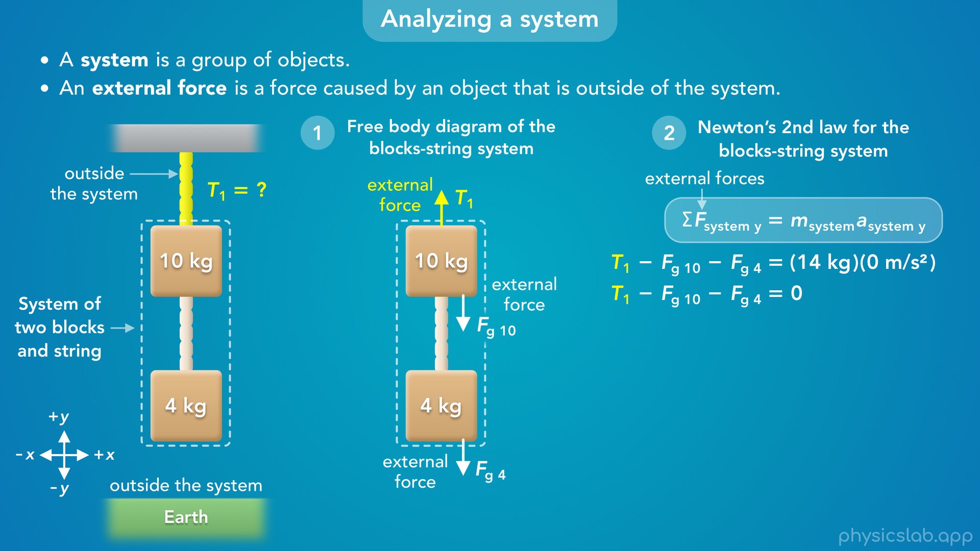
Notes:
• So the right side becomes zero

Slide 53
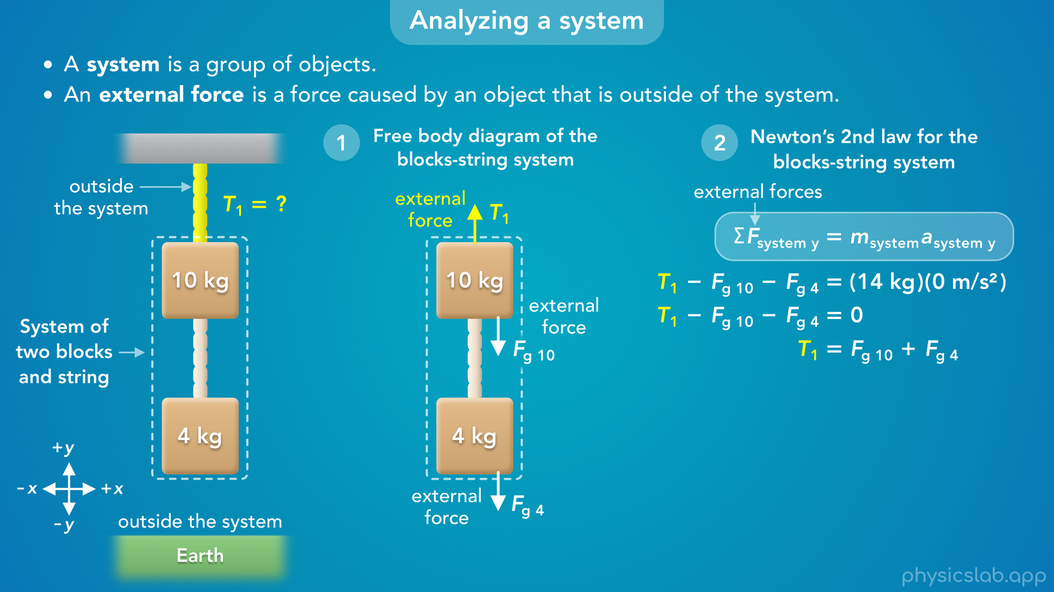
Notes:
and the upwards tension force T1 is equal to the total downwards gravitational force, the total weight of the two blocks.

Slide 54

Notes:
• If we plug in the masses and calculate the two weights

Slide 55
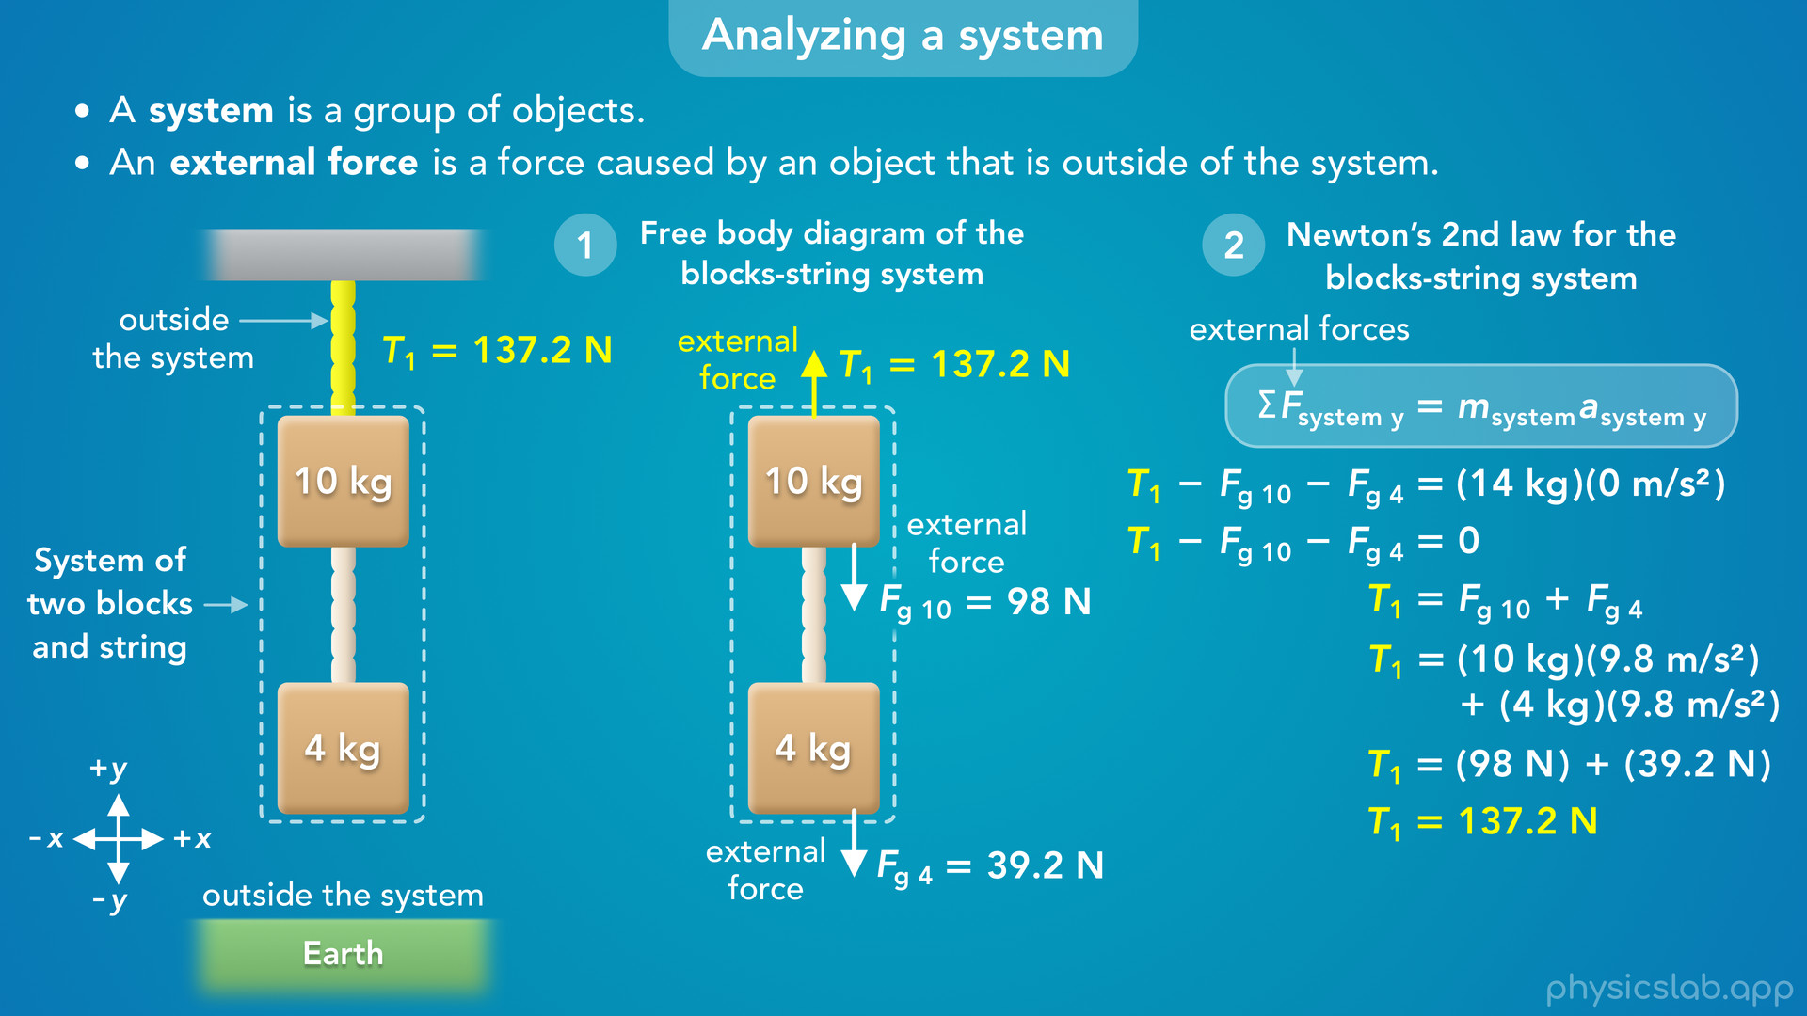
Notes:
we get 137.2 N for the total weight and for the tension force, T1.
• That’s the same thing we figured out before, but this is how we get there by applying Newton’s 2nd law to the system.

Slide 56
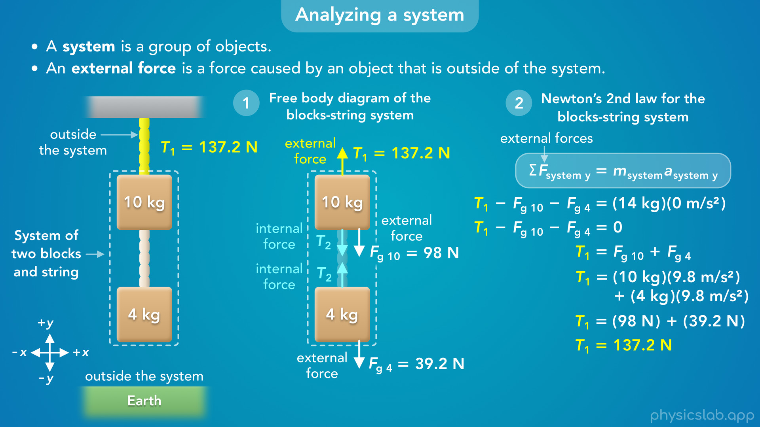
Notes:
• Again, the tension forces from the bottom string, T2, are internal forces for this system.
• So they don’t show up in the equation for Newton’s 2nd law and we cannot solve for T2 by analyzing this system. We can only solve for external forces, like T1, or the weight forces.
• This method might seem confusing at first, but it’ll make a lot of problems easier, especially when things are accelerating, and when we work with pulley systems.

