Slide 1
Ideal String
Slides Version 1
This includes:
Slides with screenshot images from the video.
The video narration in the slide notes.
A blank template slide with the same background and font as the video.
Slides with some basic graphics from this video for you to use however you like.
Feel free to add, delete and edit slides to make your own presentation. You can use these slides in class or share them with your students, but please do not share them with anyone else.
If you have any feedback, suggestions or questions about these slides please email me at chris@physicslab.app or send me a message on Discord @physicslab.
physicslab.app

Slide 2
Heading
Text

Slide 3




Free body diagram

Slide 4




















Slide 5
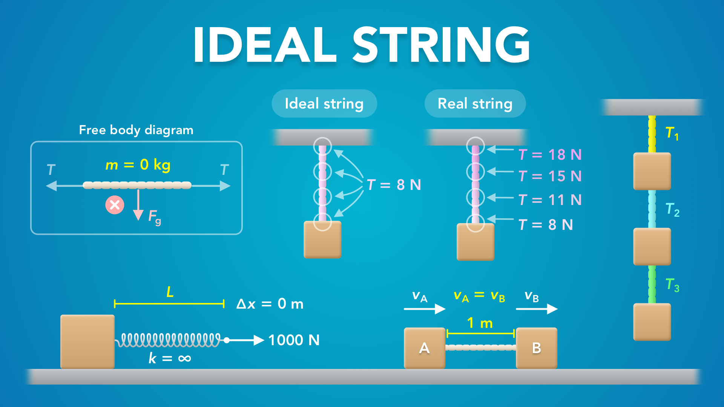
Notes:
Ideal String
physicslab.app
If you have any questions, suggestions or feedback about these slides please email me at chris@physicslab.app or send me a message on Discord @physicslab.

Slide 6

Notes:
• Hey everyone! In this video we’re going to learn about the characteristics of an ideal string.

Slide 7
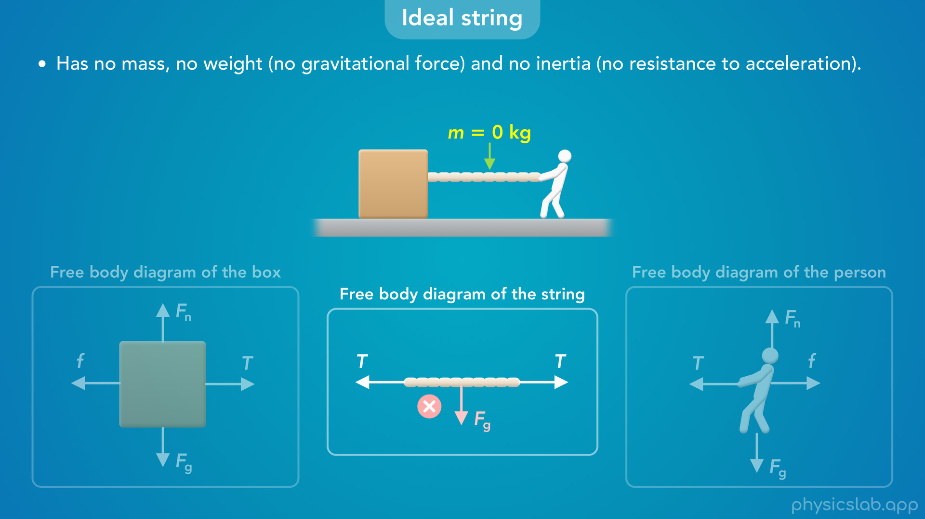
Notes:
• First, we’ll learn how an ideal string has no mass, no weight and no inertia.

Slide 8
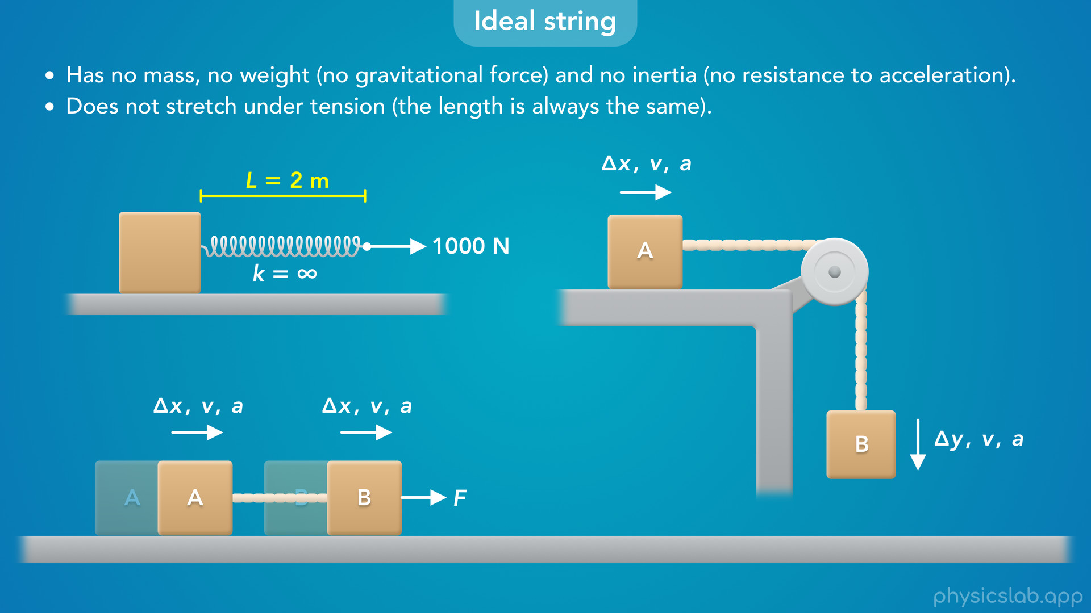
Notes:
• Second, it does not stretch under tension, and the objects at each end have the same motion.

Slide 9
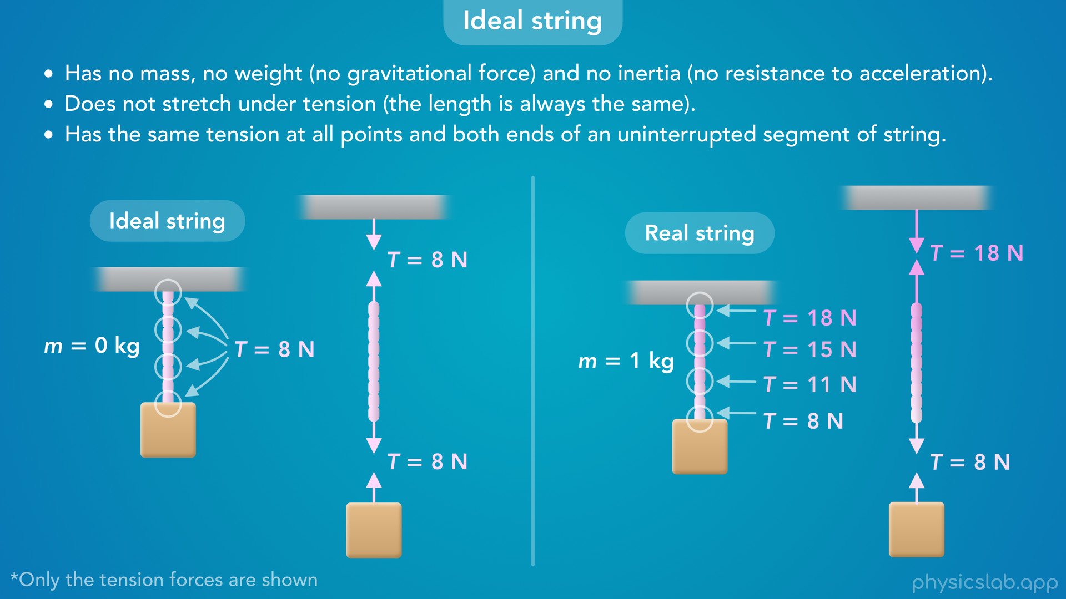
Notes:
• And third, the tension is the same at every point and both ends of an uninterrupted segment of string.

Slide 10

Notes:
• So let’s cover each one in detail so we know how to apply these assumptions when solving a problem.

Slide 11
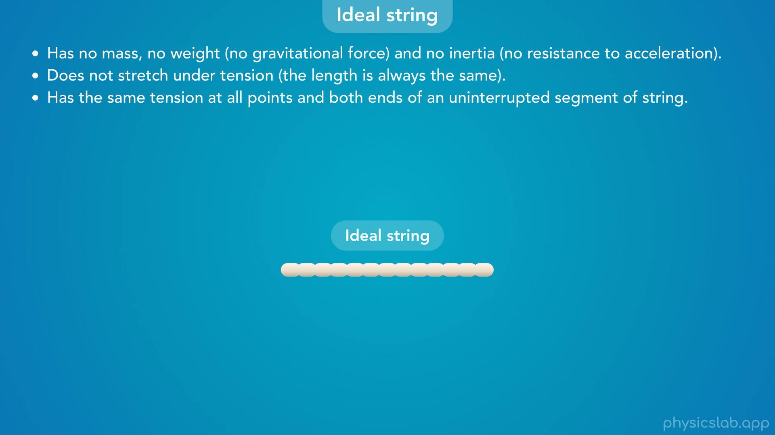
Notes:
• An ideal string is a simplified, theoretical string that has the three characteristics we just mentioned:
• It has no mass, no weight and no inertia…
• it does not stretch under tension…
• and it has the same tension at all points and both ends of an uninterrupted segment of string.

Slide 12
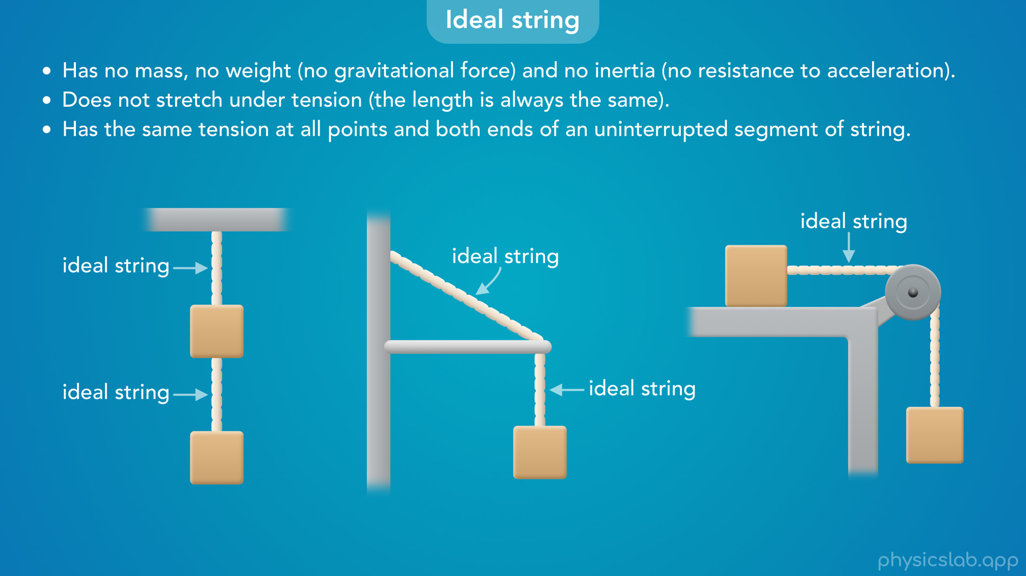
Notes:
• In this course, we’re going to assume every string is an ideal string, unless we’re told otherwise.
• So let’s go through each one.

Slide 13
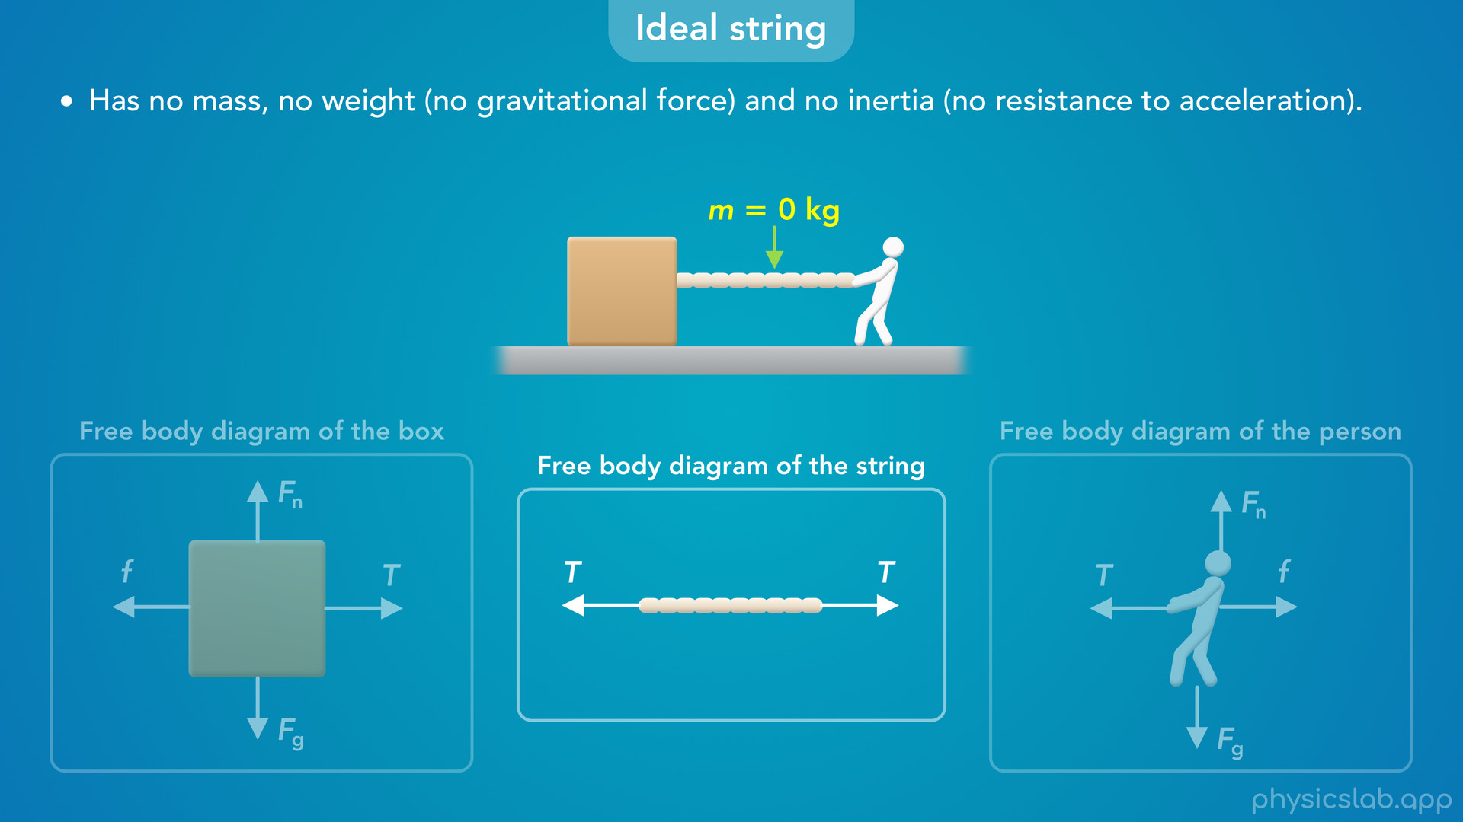
Notes:
• First, an ideal string has no mass, which also means that it has no weight and no inertia.
• So if we draw a free body diagram of an ideal string there is no gravitational force acting on the string, because it has no mass.

Slide 14
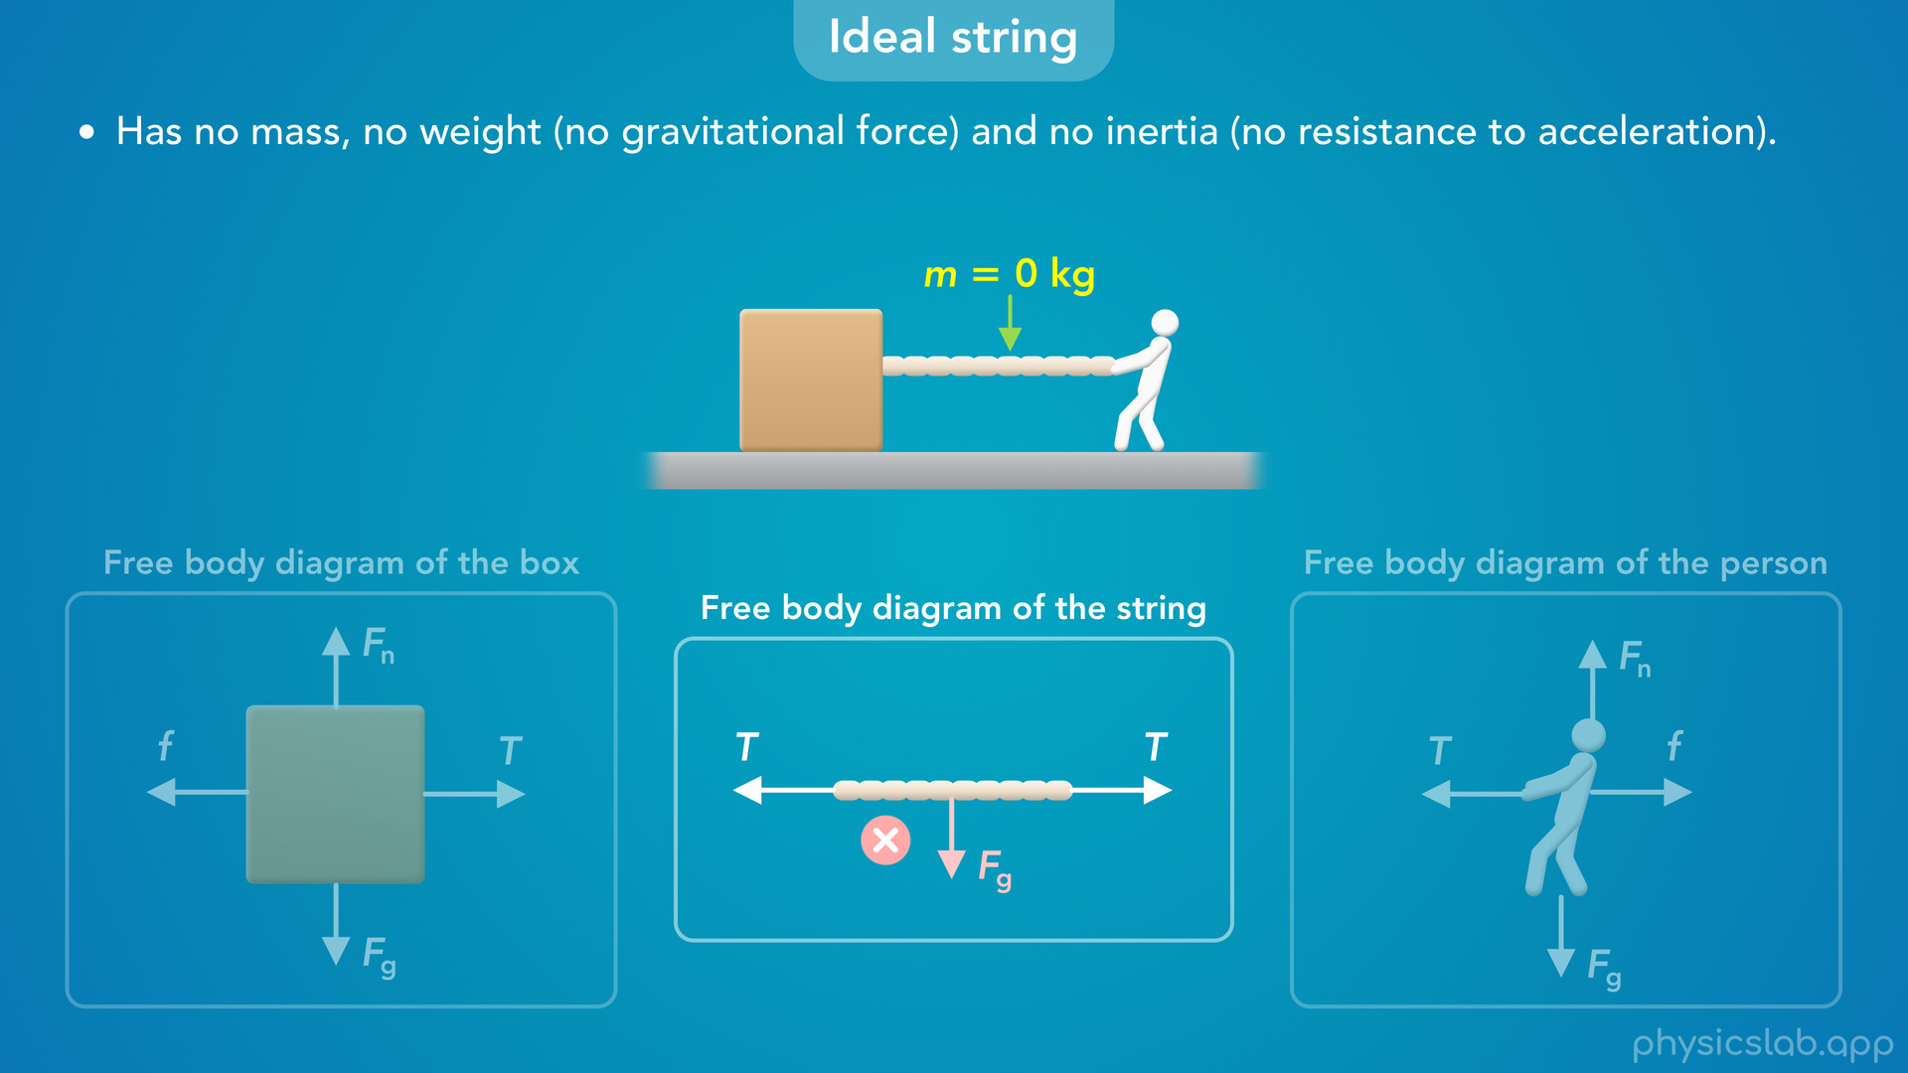

Slide 15
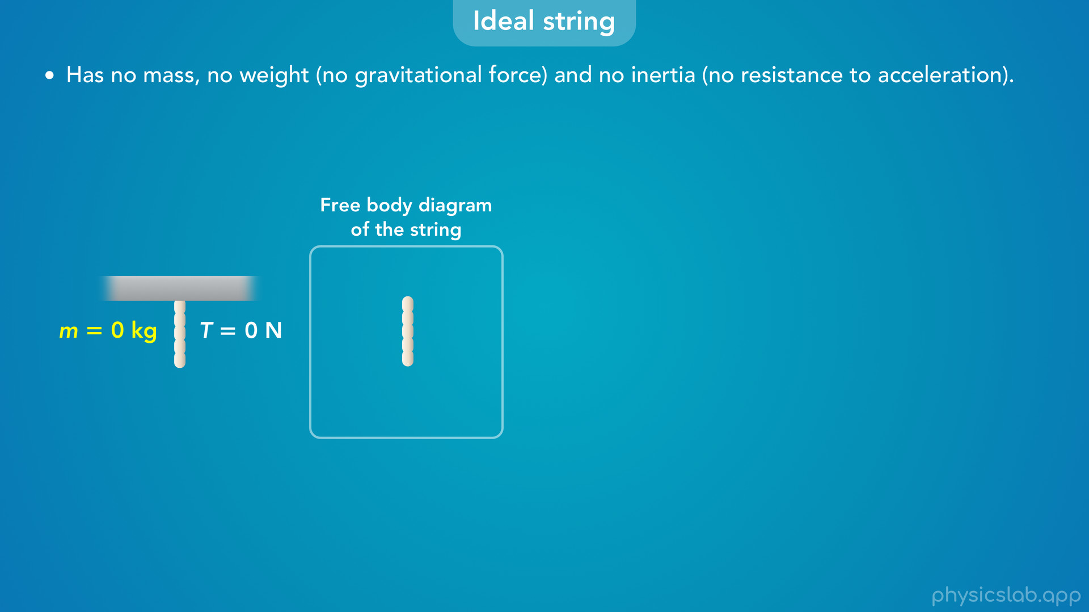
Notes:
• If we suspend an ideal string from the ceiling with nothing attached, we’re going to assume that there is no tension in the string because there is no gravitational force, or any other force, pulling it down.

Slide 16
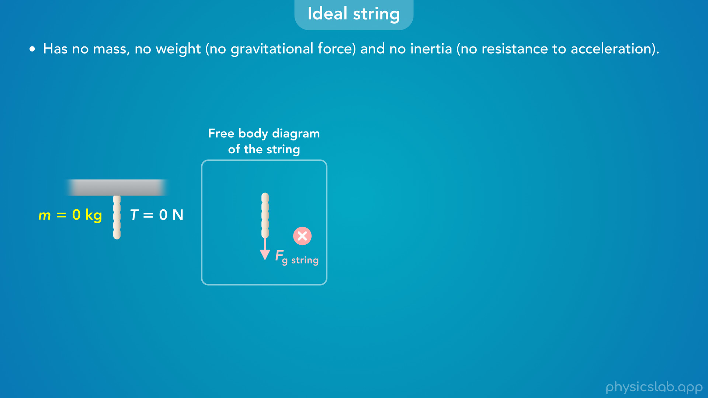

Slide 17
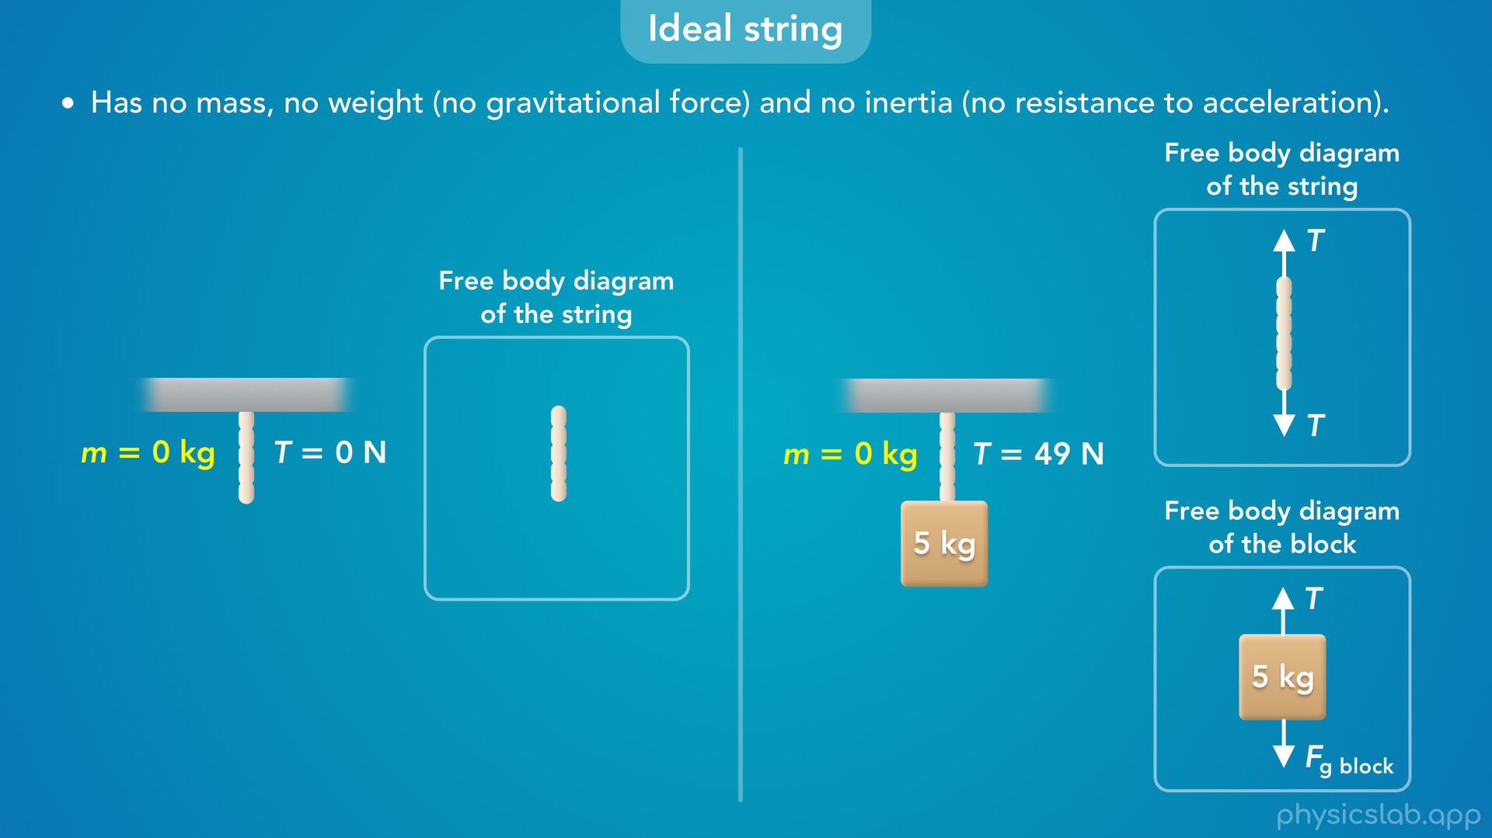
Notes:
• If we attach a block that *does* have mass to the bottom of the string, there would be a gravitational force on the *block*.
• So the block would pull down on the string, and there *would* be tension in the string.
• In the free body diagram of *that* string, we would draw the force from the block pulling down on the string but we would not draw a gravitational force on the string itself, because the string has no mass.

Slide 18
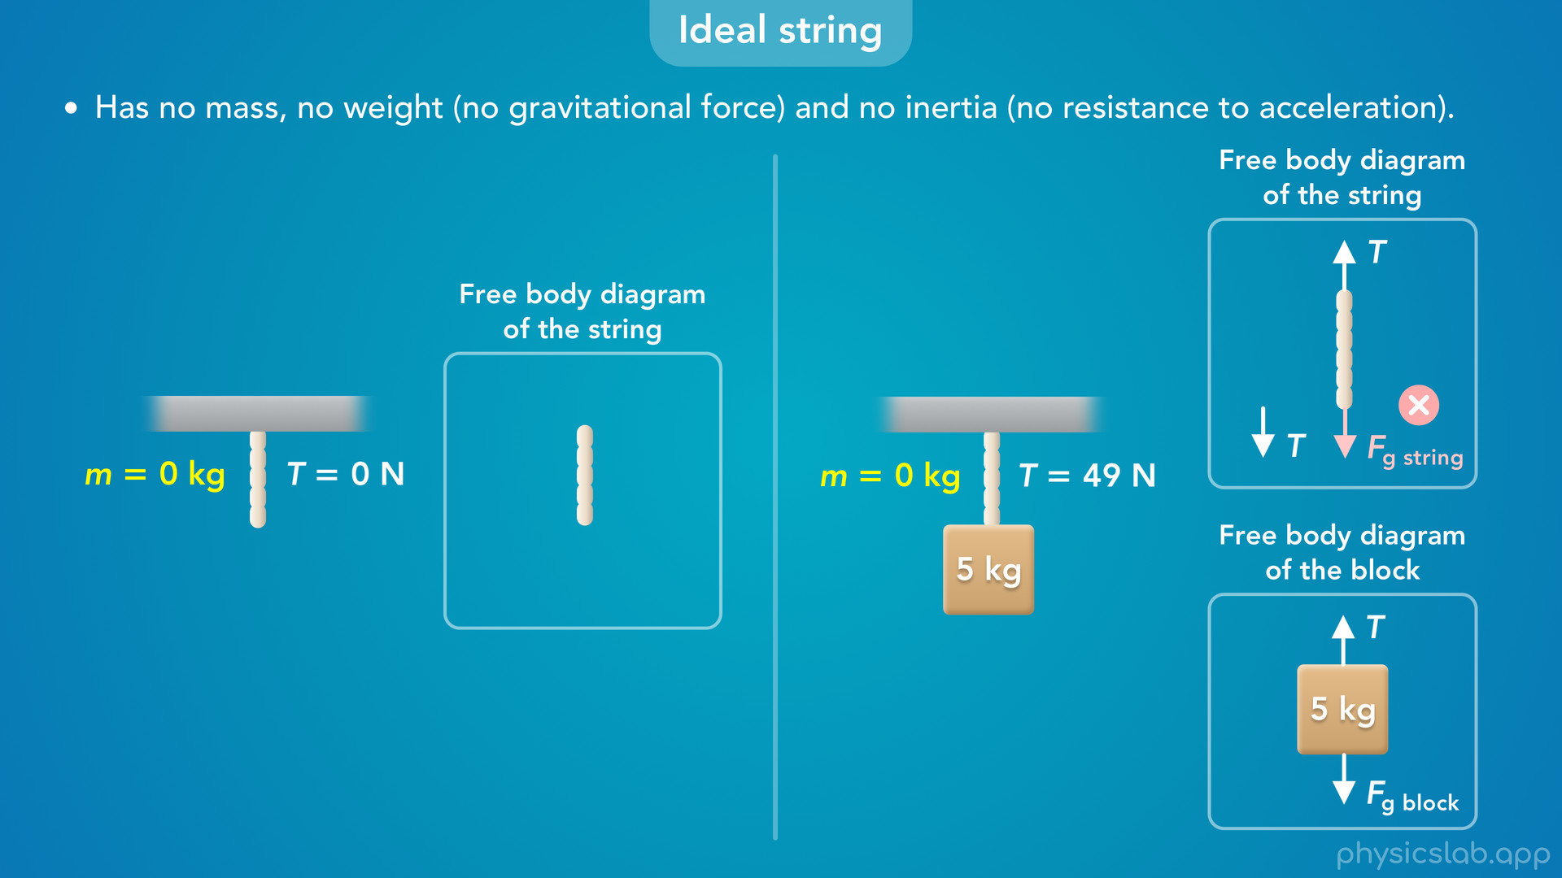

Slide 19
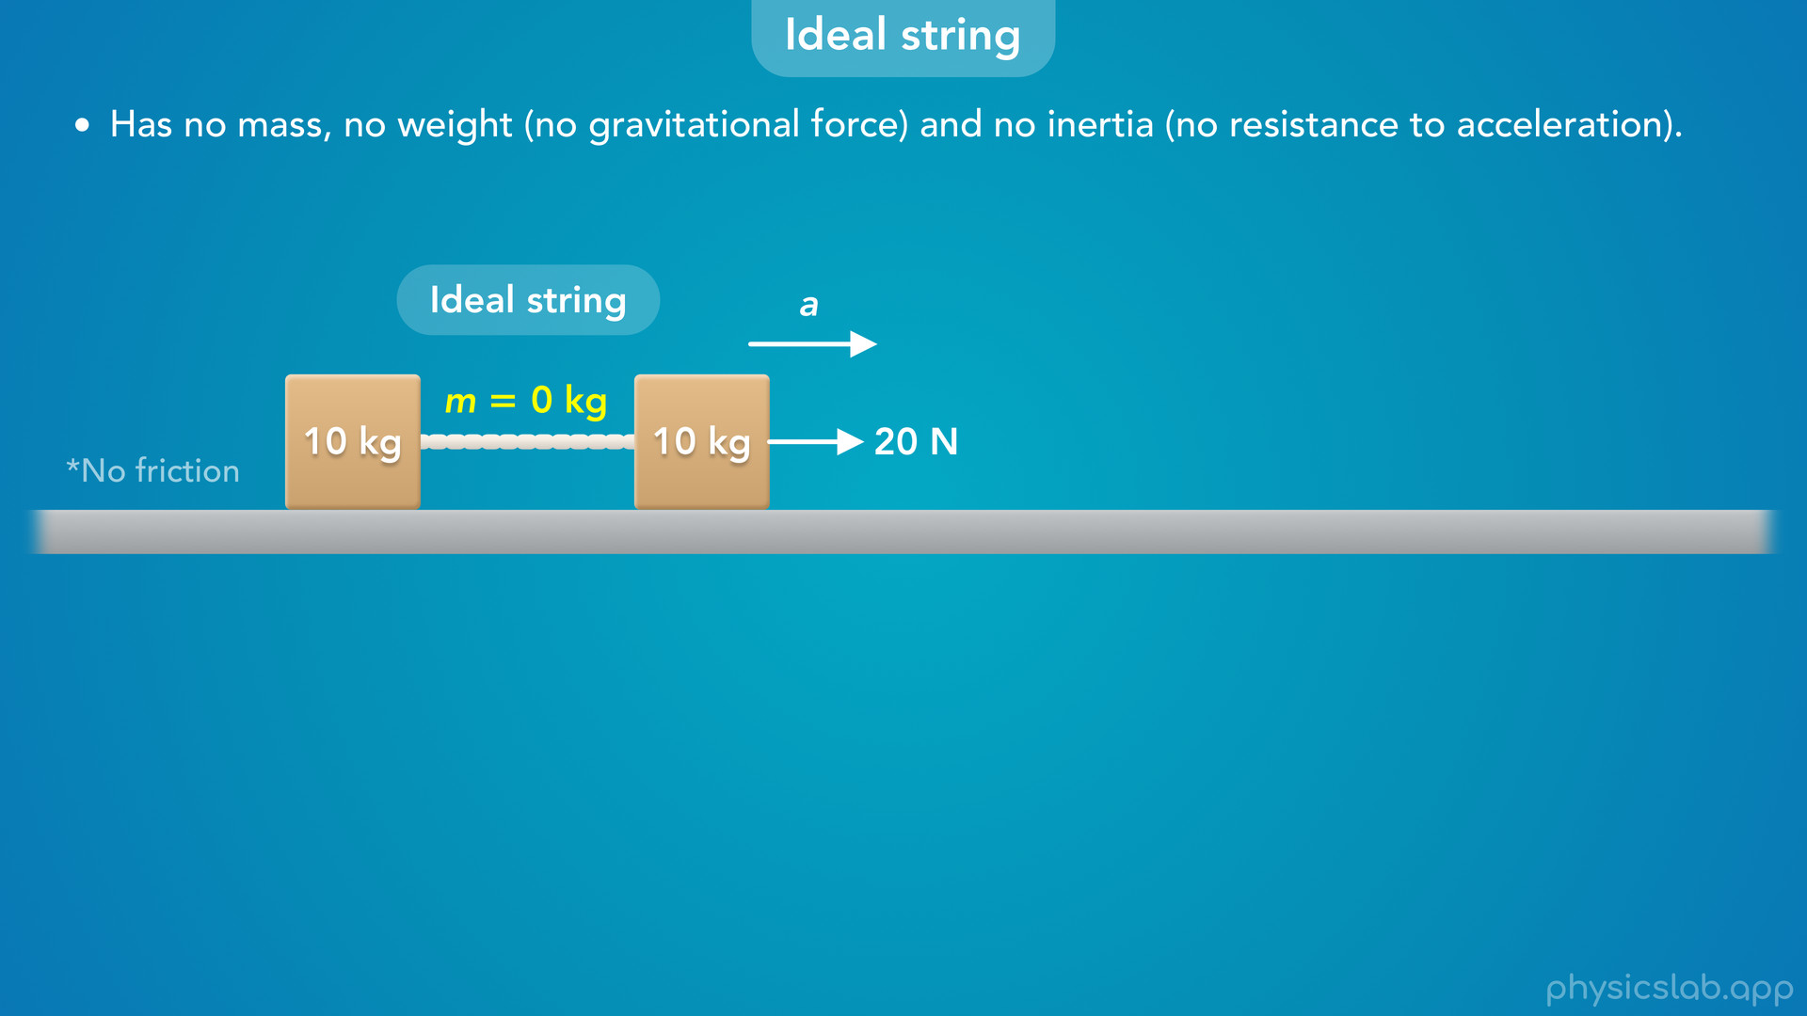
Notes:
• Without any mass, an ideal string also has no inertia, it has no resistance to acceleration.
• For example, let’s say we have two 10 kg blocks attached with an ideal string and they’re on a frictionless surface.
• If we pull on the right block with 20 N of force, the two blocks and the string will accelerate to the right.

Slide 20
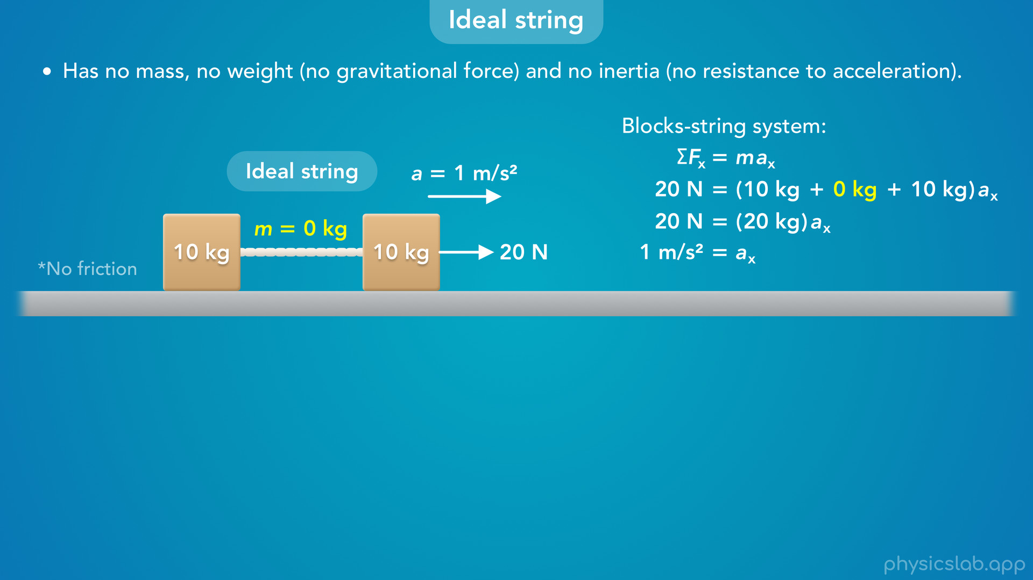
Notes:
• When we apply Newton’s 2nd law to the system of two blocks and the string together, the string has no mass, so it does not add inertia to the system.
• The 20 N force only needs to accelerate 20 kg of mass from the two blocks, so the acceleration is 1 m/s^2.

Slide 21
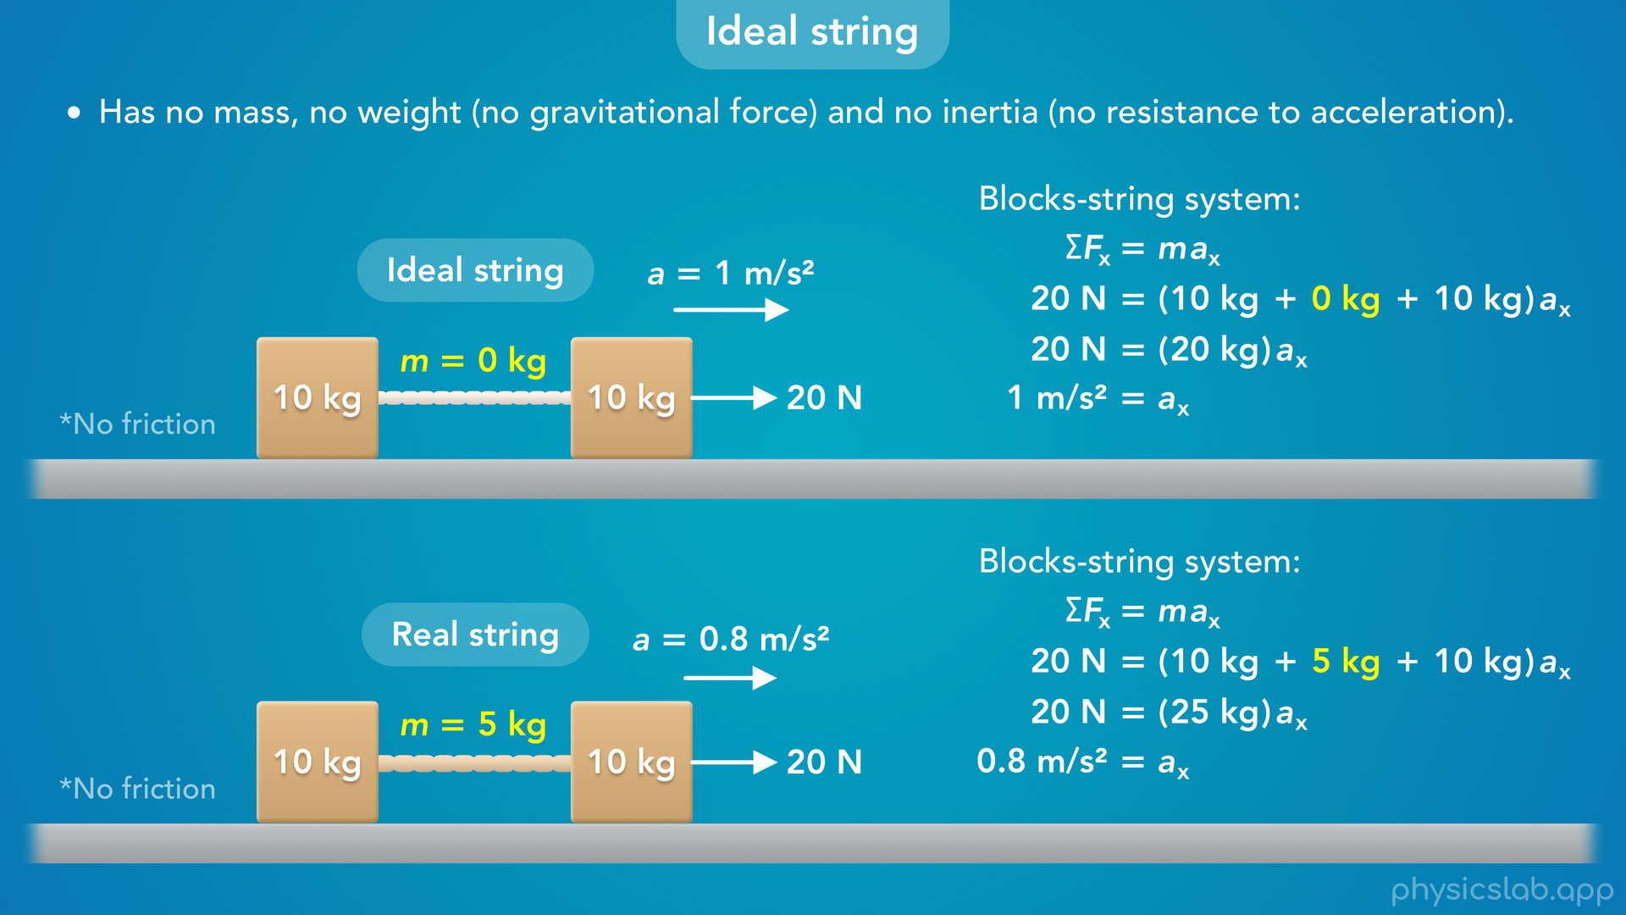
Notes:
• If this was a real string that had a mass of 5 kg, then the 20 N force would have to accelerate 25 kg, the mass of the blocks plus the mass of the string.
• In that case the acceleration would be slower, 0.8 m/s^2.
• So a real string has some inertia, but an ideal string has no inertia so the string itself does not affect the acceleration.

Slide 22
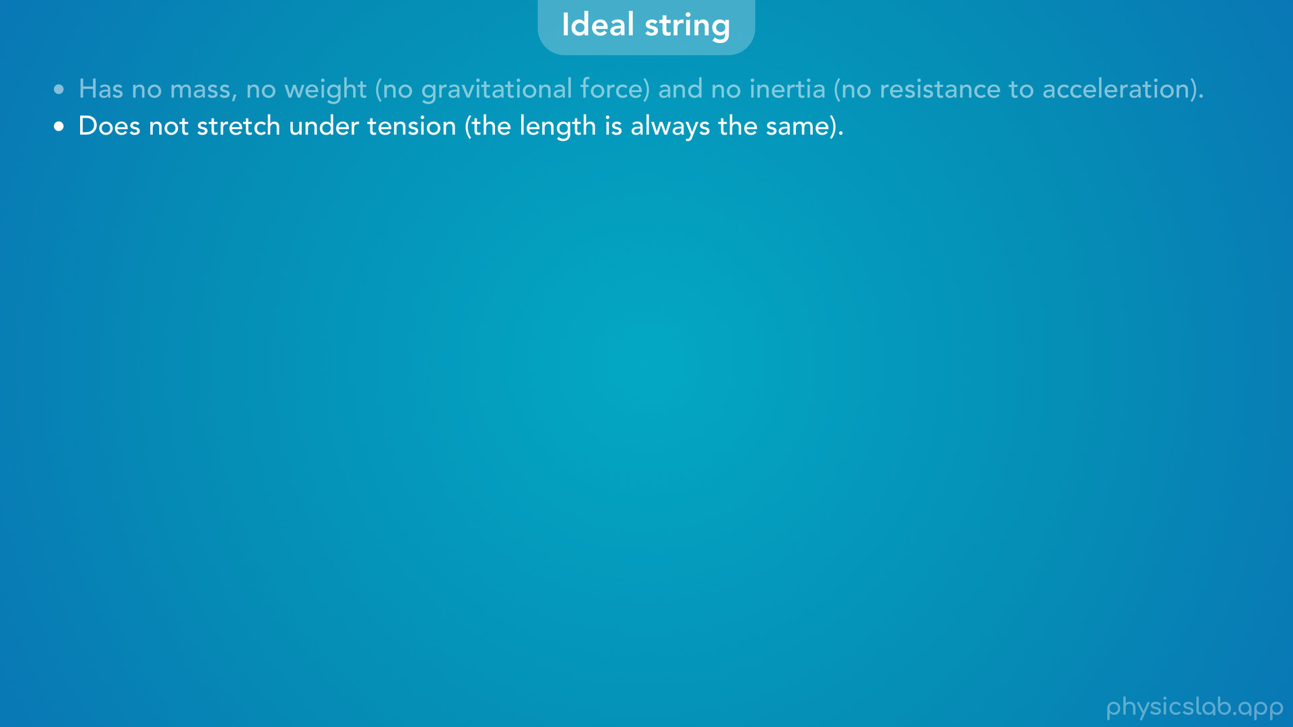

Slide 23
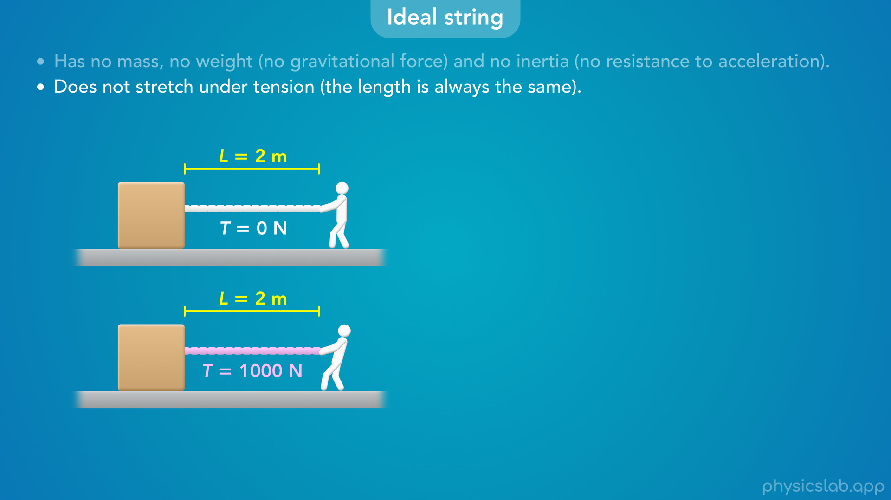
Notes:
The second thing we need to know about an ideal string is that it does not stretch under tension, so the length is always the same.
For example, this string is 2 m long when there is no tension and when there’s 1000 N of tension.
It doesn’t matter how hard you pull, an ideal string will never stretch.

Slide 24
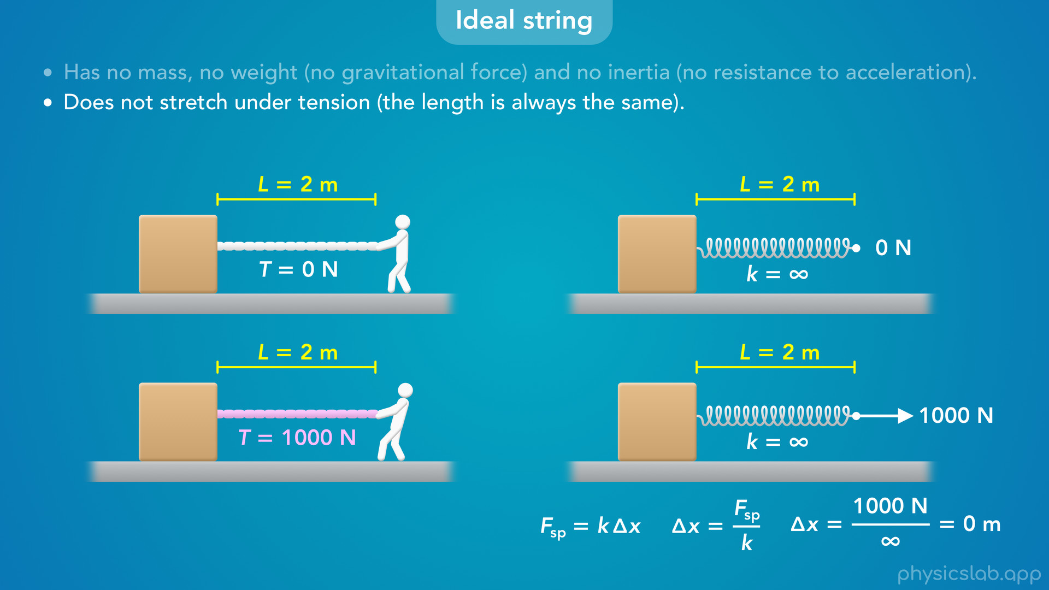
Notes:
• We could think of it like a spring that has an infinite stiffness, an infinite spring constant, k.
• Hooks law says that the change in length, delta x is inversely proportional to the spring constant.
• If k is infinite, then the change in length will be zero no matter how much force we apply.

Slide 25
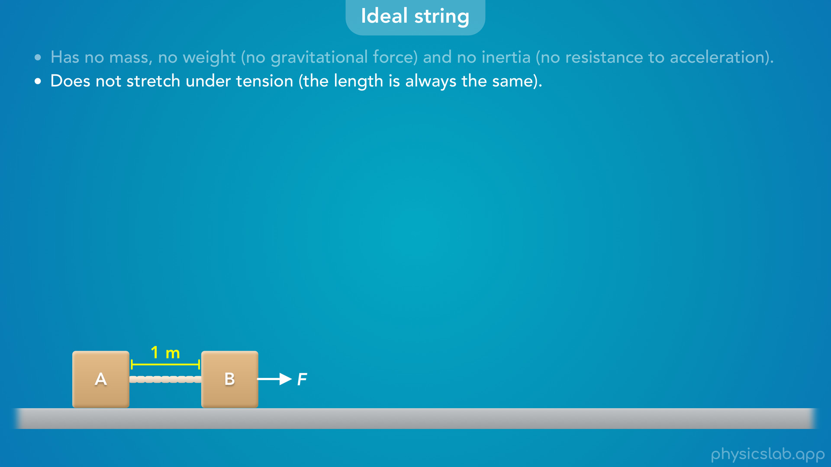
Notes:
• If the length of a string doesn’t change, this also means that the objects attached to each end will move together, they’ll have the same motion.

Slide 26
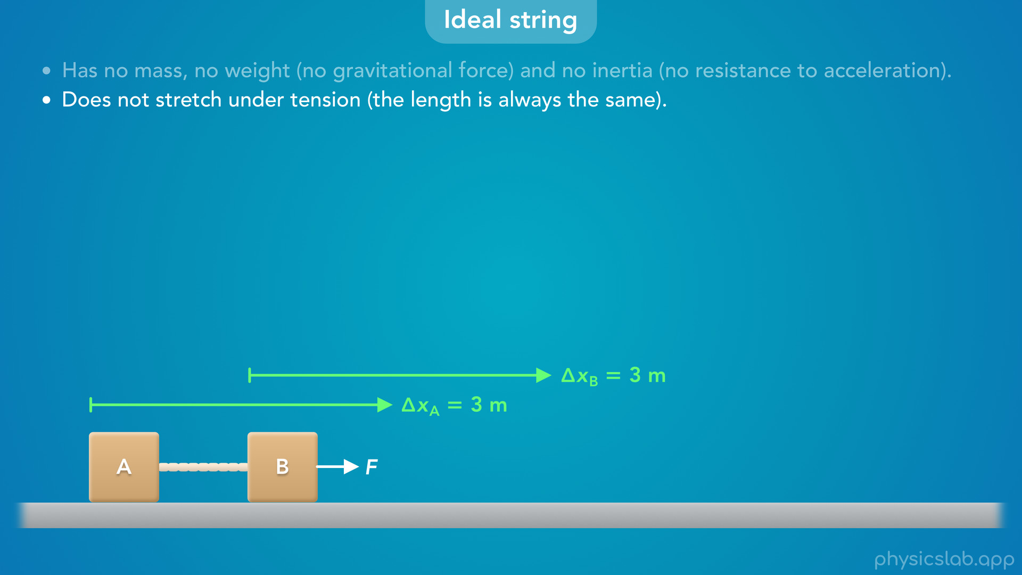
Notes:
• During any period of time, these two blocks will move the same displacement delta x.

Slide 27
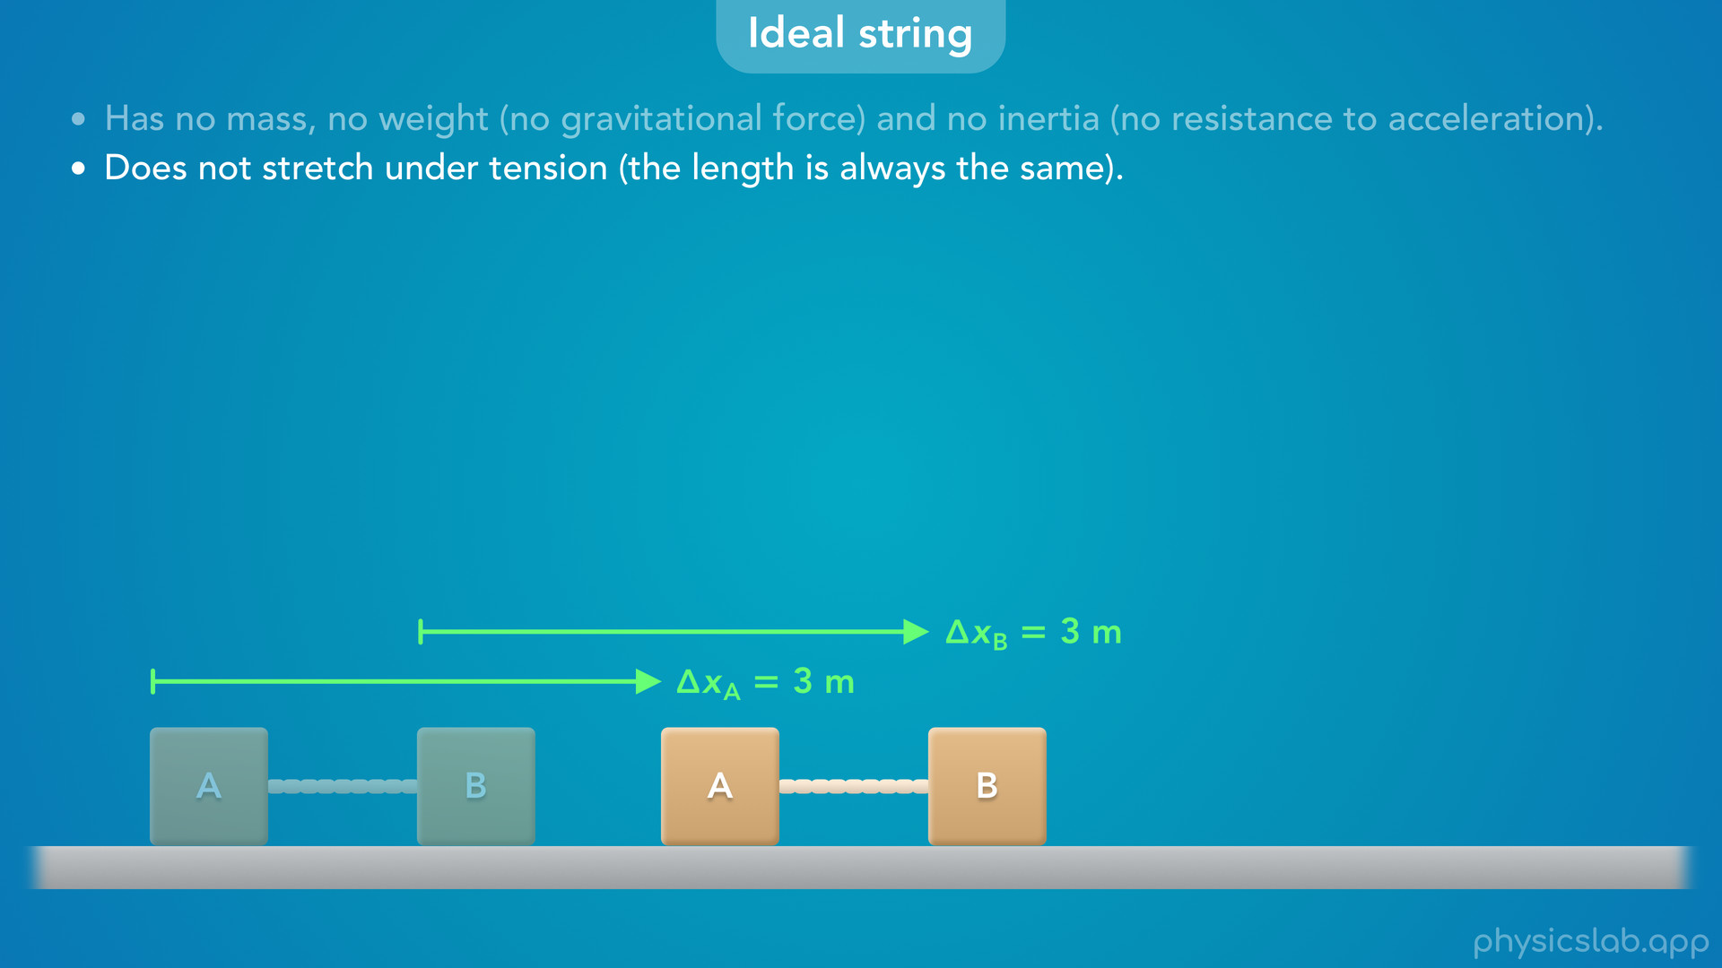

Slide 28
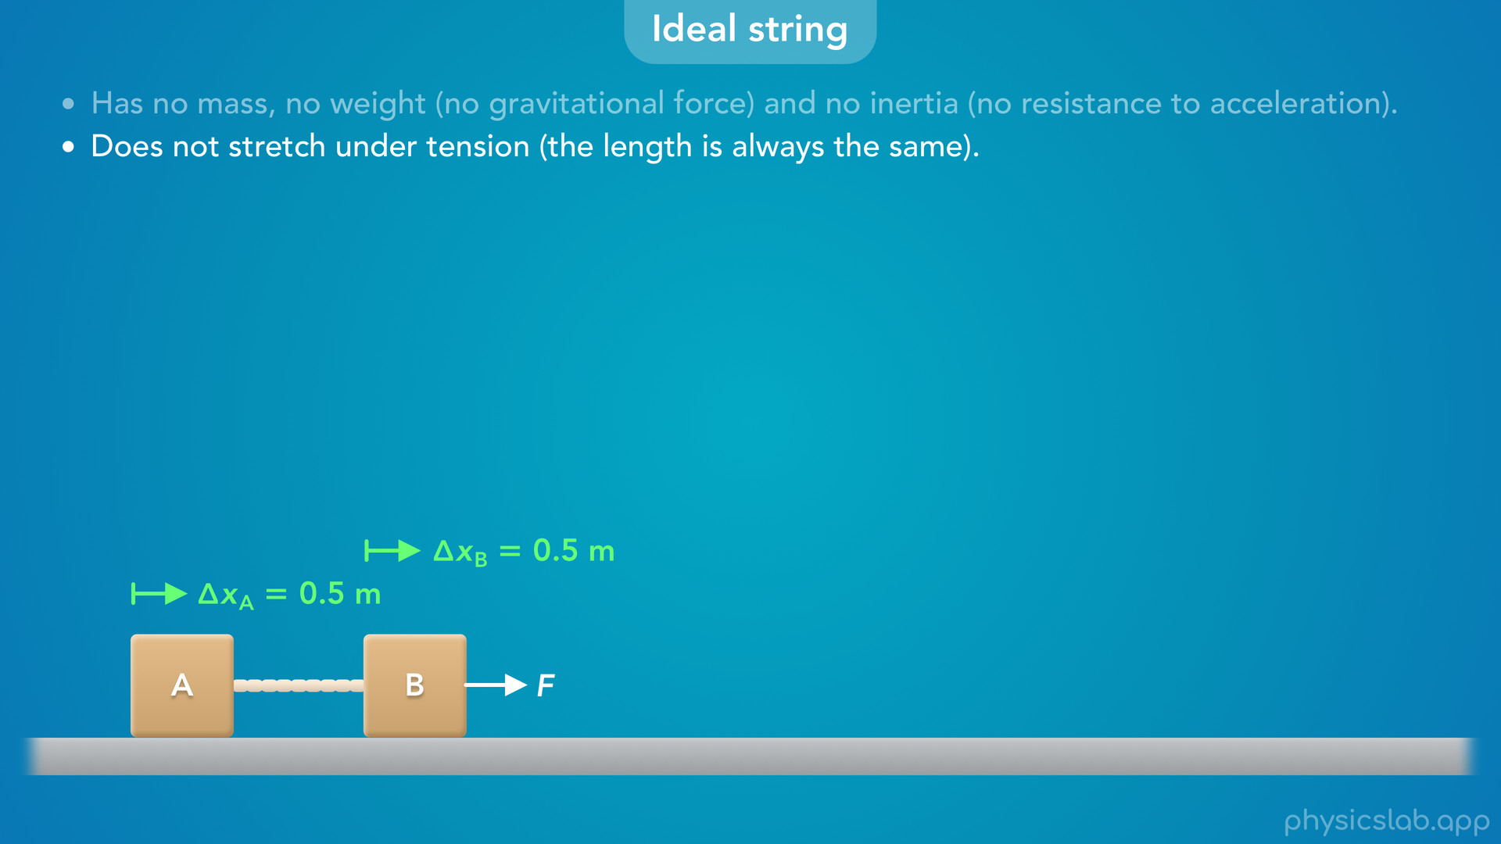
Notes:
• If block A moves 0.5 m, block B must also move 0.5 m.

Slide 29
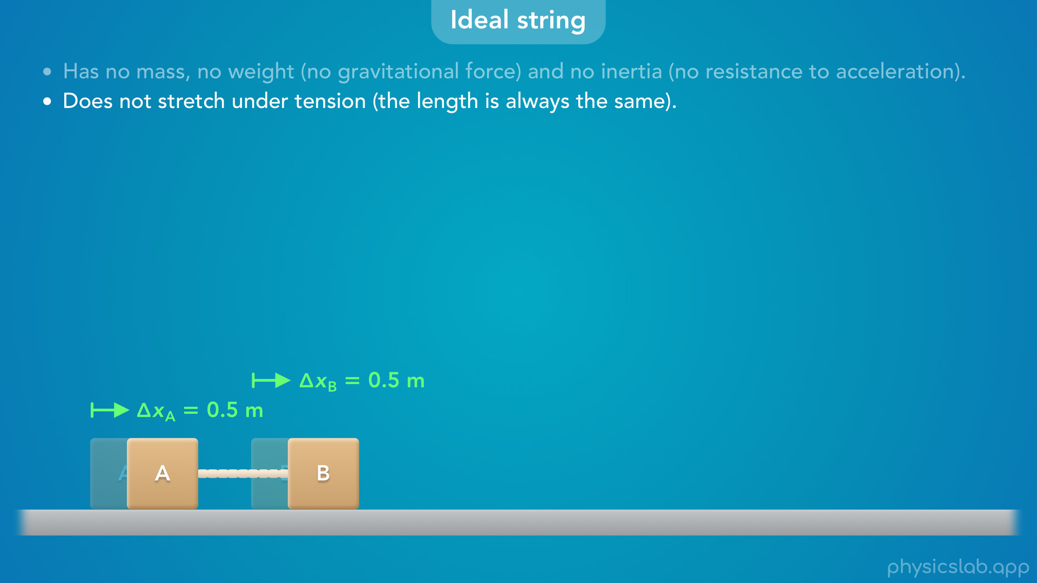

Slide 30
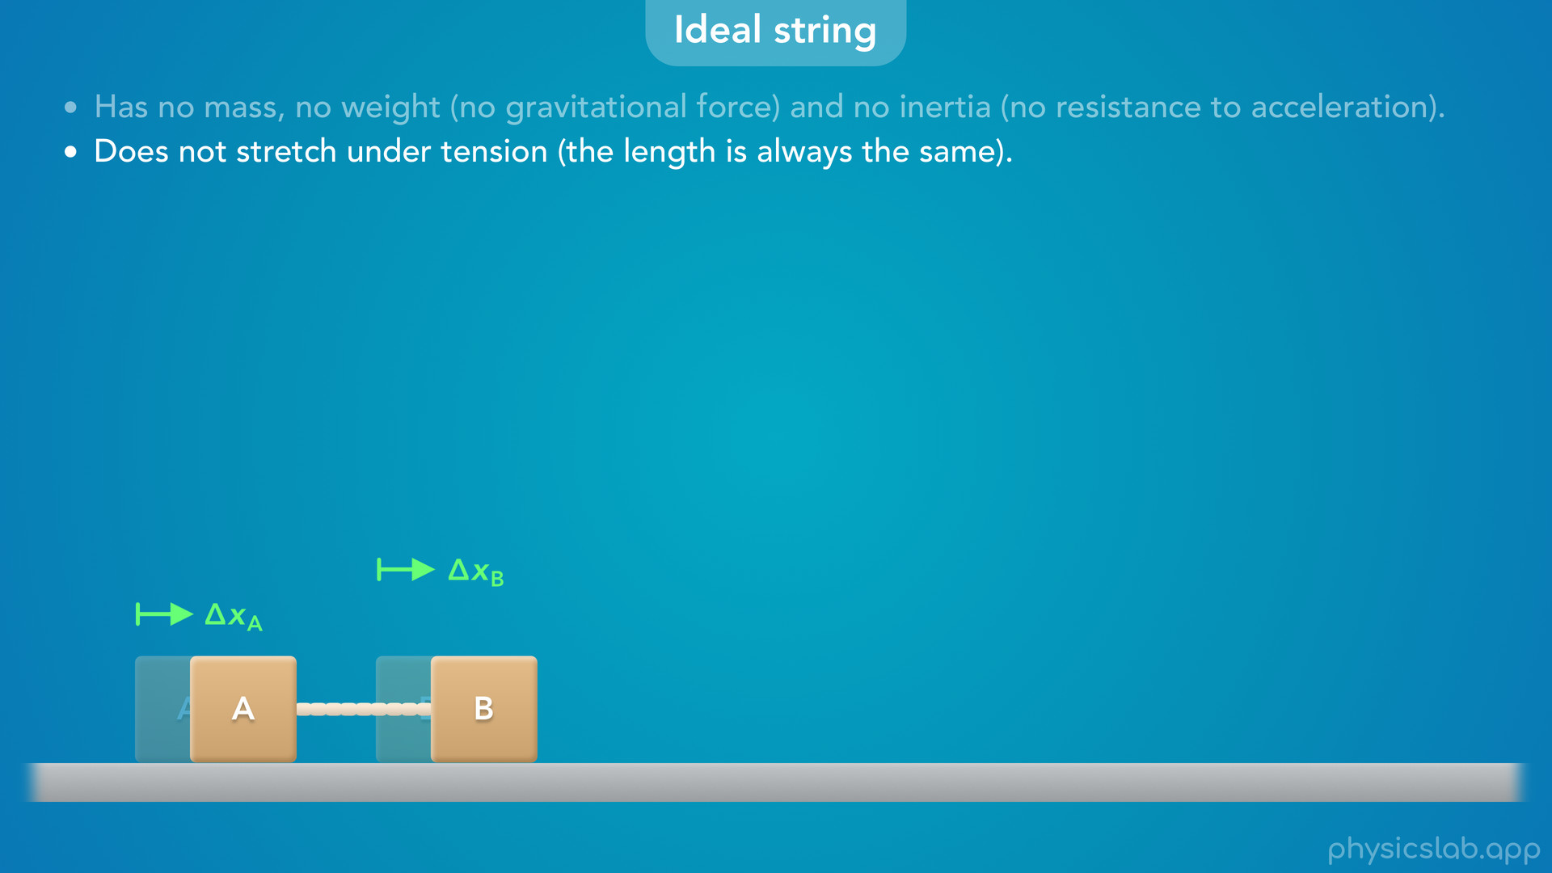
Notes:
• If one block moved a different distance than the other, the string would have to get longer or shorter.

Slide 31
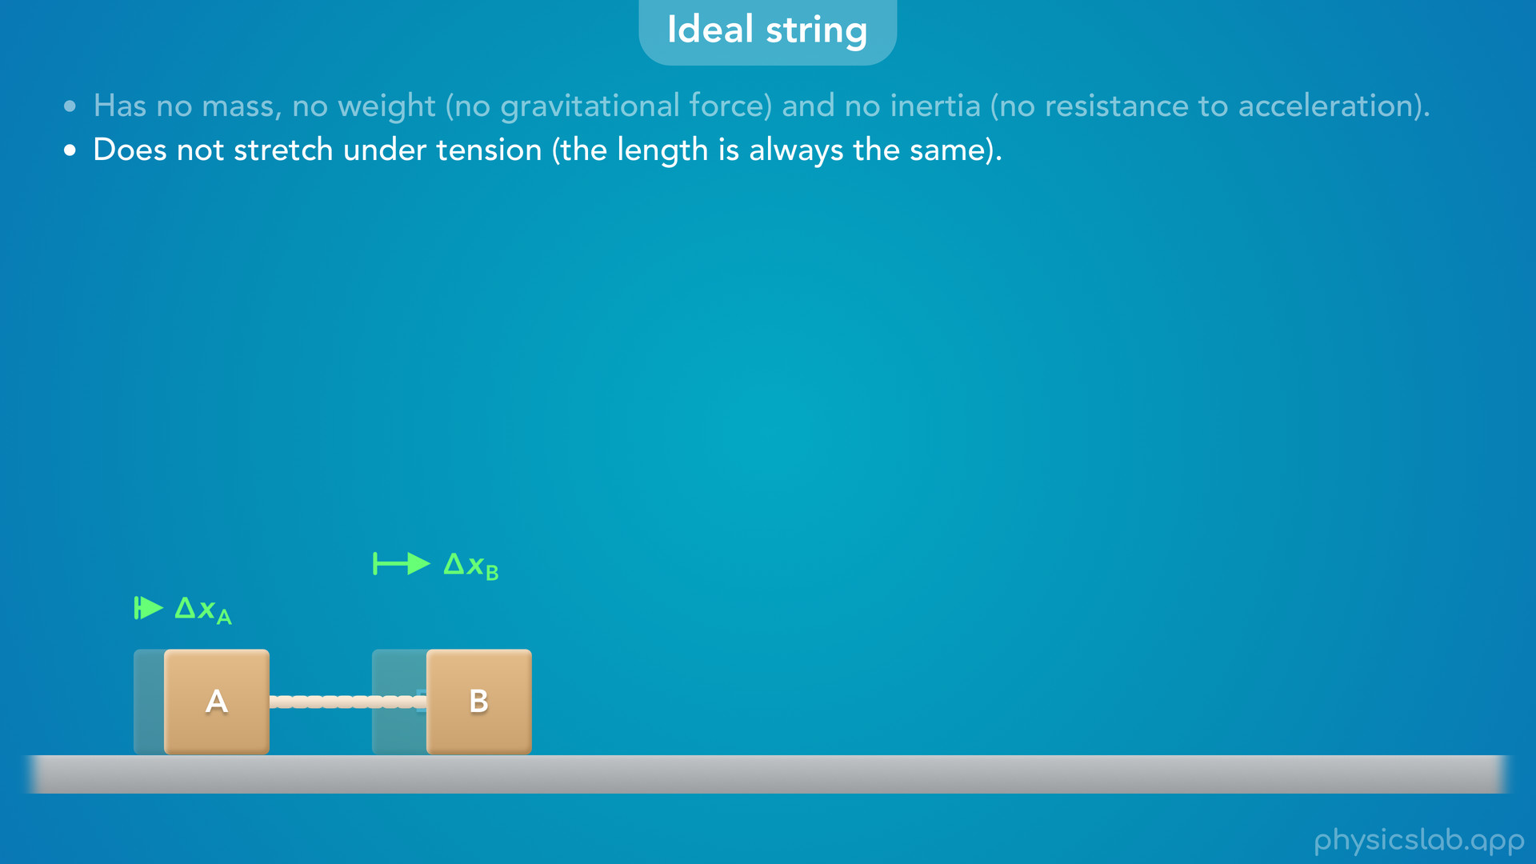

Slide 32
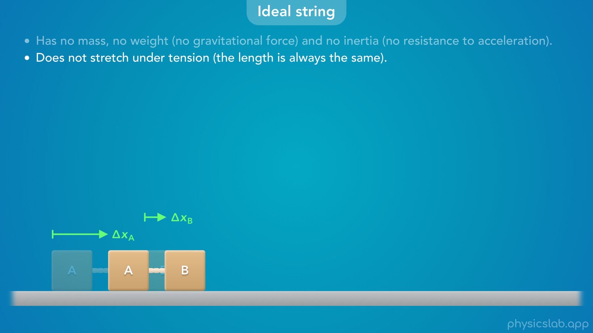

Slide 33
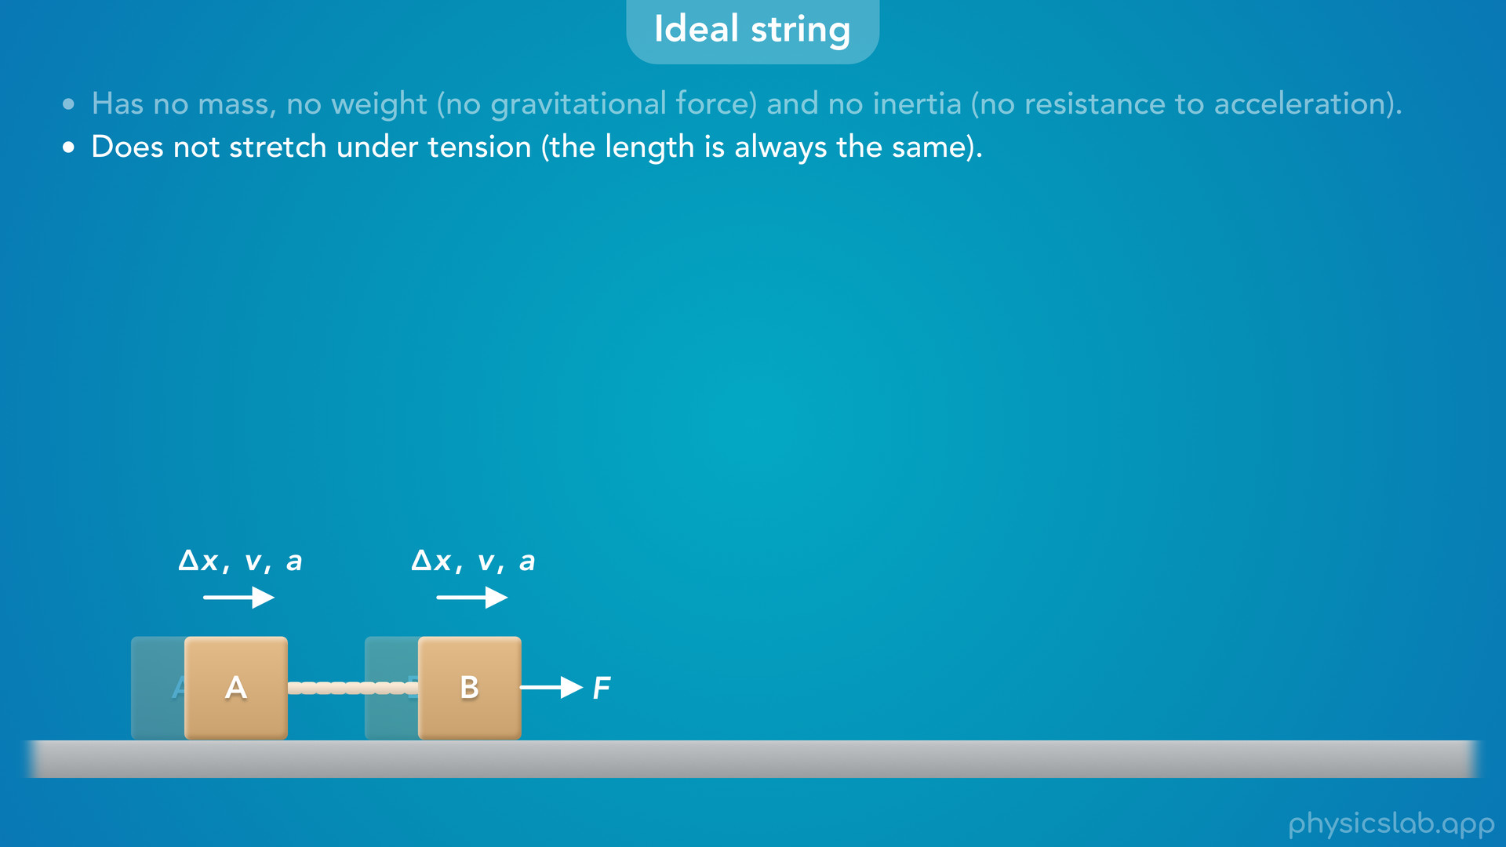
Notes:
• And if the blocks have the same displacement, they also have the same velocity and acceleration, and we’ll come back to that in other videos.

Slide 34
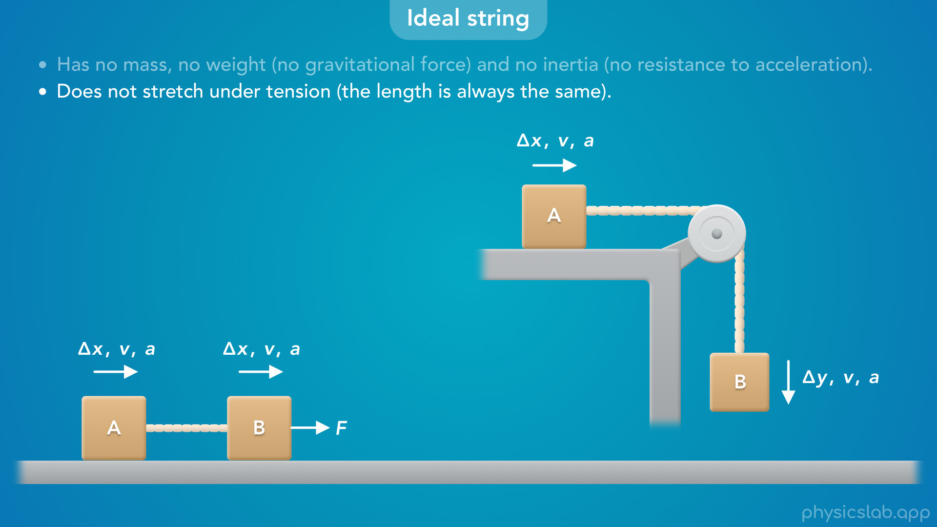
Notes:
• When we work with pulley systems, objects might be moving horizontally and vertically.
• But if the string doesn’t change length, the objects will have the same motion, but in different directions.

Slide 35
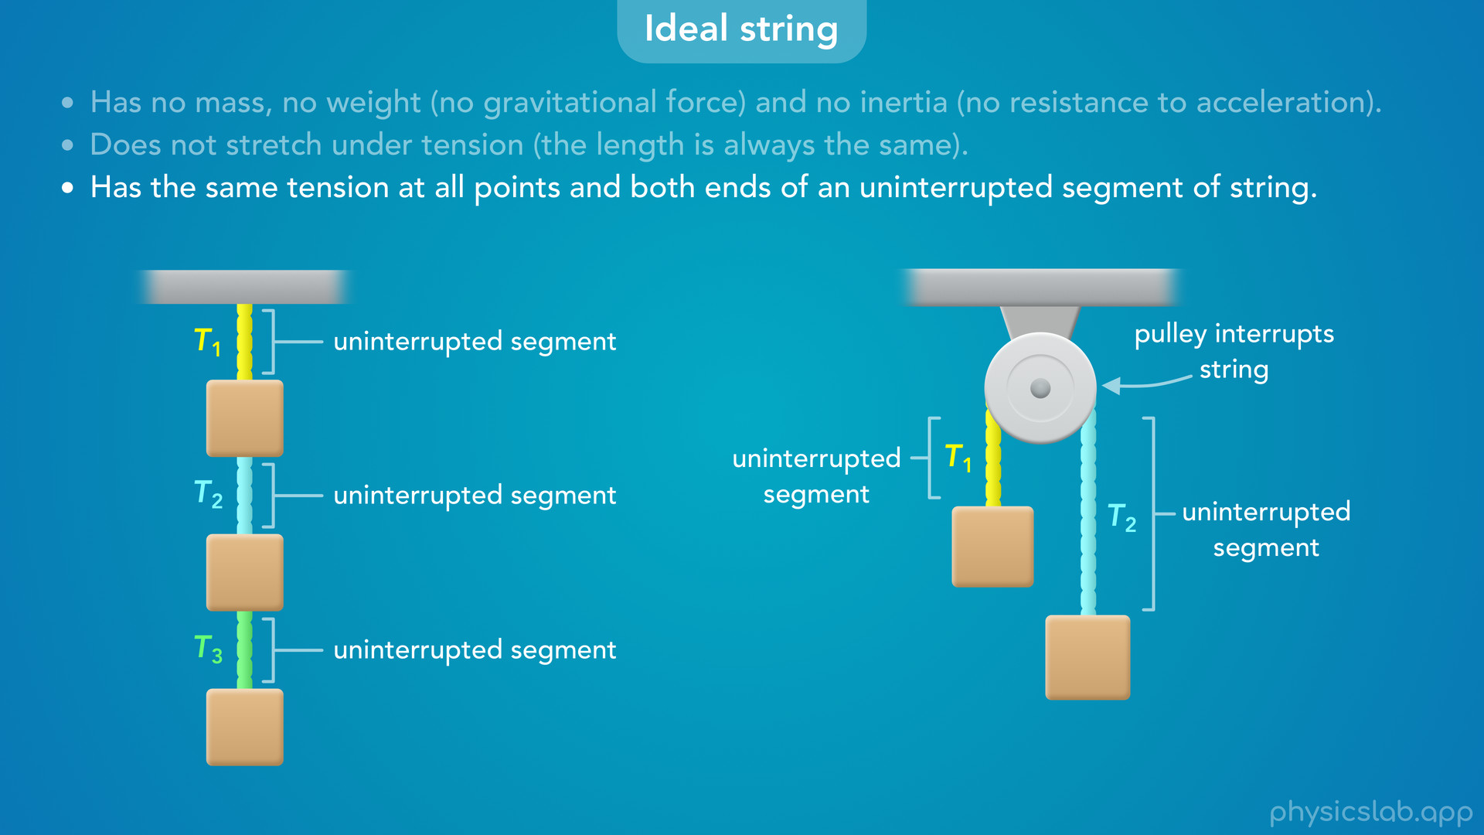
Notes:
• The last thing we need to know is that an ideal string has the same tension at all points and both ends of an uninterrupted segment of string.
• First, let’s define “uninterrupted” as a segment of string where nothing is contacting the middle of the string, just the ends.
• If we only have one segment of string like this, its uninterrupted.
• If we have more than one string then we’re dealing with multiple separate segments with different tensions.
• And when we work with pulleys systems, the pulley is contacting or interrupting the string in the middle.
• So even though it’s one string going around the pulley, we have two separate segments and potentially two different tensions.
• So that’s what we mean by an uninterrupted segment of string.

Slide 36
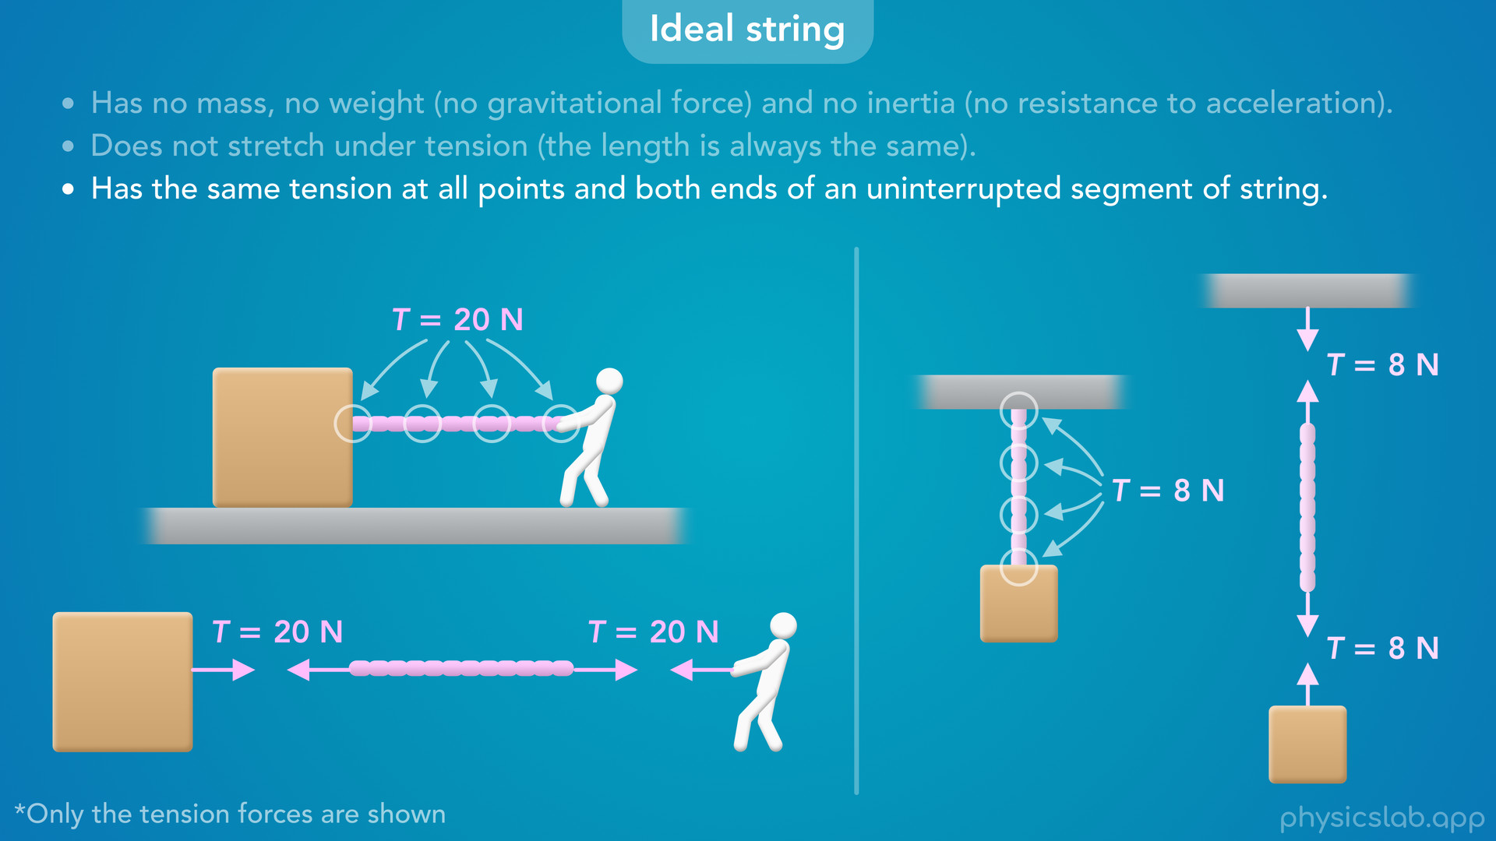
Notes:
• And within one segment, an ideal string has the same tension at all points in the string and at both ends.
• So in this example, we can say there is 20 N of tension in the string, 20 N of tension at every point in the string, and the tension forces exerted on the block and the person are both 20 N.
• Notice that the force at each end is not double or half of 20 N.
• Each force has the same magnitude as the tension in the string.
• This is also true for vertical strings.
• The weight of this block is creating 8 N of tension in the string.
• That means the tension forces on the block and the ceiling are both 8 N.

Slide 37
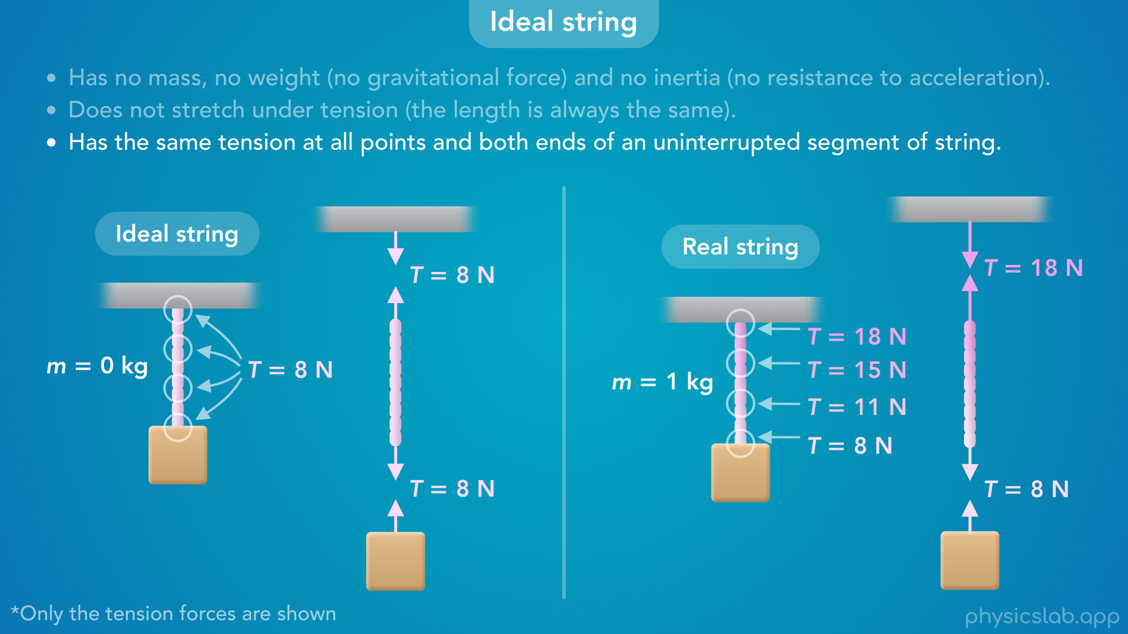
Notes:
• This is only true because an ideal string has no mass.
• But what about a real string that does have mass?
• In that case, the bottom of the string only needs to hold up the weight of the block.
• But the top of the string (and the ceiling) need to hold up the weight of the block plus the weight of the string.

Slide 38
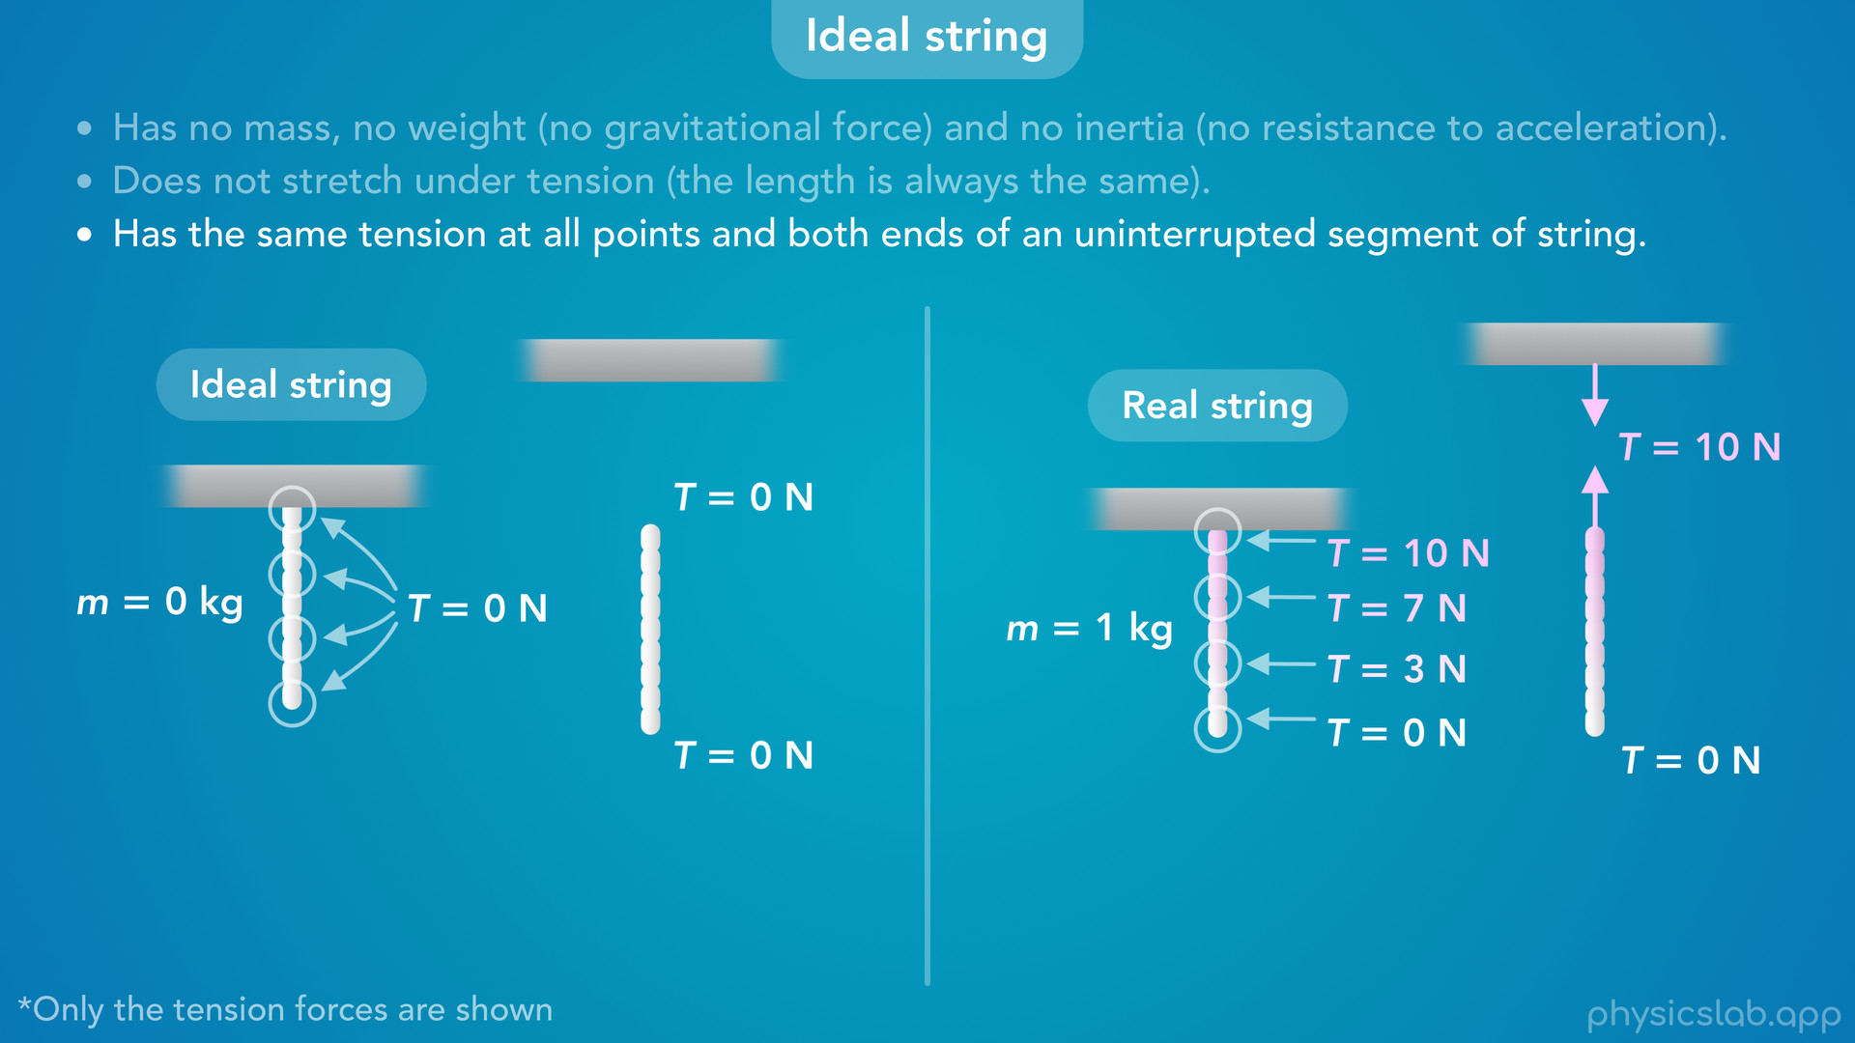
Notes:
• This happens even if there’s no block attached to the bottom.
• A real string has mass, so its own weight causes the tension.
• We’re not going to get into the math, but you should know conceptually that the tension in a real string increases as you go up, because each part of the string needs to support the weight of the string below it.

Slide 39
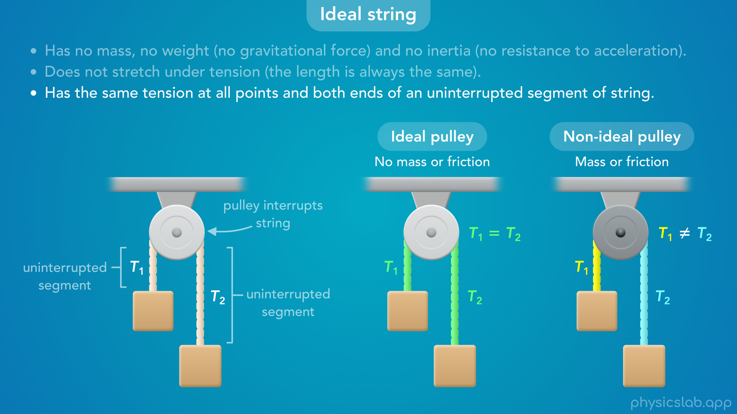
Notes:
• Like we mentioned, we need to treat the string on each side of a pulley as separate segments that may have different tensions.
• If it’s an ideal pulley, with no mass or friction, the tension will be the same on both sides.
• But if it’s a non-ideal pulley that has mass or friction, the tension will be different on each side, and we’ll cover that more in another video.

