Slide 1
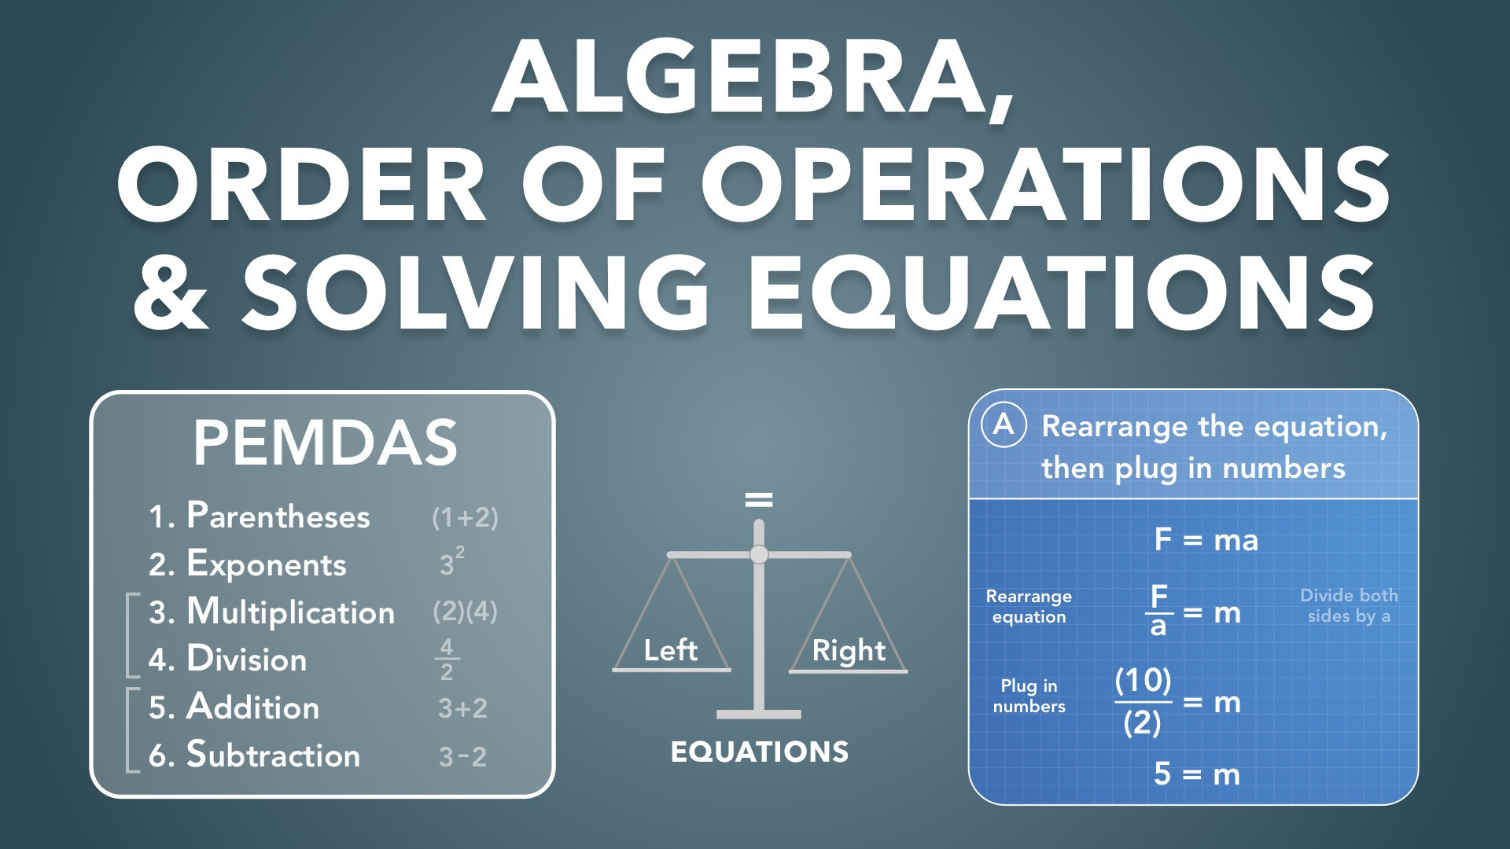
Notes:
Algebra, Order of Operations & Solving Equations
Slides Version 1
physicslab.app
These slides include screenshots from the video. Want more slides? Less slides? Different material on the slides or a different format? If you have any questions, suggestions or feedback about these slides please email me at chris@physicslab.app or send me a message on Discord @physicslab.

Slide 2
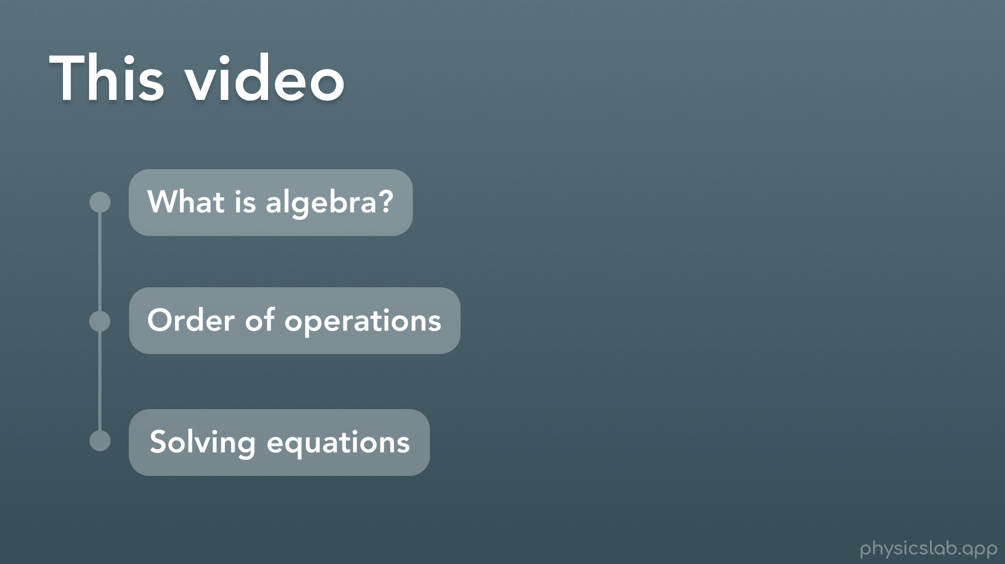
Notes:
Hey everyone, welcome to this Basics video on algebra, the order of operations, and solving equations. Like I said in the last video, the stuff in this video might just be a refresher for some people, but you definitely need to have this down because you’ll be doing it a lot in physics class so it will probably help everyone to watch.
In this video we’ll answer the question “what is algebra”, we’ll cover the order of operations, and we’ll learn how to solve equations which, turns out, you will probably be doing every time you solve a physics problem

Slide 3
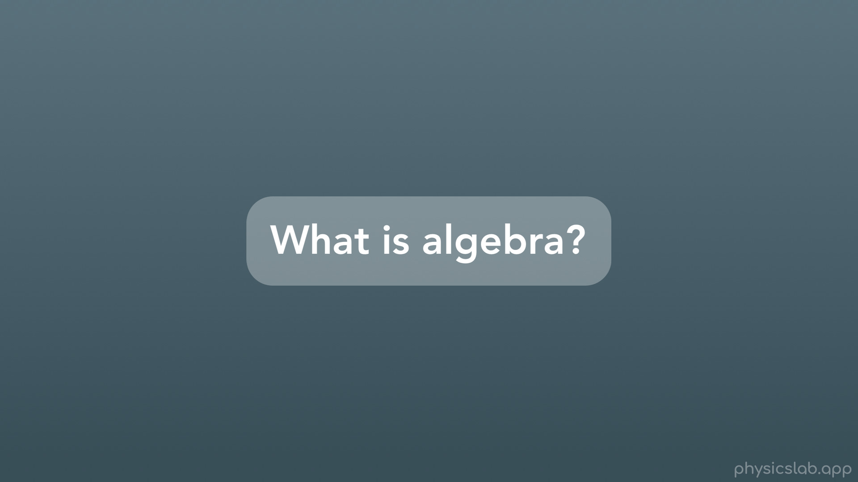
Notes:
Alright so, what is algebra?

Slide 4
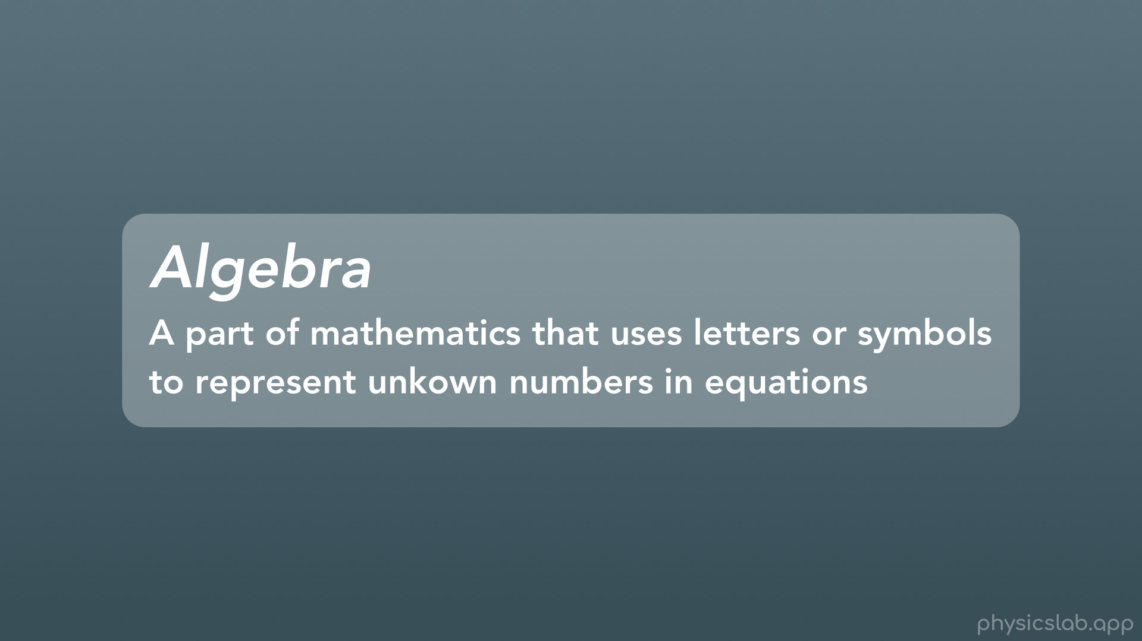
Notes:
Algebra is a part of mathematics that uses letters or symbols to represent unknown numbers in equations. What does that mean?

Slide 5
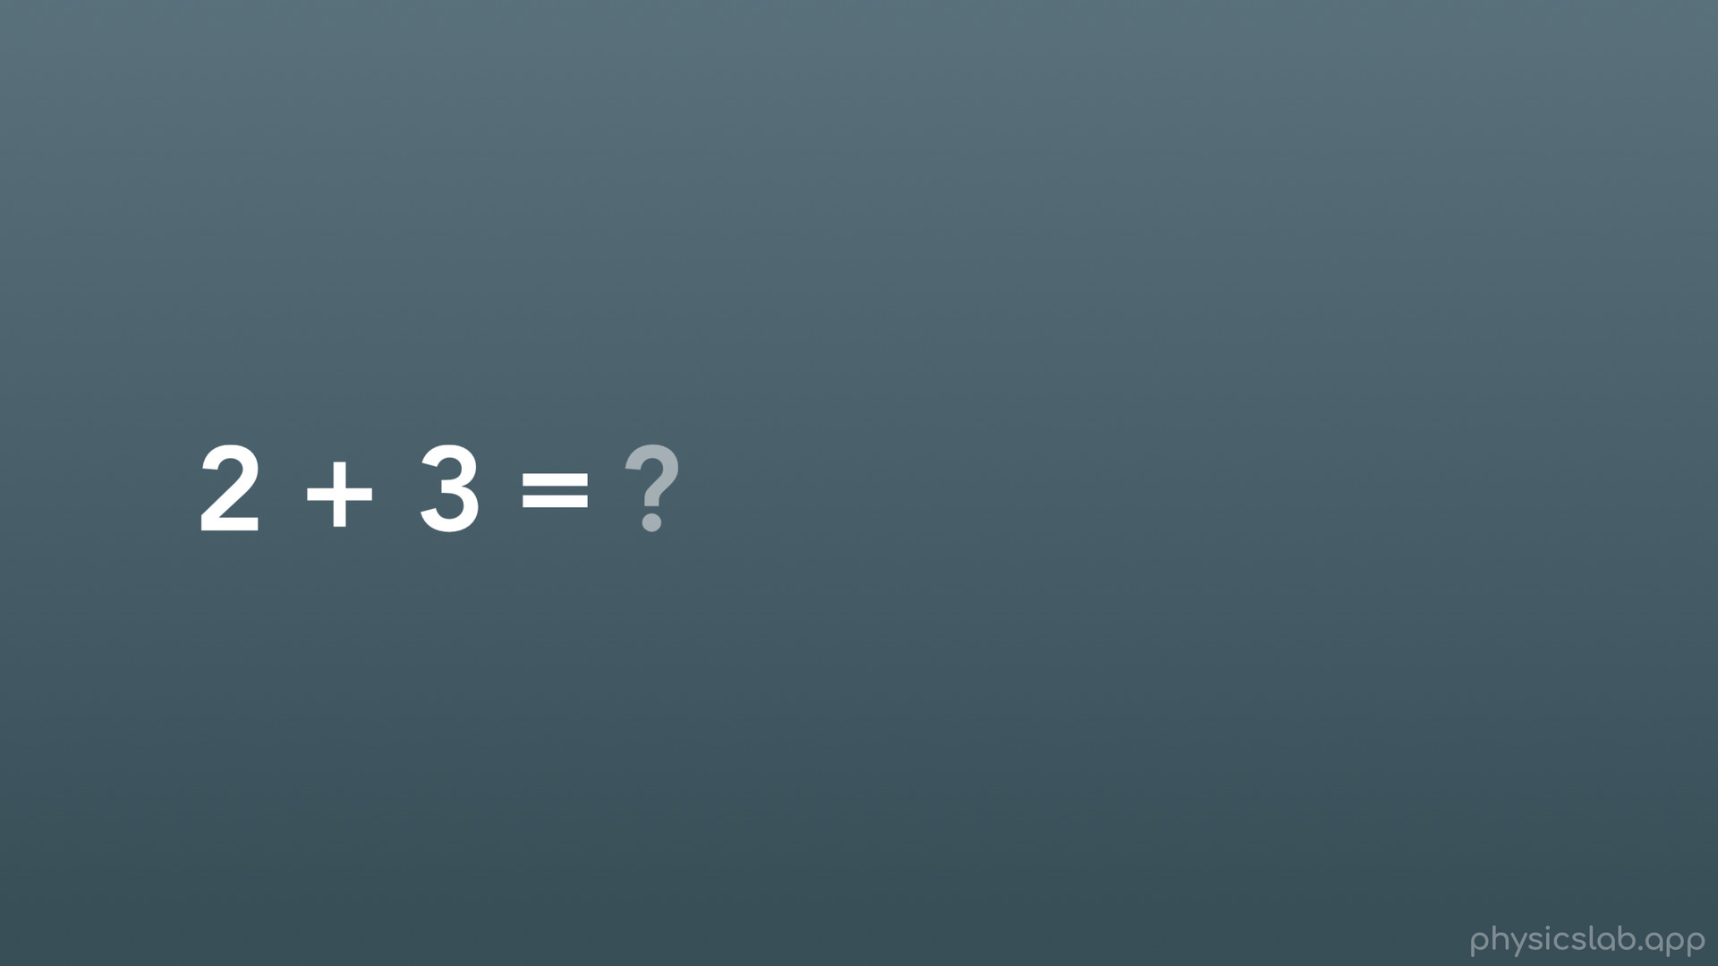
Notes:
So usually in math you’re used to a problem like this, where it asks you to do the math and find the answer. So it’s basically asking us: 2 + 3 = what?

Slide 6
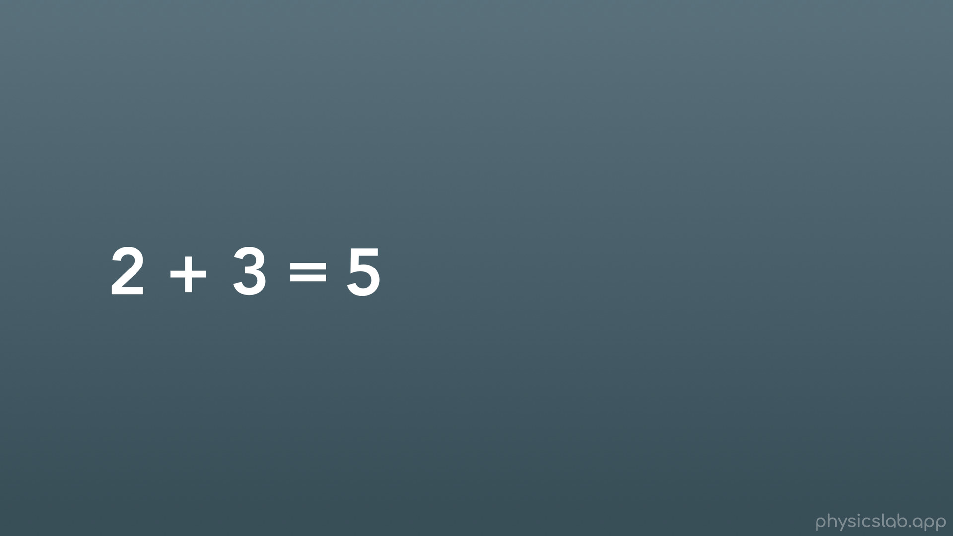
Notes:
We would just add 2 and 3, and we’d get that 2+3=5. Easy enough.

Slide 7
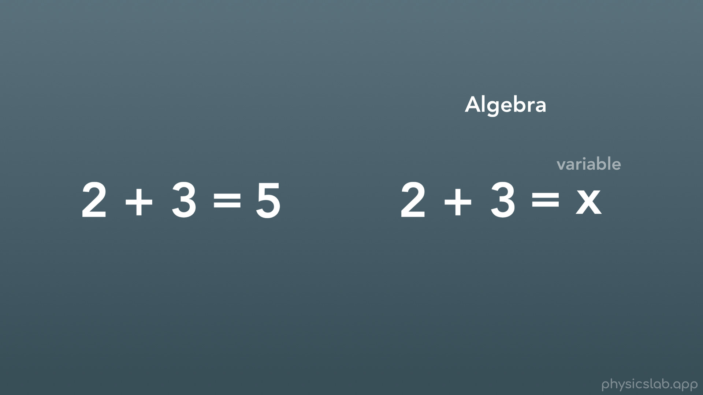
Notes:
Algebra is slightly different. In algebra, when we have an unknown, instead of leaving that space blank or writing a question mark, we replace the unknown number with what we call a variable. In this case, we’re using the letter x as our variable (note this is NOT a multiplication sign). We almost always use letters for our variables, but they can be whatever you want.

Slide 8
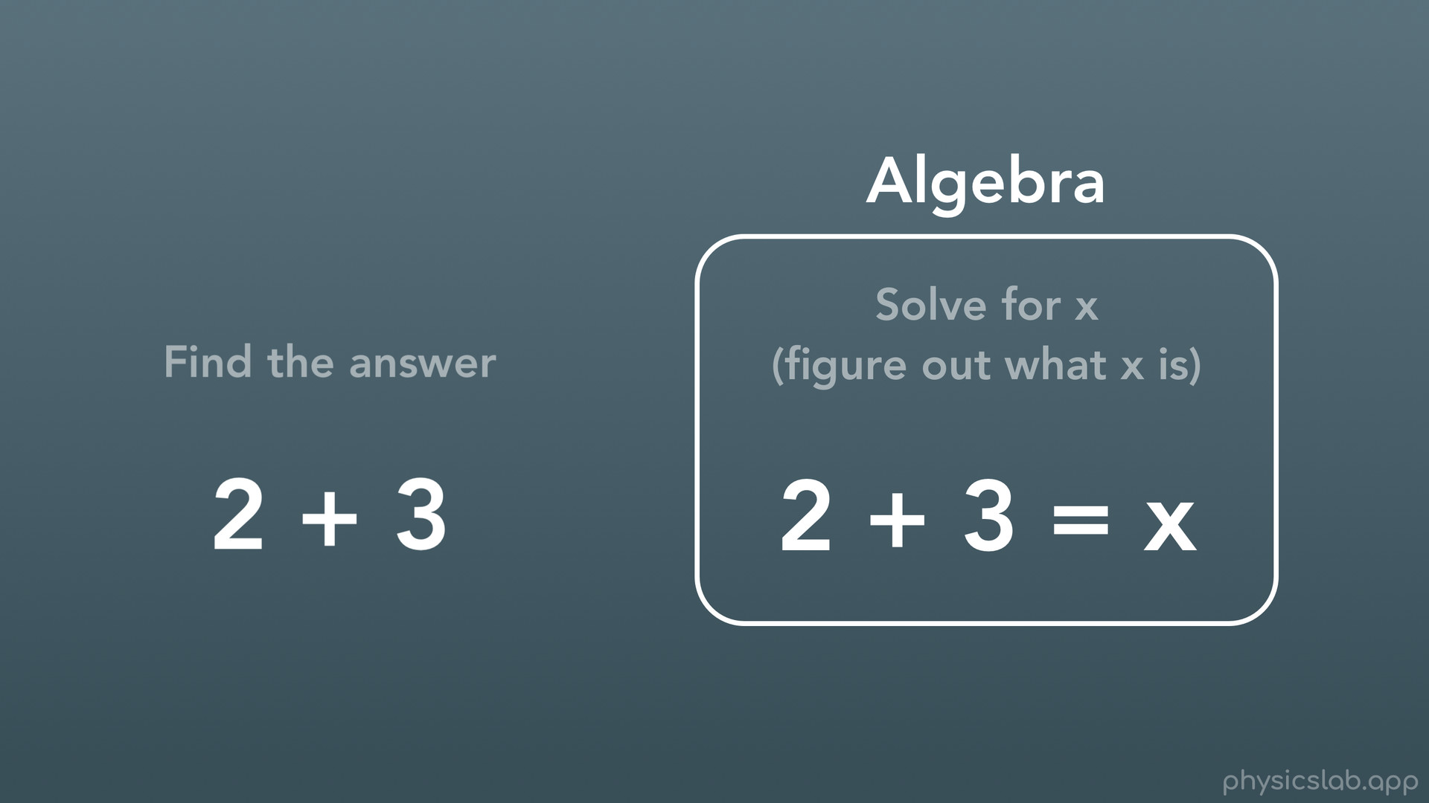
Notes:
And that’s pretty much the difference between the math we’re used to and algebra. Instead of being told what math to do and to just find the answer, we write out a full equation and put variables in place of numbers we don’t yet, and then we solve for those variables (or figure out what numbers they are).

Slide 9
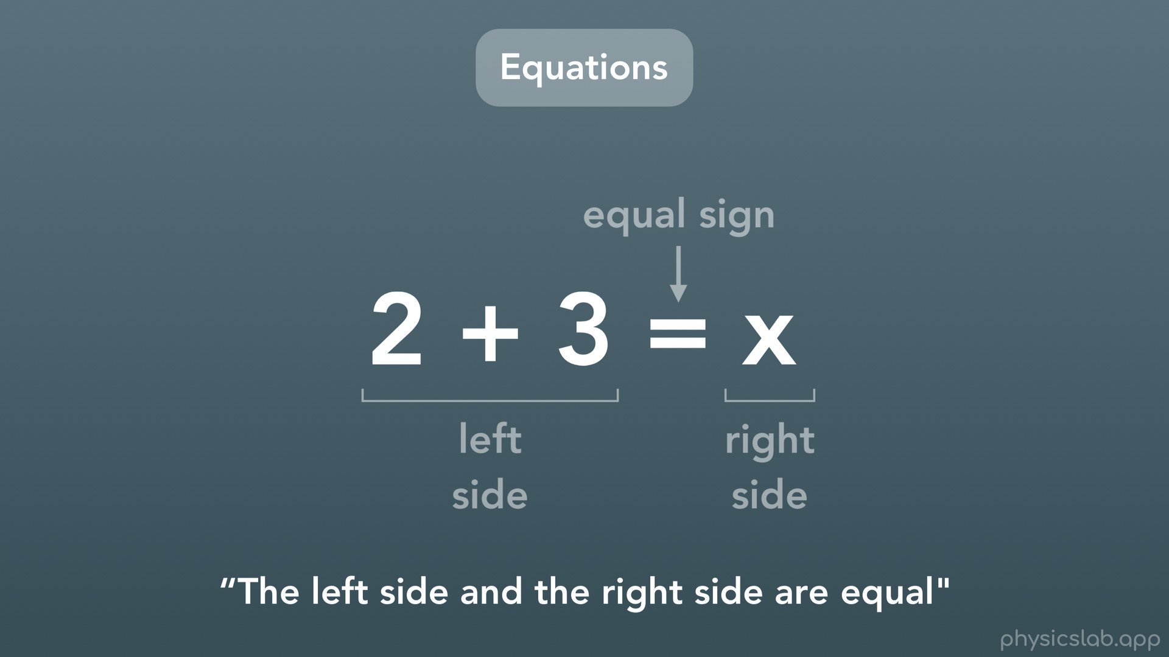
Notes:
Let’s take a closer look at equations. Every equation has 3 things: a left side with stuff in it, a right side with stuff in it, and an equal sign in the middle. As a whole, an equation is basically a statement that says “the left side and the right side are equal”. Everything that’s on the left side of the equal sign is equal to everything that’s on the right side of the equal sign.

Slide 10
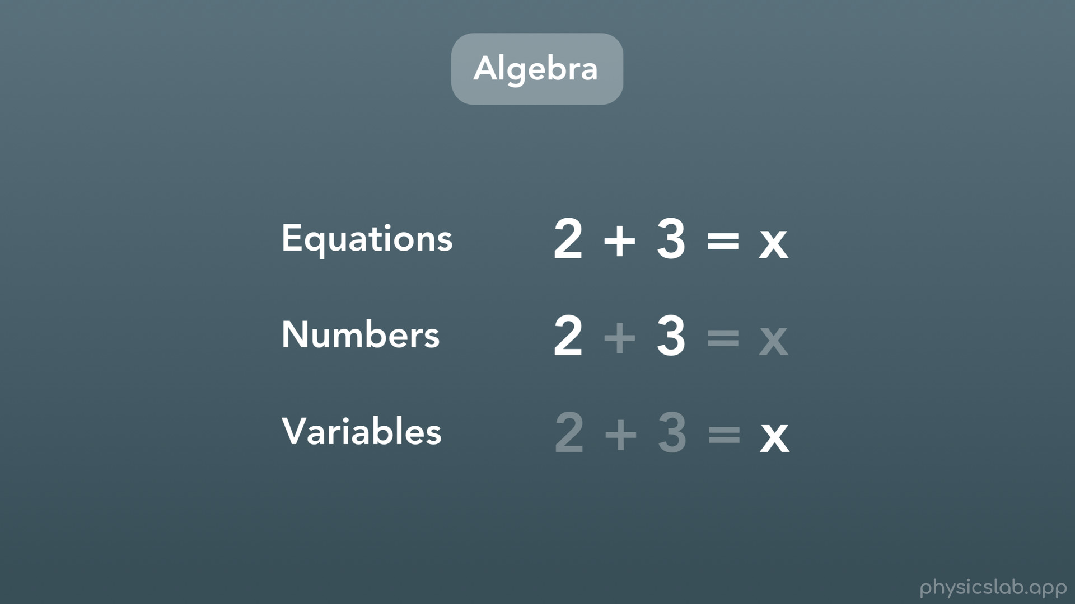
Notes:
To sum it up: in algebra we have equations, and those equations consist of numbers and variables. And usually, our job is to figure out what those variables are.

Slide 11
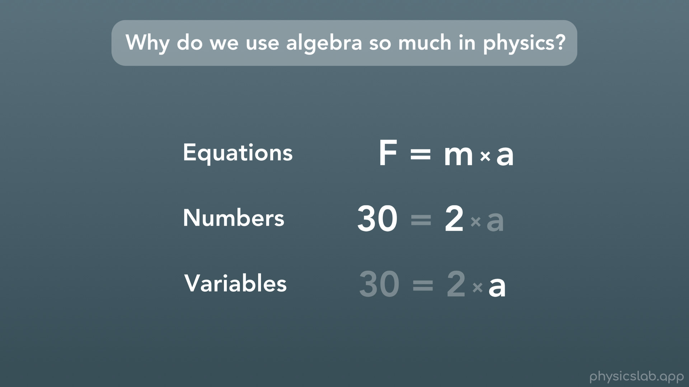
Notes:
So why do we use algebra so much in physics?
Well because in physics, we’re using equations all the time. When you see one on your equation sheet like this one (force = mass times acceleration), all of the things in it are variables. There aren’t any numbers, because we can plug in any numbers you want, as long as the left side and the right side are equal. As we work through a physics problem, usually we’ll replace some of the variables with numbers that we know or that we’re given. And usually, there will only be one variable left, which we’ll have to solve for, and that will be our answer.

Slide 12
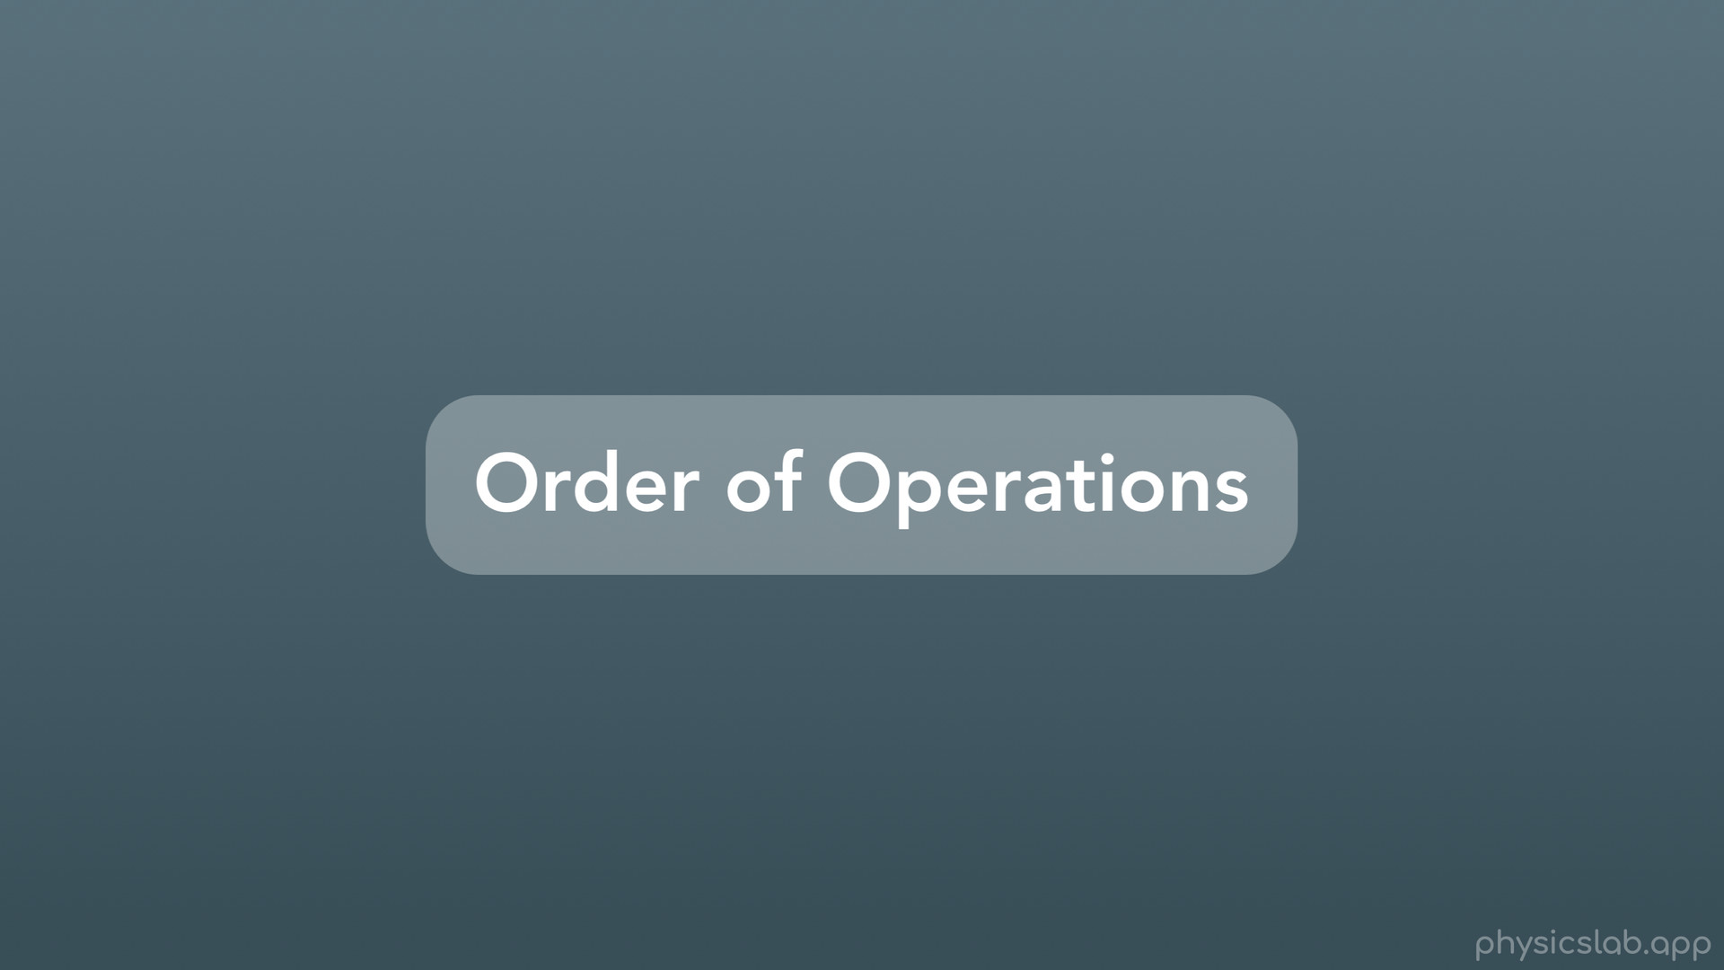
Notes:
Before we can start solving equations, there’s one thing we need to cover: the order of operations.

Slide 13
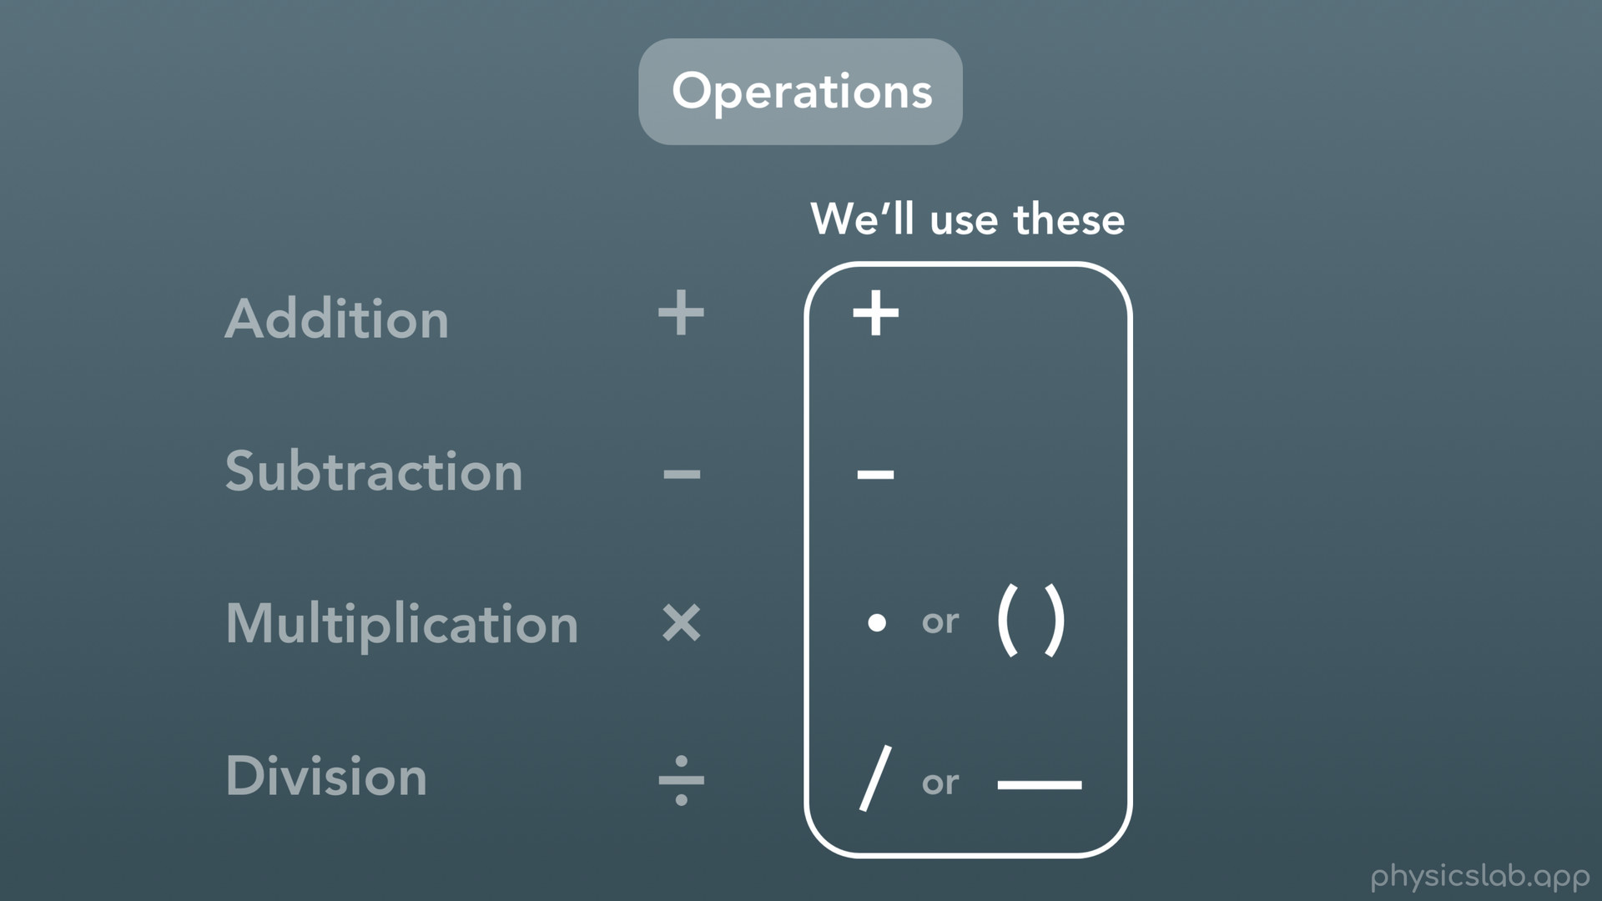
Notes:
You might not have called them operations before, but these are operations. You use them all the time: addition, subtraction, multiplication and division. Each one has a symbol that we commonly use.
Moving forward though, we’ll be using these symbols to represent each operation. For addition and subtraction we still use the same plus sign and minus sign. But for multiplication, we have options. Sometimes you’ll see multiplication written as a dot, but more commonly you’ll see 2 numbers that are next to each other, and at least one of them is inside parentheses, with no other symbol between them. This means to multiply the two numbers. And finally for division, we use symbols for fractions. This might be written as a regular slant, or more commonly you’ll write the fraction out with a number on top (the numerator), and a number on the bottom (the denominator).

Slide 14
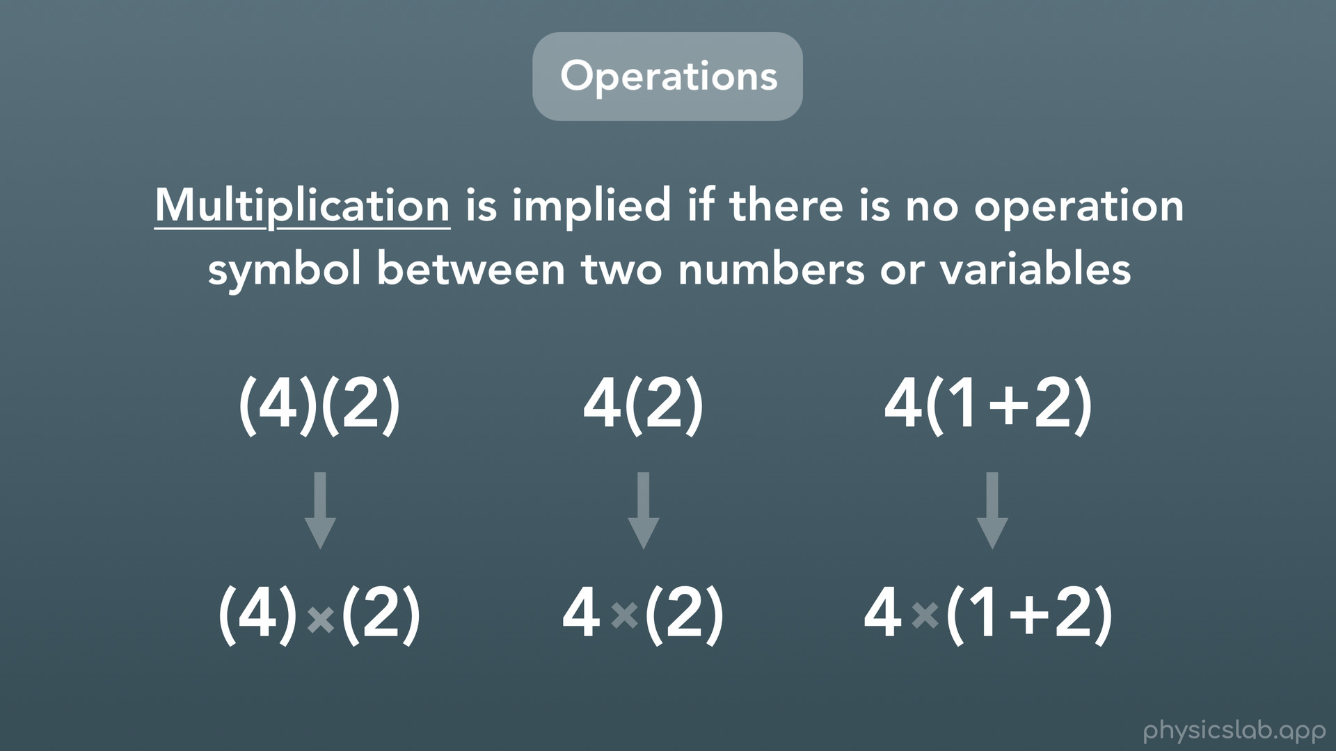
Notes:
Just to reiterate because this is used the most in physics. Multiplication is implied if there is no operation symbol between two numbers or variables. These are all examples of things that are being multiplied. We have 4 times 2, both in parentheses. 4 times 2, but only the 2 is in parentheses. We have 4 times the sum of 1+2.

Slide 15
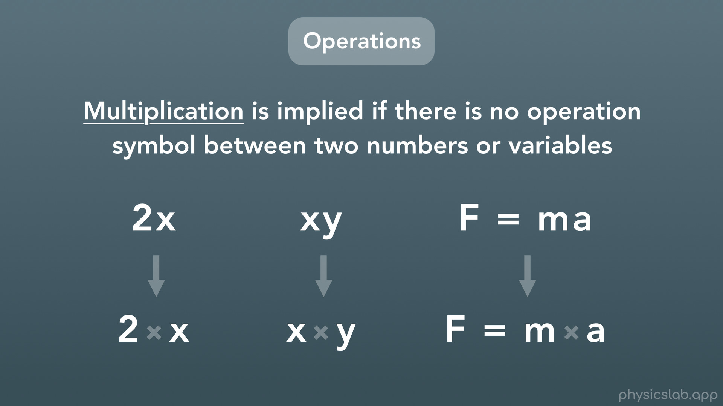
Notes:
With variables, we don’t really use parentheses, because we can’t get confused writing a letter next to a number. Here we have 2 times x, x times y, and F = m times a.

Slide 16
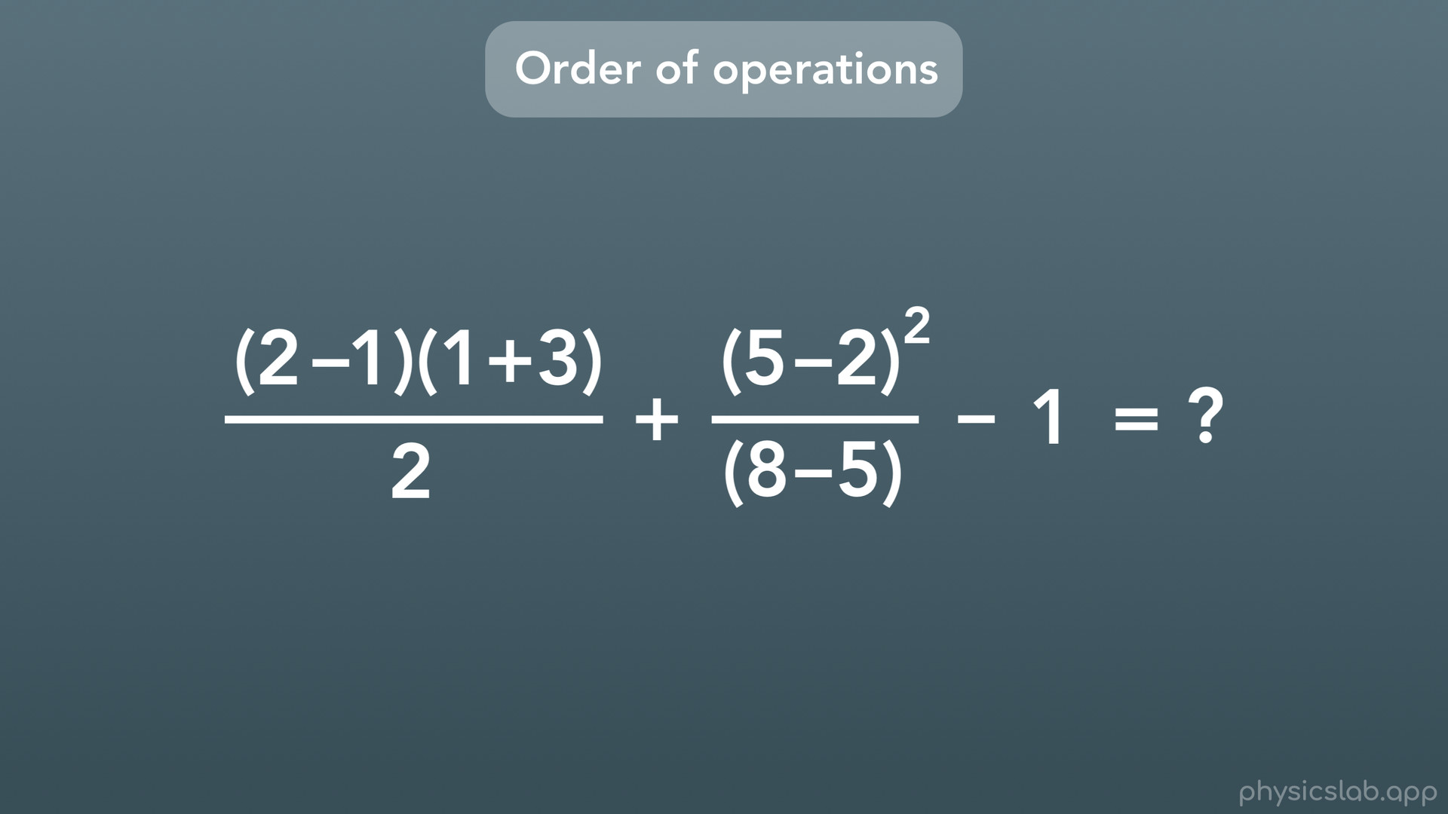
Notes:
Great, so we know what the operations are and what they look like. But say we’re given an equation like this, and we have to start doing the math. Where do we start? Do we just work left to right, or start with what looks easier?

Slide 17
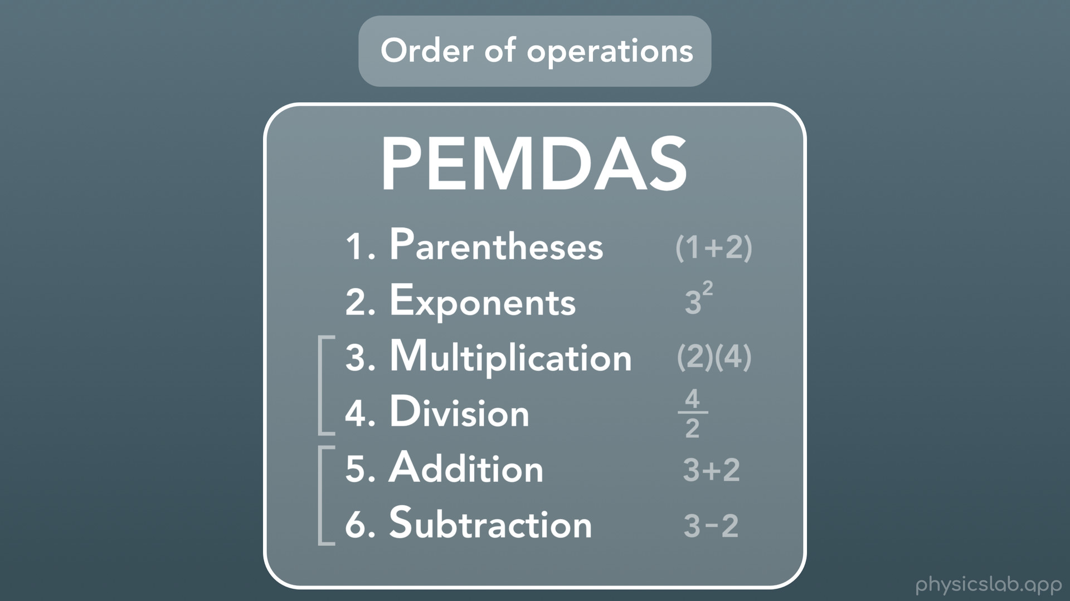
Notes:
There’s actually an agreed upon set of rules for what order you’re supposed to do the math, and that’s called the order of operations. The reason this exists is so that anyone can look at the same math written down and get the same answer.
1st you do the math that is inside a set of parentheses. 2nd, you calculate any numbers with exponents. 3rd and 4th, you do any multiplication and division. Then 5th and 6th, you do any addition and subtraction. We have brackets here on the left because you can really do the multiplication and division at the same time, and you can do the addition and subtraction at the same time. BUT multiplication and division come BEFORE addition and subtraction. To memorize this order of operations, we use the word PEMDAS, which is the first letter of each operation.
There are different ways to remember the letters in PEMDAS, but the one I hear the hear the most is Please Excuse My Dear Aunt Sally.

Slide 18
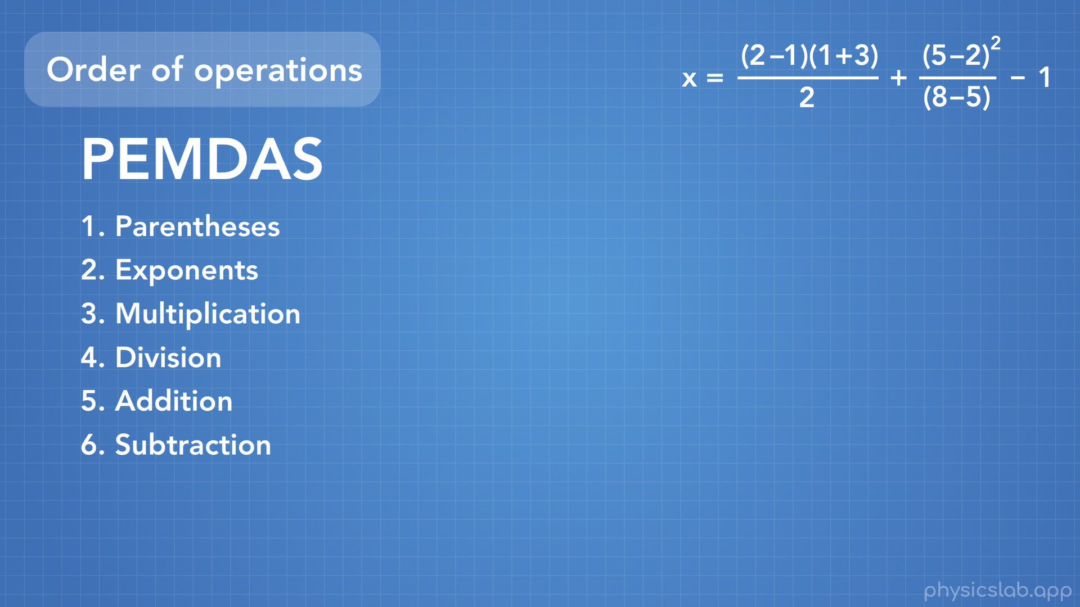
Notes:
Let’s work through an example of how to use the order of operations. Here is that equation we saw before, and we want to do all of the math on the left side to figure out what x equals.

Slide 19
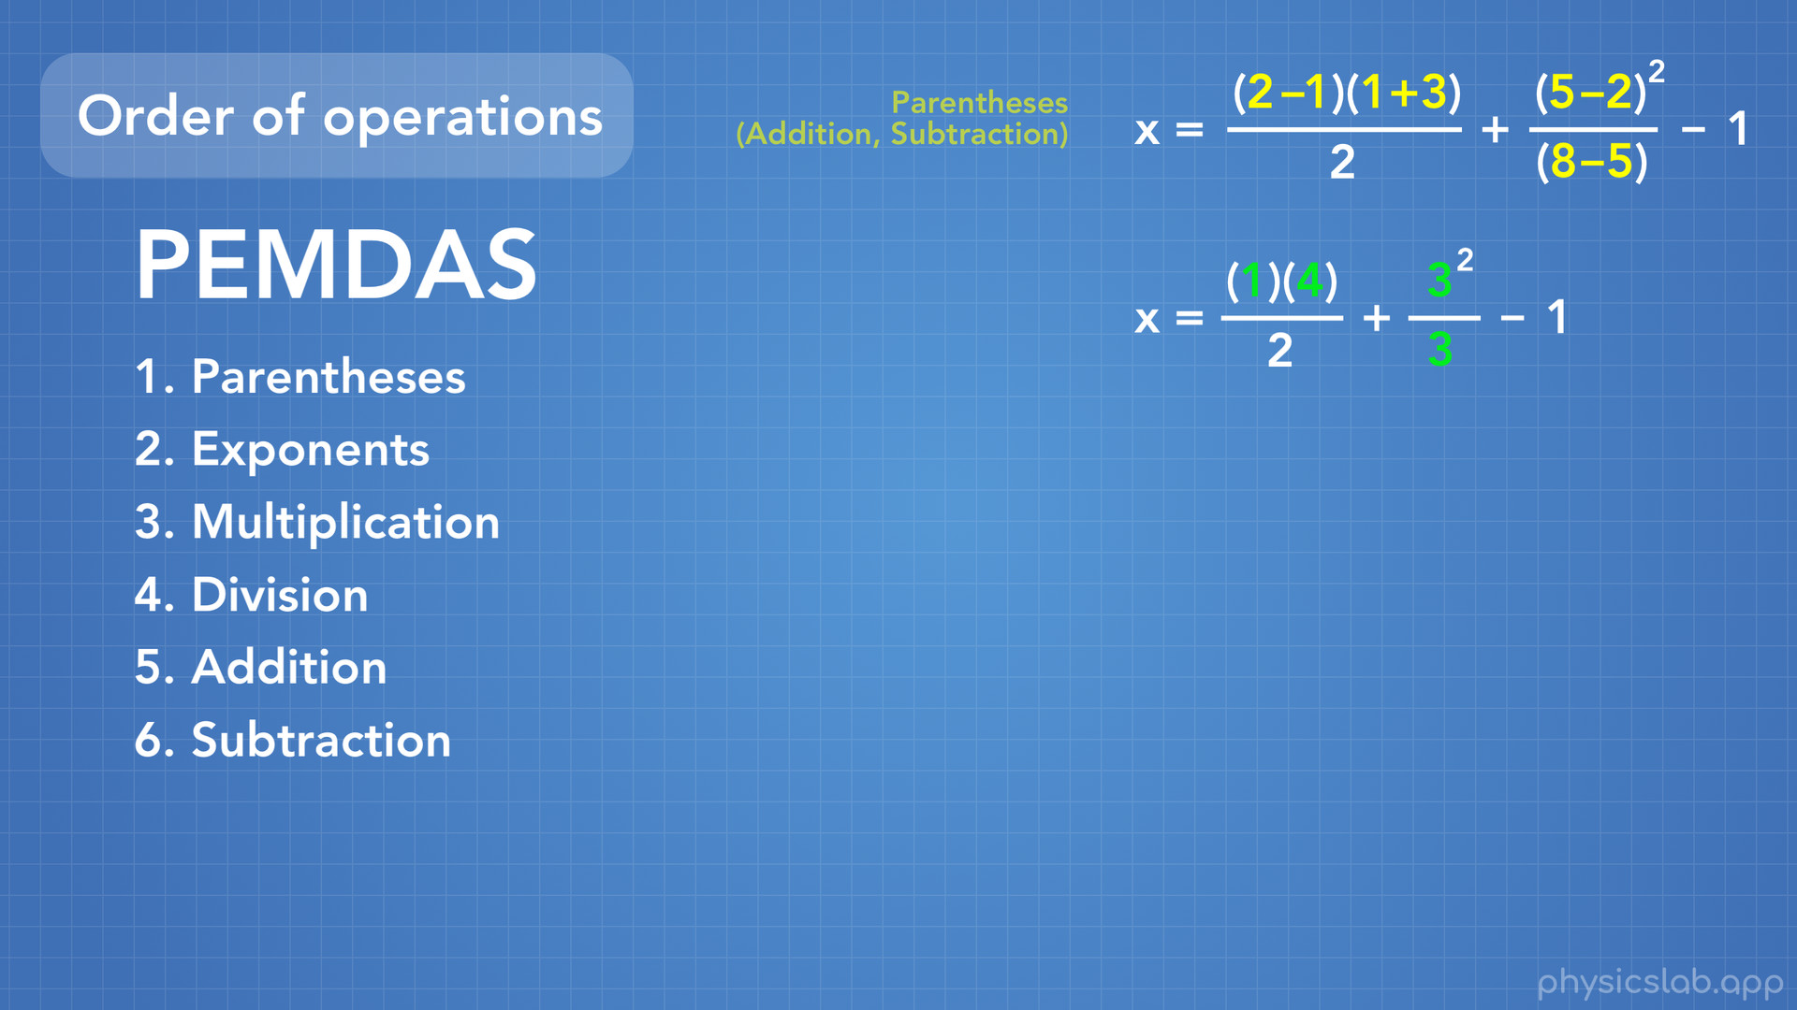
Notes:
First we do any math inside a set of parentheses. A key thing here is that the stuff inside parentheses also follows the order of operations. In our case everything in parentheses is addition and subtraction, so we can do that all in one step. 2-1 becomes 1, 1+3 becomes 4, 5-2 becomes 3, and 8-5 becomes 3.

Slide 20
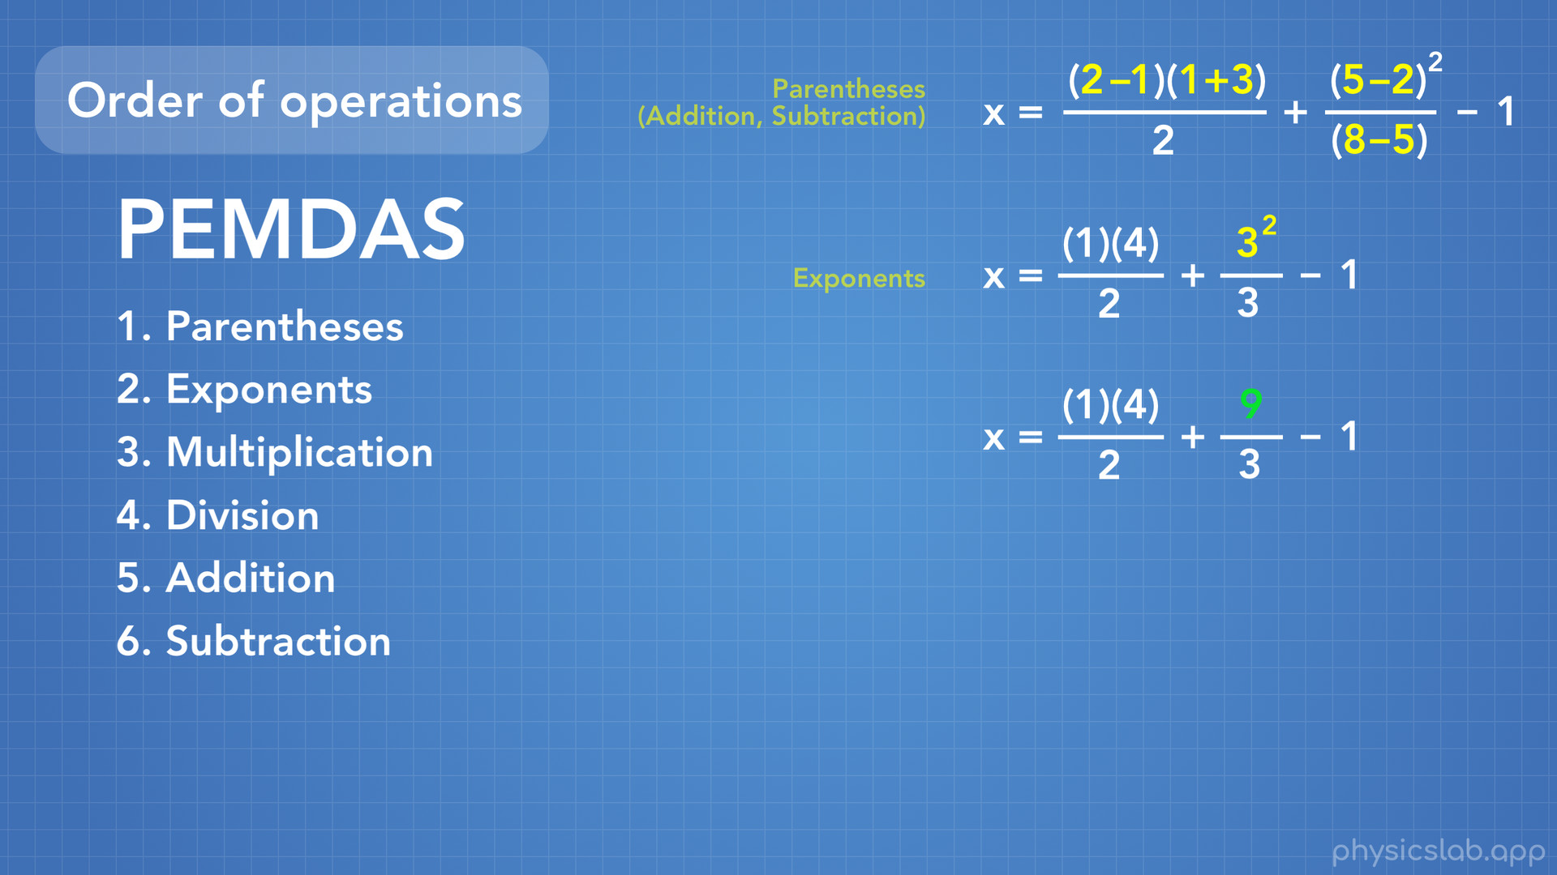
Notes:
Next up is any number with an exponent. Here we now have 3 square, 3 with an exponent of 2. We calculate 3 squared, which is 3x3, and we get 9.

Slide 21
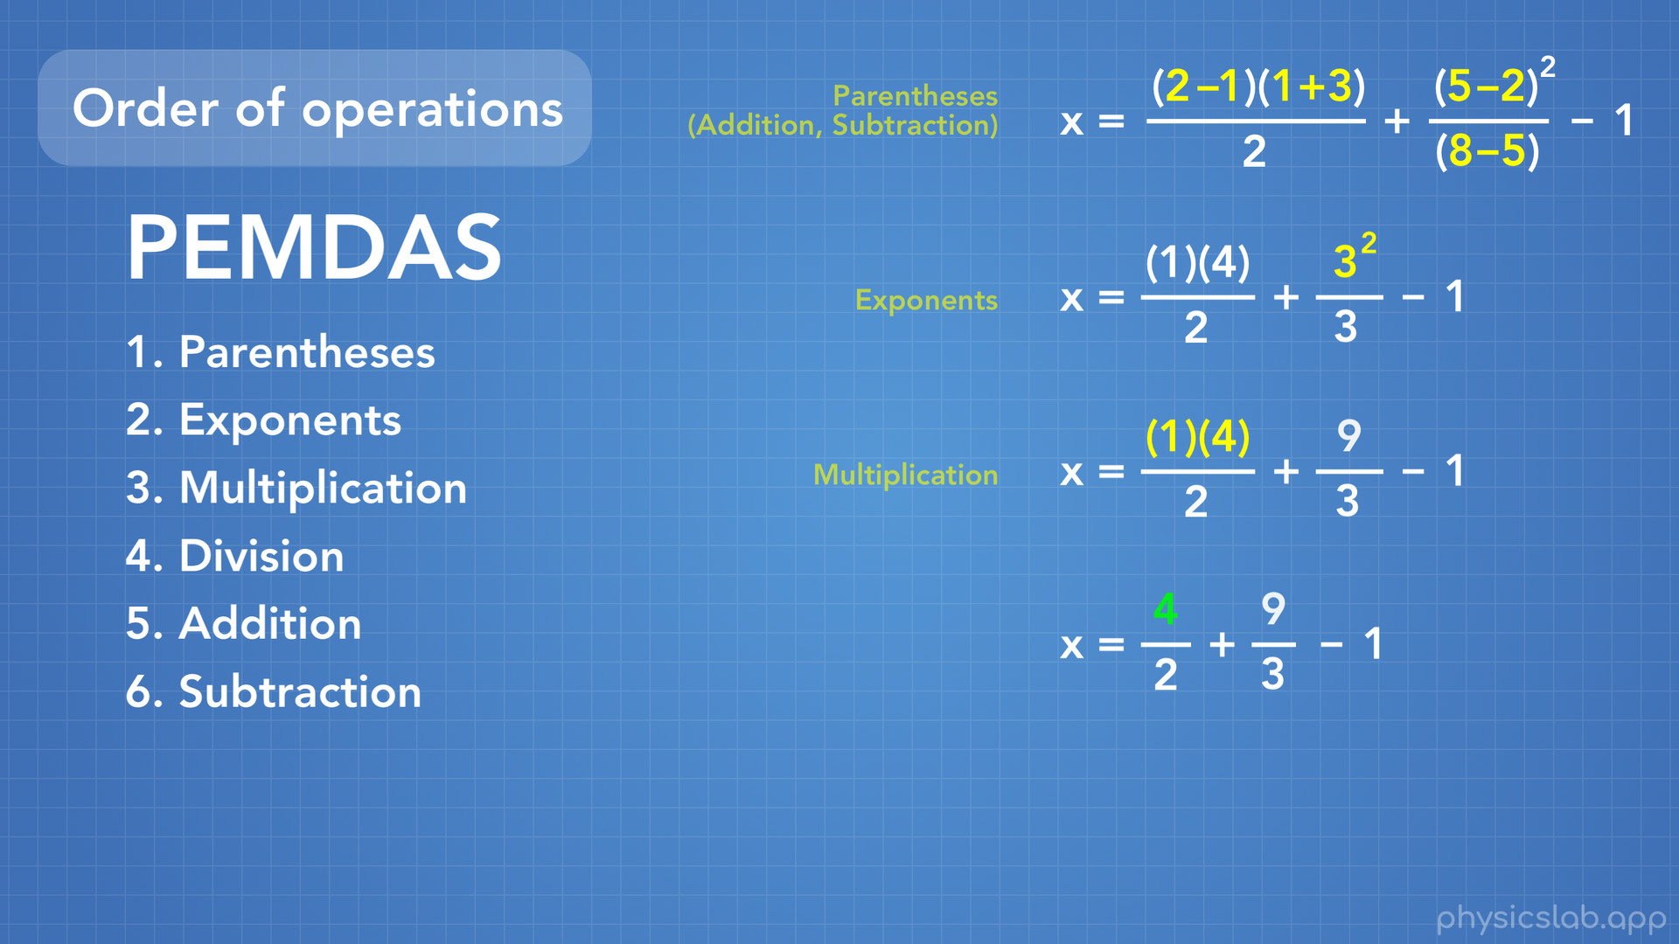
Notes:
Next we do multiplication. Remember that numbers in parentheses next to each other means multiplication. Here we have 1 x 4, which becomes 4.

Slide 22
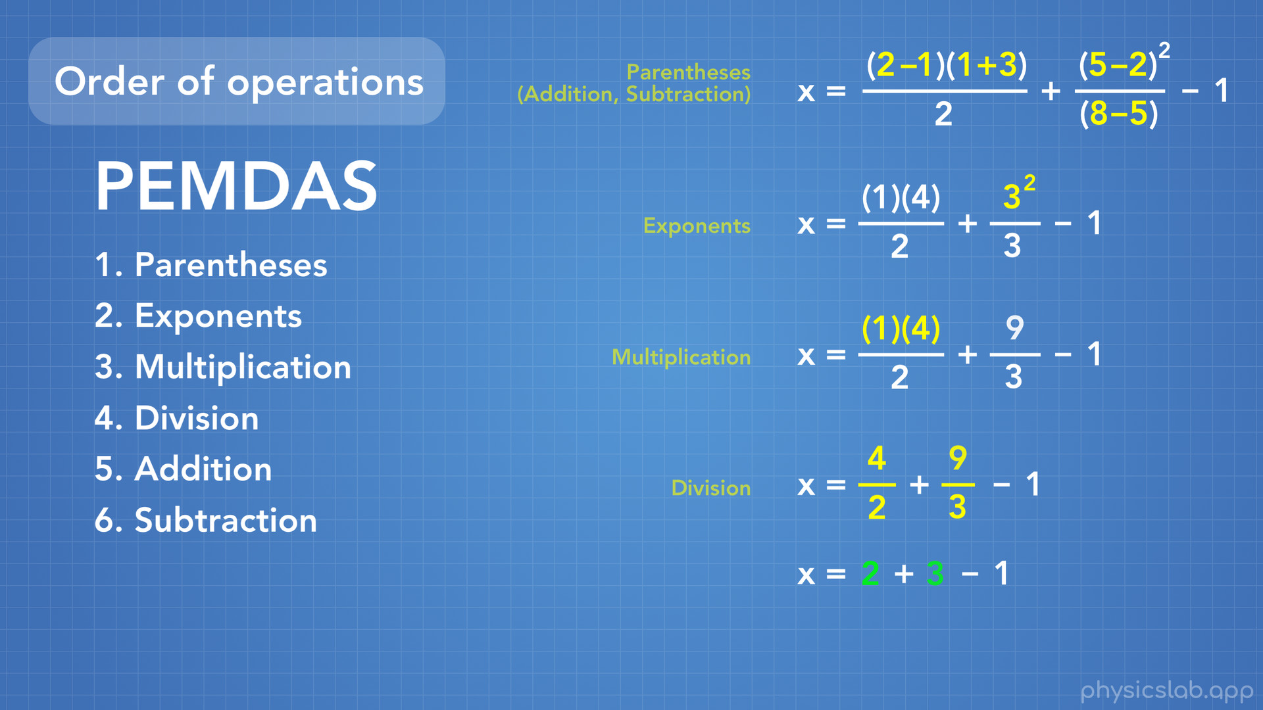
Notes:
Next we do any division in our equation. Here we have 4/2 which becomes 2, and 9/3 which becomes 3.

Slide 23
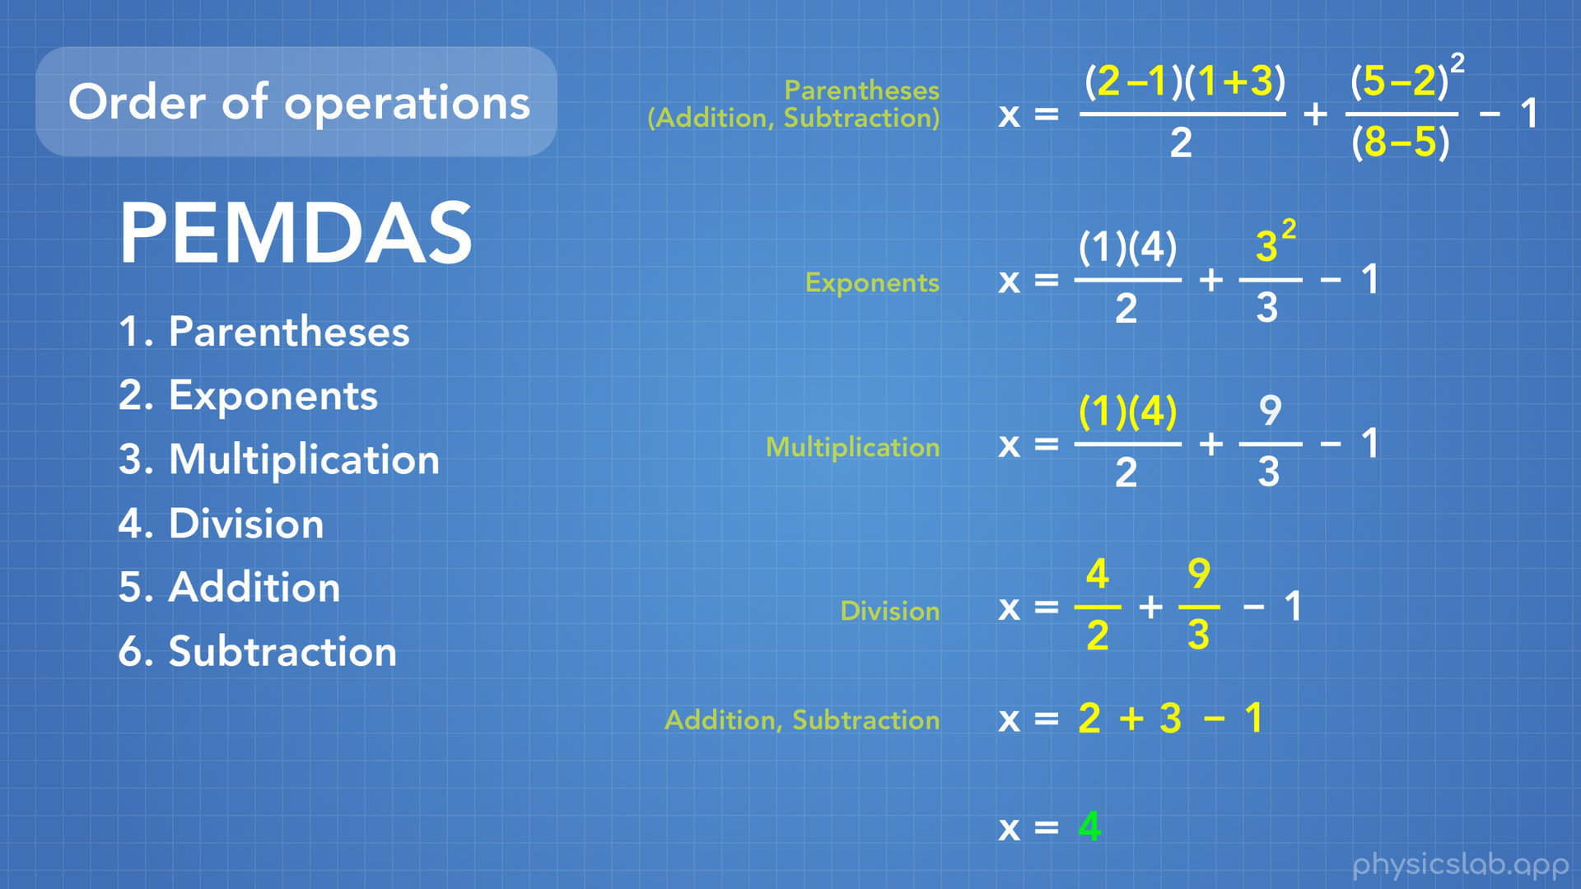
Notes:
All we have left is addition and subtraction which we can do together. So 2+3-1 becomes 4.

Slide 24
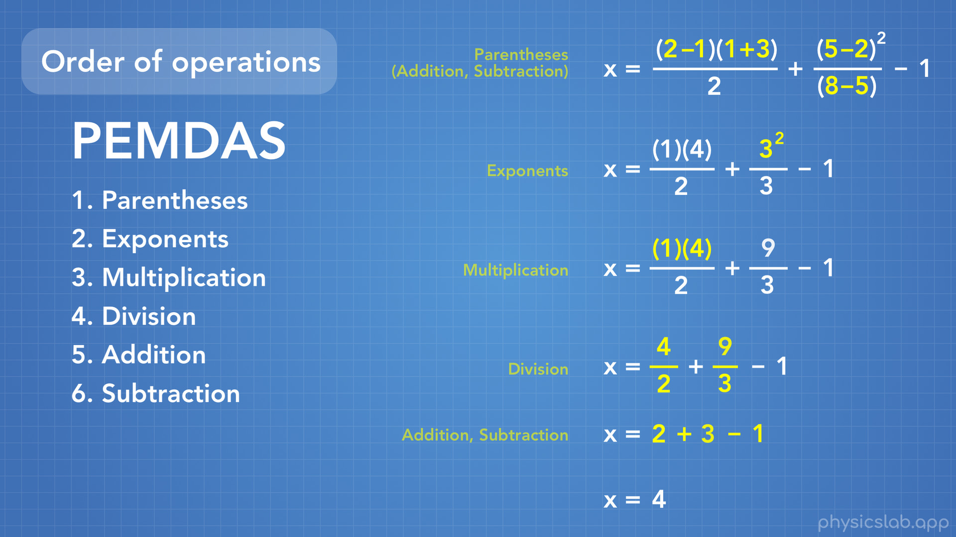
Notes:
And there we go. We took this big bunch of math and simplified it down to get 4. And anyone else who sees the same bunch of math and simplifies this down will get the exact same answer, as long as they use the order of operations.

Slide 25
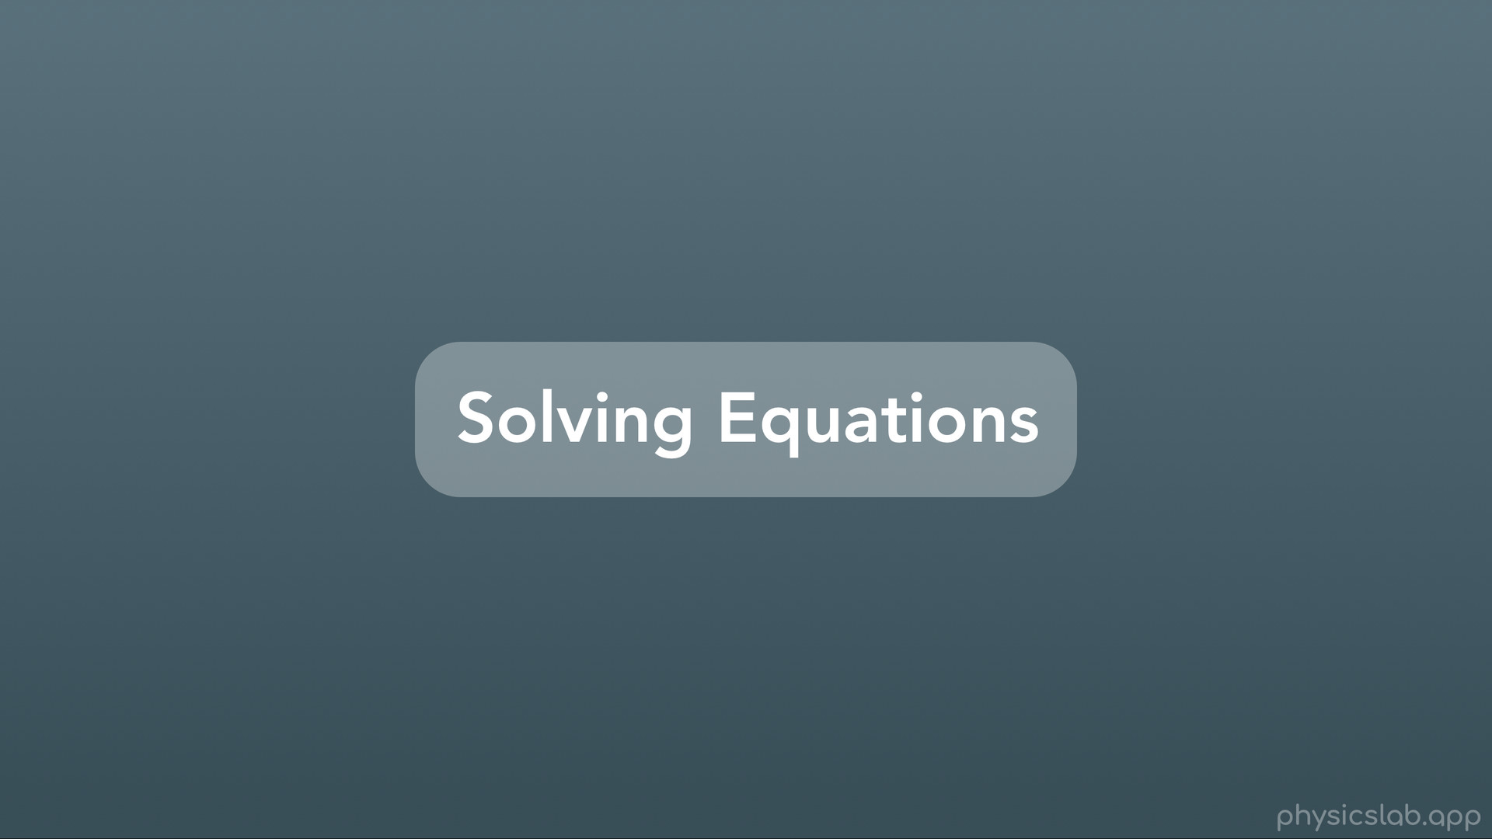
Notes:
Finally we’re ready for solving equations.

Slide 26
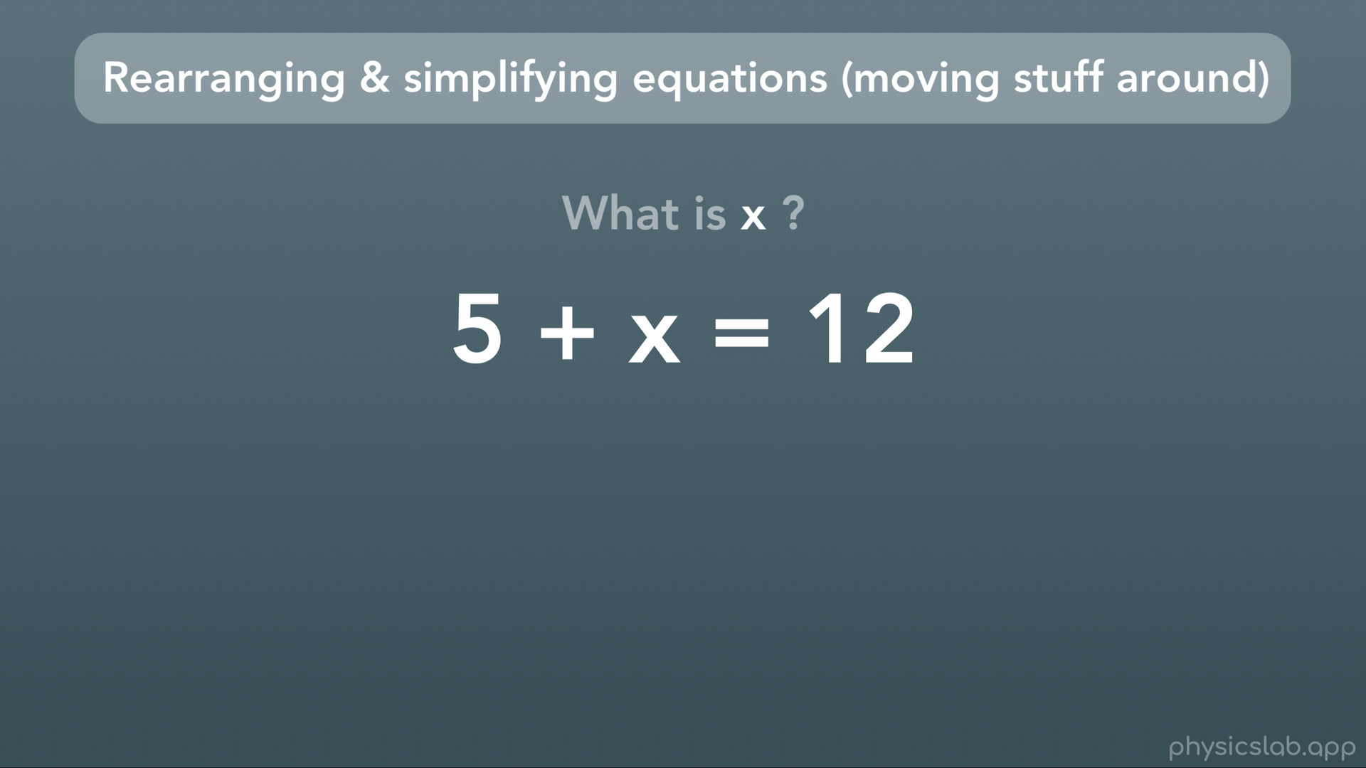
Notes:
In order to solve an equation, which just means figuring out what the variables are, it’s easiest if we rearrange or simplify the equation, which just means moving stuff around, so that the variable we’re solving for is on one side all by itself. Then the equation will just tell us the answer, like in the example we just did.
Here’s an example. We have this equation, and we want to figure out what is our variable x? Well, you could think about it in your head for bit and reason it our: “5 plus what gives me 12?”. Or, we can rearrange the equation so we don’t have to do any “thinking”.

Slide 27
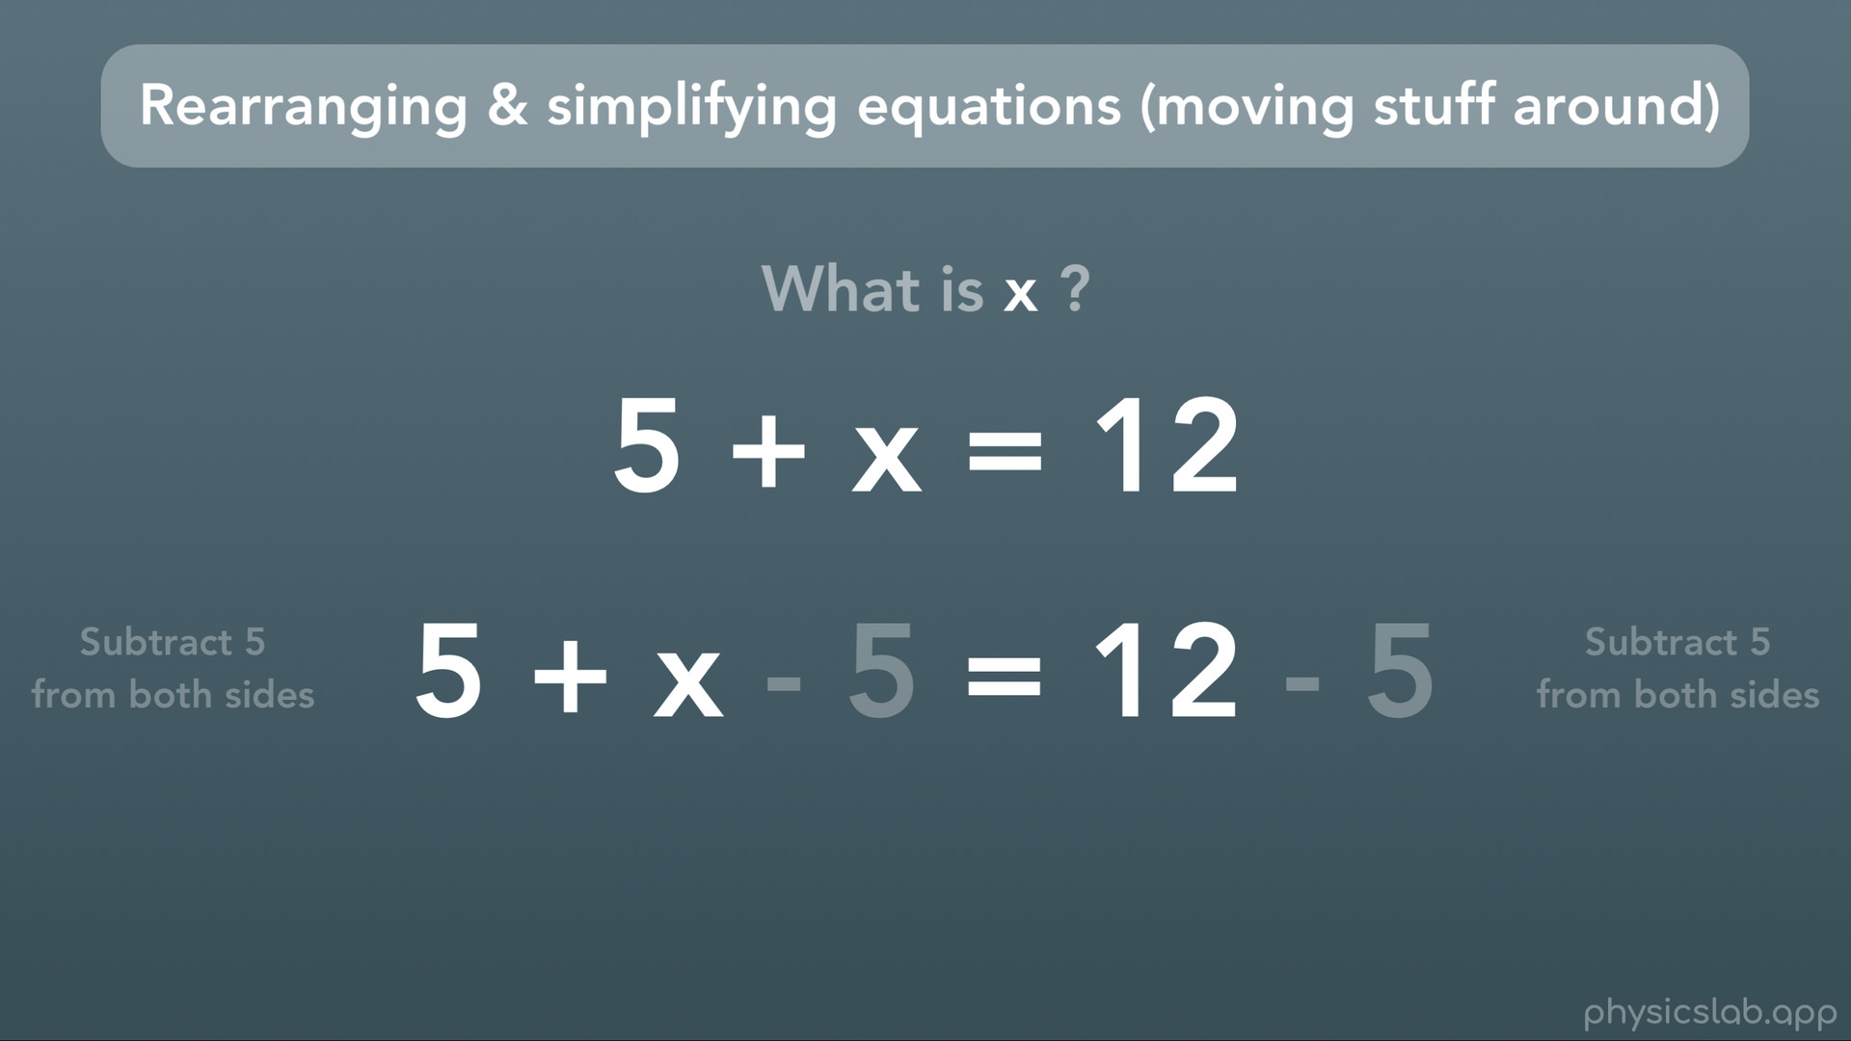
Notes:
In this case, we’re going to subtract 5 from both sides of the equation.

Slide 28
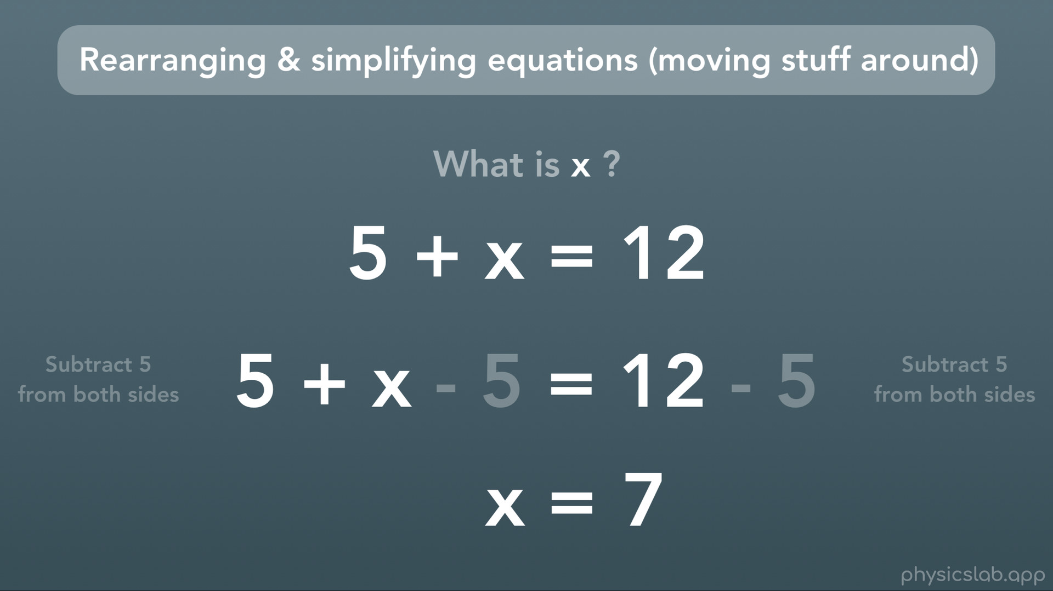
Notes:
5-5 is zero and goes away, and 12-5 is 7. And there’s our answer. Our variable x is all by itself on one side, and the other side is simplified to just one number, so we know x=7.

Slide 29
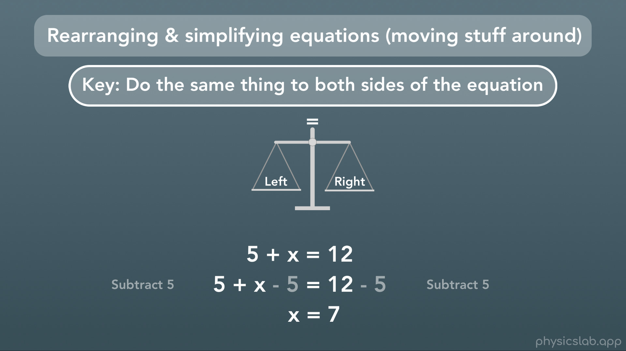
Notes:
What we just did there was the big important thing about equations: you can do whatever you want to them, as long as you do the same thing to both sides of the equation. That way, the equation is still a correct statement. Think of it like a balance. We have our left side and our right side, and as long as we do the same thing to both sides, our equation is still true. In that example we subtracted 5 from both sides to get our answer.

Slide 30
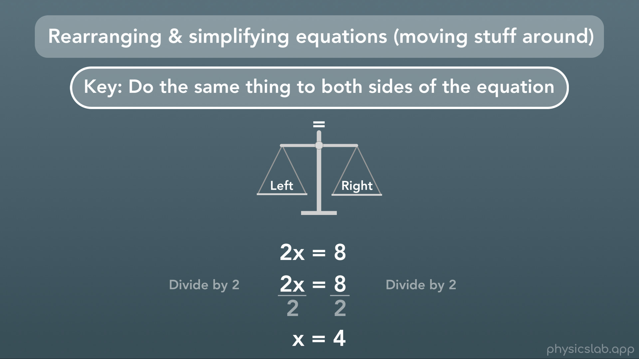
Notes:
For this equation, we can divide both sides by 2 to get x all by itself and get find our answer.

Slide 31
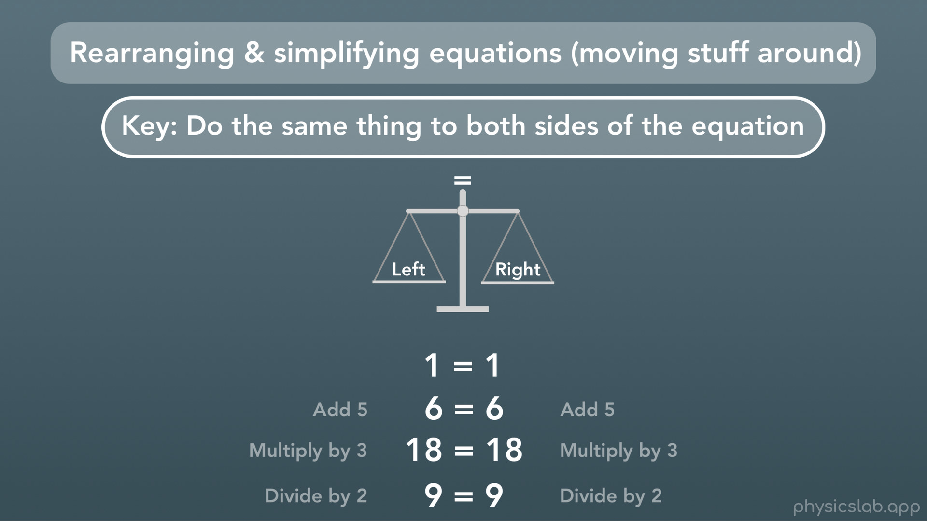
Notes:
Check out an equation with no variables. Obviously 1 = 1. And no matter what we do, as long as we do the same to both sides, our equation is still true. That’s the only job of the equation, to keep the left and right sides equal.

Slide 32
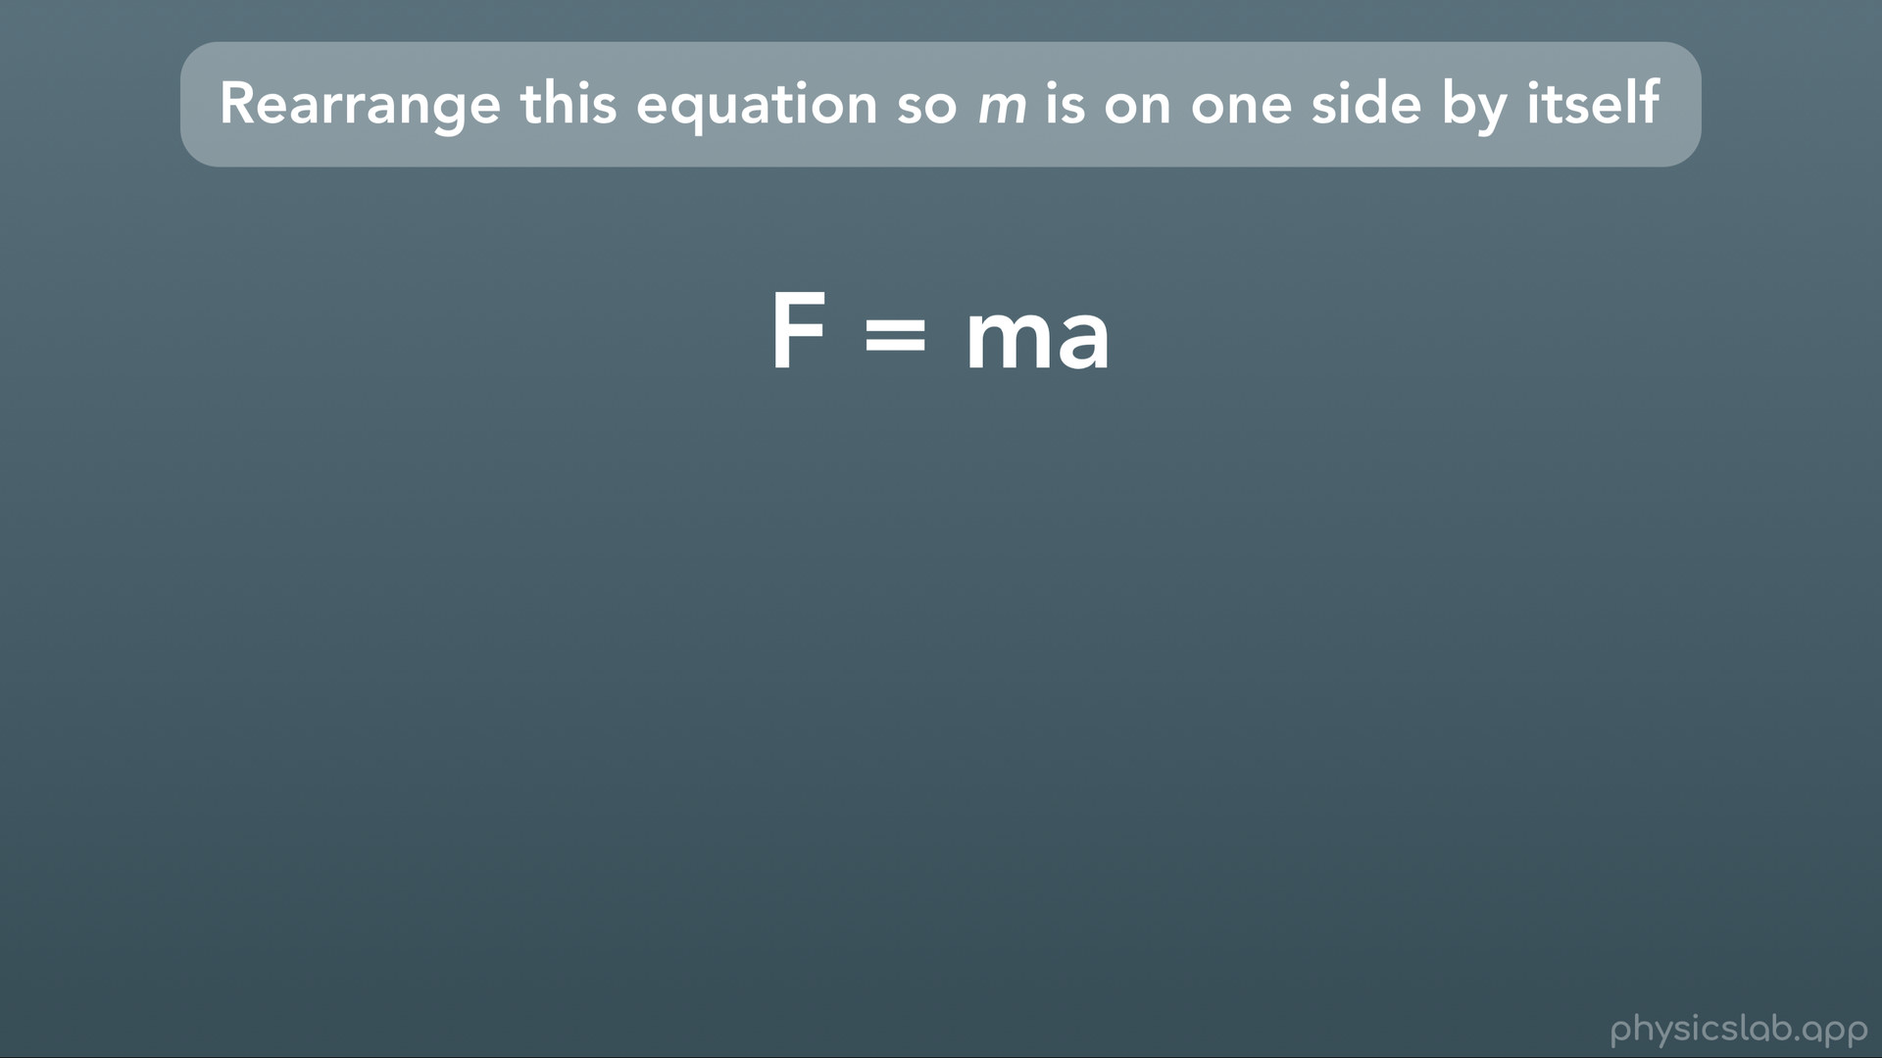
Notes:
Let’s try rearranging an equation that only has variables in it. Here we have the equation F=ma, which stands for Force=mass x acceleration. Say we wanted to get the variable m all by itself on one side.

Slide 33
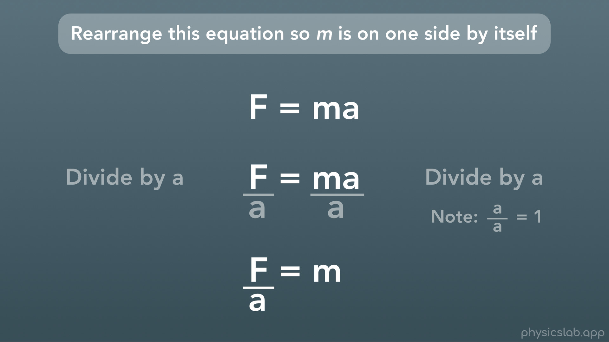
Notes:
Well all we have to do is divide both sides by a. Note that on the right we have a/a, and any number (or variable) divided by itself = 1, so we have mx1, or just m. Now we have F/a = m. We have m all by itself, and this equation is still true.

Slide 34
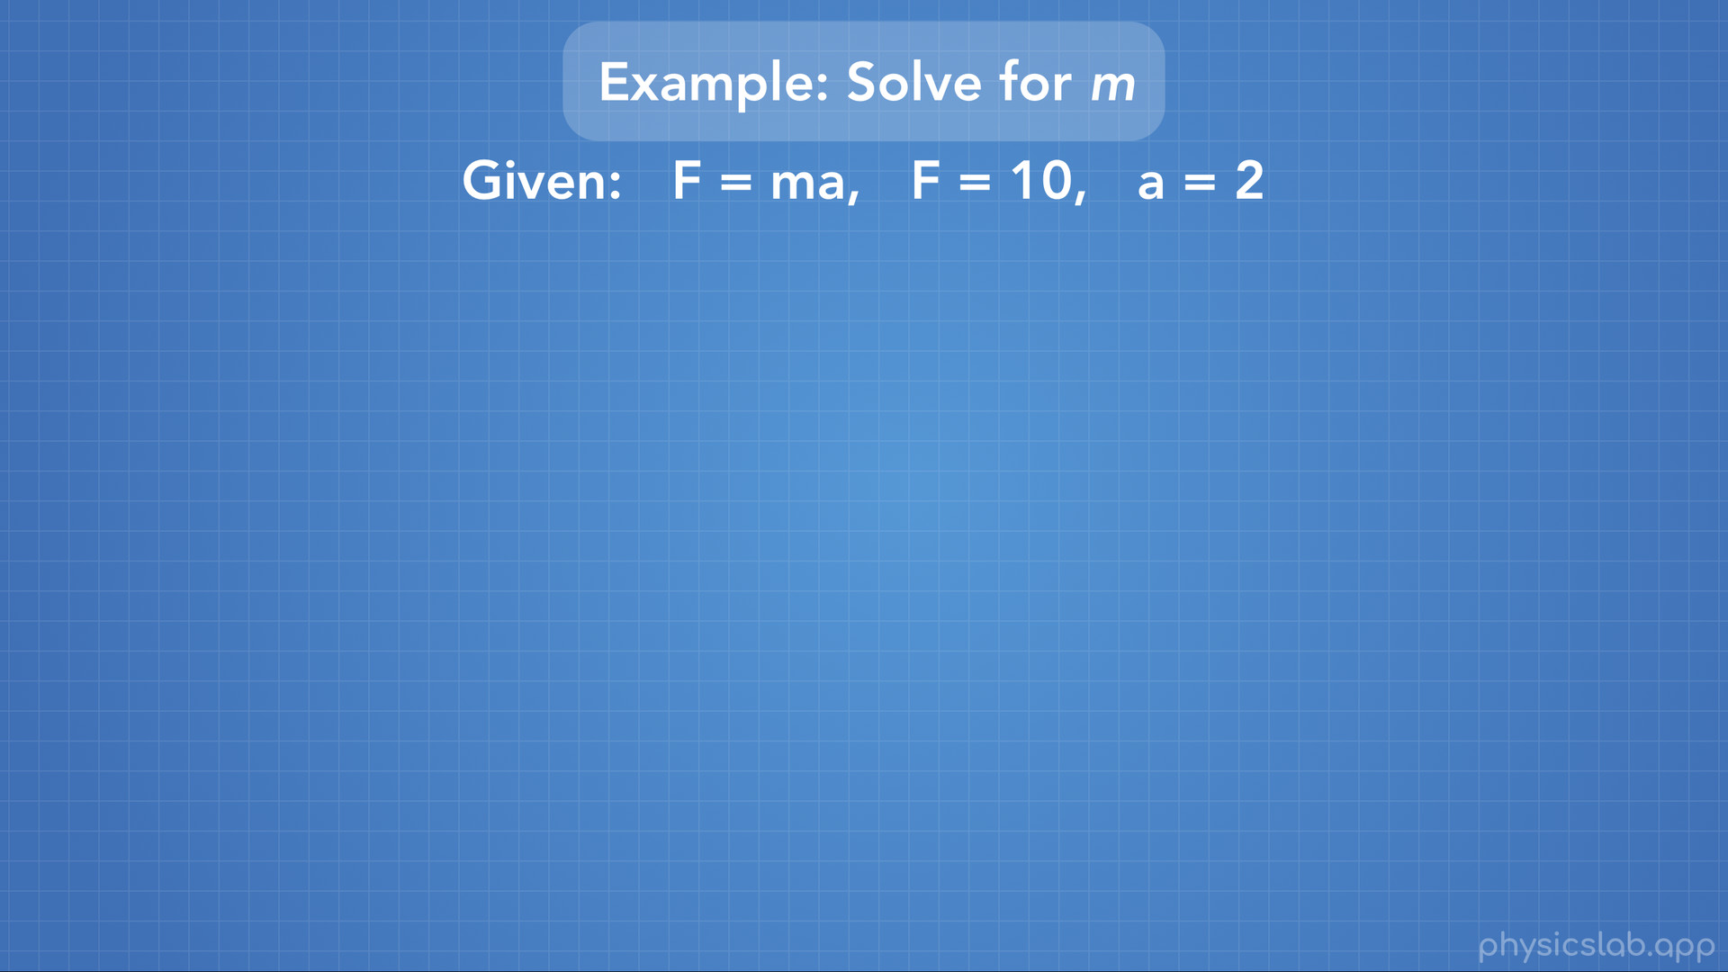
Notes:
Let’s try one quick example. Say that we want to solve for the variable m, given the equation F=ma, that F=10 and that a=2. Well, we have 2 paths we can take.

Slide 35
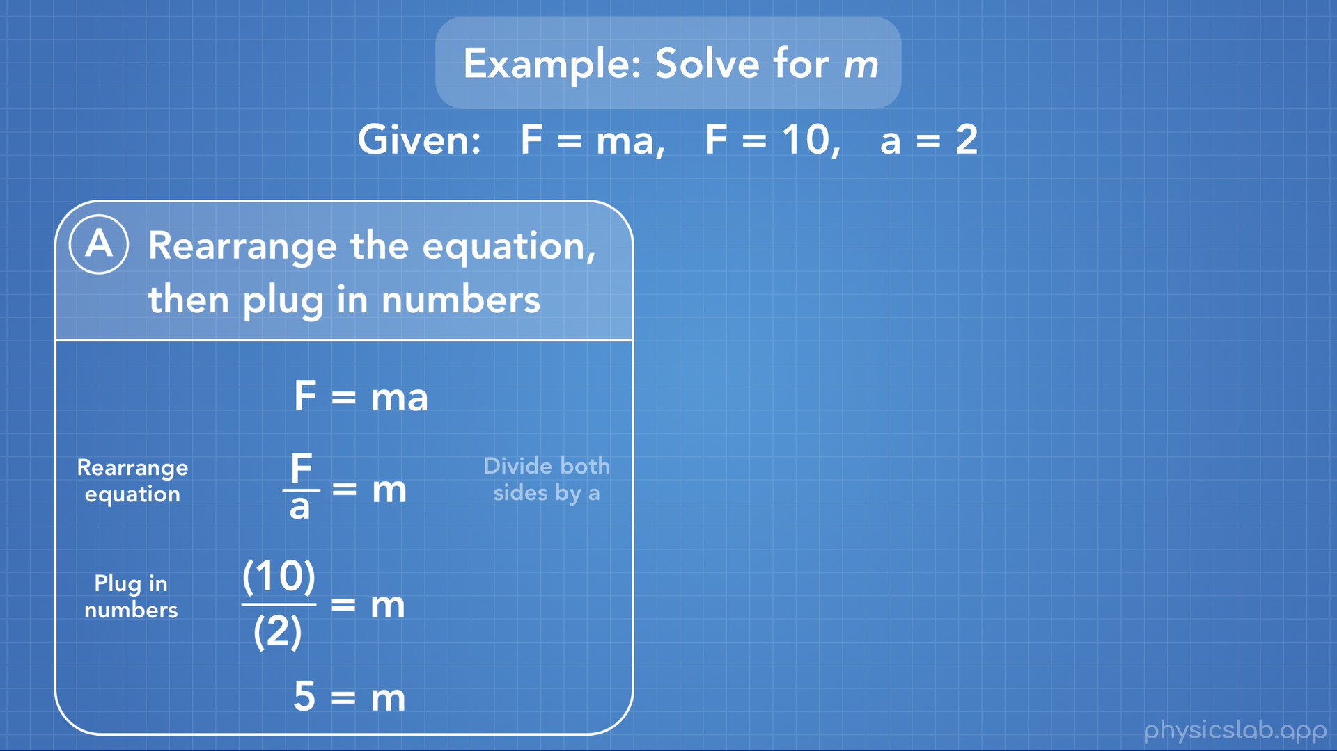
Notes:
Path A is to rearrange the equation first, and then plug in the numbers. Here we start with our equation F=ma, we divide both sides by a to get F/a=m, and now the variable we want to find, m, is all by itself. So we can plug in the numbers we’re given, F=10 and a=2, do the math and find that m=5.

Slide 36
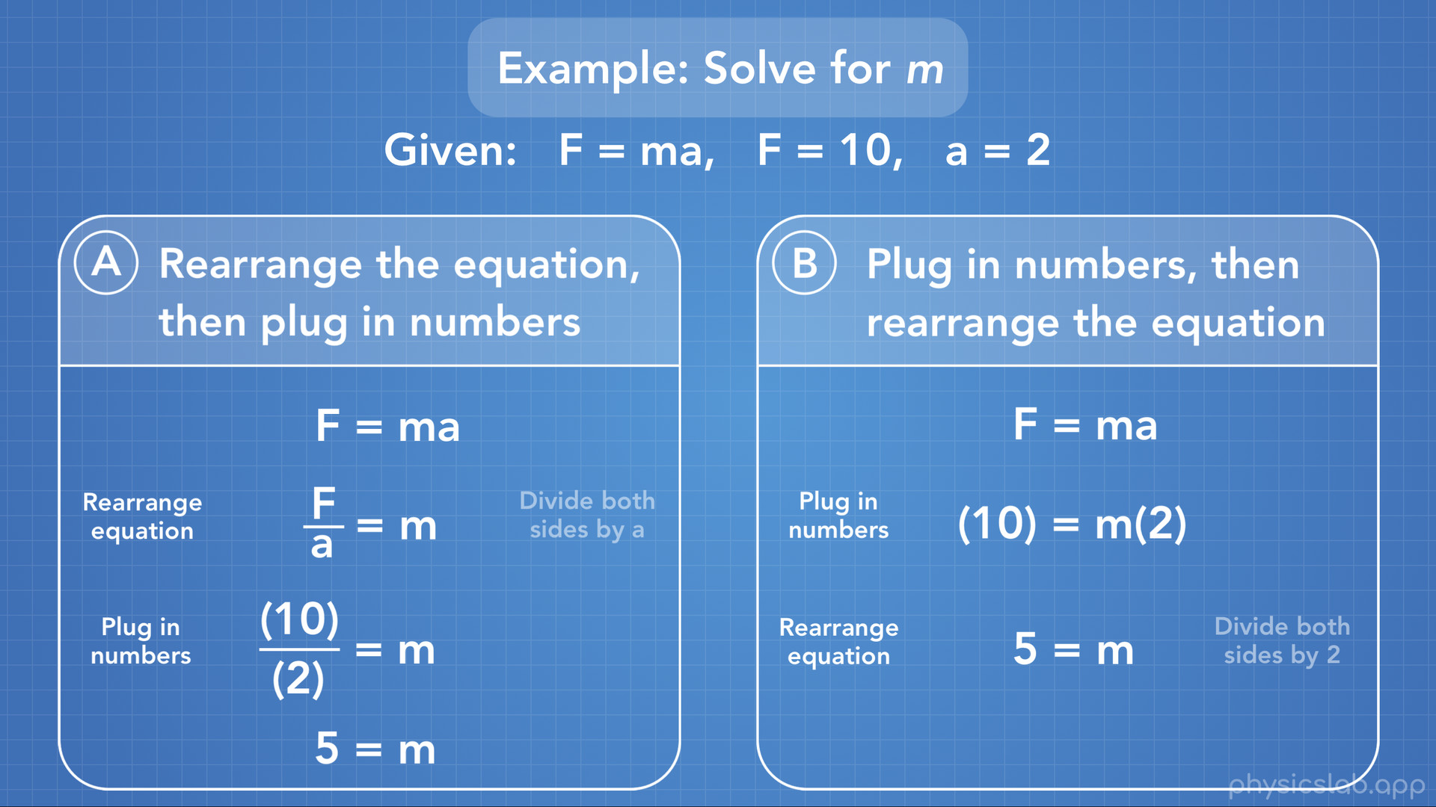
Notes:
Path B is to plug in the numbers first, then rearrange the equation. Here we have our equation F=ma, we plug in F=10 and a=2, and we’re left with 10=m x 2. Next we would divide both sides by 2, and we get m = 5.
Both of these paths work. Sometimes different people will have different preferences what they do first, and a lot of the time we go back and forth between rearranging the equation and plugging in numbers, so that the equation is easiest for us to work with.

Slide 37

Notes:
So let’s do a quick recap.

Slide 38
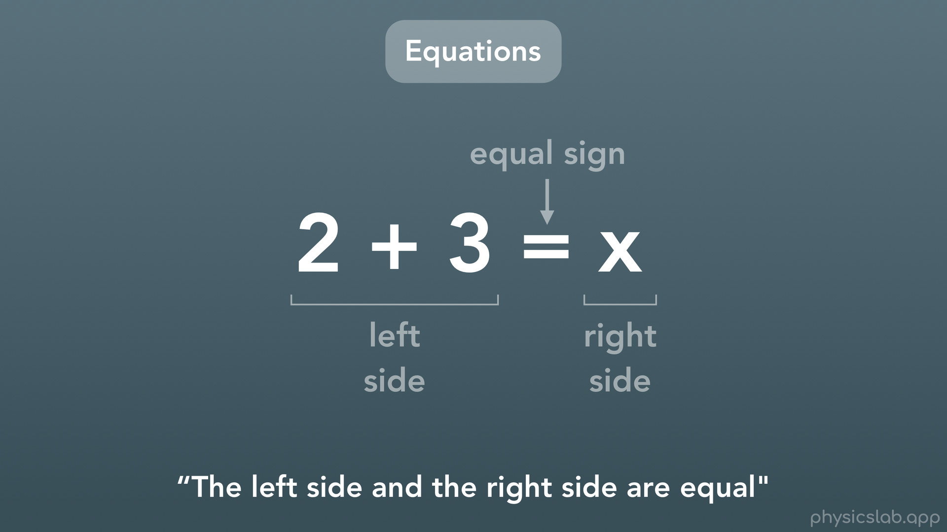
Notes:
We learned about algebraic equations which have both numbers and variables in them. Every equation has a left side, a right side, and an equal sign, and the equation is saying that the left side and the right side are equal.

Slide 39
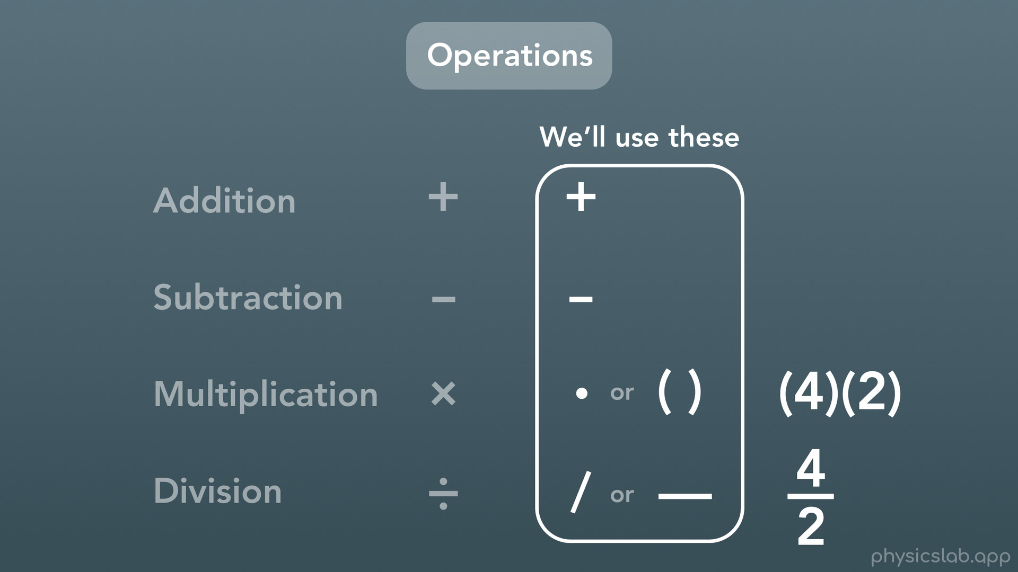
Notes:
We covered the symbols that we’ll use to represent each of the math operations.

Slide 40
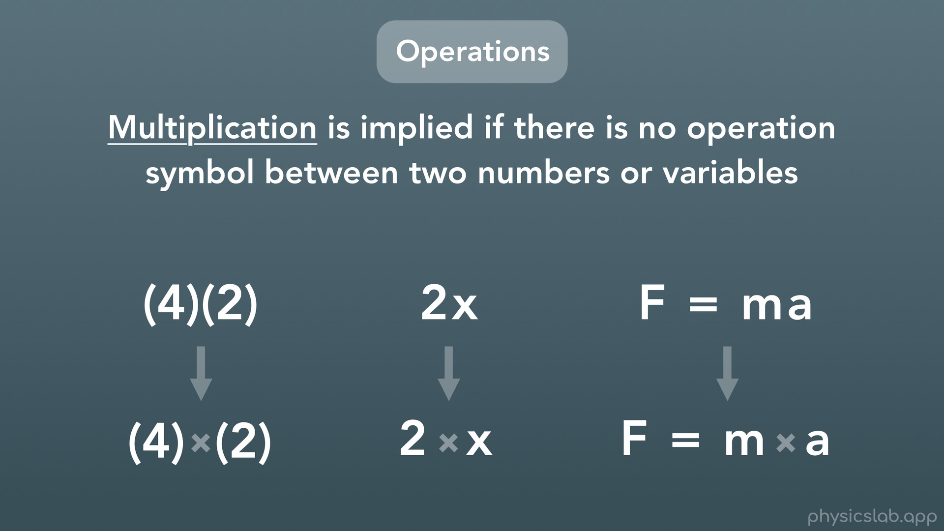
Notes:
And we learned that multiplication is implied if there is no operation symbol between 2 numbers or variables.

Slide 41
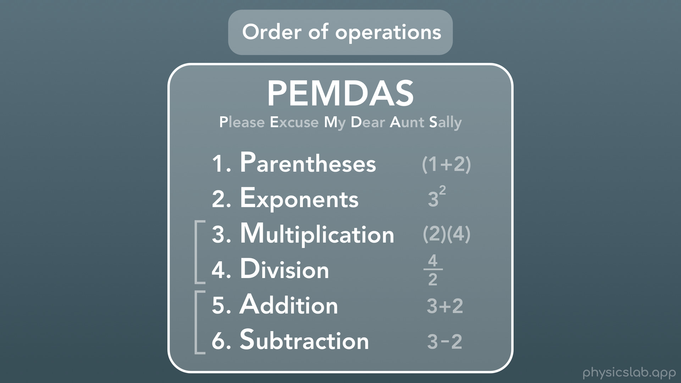
Notes:
Next we covered the order of operations and a trick to remember them.

Slide 42
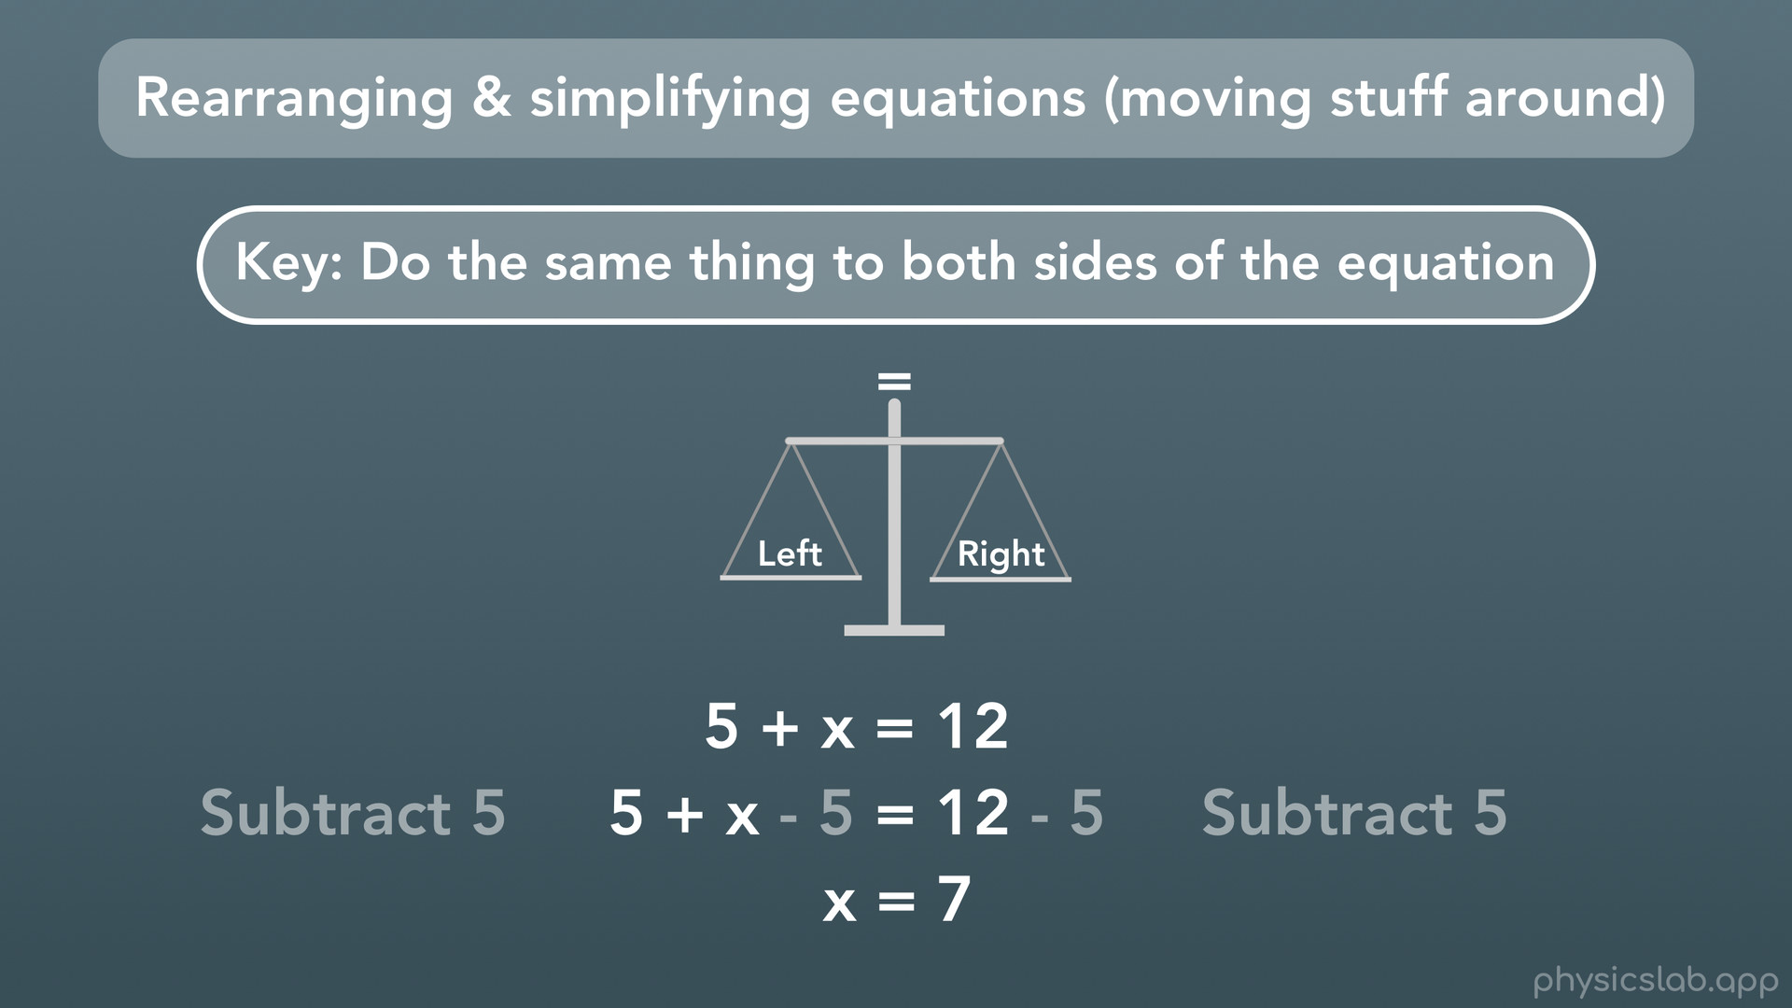
Notes:
And finally, we learned that the key to solving and rearranging equations is to keep the equation balanced by doing the same thing to both sides of the equation.

