Slide 1
Springs and Hooke’s Law - Equation and Variables
Slides Version 2
This version includes:
Slides with screenshot images from the video.
The video narration in the slide notes.
A blank template slide with the same background and font as the video.
Slides with some basic graphics from this video for you to use however you like.
Feel free to add, delete and edit slides to make your own presentation. You can use these slides in class or share them with your students, but please do not share them with anyone else.
If you have any feedback, suggestions or questions about these slides please email me at chris@physicslab.app or send me a message on Discord @physicslab.
physicslab.app

Slide 2
Heading
Text

Slide 3















Slide 4
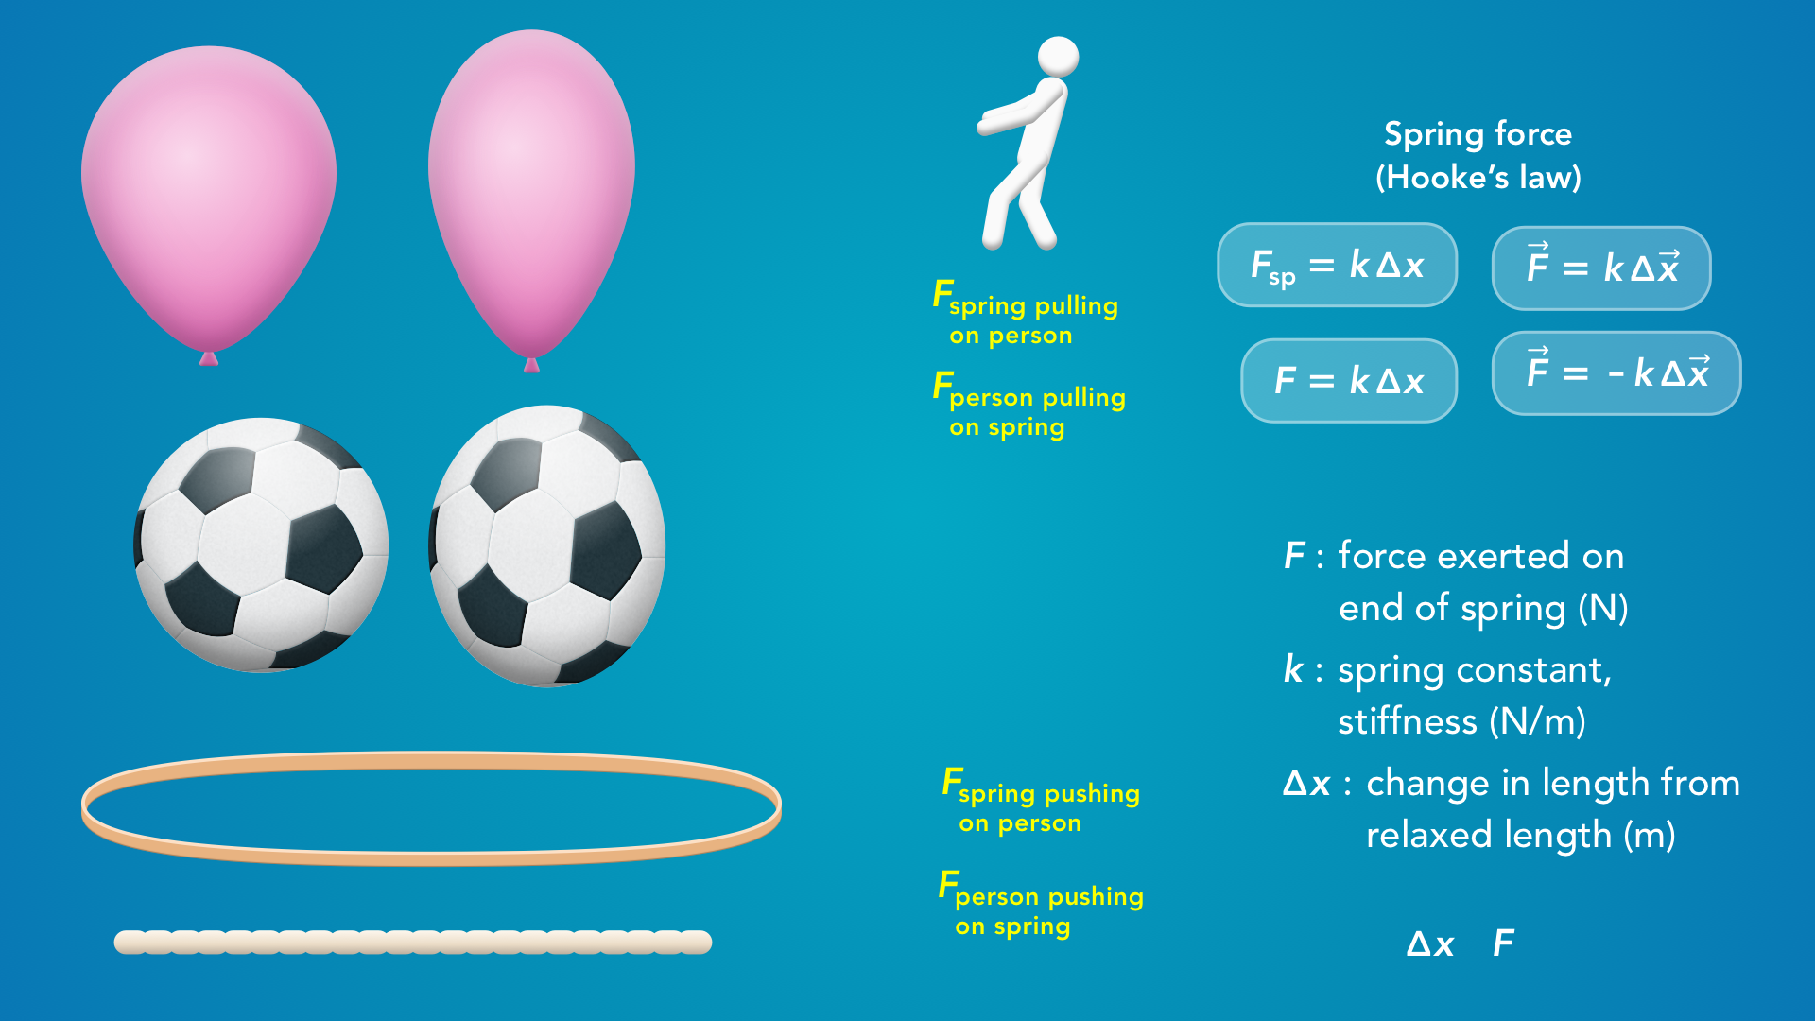

























Slide 5

























Slide 6
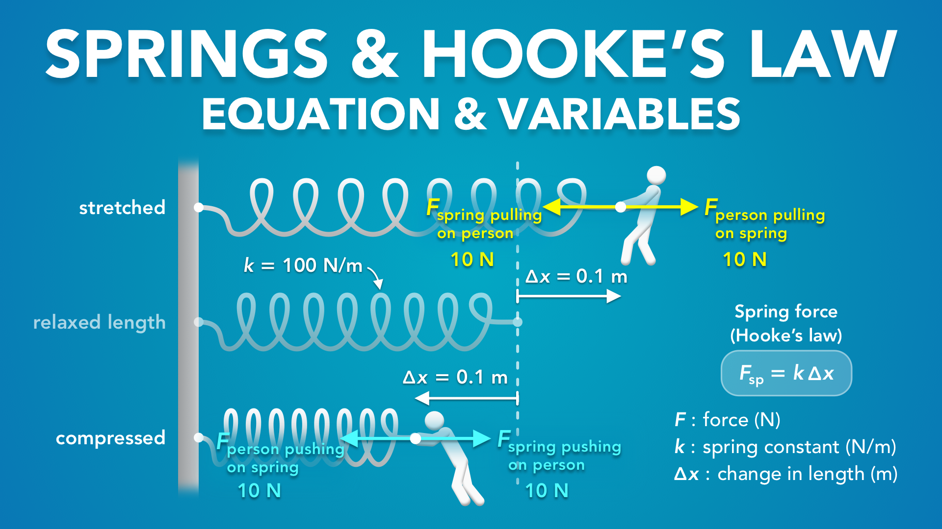
Notes:
Springs and Hooke’s Law - Equation and Variables
physicslab.app
If you have any questions, suggestions or feedback about these slides please email me at chris@physicslab.app or send me a message on Discord @physicslab.

Slide 7

Notes:
• Hey everyone! In this video we’re gonna cover the equation for Hooke’s law in more detail, and we’ll talk about some common points of confusion.

Slide 8
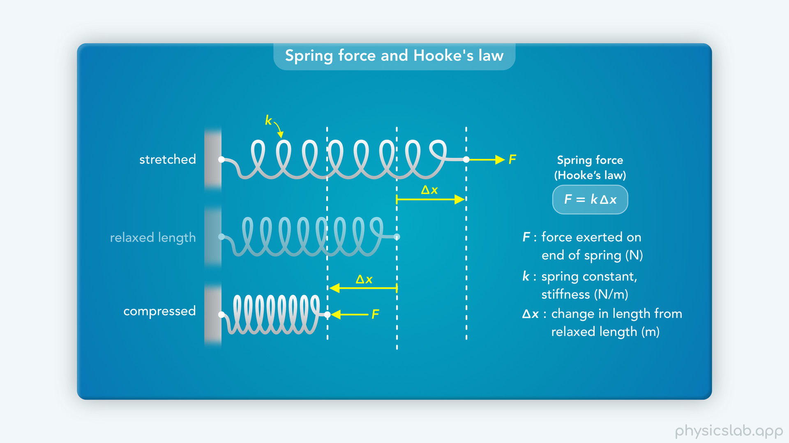
Notes:
• We introduced springs and hooke’s law in the last video, so watch that one first.

Slide 9
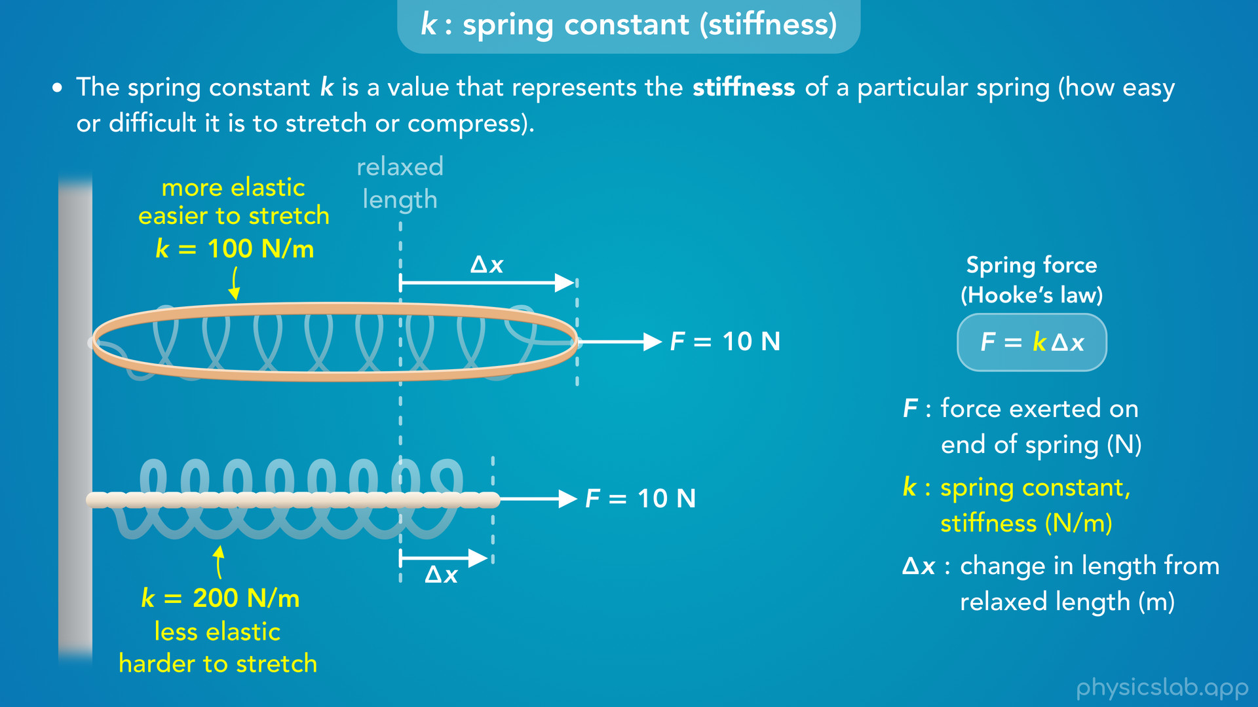
Notes:
• This video will start by exploring the spring constant, k.
• What does this variable actually represent?
• And how does the stiffness of a spring affect the force and the change in length?

Slide 10
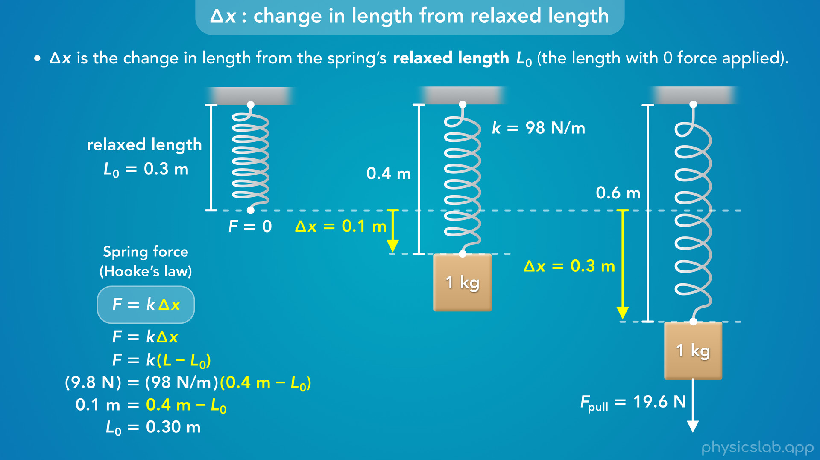
Notes:
• After that, we’ll talk about the change in length, delta x.
• If a problem has multiple steps, or if there’s a mass hanging from a spring, how are we actually supposed to measure delta x?

Slide 11
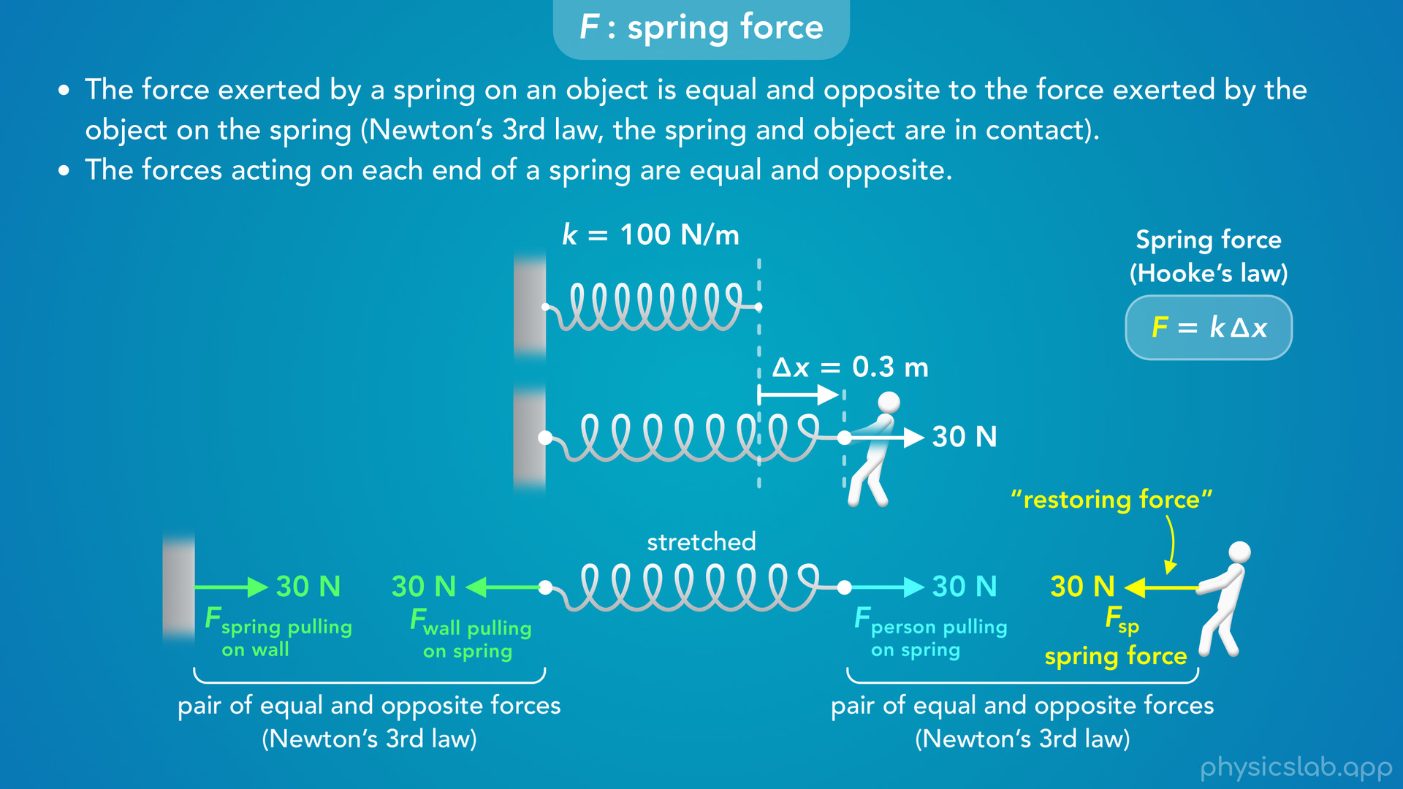
Notes:
• And finally, we’ll talk about the spring force, F.
• Is this the force acting on one end of the spring, or both ends?
• What happens when a spring is attached to a fixed object like a wall?
• And what are the directions of the spring forces?

Slide 12

Notes:
• So let’s start with the spring constant.

Slide 13
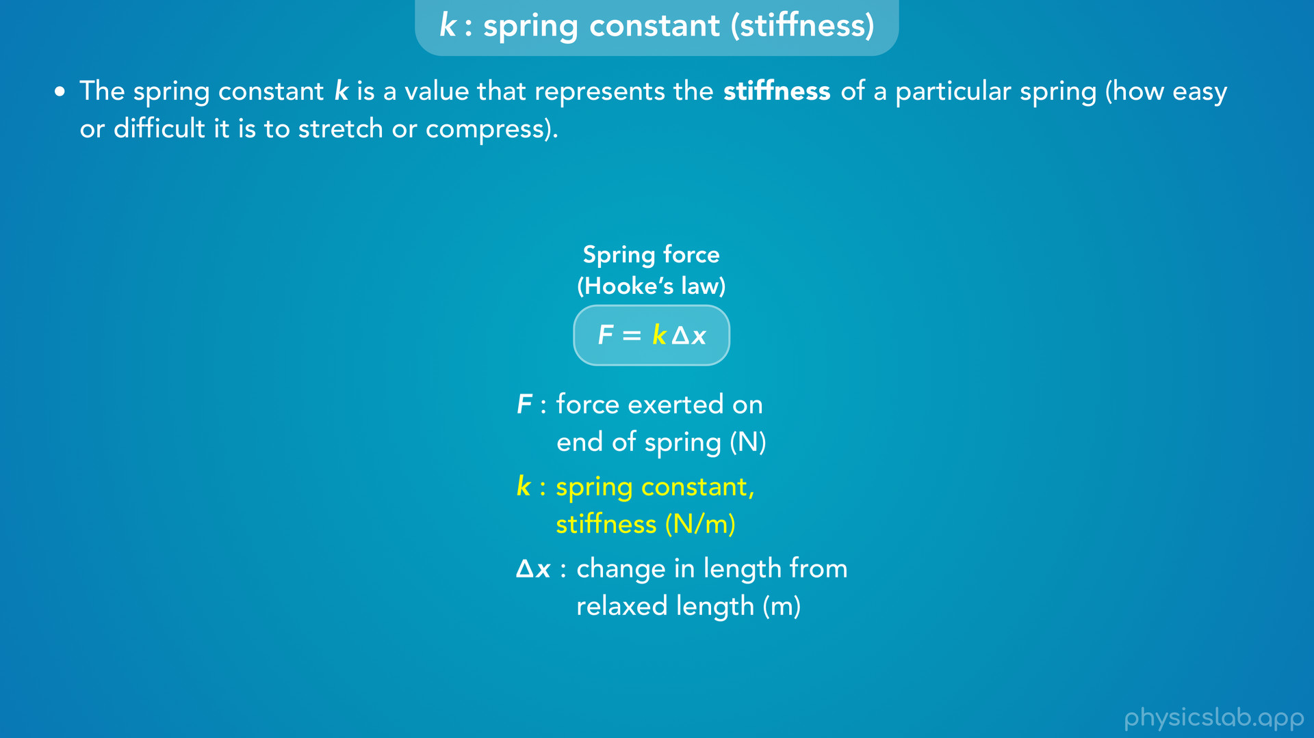
Notes:
• “The spring constant k is a value that represents the stiffness of a particular spring, which is how easy or difficult it is to stretch or compress”.

Slide 14
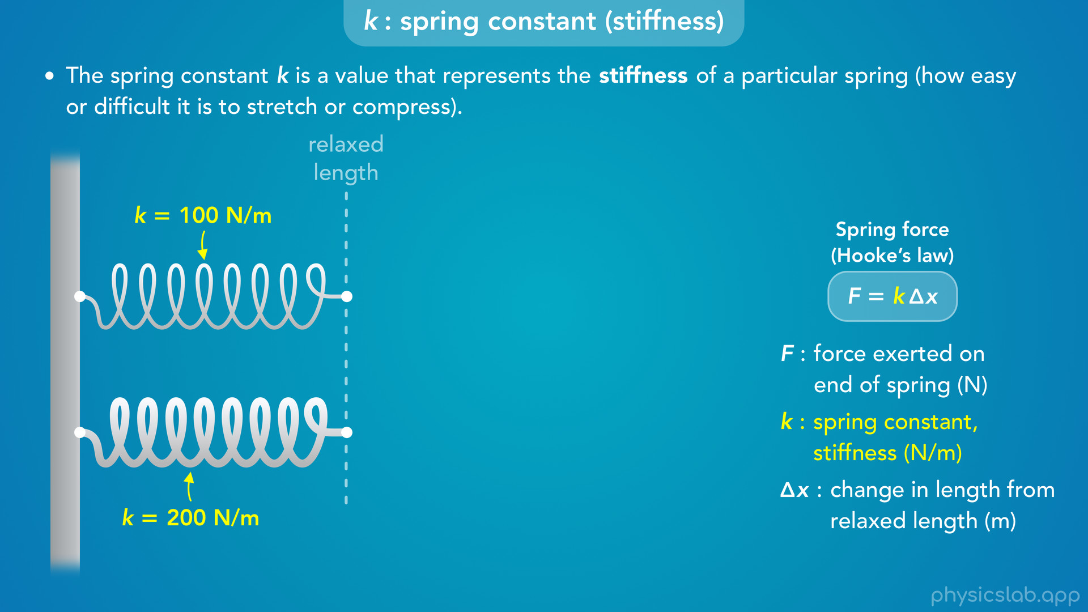
Notes:
• So let’s compare two springs.
• The top one has a spring constant of 100 N/m, and the bottom one has a spring constant of 200 N/m.

Slide 15
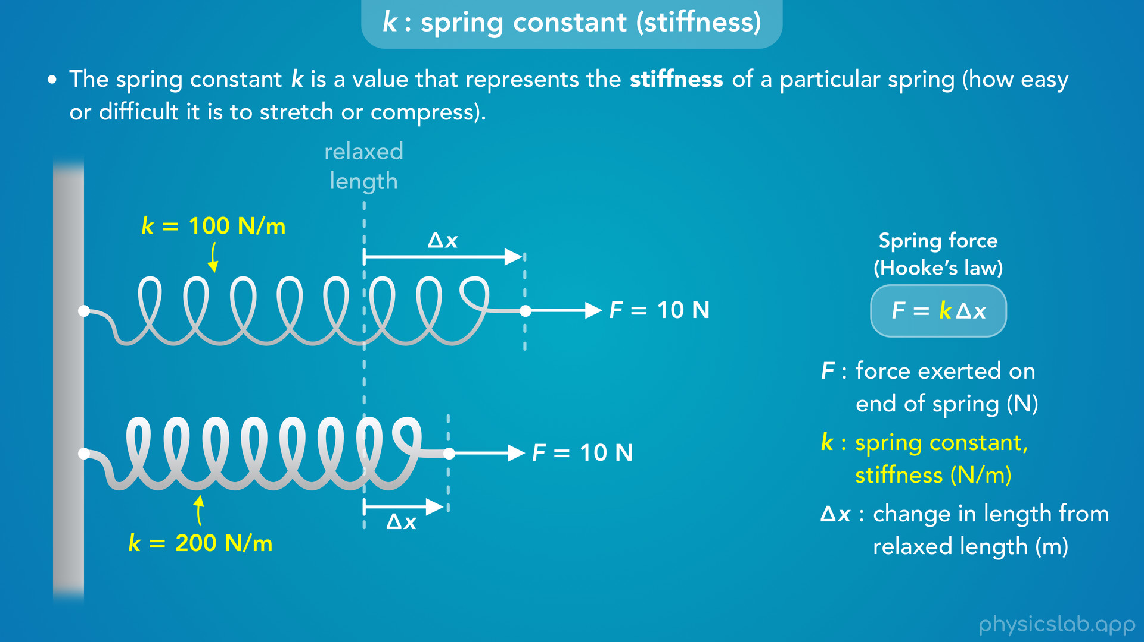
Notes:
• If we apply the same amount of force to both springs, the top spring will stretch more than the bottom spring.

Slide 16
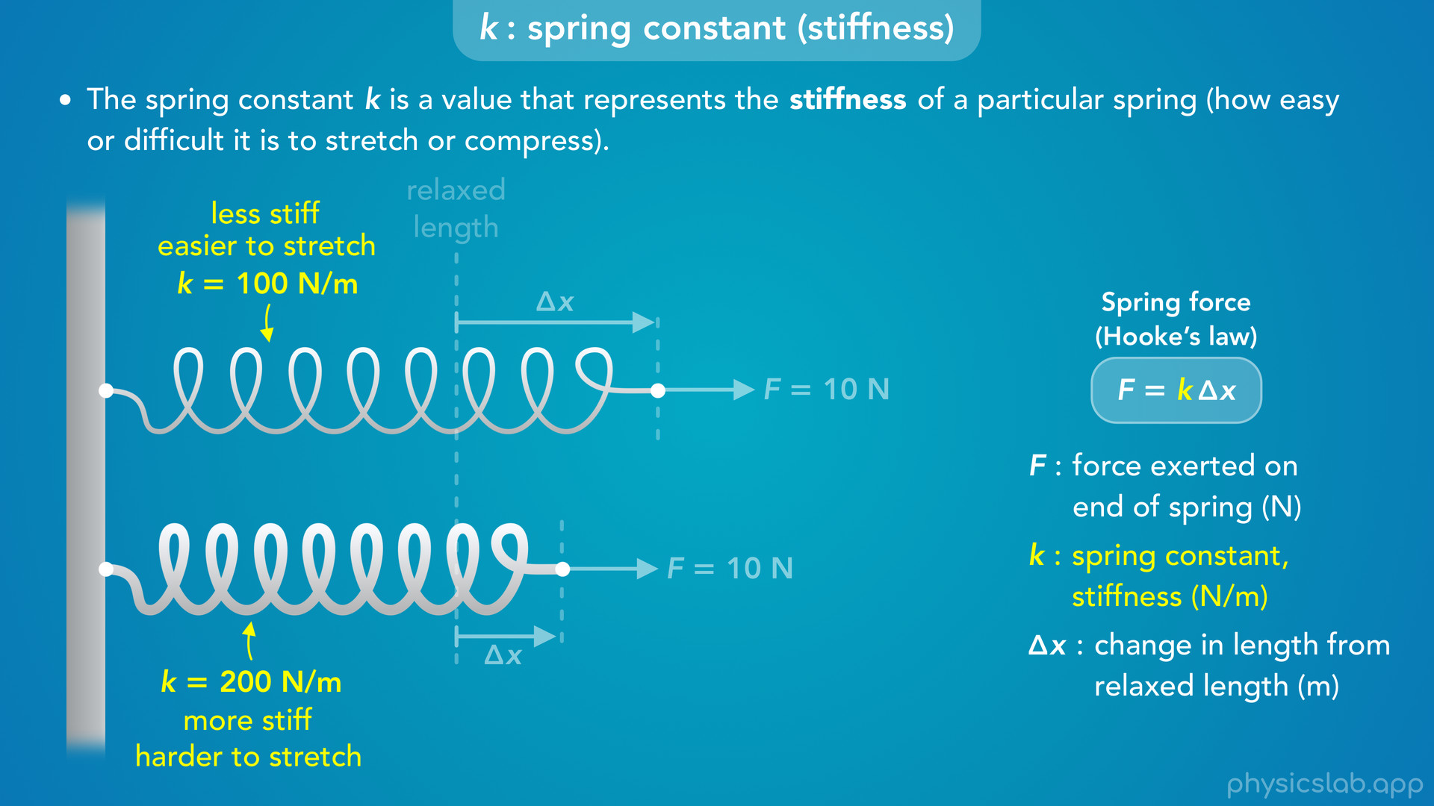
Notes:
• In the real world, the spring constant depends on the thickness or the shape of the spring, the material that the spring is made of, and some other factors.
• And we can simplify all of that into one value called the spring constant.
• But it will help to have some intuition for what this value means.
• If the spring constant is smaller, we say the spring is less stiff, which means it’s easier to stretch.
• If the spring constant is bigger, the spring is more stiff, and it’s harder to stretch.

Slide 17

Notes:
• If we compared the springs to different materials, a smaller spring constant would be more elastic like a rubber band, and a larger spring constant would be less elastic, like a piece of string.
• If we pull on both materials with same amount of force, the rubber band will stretch more than the string.

Slide 18
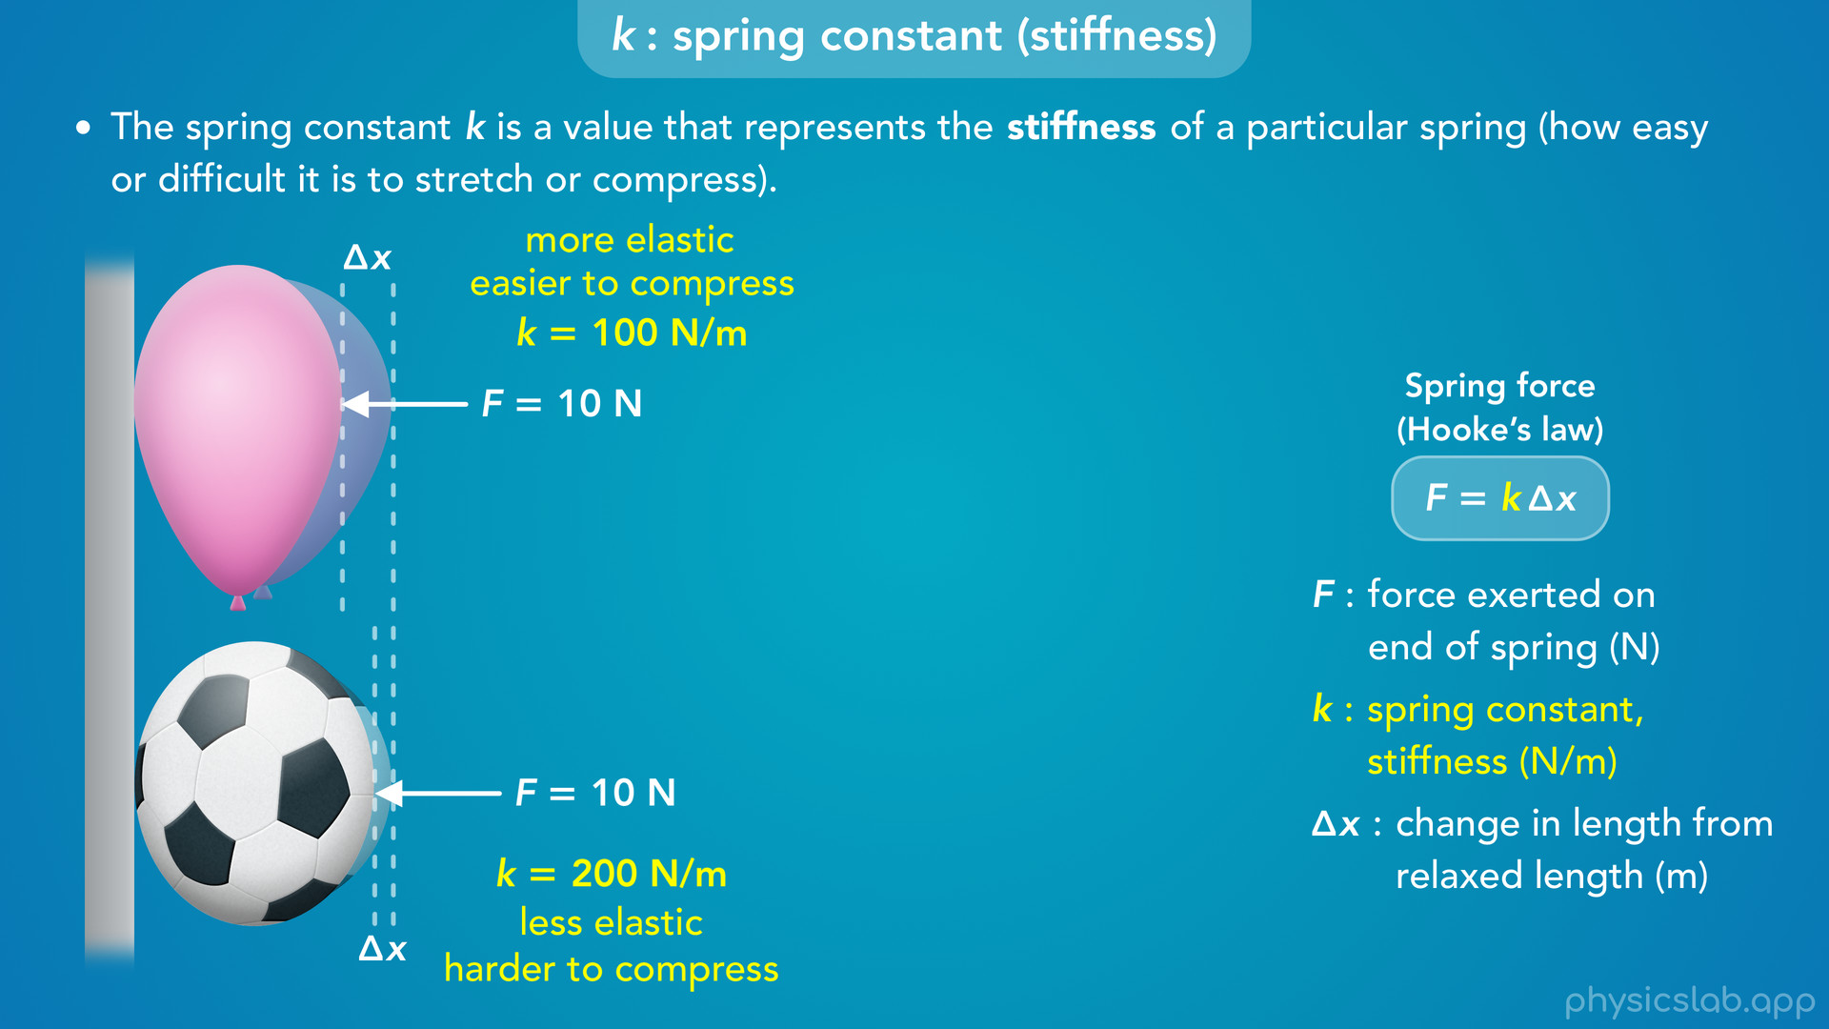
Notes:
• If we think about compressing the springs, the one with a lower value of k is more like a balloon, and the one with a higher value of k is more like a soccer ball.
• The balloon is easier to squeeze than the ball, and if we apply the same pushing force to both objects, the balloon will compress more than the ball.

Slide 19
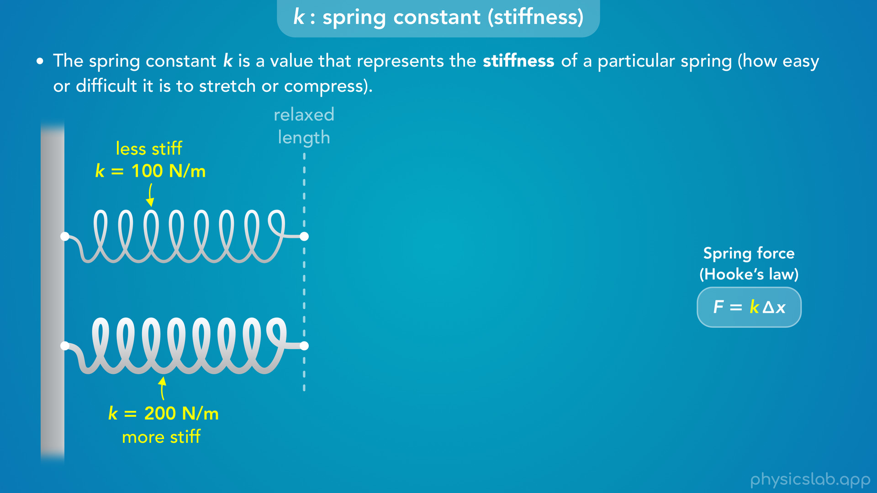
Notes:
• So how do these springs compare to each other when we start using this equation?
• There’s basically two ways we can think about this.

Slide 20
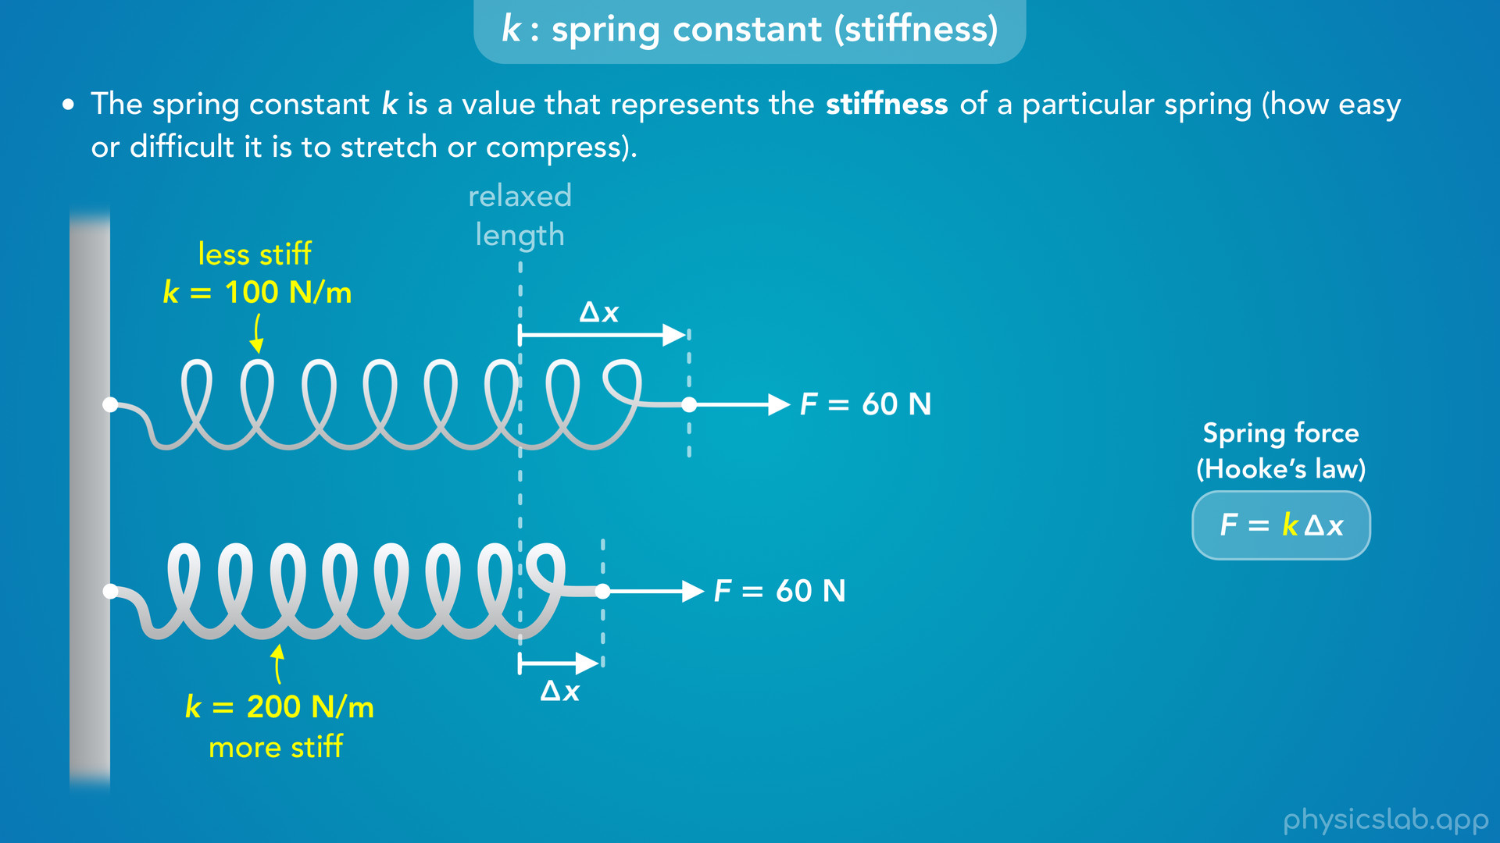
Notes:
• First, like we just mentioned, if we apply the same amount of force to both springs, the top spring will have a larger change in length than the bottom spring.
• For example, let’s pull each spring with 60 N of force.

Slide 21
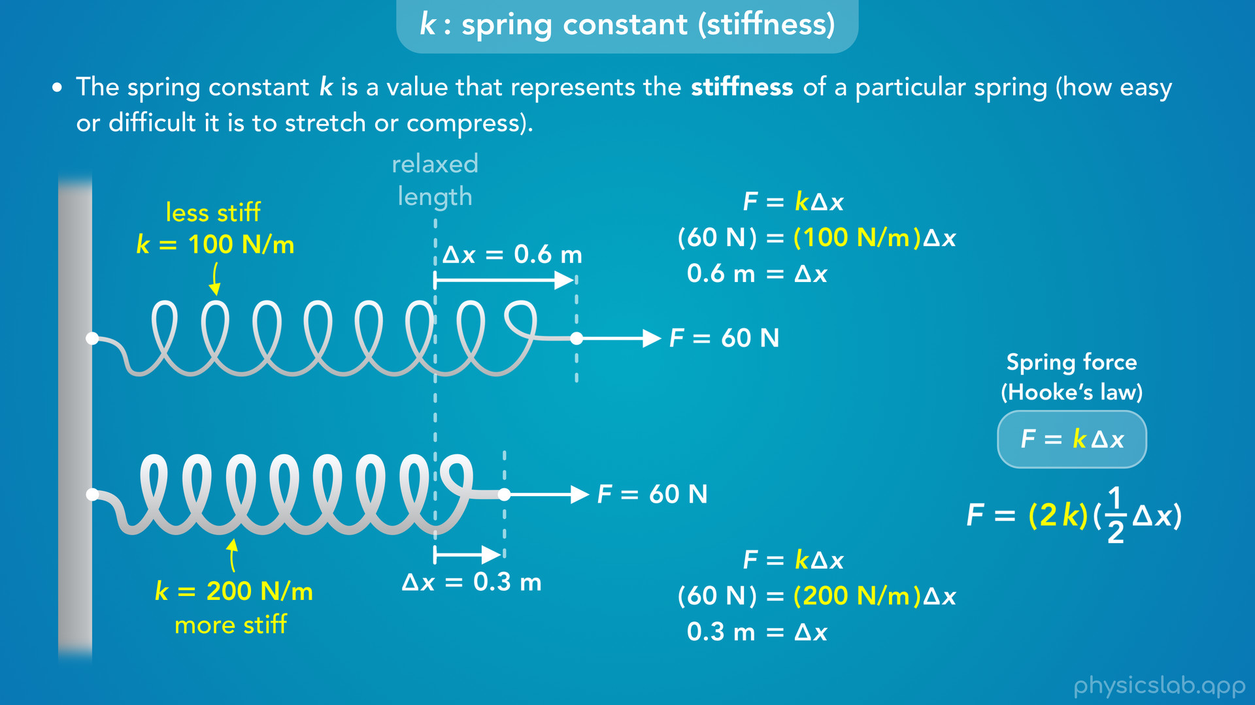
Notes:
• For the top spring, we plug in 100 N/m for k, which gives us 0.6 m for delta x.
• For the bottom spring we plug in 200 N/m for k, which gives us 0.3 m for delta x.
• The bottom spring has twice the spring constant, so it only stretches half as much using the same force.

Slide 22

Notes:
• And this is true for any amount of force.
• If we increased the force on both springs to 80 N, the top spring will stretch 0.8 m and the bottom spring will stretch 0.4 m, still half as much as the top spring.

Slide 23
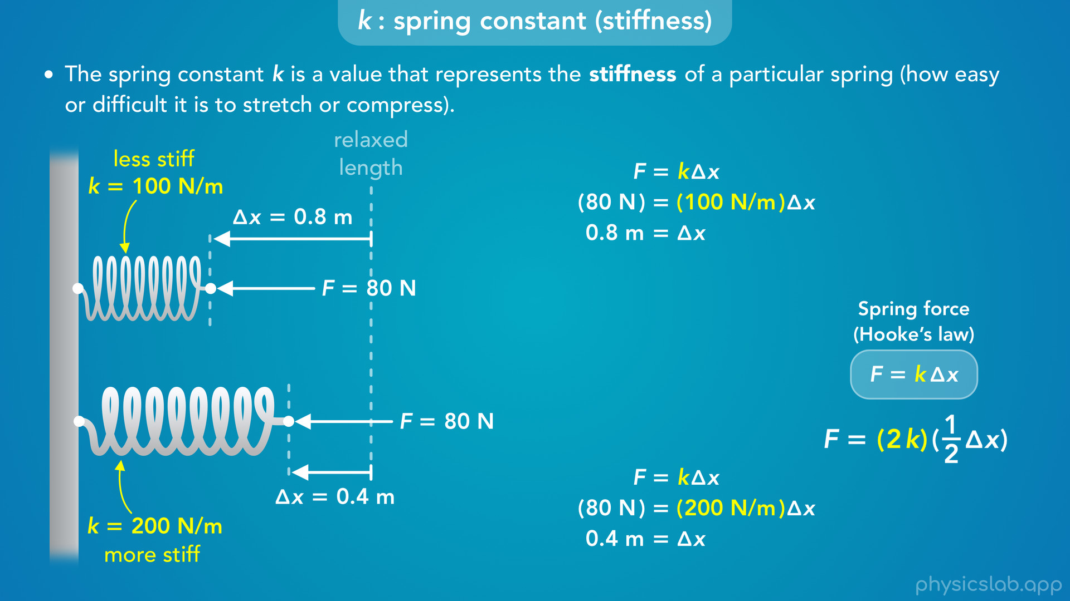
Notes:
• And the same thing applies if we compressed the springs instead.
• If we push on each spring with 80 N of force, the top spring gets shorter by 0.8 m and the bottom spring gets shorter by 0.4 m.

Slide 24
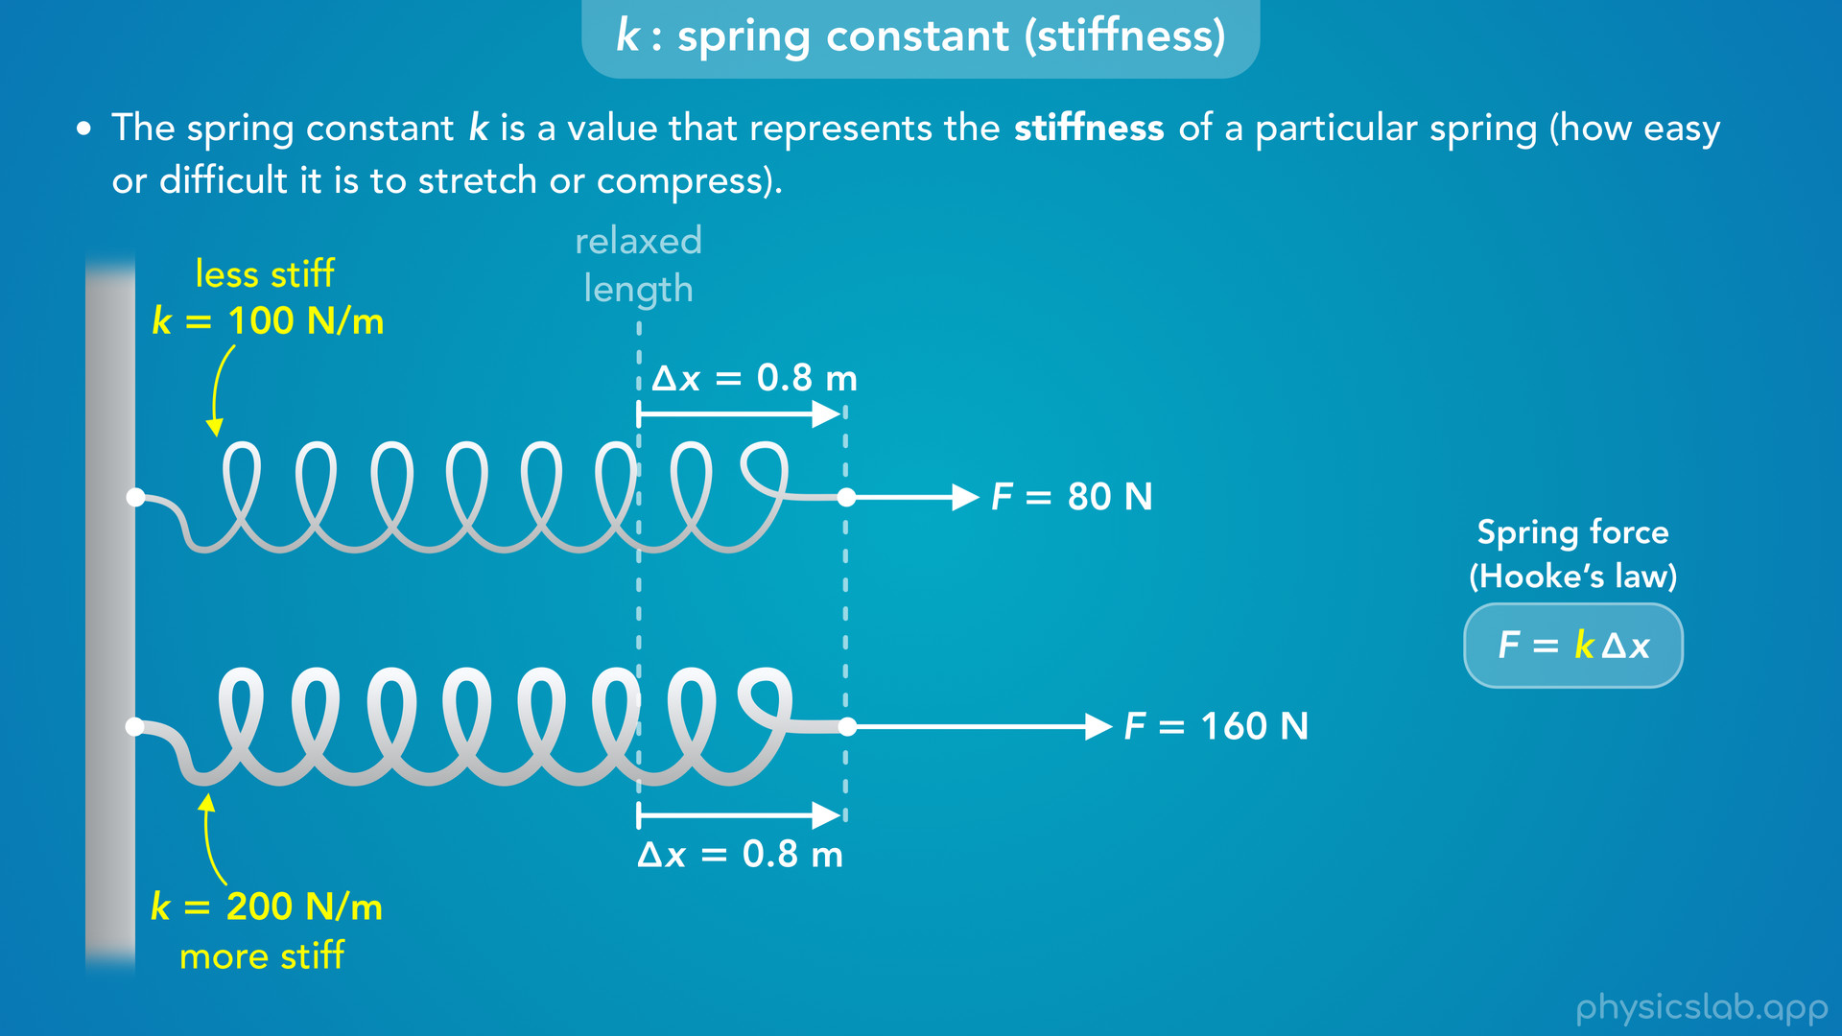
Notes:
• The other way to think about the two spring constants, is that the bottom spring requires more force to stretch the same amount.
• Let’s say we’re trying to stretch each spring 0.8 m.

Slide 25
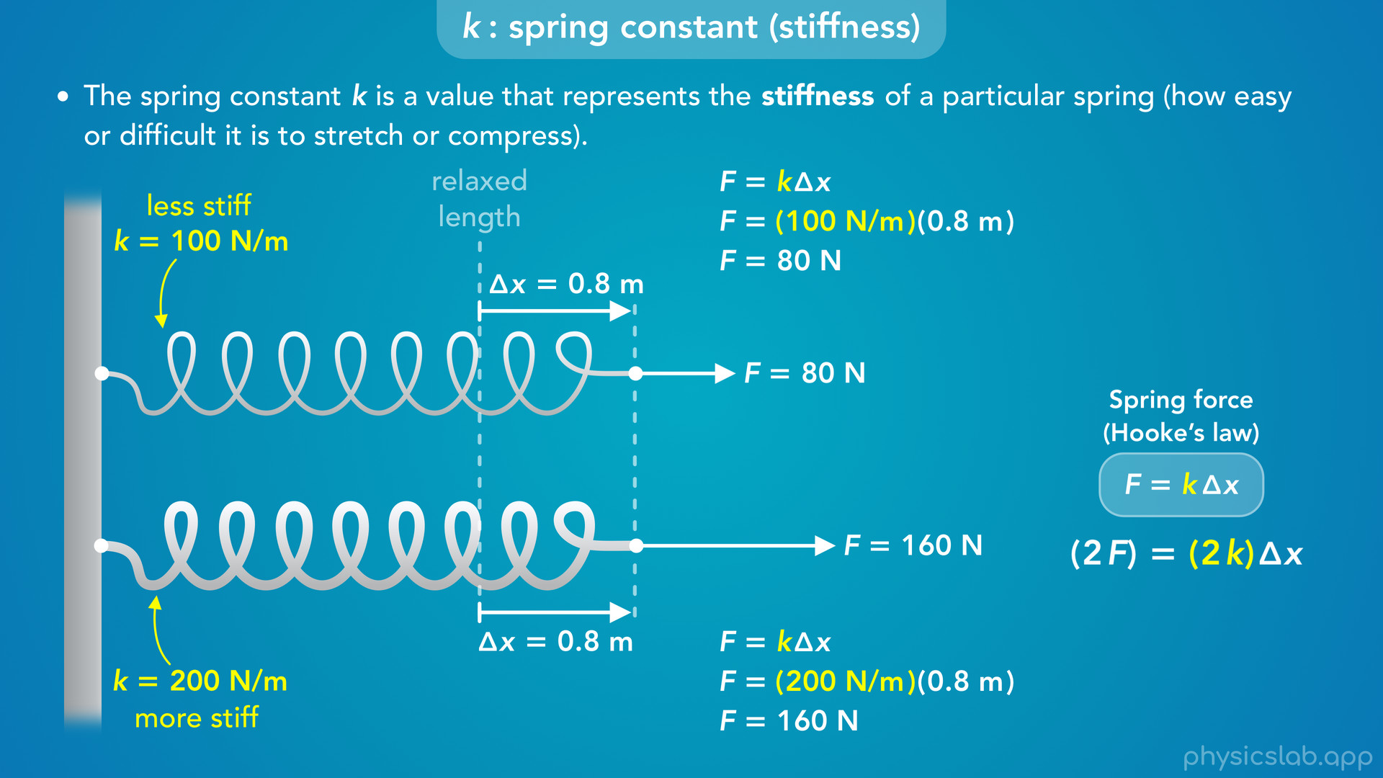
Notes:
• For the top spring, we would need 80 N of force.
• For the bottom spring, we need 160 N of force.
• So to get the same delta x, a spring with twice the value of k requires twice the force.

Slide 26
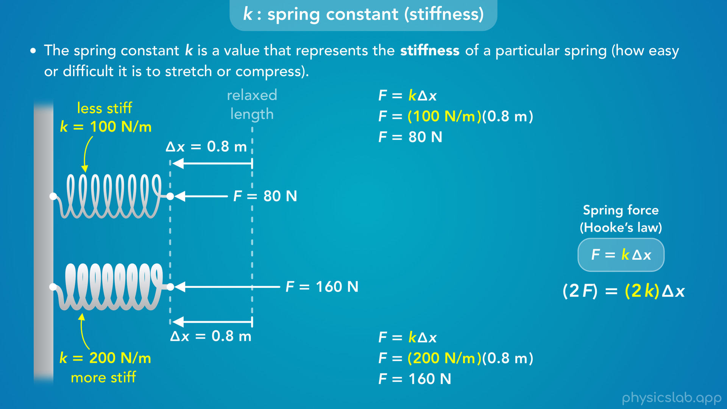
Notes:
• And again, the same thing is true if we’re trying to compress the springs.

Slide 27
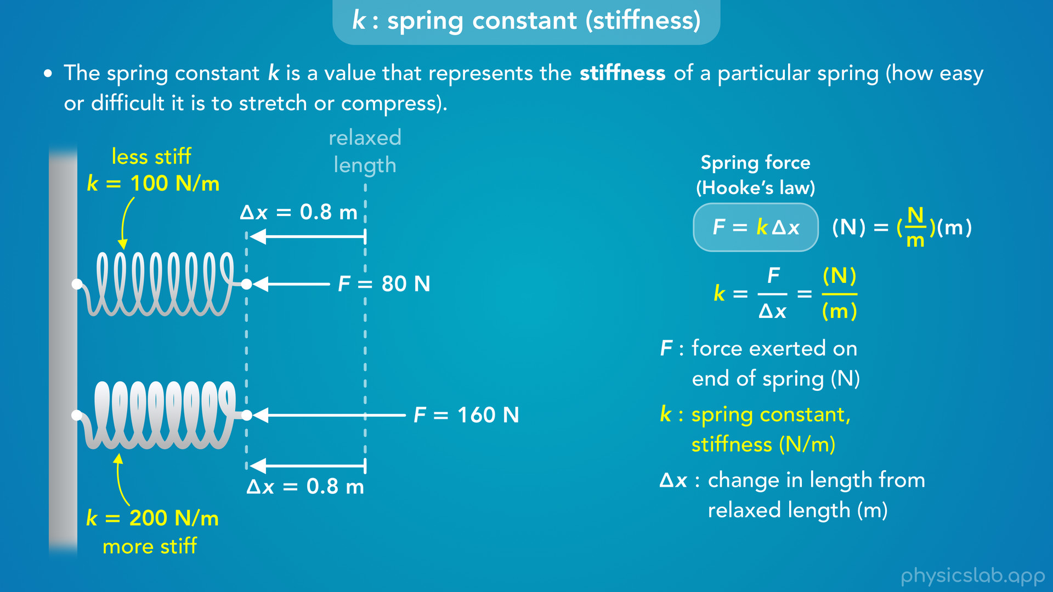
Notes:
• The last thing to mention is that this equation is how we get the SI unit for k.
• If we rearrange the equation, k equals F divided by delta x.
• The unit for F is newtons and the unit for delta x is meters, so the unit for k is N/m.

Slide 28

Notes:
• Alright, now let’s talk about delta x, and how we’re supposed measure this in different scenarios.

Slide 29
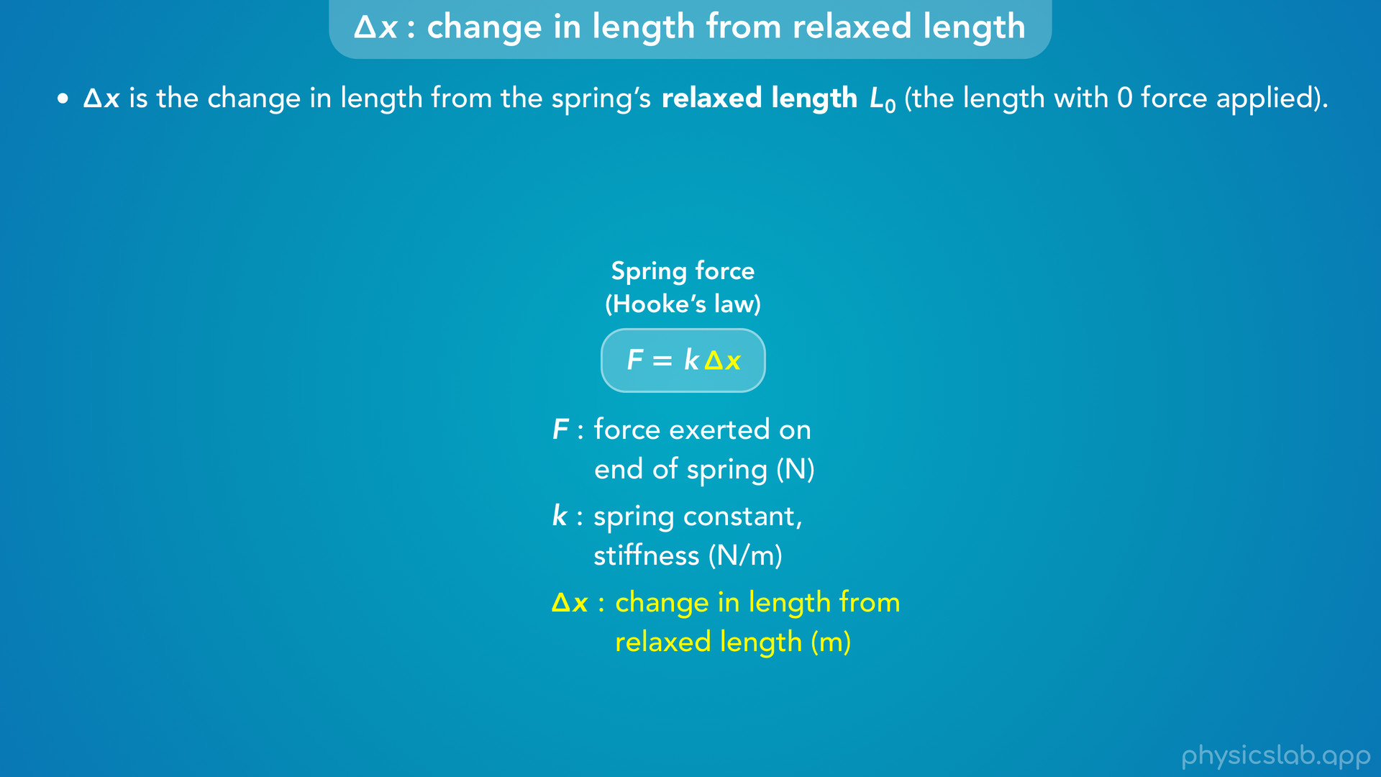
Notes:
• “delta x is the change in length from the spring’s relaxed length, which we’ll call L zero, the length with 0 force applied”.

Slide 30
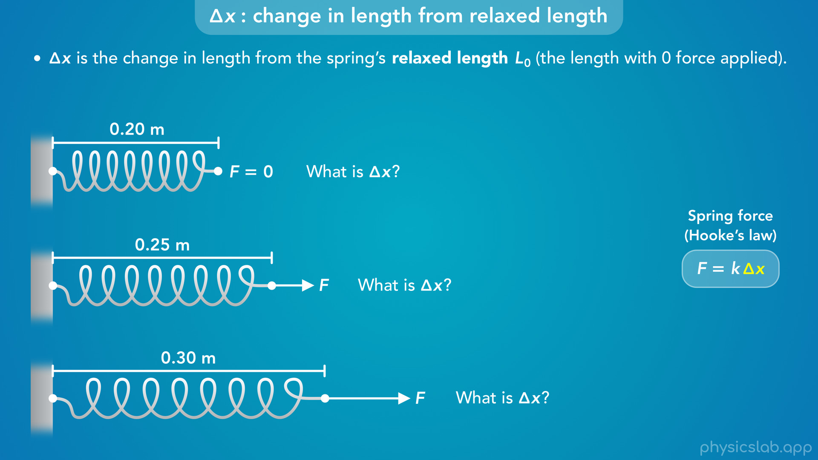
Notes:
• So here’s a spring that has no force being applied to it, and it has a length of 0.2 m.
• Let’s take that spring and apply a pulling force, so the new length is 0.25 m.
• Then let’s apply a greater pulling force, so the new length is 0.3 m.
• Pause the video and figure out what delta x would be for each of these cases.

Slide 31
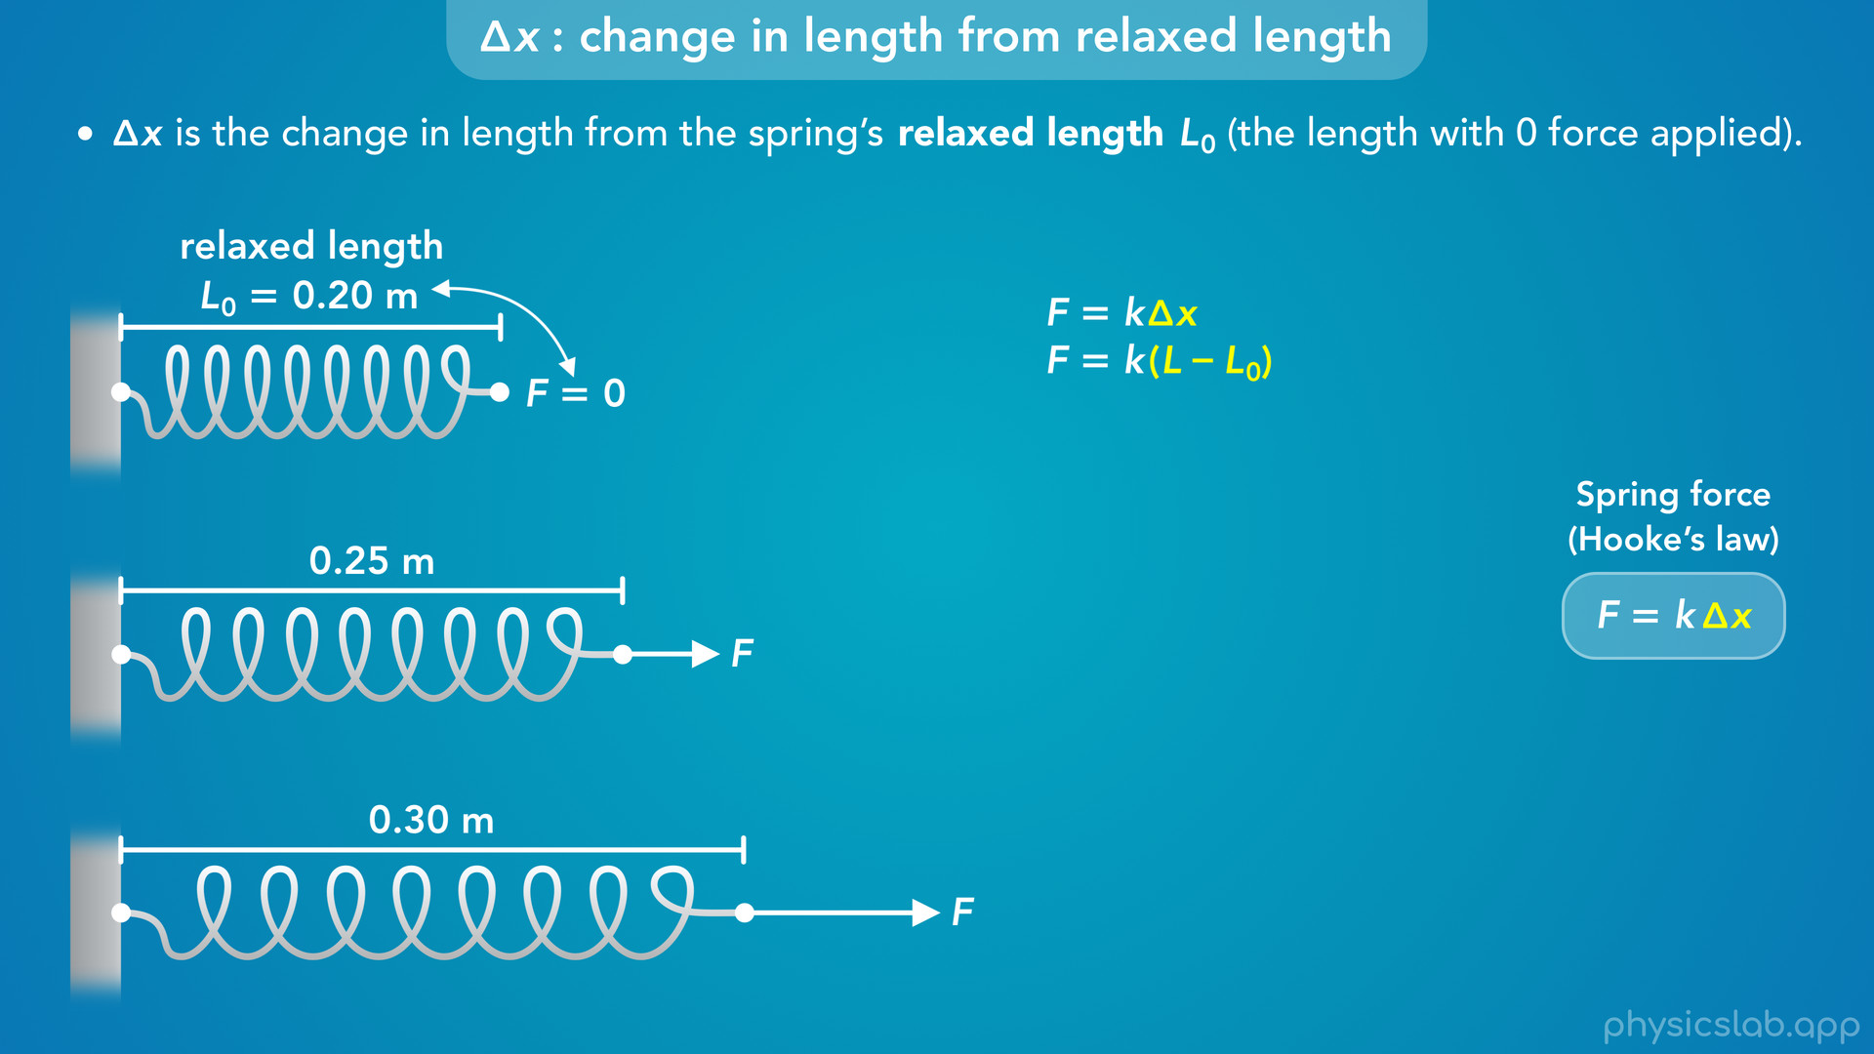
Notes:
• So we can think of delta x as the length of the spring, L, minus the relaxed length, L zero.
• In the first picture, the spring has no force applied to it, so 0.2 m is the relaxed length.

Slide 32
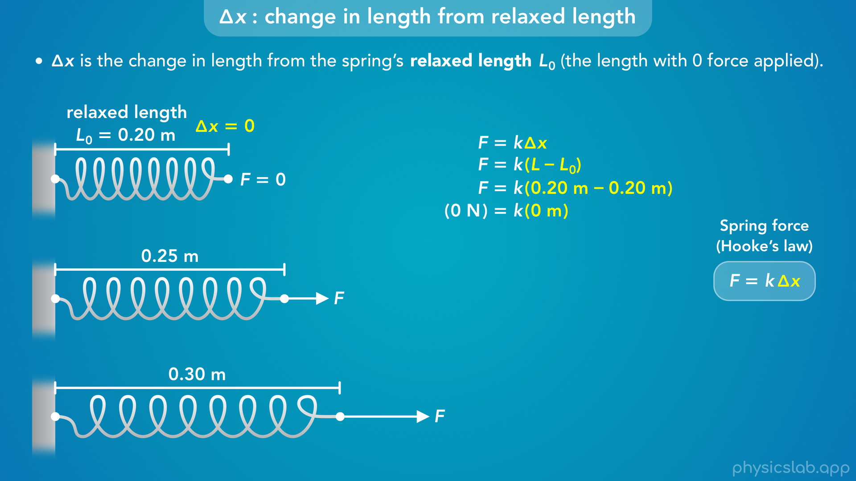
Notes:
• The spring is not being stretched or compressed, so delta x is zero.

Slide 33
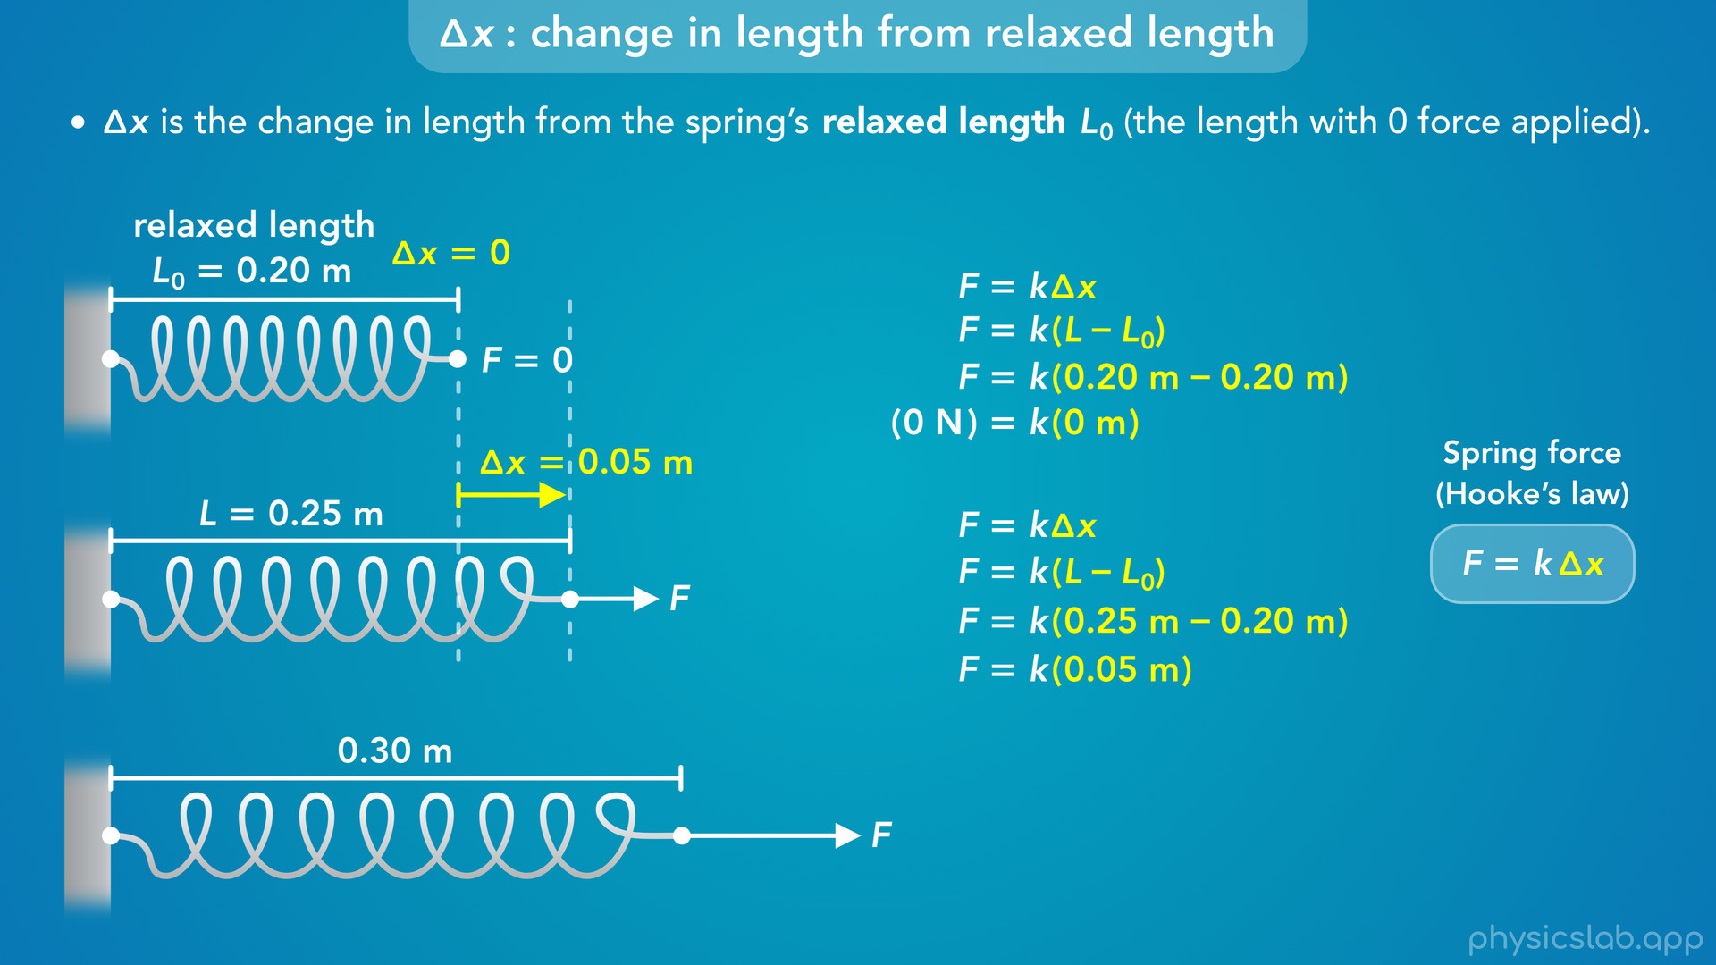
Notes:
• In the second picture, there’s a force applied to the spring and it gets longer.
• Delta x would be the new length, 0.25 m, minus the relaxed length, 0.2 m, which gives us 0.05 m.
• That’s how much the spring stretched.

Slide 34
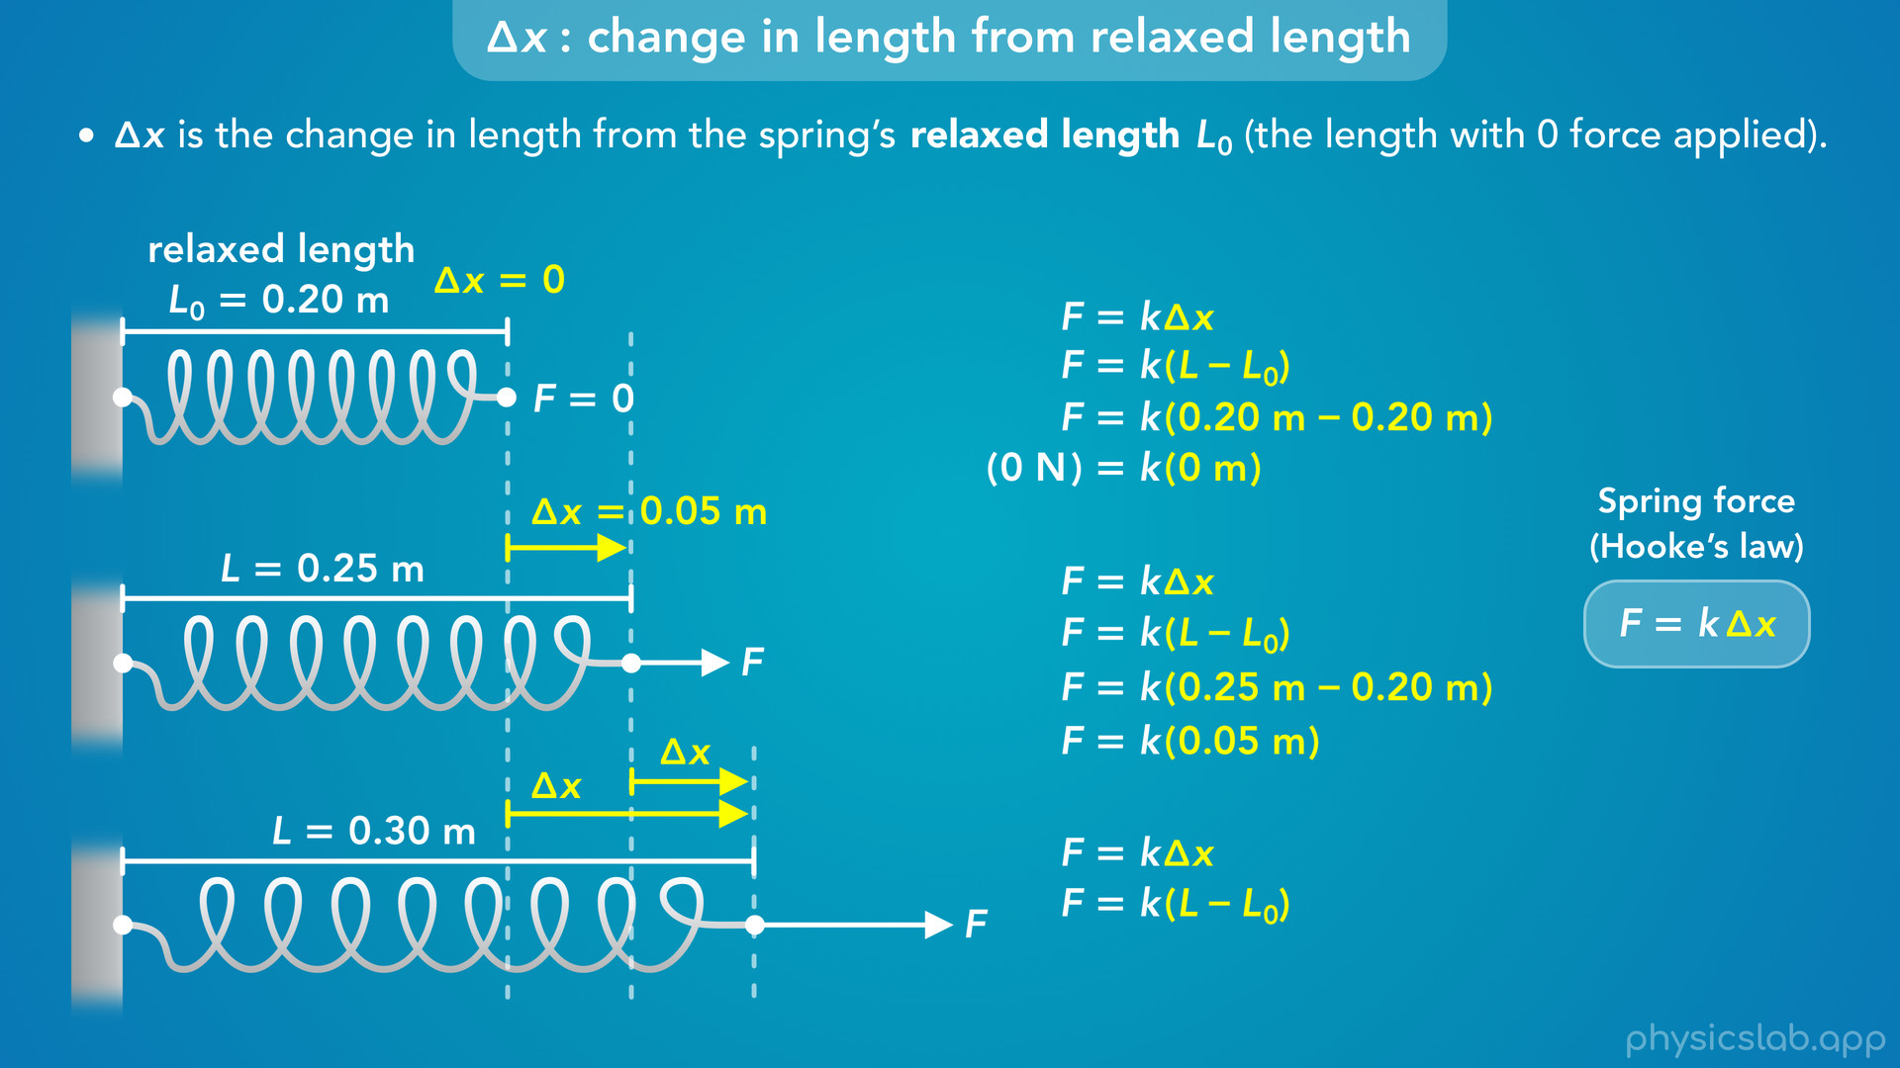
Notes:
• In the third picture, the force is greater and the spring stretches even more.
• But are we supposed to compare this new length to 0.25 m or 0.2 m?

Slide 35
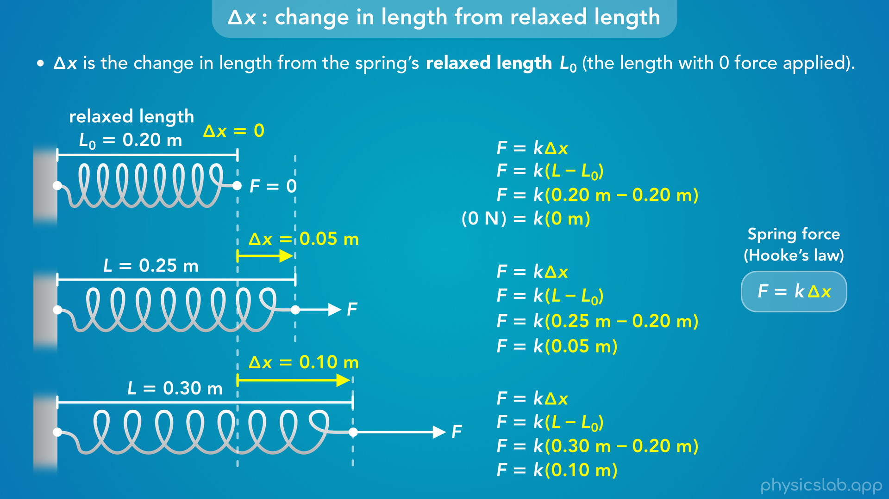
Notes:
• Delta x is measured relative to the relaxed length, so it would be 0.3 minus 0.2, which is 0.1 m.
• That’s the value we use for delta x in the equation for Hooke’s law.
• So keep in mind that a problem might involve multiple steps where a spring changes length more than once.
• At any point in time, delta x is the difference between the current length and the relaxed length, which is when no force is applied.
• It’s always good to start a problem by drawing a picture, and for spring problems, it’ll help if we draw the spring at its relaxed length so we know what to compare to when finding delta x.

Slide 36
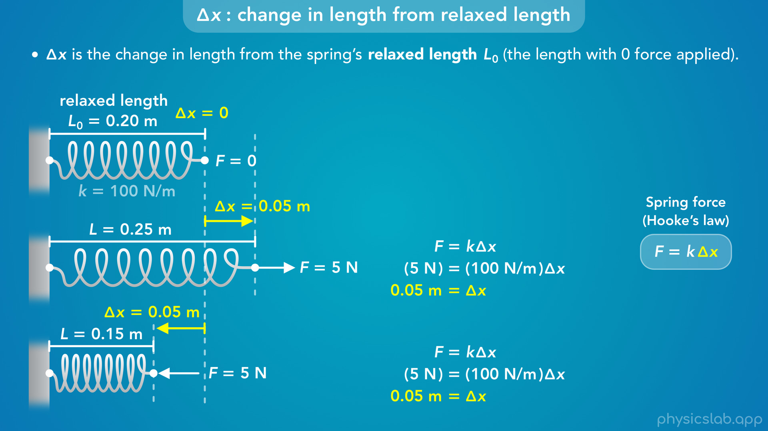
Notes:
• Another thing to remember is that the magnitude of delta x is the same whether the spring is stretched or compressed.
• If we pulled on the spring and pushed on the spring with 5 N of force, delta x will have the same magnitude in both cases.
• If the spring constant is 100 N/m, then delta x is 0.05 m.
• So if we’re stretching the spring, the new length will be 0.25 m.
• If we’re compressing the spring, the new length will be 0.15 m.

Slide 37
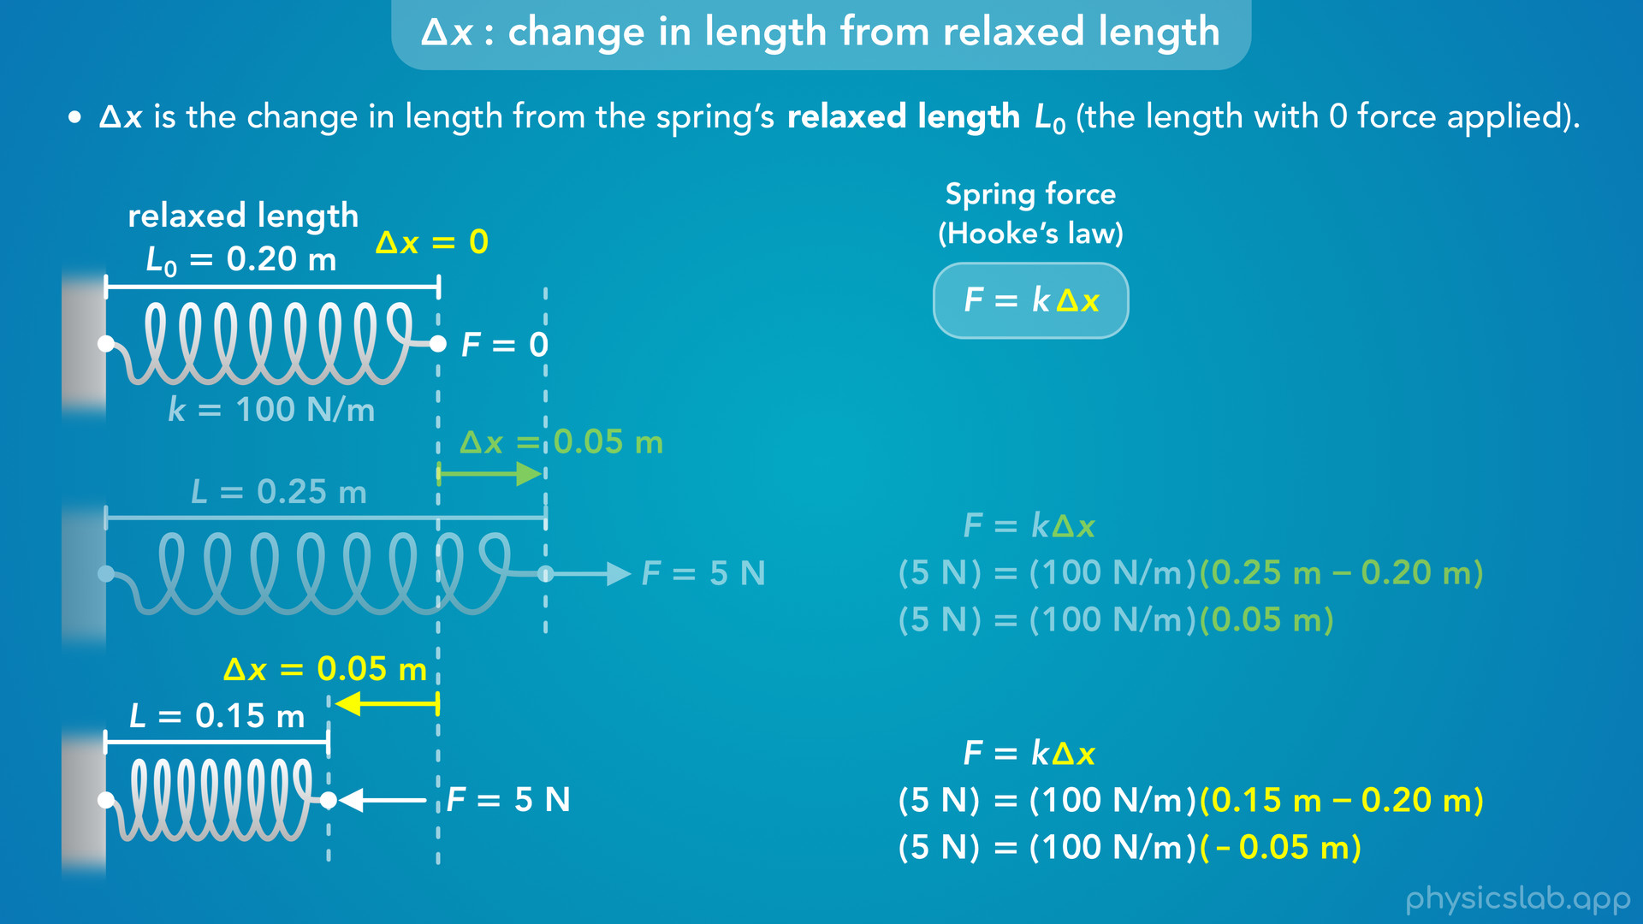
Notes:
• But if the bottom spring is shorter, wouldn’t delta x be 0.15 m minus 0.2 m?
• That would give us negative 0.05 m for delta x.
• So what does the negative sign mean?

Slide 38
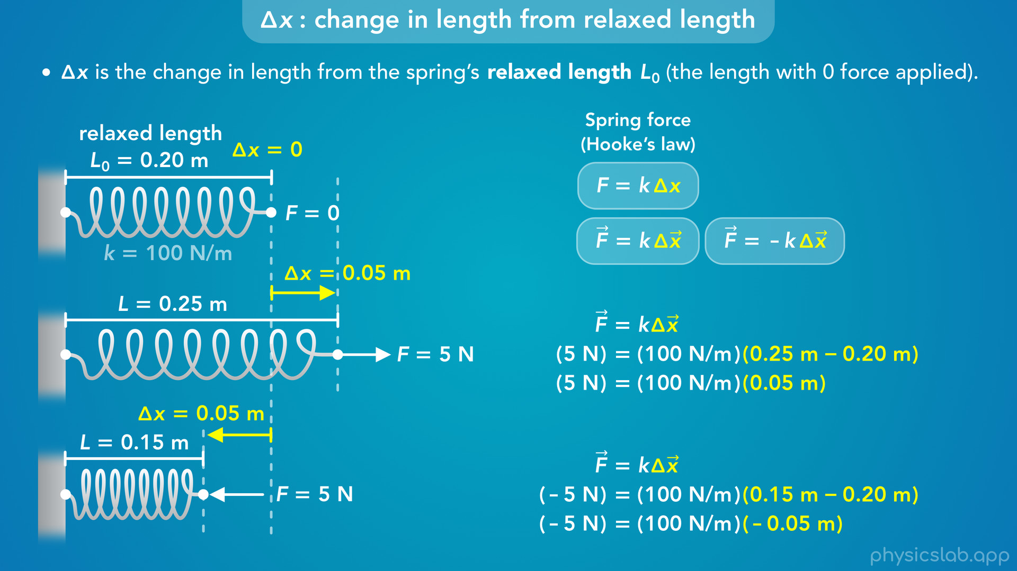
Notes:
• In a way, it’s telling us the direction of delta x.
• You may see the equation for Hooke’s law written like this, where F and delta x are vectors which have a direction, and sometimes there’s a negative sign.
• These versions try to take into account the direction of F and delta x, but they need to be used is specific ways.
• Things can get pretty confusing as we’ll see later, because there are forces being exerted on the spring at both ends, and forces exerted by the spring on other objects.
• So it’s hard to know which direction to use for F.

Slide 39
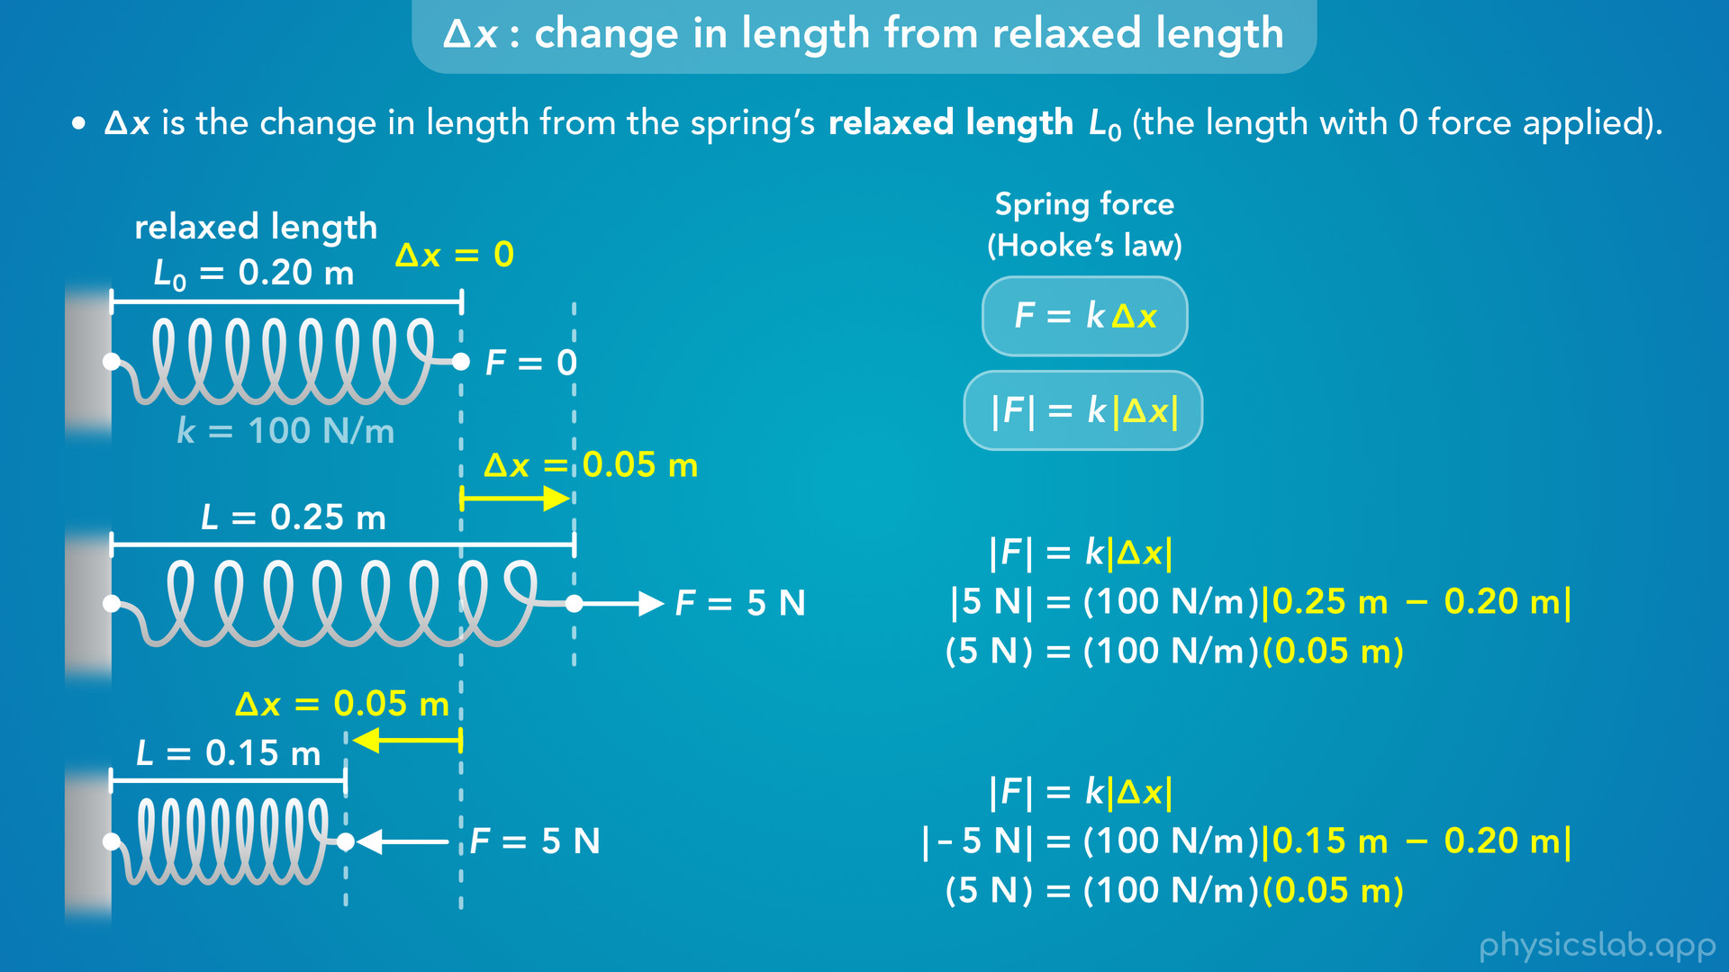
Notes:
• Instead of trying to include direction in this equation, it’s easier if we just use the magnitudes or the absolute values of F and delta x which are always positive.
• And for the directions, we’ll use our intuition about springs.
• When the spring is longer, the force exerted on the spring must be pulling away from the spring.
• When the spring is shorter, the force exerted on the spring must be pushing towards the spring.

Slide 40
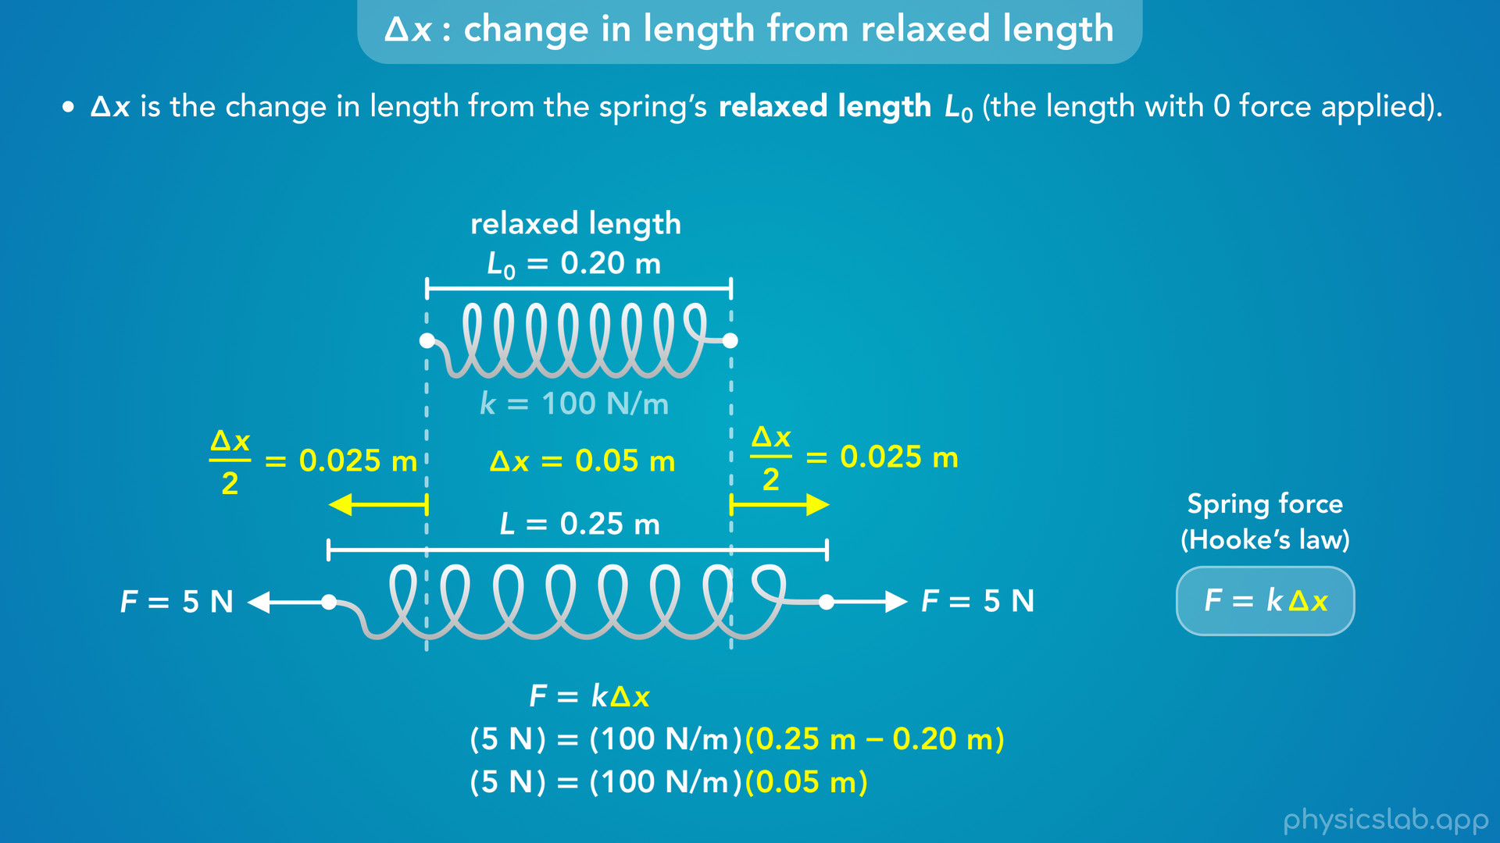
Notes:
• Here’s an example of why this method is easier.
• Instead of keeping the left end of the spring fixed in place, what if we stretch the spring at both ends?
• In this case, it’s not clear which directions we would plug in for F and delta x in this equation.
• So it’s easier if we just think about the change in length, not the displacement of either end.
• The relaxed length is 0.2 m, the new length is 0.25 m, so delta x is 0.05 m.
• And the spring got longer, so the forces acting on each end of the spring must be pulling away from the spring.

Slide 41
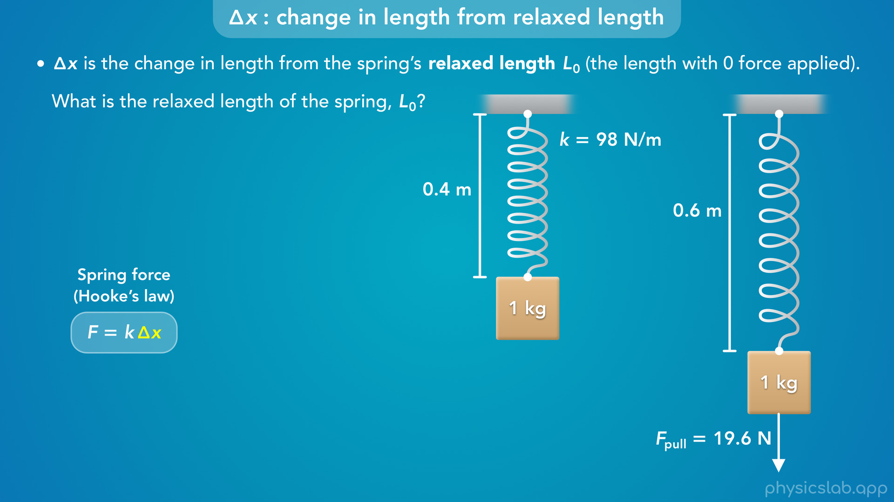
Notes:
• There’s one more common point of confusion when it comes to delta x.
• What if a problem said that a 1 kg box is hanging at rest on the end of a spring, and the length of the spring is 0.4 m.
• Then, the box and spring are pulled down with a force of 19.6 N, and the new length of the spring is 0.6 m.
• Pause the video and answer this question: what is the relaxed length of this spring?

Slide 42
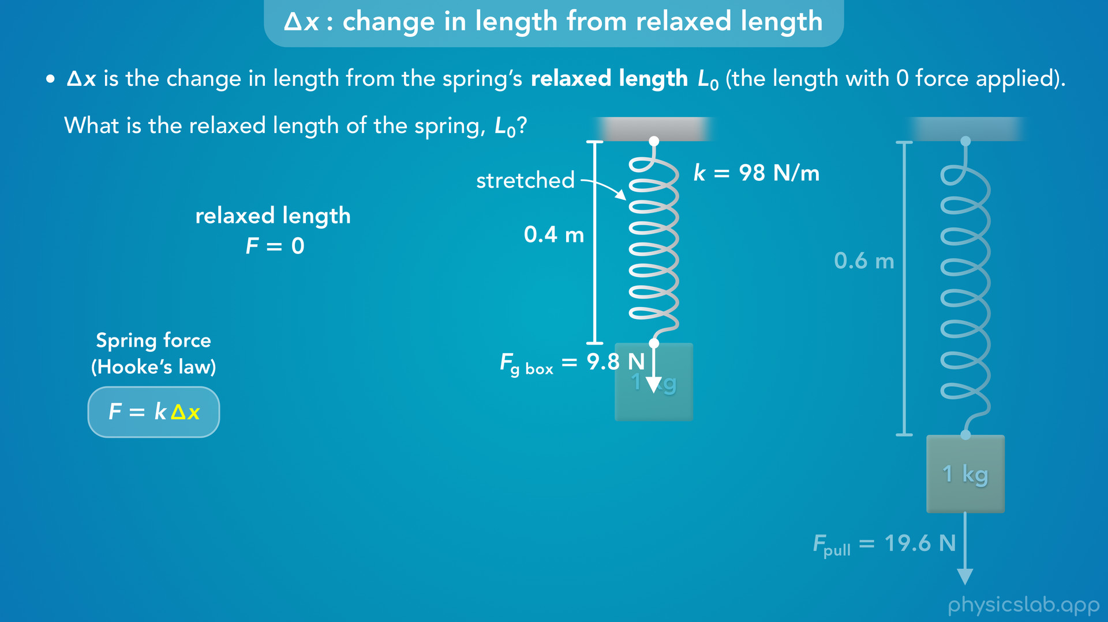
Notes:
• So it might look like the relaxed length is 0.4 m.
• But remember, the spring is at the relaxed length when there is no force acting on the spring.
• We’ll cover this more in the example problem later, but the weight of the 1 kg box is actually being applied to the spring.
• The weight of the box is 9.8 N, so the spring is 0.4 m long when there’s a 9.8 N force pulling it down.
• The spring is actually stretched at that time, and this is not the relaxed length.

Slide 43
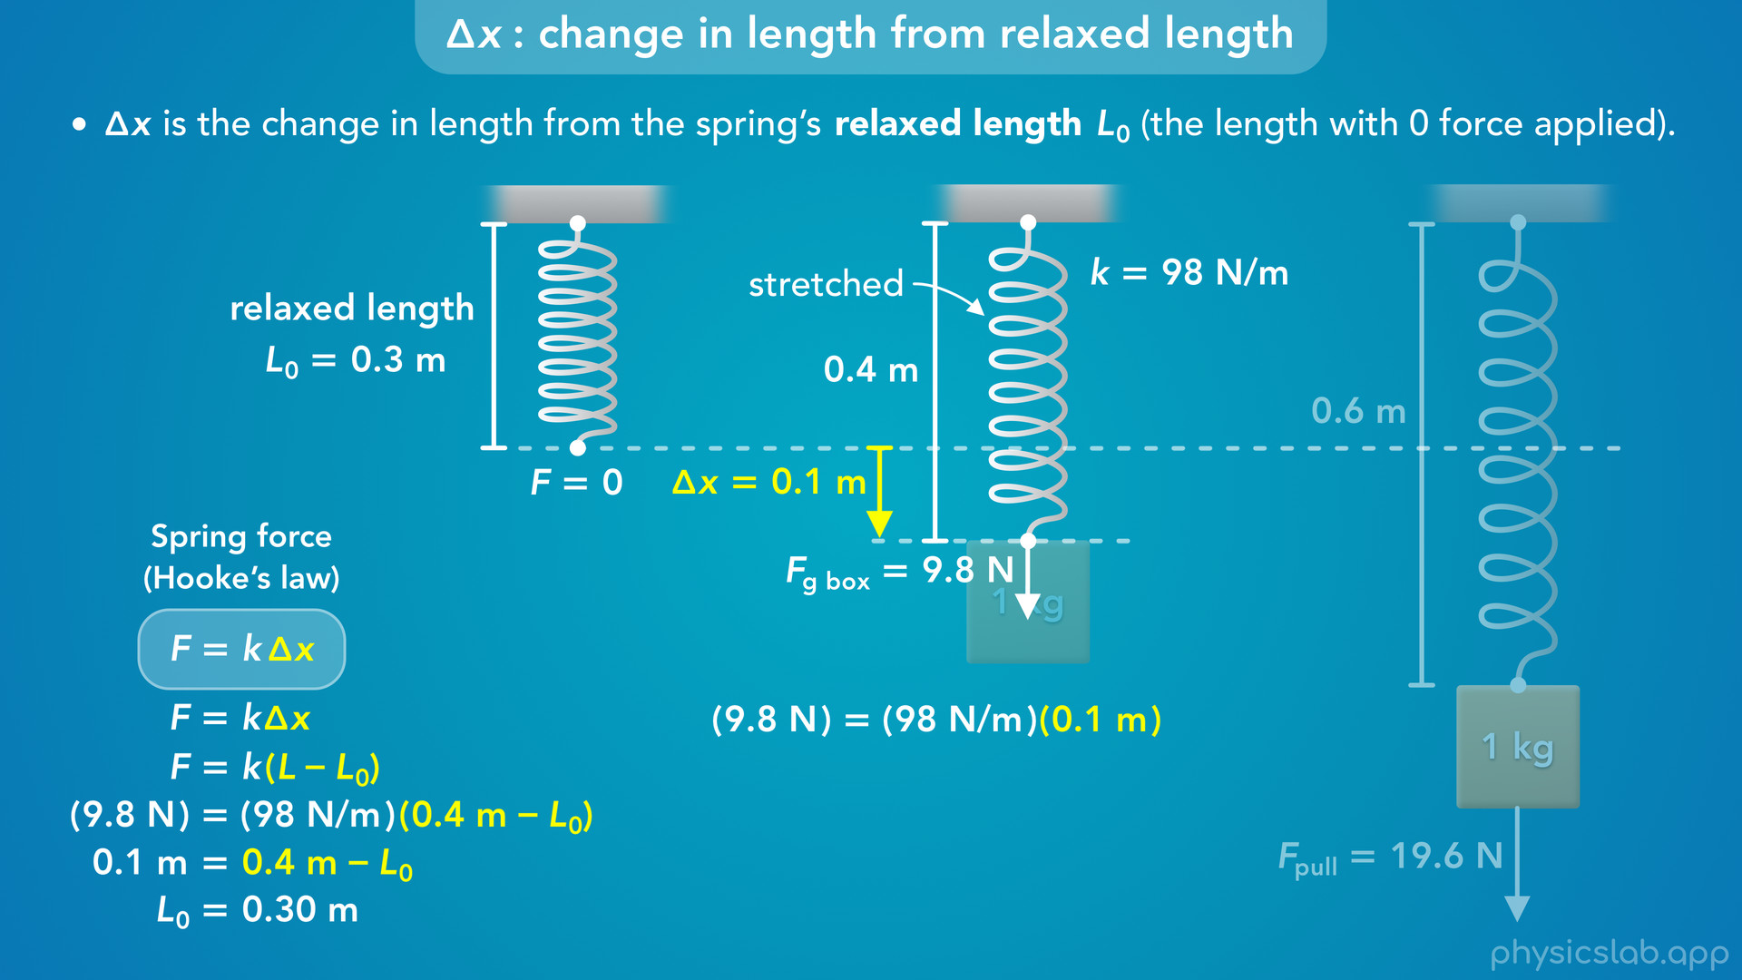
Notes:
• If we wanted to find that, we can use the equation for hooke’s law.
• The force is 9.8 N, the spring constant is 98 N/m, and the length with this force is 0.4 m.
• If we solve this equation for the relaxed length, L zero, we get 0.3 m.
• That’s the length of the spring when there is nothing attached and there is no force being applied.
• When the 1 kg box is attached, the force is 9.8 N and delta x is 0.1 m, 0.4 minus 0.3.

Slide 44
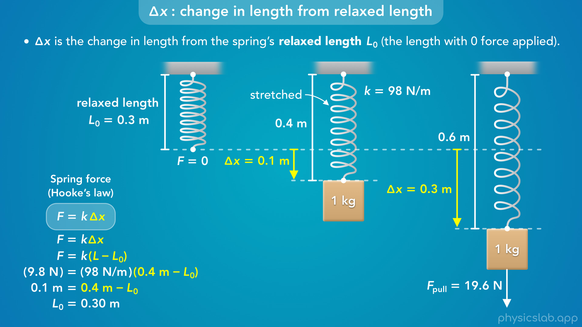
Notes:
• So we might not be given the relaxed length, and we might have to find it.
• Which is why it helps to draw the spring at the relaxed length with no forces, so we remember that we’re measuring delta x from that length.

Slide 45

Notes:
• Alright, the last thing to talk about is the spring force, F.
• What forces are involved with springs, and what are their directions?

Slide 46
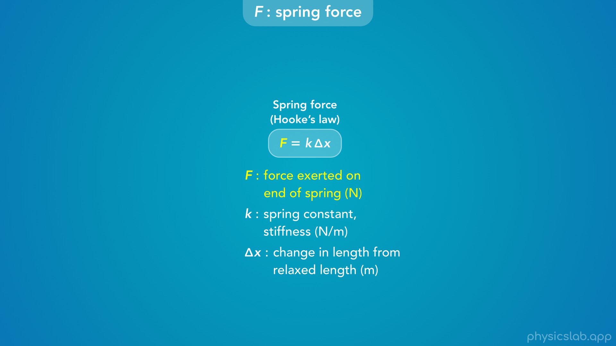
Notes:
• So far we’ve kept things simple, but this can get confusing as we’ll see in minute.

Slide 47
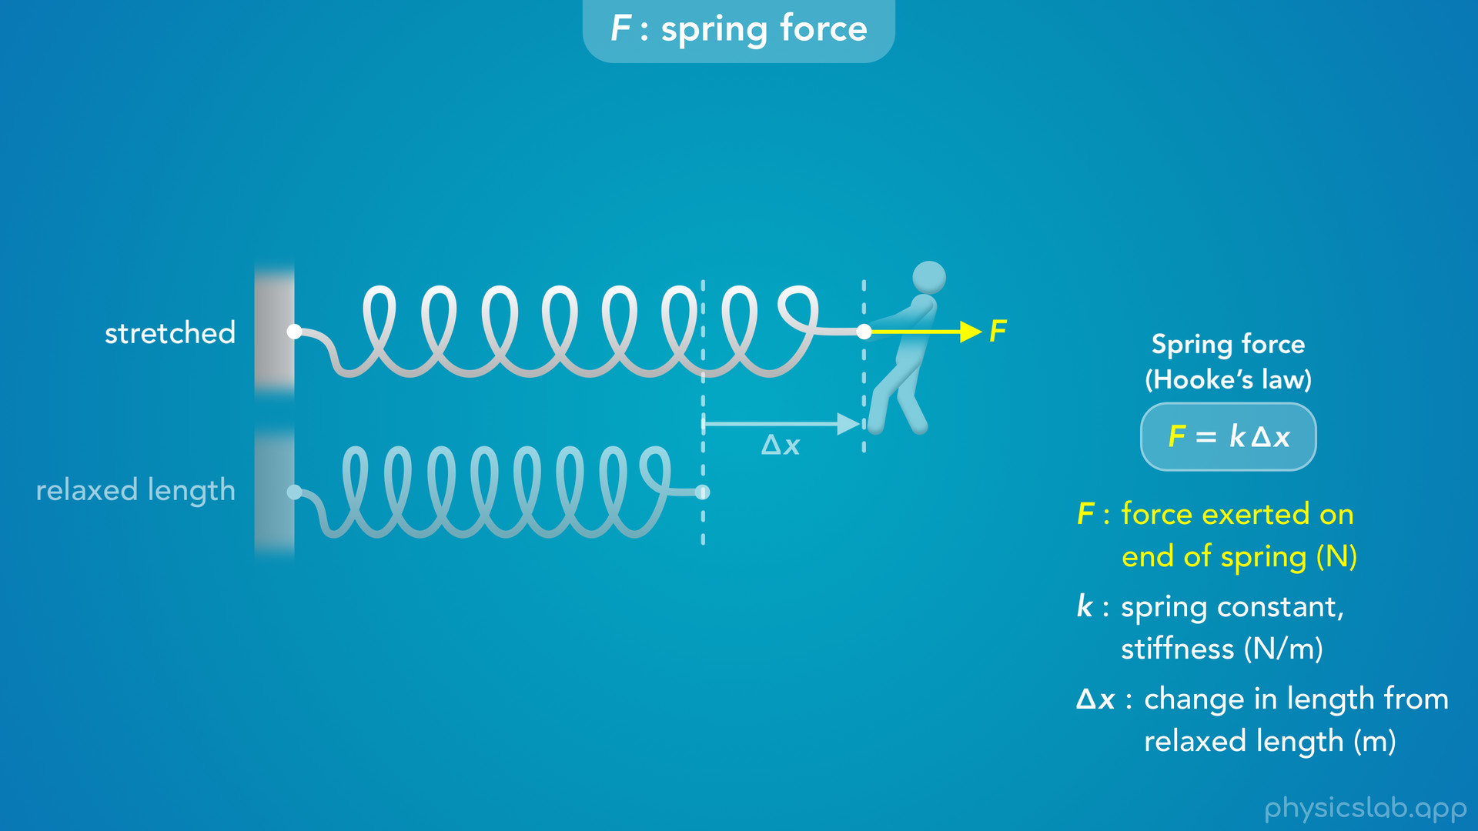
Notes:
• Let’s say we have a spring at its relaxed length, and then a person stretches the spring.
• In order for the spring to get longer, the force exerted on the spring must be a pulling force that acts away from the spring.

Slide 48
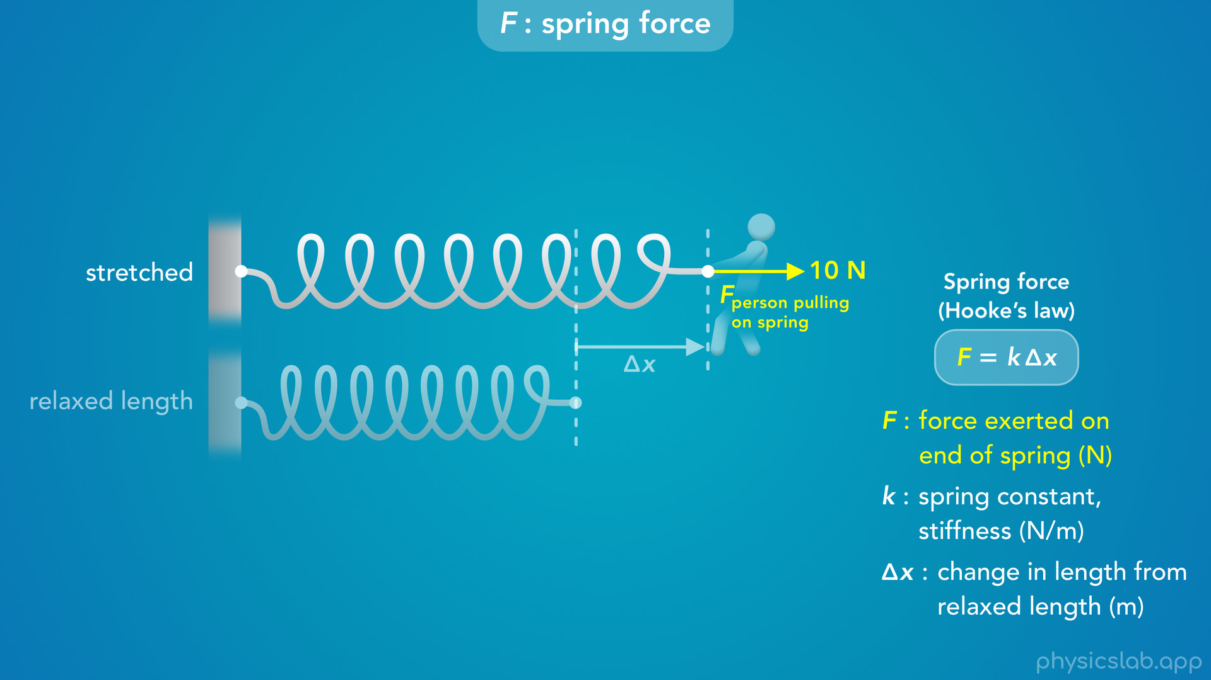
Notes:
• Let’s label this as the force from the person pulling on the spring, and maybe it has a magnitude of 10 N.

Slide 49
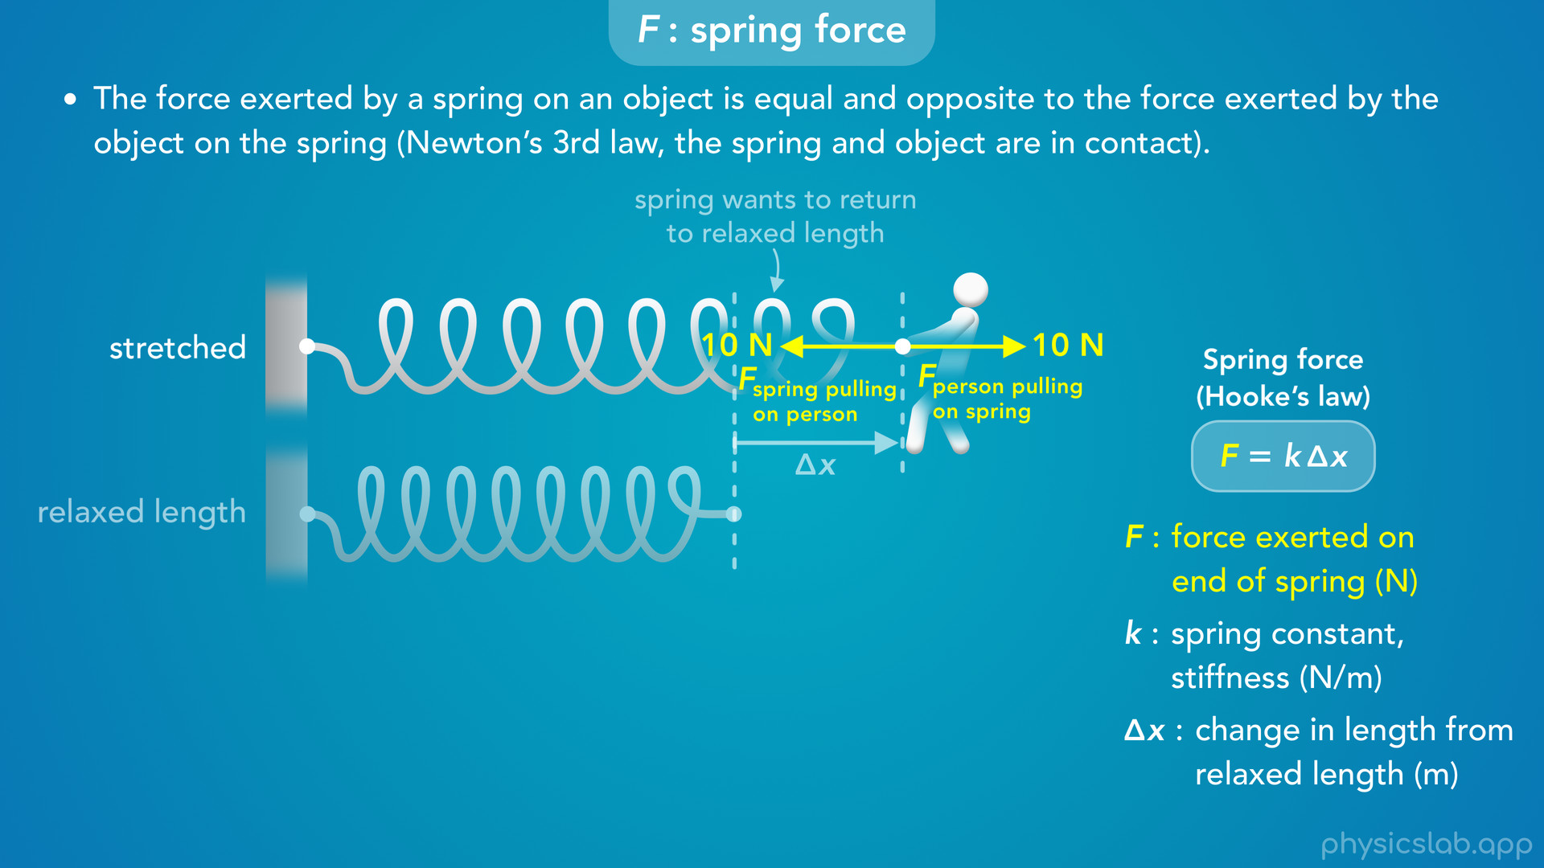
Notes:
• According to Newton’s 3rd law, forces come in pairs.
• “So the force exerted by a spring on an object is equal and opposite to the force exerted by the object on the spring, again this is Newton’s 3rd law and the spring and object are in contact”.
• So if the person is pulling on the spring, then the spring is also pulling on the person with an equal and opposite force.
• The force exerted by the spring on the person acts to the left and it has the same magnitude of 10 N.
• The person is pulling on the spring to the right, and the spring is pulling on the person to the left.
• So which force are we referring to in the equation for Hooke’s law?
• Well, these forces will have the same magnitude, and if we only use the magnitudes in this equation, then F can refer to either force: the force exerted on the spring by the person, or the force exerted on the person by the spring.

Slide 50
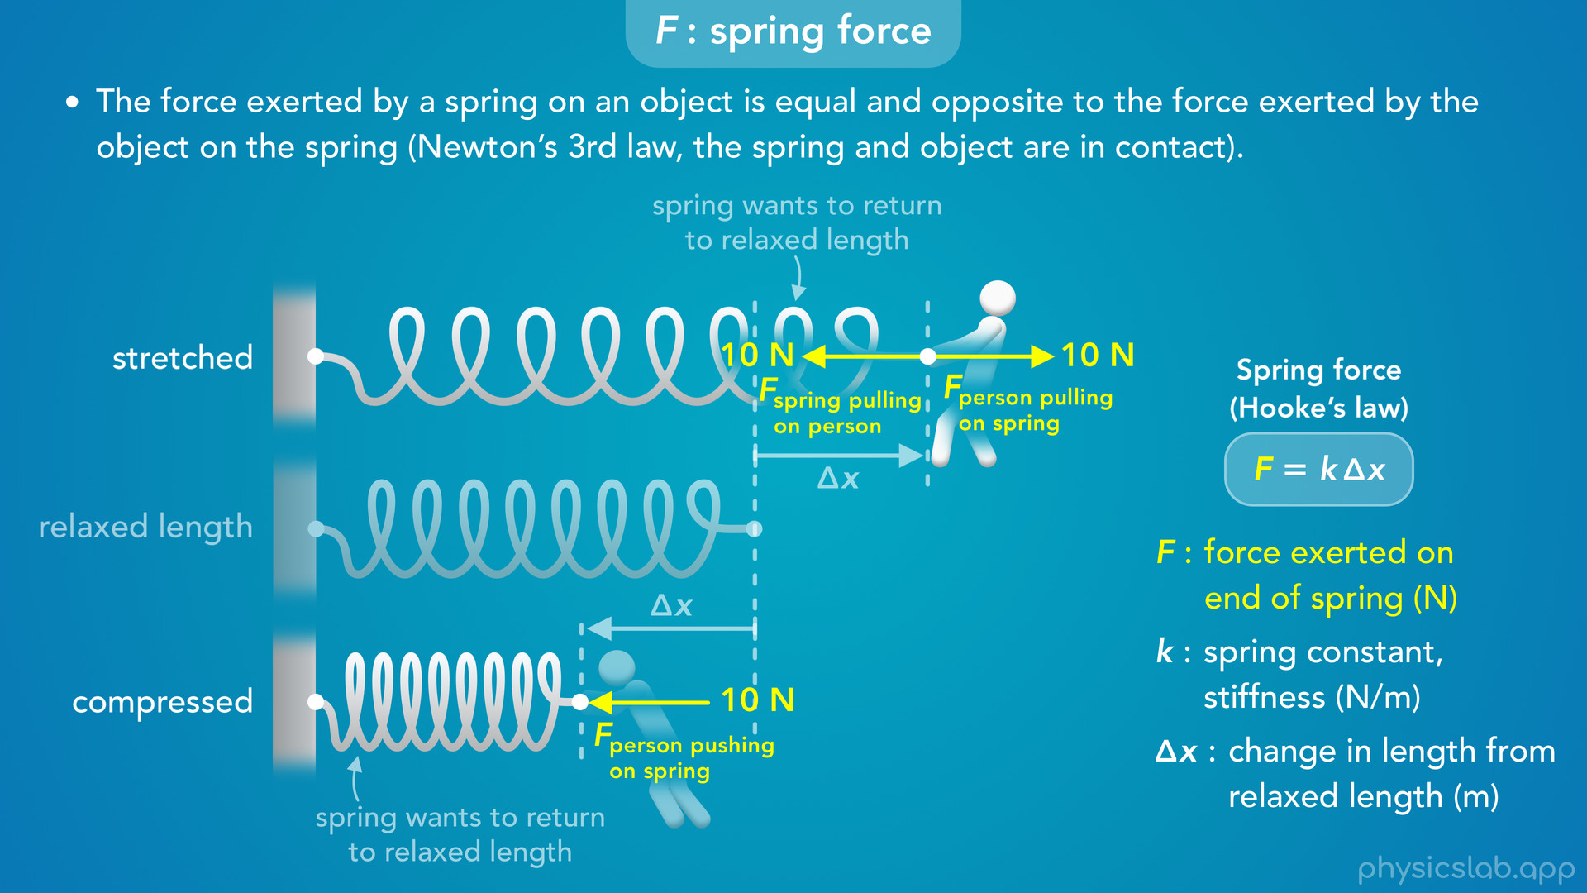
Notes:
• What are the directions of the forces if the spring is compressed?
• When the spring is shorter than its relaxed length, the force exerted on the spring must be a pushing force acting towards the spring.
• So there’s a force from the person pushing on the spring which acts to the left.

Slide 51
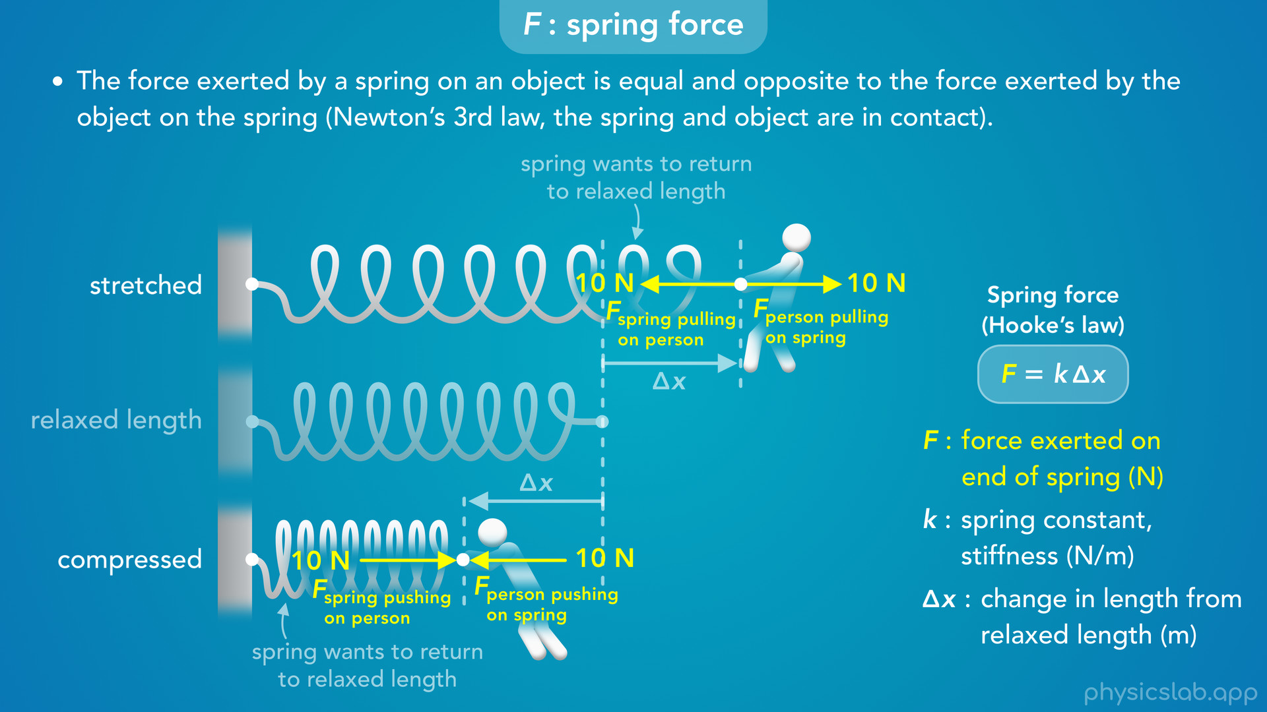
Notes:
• But the spring is also pushing the person to the right with an equal and opposite force.
• And again, Hooke’s law is referring to the magnitude of either force because they’re the same.

Slide 52
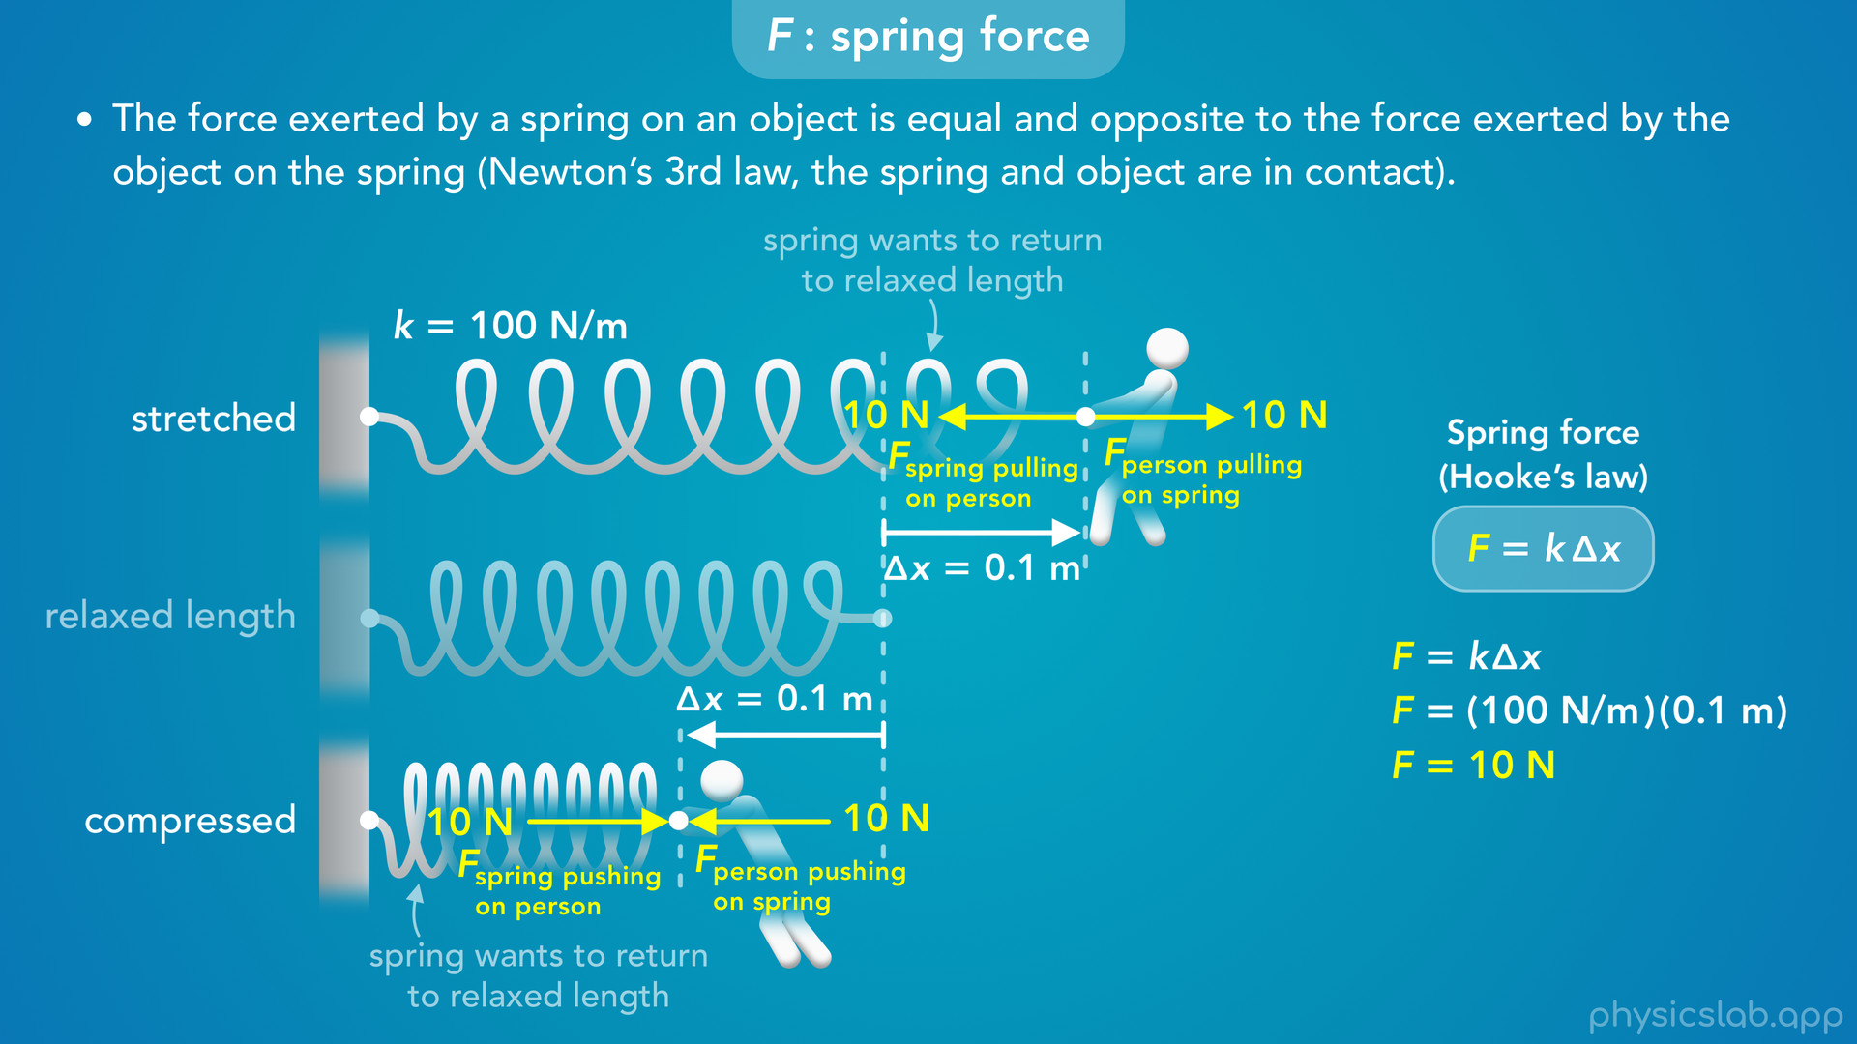
Notes:
• For example, if the spring constant k is 100 N/m, and the person stretches or compresses the spring by 0.1 m which is delta x, then Hooke’s law says that F is 10 N.
• When it’s stretched, the person is pulling on the spring with 10 N and the spring is pulling on the person with 10 N.
• When it’s compressed, the person is pushing on the spring with 10 N and the spring is pushing on the person with 10 N.

Slide 53
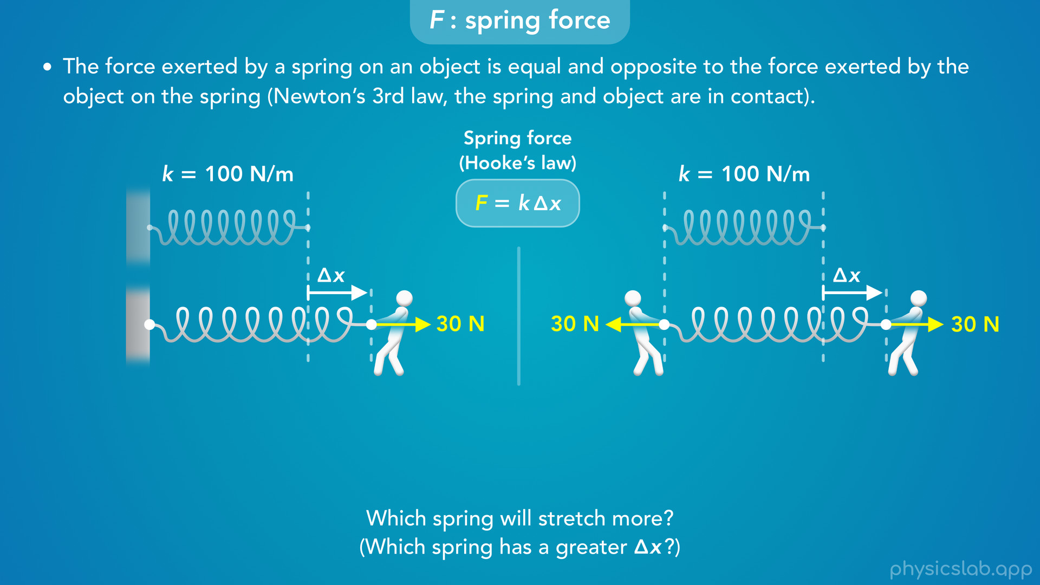
Notes:
• So those are the forces on one end, but here’s where things can get confusing.
• In this first example, the left end of the spring is attached to a wall, and a person is pulling on the right end with 30 N of force.
• In the second example, a person is pulling on the left end with 30 N of force and another person is pulling on the right end with 30 N of force.
• Both springs have the same relaxed length and the same spring constant of 100 N/m.
• Pause the video and answer this question: which spring will stretch more?
• So it might seem like there’s more force acting on the right spring because there’s 30 N acting on each end, and the left spring only has 30 N on one end.
• But what’s happening where the spring is attached to the wall? Are there any forces on that end?

Slide 54
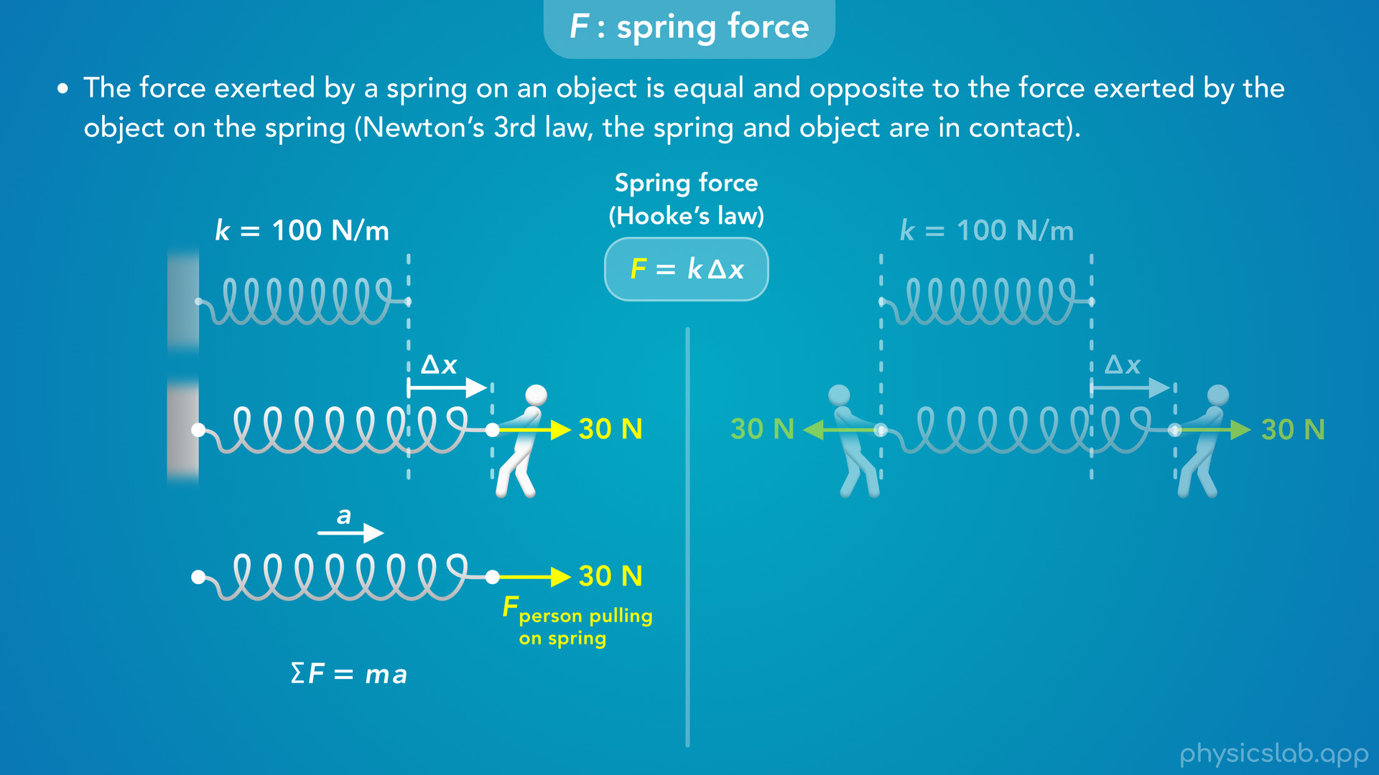
Notes:
• If we look at a free body diagram of the spring, there’s a 30 N force from the person to the right.
• According to Newton’s 2nd law, that would cause the spring to accelerate to the right

Slide 55
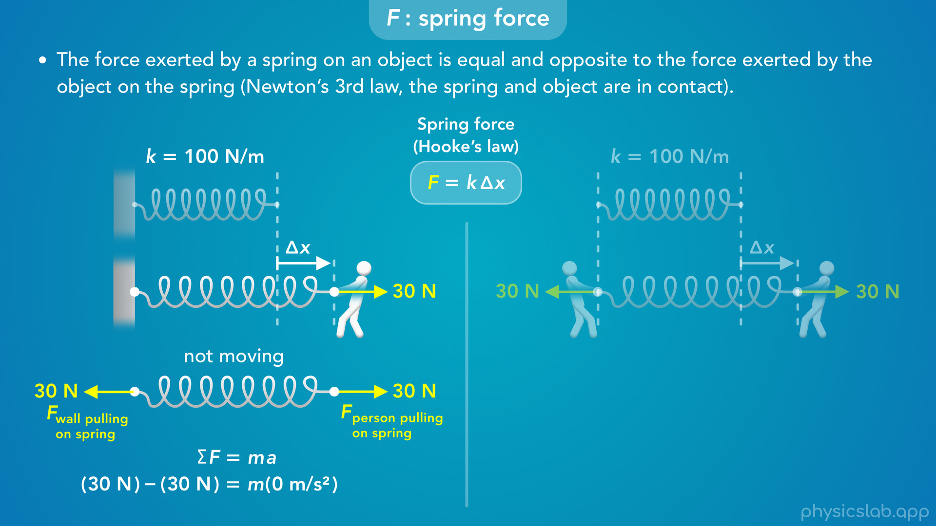
Notes:
but we’re assuming that the spring remains at rest and attached to the wall.
• The means the wall must also be exerting a pulling force on the spring that acts to the left.
• What would be the magnitude of that force?
• If the spring is not moving, then the net force is zero, so this is also 30 N.

Slide 56
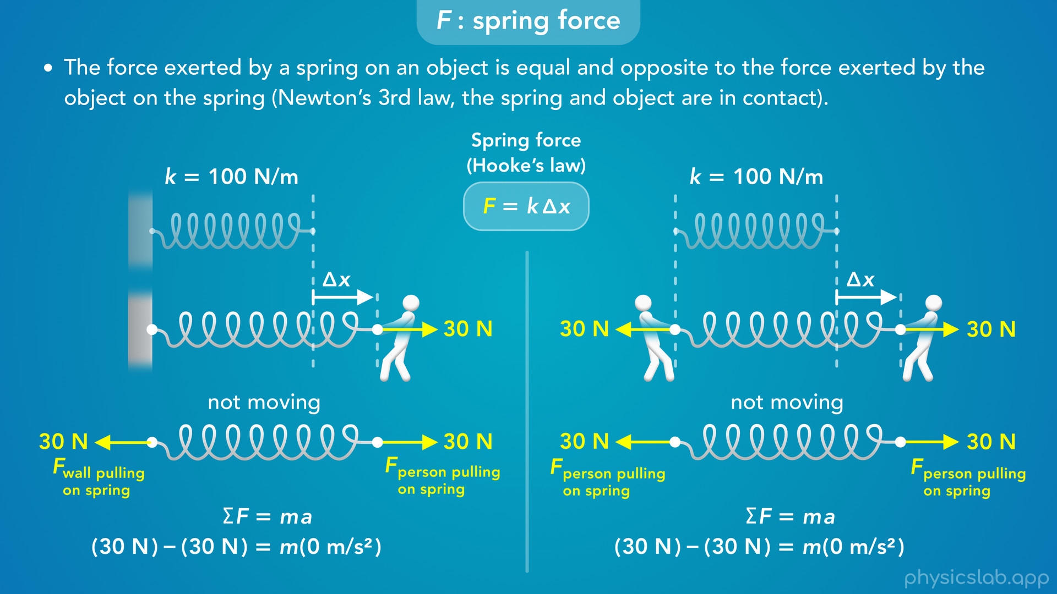
Notes:
• So when we work with springs, some forces will be obvious.
• But anywhere that the spring is in contact with an object, the object is also exerting a force on the spring.

Slide 57
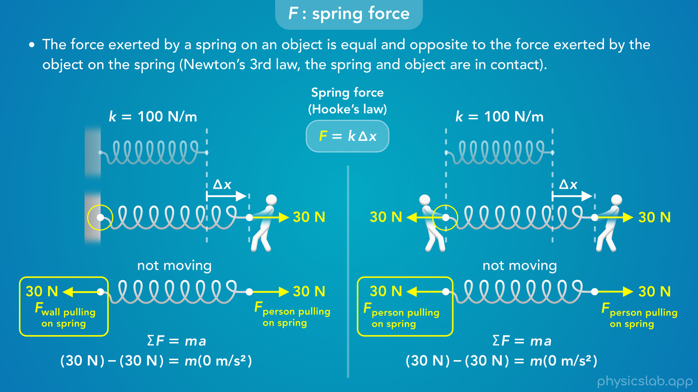
Notes:
• So these two scenarios are identical. The wall is pulling this spring to the left with 30 N of force, just like the person is pulling this spring to the left with 30 N of force.

Slide 58
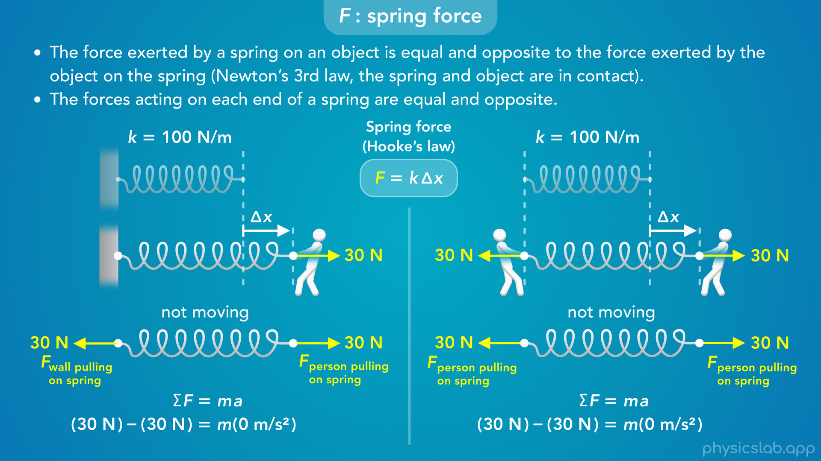
Notes:
• This is another important point to remember about springs.
• The forces acting on each end of a spring are equal and opposite.
• If the spring is not moving, then we know this is true because the net force on the spring is zero, so the forces at each end are balanced.
• But we could also say this is just a true fact for “ideal springs”, which we’ll cover in the next video.

Slide 59
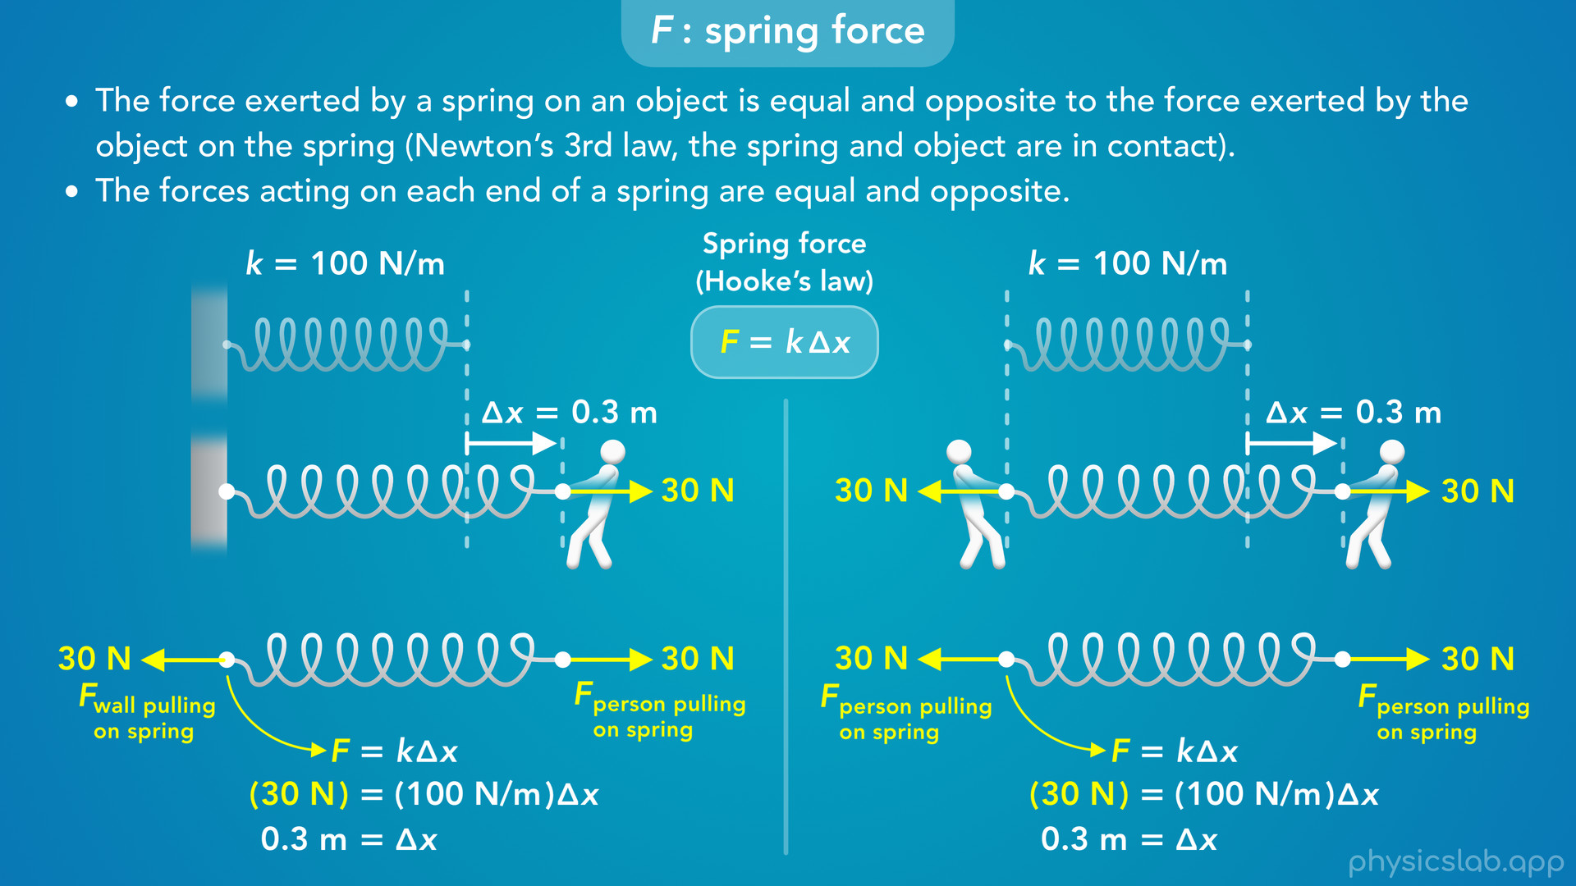
Notes:
• So if there’s 30 N of force acting at both ends of the springs, how do we find delta x? What do we plug in for F in this equation?
• F is the force exerted on one end of the spring.
• These forces have the same magnitude, and we plug in 30 N for F in this equation.
• With a spring constant of 100 N/m, delta x will be 0.3 m.
• That’s how much the springs stretch in both of these scenarios.
• We do not add the forces together and use 60 N.
• We do not divide 30 N by 2 and use 15 N.
• And we do not use the net force of 0 N.
• We just use the force at one end, which is 30 N.

Slide 60
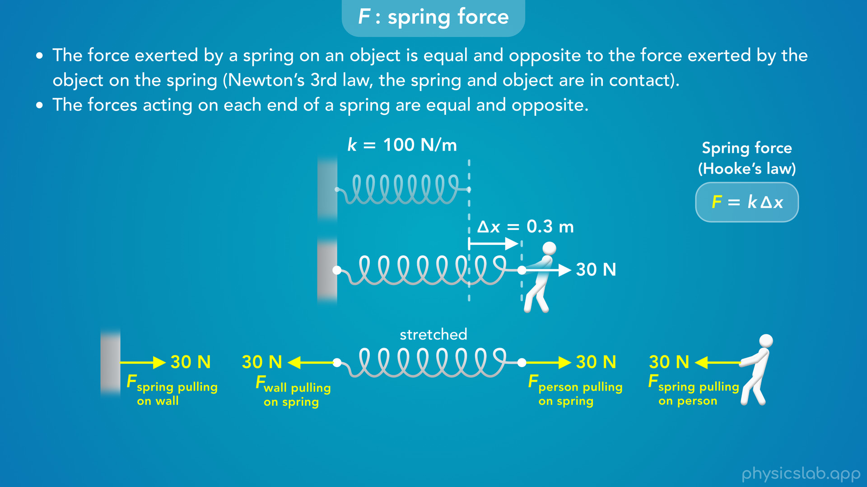
Notes:
• So, unless a spring is just floating in space, there’s actually 4 forces that are involved, a pair at each end.
• If we also draw free body diagrams of the wall and the person, we can see all of these forces.
• In this example the spring is stretched.

Slide 61

Notes:
• At the right end, there’s a force from the person pulling on the spring, and there’s a force from the spring pulling on the person.
• These are a pair of equal and opposite forces from Newton’s 3rd law.
• At the left end, there’s a force from the wall pulling on the spring, and a force from the the spring pulling on the wall.
• These are a different pair of forces.
• But all 4 of these forces have the same magnitude, which is the value of F in the equation for Hooke’s law.

Slide 62

Notes:
• When working on a physics problem, we usually just care about the forces acting on one object, like the person, and not the spring.
• So if we draw a free body diagram with all of the forces acting on the person, one of those forces is from the spring.

Slide 63

Notes:
• So moving forward, we’re going to label this as “the spring force”, or F sp.
• We’re also going to use this in Hooke’s law so we remember that this equation is for the spring force.
• You may also see this force referred to as the “restoring force”, which is the force acting on the person because the spring is trying to restore itself to its relaxed length.

Slide 64

Notes:
• So these are all of the forces involved with this spring.
• We can figure out their directions based on whether the spring is longer or shorter that its relaxed lenght, whether it’s being stretched or compressed.
• And they all have the same magnitude, which is the value that we use for F in this equation.

Slide 65

Notes:
• In the next video, we’ll talk about ideal springs and the assumptions that we’re making when we use Hooke’s Law.

Slide 66

Notes:
• We’ll also look at a graph of the spring force for different springs...

Slide 67

Notes:
• …and we’ll see how a scale can measure weight using Hooke’s law.

