Slide 1
Introduction to Centripetal Acceleration
Slides Version 1
This version includes:
Slides with screenshot images from the video.
The video narration in the slide notes.
A blank template slide with the same background and font as the video.
Slides with some basic graphics from this video for you to use however you like.
Feel free to add, delete and edit slides to make your own presentation. You can use these slides in class or share them with your students, but please do not share them with anyone else.
If you have any feedback, suggestions or questions about these slides please email me at chris@physicslab.app or send me a message on Discord @physicslab.
physicslab.app

Slide 2
Heading
Text

Slide 3





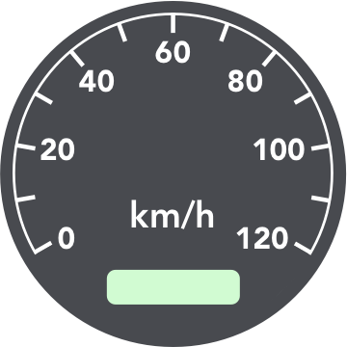



















Slide 4








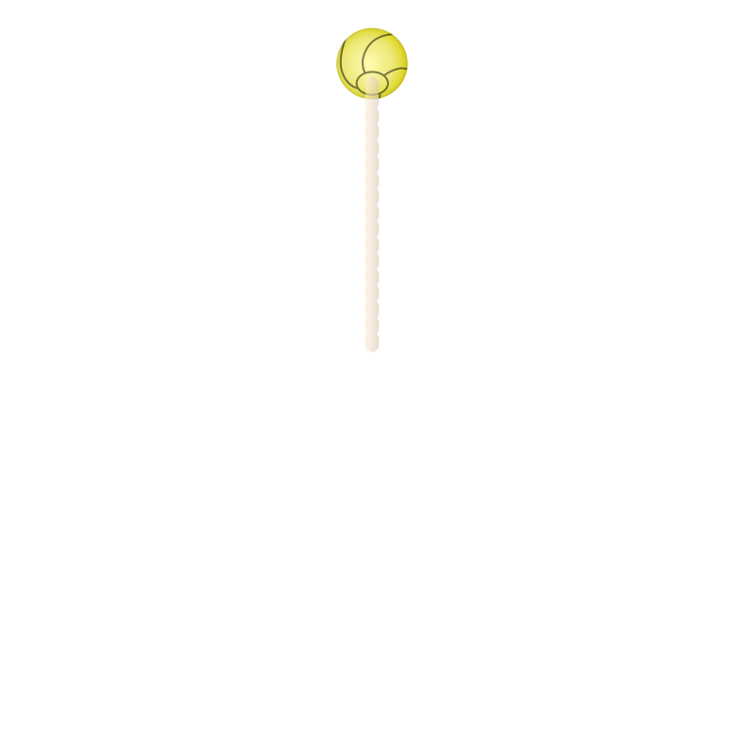




Slide 5


Slide 6




Slide 7


Slide 8
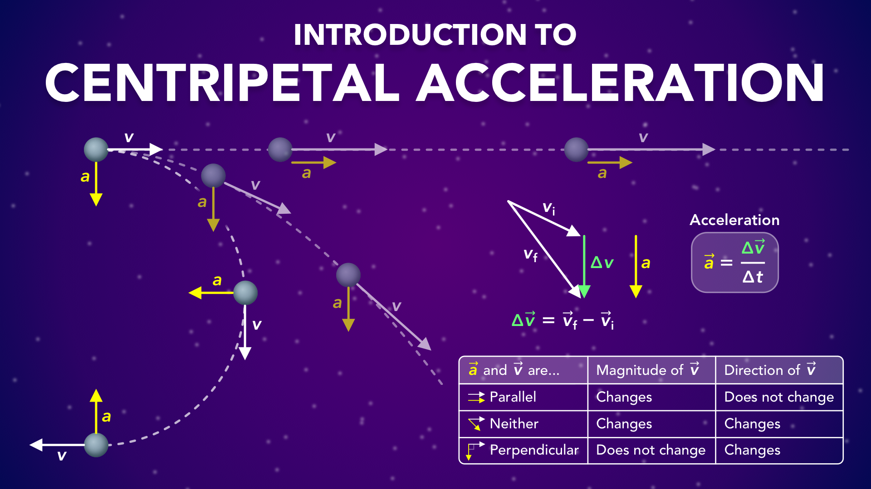
Notes:
Introduction to Centripetal Acceleration
physicslab.app
If you have any questions, suggestions or feedback about these slides please email me at chris@physicslab.app or send me a message on Discord @physicslab.

Slide 9
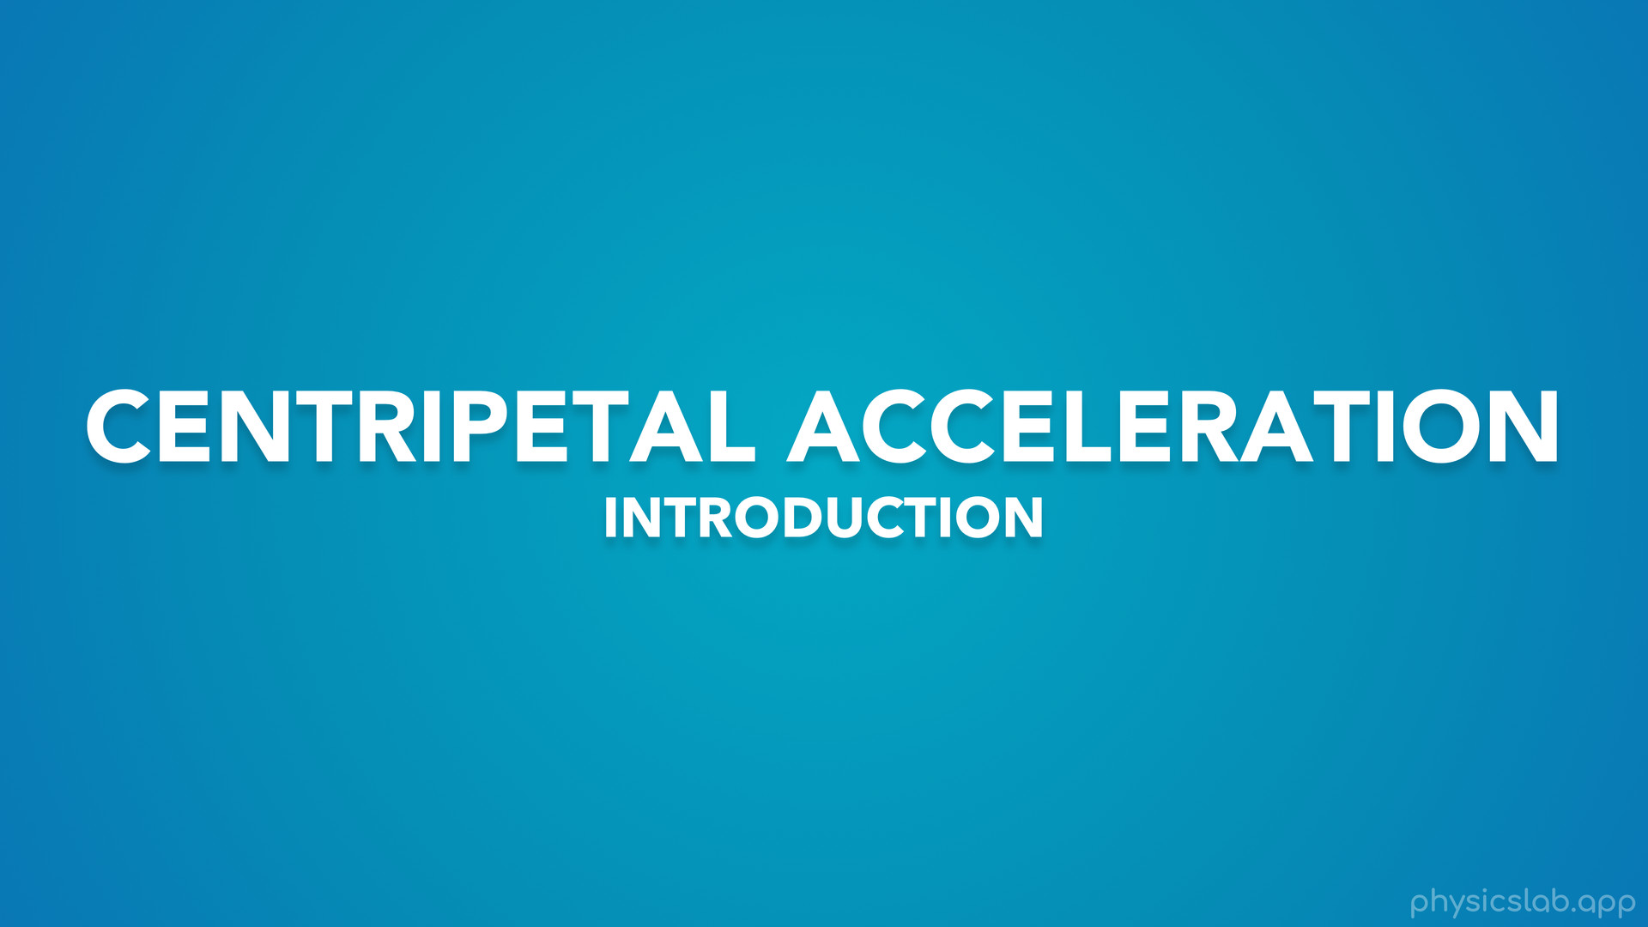
Notes:
In this video we’re gonna start learning about centripetal acceleration.

Slide 10
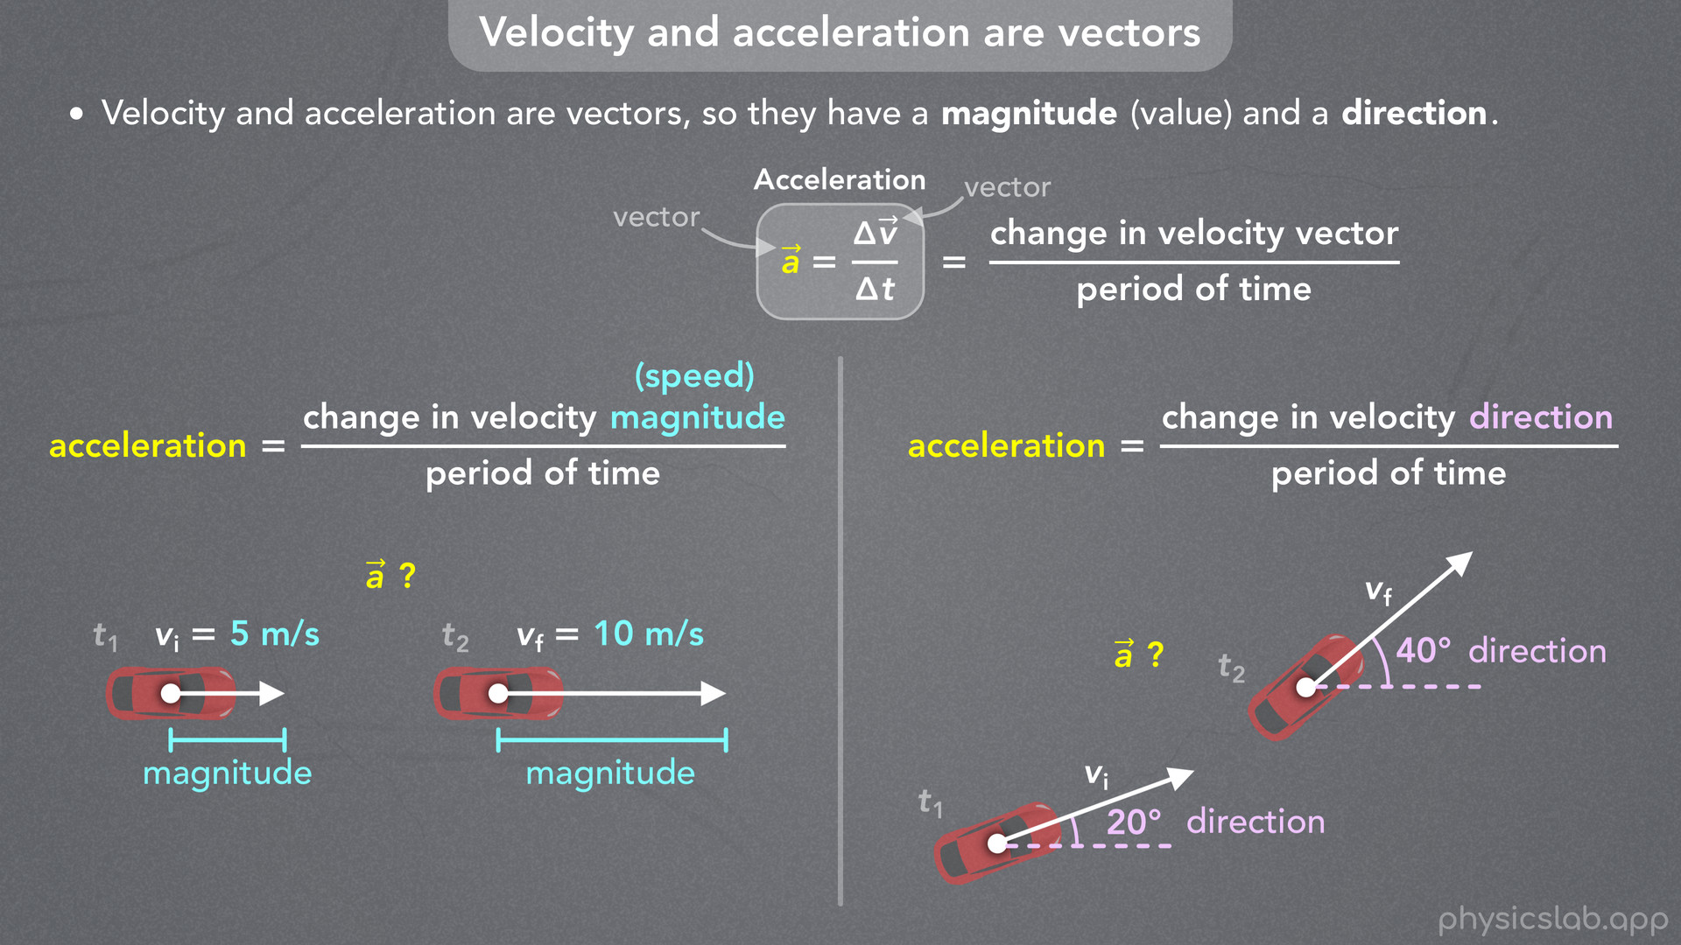
Notes:
• This concept can be confusing, so we’ll start with a quick review of velocity and acceleration vectors.

Slide 11
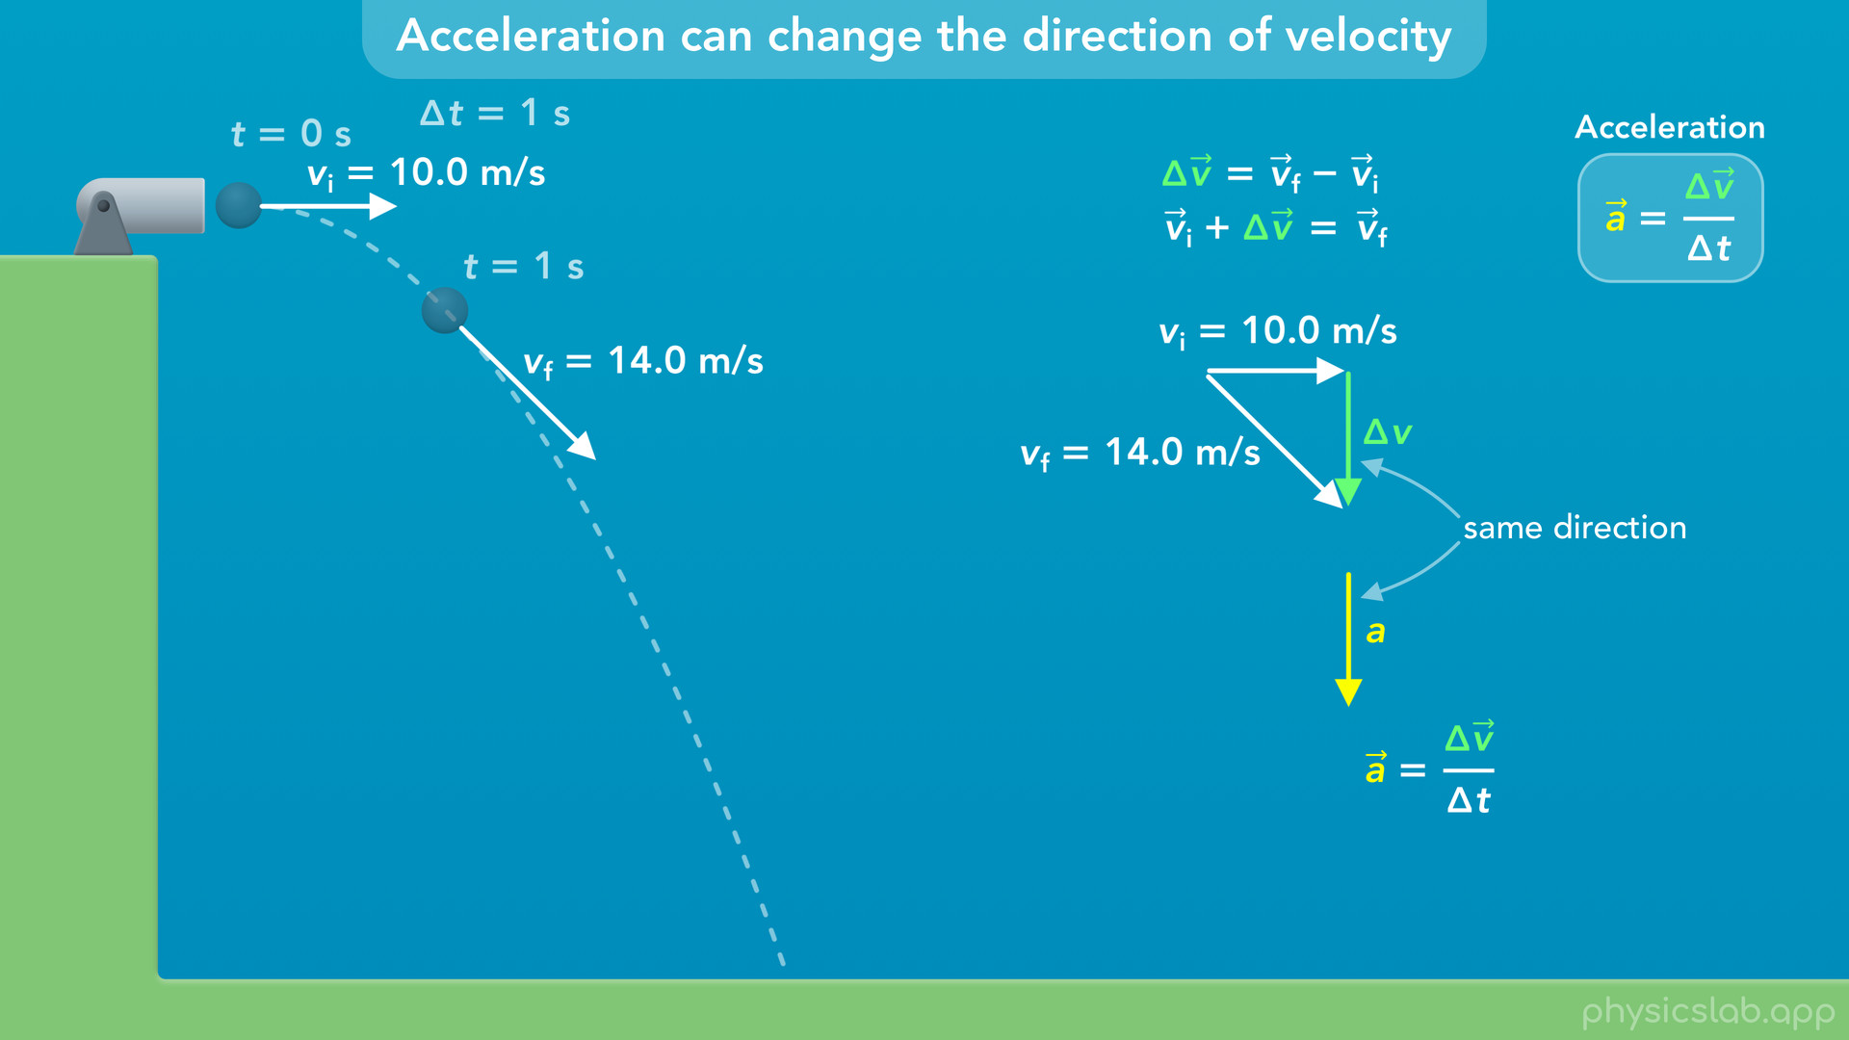
Notes:
• Then we’ll look at some examples of how to find the acceleration vector using the tip to tail method.

Slide 12
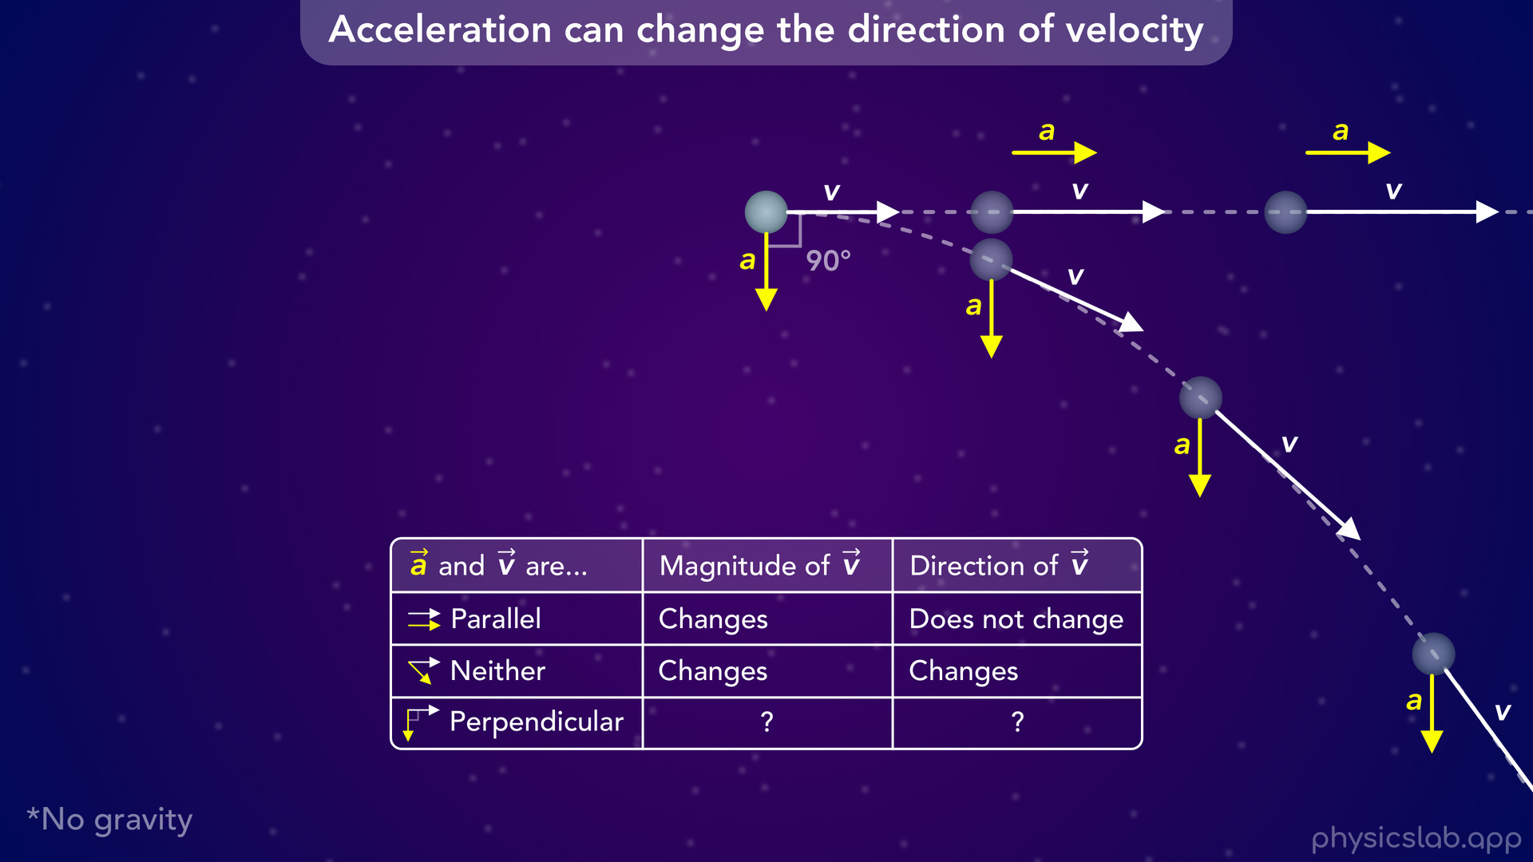
Notes:
• We’ll see how the acceleration affects the velocity when they’re parallel, perpendicular, or somewhere in between.

Slide 13
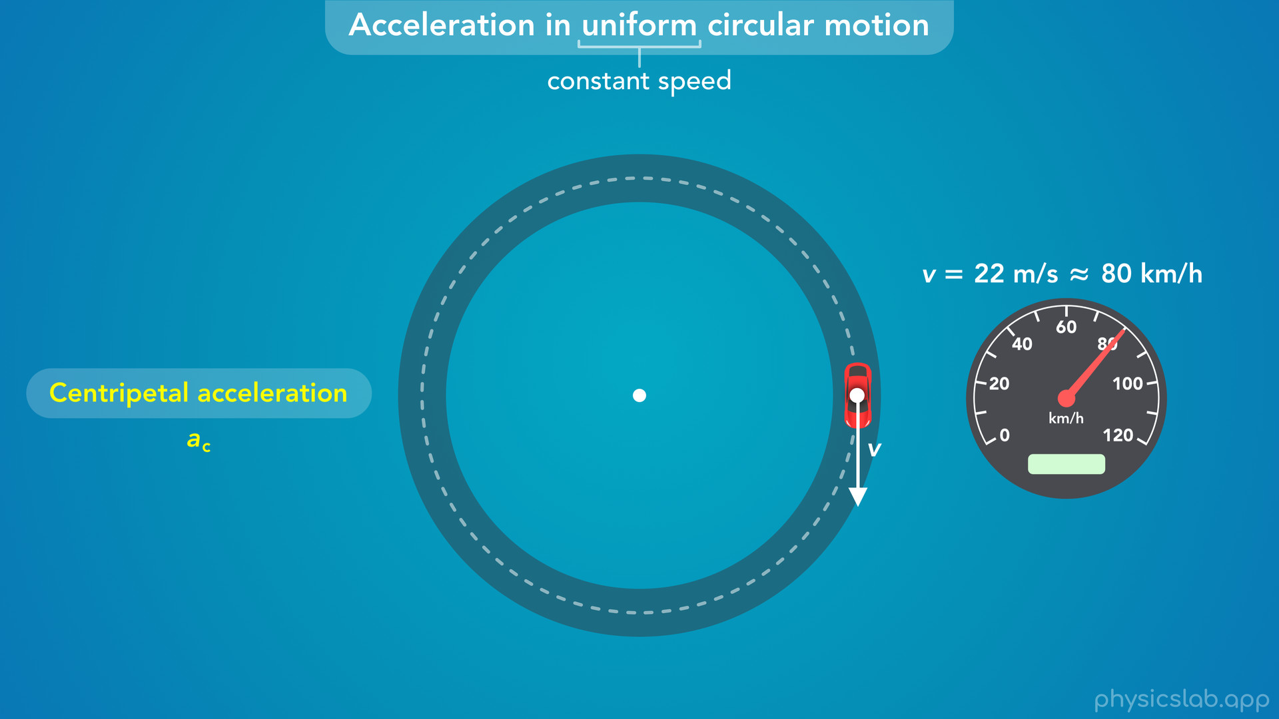
Notes:
• By the end of the video, we’ll have some intuition about centripetal acceleration and how it affects motion.
• This will set us up for the next video, which will cover the equation for centripetal acceleration.

Slide 14

Notes:
• Let’s start with a quick recap of uniform circular motion.

Slide 15
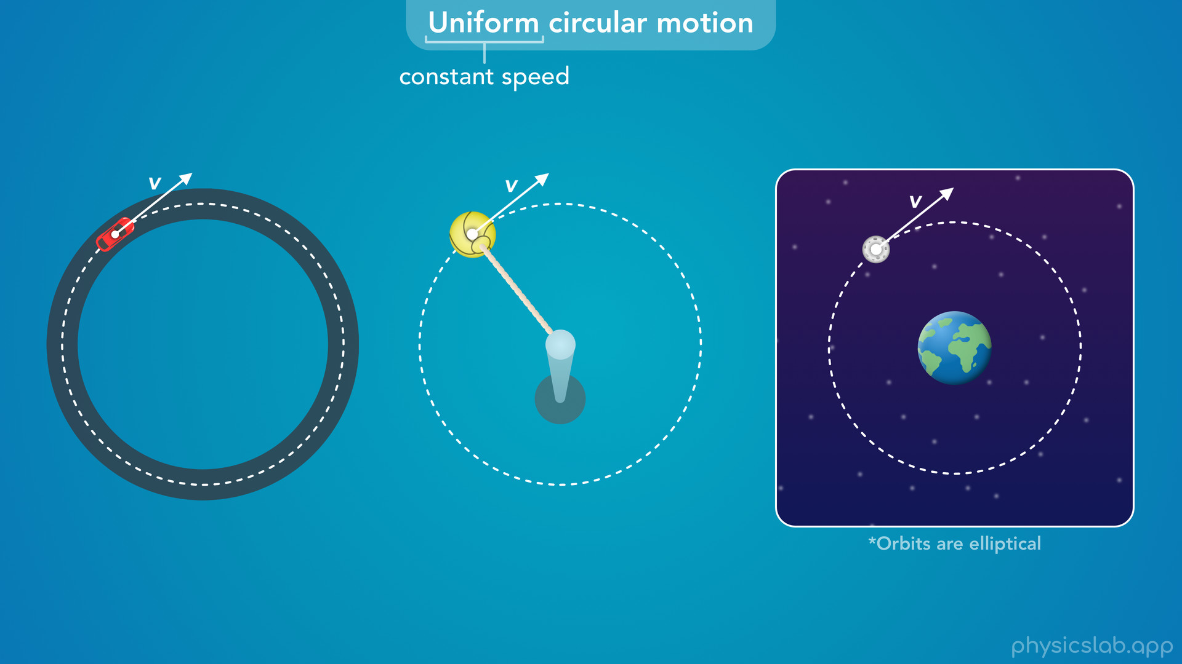
Notes:
• In a previous video, we learned that uniform circular motion is when an object moves around a circular path at a constant speed.

Slide 16
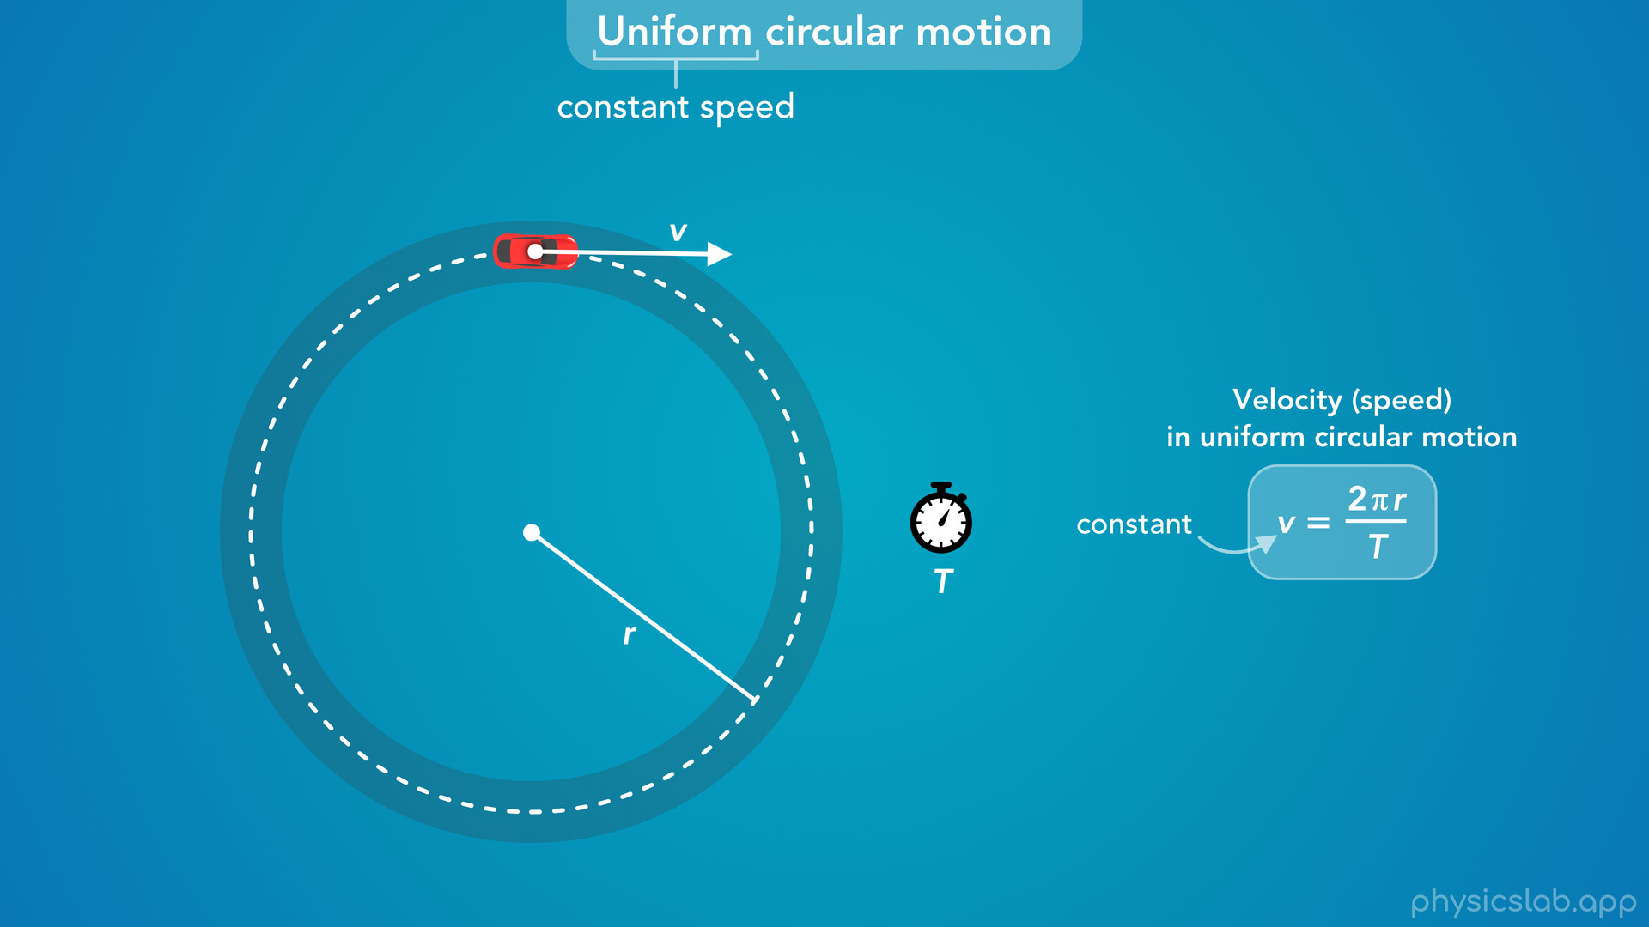
Notes:
• If we know the radius of the circle and the time it takes to complete one revolution, we can calculate the speed using this equation.

Slide 17
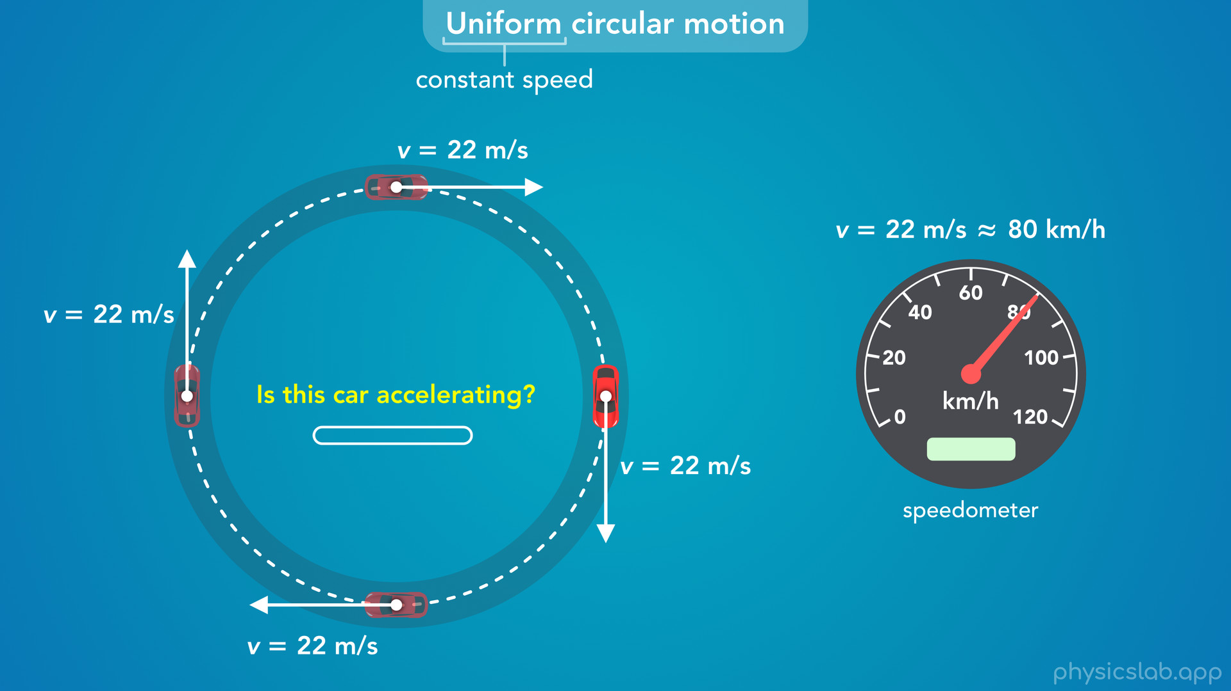
Notes:
• For example, the speed of this car is 22 m/s, which is about 80 km/h.
• The speedometer in the car would show that speed, and it doesn’t change as the car drives around the circle.
• So the car is not speeding up and it’s not slowing down.
• If that’s the case, then take a few seconds to think about this question: is this car accelerating?
• If the speed is not changing, we might think there’s no acceleration.

Slide 18
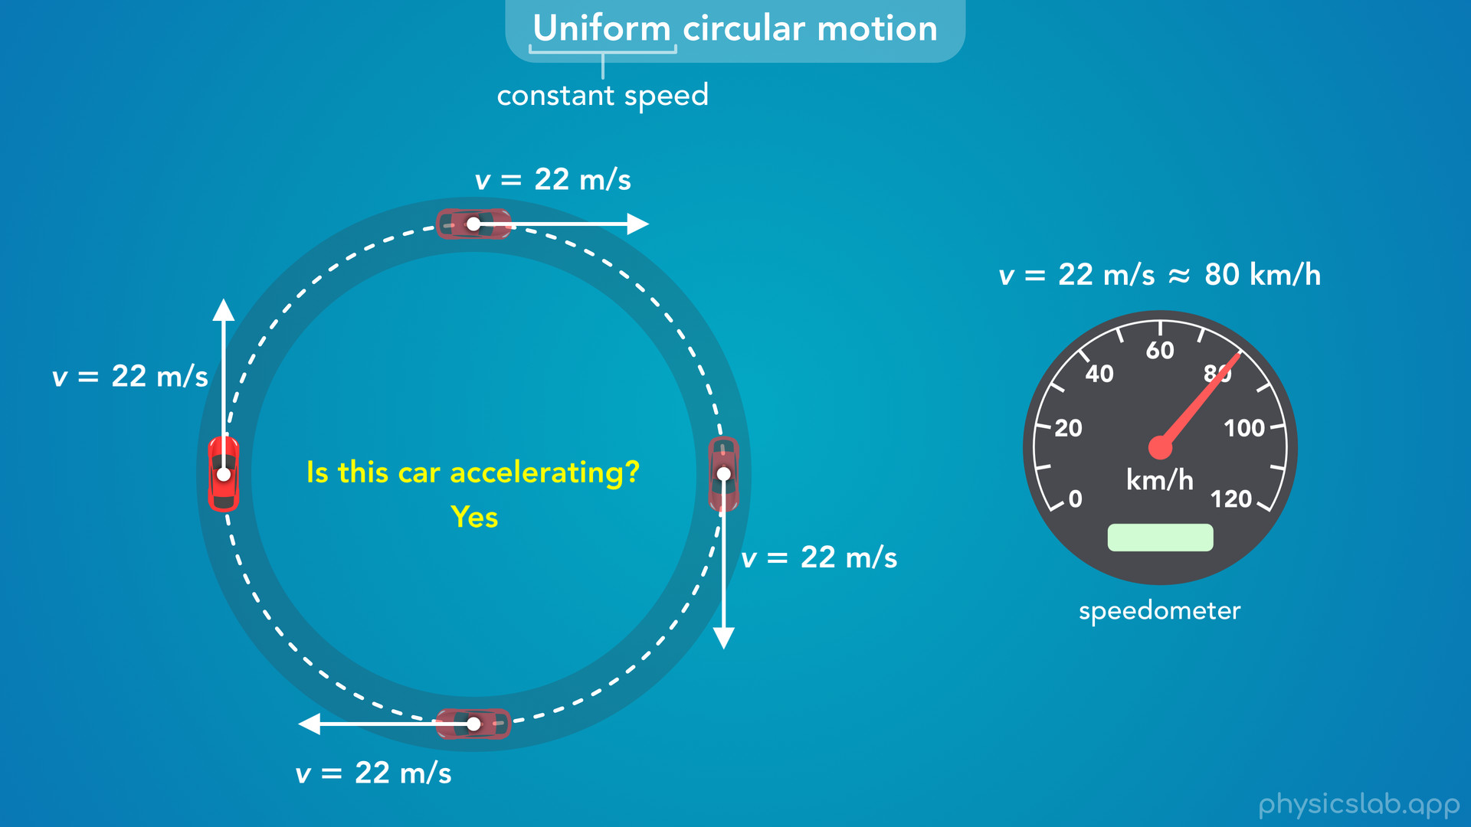
Notes:
• However, the answer is yes, this car is accelerating.
• So how can that be?

Slide 19
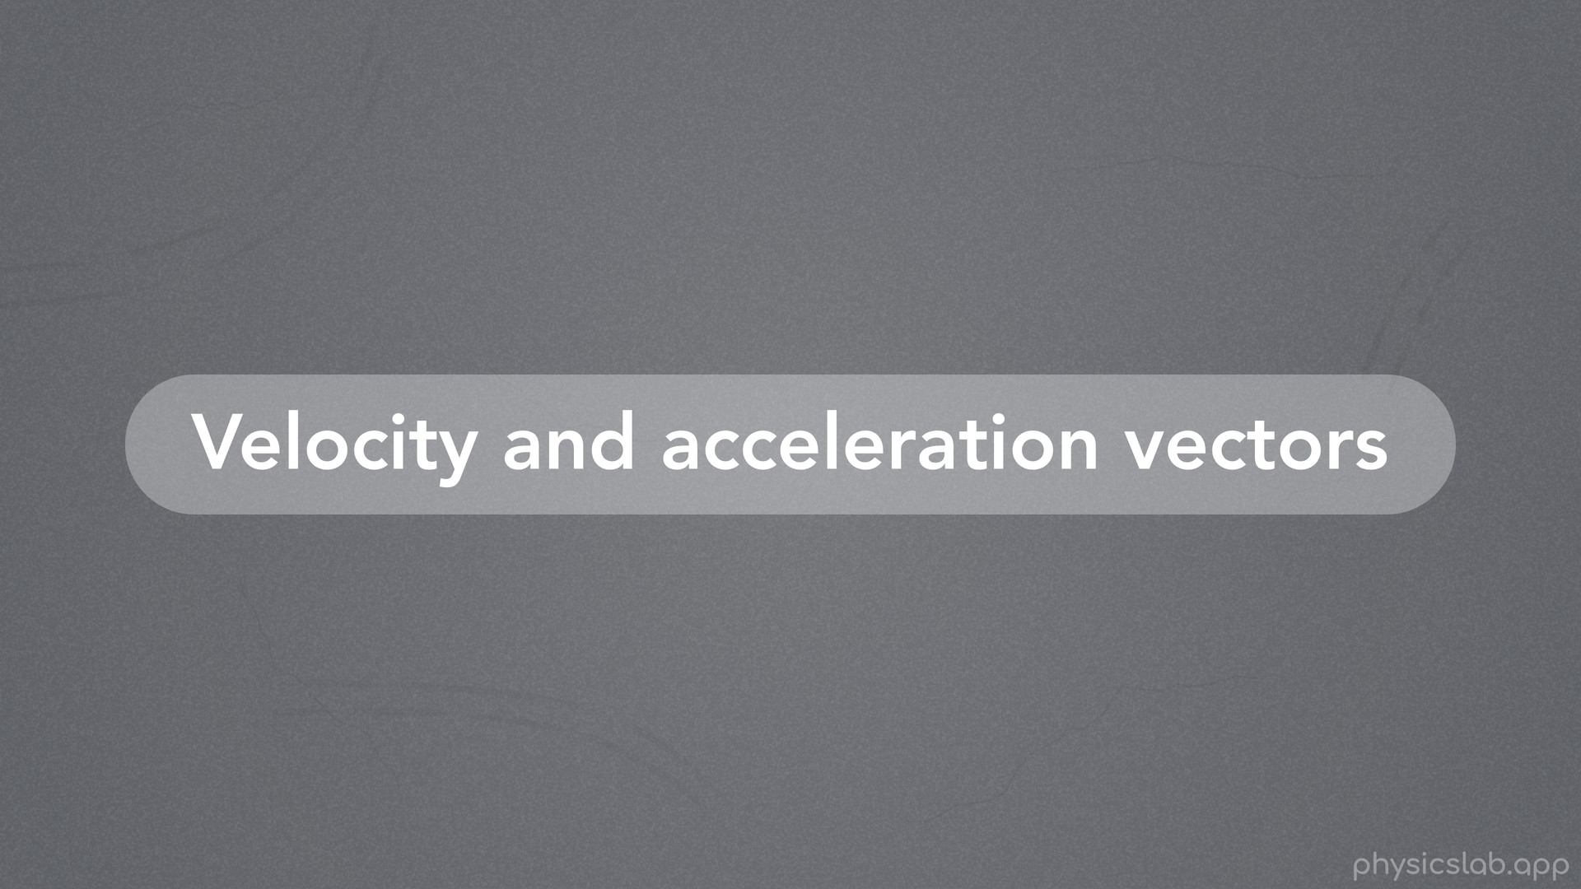
Notes:
• To understand acceleration in circular motion, we need to do a quick review of velocity and acceleration vectors.

Slide 20
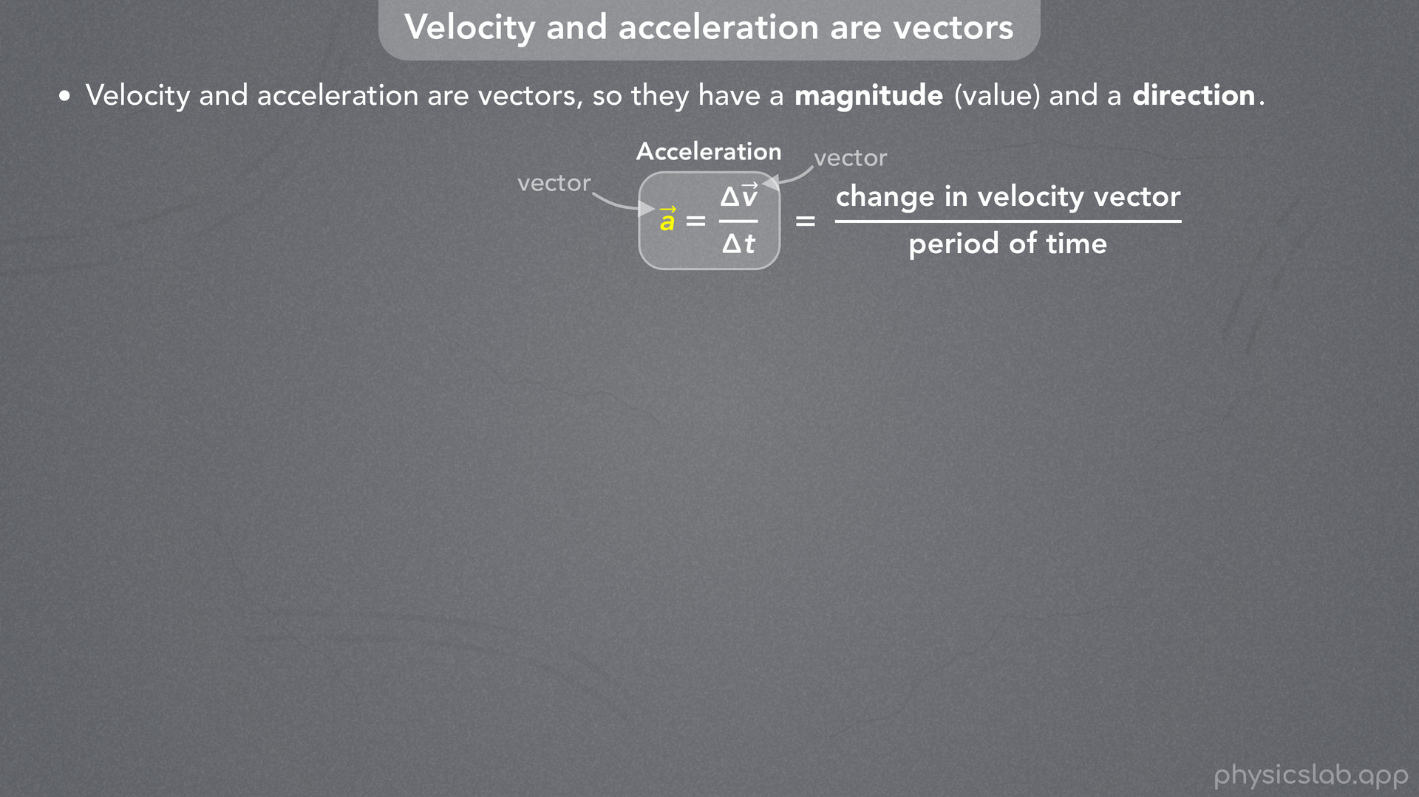
Notes:
• We know that acceleration is the change in velocity over time.
• But remember, velocity and acceleration are vectors so they have a magnitude, or a value, and a direction.
• We can include these vector symbols above acceleration and velocity to remind us that they’re both vectors.
• So acceleration is a change in the velocity *vector* over a period of time.

Slide 21
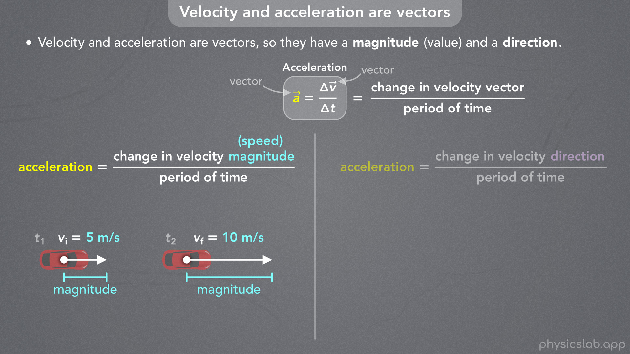
Notes:
• But velocity has a magnitude and a direction, so acceleration can be a change to either one.
• First, acceleration can be a change in the velocity magnitude, which we also call the speed.
• The magnitude is the value, or the number, and it’s represented by the length of the vector.

Slide 22
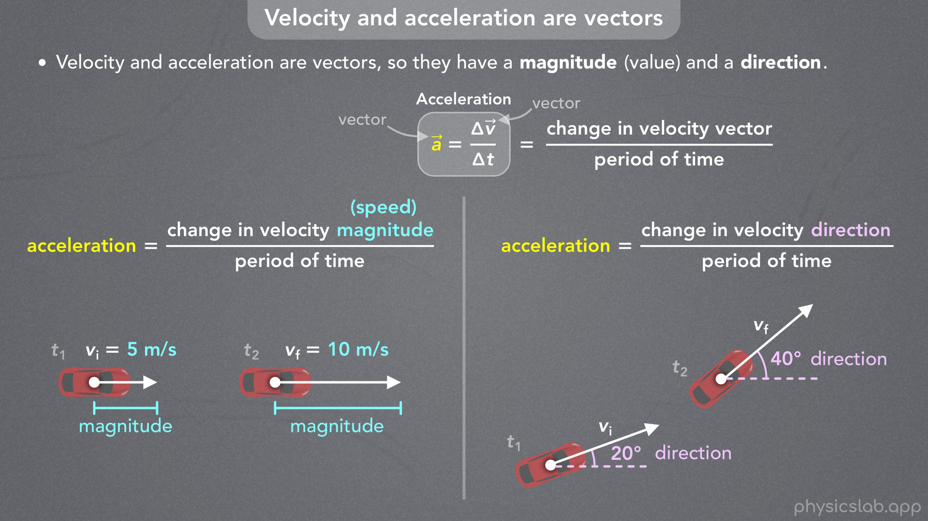
Notes:
• But acceleration can also be a change in the velocity direction over time.
• In this example, the car is turning and the direction of the velocity is changing, which we can see using these angles.
• So if these are the velocity vectors at two points in time, what does the acceleration vector look like in each case?
• Let’s go through an example for each type of acceleration.

Slide 23
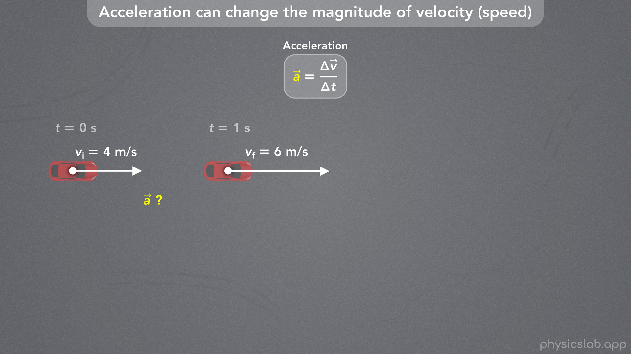
Notes:
• First, acceleration can change the magnitude of velocity, which is the speed.
• Here we have a car moving to the right and it’s speeding up.
• Let’s look at the velocity of the car at two moments in time.
• We’ll say the initial velocity is 4 m/s to the right.
• And one second later, the final velocity is 6 m/s to the right.
• Given these velocity vectors, what is the magnitude and direction of the acceleration vector?

Slide 24
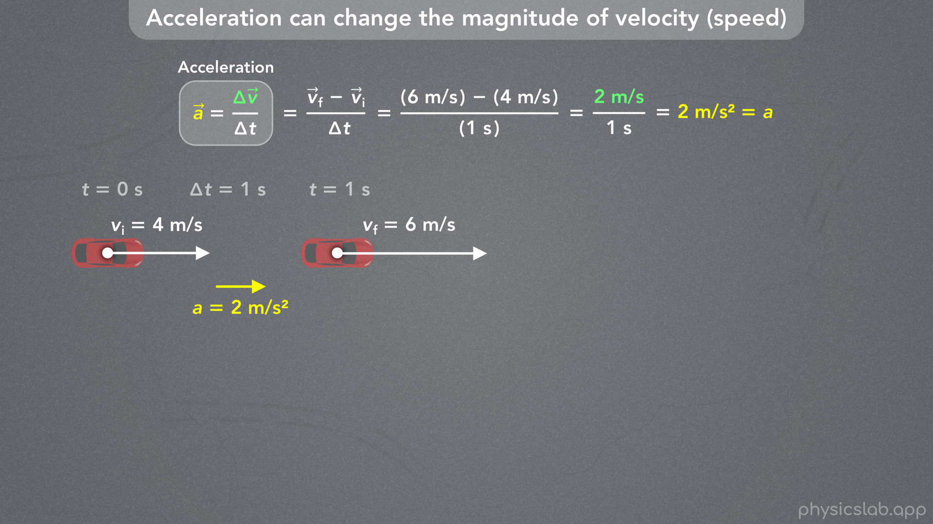
Notes:
• When an object is moving in a straight line, we normally just use numbers to calculate the acceleration.
• The change in velocity is the final velocity minus the initial velocity.
• If we say right is the positive direction, that would be 6 m/s minus 4 m/s, divided by the period of time, 1 s.
• So the change in velocity is positive 2 m/s, and the acceleration is 2 m/s per second, or 2 m/s^2.
• Since the acceleration is positive, the acceleration vector points to the right.

Slide 25
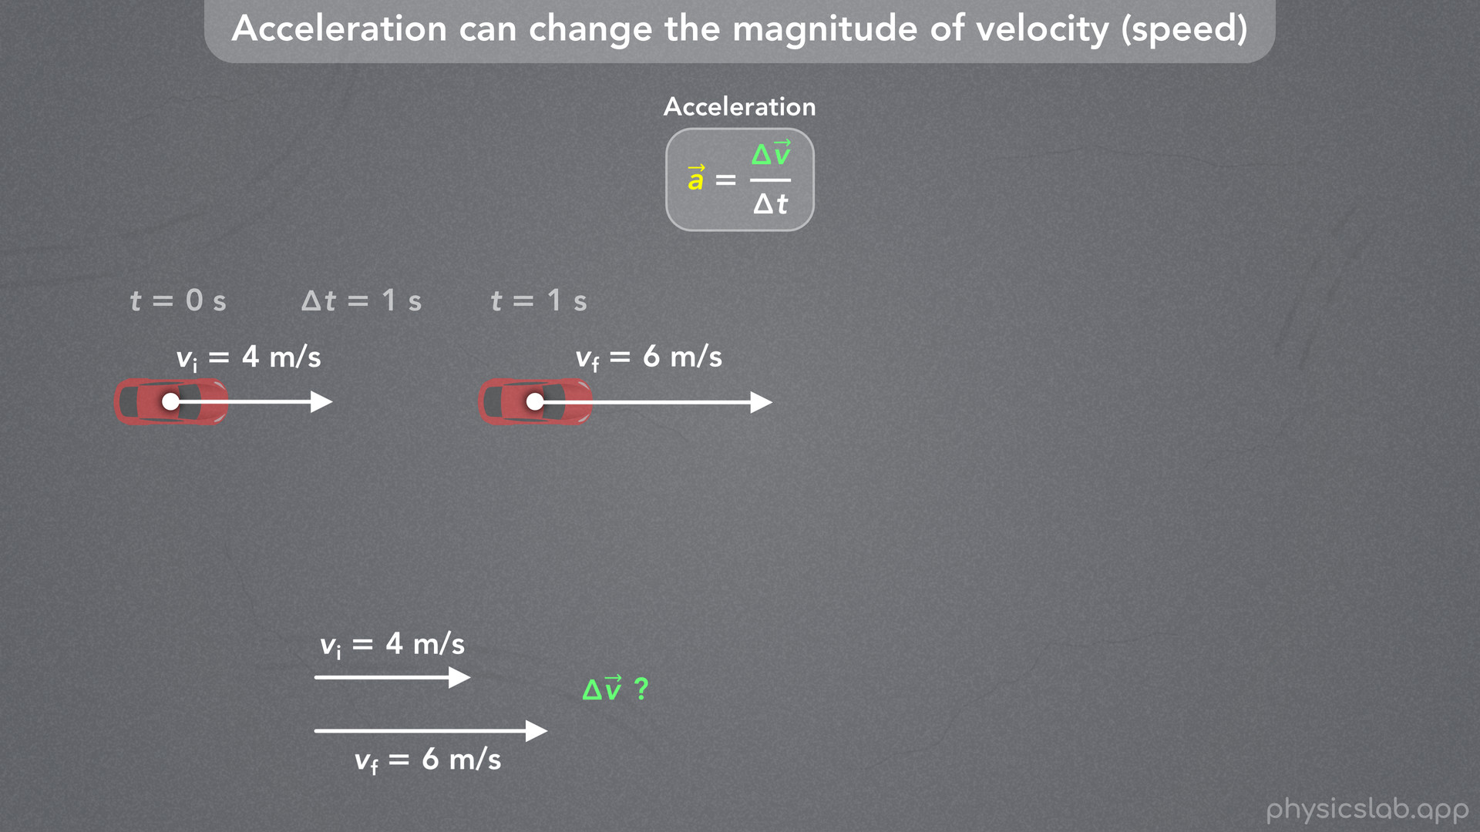
Notes:
• That’s one way to do it.
• But for this video, we’ll need to find the acceleration vector graphically using the velocity *vectors* and the tip-to-tail method.
• So if these are the initial and final velocity vectors, how do we draw the vector that represents the change in velocity, delta v?

Slide 26
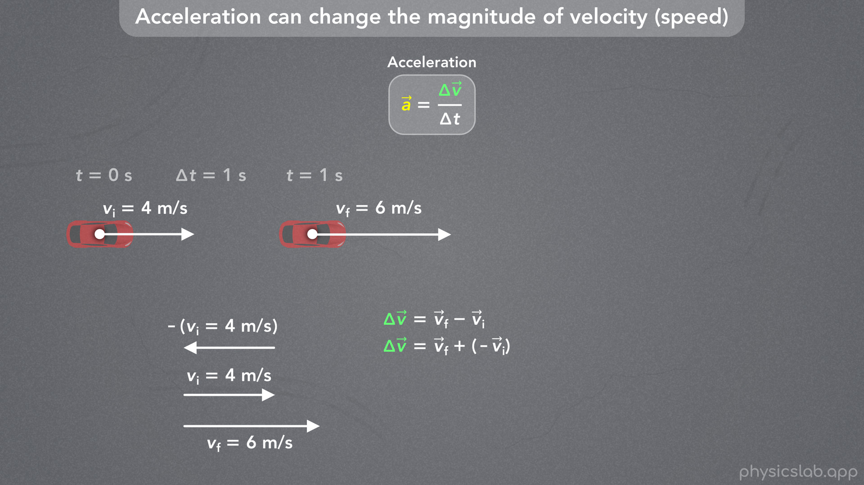
Notes:
• We know that the change in velocity is equal to the final velocity minus the initial velocity.
• Remember, these are vectors, so we can find delta v using vector subtraction.
• For the tip to tail method, we want to change this to vector addition.
• v final minus v initial is the same thing as v final plus the negative of v initial.
• The negative means we flip that vector, so its pointing in the opposite direction.
• v initial points to the right, so negative v initial points to the left, but it has the same length.

Slide 27
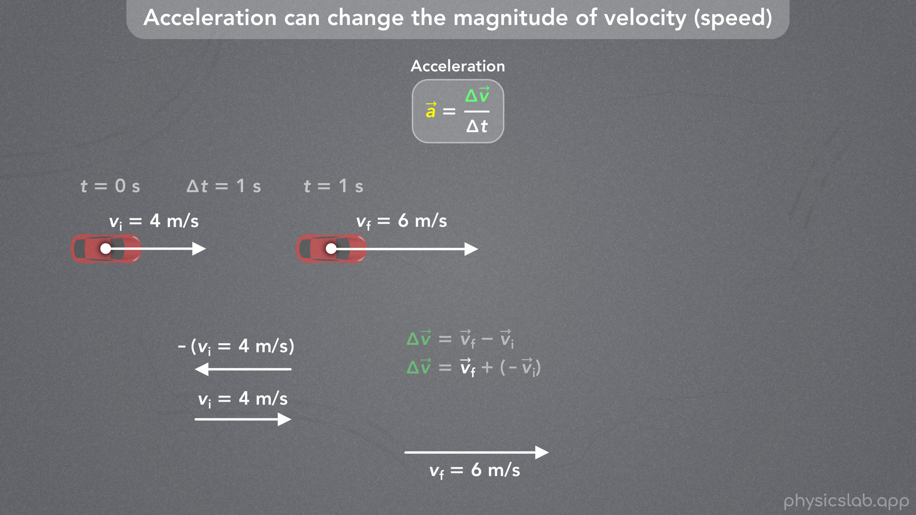
Notes:
• Now, to find the change in velocity vector using the tip to tail method, we start with the final velocity vector

Slide 28
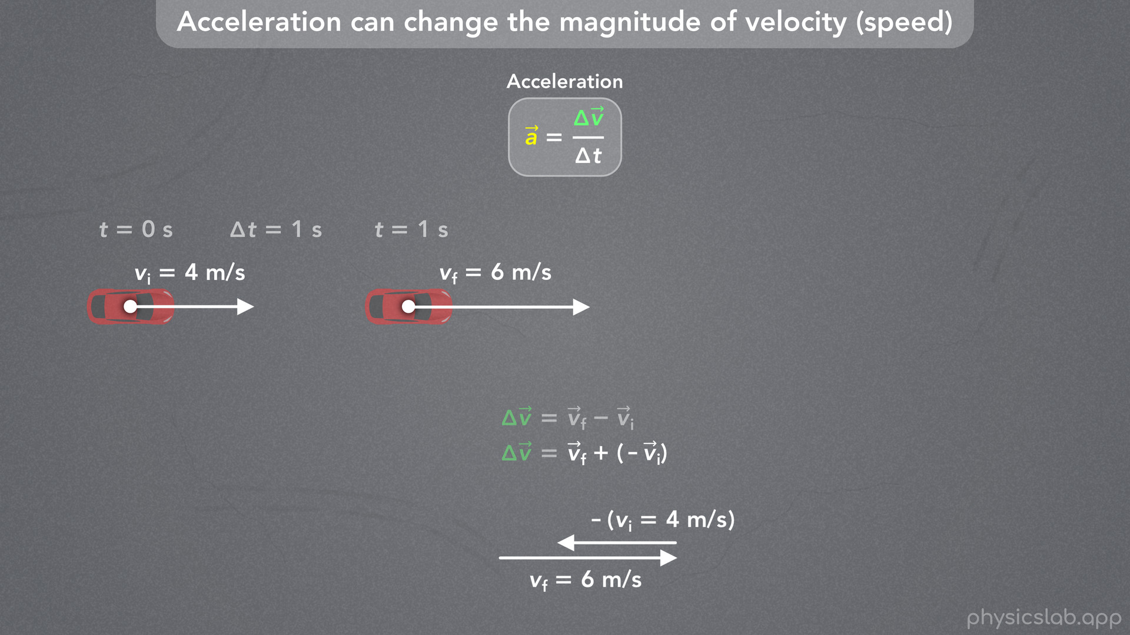
Notes:
and then we add the negative of the initial velocity vector, so it starts at the end of the first vector.
• The vectors would overlap, so we’re gonna draw them next to each other.

Slide 29
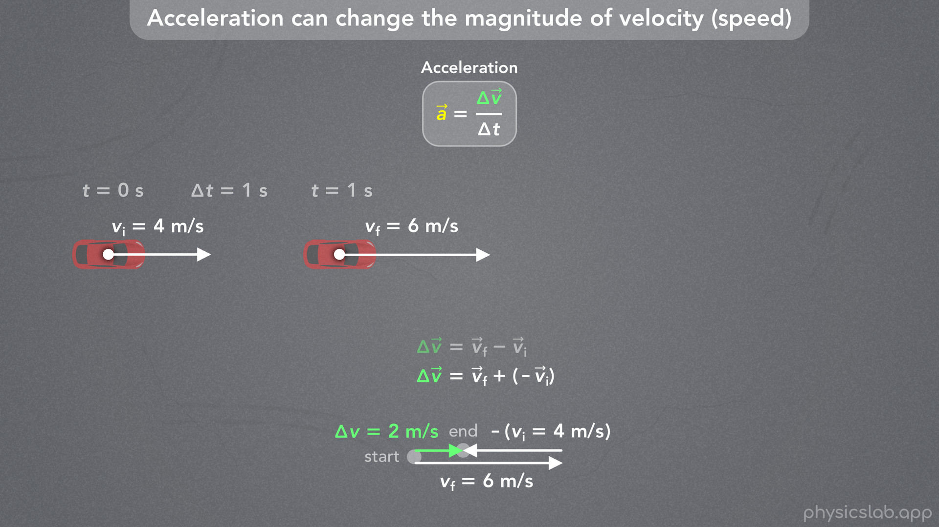
Notes:
• Now, the change in velocity vector, delta v, is the sum of these two vectors, so it starts at the start of the first vector, and ends at the end of the second vector.
• So delta v points to the right and it has a length or magnitude of 2 m/s, 6 minus 4.

Slide 30
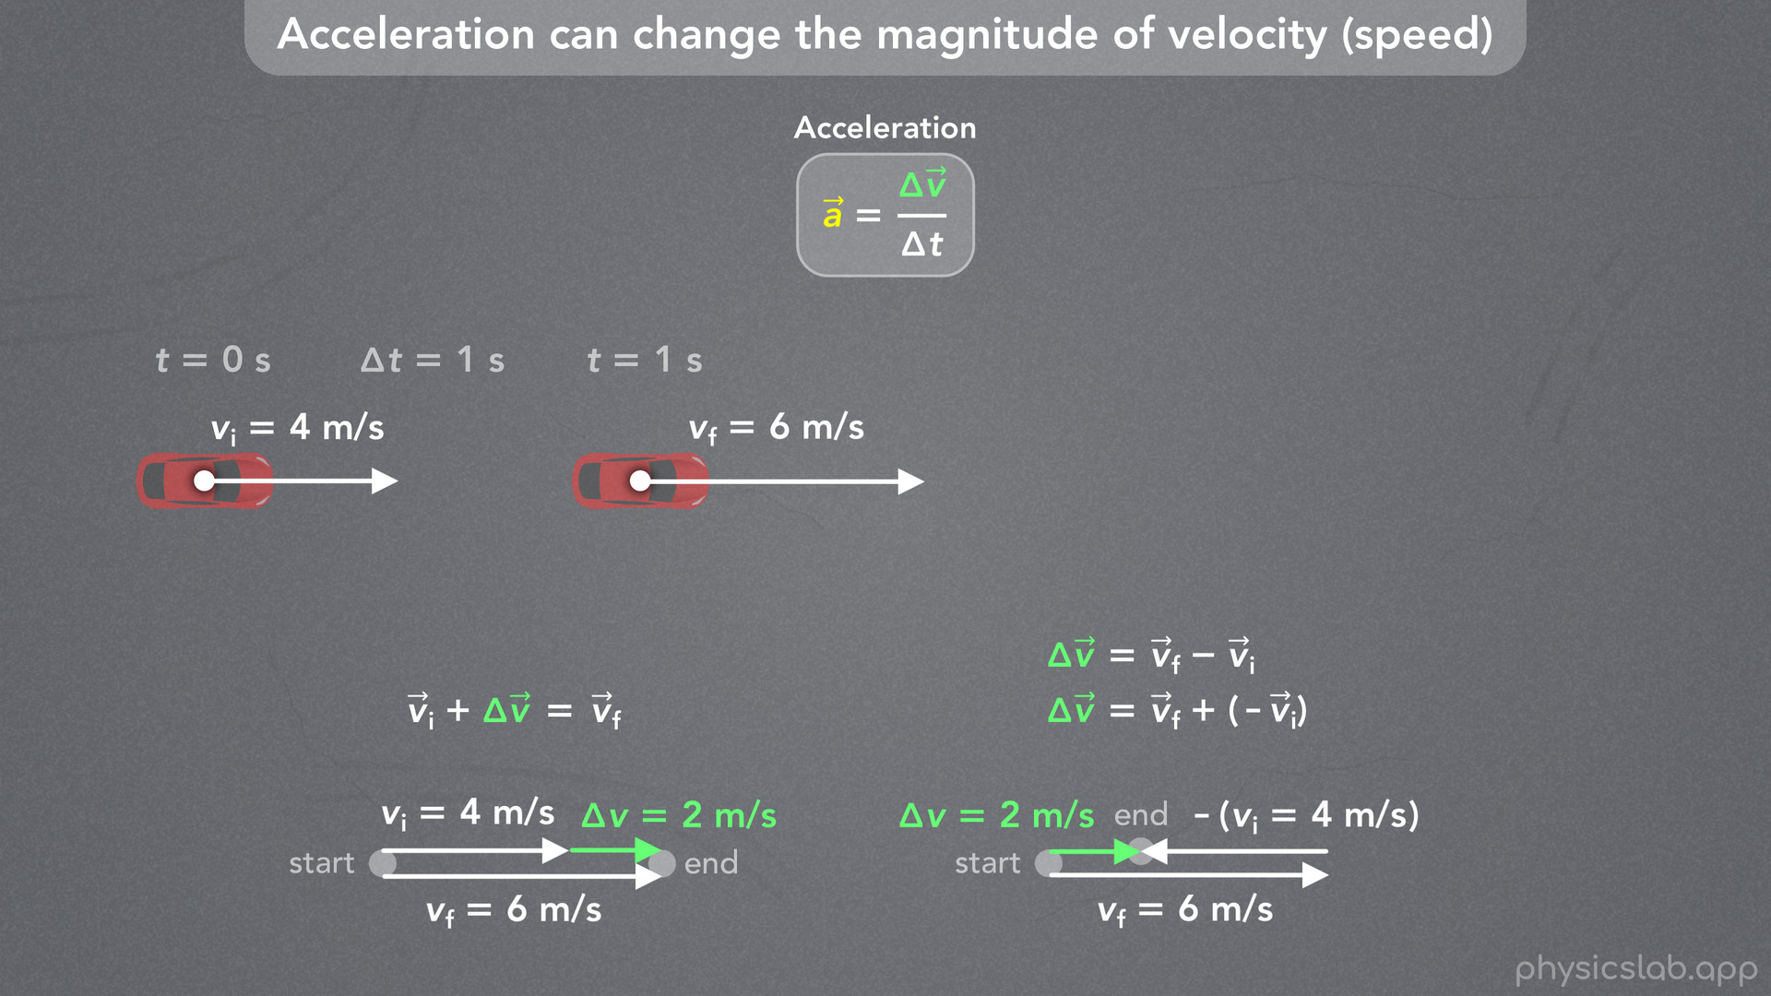
Notes:
• Another way to look at this is that the initial velocity vector plus the change in velocity vector equals the final velocity vector.
• 4 m/s plus 2 m/s equals 6 m/s.

Slide 31
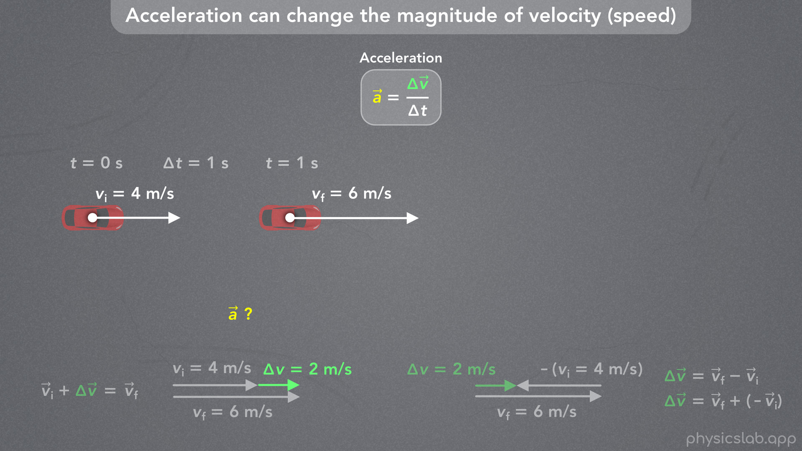
Notes:
• So if this is delta v, the change in velocity vector, how do we draw the acceleration vector?

Slide 32
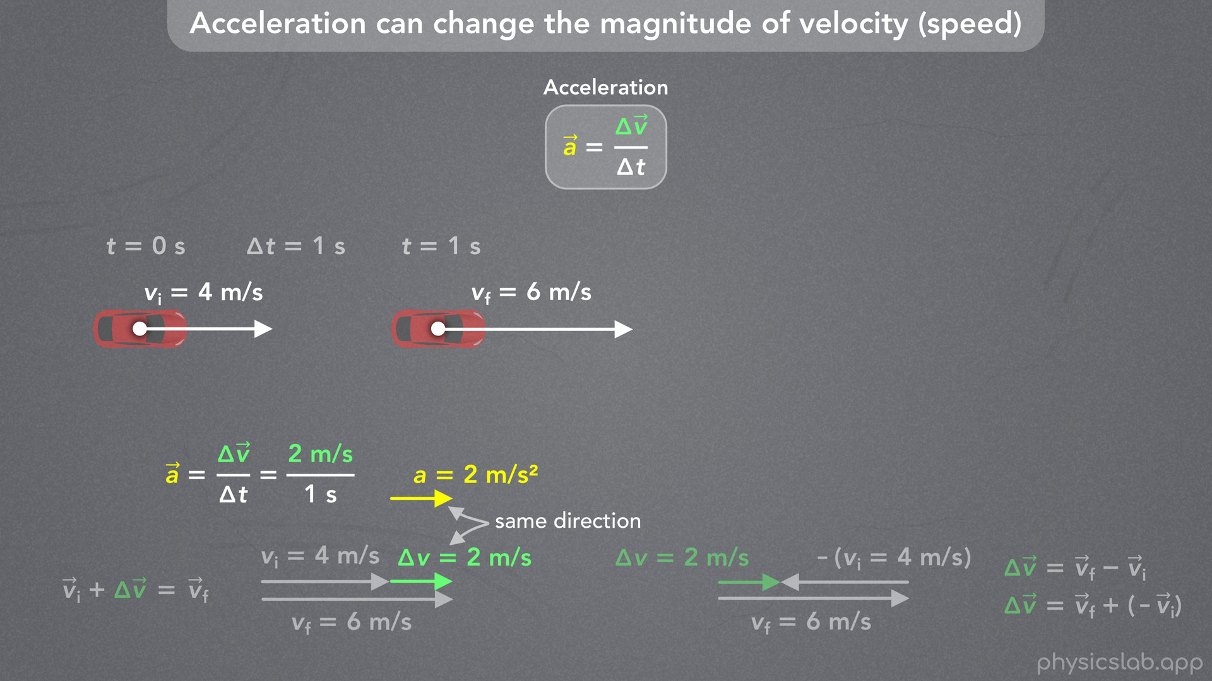
Notes:
• Acceleration is just the change in velocity vector divided by the period of time, which is 1 second.
• So the acceleration vector has a magnitude of 2 m/s^2.
• And an important thing to remember is that the acceleration vector has the same direction as the change in velocity vector.
• So the acceleration of the car is 2 m/s^2 to the right.
• This causes the magnitude of the velocity to increase from 4 m/s to 6 m/s during this period of time.

Slide 33
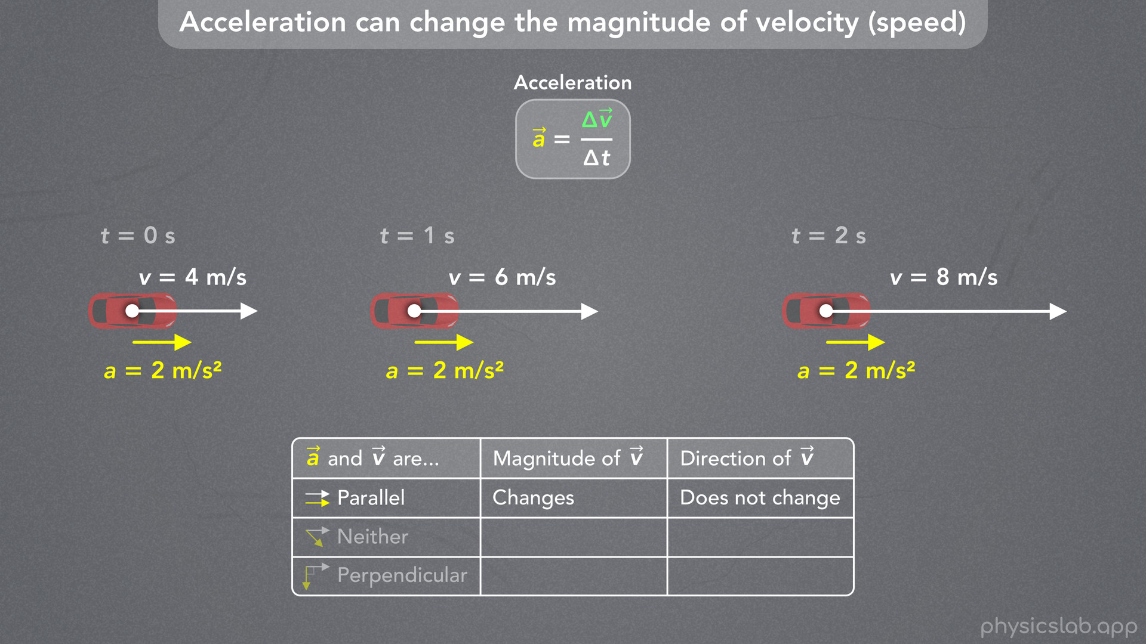
Notes:
• In this example, notice that the acceleration vector and the velocity vector are always parallel.
• And the acceleration causes the magnitude of the velocity to change, the velocity vector gets longer over time.
• But the direction of the velocity does not change, it’s always pointing to the right.
• Let’s make a note of this for later.
• The acceleration and velocity vectors can be parallel, perpendicular, or somewhere in between, where they’re neither parallel nor perpendicular.
• In this case they’re parallel, and the magnitude of the velocity changes, but the direction of the velocity does not change.
• So, how can acceleration change the velocity’s direction?

Slide 34
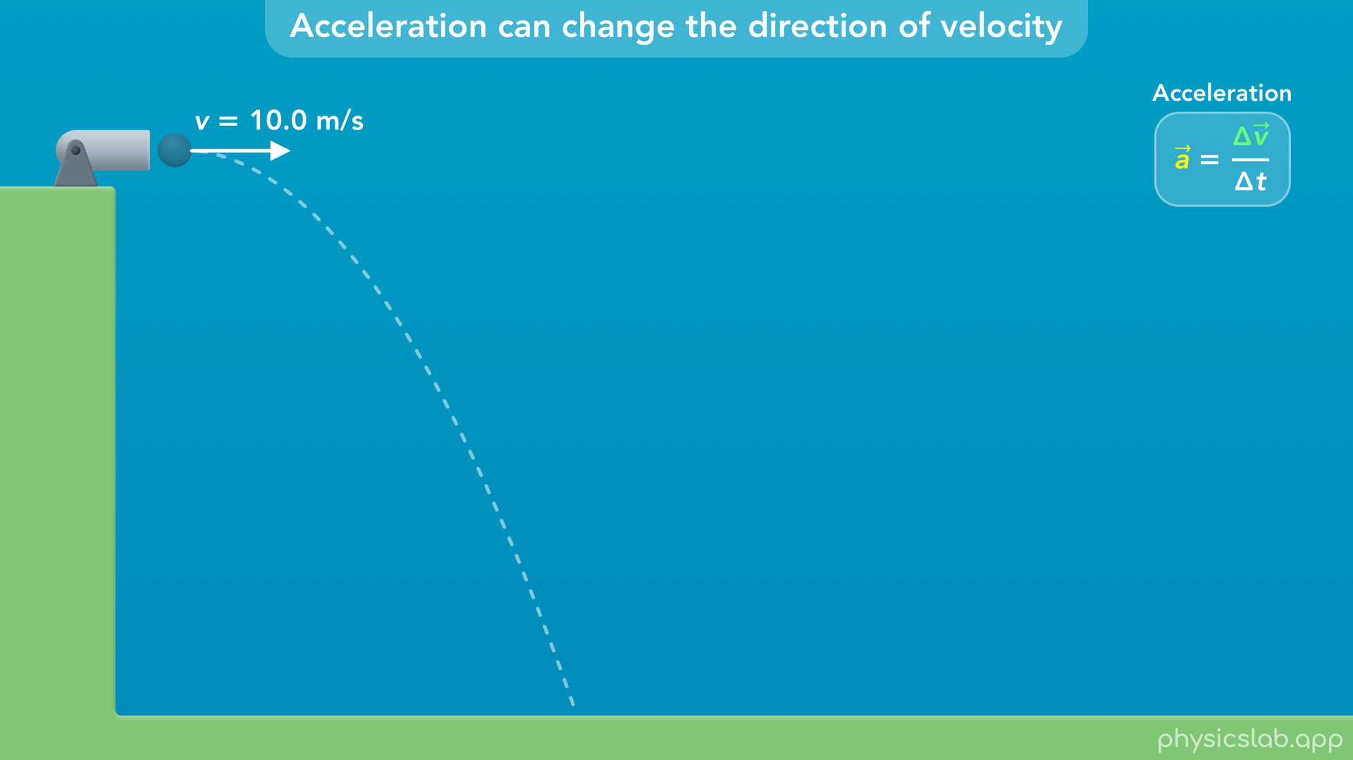
Notes:
• This is what happens in projectile motion.
• In this example, a ball is shot out of a cannon with a velocity of 10 m/s to the right and it falls to the ground.

Slide 35
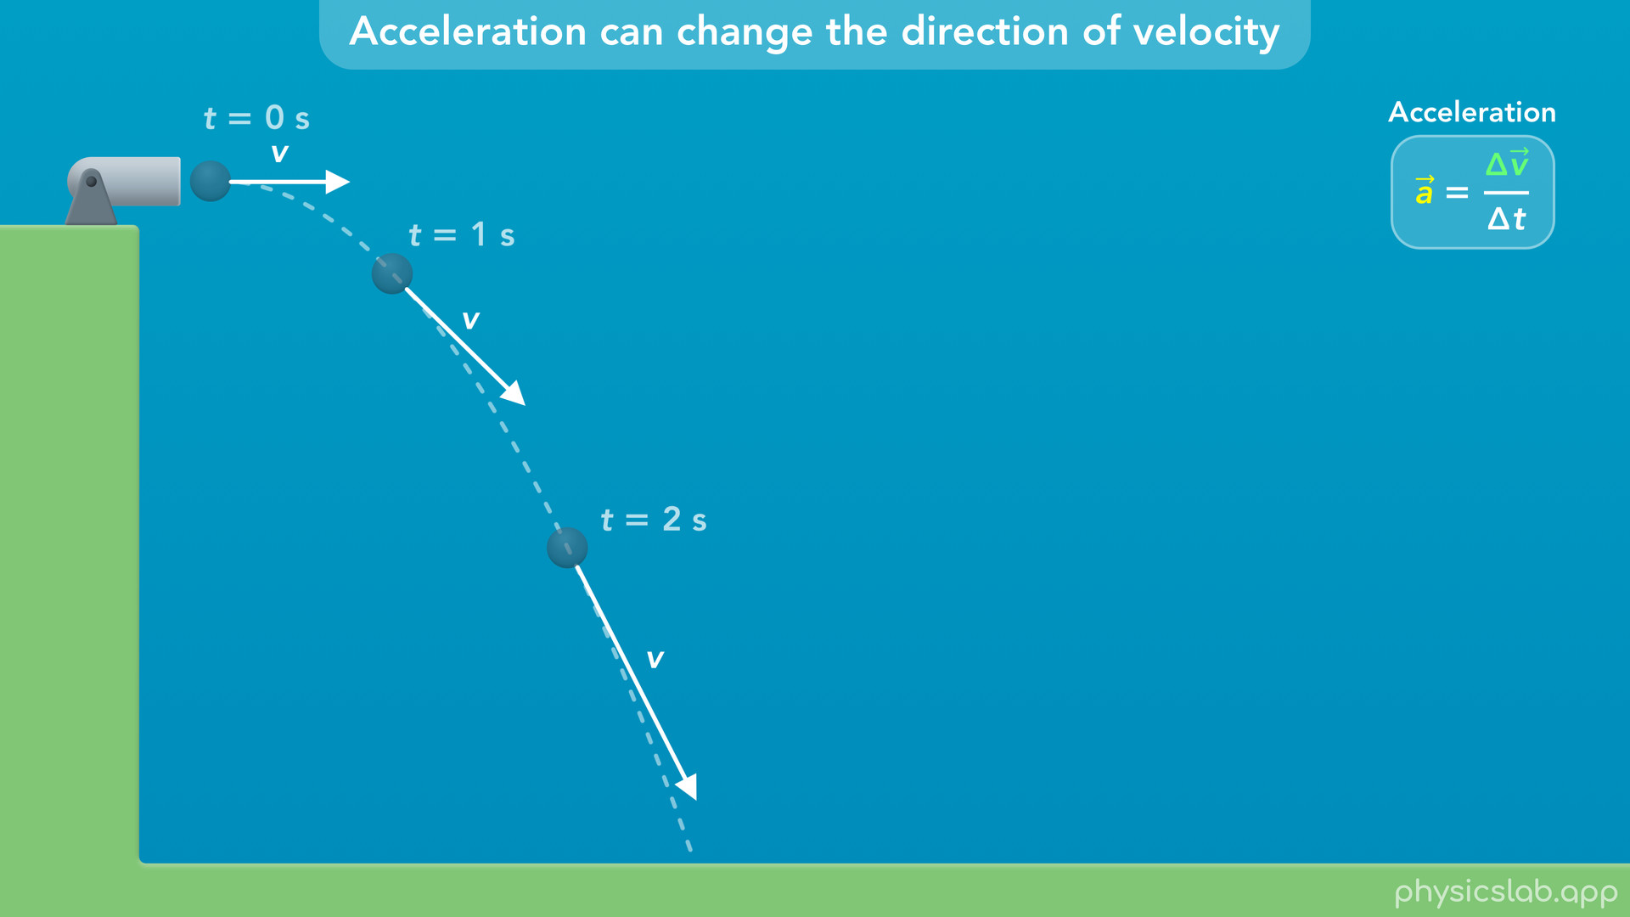
Notes:
• Here’s a snapshot of the ball’s velocity vector at three different points.

Slide 36

Notes:
• We can see that the angle of the velocity vector is changing over time.
• So why is the velocity vector turning? Why is it changing direction?

Slide 37
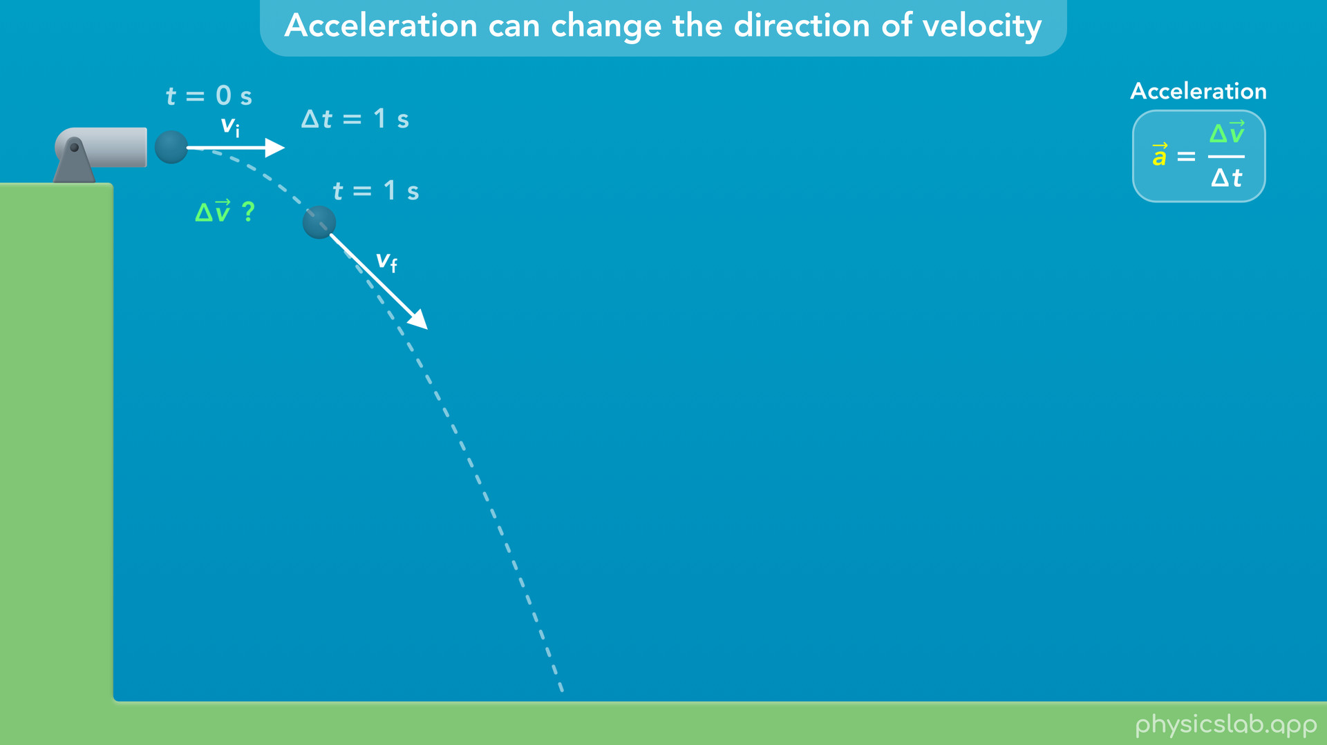
Notes:
• Let’s look at these two points in time, and we’ll call these the initial and final velocities.
• What would be the change in velocity vector, delta v, during this period of time?

Slide 38
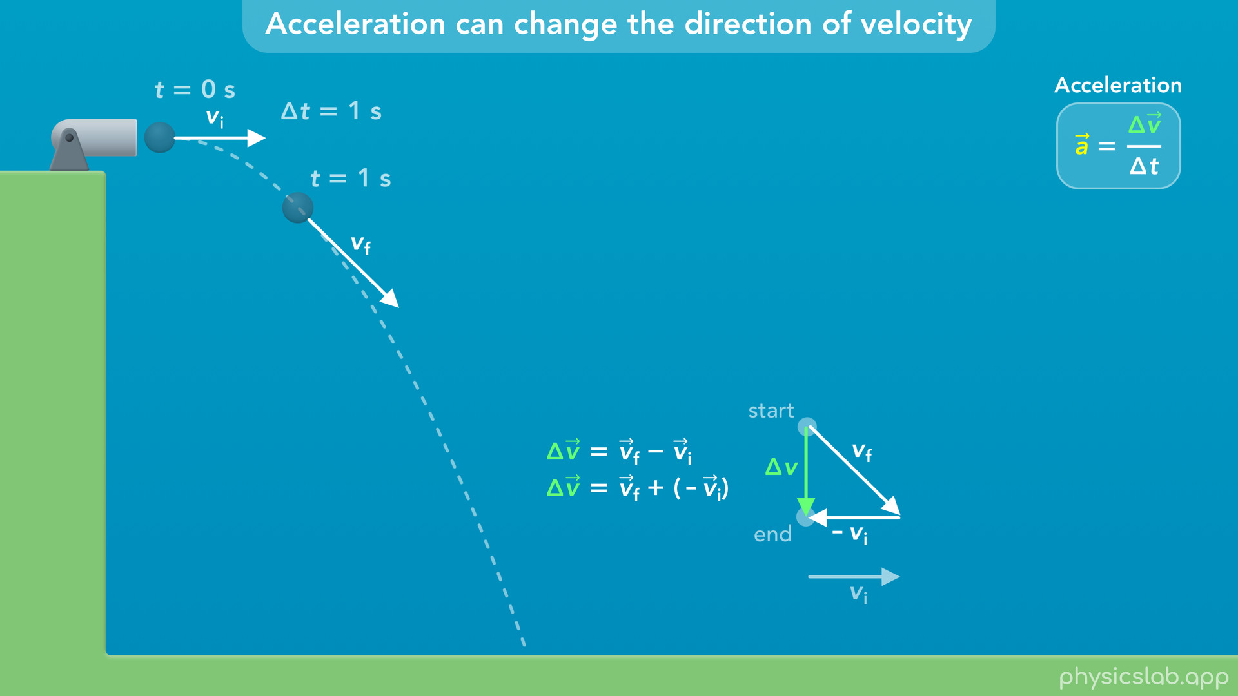
Notes:
• Just like before, delta v is equal to v final minus v initial… or v final plus the negative of v initial.
• So we start with the final velocity vector, and then we add the negative of the initial velocity vector.
• Now, the change in velocity vector is the sum of these two vectors.
• It starts at the start of the first vector, and ends at the end of the second vector.
• So delta v looks like this.

Slide 39
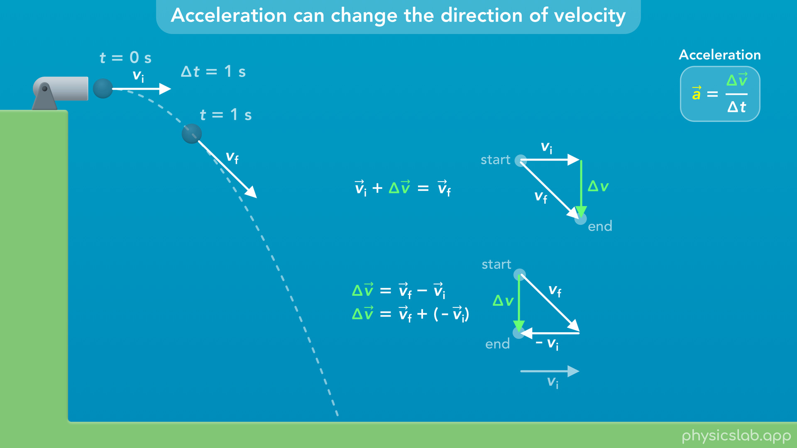
Notes:
• We could also say that the initial velocity vector… plus the change in velocity vector… gives us the final velocity vector.

Slide 40
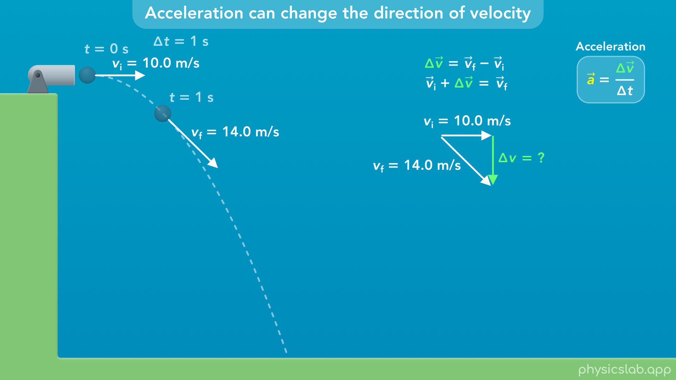
Notes:
• So far, we haven’t used any numbers, we’re just adding vectors graphically.
• But these vectors do have values. Their magnitudes are represented by the length of the vectors.
• For this example, the initial velocity is 10 m/s, and the final velocity, 1 second later, is 14 m/s.
• So what is the magnitude of the change in velocity vector, delta v?
• The initial and final velocities are in different directions, so it’s not just 14 minus 10.
• We’re looking for the length of this side of the triangle.

Slide 41
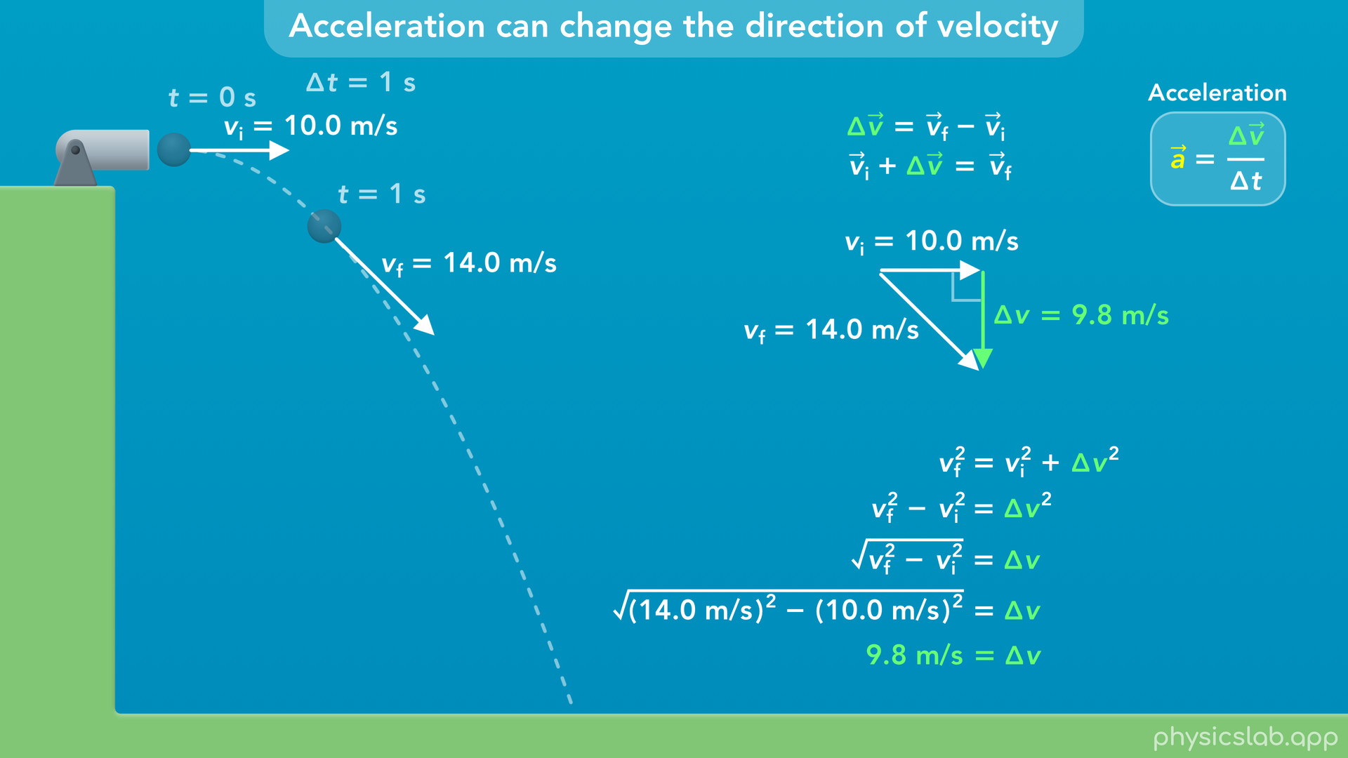
Notes:
• This happens to be a right triangle, so we can use the pythagorean theorem.
• v final is the hypotenuse, so v final squared equals v initial squared plus delta v squared.
• We can subtract v initial squared… then take the square root of both sides… and then plug in 14 m/s for v final and 10 m/s for v initial.
• That gives us 9.8 m/s for delta v.
• So that’s the length and the magnitude of this vector.
• It might be weird to think about the change in velocity like this, but the initial and final velocities are vectors, and the change in velocity is also vector with its own magnitude and a direction.

Slide 42

Notes:
• Now, what would be the acceleration vector?

Slide 43
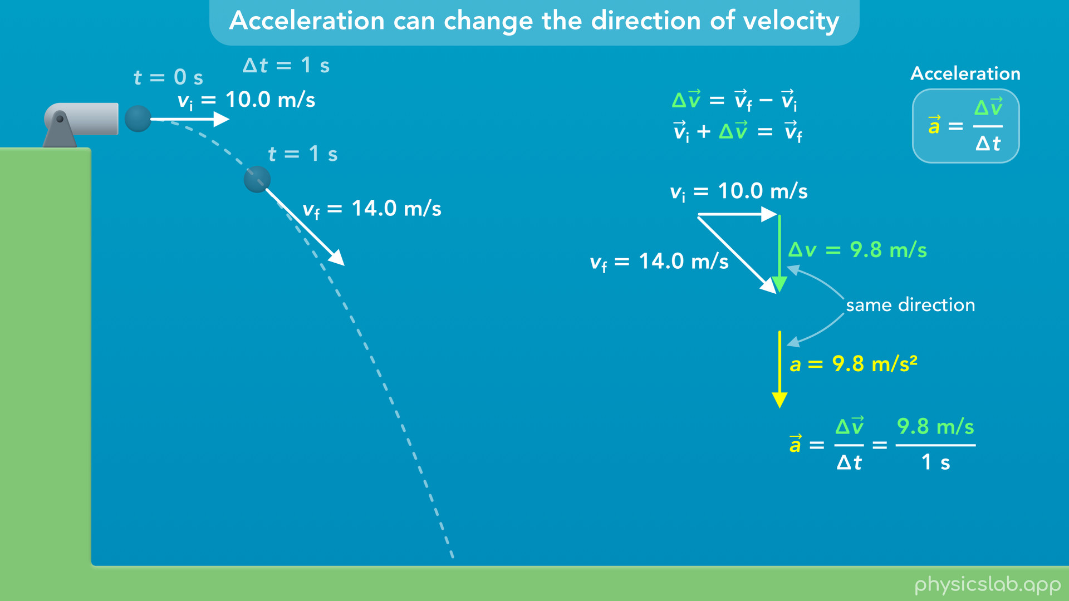
Notes:
• Acceleration is the change in velocity vector divided by the period of time, which is 9.8 m/s divided by 1 second.
• So the magnitude of the acceleration vector is 9.8 m/s^2, and it has the same direction as the change in velocity vector, which is downwards.

Slide 44

Notes:
• This should look familiar, because it’s the acceleration due to gravity, g.
• Any object in projectile motion, or free fall, is accelerating downwards at 9.8 m/s^2.

Slide 45
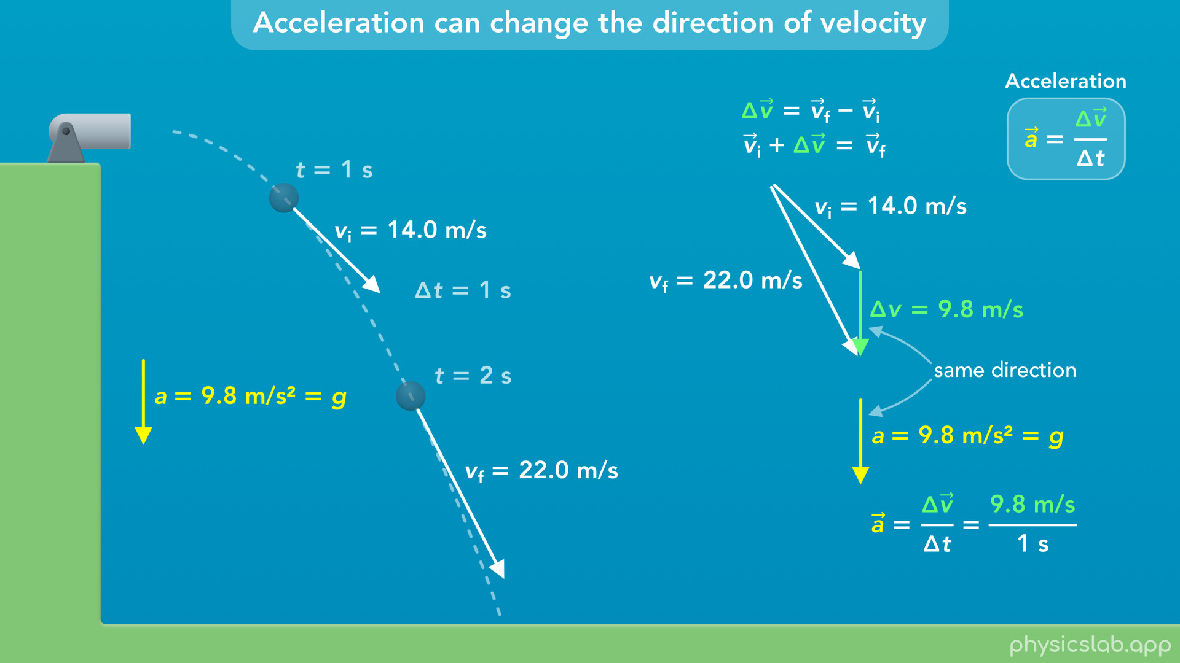
Notes:
• If we used the velocity vectors at 1 second and 2 seconds, the change in velocity vector would be the same during this period of time.
• So the acceleration vector between 1 second and 2 seconds is also 9.8 m/s^2 downwards.

Slide 46
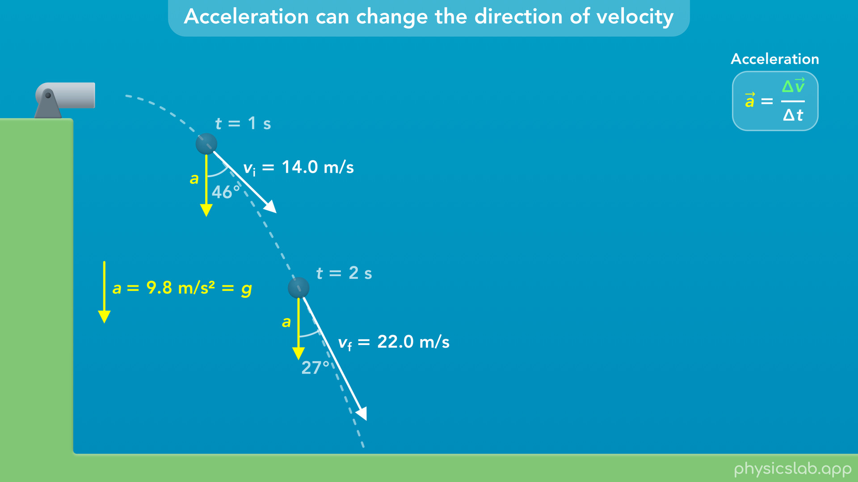
Notes:
• In projectile motion, the acceleration is caused by gravity, so the acceleration vector always points downwards no matter what direction the velocity vector is pointing.
• We can think of the acceleration vector as pulling down on the velocity vector every second.
• The result is that the acceleration is *turning* the velocity vector and changing its *direction* over time.
• But notice that the velocity vector is also getting longer, the ball is moving faster over time.
• So let’s add this to our table.
• After the ball is launched, the acceleration and velocity vectors are not parallel and they’re not perpendicular.
• The angle between the vectors is somewhere between 0 and 90 degrees.
• The result is that the magnitude of the velocity changes, and the direction of the velocity also changes.

Slide 47
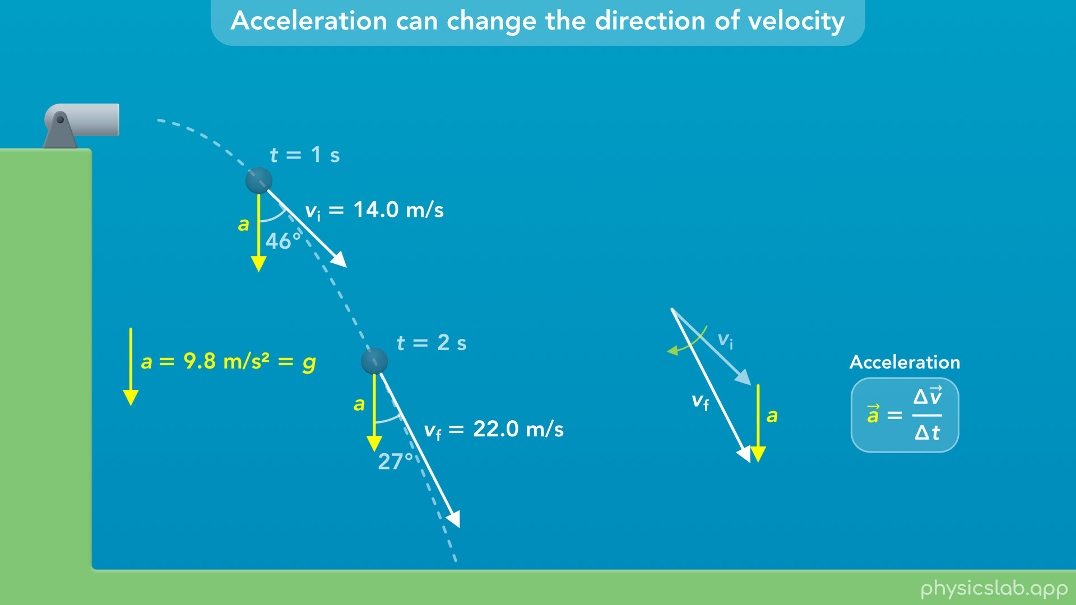
Notes:
• In projectile motion, the acceleration is caused by gravity, so the acceleration vector always points downwards no matter what direction the velocity vector is pointing.
• We can think of the acceleration vector as pulling down on the velocity vector every second.
• The result is that the acceleration is *turning* the velocity vector and changing its *direction* over time.
• But notice that the velocity vector is also getting longer, the ball is moving faster over time.

Slide 48
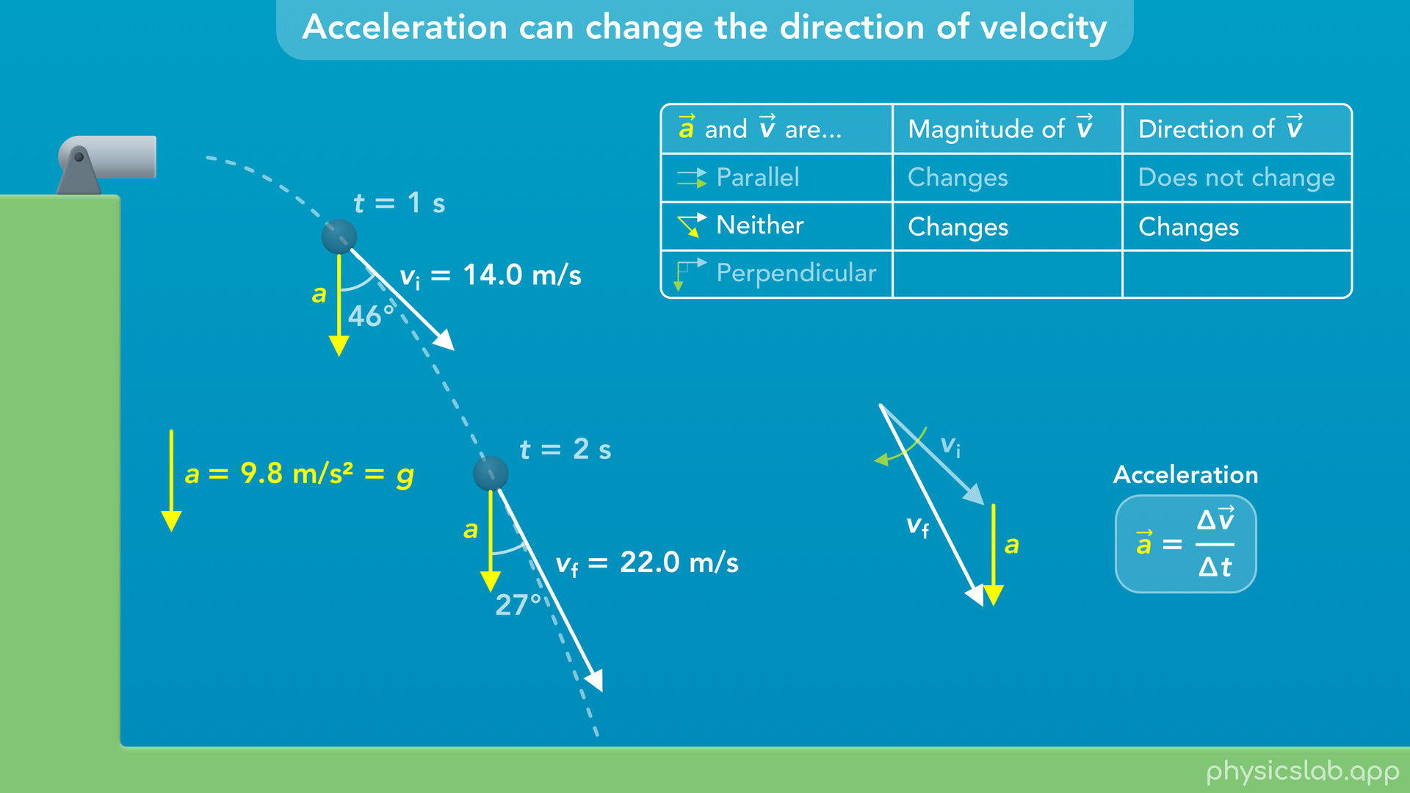
Notes:
• So let’s add this to our table.
• After the ball is launched, the acceleration and velocity vectors are not parallel and they’re not perpendicular.
• The angle between the vectors is somewhere between 0 and 90 degrees.
• The result is that the magnitude of the velocity changes, and the direction of the velocity also changes.

Slide 49
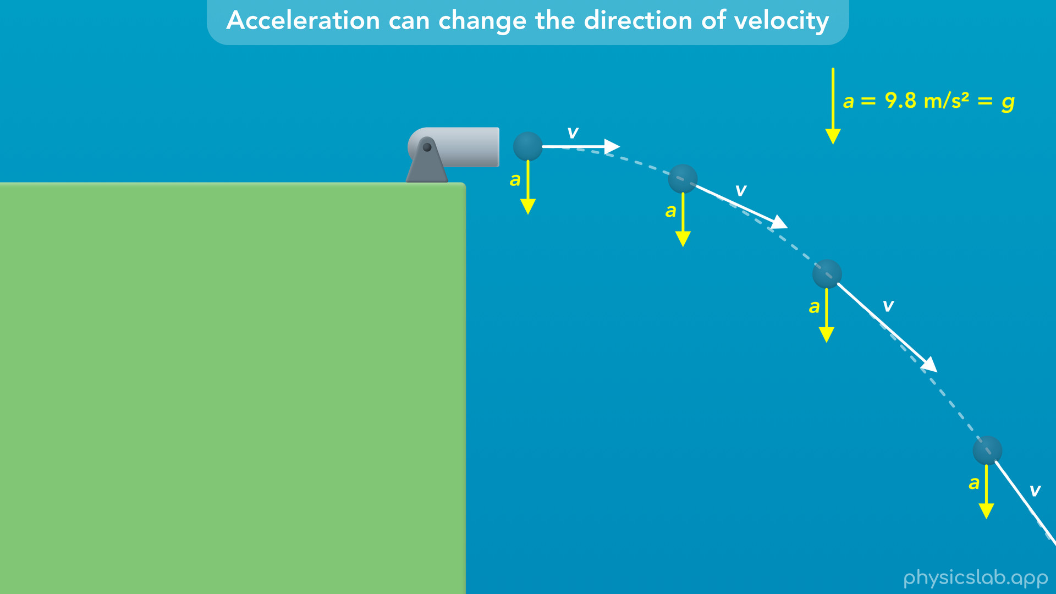
Notes:
• So this is the motion that we get when the acceleration vector is always pointing down.
• In projectile motion, the acceleration is caused by gravity.

Slide 50
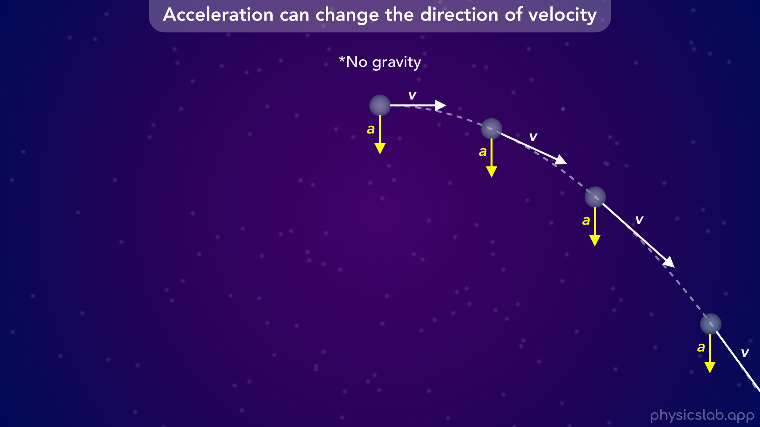
Notes:
• But now let’s imagine we’re deep in outer space and there is no gravity, so we can focus on the motion and the vectors.
• It doesn’t matter what’s causing the acceleration, the motion will be the same.

Slide 51
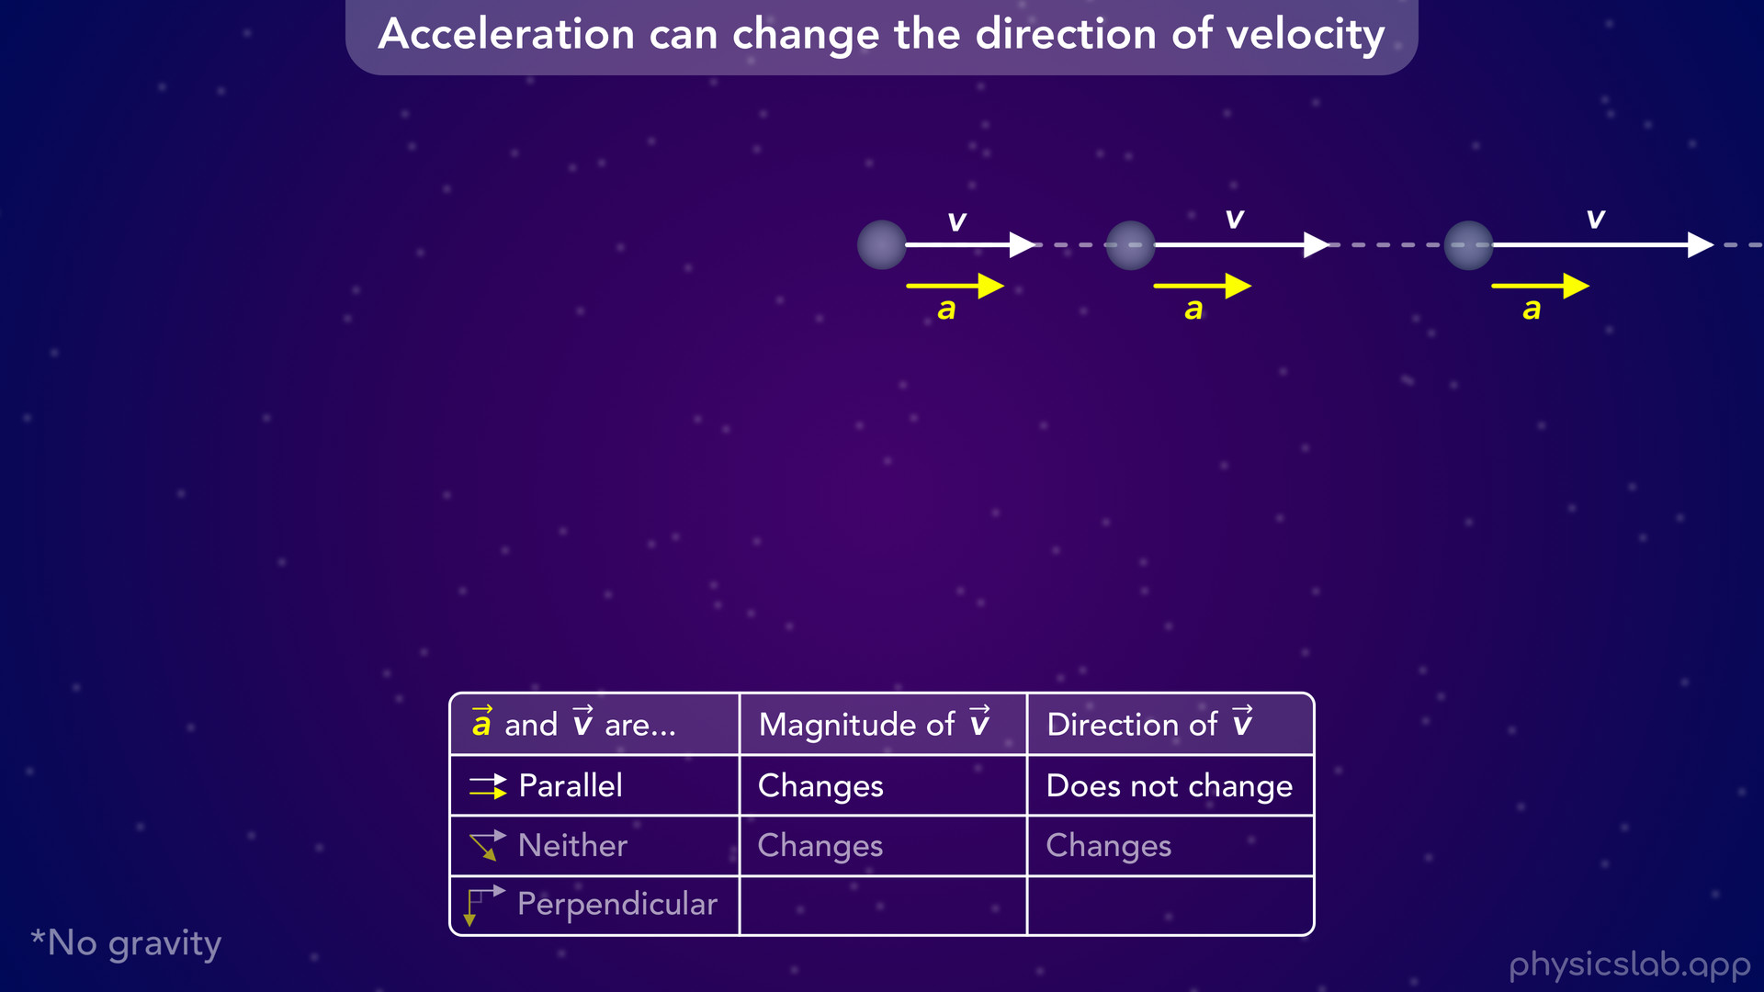
Notes:
• Like we saw with the car example, if the acceleration and the velocity are parallel, the magnitude of the velocity changes but the direction of the velocity does not change.
• The speed changes, but the object moves in a straight line.

Slide 52
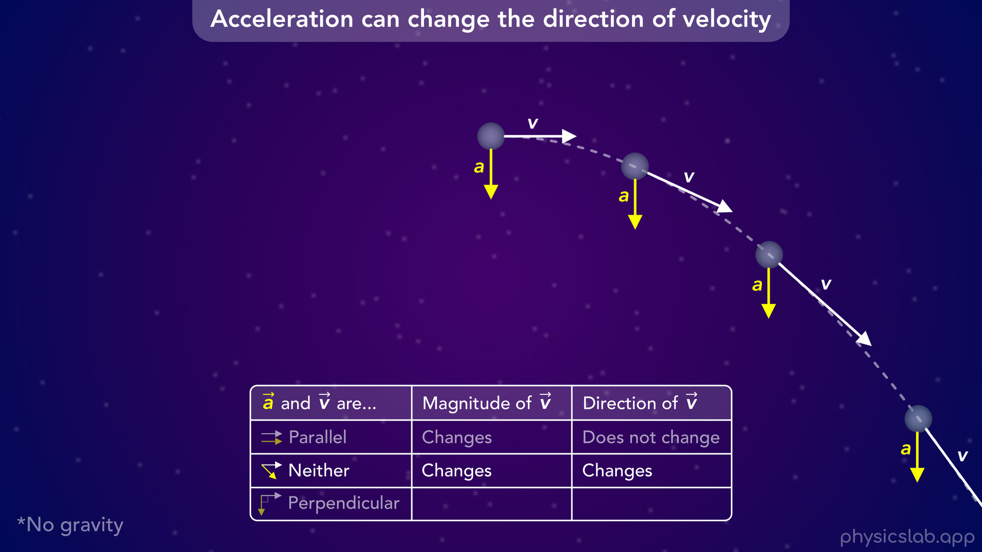
Notes:
• If the acceleration and velocity are not parallel or perpendicular throughout the motion, the magnitude and the direction of the velocity both change.
• That’s what happens in projectile motion.

Slide 53
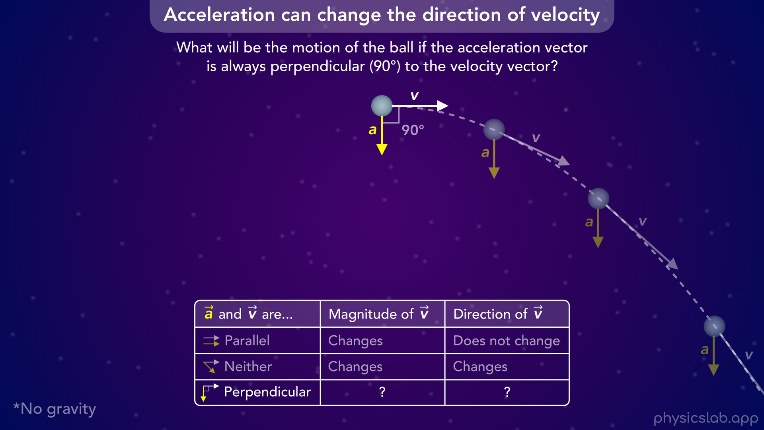
Notes:
• Now, here’s the question: What will be the motion of this ball if the acceleration vector is always perpendicular to the velocity vector, so the angle between the vectors is always 90 degrees.
• The initial velocity is still to the right, but when the velocity vector changes direction, we’re saying that the acceleration vector must remain perpendicular to the velocity.
• Pause the video and take some time to imagine how this ball will move.
• What will happen to the magnitude and direction of the velocity over time?
• What will happen to the direction of the acceleration vector?
• And what do you think the path of the ball will look like?

Slide 54
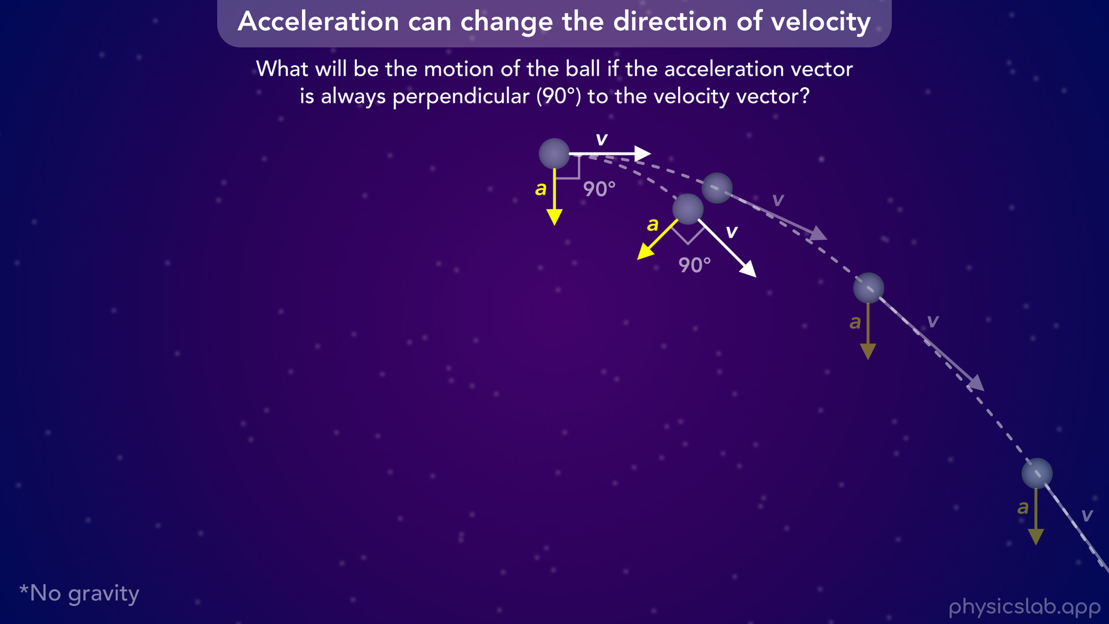
Notes:
• If we look at the ball after a short amount of time, we can see the acceleration caused the velocity vector to turn downwards like it did before.
• But in this scenario, the acceleration vector is fixed to the velocity vector, so the acceleration is also turning, it’s no longer pointing straight down.
• So now, the acceleration is going to pull the velocity vector down and to the left.

Slide 55
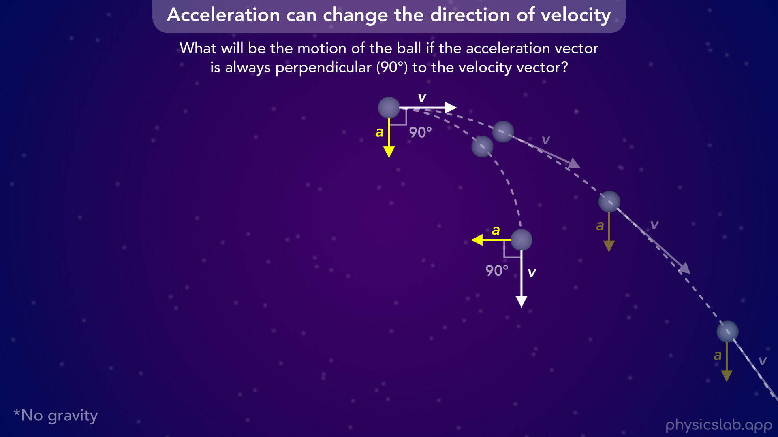
Notes:
• At this point, the velocity vector is pointing down and the acceleration vector is pointing to the left.
• The path of the ball is taking a sharper turn than it did with the projectile motion example.
• What do you think the motion looks like after this point?
• Again, there’s no gravity, but the acceleration is pointing to the left so now it’s like the ball is *falling* to the left instead of down.

Slide 56
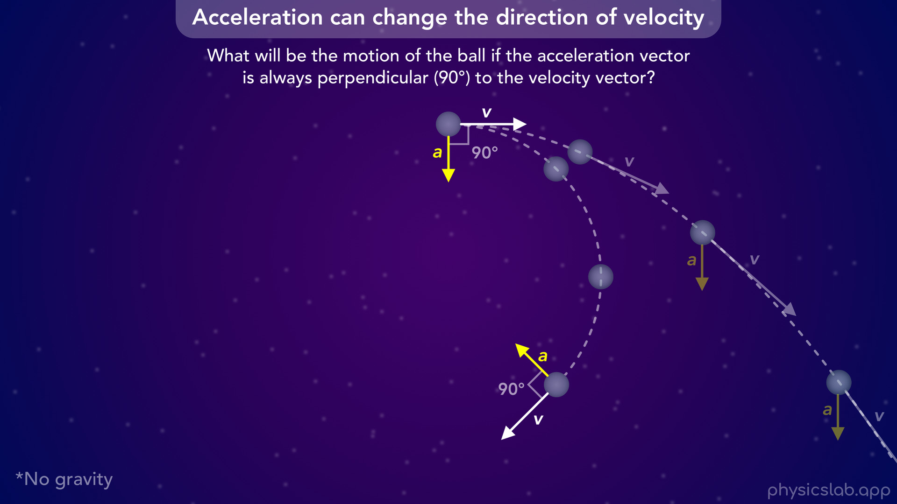
Notes:
• If we keep going, the acceleration turns the velocity vector to the left.
• And now the acceleration is pointing to the left and its pointing up.

Slide 57
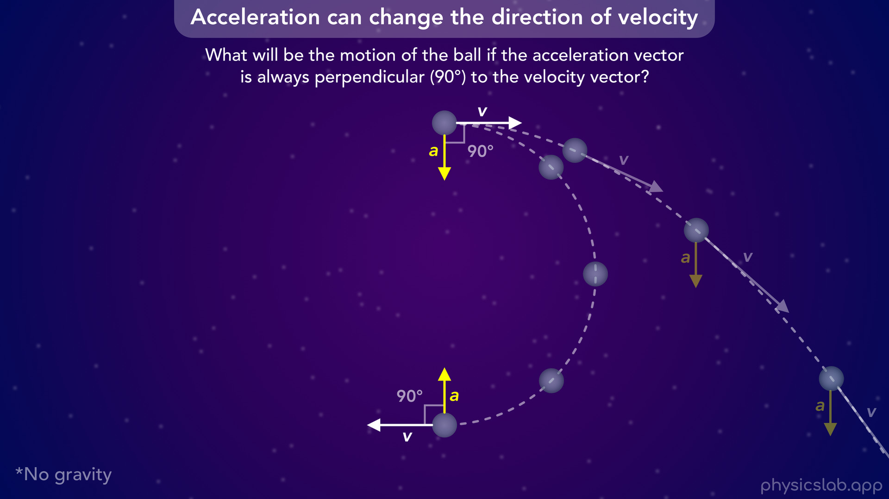
Notes:
• At this point, the velocity vector is pointing to the left and the acceleration vector has completely turned upside down.
• So now it’s like the ball is falling upwards.

Slide 58
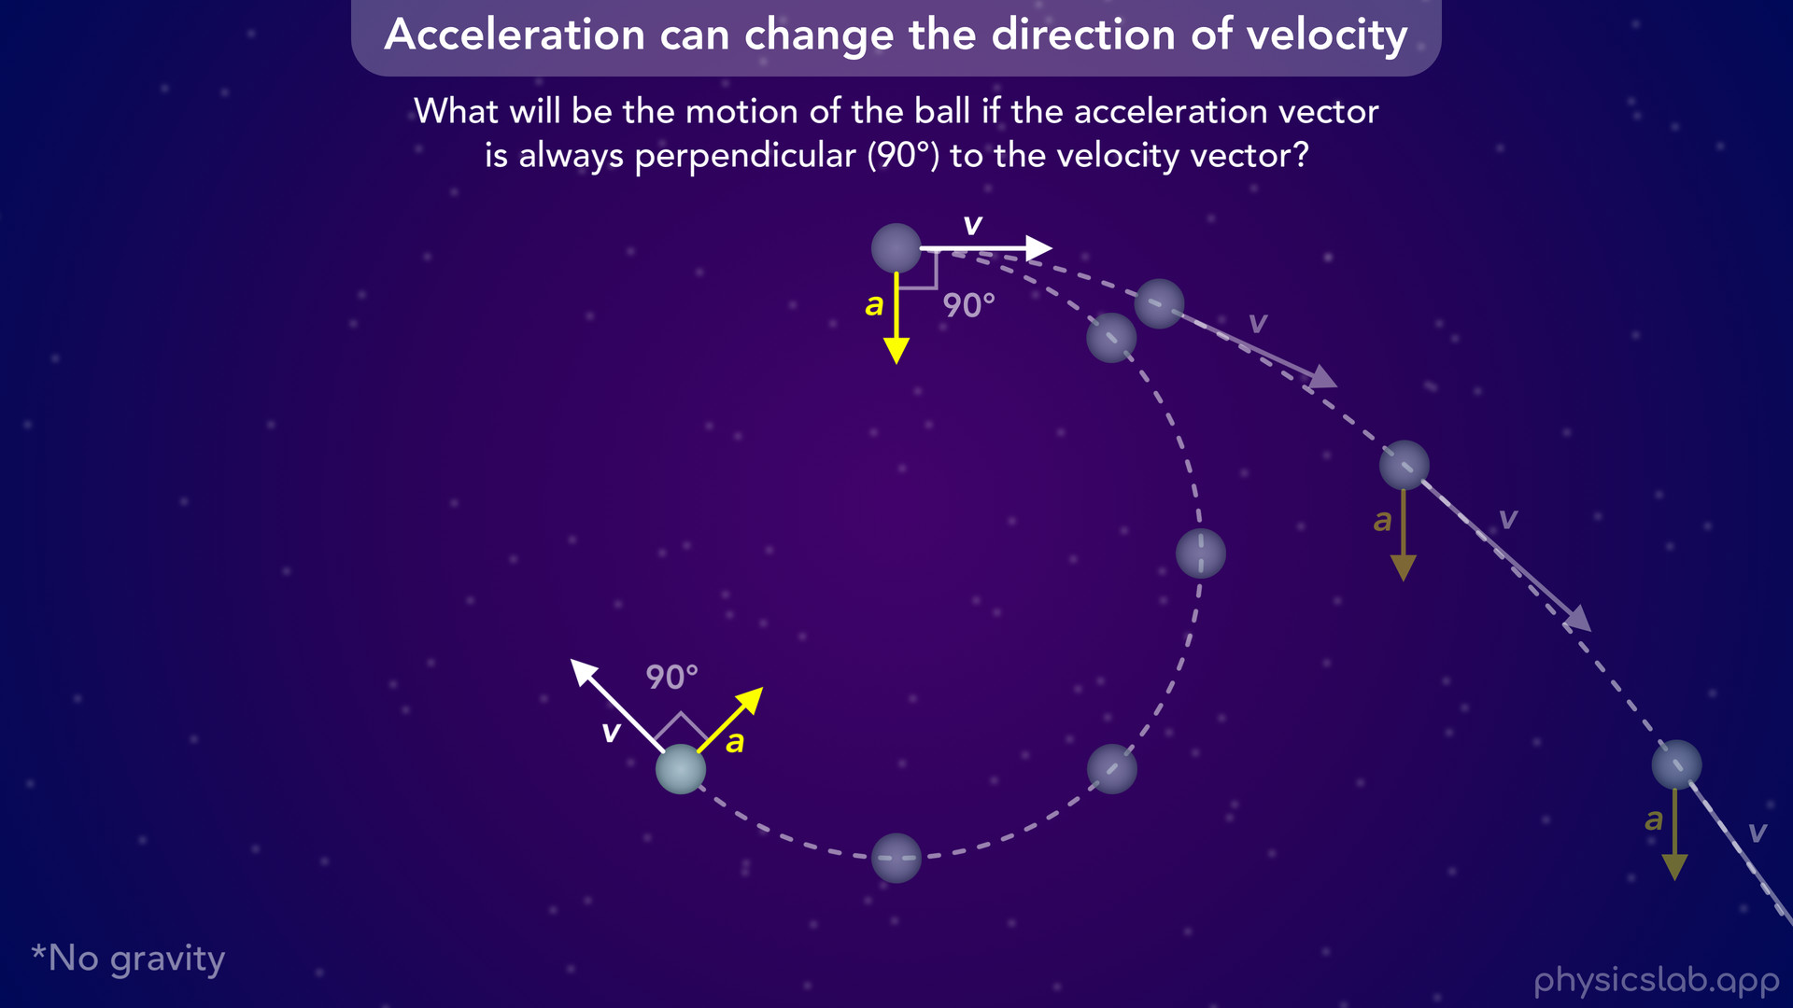

Slide 59
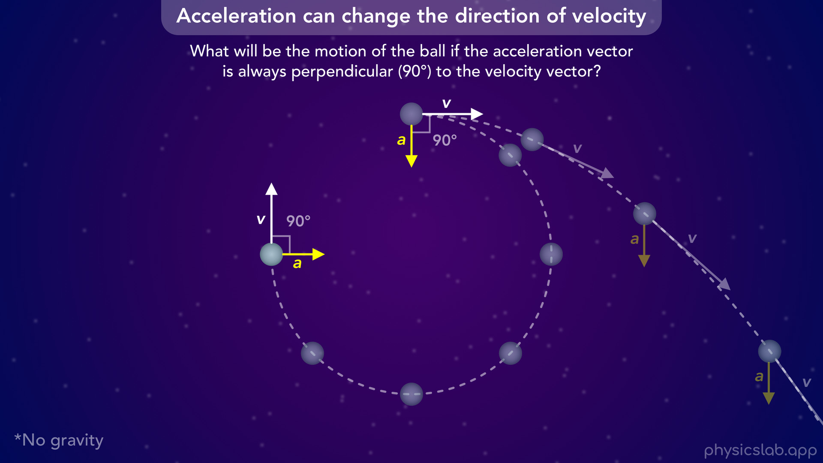

Slide 60


Slide 61

Notes:
• And if we let this play out… the ball eventually returns to its original position, and it will continue moving in a circle.
• This is what the motion looks like if the acceleration is always perpendicular to the velocity.

Slide 62

Notes:
• This is what the motion looks like if the acceleration is always perpendicular to the velocity.
• Notice that the magnitude of the velocity does not change throughout the motion, the velocity vector is always the same length.
• This means the speed of the ball is constant.

Slide 63

Notes:
• So, what we’re looking at is uniform circular motion.

Slide 64

Notes:
• The velocity vector is always tangent to the circular path.

Slide 65

Notes:
• And the acceleration vector is always perpendicular to the velocity vector.

Slide 66

Notes:
• This is the last row in our table.
• When the acceleration and velocity vectors are perpendicular, the magnitude of the velocity does not change, but the direction of the velocity changes.
• The velocity vector is turning, or rotating, as the object goes around the circle.

Slide 67

Notes:
• If the velocity is tangent to the circle, and the acceleration is perpendicular to the velocity, that means the acceleration is always pointing directly towards the center of the circle.

Slide 68

Notes:
• So we call this, centripetal acceleration.
• The word centripetal means “towards the center”, and we use the subscript c for centripetal acceleration.
• It’s important to understand that this is not a new type of acceleration.
• This is just what the acceleration looks like when an object is moving in a circle.
• Circular motion is pretty common, so we give this its own label, centripetal acceleration.

Slide 69

Notes:
• This applies to any object in circular motion…
• … like the moon orbiting the earth...

Slide 70

Notes:
• … a tetherball swinging around a pole…

Slide 71

Notes:
• … or a car driving around a circular road.
• Even though the car’s speed is constant, the direction of the velocity is changing, and the car is always accelerating towards the center of the circle.

Slide 72

Notes:
• In the next video, we’ll use the tip to tail method to show how the centripetal acceleration always points towards the center of the circle.
• We’ll also derive the equation for the magnitude of the centripetal acceleration, and we’ll go through some examples to see how the acceleration is related to the speed and the radius of the circle.

