Slide 1
Tension in Static Systems - Intro
Slides Version 1
This version includes:
Slides with screenshot images from the video.
The video narration in the slide notes.
A blank template slide with the same background and font as the video.
Slides with some basic graphics from this video for you to use however you like.
Feel free to add, delete and edit slides to make your own presentation. You can use these slides in class or share them with your students, but please do not share them with anyone else.
If you have any feedback, suggestions or questions about these slides please email me at chris@physicslab.app or send me a message on Discord @physicslab.
physicslab.app

Slide 2
Heading
Text

Slide 3























Free body diagram

Slide 4
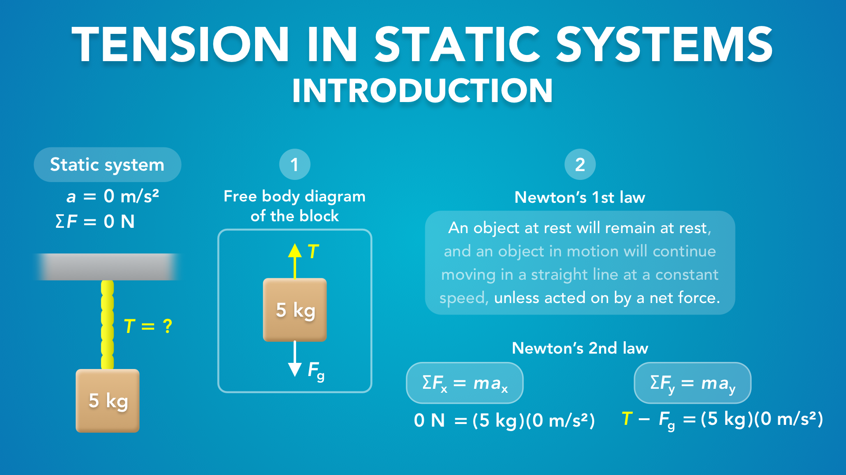
Notes:
Tension in Static Systems - Introduction
physicslab.app
If you have any questions, suggestions or feedback about these slides please email me at chris@physicslab.app or send me a message on Discord @physicslab.

Slide 5
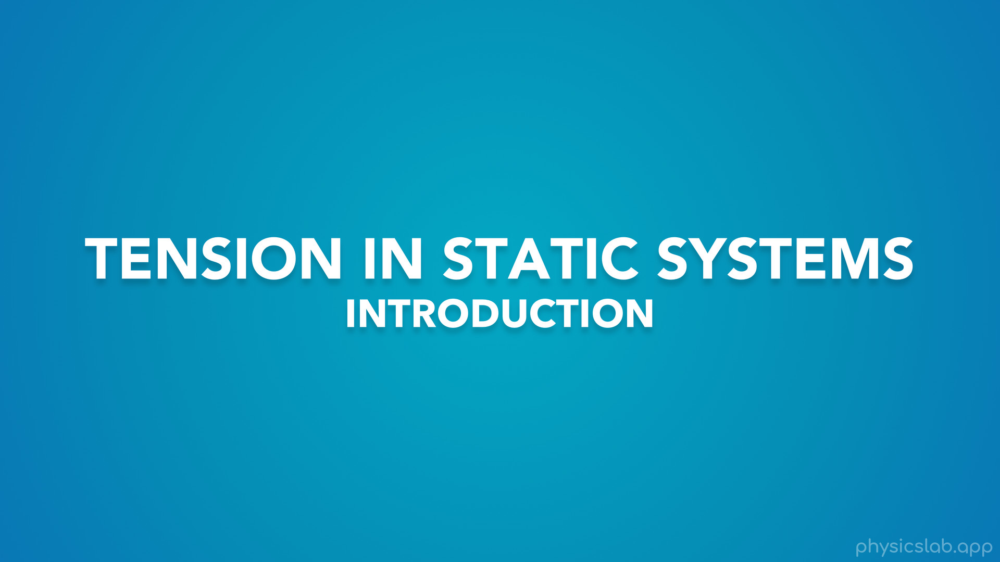
Notes:
In this video we’re going to start learning about tension in static systems.

Slide 6
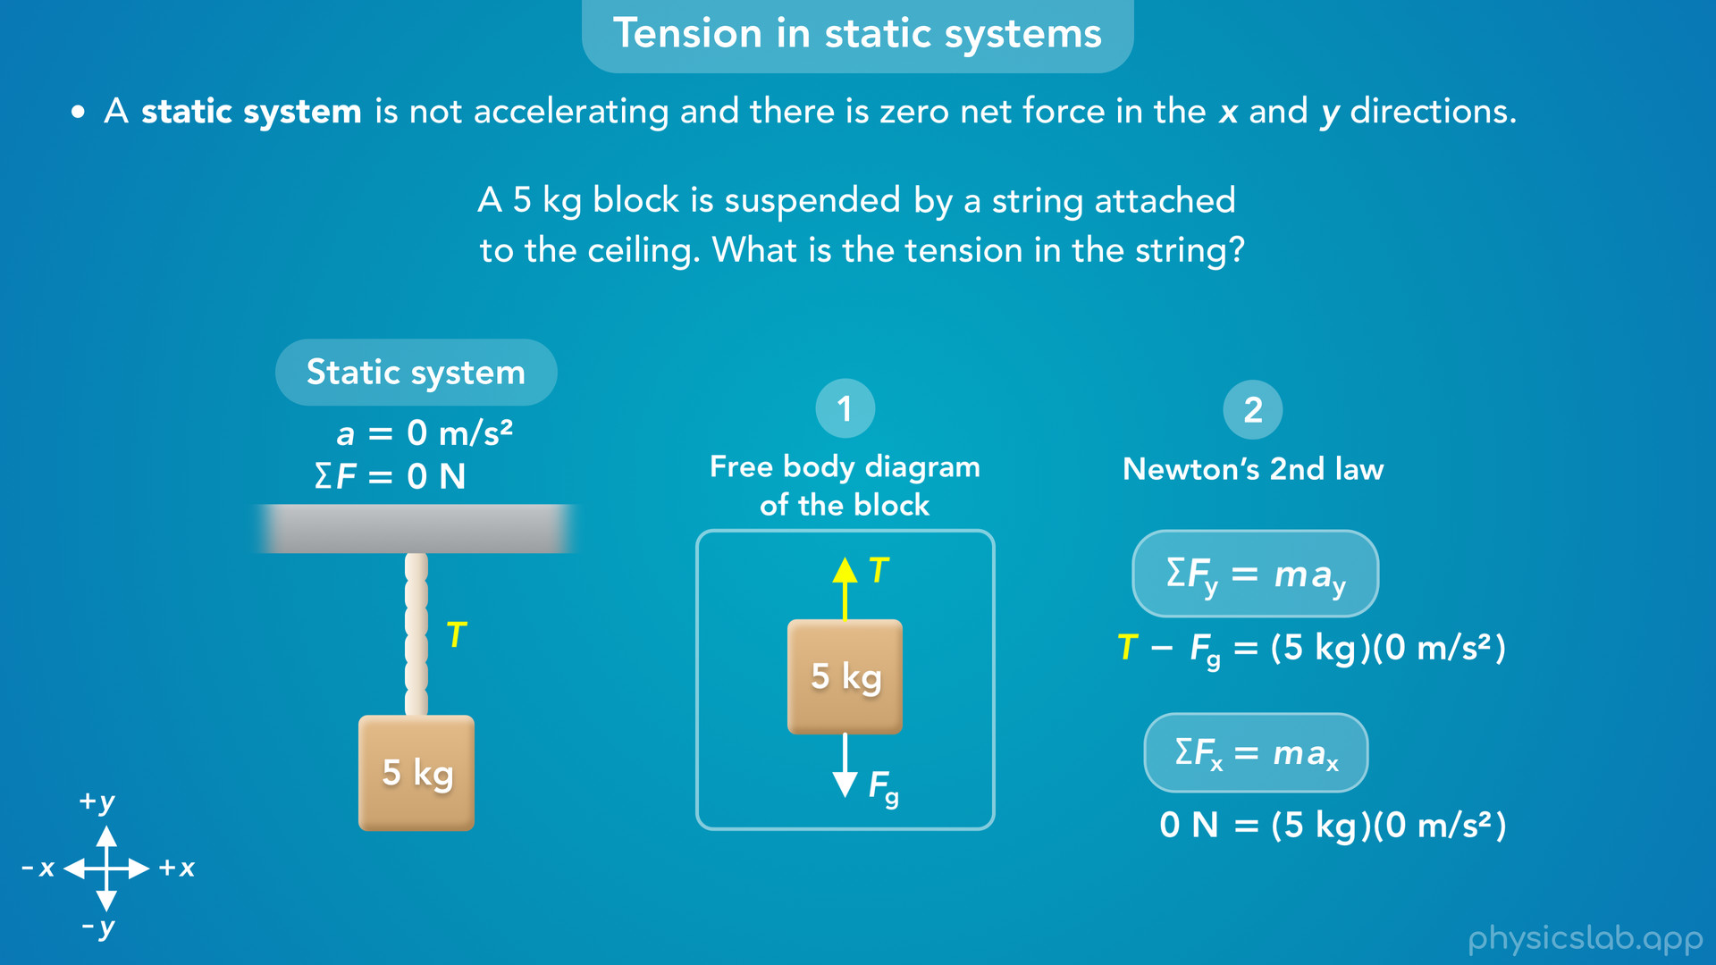
Notes:
• This video will use a simple example so we can learn what a static system is, how to apply Newton’s laws of motion, and the steps for solving static tension problems.
• Once we understand the basics, we’ll go through more examples in the next few videos.

Slide 7
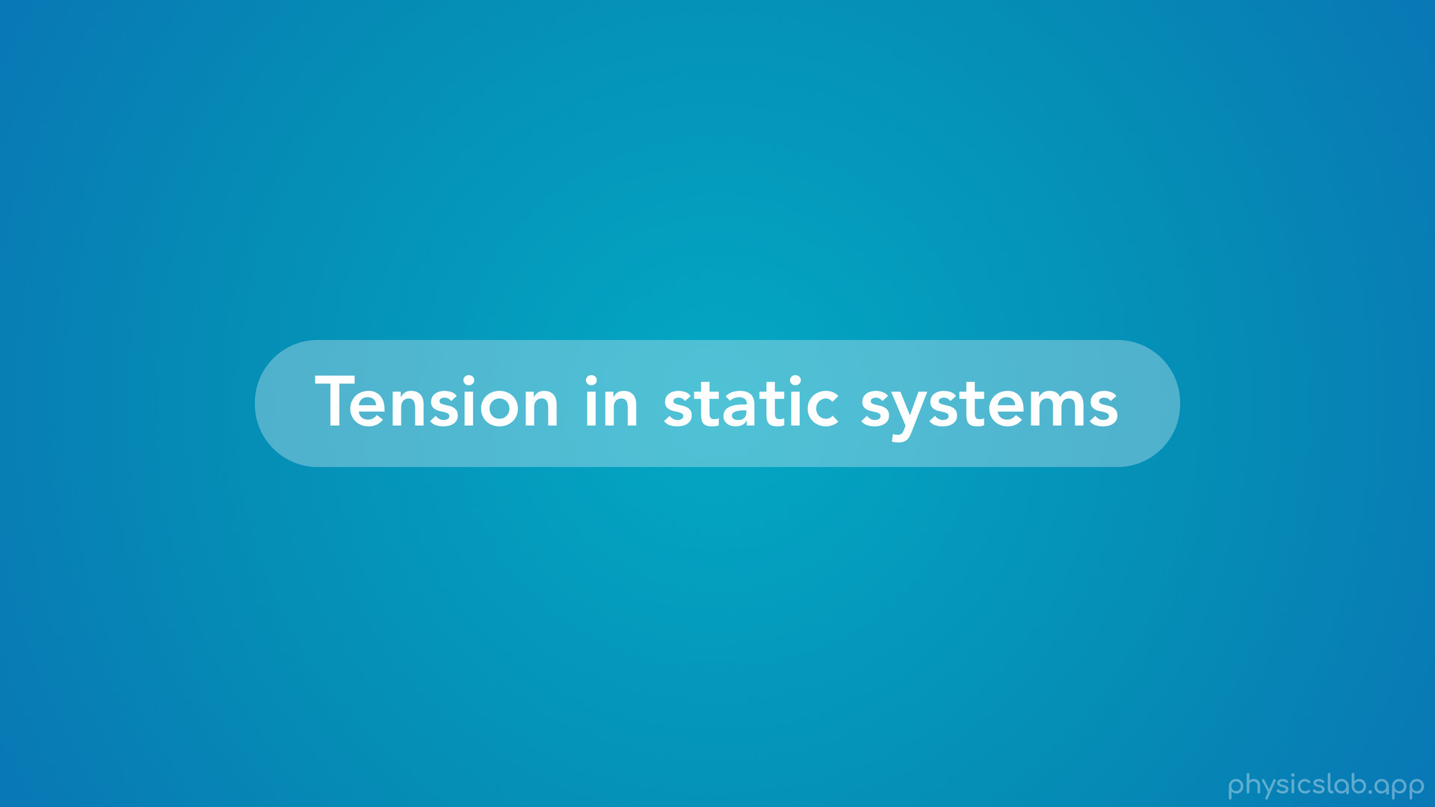
Notes:
• So what is a static system, and how do we solve these types of problems?

Slide 8
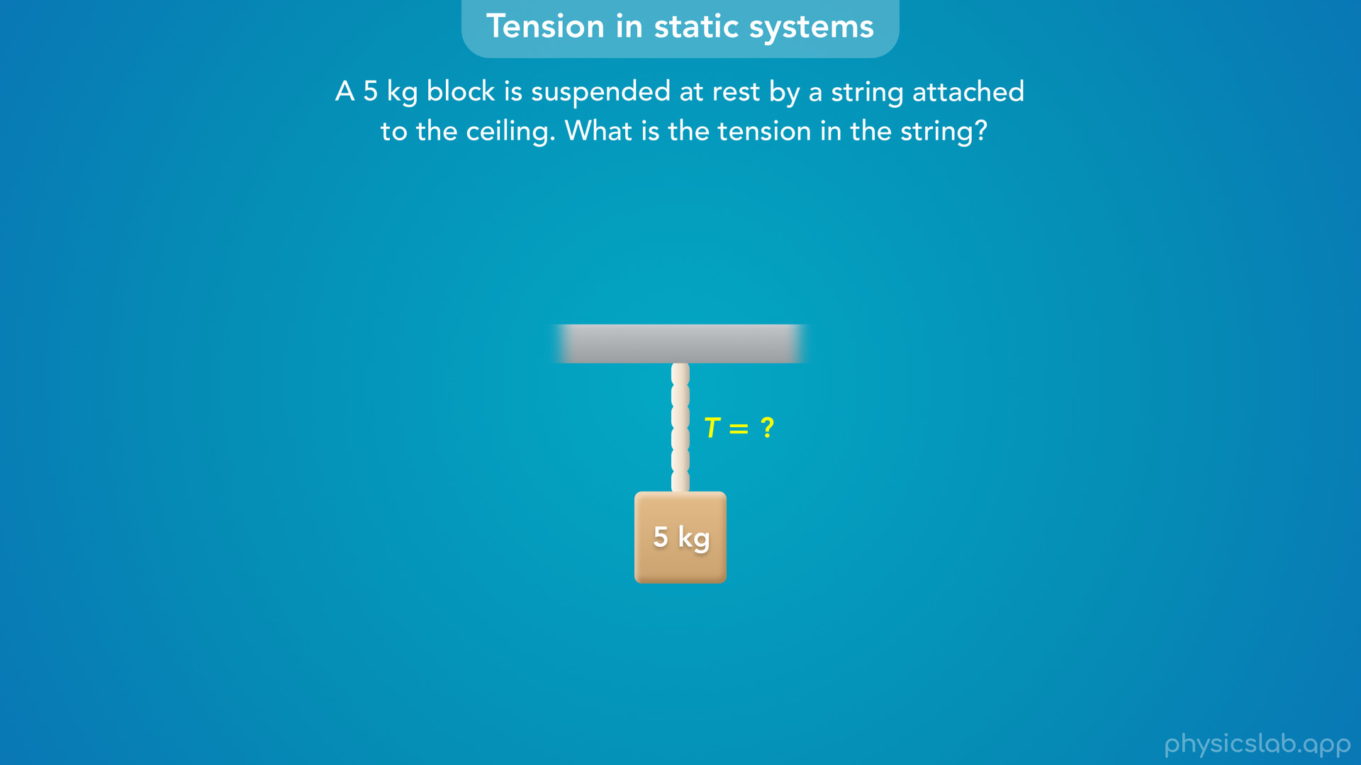
Notes:
• Here’s the example we’re gonna use.
• A 5 kg block is suspended at rest by a string attached to the ceiling. What is the tension in the string?

Slide 9
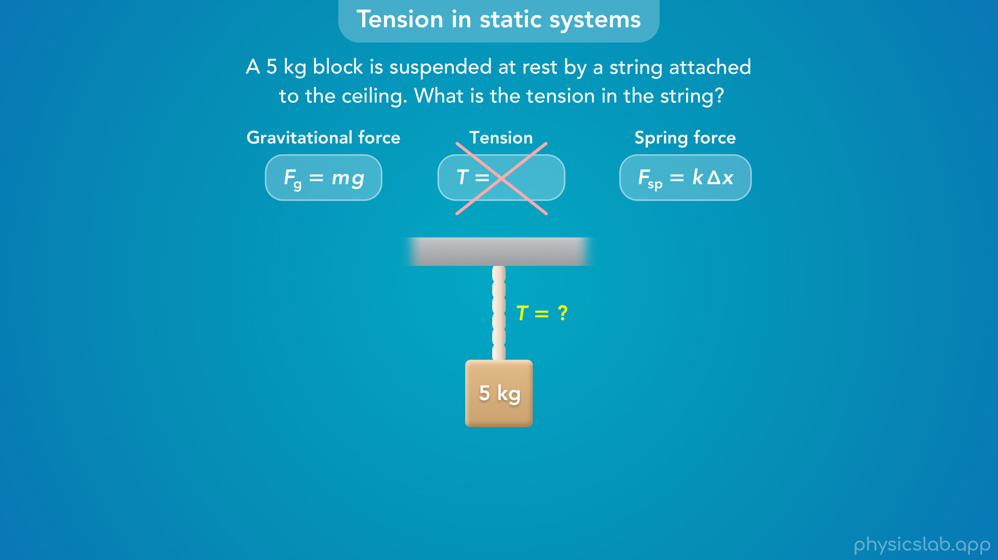
Notes:
• Like we mentioned in a previous video, there’s no equation for tension like there is for other types of forces.

Slide 10
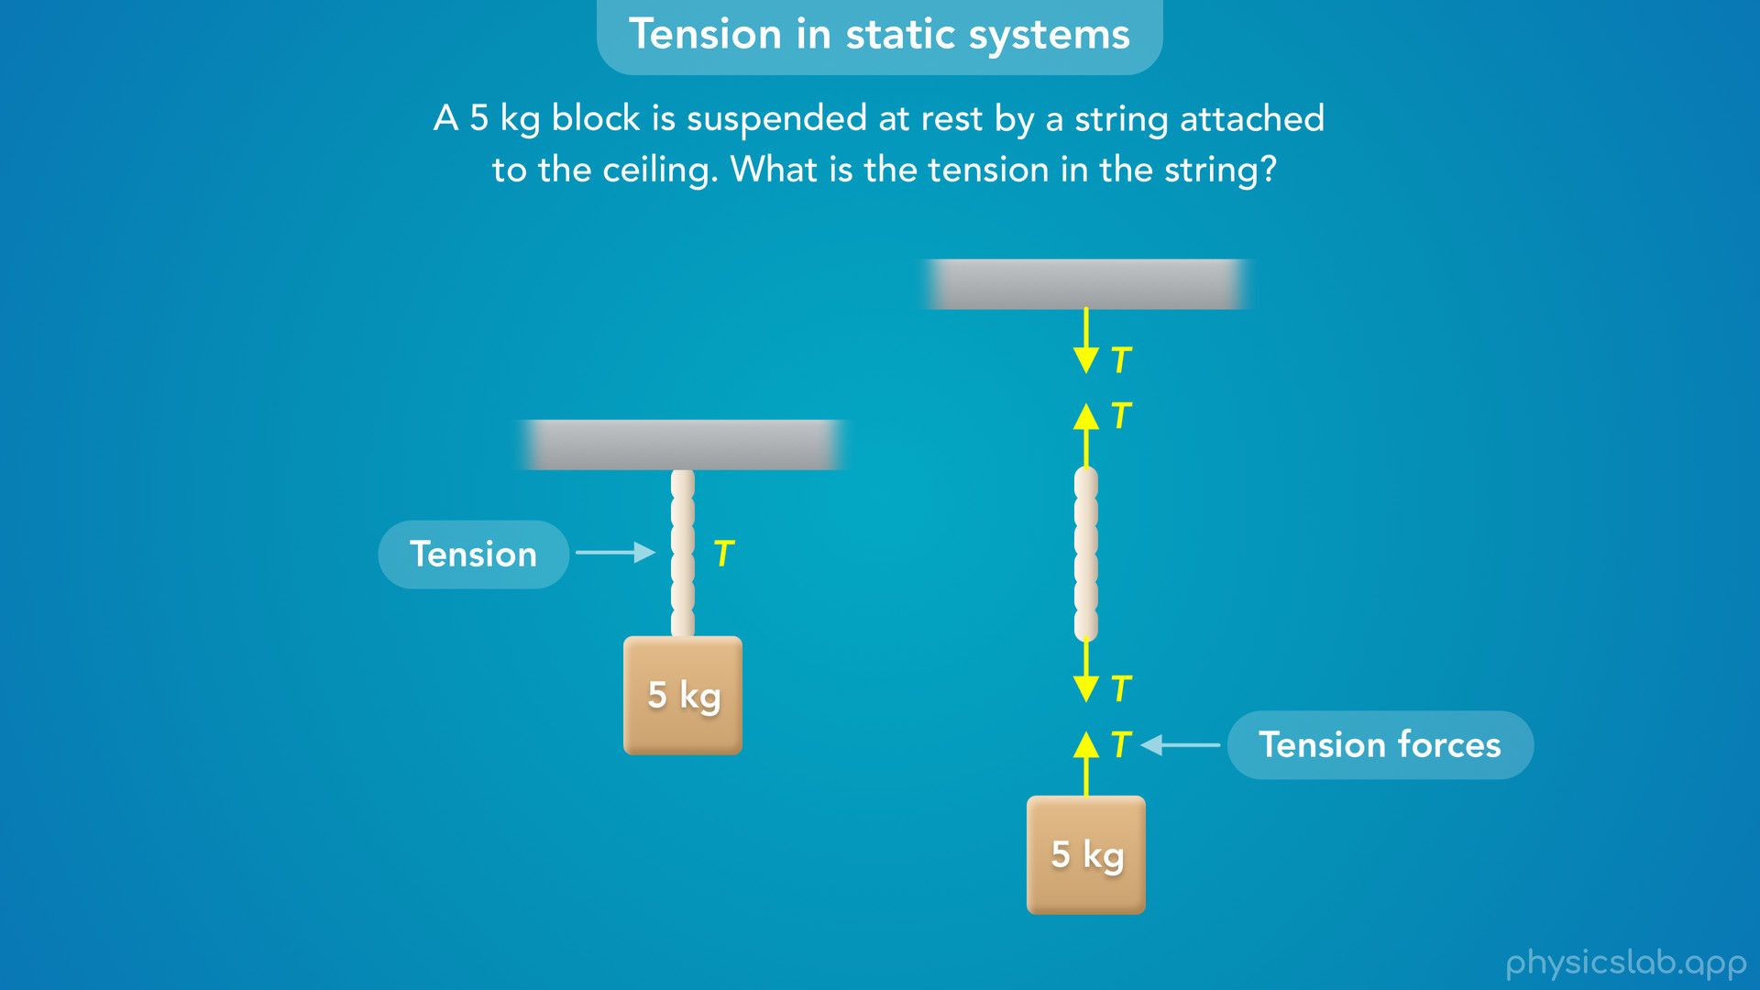
Notes:
• But we know that for an ideal string, the tension *in* the string has the same magnitude as the tension forces at each end.
• For example, if the tension forces on the block, the string and the ceiling were 10 N, that means the tension in the string would be 10 N.
• So to answer this question, all we need to do is find the magnitude of one of these tension forces.
• So how do we do that?

Slide 11
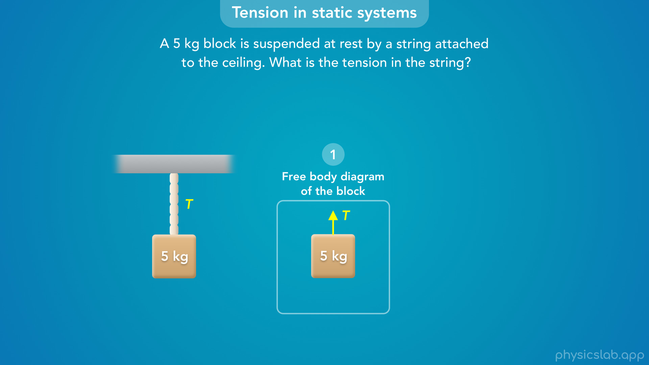
Notes:
• Whenever we’re dealing with forces, the first step is to draw a free body diagram.
• The tension forces are acting on the block, the string and the ceiling, but we’re going to focus on the free body diagram of the block.

Slide 12
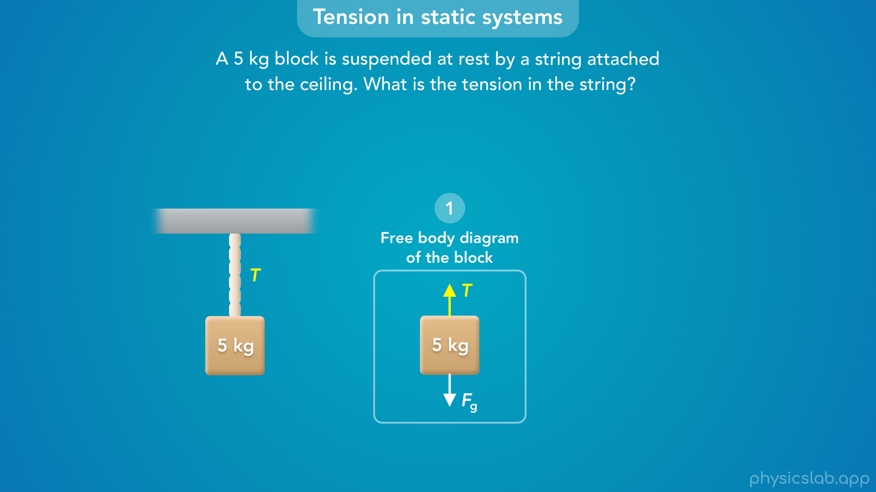
Notes:
• Remember, tension is always a pulling force that acts away from the object, in the same direction as the string.
• So if there’s tension in the string, there is an upwards tension force on the block.
• The only other force acting on the block would be a downwards gravitational force from the earth.

Slide 13
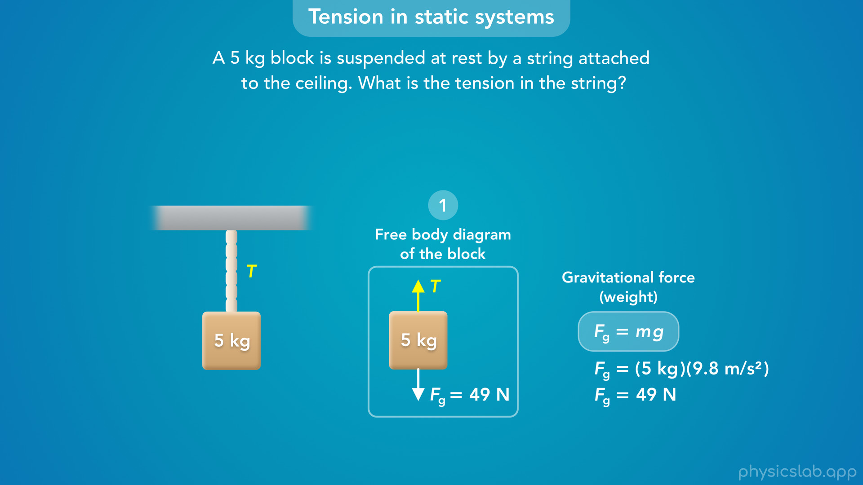
Notes:
• And we know the gravitational force or weight is equal to mg, its mass times the acceleration due to gravity.
• That would be 5 kg times 9.8 m/s^2, which equals 49 N.
• So there’s only two forces acting on the block - an upwards tension force and downwards gravitational force of 49 N.
• So how do we find the tension force?
• Well what’s happening to the block? Is it falling down? Is it moving upwards?

Slide 14

Notes:
• The block is not moving, so the forces on the block are balanced, which means the tension force is also 49 N.
• And, that’s the magnitude of the tension in the string.
• This is a simple example, but how do we work through this when the scenario is more complicated?
• And what reasoning did we just use, how do we know the forces are balanced?

Slide 15
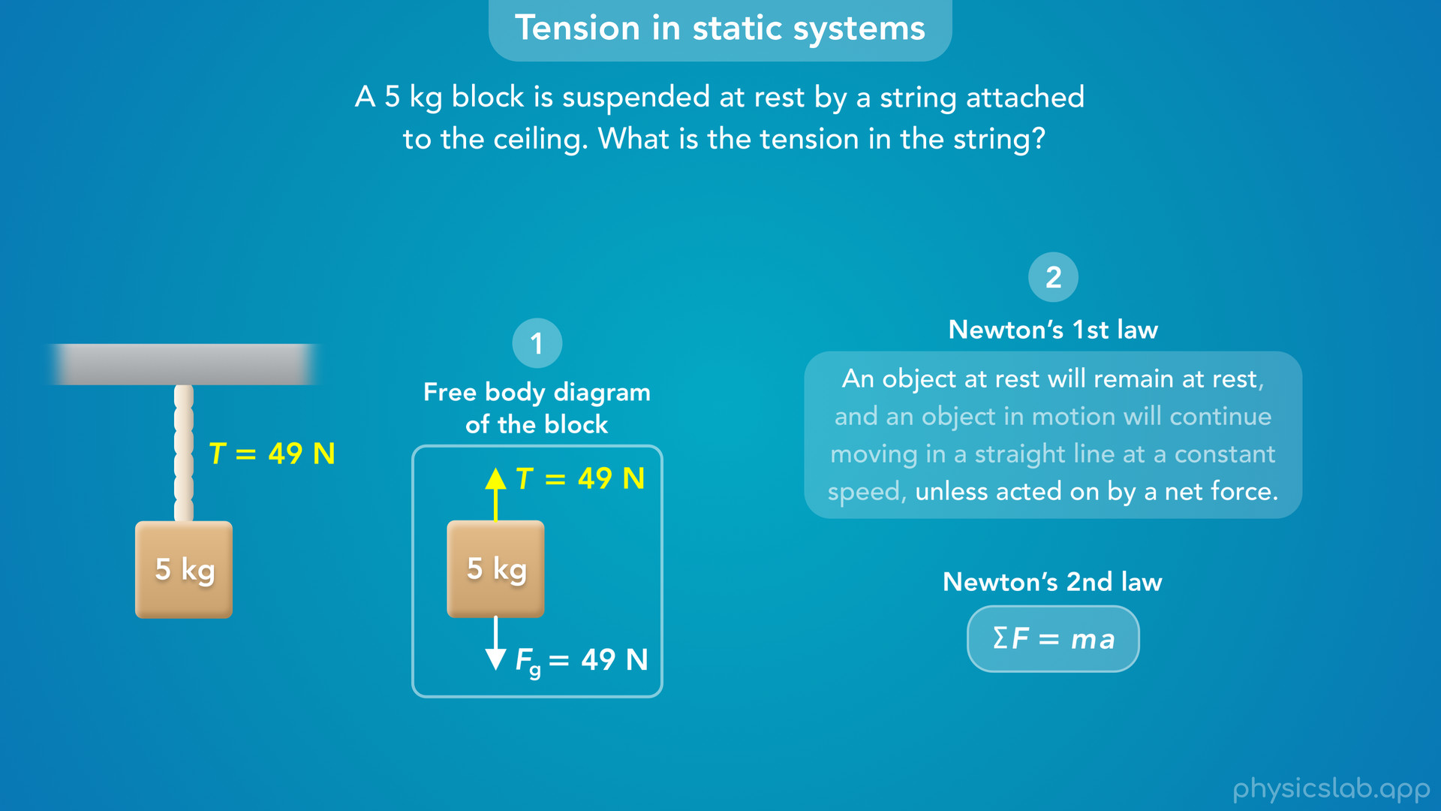
Notes:
• We just applied Newton’s 1st or 2nd law of motion.

Slide 16
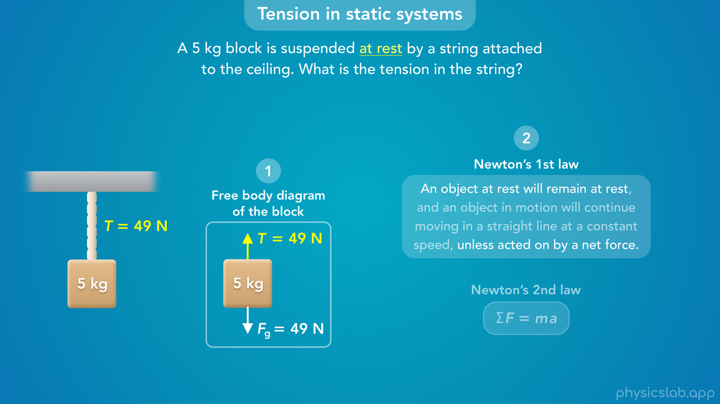
Notes:
• Newton’s 1st law says that an object at rest will remain at rest unless acted on by a net force.
• Remember, if an object is at rest, that means it’s not moving.
• And this question actually told us directly that the block is at rest.
• But even if it didn’t say that, we would still assume the block is at rest based on the context of the question.
• It says the block is suspended, and we’re not told that anything is moving.
• So if the block is not moving, Newton’s 1st law says that there is no net force acting on the block.
• That means the forces are balanced and they cancel each other out.
• So the tension force must have the same magnitude as the gravitational force.

Slide 17
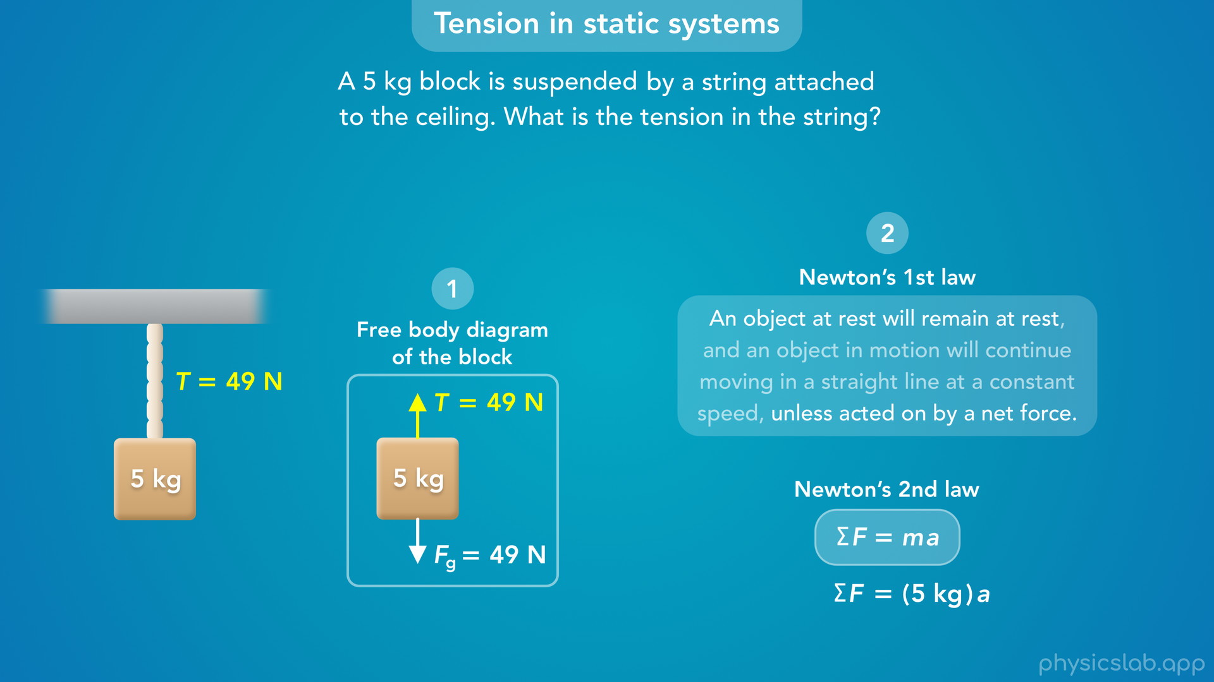
Notes:
• We also could have used Newton’s 2nd law of motion, which says that the net force acting on the block is equal to its mass times its acceleration.

Slide 18
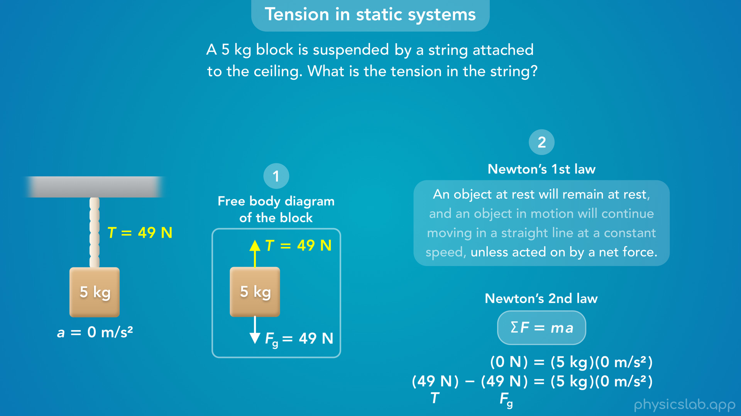
Notes:
• And what’s the acceleration of this block?
• If it’s not moving, then it’s not accelerating, its acceleration is 0 m/s^2.
• And if we plug in zero for the acceleration, the net force must be zero.
• These two forces act in opposite directions, and the tension force minus the gravitational force must be zero, so they have the same magnitude.

Slide 19
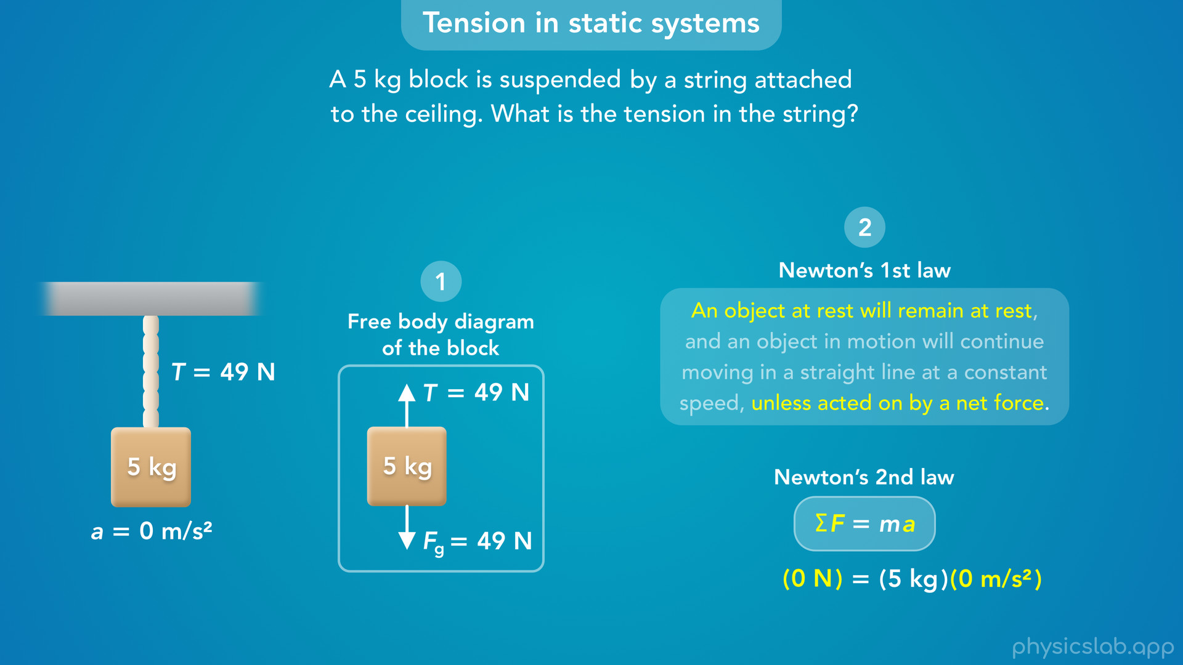
Notes:
• So Newton’s 1st law basically says, *if* there’s a net force, the object will accelerate, and it will not remain at rest.
• Newton’s 2nd law says the same thing using an equation.
• But this equation will also let us calculate the net force or the acceleration when they’re not zero.

Slide 20
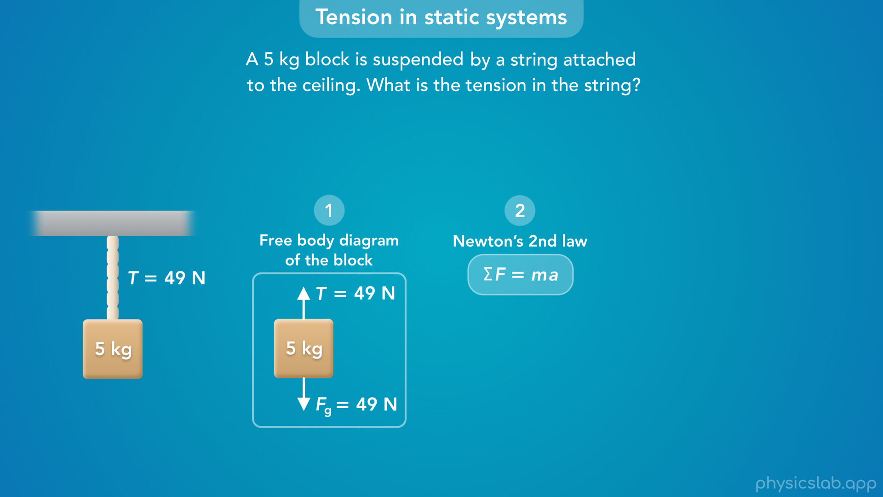
Notes:
• So moving forward, we’re just going to use Newton’s 2nd law.

Slide 21
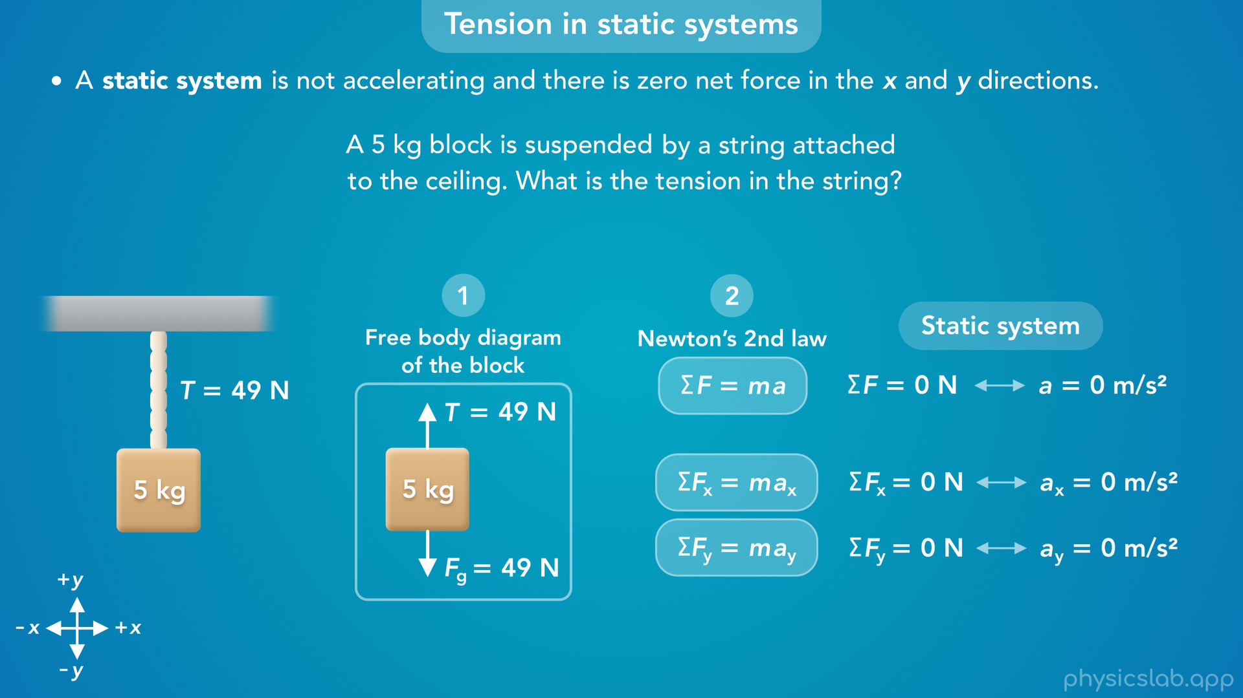
Notes:
• If we’re told the object is not moving, or if we can assume it’s not moving, then the acceleration is zero, and the net force is zero.
• This is what we call a static system.
• A static system is not accelerating and there is zero net force in the x and y directions.
• Remember that we apply Newton’s 2nd law to the x and y directions separately.
• So a static system has zero net force and zero acceleration in the x and y directions.
• That will be important when we have tension forces in two dimensions.

Slide 22
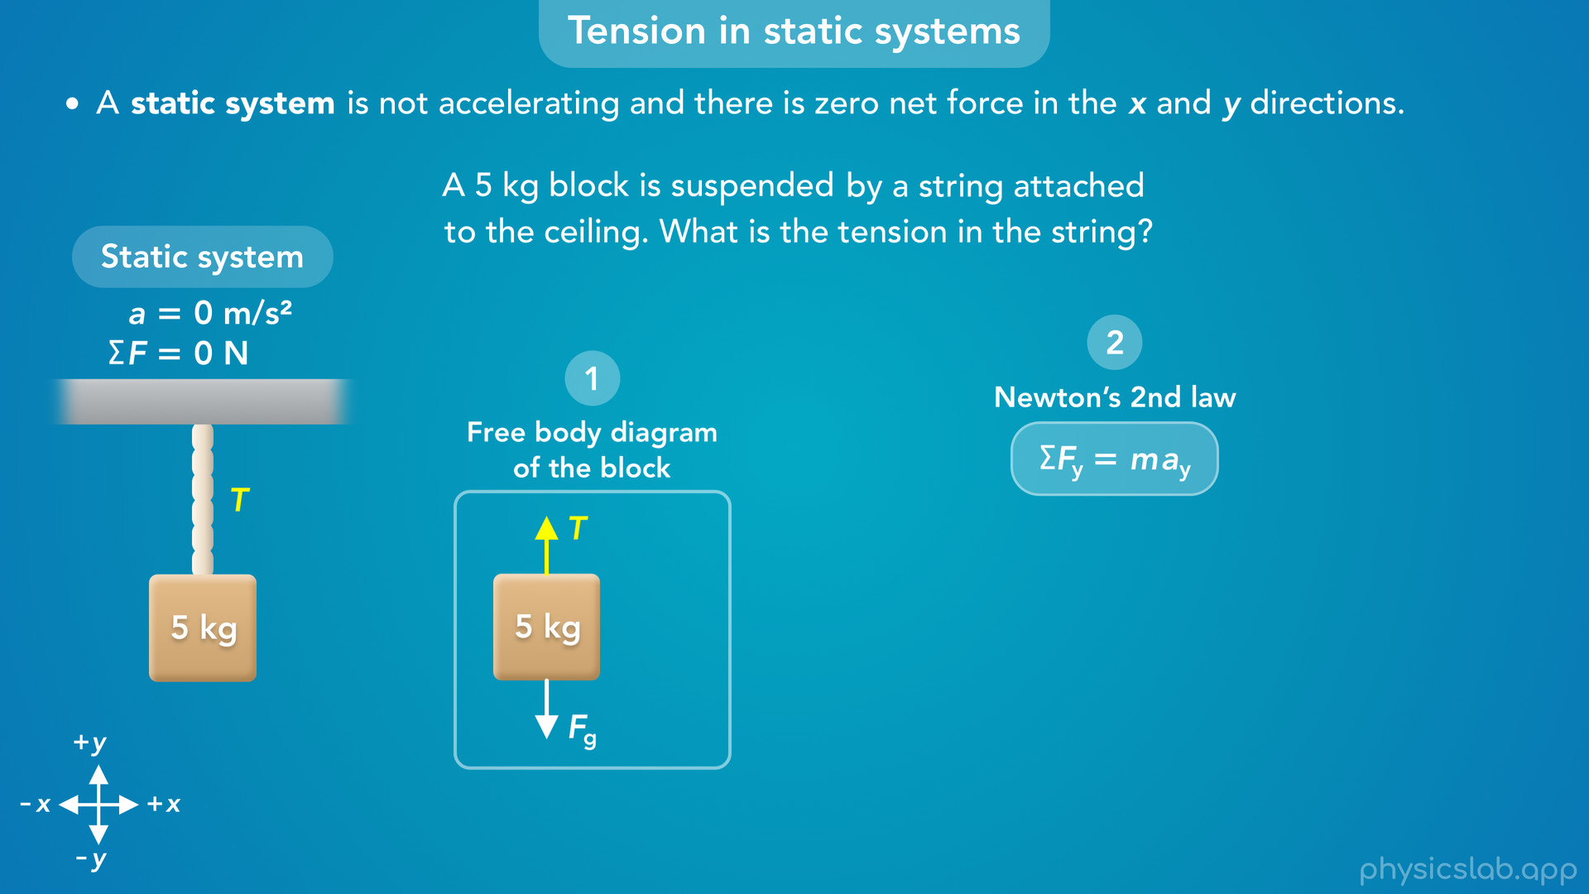
Notes:
• But for this example, we only have vertical forces, and we only need to apply Newton’s 2nd law in the y direction.

Slide 23
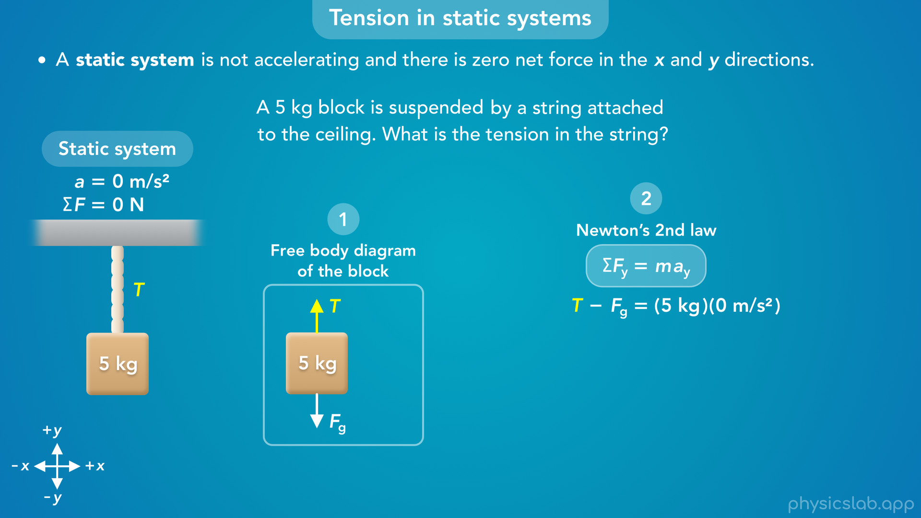
Notes:
• If we choose up to be the positive direction, then the net force would be the tension force, T, minus the gravitational force, Fg.
• The mass of the block is 5 kg, but we’re going to plug in 0 for the acceleration because we’re assuming the block is at rest.

Slide 24

Notes:
• So the right side becomes zero, which also means the net force is zero.

Slide 25
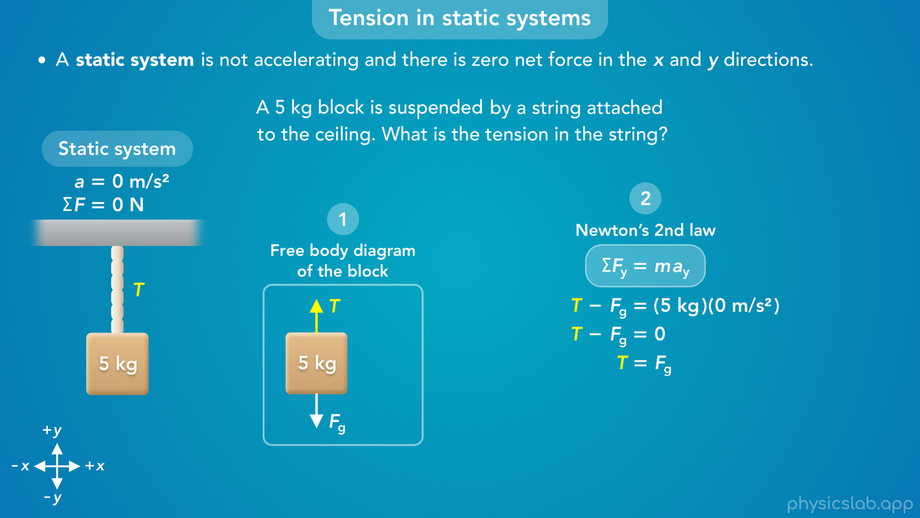
Notes:
• Then we can rearrange the equation and see that the tension force is equal to the gravitational force.

Slide 26
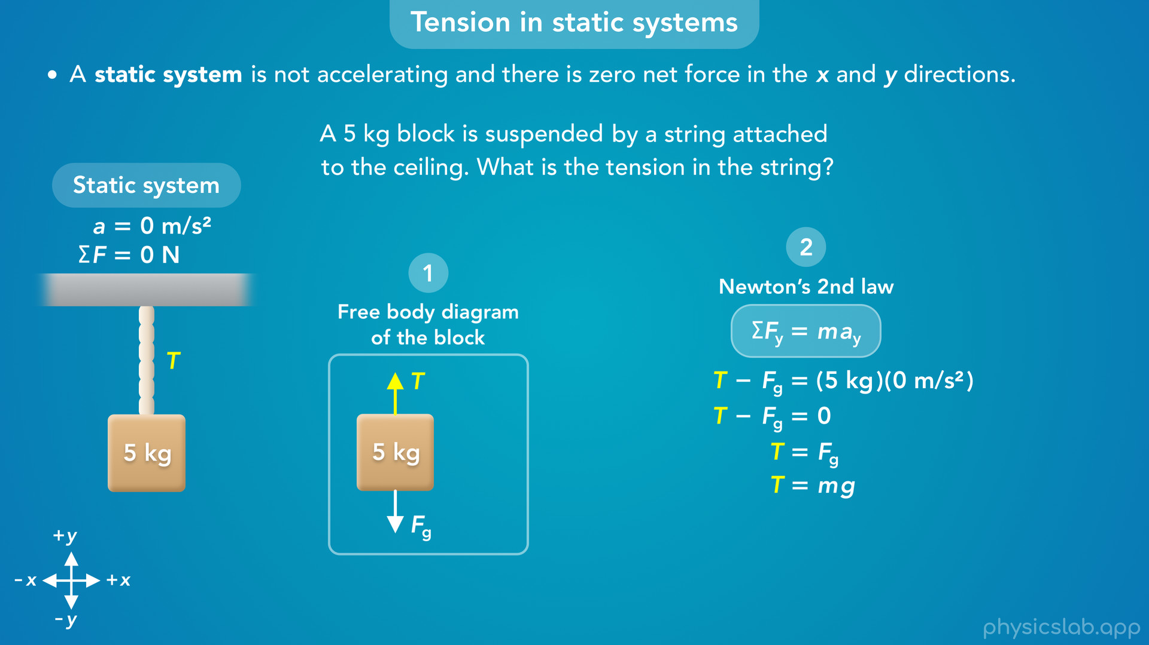
Notes:
• We can replace Fg with m times g…

Slide 27
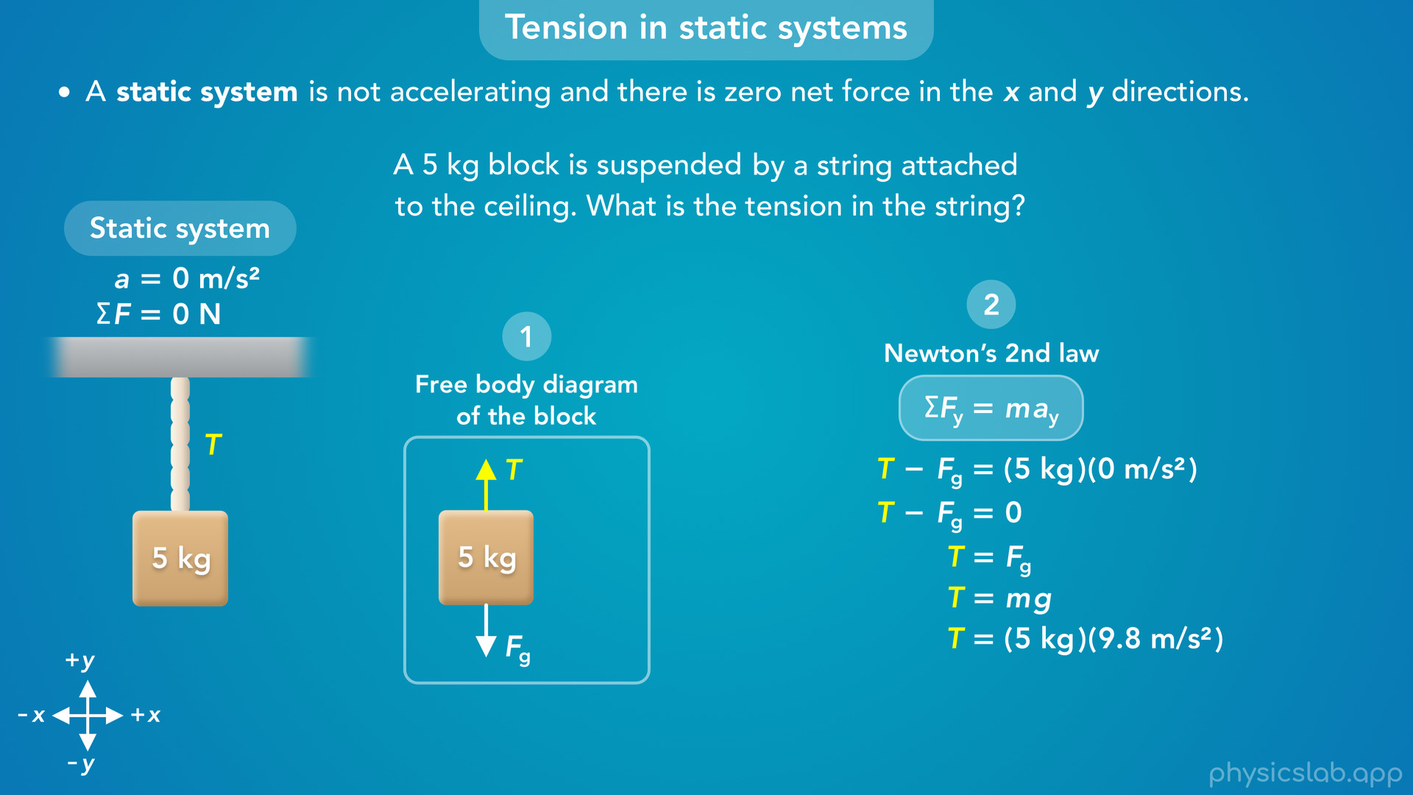
Notes:
…plug in 5 kg for the mass and 9.8 m/s^2 for g…

Slide 28
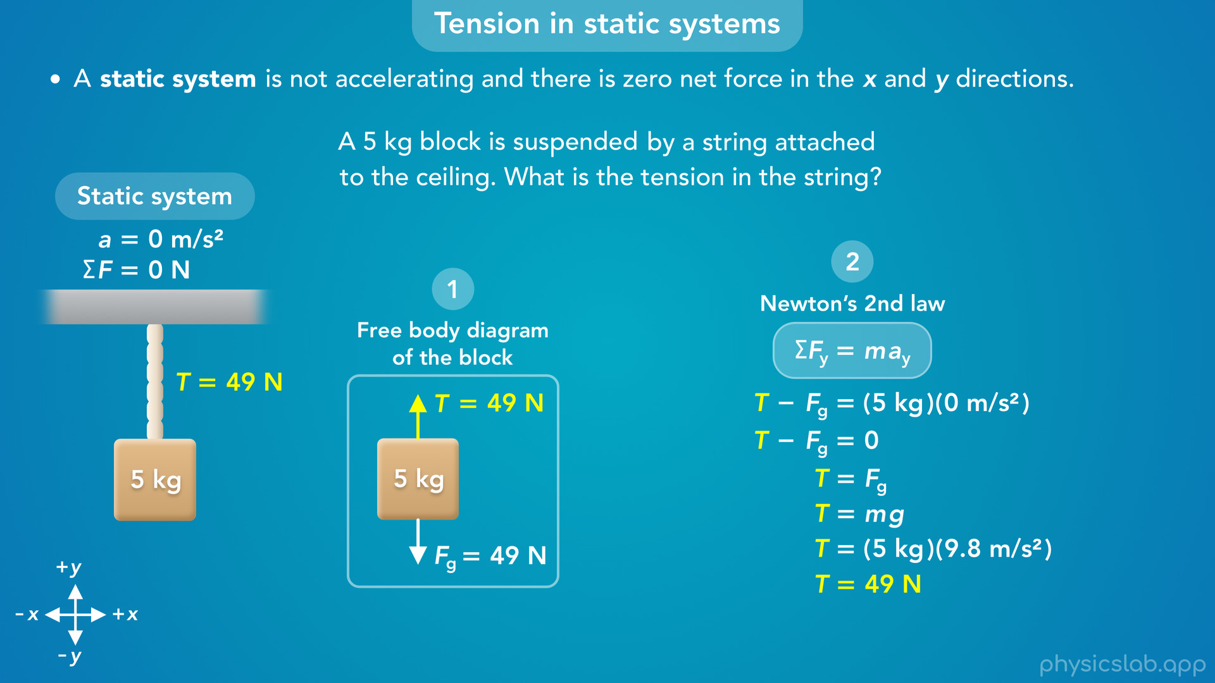
Notes:
…and we get 49 N for the gravitational force and the tension force.
• So the tension in the string is 49 N.
• Remember, 9.8 m/s^2 is the acceleration due to gravity, g, not the acceleration of the block, which is zero.
• We plugged in the mass and g to calculate the gravitational force at the end, this is not the mass times acceleration in Newton’s 2nd law.

Slide 29
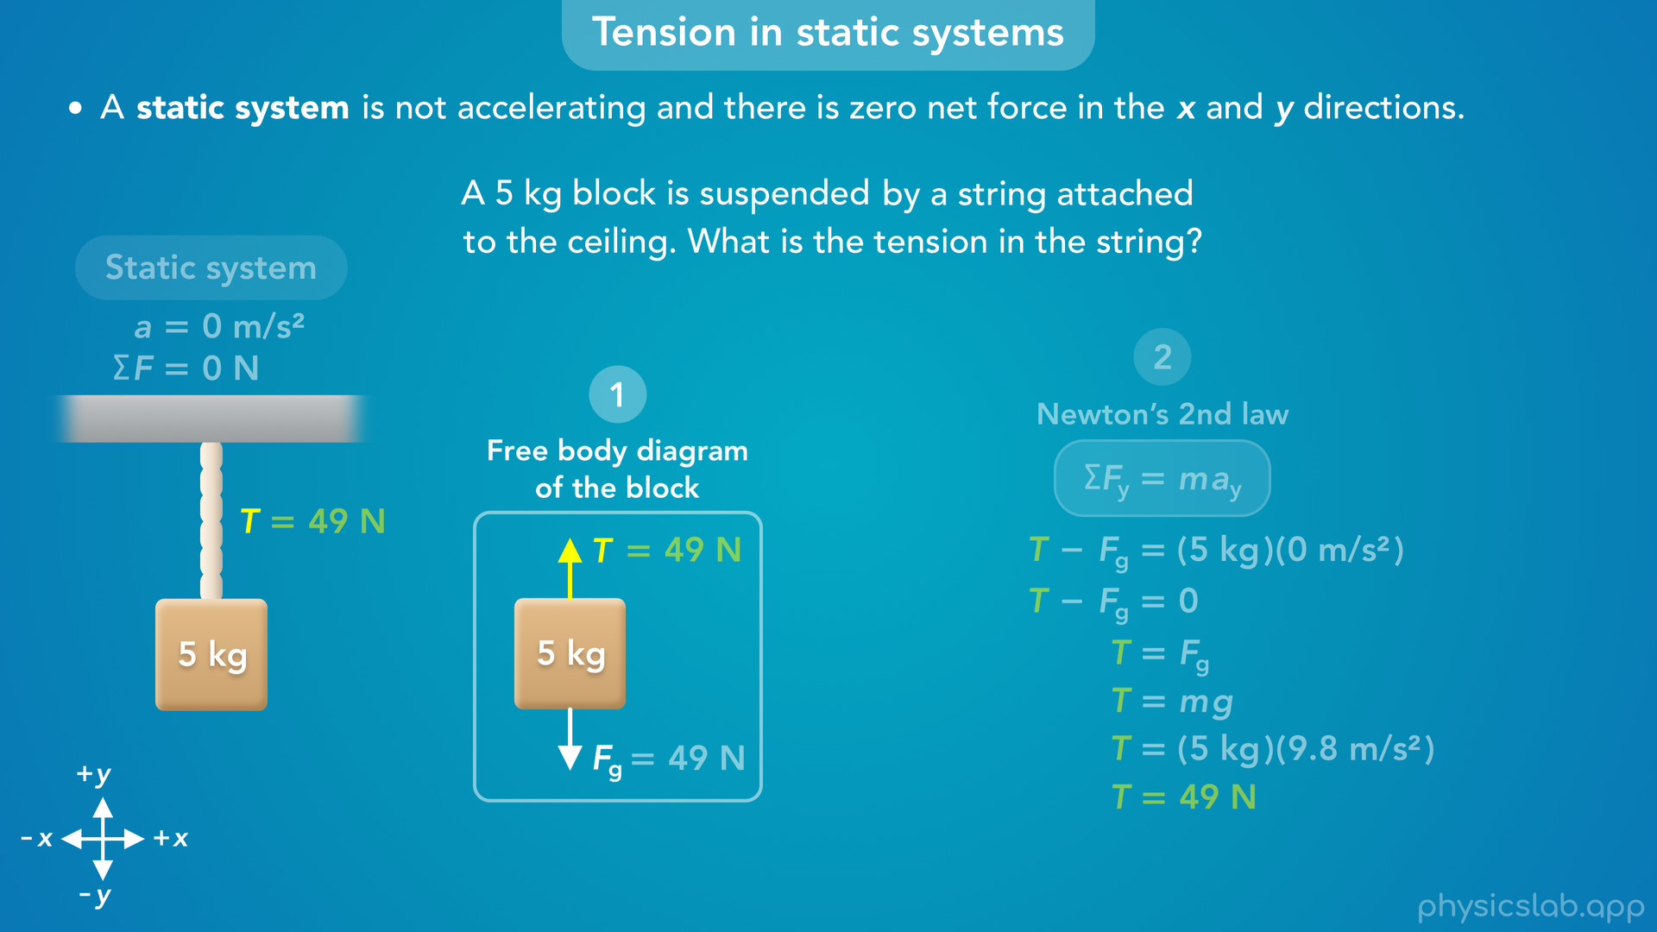
Notes:
• Alright so that’s how we would find a tension force in a static system.
• Step 1 is to draw a free body diagram.
• We usually focus on the object that’s attached to the string like this block, because we can use the gravitational force on the block to help us solve the problem.
• A free body diagram of the string or the ceiling wouldn’t give us any more information, so we needed to use the block.
• We also need to establish the coordinate system, the x and y axes.

Slide 30
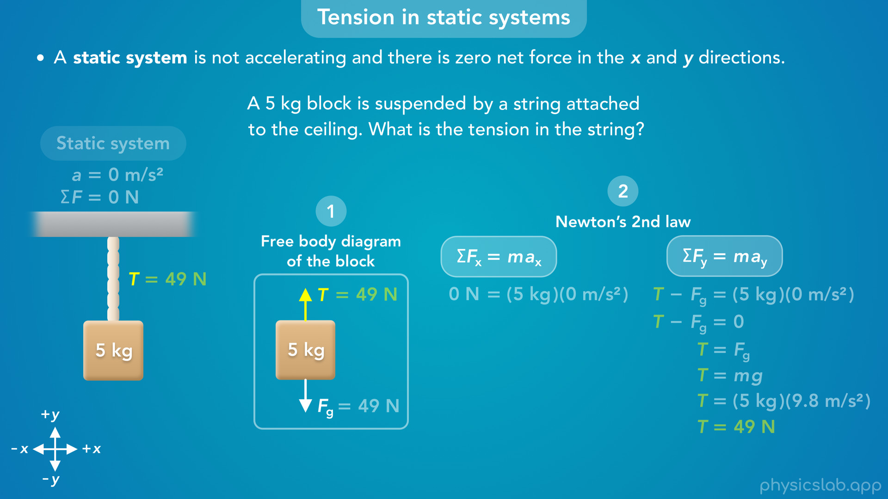
Notes:
• Step 2 is to apply Newton’s 2nd law in the x and y directions.
• In this example, we only have forces in the y direction so we only use Newton’s 2nd law in the y direction.
• There are no forces in the x direction, so that wouldn’t help us.
• In other scenarios, we might need to use the x direction, the y direction, or both..

Slide 31
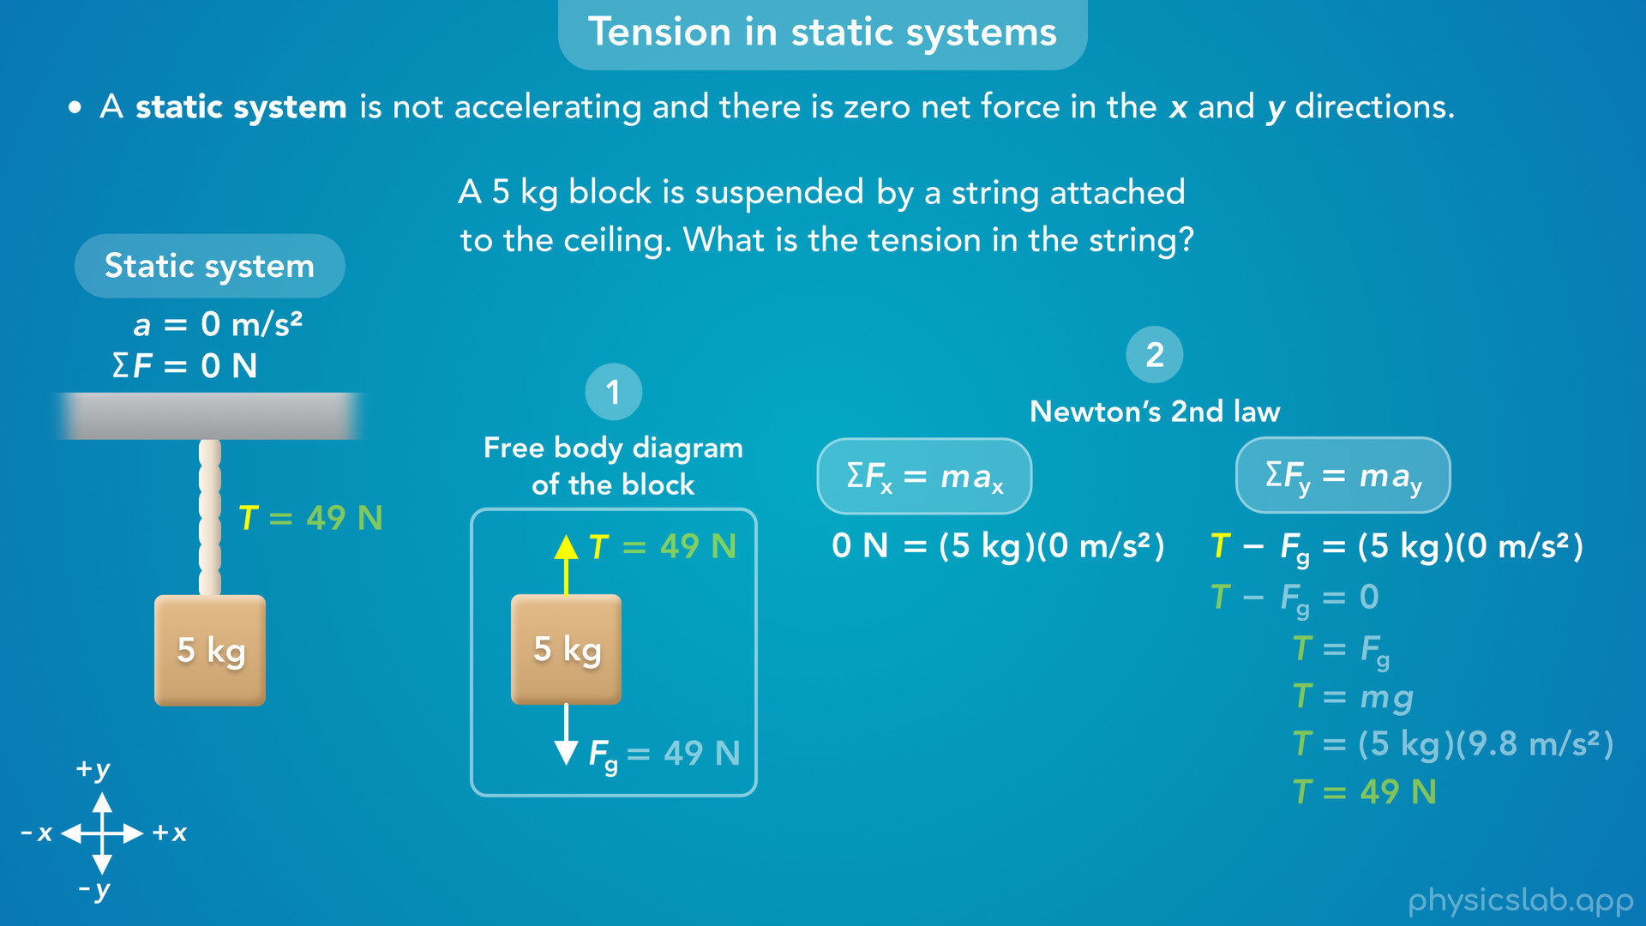
Notes:
• Next, if we’re told that the object is not moving, or if we can assume it’s not moving given the context of the question, then we know the acceleration and net force are zero in the x and y directions.

Slide 32
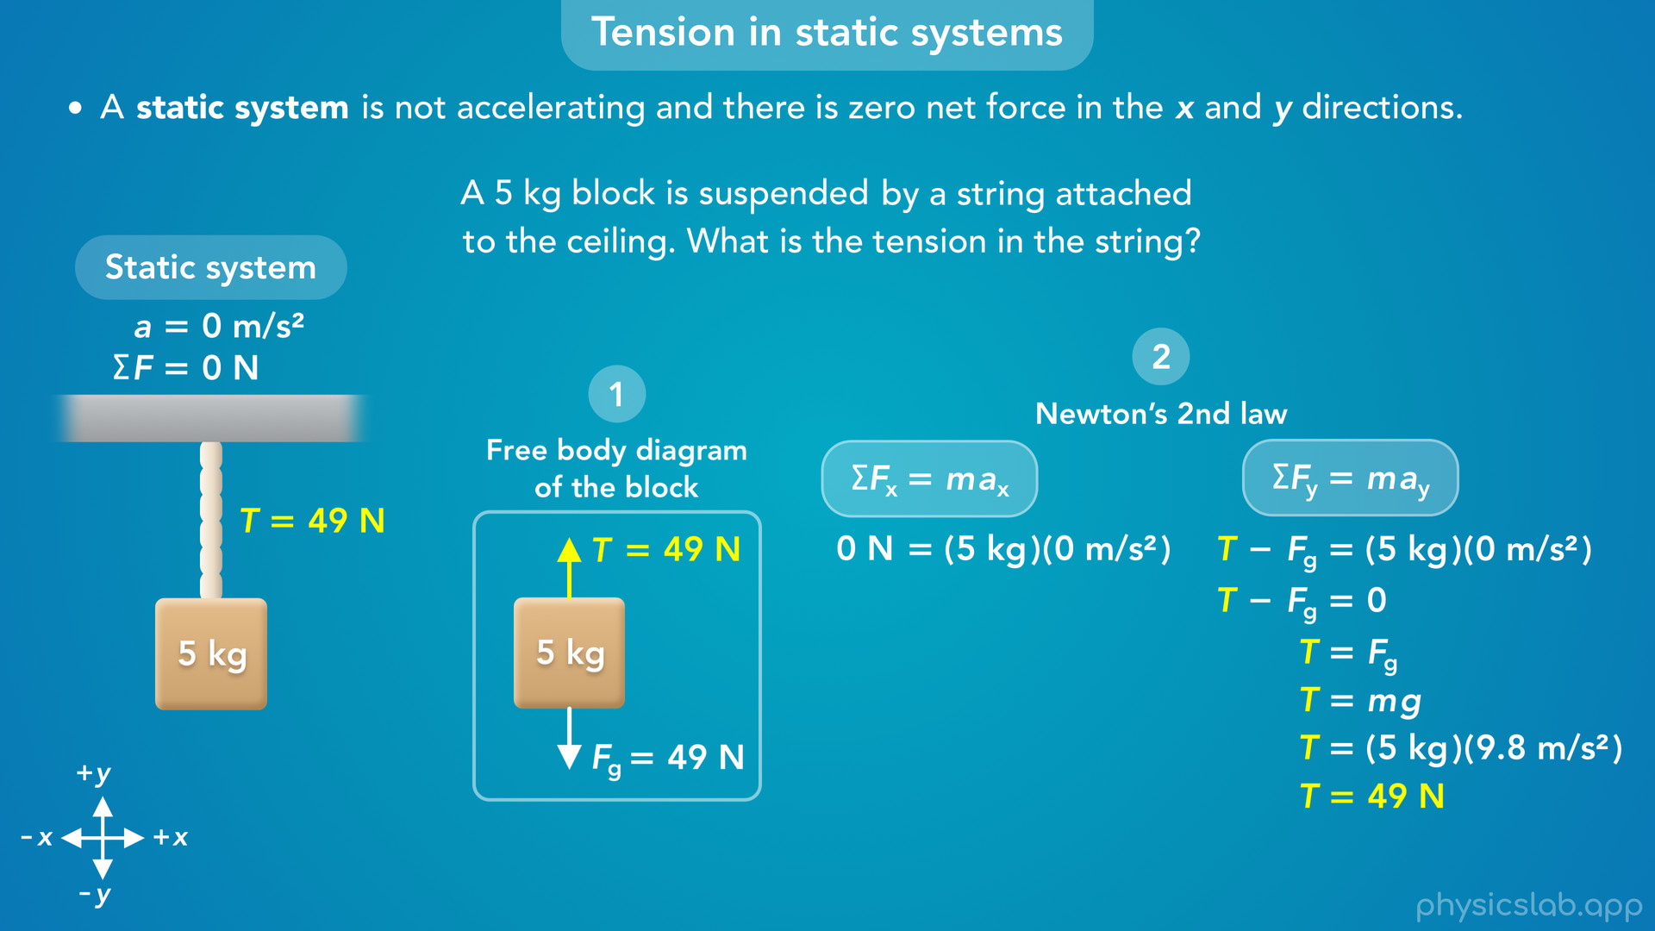
Notes:
• Then we can find an unknown tension force by relating it to the other forces.

Slide 33
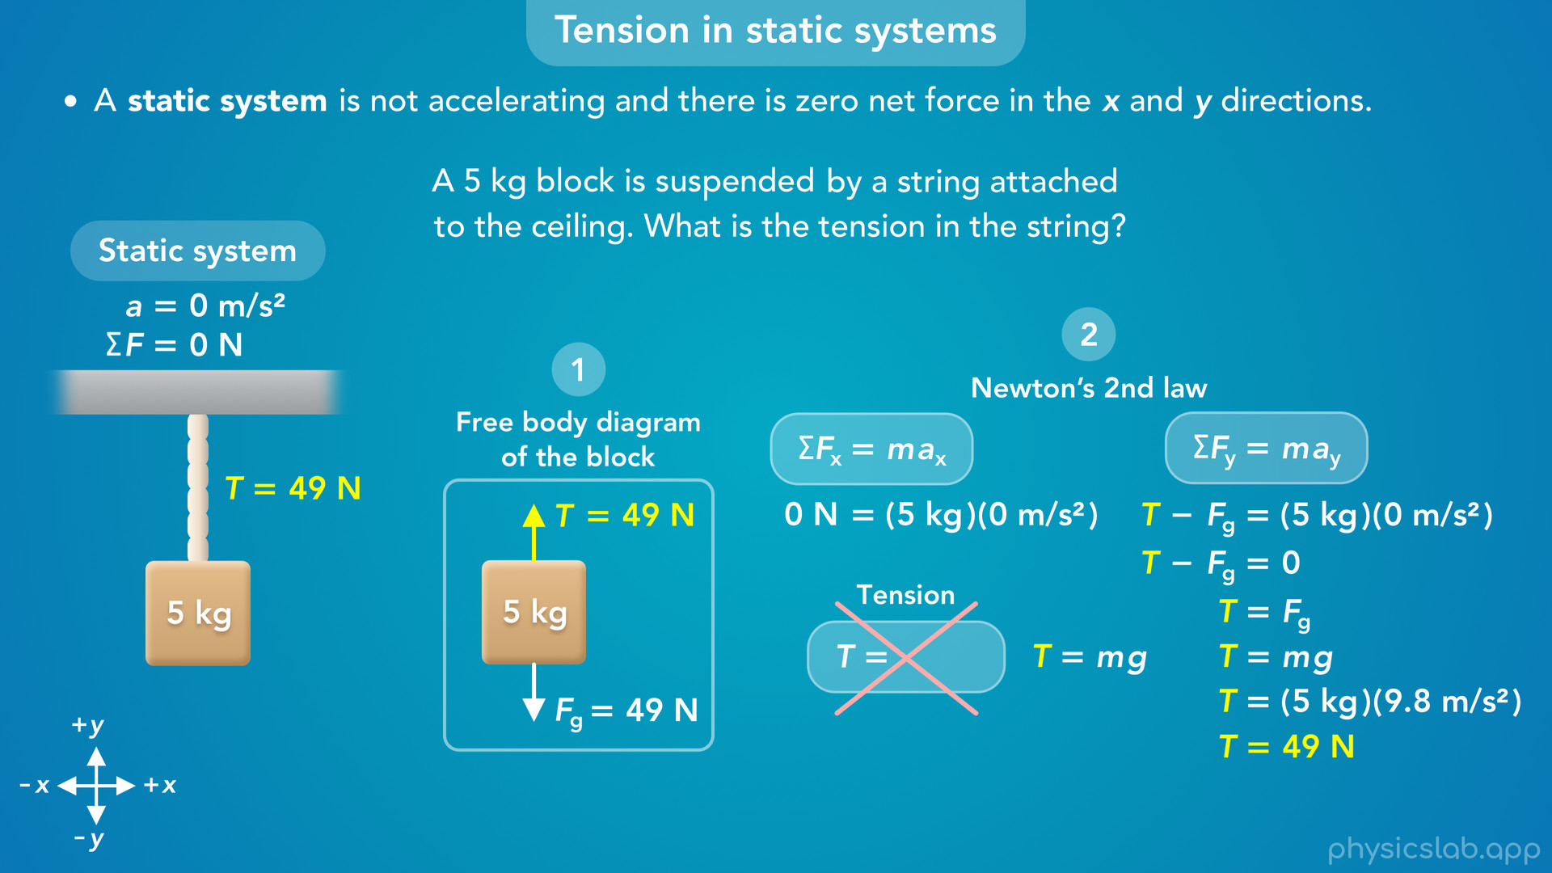
Notes:
• That’s the important thing to understand about tension, there is no general equation we can use to calculate it.
• In this example, the tension force is equal to mg, the gravitational force on this block.
• But this equation does not apply to other scenarios, it’s only true in this case, and we got this equation from Newton’s 2nd law.
• As we cover more examples in the next few videos, we’ll follow the same steps, but we’ll end up with different equations

