Slide 1
Linear Motion 1 - Position, Velocity & Acceleration
Slides Version 2
This version includes:
Slides with screenshot images from the video.
The video narration in the slide notes.
A blank template slide with the same background and font as the video.
Slides with some basic graphics used in this video.
Feel free to add, delete and edit slides to make your own presentation. You can use these slides in class or share them with your students, but please do not post them online.
If you have any feedback, suggestions or questions about these slides please email me at chris@physicslab.app or send me a message on Discord @physicslab.
physicslab.app

Slide 2
Heading
Text

Slide 3
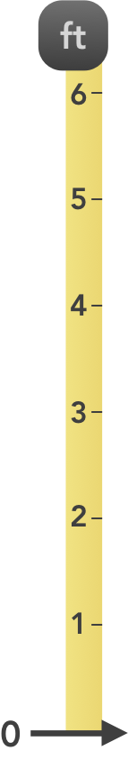







Slide 4




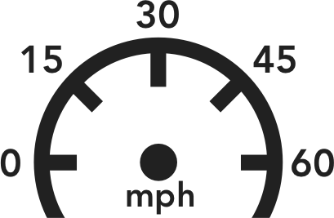




Slide 5

The gridlines in the background can be unlocked and deleted

Slide 6
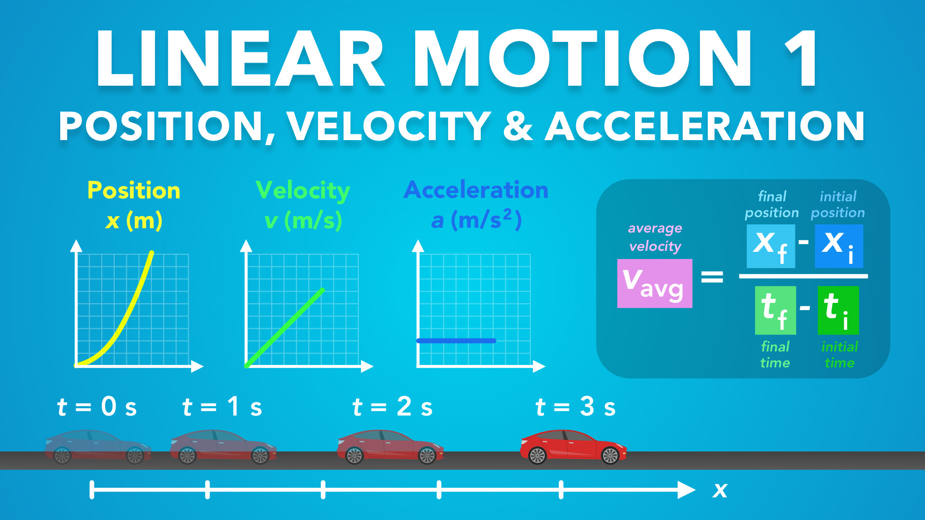
Notes:
Linear Motion 1 - Position, Velocity & Acceleration
Slides Version 2
This version includes:
Slides with screenshot images from the video.
The video narration in the slide notes.
A blank template slide with the same background and font as the video.
A slide with some basic graphics used in this video.
Feel free to add, delete and edit slides to make your own presentation. You can use these slides in class or share them with your students, but please do not post them online.
If you have any feedback, suggestions or questions about these slides please email me at chris@physicslab.app or send me a message on Discord @physicslab.
physicslab.app

Slide 7

Notes:
Hey everyone, welcome to the first video on Linear Motion. These videos will introduce us to kinematics by starting with motion in a straight line, or one dimensional motion. Then in later videos we’ll cover motion in two dimensions.
In this video we’ll talk
i. Position and displacement
ii. Velocity
iii. Acceleration
iv. These are the key elements that we’ll need for learning kinematics

Slide 8
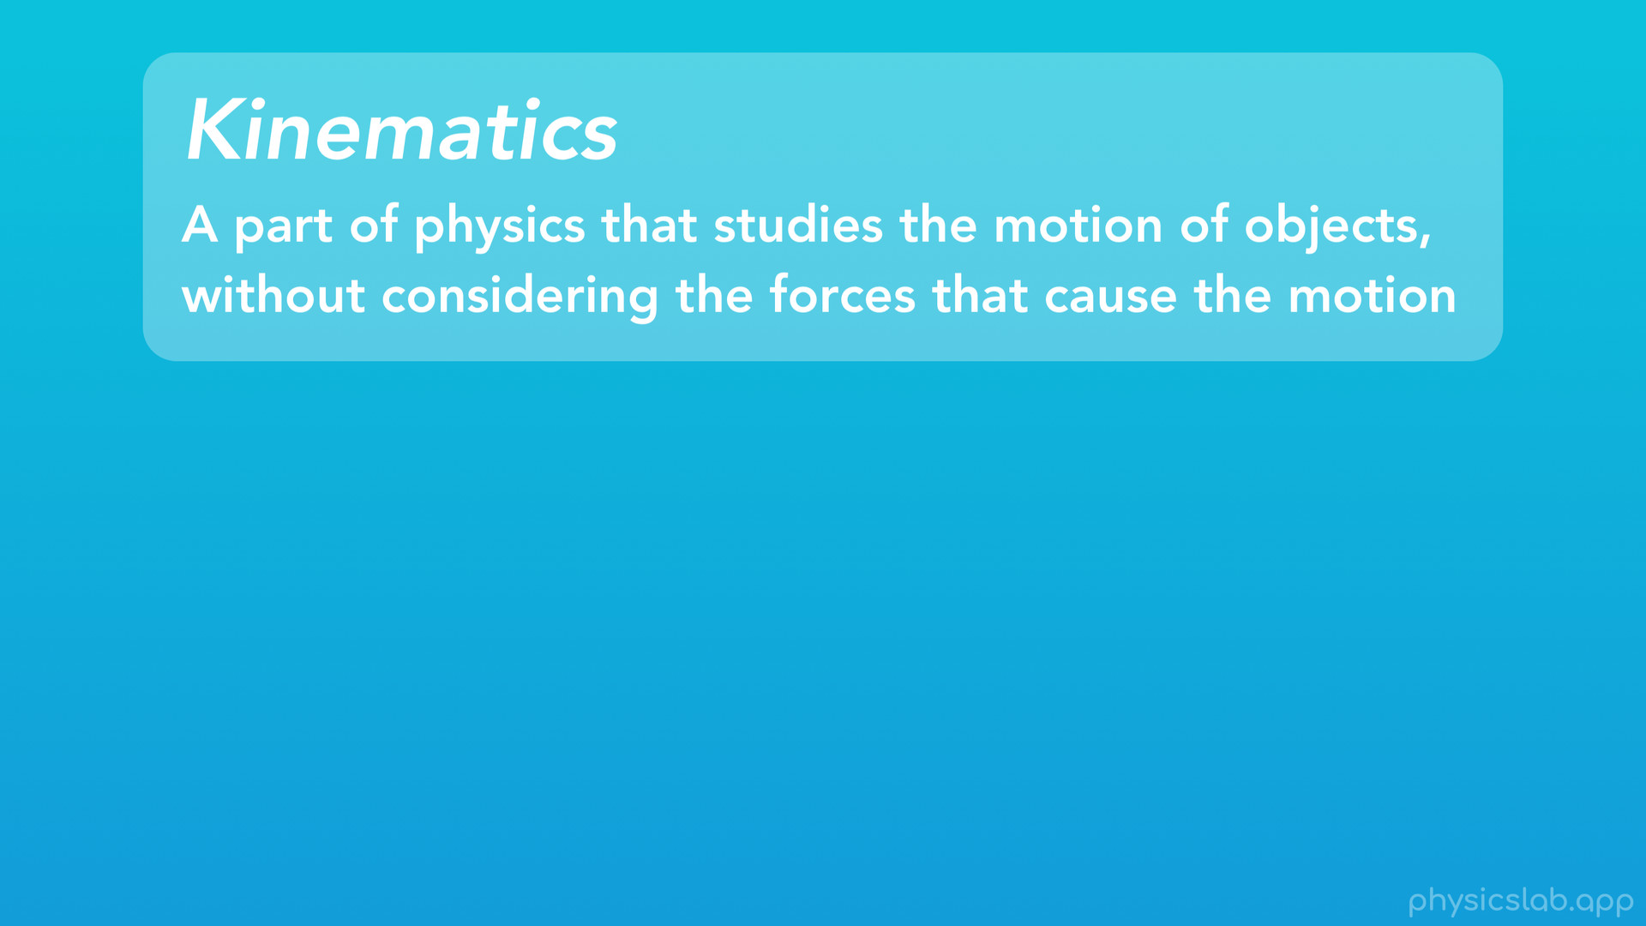
Notes:
So before we begin, what is kinematics? Kinematics is a part of physics that studies the motion of objects, without considering the forces that cause the motion.

Slide 9
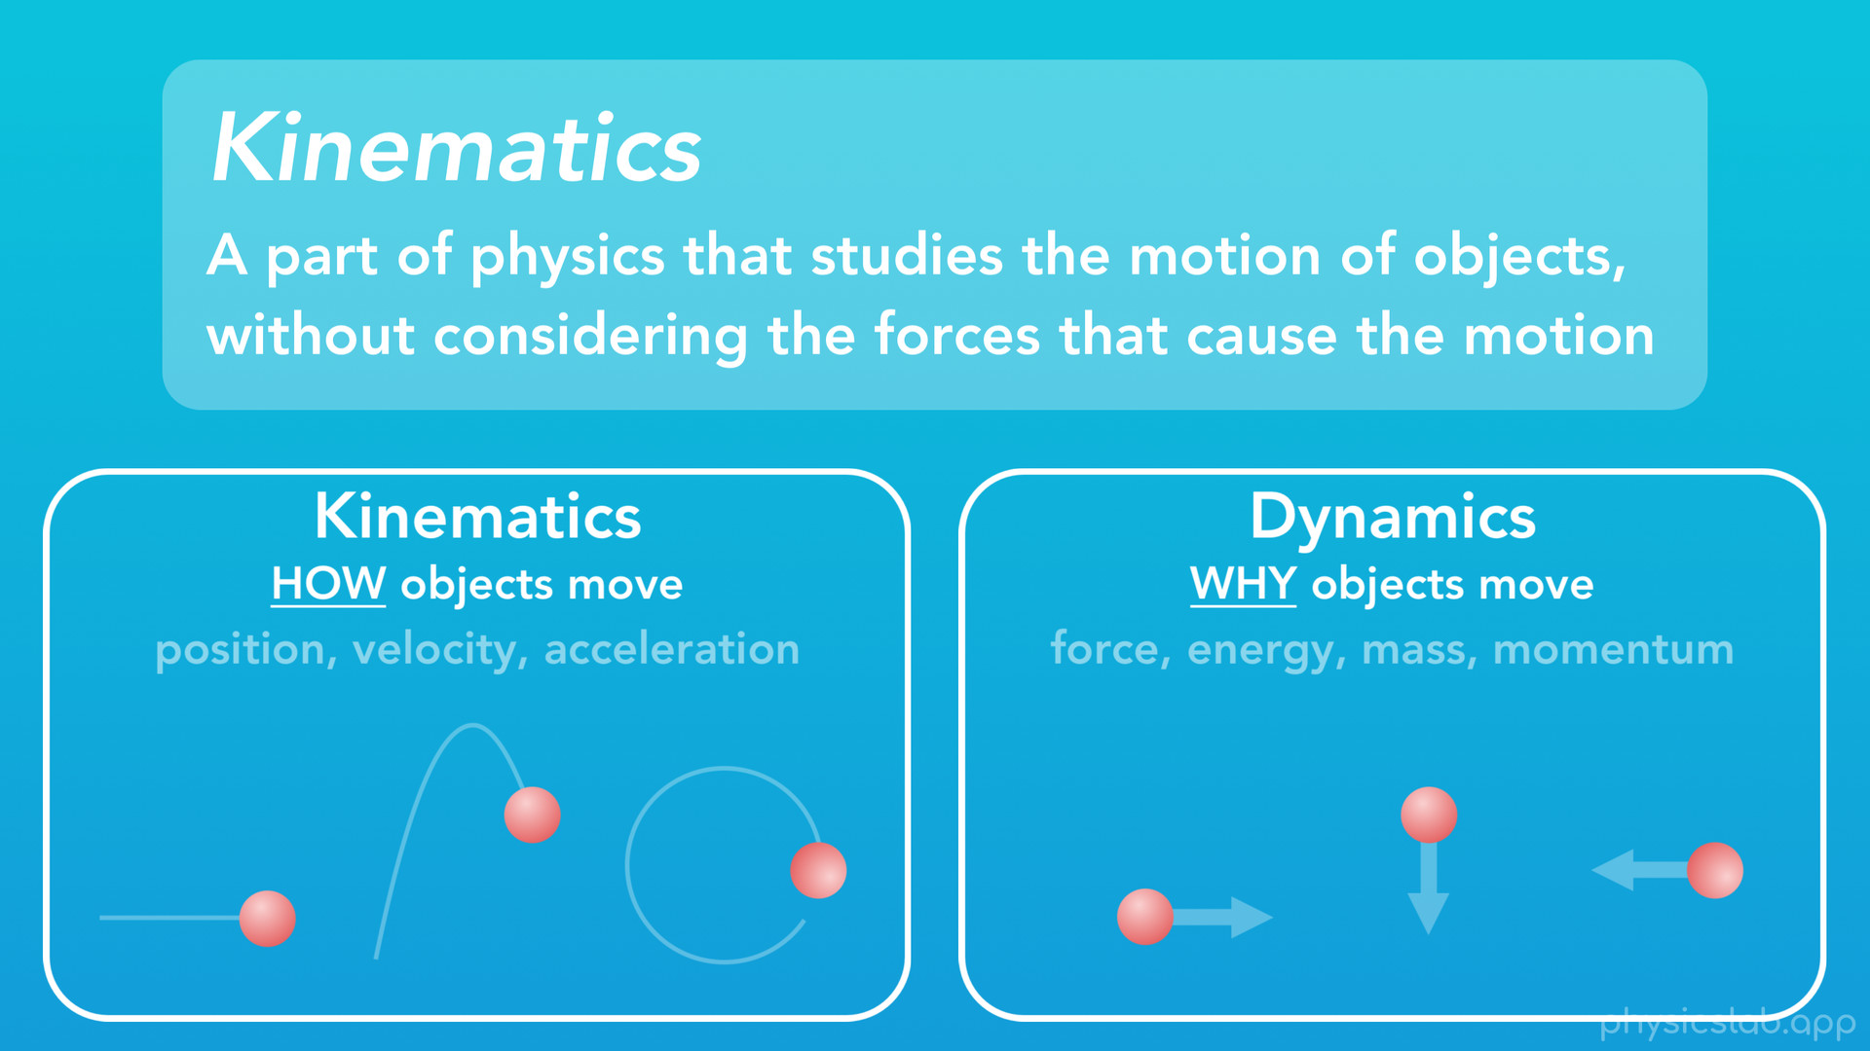
Notes:
So basically, kinematics focuses on “how” objects move, or the “way” they move and the paths they take over time. We’ll learn how to describe an object’s motion using things like position, velocity and acceleration. In kinematics, we can answer questions like: where will an object be at a certain point in time?, what direction is it going and how fast is it moving?
On the other hand, dynamics focuses on “why” objects move, or what “causes” them to move. This includes things like forces, energy, mass and momentum.
When learning physics, we usually start with kinematics, and learn how to “describe” the motion of objects first. Then in later sections, we’ll learn dynamics and what causes that motion.
So, let’s get into kinematics.

Slide 10

Notes:
First, we’ll start with position and displacement.

Slide 11
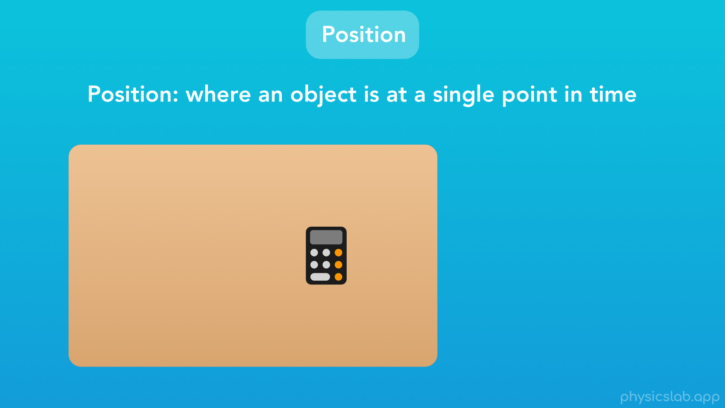
Notes:
So, position is pretty simple. We’re going to describe position as “where an object is at a single point in time”.

Slide 12
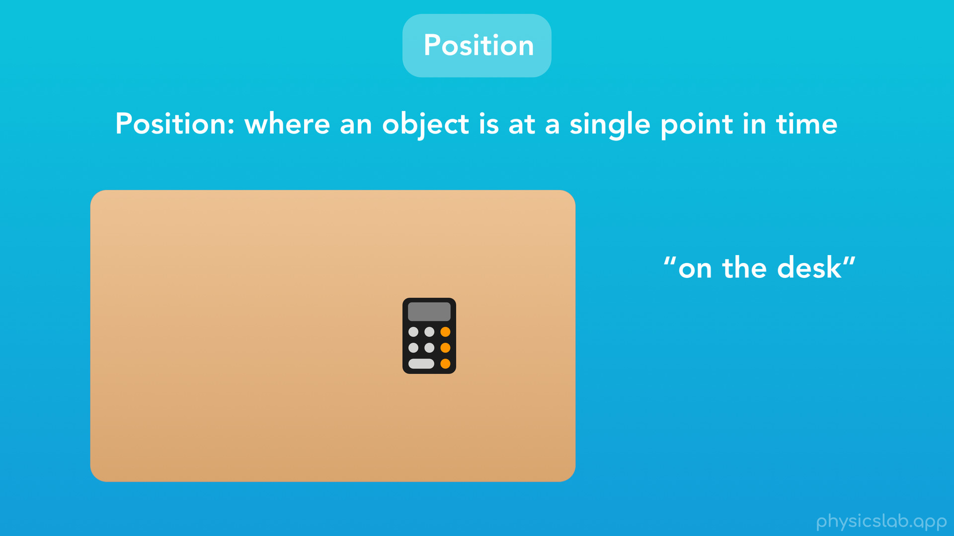
Notes:
For example, we might say the position of this calculator is “on the desk”.

Slide 13
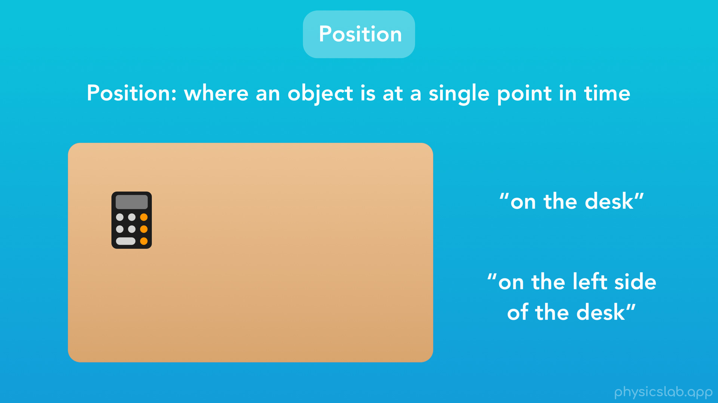
Notes:
But the calculator could be any place on this desk. If we want to be more specific, we could say the calculator is “on the left side of the desk”. This is how we’re used to describing position in everyday life.

Slide 14

Notes:
As another example, here’s a flag attached to a flagpole. How would we describe the position of the flag?

Slide 15

Notes:
Here we might say the flag is “high”.

Slide 16

Notes:
And here we might say the flag is “low”. Again, this is how we’re used to describing position.
But in physics, we need to be extremely specific about where things are. The laws of physics deal with exact positions at exact times. We can’t plug things like “low” or “the left side of the desk” into our physics equations. So how do we be more specific?

Slide 17
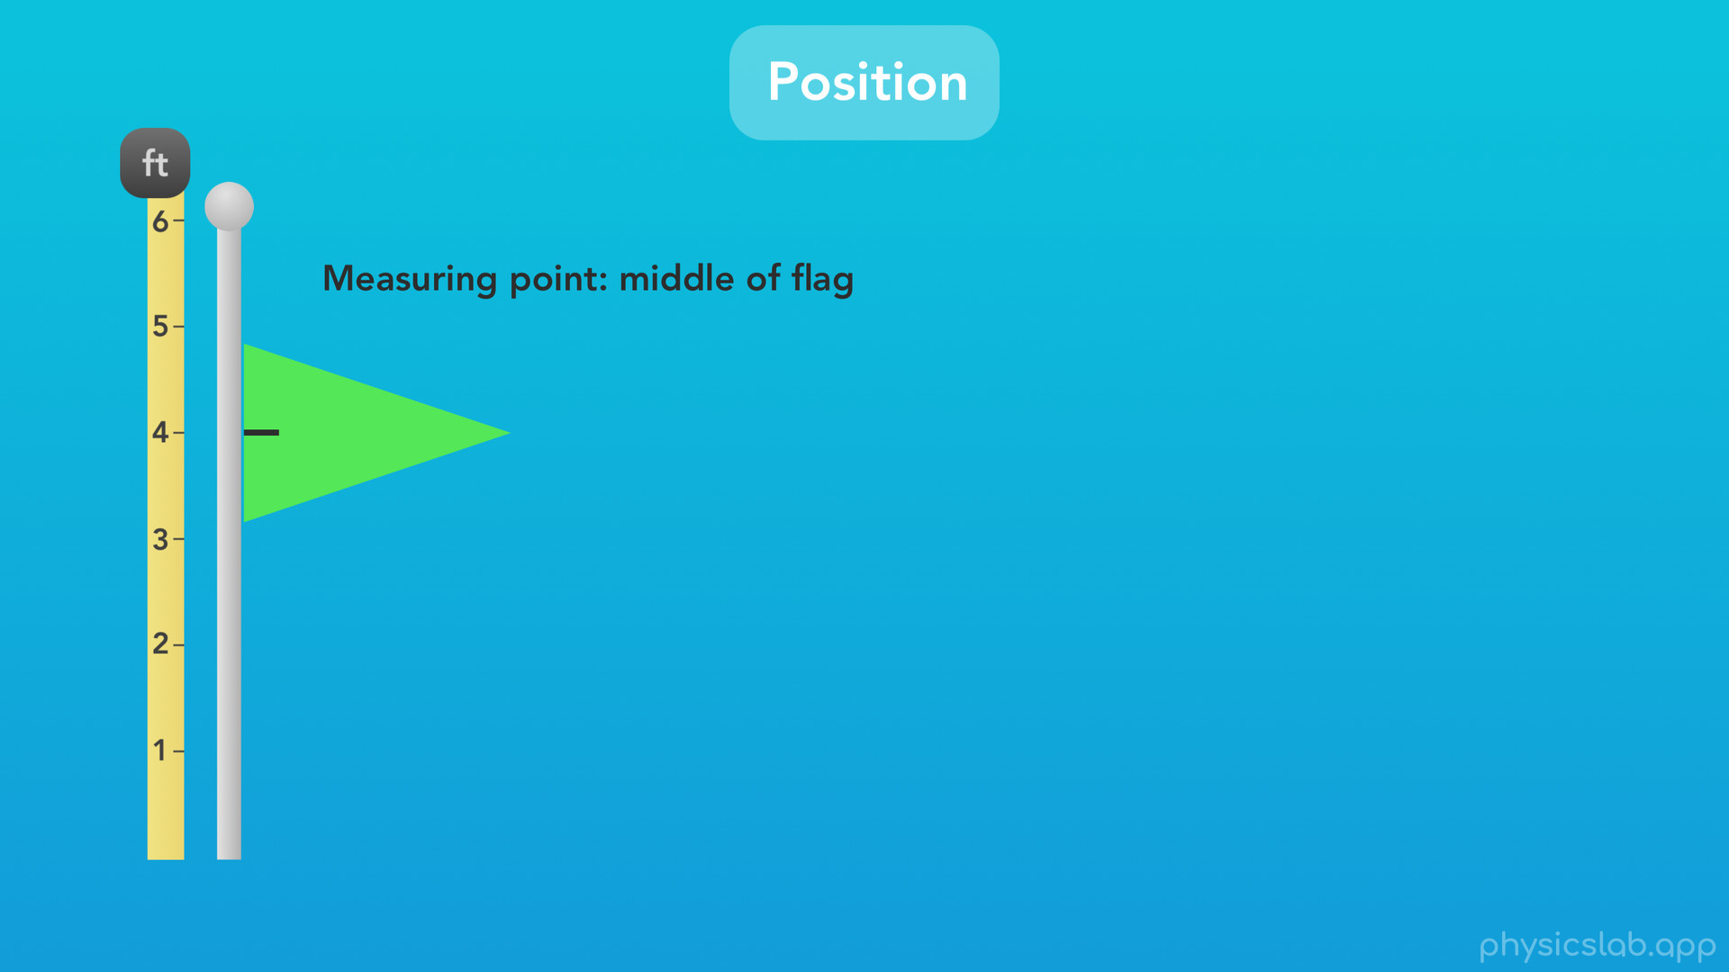
Notes:
We use numbers. If we hold up a tape measure so the end is at the bottom of the flagpole, we can measure exactly where the flag is using numbers. Since all objects have some length or width, we’ll need to pick a point on the object to measure. Most of the time, we’ll pick the middle, so let’s measure from the middle of the flag.

Slide 18
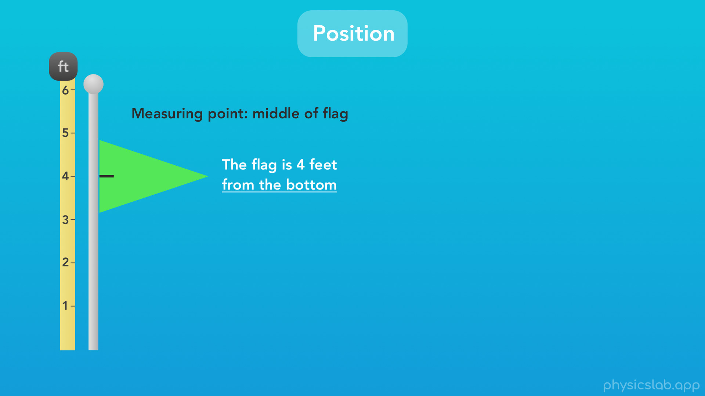
Notes:
Now instead of saying “high” or “low”, we can more precisely say “the flag is 4 feet from the bottom”

Slide 19
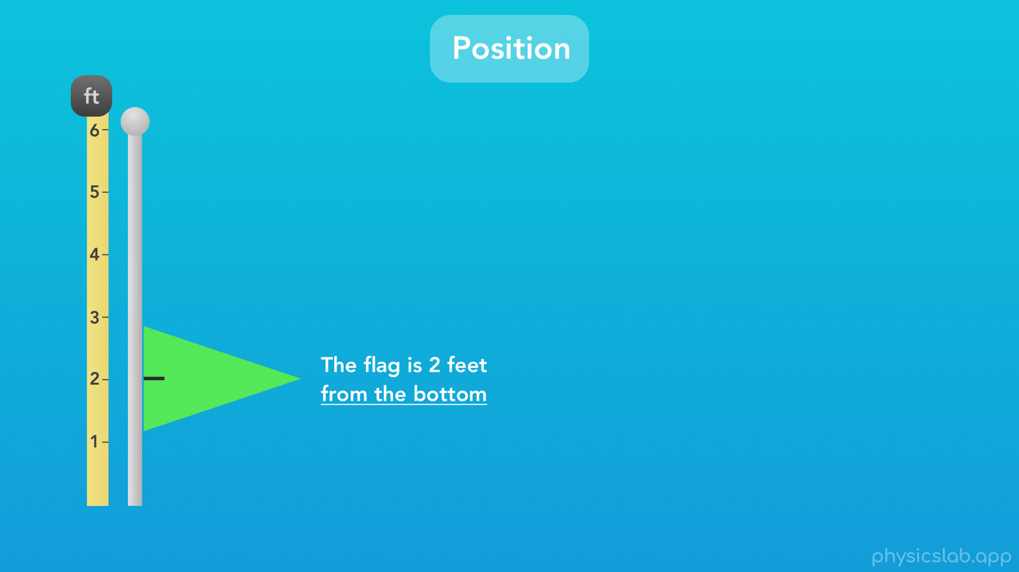
Notes:
or here “the flag is 2 feet from the bottom”. Now we’re describing the exact position of the flag on this flagpole.

Slide 20
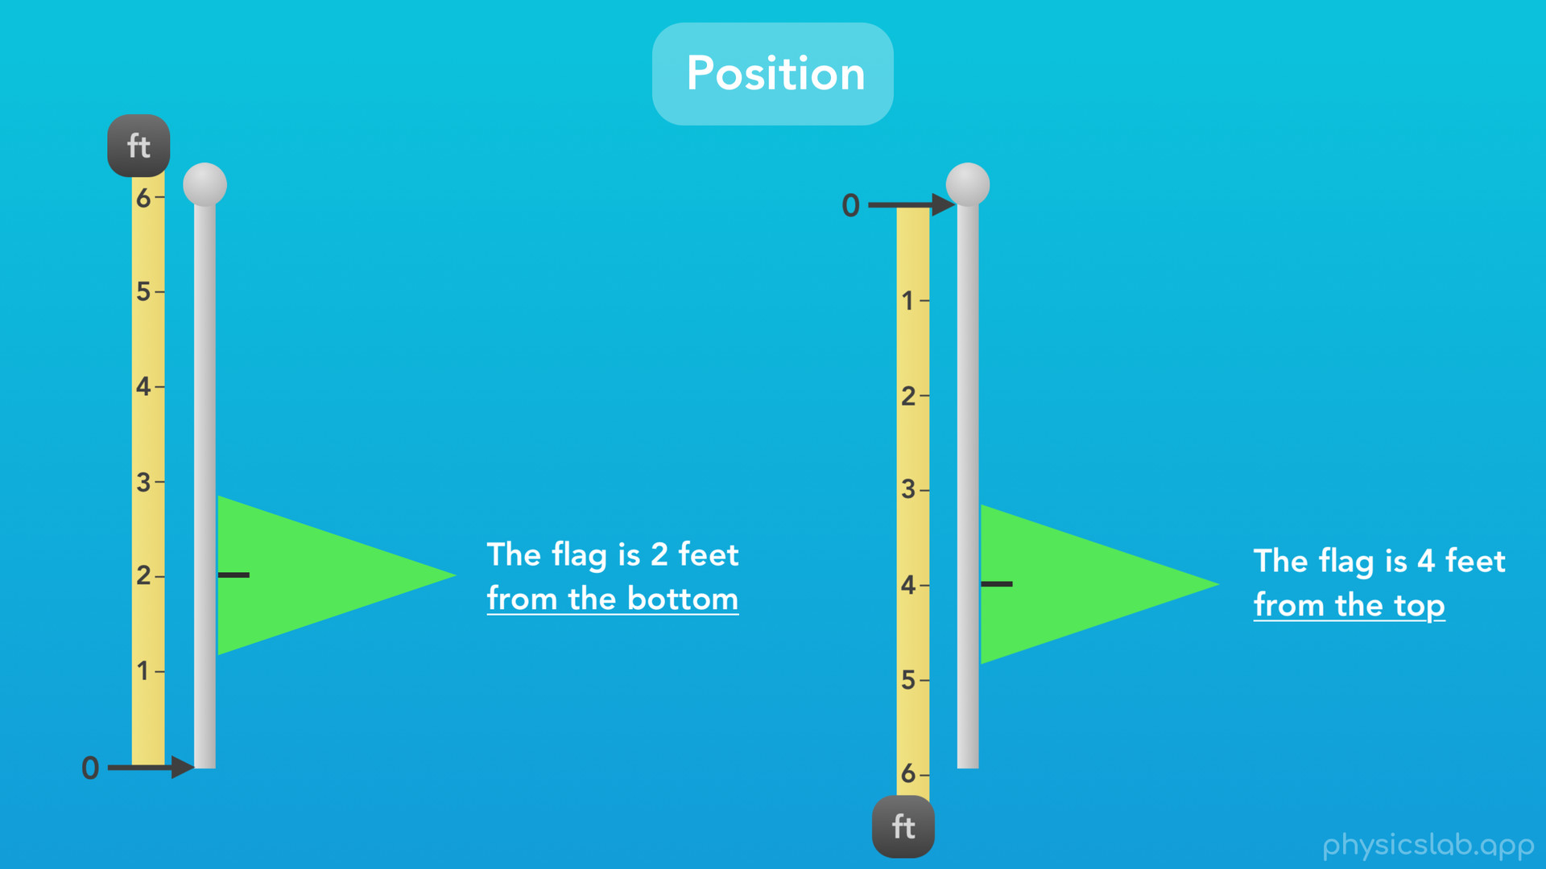
Notes:
Also, notice how we’re measuring the position of the flag relative to the bottom of the flagpole, where the position would be zero. We always have to measure position relative to some point. And we don’t have to pick the bottom. What if we measured the position of the flag from the top of the flagpole? Now the top of the flagpole has a position of zero, and if the flag was in the same position as it is on the left, now we would say the “flag is 4 feet from the top”. Both ways of measuring are fine, all we need to do is pick our zero point that we’re measuring from.
Now, since this flag can only move up or down this flag pole in a straight line, we are measuring position along one dimension. We can describe the position of the flag using only a single number, like 4 feet. One dimensional motion, or linear motion, is what we’ll be learning first.

Slide 21
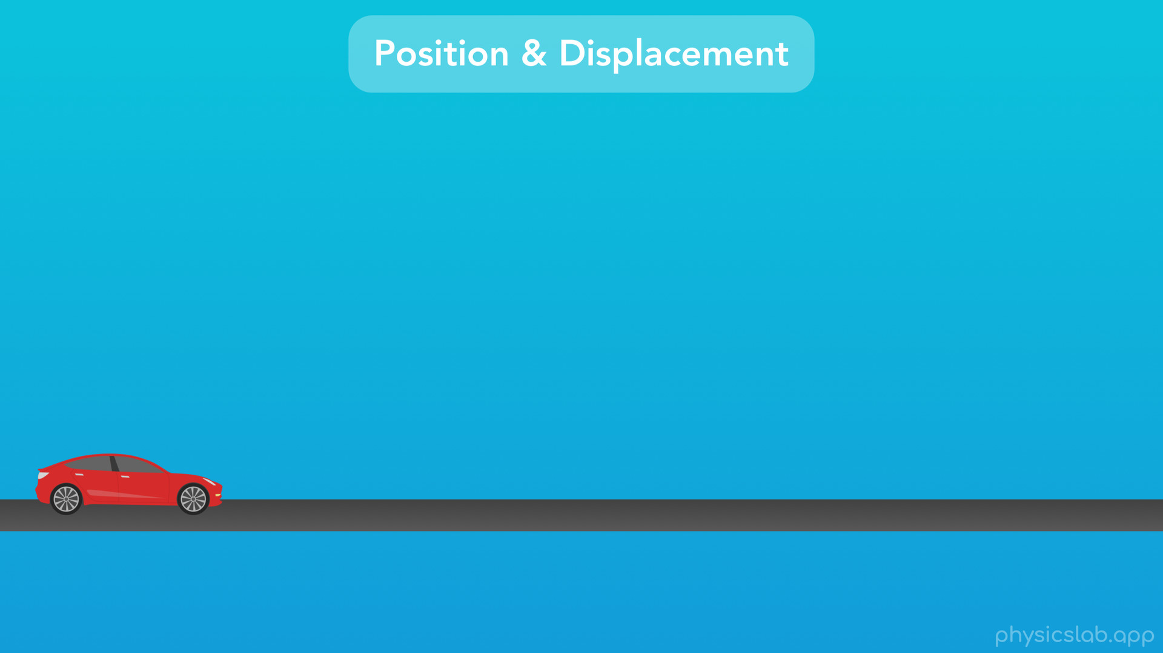
Notes:
So, as we start to talk about the position, velocity and acceleration of objects, I think it’ll help if we stick with one real world example that we can relate everything to. Let’s use a car driving along a flat, straight road.

Slide 22
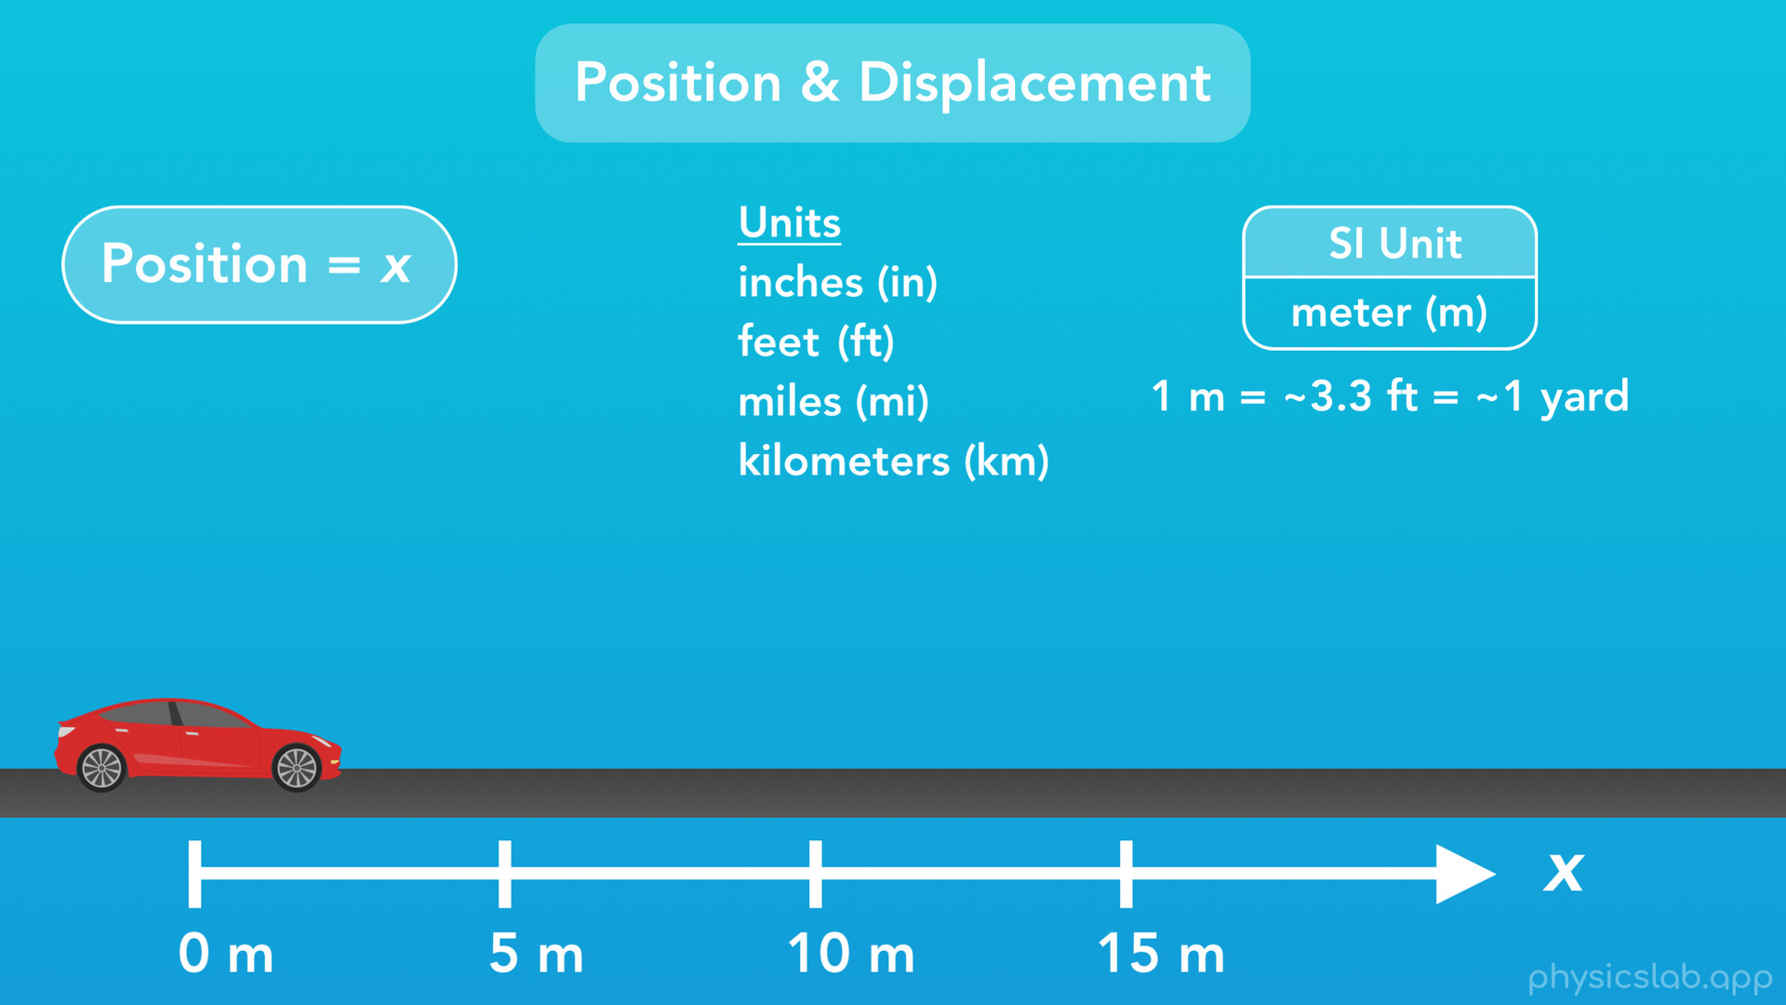
Notes:
Just like we held a tape measure up to our flagpole to measure the position of the flag, we’re going to use this number line to show the position of the car along the road. In physics, we represent the horizontal position of an object using the variable x. Position could have any unit of length or distance, such as inches, feet, miles or kilometers. But we’ll be using the SI unit of position, which is meters, or lowercase “m” for short. As a reference, 1 meter is equal to about 3.3 feet, or about 1 yard.

Slide 23
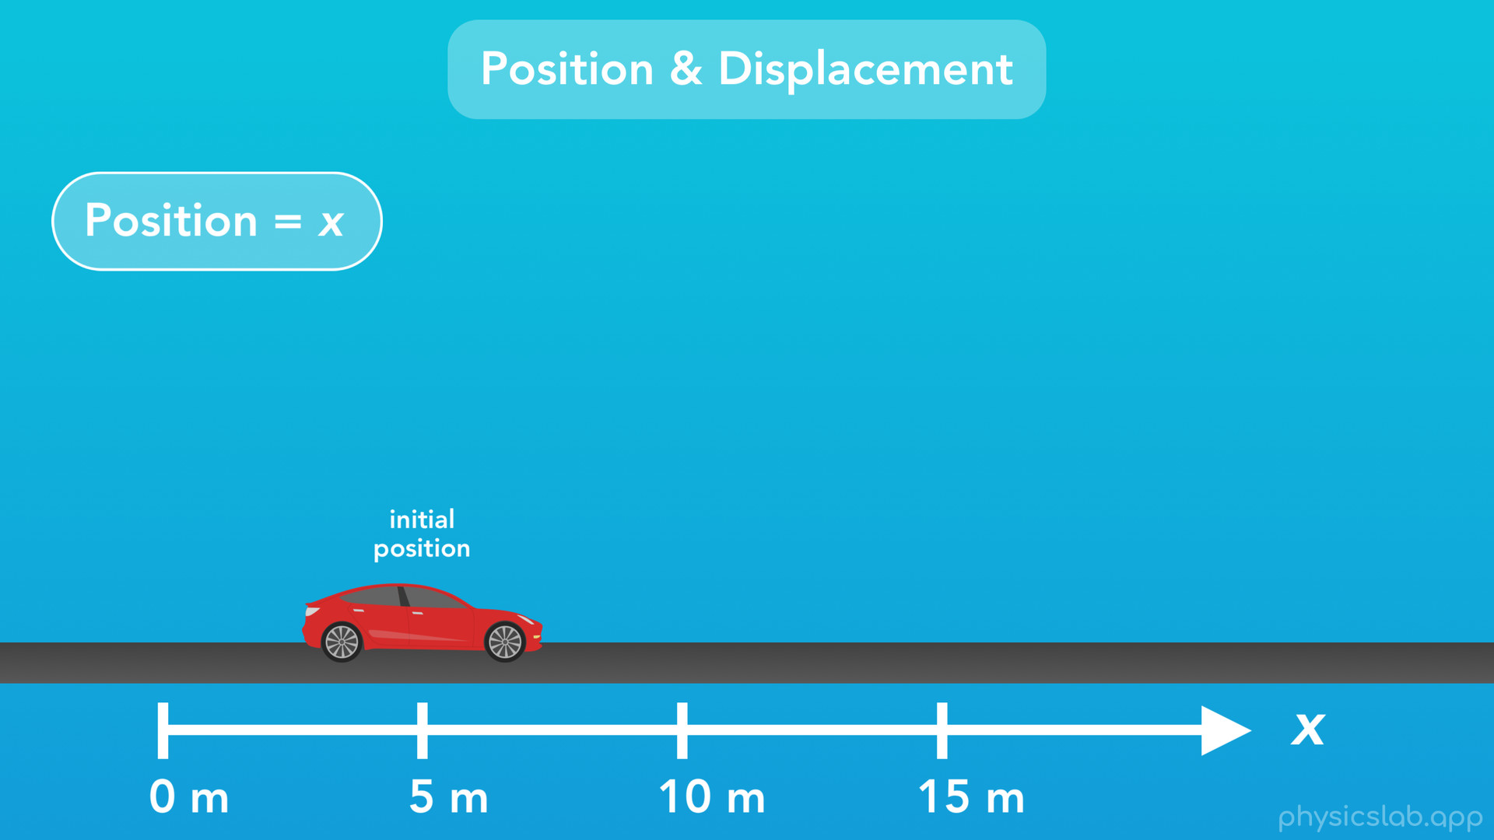
Notes:
So let’s say that the car starts at a position of 5 meters

Slide 24
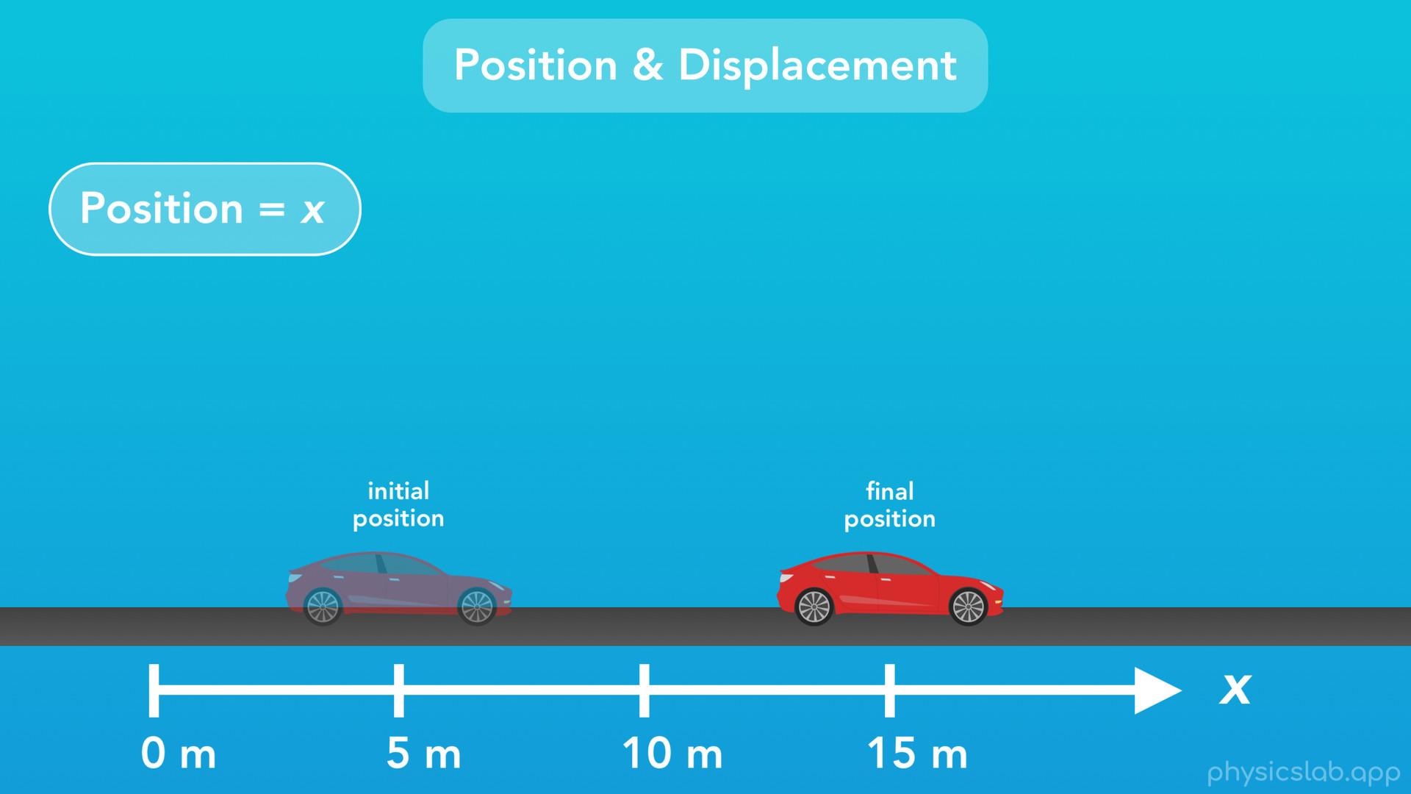
Notes:
but then it drives to a position of 15 meters.

Slide 25
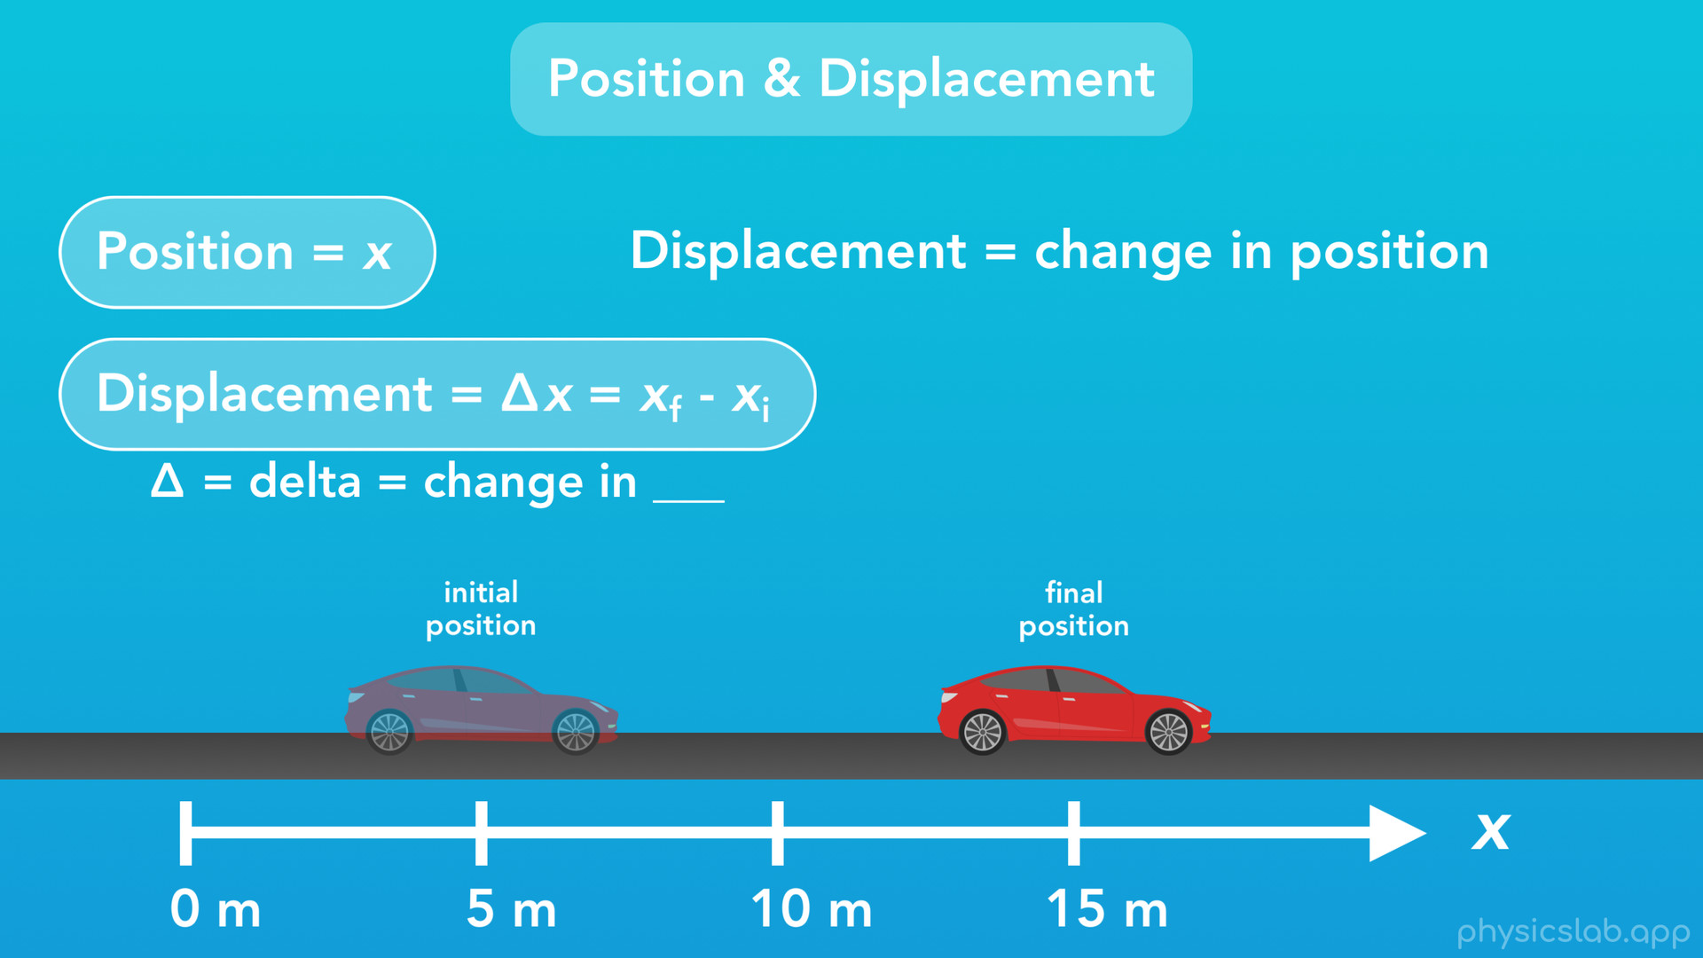
Notes:
This is what we call displacement. Displacement is the change in position of an object. Here’s our equation for displacement. This little triangle here is called “delta”. It’s a letter of the Greek alphabet and it means the “change in” something. In this case, it means the change in position. The way we actually calculate displacement is the final position minus the initial position.

Slide 26
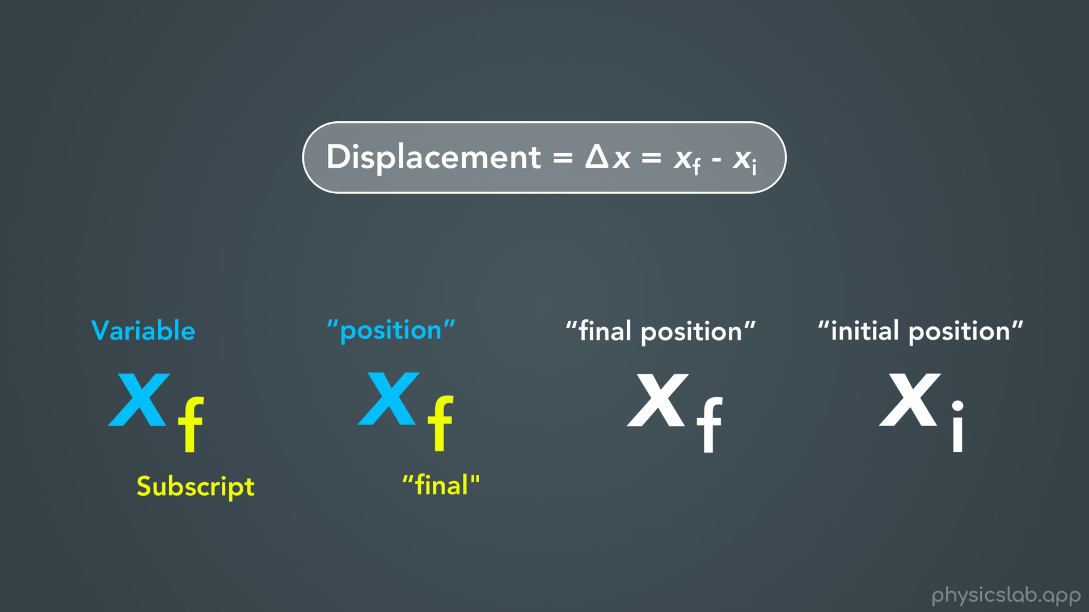
Notes:
Let’s take a closer look at this.
You’ll notice in this equation we have the variable “x”, which means position, but we also have these tiny letters “f” and “i”. When we have a variable with a small letter or number at the bottom right, the larger letter is our variable and the small letter is called a “subscript”. The variable “x” means “position” and the subscript “f” means “final”, so together as a whole they mean “final position”. And “x sub i” or “x i” means initial position.

Slide 27
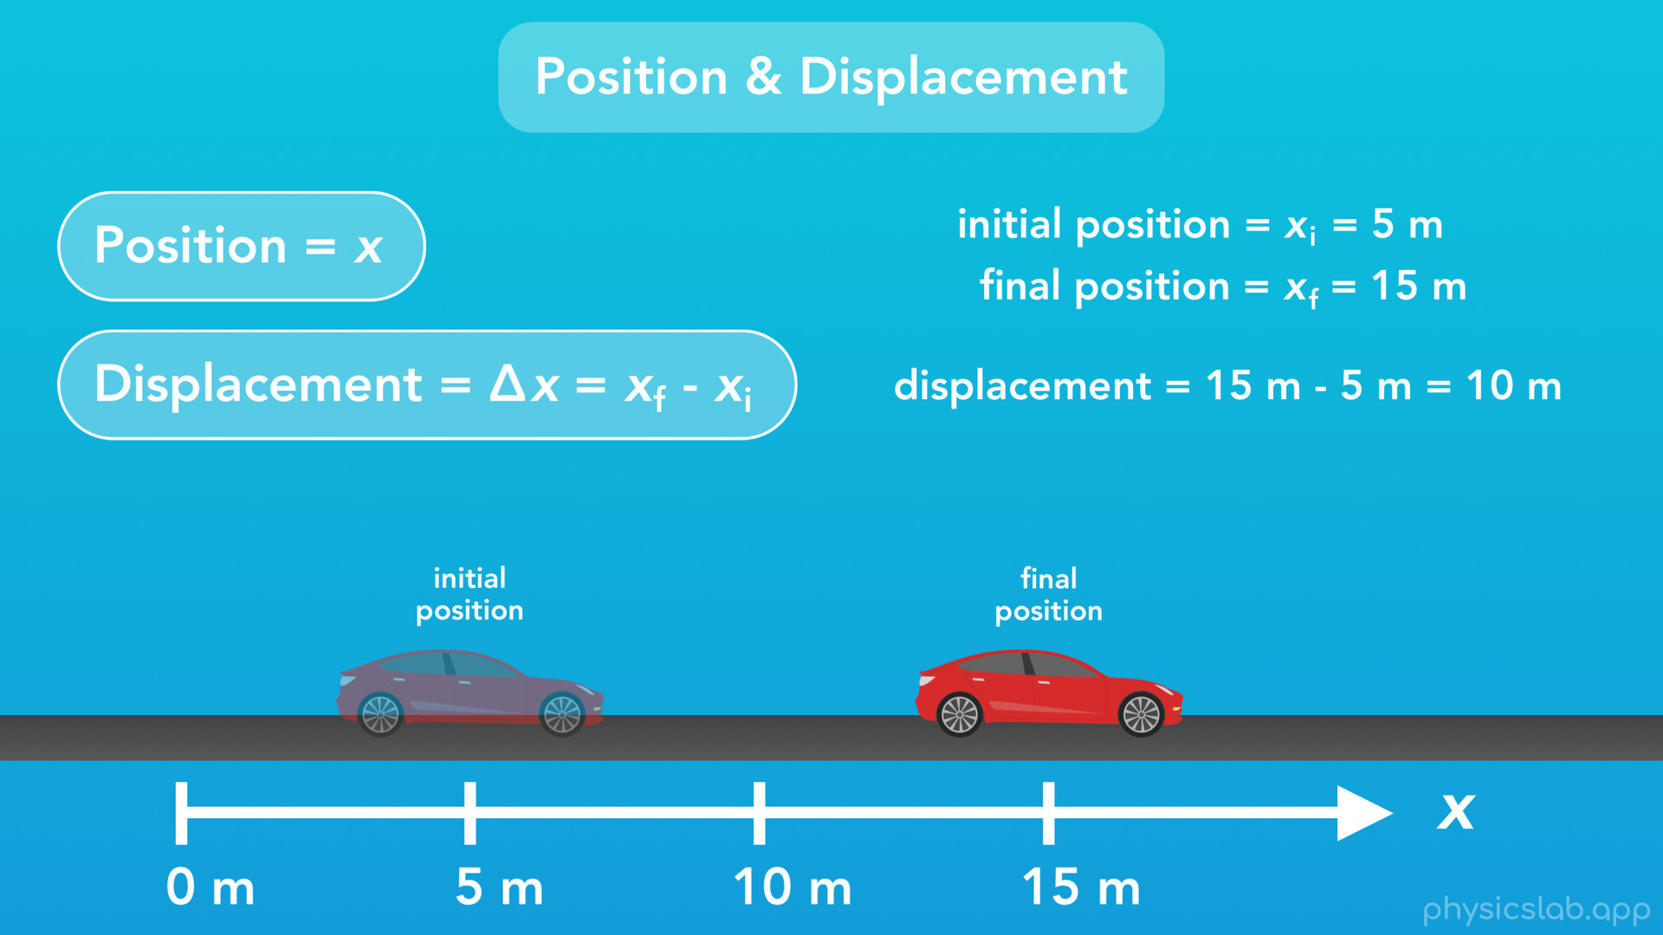
Notes:
So, what was the displacement of the car? The initial position or “x i” is 5 meters, and the final position or “x f” is 15 meters. From our equation, we see that the displacement is the final position minus the initial position. In our case that would be 15 meters minus 5 meters, which gives us 10 meters. So when the car drove forward, its displacement was 10 meters.

Slide 28
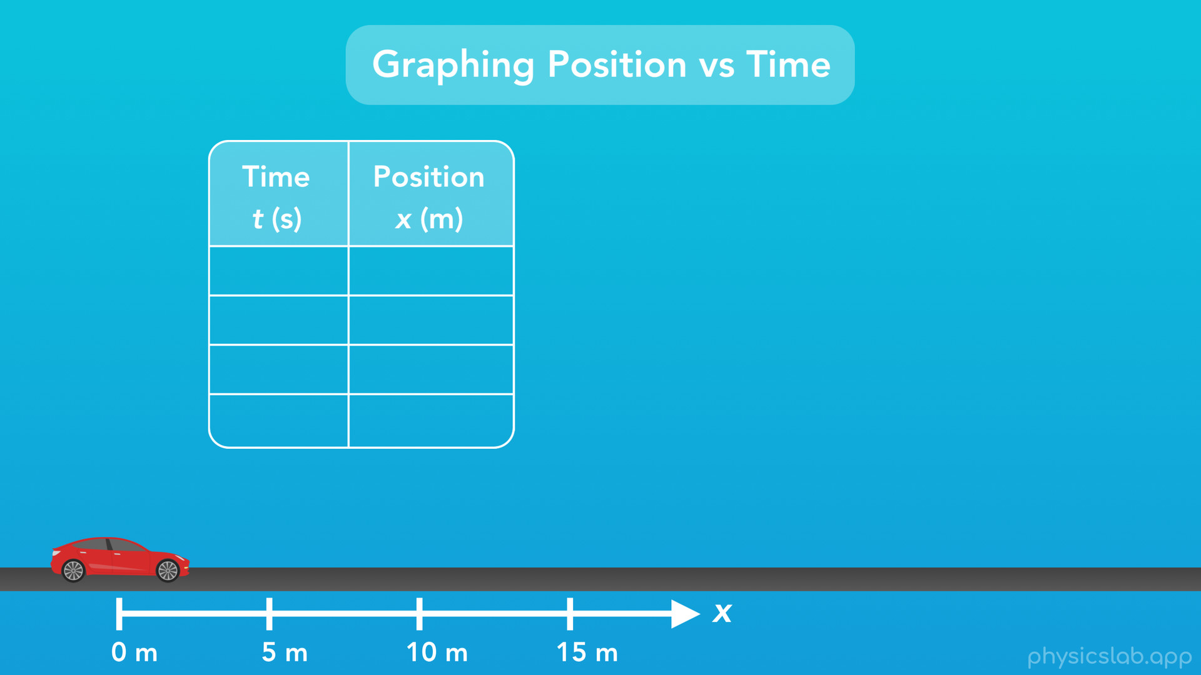
Notes:
So now that we have an idea of what position is, let’s take a look at how we could graph the position of this car over time as it moves.

Slide 29
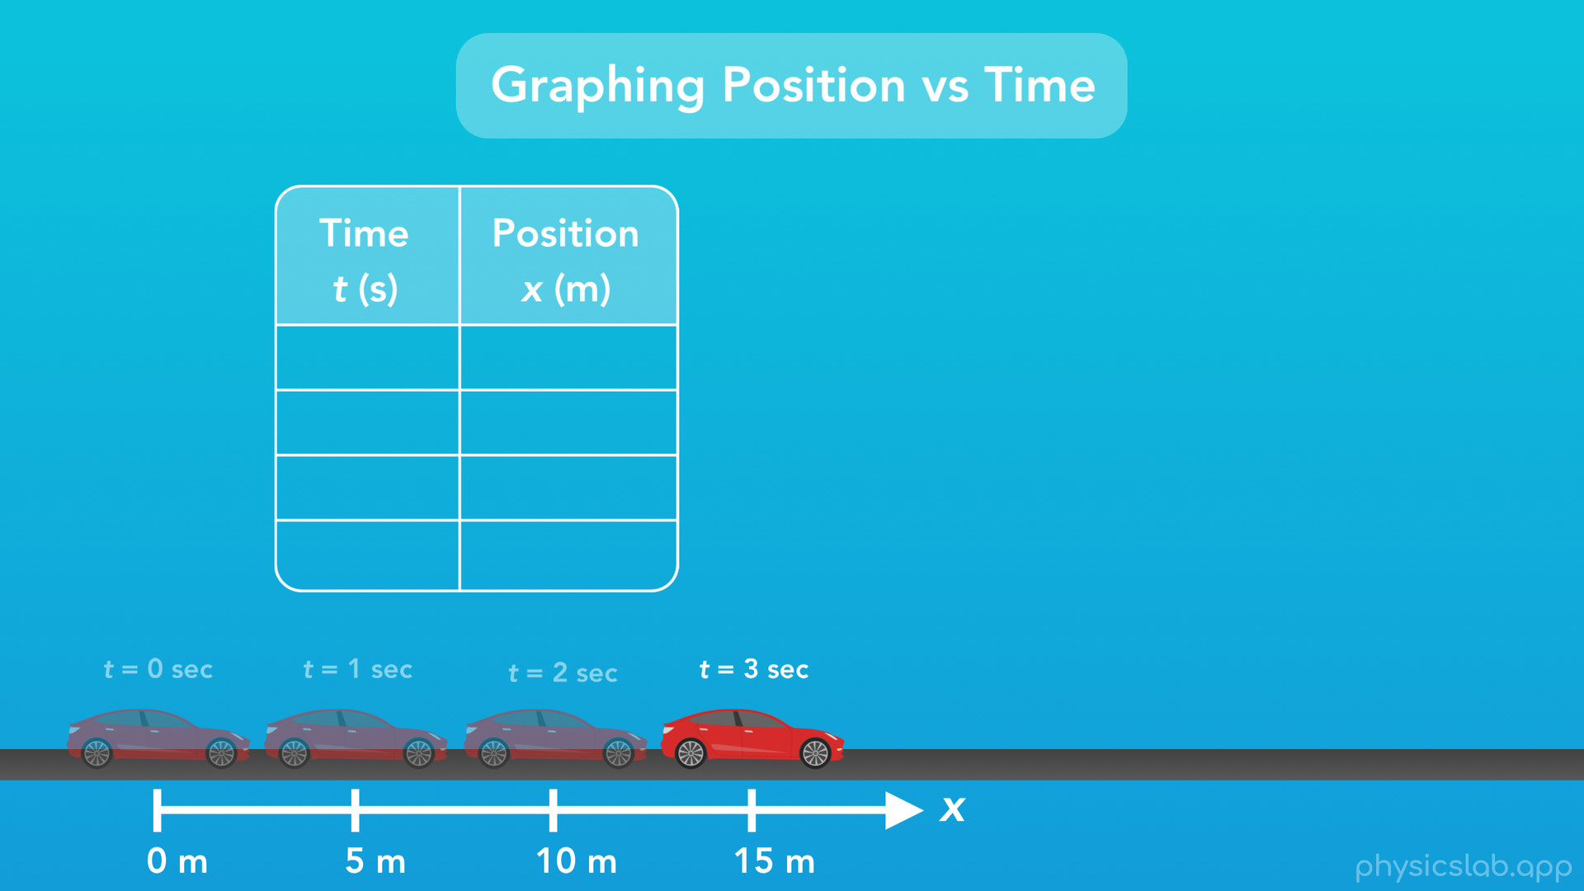
Notes:
To do that, we’ll start by listing the position of the car at different points in time, as if someone was standing on the side of the road with a stopwatch, and recording the position of the car at different times. So let’s say the car is driving forward like this.

Slide 30
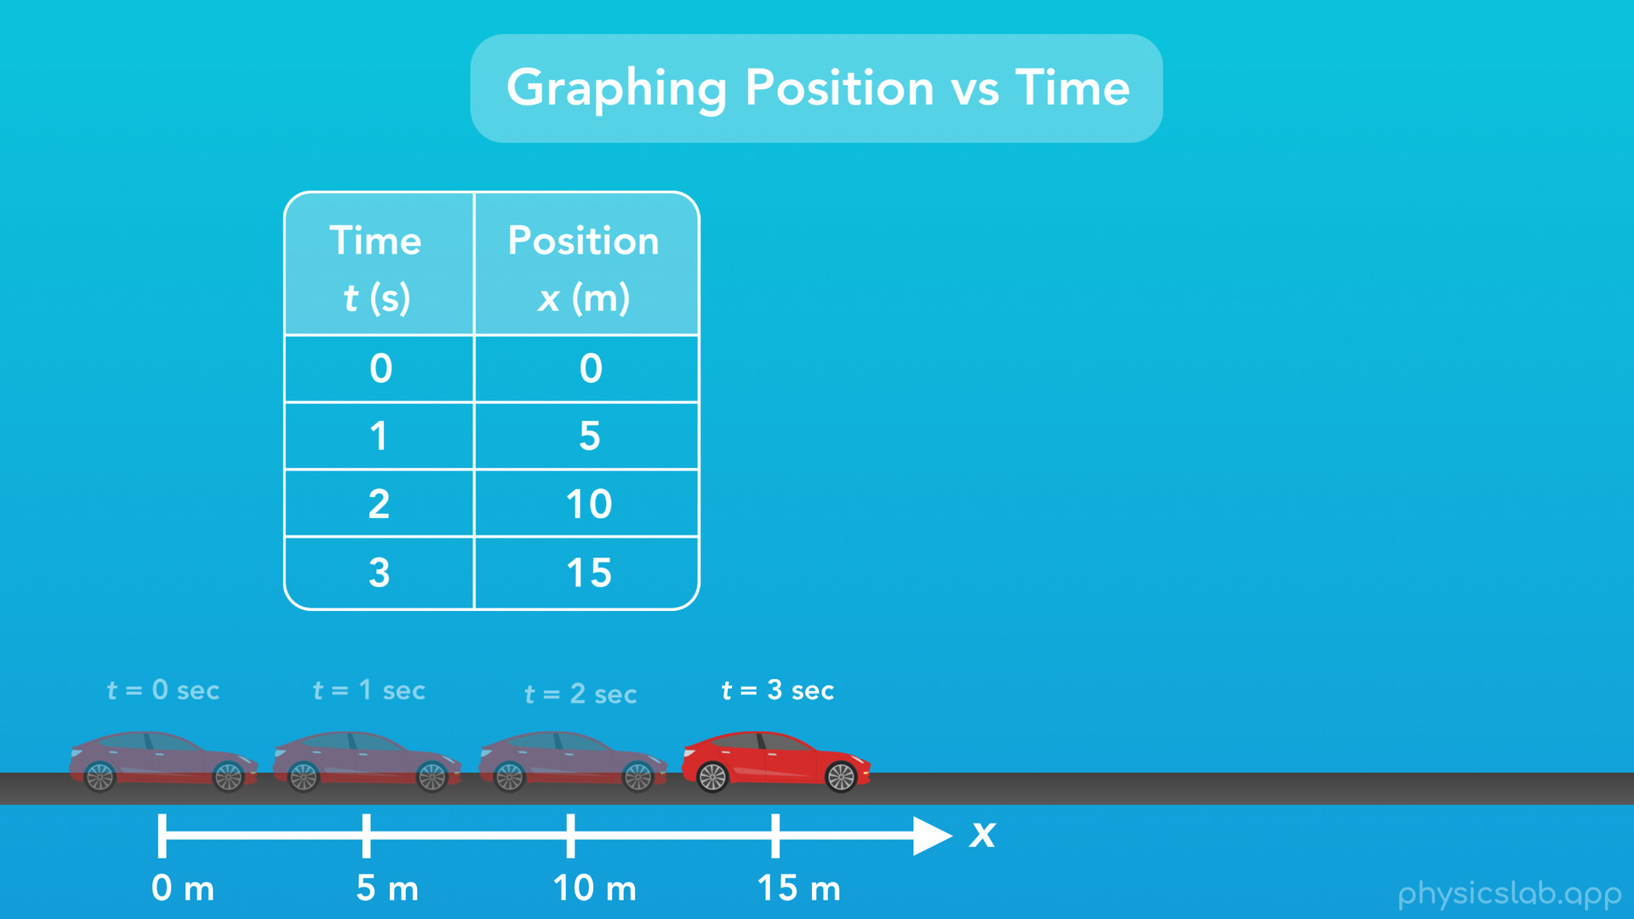
Notes:
At the very beginning, the position of the car is 0 meters. After 1 second, the car’s position is 5 meters. After 2 seconds, the cars position is 10 meters, and after 3 seconds the car’s position is 15 meters. Now we have a table showing the car’s position at different points in time.

Slide 31
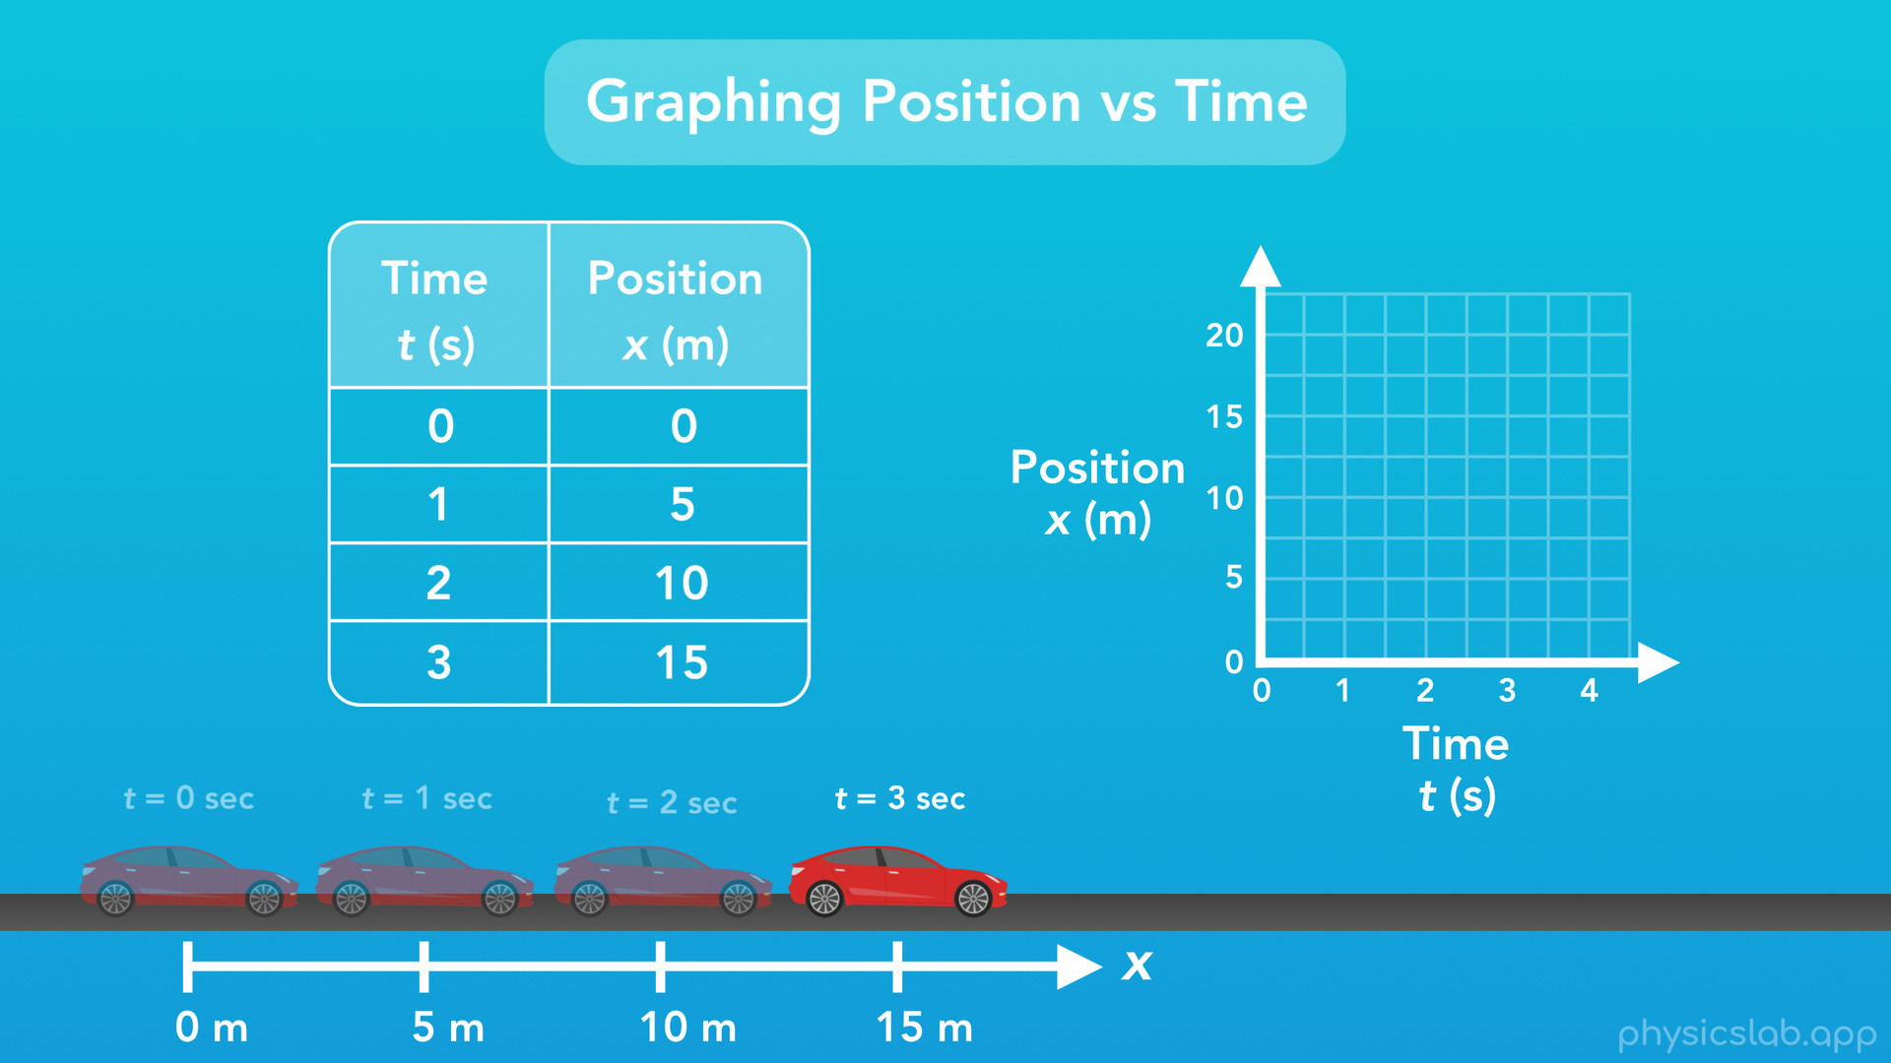
Notes:
What would a graph of the car’s position over time look like? We’ll start with an empty graph, where the x-axis or the horizontal axis represents time, and the y-axis or the vertical axis represents the position of the car on the road. Now it might seem weird that we’re putting the car’s horizontal position on the vertical axis of the graph. The reason is that we always put time on the x-axis or horizontal axis. That will make more sense throughout the course, but for now just know that we always put time on the horizontal axis of a graph.

Slide 32

Notes:
So how do we graph the position of this car over time? We start by plotting points that we have in our table on the left. When time equals zero seconds, the position of the car is zero meters, so we’ll plot that point on our graph where time equals zero and position equals zero. Next, when time equals 1 second, the position of the car is 5 meters, so we’ll plot that point where time equals 1 second and position equals 5 meters. When the time equals 2 seconds, the car’s position is 10 meters, and when time equals 3 seconds, the car’s position is 15 meters.

Slide 33
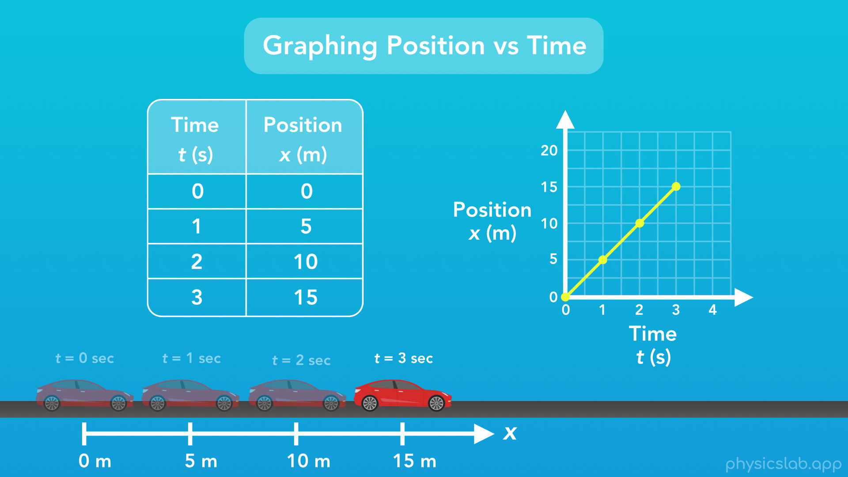
Notes:
Now that we have some data points on our graph, we’ll connect the points with lines. And there we go. For this car’s motion we’ve graphed the car’s position vs time.

Slide 34

Notes:
Next, let’s talk about velocity.

Slide 35
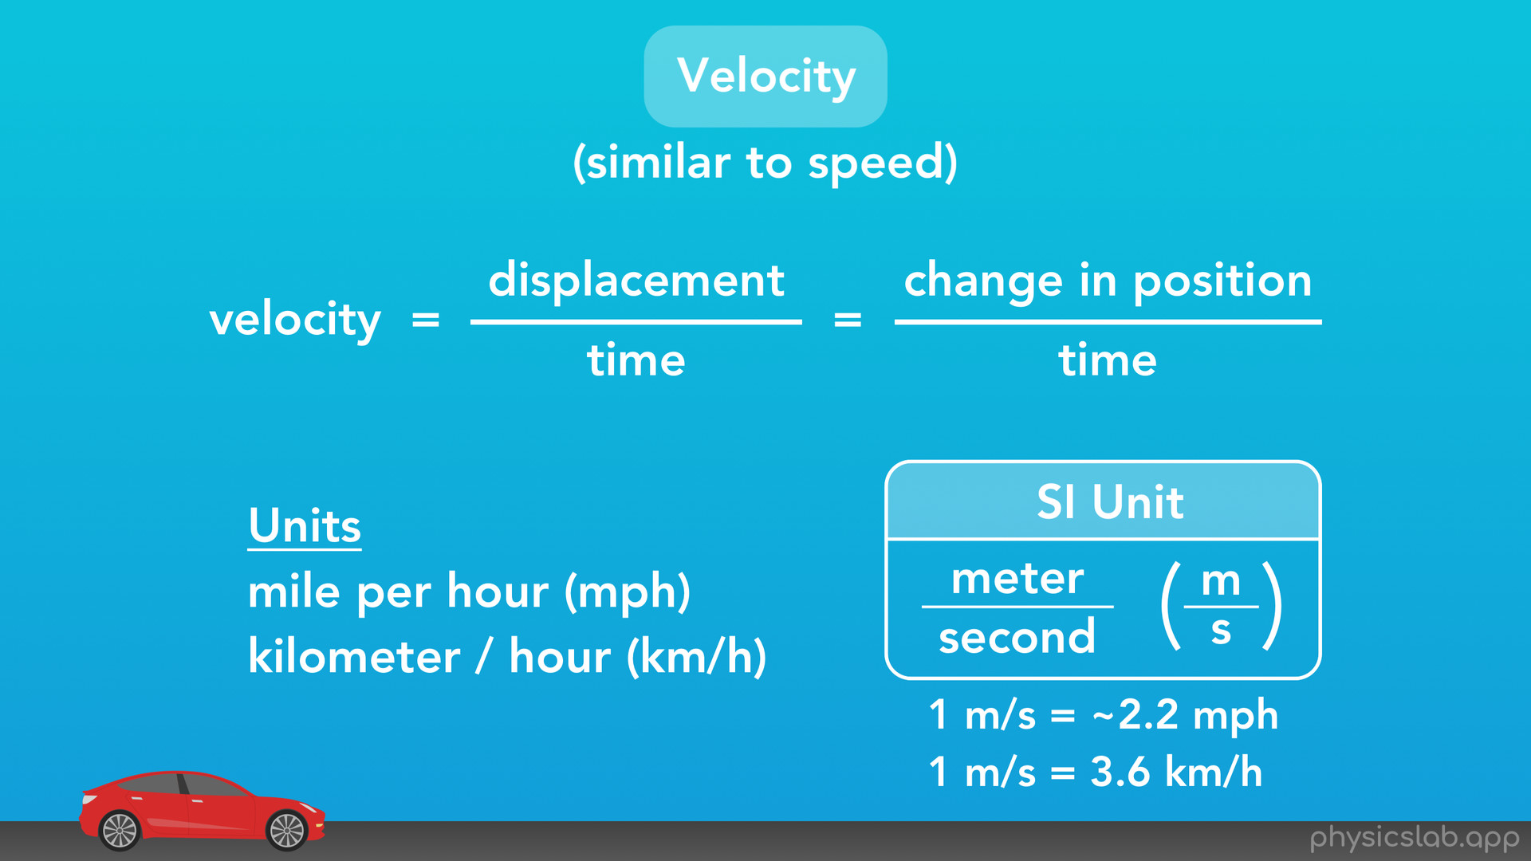
Notes:
Velocity is similar to speed, but we’ll talk about why it’s different from speed later on.
Velocity is defined as the displacement of an object divided by the amount of time it takes the object to travel, which is the same thing as the change in position of an object divided by the time. There are a few common units we use to describe velocity or speed, such as miles per hour or kilometers per hour. But the unit we use in physics, the SI unit of velocity, is meters per second, abbreviated as m over s. For reference, 1 meter per second is roughly 2.2 mph and 3.6 km/h.

Slide 36
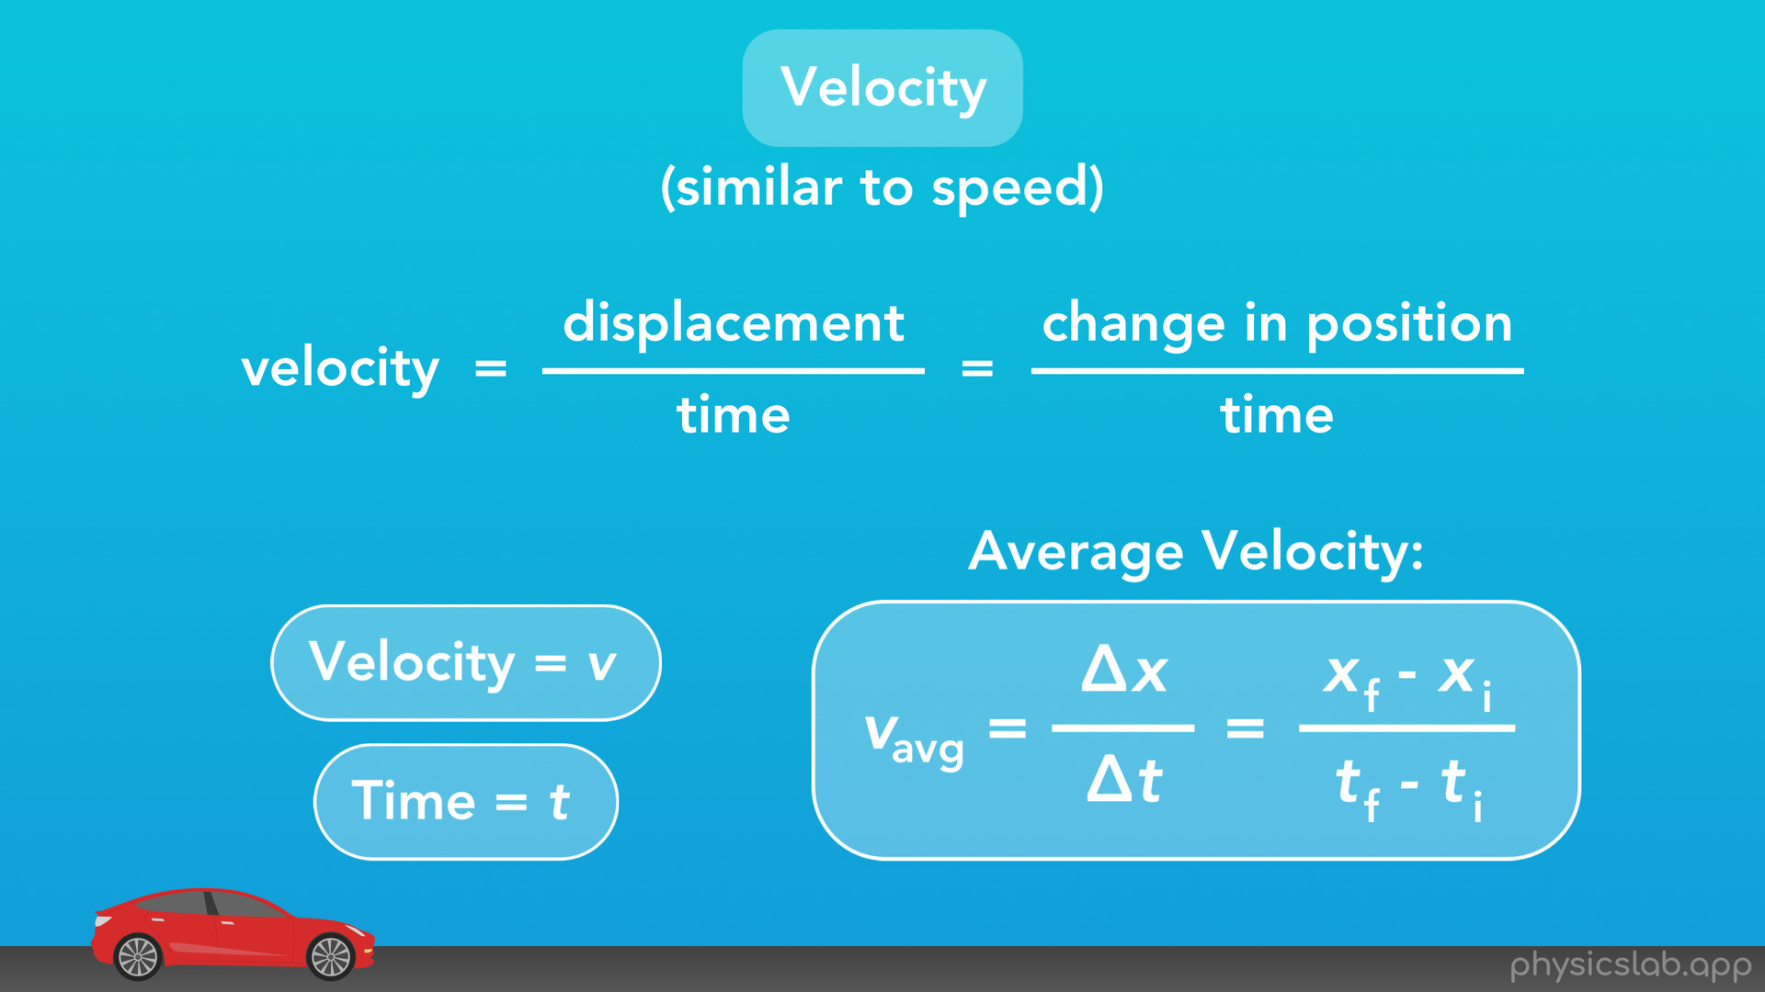
Notes:
We represent velocity using the variable “v”. And, we represent time using the variable “t”. So here is our equation for the average velocity of an object. We could say the average velocity equals the displacement over time, or we could write out each of the variables separately.

Slide 37
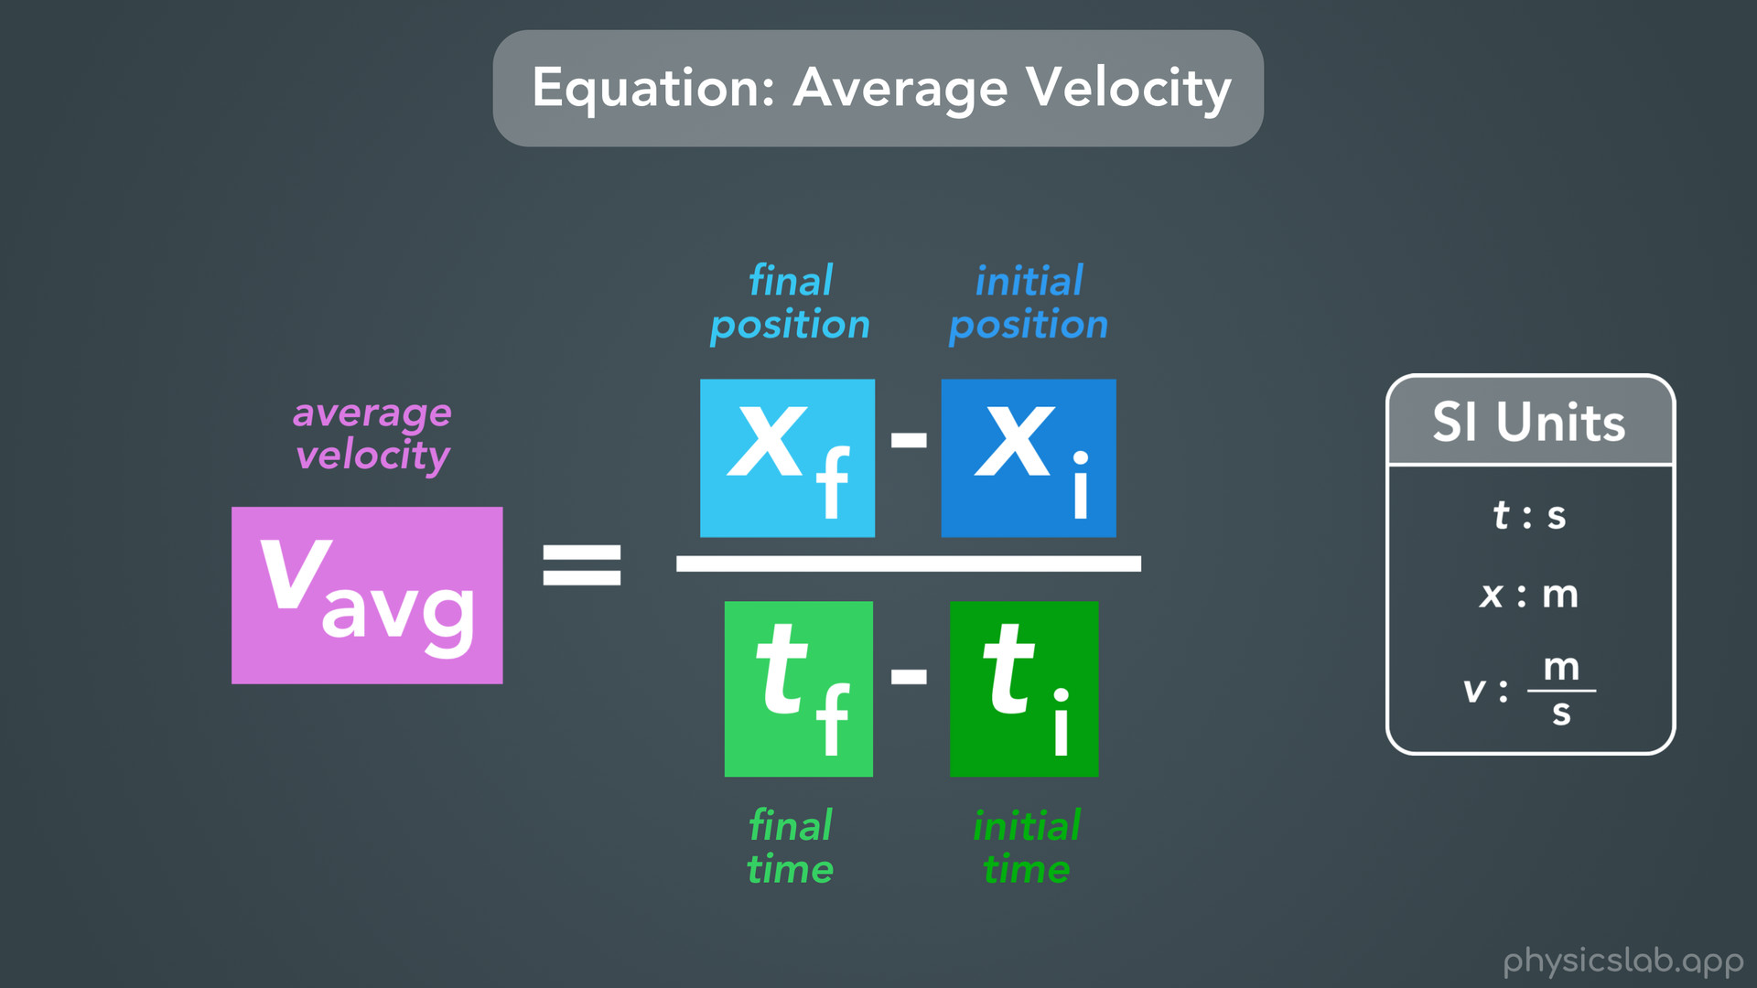
Notes:
Let’s take a closer look at that equation.
V with the subscript “avg” is the average velocity, “xf” is the final position, “xi” is the initial position, “tf” is the final time, and “ti” is the initial time. All together, this equation says that the average velocity of an object equals the final position minus the initial position, divided by the final time minus the initial time. Another way to say it is the average velocity equals the change in position over the change in time. Here are the SI units for the variables in this equation: time or “t” is in seconds, position or “x” is in meters, and velocity or “v” is in meters per second.
An important thing when we use physics equations like this one, the math only works out if we plug in numbers using SI units. We can only get velocity in meters/second if we plug in position in meters and time in seconds. Of course you could use any units you want, like inches and hours, but then your velocity will be in inches/hour and things could get a little crazy, especially if you’re using multiple equations in a problem. So just remember to stick with SI units when using equations.

Slide 38
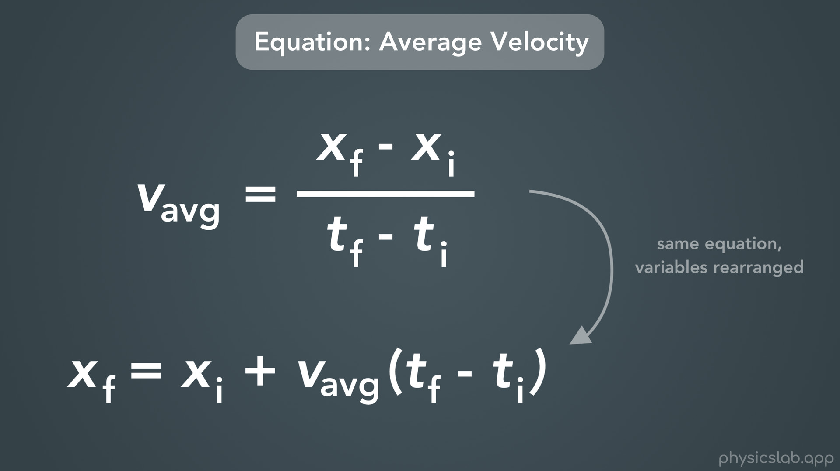
Notes:
One more thing I want to note here is that this equation we just learned is the same thing as this equation, which you might see in class or on your equation sheet. These are the exact same equation, but the variables in the equations have been rearranged using algebra, like we learned in a previous video.

Slide 39
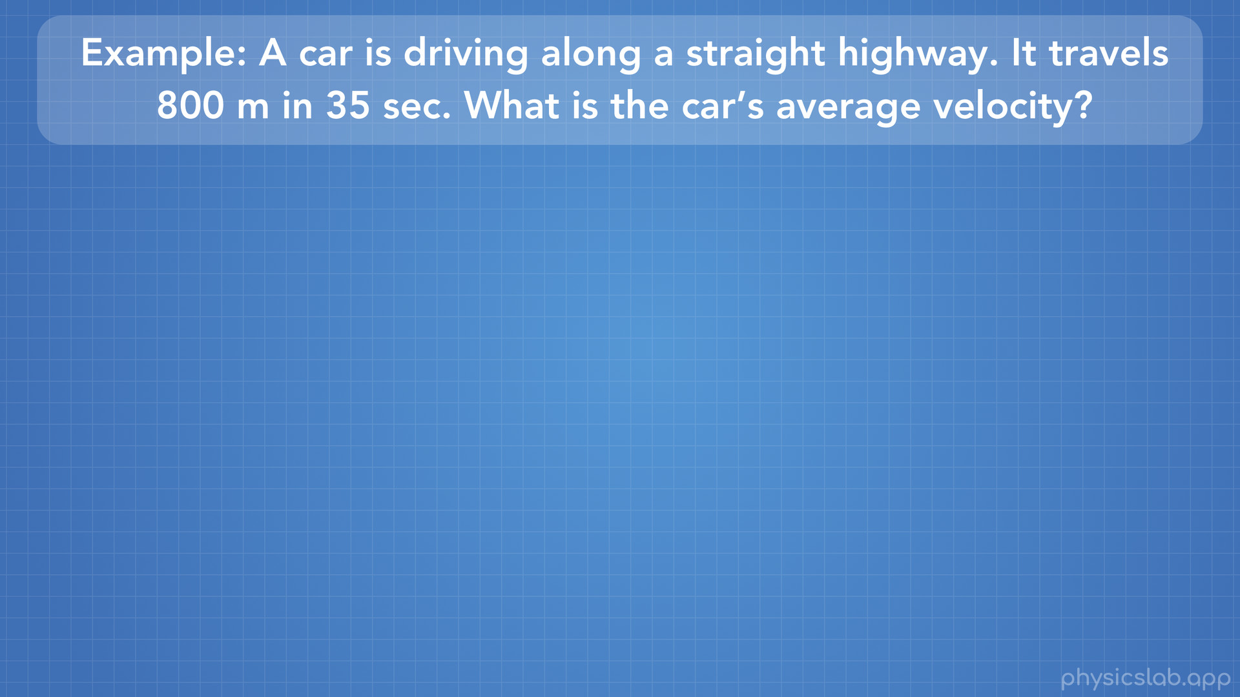
Notes:
So let’s do an example problem to try out this equation. A car is driving along a straight highway. It travels 800 meters in 35 seconds. What is the car’s average velocity?

Slide 40
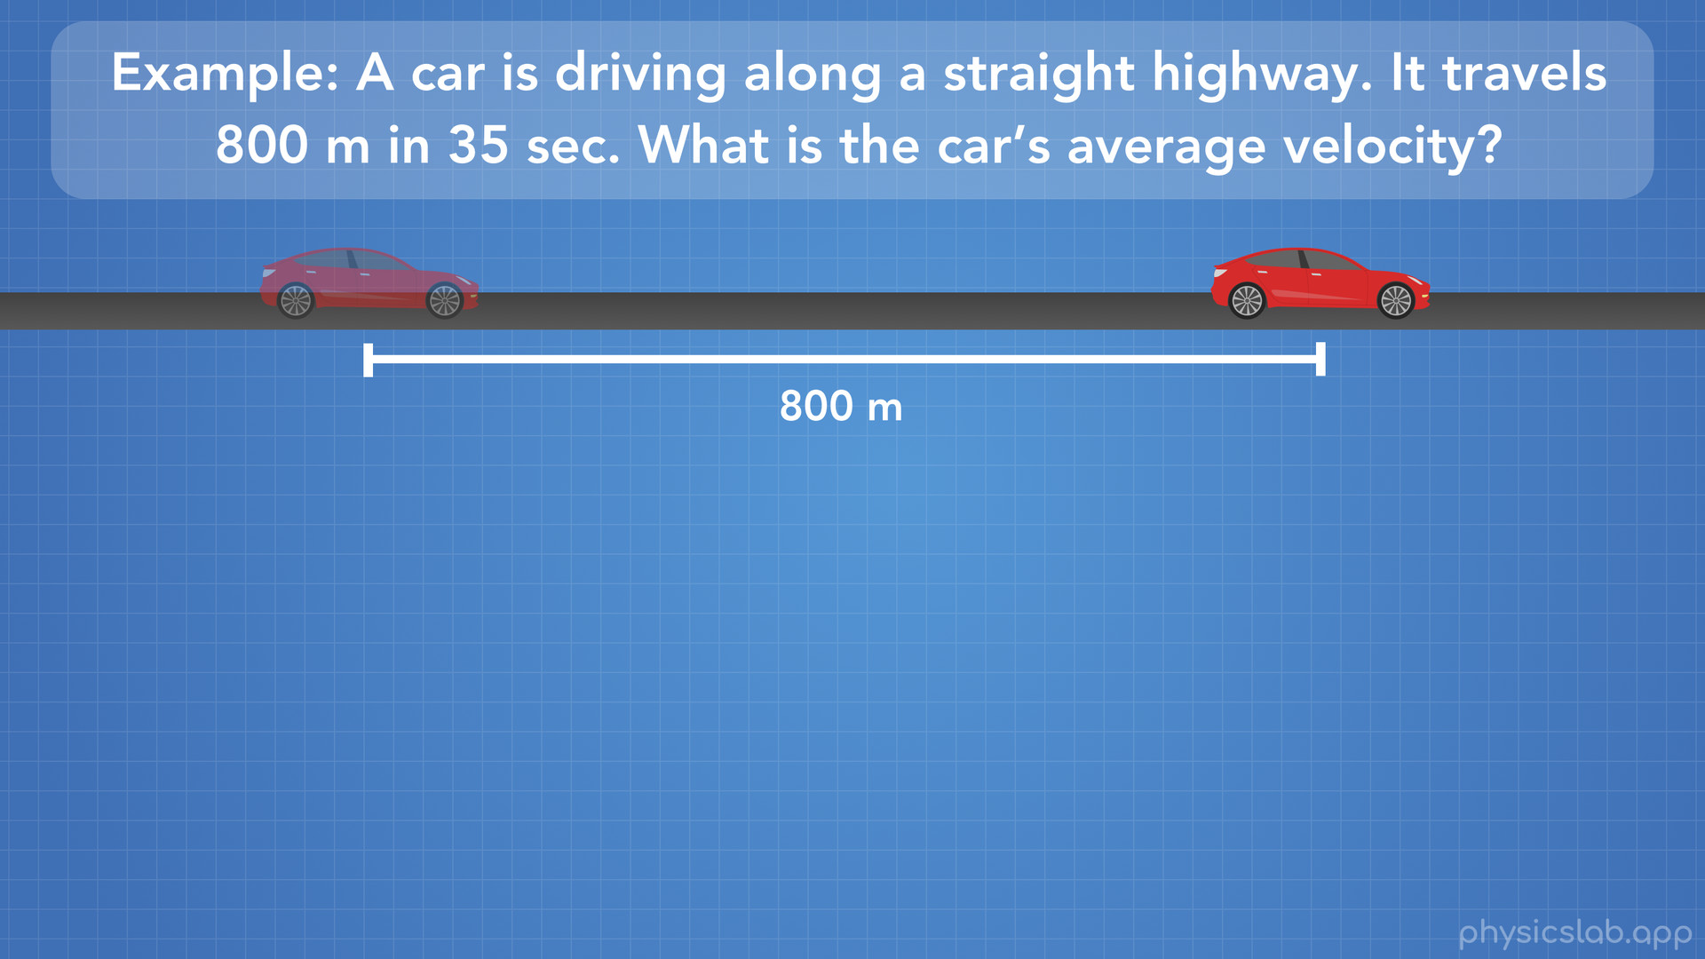
Notes:
First let’s draw a picture to see what this looks like. We have a car on a straight road that travels 800 meters.

Slide 41
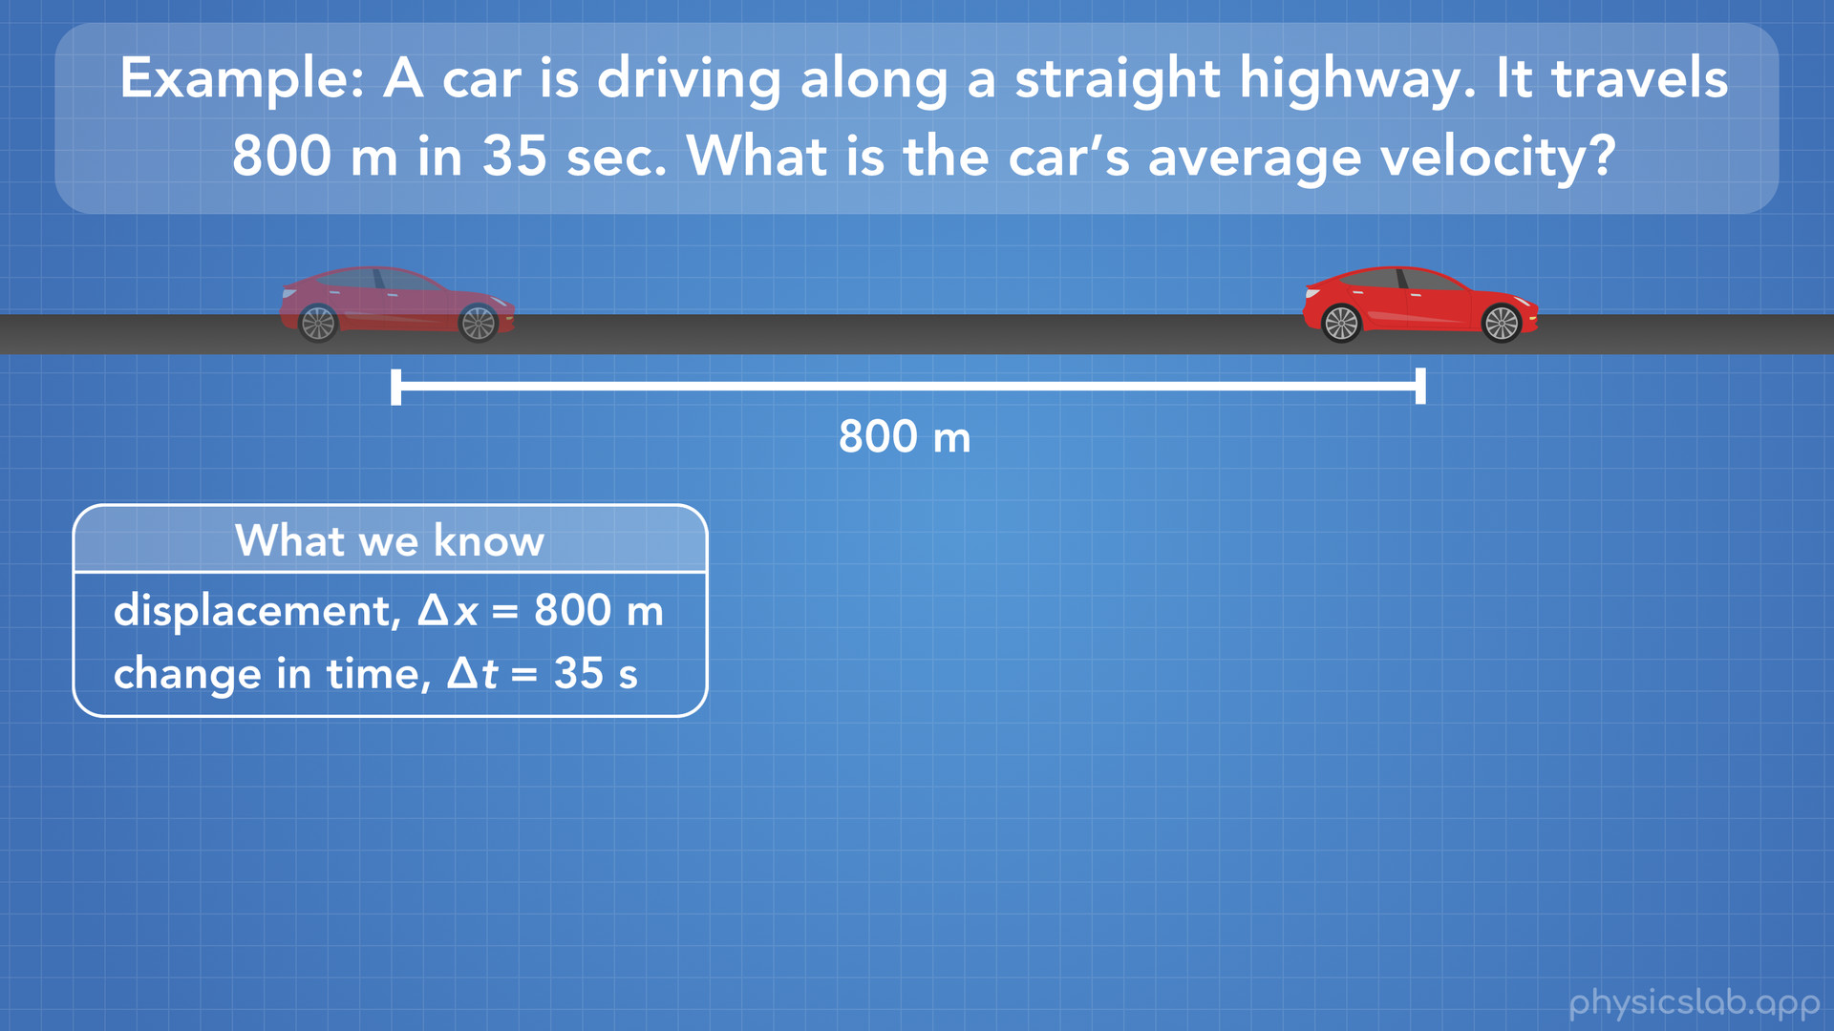
Notes:
Next, we need to write down what we know. For this problem we know that the change in the car’s position, or the displacement of the car, is 800 meters. We also know that the change in time is 35 seconds, which is the amount of time that it takes the car to travel 800 meters.

Slide 42
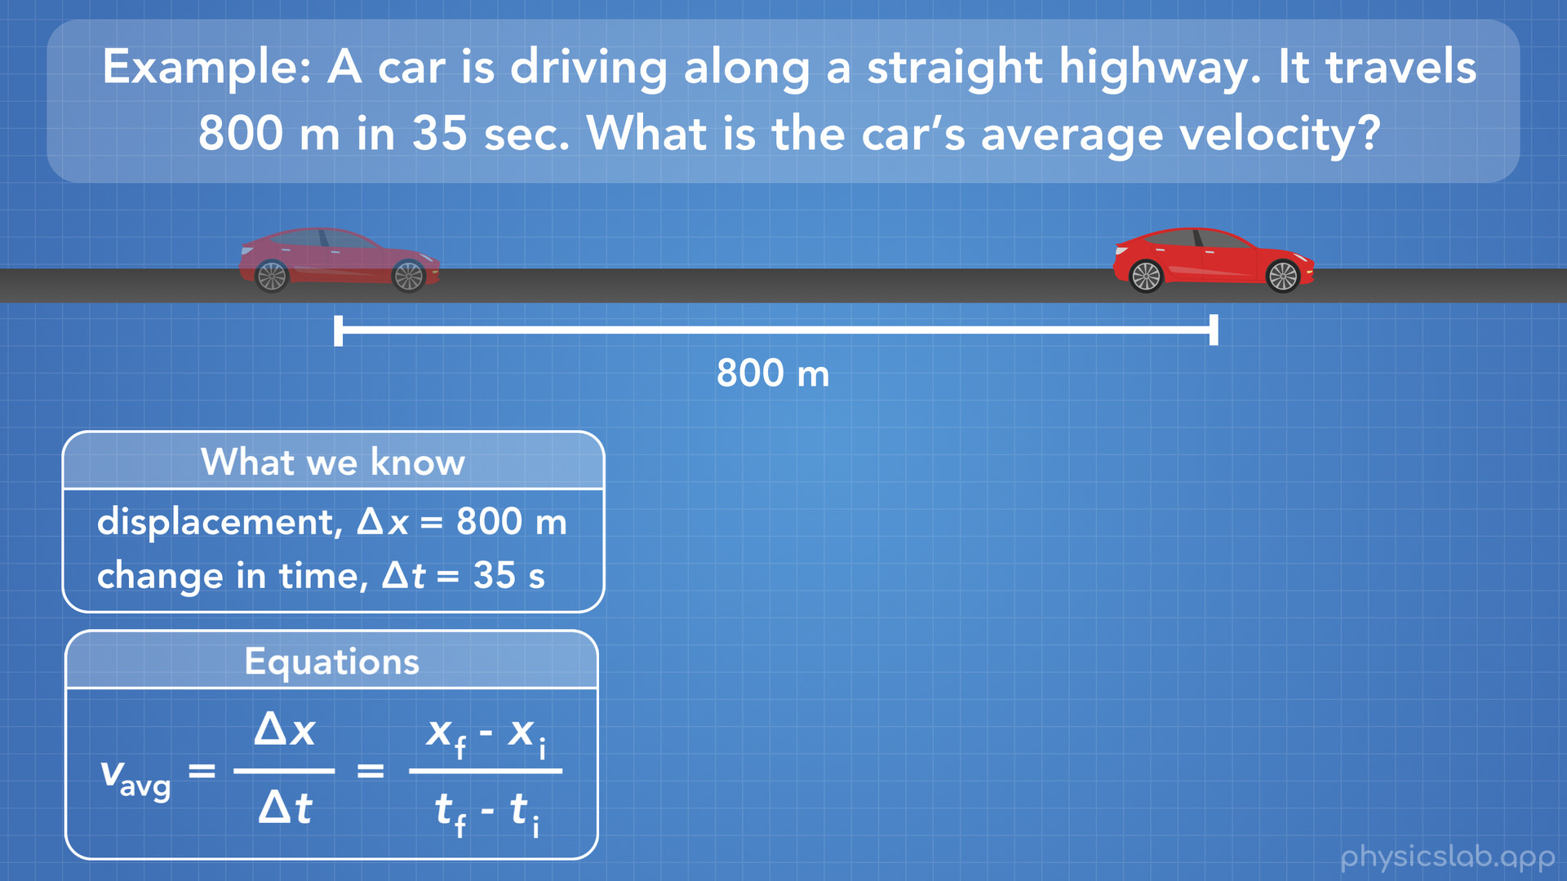
Notes:
Next, we’ll list the equations that we might be able to use. The problem wants us to find the average velocity, so we’ll use the equation for average velocity that we just learned.

Slide 43
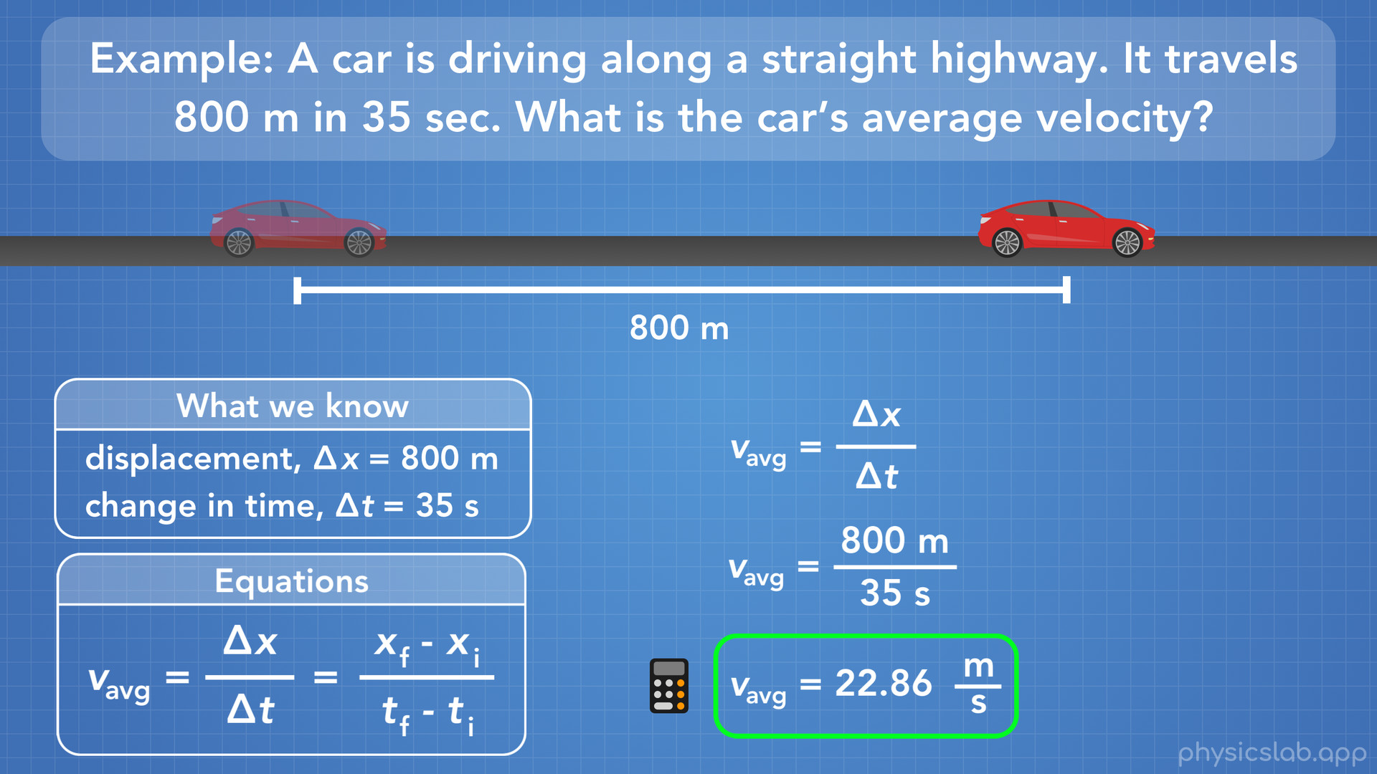
Notes:
Since we know the displacement and the change in time, we can just use the first part of our equation: average velocity equals the displacement divided by the change in time. We plug in 800 meters for the displacement, and 35 seconds for the change in time. Don’t forget that we always need to include our units. Using our calculator we’ll do 800 divided by 35, and we find the average velocity equals 22.86 meters per second (rounded to 2 decimal places).

Slide 44
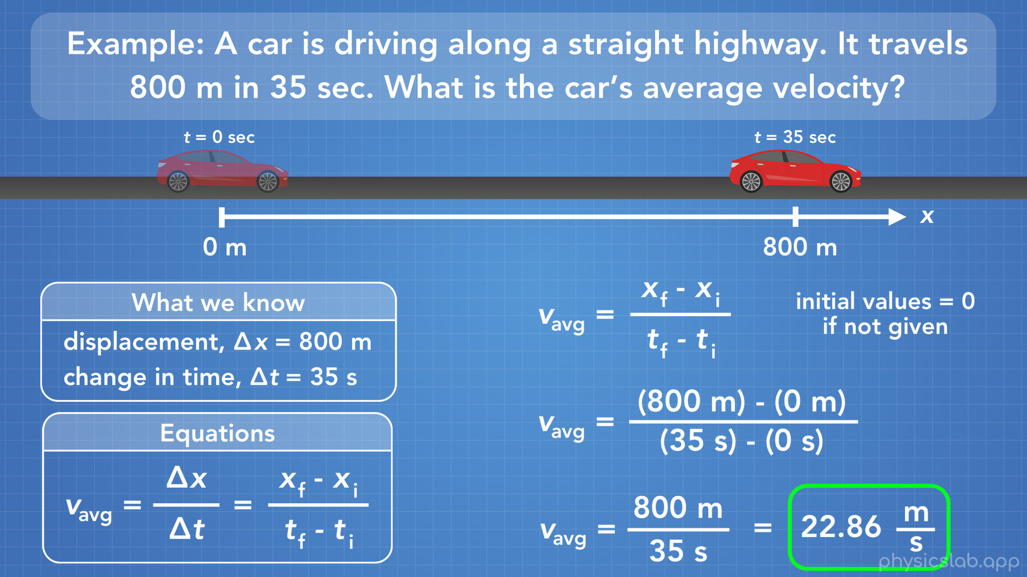
Notes:
So you might have asked, why didn’t we use the other part of our equation, with the initial and final variables? Well we can try that. Here we’re using the equation: average velocity equals the final position minus the initial position, divided by the final time minus the initial time. The question is, where do we plug in our 800 meters and 35 seconds? Well, since the problem doesn’t say what the initial position of the car is, or what the initial time is, then we’ll always assume that the initial values are zero if they’re not given.
In this case, here’s what our picture looks like. Now we can see that the car has an initial position and a final position. At the initial position, we assume that the time equals 0 seconds and the position is 0 meters. At the final position, time equals 35 seconds and the position is 800 meters.
Now we can plug in 800 meters for the final position, 0 meters for the initial position, 35 seconds for the final time, and 0 seconds for the initial time. Again, don’t forget your units. 800 minus 0 is 800, and 35 minus 0 is 35. Now we’re left with the same equation as last time, and we find the average velocity of the car is 22.86 meters per second. So both ways of doing this are fine. The thing to remember is if we are not given the initial values in a problem, we assume the initial values are zero. But what if we are given both the initial and the final values?

Slide 45
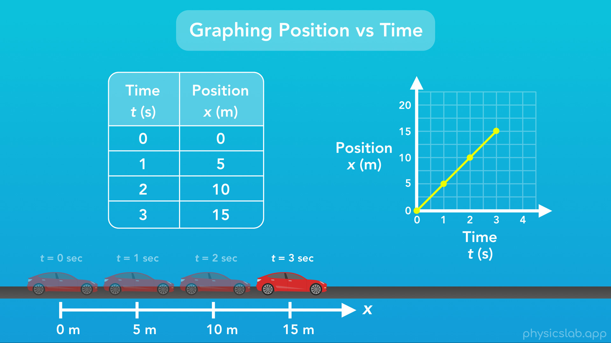
Notes:
Let’s use the example from when we made a table of a car’s position at different times while it moves.

Slide 46
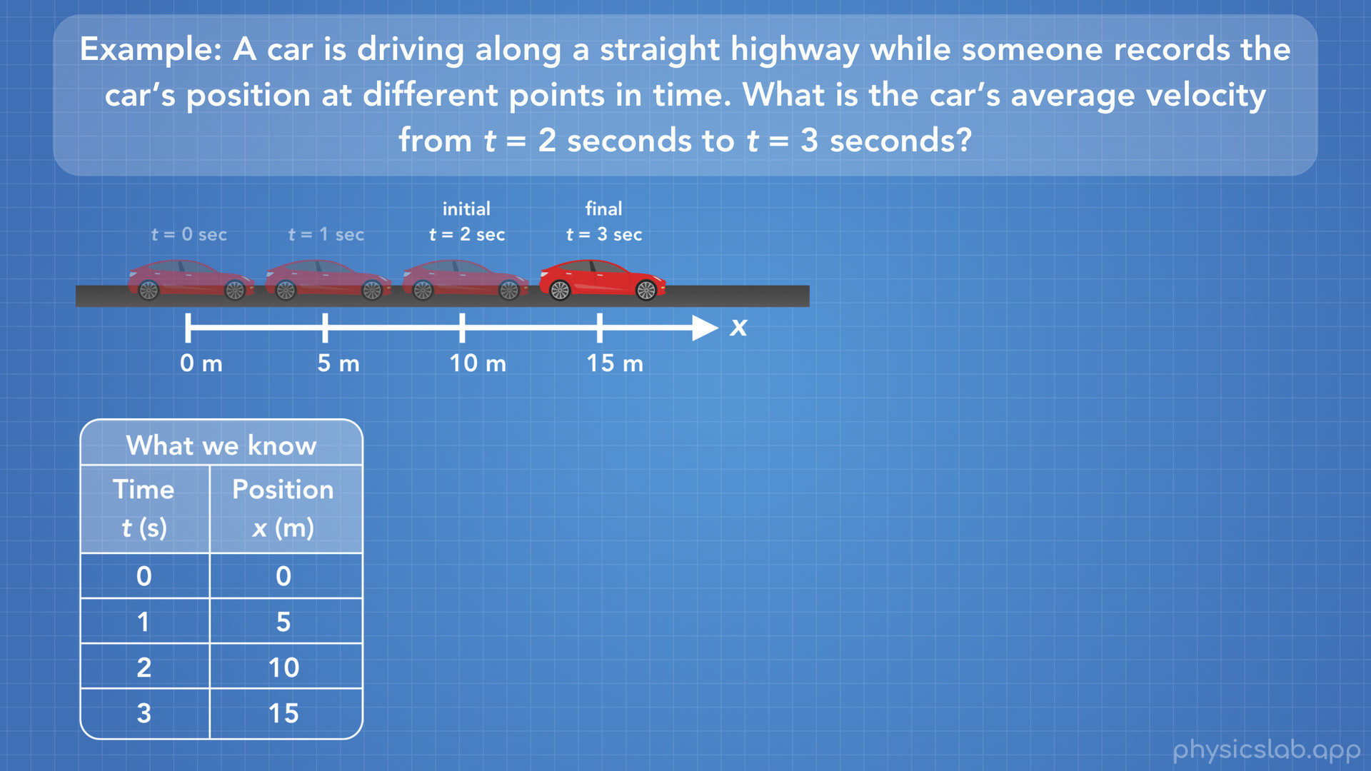
Notes:
Here is the new problem: A car is driving along a straight highway while someone records the car’s position at different points in time. What is the car’s average velocity from time t=2 seconds to time t=3 seconds? First, here is our picture of this scenario. Next we’ll write down what we know, in this case we are given this table of the car’s position at different times.

Slide 47
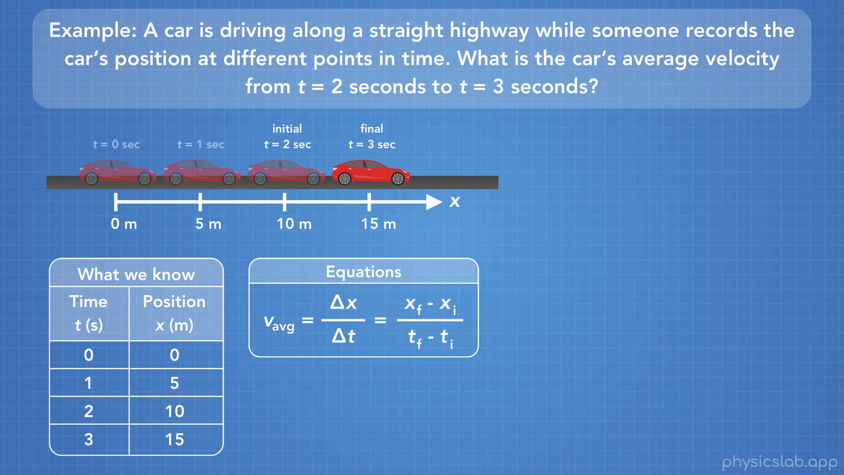
Notes:
Next we write the equations we can use to solve this problem.

Slide 48
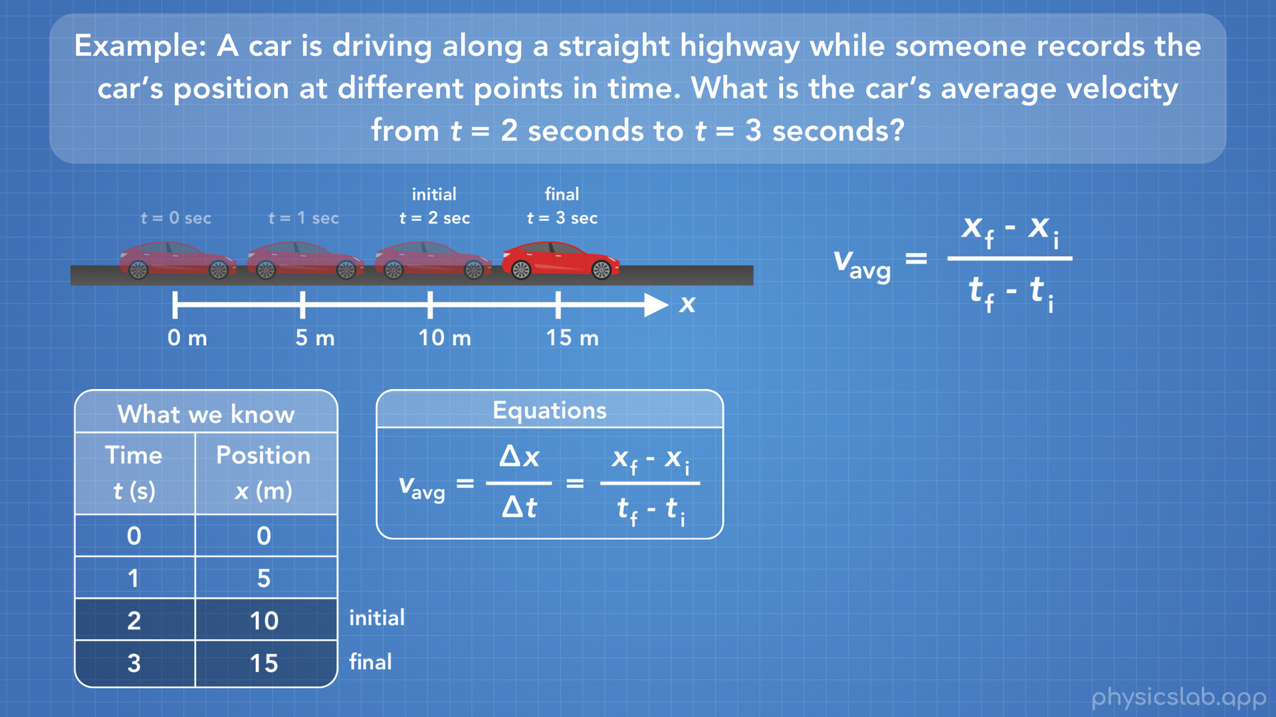
Notes:
Now this time, we’re specifically given an initial point and a final point, so we’ll have to use that part of our equation.

Slide 49
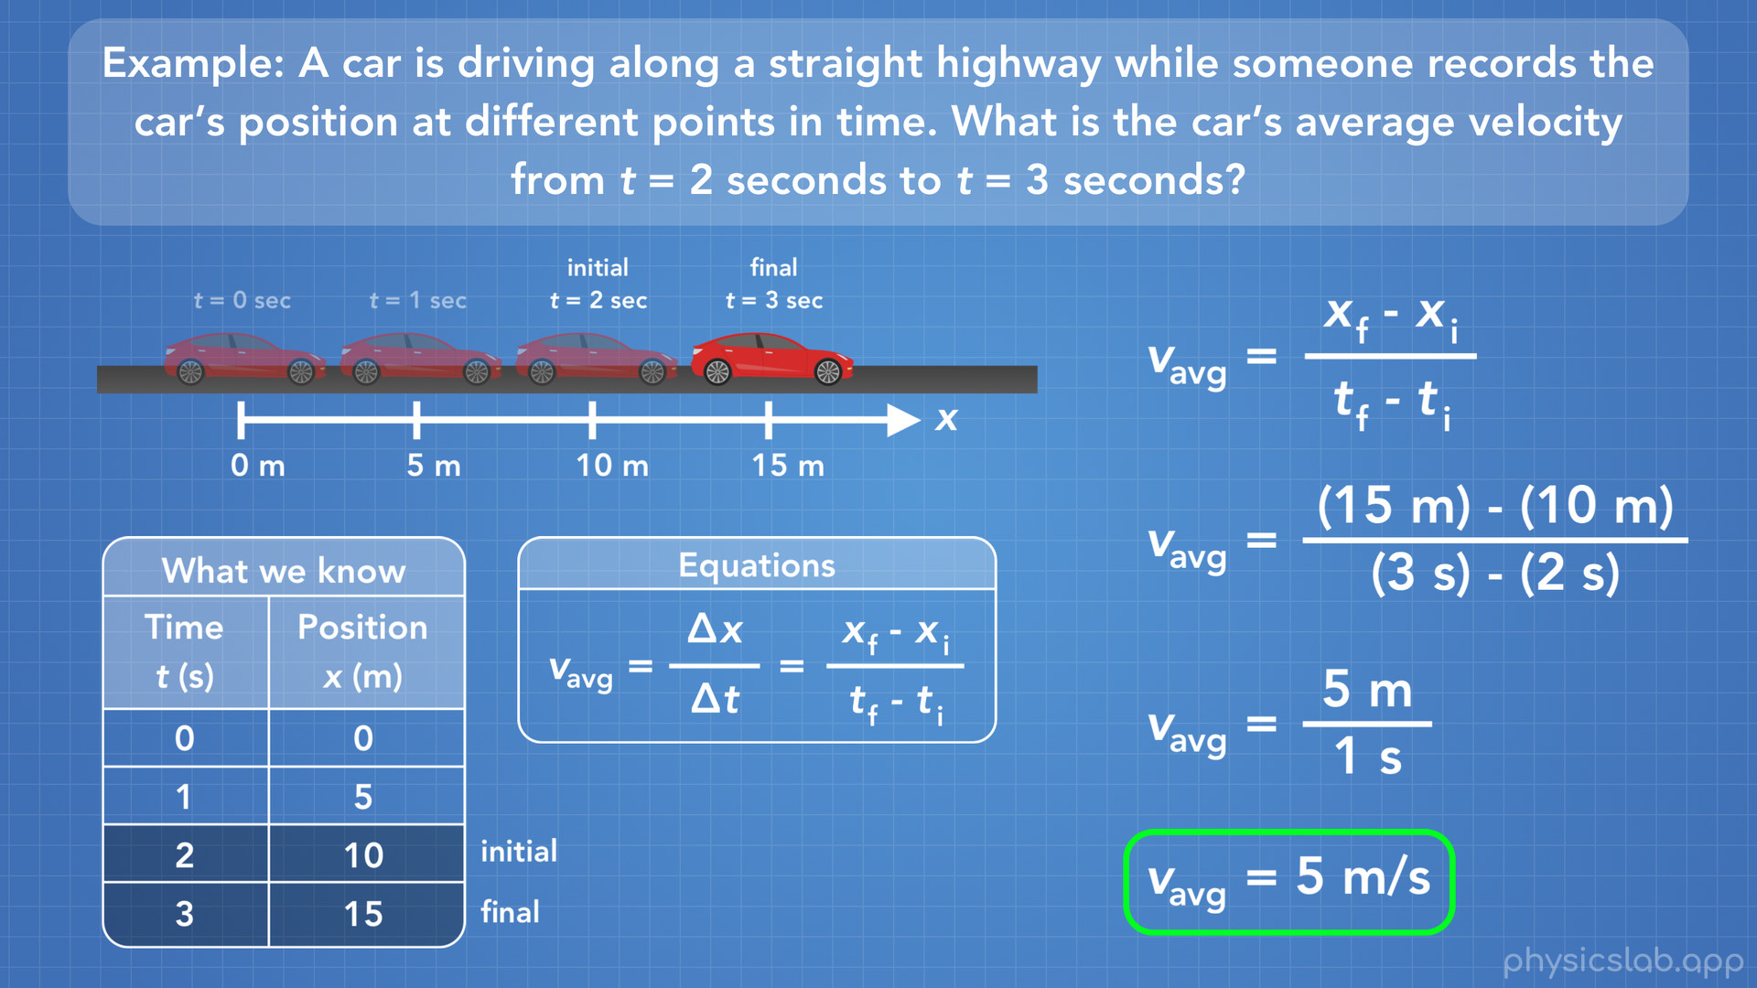
Notes:
Our initial point is when time equals 2 seconds and the car’s position is 10 meters, and our final point is when time equals 3 seconds and the car’s position is 15 meters. Now in our equation, we can plug in 15 meters for the final position, 10 meters for the initial position, 3 seconds for the final time, and 2 seconds for the initial time. 15 minus 10 gives us 5 meters, and 3 minus 2 gives us 1 second. 5 divided by 1 gives us 5, so the average velocity of the car between these 2 points is 5 meters per second. And that’s how we can use the equation for average velocity.

Slide 50
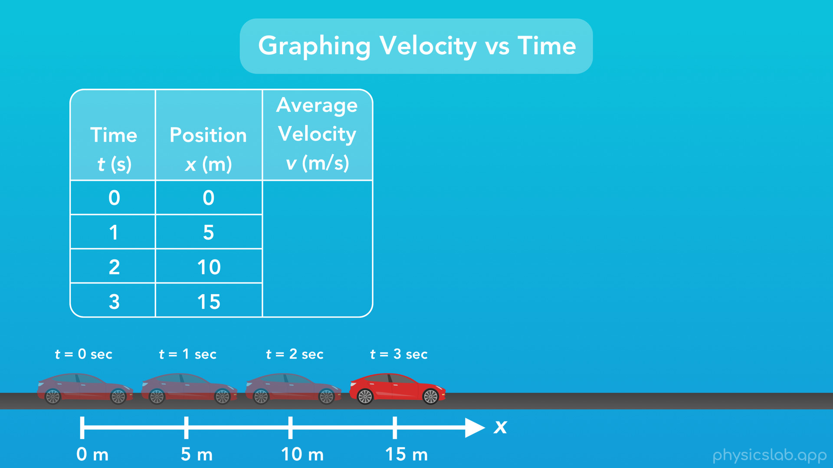
Notes:
So just like we did with position, let’s see if we can graph a car’s average velocity over time. We’ll use the same motion of the car moving from when we graphed the position, and then we can use the same data points that we had for the times and positions of the car. What we’re going to do is calculate the average velocity of the car as it travels between each of these positions, using our equation for average velocity.

Slide 51
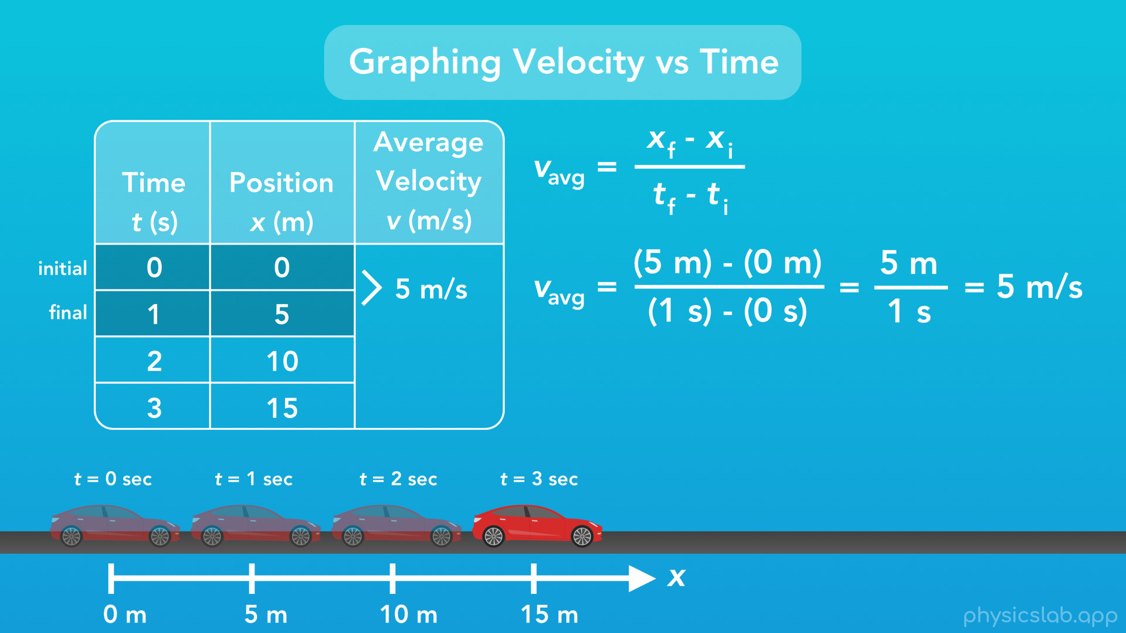
Notes:
Between the 1st and 2nd positions, the average velocity equals 5 meters minus 0 meters, divided by 1 second minus 0 seconds, which gives us 5 meters over 1 second, or 5 m/s.

Slide 52
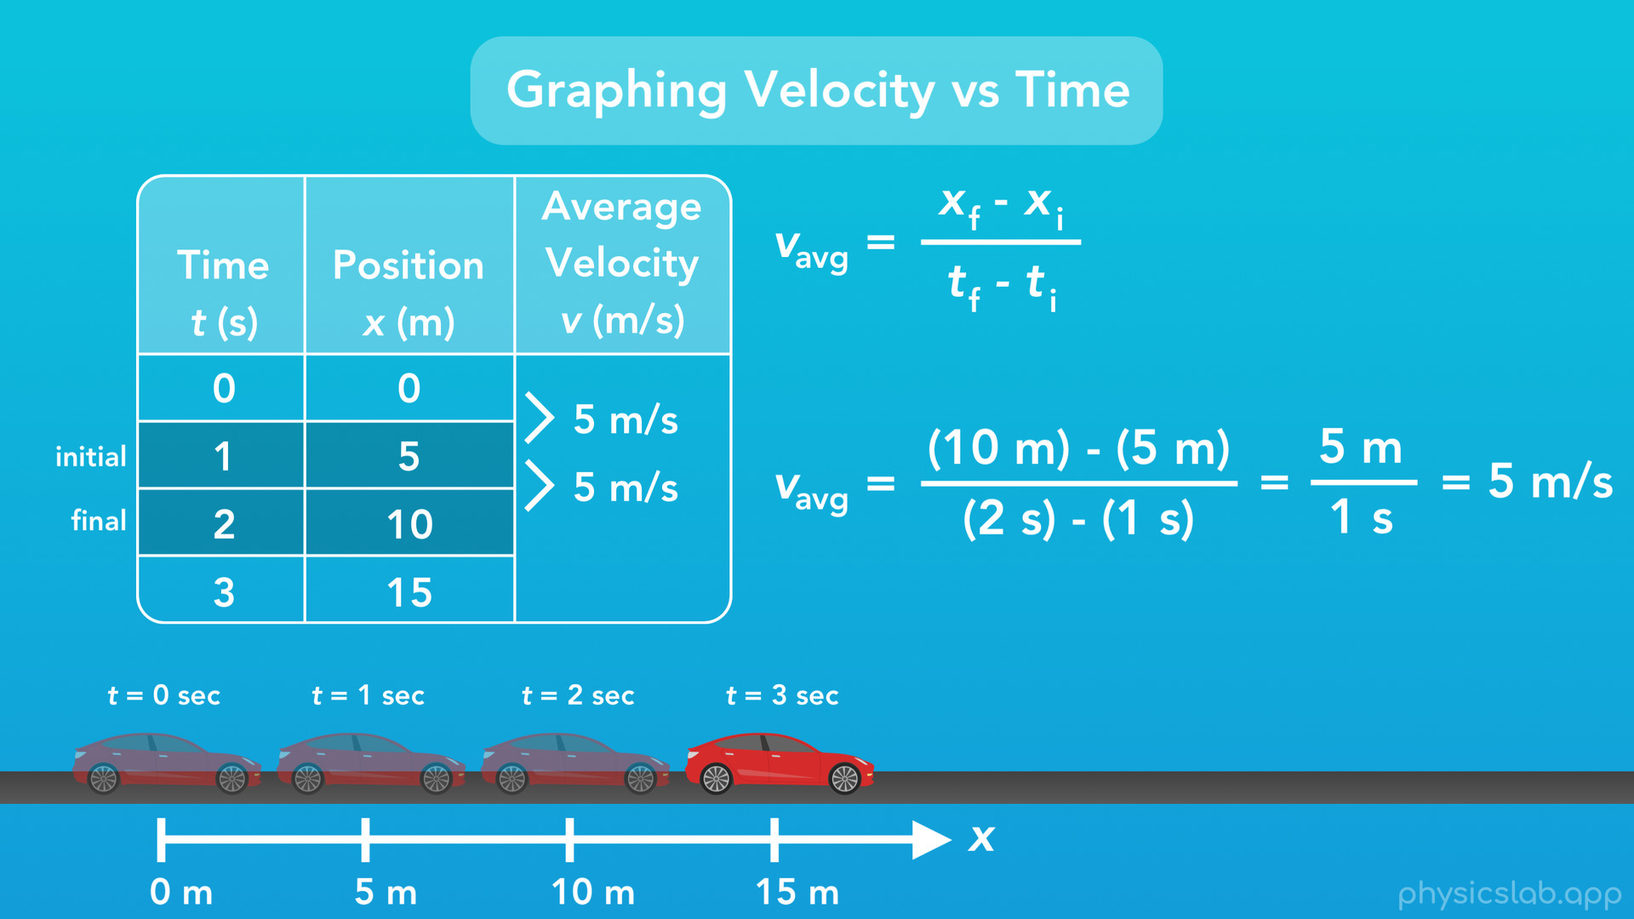
Notes:
Between the 2nd and 3rd positions, the average velocity equals 10 meters minus 5 meters, divided by 2 second minus 1 seconds, which gives us 5 meters over 1 second, or 5 m/s.

Slide 53
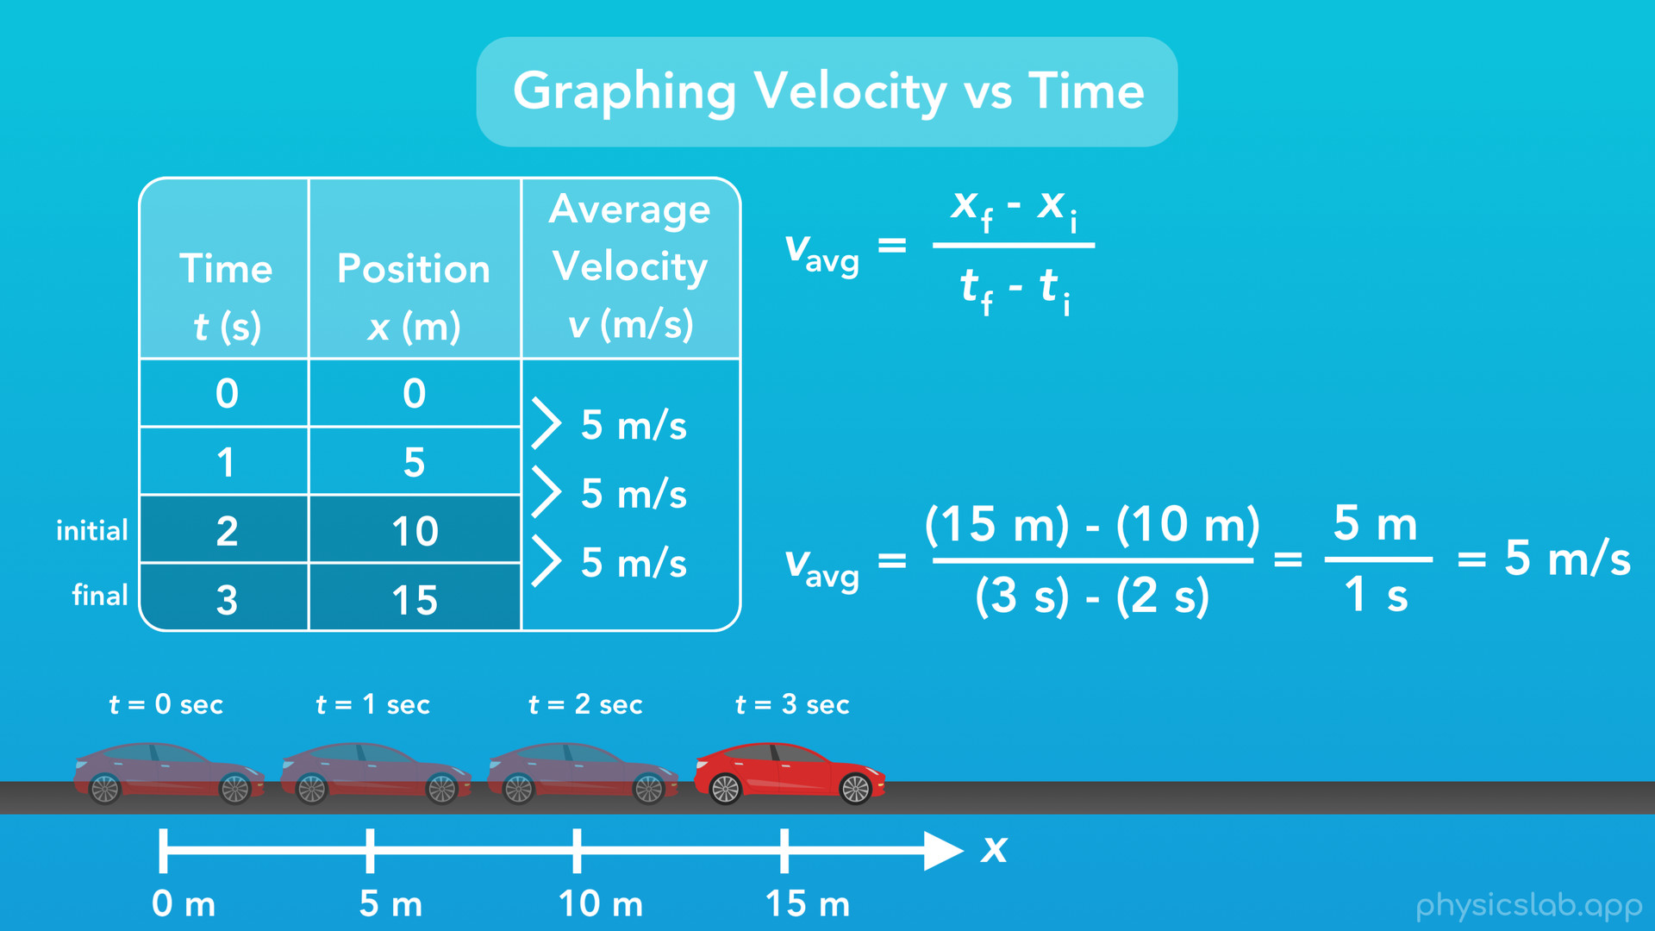
Notes:
And last, between the 3rd and 4th positions, the average velocity equals 15 meters minus 10 meters, divided by 3 second minus 2 seconds, which gives us 5 meters over 1 second, or 5 m/s.

Slide 54
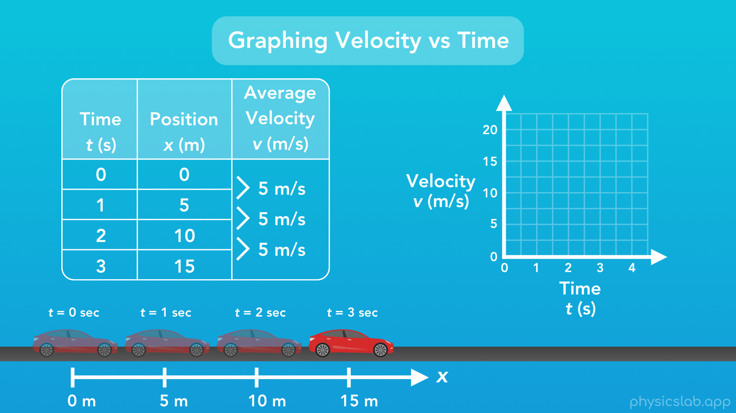
Notes:
Great, now let’s graph that. Again the x-axis or horizontal axis will be used to represent time, but this time the vertical y-axis will represent the velocity of the car.

Slide 55
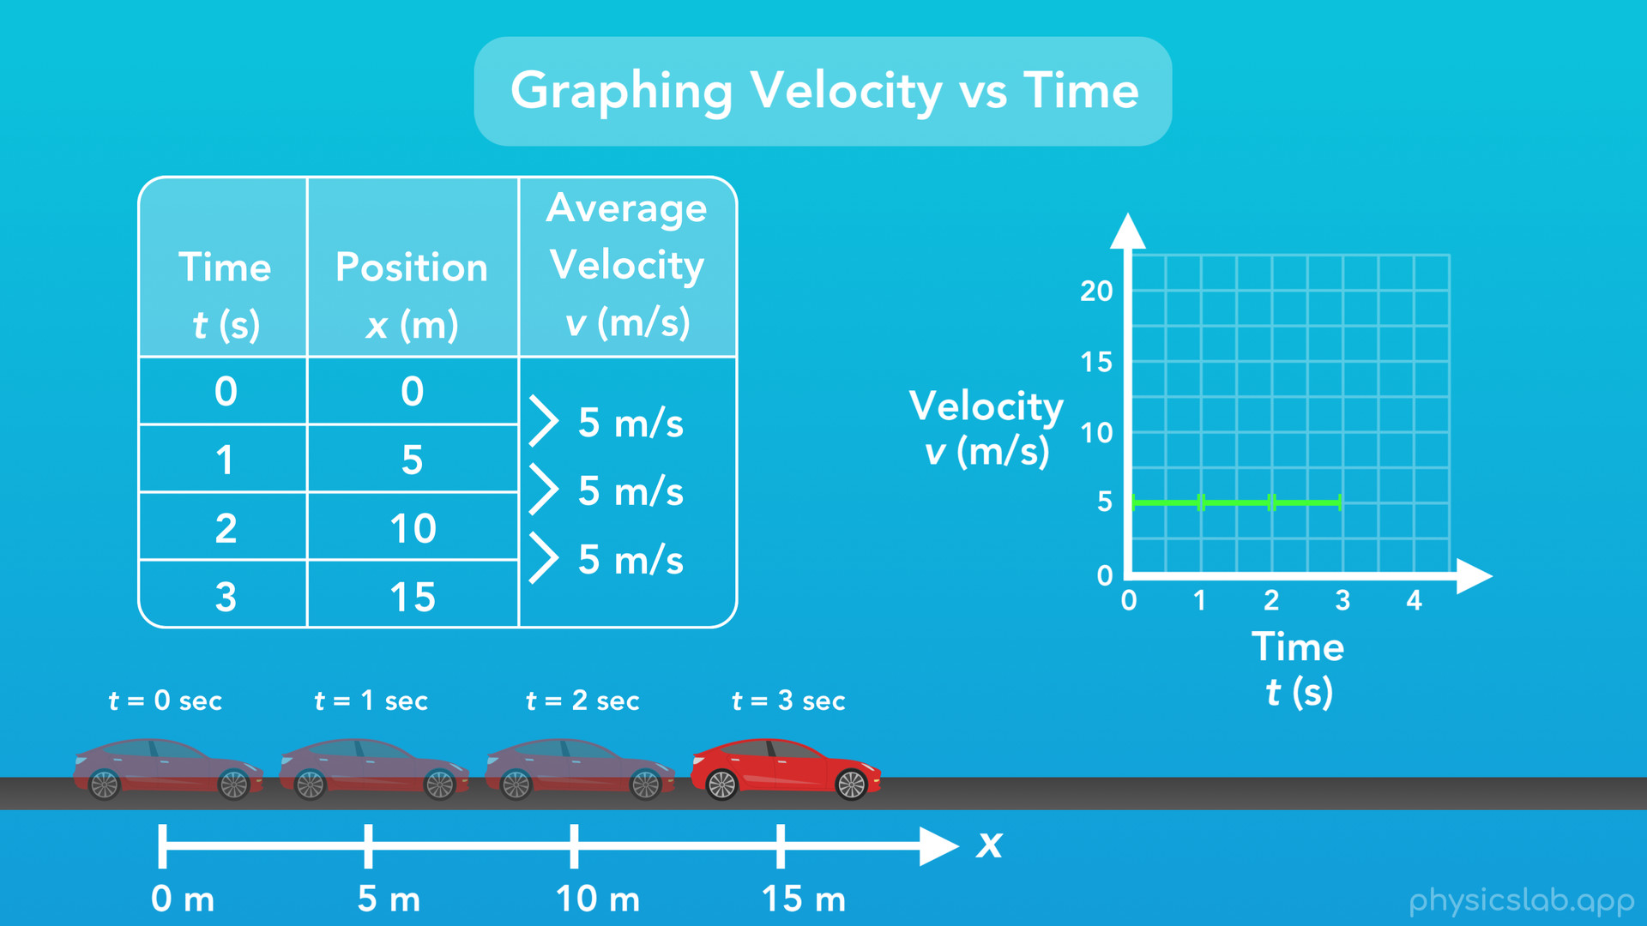
Notes:
Now, notice how each of these velocities do not correspond to a specific time point. We didn’t calculate that the car was traveling 5 m/s at exactly 1 second, we only found the average velocity of the car as it travelled between 2 points. So instead of plotting points, let’s just draw lines. This isn’t how you would normally graph data, but we’ll clear that up in a minute.
So as the car travelled from 0 seconds to 1 second, the average velocity was 5 m/s. From 1 second to 2 seconds, the average velocity is 5 m/s. And from 2 seconds to 3 seconds, it’s 5 m/s. So here’s a nice graph that let’s us visualize the average velocities that we found.
But, what did we graph exactly? We were given the car’s position at different points in time, then we found the car’s average velocity as it drove between each of those points, and we plotted that average velocity across each time interval. And it appears that the car is traveling at a constant 5 m/s the entire time. But do we know that for sure?

Slide 56
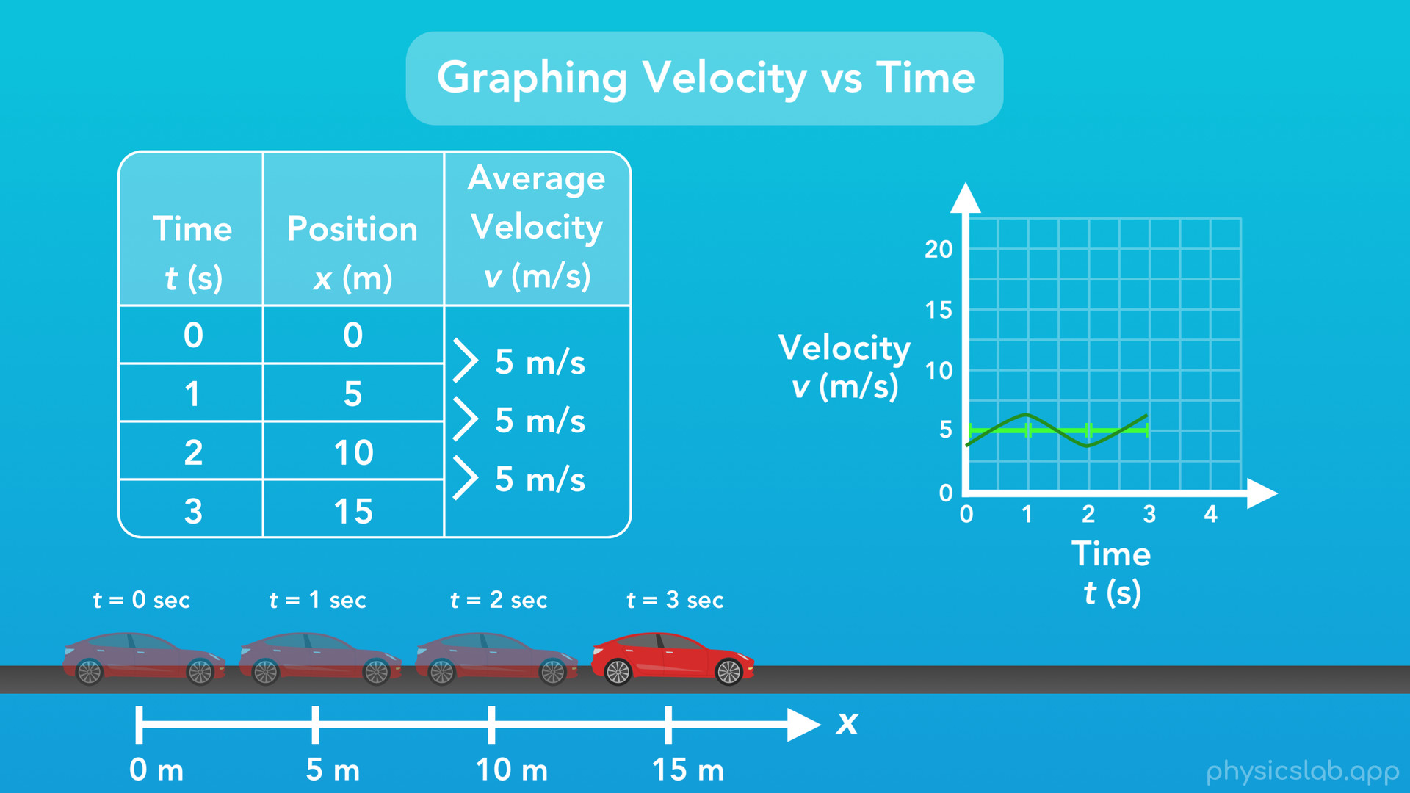
Notes:
When you’re driving, your speed might vary a little right? Is it possible the car’s velocity went up and down like this, but the average for each interval was 5 m/s? That is actually possible, but we don’t know, because we didn’t graph the car’s true velocity at every single instant in time, only the averages.

Slide 57
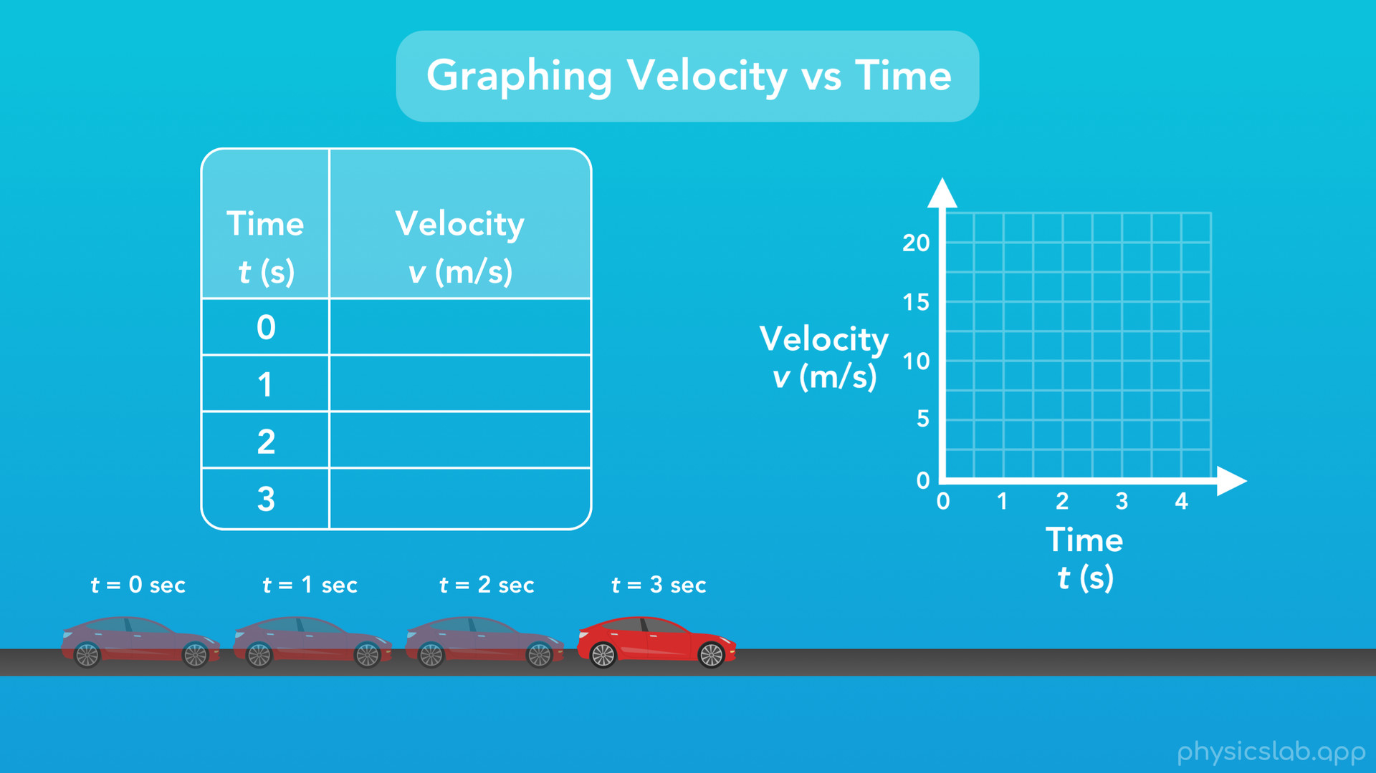
Notes:
So how could we do that?

Slide 58
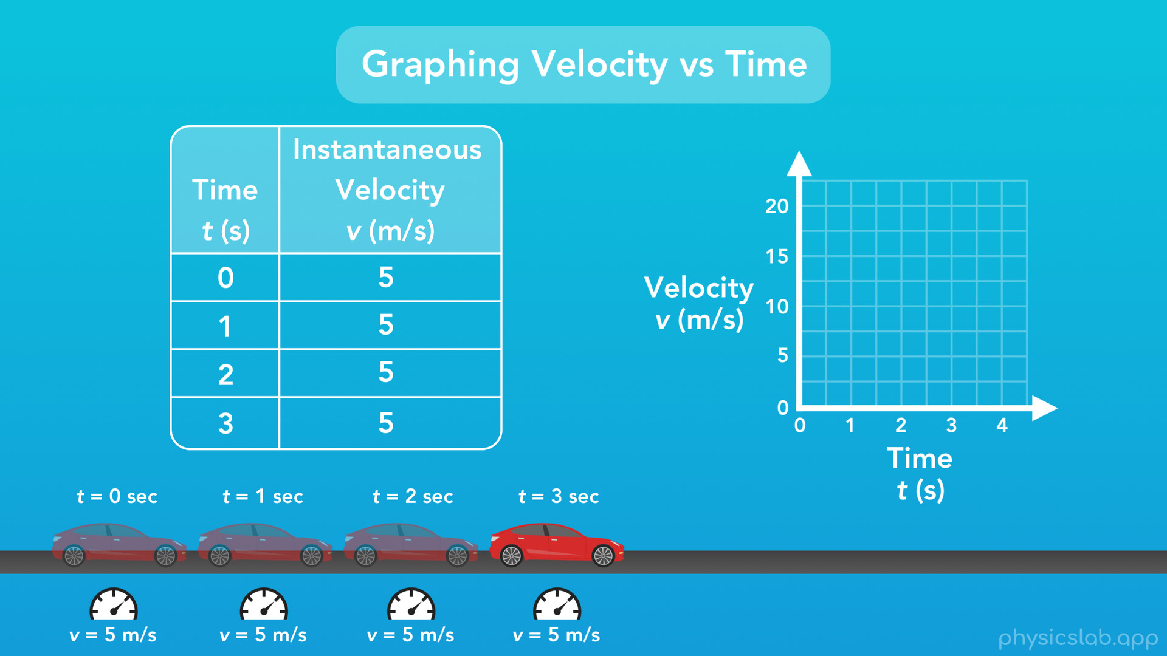
Notes:
Well every car has a speedometer which tells the driver how fast the car is moving. Usually it used units of mph or km/h, but for this example let’s say the speedometer reads m/s. What if one of the passengers in the car watched the speedometer and wrote down the car’s velocity at different points in time? At the start of this test, they notice the speedometer reads 5 m/s. At 1 second, it reads 5 m/s. At 2 seconds it reads 5 m/s, and at 3 seconds it reads 5 m/s again.
Now what we have is a table showing the car’s true velocity at specific points in time, or what we call the “instantaneous velocity”, meaning the car’s velocity at a specific instant. This is different than when we found the car’s average velocity between time points. However, since the car’s velocity actually didn’t change over time, it turns out that the instantaneous velocities are the same as the average velocities.

Slide 59

Notes:
So now we can graph the instantaneous velocity, and each point in our table corresponds with a point on the graph. At 0 seconds the velocity is 5 m/s, at 1 second the velocity is 5 m/s, at 2 seconds the velocity is 5m/s and again at 3 seconds the velocity is 5m/s.

Slide 60
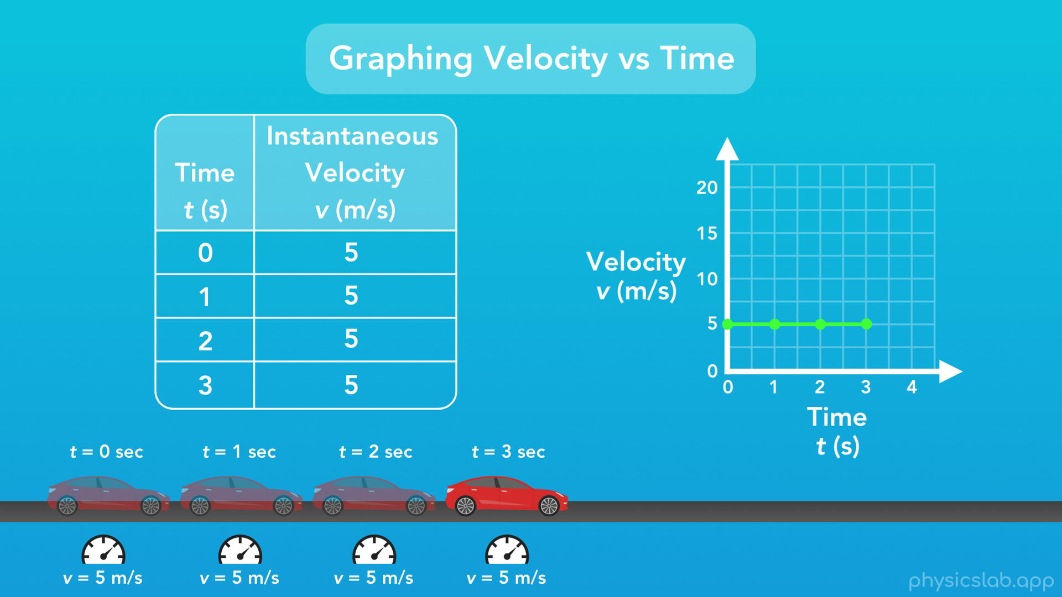
Notes:
Now we can connect our data points with a line, and we have a graph of the car’s instantaneous velocity over time.

Slide 61
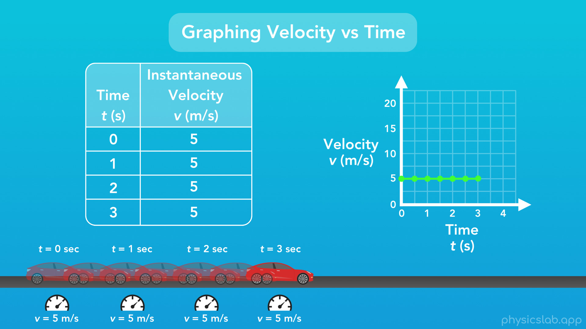
Notes:
And if the person in the car recorded the velocity even quicker, we could have points every half second, and so on.
So yeah, it turns out the car’s velocity really was a constant 5 m/s and didn’t change over time, so this graph of velocity is just a horizontal line that doesn’t go up or down over time.

Slide 62

Notes:
So here’s a question: what would the car have to do so that the velocity graph increases over time?

Slide 63

Notes:
Well for that we would need acceleration.

Slide 64

Notes:
Acceleration is defined as the change in velocity of an object over time. Acceleration is a little less relatable than velocity, but it’s still something most of us are used to. If you’ve ever heard somebody say something like “my car can go from 0 to 60 in 4 seconds”, they’re talking about acceleration. What they’re really saying is “my car can go from 0 mph to 60 mph in 4 seconds”.

Slide 65

Notes:
That means the acceleration of the car is it’s change in velocity (which is 60mph), over the period of time (which is 4 seconds). 60 divided by 4 is 15, so the acceleration is 15 mph per second. That’s the same as saying the car can go 15 mph faster, every second. When the car is accelerating, after every second that passes, the speedometer moves up another 15 mph.

Slide 66

Notes:
This unit might look strange, but that’s what acceleration is: velocity (miles per hour) divided by time (seconds). Written another way, the unit of acceleration is a unit of position per unit of time, and that whole thing per unit of time.

Slide 67

Notes:
So what would the SI unit of acceleration be? Well our SI unit of position is meters and our SI unit of time is seconds. So this unit would be meters per second, per second. Mathematically, that's actually the same as meters divided by seconds times seconds, which is the same as meters divided by seconds squared. And that's our SI unit for acceleration: meters per second squared, abbreviated m over s squared.

Slide 68

Notes:
And, we’ll be representing acceleration with the variable lowercase “a”.

Slide 69

Notes:
So a car is one example of an object that can accelerate. What’s another example? Well it turns out that if you drop an object, like a ball, it will actually accelerate as it falls. This is what we call the “acceleration due to gravity”. We don’t need to understand gravity yet or why this happens, but this is a good time to mention that all objects that are falling with gravity have the exact same acceleration. This acceleration due to Earth's gravity is 9.8 m/s^2 towards the earth, and we represent this special value using “lowercase g”. We’ll leave it at that for now and come back to it later.

Slide 70

Notes:
So how do we calculate the acceleration of an object? Here’s our equation: acceleration equals the change in velocity over the change in time. You might notice it looks similar to our equation for velocity.

Slide 71

Notes:
Let’s take a closer look.
So “a” is acceleration, “vf” is the final velocity, “vi” is the initial velocity, “tf” is the final time, and “ti” is the initial time. So this equation says that the acceleration of an object is the final velocity minus the initial velocity, divided by the final time minus the initial time. Another way to say it is the acceleration is the change in velocity divided by the change in time. Here are the SI units for the variables in this equation: time is in seconds, velocity is in m/s, and acceleration is in m/s^2.
And, although it’s not super important, I want to mention that just like our equation for average velocity, this here is really the equation for average acceleration. But we won’t be dealing with changing accelerations in this course, so the acceleration at any time will always be the same as the average acceleration.

Slide 72

Notes:
And like before, you might see this equation written a different way, like this. Again, these are the same equation, but with the variables arranged in different ways.

Slide 73

Notes:
So let’s try an example problem. A car starts from rest when the driver hits the gas, and after 4.5 seconds the car is going 27 m/s. What is the car’s acceleration?

Slide 74

Notes:
First let’s draw a picture to see what this looks like.
Next we need to write down what we know. The problem says that the car starts from rest. In physics, when we say an object is “at rest”, that means that it’s not moving and therefore its velocity is zero. So, we know that at the starting point, when no time has passed, we’ll say that the initial time is 0 seconds, and we know the initial velocity is 0 m/s since the car was at rest.

Slide 75

Notes:
We also know that at the final point, the final time is 4.5 seconds and the final velocity is 27 m/s.

Slide 76

Notes:
Next, we write the equations that might apply to this problem, and here we’re looking at our equation for acceleration. Since we’re dealing with an initial and final velocity, let’s use the right part of the equation. So acceleration equals the final velocity minus the initial velocity, divided by the final time minus the initial time.

Slide 77

Notes:
Next we’ll plug in the variables that we know: the final velocity is 27 m/s, the initial velocity is 0 m/s, the final time is 4.5 seconds, and the initial time is 0 seconds. And don’t forget to keep track of your units. I usually find it easiest to write it out like this, with each number and its unit in parentheses, so I can keep them together. If this looks a little cluttered, here’s just the math that we’re doing: 27 minus 0 divided by 4.5 minus zero.
If we plug that into our calculator, we find that the acceleration of the car is 6 m/s^2. We know the units for our answer because we know the SI unit for acceleration is m/s^2, and we’ve followed the rule of only plugging the correct SI units into this equation.
So you might have asked “why did we have to use the right side of the equation for acceleration? Could we have used the other part? Acceleration equals change in velocity over change in time?” Yeah, we definitely could have done that too. Instead of using initial and final values for velocity and time, we could have used change in velocity and change in time. We might have read the problem and thought “well it starts at rest and speeds up to 27 m/s, so the change in velocity is just 27 m/s. And it takes 4.5 seconds to speed up, so the change in time is 4.5 seconds.
That way works too, and for this problem it seems simpler. But sometimes the car isn’t starting at rest and the initial velocity isn’t zero, and later on we’ll learn that if the car is going the other way the velocity is actually negative, so we’d have to write out initial and final velocities anyway to keep track of everything. So long story short, writing out initial and final values is a good habit to make sure we don’t mess up, but for simple problems like this one we don’t need to.

Slide 78

Notes:
Alright, so just like we did with position and velocity, let’s try to graph the acceleration of a car over time. This is the new motion of our car. Like before, we can imagine there is someone in the car looking at the speedometer and writing down the velocity of the car at different points in time. This is what we get: at 0 seconds the velocity is 0 and the car isn’t moving. At 1 second the velocity is 5 m/s, at 2 seconds the velocity is 10 m/s, and at 3 seconds the velocity is 15 m/s.

Slide 79

Notes:
Now we can calculate the average acceleration of the car between each pair of time points, using our equation for acceleration, and I’ll do the math for us. What we’ll find is that the acceleration between seconds 0 and 1 is 5m/s^2...

Slide 80

Notes:
between seconds 1 and 2 it’s 5m/s^2...

Slide 81

Notes:
and between seconds 2 and 3 it’s still 5m/s^2. Since we’re not always starting with initial values of zero here, this is a good example of when we’ll need the final and initial values in our equation.
So, we can see that the velocity is increasing over time, but the acceleration of the car stays the same. And that makes sense: the car has some acceleration, and acceleration is the change in velocity over time, so the car’s velocity changes over time.

Slide 82

Notes:
So what does our graph of acceleration look like? As always we have time along our horizontal axis, and now we have acceleration along our vertical axis.

Slide 83

Notes:
For the period of 0 to 1 seconds we know the acceleration is 5 m/s^2, from 1 to 2 seconds it’s 5m/s^2, and from 2 to 3 seconds it’s 5m/s^2.
There we go, we have a graph of the car’s acceleration over time. However like we covered with velocity, this is just a graph of the car’s average acceleration plotted across each time period.
But could we do what we did with velocity? Instead of just calculating the average, could we measure the car’s acceleration at different points in time, using some special speedometer that measures acceleration?

Slide 84

Notes:
Actually, we could. There are things called “accelerometers” which measure acceleration, and interestingly enough you have one in your phone. That’s actually what tells your phone when you rotate it sideways so that it knows to rotate the screen. That will actually make sense once we’ve learned about forces and gravity later on in the course.
Anyway, back to our graph. So like we said, this car has an acceleration causing the car to speed up and car’s velocity to increase, but the actual value of the acceleration doesn’t change over time. In this course and in most courses, this is as far as we’ll go. We won’t deal with accelerations that change over time.

Slide 85

Notes:
But could we have an object with an acceleration that changes over time like this?

Slide 86

Notes:
We actually could. Just like velocity is the change in position over time, and acceleration is the change in velocity over time

Slide 87

Notes:
“jerk” or “jolt” is the change in acceleration over time. And it turns out we could keep going. I just learned from googling this that the next steps would be a “jounce” or “snap”, a “flounce” or “crackle”, and a “pounce” or “pop”. This isn’t a joke: jounce, flounce and pounce (and snap, crackle and pop) are real physics terms.
But yeah, for this course, we’ll only work with position, velocity and acceleration.

Slide 88

Notes:
Alright, lots of stuff in this video, let’s do a recap.

Slide 89

Notes:
First we learned about position, which has the SI unit of meters. And displacement, which is the change in position.

Slide 90

Notes:
We also learned how we can graph an object’s position over time.

Slide 91

Notes:
Next, we learned about velocity, which is the displacement over time or the change in position over time. The SI unit for velocity is m/s, and we learned the equation for average velocity.

Slide 92

Notes:
We also learned how we could measure and graph an object’s velocity over time.

Slide 93

Notes:
Last, we learned about acceleration, which is the change in velocity over time. The SI unit for acceleration is m/s^2, and we learned the equation for calculating acceleration.

Slide 94

Notes:
And finally we learned how we can graph the acceleration of an object over time.

