Slide 1
Springs and Hooke’s Law - Introduction
Slides Version 2
This version includes:
Slides with screenshot images from the video.
The video narration in the slide notes.
A blank template slide with the same background and font as the video.
Slides with some basic graphics from this video for you to use however you like.
Feel free to add, delete and edit slides to make your own presentation. You can use these slides in class or share them with your students, but please do not share them with anyone else.
If you have any feedback, suggestions or questions about these slides please email me at chris@physicslab.app or send me a message on Discord @physicslab.
physicslab.app

Slide 2
Heading
Text

Slide 3












Slide 4

















Slide 5

















Slide 6














Slide 7















Slide 8
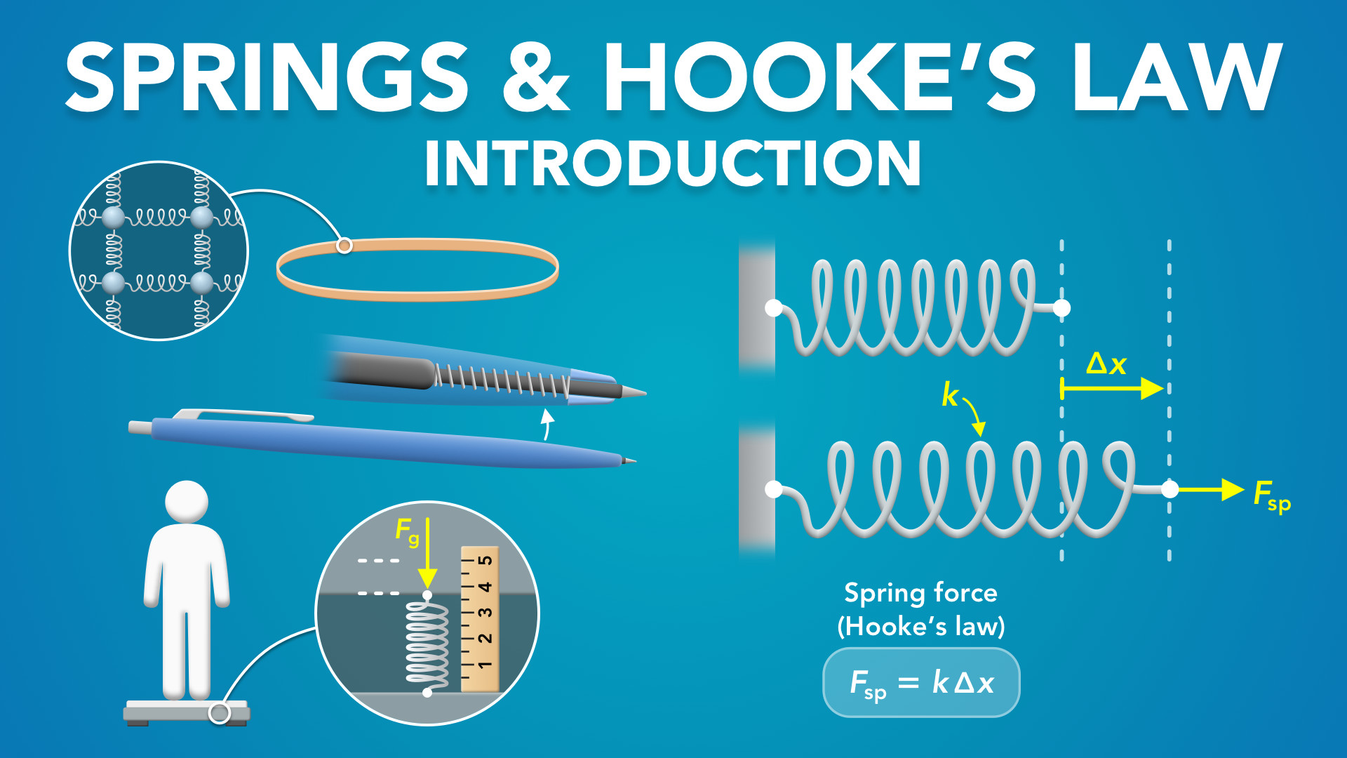
Notes:
Springs and Hooke’s Law - Introduction
physicslab.app
If you have any questions, suggestions or feedback about these slides please email me at chris@physicslab.app or send me a message on Discord @physicslab.

Slide 9

Notes:
• Hey everyone, in this video we’re gonna start learning about springs and hooke’s law.

Slide 10
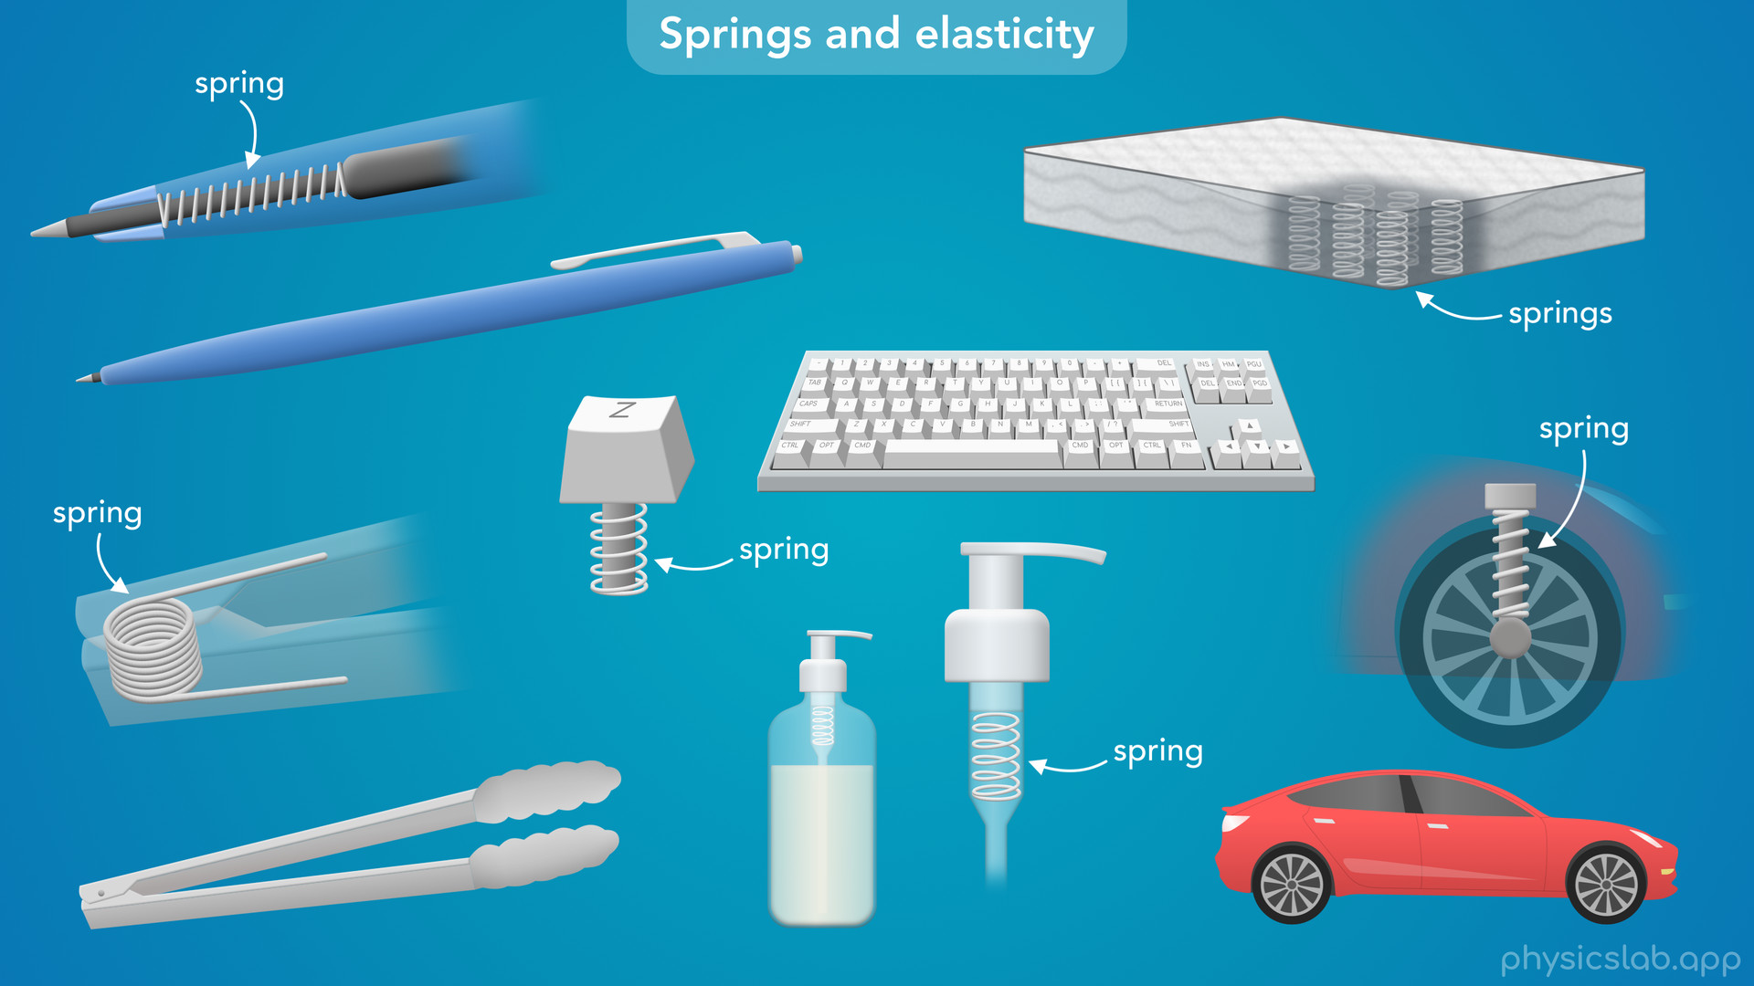
Notes:
• We’ll talk about springs, how they work, and why we use them in so many places.

Slide 11
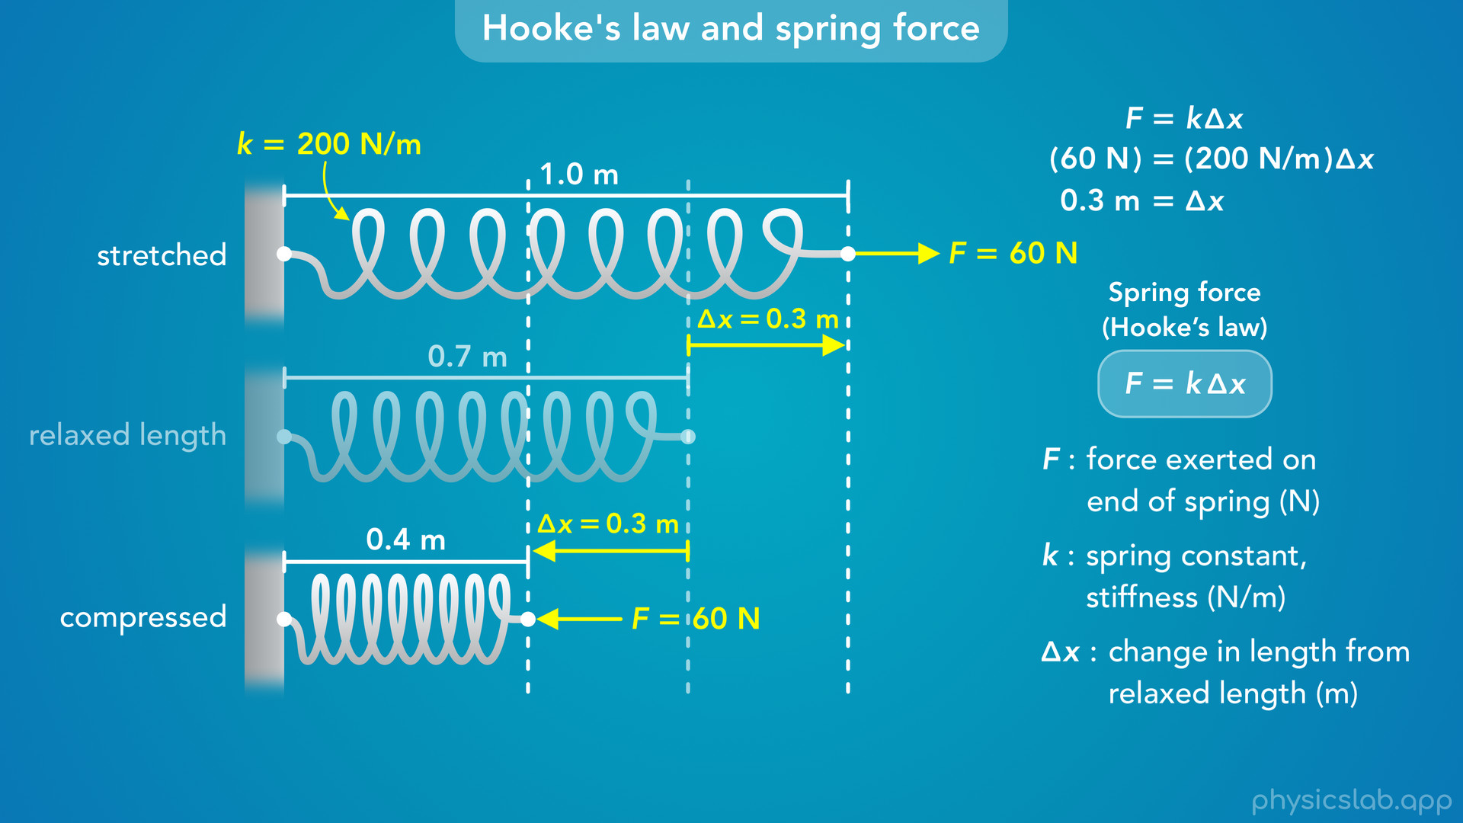
Notes:
• Then we’ll talk about hooke’s law and the equation for spring force.
• This will just be an introduction, and we’ll cover the details and some common points of confusion in the next few videos.

Slide 12

Notes:
• So what are springs, how do they work, and where do they show up in the real world?

Slide 13
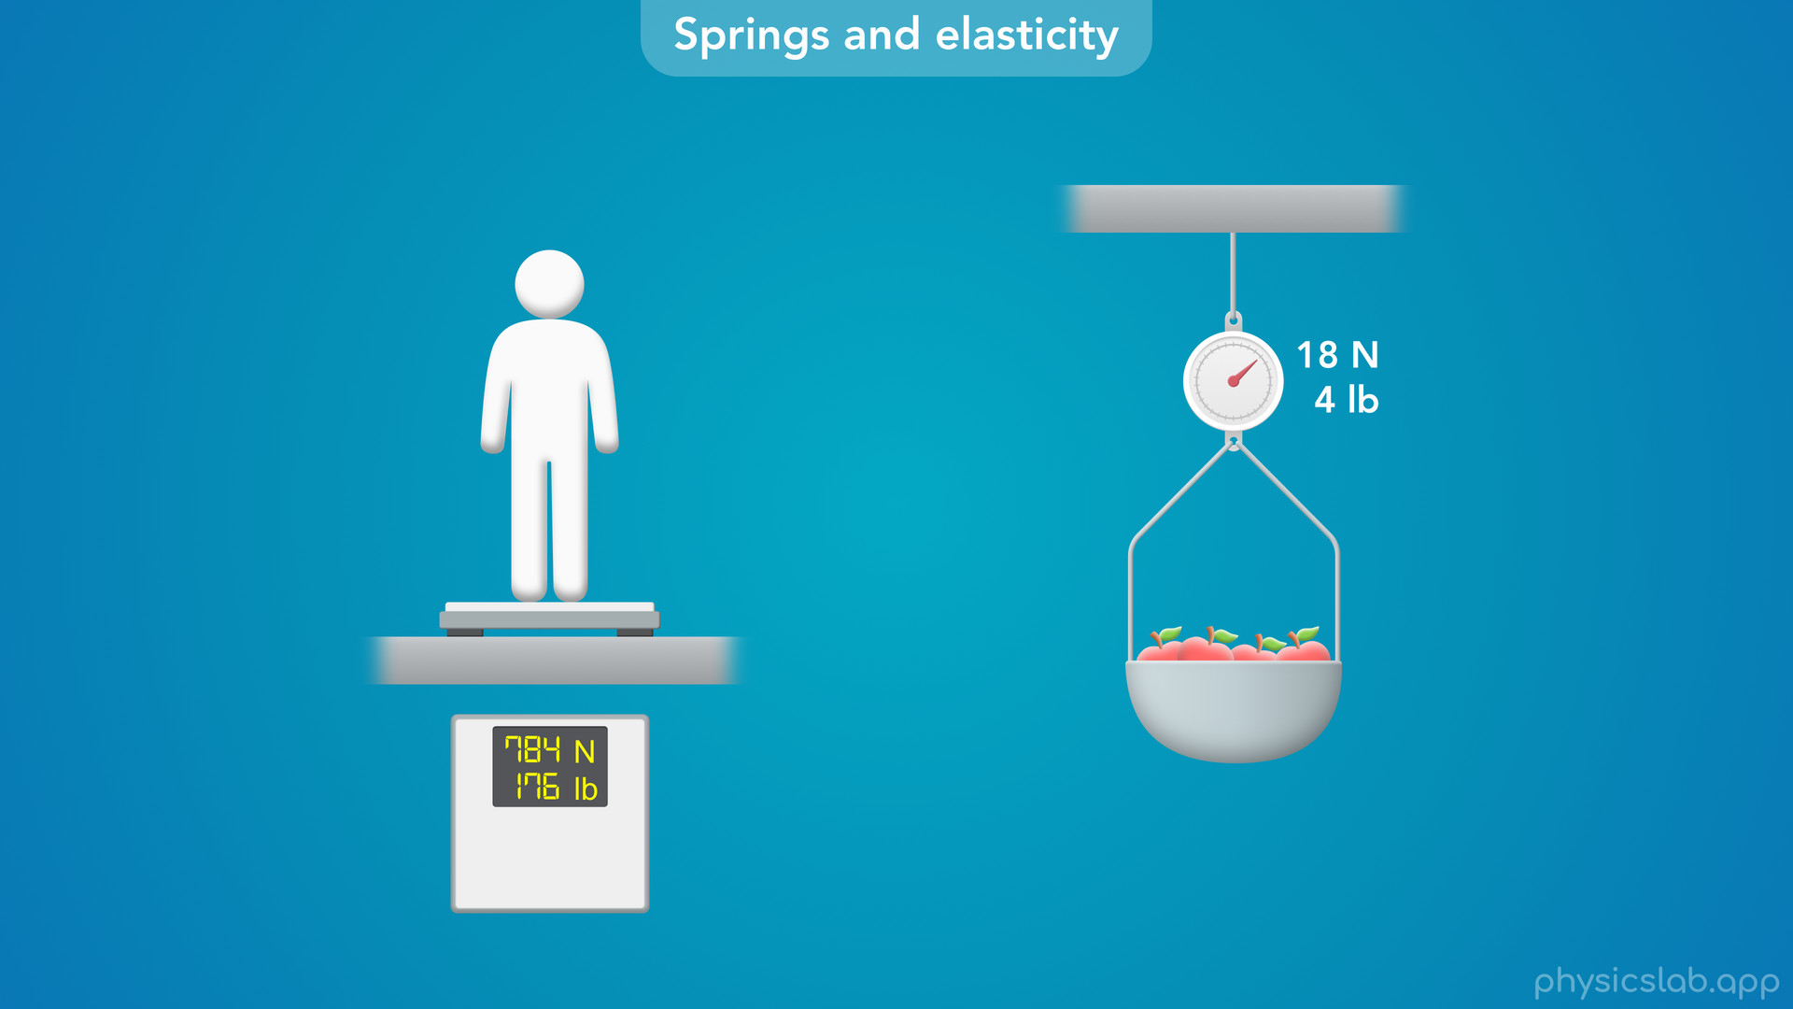
Notes:
• You’ve probably used a scale at some point to measure your own weight or the weight of some objects.
• But have you ever thought about how a scale works?
• If you stand on a scale and it reads 784 N or 176 lb, where is that number coming from? How does the scale actually know how much you weigh?

Slide 14
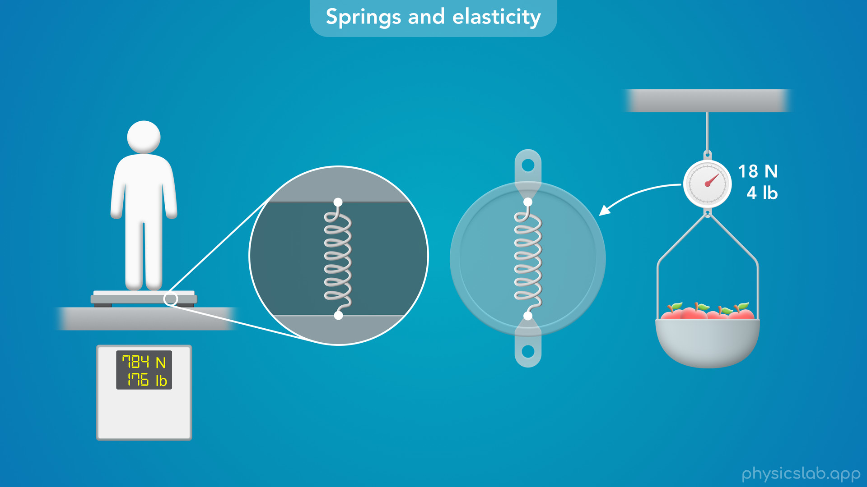
Notes:
• If we look inside, many scales work by using some form of a spring.

Slide 15
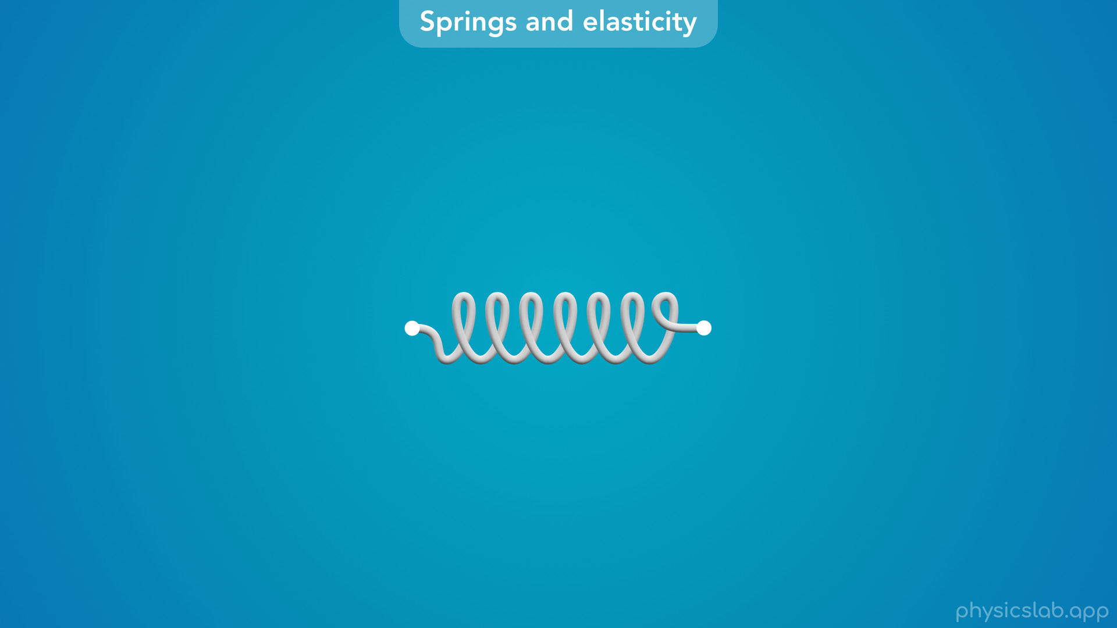
Notes:
• A spring is an object that changes length when we apply a force to both ends.

Slide 16
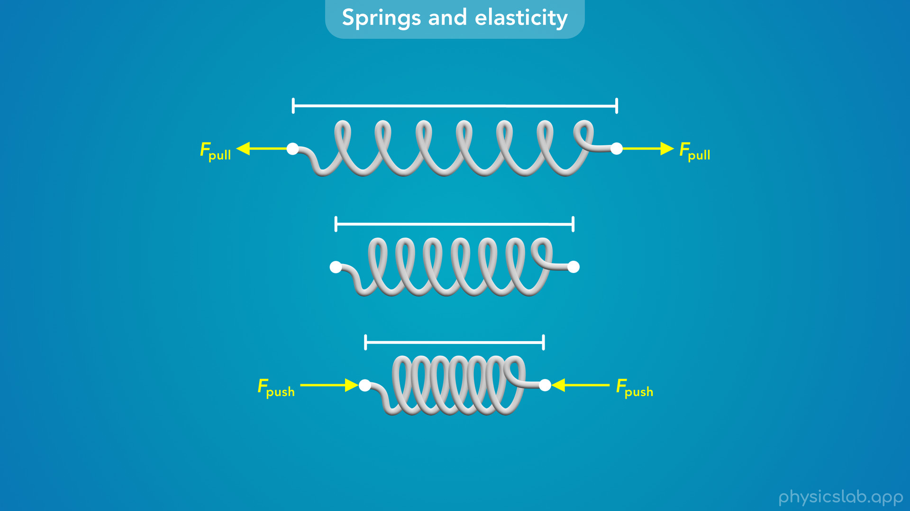
Notes:
• A spring is an object that changes length when we apply a force to both ends.
• If we pull on the ends of a spring, it gets longer.
• And if we push on the ends, it gets shorter.

Slide 17
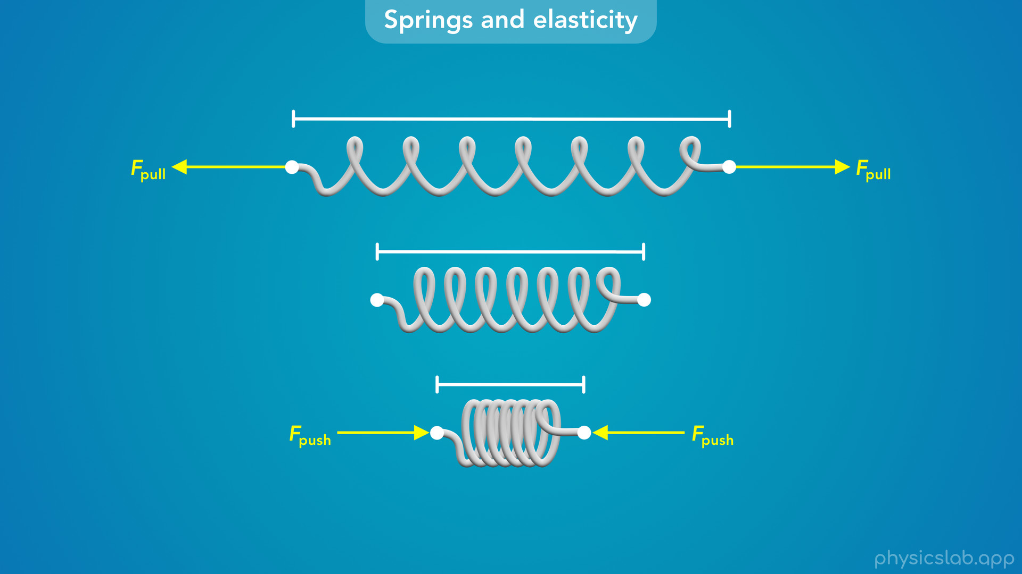
Notes:
• Not only that, but the more force that we apply, the longer or shorter the spring will get.

Slide 18
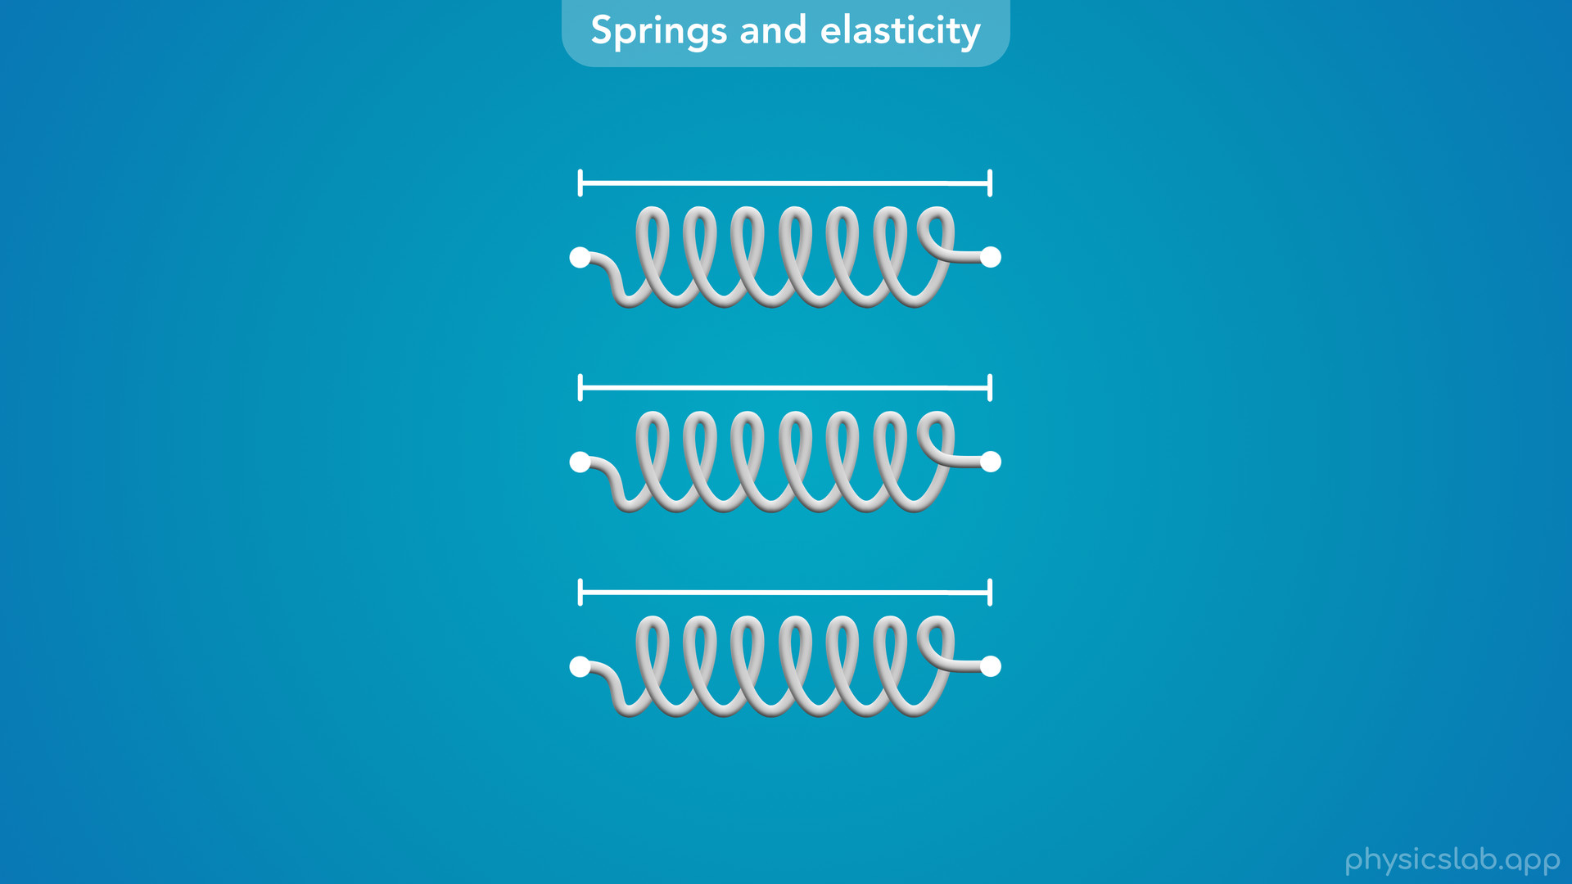
Notes:
• But it won’t stay that way on its own.
• When we remove the forces, a spring will always return to its original length.

Slide 19
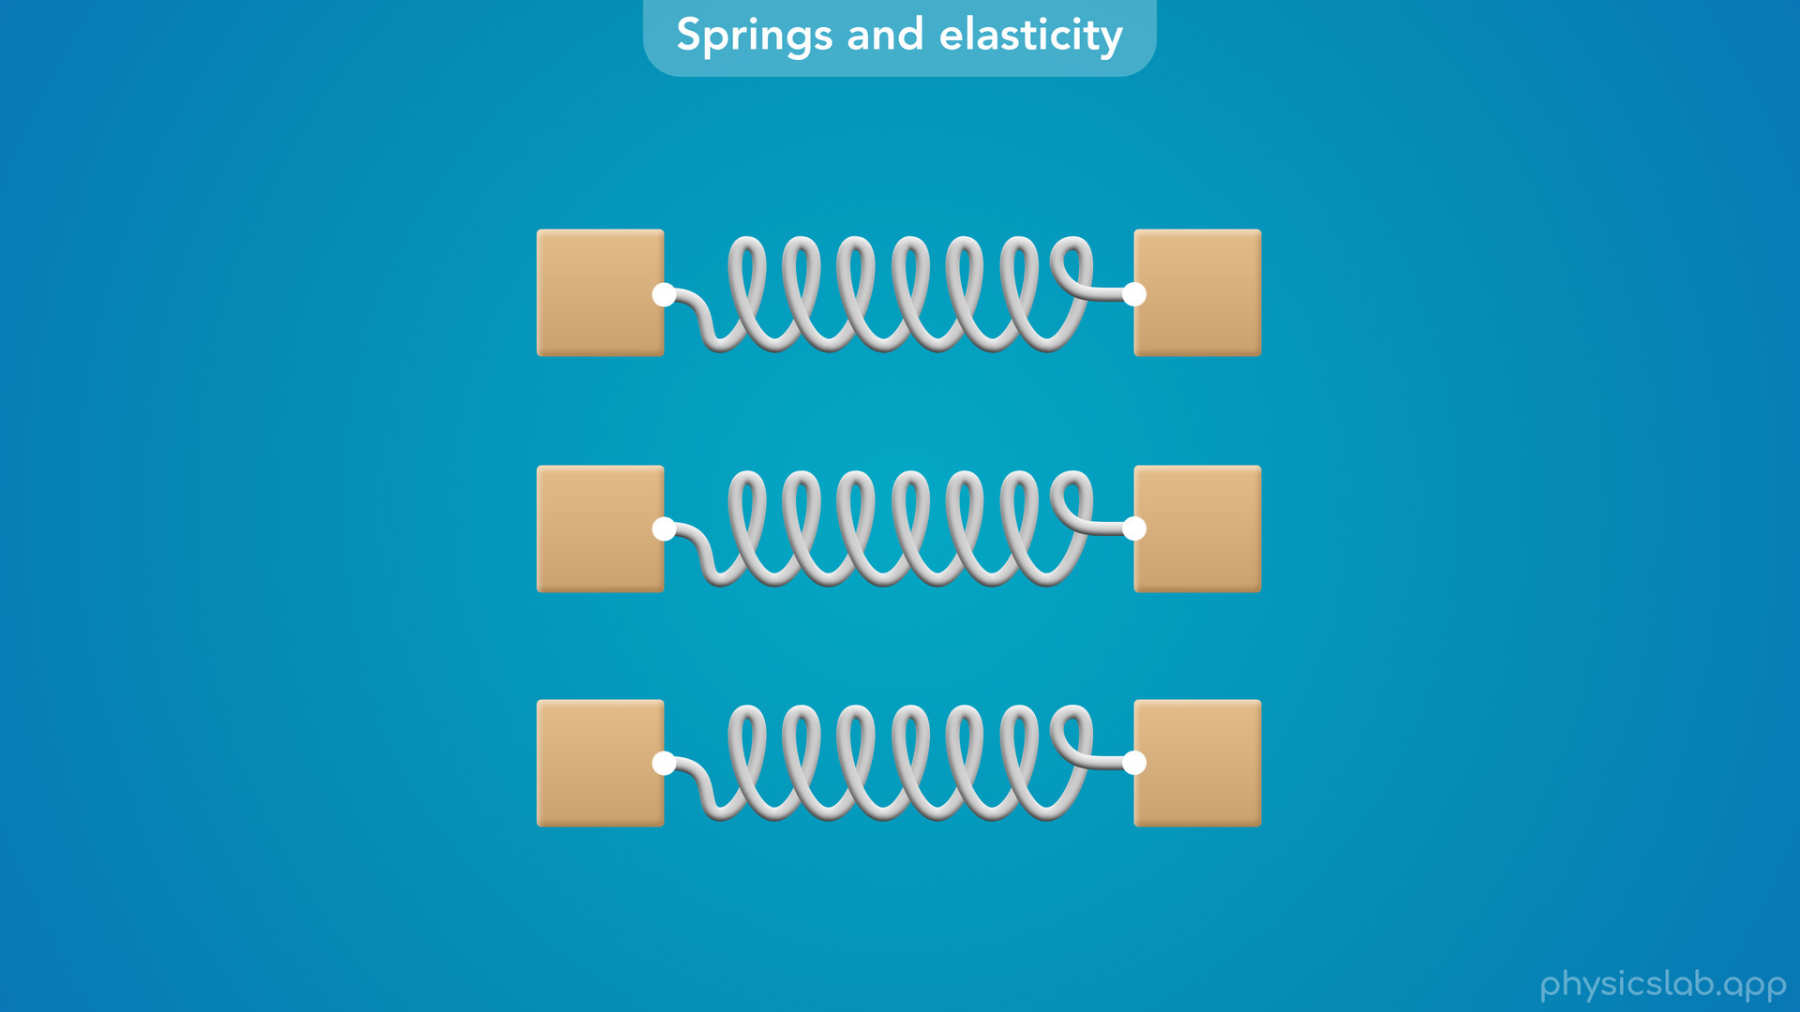
Notes:
• What happens if a spring is attached to an object at both ends?

Slide 20
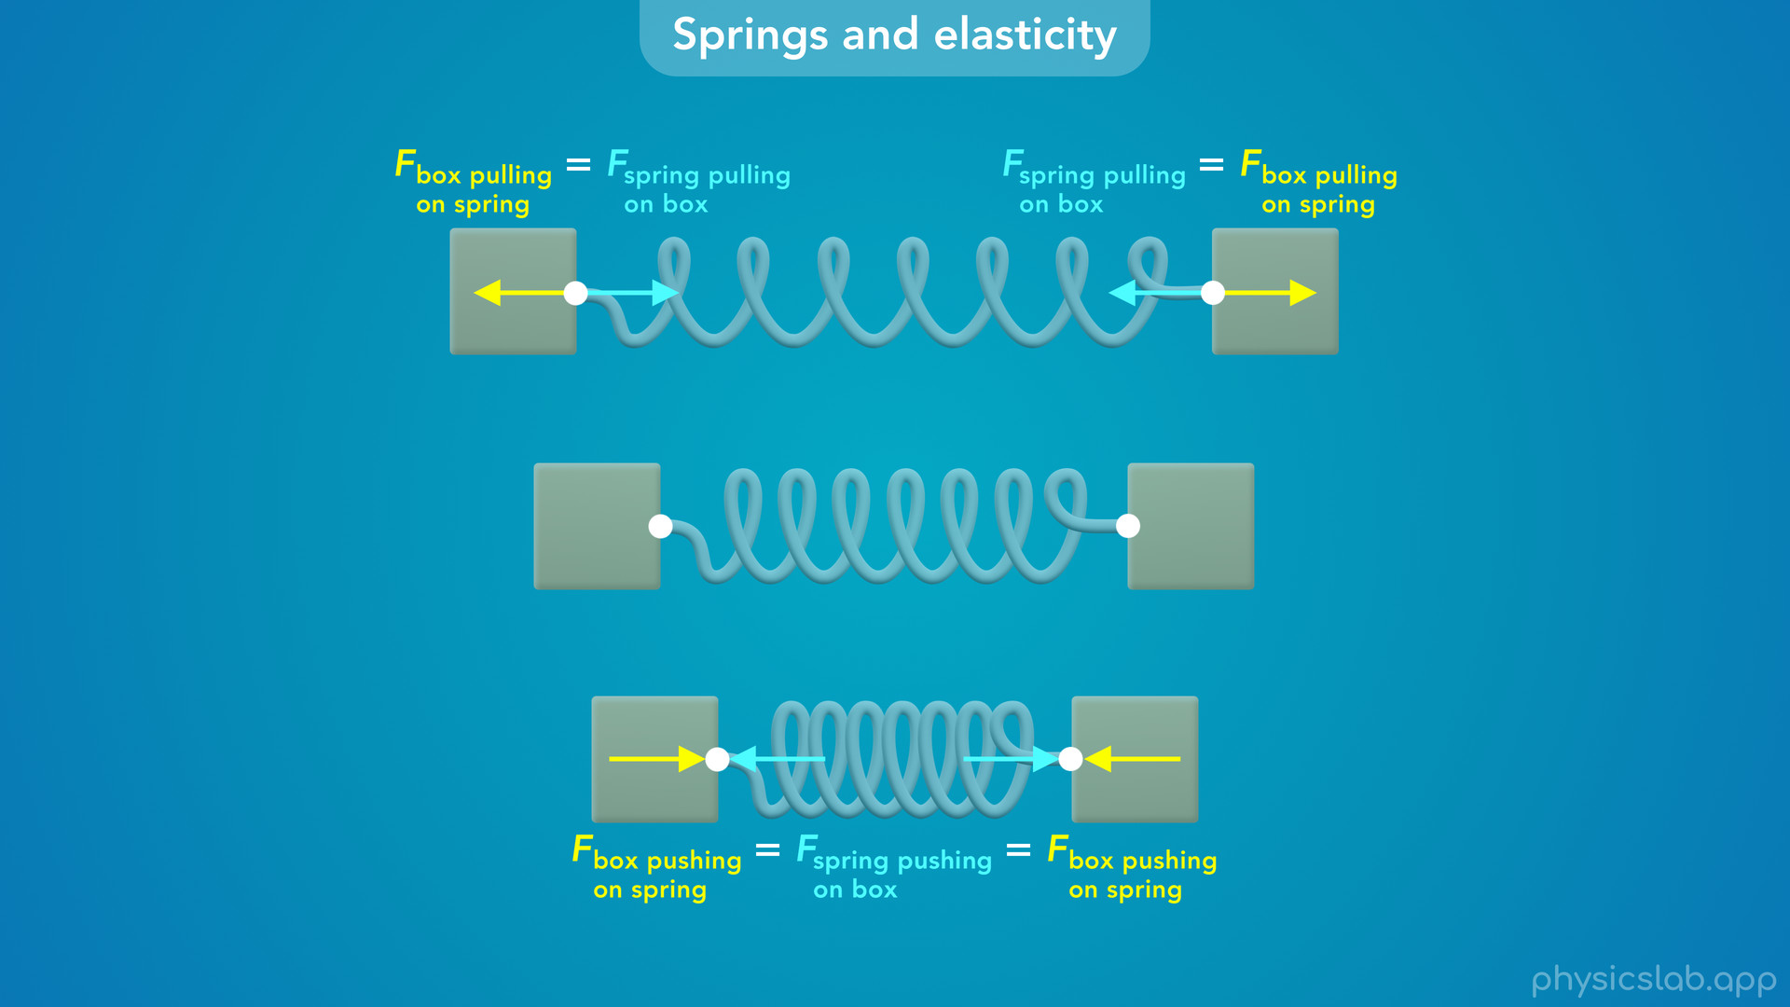
Notes:
• According to Newton’s 3rd law, if the object is exerting a force on the spring, then the spring is exerting an equal and opposite force on the object.

Slide 21
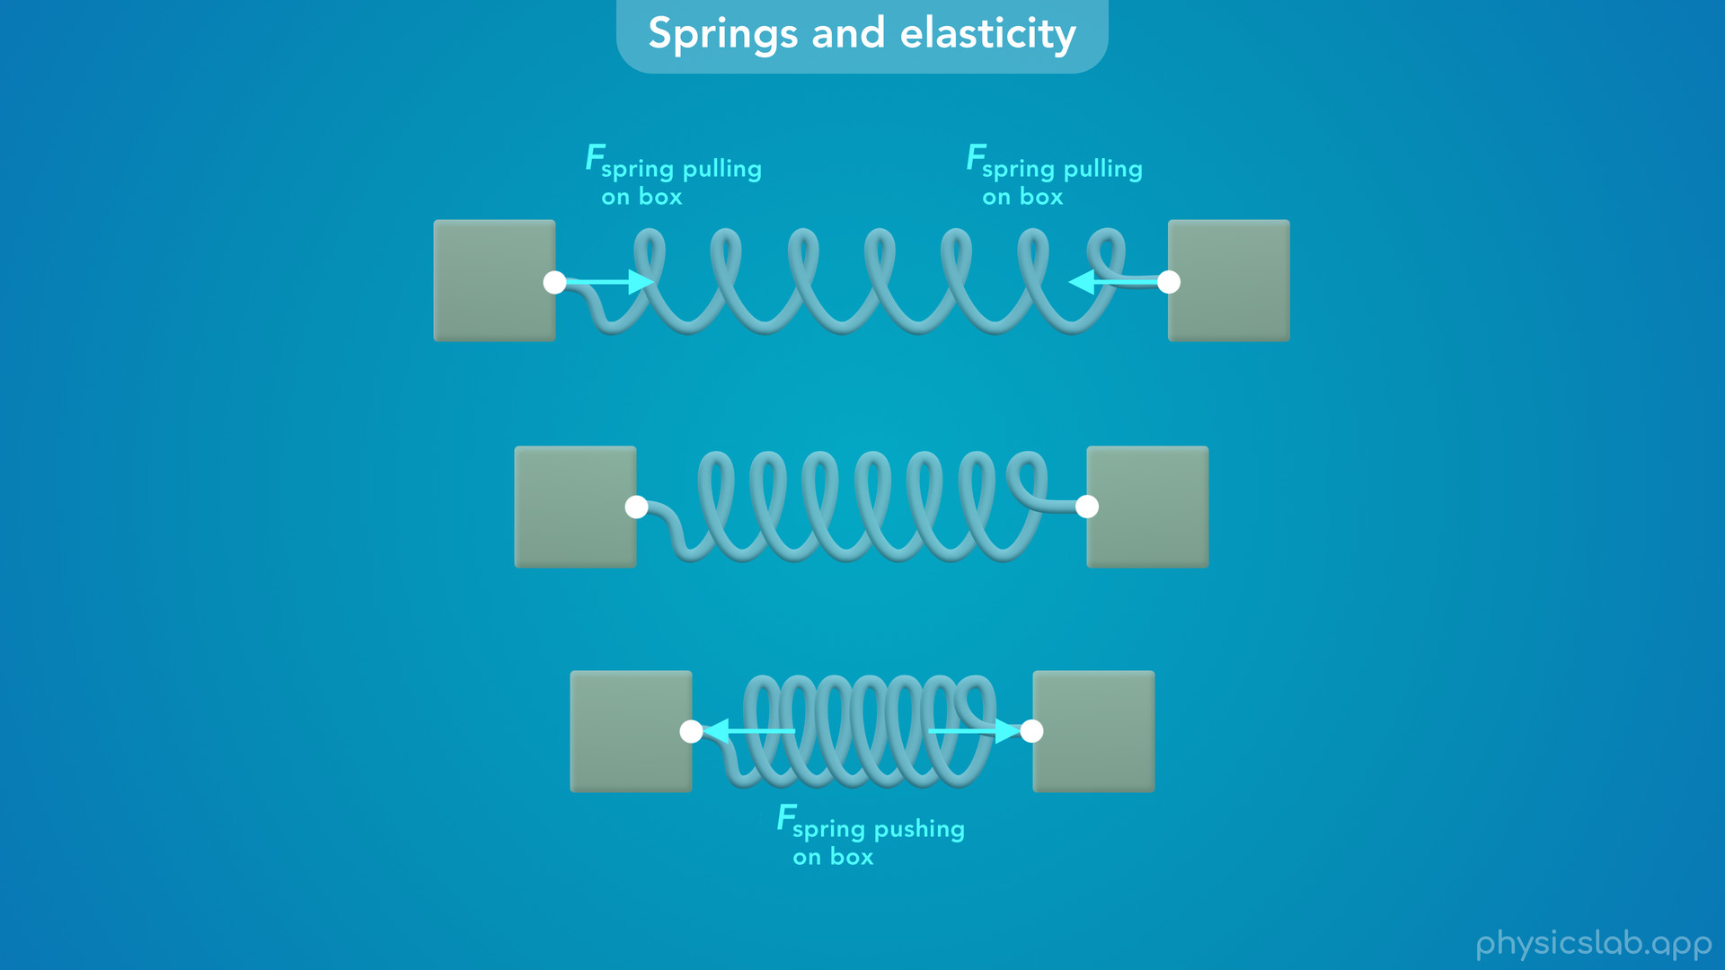
Notes:
• So if we stretch a spring and make it longer, the spring wants to return to its original length, so it’ll try to pull the objects together.
• And if we compress a spring and make it shorter, the spring will try to push the objects apart.

Slide 22

Notes:
• The fact that a spring always returns to its original length is actully really useful.
• So we use springs in a lot of different ways.

Slide 23
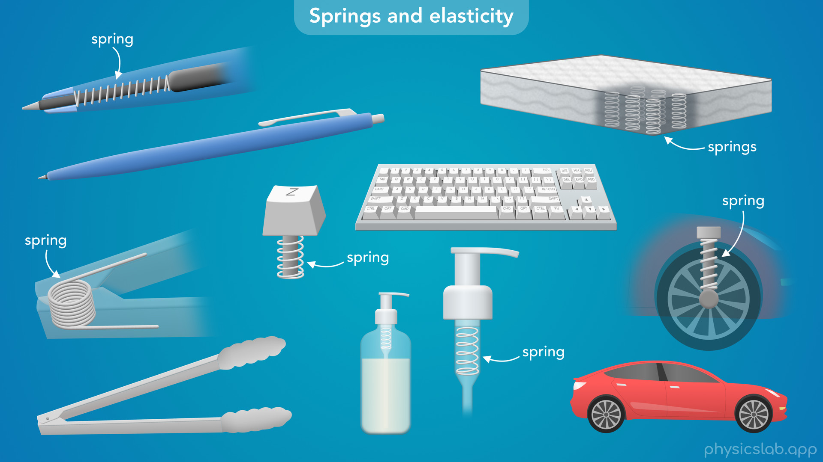
Notes:
• The spring inside of a pen is what makes the tip retract back into the pen when you click it. Without the spring, the pen wouldn’t work.
• When you use a keyboard, every key has some type of spring below it, which is why the keys return to their position when you let go.
• Some springs, like the one in pair of kitchen tongs, are what we call torsional springs which can rotate.
• This spring is always trying to open the tongs, so you only have to squeeze them together, you don’t have to pull them apart.
• When you use a soap dispenser with a pump, there’s a spring inside the top which forces the pump back up when you let go.
• Without the spring, you’d have to pull the pump back up every time you use it.
• A lot of mattresses are filled with springs, which is why they return to their original shape when you get back out bed.
• And cars, bikes and most vehicles have springs near the axle in the wheels, which is part of the suspension.
• These springs are pretty big, and when you’re riding in a car, your seat is actually separated from the wheels by these springs.
• Without the springs, it would be a pretty rough ride, and you’d feel all of the bumps in the road.

Slide 24
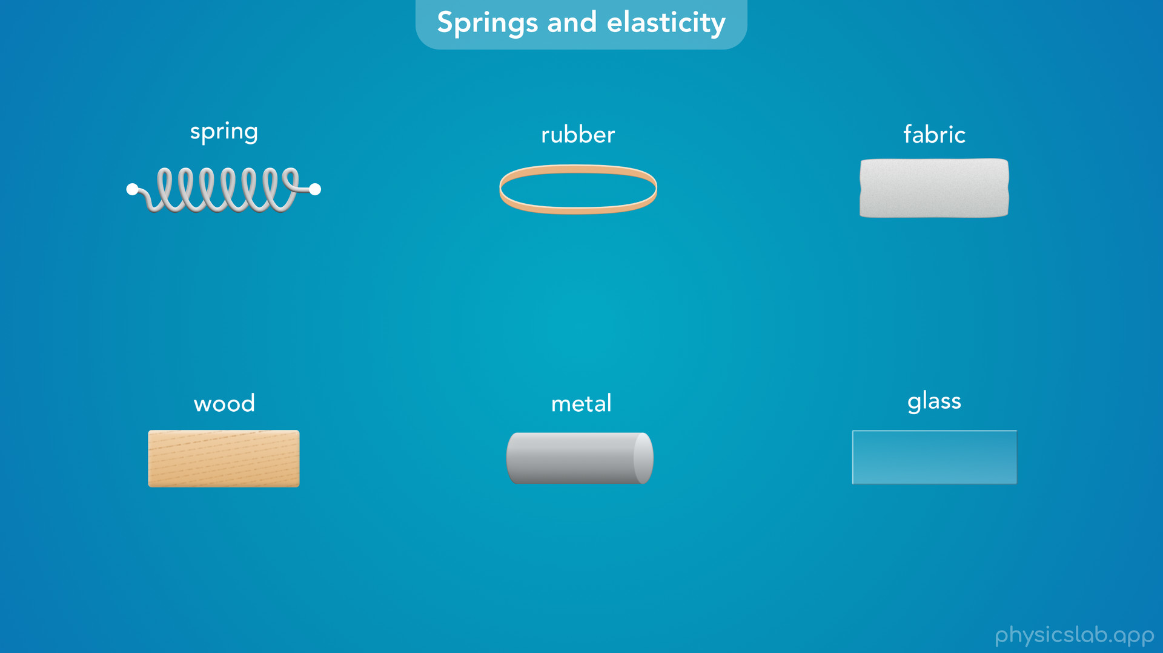
Notes:
• So springs show up everywhere.
• And not only that, but it turns out that all materials actually behave just like springs.

Slide 25
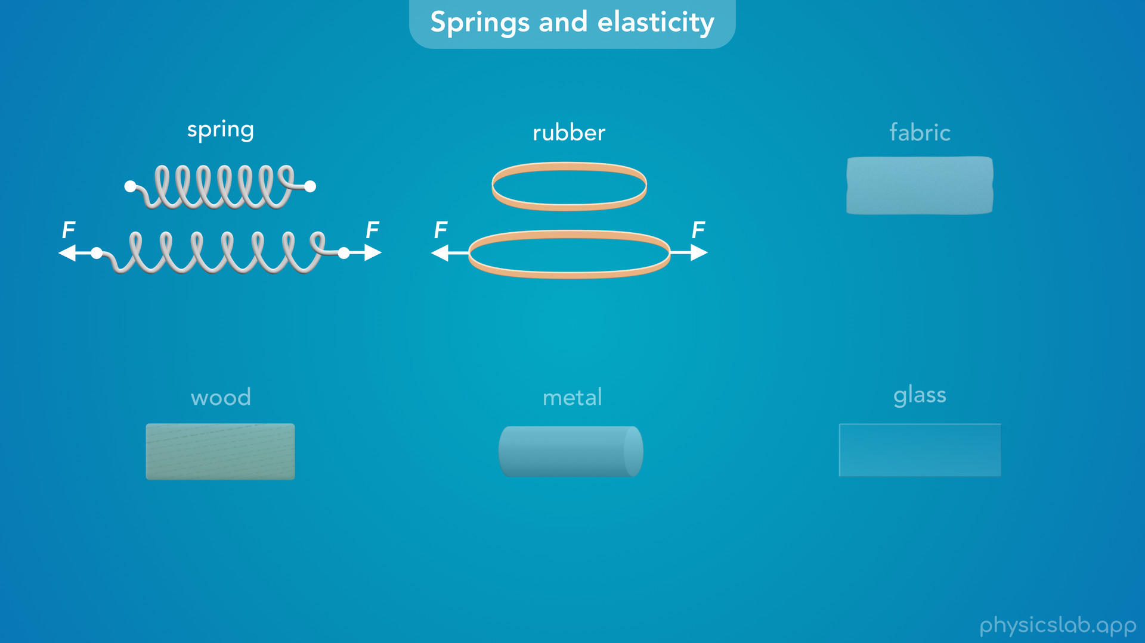
Notes:
• For stretchy materials like rubber, this is more obvious.
• When you pull on a rubber band it gets longer, just like a spring.

Slide 26
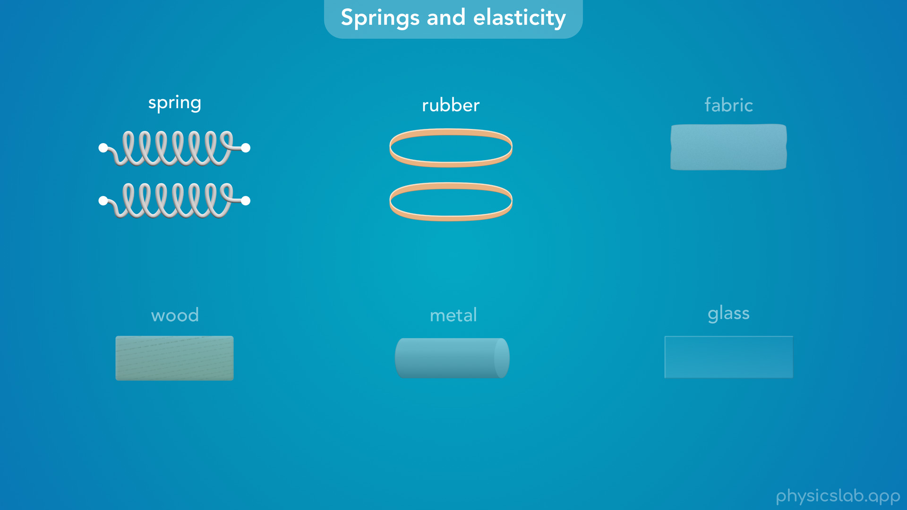
Notes:
And when you let go, it returns to its original shape.

Slide 27
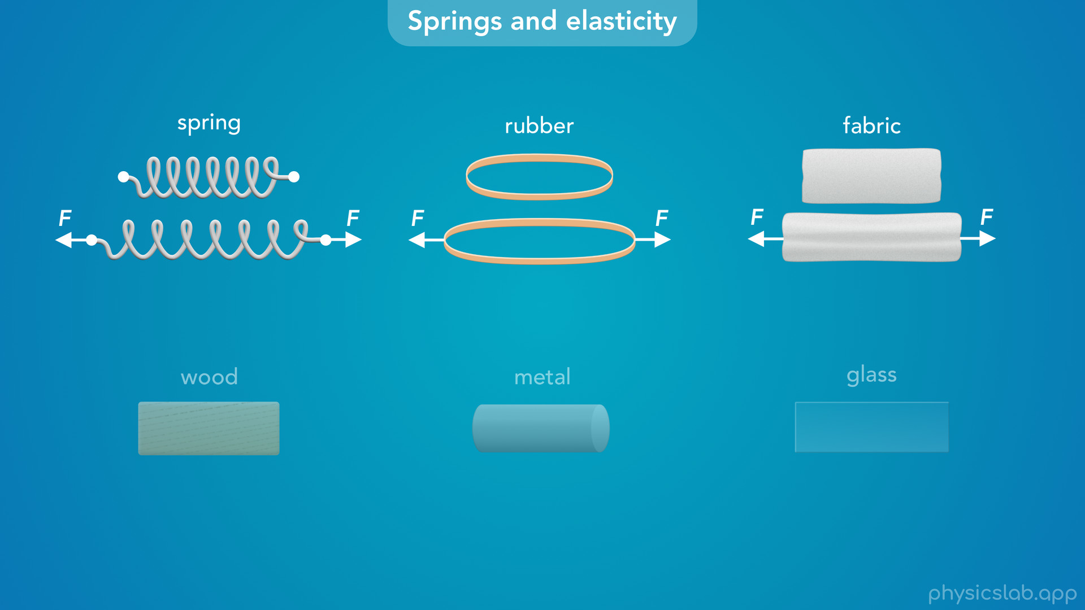
Notes:
• Most types of fabric are also pretty elastic, and they behave in the same way.

Slide 28
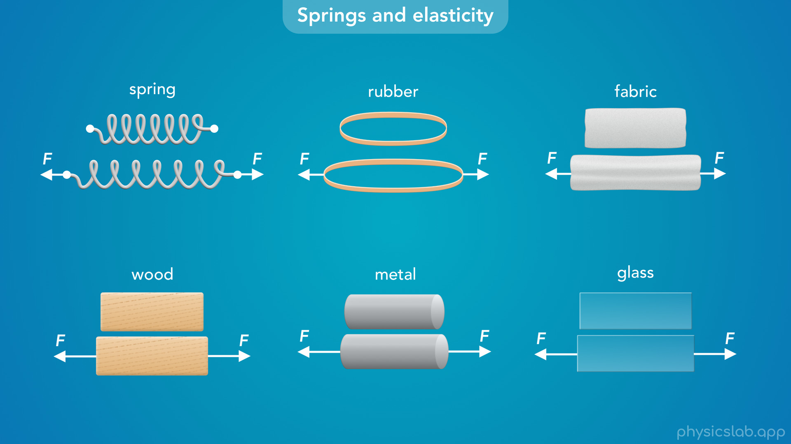
Notes:
• Even materials that you don’t think of as stretchy, like wood, metal or glass, also act like springs.
• But the stiffer the material, the more force you have to apply to get it to stretch.
• So you won’t be able to see any stretching if you pull on a metal rod with your hands.

Slide 29
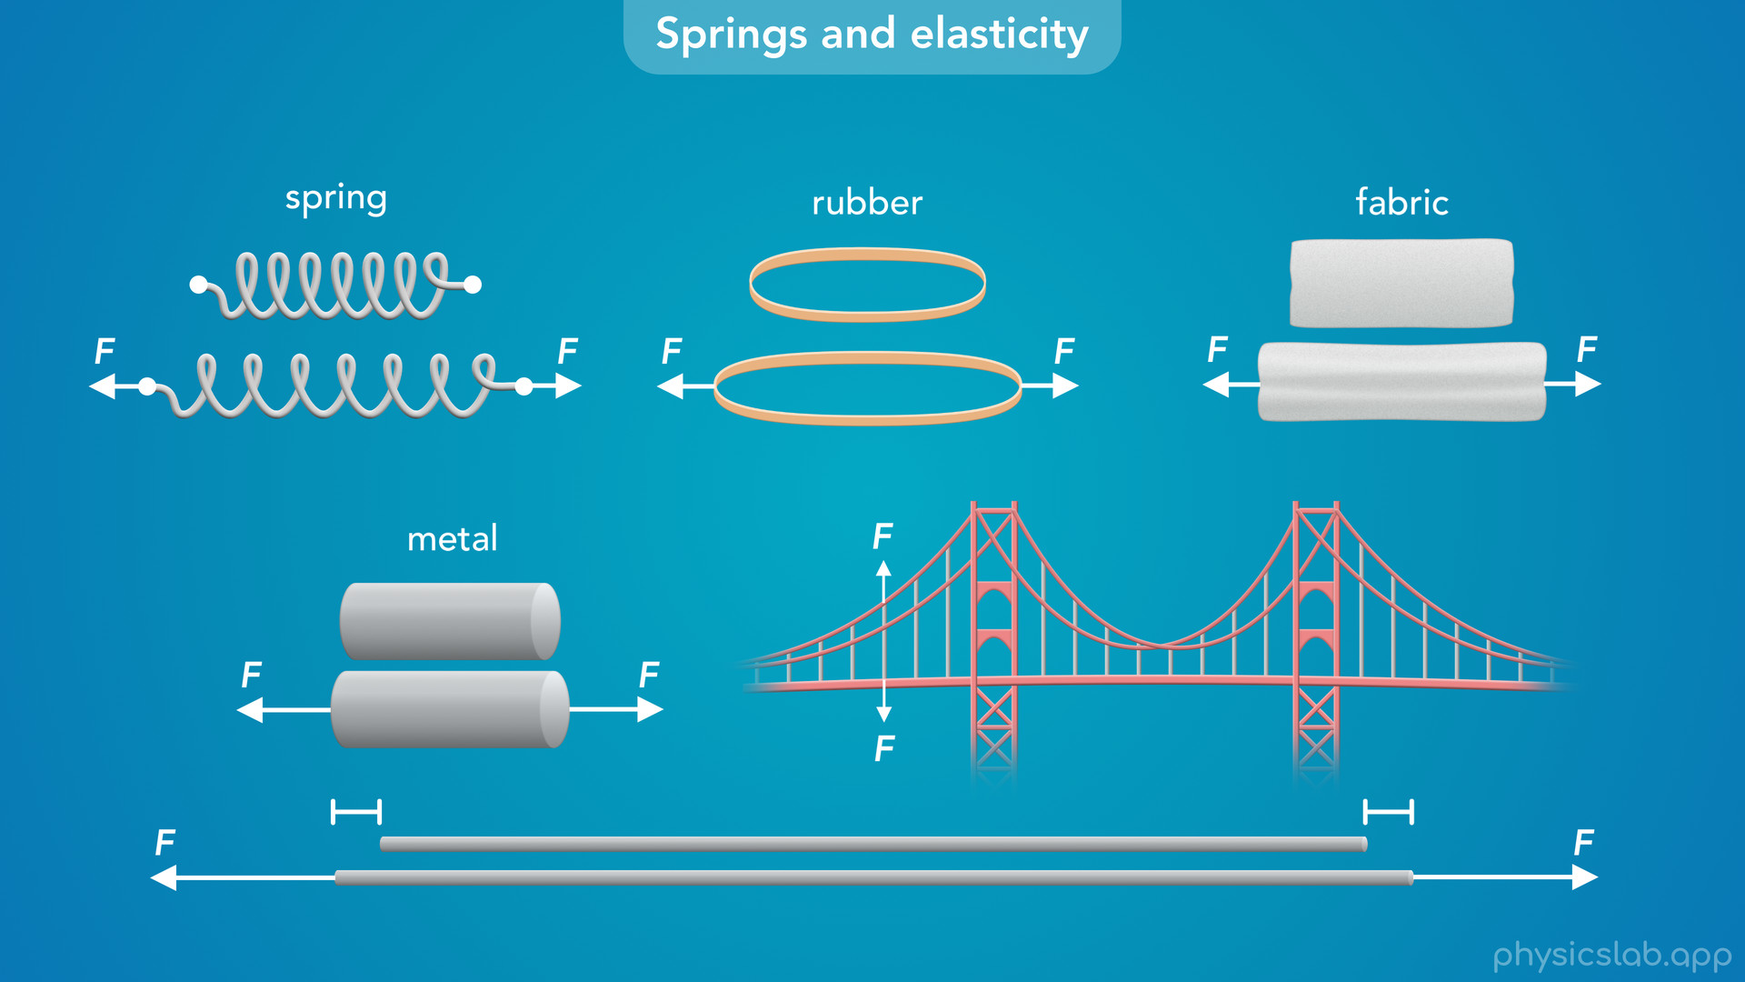
Notes:
• But if the force is big enough or the object is really thin, like a metal wire or a guitar string, then we can actually see it stretch a small amount.
• And if the object is really big, like a bridge or a building, then we definitely have to think about how it’s going to stretch on a large scale.

Slide 30
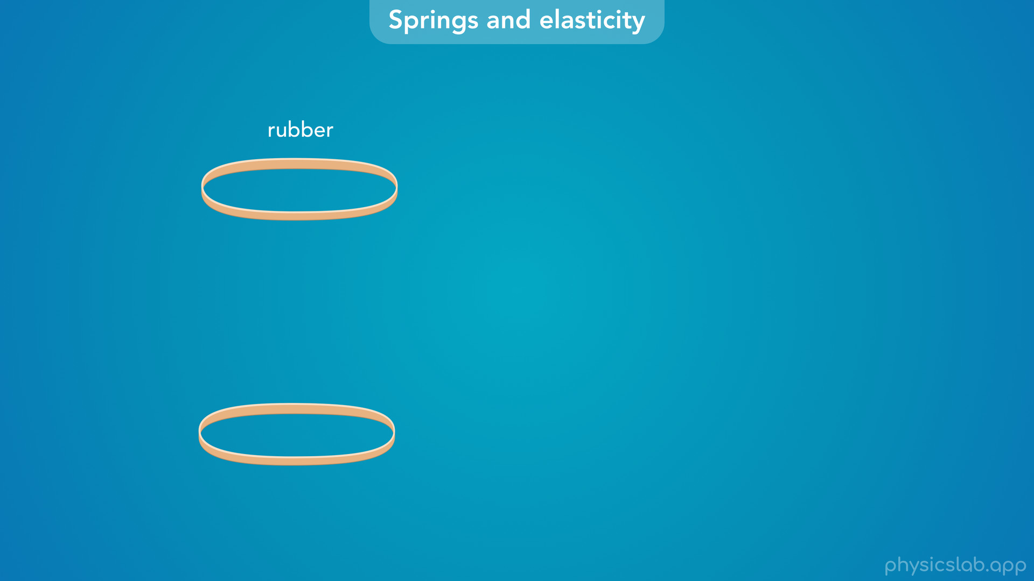
Notes:
• So why do materials behave like springs?

Slide 31
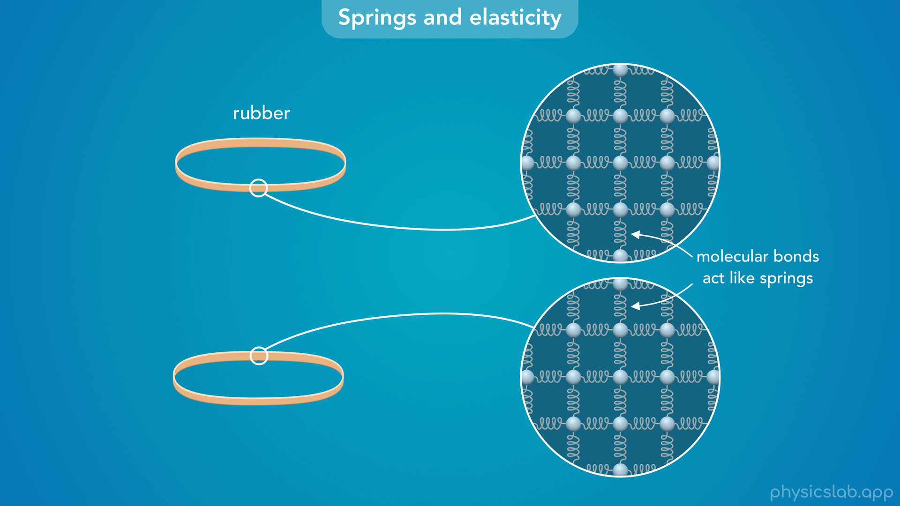
Notes:
• Everything is made of atoms and molecules, and we can imagine that the molecular bonds act like tiny springs.

Slide 32
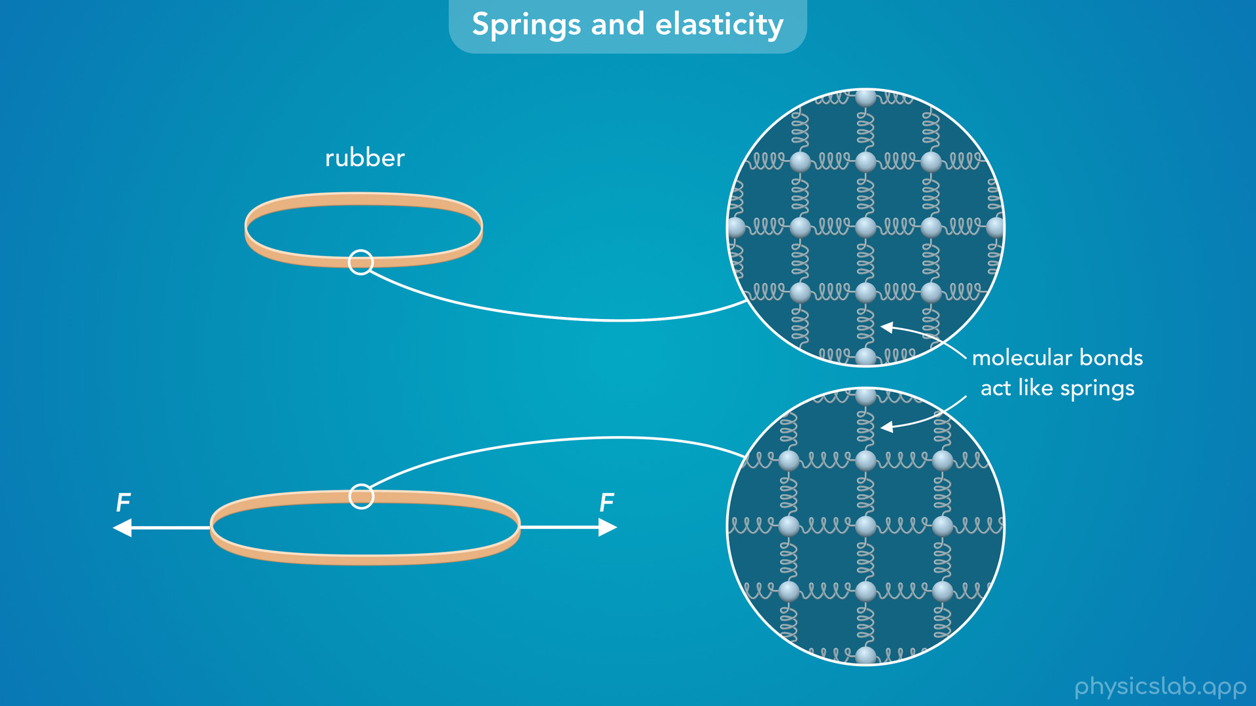
Notes:
• When you pull on the material, you’re applying a force to all of the springs so they get longer, and the material stretches.

Slide 33
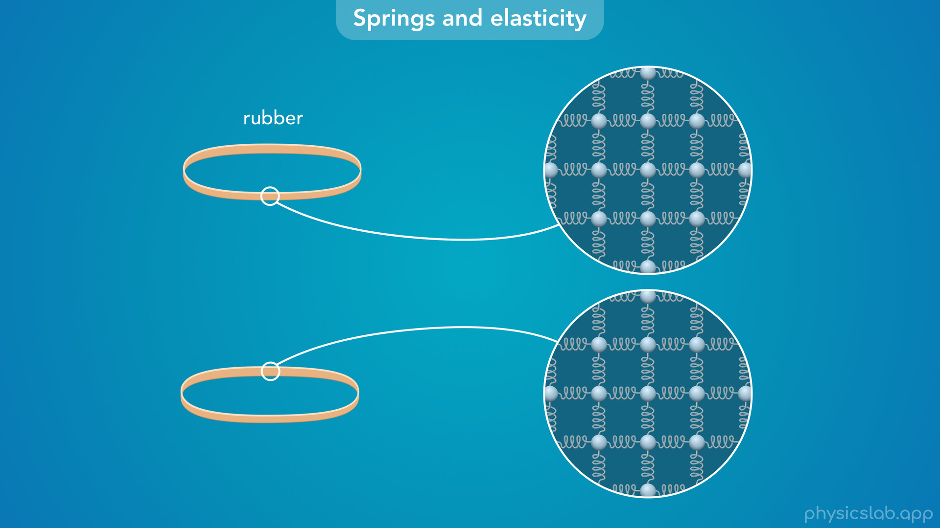
Notes:
• When you let go, the springs go back to their original length and the object returns to its original shape.

Slide 34
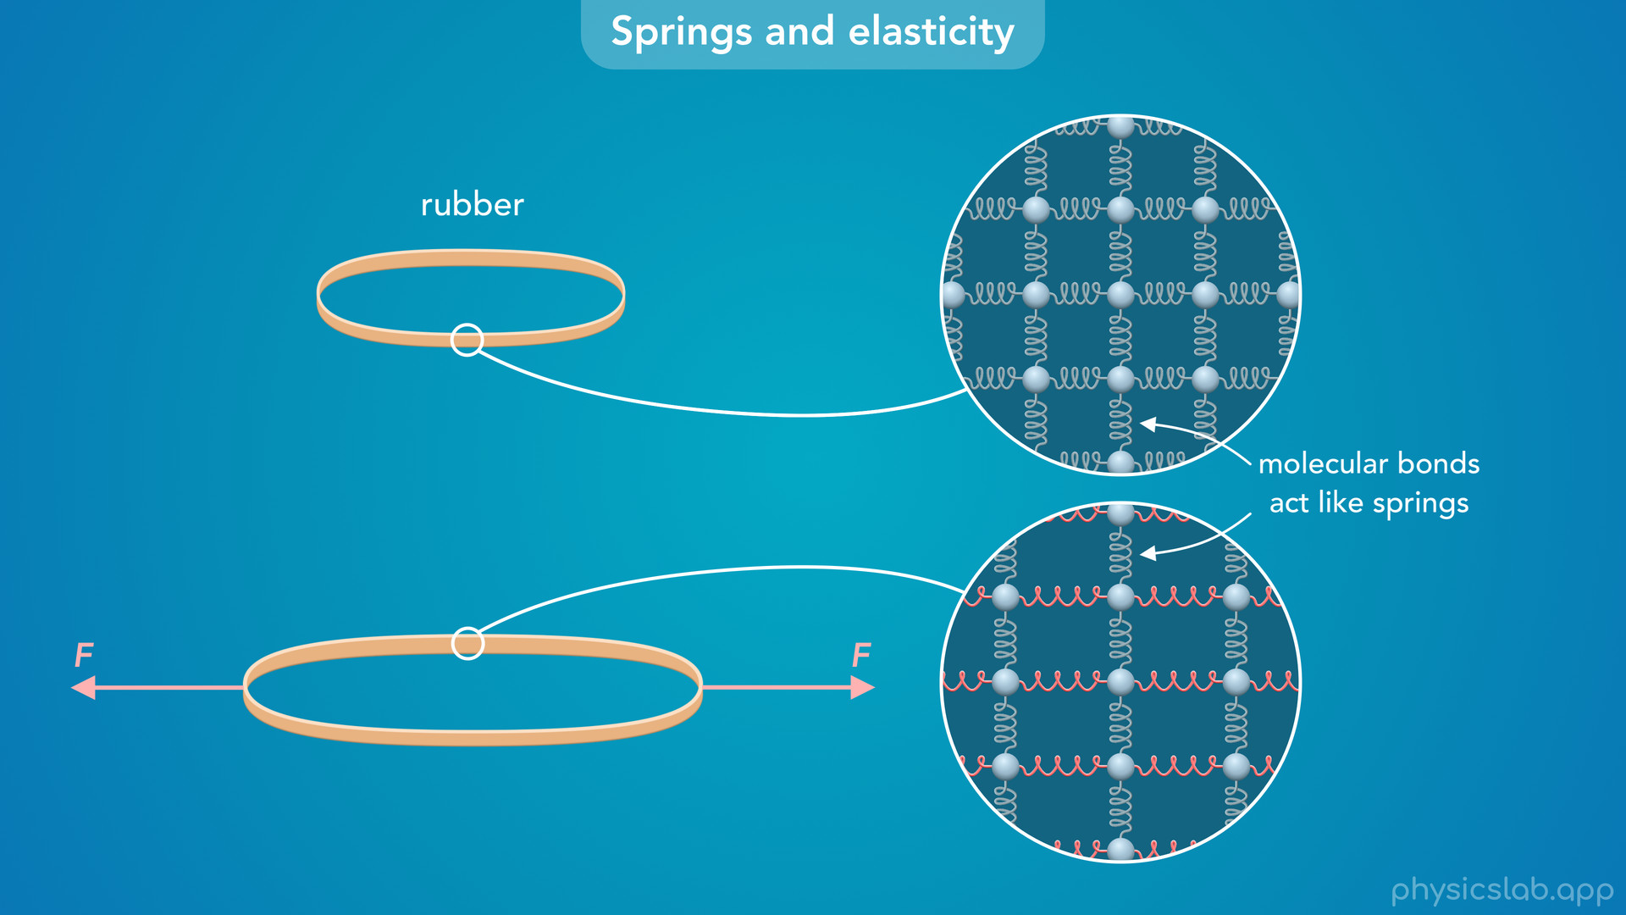
Notes:
• If the force is too strong, then these bonds will eventually break and the material will be permanently deformed.
• But as long as the force is below that limit, all materials really do behave like springs.

Slide 35
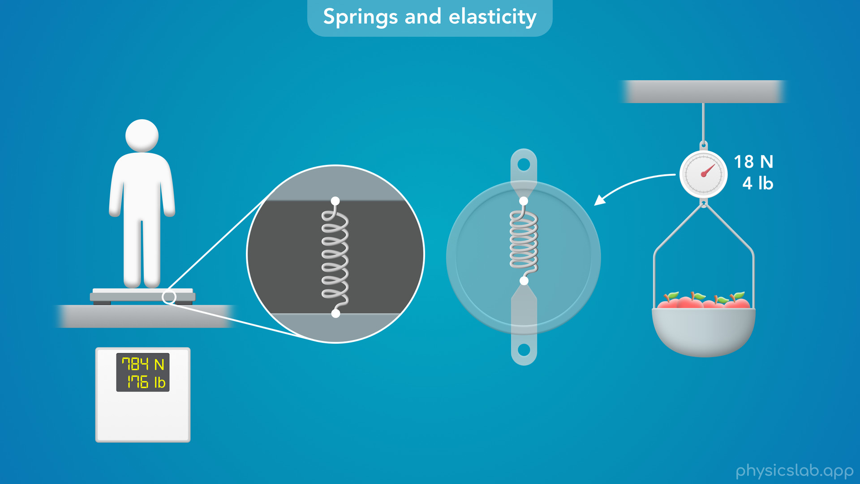
Notes:
• So going back to these scales, how do they use springs to measure an object’s weight?

Slide 36
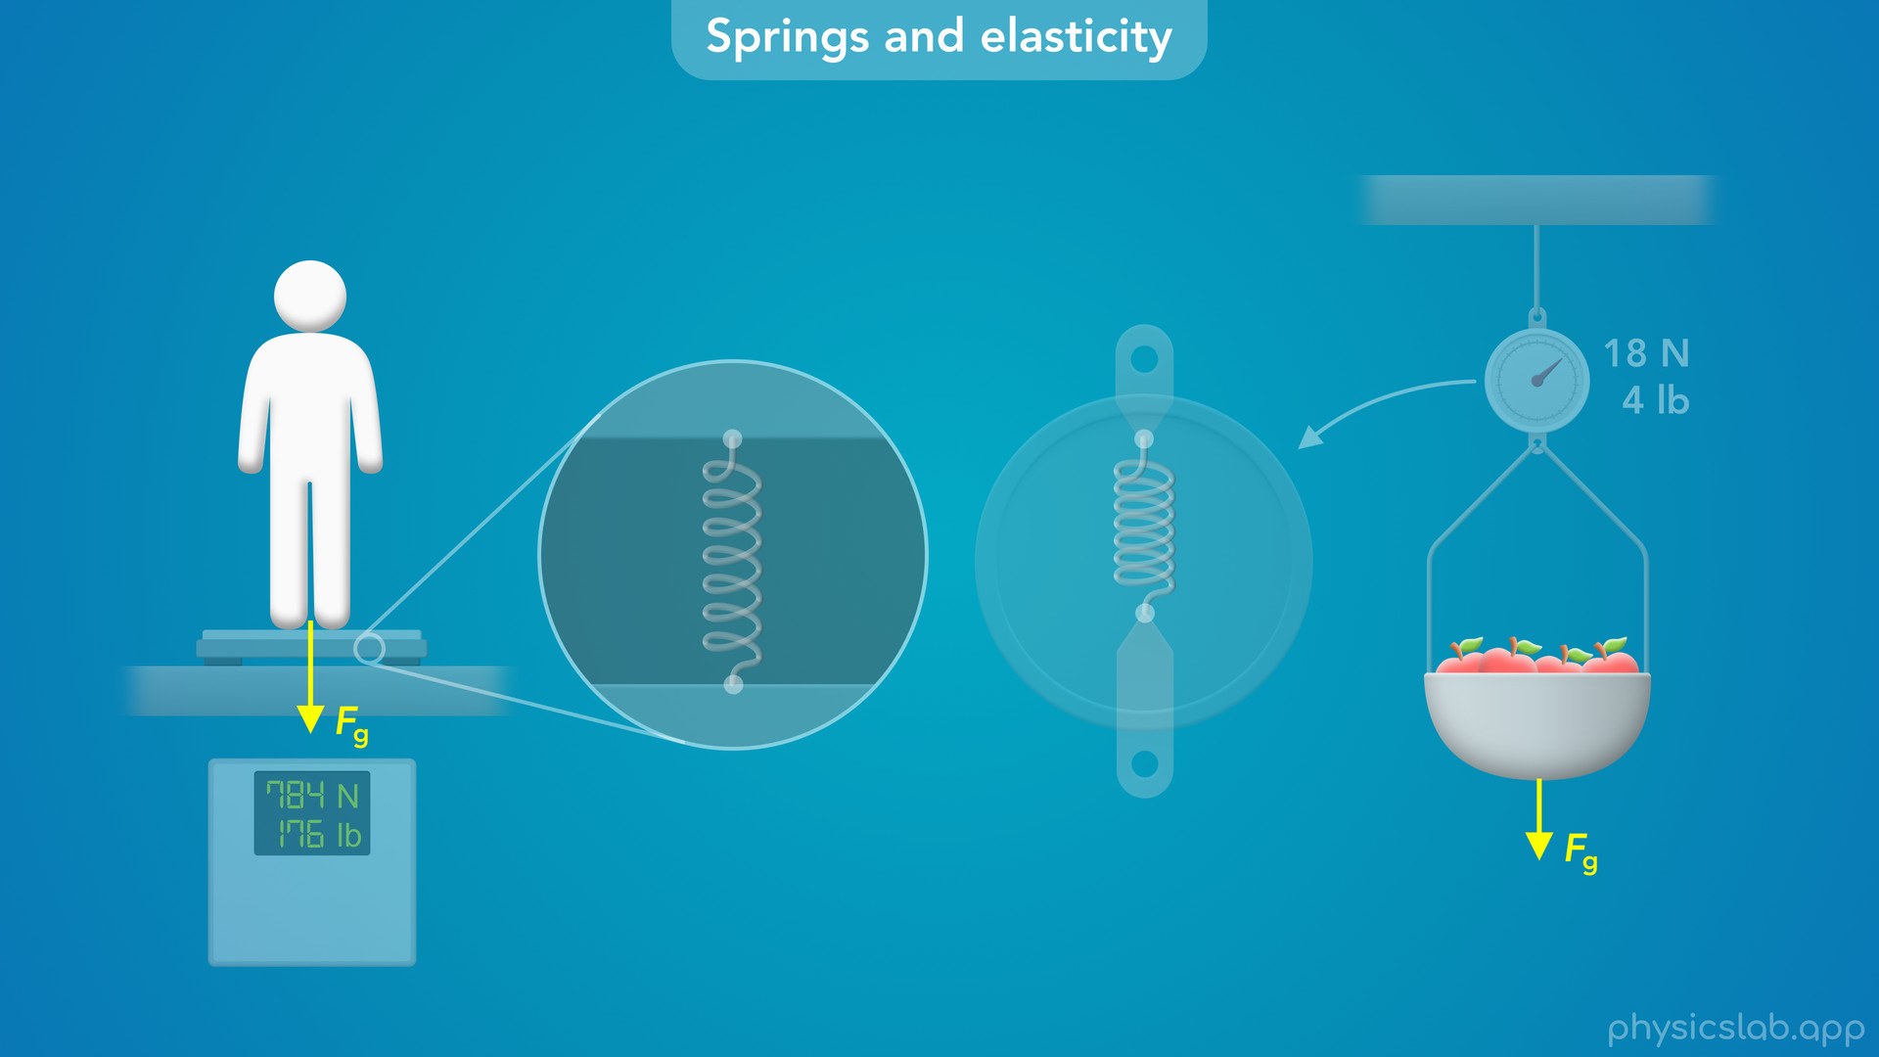
Notes:
• Well we learned that weight is just the gravitational force on an object.

Slide 37

Notes:
• And if the object is at rest, like it is when we use a scale, that weight force is being applied to the spring.

Slide 38
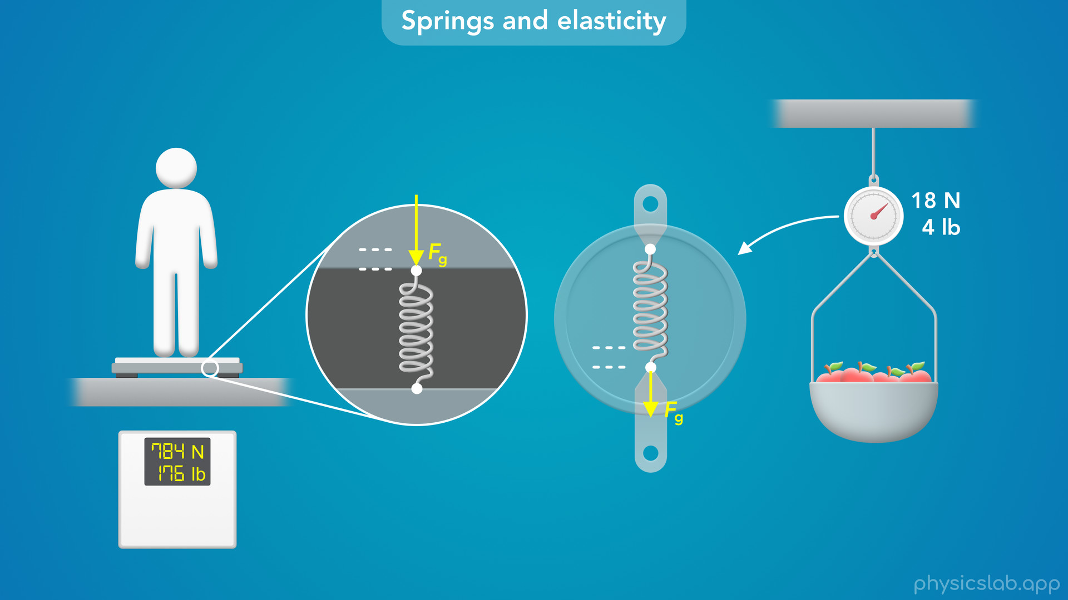
Notes:
• And if we apply a force to a spring, it changes length.

Slide 39
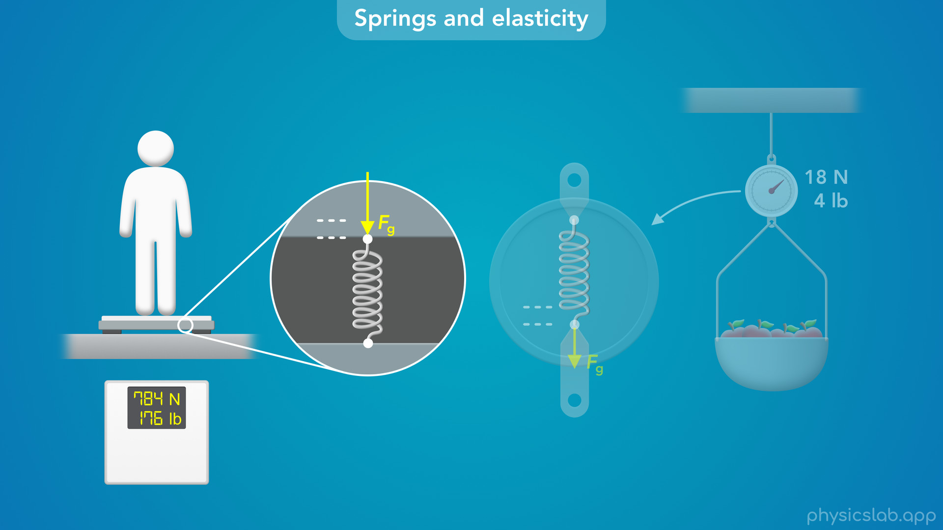
Notes:
• For some scales, the weight force compresses the spring…

Slide 40
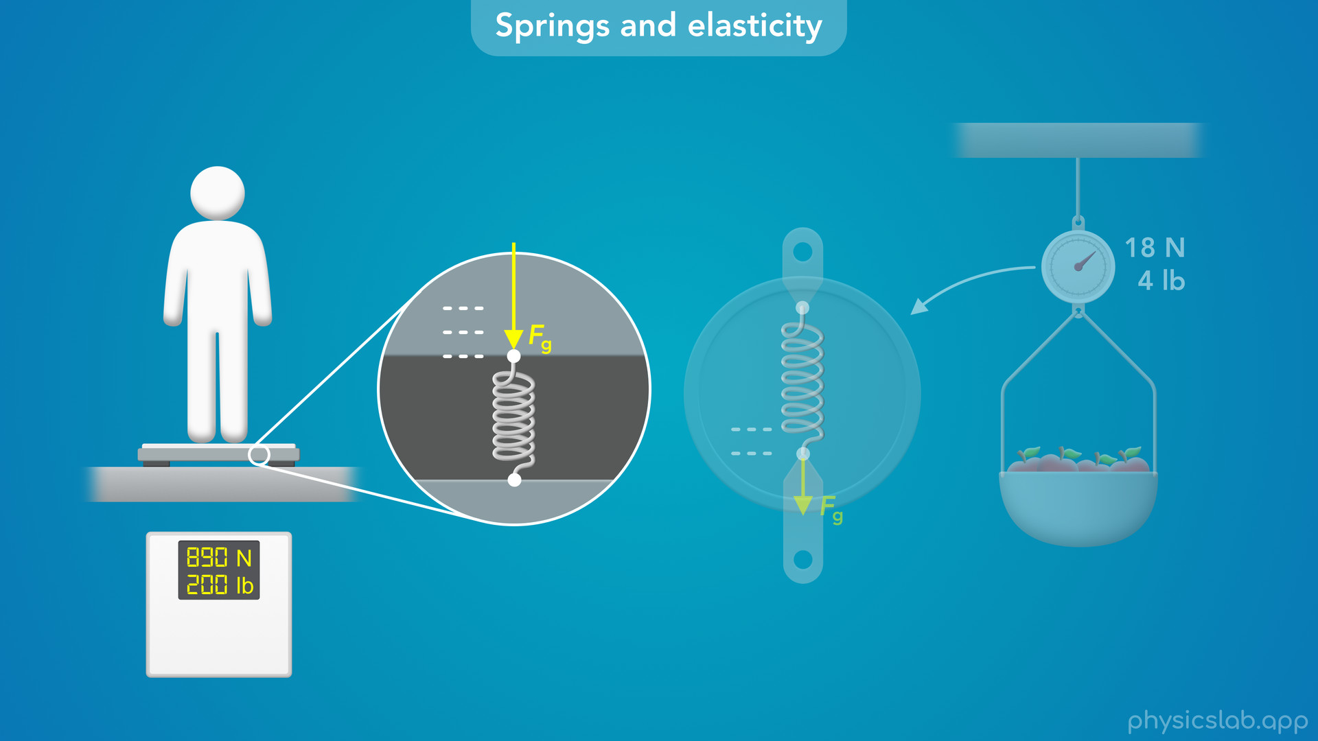
Notes:
and the greater the weight force, the shorter the spring gets.

Slide 41
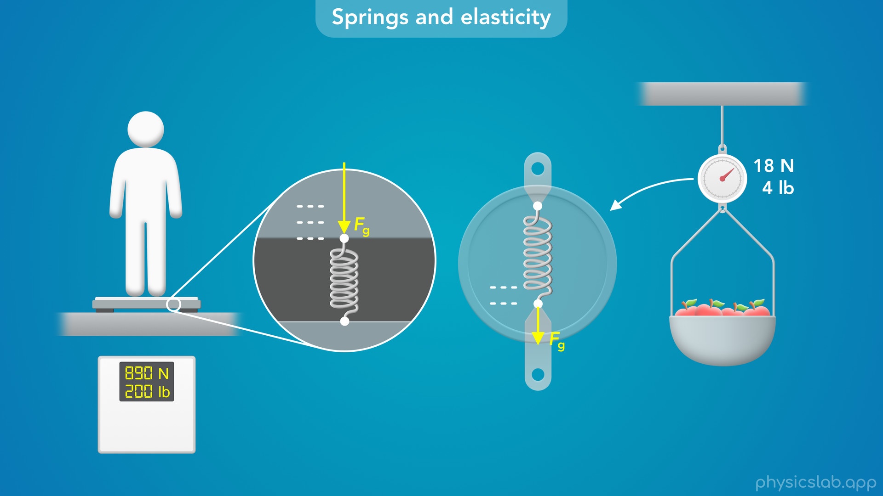
Notes:
• For other scales, the weight force stretches the spring…

Slide 42

Notes:
and the greater the force, the longer the spring will stretch.

Slide 43
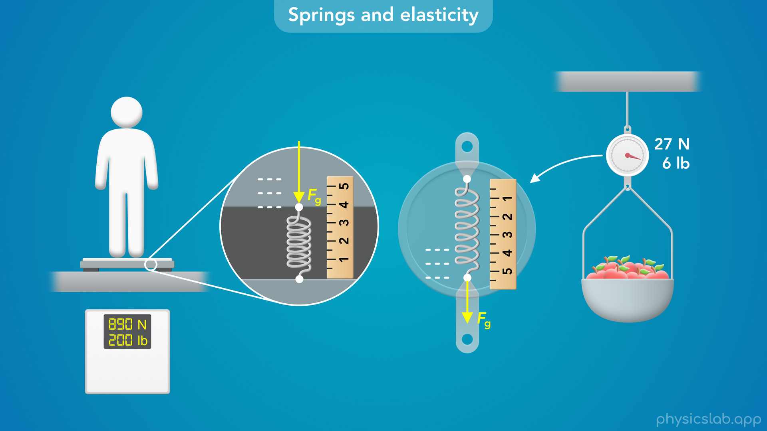
Notes:
• So if the scale knows how much force is required to stretch or compress the spring a certain amount, then the scale can just measure the new length of the spring to determine the force being applied, which is the weight of the object.
• So how is the change in length related to the force?

Slide 44

Notes:
• This is exactly what’s described by Hooke’s law.

Slide 45
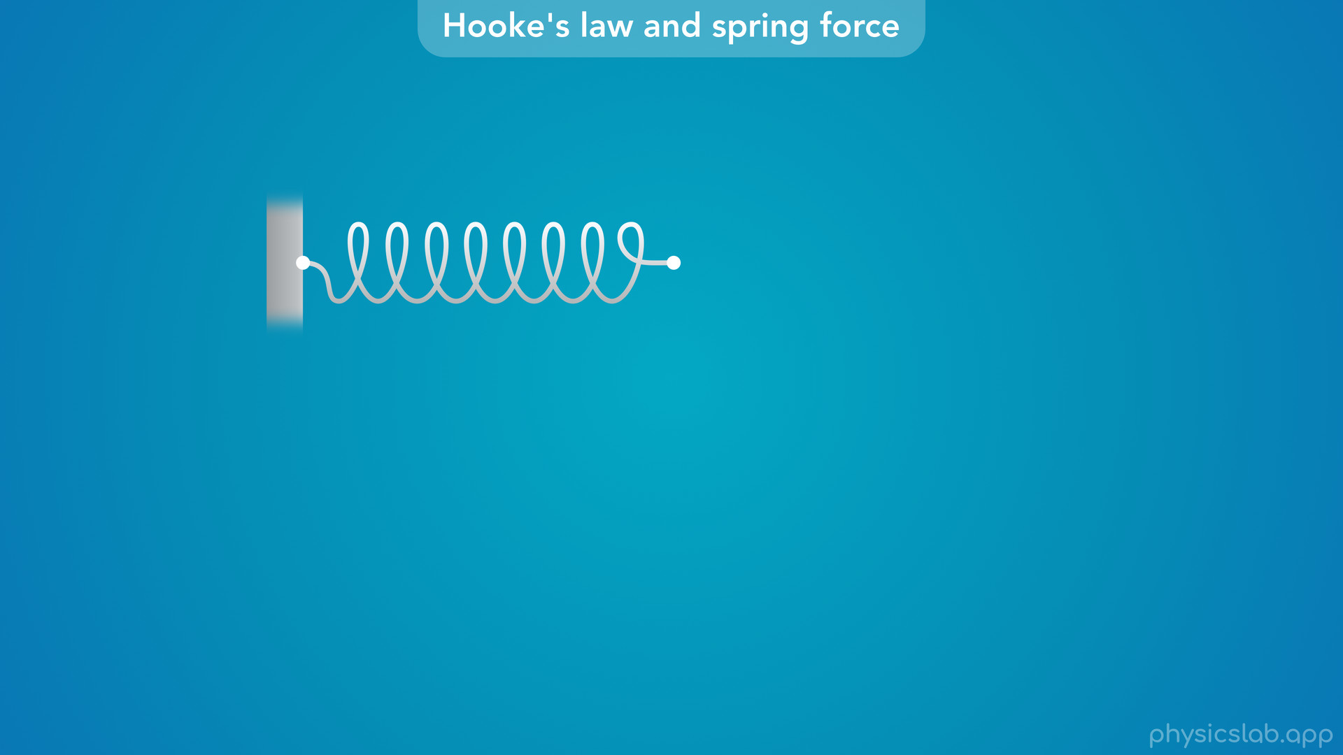
Notes:
• Here we have a spring with one end attached to a wall and the other end is free to move.

Slide 46
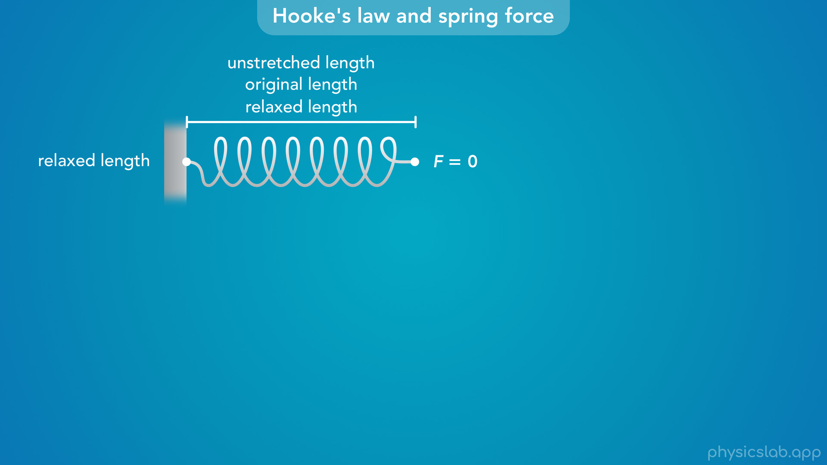
Notes:
• When there is no force trying to stretch or compress the spring, we say the spring is relaxed and this is its relaxed length.
• You might also see this referred to as the unstretched length or the original length.

Slide 47
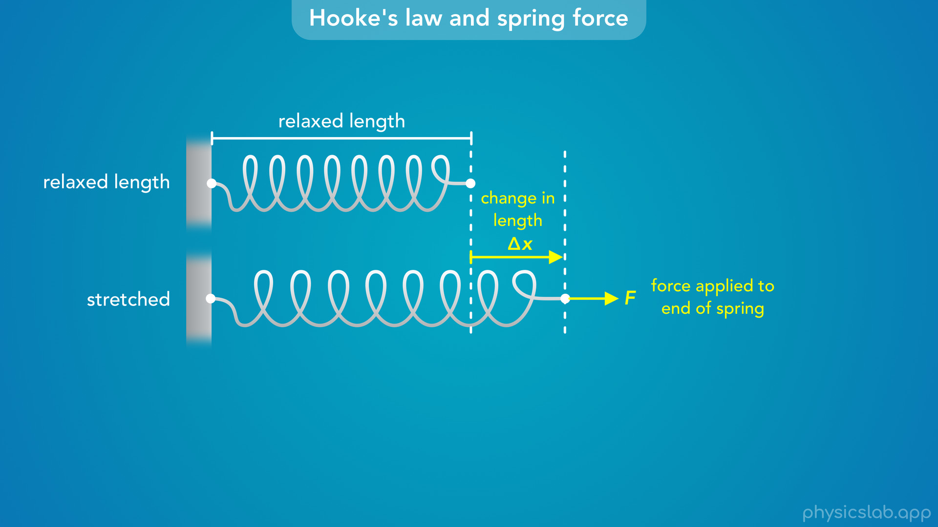
Notes:
• If we apply a pulling force to the end of that spring, it’s going to stretch and get longer.
• We’re gonna label this force as F, and we’ll label the change in length as delta x.
• It might be easier to think of this as delta L for the change in length.
• But it’s more common to use delta x, and you can think of it as the displacement of the end of the spring.

Slide 48
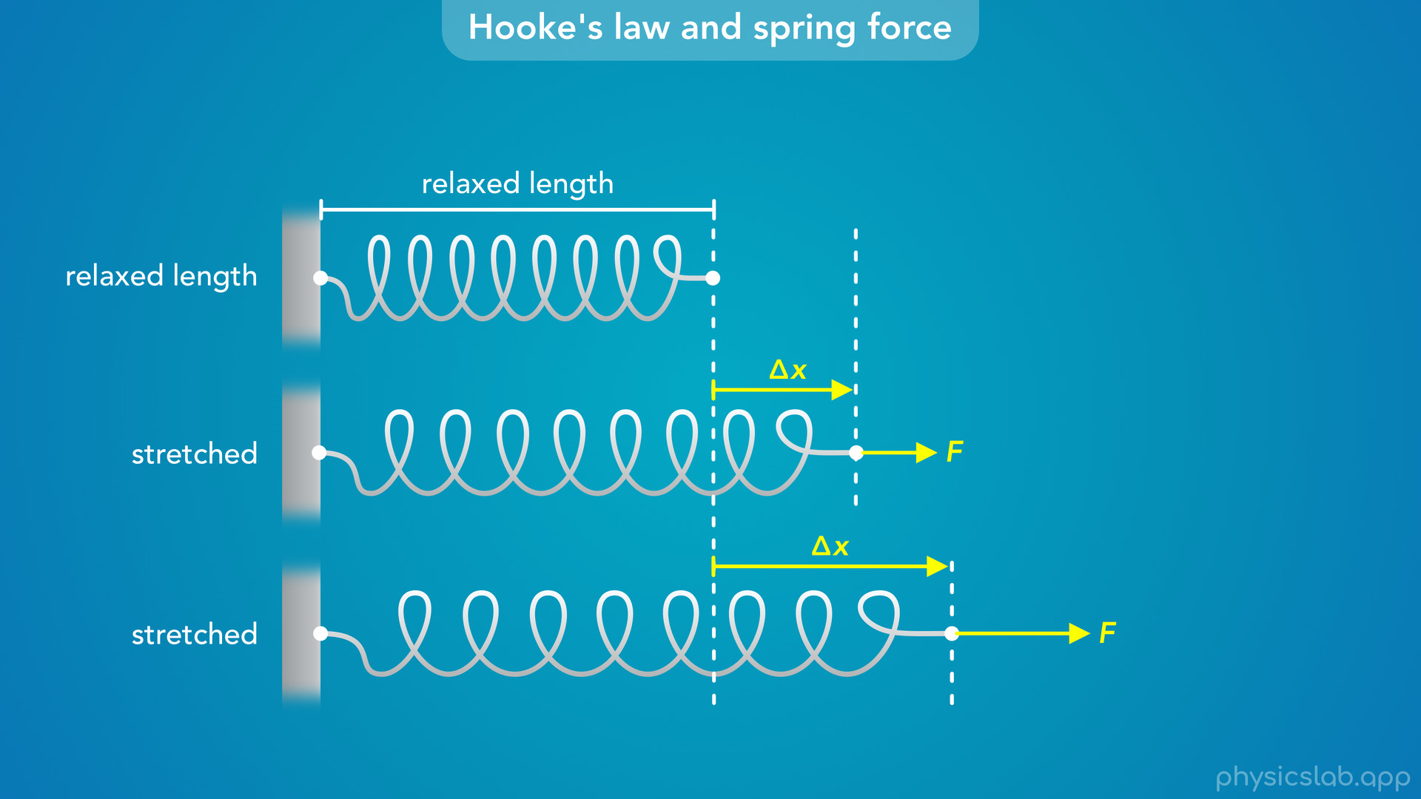
Notes:
• Now, what happens if we increase the pulling force?
• The spring will stretch even more, and delta x will increase.

Slide 49
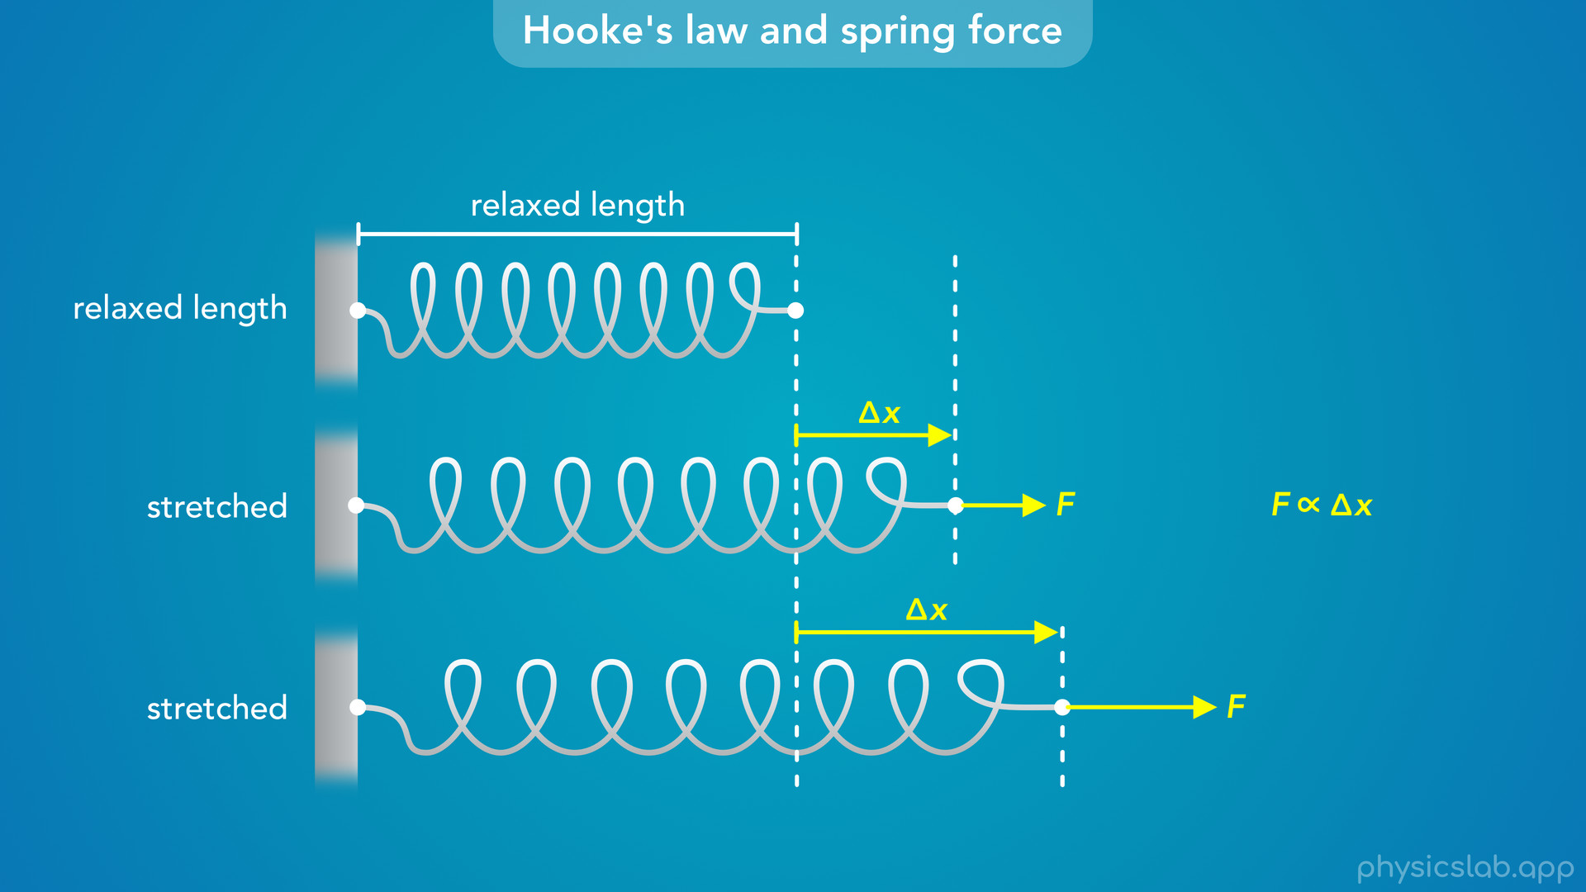
Notes:
• So it seems like the force might be proportional to the change in length.
• If F is bigger, delta x is bigger.
• And if F is smaller, delta x is smaller.

Slide 50
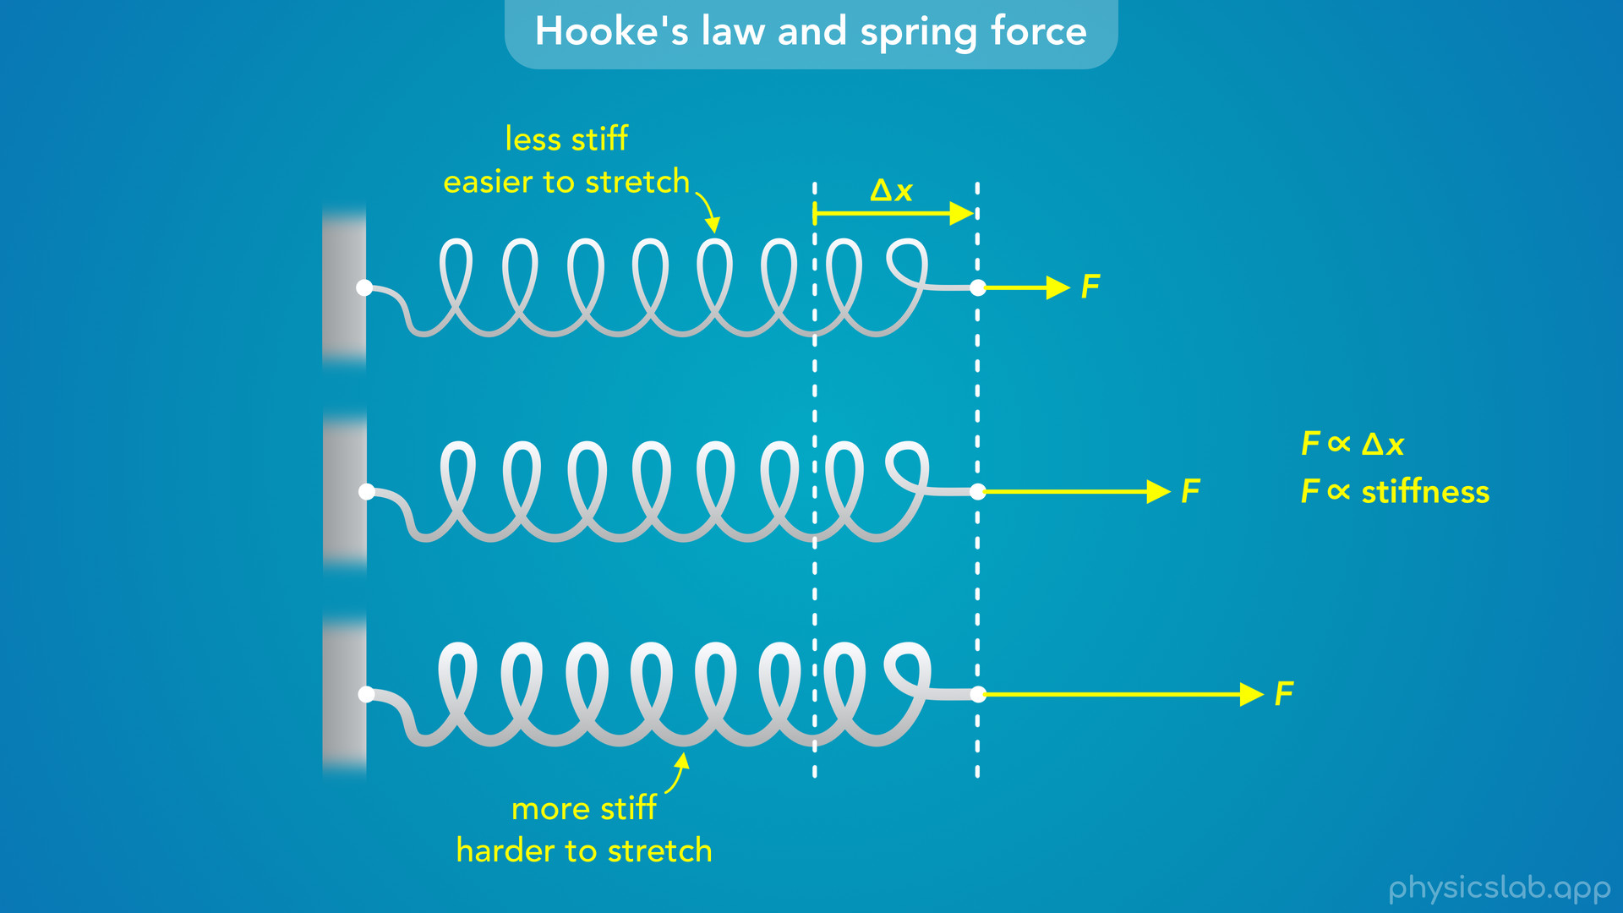
Notes:
• But not all springs are the same, some are harder to stretch than others.
• If we have a different spring that’s stiffer, maybe it’s made of thicker wire, it’s going to require more force to stretch the same amount.
• The stiffer the spring, the more force that we need to get the same delta x.
• So F is proportional to delta x, but it also depends on the stiffness of the spring, how easy or hard it is to stretch.

Slide 51
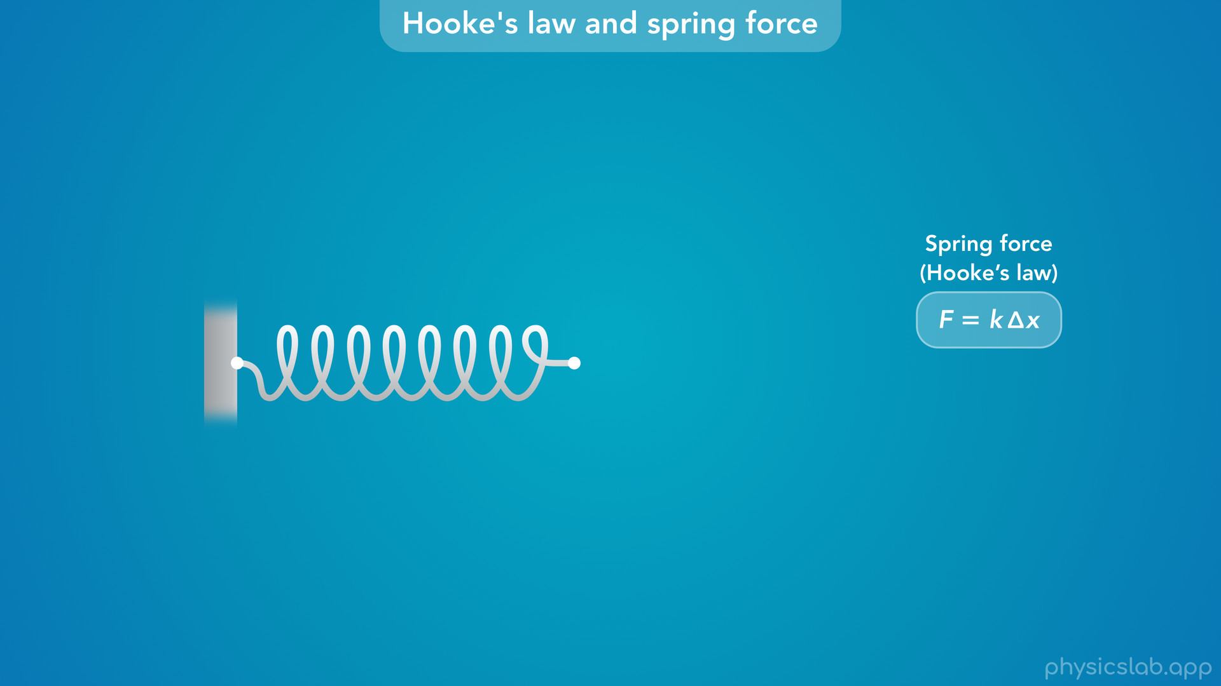
Notes:
• The actual equation that relates all three looks like this.
• We call this Hooke’s law after the physicist Robert Hooke who discovered this relationship in 1660.

Slide 52
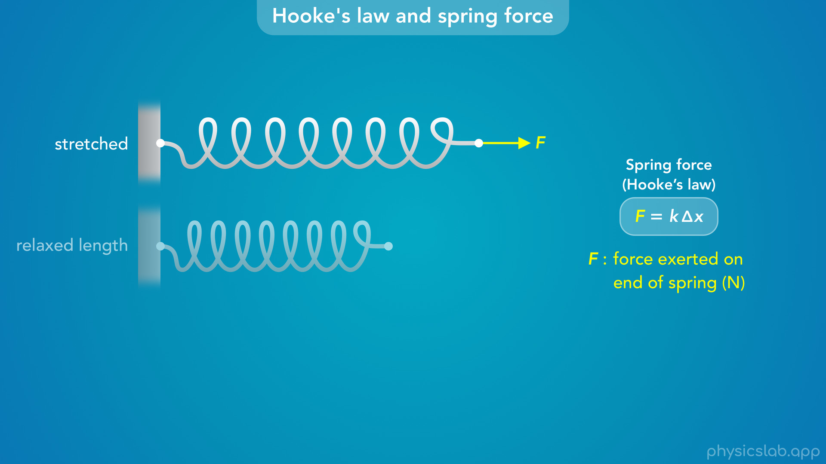
Notes:
• F is the force exerted on the end of the spring, in units of Newtons.

Slide 53
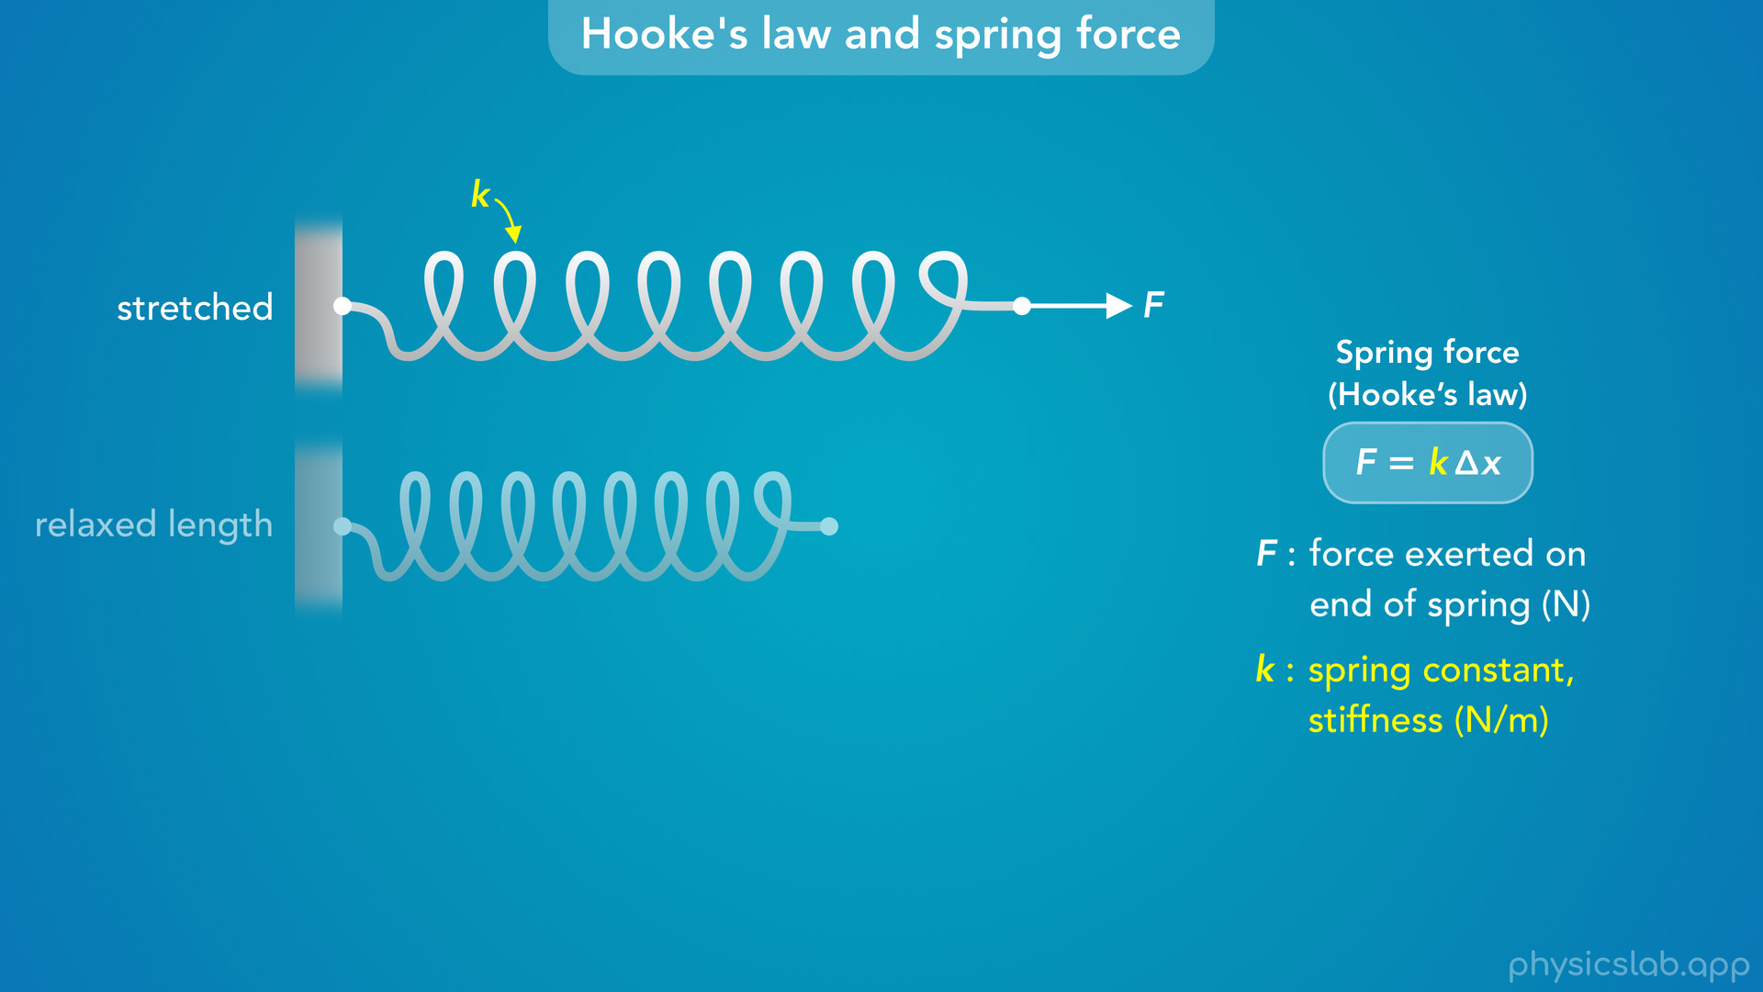
Notes:
• Lowercase k is what we call the spring constant, which represents the stiffness of the spring, in units of N/m.

Slide 54
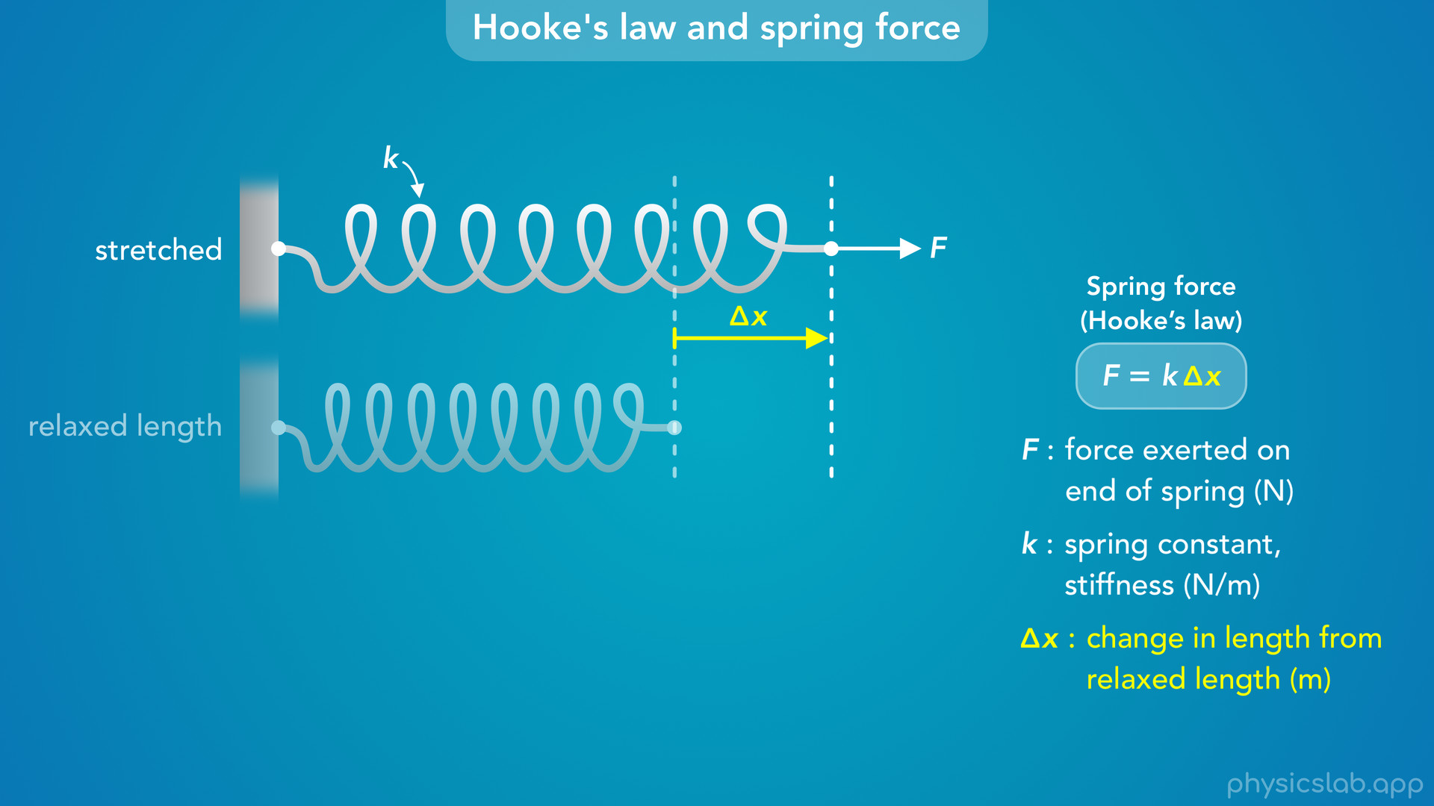
Notes:
• And delta x is the change in length from the relaxed length, in units of meters.

Slide 55
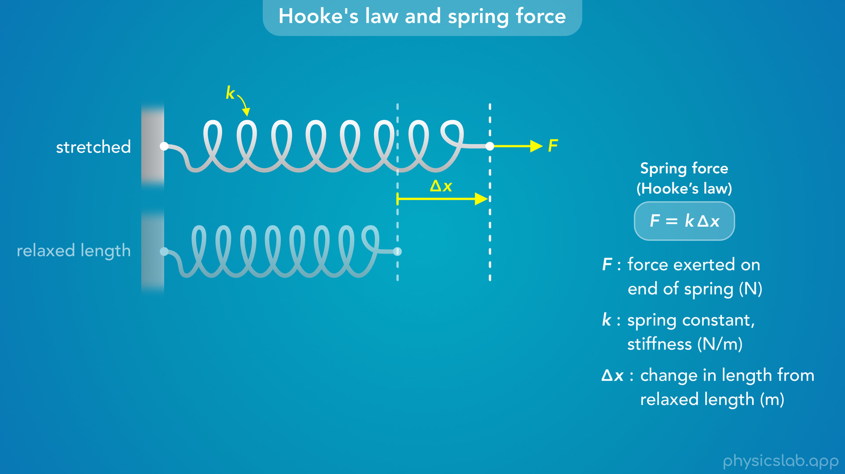
Notes:
• The equation says that the force is equal to the spring constant multiplied by the change in length.

Slide 56
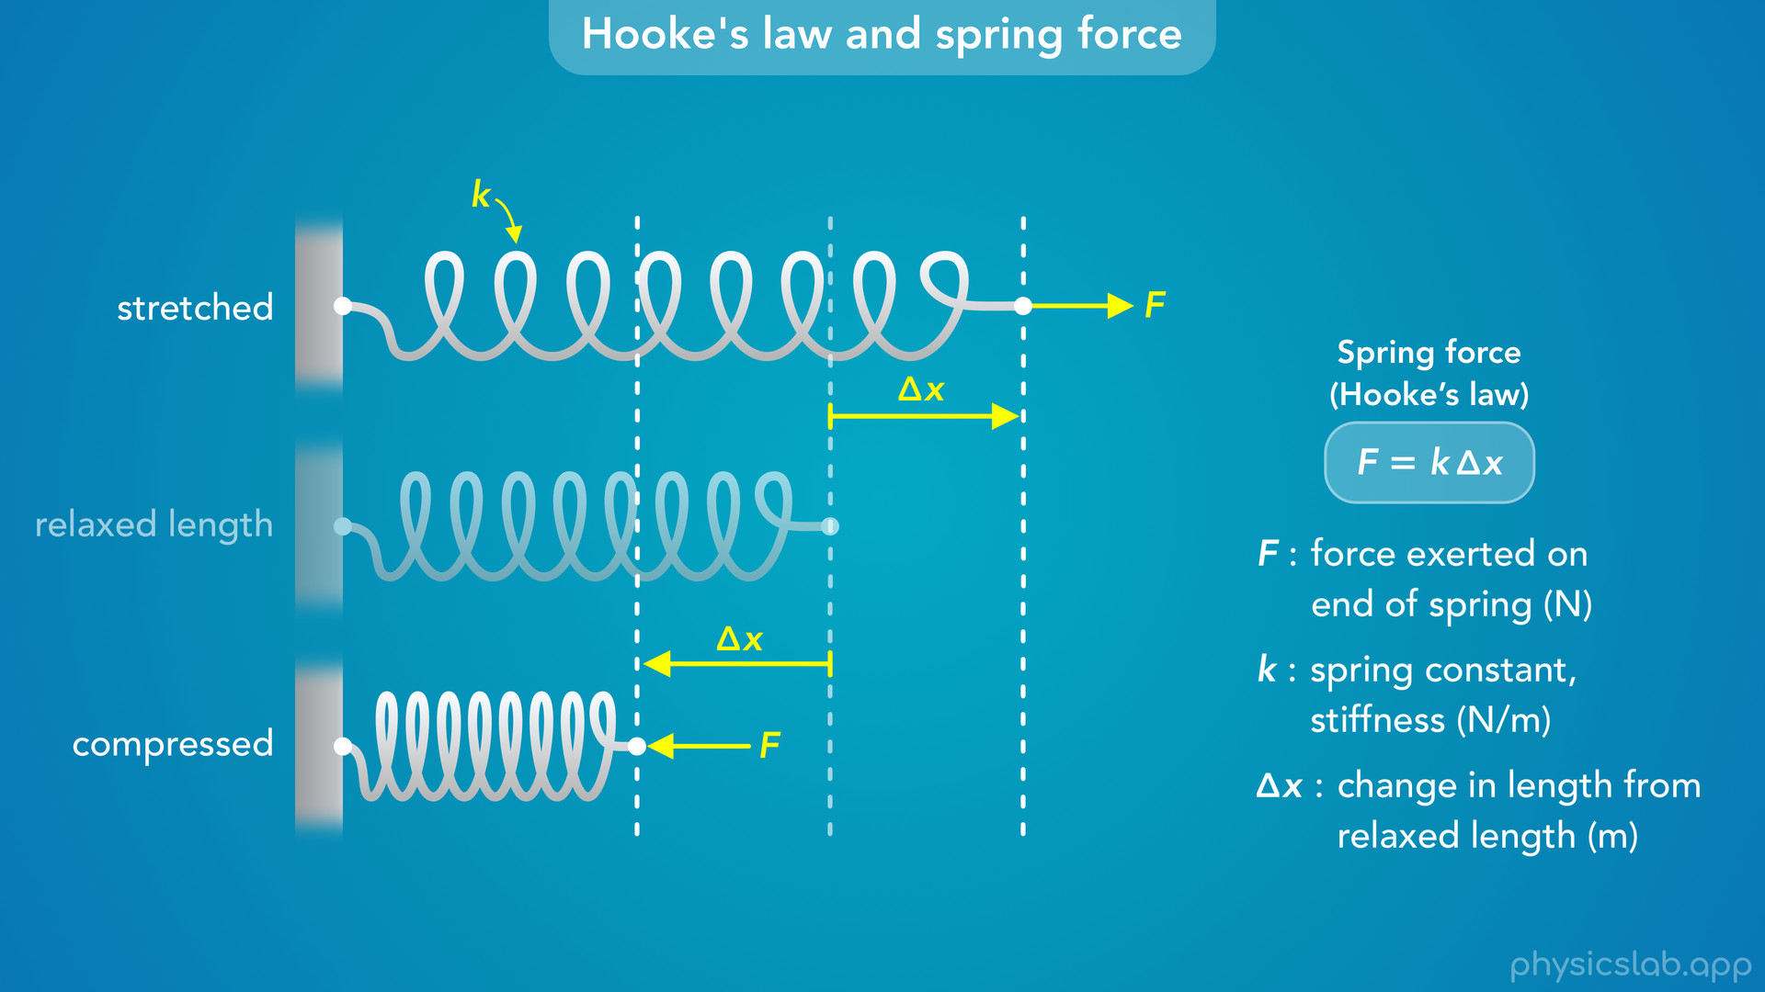
Notes:
• This applies when a spring is stretched, but it also applies when a spring is compressed.
• If we push on the end of this spring it gets shorter, and delta x is still the change in length from the relaxed length.
• So the same amount of force will stretch or compress a spring by the same amount.

Slide 57
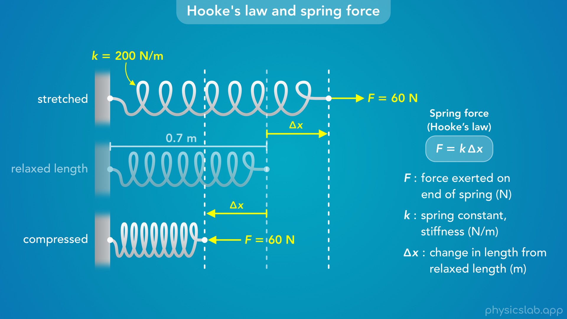
Notes:
• Let’s look at an example using numbers.
• The relaxed length of this spring is 0.7 m. That’s the length with no force applied.
• The spring constant k is 200 N/m.
• If we apply a 60 N pulling force or a 60 N pushing force on the end of the spring, what will be the change in length, delta x?

Slide 58

Notes:
• Using this equation, we would plug in 60 N for F and 200 N/m for k, and we get 0.3 m for delta x.
• So if we’re pulling on the spring with 60 N of force, it gets 0.3 m longer so the new length is 1 m.
• If we’re pushing on the spring with 60 N of force, it gets 0.3 m shorter and the new length is 0.4 m.
• So the force is related to the change in length, delta x, not the actual length of the spring.
• And for a given amount of force, the change in length is the same in either direction.

Slide 59
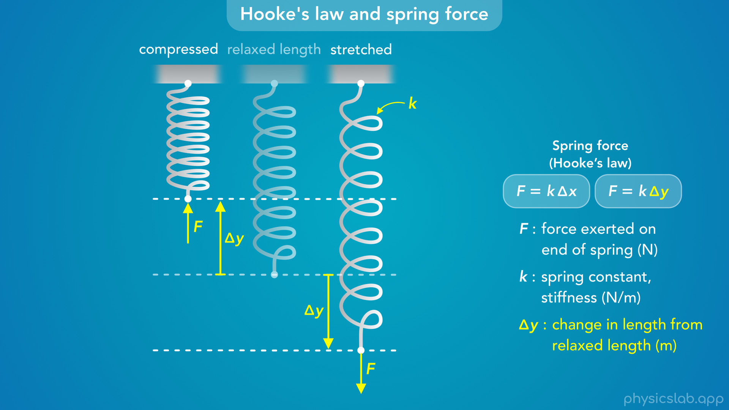
Notes:
• Sometimes we’ll be working with a horizontal spring like this, and sometimes the spring will be vertical.
• The equation for Hooke’s law still works the same way, but in this case, it might make more sense to use delta y instead of delta x.
• Again, this is just the change in length from the relaxed length - how much the spring is stretched or compressed.
So that’s an introduction to springs and Hooke’s law.

Slide 60
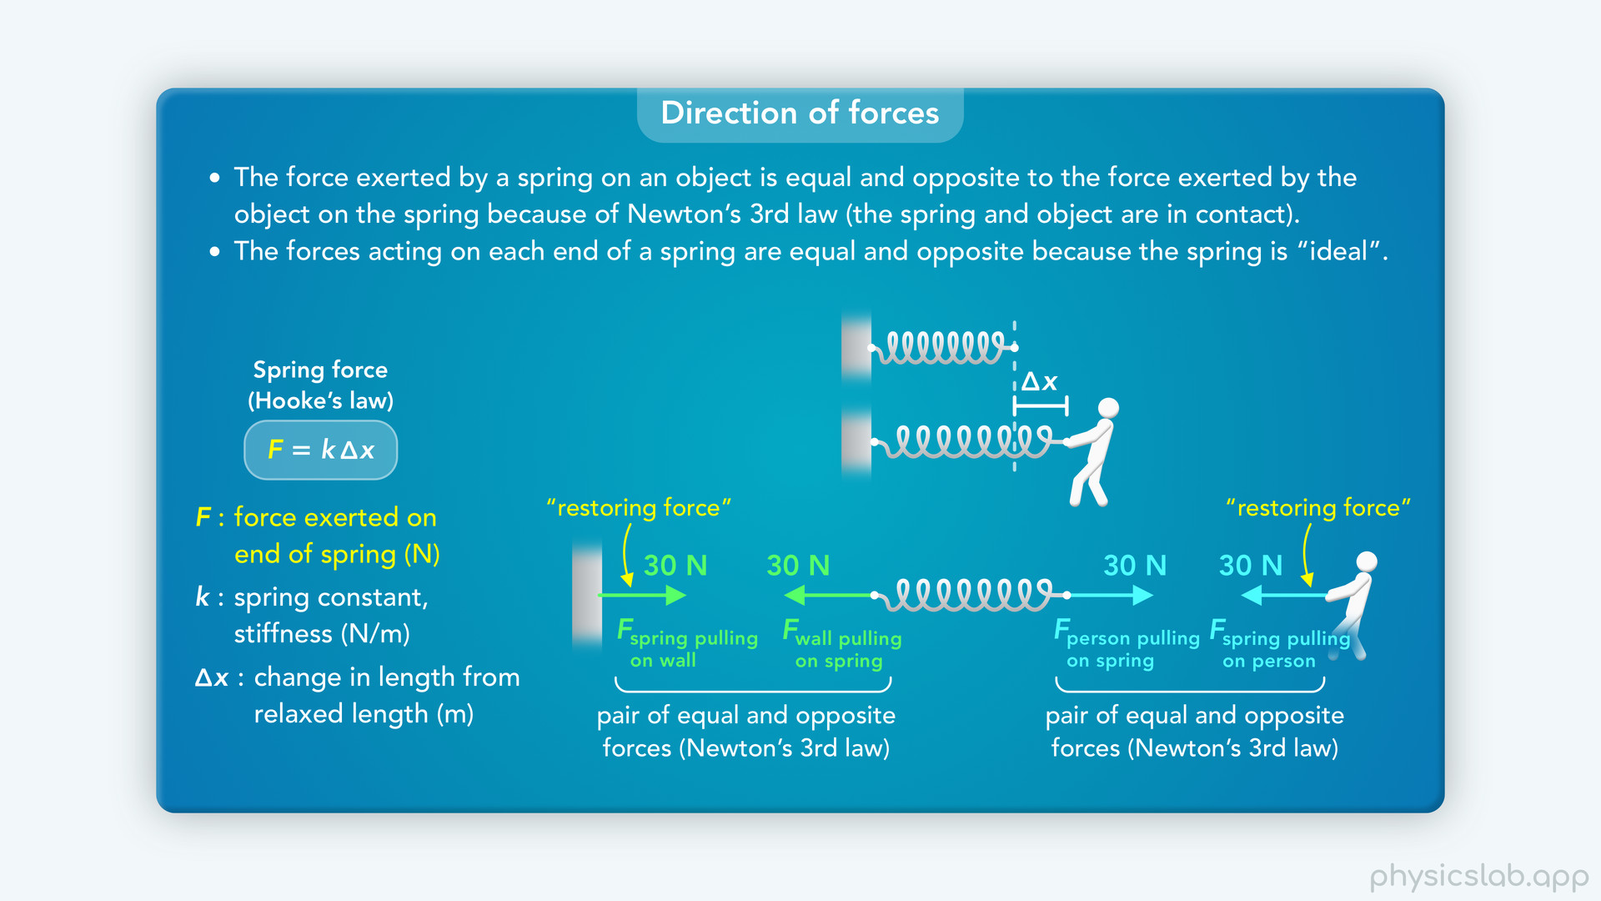
Notes:
• In the next video, we’ll cover each part of this equation in more detail, and we’ll address some common points of confusion.

