Slide 1
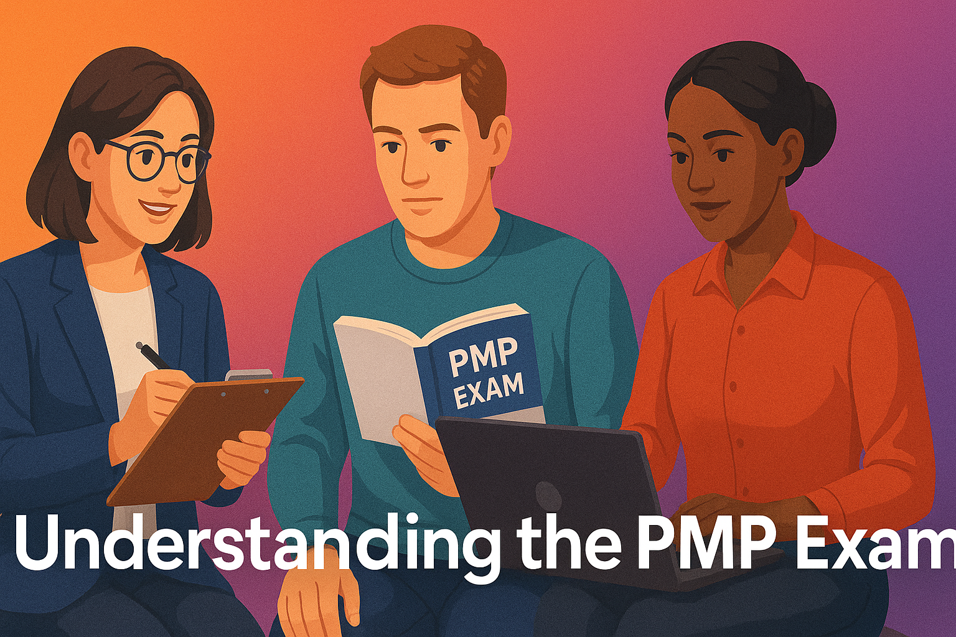

Slide 2
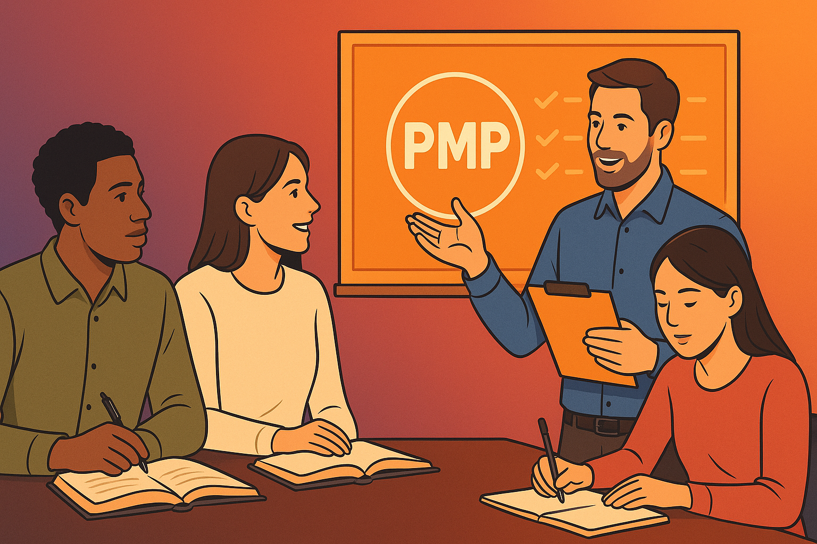

Understanding the PMP Exam
What PMI-PMP Exam Expects of you?
What Kind of Questions to Expect in Exam?
Familiarizing Yourself with Jargon of PMI-PMP

