Slide 1
Intro to Projectile Motion
Slides Version 2
This version includes:
Slides with screenshot images from the video.
The video narration in the slide notes.
A blank template slide with the same background and font as the video.
Slides with some basic graphics from this video for you to use however you like.
Feel free to add, delete and edit slides to make your own presentation. You can use these slides in class or share them with your students, but please do not post them online.
If you have any feedback, suggestions or questions about these slides please email me at chris@physicslab.app or send me a message on Discord @physicslab.
physicslab.app

Slide 2
Heading
Text

Slide 3












Slide 4



























Slide 5
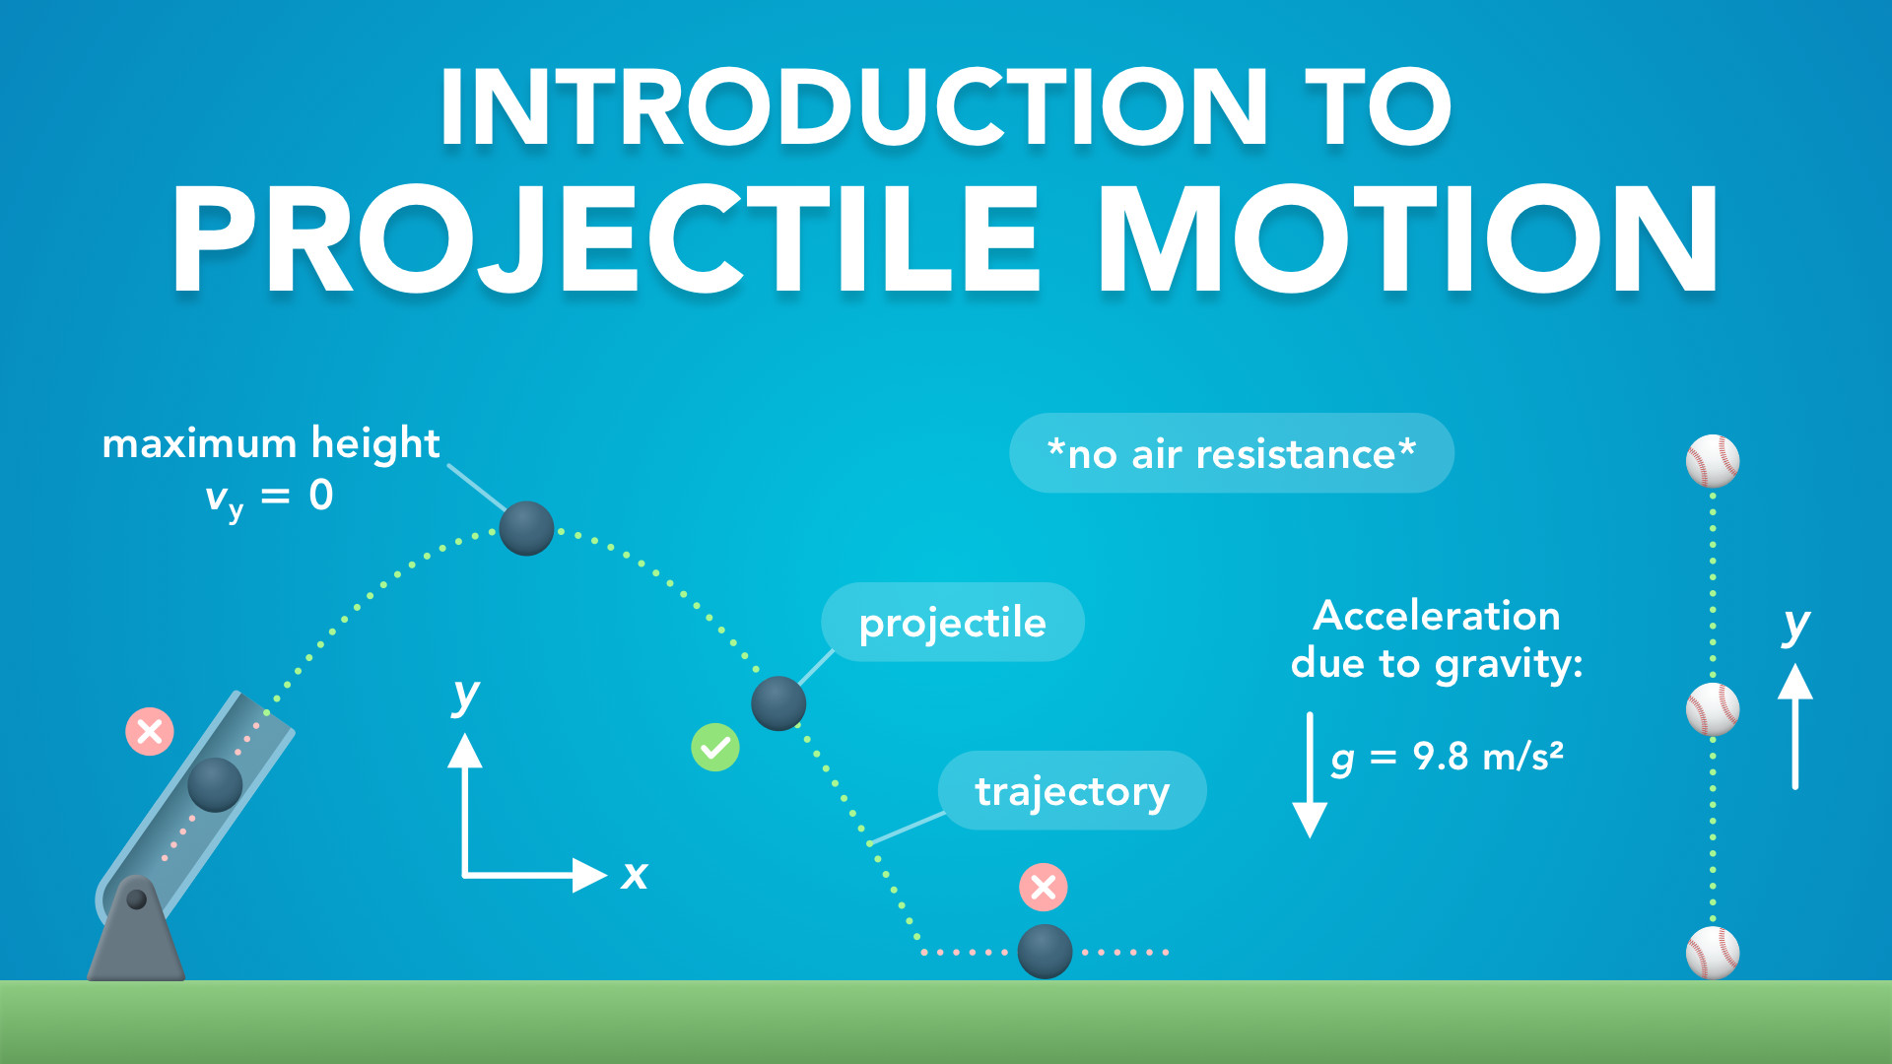
Notes:
Introduction to Projectile Motion
physicslab.app
If you have any questions, suggestions or feedback about these slides please email me at chris@physicslab.app or send me a message on Discord @physicslab.

Slide 6
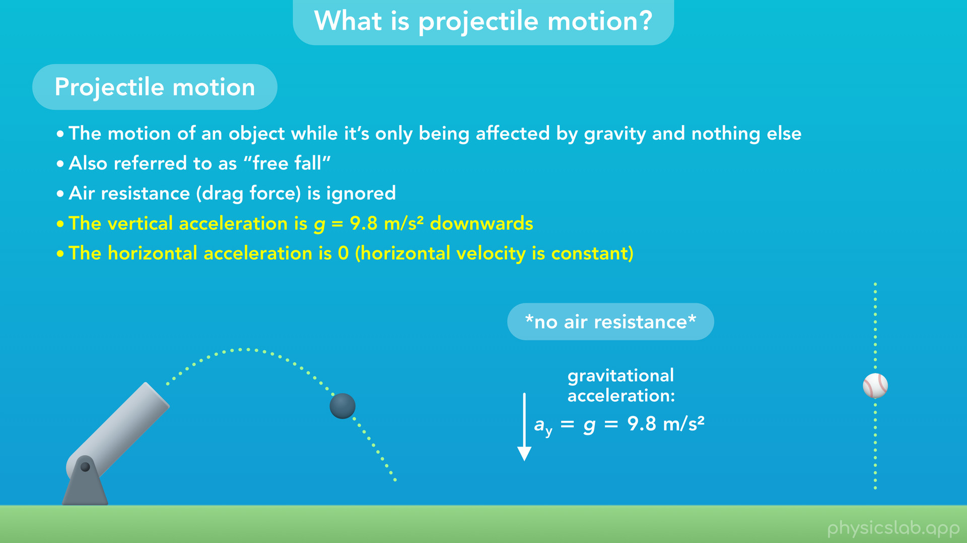
Notes:
• Hey everyone, in this video we’re going to introduce projectile motion.
• We’ll start with some examples and definitions.

Slide 7
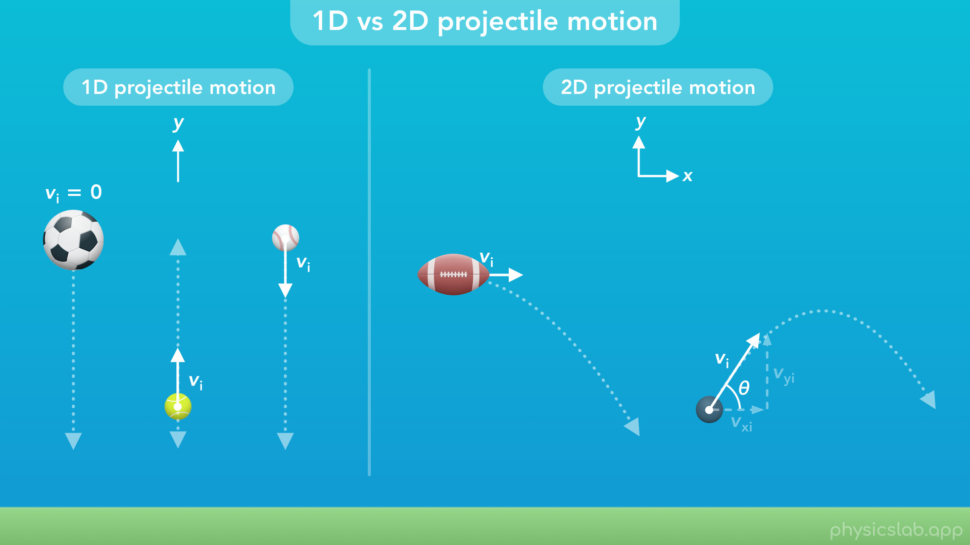
Notes:
• Then we’ll talk about the difference between one-dimensional and two-dimensional projectile motion.

Slide 8
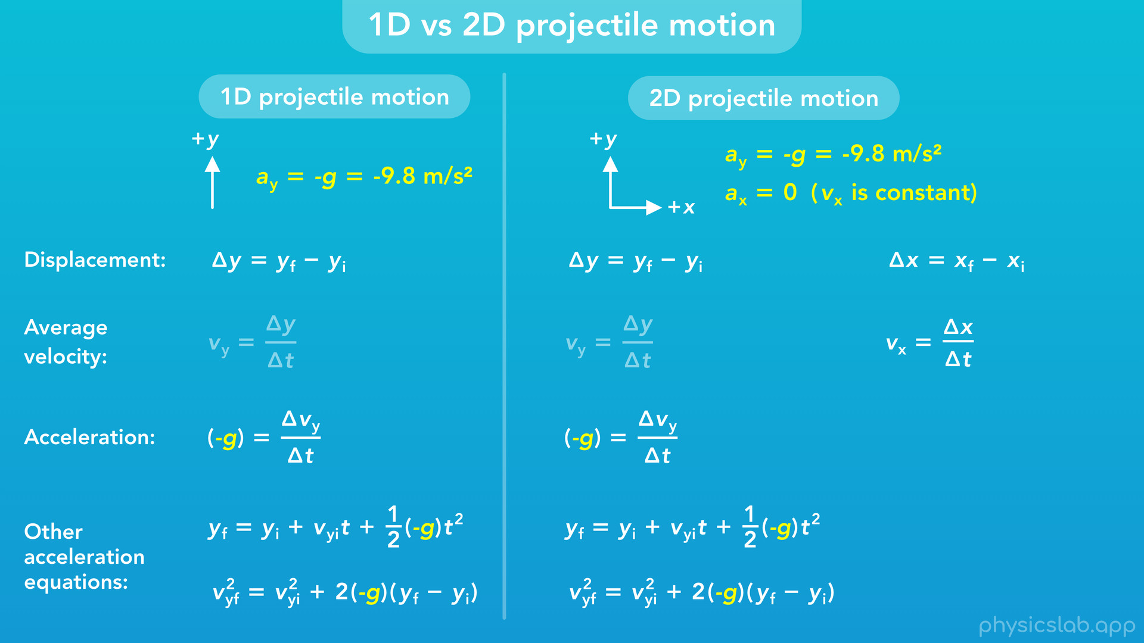
Notes:
• After that, we’ll do a quick overview of the kinematic equations.

Slide 9
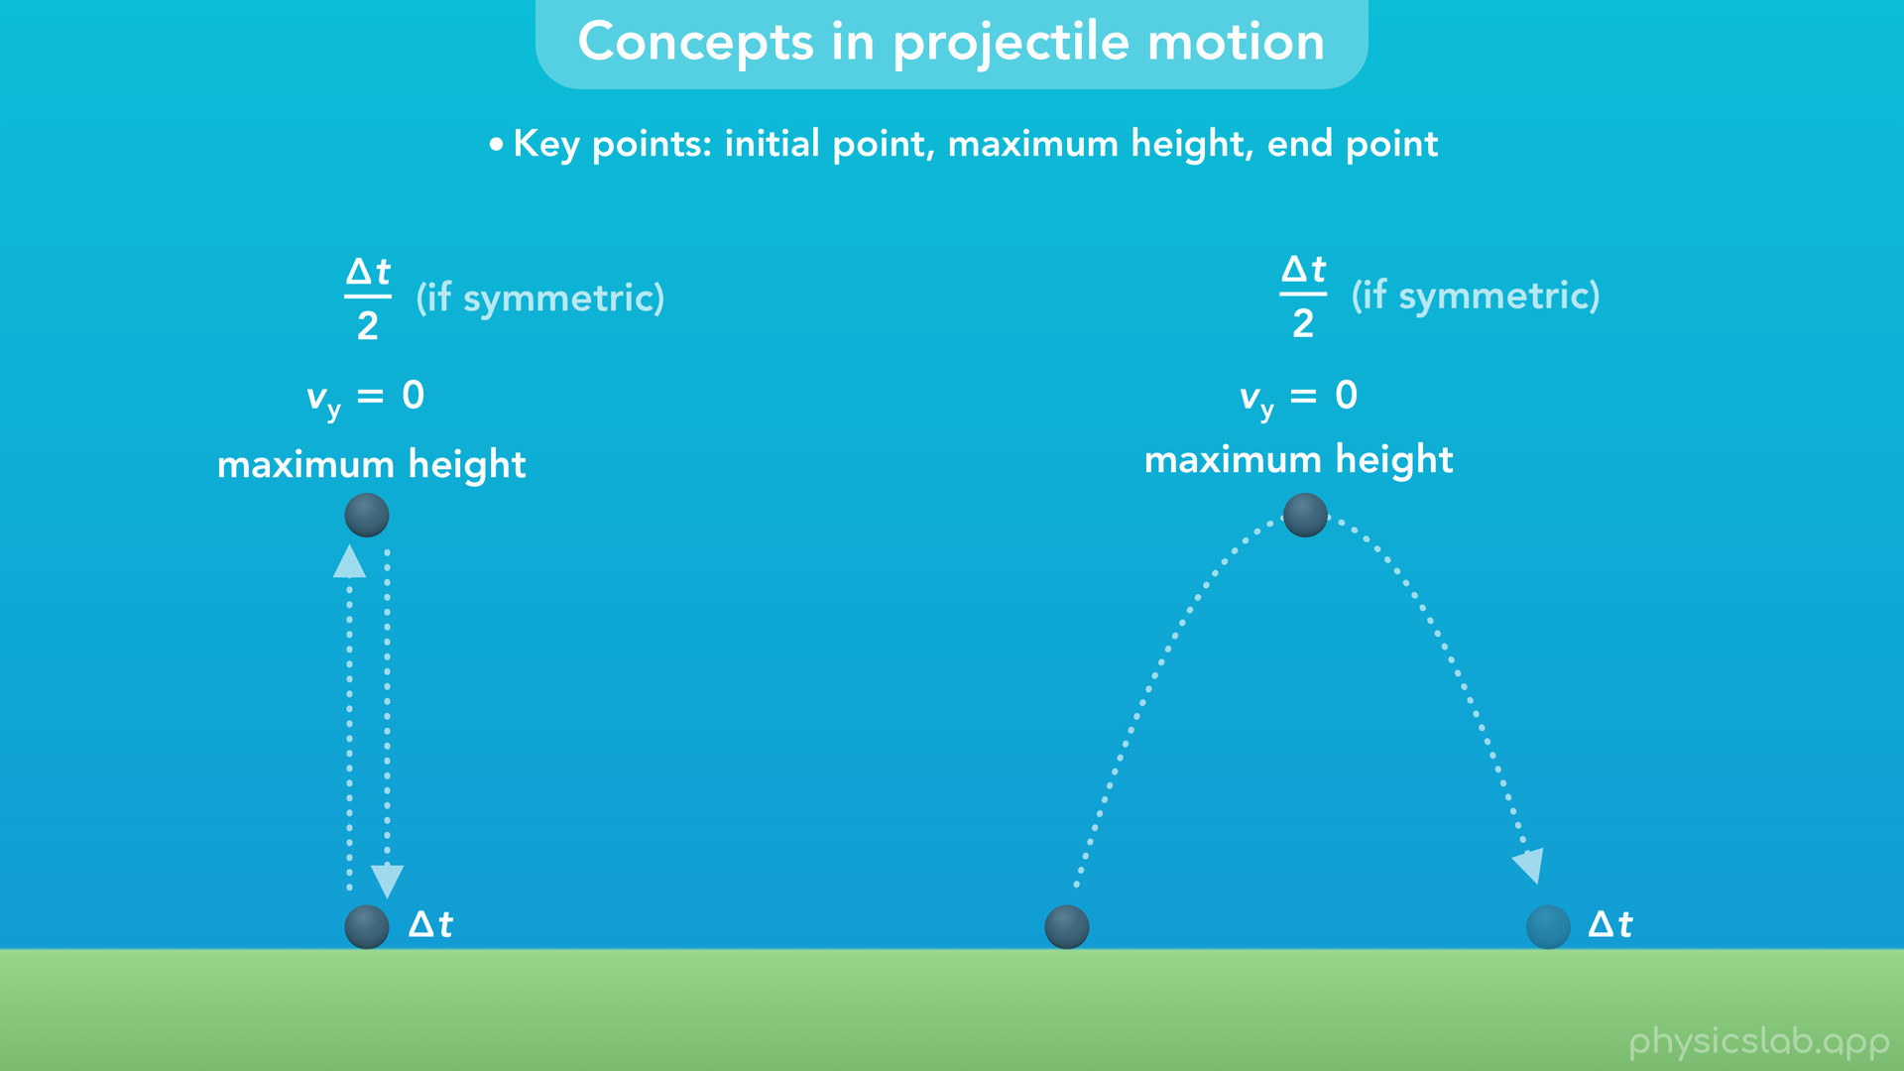
Notes:
• And finally, we’ll cover some important things to know when working with projectile motion.

Slide 10
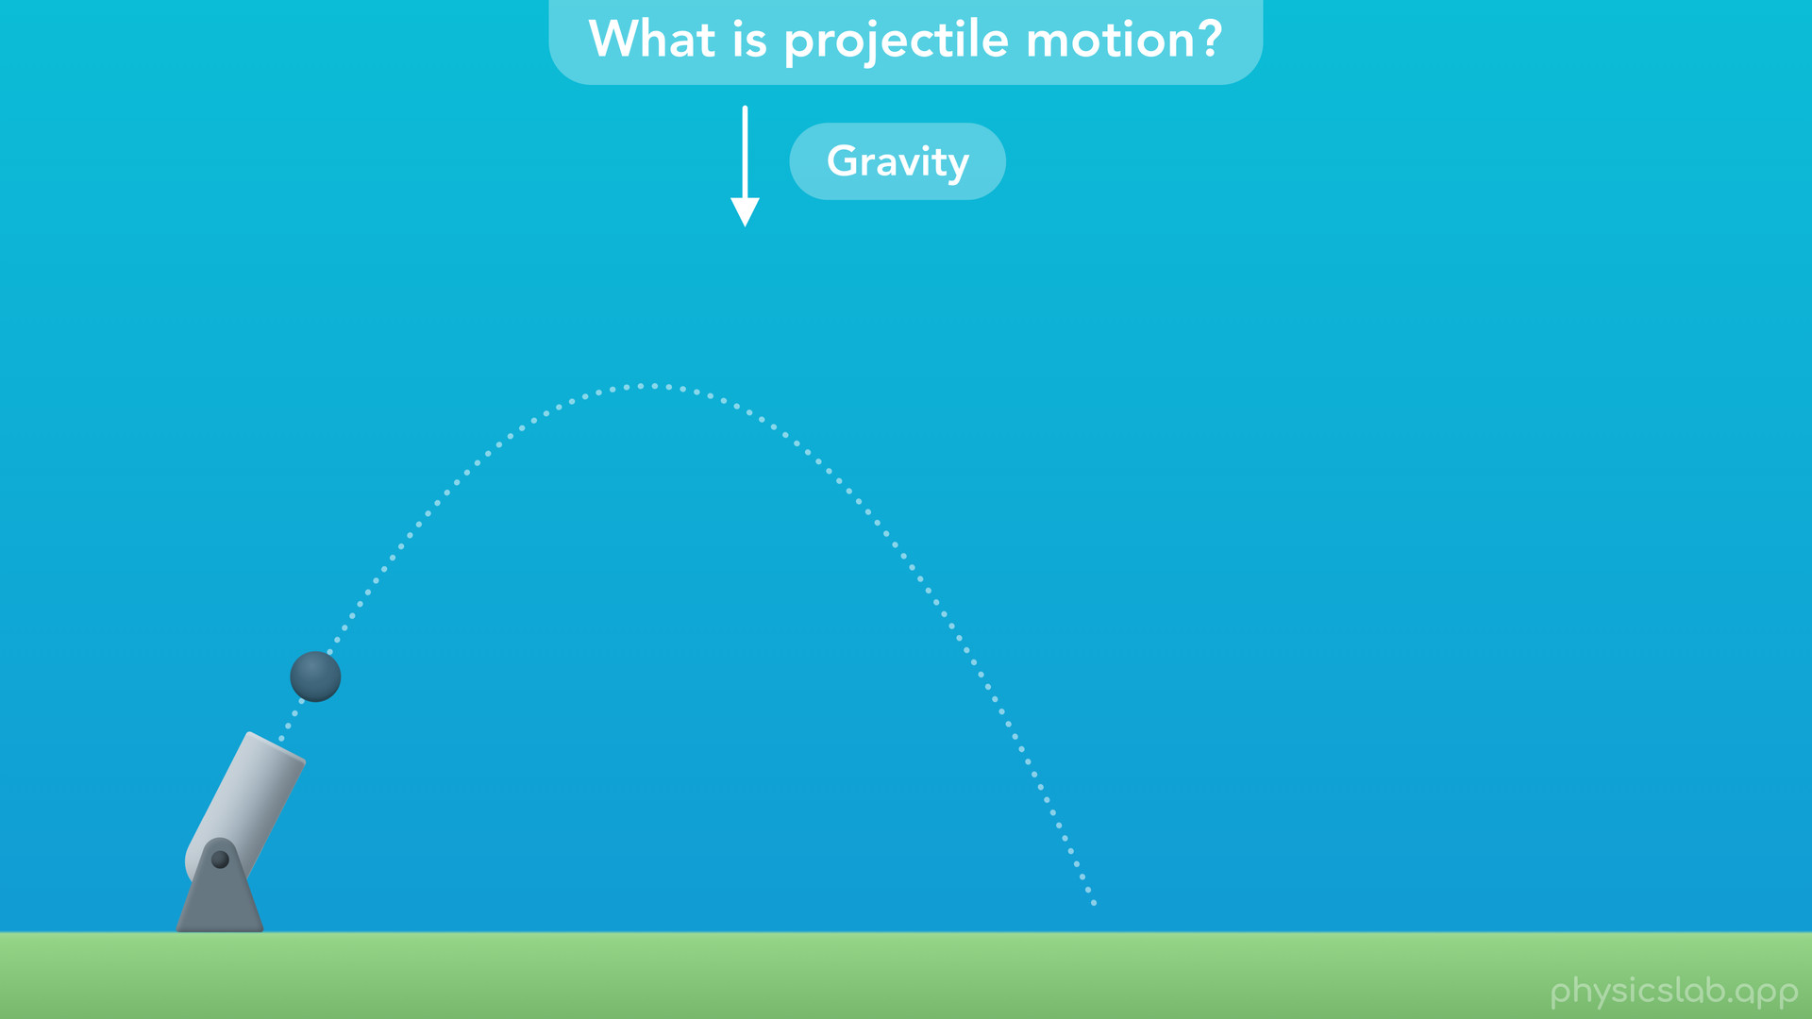
Notes:
• So what are we talking about when we say projectile motion?

Slide 11
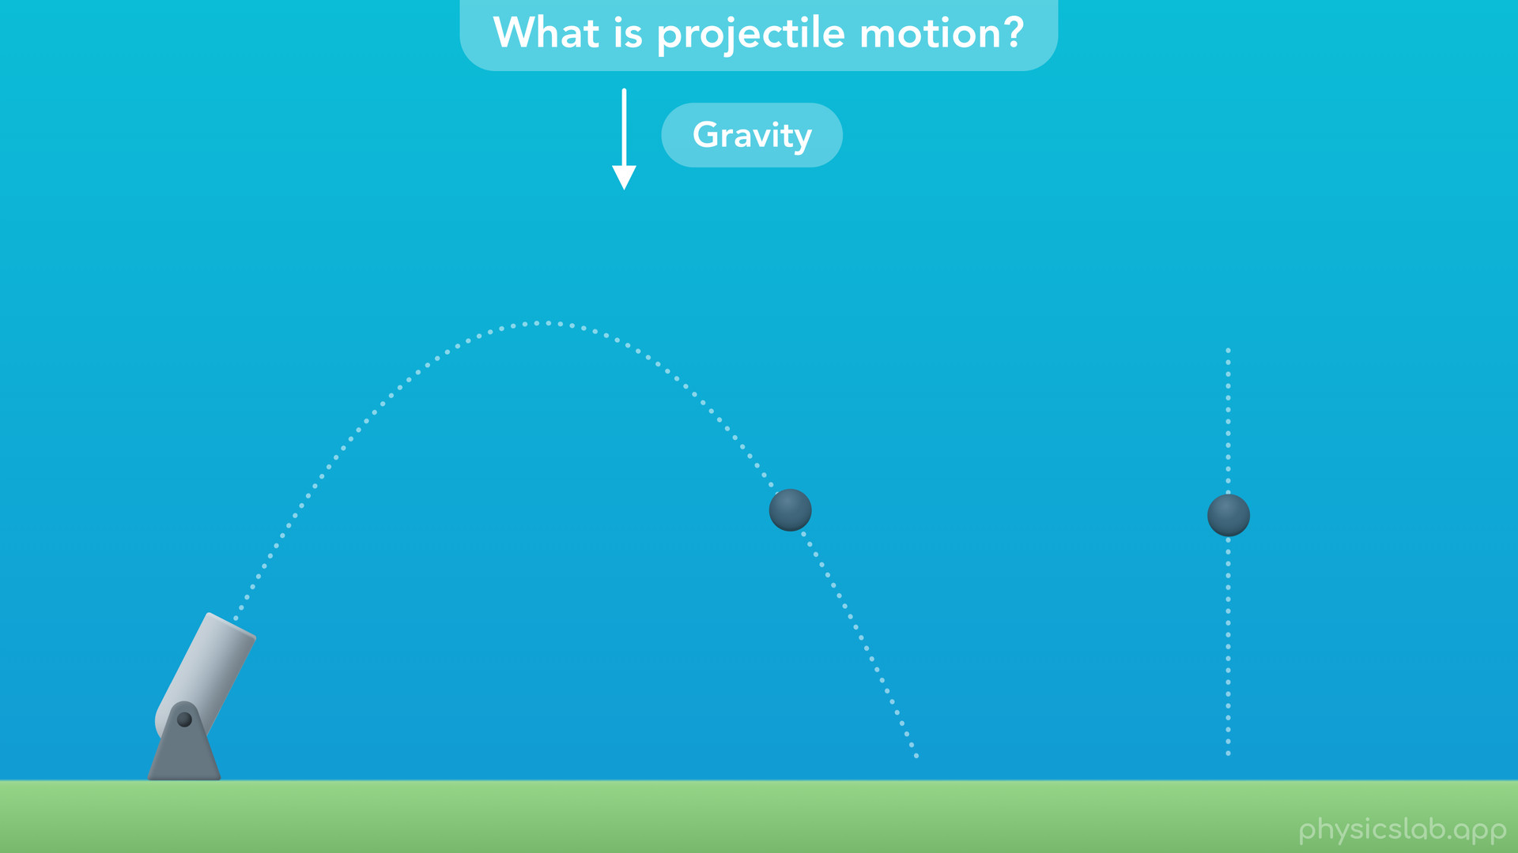
Notes:
• Basically, it’s when an object moves through the air and is only affected by gravity. The object could be moving sideways, or falling straight down.

Slide 12
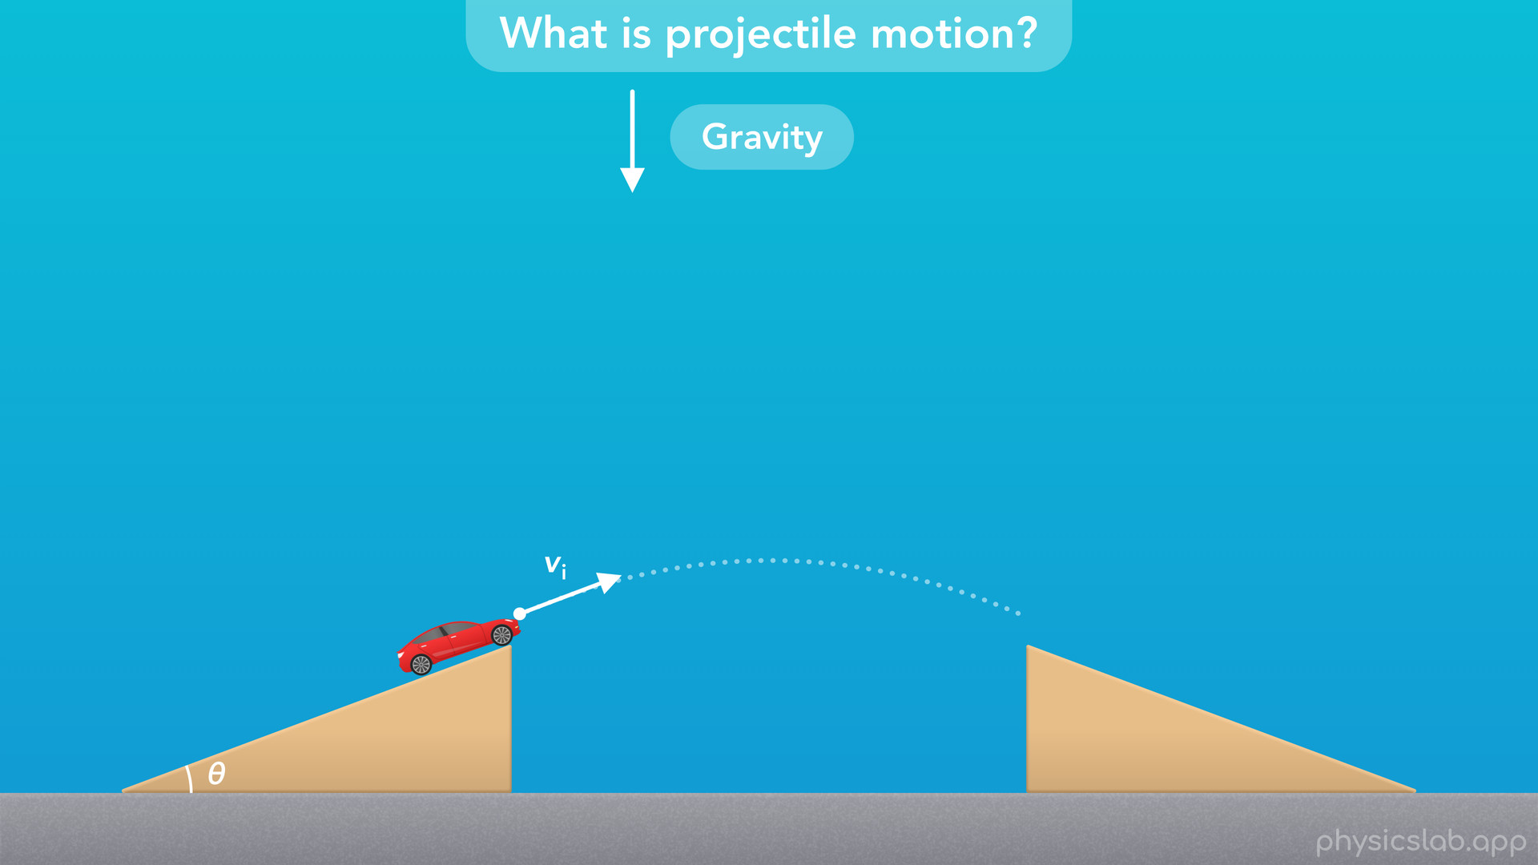
Notes:
• The object’s initial speed and angle determine it’s path through the air.

Slide 13
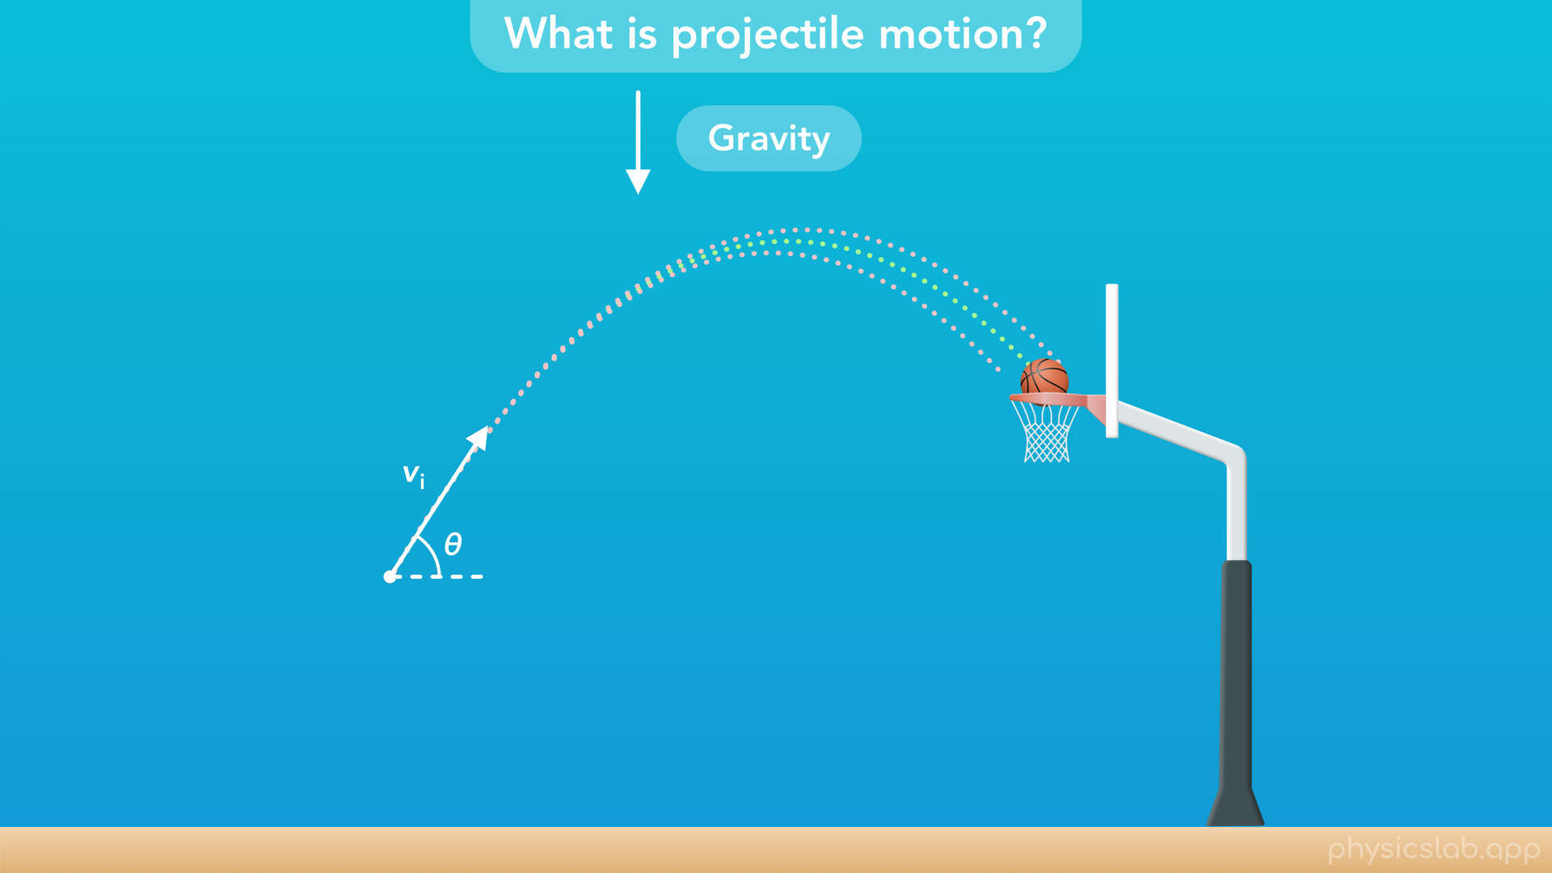
Notes:
• This shows up a lot in sports.
• Sometimes, the path of the ball has to be precise.

Slide 14
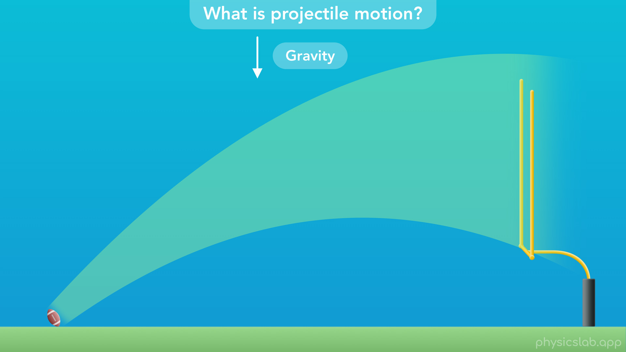
Notes:
• Other times, the ball can have a wide range of motions.

Slide 15
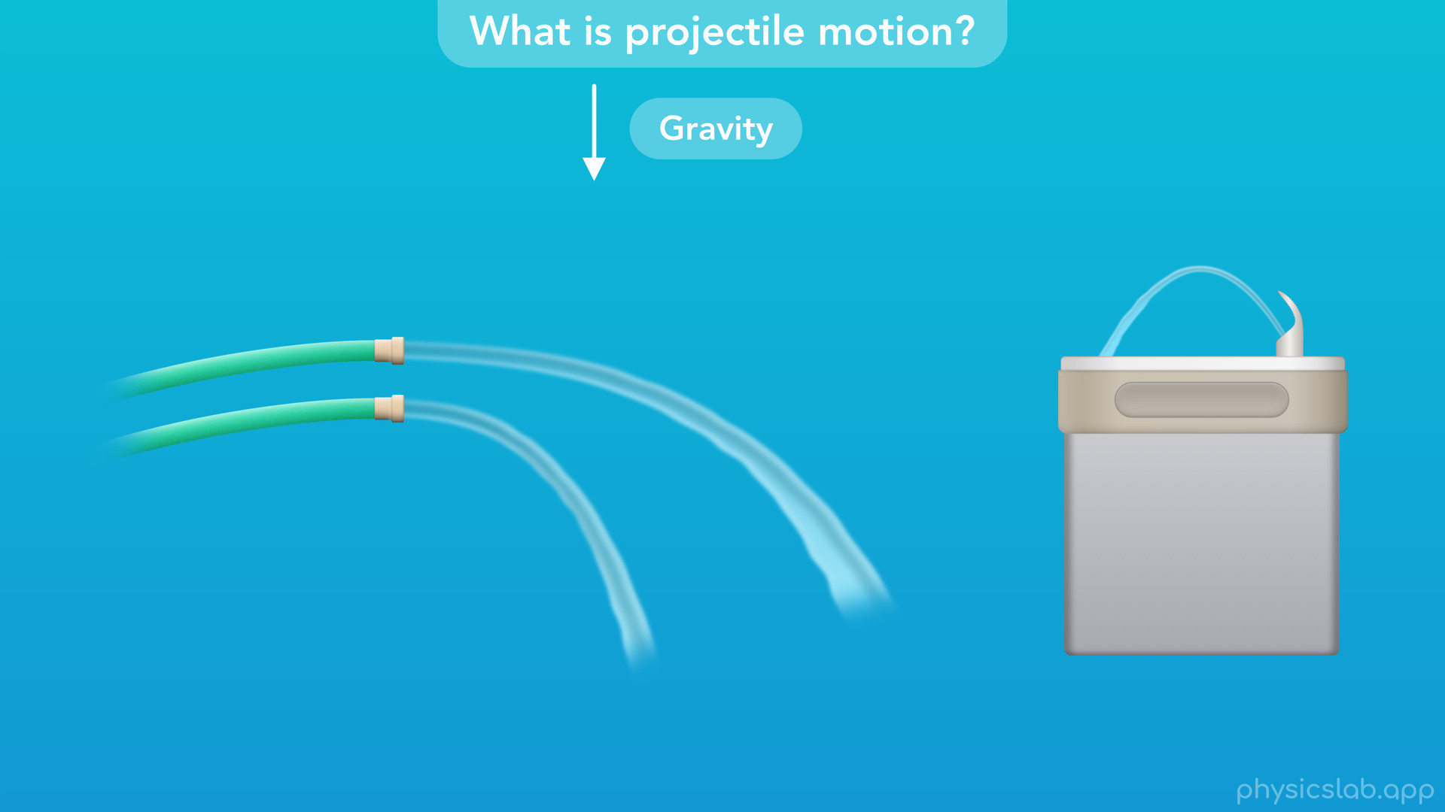
Notes:
• We usually focus on a single object, but projectile motion can help us describe other things, like the shape of a stream of water.

Slide 16
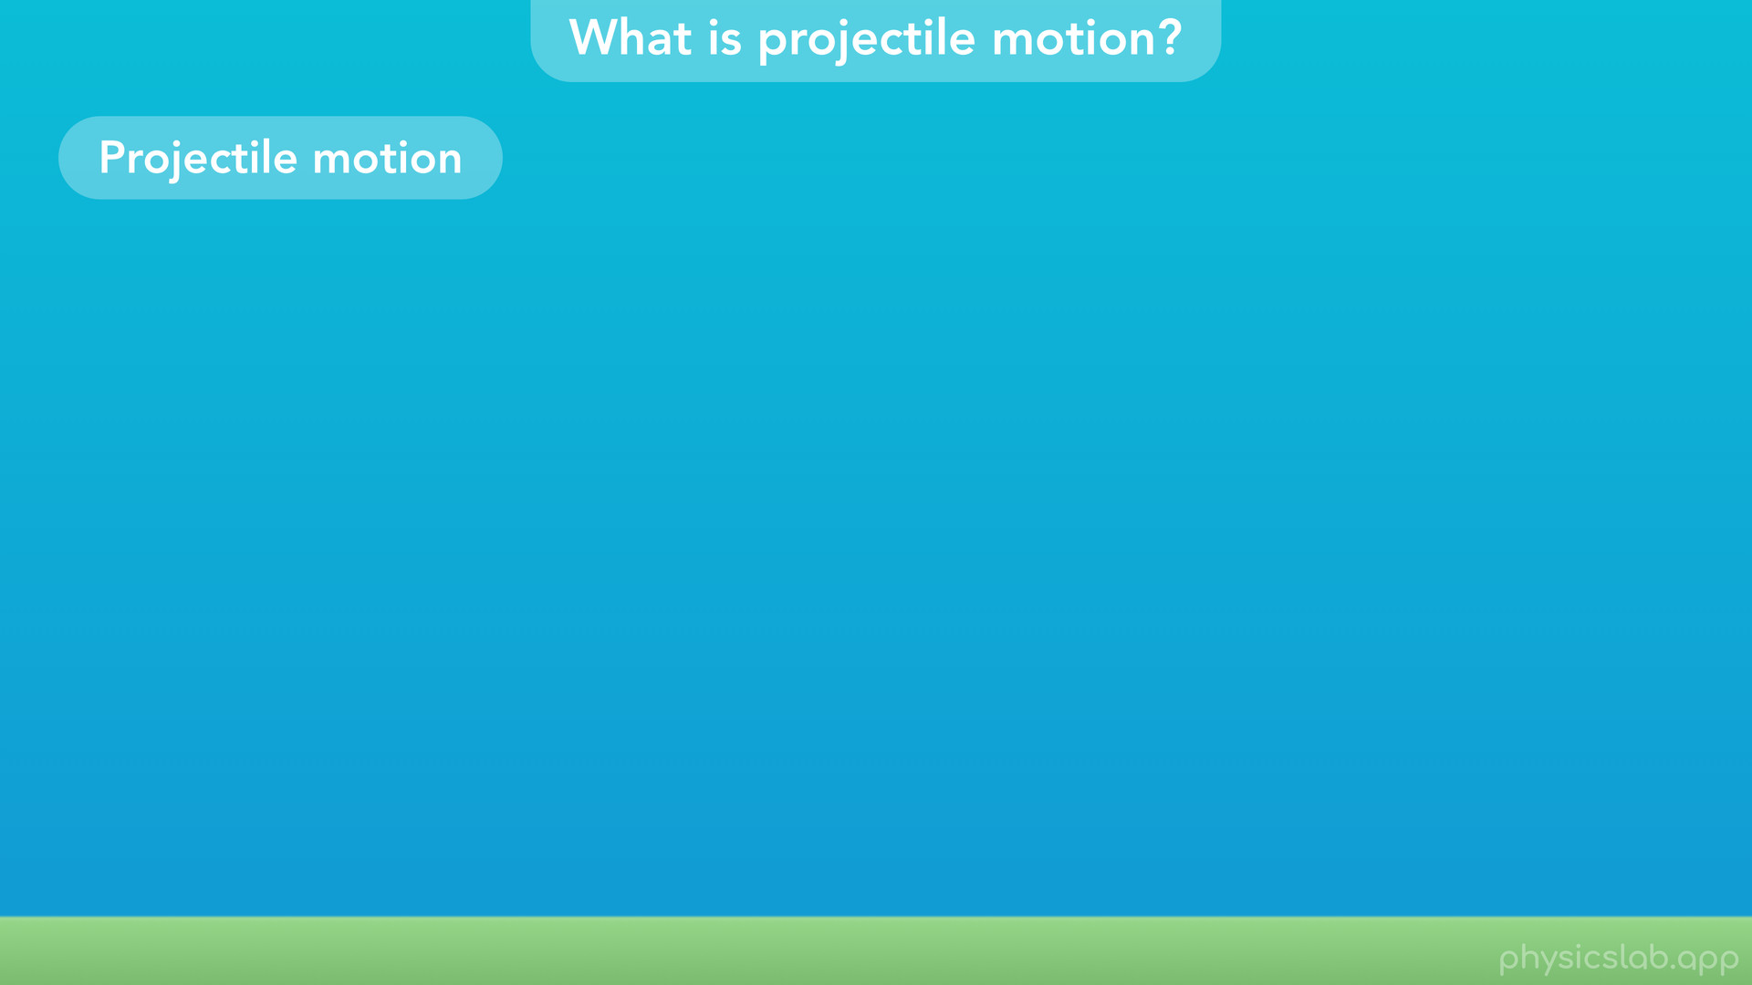
Notes:
• Those are some examples of projectile motion, but what does the term really mean in physics?

Slide 17
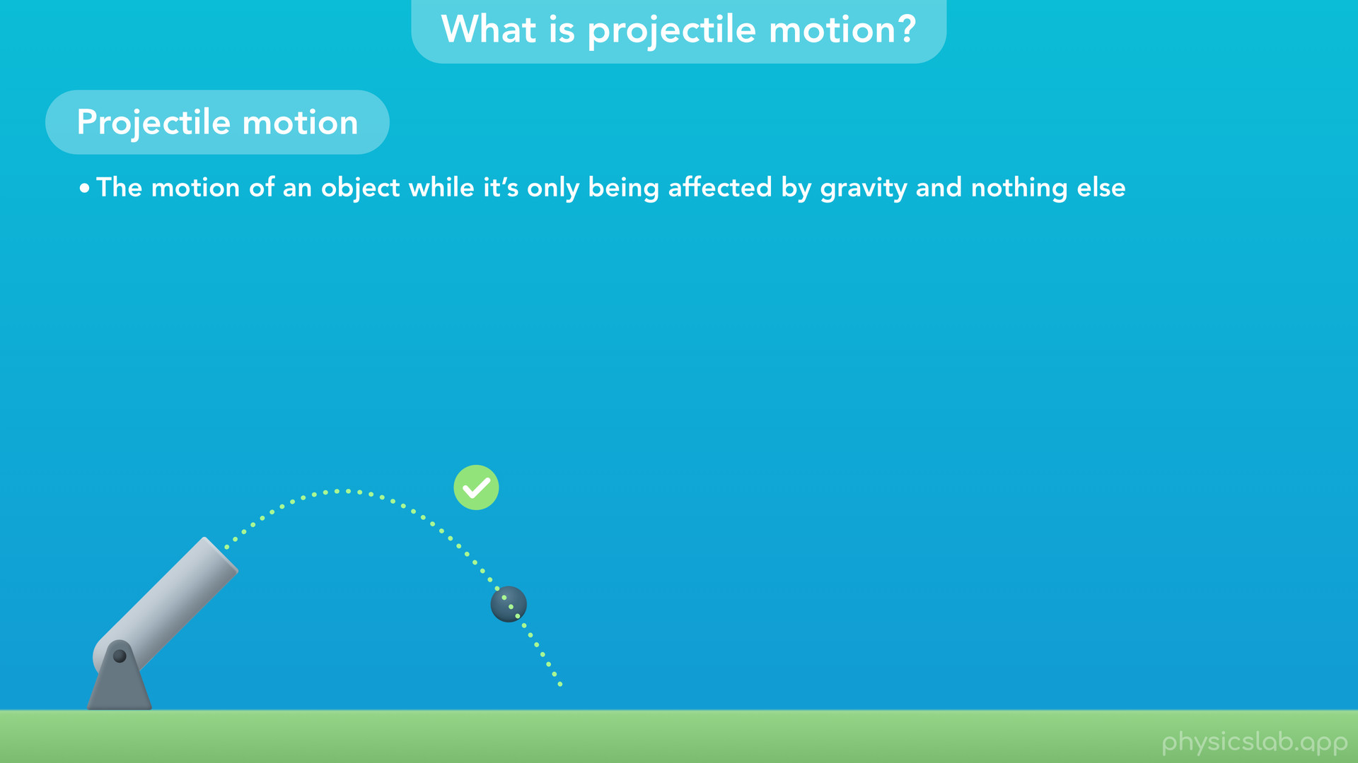
Notes:
• Projectile motion is “the motion of an object while it’s only being affected by gravity and nothing else”.
• Projectile motion only refers to the period of time when the object is moving through the air and it’s not touching anything else.

Slide 18
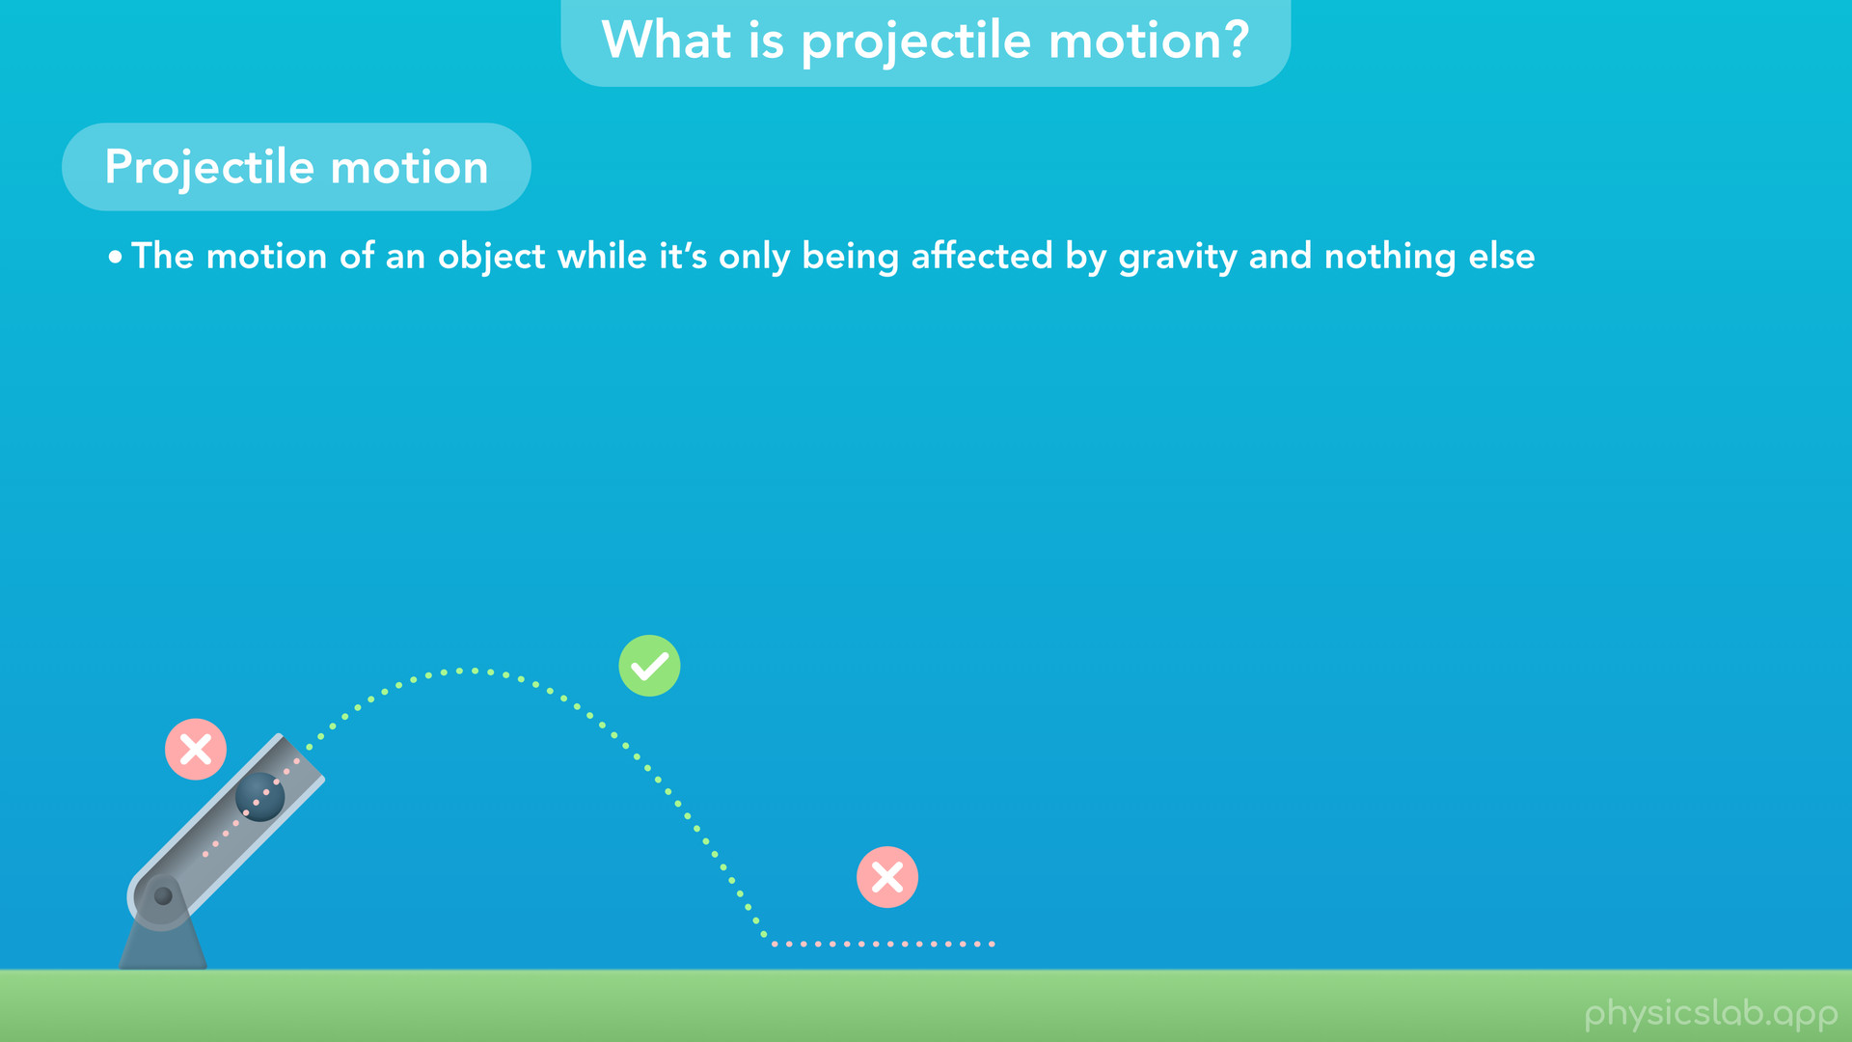
Notes:
• So the canon ball is not in projectile motion when it’s accelerating inside the canon or when it’s rolling on the ground. It’s only in projectile motion when it’s in the air.

Slide 19
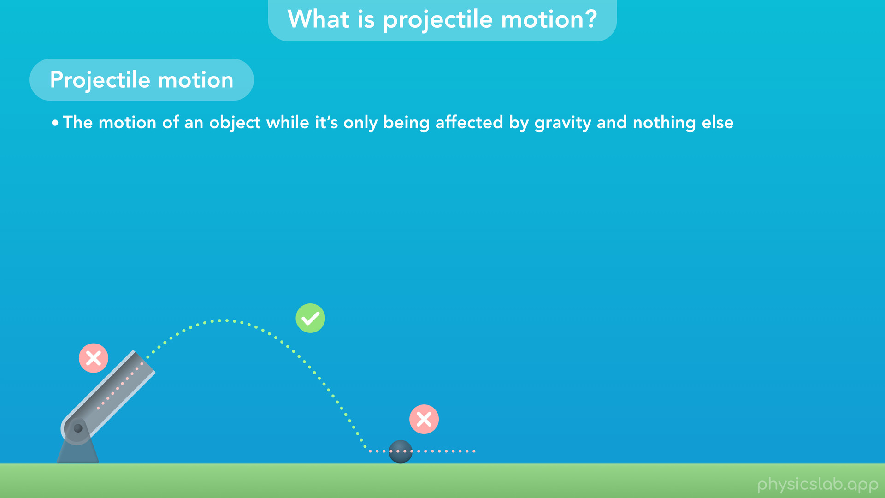

Slide 20
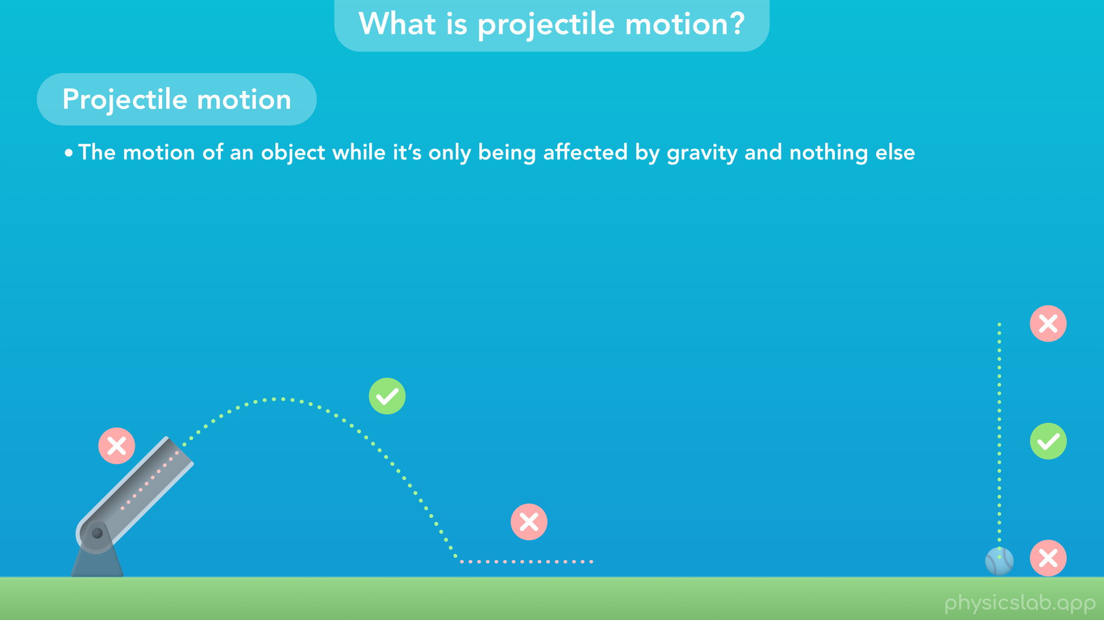
Notes:
• The ball on the right is only in projectile motion between the moment it’s released and the moment it hits the ground.

Slide 21
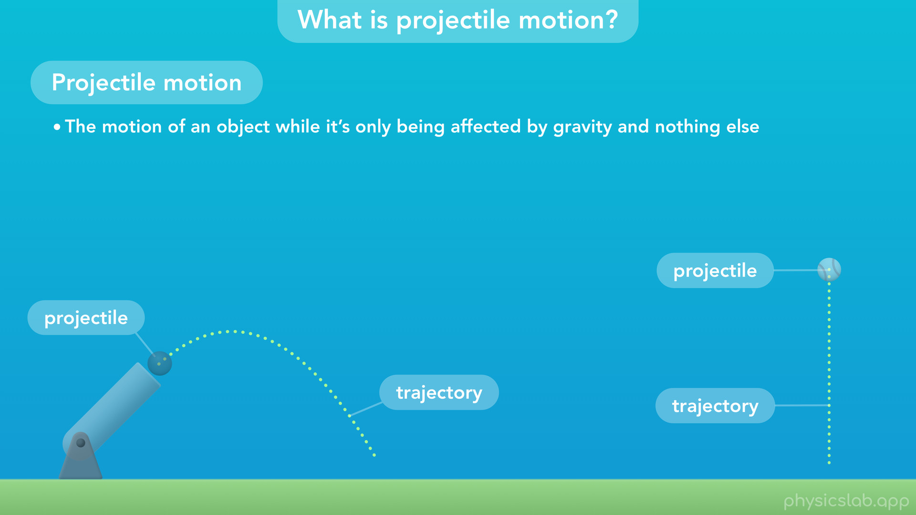
Notes:
• We call the object a projectile, and we call the path of the projectile motion the trajectory.

Slide 22
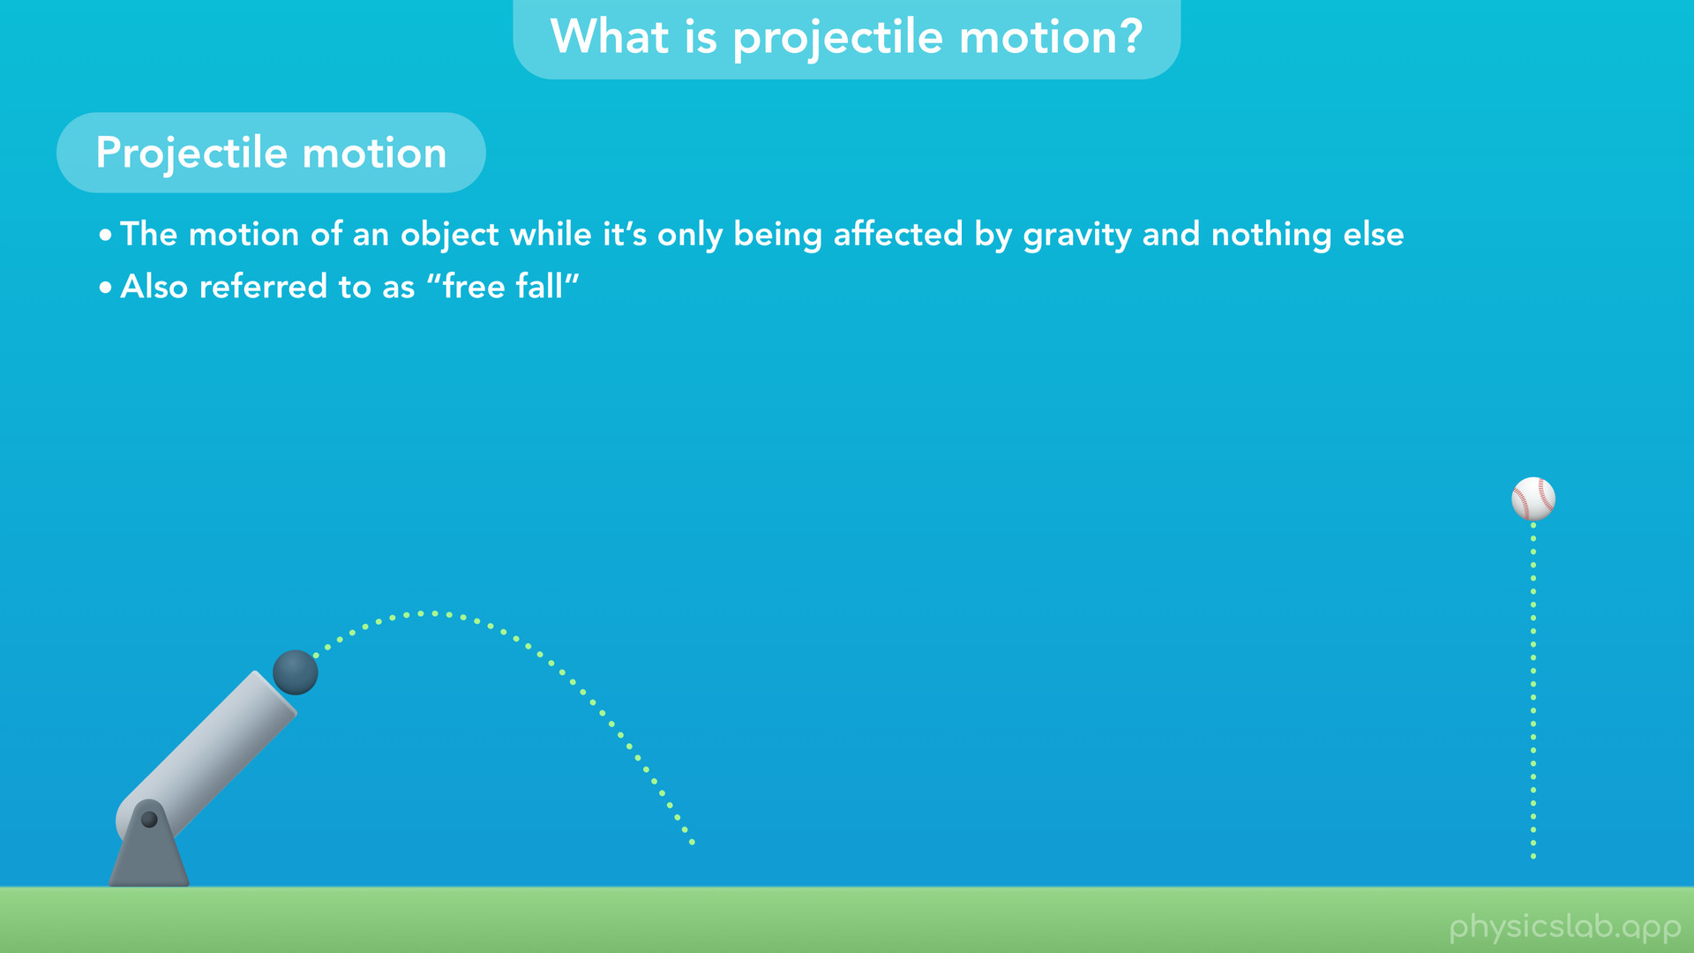
Notes:
• Projectile motion is also referred to as “free fall”, but the terms are sometimes used in different ways and we’ll come back to that later.

Slide 23
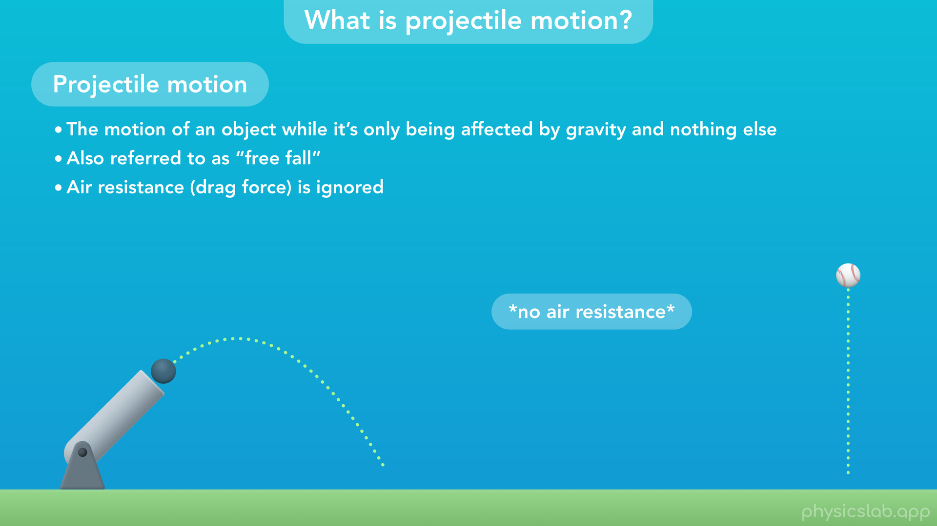
Notes:
• If we say an object is in projectile motion, then air resistance (or the drag force) is ignored. Basically, air resistance makes the calculations a lot more complicated, and we can still predict the motion pretty accurately by ignoring air resistance.

Slide 24
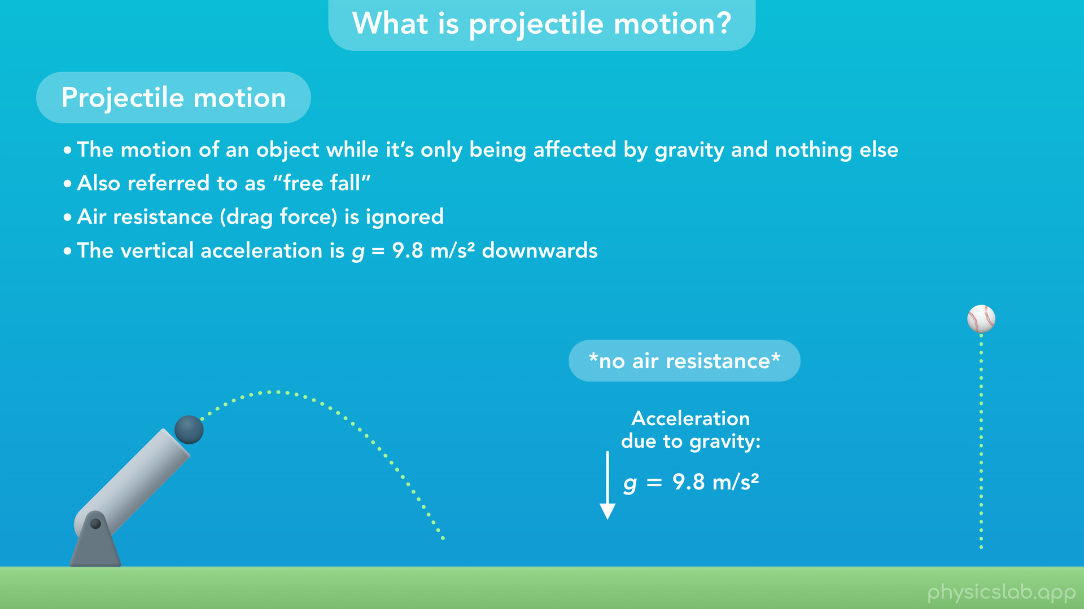
Notes:
• Finally, in projectile motion, the vertical acceleration of the object is 9.8 m/s^2 downwards, represented with the constant, lowercase g. This is the acceleration due to gravity. If there’s no air resistance, then gravity causes all objects to fall down at the same rate, 9.8 m/2^2.

Slide 25

Notes:
• The horizontal acceleration is zero, which means the horizontal velocity is constant.

Slide 26

Notes:
These might be the most important things to remember about projectile motion because they determine which kinematic equations and values we’re gonna use.

Slide 27
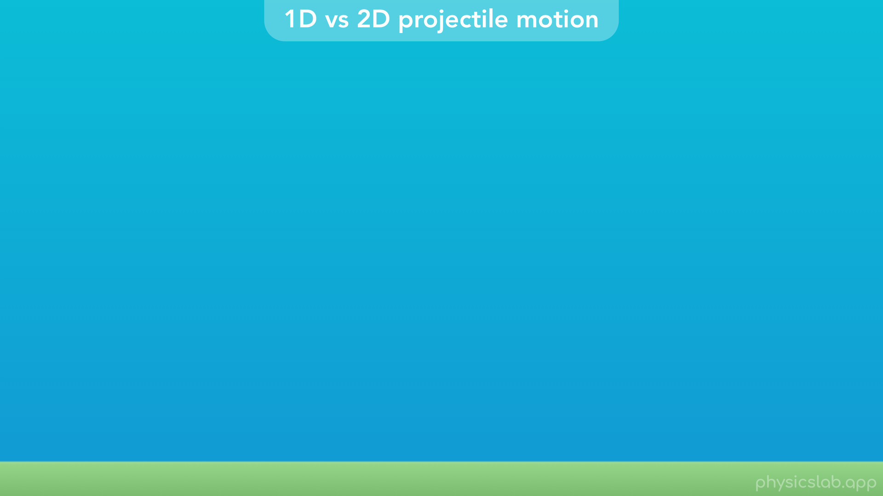
Notes:
• Now let’s talk about one-dimensional vs two-dimensional projectile motion.
• Here’s a few different scenarios that we might see.

Slide 28
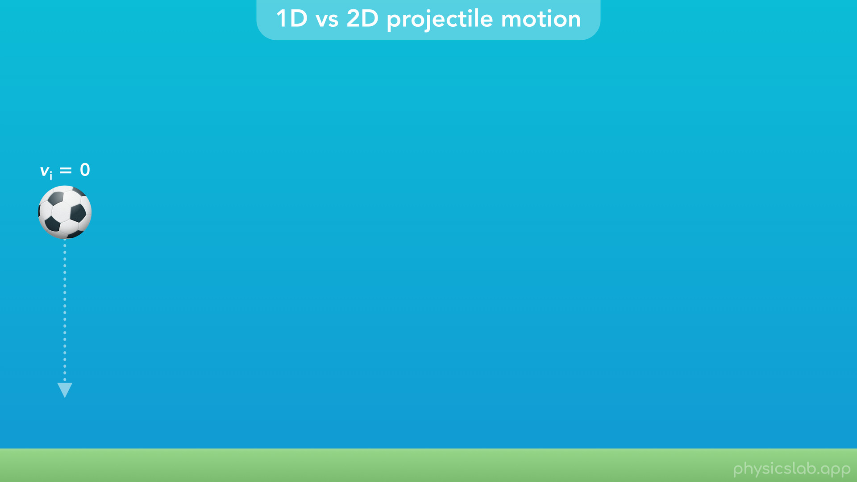
Notes:
• An object could be dropped from rest, meaning it has no initial velocity and it falls straight down.

Slide 29
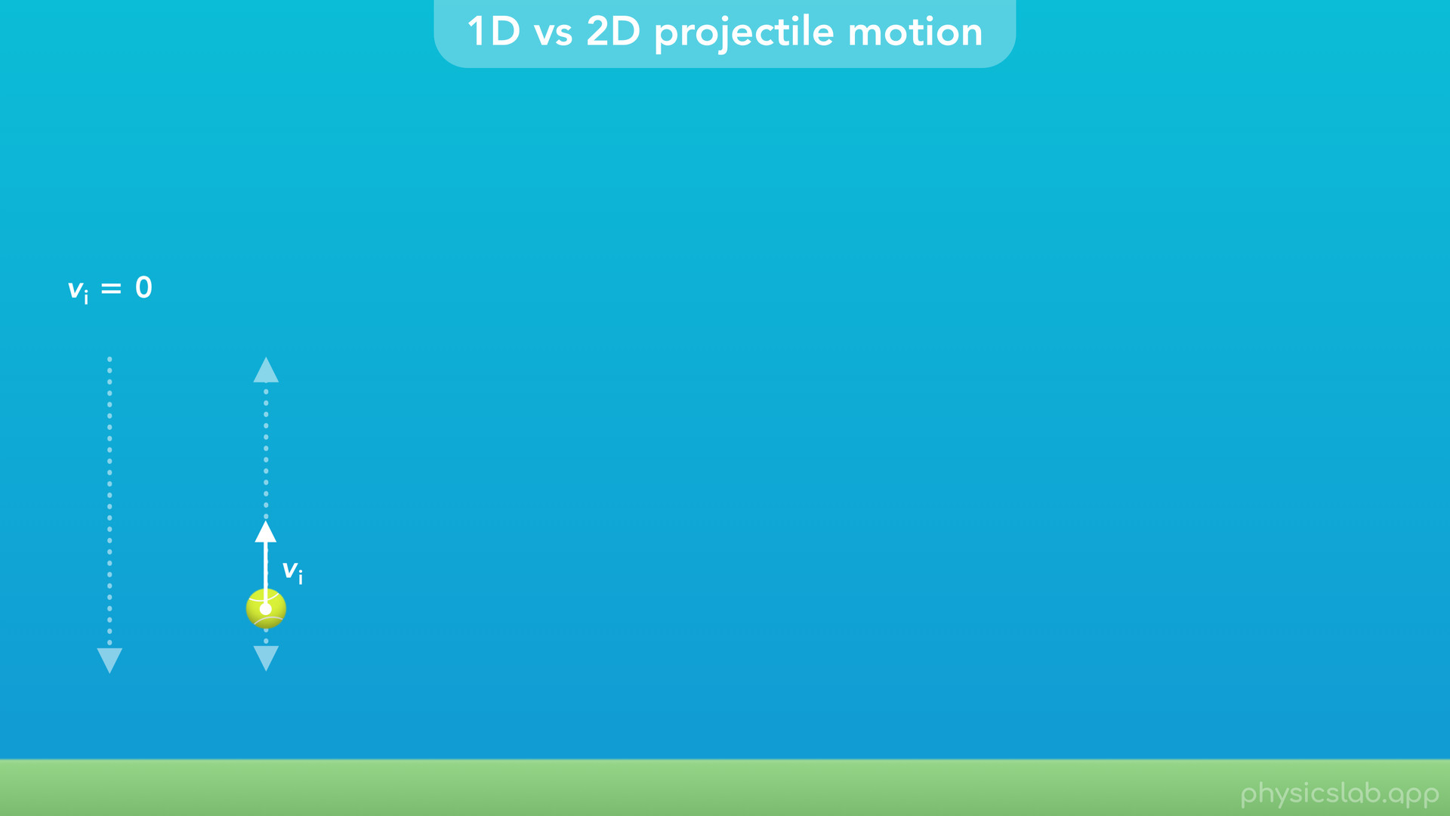
Notes:
• It could have an initial upwards velocity, so it moves up and then falls down.

Slide 30
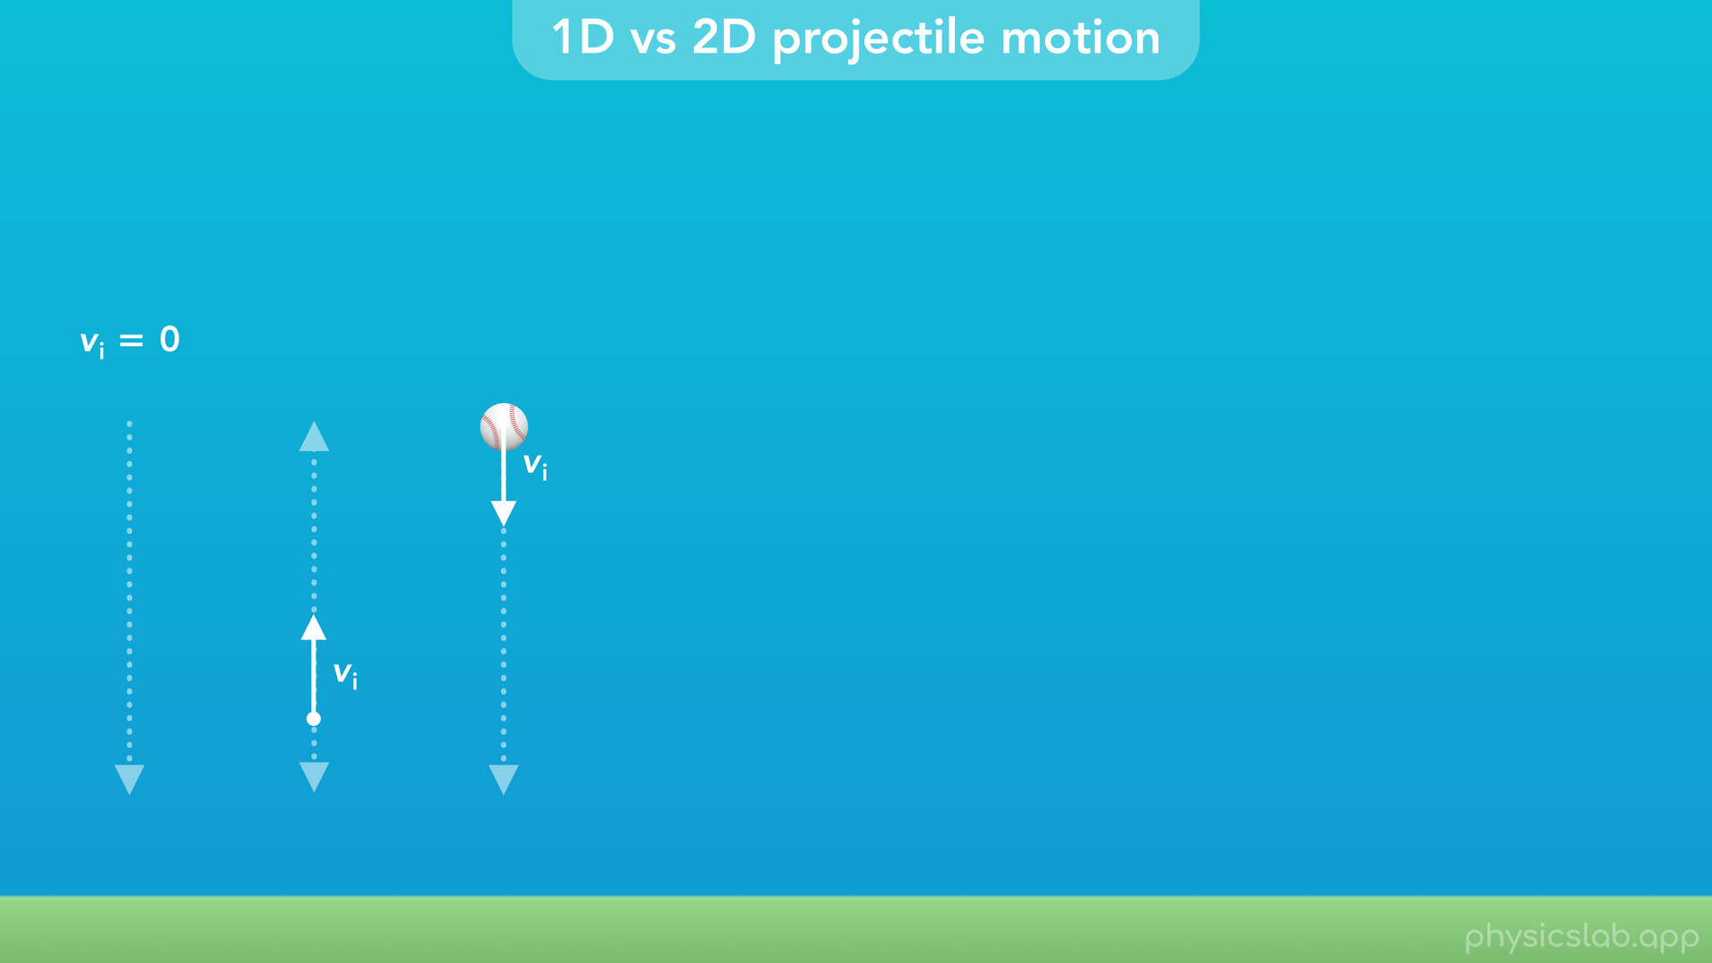
Notes:
• It could have an initial downwards velocity so it falls straight down.

Slide 31
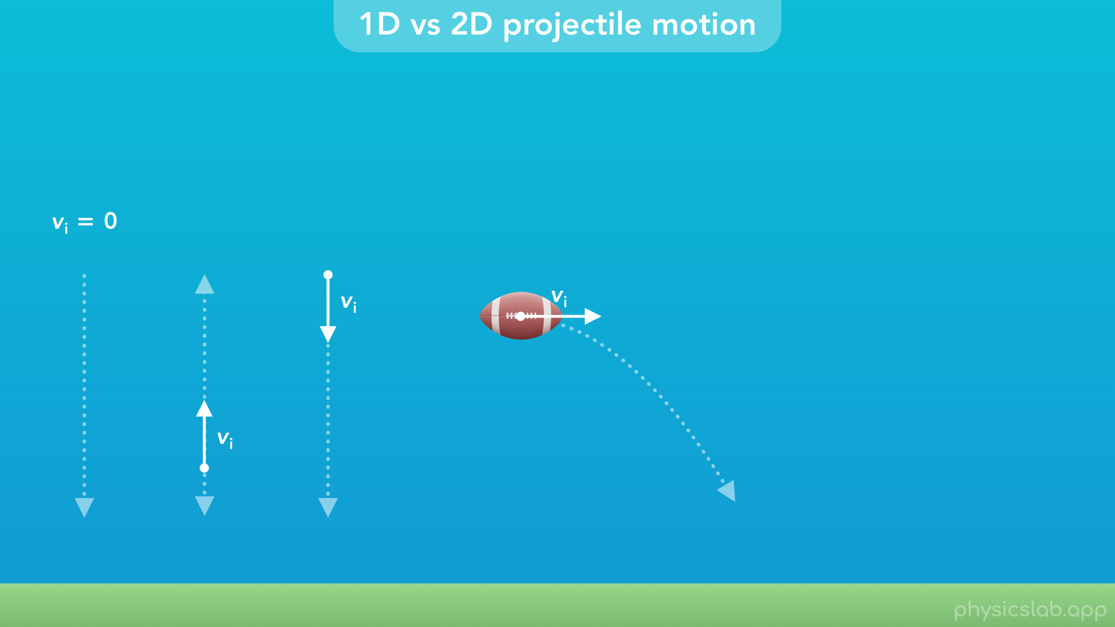
Notes:
• It could have an initial horizontal velocity and fall sideways….

Slide 32
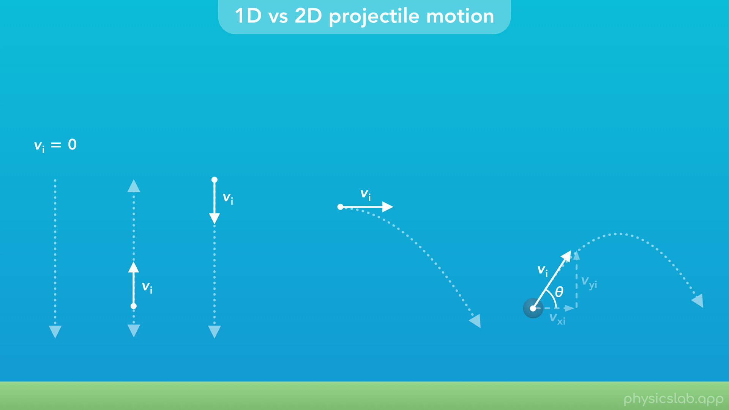
Notes:
• And it could also have an initial velocity at an angle, so it has an initial horizontal velocity and an initial vertical velocity.

Slide 33
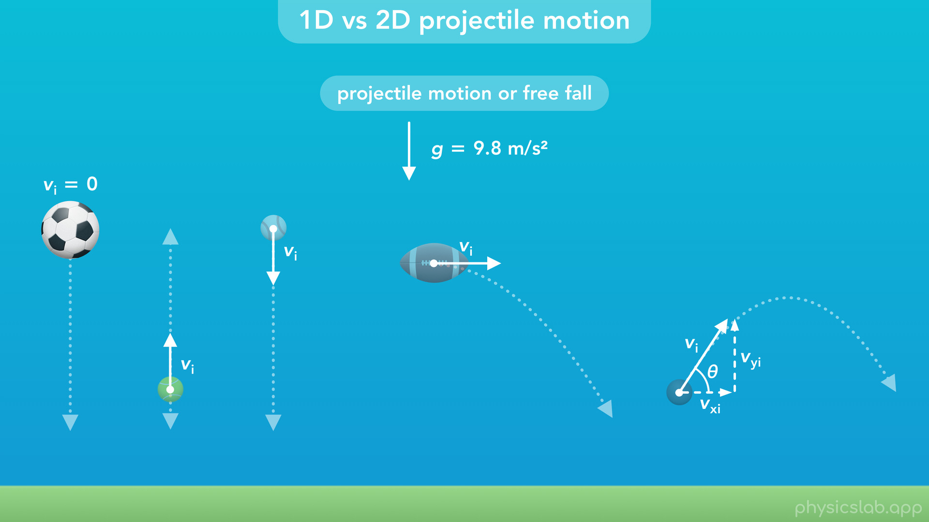
Notes:
• In this course, we’re going to call all of these scenarios projectile motion, or we might say all of these things are in free fall. In every case, when the object is in the air, the only thing affecting the motion is gravity, so the vertical acceleration is 9.8 m/s^2 downwards.

Slide 34

Notes:
• We’re gonna say the examples on the left are one-dimensional projectile motion because they only move vertically and we only use the kinematic equations in the y direction. The examples on the right are two-dimensional projectile motion because they move in the vertical and horizontal directions, so we use the x and y kinematic equations and two-dimensional vectors.

Slide 35
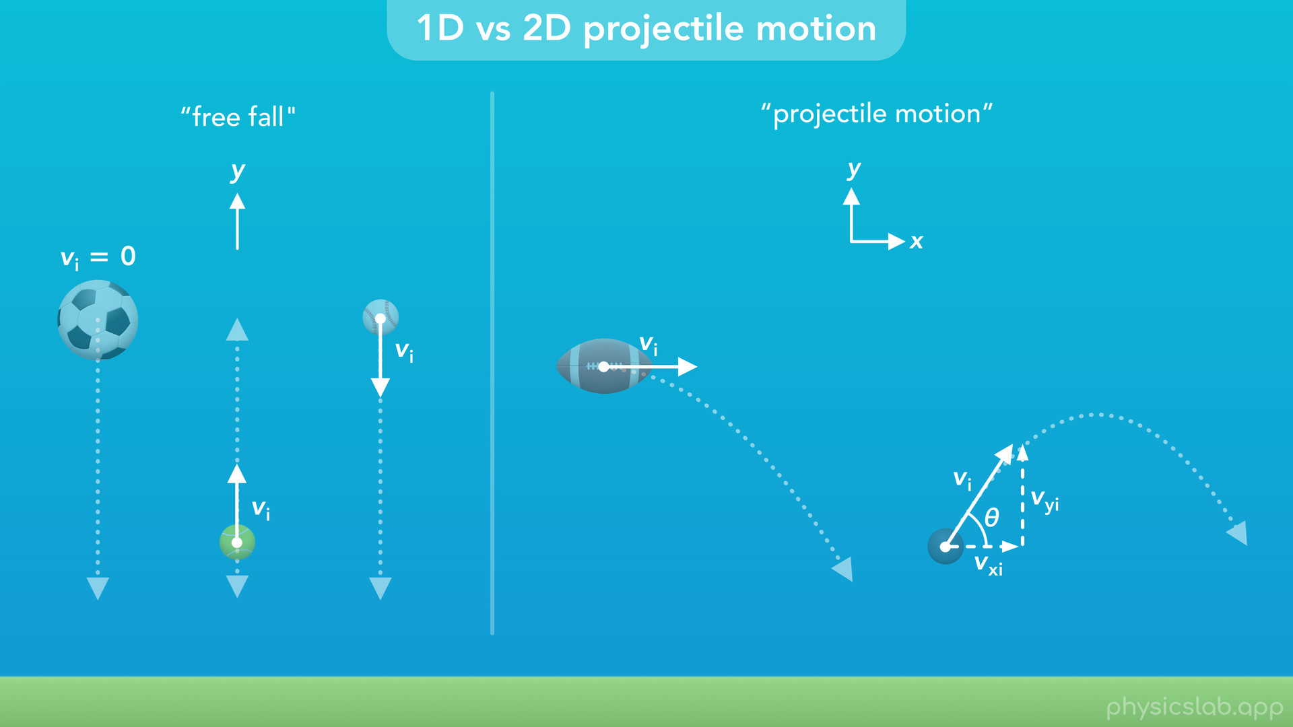
Notes:
• In other places, the term “projectile motion” might only refer to the two-dimensional projectile motion. And the term “free fall” might refer to one-dimensional projectile motion. So that’s something to be aware of. But again, we’re gonna call all of these “projectile motion” and split them up as one-dimensional and two-dimensional.

Slide 36
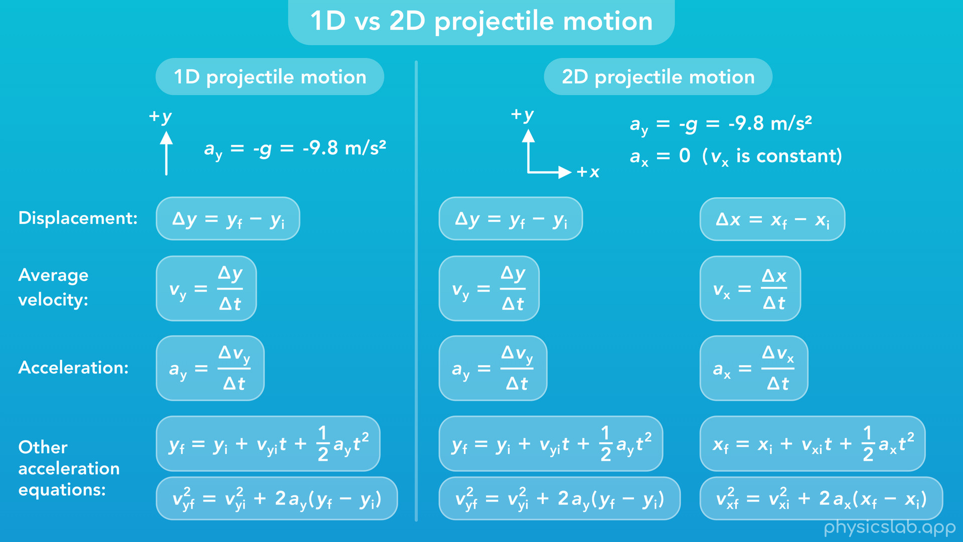
Notes:
• So how do we apply the kinematic equations that we already know to projectile motion?

Slide 37
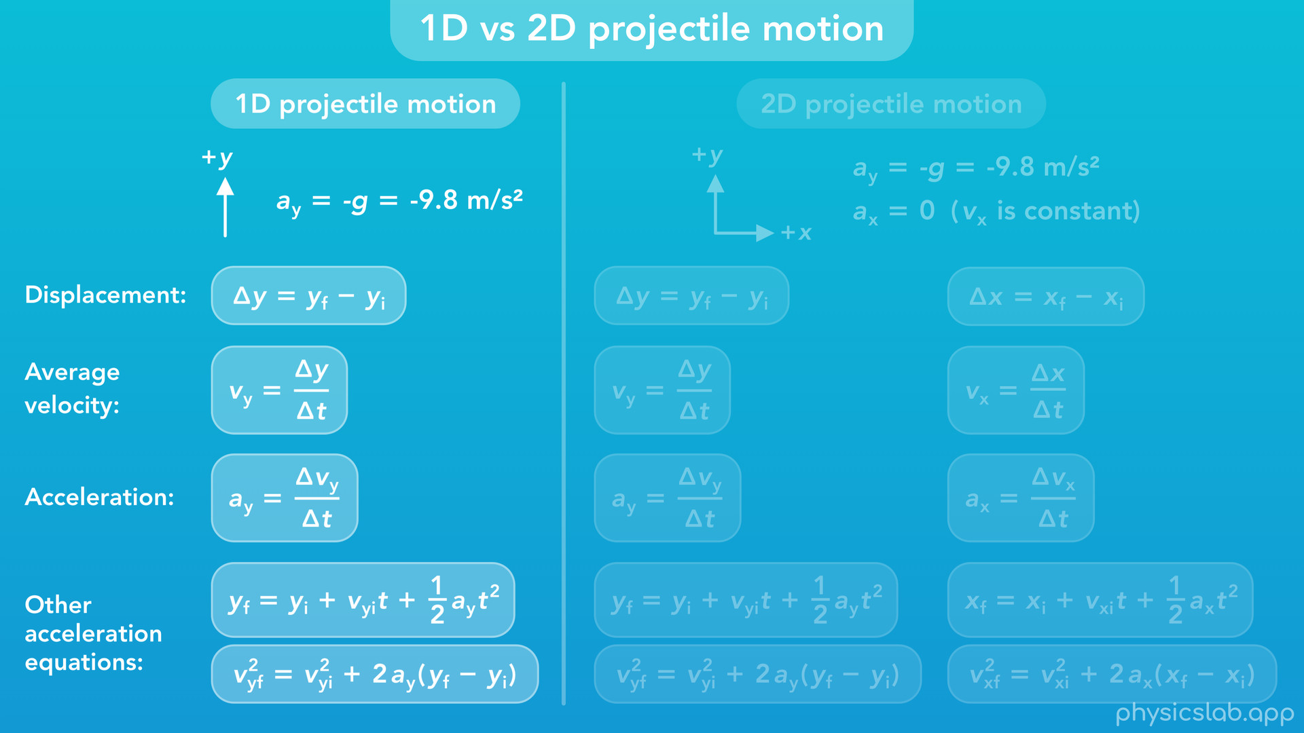
Notes:
• For 1D projectile motion, we only need the equations for the y direction.

Slide 38
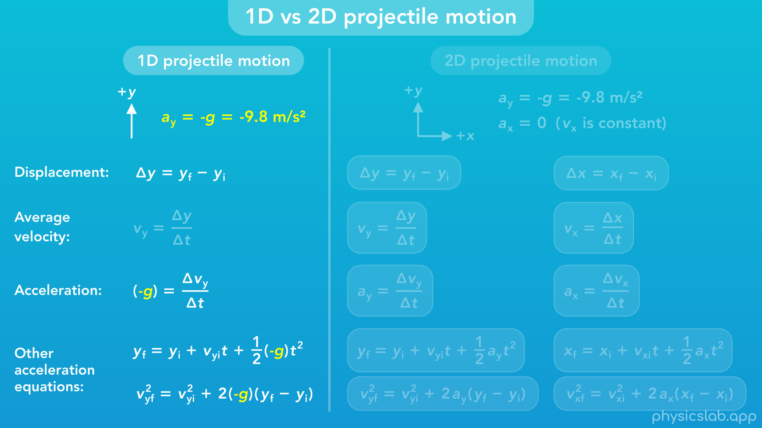
Notes:
If we choose up to be the positive y direction, then the acceleration would be negative because it points down. So when we use these equations, we plug in negative g or negative 9.8 m/s^2 for the acceleration, ay. And since there’s acceleration, the y velocity is not constant, and we don’t really use the equation for average velocity.

Slide 39
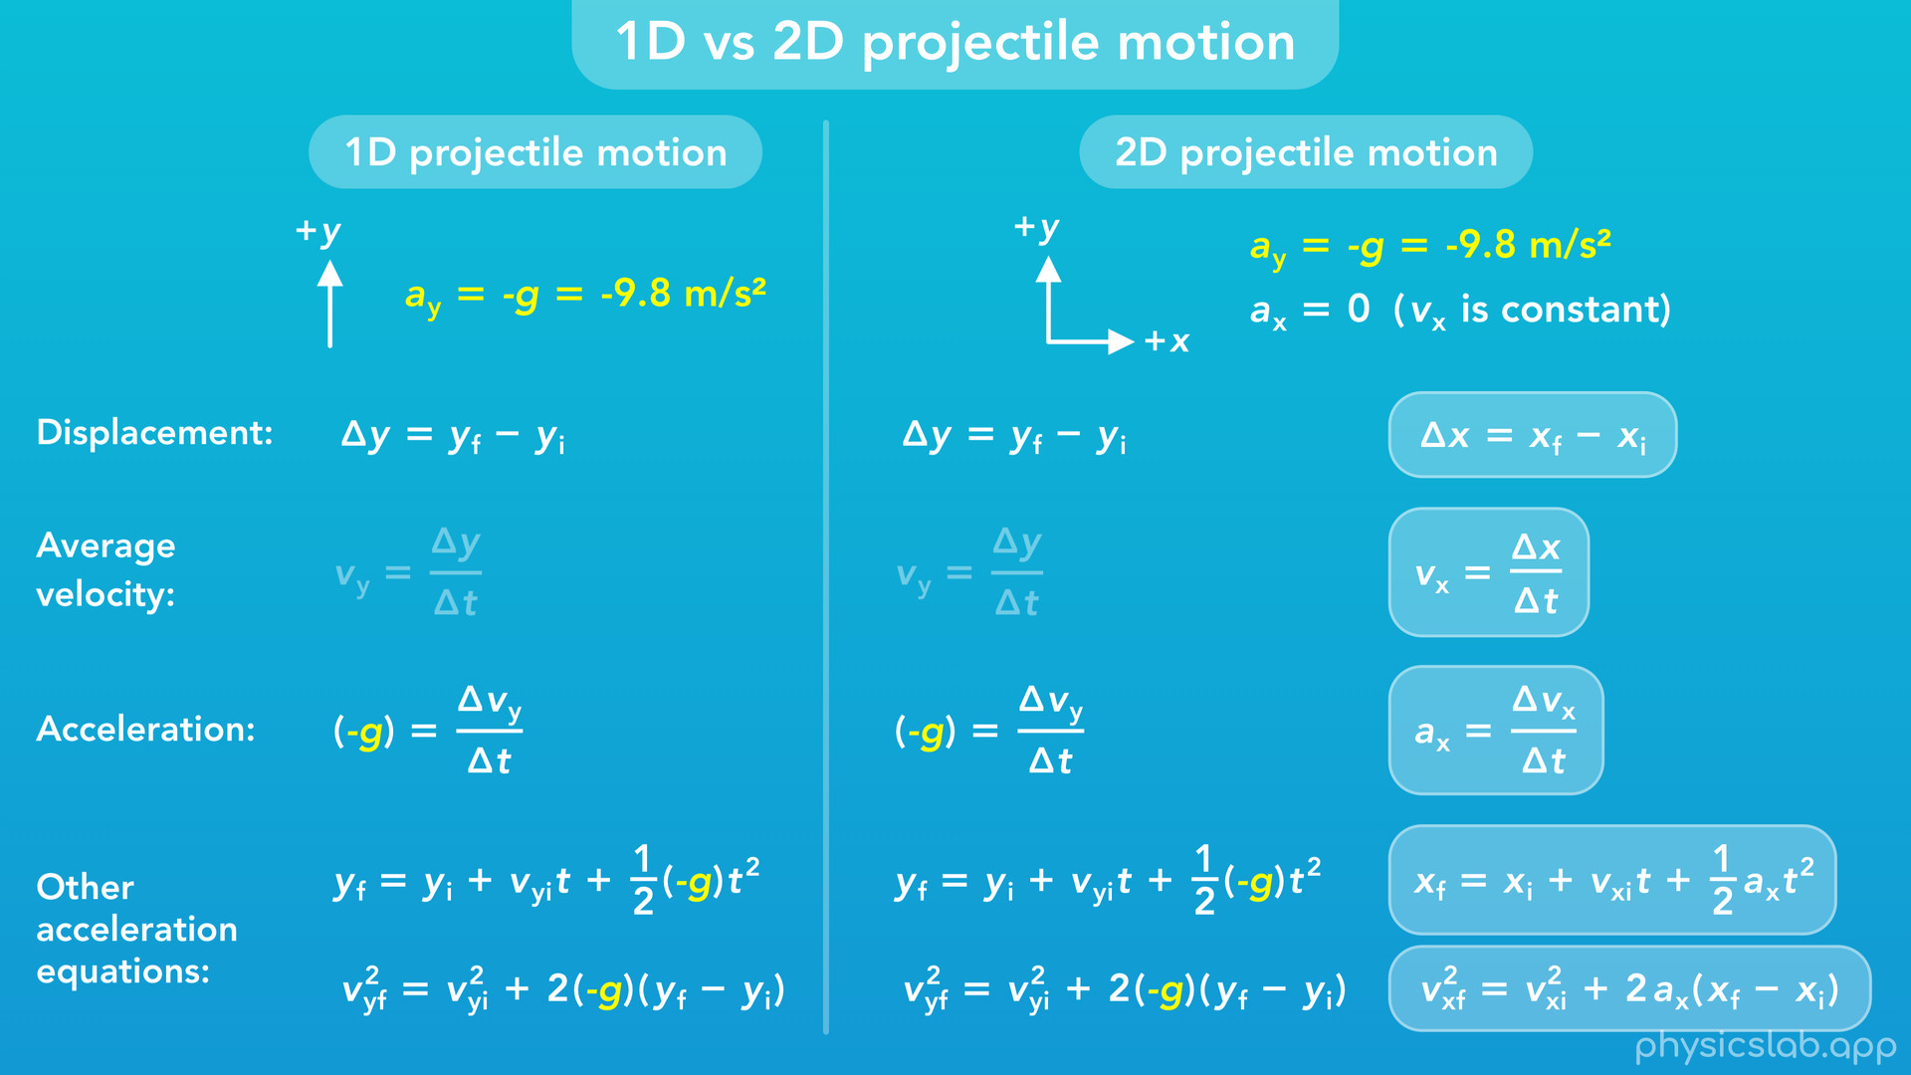
Notes:
• For 2D projectile motion, the equations for the y direction will be the same.

Slide 40
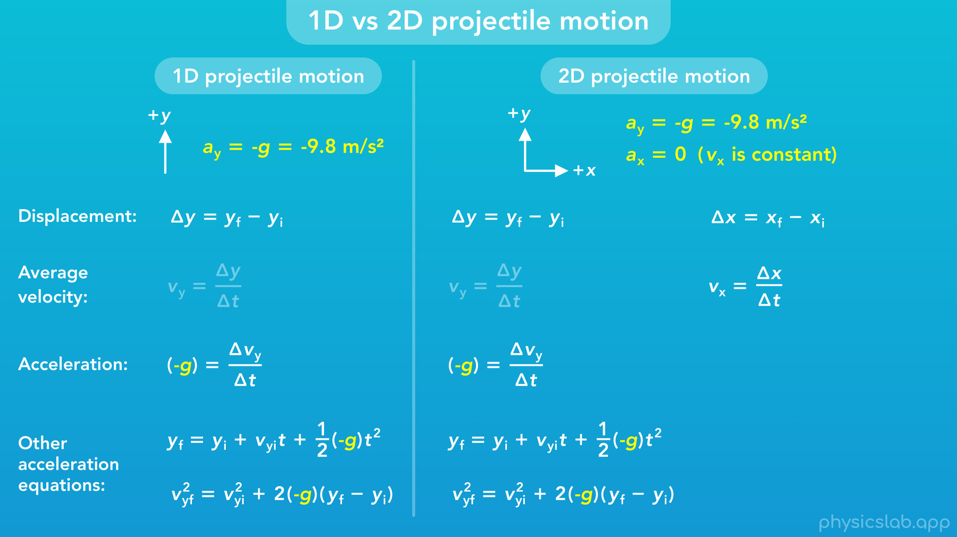
Notes:
But since there’s no acceleration in the x direction, then the x velocity is constant, and we won’t use the x equations with acceleration.
1D and 2D projectile motion are really just specific cases of 1D and 2D motion where we know the acceleration is 9.8 m/s^2 downwards.

Slide 41
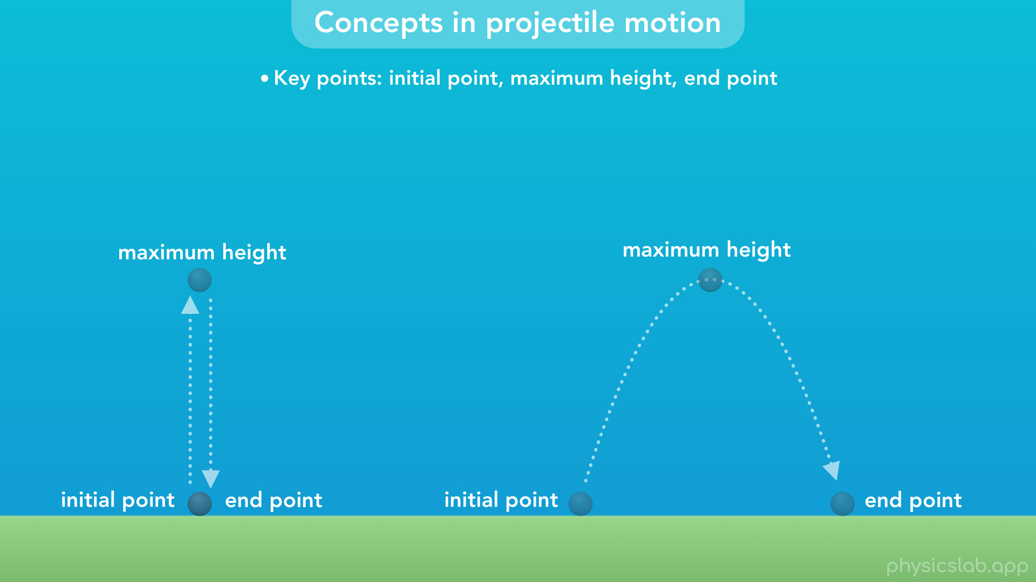
Notes:
• But there are a few things about projectile motion which we need to remember when solving problems. This will just be a summary and the next few videos will cover these in more detail.
• First, every problem is different but there are some key points in the trajectory that are important to think about: the initial point, the point of maximum height, and the point when the object hits the ground or the motion ends.

Slide 42
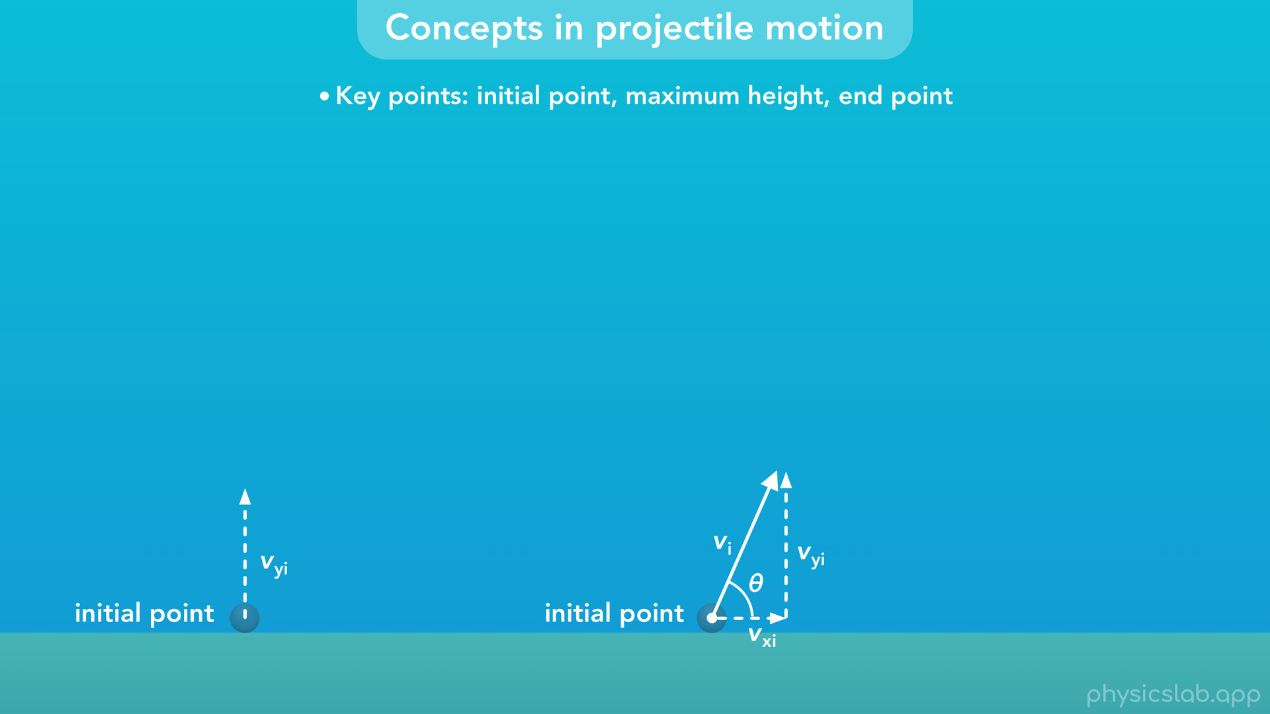
Notes:
• Usually, we’re given the velocity at the initial point. If it’s 1D projectile motion, that will just be the initial y velocity. If it’s 2D projectile motion, we’ll might be given the magnitude and angle of the initial velocity vector. Then we have to find the components of that velocity vector, which are the initial x velocity and the initial y velocity. Then we can use those velocities in the x and y equations.

Slide 43
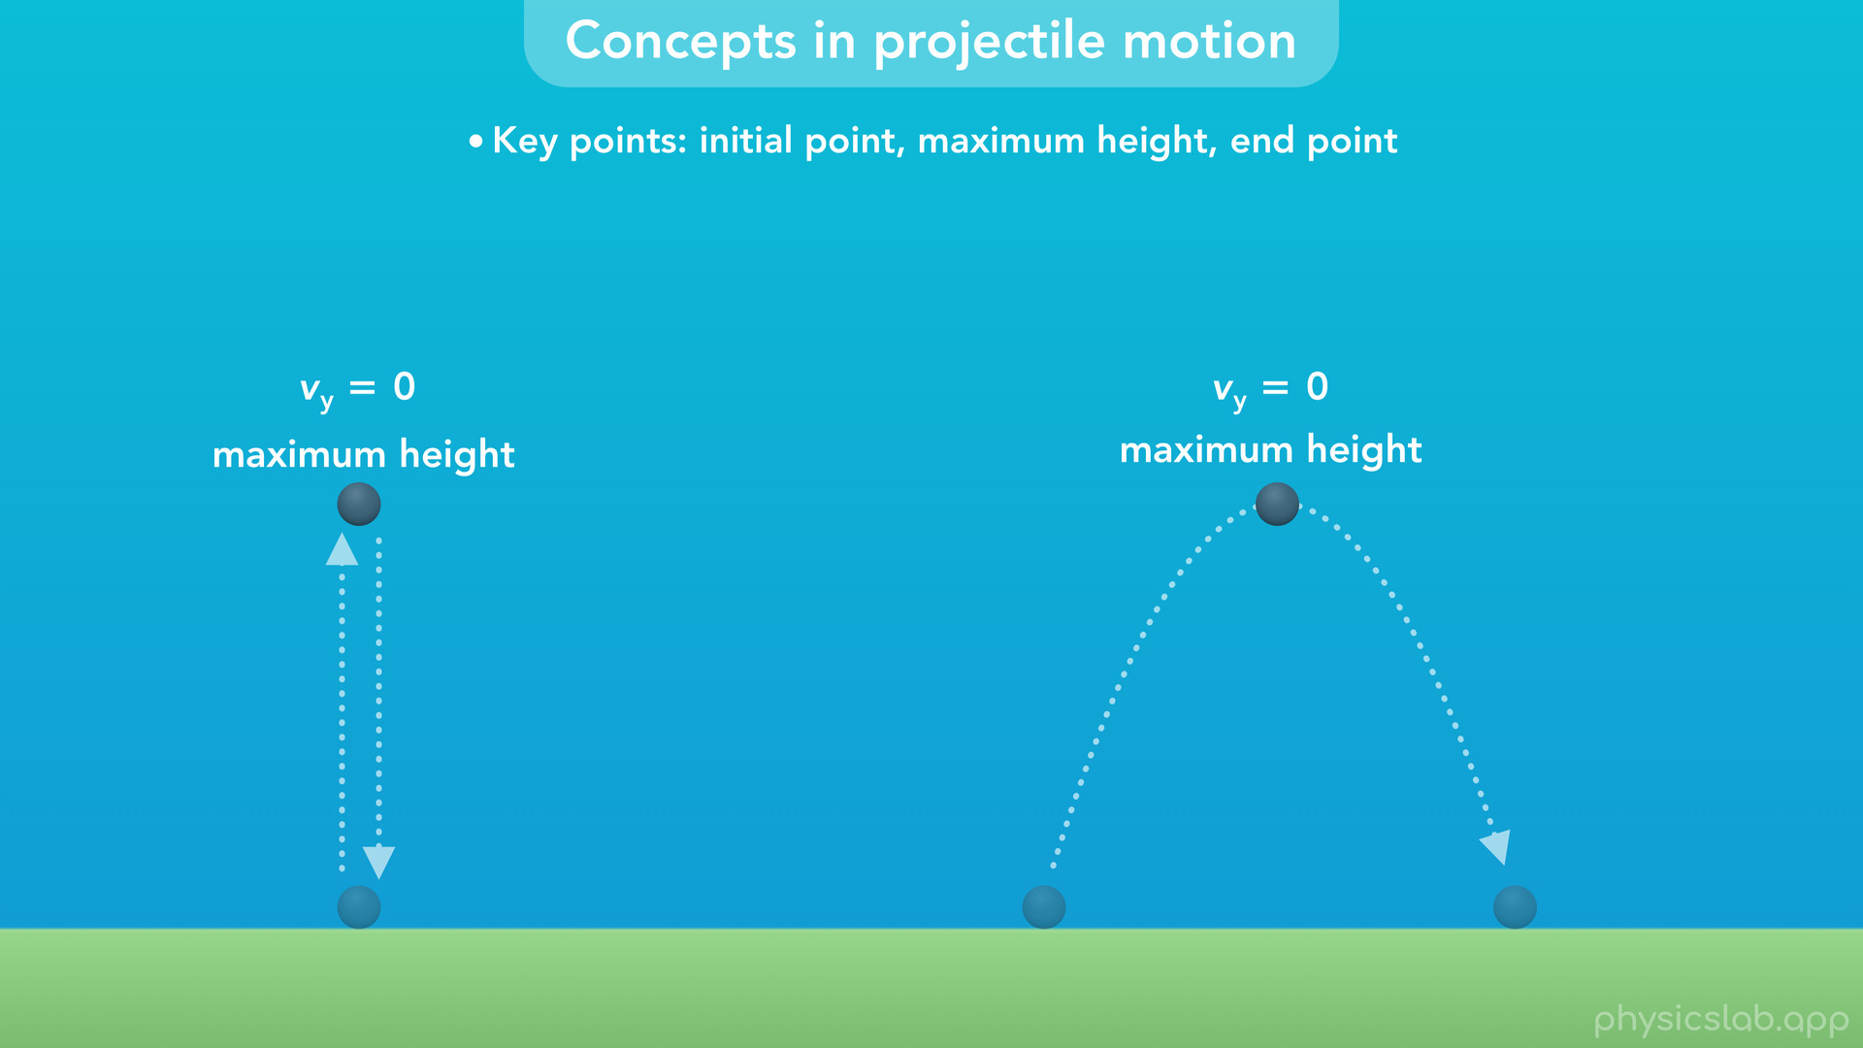
Notes:
• When the object reaches its maximum height, the vertical velocity, vy, is zero. This applies to 1D and 2D projectile motion.

Slide 44
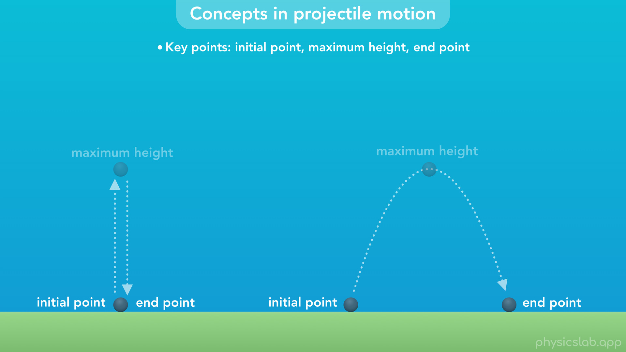
Notes:
Also, if the initial and final points are at the same height, the trajectory is symmetric.

Slide 45
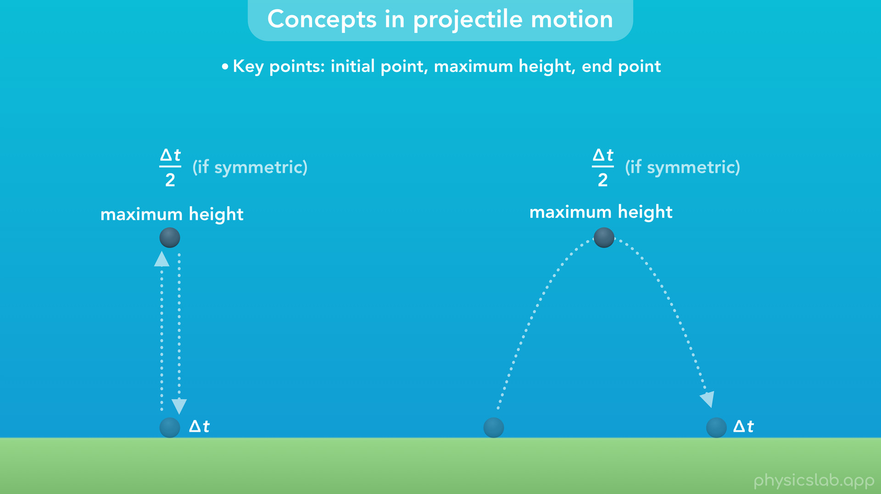
Notes:
The amount of time it takes to reach the maximum height is half the time it takes to reach the final point, its half the duration of the full trajectory.
Again, this is only true if the initial and final points are at the same height.

Slide 46
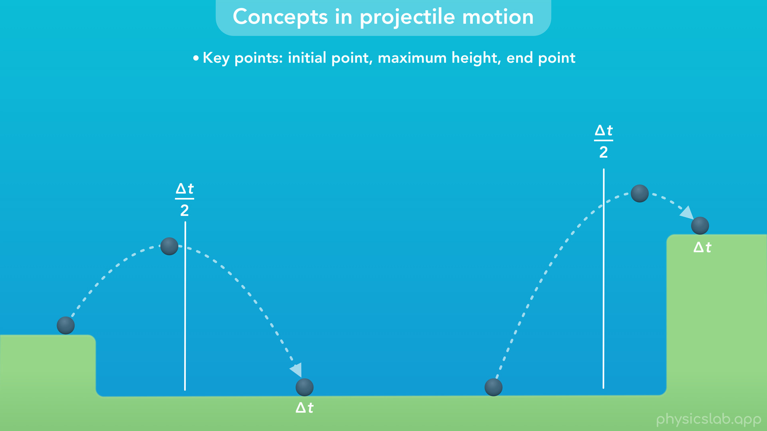
Notes:
If the object starts and ends at different heights, the trajectory is not symmetric and the time at the maximum height is not half of the total time.

Slide 47
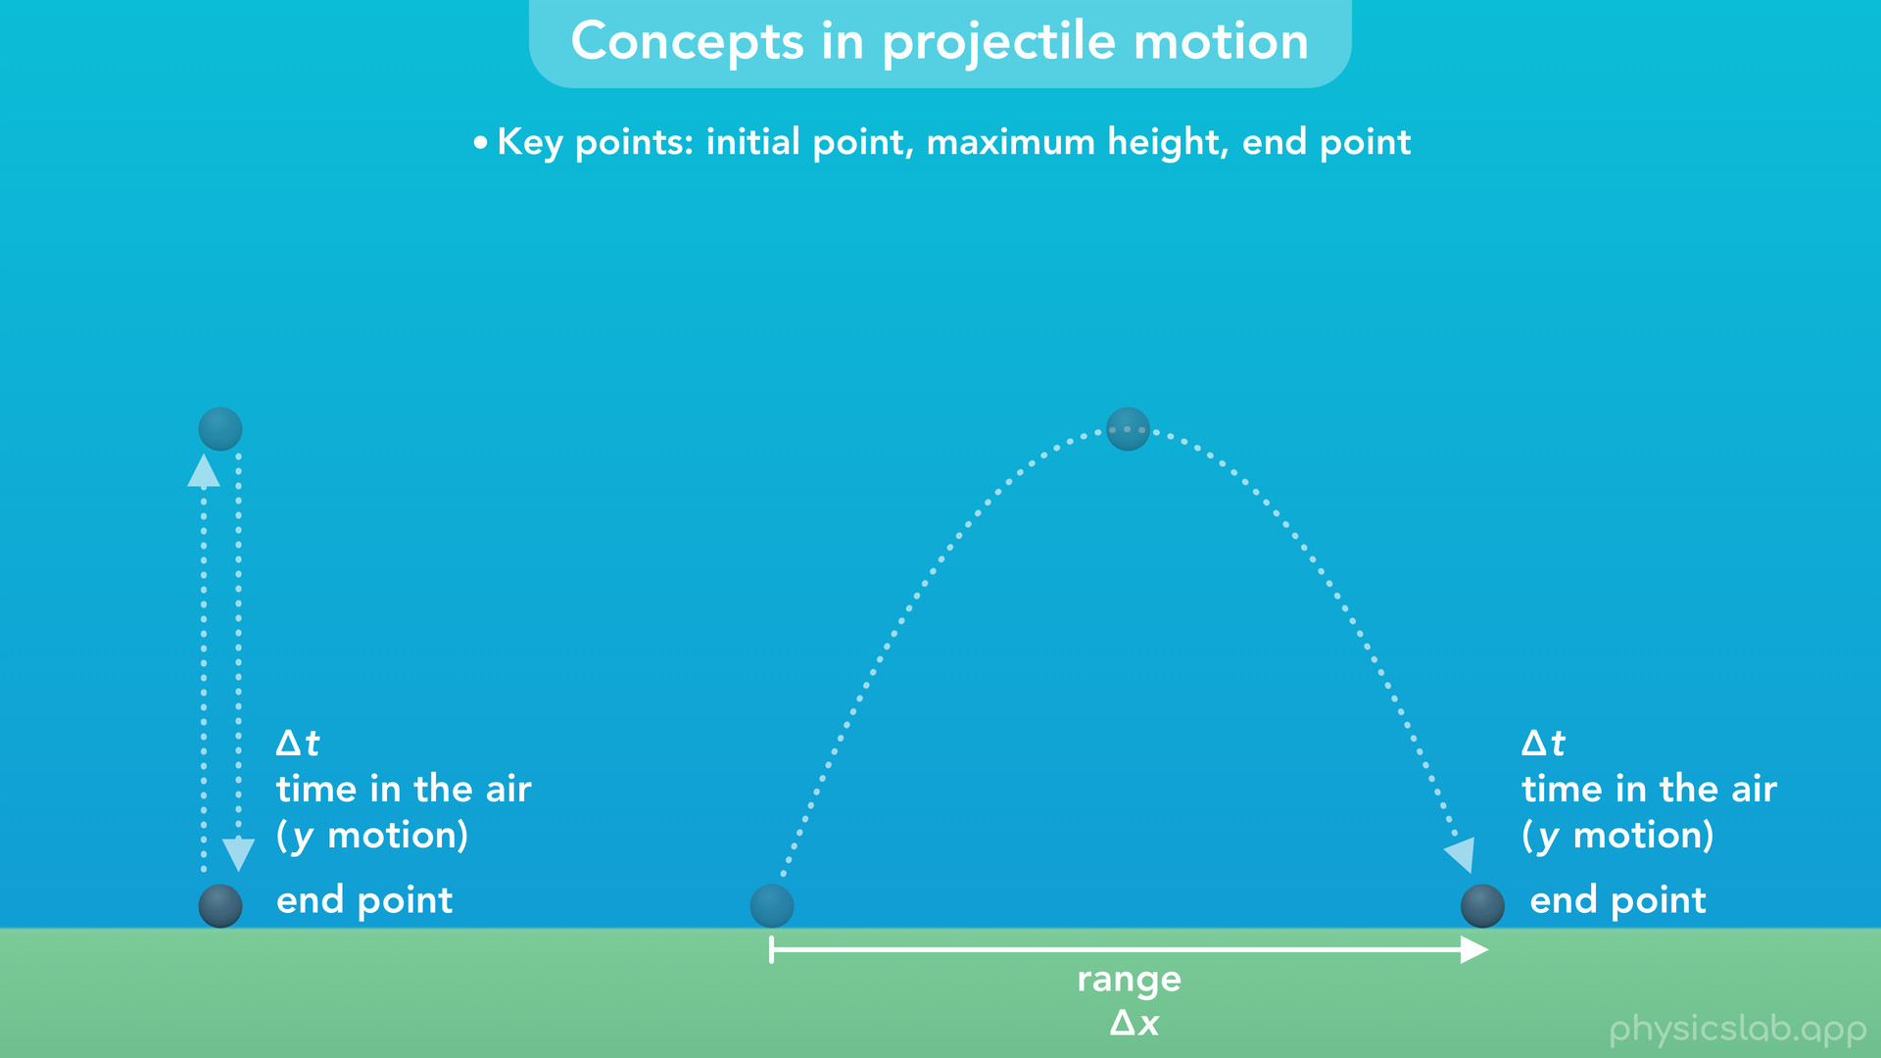
Notes:
• At the point when the object hits the ground or anything else, the projectile motion ends. We call the horizontal distance between the initial and final points the range of the projectile motion.
• Another important concept is that the duration of the motion, the amount of time the object is in the air, is only determined by the y motion, and doesn’t depend on the x motion.

Slide 48
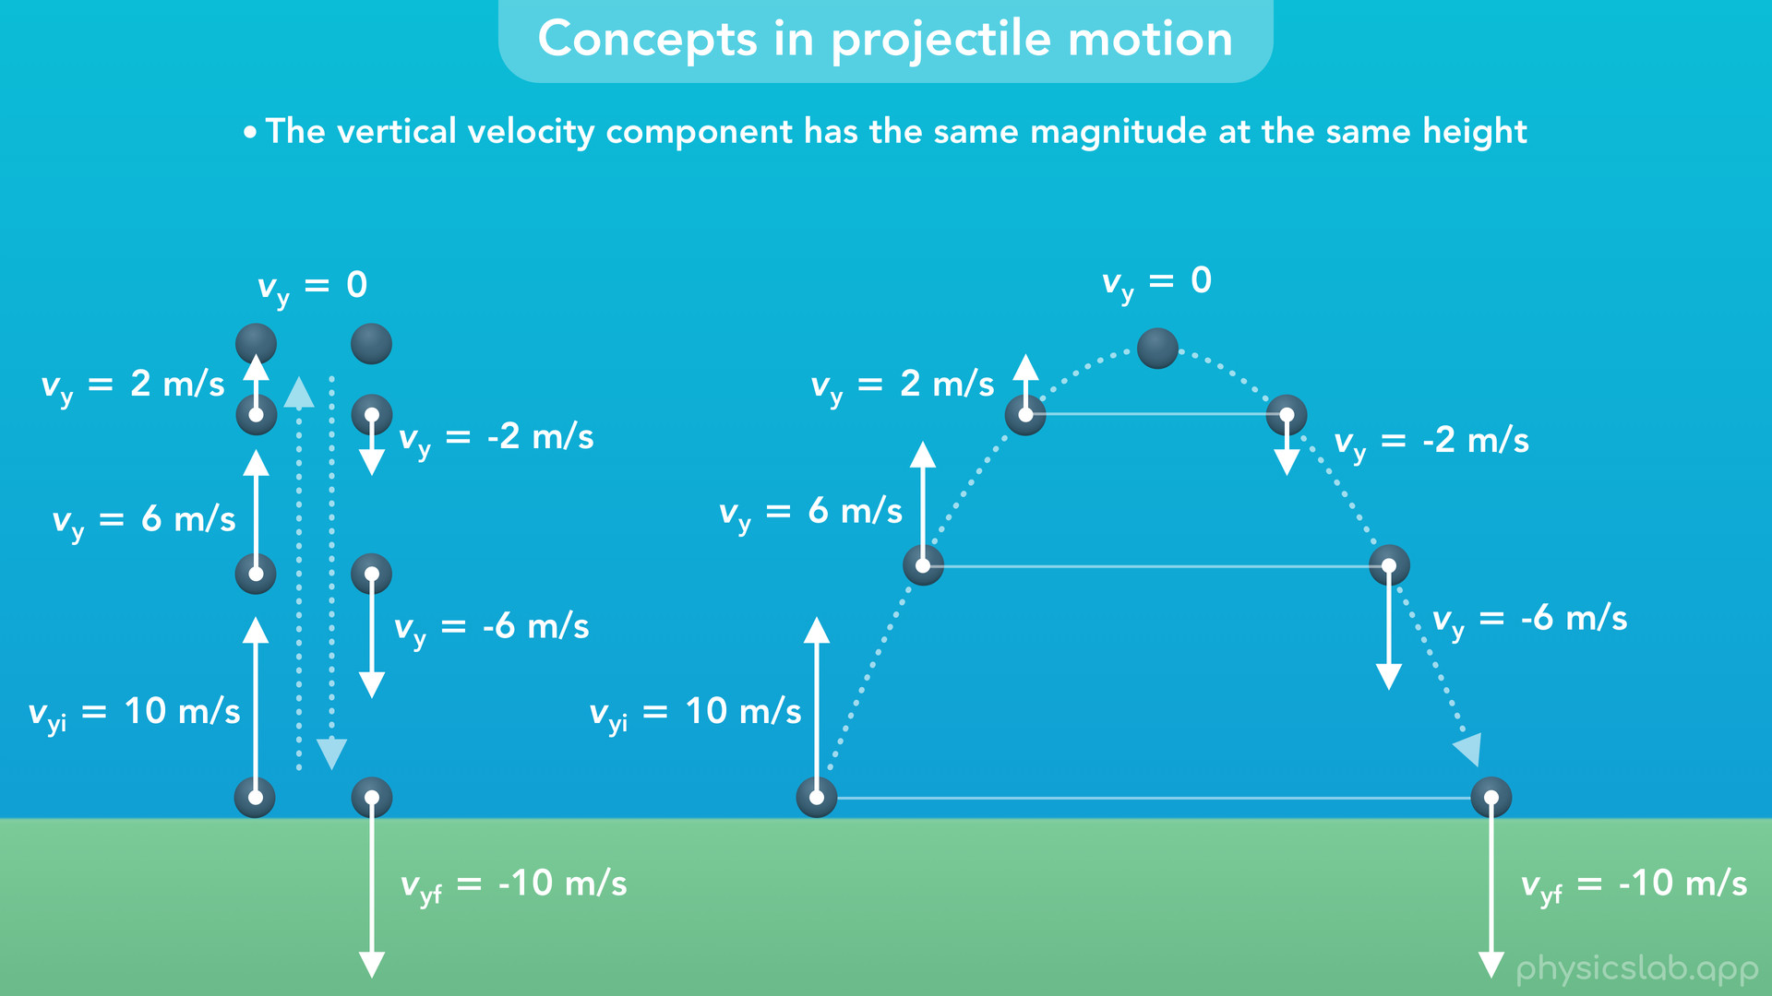
Notes:
• Next, the vertical velocity, vy, has the same magnitude at the same height on both sides of the trajectory, but they have opposite directions.

Slide 49
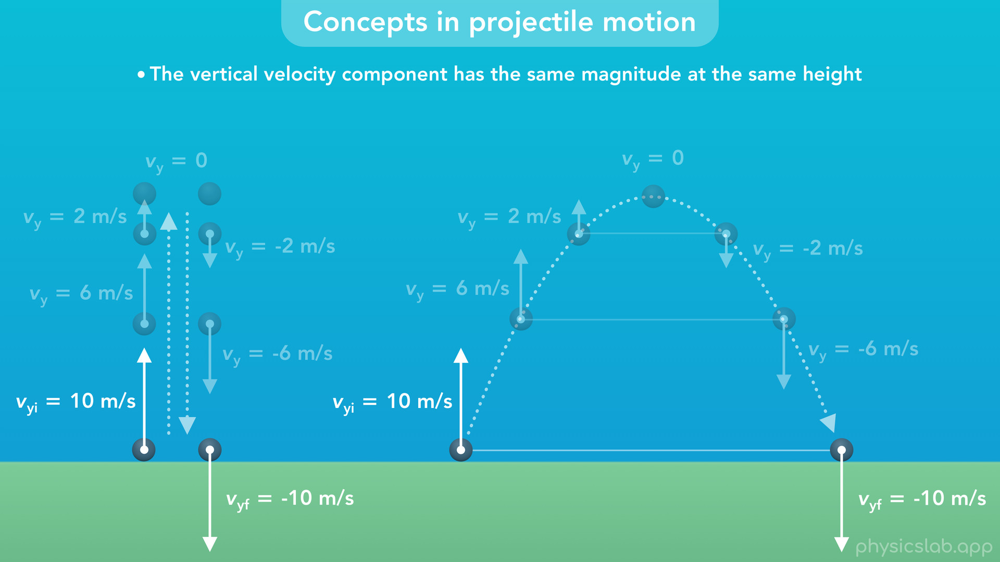

Slide 50
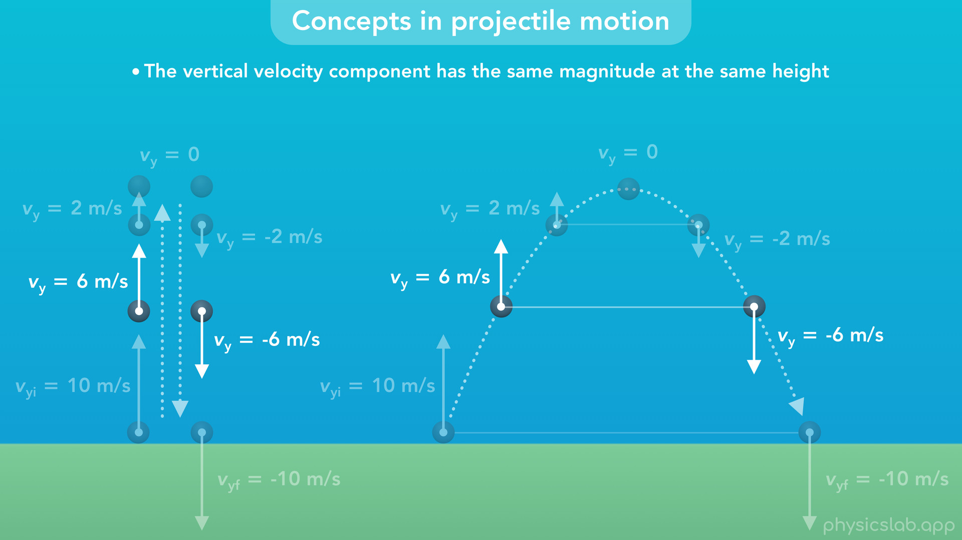

Slide 51
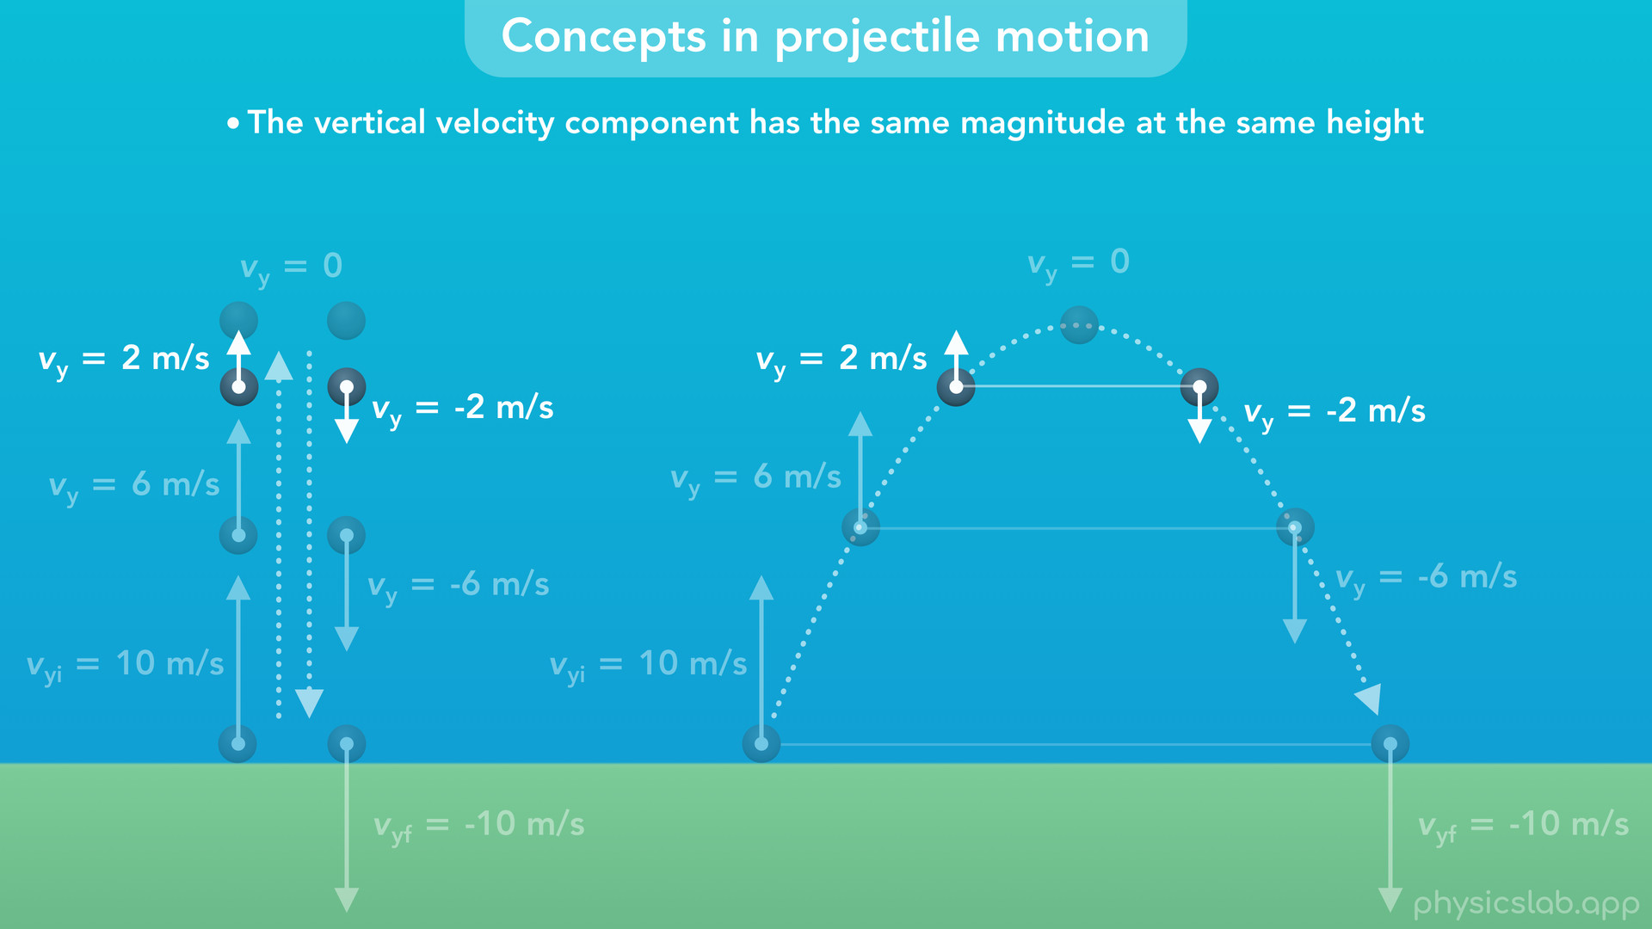

Slide 52
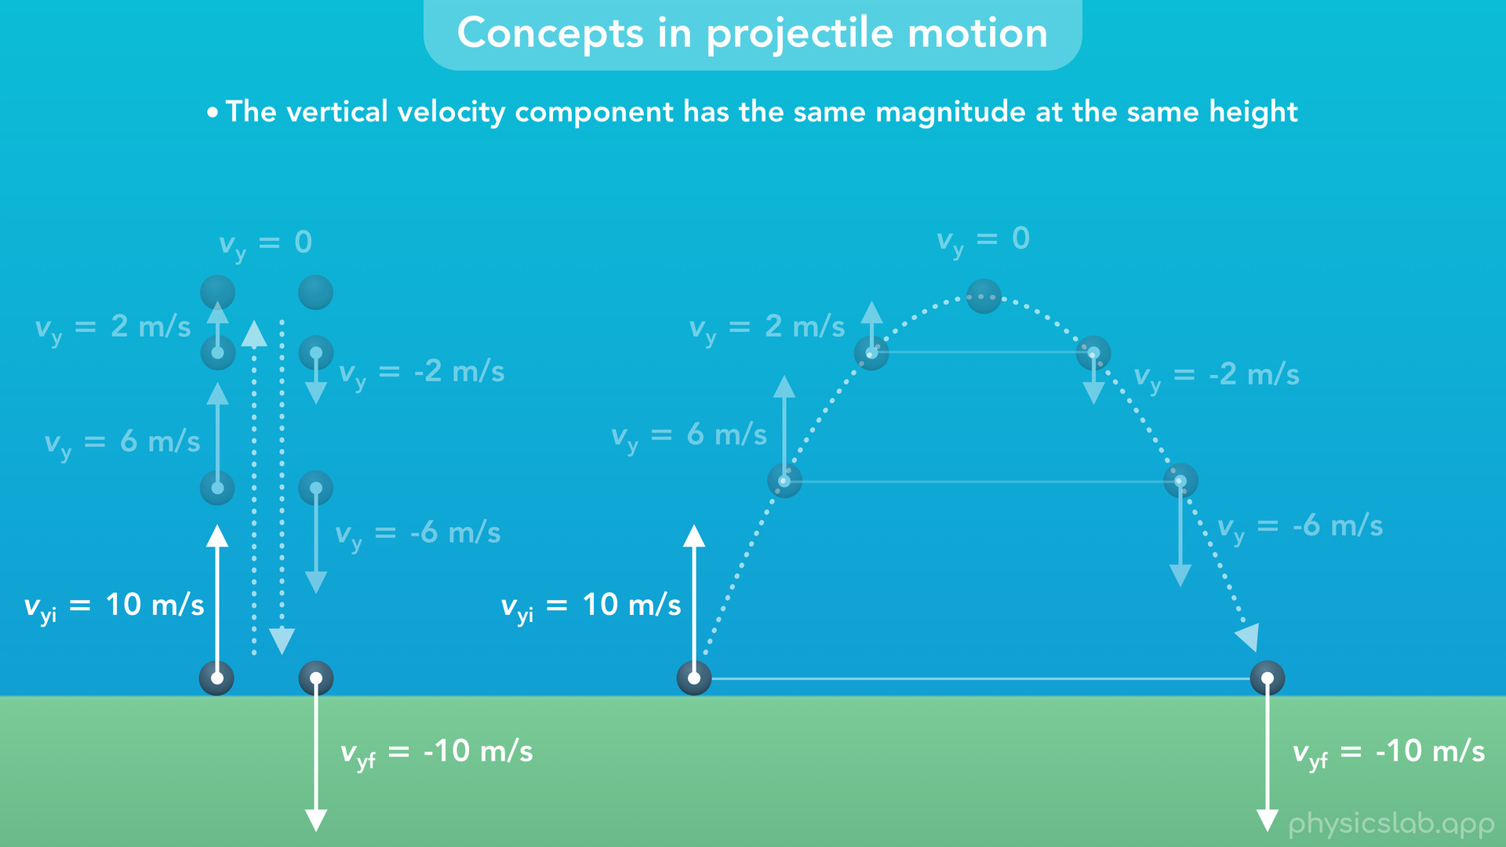
Notes:
If the initial and final points are at the same height, the final y velocity is the same as the initial y velocity, but it has the opposite sign.

Slide 53
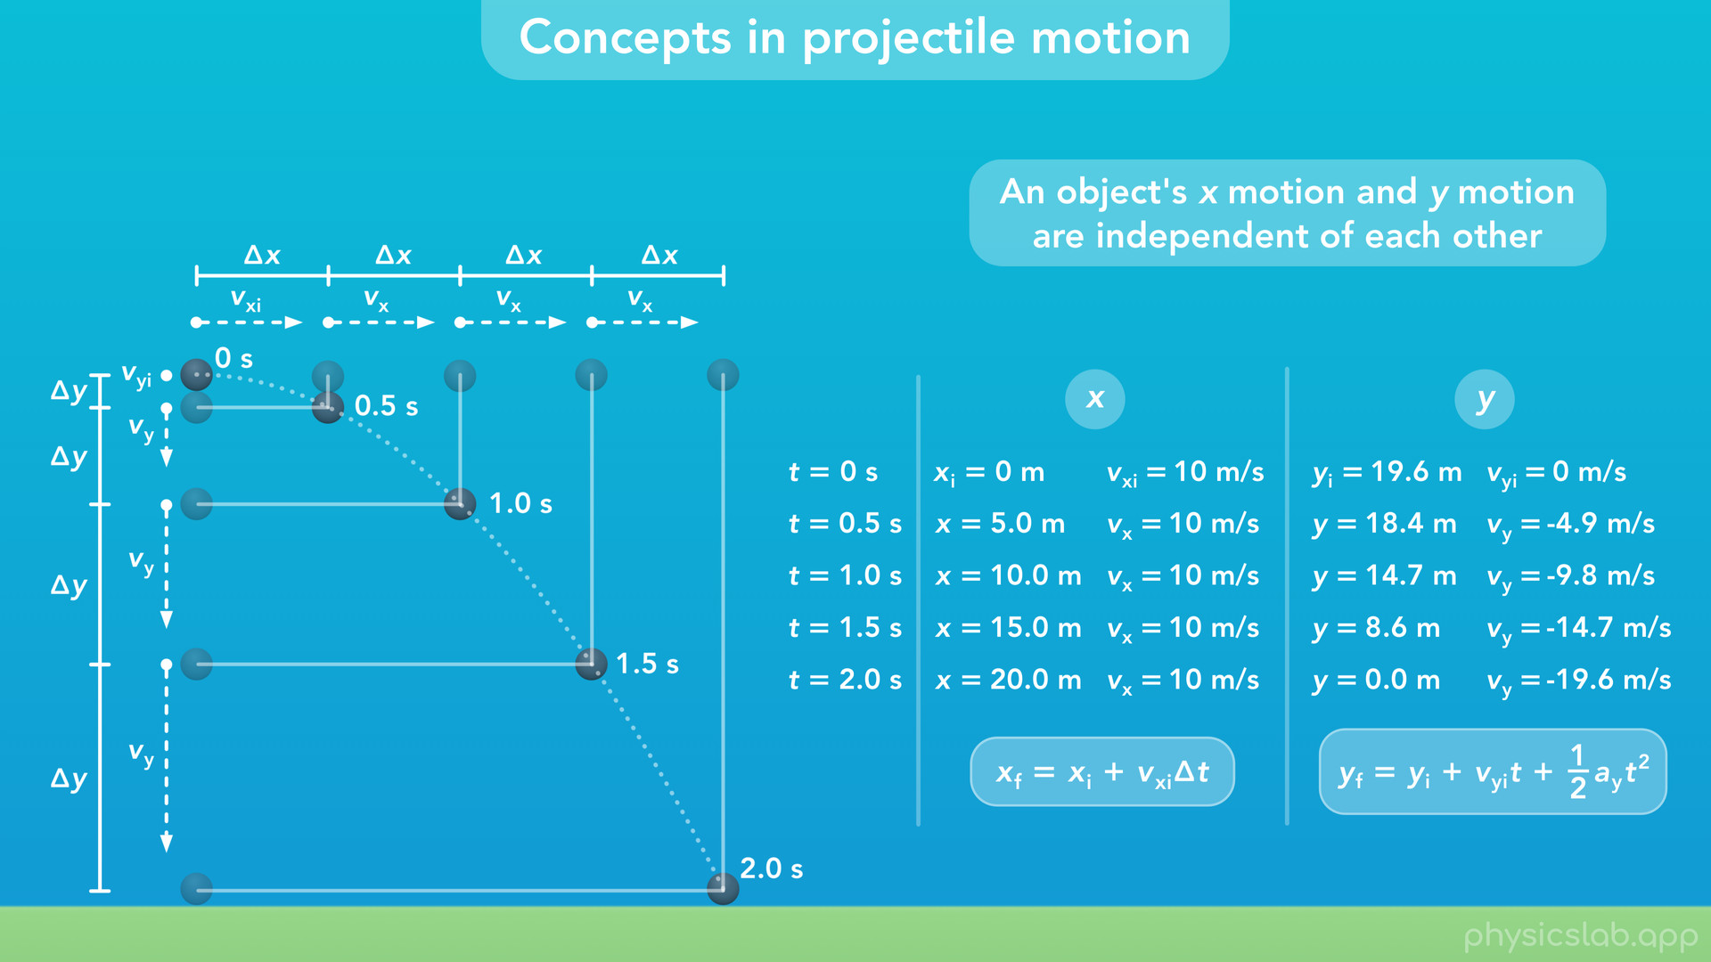
Notes:
• Finally, we learned in the lesson on 2D motion that the x and y motions are completely independent of each other.

Slide 54
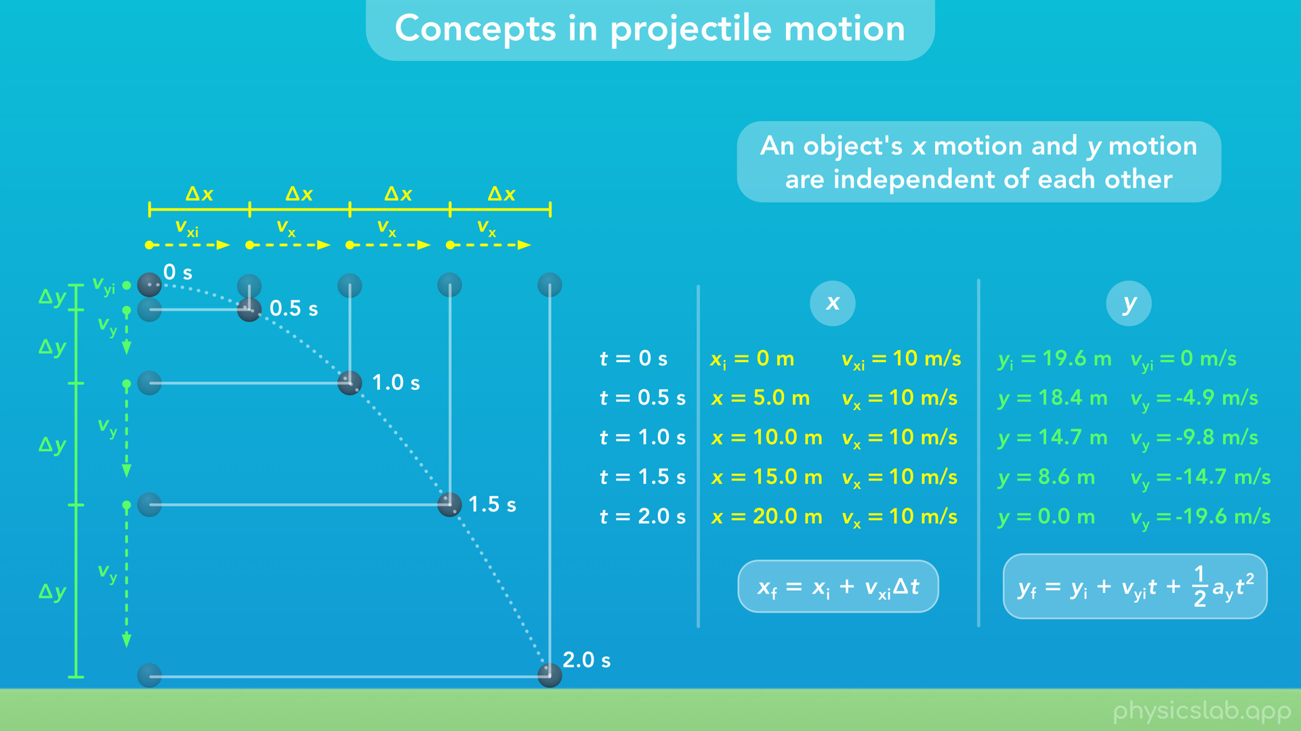
Notes:
So for 2D projectile motion, we’re gonna study the x and y motions separately. Since we might be dealing with a lot of variables and equations, it’ll definitely help to keep the x and y motions organized.

