Slide 1
Newton’s Law of Universal Gravitation
Slides Version 2
This version includes:
Slides with screenshot images from the video.
The video narration in the slide notes.
A blank template slide with the same background and font as the video.
Slides with some basic graphics from this video for you to use however you like.
Feel free to add, delete and edit slides to make your own presentation. You can use these slides in class or share them with your students, but please do not share them with anyone else.
If you have any feedback, suggestions or questions about these slides please email me at chris@physicslab.app or send me a message on Discord @physicslab.
physicslab.app

Slide 2
Heading
Text

Slide 3
Heading
Text

Slide 4


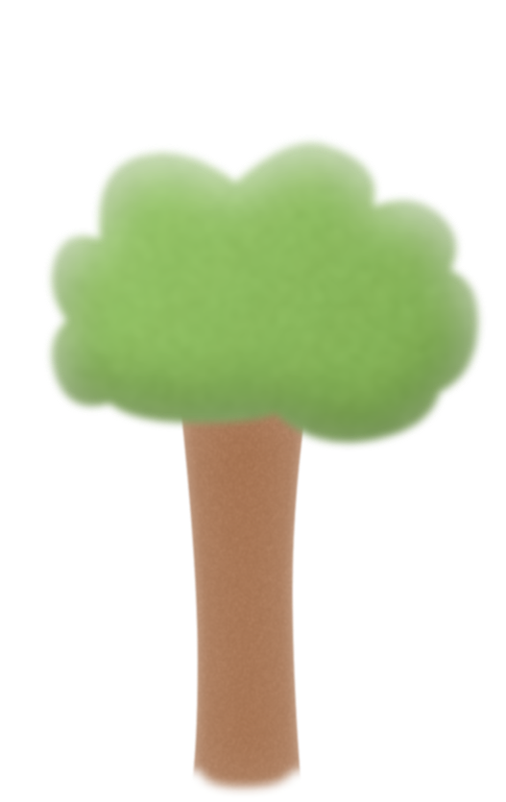







Slide 5





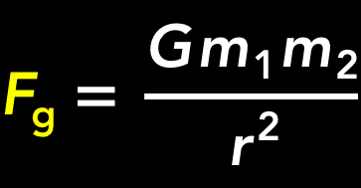
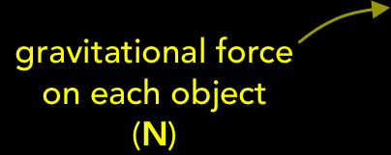


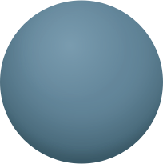



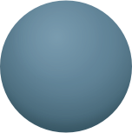




Slide 6
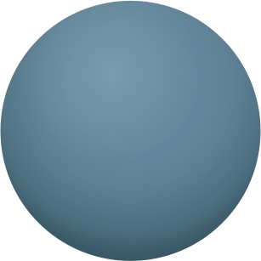




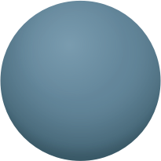
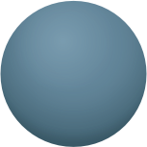












Slide 7
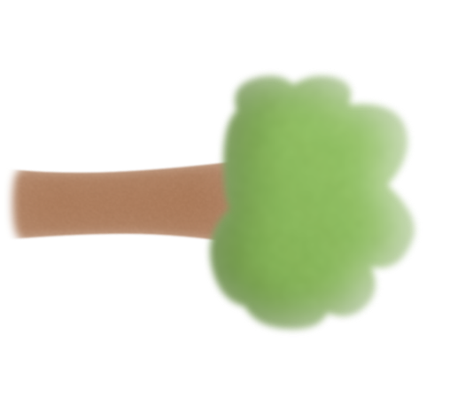










Slide 8




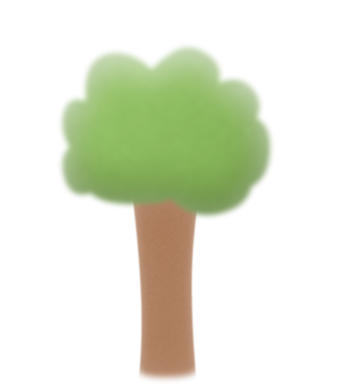




Slide 9
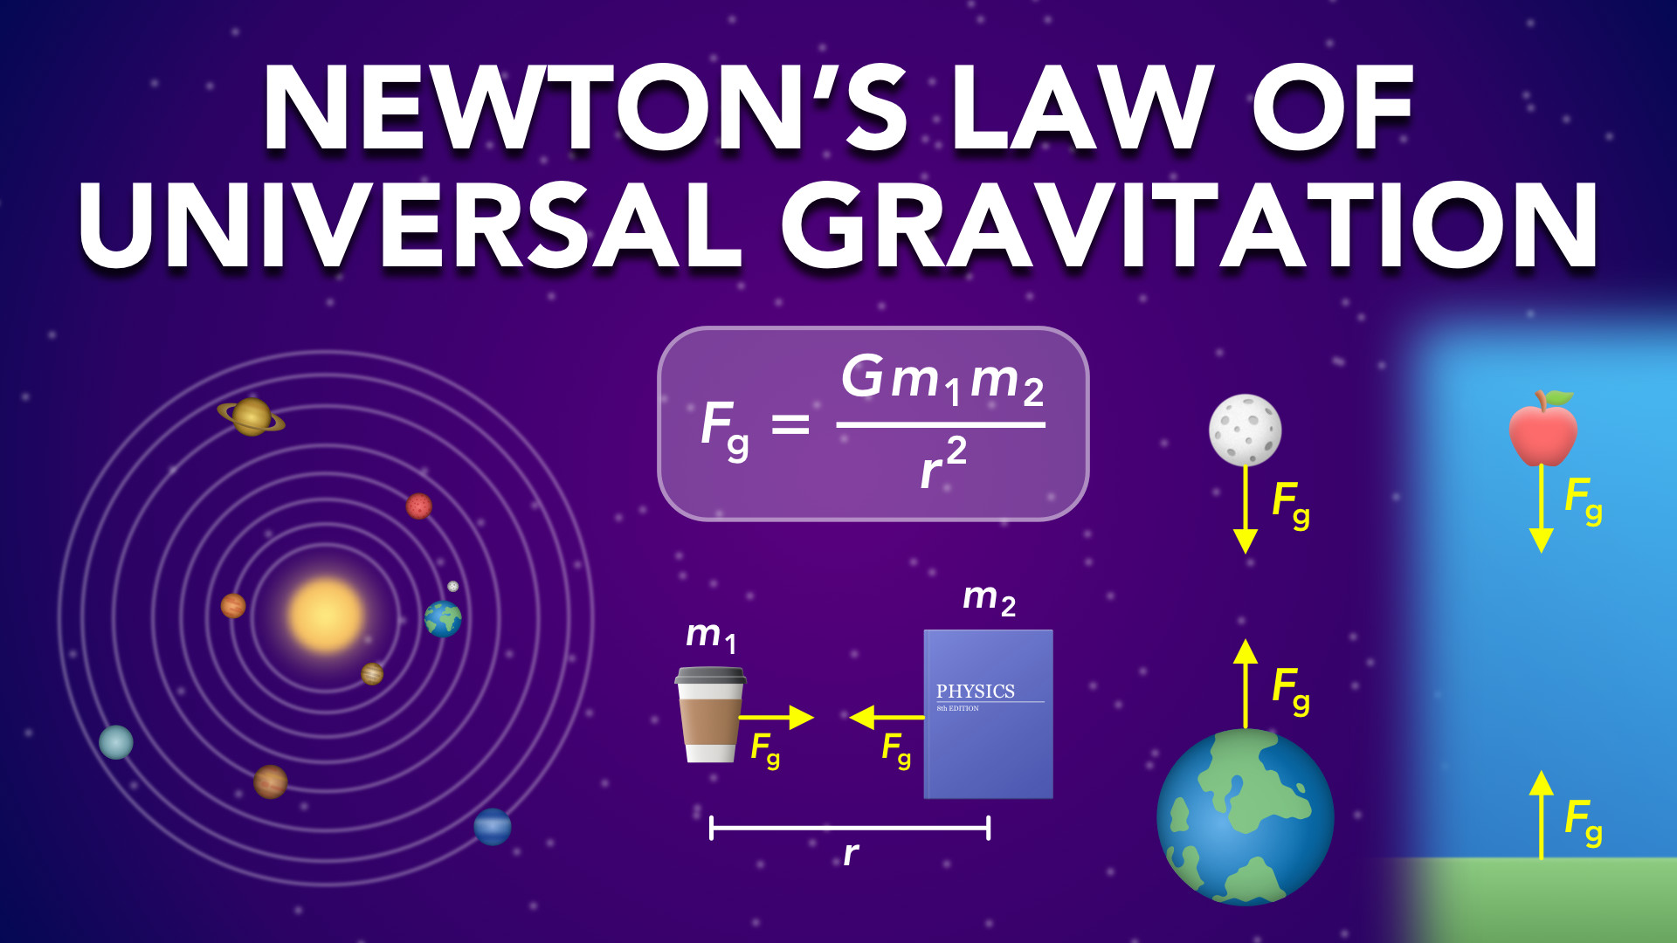
Notes:
Newton’s Law of Universal Gravitation
physicslab.app
If you have any questions, suggestions or feedback about these slides please email me at chris@physicslab.app or send me a message on Discord @physicslab.

Slide 10
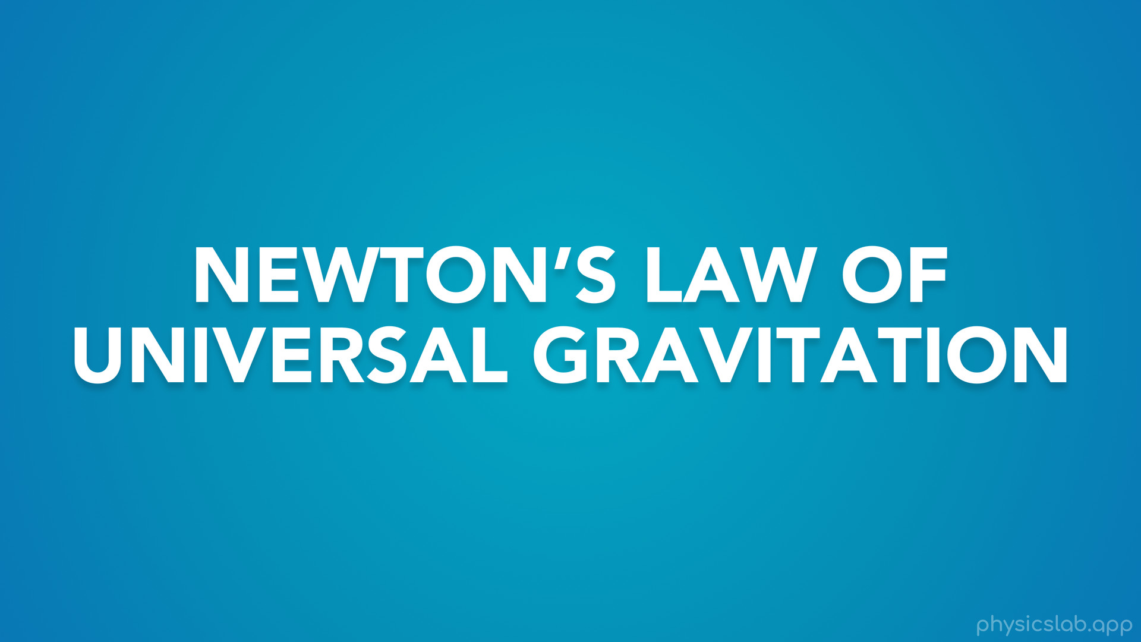
Notes:
• Hey everyone, in this video we’re gonna learn about Newton’s law of universal gravitation.

Slide 11
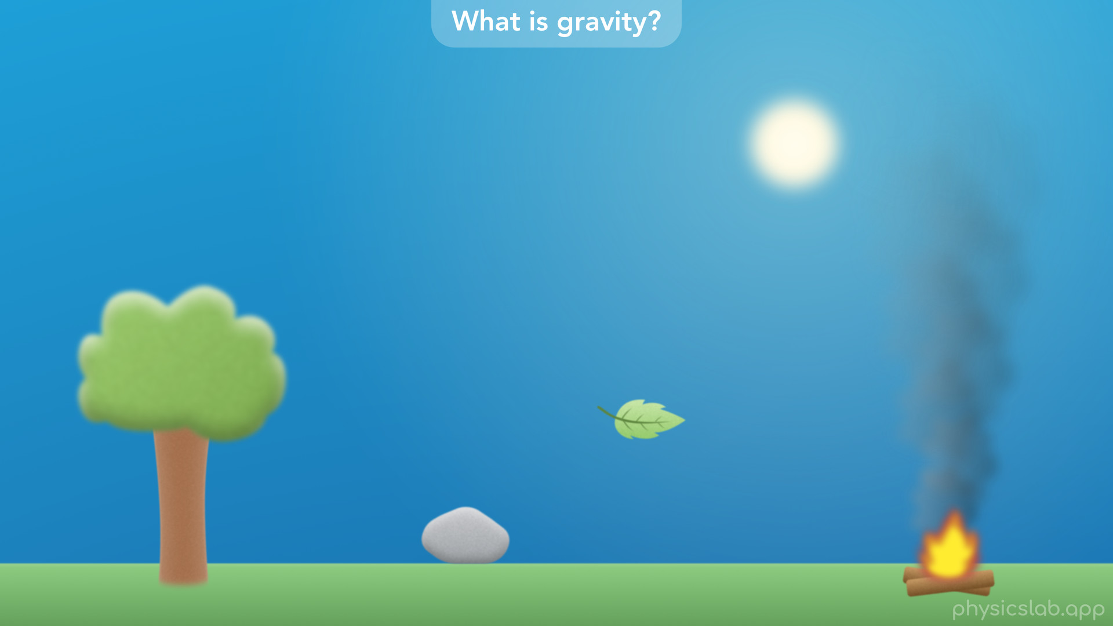
Notes:
• We’ll start by answering the question: what is gravity, and how did we figure it out?

Slide 12
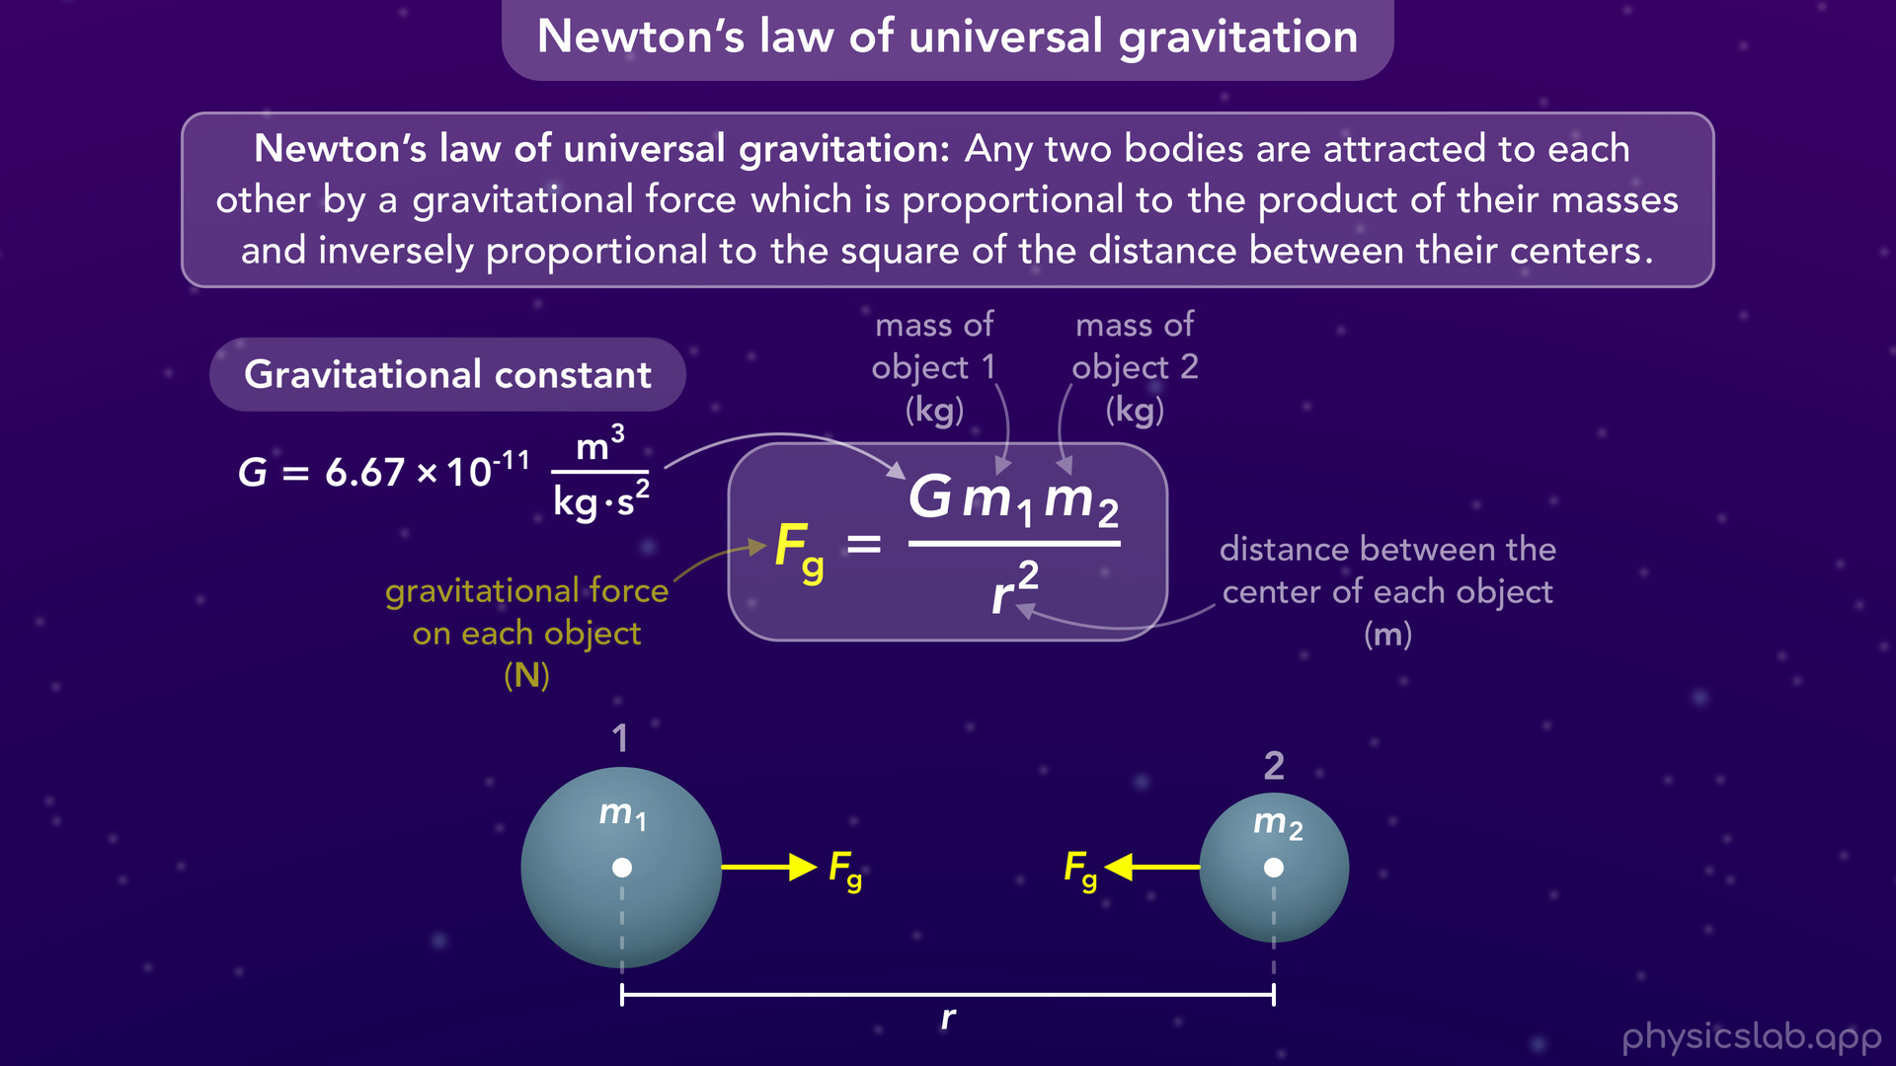
Notes:
• Then we’ll explore Newton’s law of universal graviation, and how to use this equation.

Slide 13
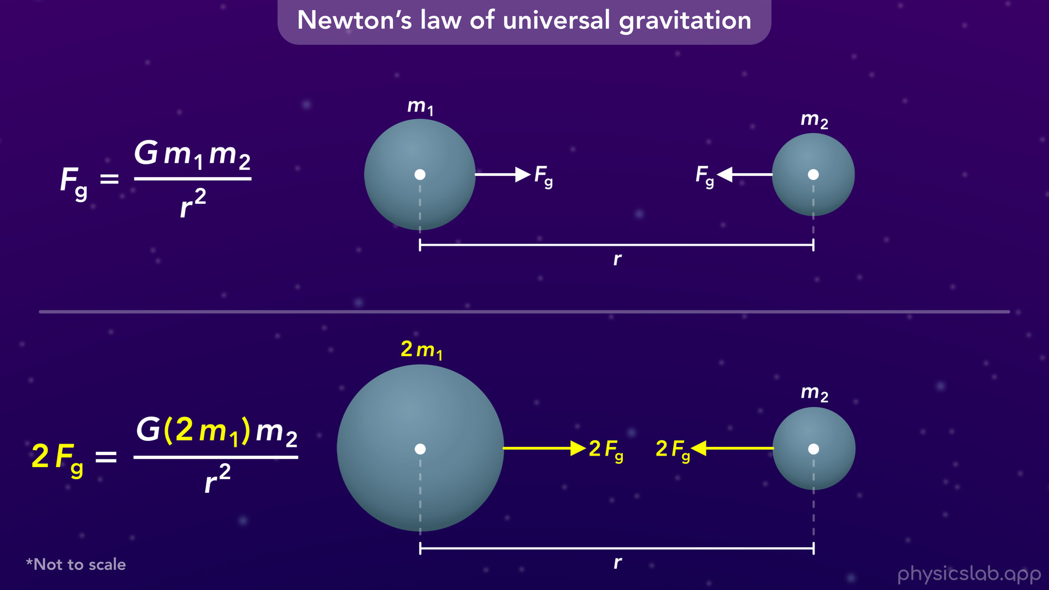
Notes:
• We’ll see how changing the variables in the equation affects the gravitational force.

Slide 14
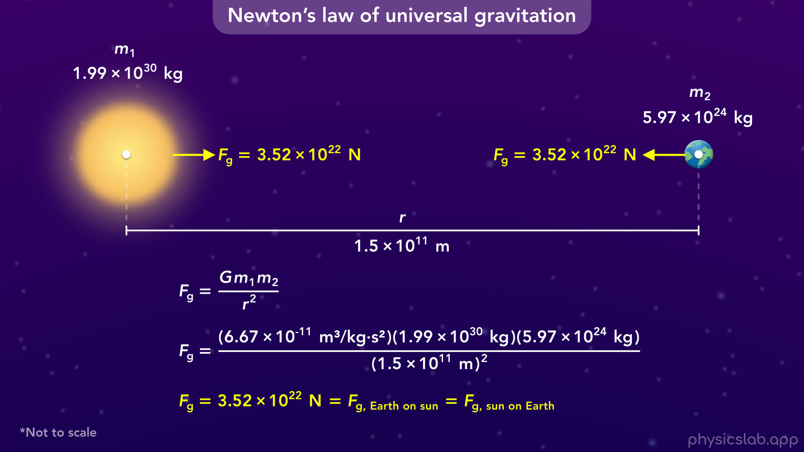
Notes:
• After that, we’ll walk through a few examples and see how gravity works on a large scale...

Slide 15
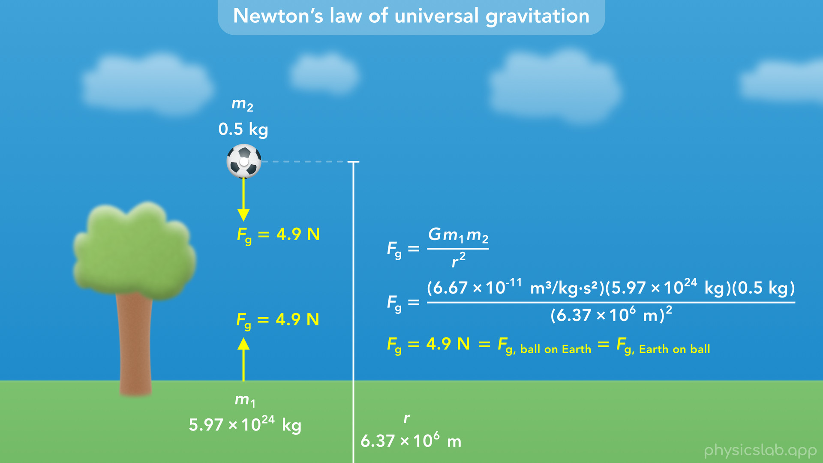
Notes:
• and on a small scale here on Earth.

Slide 16
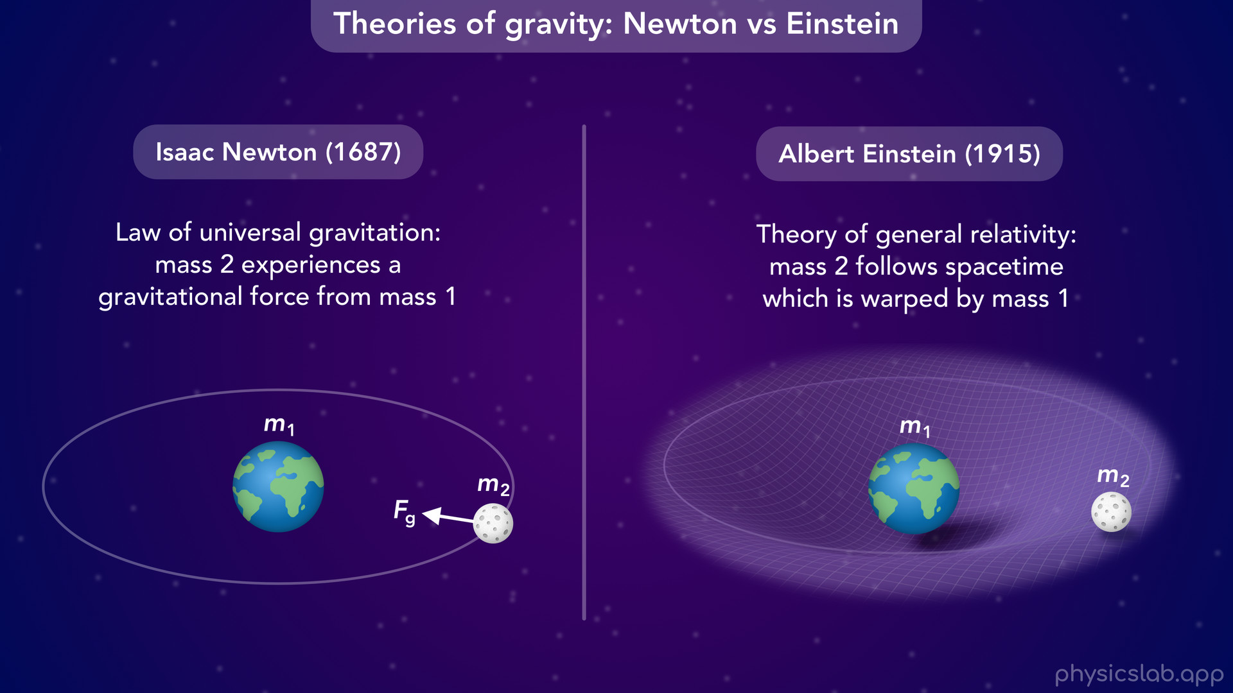
Notes:
• At the end, we’ll talk about the difference between Newton and Einsteins theories of gravity, and which one we should use.

Slide 17
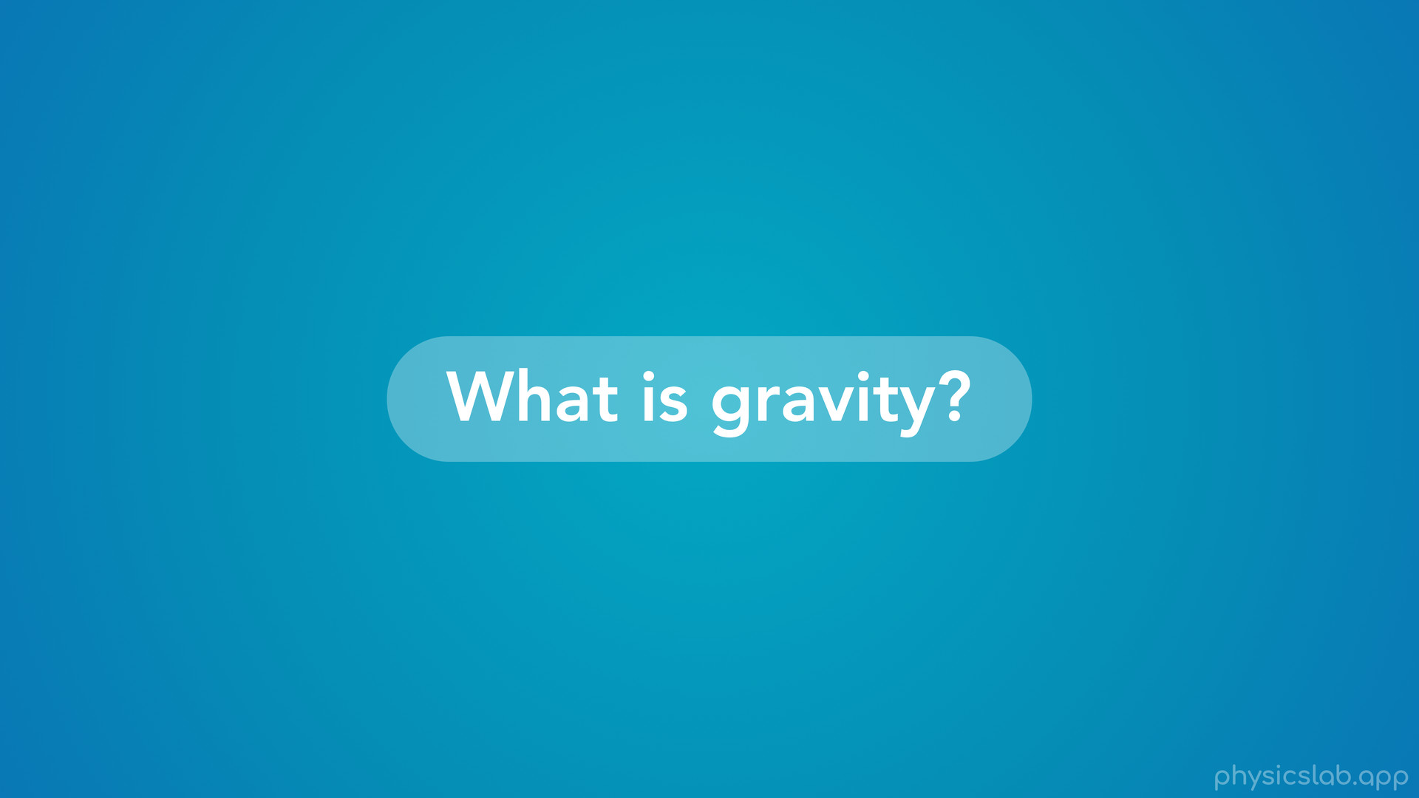
Notes:
• So, what is gravity?

Slide 18
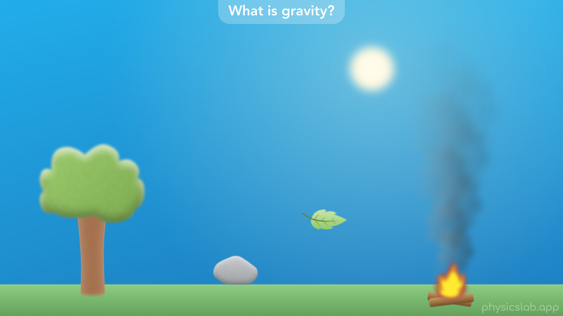
Notes:
• People have been trying to understand the world and the universe for thousands of years.
• One of the big questions was, why do objects fall towards the earth?
• Some ancient philosophers like Aristotle believed that the earth was the center of the universe.
• Objects have their natural place, and a falling object is trying to reach the center of the earth.
• They thought that heavier objects fall faster.
• And things that were lighter, like smoke, naturally wanted to move upwards.

Slide 19
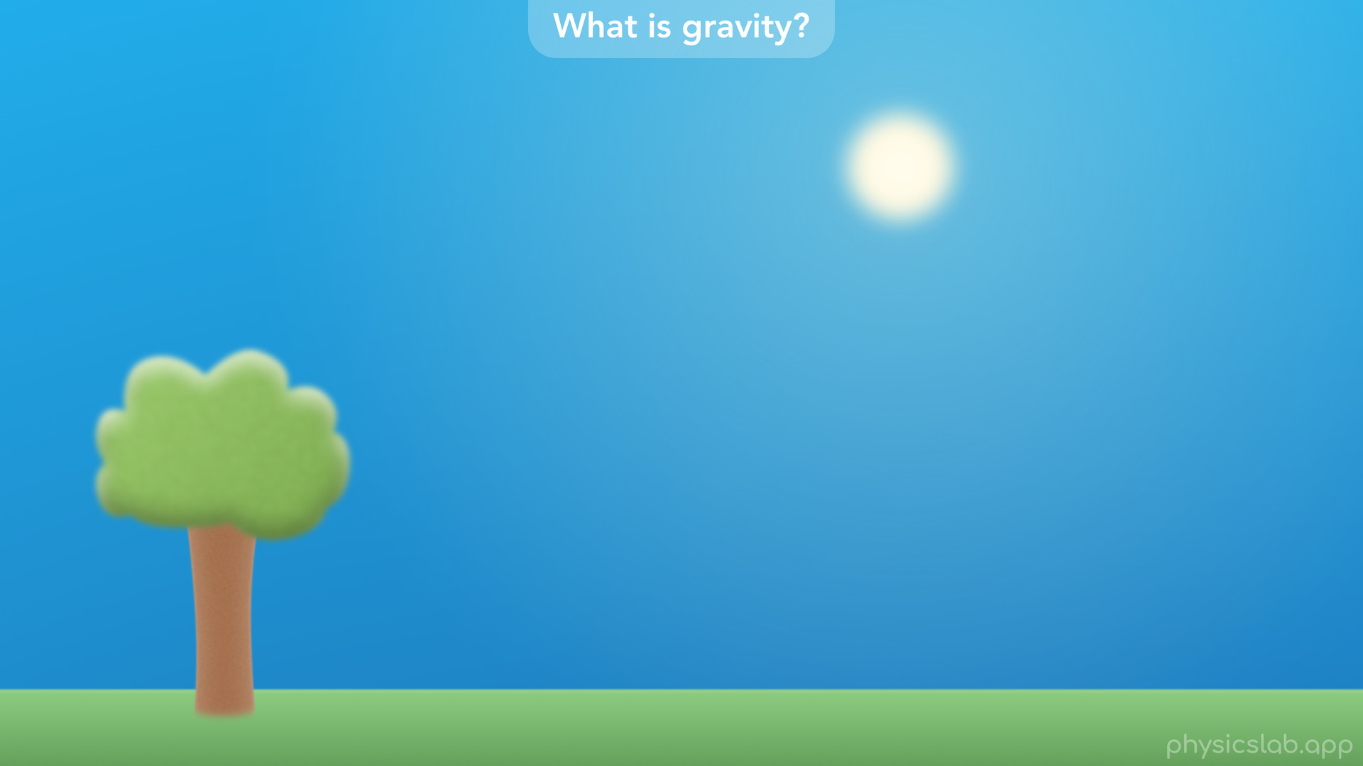
Notes:
• People also wanted to explain what they saw in the sky.

Slide 20
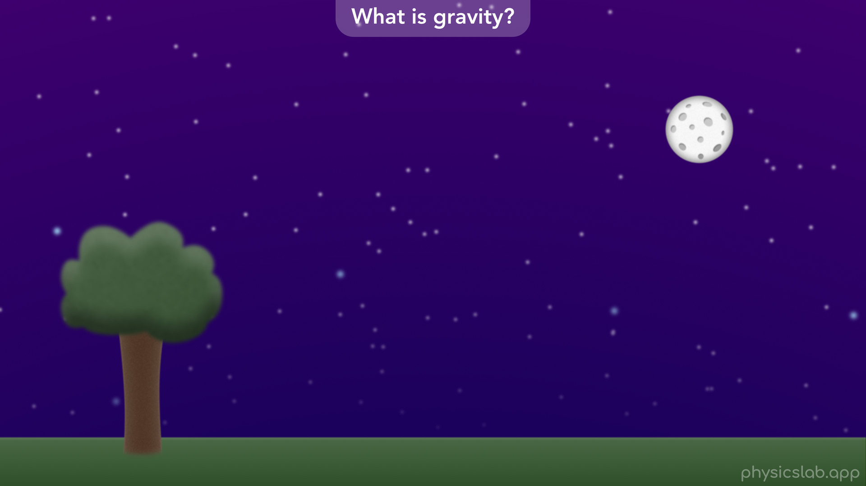
Notes:
• Why do the sun and the moon, rise and fall every day?
• How can we predict the motion of the planets and the stars?

Slide 21
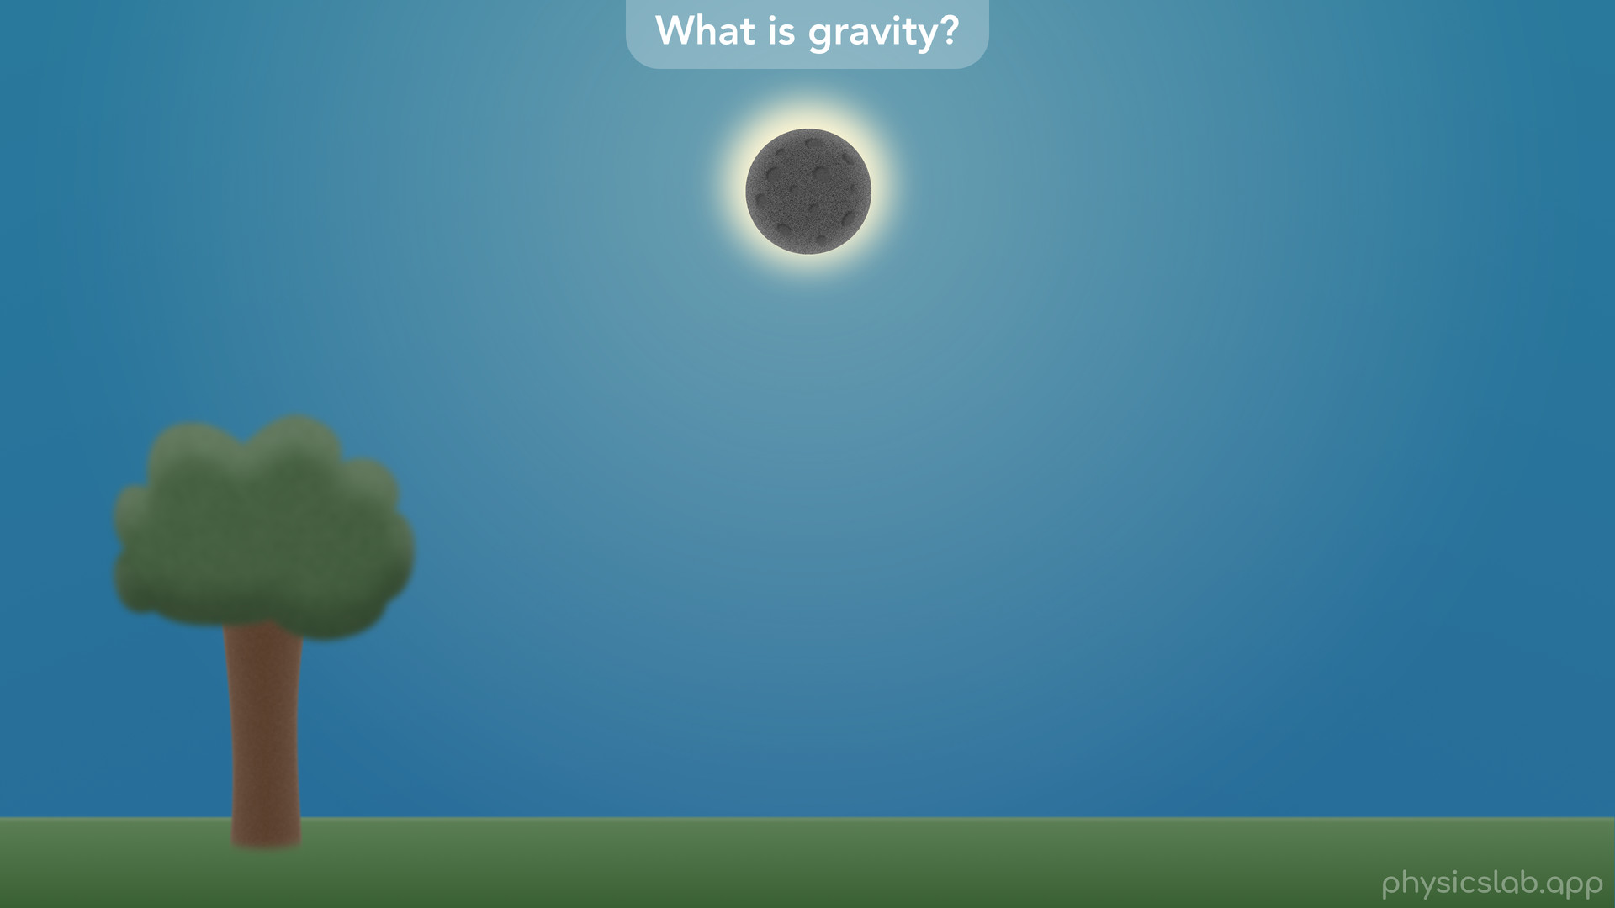
Notes:
• When will we see the next solar eclipse?
• And most of all, who or what is causing these things to happen?

Slide 22
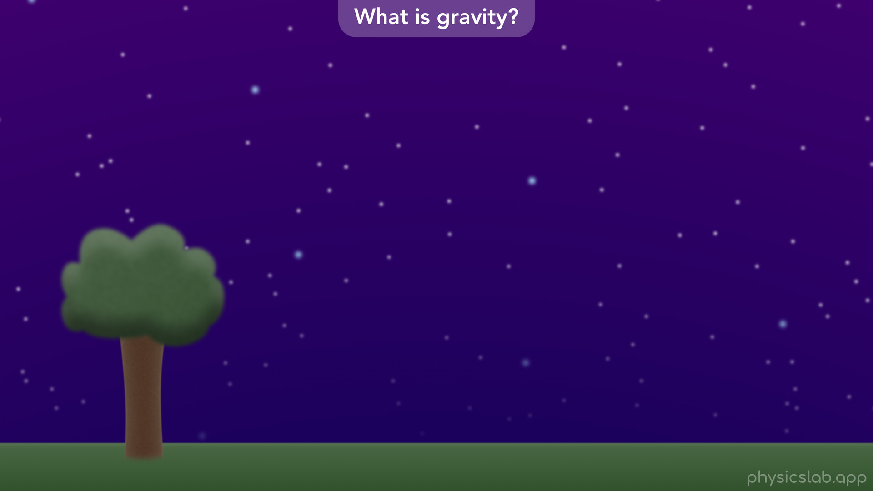
Notes:
• Like before, people thought that the earth was the center of the universe.
• It seemed like the sun, the moon, the planets and the stars all revolved around the earth.

Slide 23
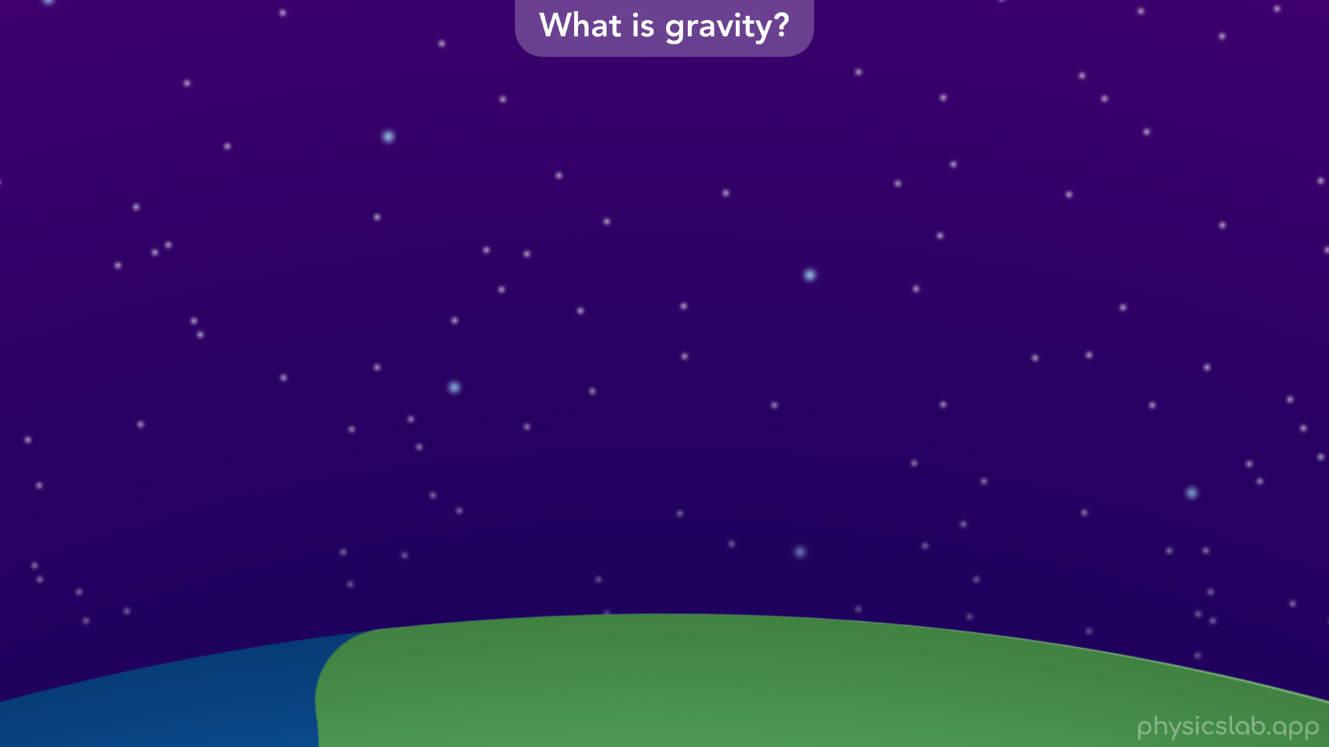

Slide 24
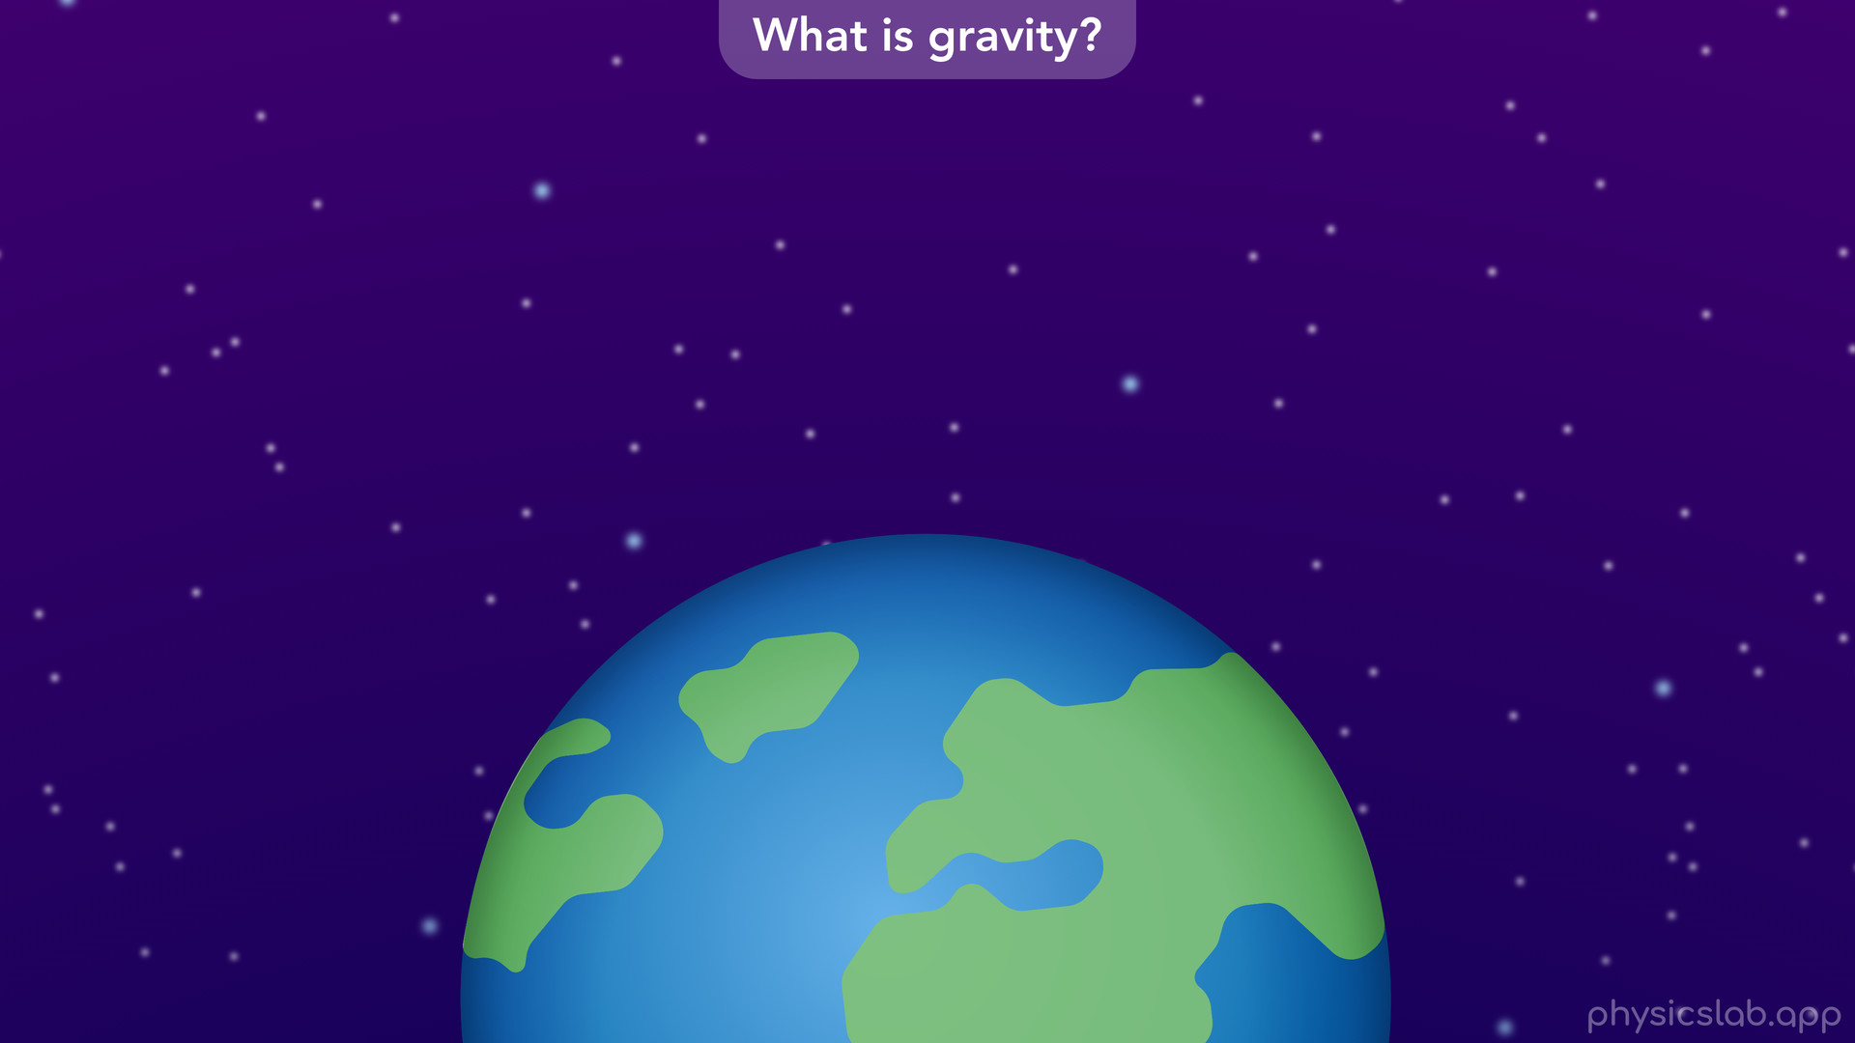

Slide 25
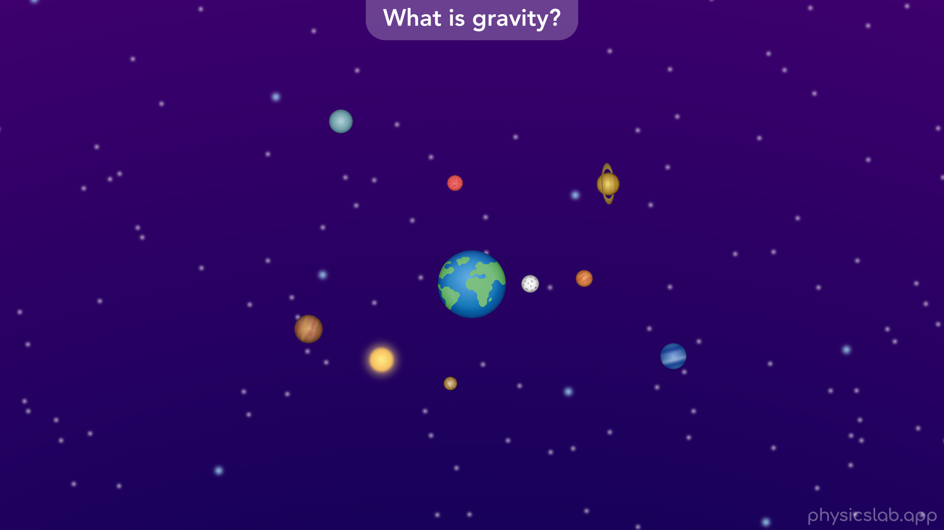
Notes:
• Astronomers could use telescopes to carefully track the motion of the planets.

Slide 26
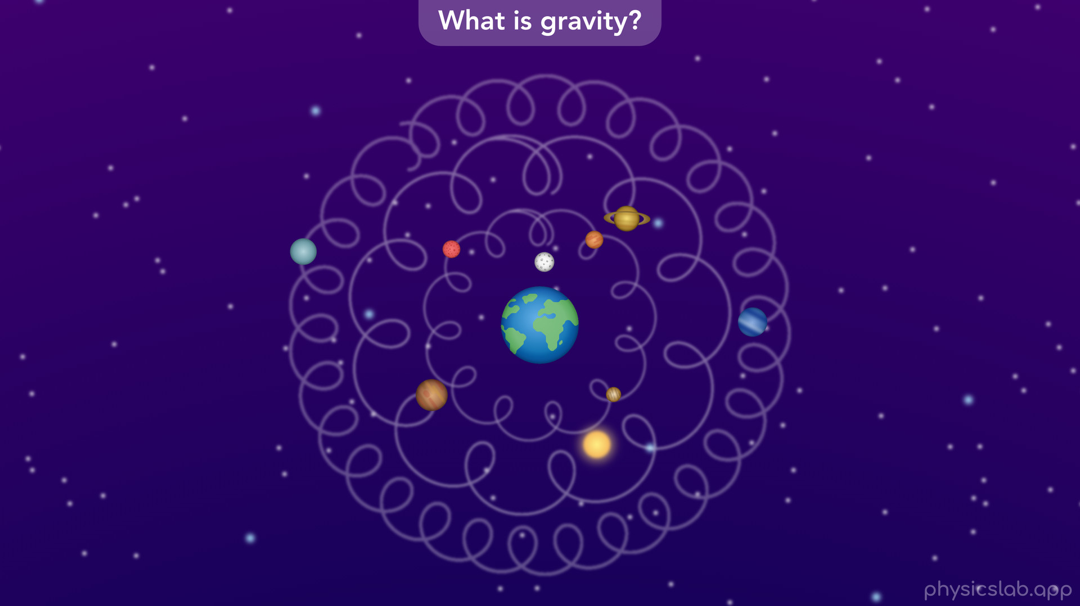
Notes:
• When they drew the orbits with the earth at the center, they weren’t perfect circles.
• The planets seemed to wobble around their own circular paths.
• This view of the solar system lasted for over a thousand years.

Slide 27
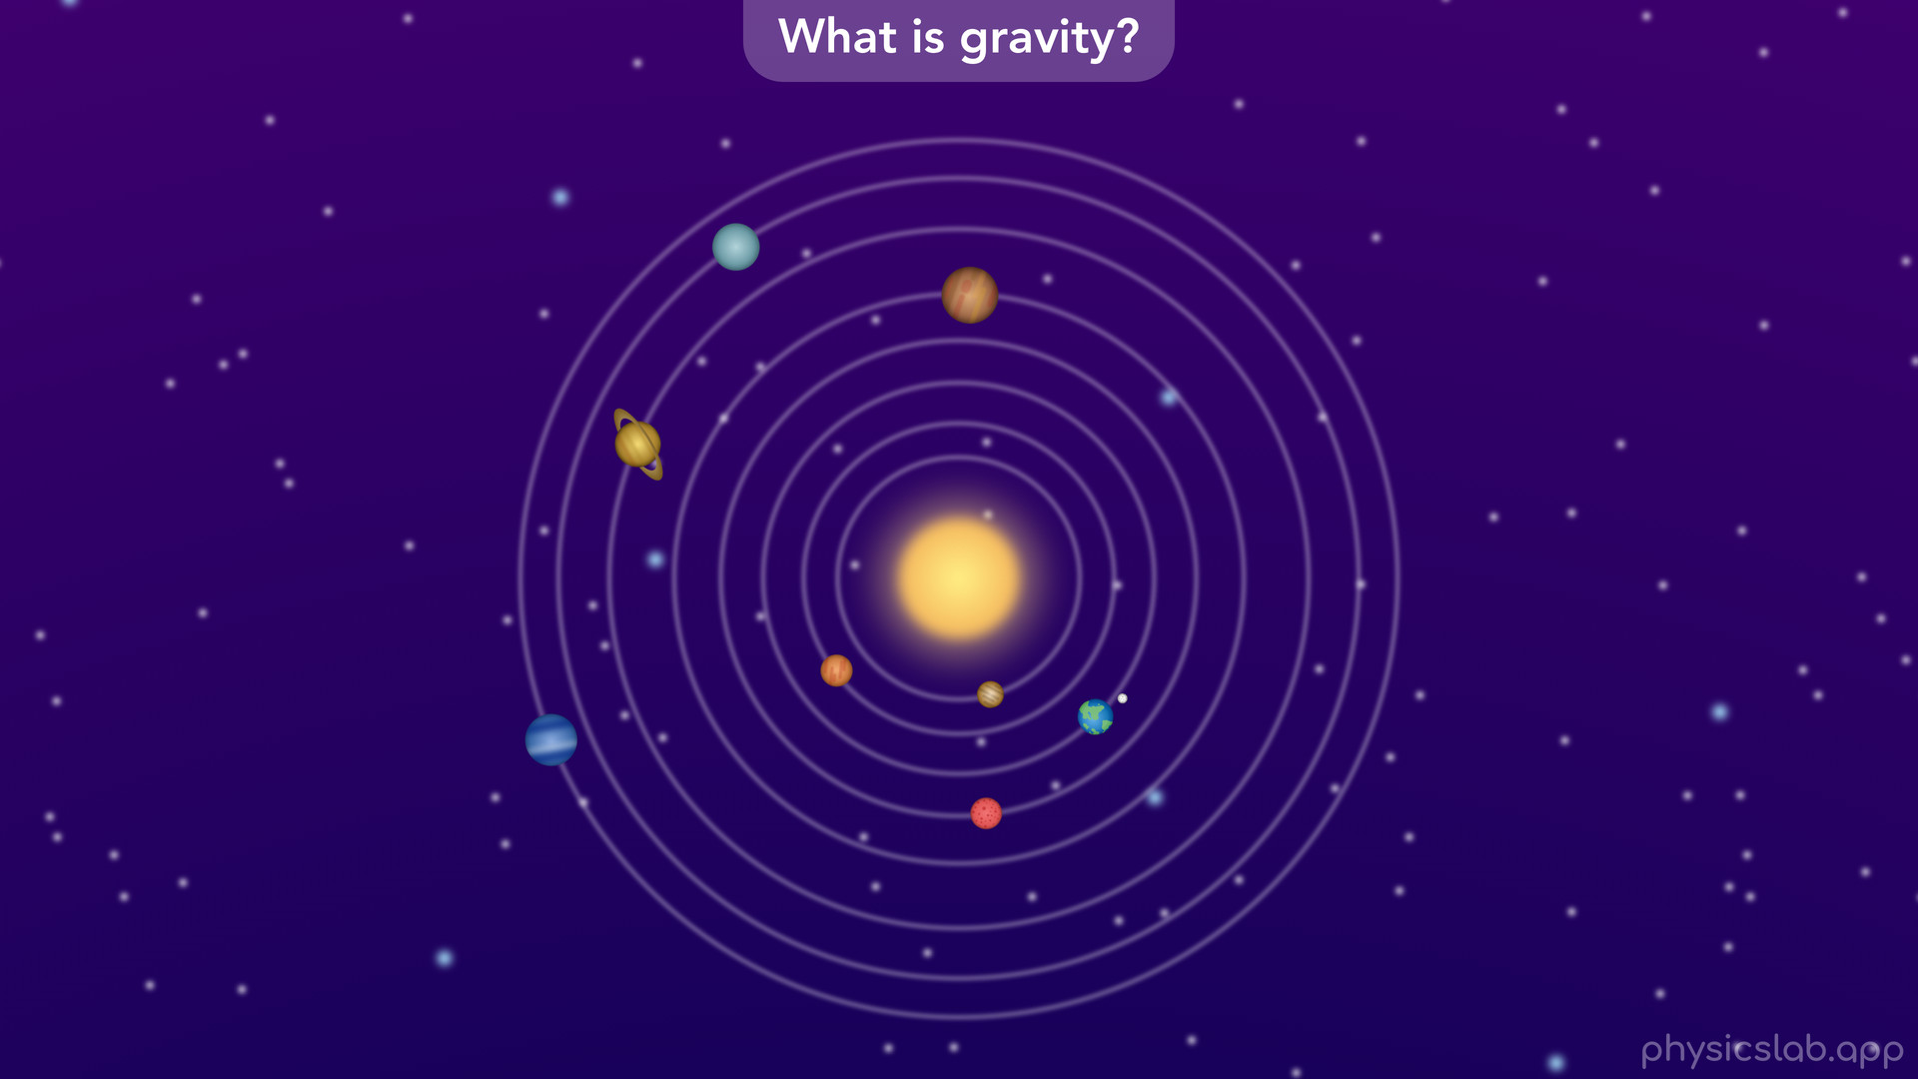
Notes:
• It wasn’t until Nicolaus Copernicus came along in the 16th century that people started to consider that the planets revolved around the sun, not the earth.
• That meant the earth was just another planet and not the center of the universe, which took some time to catch on.
• But now the orbits seemed to be perfect circles.
• An astronomer named Johannes Kepler realized that the orbits were not quite circles, they’re actually ellipses.
• He also described how the planets move with what we now call Kepler’s laws of planetary motion.
• Although we had a better understanding of how planets move, we still didn’t know what caused them to move that way.

Slide 28
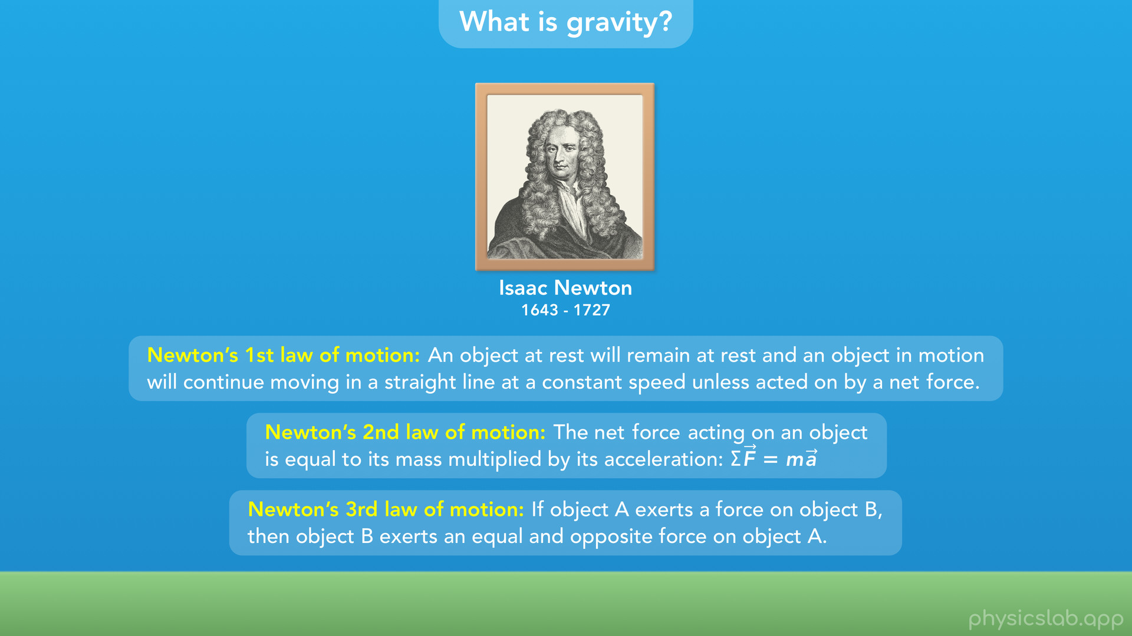
Notes:
• That’s where Isaac Newton comes in.
• Around the same time that he was putting together the 3 laws of motion that we just learned about, he was also wondering what causes objects to fall towards the earth.

Slide 29
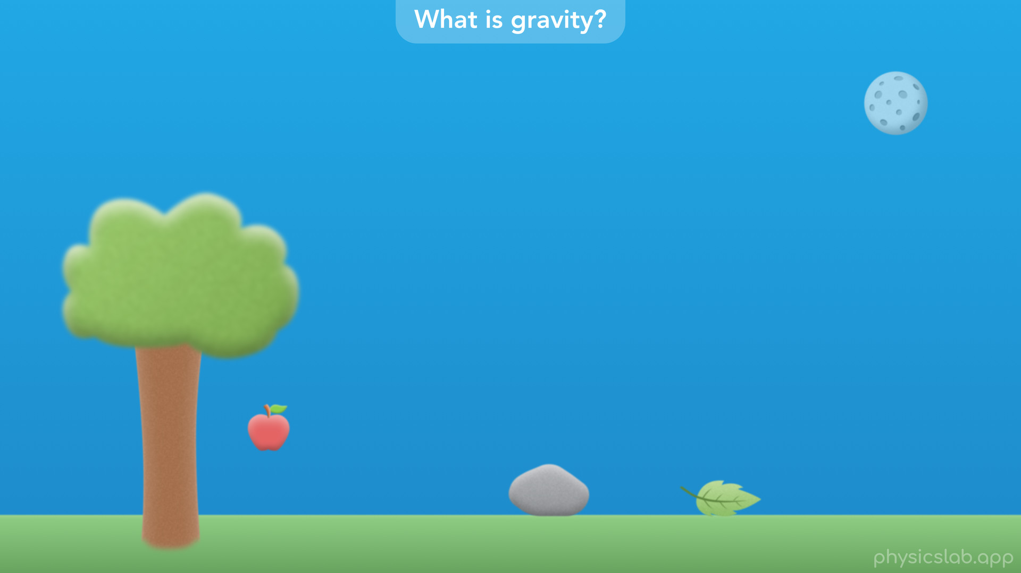
Notes:
• As the story goes, he was sitting next to an apple tree when an apple fell to the ground.

Slide 30
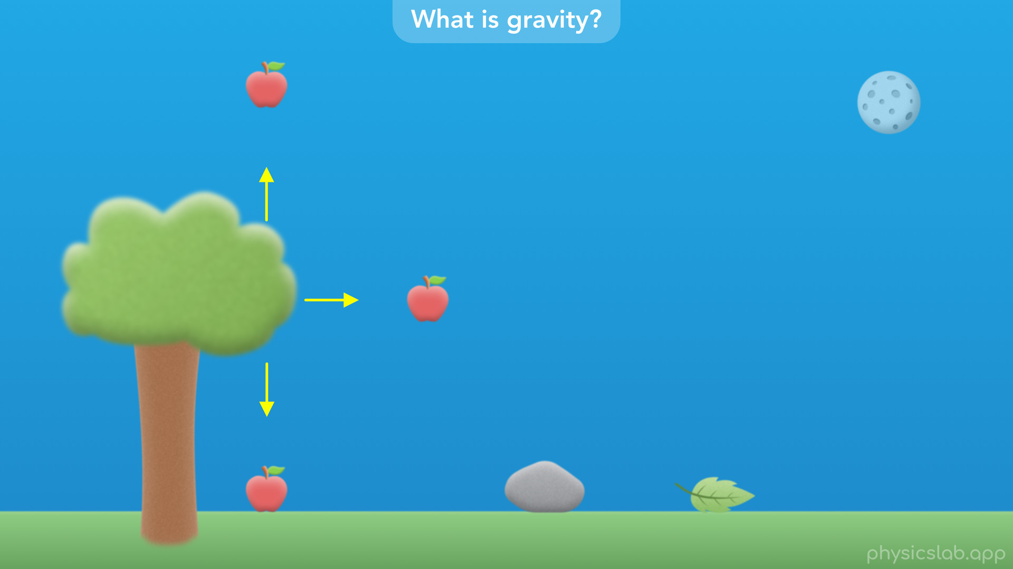
Notes:
• Newton wondered, “why does the apple fall down and not up, or sideways?”

Slide 31
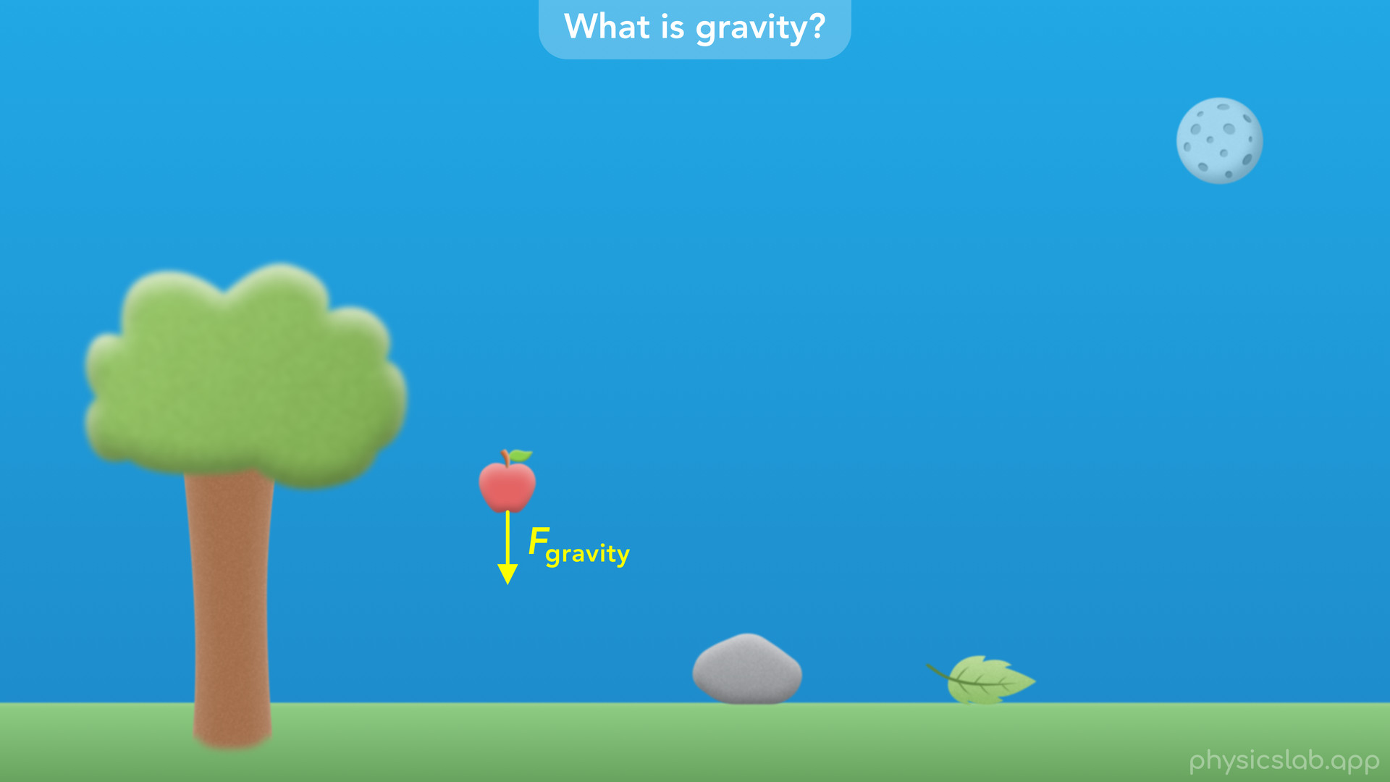
Notes:
• He thought there must be some force acting on the apple that pulls it towards the earth, which he referred to as the force of gravity.

Slide 32
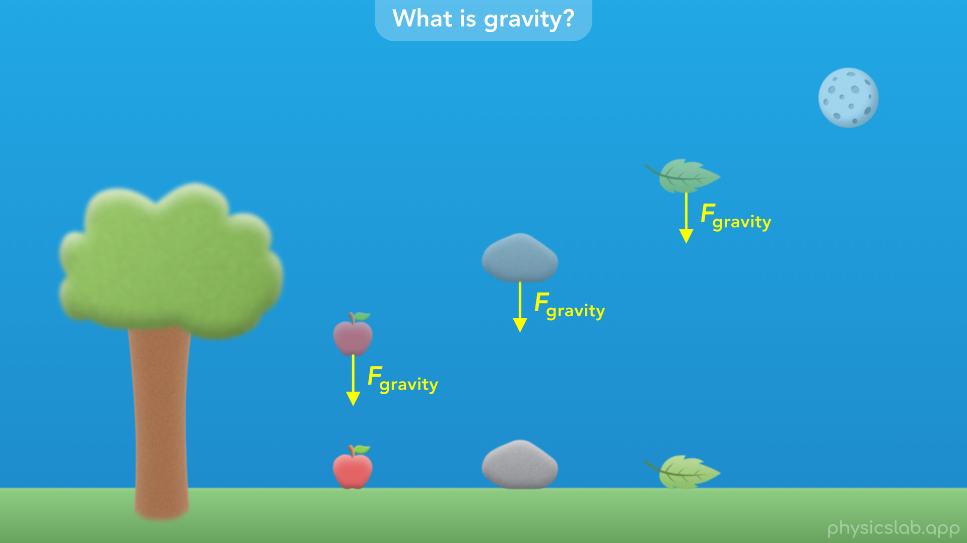
Notes:
• This force must be pulling every object towards the earth, no matter how high it is above the ground.

Slide 33
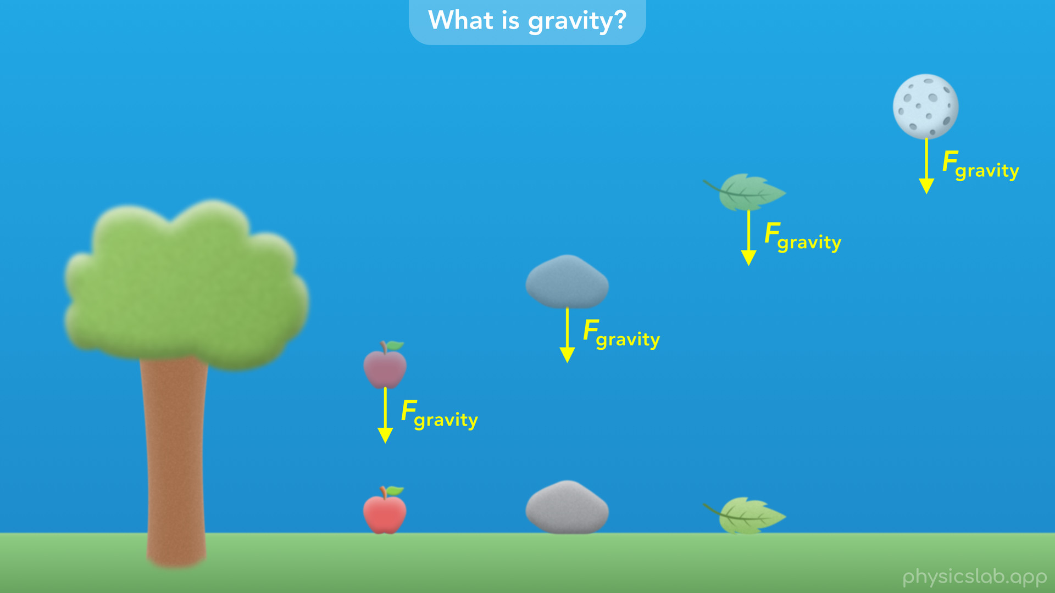
Notes:
• If that was true... then maybe this force applies to every object in the universe, including the moon.

Slide 34
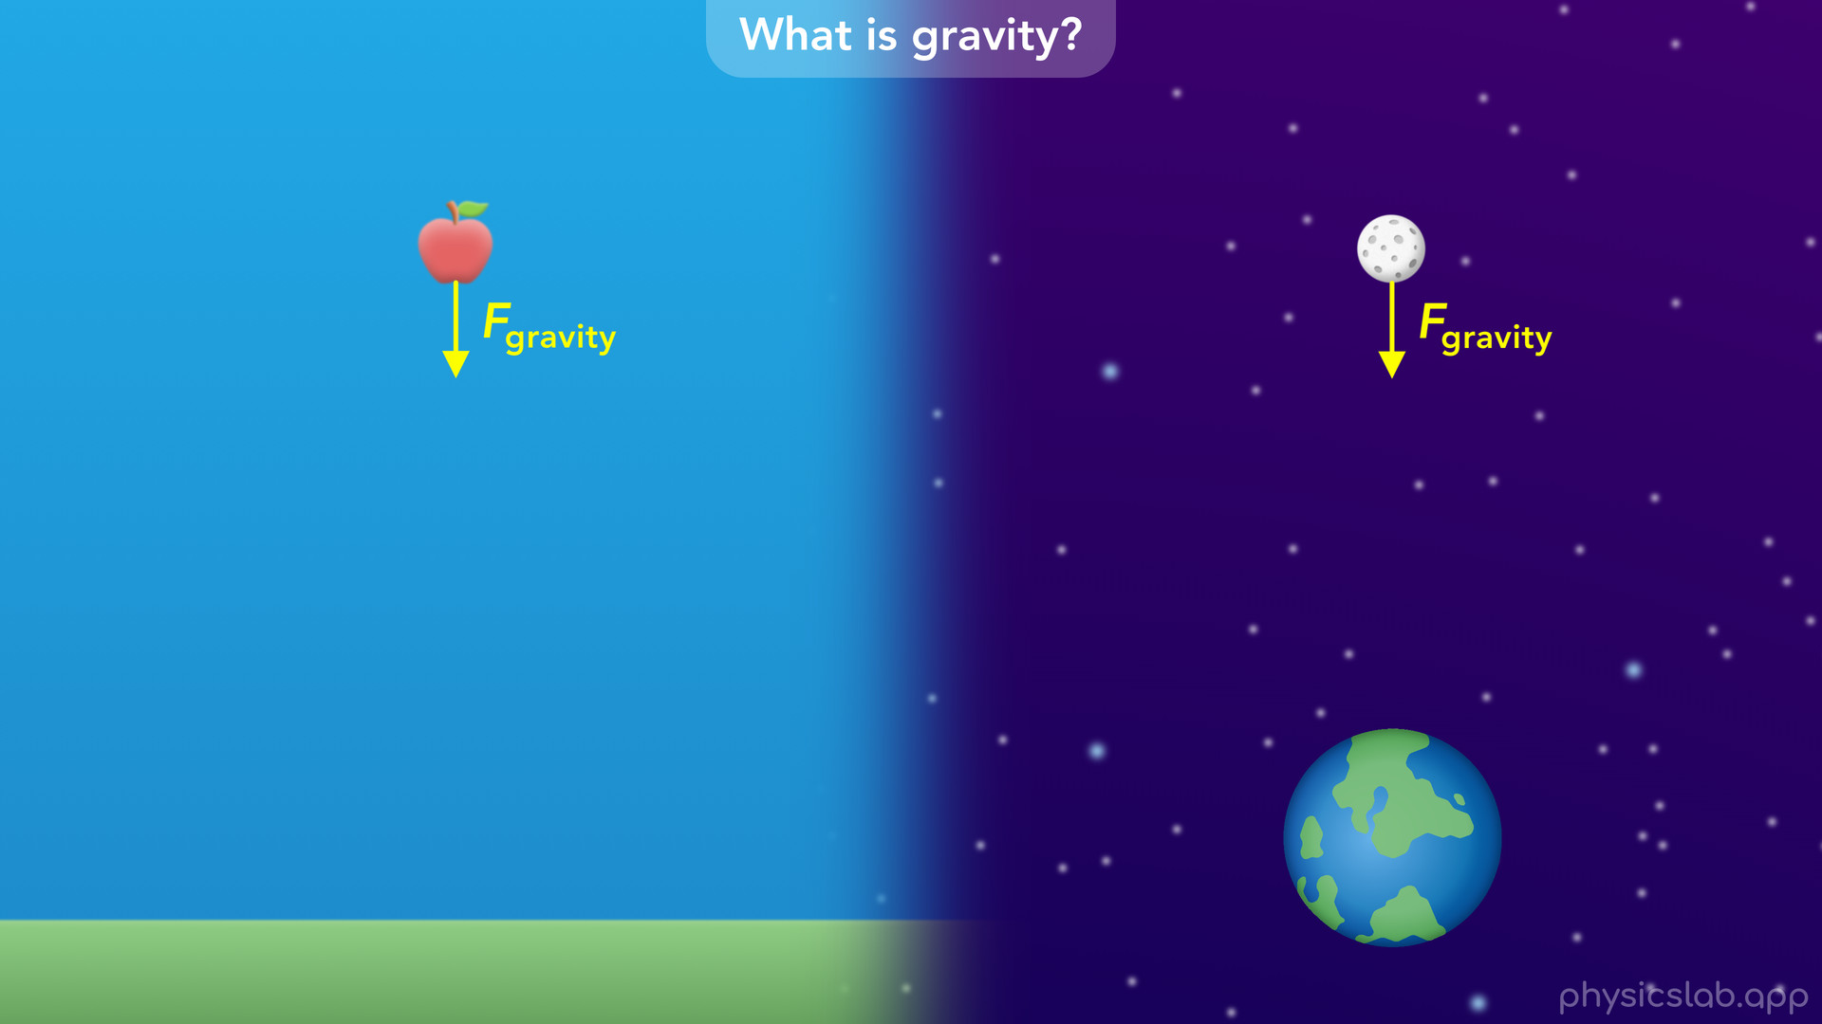
Notes:
• Newton realized that the same force of gravity that causes an apple to fall to the ground, also pulls the moon towards the earth and keeps the moon in orbit.

Slide 35

Notes:
• And if Newton’s third law of motion was true, then the apple and the moon also pull on the earth with the same force.

Slide 36
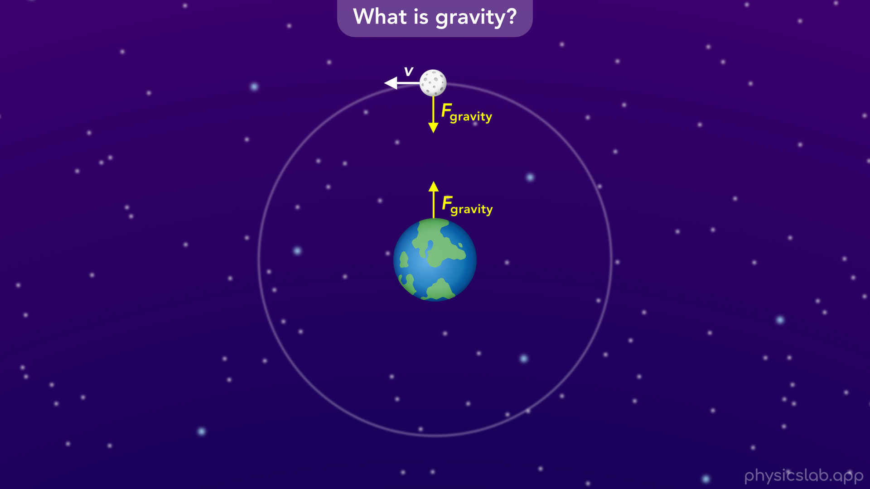
Notes:
• The reason that the moon didn’t fall straight towards the earth was that moon was constantly moving sideways in a circular orbit, and its own inertia keeps it from falling.
• We’re going to learn more about that in another lesson, but Newton realized this was the force that caused the moon to orbit the earth...

Slide 37
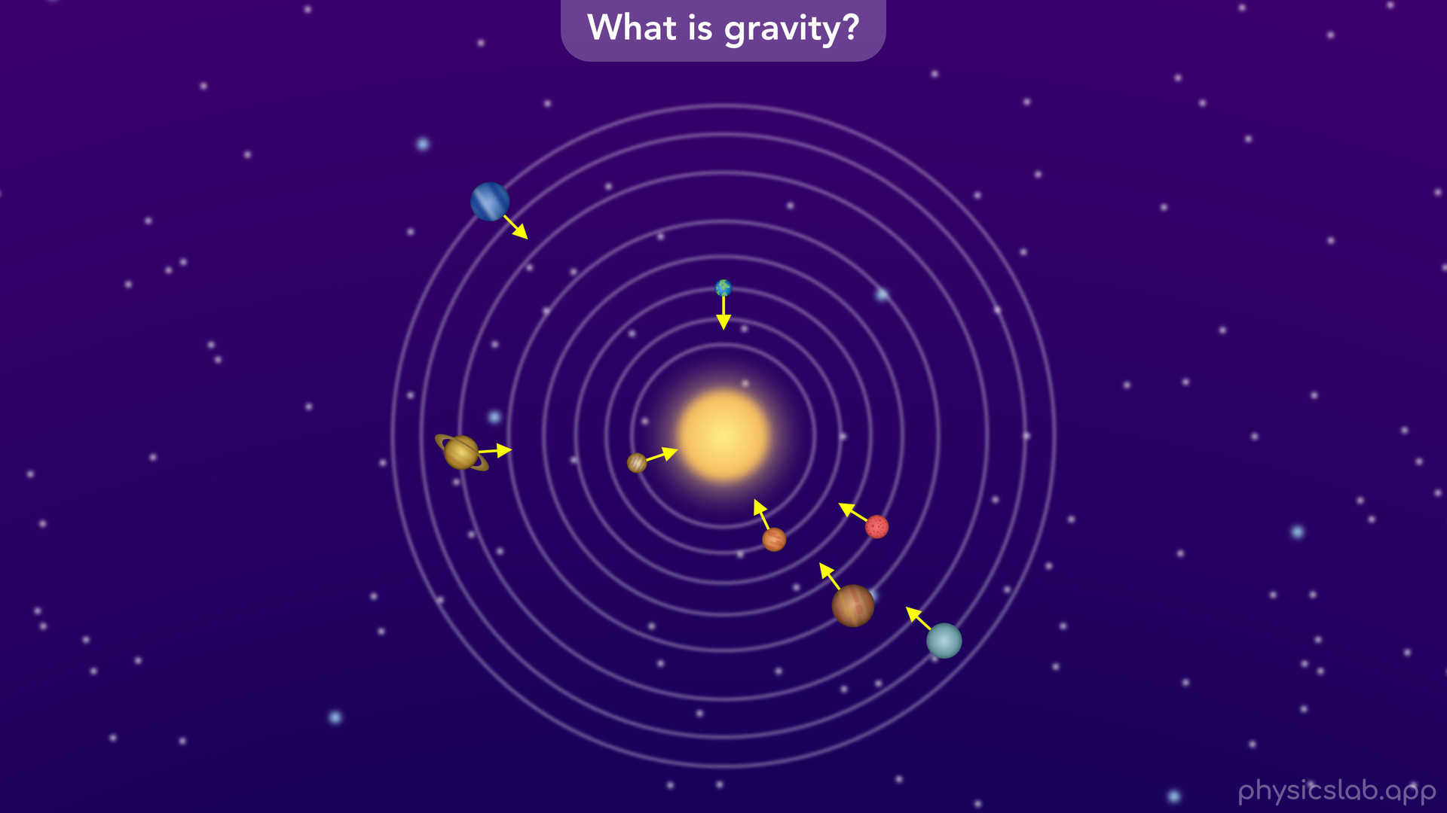
Notes:
• … and it caused the planets to orbit the sun.
• All of this motion could now be explained using a single force, the force of gravity.
• And it must be acting between any two objects in the universe.

Slide 38
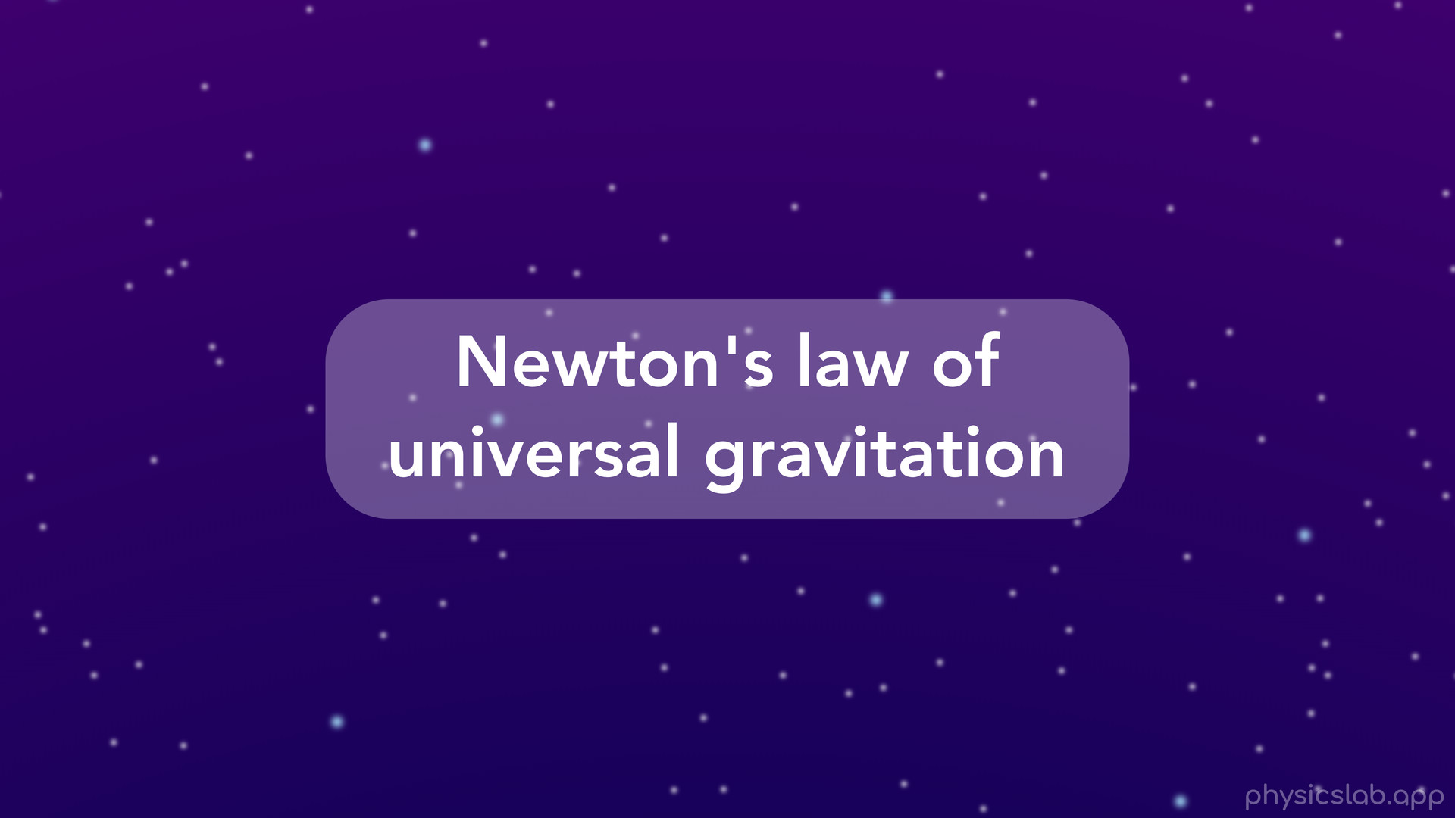
Notes:
• This is what we call Newton’s law of universal gravitation.

Slide 39
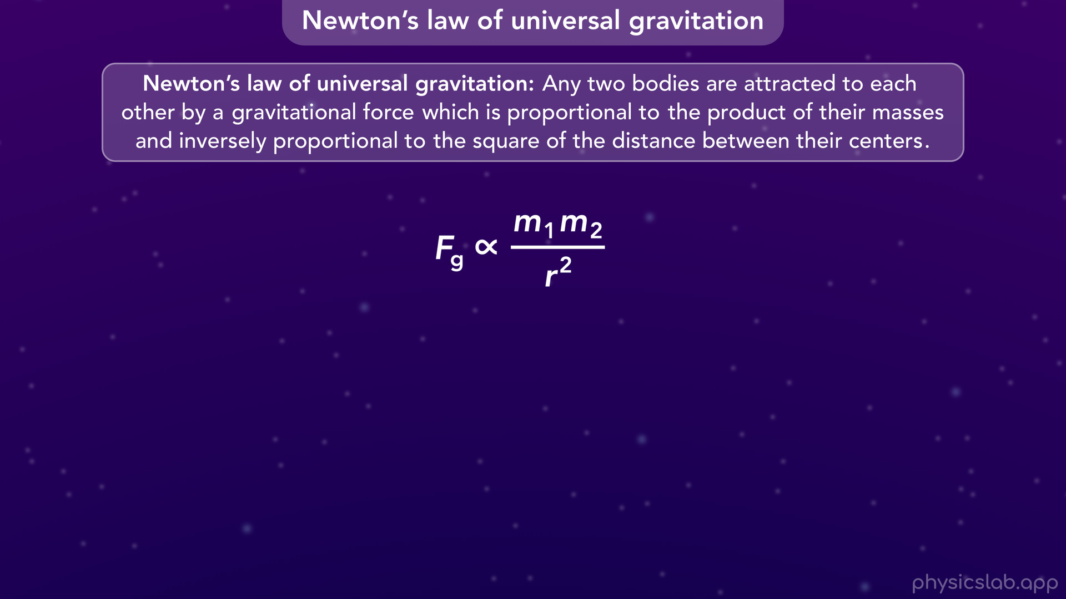
Notes:
• By observing different masses at different distances, Newton was able to come up with this statement and this relationship:
• Any two bodies are attracted to each other by a gravitational force which is proportional to the product of their masses and inversely proportional to the square of the distance between them.

Slide 40
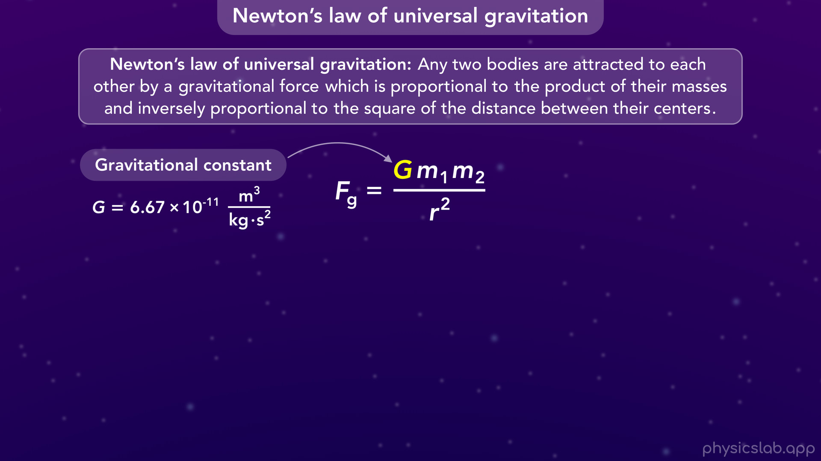
Notes:
• Newton figured out this relationship, but he knew it was missing a constant, which he called G, that would turn it into an exact equation that let’s you calculate the gravitational force.
• It took about a hundred years for the value of G, the gravitational constant, to be accurately determined by a scientist named Henry Cavendish.

Slide 41
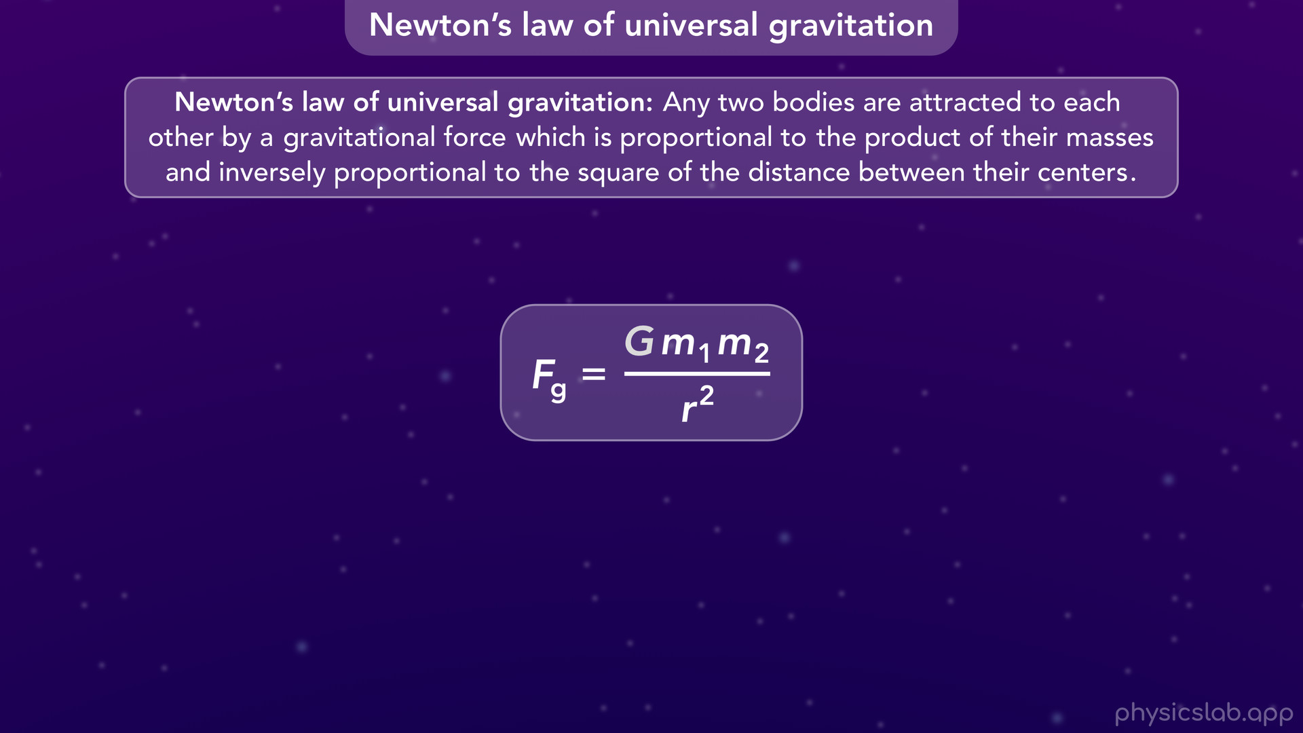
Notes:
• So now, this is the equation we use for Newton’s law of universal gravitation.

Slide 42
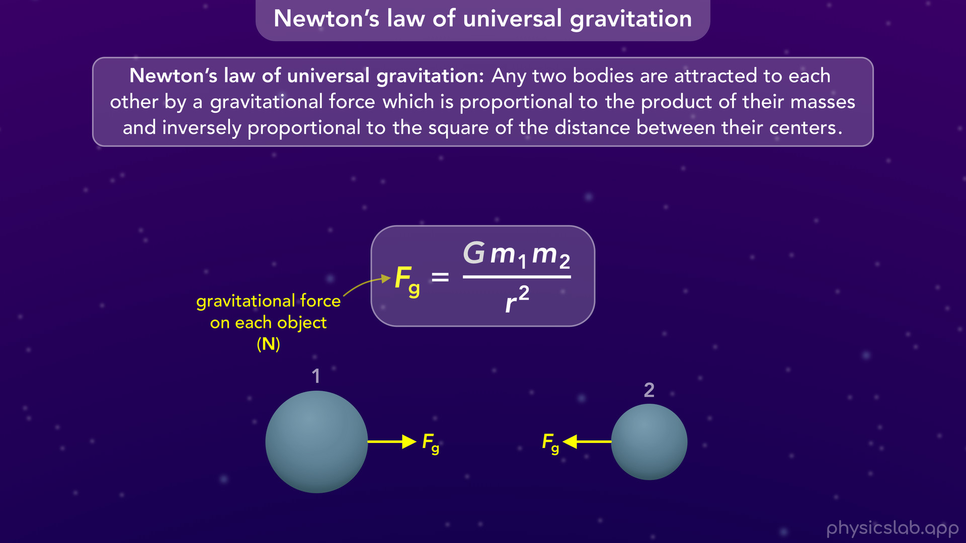
Notes:
• If we have any two objects, or “bodies” as Newton said, then they each exert a gravitational force, Fg, on the other object.
• Since it’s a force, it has units of Newtons.
• This applies to any two objects in the universe, which is why we call it the law of universal gravitation.

Slide 43
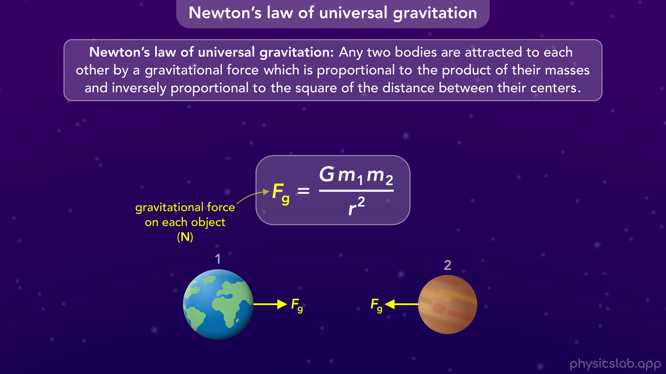
Notes:
• These could be two planets

Slide 44
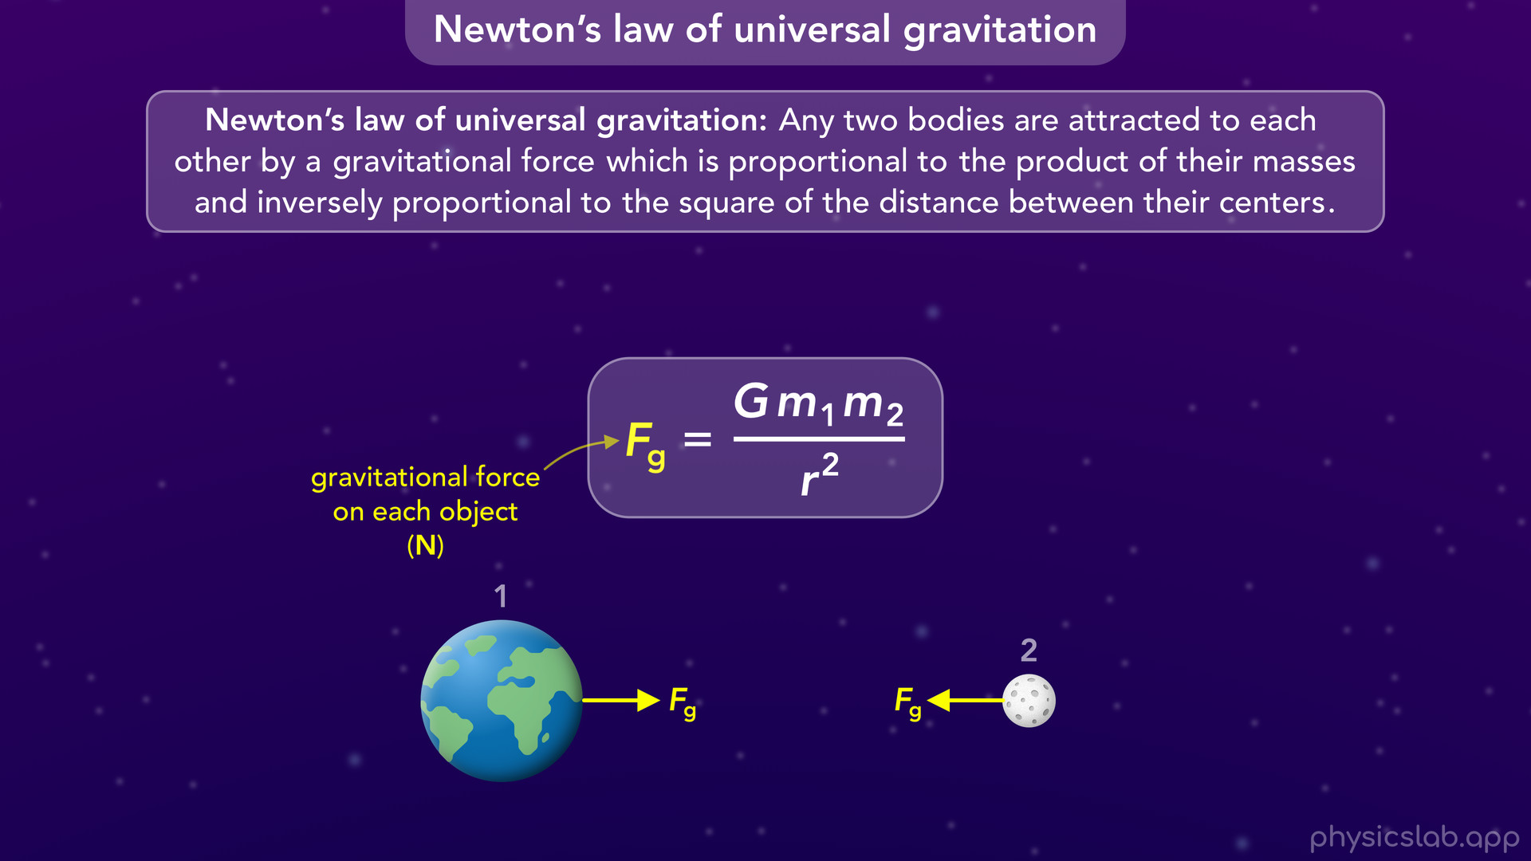
Notes:
a planet and a moon

Slide 45
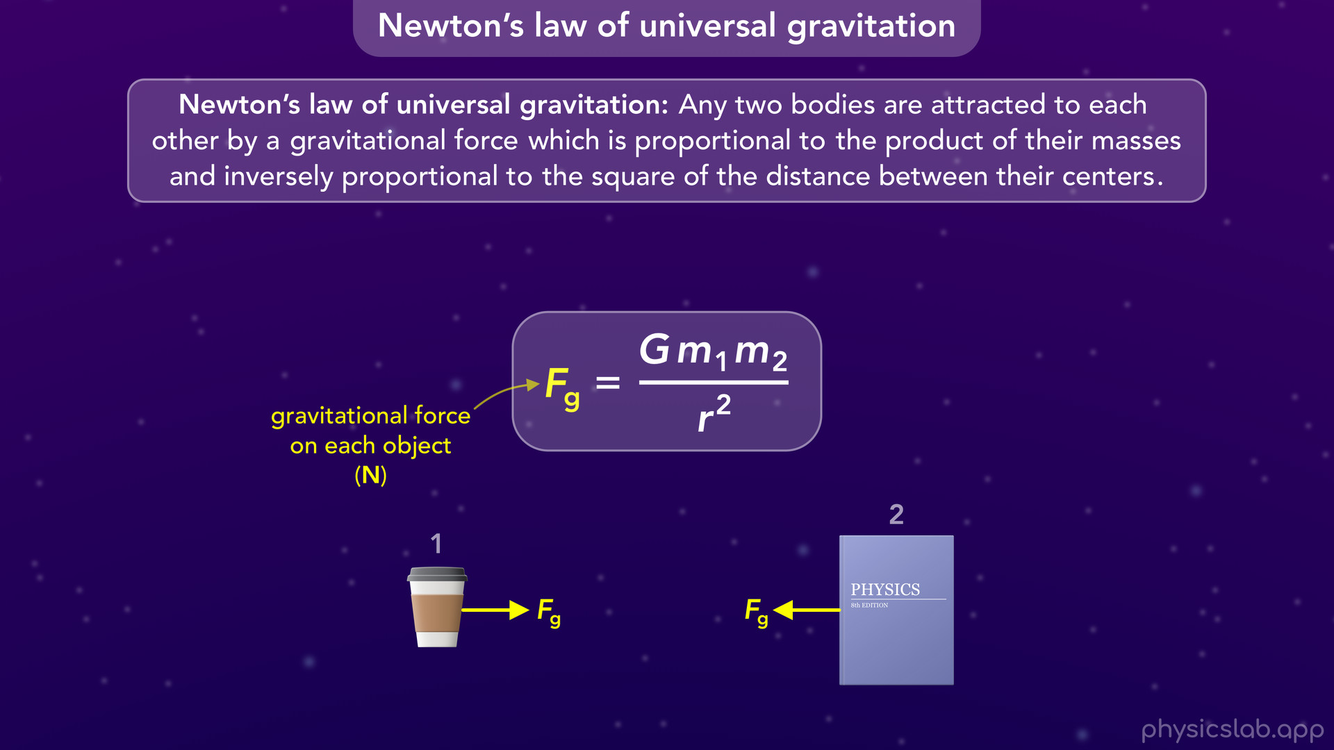
Notes:
or even two small objects like a cup and a book.

Slide 46
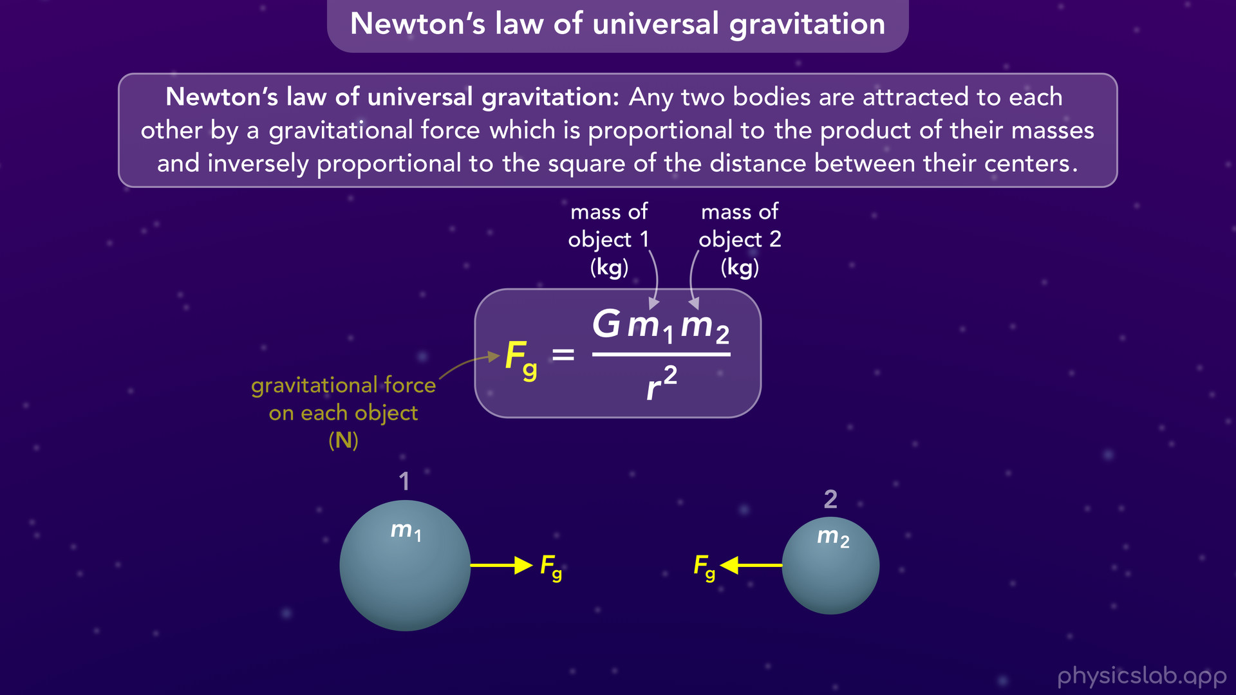
Notes:
• m1 and m2 are the masses of the two objects or bodies in kilograms.
• It doesn’t matter which mass is which, and it doesn’t matter if one is bigger than the other.

Slide 47
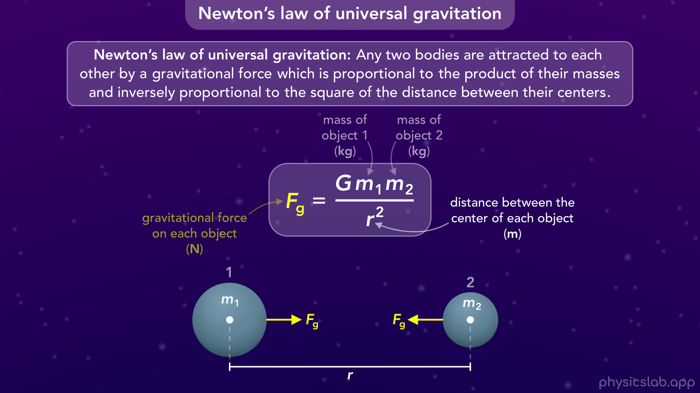
Notes:
• r is the distance between the center of each object, in meters. Keep in mind that r is not the distance between the edge of each object.

Slide 48
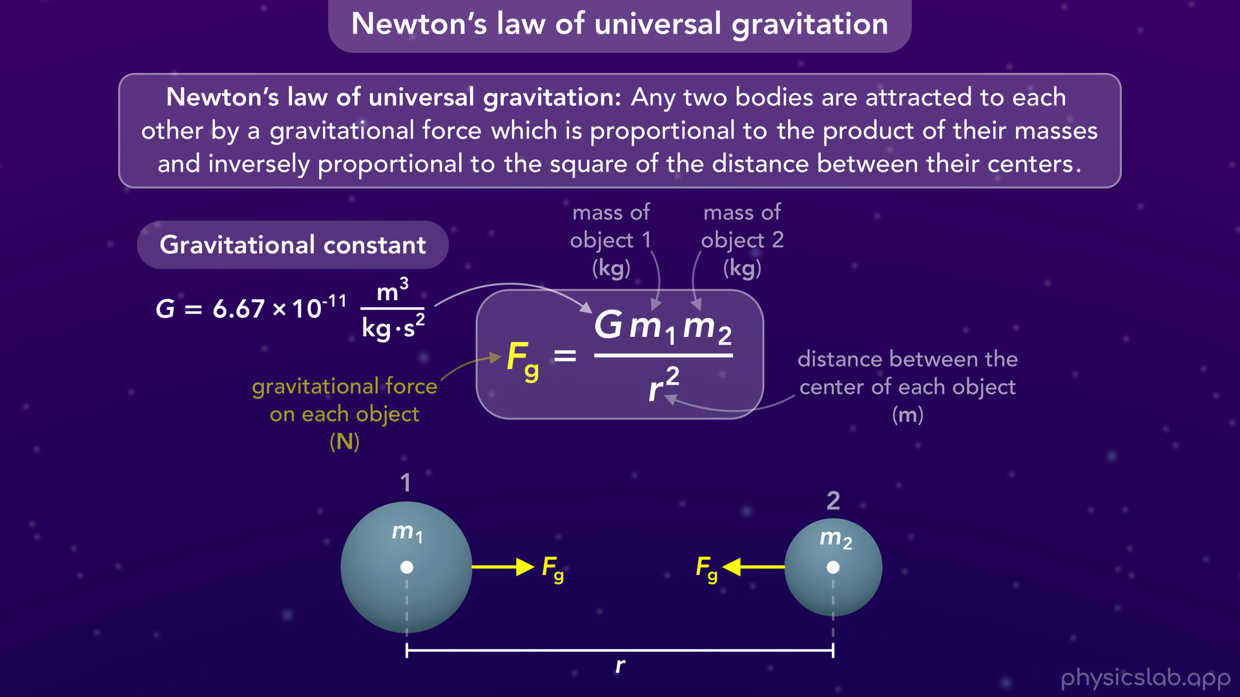
Notes:
• And capital G is the gravitational constant, which is equal to 6.67 times 10^ -11. It has units of m^3 / kg s^2, which are just the units we have to plug in to make this equation work.

Slide 49
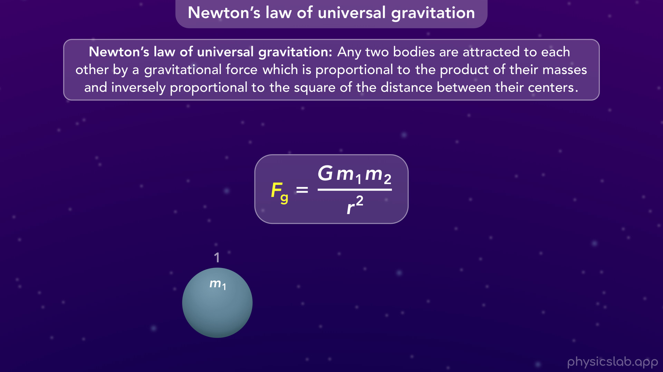
Notes:
• There’s a few important things to mention.
• We need two objects for this force to exist. If there’s only one object, there’s no gravitational force.

Slide 50

Notes:
• The gravitational force on one object always points towards the other object.

Slide 51

Notes:
• It’s always an attractive force, which means each object pulls the other one towards it.

Slide 52

Notes:
• The same amount of force acts on both objects. These are a pair of equal and opposite forces from Newton’s 3rd law of motion.

Slide 53

Notes:
• This is also a non-contact force, because the two objects pull on each other from a distance, in a similar way that two magnets attract each other without being in contact.
• It doesn’t matter how far apart they are, there will always be some gravitational force between the two objects.

Slide 54

Notes:
• Finally, you may also see m1 and m2 replaced with capital M and lower case m.
• The equations are the same, it’s just a different way to write it.

Slide 55

Notes:
• Before we walk through some examples, let’s do some proportional reasoning and see how changing each variable affects the gravitational force.

Slide 56
Notes:
• If we double mass 1 and keep everything else the same, then the gravitational force also doubles, because m1 is in the numerator in this equation.
• Notice that the force on each mass doubled even though we only changed mass 1. The same force always acts on both objects.

Slide 57

Notes:
• If object 1 only has half the mass, then we only have half the gravitational force on each object.

Slide 58

Notes:
• And the same things apply to mass 2.
• If we double it, then the gravitational force also doubles.

Slide 59

Notes:
• And if we divided by 2, the gravitational force is also divided by 2.
• So larger masses have a stronger gravitational force, and smaller masses have a weaker gravitational force.

Slide 60

Notes:
• What if we change the distance between the two objects?
• If we double r, it’s squared in this equation, and its in the denominator, so the gravitational force is actually divided by 4.
• The gravitational force is weaker when the objects are farther apart.

Slide 61

Notes:
• And if we divide the distance by 2, then the gravitational force is multiplied by 4.
• So the gravitational force is stronger when the objects are closer together.

Slide 62


Slide 63

Notes:
• Now let’s look at some examples, starting with the gravitational force between the sun and the Earth.
• Keep in mind that this is not drawn to scale.

Slide 64

Notes:
• We’ll call the sun mass 1 and the earth mass 2, but it doesn’t matter which is which.
• The distance between their centers is about 1.5 times 10 ^ 11 meters.
• The distance and the masses are pretty large so we’re writing them using scientific notation.
• So what would be the magnitude of the gravitational force acting on the sun and the earth?
• Pause the video and see if you can solve it before moving on.

Slide 65

Notes:
• The value of G, the gravitational constant, is 6.67 x 10^ -11 and it has these units.
• Then we can plug in the mass of the sun, which is 1.99 x 10 ^30 kg.
• Then we can plug in the mass of the earth, 5.97 x 10 ^ 24 kg.
• Finally, we plug in the distance between their centers for r, which 1.5 x 10 ^ 11 m. And remember, r is squared in this equation.

Slide 66

Notes:
• If we plug that into our calculator, we get 3.52 x 10 ^ 22 N for the gravitational force.
• That’s the force exerted on the sun by the earth, and its the force exerted on the earth by the sun.
• They each pull each other with the same amount of force.
• Notice that the two masses are pretty large, but the distance is also pretty large. In this case, we get a large gravitational force.

Slide 67


Slide 68

Notes:
• Now let’s look at the force between the earth and the moon.
• We’ll say the moon is mass 1 and the earth is mass 2.
• Pause the video and see if you can calculate the gravitational force.

Slide 69

Notes:
• We always plug in the same value for G.
• Now we plug in 7.35 x 10 ^ 22 kg for the mass of the moon. And we plug in 5.97 x 10 ^24 kg for the mass of the earth.
• Then we plug in 3.84 x 10 ^8 m for r.

Slide 70

Notes:
• When we calculate that, we get 1.98 x 10 ^20 N for the gravitational force on the moon and the earth.
• This is still a pretty large gravitational force.

Slide 71


Slide 72

Notes:
• Now, what if we have a large object and a small object, like the earth and a ball.
• What would be the gravitational force between them?

Slide 73

Notes:
• We would plug in the value for G, then 5.97 x 10 ^24 kg for the mass of the earth, 0.5 kg for the mass of the ball, and 6.37 x 10 ^ 6 m for the distance between their centers.
• That gives us 4.9 N for the gravitational force. This is a lot smaller than the other forces, but it’s still significant.
• The earth pulls on the ball with 4.9 N of force, but the ball also pulls on the earth with 4.9 N of force.

Slide 74

Notes:
• If both objects start from rest, we can see the ball will accelerate towards the earth.
• The earth also accelerates towards the ball, but its acceleration is too small to see because it has such a large mass.
• We talked about that in the video on Newton’s 3rd law of motion.
• The motion of the earth and the ball might be different, but the forces are the same.
• Nothing changes just because one object is much smaller. This law and this equation work the same way for any two objects.

Slide 75

Notes:
• Remember that the value of r is the distance between their centers, its not measured from the surface of the earth.
• And this picture is not drawn to scale. This distance that we used is roughly equal to the radius of the earth, the distance between the center and the surface.
• So if we use the correct scale…

Slide 76


Slide 77


Slide 78

Notes:
the earth and the ball would actually look like this.
• But nothing changes at this scale.
• The mass of the earth and the mass of the ball are still the same, and r is still the distance between the center of the ball and the center of the earth, which we can no longer see.
• The earth still pulls on the ball and the ball still pulls on the earth with 4.9 N of force.

Slide 79

Notes:
• We’re used to seeing gravity from this point of view, and we say objects fall down. But that’s just because we say up is away from the earth.

Slide 80


Slide 81

Notes:
• So Newton’s law of universal gravitation works the same way at this scale.
• When we think of gravity on earth, the two objects are the earth and some small object, and the distance between their centers is roughly equal to the radius of the earth.

Slide 82

Notes:
• And at this scale, the gravitational force acting on the small object is called the weight force, or the weight of the object, and we’ll talk more about that in another video.

Slide 83

Notes:
• So if Newton’s law of universal gravitation says that every two objects attract each other, why don’t we see that with two small objects?
• Why don’t these balls roll towards each other?

Slide 84

Notes:
• Well let’s calculate the gravitational force that they exert on each other.

Slide 85

Notes:
• We plug in the same value for G, we plug in both masses, 0.5 kg and 0.6 kg, and we plug in 1 m for r, the distance between their centers.
• When we calculate that, we get 2 x 10 ^ -11 N for the gravitational force that each ball exerts on the other ball.
• That exponent is negative, which means the number is very small.
• The two masses are not that big, so the gravitational force between them is almost negligible.

Slide 86

Notes:
• And they don’t move towards eachother because there are other forces on each ball, like friction from the ground, that acts in the opposite direction.

Slide 87

Notes:
• If the balls were 1 meter apart in space, where there’s no friction, they would accelerate towards each other but very slowly.

Slide 88

Notes:
• It would take hours for them to hit each other because the gravitational force is so small.
• But even if it’s small, there is still a gravitational force between any two objects in the universe.

Slide 89


Slide 90

Notes:
• Before we go, we need to mention one thing, the difference between Netwon and Einsteins theories of gravity.

Slide 91

Notes:
• We just learned about Isaac Newton’s theory of how gravity works, which was published in 1687 along with his 3 laws of motion.
• According to this theory, two objects exert gravitational forces on each other because of their mass.
• So the moon stays in orbit around the Earth because the moon experiences a gravitational force from the earth.
• This theory of gravity lasted for a long time because it matched all of our observations and measurements.

Slide 92

Notes:
• But as we observed more of the universe and we got better at measuring things, there were a few places where Newton’s gravitational force wasn’t enough to explain what we saw.
• For example, the orbit of the planet mercury was slightly off from the orbit you would predict with Newton’s law of gravity.

Slide 93

Notes:
• And it couldn’t explain why light bends around a massive object like a black hole.

Slide 94
Notes:
• In 1915, Albert Einstein published his theory of relativity.
• According to this theory, space and time are one continuous thing called spacetime.
• Objects with mass, like the earth, warp spacetime, and other objects like the moon, are just following that curved spacetime.
• There are no gravitational forces involved.
• Einstein’s theory was able to explain the orbit of mercury and light bending around black holes.
• And so far, it matches all of our observations of the universe, so it’s technically replaced Newton’s theory of how gravity works.
• But it’s pretty complicated and Newton’s law is accurate enough for most situations, so we still use Newton’s law today.

Slide 95
Notes:
• There are only a few cases where we need to use Einstein’s theory instead, like when we study massive objects like black holes.

Slide 96

Notes:
• Or if we need to accurately predict the orbit of planets like mercury.

Slide 97

Notes:
• But the difference between Newton’s prediction and Einsteins prediction is extremely small, about 1 hundredth of a degree of difference for every hundred years.

Slide 98

Notes:
• But for most things, Newton’s equation for gravitationl force is accurate enough.
• We used this equation to send astronauts to the moon…

Slide 99

Notes:
• … and we can definitely use it to study gravity on earth.

