Slide 1
How to Add Vectors
Slides Version 2
This version includes:
Slides with screenshot images from the video.
The video narration in the slide notes.
A blank template slide with the same background and font as the video.
Slides with some basic graphics from this video for you to use however you like.
Feel free to add, delete and edit slides to make your own presentation. You can use these slides in class or share them with your students, but please do not post them online.
If you have any feedback, suggestions or questions about these slides please email me at chris@physicslab.app or send me a message on Discord @physicslab.
physicslab.app

Slide 2
Heading
Text

Slide 3





















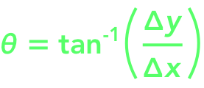

Slide 4





Slide 5
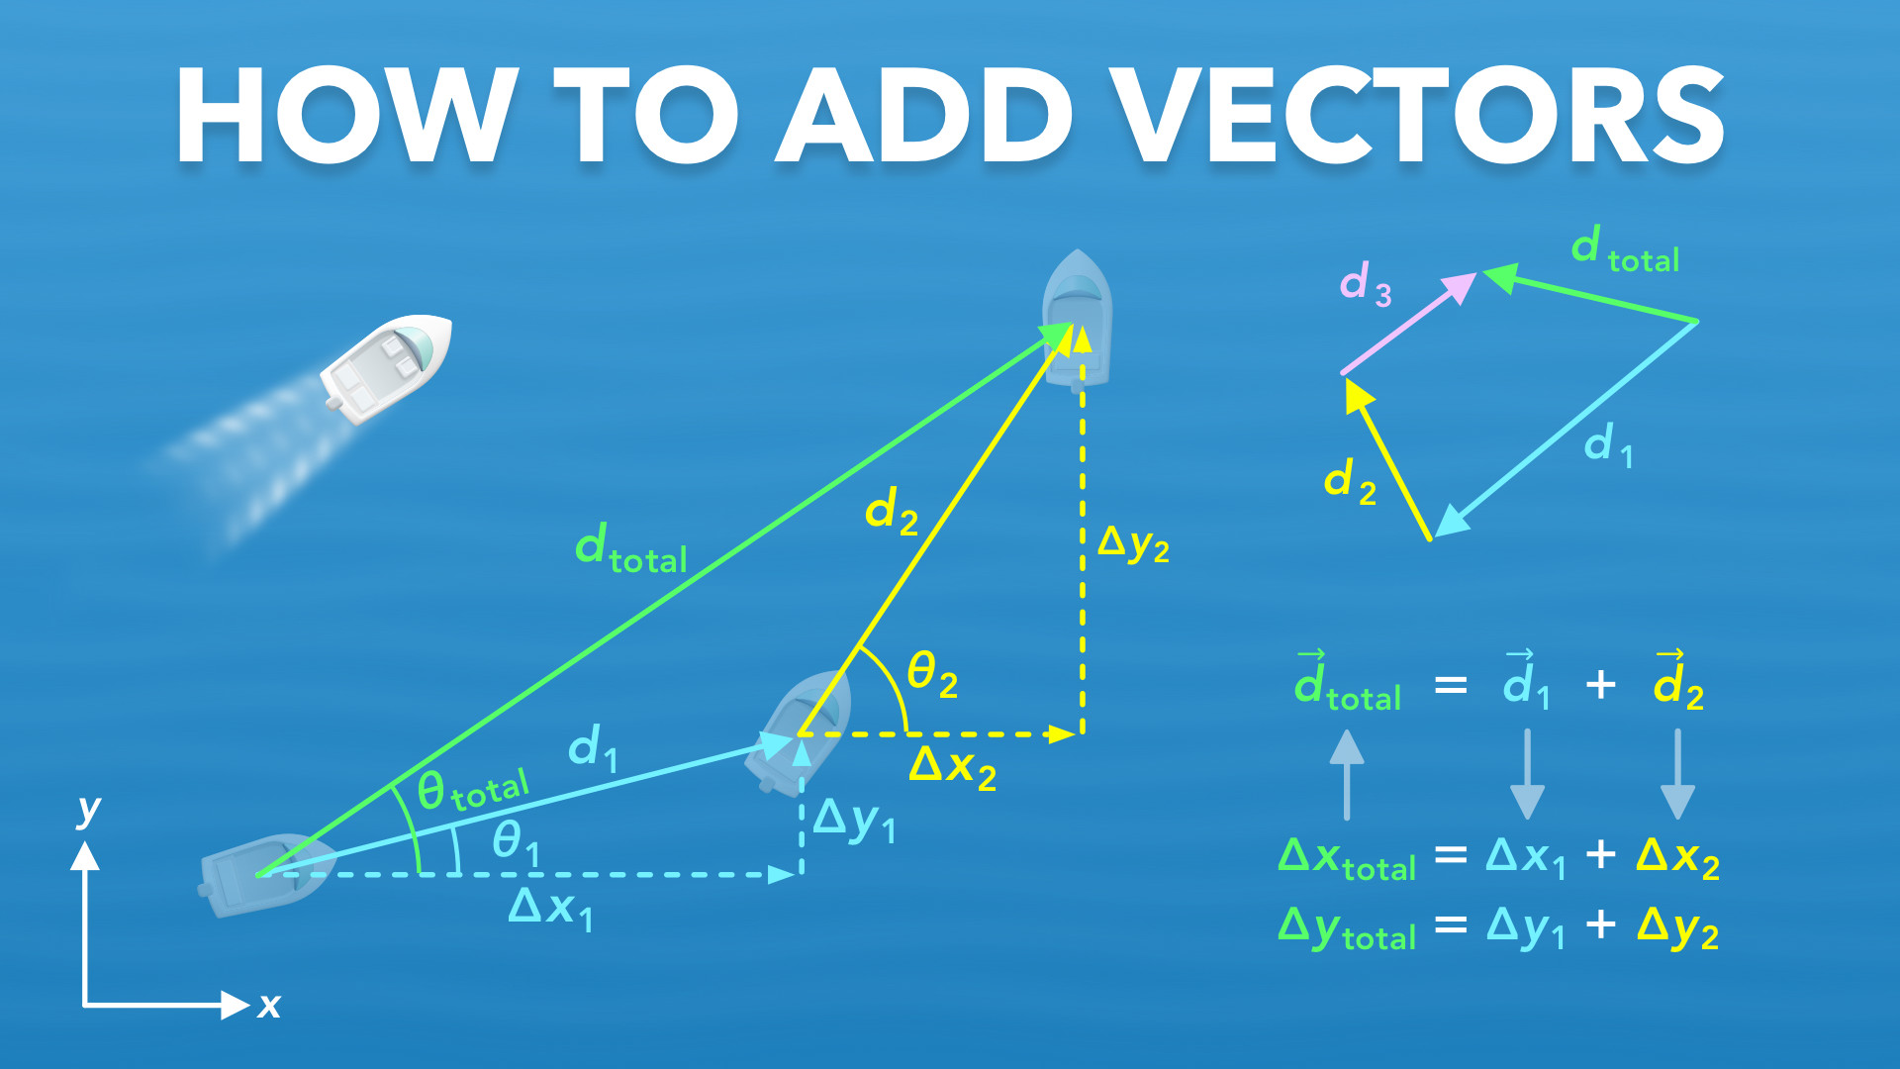
Notes:
How to Add Vectors
physicslab.app
If you have any questions, suggestions or feedback about these slides please email me at chris@physicslab.app or send me a message on Discord @physicslab.

Slide 6
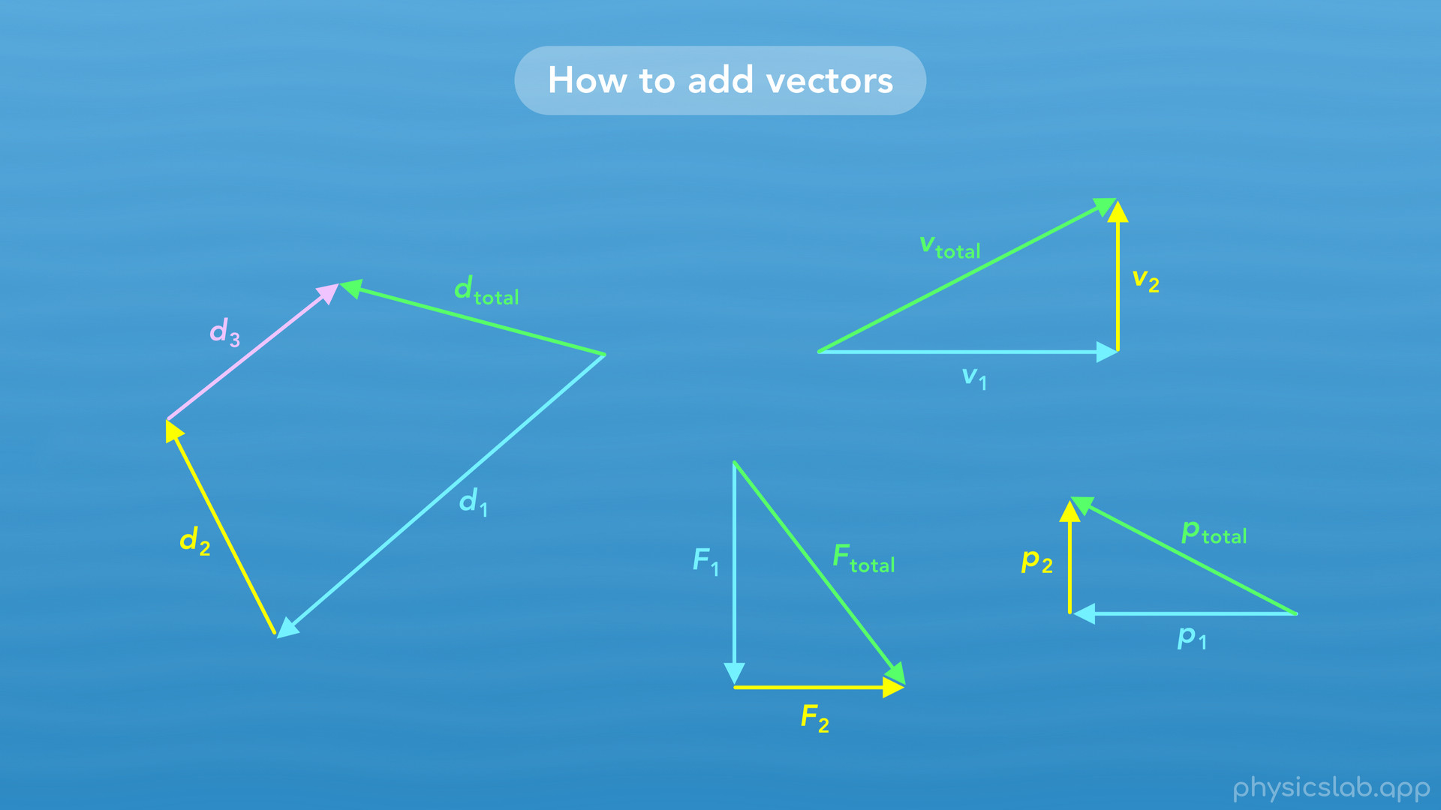
Notes:
• Hey everyone, in this video we’re going to learn how to add vectors. We’re gonna use displacement vectors, but the same things apply when we add any type of vectors, like velocity, force, or momentum vectors later in the course.

Slide 7
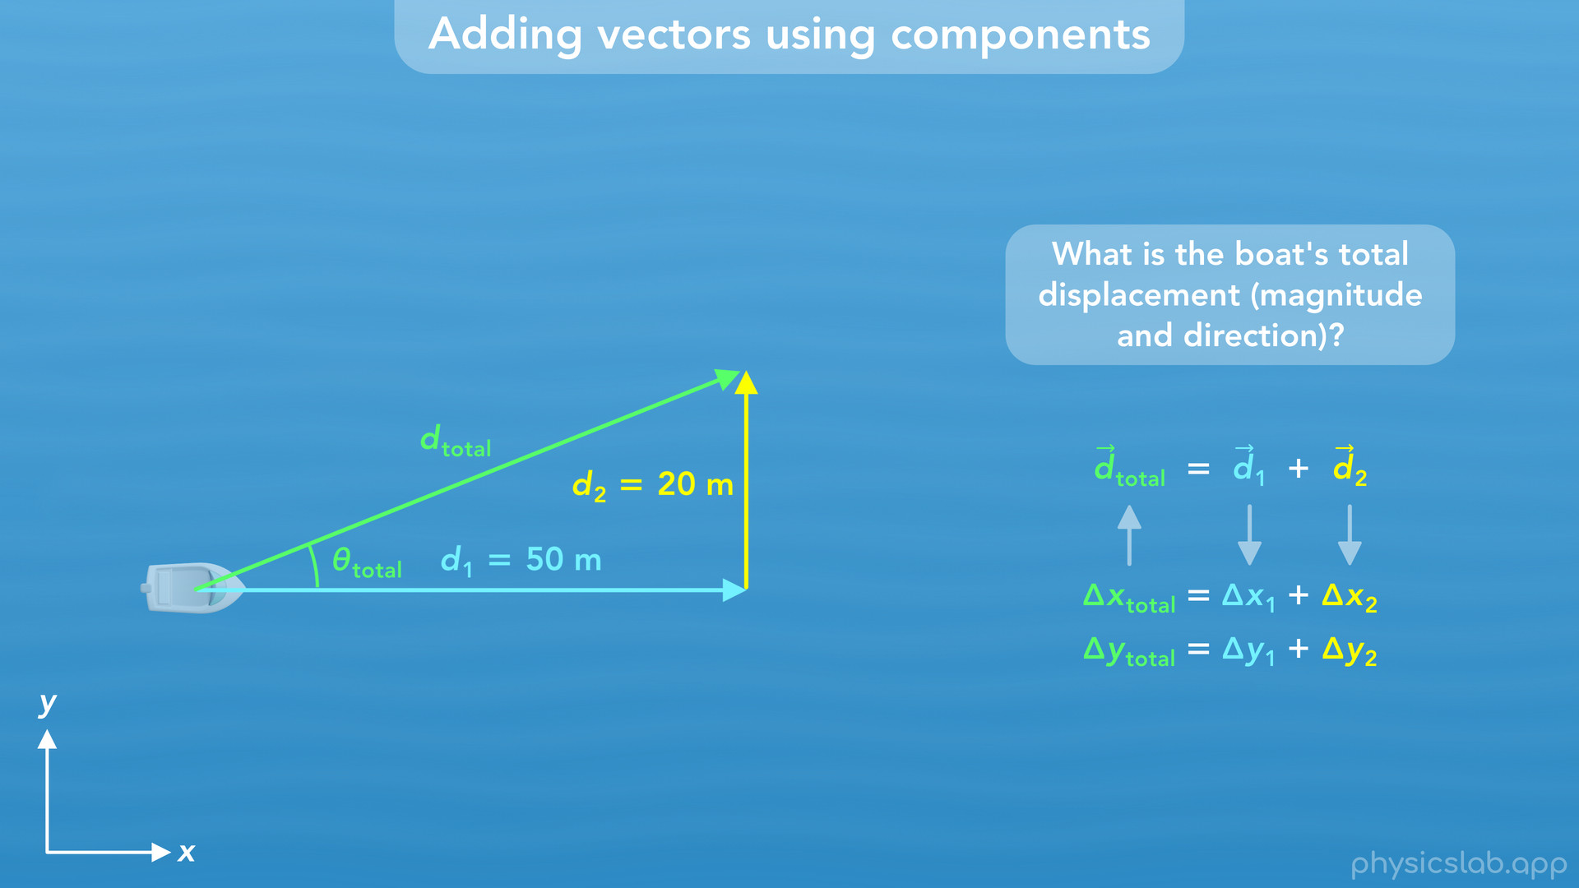
Notes:
• In the first example, we’ll learn how to add one-dimensional vectors…

Slide 8
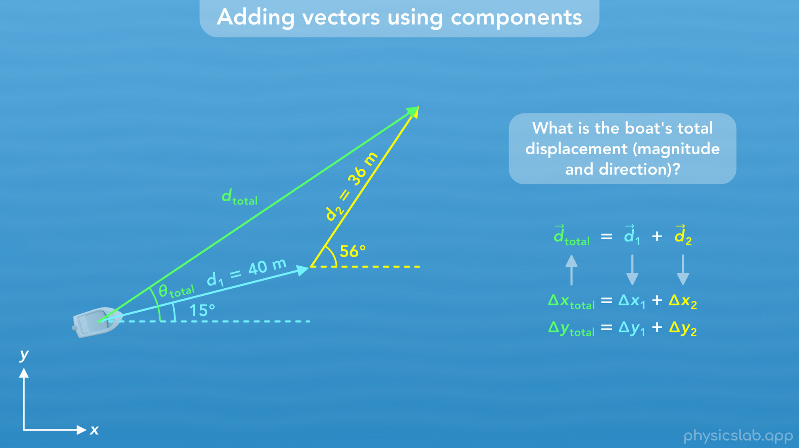
Notes:
• Then in the second example, we’ll add two dimensional vectors…

Slide 9
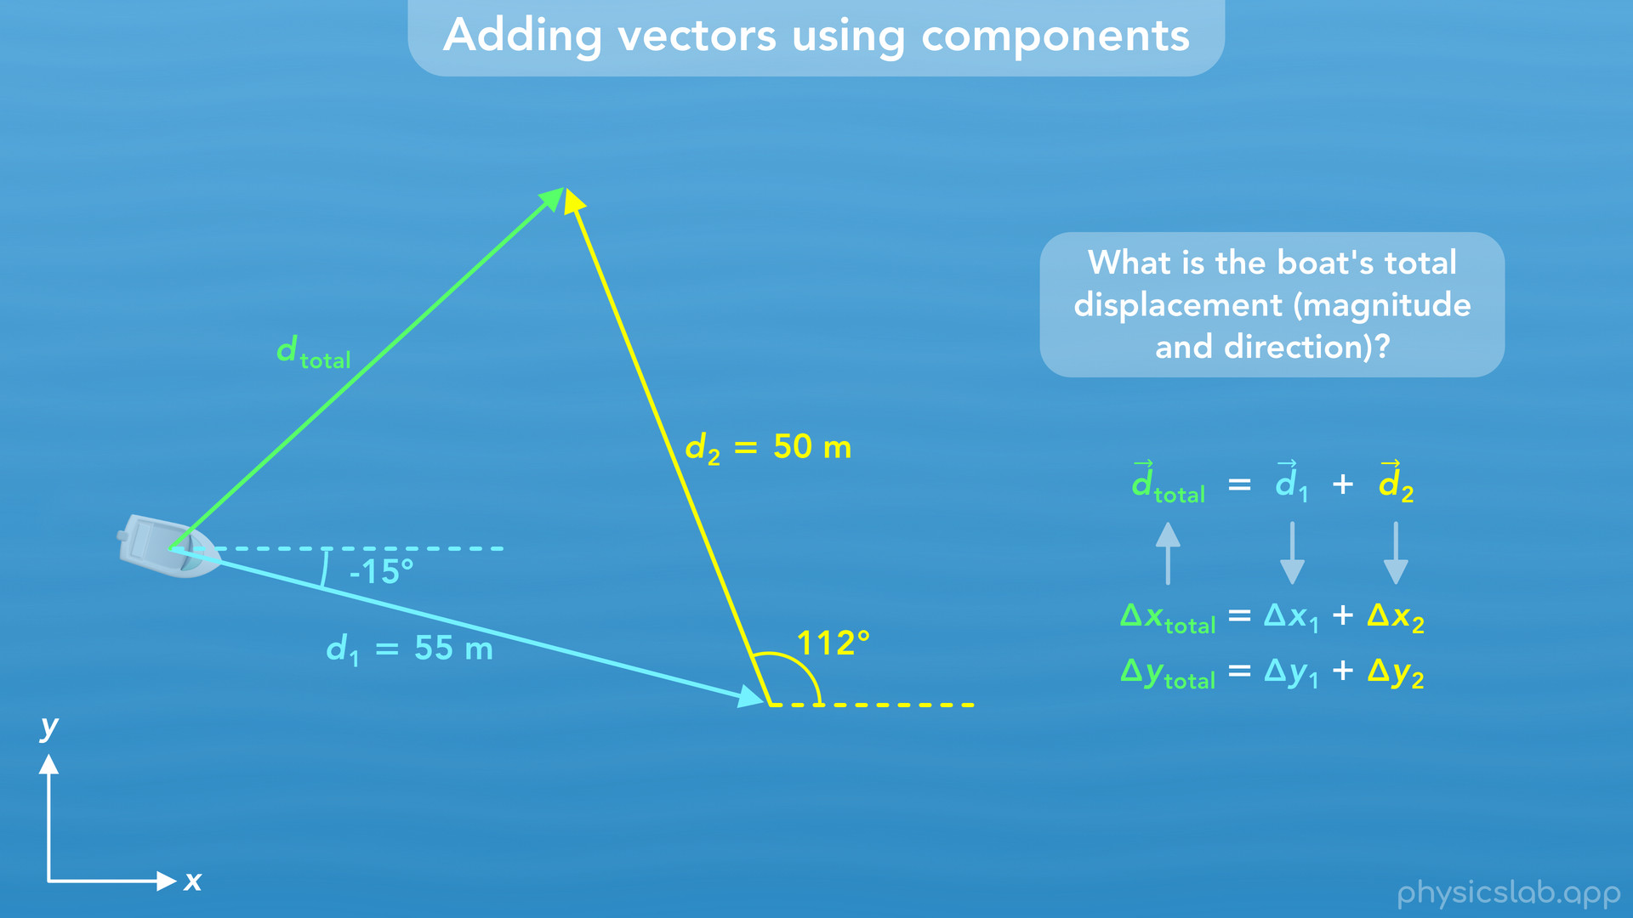
Notes:
• And the third example will include negative components and how to work with different types of angles.

Slide 10
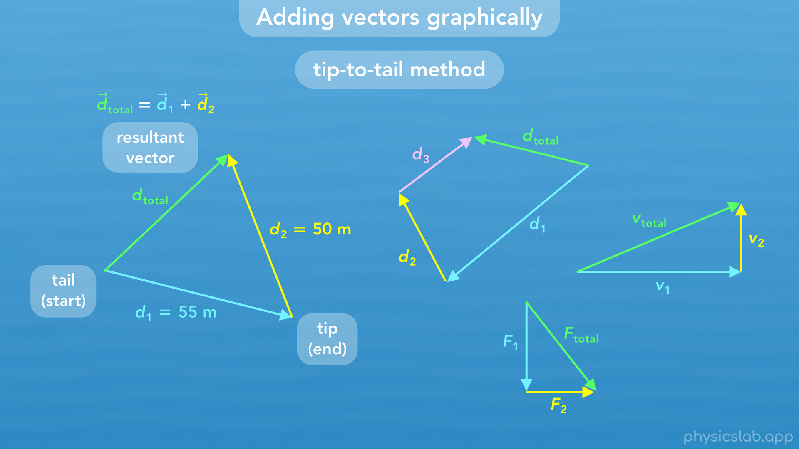
Notes:
• At the end, we’ll learn how to add vectors graphically using the tip-to-tail method.

Slide 11
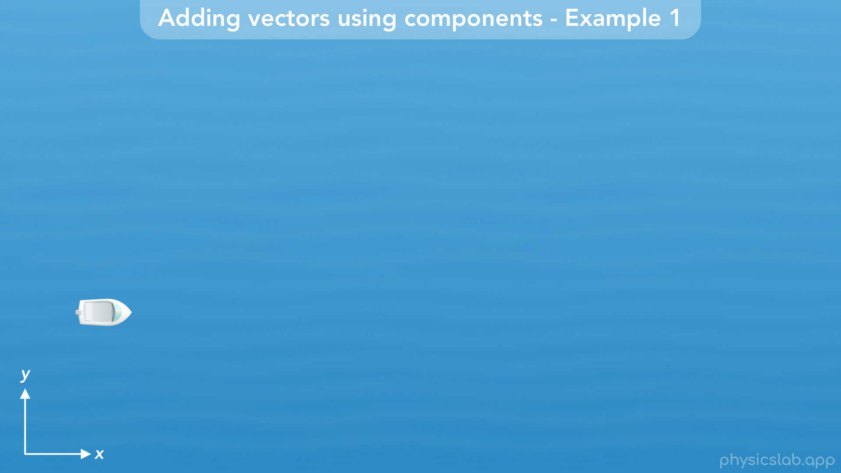
Notes:
• For these examples, we’re gonna follow the displacement of a boat.

Slide 12
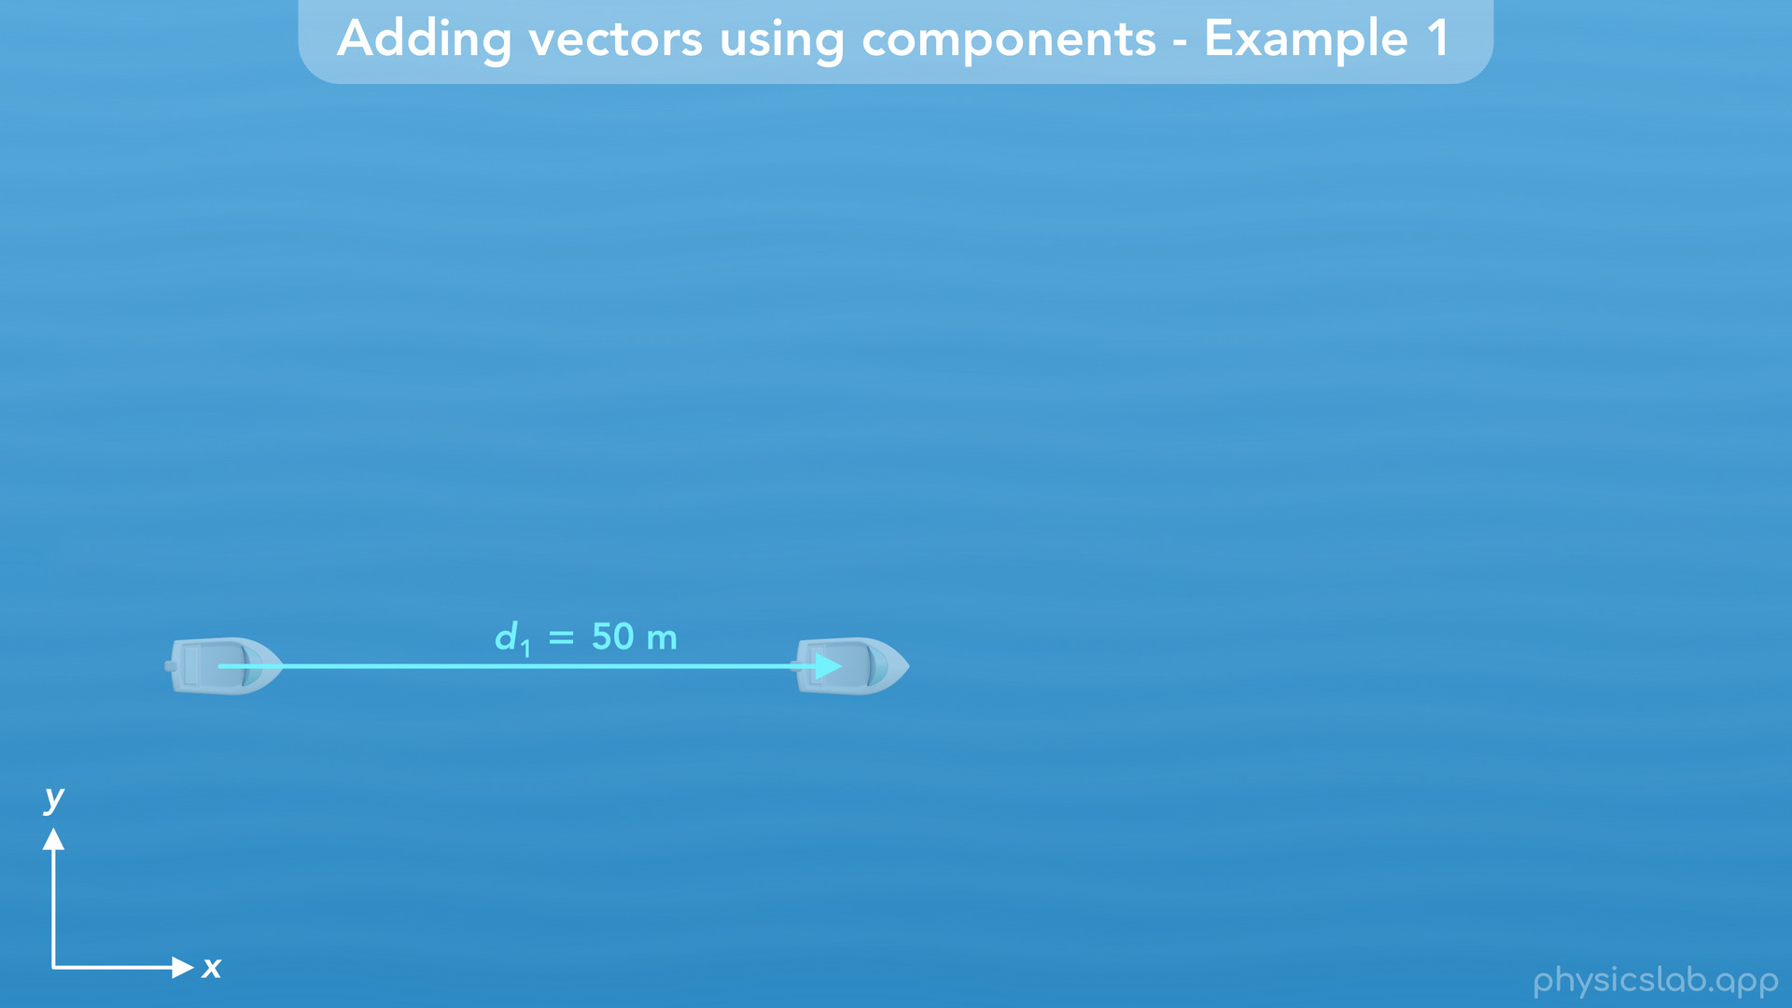
Notes:
Let’s say the boat moves 50 m to the right, in the x direction

Slide 13
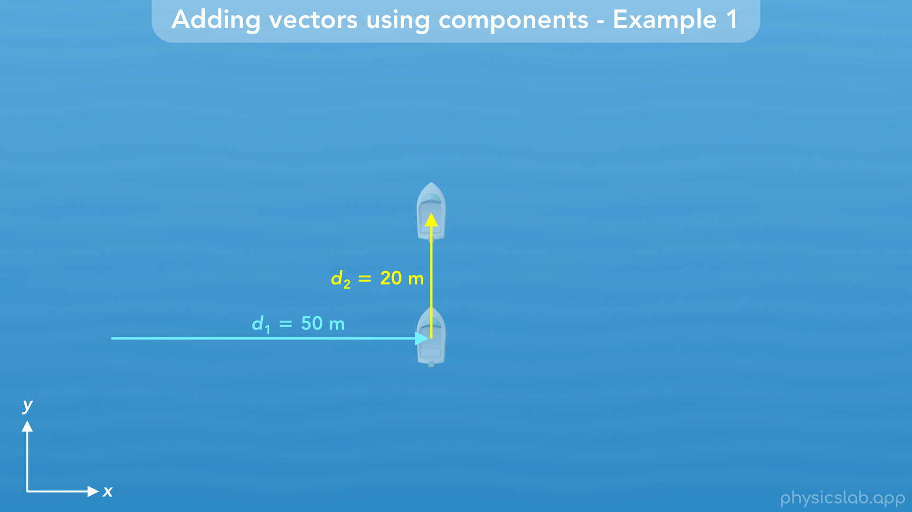
Notes:
and then it moves 20 m up, in the y direction.

Slide 14
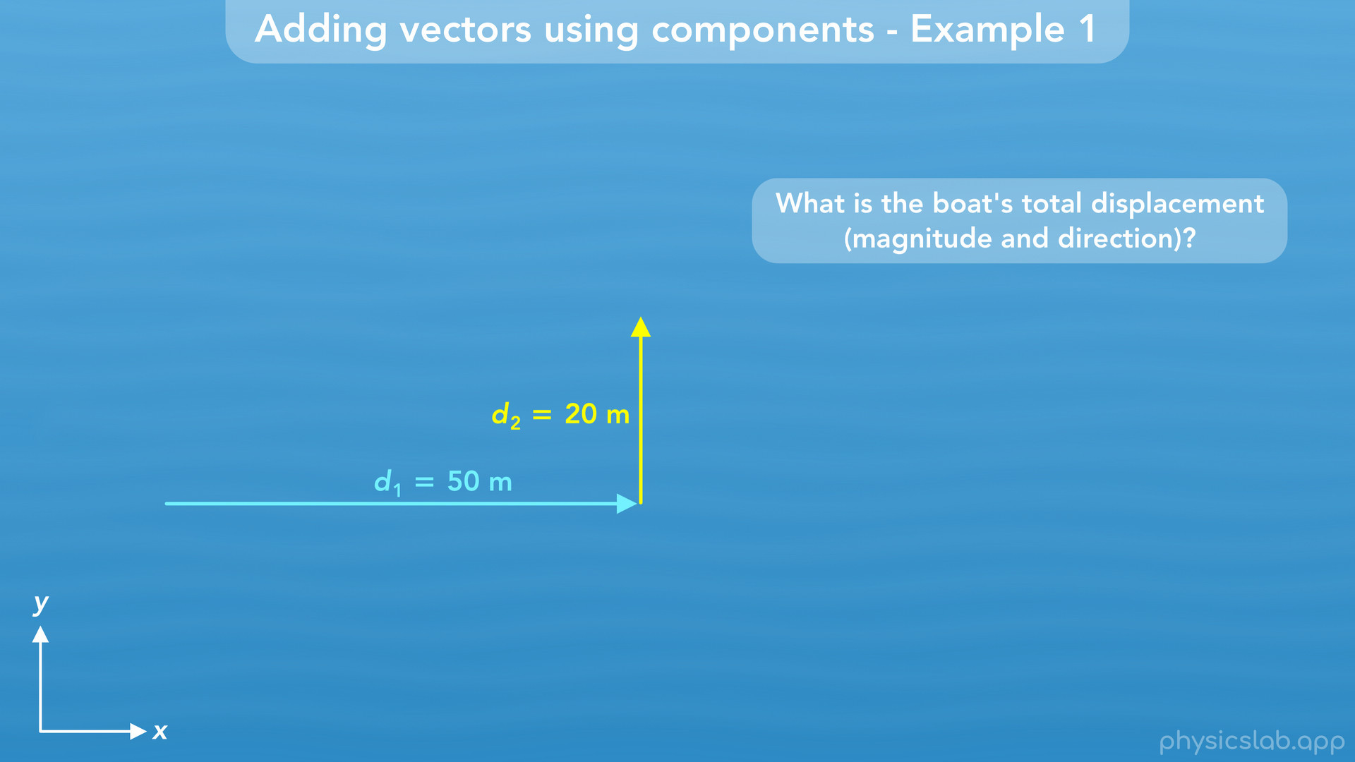
Notes:
• During the first part, this is the boat’s displacement vector, which we’ll call d1 for displacement 1. It has a magnitude of 50 m.
• The second displacement vector, d2, has a magnitude of 20 m.
• What is the boat’s total displacement (specifically the magnitude and direction)?

Slide 15
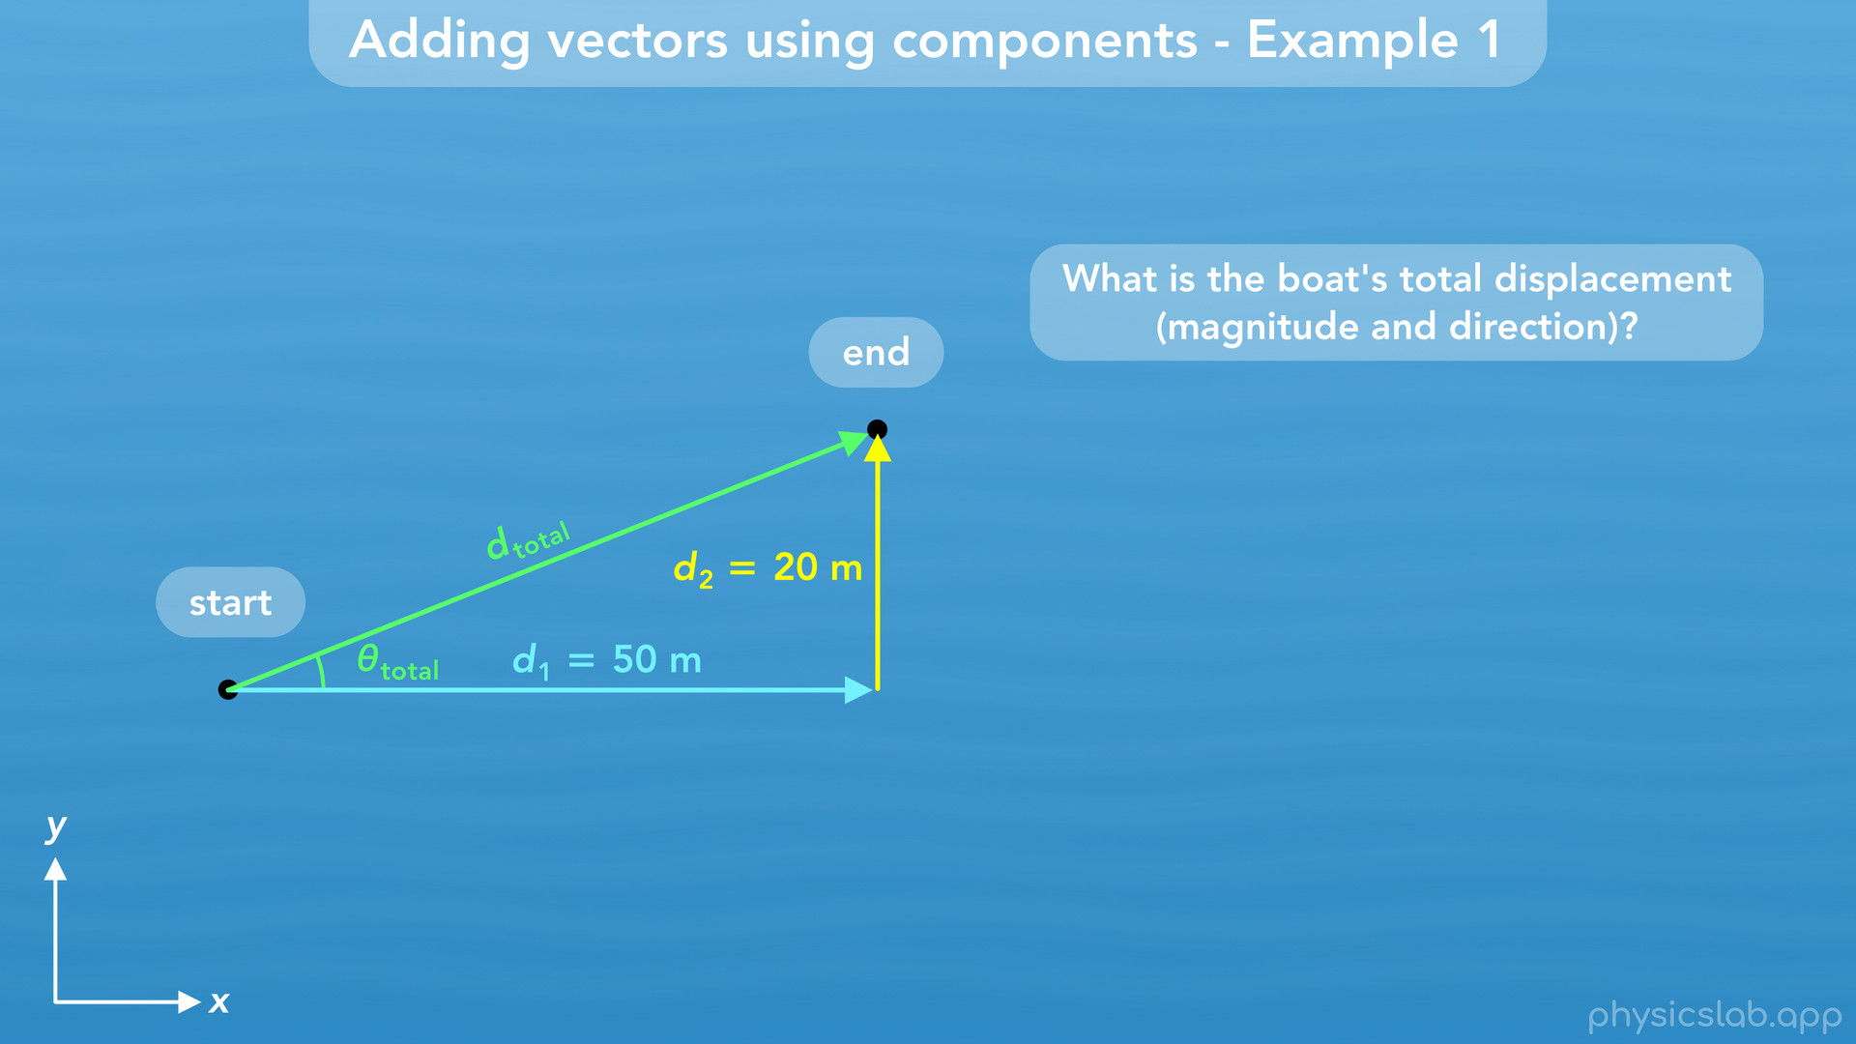
Notes:
• The boat travelled these two displacements, but we want to find the vector that tells us the total displacement between the start position and the end position. This vector, d total, is the sum of the d1 vector plus the d2 vector.

Slide 16
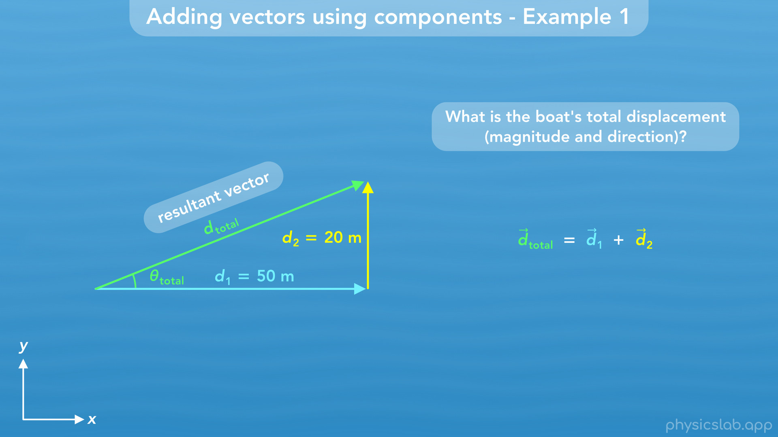
Notes:
This is what we call the resultant vector when we add d1 plus d2. So how do we find the magnitude and the angle of d total?

Slide 17
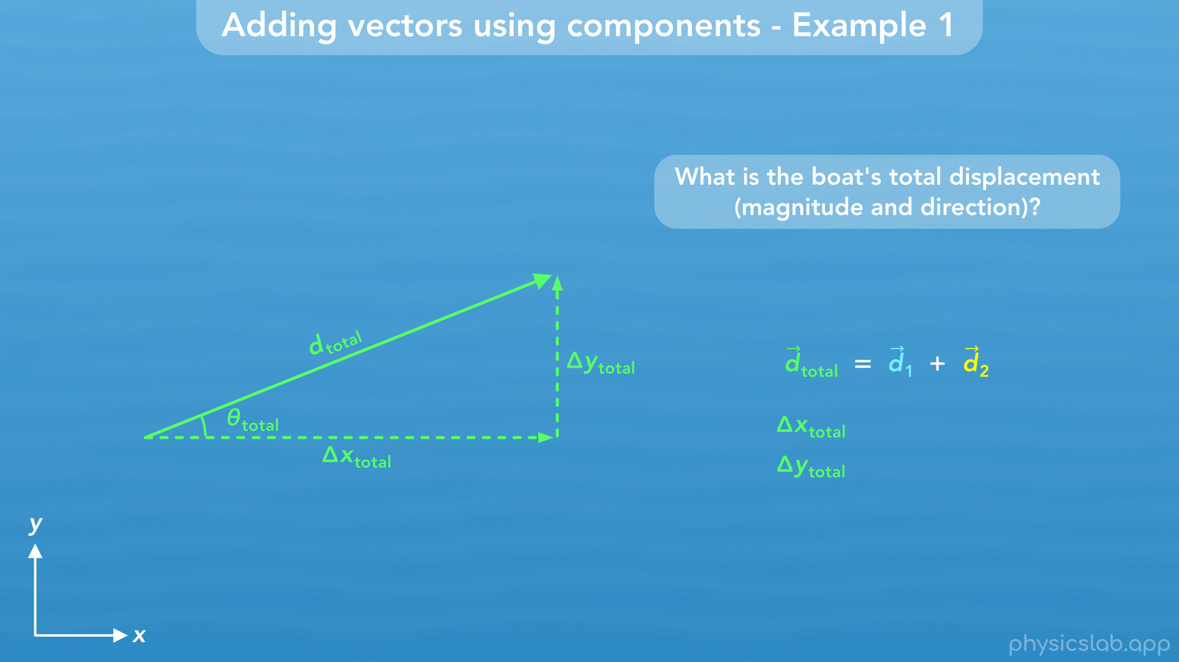
Notes:
• We learned in a previous video that if we want to find the magnitude and angle of a vector, we need to know its x and y components. So how can we find the components of d total?

Slide 18
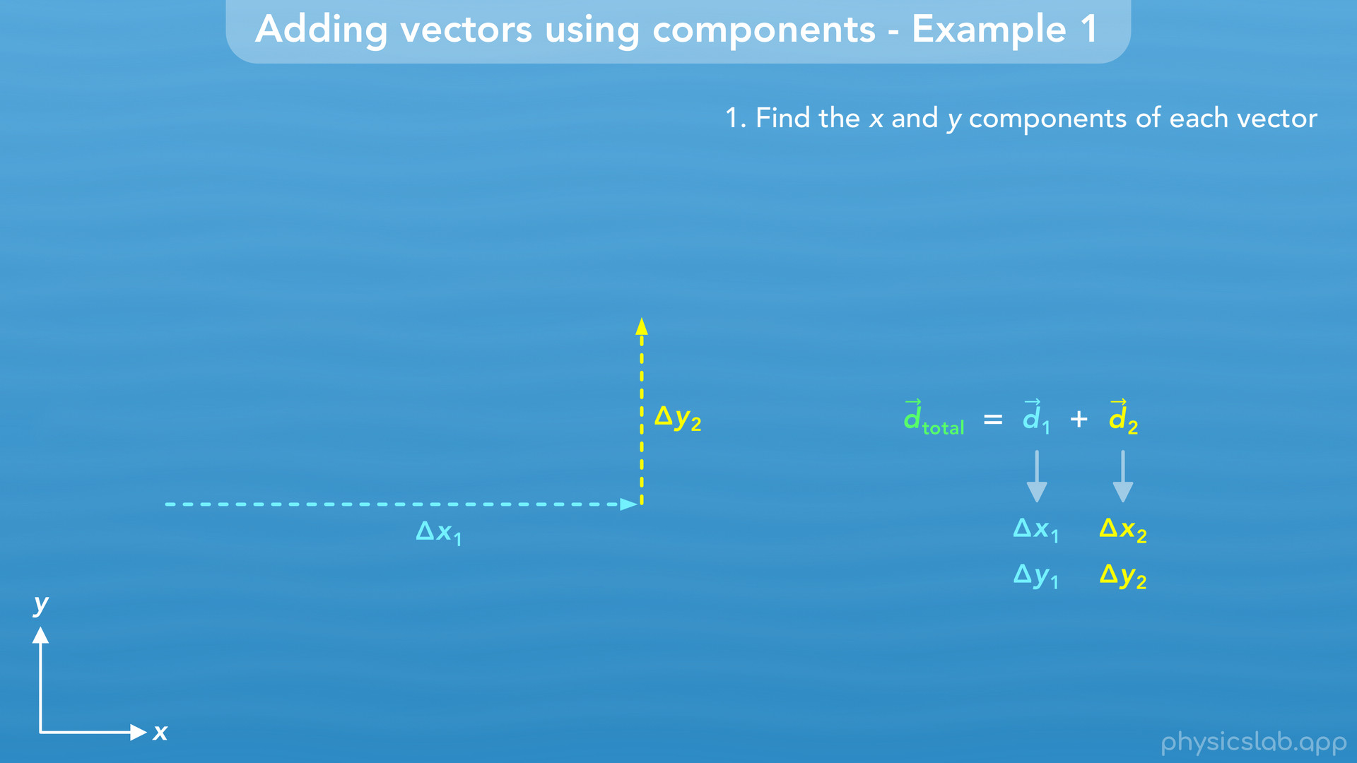
Notes:
• First, we need to find the x and y components of d1 and d2.

Slide 19
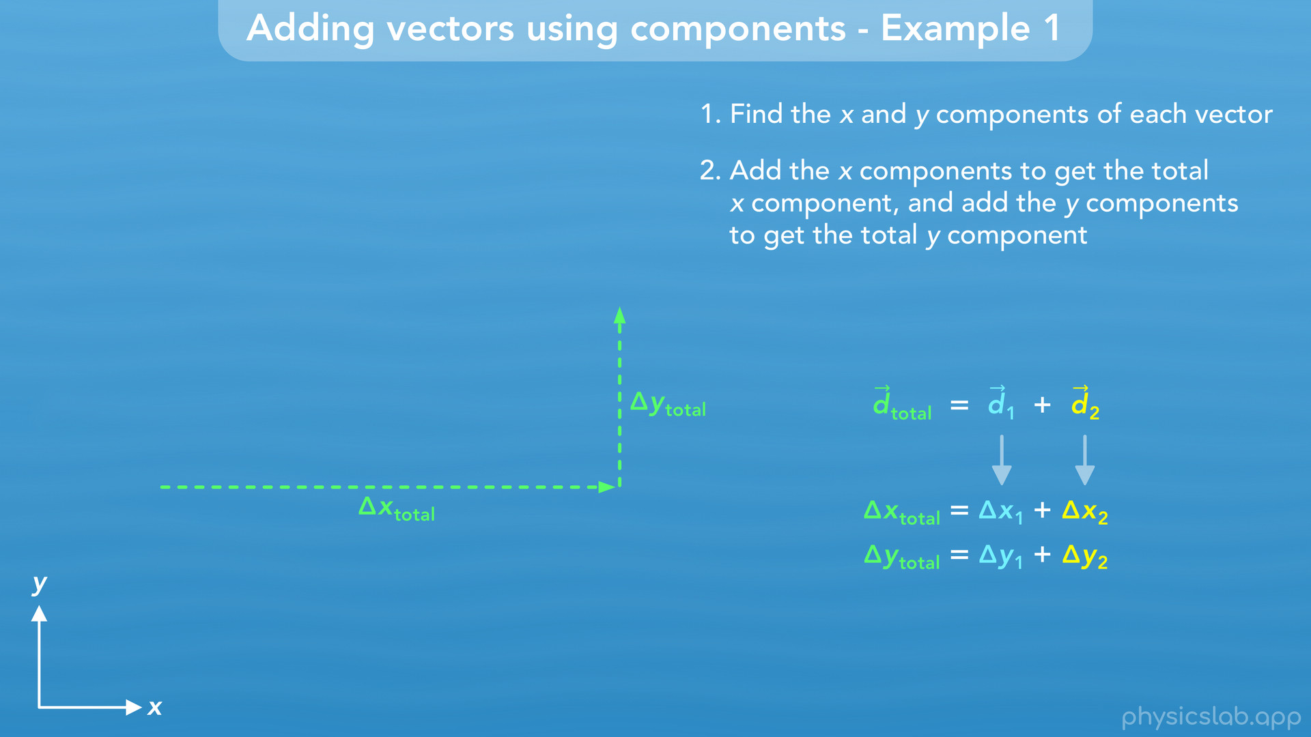
Notes:
Second, we add the x components to get the total x component, and we add the y components to get the total y component.

Slide 20
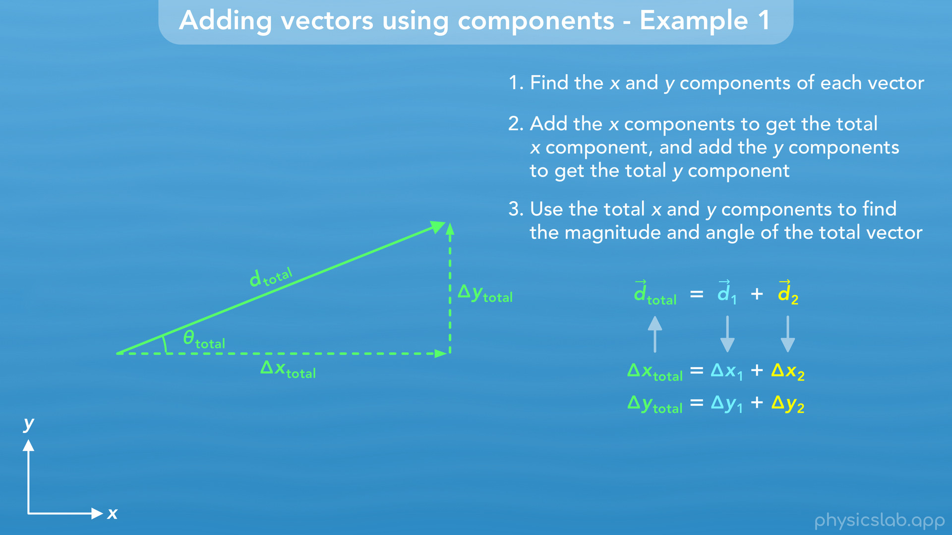
Notes:
Third, we use the total x and y components to find the magnitude and angle of the total displacement vector. Let’s walk through each step.

Slide 21
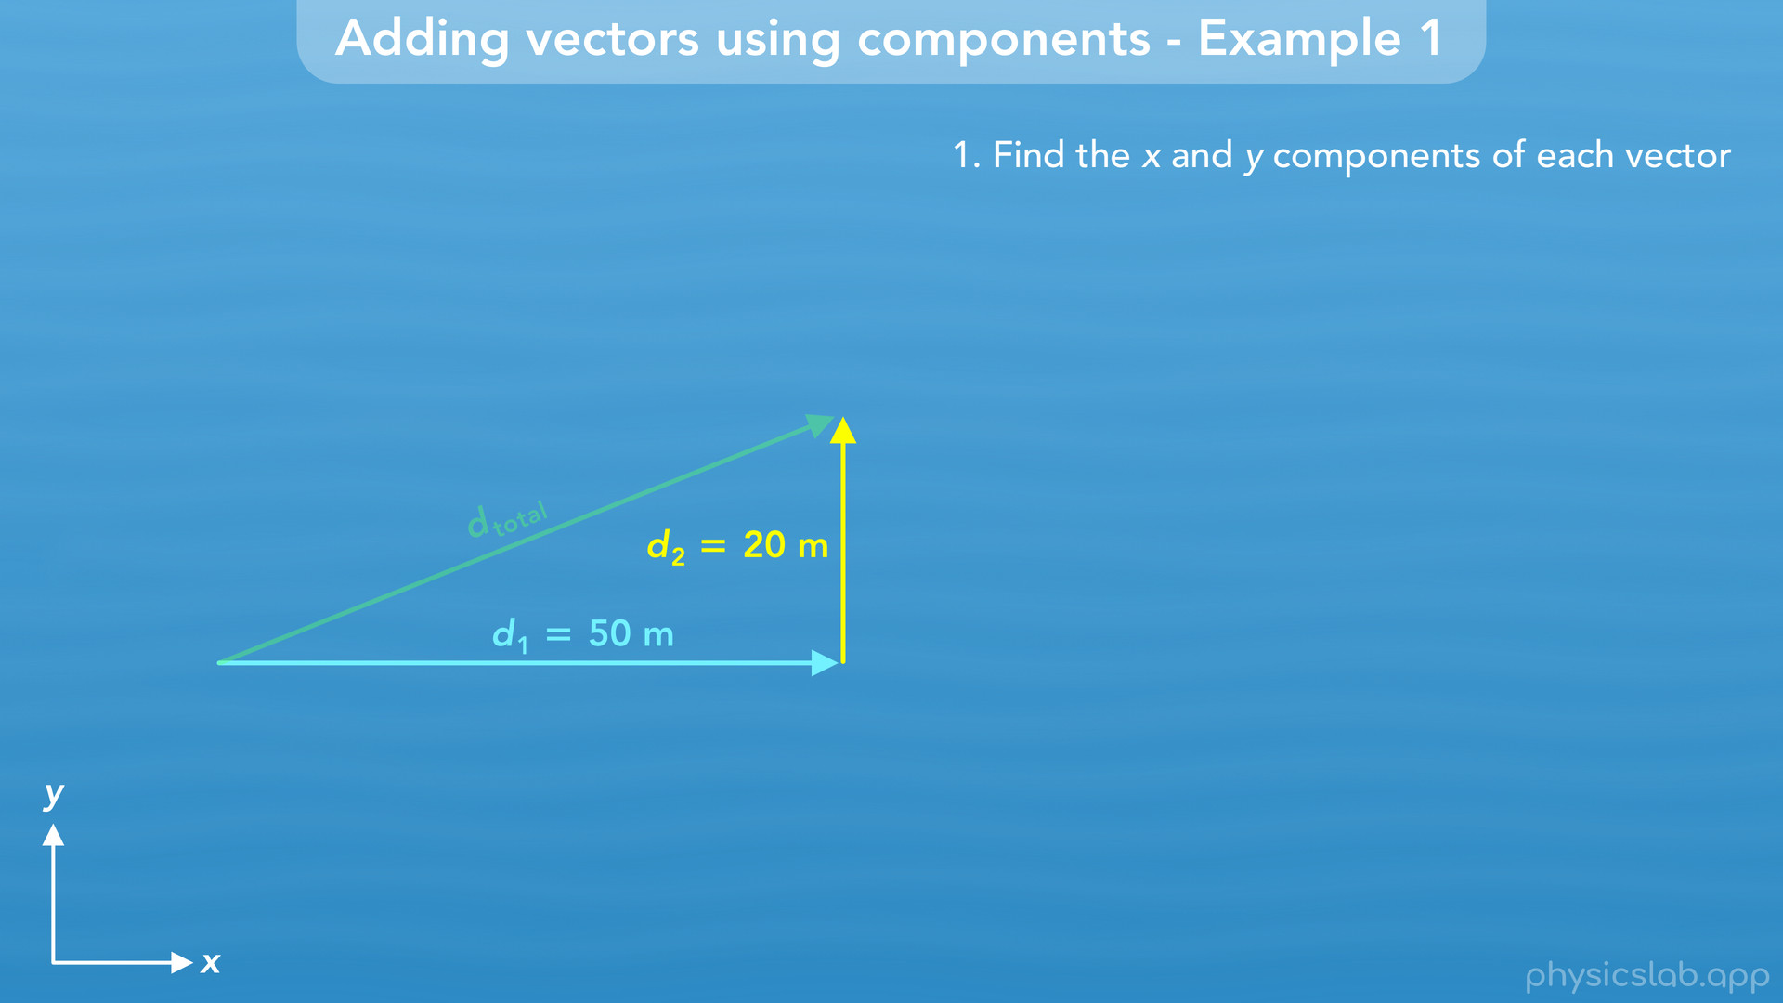
Notes:
• First let’s find the components of d1 and d2.

Slide 22
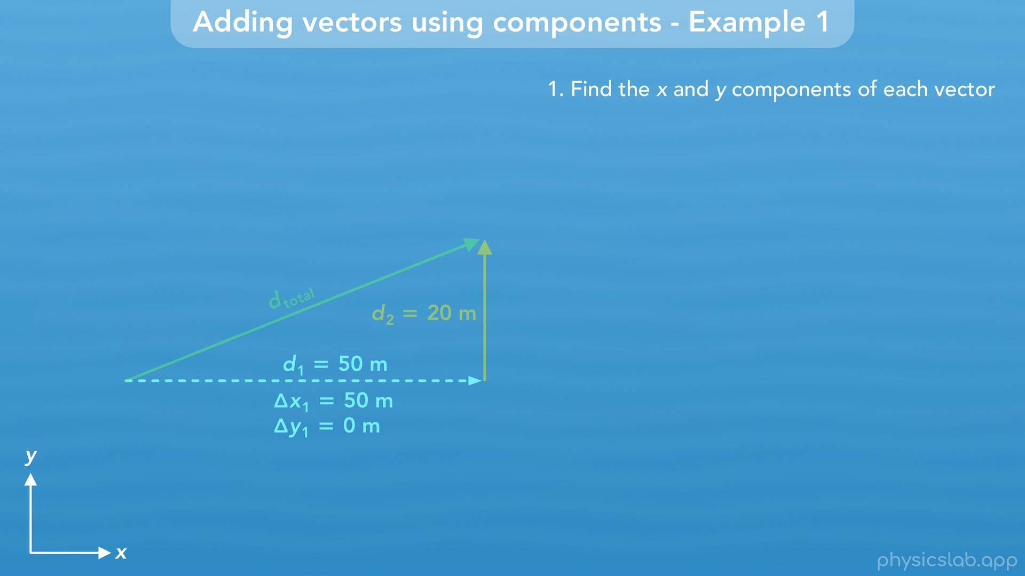
Notes:
D1 is pointing directly in the positive x direction, so delta x1, the x component of d1, would be 50 m, the same as the vector itself. D1 doesn’t have a y component because it’s parallel to the x axis, so delta y1 would be 0.

Slide 23
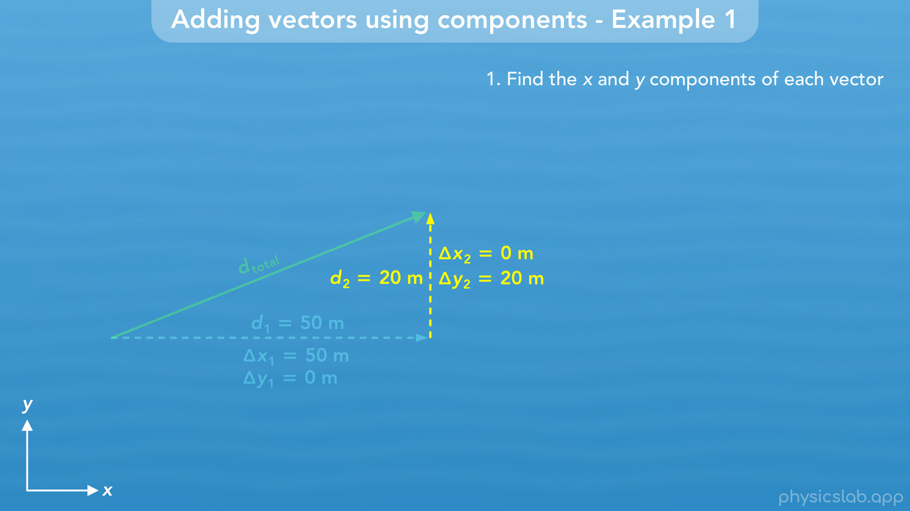
Notes:
D2 is pointing in the y direction, so delta y2, the y component of d2, is 20 m. D2 doesn’t have an x component, because it’s parallel to the y axis, so delta x2 is 0.

Slide 24
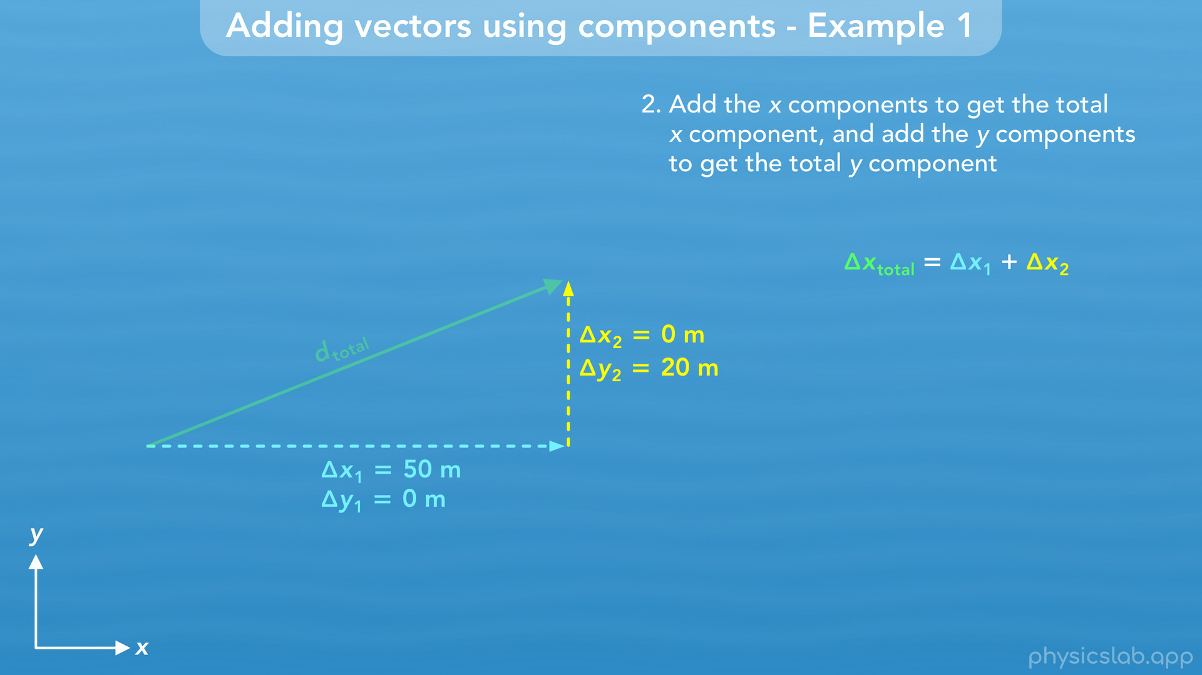
Notes:
• Now, let’s find the x and y components of d total. Delta x total would be delta x1 plus delta x2.

Slide 25
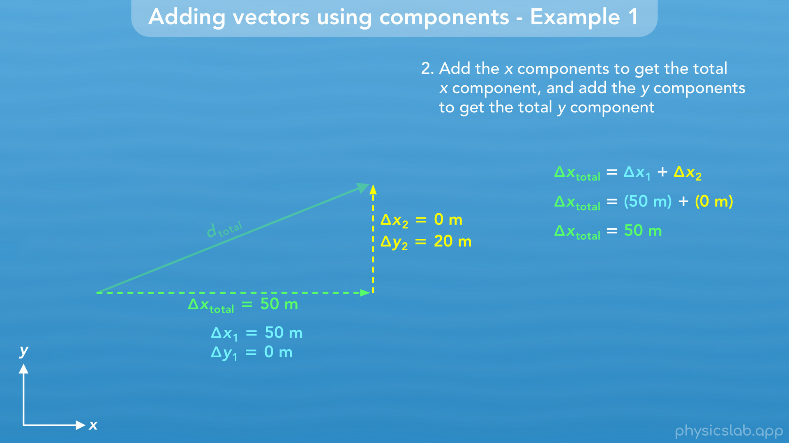
Notes:
Delta x1 is 50 m and delta x2 is 0, so delta x total is just 50 m.

Slide 26
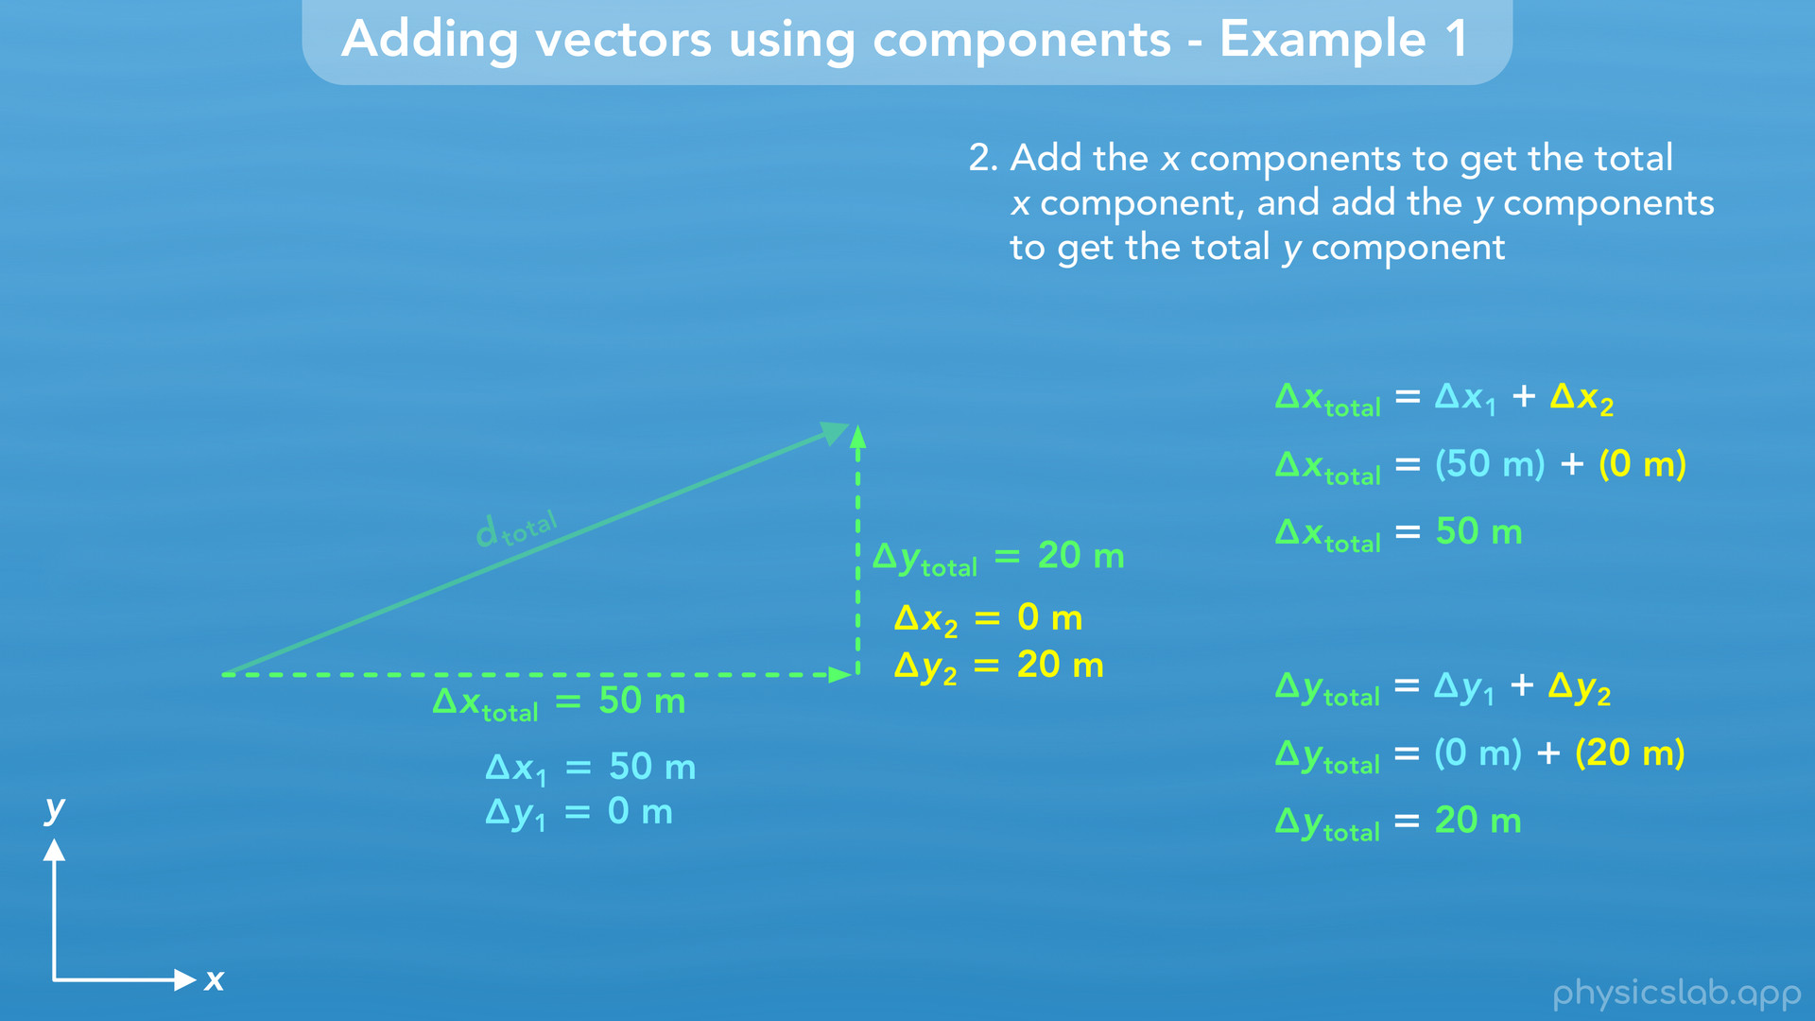
Notes:
We do the same for the y components. Delta y1 is 0, and delta y2 is 20 m, so delta y total is 20 m.
This is the simplest example of adding two vectors because each vector is one dimensional. We might have been able to see that the x component of d total is 50 m and the y component is 20 m. But it’s worth walking through the steps, and we’ll do a more complicated example next.

Slide 27
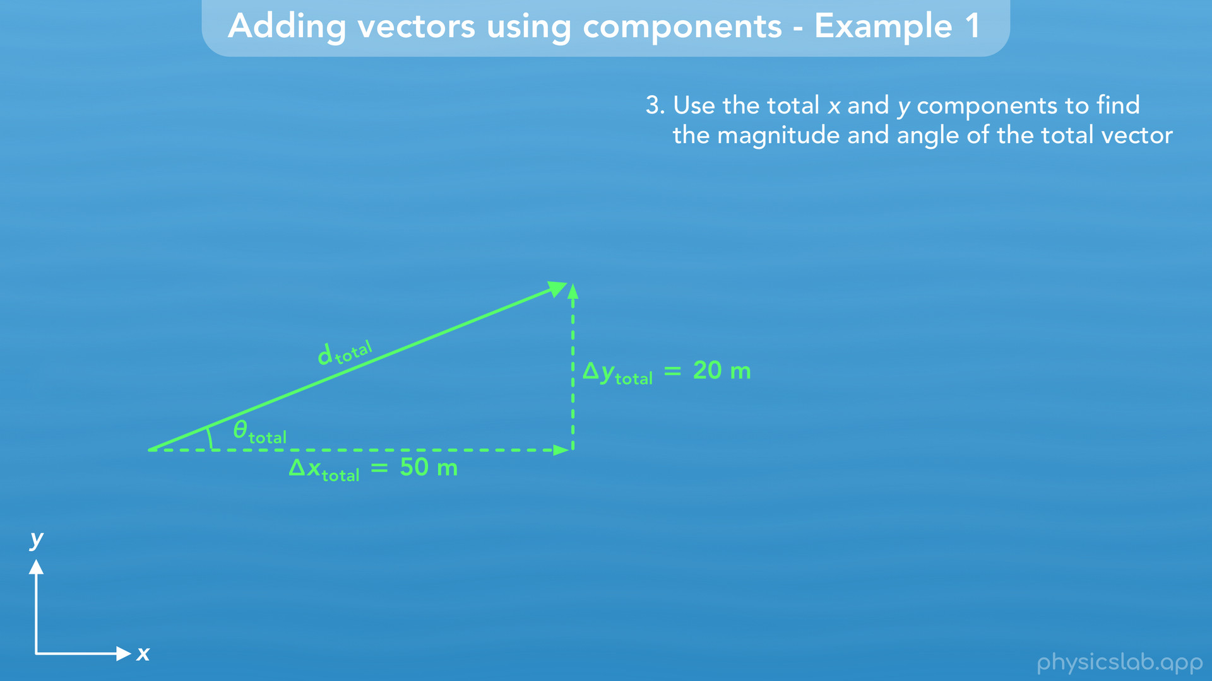
Notes:
• So now that we have the components of the total displacement vector, we can find the magnitude and the angle. Remember, the components and the vector form a right triangle, so we can use geometry and the trig functions to find what we’re looking for.

Slide 28
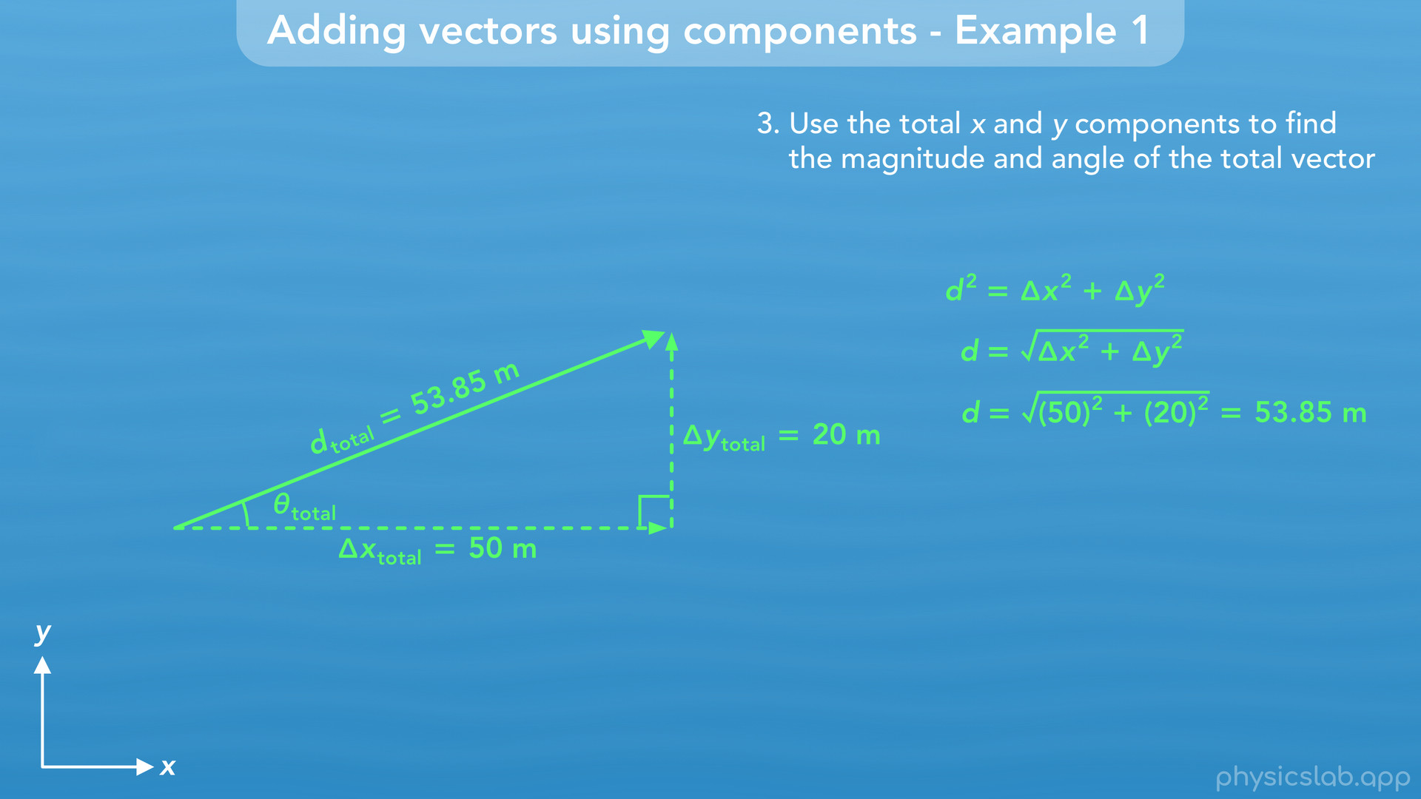
Notes:
• For the magnitude, we use the Pythagorean theorem. We’re not gonna write the total subscript to keep things easier to read. We plug in 50 for delta x and 20 for delta y, and we find that the magnitude is 53.85 m.

Slide 29
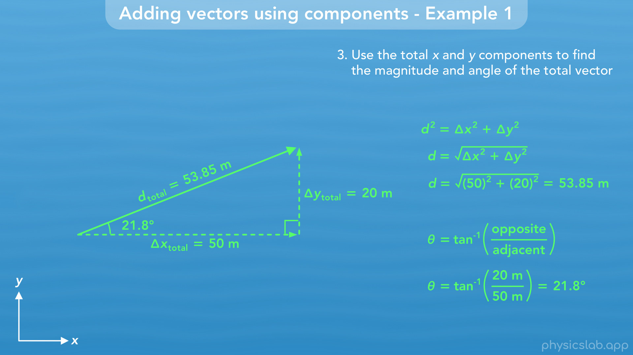
Notes:
• For the angle, we use the inverse tangent function. If we wanna find this angle, then we plug in 20 for delta y which is the opposite side, and 50 for delta x which is the adjacent side. That gives us 21.8 degrees for this angle.

Slide 30
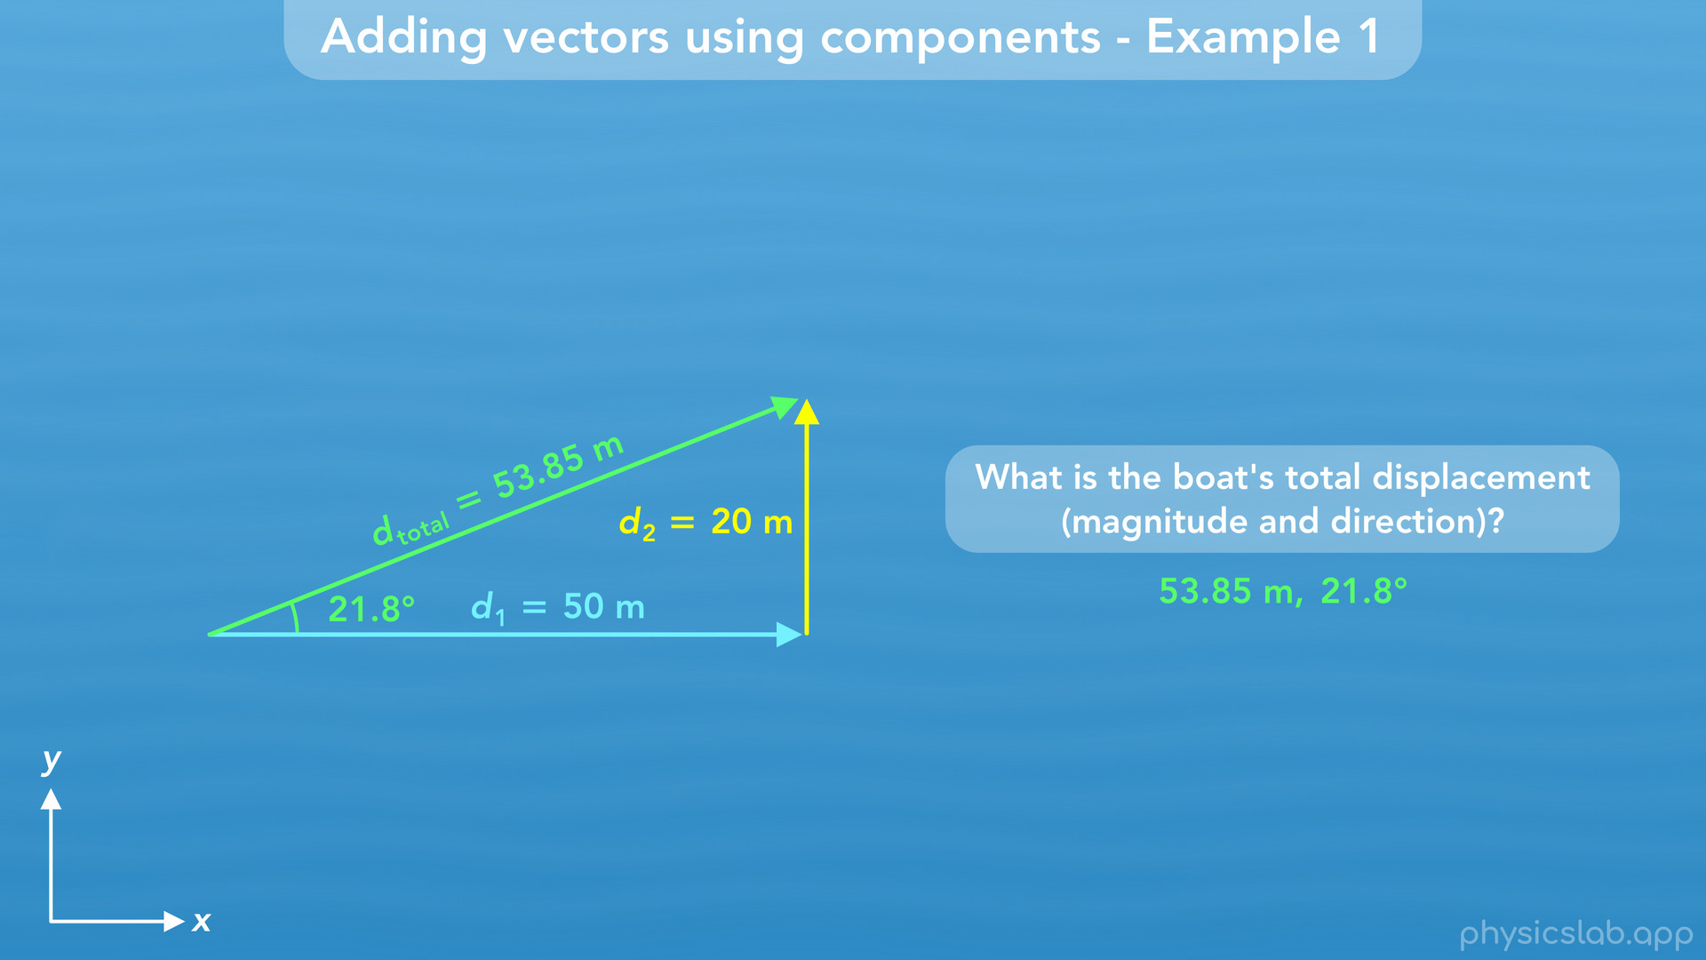
Notes:
• So the boat travelled along displacement 1 and displacement 2, and it’s total displacement was 53.85 m at an angle of 21.8 degrees.

Slide 31
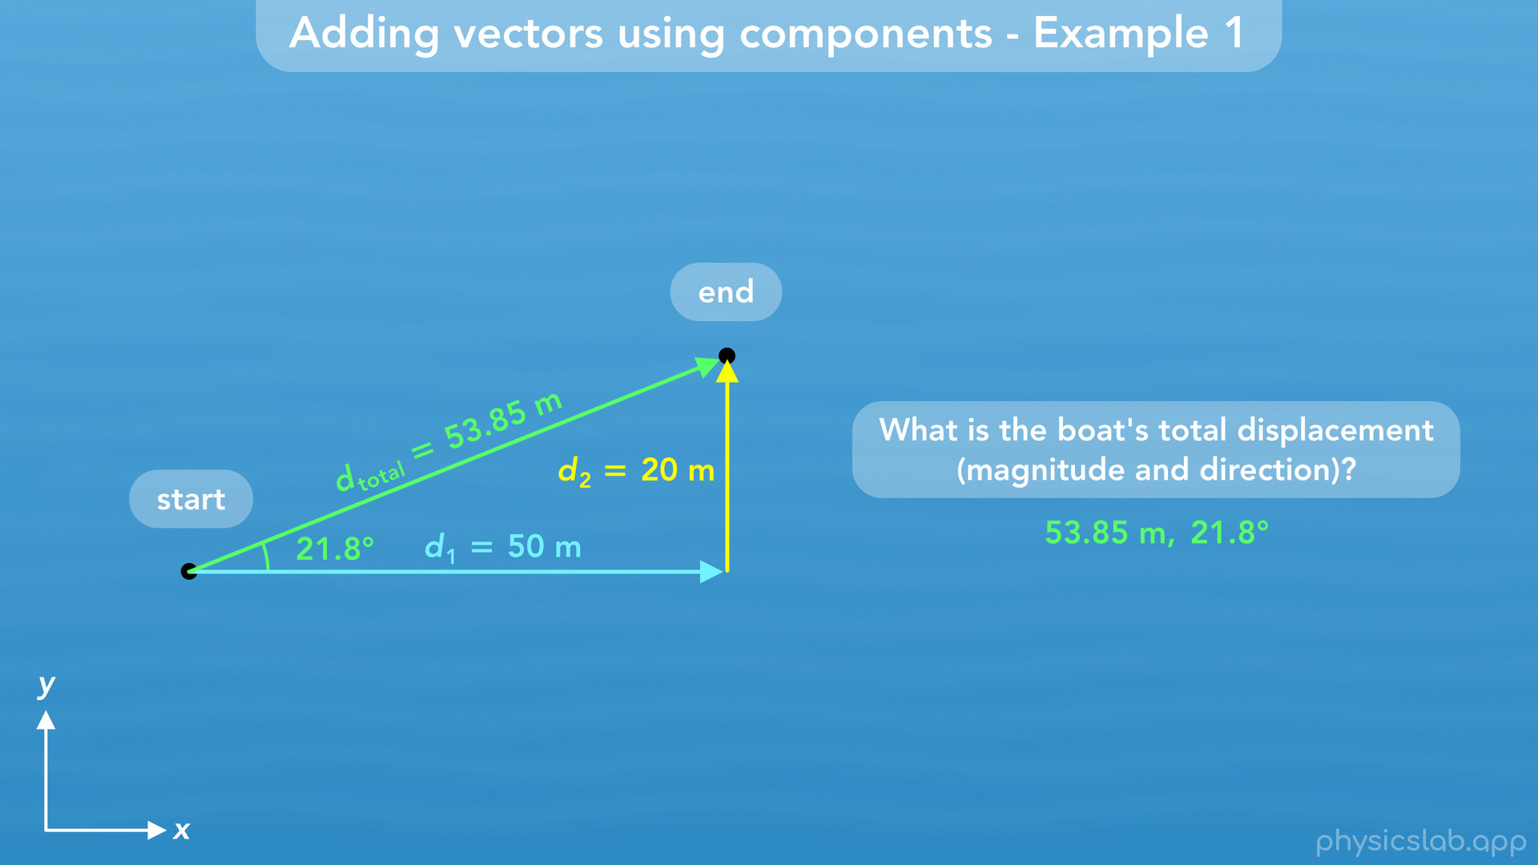
Notes:
53.85 m is the straight line distance between the start point and end point.

Slide 32
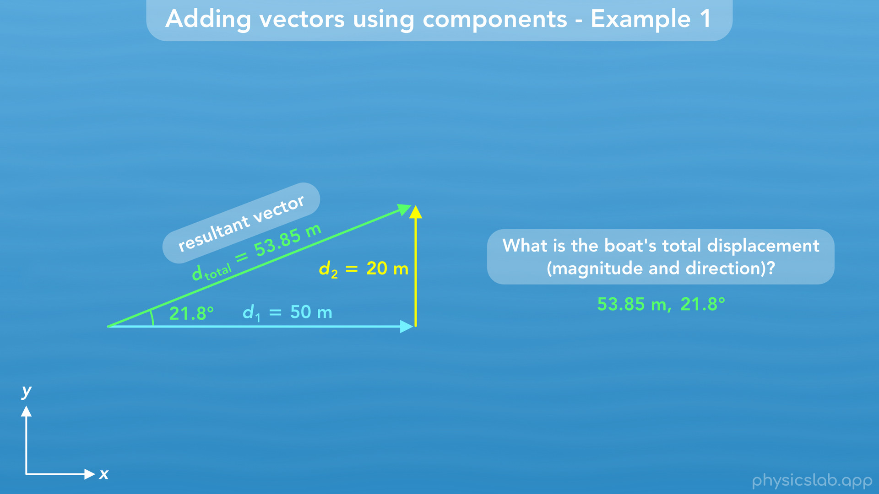
Notes:
• So that’s how we add one dimensional vectors to find a total vector, or a resultant vector.

Slide 33
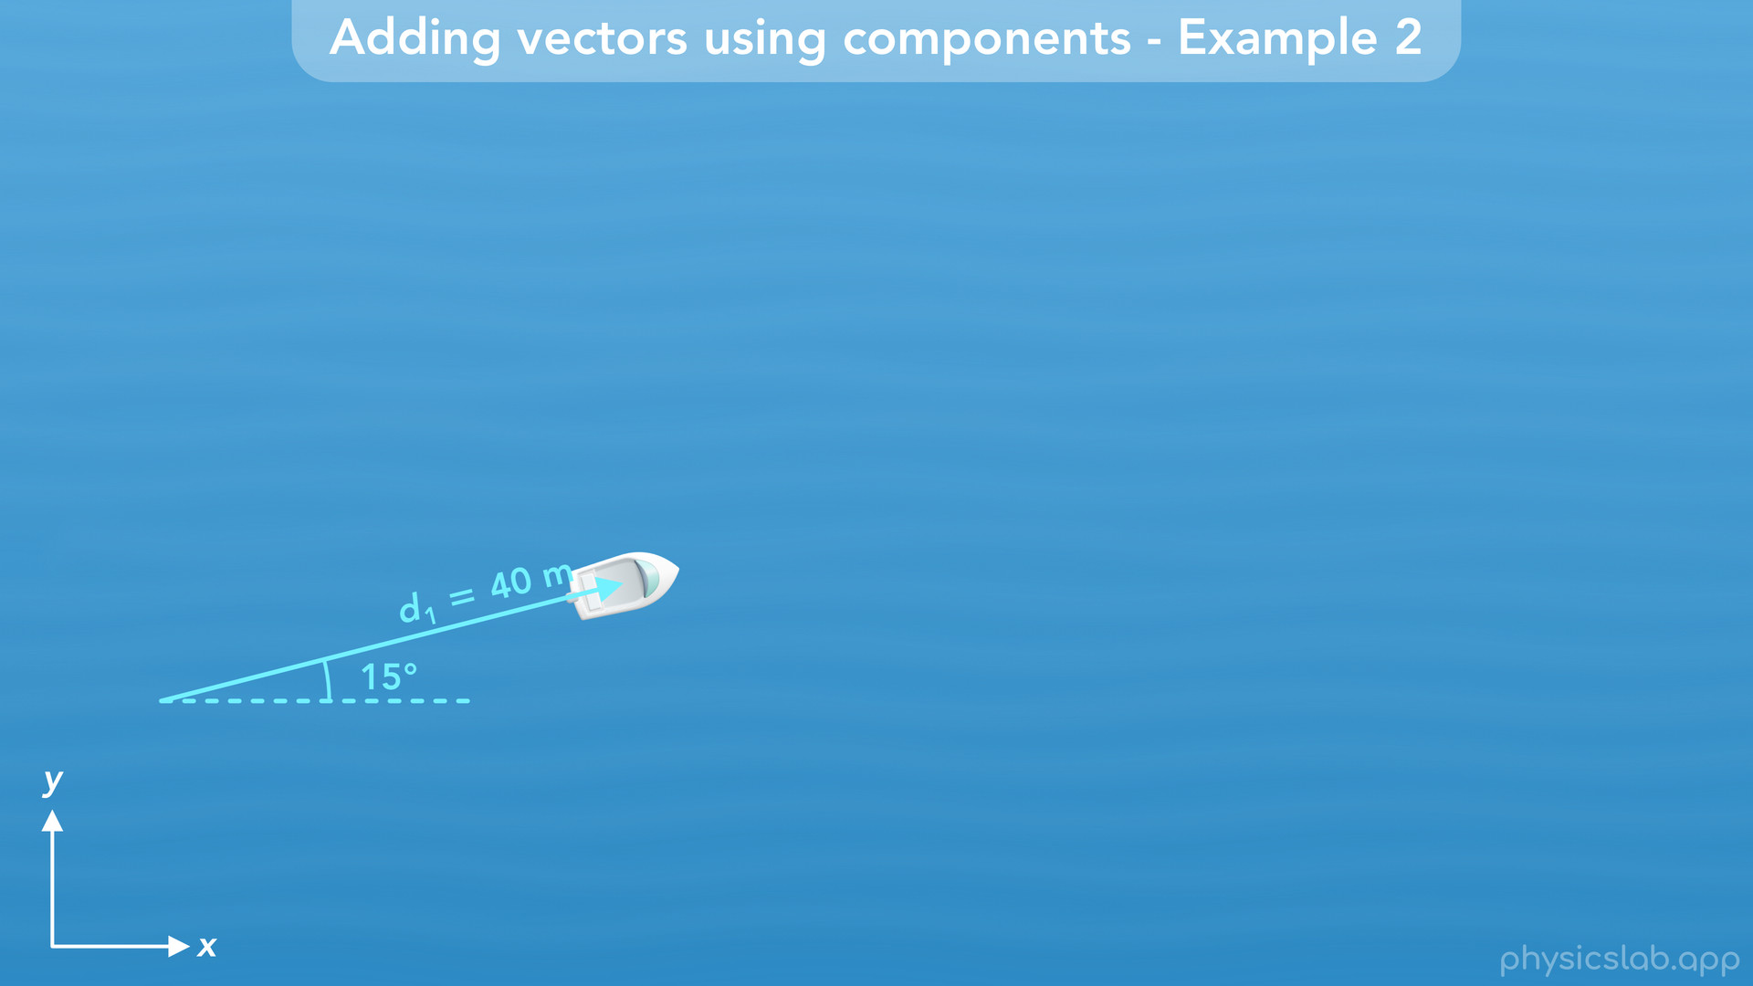
Notes:
• Now let’s do another example and see how we add two dimensional vectors.
• This time, the boat travels 40 m at an angle of 15 degrees

Slide 34
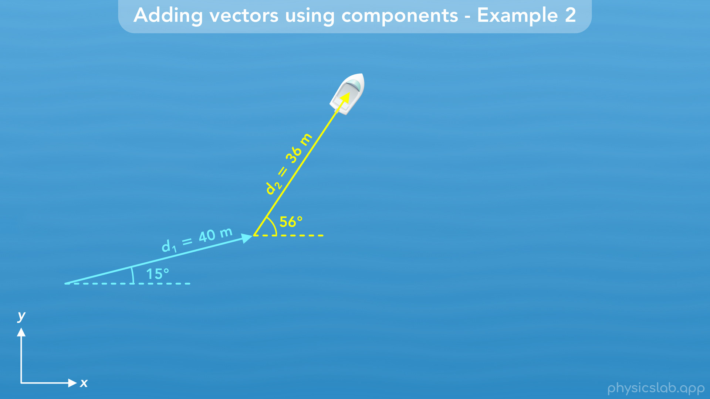
Notes:
and then it travels 36 m at an angle of 56 degrees.

Slide 35
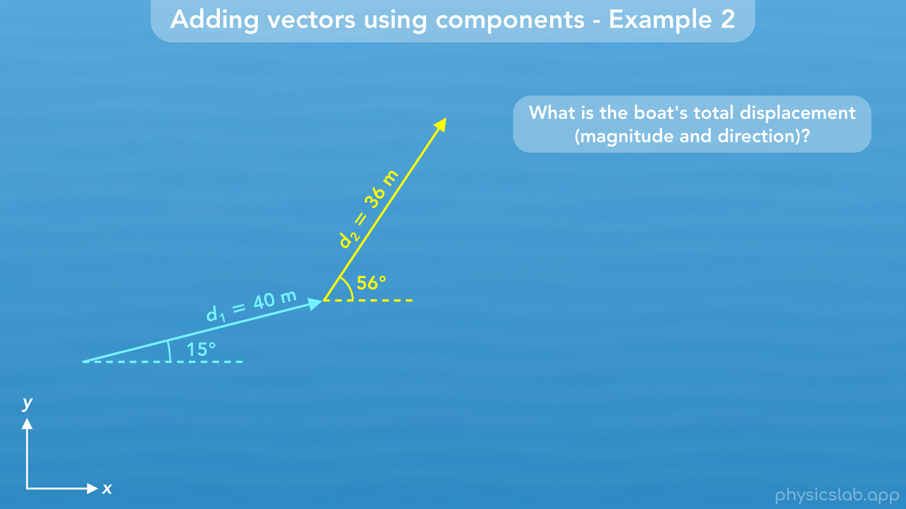
Notes:
What is the boat’s total displacement?

Slide 36
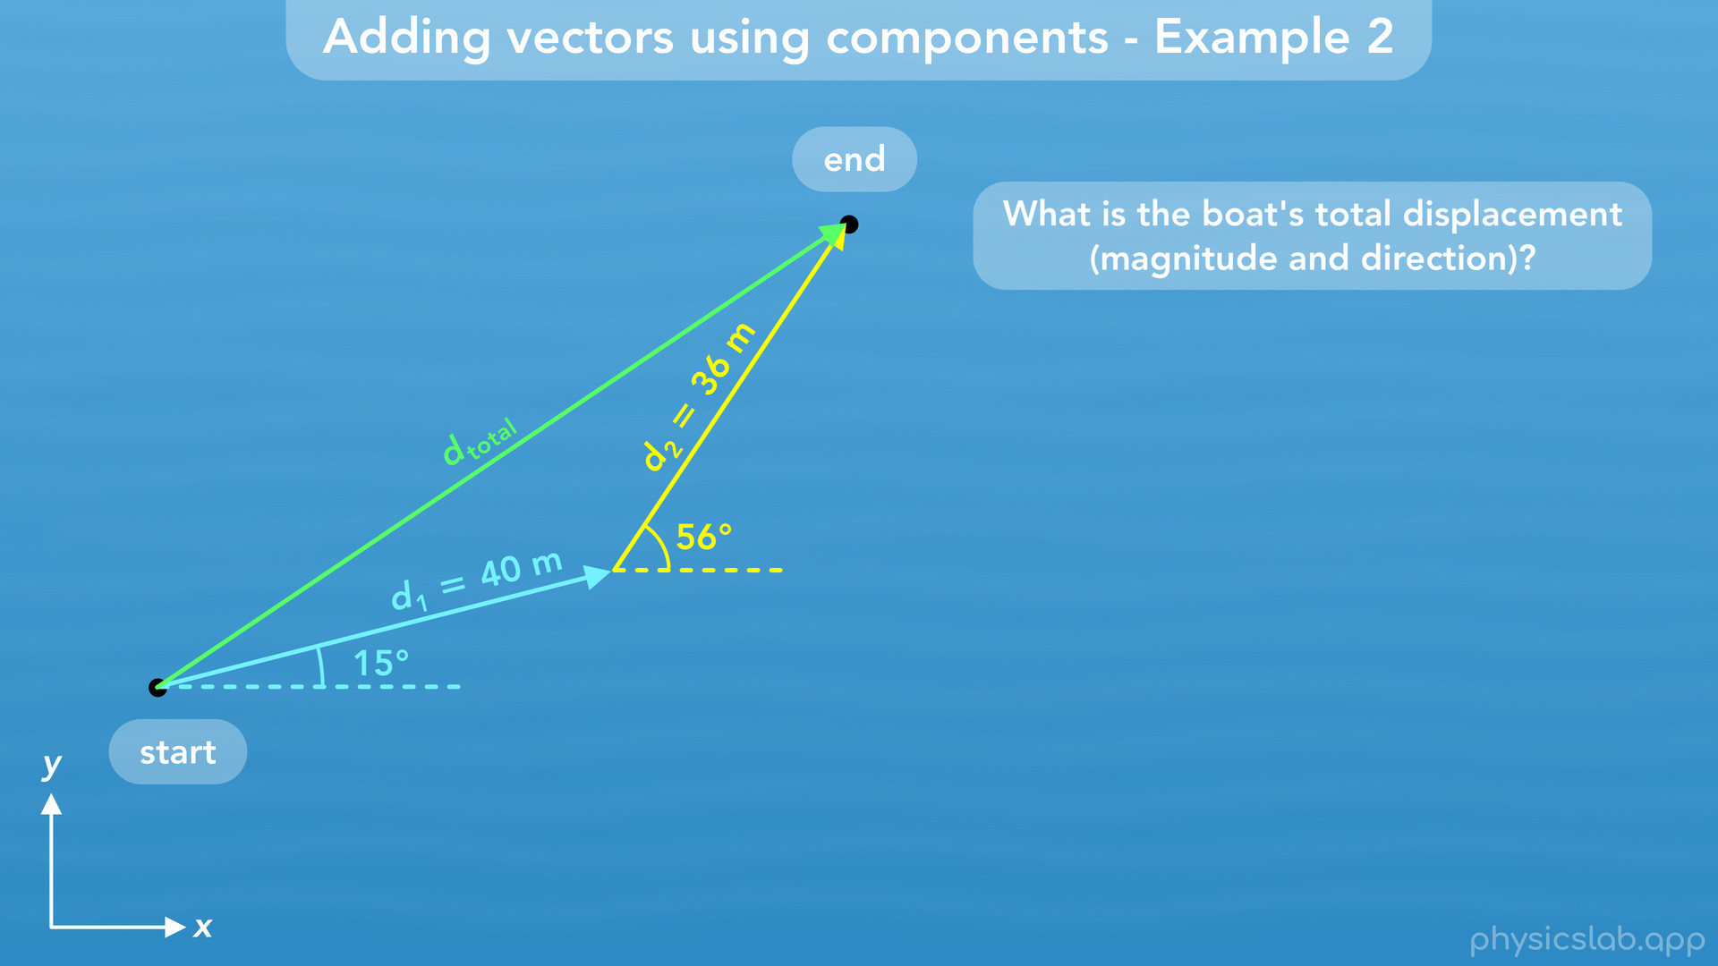
Notes:
• Like before, the total displacement vector starts at the beginning of the first vector d1 and ends at the end of the second vector d2. So it points from the boat’s start position to the end position.

Slide 37
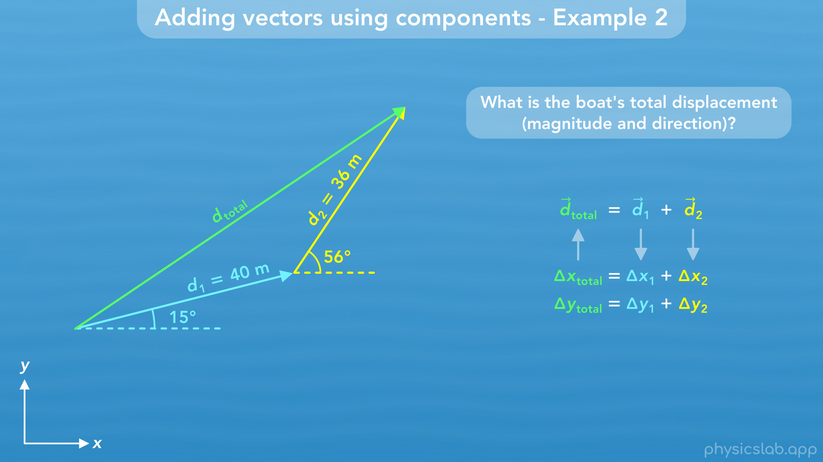
Notes:
• To find d total, we need to find its x and y components. This time, d1 and d2 are both two dimensional vectors, so they each have x and y components. Again, the total x component will be delta x1 plus delta x2, and the total y component will be delta y1 plus delta y2.

Slide 38
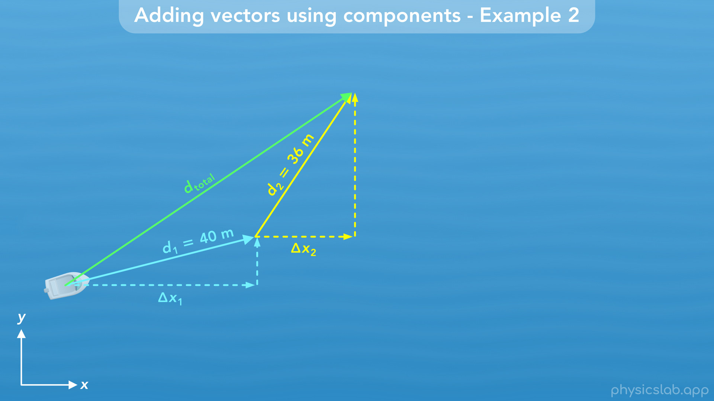
Notes:
Hopefully this makes sense.

Slide 39
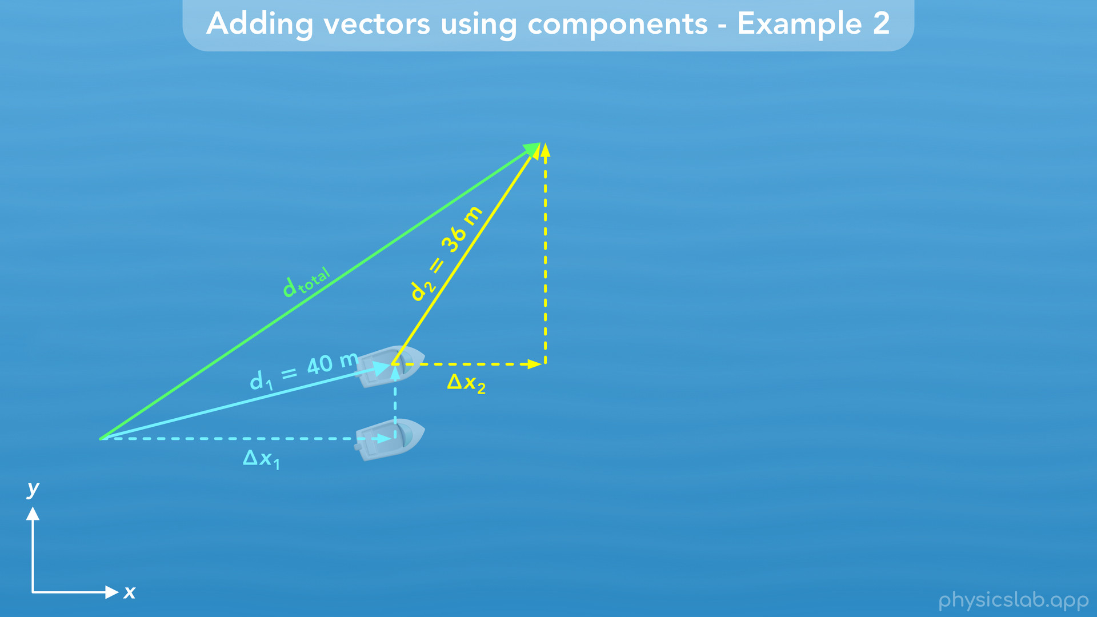
Notes:
First, the boat moves to the right a displacement of delta x1.

Slide 40
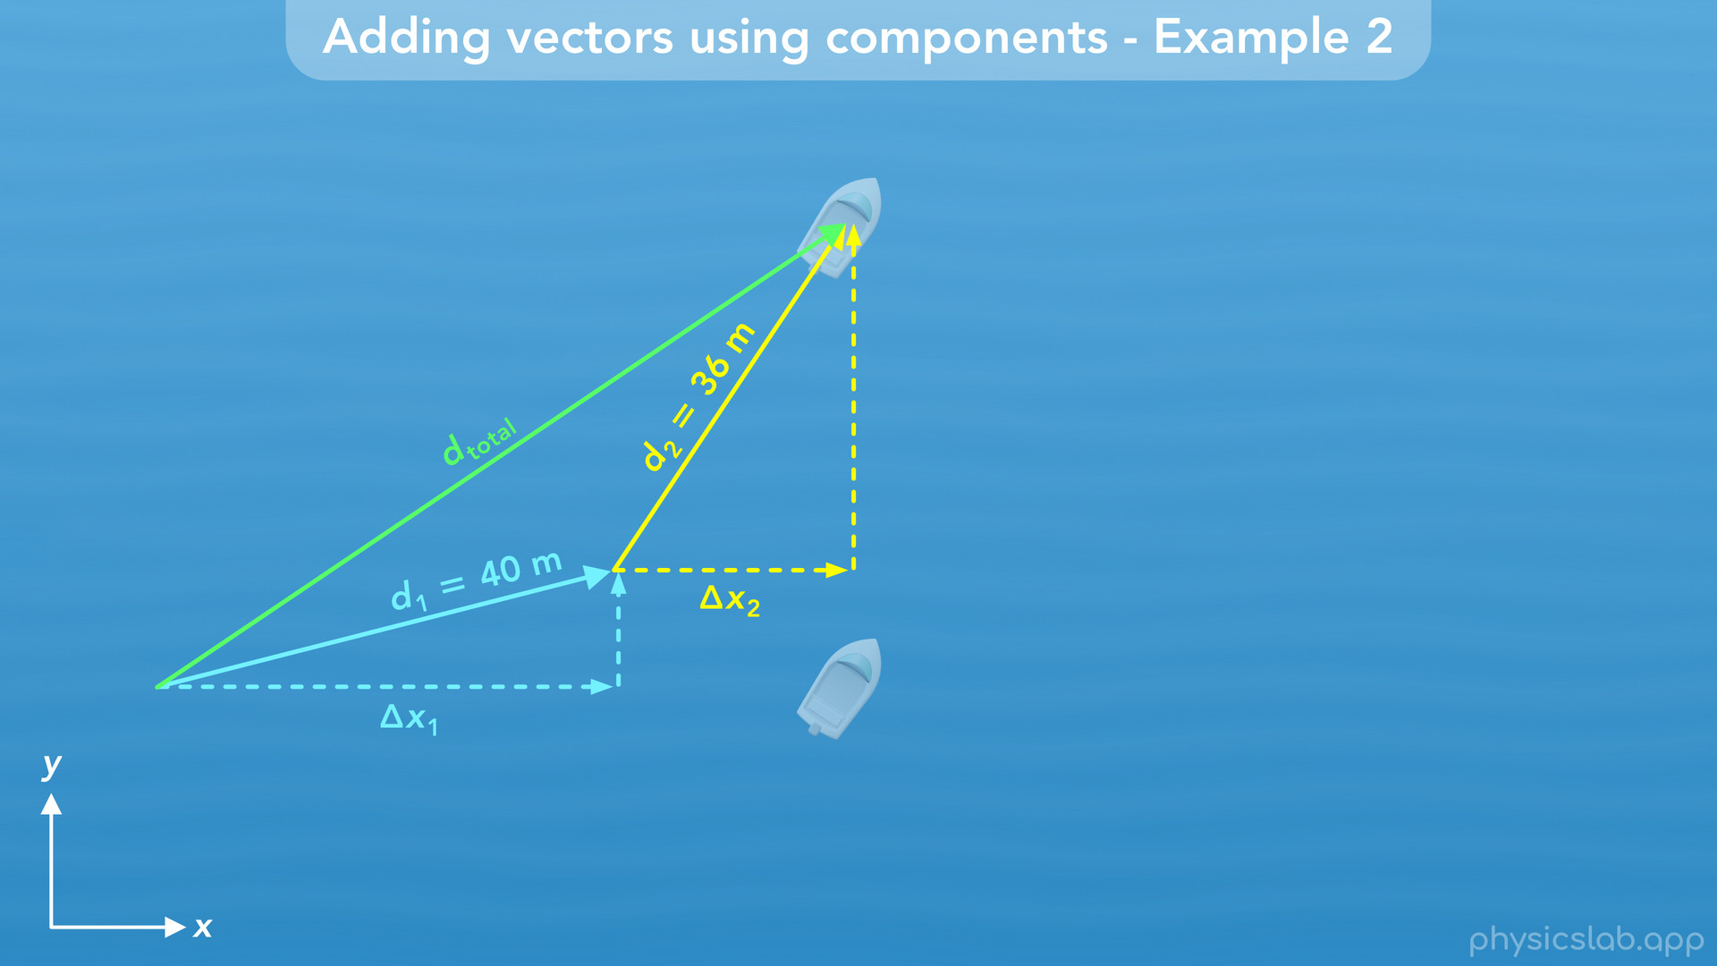
Notes:
Then it moves to the right again a displacement of delta x2.

Slide 41
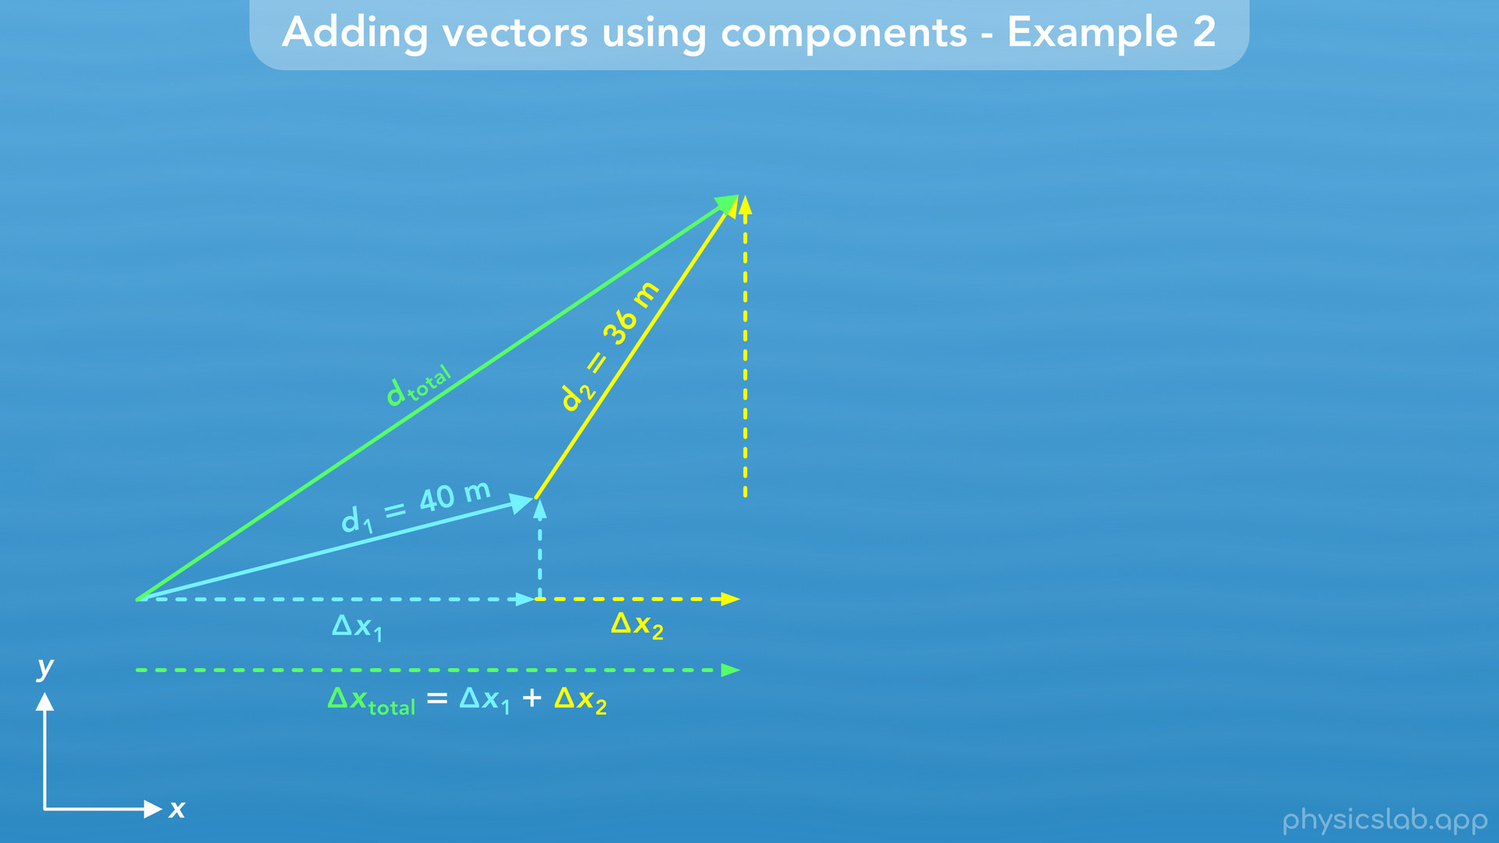
Notes:
So it’s total displacement to the right, in the x direction, is the sum of those two displacements, delta x1 plus delta x2.

Slide 42
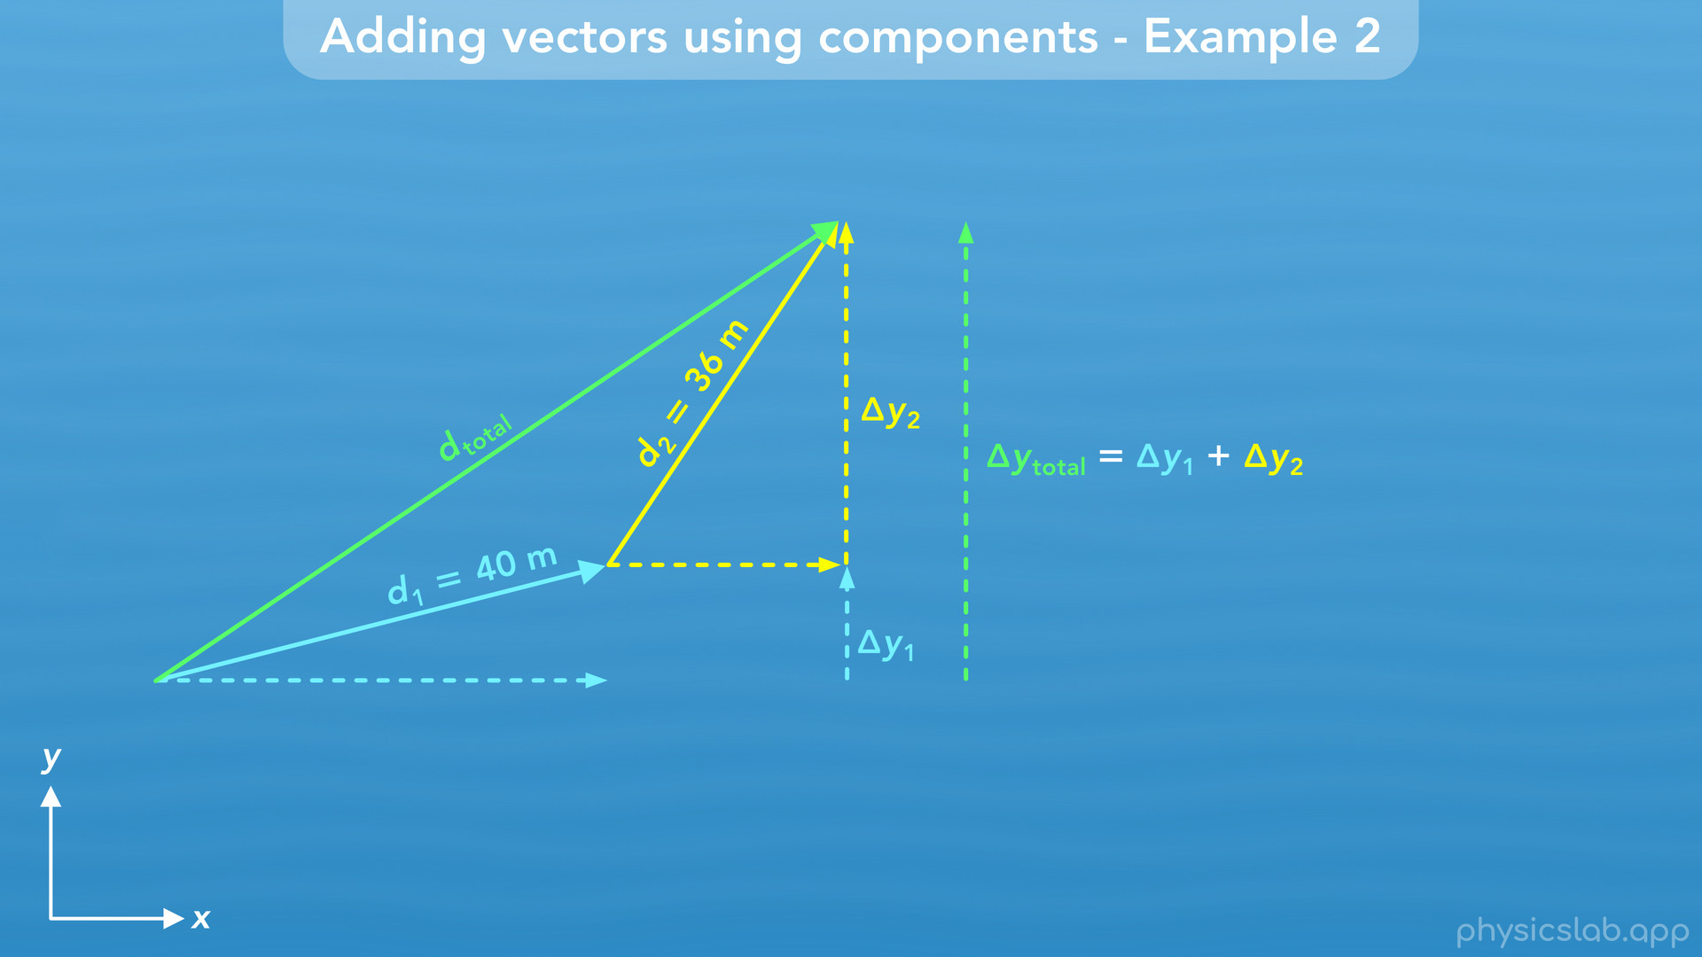
Notes:
And the same thing is true for the y direction. The boat moves up delta y1, then it moves up again delta y2, so overall, it moves up a total of delta y1 plus delta y2.

Slide 43
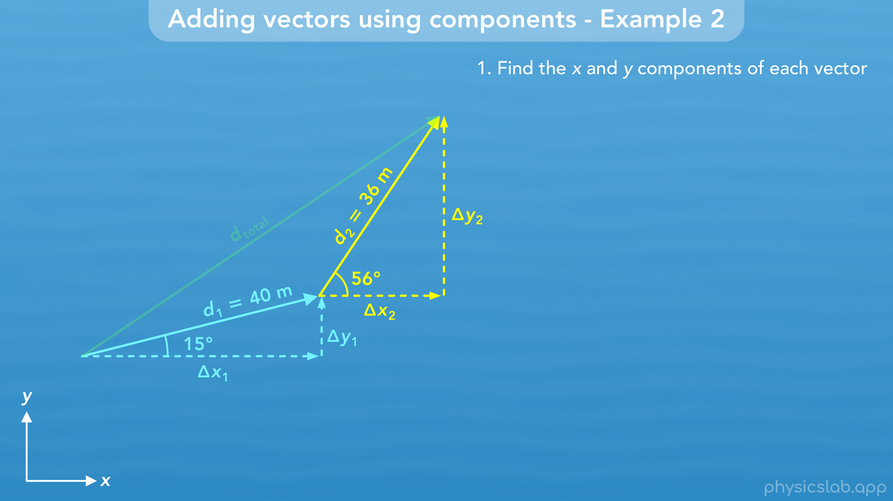
Notes:
• So let’s find the components of d1 and d2, starting with d1.

Slide 44
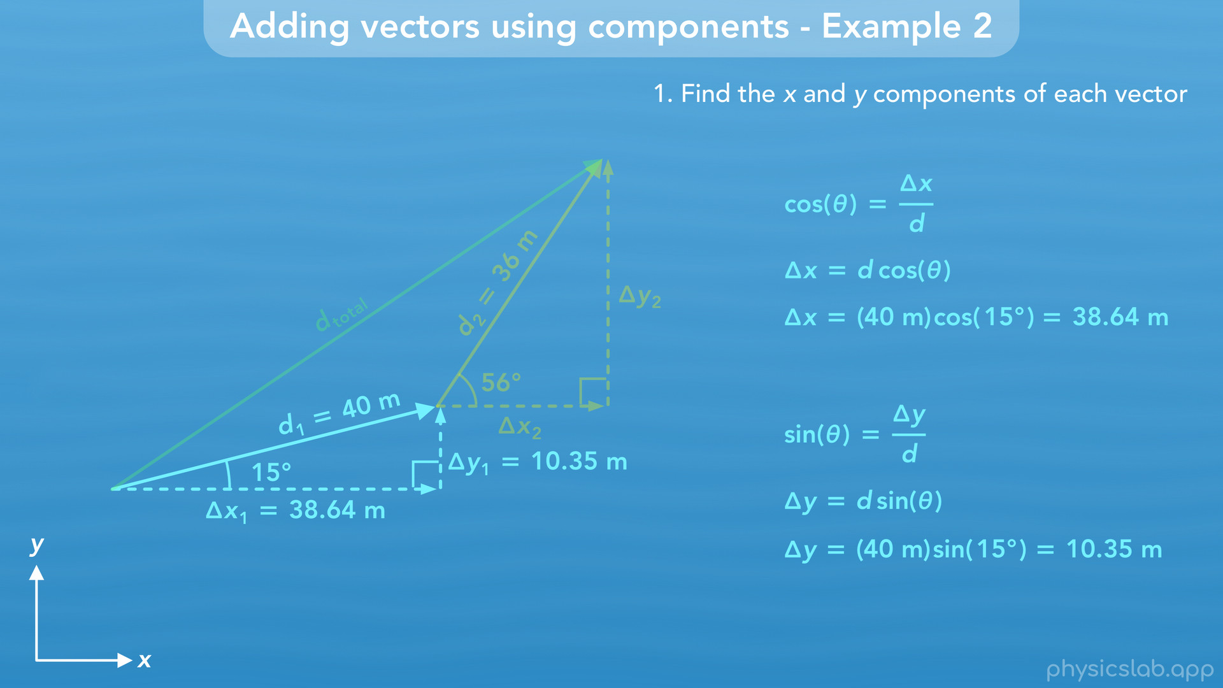
Notes:
• We’re gonna move quickly through the math since we’ve done this a few times, but feel free to pause and check the math if you’re not sure about one of the steps. Remember, components form a right triangle with a vector, so we use the right triangle trig functions to find the components.
• Delta x is adjacent to the 15 degree angle, so delta x equals d times the cosine of theta. We plug in 40 m for d and 15 degrees for theta, and we get 38.64 m for delta x. Delta y is opposite from the 15 degree angle, so delta y is d times the sine of theta. Again we plug in 40 m for d and 15 degrees for theta, and we get delta y is 10.35 m. So those are the x and y components of the first vector, d1.

Slide 45
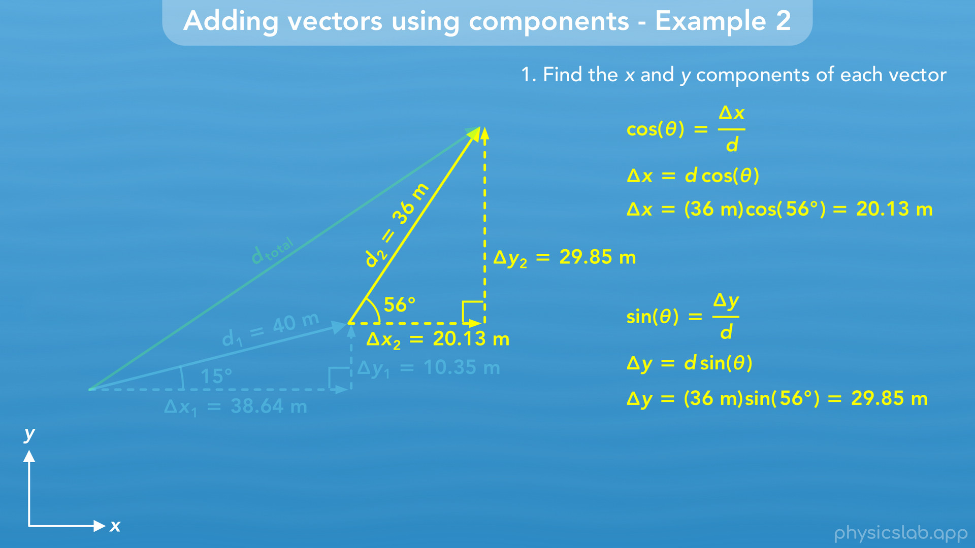
Notes:
• Now let’s move on to d2. Delta x is d times the cosine of theta. Now we plug in 36 m for d and 56 degrees for theta. When we do that, we get 20.13 m for delta x. Delta y is d times the sine of theta. When we plug in the numbers, we get 29.85 m for delta y. Those are the x and y components of the second vector, d2.

Slide 46
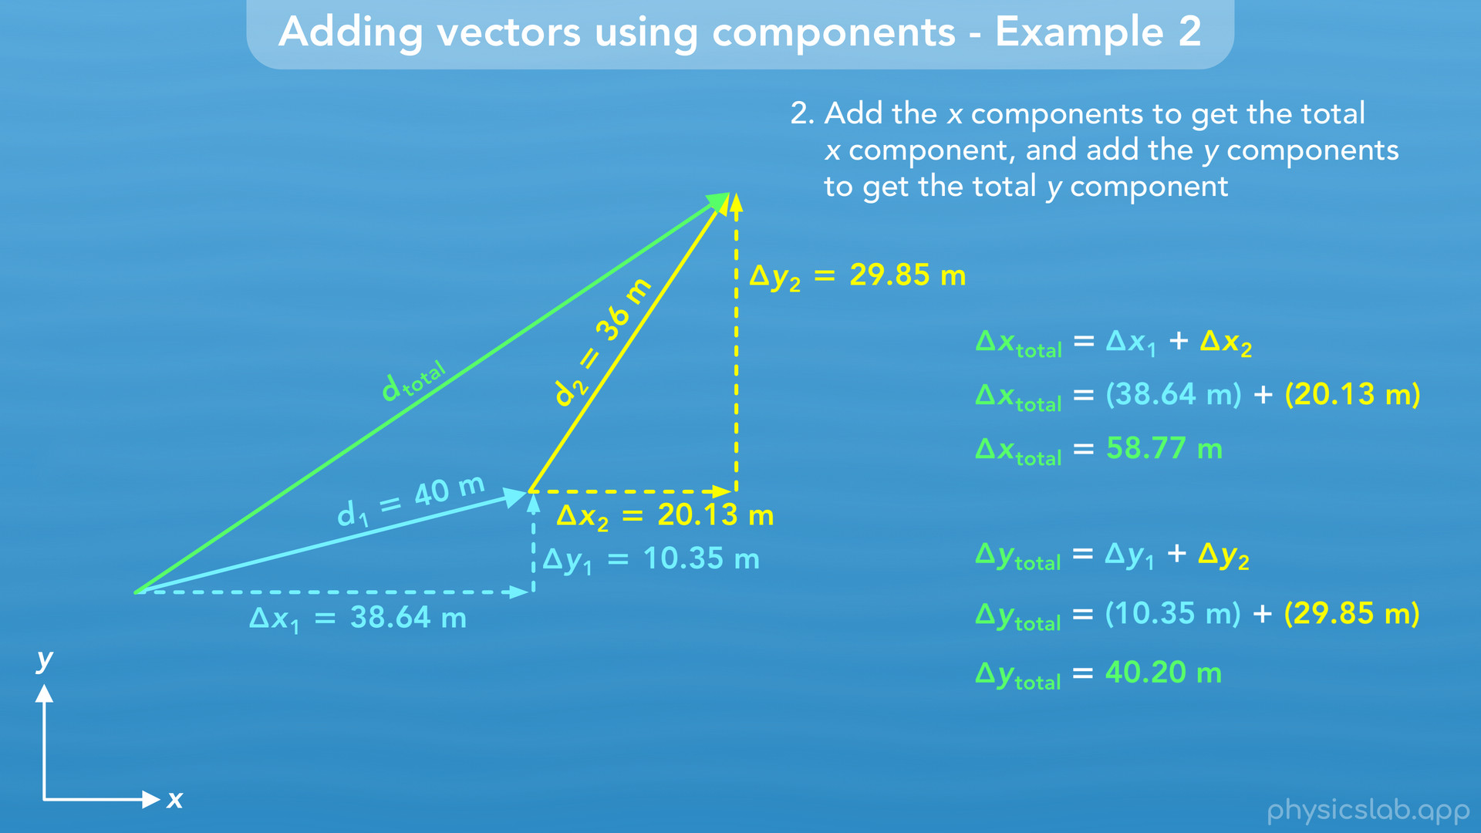
Notes:
• Now we wanna find the components of d total. The x component, delta x total, would be delta x1 plus delta x2. That’s 38.64 m plus 20.13 m, so delta x total is 58.77 m. The y component would be delta y1 plus delta y2, which is 10.35 m plus 29.85 m, so delta y total is 40.20 m.

Slide 47
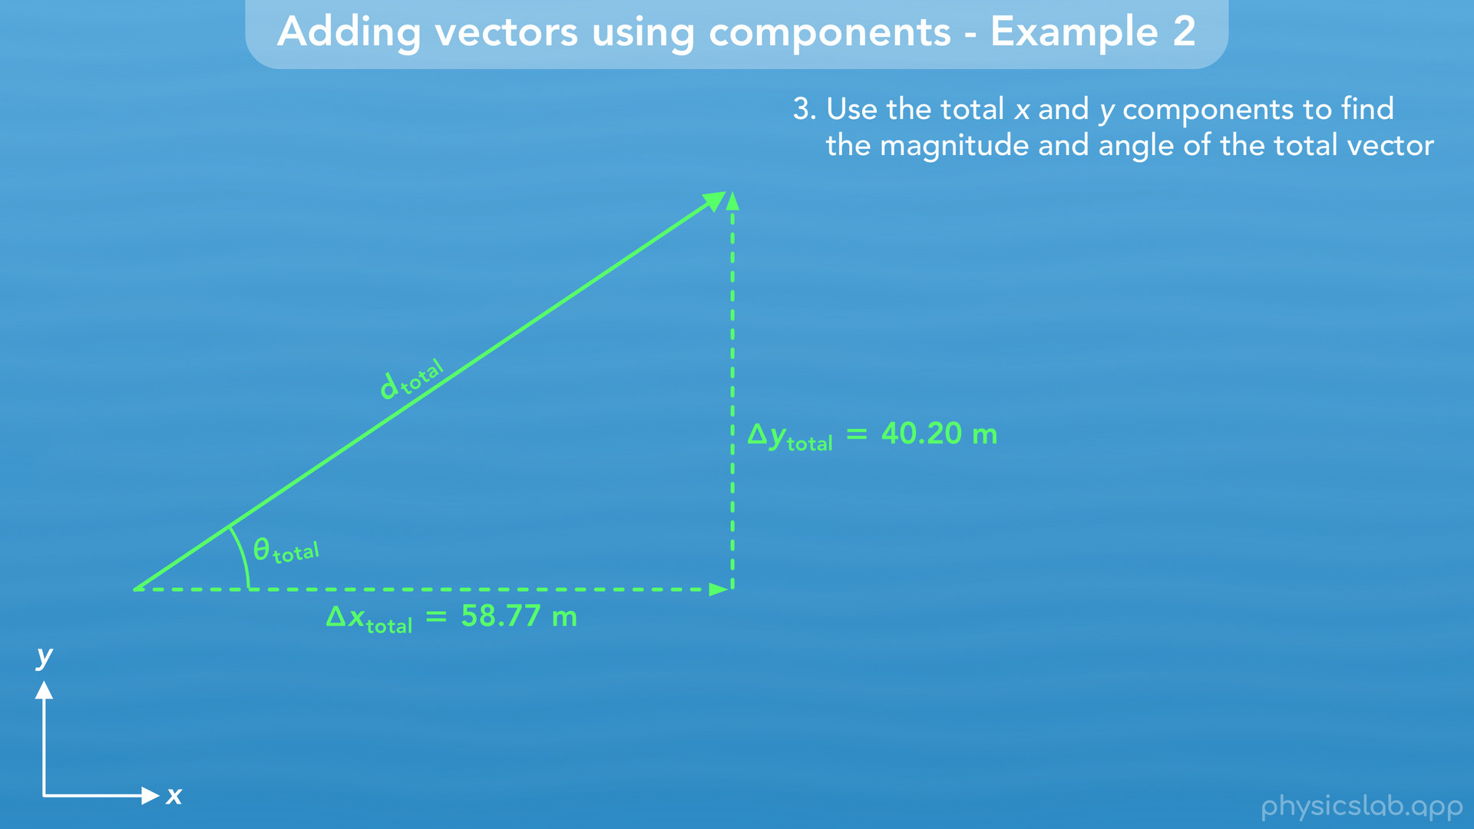
Notes:
• Now that we have the components of the total displacement vector, we can find its magnitude and angle.

Slide 48
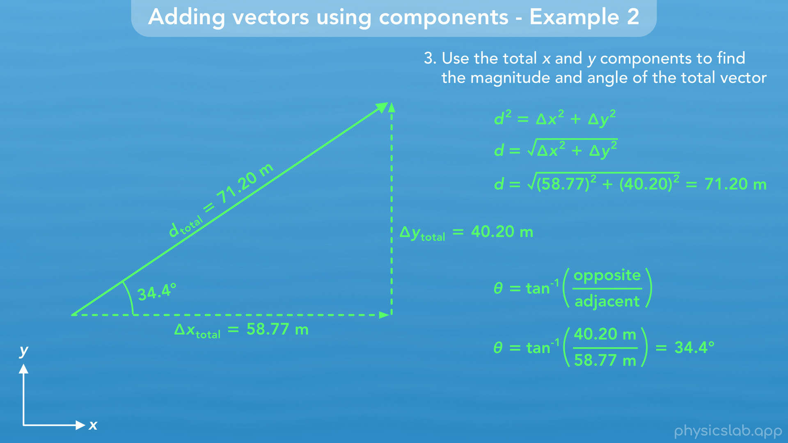
Notes:
Using the Pythagorean theorem for the magnitude, we plug in 58.77 m for delta x and 40.20 m for delta y. That gives us 71.20 m for the magnitude. To find this angle, we use the inverse tangent function, and we plug in 40.20 for the opposite side, delta y, and 58.77 for the adjacent side, delta x. That gives us 34.4 degrees for this angle.

Slide 49
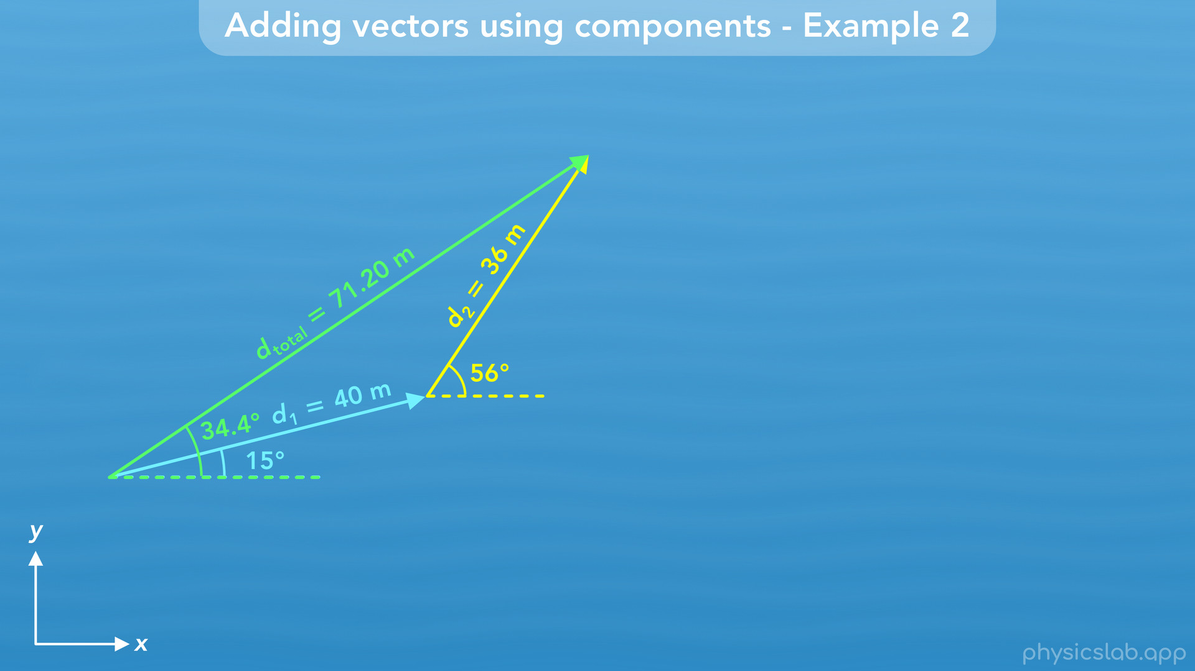

Slide 50
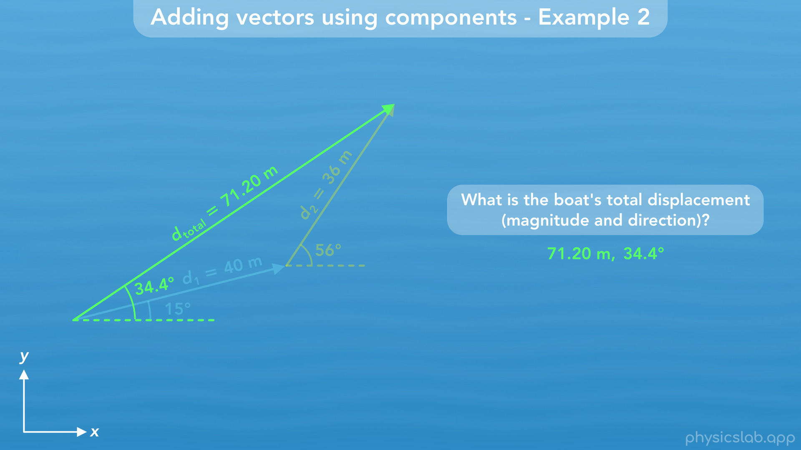
Notes:
• So when the boat travelled these two displacements, d1 and d2, the boat’s total displacement was 71.20 m at an angle of 34.4 degrees.

Slide 51
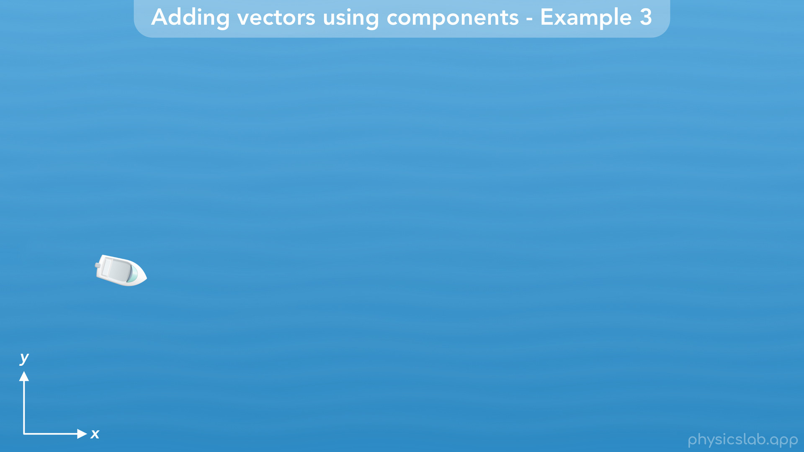
Notes:
• Now let’s look at one more example that involves negative components.

Slide 52
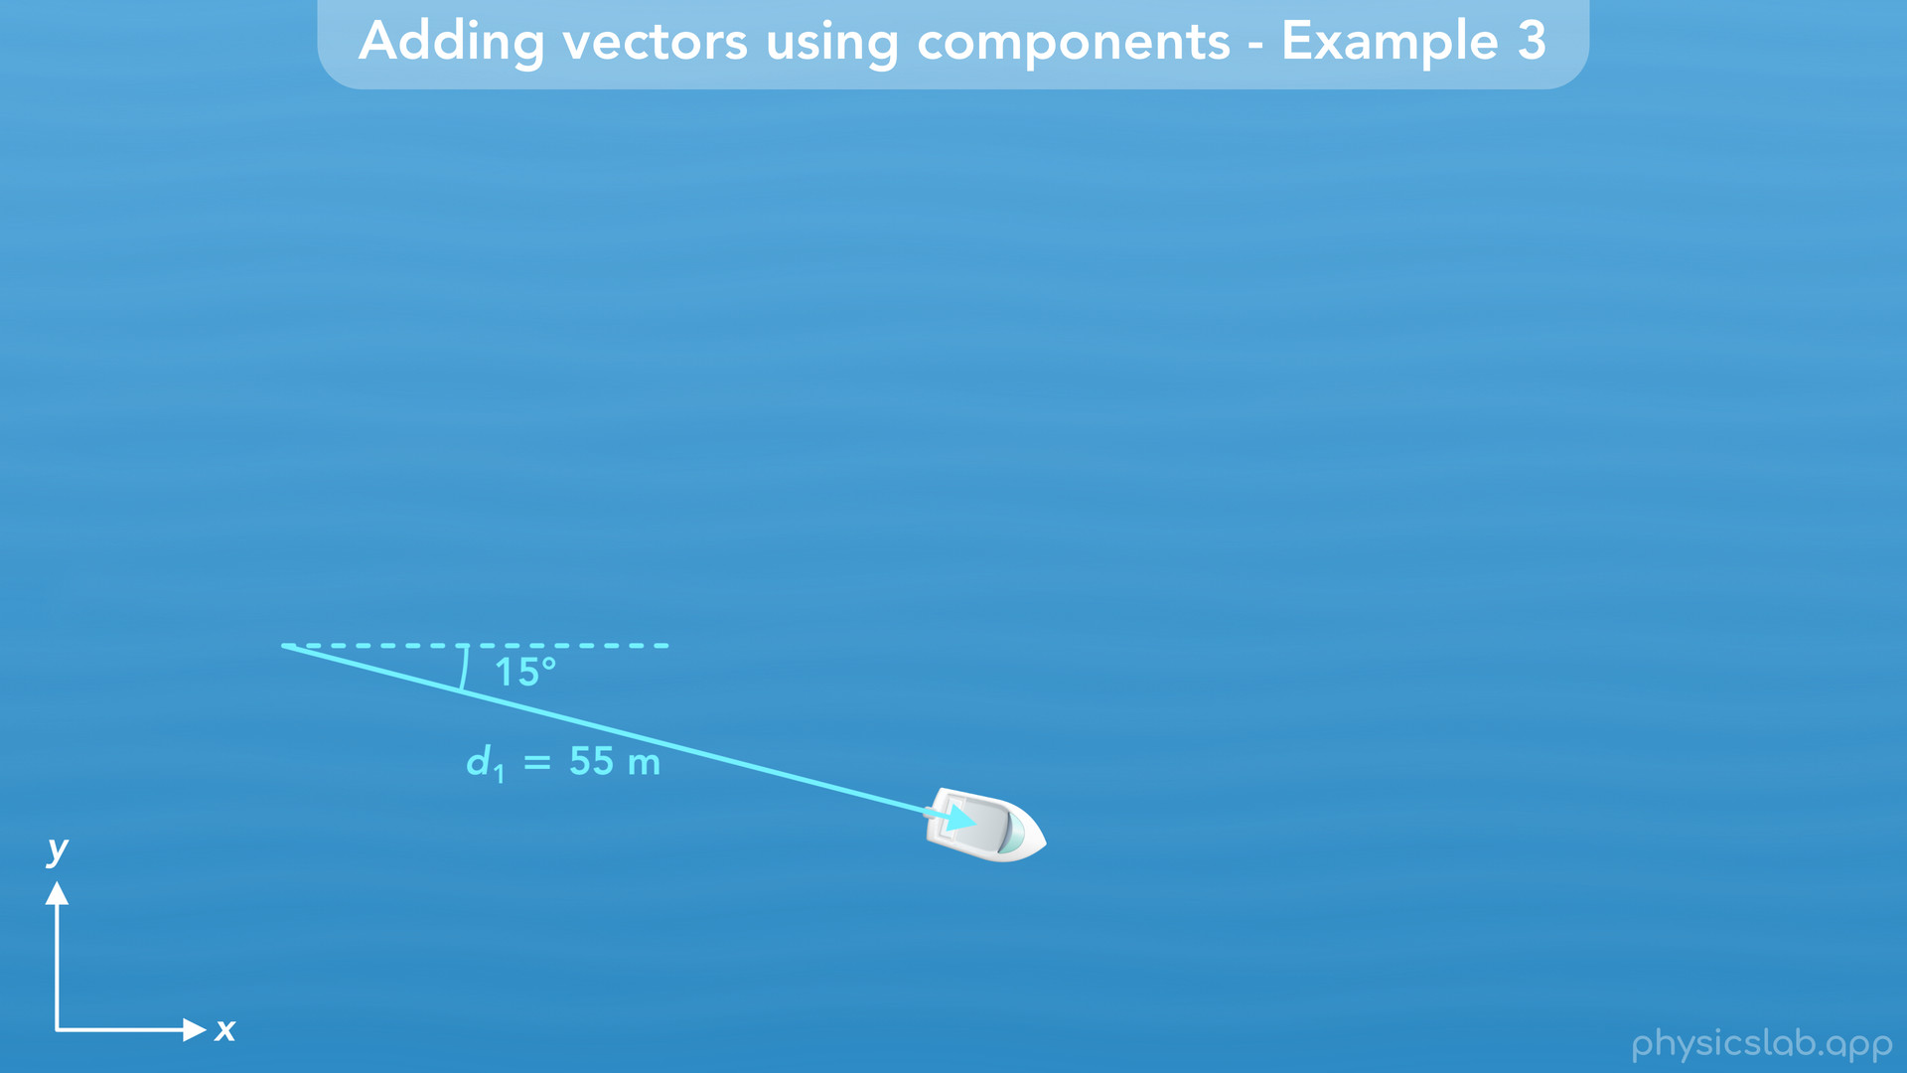
Notes:
• First, the boat travels 55 m in this direction

Slide 53
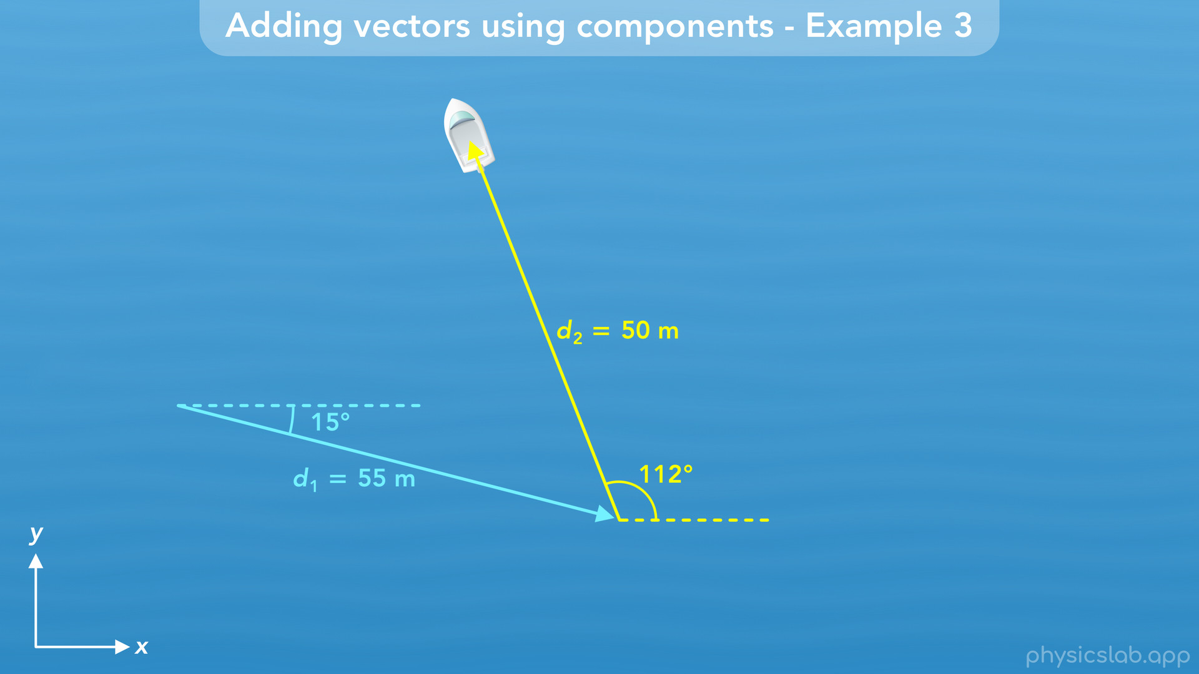
Notes:
and then 50 m in this direction.

Slide 54

Notes:
What is the magnitude and angle of the total displacement vector?

Slide 55

Notes:
• The first vector, d1, has a magnitude of 55 m. But this time, it’s at an angle of 15 degrees below the positive x axis.

Slide 56

Notes:
Using the convention that we learned in a previous video, we would say it has an angle of negative 15 degrees because it’s clockwise from the positive x axis. Positive 15 degrees would be the reference angle.

Slide 57

Notes:
• The second vector, d2, has a magnitude of 50 m, and an angle of 112 degrees.

Slide 58

Notes:
The reference angle would be 68 degrees between the vector and the x axis.

Slide 59

Notes:
• So what do the components look like? There’s a lot of stuff overlapping each other in this example, so we’re not gonna look at everything at once. And we should probably keep track of the numbers on the side. This might look confusing, but everything works the same as before.

Slide 60

Notes:
• D1 has x and y components…

Slide 61

Notes:
d2 has x and y components…

Slide 62

Notes:
and d total has x and y components.

Slide 63

Notes:
• We’re still going to add delta x1 plus delta x2 to get delta x total.

Slide 64

Notes:
• And we still add delta y1 plus delta y2 to get delta y total. These might look confusing because they’re in different directions, but we’ll explain that as we work through the example.

Slide 65

Notes:
• So first we need to find the components of d1 and d2.
• Let’s start with d1. Now that we’re dealing with negative components, there’s two ways we can do this, which we talked about in a previous video.
• The first method is to use the reference angle between the vector and the x axis, which is positive 15 degrees. The x component is still d times the cosine of this angle, so we plug in 55 m for d and 15 degrees for theta, and we get 53.13 m for delta x. Now we need to check if the component is positive or negative. Since it’s pointing to the right, in the positive x direction, delta x is positive 53.13 m.
• The y component is 55 m times the sine of 15 degrees, which is 14.24 m. But we can see that the y component is pointing down, in the negative y direction, so delta y is actually negative 14.24 m.

Slide 66

Notes:
• The other way we can do this is by using the conventional way of describing angles. We measure a vector’s angle relative to the positive x axis. Counterclockwise angles are positive and clockwise angles are negative. If it helps, you can draw the vector at the origin of the x and y axes to get a better picture of the angle between the vector and the positive x axis. This vector is 15 degrees clockwise from the positive x axis, so it’s angle would be negative 15 degrees.
• If we plug negative 15 degrees into the sine and cosine functions, then we still get positive 53.13 m for delta x. But now the sine function gives us negative 14.24 m for delta y. So if we use this method and plug in the conventional angle, the positive and negative components are taken care of.

Slide 67

Notes:
• Let’s save these values for later, and find the components of the second vector, d2. This vector has an angle of 112 degrees, and the reference angle is 68 degrees.

Slide 68

Notes:
• Let’s use the 68 degrees first. The x component would be 50 m times the cosine of 68 degrees, which is 18.73 m. But the x component is pointing in the negative x direction, so delta x would be negative 18.73 m.
• The y component is 50 m times the sine of 68 degrees, which is 46.36 m. That stays positive because the y component is pointing in the positive y direction.

Slide 69

Notes:
• Now let’s try using the conventional angle of 112 degrees counterclockwise from the positive x axis. If we plug that in, now we get negative 18.73 m for delta x, and positive 46.36 m for delta y. So those are the components of d2.

Slide 70

Notes:
• Now we need to find the components of the total displacement vector.

Slide 71

Notes:
• Delta x total equals delta x1 plus delta x2. Delta x1 is 53.13 m and delta x2 is negative 18.73 m. That gives us 34.40 m for delta x total. Notice how we’re adding the two components, but delta x2 just happens to be a negative value, so the math is the same as 53.13 minus 18.73.

Slide 72

Notes:
• When we add the components graphically, we start with delta x1, then we add delta x2, which is negative and points to the left. So the sum of the two components, delta x total, looks like this.
The boat moves 53.13 m to the right, then 18.73 m left, so the overall displacement is 34.4 m to the right. This is why we needed to keep track of negative components, so the directions add together correctly. Drawing the vectors and components can help us see what’s going on, but the numbers take care of things for us. We ended up with a positive 34.4 m for delta x total, which is the correct value and direction.

Slide 73

Notes:
• Now let’s find the total y component. We plug in negative 14.24 m for delta y1, and positive 46.36 m for delta y2, which gives us 32.12 m for delta y total.

Slide 74

Notes:
In the y direction, the boat moves down 14.24 m, then up 46.36 m, so it’s total displacement is 32.12 m up, in the positive y direction.

Slide 75

Notes:
• Now we can find the magnitude and angle of the total displacement vector using the same equations as before.

Slide 76

Notes:
• For the magnitude, we plug in 34.40 for delta x and 32.12 for delta y, and we get 47.06 m for the magnitude.
• For the angle, we plug in the same values for delta y and delta x, and we get an angle of 43 degrees.

Slide 77

Notes:
• So the total displacement of the boat is 47.06 m at an angle of 43 degrees.

Slide 78

Notes:
• Those are some examples of how we add vectors by using the components. Now let’s talk about adding vectors graphically using the tip-to-tail method.

Slide 79

Notes:
• In the examples we did, the vectors were already drawn for us. But most of the time we’re gonna be given a word problem like this.
• A boat travels 55 m at an angle of negative 15 degrees, and then travels 50 m at an angle of 112 degrees. What is the magnitude and direction of the boat’s total displacement?

Slide 80

Notes:
• This is the same question as the last example, except we’re only given the values and we have to draw the vectors ourselves. We could answer this question without drawing anything. If we keep track of the values for the vectors, components and angles, we can do the same math as before and get the same answer. But let’s see how we would draw the vectors based on this information.

Slide 81

Notes:
• It usually helps to draw the x and y axes so we can figure out the angle of the vector.

Slide 82

Notes:
• The first vector has a magnitude of 55 m and an angle of negative 15 degrees. So, starting at the origin, we draw a vector that’s 55 m long, and negative 15 degrees means the angle is 15 degrees clockwise from the positive x axis. That’s the conventional way to describe angles, but the question also could have said this vector is 15 degrees below the positive x axis.
• Obviously, we can’t draw an arrow that’s 55 m long, so just draw an arrow that’s large enough so we have room to label the magnitude, angle, and maybe the components.

Slide 83

Notes:
Let’s move this vector over here for now.

Slide 84

Notes:
• The second vector has a magnitude of 50 m and an angle of 112 degrees. So it’s 50 m long and it’s 112 degrees counterclockwise from the positive x axis.

Slide 85

Notes:
If we wanted to use the reference angle, then 180 degrees minus 112 degrees is 68 degrees.

Slide 86

Notes:
• So now that we have these two vectors, how do we add them together?

Slide 87

Notes:
• We use what’s called the tip-to-tail method. The tail of a vector is the starting point, and the tip is the end point or the tip of the arrow. A vector points from its tail to its tip, and if we imagine the object moving along the displacement vector, the object starts at the tail and ends at the tip.

Slide 88

Notes:
• Using the tip-to-tail method, we draw the first vector

Slide 89

Notes:
then we place the tail of the second vector at the tip of the first vector. So the second vector starts where the first vector ends.

Slide 90

Notes:
Now, the sum of the two vectors, the resultant vector, starts at the beginning of vector 1 and ends at the end of vector 2. That’s the tip-to-tail method.

Slide 91

Notes:
If the object moves along the total displacement vector, it has the same start and end point as if it travelled along vectors 1 and 2.

Slide 92


Slide 93

Notes:
• This works for adding any vectors, like velocity and force vectors. We can add as many vectors as we want, tip-to-tail

Slide 94

Notes:
and the resultant vector will point from the start of the first vector to the end of the last vector.

Slide 95

Notes:
• These are 2 dimensional vectors, but it works the same for 1 dimensional vectors, like adding the components in the last example.

Slide 96

Notes:
We started with delta x1, then we placed the tail of delta x2 at the tip of delta x1. The total x component started at the beginning of the first component and ended at the end of the second component.
So that’s how we add vectors graphically

Slide 97

Notes:
• That’s all we’re gonna cover in this video, so let’s do a summary of the main points.

Slide 98

Notes:
• We can add vectors together to find the resultant vector by using components.

Slide 99

Notes:
• We start by finding the components of the first vector…

Slide 100

Notes:
• Then we find the components of the second vector, and we repeat that for every vector that we’re adding.

Slide 101

Notes:
• Next, we add the x components together and the y components together to find the components of the resultant vector. This is where it’s important that we keep track of the positive and negative signs.

Slide 102

Notes:
• Finally, we use the components of the resultant vector to find its magnitude and angle.

Slide 103

Notes:
• If we wanna add vectors graphically, we use the tip-to-tail method.

Slide 104

Notes:
• We draw the first vector, and then we start the next vector at the tip of the previous vector. Then the resultant vector starts at the begging of the first vector and ends at the end of the last vector.

Slide 105

Notes:
This works for any type of vectors, and we can add as many as we want.

