Slide 1
Springs and Hooke’s Law - Ideal Springs and Graphs
Slides Version 2
This version includes:
Slides with screenshot images from the video.
The video narration in the slide notes.
A blank template slide with the same background and font as the video.
Slides with some basic graphics from this video for you to use however you like.
Feel free to add, delete and edit slides to make your own presentation. You can use these slides in class or share them with your students, but please do not share them with anyone else.
If you have any feedback, suggestions or questions about these slides please email me at chris@physicslab.app or send me a message on Discord @physicslab.
physicslab.app

Slide 2
Heading
Text

Slide 3













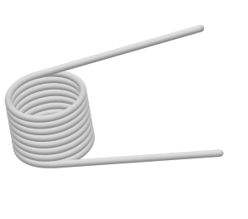










Slide 4


























Slide 5

















Slide 6







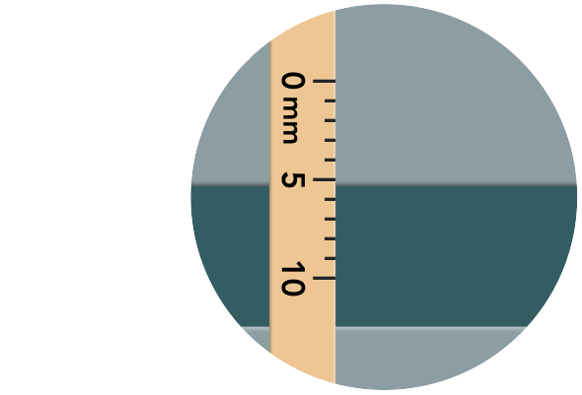











Slide 7
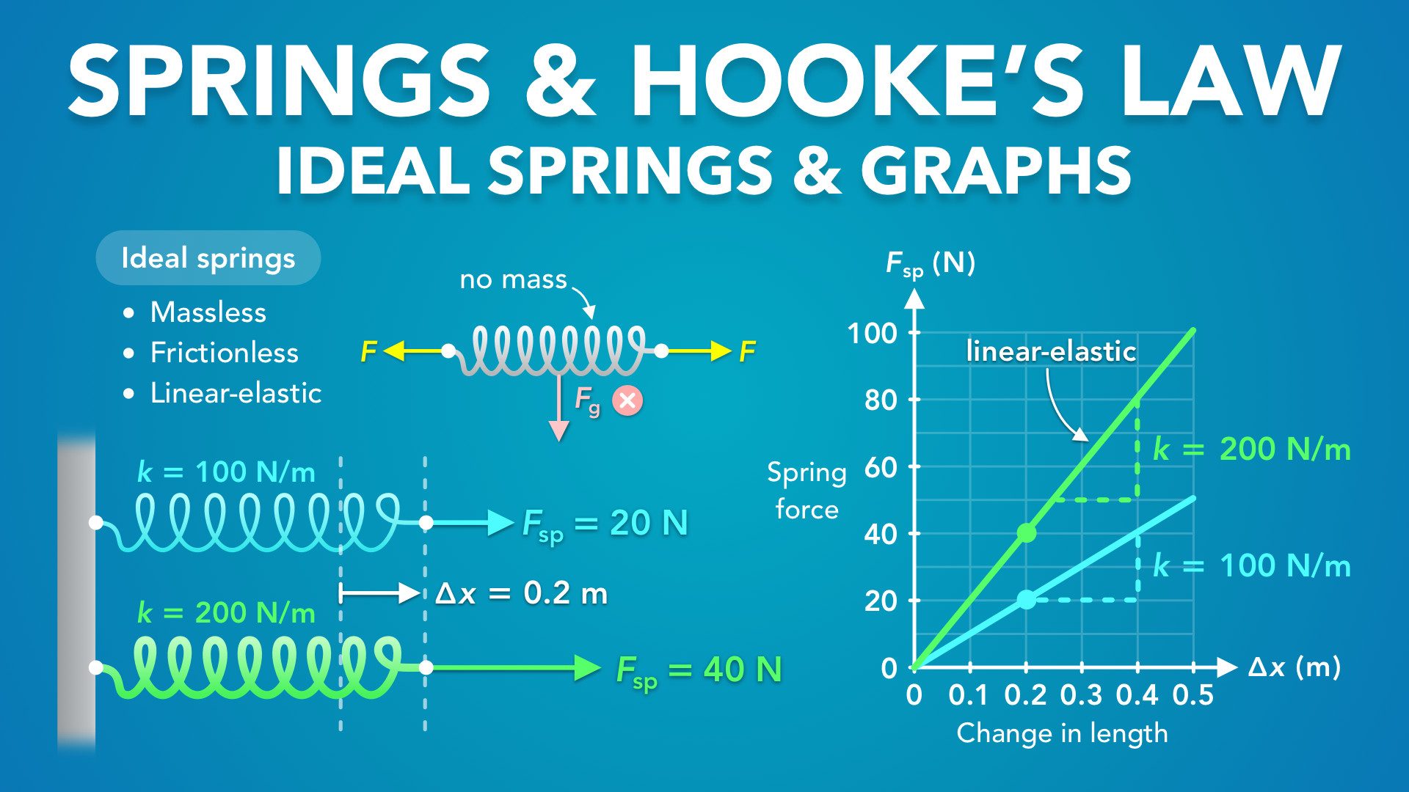
Notes:
Springs and Hooke’s Law - Ideal Springs and Graphs
physicslab.app
If you have any questions, suggestions or feedback about these slides please email me at chris@physicslab.app or send me a message on Discord @physicslab.

Slide 8

Notes:
• Hey everyone, in this video we’re gonna learn about ideal springs and how we can graph the equation for Hooke’s law.

Slide 9
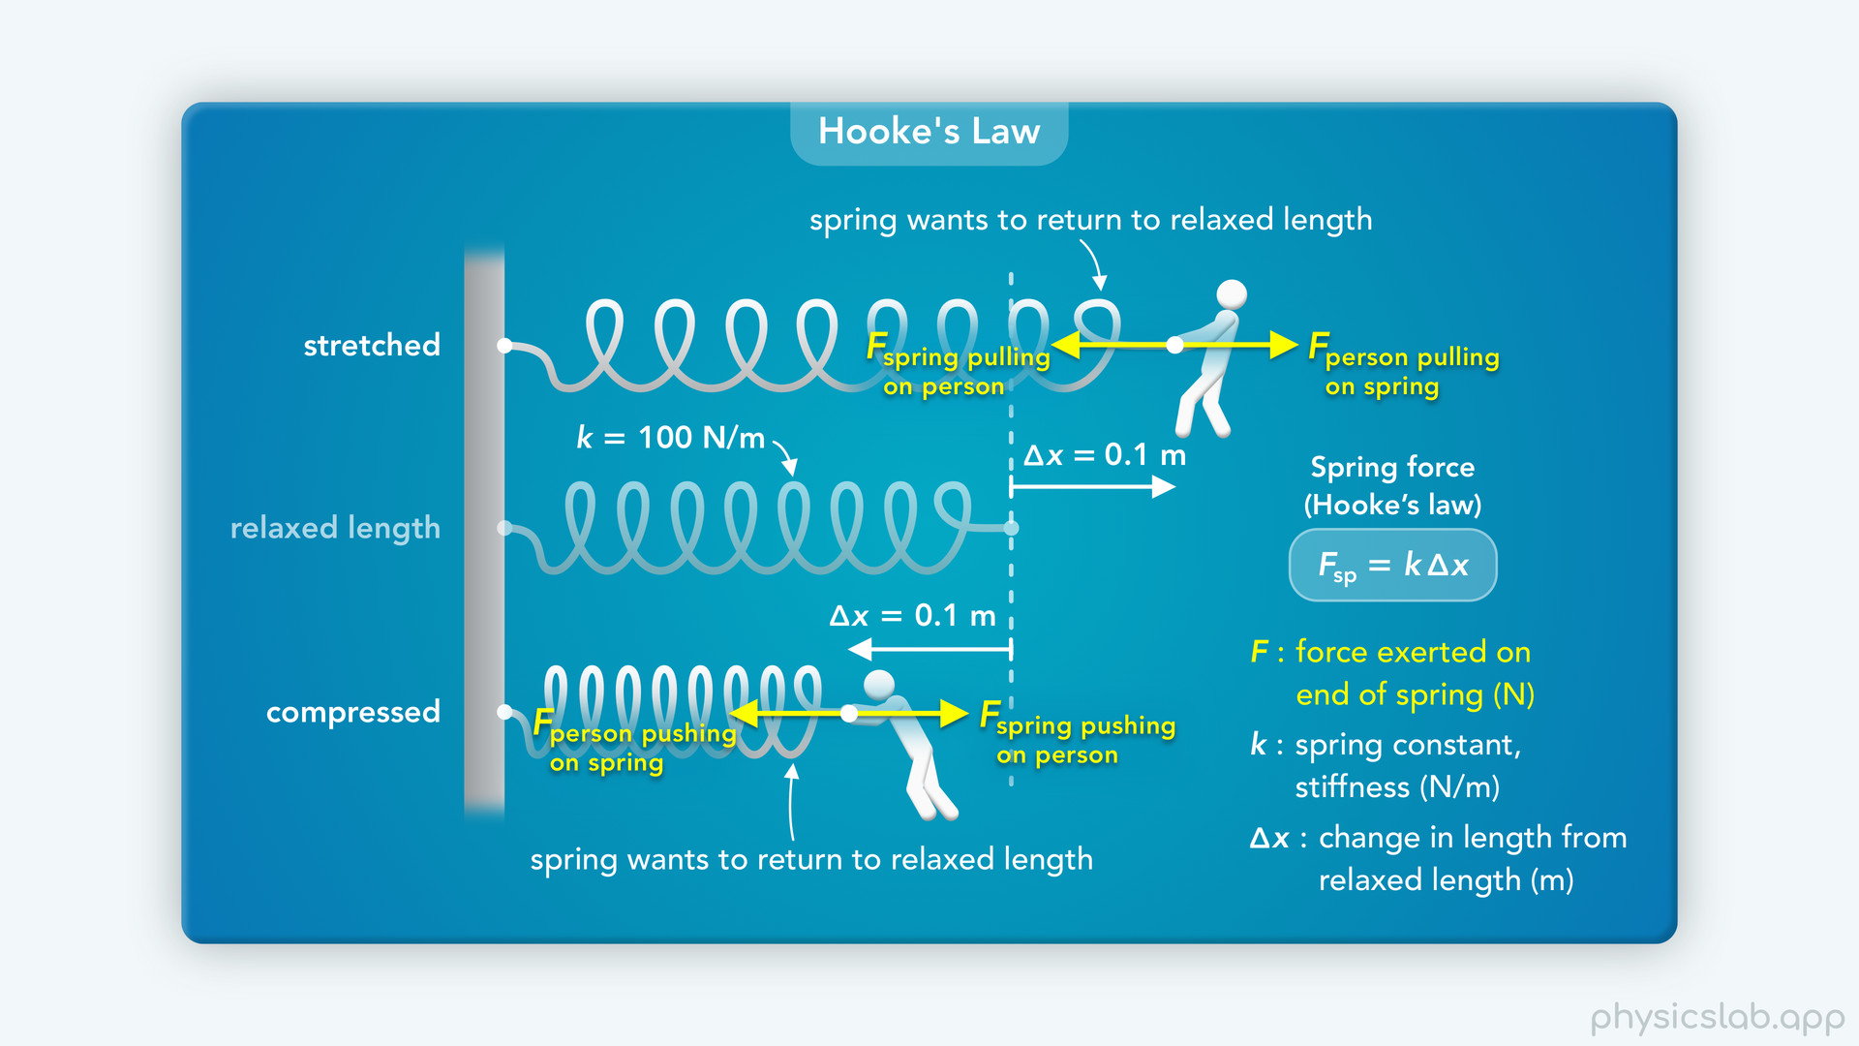
Notes:
• We covered hooke’s law in the last few videos, but there are a few assumptions that we need to cover.

Slide 10
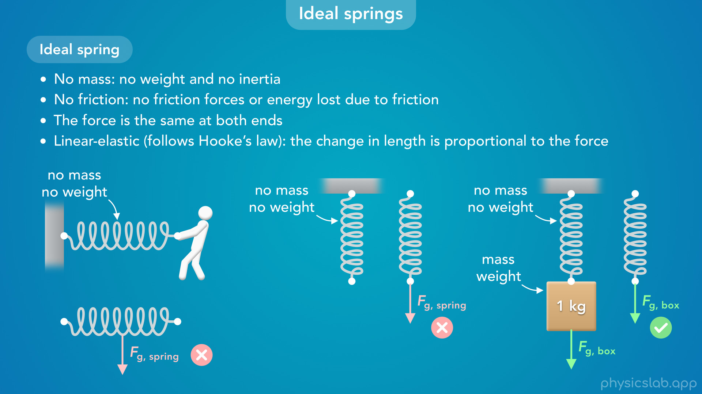
Notes:
• We’re only going to work with ideal springs, so we’ll start by defining what that means.

Slide 11
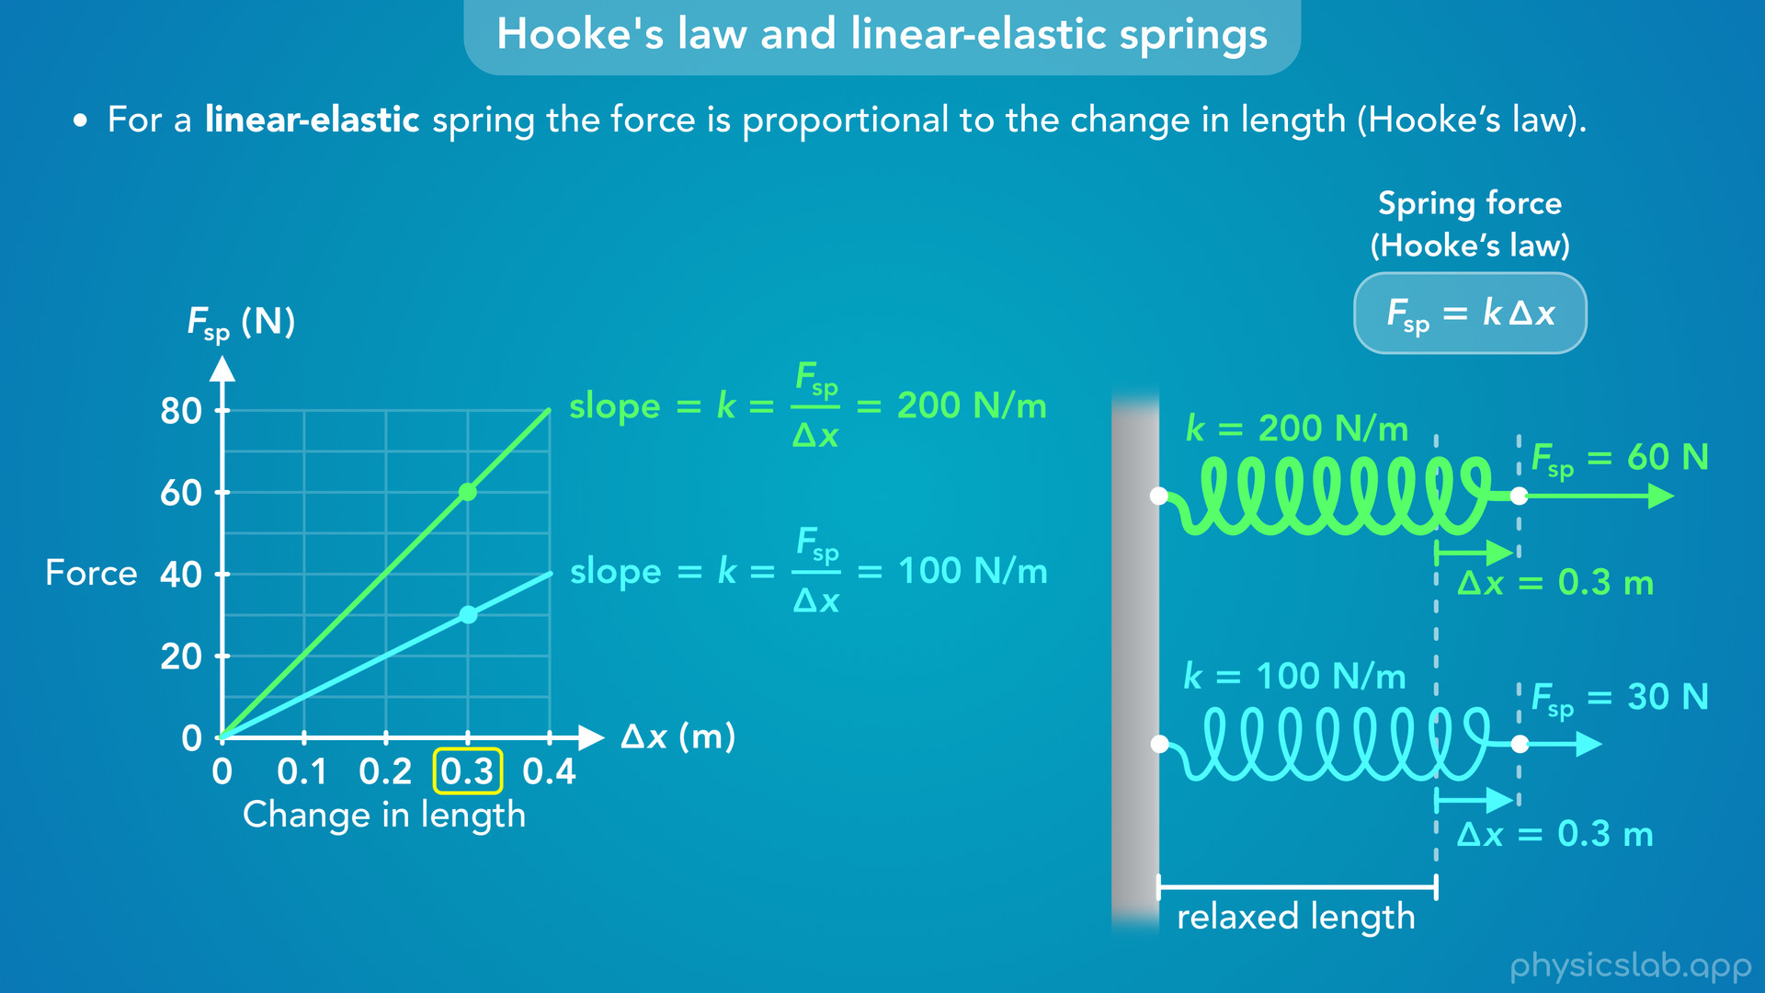
Notes:
• Then we’ll talk about linear elastic springs and how we can graph the equation for hooke’s law.

Slide 12
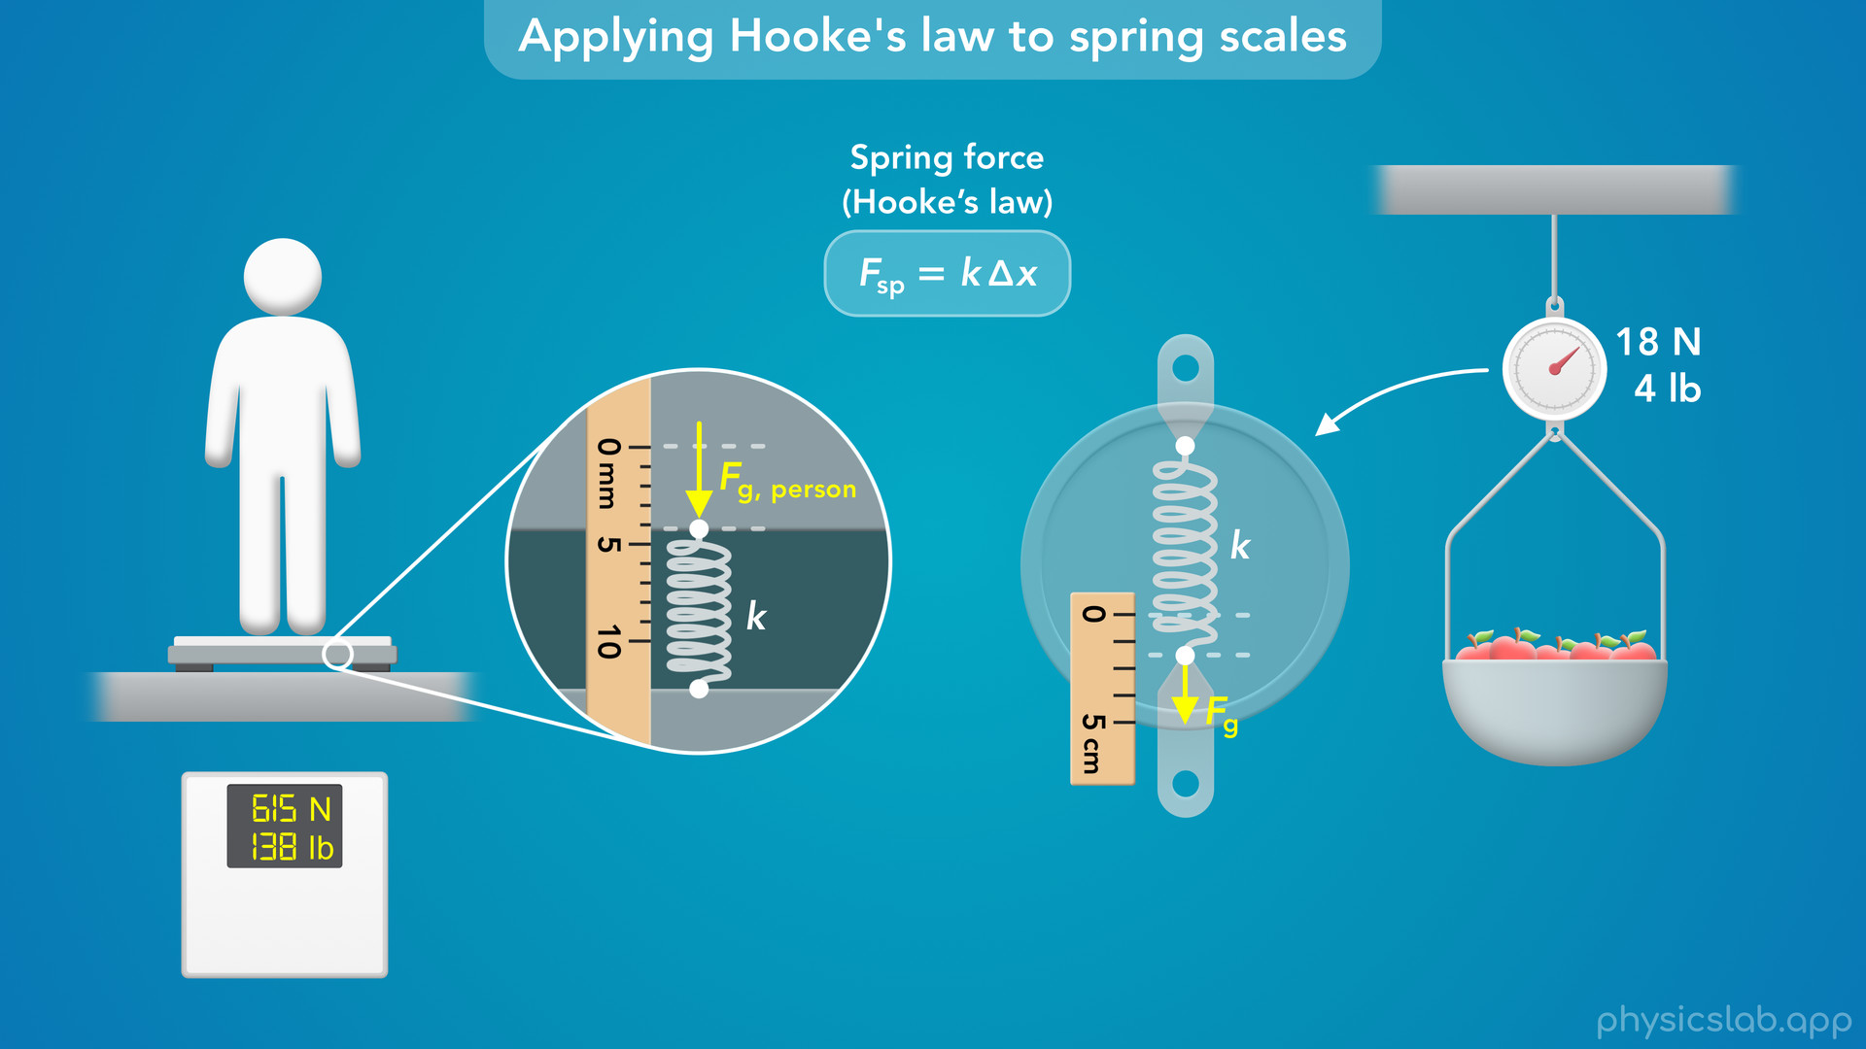
Notes:
• And the end, we’ll revisit the springs scales that we talked about in a previous video, and figure out how we can use hooke’s law to measure the weight of an object.

Slide 13

Notes:
• So what is an ideal spring, and what are the assumptions that go with it?

Slide 14
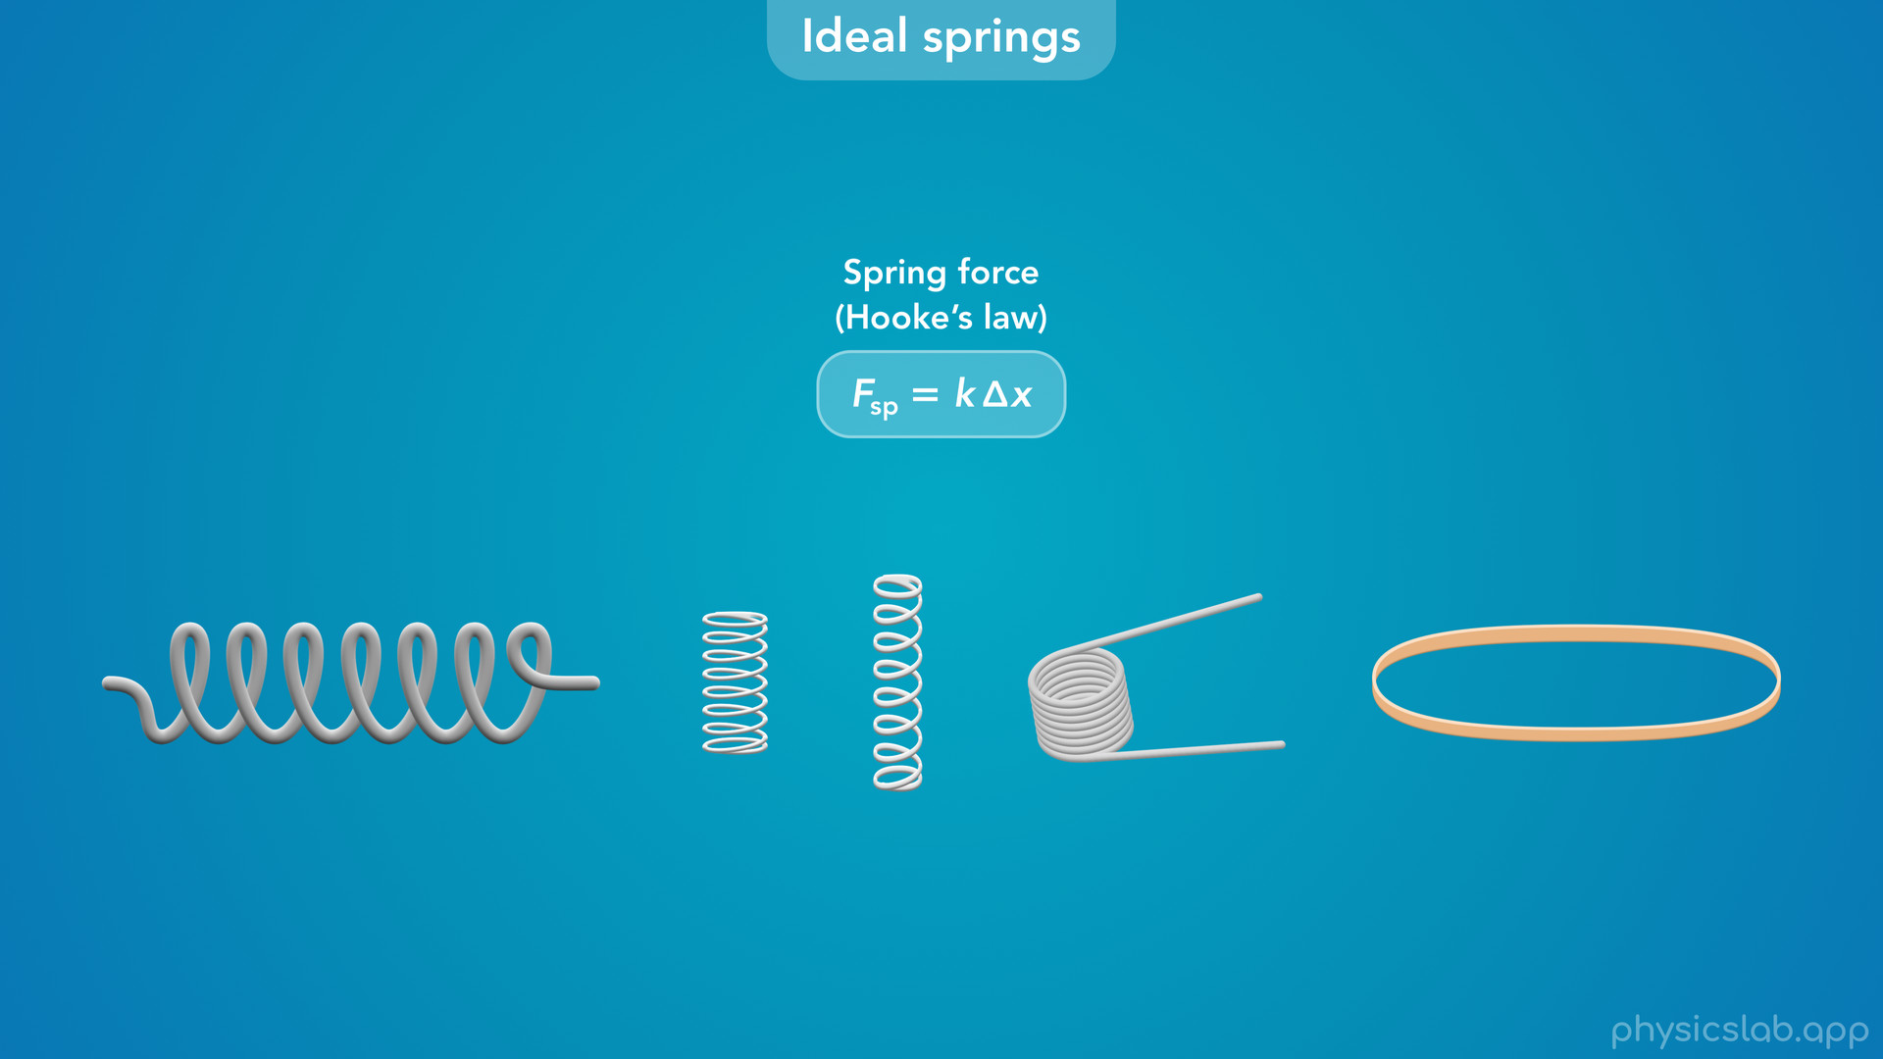
Notes:
• We’ve learned about Hooke’s law and how to use this equation, but does this actually apply to every spring?

Slide 15
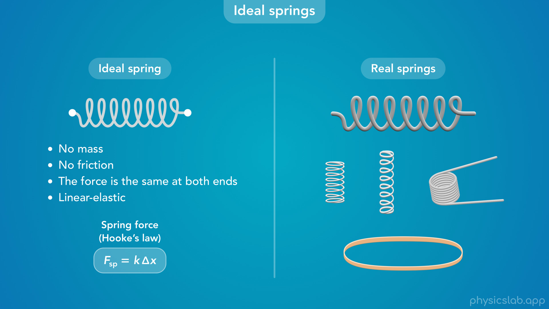
Notes:
• In the real world, there’s many different types of springs, and elastic materials don’t always follow this law.
• But in most cases, and any time we deal with springs in this course, we’re going to assume it’s an ideal spring.
• This means it has no mass, no friction, the force is the same at both ends, and its linear elastic.
• An ideal spring is a simplified, theoretical spring that follows all of these assumptions.
• These are not exactly true for real springs, but they’re pretty close.
• So what do these assumptions mean?

Slide 16
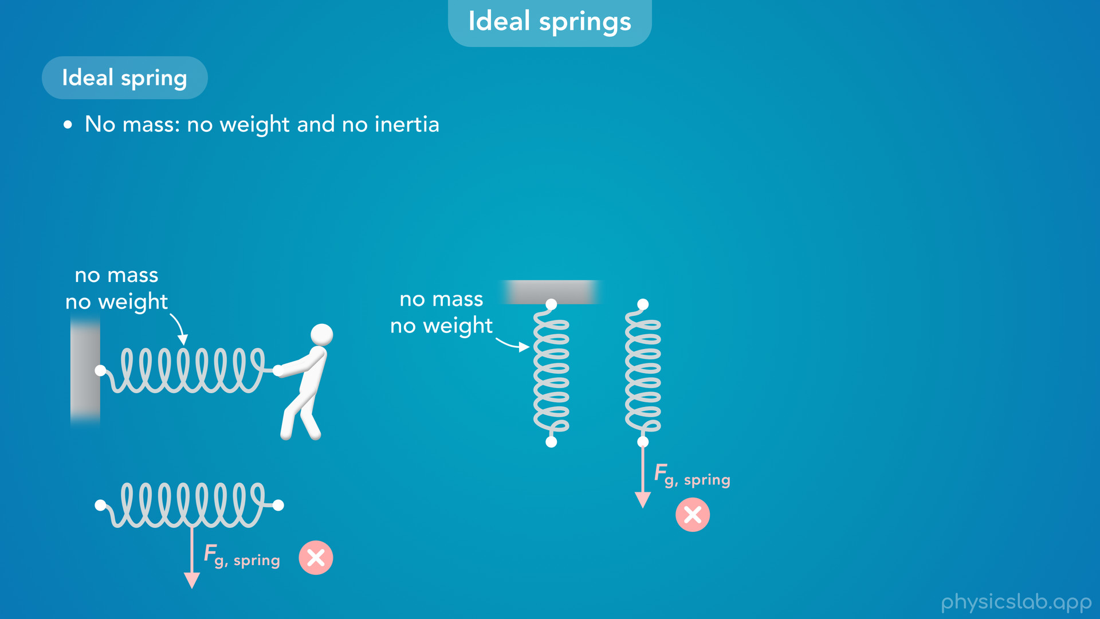
Notes:
• An ideal spring has no mass, so it has no weight and no inertia.
• If we draw a free body diagram of an ideal spring, we do not include the gravitational force acting on the spring itself.
• It has no mass, so it has no weight.

Slide 17
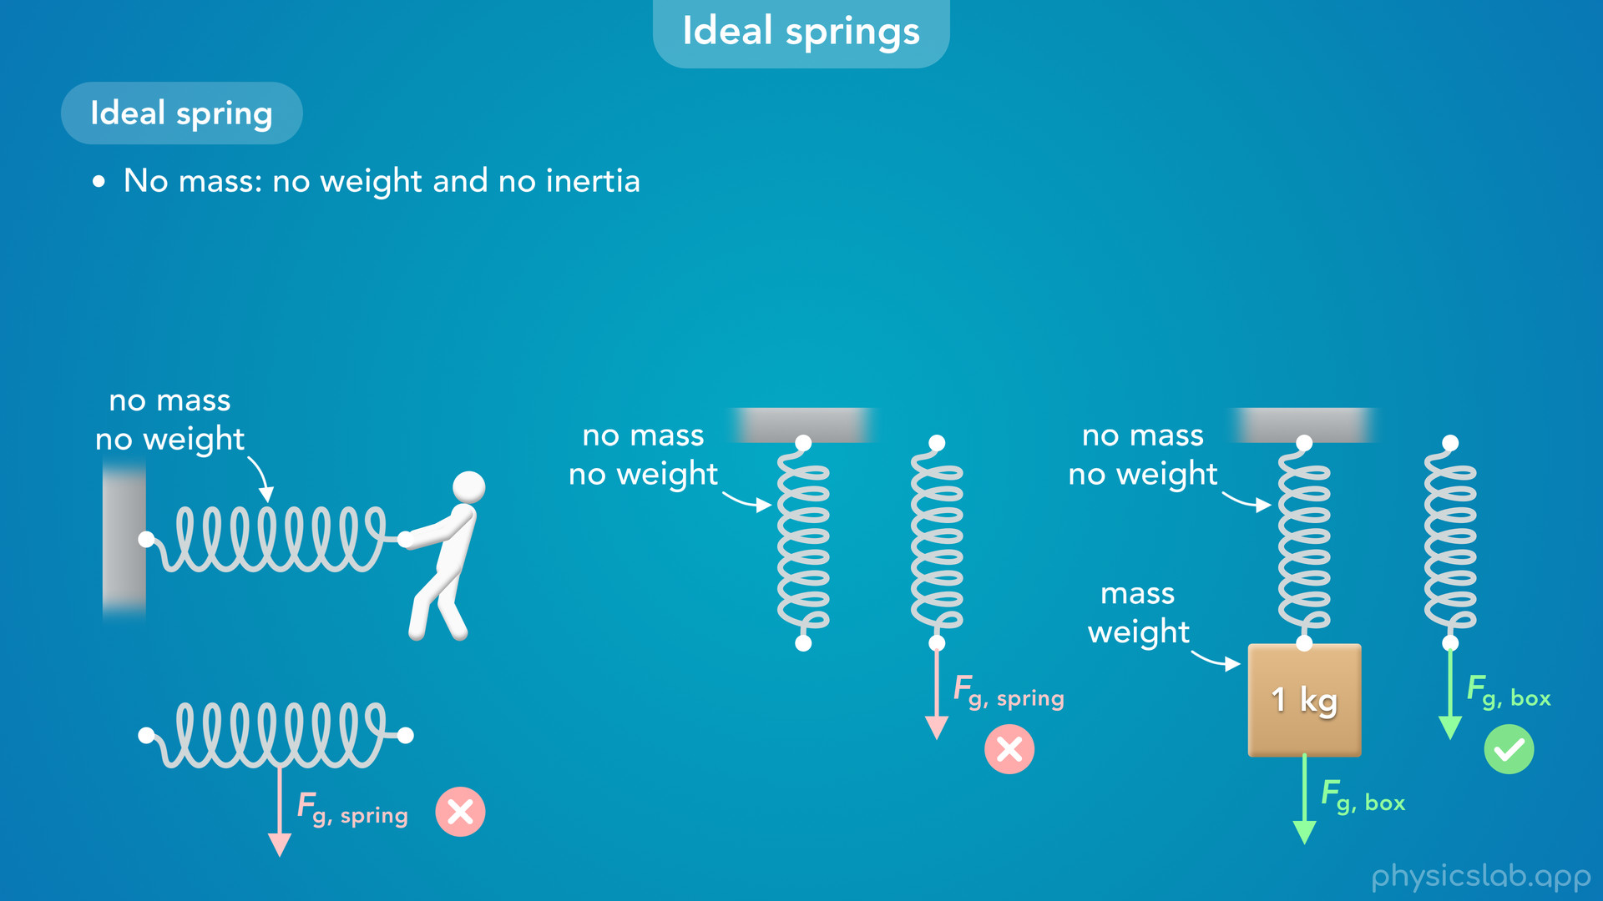
Notes:
• If another object is attached to the spring, like this box, then the weight of the box can be applied to the spring, but there’s no additional weight force on the spring itself.

Slide 18

Notes:
• If an ideal spring has no mass, then it also has no inertia. It has no resistance to acceleration, or a change in its state of motion.

Slide 19
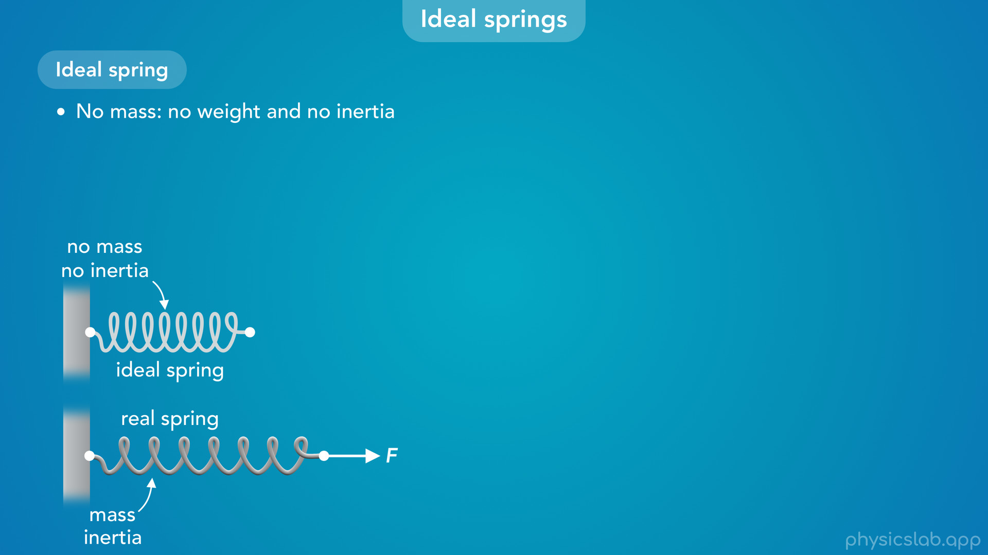
Notes:
• If we apply a force to a real spring that has mass and inertia, it will take some amount of time for the spring to move and change length.

Slide 20

Notes:
• But if we apply a force to an ideal spring, we assume that the spring can stretch or compress instantly.

Slide 21
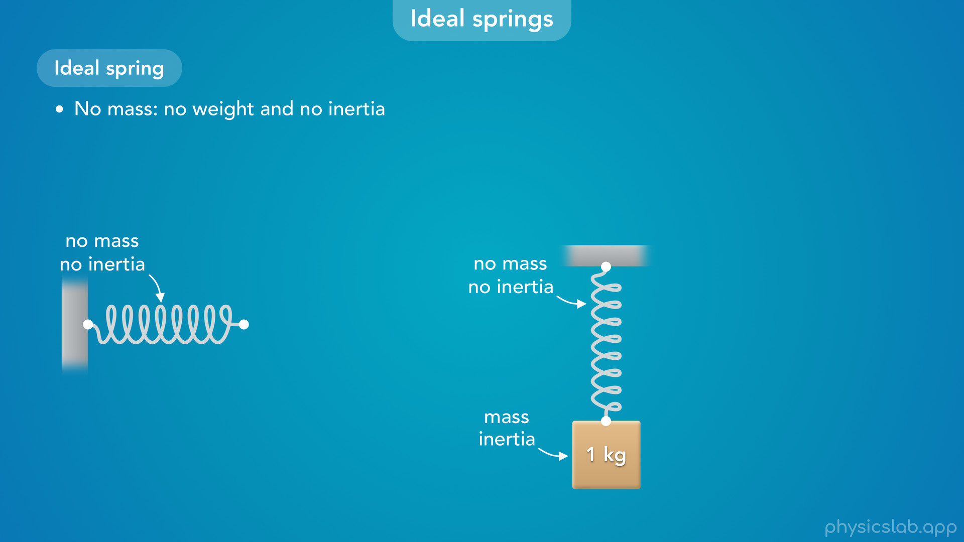
Notes:
• When we cover simple harmonic motion, there might be other objects that have inertia like this box, but we’re going to assume the spring has no mass and it does not add any inertia.

Slide 22
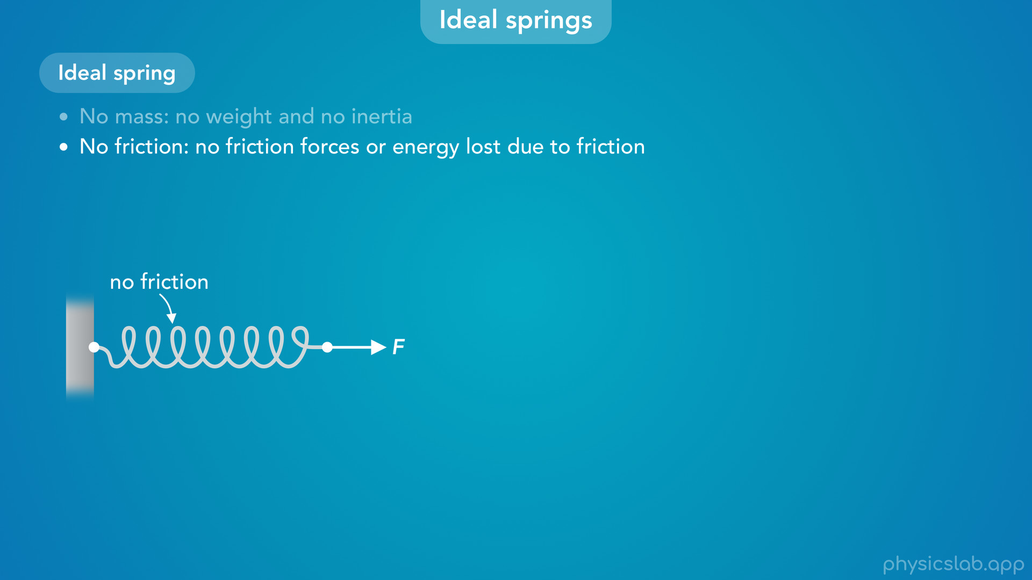
Notes:
• We also assume an ideal spring has no friction.
• So we don’t have to worry about any friction forces between the coils in the spring when it stretches or compresses.

Slide 23
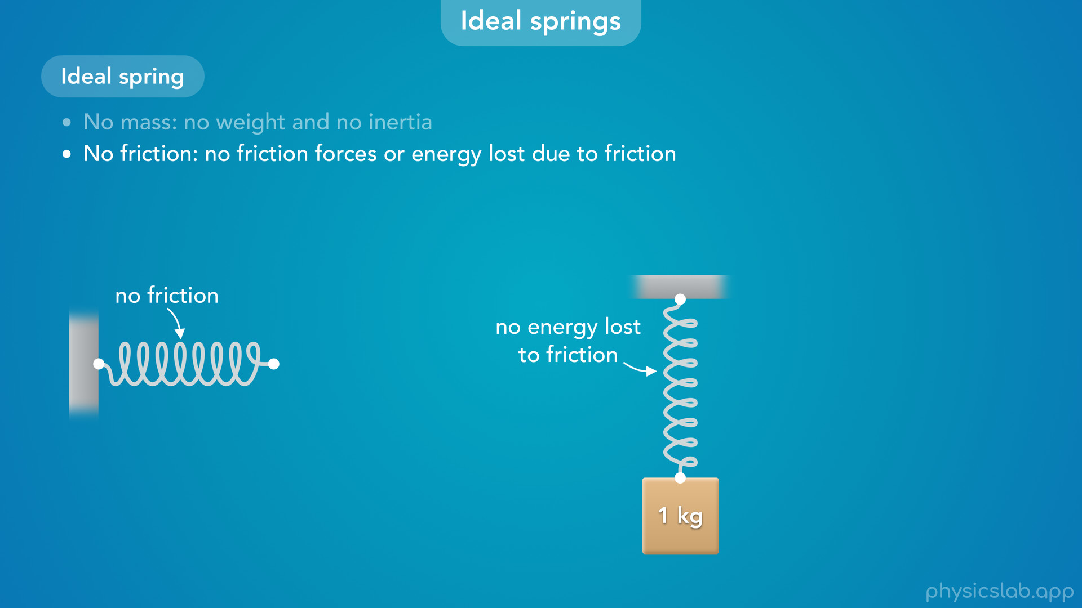
Notes:
• This also means that no energy is lost to friction when the spring changes length, which will be important when we cover energy and simple harmonic motion.

Slide 24
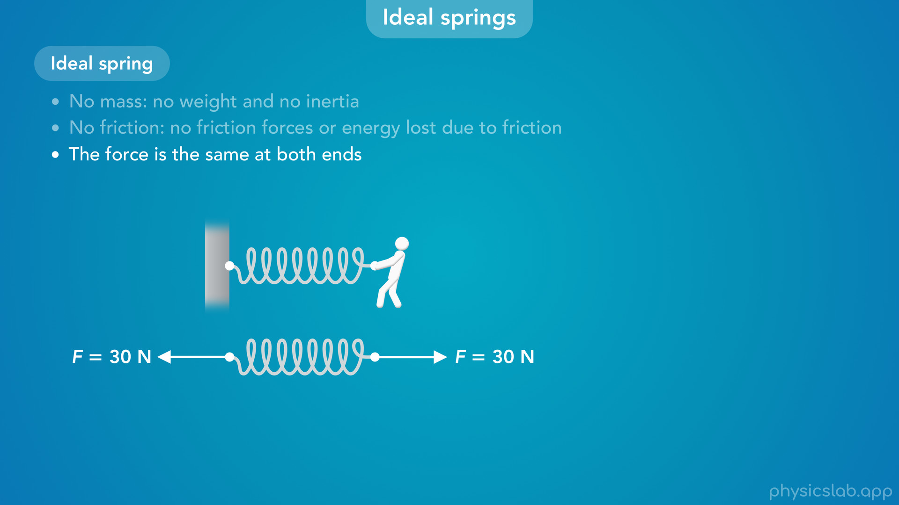
Notes:
• Like we mentioned before, we’re going to assume that the force is the same at both ends of an ideal spring.

Slide 25
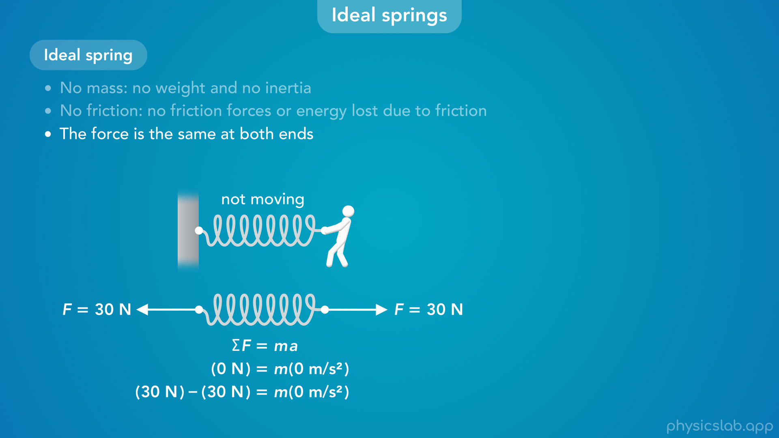
Notes:
• If the spring is at rest, then this makes sense because the net force acting on the spring must be zero, so the forces are balanced.

Slide 26
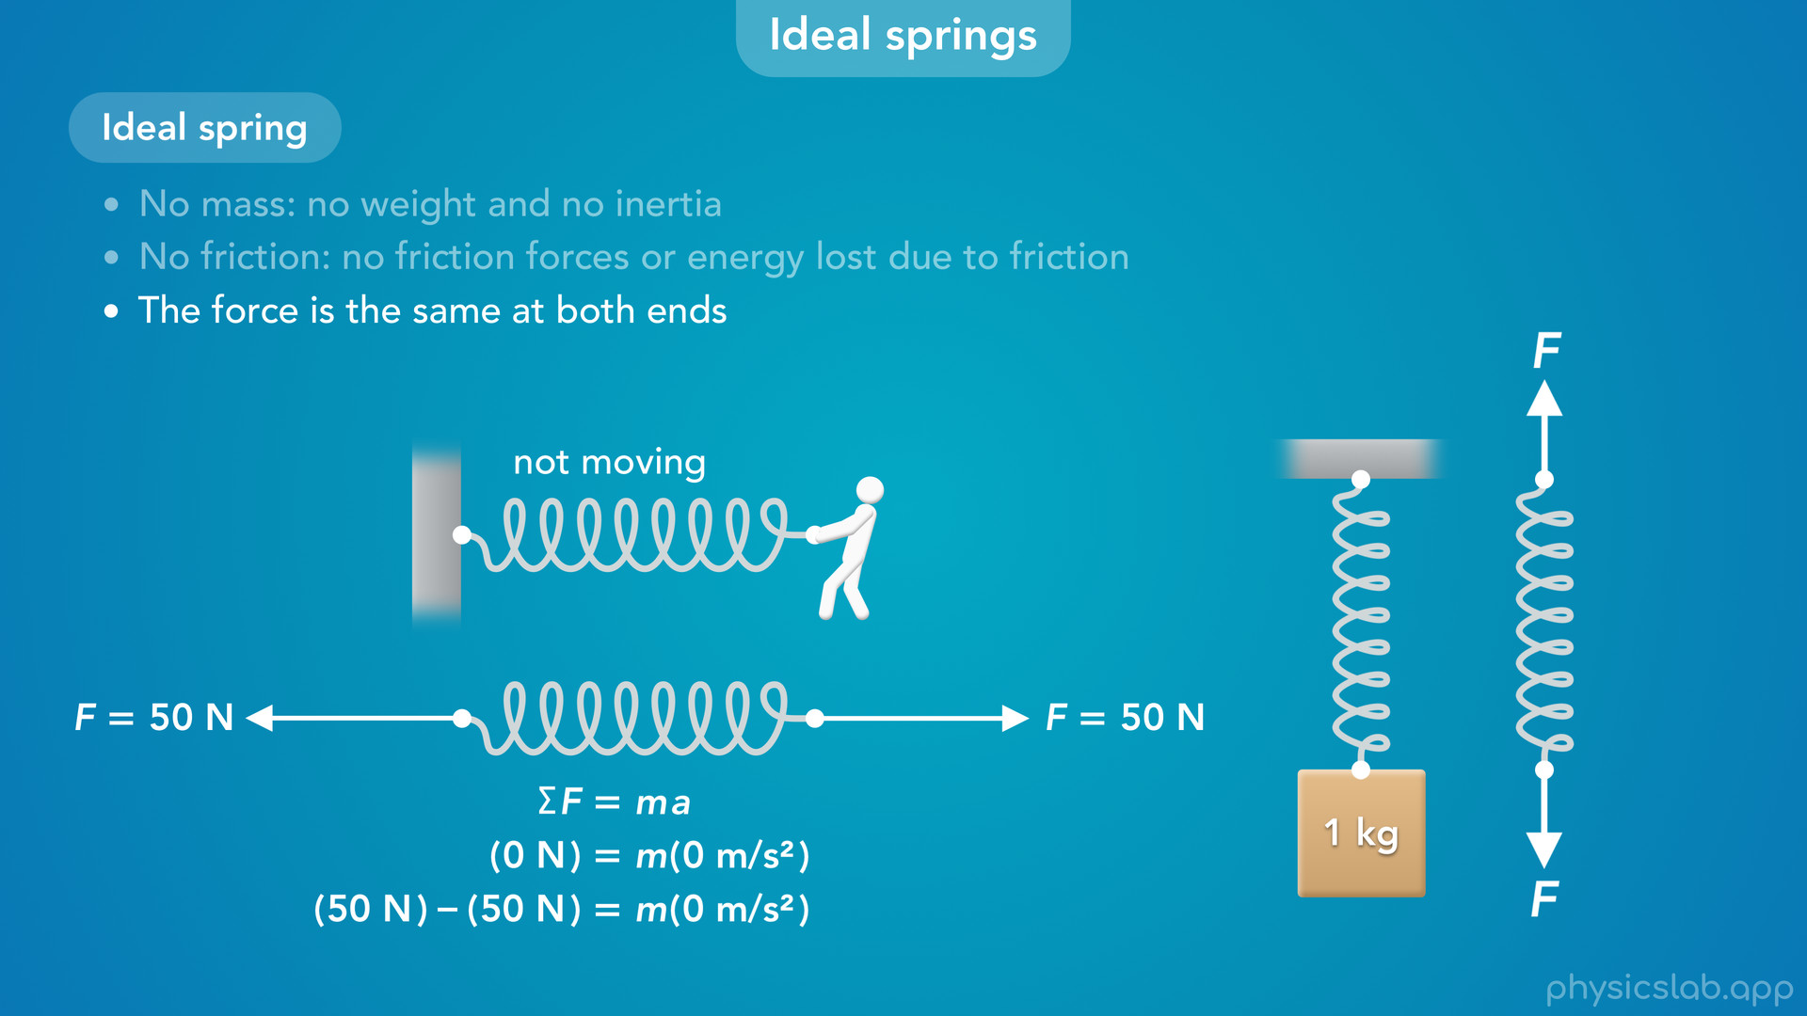
Notes:
• But what if the spring is moving, or the applied force is changing over time?
• For an ideal spring, we’re still going to assume that any force applied to one end of the spring is instantly transferred to the other end of the spring, and the force at both ends will be equal at any time.

Slide 27
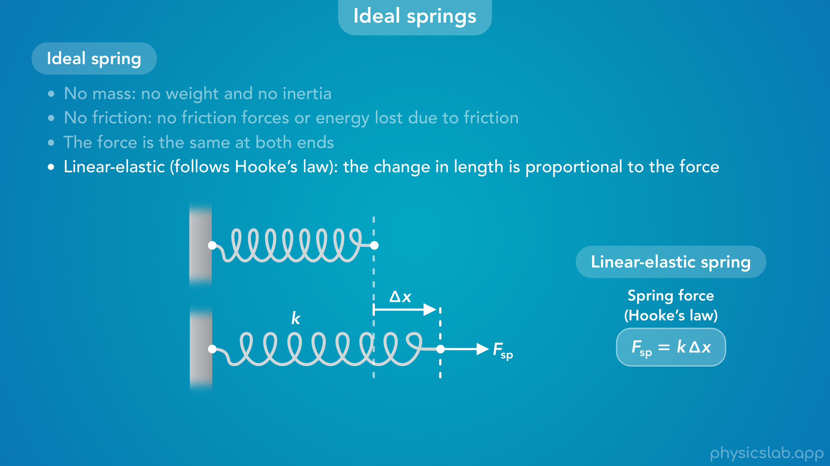
Notes:
• Finally, an ideal spring is linear elastic, which just means that it follows the equation for Hooke’s law, and the change in length (delta x) is proportional to the force, F.

Slide 28
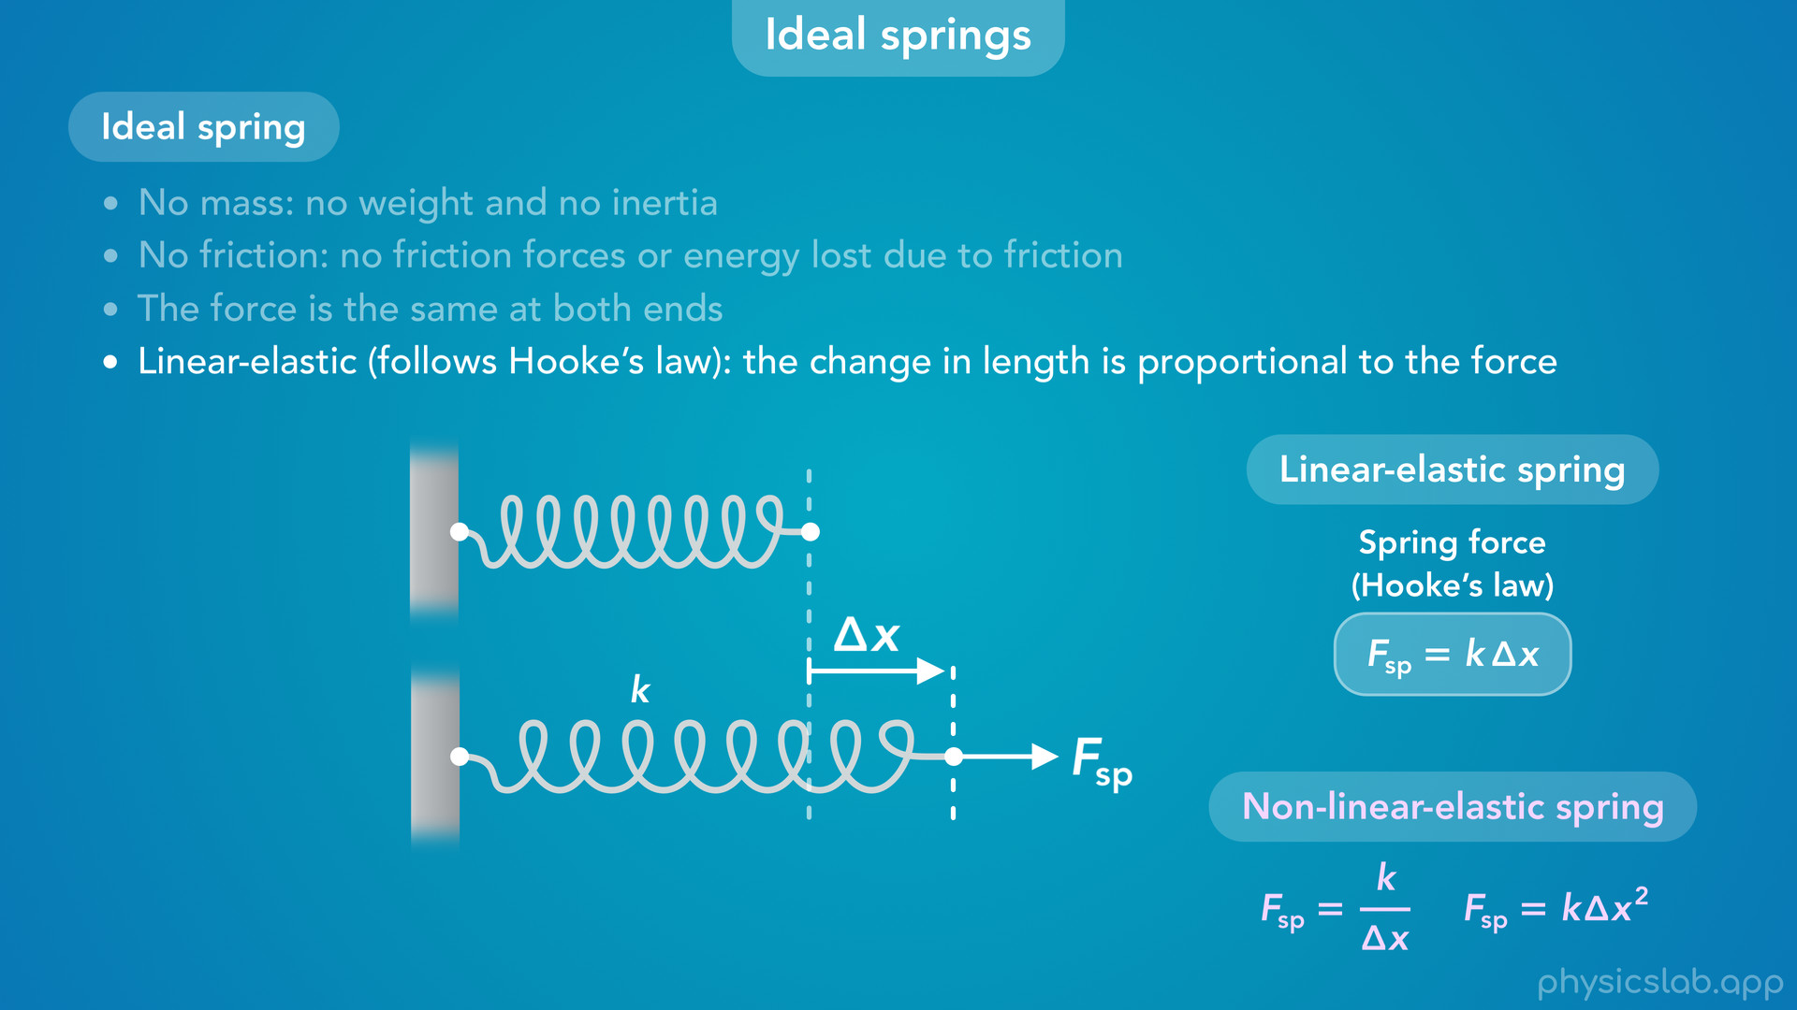
Notes:
• By comparison, a non-linear-elastic spring might have a relationship like this, where F is proporitonal to 1 over delta x, or delta x squared.

Slide 29

Notes:
• Let’s explore that last point.
• Why do we call these linear elastic springs?

Slide 30
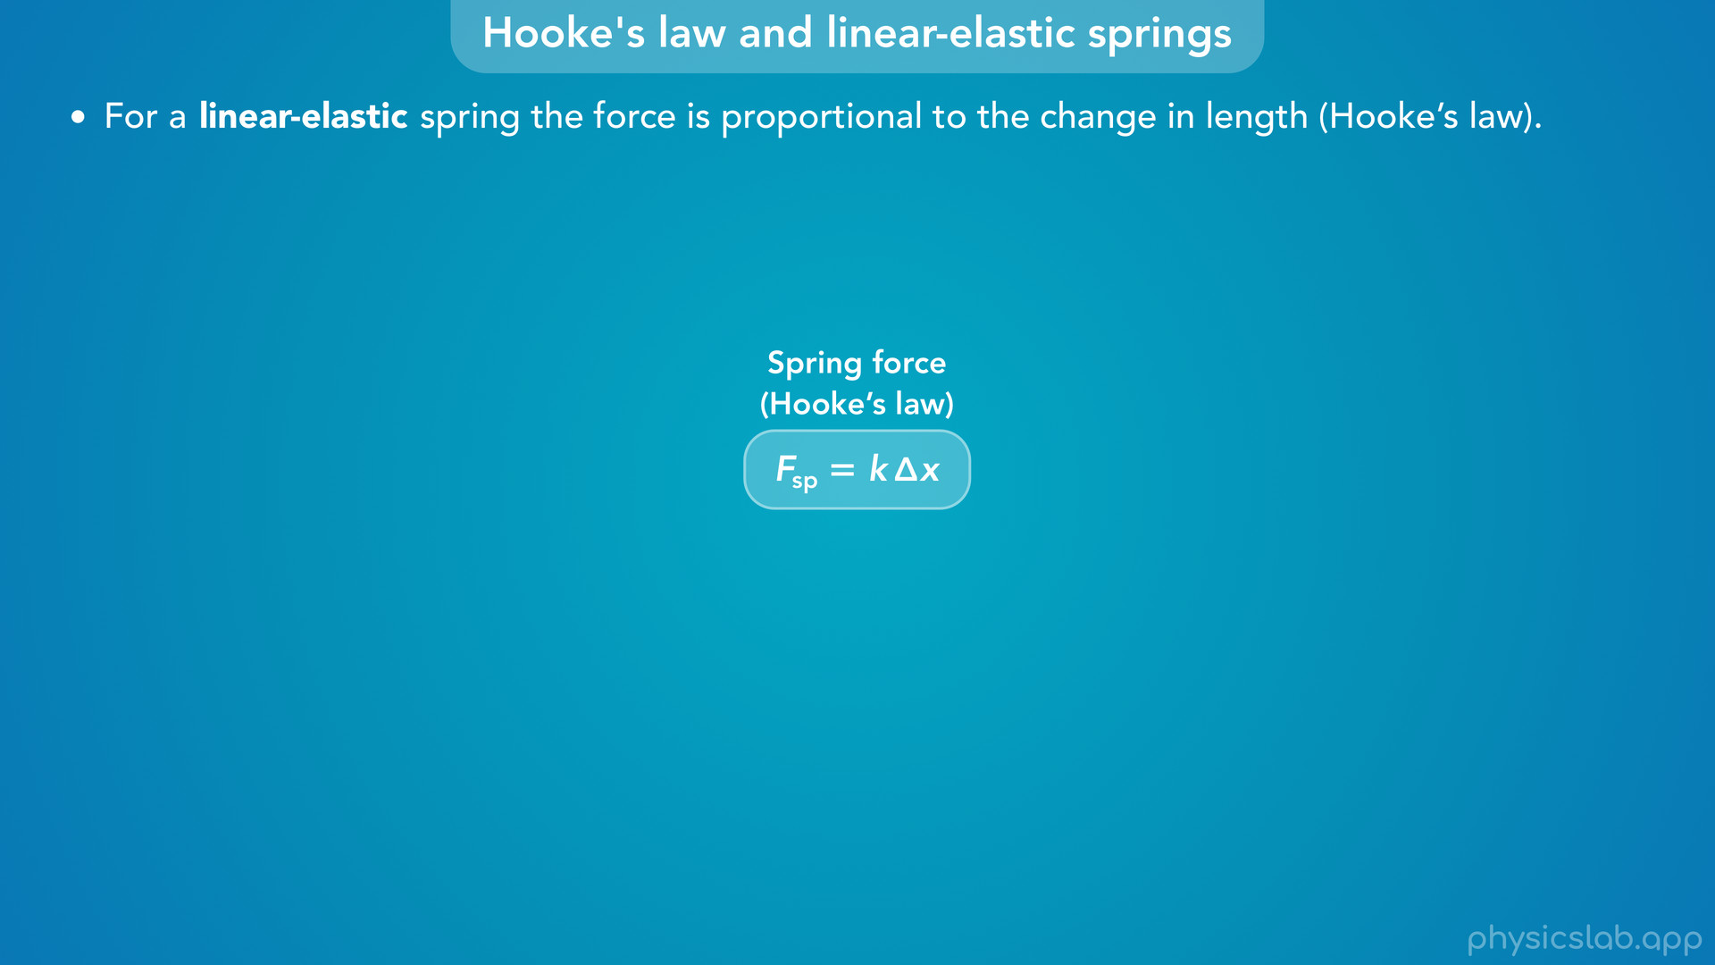
Notes:
• We said that for a linear elastic spring, the force is proportional to the change in length, which means that it follows Hooke’s law.

Slide 31
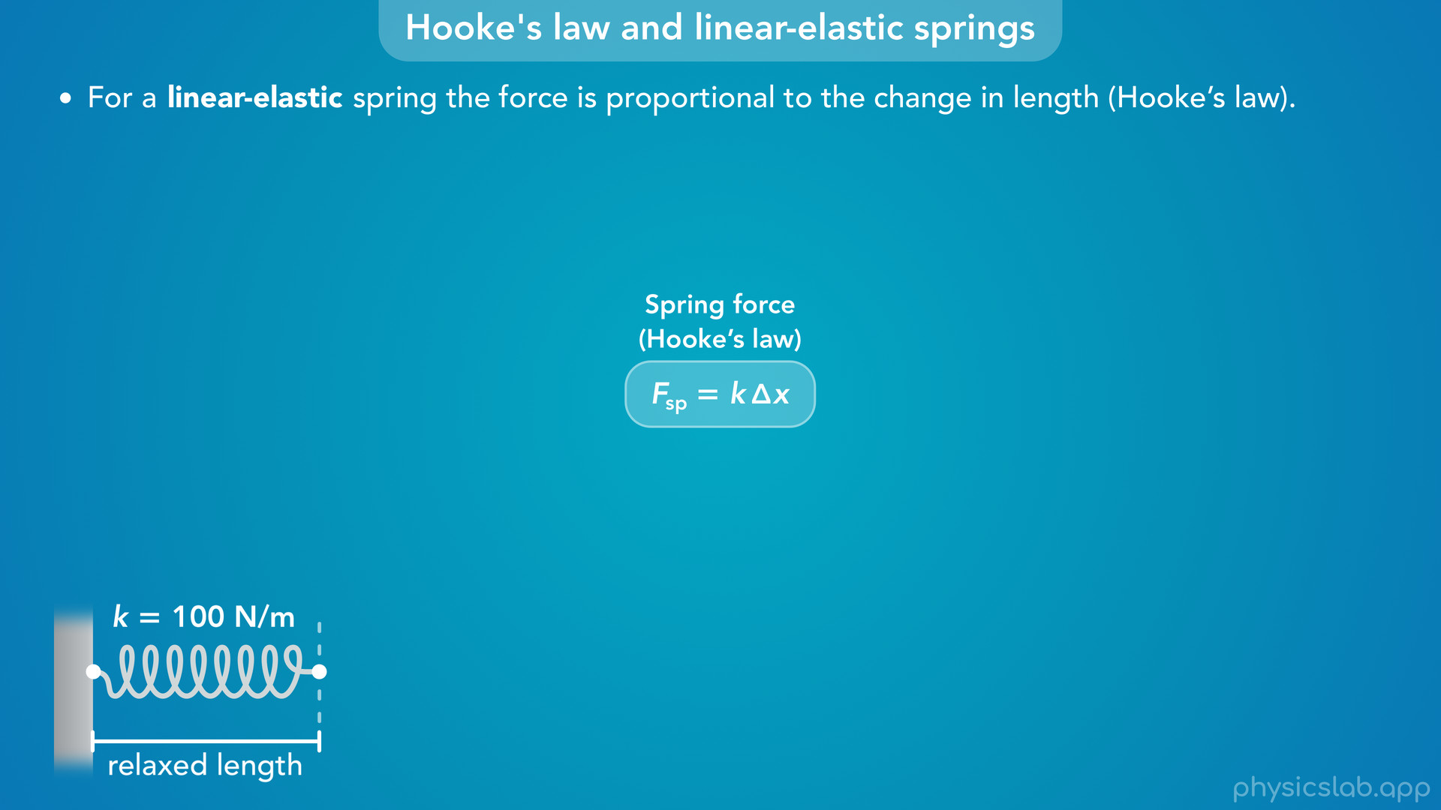
Notes:
• So let’s say we have a spring attached to a wall with a spring constant k of 100 N/m and it starts at its relaxed length.

Slide 32
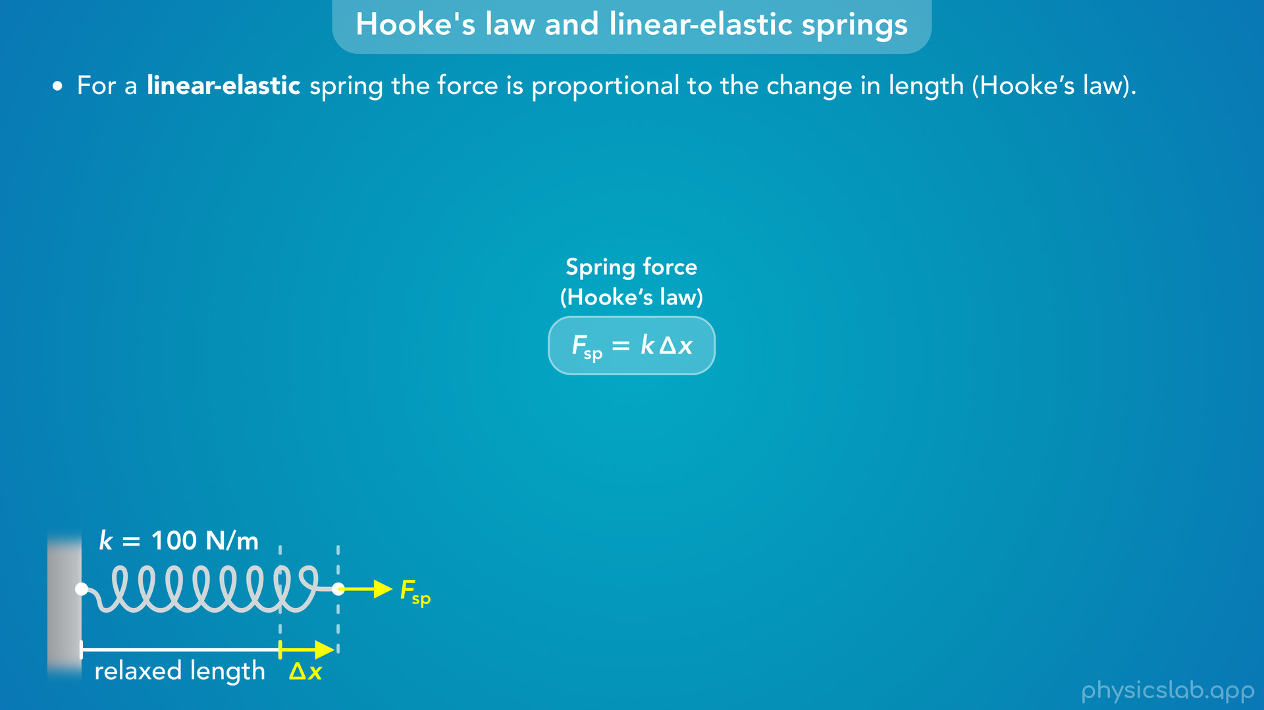
Notes:
• If we apply a force F, the spring will stretch some amount, delta x.

Slide 33
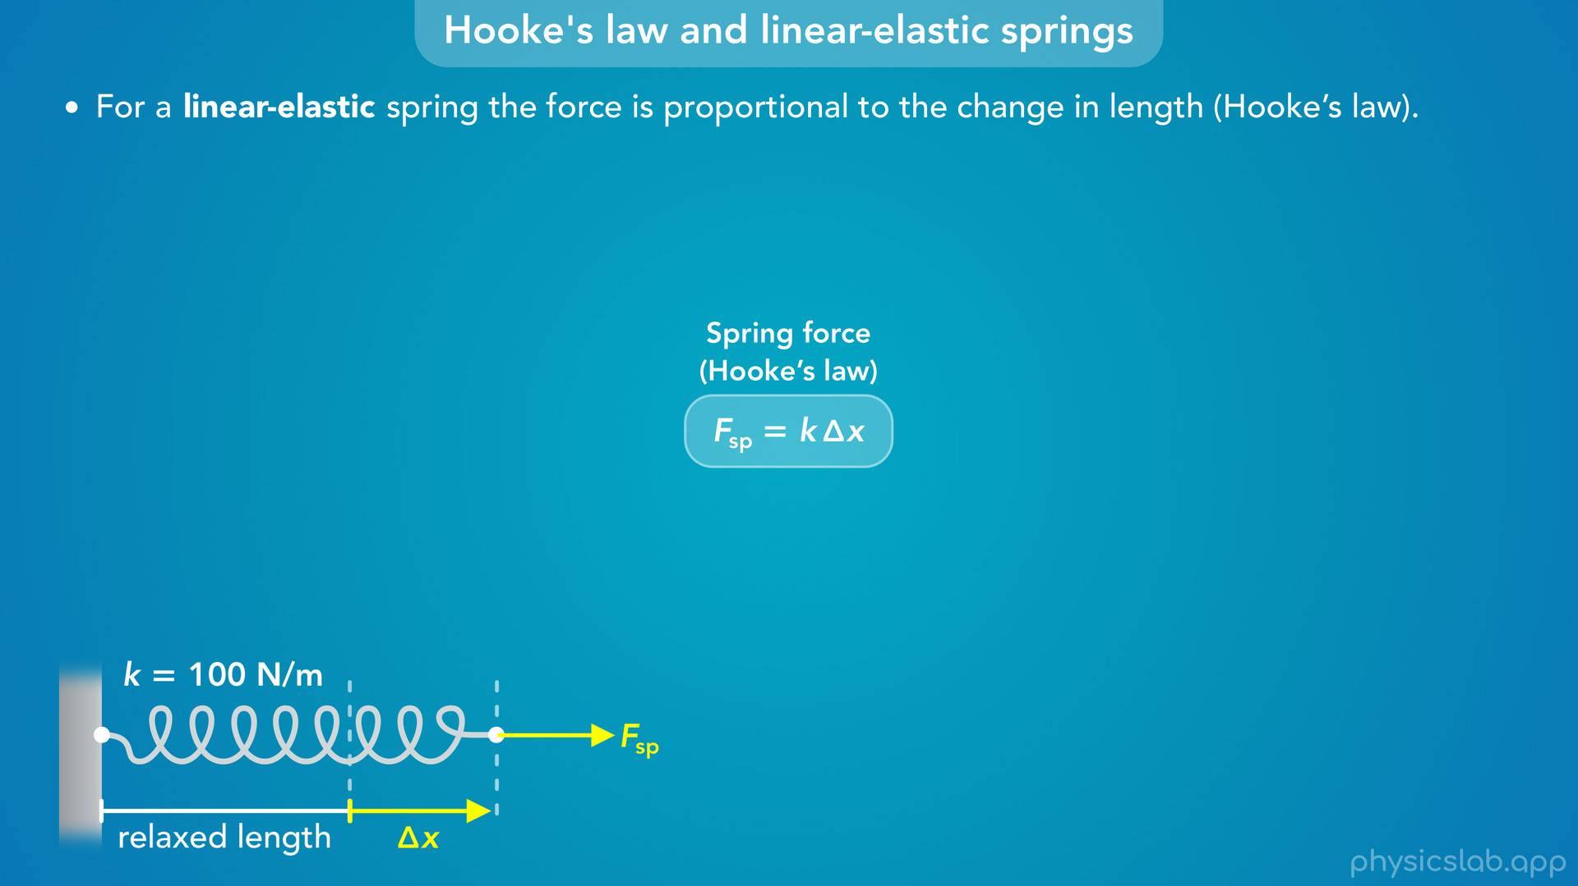
Notes:
• We know that if we change the force, then delta x will also change, the spring will get longer and shorter.

Slide 34
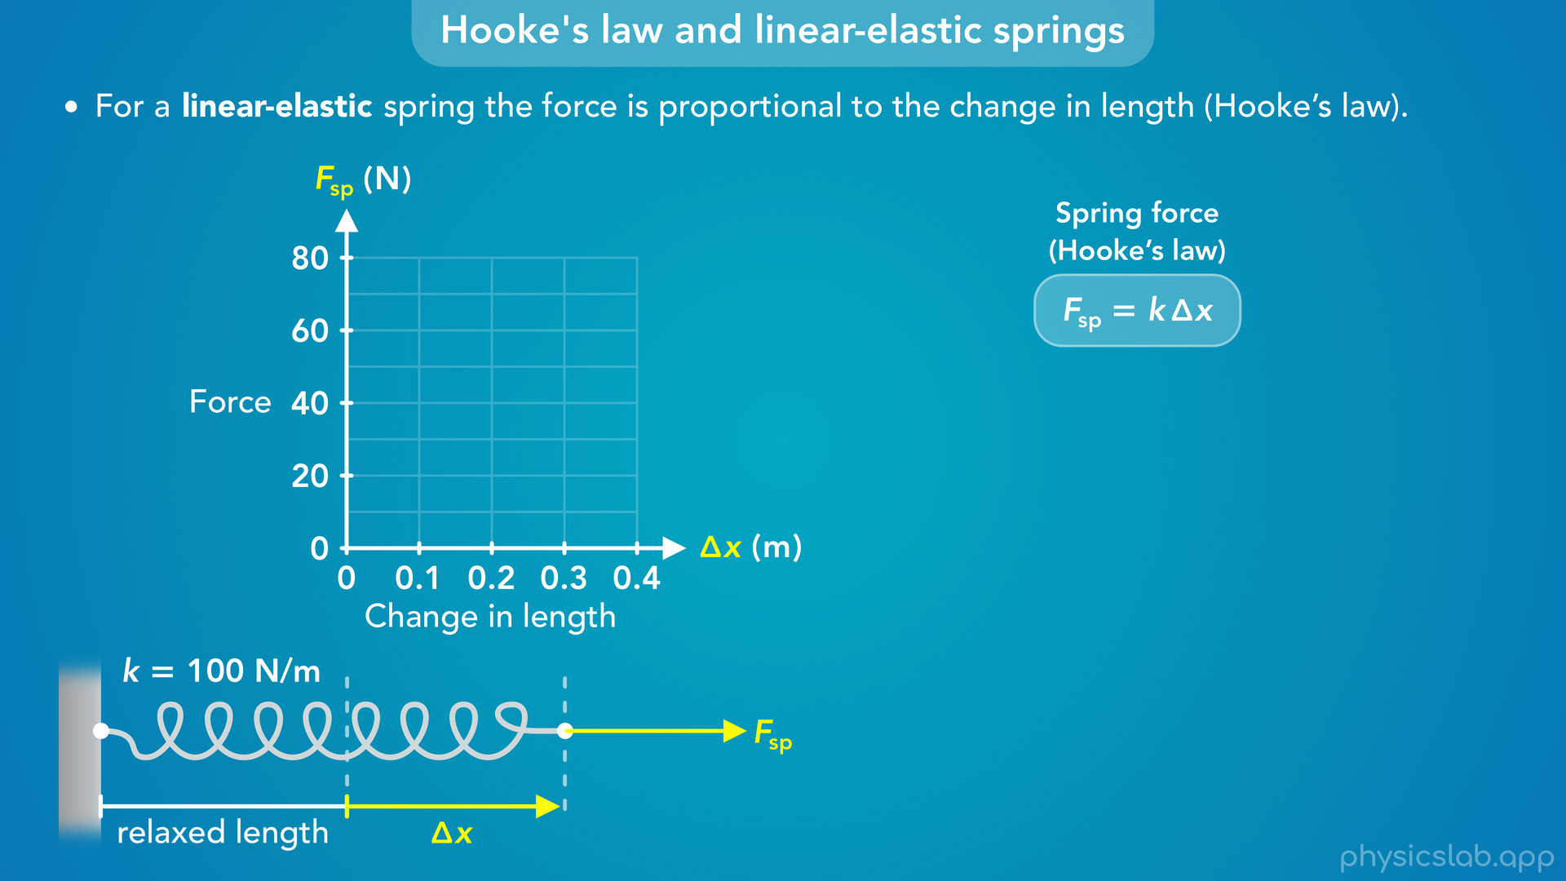
Notes:
• So how would we graph this relationship?
• The horizontal axis is the change in length, delta x, and the vertical axis is the magnitude of the force applied to the spring.
• Pause the video and see if you can figure out what the graph would like for this spring.

Slide 35
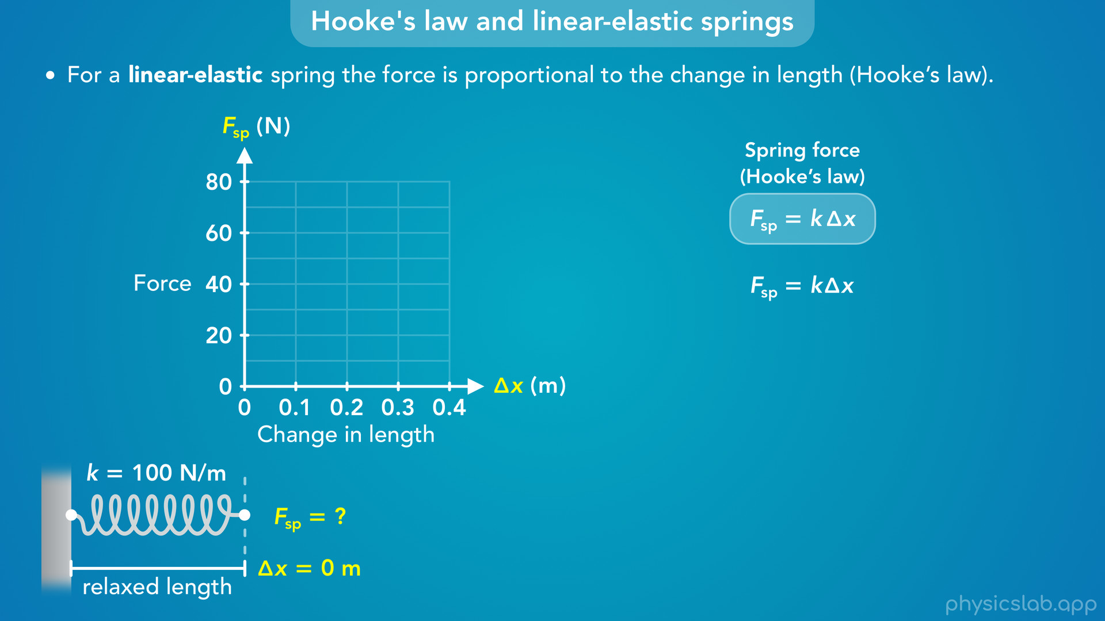
Notes:
• We can use the equation from Hooke’s law to plot some points on the graph.
• What would the force be if the spring is at its relaxed length and delta x is zero?

Slide 36
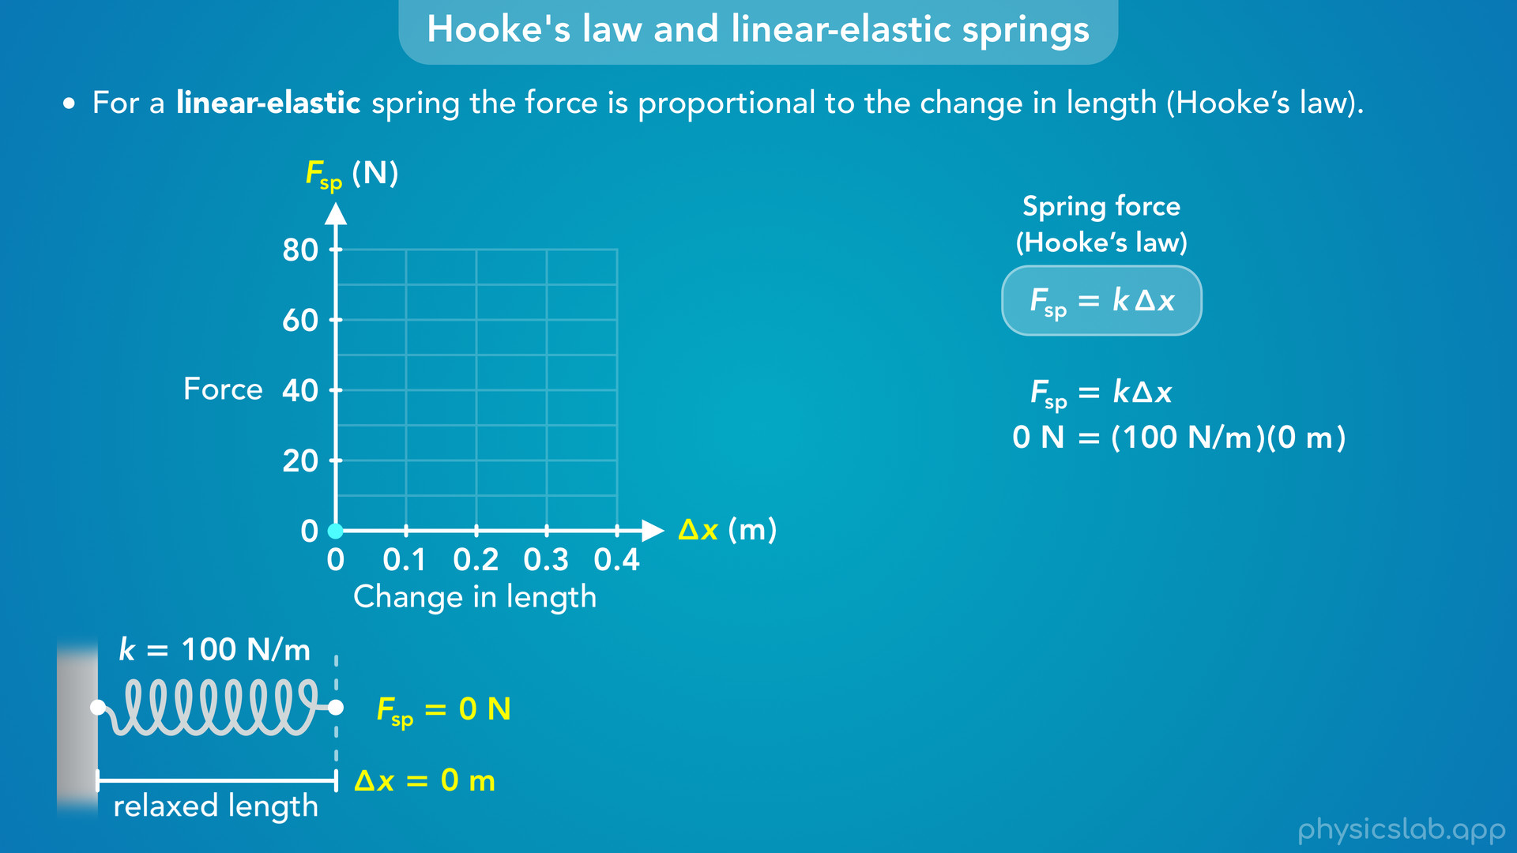
Notes:
• The spring constant k is 100 N/m, and if we plug in 0 m for delta x we get 0 N for the force.
• So the first point on the graph is where delta x and F are both zero.

Slide 37
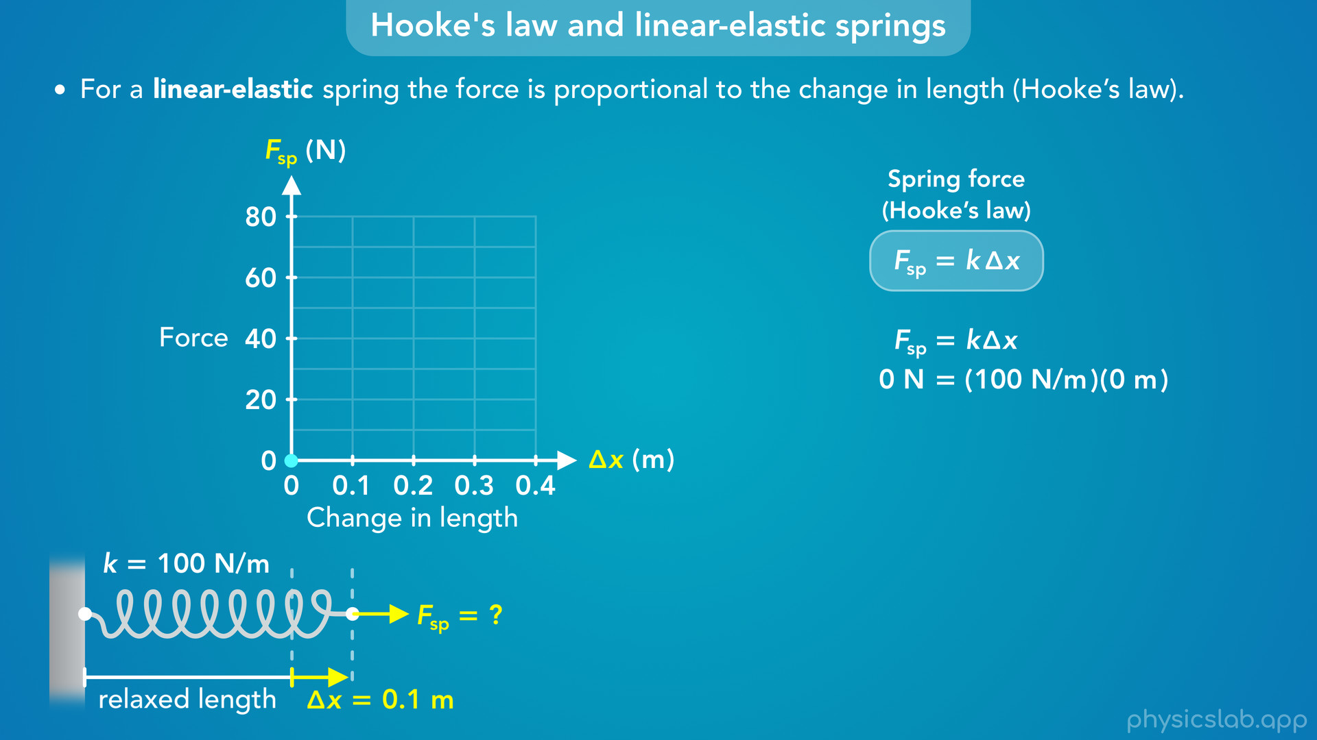
Notes:
• How much force would be required to stretch the spring by 0.1 m?

Slide 38
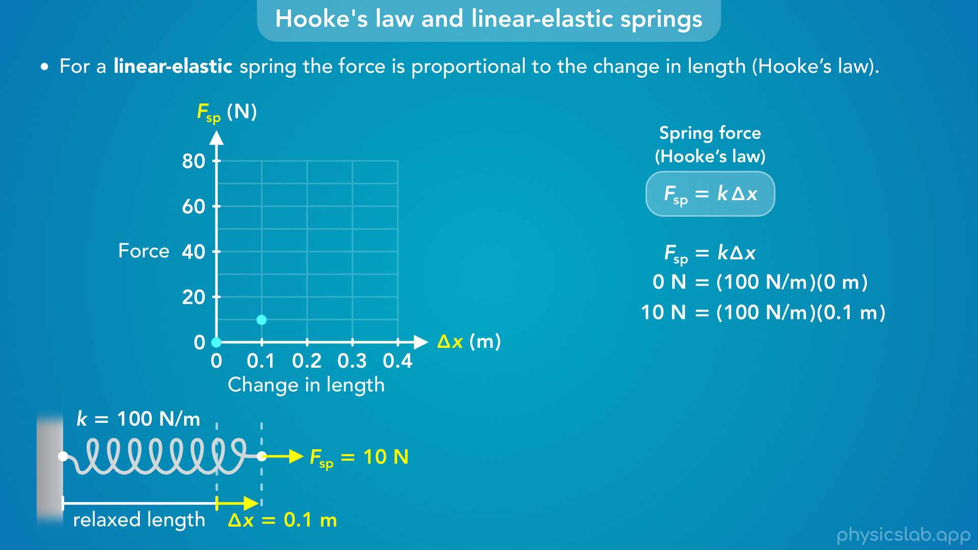
Notes:
• If we plug that into the equation, we get 10 N for the force.

Slide 39
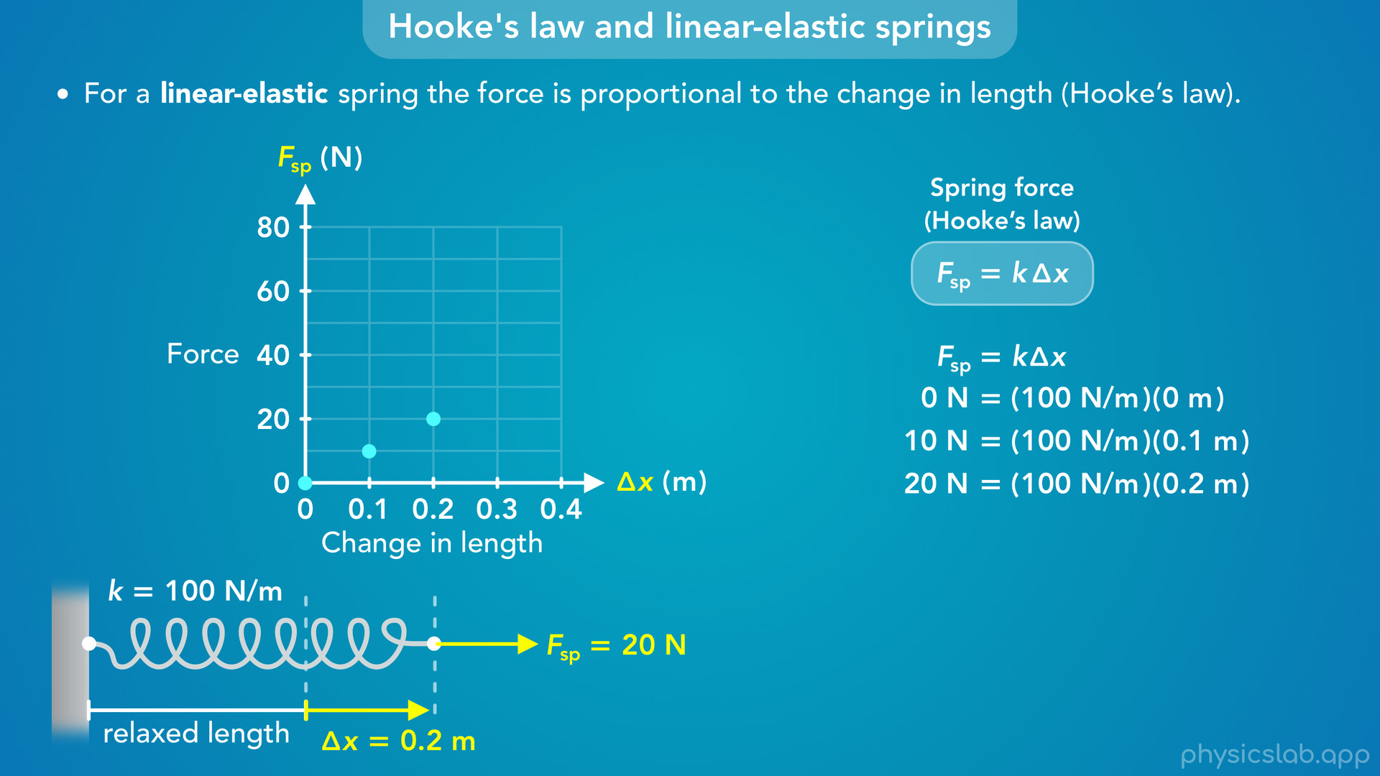
Notes:
• And we can keep doing this with more values.
• If delta x is 0.2 m, F is 20 N.

Slide 40
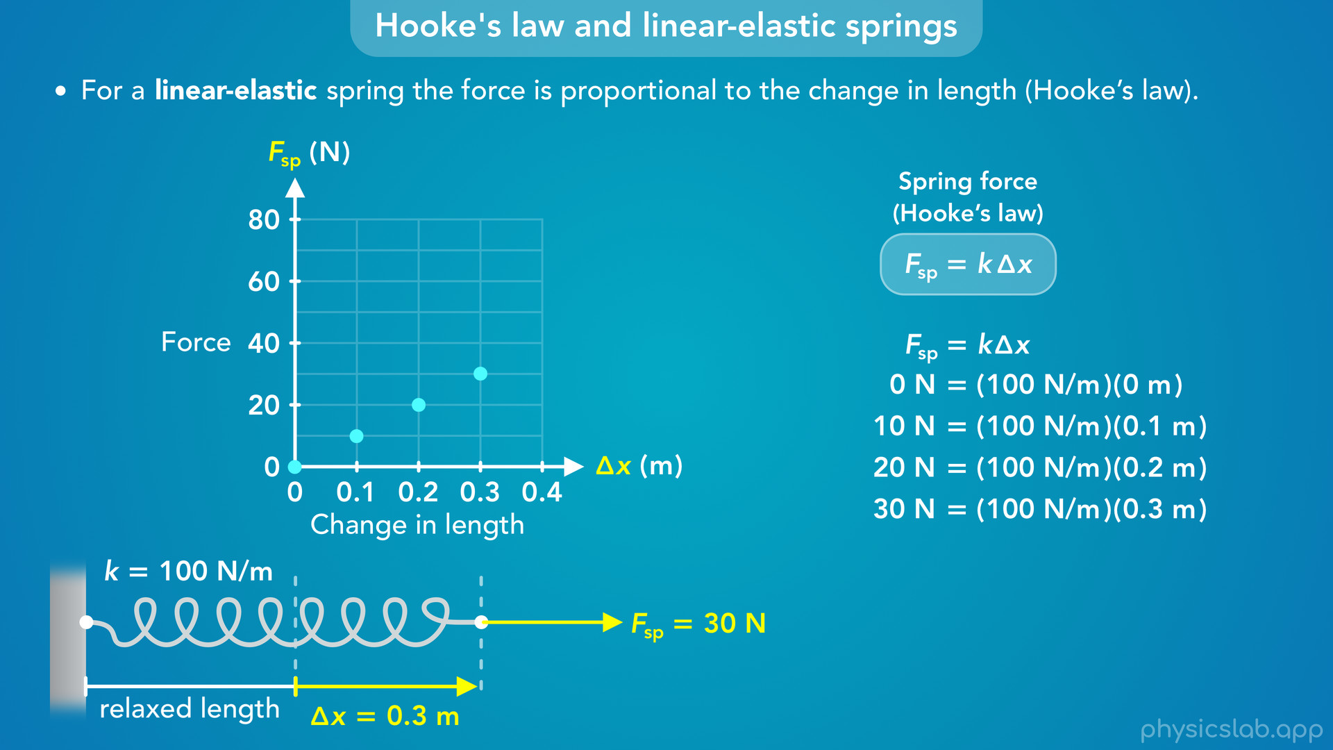
Notes:
• If delta x is 0.3 m, F is 30 N.

Slide 41
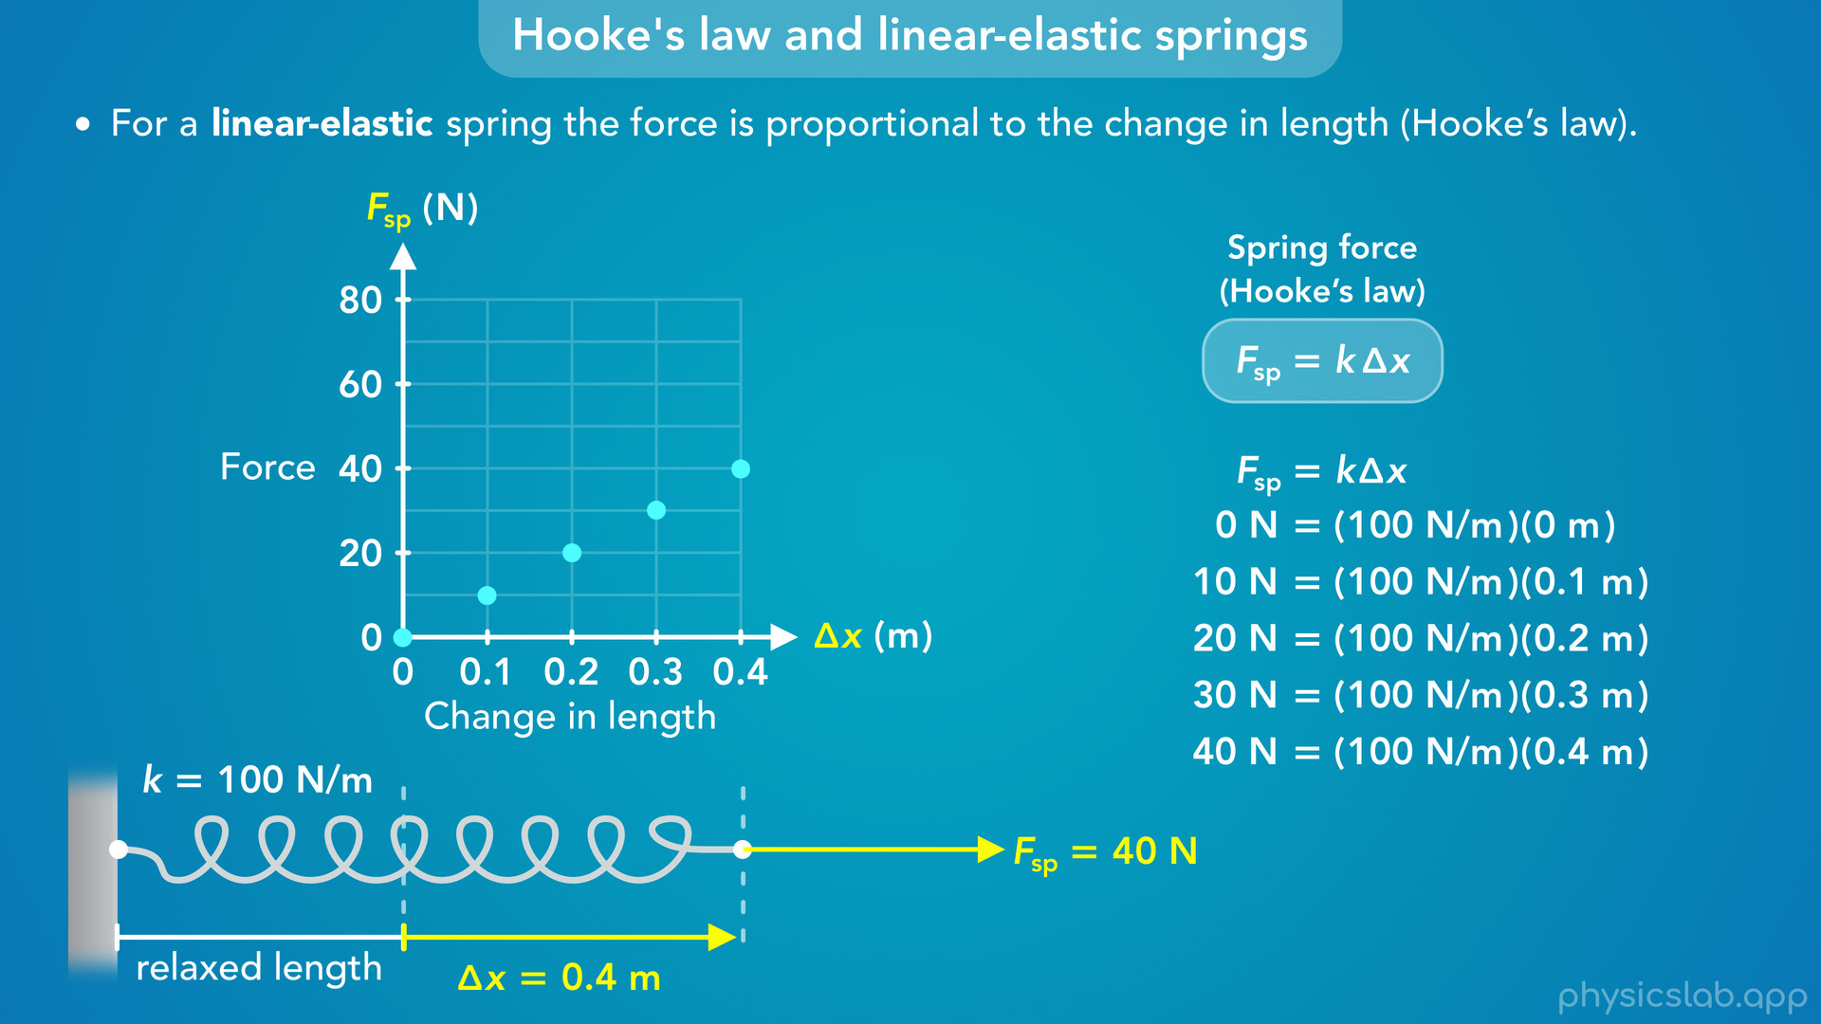
Notes:
• And if delta x is 0.4 m, F is 40 N.

Slide 42
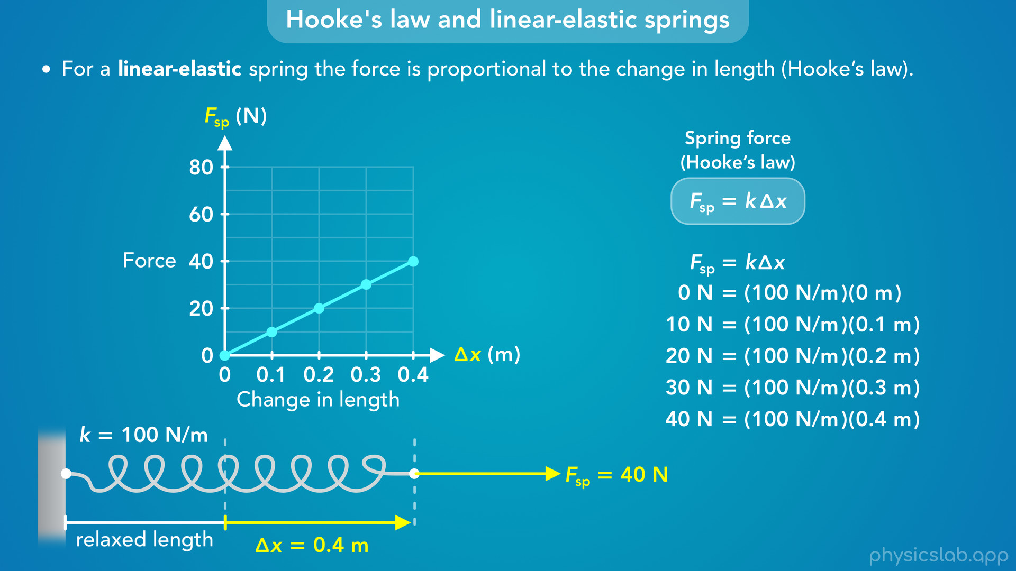
Notes:
• So, the graph of the force vs delta x is a straight line with a constant slope.

Slide 43
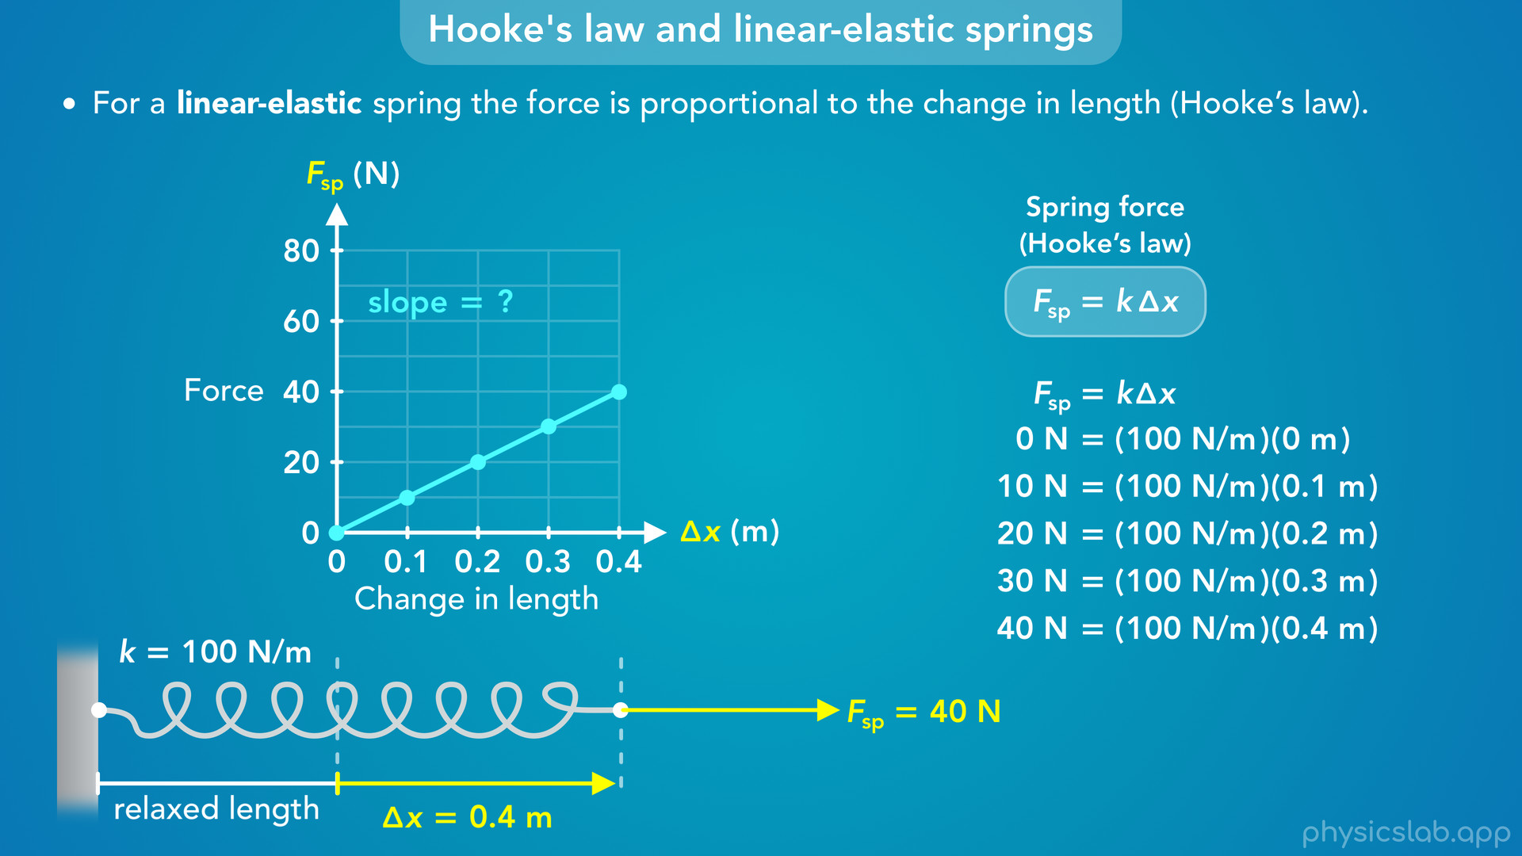
Notes:
• Pause the video again and take a second to calculate the slope of this line, and think about what the slope represents.

Slide 44

Notes:
• The slope of a line is the change in y over the change in x.
• For this graph, that would be the force divided by delta x, and we could find the slope by dividing 40 N by 0.4 m.
• That gives us 100 N/m for the slope of this line.

Slide 45
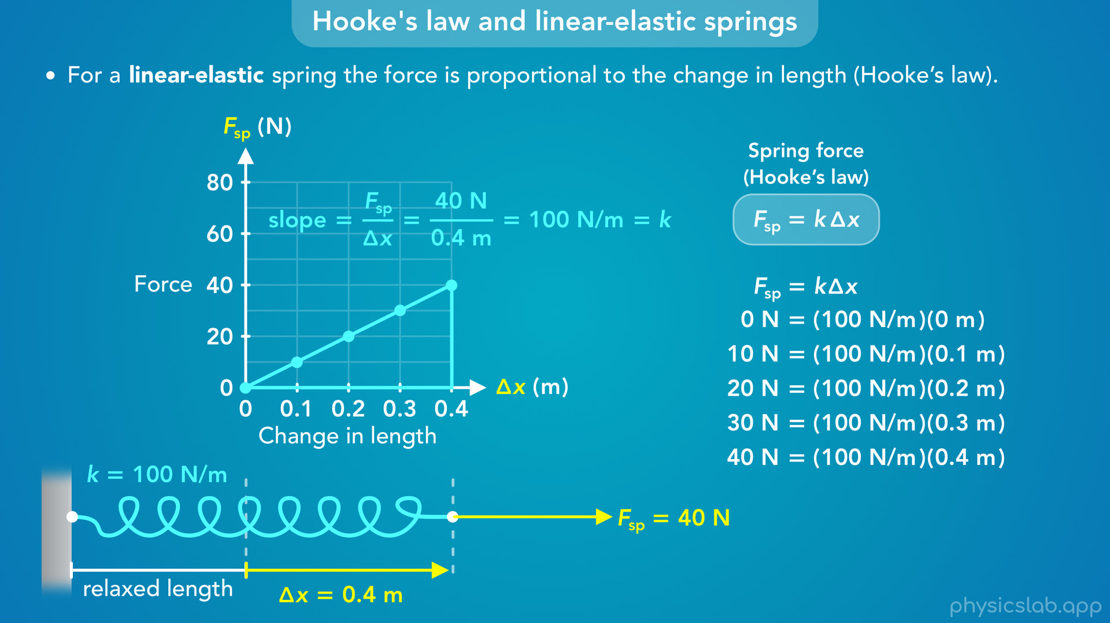
Notes:
• 100 N/m is the spring constant, k, for this spring.

Slide 46
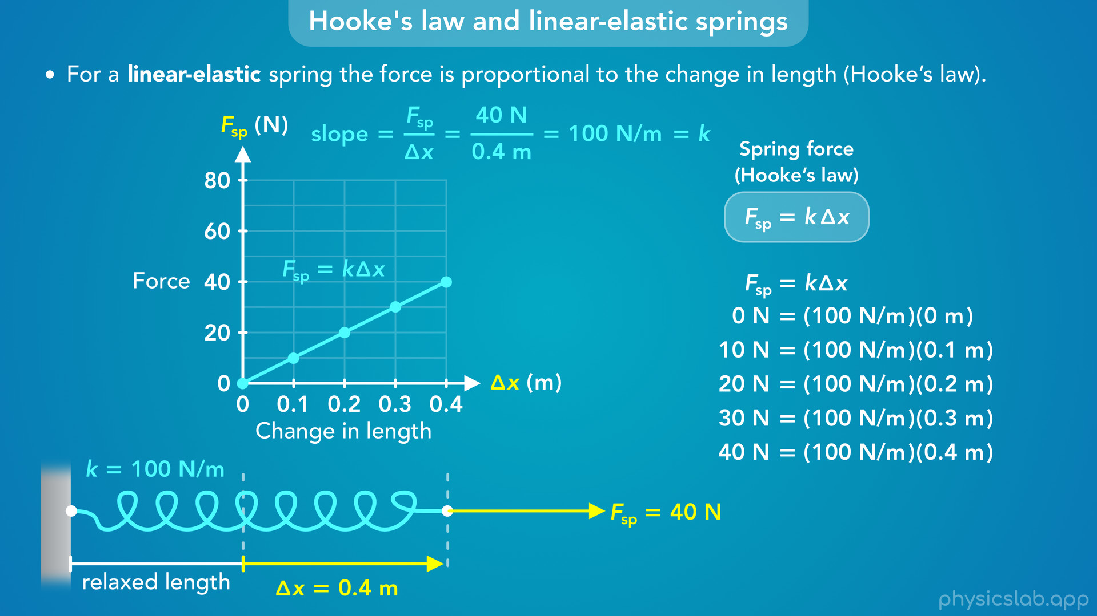

Slide 47
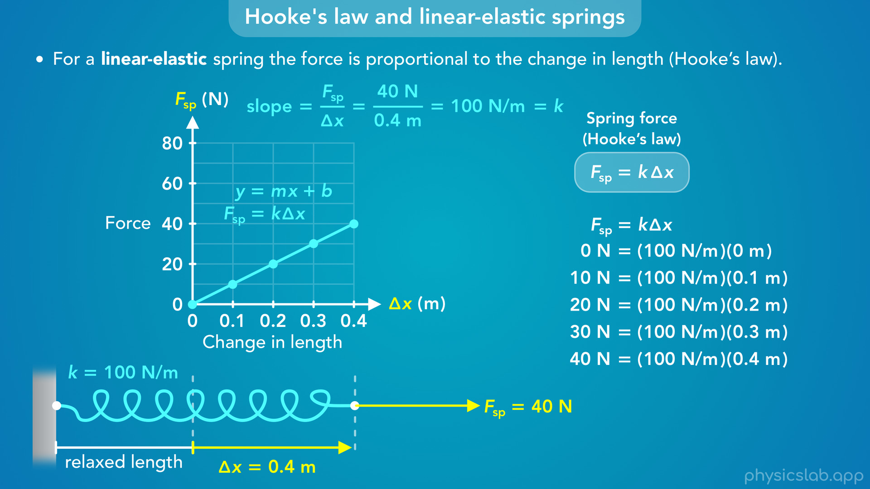
Notes:
• The line that we graphed is just the equation for Hooke’s law, force as a function of delta x.
• If we compare this to the slope intercept form of a line, the y axis is the force, F, the slope is the spring constant, k, the x axis is the change in length, delta x, and the y intercept is zero. The force is zero when delta x is zero.

Slide 48
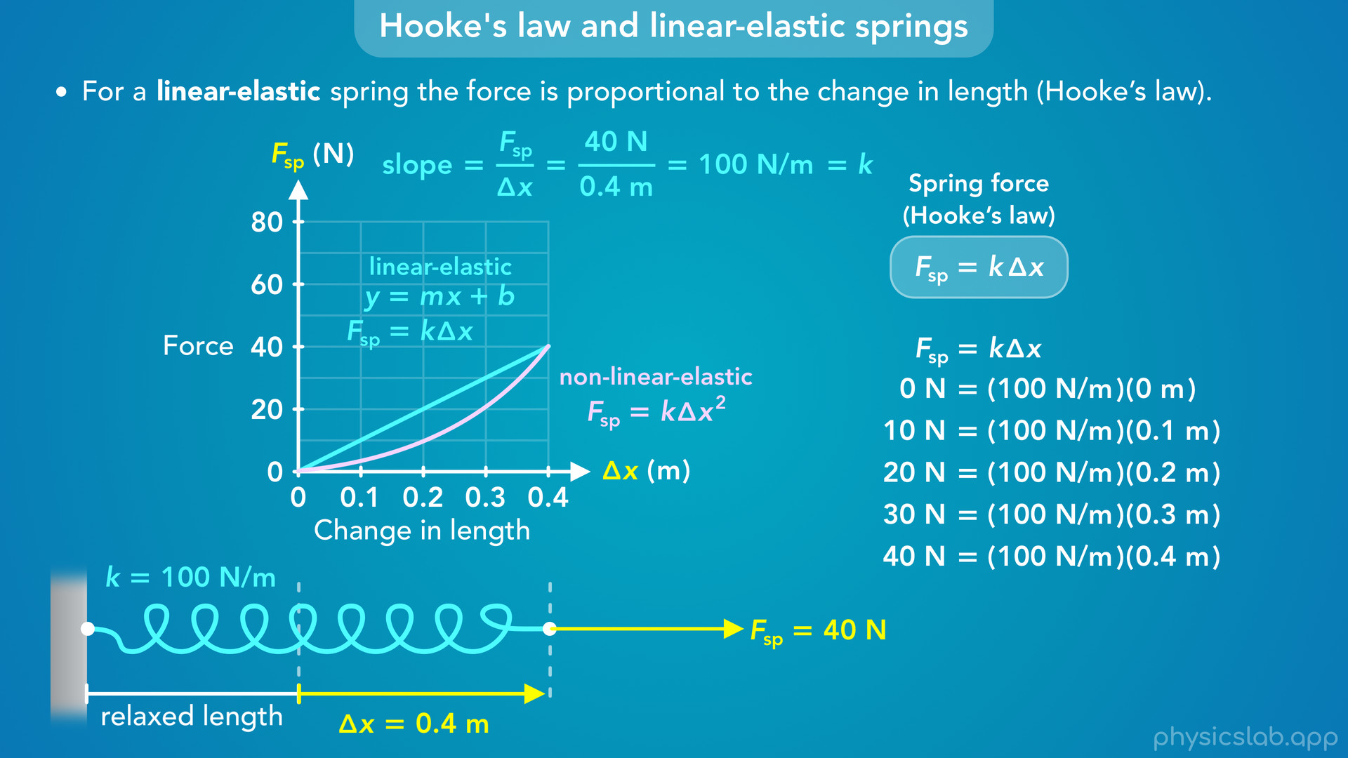
Notes:
• So this is why we refer to the spring as being linear-elastic.
• The graph of the force vs the change in length is a straight line with a constant slope.
• The graph of a non-linear-elastic spring might look something like this, where the line is curved, so it’s not linear.

Slide 49
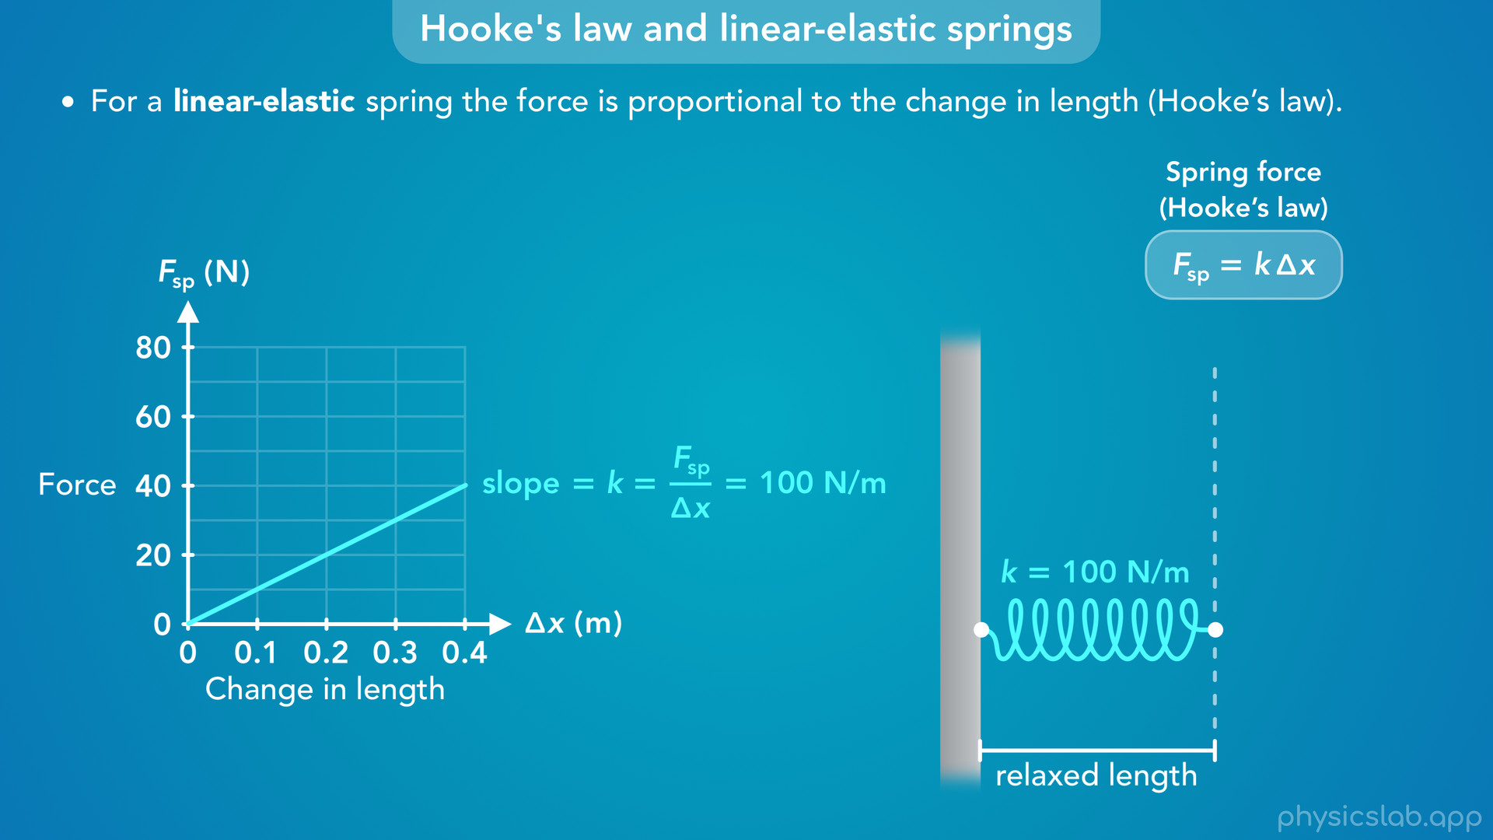

Slide 50
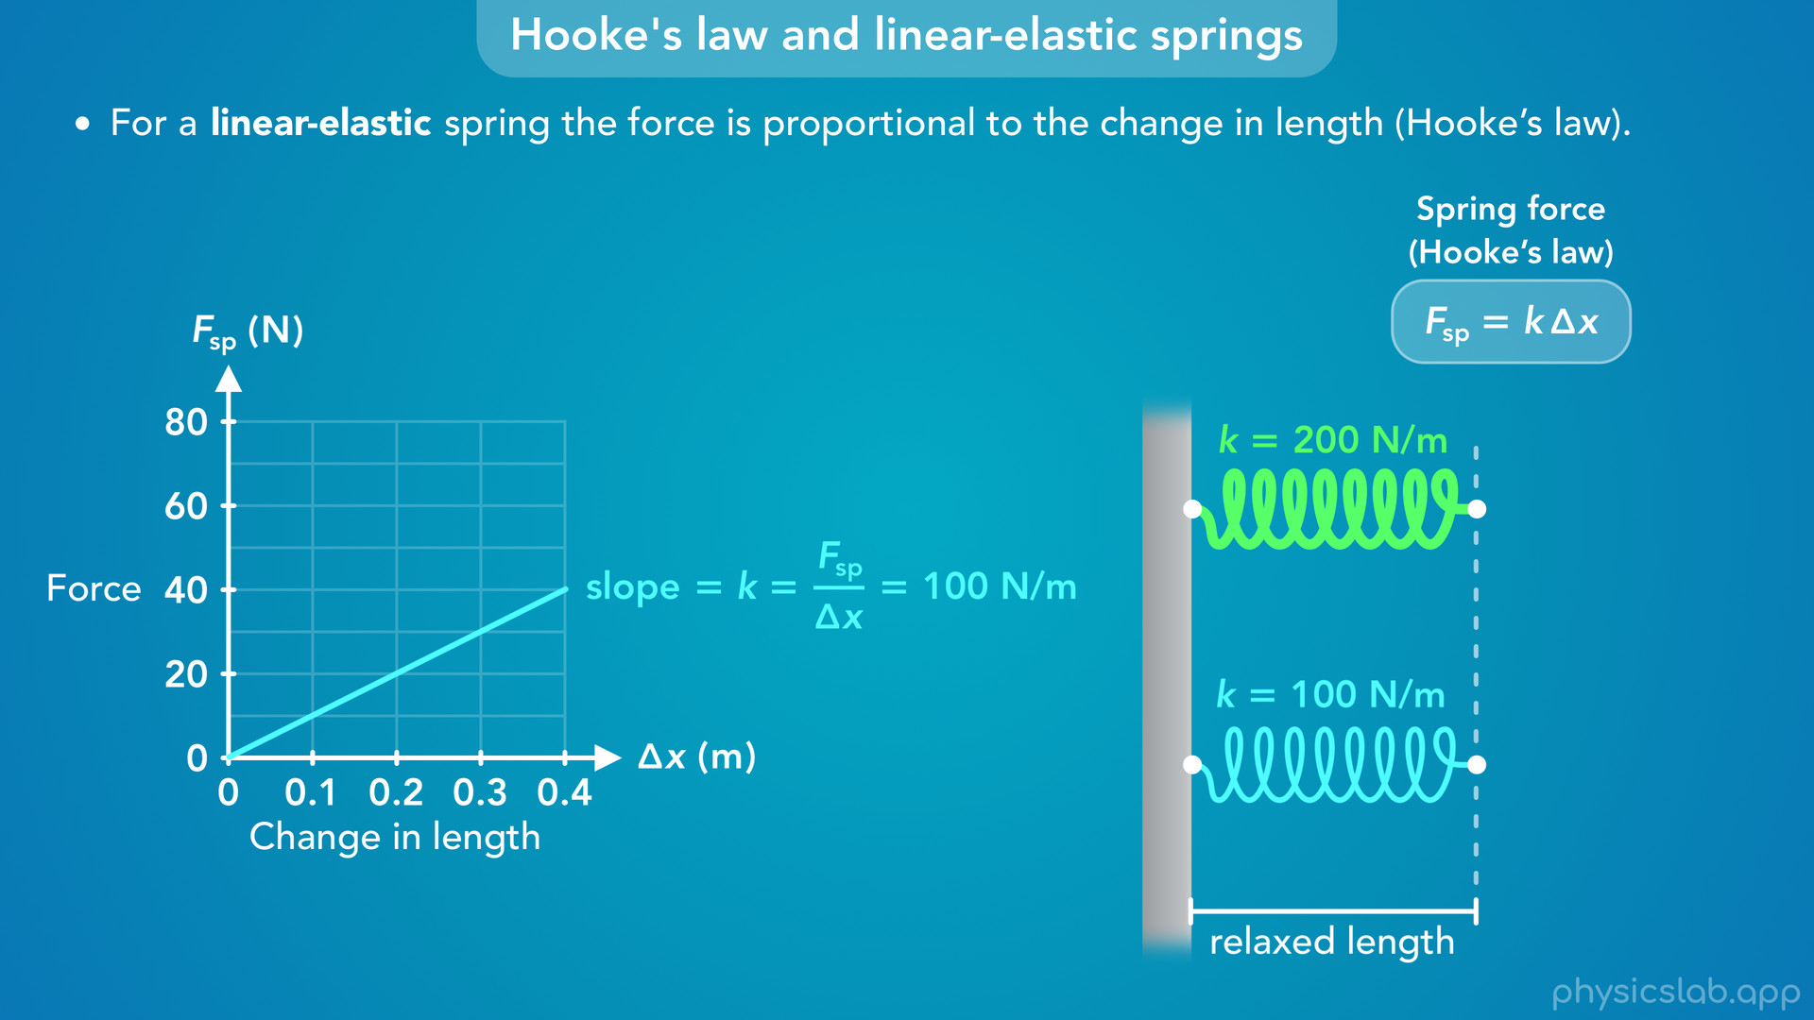
Notes:
• What if we had a spring that was twice as stiff, with a spring constant of 200 N/m?

Slide 51
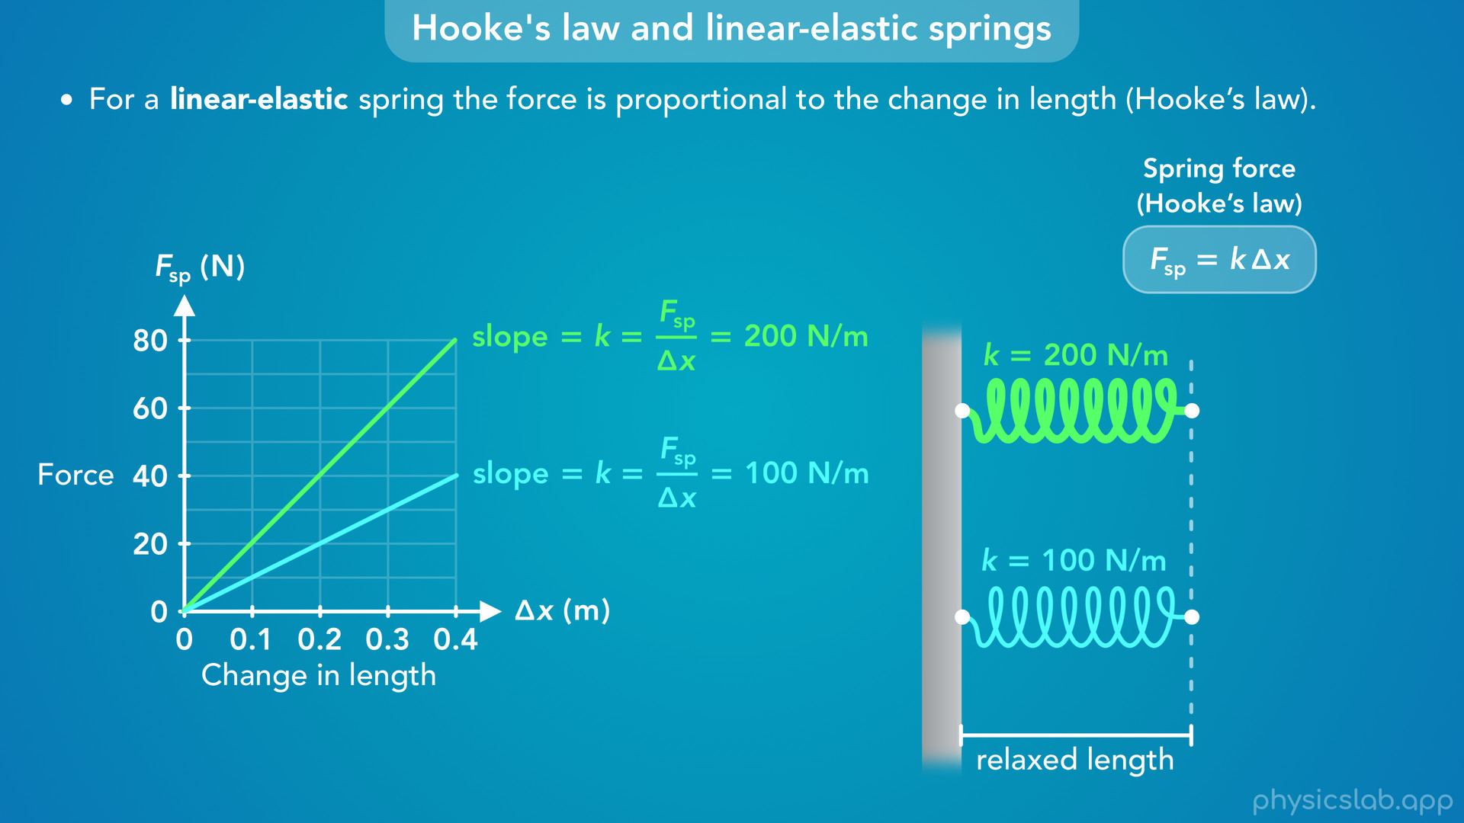
Notes:
• The graph would look like this, and it would have twice the slope.

Slide 52

Notes:
• For example, if we want to stretch both springs by the same delta x of 0.3 m, the first spring requires 30 N of force and the stiffer springs requires 60 N of force, twice as much.

Slide 53
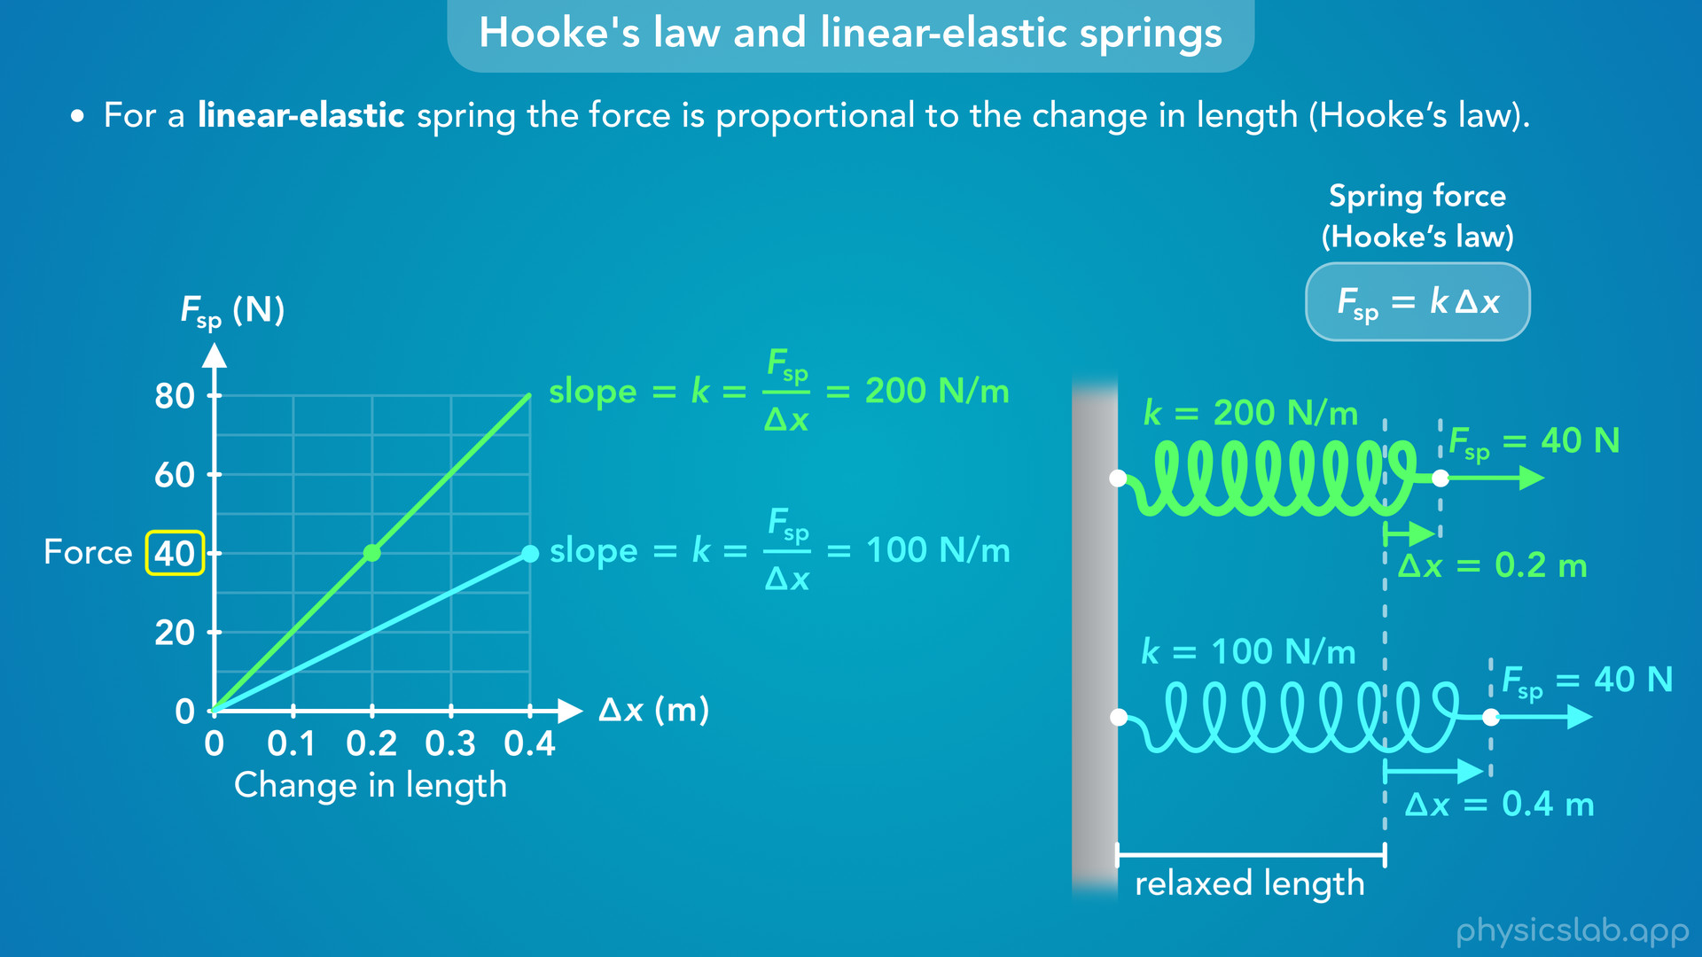
Notes:
• Or, if we apply the same amount of force to both springs, like 40 N, the first spring will stretch more, 0.4 m, and the stiffer spring will stretch half as much, 0.2 m.

Slide 54
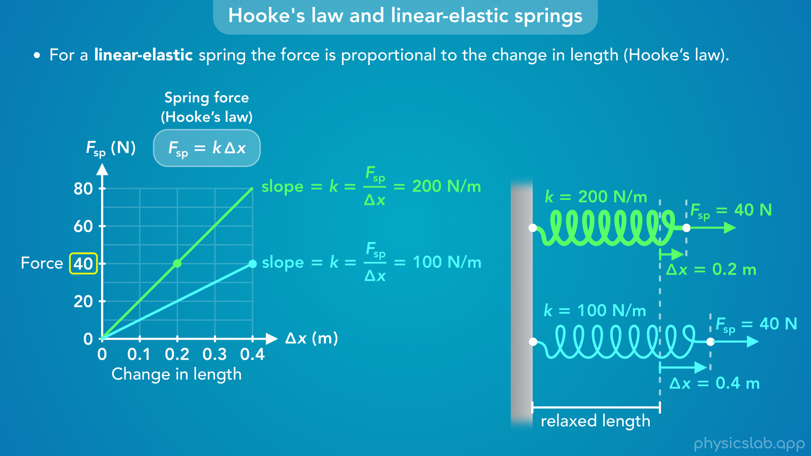
Notes:
• So this graph is another way to think hooke’s law and the relationship between the force and the change in length.

Slide 55
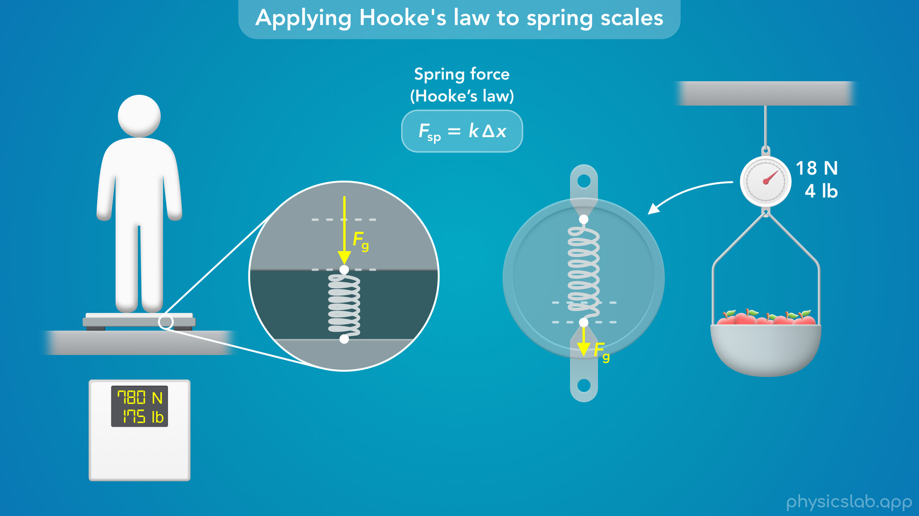
Notes:
• So that’s everything we’re gonna learn about Hooke’s law.
• Before we do some example problems, how can we apply what we learned to the spring scales from a previous video?
• Both of these scales work the same way, so let’s just look at the scale that you stand on, where the spring is compressed.

Slide 56
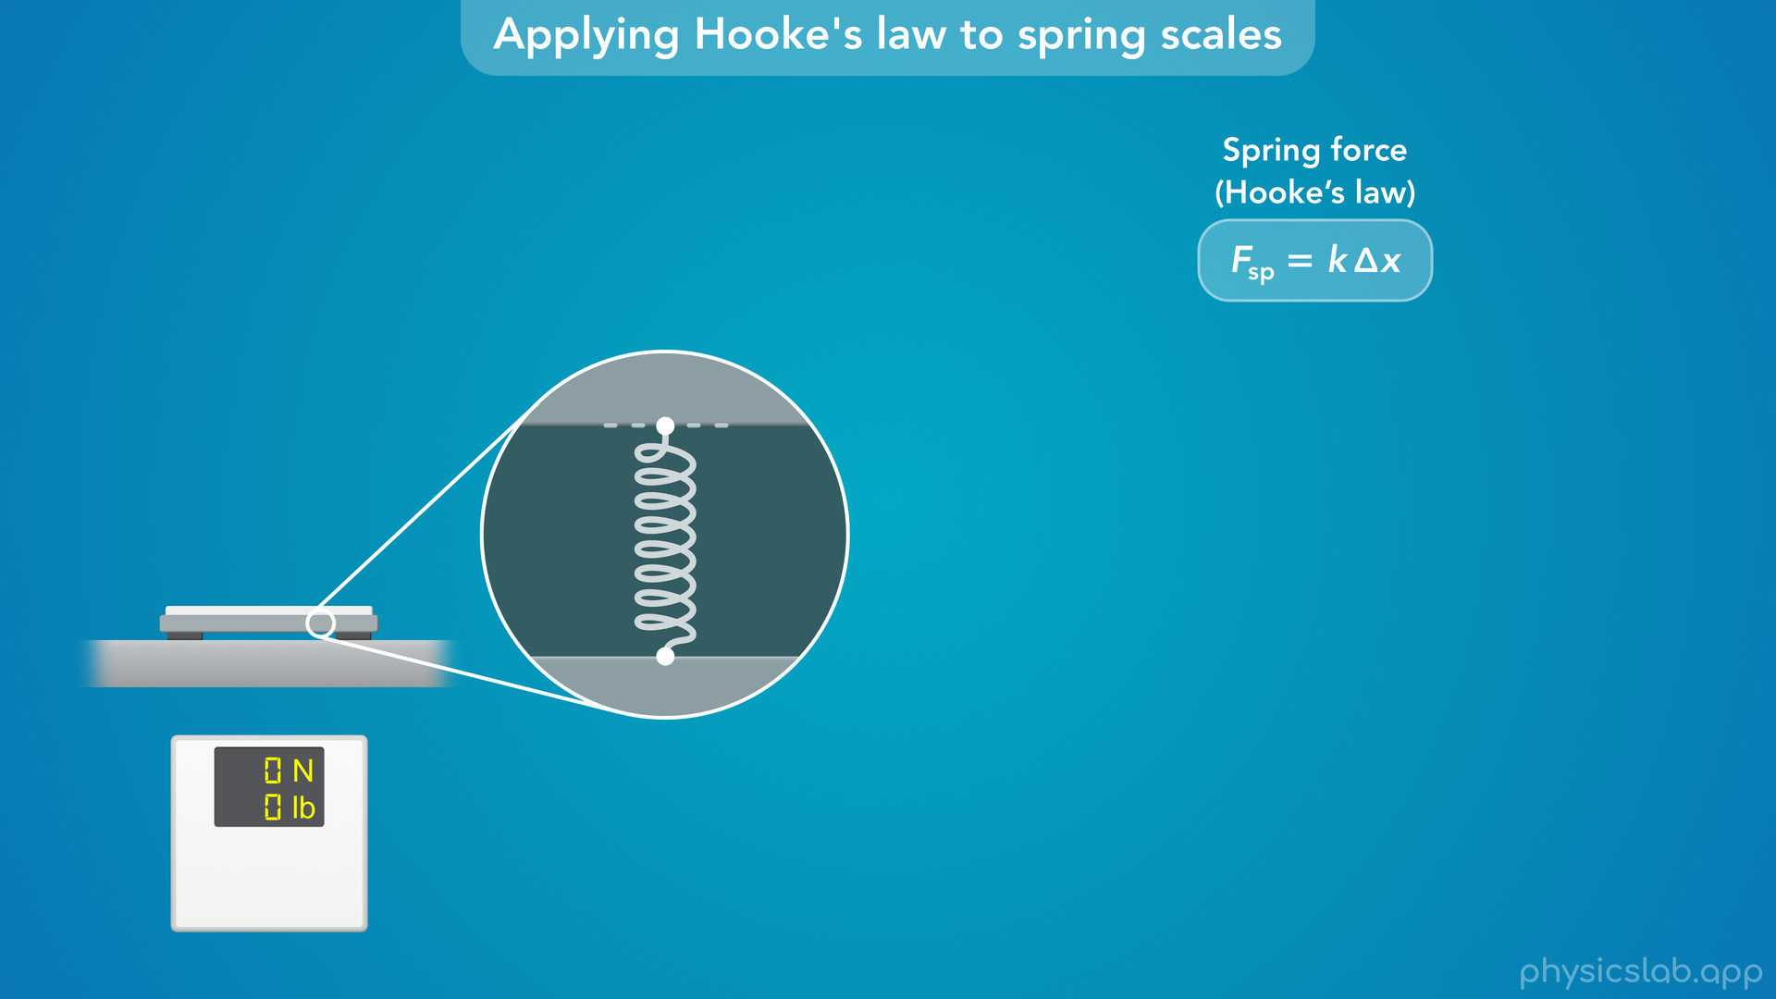
Notes:
• How would we design this scale to measure the weight of a person?

Slide 57
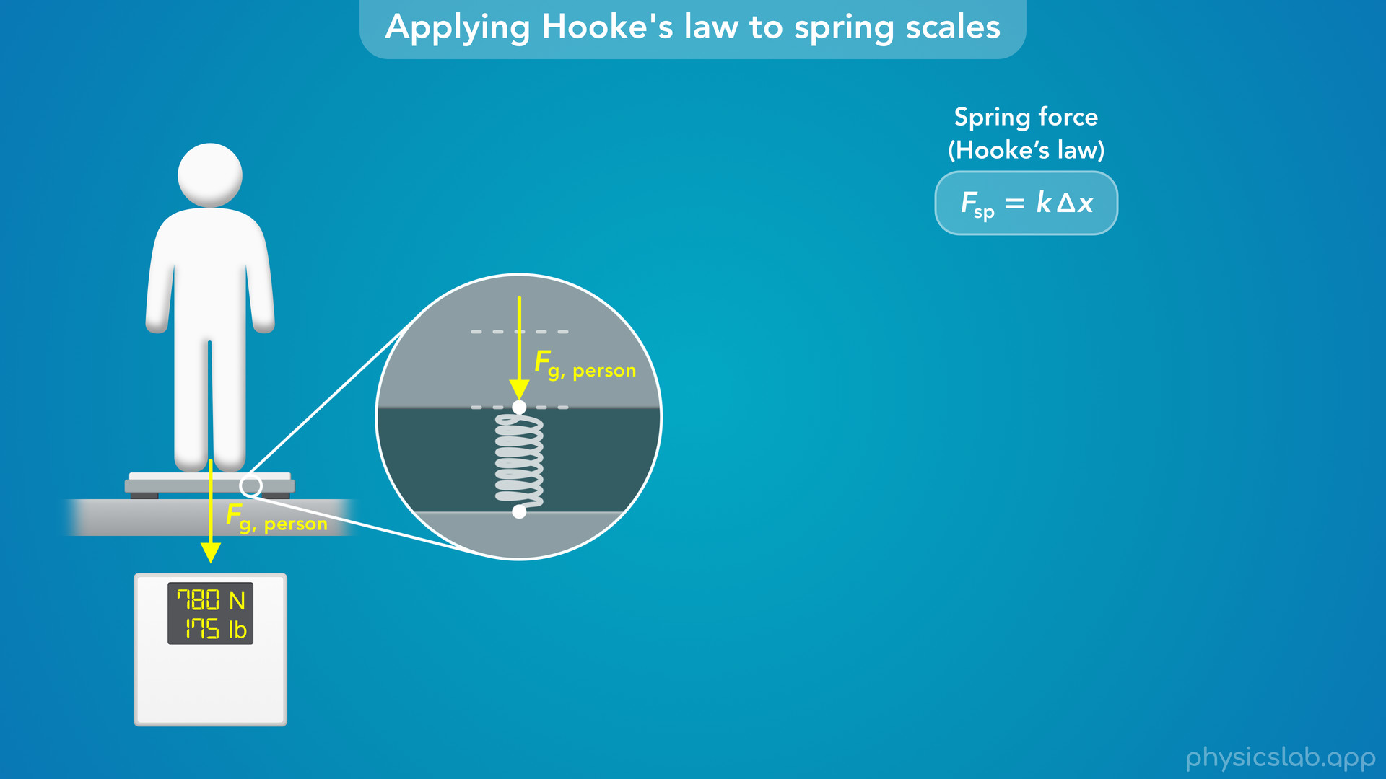
Notes:
• When the person stands on the scale, their weight force will be applied to the spring in the scale, which will compress the spring.

Slide 58
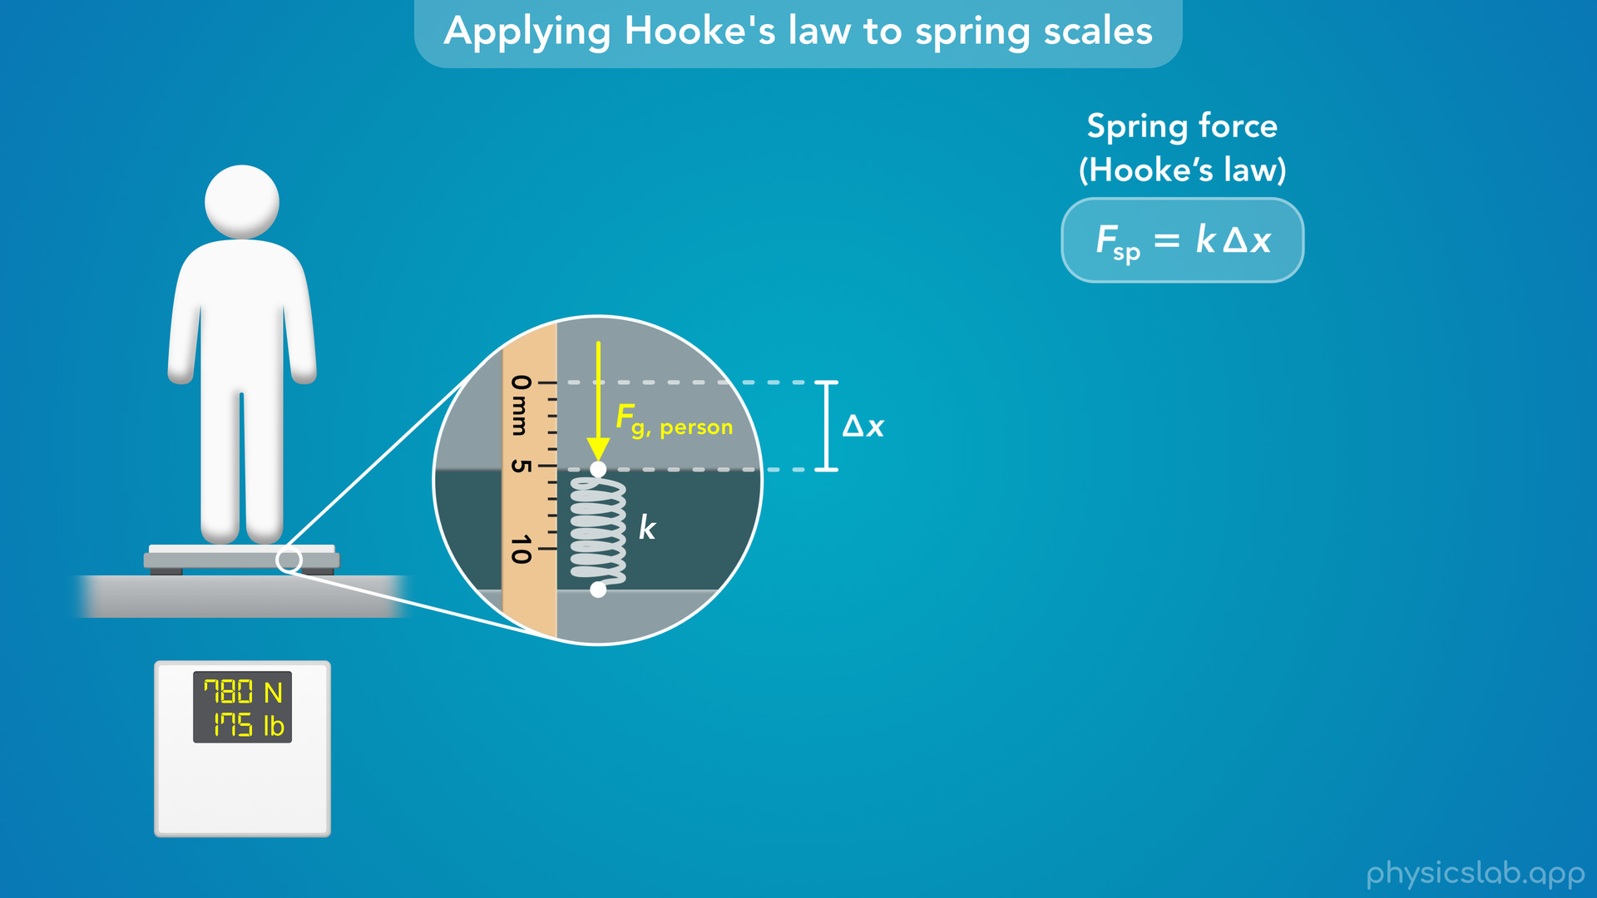
Notes:
• If we wanna calculate the force, we need to know the spring constant and the change in length of the spring.

Slide 59
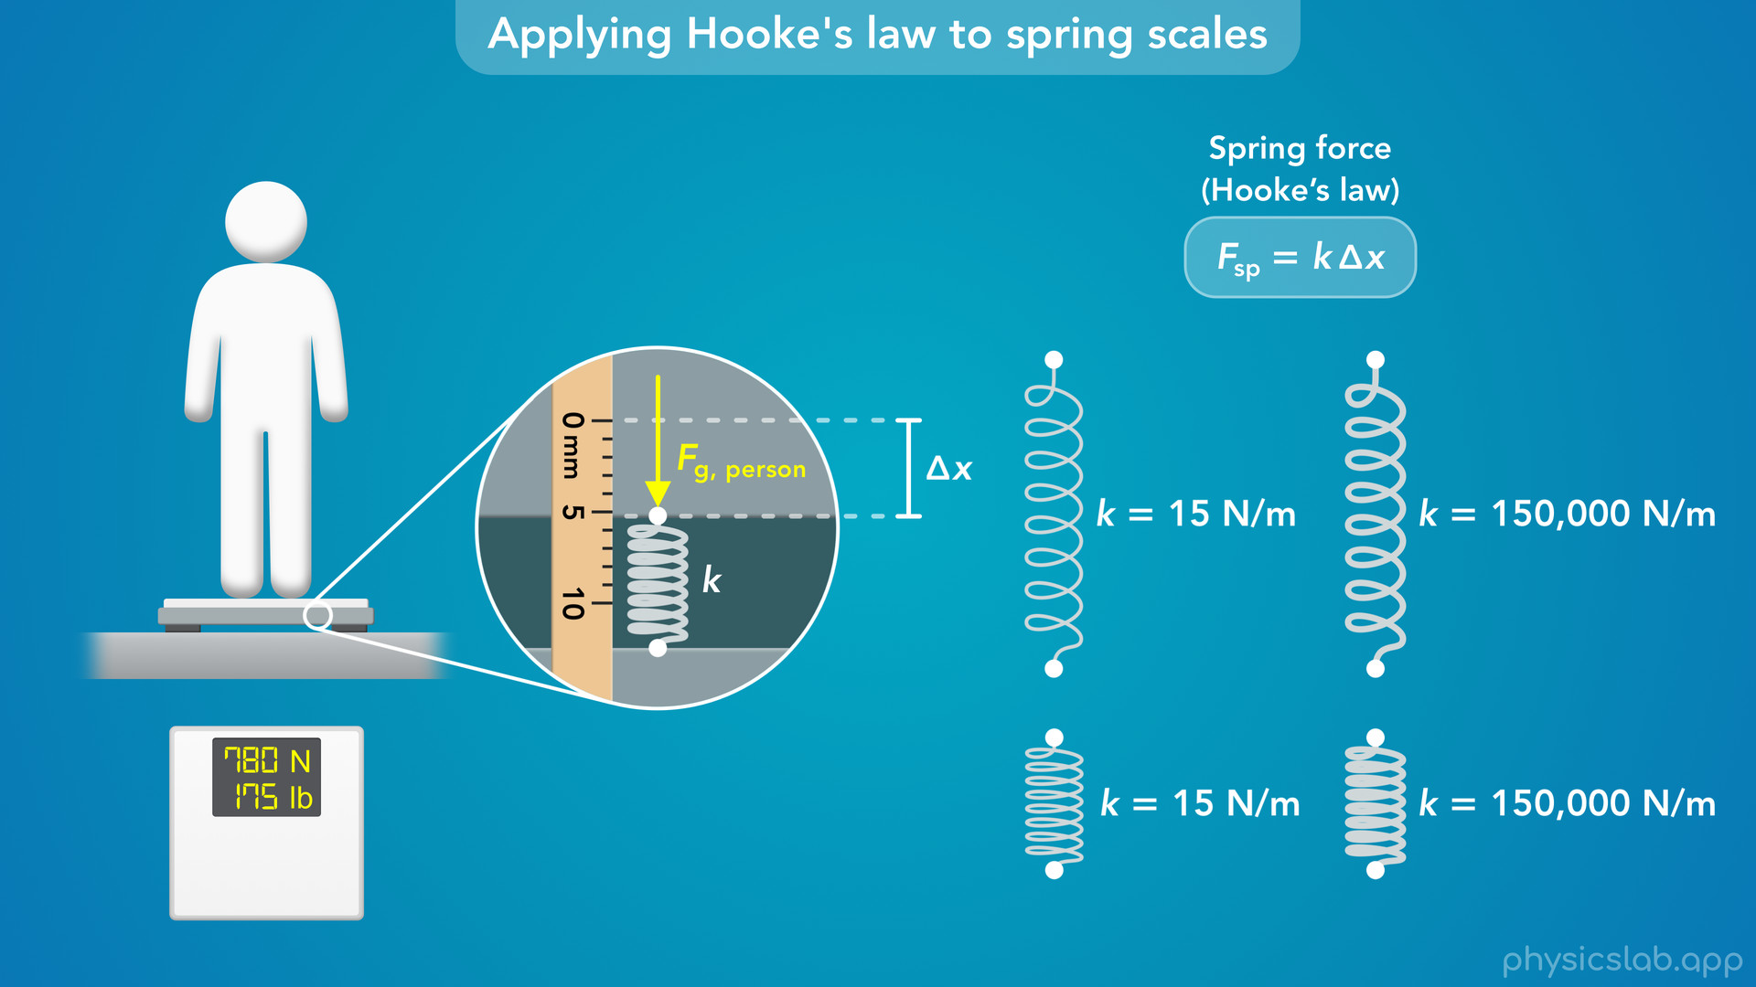
Notes:
• We can choose our own spring so we’ll know the spring constant, and then we can measure the change in length to get the force.

Slide 60
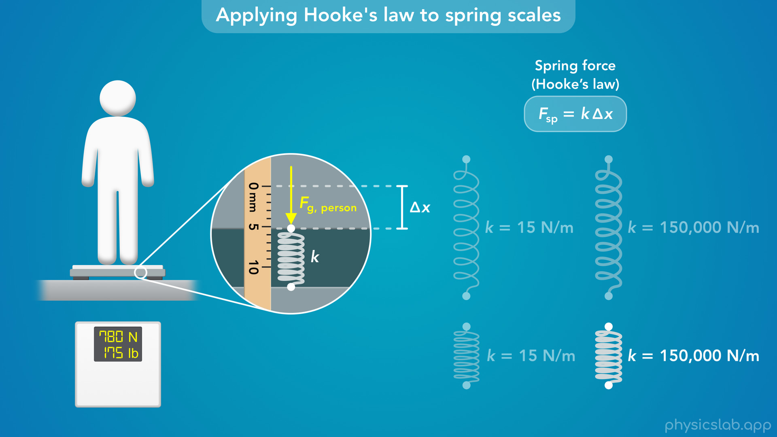
Notes:
• And we probably don’t want the scale to move very much when we stand on it, so we need a spring that will only compress a small amount under the weight of person.
• To get a smaller delta x for a given force, we want to choose a stiff spring with a very large spring constant, something like 150,000 N/m.

Slide 61
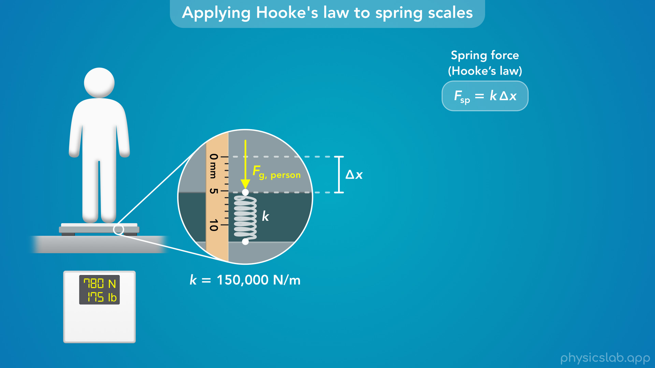
Notes:
• Now, when a person stands on the scale, we can measure the change in length from the relaxed length, and use Hooke’s law to find the force.

Slide 62

Notes:
• If the change in length is 5.2 mm, we need to convert that to meters and plug that into this equation along with the spring constant.

Slide 63

Notes:
• That gives us 780 N for the force acting on this spring, so the weight of the person is 780 N, or about 175 lb.

Slide 64

Notes:
• If a different person stands on the scale and delta x is 4.1 mm, the weight of the person would be 615 N or 138 lb.
• So for a digital scale like this one, there would be a small computer chip that’s programmed with the spring constant.
• It would measure the change in length, calculate the force and display that on the screen.

Slide 65

Notes:
• This is a simple calculation, but we can also think of the scale as measuring the change in length as an input and determining the force as the output.
• It can do this for any value of delta x, up to some limit based on the length of the spring.

Slide 66


Slide 67


Slide 68

Notes:
• Notice that since the spring constant is very large, a small change in delta x results in a large change in the calculated force.
• If delta x changes by just 0.1 mm, the calculated force will change by 15 N or about 3 and a half pounds.
• So a scale has to measure the change in length very precisely for it to be useful.

Slide 69
Notes:
• Scales can be designed in different ways, but that’s how a spring scale measures an object’s weight using Hooke’s law.

