Slide 1
Weight and Normal Force on an Incline
Slides Version 2
This version includes:
Slides with screenshot images from the video.
The video narration in the slide notes.
A blank template slide with the same background and font as the video.
Slides with some basic graphics from this video for you to use however you like.
Feel free to add, delete and edit slides to make your own presentation. You can use these slides in class or share them with your students, but please do not share them with anyone else.
If you have any feedback, suggestions or questions about these slides please email me at chris@physicslab.app or send me a message on Discord @physicslab.
physicslab.app

Slide 2
Heading
Text

Slide 3








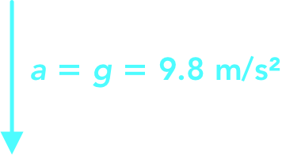









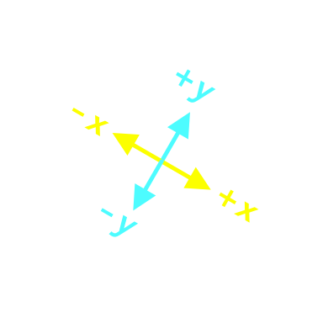
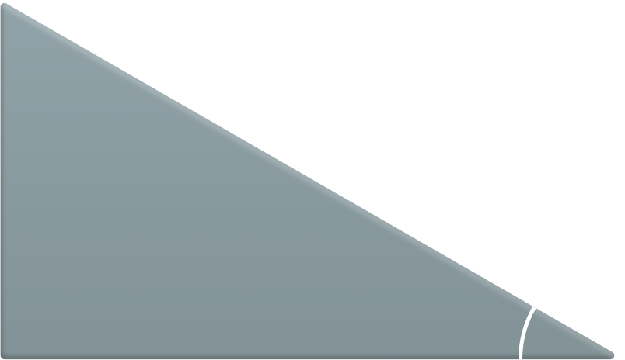













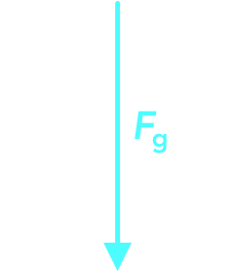

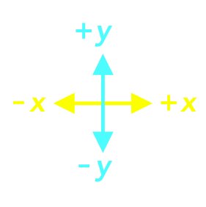







Slide 4
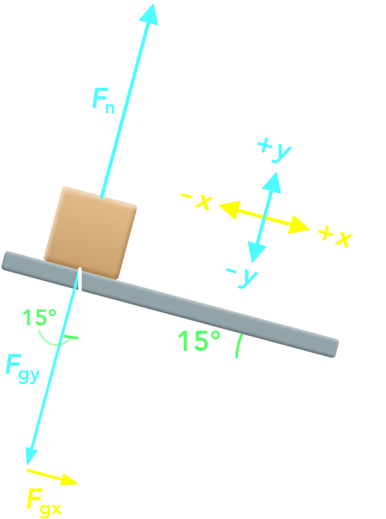
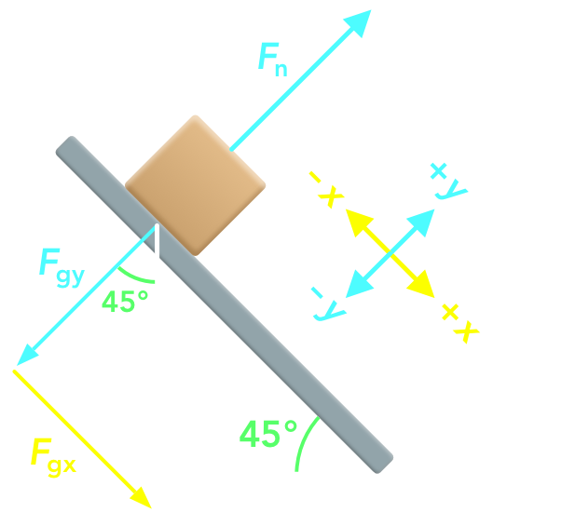
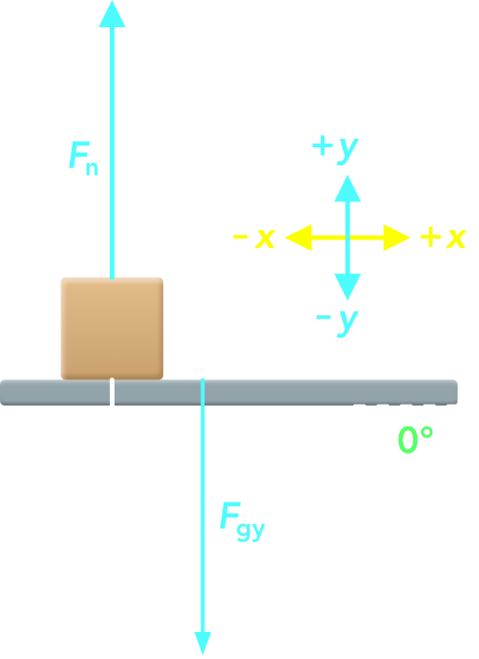

Slide 5
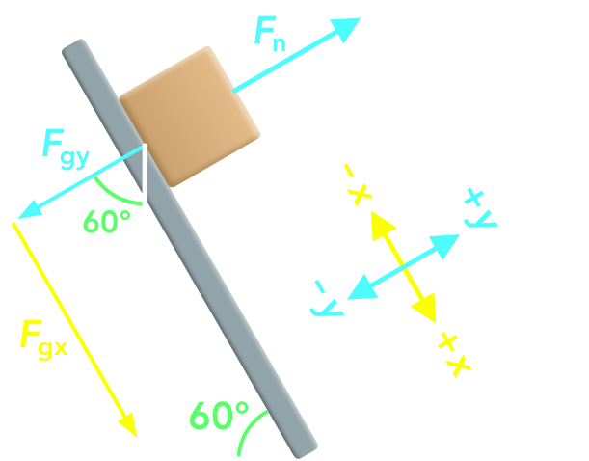
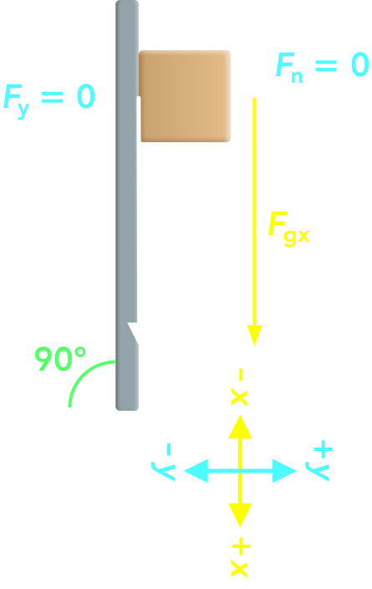

Slide 6
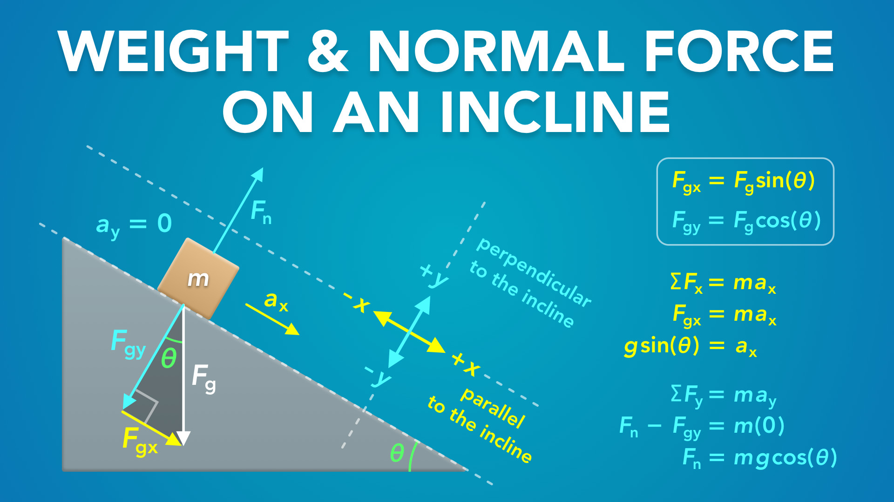
Notes:
Weight & Normal Force on an Incline
physicslab.app
If you have any questions, suggestions or feedback about these slides please email me at chris@physicslab.app or send me a message on Discord @physicslab.

Slide 7
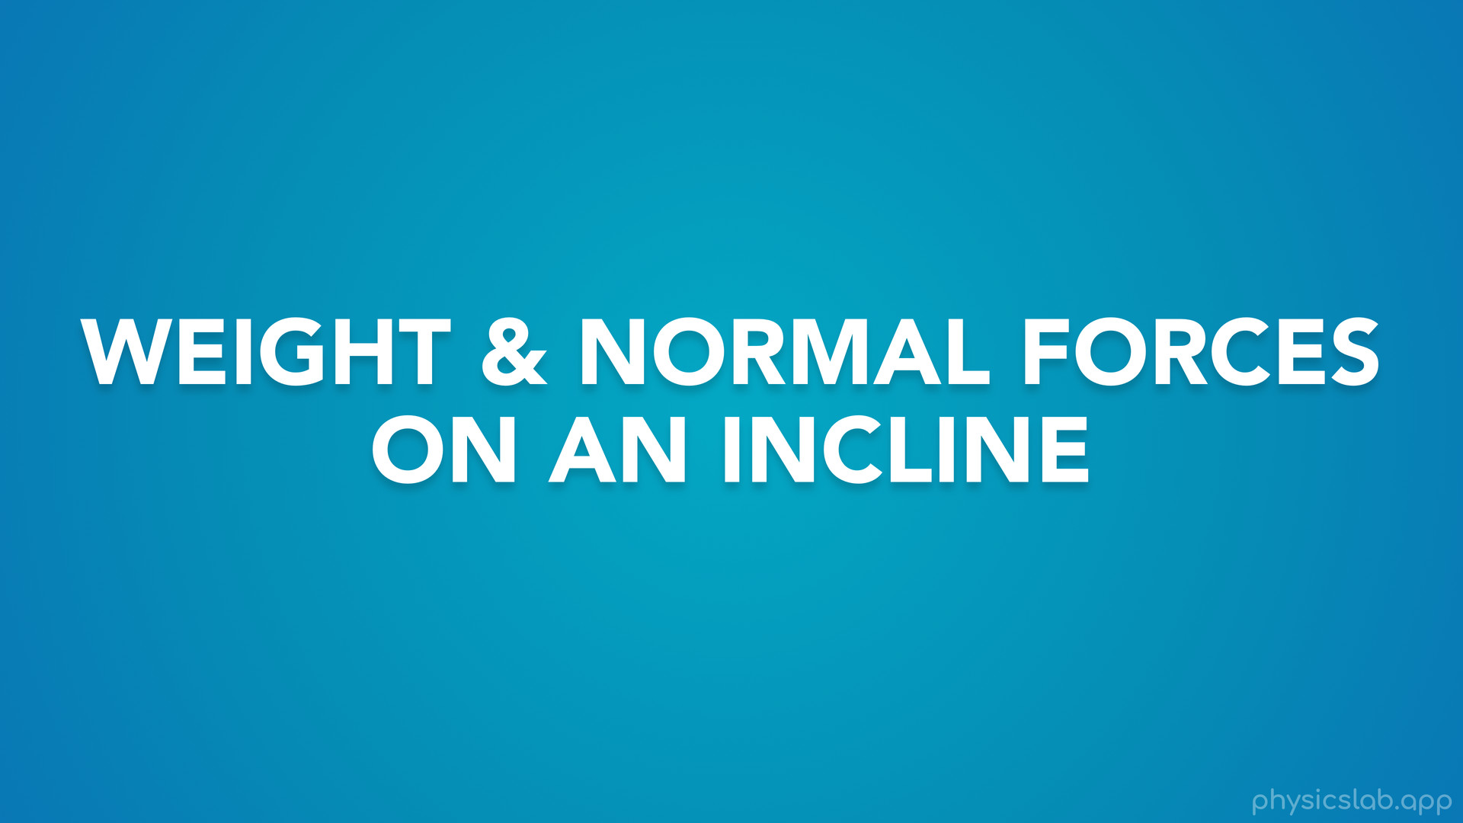
Notes:
• Hey everyone, in this video we’re gonna learn about weight and normal forces on an incline.

Slide 8
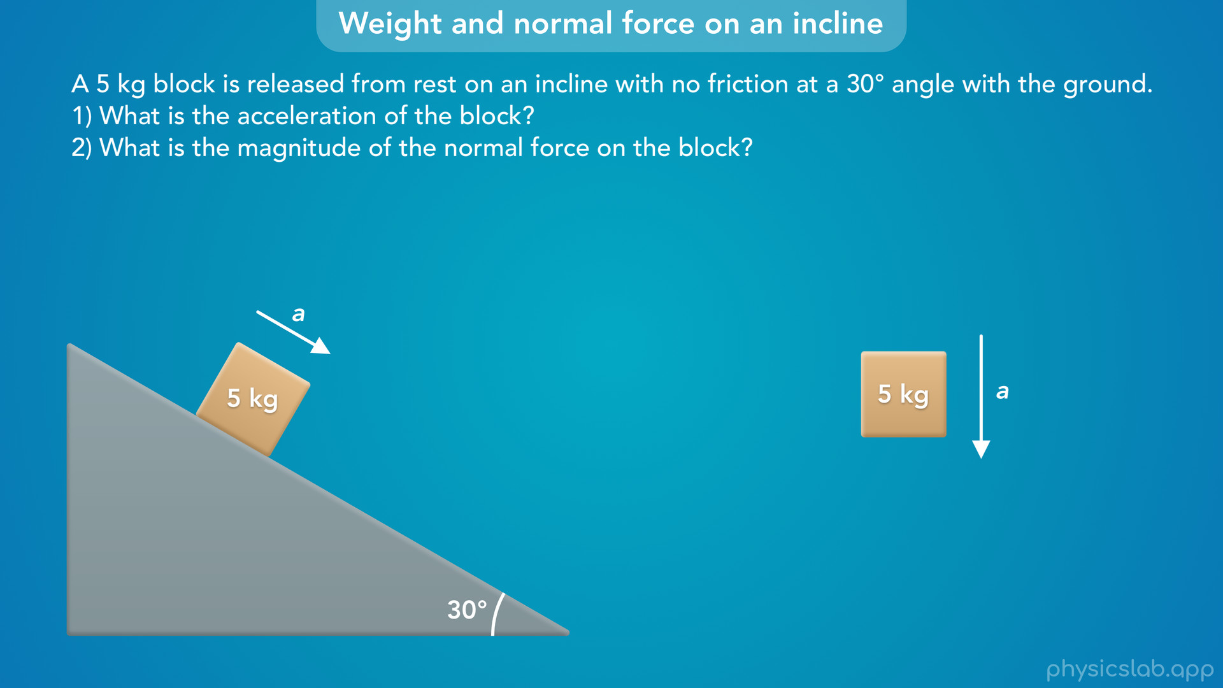
Notes:
• We’ll talk about how an object accelerates on an incline...

Slide 9
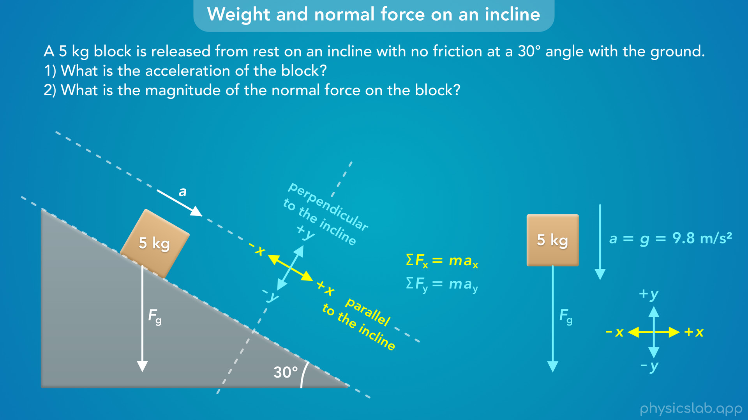
Notes:
• … and we’ll learn how to set up our coordinate system so we can use the equations for Newton’s 2nd law.

Slide 10
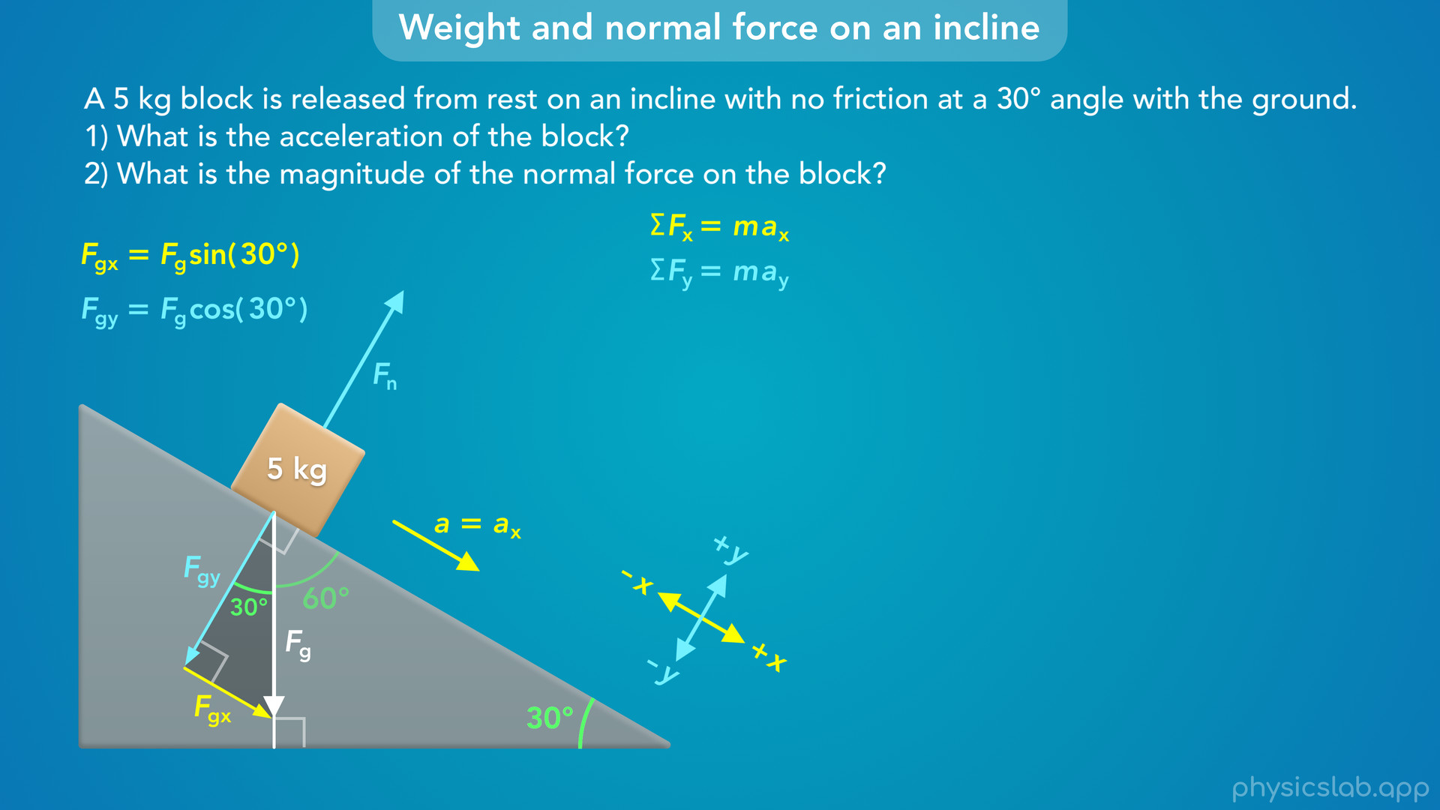
Notes:
• We’ll explain how to find the angles and the components of the weight force....

Slide 11
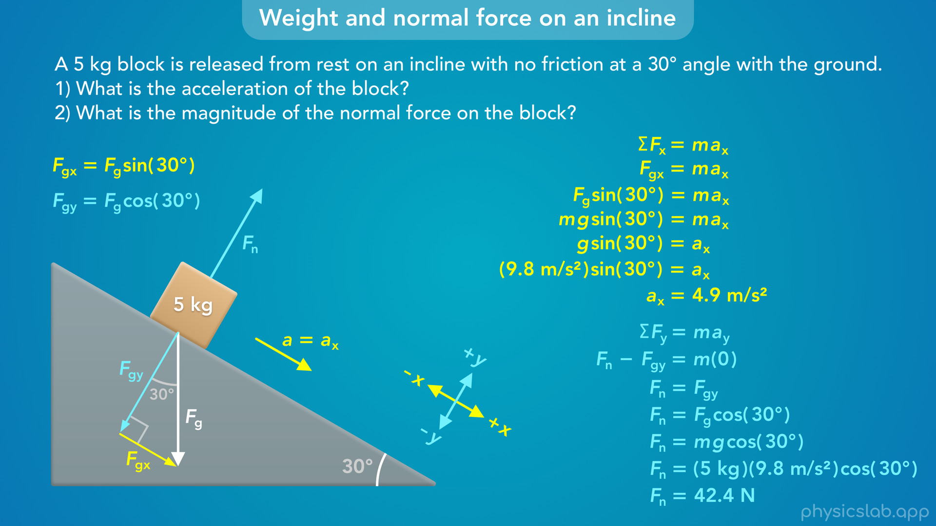
Notes:
• … and then we’ll use Newton’s 2nd law in the x and y directions to find the acceleration and the normal force.

Slide 12
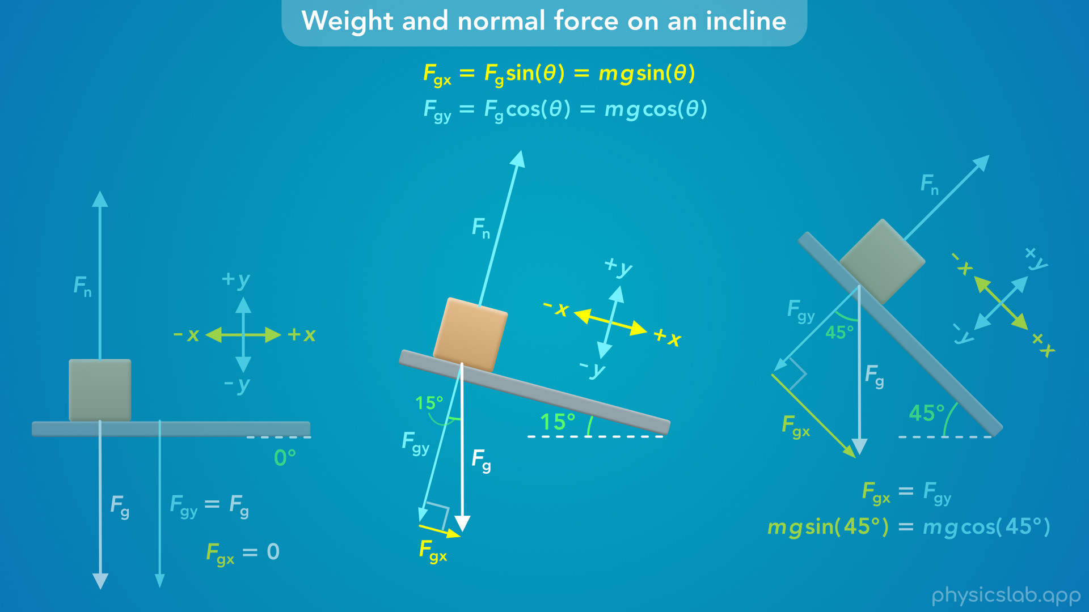
Notes:
• At the end, we’ll see how the weight components and the normal force change at different angles.

Slide 13
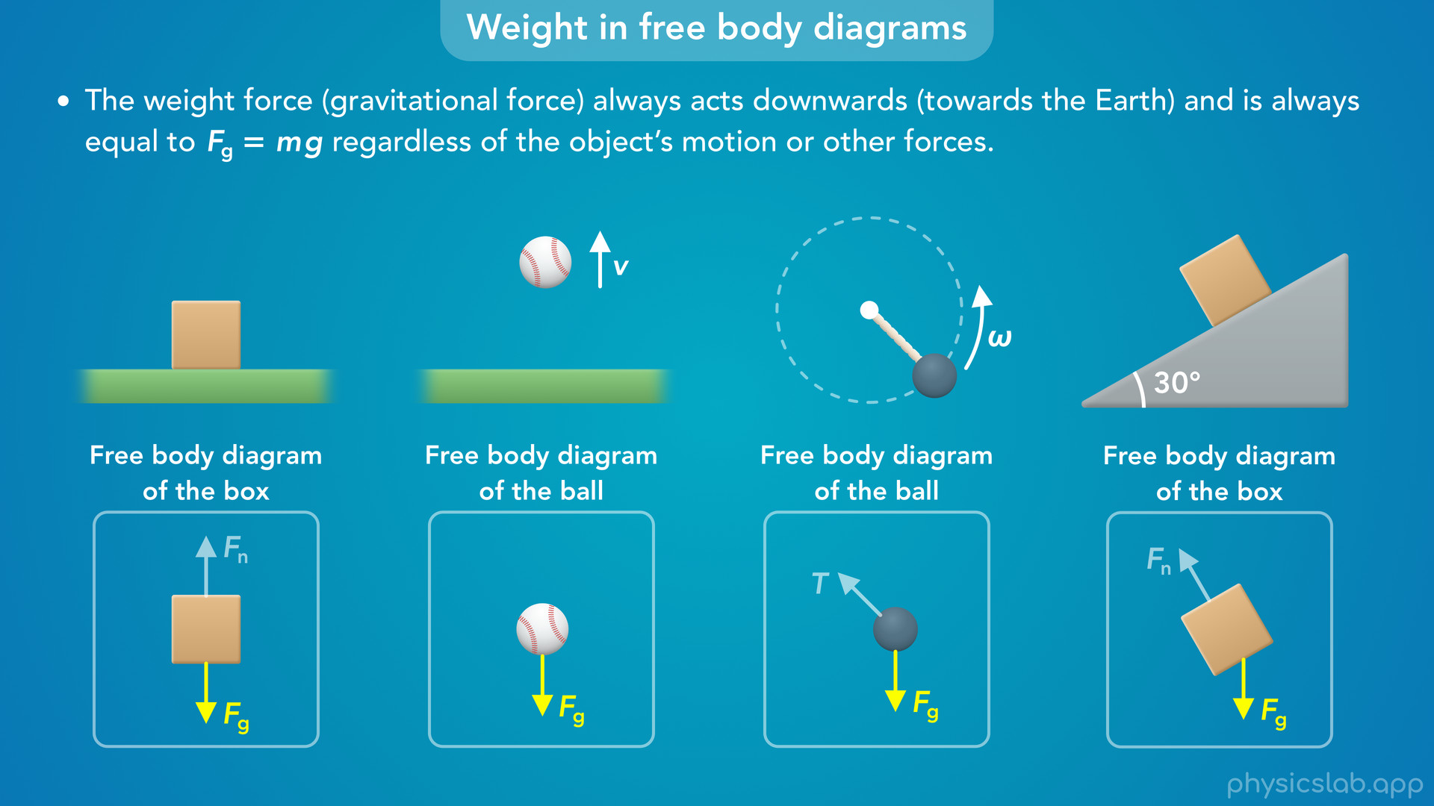
Notes:
• In a previous video, we learned that the weight force acting on an object always points vertically downwards, towards the center of the earth.

Slide 14
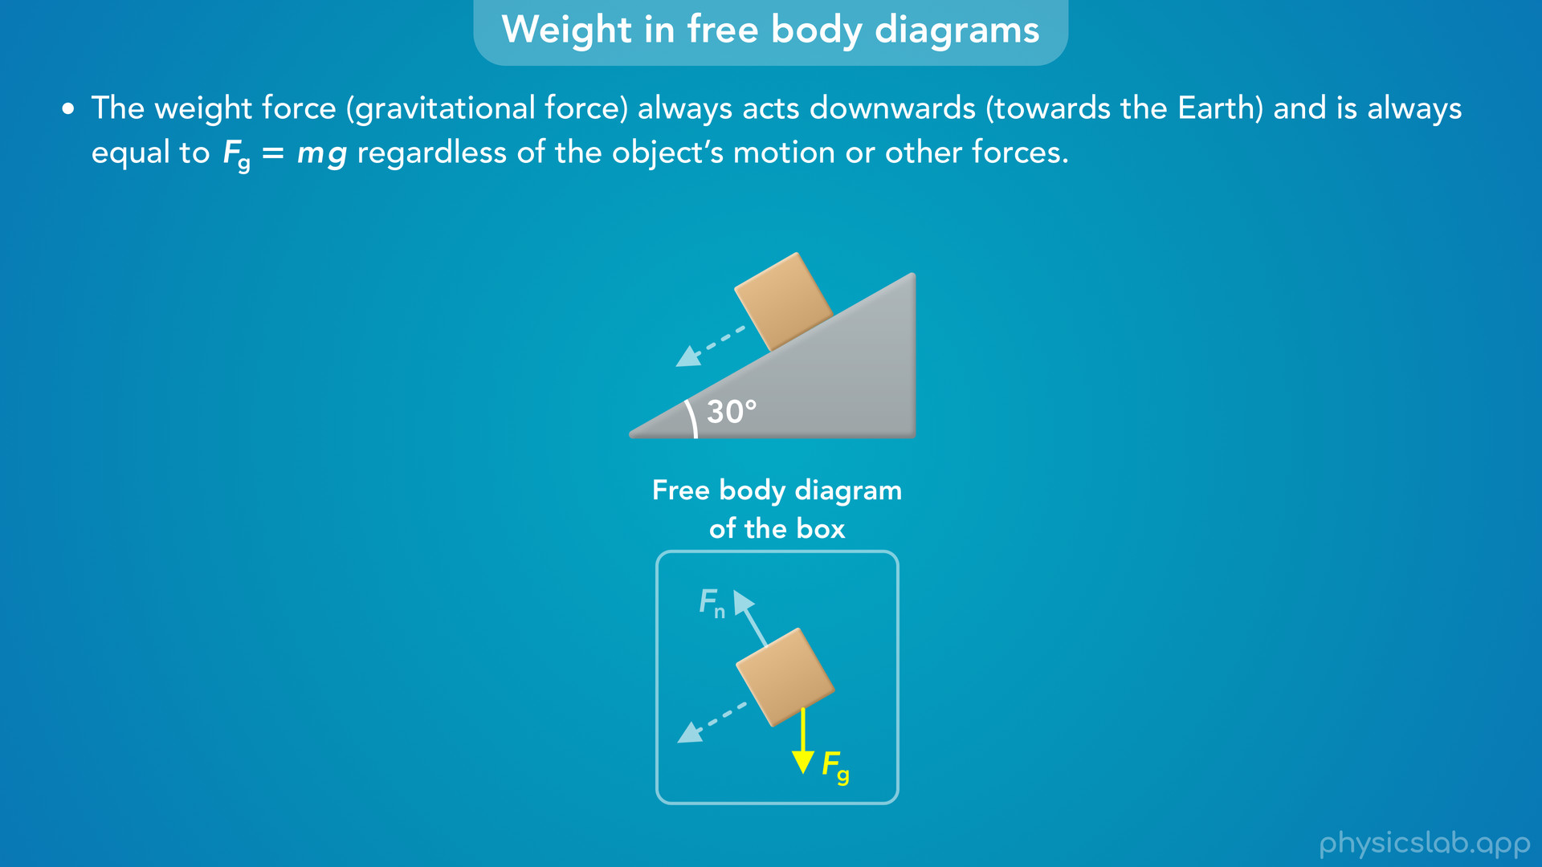
Notes:
• If we’re dealing with an object on an incline, then the motion is not vertical or horizontal, and the weight force is at an angle to the direction of the motion.
• In those cases, how do we apply Newton’s 2nd law?
• How does gravity affect the motion, and how does the angle affect the normal force?

Slide 15
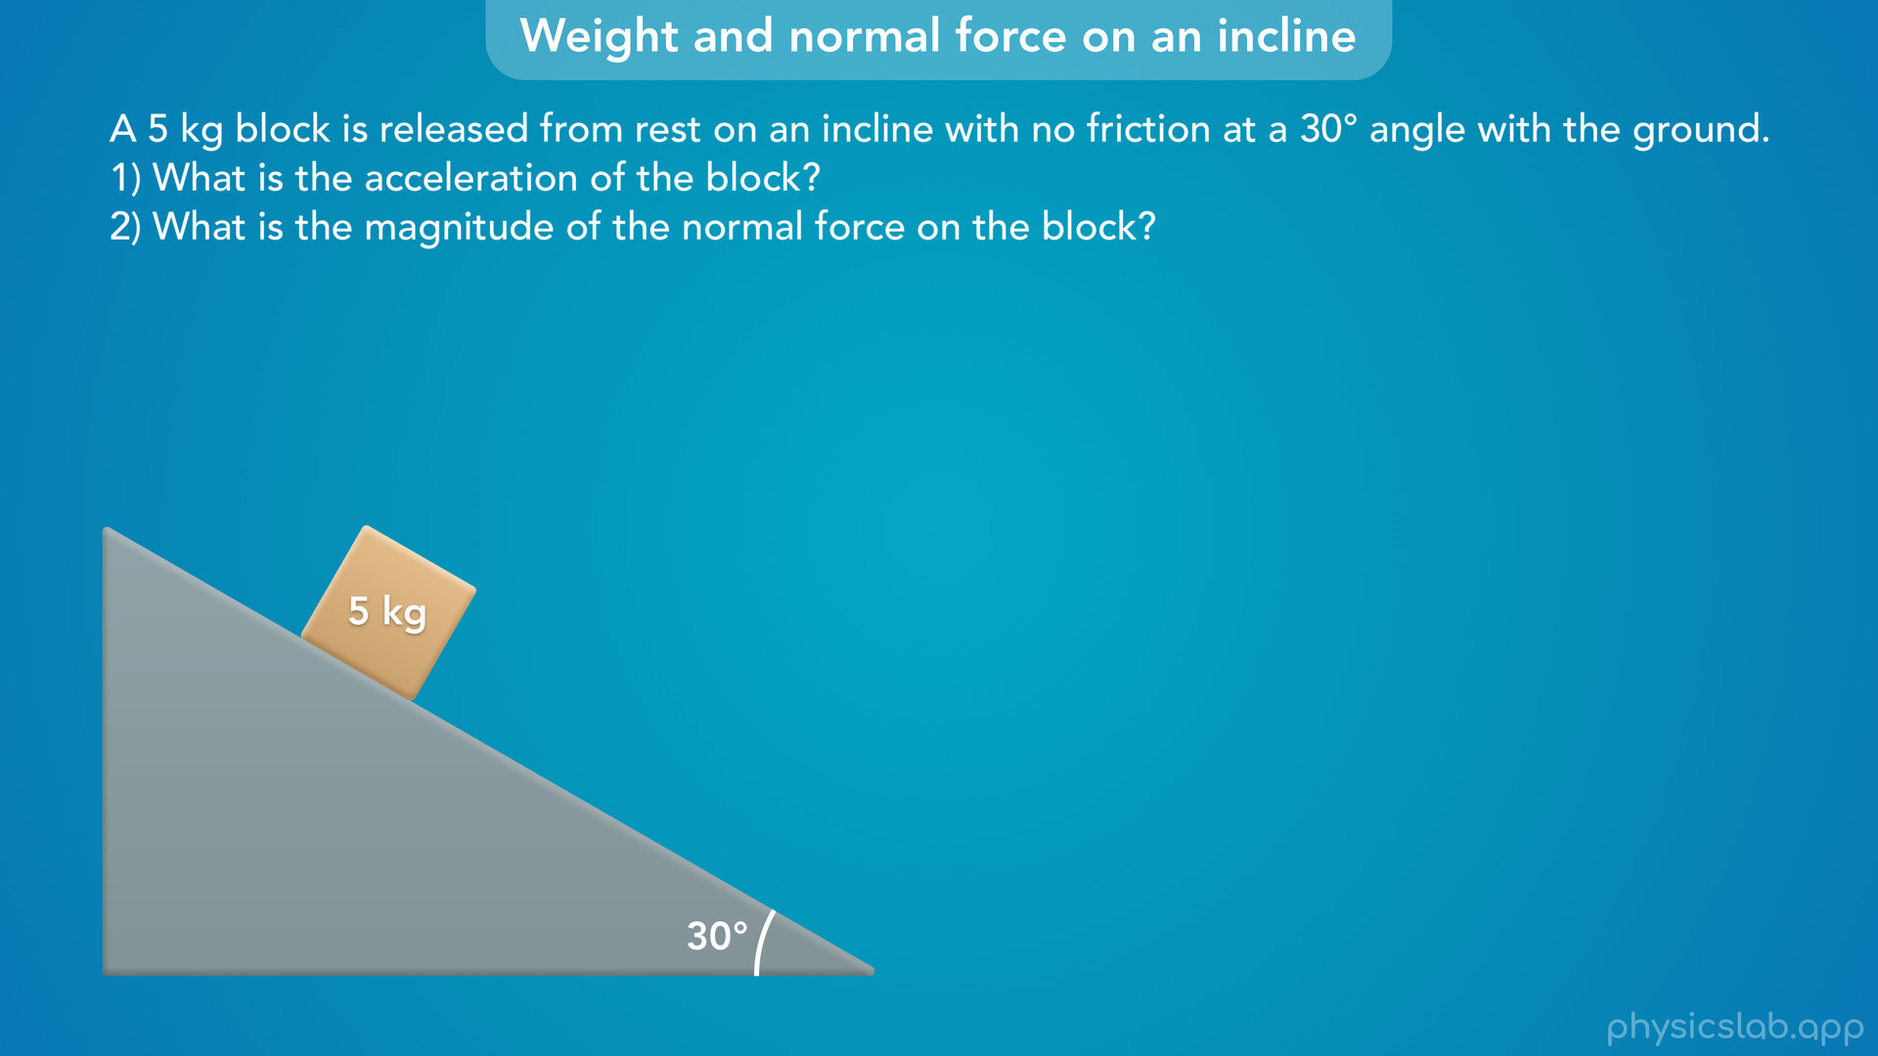
Notes:
• Let’s use this example to explore the forces and motion of an object on an incline.
• A 5 kg block is released from rest on an incline with no friction that is at a 30 degree angle with the ground. What is the acceleration of the block? And what is the magnitude of the normal on the block?
• Before we walk through this example, pause the video and see if you can figure it out first, or at least take a minute to think through how the incline angle affects the acceleration and the normal force.

Slide 16
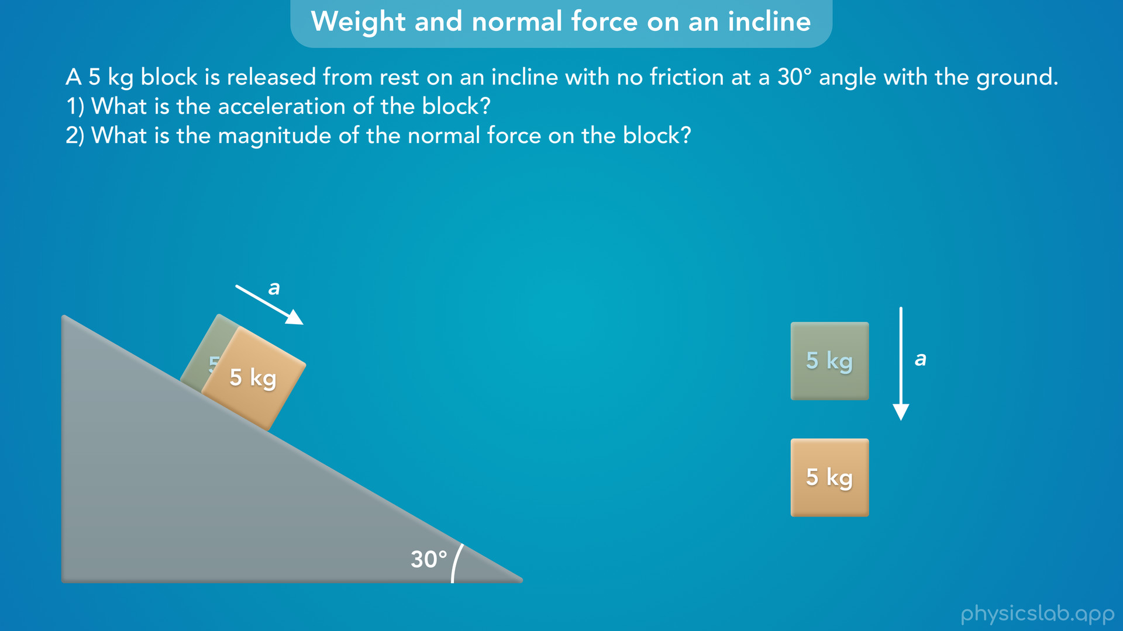
Notes:
• So this block is released from rest and there’s no friction, so the block accelerates down the incline because of gravity.
• This is similar to how the block would accelerate downwards in free fall, or projectile motion.
• However, the accelerations are not the same. In free fall, the acceleration would be g, 9.8 m/s². But the block on the incline is going to accelerate slower than that. There’s no friction on the incline, so why would that be?

Slide 17
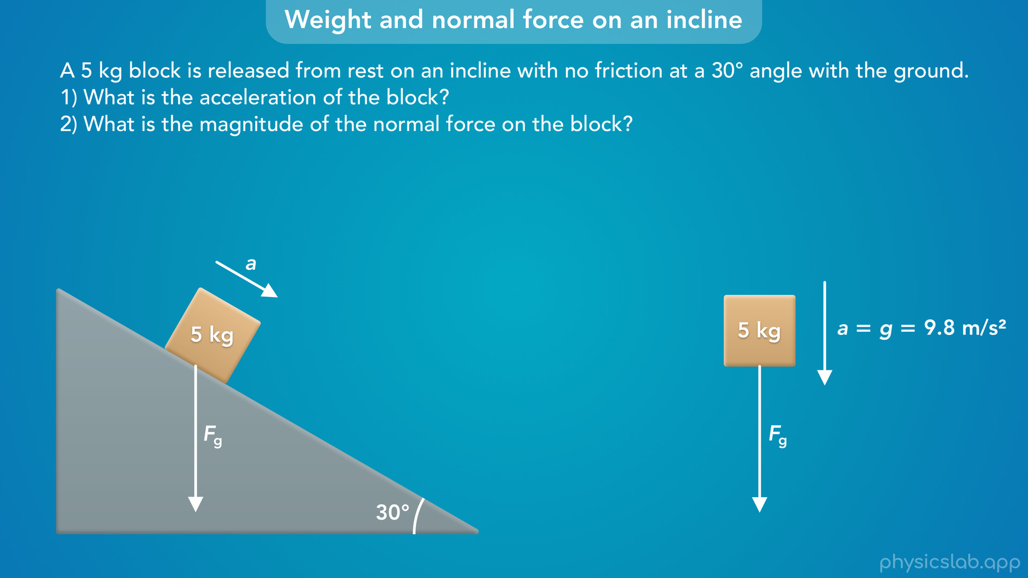
Notes:
• Let’s draw the weight force, or the gravitational force, on each block. They’re the same block with the same mass, so the weight force is the same and it aways points vertically downwards.
• But notice that the block on the incline is moving down and to the right. Its acceleration is not in the same direction as the weight force. So not all of the weight force is contributing to its acceleration.

Slide 18

Notes:
• In order to analyze the forces and motion of an object, we use the equations for Newton’s 2nd law in the x direction and the y direction.
• In most scenarios like the one on the right, the object moves vertically or horizontally.
• So we set up our coordinate system like this, where the x axis is horizontal and the y axis is vertical.
• But if an object is accelerating in a different direction, like the box on the incline, then it’s easier if we rotate our coordinate system so one of the axes points in the direction of the acceleration.

Slide 19

Notes:
• We usually say that the x axis is parallel to the incline and the y axis is perpendicular to the incline.

Slide 20

Notes:
• This way we can use Newton’s 2nd law in the x and y directions, because the block is accelerating in this x direction, so a would be ax. And the block is not accelerating in this y direction, so ay would be 0.

Slide 21

Notes:
• So now that we established our coordinate system, let’s draw all of the forces on this box and their x and y components.
• The weight force, or the gravitational force, points vertically downwards.
• Since the block is in contact with the incline, there’s a normal force acting on the block that is perpendicular to the surface of the incline. Remember, normal means perpendicular.

Slide 22

Notes:
• So the normal force is actually pointing in this y direction.

Slide 23

Notes:
• But the weight force is not pointing directly in the x or y direction, so we need to draw its x and y components.

Slide 24

Notes:
• The y component would be parallel to the y axis, or perpendicular to the incline

Slide 25

Notes:
and the x component would be parallel to the x axis, and parallel to the incline.

Slide 26

Notes:
• You can draw the components in different places as long as they point in the right direction

Slide 27

Notes:
but we’re going to draw them like this so they form a right triangle, and the y component is starting on the box.
• So this is the x component of the weight force, Fgx, and this is the y component of the weight force, Fgy.

Slide 28

Notes:
• We could also say that this is the component of the weight force that is parallel to the incline, and this is the component that is perpendicular to the incline, but we’ll stick with x and y.

Slide 29
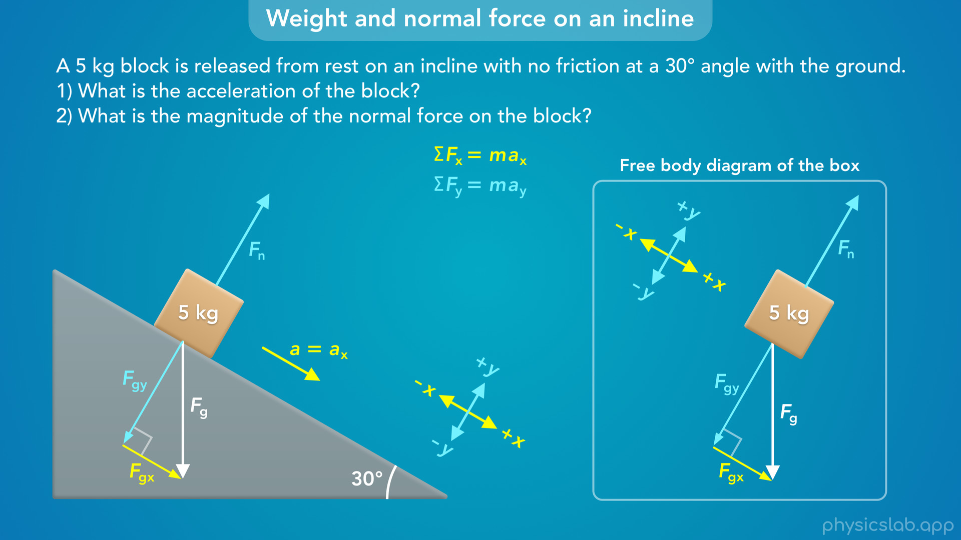
Notes:
• Normally we would draw a free body diagram of the box with no other objects or surfaces, but for incline problems, it usually helps to include the incline in the picture.

Slide 30

Notes:
• That’s because the next step is to write out how the components of the weight force, Fgx and Fgy are related to Fg.
• Remember that we use right triangle trig, usually sine and cosine, to find the components of a vector.
• But what are the angles inside this right triangle?
• We’re told that the angle between the incline and the ground is 30 degrees, but how does that translate to the angles in this triangle?
• We just need to do some geometry. There’s multiple ways to think through this, and after you do it a few times you’ll probably just memorize which angle is which.

Slide 31
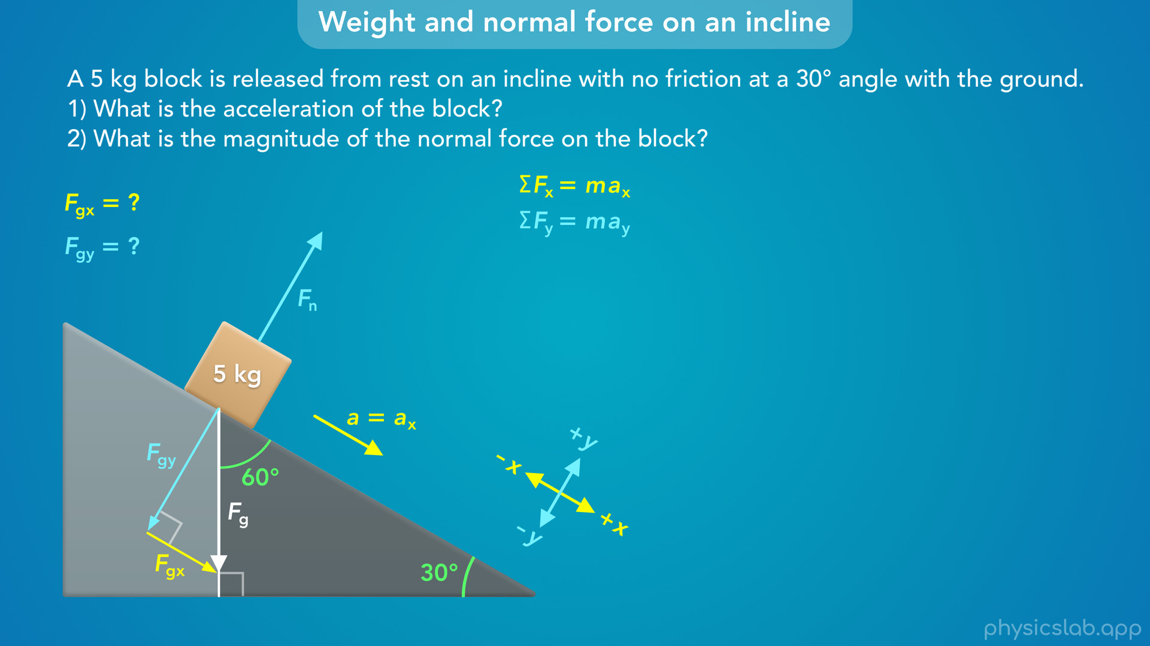
Notes:
• But one way, is to extend the line of the weight force vector to the ground, so that we form this right triangle.
• If this bottom angle is 30 degrees, than this top angle must be 90 degrees minus 30 degrees, which is 60 degrees.

Slide 32

Notes:
• Now, we know that the y component is perpendicular to the incline, so this total angle must be 90 degrees.
• If this angle is 60 degrees, then this angle must be 90 minus 60, which is 30 degrees.
• We’ll summarize this later, but the angle between the incline and the ground is the same as the angle between the weight force vector and the y component, Fgy.

Slide 33

Notes:
• So using right triangle trig, the y component is equal to the hypotenuse, Fg, times the cosine of 30 degrees.

Slide 34

Notes:
• And the x component is equal to Fg times the sine of 30 degrees.

Slide 35
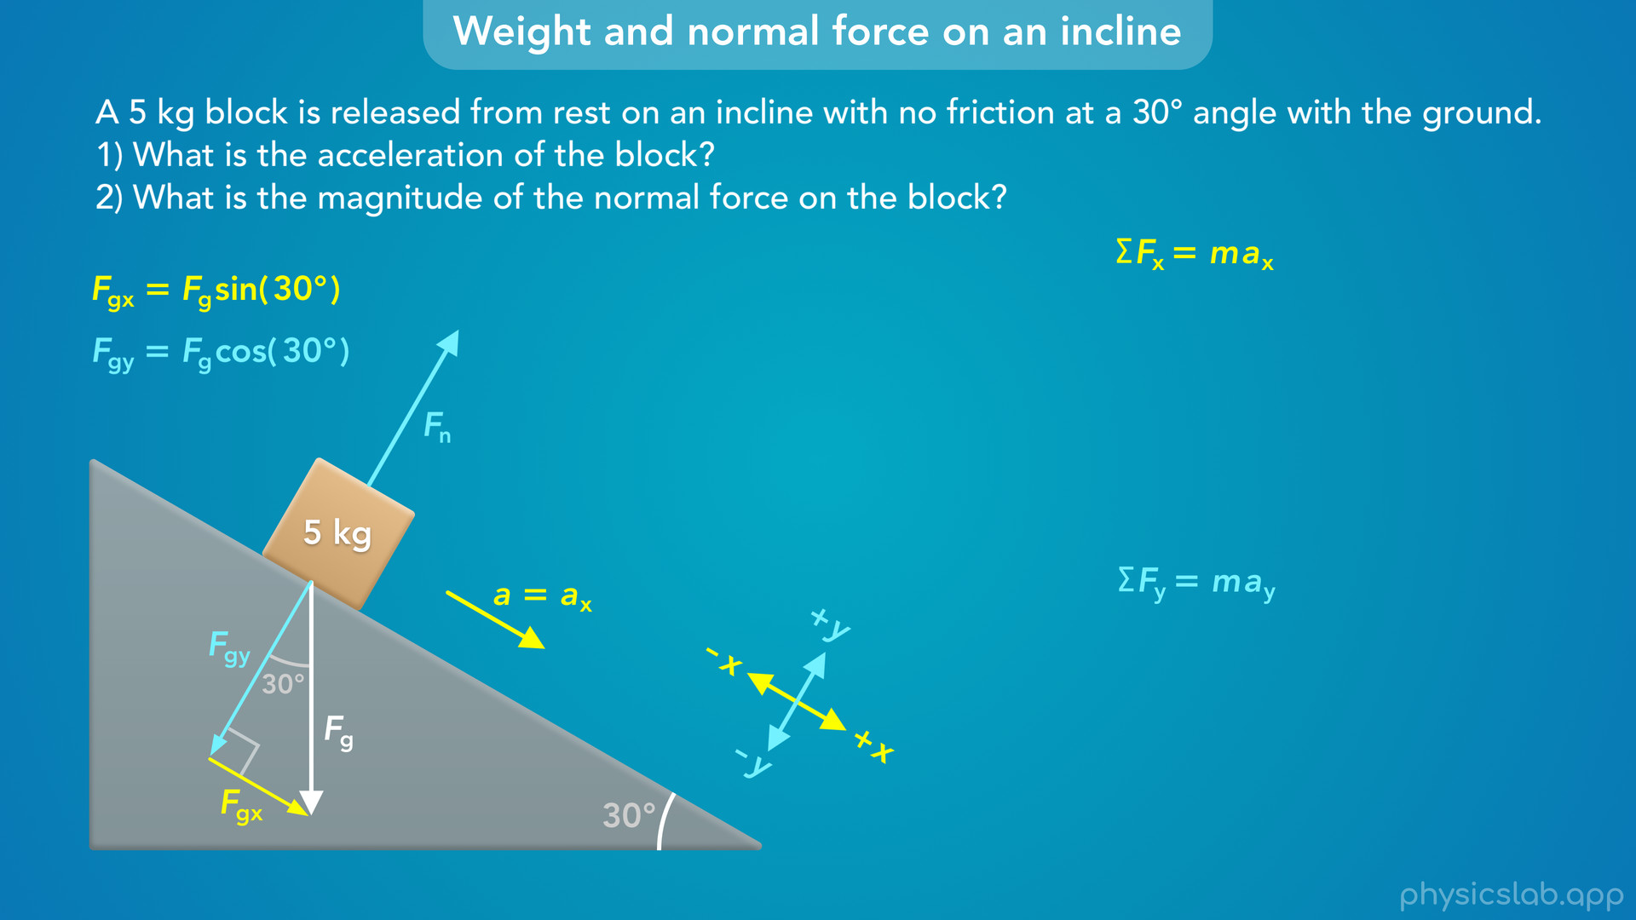
Notes:
• So now, we can apply Newton’s 2nd law in the x and y directions to answer these questions.

Slide 36
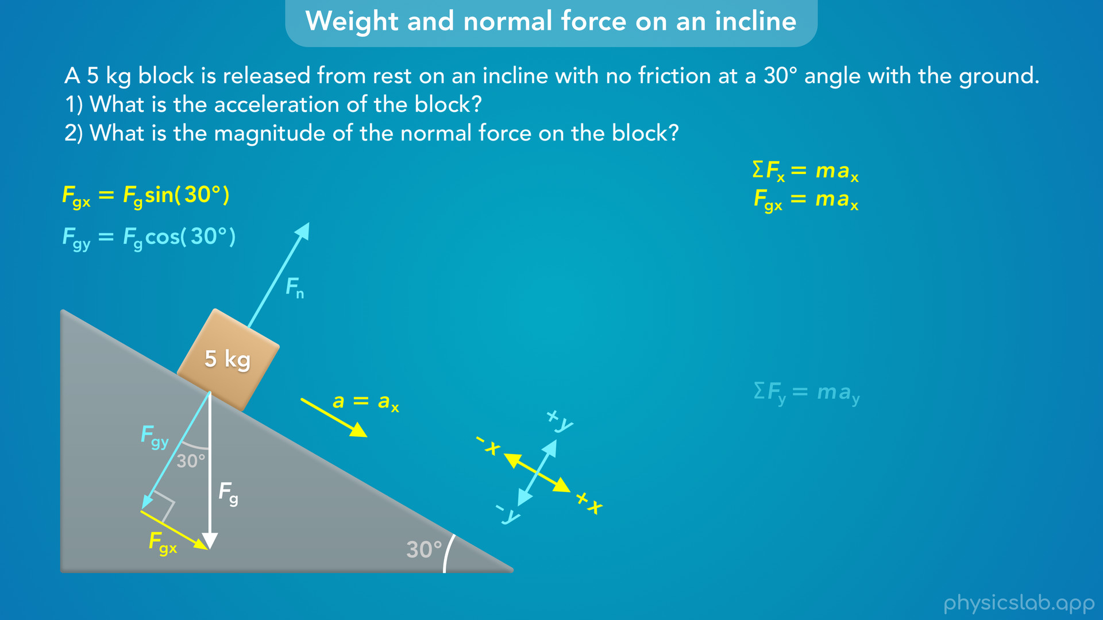
Notes:
• First, the net force in the x direction is equal to the mass times the acceleration in the x direction.
• Since there’s no friction, the only force acting in the x direction is Fgx, the x component of the weight force.

Slide 37

Notes:
• We just found that Fgx is equal to Fg times the sine of 30 degrees.

Slide 38
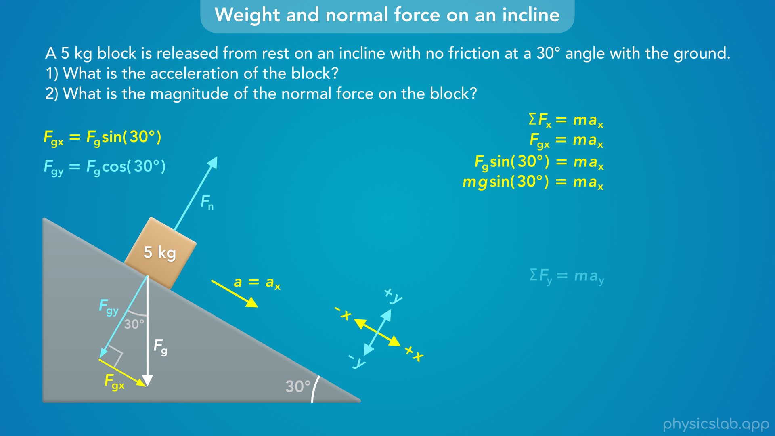
Notes:
• And we learned in the last video that we can replace Fg with m times g, the mass times the strength of the gravitational field, or the acceleration due to gravity.

Slide 39

Notes:
• The mass, m, is on both sides of this equation so we can divide each side by the mass.

Slide 40
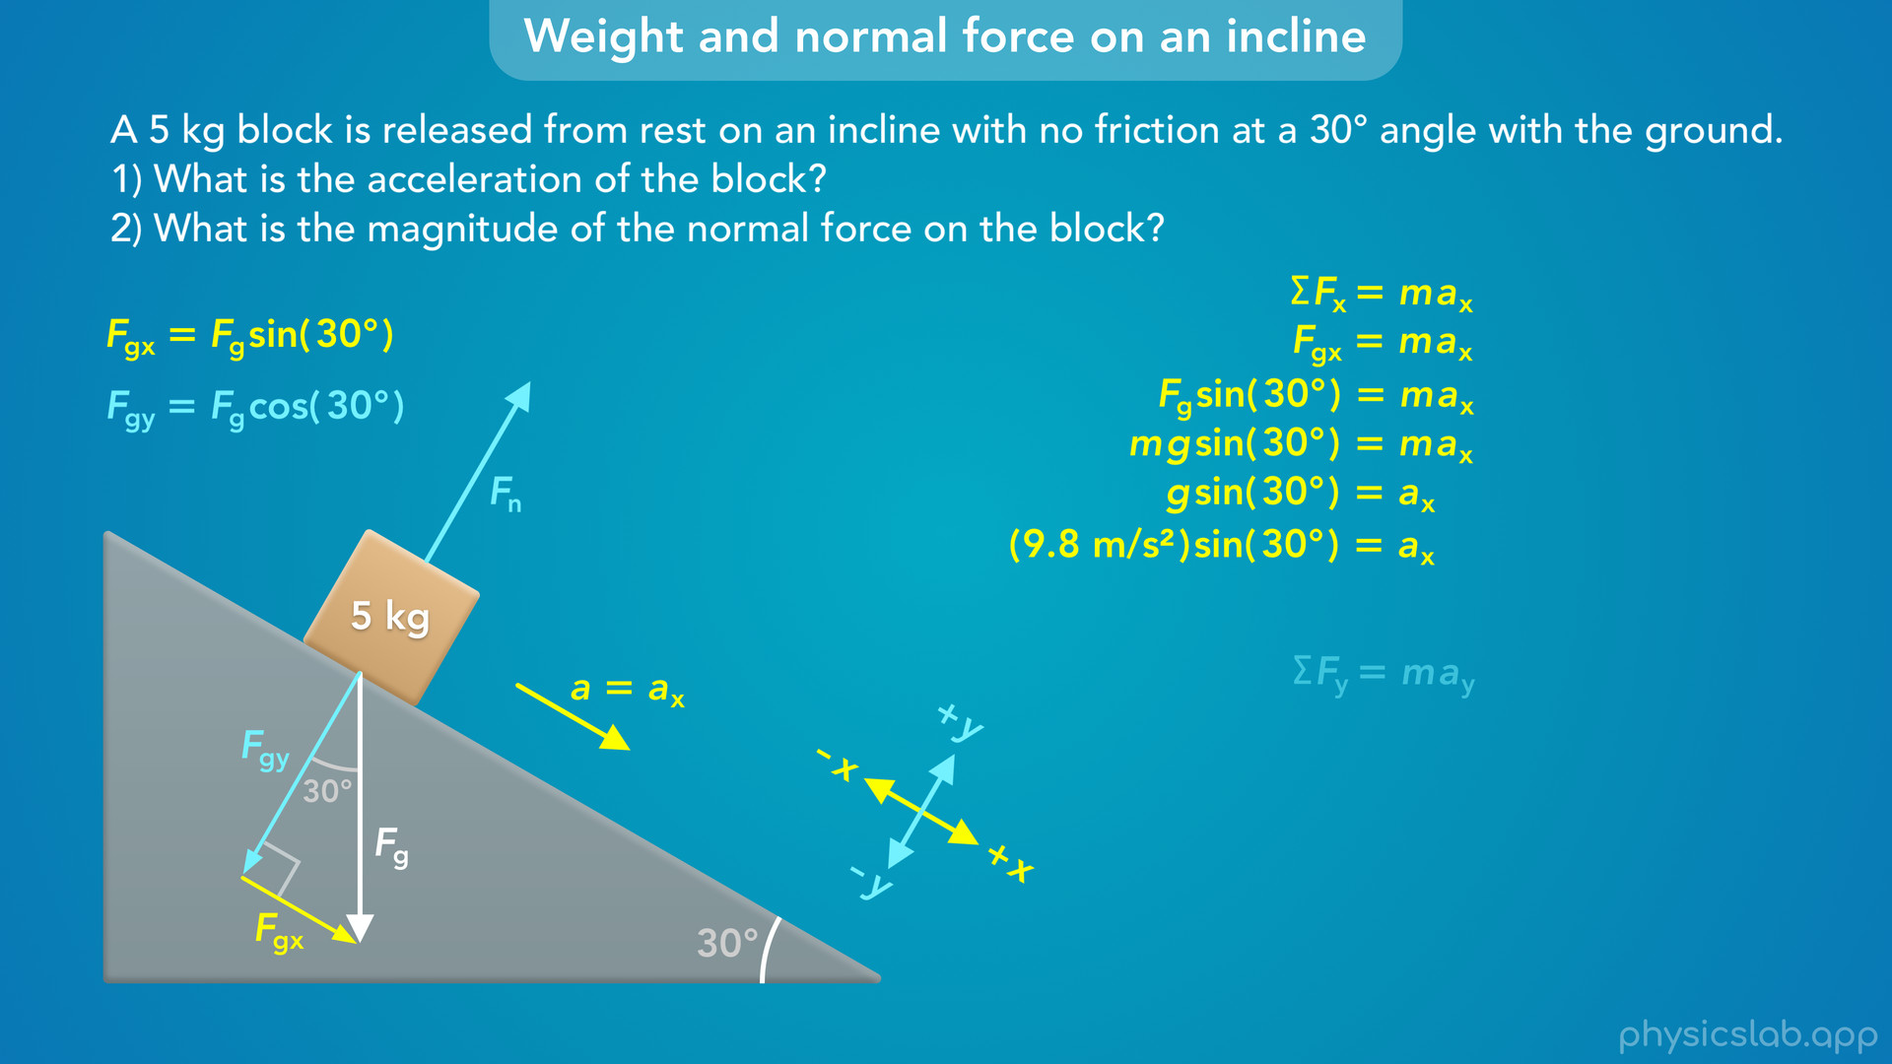
Notes:
• Then we plug in 9.8 m/s² for g…

Slide 41
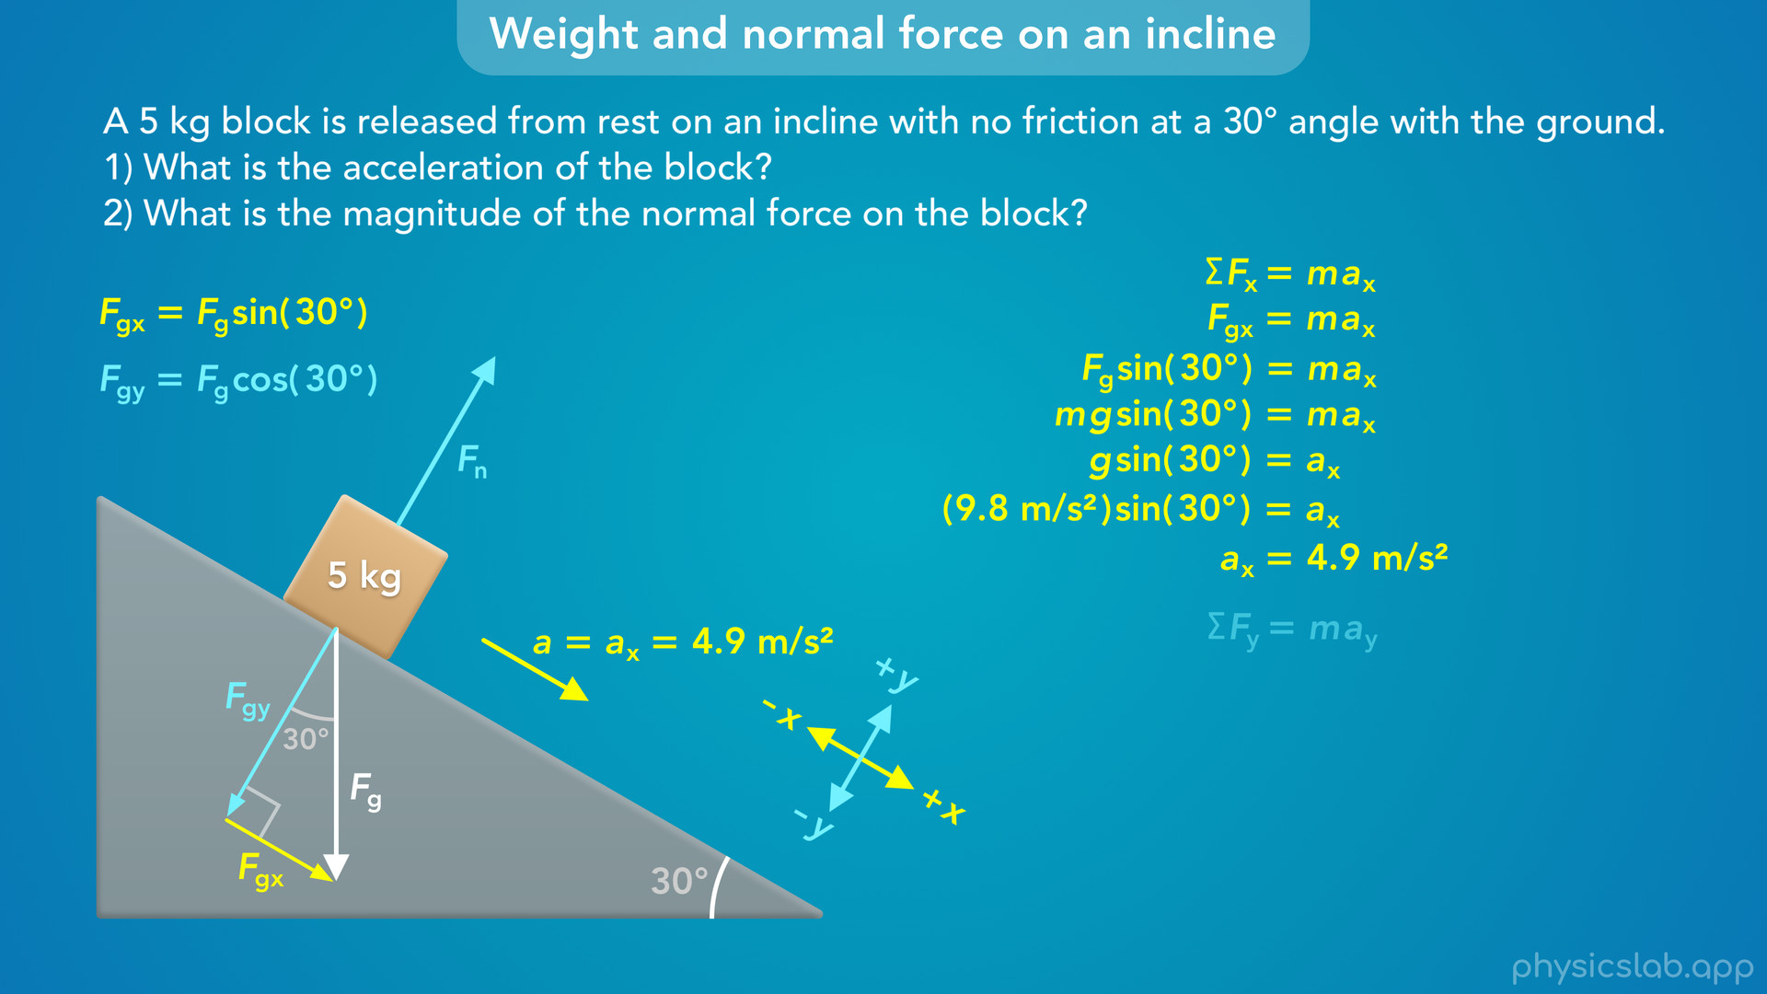
Notes:
and we find that ax is 4.9 m/s².

Slide 42
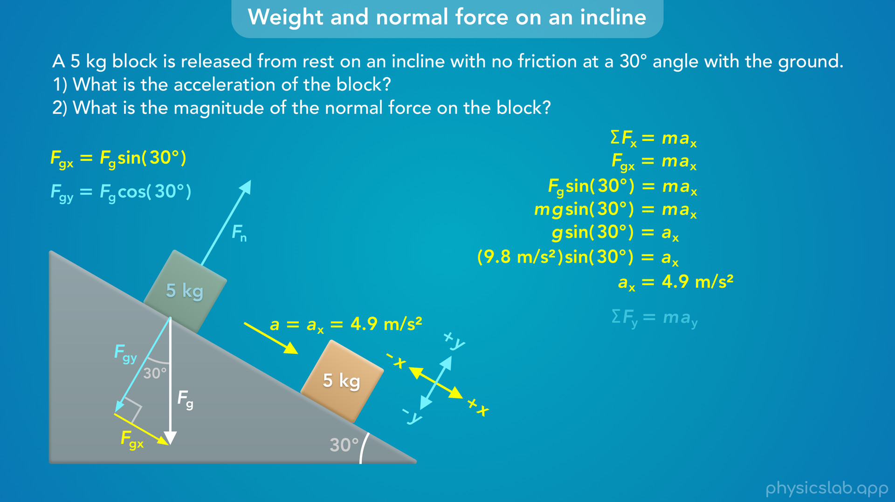
Notes:
• That is the acceleration of the block in the x direction, down the incline, which is what the first question is asking for.

Slide 43
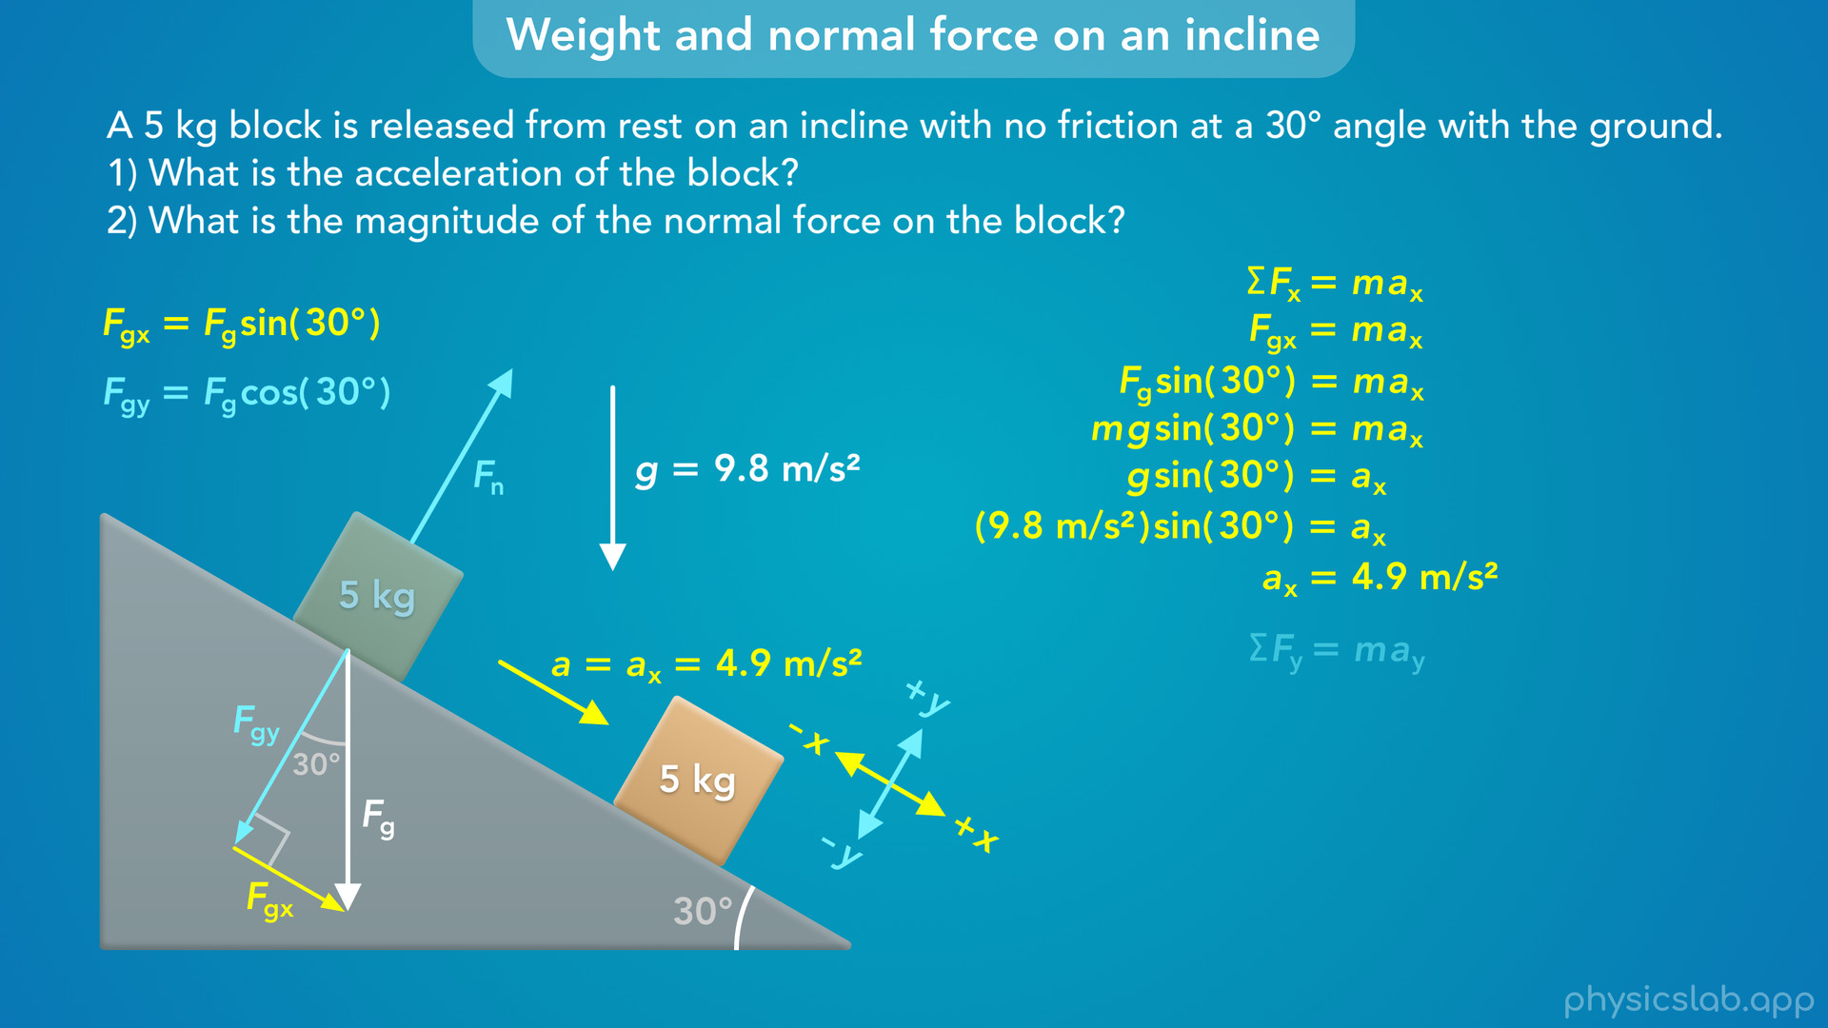
Notes:
• So notice that g, the acceleration due to gravity in free fall, is 9.8 m/s², but the acceleration of this block down the incline is slower than that, 4.9 m/s².
• That’s because only the x component of the weight force is causing it to accelerate in this direction.

Slide 44
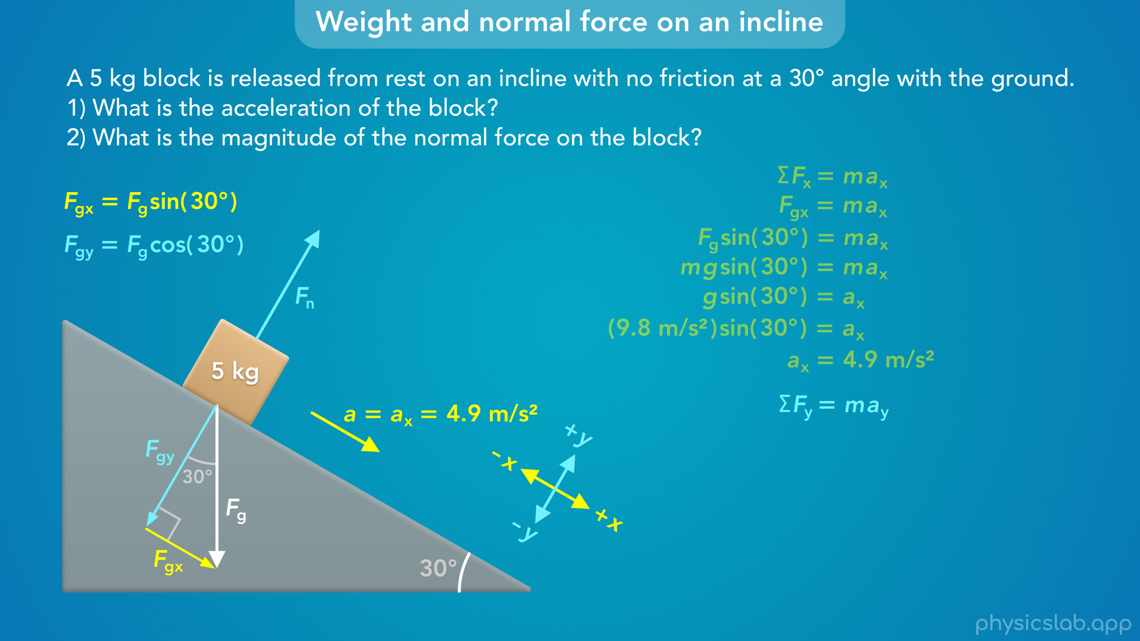
Notes:
• The 2nd question is asking for the normal force, which is in the y direction, so let’s apply newton’s 2nd law in that direction.

Slide 45

Notes:
• The net force in the y direction is equal to the mass times the acceleration in the y direction.
• The net force would be the normal force minus Fgy, because the normal force points in the positive y direction and Fgy points in the negative y direction.

Slide 46

Notes:
• The box is only accelerating in the x direction, parallel to the incline.
• But the box is not accelerating in the y direction.

Slide 47
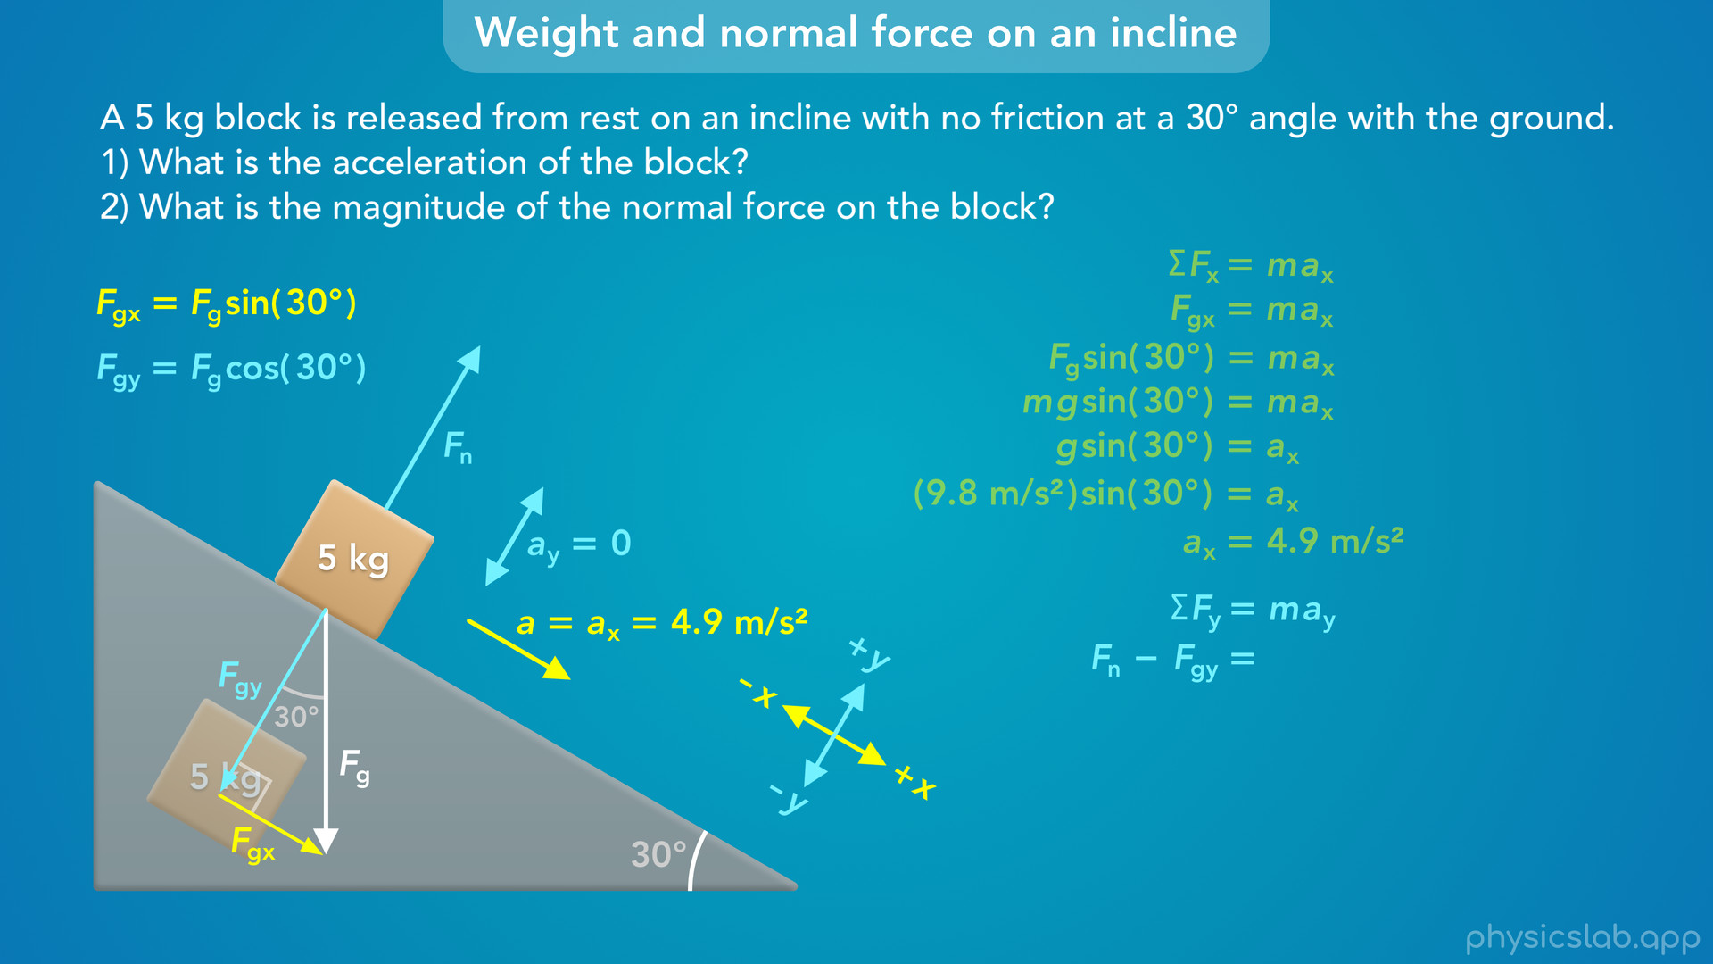
Notes:
It’s not moving into the incline in the negative y direction

Slide 48
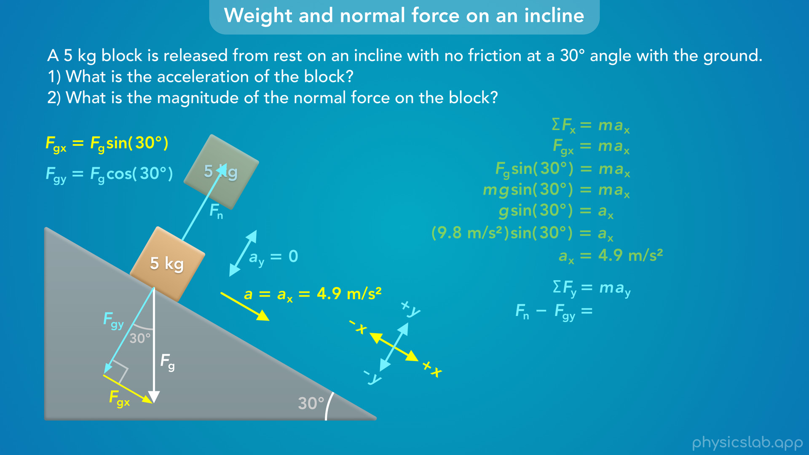
Notes:
and it’s also not moving away from the incline, in the positive y direction.

Slide 49

Notes:
• So we can plug in zero for ay, and we can say the net force is zero in the y direction.

Slide 50

Notes:
• This means that the normal force is equal in magnitude to the y component of the weight force, since there are no other forces in the y direction.

Slide 51

Notes:
• We can replace Fgy with Fg cosine of 30 degrees

Slide 52
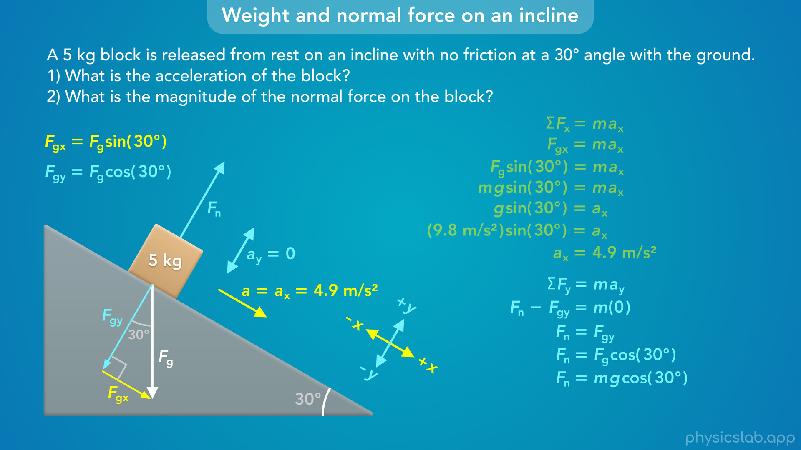
Notes:
and we can replace Fg with m times g.

Slide 53

Notes:
• If we plug in 5 kg for the mass and 9.8 m/s² for g…

Slide 54

Notes:
we get 42.4 N for the normal force.
• Since the y component of the weight force is less than the weight force, the normal force is also less than the weight force when an object is on an incline.

Slide 55
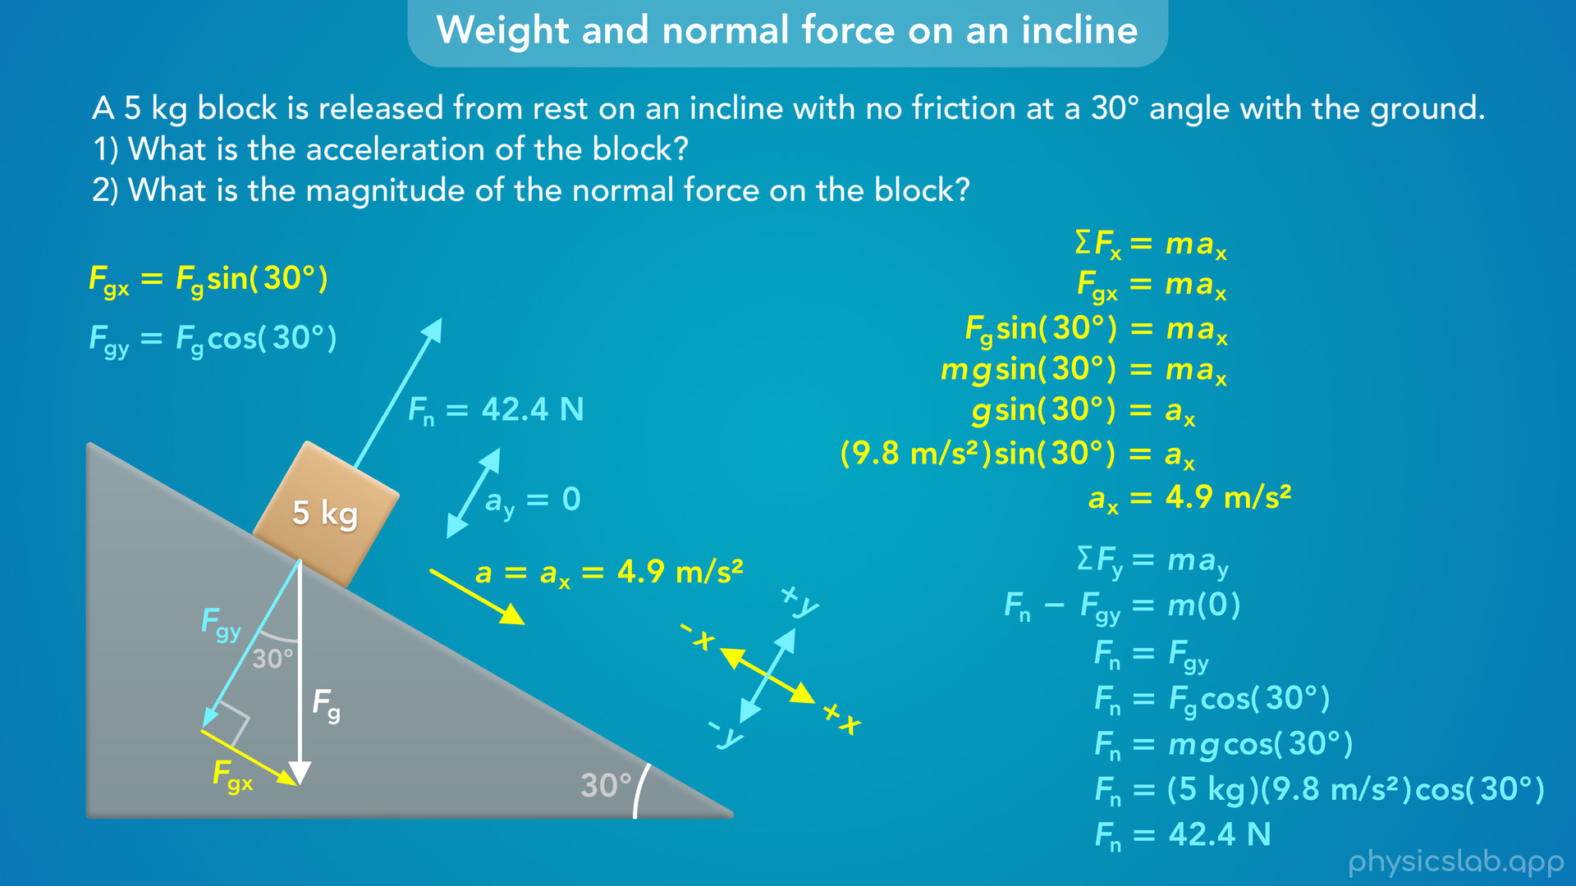
Notes:
• So that’s an example of finding the acceleration and the normal force for an object on a incline with no other forces.
• In the future, there might also be friction or tension forces on the block, but we would work through those problems in the same way.

Slide 56
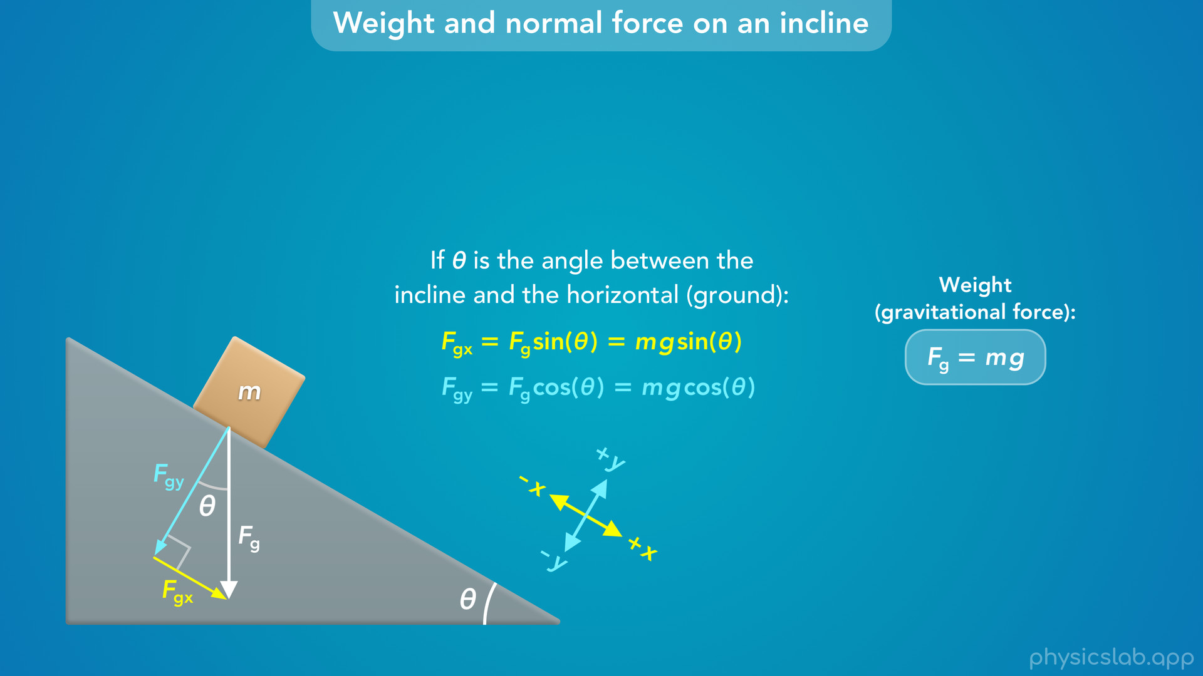
Notes:
• So in general, if an object is on an incline, and if theta is the angle between the incline and the horizontal, or the ground, then theta is also the angle between the weight force vector and the y component, assuming the y axis is perpendicular to the incline.
• If that’s all true, then Fgx is equal to Fg sin of theta, and Fgy is equal to Fg cosine of theta.
• And we can replace Fg with m times g, from the equation for the weight force.
• This is something that you’ll probably start to memorize after you work through some incline problems.
• But you can always figure out which angle is which, and when to use sine and cosine, using the steps we followed earlier.

Slide 57
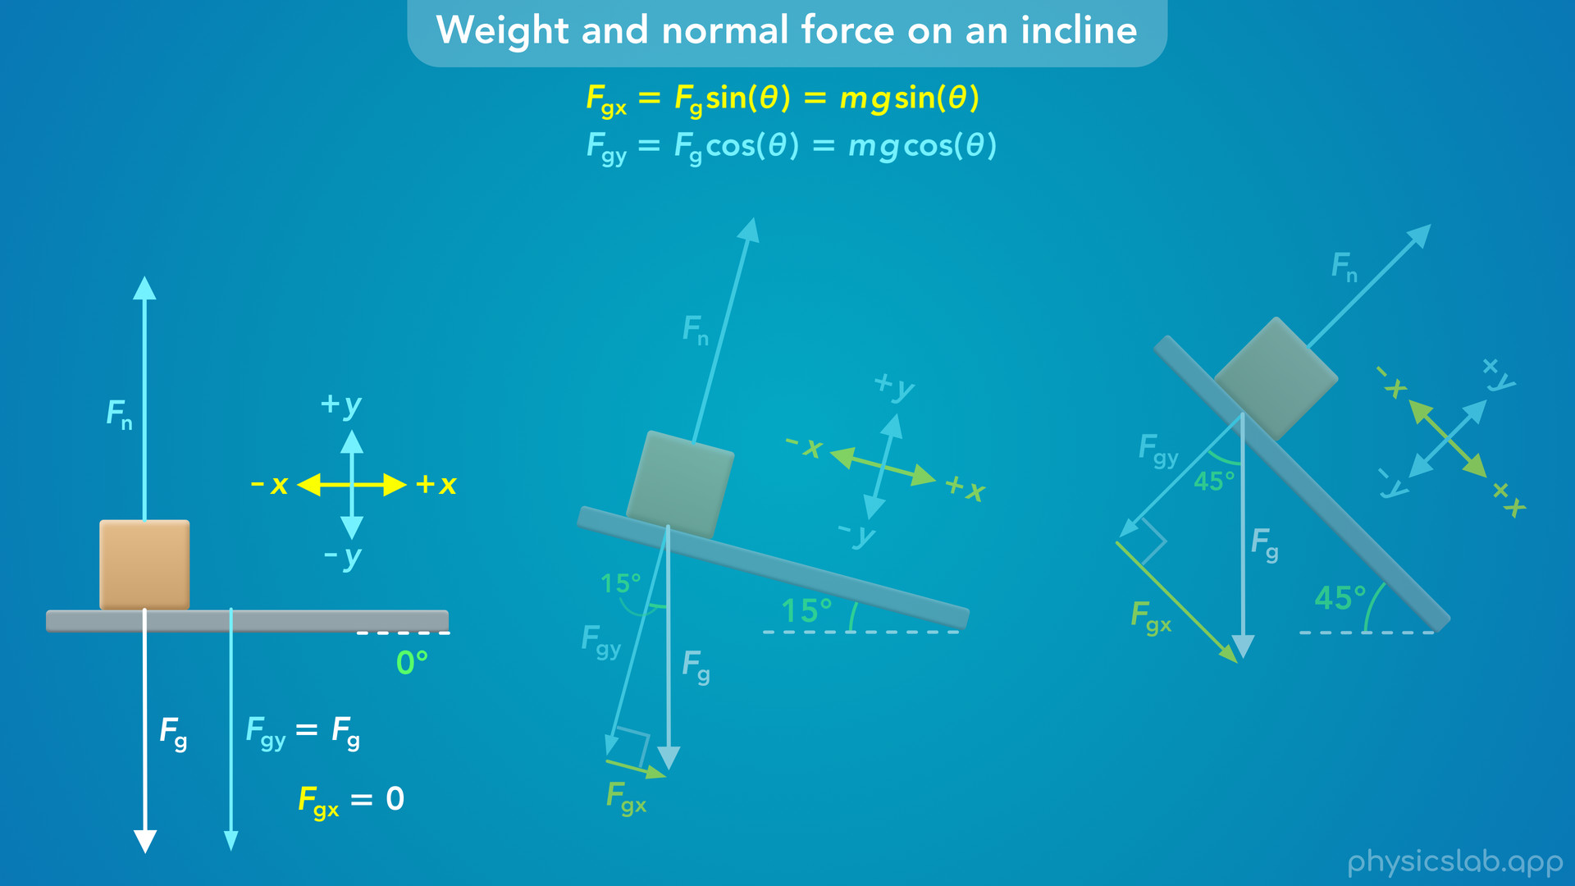
Notes:
• To help us get a better understanding of the weight and normal force on inclines, let’s just see what they look like at different angles.
• In every case, we’ll still say the x axis is parallel to the incline and the y axis is perpendicular to the incline.
• If the surface was horizontal, then the angle would be 0 degrees. The weight force, Fg, would be parallel to the y axis, so Fgy would be the same as Fg. And Fgx would be 0, there’s no component of the weight force that’s parallel to the surface, so the block would not accelerate. And the normal force is equal to the full weight force, because Fgy is equal to Fg.

Slide 58
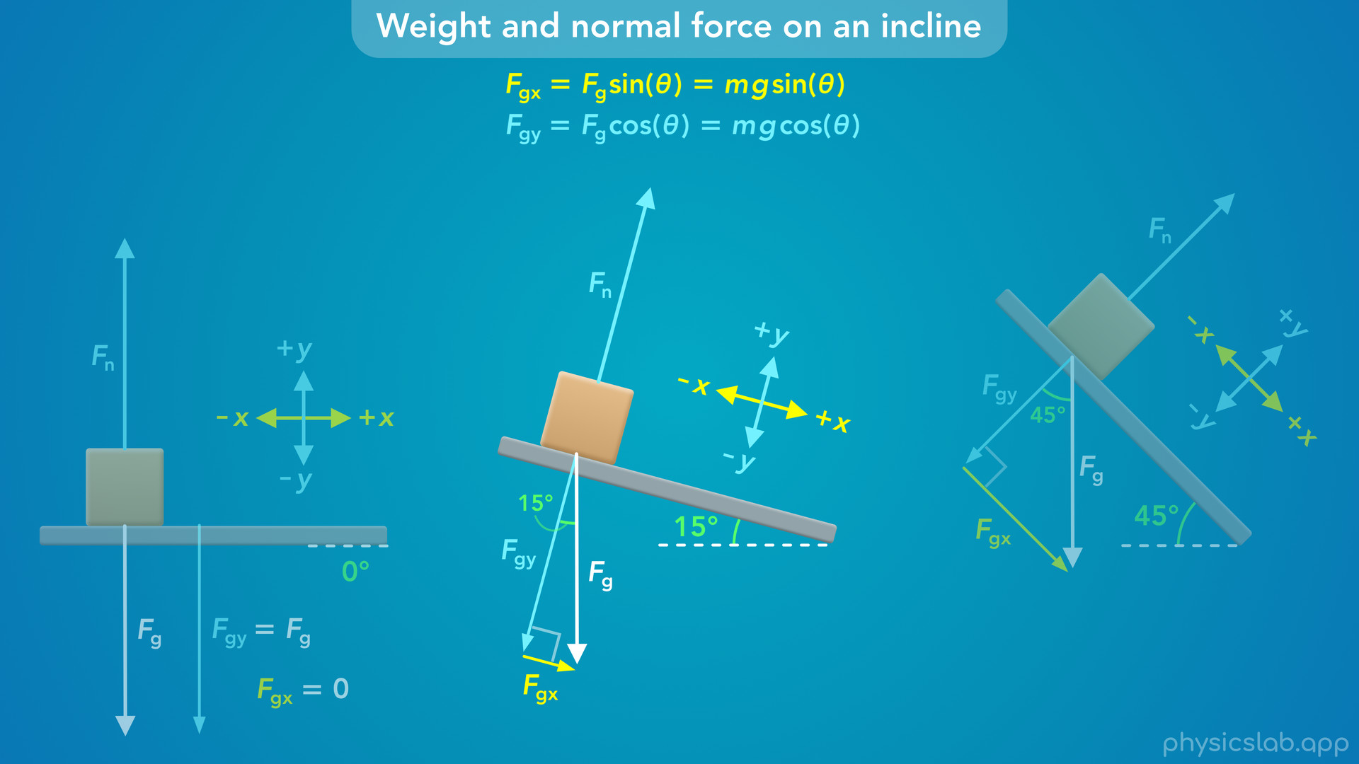
Notes:
• If we rotate the incline to 15 degrees, now there’s a small x component to the weight force, which would cause the block to accelerate slowly down the incline. The y component of the weight, and the normal force, both decrease, they’re no longer equal to the full weight force.

Slide 59
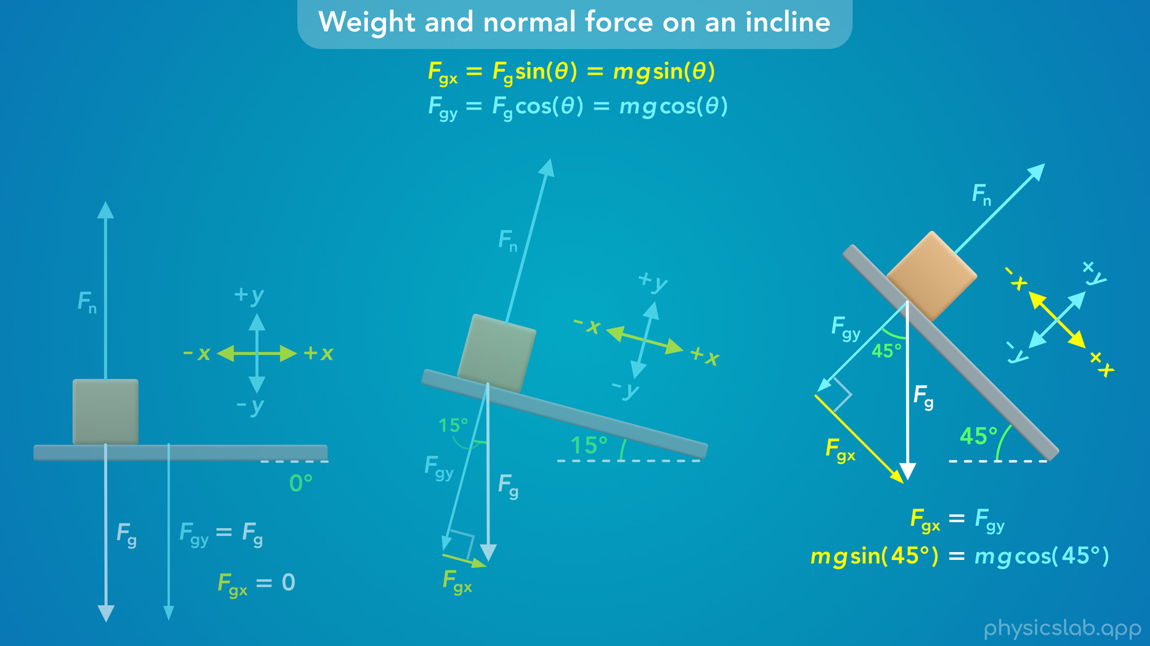
Notes:
• If we rotate the incline to 45 degrees, the weight force is even more aligned to the incline and the x axis. Fgx increases and the block would accelerate faster. And Fgy and the normal force decrease. Since the sine of 45 degrees is equal to the cosine of 45 degrees, Fgx and Fgy are equal at this angle.

Slide 60
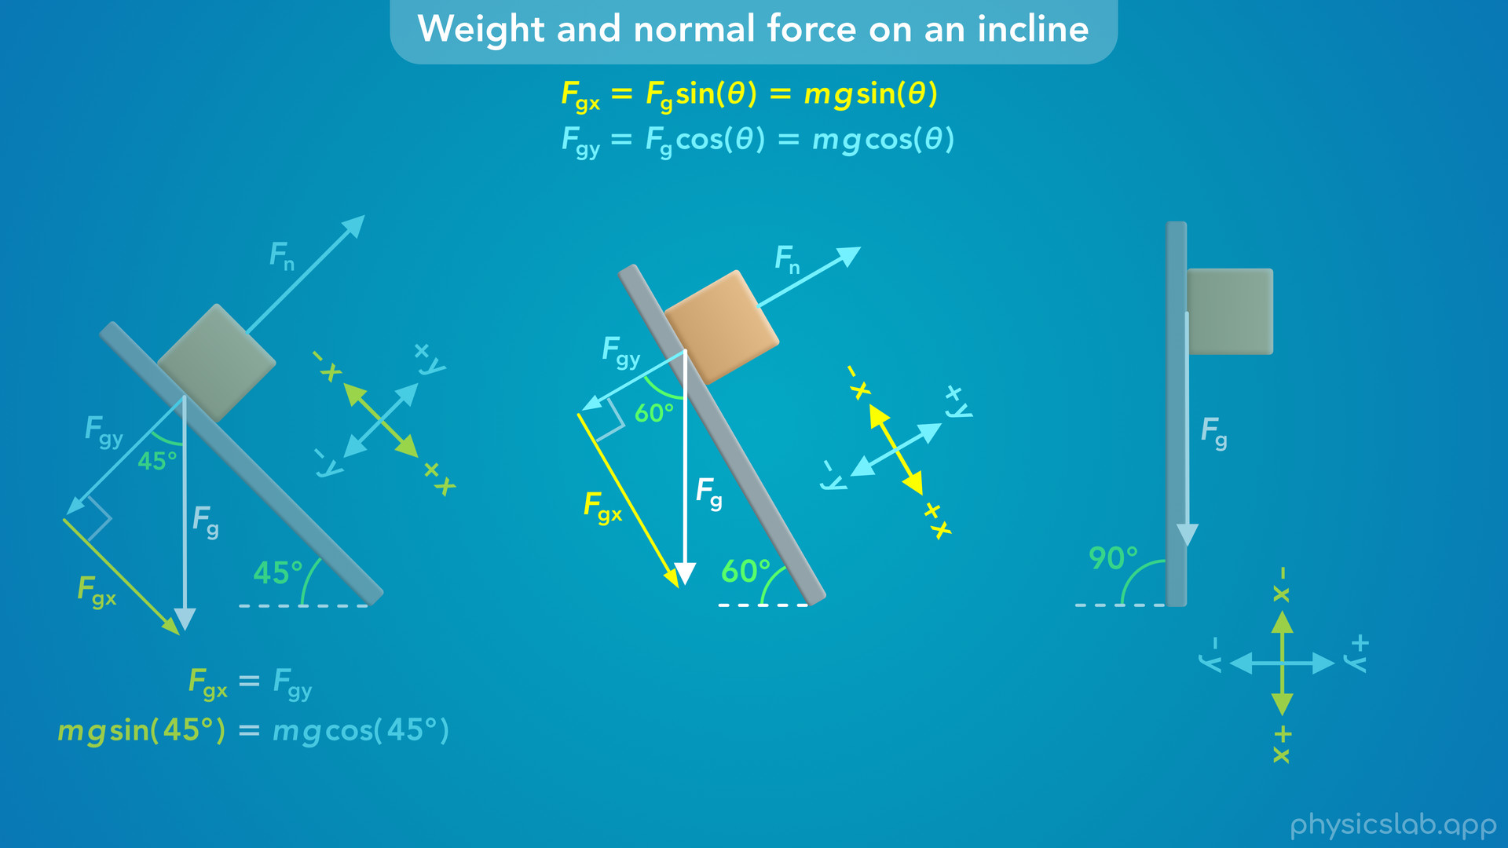
Notes:
• If we rotate the incline to 60 degrees, the weight force is even more aligned to the incline and the x axis. Fgx gets bigger, and the block would accelerate down the incline even faster. And Fgy and the normal force get even smaller.

Slide 61
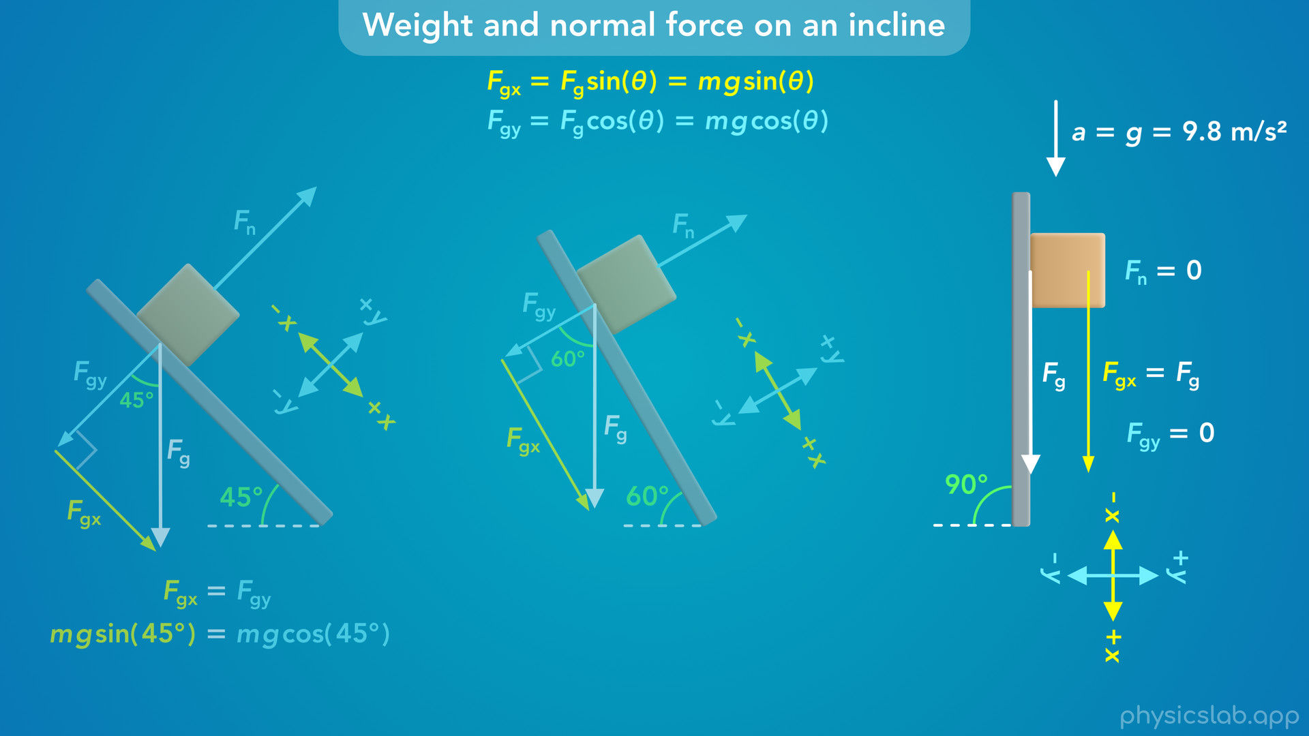
Notes:
• Finally, we rotated the incline to 90 degrees so the surface was vertical, then the entire weight force would be in the x direction, parallel to the inccline, So Fgx is equal to Fg. And there’s no component of the weight force acting perpendicular to the incline, so Fgy would be zero. This also means that the normal force would be zero, because there is nothing pushing the block against the incline. The block might appear to be touching the surface, but in this scenario the block is in free fall. The only force acting on it is the weight force, so it accelerates downwards at g, 9.8 m/s².

Slide 62
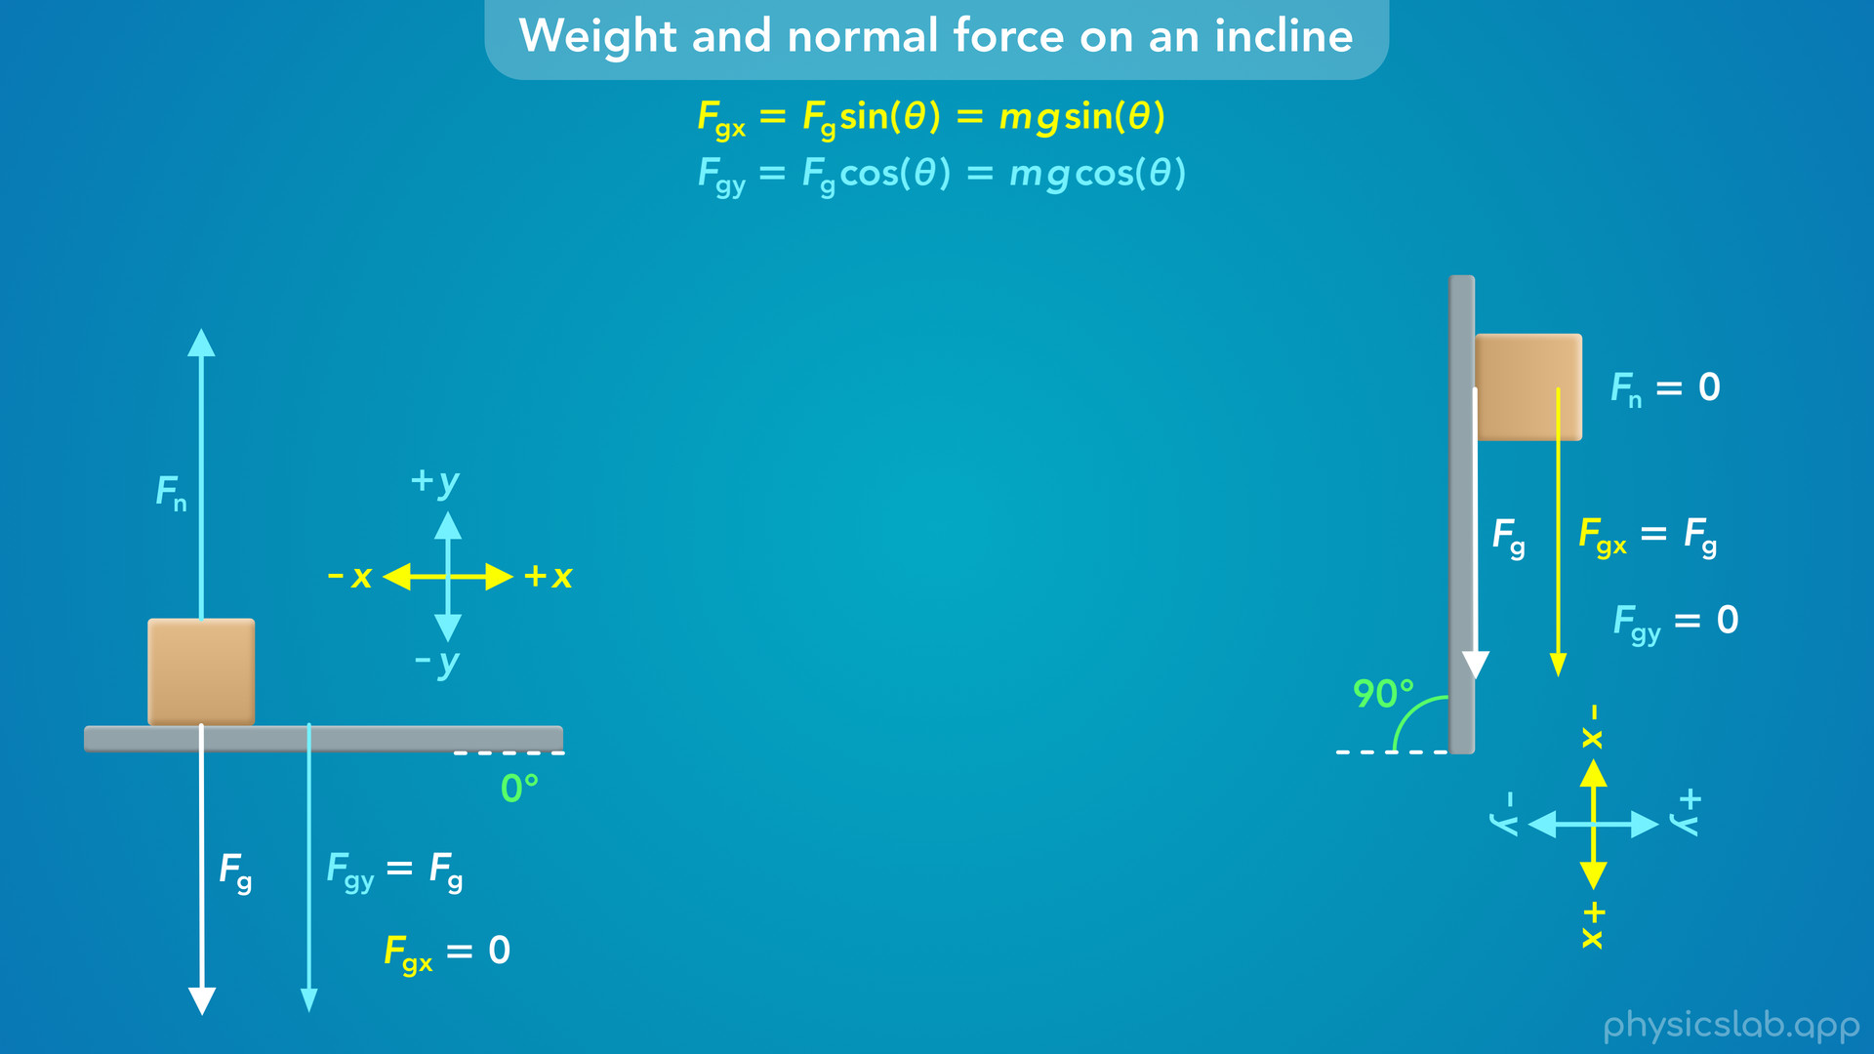
Notes:
• So most of the time, the forces and the motion will be either vertical or horizontal.

Slide 63
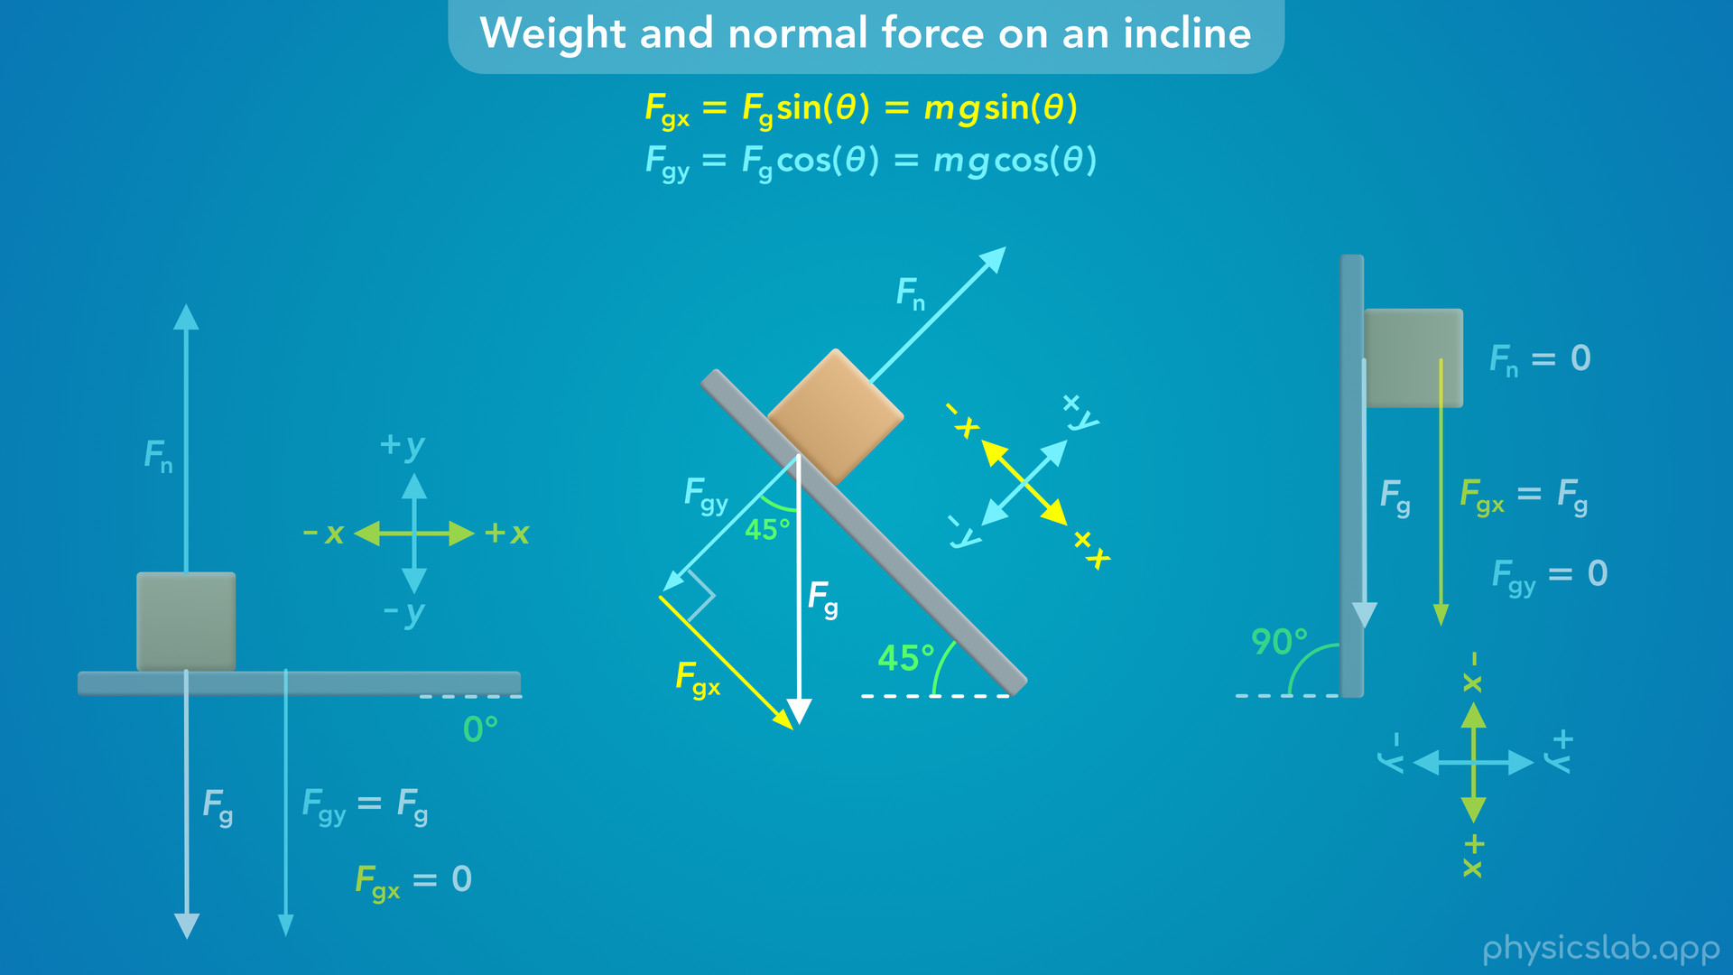
Notes:
• But if we have an object on an incline, we’re usually going to rotate our coordinate system and use the x and y components of the weight force.

