Slide 1
Introduction to Friction
Slides Version 2
This version includes:
Slides with screenshot images from the video.
The video narration in the slide notes.
A blank template slide with the same background and font as the video.
Slides with some basic graphics from this video for you to use however you like.
Feel free to add, delete and edit slides to make your own presentation. You can use these slides in class or share them with your students, but please do not share them with anyone else.
If you have any feedback, suggestions or questions about these slides please email me at chris@physicslab.app or send me a message on Discord @physicslab.
physicslab.app

Slide 2
Heading
Text

Slide 3



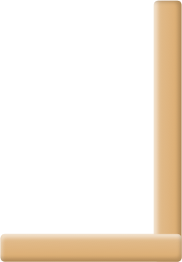



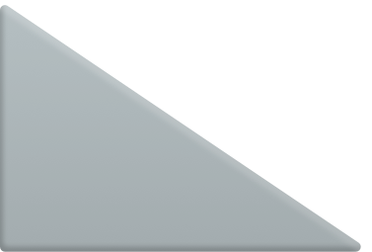




Slide 4

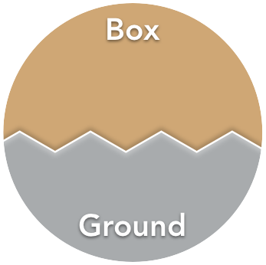

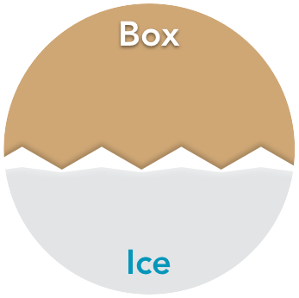

Slide 5


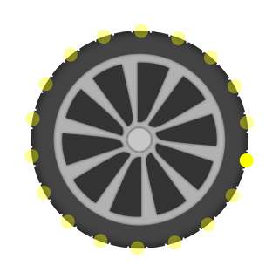
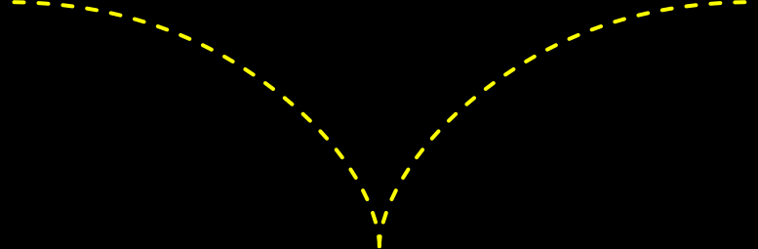
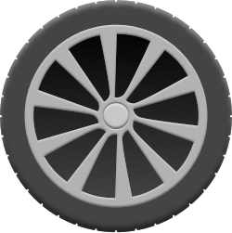




Slide 6
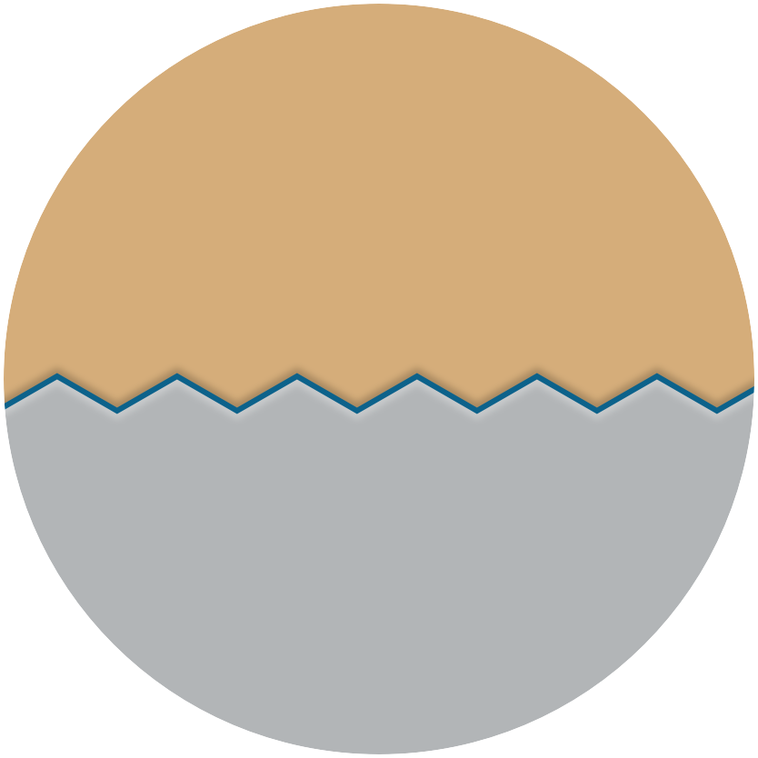

Slide 7



Slide 8
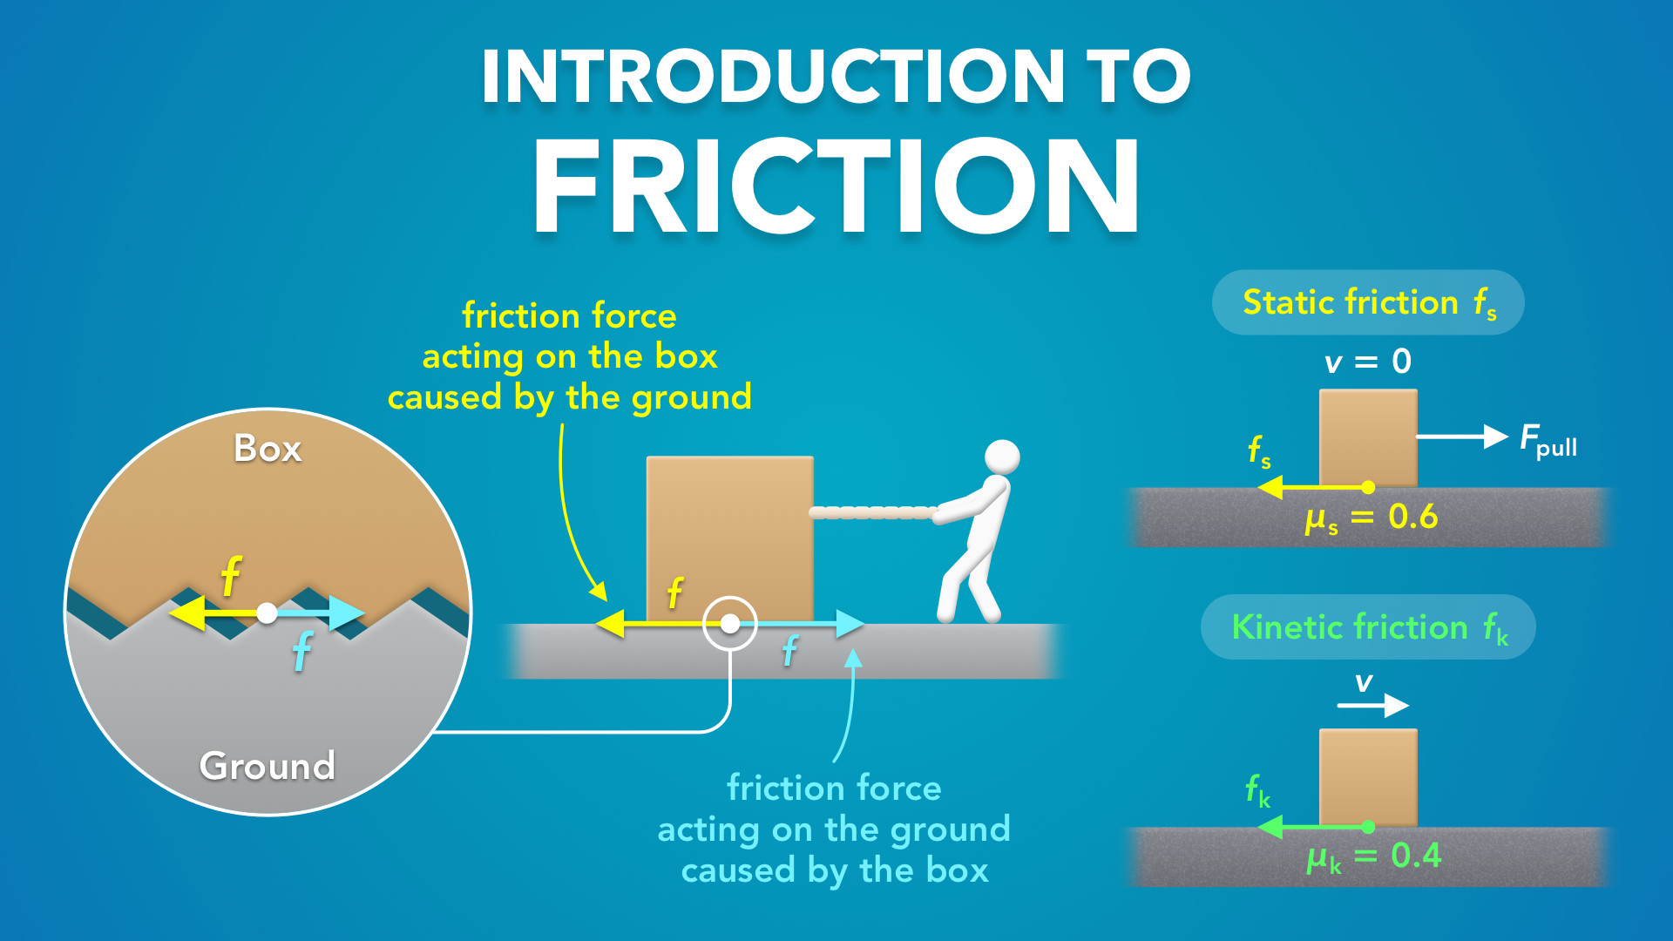
Notes:
Introduction to Friction
physicslab.app
If you have any questions, suggestions or feedback about these slides please email me at chris@physicslab.app or send me a message on Discord @physicslab.

Slide 9
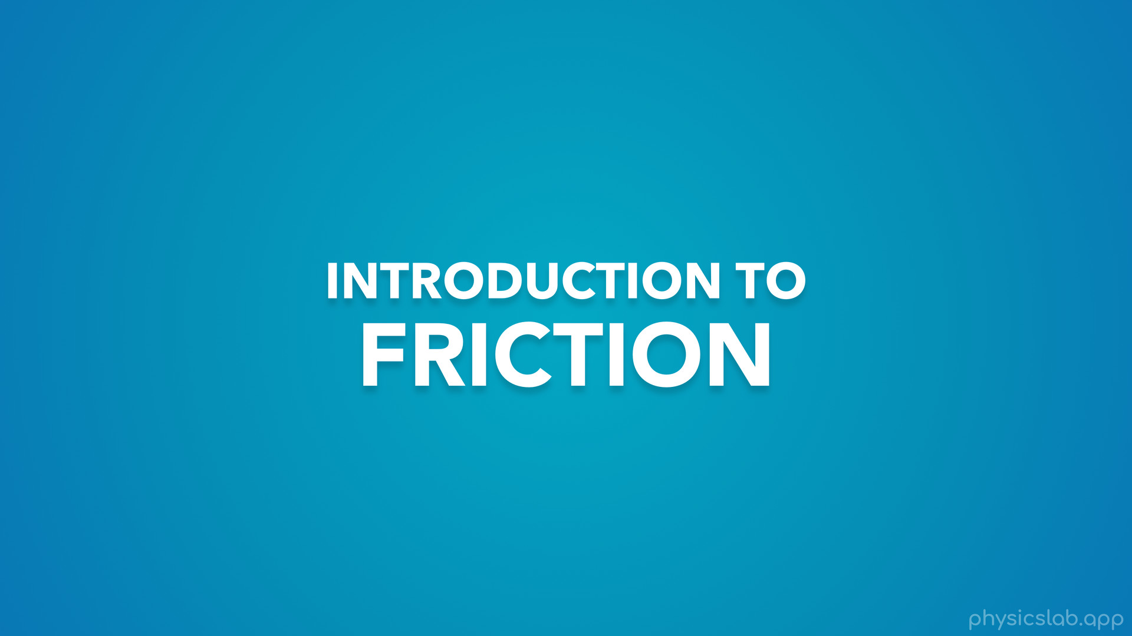
Notes:
• Hey everyone! In this video we’re gonna get an introduction to friction.
• Then we’ll go into more detail in the next few videos.

Slide 10
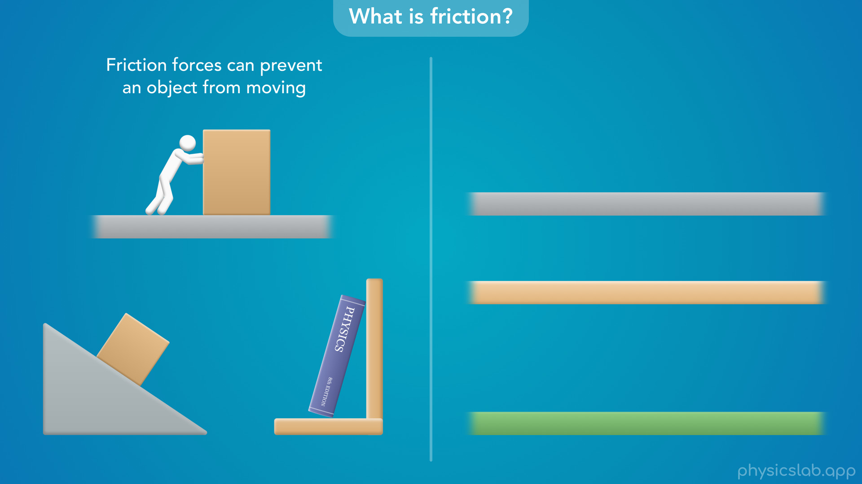
Notes:
• So what is friction?
• Friction is a force that we experience all the time, and it’s acting on most objects even if we don’t realize it.
• First, friction forces can act on an object that is not moving and they can prevent it from moving.

Slide 11
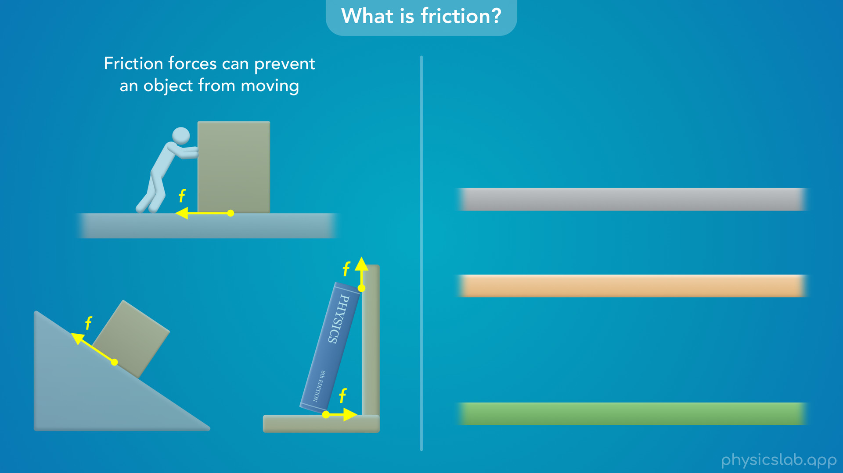
Notes:
• If you try pushing a box across a surface and it won’t move, it’s because the surface is exerting a friction force on the box.
• If an object is on an incline and it doesn’t slide down, there must be a friction force keeping it at rest.
• And if you lean an object against a surface, there might be multiple friction forces preventing it from falling.

Slide 12
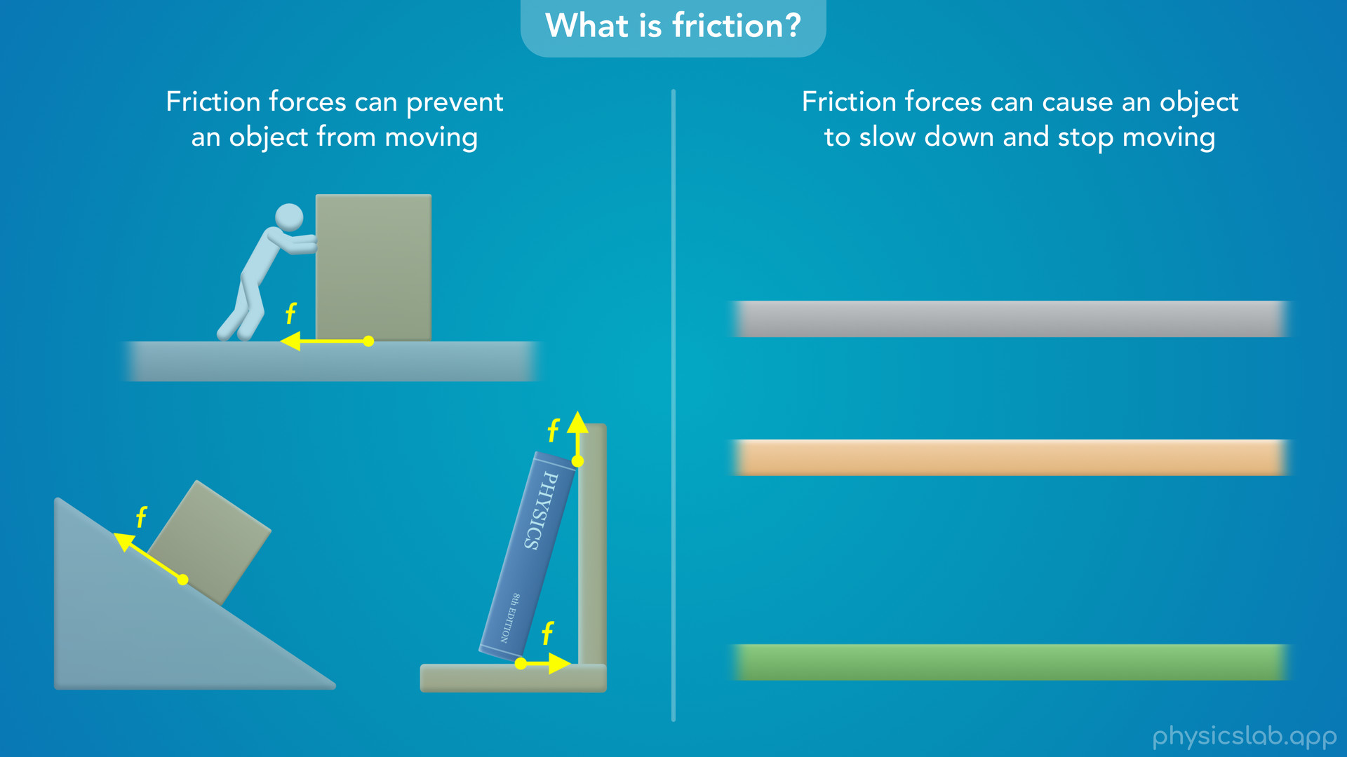
Notes:
• Friction forces can also act on a moving object and cause it to slow down and stop moving.
• If an object is sliding or rolling across a surface, there’s a friction force acting against its motion.
• If there are no other forces to keep it moving, the object will slow down and stop.

Slide 13
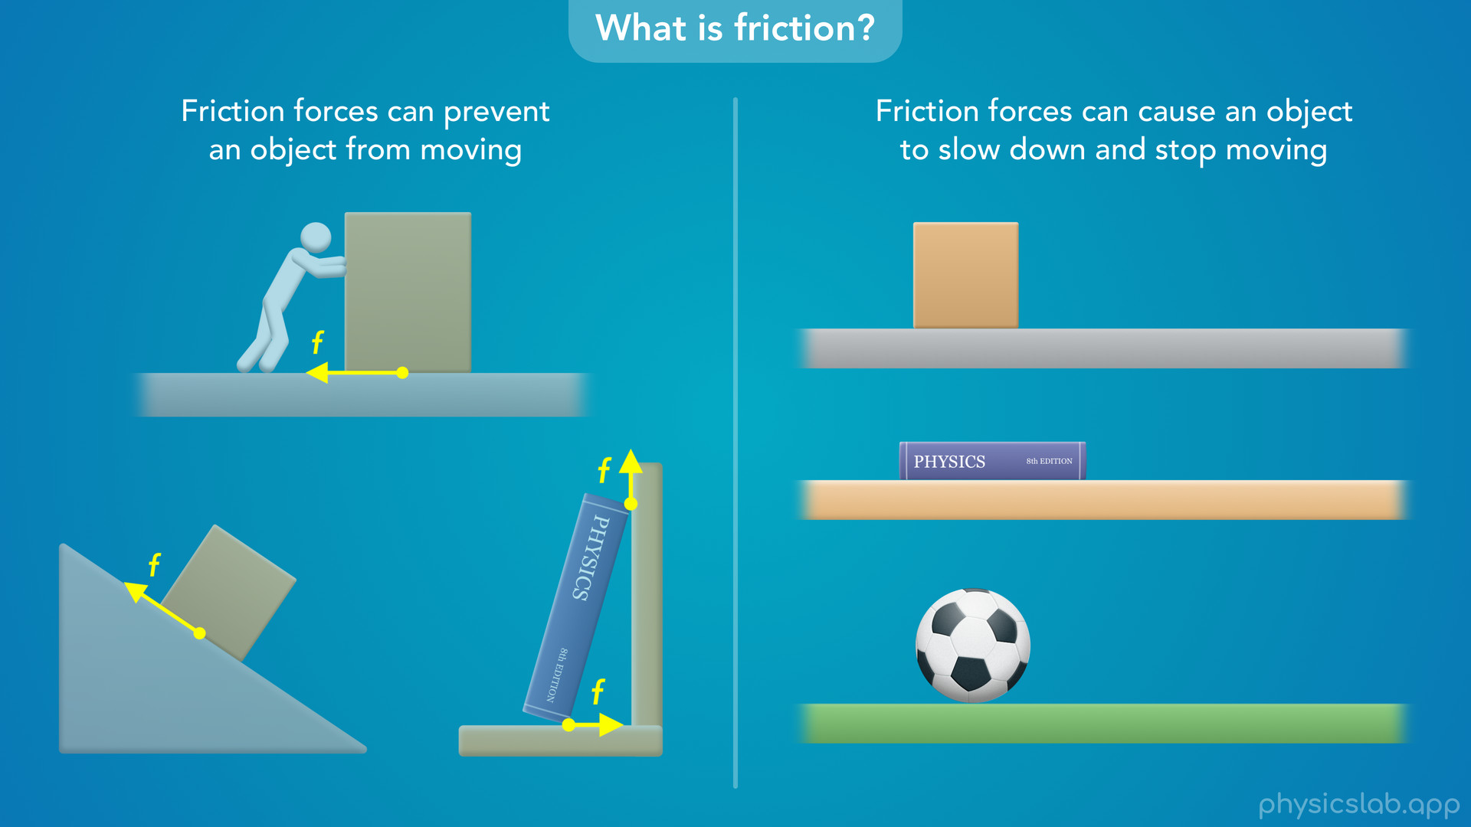

Slide 14
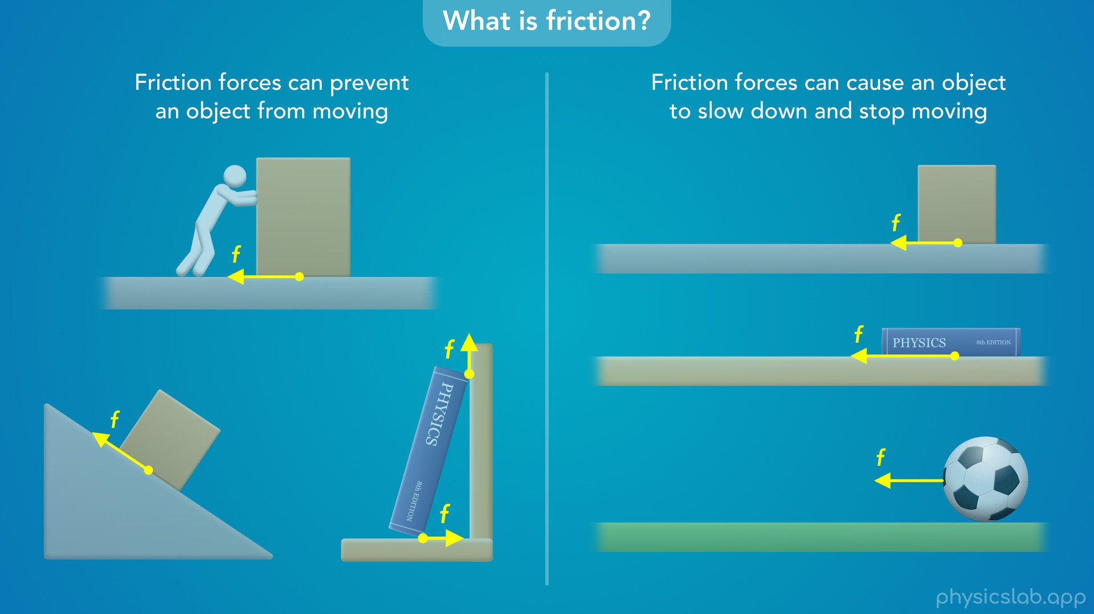
Notes:
• We talked about that in the lesson on Newton’s 1st law of motion.
• Moving objects don’t stop on their own, there must be a net force causing them to slow down, and that force is usually friction.

Slide 15
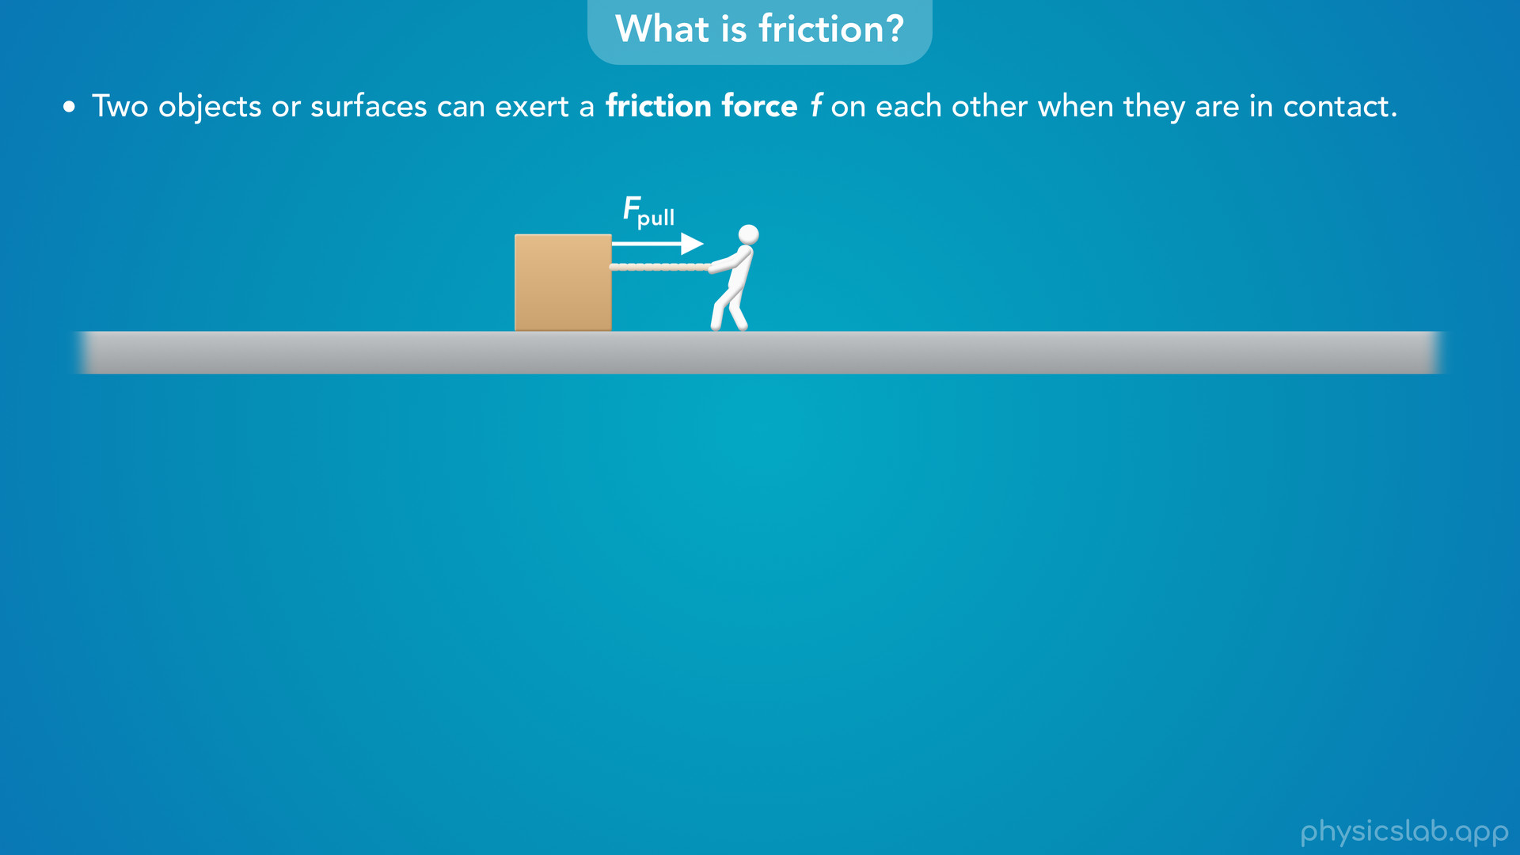
Notes:
• So what is a friction force?
• Two objects or surfaces can exert a friction force on each other when they are in contact, and we represent a friction force with the lowercase f.
• So let’s say there’s a box sitting on the ground and you try to pull the box to the right.

Slide 16
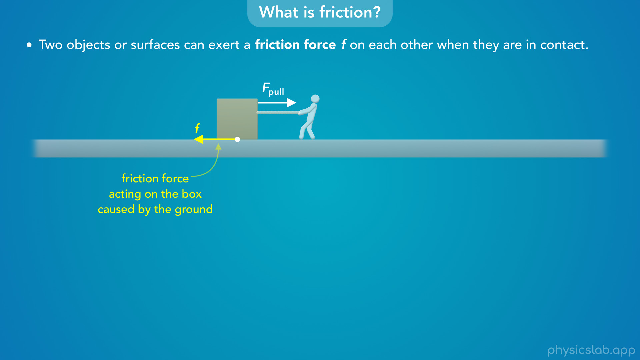
Notes:
• The ground will exert a friction force on the box that points to the left.

Slide 17
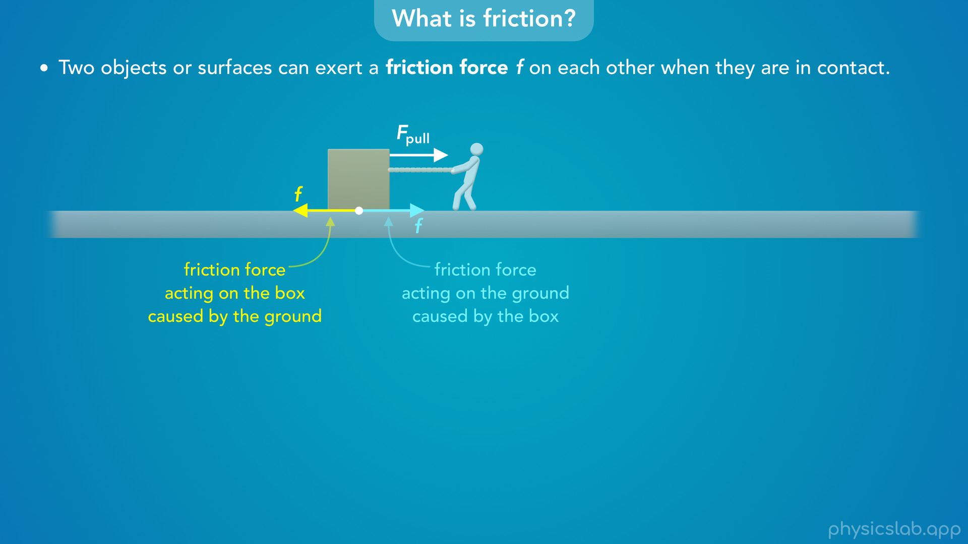
Notes:
• But we know that forces come in pairs from Newton’s 3rd law of motion, so the box will also exert an equal and opposite friction force on the ground to the right.
• We’re usually only focused on the forces that are acting on one object like the box, so let’s just focus on the friction force acting on the box.
• A friction force acts where two objects or surfaces are in contact, so this friction force acts on the bottom of the box where it’s in contact with the ground.

Slide 18

Notes:
• But we usually draw forces starting on the side of an object so they’re easier to see.

Slide 19
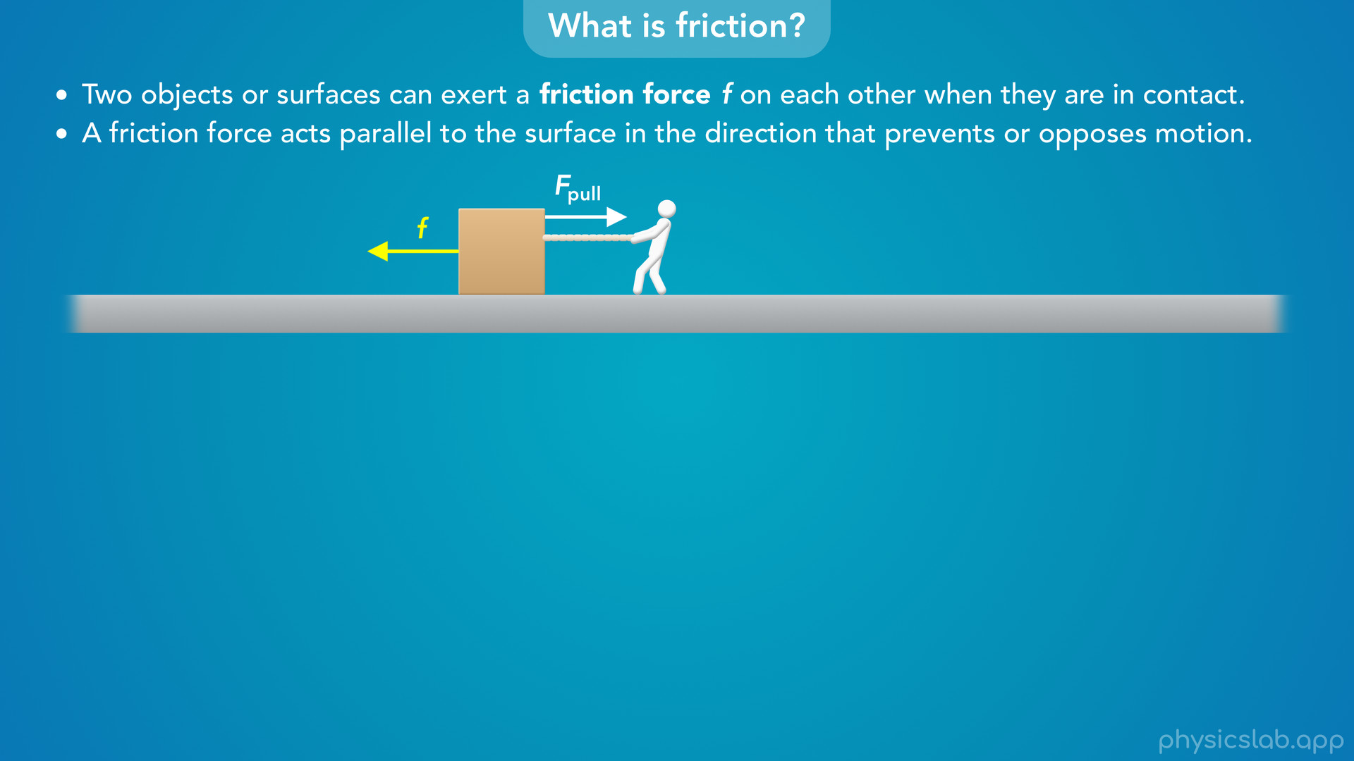
Notes:
• One important thing to remember is that a friction force acts parallel to the surface in the direction that prevents or opposes motion.
• So this friction force is parallel to the ground, they’re both horizontal.

Slide 20
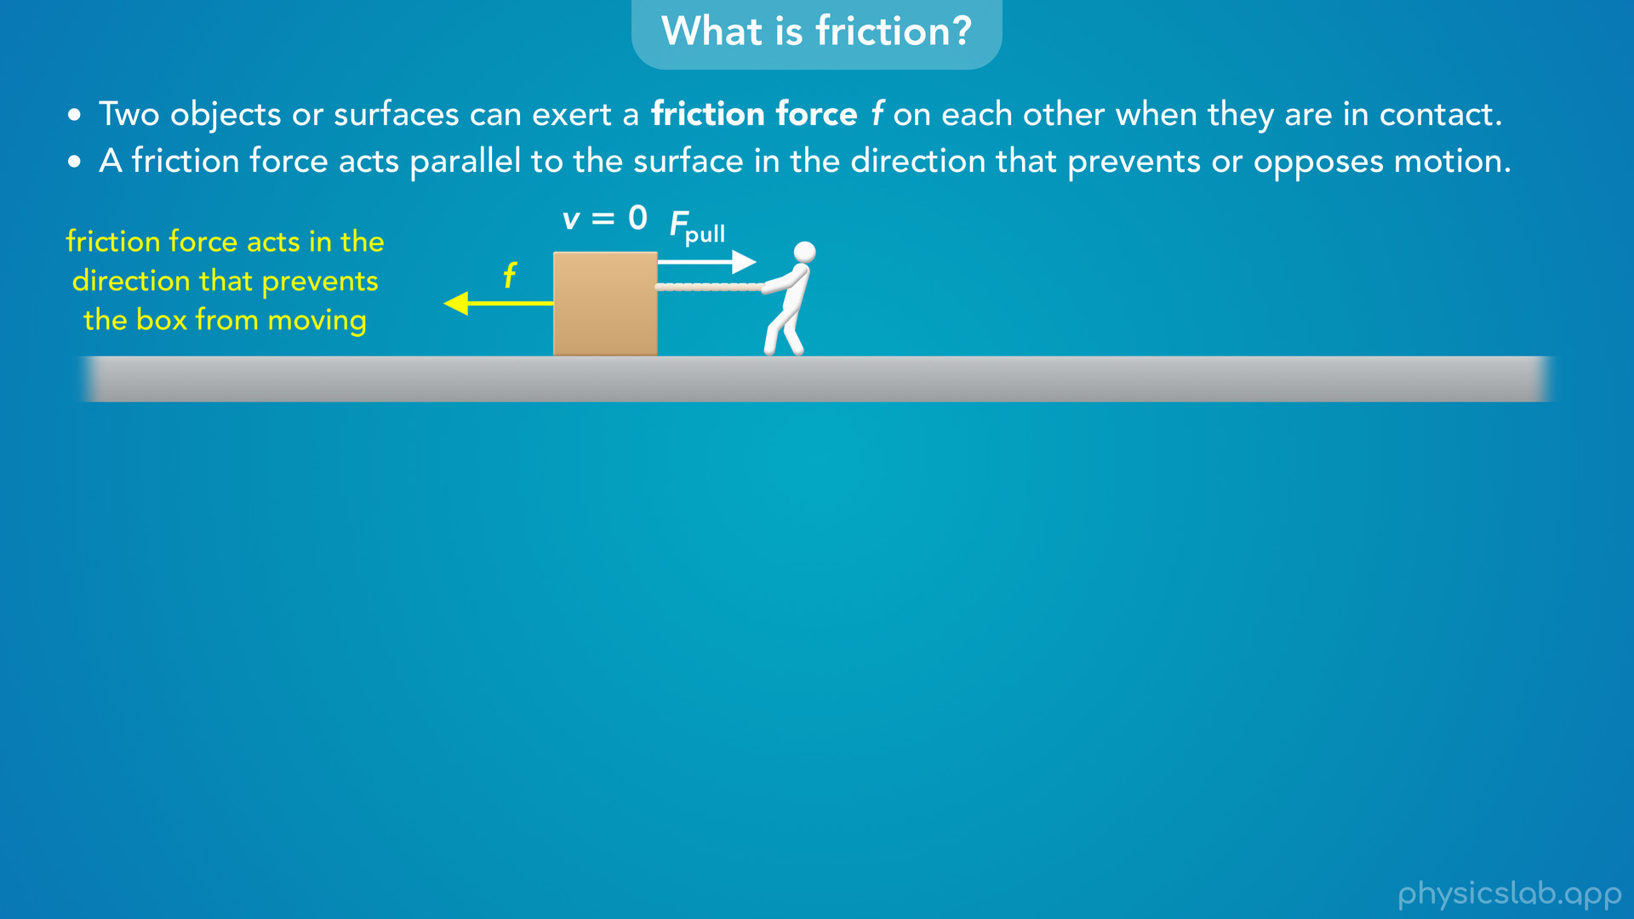
Notes:
• If the box doesn’t move, we would say the friction points to the left because it’s preventing the box from moving.

Slide 21
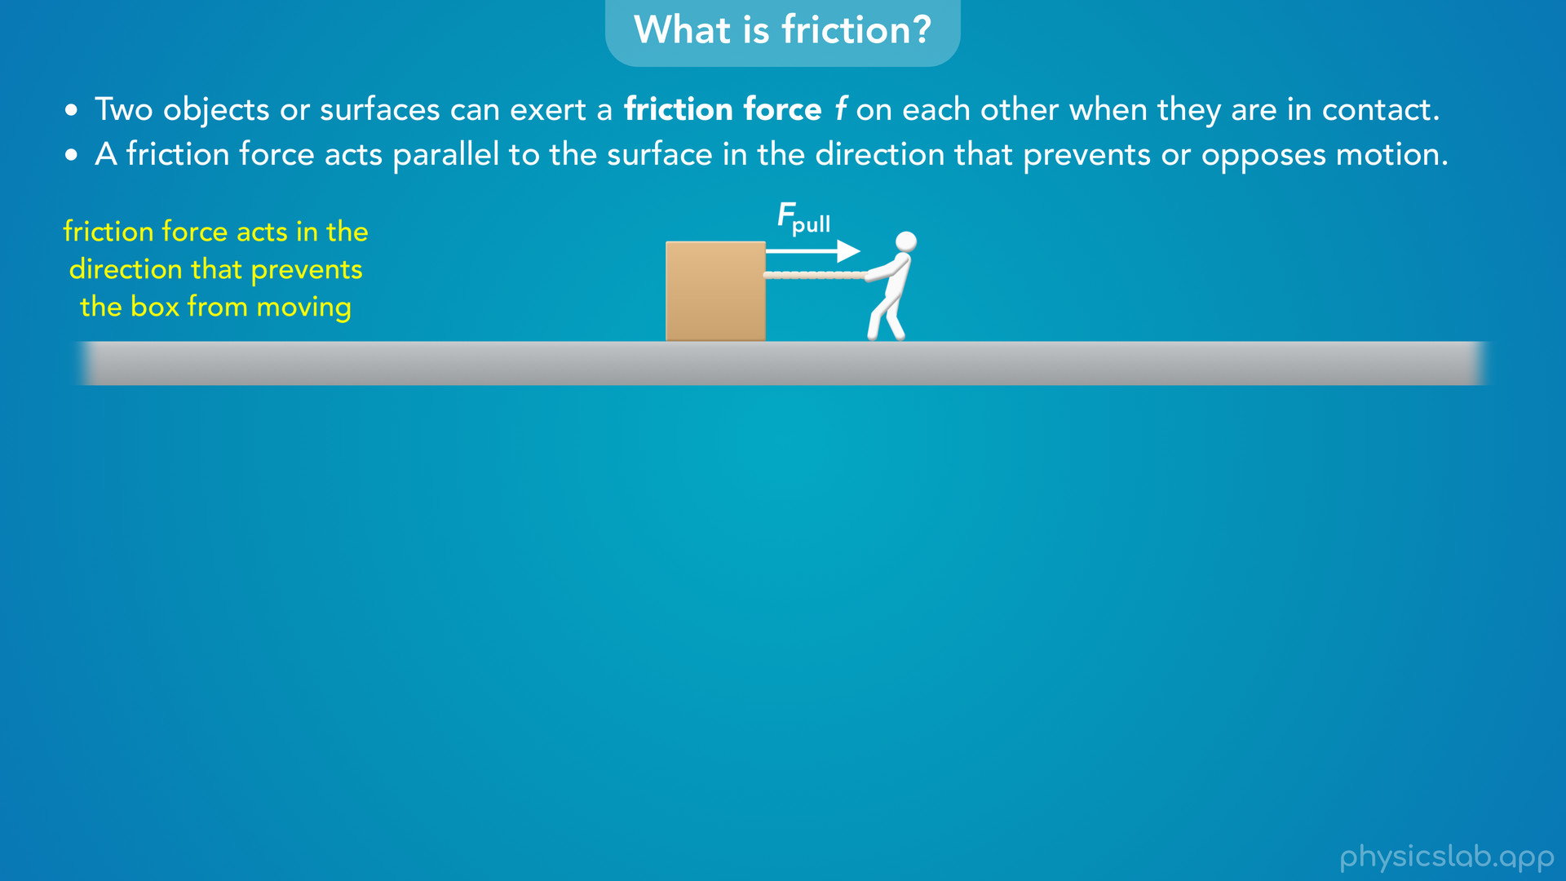
Notes:
• Without that friction force, the box would move to the right, so the friction force must be acting to the left.

Slide 22
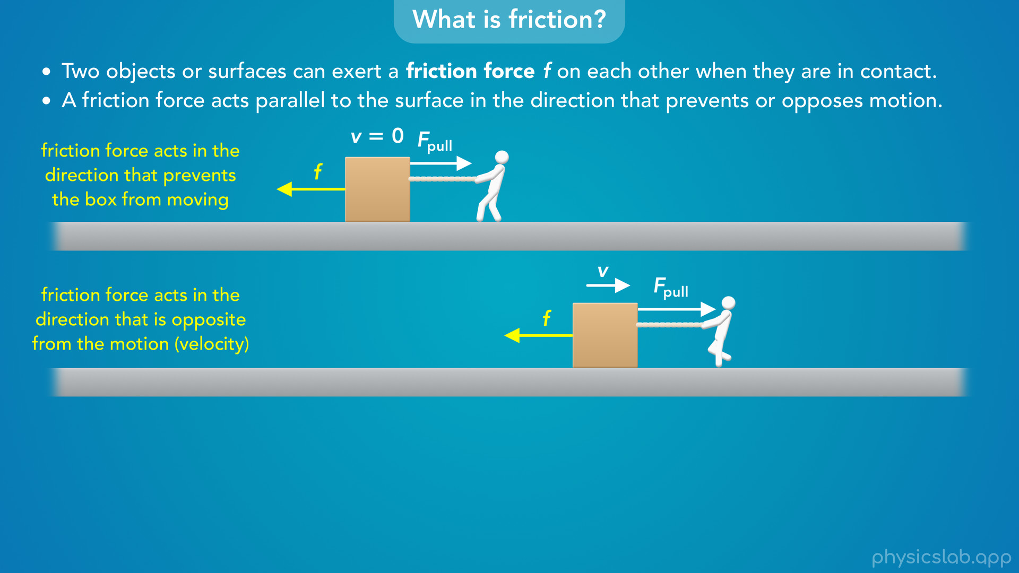
Notes:
• If you pull harder on the box and you get it moving, then the boxes motion is to the right, so we would say the friction force points to the left because it opposes the boxes motion.
• The friction force on the box has the opposite direction as the velocity of the box.

Slide 23
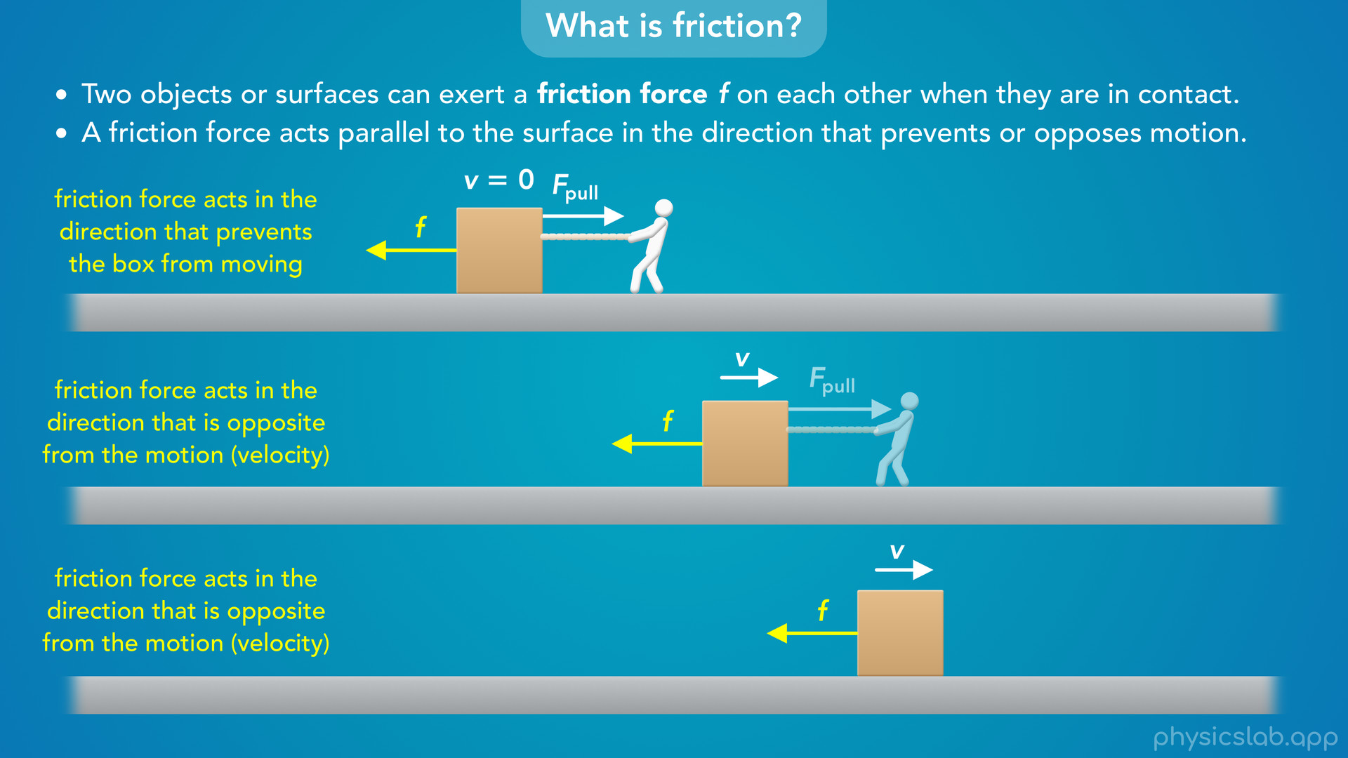
Notes:
• And if you stop pulling on the box, there’s still a friction force from the ground while it’s moving, and it still points to the left, in the opposite direction as the velocity.
• So a friction force can act on a non-moving or a moving object, and its direction always prevents or opposes the object’s motion.

Slide 24
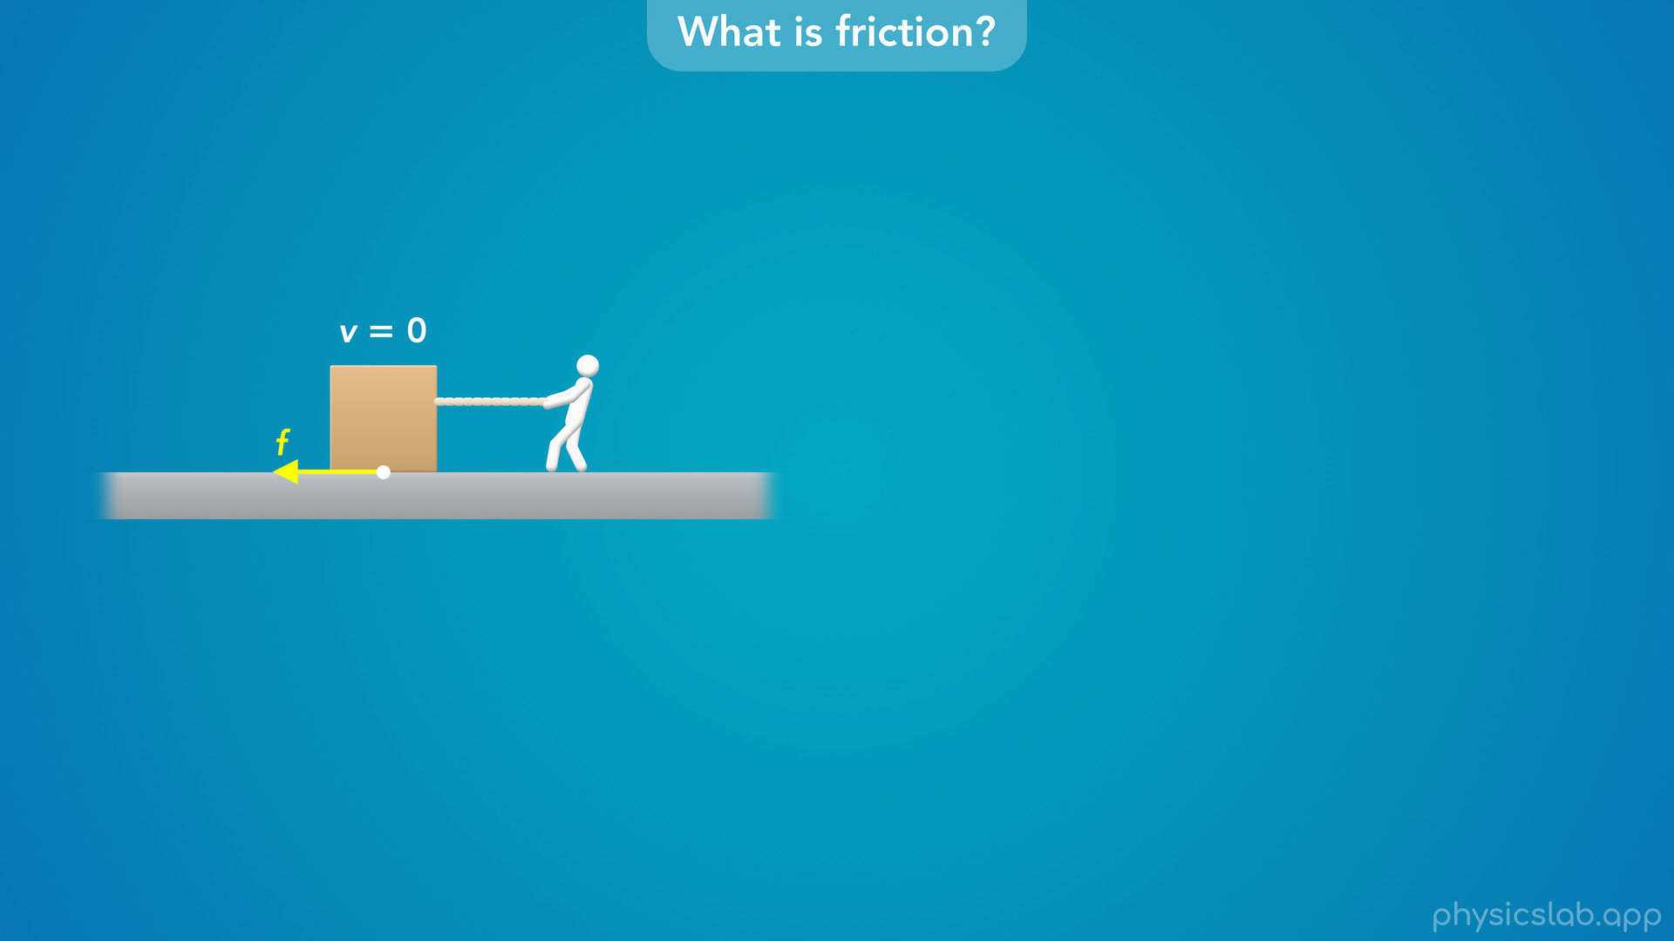
Notes:
• But what actually causes a friction force?
• How can the ground apply a sideways force on the box?

Slide 25
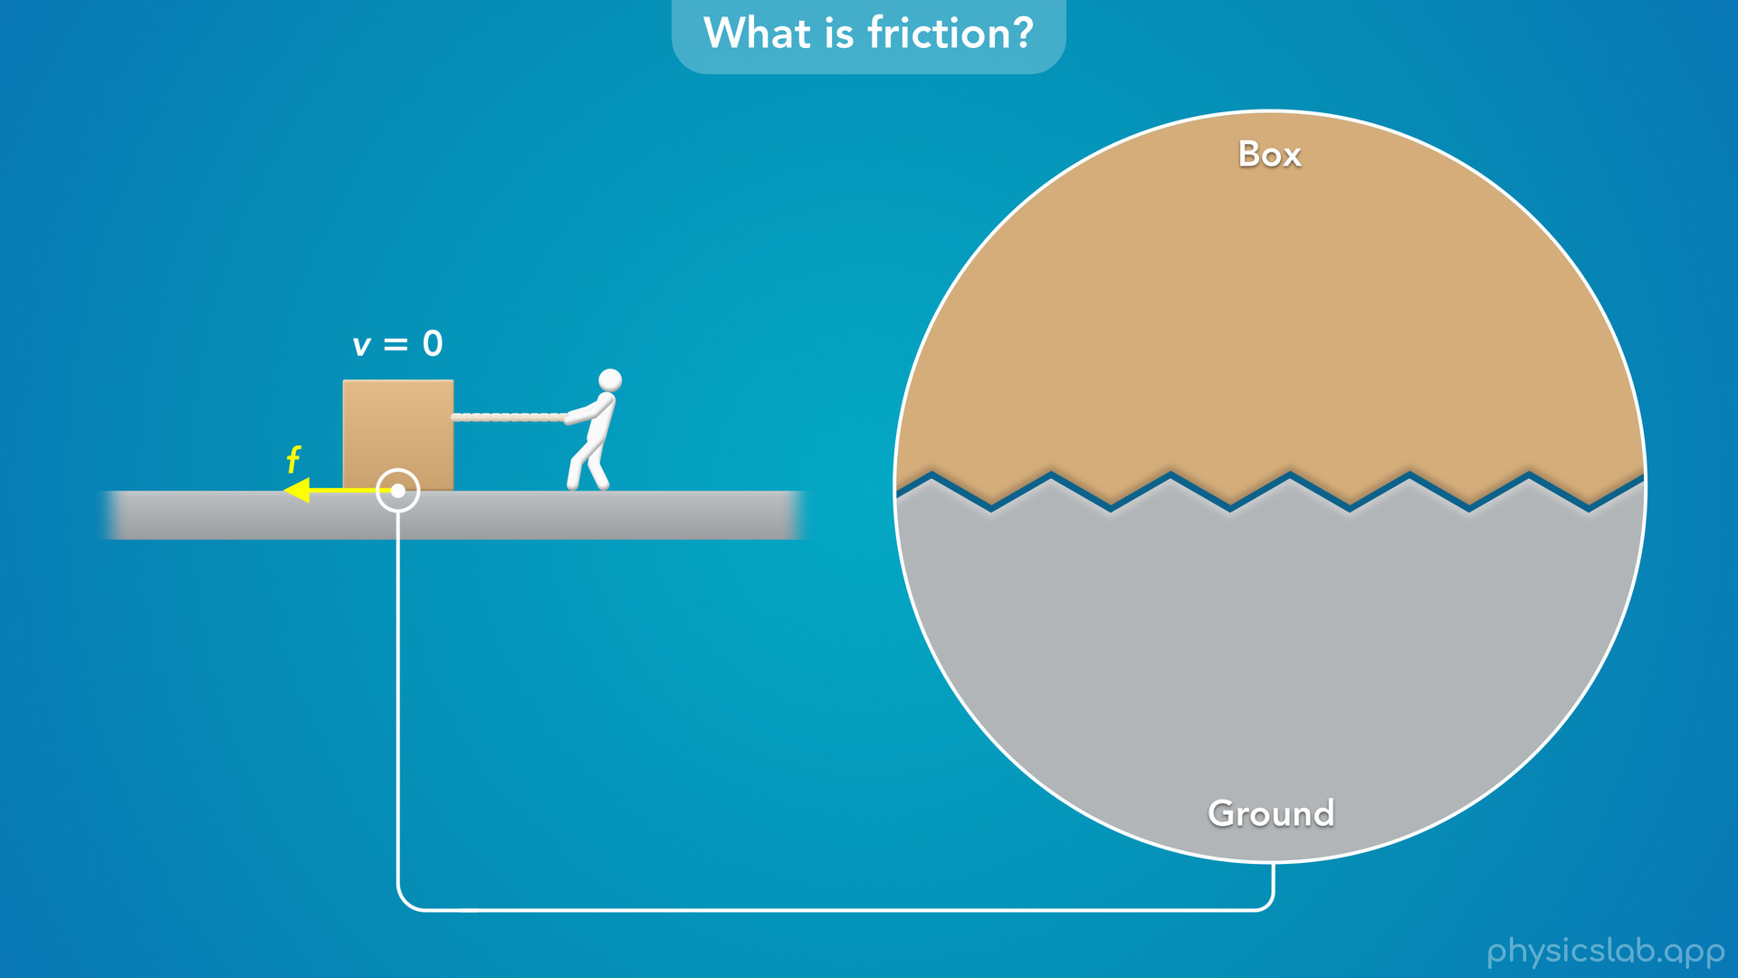
Notes:
• Objects and surfaces might appear to be smooth, but if we zoom in, all surfaces have some amount of roughness.
• We can imagine there are a bunch of small bumps, little peaks and valleys on the surface of each object.

Slide 26

Notes:
• If you try pulling this box to the right, the bumps on the box will get stuck against the bumps on the ground.

Slide 27
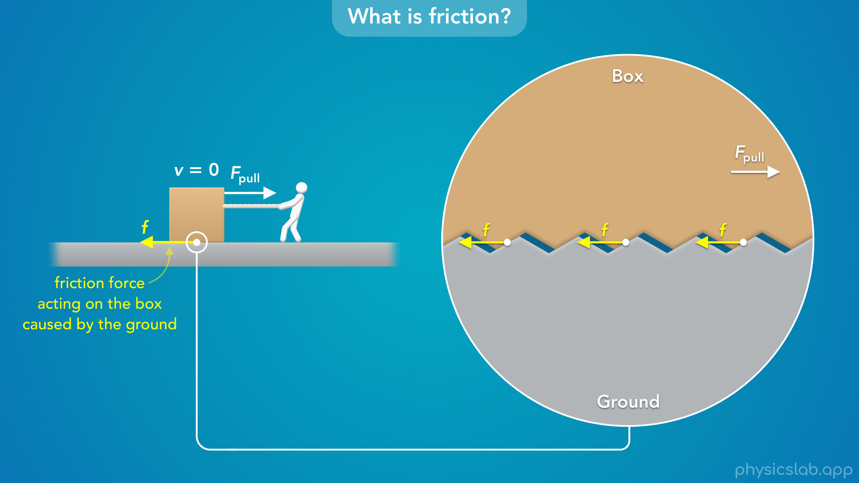
Notes:
• The ground exerts a bunch of small forces on the box to the left, and if we add them all together we get the friction force on the box.

Slide 28

Notes:
• The box also exerts equal and opposite forces on the ground, which add up to the friction force exerted on the ground by the box.

Slide 29
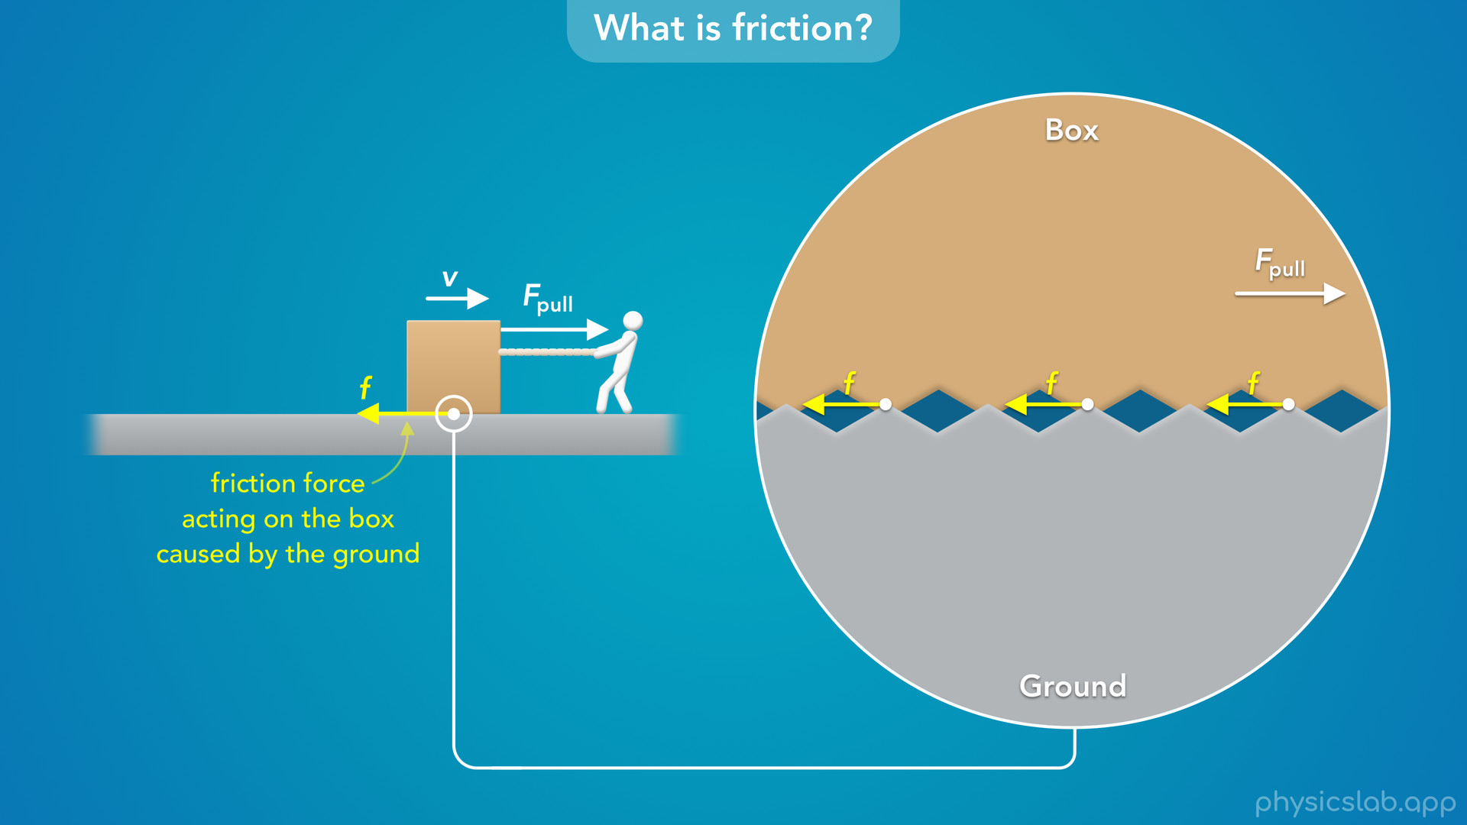
Notes:
• If you pull hard enough to get the box to slide to the right, there is still a friction force on the box acting to the left as it rubs against the ground.
• So a friction force is caused by the microscopic roughness of each object or surface.

Slide 30
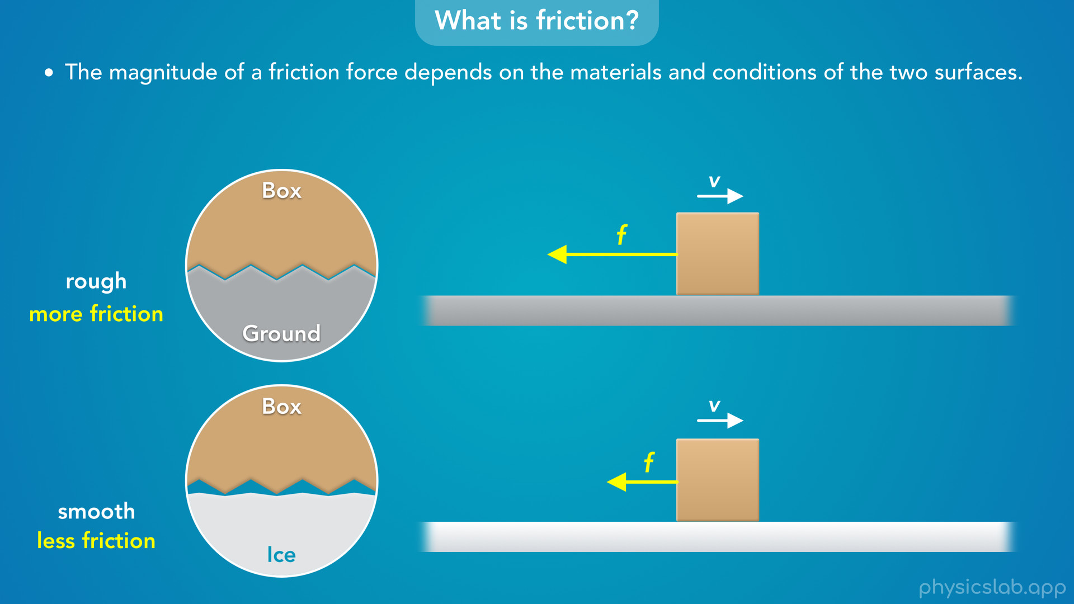
Notes:
• But some surfaces are rougher than others, and the magnitude of a friction force depends on the materials and conditions of the two surfaces.
• So this ground might be pretty rough, but what if the box is sitting on something like ice?
• We’re simplifying things a little, but ice is pretty smooth and the bumps on the surface aren’t as big.
• So there would be more friction between the box and the ground, and less friction between the box and the ice.

Slide 31
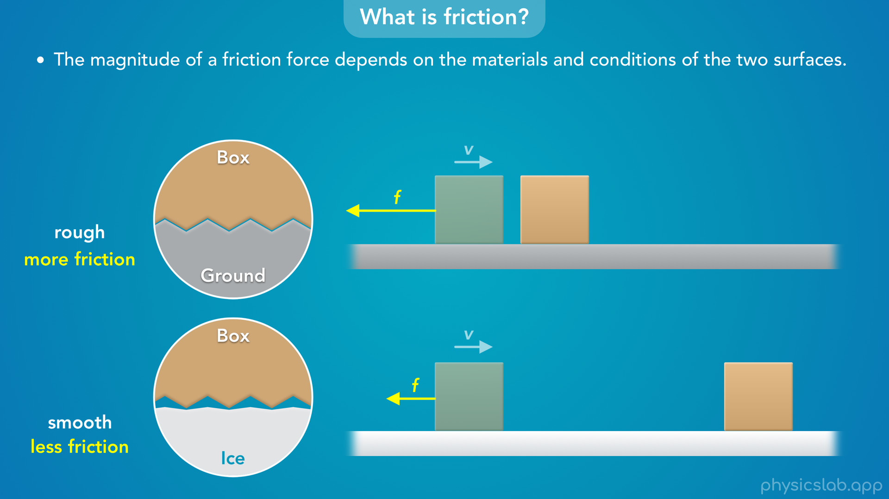
Notes:
• If we slide the boxes with the same initial speed, the friction force from the ground is greater so the box slows down sooner.
• The friction force from the ice is smaller, so the box travels farther before it stops.

Slide 32
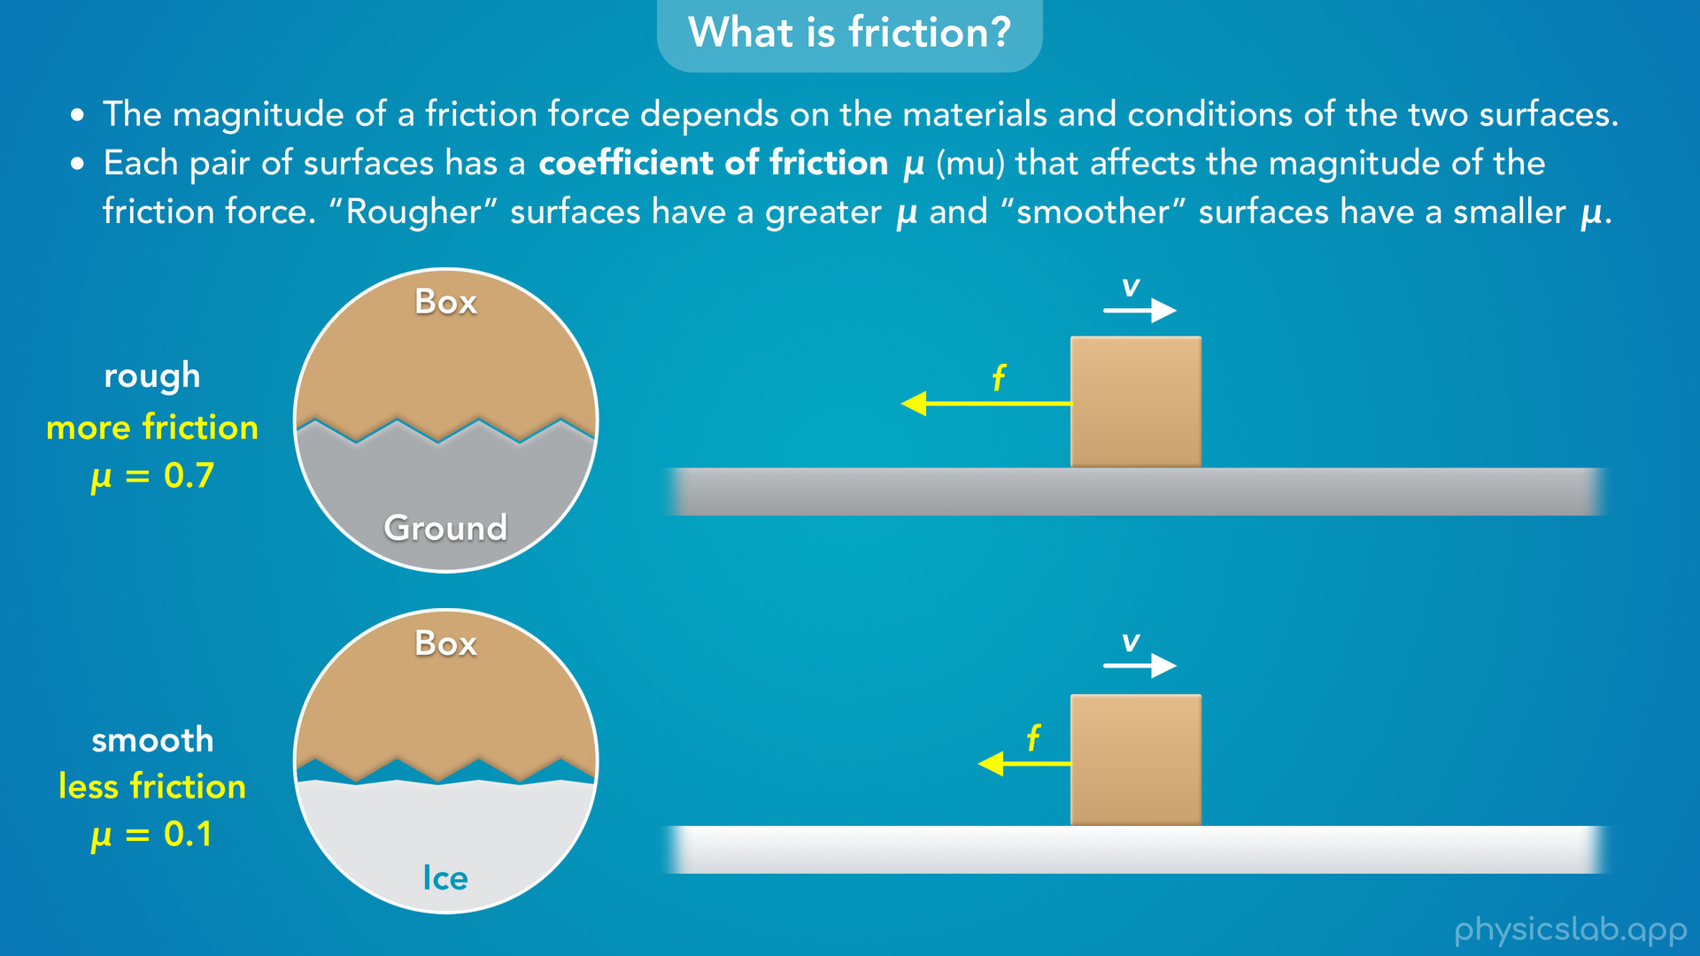
Notes:
• But describing surfaces as rough or smooth isn’t very precise.
• We need a way to quantify how rough a surface is so we can calculate the friction forces.
• Luckily, there’s something called the coefficient of friction.
• Each pair of surfaces has a coefficient of friction, represented with the greek letter mu, that affects the magnitude of the friction force.
• Rougher surfaces have a greater coefficient of friction, and smoother surfaces have a smaller coefficient of friction.
• So for the box and the ground, the coefficient of friction might be 0.7.
• And for the box and the ice, it might be much smaller, like 0.1.
• The coefficient of friction is just a number, it doesn’t have a unit.
• It’s usually between 0 and 1, and a bigger number means there’s more friction between the two surfaces.

Slide 33
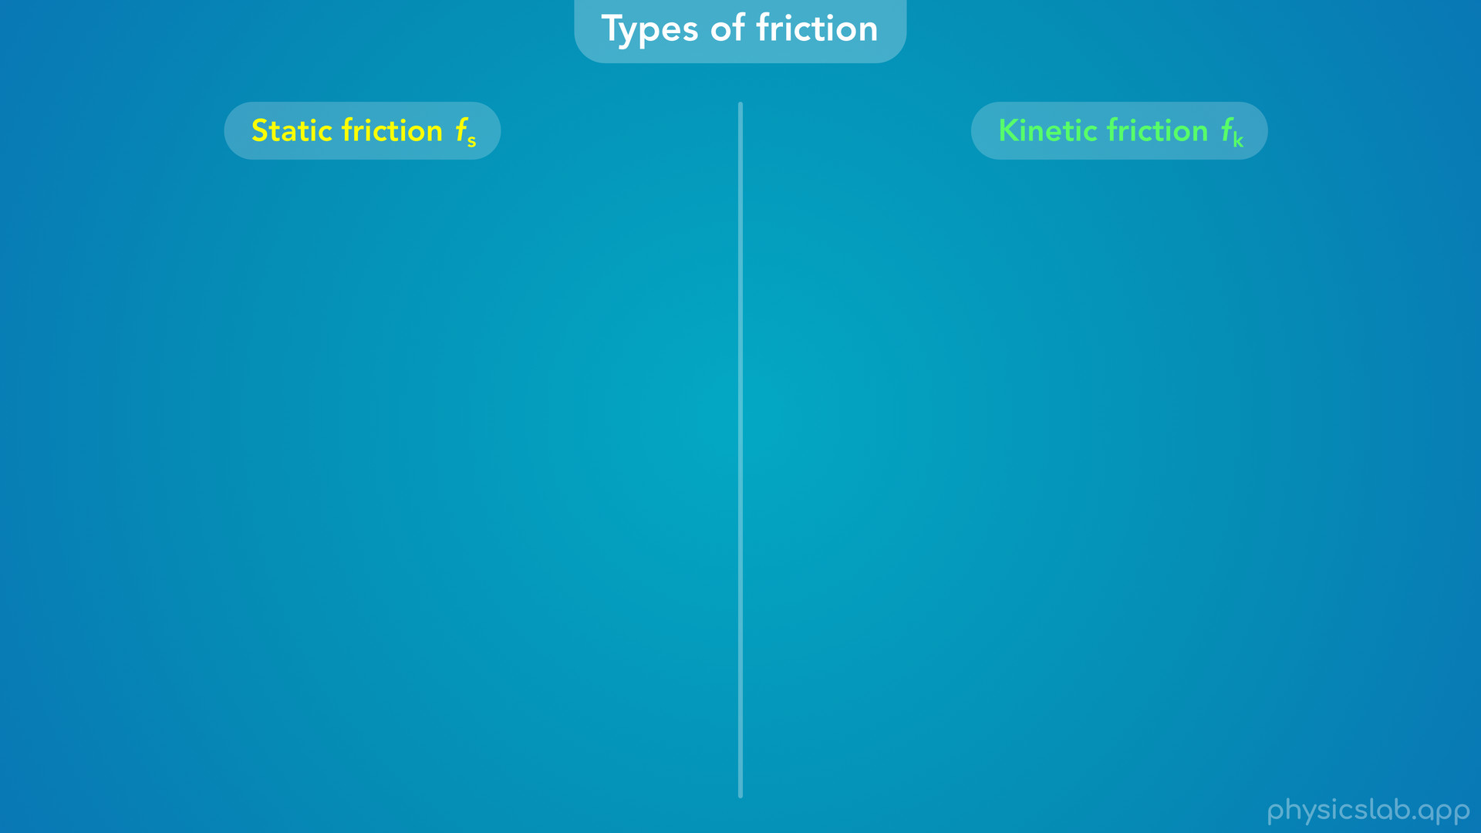
Notes:
• The last thing to mention in this video is the different types of friction.
• We’re mostly just gonna use static friction and kinetic friction, and we’ll use the subscripts s and k to label each one.

Slide 34
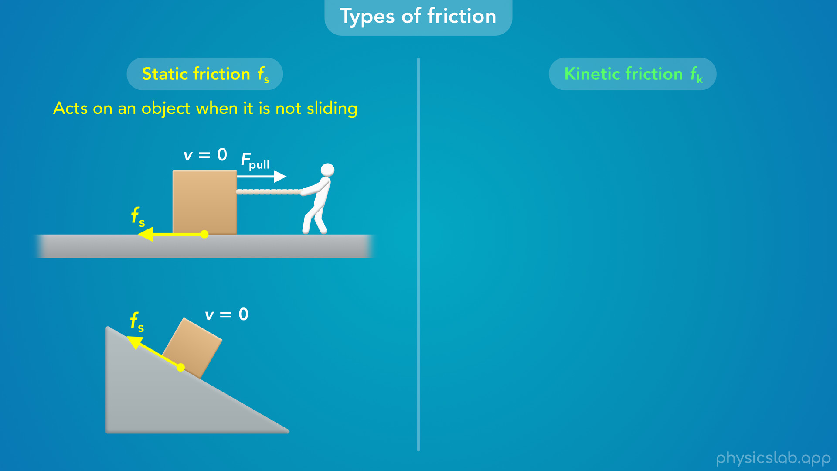
Notes:
• Static friction acts on an object when it is not sliding along a surface.
• So if you pull on this box to the right but it doesn’t move, then the ground must be exerting a static friction force on the box to the left.
• Or if this box is sitting on an incline but it doesn’t slide down, then the incline surface must be exerting a static friction force on the box that points in this direction.
• Remember, a friction force is always parallel to the surface that the object is in contact with.
• And this static friction force is preventing the box from sliding down.

Slide 35
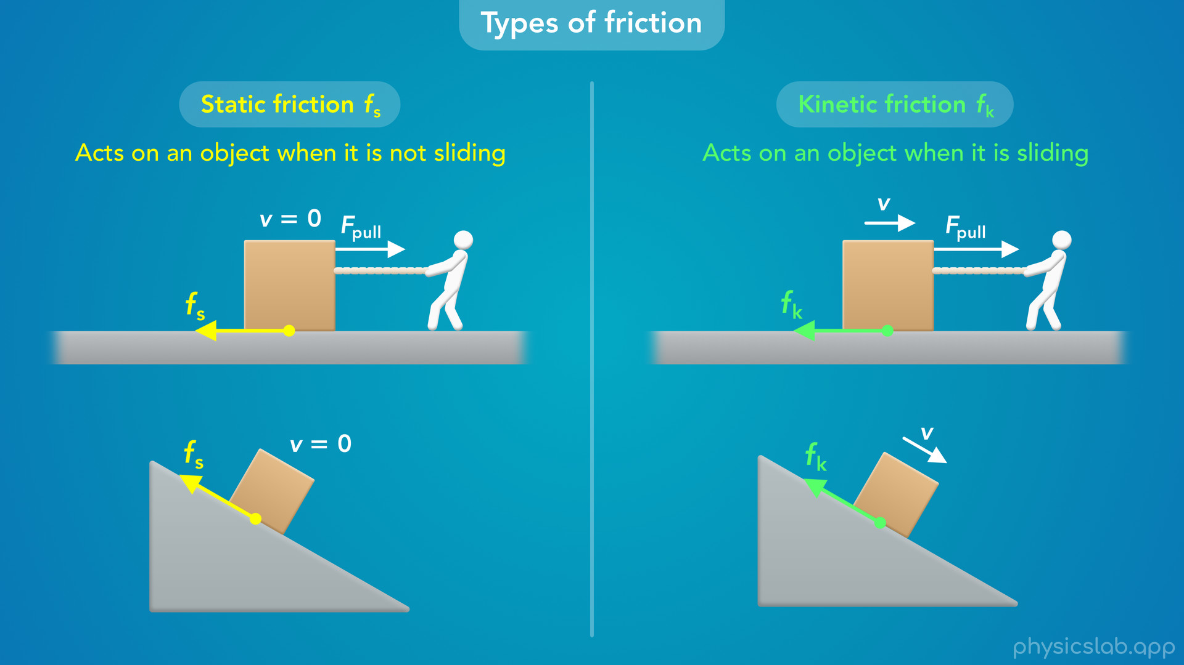
Notes:
• On the other hand, kinetic friction acts on an object when it is sliding along a surface.
• So if you get this box to slide to the right, then the ground is now exerting a kinetic friction force on the box, not a static friction force.
• And if this box does slide down the incline, the incline would be exerting a kinetic friction force on the box, in the opposite direction as the velocity.

Slide 36
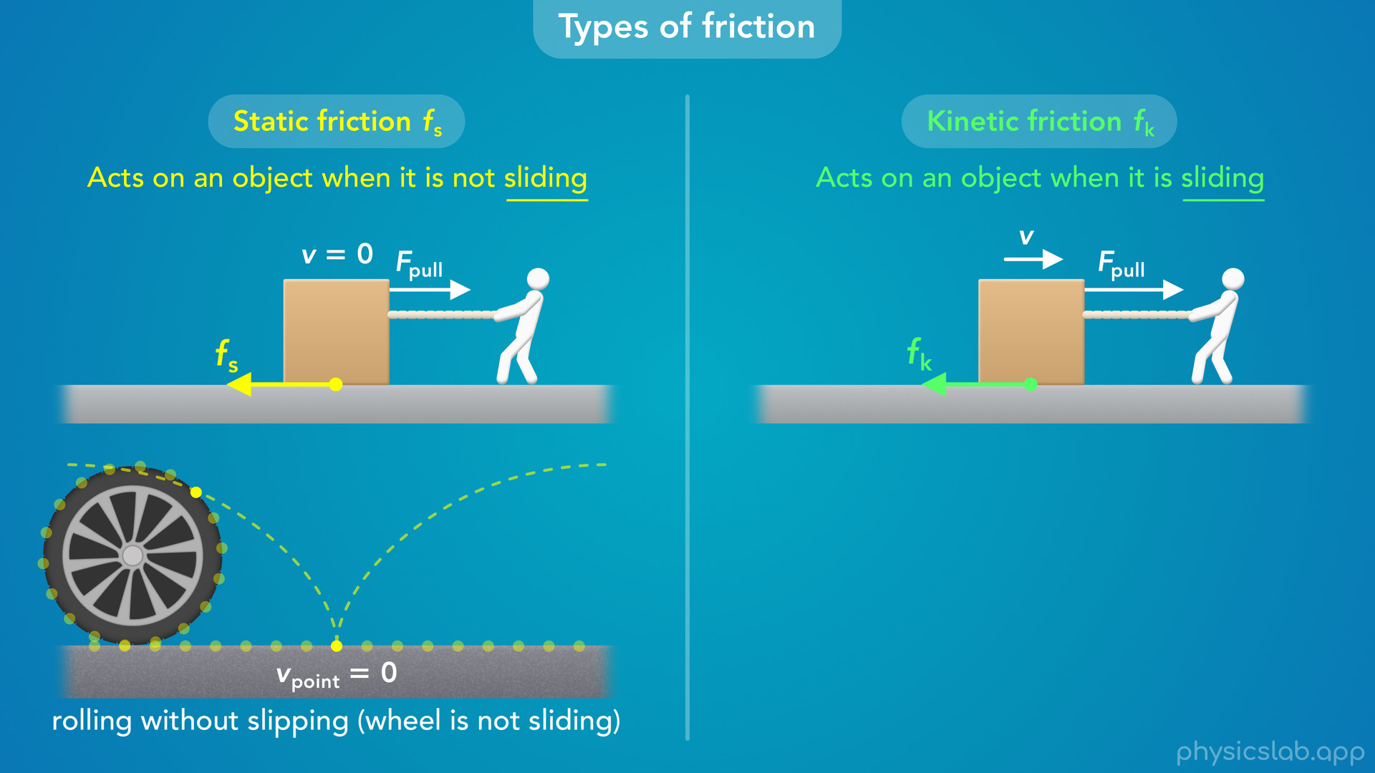
Notes:
• Notice that we’re specifically using the word “sliding”, not “moving”.
• This is important because some objects can also roll along a surface.
• If this wheel is rolling along the ground like you’d expect, we call this “rolling without slipping”.
• It turns out that the point on the wheel that is touching the ground at any moment is not moving relative to the ground.

Slide 37
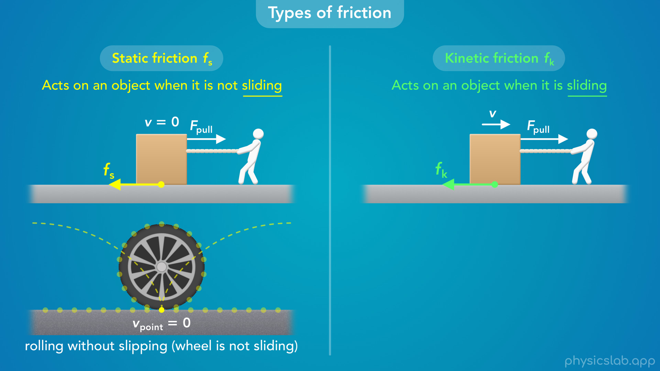

Slide 38
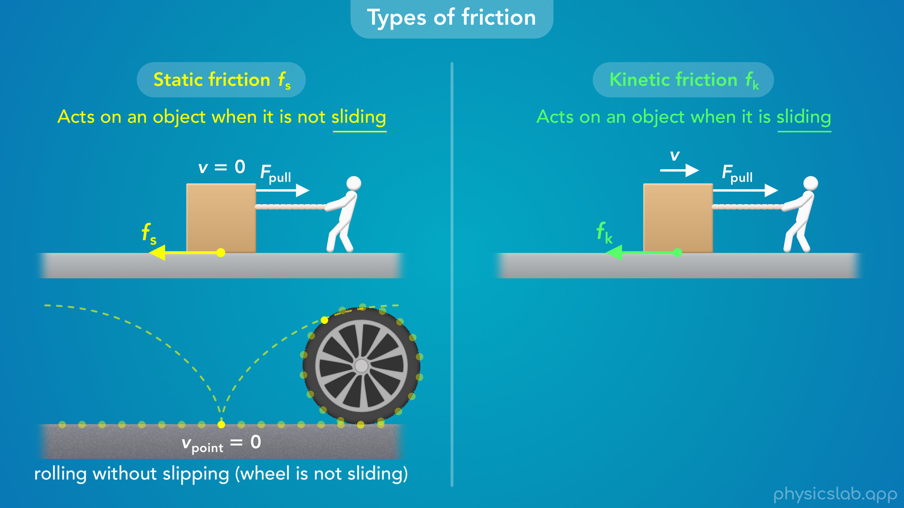

Slide 39
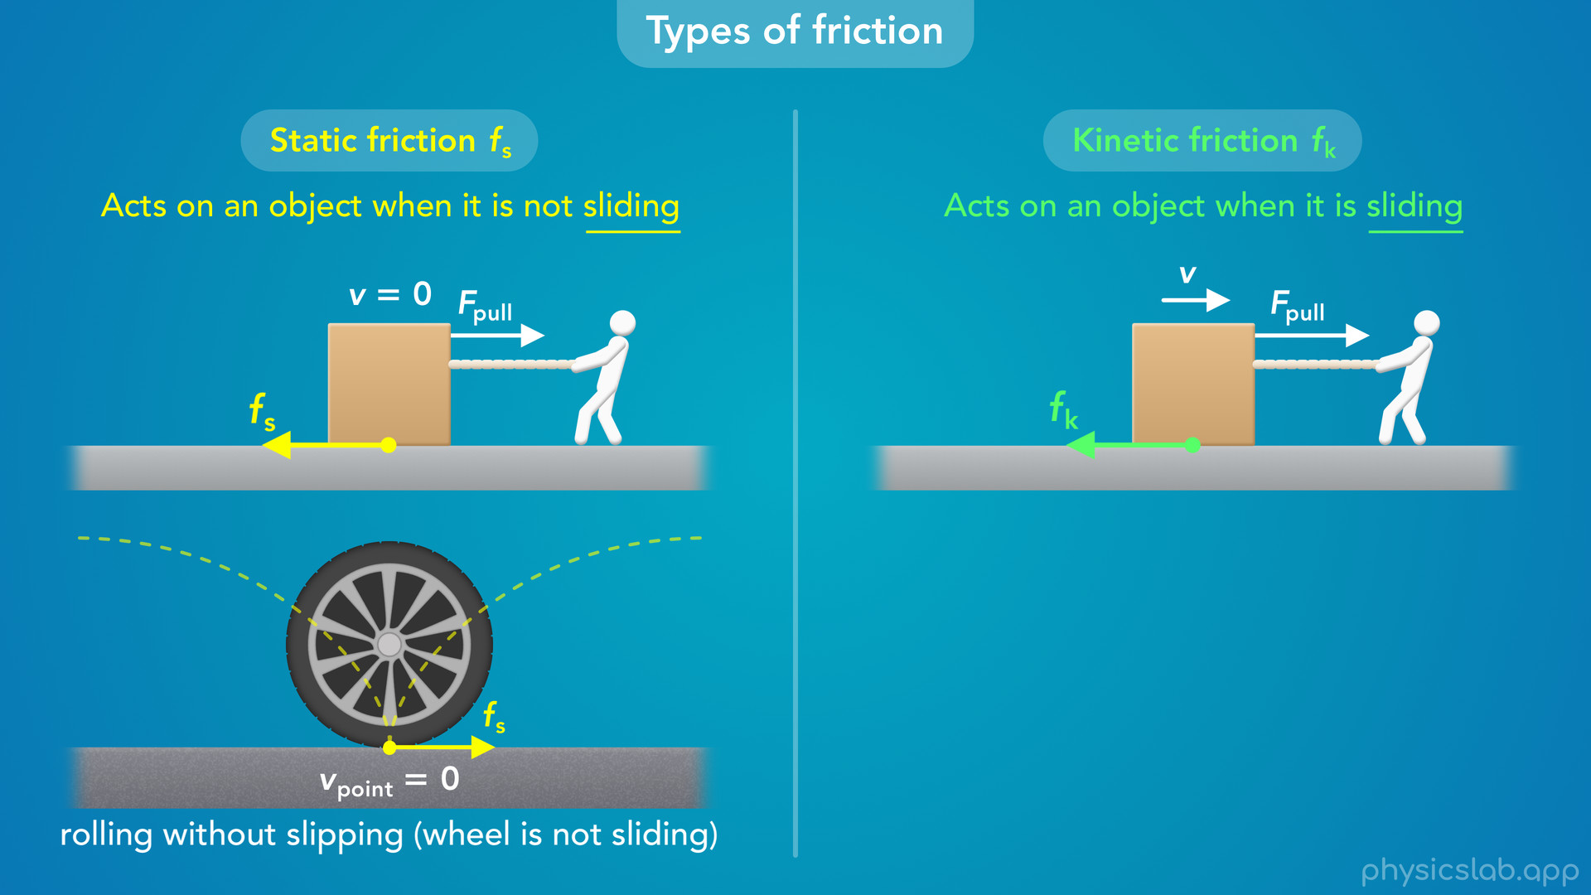
Notes:
• So the friction force that acts on the wheel at that point is a static friction force.
• The wheel is moving, but it’s not sliding.

Slide 40
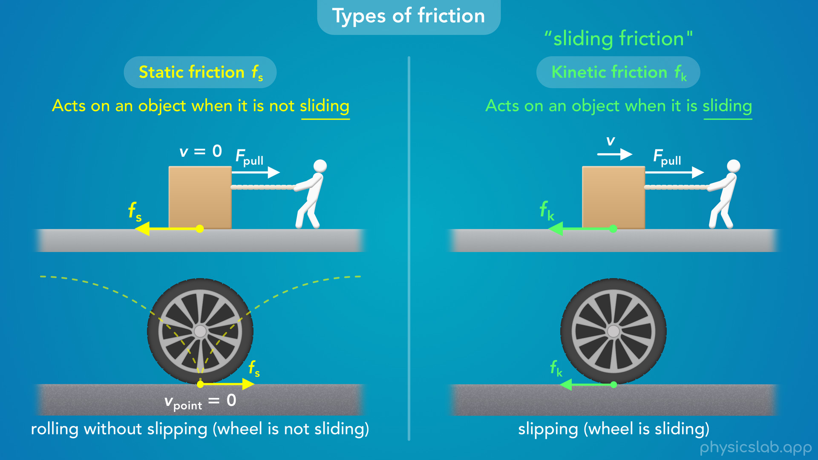
Notes:
• On the other hand, if the wheel was sliding across the ground, the friction force on the wheel would be kinetic friction.
• Don’t worry if that’s confusing, we’ll cover it more in other videos.
• But remember that static friction exists when the object is not sliding, and kinetic friction exists when the object is sliding, which is why kinetic friction is sometimes referred to as “sliding friction".

Slide 41
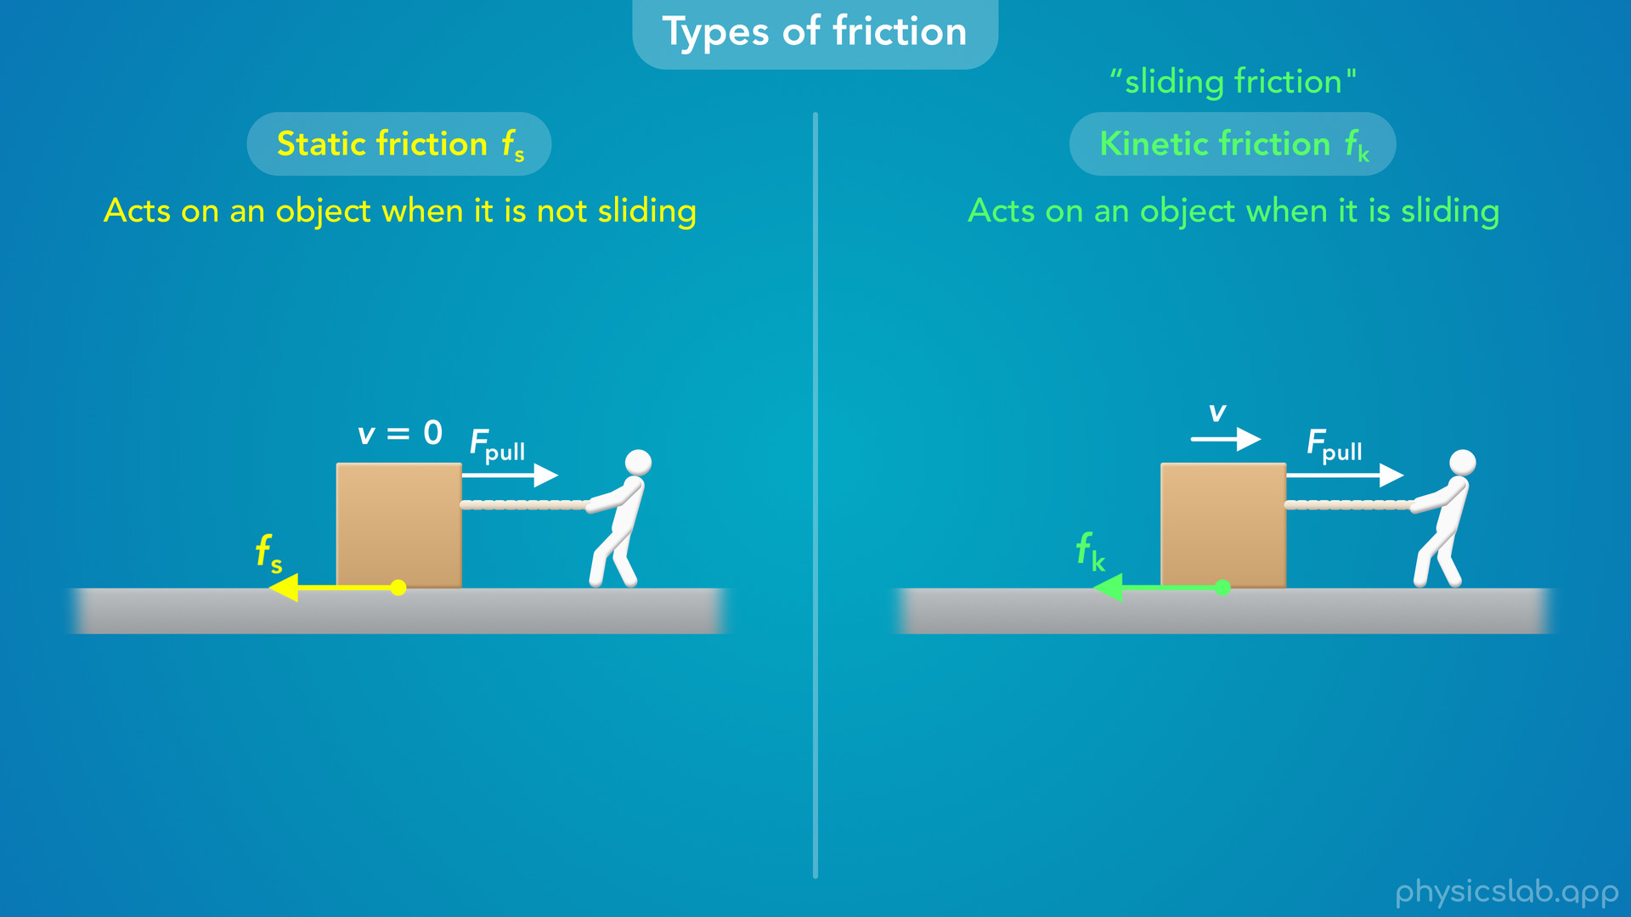
Notes:
• So the friction force on an object will either be static or kinetic, it won’t be both at the same time.

Slide 42
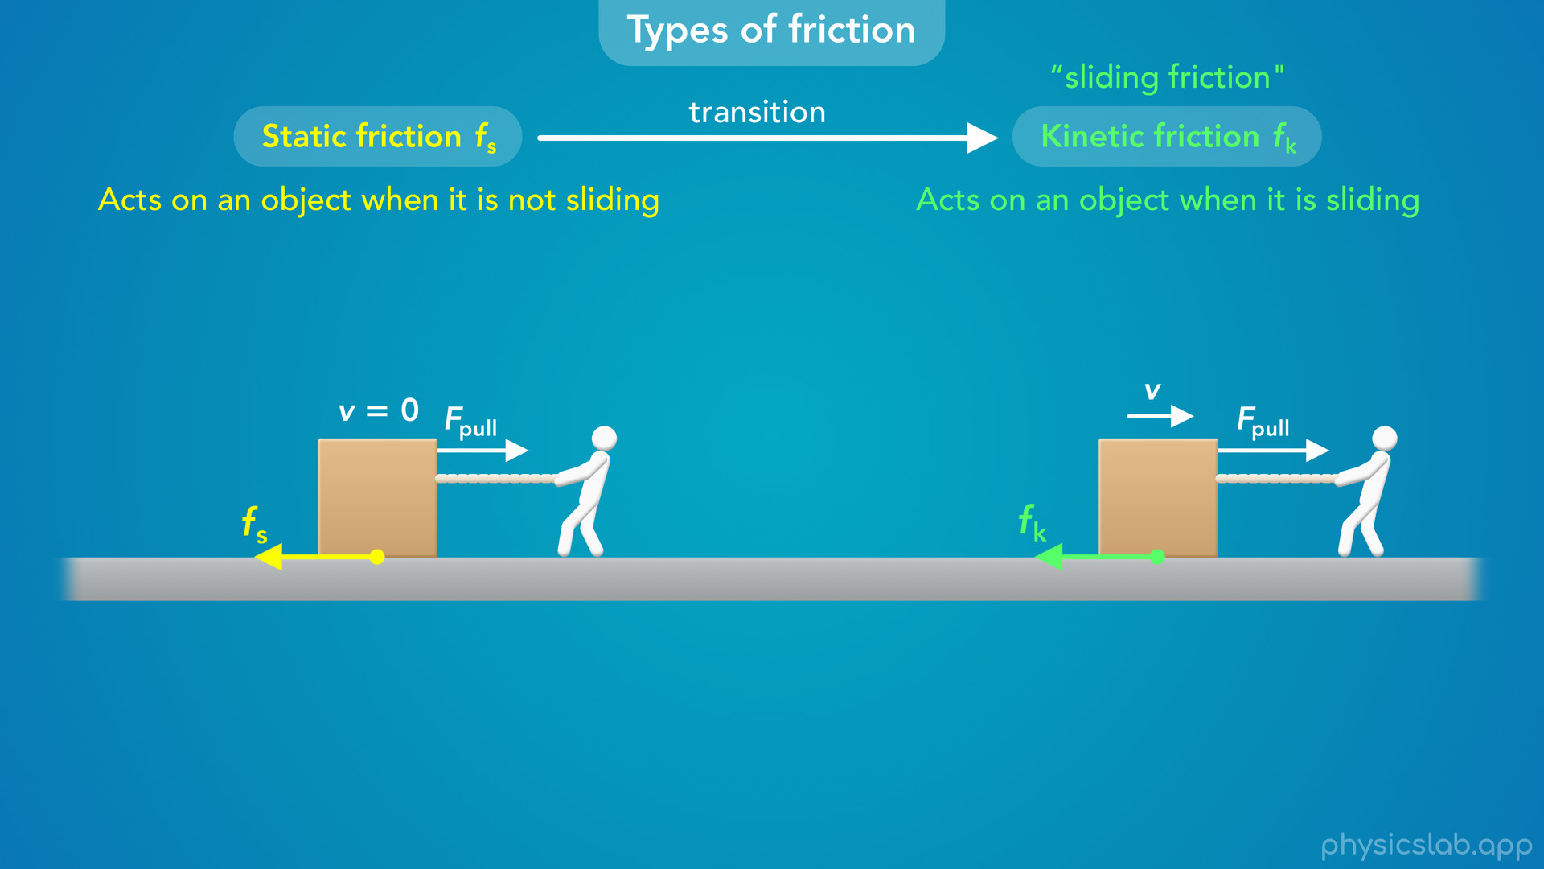
Notes:
• But as we’ll learn in another video, the friction force can transition from static friction to kinetic friction.

Slide 43
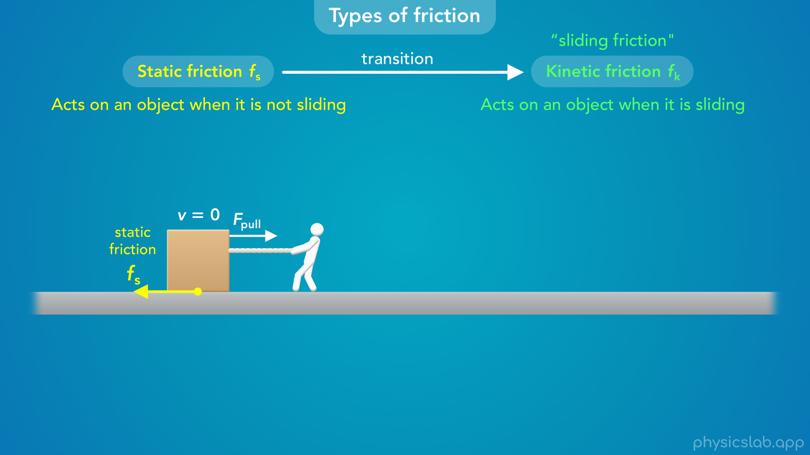
Notes:
• If you pull on this box but it doesn’t move, the friction force is static friction.

Slide 44

Notes:
• But if you pull hard enough then the box will eventually start to move.

Slide 45
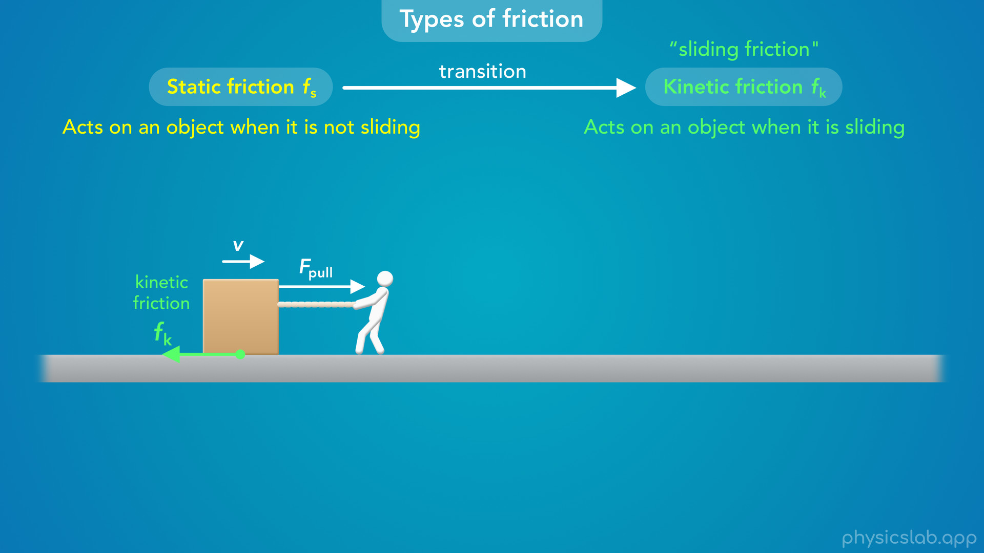
Notes:
• At that moment, the friction force changes from static friction to kinetic friction.

Slide 46
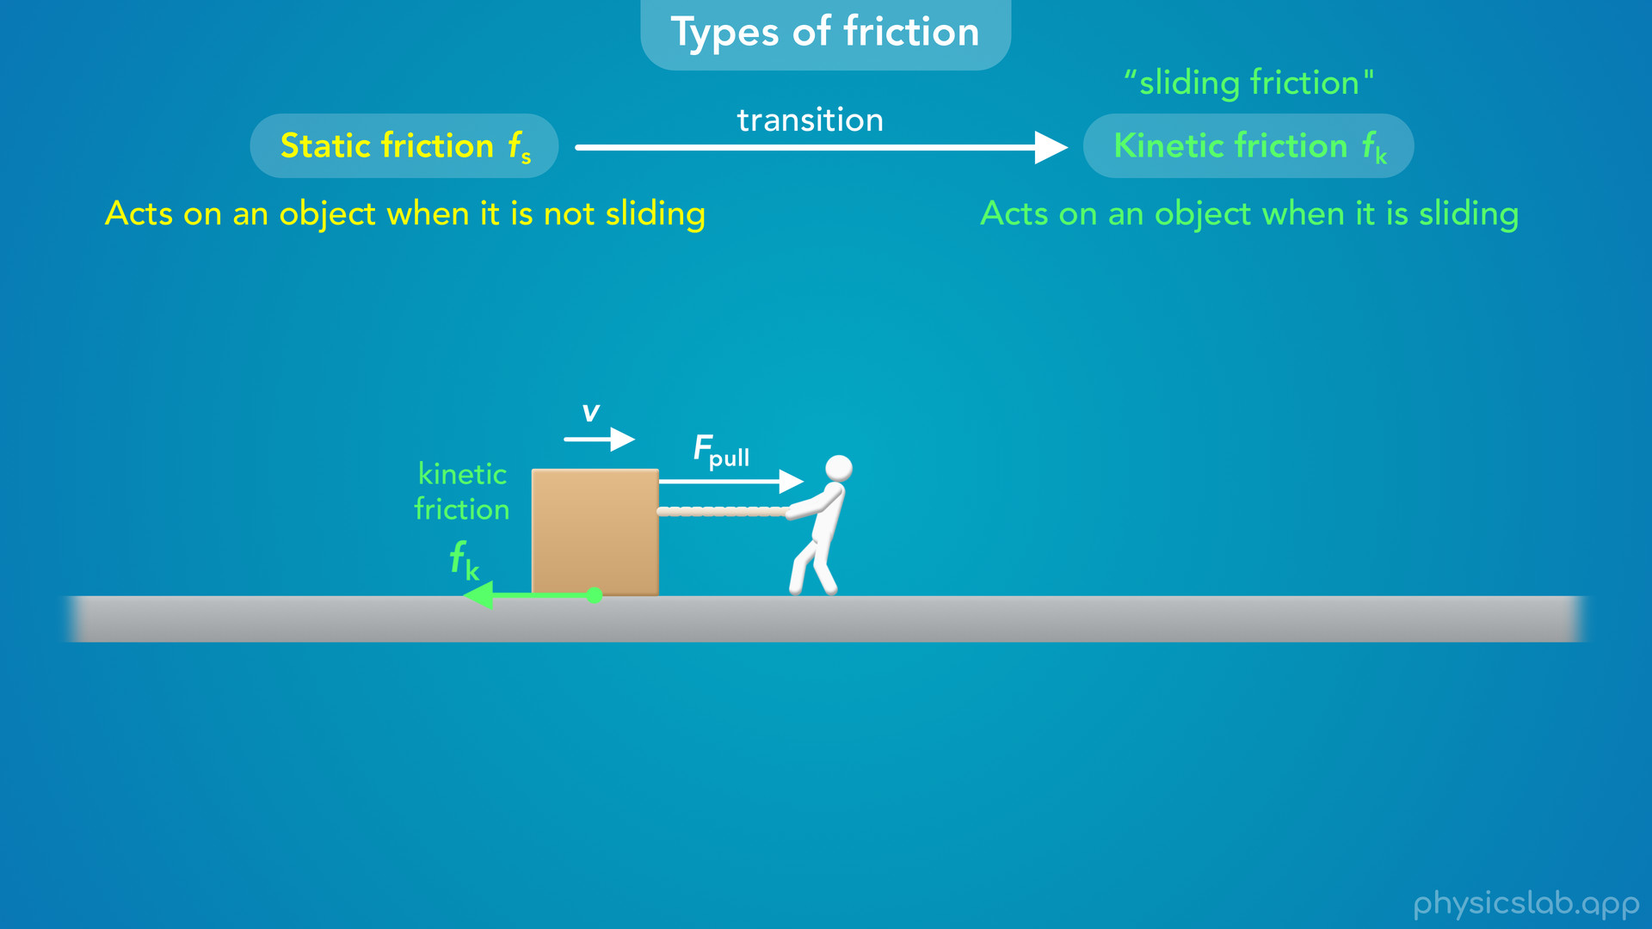

Slide 47
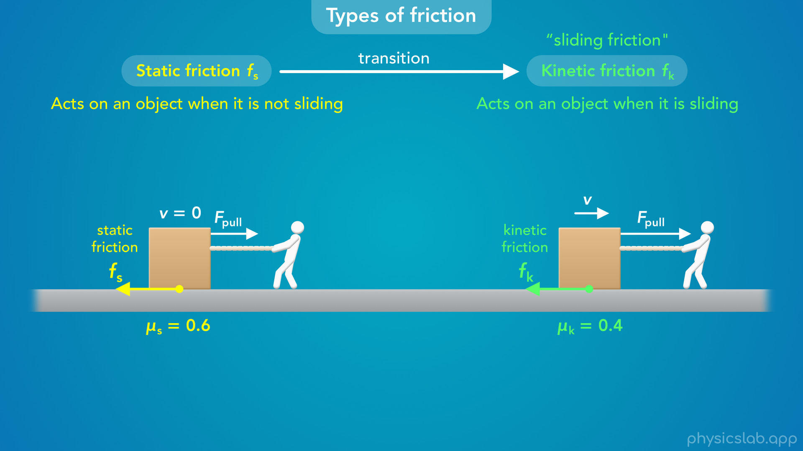
Notes:
• Each type of friction behaves in a slightly different way, and it turns out that there’s a different coefficient of friction for each type, even when the surfaces are the same.
• In the next few videos, we’ll learn more about each type of friction and this transition from static friction to kinetic friction.

