Slide 1
Pulley Systems - Introduction
Slides Version 1
This version includes:
Slides with screenshot images from the video.
The video narration in the slide notes.
A blank template slide with the same background and font as the video.
Slides with some basic graphics from this video for you to use however you like.
Feel free to add, delete and edit slides to make your own presentation. You can use these slides in class or share them with your students, but please do not share them with anyone else.
If you have any feedback, suggestions or questions about these slides please email me at chris@physicslab.app or send me a message on Discord @physicslab.
physicslab.app

Slide 2
Heading
Text

Slide 3



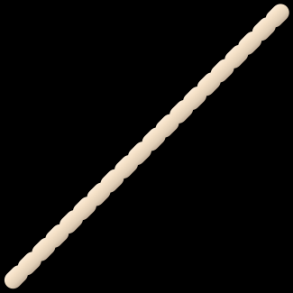




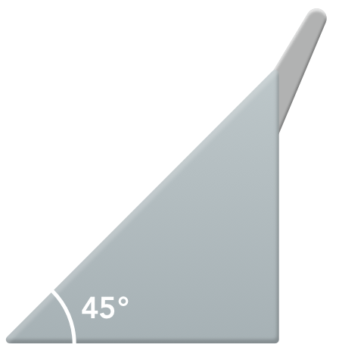








Slide 4






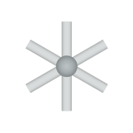
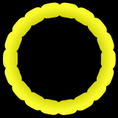









Slide 5


















Slide 6
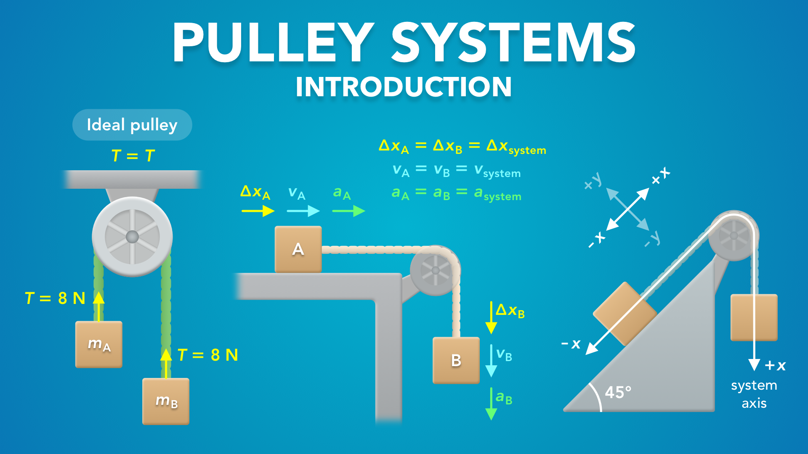
Notes:
Pulley Systems - Introduction
physicslab.app
If you have any questions, suggestions or feedback about these slides please email me at chris@physicslab.app or send me a message on Discord @physicslab.

Slide 7

Notes:
In this video we’re going to start learning about pulley systems.

Slide 8
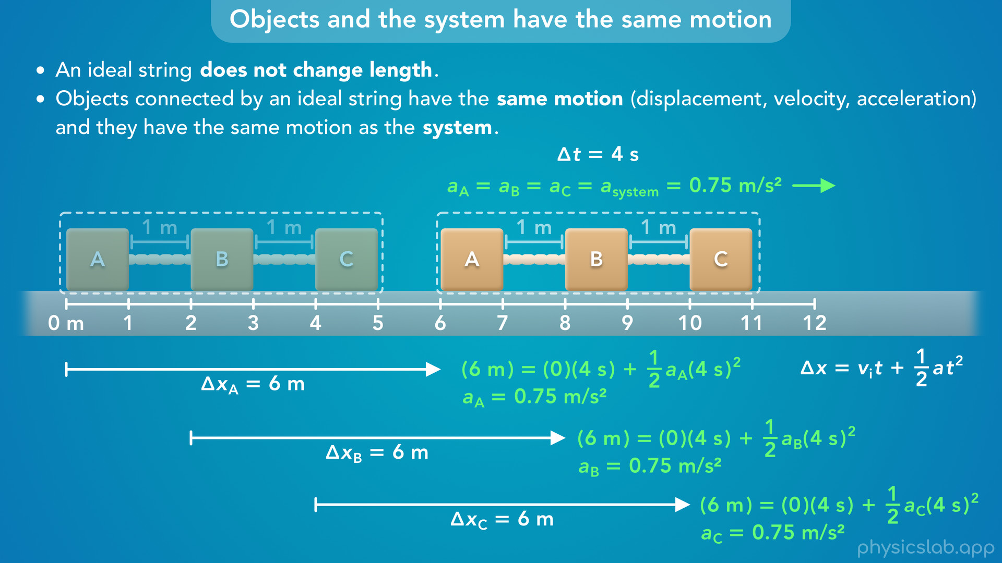
Notes:
• In the previous video, we learned that objects connected by strings will have the same motion.
• We’re going to apply that to pulley systems, so make sure you watch that video first.

Slide 9
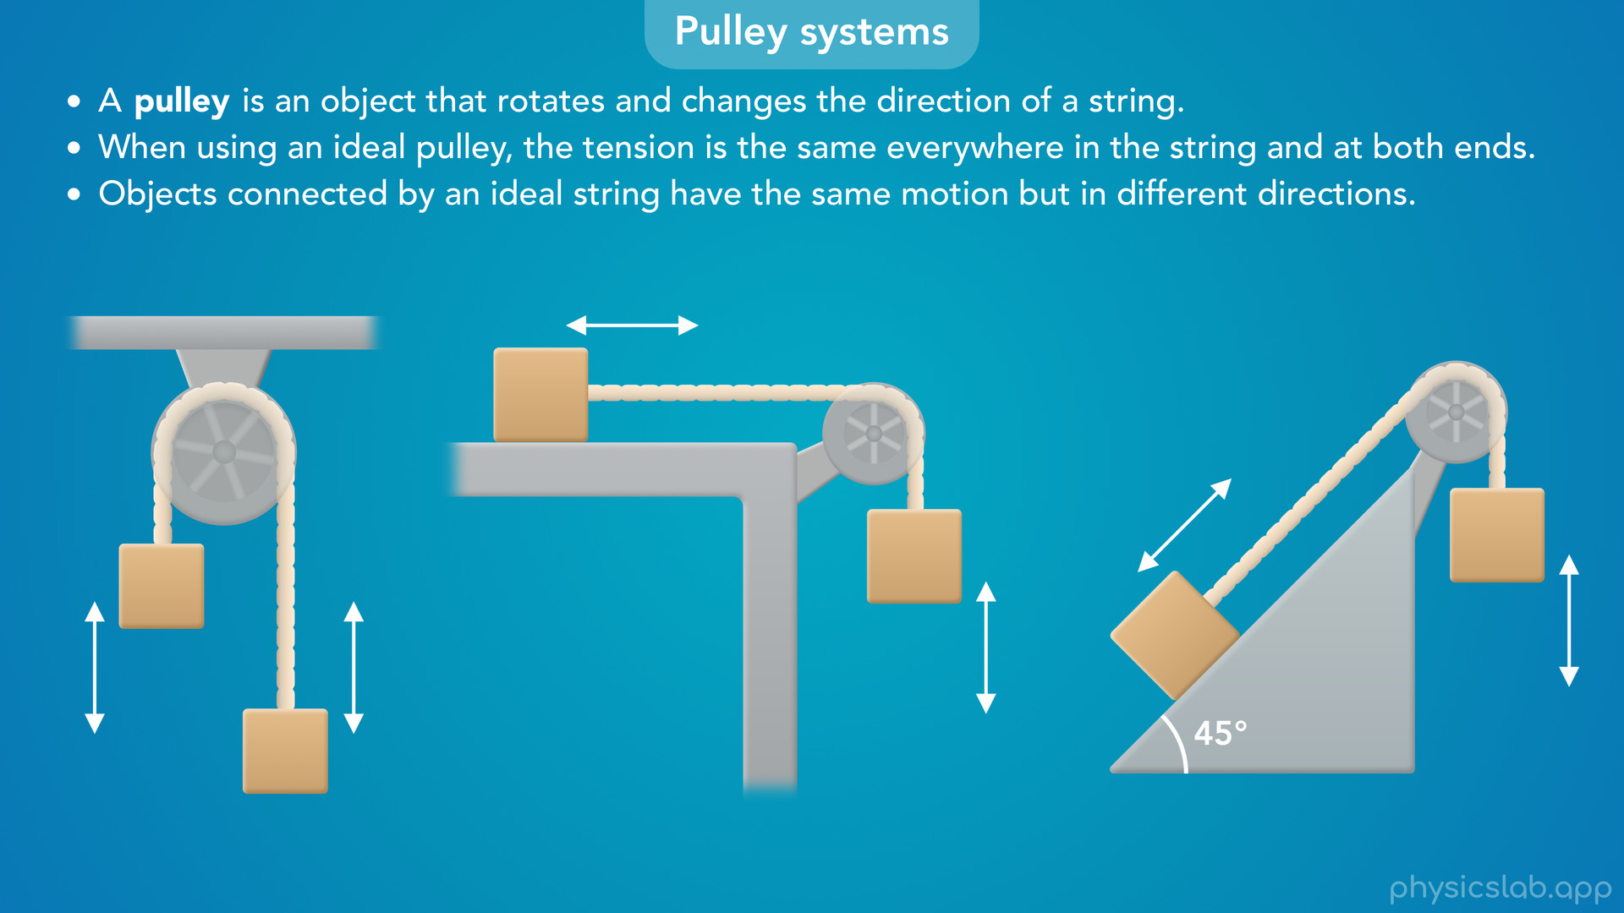
Notes:
• This video will start with a quick introduction to pulley systems.

Slide 10
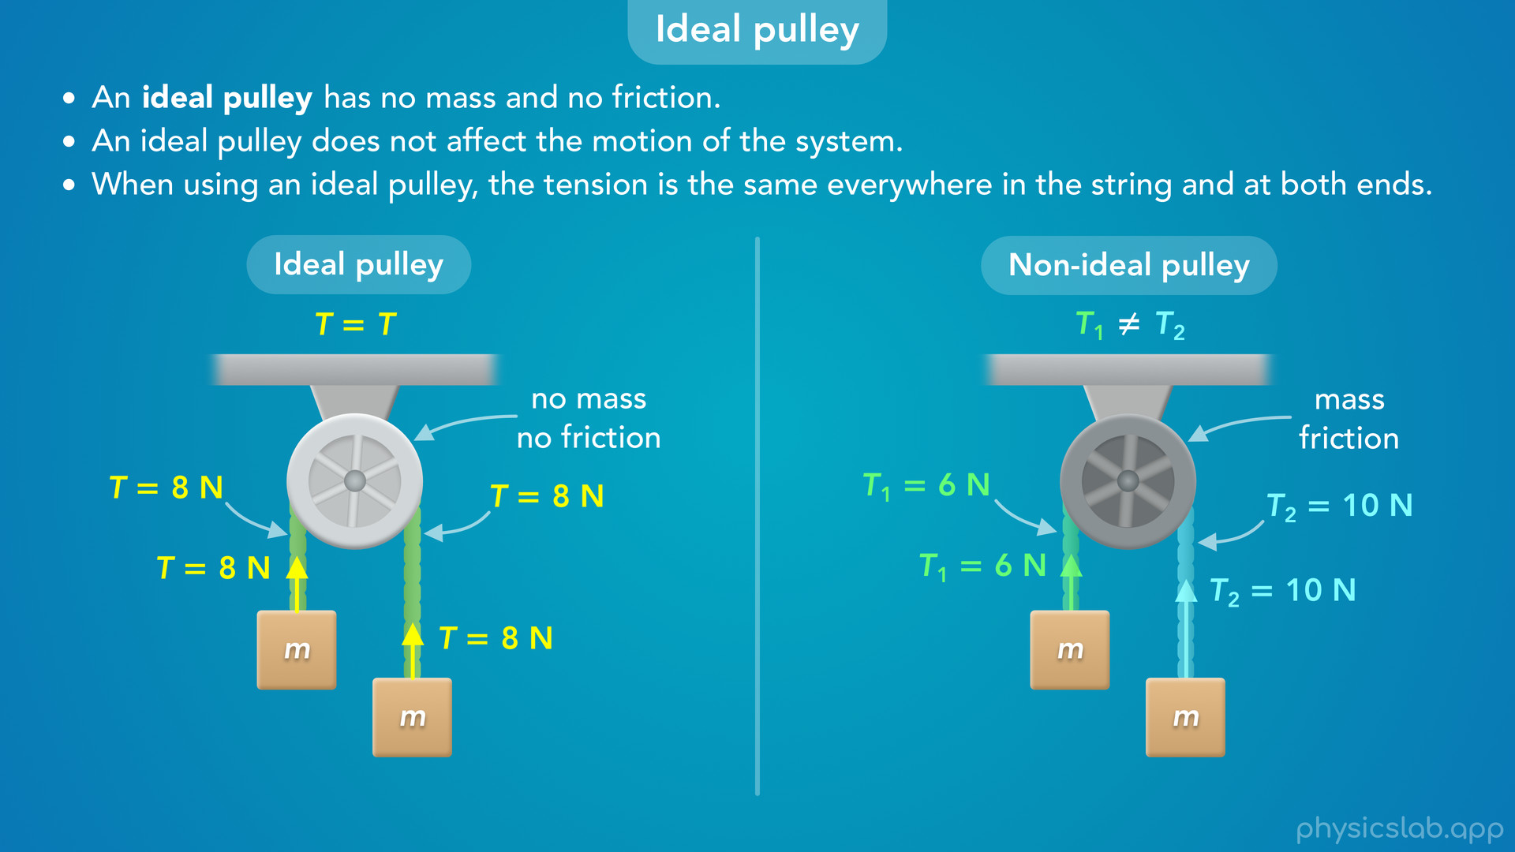
Notes:
• Then, we’ll learn about ideal and non-ideal pulleys and how they affect the tension and the motion of the system.

Slide 11
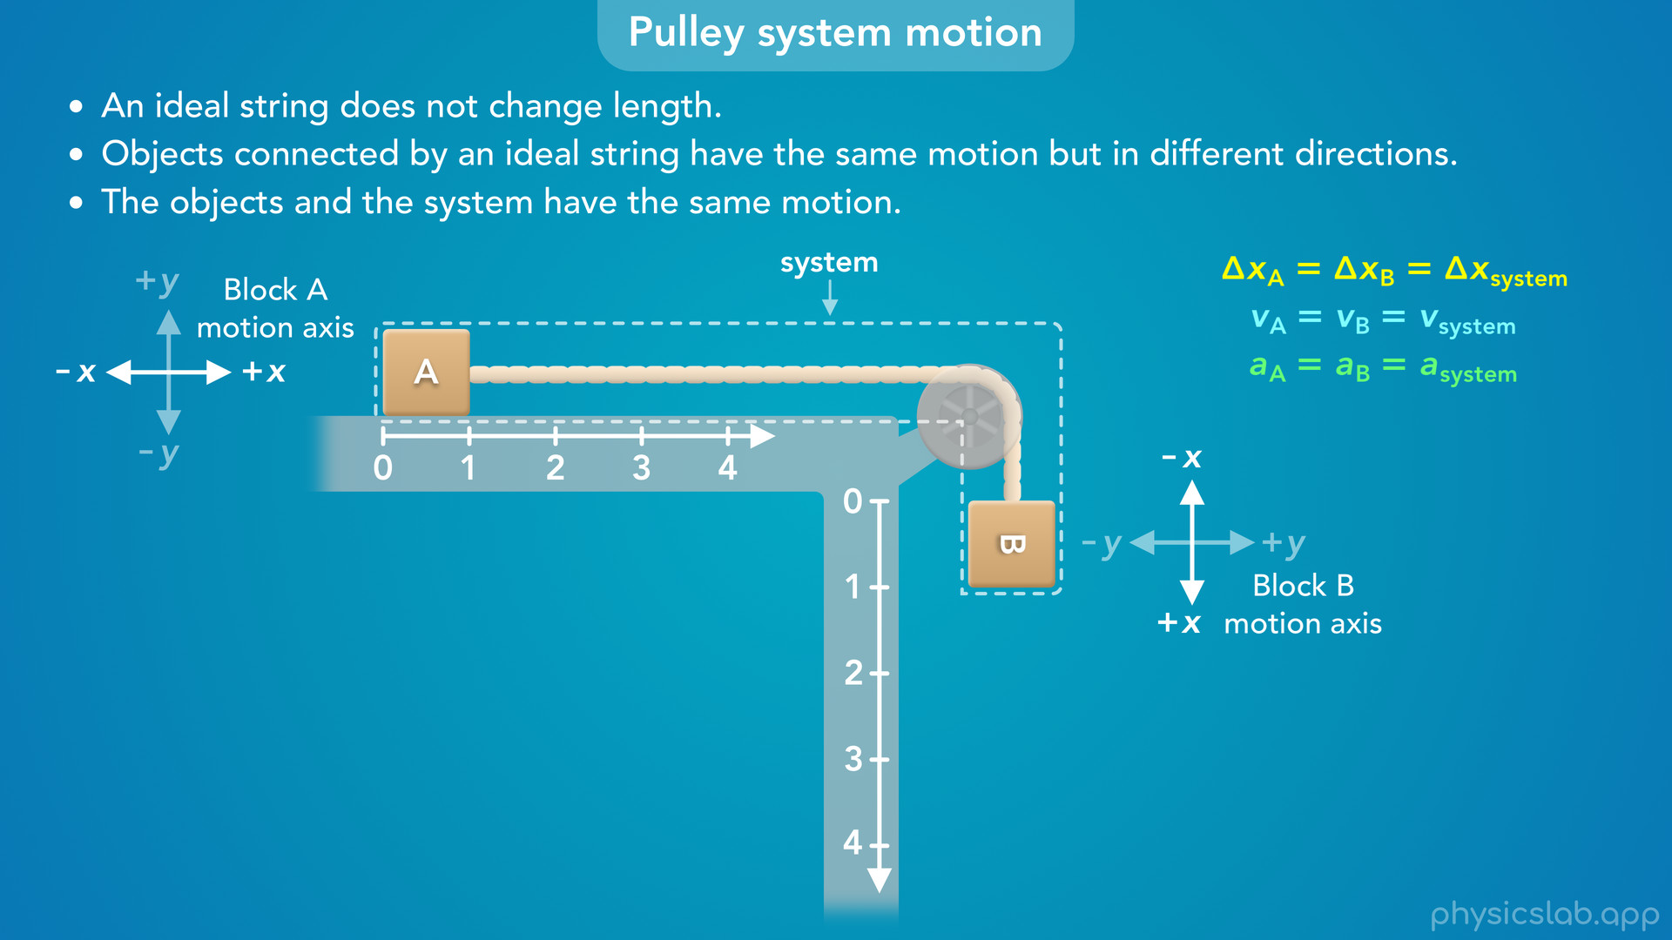
Notes:
• And finally, we’ll explain how the objects in a pulley system have the same motion, but in different directions.
• And we’ll learn how to choose the coordinate system for each block and the overall system.

Slide 12

Notes:
• So what is a pulley system?

Slide 13
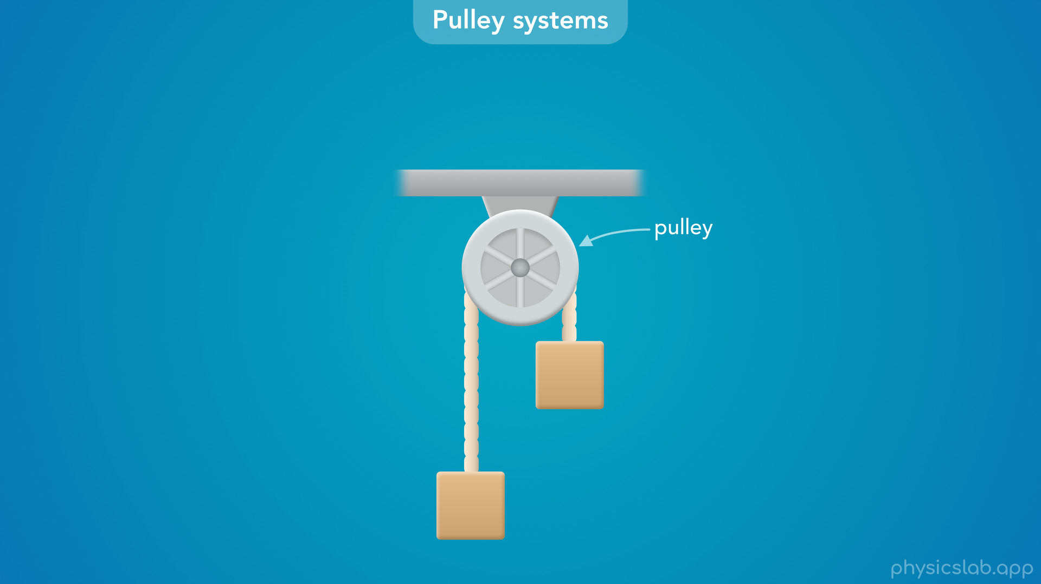
Notes:
• A pulley system usually includes a pulley, a string, and objects attached to each end of the string.

Slide 14
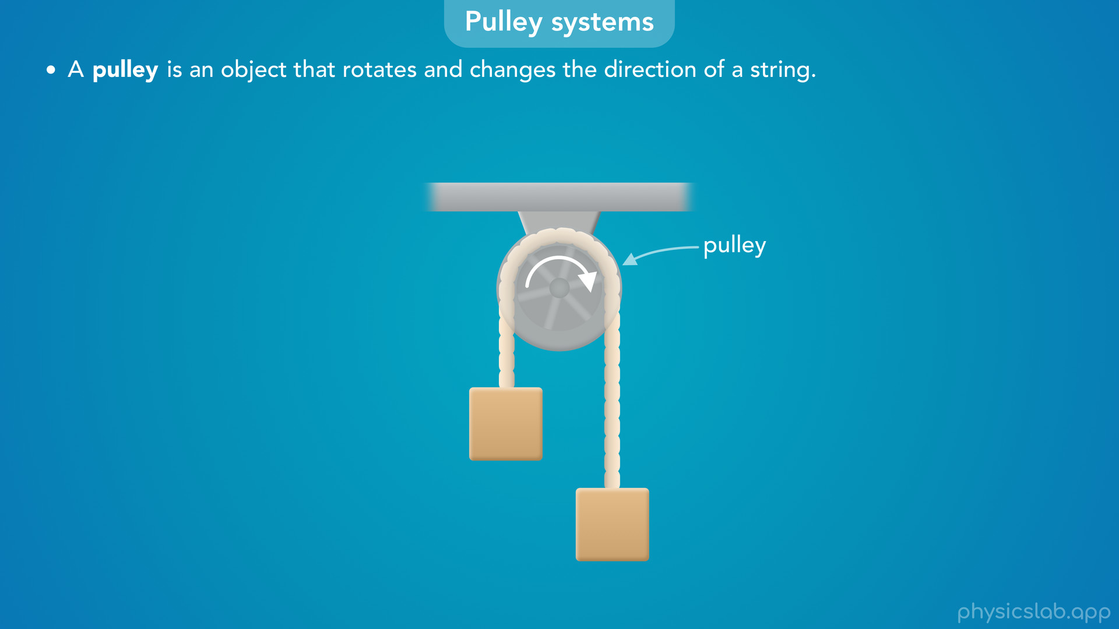
Notes:
• A pulley is an object that rotates and changes the direction of a string.
• So we can see this string is wrapped around the outside of the pulley.
• The string and the blocks can move in either direction, and the pulley is free to rotate as the string moves around it.

Slide 15
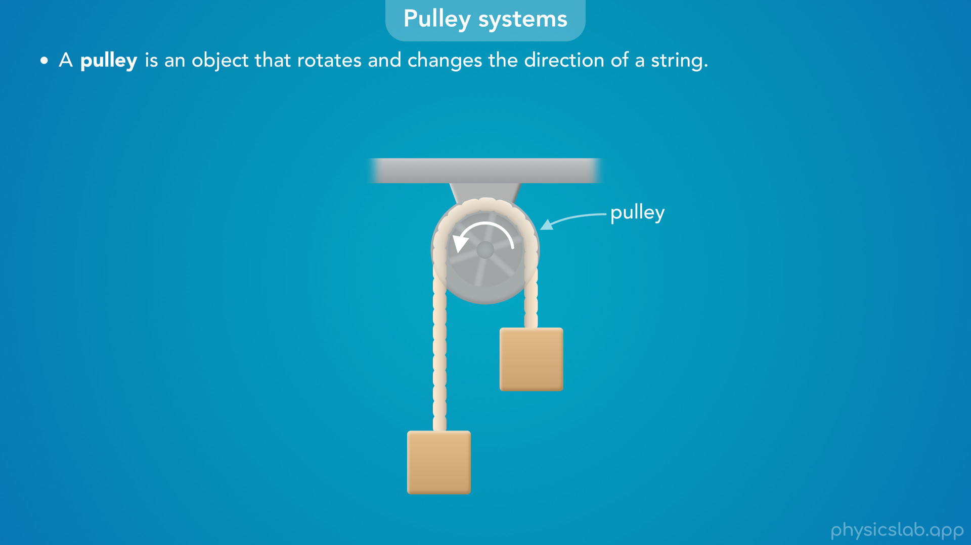

Slide 16
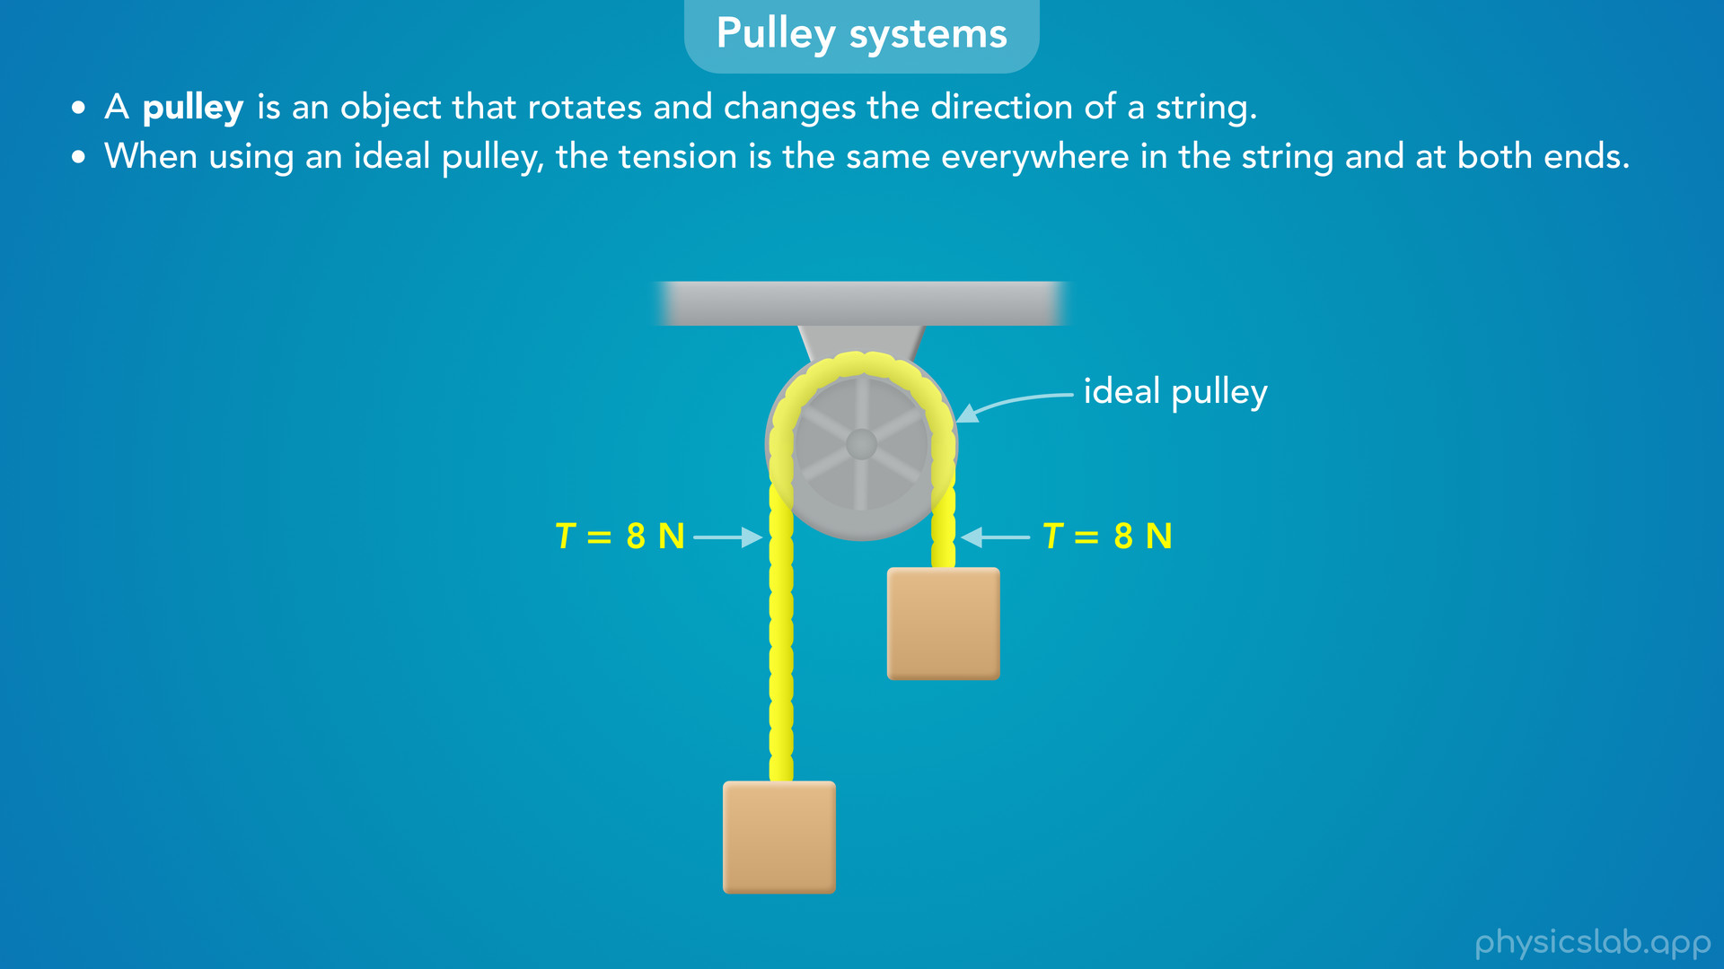
Notes:
• There’s two important things to know about pulley systems, and we’ll explain these more later in the video.
• First, when using an ideal pulley, the tension is the same everywhere in the string, and at both ends.

Slide 17
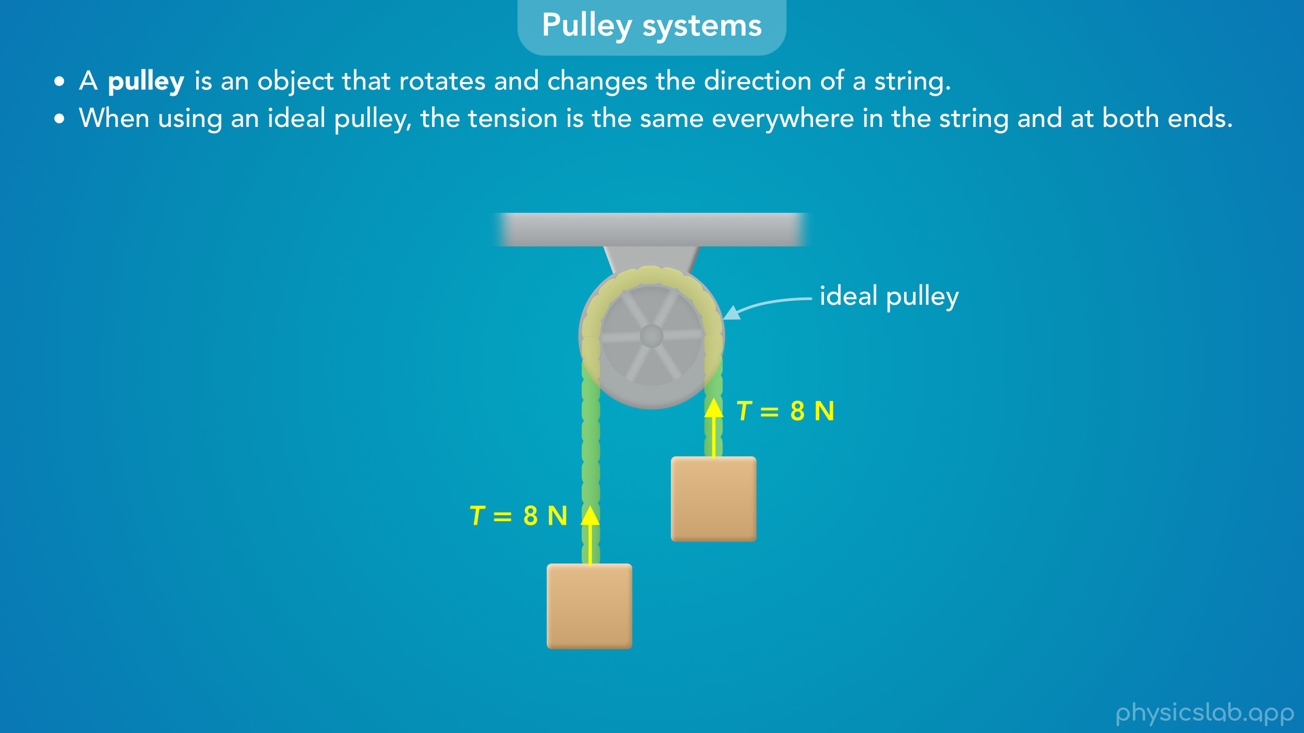
Notes:
• So even though the string is changing directions around the pulley, the tension force on each block has the same magnitude.

Slide 18
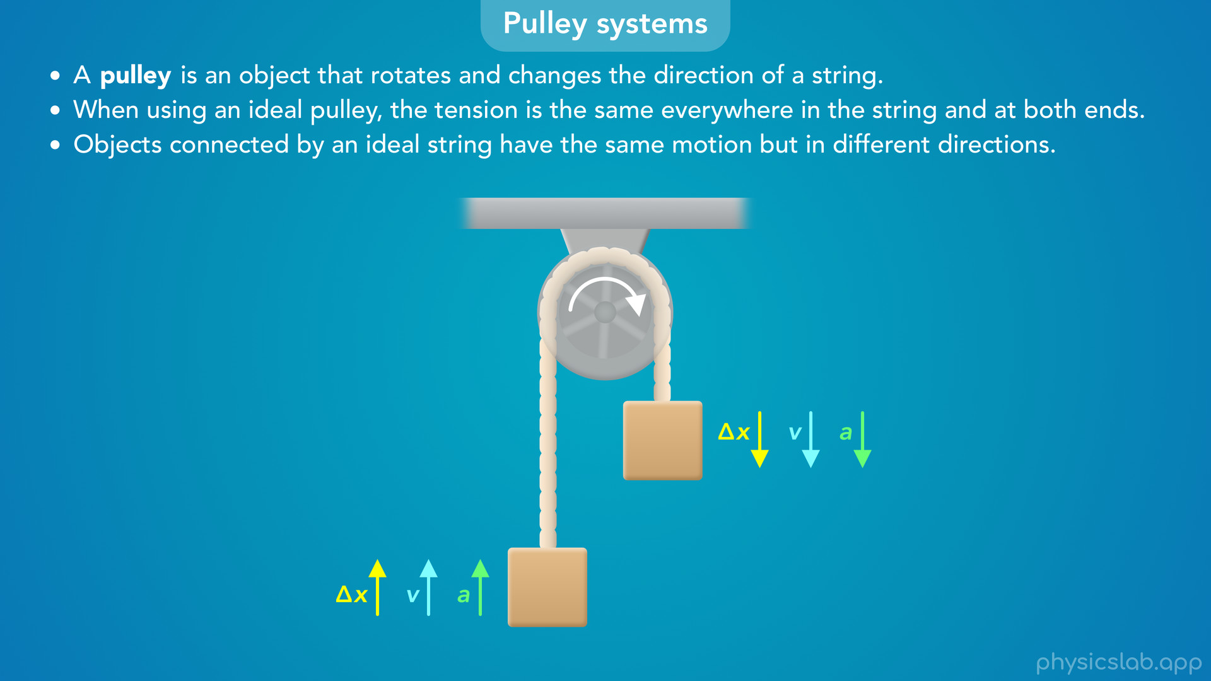
Notes:
• The other thing to know is that objects connected by an ideal string have the same motion, but in different directions.
• So when these blocks move, they have the same displacement, the same velocity, and the same acceleration.
• But one is moving up and the other is moving down.

Slide 19

Notes:
• We could have both blocks moving vertically, like this.
• Or we could have one block moving horizontally and the other moving vertically.
• We could also have one of the blocks on an incline.
• We’re going to walk through an example with the middle system in the next video, but the methods that we’ll use apply to any pulley system.
• So that’s a quick introduction.
• Now, let’s explain those two important things in more detail.

Slide 20

Notes:
• First, what is an ideal pulley, and how does it affect the tension and the motion of the system?

Slide 21
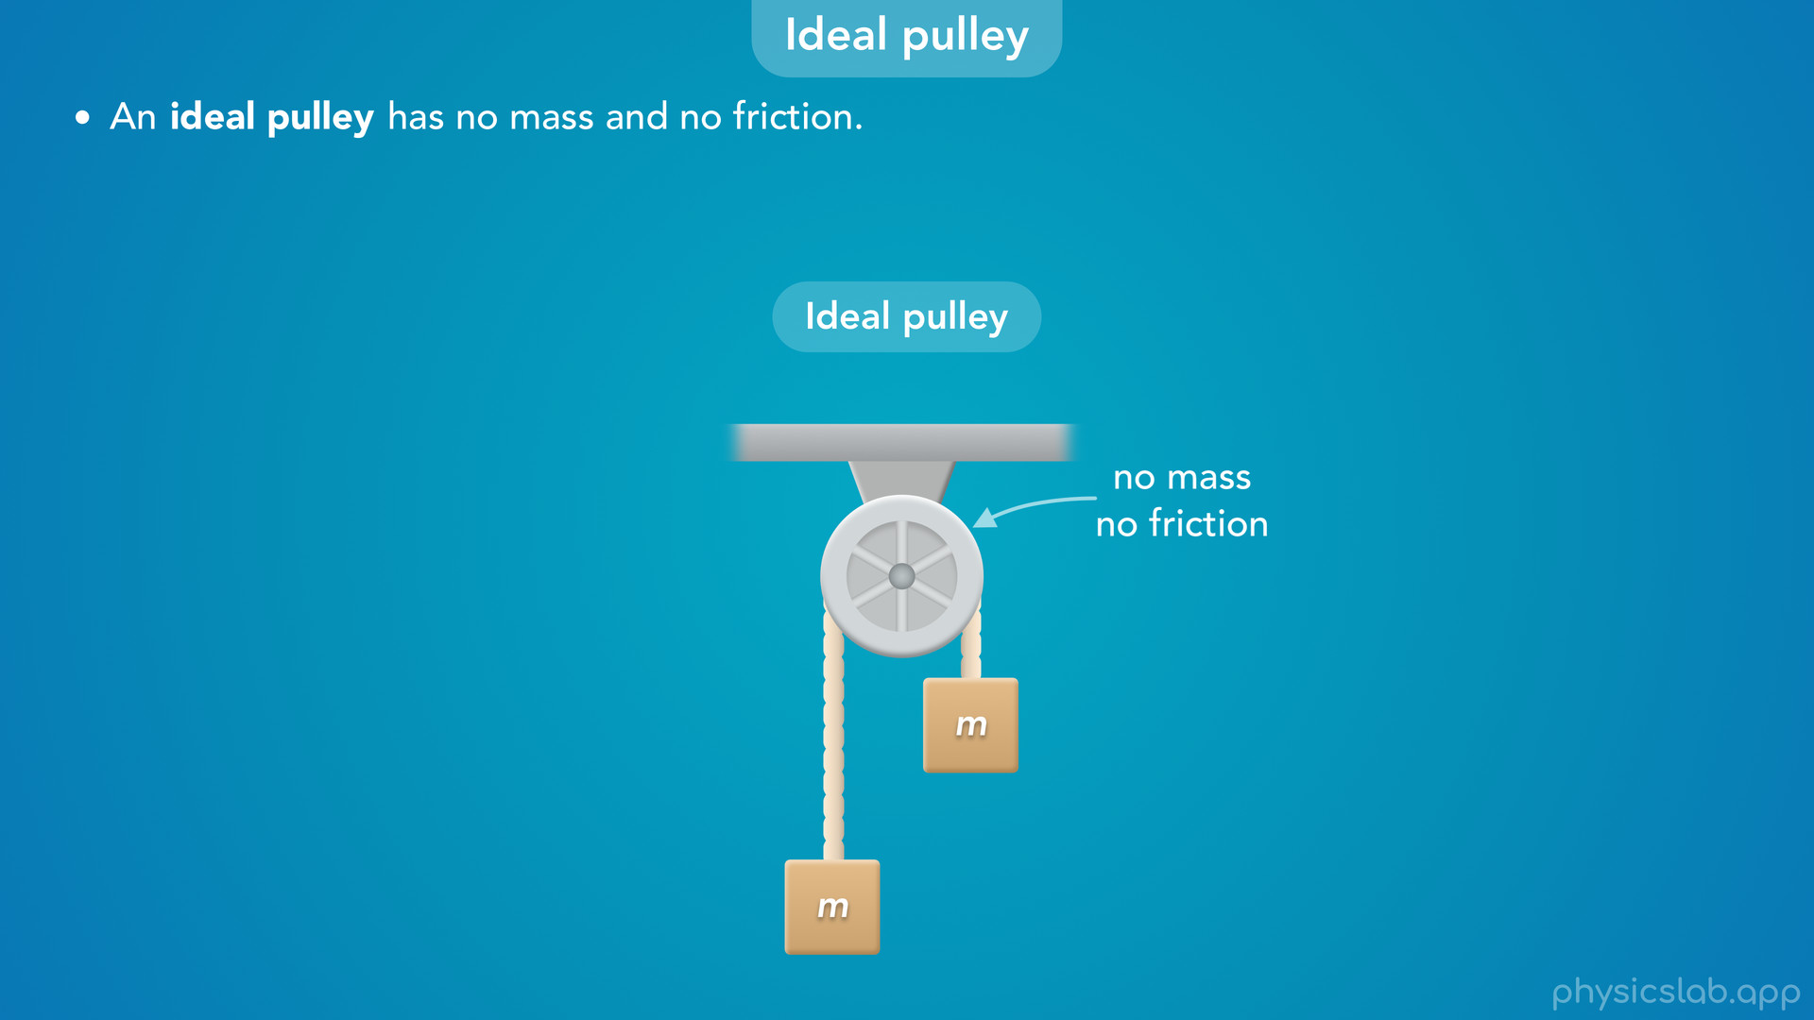
Notes:
• An ideal pulley has no mass and no friction.

Slide 22
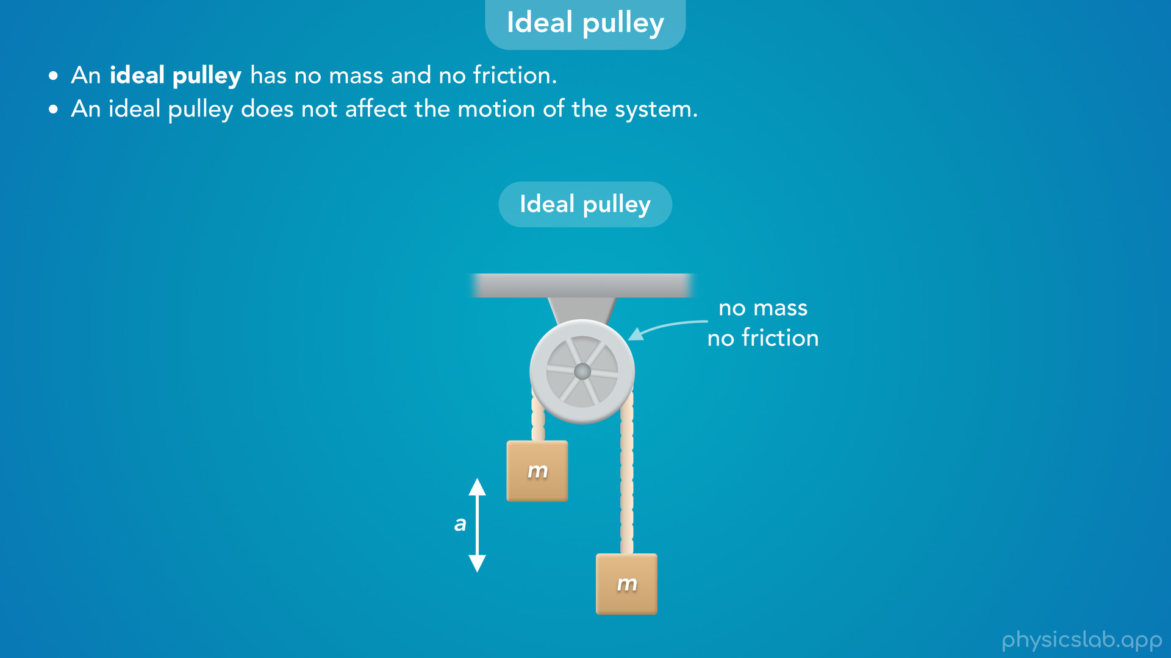
Notes:
• This means that an ideal pulley does not affect the motion of the system.
• The pulley has no mass, so it has no inertia that would resist the acceleration of the system.
• The only inertia comes from the mass of the blocks.
• And there’s no friction force trying to prevent the pulley from rotating, so it doesn’t add any forces that we need to consider.

Slide 23
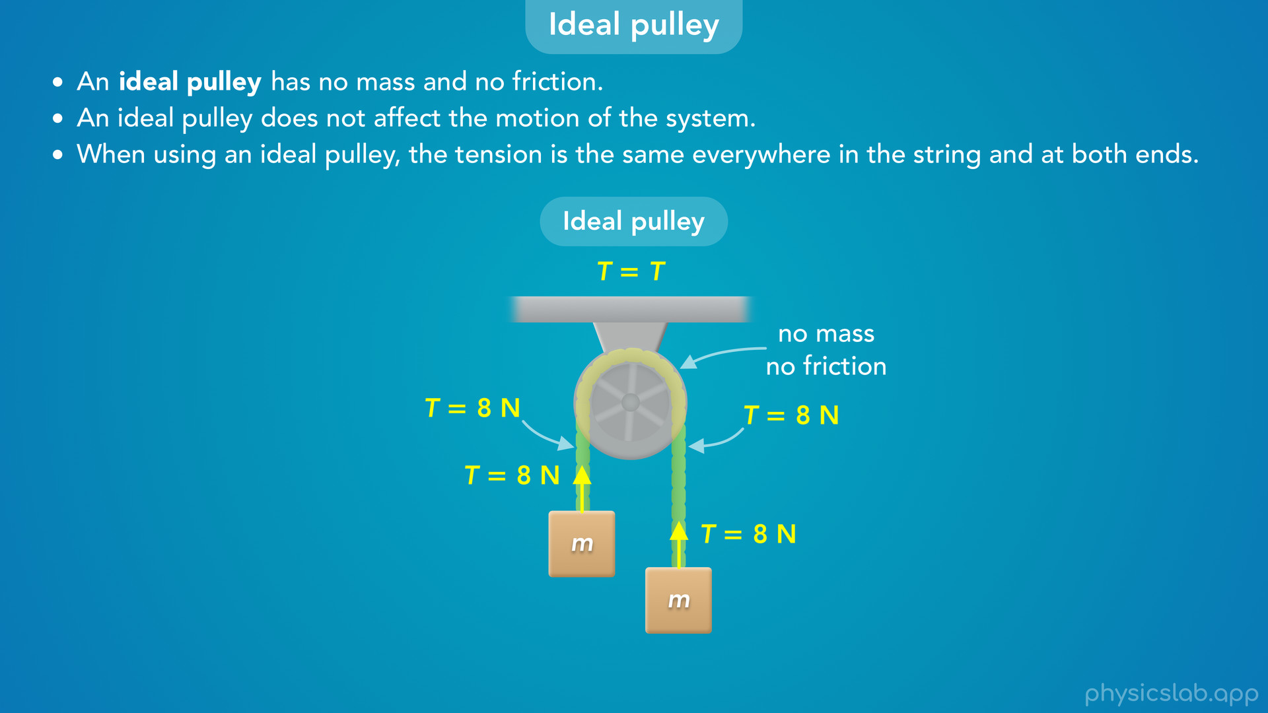
Notes:
• This also means that when using an ideal pulley, the tension is the same everywhere in the string and at both ends.
• For example, the tension at every point in this string is 8 N.
• The left side and the right side have the same tension, and the tension forces on the blocks are both 8 N.

Slide 24

Notes:
• By comparison, a non-ideal pulley has mass and/or friction.
• That means it has rotational inertia, and friction is applying a torque on the pulley.
• So a non-ideal pulley does affect the motion of the system, and the tension is different on each side.
• We’re going to work with non-ideal pulleys when we learn about rotational dynamics.

Slide 25
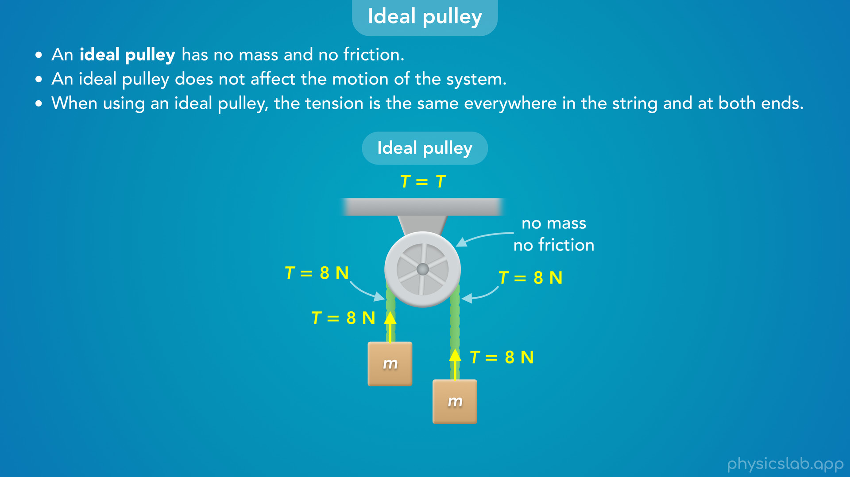
Notes:
• But for now, we’re going to use ideal pulleys.
• When working on a problem, we can assume the pulley is ideal, unless we’re told that it has mass or friction.

Slide 26
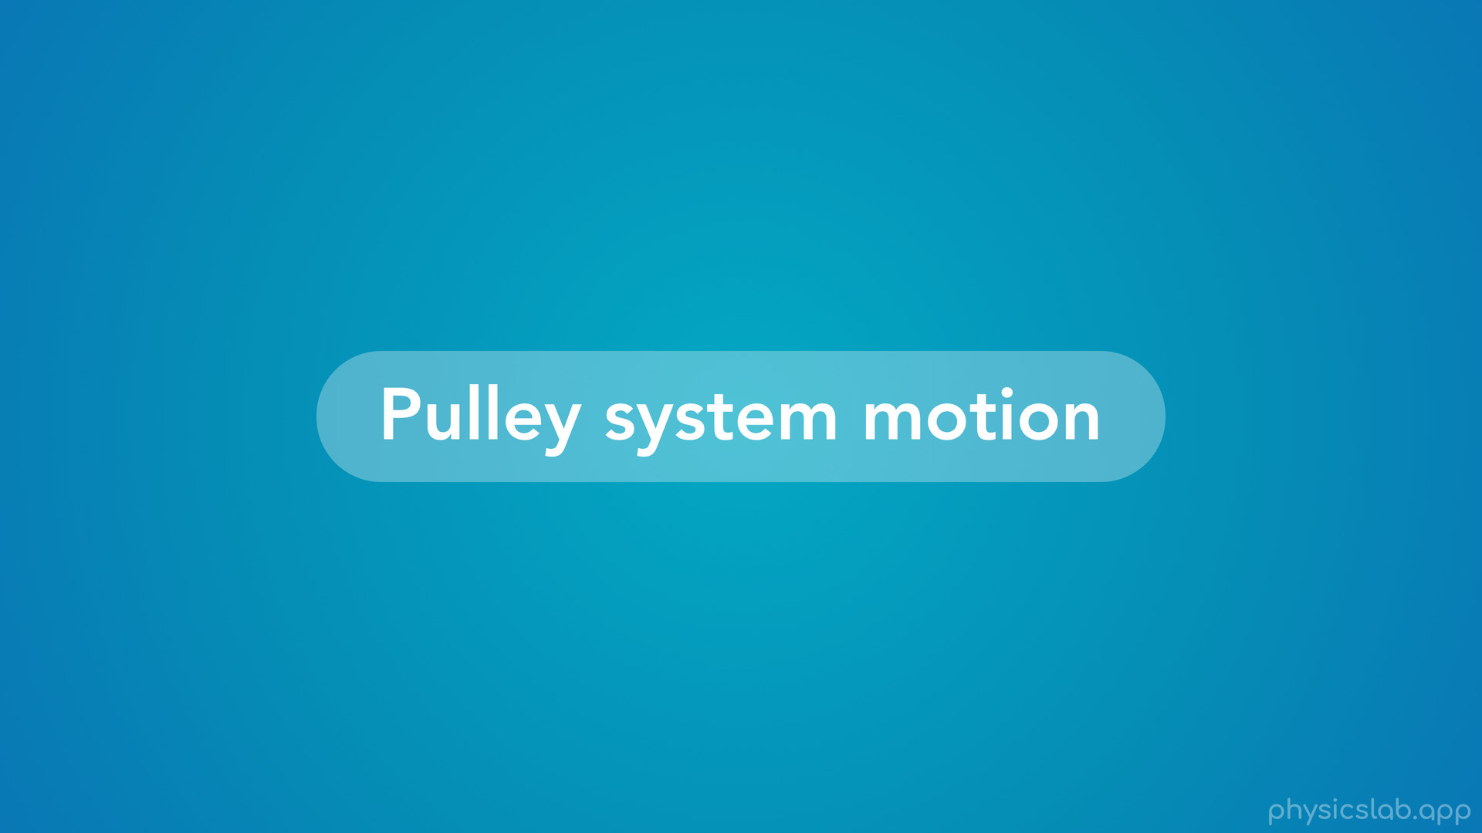
Notes:
• The other important thing we need to understand is how pulley systems move.

Slide 27
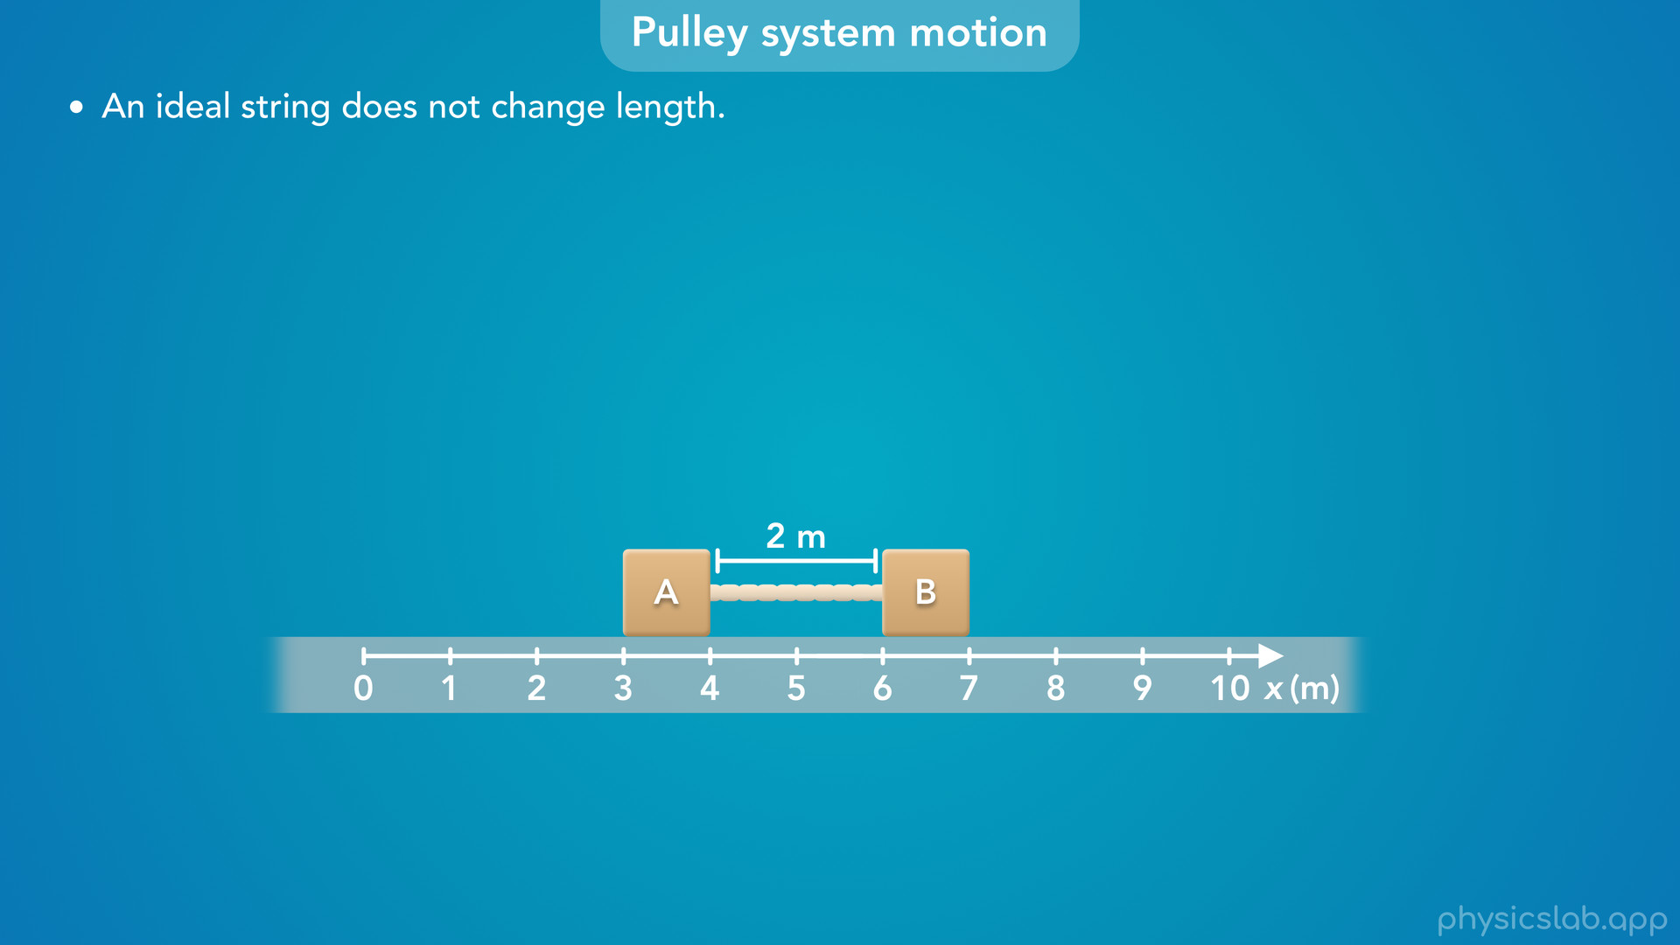
Notes:
• We covered some of this in the previous video, so make sure you watch that first.
• But let’s do a quick recap and then apply this to pulley systems.
• Here we have two blocks connected by a string.
• We learned that an ideal string does not change length.
• So this string will be 2 m long no matter how the blocks move or how much tension is in the string.

Slide 28
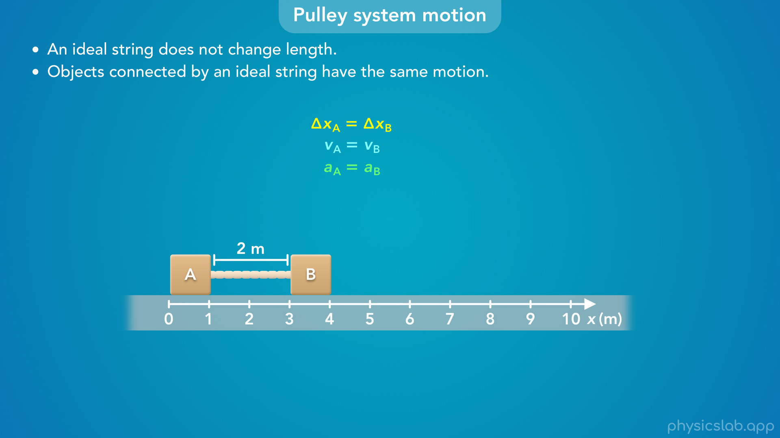
Notes:
• This means that objects connected by an ideal string have the same motion.

Slide 29
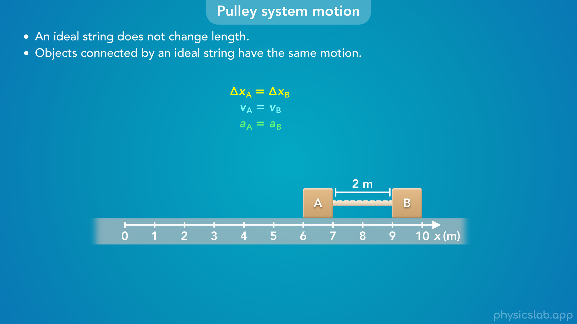

Slide 30
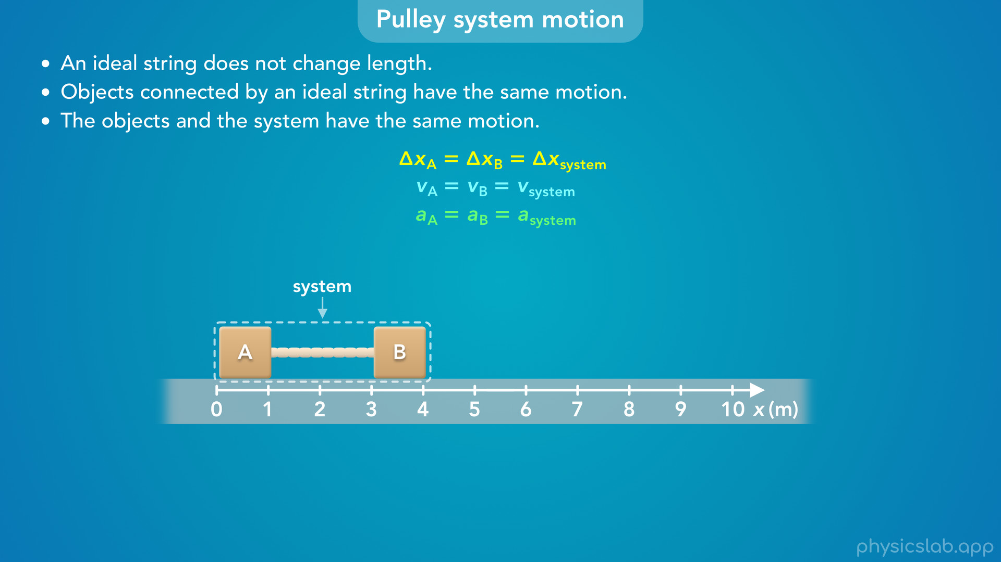
Notes:
• These objects move together as a group, which we call a system.
• So we can say that objects and the system have the same motion.

Slide 31
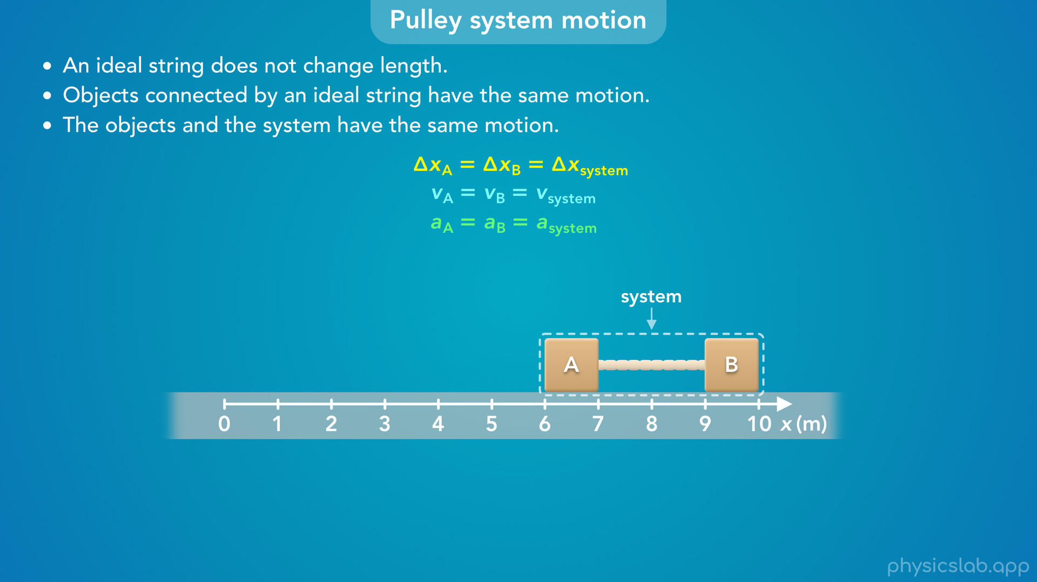

Slide 32
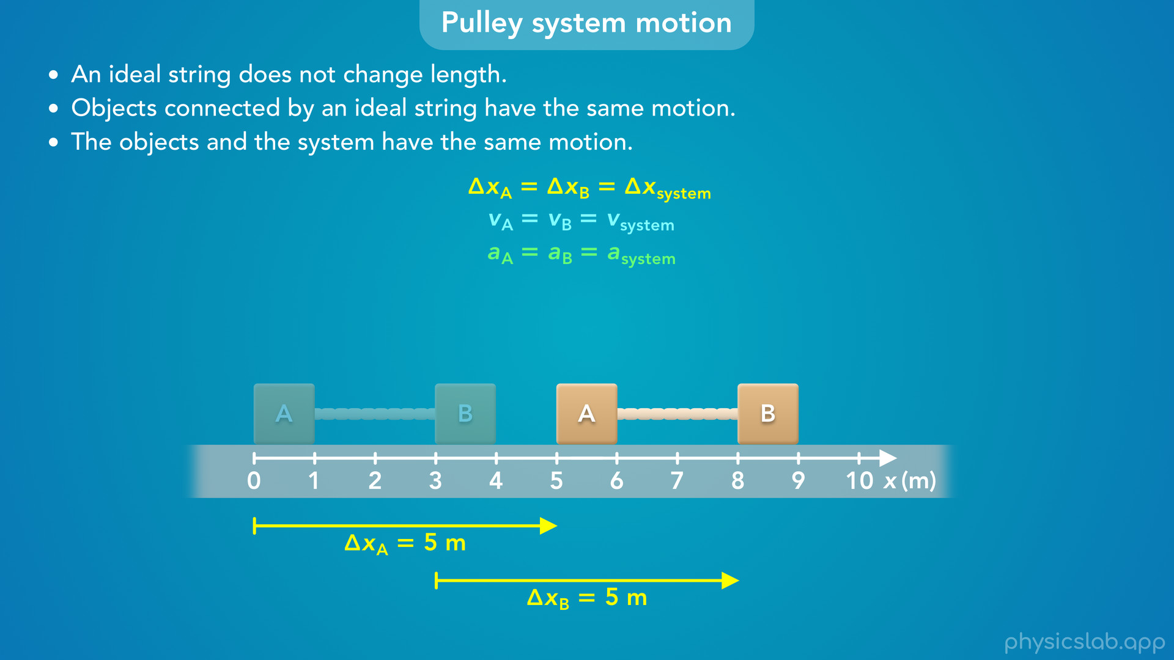
Notes:
• Over any period of time, block A and block B will have the same displacement

Slide 33
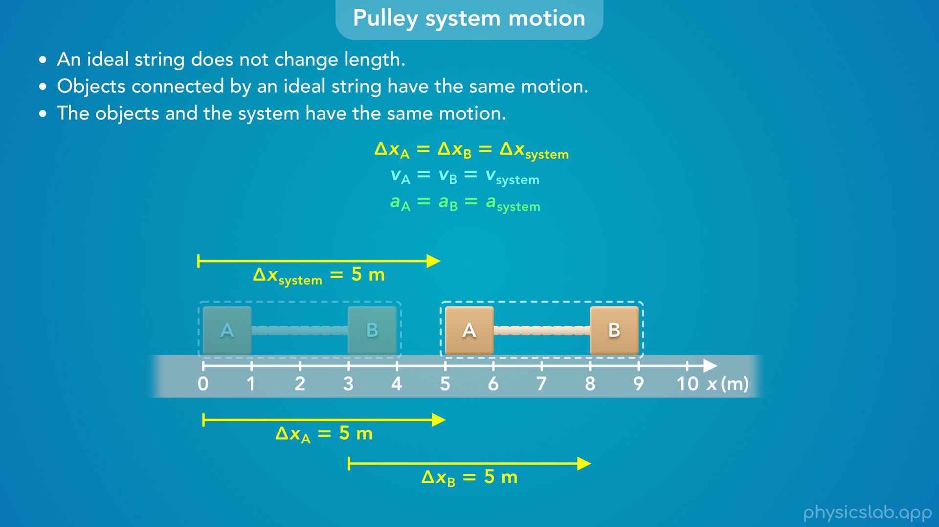
Notes:
which is also the displacement of the system.

Slide 34
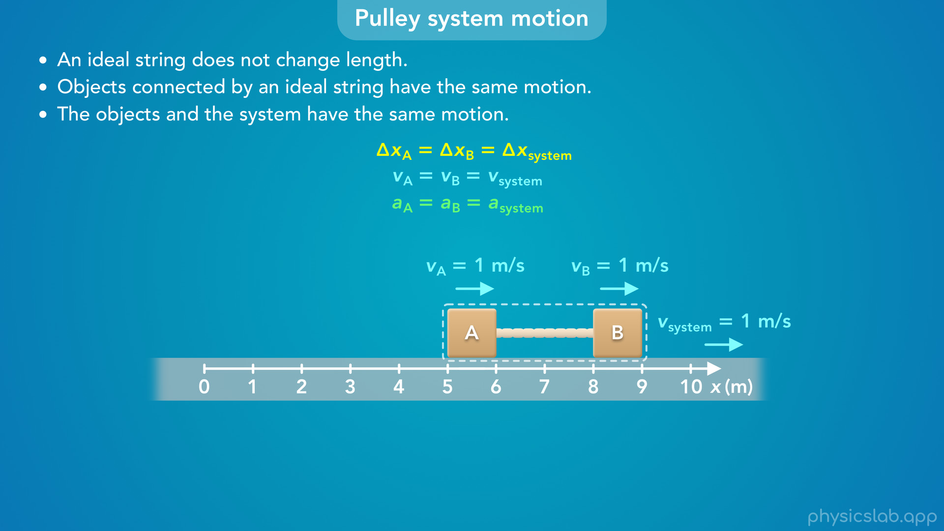
Notes:
• At any moment, the blocks will also have the same velocity, which is the same velocity as the system.

Slide 35

Notes:
• And, the blocks will always have the same acceleration, and that’s also the acceleration of the system.

Slide 36
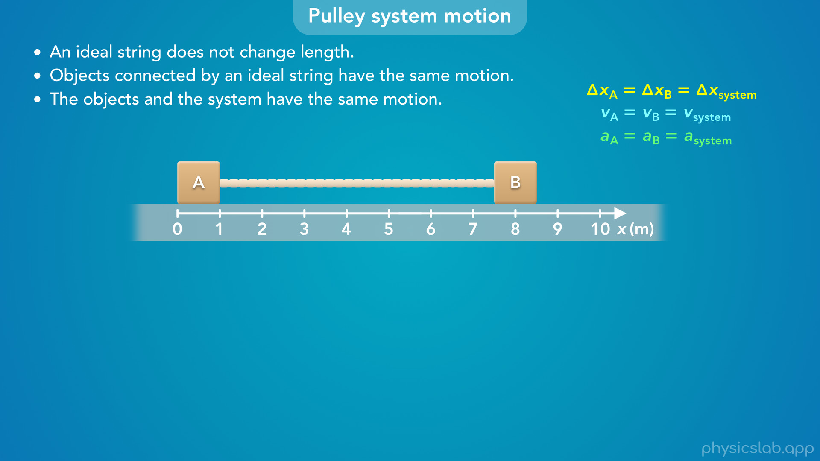
Notes:
• So blocks that are connected by a string will move together.

Slide 37
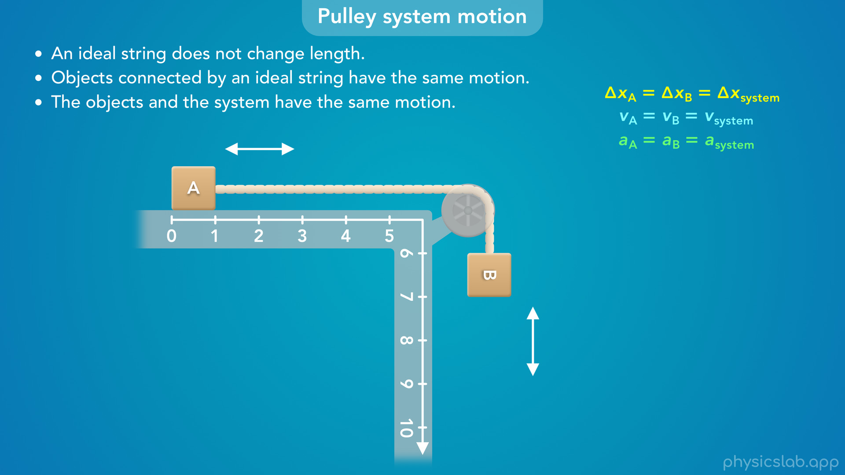
Notes:
• And if we take the string and wrap it around a pulley, this concept still applies.
• Block A is moving horizontally and block B is moving vertically, but they still move together.

Slide 38
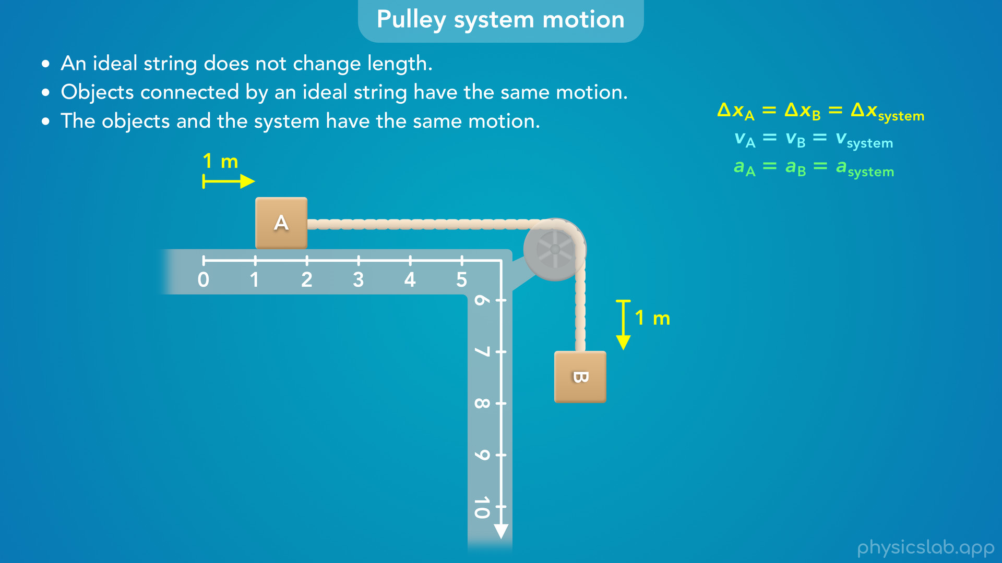
Notes:
• If block A moves 1 m to the right, block B moves 1 m down.

Slide 39
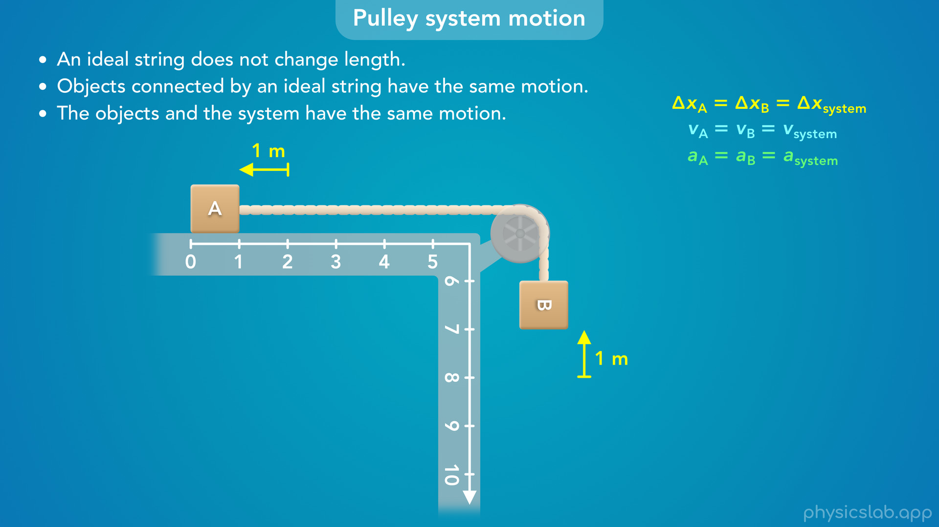
Notes:
• If block A moves 1 m to the left, block B moves 1 m up.

Slide 40
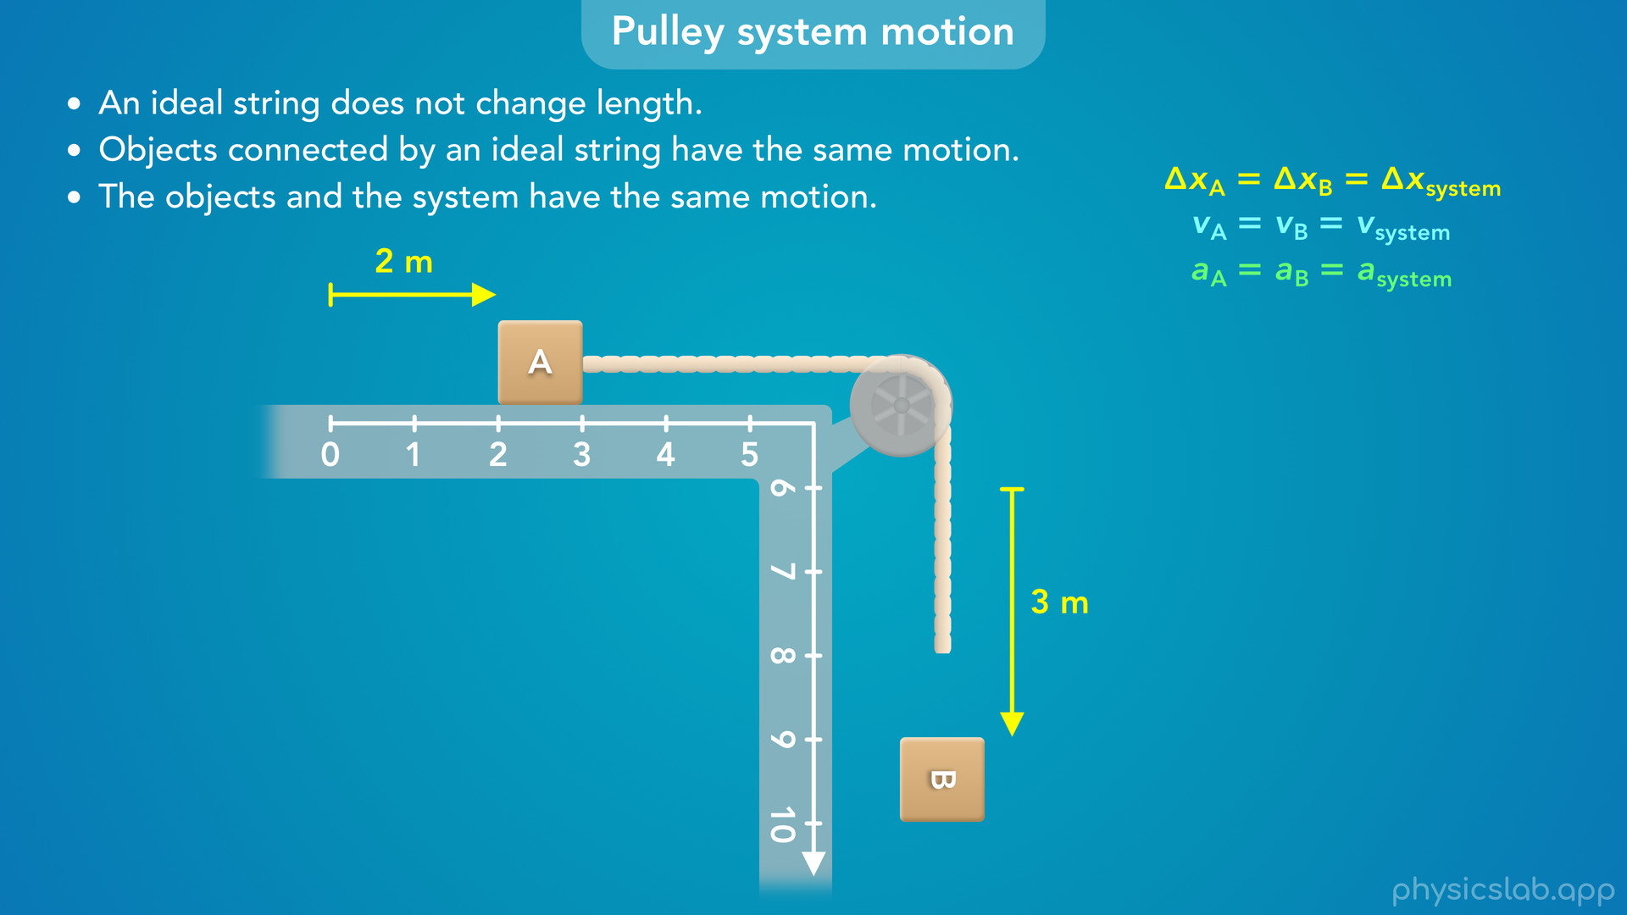
Notes:
• If one block moved a different amount, the string would have to get longer or shorter.
• For example, if block A moved 2 m to the right and block B moved 3 m down…

Slide 41
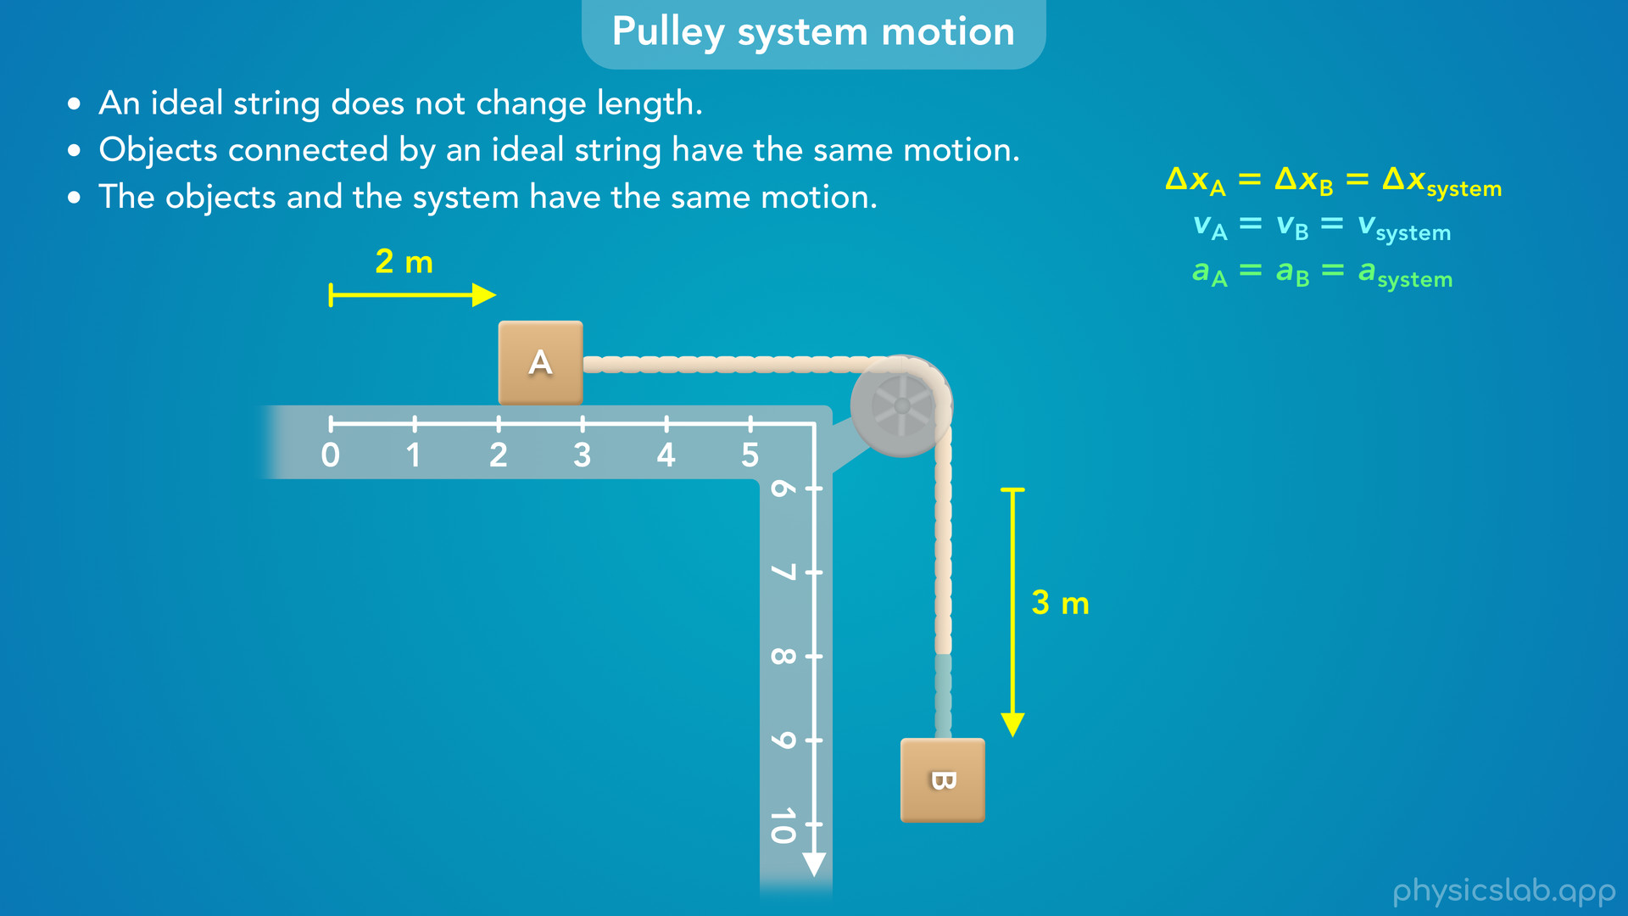
Notes:
the string would have to get longer.

Slide 42
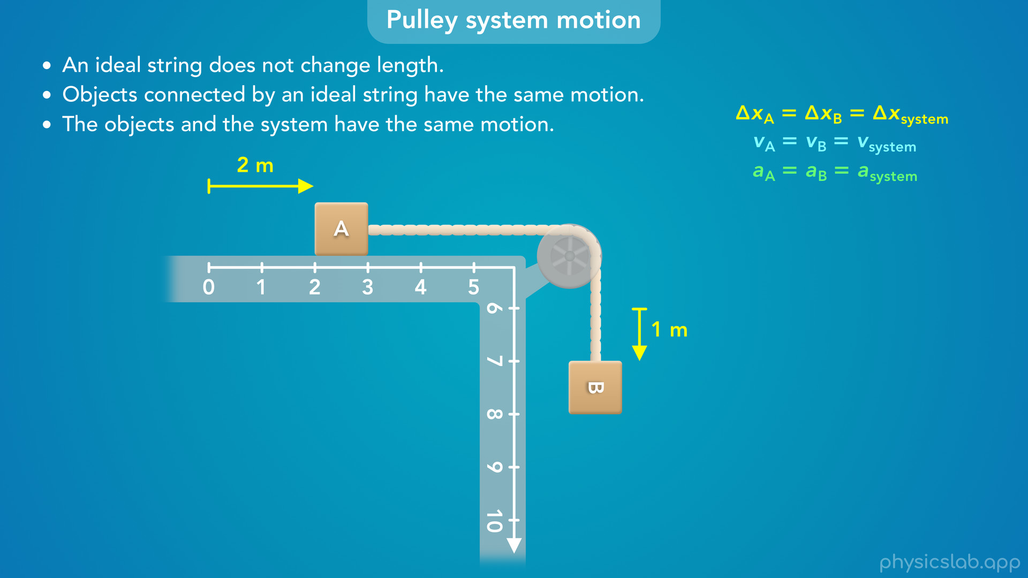
Notes:
• Or if block B only moved 1 m down, the string would have to get shorter.

Slide 43
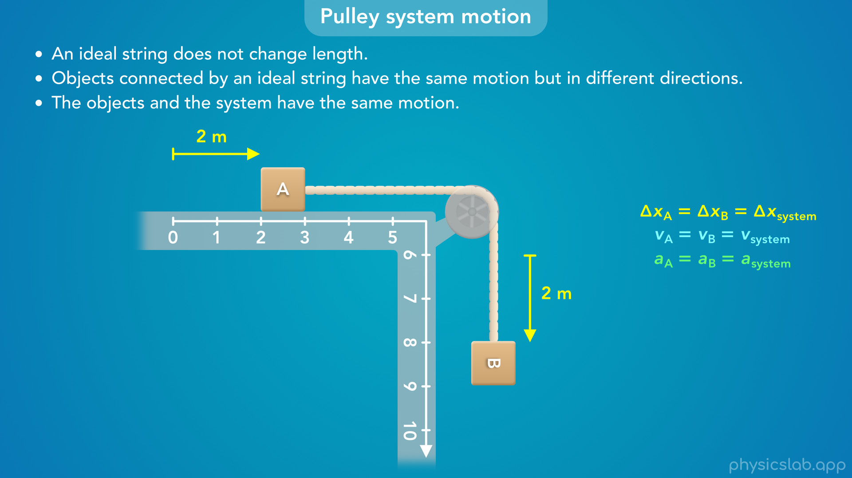
Notes:
• We assume that the string doesn’t change length, so the blocks move the same amount, but in their own direction.
• So let’s change this to say, objects connected by an ideal string have the same motion but in different directions.

Slide 44
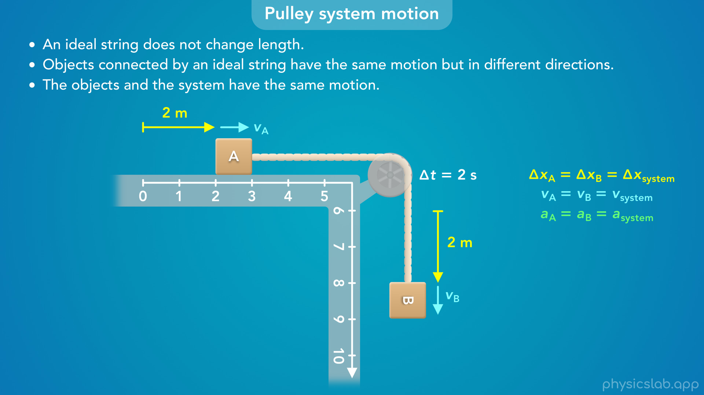
Notes:
• If the blocks have the same displacement over the same period of time, they also have the same velocity.
• Let’s say each block moves 2 m over a period of 2 seconds at a constant velocity.

Slide 45
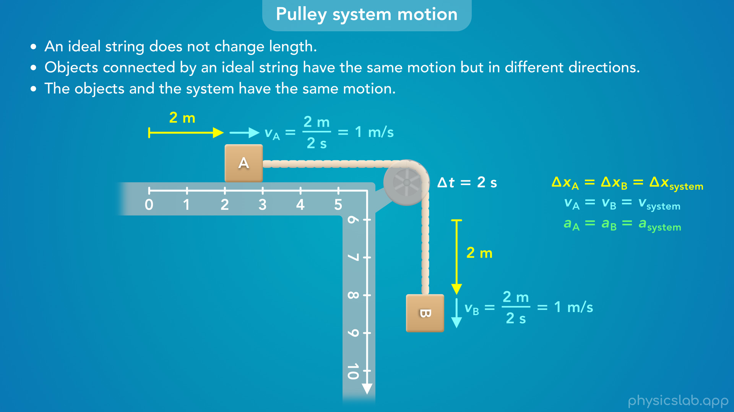
Notes:
• The velocity of block A is 1 m/s to the right, and the velocity of block B is 1 m/s down.

Slide 46
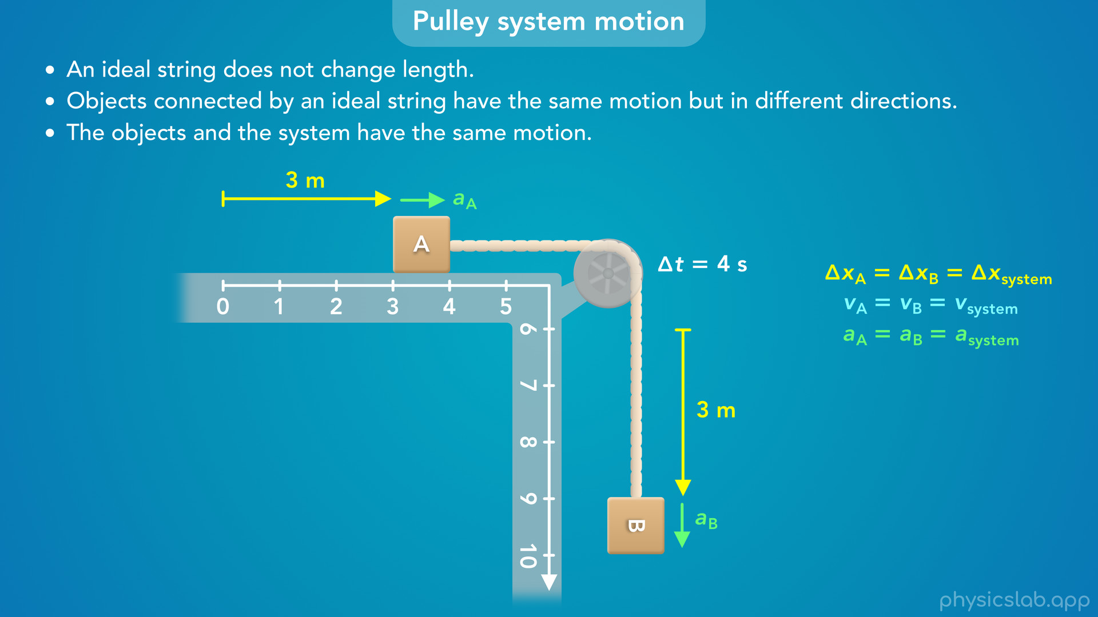
Notes:
• Now let’s say the blocks start from rest and they accelerate, and each block moves 3 m over a period of 4 seconds.

Slide 47
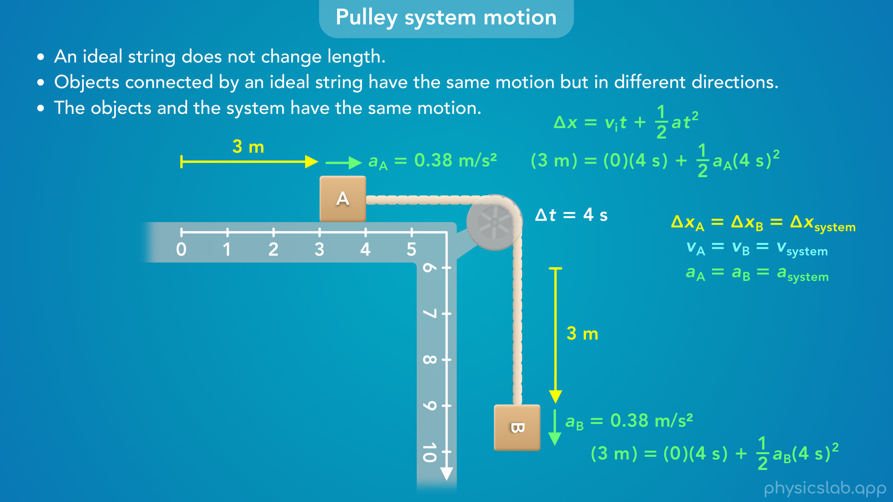
Notes:
• We can calculate the acceleration using this equation.
• Each block moved the same displacement in the same amount of time, so they have the same acceleration of 0.38 m/s².

Slide 48
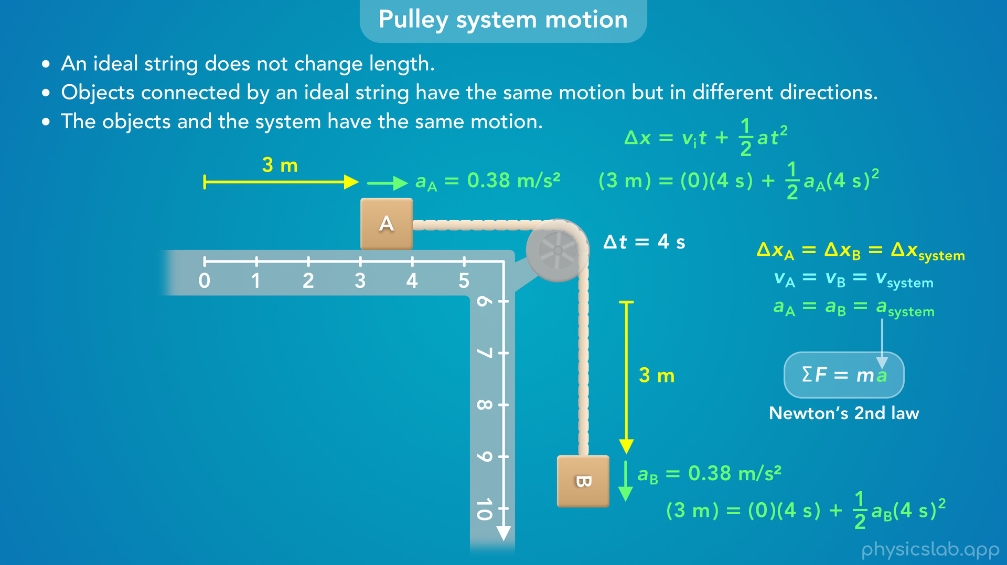
Notes:
• From Newton’s 2nd law, we know that forces affect the acceleration, and the fact that the blocks have the same acceleration will be useful when solving a problem.

Slide 49
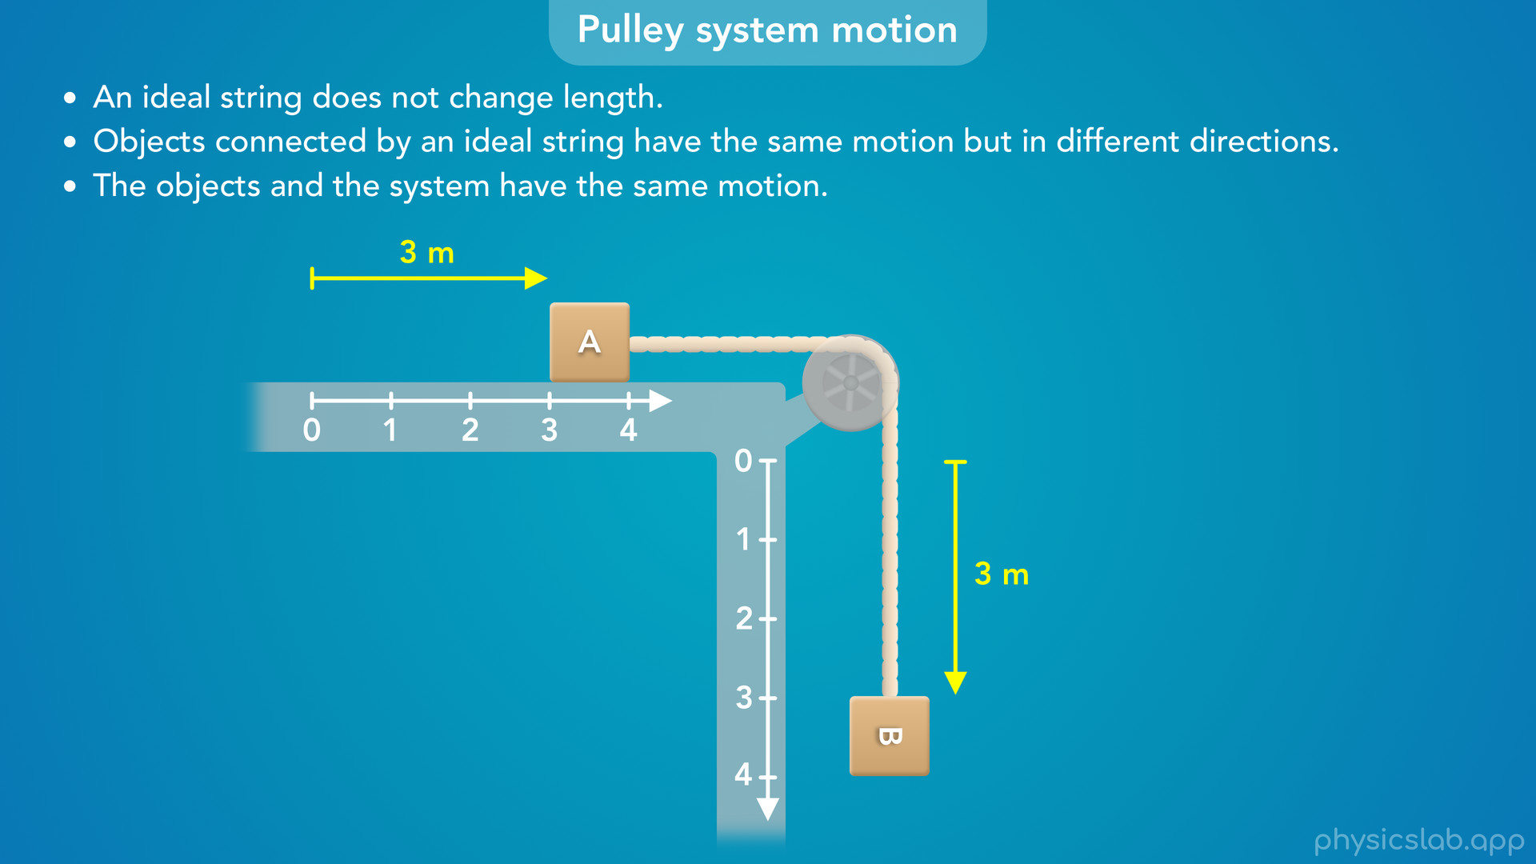
Notes:
• So the blocks have the same motion.
• But since they’re moving in different directions, we’re going to use a separate axis, or a separate coordinate system, for each block.
• With pulley systems, we don’t care how long the string is, or how far apart the blocks are.
• The important thing is that the blocks always move the same amount.

Slide 50
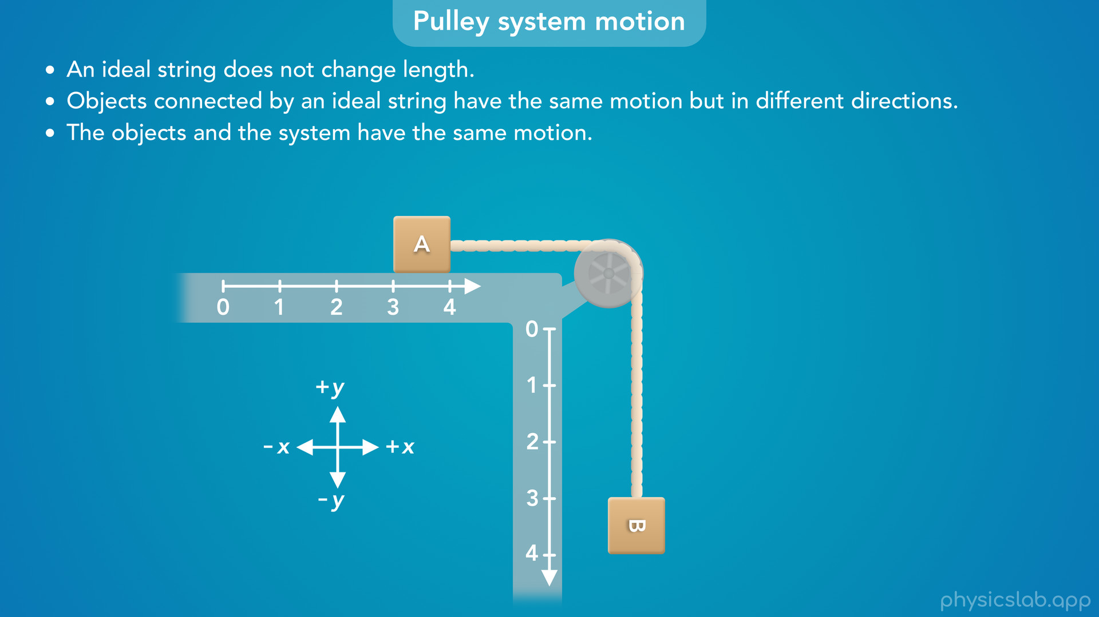
Notes:
• In other scenarios, we normally use one x and y coordinate system, where x is horizontal and y is vertical.

Slide 51
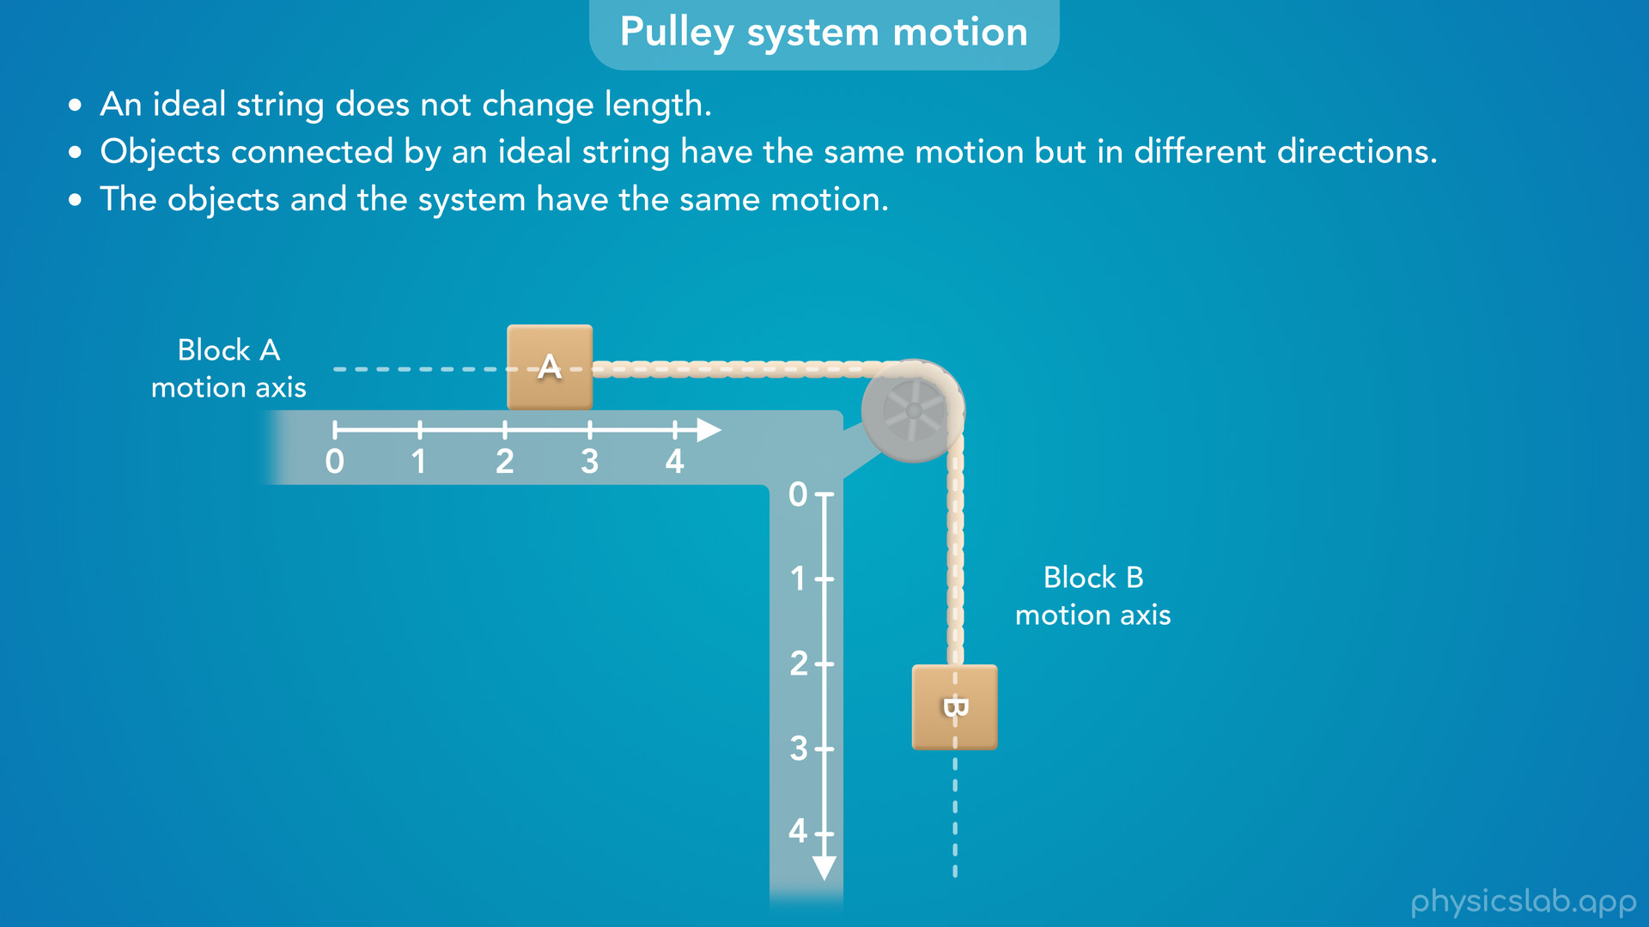
Notes:
• But in a pulley system, each block can only move back and forth along one axis, parallel to the segment of string that it’s attached to.
• We could call this the motion axis for each block.

Slide 52
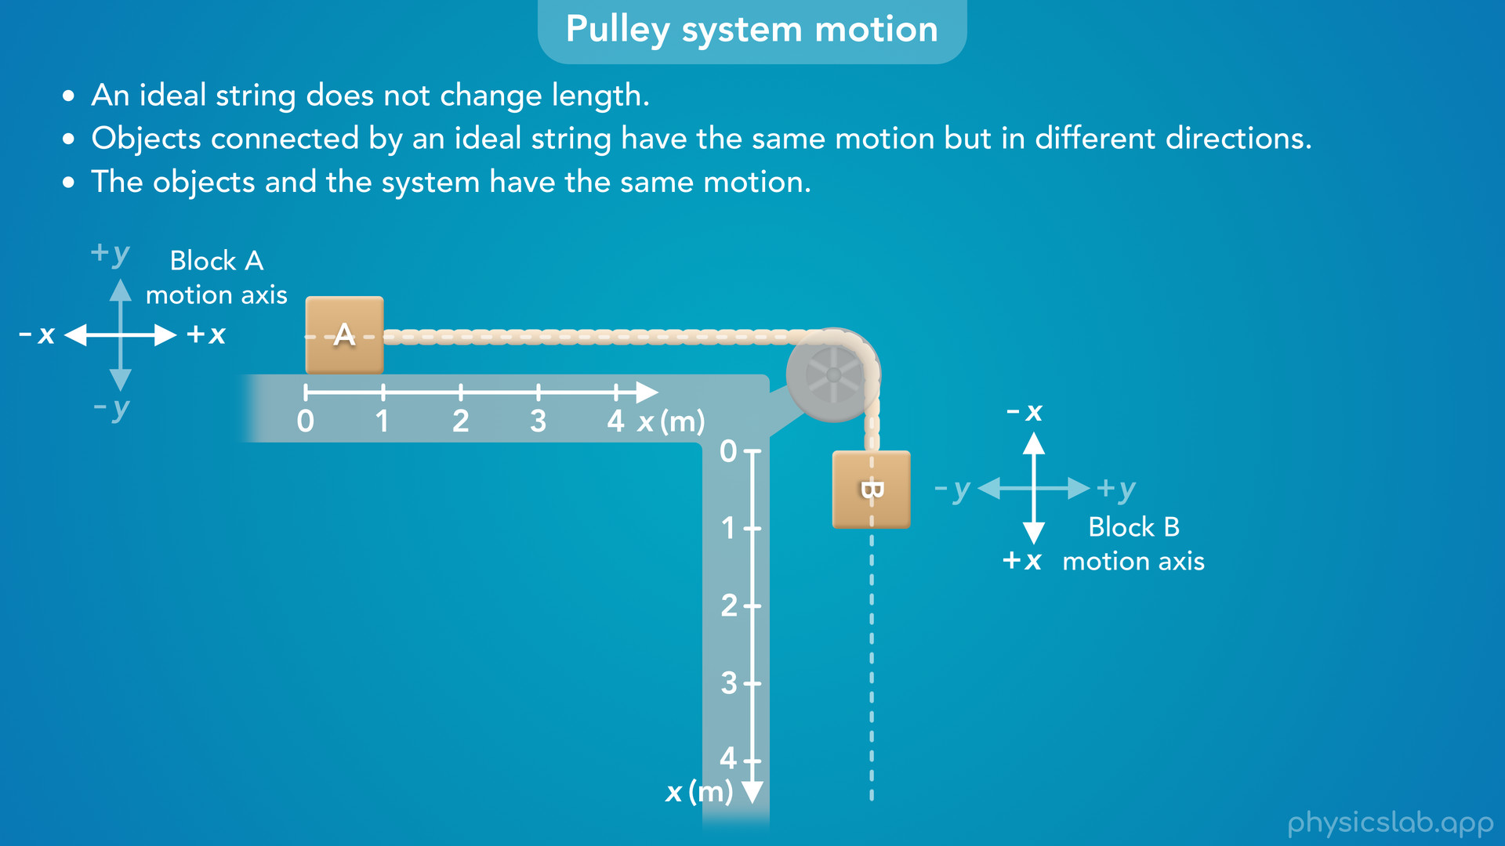
Notes:
• But, we’re going to label both of these as the x axis for that block.
• For block A, the x axis is horizontal and right is the positive direction.
• For block B, we’re going to rotate the coordinate system so the x axis is vertical, and down is the positive direction.
• Since the motions of the blocks are connected, this will make things easier when we apply Newton’s 2nd law.

Slide 53
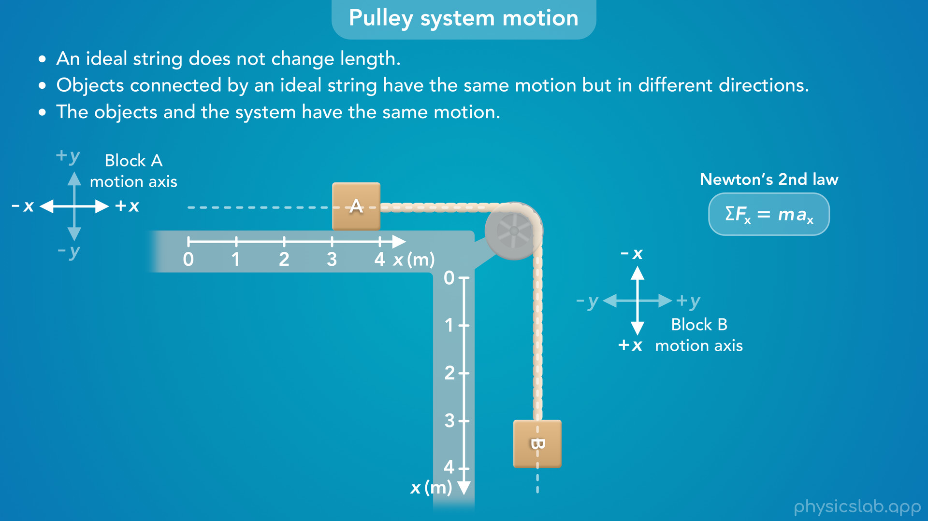
Notes:
• If block A moves in the positive x direction, block B also moves in the positive x direction.

Slide 54
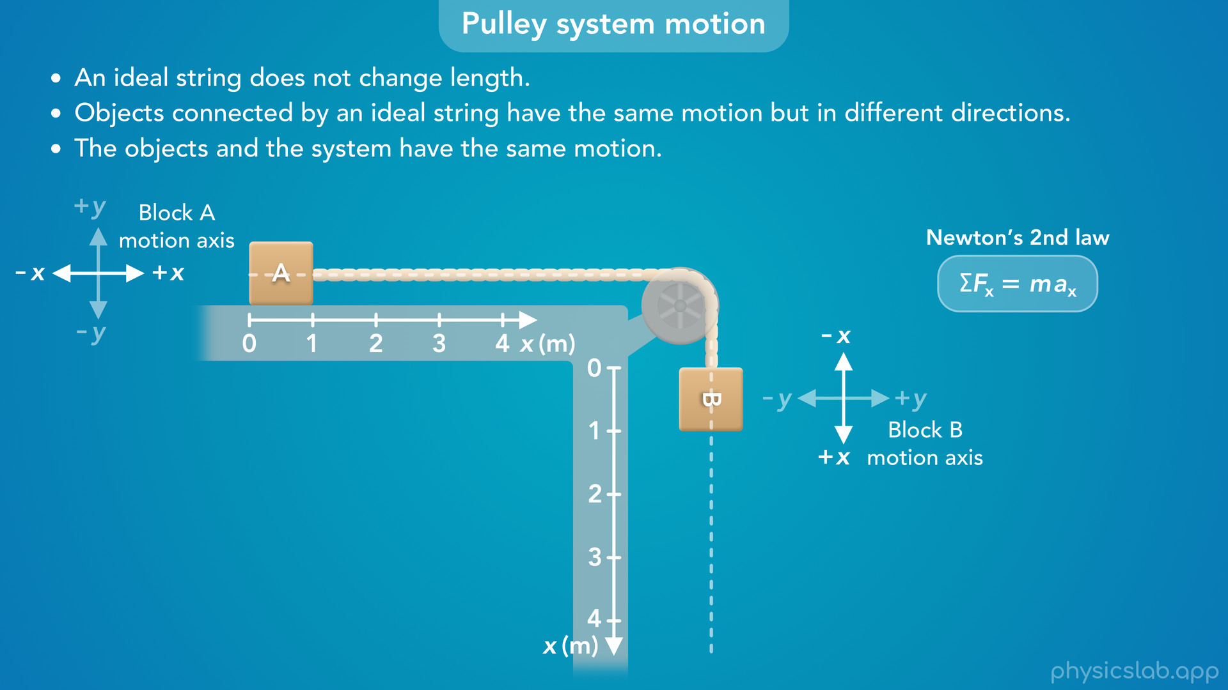
Notes:
• If block A moves in the negative x direction, block B also moves in the negative x direction.

Slide 55
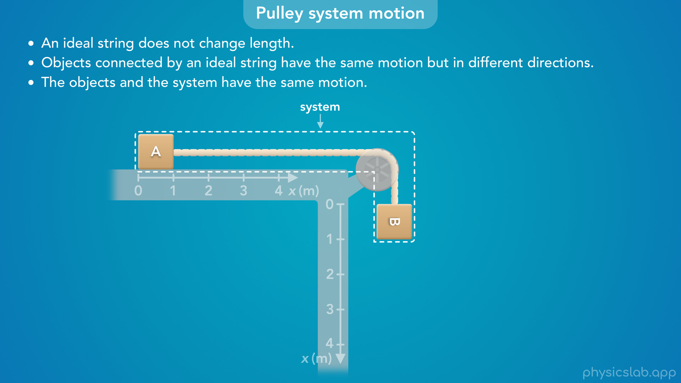
Notes:
• This also makes it easier to describe the motion of the overall system.
• If the blocks are accelerating in different directions, what direction would the system be accelerating?

Slide 56
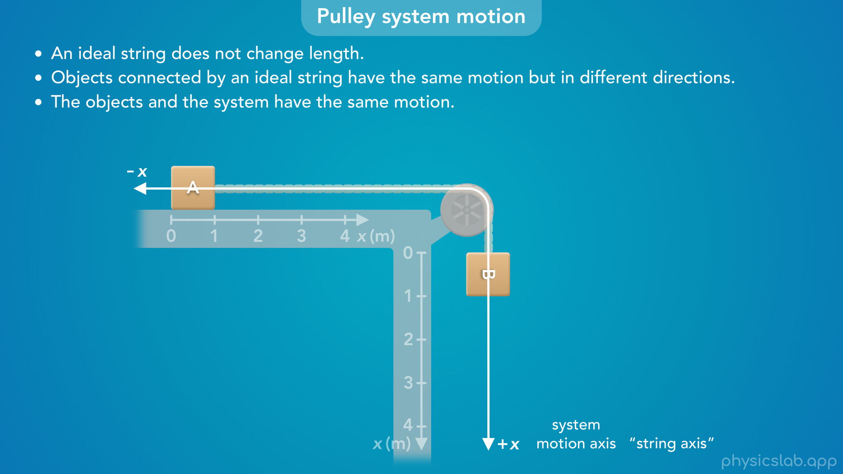
Notes:
• We could draw the motion axis for the system like this, following the string around the pulley.
• Maybe it helps to think of this as the “string axis”.

Slide 57
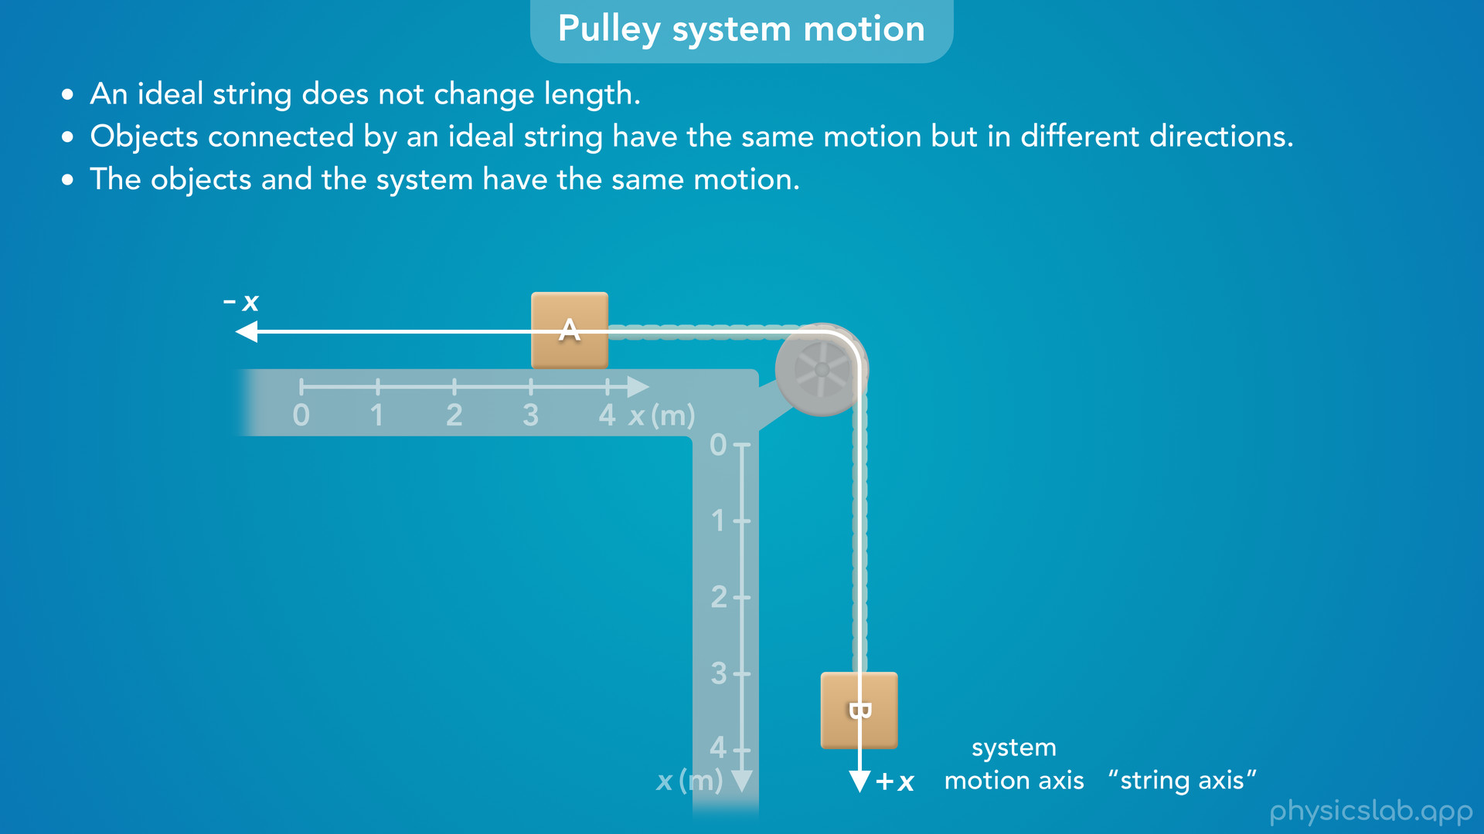
Notes:
• Then, we can say the system either moves in the positive x direction…

Slide 58
Notes:
or the system moves in the negative x direction.

Slide 59

Notes:
• So when we analyze the blocks separately, we can use these coordinate systems for each block.

Slide 60

Notes:
• And when we analyze the system, we can use this shared motion axis.

Slide 61

Notes:
• The same thing applies to other pulley systems.

Slide 62

Notes:
• When we’re analyzing the blocks separately, we can rotate the coordinate systems so that each block is moving in the positive x direction.

Slide 63

Notes:
• And when we analyze the system, we can use a shared motion axis so that each block and the overall system is moving in the positive x direction.

