Slide 1
Newton’s 1st Law of Motion
Slides Version 2
This version includes:
Slides with screenshot images from the video.
The video narration in the slide notes.
A blank template slide with the same background and font as the video.
Slides with some basic graphics from this video for you to use however you like.
Feel free to add, delete and edit slides to make your own presentation. You can use these slides in class or share them with your students, but please do not share them with anyone else.
If you have any feedback, suggestions or questions about these slides please email me at chris@physicslab.app or send me a message on Discord @physicslab.
physicslab.app

Slide 2
Heading
Text

Slide 3
Heading
Text

Slide 4

















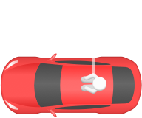













Slide 5



Slide 6






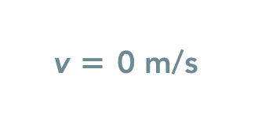




Slide 7























Slide 8
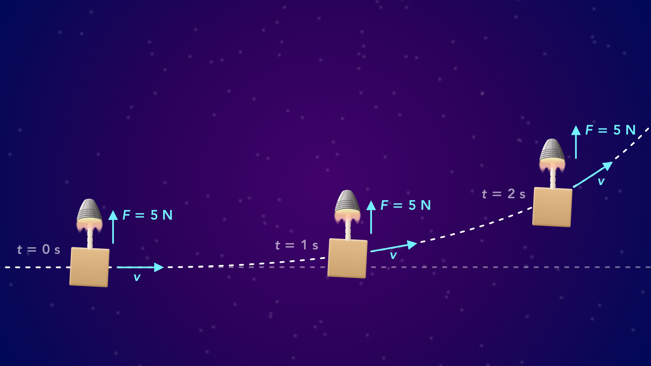
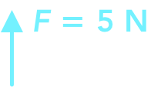






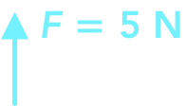
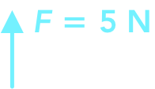





Slide 9
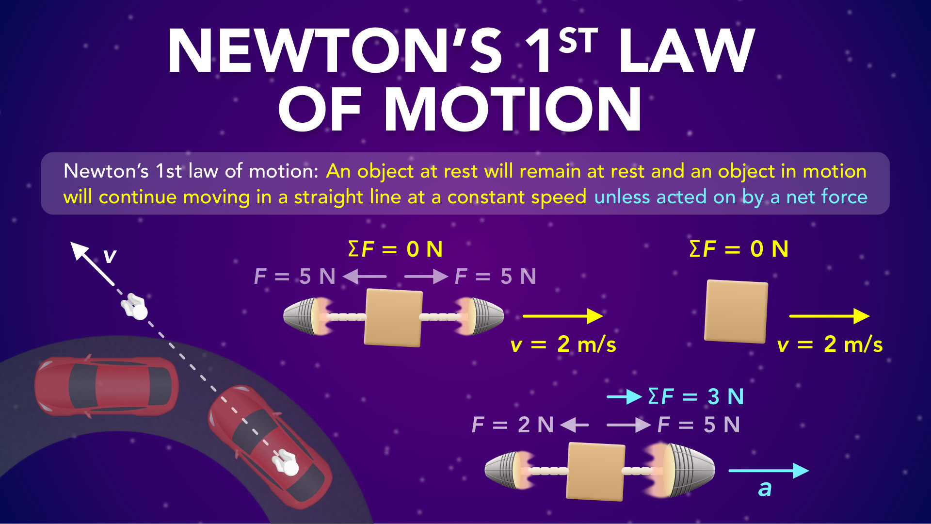
Notes:
Newton’s 1st Law of Motion
physicslab.app
If you have any questions, suggestions or feedback about these slides please email me at chris@physicslab.app or send me a message on Discord @physicslab.

Slide 10
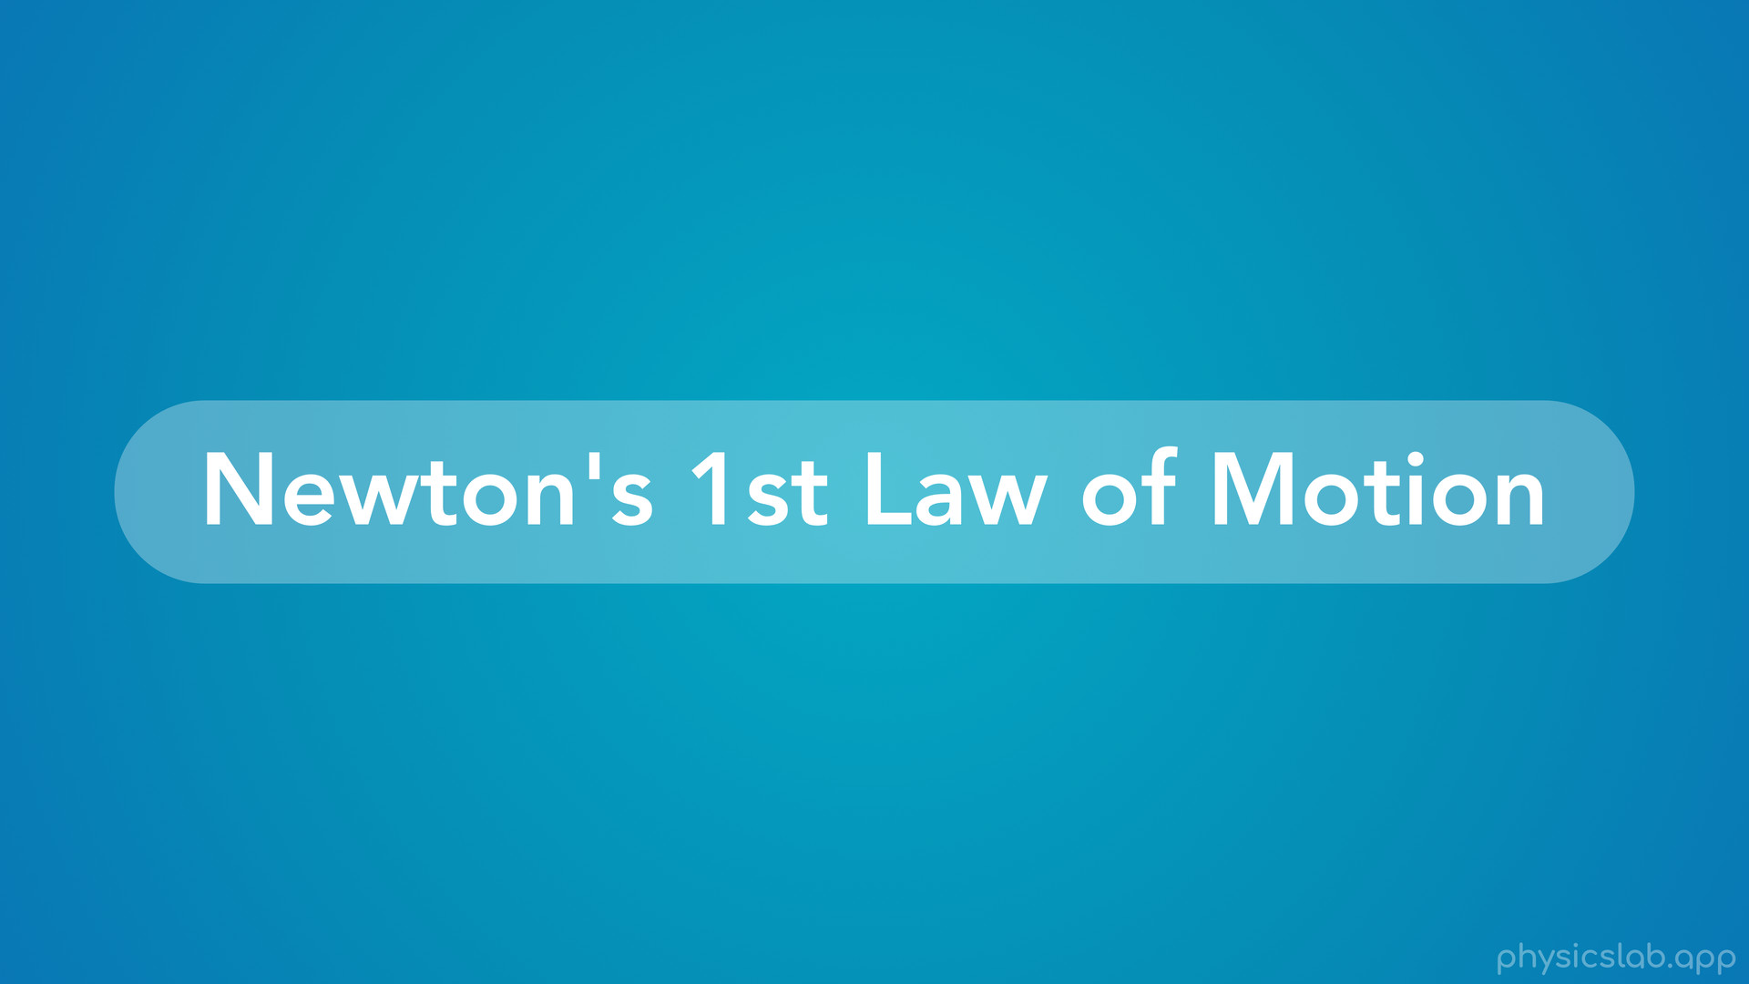
Notes:
• Hey everyone, in this video we’re gonna learn about Newton’s 1st law of motion.

Slide 11
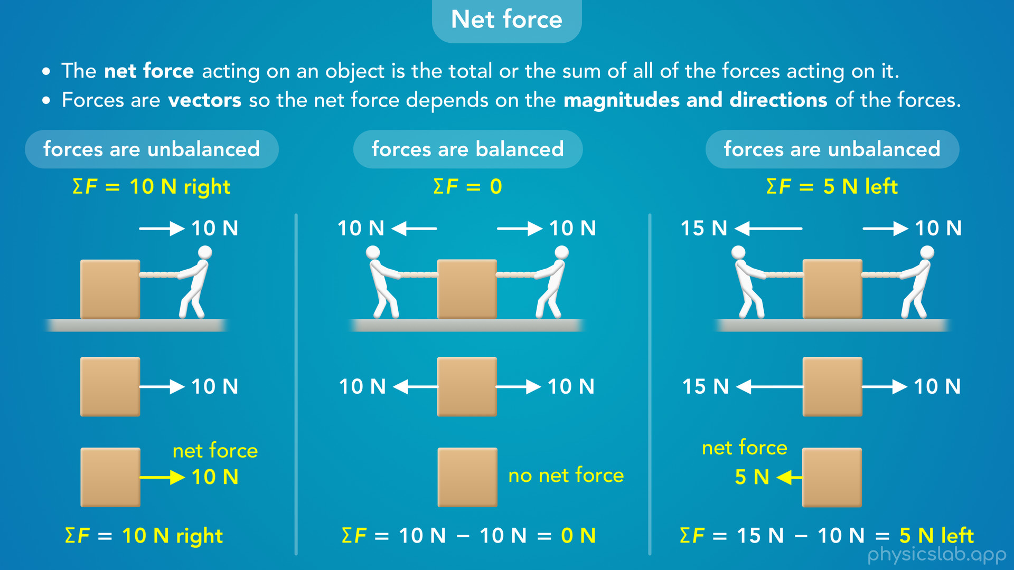
Notes:
• We’ll cover balanced and unbalanced forces and how to calculate the net force on an object.

Slide 12
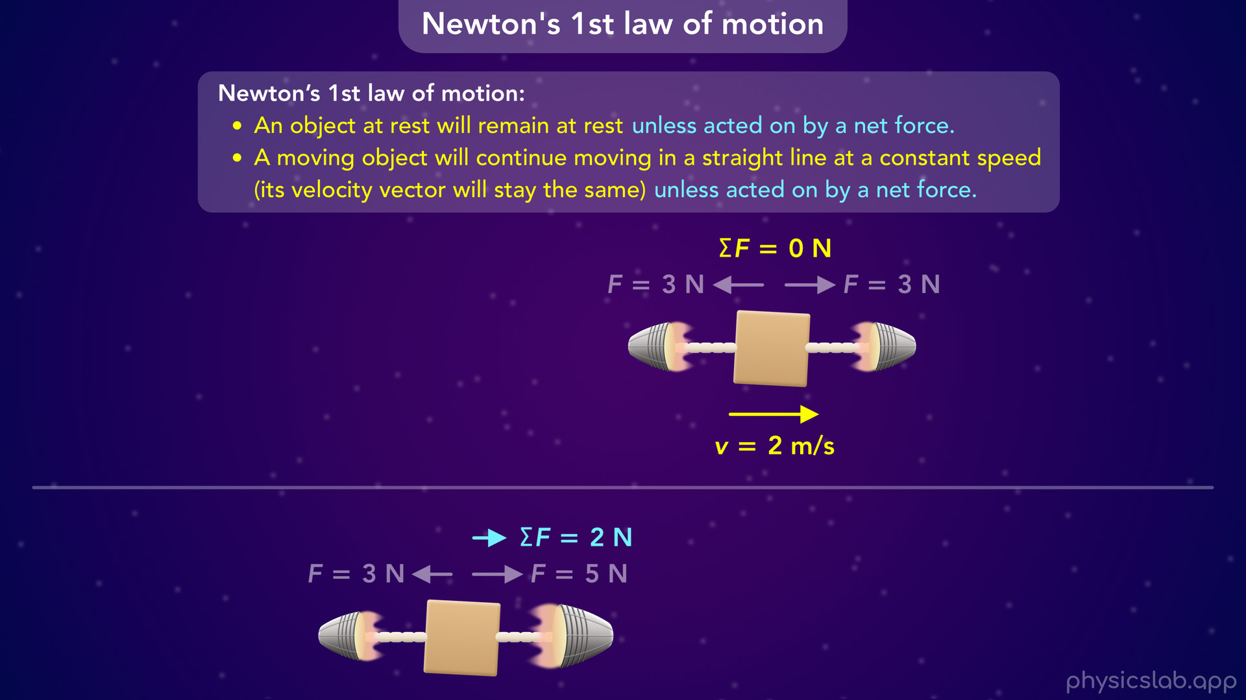
Notes:
• And then, we’ll explore Newton’s 1st law and learn how a net force affects an object’s motion.

Slide 13
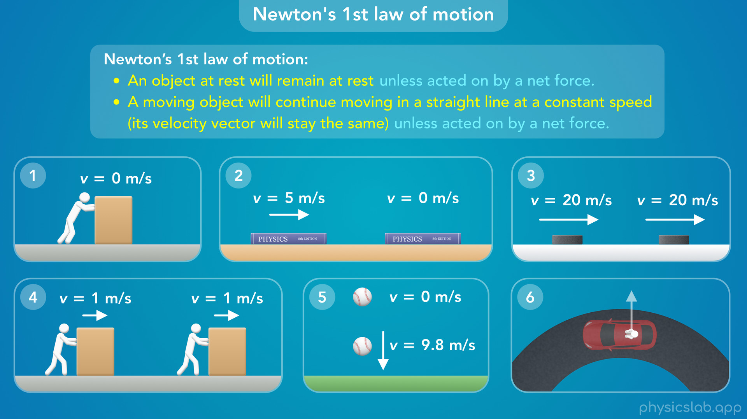
Notes:
• After that, we’ll look at some different scenarios and we’ll try to explain what’s happening using Newton’s 1st law of motion.

Slide 14
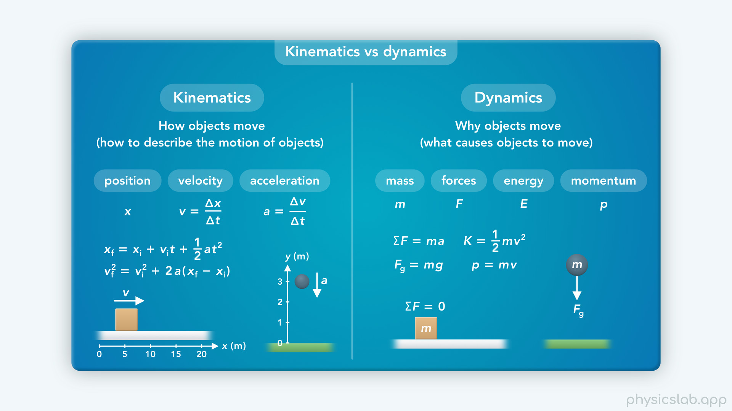
Notes:
• In the last video, we mentioned that everything we’ve learned so far has been kinematics, which covers how objects move.
• Now, we’re moving on to dynamics, which covers why objects move and what causes them to move.

Slide 15
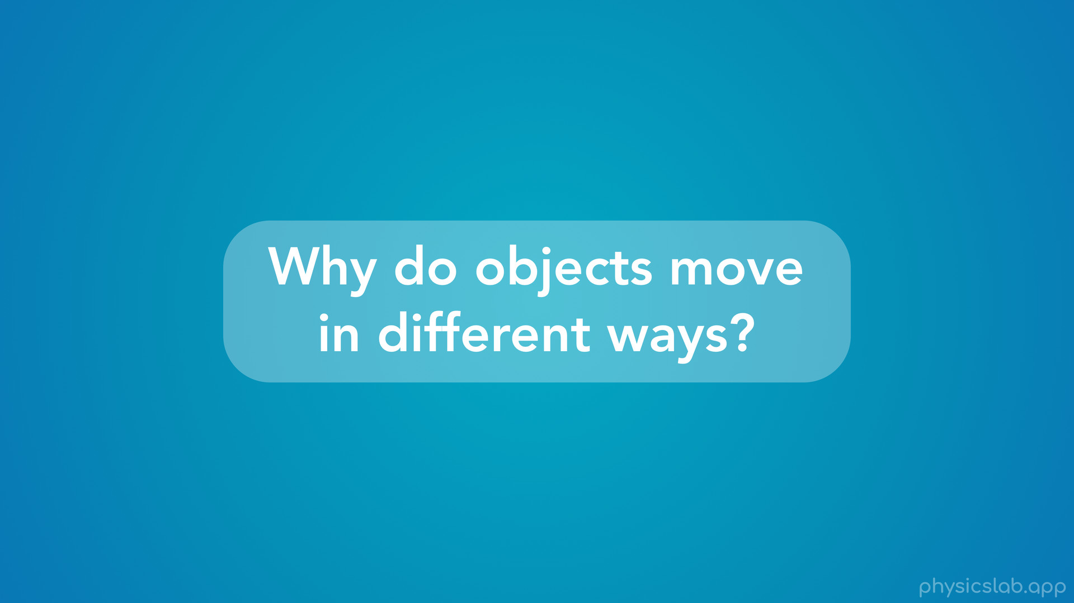
Notes:
• So let’s start this video by trying to answer the question: why do objects move in different ways?

Slide 16
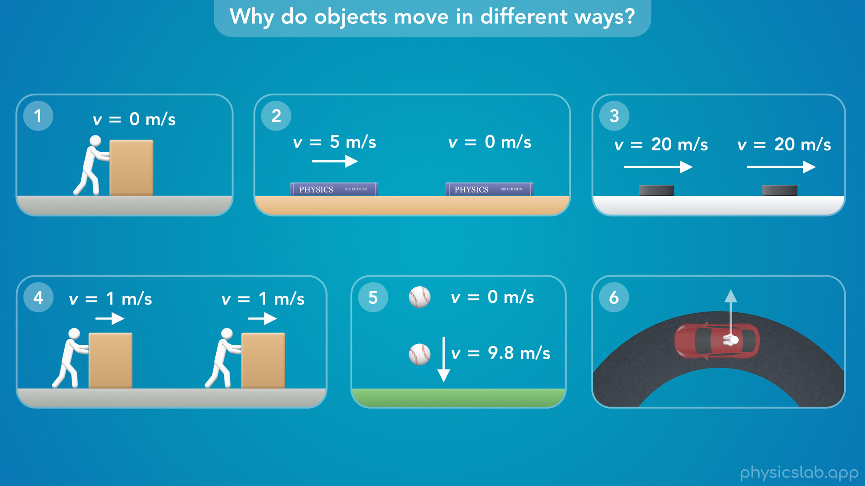
Notes:
• Even though we see things moving and not moving all around us, we usually don’t think about what’s causing those things to happen.
• Let’s look at 6 different scenarios and see if we can explain why the object is moving in a certain way. Then we’ll come back to these after we learn about Newton’s 1st law of motion.
• Pause the video and write down your explanation after each one, or try to explain it out loud, but see if you can come up with a reason before moving on.

Slide 17
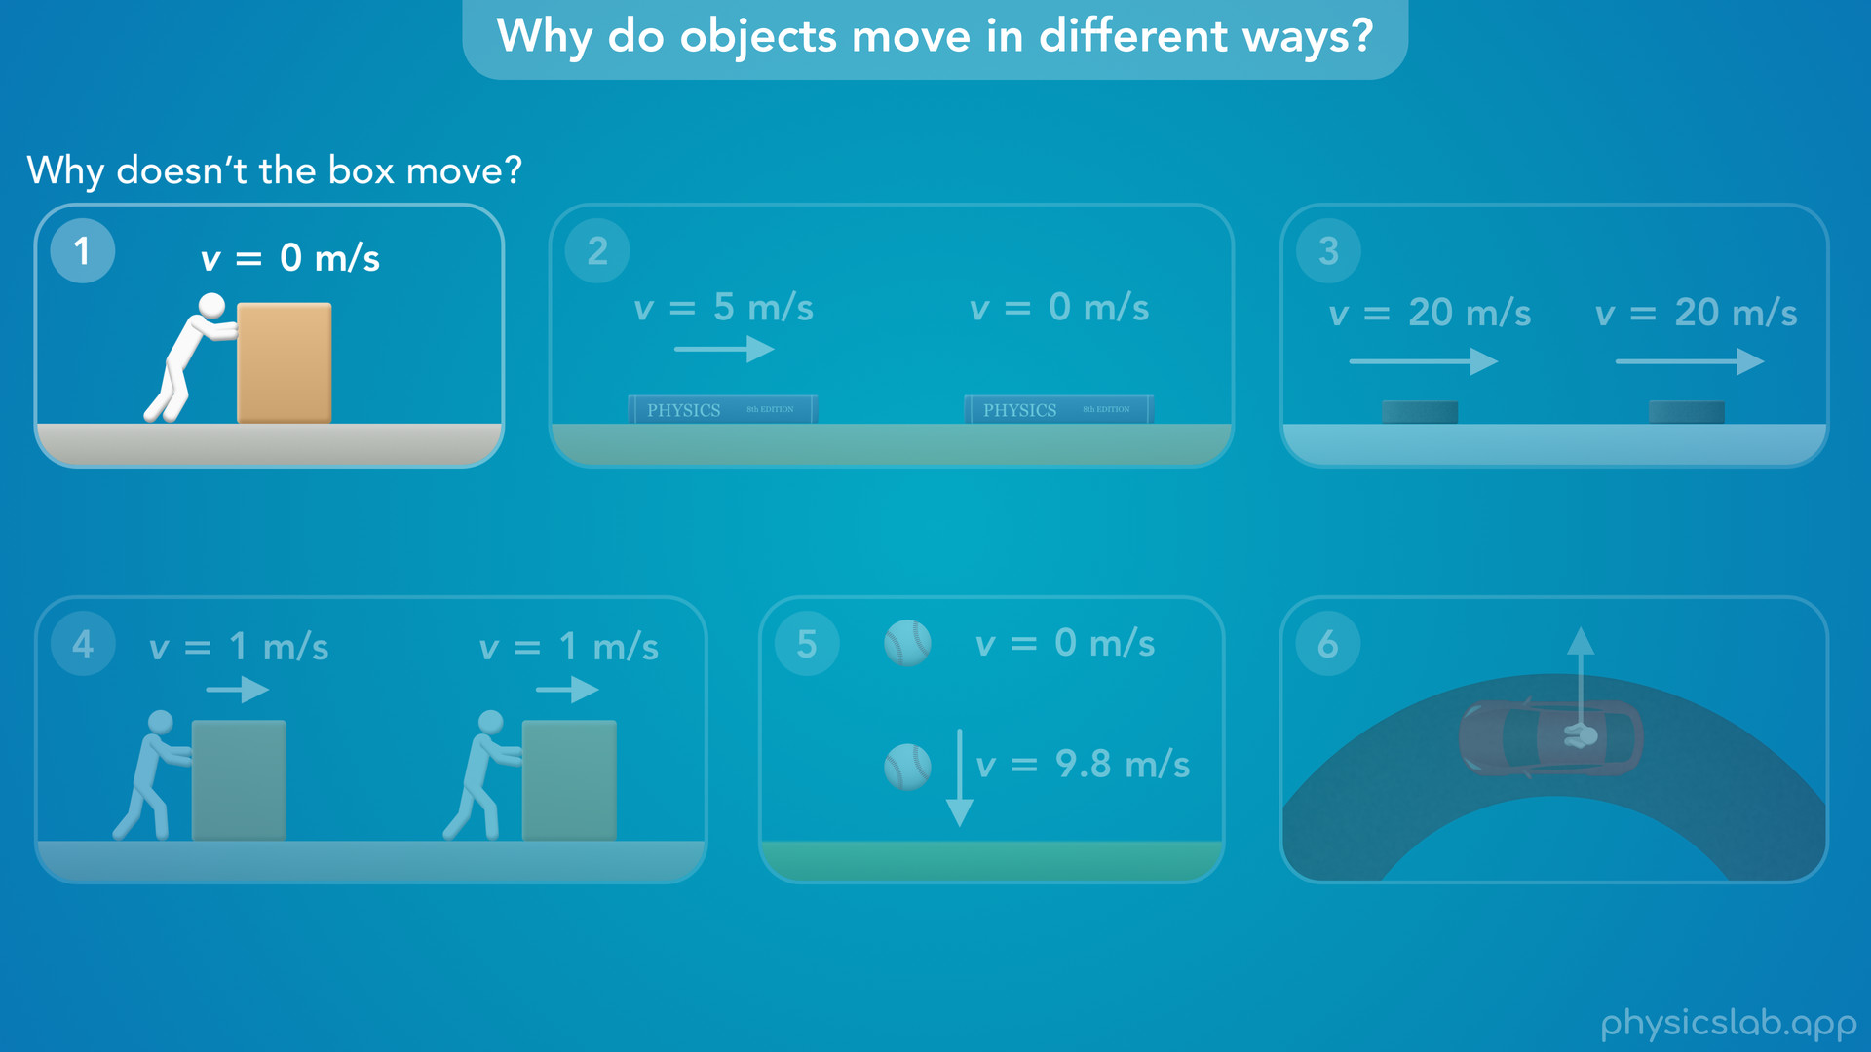
Notes:
• So first, let’s say you’re trying to slide a box across the floor. You push it as hard as you can but it still doesn’t move. So in this scenario, “why doesn’t the box move?”

Slide 18
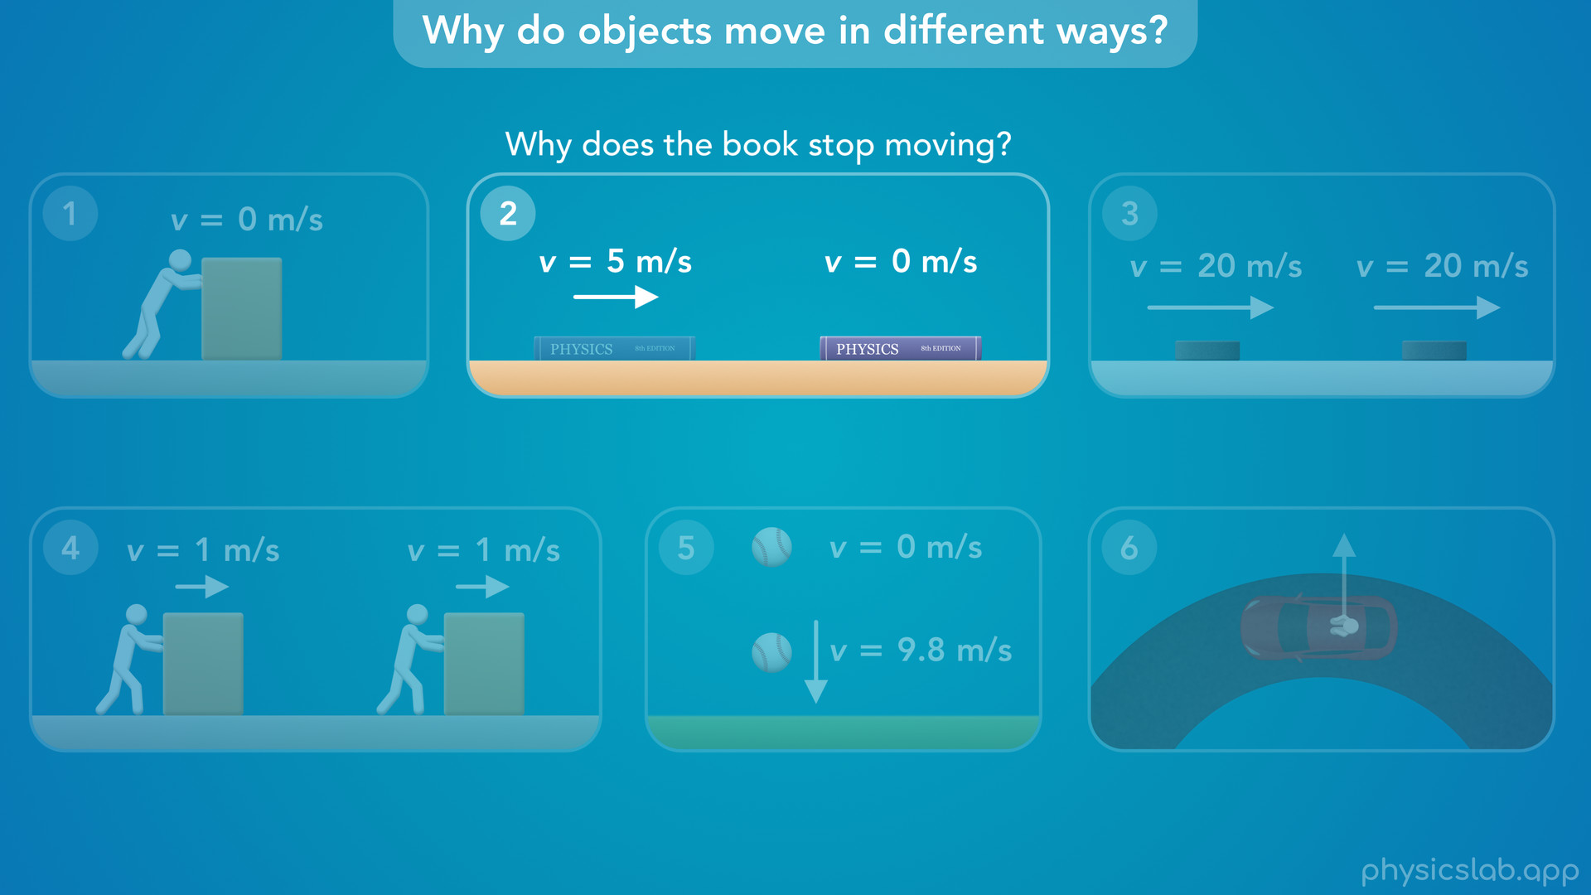
Notes:
• In the next scenario, you grab a book, slide it across a table with some initial speed, and then it stops. So, “why does the book stop moving?”

Slide 19
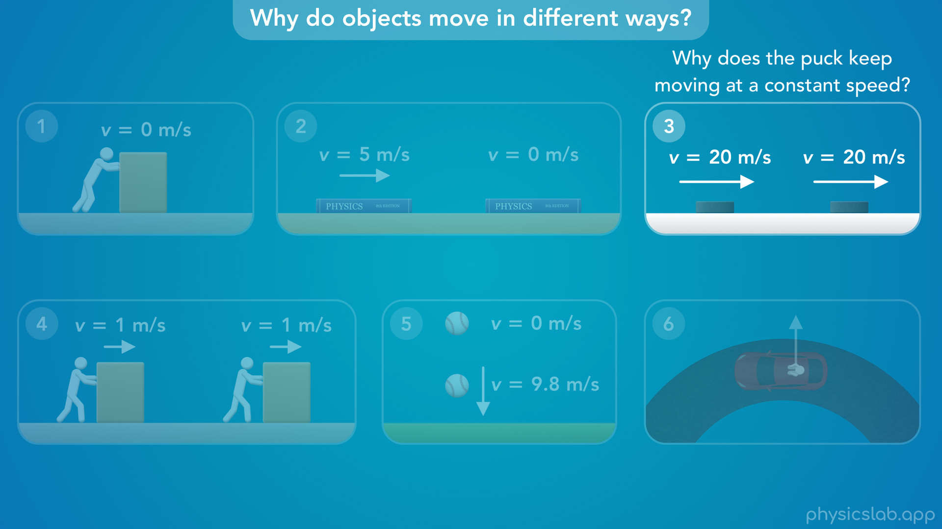
Notes:
• Now let’s say you’re watching a hockey game, and a player passes the puck across the ice. The puck seems to be moving at a constant speed and it doesn’t stop. If the book stopped on its own, then why does the puck keep moving at a constant speed?

Slide 20
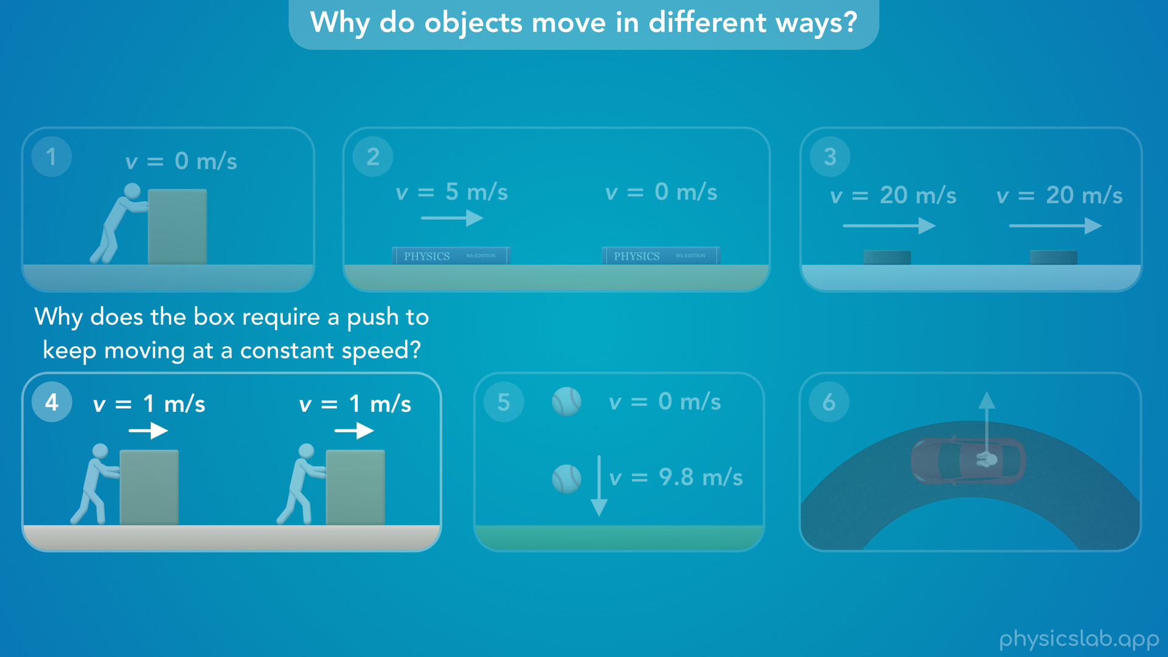
Notes:
• In the next scenario, you’re trying to move another box. But this time, the box slides across the floor with a constant speed while you’re pushing it. And if you stop pushing, the box stops moving. If the hockey puck moved at a constant speed on its own, then “why does the box require a push to keep moving at a constant speed”?

Slide 21
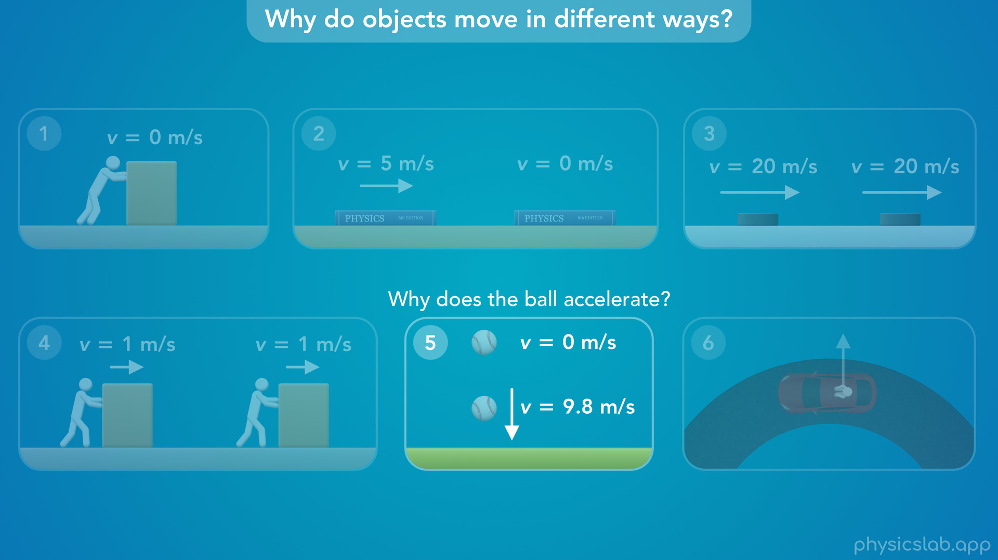
Notes:
• Now let’s say you drop a ball from rest. We know from projectile motion that the ball will accelerate downwards, and 1 second later its speed is 9.8 m/s. So “why does the ball accelerate”, and why doesn’t it fall at a constant speed?

Slide 22
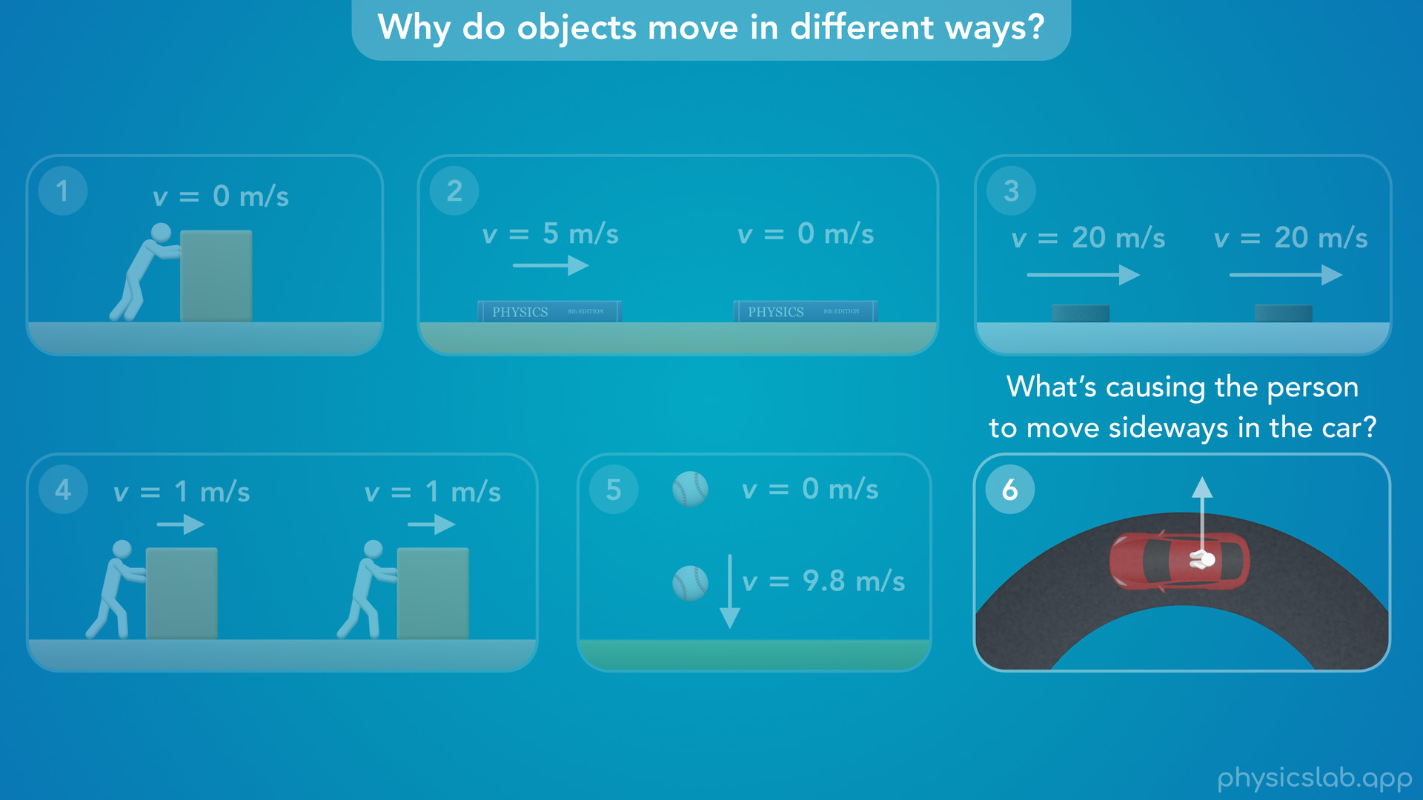
Notes:
• In the last example, a person is riding in a car, and the car is turning quickly around a corner. If you’ve been in this scenario, you probably felt like something was causing you to move sideways towards the outside of the turn, and you had to lean against a door or hold on to something. So in this scenario, “What’s causing the person to move sideways in the car” while the car is turning?

Slide 23
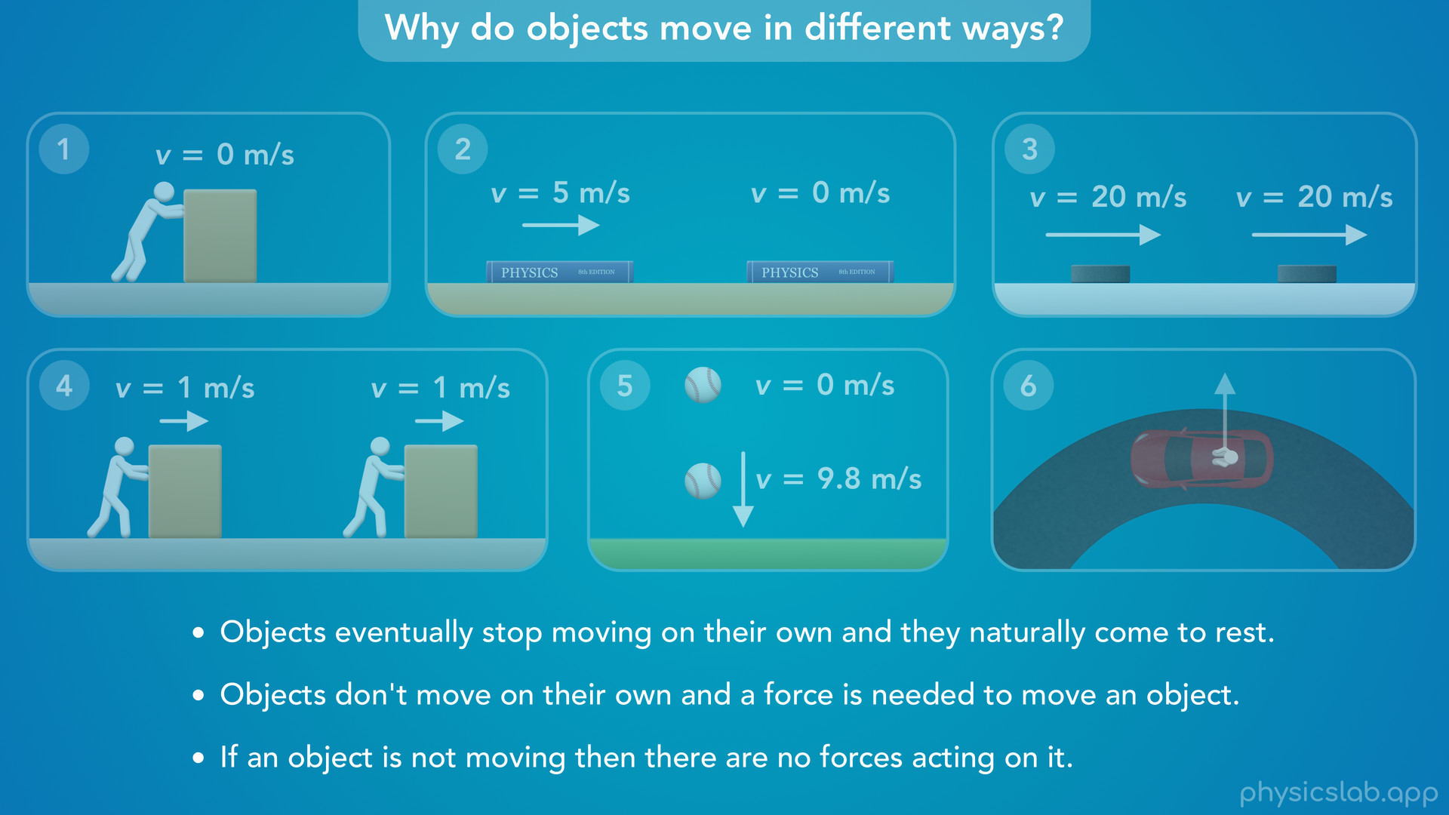
Notes:
• Alright so hopefully you were able to come up with some explanation for each scenario.
• Here are some common things that people think of:
• Objects eventually stop moving on their own and they naturally come to rest.
⁃ That might explain why the book slows down and stops, but it doesn’t explain why the hockey puck keeps moving. Maybe it just needs more time to stop on its own.
• Next, objects don’t move on their own and a force is needed to move an object. So maybe there’s a force that’s pushing this person to the side as the car turns. And maybe that’s why you had to push on this box to keep it moving.
⁃ But if that’s true, why doesn’t the hockey puck need a force to keep it moving? And does a force move an object at a constant speed, like the box, or does a force cause an object to accelerate like the ball?
• And finally, if an object is not moving then there are no forces acting on it.
⁃ Does that explain why the first box isn’t moving? The person is definitely applying a force to the box, but it still doesn’t move.

Slide 24
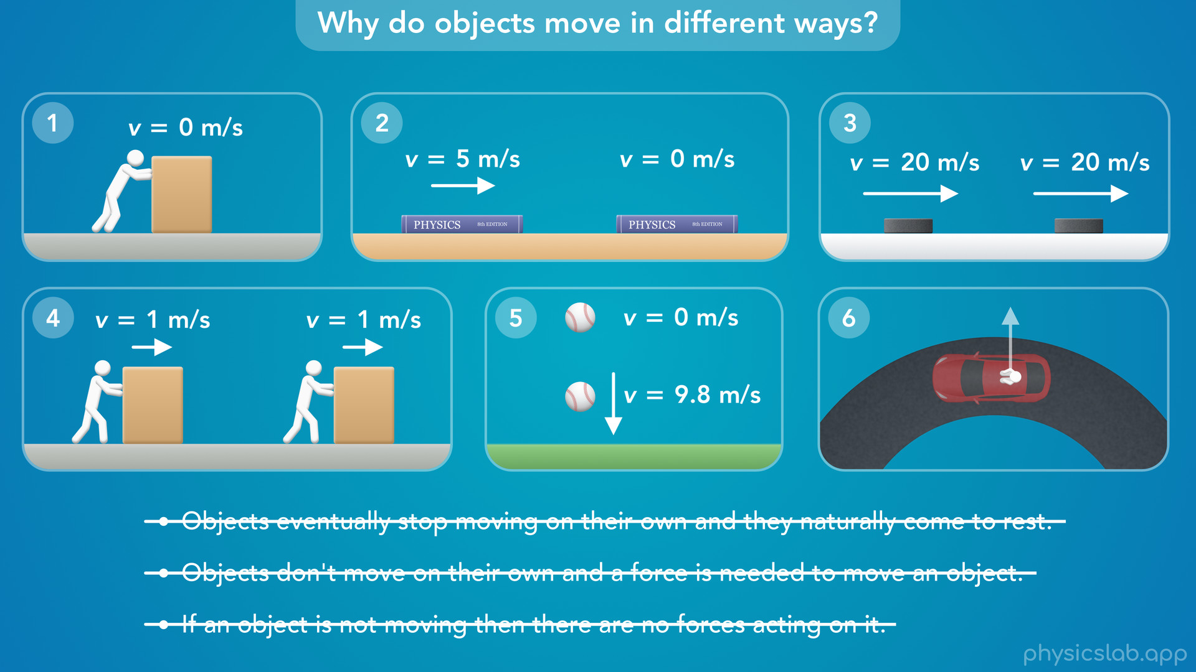
Notes:
• Even though these statements feel like they match what we observe in everyday life, they’re actually not true.
• But if you used any of them to explain these scenarios, you’re not alone. For thousands of years, these are some of the ways that people explained motion. Nobody was really sure why things behaved the way they do, and even the smartest people in every period came up with some theories that sound pretty weird today.

Slide 25
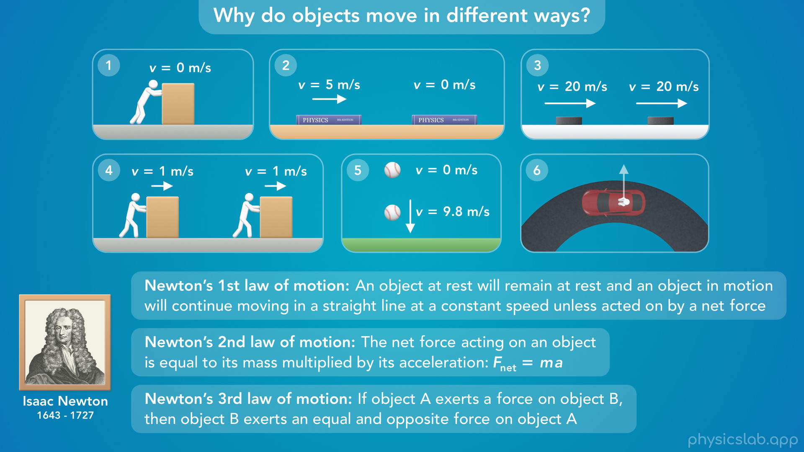
Notes:
• Over time, people started to piece things together. And eventually, an English philosopher named Isaac Newton summarized things with what we now call Newton’s 3 laws of motion.
• We can use these laws to explain the scenarios above and pretty much all motion that we see. We’re gonna cover Newton’s 1st law in this video, the other laws in the next few videos.

Slide 26
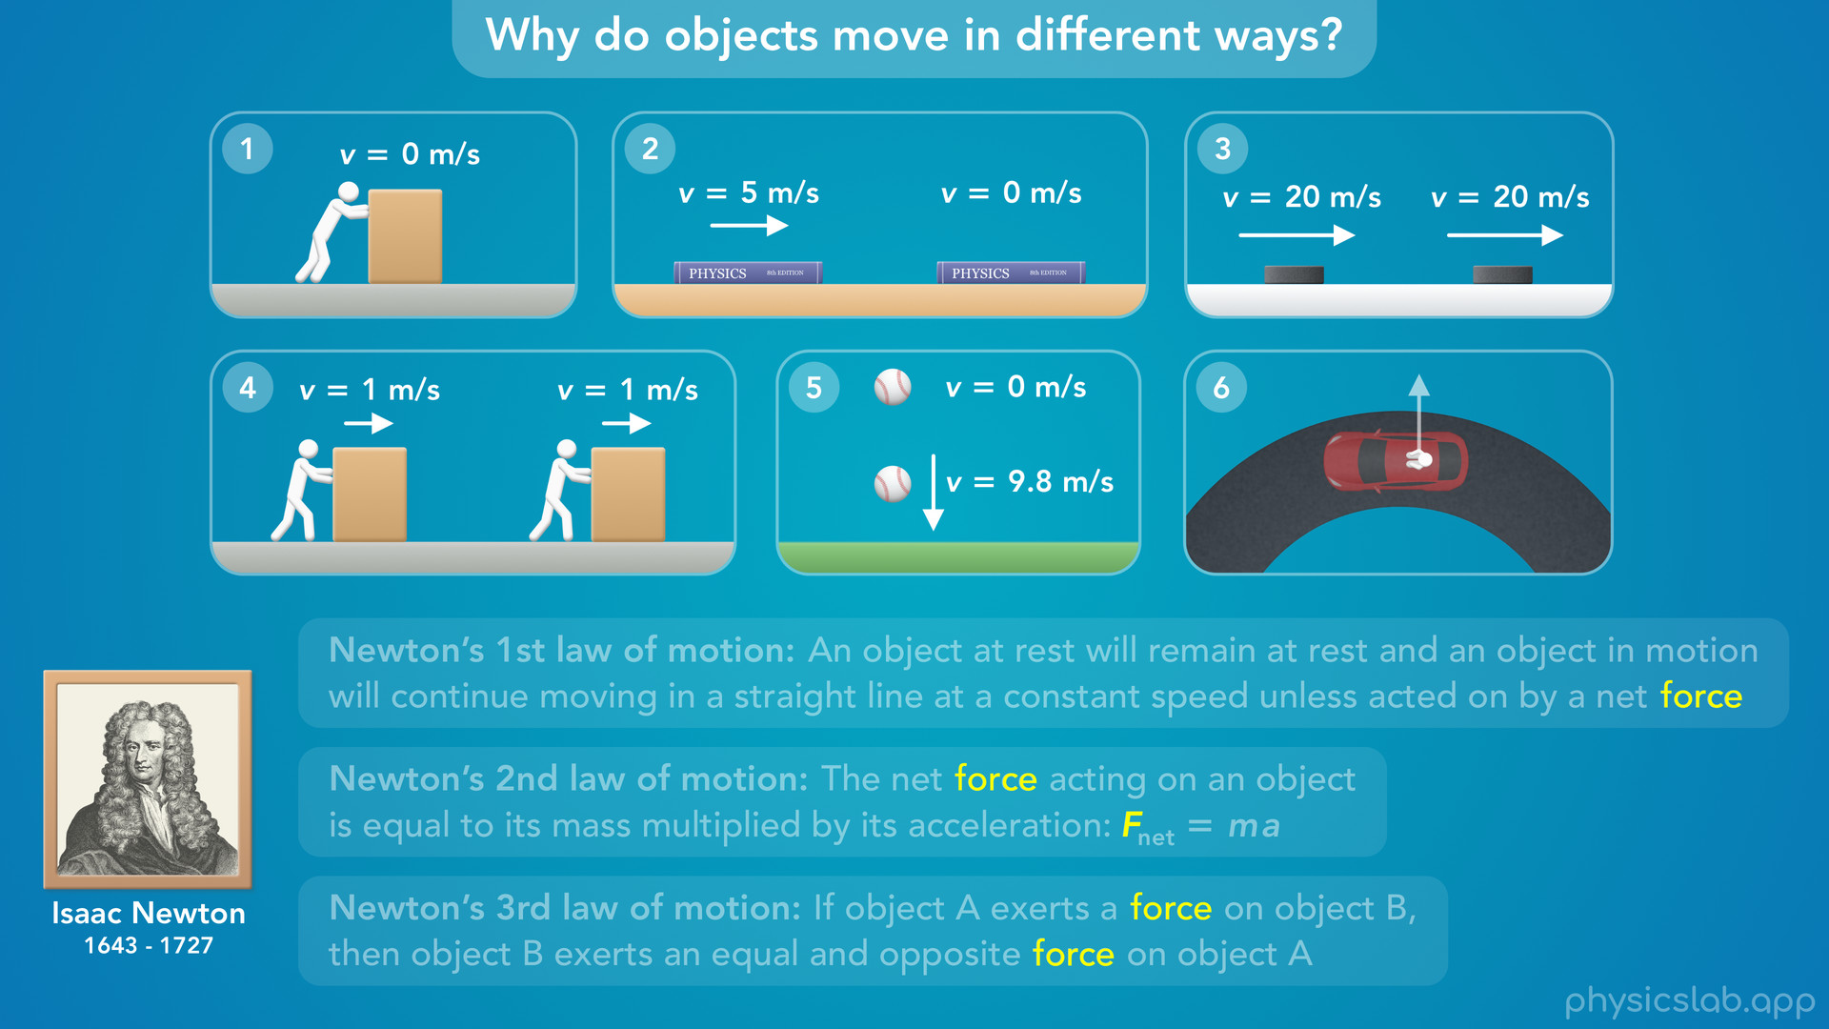
Notes:
• We need to understand forces in order to understand these laws and we covered forces in the last video, so watch that one first.

Slide 27

Notes:
• But if we look at the first two laws, it’s not a force that affects motion, it’s a net force.

Slide 28

Notes:
• So let’s explain what a net force is, and then we can learn Newton’s 1st law of motion.

Slide 29
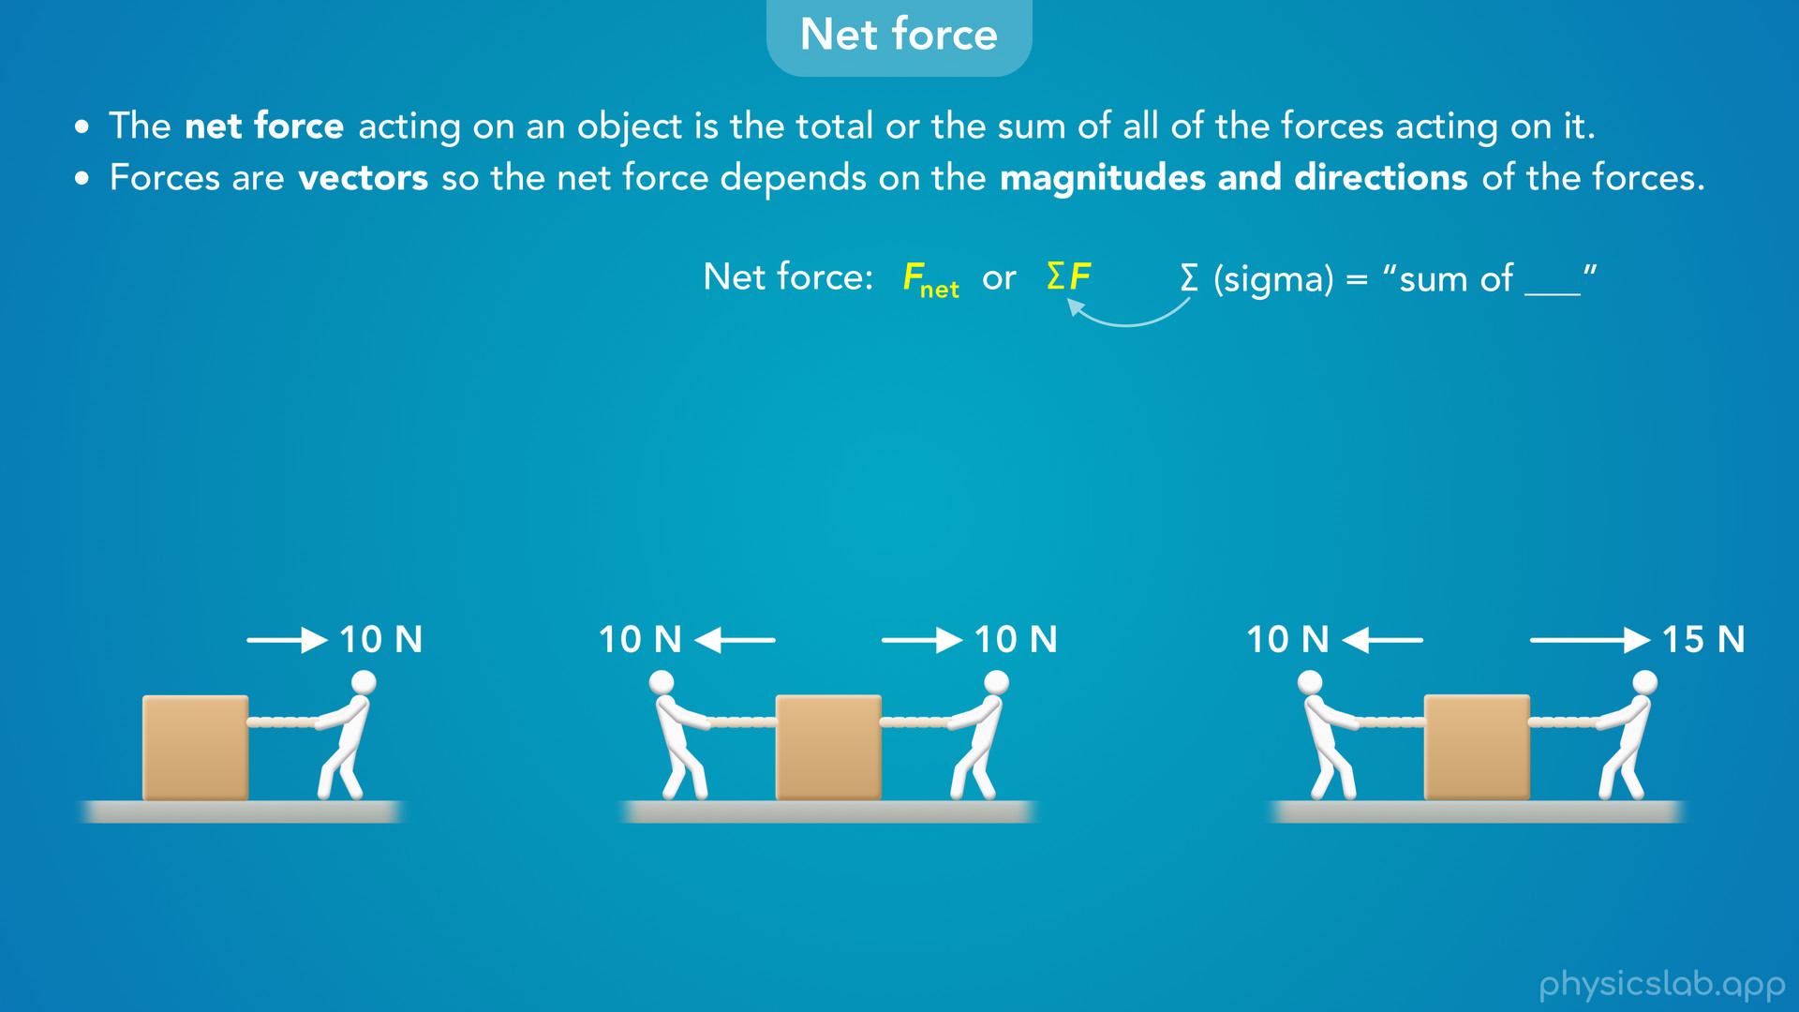
Notes:
• The net force acting on an object is the total, or the sum of all of the forces acting on it.
• And remember, forces are vectors, so the net force depends on the magnitudes and the directions of the forces.
• We can write net force like this, but we’re usually gonna write it like this. The greek letter “sigma” means “the sum of” multiple things. So “sigma F” means the sum of all the forces, which is the net force.

Slide 30
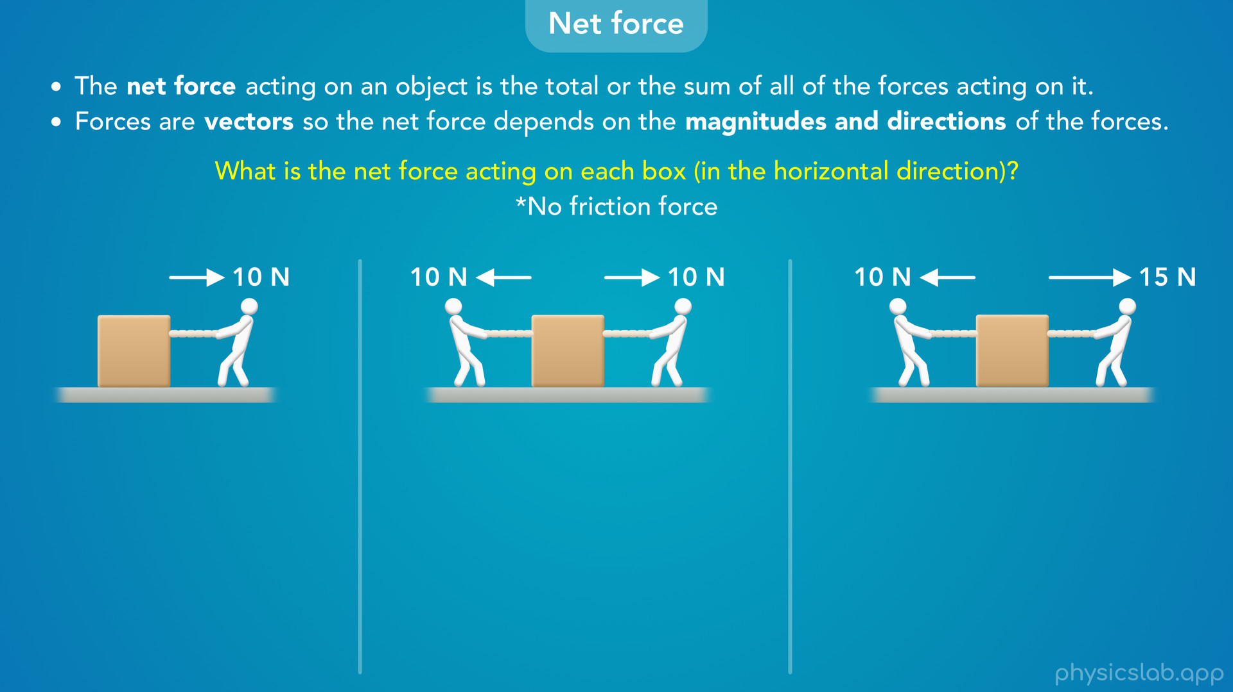
Notes:
• So in the examples below, what is the net force acting on each box in the horizontal direction?
• And to keep things simple, let’s say there’s no friction force on the boxes.

Slide 31
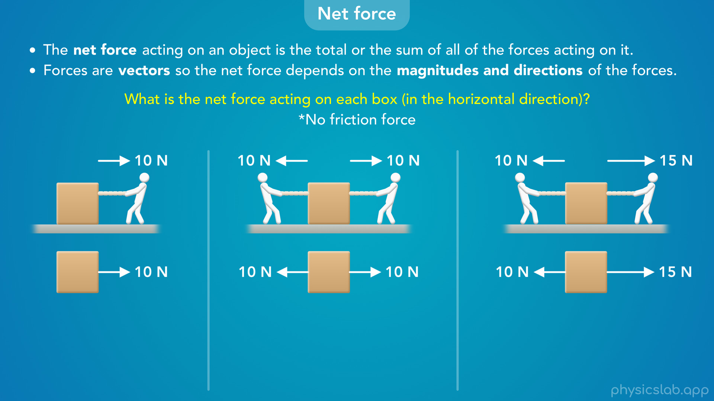
Notes:
• Ok so first, let’s draw free body diagrams that just show the horizontal forces on each box.

Slide 32
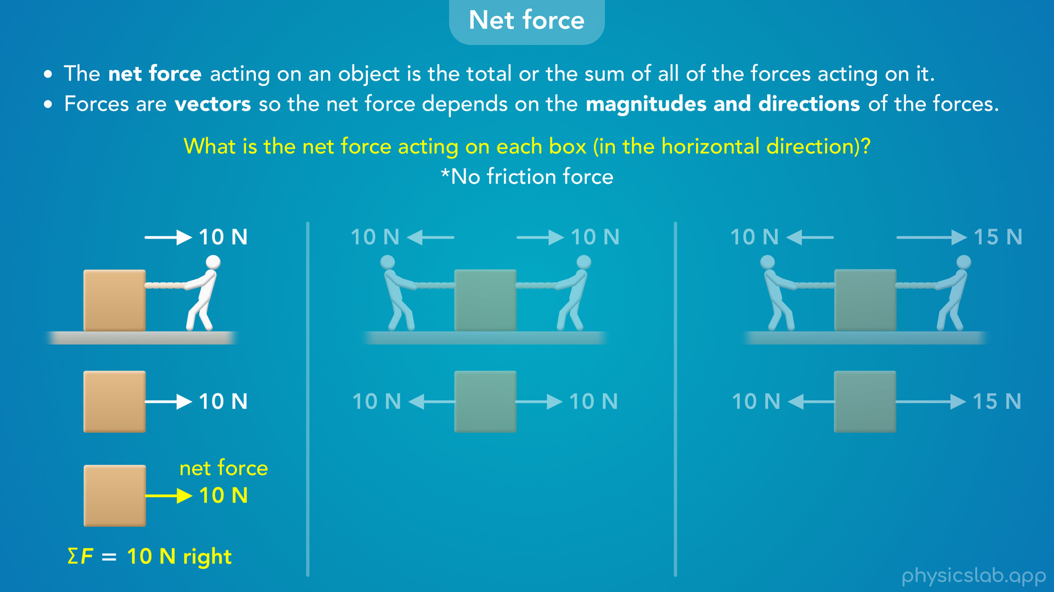
Notes:
• In the first example, the person is pulling the box to the right with 10 N of force. Remember, a newton, capital N, is the SI unit of force. Since the box only has one force acting on it, that’s also the net force on the box. So the net force is 10 N to the right.

Slide 33
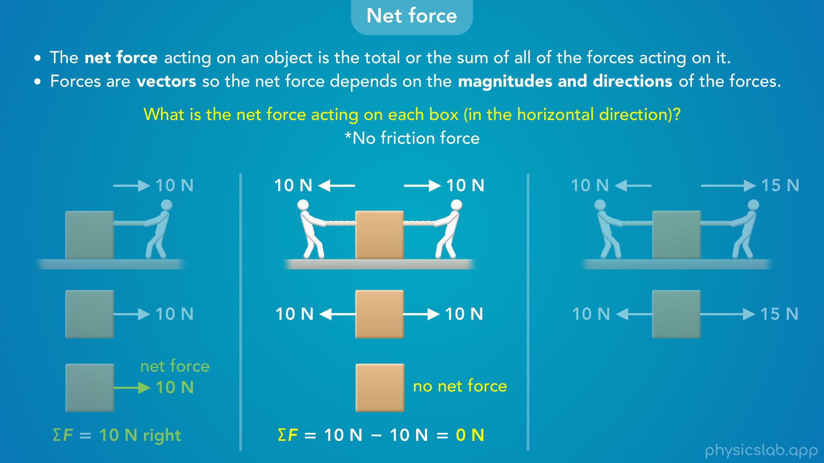
Notes:
• In the second example, there’s a 10 N force acting to the right, and a 10 N force acting to the left. In this case, the net force is 10 N minus 10 N which is 0 N. So there’s no net force on this box. We’re subtracting one force from the other because they point in opposite directions, and since forces are vectors, we need to account for those directions. We’ll cover this more in the next video, but we can think of it like a game of tug-of-war. The two forces have the same magnitude or strength, 10 N, and they’re pulling in opposite directions, so they cancel out and there’s zero net force.

Slide 34
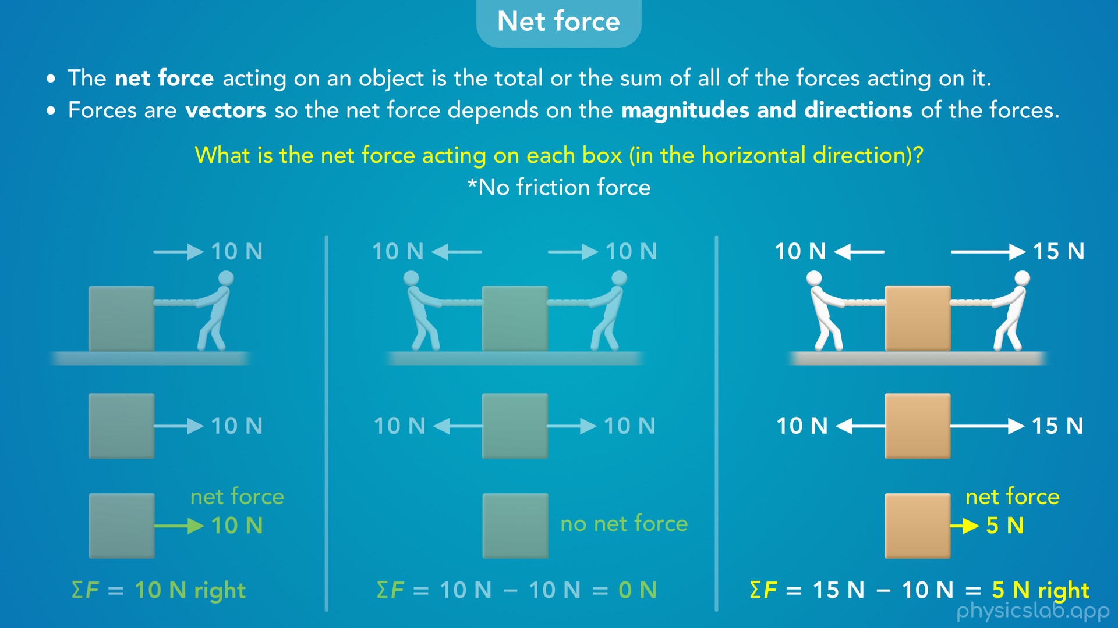
Notes:
• In the third example, a person is pulling to the right with 15 N of force, and a person is pulling to the left with 10 N of force. This means the person on the right is pulling harder than the person on the left. So now, the net force is 15 N minus 10 N, which is 5 N. So the net force on this box is 5 N to the right. We could think of the left force as canceling out 10 N from the right force, so we’re left with 5 N on the right.

Slide 35
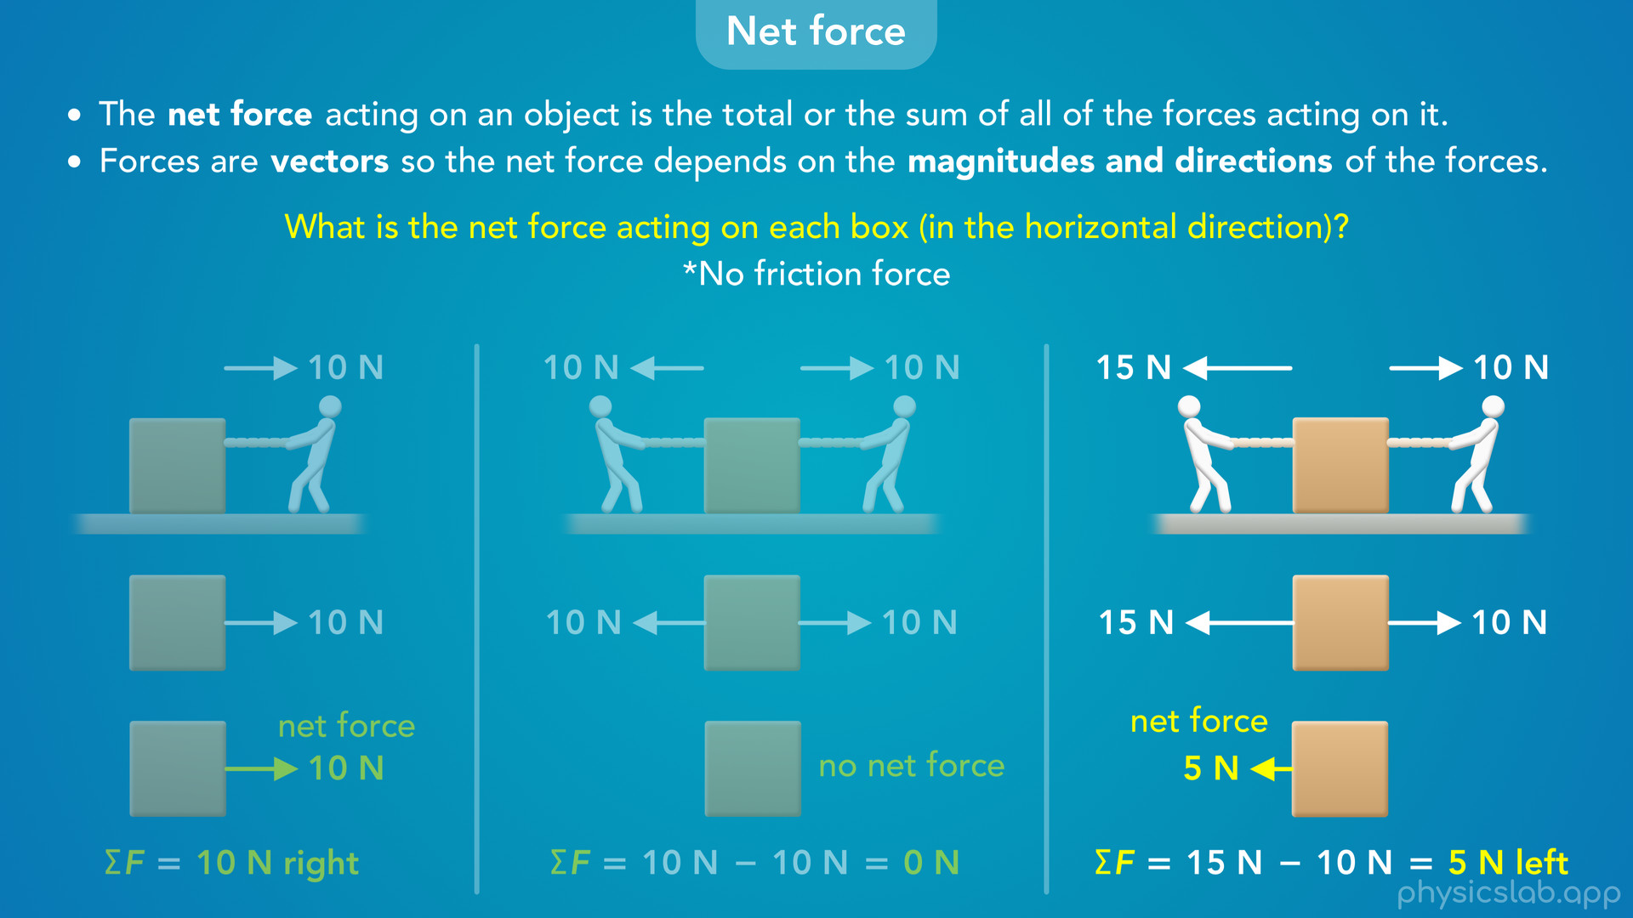
Notes:
• If the forces were switched and the left person was pulling harder, then the net force would be 5 N to the left.

Slide 36
Notes:
• So those are the net forces acting on each box. A net force is not a certain type of force, it’s just the total or the sum of all of the forces on the object.
• For the 2nd box, we would say the forces are balanced, because the forces on each side have the same magnitude and the net force is zero.
• For the 1st box, we would say the forces are unbalanced. There’s only one force pulling to the right, and there’s no other force to balance it out.
• For the 3rd box, we would also say the forces are unbalanced. There’s two forces in opposite directions, but the left force is stronger, so they’re not balanced and there’s a net force to the left.
• We’ll go into more detail in the next video, but that’s all we need to know for now.

Slide 37
Notes:
• So we’ve learned about forces, and net forces, so now let’s learn about Newton’s 3 laws of motion.

Slide 38
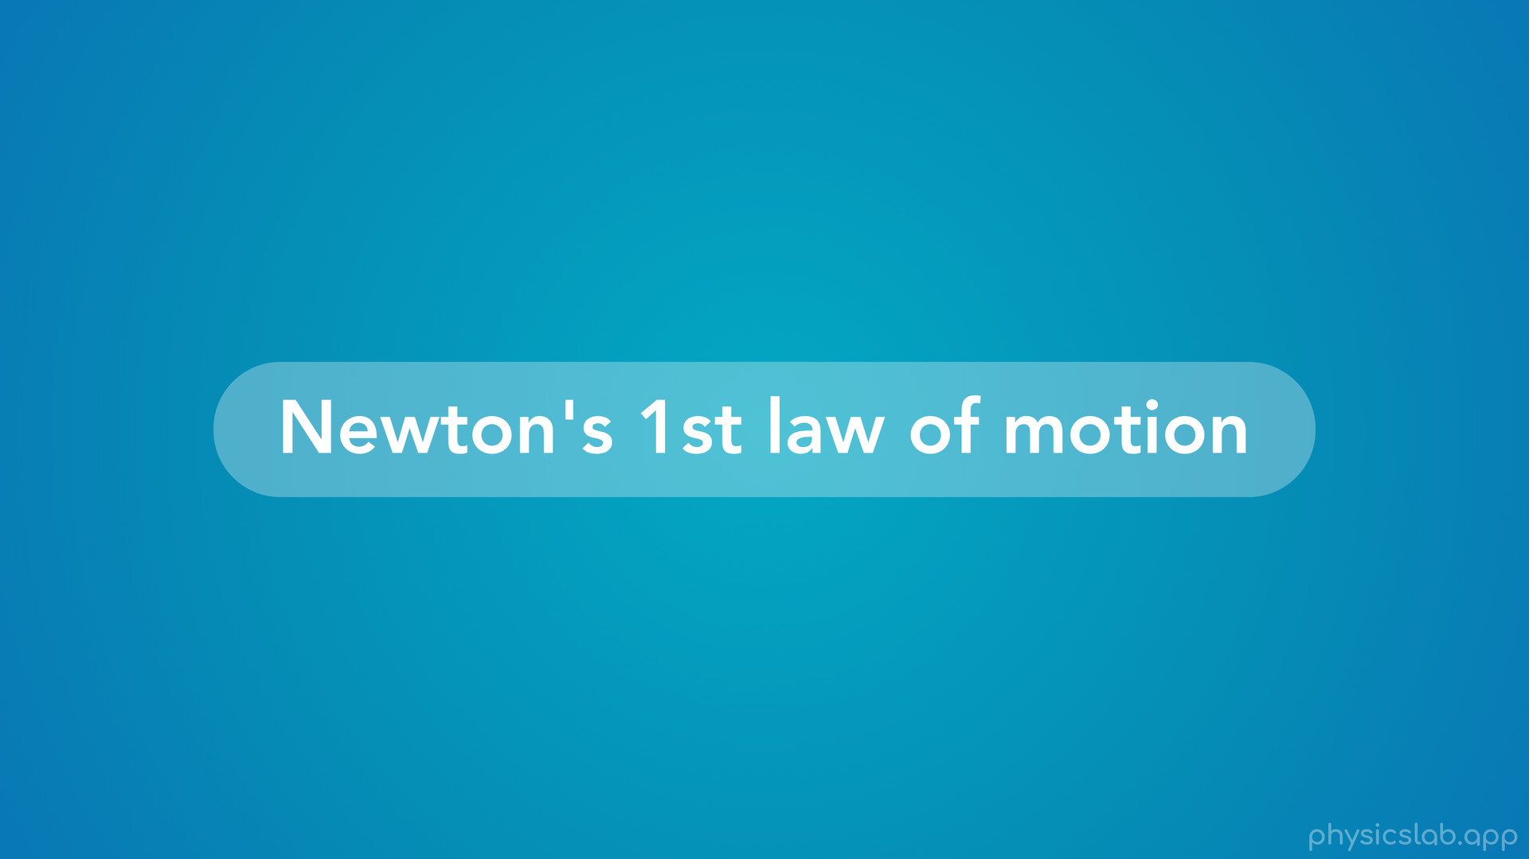
Notes:
• We’ll start with the 1st law and cover the next two in other videos.

Slide 39
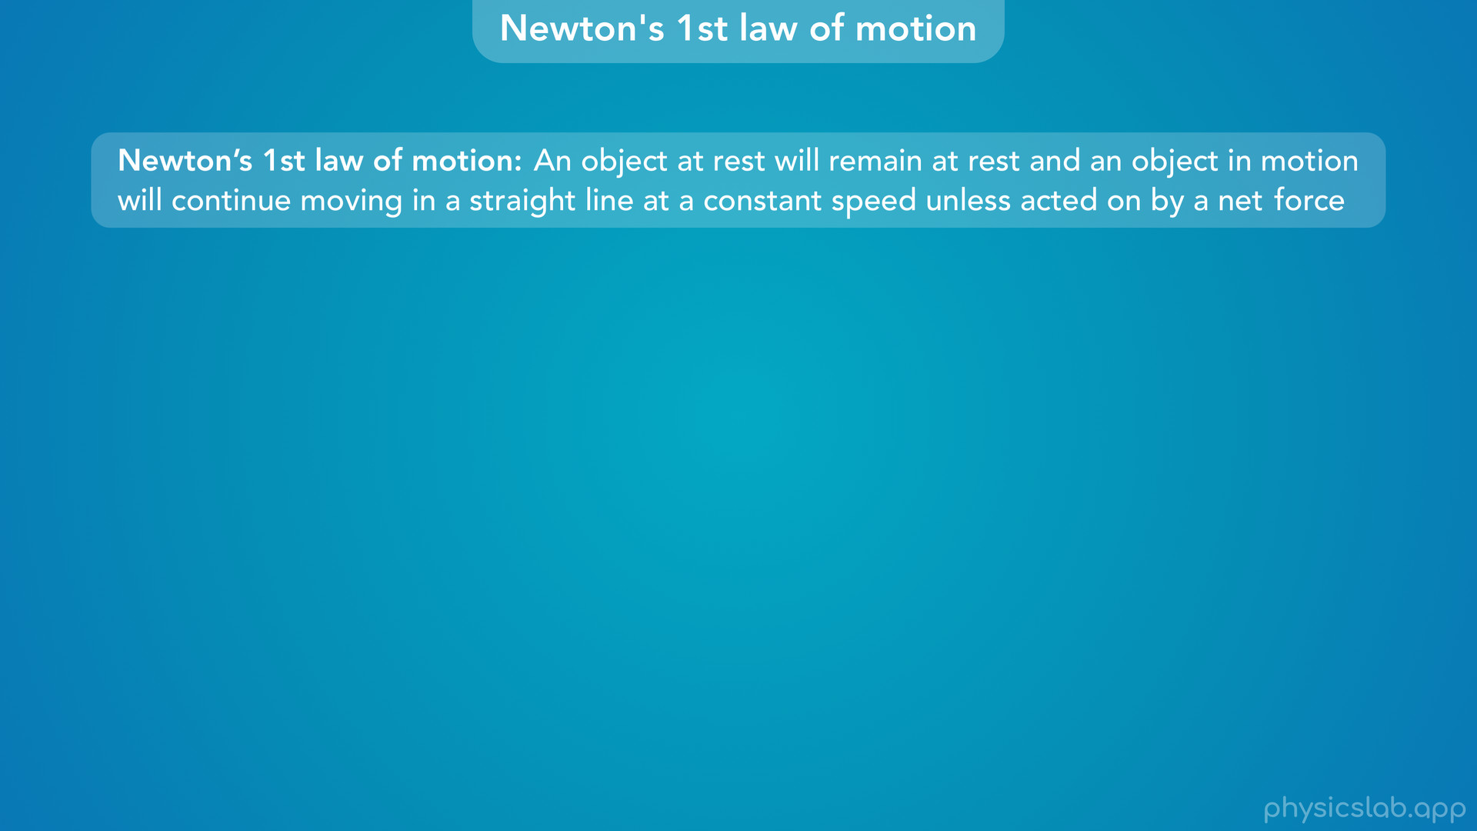
Notes:
• Newton’s 1st law of motion says that “an object at rest will remain at rest, and an object in motion will continue moving in a straight line at a constant speed unless acted on by a net force”.

Slide 40
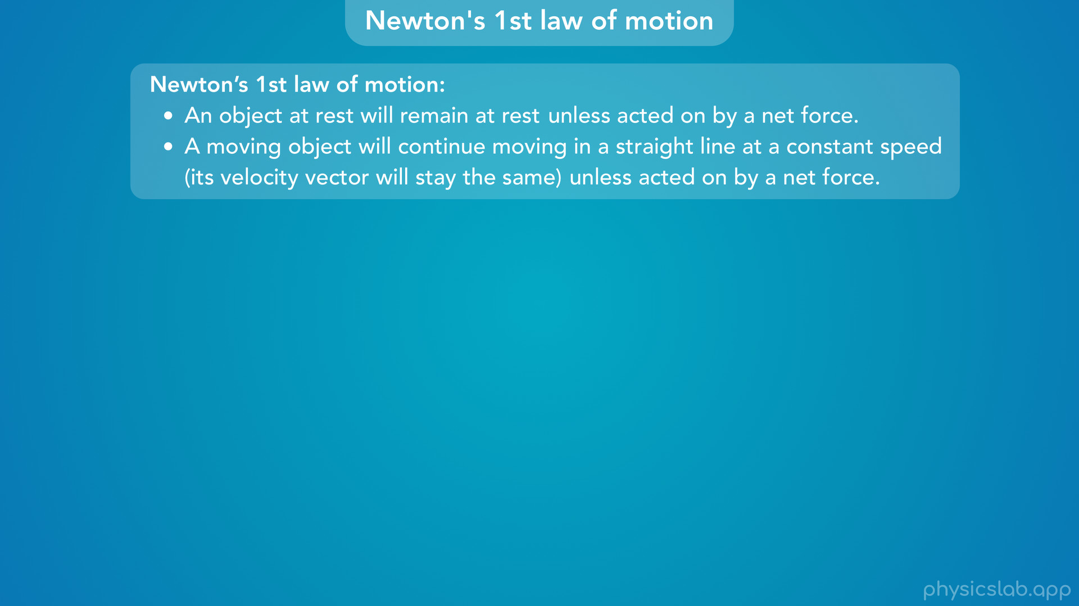
Notes:
• There’s really two parts to this law, so let’s split them up and talk about each one.

Slide 41
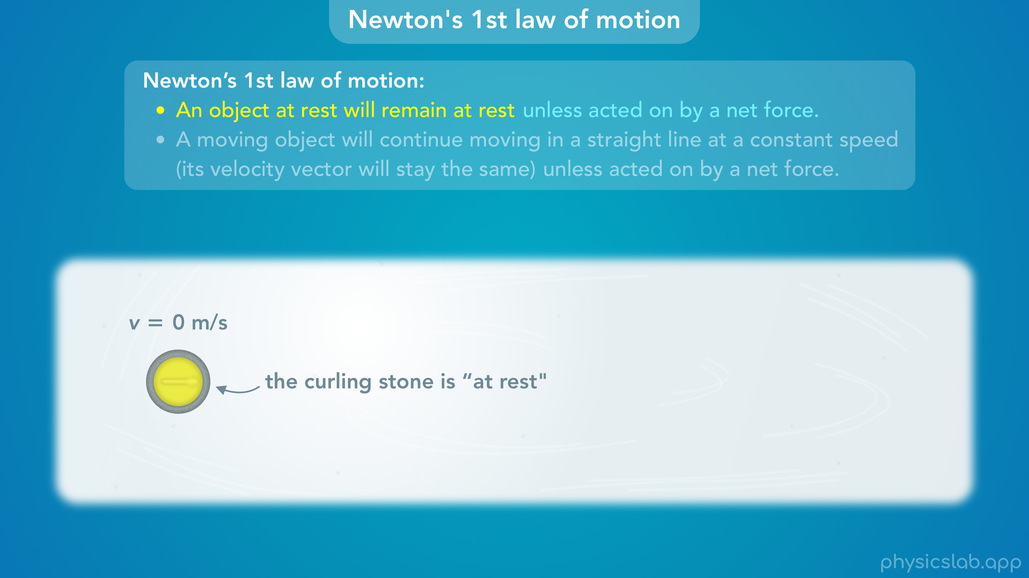
Notes:
• First, an object at rest will remain at rest unless acted on by a net force.
• So let’s say we have a curling stone sitting at rest on some ice. Remember, “at rest” means the object isn’t moving.
• Newton’s 1st law says that this curling stone will remain at rest, it will continue to not move, unless a net force is applied to it. So if you want the stone to start moving, you need to push it with a net force.

Slide 42
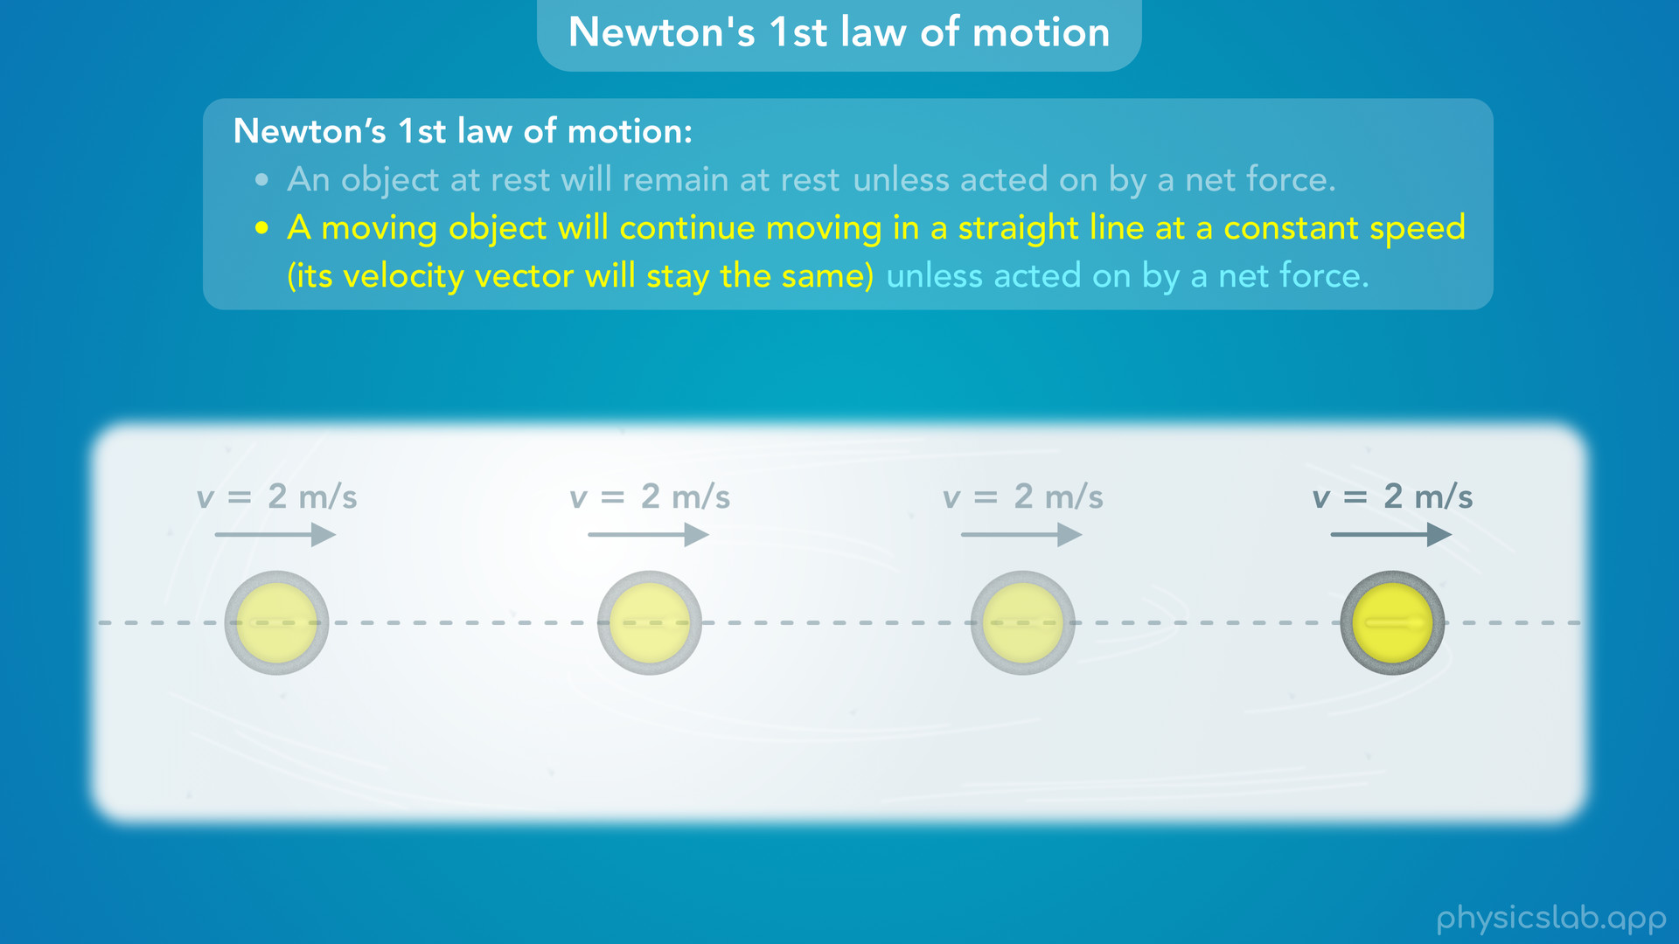
Notes:
• The second part says that “a moving object will continue moving in a straight line at a constant speed (which means its velocity vector will stay the same) unless acted on by a net force”.
• So let’s say someone already pushed the curling stone. Once it’s moving, it will continue to move in a straight line at a constant speed, forever. It won’t speed up, it won’t slow down, and it won’t change direction.
• If we want to stop the curling stone, we need to apply a net force.

Slide 43
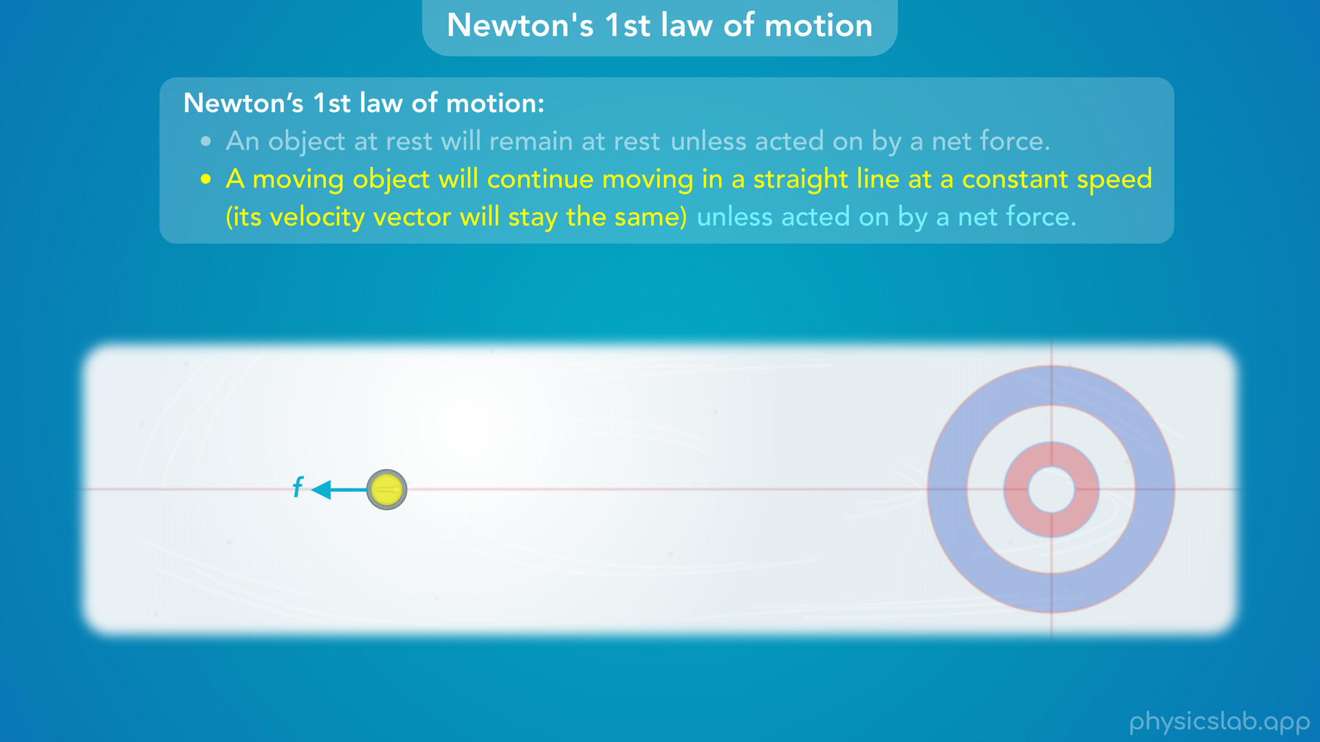
Notes:
• And that’s usually what happens. Even though ice is slippery, there’s still some friction force acting on the curling stone in the opposite direction.

Slide 44
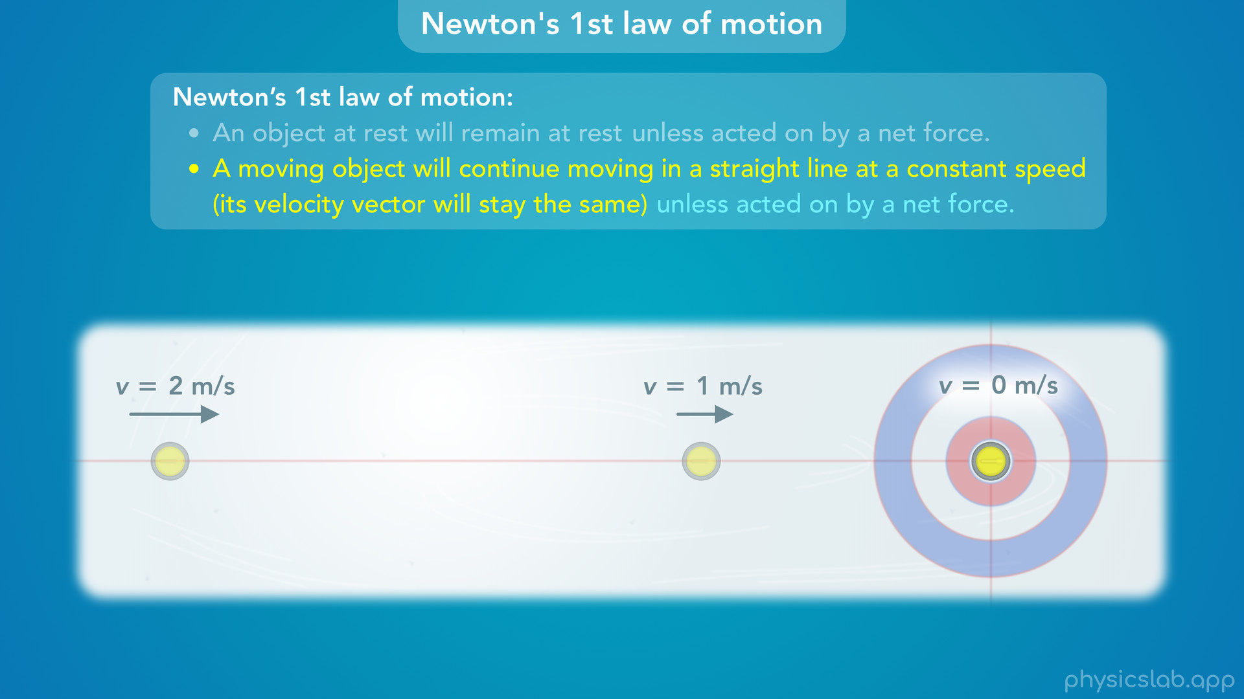
Notes:
That friction is the net force which is slowing it down, or changing its speed according to Newton’s 1st law.

Slide 45
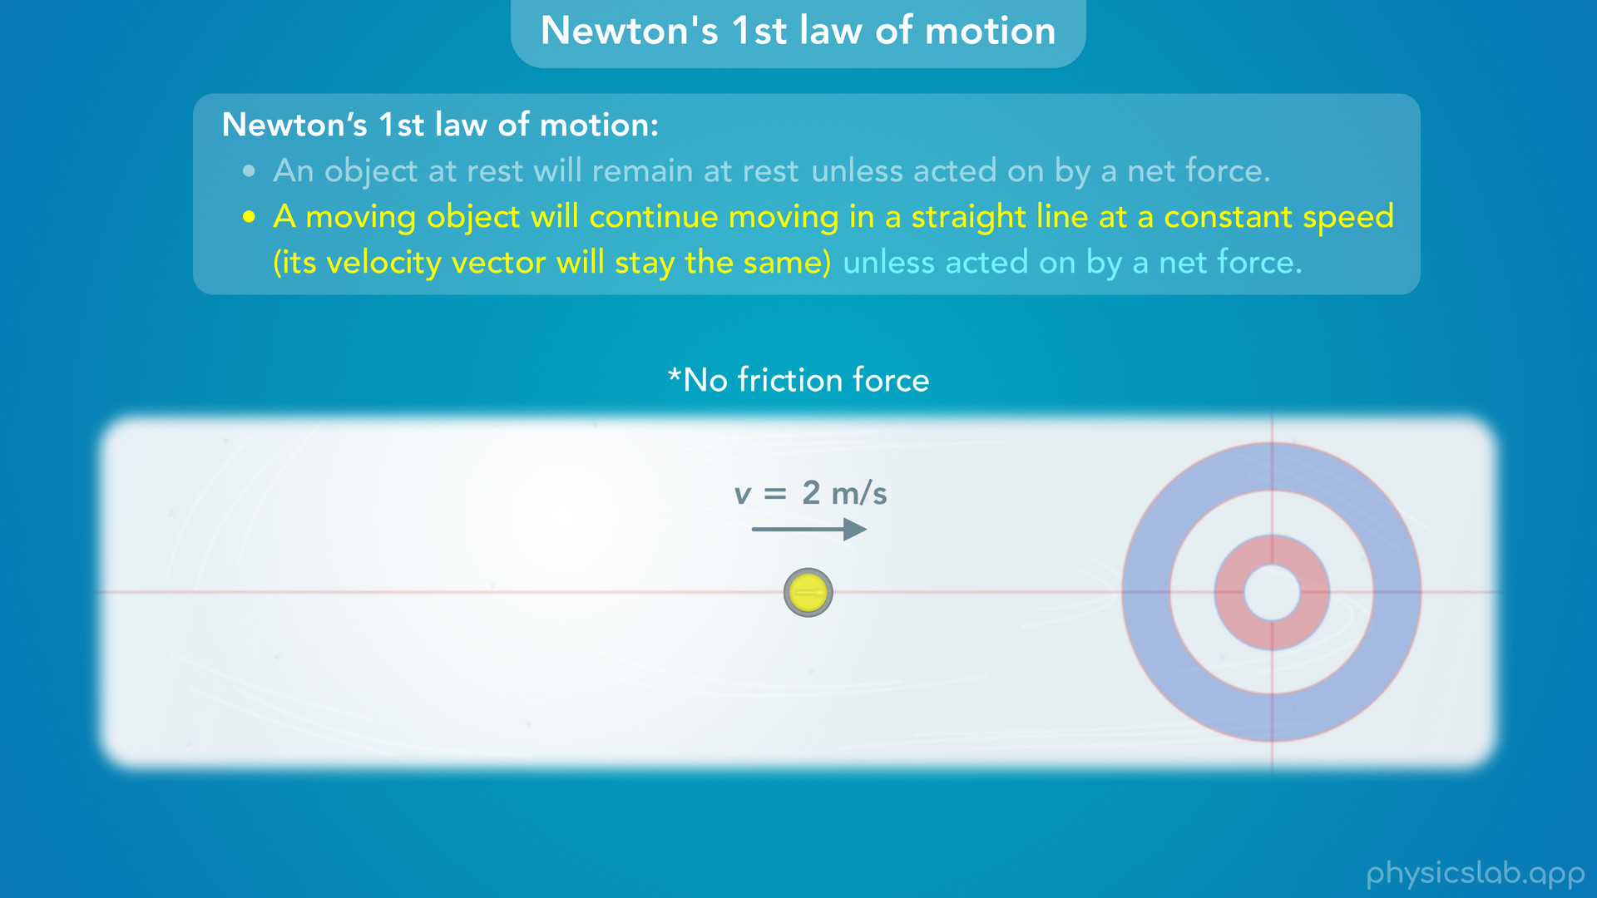
Notes:
• If the ice had no friction, and there was no air resistance, then the curling stone would move at a constant speed forever.

Slide 46
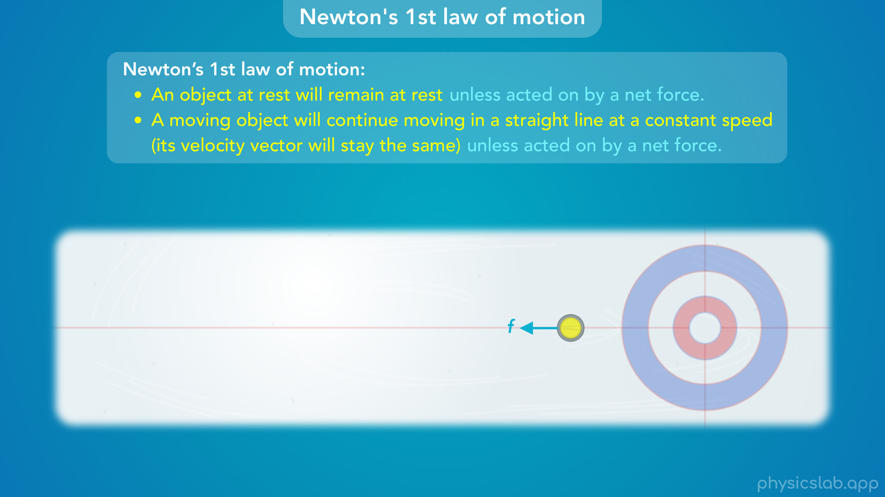
Notes:
• Pretty much every object has a friction force acting on it, so it can make things a little confusing when we’re trying to learn how forces affect motion.
• It helps to think about objects sliding on ice with no friction, but let’s go somewhere else where there are no other forces to worry about...

Slide 47
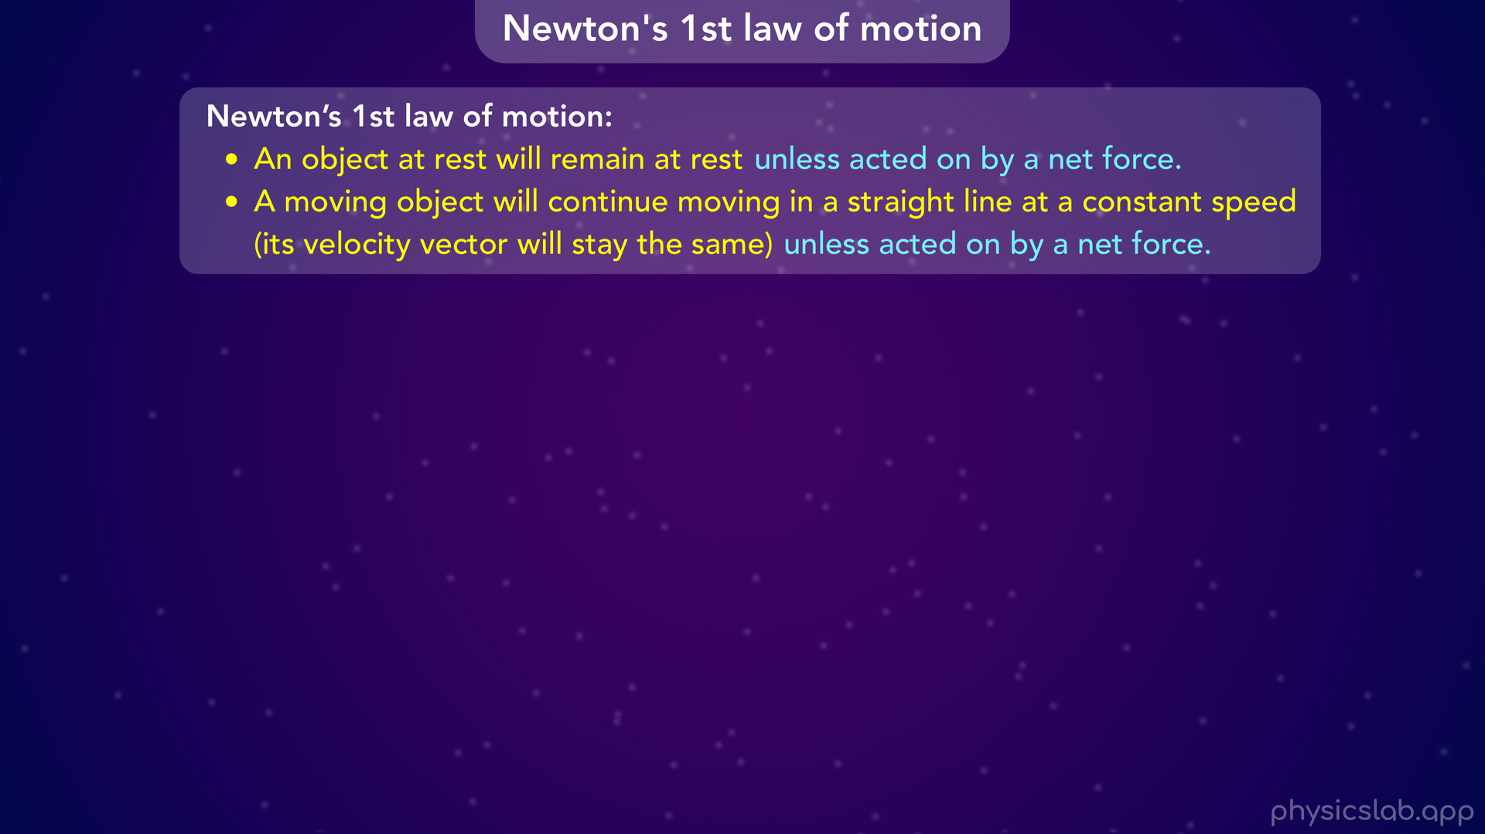
Notes:
• … somewhere deep in outer space. The laws of physics work the same way everywhere in the universe.

Slide 48
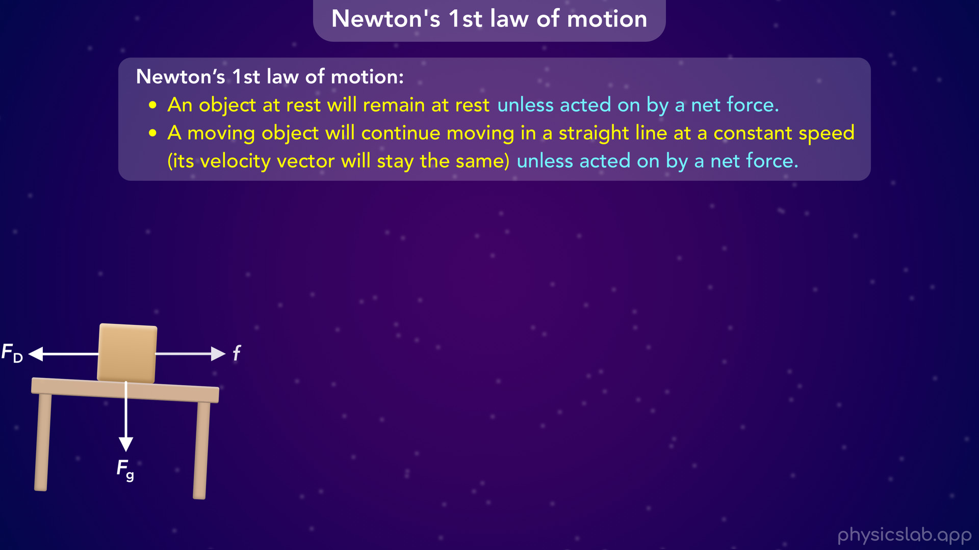

Slide 49
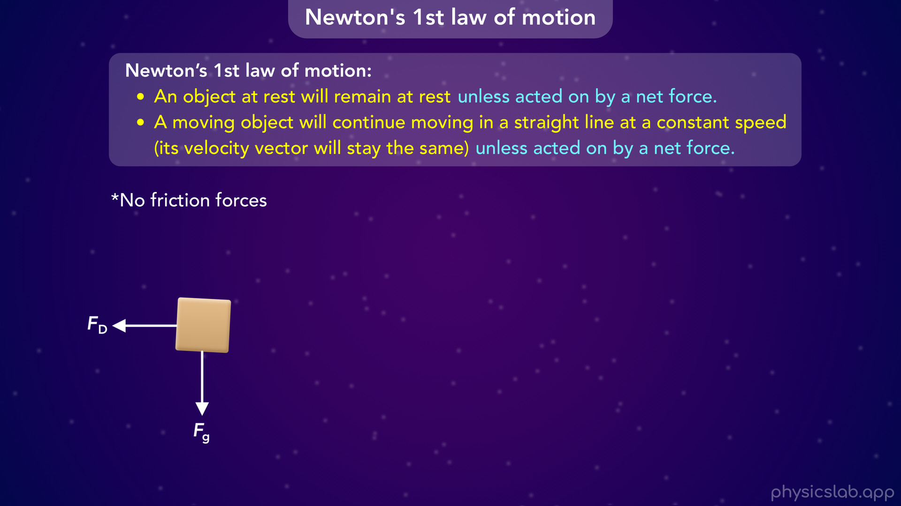
Notes:
But out here, we can imagine an object has no friction forces, because it’s not touching any surface…

Slide 50
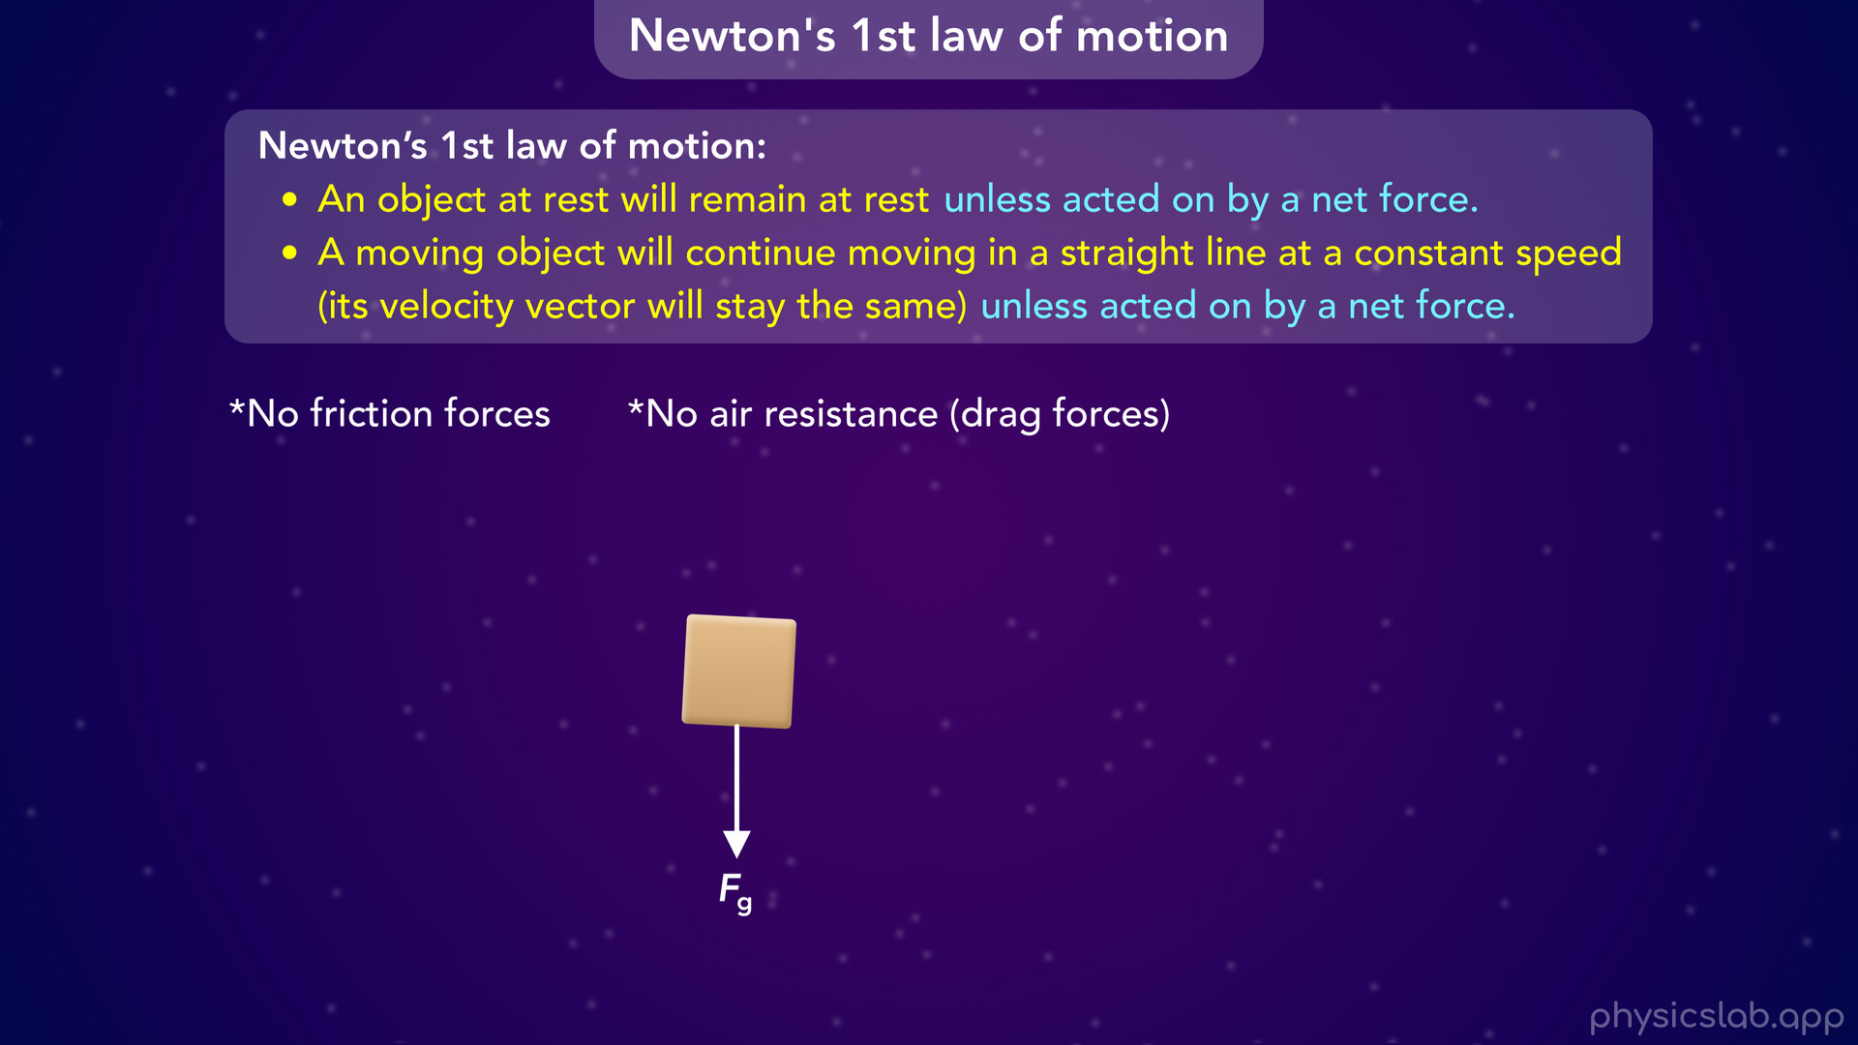
Notes:
there’s no air resistance because there’s no air in the vacuum of space…

Slide 51
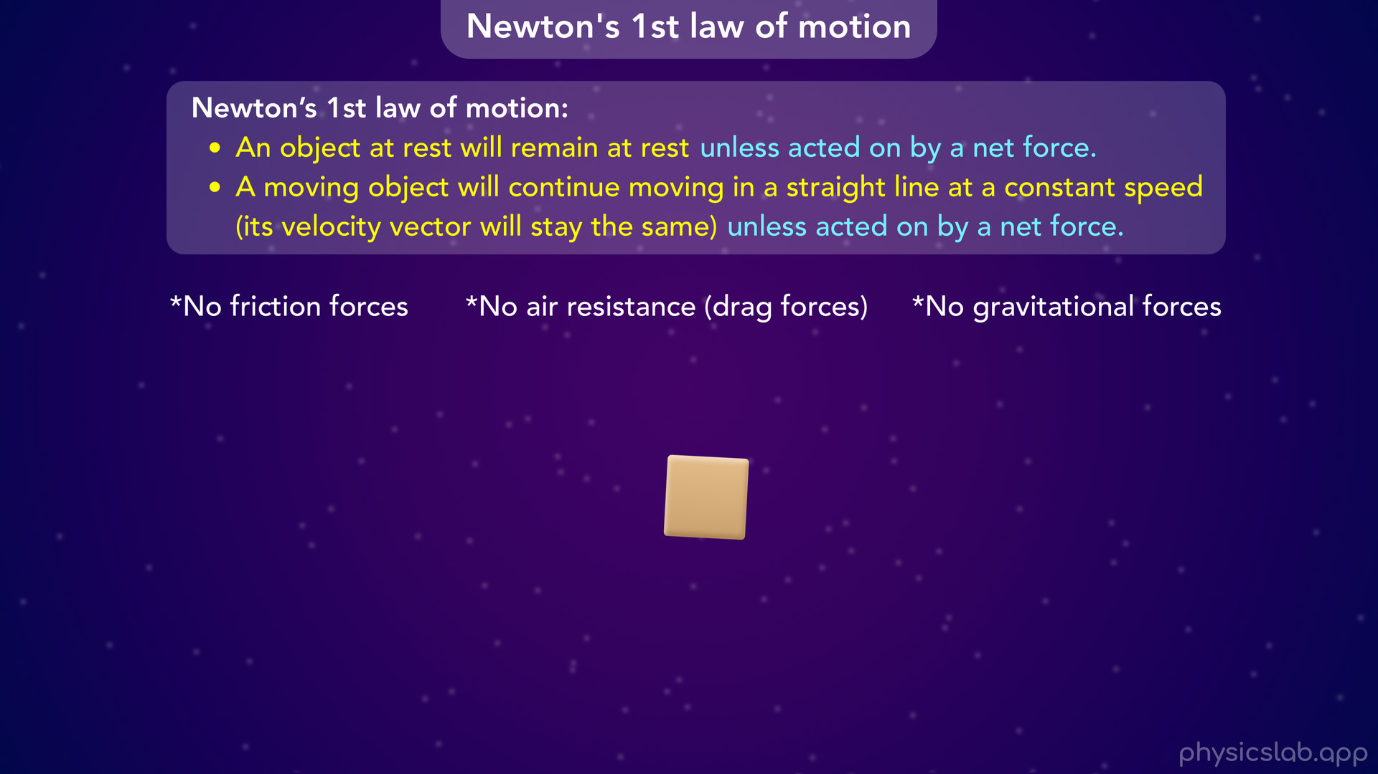
Notes:
and we’ll assume there’s no gravitational forces because the object is far away from the Earth, the sun and other planets.

Slide 52
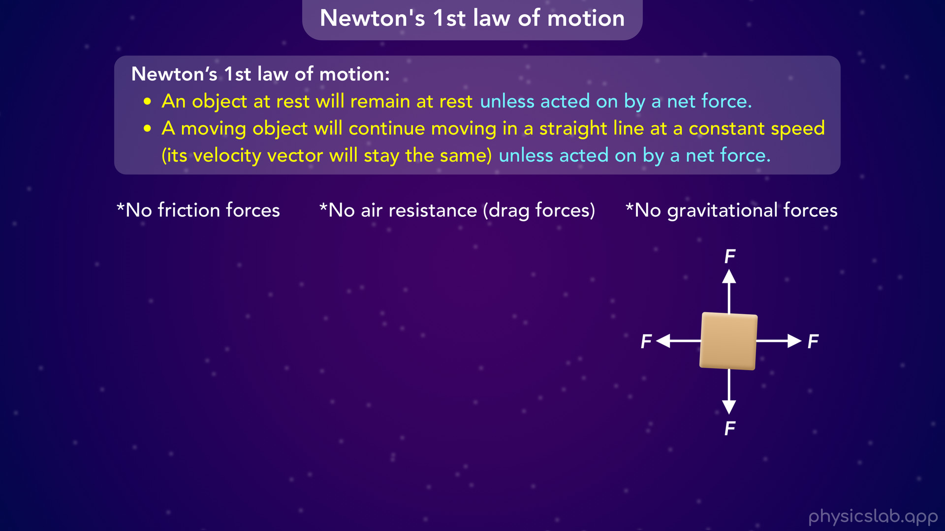
Notes:
• So this box is free to float around in space, and we can apply our own forces to better understand how they affect its motion.

Slide 53
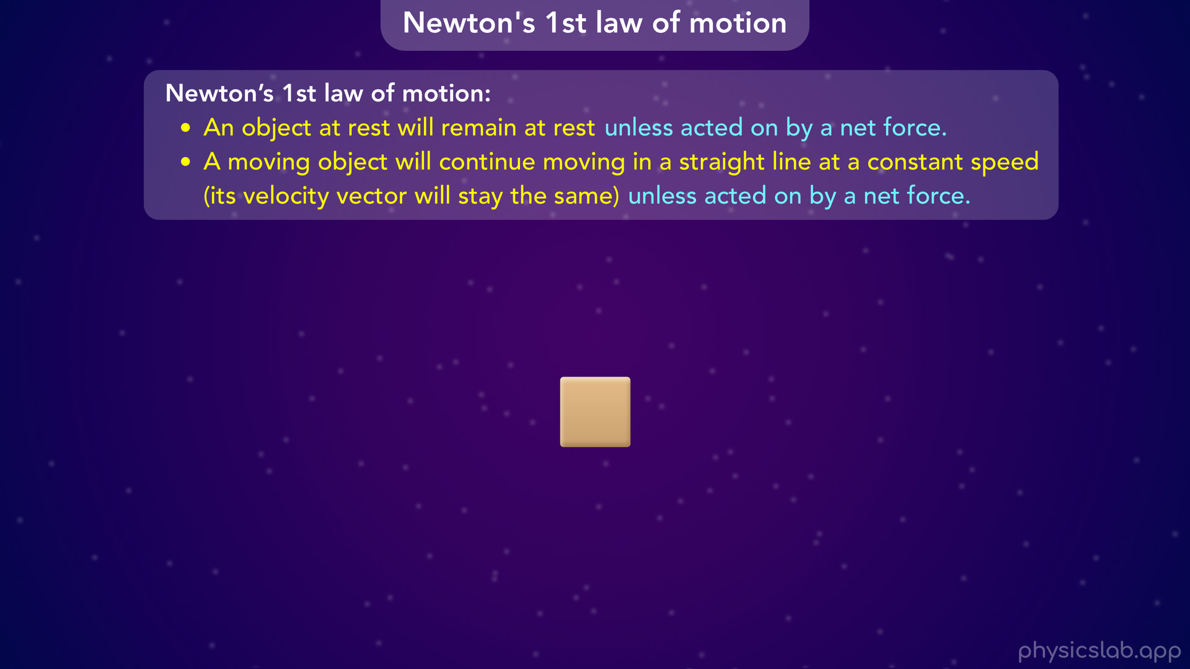
Notes:
• This is really how we wanna start thinking about objects, forces and motion. Instead of assuming an object will behave a certain way, we wanna start from the ground up. Imagine the object with no forces acting on it…

Slide 54
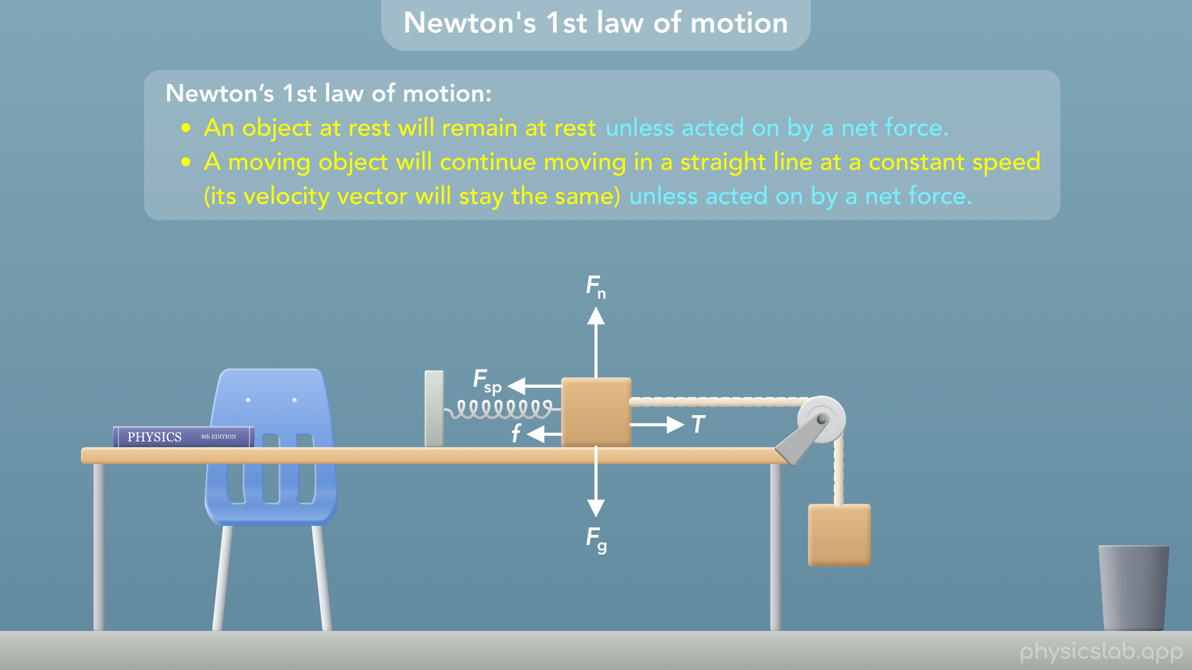
Notes:
• …then we can add on any forces that are involved in different situations, and then we can figure out the motion from there.
• But fundamentally, all object’s follow Newton’s laws of motion...

Slide 55
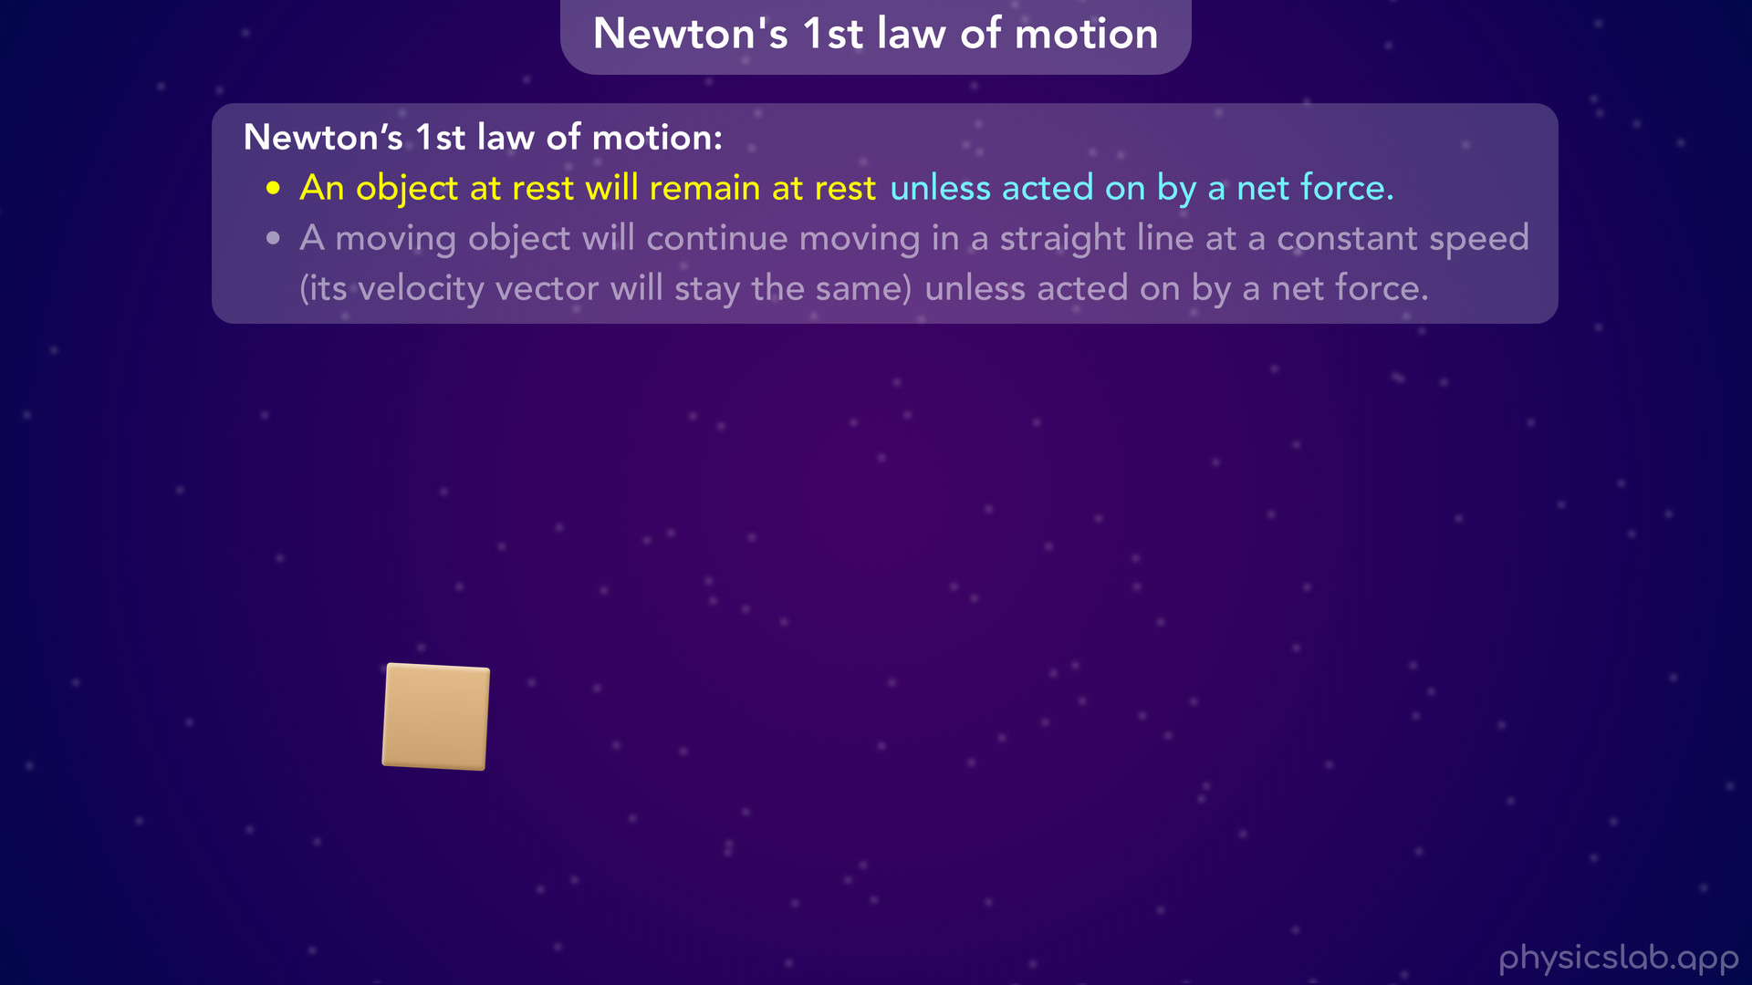
Notes:
…which start, with how objects move when there is no net force.

Slide 56
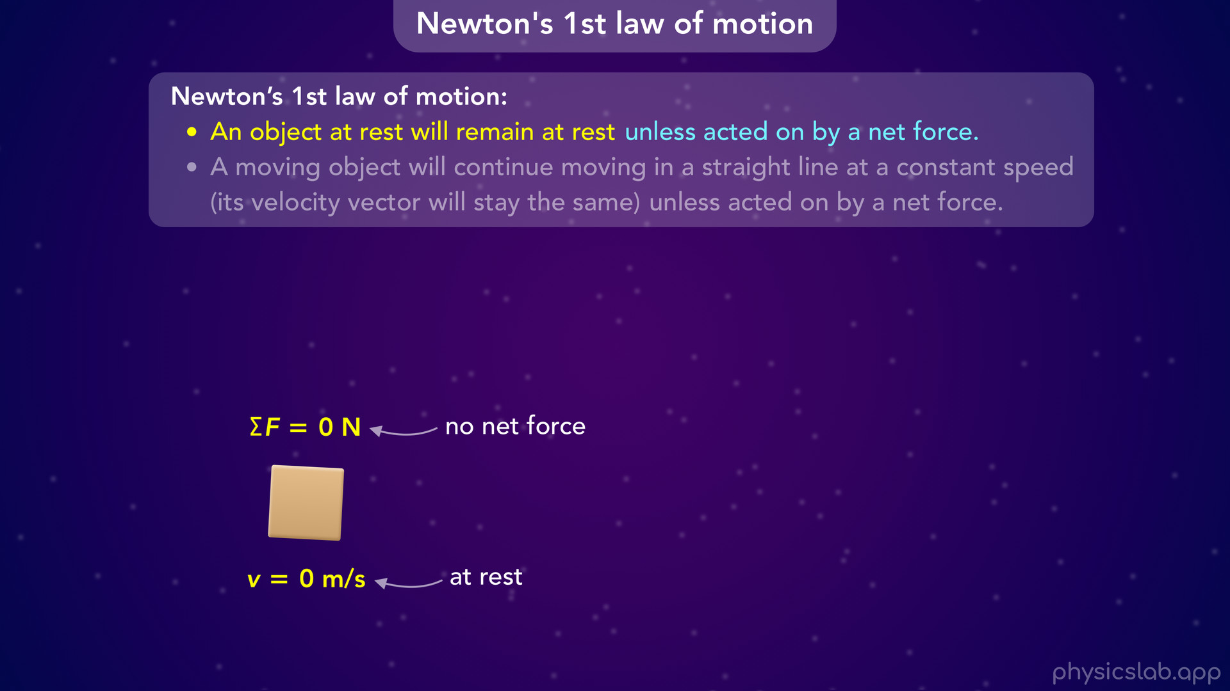
Notes:
• So, let’s say we have a box that is not moving. The box is at rest and it has zero speed. We’re assuming that there are no forces acting on the box, which means the net force on the box is zero.
• According to Newton’s 1st law, this box will remain at rest forever.
• The only way that it’ll start to move is if some net force is applied to it, which we’ll get to in a second.

Slide 57

Notes:
But this means that “a force is not required to keep an object at rest”. Objects remain at rest on their own.

Slide 58

Notes:
• Now let’s look at a box that is already moving at 2 m/s. Again, there are no forces and no net force on the box.

Slide 59

Notes:
According to Newton’s 1st law, the box will continue moving in a straight line at a constant speed forever. The net force is zero, so the velocity is constant. The box doesn’t speed up, slow down, or change direction. So we can say “a force is not required to keep an object moving”.
• You might be thinking, well, why is the box moving? Wouldn’t a force be required to get it moving? Otherwise it would remain at rest. And that’s true. There’s a subtle difference between those two things that can be confusing.
• A net force is required to change its velocity from not moving to 2 m/s.

Slide 60

Notes:
But this box was already moving at 2 m/s,

Slide 61

Notes:
and newtons 1st law is saying a force is not required to keep it moving.

Slide 62

Notes:
• This is known as “inertia”, which is the tendency for an object to maintain its state of motion, or resist a change to its state of motion.
• So we could say this box will move at a constant velocity forever because of its own inertia, or because it follows Newton’s 1st law, which is often referred to as the law of inertia.
• So that’s what happens when there are no forces involved. But Newton’s 1st law only mentions a net force, so what’s another scenario where the net force is zero?

Slide 63

Notes:
• Since we’re in space, let’s add some rocket thrusters that pull the box in opposite directions. In this case each thruster pulls with the same amount of force, 3 N. So what is the net force on the box?

Slide 64

Notes:
• It would be 3 N minus 3 N which is 0 N. The forces have the same strength and pull in opposite directions so they cancel out, and there’s no net force.

Slide 65

Notes:
• If the box is at rest then it will remain at rest, and we can say “an object at rest may have forces acting on it (but the net force is zero)”.

Slide 66

Notes:
• What if this same box was already moving at 2 m/s?

Slide 67

Notes:
The net force is still zero, so the velocity is constant.

Slide 68

Notes:
This box will move in a straight line at 2 m/s forever.

Slide 69

Notes:
• Again, it doesn’t matter how or why the box was moving to begin with, maybe someone gave it a push. But it’s already moving and the net force is zero, so it will continue moving with a constant velocity.
• And we could say that “an object moving with a constant velocity may have forces acting on it (but the net forces is zero).

Slide 70

Notes:
• But what if there is a net force?
• Let’s say the rocket thruster on the right is now pulling with 5 N of force.

Slide 71

Notes:
Now net force on the box is 5 N minus 3 N

Slide 72

Notes:
which is 2 N to the right.

Slide 73

Notes:
According to Newton’s 1st law, the box will not remain at rest or move at a constant speed. The net force is not zero, so the velocity will change.

Slide 74

Notes:
• It turns out that the box will accelerate and speed up in the direction of the net force, which will be explained by Newton’s 2nd law.
• So, if this box started at rest, the net force of 2 N will cause it to start moving and speed up over time.

Slide 75


Slide 76

Notes:
• Or let’s say the net force was acting to the left and the box was already moving at 2 m/s. The net force would cause it to slow down because it’s in the opposite direction as the velocity.

Slide 77

Notes:
• So we can say that “if an object’s velocity changes, there must be a net force acting on it”.

Slide 78

Notes:
• When we think of velocity, we usually think of the magnitude, or how fast something’s moving. But velocity is a vector so it has a magnitude (which we call speed) and it has a direction.
• Newton’s 1st law applies to both parts. The speed and/or the direction will change if there’s a net force. We saw how the speed would change, but how would the direction change?

Slide 79

Notes:
• That happens if the net force is not parallel to the velocity.
• So if this box is initially moving to the right and the net force is upwards, the velocity will change direction.

Slide 80

Notes:
• Newton’s 1st law says a moving object will continue moving in a straight line at a constant speed unless acted on by a net force.

Slide 81

Notes:
• So we can say “if the direction of an object’s velocity changes, there must be a net force acting on it”.

Slide 82

Notes:
• So here’s a quick summary of Newton’s 1st law of motion.

Slide 83

Notes:
• First, an object at rest will remain at rest if there is no net force acting on it. There may be forces, but there’s no net force because they cancel out.

Slide 84

Notes:
• Second, a moving object will continue moving in a straight line at a consant speed if there is no net force acting it. Again, there may be forces, but there’s no net force.

Slide 85

Notes:
• If there is a net force acting on the object, its velocity will change. It might speed up…

Slide 86

Notes:
it might slow down…

Slide 87

Notes:
or it might change direction.

Slide 88

Notes:
• While we’re here, let’s explain why those statements we saw before aren’t true.

Slide 89

Notes:
• First, “objects eventually stop moving on their own and they naturally come to rest”. Now we know from Newton’s 1st law that objects actually keep moving on their own because of their inertia.

Slide 90

Notes:
• If a moving object slows down and stops, it’s because there’s some net force causing it to do that.

Slide 91

Notes:
• Next, objects don’t move on their own and a force is needed to move an object.
• Here’s where we need to be more specific. Objects continue to move on their own once they’re moving, and a force is not needed to keep an object moving.

Slide 92

Notes:
• But if we meant that objects don’t start to move on their own, then that’s true, a net force is needed to get an object moving from rest. So we could say that one’s half true, we just need to be specific about the word “move”.

Slide 93


Slide 94

Notes:
• And last, if an object is not moving then there are no forces acting on it.
• It’s true that an object will remain at rest if there are no forces acting on it, but we also saw that an object will remain at rest if there are forces acting on it, as long as the net force is zero.

Slide 95

Notes:
• So that’s Newton’s 1st law of motion.
• It’s easy to see how objects move in space when there’s no other forces involved…

Slide 96

Notes:
• …but let’s go back to the real world and use Newton’s 1st law to explain the scenarios from before.
• We still have a lot more to learn about forces so don’t worry if something doesn’t make sense yet.

Slide 97

Notes:
• So first, if you push on a box and it doesn’t move, what’s going on?

Slide 98

Notes:
• According to Newton’s 1st law, if box remains at rest then the net force on the box must be zero. So let’s look at a free body diagram of the box, and just focus on the horizontal forces.
• If the person is applying a pushing force to the right, how can the net force be zero?

Slide 99

Notes:
Well, there must be another force with the same magnitude acting to the left, and in this case that force is friction.

Slide 100

Notes:
• For example, maybe both forces have a strength of 30 N, so the net force is 0, and the box remains at rest.
• If one force was greater, then the box would start to accelerate. But since it remains at rest, we know that the net force on the box must be zero.

Slide 101

Notes:
• In the next scenario, when you slide a book across a table, why does it slow down and stop?

Slide 102

Notes:
• According to Newton’s 1st law, there must be a net force acting on the book.
• After you let go, there is only a friction force acting on the book in the horizontal direction

Slide 103

Notes:
maybe it’s something like 8 N. So the net force on the book is that friction force, 8 N to the left.
Since the net force is not zero, the velocity changes, from 5 m/s to 0 m/s.
The book doesn’t stop on its own, it stops because of the net force. If there was no friction, the book would keeping moving because of its own inertia.

Slide 104

Notes:
• You might be asking, once the book stops, why does it remain at rest if there’s a net force?
• Well it turns out that once the book stops moving, there’s no longer a friction force. We’ll explain that more in the lesson on friction, but now that there’s zero net force, the book remains at rest.

Slide 105

Notes:
• In the next scenario, why does the hockey puck keep moving at a constant speed?

Slide 106

Notes:
• According to Newton’s 1st law, there must be no net force on the puck.
• If the speed actually is constant, then there’s no friction force on the puck, because the net force is zero and there’s no other horizontal forces.
• So without friction, the puck will move in a straight line at a constant speed forever.

Slide 107

Notes:
• But in the real world, there is a small friction force, maybe something like 0.1 N. So there actually would be a net force on the puck and it would slow down and eventually stop.

Slide 108

Notes:
• Next, why does this box require a push to keep moving at a constant speed?

Slide 109

Notes:
• Let’s say the person is pushing the box to right with 35 N of force. If the box is moving at a constant speed, Newton’s 1st law tells us that the net force must be zero.

Slide 110

Notes:
So there must be a 35 N friction force (or some other force) acting to the left.
The box does require a net force to start moving from rest, maybe another person helped get it moving. But while it’s moving at a constant speed of 1 m/s, the net force must be zero. If either force was greater, then the box would speed up or slow down.

Slide 111

Notes:
• In the next scenario, why does the ball accelerate downwards?

Slide 112

Notes:
• If the speed is changing, Newton’s 1st law says that there must be a net force acting on the ball.
• And it turns out that the only force is a downwards gravitational force from the earth, if we ignore air resistance.

Slide 113

Notes:
For a baseball that force is about 1.5 N.
So the net force on the ball is 1.5 N downwards, which causes the ball’s velocity to change.

Slide 114

Notes:
• In the last scenario, the car is turning around a sharp corner and the person feels like they’re moving sideways, towards the outside of the turn. So what’s going on?

Slide 115

Notes:
• Let’s look at this point in time when the car is here.

Slide 116

Notes:
The person’s velocity at that moment is pointing in this direction, and Newton’s 1st law says that the person will continue moving in a straight line unless there is a net force acting on them.

Slide 117

Notes:
So if we removed all the forces on the person, they would naturally move like this because of their inertia.

Slide 118

Notes:
• But there is a net force on the person from the seatbelt, or other forces from the car, so they don’t move in a straight line.

Slide 119

Notes:
The seatbelt forces their velocity to change direction, but person’s inertia wants them to be out here. So there isn’t a force pushing them outwards, its their inertia causing them to move sideways.
Don’t worry if this is confusing, it’ll make more sense when we learn about centripetal force. But this scenario can be explained using Newton’s 1st law of motion and an object’s tendency to move in a straight line because of its inertia.

Slide 120

Notes:
• So those are examples of how we can start to apply Newton’s 1st law of motion. Again, don’t worry if any of that was confusing, we’ll learn a lot more throughout the rest of this unit.

Slide 121

Notes:
• In the next video, we’ll learn about Newton’s 2nd law of motion and cover free body diagrams in more detail.
• Newton’s 2nd law is very similar to Newton’s 1st law, but it actually tells us how the acceleration is related to the net force using numbers and the one of the most famous equations in physics: F net = m a.

Slide 122

Notes:
• But that’s it for this video, so let’s do a quick summary.

Slide 123

Notes:
• The net force acting on an object is the total or the sum of all the forces acting on it.
• We usually write net force as sigma F, which means the sum of all the forces.
• If there’s only one force, then that’s also the net force.
• If there are multiple forces, we add them together if they’re in the same direction, and we subtract them if they’re in opposite directions.
• If the forces in each direction have the same magnitude, they cancel out and the net force is zero.

Slide 124

Notes:
• We say the forces are balanced if the net force is zero,

Slide 125

Notes:
and the forces are unbalanced if there is a net force in one direction.

Slide 126

Notes:
• Newton’s 1st law of motion has two parts.
• First, an object at rest will remain at rest unless acted on by a net force.
• There may be forces, but there’s no net force because they cancel out.
• So if an object is not moving, a net force is not required to keep it at rest, it’ll stay that way on its own.

Slide 127

Notes:
• Second, a moving object will continue moving in a straight line at a constant speed unless acted on by a net force. Again, this could mean there’s no forces on the object, or there are forces that cancel out so there’s no net force.
• A net force is not required to keep an object moving, it continues moving on its own because of its inertia.

Slide 128

Notes:
• If there is a net force acting on an object, then it will not remain at rest and it’s velocity will change.
• The net force might cause the object to start moving from rest or speed up.
• It might cause the object to slow down or stop.
• Or, since velocity is a vector, it could also cause the velocity to change direction, not just magnitude.

Slide 129
Notes:
• We can use Newton’s 1st law to explain any motion that we see, at least conceptually.

Slide 130
Notes:
• If an object isn’t moving, then there is no net force on the object. That could mean there’s no forces (which almost never happens), or there’s forces acting in opposite directions that cancel out.

Slide 131
Notes:
• When moving objects slow down and stop, there must be a net force acting on it, and it’s usually a friction force.

Slide 132
Notes:
• If there was no friction or air resistance, moving objects would continue moving in a straight line at a constant speed if the net force is zero.

Slide 133
Notes:
• If an object is moving at a constant velocity, Newton’s 1st law tells us that the net force must be zero, otherwise the object would accelerate.

Slide 134
Notes:
• That’s what happens in projectile motion. If we ignore air resistance, the only force acting on the object is a downwards gravitational force, and that net force causes the object to accelerate downwards.

Slide 135

Notes:
• And don’t forget that velocity is a vector, so a net force can also change an object’s direction, not just its speed.
• Newton’s 1st law says that an object wants to continue moving in a straight line because of its inertia. So if it doesn’t move in a straight line, there must be a net force acting on the object.

