Slide 1
Pulley Systems - Analyzing Objects and Systems
Slides Version 1
This version includes:
Slides with screenshot images from the video.
The video narration in the slide notes.
A blank template slide with the same background and font as the video.
Slides with some basic graphics from this video for you to use however you like.
Feel free to add, delete and edit slides to make your own presentation. You can use these slides in class or share them with your students, but please do not share them with anyone else.
If you have any feedback, suggestions or questions about these slides please email me at chris@physicslab.app or send me a message on Discord @physicslab.
physicslab.app

Slide 2
Heading
Text

Slide 3

Free body diagram

Slide 4
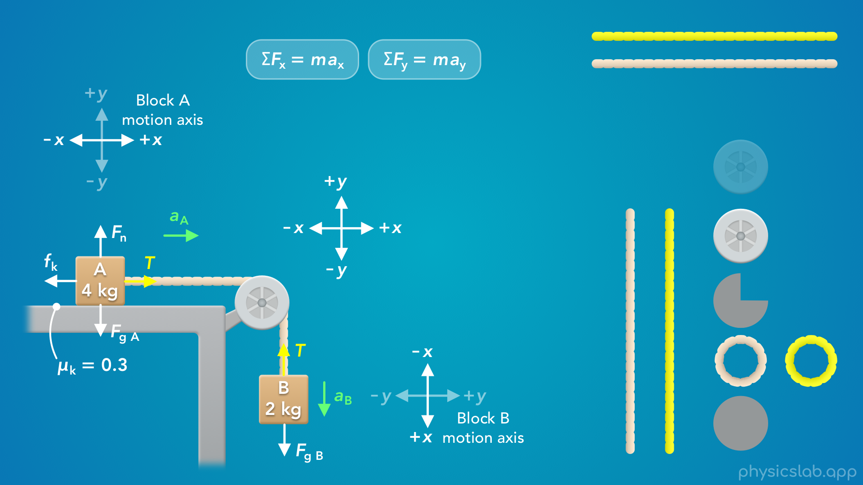











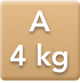







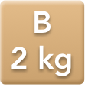





Slide 5




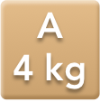
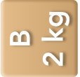








Slide 6
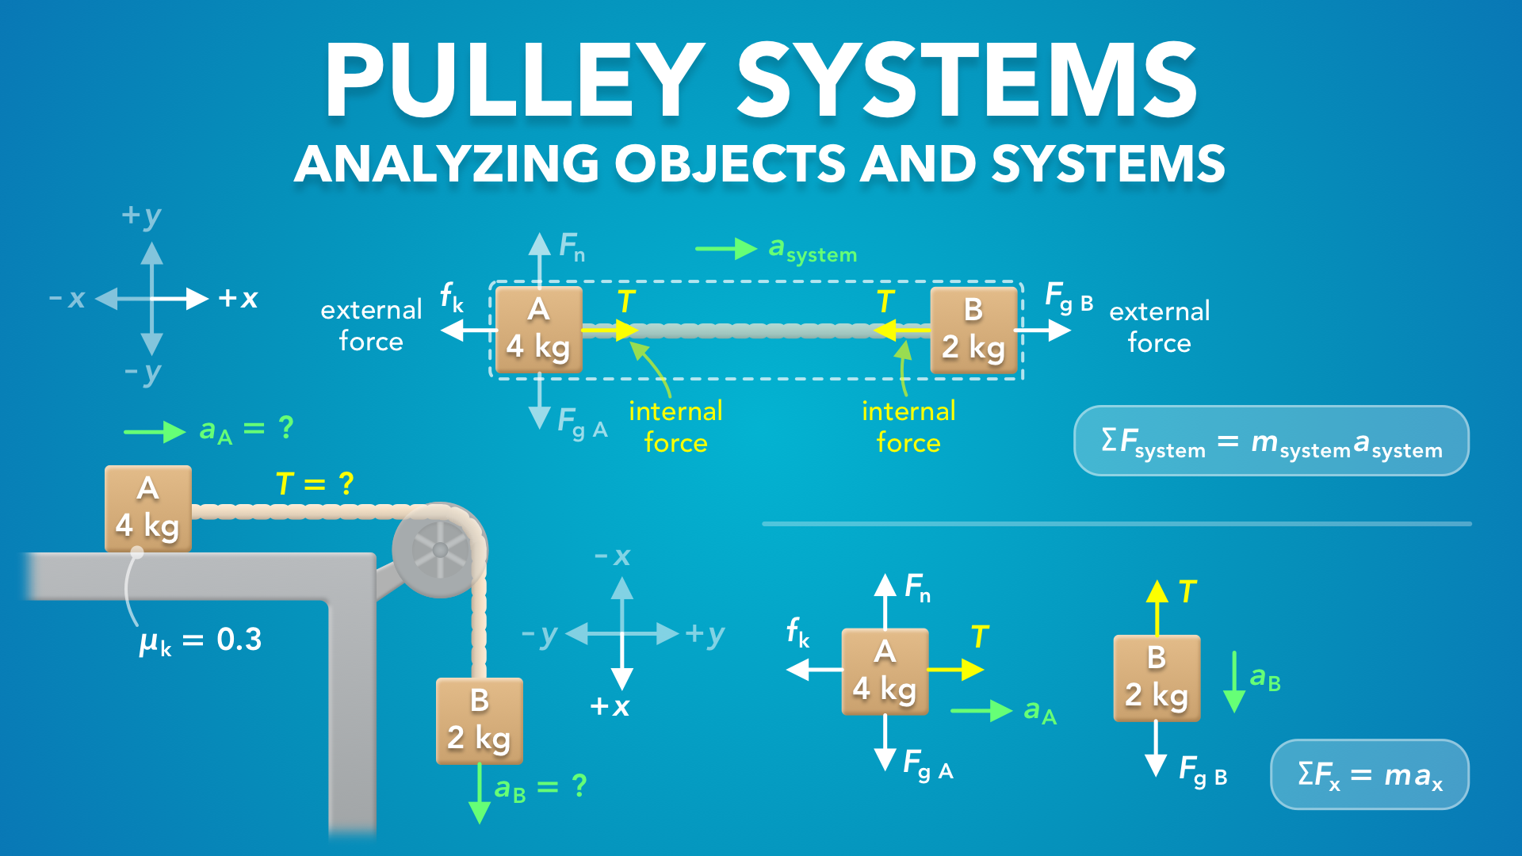
Notes:
Pulley Systems - Analyzing Objects and Systems
physicslab.app
If you have any questions, suggestions or feedback about these slides please email me at chris@physicslab.app or send me a message on Discord @physicslab.

Slide 7

Notes:
In this video we’re gonna go through an example of how to analyze pulley systems.

Slide 8
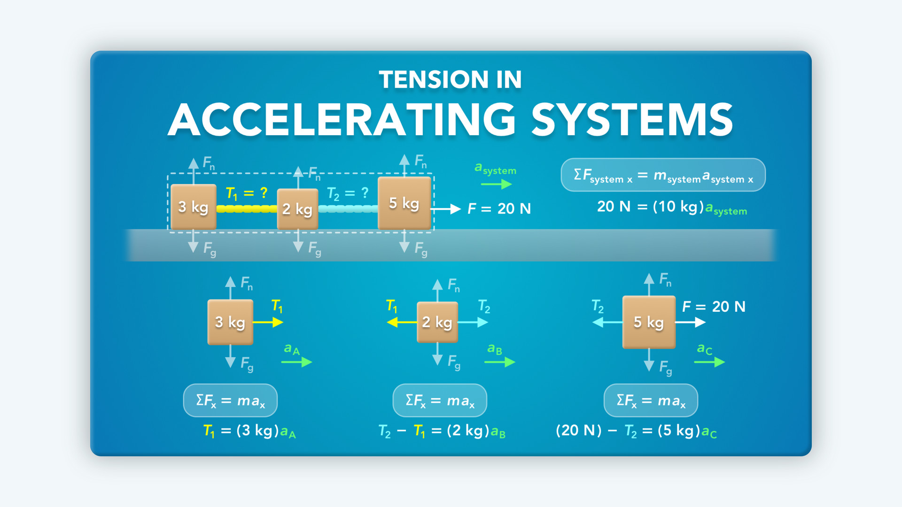
Notes:
• In a previous video, we learned how to analyze objects and systems.
• We’re going to apply this to pulley systems, so it’ll help if you watch that video first.

Slide 9
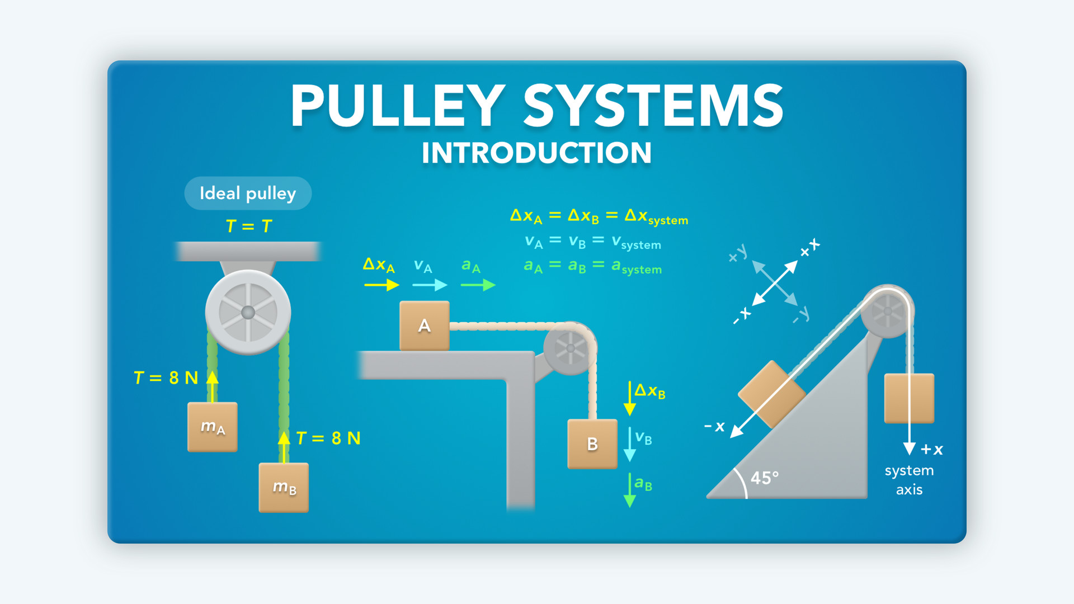
Notes:
• Also, make sure you watch the last video, where we learned that the blocks in a pulley system have the same acceleration, and how to set up the coordinate systems for each block and the overall system.

Slide 10
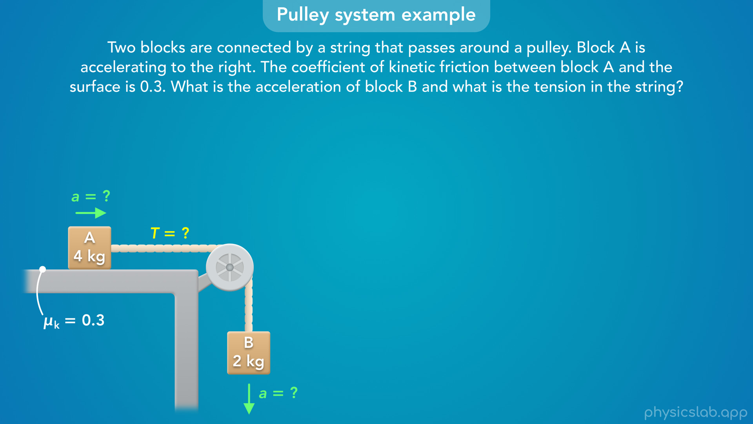
Notes:
• In this video we’re gonna walk through an example with a pulley system and learn how to find the acceleration of the blocks and the tension in the string.

Slide 11
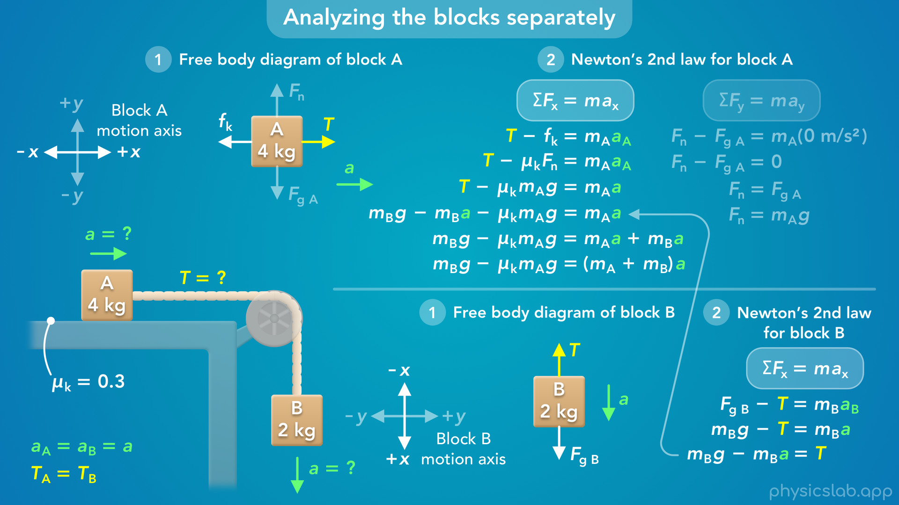
Notes:
• One method that we’ll use is to analyze the blocks separately.

Slide 12
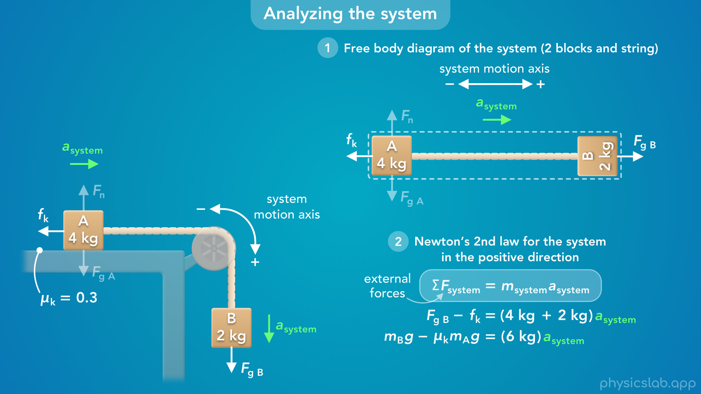
Notes:
• We’ll also look at an easier way to find the acceleration, by analyzing the blocks together.
• We’ll learn how to draw a free body diagram of the system and apply Newton’s 2nd law in the direction of motion.

Slide 13

Notes:
• So let’s walk through this example.

Slide 14
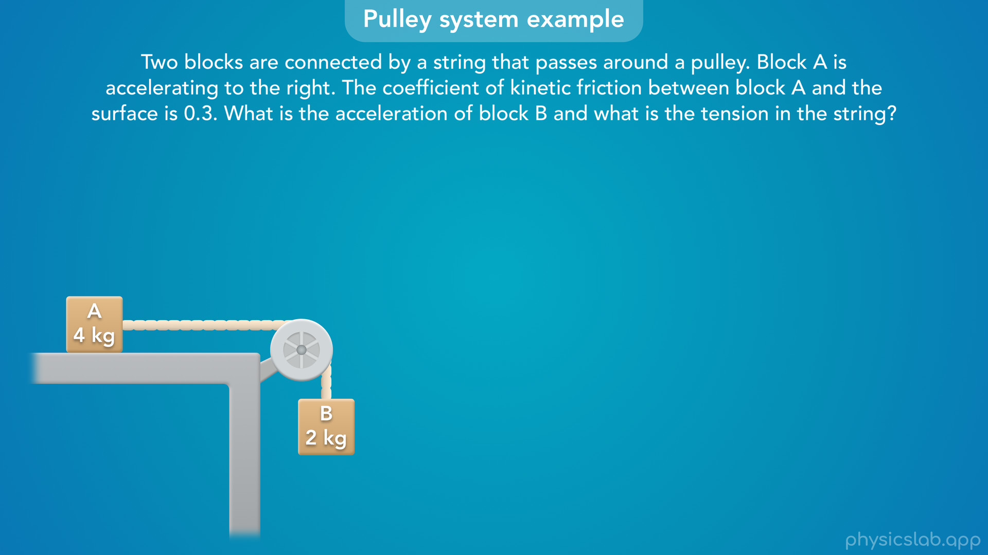
Notes:
• Two blocks are connected by a string that passes around a pulley. Block A is accelerating to the right. The coefficient of kinetic friction between block A and the surface is 0.3. What is the acceleration of block B and what is the tension in the string?
• Before we walk through it, pause the video and see if you can solve this first.
• Or at least try to draw the free body diagrams of the blocks and the system, and write out Newton’s 2nd law for each one.

Slide 15
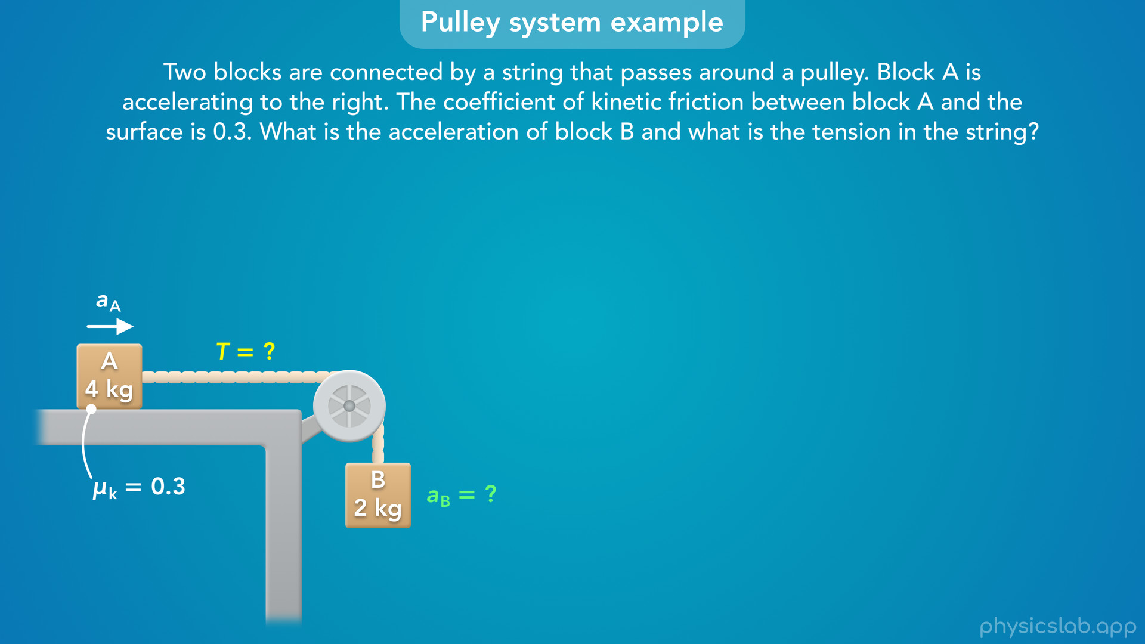
Notes:
• So what information are we given?
• We know that block A is accelerating to the right.
• The coefficient of kinetic friction, mu k, between block A and the surface is 0.3.
• And the mass of each block is included in the diagram.
• We want to find the acceleration of block B, and the tension in the string.

Slide 16
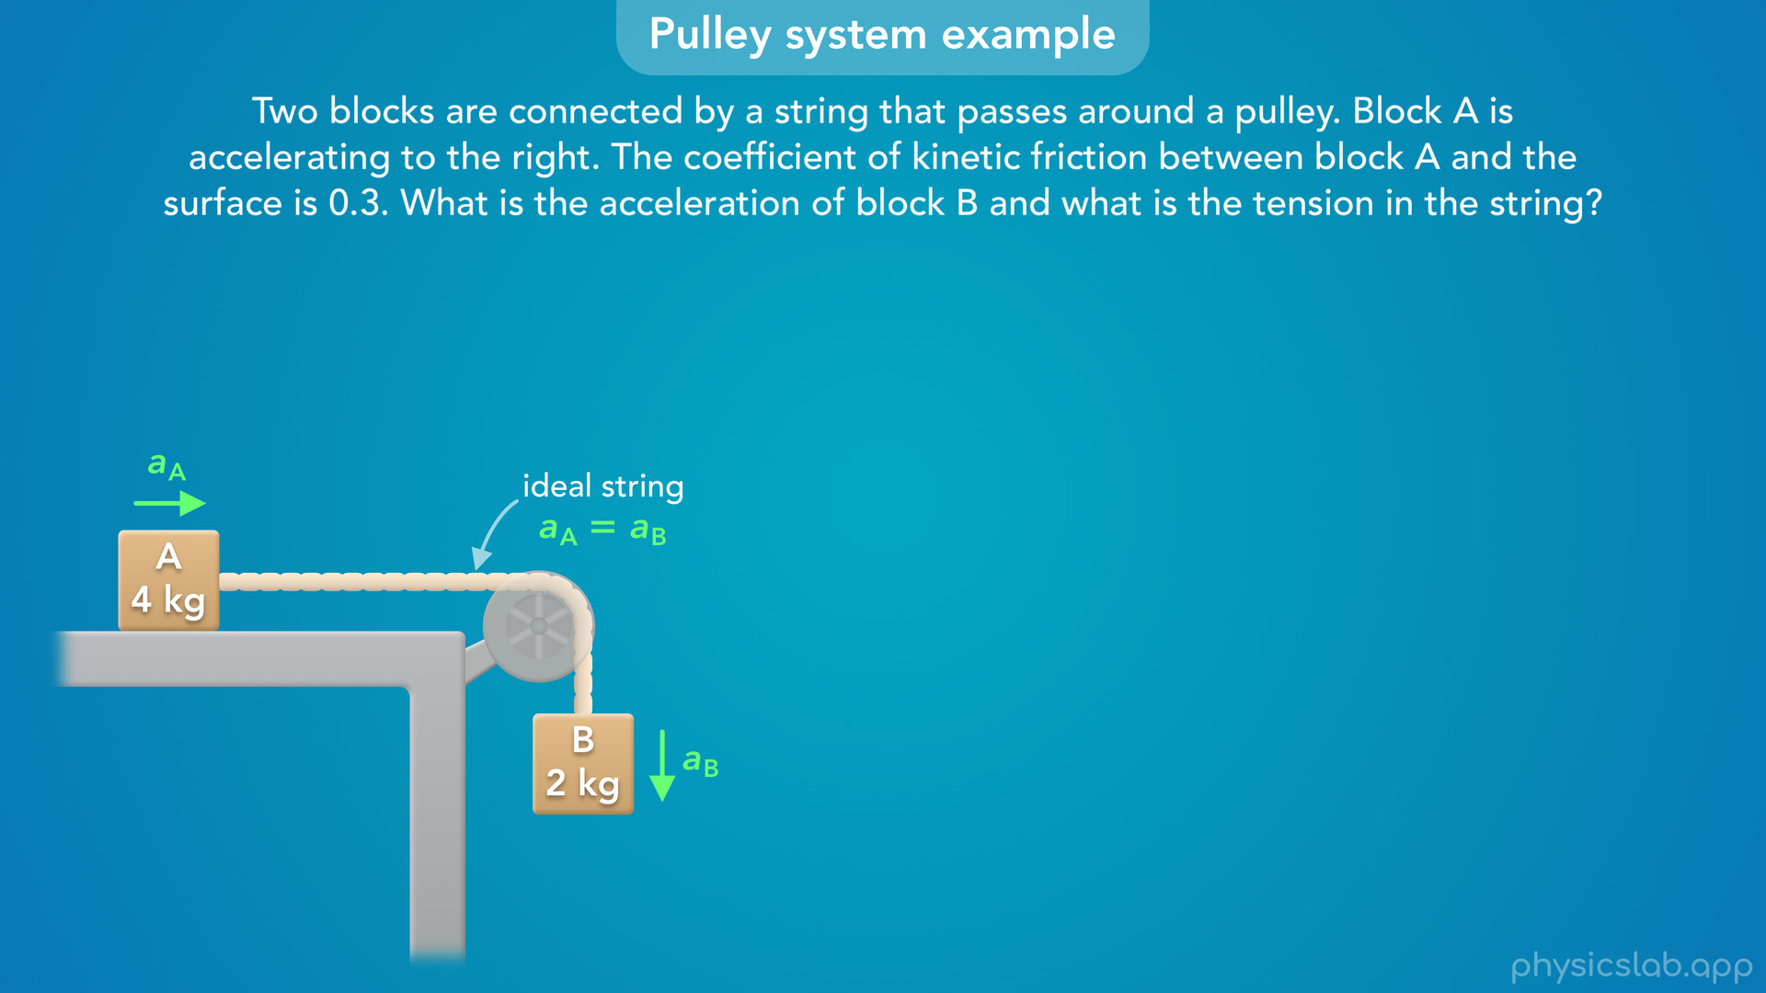
Notes:
• So what assumptions can we make about this scenario?
• First, we can assume this is an ideal string because we’re not told otherwise.
• So the string has no mass and the length doesn’t change.
• This means the blocks move together and block B has the same acceleration as block A.
• And if block A is accelerating to the right, then block B must be accelerating down, and we can find either acceleration because they’re the same.

Slide 17
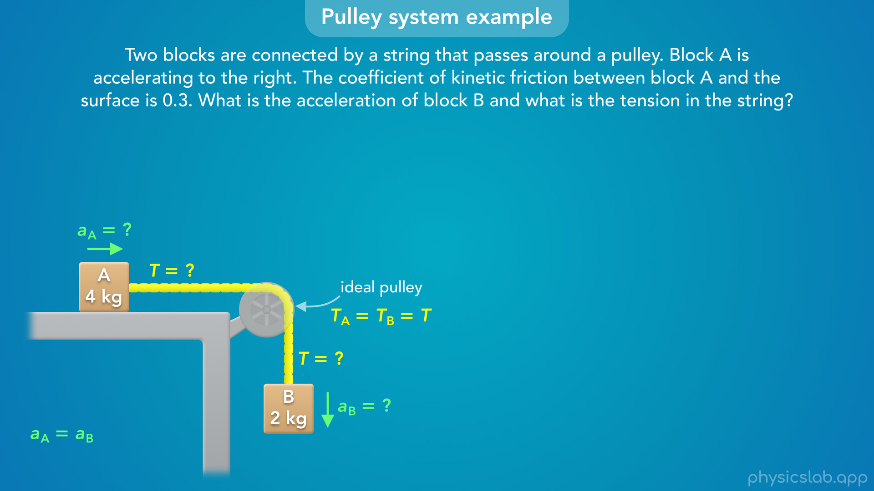
Notes:
• We can also assume this is an ideal pulley because we’re not told that the pulley itself has mass or friction.
• So the tension will be the same everywhere in the string, and the tension forces on each block will be the same.
• So to find the tension, we can solve for the tension force on either block.

Slide 18
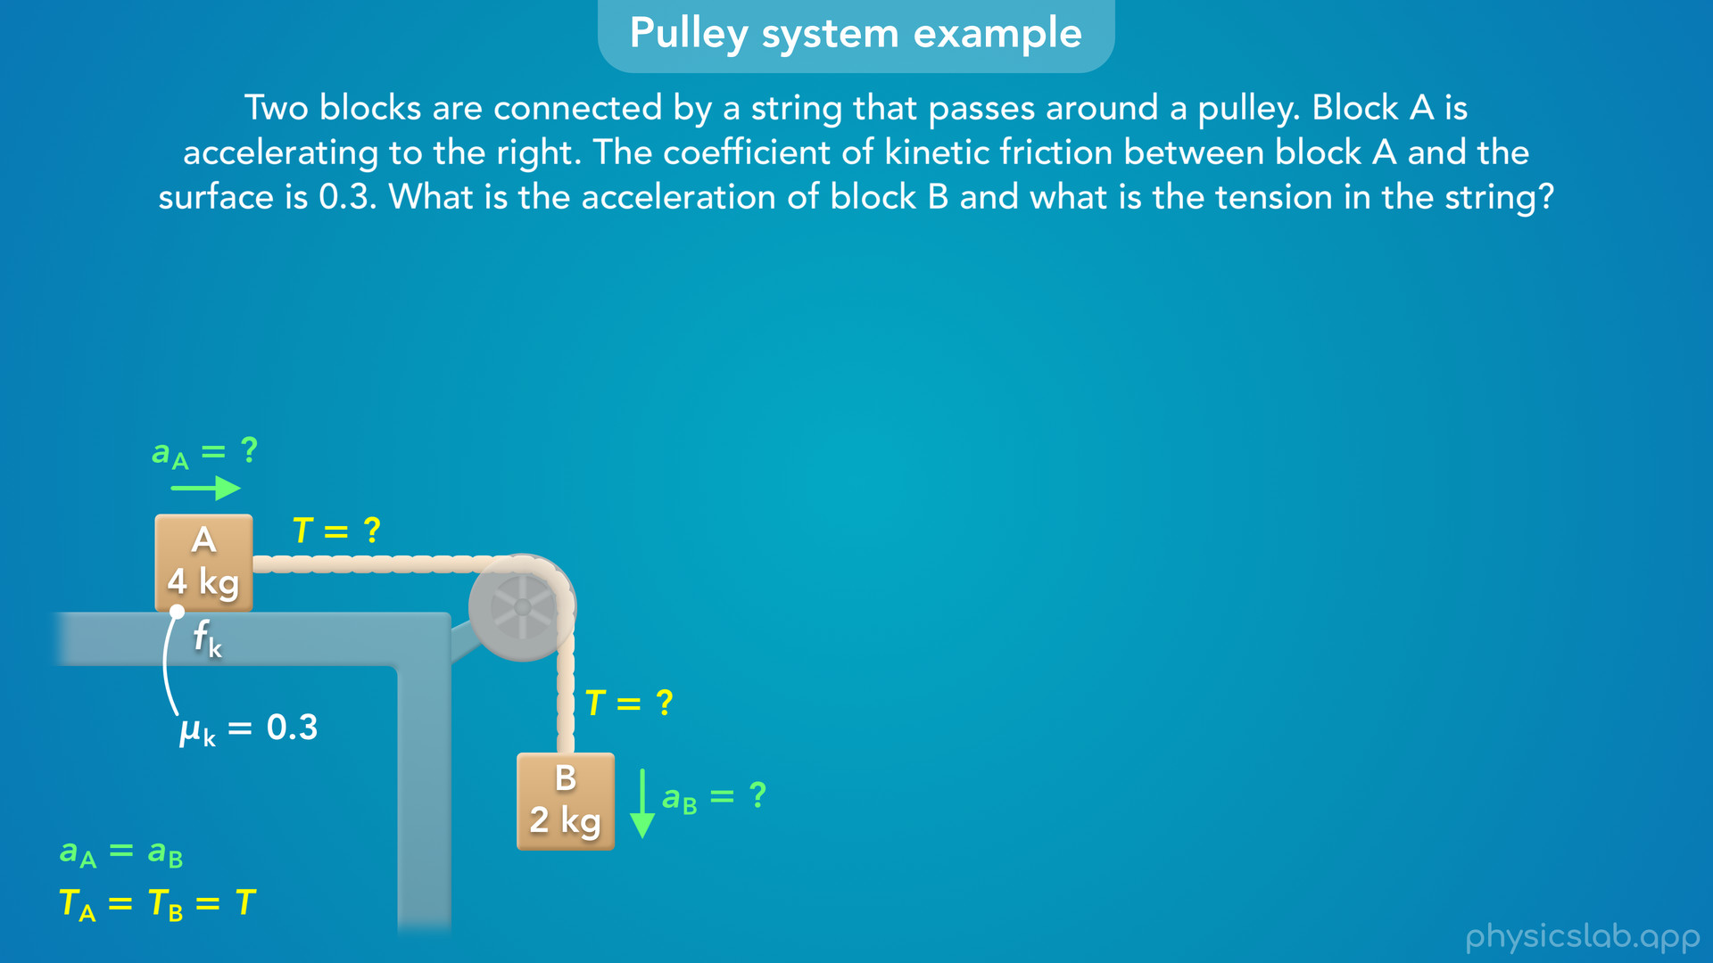
Notes:
• Also, we’re given the coefficient of kinetic friction for this surface, and we know block A is moving.
• That means there’s a kinetic friction force acting on block A.

Slide 19
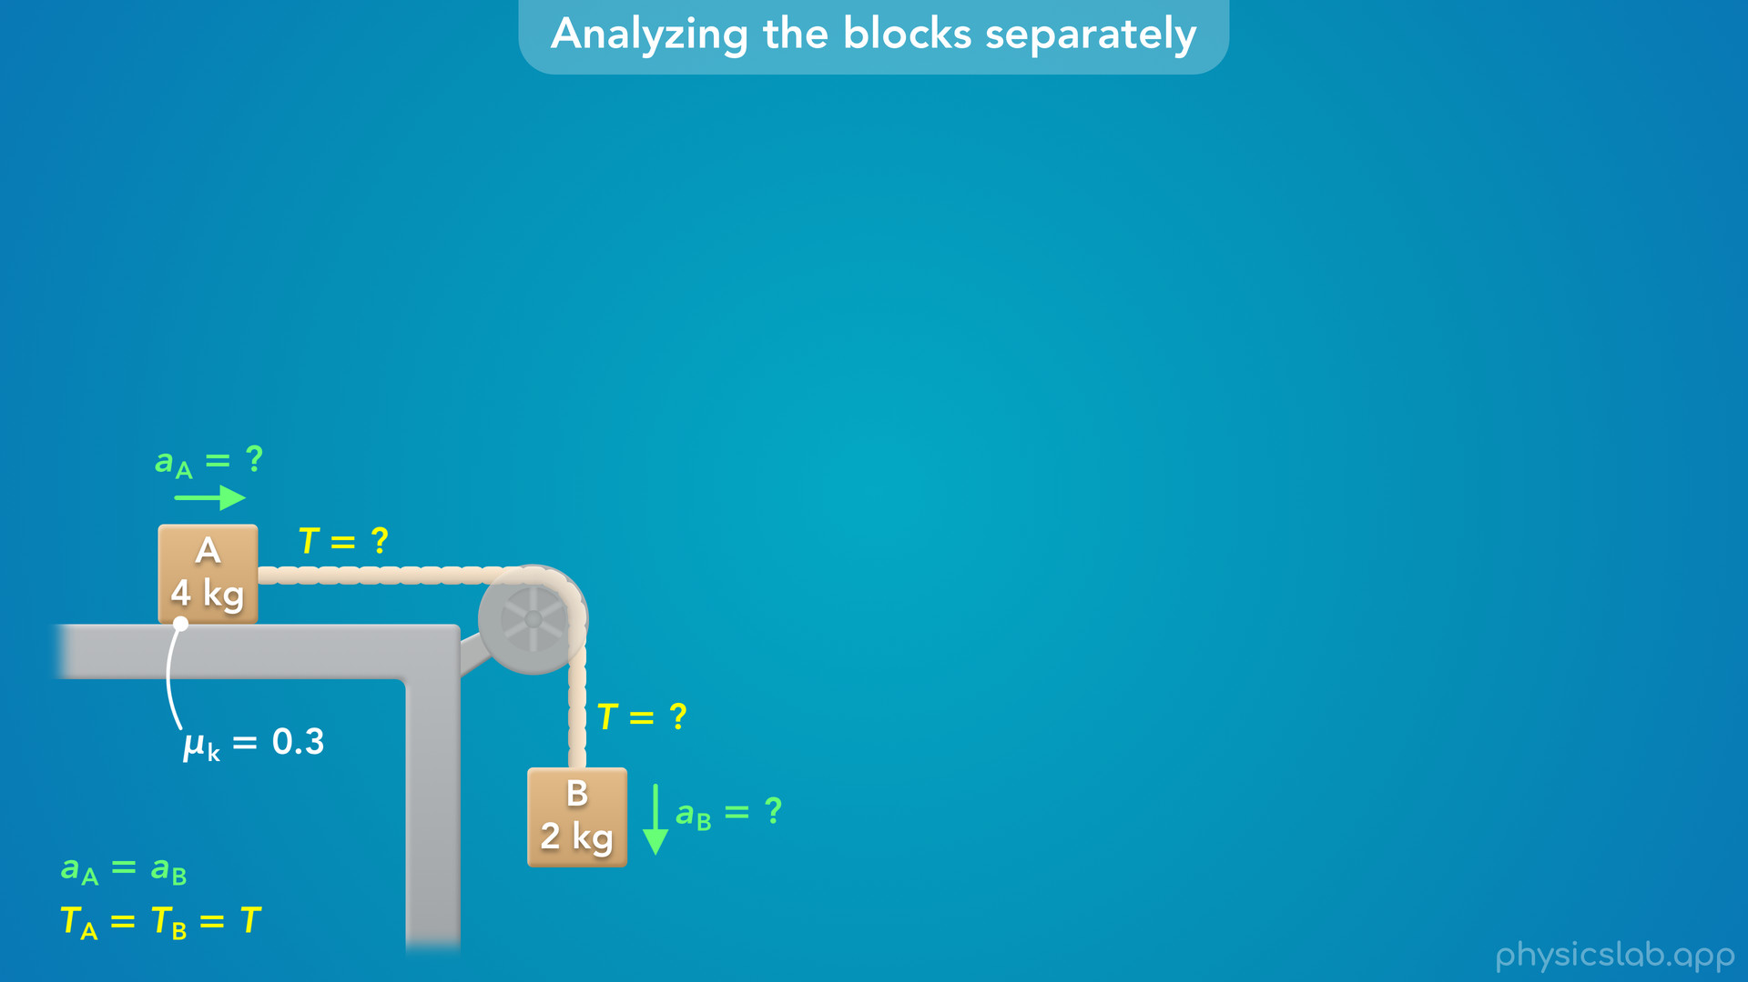
Notes:
• Alright, so the first way we can solve this is by analyzing the blocks separately.
• Let’s start by drawing the forces on the blocks in this diagram.

Slide 20
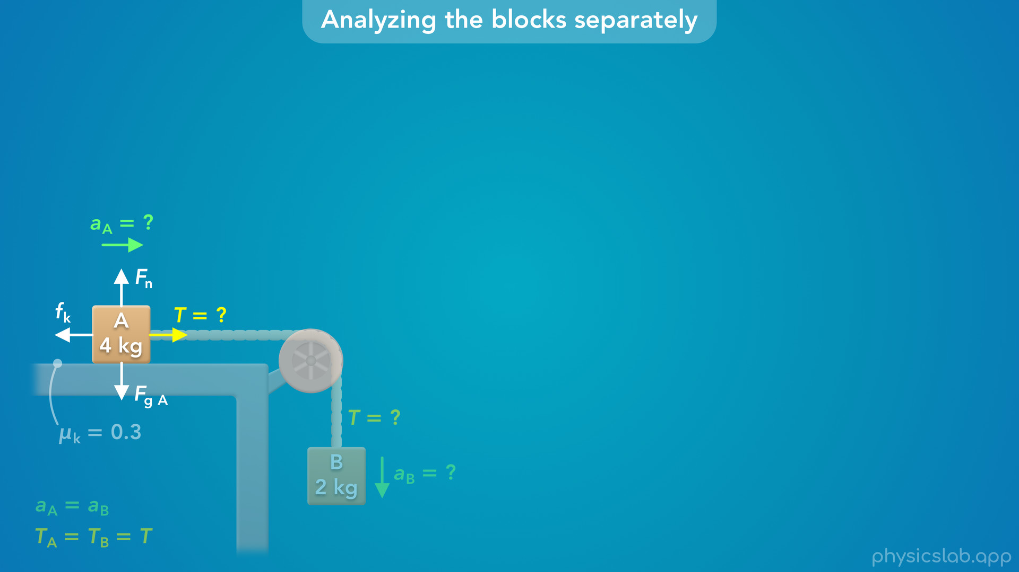
Notes:
• First, what forces are acting on block A?
There’s a downwards gravitational force from the earth, and there’s an upwards normal force from this surface.
• There’s also a tension force from the string acting to the right.
• Tension is always a pulling force that acts in the direction of the string.
• What would be the direction of the friction force?
• If block A is moving to the right, the kinetic friction force acts to the left, in the opposite direction as the motion.

Slide 21
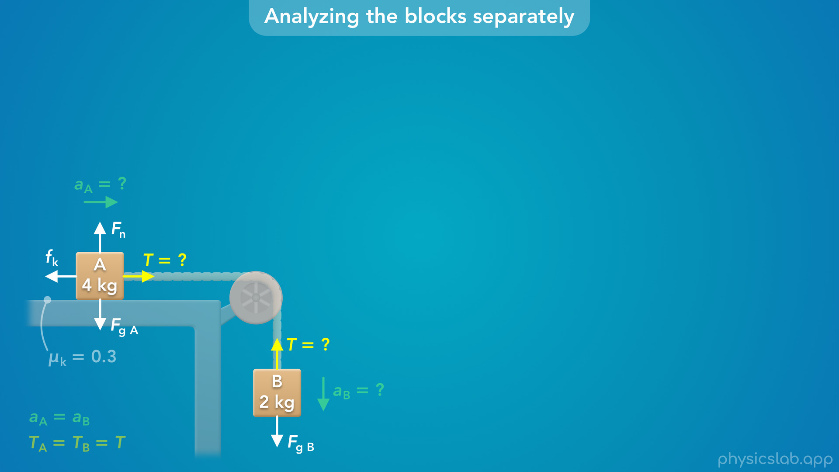
Notes:
• Next, what forces are acting on block B?
• There’s a downwards gravitational force from the earth.
• And there’s an upwards tension force from the string.
• Block B is not touching a surface, so there is no normal force and no friction force.
• So those are the forces on each block.
• Keep in mind that length of these force vectors are not drawn to scale.

Slide 22
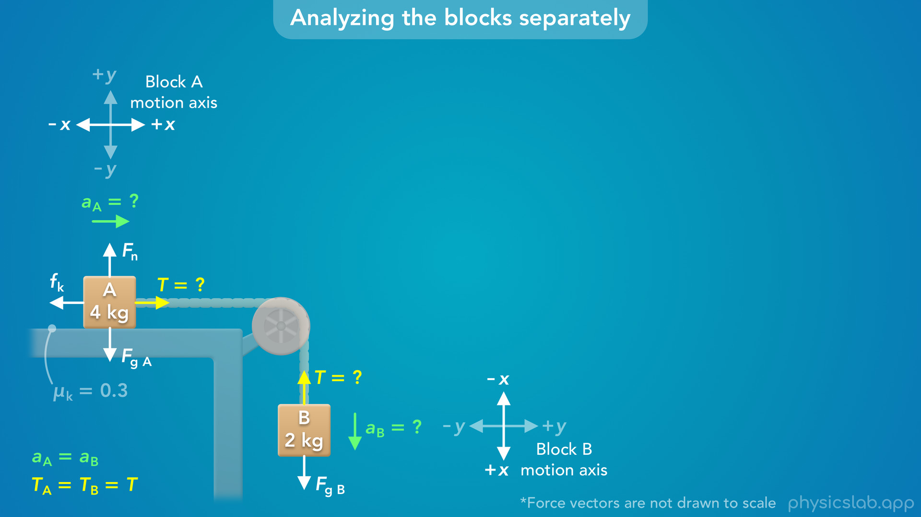
Notes:
• Next, how should we set up the coordinate system for each block?
• For block A, we’ll have the x axis be horizontal, and right will be the positive direction.
• For block B, we’ll rotate the coordinate system so the x axis is vertical, and down is the positive direction.
• This way, we can say each block will be moving in the positive x direction.

Slide 23
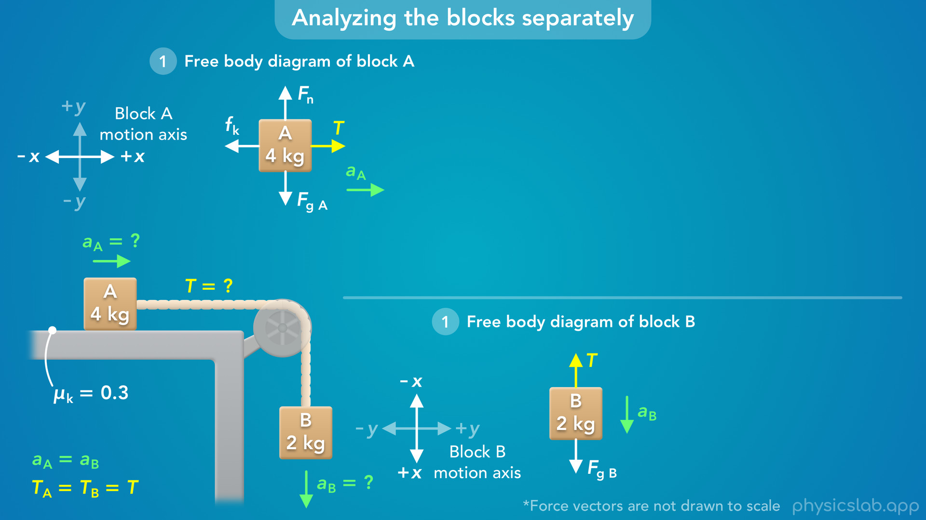
Notes:
• Now, let’s move the blocks and the forces over here so we can see the free body diagram for each block on its own.

Slide 24
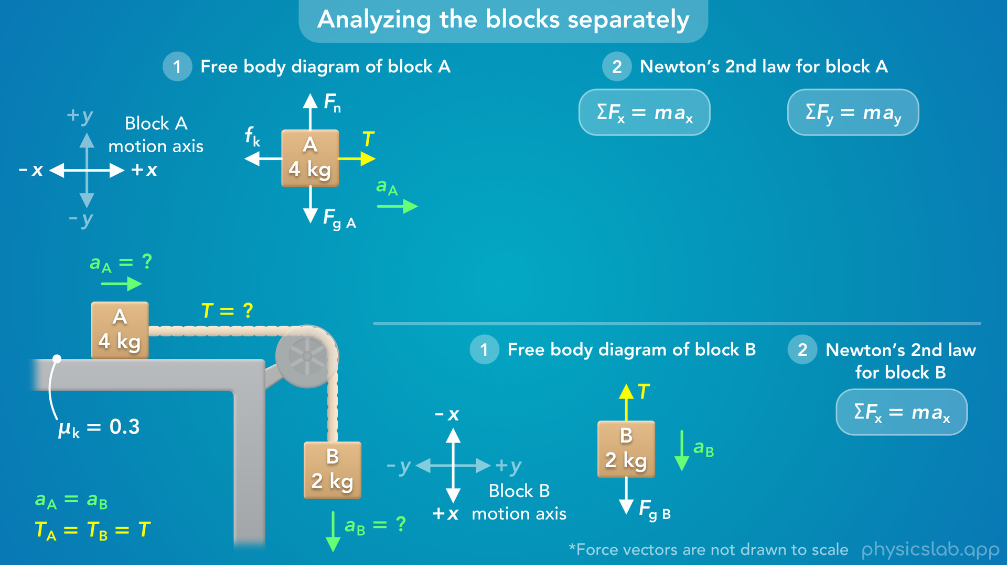
Notes:
• Next, we can apply Newton’s 2nd law to each block to find the tension and the acceleration.

Slide 25
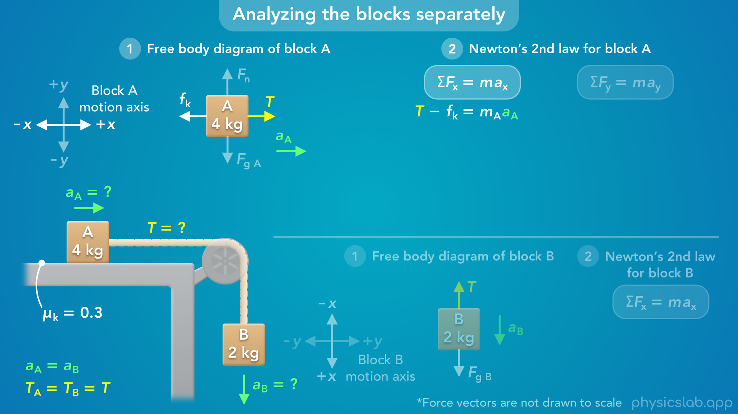
Notes:
• For block A, we have forces in the x direction and the y direction, which is up and down for block A.
• What would be the net force in the x direction?
• If right is positive, then the net force is the tension force minus the friction force.
• We know the mass of block A is 4 kg, but we’re going to leave that as a variable for now.
• And we don’t know the acceleration of block A.

Slide 26
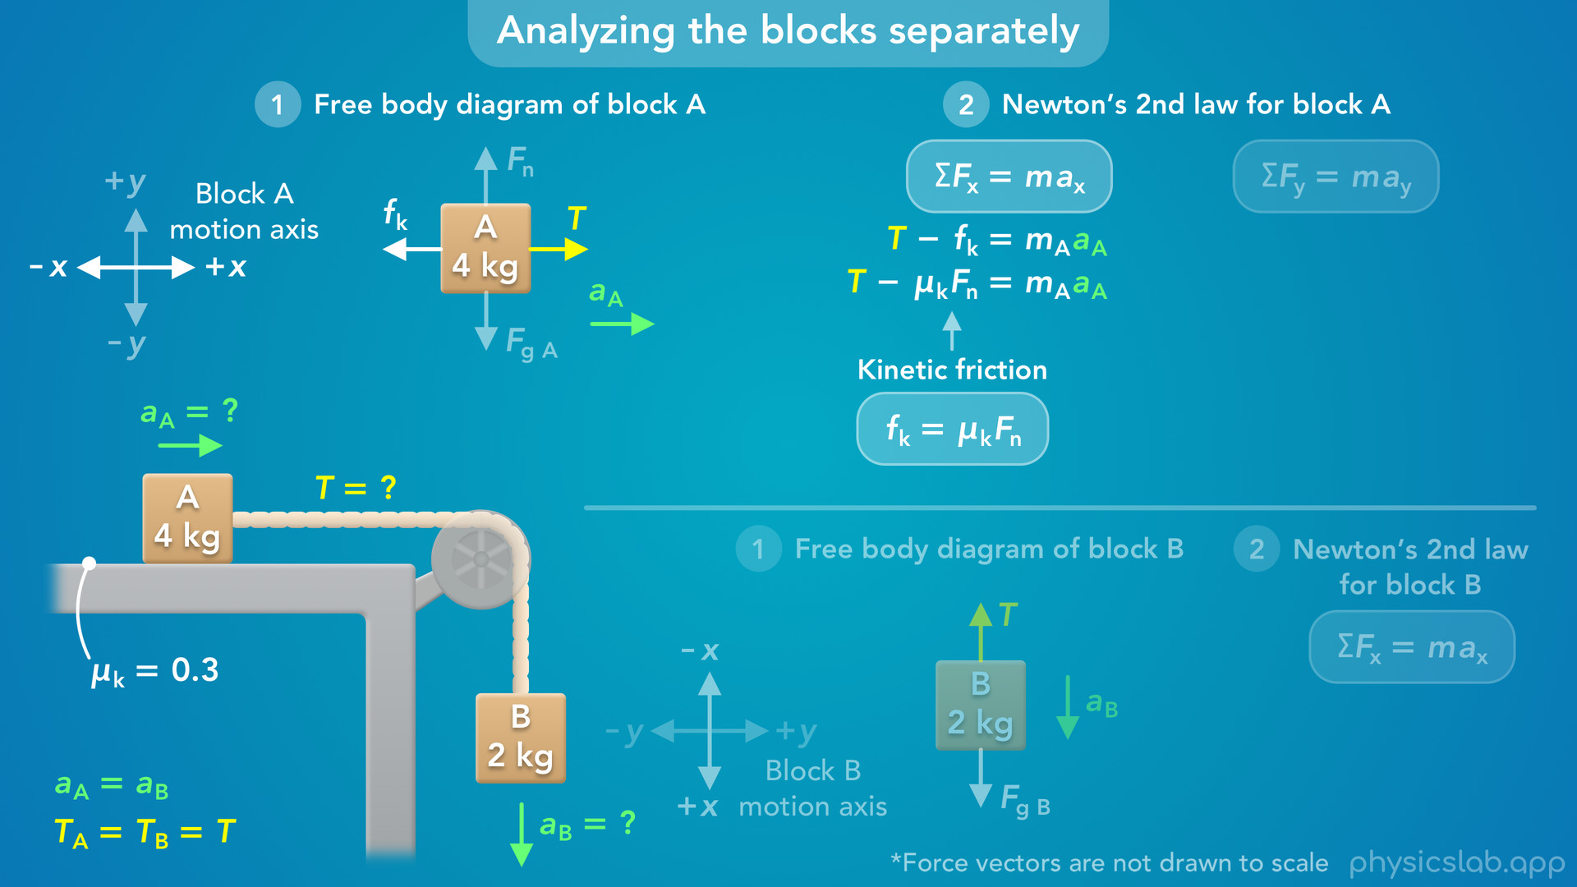
Notes:
• Next, using the equation for kinetic friction, we can replace the friction force with the coefficient of kinetic friction times the normal force.
• We know the coefficient is 0.3, but what about the normal force?

Slide 27
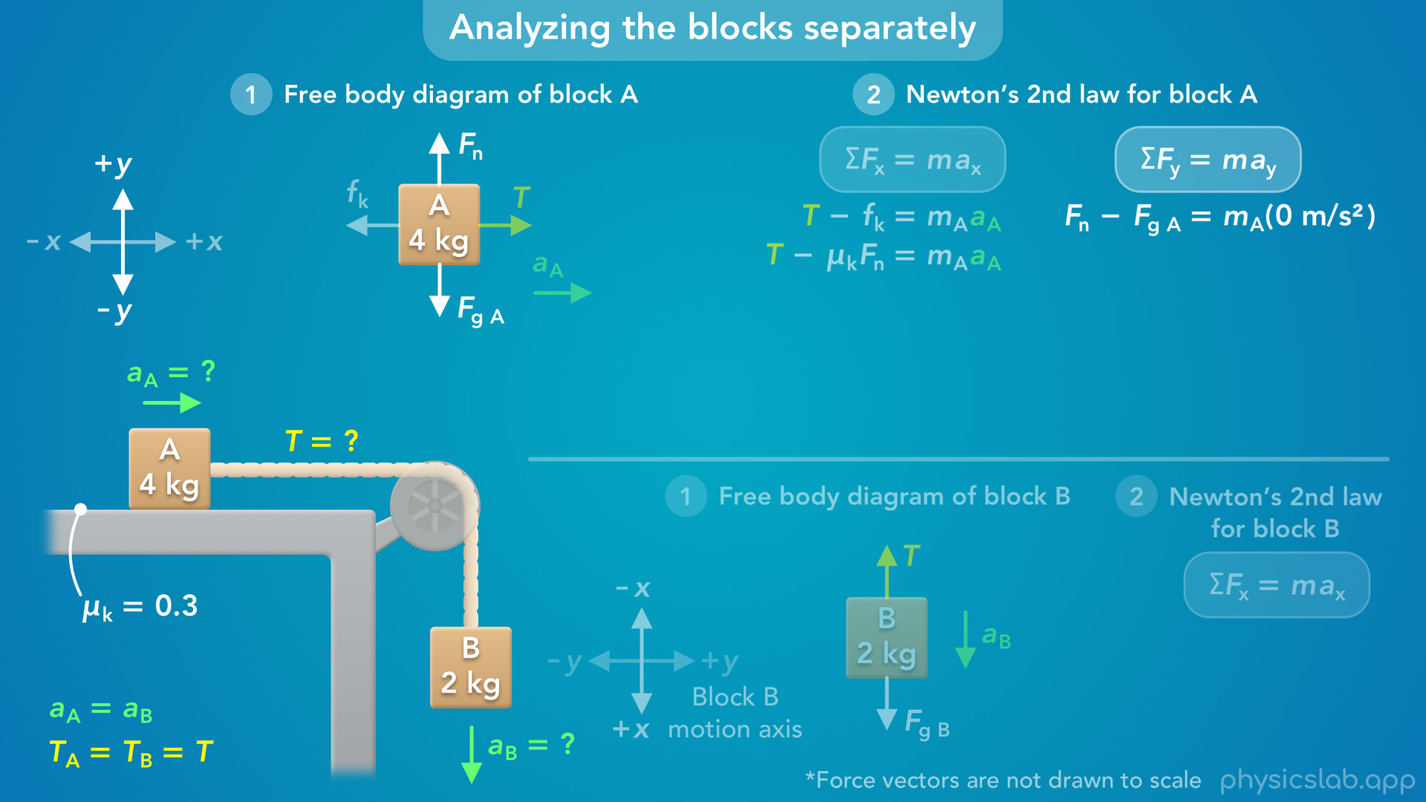
Notes:
• That’s acting in the y direction for block A, so let’s apply Newton’s 2nd law in the y direction.
• If up is positive, the net force would be the normal force minus the gravitational force.
• What’s the acceleration of block A in this y direction?
• Block A is not moving up or down, so its acceleration in this direction is zero.

Slide 28
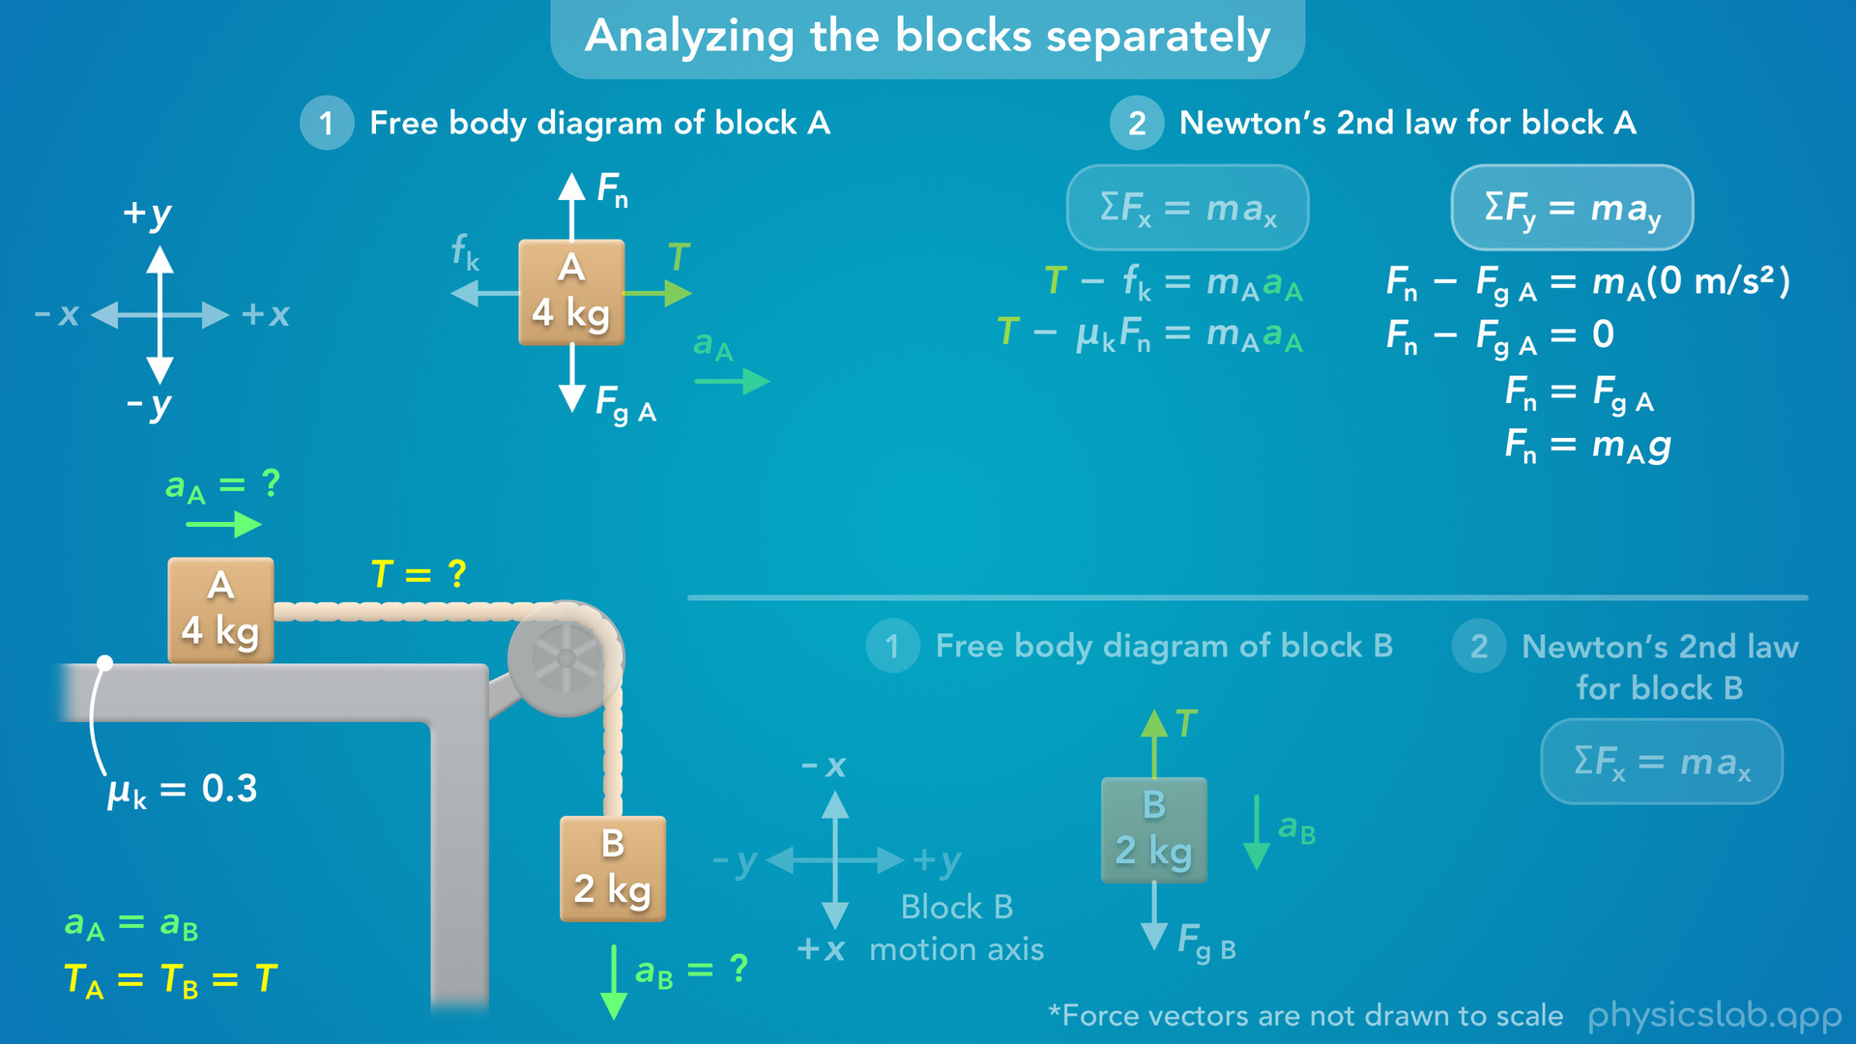
Notes:
• This means the net force in the y direction is zero, and the normal force is equal to the gravitational force.
• The vertical forces are balanced on block A.
• We can replace Fg with mass A times the acceleration due to gravity, and that gives us an equation for the normal force.

Slide 29
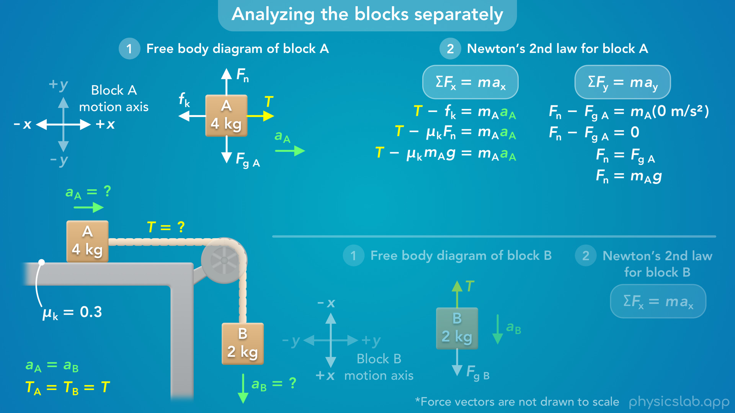
Notes:
• Now, we can replace the normal force in the x equation with mass A times g.
• So we know everything in this equation except for the tension and the acceleration.
• But we’ll leave everything as variables for now.

Slide 30
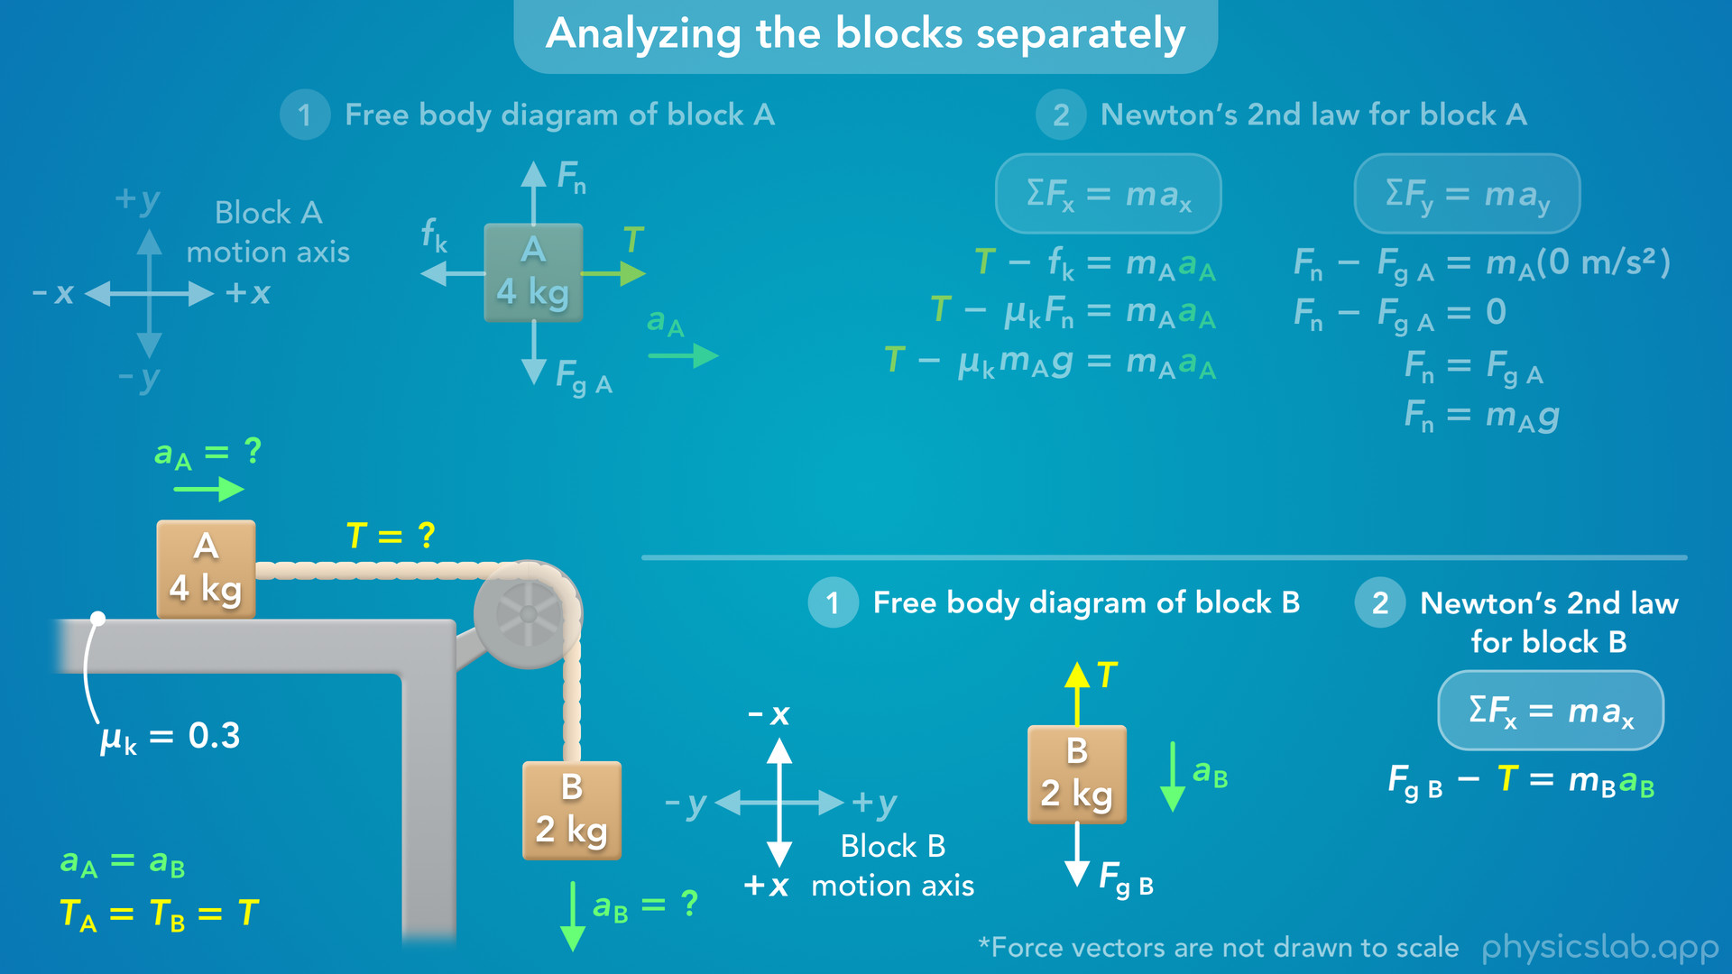
Notes:
• Next, let’s apply Newton’s 2nd law to block B.
• We chose a coordinate system for block B where down is the positive x direction.
• So what is the net force on block B in this direction?
• The gravitational force is acting in this positive x direction, and the tension force is acting in this negative x direction.
• So the net force in this direction is Fg minus T.
• We know the mass of block B is 2 kg, but we’ll leave that as a variable.
• And we don’t know the acceleration of block B.

Slide 31
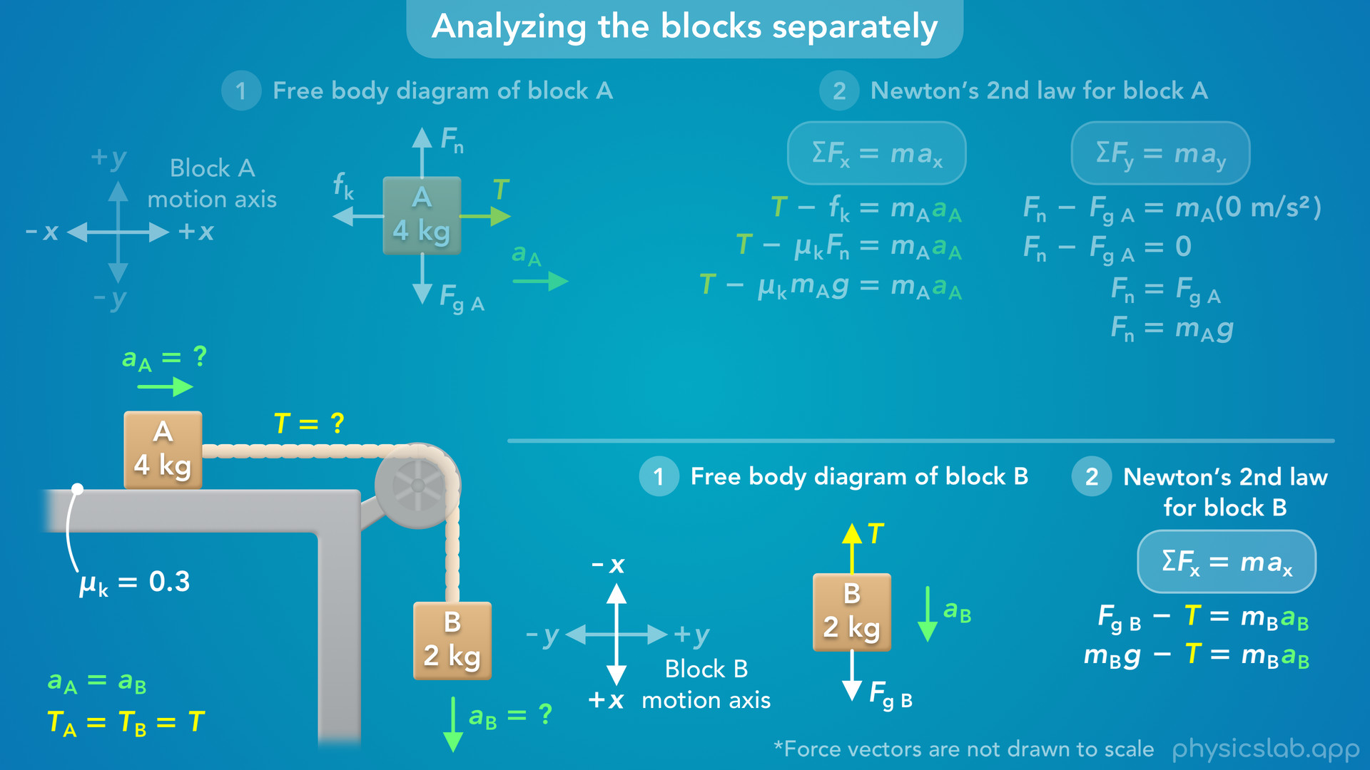
Notes:
• Next, we can replace Fg with mass B times g.
• Now we know everything in this equation except the tension and the acceleration.

Slide 32
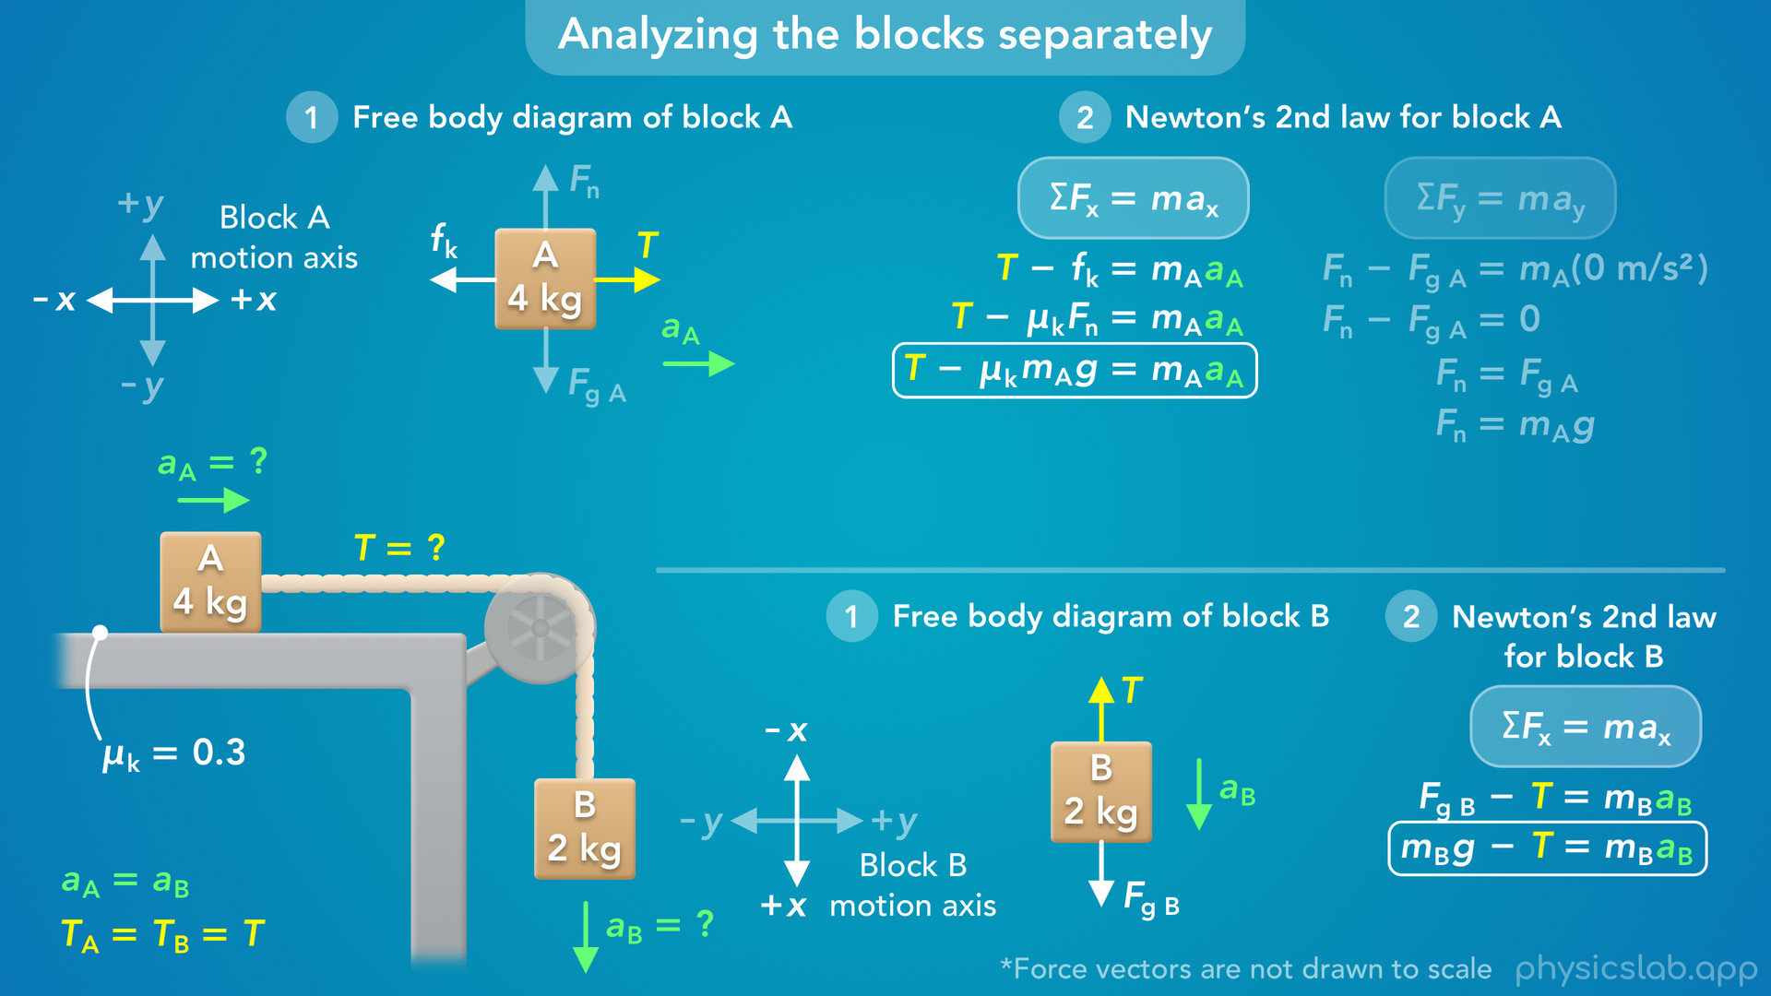
Notes:
• So now, we have two equations that include tension and acceleration, one equation for each block.

Slide 33
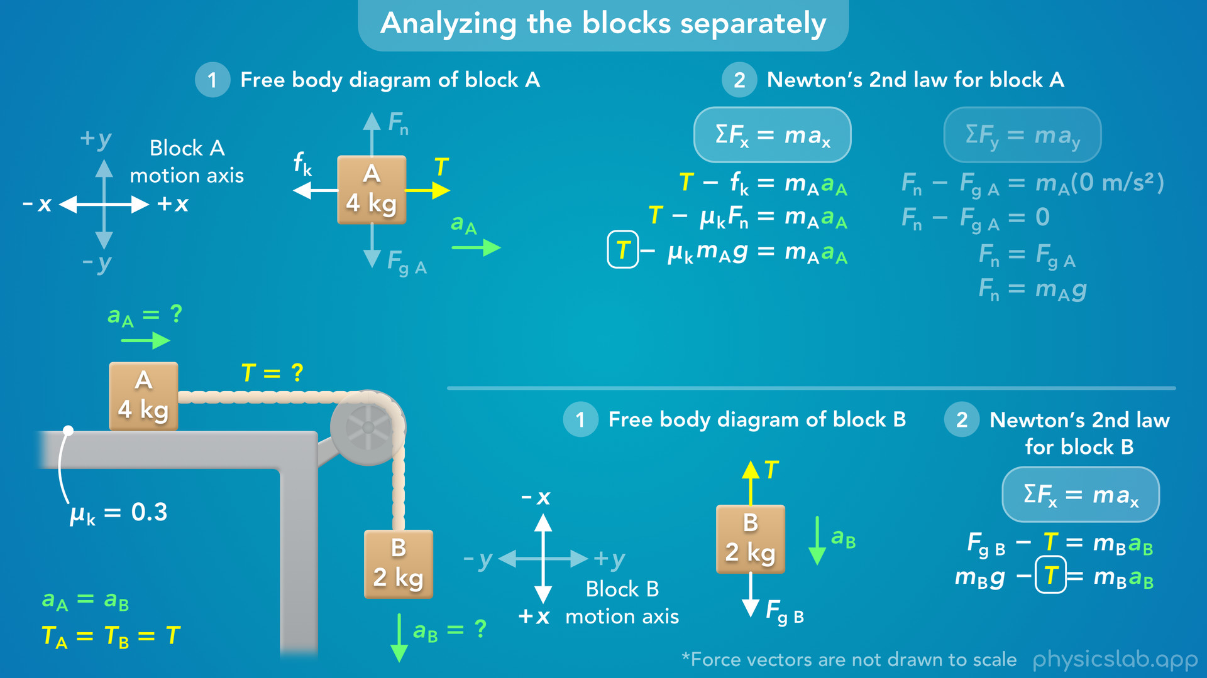
Notes:
• We know the magnitude of the tension force is the same for each block, so T is the same in each equation.

Slide 34

Notes:
• We also know that the blocks have the same acceleration because they’re connected by a string.
• So we can use the same variable for the acceleration in both equations.
• Let’s just use the variable a.
• We know the accelerations have the same magnitude or value, but what about the direction?
• How do we know that a is positive in each equation, and not negative?
• This is the reason that we set up the coordinate systems like we did.
• We chose right to be positive for block A, and down to be positive for block B, because those are the directions the blocks are accelerating.
• So the acceleration will be positive in both equations.

Slide 35

Notes:
• Now that we have two equations with two unknown variables, T and a, we can solve for both using substitution.
• There’s more than one way to do this, but let’s start with the equation for block B.
• If we add T and subtract mBa from both sides, we get an equation where T is on one side by itself.
• So we know T is equal to mBg minus mBa.

Slide 36
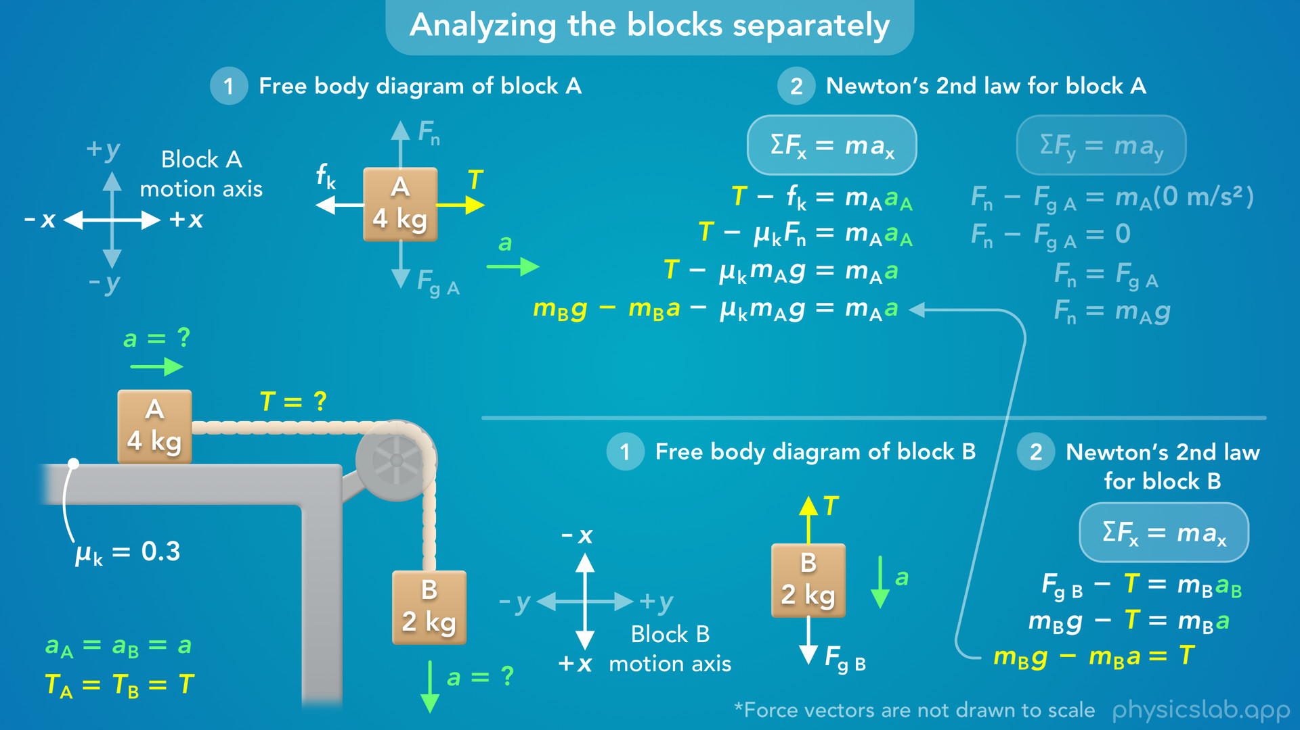
Notes:
• Now, in the equation for block A, we can replace T with mBg minus mBa.
• Now the acceleration is the only unknown variable.

Slide 37
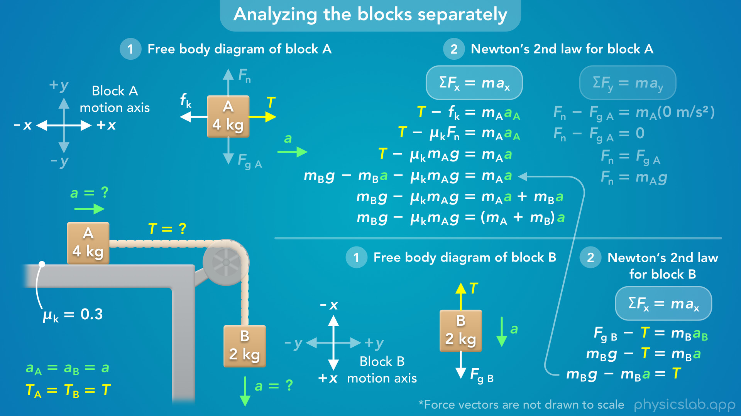
Notes:
• Next, we can add mBa to both sides… and we can factor out the acceleration from these two terms on the right.

Slide 38
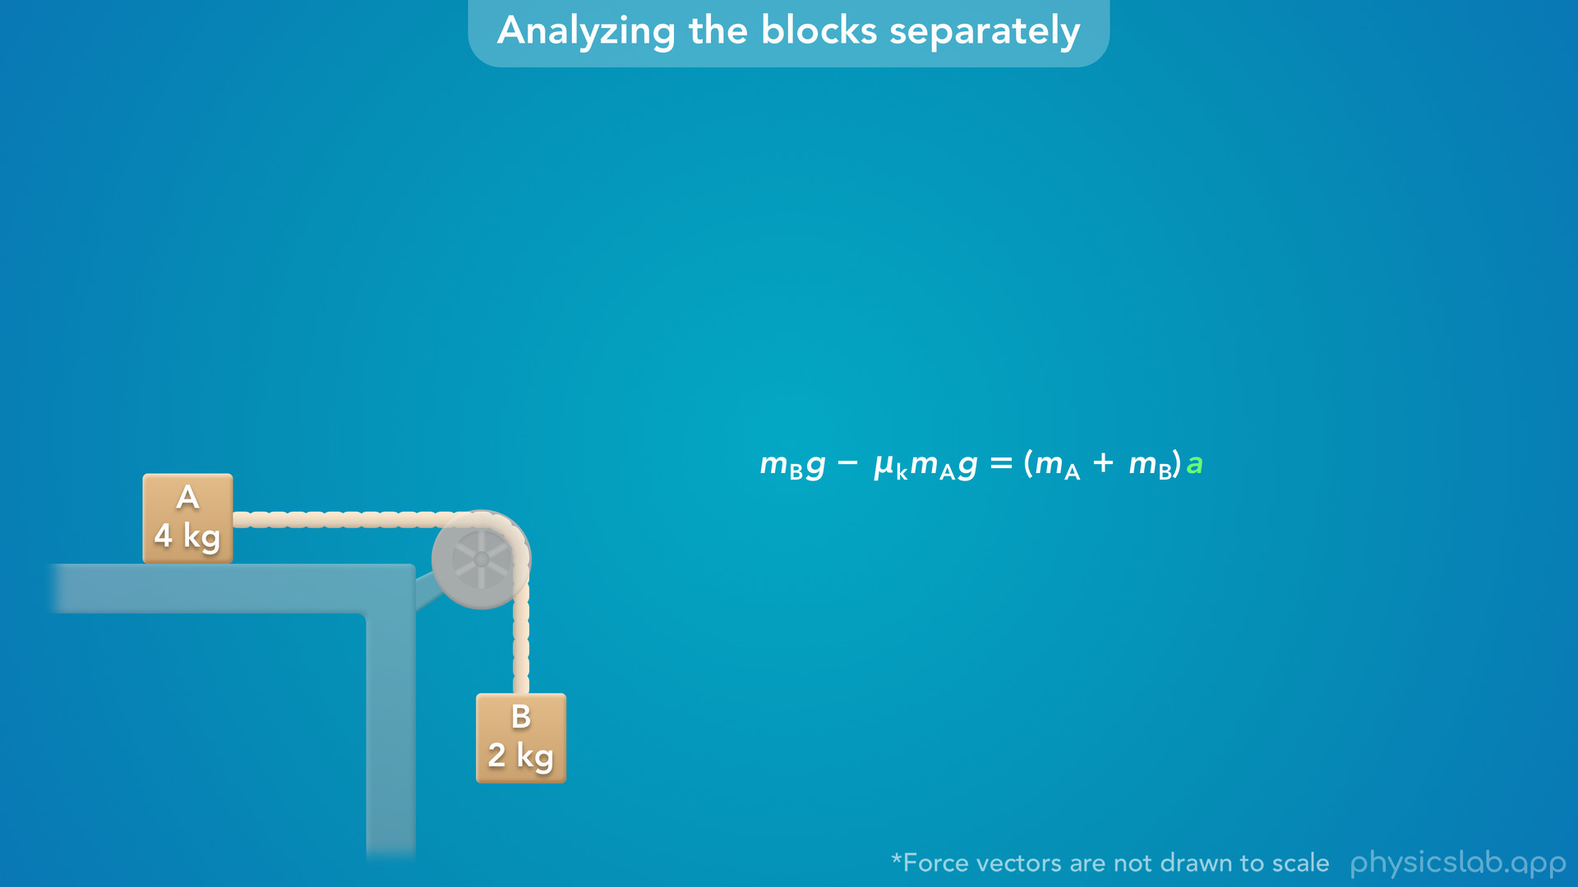
Notes:
• Before we continue, take a closer look at this equation and see if you notice anything interesting.
• What do each of these terms represent?

Slide 39
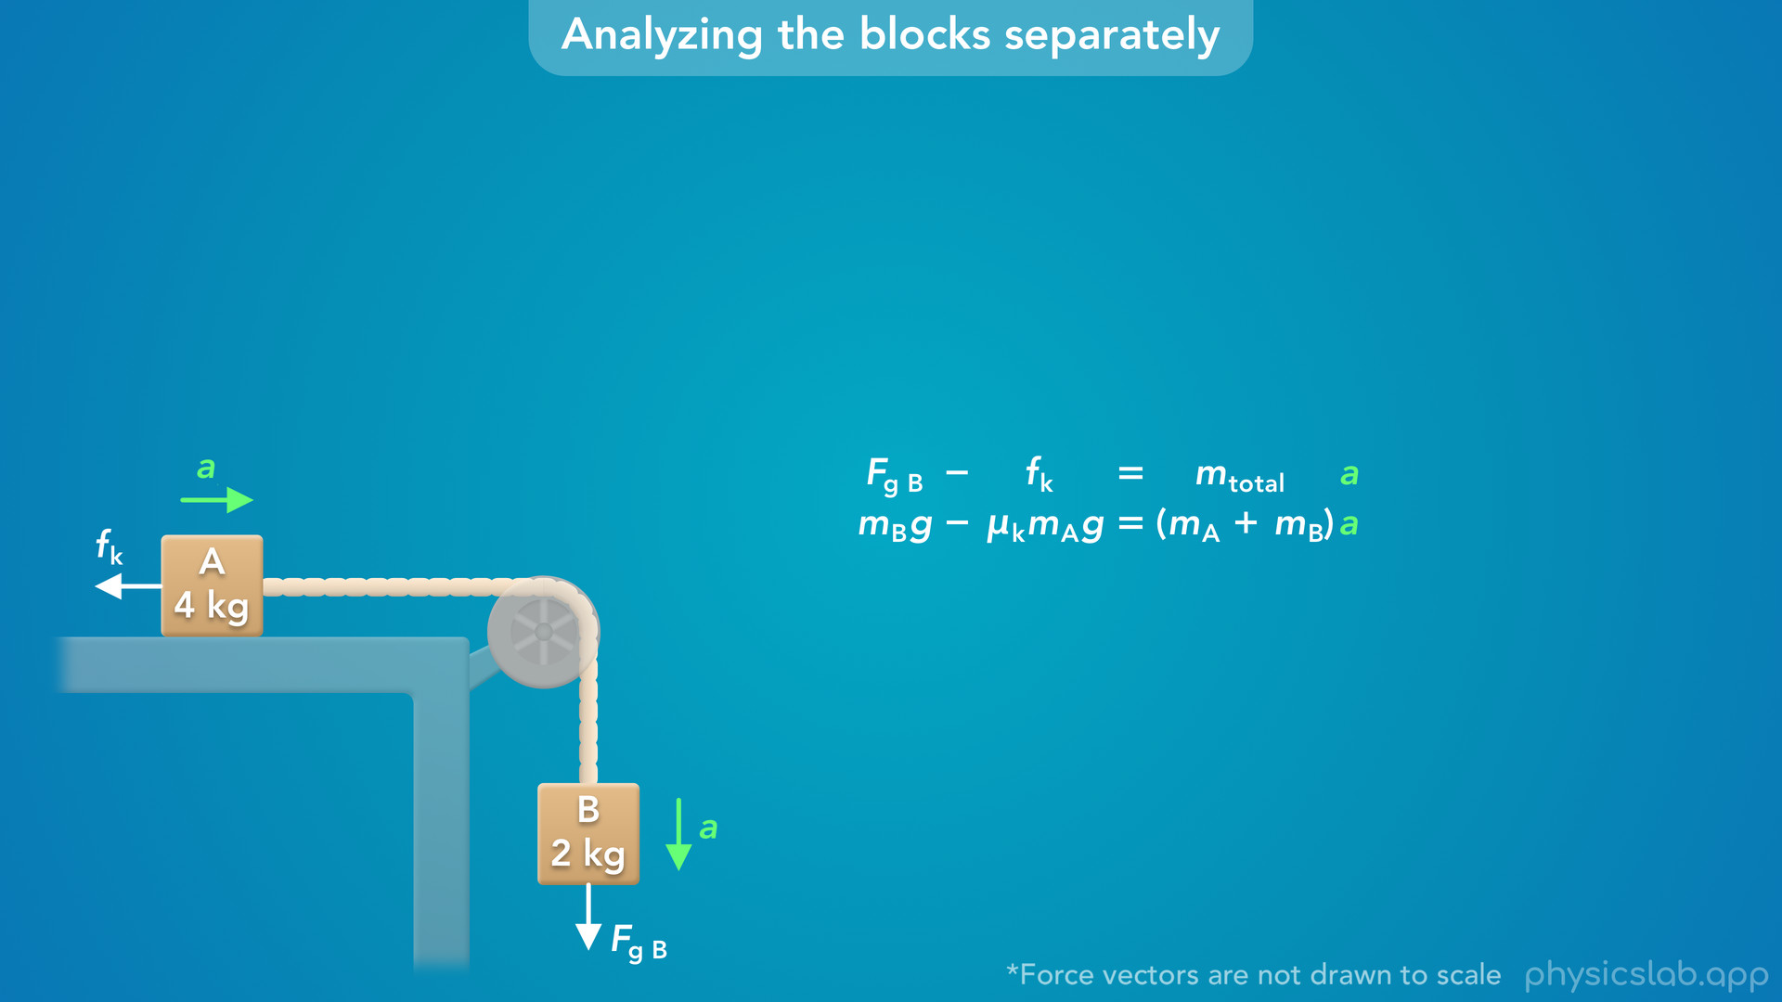
Notes:
• The first term is the gravitational force that’s pulling down on block B.
• The second term is the friction force acting to the left on block A.
• mA plus mB is the total mass of the two blocks.
• And a is the acceleration of the blocks.

Slide 40
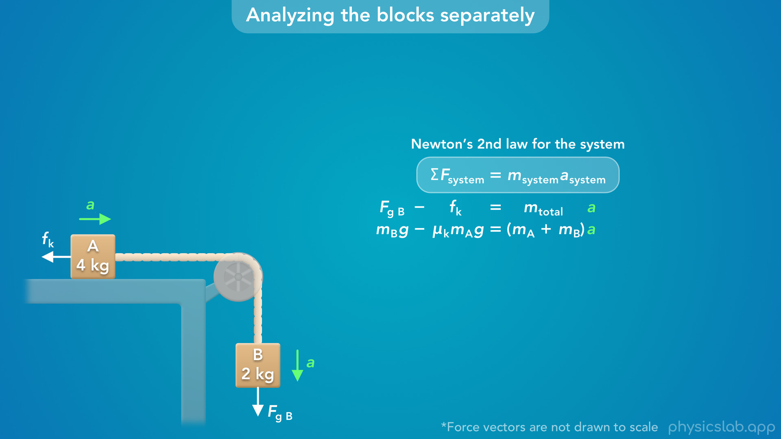
Notes:
• This equation is newtons 2nd law applied to the overall system.
• The gravitational force on block B and the friction force on block A are the only two forces affecting the motion of the system.
• And the net force is causing the total mass of the system to accelerate.
• We’re going to cover this in the second part of the video…

Slide 41

Notes:
but it’s interesting to see that we get the same thing by combining the equations for each block.

Slide 42
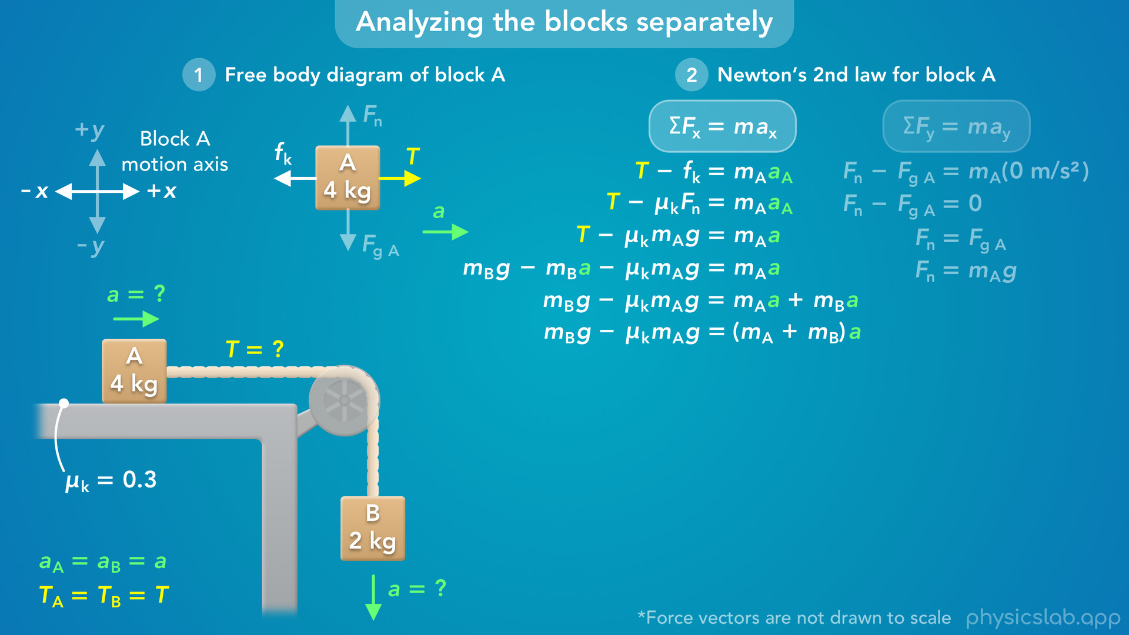
Notes:
• Alright so let’s continue solving for the acceleration.

Slide 43
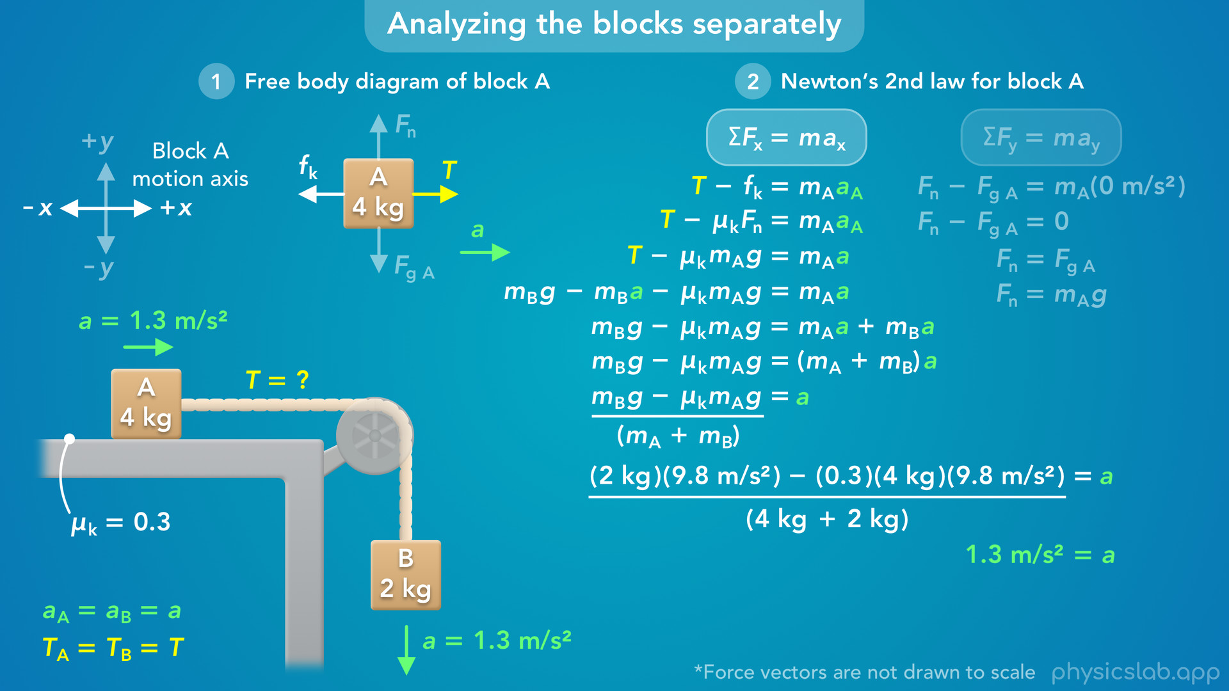
Notes:
• We can divide both sides by mA plus mB, so a is on the right side by itself.
• Now we can plug in all of the values that we know: 4 kg for mass A, 2 kg for mass B, 0.3 for the coefficient of friction, and 9.8 m/s^2 for g.
• When we calculate that, we get 1.3 m/s^2 for the acceleration.
• So block A is accelerating to the right at 1.3 m/s^2… and block B is accelerating down at 1.3 m/s^2.

Slide 44
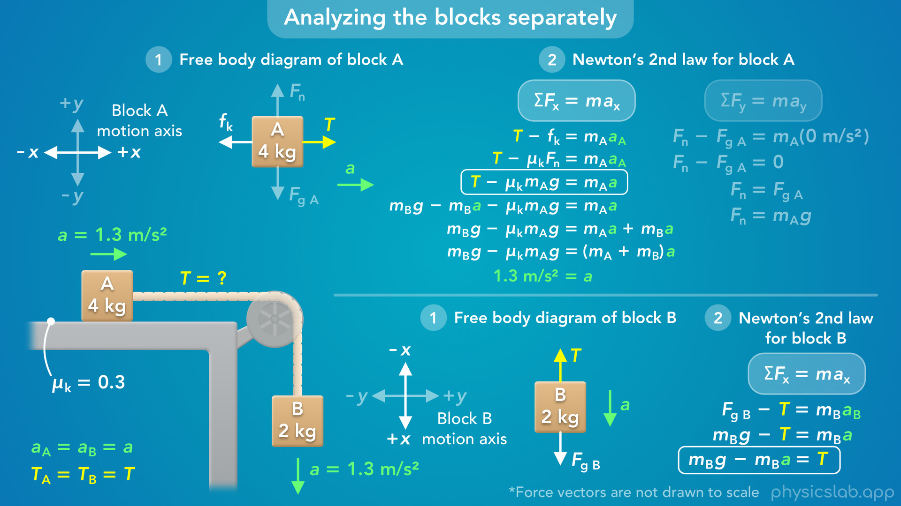
Notes:
• Now, to solve for the tension, we can plug in this value for the acceleration in the equation for either block.

Slide 45
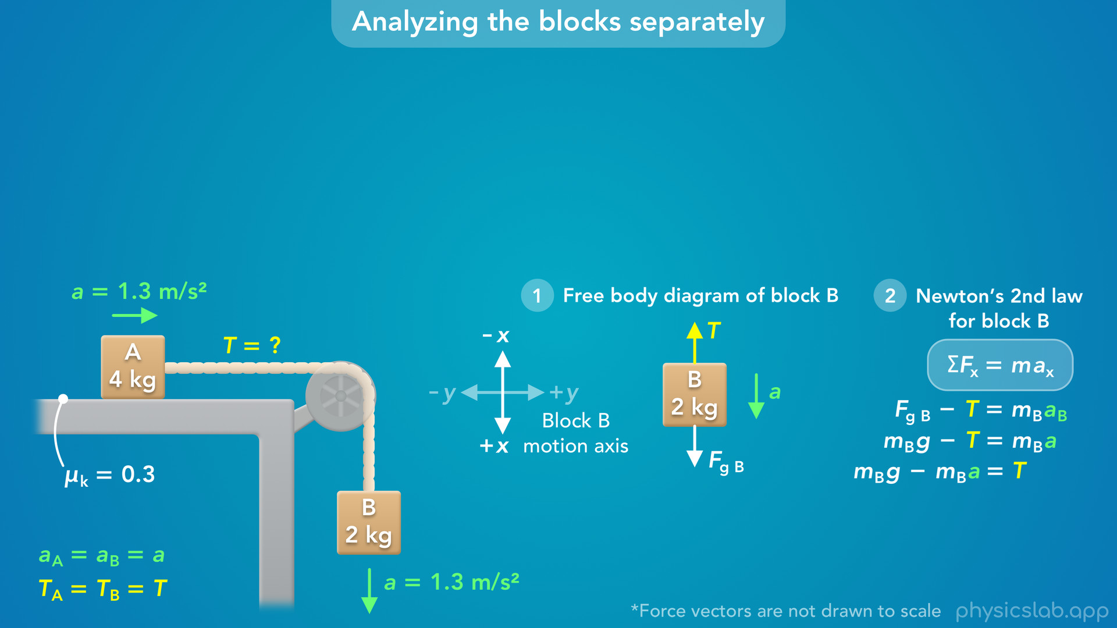
Notes:
• The equation for block B is shorter so let’s use that.

Slide 46
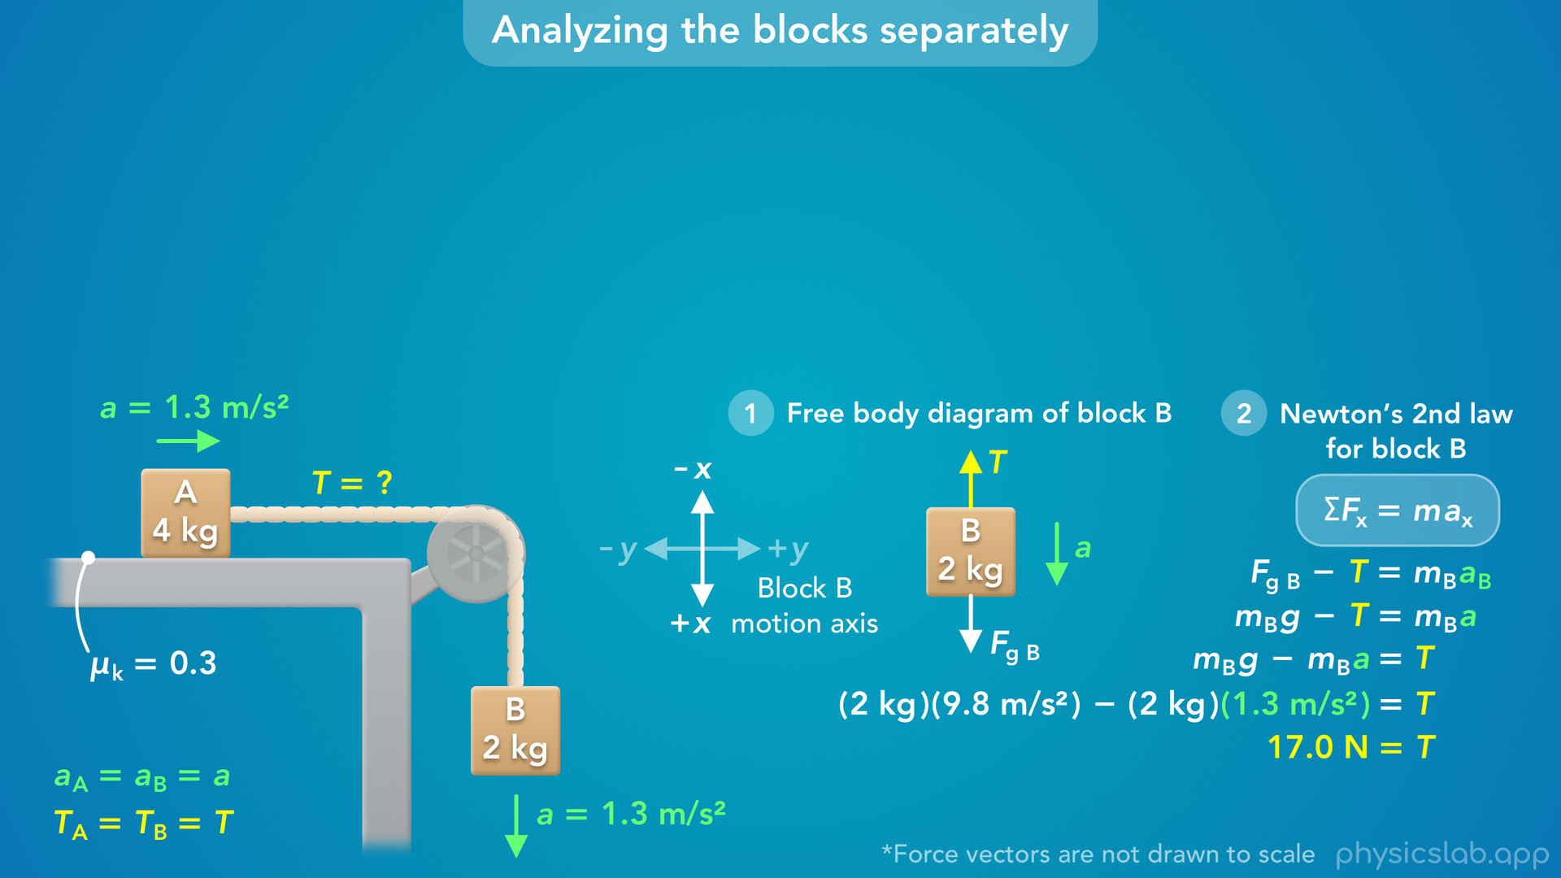
Notes:
• We plug in 1.3 m/s^2 for a, 2 kg for mass B and 9.8 m/s^2 for g.
• That gives us 17 N for the tension.

Slide 47
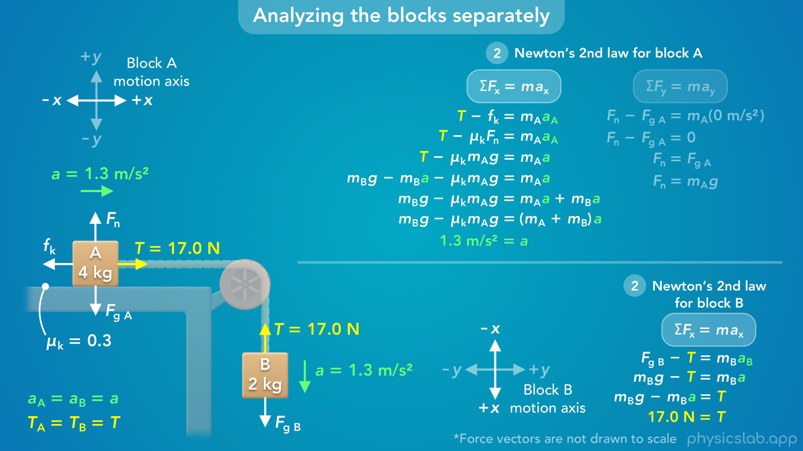
Notes:
• So those are the answers to the question.
• The acceleration of block B is 1.3 m/s^2, the same as block A.
• And the tension force on each block is 17 N, so the tension in the string is 17 N.

Slide 48
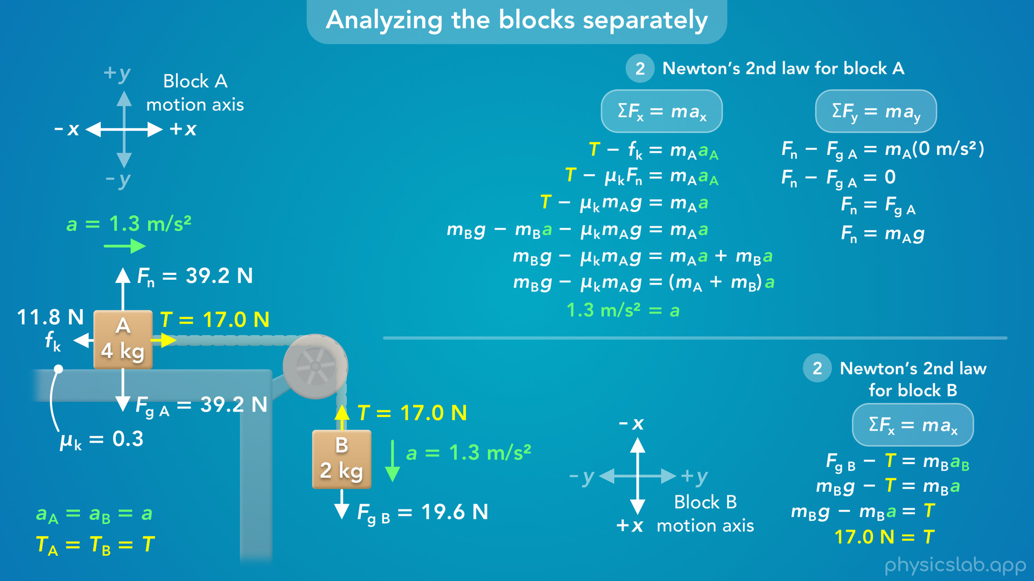
Notes:
• We mentioned that these force vectors are not drawn to scale, so here’s what they look like with the correct magnitudes.
• For block A, the normal force and the gravitational force are balanced in that y direction.
• In that x direction, the tension force is greater than the friction force, and block A accelerates to the right.
• For block B, the downwards gravitational force is greater than the upwards tension force, so block B accelerates down.
• The magnitude of the tension forces and the accelerations are the same for both blocks.
• So that’s how we could solve this by analyzing the blocks separately.

Slide 49
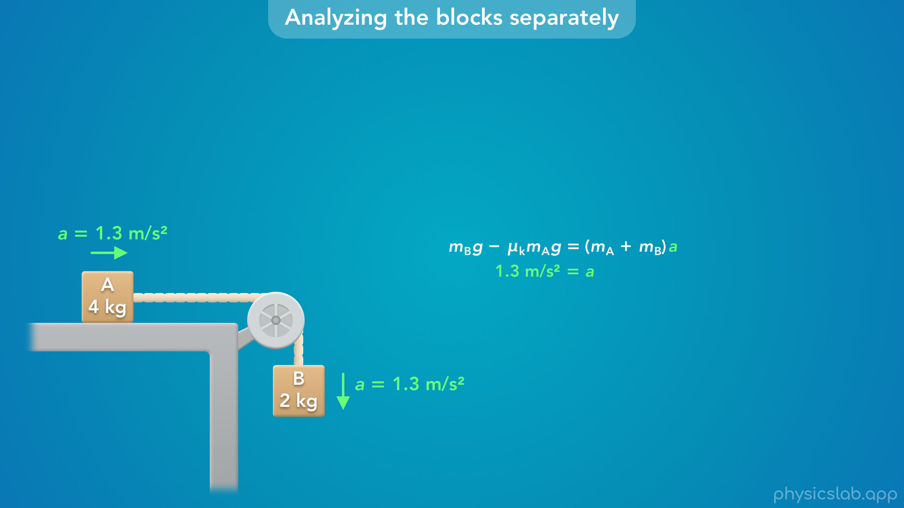
Notes:
• But we mentioned that we could also get this equation by analyzing the system.
• So how do we do that?

Slide 50
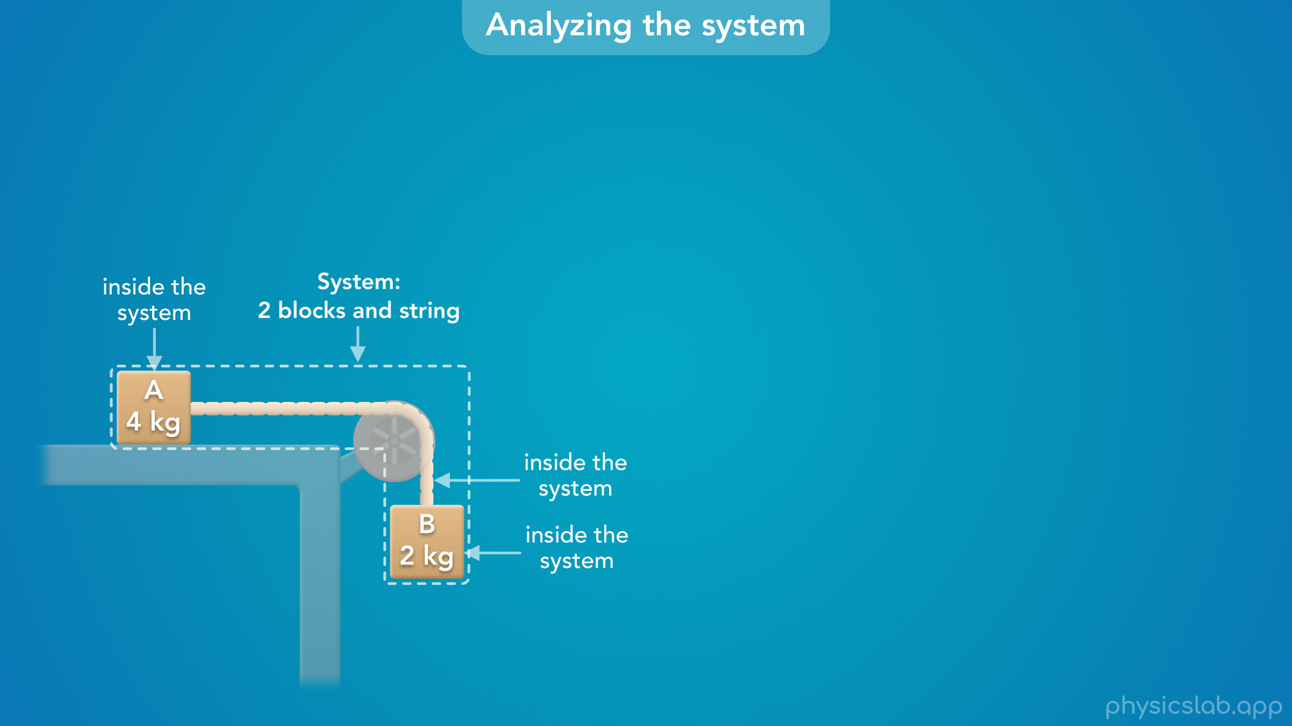
Notes:
• First, let’s define the system that we want to analyze.
• We’ll say that the two blocks and the string are inside the system.
• That means this surface, the pulley, the earth and everything else is outside the system.

Slide 51
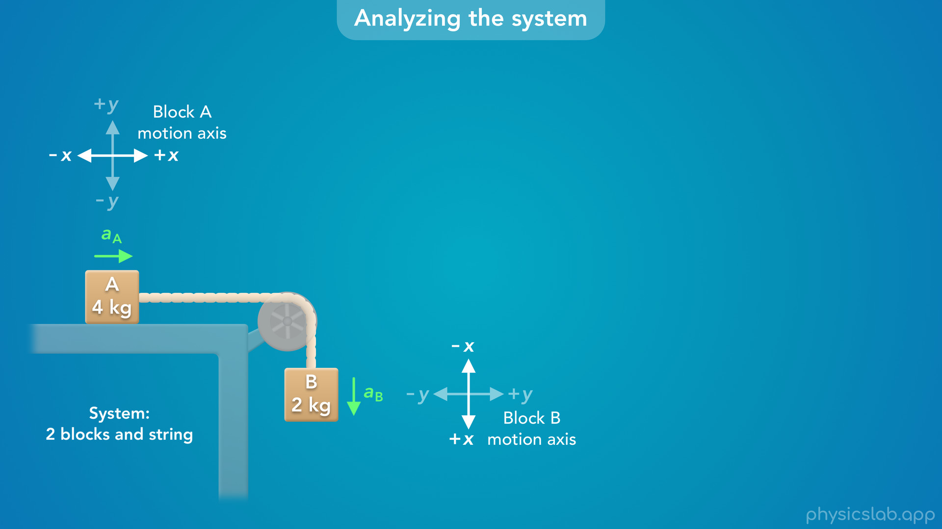
Notes:
• Now let’s think about how the system is moving.
• Block A is accelerating to the right and block B is accelerating down, and the blocks move together.
• When we analyzed the blocks separately, we set up the coordinate systems so each block is moving in the positive x direction.
• That’s the motion axis for each block.

Slide 52
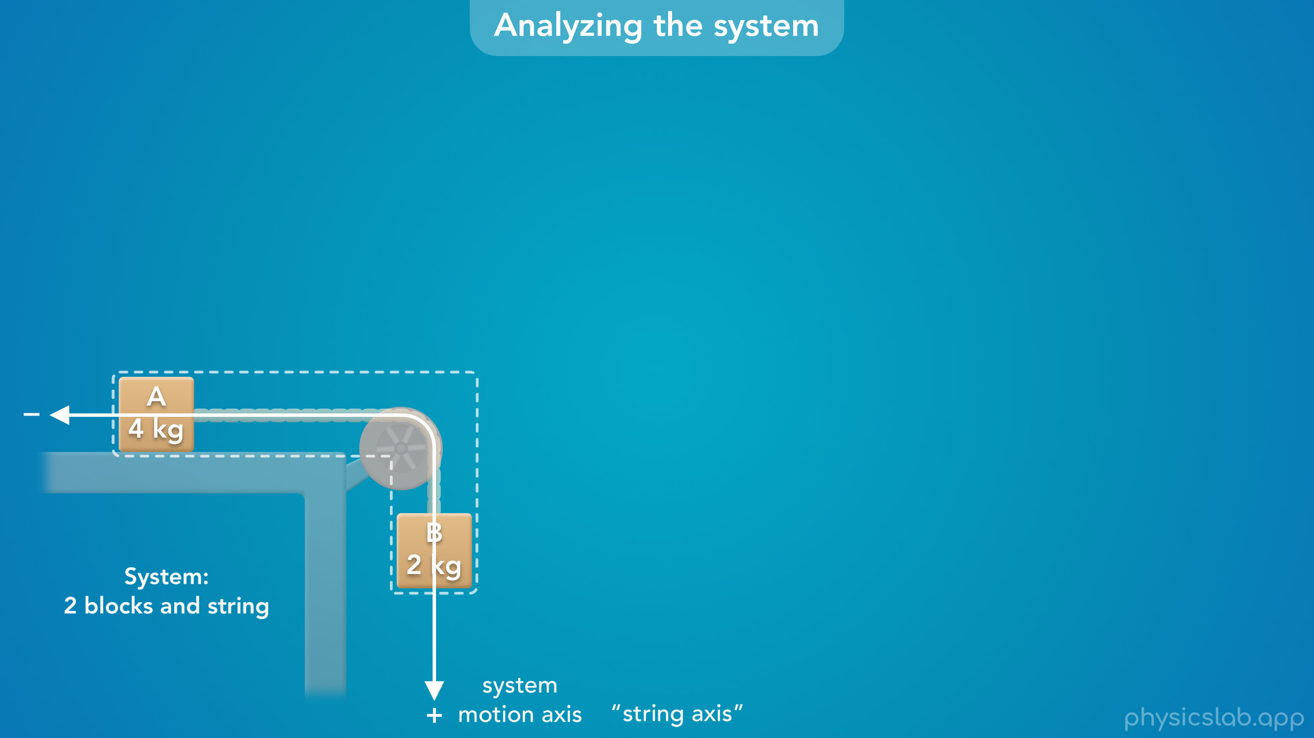
Notes:
• But now that we’re analyzing the overall system, we can use a system motion axis that follows the path of the string around the pulley.
• We could also think of this as the string axis.

Slide 53

Notes:
• We’ll choose the positive direction to be the direction that the blocks are accelerating, where block A moves to the right and block B moves down.

Slide 54
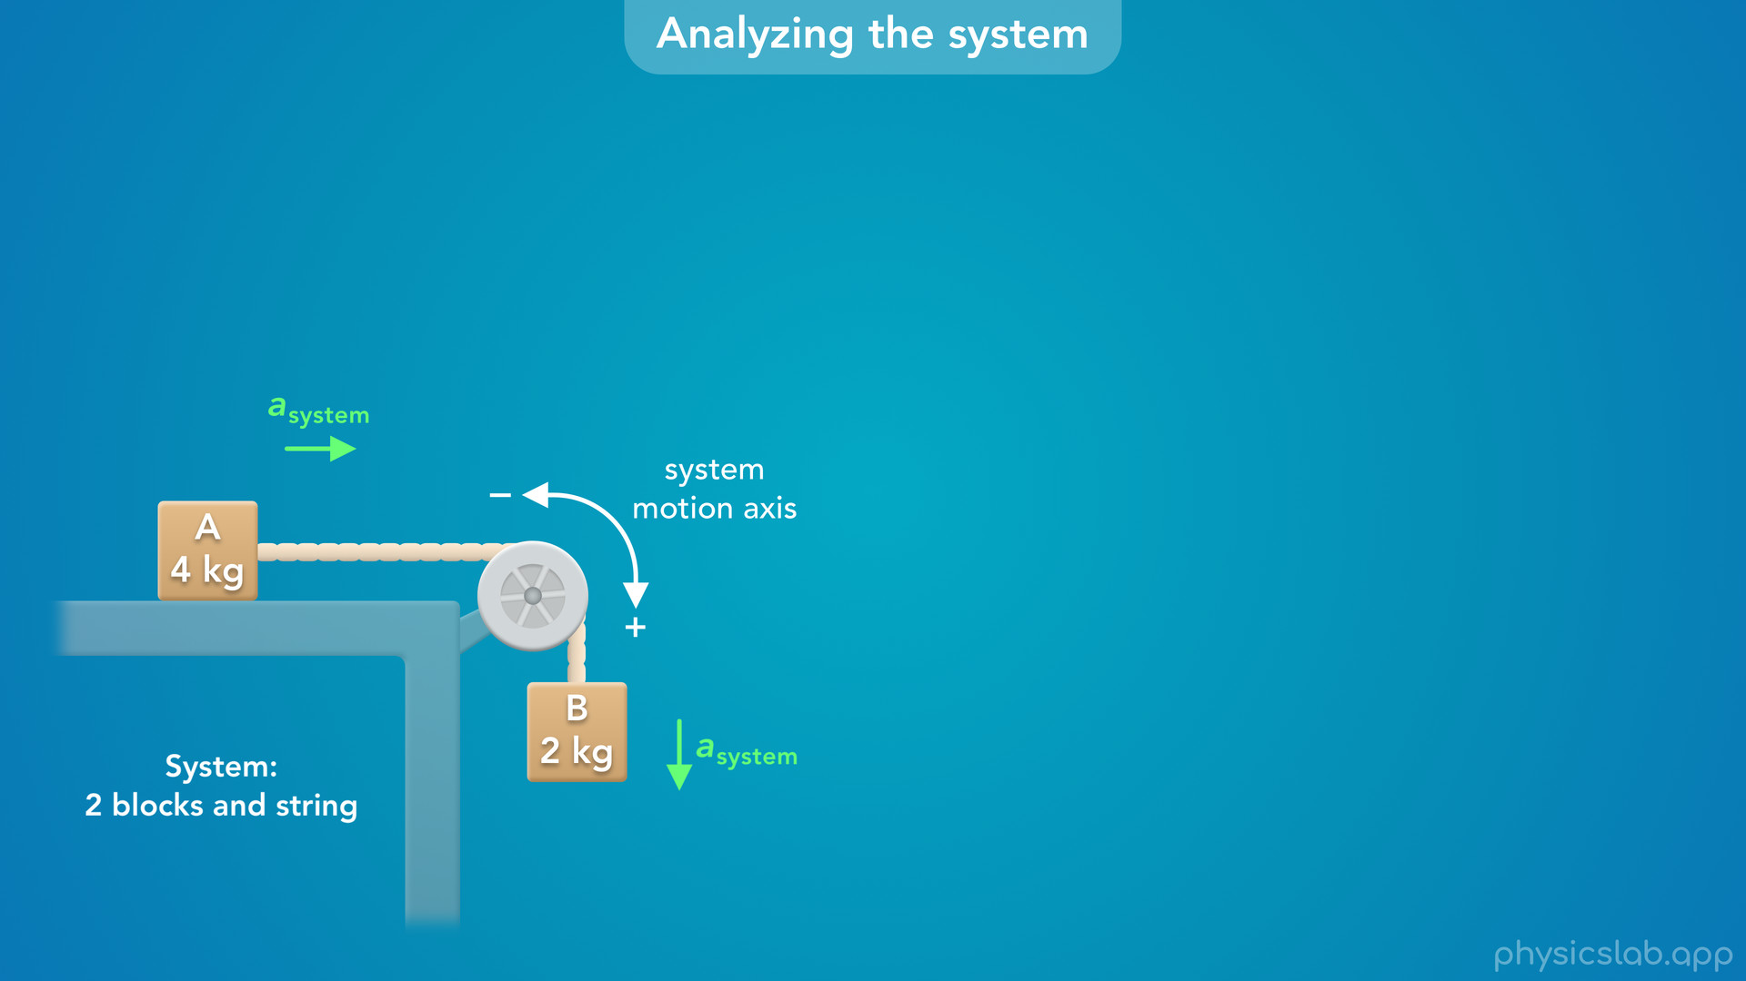
Notes:
• We could also say the positive direction is when the pulley is rotating clockwise, and the negative direction would be if the pulley rotates counterclockwise.
• This has nothing to do with the conventional directions for rotational motion.
• The pulley happens to be rotating clockwise because of the string, so we’ll call that the positive direction.

Slide 55
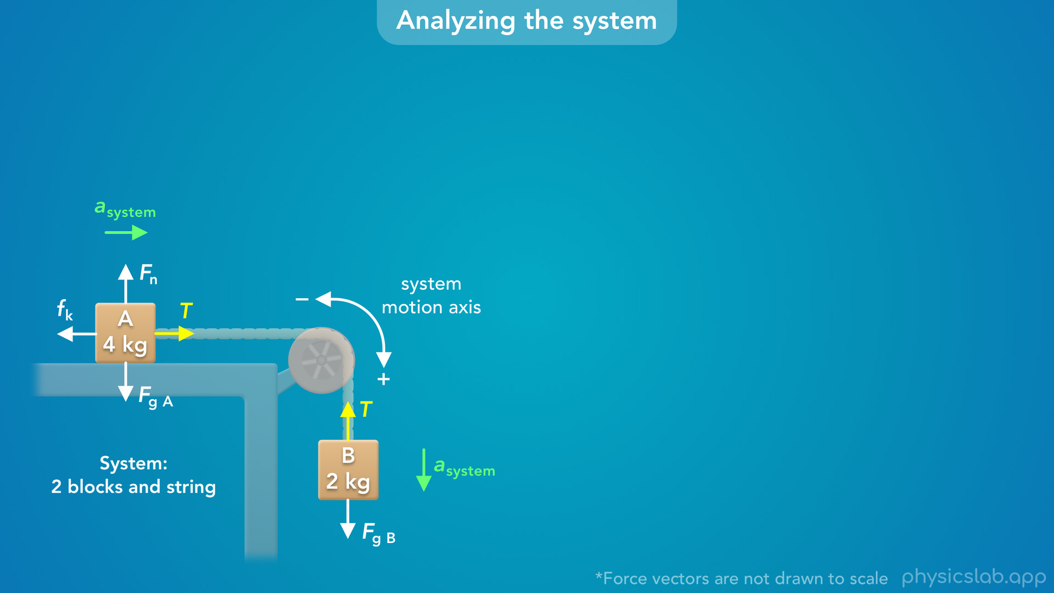
Notes:
• So, the entire system is accelerating in the positive direction using this motion axis.
• But which forces are causing the system to accelerate?
• These are all of the forces on the blocks, and we could just use this diagram with everything together.
• But it might help if we draw a free body diagram for the overall system. So what would that look like?

Slide 56
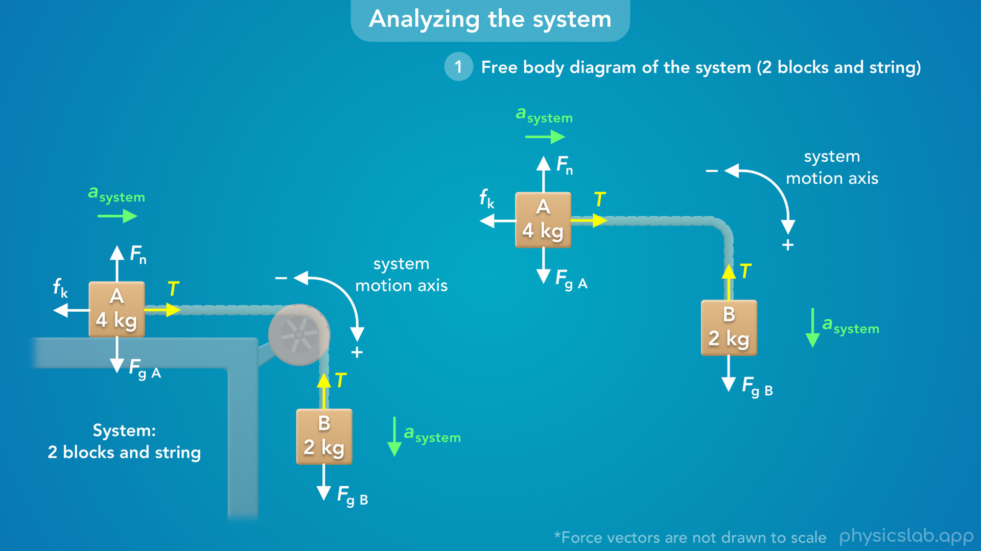
Notes:
• We can take the system and the motion axis…

Slide 57

Notes:
• … and straighten it out by rotating block B.

Slide 58

Notes:
• In this view, the system is accelerating to the right, in the positive direction using this motion axis.

Slide 59


Slide 60

Notes:
• And now we have a better picture of which forces might be affecting the acceleration.
• If you prefer, you can also just use the original diagram.
• So now, how do we find the acceleration?
• The next step is to apply Newton’s 2nd law to the system.
• The net force on the system is equal to the total mass times the acceleration.
• But when we write out the net force on the system, we only include external forces, which are forces caused by objects that are outside the system.
• So which of these are external forces?

Slide 61

Notes:
• The gravitational force on each block are external forces because they’re caused by the earth which we decided is outside the system.

Slide 62

Notes:
• The normal force on block A is an external force because it’s caused by this surface which is outside the system.

Slide 63

Notes:
• The friction force on block A is also caused by this surface so, that’s an external force.

Slide 64

Notes:
• What about the tension forces?
• We decided that the string is inside the system, so these would be internal forces.
• We only include external forces in Newton’s 2nd law, so we’re going to ignore the tension forces.

Slide 65


Slide 66

Notes:
• Now let’s write out the equation for Newton’s 2nd law.
• Normally, we apply this in the x direction or the y direction.
• But now, we’re going to apply this in the positive direction using the system motion axis.
• So how do we write the net force?
• The gravitational force on block B is pointing in the positive direction, so we include that force as positive.
• The friction force on block A is pointing in the negative direction, so we include that force as negative, or we subtract it.

Slide 67

Notes:
• And those are the only two external forces acting along this motion axis.
• The gravitational force and the normal force on block A are perpendicular to this axis.
• So those forces do not affect the acceleration, in the same way that a force in the y direction does not affect the acceleration in the x direction.
• If we look at the original diagram, block A is accelerating to the right.
• The gravitational force and the normal force are not acting in that direction, so we do not include them in Newton’s 2nd law for the system.
• We’re only focused on the forces that are parallel to the acceleration.

Slide 68

Notes:
• So the next part of this equation is the total mass of the system.
• So we’re going to add the mass of the blocks together, and we’re assuming the string has no mass.
• And we don’t know the acceleration, that’s what we’re trying to find.
• So Newton’s 2nd law says that the gravitational force on block B minus the friction force on block A, is accelerating 6 kg of mass.

Slide 69

Notes:
• Next, we can replace Fg with mass B times g.
• What about the friction force on block A?
• We already found this before, the kinetic friction force is equal to the coefficient of kinetic friction times the normal force.
• For block A, the vertical forces are balanced, so the normal is equal to the gravitational force, which is equal to mass A times g.
• So we can replace the friction force with mu k times mass A times g.
• Now, we know everything in this equation except for the acceleration, so we can solve this.

Slide 70

Notes:
• But notice, if we write out the total mass as mA plus mB…
• … this is the exact same equation that we got earlier, when we combined the equations for Newton’s 2nd law for each block.
• In that case, we found an equation for the tension using block B, and we substituted that in place of T for block A.
• When we did that, the tension force no longer appeared in that equation…

Slide 71

Notes:
• … That’s the same result we get by ignoring the tension forces when we analyze the system, because here, tension is an internal force.
• So we get the same equation, and analyzing the system is a faster way to solve for the acceleration.

Slide 72

Notes:
• Now let’s do that by plugging in numbers.

Slide 73

Notes:
• Mass A is 4 kg, mass B is 2 kg, the coefficient of friction is 0.3, and g is 9.8 m/s^2.
• We can divide both sides by the total mass of 6 kg… and we get 1.3 m/s^2 for the acceleration of the system.

Slide 74

Notes:
• So that’s the acceleration of block A and block B.

Slide 75

Notes:
• It’s also important to mention that this is how we know the system is accelerating in this direction.
• The question told us that block A is accelerating to the right.
• But if it didn’t tell us, we could figure that out by analyzing the system.
• We can calculate the friction force on block A and the gravitational force on block B.
• The gravitational force is greater, so the system must be accelerating in that direction.

Slide 76

Notes:
• So that’s the acceleration.
• But how do we find the tension?
• Since the string is inside the system, these are internal forces and we can not solve for the tension by analyzing the system.

Slide 77

Notes:
• So we have to apply Newton’s 2nd law to one of the blocks like we did before.
• This way the tension force will show up in the free body diagram and Newton’s 2nd law.

Slide 78

Notes:
• But now, we know the acceleration of each block, so we can plug in 1.3 m/s^2 for a in both equations.
• Then we can solve for the tension using either block.

Slide 79

Notes:
• For block A, we can rearrange the equation so T is on the left side by itself.
• Then we can plug in the values that we know… and we get 17 N for the tension force on block A.

Slide 80

Notes:
• For block B, we can just plug in the values that we know… and we get 17 N for the tension force on block B.
• So the tension in the string is 17 N, which is the same answer we got before.
• But this time, we found the acceleration first by analyzing the system.
• And once we know the acceleration of each block, we can find the tension force using Newton’s 2nd law for either block.
• Analyzing one of the blocks on its own is the only way to find the tension force, because we need tension to show up in the free body diagram and Newton’s 2nd law.

Slide 81

Notes:
• Let’s do a recap of this example.

Slide 82

Notes:
• We have a pulley system with two blocks, and the question wanted us to find the acceleration of block B and the tension in the string.

Slide 83

Notes:
• We can assume the blocks have the same acceleration and the same tension force.

Slide 84

Notes:
• One way to solve this is by drawing a free body diagram and applying Newton’s 2nd law to each block on its own.
• We use a different coordinate system for each block, where the block is accelerating in the positive x direction.
• That gives us two equations.

Slide 85

Notes:
• Since the tension force and the acceleration are the same for each block, we can substitute those variables between the two equations.
• That let’s us solve for the acceleration and the tension.

Slide 86

Notes:
• The other way we can solve for the acceleration is by analyzing the system.
• We can use a system motion axis where each block and the overall system is moving in the positive direction.
• And we can draw the forces in the original diagram, or we can draw a free body diagram where we straighten out the system.

Slide 87

Notes:
• We only include external forces in Newton’s 2nd law for the system, so we do not include the tension forces.

Slide 88

Notes:
• And we’re only focused on the forces that are parallel the motion axis, so we don’t include the gravitational force or the normal force on block A.

Slide 89

Notes:
• And finally, we use the total mass of the two blocks.
• This let’s us solve for the acceleration, but we can’t use this to find the tension force.

Slide 90

Notes:
• So we have to take that acceleration and plug it into Newton’s 2nd law for one of the blocks on their own.
• And we can use either block, because they have the same acceleration and the same tension.

Slide 91

Notes:
• So that’s an example of working with pulley systems.
• If we only need to find the acceleration, it’s easier to analyze the system.
• Otherwise, it probably helps to draw a free body diagram and apply Newton’s 2nd law to each block.
• That let’s us solve for the tension and it shows us how all of the forces are related.

