Slide 1


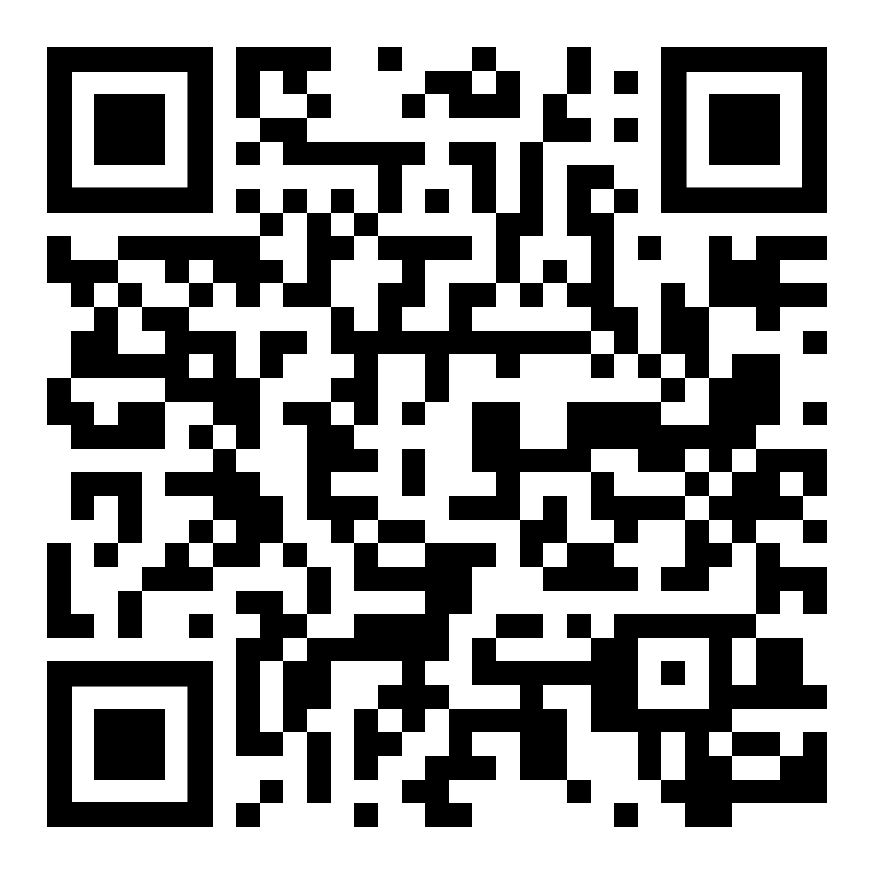
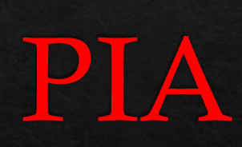
Positive Impact Academy
Additional Resources & Study Materials
My NC Pre-Licensing Success Package
18 Modules
Help with the Challenging Areas
Agency
Licensing Law, Etc.
Sign Up Online Today
PositiveImpactAcademy.com
Disclosure: EP will receive a commission when you sign up with their code.

