Slide 1
Newton’s 2nd Law of Motion
Slides Version 2
This version includes:
Slides with screenshot images from the video.
The video narration in the slide notes.
A blank template slide with the same background and font as the video.
Slides with some basic graphics from this video for you to use however you like.
Feel free to add, delete and edit slides to make your own presentation. You can use these slides in class or share them with your students, but please do not share them with anyone else.
If you have any feedback, suggestions or questions about these slides please email me at chris@physicslab.app or send me a message on Discord @physicslab.
physicslab.app

Slide 2
Heading
Text

Slide 3


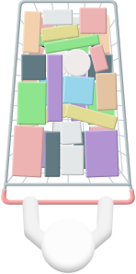




Slide 4



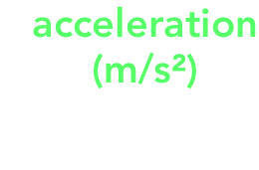





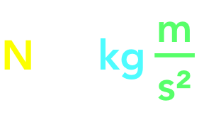



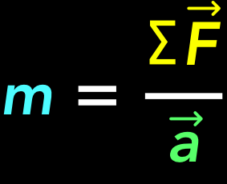
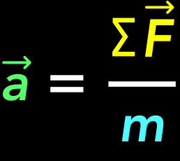


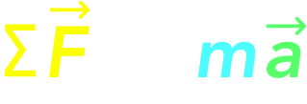



Slide 5
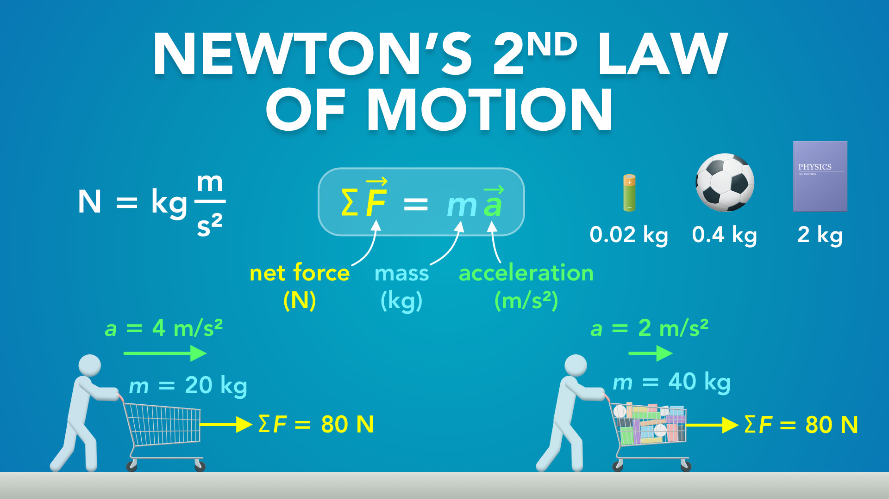
Notes:
Newton’s 2nd Law of Motion
physicslab.app
If you have any questions, suggestions or feedback about these slides please email me at chris@physicslab.app or send me a message on Discord @physicslab.

Slide 6
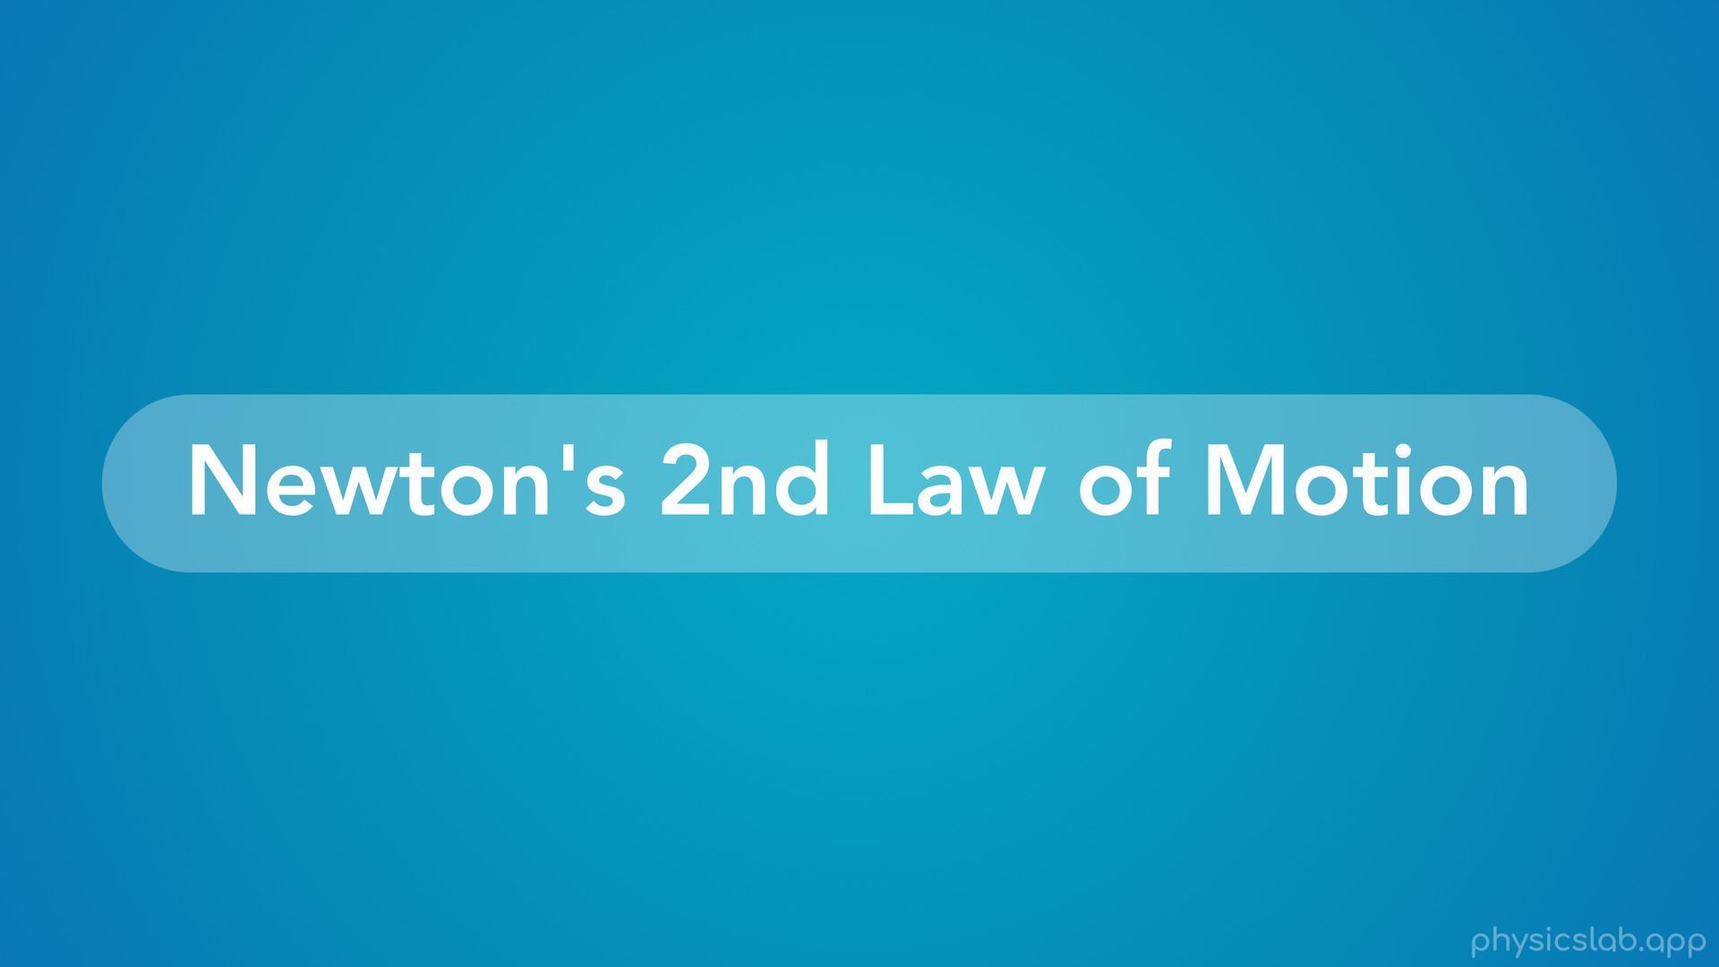
Notes:
• Hey everyone, in this video we’re gonna learn about Newton’s 2nd law of motion.

Slide 7
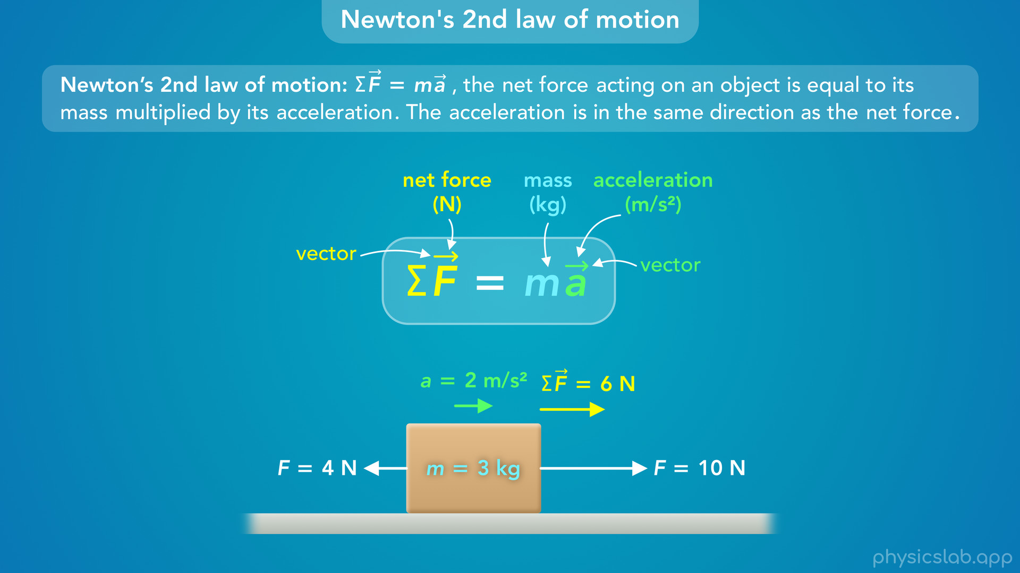
Notes:
• We’ll learn the famous equation from Newton’s 2nd law, and we’ll talk about each part:

Slide 8
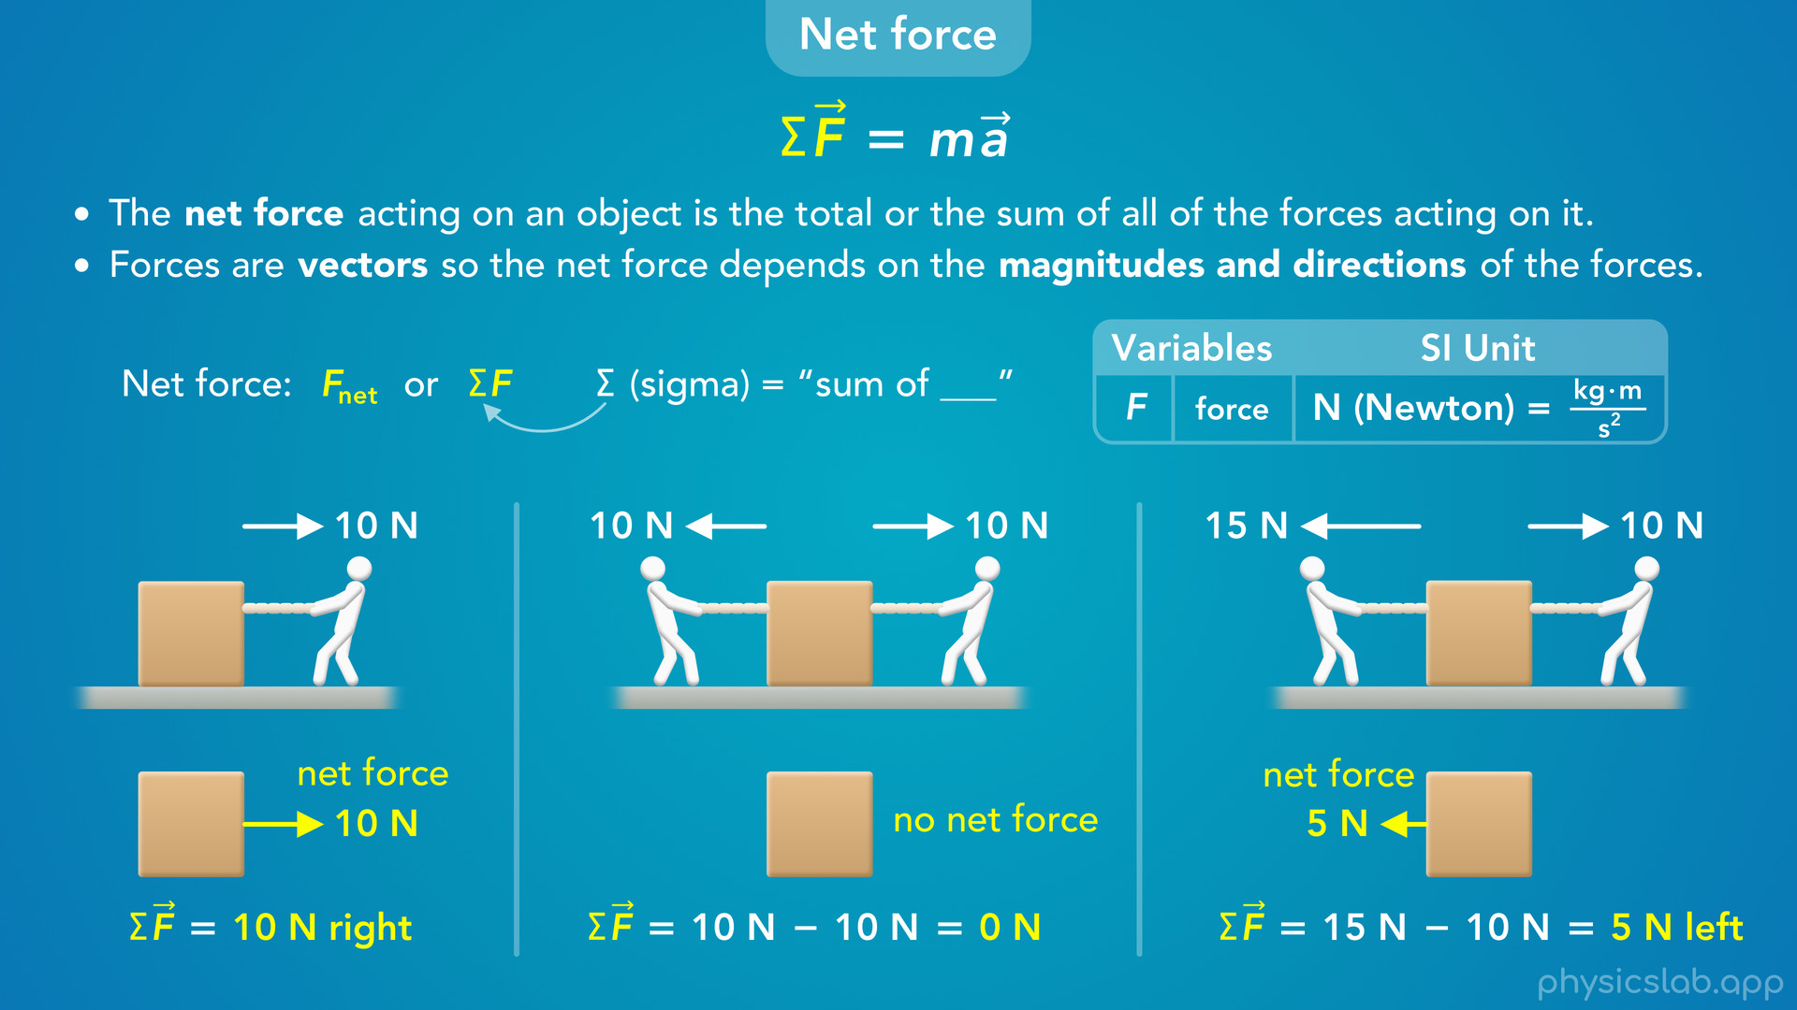
Notes:
• Net force...

Slide 9
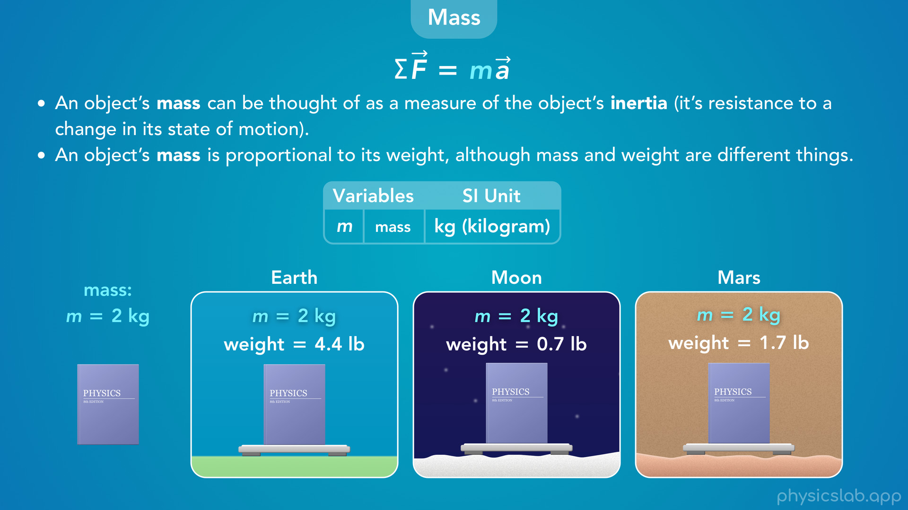
Notes:
• …mass…

Slide 10
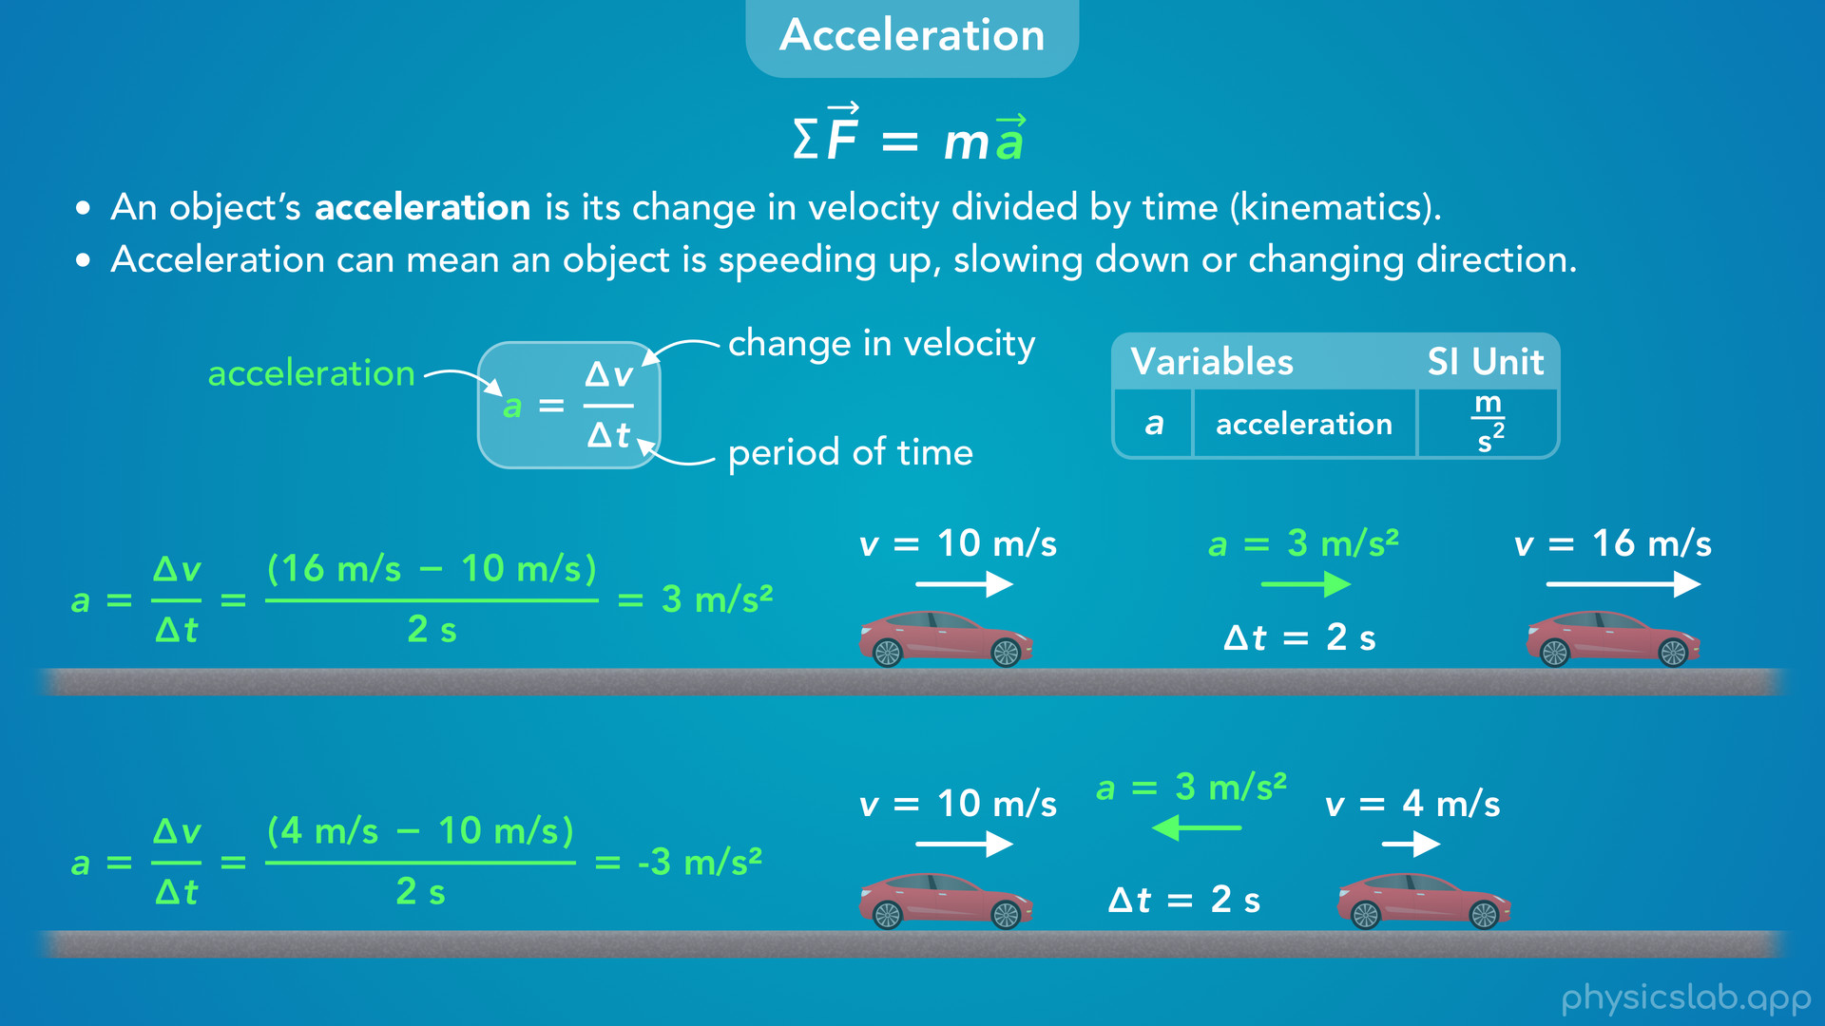
Notes:
• … and acceleration.

Slide 11
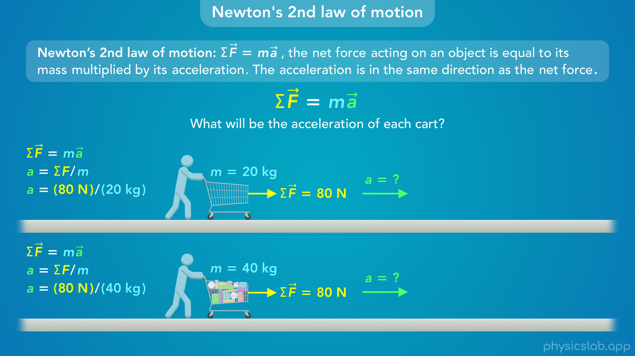
Notes:
• Then we’ll use Newton’s 2nd law to figure out the acceleration of an object.

Slide 12
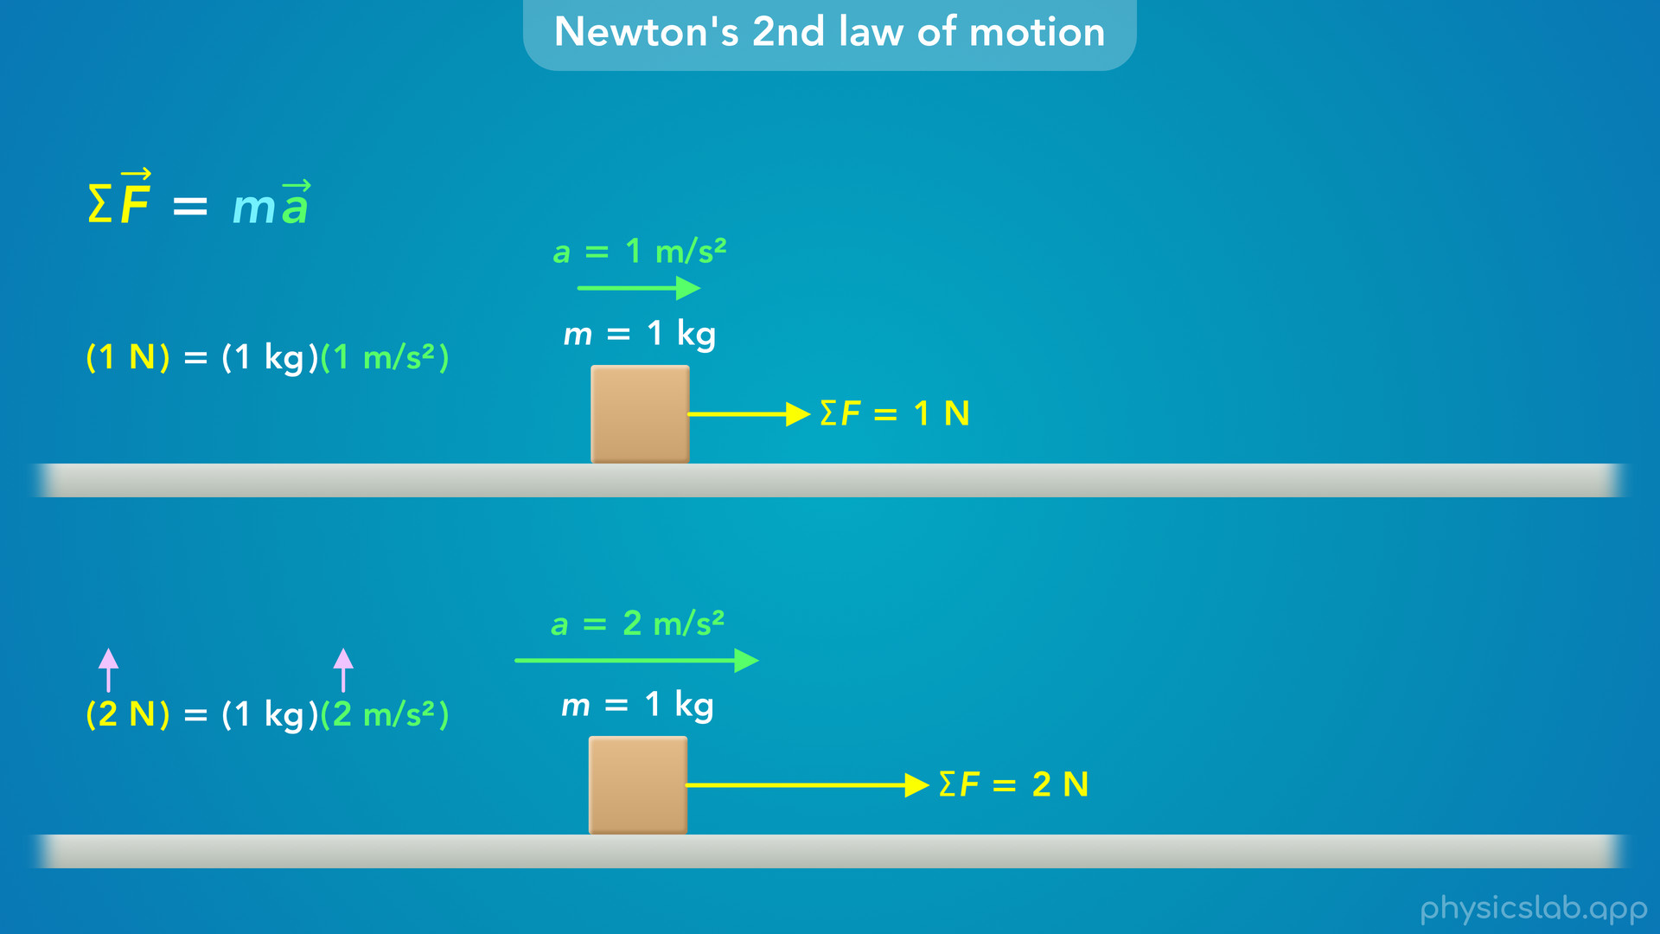
Notes:
• After that, we’ll play around with this equation and see how changing one variable affects the others.

Slide 13
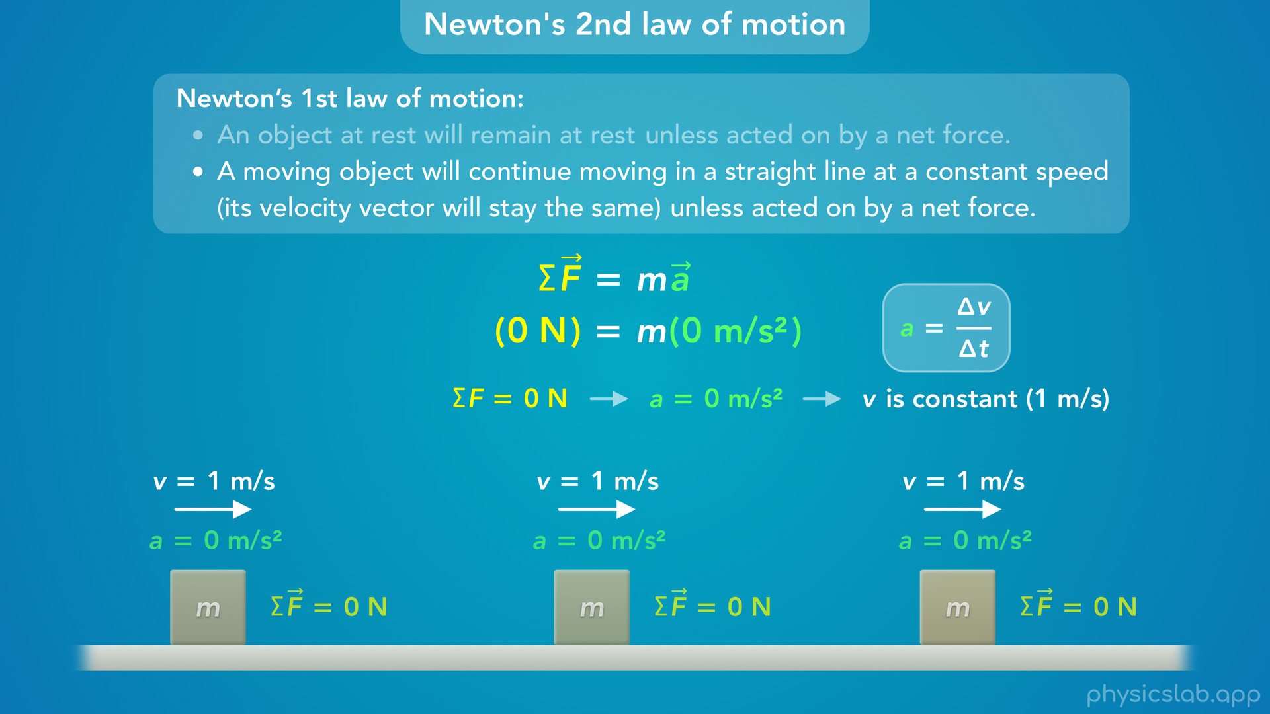
Notes:
• At the end, we’ll talk about how we can basically replace Newton’s 1st law with Newton’s 2nd law.

Slide 14
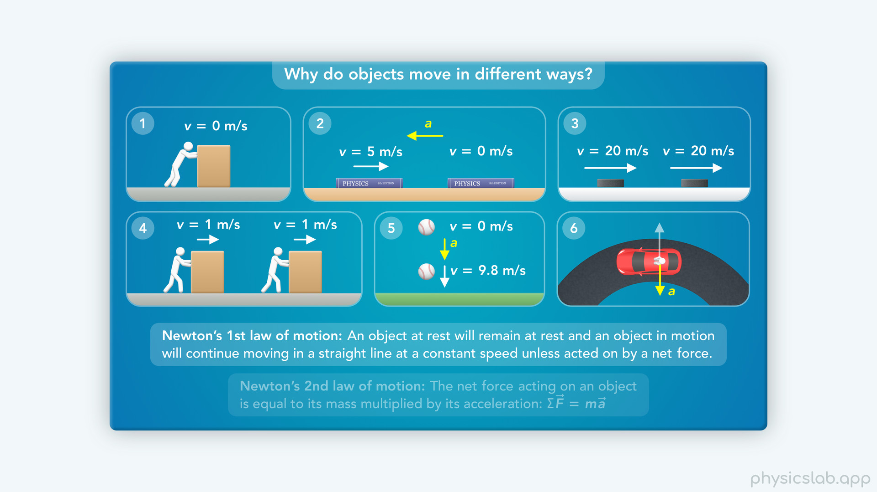
Notes:
• In the last video, we learned about Newton’s 1st law of motion, which tells us why an object is accelerating or not accelerating.

Slide 15
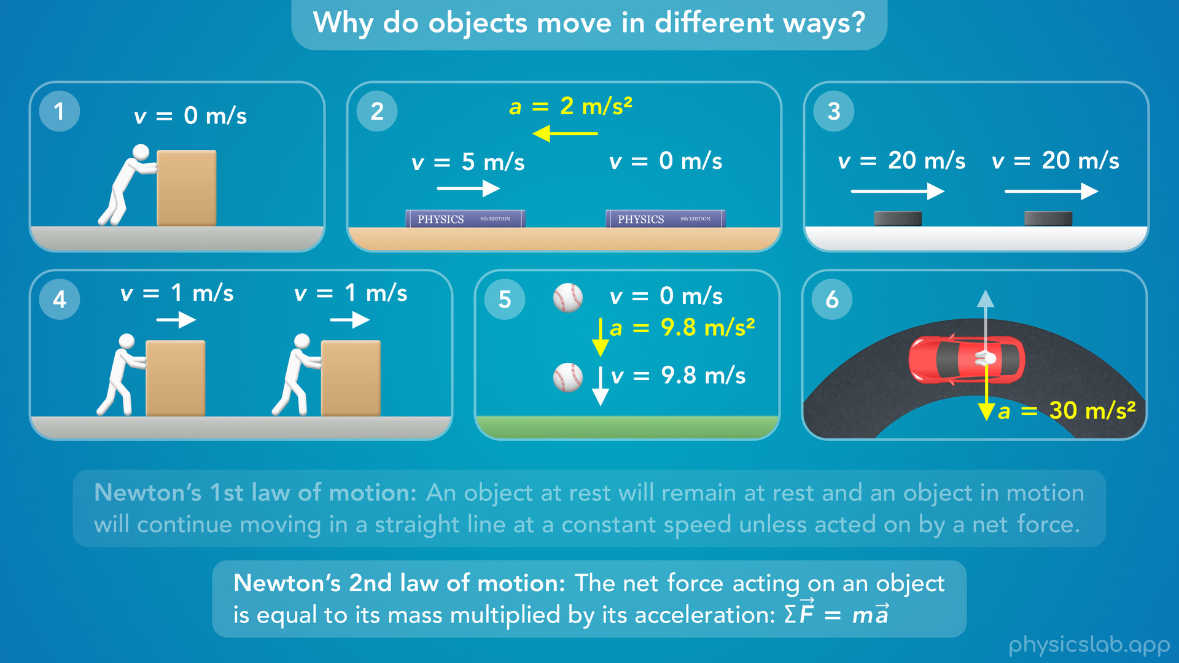
Notes:
• But that was more conceptual. How do we find the actual value or magnitude of the acceleration using numbers?
• For that, we need Newton’s 2nd law of motion.

Slide 16
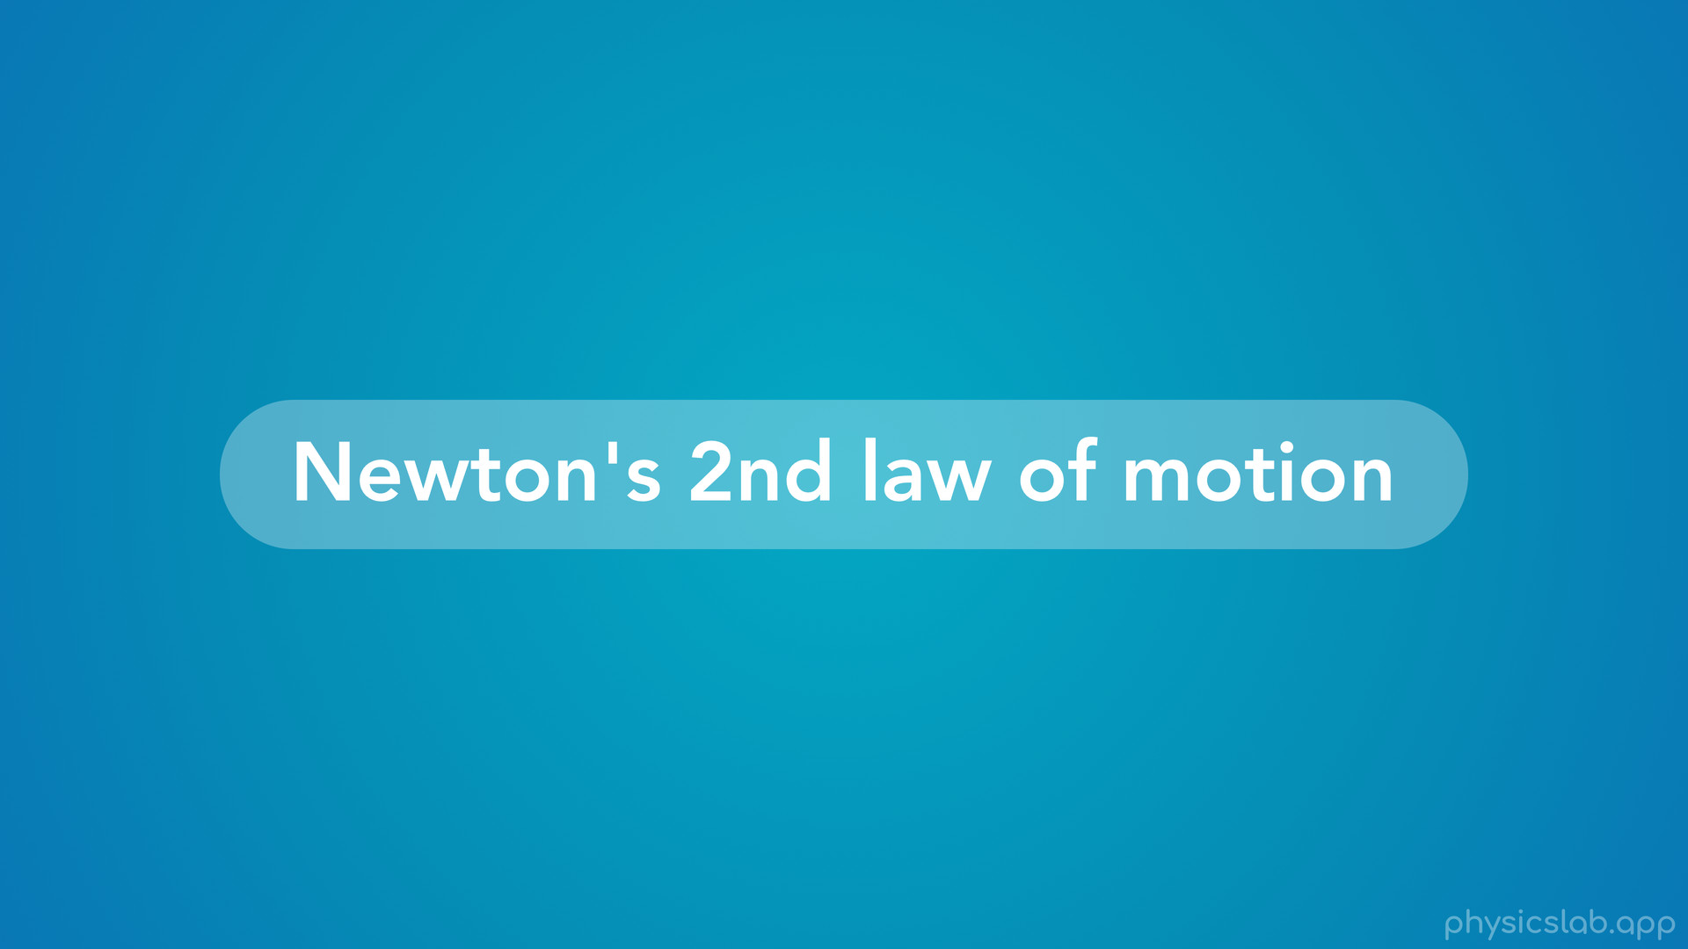
Notes:
• So let’s try to understand the concept behind Newton’s 2nd law, and how we can use this new equation.

Slide 17
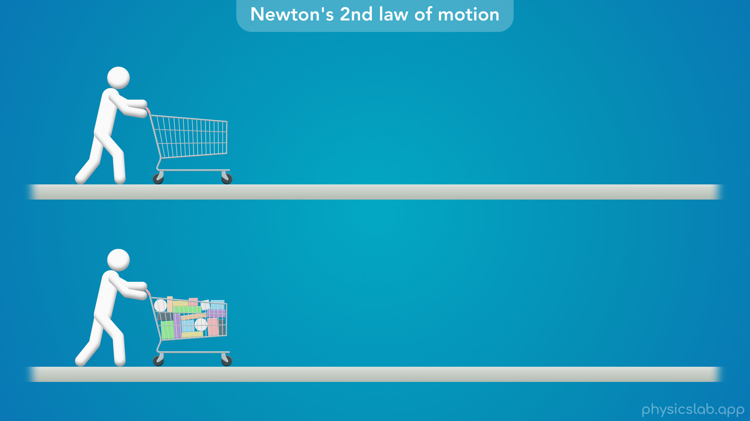
Notes:
• Think about the last time you went grocery shopping.

Slide 18
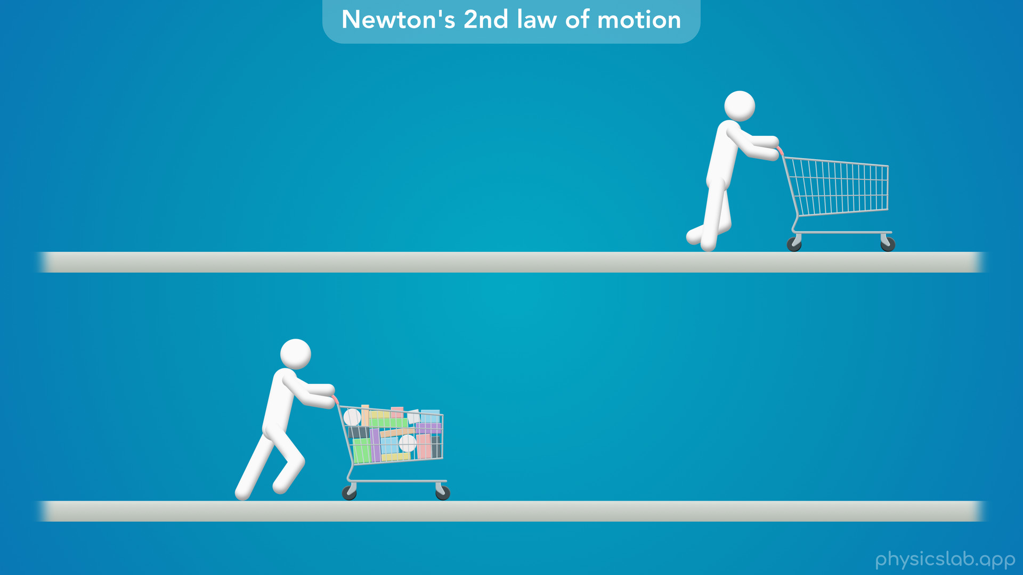
Notes:
• You might have noticed that it’s easy to move your cart in the beginning.
• But once the cart is full, you have to push a lot harder to get it moving.
• Why do you think that is? You might think there’s a bigger friction force on the full cart which is acting against you, but that’s not the reason.

Slide 19
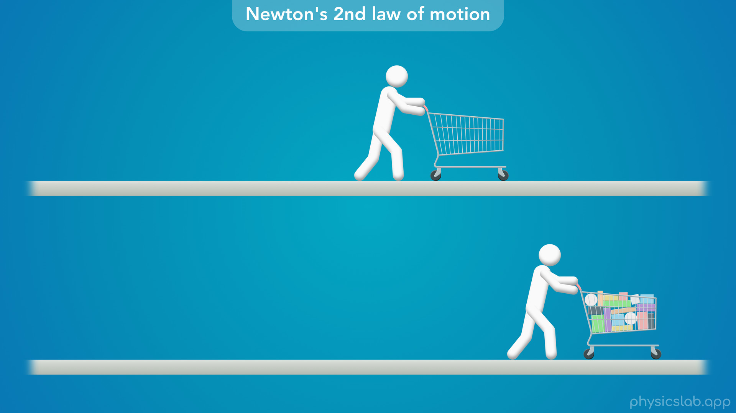
Notes:
• Not only is it harder to get the cart moving, it’s also harder to slow down and stop.

Slide 20
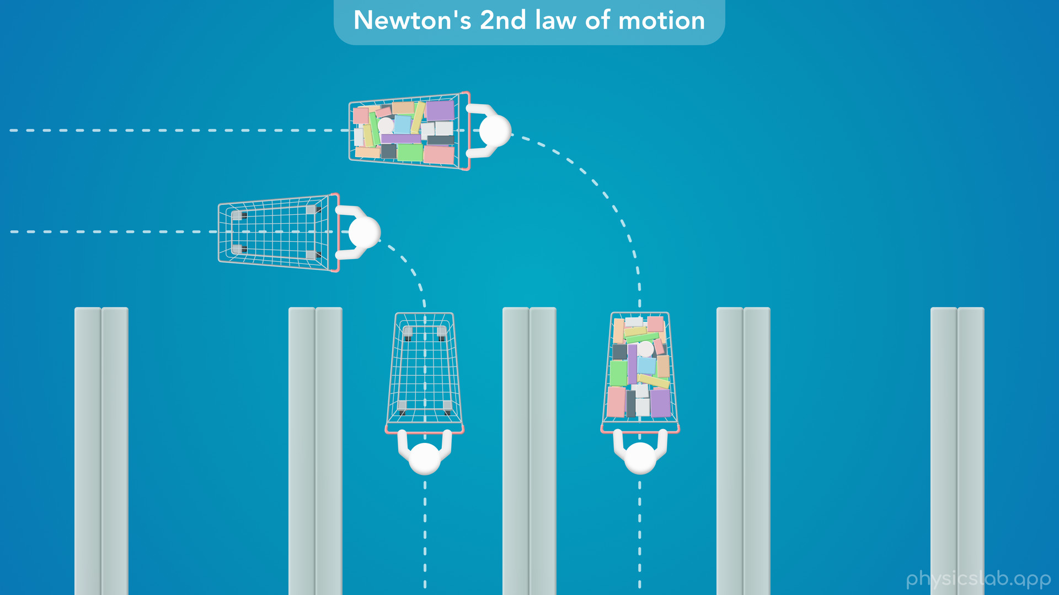
Notes:
• You might have also noticed that it’s easy to turn the cart when it’s empty.
• But when it’s full, it wants to keep going straight and it takes a lot of force to turn it.
• So what’s going on? Clearly, the only difference is how much stuff is in the cart.
• So how do we describe that stuff in physics, and how would Newton explain this scenario?

Slide 21
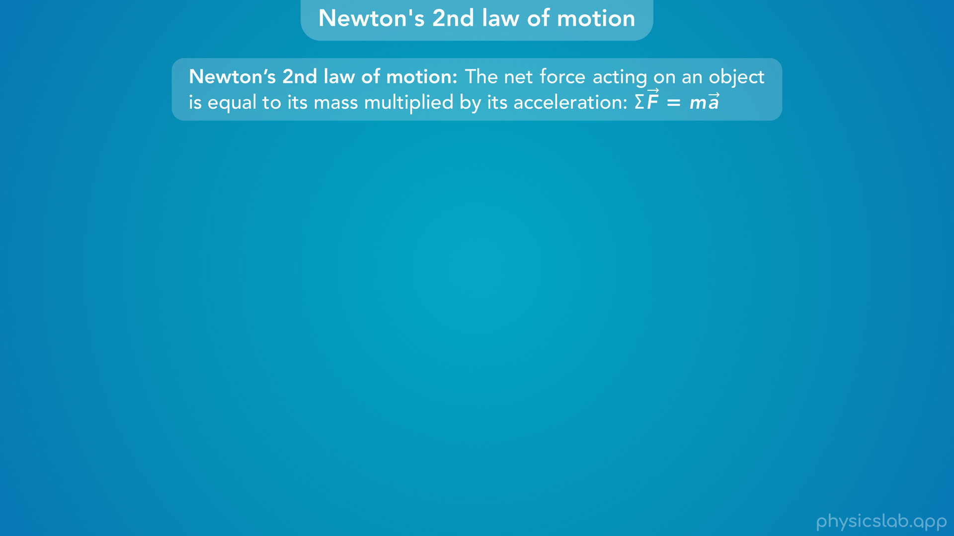
Notes:
• Newton’s 2nd law says that “the net force acting on an object is equal to its mass multiplied by its acceleration, so Fnet = ma.” This law is basically just this equation using words. And the little arrows mean that the force and the acceleration are vectors, and we need to consider their direction.

Slide 22
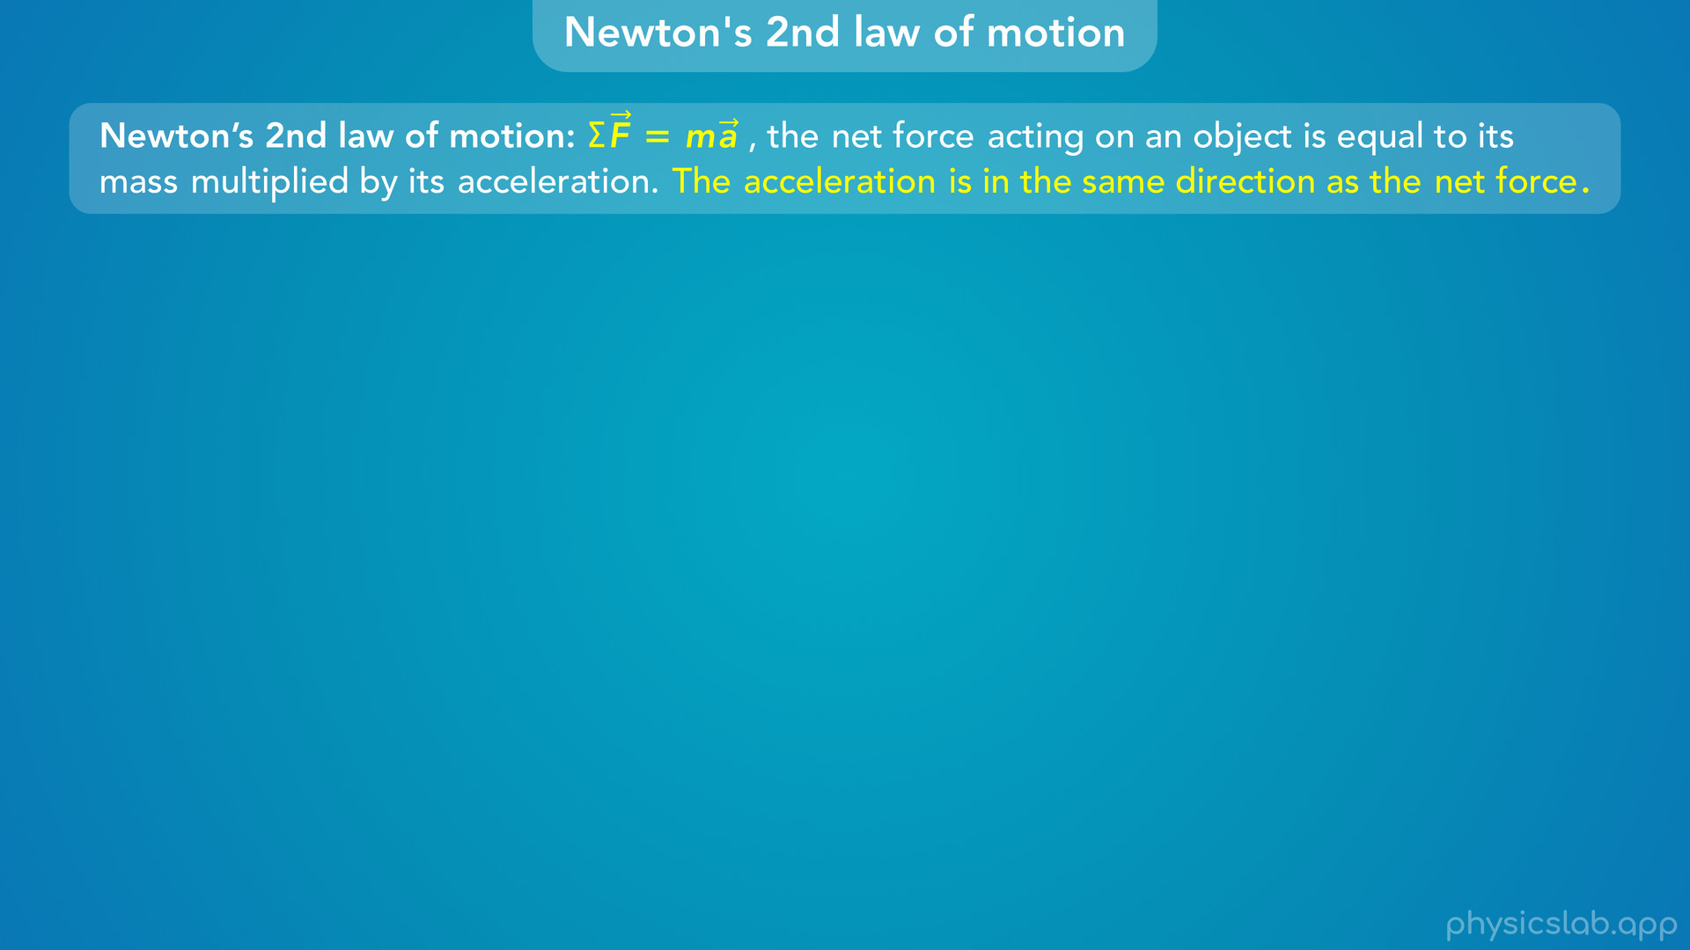
Notes:
• So let’s rewrite this law with the equation up front, and we’ll we add this sentence: “The acceleration is in the same direction as the net force”.

Slide 23
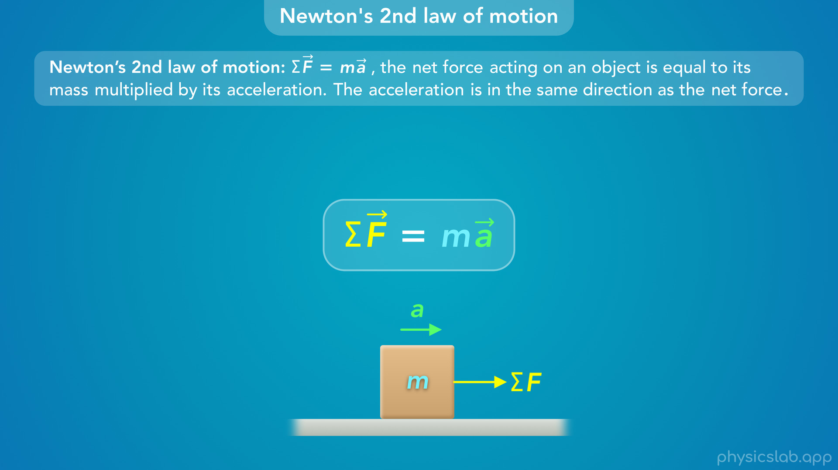
Notes:
• So let’s take a closer look at this equation.

Slide 24
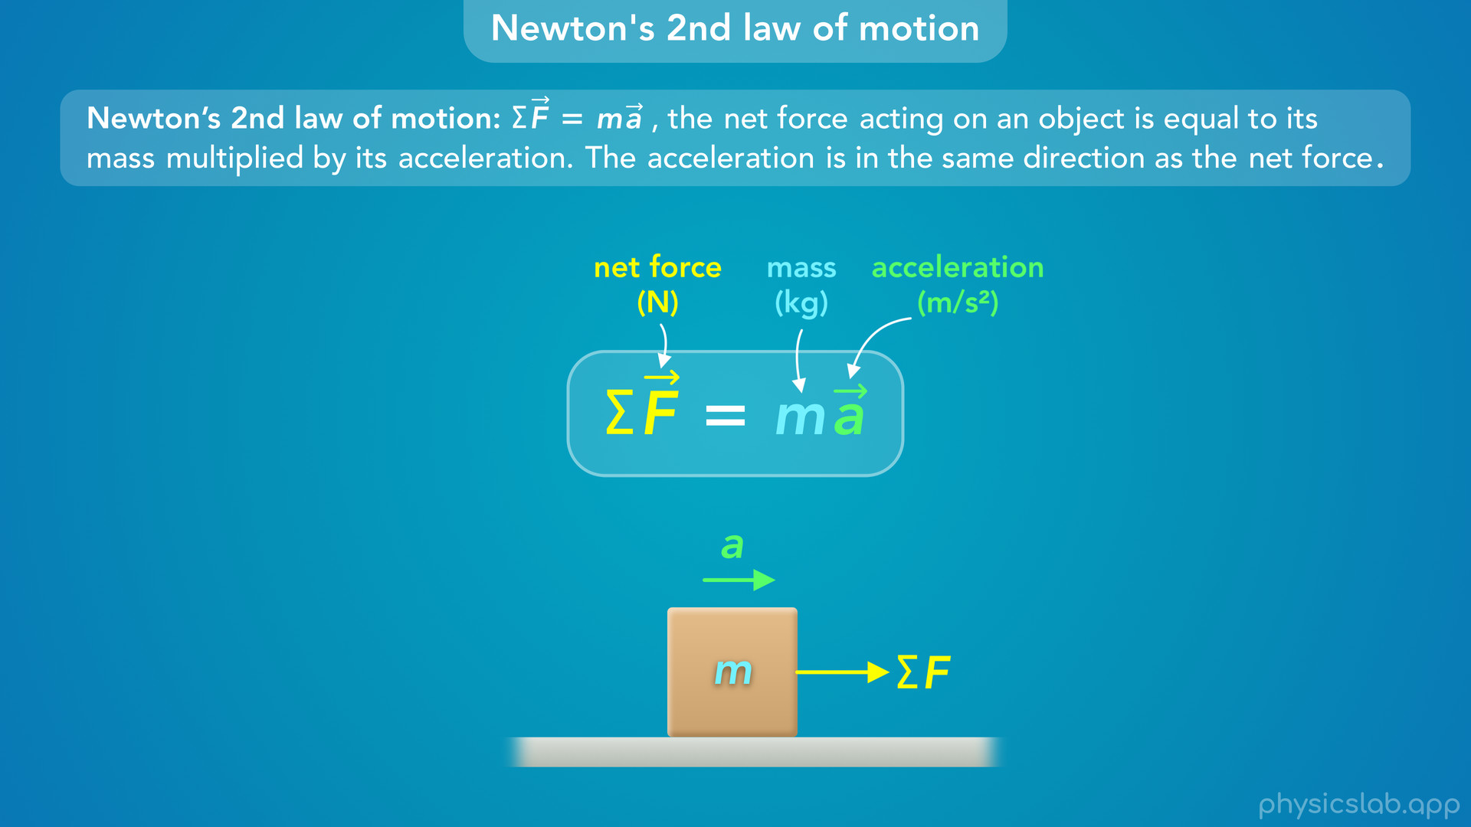
Notes:
• Sigma F is the net force acting on an object, m is the mass of the object, and a is the acceleration of the object.

Slide 25
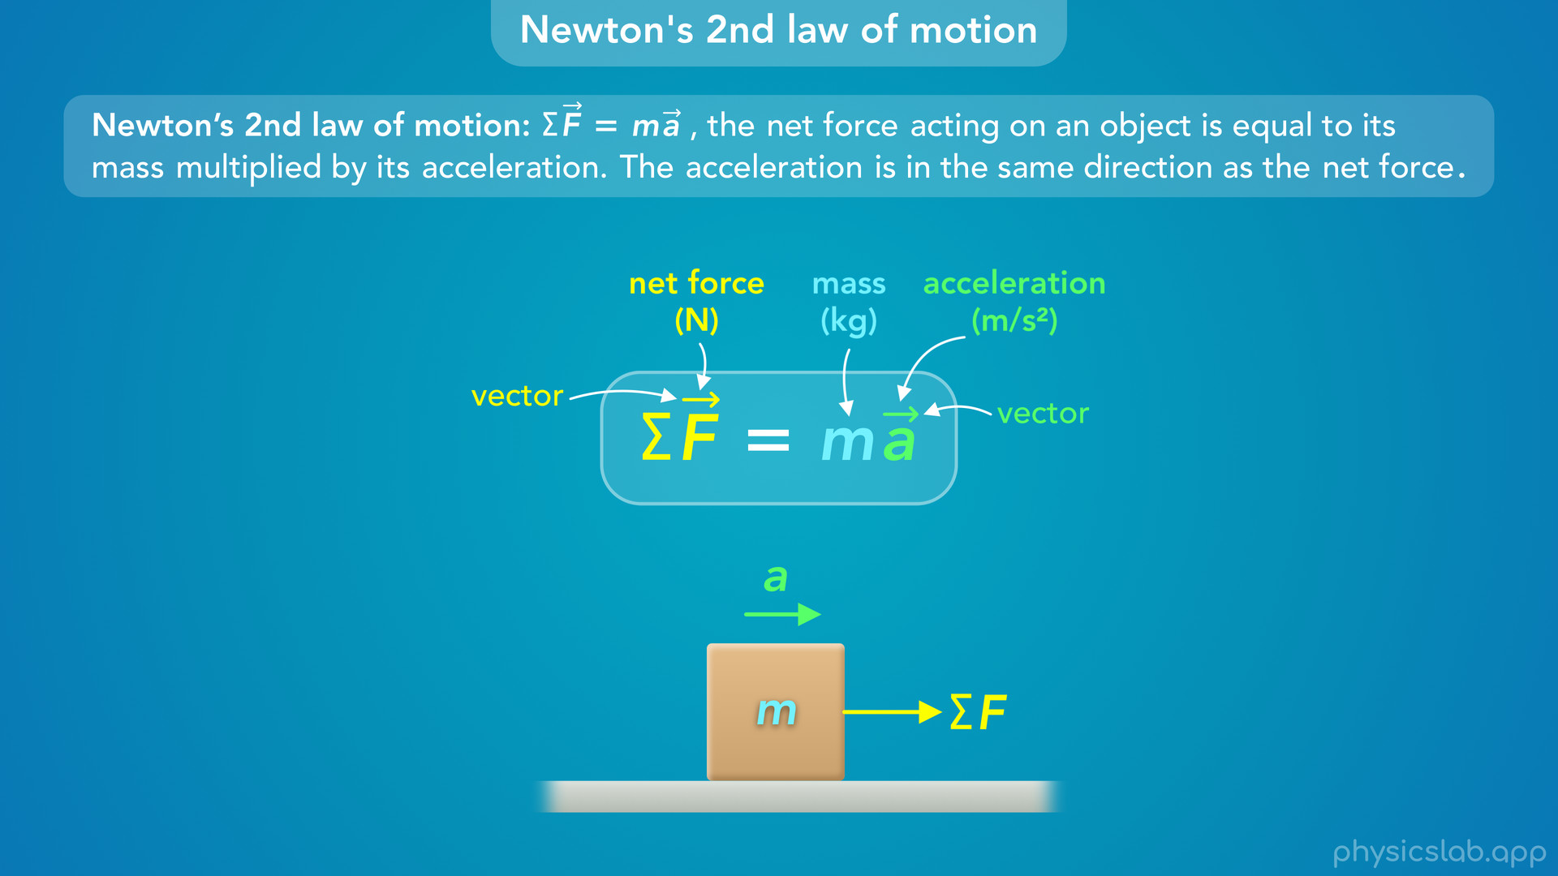
Notes:
• The net force and the acceleration are vectors, which means they have a magnitude and a direction.
• Let’s go through each one.

Slide 26
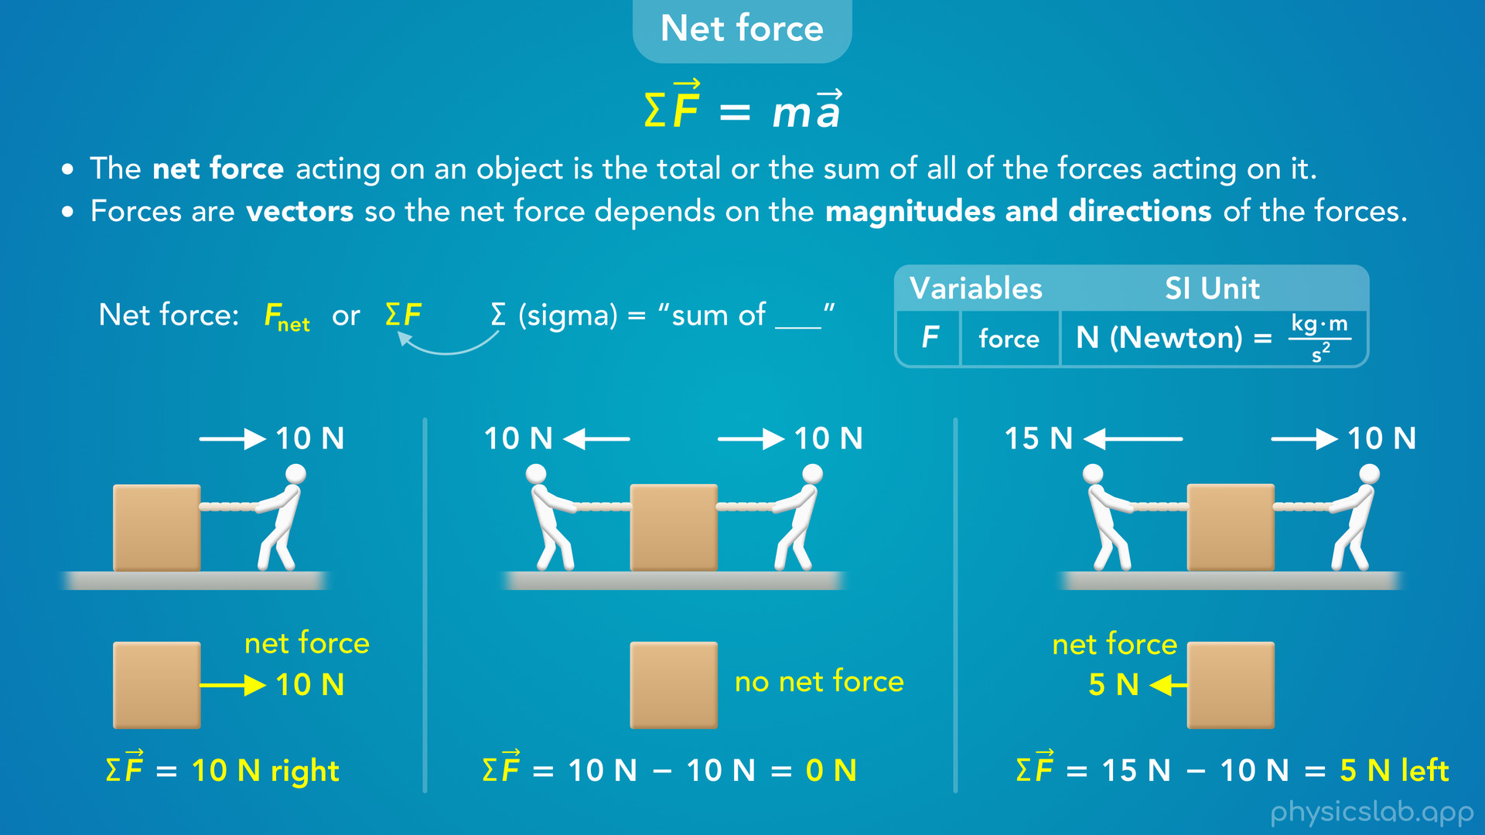
Notes:
• In a previous video, we learned that the net force acting on an object is the total or the sum of all the forces acting on it. And forces are vectors so the net force depends on the magnitudes and directions of the forces.
• We can write net force as Fnet or as “sigma” F which means the sum of the forces.
• The SI unit for force is a Newton, capital N, which is equal to 1 kg m/s².
• So In this example, there’s only one force acting on the object so that’s also the net force, 10 N to the right.
• In this example, the net force is 10 N minus 10 N, which is 0 N. The forces have the same magnitude and they act in opposite directions so they cancel out.
• In this example, the net force is 15 N minus 10 N, which is 5 N to the left.

Slide 27
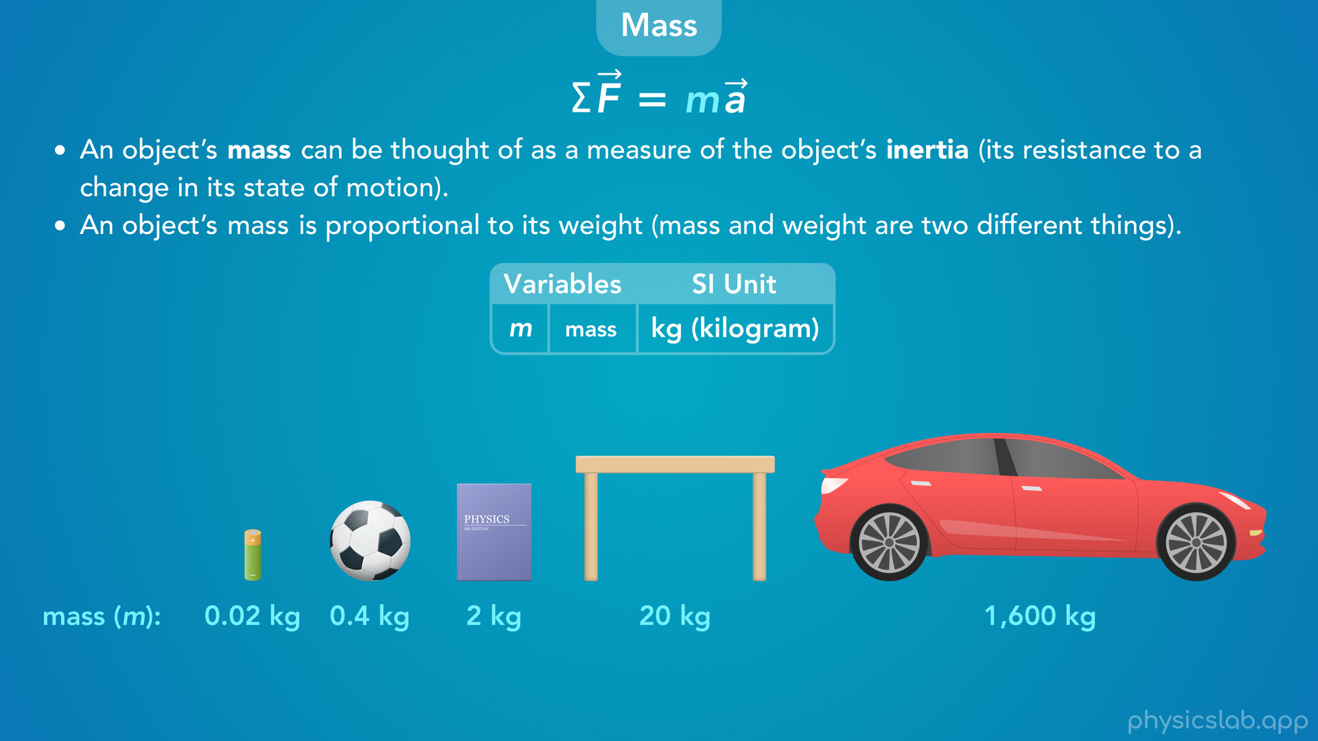
Notes:
• The next thing we need to talk about is mass.
• An object’s mass can be thought of as a measure of the object’s inertia (its resistance to a change in its state of motion).
• That’ll make more sense as we go along, but if you’re new to the concept of mass, it might help to think of it as the weight of an object.
• That’s because an object’s mass is proportional to its weight, so heavier objects have more mass.
• And the SI unit for mass is the kilogram, or lowercase kg.

Slide 28
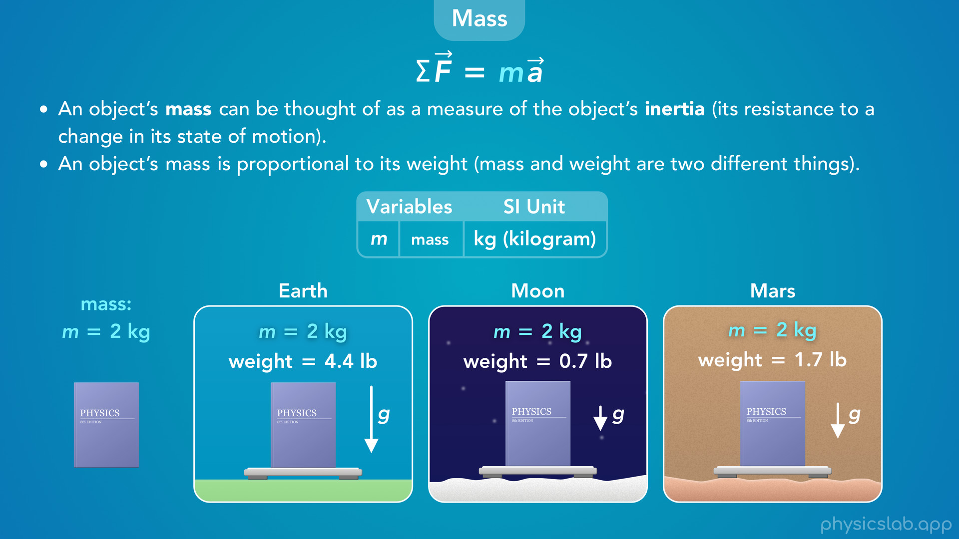
Notes:
• It’s very important to note that mass and weight are two different things.
• Mass is an intrinsic property of an object, and weight is the amount of gravitational force on the object.
• This book always has the same mass of 2 kg whether its on earth, on the moon or on mars. But the weight of the book will change depending on the strength of the planet’s gravity. So it weighs less on the moon, but its mass is still 2 kg.
• We’ll learn more about weight in another lesson.

Slide 29
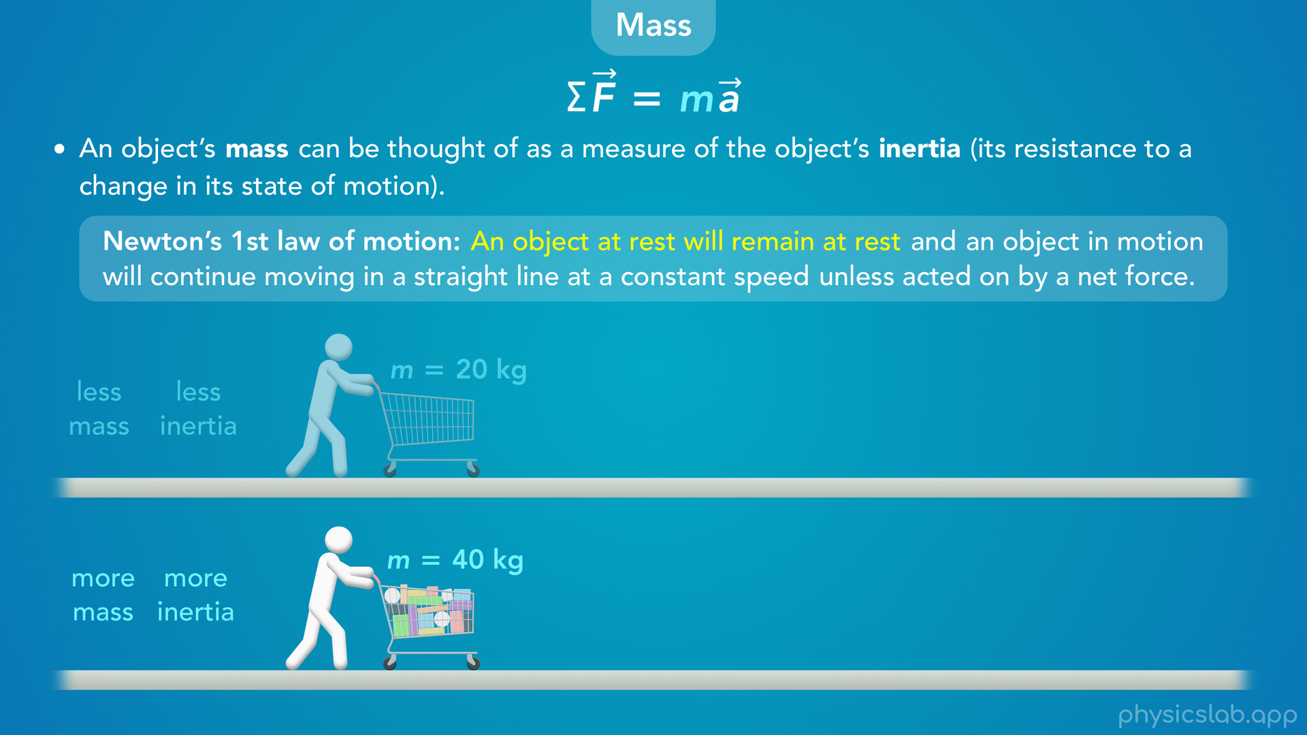
Notes:
• For now, it’s more important to think about mass as the inertia of an object.
• Let’s look at the two shopping carts again. The full cart has a greater mass than the empty cart, so it has more inertia.
• When you have to push harder to move the full cart, what you’re experiencing is the cart’s inertia, which is described in Newton’s 1st law of motion: An object at rest will remain at rest and an object is motion will continue moving in a straight line at a constant speed unless acted on by a net force.

Slide 30
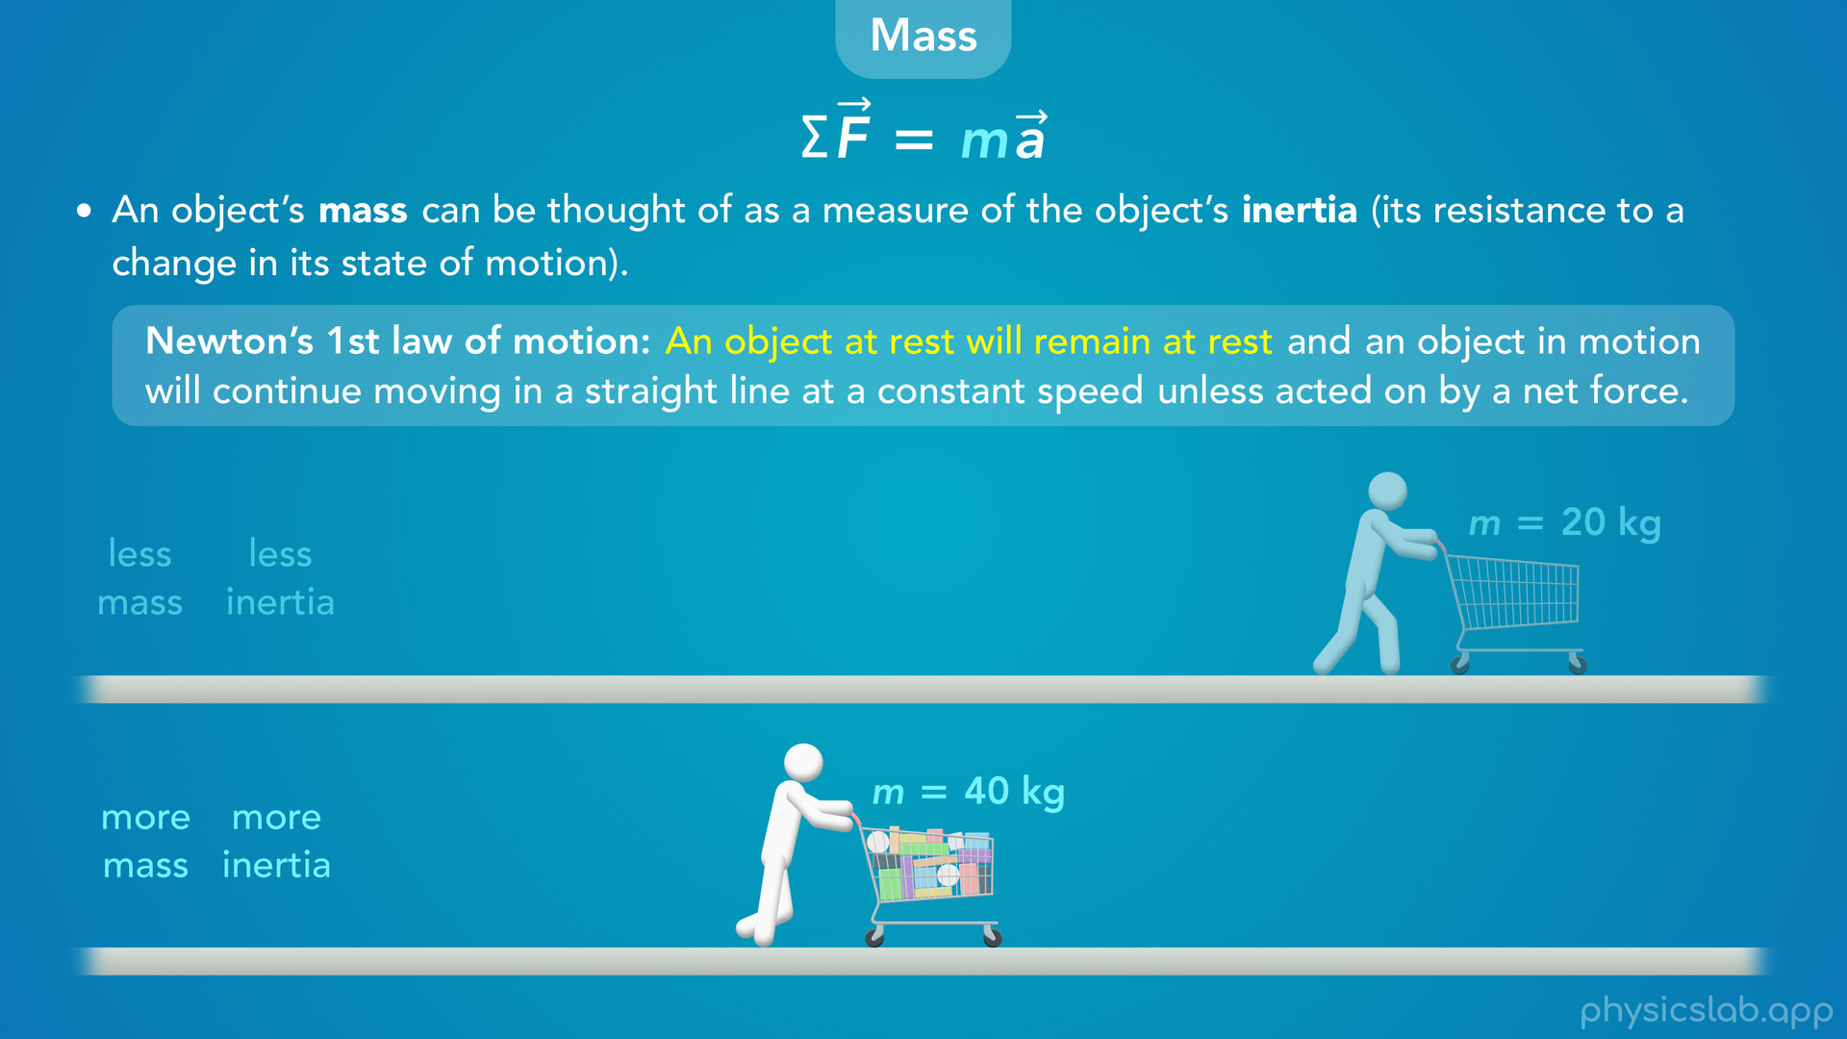
Notes:
• The thing we’re adding now is that an object with more mass and inertia wants to remain at rest more than an object with less mass and inertia. It’s harder to get it moving, it has more resistance to a change in its state of motion, which is currently at rest.

Slide 31
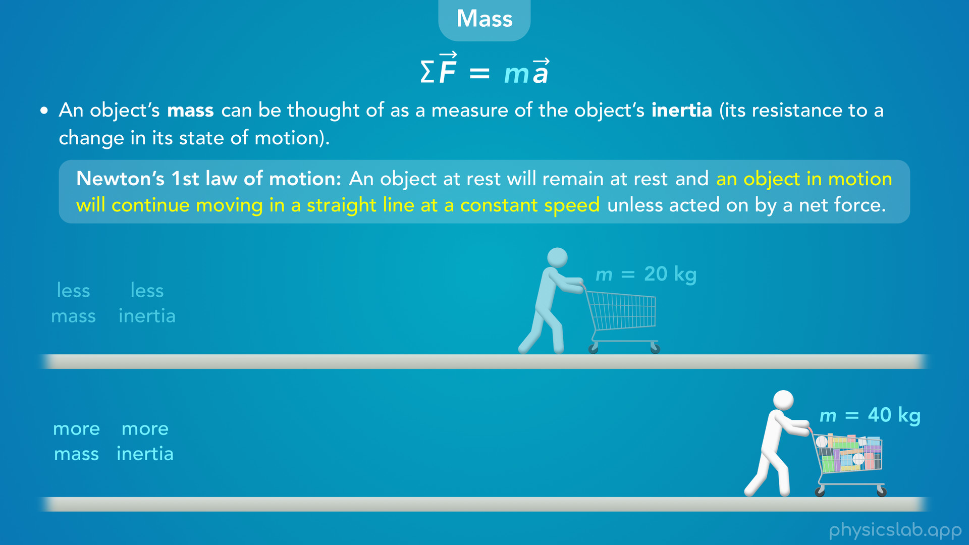
Notes:
• Once the carts are moving, the cart with more mass and inertia wants to keep moving more than the cart with less mass and inertia. It’s harder to slow down, it has more resistance to a change in its current state of motion.
• We’ll use numbers to describe this stuff in a minute, but that’s how we can think of mass and inertia as a concept.

Slide 32
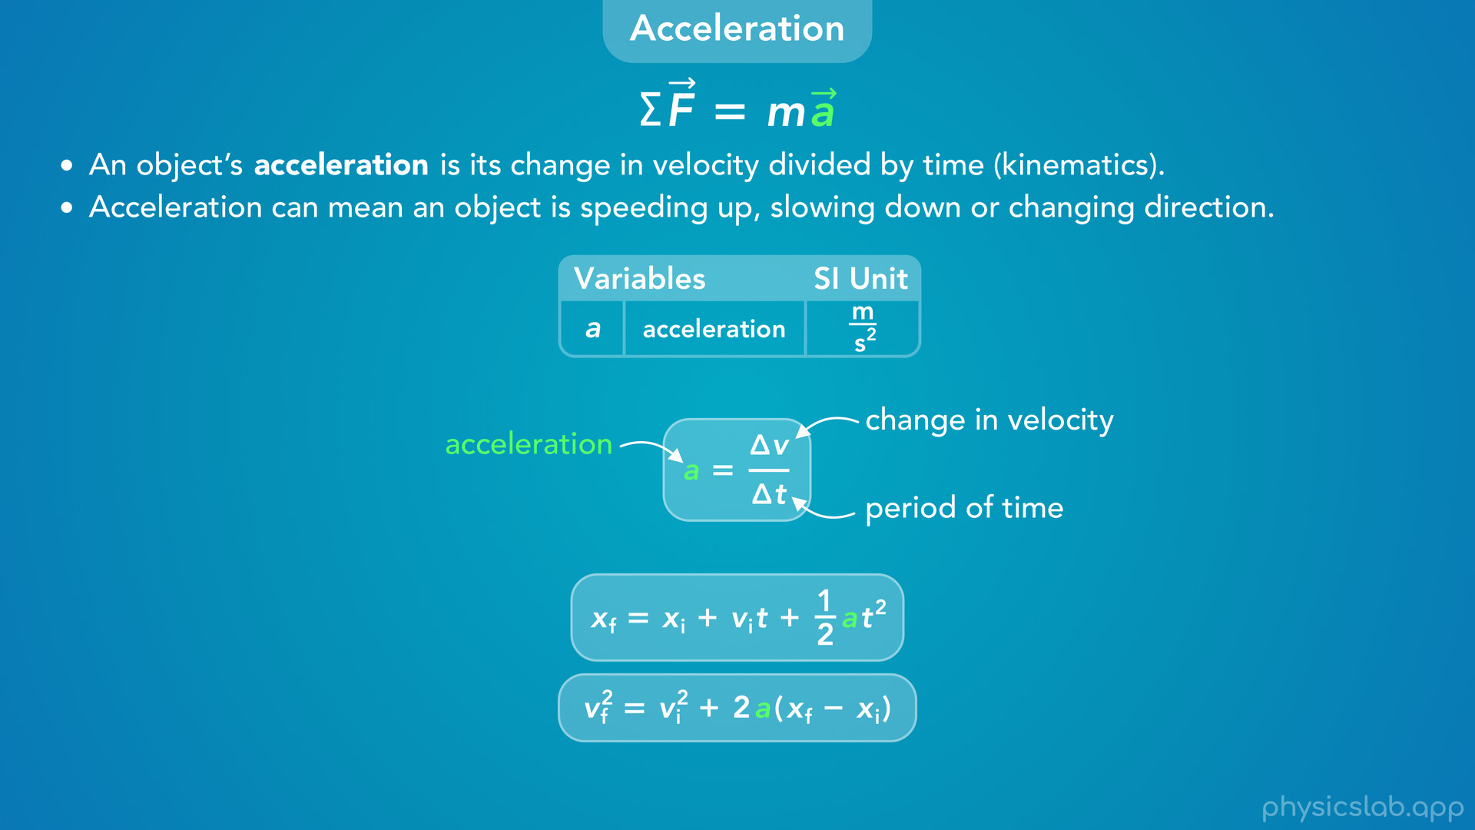
Notes:
• The last part of the equation is acceleration.
• An object’s acceleration is just its change in velocity divided by time, which we covered in kinematics.
• Acceleration also shows up in a few other kinematic equations. And the SI unit of acceleration is m/s².
• It’s important to remember that acceleration is a vector, so acceleration can mean an object is speeding up, slowing down or changing direction.

Slide 33
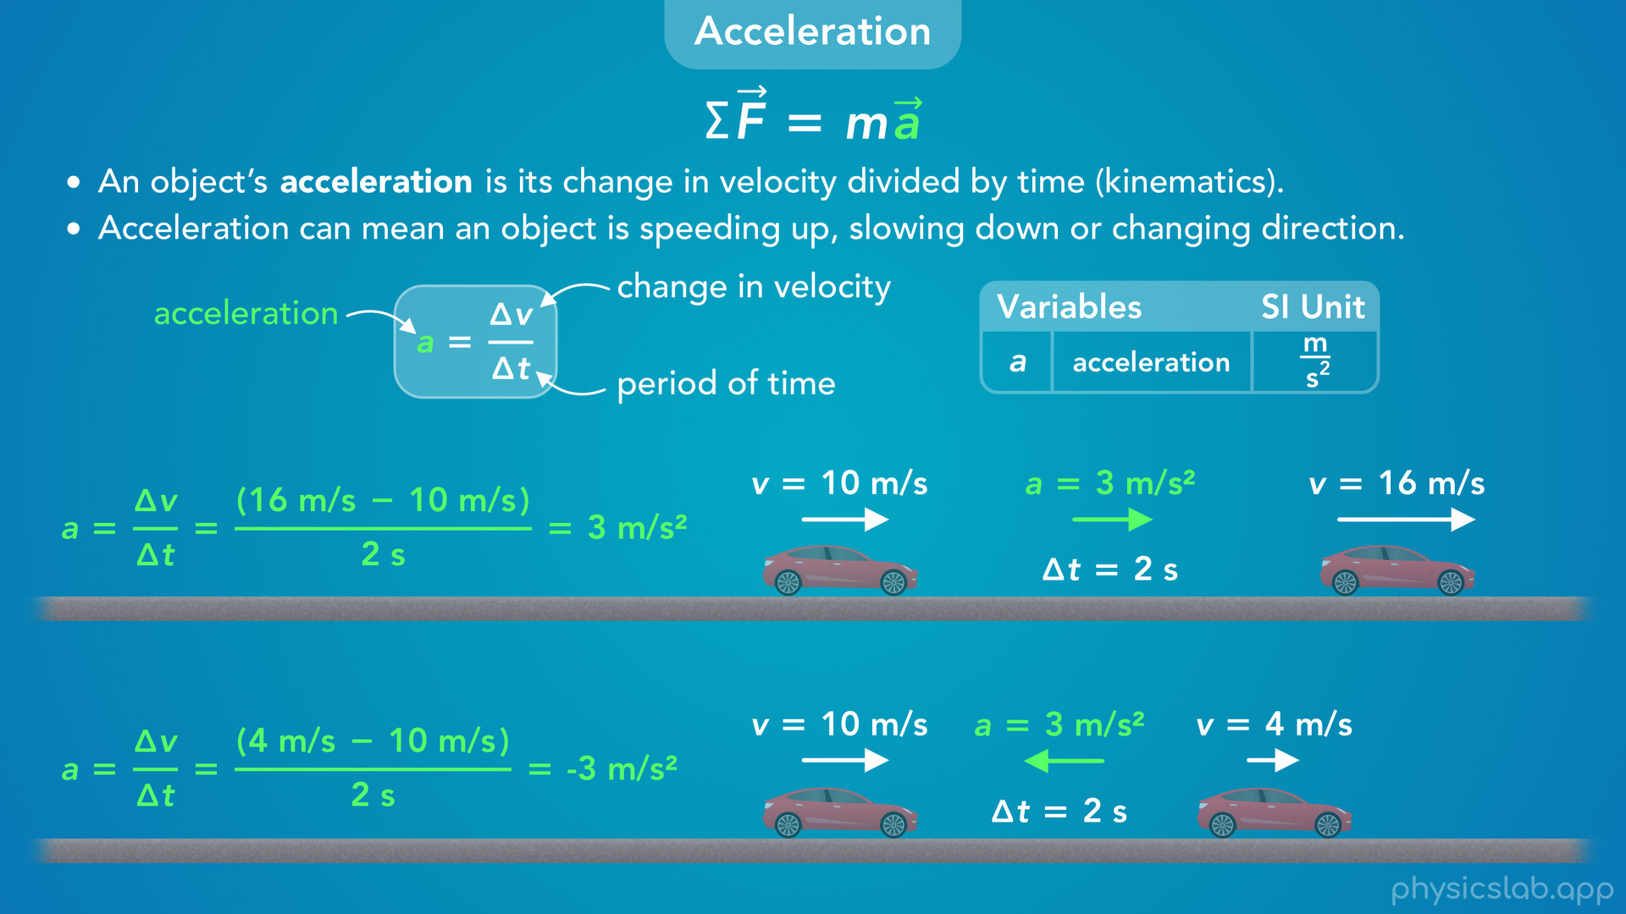
Notes:
• Here’s a quick example.
• The top car speeds up from 10 m/s to 16 m/s over 2 seconds, so it’s acceleration is 3 m/s² to the right.
• The bottom car slows down from 10 m/s to 4 m/s over 2 seconds, so its acceleration is negative 3 m/s², or 3 m/s² to the left.
• Again, acceleration doesn’t mean speeding up, it means any change in velocity over time.

Slide 34
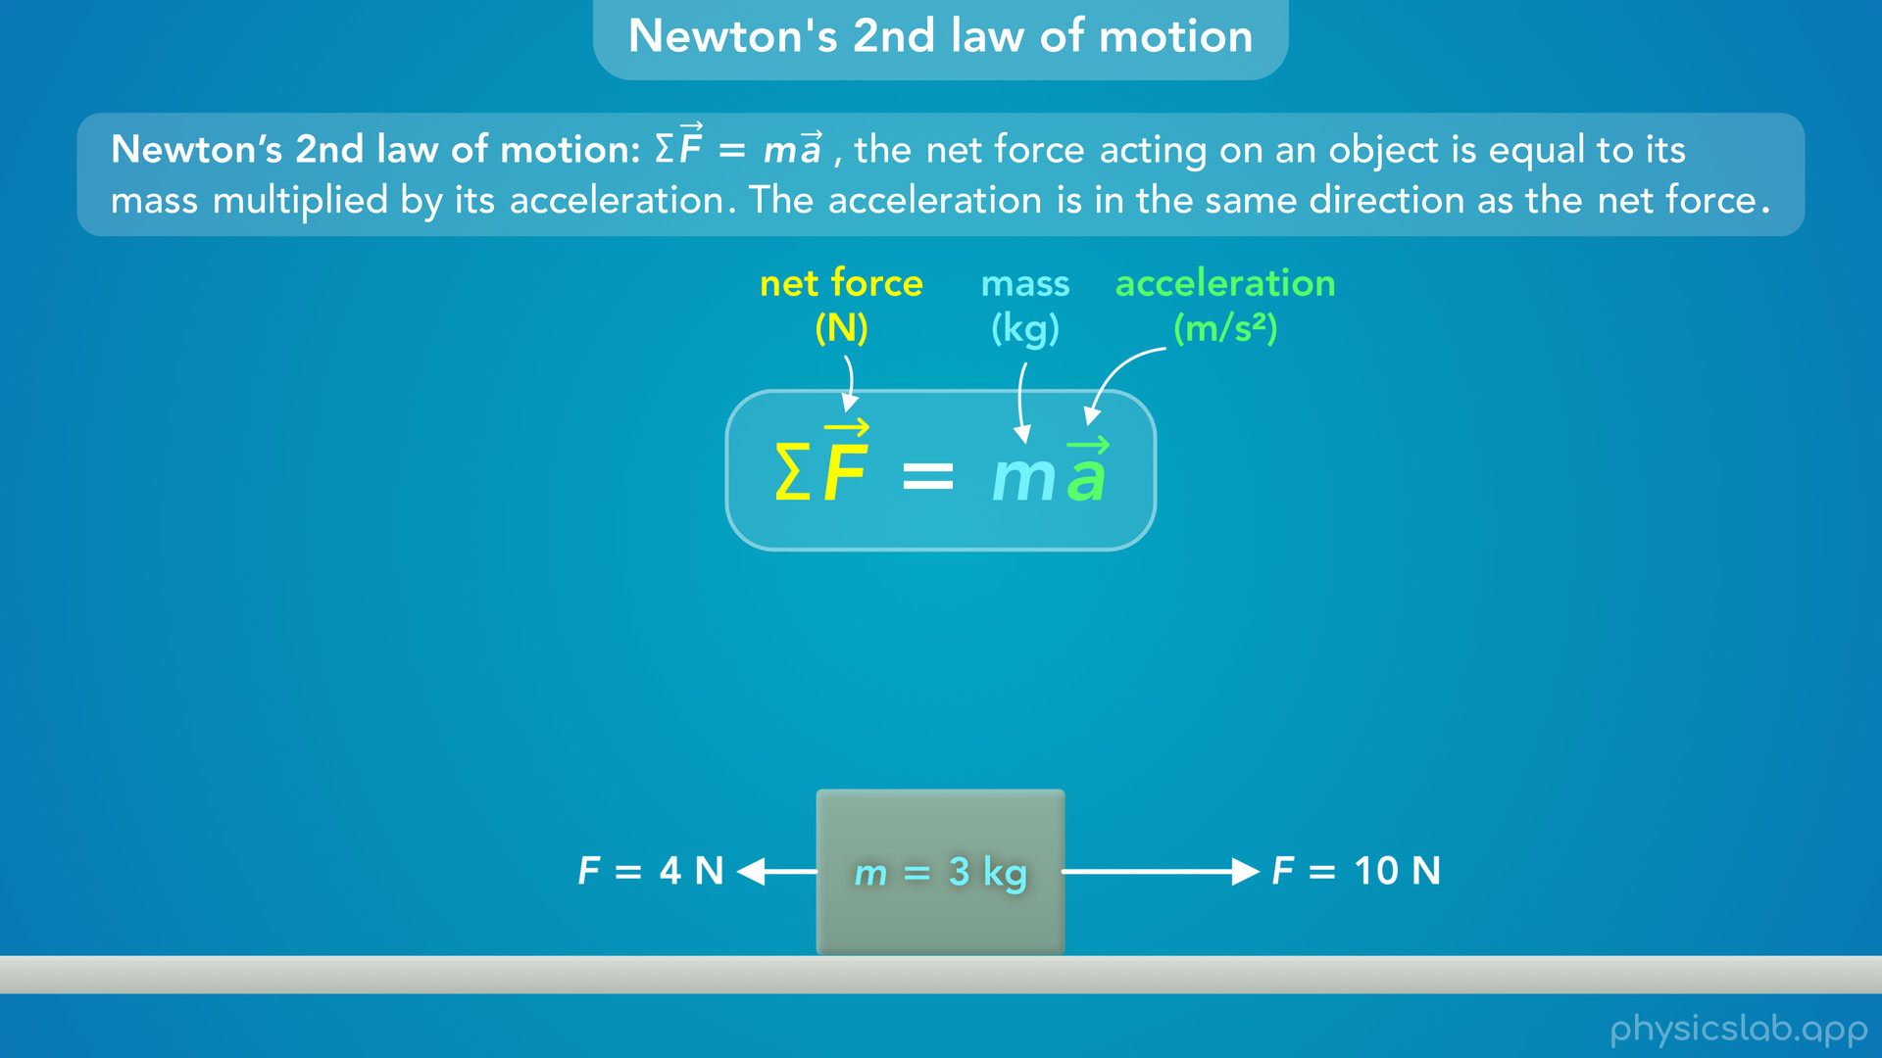

Slide 35
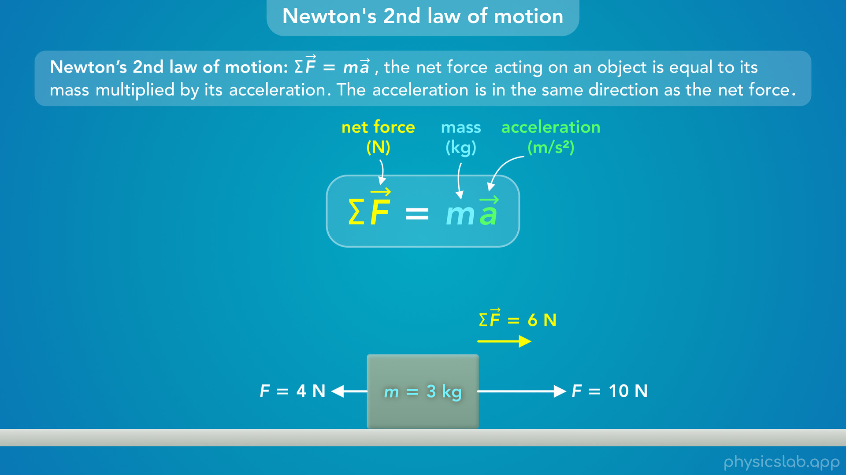
Notes:
• So let’s put these things together.
• This box has a mass of 3 kg. There’s a 10 N force acting to the right and a 4 N force acting to the left, so the net force on the box is 6 N to the right.

Slide 36
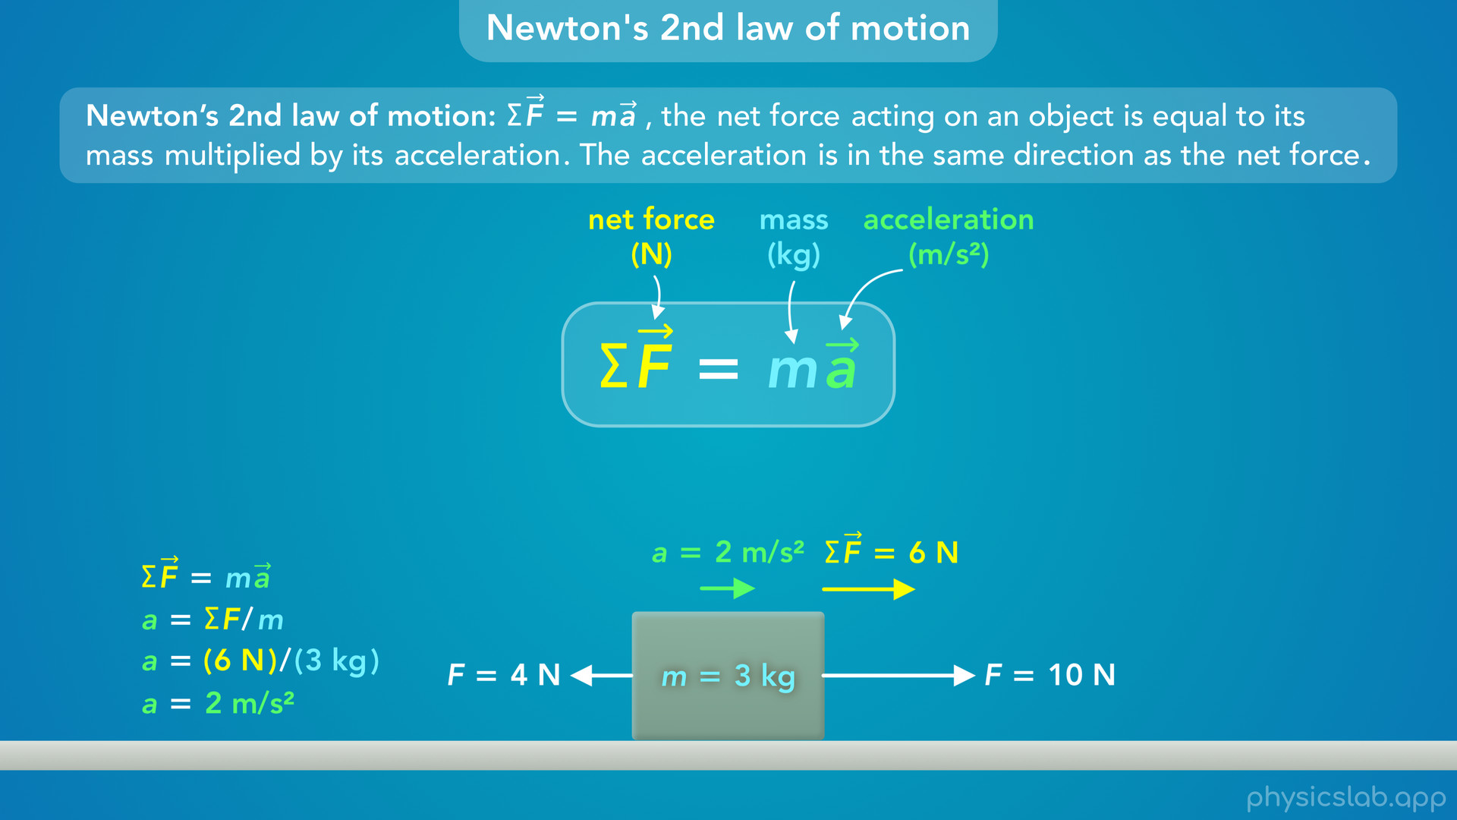
Notes:
• Newton’s 2nd law of motion says that the net force is equal to the mass times the acceleration, so the acceleration of the box is the net force divided by the mass, which is 6 N divided by 3 kg, which gives us 2 m/s².

Slide 37
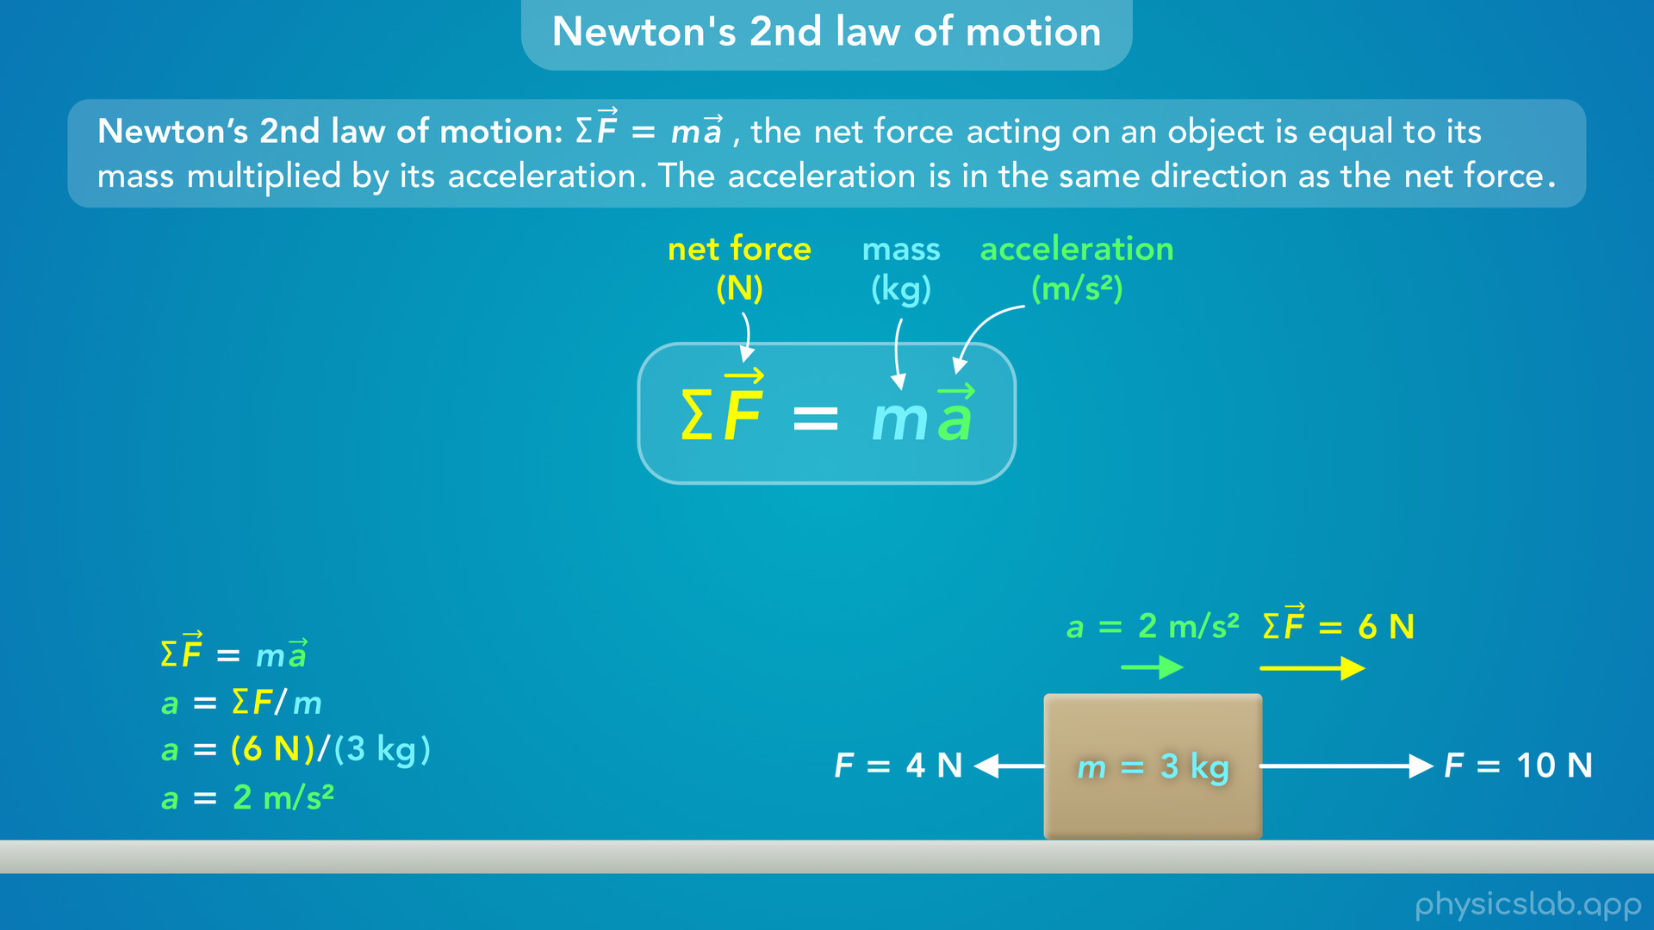
Notes:
• So the net force on this box causes it to accelerate in that direction.
• And the net force, the mass, and the acceleration are related using this equation.

Slide 38
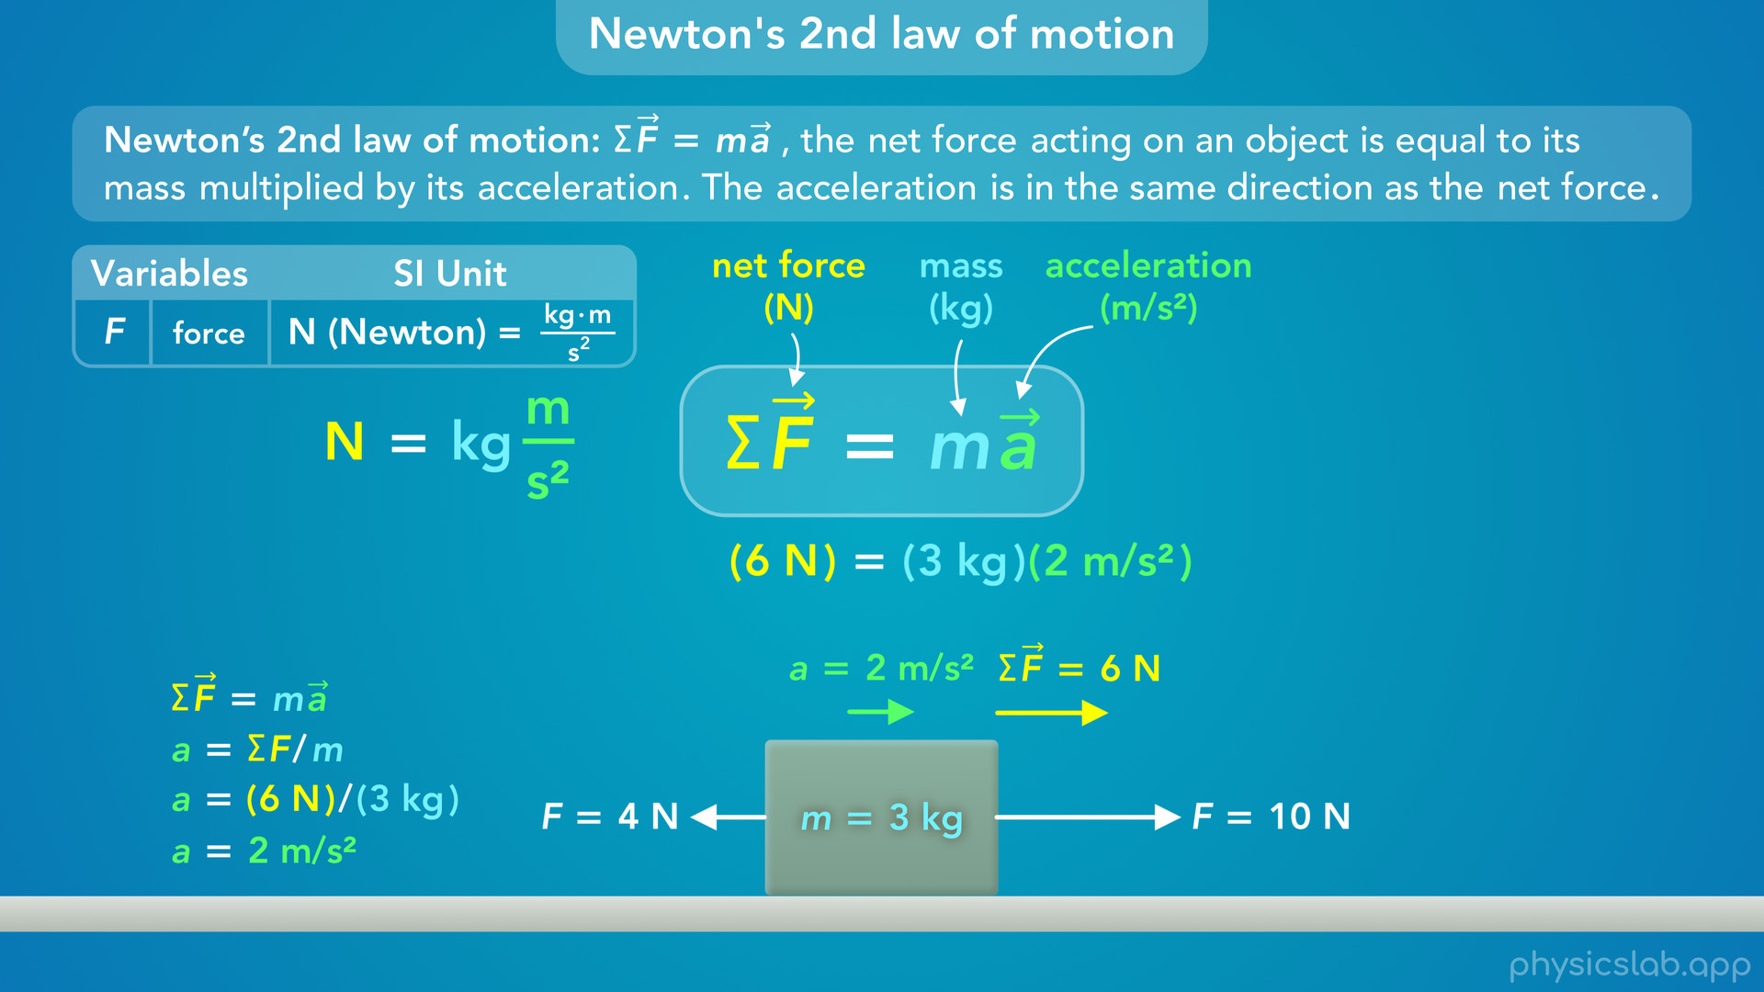
Notes:
• This is where we get the unit of Newtons. The force, in Newtons, is equal to the mass, in kilograms, times the acceleration, in m/s².
• This was a simple example, but this equation is the foundation for a lot of physics, and we’re gonna use it in different ways throughout the course.

Slide 39
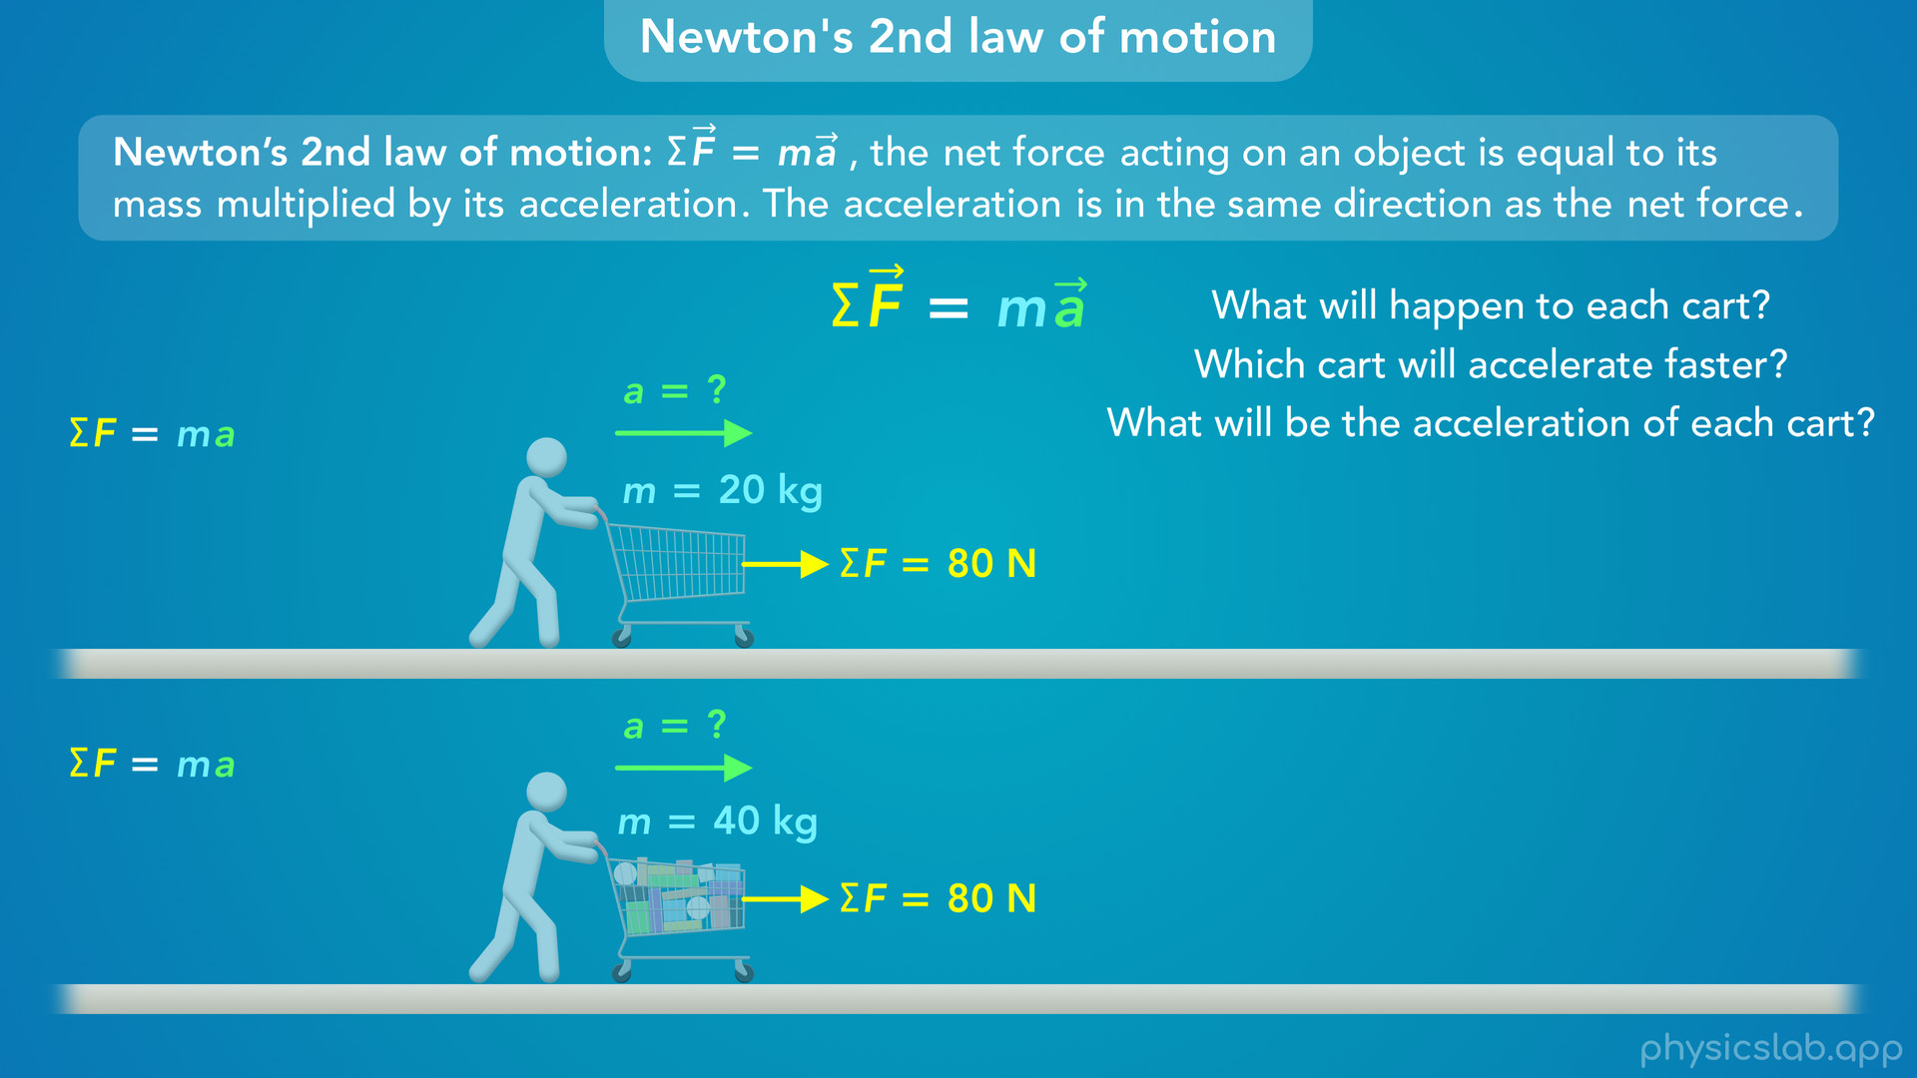
Notes:
• Let’s start by applying it to the shopping cart example.
• The empty cart has a mass of 20 kg and the full cart has a mass of 40 kg. Each cart is being pushed to the right and we’ll say the net force on each one is 80 N.
• Pause the video and try to answer these questions: What will happen to each cart, and how will they move, or not move? Which cart will accelerate faster? And try to calculate the acceleration of each cart.

Slide 40
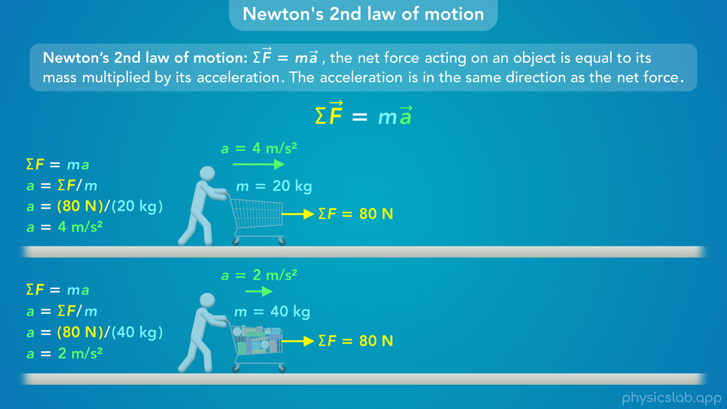
Notes:
• We can rearrange this equation so the acceleration is equal to the net force divided by the mass
• For the empty cart, we plug in 80 N for the net force and 20 kg for the mass, and we get 4 m/s² for the acceleration of the empty cart.
• For the full cart, we plug in 80 N for the net force and 40 kg for the mass, and we get 2 m/s² for the acceleration of the full cart.

Slide 41
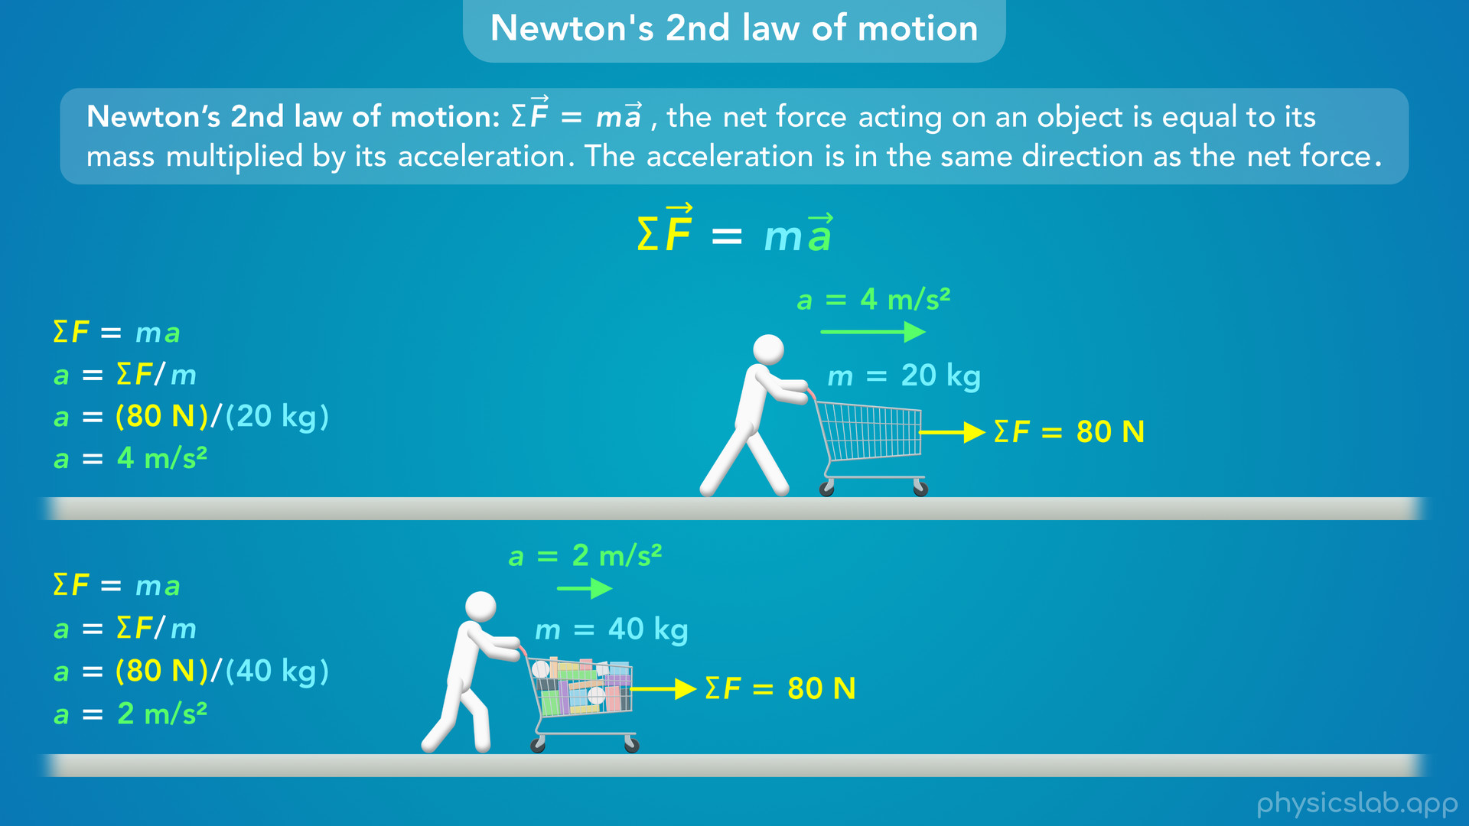
Notes:
• So, the carts have the same net force to the right which causes them to accelerate in that direction. But notice that the full cart has twice the mass, so it has half the acceleration.
• This is the mathematical way to describe why the full cart feels harder to push. If you apply the same force to both carts, the full cart accelerates slower and it takes longer to speed up because it has more mass and more inertia.

Slide 42
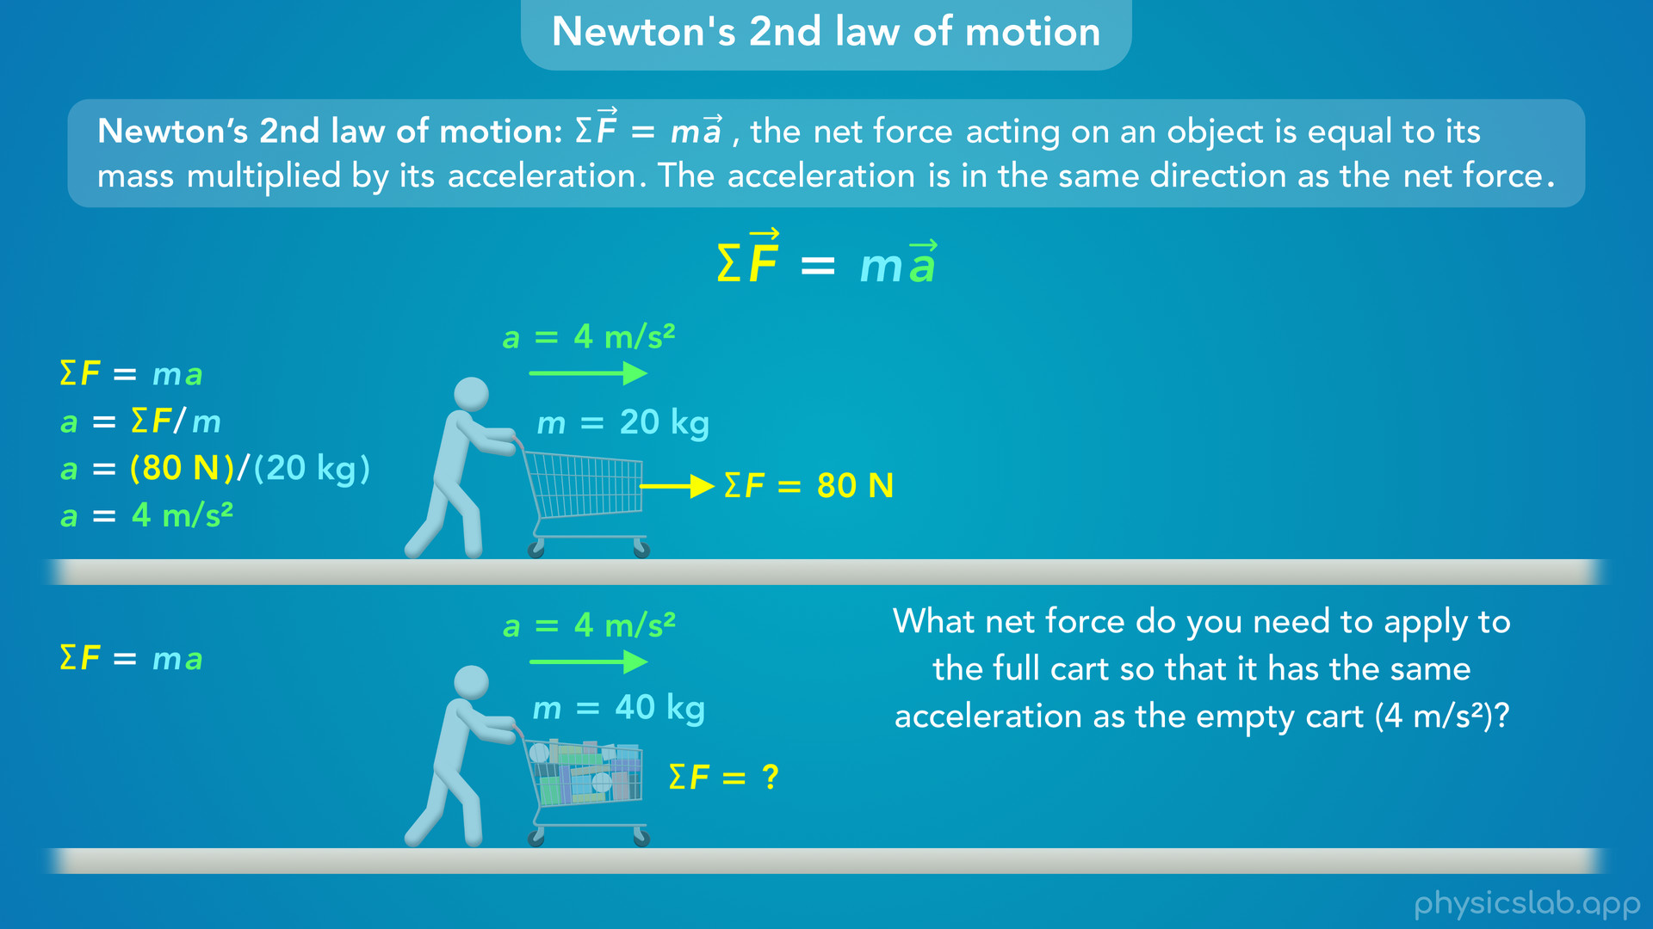
Notes:
• Let’s think of it another way. What net force do you need to apply to the full cart so that it has the same acceleration as the empty cart, which is 4 m/s²?

Slide 43
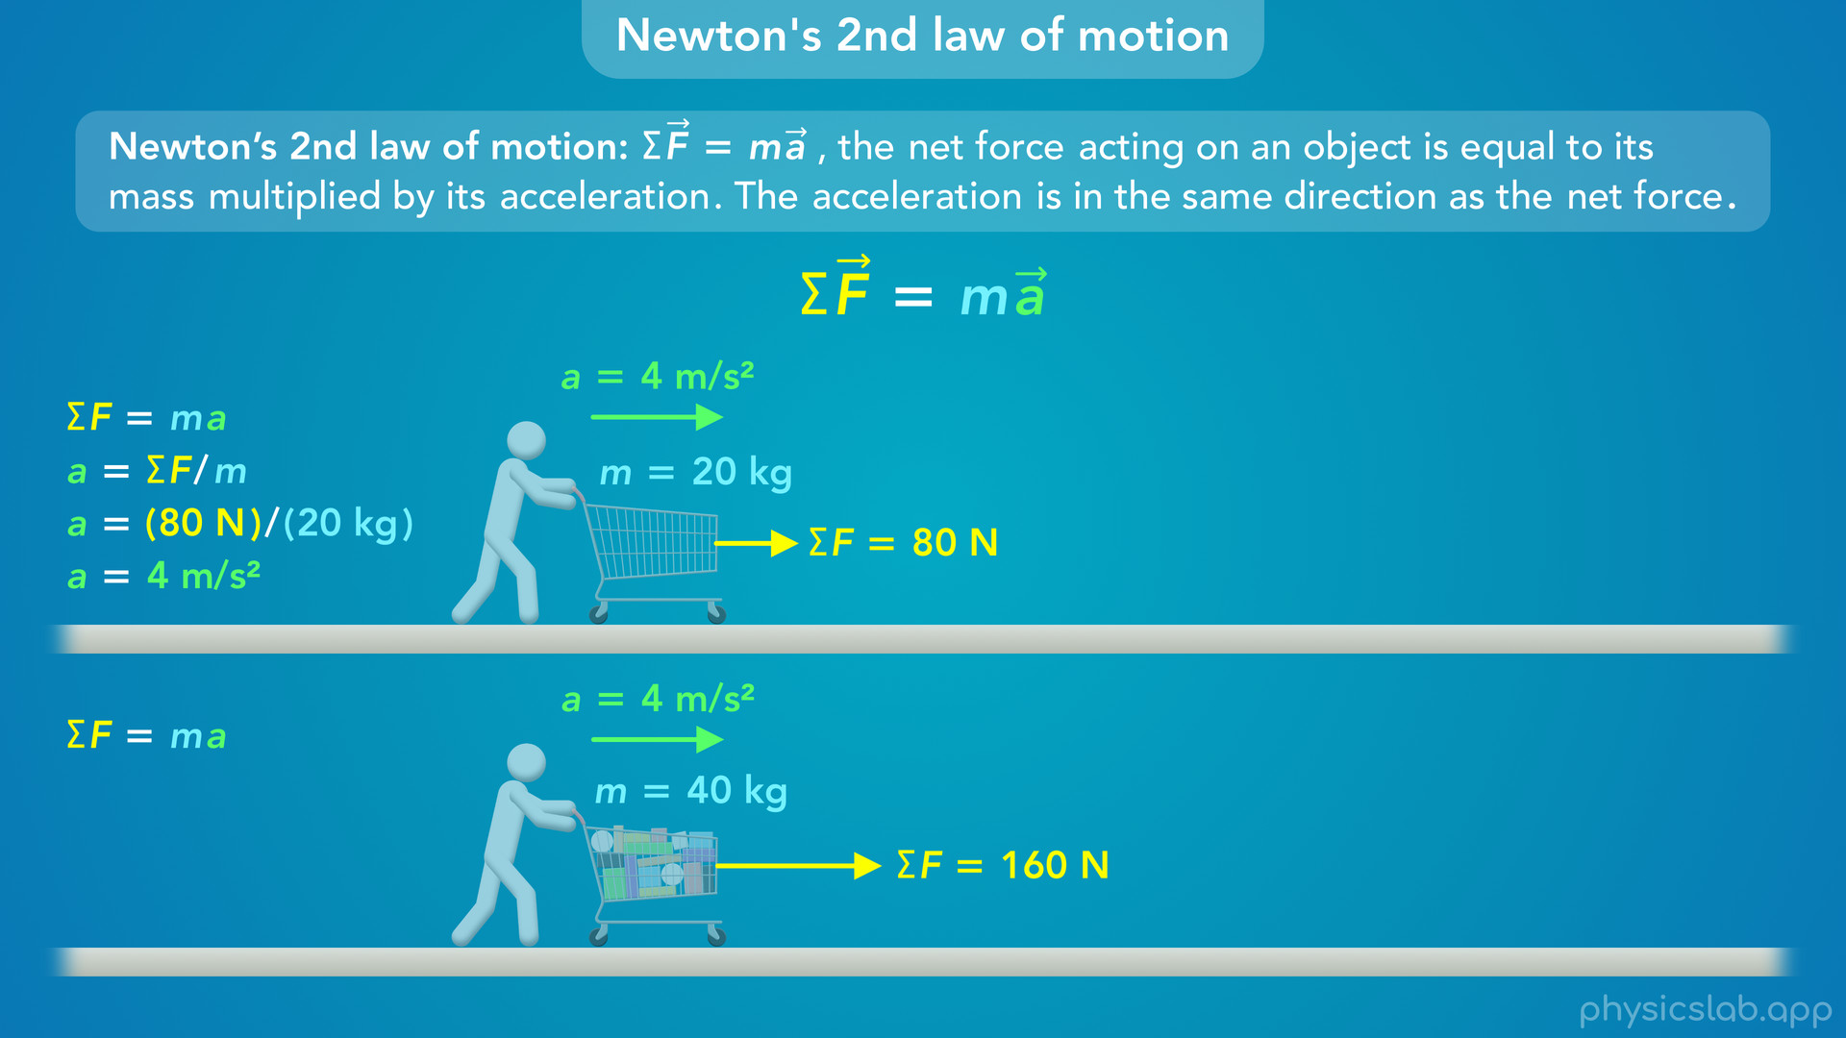
Notes:
• You might have been able to just think it through and realize that the full cart has twice the mass so it needs twice the net force to get the same acceleration, so the net force would have to be 160 N.

Slide 44
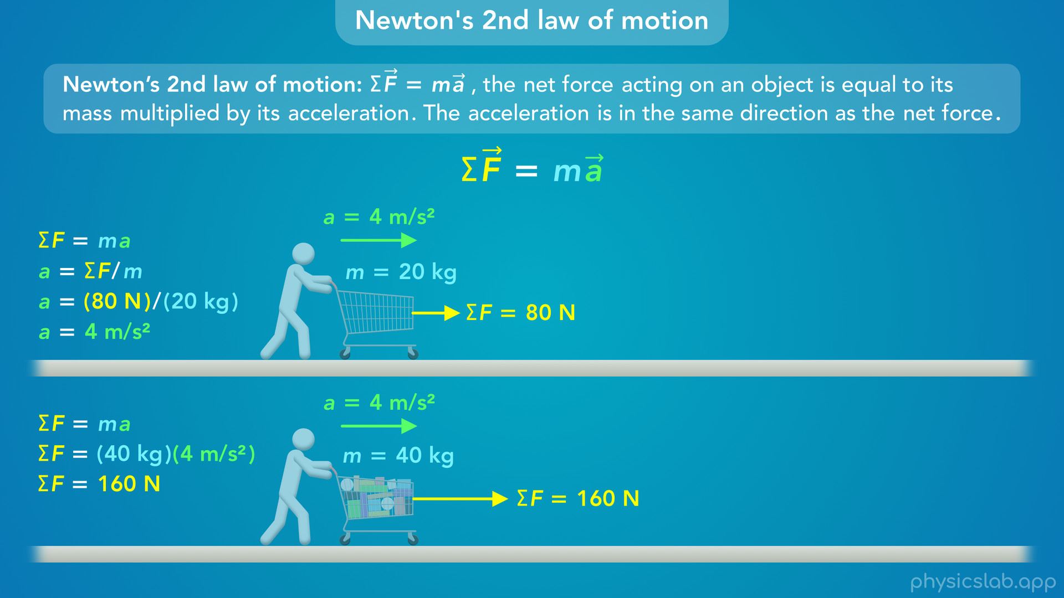
Notes:
• We can also calculate it using Newtons 2nd law. If we plug in 40 kg for the mass and 4 m/s² for the acceleration, we multiply them together to get 160 N for the net force.

Slide 45
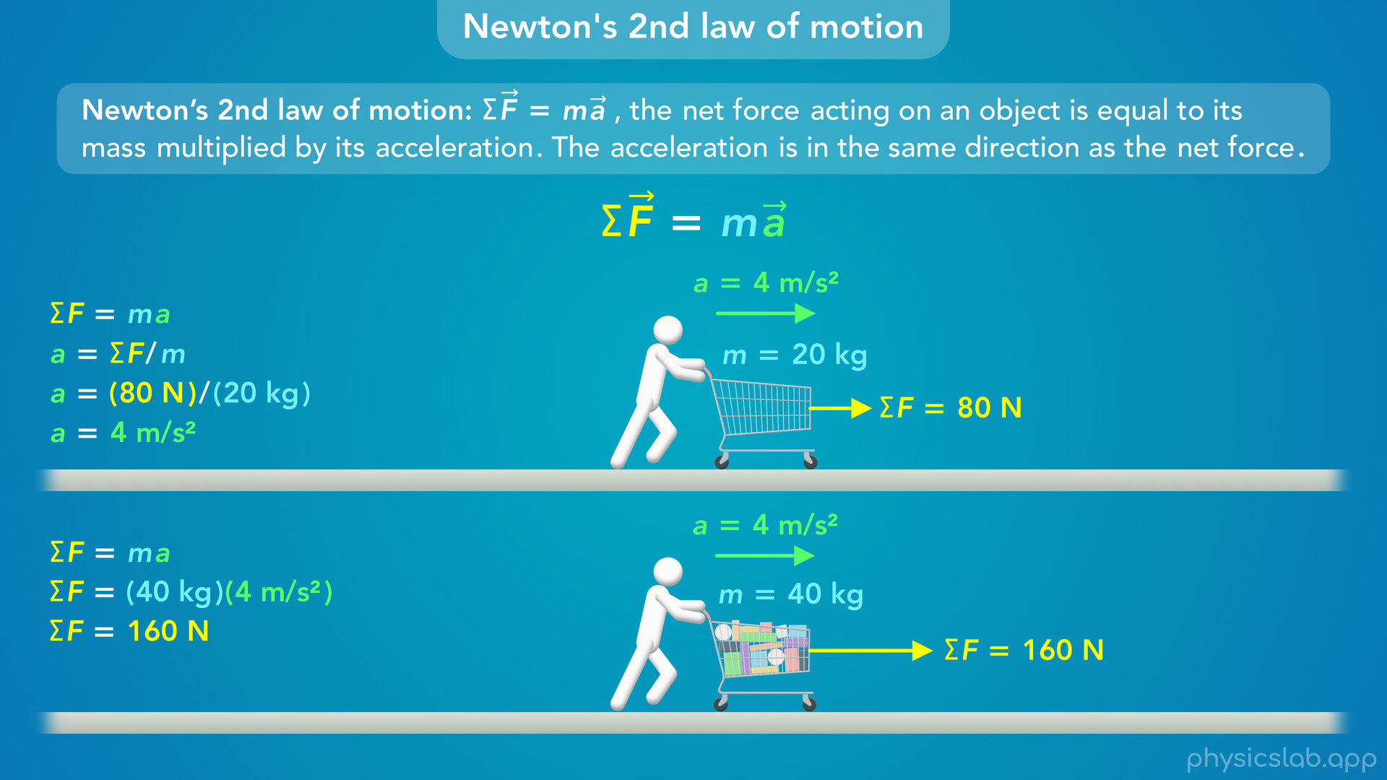
Notes:
• So we have to push the full cart with more force if we want it to accelerate at the same rate as the empty cart.

Slide 46
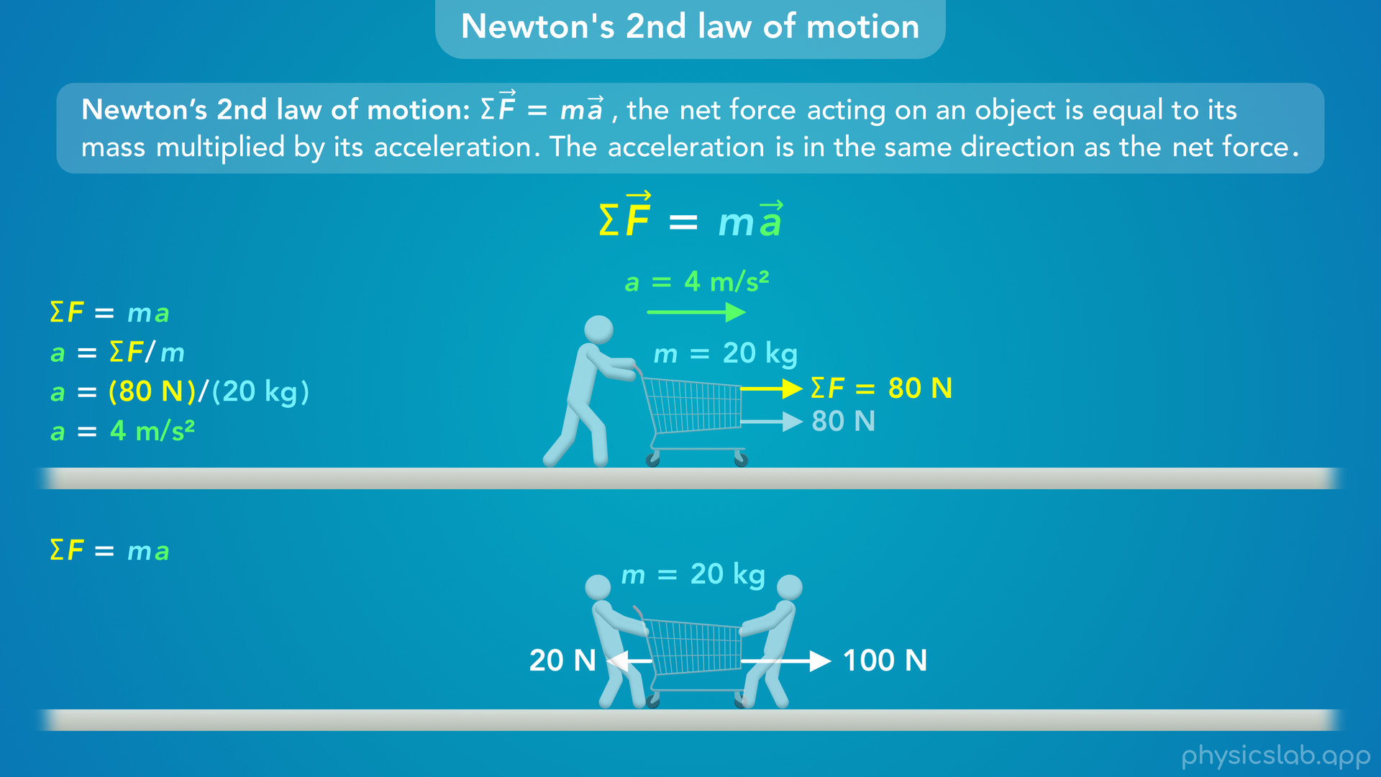
Notes:
• But there’s three important things to remember about this equation in Newton’s 2nd law.
• First, all that matters is the net force on the object.
• So let’s say two people are pulling on the bottom cart in opposite directions, with 2 different forces. Neither of those individual forces is equal to mass times acceleration.

Slide 47
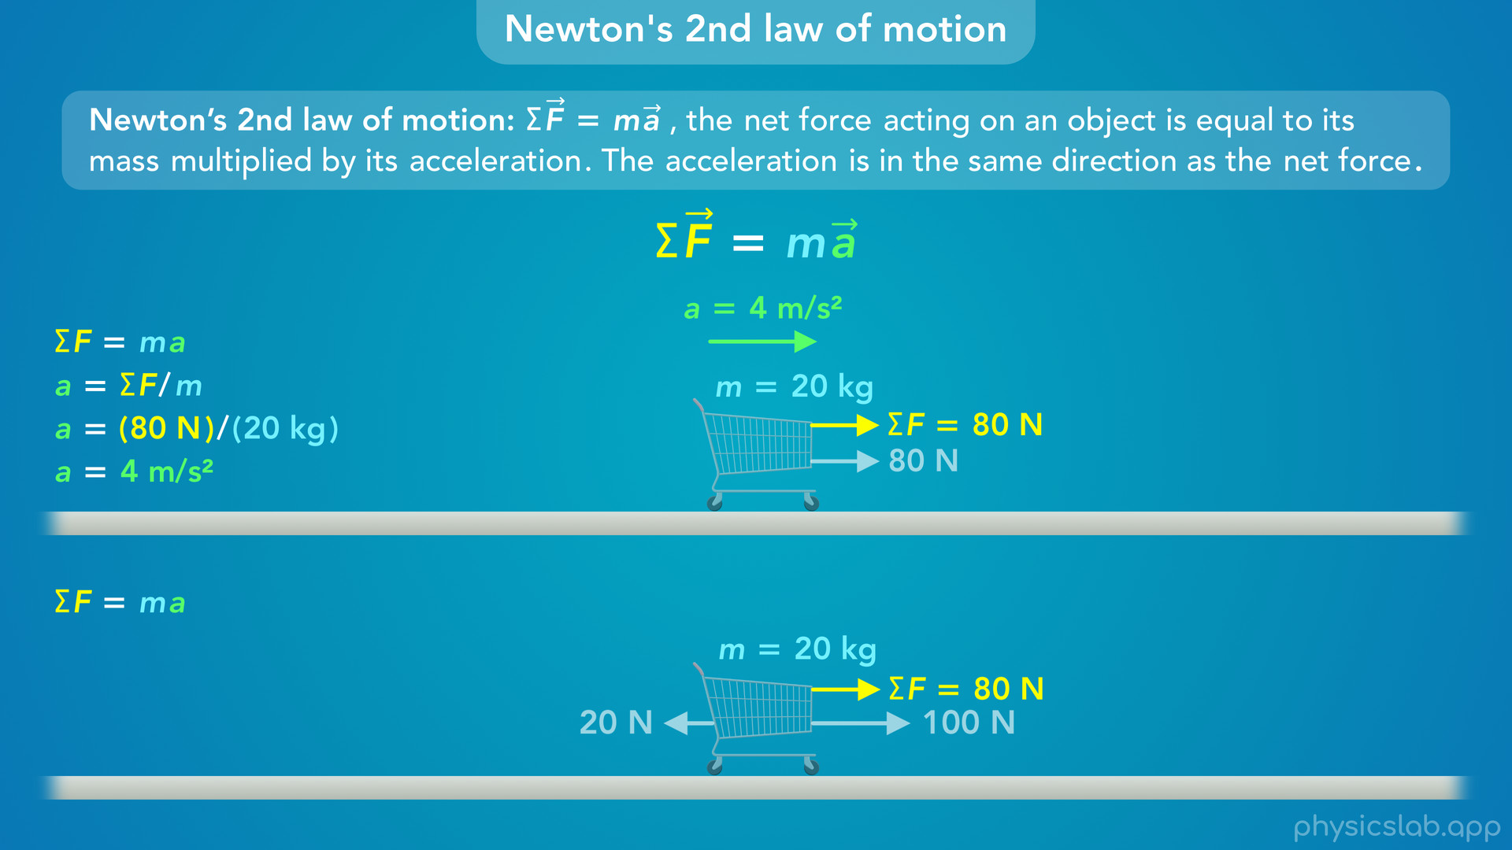
Notes:
We have to use the net force, which in this case is 100 - 20 or 80 N to the right.

Slide 48
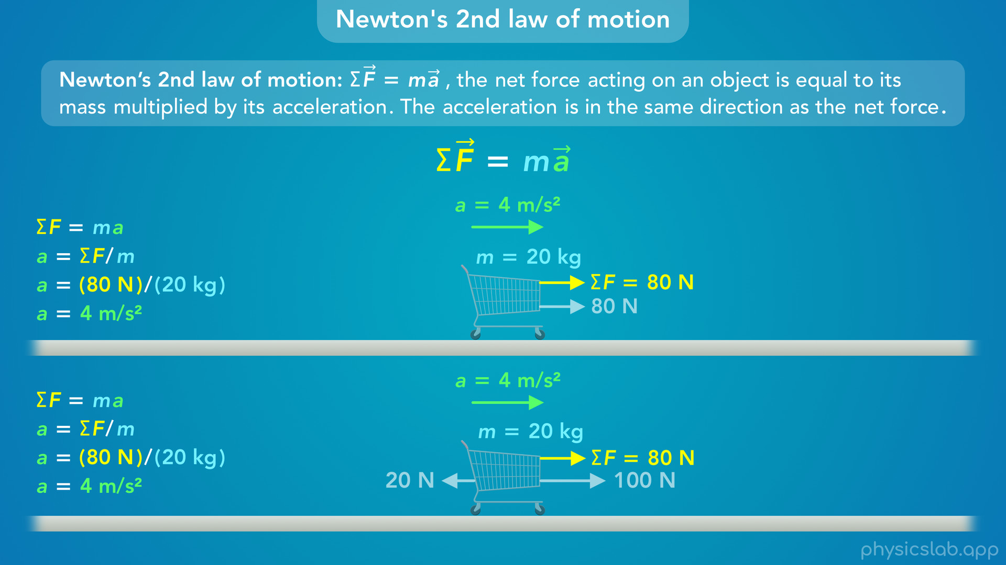
Notes:
That 80 N net force is what we use in this equation.
So even though these two carts have different forces acting on them, they have the same net force, and the same mass, so they have the same acceleration.

Slide 49

Notes:
• The next thing to remember is that the acceleration is the same direction as the net force.
• So if these two forces were switched and the net force was 80 N to the left, this bottom cart would accelerate to the left.

Slide 50

Notes:
• And third, this equation relates the net force to the acceleration, it doesn’t say anything about the velocity of the object. Acceleration is the change in velocity over time, so the change in velocity is related to force, but not the velocity itself.

Slide 51

Notes:
• For example, let’s say the top cart is at rest and the bottom cart is moving with a constant speed of 3 m/s. Let’s ignore friction and assume the net force on each cart is zero. The bottom cart keeps moving because of its inertia, from Newton’s 1st law of motion.

Slide 52

Notes:
• Since the net force on each cart is zero, the acceleration of each cart is zero. The net force doesn’t tell us anything about the actual velocity of the cart, it only tells us how the velocity is changing, which is the acceleration. The net force is zero, so the velocity doesn’t change, but Newton’s 2nd law doesn’t tell us how fast its currently moving. We would need more information to figure that out.

Slide 53

Notes:
• Even if the carts have the same net force and acceleration, they might’ve had different initial speeds, so we can’t figure out how fast they’re moving at a given time just using Newton’s 2nd law. That only gives us the acceleration, and then we can use kinematics to figure out its velocity or position at a certain time.

Slide 54

Notes:
• So that’s how we can use Newton’s 2nd law to calculate things.
• Since we use this equation a lot, it helps to have a strong intuition for how the variables are related.

Slide 55

Notes:
• Like any equation, we can rearrange this in different ways.

Slide 56

Notes:
• This first form is probably the best way to think about mass and inertia. If you apply a net force to an object and measure its acceleration, you can calculate the object’s mass. If it accelerates faster, the mass must be smaller.

Slide 57

Notes:
If it accelerates slower, the mass must be greater.
• Remember, the left and right side of an equation have to be equal, so a change to one side has to be reflected on the other side. If the denominator is smaller, then we’re dividing the net force by a smaller number and the fraction is bigger, so the left side also has to be bigger. If we divide the net force by a bigger number, then the fraction is smaller so the left side is also smaller.

Slide 58

Notes:
• This other form makes it easier to calculate acceleration if we know the net force and the mass.
• If the net force is constant and we increase the mass, the acceleration will decrease.

Slide 59

Notes:
If we decrease the mass, the acceleration will increase.

Slide 60

Notes:
• And let’s look at the original equation.
• If we keep the mass constant and increase the net force, the acceleration will also increase.

Slide 61

Notes:
If we decrease the net force, the acceleration will decrease.

Slide 62

Notes:
• Or if we keep the acceleration constant and increase the net force, the mass must be greater.

Slide 63

Notes:
If we have a smaller net force but the same acceleration, the mass must be smaller.

Slide 64

Notes:
• Let’s see what this looks like using numbers. We’ll go through this quickly so feel free to pause at any point to look at the math.
• Here we have a 1 N net force acting on a 1 kg box, so it accelerates at 1 m/s².
• If we keep the same mass but we double the net force, then we also double the acceleration. Or we can say if we have twice the acceleration then we must have twice the net force.

Slide 65

Notes:
• If we have half the net force, then we get half the acceleration.

Slide 66

Notes:
• If the net force is the same but the object has twice the mass, then it’ll have half the acceleration.

Slide 67

Notes:
• If the object has half the mass, it has twice the acceleration.

Slide 68

Notes:
• Now let’s keep the acceleration the same. If we have twice the mass then we also need twice the net force.

Slide 69

Notes:
• And if we have half the mass, we only need half the net force.

Slide 70

Notes:
• So that’s Newton’s 2nd law of motion.
• We mentioned before that this basically replaces Newton’s 1st law, so what does that mean?

Slide 71

Notes:
• Newton’s 1st law says an object at rest will remain at rest unless acted on by a net force.
• If we take Newton’s 2nd law equation and plug in zero net force, that means the acceleration must be zero. (The mass will never be zero for the things we study in this course.)
• Acceleration is the change in velocity overt time, so if the acceleration is zero, that means the change in velocity is zero, so the velocity is constant if there’s zero net force.
• If an object is at rest, its velocity is 0 m/s, but its a constant 0 m/s. The velocity doesn’t change and it remains at rest.

Slide 72

Notes:
• If there is a net force, then there’s also acceleration, so the velocity changes and the object does not remain at rest.

Slide 73

Notes:
• If an object is moving and there’s zero net force, then there’s zero acceleration and the velocity is constant. The object moves in a straight line at a constant speed if there’s no net force.

Slide 74


Slide 75

Notes:
• Again, if there is a net force, then there’s acceleration, so the velocity changes.

Slide 76

Notes:
• We’re going to refer to Newton’s 2nd law a lot more than the 1st law, because it lets us calculate things and it covers things conceptually.
• If there’s no net force, the acceleration is zero so the velocity is constant.
• If there is a net force, then there is acceleration so the velocity changes.

Slide 77


Slide 78

Notes:
• Newton’s 2nd law of motion is one of the connections between dynamics and kinematics.
• The left side is the sum of all the forces that are acting on the object, and it’ll include the equations and variables for different types of forces.
• The right side tells us the acceleration of the object, which we can use with the kinematic equations to study its motion.

Slide 79

Notes:
• A problem might give us the motion and ask us to figure out the forces, or it might give us the forces and ask us a question about the motion. And sometimes it’ll be a combination of both.
• We’re gonna use this equation a lot and we’ll see how useful it is throughout the rest of the course.

Slide 80

Notes:
• In the next video, we’ll learn how to draw free body diagrams and use Newton’s 2nd law in two dimensions: the x direction and the y direction.

