Slide 1
Normal Force
Slides Version 2
This version includes:
Slides with screenshot images from the video.
The video narration in the slide notes.
A blank template slide with the same background and font as the video.
Slides with some basic graphics from this video for you to use however you like.
Feel free to add, delete and edit slides to make your own presentation. You can use these slides in class or share them with your students, but please do not share them with anyone else.
If you have any feedback, suggestions or questions about these slides please email me at chris@physicslab.app or send me a message on Discord @physicslab.
physicslab.app

Slide 2
Heading
Text

Slide 3









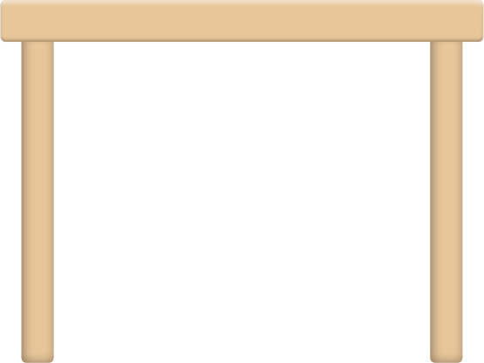


Slide 4


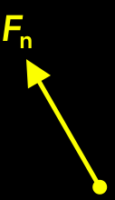



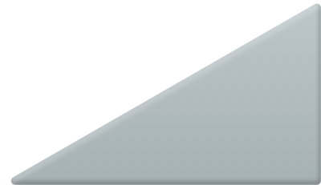





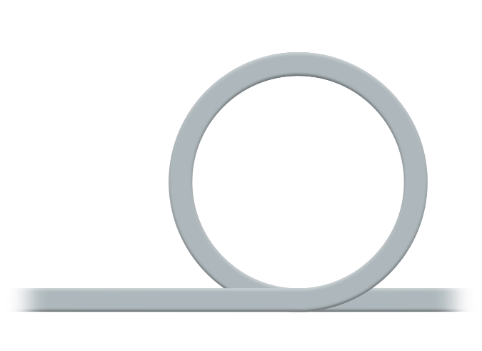



















Slide 5









Slide 6
















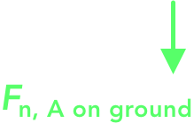
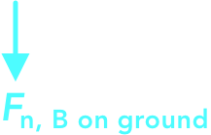



Slide 7
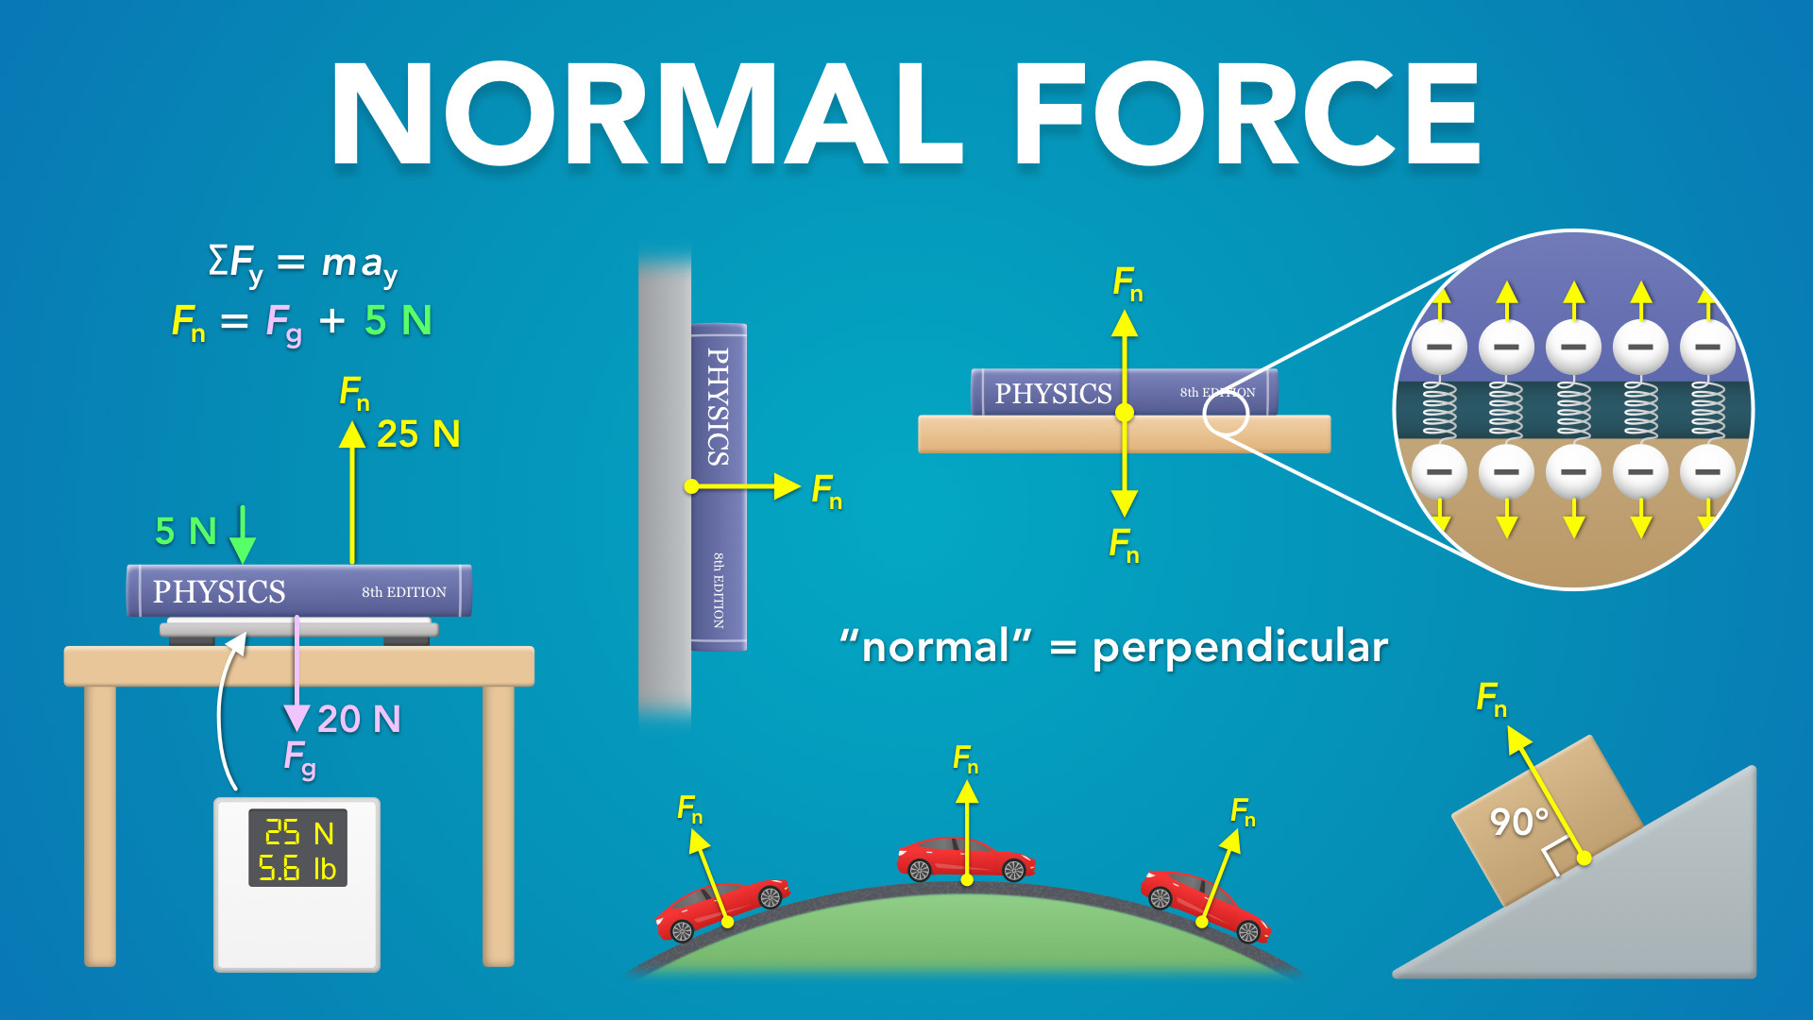
Notes:
Normal Force
physicslab.app
If you have any questions, suggestions or feedback about these slides please email me at chris@physicslab.app or send me a message on Discord @physicslab.

Slide 8

Notes:
• Hey everyone! In this video, we’re going to learn about normal forces.

Slide 9
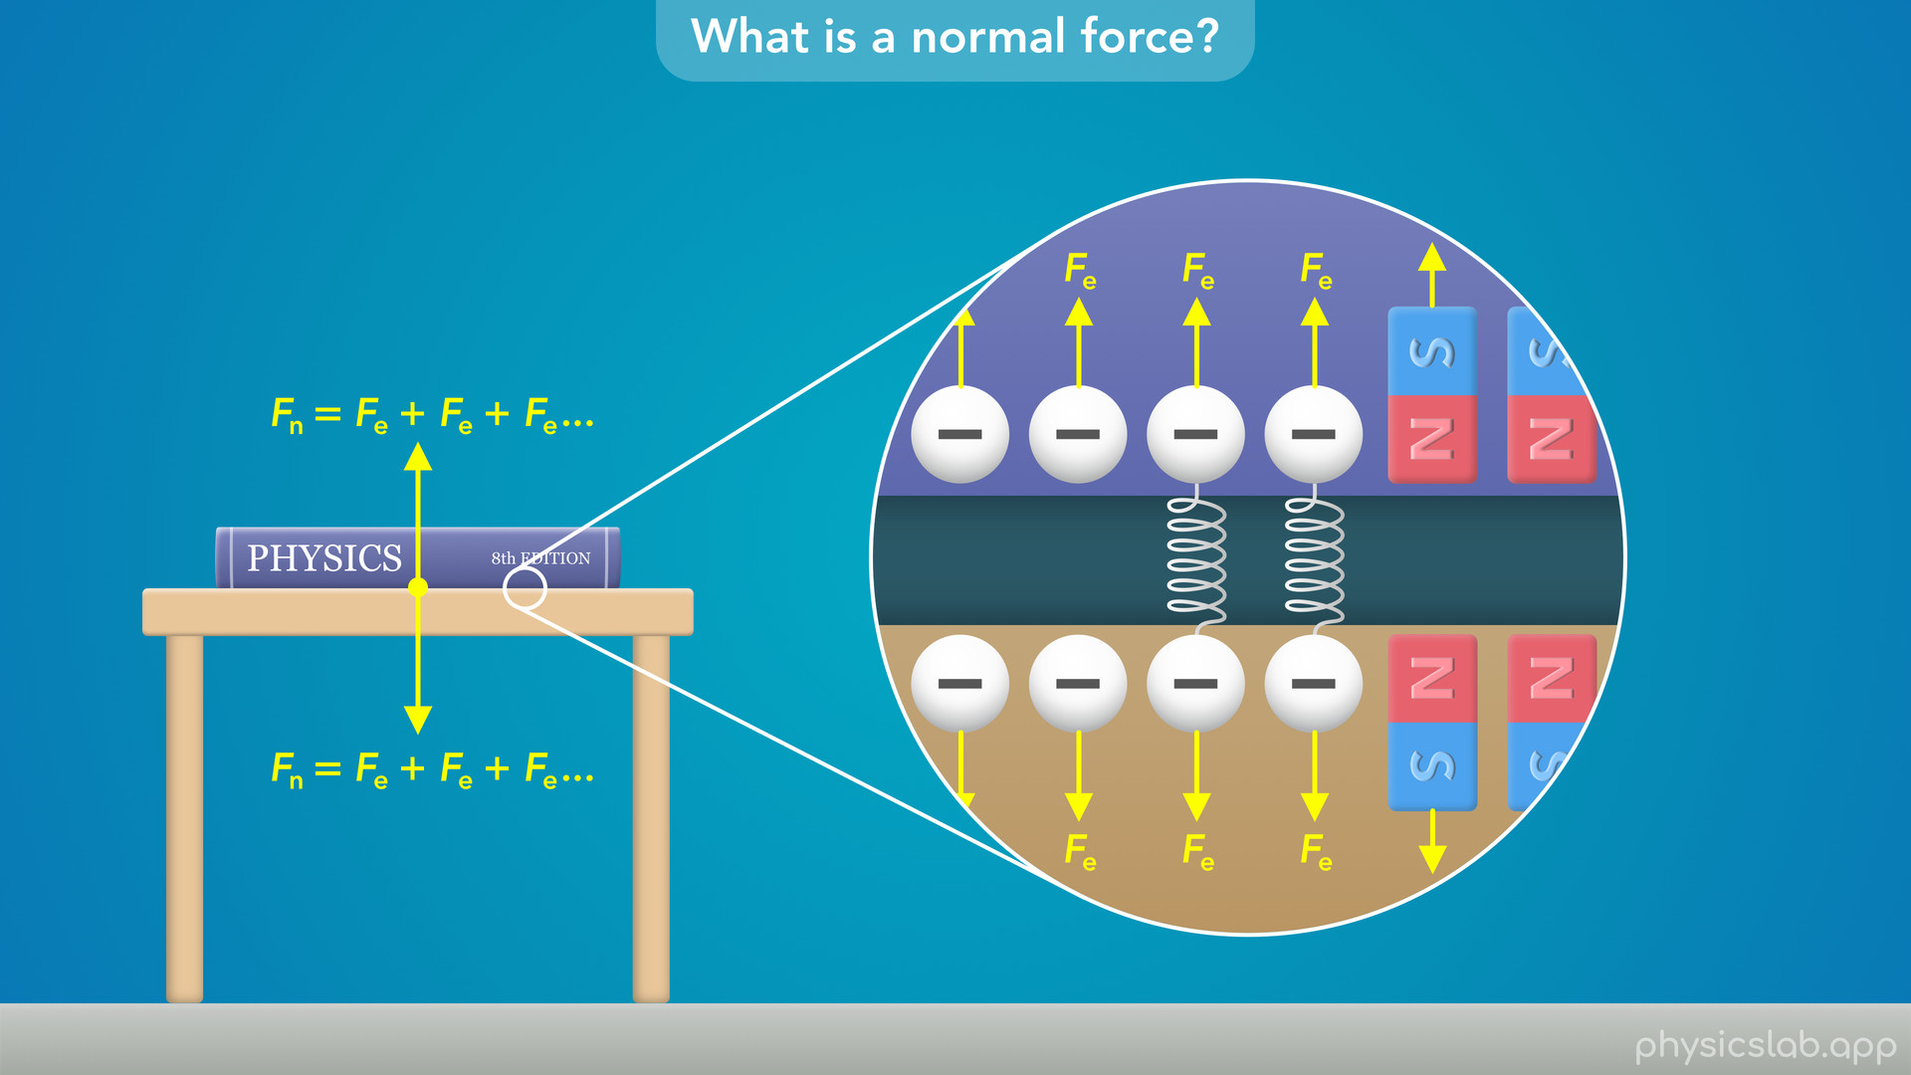
Notes:
• We’ll start by explaining what causes a normal force.

Slide 10
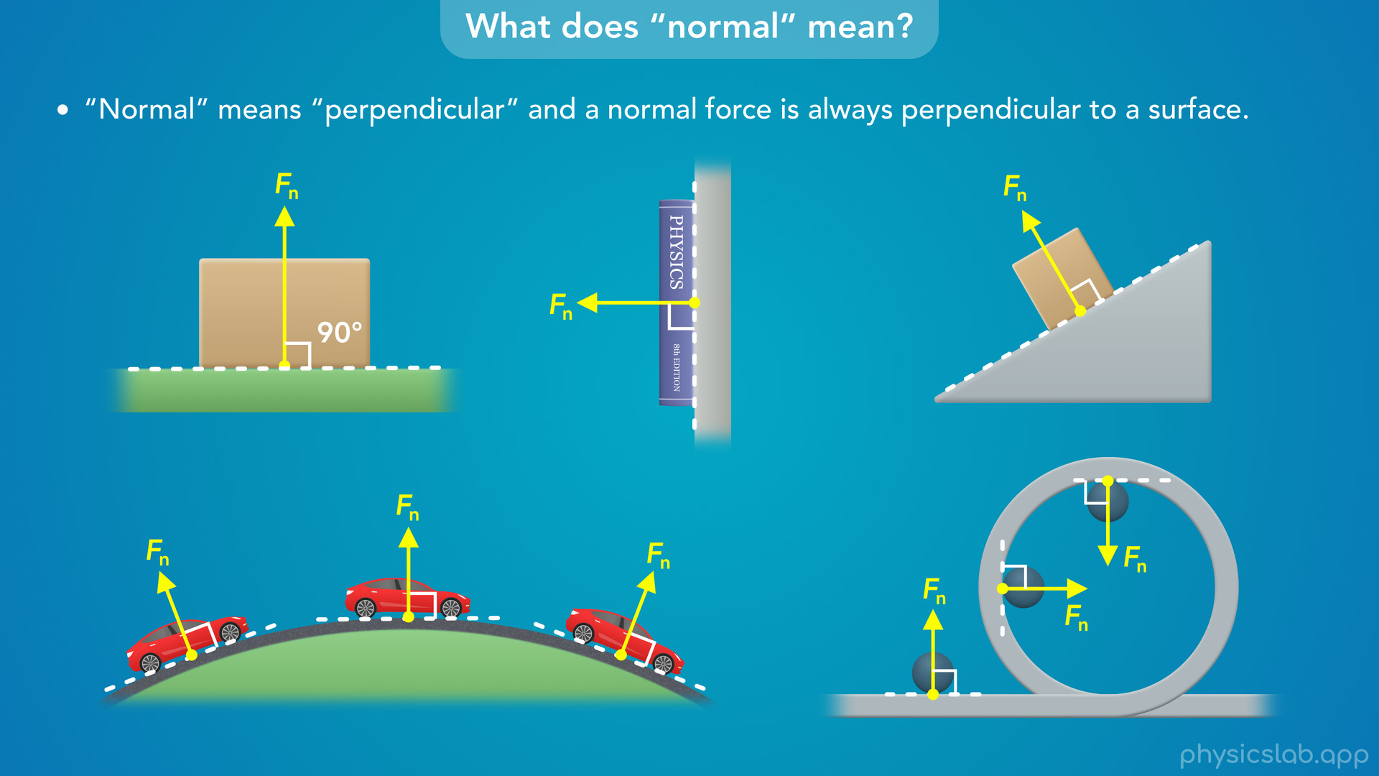
Notes:
• Then we’ll explain what the word normal actually means.

Slide 11
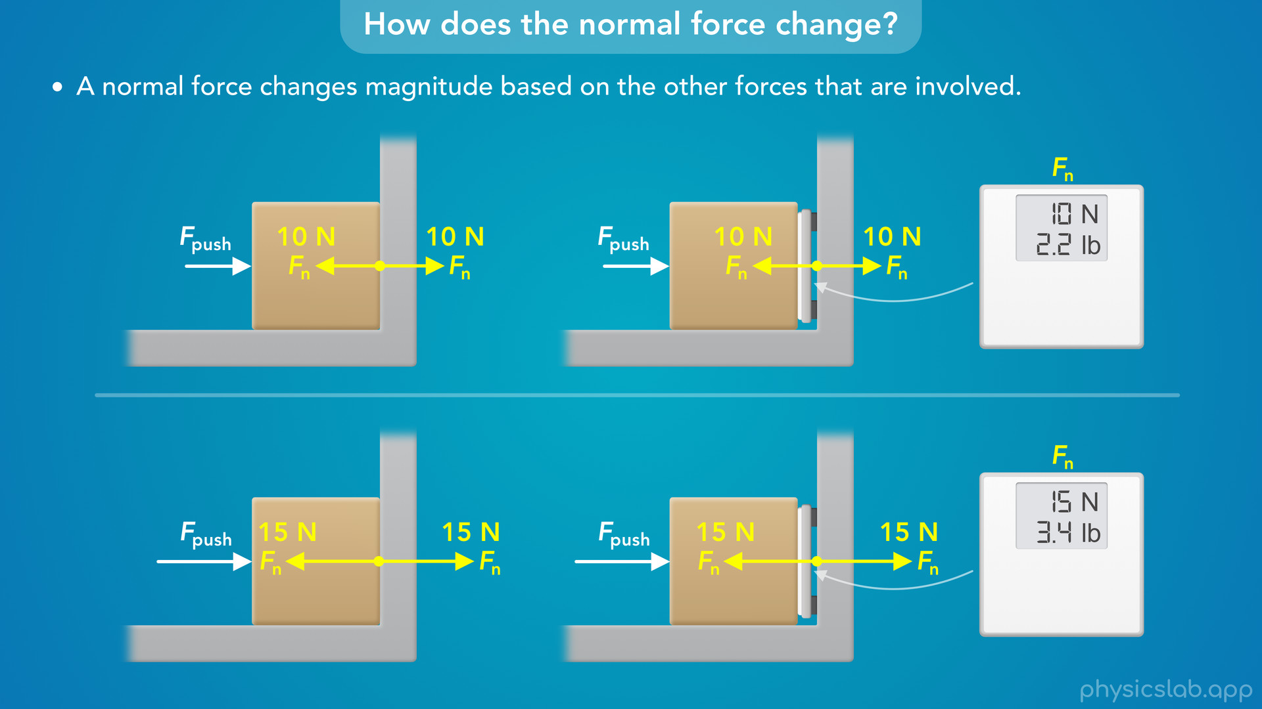
Notes:
• After that, we’ll see how the magnitude of a normal force can change based on the other forces involved.

Slide 12
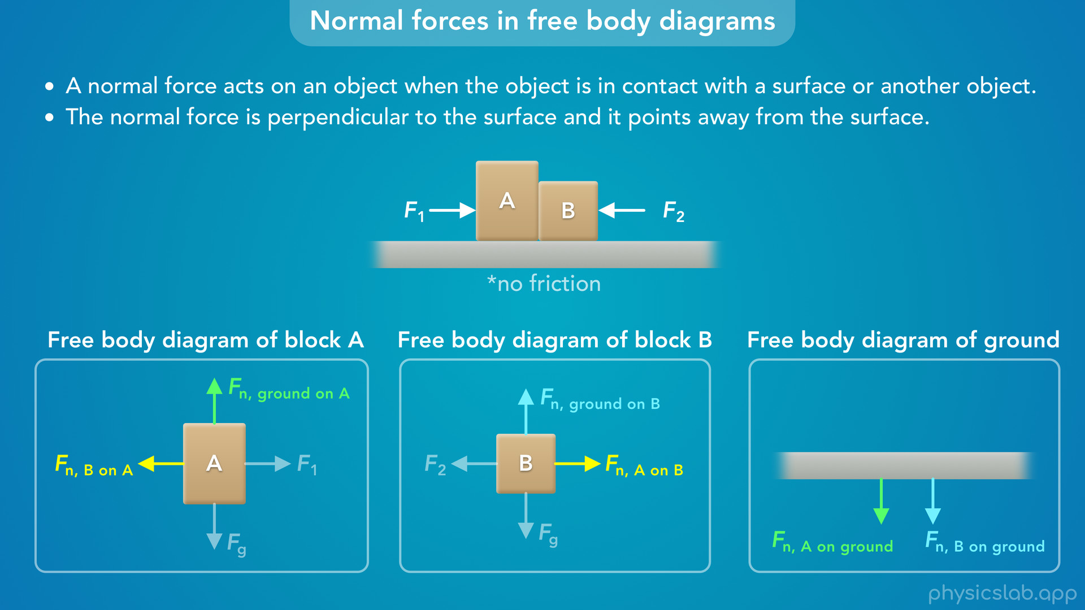
Notes:
• We’ll also talk about how to draw a normal force in free body diagrams.

Slide 13
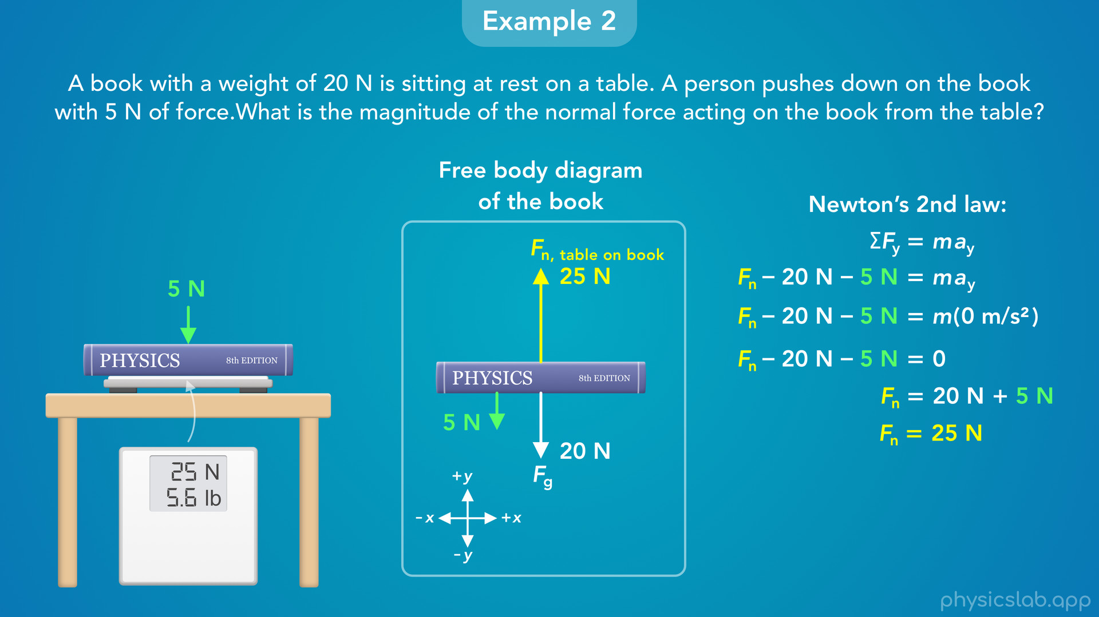
Notes:
• At the end, we’ll walk through a few example questions.

Slide 14
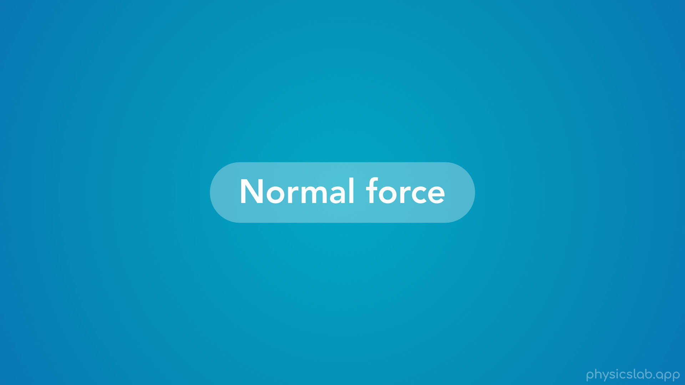
Notes:
• So, what is a normal force?

Slide 15
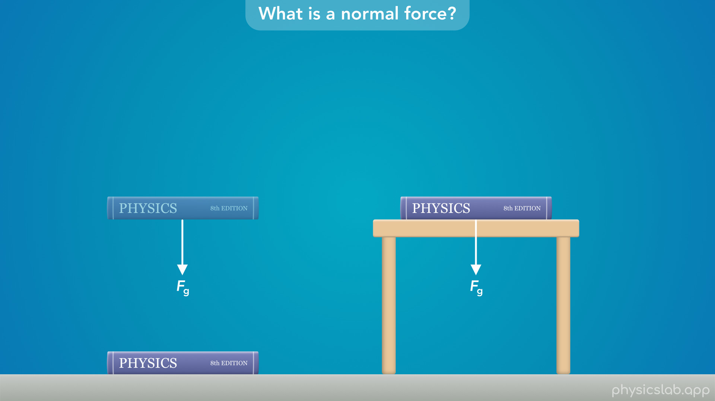
Notes:
• If we drop a book, we know that gravity is going to cause it to fall down.
• But if we place a book on a table, why doesn’t it fall through the table?
• The force of gravity is still pulling it down, so if the book doesn’t move, there must be another force on the book that’s acting upwards.

Slide 16
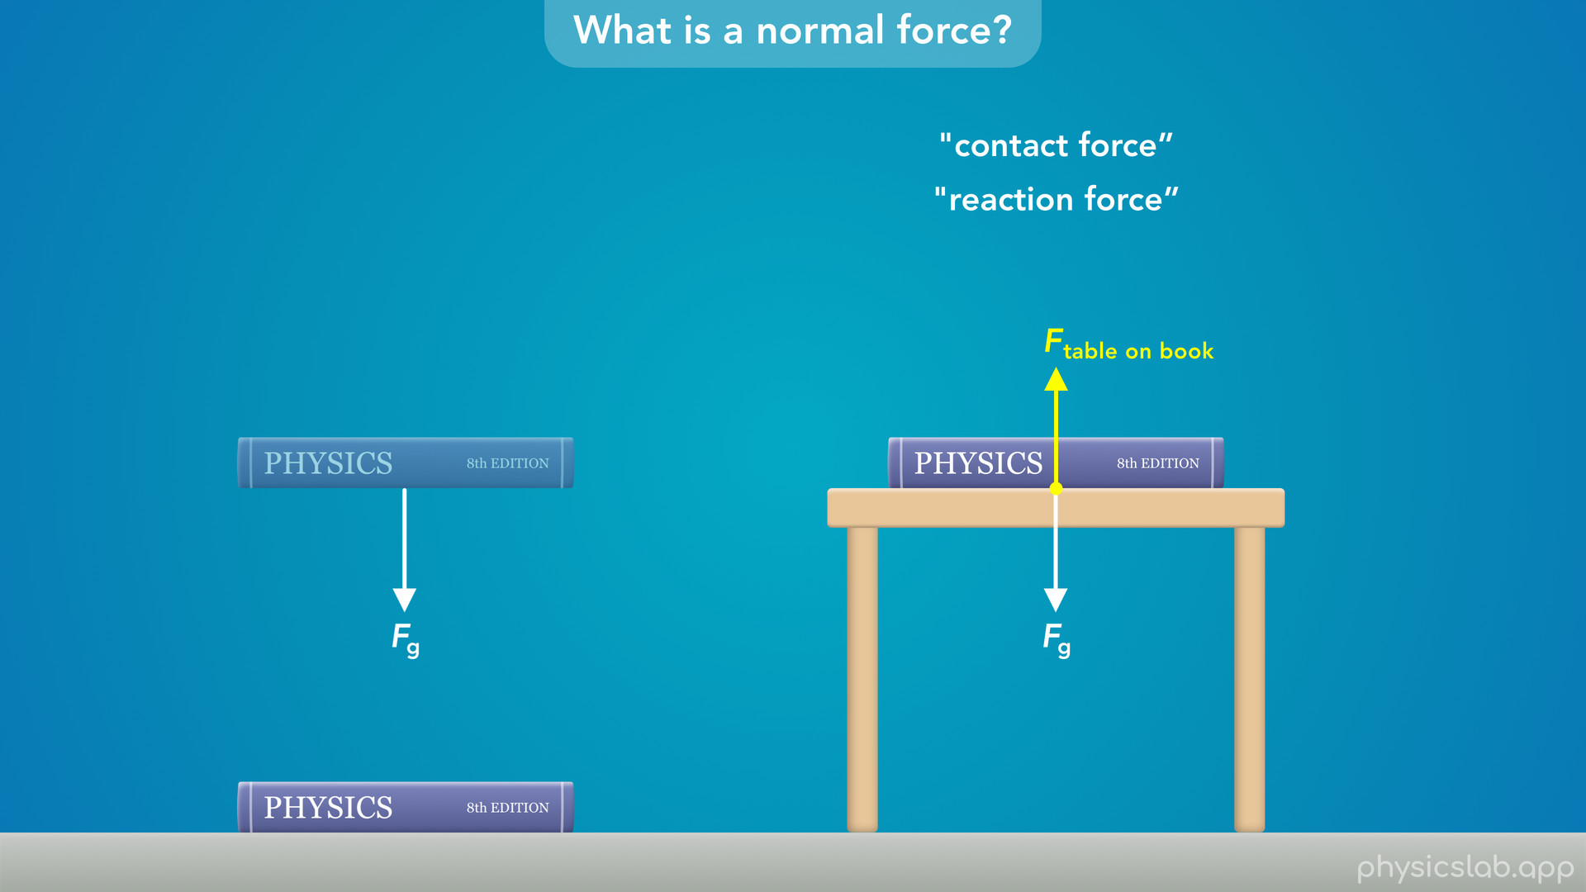
Notes:
• And there is. There’s a force from the table that is pushing up on the book.
• This force exists because the book and the table are in contact with each other.
• There’s a few different names for this type of force, like a contact force or a reaction force.

Slide 17
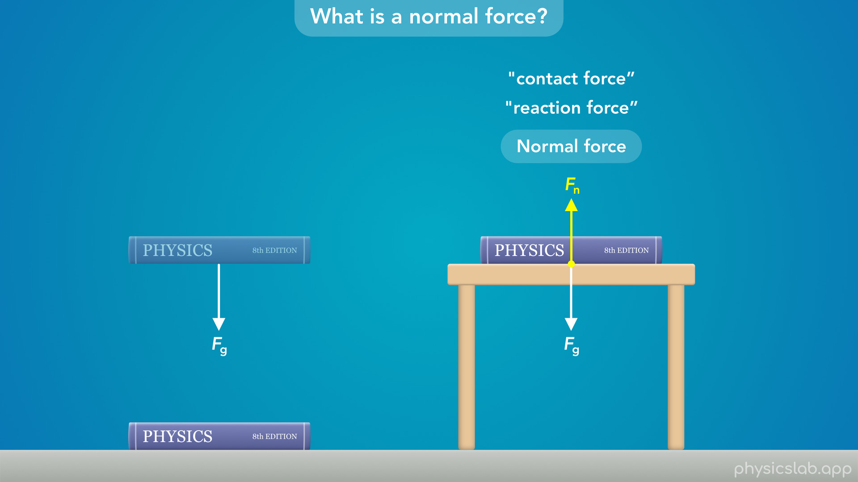
Notes:
• But we’re going to call this a normal force, and label it as Fn.

Slide 18
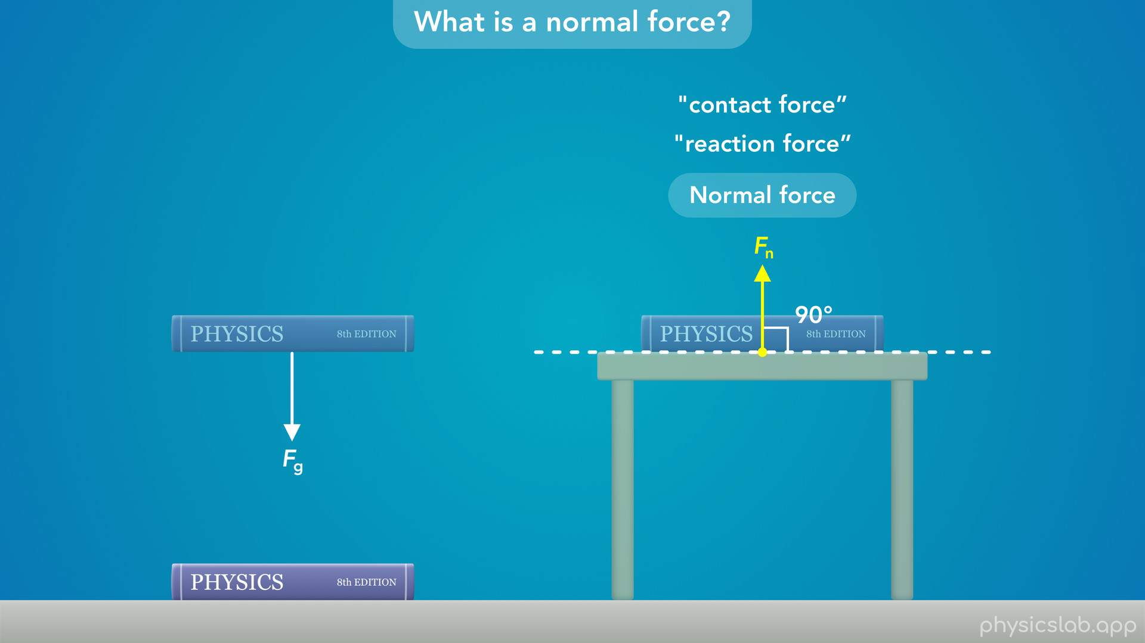
Notes:
• We’ll talk more about this in a minute, but the word “normal” just means “perpendicular”, and we call this a normal force because it’s direction is perpendicular to the surface of the table.

Slide 19
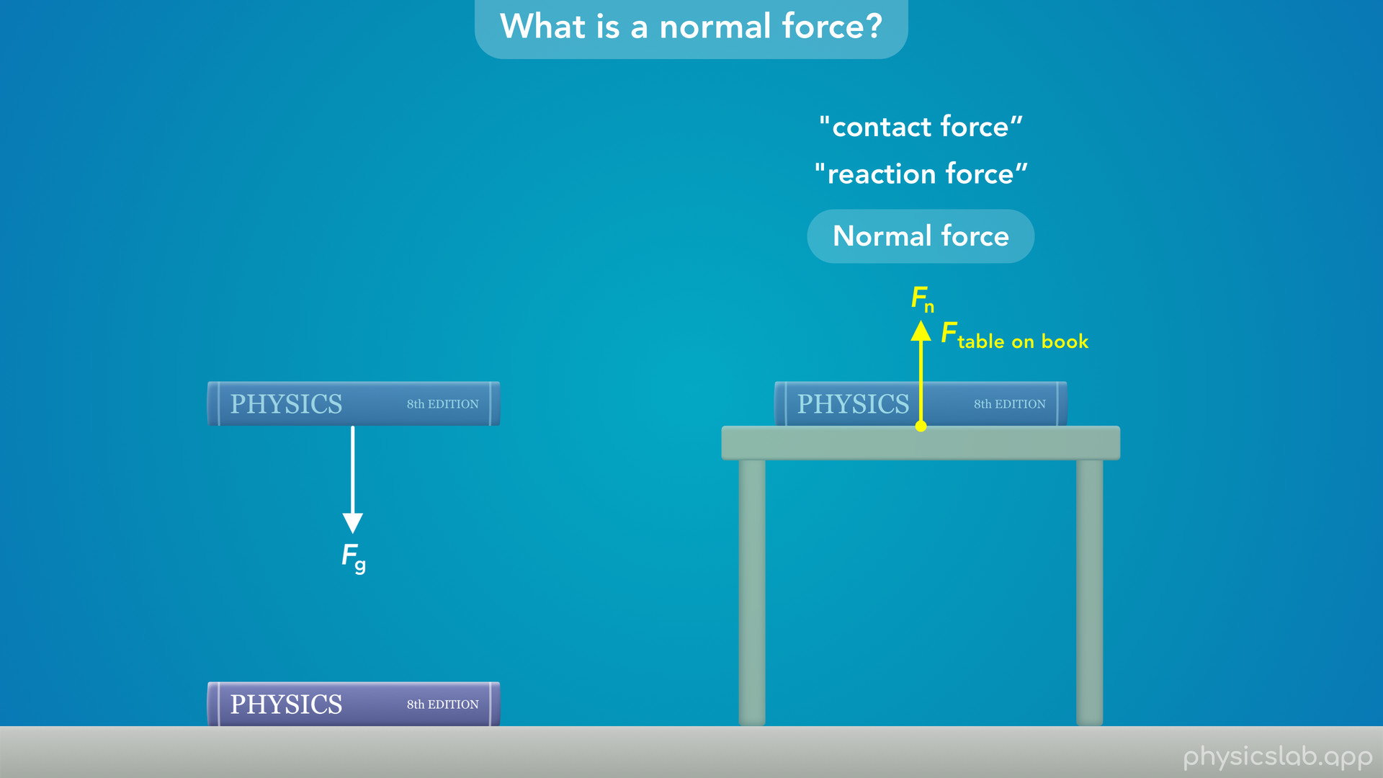
Notes:
• So this is just the force acting on the book from the table because they’re in contact.

Slide 20
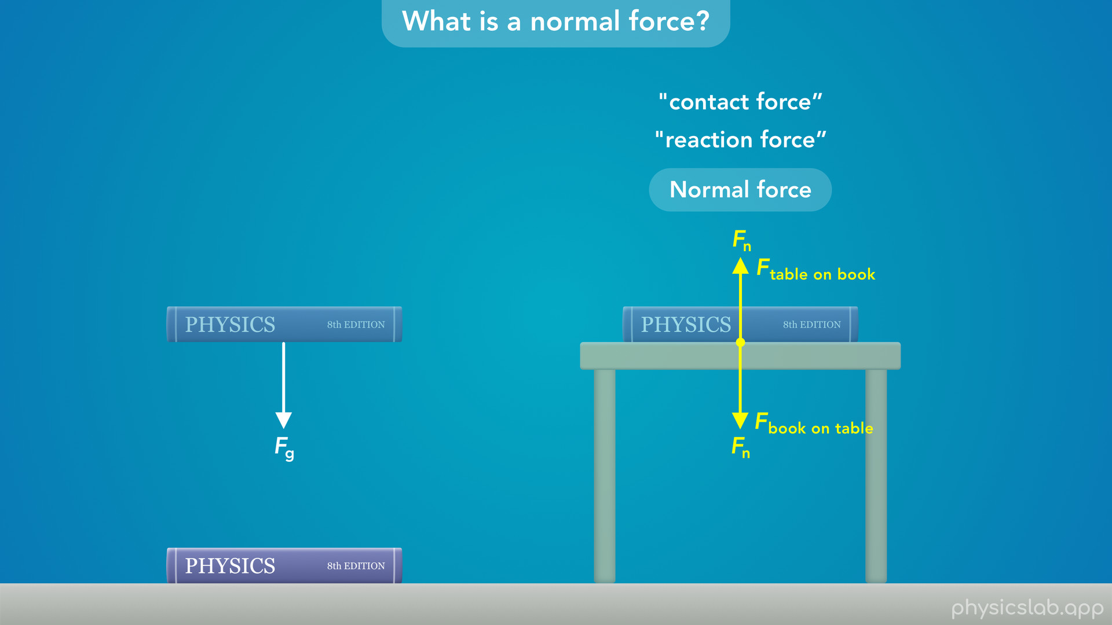
Notes:
• And we learned in the last video on Newton’s 3rd law that the book must also be exerting a downwards force on the table with the same magnitude.

Slide 21
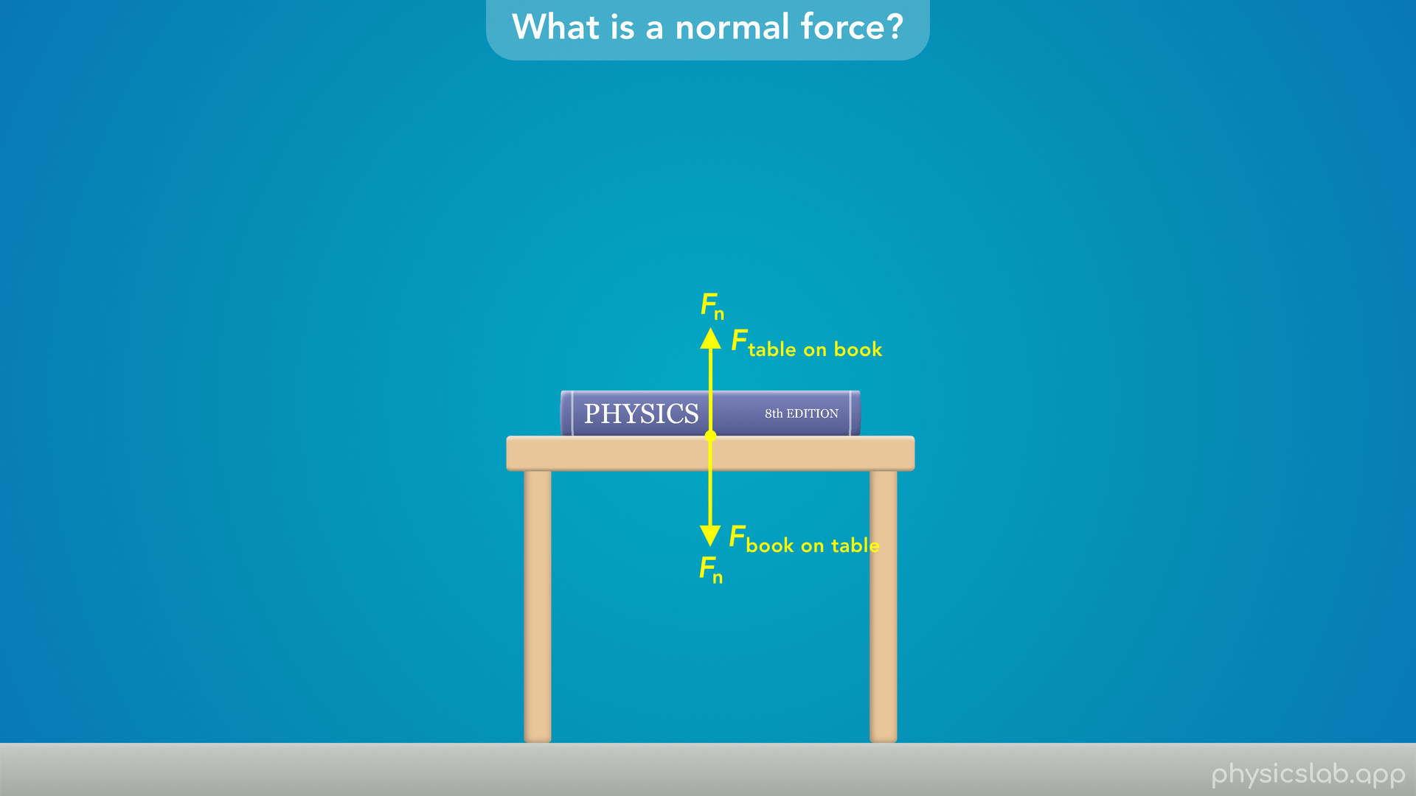
Notes:
• But what actually causes a normal force or a contact force, and why don’t objects move through each other?
• It may look like this book is touching the table, but let’s zoom in and look at these two objects at the atomic level.

Slide 22
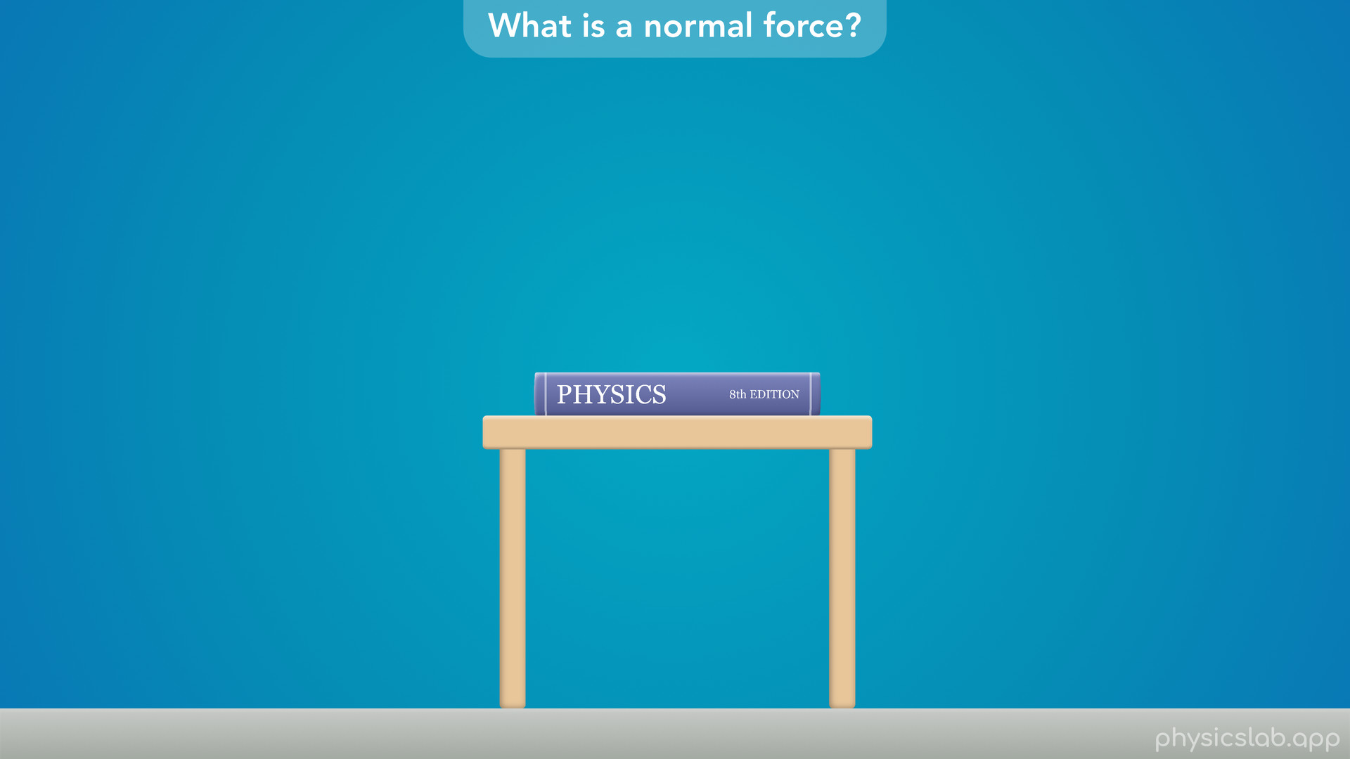

Slide 23
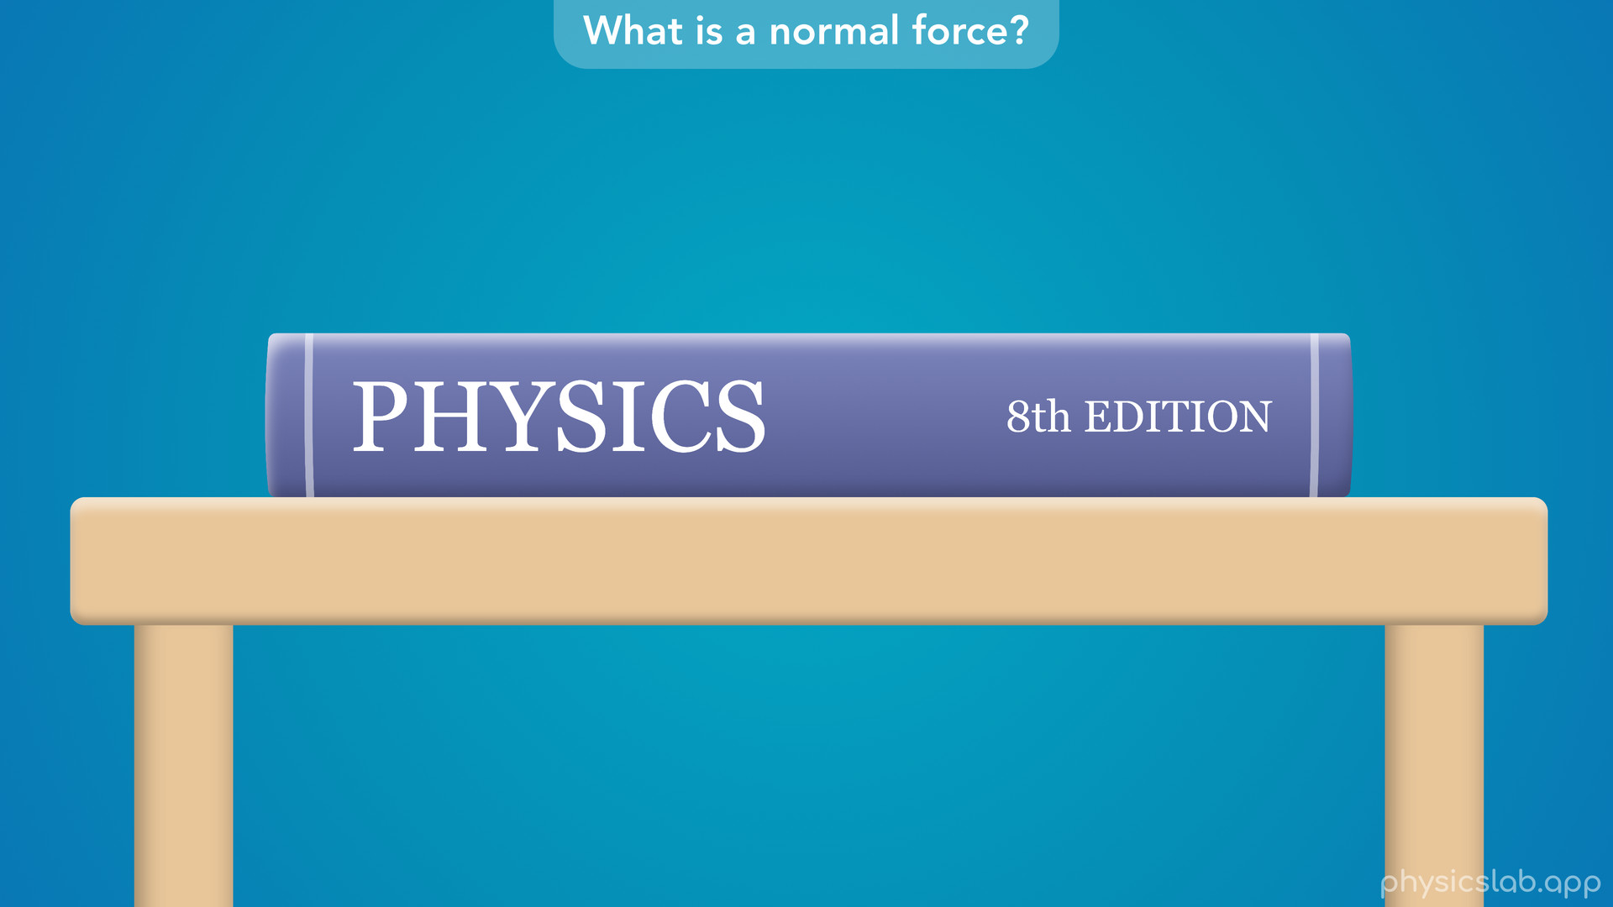

Slide 24
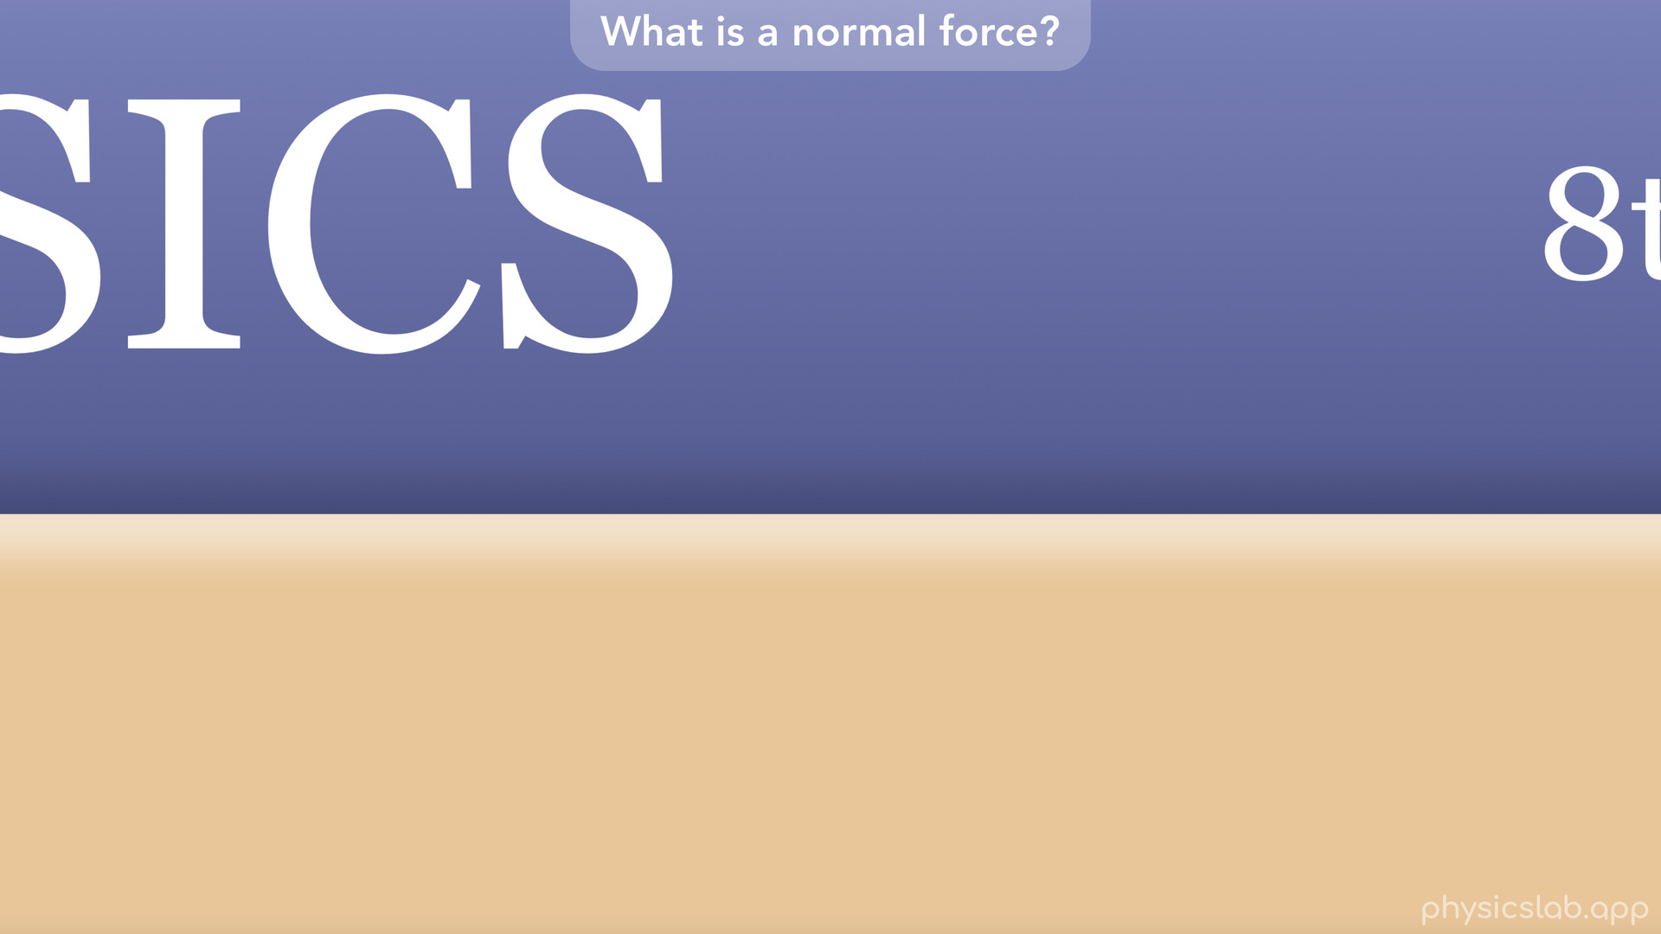

Slide 25
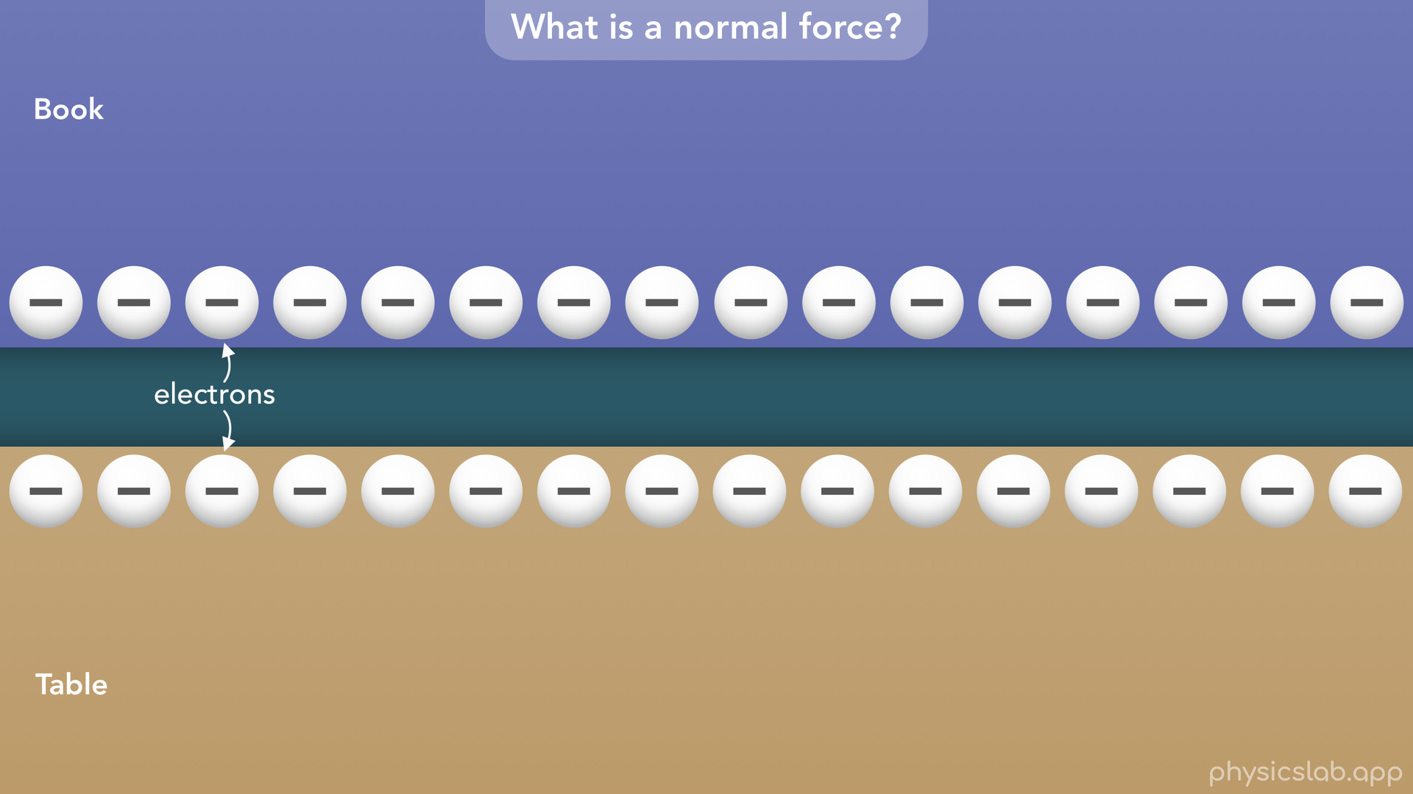
Notes:
• All objects are made of atoms, which consist of particles called protons, neutrons and electrons.

Slide 26
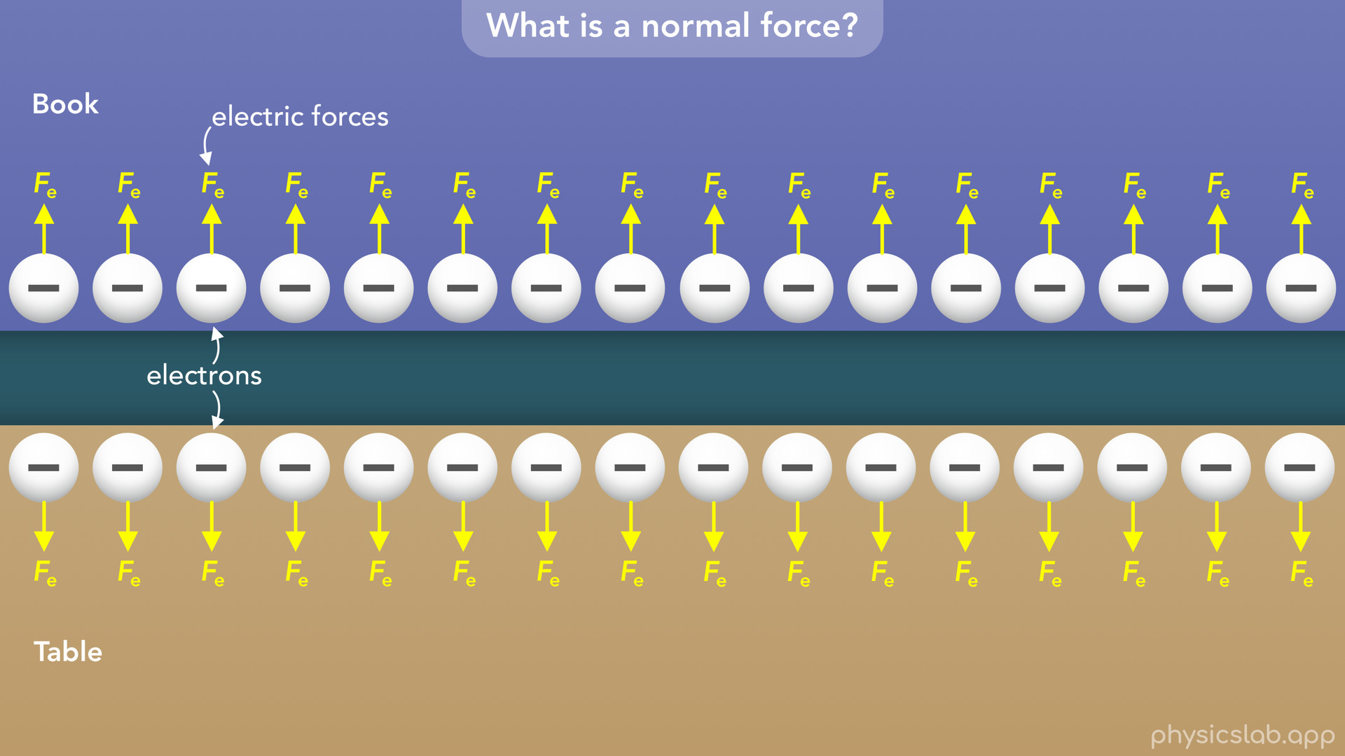
Notes:
• Electrons are negatively charged, and two particles with the same charge repel each other.
• So the electrons in the book and the electrons in the table repel each other with equal and opposite electric forces.
• And the two objects are not actually touching at this scale.

Slide 27
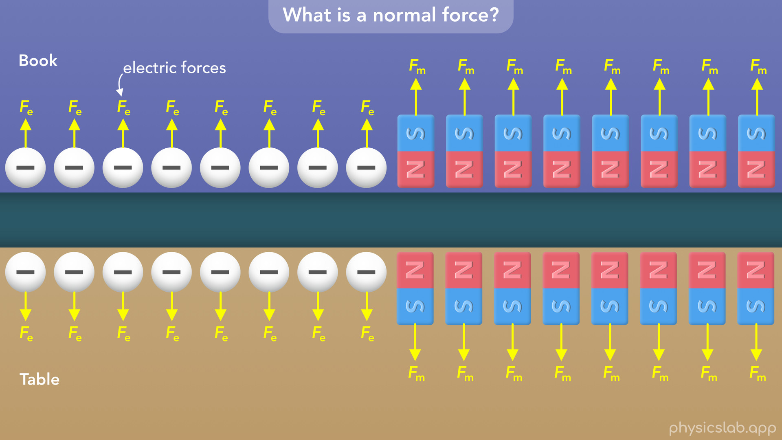
Notes:
• This is similar to how the same poles of two magnets repel each other with magnetic forces.

Slide 28
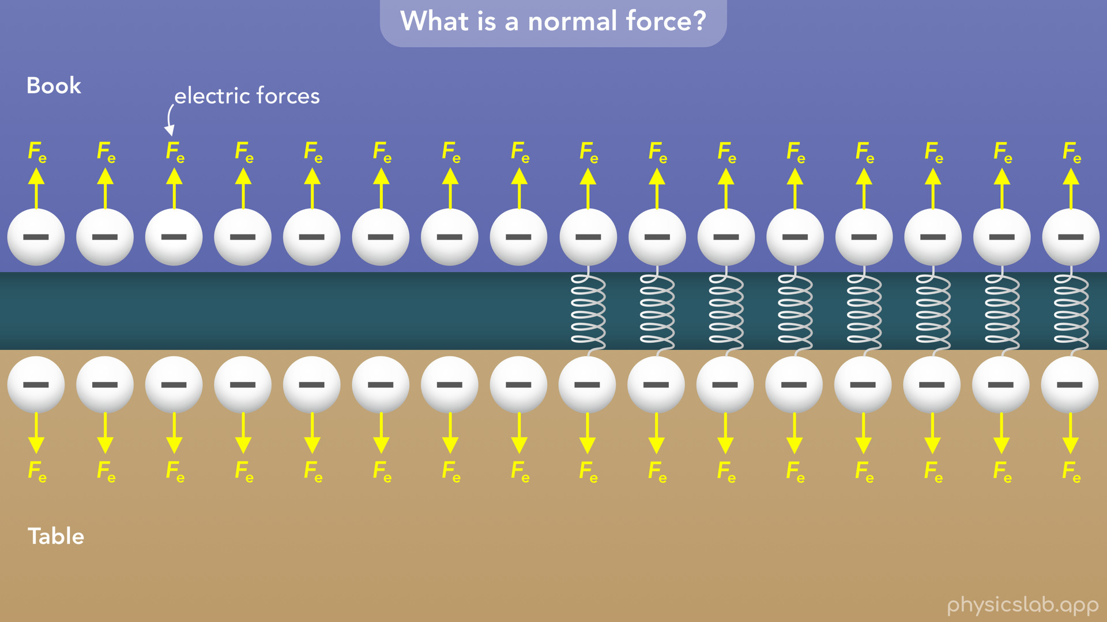
Notes:
• It’s almost like there are a bunch of tiny springs between the electrons of each object, pushing them apart.

Slide 29
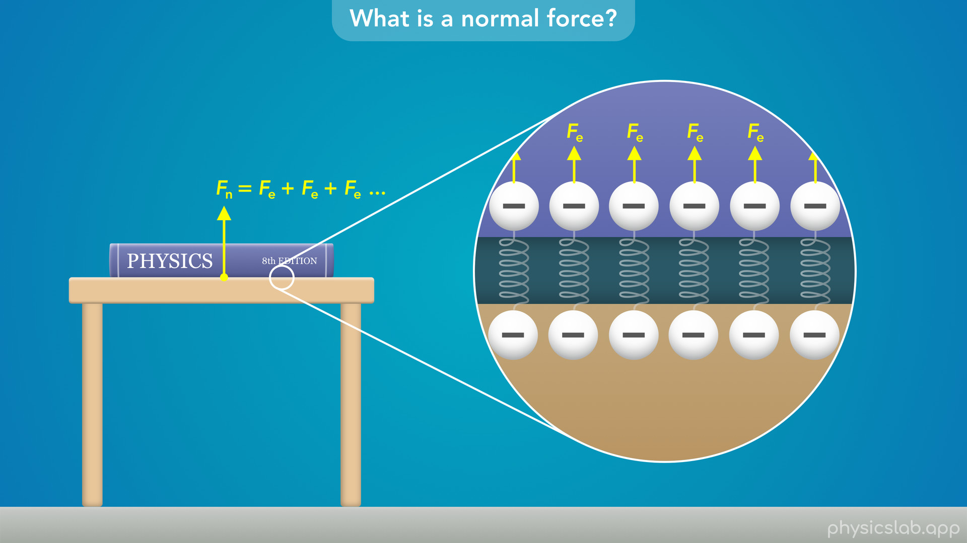
Notes:
• So the normal force acting upwards on the book is all of the electric forces on the book’s electrons added together.

Slide 30

Notes:
• And the same is true for the normal force acting downwards on the table.

Slide 31

Notes:
• So, if you try pushing the book into the table, the table pushes back with an equal and opposite force.

Slide 32
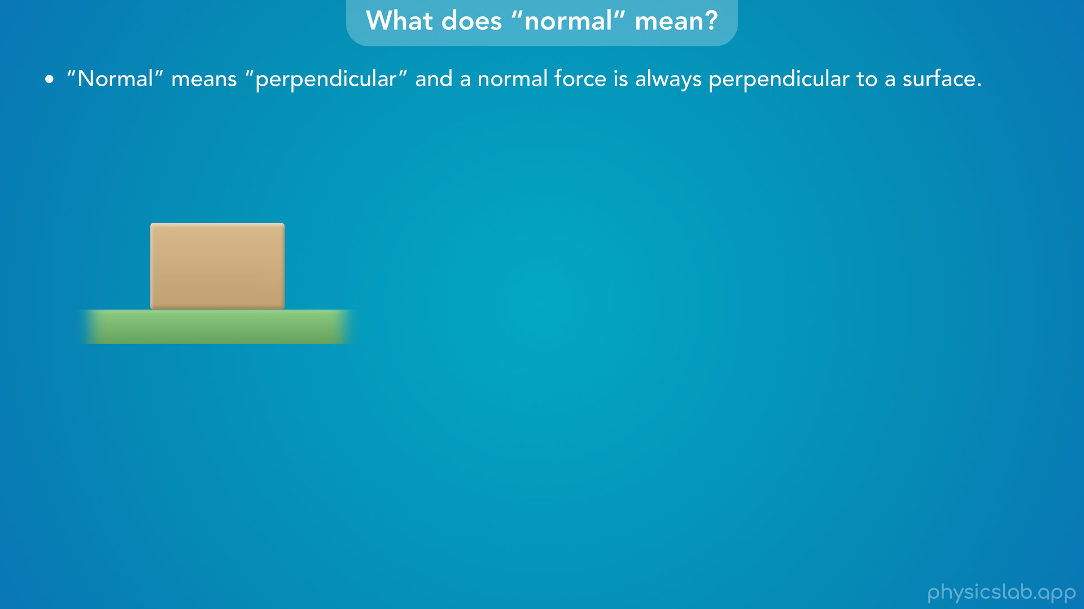
Notes:
• Now let’s talk about the word “normal” in normal force.
• Normal means perpendicular and a normal force is always perpendicular to a surface.

Slide 33
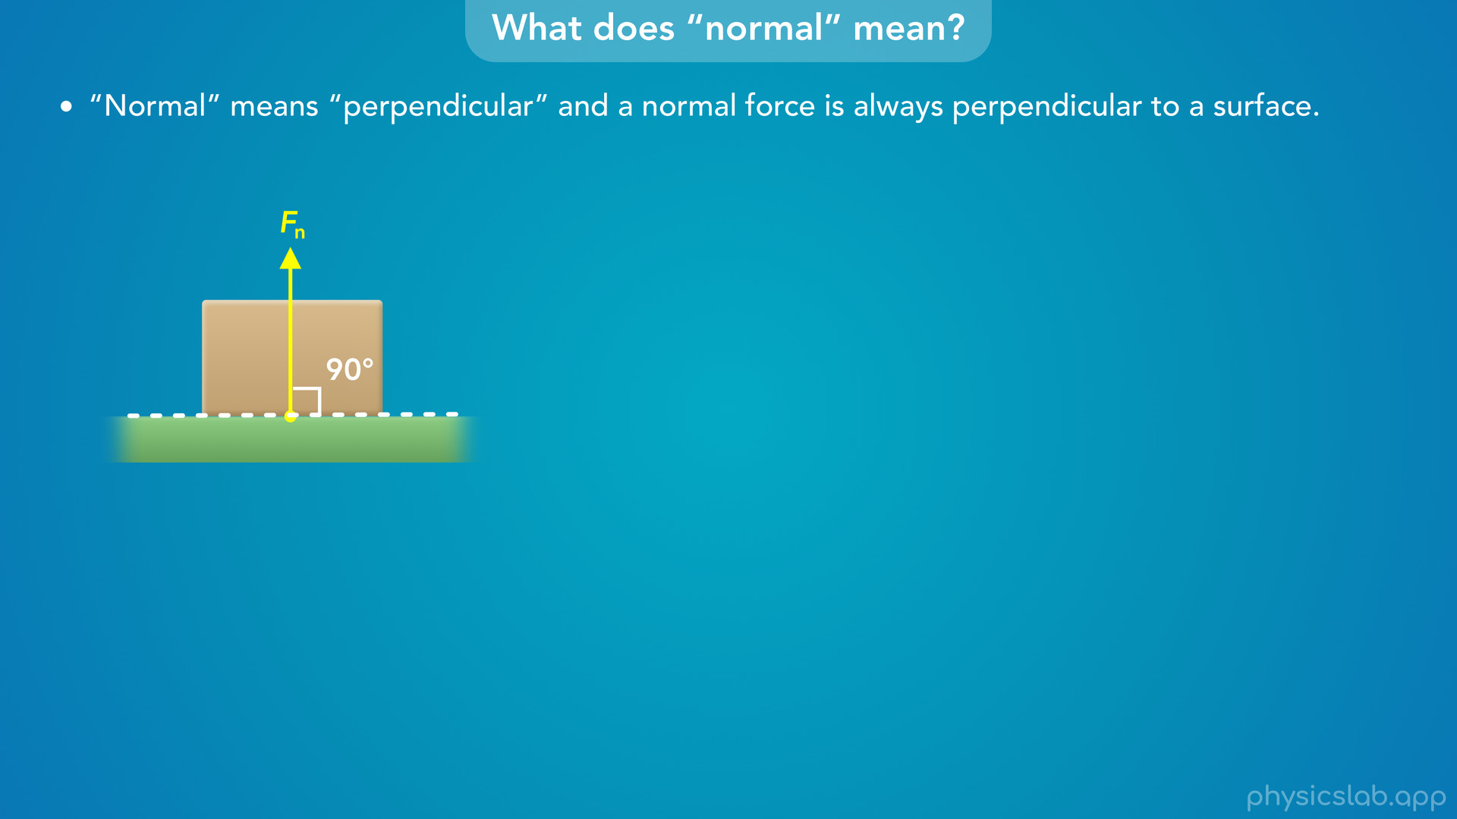
Notes:
• So the normal force acting on this block is perpendicular to the ground.
• That means that the angle between the normal force and the ground is a right angle or 90 degrees.

Slide 34
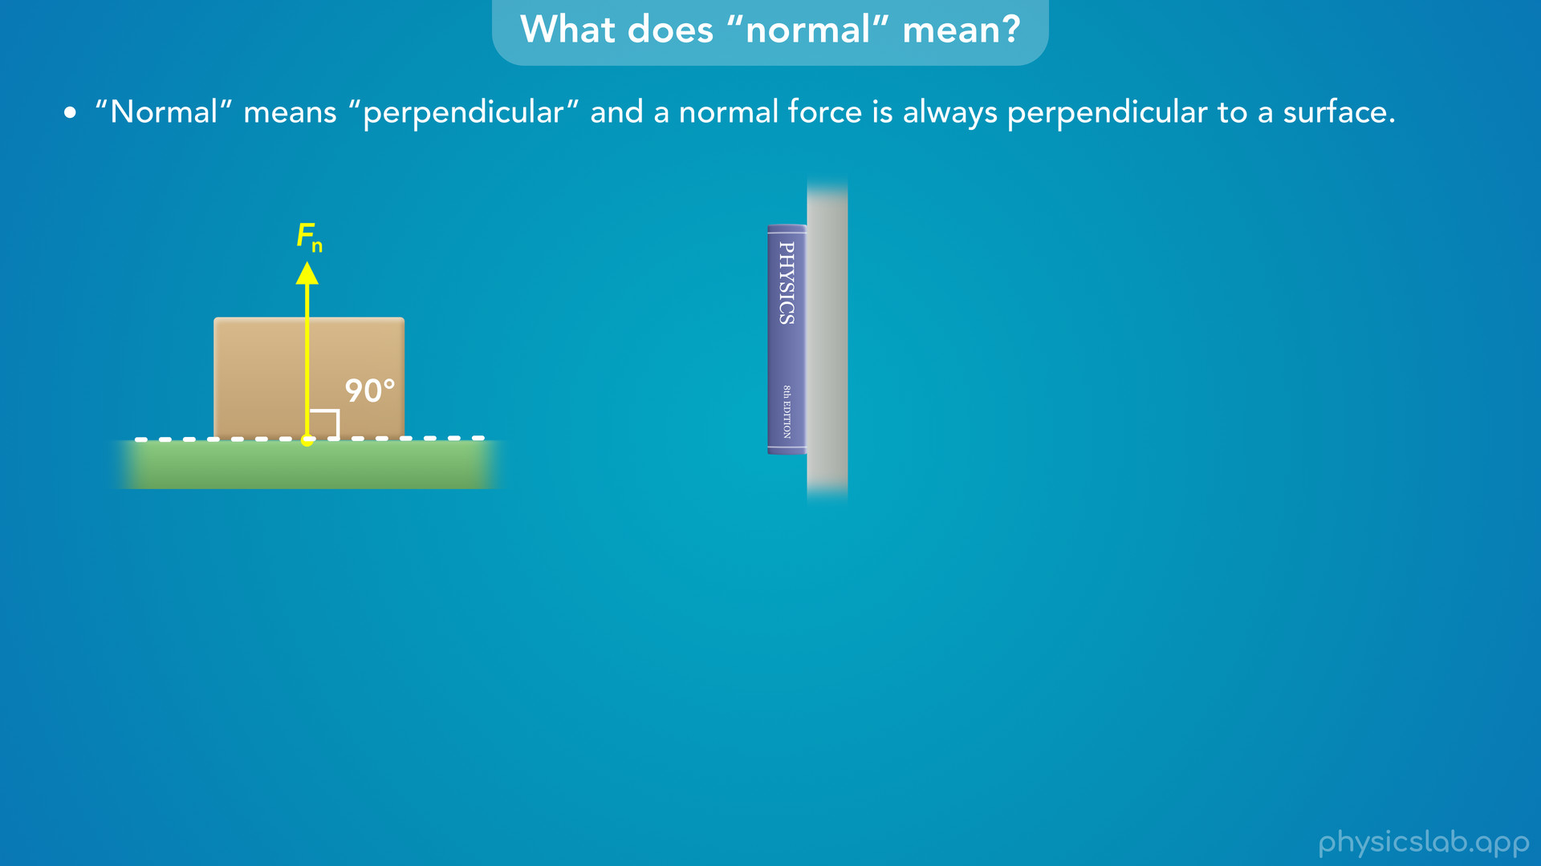

Slide 35
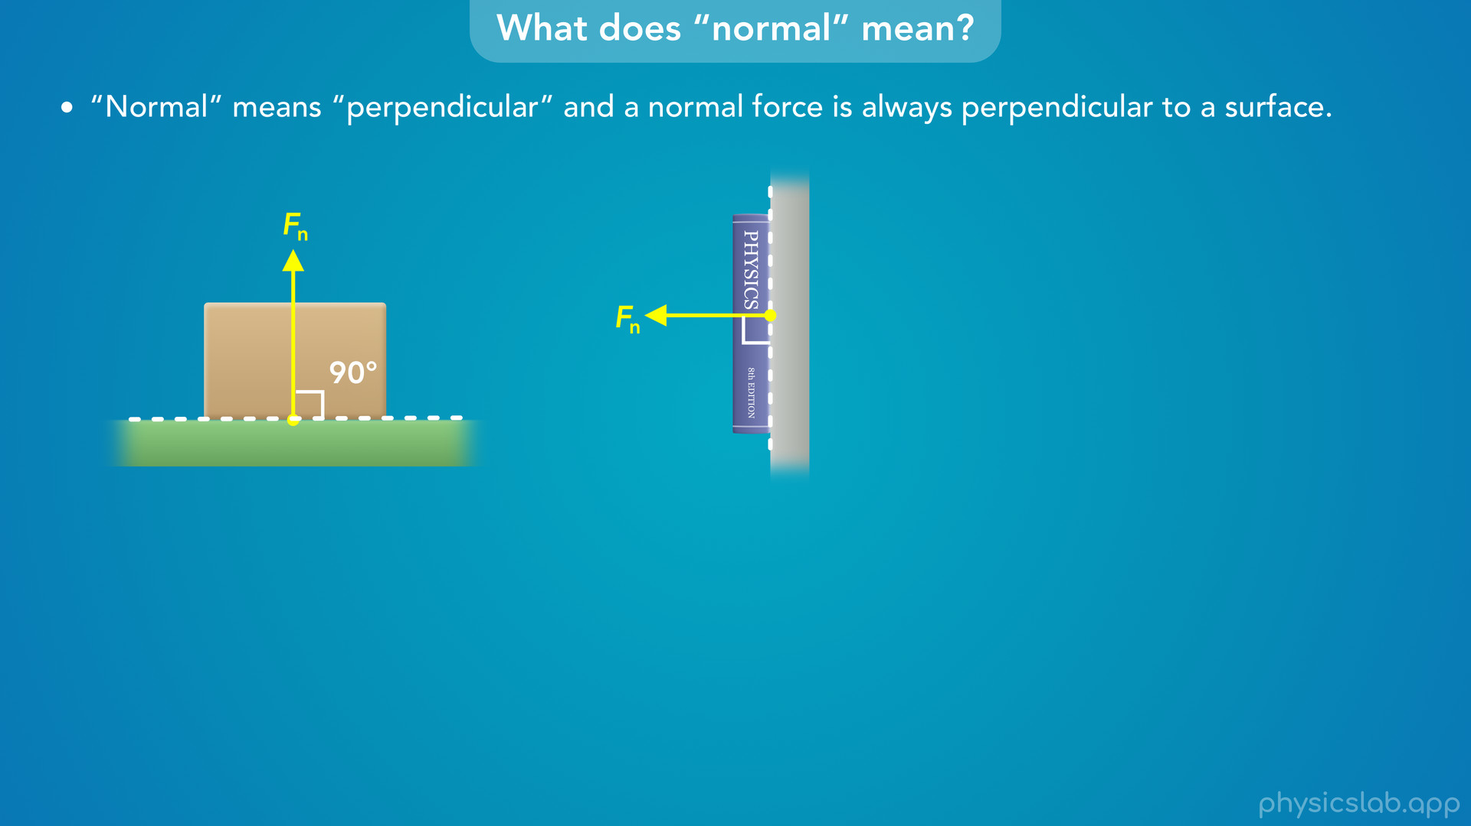
Notes:
• If we held a book against a wall, the normal force on the book would be perpendicular to the wall.

Slide 36
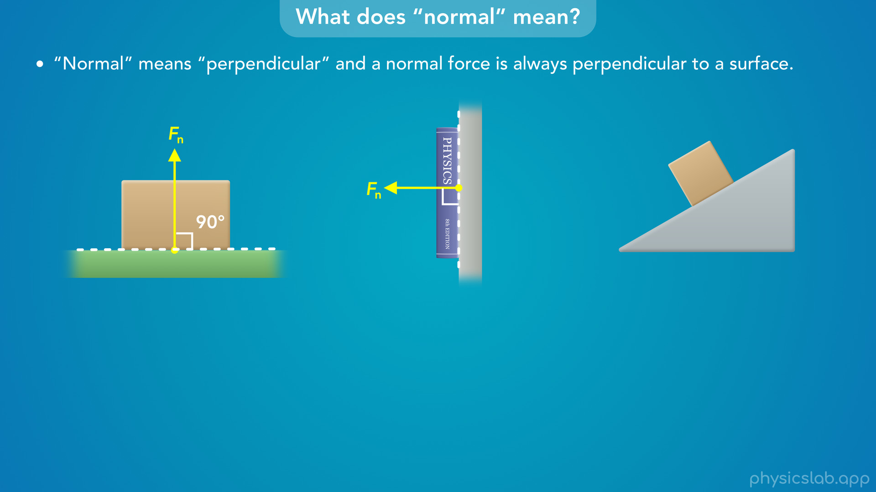

Slide 37
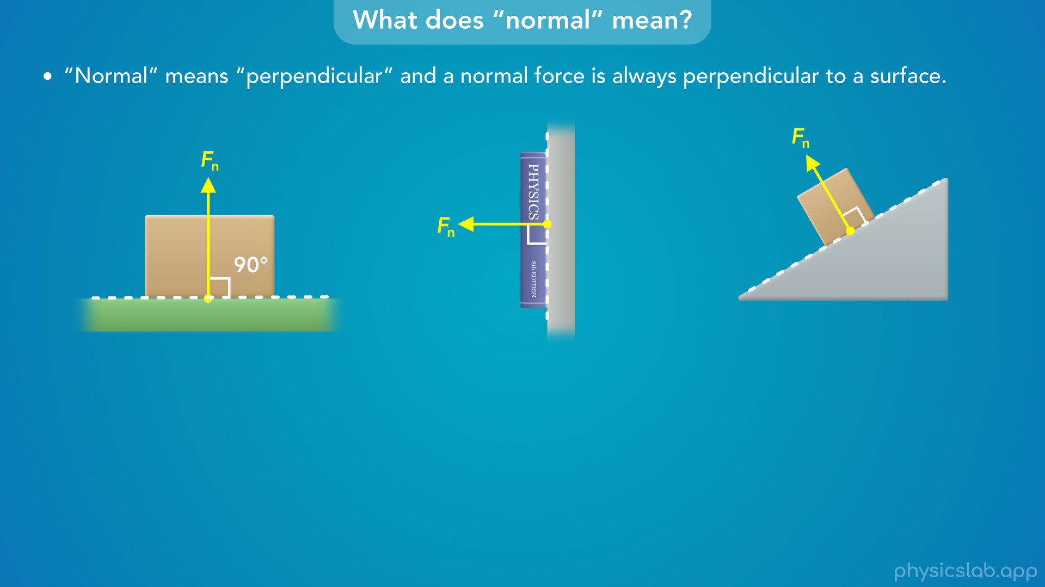
Notes:
• The normal force acting on this block is perpendicular to the surface of this ramp.

Slide 38
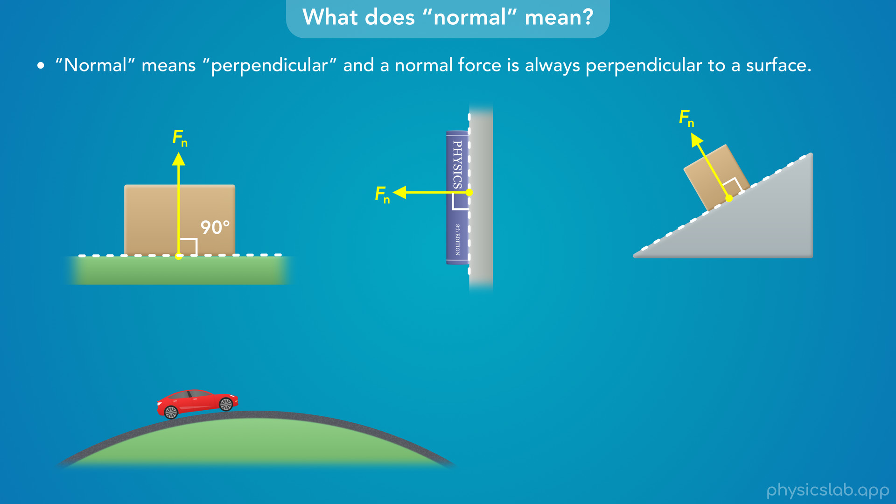

Slide 39
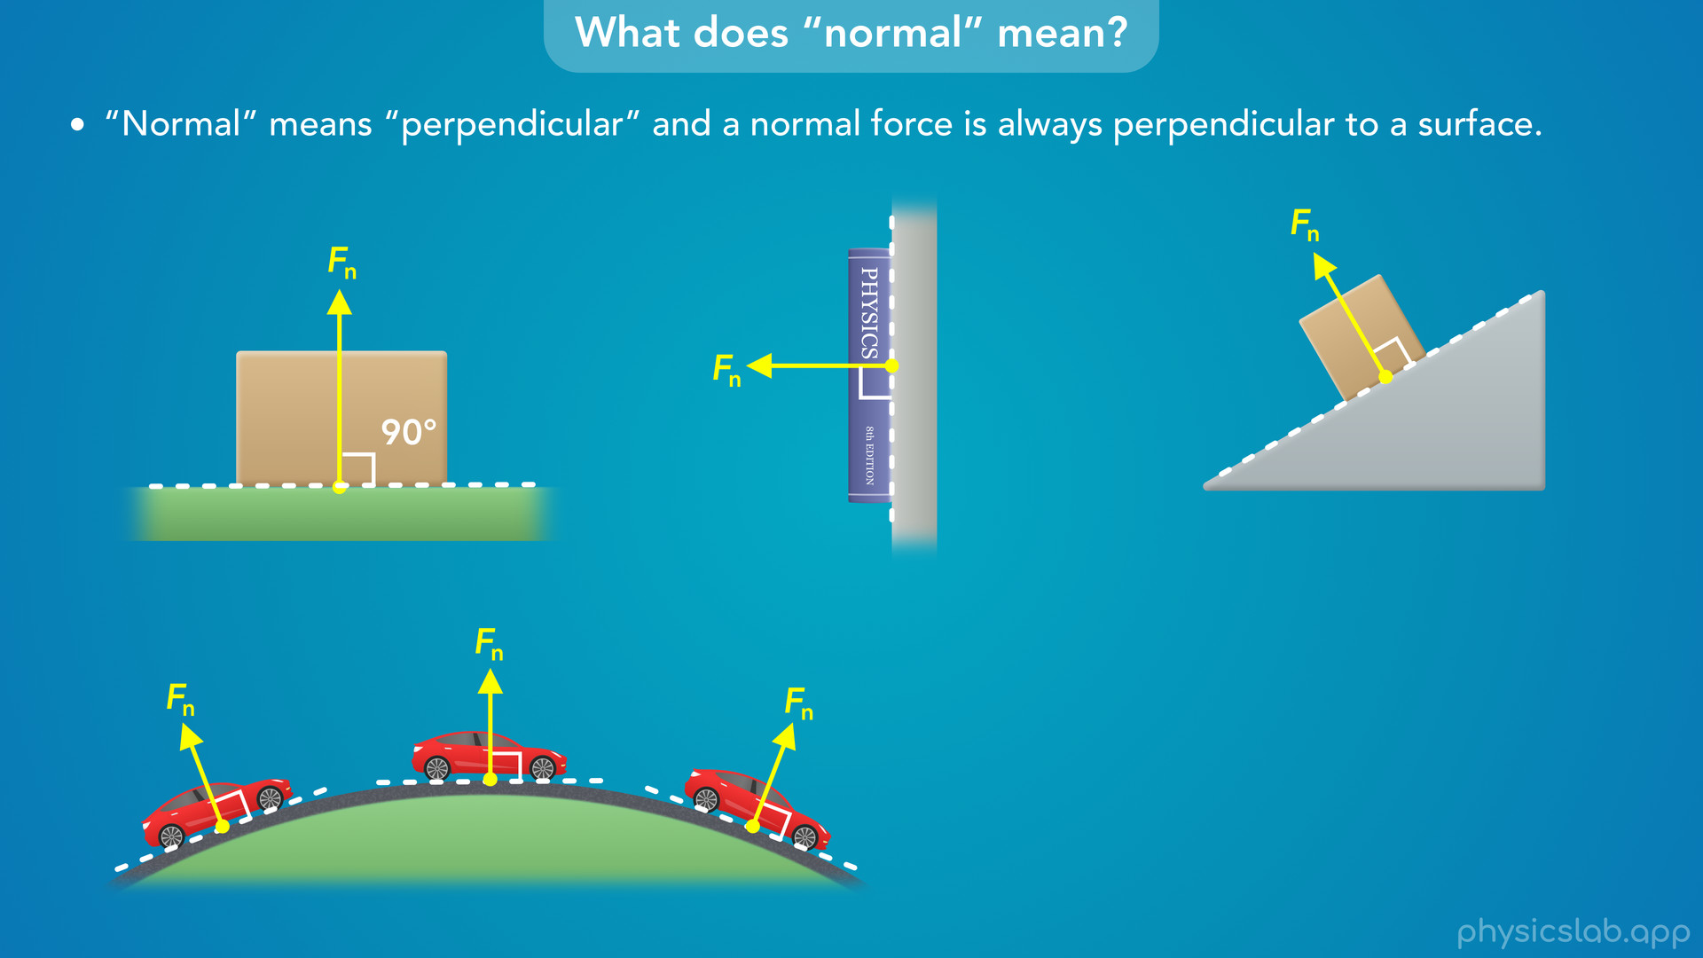
Notes:
• As this car drives over a hill, the normal force on the car is always perpendicular to the road at that point.

Slide 40
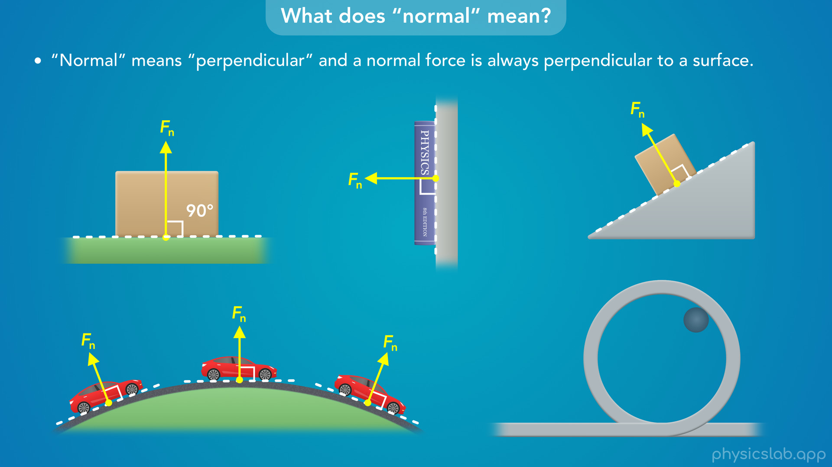

Slide 41
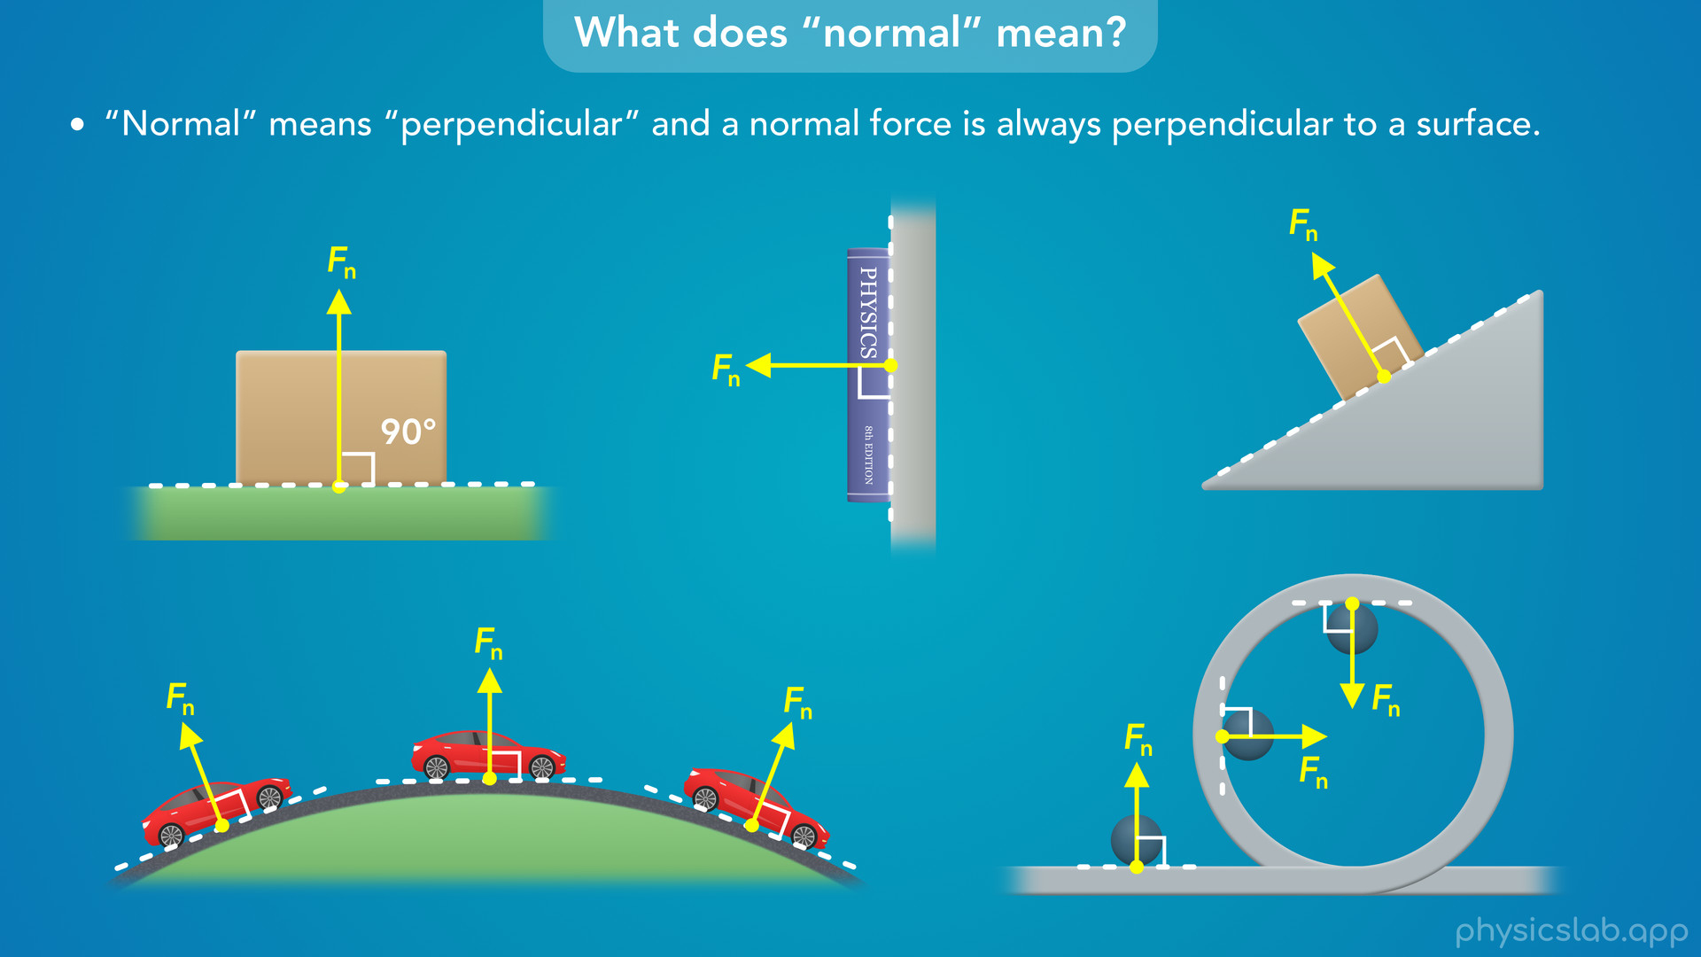
Notes:
• And if a ball is rolling around the inside of a circular track, the normal force on the ball is always perpendicular to the track.

Slide 42
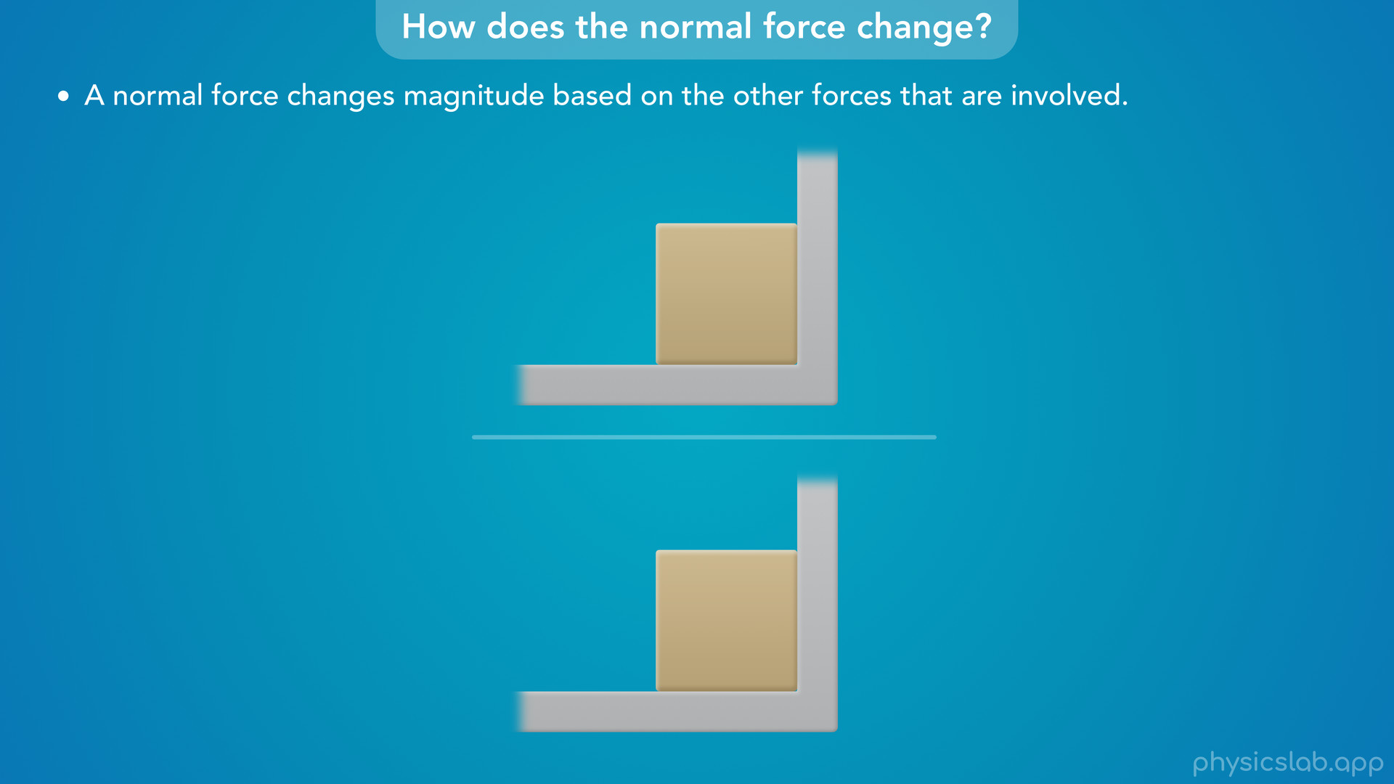
Notes:
• One of the interesting things about a normal force is that it changes magnitude based on the other forces that are involved.

Slide 43
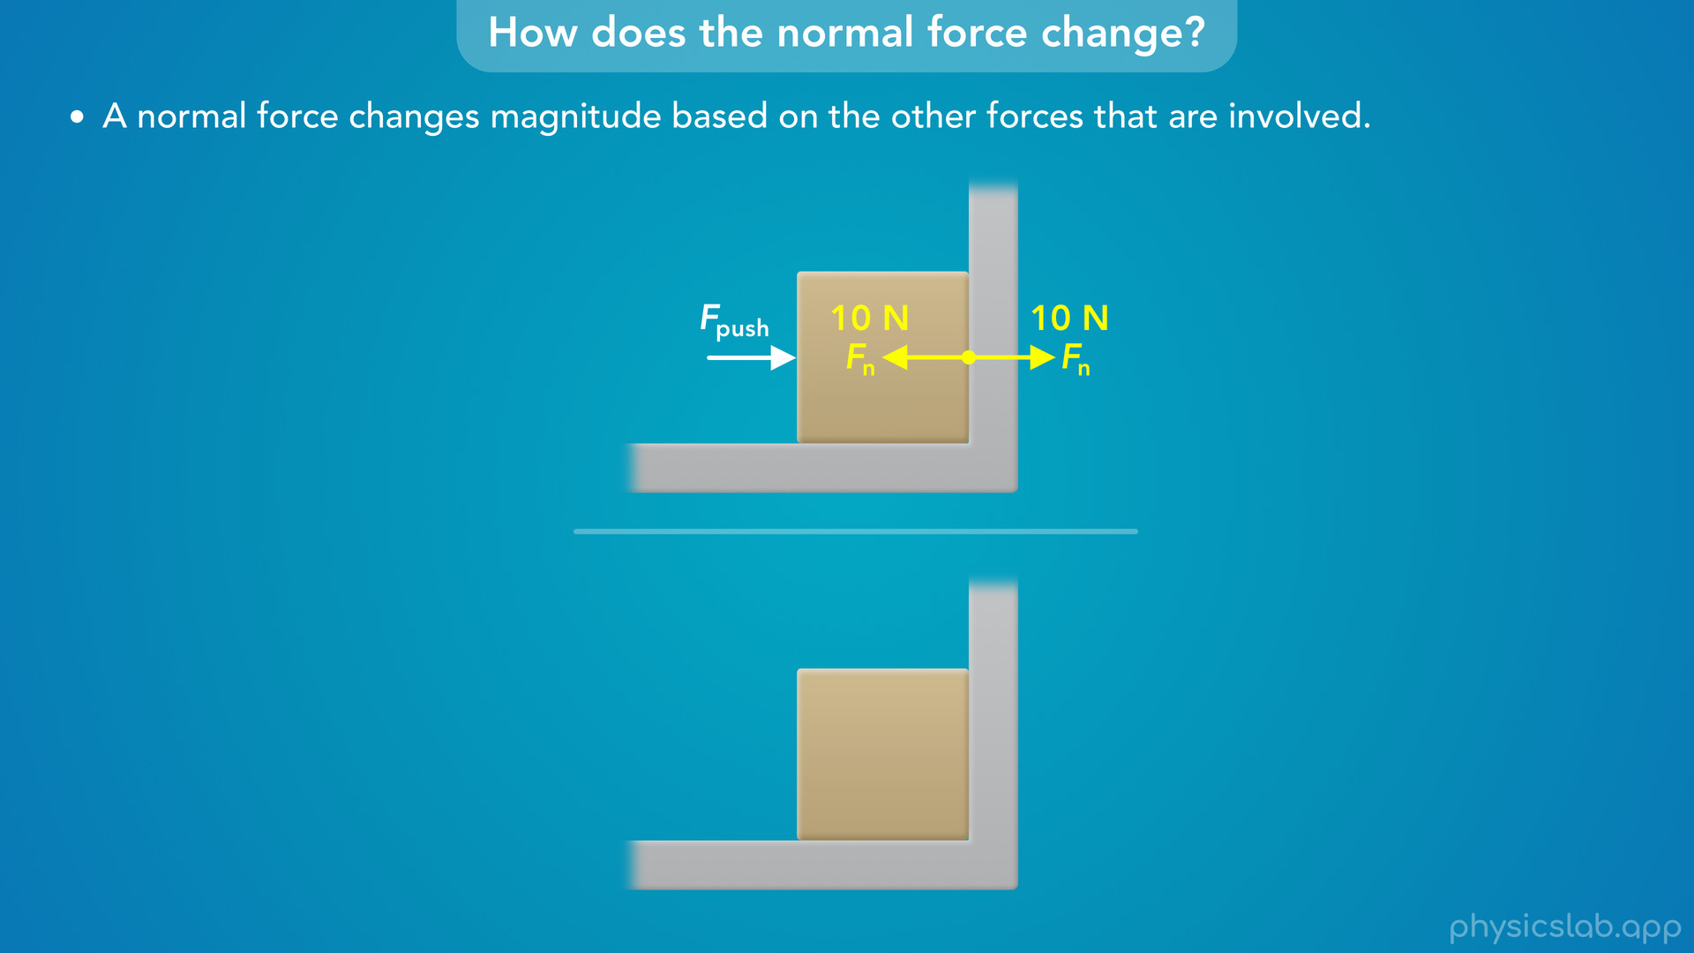
Notes:
• Let’s say a person is pushing this block against a wall.
• The block and the wall exert equal and opposite normal forces on each other.
• Let’s say they’re pushing on each other with 10 N of force.

Slide 44
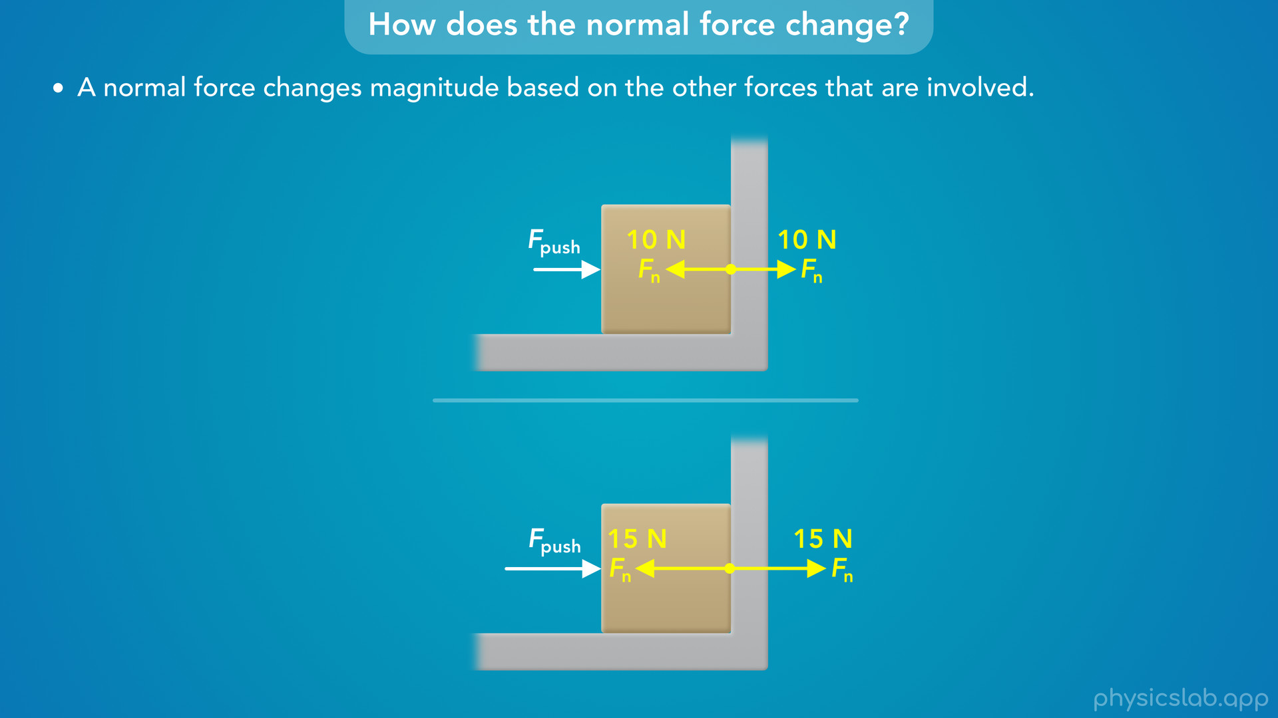
Notes:
• If the person pushes harder on the block, then the block pushes harder on the wall, and the wall pushes harder on the block.
• The magnitudes of these normal forces get bigger.

Slide 45

Notes:
• But unless we have an object that’s flexible, we can’t really see this normal force changing.

Slide 46
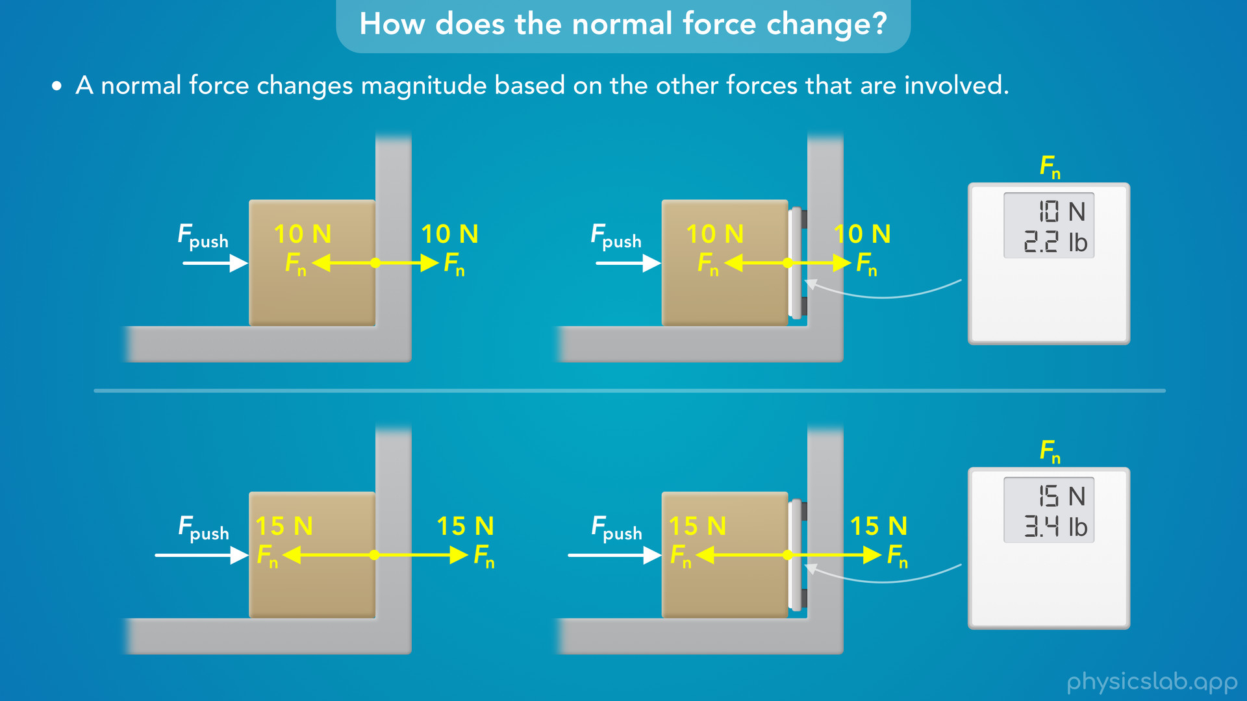
Notes:
• One thing we can do is insert a scale between the two objects. This will measure the normal force between the block and the wall.
• So now when the person exerts more or less force on the block, we can see the normal force is changing.

Slide 47
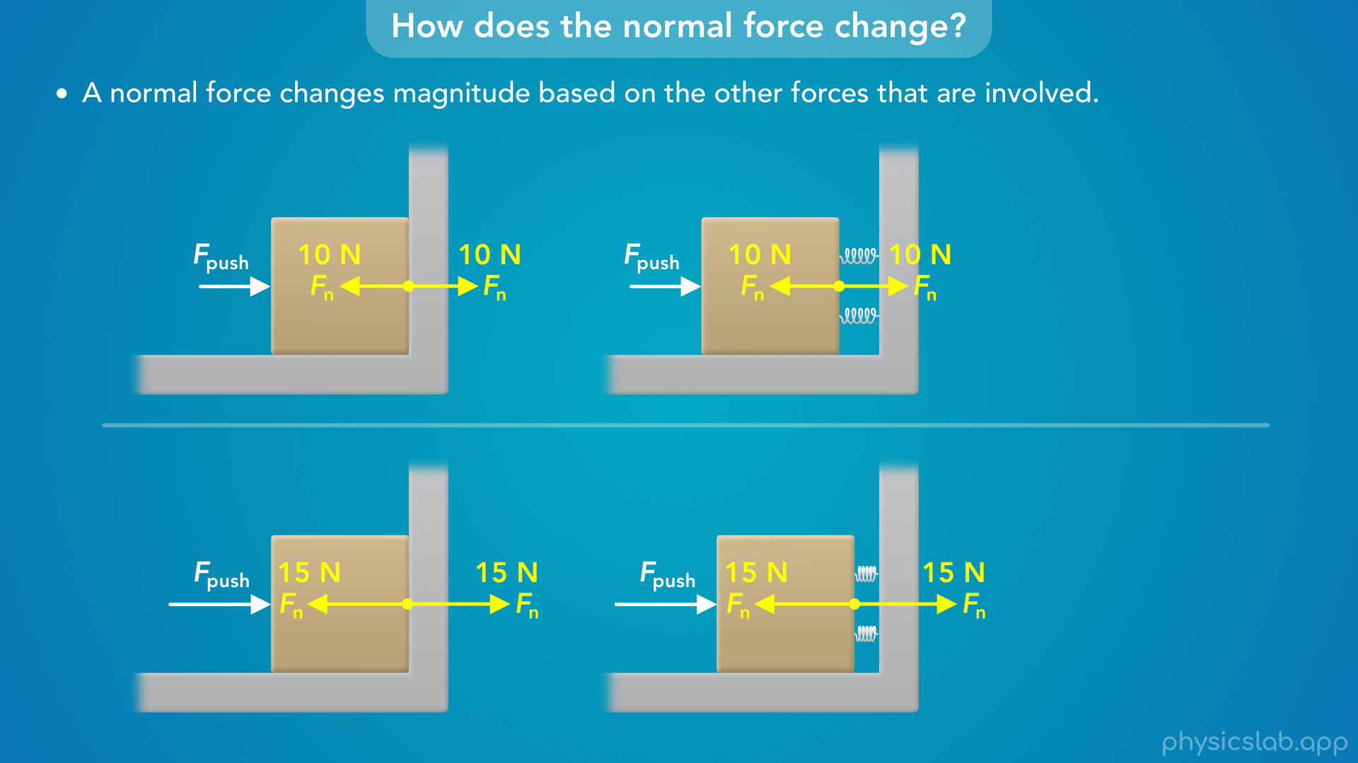
Notes:
• Another thing we can do is imagine there are springs between the two objects.
• When you push on a spring, it gets shorter, so that would give us a visual indication that the normal force between the block and the wall is changing.

Slide 48
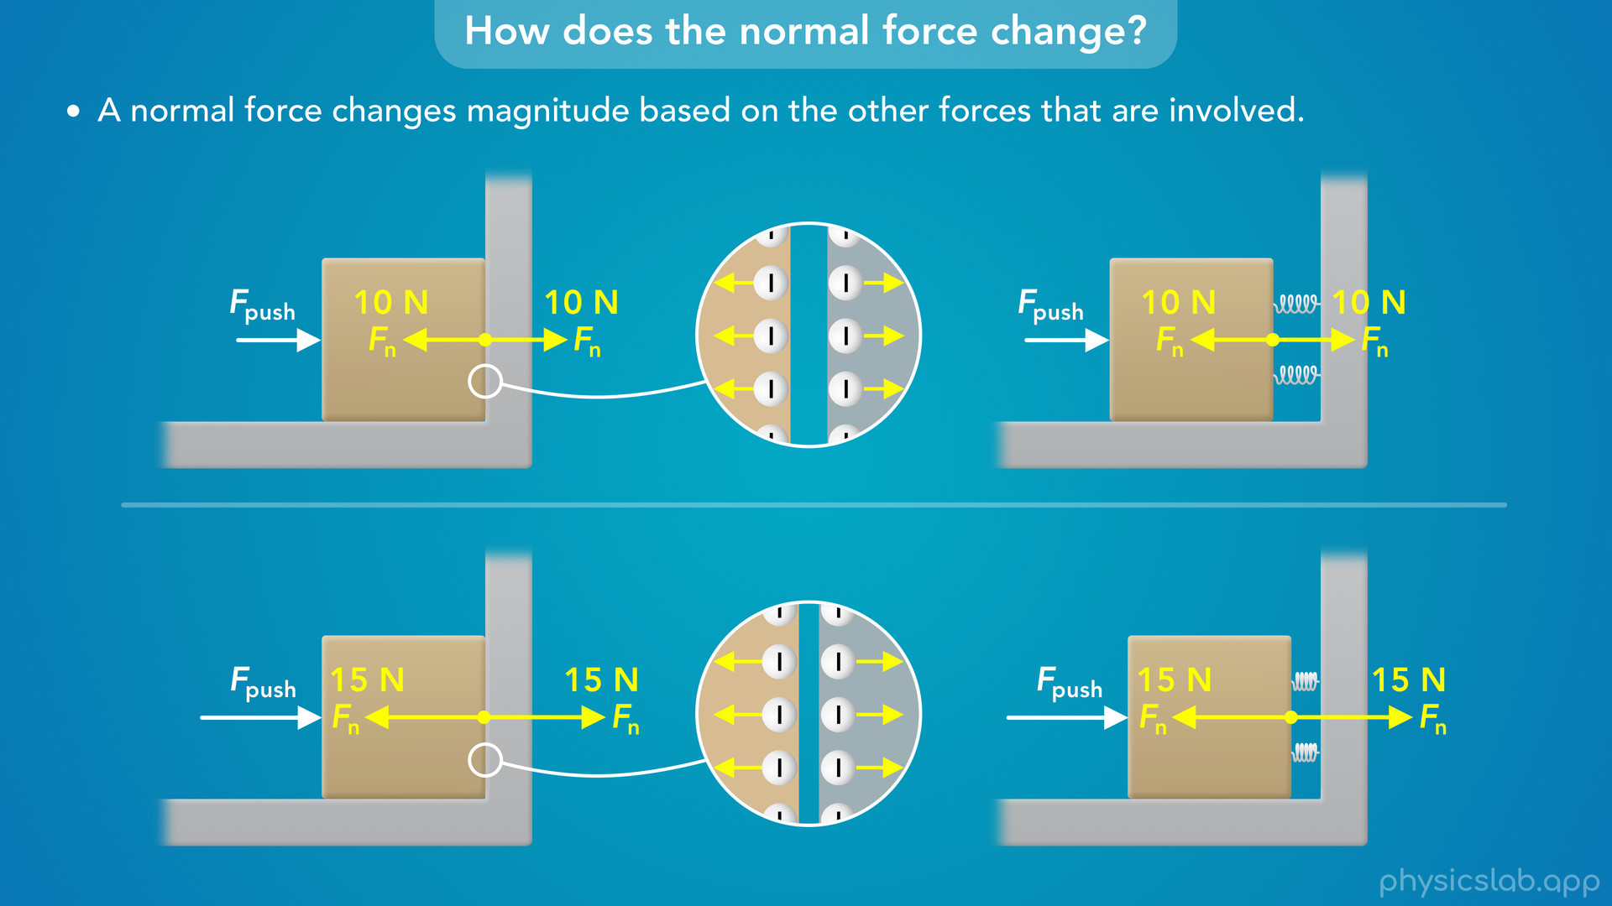
Notes:
• This is basically what’s happening between the electrons in the block and the electrons in the wall, but the movement is so small that we can’t see it.

Slide 49
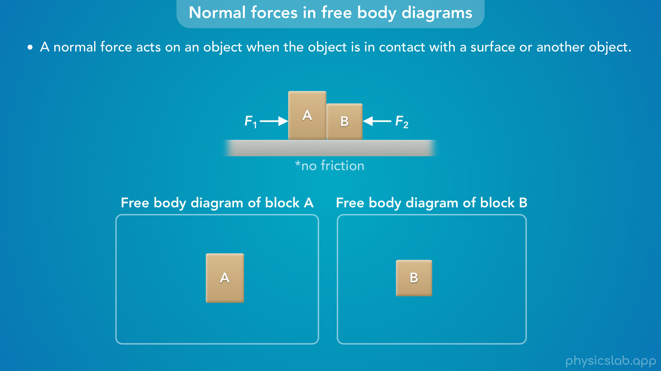
Notes:
• So when do we include a normal force in a free body diagram, and how do we draw it?
• Here we have 2 blocks being pushed together by two forces on a surface with no friction.
• Where do we draw normal forces in the free body diagram for each block?
• A normal force acts on an object when the object is in contact with a surface or another object.

Slide 50
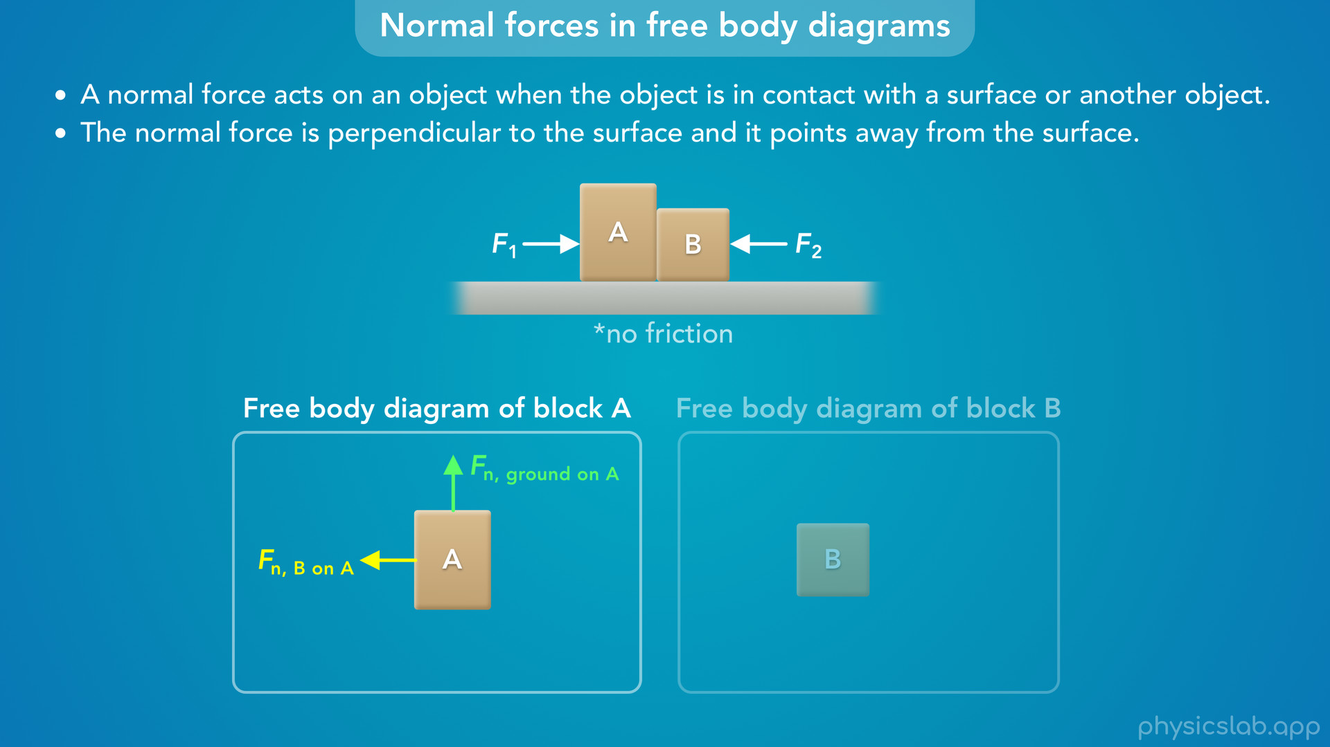
Notes:
• Block A is in contact with the ground, so there must be a normal force on block A from the ground.
• The normal force is perpendicular to the ground and it points away from the ground, so it’s upwards.
• For free body diagrams, we usually draw a force vector starting on the edge of the object, so it would look like this.
• But block A is also in contact with block B, so there must be a normal force on block A from block B.
• That would point to the left, perpendicular the surface between blocks A and B, and it points away from block B.

Slide 51
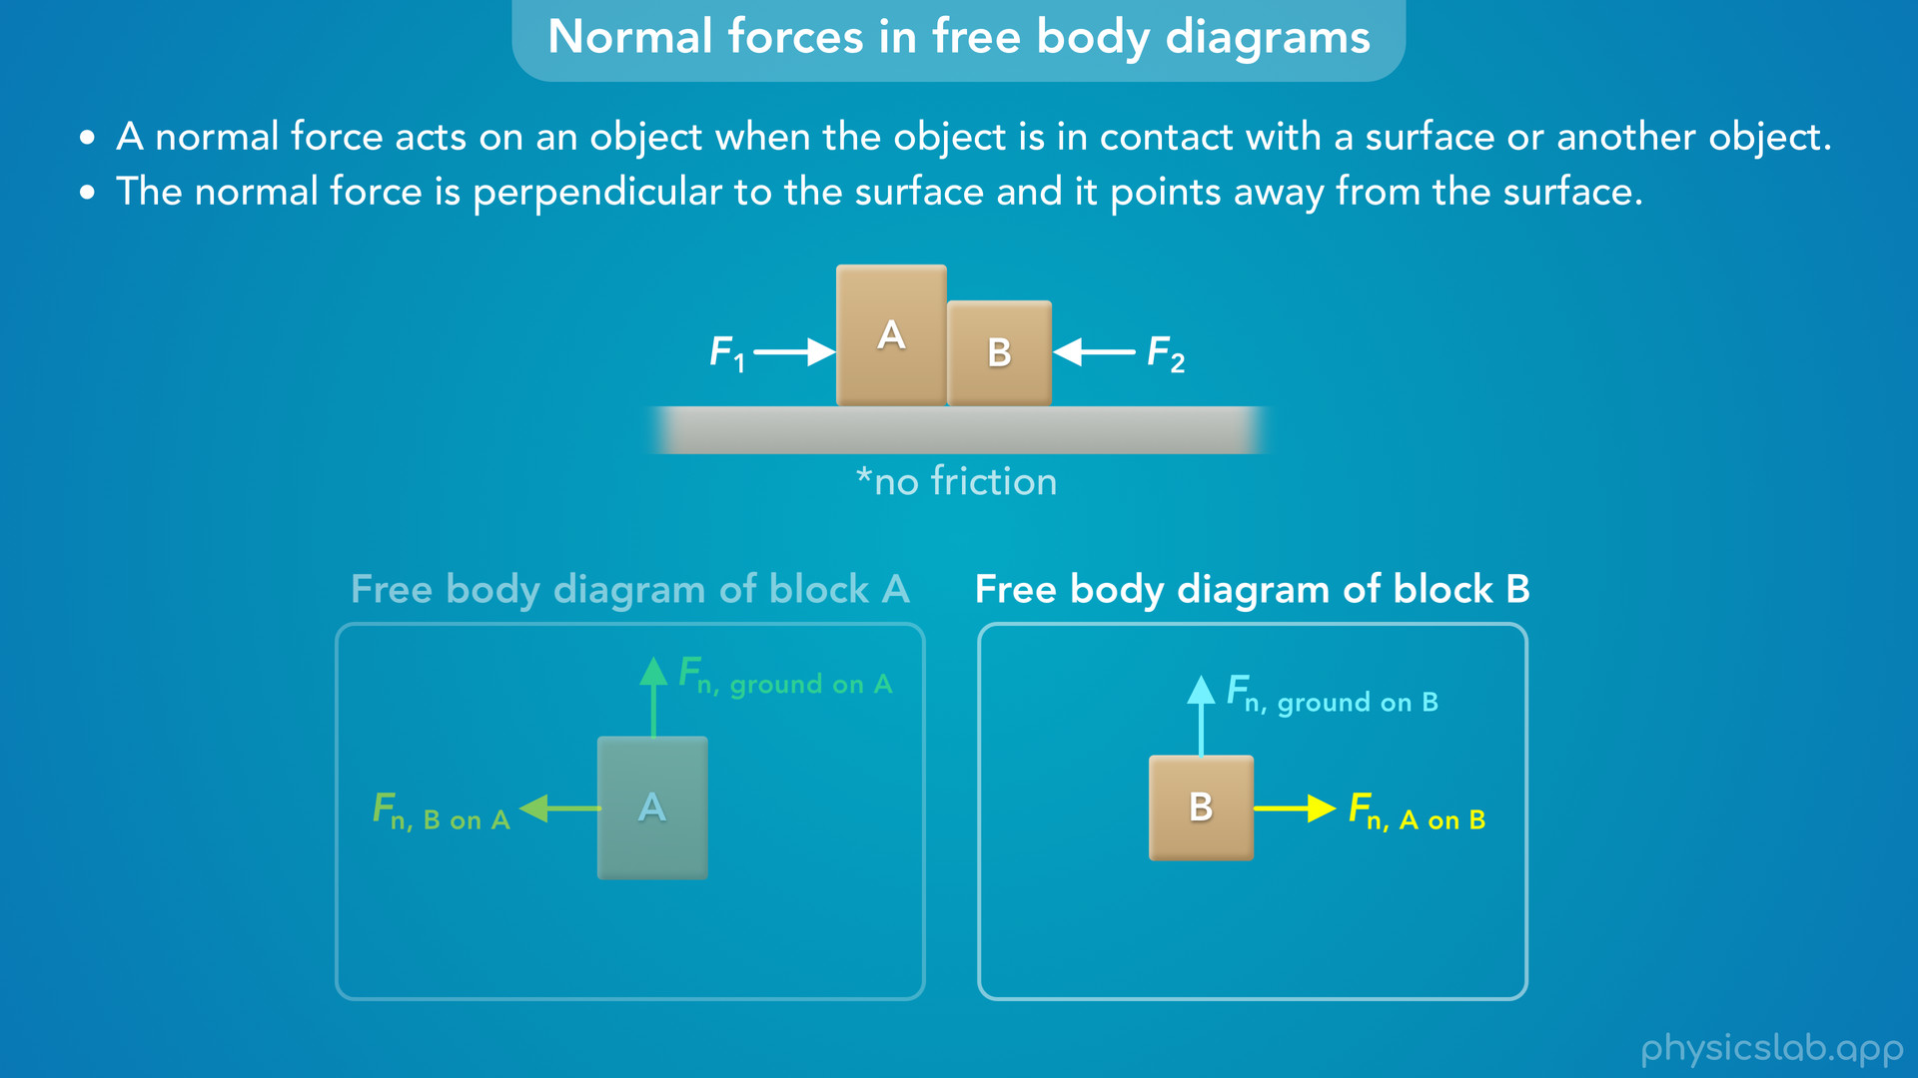
Notes:
• Block B is in contact with the ground, so there must be a normal force acting upwards on block B, away from the ground.
• And block B is in contact with block A, so there must be a normal force acting to the right, away from block A.

Slide 52
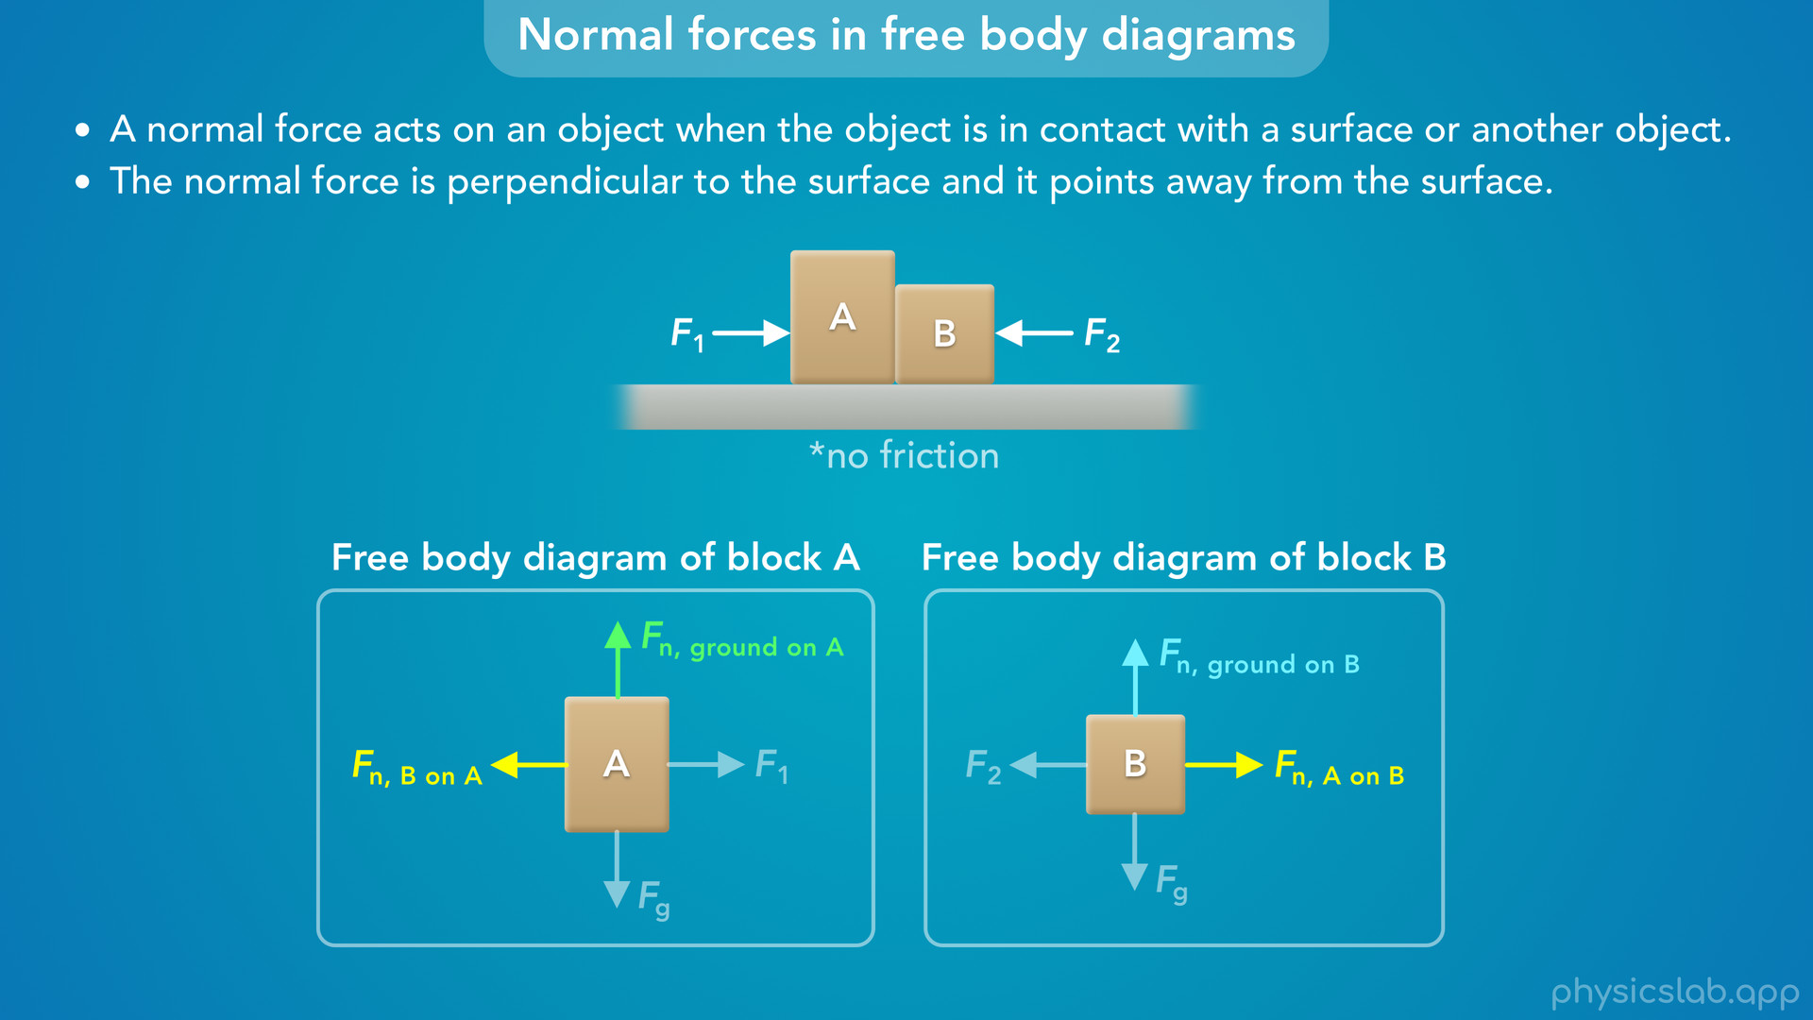
Notes:
• There are other forces acting on each block, which we’ll cover in other lessons.

Slide 53
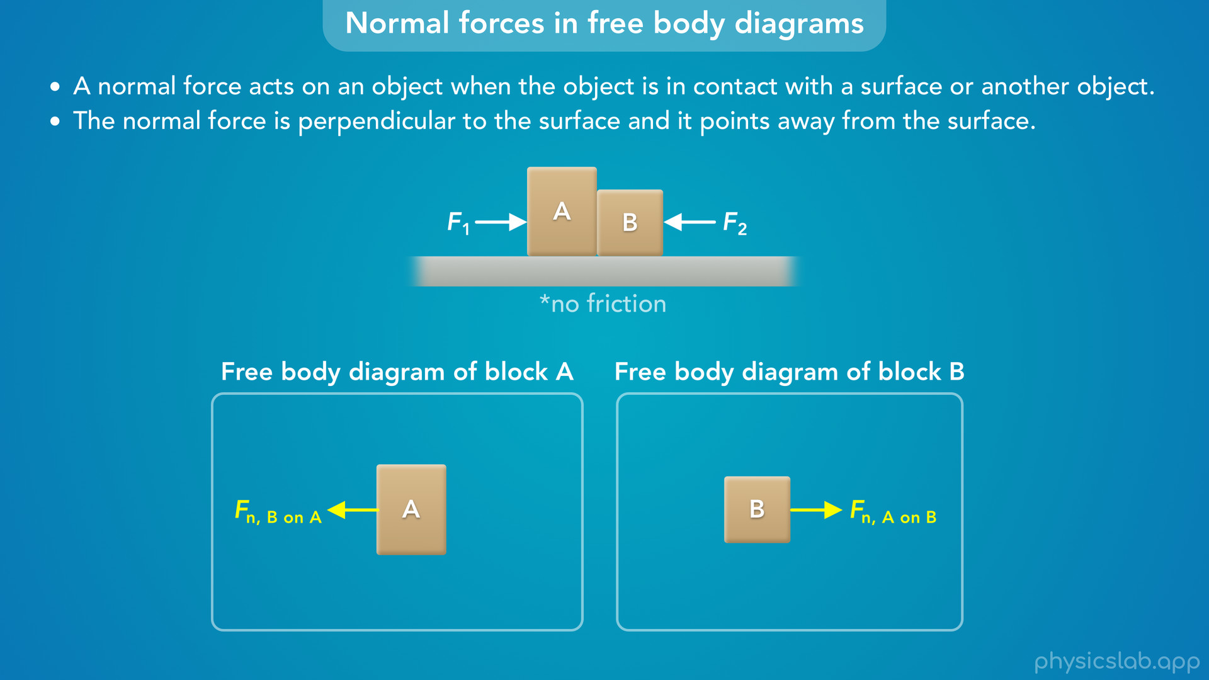
Notes:
• But these two forces are an equal and opposite pair of forces from Newton’s 3rd law, so they must have the same magnitude.

Slide 54
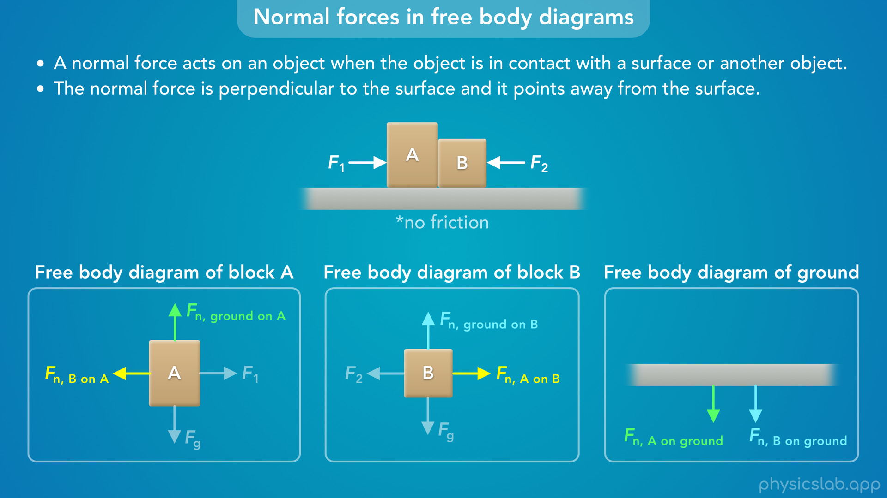
Notes:
• And if we drew a free body diagram of the ground, we would see the normal forces acting on the ground from the two blocks.

Slide 55

Notes:
• So do we always include a normal force in a free body diagram?
• Only if the object is in contact with a surface.
• So if this ball is falling through the air, there would not be a normal force acting on it.

Slide 56

Notes:
• And if we have these two blocks attached with a string, there’s only a normal force on the block that is in contact with a surface.
• The force acting on the blocks from the string is a tension force, not a normal force.

Slide 57

Notes:
• So that’s what a normal force is, but how do we calculate it? Let’s look at a few examples.

Slide 58

Notes:
• “A book with a weight of 20 N is sitting at rest on a table. What is the magnitude of the normal force acting on the book from the table?”

Slide 59

Notes:
• We always start by drawing a free body diagram of the object that we’re focusing on.

Slide 60

Notes:
• The book has a weight of 20 N, which means there’s a downwards gravitational force on the book of 20 N, which we’ll cover in another lesson.

Slide 61

Notes:
• Are there any other forces on the book? The book is in contact with the table, so there must be a normal force on the book acting upwards from the table.

Slide 62

Notes:
• Now let’s establish our coordinate system. We usually say right is the positive x direction and up is the positive y direction.

Slide 63

Notes:
• Now we can write out the equation for Newton’s 2nd law, and since we only have vertical forces, we can just write Newton’s 2nd law for the y direction.

Slide 64

Notes:
• The net force would be the normal force minus the gravitational force of 20 N, because we said up is positive and down is negative.

Slide 65

Notes:
• The question said that the book is at rest, which means it’s not moving so its acceleration is zero, and we can plug in 0 for ay.

Slide 66

Notes:
• The right side just becomes zero, because anything multiplied by zero is zero.
• So, Newton’s 2nd law is saying that the net force on this book is zero because it’s not accelerating.

Slide 67

Notes:
• If we rearrange this equation, we find that the normal force acting on the book from the table is 20 N, which is equal to the gravitational force.

Slide 68

Notes:
• Also, if the question had asked for the normal force acting on the table from the book, it would also be 20 N, because Newton’s 3rd law says that those forces are equal and opposite.

Slide 69

Notes:
• So in this example, the normal force is equal in magnitude to the gravitational force. But will that always be the case?

Slide 70

Notes:
• This does happen a lot, but only in examples where these are the only two vertical forces on the object, and the net force is zero.

Slide 71

Notes:
• This is why we can use a scale to measure the weight of an object, which is the gravitational force.
• The scale measures the normal force, which in this case is equal to the weight of the book.

Slide 72

Notes:
• But what would happen if there was another force acting on the book?
• Let’s say a person is pushing down on the book with 5 N of force.

Slide 73

Notes:
• Now we have to include that force in the free body diagram and the equation for Newton’s 2nd law.
• The net force would be the normal force minus the 20 N gravitational force, minus the 5 N force.
• It’s negative because it’s acting downwards, in the same direction as the 20 N force.

Slide 74

Notes:
• The acceleration is still zero, so now the normal force is equal to the 20 N gravitational force plus the 5 N force.

Slide 75


Slide 76

Notes:
• So the normal force is 25 N upwards.

Slide 77

Notes:
• If you’re wondering why the 5 N is added to the 20 N and not subtracted, remember that we did plug in negative 5 N in the original equation for Newton’s 2nd law.

Slide 78

Notes:
• But now we’ve rearranged that equation to solve for the normal force, so this plus sign no longer matches the direction of the 5 N force.

Slide 79

Notes:
• Let’s place a scale between the book and the table.
• The normal force was 20 N before, but if we push the book downwards with an additional 5 N of force, the normal force increases by 5 N which is measured by the scale.

Slide 80

Notes:
• What if instead of pushing down, we pulled up on the book with 5 N of force? That’s not enough to overcome the weight, so the book is still in contact with the table and there’s still a normal force.

Slide 81

Notes:
• But now the 5 N force is positive in the net force equation

Slide 82

Notes:
so the normal force is equal to 20 N minus 5 N, which is 15 N.
• By pulling up on the book, but not enough to lift it off the table, we’ve decreased the normal force between the table and the book.
• So the scale measures the normal force, and it only measures the weight if there are no other forces involved.

Slide 83

Notes:
• Let’s look at one more example where an object is accelerating.
• A 10 kg block and a 6 kg block are being pushed by a 30 N force on a frictionless surface. If the blocks accelerate at 2 m/s², what is the magnitude of the force exerted on the 6 kg block from the 10 kg block?

Slide 84

Notes:
• Let’s draw a free body diagram of the 6 kg block.

Slide 85

Notes:
• The block is in contact with the ground so there’s an upwards normal force from the ground.

Slide 86

Notes:
• There’s also a downwards gravitational force.
• But what horizontal forces do we draw on the 6 kg block? Do we draw the 30 N force to the right?
• Well the 30 N force is only acting on the 10 kg block, so it would show up in the free body diagram of the 10 kg block.
• But it’s not touching the 6 kg block.

Slide 87

Notes:
• The force that is acting on this block is a normal force from the 10 kg block acting to the right, because the blocks are in contact.
• That’s the force we’re trying to find.

Slide 88

Notes:
• That force is horizontal, so let’s use Newton’s 2nd law in the x direction.

Slide 89

Notes:
• The net horizontal force is the normal force from the 10 kg block, and there are no other horizontal forces because there’s no friction.

Slide 90

Notes:
• We can plug in 6 kg for the mass and 2 m/s² for the acceleration, because both blocks are accelerating at that rate.

Slide 91

Notes:
• That gives us 12 N for the magnitude of the normal force acting on the 6 kg block from the 10 kg block.
• That’s the only horizontal force on the 6 kg block, and that’s what causes it to accelerate at 2 m/s².

Slide 92

Notes:
• So that’s all we need to know about normal forces.
• They’re caused by the electrons in two objects repelling each other.

Slide 93
Notes:
• Normal means perpendicular, and a normal force is always perpendicular to the surface.

Slide 94

Notes:
• The magnitude of a normal force will change depending on the other forces involved.

Slide 95
Notes:
• And we draw a normal force in a free body diagram if the object is in contact a surface or another object.

