Slide 1
Tension in Static Systems - Tension in 2D
Slides Version 1
This version includes:
Slides with screenshot images from the video.
The video narration in the slide notes.
A blank template slide with the same background and font as the video.
Slides with some basic graphics from this video for you to use however you like.
Feel free to add, delete and edit slides to make your own presentation. You can use these slides in class or share them with your students, but please do not share them with anyone else.
If you have any feedback, suggestions or questions about these slides please email me at chris@physicslab.app or send me a message on Discord @physicslab.
physicslab.app

Slide 2
Heading
Text

Slide 3






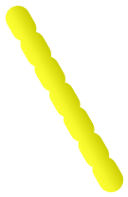
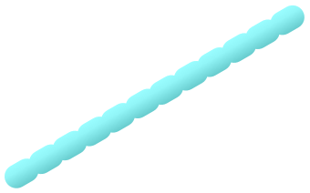


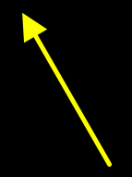
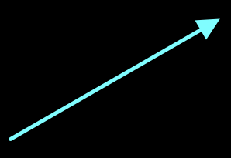

















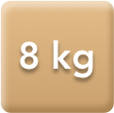















Slide 4


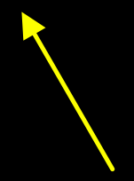






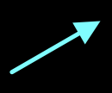





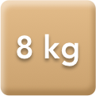





Slide 5
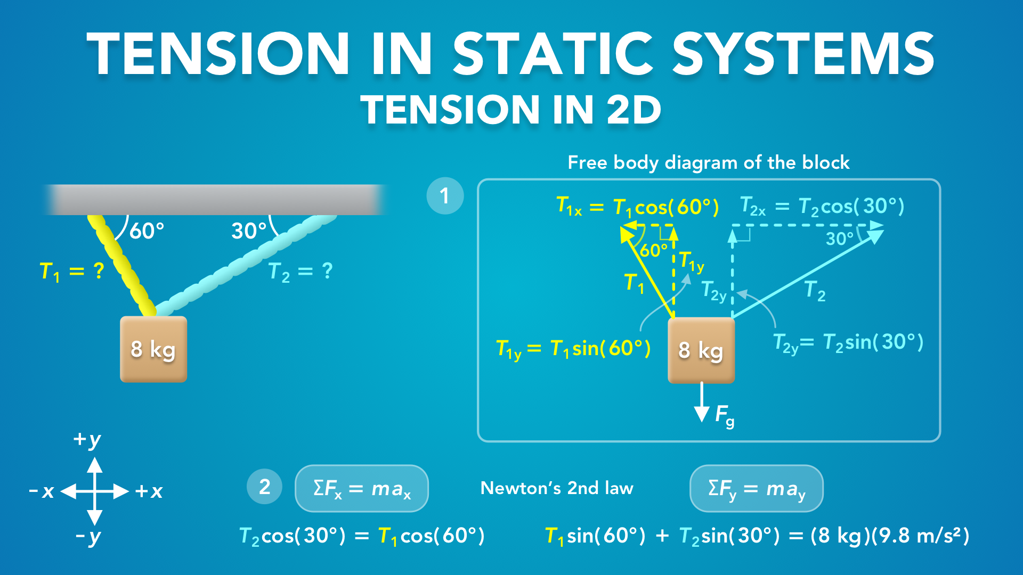
Notes:
Tension in Static Systems - Tension in 2D
physicslab.app
If you have any questions, suggestions or feedback about these slides please email me at chris@physicslab.app or send me a message on Discord @physicslab.

Slide 6
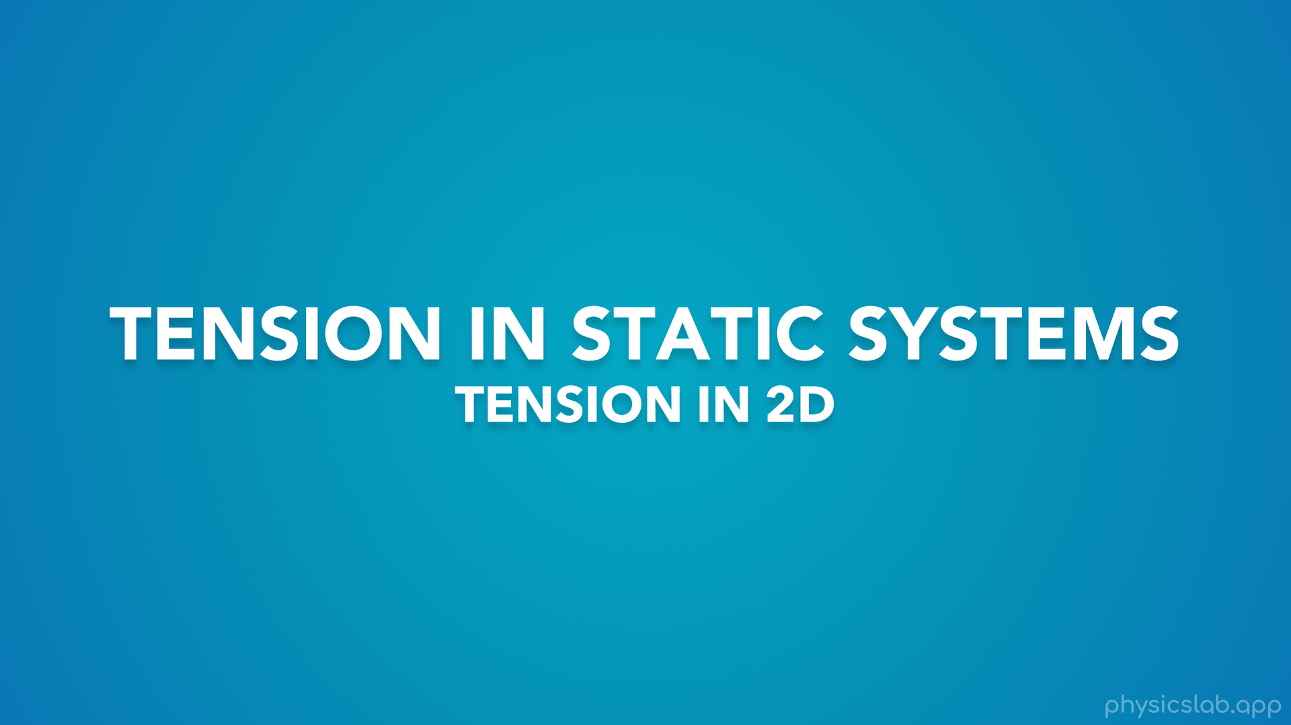
Notes:
In this video we’re gonna walk through an example of tension in two dimensions.

Slide 7
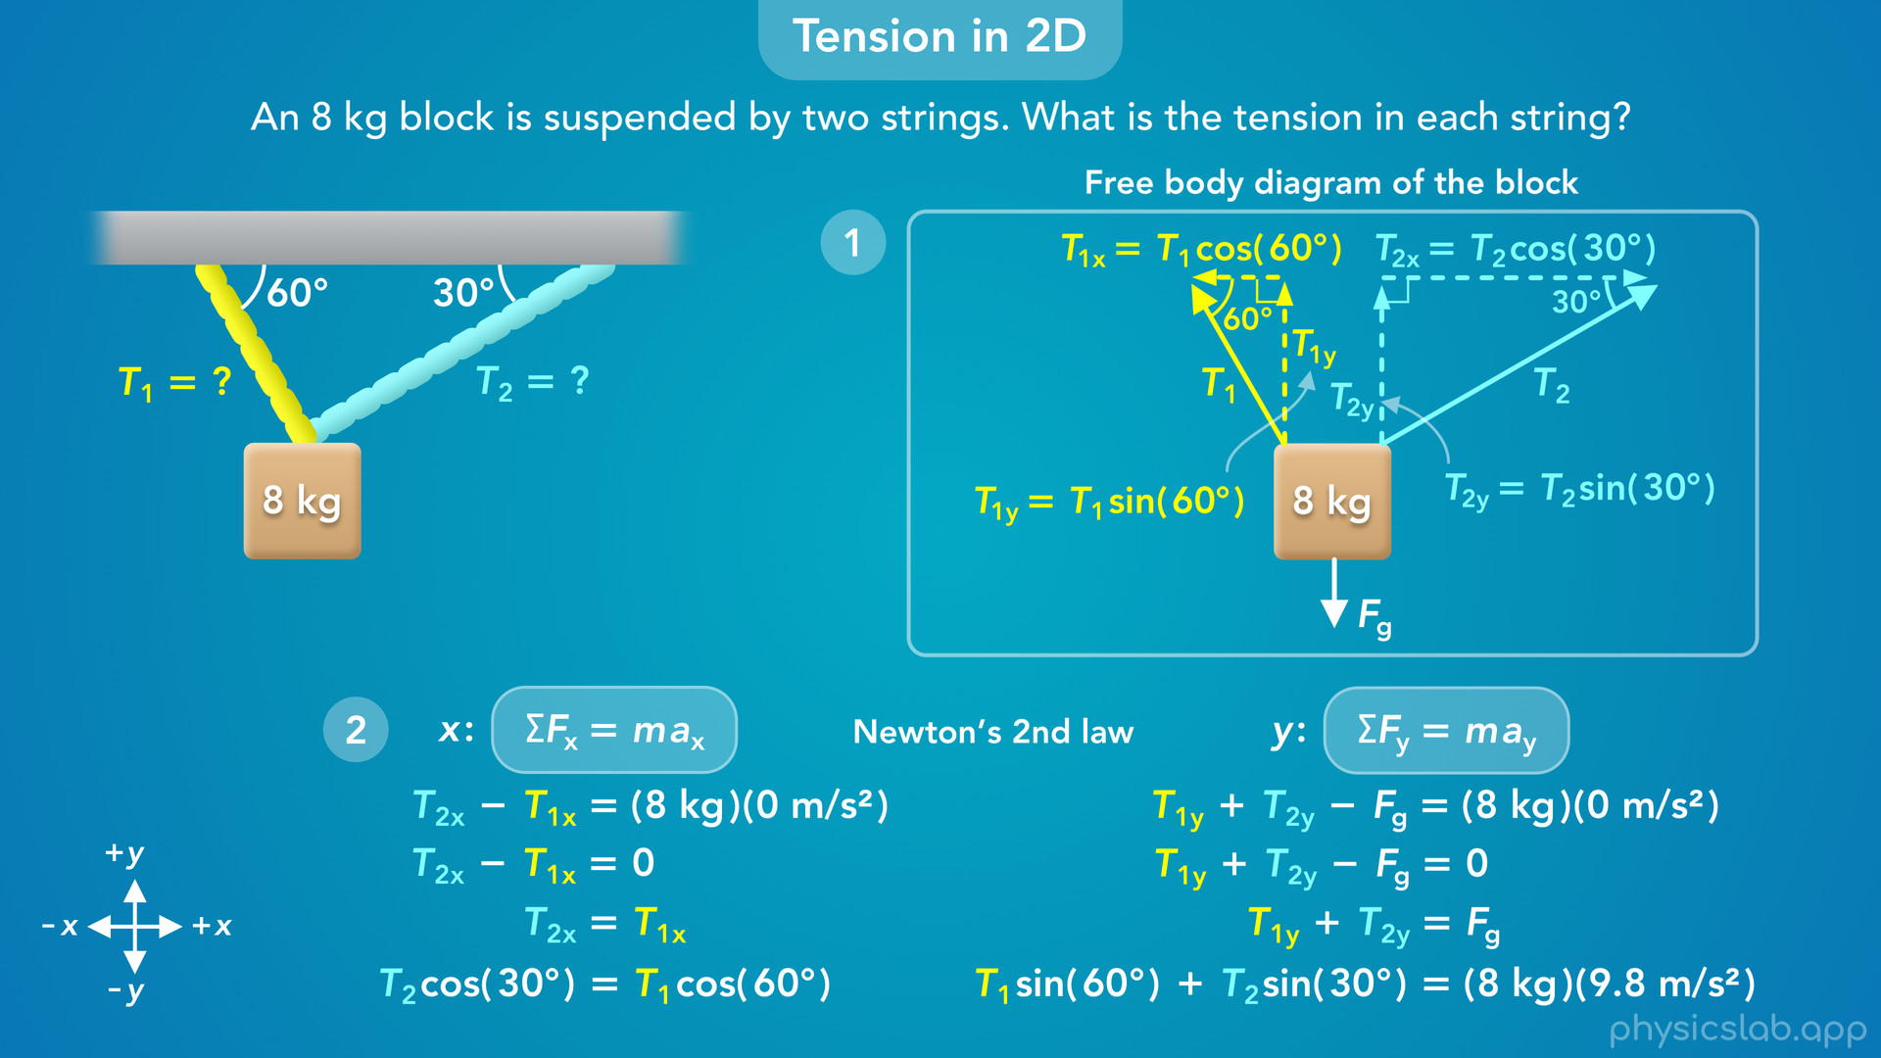
Notes:
• When we have a string at an angle, how do we find the tension in string?
• We’ll walk through how to draw the free body diagram…
• … how to find the x and y components of the tension forces…
• … and how to apply newton’s 2nd law in the x and y directions.

Slide 8
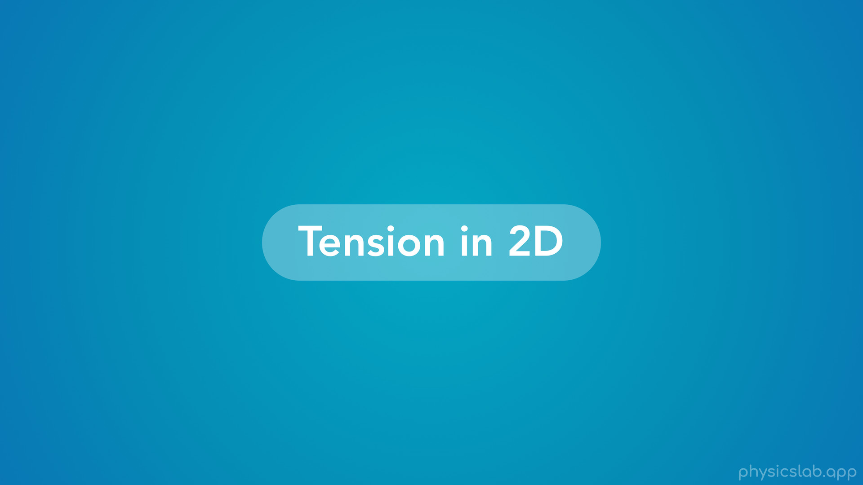
Notes:
• So let’s walk through this example of tension in two dimensions.

Slide 9
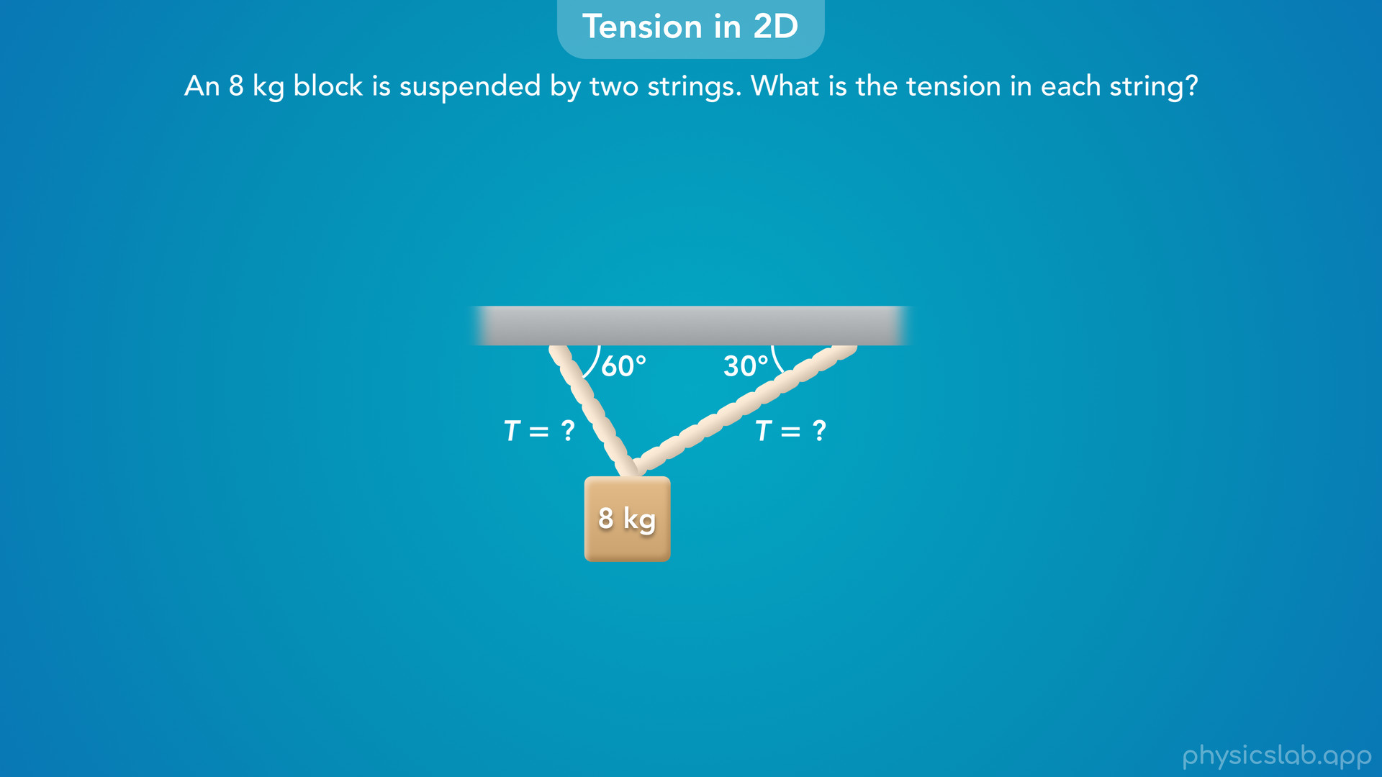
Notes:
• Here we have an 8 kg block suspended from the ceiling by two strings. What is the tension in each string?

Slide 10
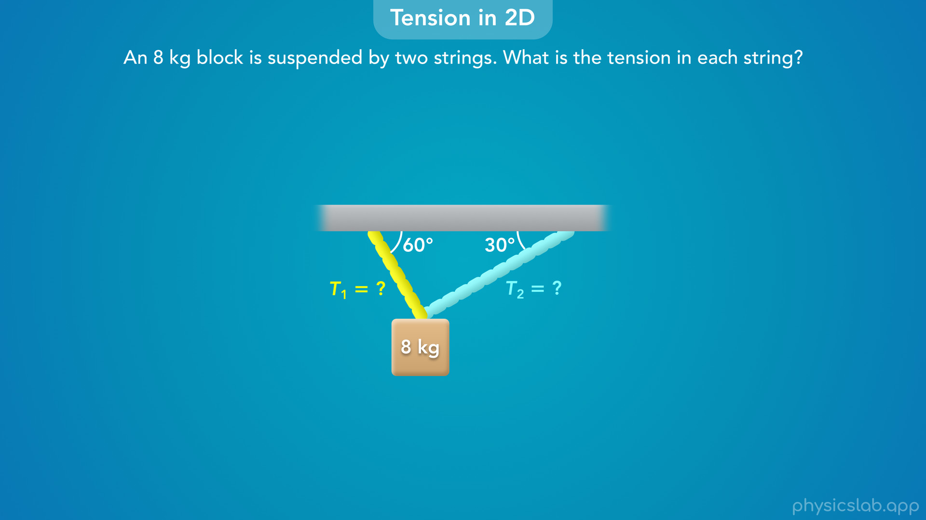
Notes:
• So we’re dealing with two different strings, and we’re going to label the tensions in the strings as T1 and T2.

Slide 11
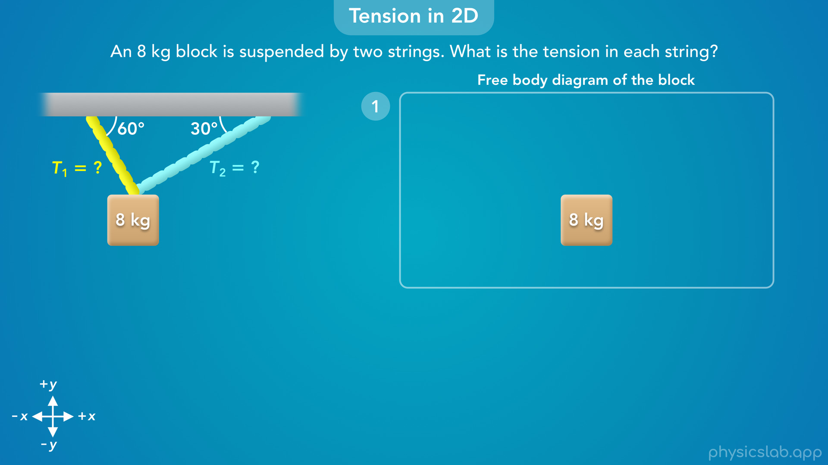
Notes:
• Like we covered in the last few videos, the first step is to draw a free body diagram of the block, and draw the coordinate system, the x and y axes.
• So what forces are acting on the block, and what are their directions?

Slide 12
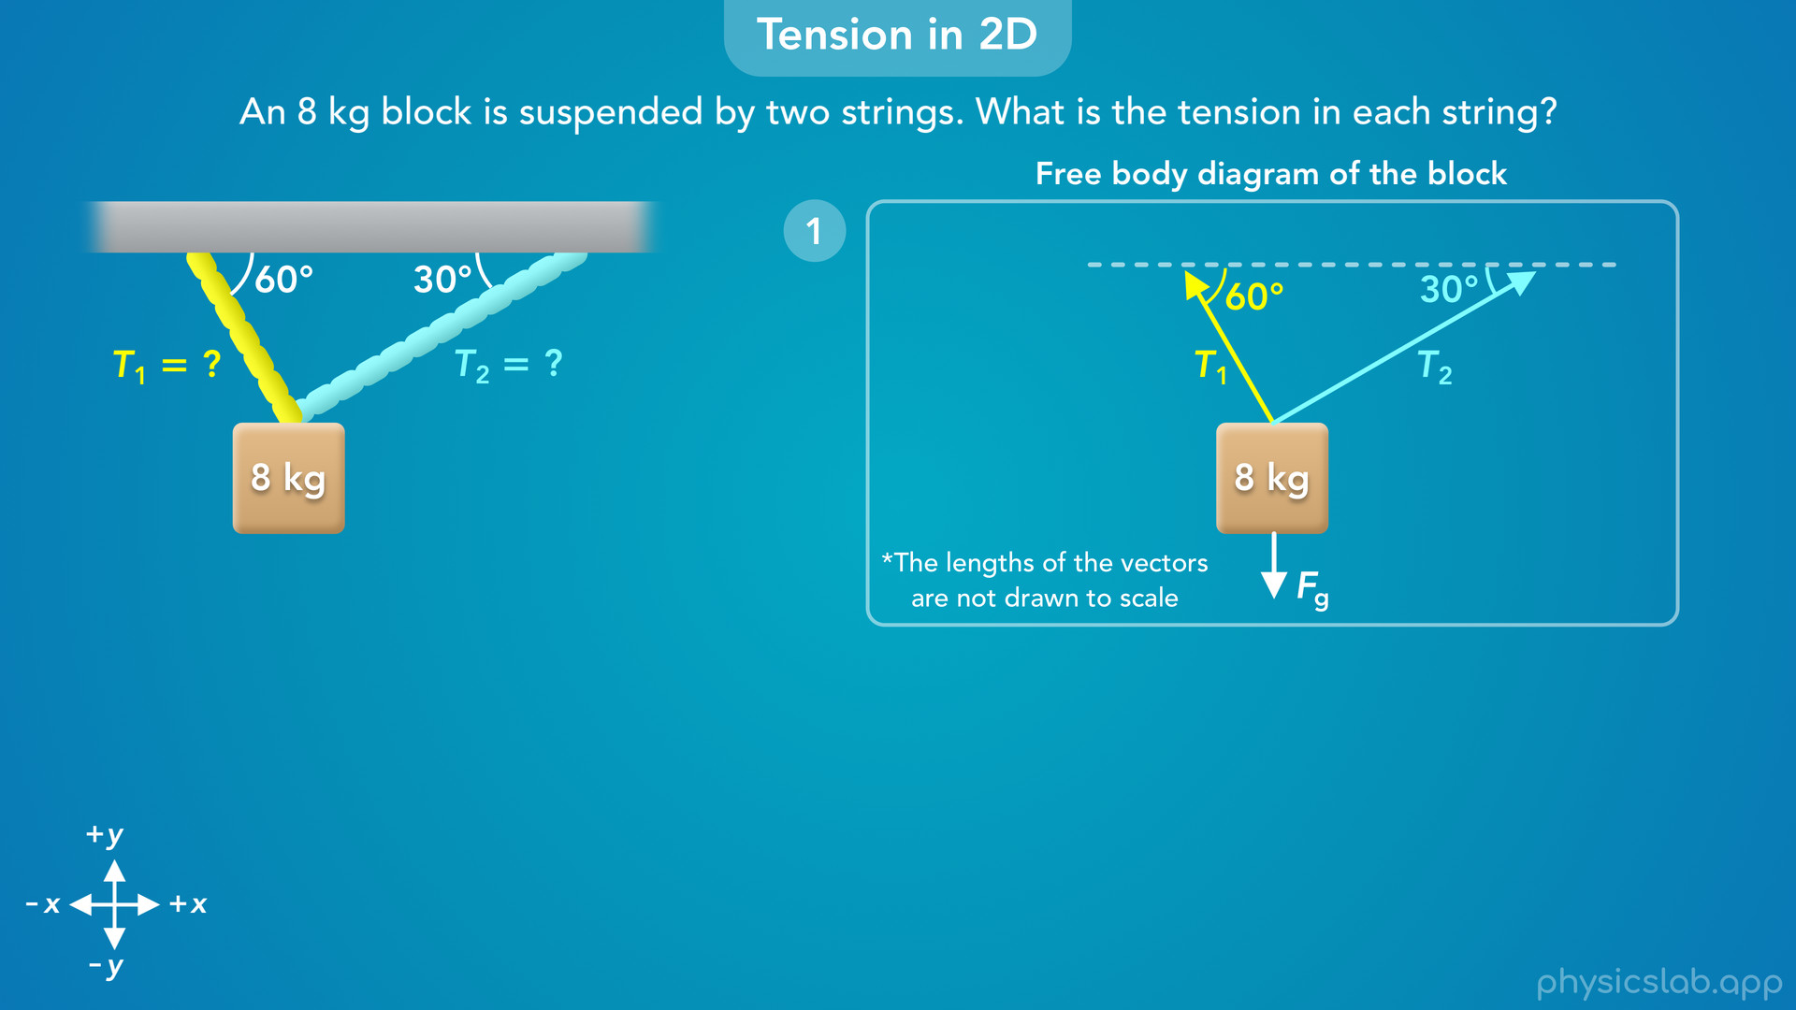
Notes:
• We know there’s a downwards gravitational force Fg, but what about the tension forces?
• Remember, tension is always a pulling force that points away from the object in the same direction as the string.
• So there’s a tension force T1, that points in the same direction as string 1… and there’s another tension force T2, that points in the same direction as string 2.
• So these forces have the same angles as the strings.
• We don’t know the magnitude of these forces, so keep in mind that the length of the vectors are not drawn to scale.

Slide 13
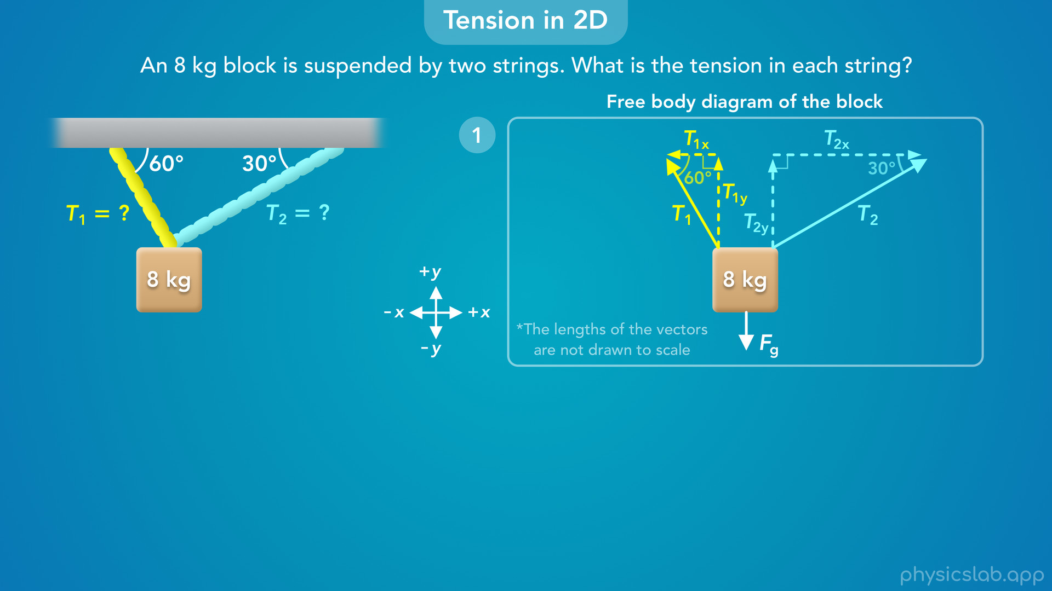
Notes:
• Next, whenever we have a force at an angle, we want to find its x and y components.
• Using our coordinate system, the components of T1 and T2 look like this.
• The components are hard to see, so let’s move the vectors apart.
• But keep in mind that the tension forces are really acting on the middle of the block where the strings are attached.
• So these are the x and y components of the tension forces.
• T1x and T2x are horizontal, parallel to the x axis.
• T1y and T2y are vertical, parallel to the y axis.

Slide 14
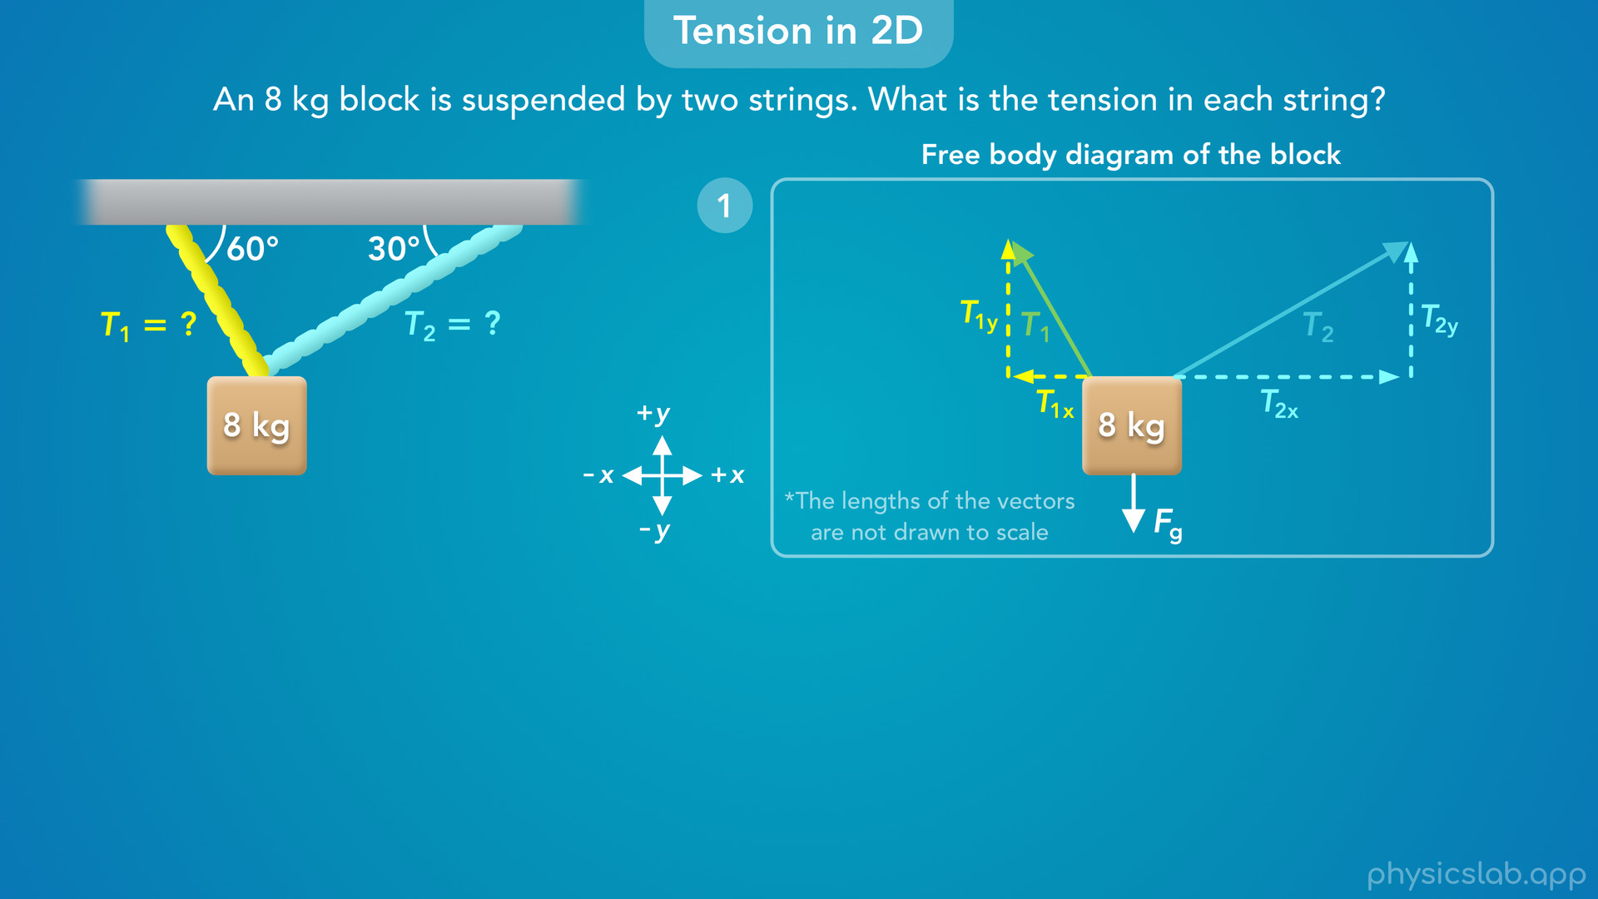
Notes:
• We could also draw the components like this…

Slide 15
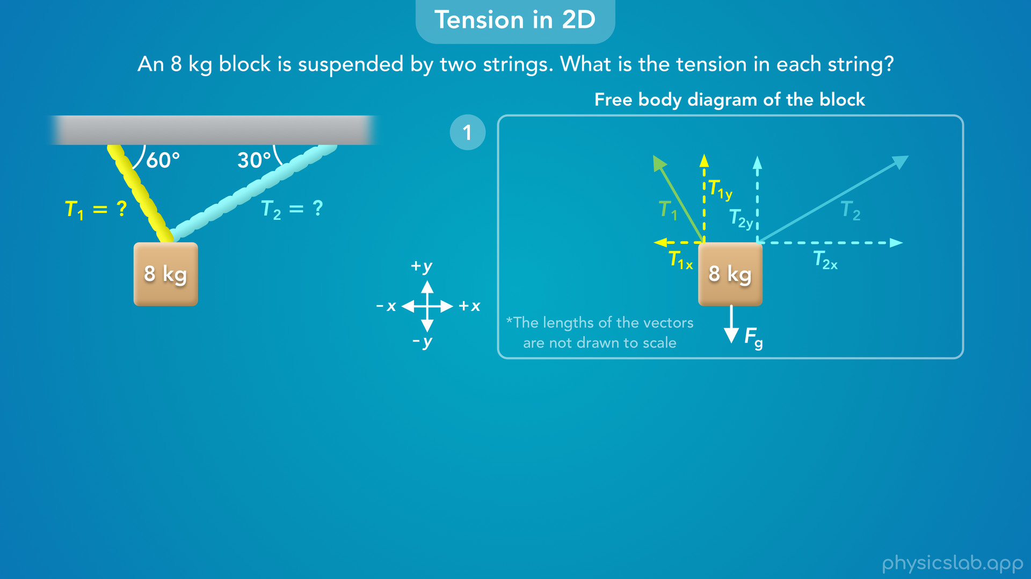
Notes:
or we could draw them like this, as long as they’re pointing in the right direction.

Slide 16

Notes:
• But we’re gonna draw them here, so we can use the angles that we’re given between the vectors and the ceiling.

Slide 17
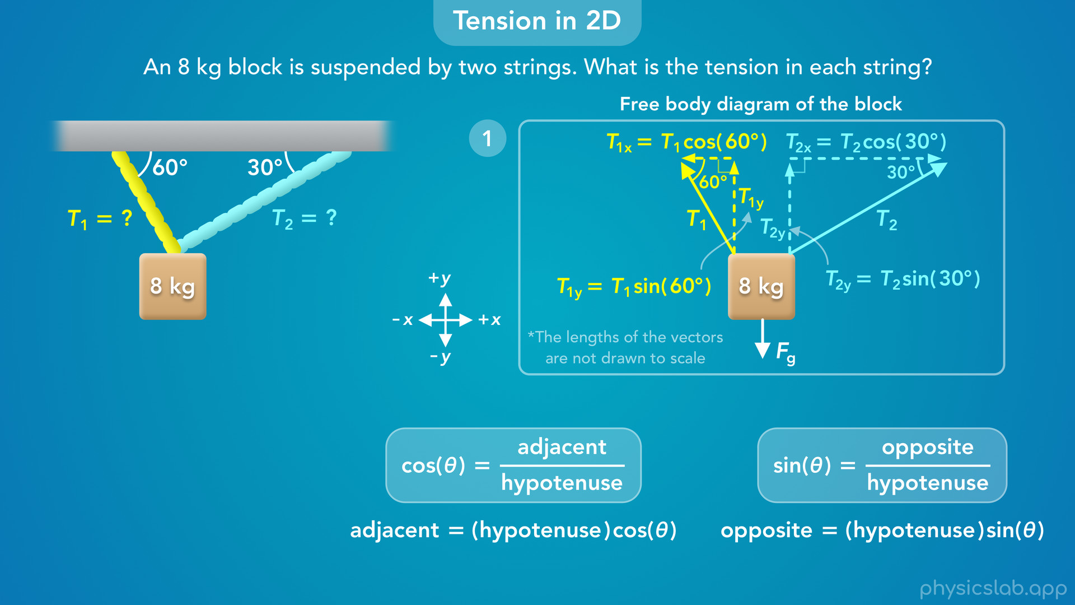
Notes:
• So using these angles and right triangle trig, how are the components related to T1 and T2?
• T1x is adjacent to this 60 degree angle, so T1x equals T1 times the cosine of 60 degrees.
• T1y is opposite from the 60 degree angle, so T1y is T1 times the sine of 60 degrees.
• T2x is adjacent to this 30 degree angle, so T2x equals T2 times the cosine of 30 degrees.
• And T2y would be T2 times the sine of 30 degrees.

Slide 18
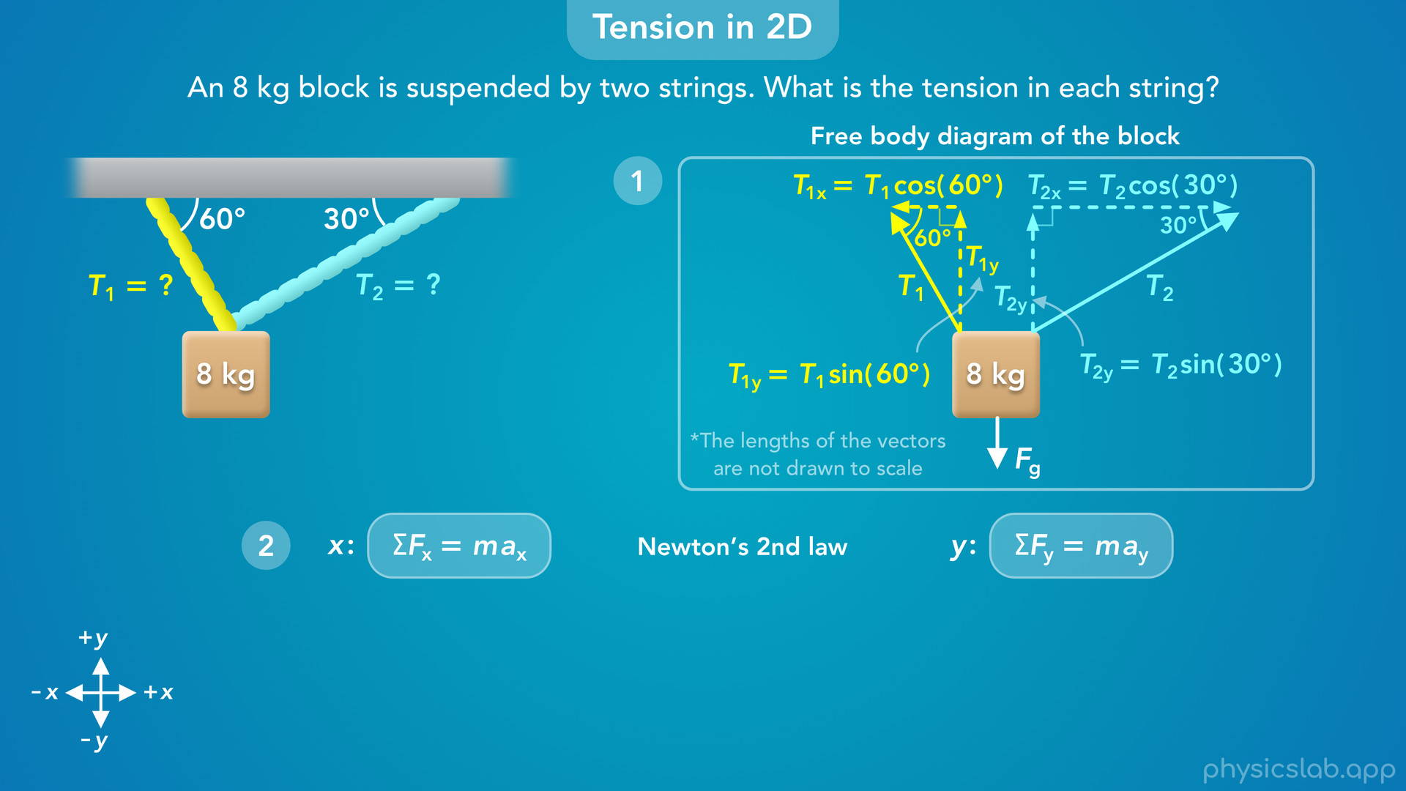
Notes:
• Alright so we have our free body diagram and the components of each force.
• The next step is to apply Newton’s 2nd law in the x and y directions.
• Since we’re dealing with tension forces at an angle, we have force components in the x and y directions, so we’re going to use the newton’s 2nd law for both directions independently.

Slide 19
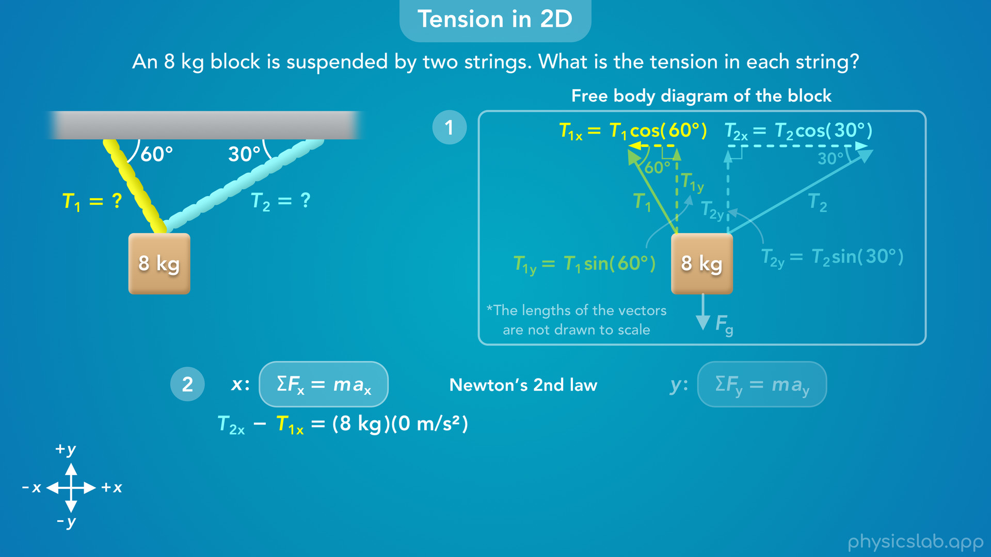
Notes:
• So, what would be the net force on this block in the x direction?
• We have T2x acting to the right, in the positive x direction, and we have T1x acting to the left, in the negative x direction.
• So the net force in the x direction would be T2x minus T1x, or we could say negative T1x plus T2x.
• The mass of the block is 8 kg.
• But in this scenario, we’re assuming that the block is at rest. It’s not moving, so the acceleration of the block is zero.

Slide 20

Notes:
• That means the net force in the x direction is zero…

Slide 21
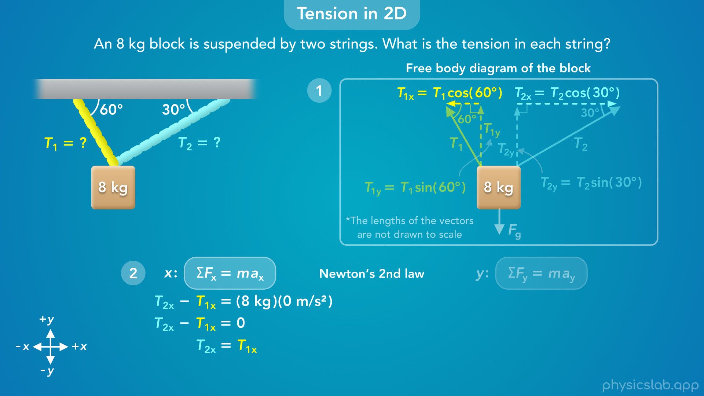
Notes:
so T2x and T1x are equal in magnitude, these two force components are balanced.

Slide 22
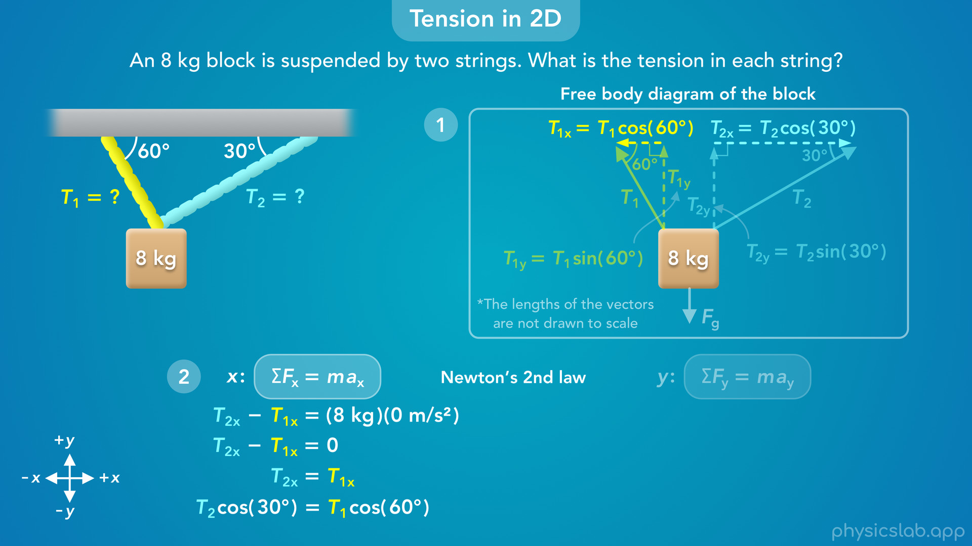
Notes:
• We can replace T2x with T2 times the cosine of 30 degrees… and replace T1x with T1 times the cosine of 60 degrees.
• Now we have one equation with two unknown variables, T1 and T2, so we still can’t solve for the tensions.

Slide 23
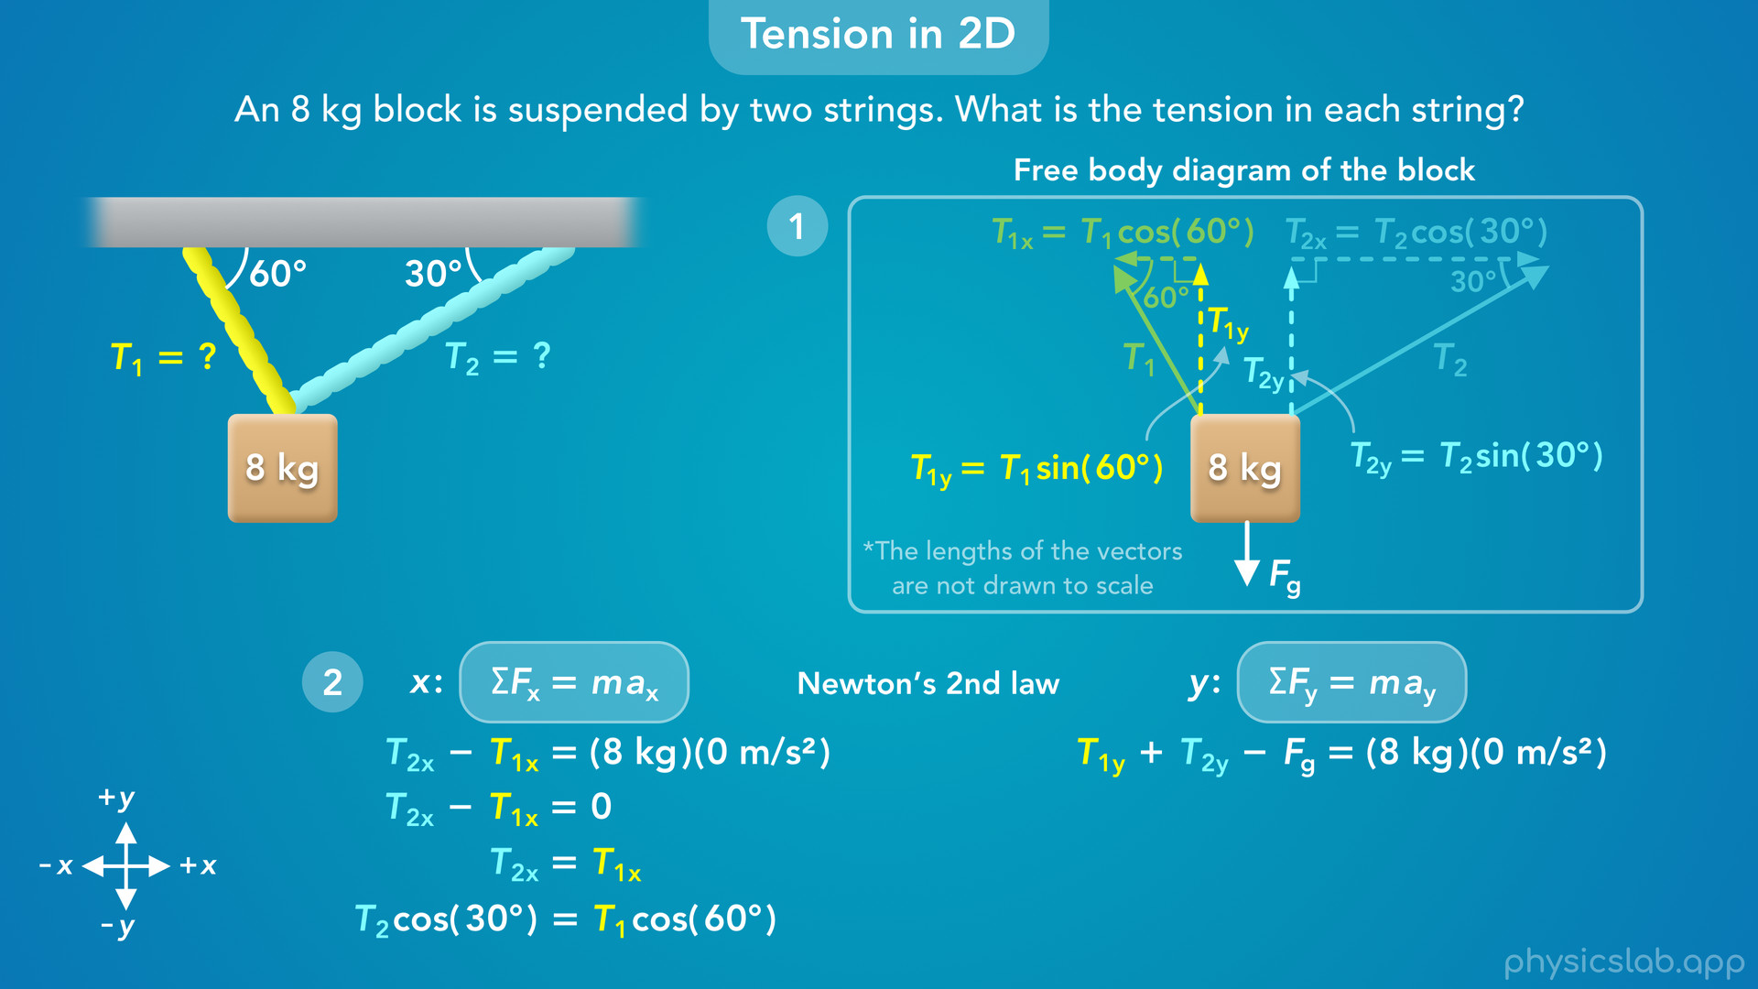
Notes:
• We need another equation, which we can get from Newton’s 2nd law in the y direction.
• So how do we write out the net force in the y direction?
• We have T1y and T2y acting upwards in the positive y direction… and we have the gravitational force acting downwards, in the negative y direction.
• So the net force is T1y + T2y minus Fg.
• Again, the mass of the block is 8 kg, but we’re gonna plug in 0 for the acceleration in the y direction because we assume the block is not moving.

Slide 24

Notes:
• So the net force in the y direction is zero…

Slide 25
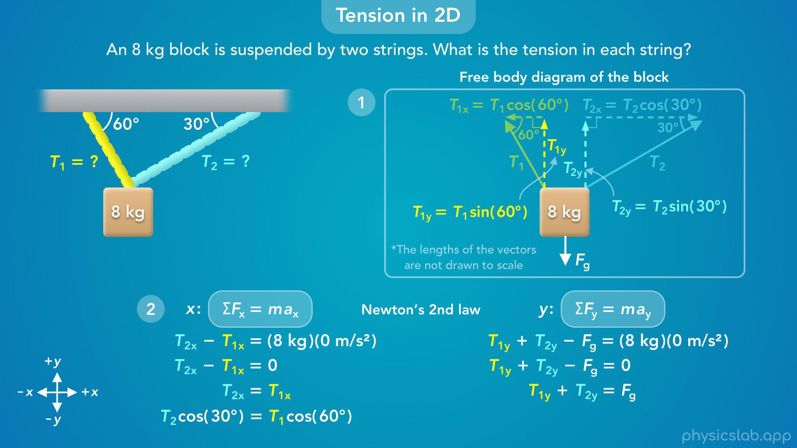
Notes:
and if we add Fg to both sides we can see that the upwards tension force components are balanced with the downwards weight force.

Slide 26
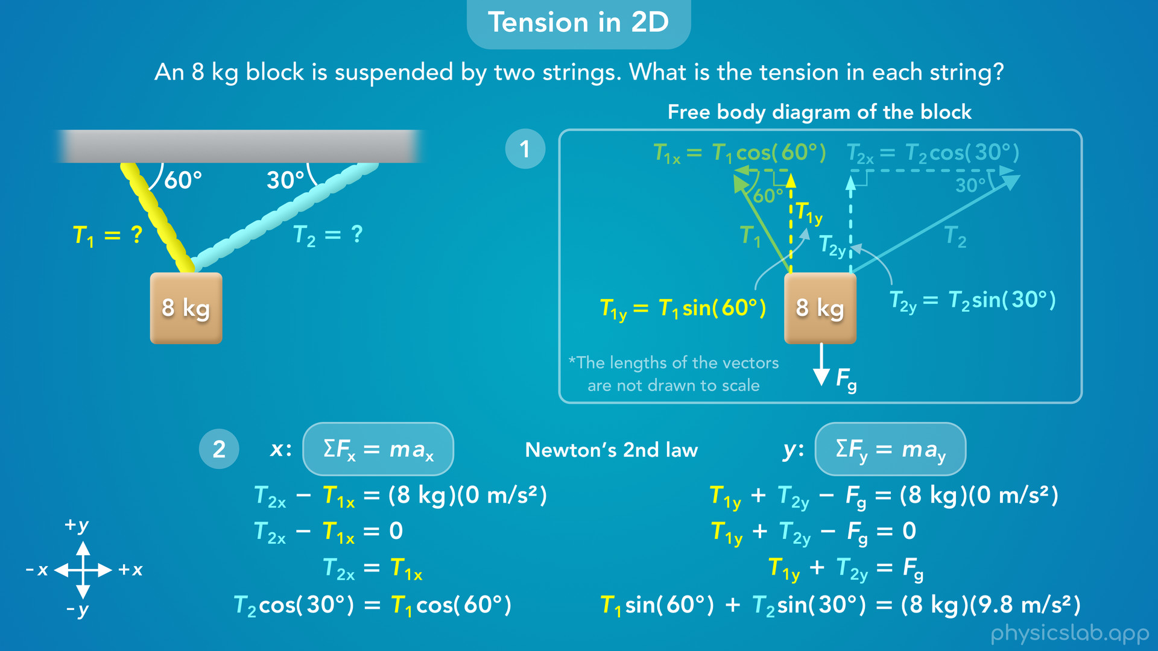
Notes:
• Now we can replace T1y with T1 times the sine of 60 degrees… we can replace T2y with T2 times the sine of 30 degrees… and we can replace Fg with the mass times the acceleration due to gravity.
• Now we have a system of two equations with two unknown variables.
• That means we can solve for T1 and T2 by doing some algebra.

Slide 27
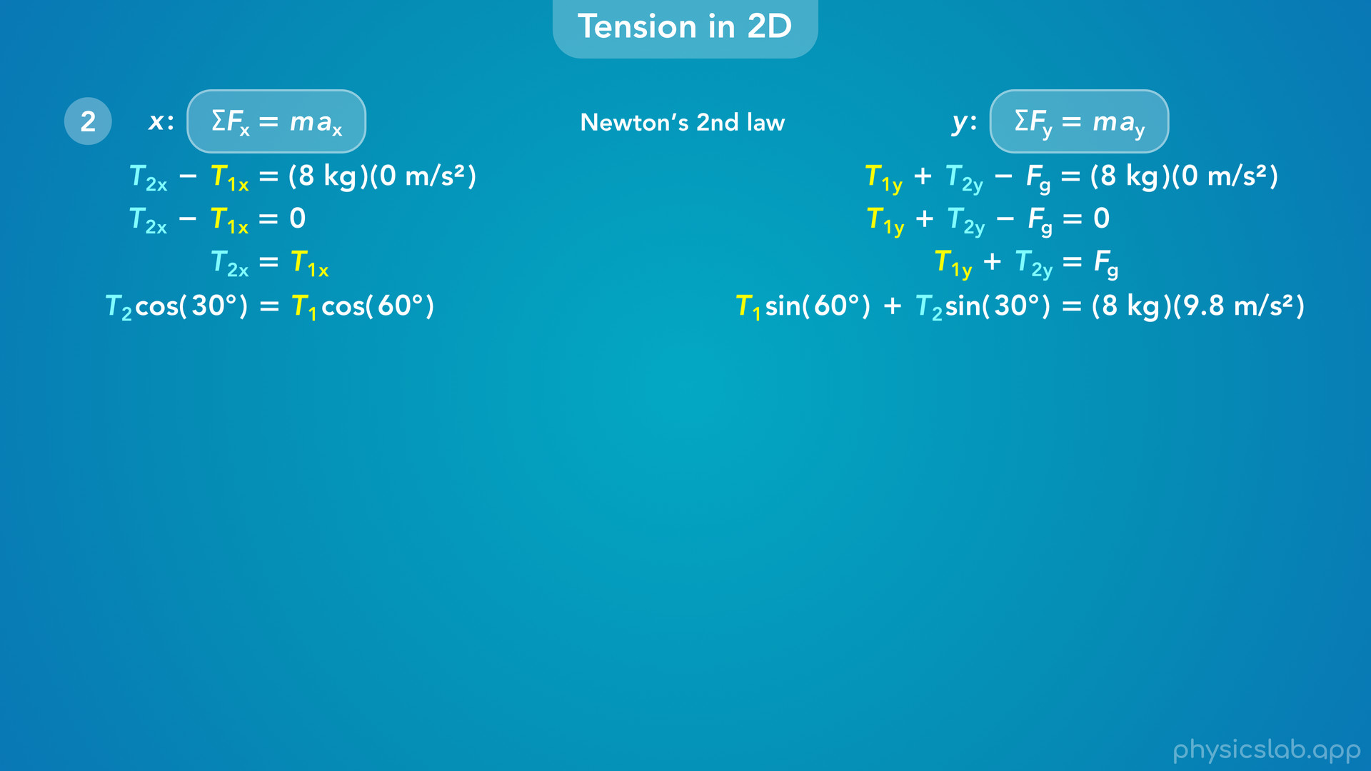
Notes:
• You can work through the math in whatever order makes sense to you, but here’s one way we can solve this.

Slide 28
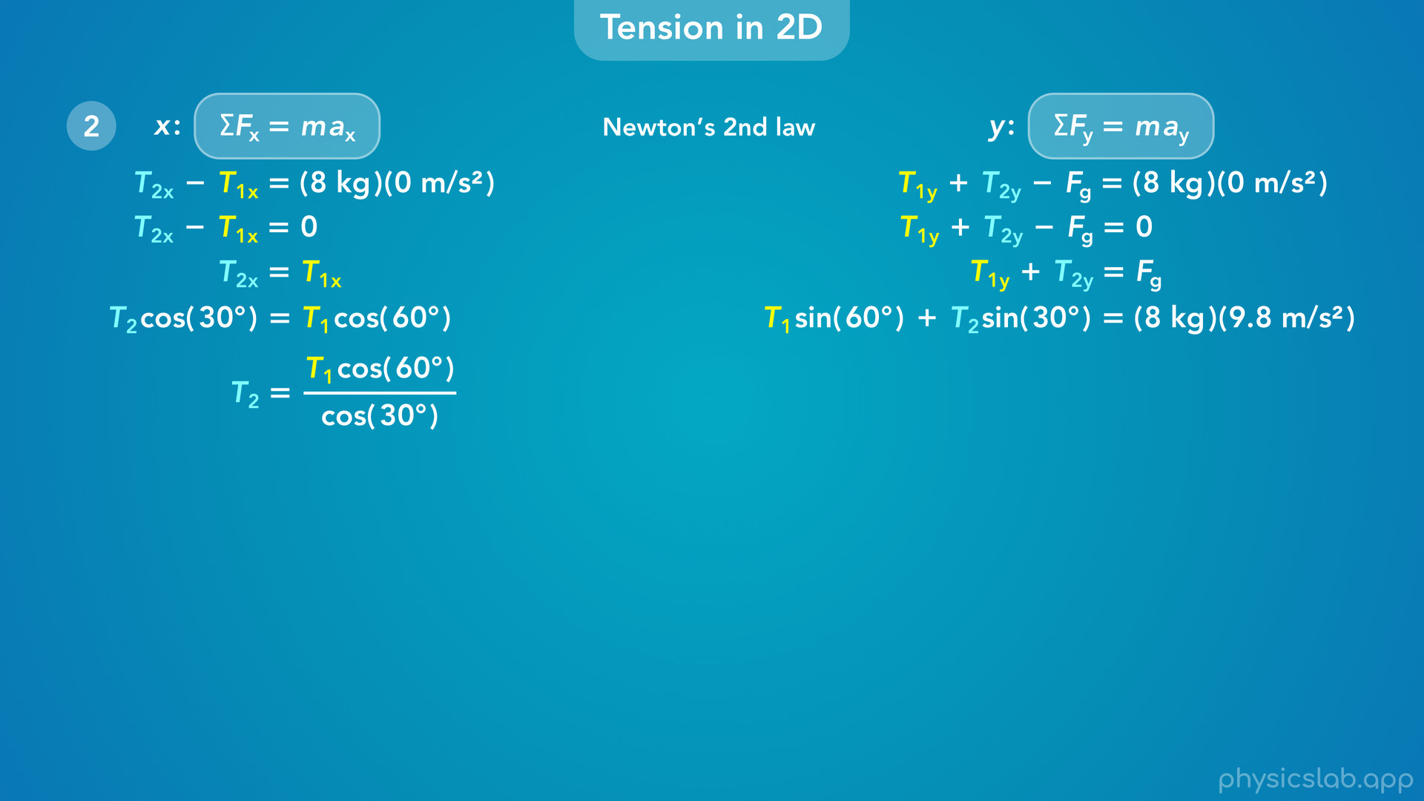
Notes:
• In the equation on the left, we can divide both sides by cosine of 30 so that T2 is on one side by itself.

Slide 29
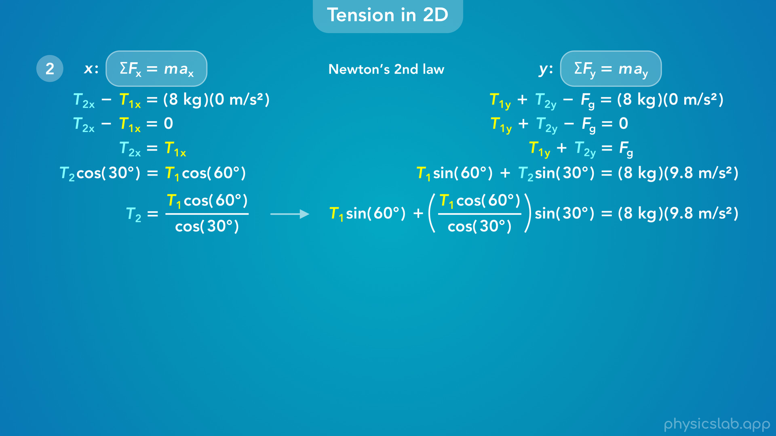
Notes:
• Now, we can take that equation for T2, and substitute that in place of T2 on the right. T2 is equal to T1 cosine of 60 divided by cosine of 30.
• Now we have an equation with only one unknown variable, T1.

Slide 30
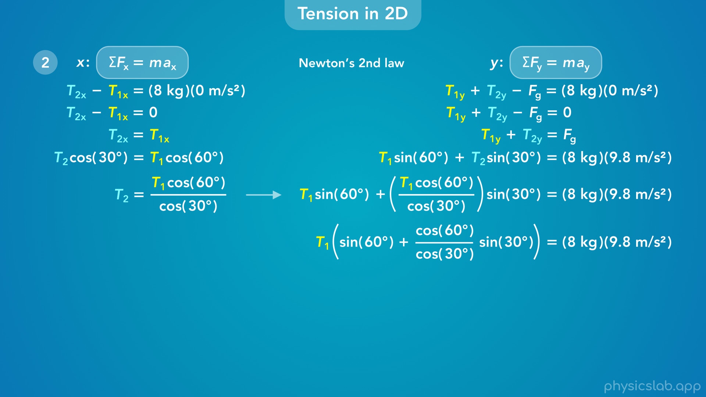
Notes:
• Next, we can factor out the common variable T1 from these two terms.

Slide 31
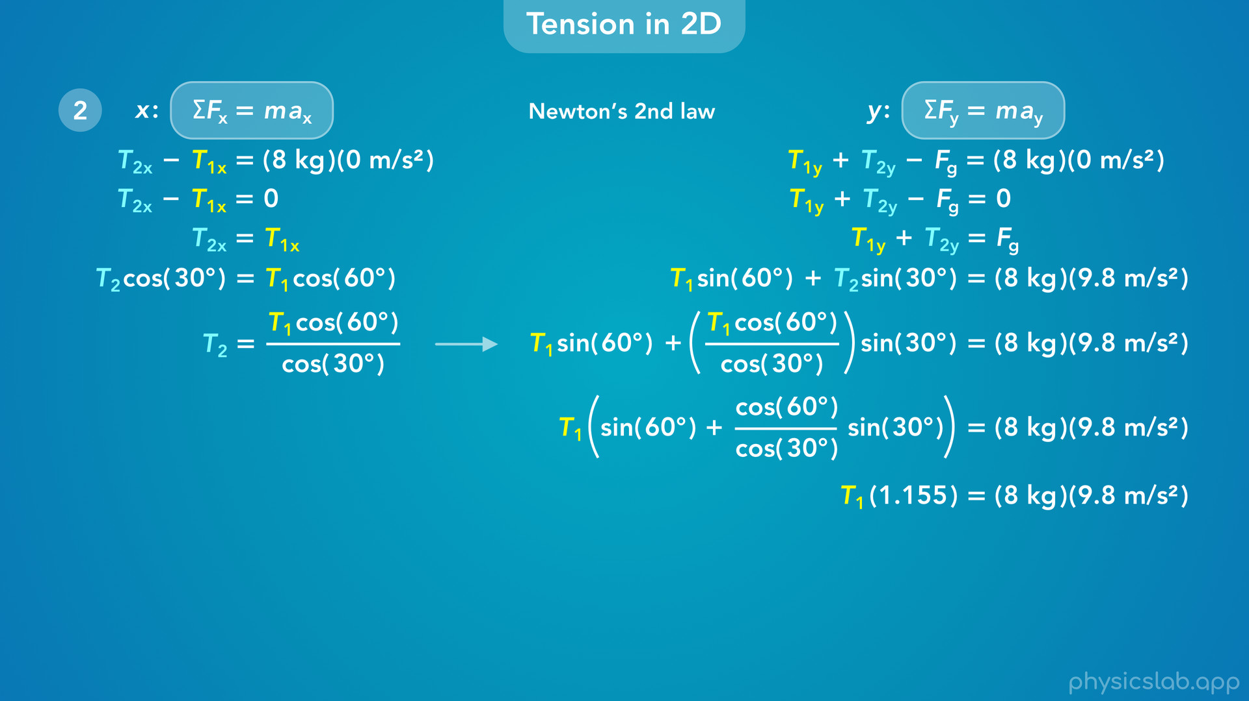
Notes:
• We could divide both sides by this large term, but let’s calculate these trig functions to get a decimal value, and we’ll keep 3 decimal places to make sure the final answer is accurate.

Slide 32
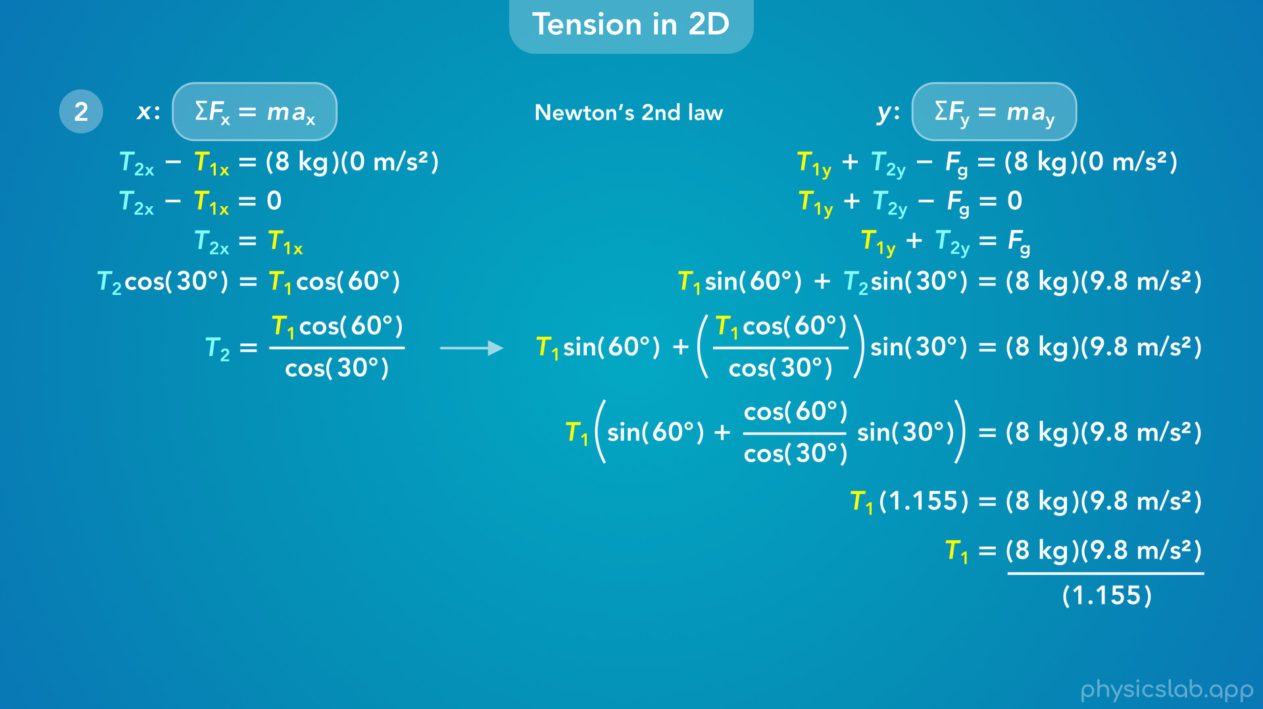
Notes:
• Then we can divide both sides by 1.155

Slide 33
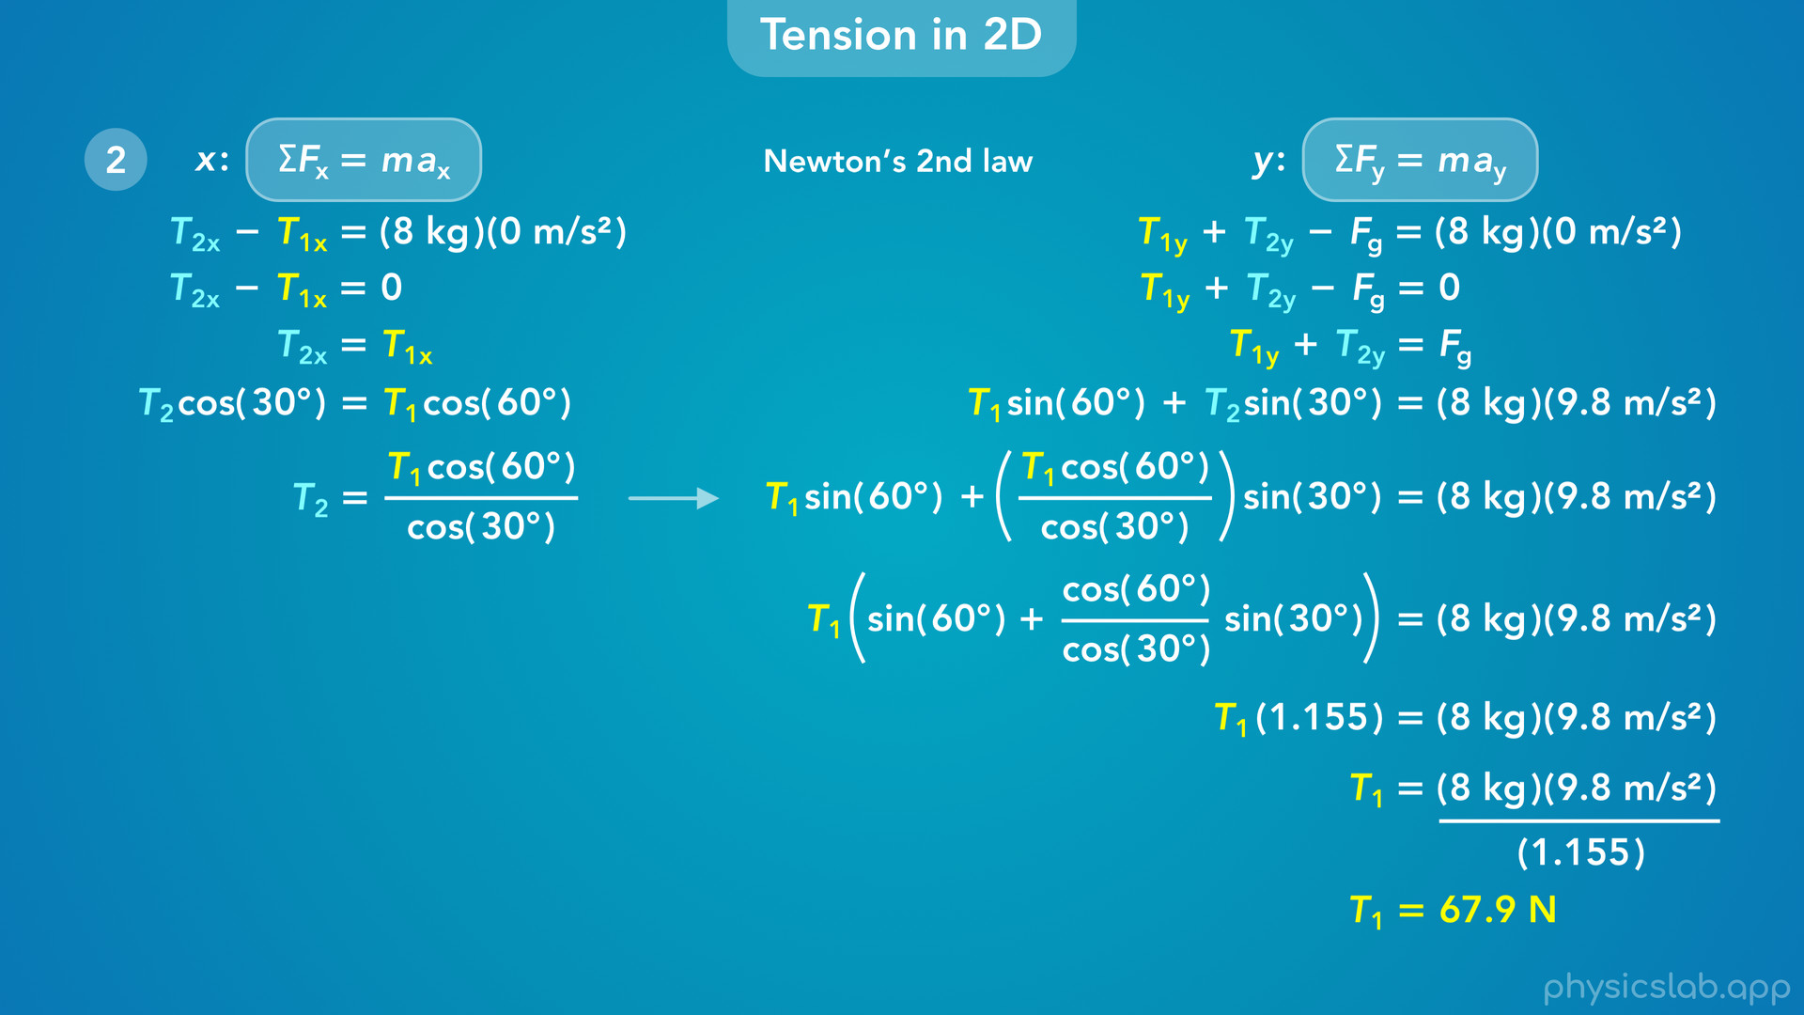
Notes:
and we get 67.9 N for T1.

Slide 34
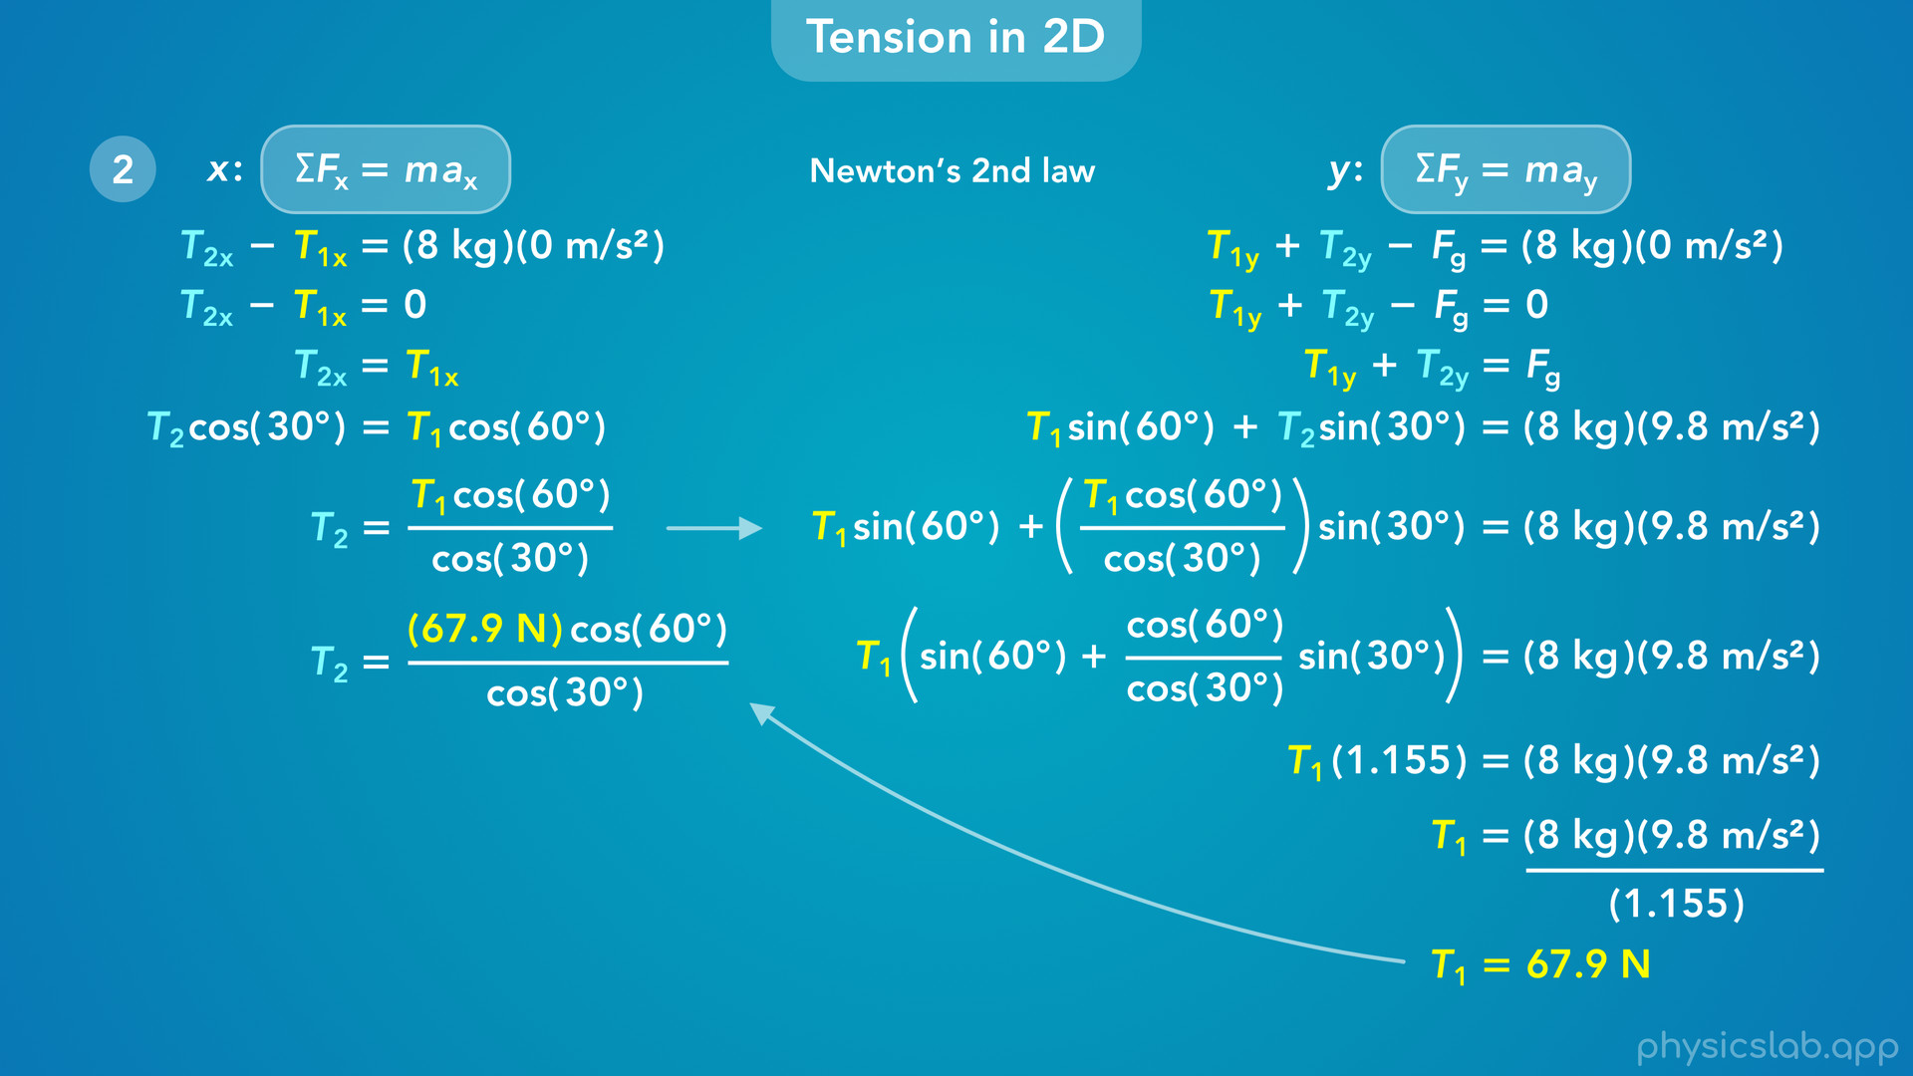
Notes:
• Now, we can take that value and plug it in for T1 in the equation on the left.

Slide 35
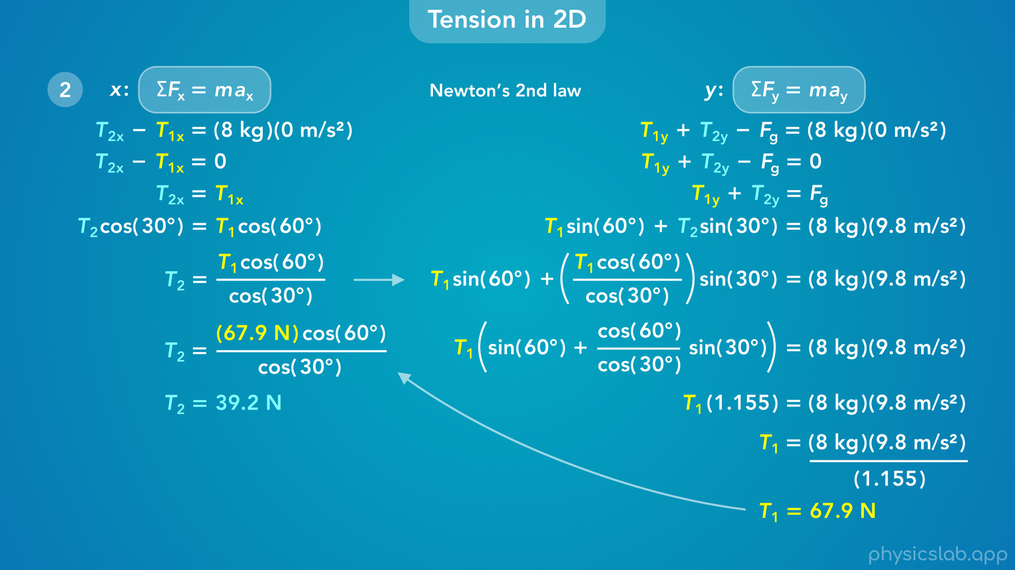
Notes:
• When we calculate that, we get 39.2 N for T2.

Slide 36
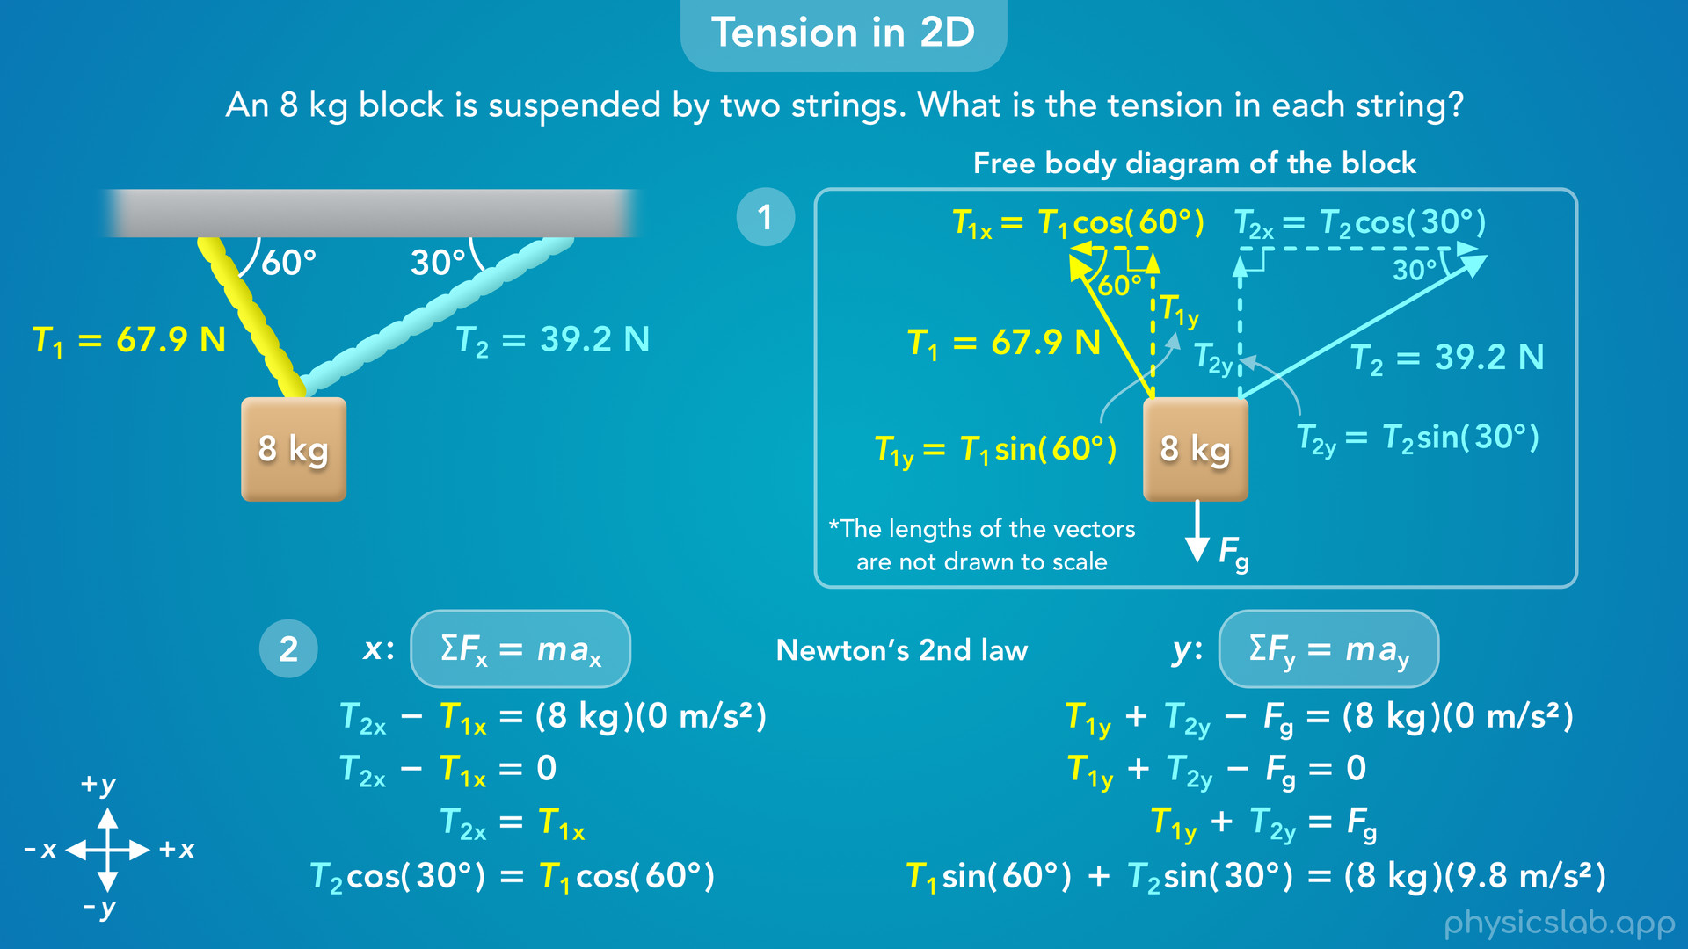
Notes:
• So those are the tensions in the two strings, T1 is 67.9 N and T2 is 39.2 N.
• Let’s do a quick recap.
• The first step is to draw a free body diagram of the block and establish our coordinate system.
• We have two different strings that can have different tensions, so we labeled them as T1 and T2.
• The tension forces on the block are pulling forces that act in the same directions as the strings, and they have the same angles.
• Next, we find the x and y components of each tension force using right triangle trig.
• Once we have our free body diagram, the next step is to apply Newton’s 2nd law in the x and y directions.
• We write out the net force in each direction, and in this example, we can assume the block is at rest, so we plug in 0 for the acceleration in each direction.
• We end up with two equations, one for each direction, and two unknown tensions.
• Then we can solve the system of equations using algebra and substitution.
• When we do that, we get a value for T1 and T2, the tension forces acting on the block.
• And the tension in each string has the same magnitude as the tension force it exerts on the block.

Slide 37
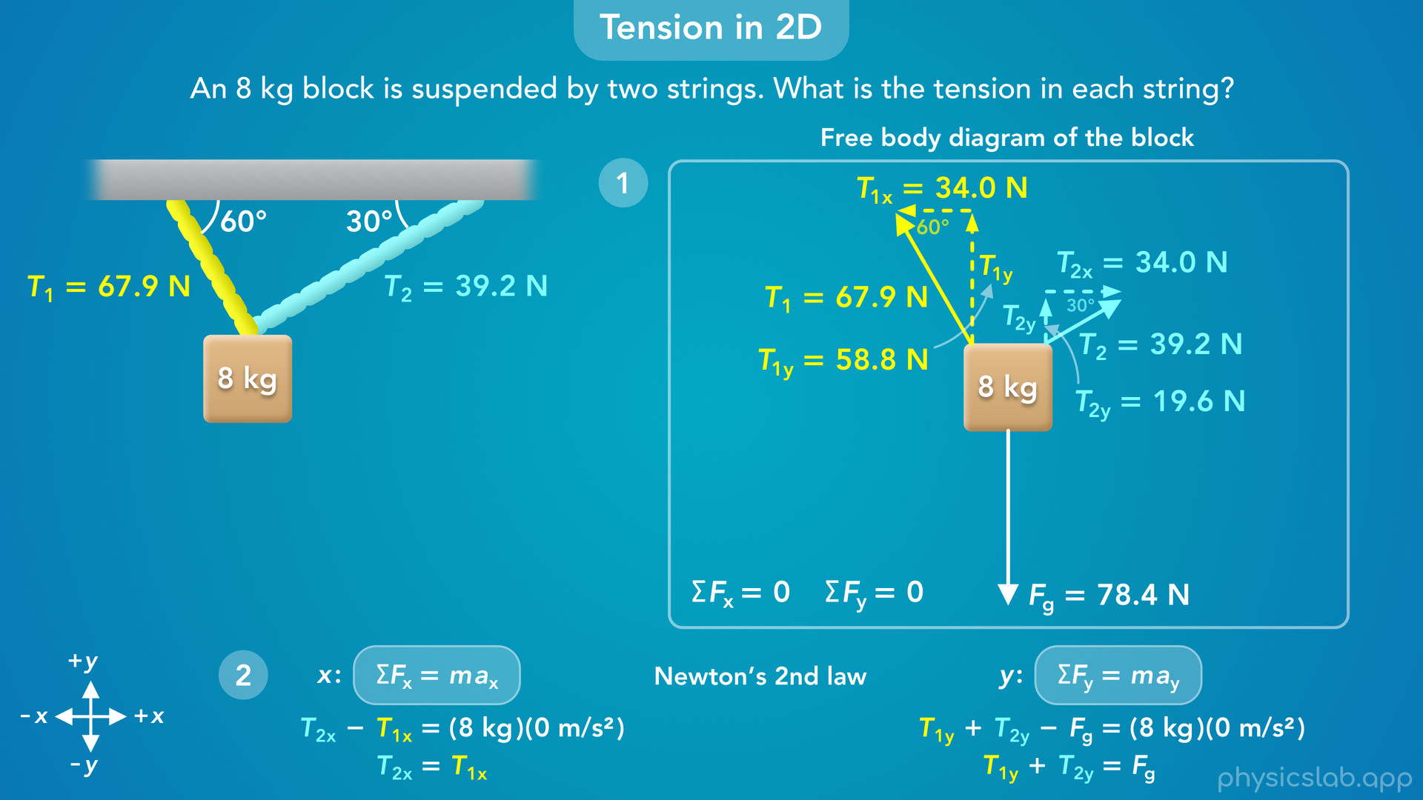
Notes:
• Remember, the length of these force vectors are not drawn to scale.
• If they were, they would look like this.
• The block is at rest so there is no net force, and the forces are balanced in each direction.

Slide 38
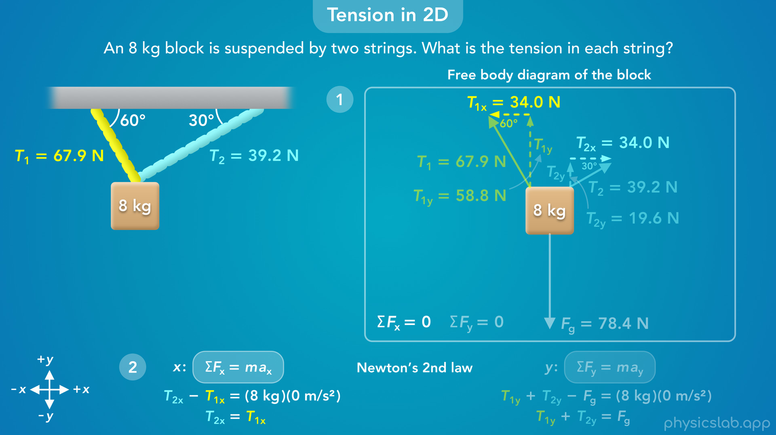
Notes:
• T1x and T2x have the same magnitude but opposite directions, so they cancel out in the x direction.

Slide 39
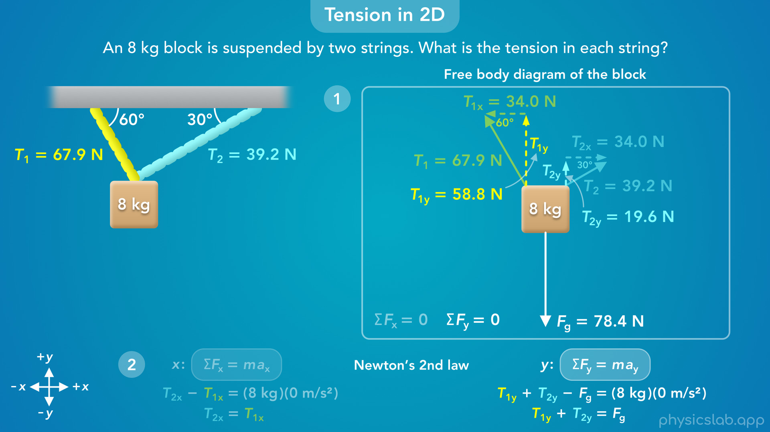
Notes:
• T1y and T2y are both acting upwards, and when added together they have same magnitude as the downwards weight force, so the forces cancel in the y direction.

Slide 40
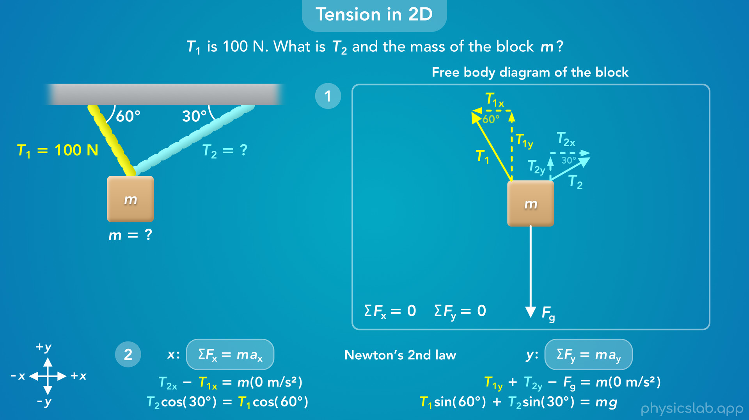
Notes:
• For this example, we were given the mass of the block and we wanted to find the tension in each string.
• But what if the question told us that the tension in string 1 is 100 N, and it wanted us to find the tension in string 2 and the mass of the block?
• Would we be able to solve that?
• Yeah we could, and we would work through it the same way.
• This free body diagram, and the equations we got from Newton’s 2nd law, tell us the relationship between the tension forces and the mass, and these relationships are true for any value of T1, T2 and m.

Slide 41

Notes:
• If we’re given one of the values, then we have two equations with two unknown variables, and we can solve for the those variables.

Slide 42
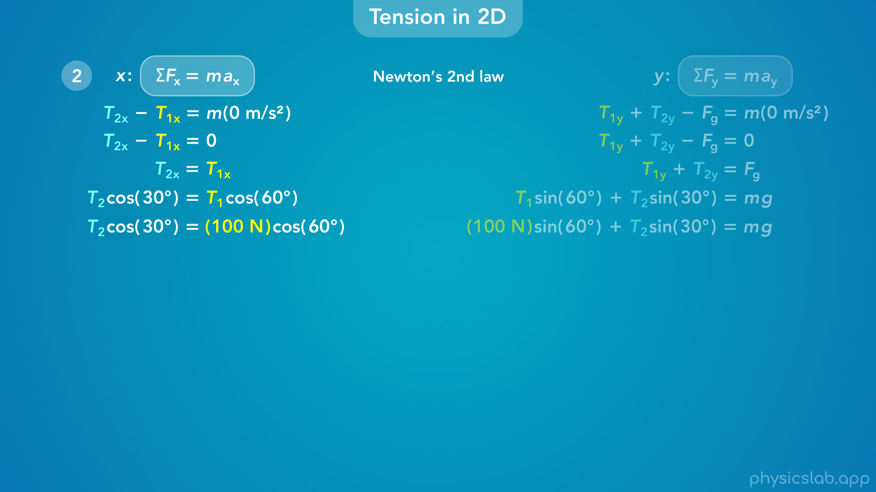
Notes:
• If we plug in 100 N for T1 in the left equation

Slide 43
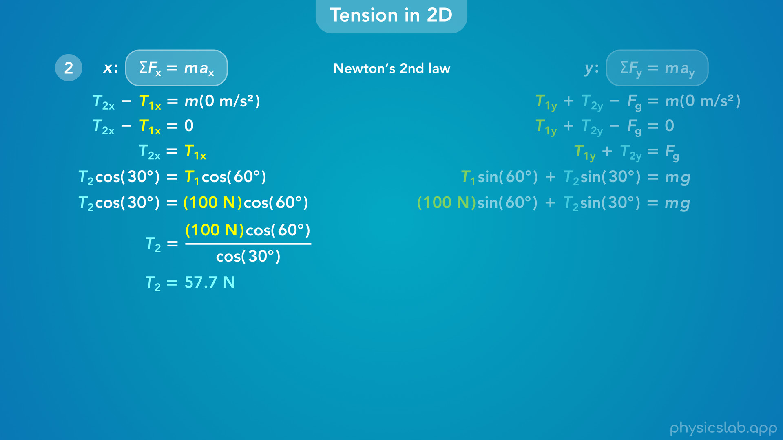
Notes:
we get 57.7 N for T2.

Slide 44
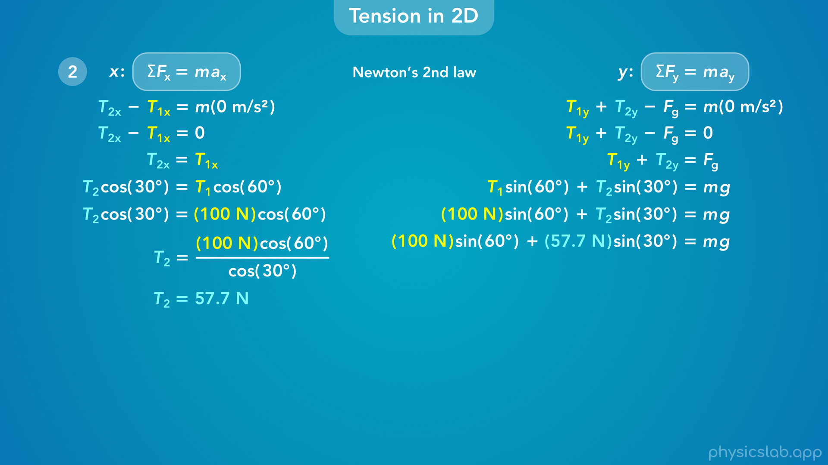
Notes:
• Then we could plug that in for T2 in the right equation

Slide 45
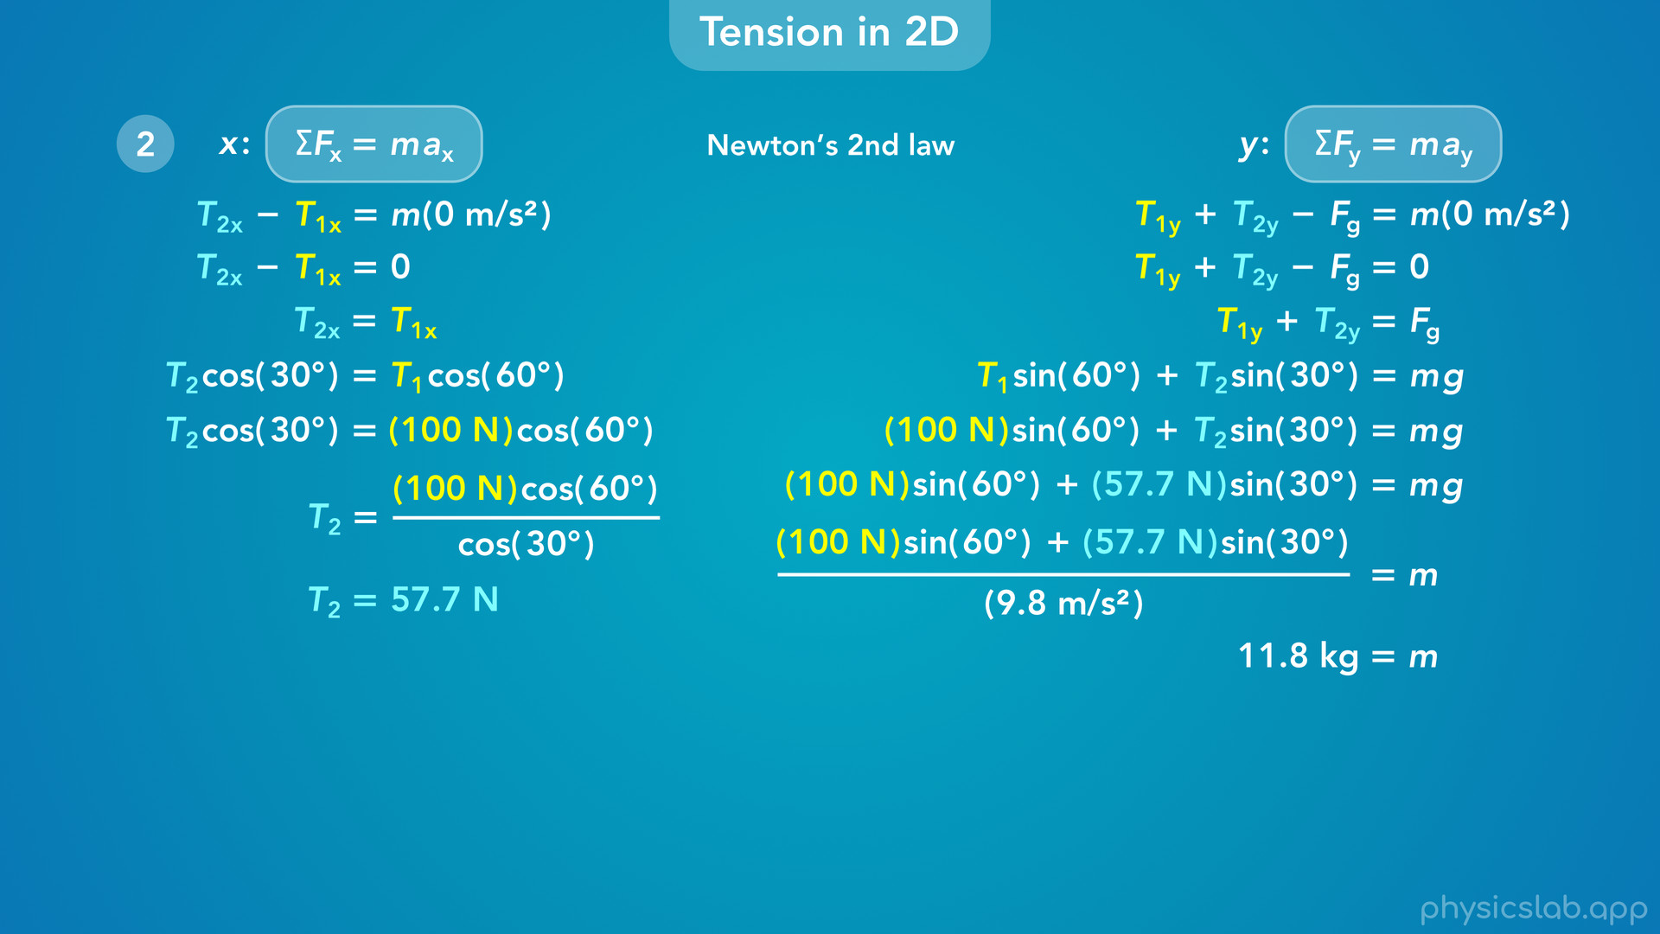
Notes:
and we get 11.8 kg for m, the mass of the block.

Slide 46
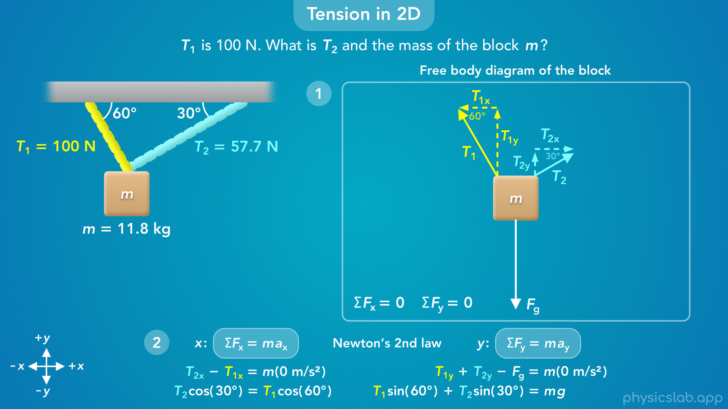
Notes:
• So we draw a free body diagram and apply newton’s 2nd law to get equations that represent the physical scenario.
• And we can plug in any values that we’re given, and solve for the other unknown values.
• These are the steps that we use for a lot of physics problems, and this is how we work with tension in two dimensions.

