Slide 1
Newton’s 2nd Law of Motion and Free Body Diagrams in 2D
Slides Version 2
This version includes:
Slides with screenshot images from the video.
The video narration in the slide notes.
A blank template slide with the same background and font as the video.
Slides with some basic graphics from this video for you to use however you like.
Feel free to add, delete and edit slides to make your own presentation. You can use these slides in class or share them with your students, but please do not share them with anyone else.
If you have any feedback, suggestions or questions about these slides please email me at chris@physicslab.app or send me a message on Discord @physicslab.
physicslab.app

Slide 2
Heading
Text

Slide 3













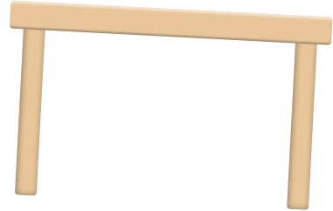





Text
Text
Text

Slide 4

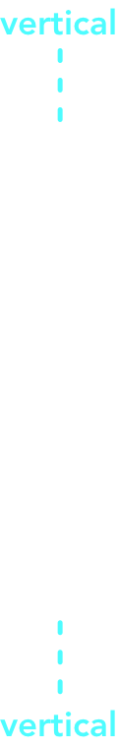











Slide 5

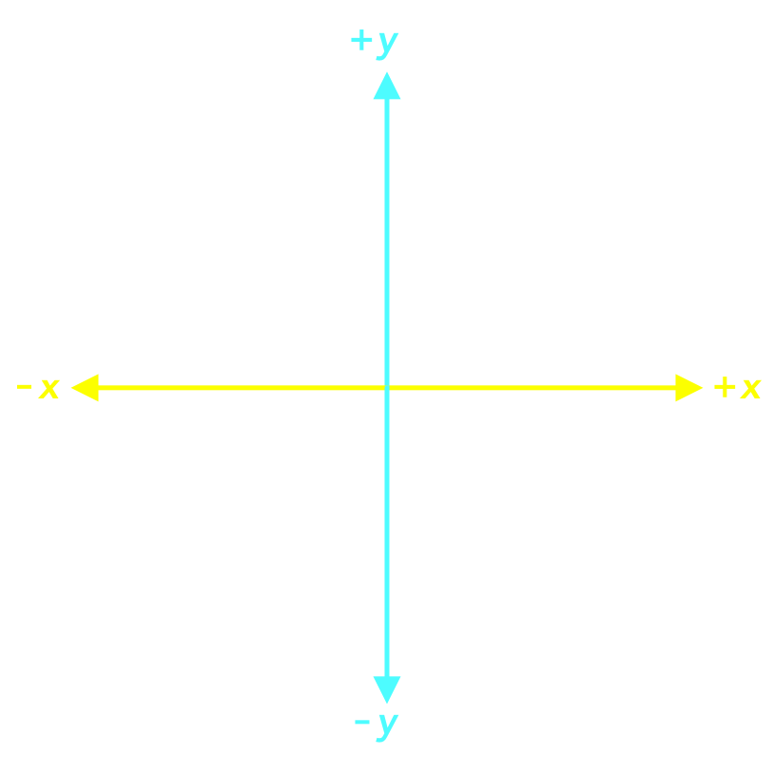



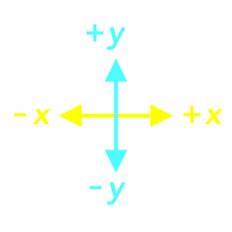

Slide 6













Slide 7

























Slide 8
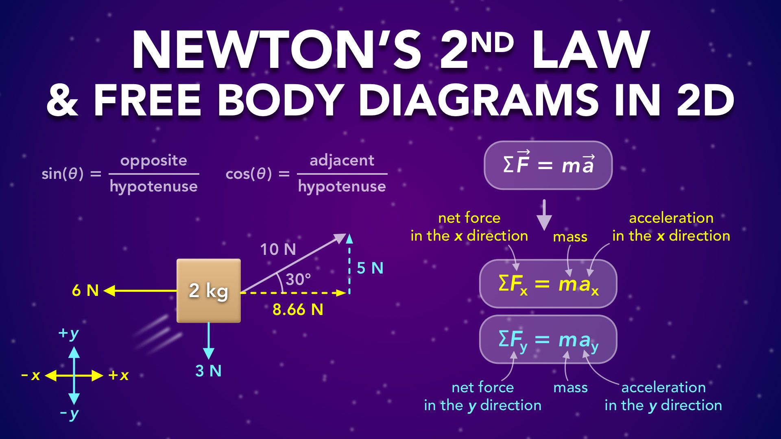
Notes:
Newton’s 2nd Law & Free Body Diagrams In 2D
physicslab.app
If you have any questions, suggestions or feedback about these slides please email me at chris@physicslab.app or send me a message on Discord @physicslab.

Slide 9
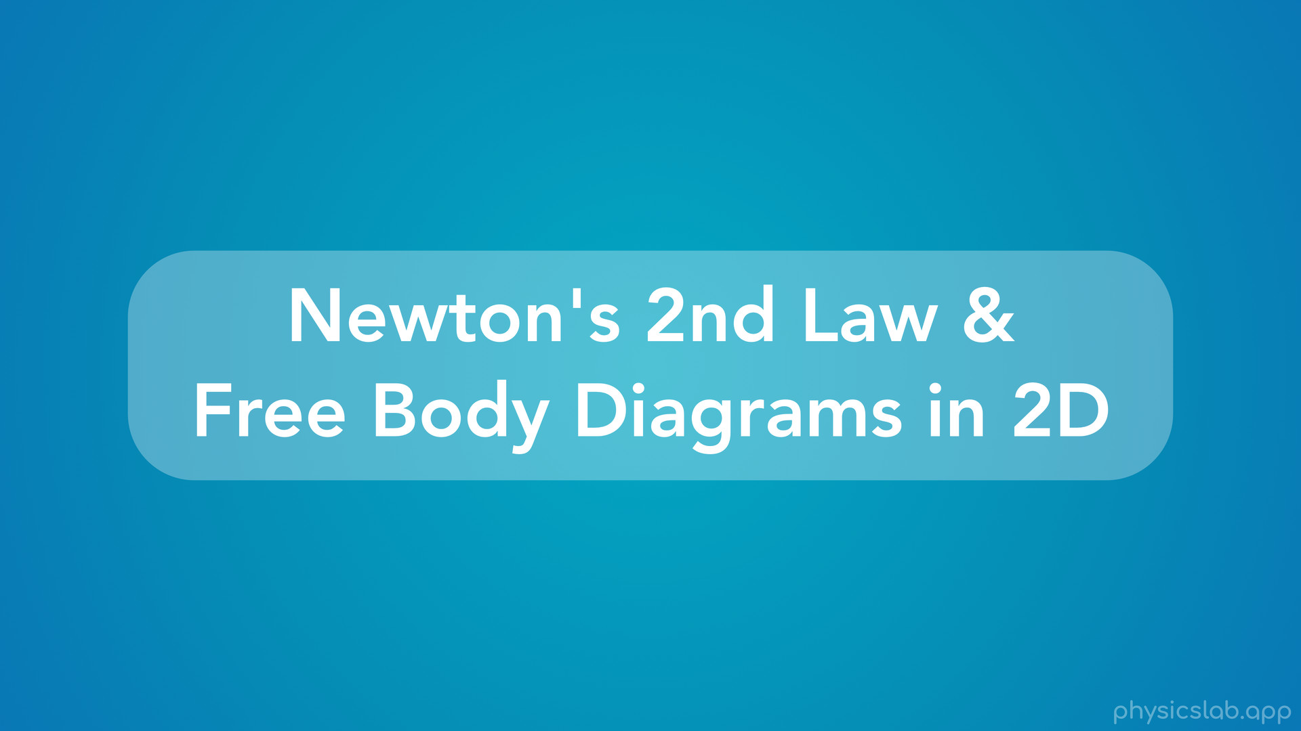
Notes:
• Hey everyone! In this video we’re gonna learn about Newton’s 2nd law and free body diagrams in 2 dimensions.

Slide 10
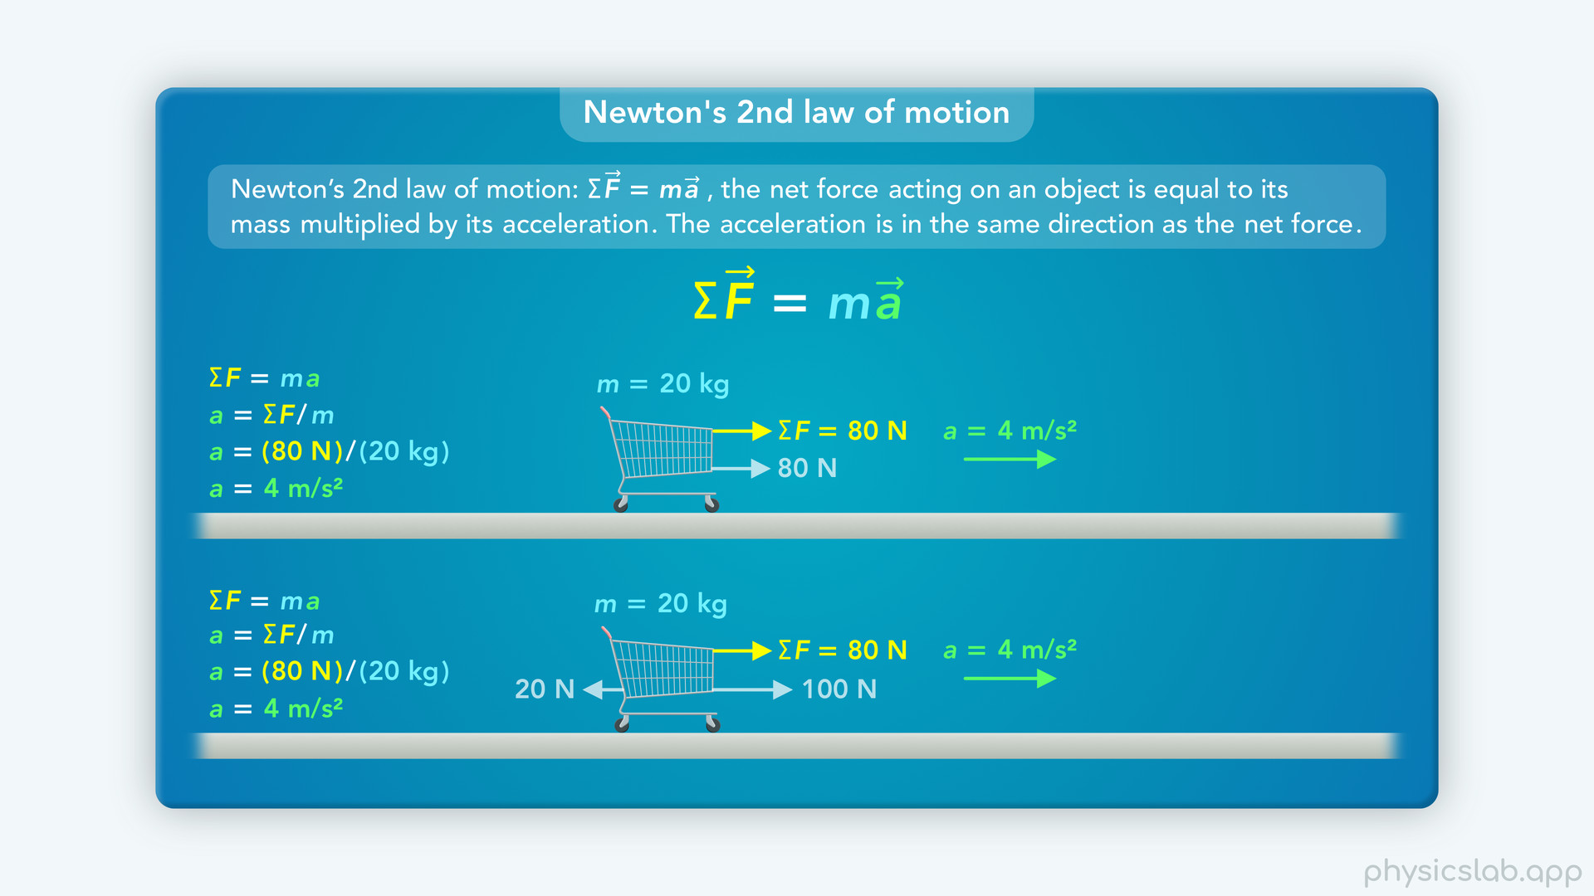
Notes:
• We covered Newton’s 2nd law in the last video, but that was more of an introduction. We only looked at one dimensional examples where the forces were acting in the horizontal direction.

Slide 11
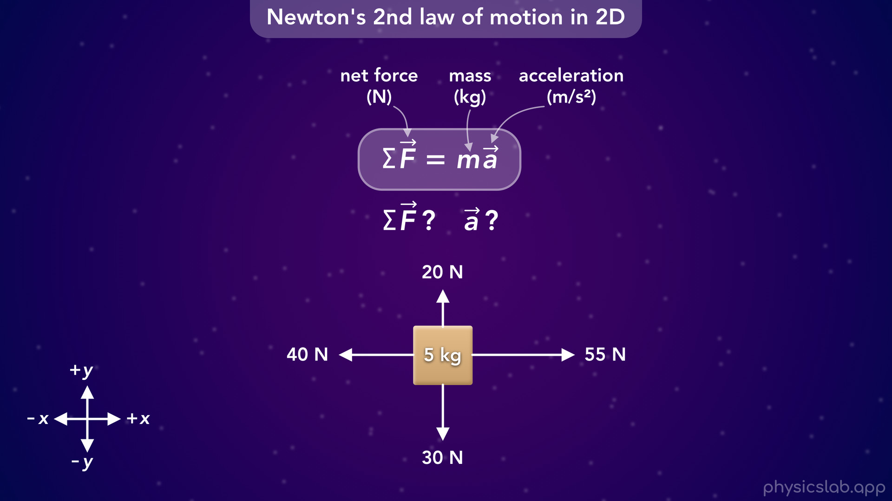
Notes:
• But most of the time, there’s gonna be forces in the horizontal and the vertical direction. In that case, how do we find the net force and the acceleration? And what direction will they be in?

Slide 12
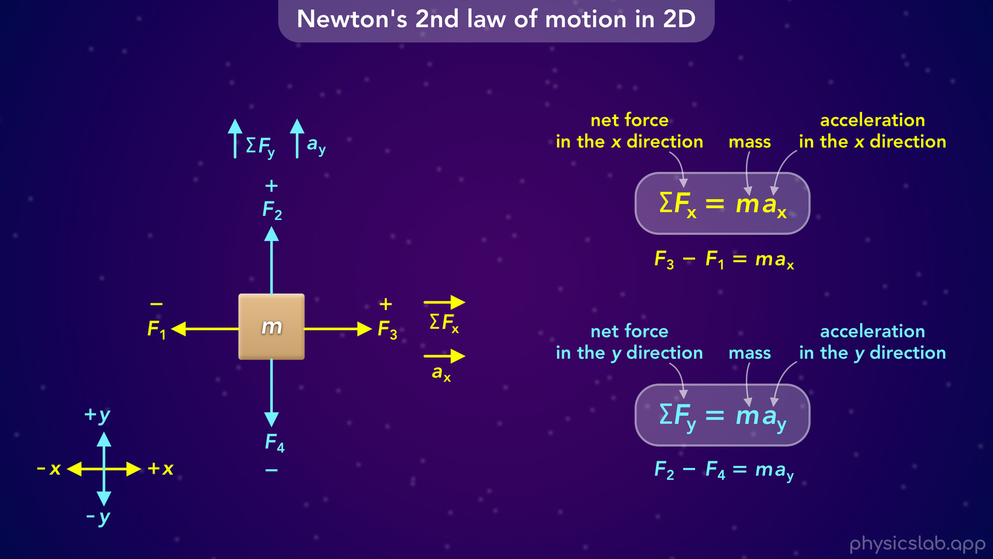
Notes:
• That’s what we’re gonna cover in this video.
• We’ll start with a simple example…

Slide 13
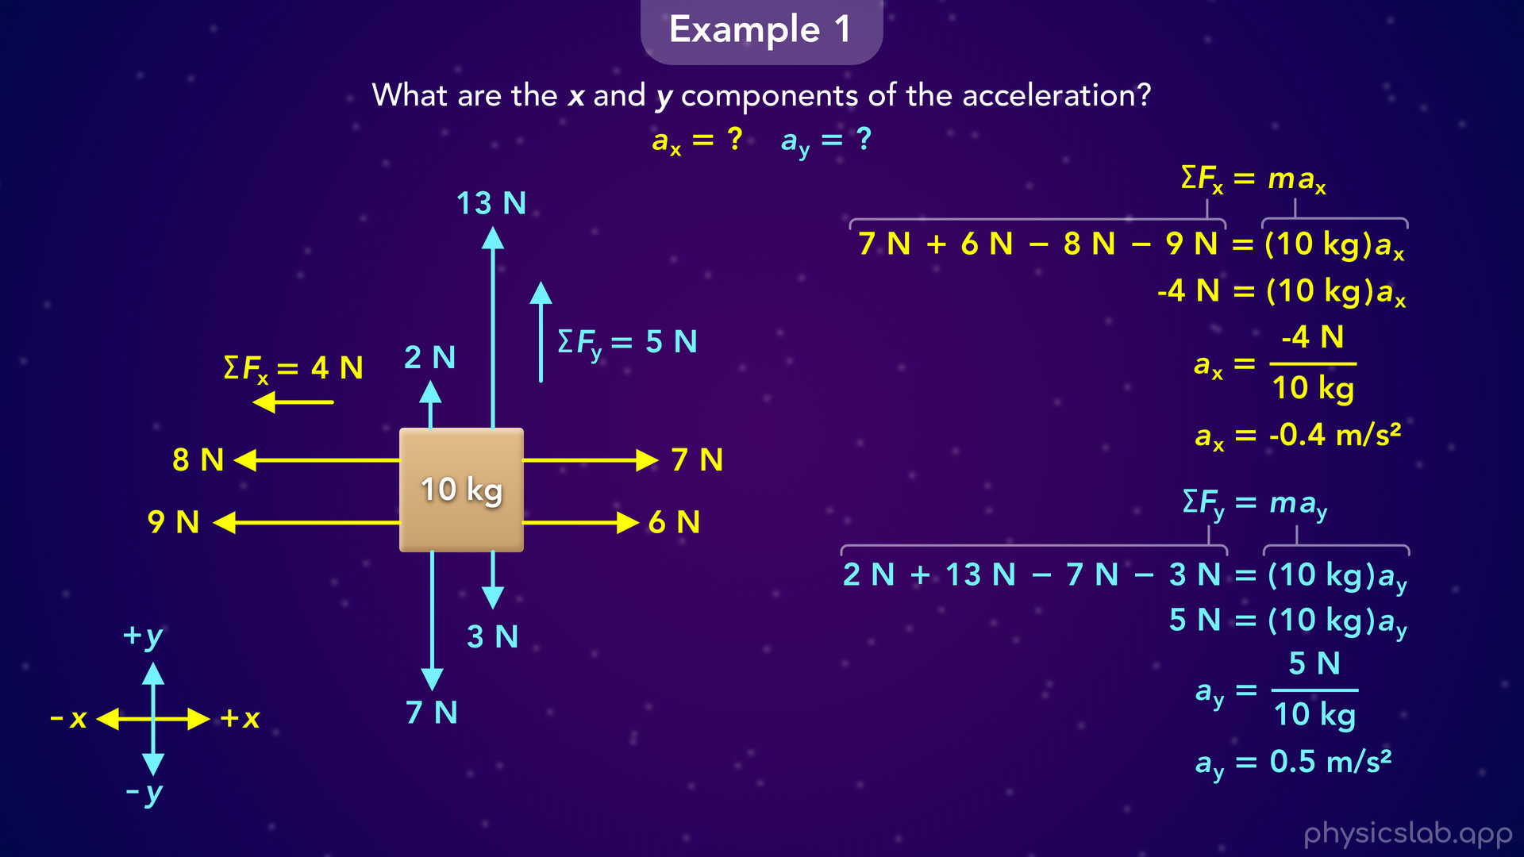
Notes:
• …Then we’ll learn how to add mutliple forces in each direction...

Slide 14
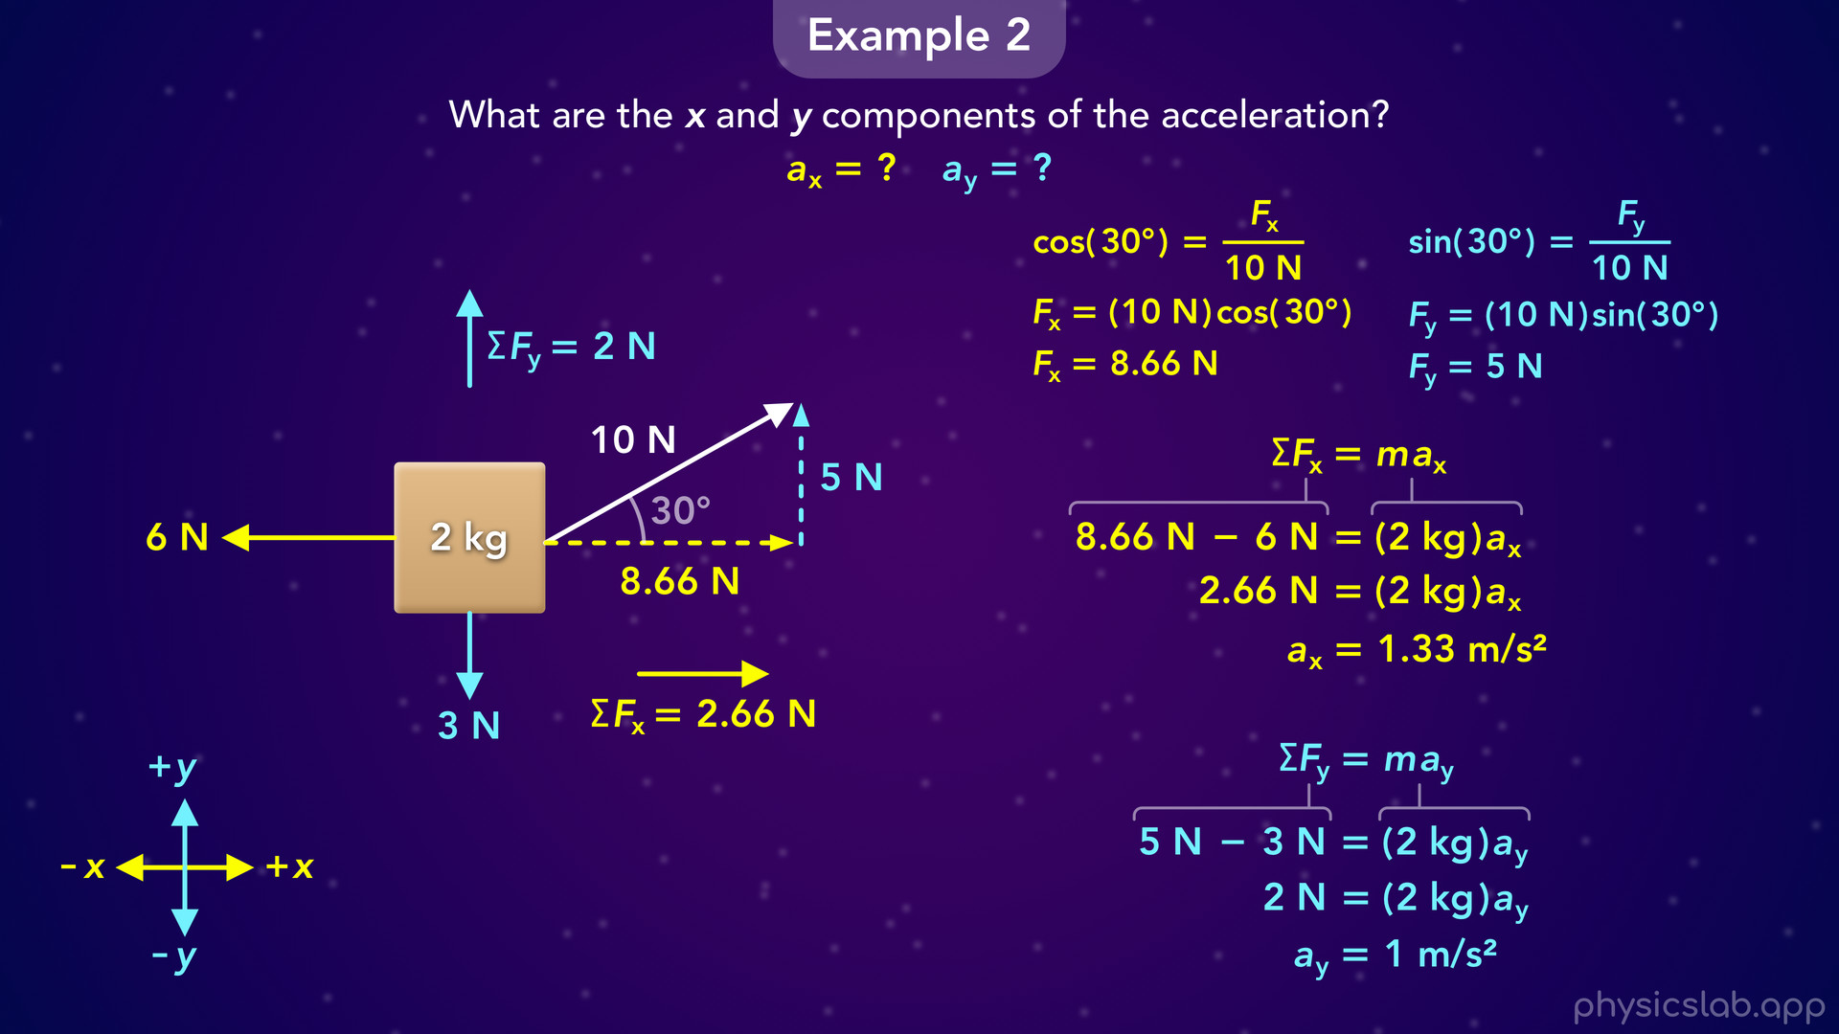
Notes:
• … and then, we’ll cover how to deal with forces that are at an angle.

Slide 15
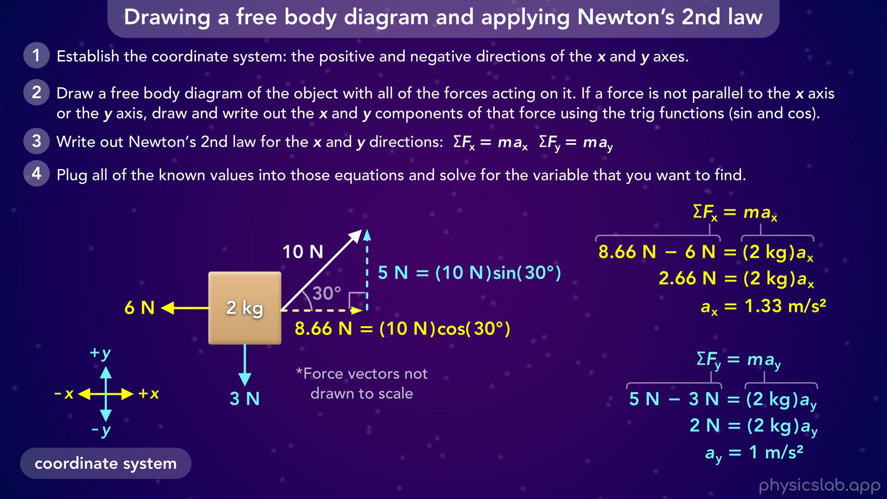
Notes:
• At the end, we’ll review the steps for drawing a free body diagram and applying Newton’s 2nd law.

Slide 16
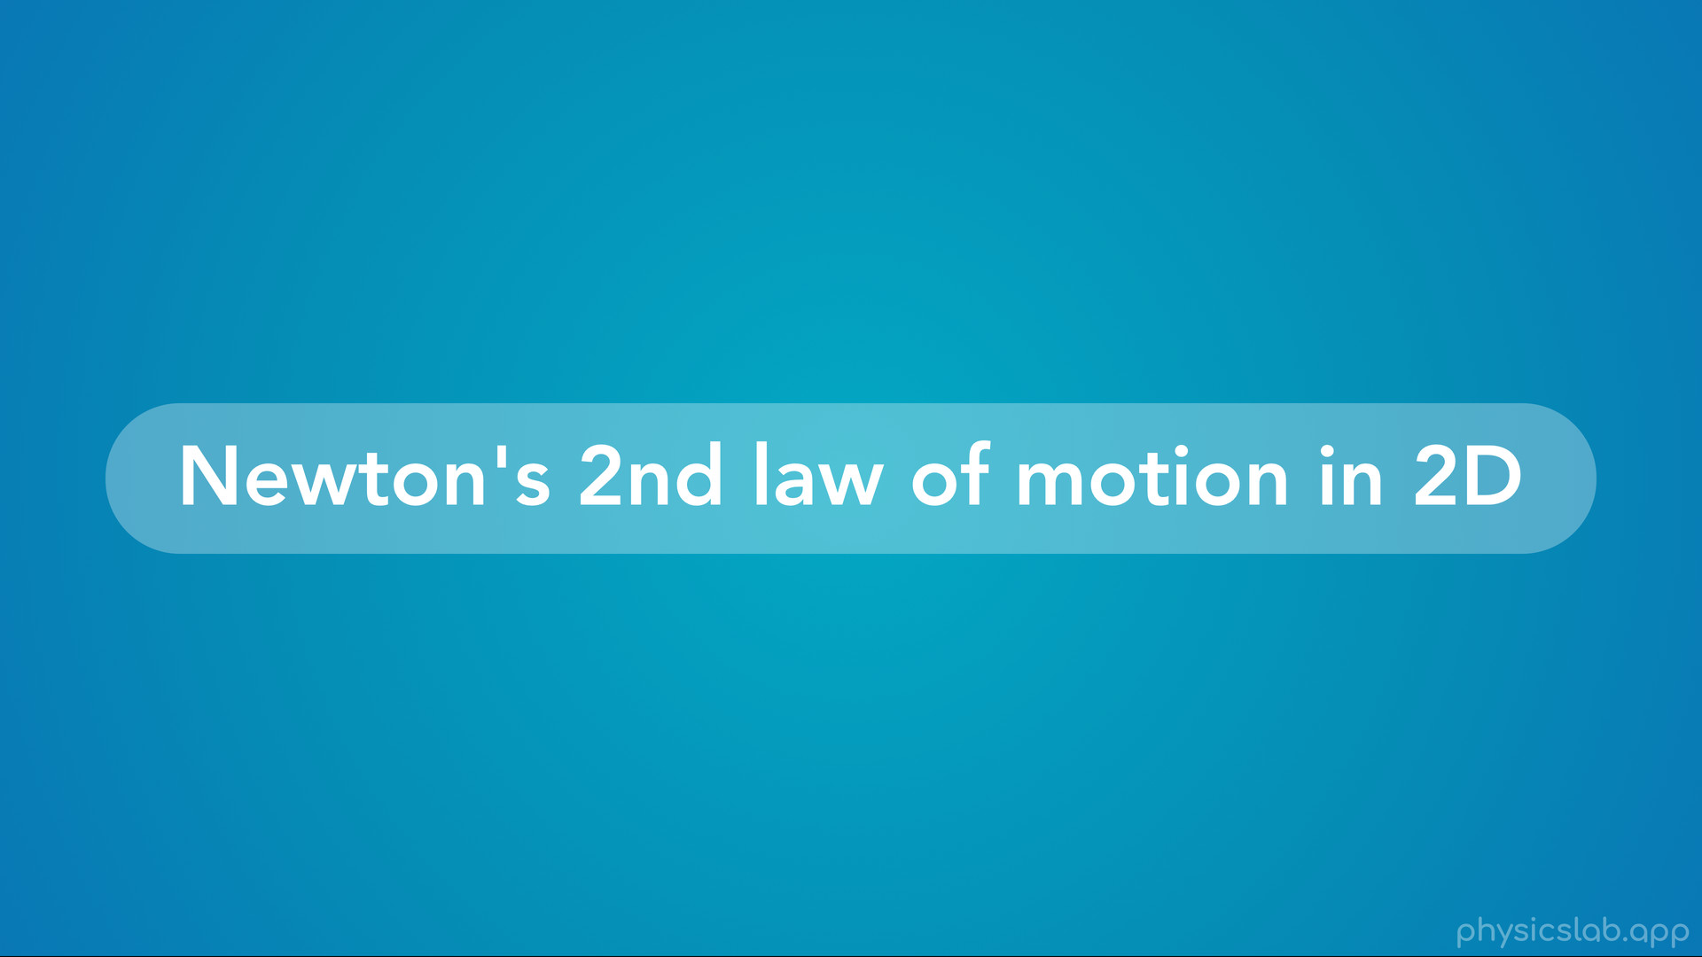
Notes:
• So let’s learn how to use Newton’s 2nd law of motion in two dimensions.

Slide 17
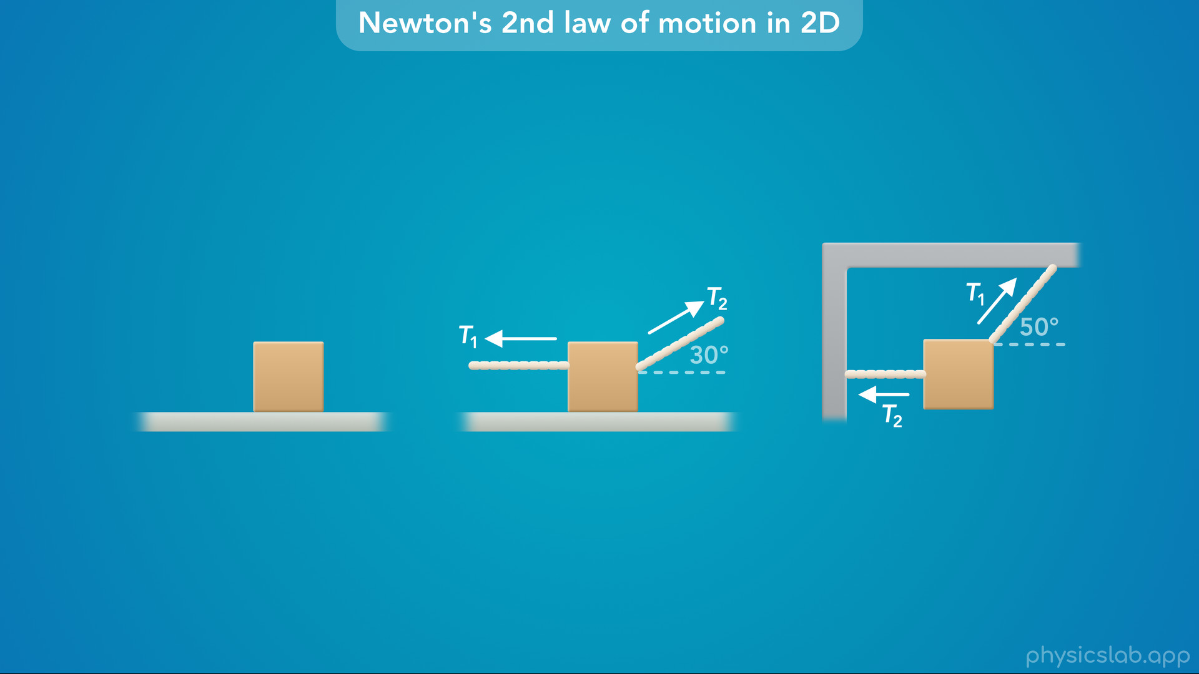
Notes:
• As we’ll learn throughout this unit, most scenarios involve more forces than the ones that we’re applying to it.

Slide 18
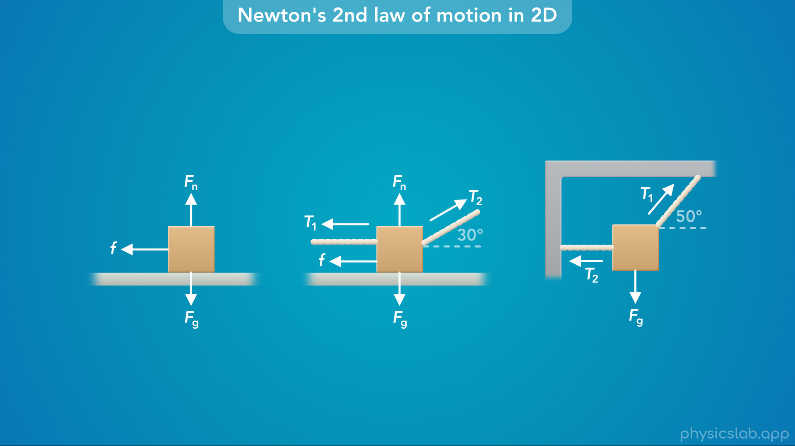
Notes:
On earth, this includes gravitational, normal and friction forces.
And objects usually move in either the horizontal or the vertical direction, but not both.

Slide 19
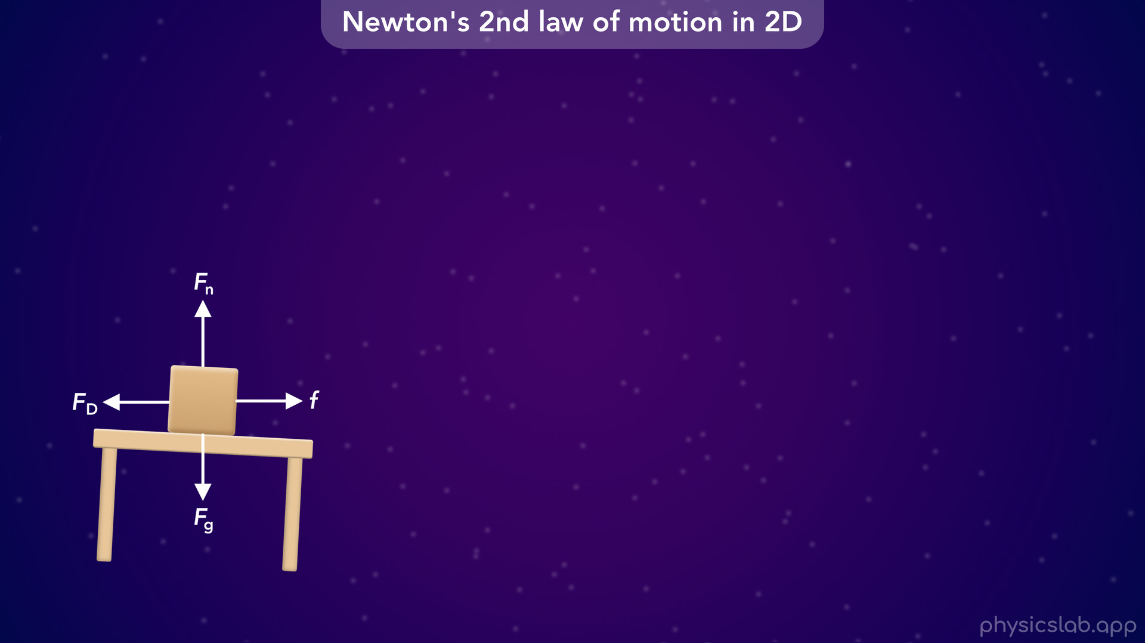
Notes:
• So to really understand how Newton’s 2nd law works in two dimensions, let’s imagine we’re deep in outer space, just like the video on Newton’s 1st law.

Slide 20
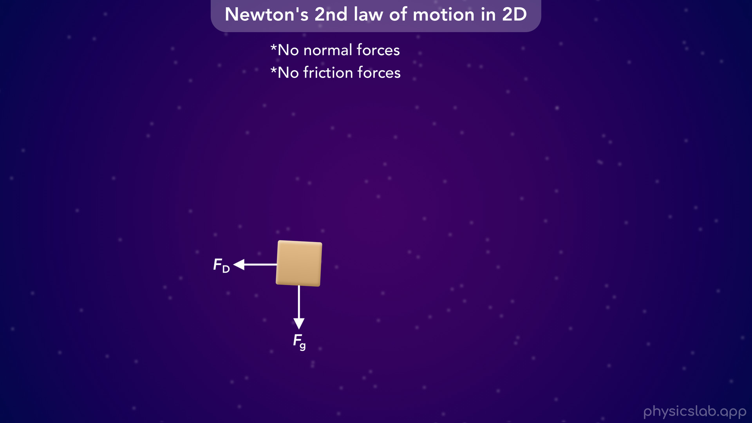
Notes:
• Out here, an object can float around on its own without touching other objects or surfaces, so we can assume there’s no normal forces or friction forces on the object.

Slide 21
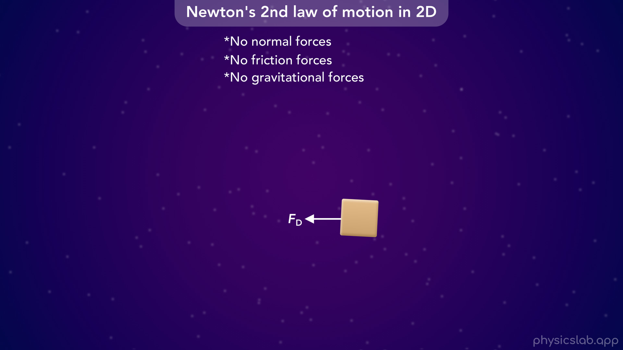
Notes:
We’re also going to assume there’s no gravitational forces

Slide 22
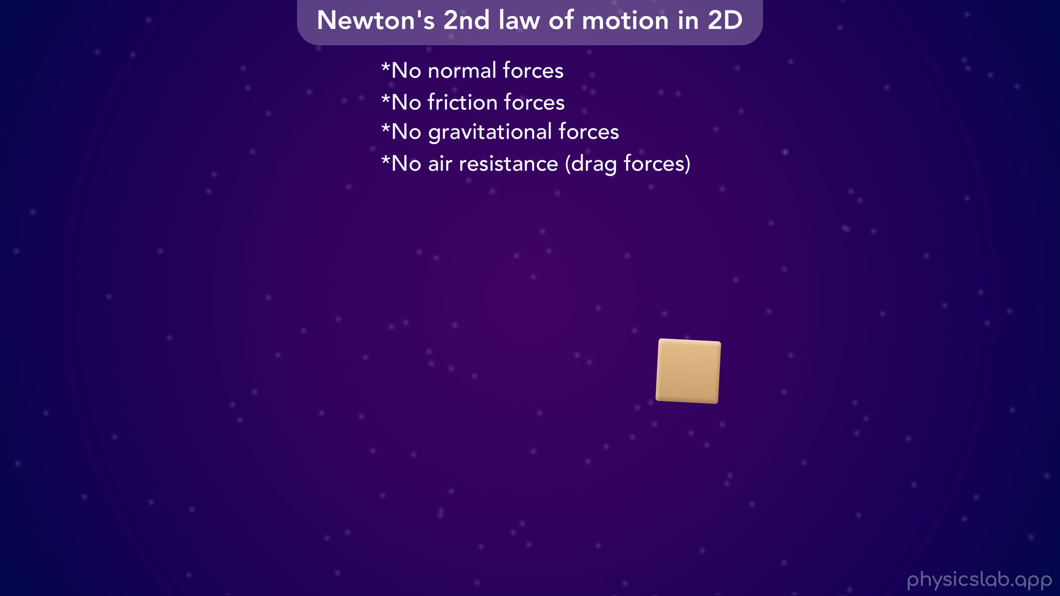
Notes:
and there’s no forces from air resistance.

Slide 23
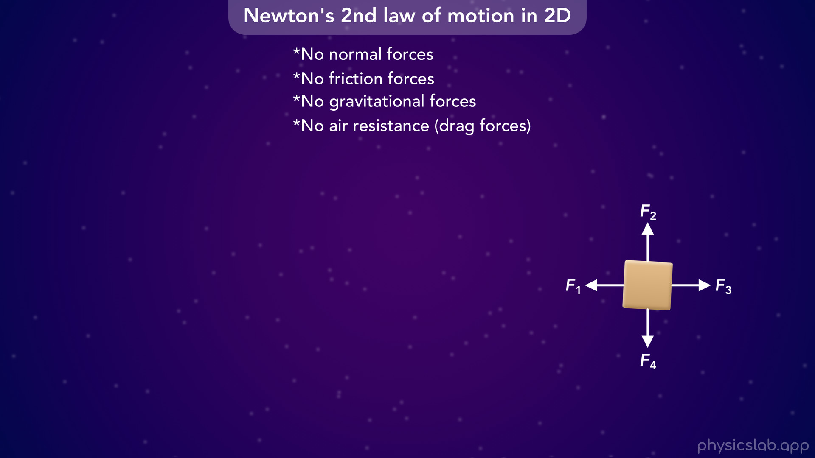
Notes:
• Then, we can apply our own forces and see how the object moves.

Slide 24
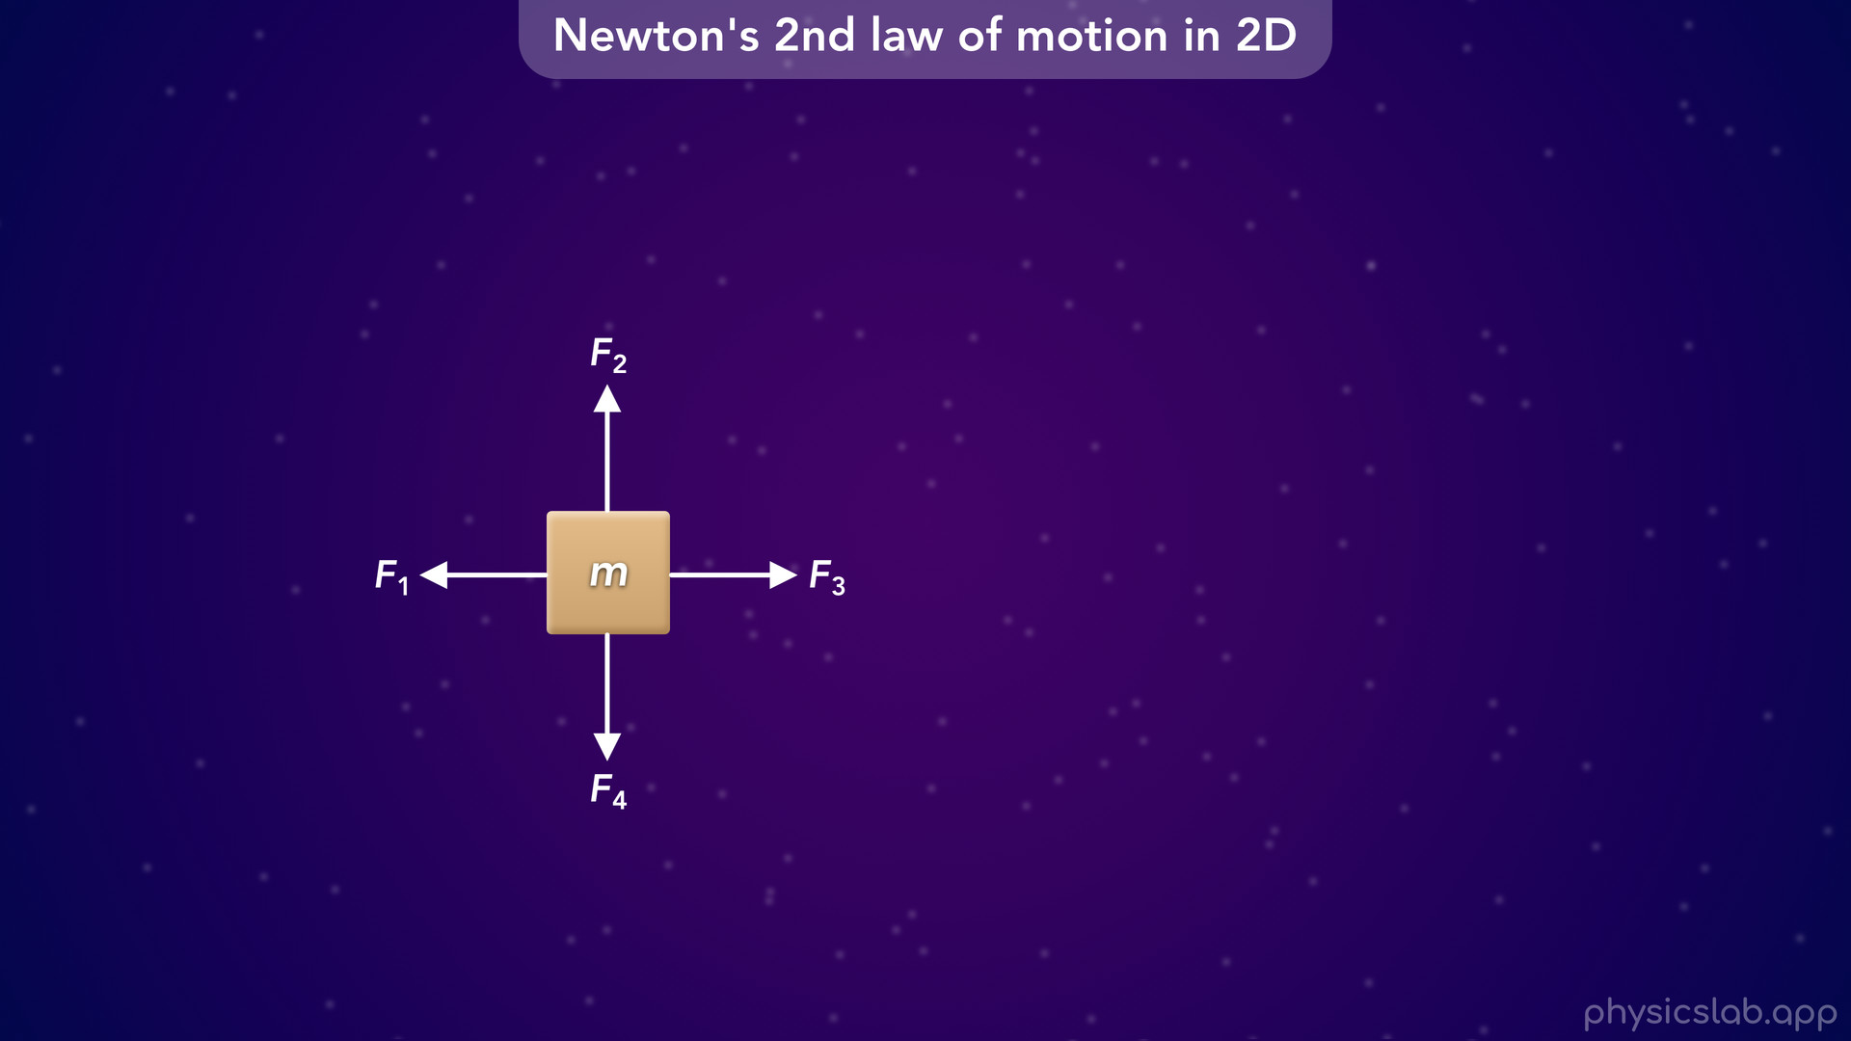
Notes:
• So let’s say we have a box with a mass of m and four forces acting on it in different directions.

Slide 25
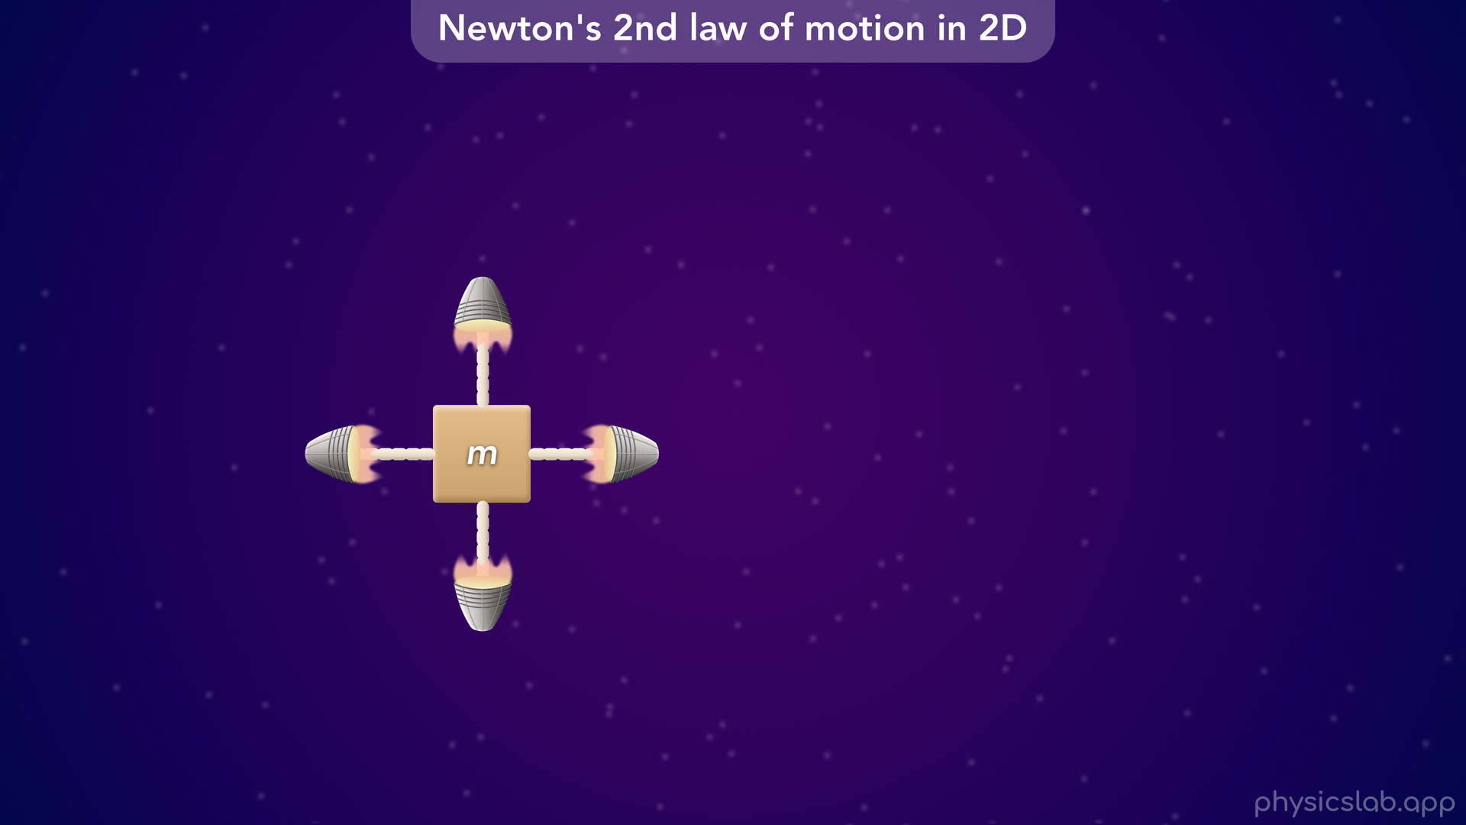
Notes:
It doesn’t matter what’s causing the forces, maybe the box is being pulled by four rocket thrusters

Slide 26
Notes:
but we’re just given these forces.
And we’re gonna start by using variables first, and then we’ll use numbers later.

Slide 27
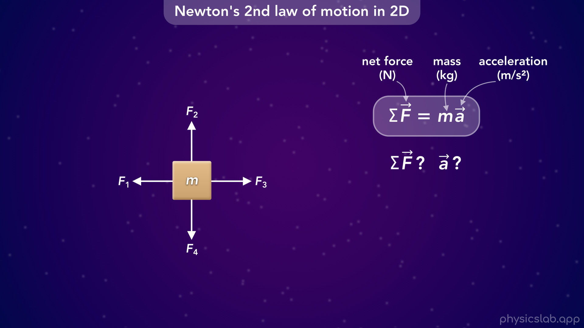
Notes:
• So how do we apply Newton’s 2nd law to this box? What would be the net force and the acceleration?

Slide 28
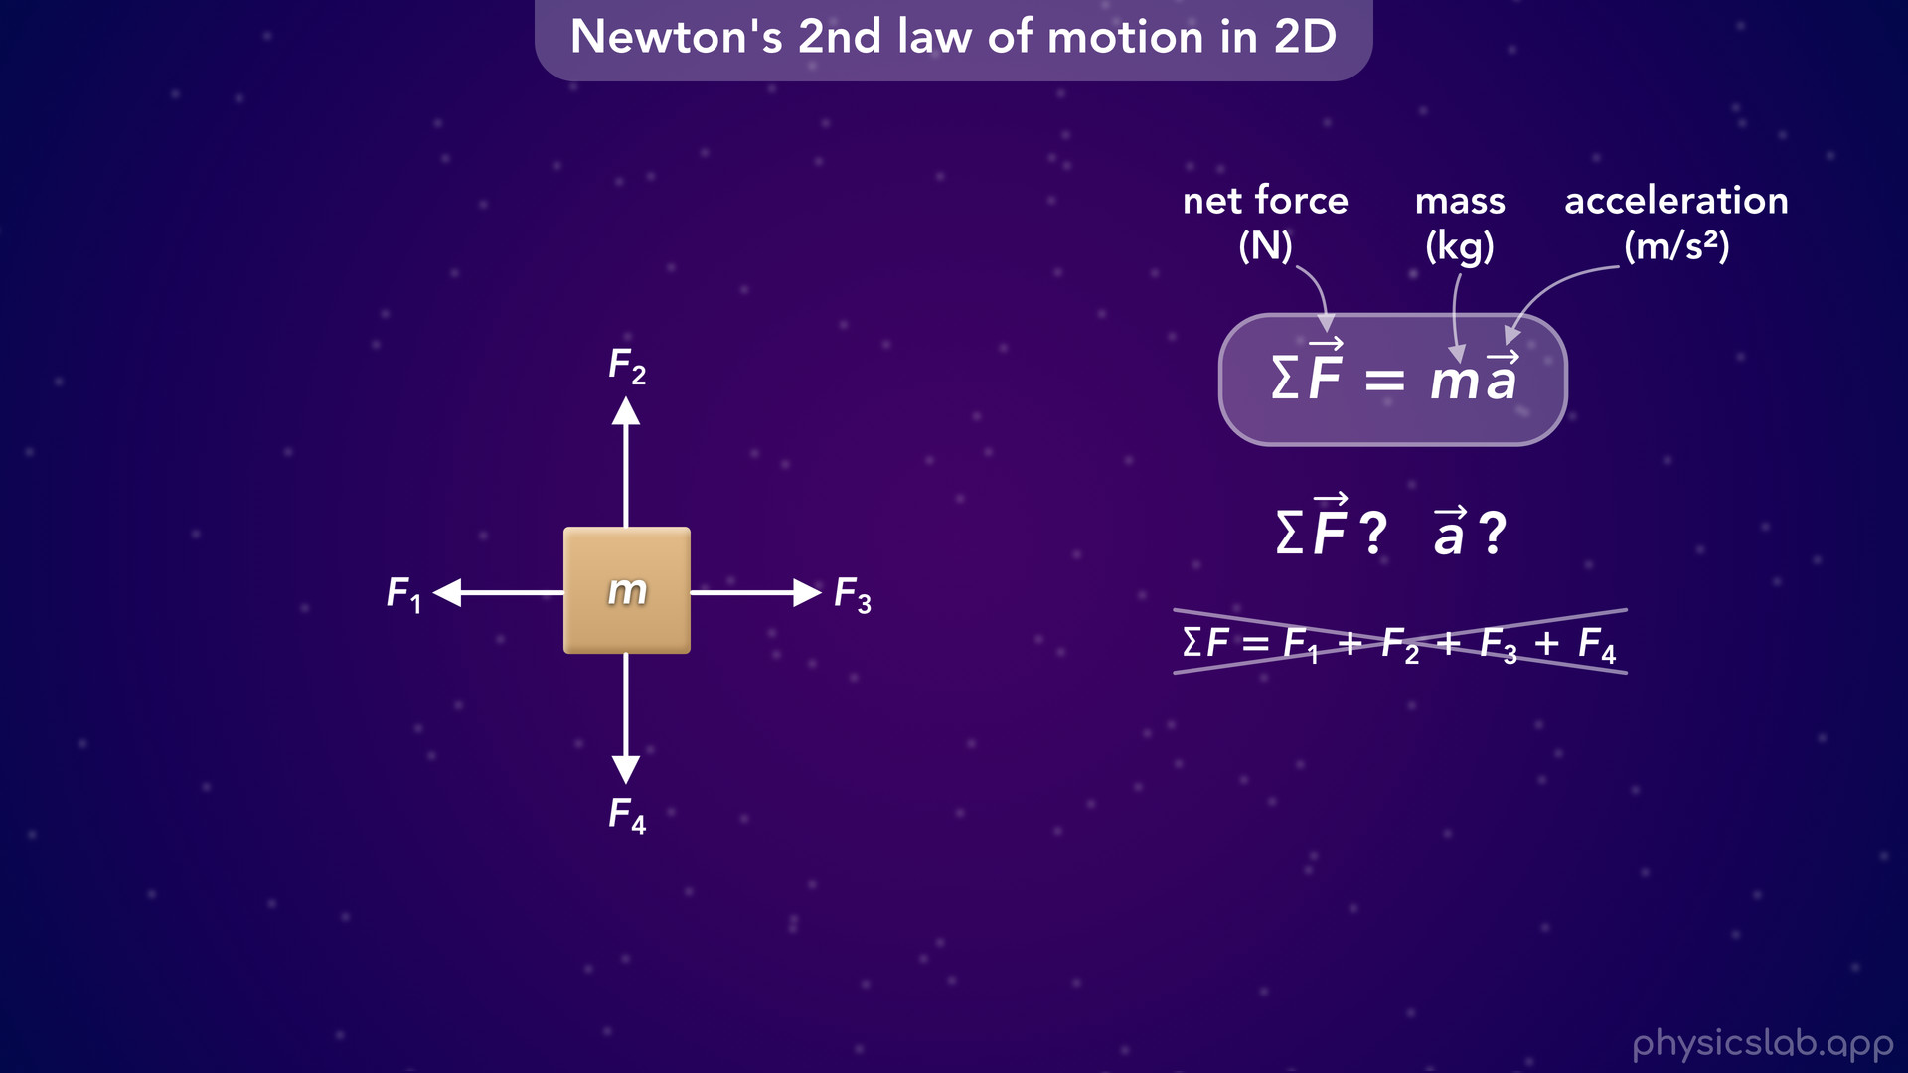
Notes:
• We might think about adding the magnitudes of all the forces together to get the net force. But we can’t actually do that in two dimensions.

Slide 29
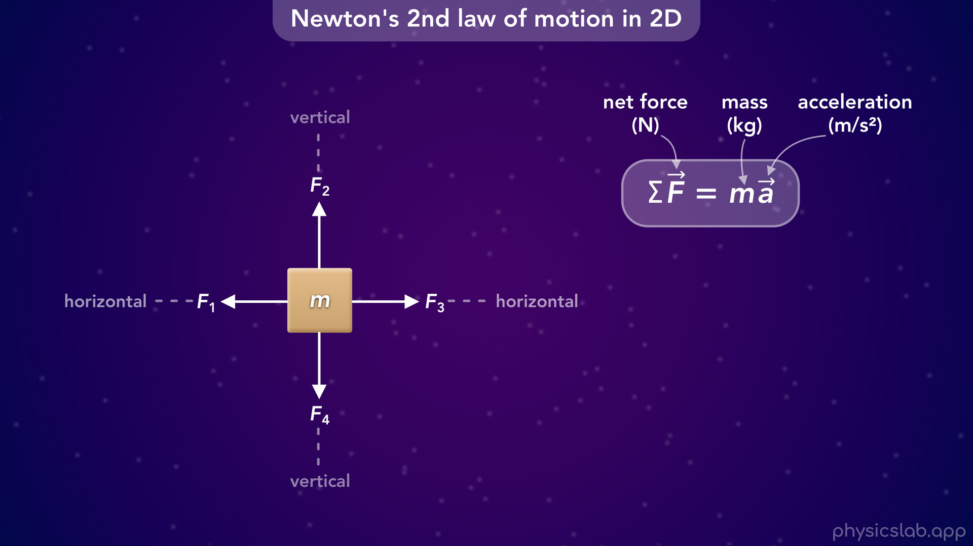
Notes:
• We can only add or subtract the values of the forces along the same axis or the same line.

Slide 30
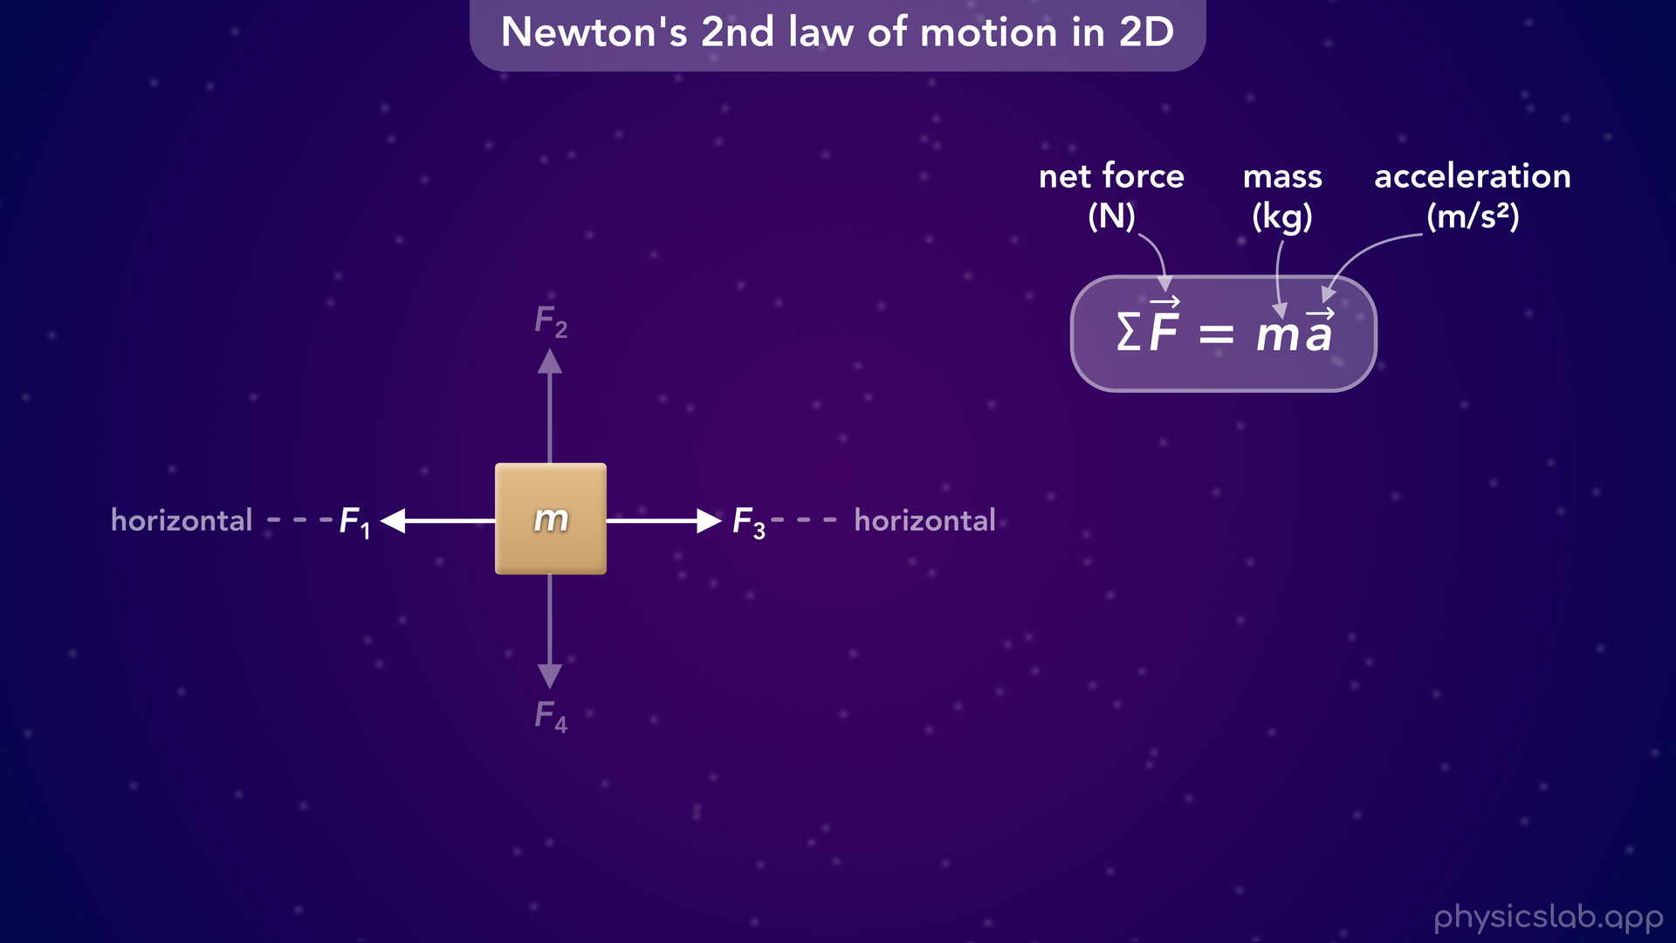
Notes:
So we can add forces 1 and 3 together because they’re both in the horizontal direction.

Slide 31
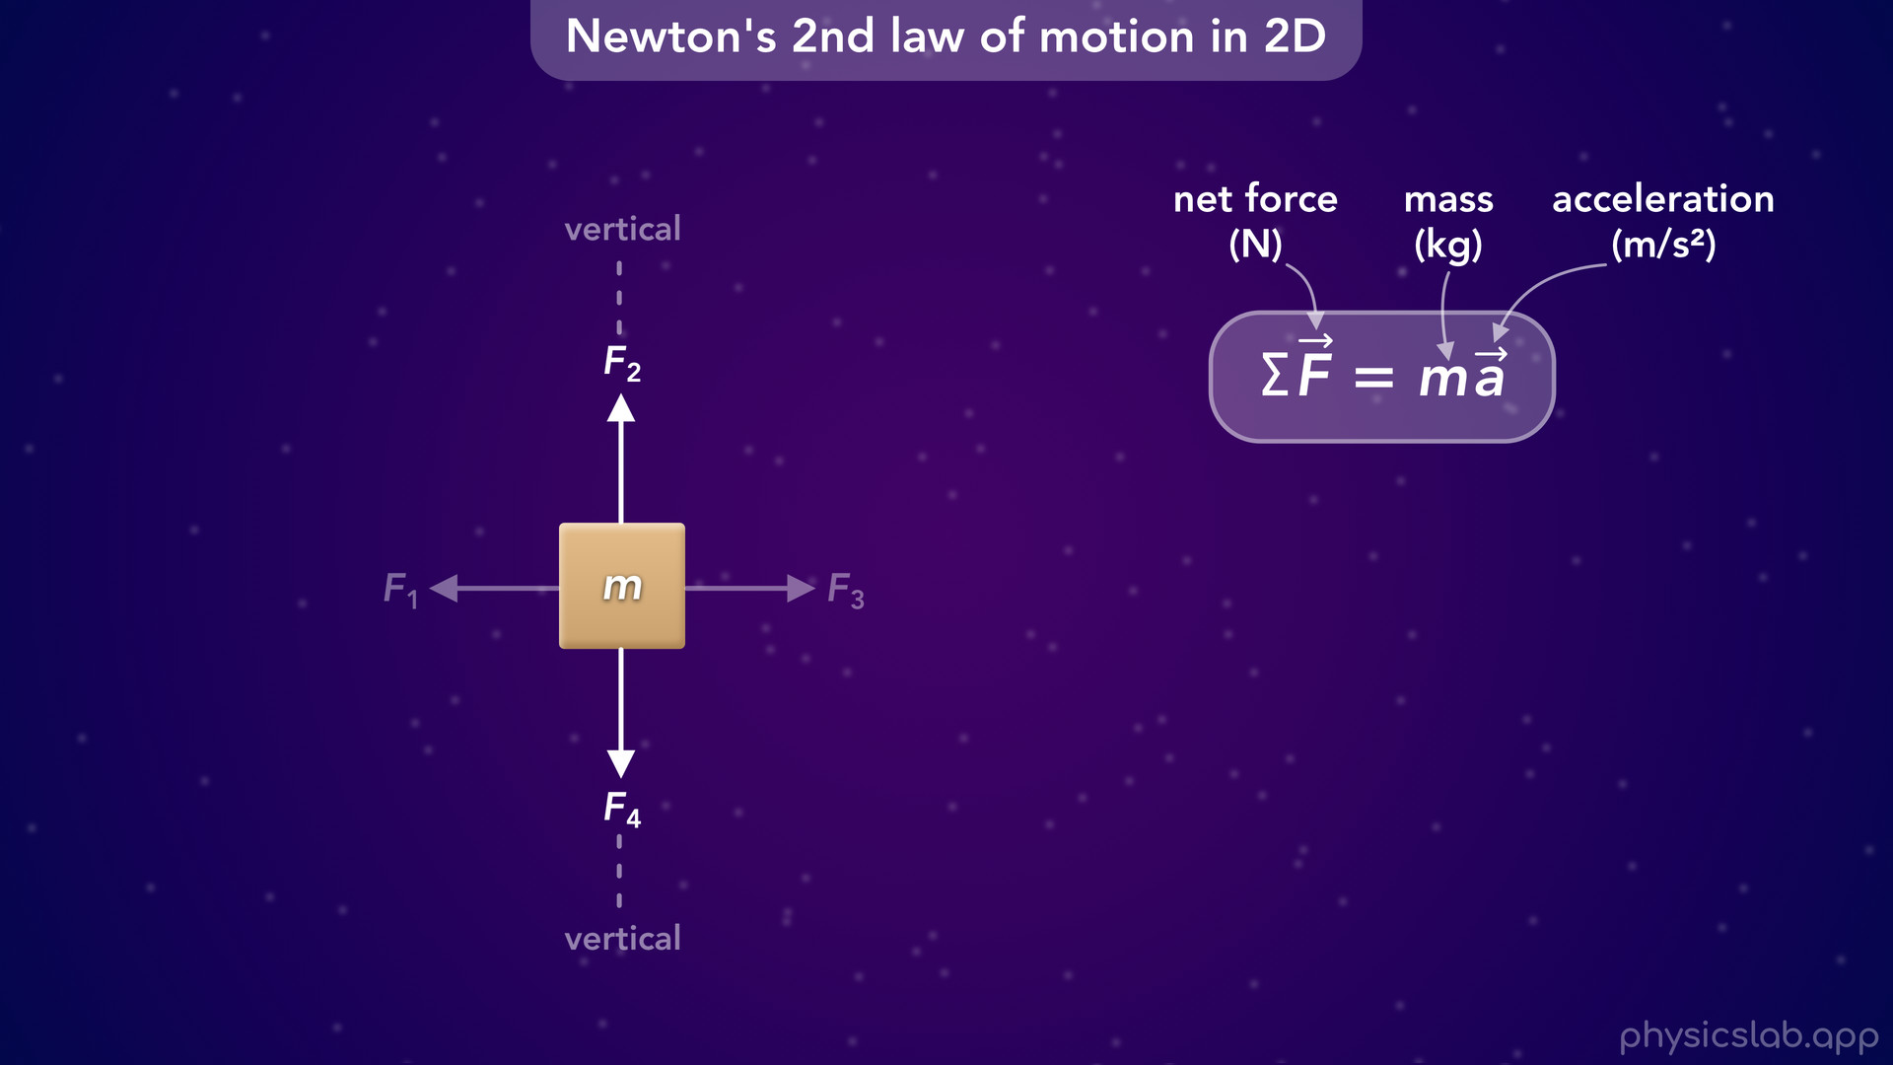
Notes:
And separately, we can add forces 2 and 4 together because they’re both in the vertical direction.

Slide 32
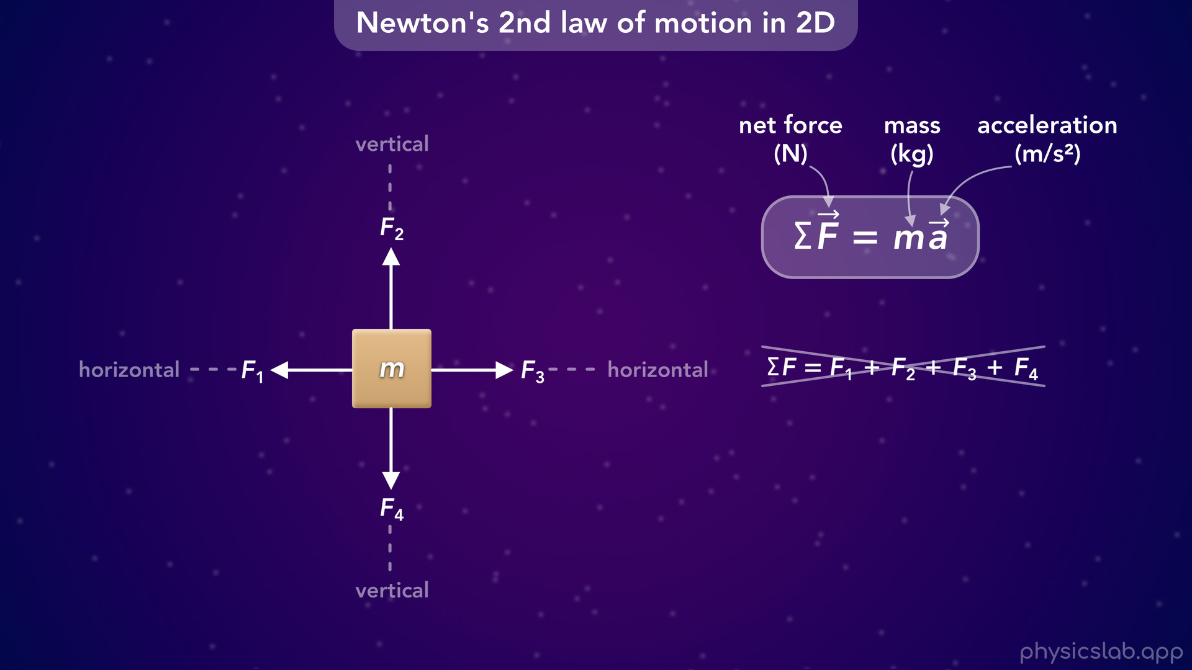
Notes:
• But we can’t add forces 1 and 3 with forces 2 and 4. So what do we do?

Slide 33
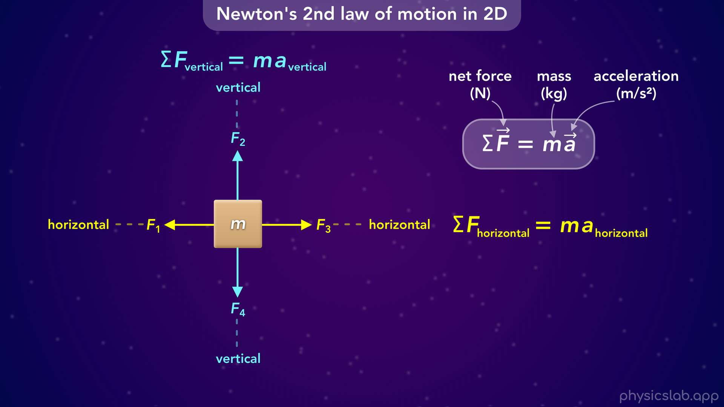
Notes:
• Well, we just focus on each direction separately and we write Newton’s 2nd law for each one.

Slide 34
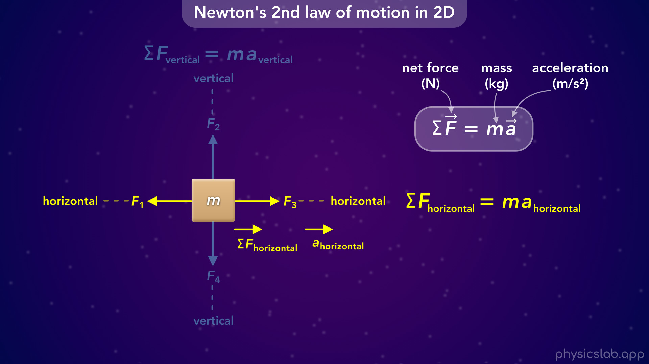
Notes:
• Let’s look at the horizontal direction. Newton’s 2nd law says that the net force in the horizontal direction is equal to the mass times the acceleration in the horizontal direction. This is basically what we did in the last video, where we only focused on one dimension.
• Even though we don’t know the values of forces 1 and 3, they’re gonna result in some net force to the left or the right, which will cause the box to accelerate in that direction. Or it won’t accelerate if the forces cancel out.

Slide 35
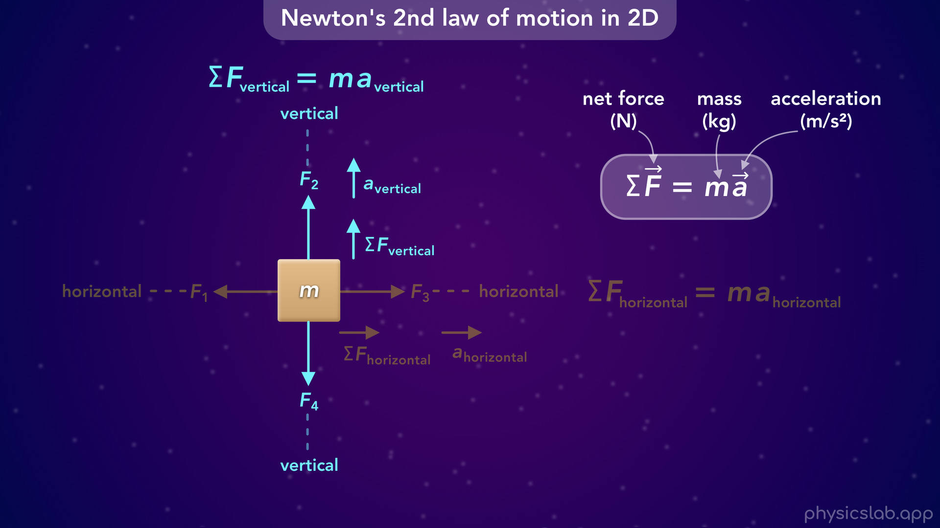
Notes:
• And we can do the same thing for the vertical axis. Forces 2 and 4 will result in a net force up or down, which will cause the box to accelerate in that direction.

Slide 36
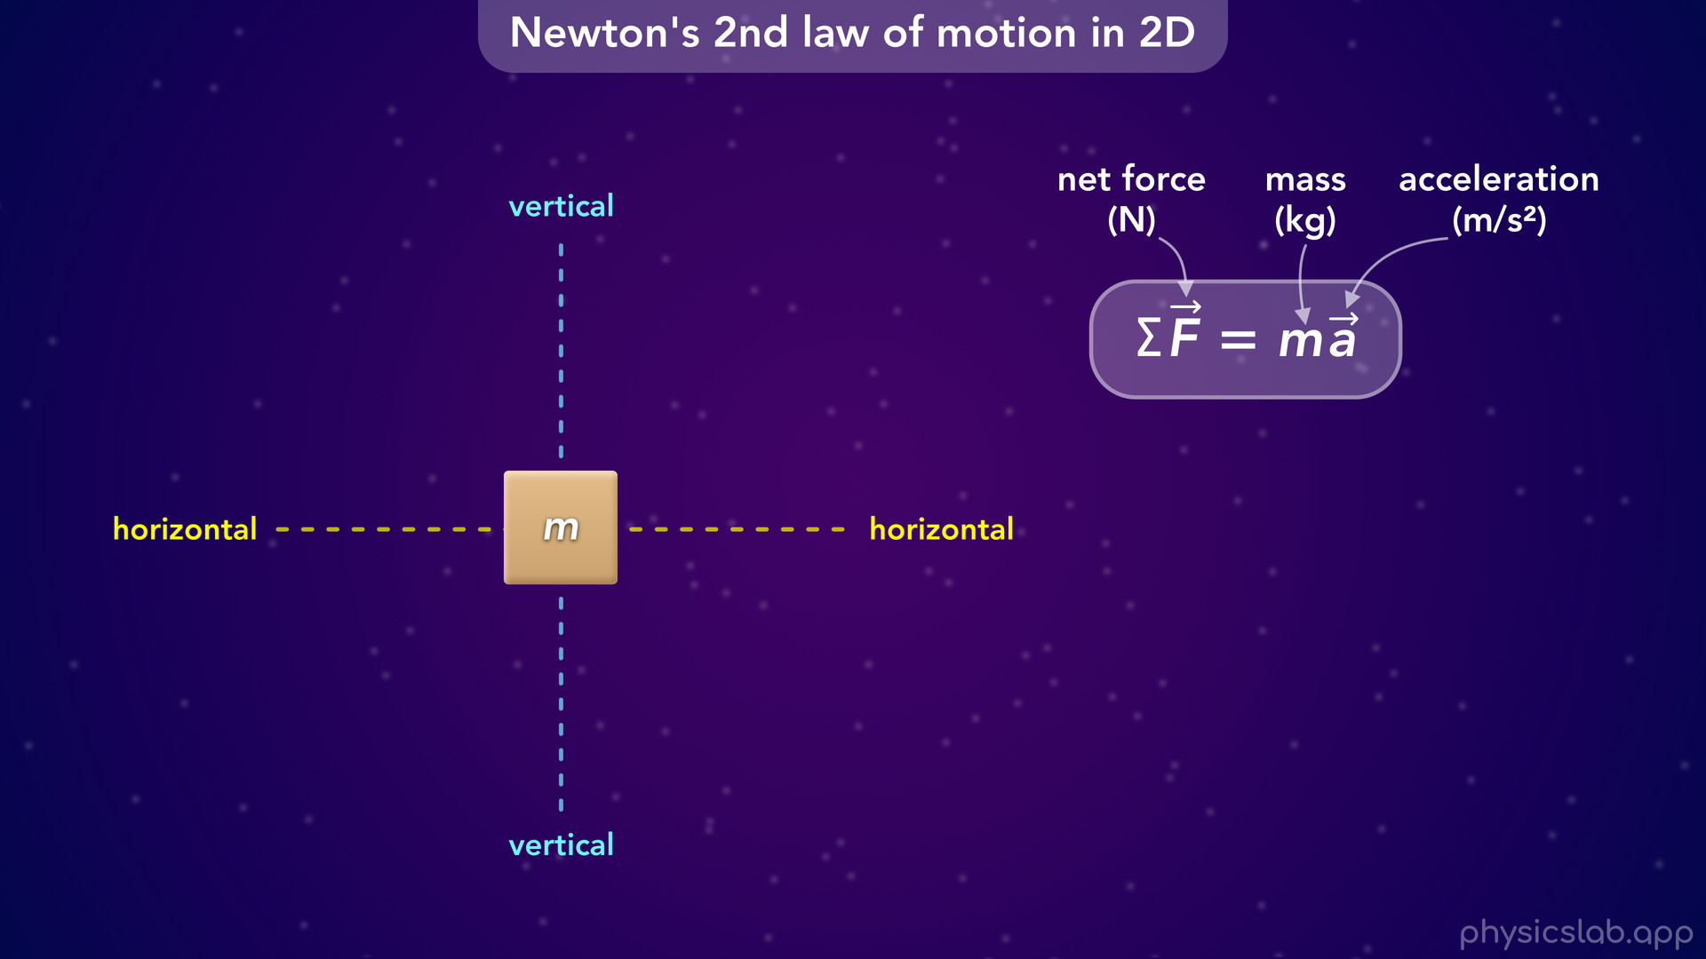
Notes:
• Instead of calling these the horizontal axis and the vertical axis…

Slide 37
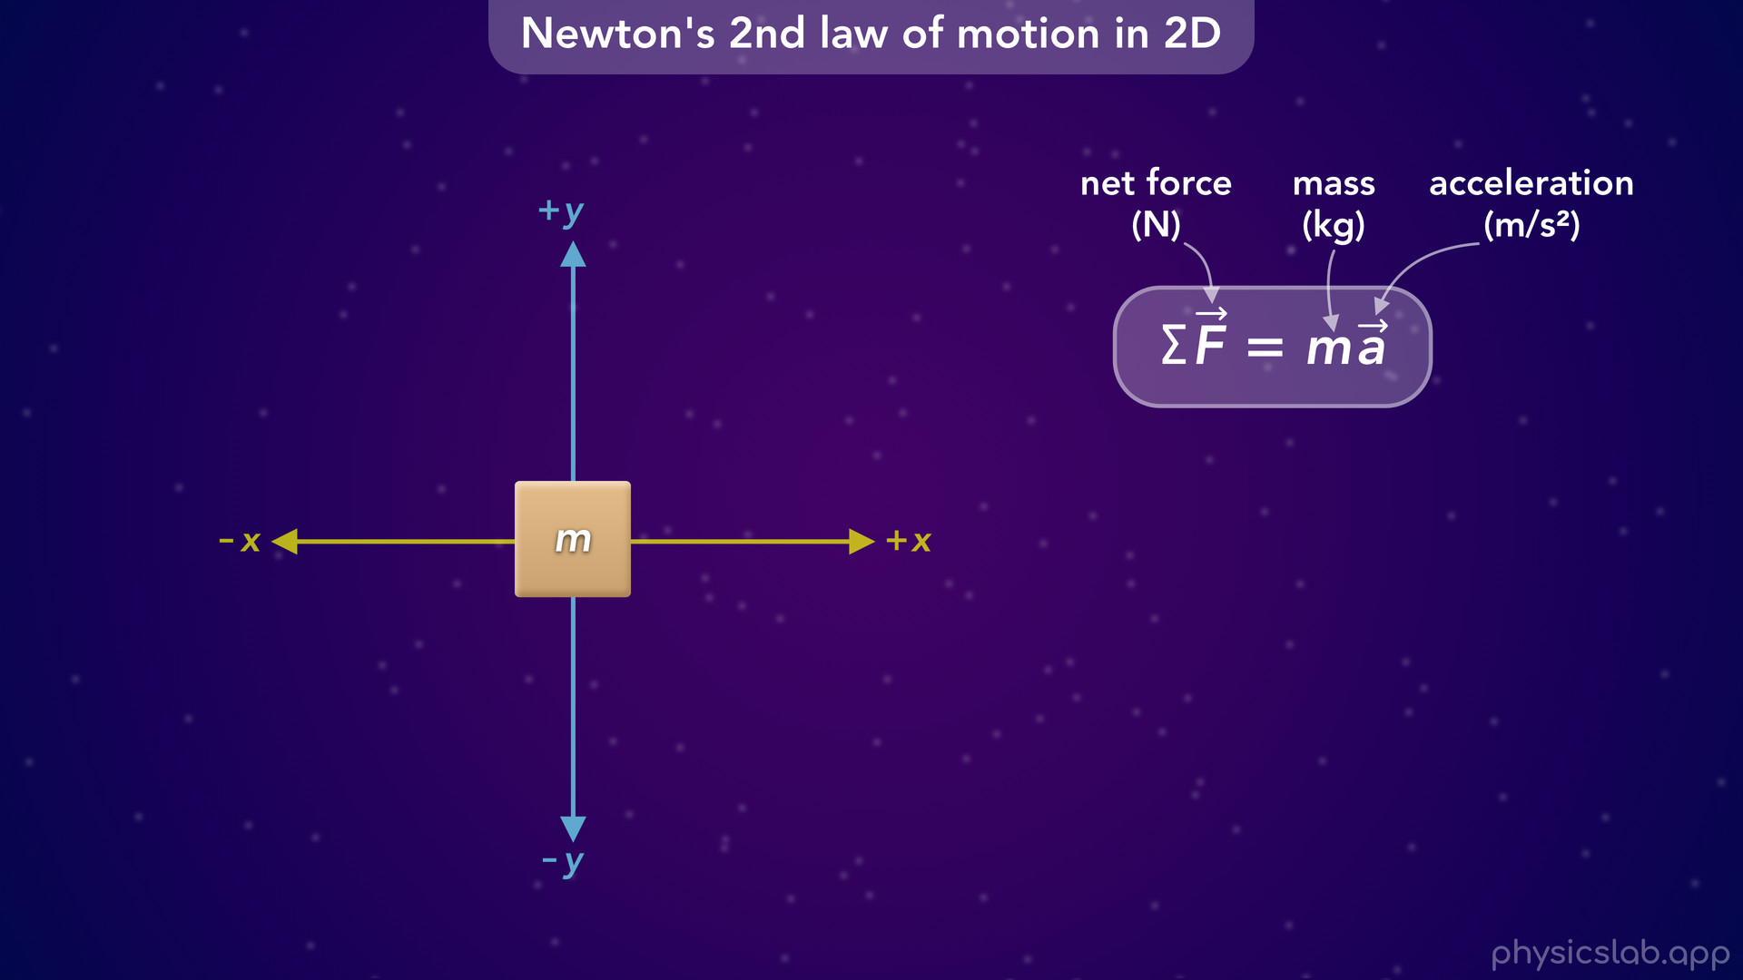
Notes:
• … we’re going to call them the x axis and the y axis, just like we did in kinematics. The x axis is usually horizontal and the y axis is usually vertical.

Slide 38
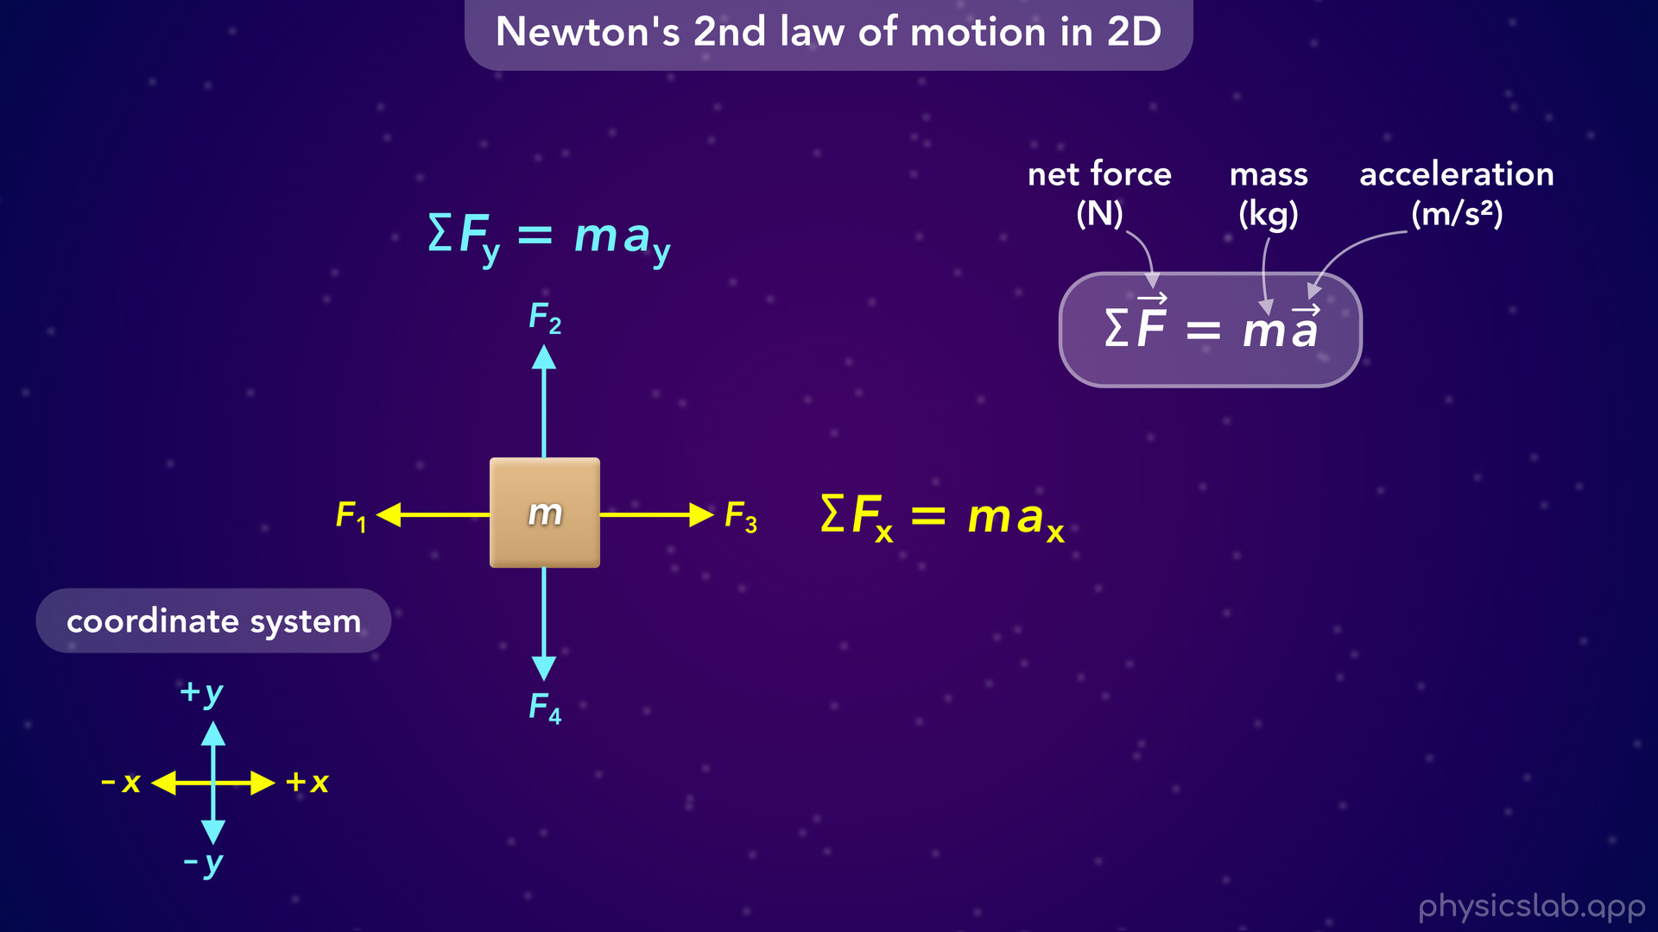
Notes:
• So now we can say the net force in the x direction is equal to the mass times the acceleration in the x direction. And the net force in the y direction is equal to the mass times the acceleration in the y direction.
• We call the x and y axes the coordinate system, and drawing the coordinate system will be the first step when solving problems.
• This is what determines which forces are acting in the x and y directions, and which forces are positive and negative when we calculate the net force.

Slide 39
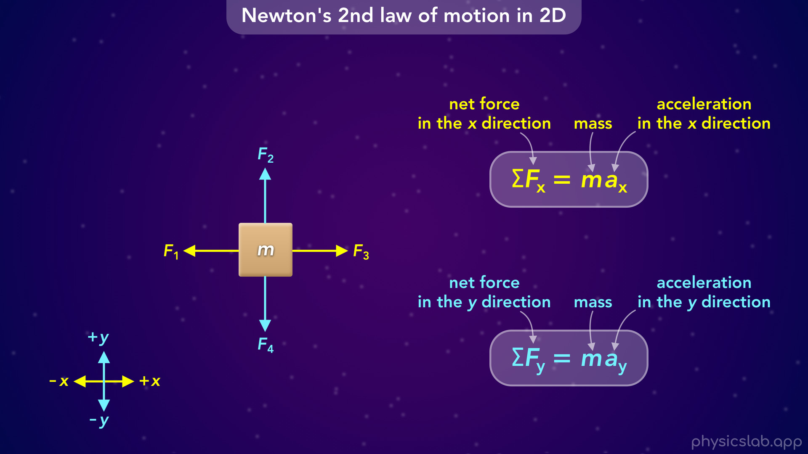
Notes:
• So this how we’re going to use Newton’s 2nd law in two dimensions.
• We’re just splitting it up into two equations, one for the x axis and one for the y axis. And the mass is the same for both equations.

Slide 40
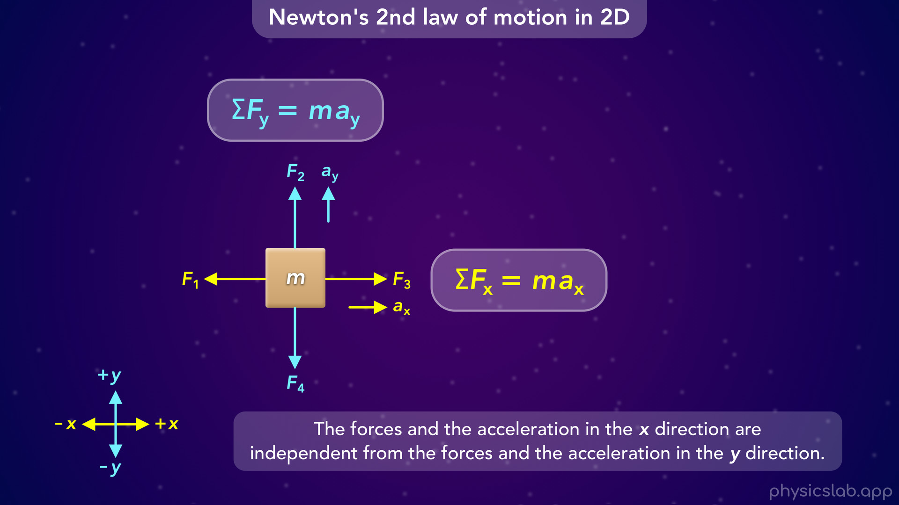
Notes:
• Just like we learned when working with projectile motion, the x and y directions are independent.
• So, the force and the acceleration in the x direction are independent from the forces and the acceleration in the y direction.

Slide 41
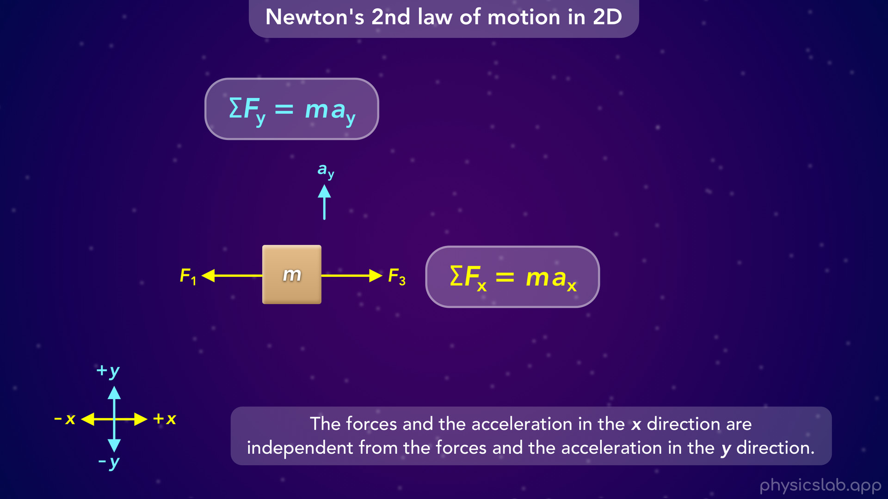
Notes:
• The horizontal forces do not not affect the vertical acceleration

Slide 42
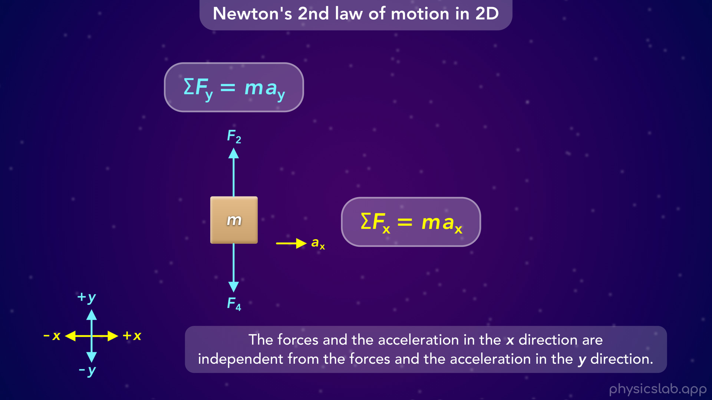
Notes:
and the vertical forces do not affect the horizontal acceleration.

Slide 43
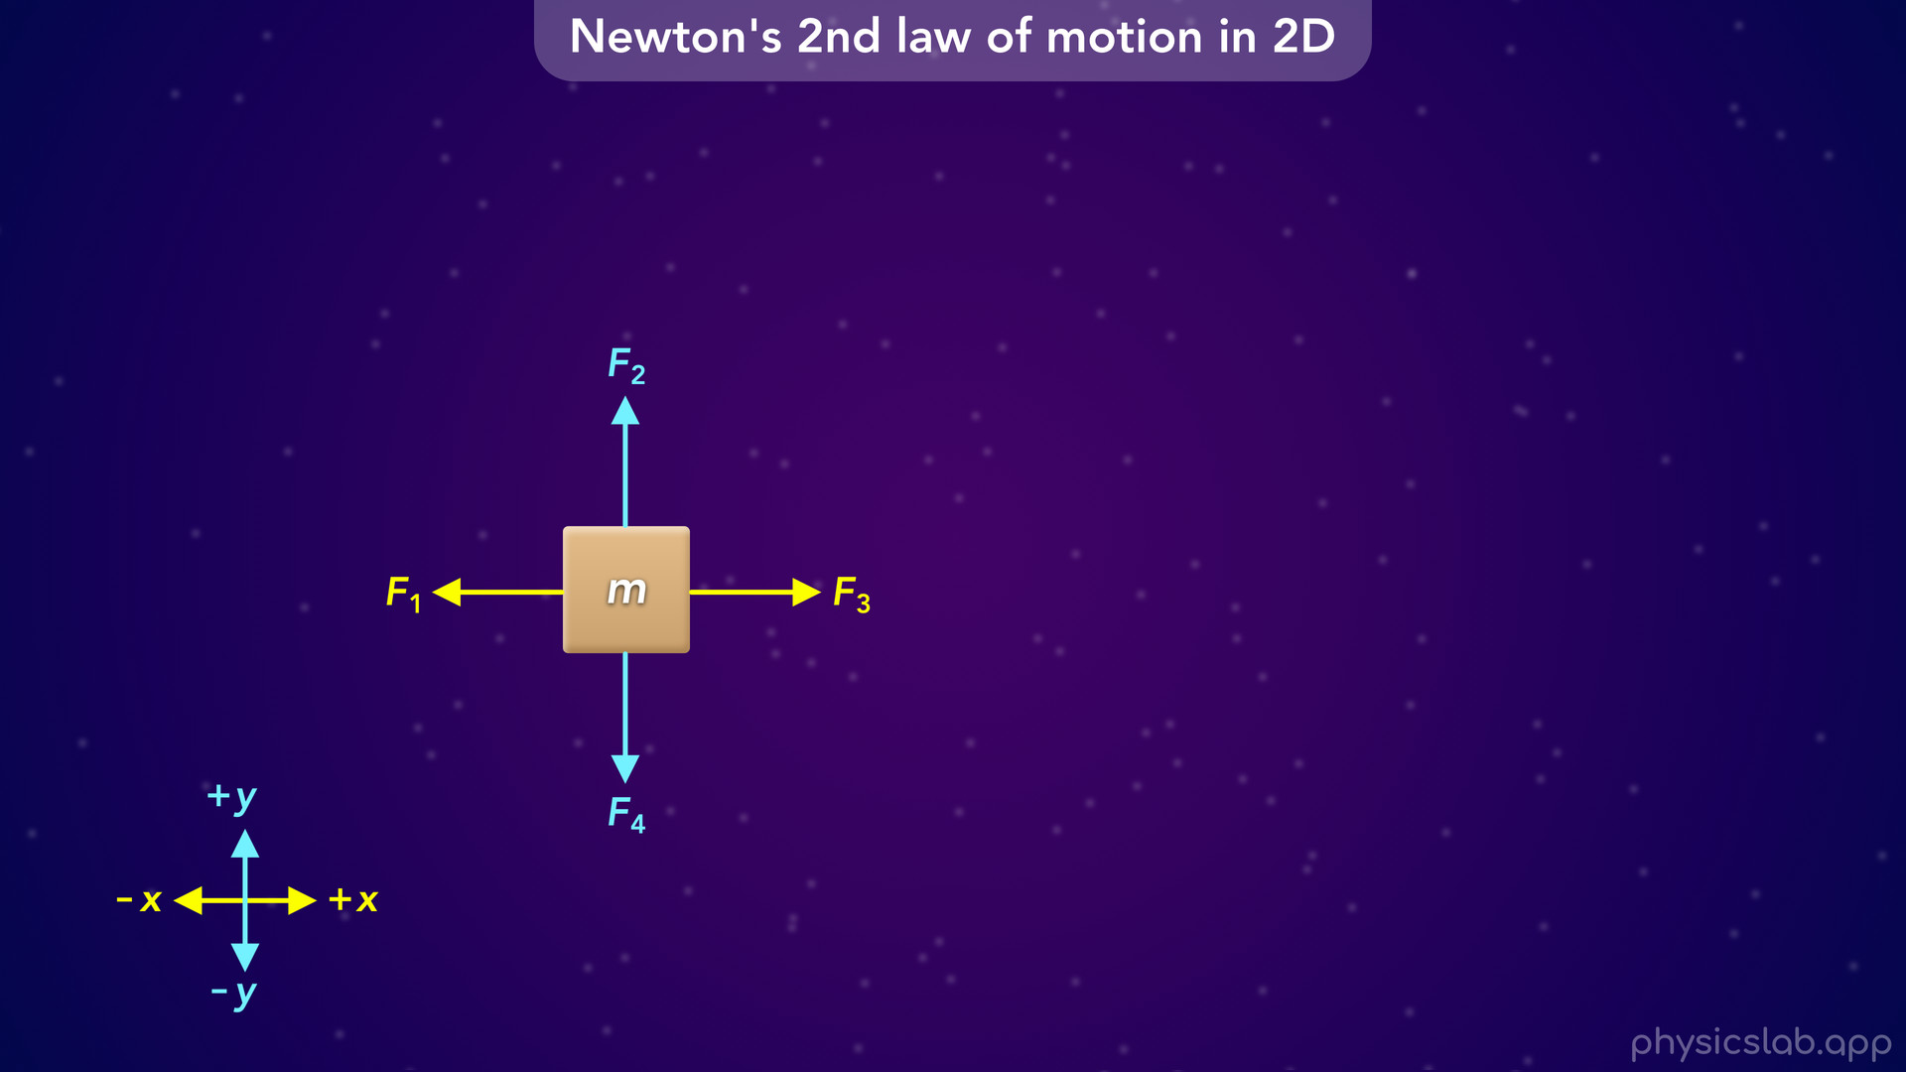
Notes:
• Alright so what does this look like using these forces?

Slide 44
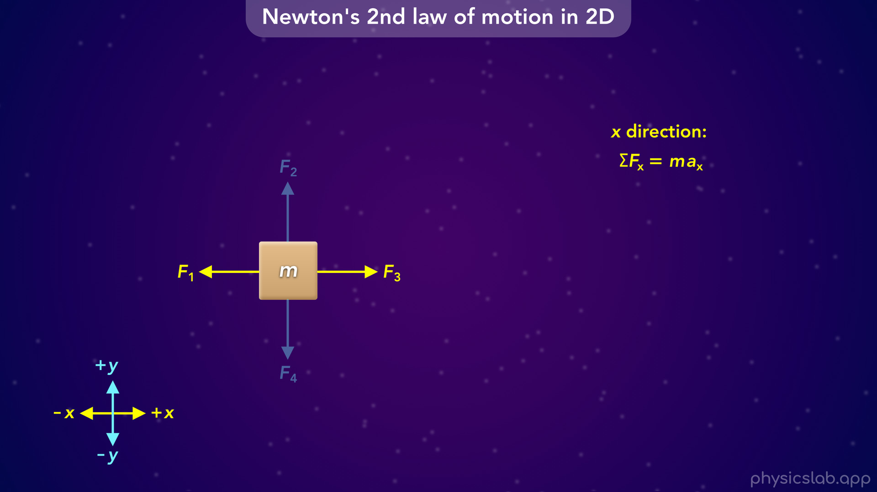
Notes:
• Let’s start with the x direction.
• The left side of this equation is the net force. Technically, we’re always adding the forces together.

Slide 45
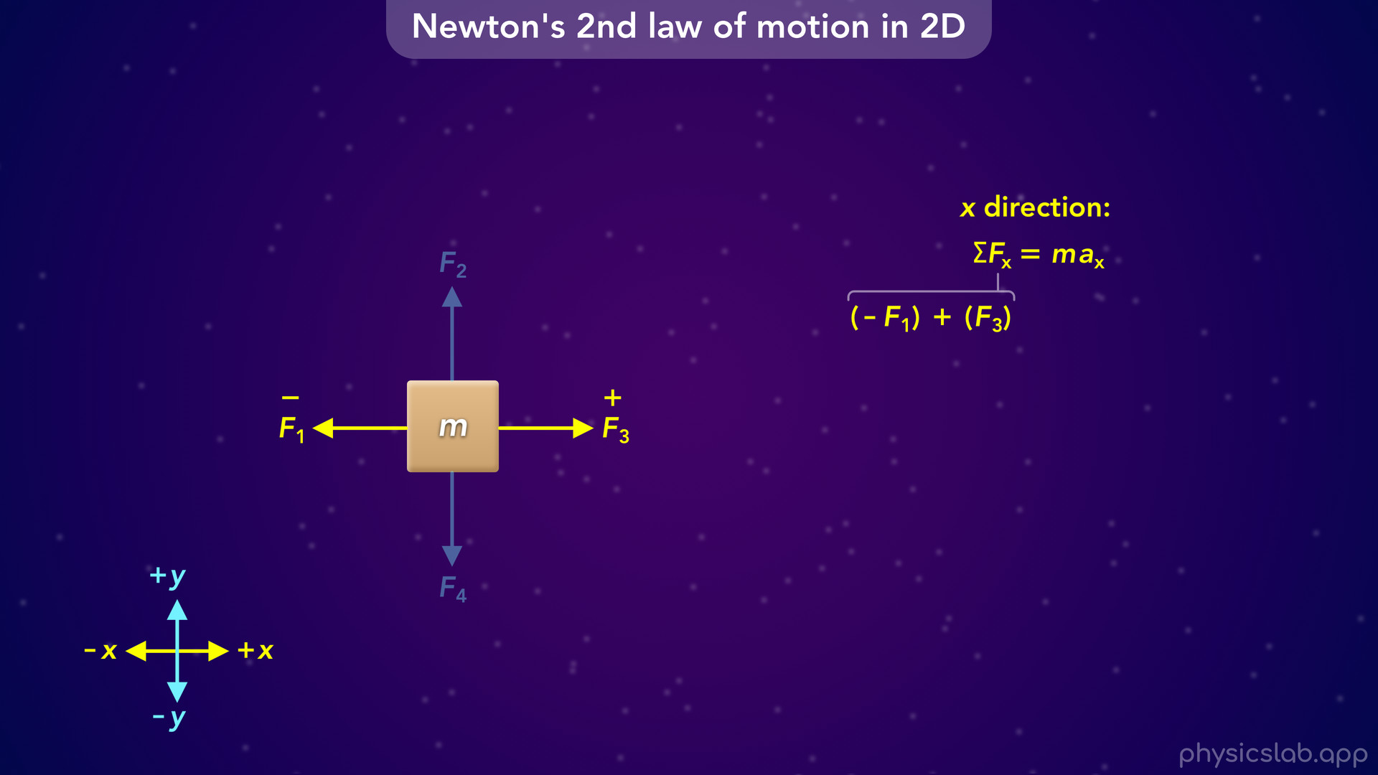
Notes:
But now that we established our coordinate system, F1 is pointing to the left, which is the negative x direction, so F1 is negative. F3 is pointing to the right, which is the positive x direction, so F3 is positive. So we can write the net force as negative F1 plus positive F3.

Slide 46
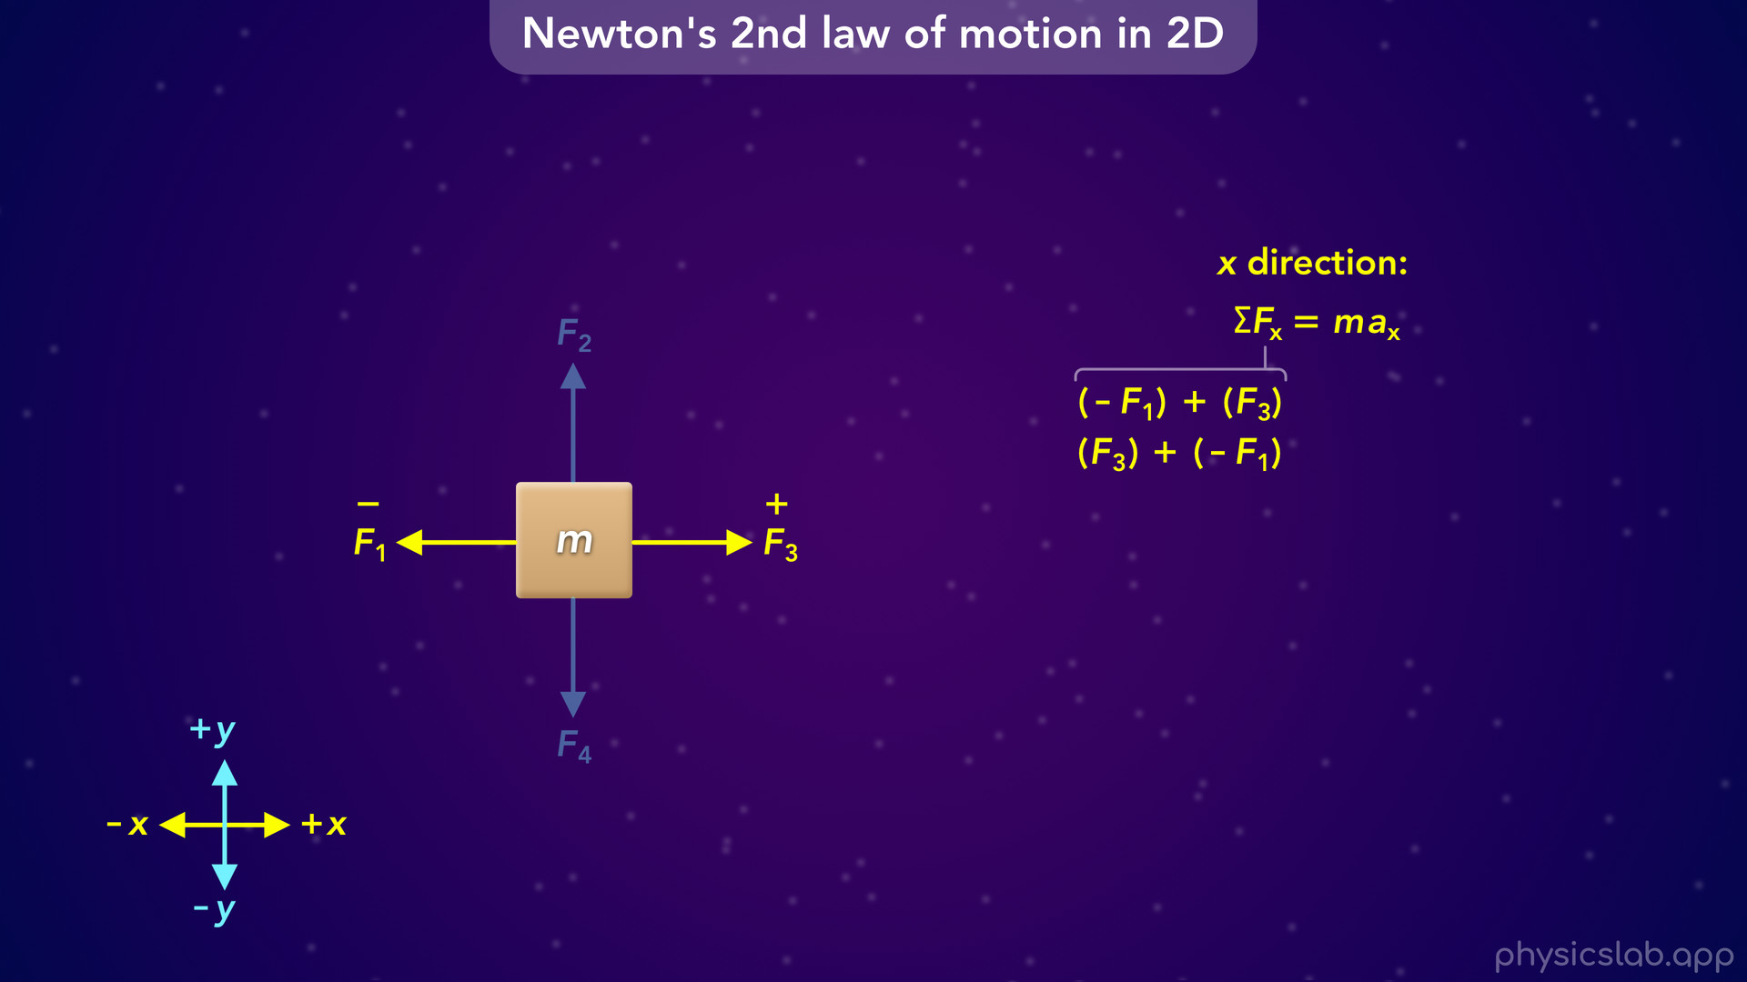
Notes:
The order doesn’t matter, so we could write positive F3 plus negative F1. Again, we’re adding the forces, but each force might be positive or negative based on its direction.

Slide 47
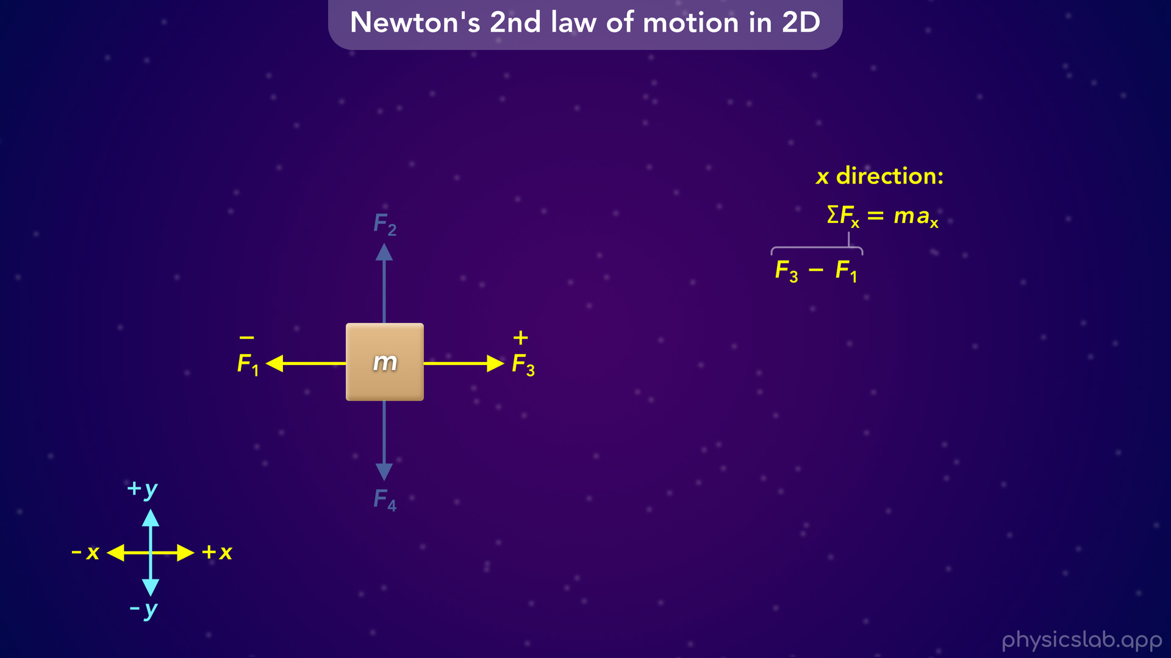
Notes:
• You can also think of it as adding all of the positive forces to the right, and then subtracting all of the negative forces to the left.
• But either way, this is the net force in the x direction

Slide 48

Notes:
which is equal to the mass times the acceleration in the x direction.

Slide 49
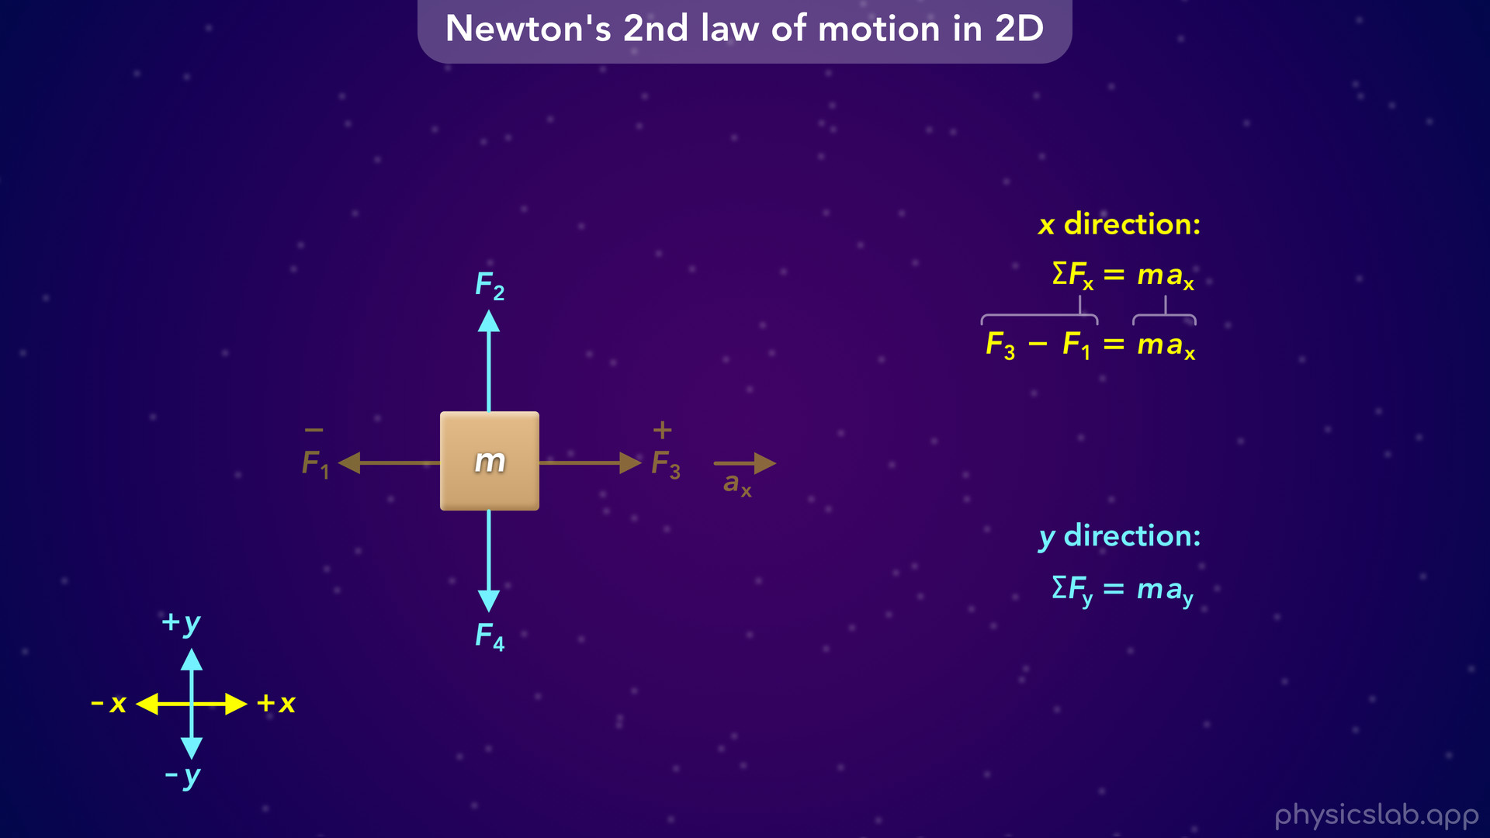

Slide 50
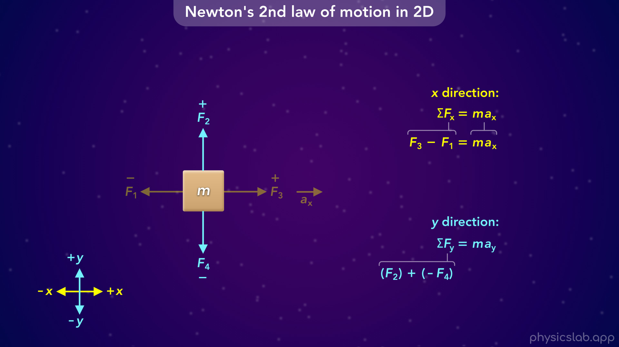
Notes:
• For the y direction, F2 is pointing up which is the positive y direction, so F2 is positive. F4 is pointing down, in the negative y direction, so F4 is negative. So the net force in the y direction is positive F2 plus negative F4.

Slide 51
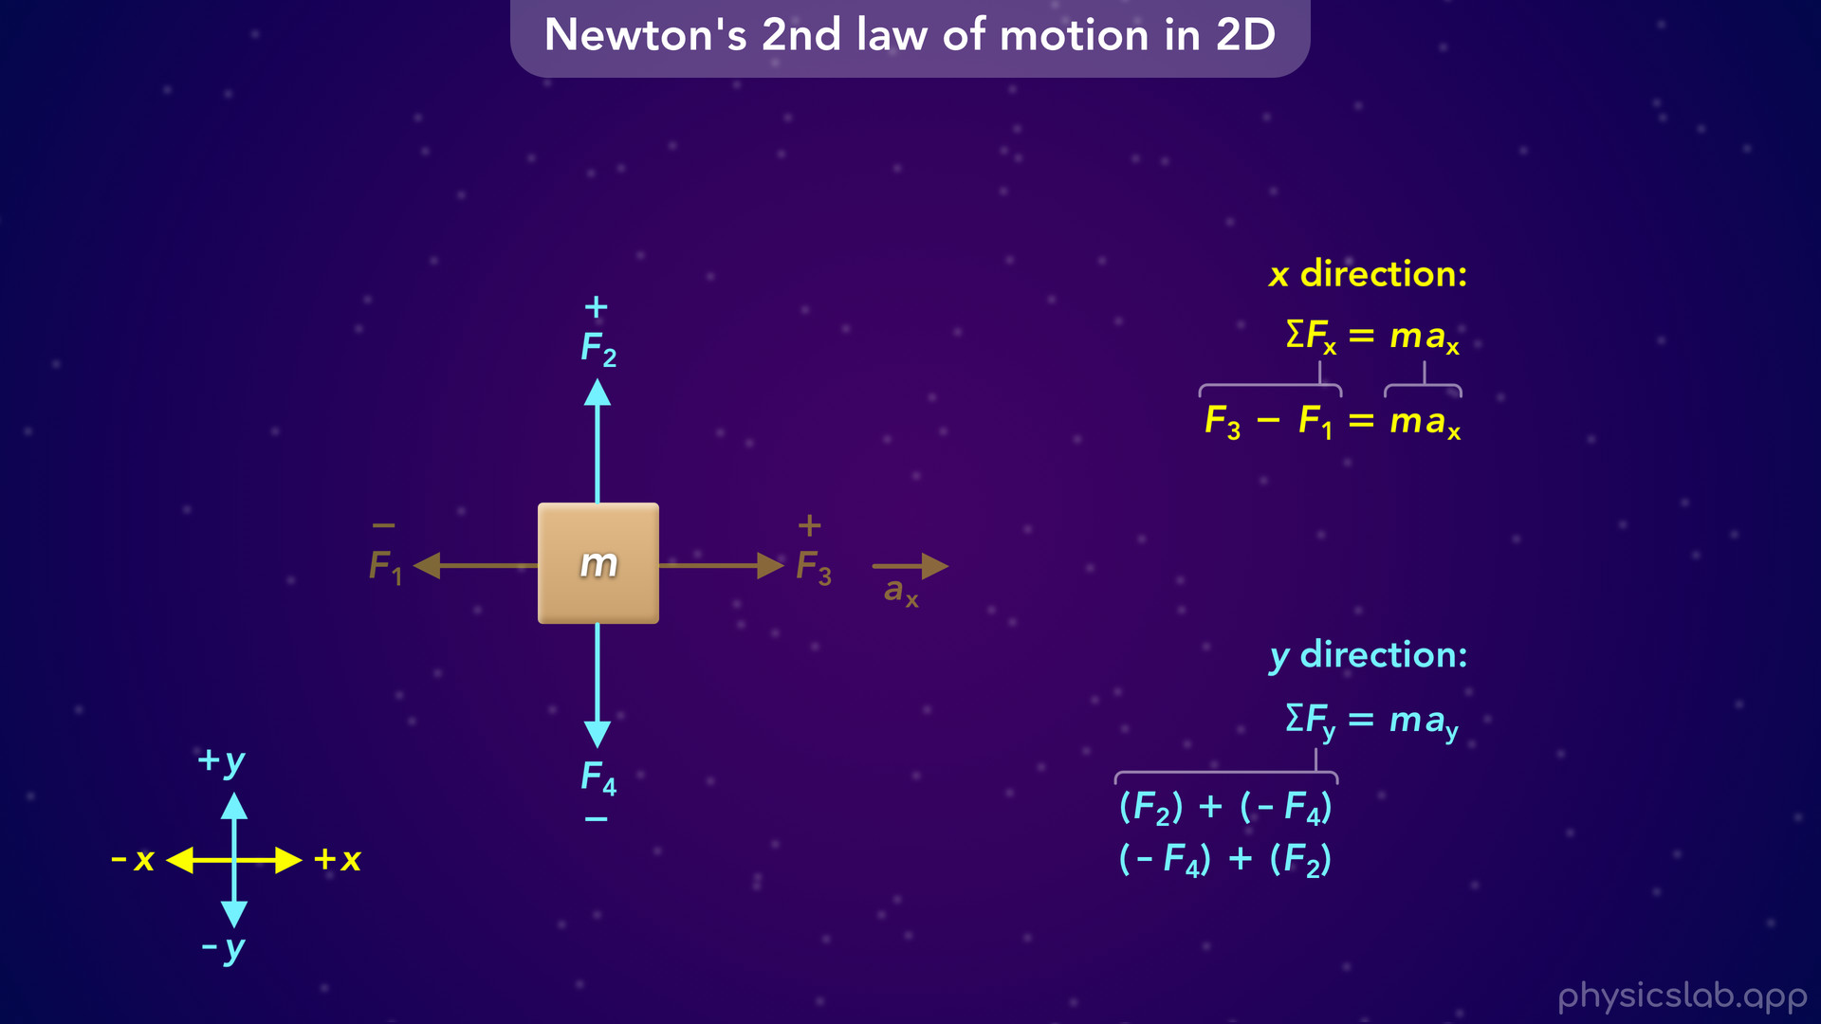
Notes:
We can also write this as negative F4 plus positive F2, or just F2 minus F4.

Slide 52
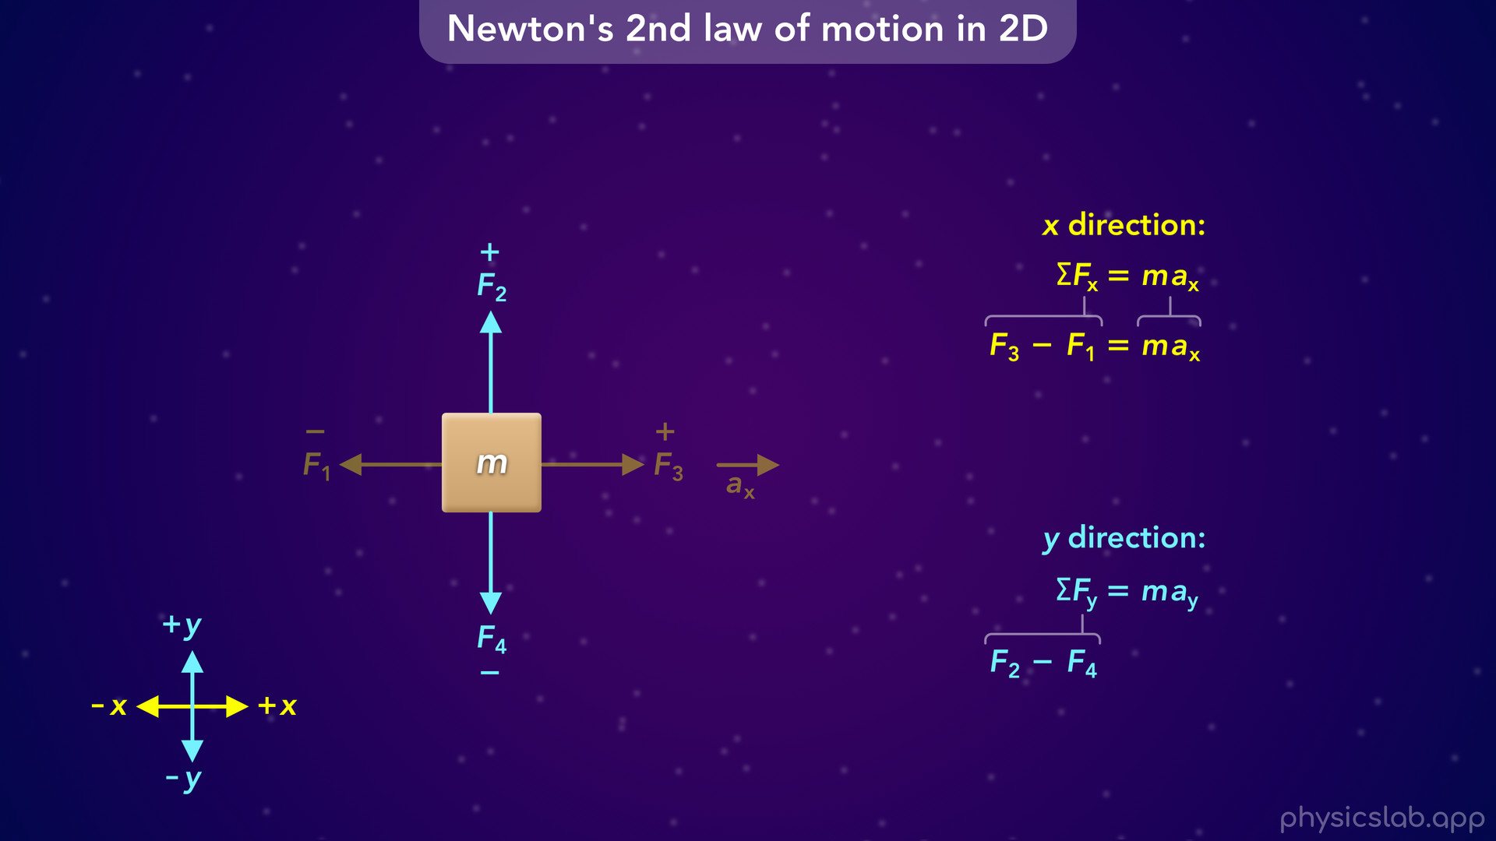
Notes:
That’s the net force in the y direction

Slide 53
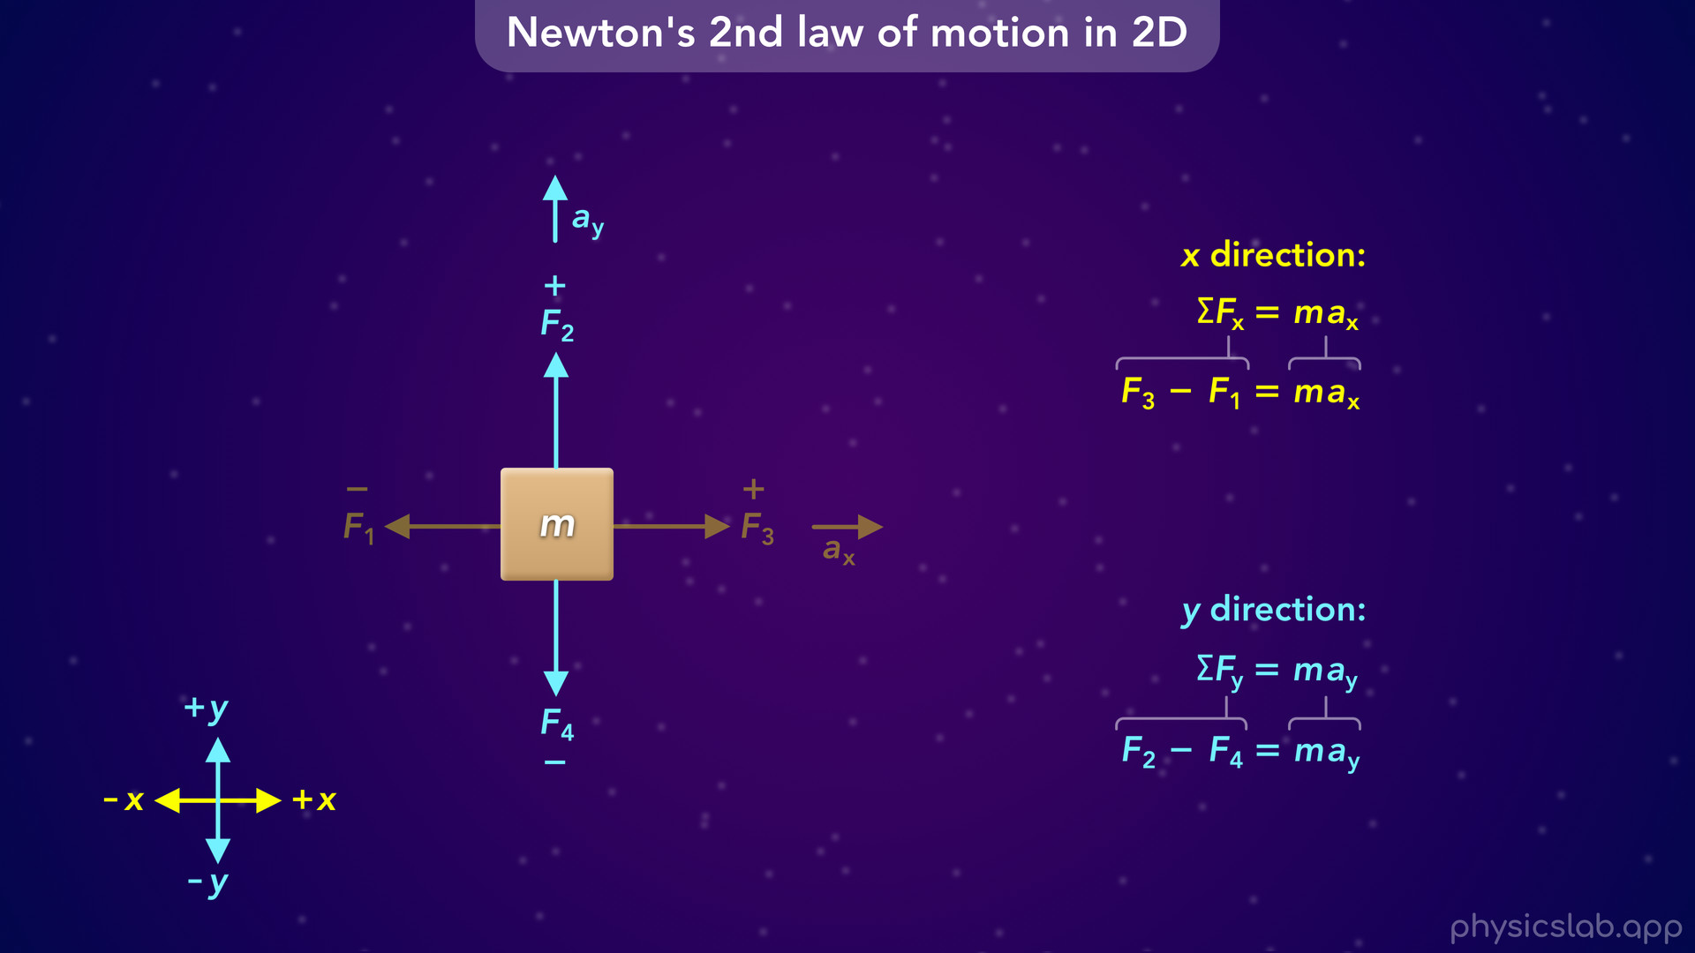
Notes:
which is equal to the mass times the acceleration in the y direction.

Slide 54
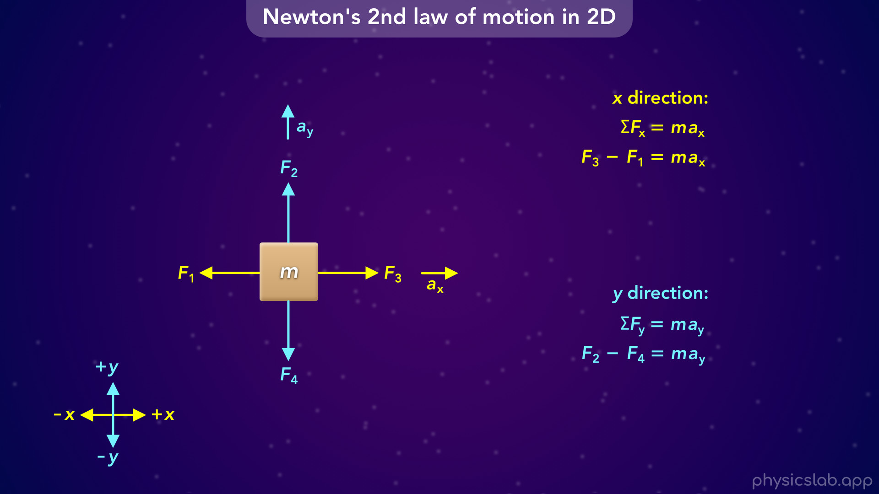
Notes:
• And that’s it, that’s how we apply Newton’s 2nd law in two dimensions.
• It might seem like we haven’t really done anything, because we don’t have any numbers and we didn’t answer any questions.
• But this is how we’re gonna start every problem that involves forces.

Slide 55
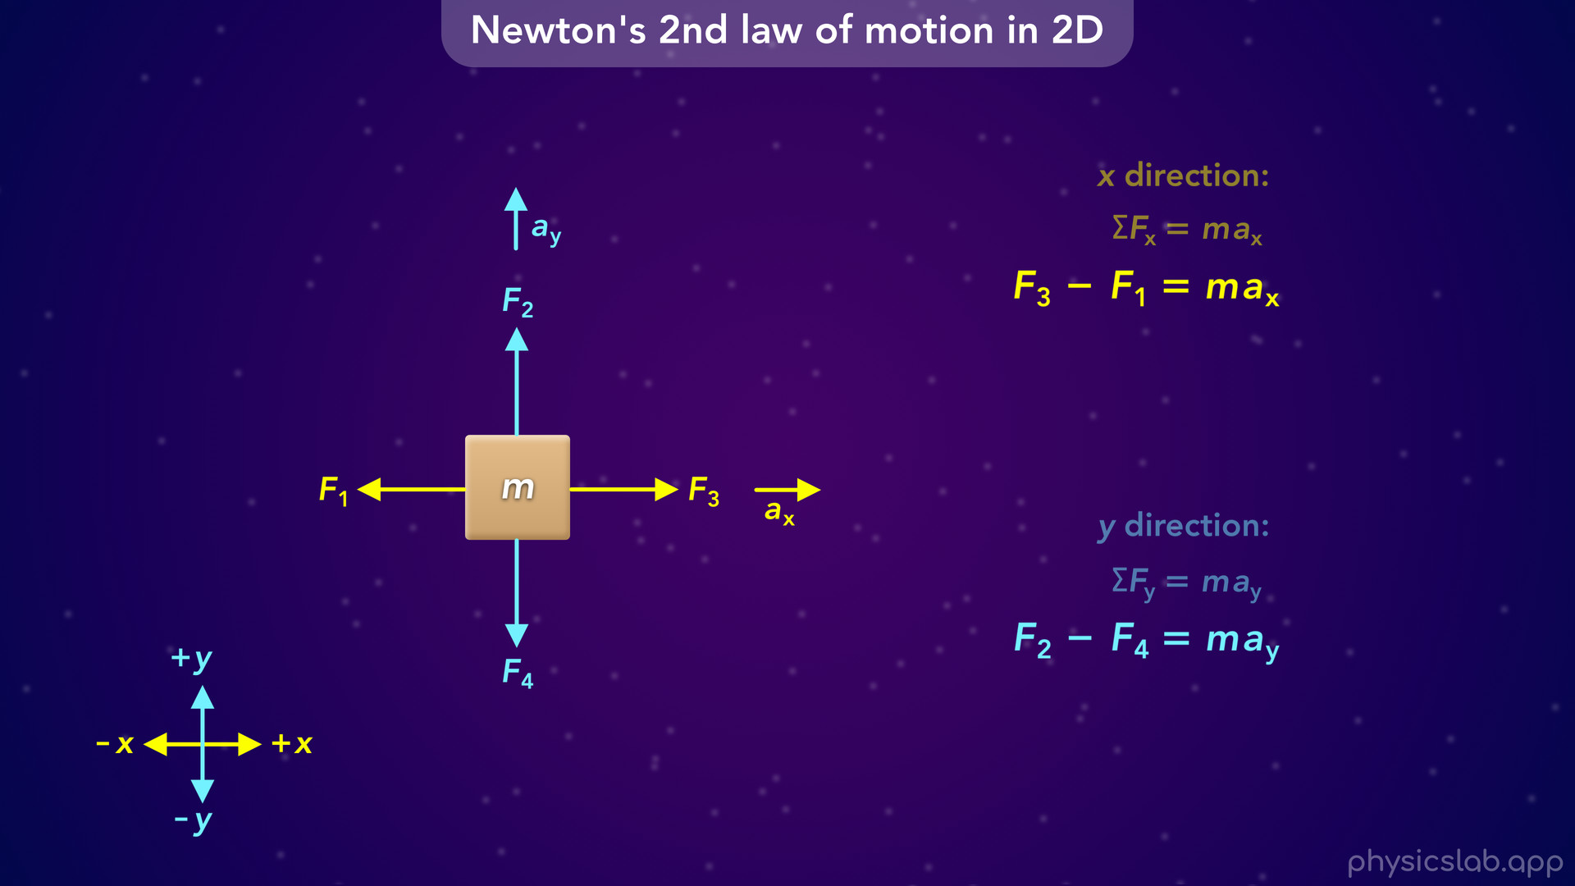
Notes:
The point of applying Newton’s 2nd law is to get these two equations, which will be different for each scenario. Once we have these equations, the physics problem just becomes an algebra problem. We’ve turned the physical scenario into two equations, and we can plug in values that we’re given and then solve for an unknown variable.

Slide 56

Notes:
• So if we were given the two forces and the acceleration in the x direction, we could solve for the mass because it’s the only unknown variable in that equation.

Slide 57

Notes:
• Or if we were given one force, the mass and the acceleration in the y direction, we could solve for the unknown force, F4.

Slide 58
Notes:
• So we don’t just use Newton’s 2nd law to find a particular thing, we use it in every scenario to get those two equations. Then we can solve for whatever the question is asking for.

Slide 59

Notes:
• So let’s walk through through an example using numbers.
• A 5 kg box has multiple forces acting on it as shown below. What is the magnitude and direction of the acceleration of the box in the x direction? So what is the value of the acceleration, and is it right or left?
• Pause the video and try answering this question on your own.

Slide 60

Notes:
• First, we want to establish our coordinate system. Again, we usually say right is the positive x direction and up is the positive y direction.
• Based on that, the 55 N force is in the positive x direction, the 40 N force is in the negative x direction, the 20 N force is in the positive y direction, and the 30 N force is in the negative y direction.

Slide 61

Notes:
• The question is asking for the acceleration in the x direction, so let’s write out Newton’s 2nd law in the x direction.

Slide 62

Notes:
• The left side of the equation is the net force, which would be 55 N minus 40 N. Again, you could also write this as 55 N plus negative 40 N, or negative 40 N plus 55 N.

Slide 63

Notes:
• The right side of the equation is the mass times the acceleration in the x direction. We can plug in 5 kg for the mass but we don’t know the acceleration, that’s what we’re trying to find.

Slide 64

Notes:
• Next, we can simplify the left side, 55 minus 40 would be 15 N. So the net force in the x direction is positive 15 N, which is 15 N to the right because right is the positive x direction.

Slide 65

Notes:
• If we divide both sides by 5 kg, then the acceleration is equal to 15 N divided by 5 kg which gives us 3 m/s². Remember, a Newton is equal to 1 kg m/s². And if we divide Newtons by kg we get m/s².

Slide 66

Notes:
• So that’s answer to this question. The magnitude of the acceleration in the x direction is 3 m/s². Since the value we got is positive, it must be accelerating to the right because right is the positive x direction.

Slide 67

Notes:
• Now let’s answer the same question but find the acceleration in the y direction.
• Pause the video and see if you can solve it first.

Slide 68

Notes:
• So now we want to use Newton’s 2nd law in the y direction.

Slide 69

Notes:
• The net force would be 20 N minus 30 N. Or we could say 20 N plus negative 30 N, or negative 30 N plus 20 N.

Slide 70

Notes:
• We still plug in 5 kg for the mass, and we wanna find the acceleration.

Slide 71

Notes:
• The left side is 20 minus 30 which is -10 N. So the net force in the y direction is negative 10 N, which is 10 N downwards because down is the negative y direction.

Slide 72

Notes:
• If we divide both sides by 5 kg, then the acceleration is -10 N divided by 5 kg which is -2 m/s². So the magnitude, or the absolute value, of the acceleration in the y direction is 2 m/s², and its direction is downwards.

Slide 73

Notes:
• So we have 5 kg box with these forces acting on it.

Slide 74

Notes:
We just found the net force and the acceleration in the x and y directions.
• But how is this box actually going to move? Will it accelerate to the right, or will it accelerate down?
• Well, it’ll do both. What we just found are the components of the actual acceleration vector. So now let’s answer this question: what is the magnitude and direction of the acceleration of the box? If we found the components, what is the actual acceleration vector?
• Pause the video and see if you can figure it out.

Slide 75

Notes:
• We learned in kinematics that we can combine the x and y components to form a right triangle where the vector is the hypotenuse. So if these are the x and y components of the acceleration, then the actual acceleration vector looks like this. And we can find the magnitude of the vector by using the pythagorean theorem.

Slide 76

Notes:
• If we plug in the values of the x and y components, we get 3.6 m/s² for the acceleration of the box. And the acceleration is in the direction of this vector.

Slide 77

Notes:
• Since we had already found the x and y components of the acceleration, that method was faster.

Slide 78

Notes:
• But we could have also combined the x and y components of the net force to find the actual net force vector.

Slide 79

Notes:
If we do that, we get 18 N for the magnitude of the net force.

Slide 80

Notes:
So we have 4 forces acting on this box, and the net force vector is 18 N in this direction.

Slide 81

Notes:
• Now that we have the magnitude of the net force vector, we can just use Newton’s 2nd law to find the acceleration vector.
• If we plug in 18 N for the net force and 5 kg for the mass, we get 3.6 m/s² for the magnitude of the acceleration. That’s the same value that we got before. And Newton’s 2nd law says that the acceleration is in the same direction as the net force.

Slide 82


Slide 83

Notes:
• So this is really what would happen if an object is free to move in any direction.
• There are multiple forces acting on the box, the net force is 18 N in this direction, so the box accelerates at 3.6 m/s² in that direction.
• In most scenarios, an object only moves in the x direction or the y direction, so we don’t usually combine them to find the actual net force or acceleration vectors. But, that’s how Newton’s 2nd law works in two dimensions.

Slide 84


Slide 85

Notes:
• If most objects experience forces in the x and y directions, why would they only move in one direction? Here’s a few quick examples.

Slide 86

Notes:
• This box 4 forces acting on it. The net force in the x direction is 2 N to the right, 8 N minus 6 N. But the 2 forces in the y direction have the same magnitude and act in opposite directions, so the net force in the y direction is zero, and we can say the forces are balanced in the y direction.

Slide 87

Notes:
This means the box will accelerate horizontally, but it won’t accelerate up or down, even though there are 2 forces in the y direction. This happens all the time when an object moves along the ground or some other horizontal surface.

Slide 88

Notes:
• For this next box, the net force in the y direction is 5 N upwards, 7 N minus 2 N. But the forces in the x direction cancel out so the theres no net force in the horizontal direction, those 2 forces are balanced.

Slide 89

Notes:
This means the box will accelerate upwards, but it won’t accelerate left or right.

Slide 90

Notes:
• For this last box, the forces are balanced in the x direction and the y direction. They each cancel out and there’s no net force in either direction.

Slide 91

Notes:
So this box doesn’t accelerate at all, even though it has 4 forces acting on it. This is what’s happening with most objects that are sitting at rest. There’s usually friction or other forces involved that are balanced in each direction.

Slide 92

Notes:
• So now that we covered the basics, let’s walk through 2 more examples.

Slide 93

Notes:
• Here’s a 10 kg box with multiple forces acting in each direction. What are the x and y components of the acceleration?
• Pause the video and try to solve it first.

Slide 94

Notes:
• We’re using the same coordinate system

Slide 95

Notes:
so these forces are in the positive x direction,

Slide 96

Notes:
these are in the negative x direction,

Slide 97

Notes:
these are in the positive y direction,

Slide 98

Notes:
and these are in the negative y direction.

Slide 99

Notes:
• Let’s start by finding the acceleration in the x direction using Newton’s 2nd law.

Slide 100

Notes:
• To get the net force we would add positive 7 N, positive 6 N, negative 8 N and negative 9 N. So now we’re adding 2 positive forces and 2 negative forces.

Slide 101

Notes:
• We can also write this as 7 N plus 6 N minus 8 N minus 9 N. This is the same thing, but you we can think of it as adding together positive forces and subtracting any negative forces.

Slide 102

Notes:
• Then we can plug in 10 kg for the mass, and we’re trying to find the acceleration.

Slide 103

Notes:
• The net force simplifies to negative 4 N, which means the net force in the x direction is 4 N to the left.

Slide 104

Notes:
• If we divide -4 N by 10 kg we get -0.4 m/s² for the acceleration in the x direction, which is 0.4 m/s² to the left.

Slide 105

Notes:
• Now let’s use Newton’s 2nd law in the y direction.

Slide 106

Notes:
• The net force would be 2 N plus 13 N minus 7 N minus 3 N.

Slide 107

Notes:
• Again, we plug in 10 kg for the mass.

Slide 108

Notes:
• The net force simplifies to positive 5 N, which means the net force in the y direction is 5 N upwards.

Slide 109

Notes:
• Then we divide 5 N by 10 kg we get positive 0.5 m/s². So the acceleration in the y direction is 0.5 m/s² upwards.
• So that’s what it looks like when we add multiple forces in each direction.

Slide 110

Notes:
• Now let’s look at one more example.
• Here we have a 2 kg box with 3 forces acting on it. But the 10 N force is at an angle. So how would we find the x and y components of the acceleration?

Slide 111

Notes:
• So we’re still going to use the same coordinate system,

Slide 112

Notes:
which means the 6 N force is in the negative x direction,

Slide 113

Notes:
and the 3 N force is in the negative y direction.

Slide 114

Notes:
• But what’s the direction of the 10 N force? Is it pointing in the x direction or the y direction? Well it’s kind of pointing in both directions, it’s pointing to the right and it’s pointing up, so we have to include it somehow in both equations.
•

Slide 115


Slide 116

Notes:
Whenever we have a force at an angle and its not parallel to the x axis or the y axis, we need to find the x and y components of that force. The x component is parallel to the x axis and it would point to the right because the 10 N force points to the right. The y component is parallel to the y axis and it points up, because the 10 N force is pointing up.

Slide 117

Notes:
• Remember, a vector and its 2 components form a right triangle, so we can use the trig functions and this angle to find the components. People like to try and memorize whether sine or cosine goes with the x or y components, but that depends on which angle is given. It’s better remember that sine is used for the component that’s opposite from the angle, and cosine is used for the component that’s adjacent or next to the angle.

Slide 118

Notes:
• In this case, the x component is next to the angle, so cosine of 30 degrees is equal to the adjacent side (the x component) divided by the hypotenuse, which is the magnitude of the vector, 10 N. If we rearrange that, we get 8.66 N for the adjacent side of the triangle, which is the x component of the 10 N force.

Slide 119

Notes:
• We do the same thing for the y component but we use sine, because the this y component happens to be opposite from the angle. That gives us 5 N for the y component.
• So even those this force is pulling the box with 10 N at this angle, we can also say that force is pulling the box to the right with 8.66 N and its pulling upwards with 5 N.

Slide 120

Notes:
We can draw the components anywhere as long as they’re pointing in the right direction.

Slide 121

Notes:
So if it helps, you can draw the y component so it’s attached to the box.

Slide 122

Notes:
The right triangle just makes it easier to find the components using the trig functions.

Slide 123

Notes:
• So now that we have the x and y components of the 10 N, we ignore the 10 N and we only use the components, and we treat them the exact same way as any other forces.

Slide 124

Notes:
• For the x direction, the net force would be 8.66 N minus 6 N, and we plug in 2 kg for the mass.

Slide 125

Notes:
• If you want, you can also leave the x component as 10 N times the cosine of 30 degrees instead of calculating it first.

Slide 126

Notes:
• 8.66 minus 6 gives us positive 2.66 N for the net force in the x direction.

Slide 127

Notes:
• If we divide that by 2 kg we get positive 1.33 m/s² for the acceleration in the x direction.

Slide 128

Notes:
• In the y direction, the net force is 5 N minus 3 N

Slide 129

Notes:
or we can leave the y component as 10 N times the sine of 30 degrees.
• Again, we plug in 2 kg for the mass.

Slide 130

Notes:
• The net force becomes positive 2 N

Slide 131

Notes:
and that gives us 1 m/s² for the acceleration in the y direction.

Slide 132


Slide 133

Notes:
• So that’s how we work with Newton’s 2nd law when there’s a force at an angle. We find the x and y components and use those instead of the original force.

Slide 134

Notes:
• To wrap things up, let’s do a quick review of the steps for drawing a free body diagram and applying Newton’s 2nd law.

Slide 135

Notes:
• The first step is to establish the coordinate system, which is the positive and negative directions of the x and y axes. WE usually say right is the positive x direciton and up is the positive y direction.

Slide 136

Notes:
• The next step is to draw a free body diagram of the object with all of the forces acting on it.

Slide 137

Notes:
And like we just covered, if a force is not parallel to the x axis or the y axis, we need to draw and write out the x and y components of that force using the trig functions, (usually sine and cosine).
• In the examples we did, the free body diagrams were already drawn for us. We were told what forces were acting on the object. But after we learn about different types of forces in this unit, you’ll be able to draw a free body diagram yourself for any scenario, and you’ll know what forces to draw in which directions.
• Also, don’t worry if your force vectors are not to scale when you draw them, unless the question says that they should be. Just make sure the direction of each force is correct, and draw angled forces long enough so you can also draw the x and y components.

Slide 138

Notes:
• The next step is to write out Newton’s 2nd law for the x and y directions.

Slide 139

Notes:
• And the last step is to plug all of the known values into those equations and solve for the variable what you want to find. So we plug in any forces that we know, the mass, or the acceleration if it’s given to us. Then the physics problem becomes an algebra problem, and we just have to solve the equations to find the value that we want.

Slide 140

Notes:
• In the next lesson, we’ll finally cover Newton’s 3rd law of motion. We’ll learn how objects exert equal and opposite forces on each other, and we’ll learn about normal forces and how they work.

