Slide 1
Centripetal Acceleration - Equation and Examples
This file includes:
Slides with screenshot images from the video.
The video narration in the slide notes.
A blank template slide with the same background and font as the video.
Slides with some basic graphics from this video for you to use however you like.
Feel free to add, delete and edit slides to make your own presentation. You can use these slides in class or share them with your students, but please do not share them with anyone else.
If you have any feedback, suggestions or questions about these slides please email me at chris@physicslab.app or send me a message on Discord @physicslab.
physicslab.app

Slide 2
Heading
Text

Slide 3
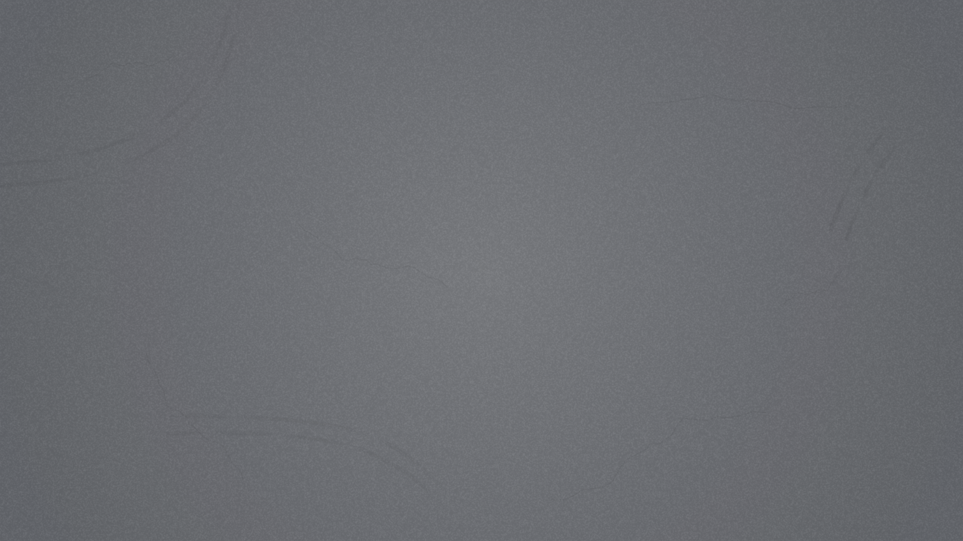










Slide 4
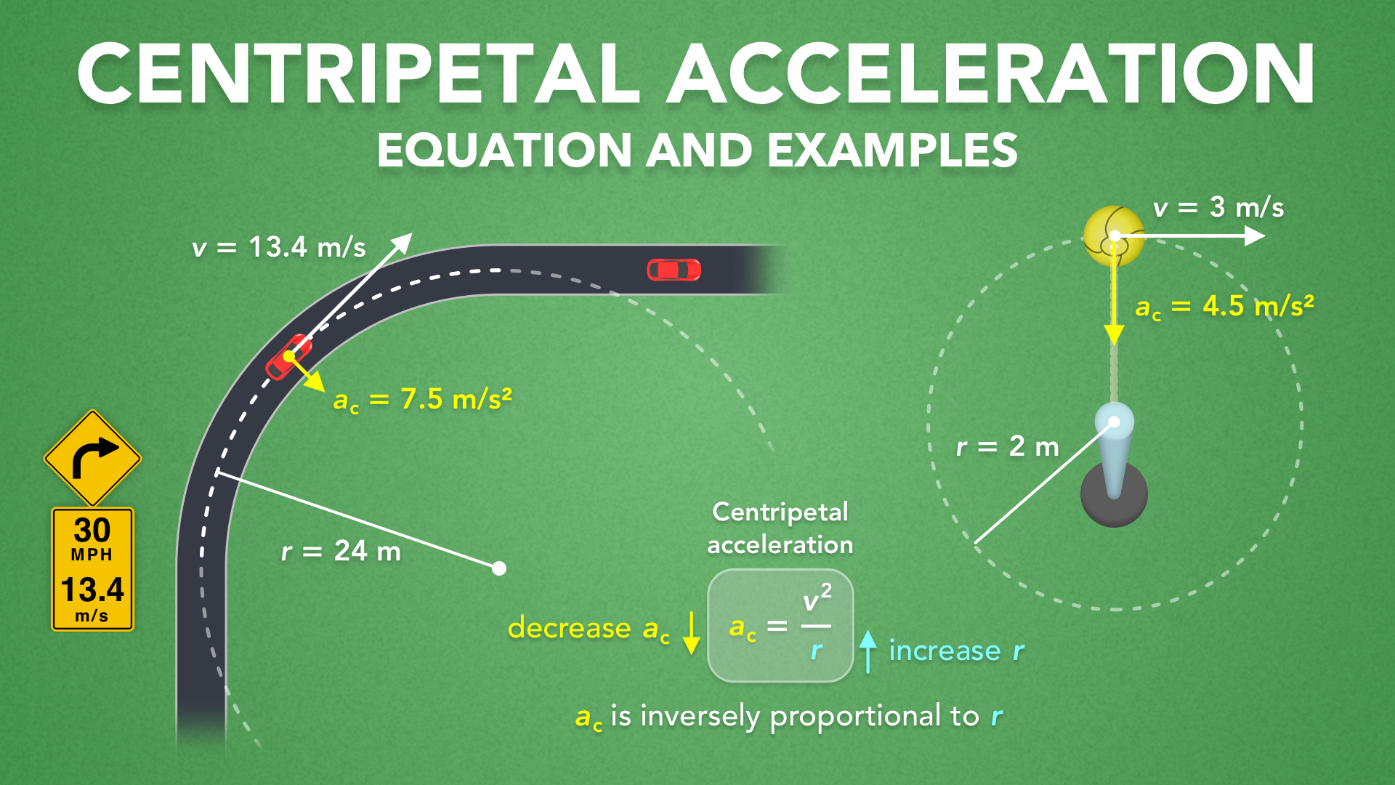
Notes:
Centripetal Acceleration - Equation and Examples
physicslab.app
If you have any questions, suggestions or feedback about these slides please email me at chris@physicslab.app or send me a message on Discord @physicslab.

Slide 5
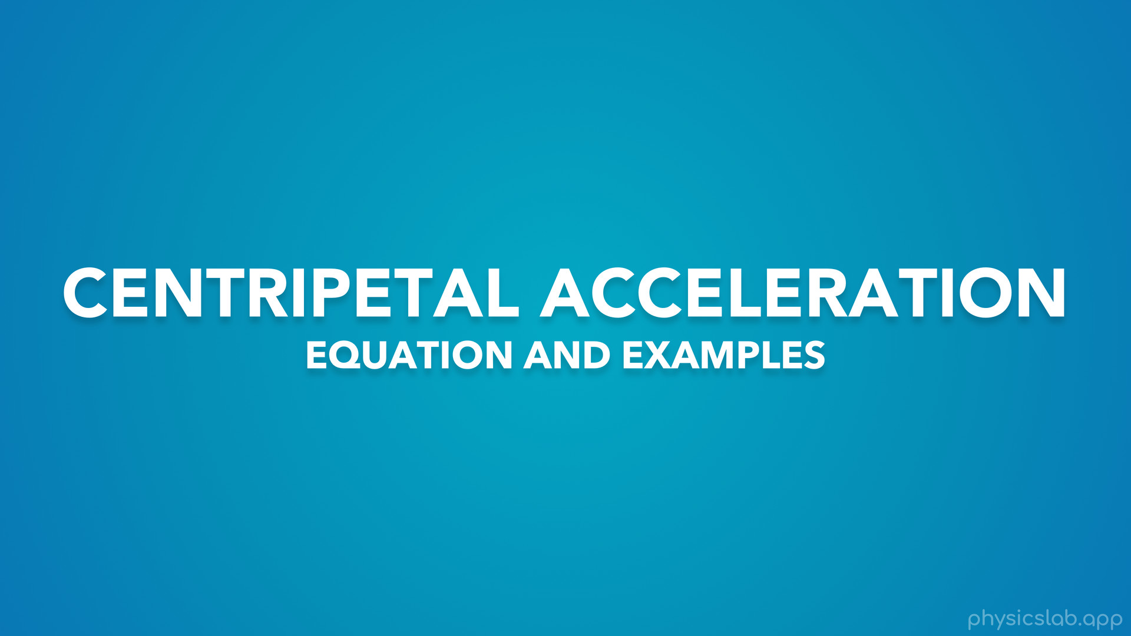
Notes:
• Hey everyone! In this video we’re gonna learn how to use the equation for centripetal acceleration.

Slide 6
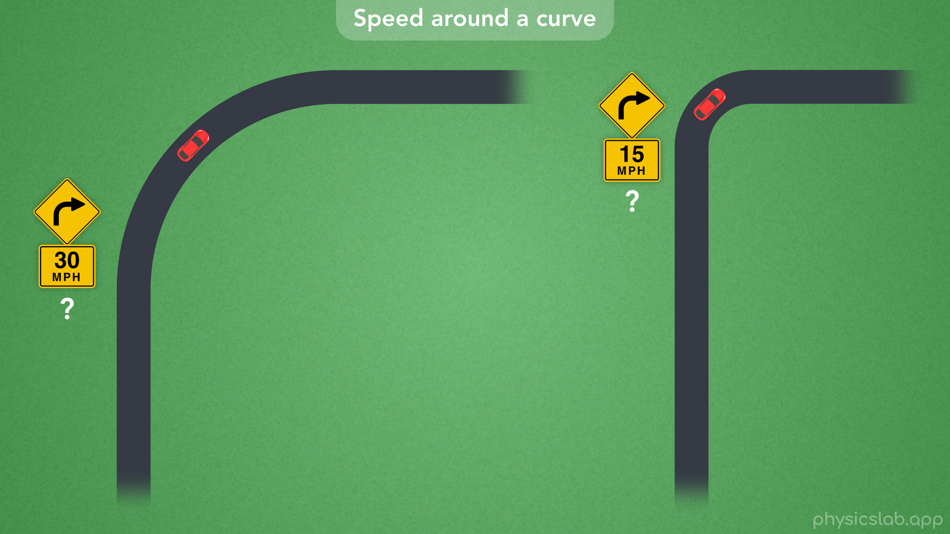
Notes:
• We’ll start with a question about speed limits around curved roads.

Slide 7
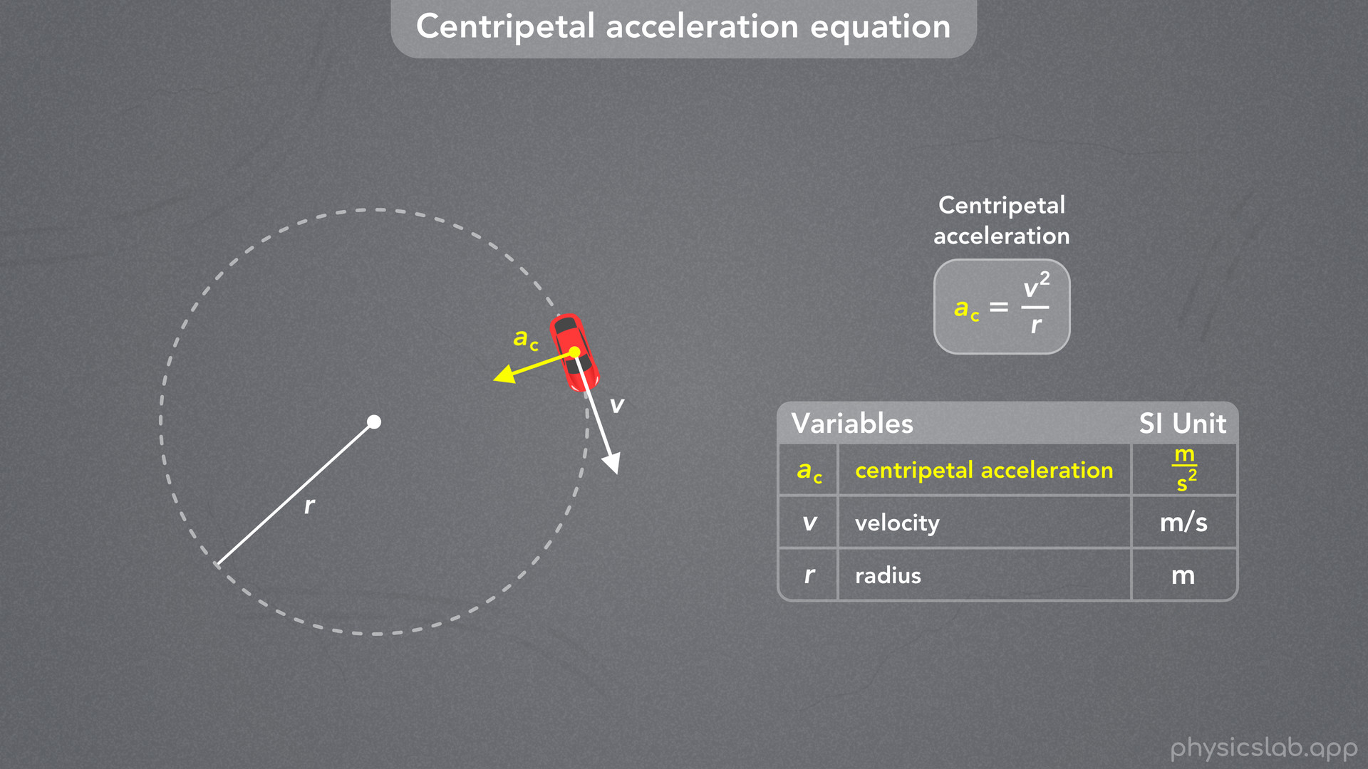
Notes:
• Then we’ll talk about the equation for centripetal acceleration…

Slide 8
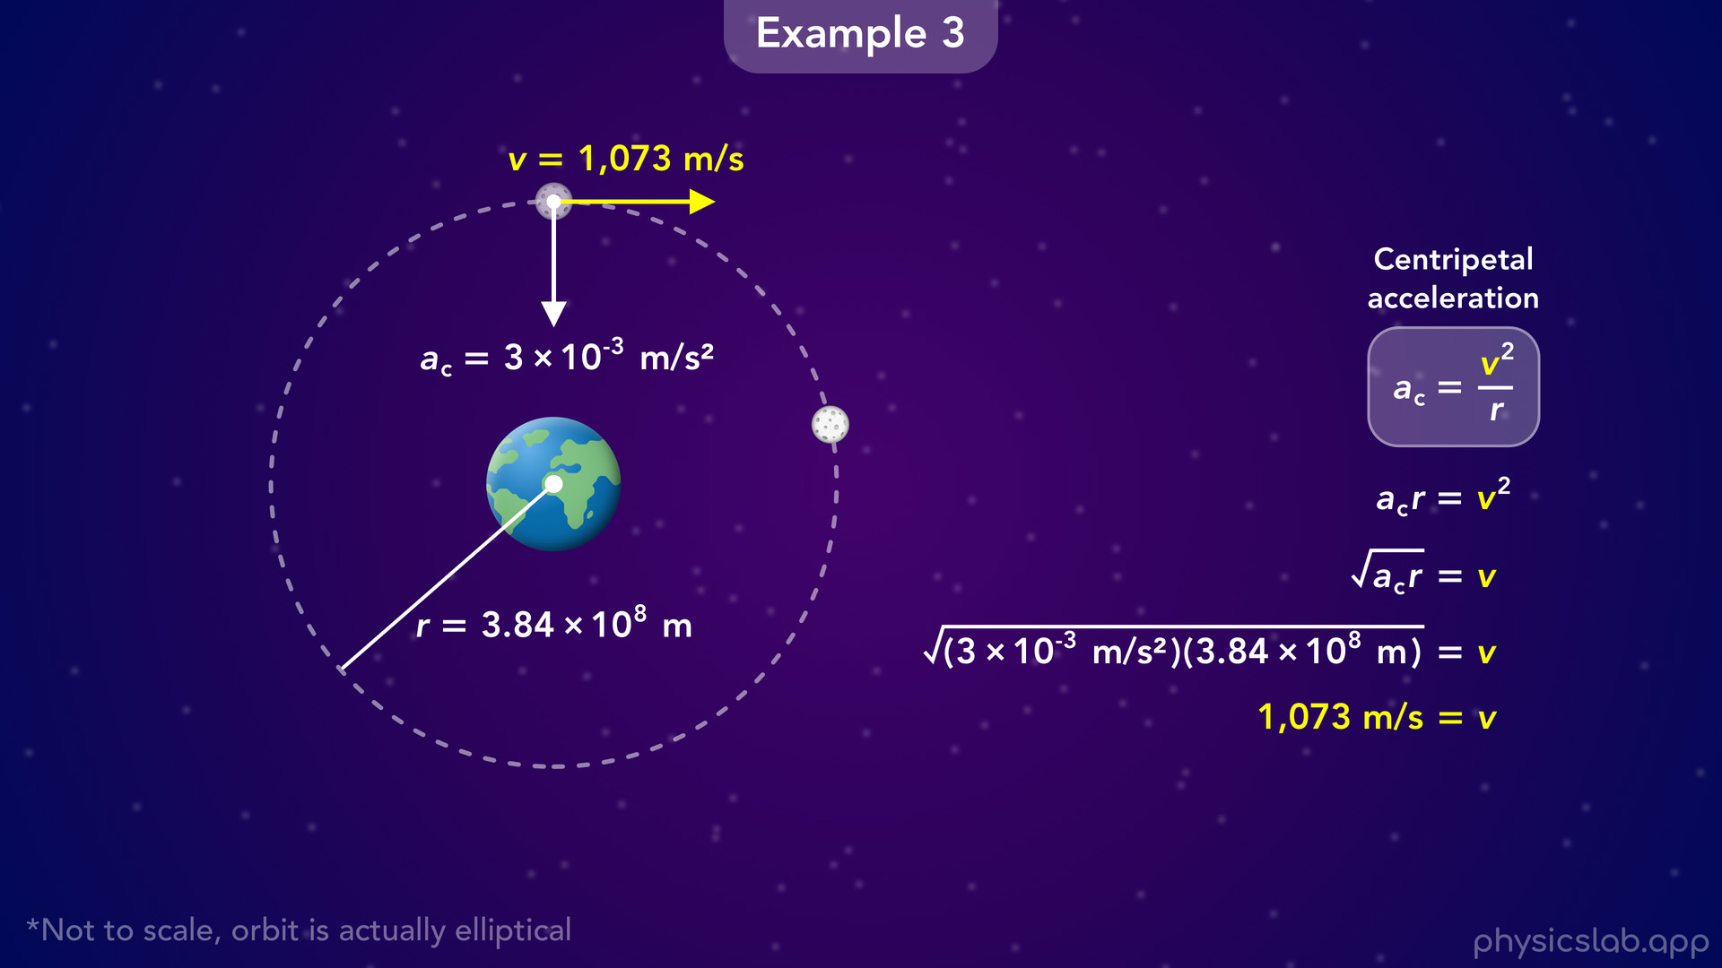
Notes:
• … and we’ll look at a few scenarios where we can apply this.

Slide 9
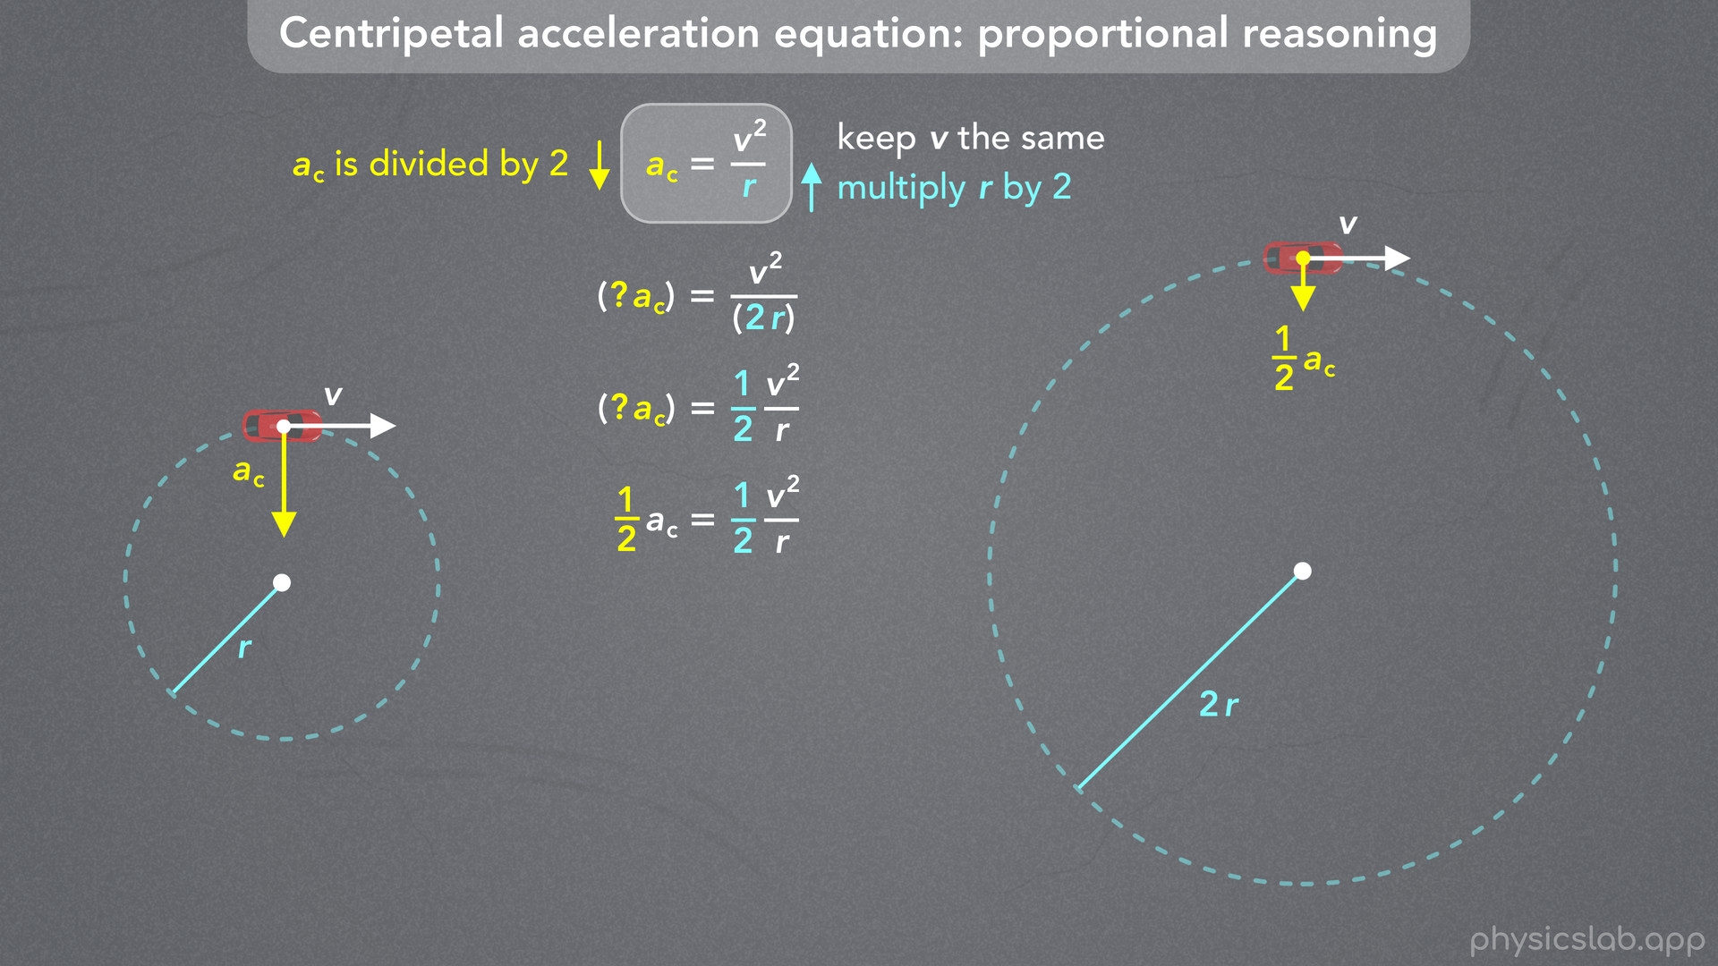
Notes:
• After that, we’ll use proportional reasoning to get a better understanding of how these variables are related.
• What happens to the centripetal acceleration when we change the velocity or the radius?

Slide 10
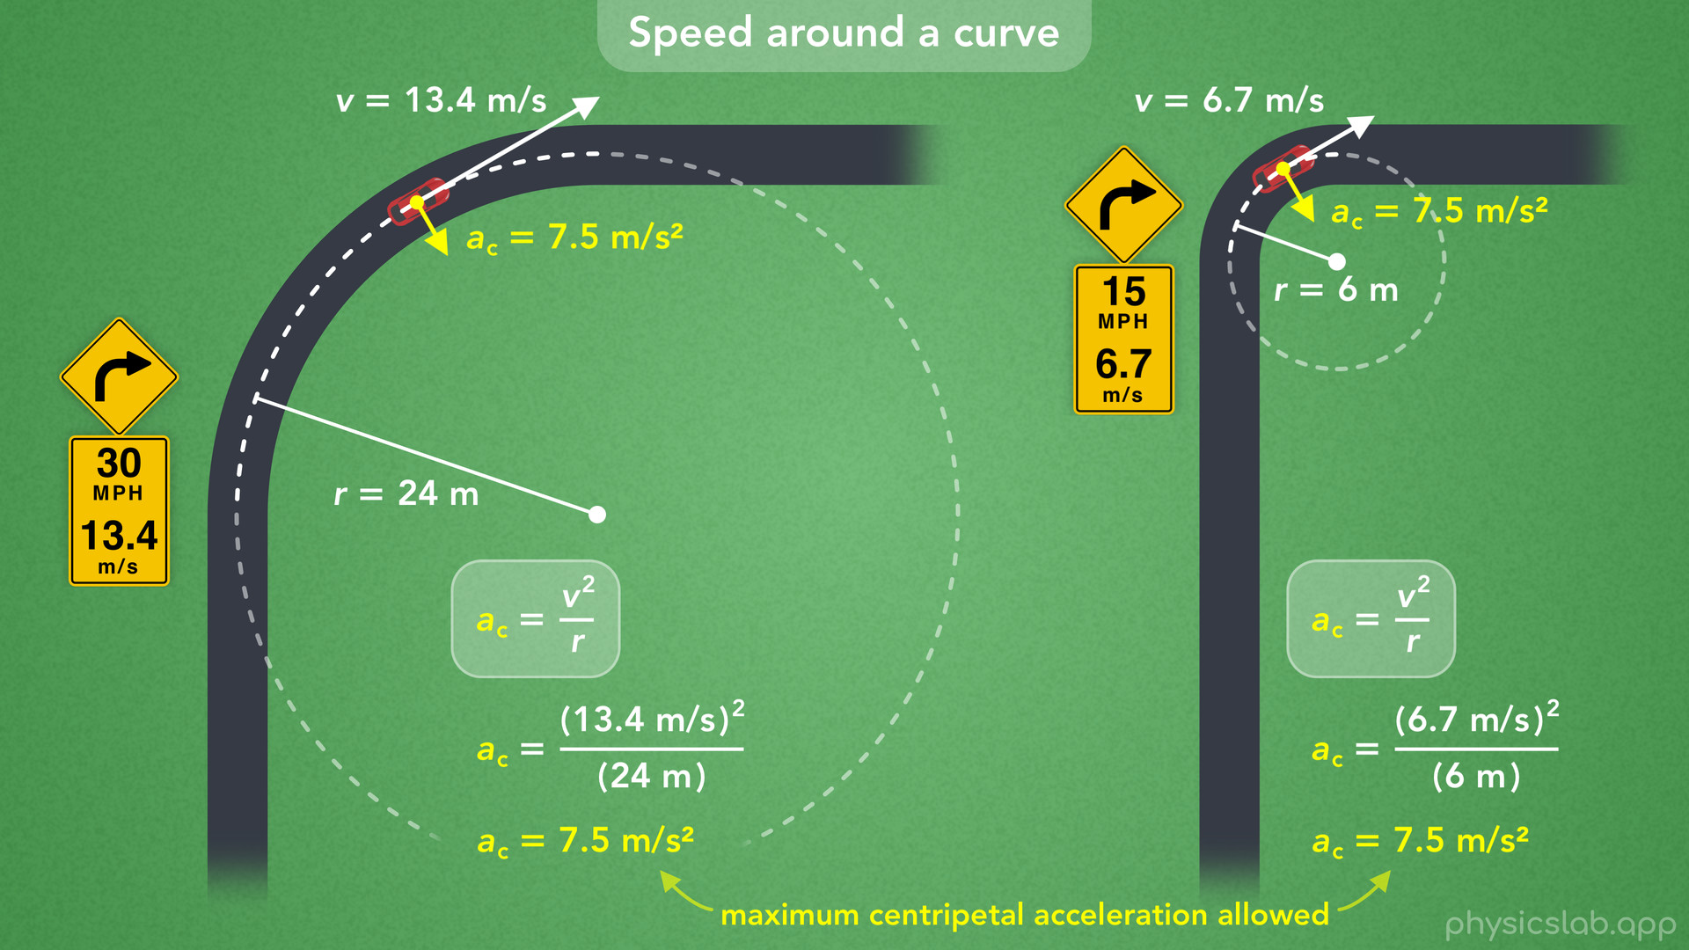
Notes:
• At the end, we’ll come back to our question about speed limits and see how they’re related to centripetal acceleration.

Slide 11
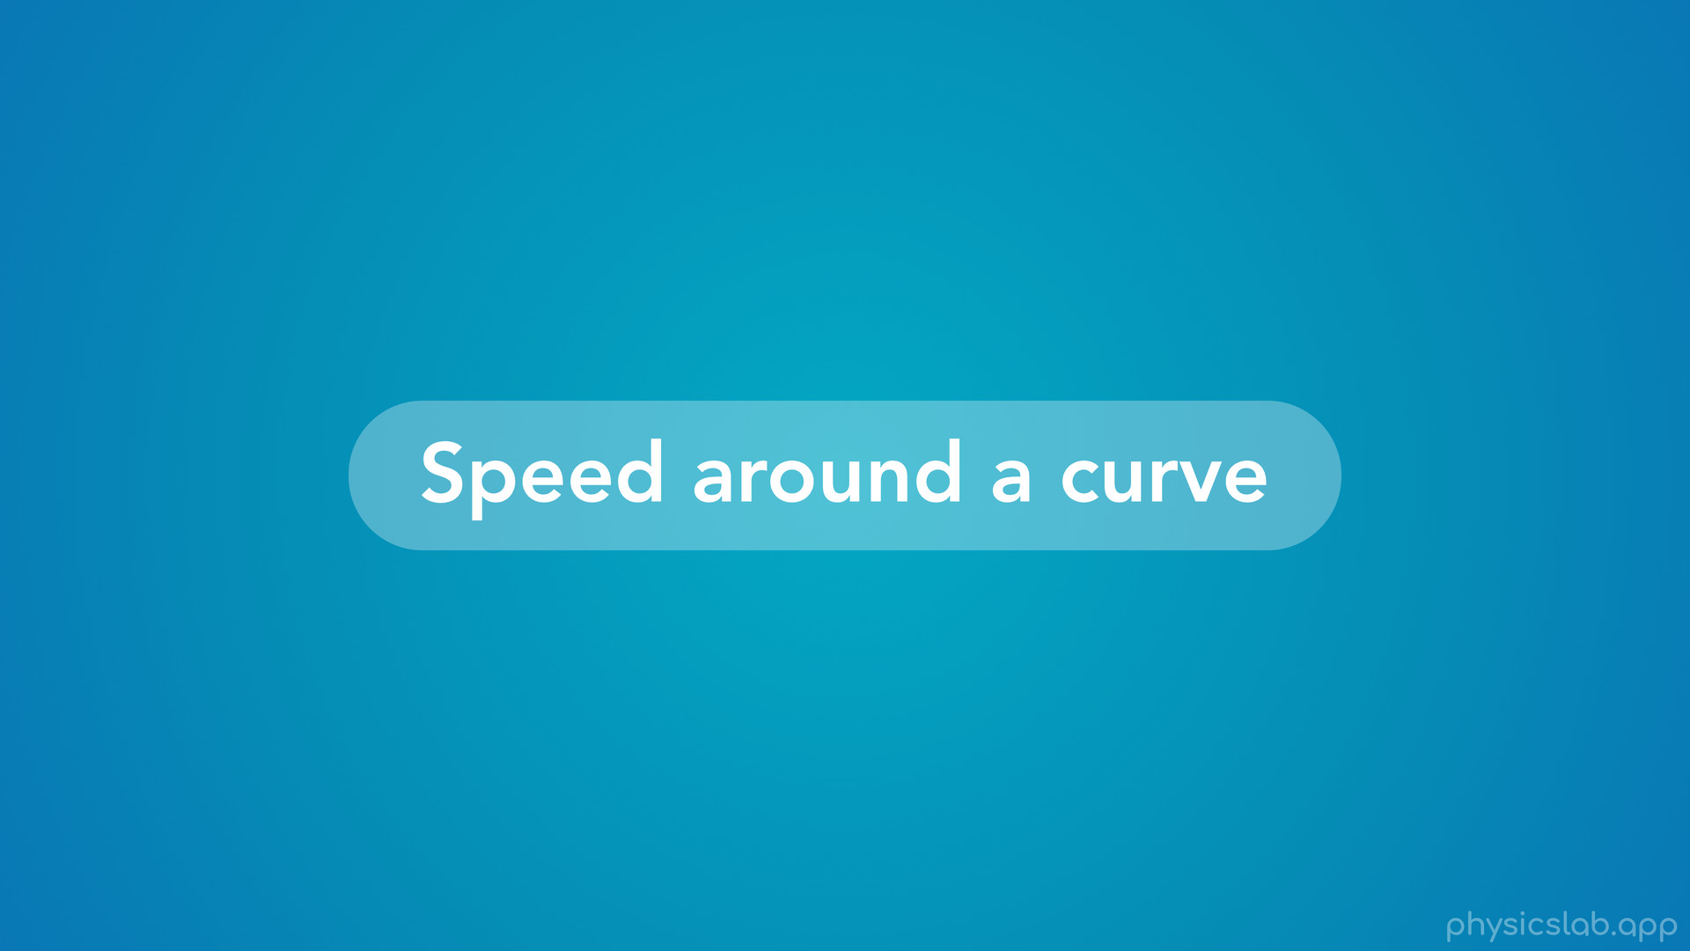
Notes:
• So let’s start with a question about speed around a curve.

Slide 12
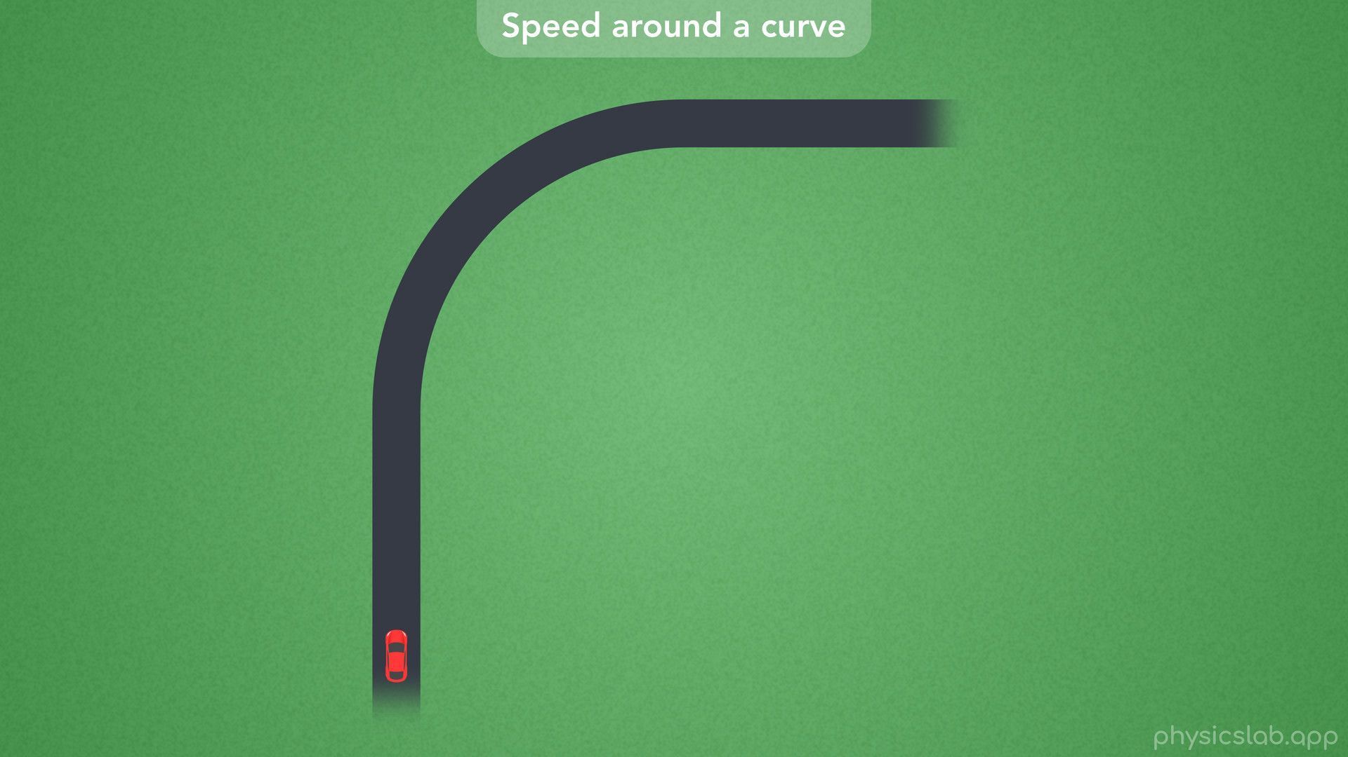

Slide 13
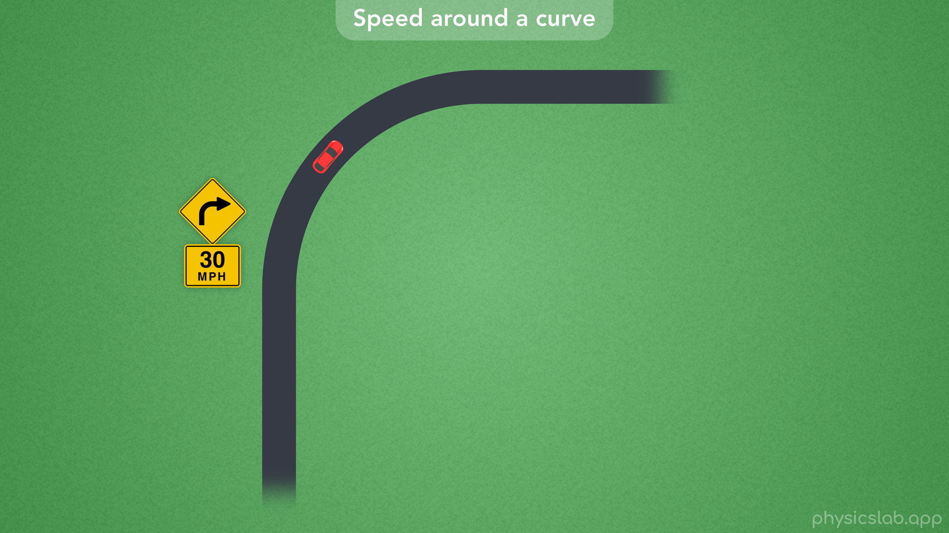
Notes:
• Imagine you’re driving or riding a bike along a straight road and you can see there’s a curve up ahead.
• Even if you don’t realize it, your instinct probably tells you to slow down when you go around the turn.
• There might even be a sign that tells you the speed limit for that curve, which is slower than the regular speed limit.

Slide 14
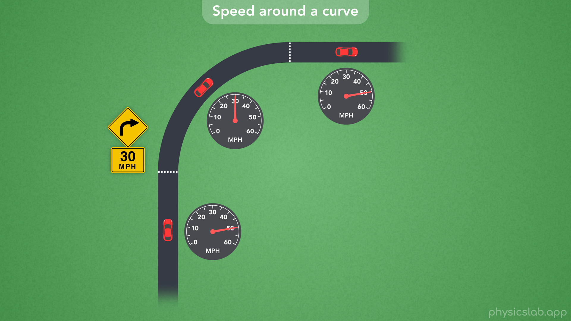
Notes:
• For example, maybe you’re driving at 50 mph on the straight parts of the road, and you have to slow down to 30 mph around the curve.

Slide 15
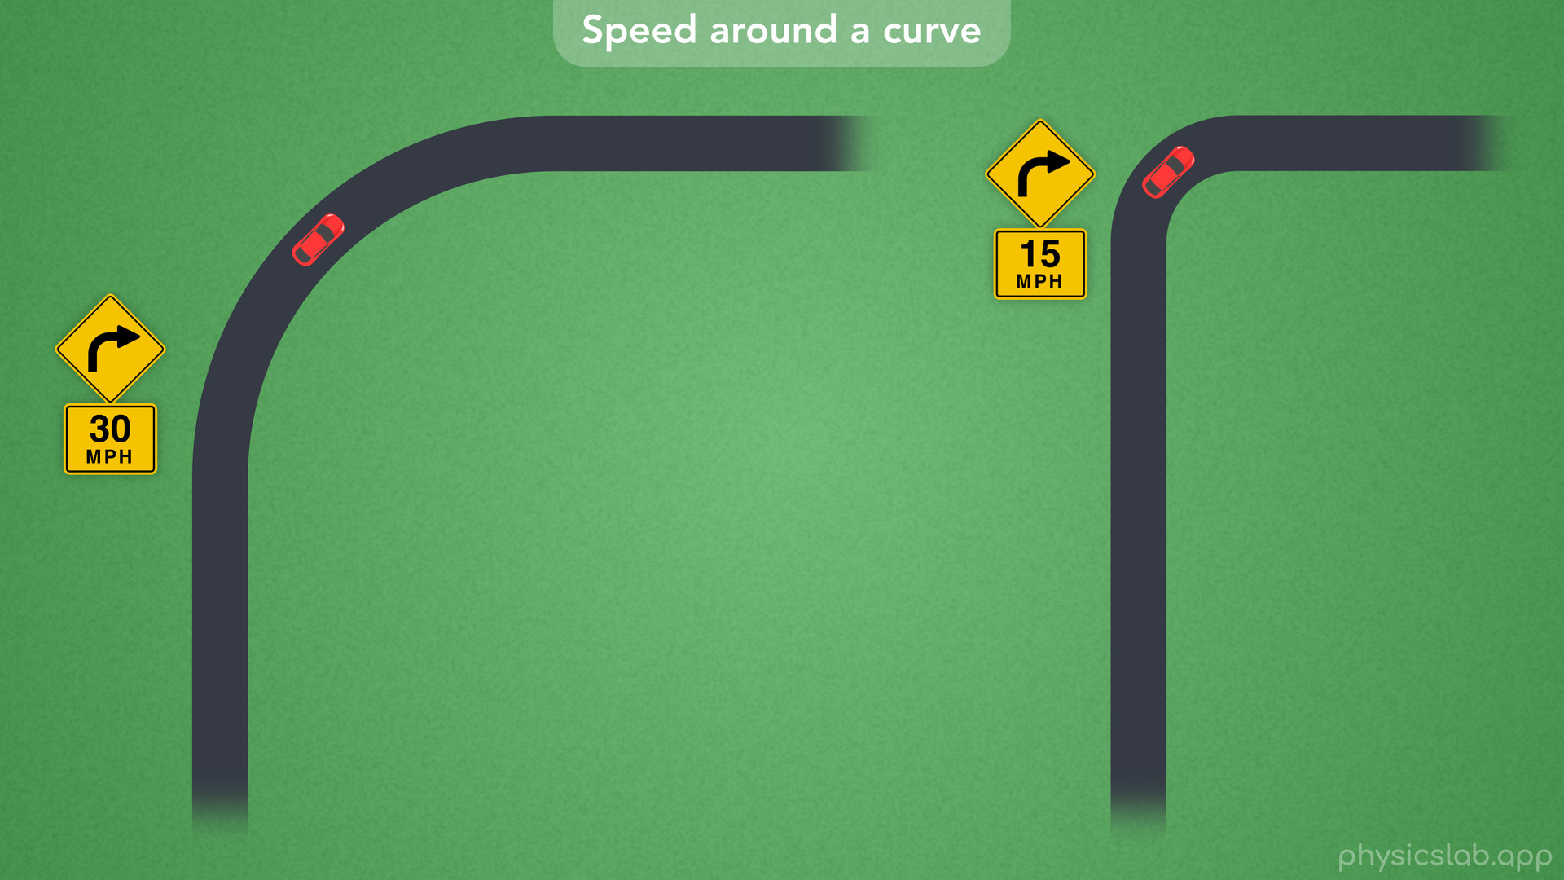
Notes:
• Different curves have different speed limits, and you might notice that you have to go even slower around a sharp turn.
• So why do the curved parts of a road have their own speed limit, and how do they come up with these numbers?
• As you might be able to guess, it has something to do with centripetal acceleration.

Slide 16
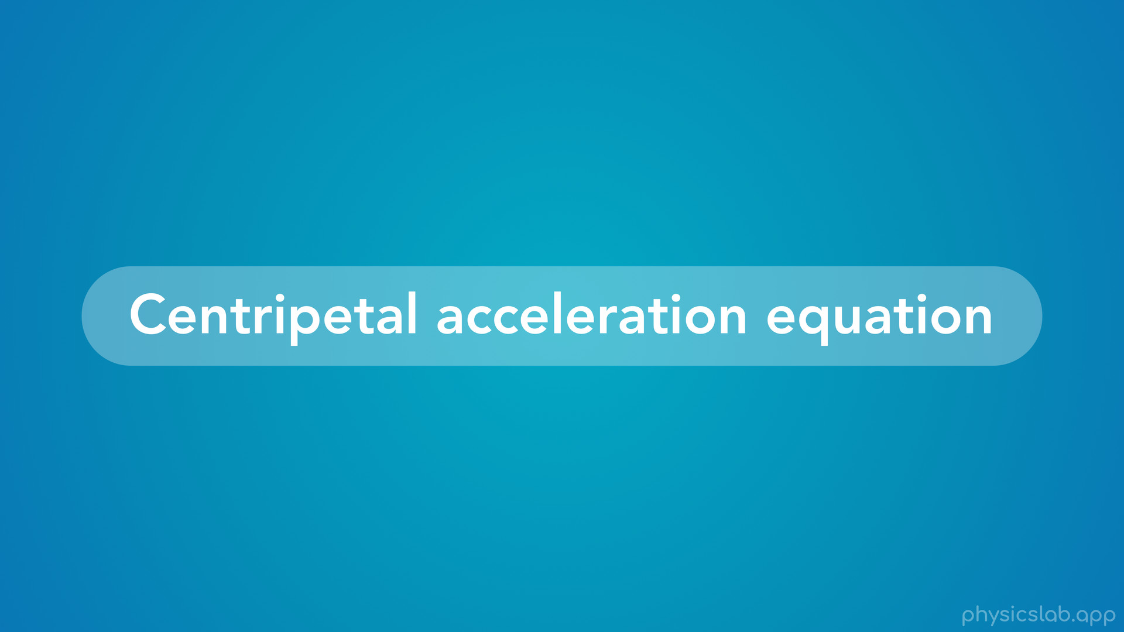
Notes:
• So let’s talk about the equation for centripetal acceleration and how to use it.

Slide 17
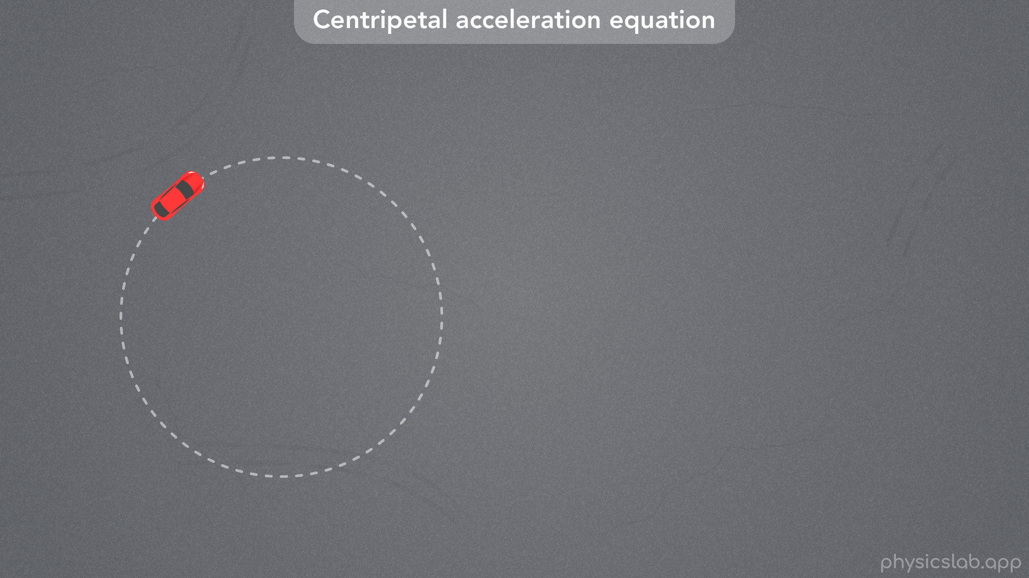
Notes:
• Here we have a car that’s in circular motion, which means the path of the car is tracing out a circle.

Slide 18
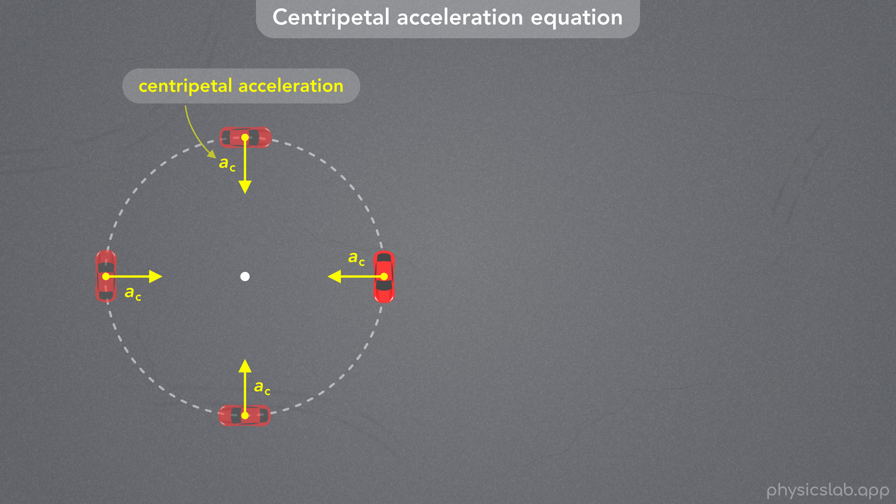
Notes:
• We learned in a previous video that “When an object is in circular motion, there is an acceleration that acts towards the center of the circle called the centripetal acceleration, ac”.

Slide 19
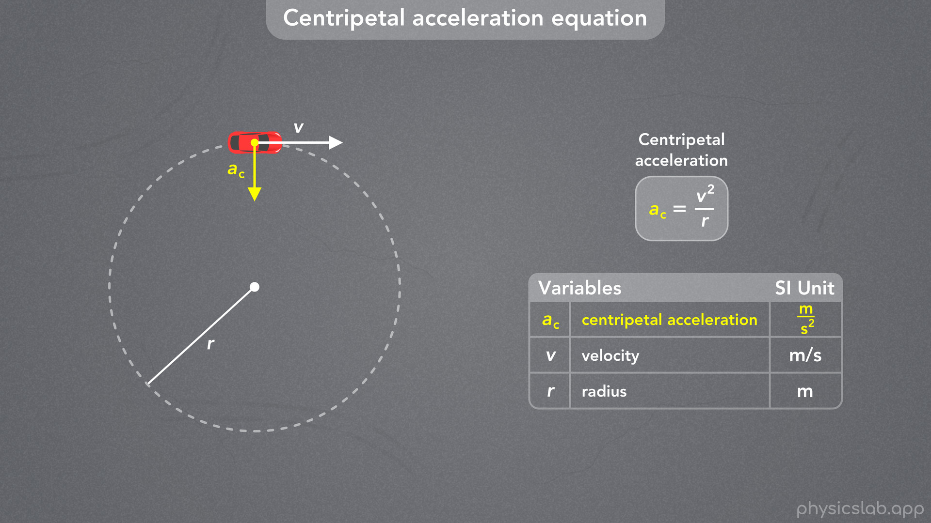
Notes:
• We also derived the equation for centripetal acceleration.
• If the car is driving with a velocity of v, and the radius of the circular path is r, then the centripetal acceleration is equal to v^2 divided by r.
• The SI unit for centripetal acceleration is m/s^2, velocity is in m/s, and the radius is in m.

Slide 20
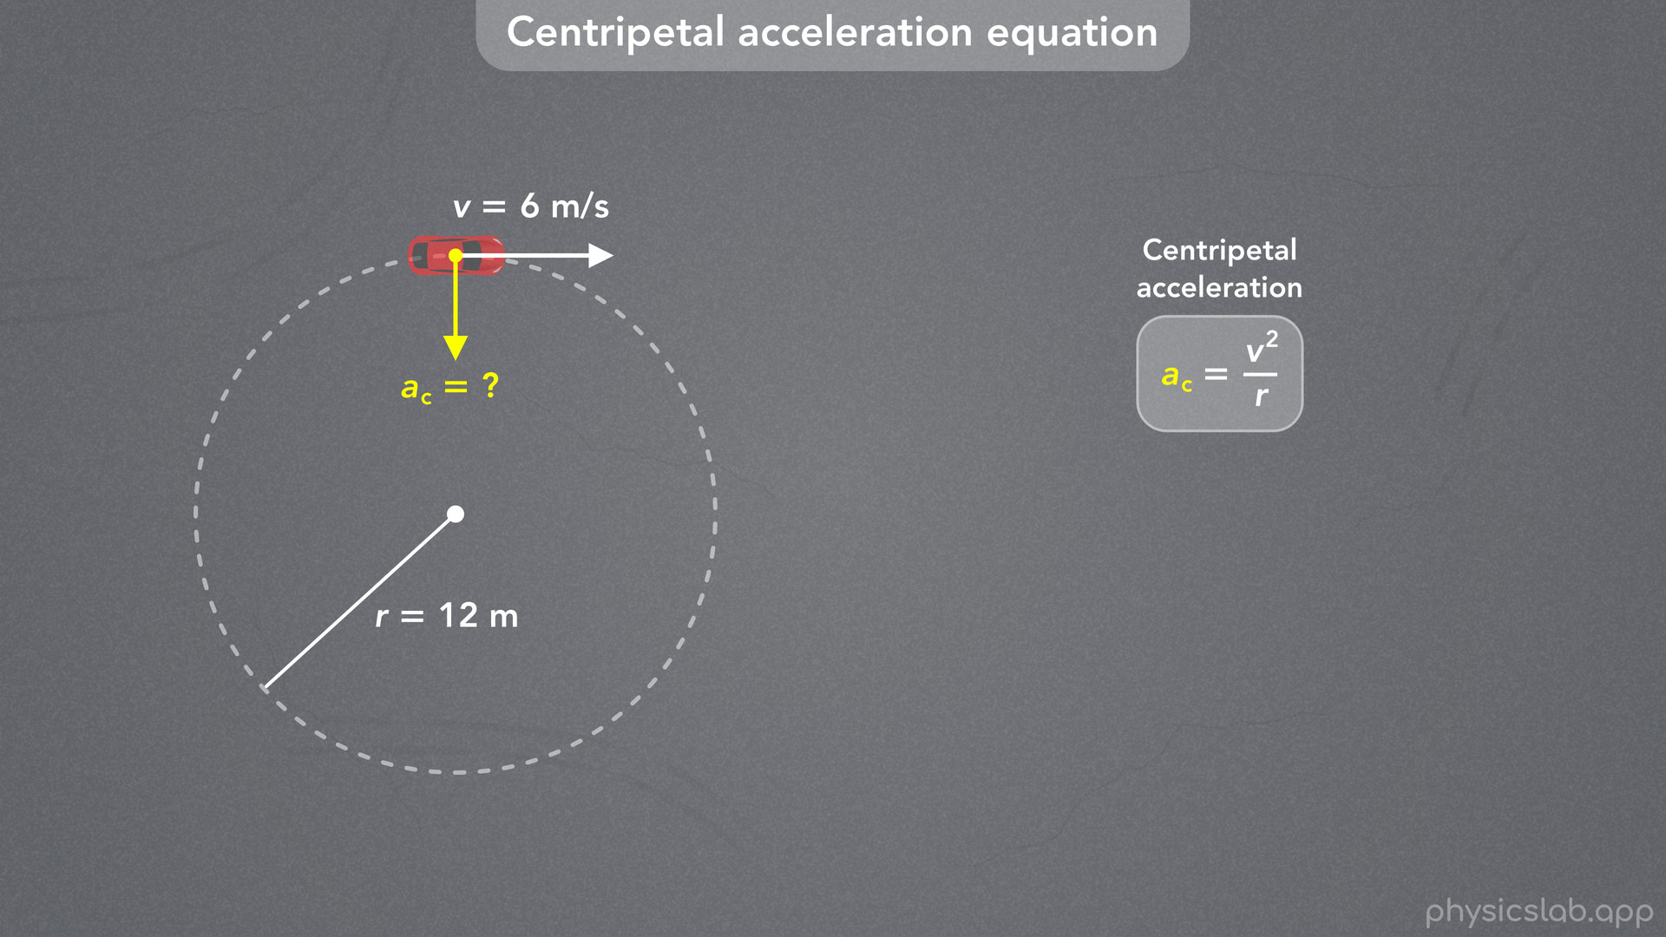
Notes:
• As an example, let’s say the car has a velocity of 6 m/s and it’s driving around a circle with a radius of 12 m.

Slide 21
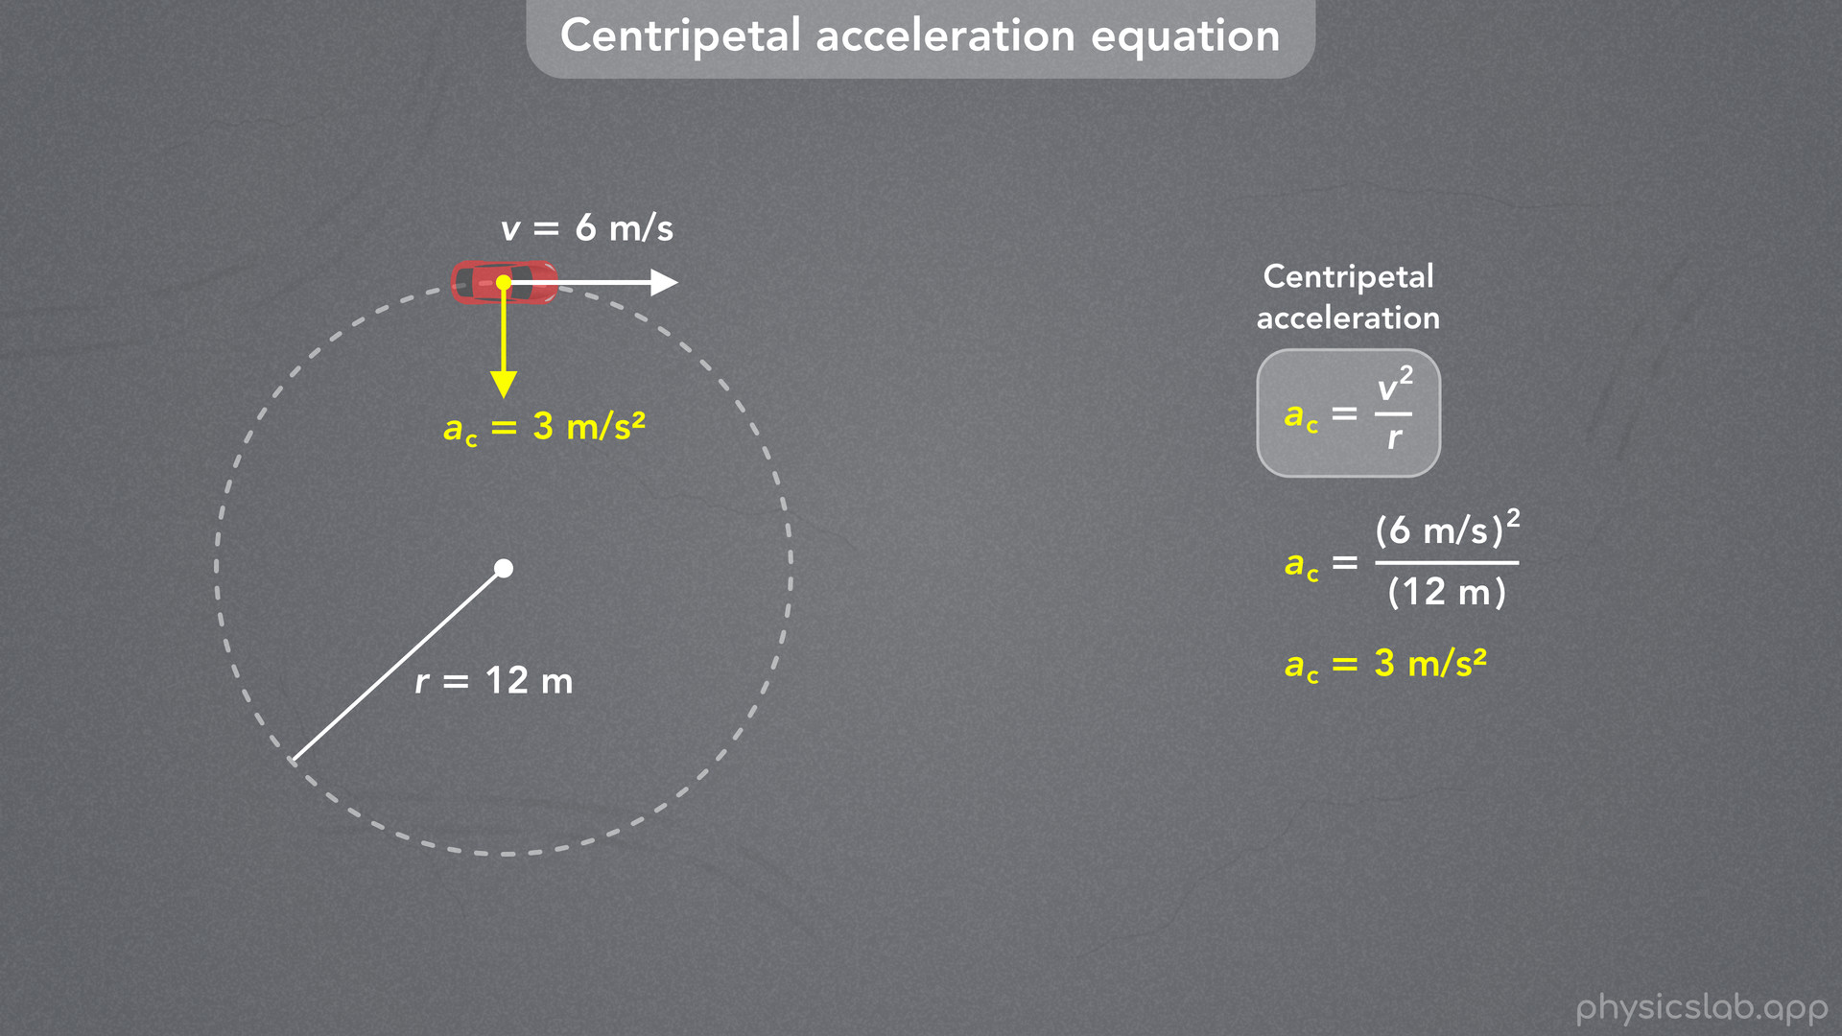
Notes:
• We can plug in 6 m/s for v and 12 m for r, and we get 3 m/s^2 for the centripetal acceleration of the car.

Slide 22
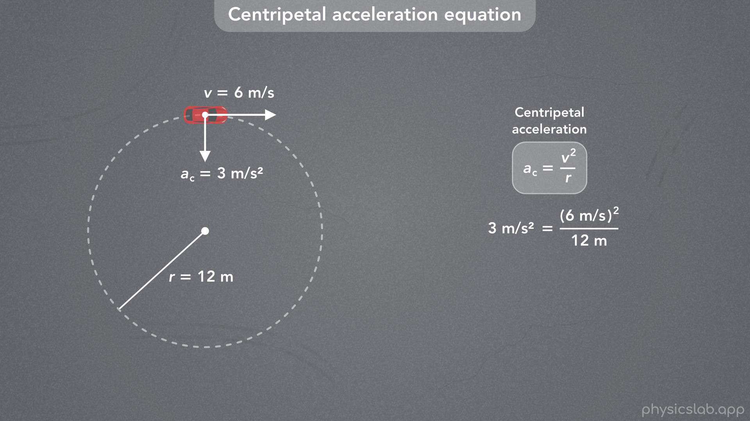
Notes:
• When thinking about centripetal acceleration, keep in mind that we derived this equation using vectors and geometry.
• This is not about cause and effect, think of it as the mathematical relationship between these three variables.

Slide 23
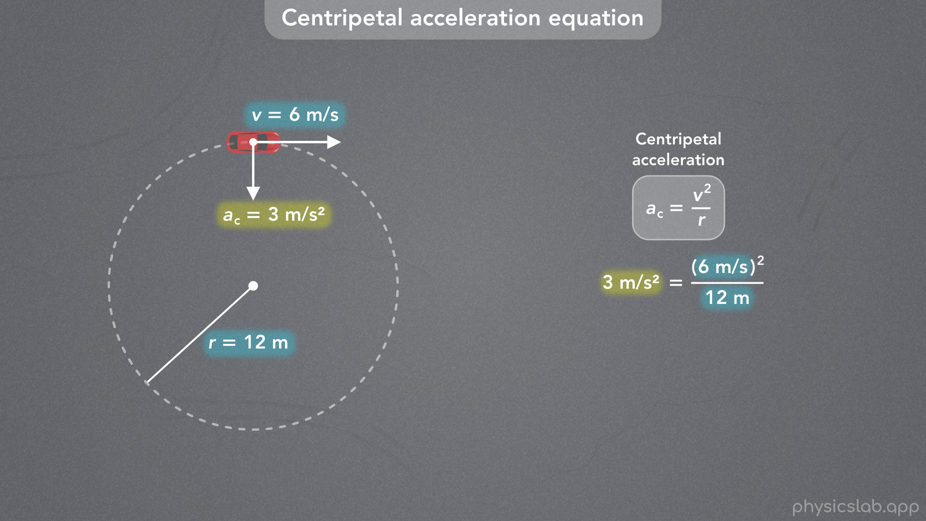
Notes:
• If we’re given this velocity and this radius, then this must be the centripetal acceleration.
• But we can be given any 2 of the numbers and solve for the third one.

Slide 24
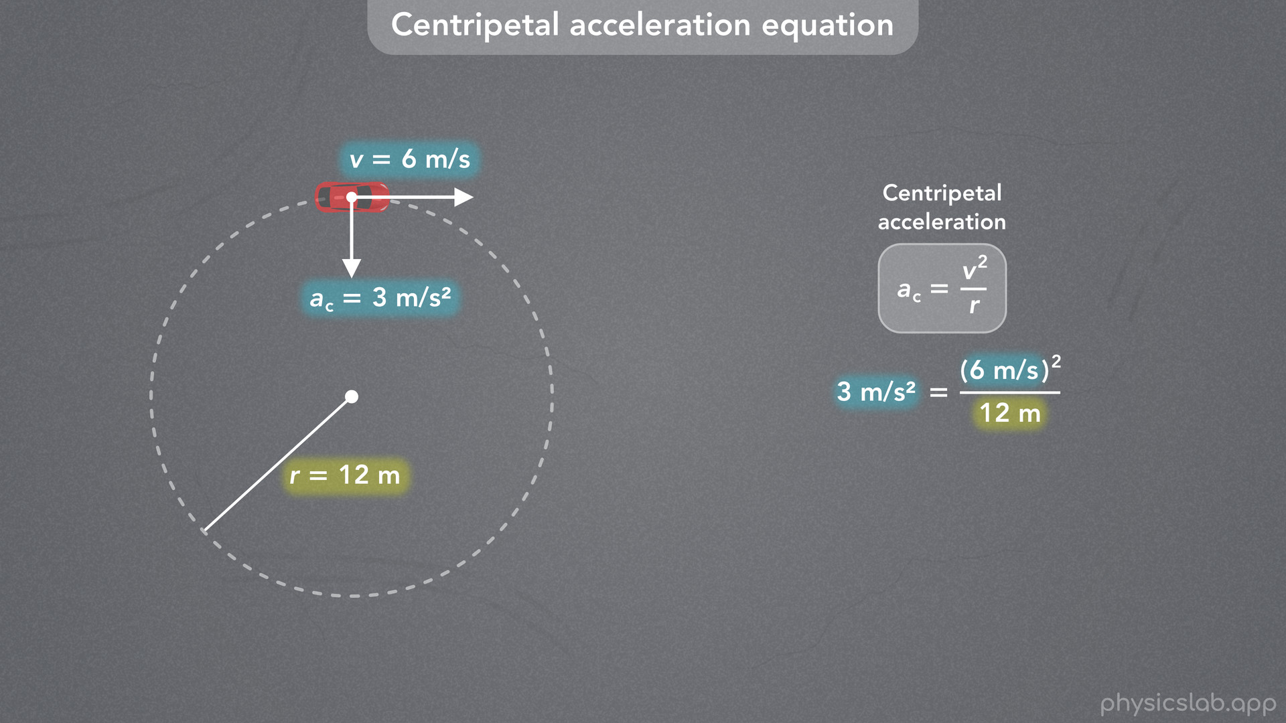
Notes:
• If we’re given this centripetal acceleration and this velocity, then the car must be following a circle with this radius.

Slide 25
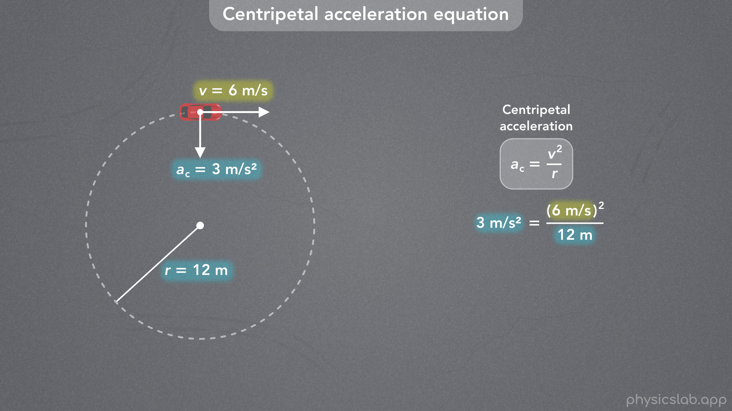
Notes:
• Or if we’re given this centripetal acceleration and this radius, then this has to be the velocity of the car.
• So that’s an overview of the equation for centripetal acceleration.

Slide 26

Notes:
• Let’s look at a few other scenarios where we can use this equation.

Slide 27
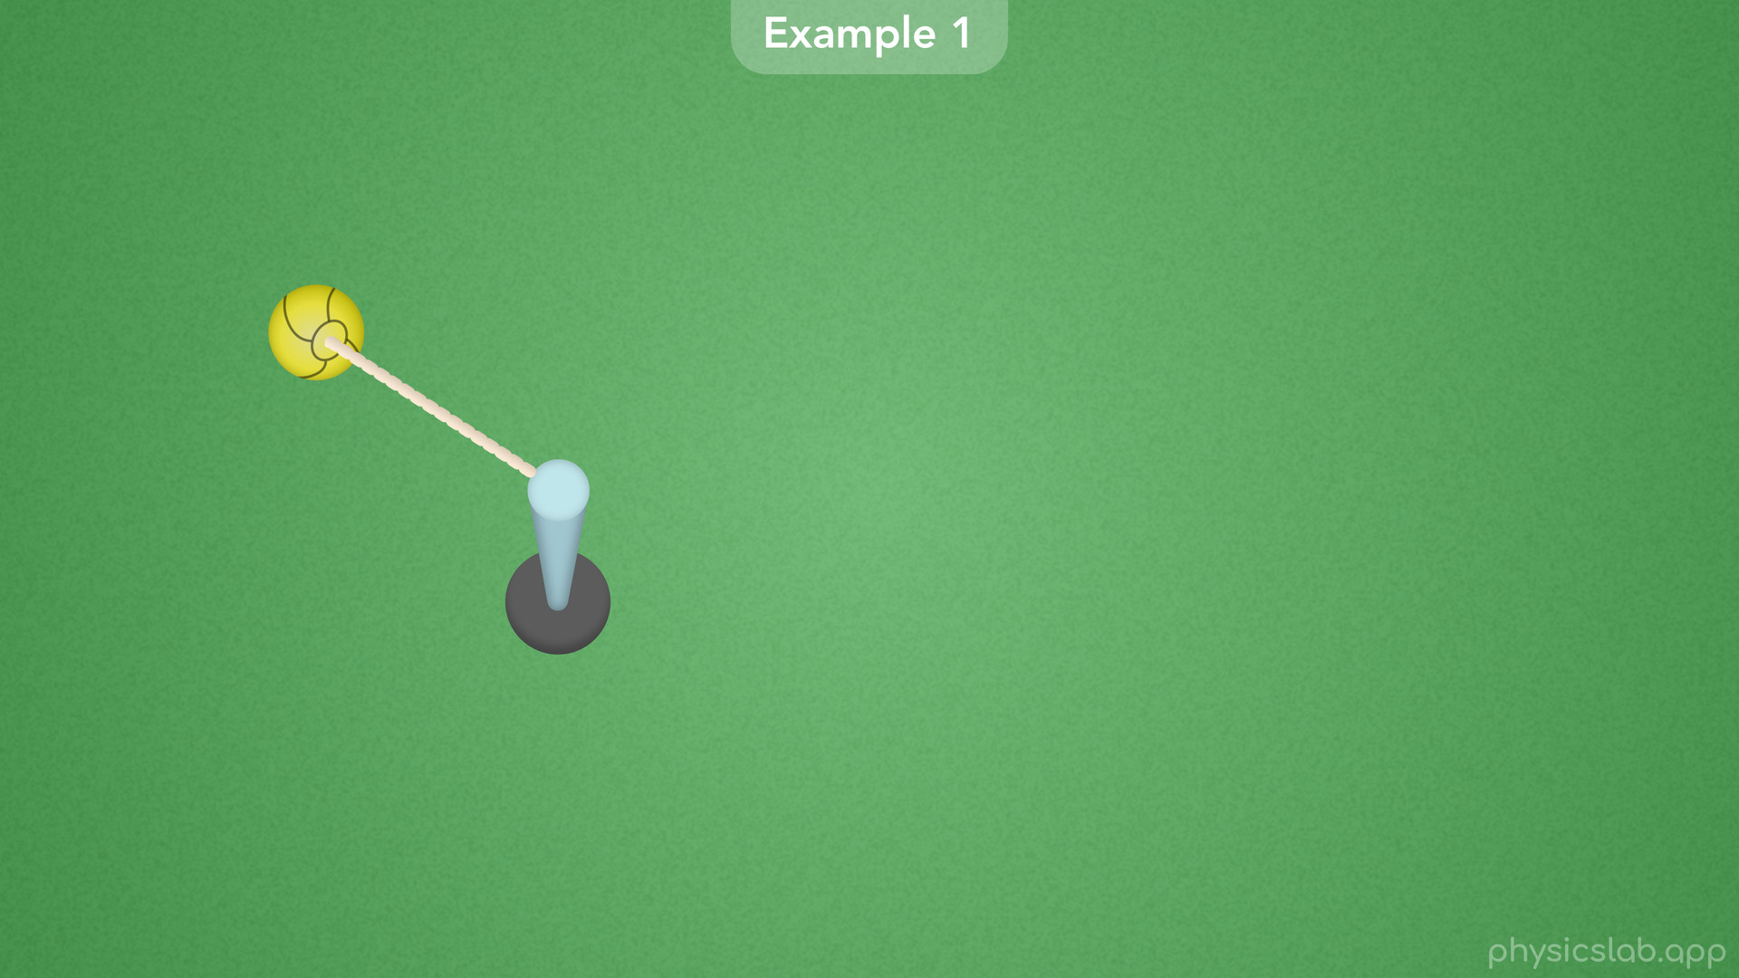
Notes:
• In this example we have a top-down view of a tetherball swinging around a pole.

Slide 28
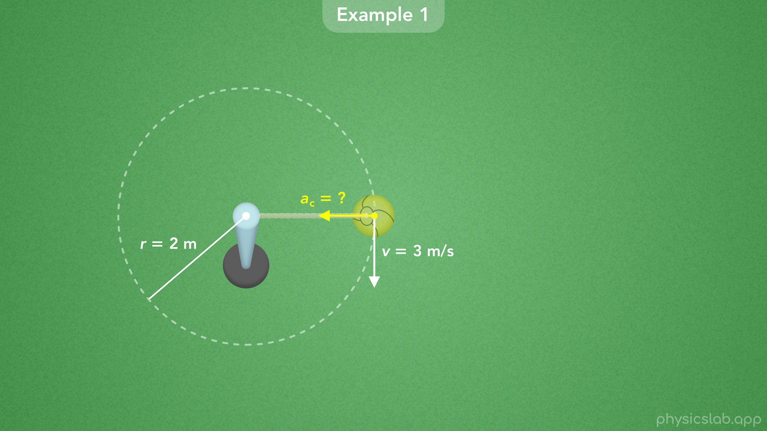
Notes:
• The ball is following a circular path with a radius of 2 m, and the velocity of the ball is 3 m/s.
• Pause the video and see if you can figure out the centripetal acceleration.

Slide 29
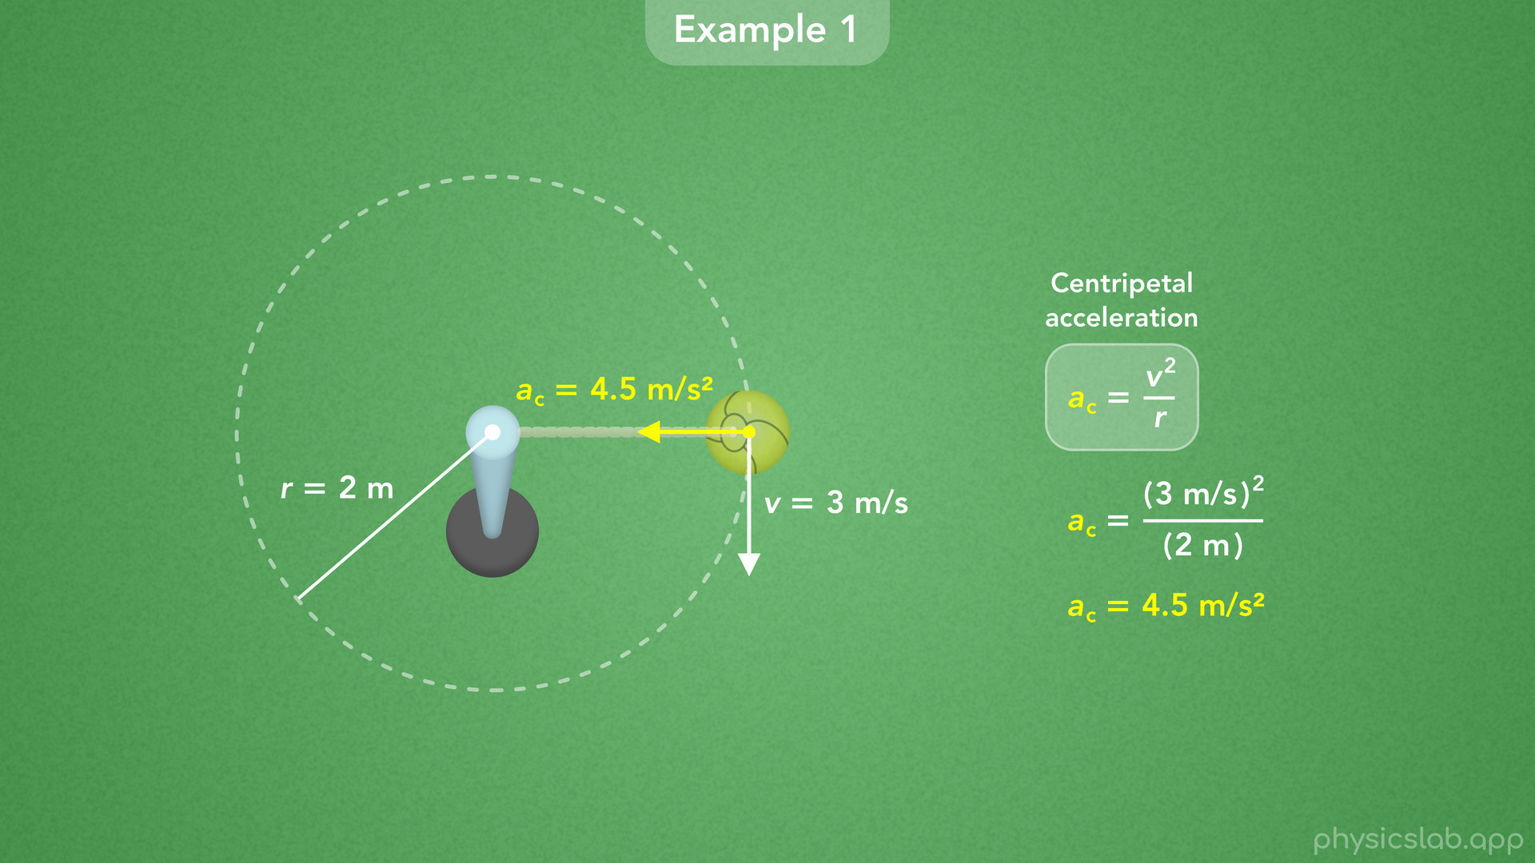
Notes:
• So here’s the equation.
• We can plug in 3 m/s for v and 2 m for r, and we get 4.5 m/s^2 for the centripetal acceleration of the ball.
• So as it swings around, the tetherball is always accelerating towards the center of the circular path.

Slide 30
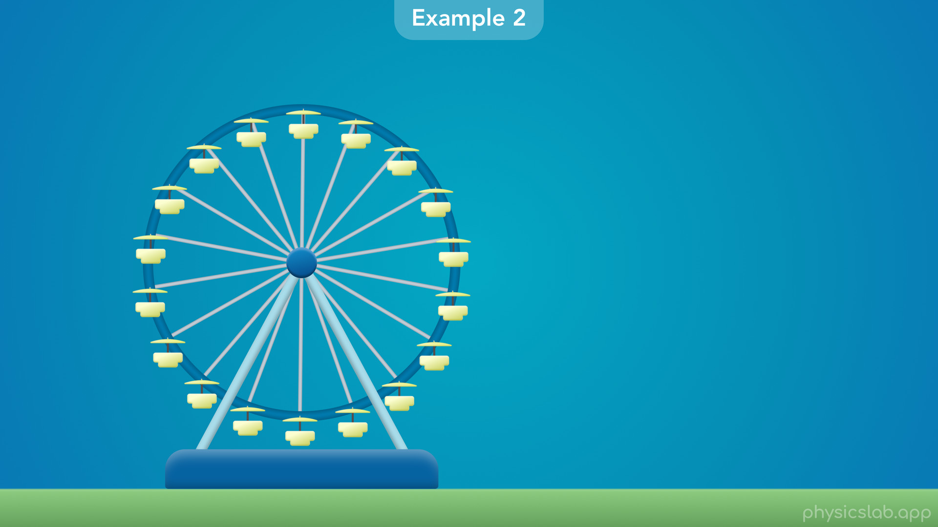
Notes:
• In the next example, we have a ferris wheel that’s turning at a constant speed.

Slide 31
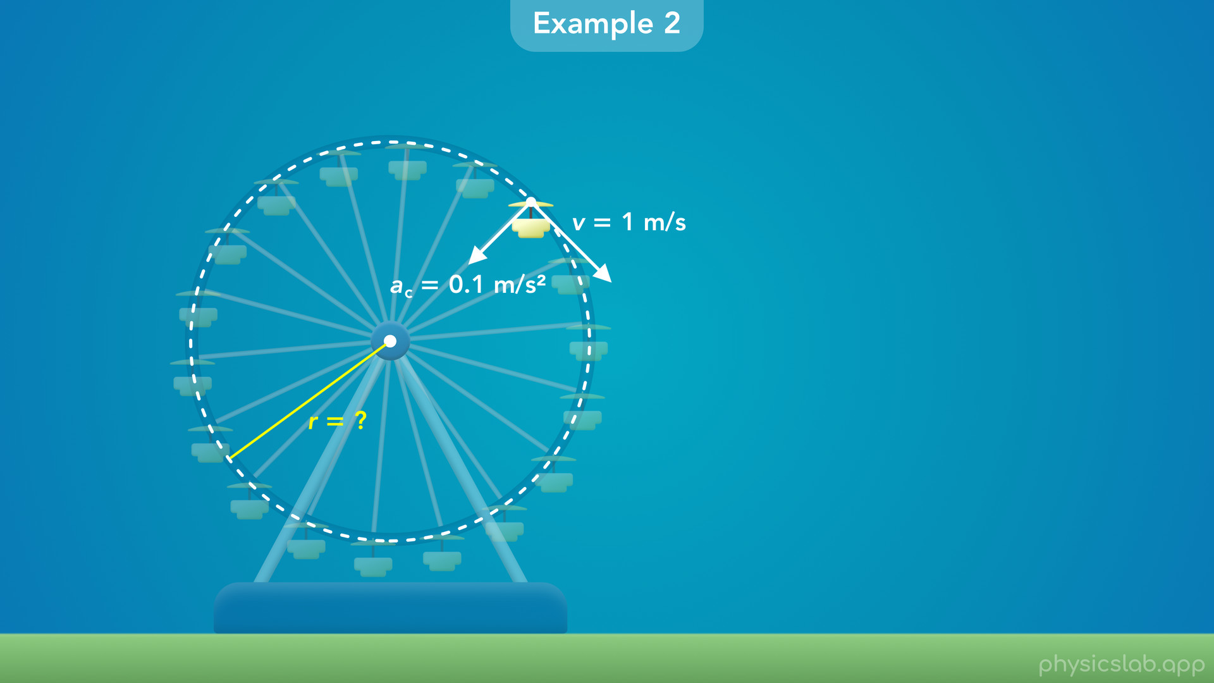
Notes:
• That means each seat on the ferris wheel is following a circular path.
• If we’re given that each seat has a velocity of 1 m/s and its centripetal acceleration is 0.1 m/s^2, then what would be the radius of the ferris wheel?

Slide 32
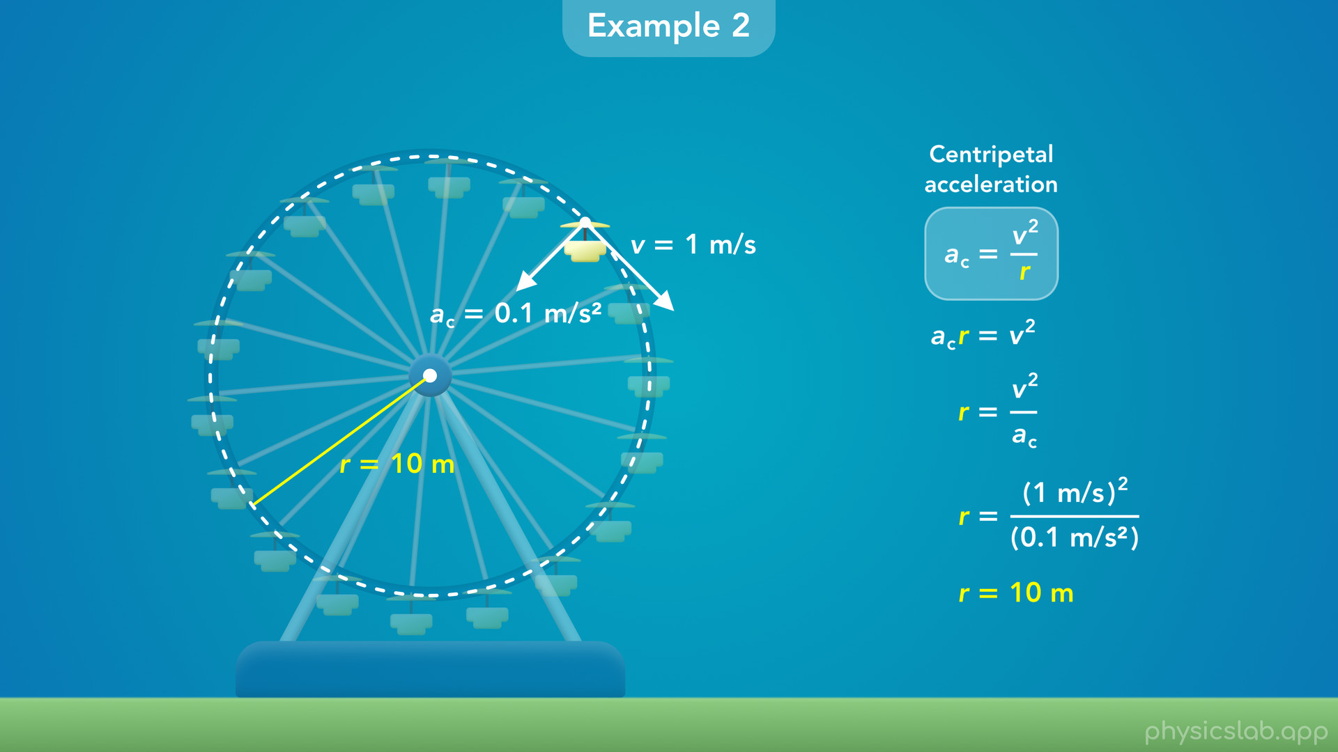
Notes:
• We could start by plugging in numbers, but let’s rearrange this equation to solve for the radius.
• First we can multiply both sides of the equation by r, and then we can divide both sides by ac.
• Now we can plug in 1 m/s for the velocity and 0.1 m/s^2 for the centripetal acceleration.
• When we calculate that, we get 10 m for the radius.

Slide 33
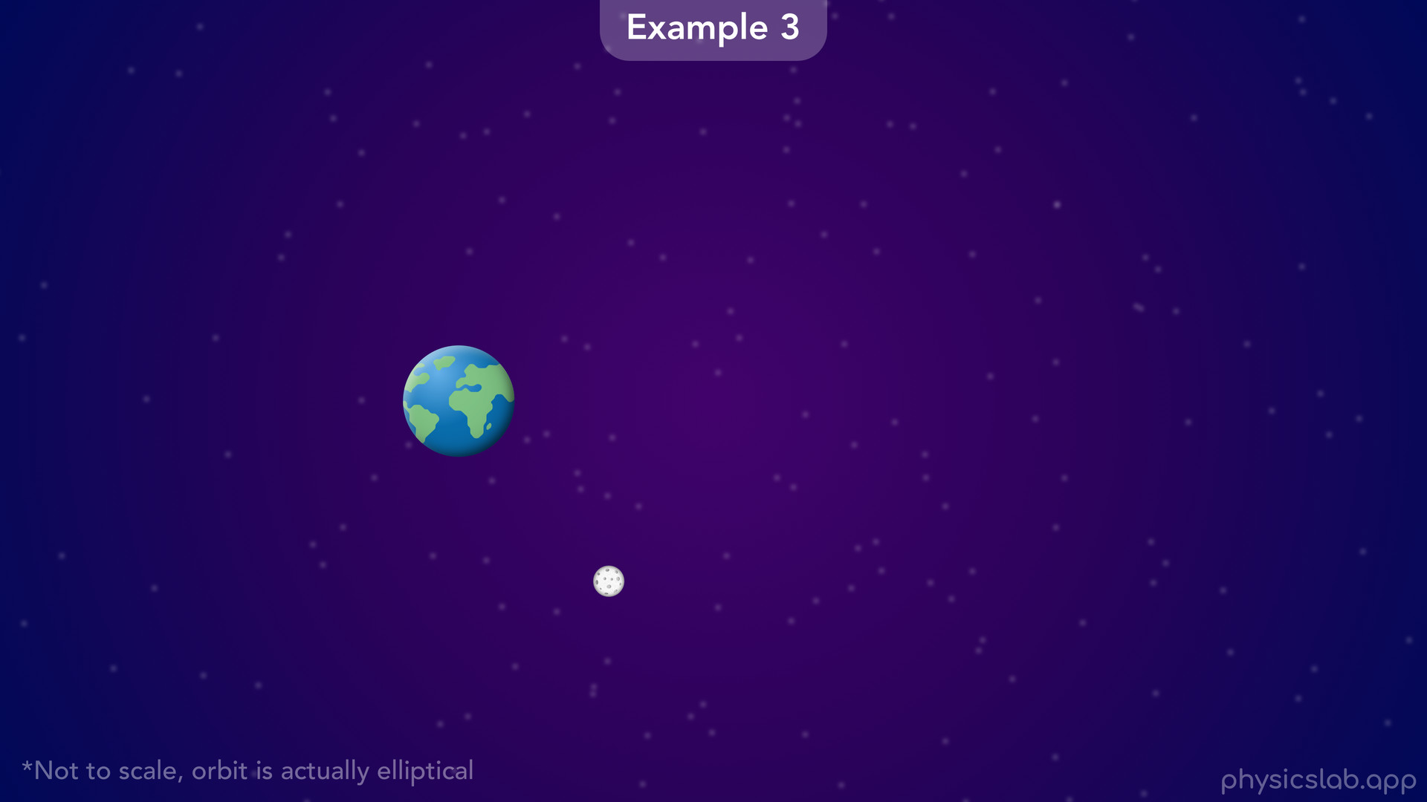
Notes:
• Now let’s look at the orbit of the moon around the earth.

Slide 34
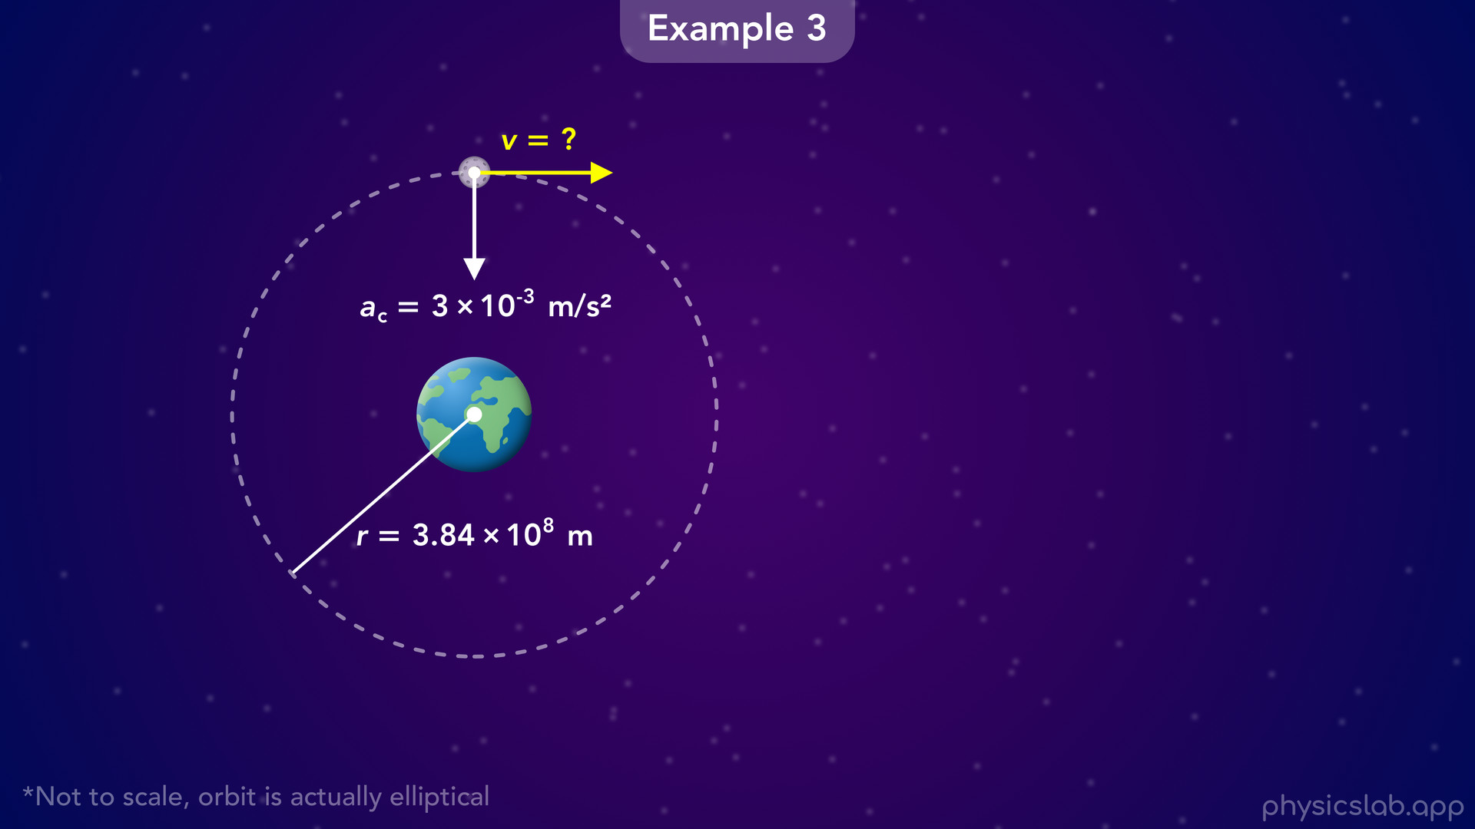
Notes:
• Technically the orbit is elliptical, but for this example let’s assume the moon follows a circular path with a radius of 3.84 x 10^8 m.
• If we’re given that the centripetal acceleration of the moon is 3 x 10^ *negative* 3 m/s^2, then what is the velocity of the moon?

Slide 35
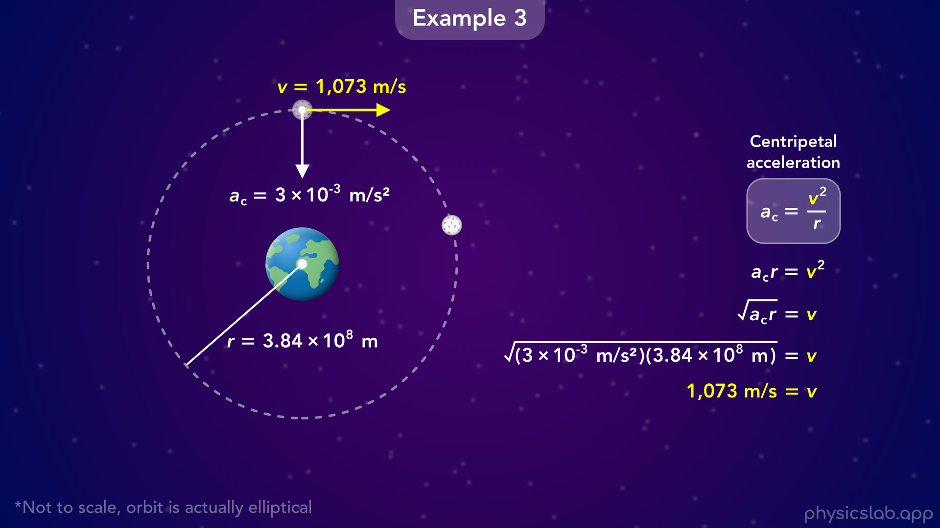
Notes:
• This time, we can rearrange the equation to solve for v.
• We multiply both sides by r, and then take the square root of both sides.
• Then we plug in these values for the centripetal acceleration and the radius.
• That gives us 1,073 m/s for the velocity of the moon in its orbit.

Slide 36
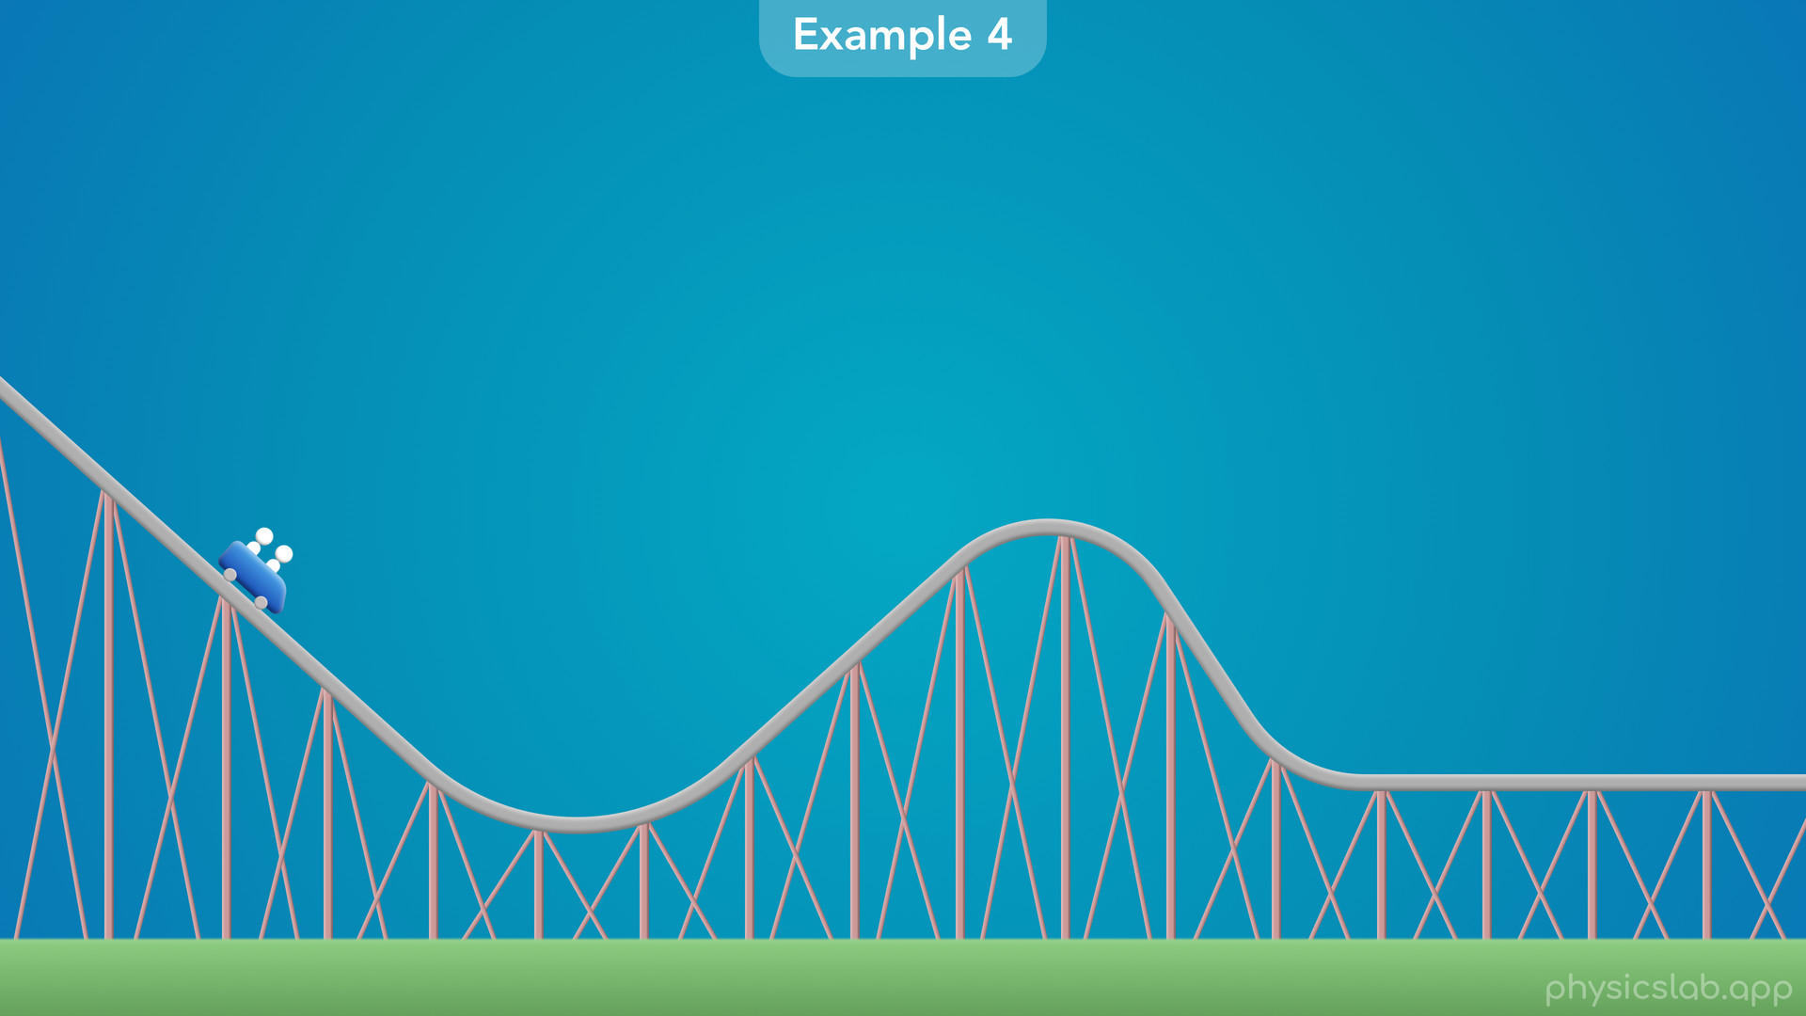
Notes:
• For the last example we have a roller coaster.
• If we look at this track, we can see that some sections are straight and some sections are curved.

Slide 37
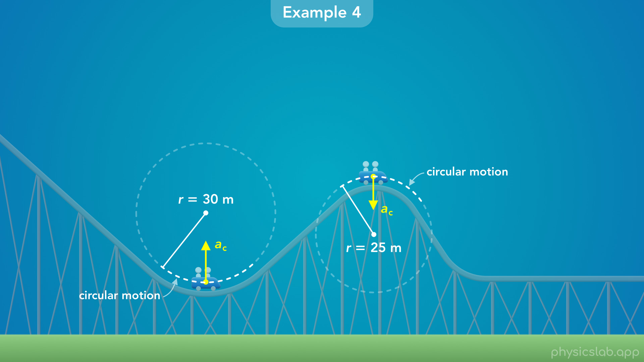
Notes:
• An important thing to remember is that an object is in circular motion any time it’s following a circular path.
• It doesn’t have to complete a full circle, it can just follow part of a circle like we see here.
• The first curve is an arc or a section of a circle with a radius of 30 m.
• And the second curve is smaller, it’s part of a circle with a radius of 25 m.
• So while the car is traveling through each of these curves, it’s in circular motion, and it’s experiencing centripetal acceleration towards the center of that circle.

Slide 38
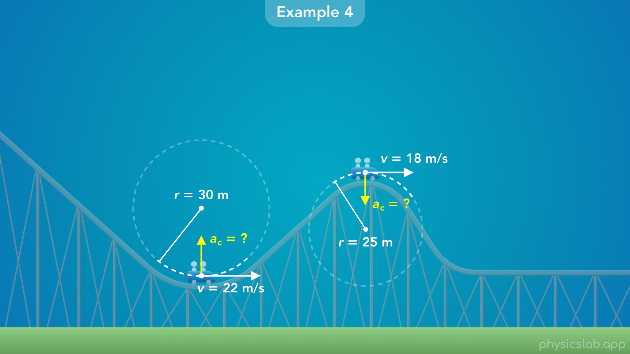
Notes:
• Let’s say the velocity of the car is 22 m/s around the first curve, and 18 m/s around the second curve.
• What would be the centripetal acceleration of the car in each case?

Slide 39
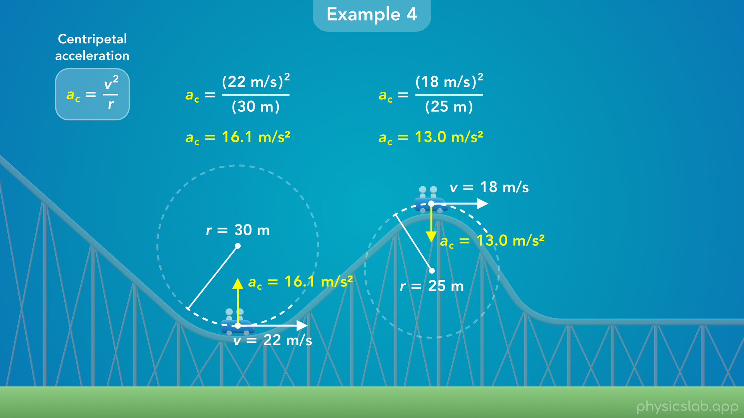
Notes:
• For the first curve, we plug in 22 m/s for v and 30 m for r, and we get 16.1 m/s^2 for ac.
• For the second curve, we plug in 18 m/s for v and 25 m for r, and we get 13 m/s^2 for ac.
• In each case, the centripetal acceleration vector points towards the center of the circular path.
• For the first curve that’s up, and for the second curve it’s down.
• So don’t forget that centripetal acceleration applies any time an object is following part of a circle.

Slide 40
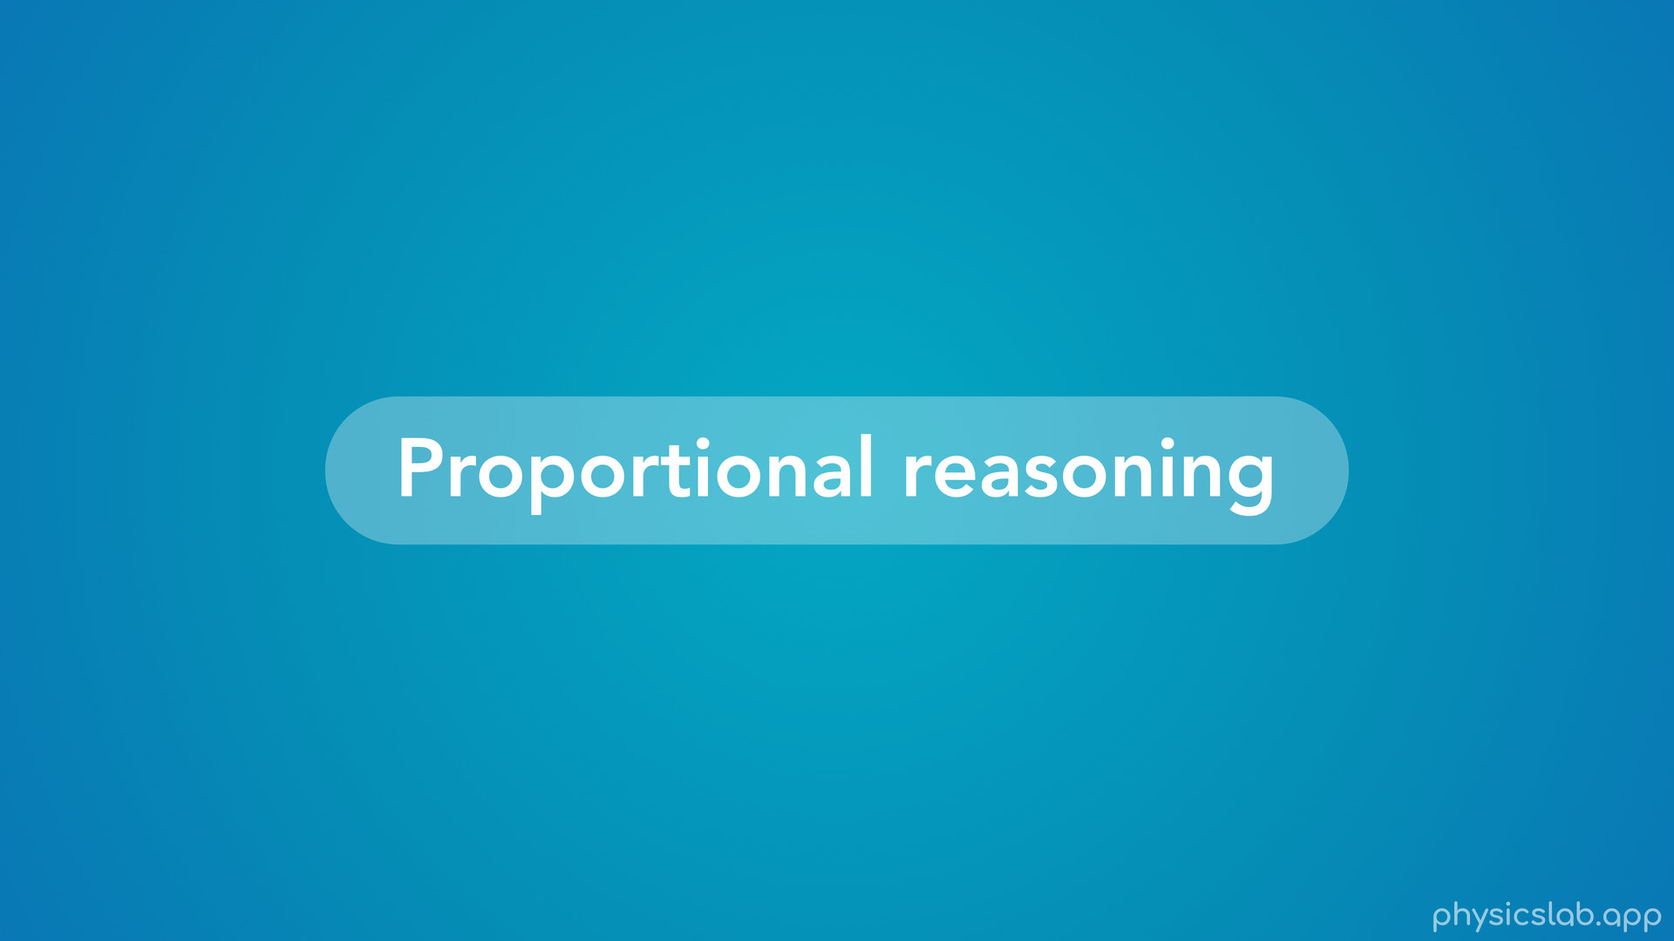
Notes:
• Alright the last thing to cover is proportional reasoning, which will give us more intuition about this equation.

Slide 41
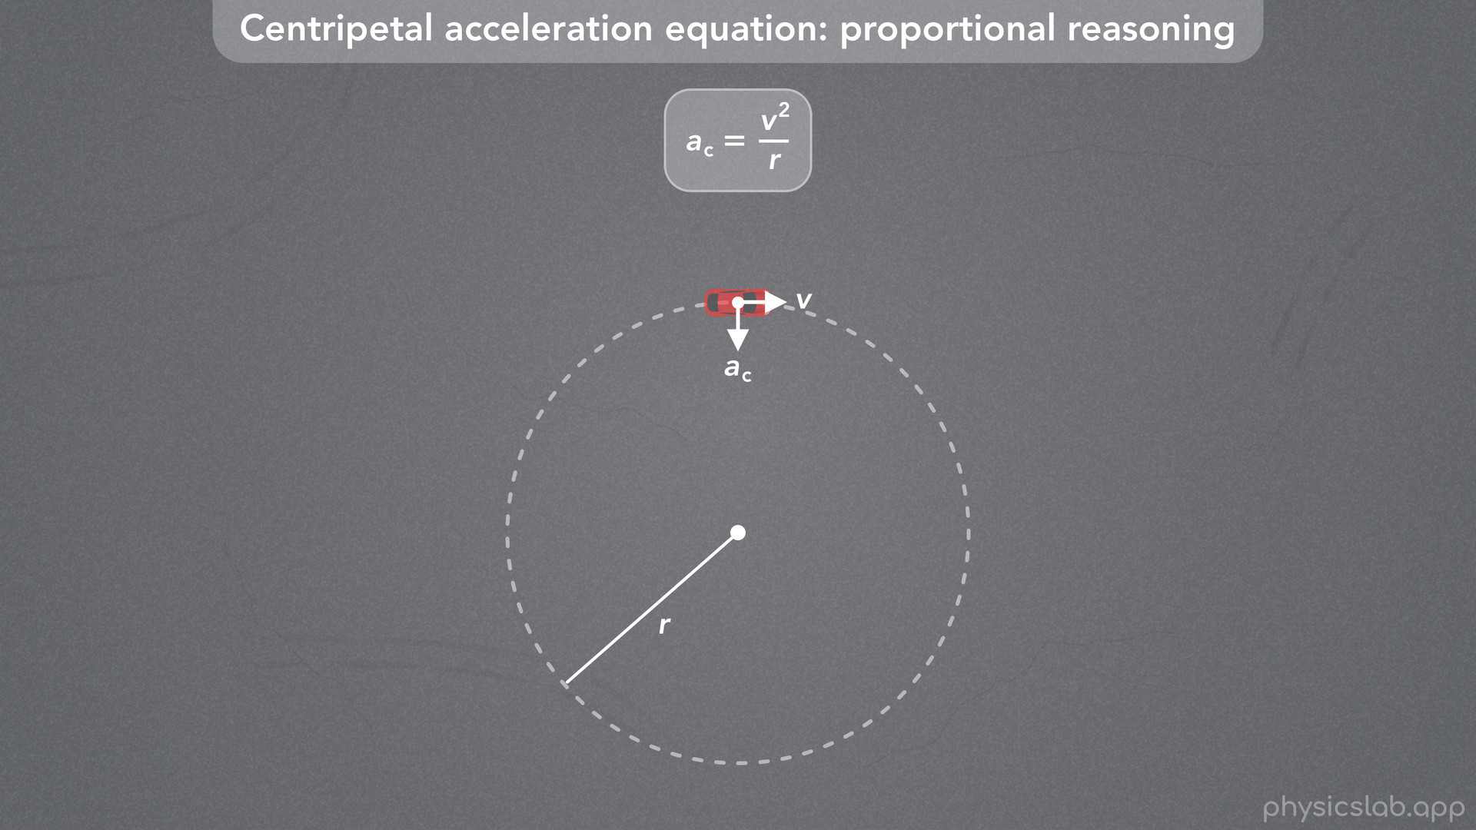
Notes:
• Proportional reasoning means how does changing one variable affect another variable.

Slide 42
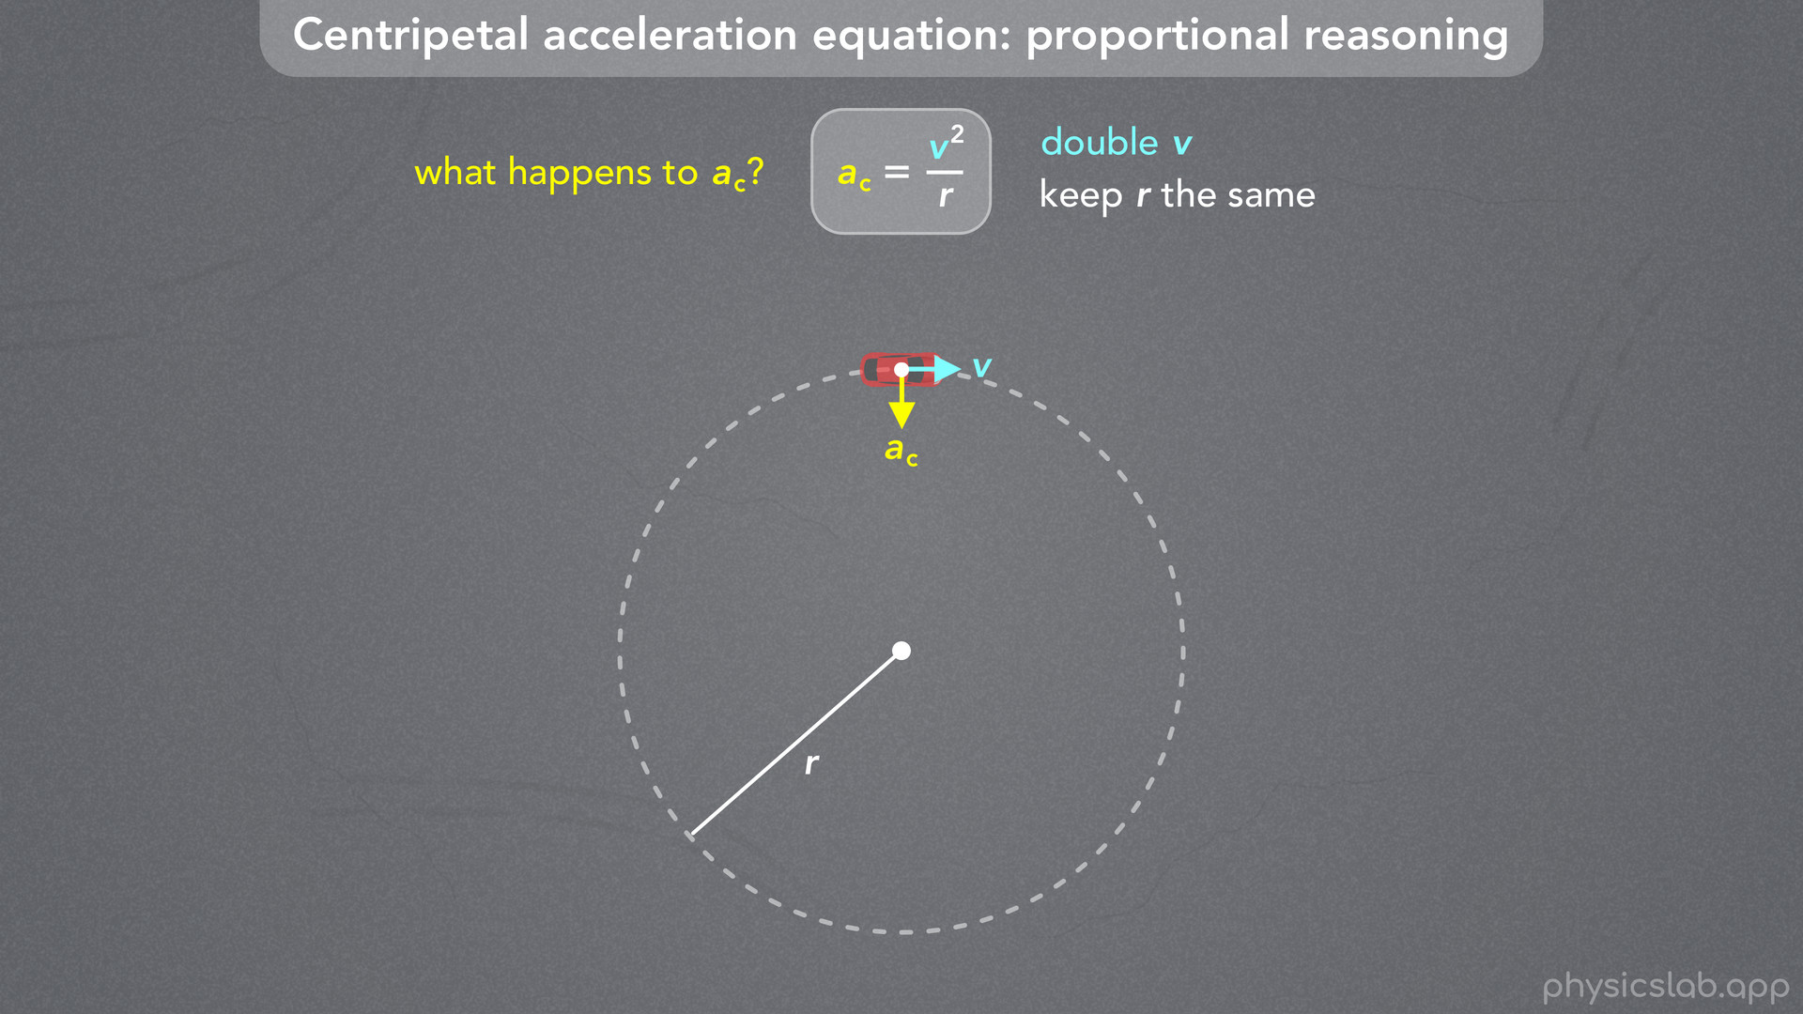
Notes:
• For example, if we keep the radius the same and we double the velocity, what happens to the centripetal acceleration?
• Would it increase or decrease, and by how much?

Slide 43
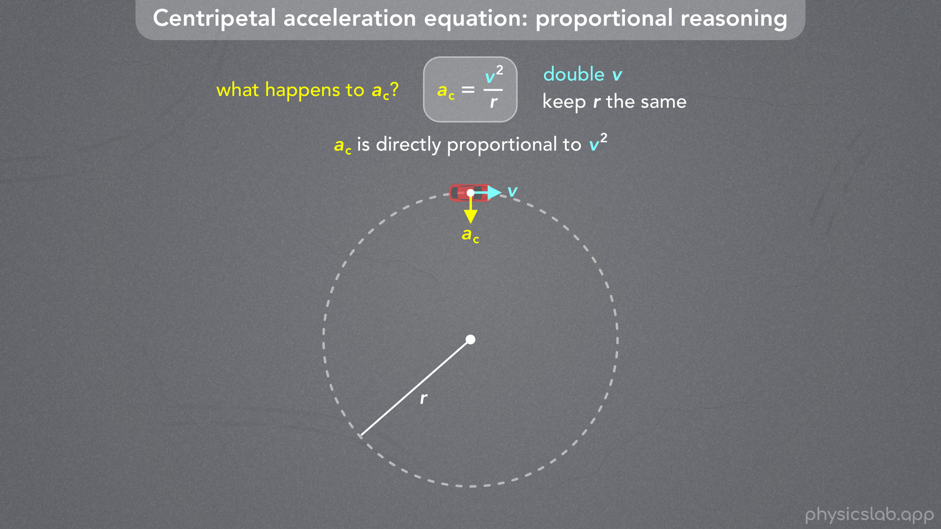
Notes:
• If we look at the equation, centripetal acceleration is directly proportional to the velocity squared, because v^2 is in the numerator of this fraction.
• Directly proportional means if one variable increases the other variable also has to increase.
• And if one decreases, the other has to decrease, for this equation to remain true.

Slide 44
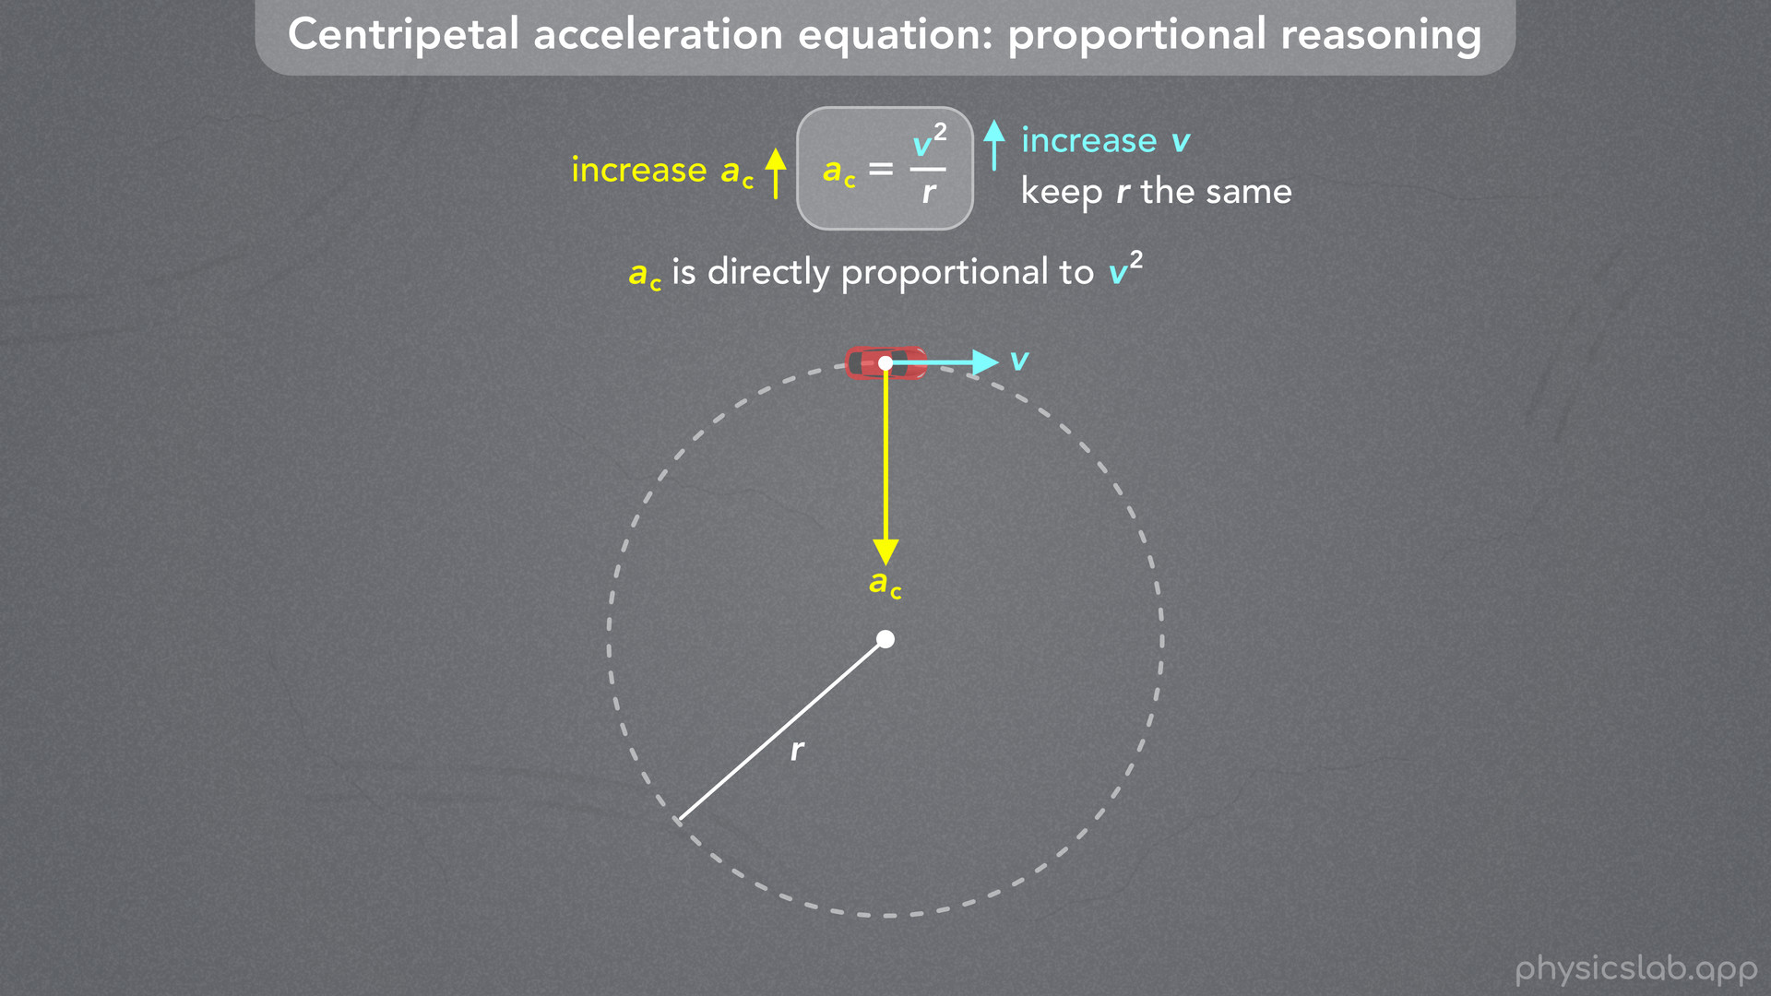
Notes:
• So, if we increase the velocity of the car, then the centripetal acceleration also has to increase if we want to keep the radius the same.

Slide 45
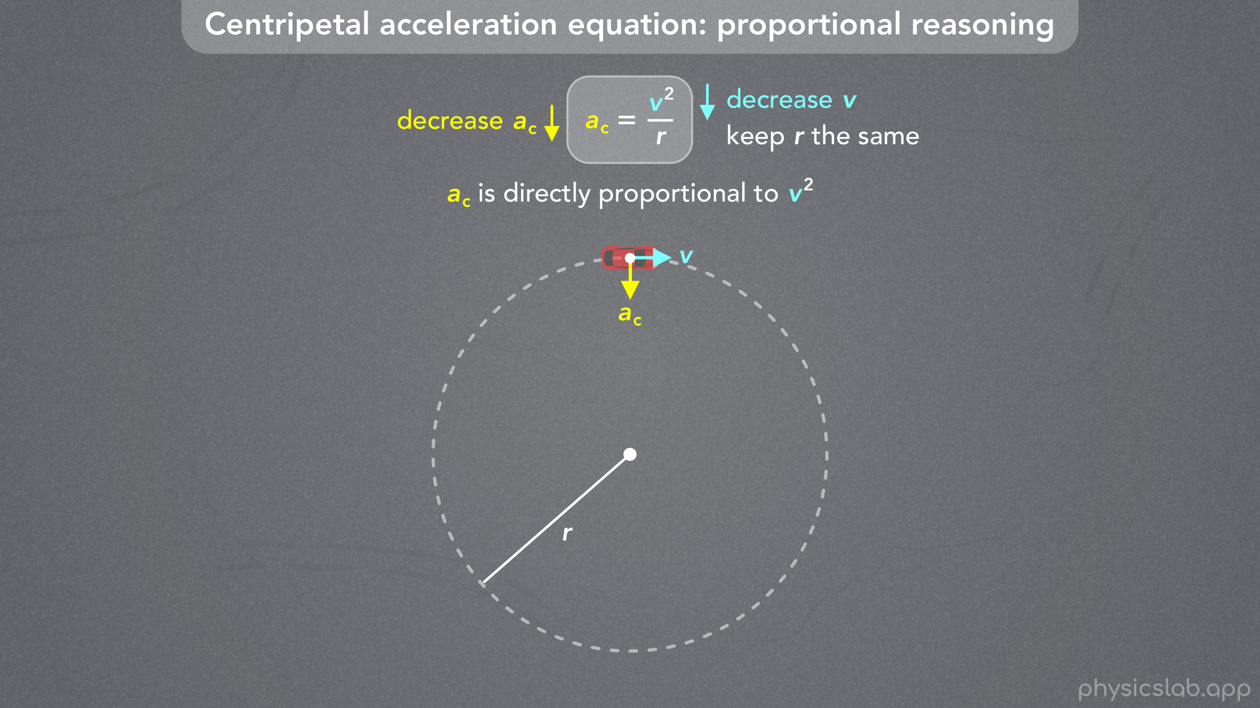
Notes:
• And if we decrease the velocity, the centripetal acceleration would have to decrease.
• We can also think of it the other way around.
• If we increase the centripetal acceleration, the velocity must increase.
• And if we decrease centripetal acceleration, the velocity must decrease.
• Like we mentioned before, this is not about cause and effect, this is just the mathematical relationship between these variables.

Slide 46
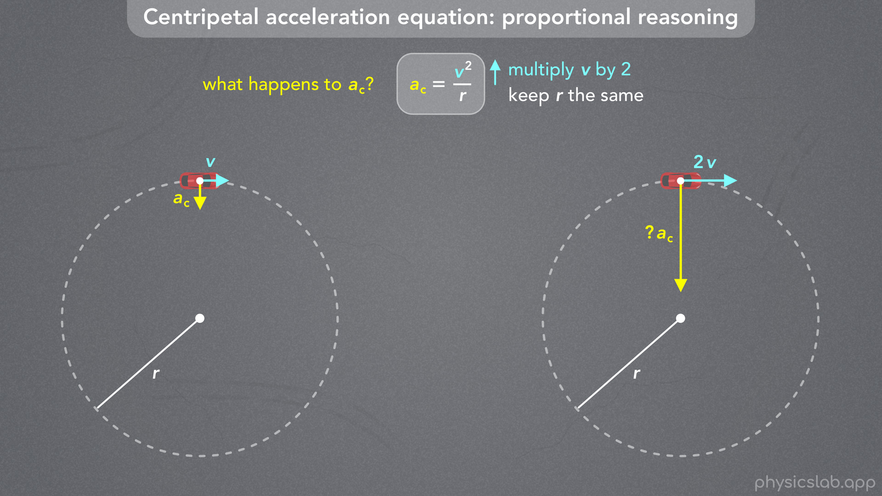
Notes:
• So back to the question, if we keep the radius of the circle the same, and we multiply the velocity by 2, what happens to the centripetal acceleration?
• What number would we multiply times ac?
• Pause the video and see if you can figure it out.

Slide 47
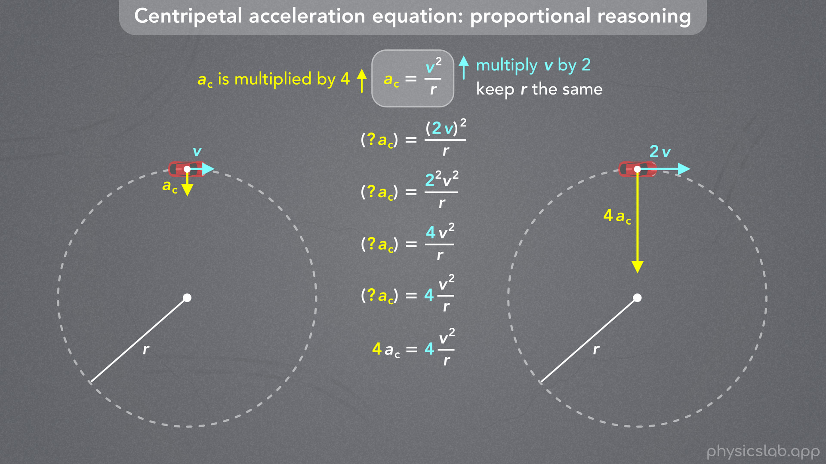
Notes:
• If we plug in 2v for the velocity, what do we have to plug in for the centripetal acceleration in order for this equation to remain true?
• Velocity is squared, so we apply this exponent to everything in the parentheses, and we get 2^2 times v^2.
• So the numerator becomes 4 v^2.
• Let’s move the 4 in front of this fraction so we can clearly see that we have 4 times v^2 over r.
• So now, what do we have to multiply times ac for this equation to be true?
• The right side is multiplied by 4 so we have to multiply the left side by 4 to keep this balanced.
• And that’s our answer.
• If we multiply the velocity by 2, then we have to multiply the centripetal acceleration by 4, if we keep the radius the same.

Slide 48
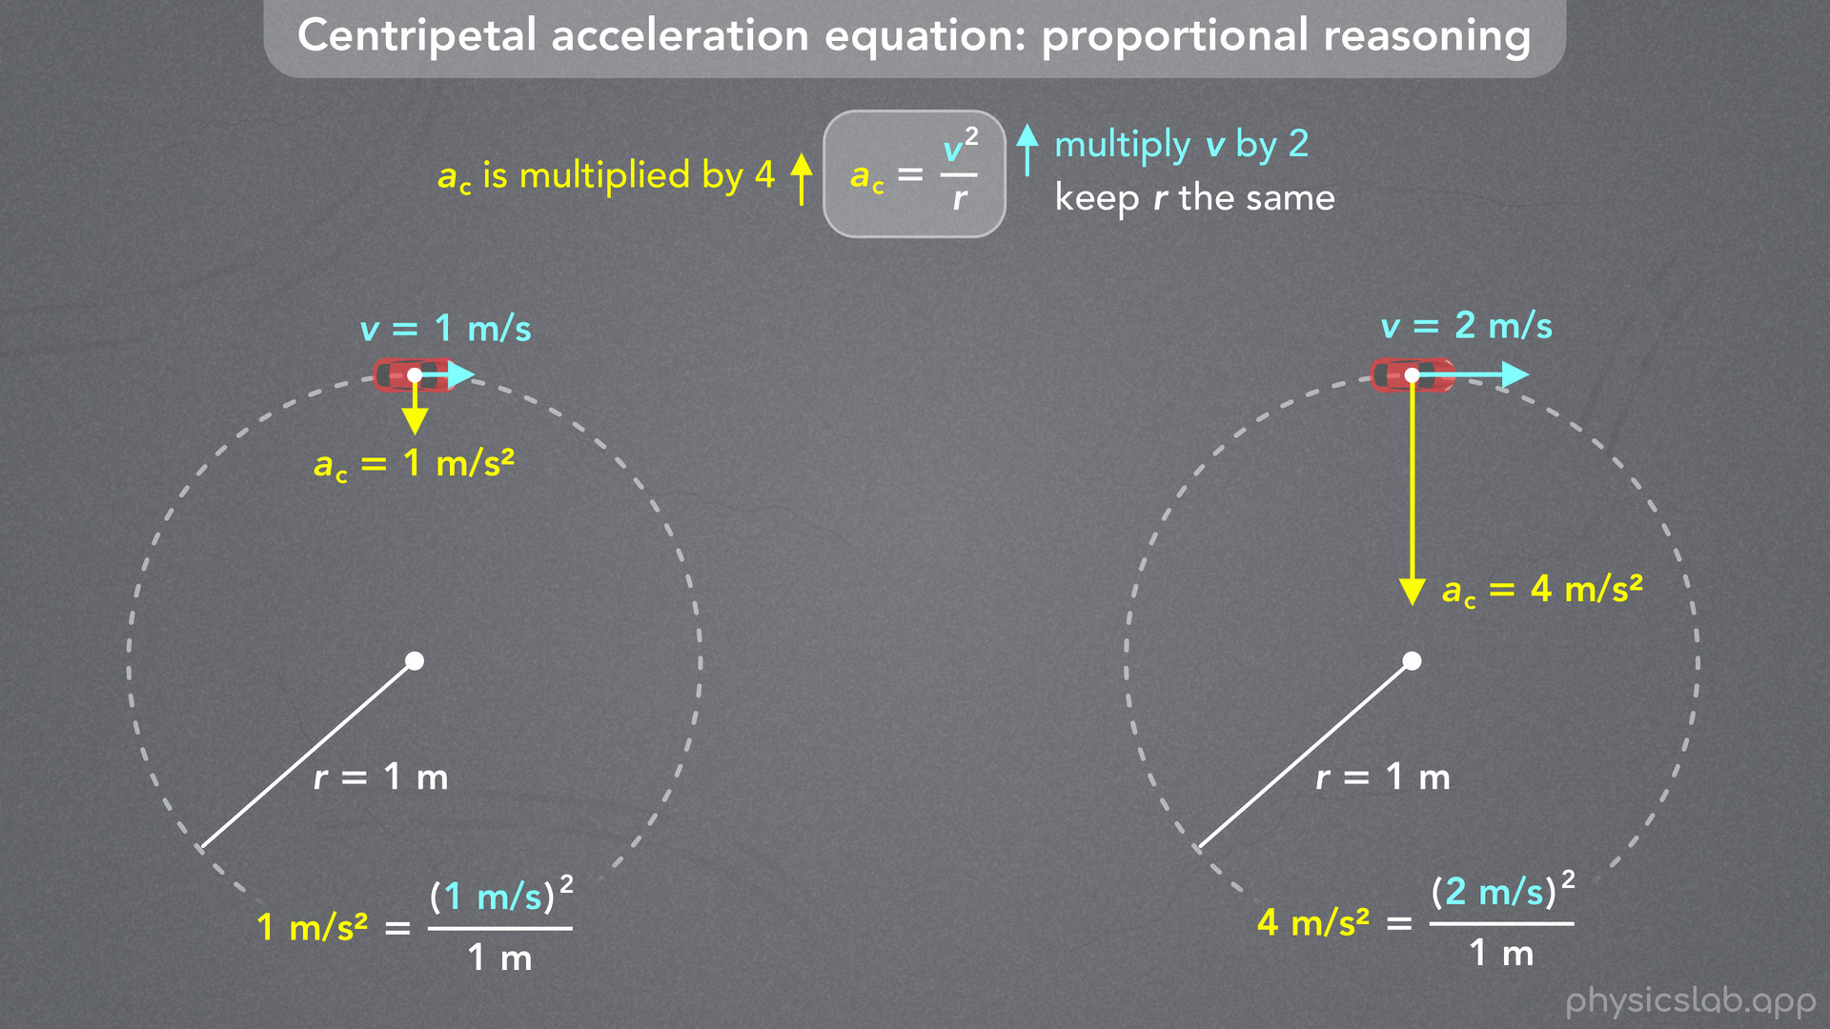
Notes:
• We could also think about this using numbers.
• To keep things simple, let’s start with 1 m/s for the velocity and 1 m for the radius, which means the centripetal acceleration is 1 m/s^2.
• If the car on the right follows a circle with the same radius, but it’s moving at 2 m/s, then it must have a centripetal acceleration of 4 m/s^2.
• So if we double the velocity, the centripetal acceleration is multiplied by 4.

Slide 49
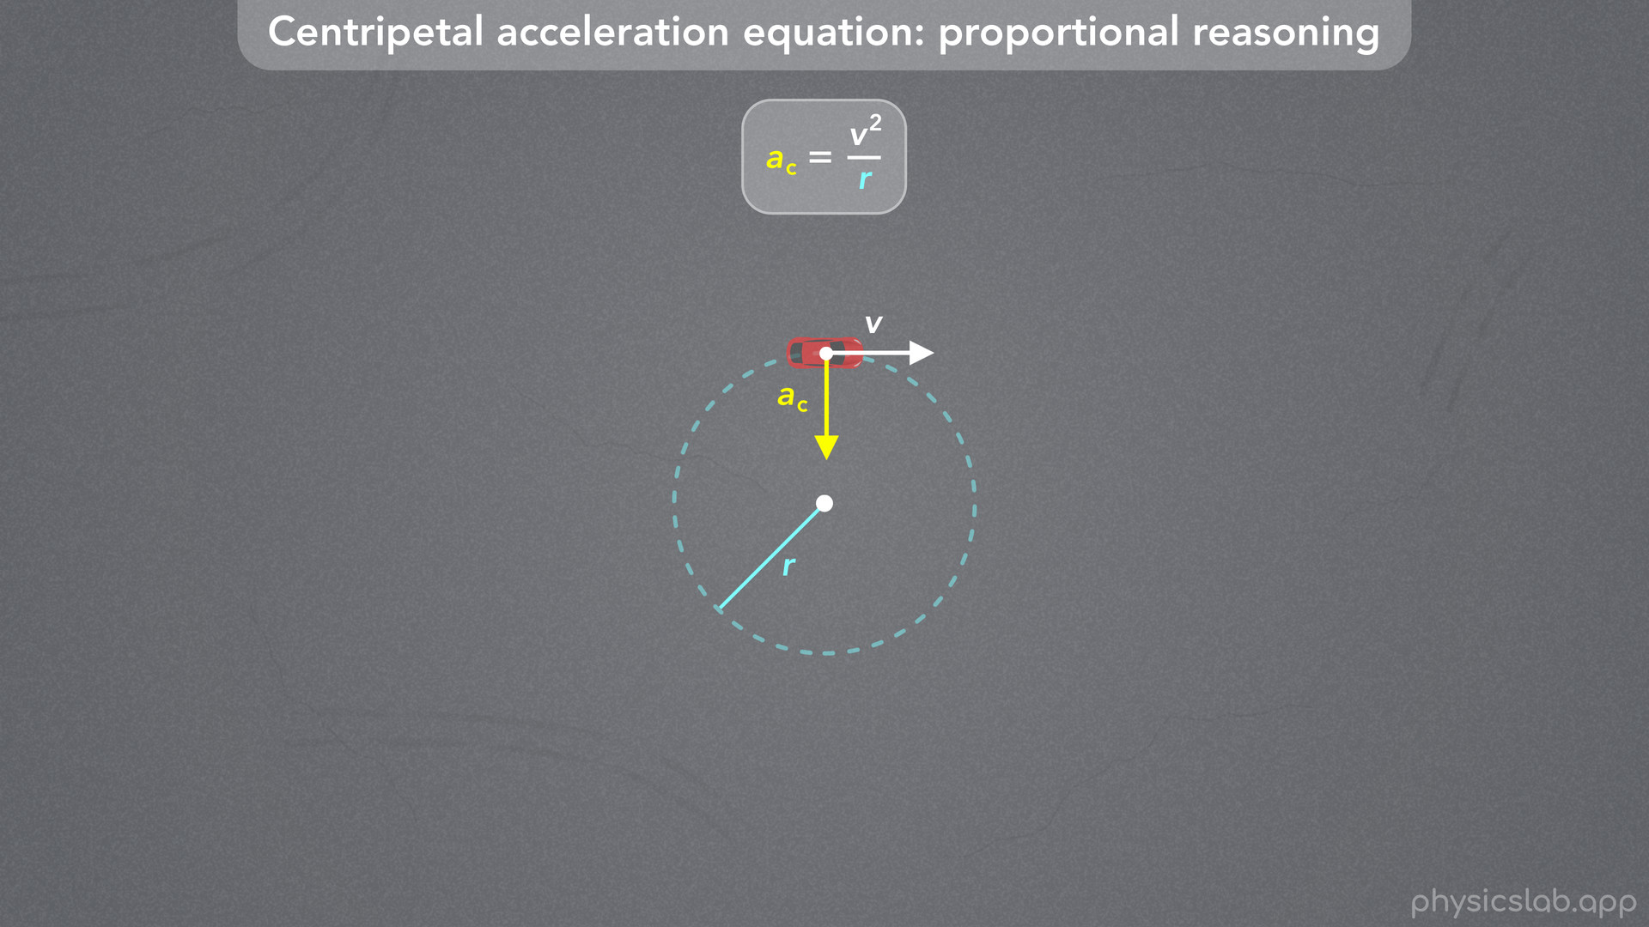
Notes:
• Let’s run through 2 more examples.
• How is centripetal acceleration related to the radius?

Slide 50
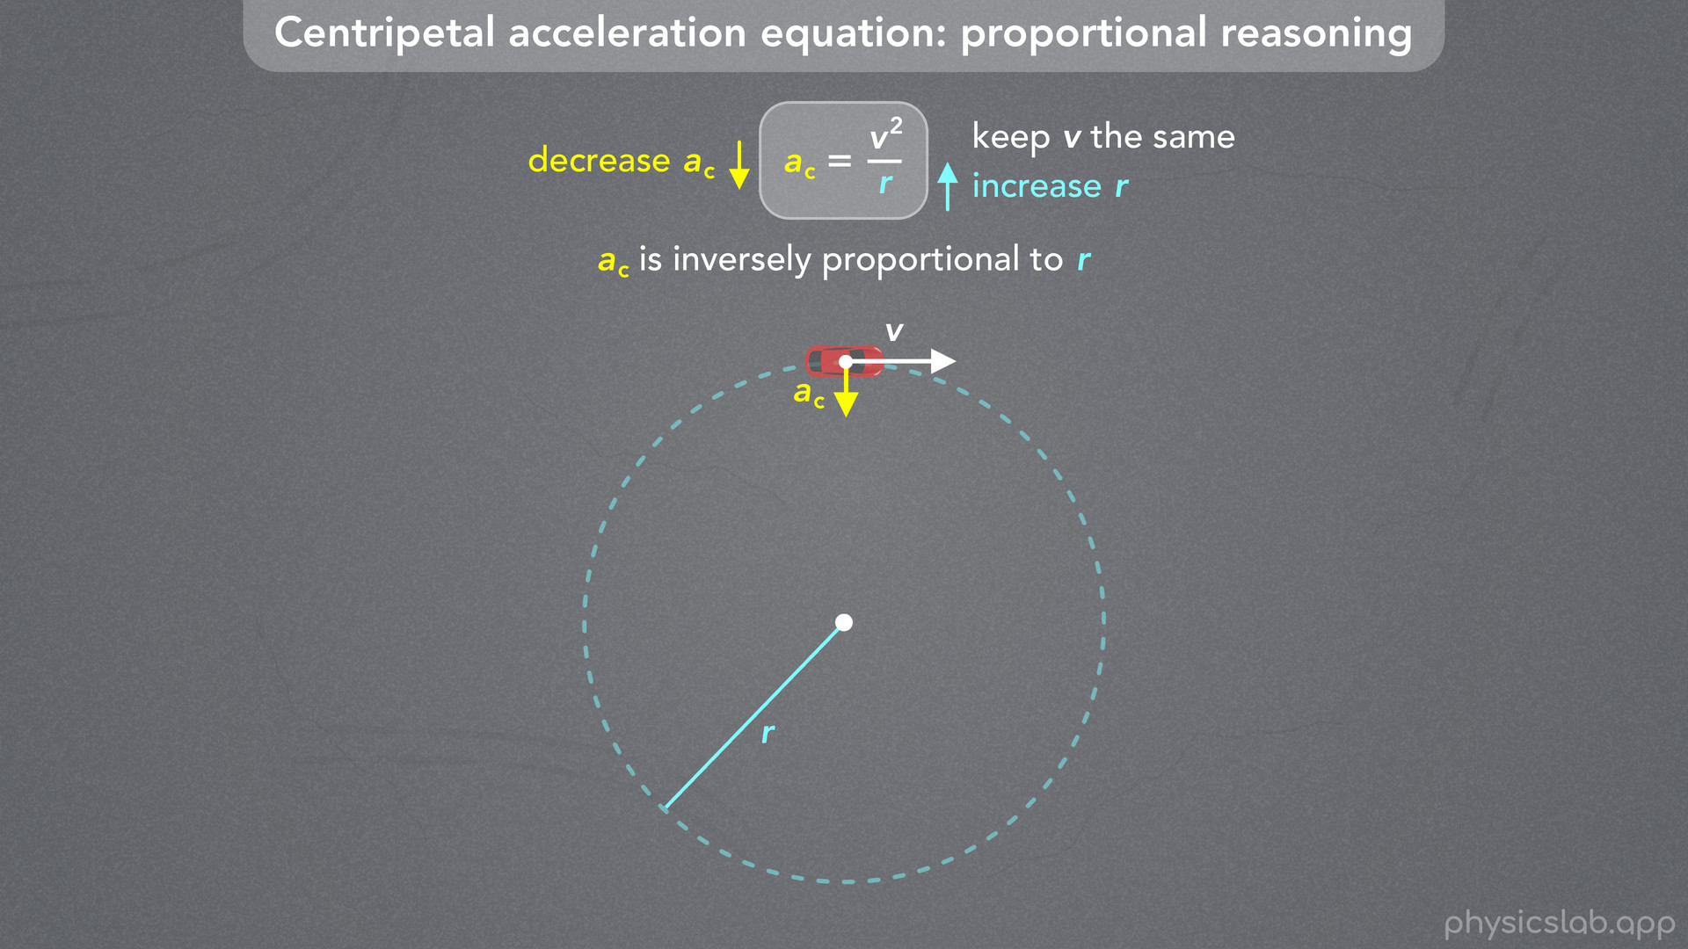
Notes:
• ac is inversely proportional to r because r is in the denominator.
• If we keep the velocity the same and we increase r, then we’re dividing v^2 by a bigger number, so this fraction gets smaller.
• And if the right side of the equation gets smaller, then the left side has to get smaller.
• So if we increase the radius, the centripetal acceleration must decrease.

Slide 51
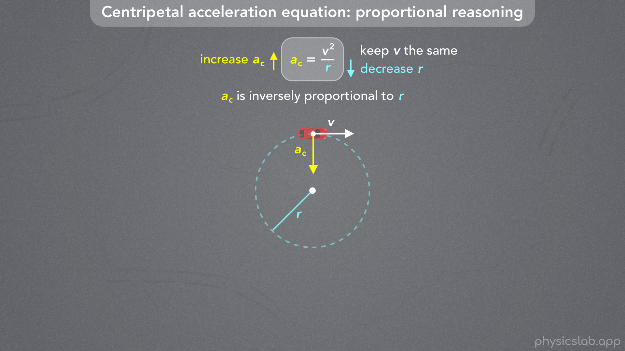
Notes:
• And if we decrease the radius, the centripetal acceleration must increase.

Slide 52
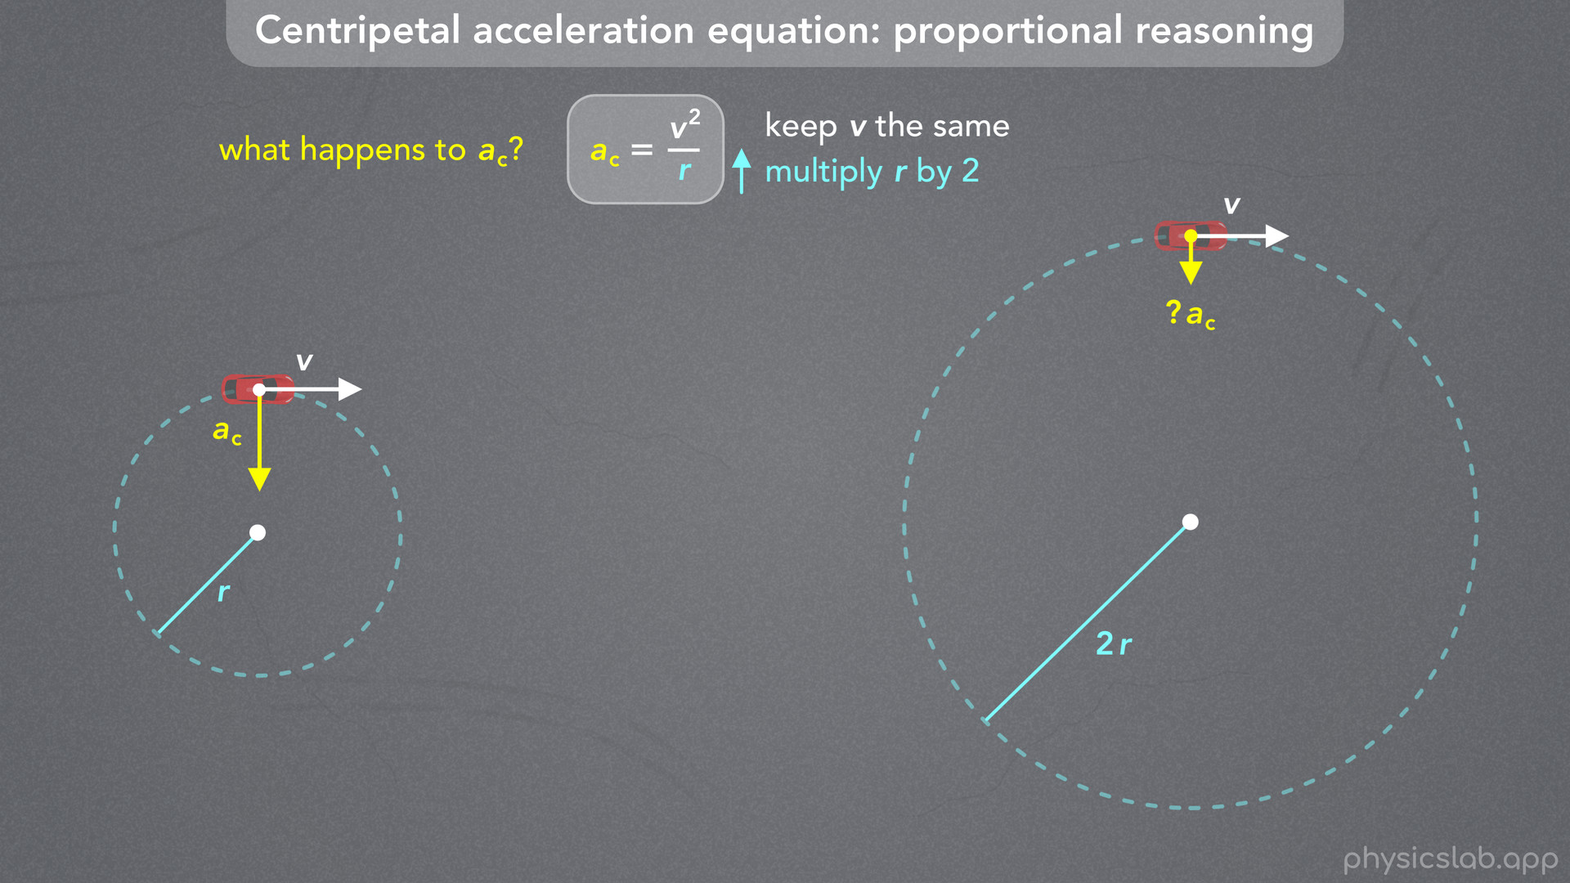
Notes:
• For example, lets keep the velocity of the car the same, and multiply the radius by 2, so the car drives around a circle that’s twice as big.
• What would happen to the centripetal acceleration?

Slide 53
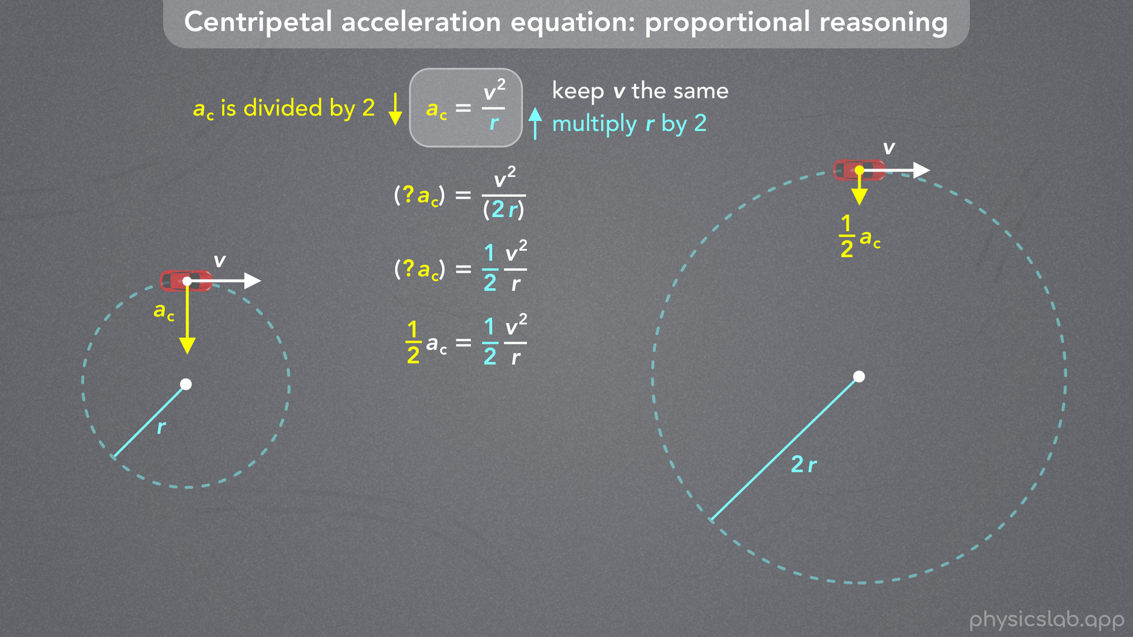
Notes:
• If we plug in 2r for the radius, then we have a 2 in the denominator.
• We can rewrite this as a separate fraction, 1/2 times v^2 over r.
• The right side of this equation is being multiplied by 1/2, which means we have to multiply the left side times 1/2.
• So if we keep the velocity the same and we double the radius, then the centripetal acceleration is divided by 2.

Slide 54

Notes:
• Using numbers, let’s say each variable starts with a value of 1.
• If we double the radius and plug in 2 m for r, then we get 1/2 or 0.5 m/s^2 for the centripetal acceleration.

Slide 55

Notes:
• The last option is to keep the centripetal acceleration fixed, and see how the velocity and radius are related to *each other*.

Slide 56

Notes:
• If we keep ac the same and we increase r, then what has to happen to v?
• Is v^2 directly or inversely proportional to r?
• Pause the video and give this some thought.

Slide 57

Notes:
• So if we increase the denominator, then we also have to increase the numerator for this fraction to stay the same.
• That means if we increase the radius, then the velocity has to increase to keep the centripetal acceleration constant.
• It might help to rearrange this equation so that r and v are on different sides.
• If we multiply both sides by r, then we get ac times r equals v^2.
• Now it’s easier to see that v^2 is directly proportional to r.

Slide 58

Notes:
• If we increase the radius, the velocity also has to increase.

Slide 59

Notes:
• If we decrease the radius, the velocity has to decrease.

Slide 60


Slide 61

Notes:
• As an example, let’s say we keep the centripetal acceleration the same, and we multiply the radius of the circle by 4.
• What has to happen to the velocity?
• Using the original equation, we plug in 4r for the radius.
• What do we multiply times v?
• We can distribute this exponent so we have the unknown number squared times v^2 divided by 4r.
• If we want the left side of the equation to stay the same, then the right side also has to stay the same, so these numbers will have to cancel out.
• If we have a 4 in the denominator, then we need a 4 in the numerator, so this number has to be 2.
• 2^2 is 4, and 4 divided by 4 is 1, which means the right side of the equation stays the same.
• So, if we multiply the radius by 4, then we have to multiply the velocity by 2, because the velocity is squared.

Slide 62

Notes:
• You might find it easier to rearrange the original equation like we did before, and multiply both sides by r.
• Now, if we plug in 4r for the radius, what do we multiply times v?
• The left side of the equation is being multiplied by 4, so the right side also has to be multiplied by 4 for the equation to be balanced.
• That means this number has to be 2, so when we square it, we get a 4 on the right.

Slide 63

Notes:
• Here’s what that looks like using numbers.
• We’re choosing to keep the centripetal acceleration the same, so if we plug in 4 m for the radius, then we have to plug in 2 m/s for the velocity.
• So those are some of the ways we can use proportional reasoning with this equation.
• Which variables we change and which variables we keep the same will depend on the problem.

Slide 64

Notes:
• Before we move on, notice that in this last example, we kept the value of the centripetal acceleration fixed, we changed the radius of the circle, and we saw how that changed the velocity.
• For a given centripetal acceleration, the car would drive faster around a bigger circle, and the car would drive slower around a smaller circle.
• This can help us answer the question from the beginning of the video.

Slide 65

Notes:
• … This is the reason that we have different speed limits for different curves.
• While the car is driving around the curve, it’s in circular motion, and the curve on the left has a larger radius than the curve on the right.

Slide 66

Notes:
• Let’s calculate the centripetal acceleration in each case.
• First, we need to convert these speed limits.
• 30 mph is about 13.4 m/s, and 15 mph is about 6.7 m/s.

Slide 67

Notes:
• For the left curve, we plug in 13.4 m/s for the velocity and 24 m for the radius, and we get 7.5 m/s^2 for the centripetal acceleration of the car around the left curve.
• For the right curve, we plug in 6.7 m/s for the velocity and 6 m for the radius, and we get 7.5 m/s^2 for the centripetal acceleration of the car around the right curve.
• So using these speed limits, the car has the same centripetal acceleration around each curve.
• The right curve has 1/4 of the radius of the left curve, so it has half the speed limit.
• In turns out that these numbers are the same because centripetal acceleration is one of the limiting factors when they design roads.
• In this example, 7.5 m/s^2 is the maximum centripetal acceleration that’s allowed when driving around any curve.

Slide 68

Notes:
• If a car drove faster than the speed limit, then it’s centripetal acceleration would exceed this maximum value.
• For example, if the car on the right was going 20 mph or 8.9 m/s, its centripetal acceleration would be 13.2 m/s^2 which is too high.
• The reason there’s a maximum value will make more sense after we learn about centripetal force.

Slide 69

Notes:
• But for now, just know that the engineers who design roads are thinking about this equation.
• For safety reasons, they start with a maximum value for centripetal acceleration.
• That number is fixed, and if they’re trying to achieve a certain speed limit, they can design the road to have a specific radius.
• Or if they know the radius of a curve, then they can calculate the speed limit.

Slide 70

Notes:
• For example, here’s a new road that has a curve with a radius of 17 m.
• If we’re told that the maximum centripetal acceleration must be 7.5 m/s^2, what should the speed limit be for this curve?

Slide 71

Notes:
• We can rearrange this equation to solve for v.
• We multiply both sides by r, then take the square root of both sides.
• Then we plug in 7.5 m/s^2 for ac and 17 m for r.
• That gives us 11.3 m/s, which is about 25 mph.
• So that would be the speed limit for this curve.

Slide 72

Notes:
• This concept shows up in other places, like when you’re turning at an intersection.
• If you drive on the right side of the road, then the radius of a left turn is a little bigger than the radius of a right turn.
• So you might notice that you can go a little faster when making a left, but you have to slow down a lot when making a right.

Slide 73

Notes:
• And if you’ve ever watched formula 1 or any other race, this is why the cars are constantly shifting gears.

Slide 74

Notes:
• Every curve on the track has some radius, and the smaller the radius, the more they have to slow down.

Slide 75

Notes:
• The teams even run simulations before the race to figure out the speed around each turn.
• And those calculations are based on the equation for centripetal acceleration.

