Slide 1
Rotational Motion
Slides Version 2
This version includes:
Slides with screenshot images from the video.
The video narration in the slide notes.
A blank template slide with the same background and font as the video.
Slides with some basic graphics from this video for you to use however you like.
Feel free to add, delete and edit slides to make your own presentation. You can use these slides in class or share them with your students, but please do not share them with anyone else.
If you have any feedback, suggestions or questions about these slides please email me at chris@physicslab.app or send me a message on Discord @physicslab.
physicslab.app

Slide 2
Heading
Text

Slide 3

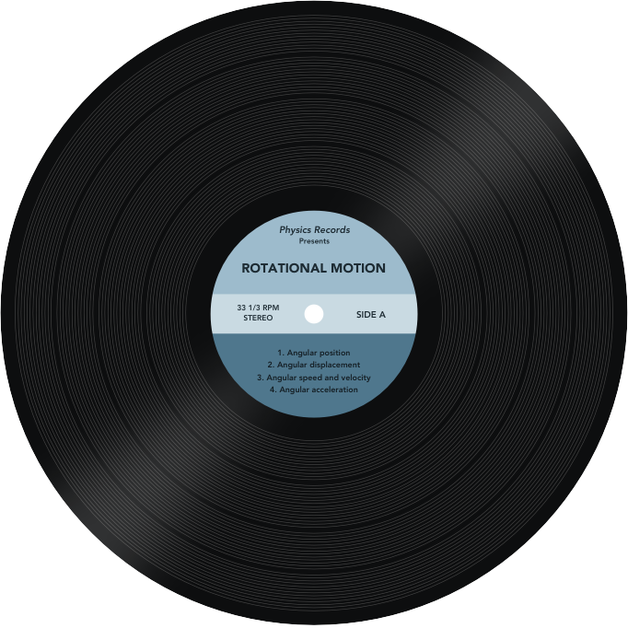
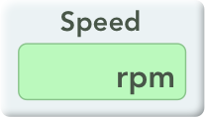
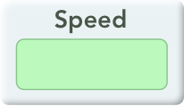

Slide 4

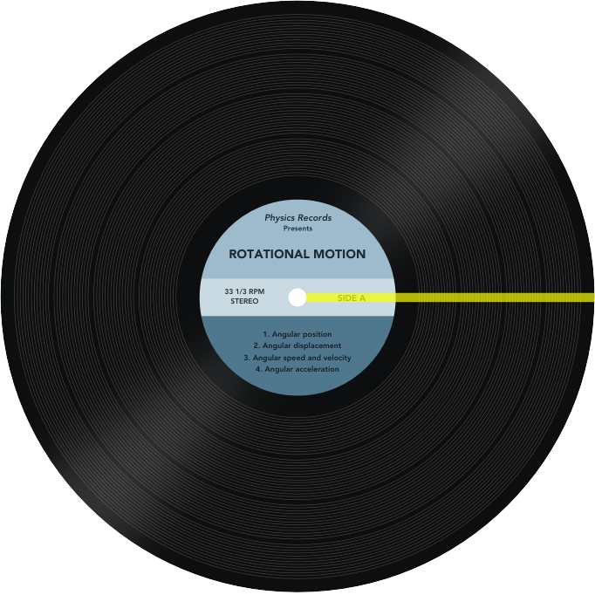



Slide 5



Slide 6







Slide 7
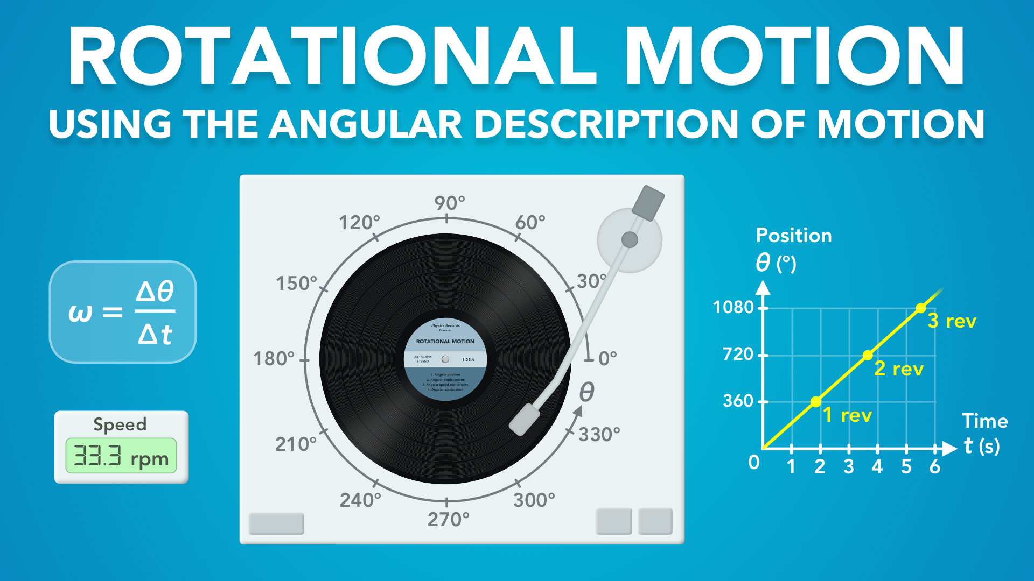
Notes:
Rotational Motion - Using the Angular Description of Motion
physicslab.app
If you have any questions, suggestions or feedback about these slides please email me at chris@physicslab.app or send me a message on Discord @physicslab.

Slide 8
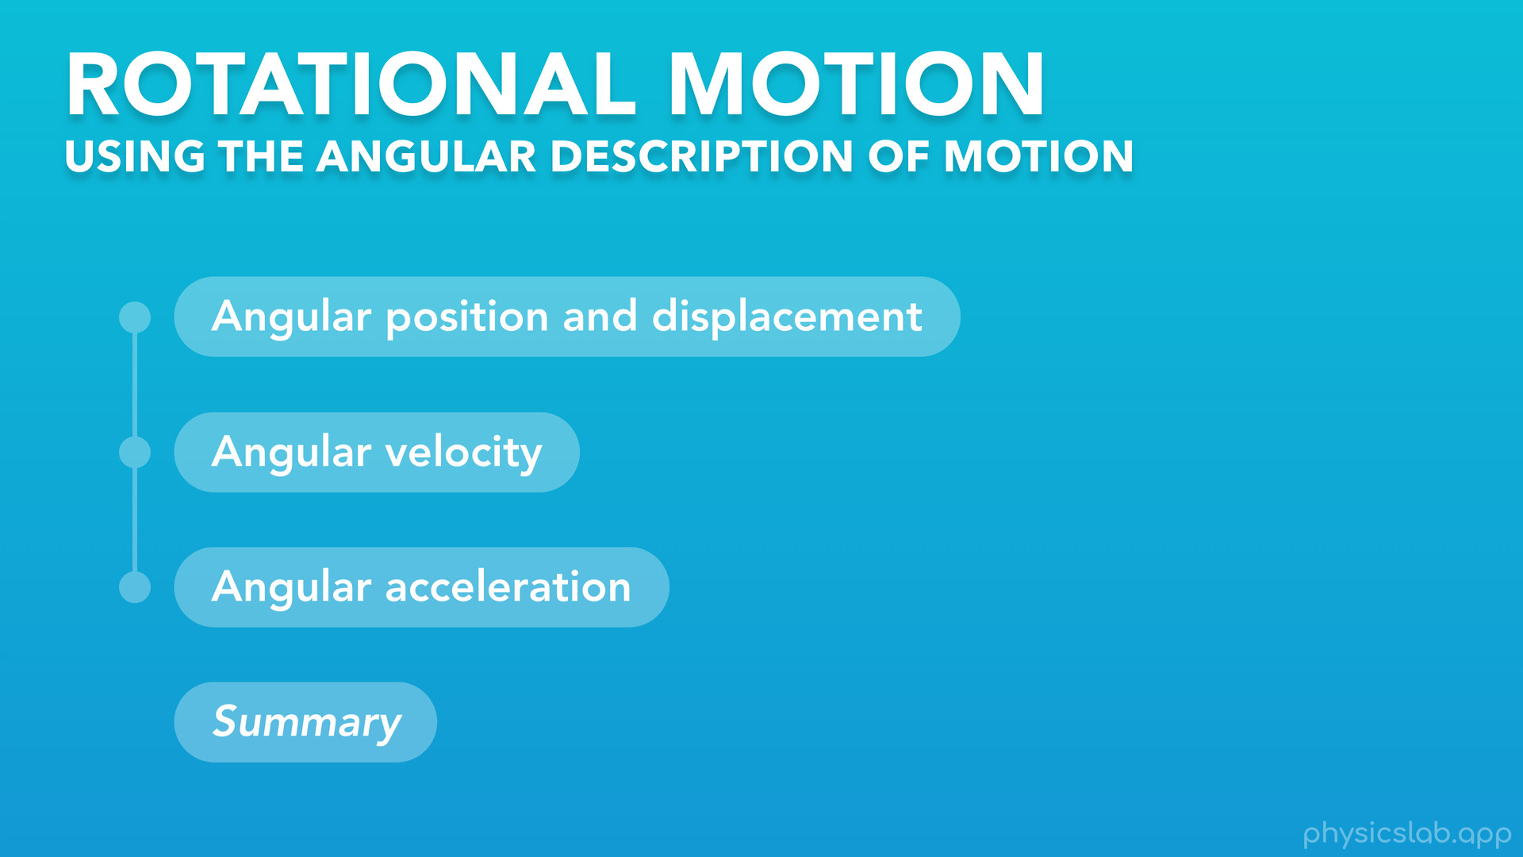
Notes:
○ Hey everyone, in this video we’re going to learn about rotational motion using the angular description of motion.

Slide 9
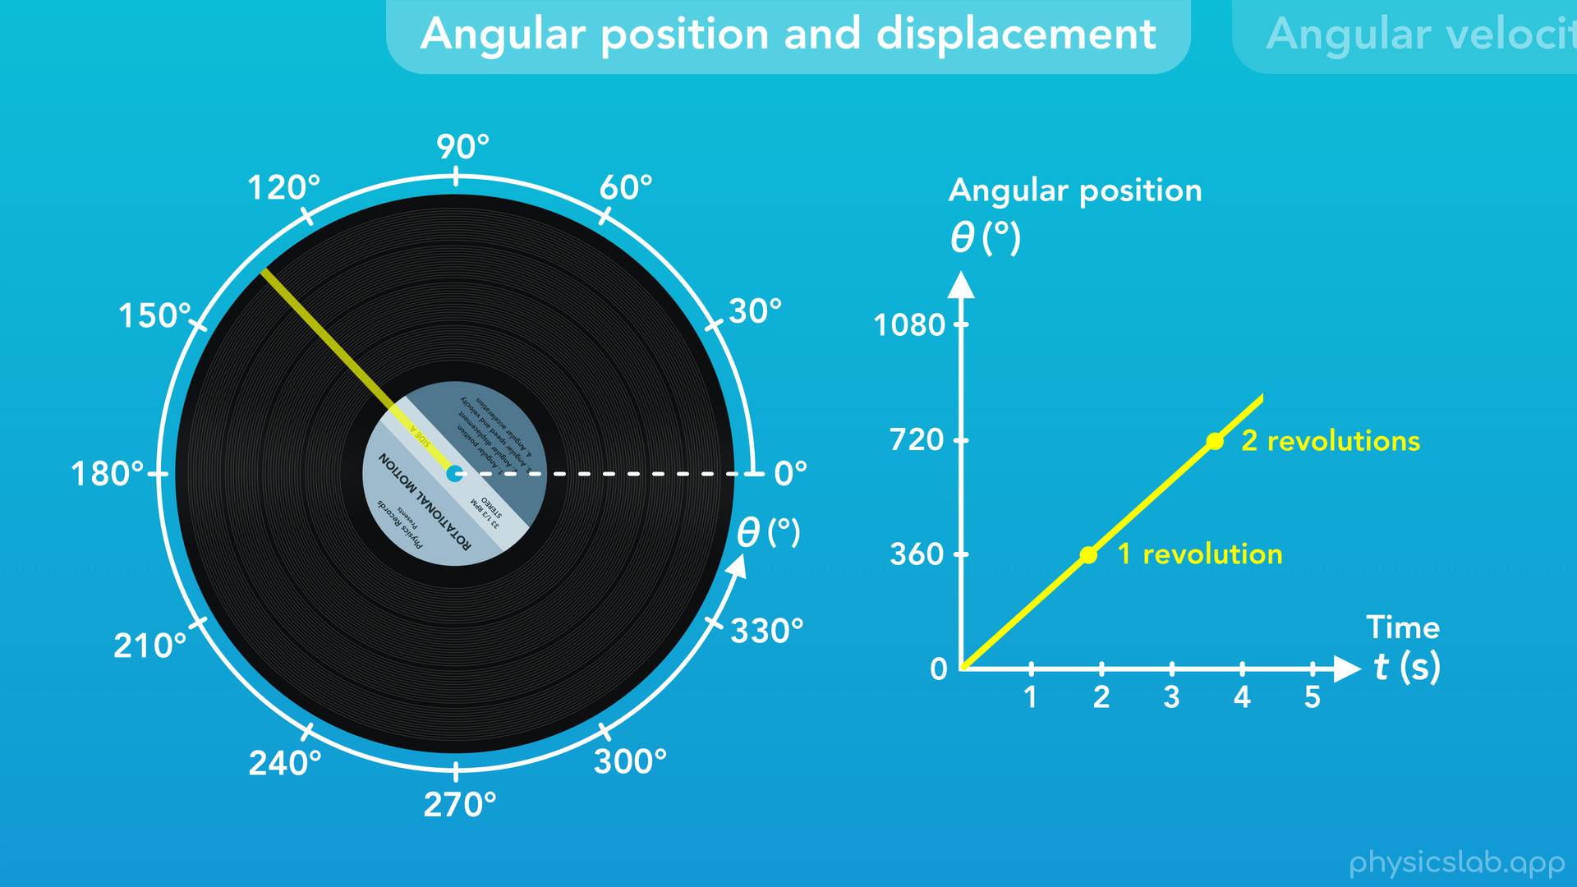
Notes:
We’ll cover angular position and displacement

Slide 10
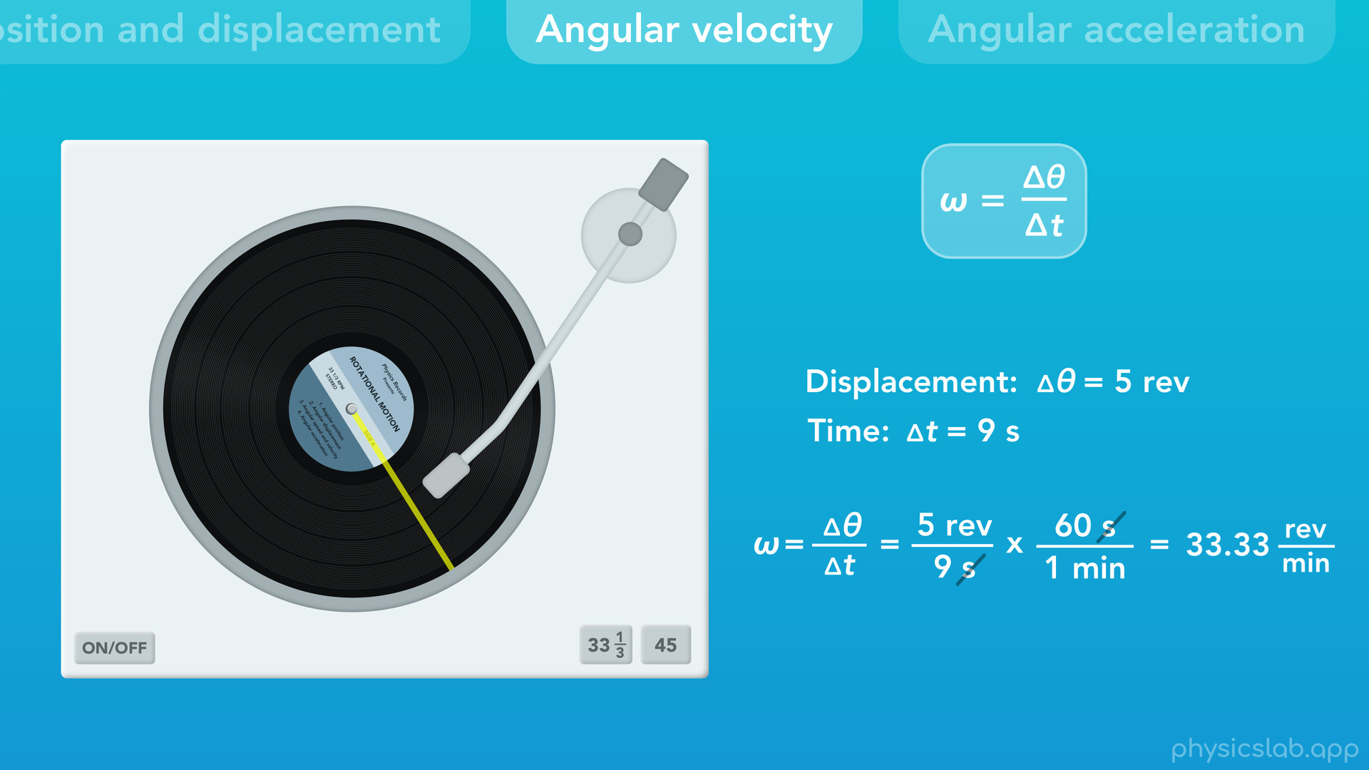
Notes:
angular velocity

Slide 11
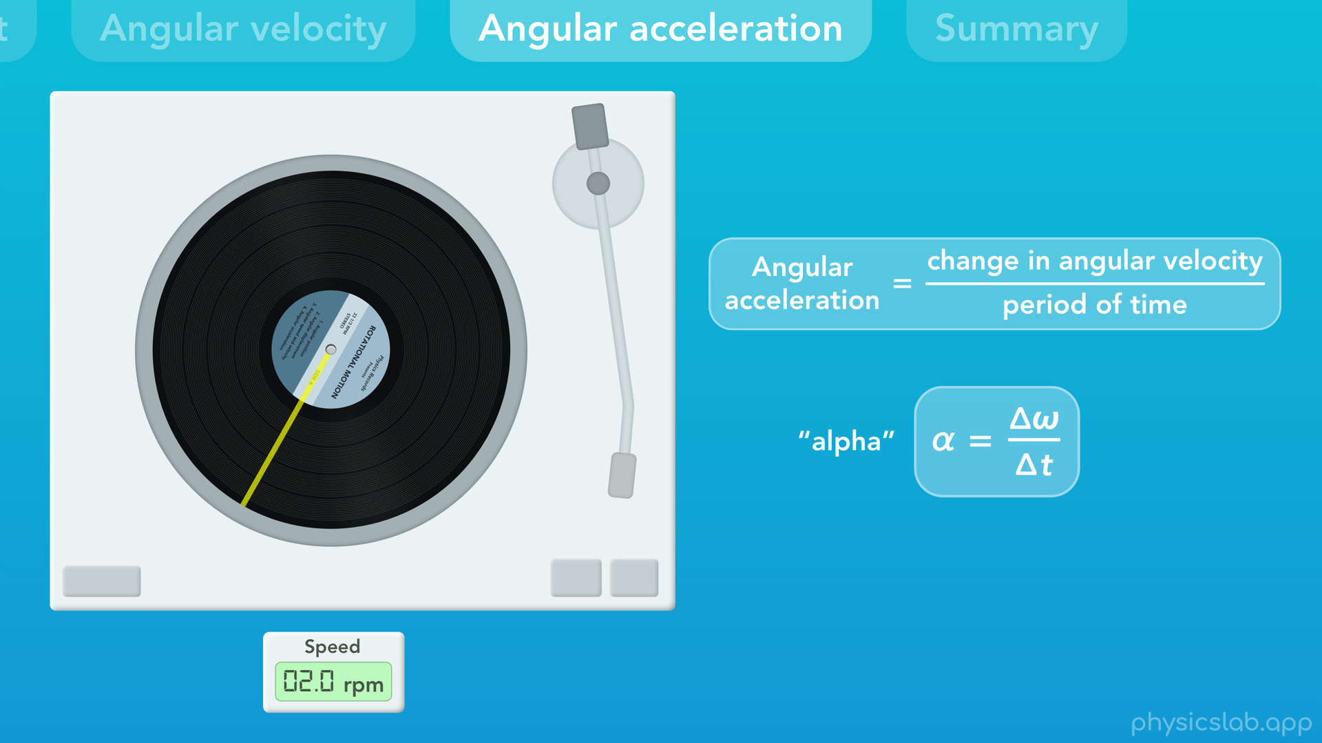
Notes:
and angular acceleration.

Slide 12
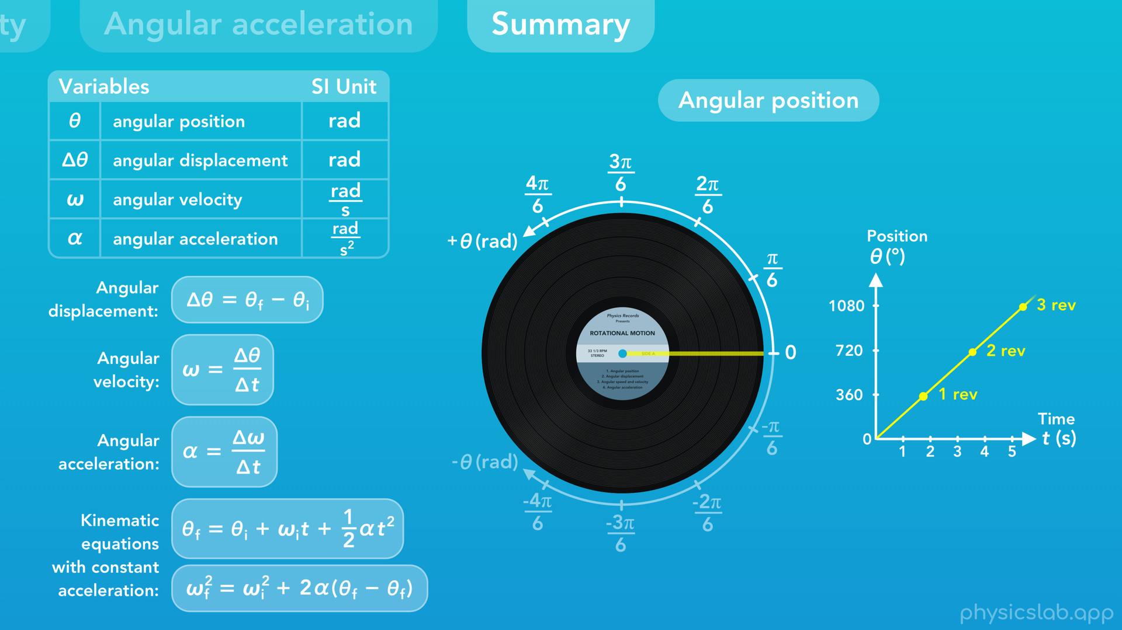
Notes:
Then we’ll do a summary of the main points at the end.

Slide 13
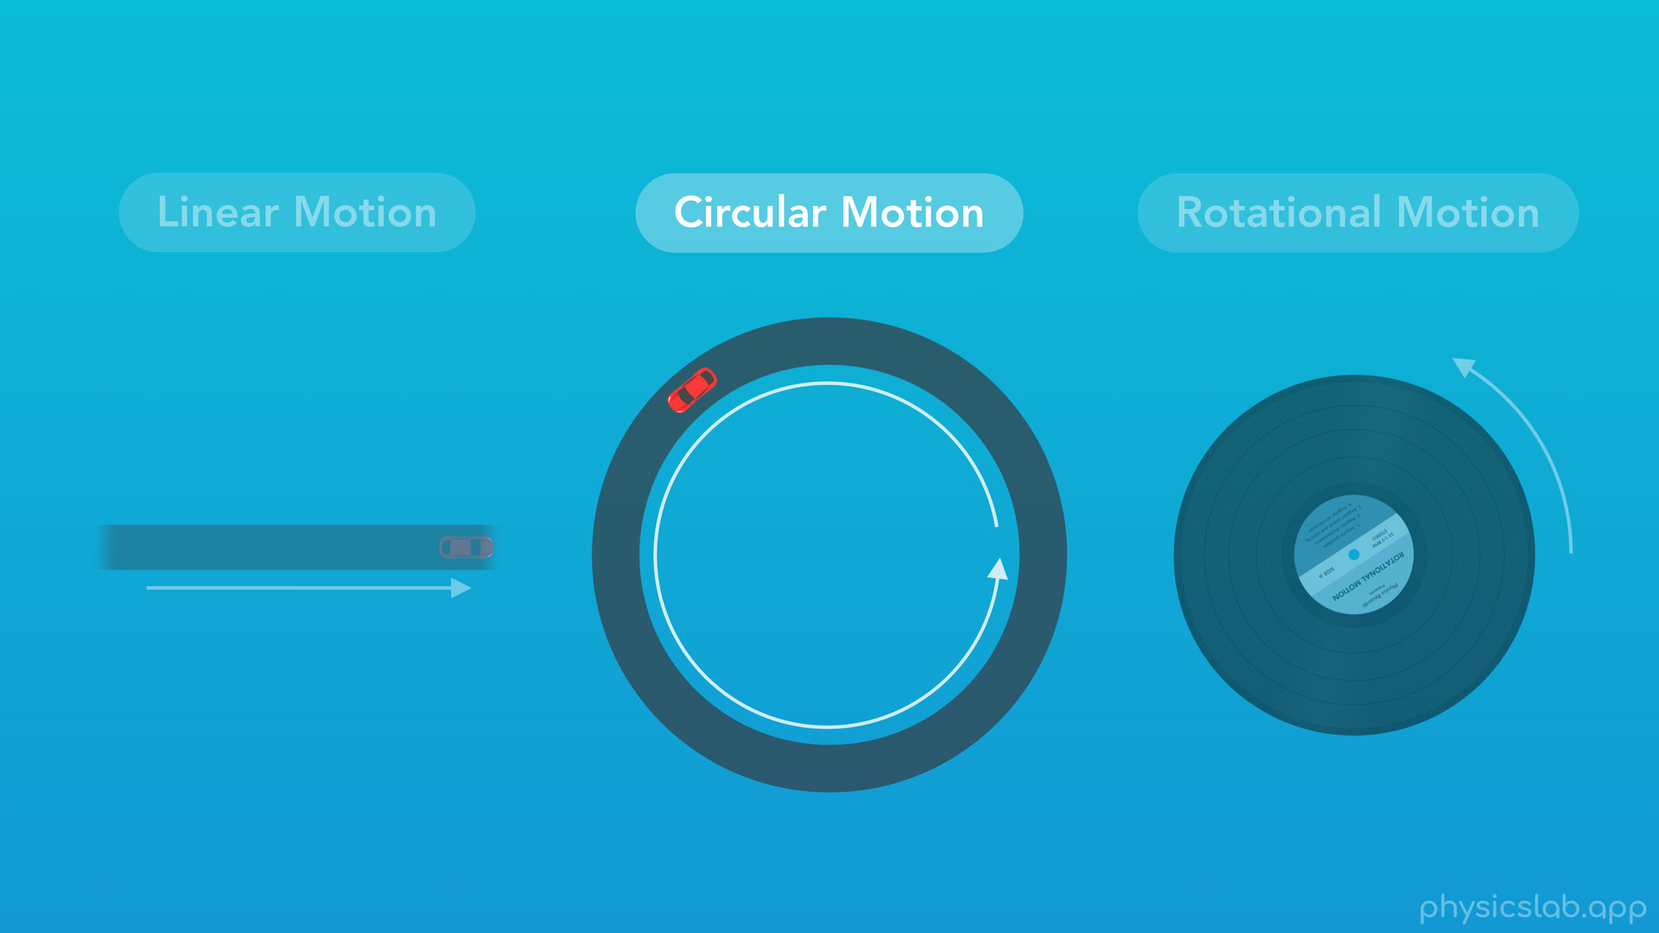
Notes:
○ In a previous video, we learned about circular motion, where an object travels along a circular path.

Slide 14
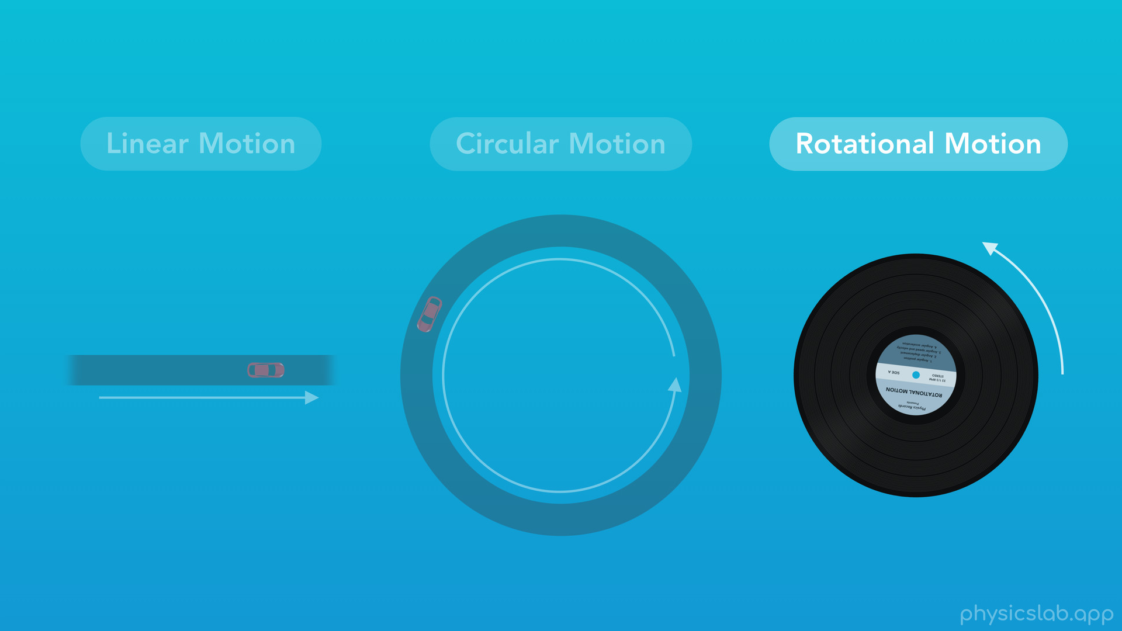
Notes:
In this video, we’ll learn about rotational motion.

Slide 15
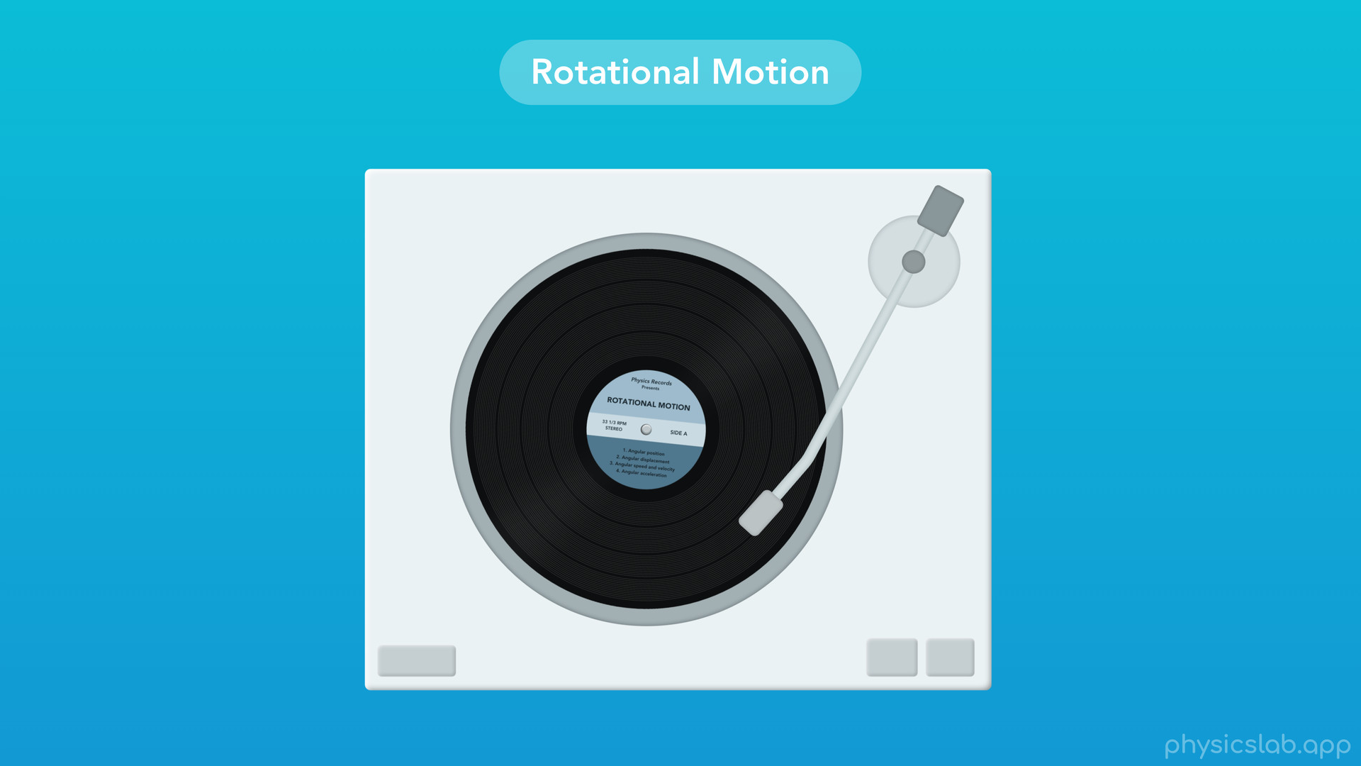
Notes:
○ This vinyl record is one example.

Slide 16
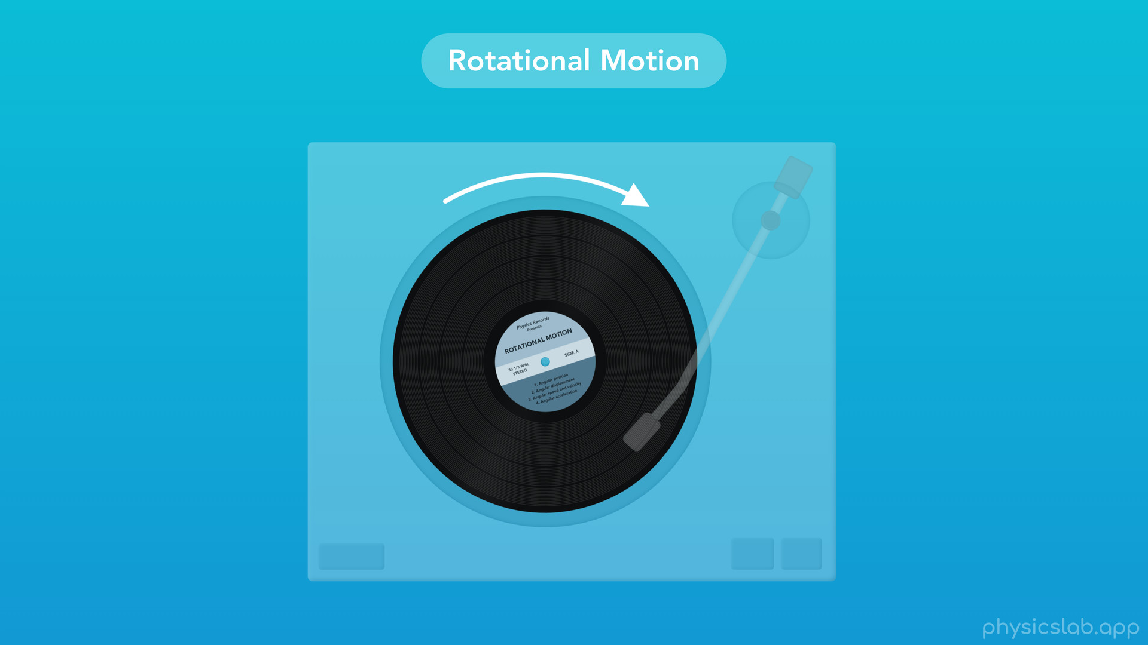
Notes:
When we say rotational motion, we’re focusing on how an object rotates around its own center. We’re not looking at how an object is translating left, right, up or down, we’re only looking at how it’s rotating or spinning.

Slide 17
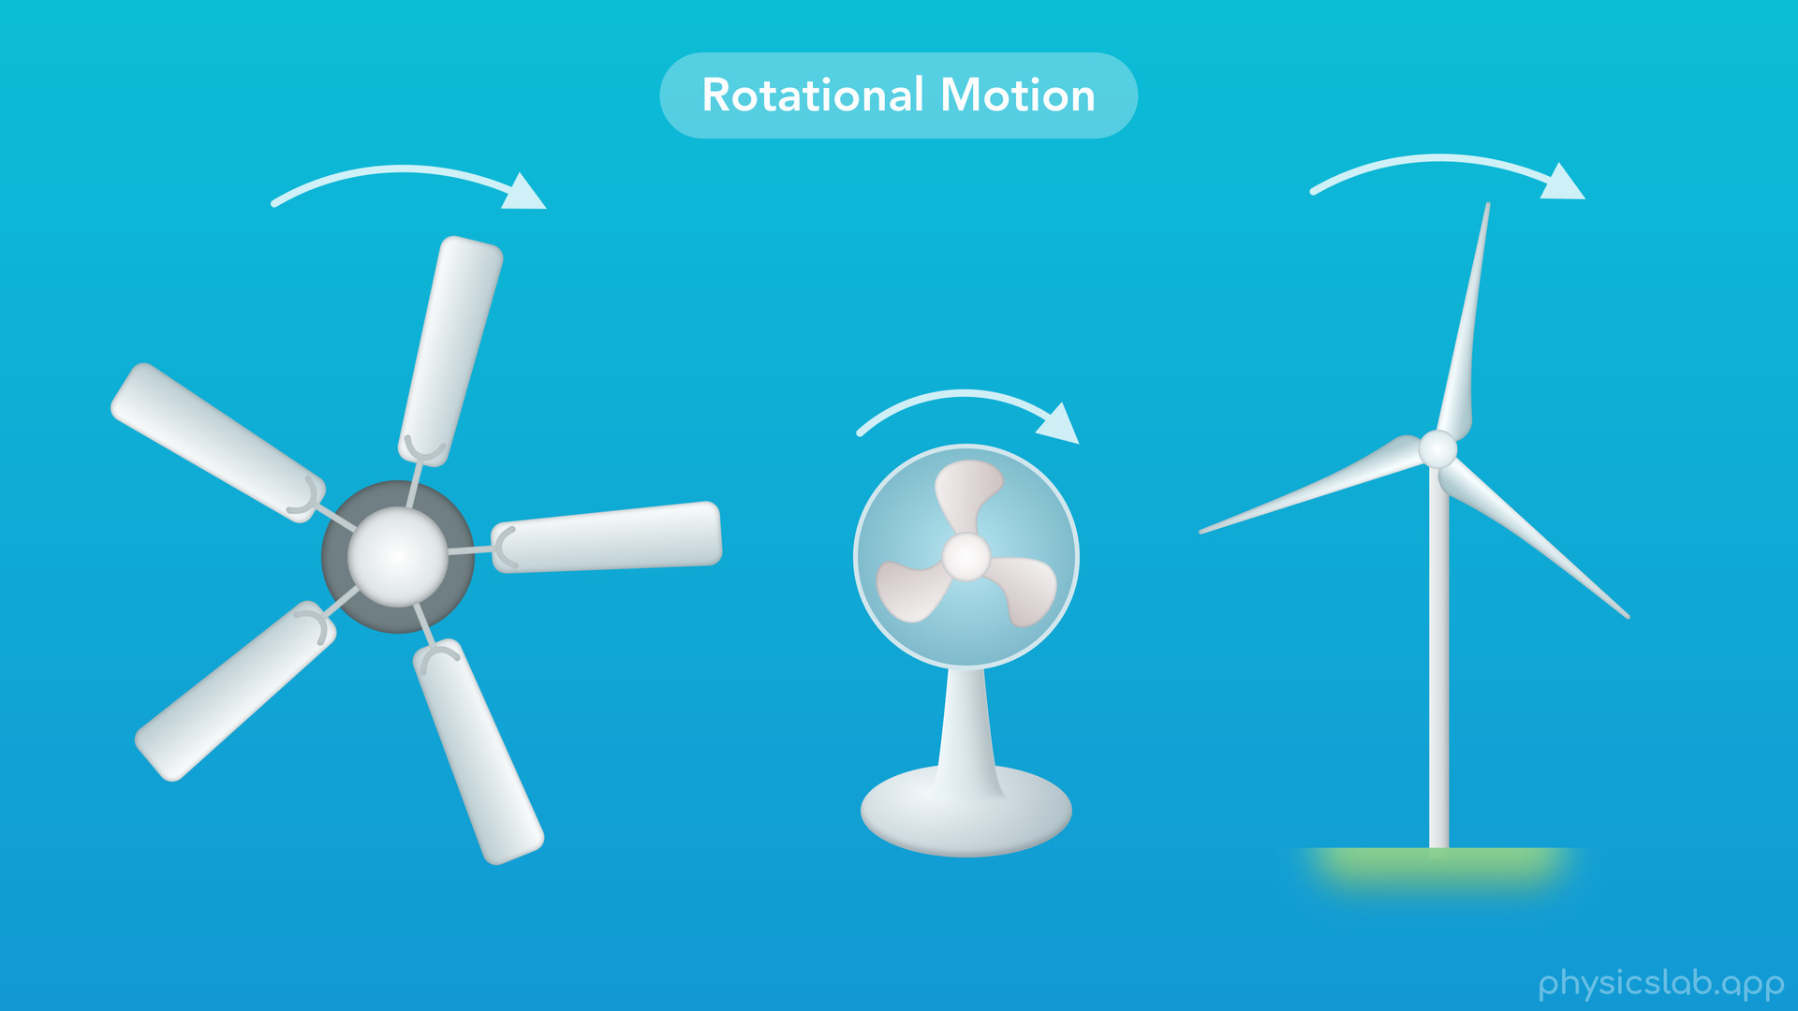
Notes:
○ Other examples include fans and wind turbines that have blades which all rotate together.

Slide 18
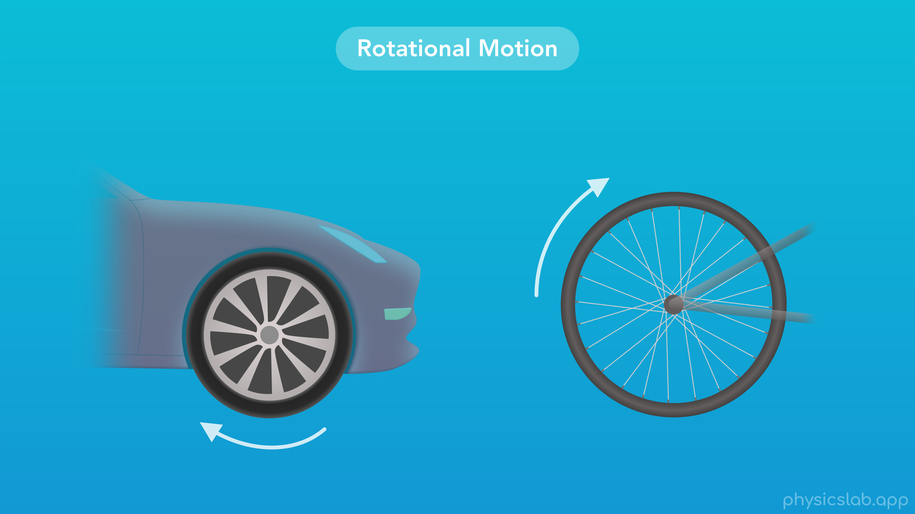
Notes:
○ We also see rotational motion with wheels. Even though the car or bike might be moving sideways, if we just look at a wheel by itself then we can focus on its rotational motion.

Slide 19
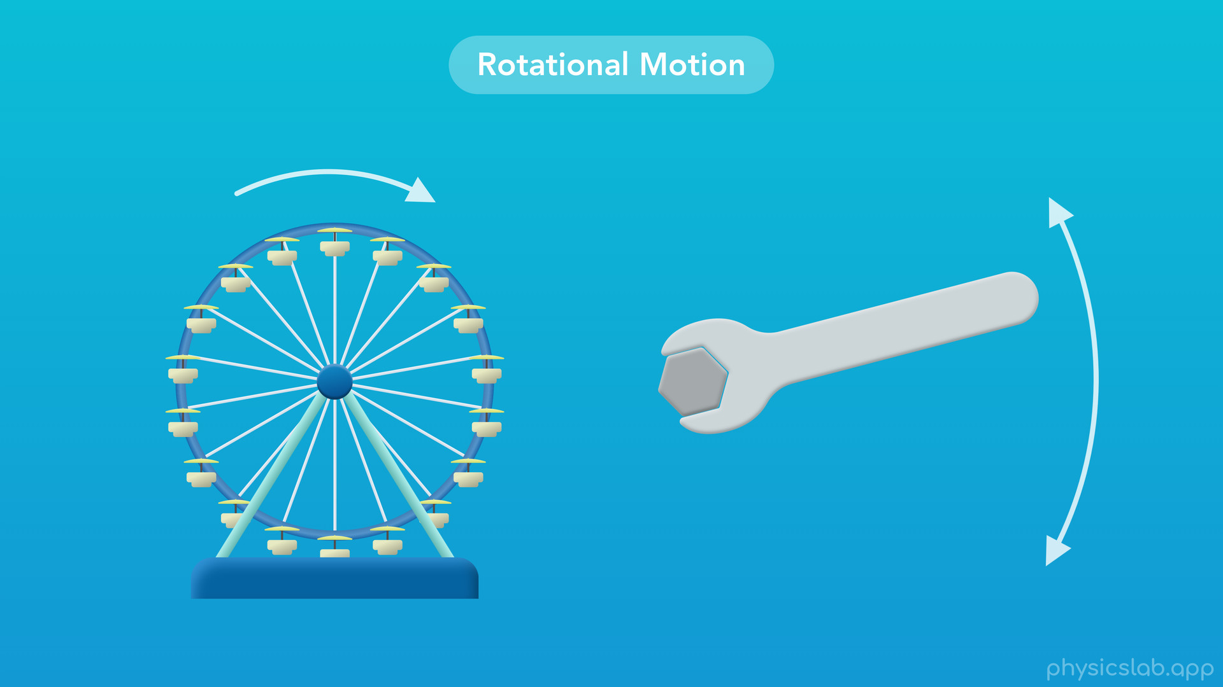
Notes:
○ Even if an object doesn’t complete a full rotation, like this Ferris wheel or this wrench, they’re still considered to be in rotational motion.

Slide 20
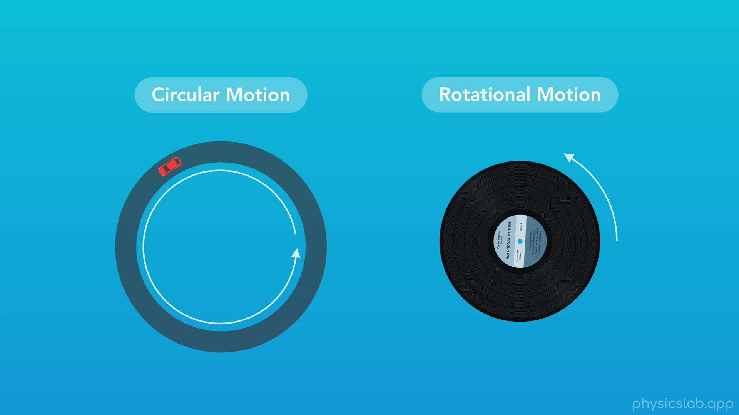
Notes:
○ Circular and rotational motion are similar, and we’ll cover that in another video. But for now, let’s focus on rotational motion.

Slide 21

Notes:
○ We’ll start with angular position and displacement.

Slide 22
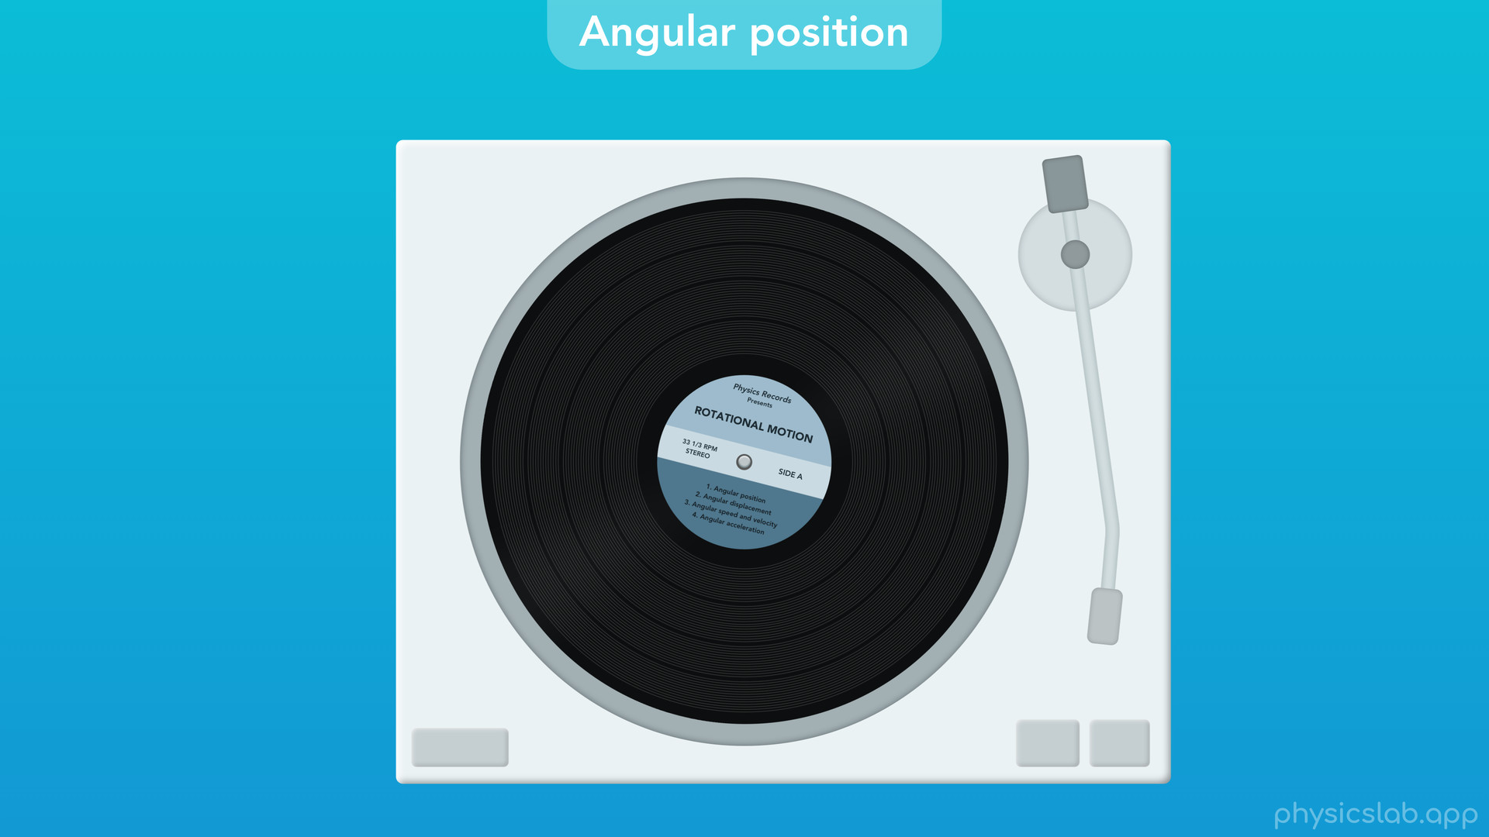
Notes:
○ We’re going to use a vinyl record as our example for rotational motion in this video.
○ How are we going to describe the position of this record over time? This might seem like a weird question because the record seems to be staying in one position. But we can see the record is moving somehow, so we’re still going to use the term position in order to describe what about the object is changing over time. It might make more sense to say we’re describing how the orientation of the record is changing, but we’ll find that using the term position is useful, because it ties into the rest of kinematics and the way we describe motion.

Slide 23
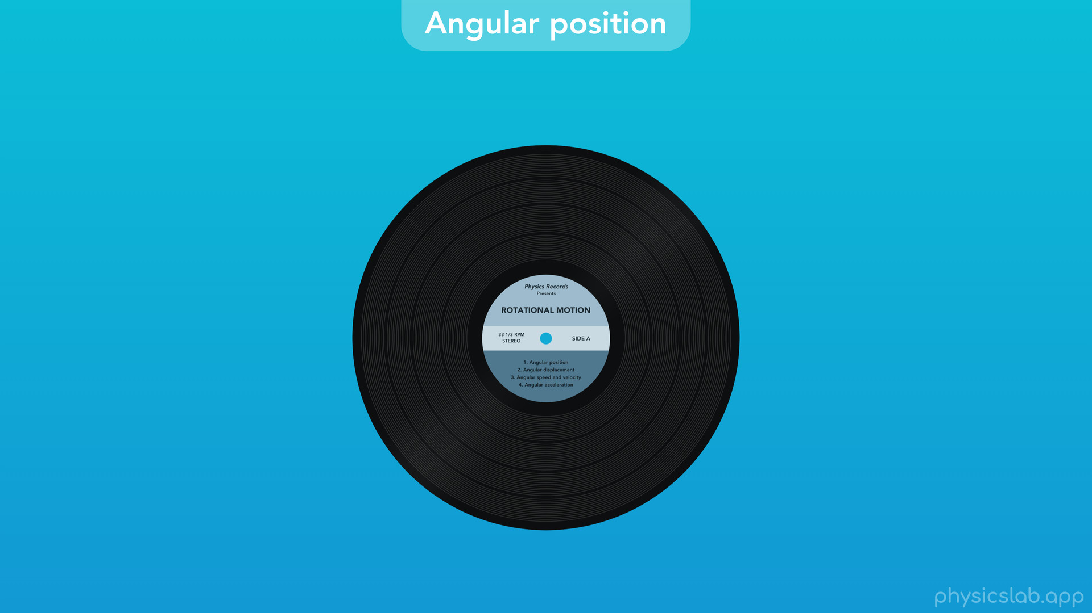
Notes:
○ So let’s say the record starts in this position.

Slide 24

Notes:
Then the record rotates and ends up in this position. How can we describe these two positions and track the motion of the record?

Slide 25
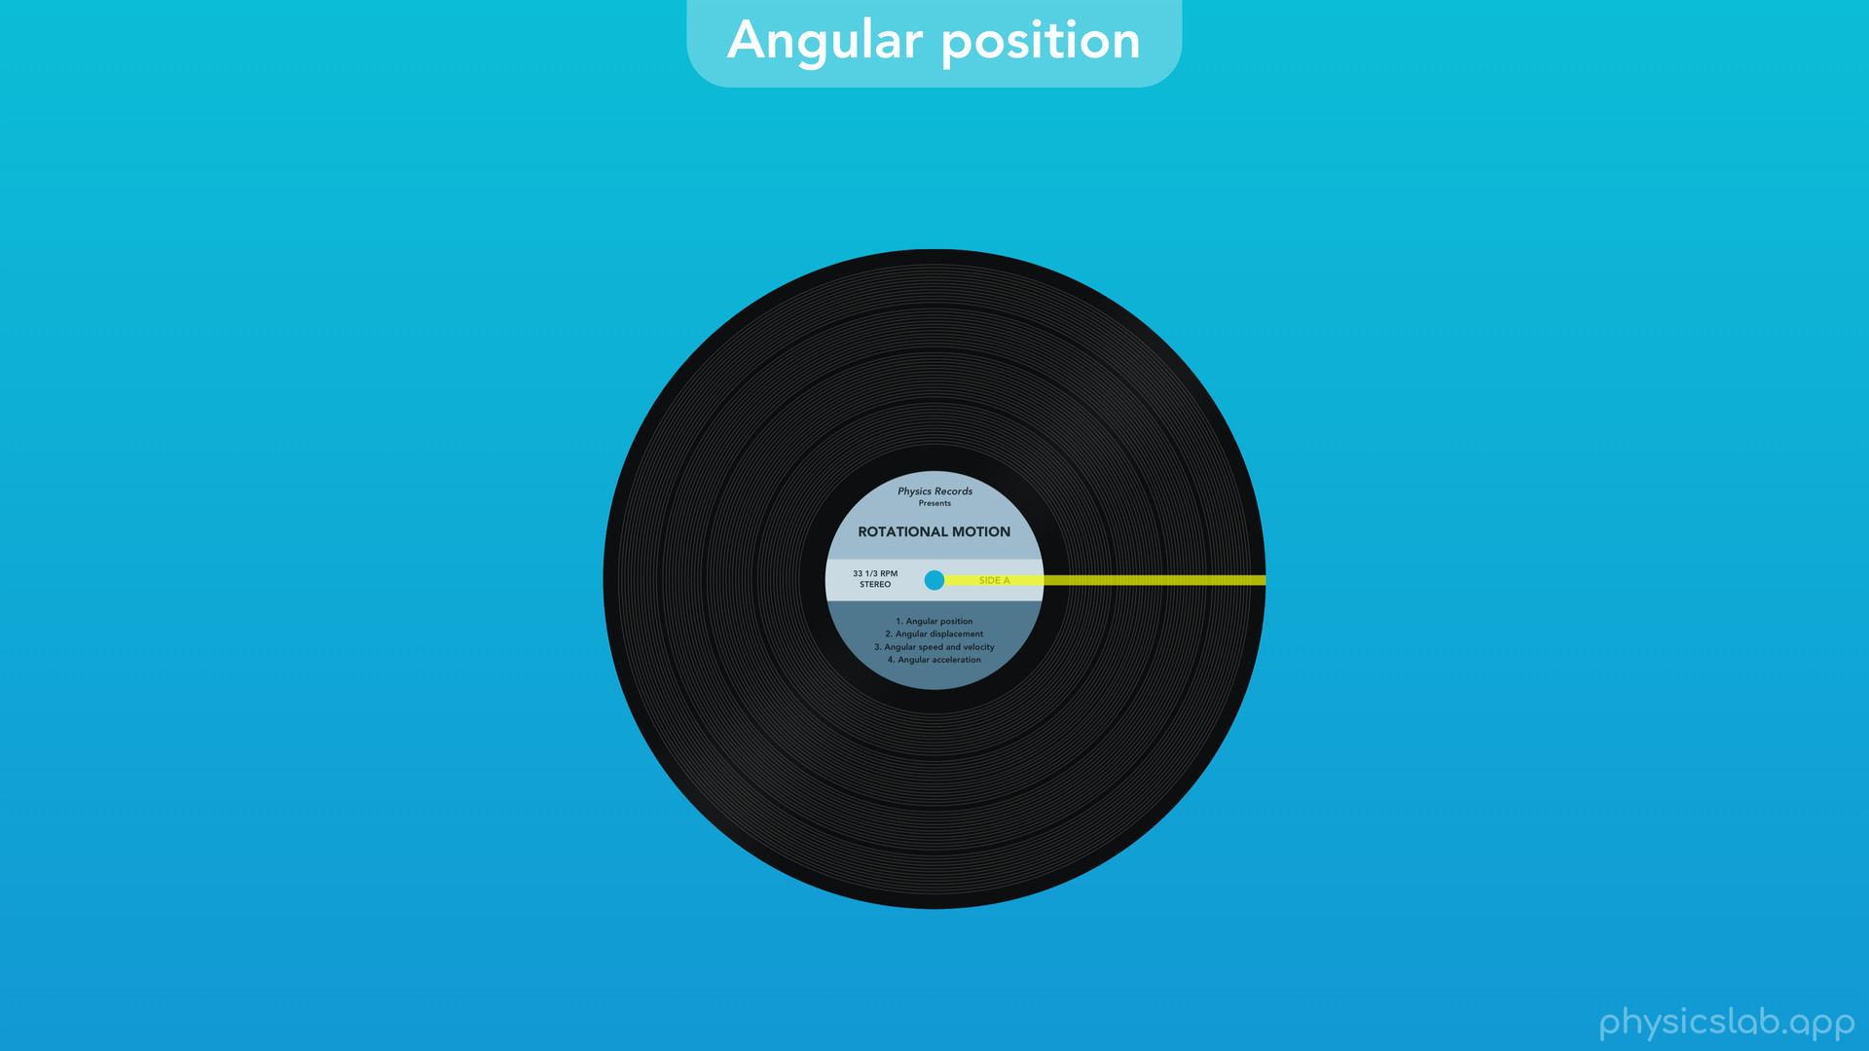
Notes:
○ It’s a little hard to see how the record is moving, so let’s place a line on it from the center to the edge. Here’s that same motion again. The record starts out in this position

Slide 26

Notes:
then rotates to this position. What’s the difference between these two positions, and what can we say about how this line moved?

Slide 27
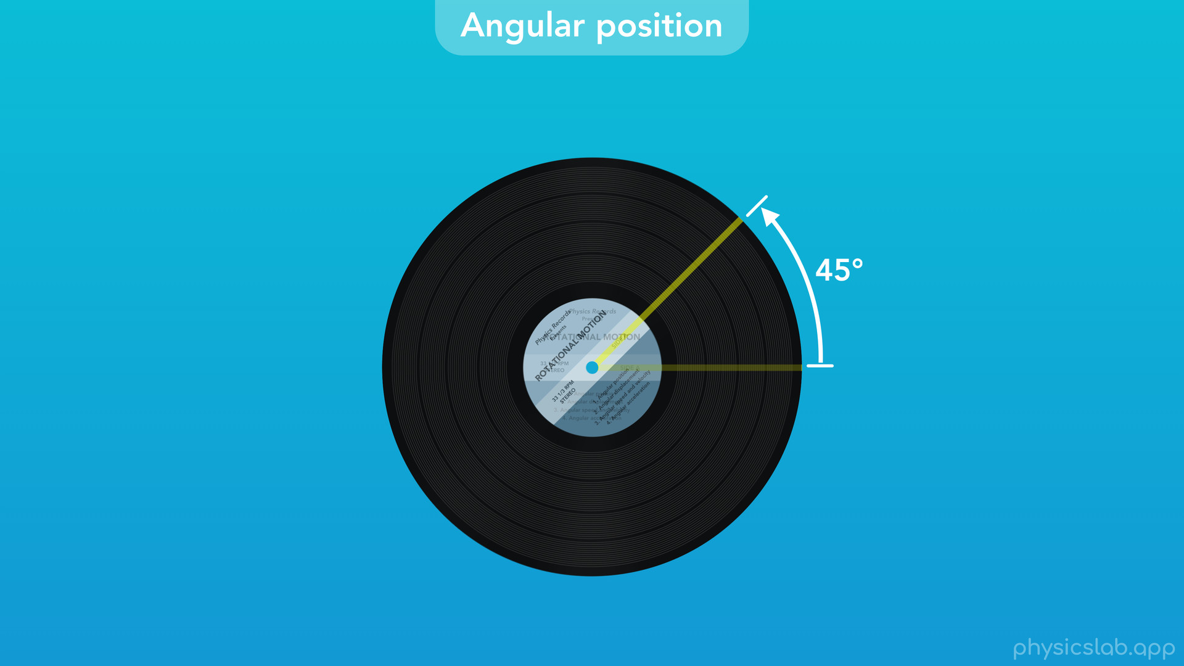
Notes:
Well, we can see that the record and the line rotated, and there’s an angle between the line at the first position, and the line at the second position. In this case the angle between the two lines is 45 degrees.

Slide 28
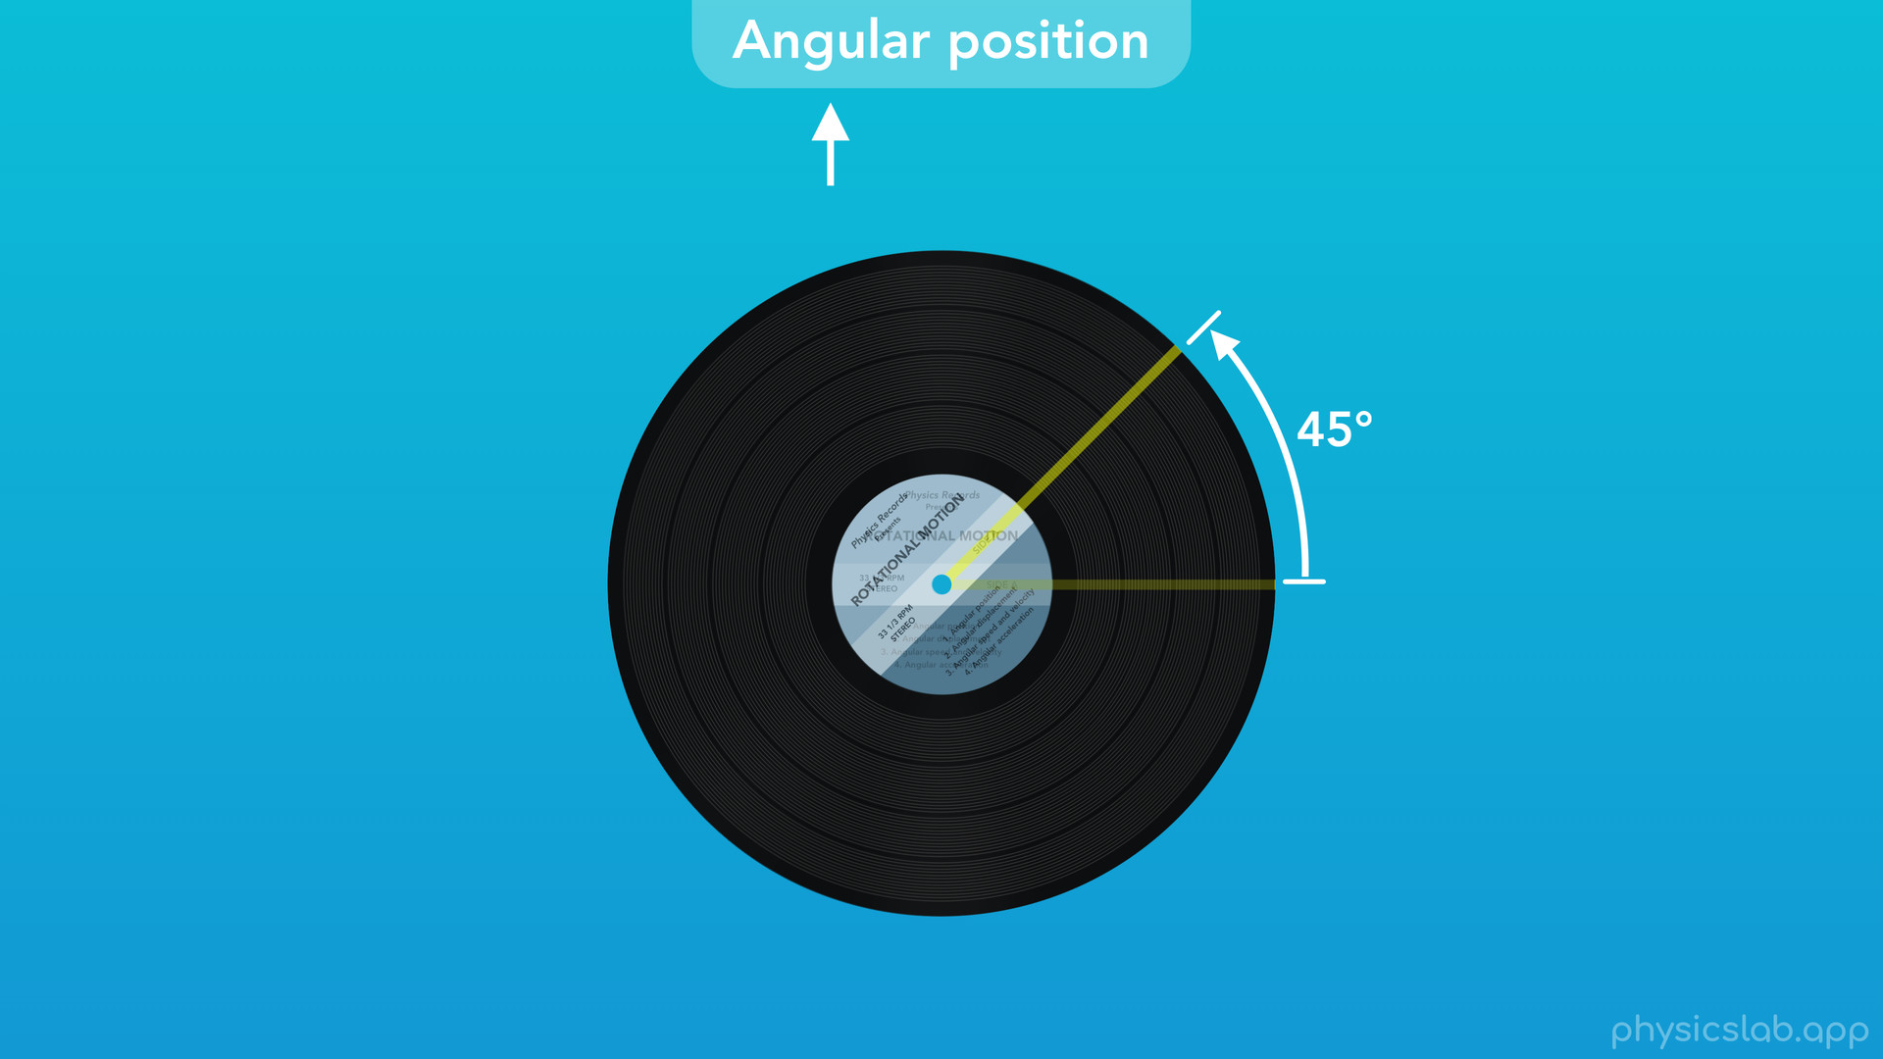
Notes:
For rotational motion, we’re going to use angles to describe how an object is moving, which is why we call this angular position and we’re using the angular description of motion.

Slide 29

Notes:
○ When we added this line, it didn’t actually matter where we put it.

Slide 30
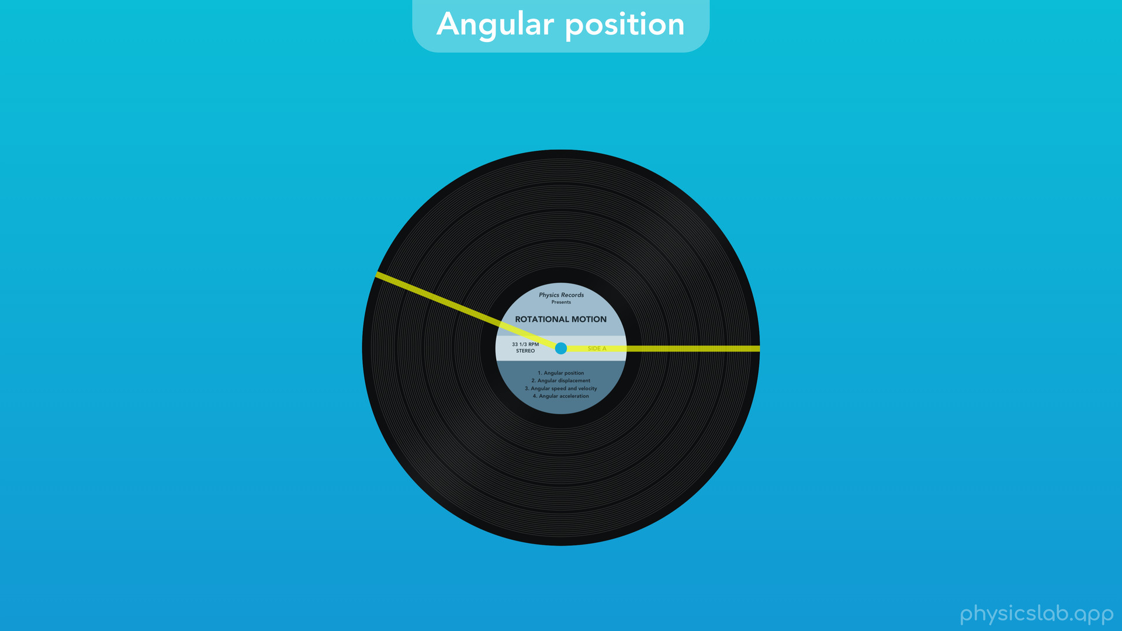
Notes:
If we add another line, we see that both lines rotate 45 degrees.

Slide 31
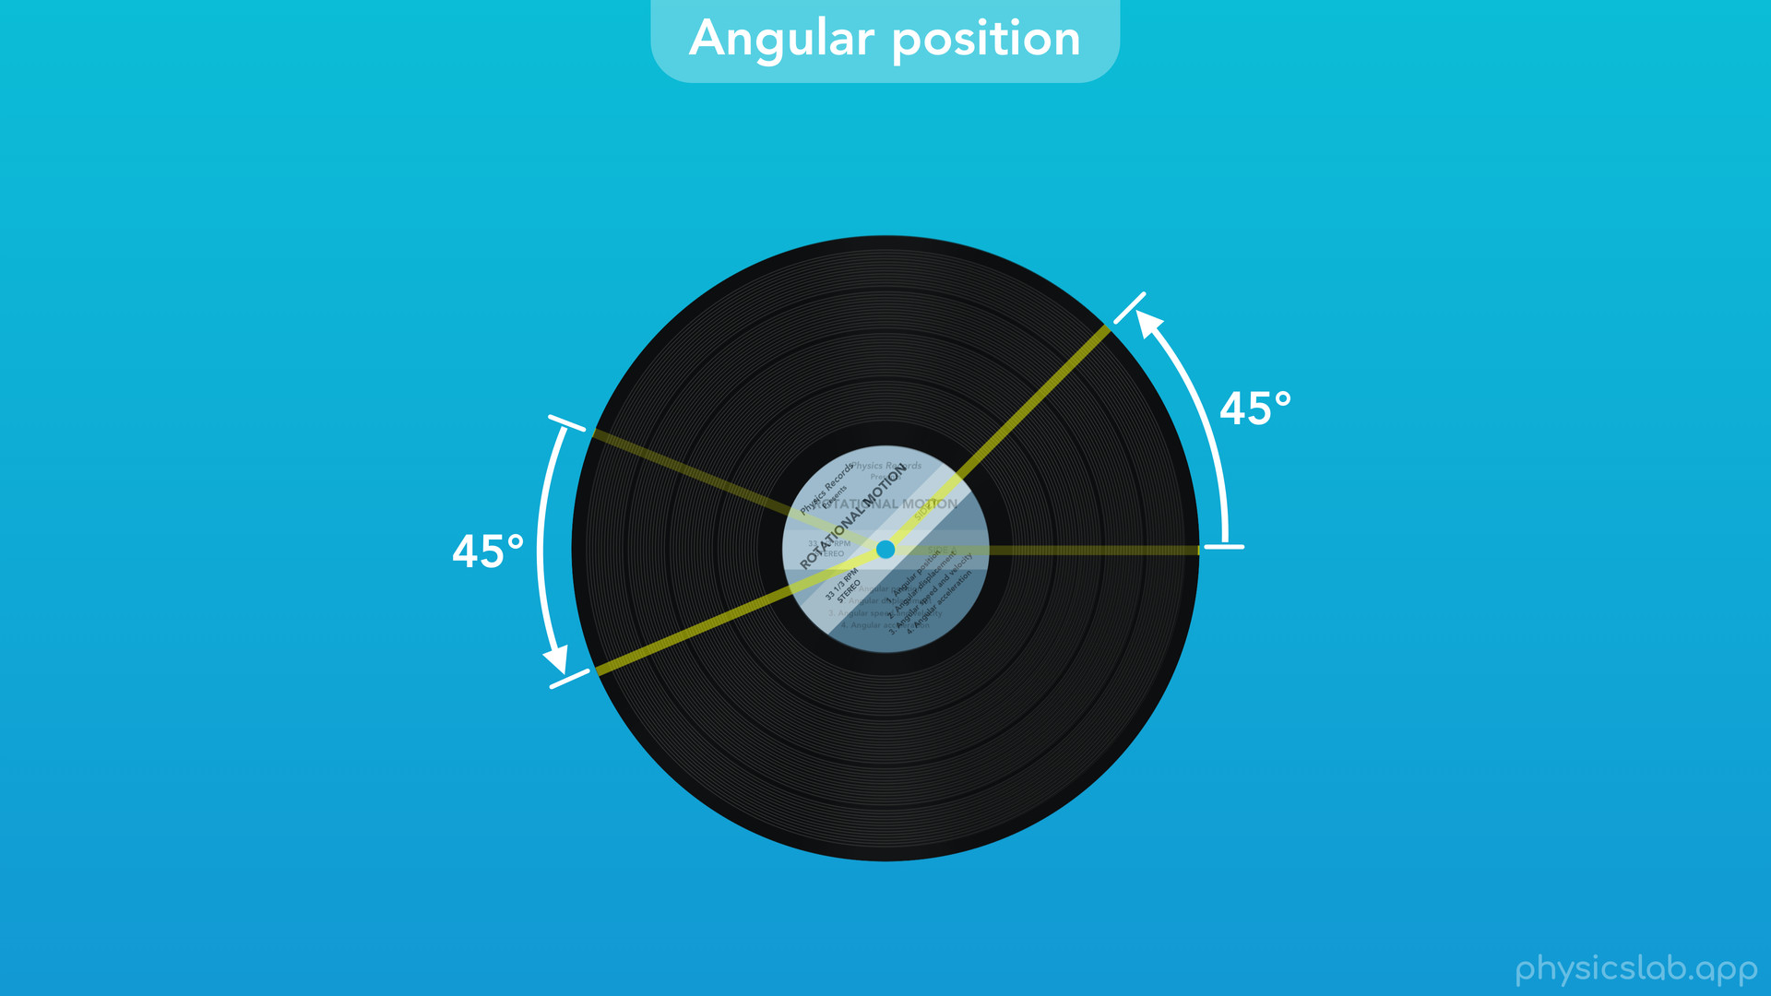

Slide 32
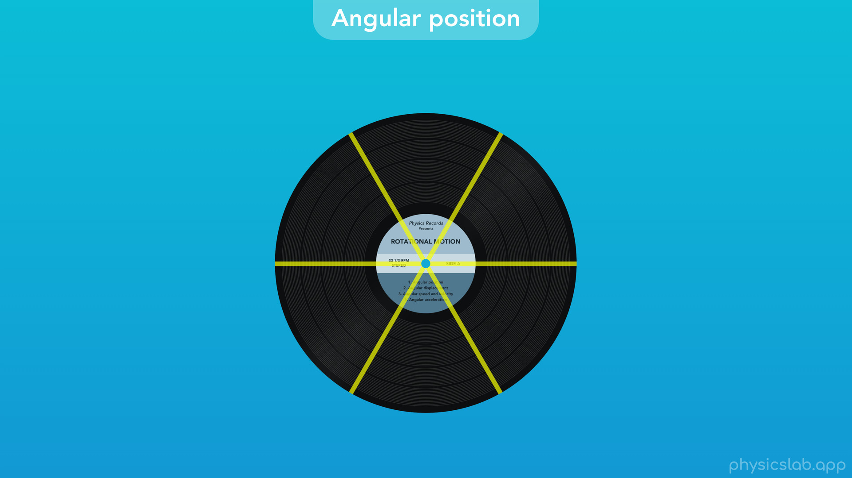
Notes:
In fact, any line on this record will rotate the same amount, because the entire object is rotating together.

Slide 33
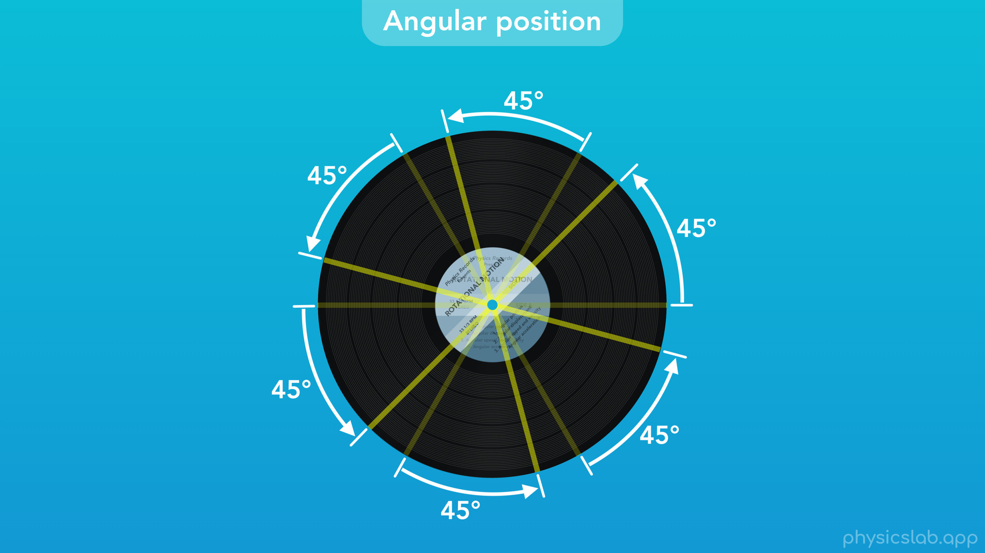

Slide 34

Notes:
○ It’s easier to show what’s happening with just one line. But keep in mind that when we talk about the angular position of this line, we’re actually representing the angular position of the entire record.

Slide 35
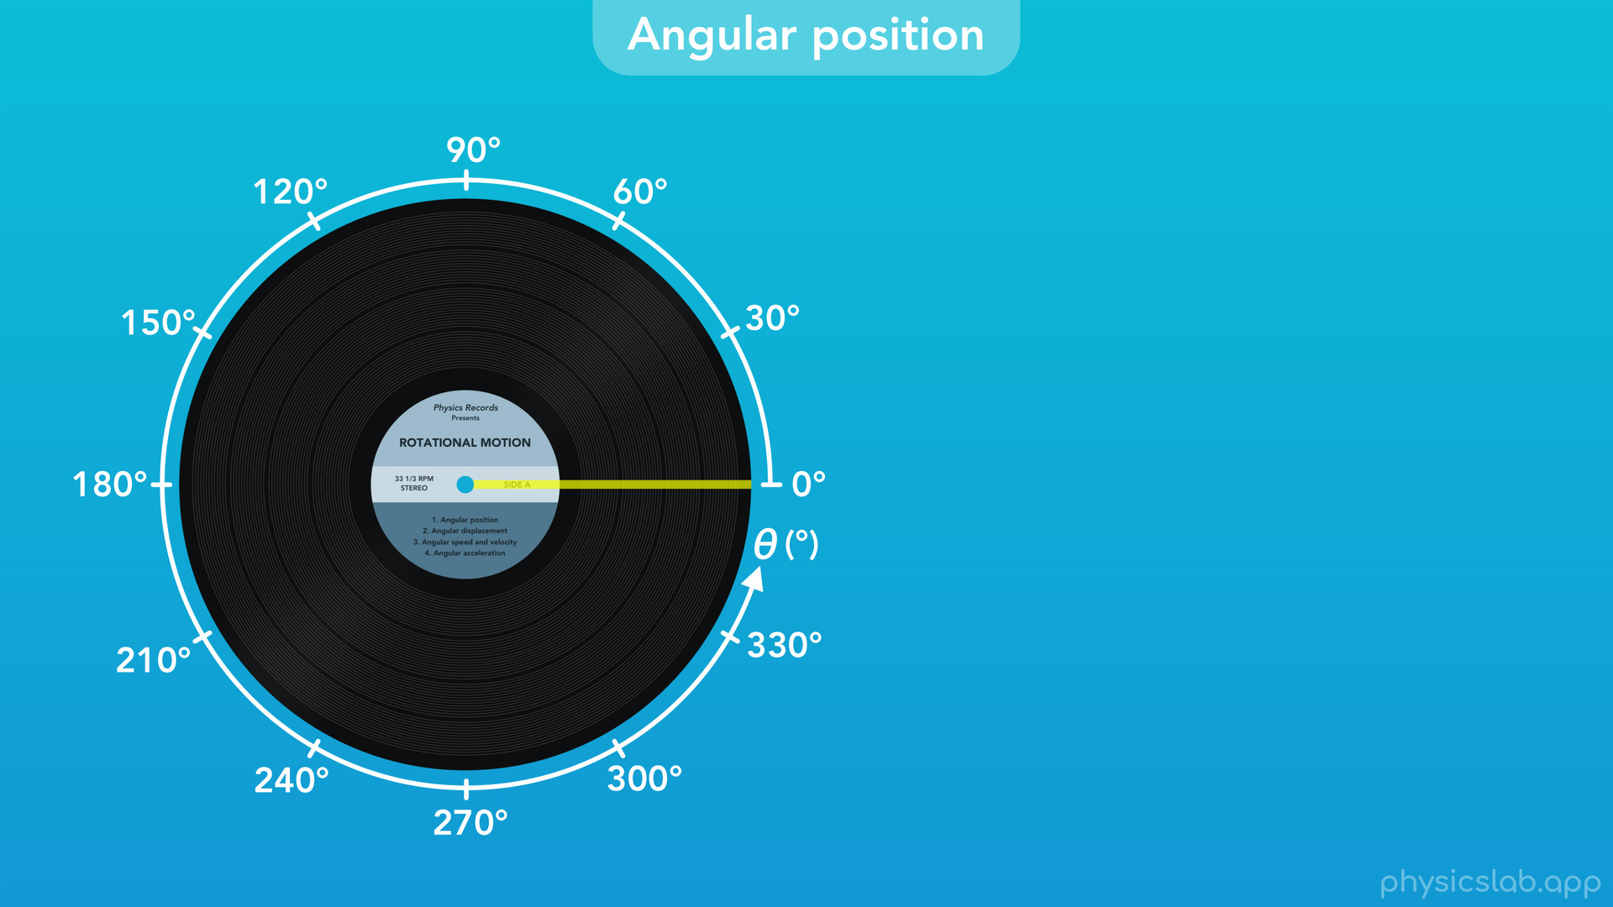
Notes:
○ So how can we track the angular position of this line? Like with other types of motion, we’re going to use an axis. Here’s an axis for angular motion.

Slide 36
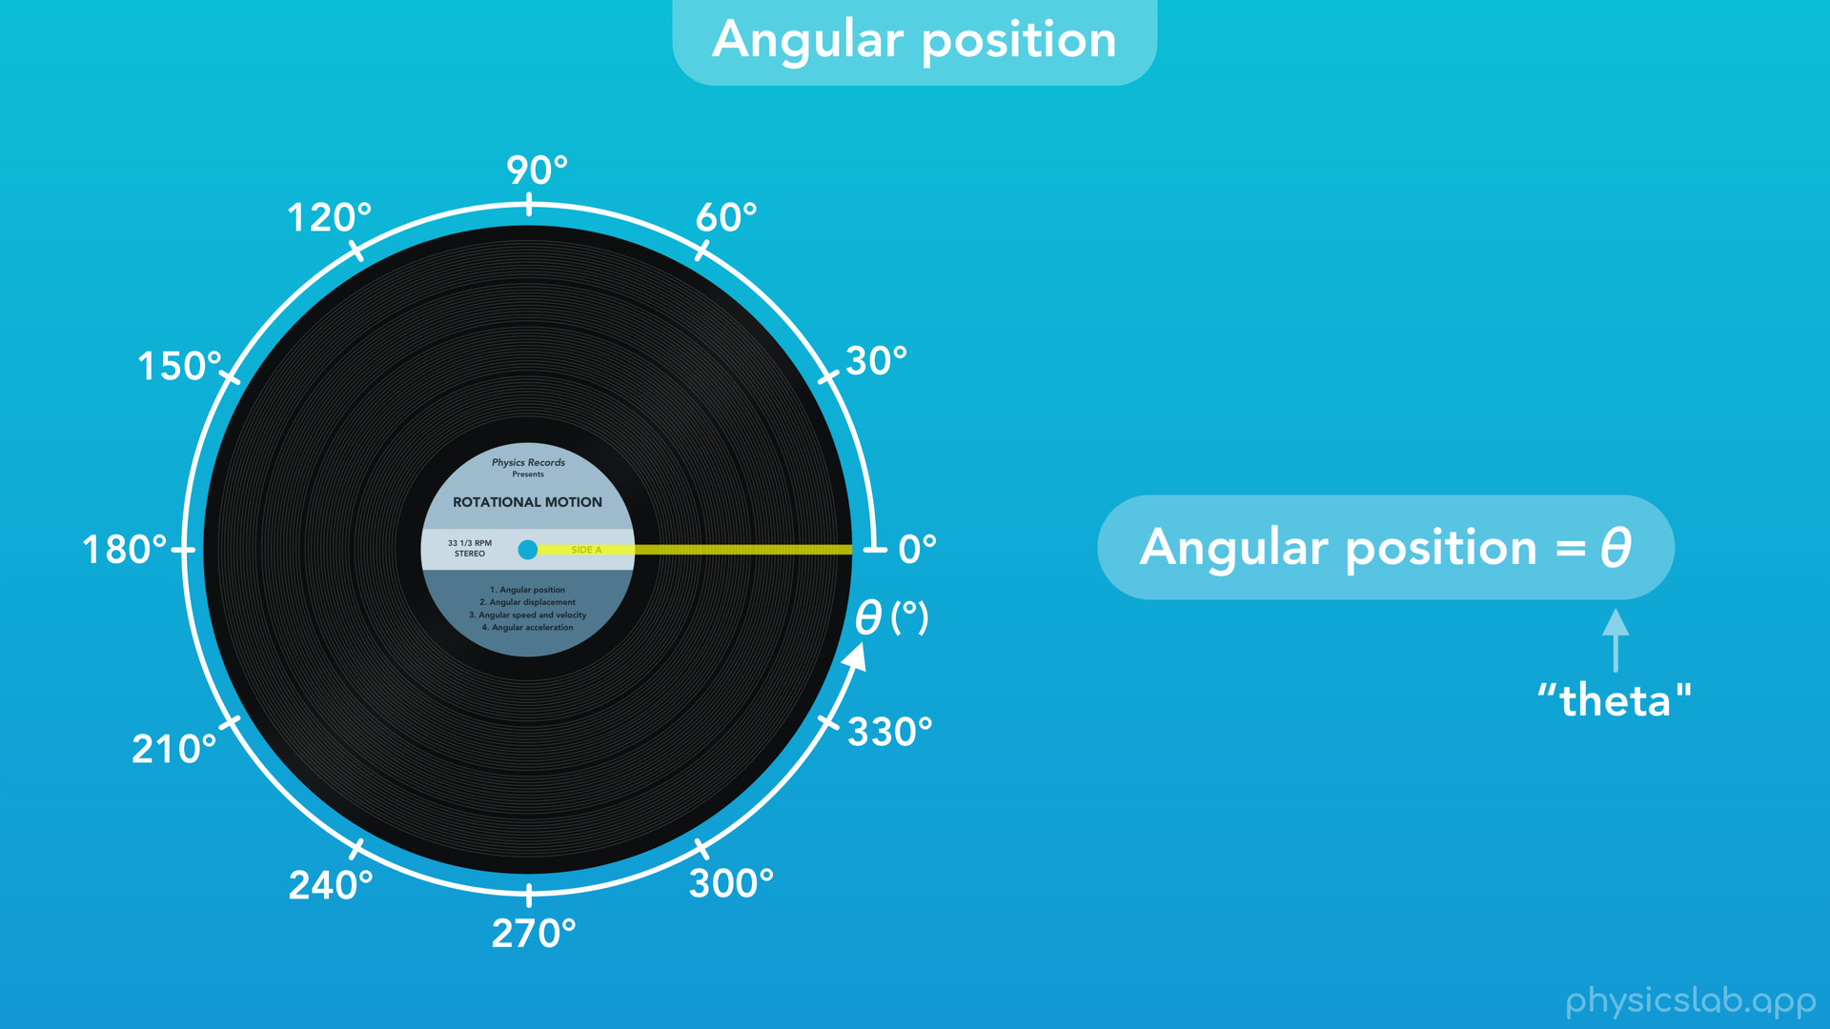
Notes:
We represent angular position using the Greek letter “theta”, which is commonly used for angles. For now, we’re going to use the unit of degrees.

Slide 37

Notes:
○ As usual, we establish a zero point for our axis, and we measure the angular position of the line on the record relative to that zero point.

Slide 38
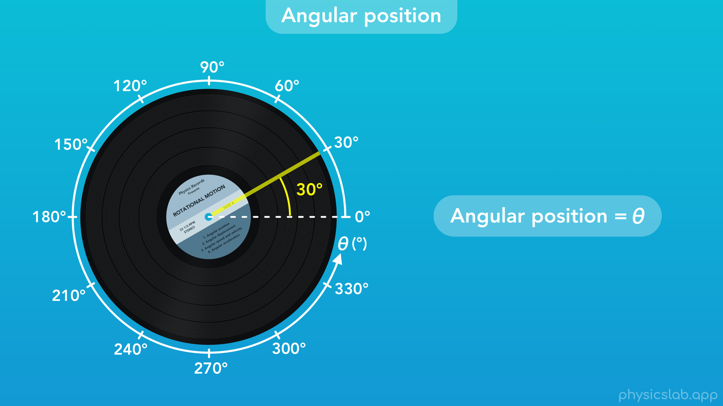
Notes:
Here, the angular position of the record would be 30 degrees.

Slide 39
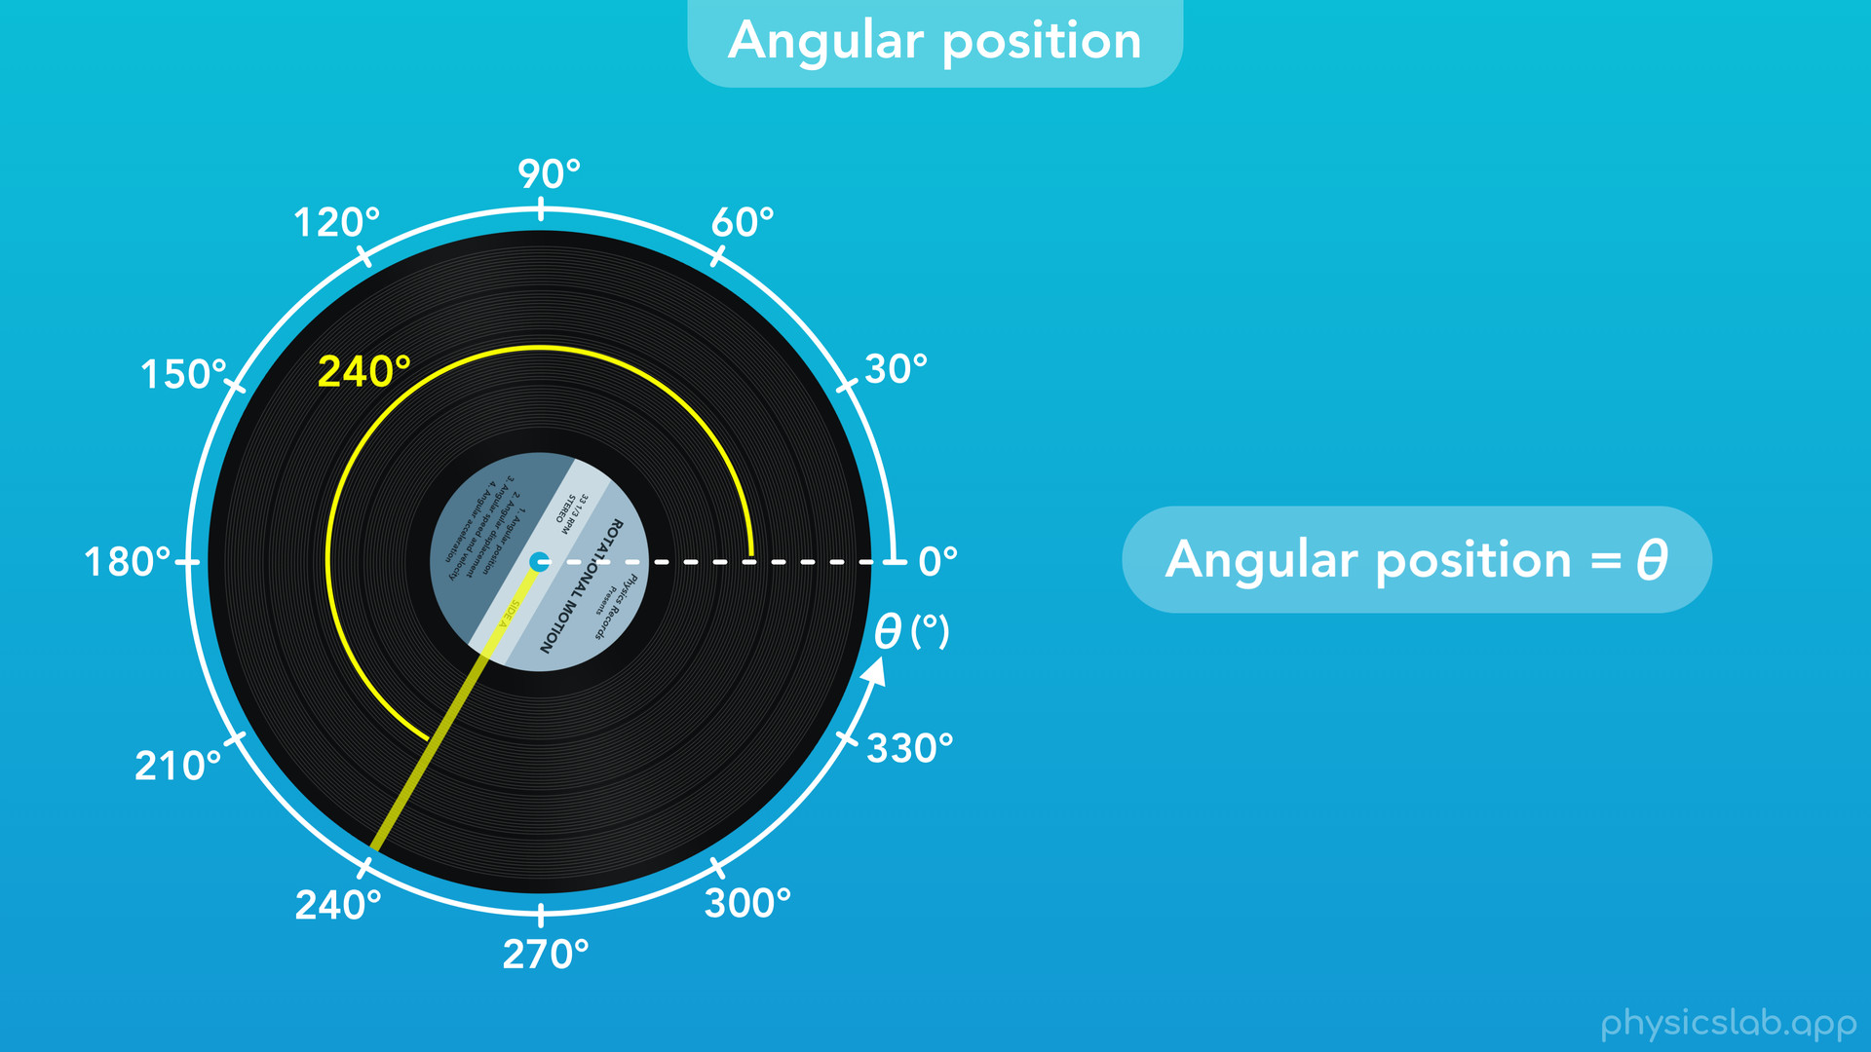
Notes:
And here, the position would be 240 deg. Remember, you can think of the angular position of the record as the angle between this line at the zero point and the line at the new position. Even if that angle is greater than 180 deg, we still measure it the same way.

Slide 40
Notes:
○ What would be the angular position of the record if it rotates a full revolution?

Slide 41

Notes:
There’s 360 degrees in a circle, so if we follow the record’s motion from the start, then the final position would be 360 degrees.

Slide 42
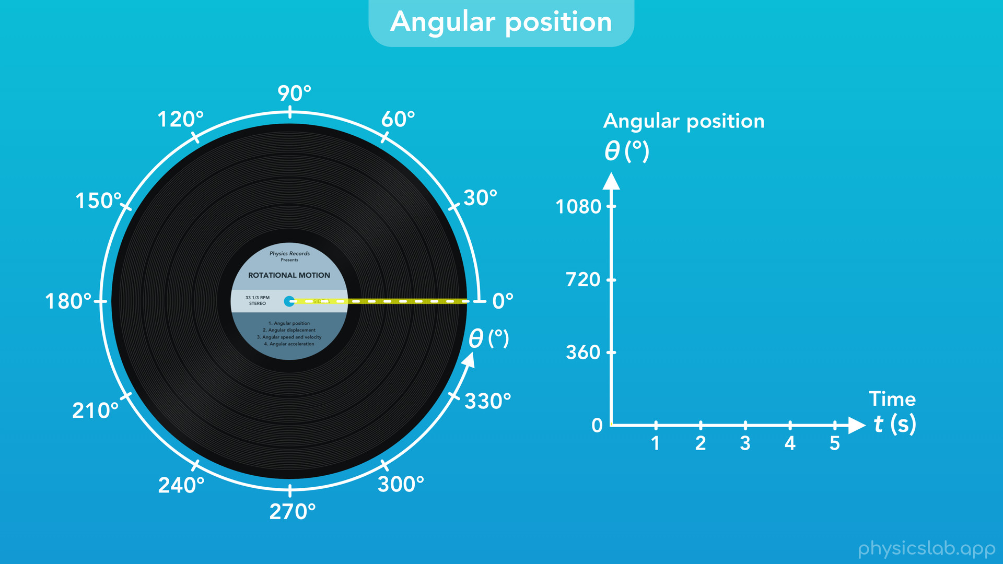
Notes:
○ What happens if the record keeps rotating? Here’s a graph of the angular position vs time.

Slide 43
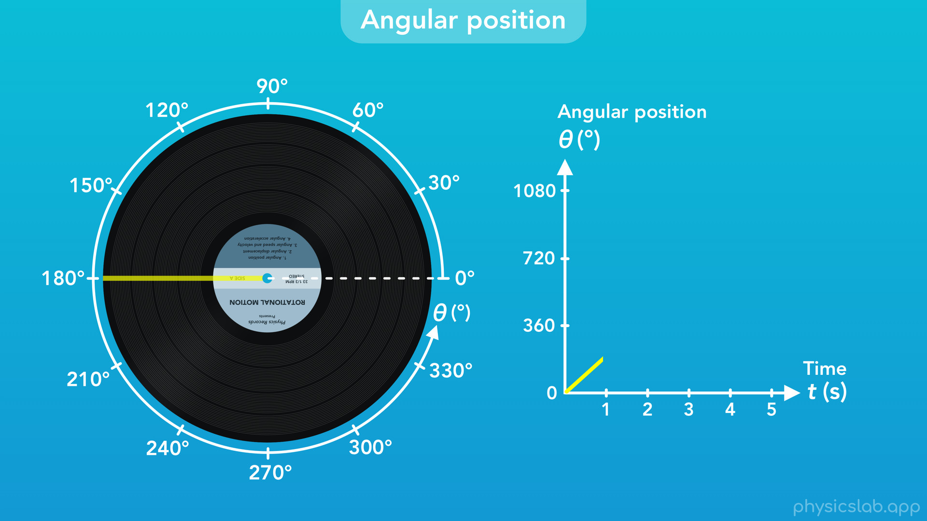

Slide 44
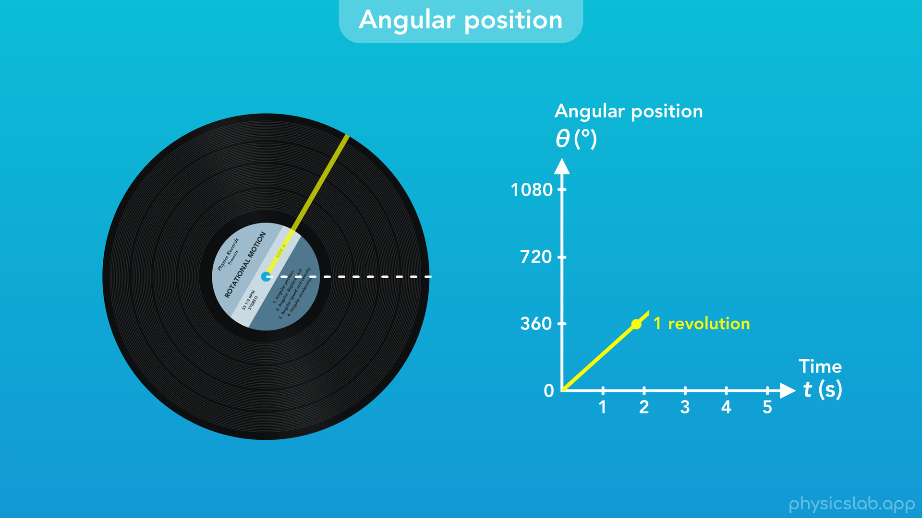
Notes:
Just like with circular motion, the angular position doesn’t reset back to 0, it keeps increasing as the record rotates.

Slide 45
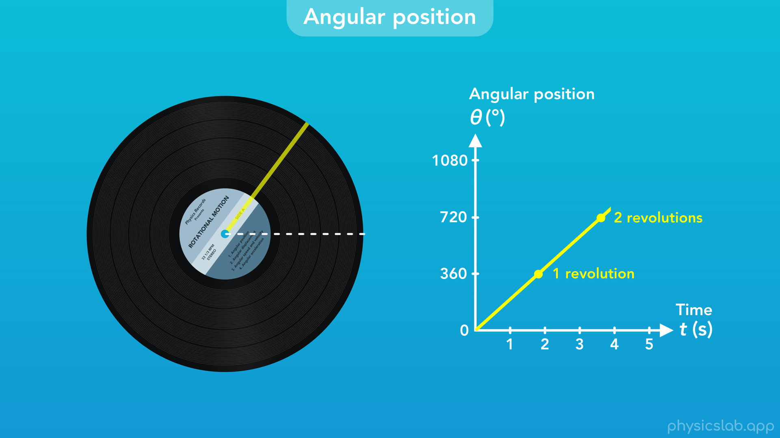

Slide 46


Slide 47
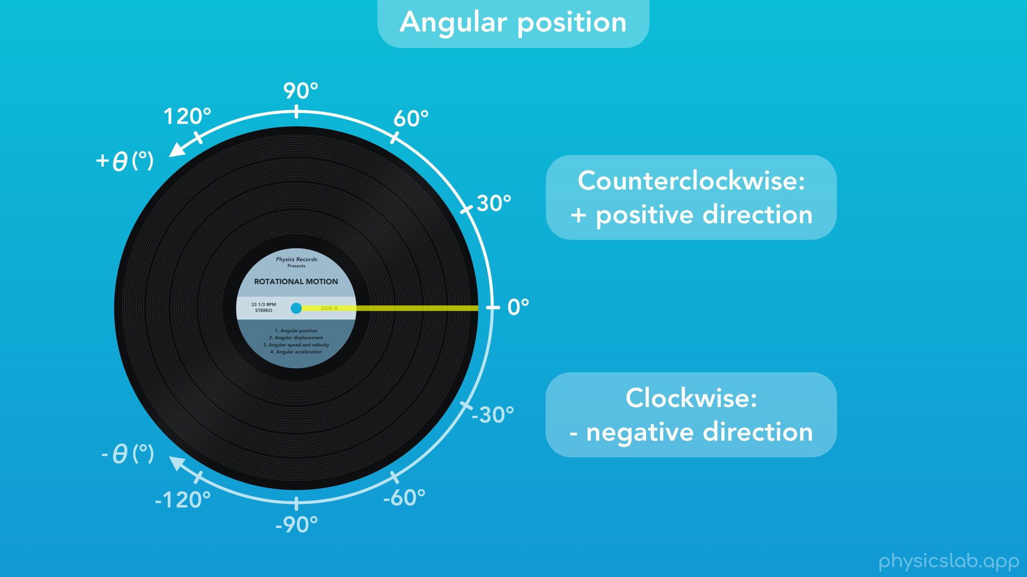
Notes:
○ What if the record rotates the other way? With any type of motion, we establish a positive and negative direction when we set up our axis. Rotational motion is similar to circular motion: counterclockwise is considered the positive direction, and clockwise is considered the negative direction. The record can rotate as far as it wants in either direction, and we measure its angular position relative to the zero point that we established.

Slide 48

Notes:
○ Now, let’s talk about units. So far, we’ve been using degrees, but there’s a few other units we need to know.

Slide 49
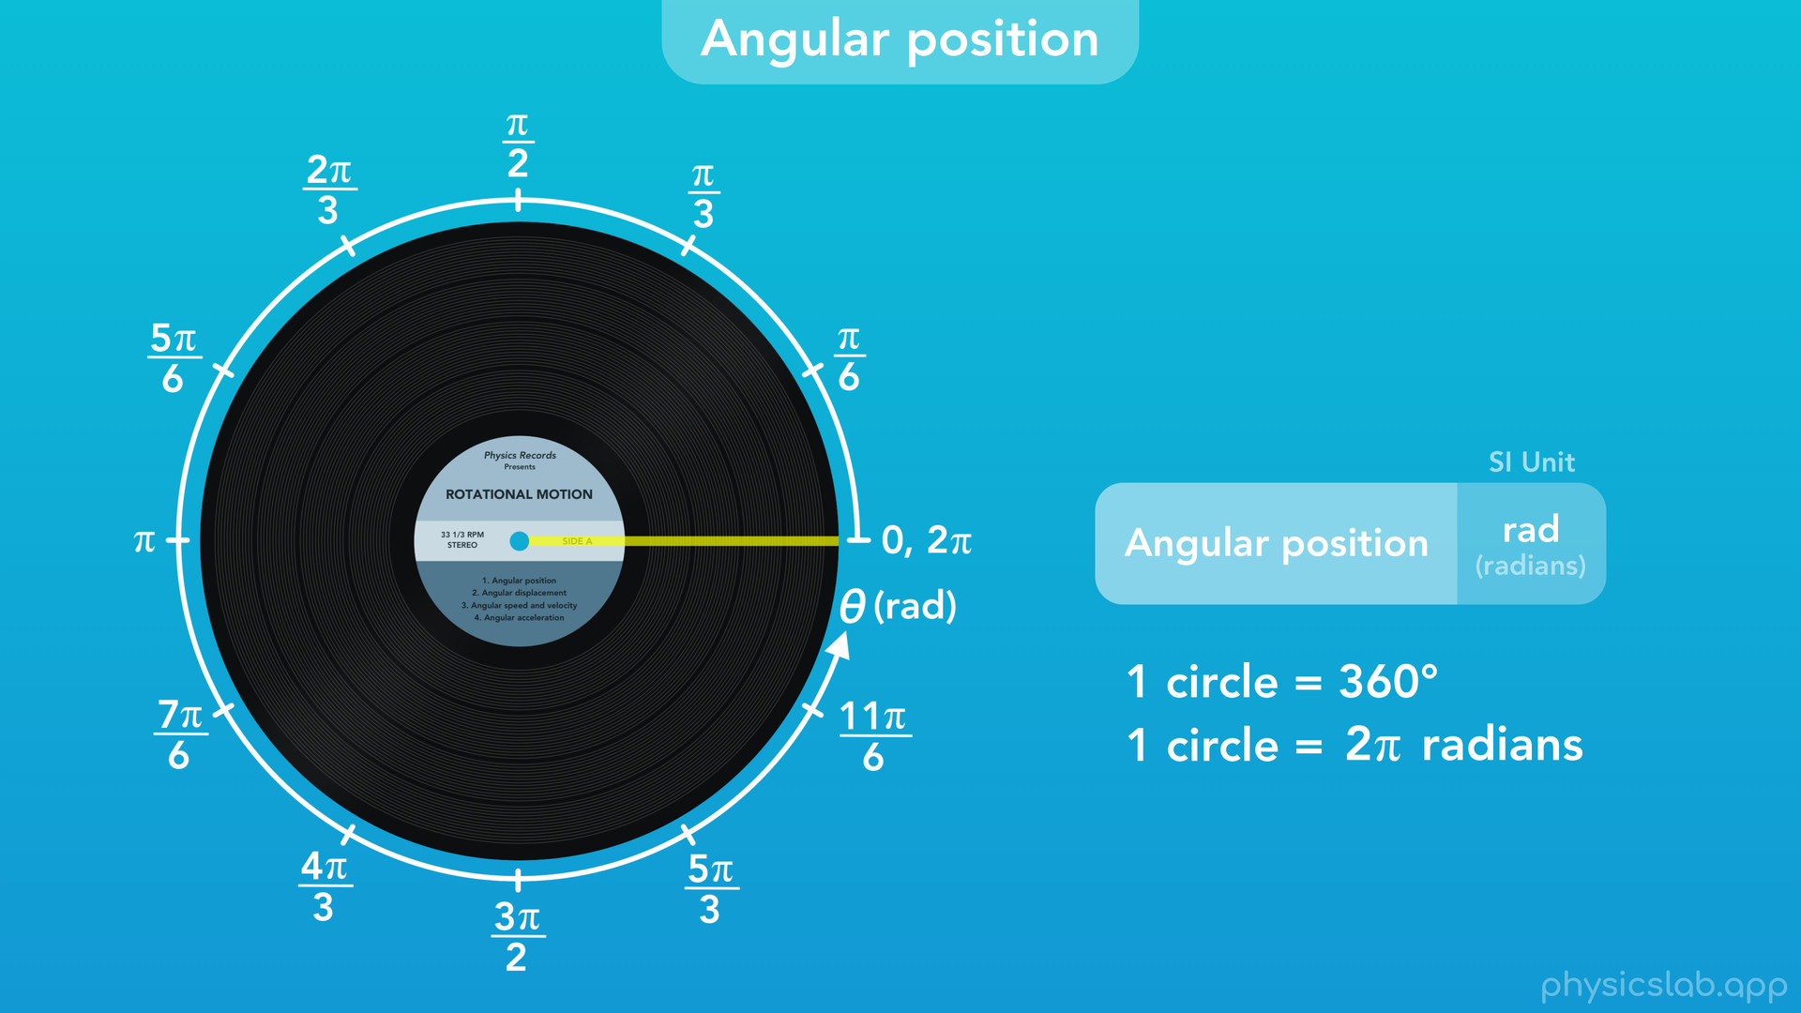
Notes:
○ First, the SI unit for angular position is radians,“rad” for short. Just like how there’s 360 degrees in a circle, there’s 2 pi radians in a circle. We learned about radians in the Basics section, so watch that video if you haven’t already.
○ So if one circle is 2 pi radians, we can break that into fractions and label this axis. Here we’re dividing the circle into 12 parts, so each segment adds pi over 6 radians. This might seem like a weird way to measure things, but just know that, like degrees, a radian is a unit that describes an angle, and there are 2 pi radians in one circle.

Slide 50
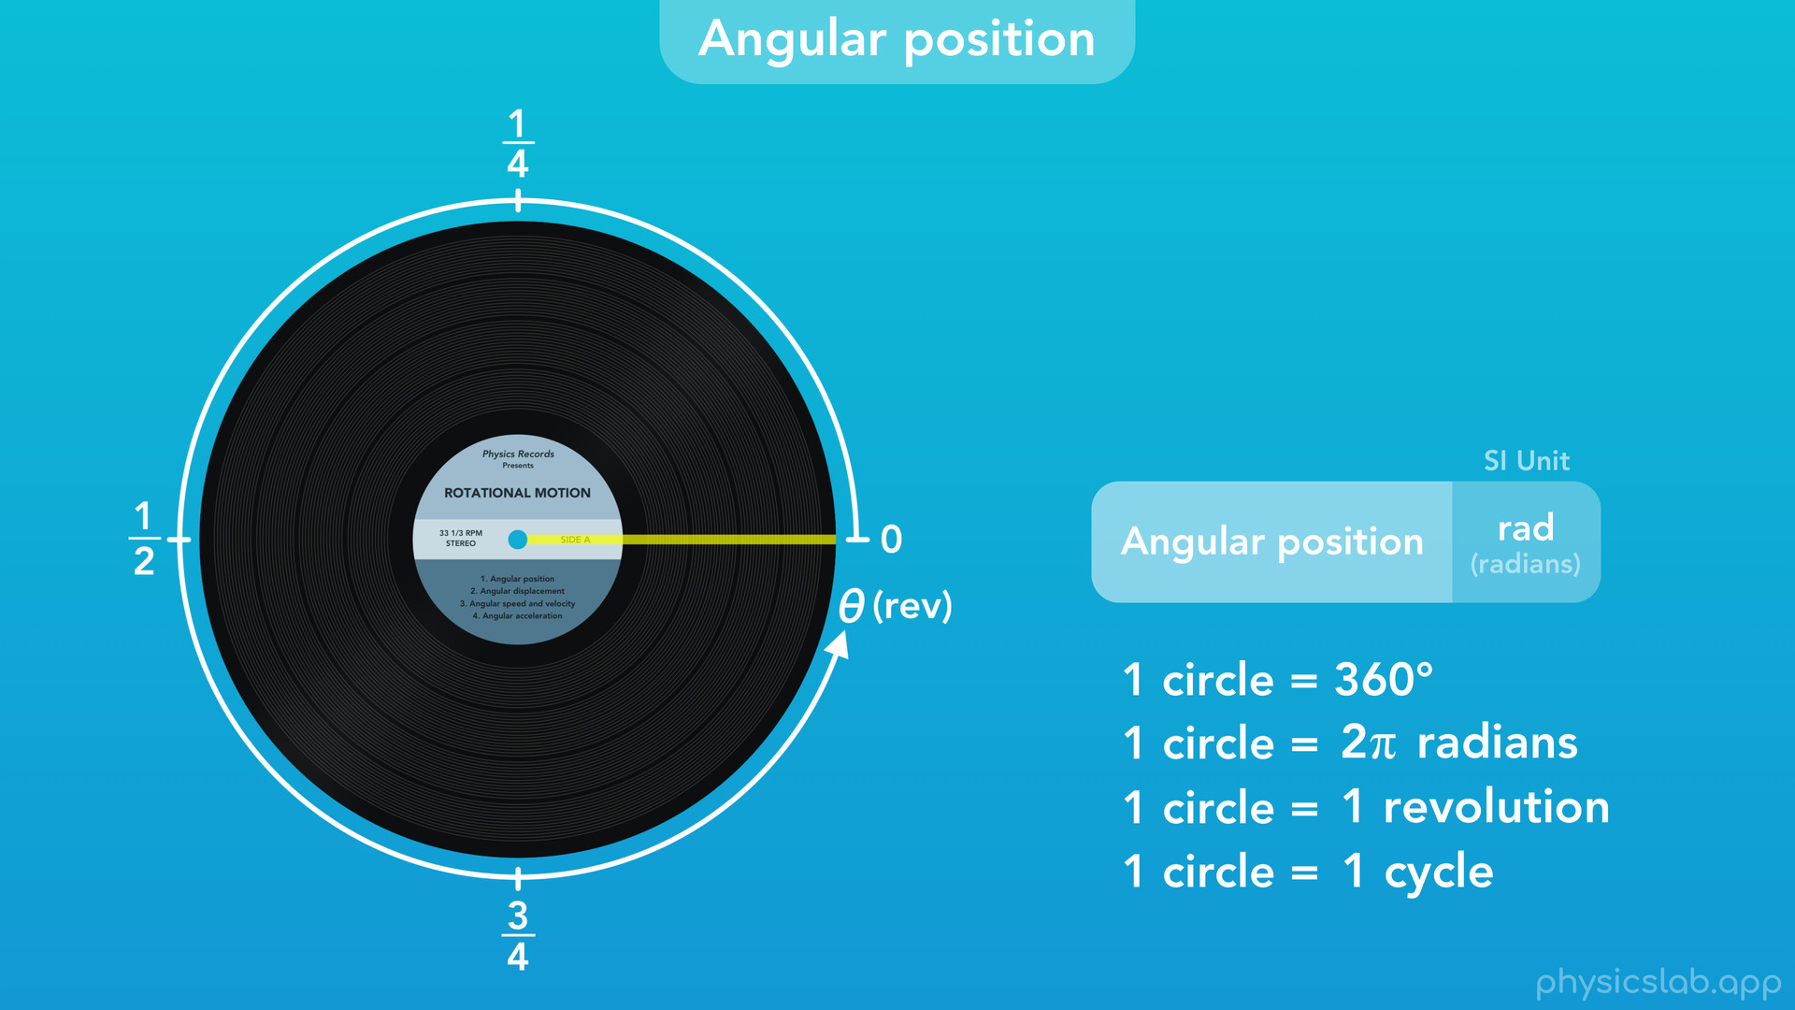
Notes:
○ We can also describe the angular position in terms of revolutions, or cycles. If an object rotates all the way around, that’s 1 revolution, or 1 cycle, and we can label the axis using fractions.
○ So those are the units we use to describe angular position, and we can use those relationships if we need to convert between different units.

Slide 51
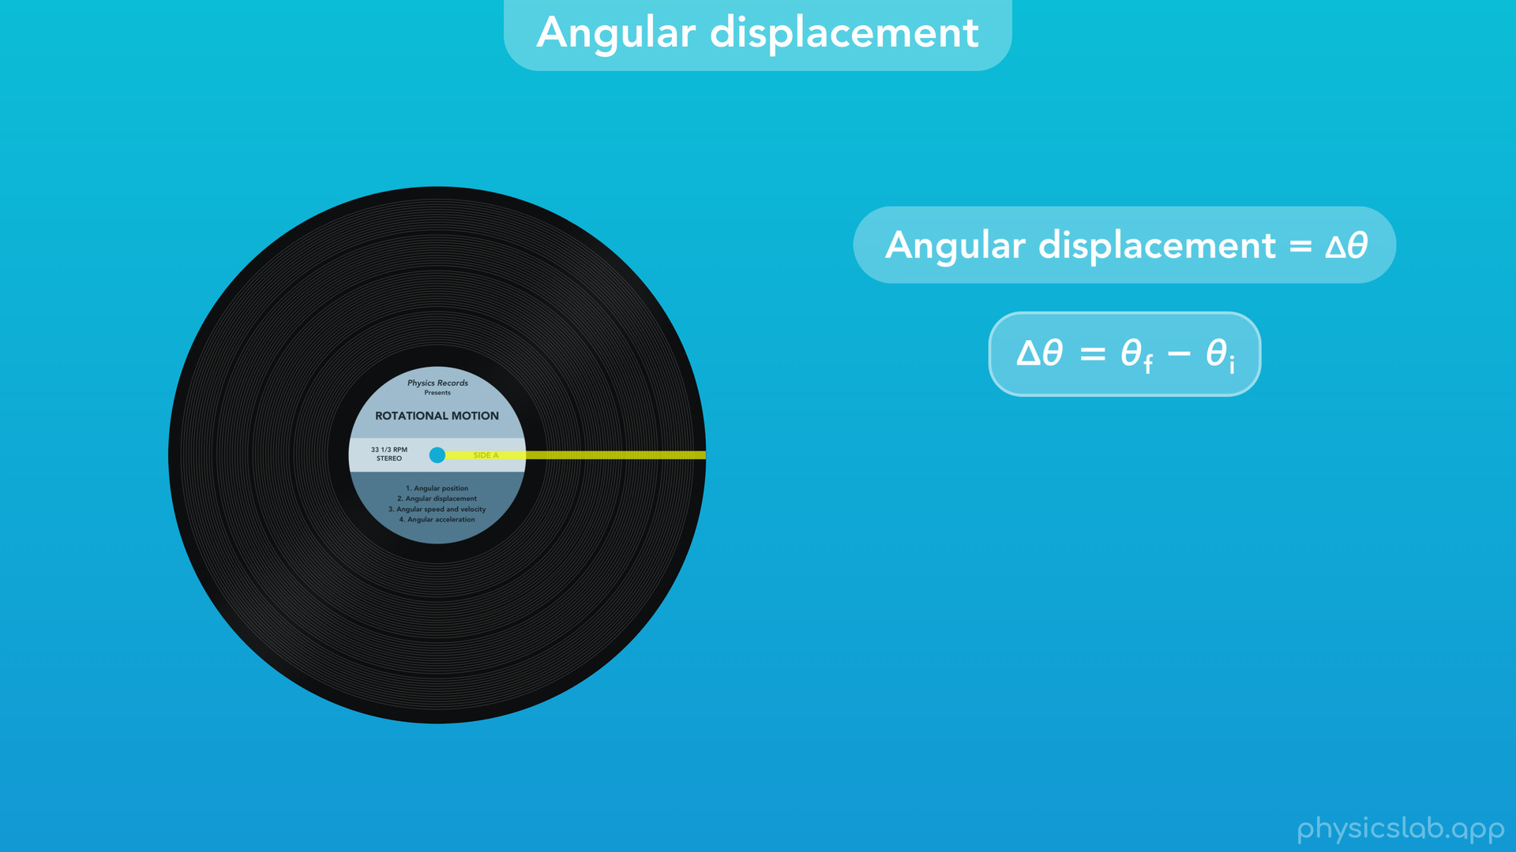
Notes:
○ Now let’s quickly cover angular displacement. Like with other types of motion, angular displacement, delta theta, is the change in angular position when an object rotates, which equals the final angular position minus the initial angular position.

Slide 52
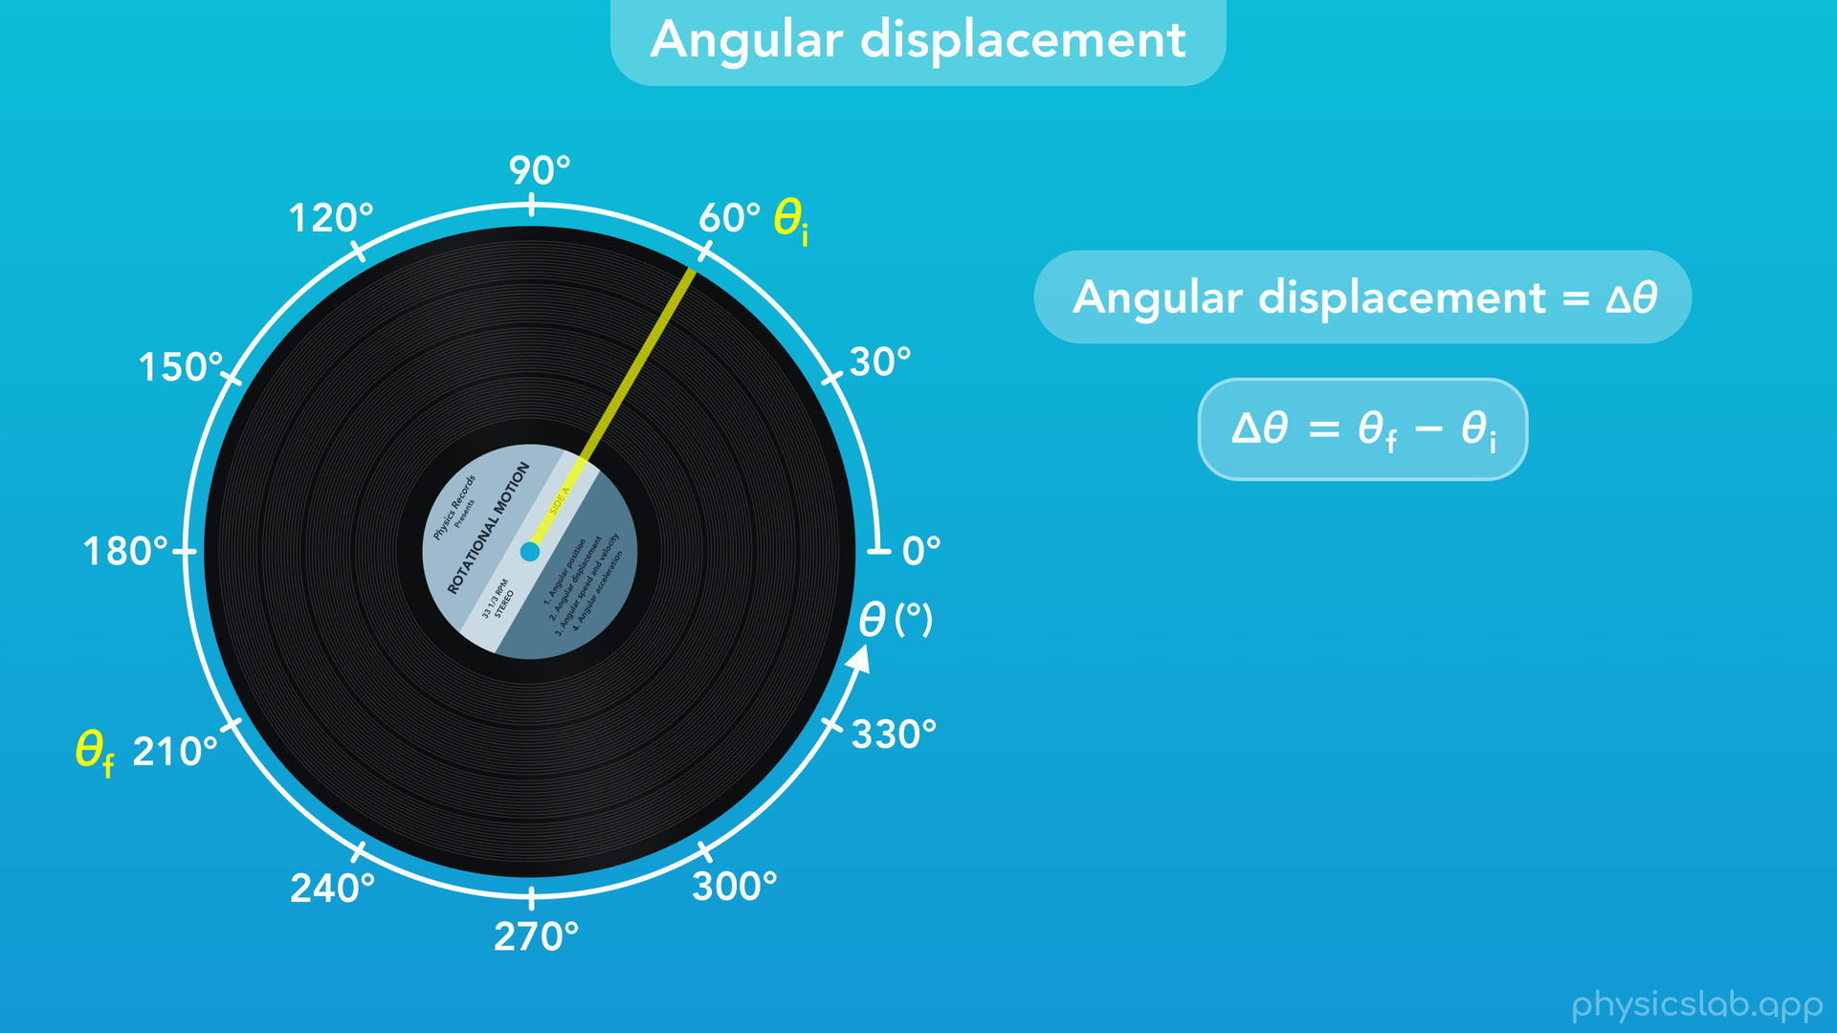
Notes:
○ If this record starts at an initial position of 60 degrees

Slide 53
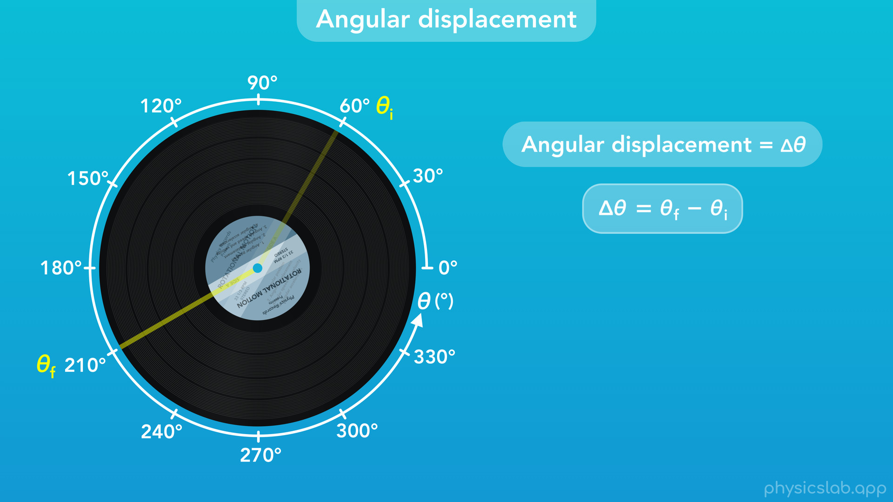
Notes:
and then rotates to a final position of 210 degrees

Slide 54
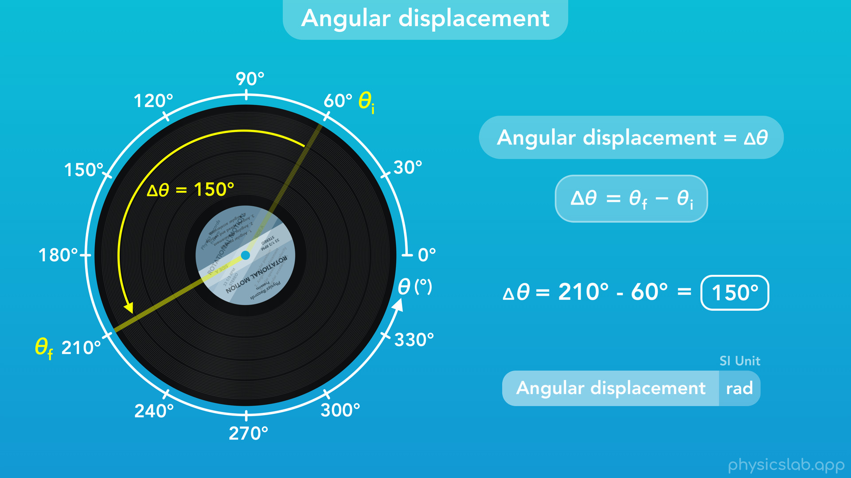
Notes:
then the angular displacement of the record would be 210 degrees minus 60 degrees, which equals 150 degrees. Like position, the SI unit for angular displacement is radians.

Slide 55

Notes:
○ Next, let’s talk about angular velocity.

Slide 56
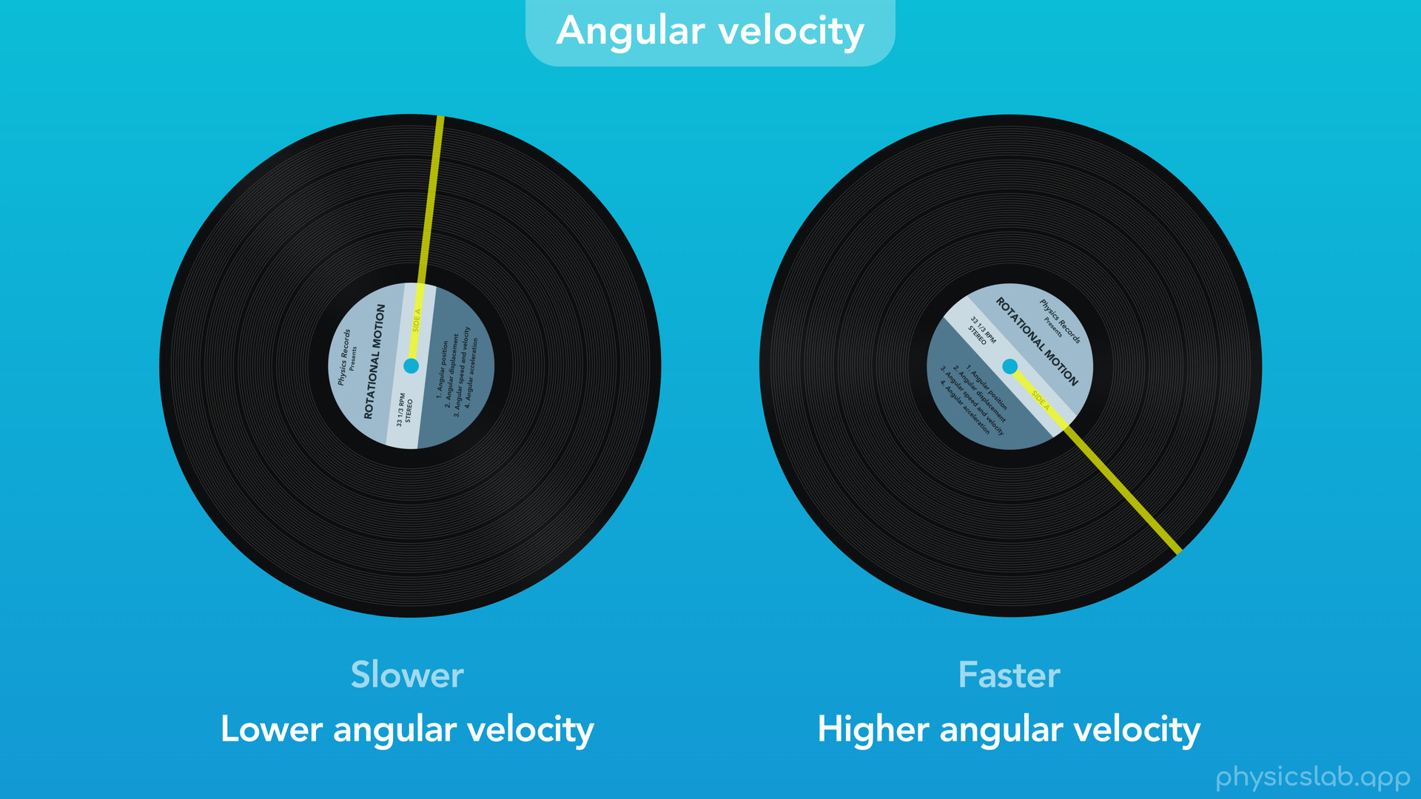
Notes:
○ Angular velocity describes how fast an object is rotating. Here we can see the record on the right has a higher angular velocity than the record on the left.

Slide 57
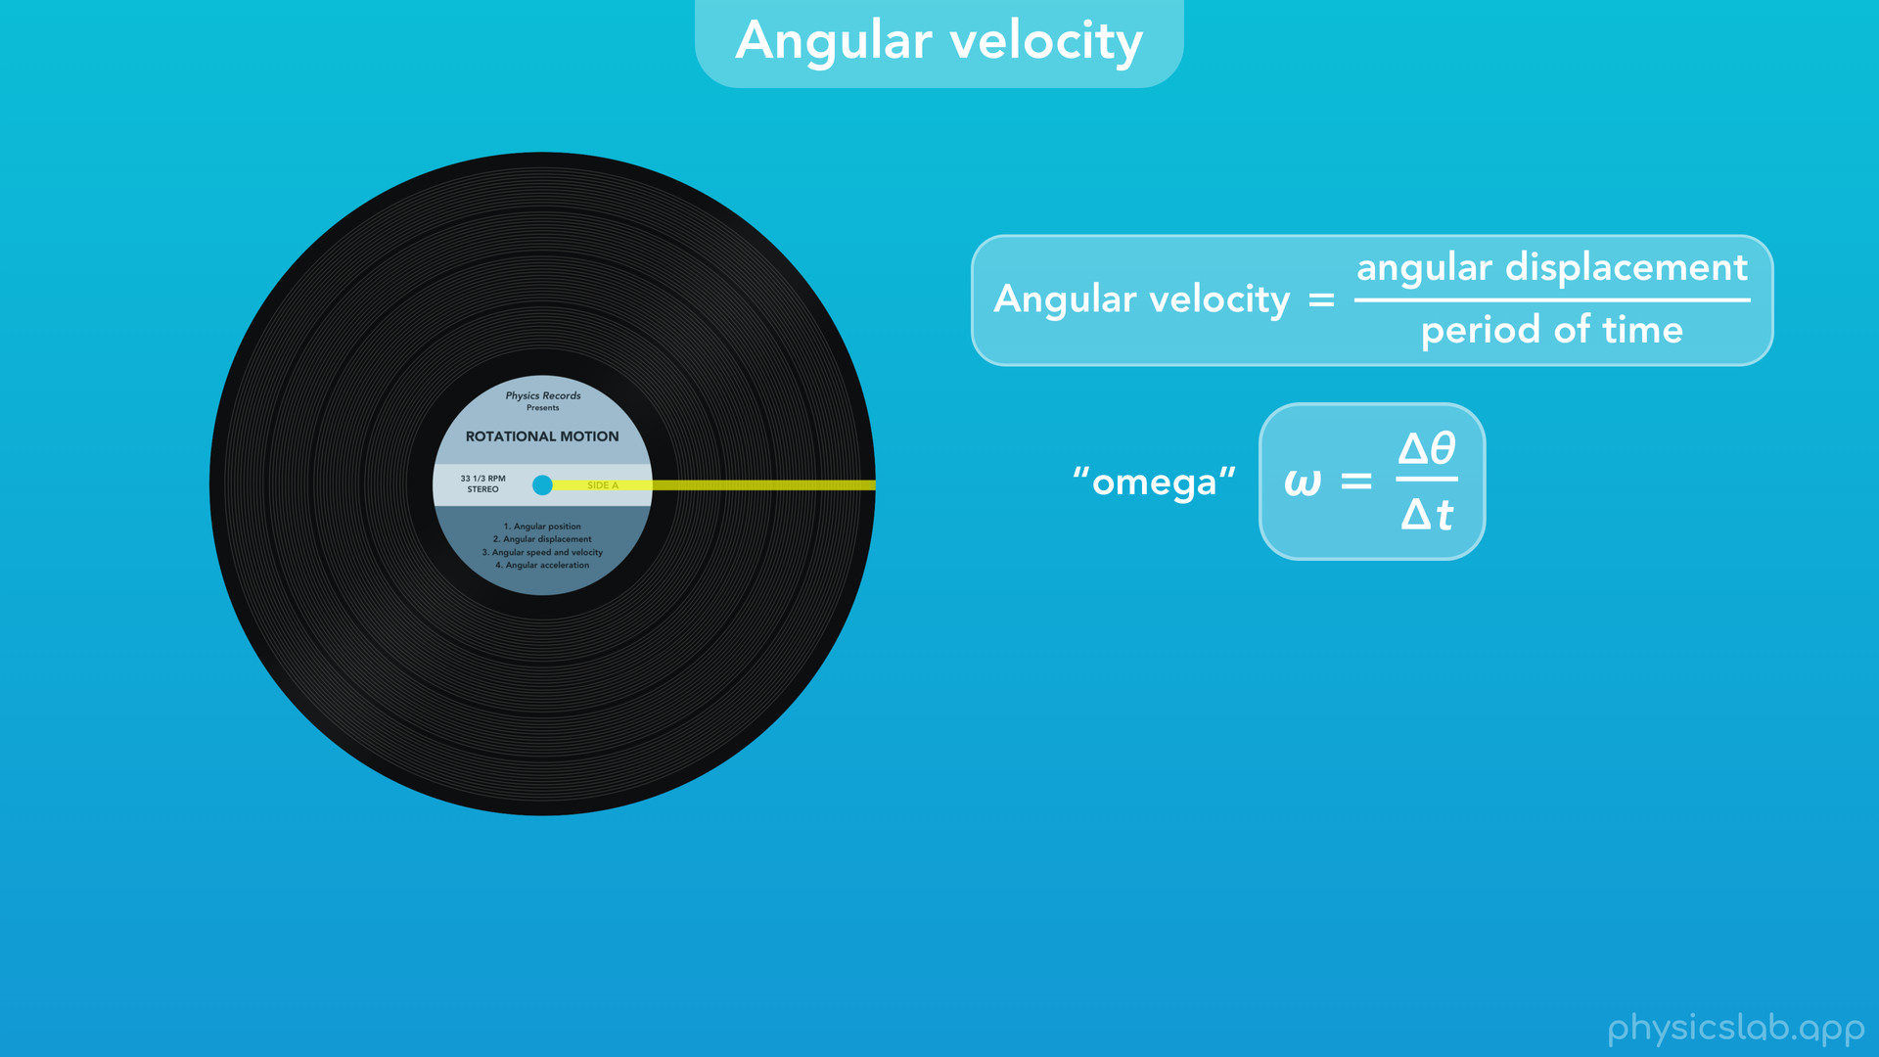
Notes:
○ Just like linear velocity, the angular velocity is the angular displacement divided by the period of time. We represent angular velocity with the Greek letter “omega”. So, the angular velocity, omega, is equal to the angular displacement, delta theta, divided by the period of time, delta t.

Slide 58
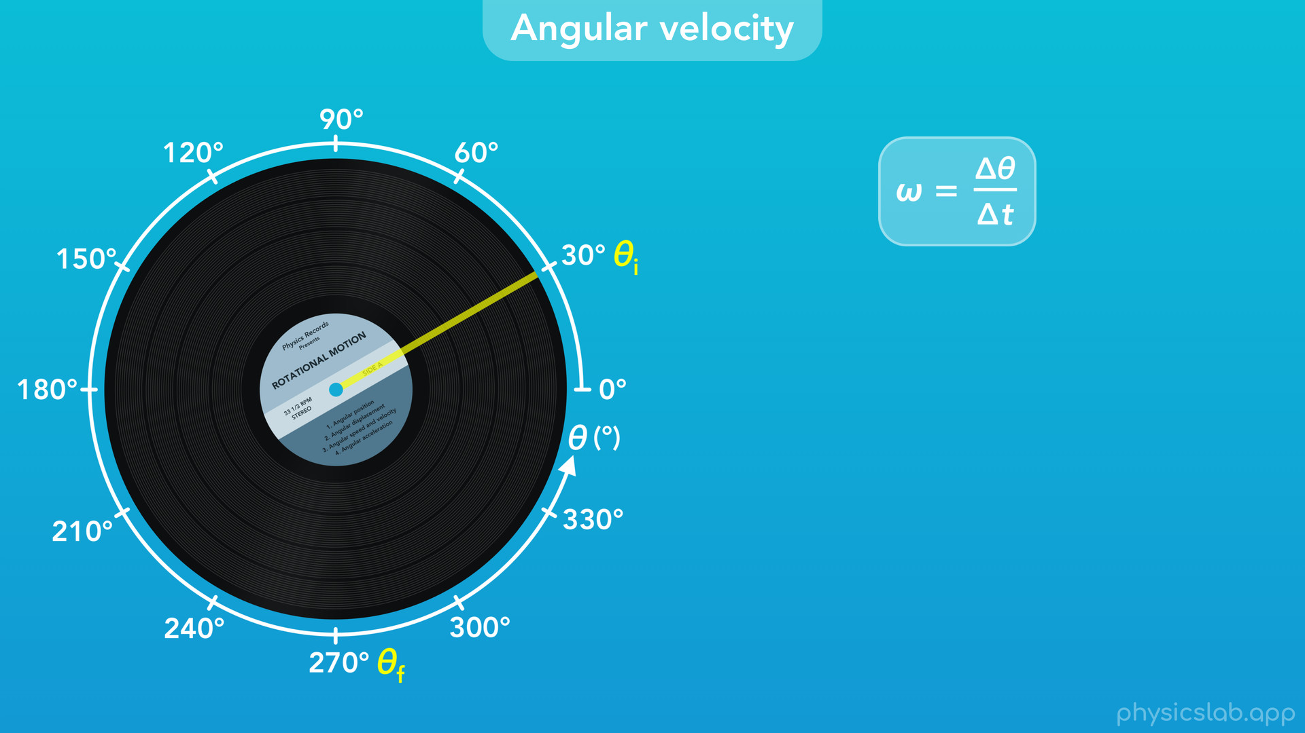
Notes:
○ Here’s an example. This record starts at an angular position of 30 degrees.

Slide 59
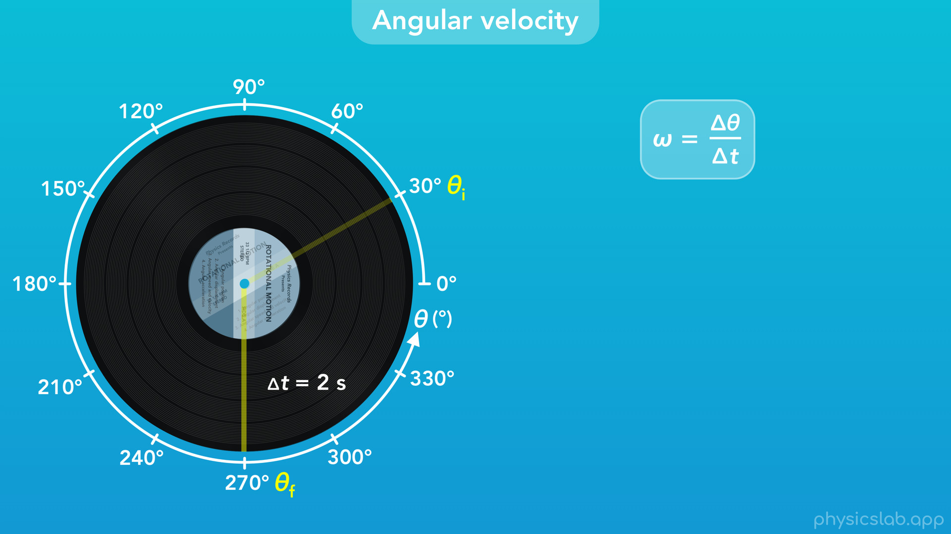
Notes:
The record rotates for 2 seconds and ends up at a final angular position of 270 degrees. What was the angular velocity of the record during that time?

Slide 60
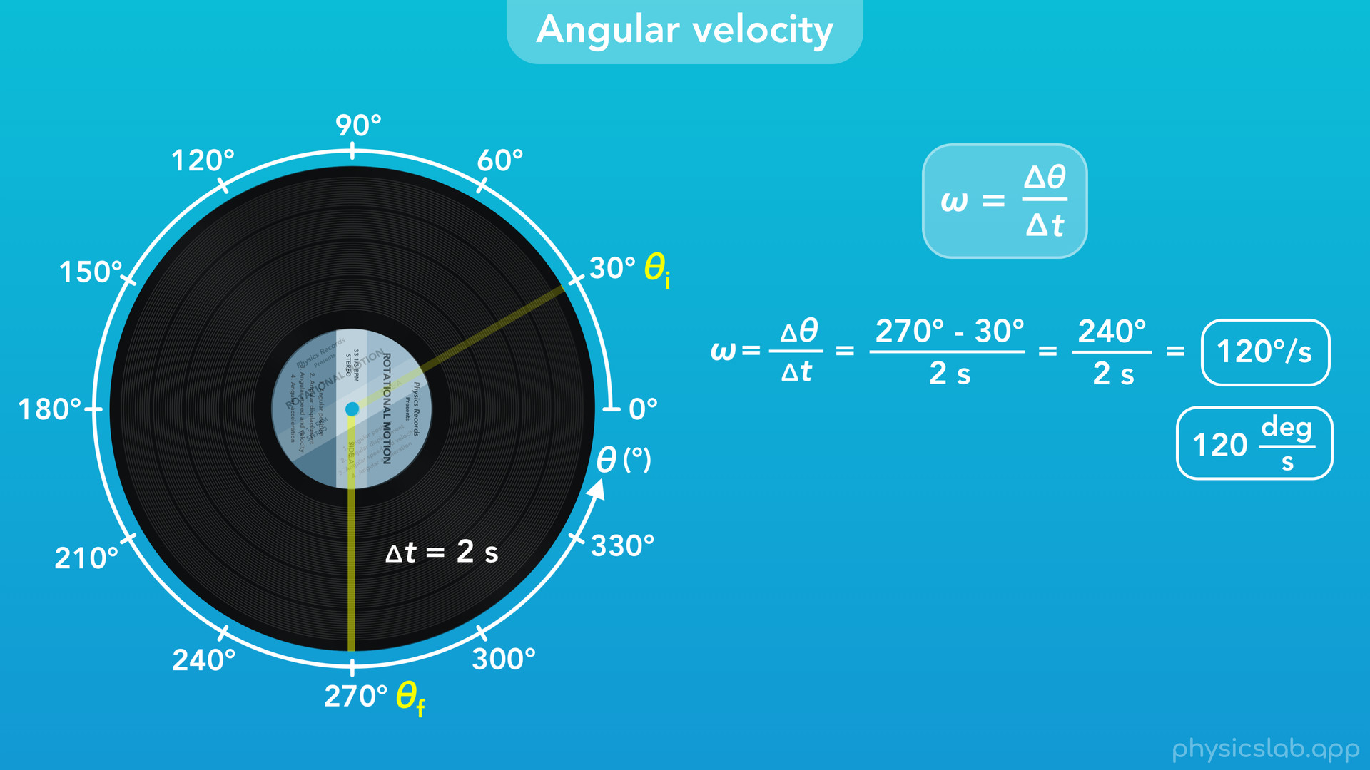
Notes:
Using the equation above, the angular velocity would be the angular displacement, 270 degrees minus 30 degrees, over the period of time, 2 s. That equals 240 degrees divided by 2 seconds, or 120 degrees per second. That means that every second, the record rotated 120 degrees.

Slide 61
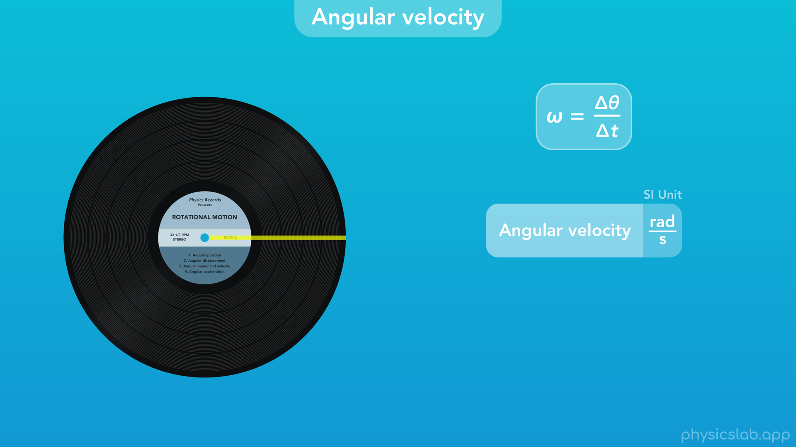
Notes:
○ Degrees per second is one unit we can use, but the SI unit for angular velocity is radians per second.

Slide 62
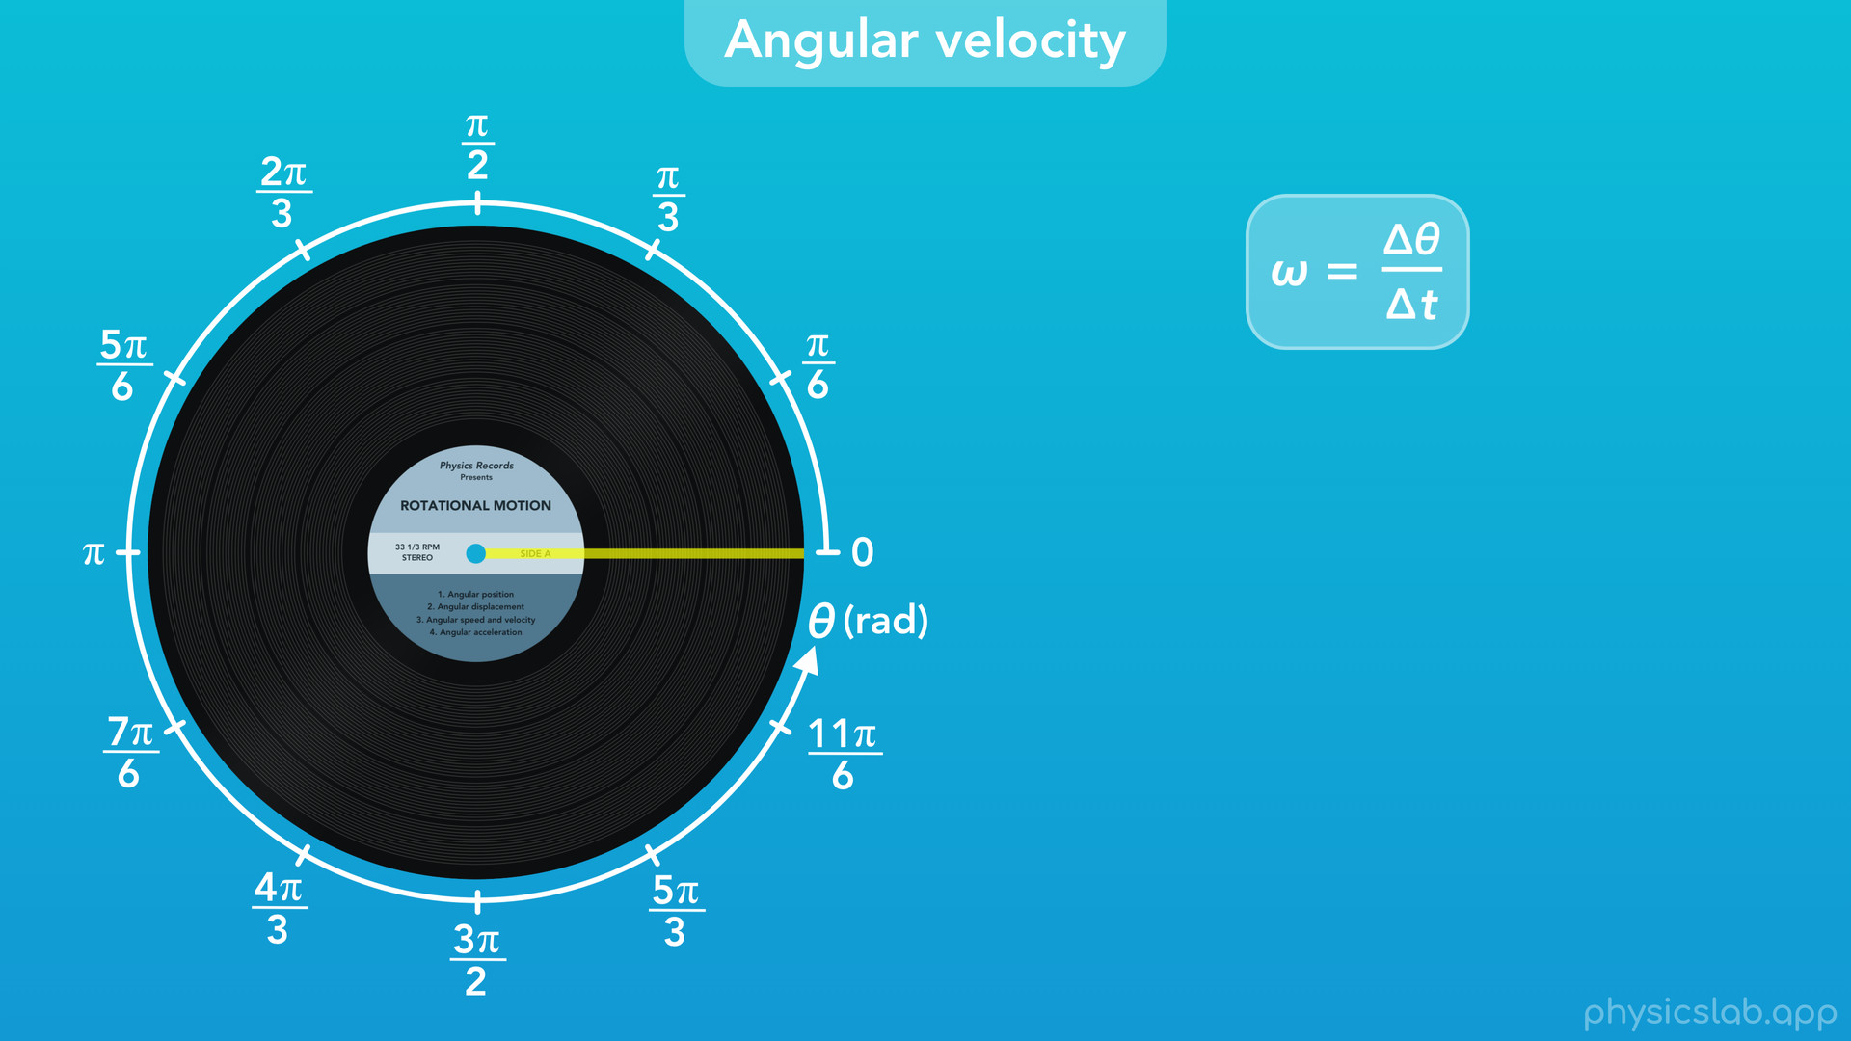
Notes:
So let’s change the units on our axis to radians.

Slide 63
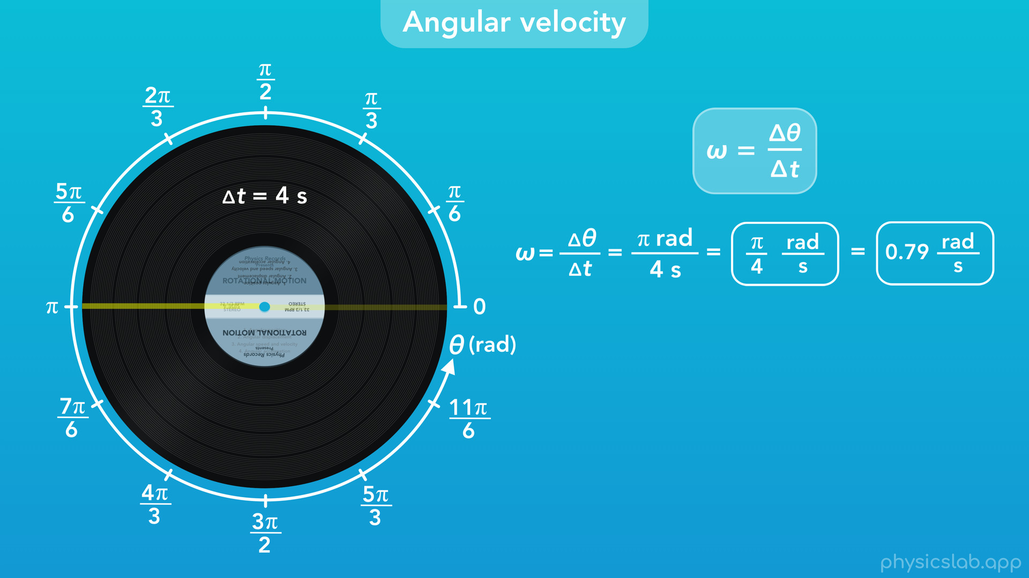
Notes:
If this record rotates half of a revolution in 4 seconds, then the angular velocity of the record was pi radians divided by 4 seconds, or pi/4 rad/s. That’s about 0.79 rad/s in decimal form.

Slide 64

Notes:
○ Here’s one more example. Let’s say we’re listening to this record and we want to measure its angular velocity. If we watch the line on the record and observe that it rotates 5 revolutions in 9 seconds

Slide 65

Notes:
then the angular velocity would be the angular displacement, 5 rev, over the period of time, 9 s. That gives us 0.56 rev / s. But let’s convert that into a more common unit.

Slide 66

Notes:
○ If we take 5 rev divided by 9 sec and we multiply it by the unit relationship of 60 sec per 1 minute, then we can cancel out the units of seconds on the top and bottom, multiply the fractions, and we get 33.33 rev/min. Revolutions per minute is a pretty common unit, and we abbreviate it as rpm. So, this record has an angular velocity of 33 1/3 rpm.
○ That’s how fast most records spin while they’re playing. The record actually tells you what speed to use on the label, and most record players have a button for 33 1/3 rpm. Actually, it usually just says 33 to keep things simple, but it’s really 33 1/3.

Slide 67

Notes:
Some records are meant to be played at 45 rpm, so there’s a button for that too. If you play a record too fast or too slow, the music won’t sound right, so it’s important that the angular velocity is perfect.
You might have noticed that this record is rotating in the clockwise direction, and we said earlier that clockwise is the negative direction. So is the angular velocity actually negative 33 1/3 rpm? Now’s a good time to review the difference between angular speed and velocity.

Slide 68


Slide 69

Notes:
○ Remember that speed is a scalar and only includes the magnitude, while velocity is a vector and includes magnitude and direction.

Slide 70

Notes:
If the angular speed of the record is 33 1/3 rpm, the angular velocity has to include a direction. For rotational motion, it could be 33 1/3 rpm counterclockwise or clockwise. Or instead, it could be positive or negative 33 1/3 rpm based on our axis, where the positive and negative tell us the direction.

Slide 71

Notes:
○ So this record has an angular speed of 33 1/3 rpm, and we could say the record is rotating counterclockwise

Slide 72

Notes:
or clockwise.

Slide 73

Notes:
Or, if we use a rotational axis, we usually say that the counterclockwise is the positive direction, and clockwise is the negative direction.

Slide 74

Notes:
So here, the record has an angular velocity of positive 33 1/3 rpm.

Slide 75

Notes:
And here, its angular velocity is -33 1/3 rpm, which is the direction records actually spin while they’re playing.

Slide 76

Notes:
○ The last thing to cover is angular acceleration.

Slide 77

Notes:
○ Angular acceleration is the change in angular velocity divided by a period of time.

Slide 78

Notes:
If we turn on this record player, the record starts with an angular speed of 0 rpm, and it needs to accelerate to reach a speed of 33 1/3 rpm before the record can be played. You might be familiar with the angular acceleration of other objects. If we say that something like a fan, a wheel, or a motor needs to get “up to speed”, that means you’re waiting for it to accelerate. Remember that acceleration is a change in velocity. Even if that change is negative, or if the object is slowing down, we still call it acceleration.

Slide 79

Notes:
○ We use the Greek letter “alpha” to represent angular acceleration, so alpha, is equal to the change in angular velocity, delta omega, divided by the period of time, delta t.

Slide 80

Notes:
○ As an example, let’s say this record starts from rest with a velocity of zero rpm, and we turn it on. Usually the record is up to speed in a few seconds, but this one is broken, so let’s say it takes 2 minutes to accelerate and reach an angular velocity of -33 1/3 rpm. What’s the angular acceleration of the record?

Slide 81

Notes:
○ The change in angular velocity would be -33 1/3 rpm minus 0 rpm. We divide that by the period of time, 2 minutes. Remember that the unit of rpm means revolutions per minute, so we are taking -33 1/3 revolutions per minute and dividing that by 2 minutes. That gives us -16.67 revolutions per minute per minute, or revolutions per minute squared. This seems like a weird unit, but it’s saying that after every minute that passes, the record increases its speed by 16.67 revolutions per minute.

Slide 82

Notes:
○ But most of the time, we’re going to use the SI unit for angular acceleration, which is radians per second squared.

Slide 83

Notes:
○ Before we wrap up, it wouldn’t be a kinematics lesson without the last two kinematic equations that we can use when an object has a constant angular acceleration.
○ Like we’ve covered in other videos, these 2 equations are the same ones from linear motion and circular motion. The only difference is we’re using variables for angular motion.

Slide 84

Notes:
○ This first equation says that the final angular position is equal to the initial angular position plus the initial angular velocity times the period of time, plus one half times the angular acceleration times the period of time squared. This can be used to solve for things such as the final angular position of a rotating object after accelerating for a period of time.

Slide 85

Notes:
○ The second equation says that the final angular velocity squared equals the initial angular velocity squared plus 2 times the angular acceleration times the angular displacement, or the final angular position minus the initial angular position. This equation can help us find the final angular velocity of a rotating object after it accelerates over a given angular displacement.
○ Again, these are the same equations you’ve already seen, but they use the variables for angular motion.

Slide 86

Notes:
○ So that’s everything we’re gonna cover, what should we be expected to know from this video?

Slide 87

Notes:
○ First, this lesson specifically focused on objects in rotational motion and how to use the angular description of motion.

Slide 88

Notes:
○ These are the variables we learned and their SI units.

Slide 89

Notes:
○ Here are the equations we covered. The first three are the definitions of angular displacement, velocity and acceleration. The last two are the kinematic equations that we can use for an object with a constant angular acceleration. All of these equations are the same ones from linear motion and from circular motion, except they use the variables for the angular description of motion above.

Slide 90

Notes:
○ When an object rotates, every point on the object rotates together, and we can draw a line on the object to help see how it’s moving. When we describe the angular position of a rotating object, we’re talking about the angle formed between this line at some position and where the line was at the zero point that we establish.

Slide 91

Notes:
The axis for angular position looks like this, and similar to circular motion, counterclockwise is the positive direction and clockwise is the negative direction.

Slide 92

Notes:
The SI unit for angular position is a radian, but there are other units that we can use, like degrees, revolutions, or cycles.

Slide 93

Notes:
Like with circular motion, if an object continues to rotate past 1 revolution, the value of position continues to increase.

Slide 94

Notes:
○ Angular velocity is how fast an object is rotating. Remember that angular speed is a scalar and only includes magnitude, but angular velocity is a vector and includes magnitude and direction.

Slide 95

Notes:
○ And finally, angular acceleration is the change in angular velocity or speed over time. If an object increases or decreases how fast it’s spinning, that’s angular acceleration.

