Slide 1
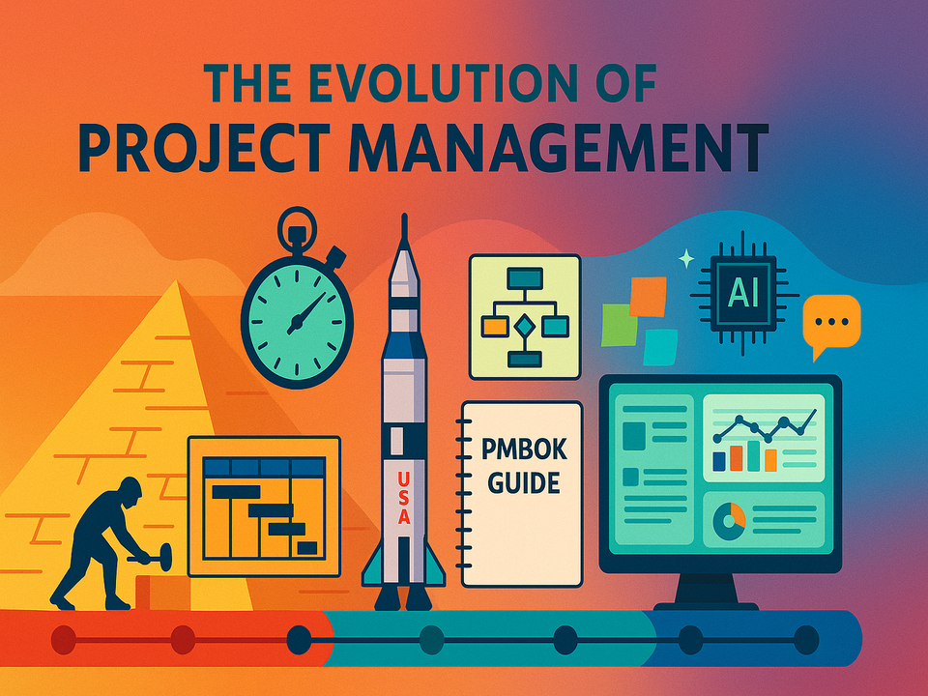

Slide 2


Evolution of
Project Management
The Genesis of
Project Management
Proctor & Gamble (P&G) – 1920s
United States Air Force (USAF) – 1950s
Program Evaluation & Review Charts (PERT) – 1960s
The Need For
Project Management
Standardized Principles, Processes & Policies
Formalized Structure & Approach

Slide 3
PMBOK 1
PMBOK 2
PMBOK 3
PMBOK 4
Focused On:
Introducing Project
Management as a
Profession
Documented Future
Learning Material
Focused On:
Growing Project Management Profession
Documented Knowledge Areas
Focused On:
New & Revised Processes
Changes to Project
Lifecycle & Organization
Various Changes
throughout 9 KAs
Focused On:
Amending Iron Triangle
Changes to 9
Knowledge Areas
Purpose:
Standardized Best
Practices, Procedures
& Knowledge
Purpose:
Consolidated Best Practices for Successful Project Completion
Purpose:
Evaluated Project Management Best Practices
Purpose:
Highlighting Growing Constraints within Project Management Profession

Slide 4
PMBOK 5
PMBOK 6
PMBOK 7
Focused On:
Changes to Rolling
Wave Planning
Introducing
Adaptive Lifecycle
Introducing Stakeholders Management as Additional KA
Focused On:
Adopted Agile
Methodologies
Stressed on
Importance of
Strategic & Business
Thinking
Focused On:
Drastic Update to PMP Exam
Structural Overhaul That Reduces 5 Sections to 3
Required Knowledge to Include Modern PM Techniques & Practices
Purpose:
Highlighting Growing Importance of Stakeholders in Project Management Environment
Purpose:
Introducing Agile
Project Management Methodologies
Counter Uncertainty
Purpose:
Introducing Concept of Putting Principles Over Processes
Made PM More Dynamic

