Slide 1
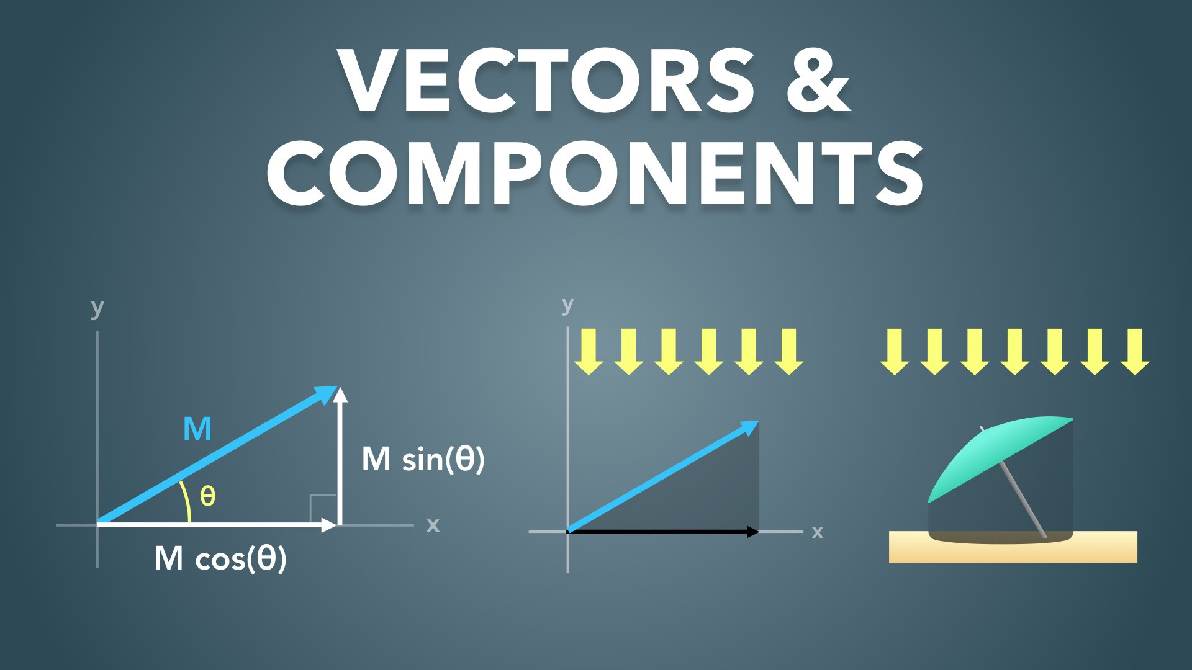
Notes:
Vectors & Components
Slides Version 1
physicslab.app
These slides include screenshots from the video. Want more slides? Less slides? Different material on the slides or a different format? If you have any questions, suggestions or feedback about these slides please email me at chris@physicslab.app or send me a message on Discord @physicslab.

Slide 2
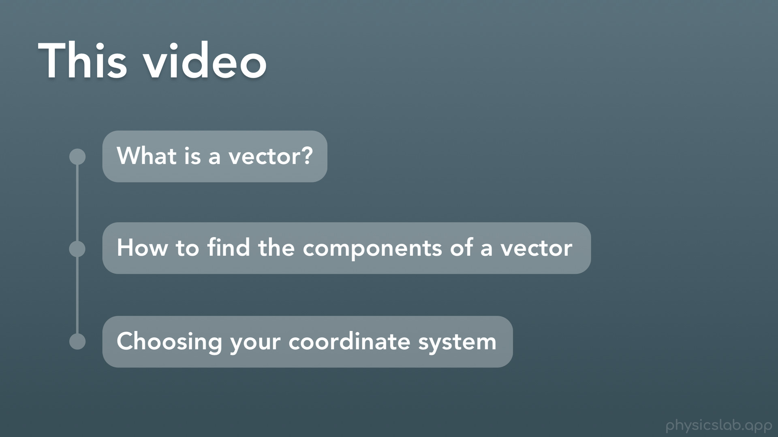
Notes:
Welcome to this video on Vectors and components. If you haven’t watched it yet, you’ll want to watch the video on trigonometry and trig functions before watching this video, or at least have a good understanding of the trig functions first.
In this video
a. We’ll answer the question, what is a vector?
b. We’ll learn how to find the components of a vector
c. And we’ll talk about choosing your coordinate system based on different problems we might be solving

Slide 3
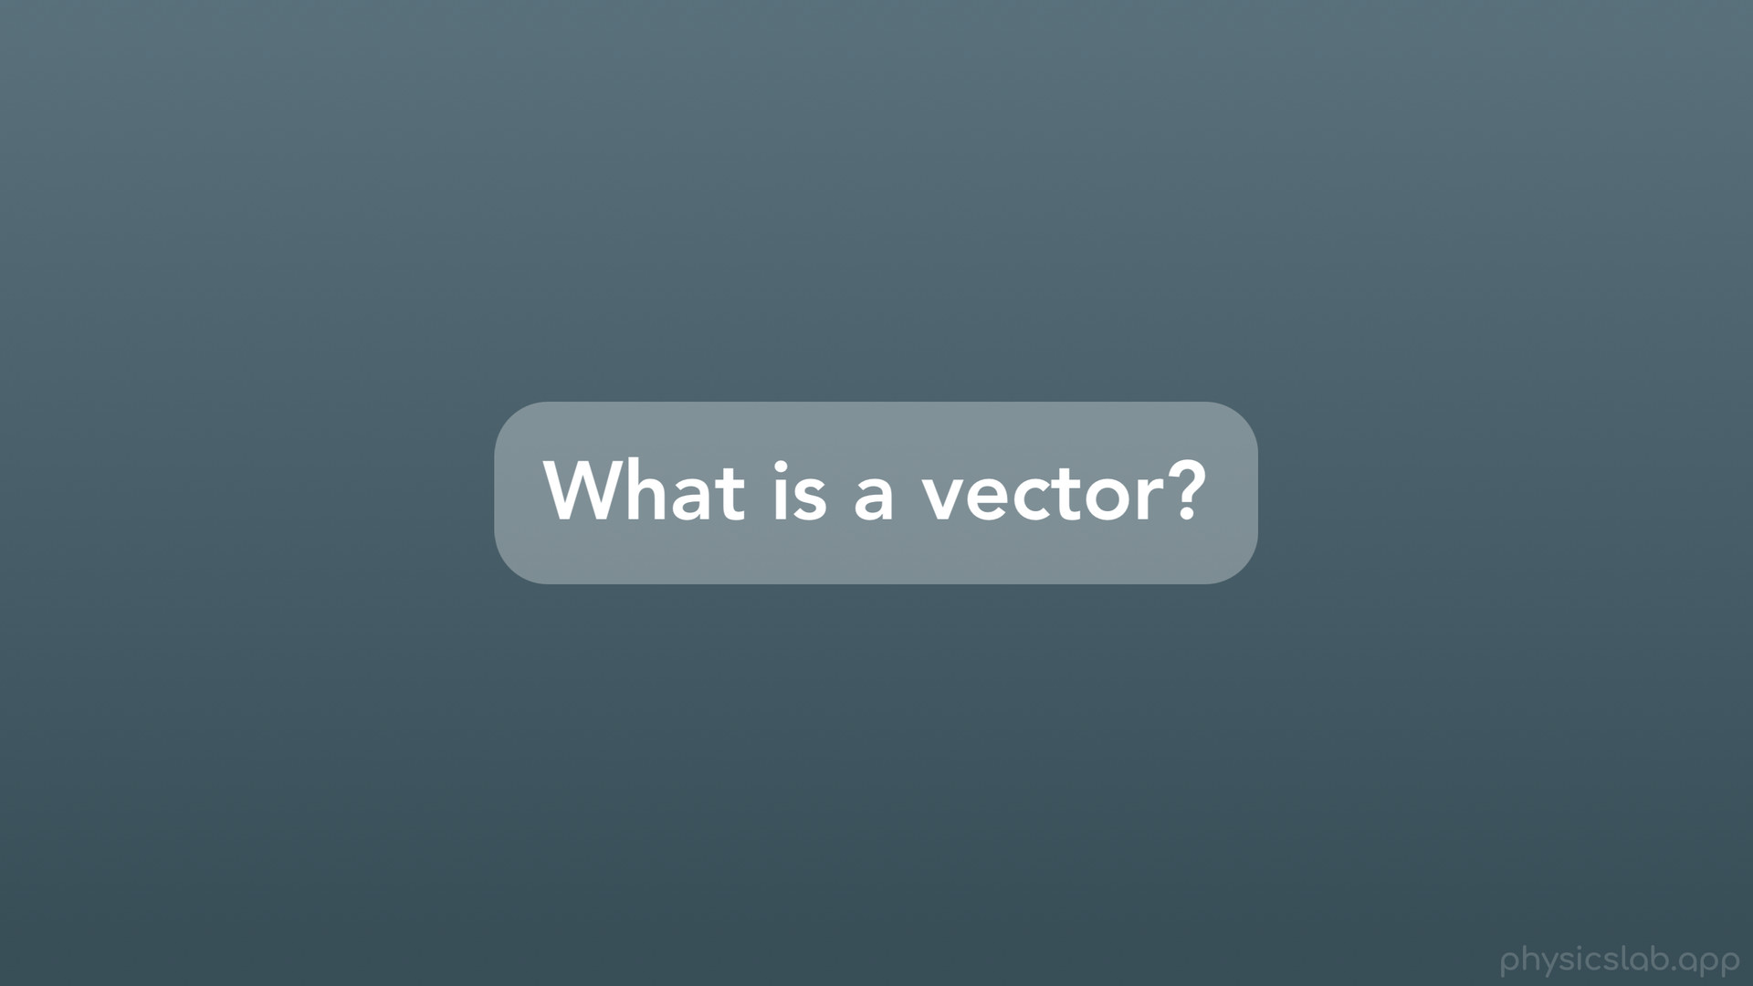
Notes:
So first, what is a vector?

Slide 4
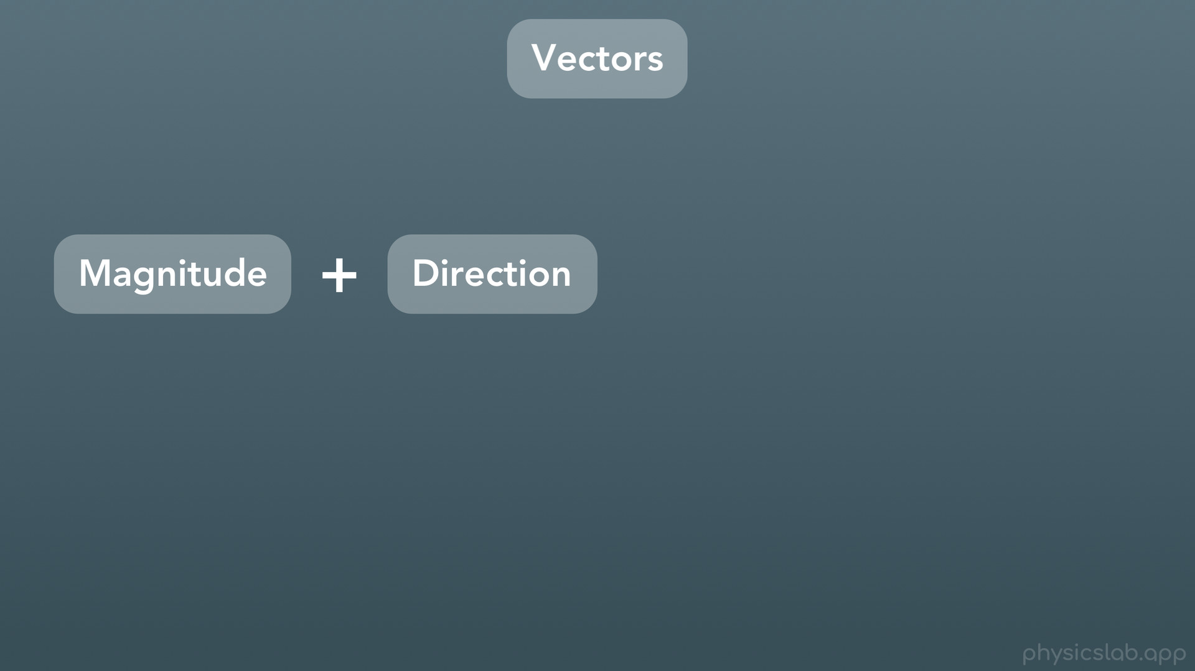
Notes:
A vector is something that has both a magnitude and a direction.

Slide 5
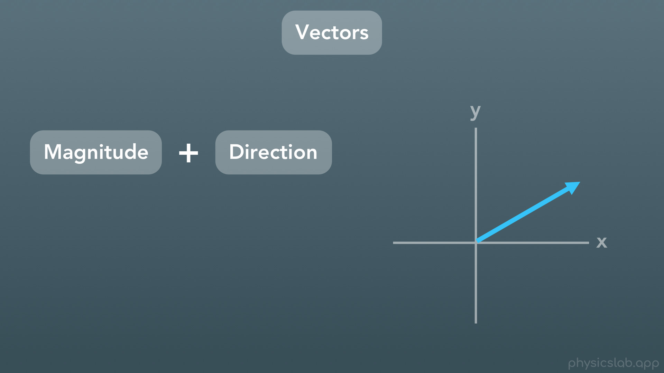
Notes:
We usually represent a vector using an arrow, and the length of the arrow is the vector’s magnitude.

Slide 6
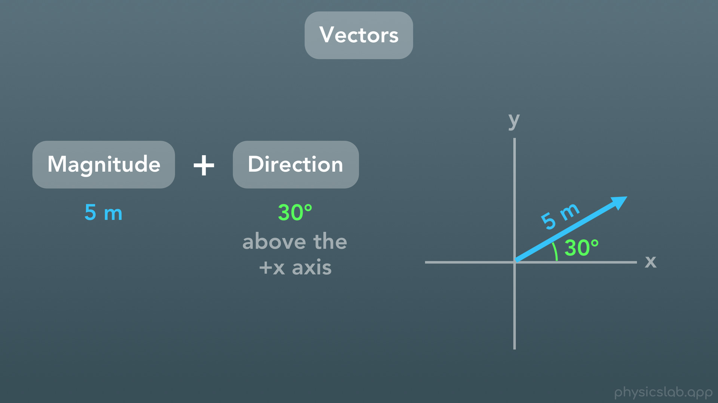
Notes:
So here we have this blue vector with a magnitude of 5 meters, and a direction of 30 degrees above the positive x axis.

Slide 7
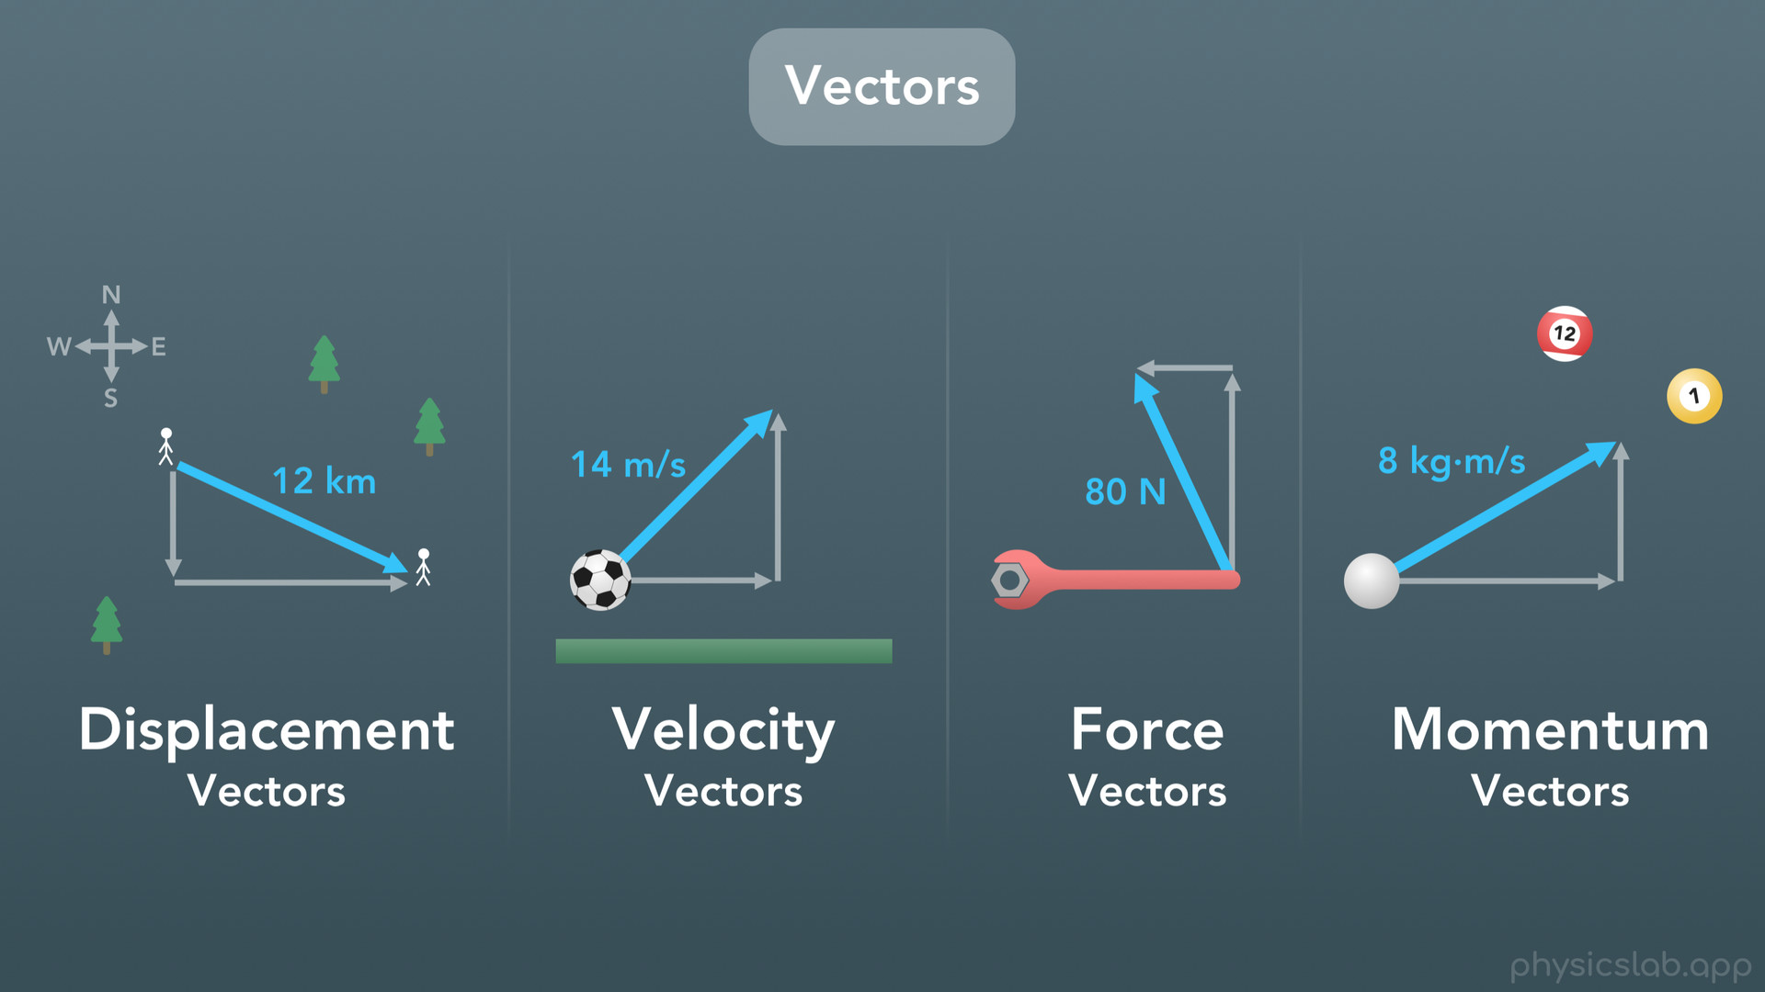
Notes:
We use vectors to represent a lot of different things in physics. We might deal with vectors that represent the displacement of an object. We can use vectors to represent the velocity of an object that’s moving. We’ll use force vectors all of the time when we draw the free-body-diagram for an object, or when we calculate the torque around some pivot point. And we can even use vectors to represent the momentum of objects, when we’re working with collisions and the conservation of momentum.

Slide 8
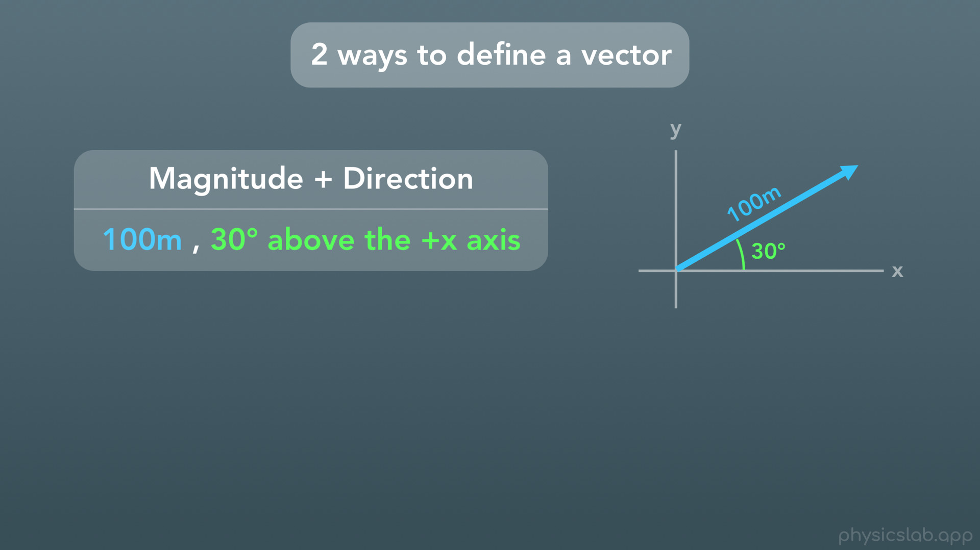
Notes:
So there are 2 ways that we can define a vector.
The first way, like we mentioned before, is by using the magnitude and direction. Here we have this blue vector with a magnitude (or length) or 100 meters, and a direction of 30 degrees above the positive x axis. This combination of magnitude and direction completely describes this specific vector. No other vector could share the same magnitude and direction.

Slide 9
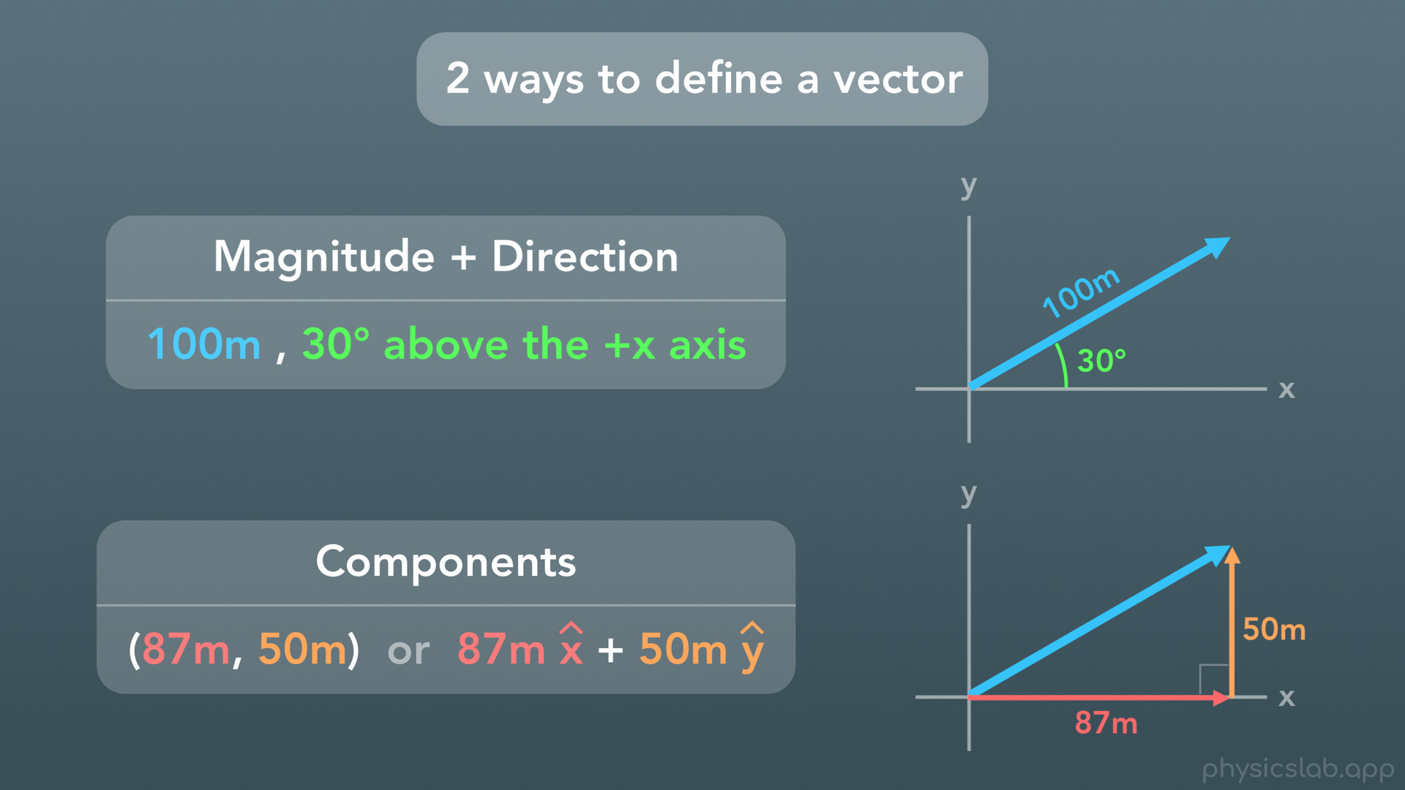
Notes:
The second way to define a vector is with its two components. If we create a right triangle with the vector as the hypotenuse of the triangle, the other 2 sides become the components of the vector. Here we have an x component of 87 meters, and a y component of 50 meters. Since right triangles always have one angle that is 90 degrees, the geometry of right triangles is more constrained. So it turns out that we can fully define this blue vector using only these two other sides. No other vector could be created using these two components.

Slide 10
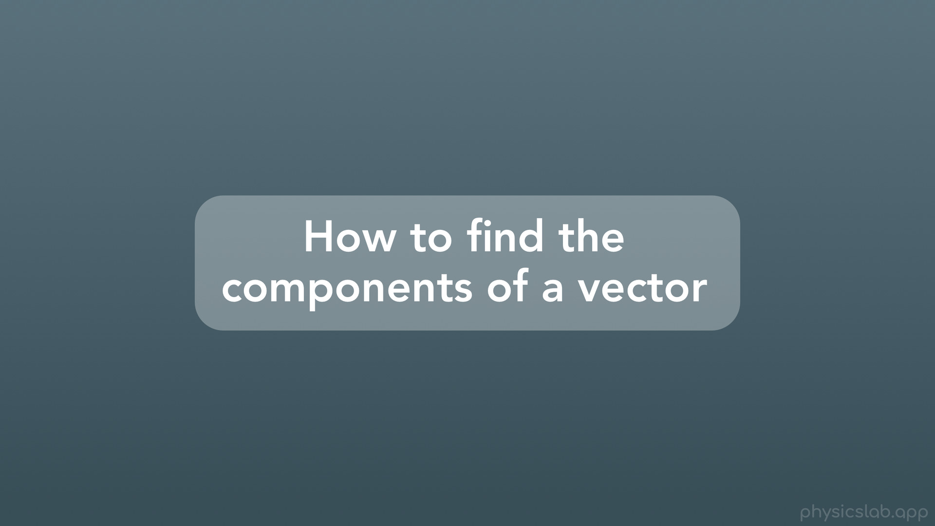
Notes:
Next, let’s learn how to find the components of a vector

Slide 11
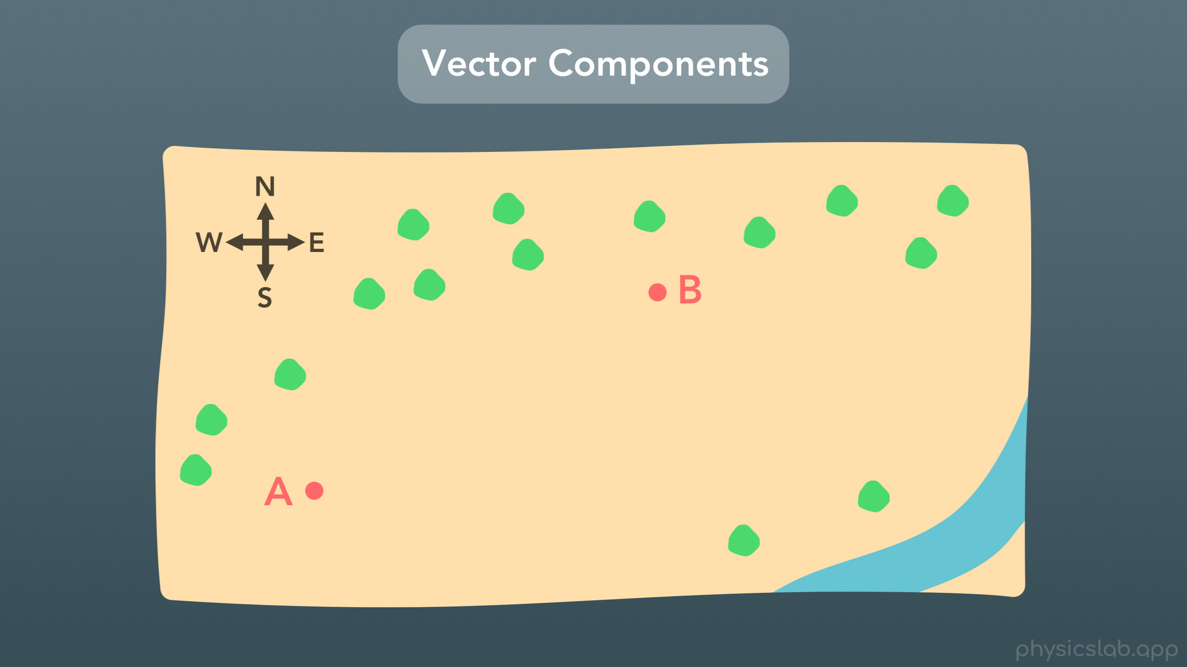
Notes:
So what exactly are components and how can we think about them? I think the easiest way is to picture a map with a compass.

Slide 12
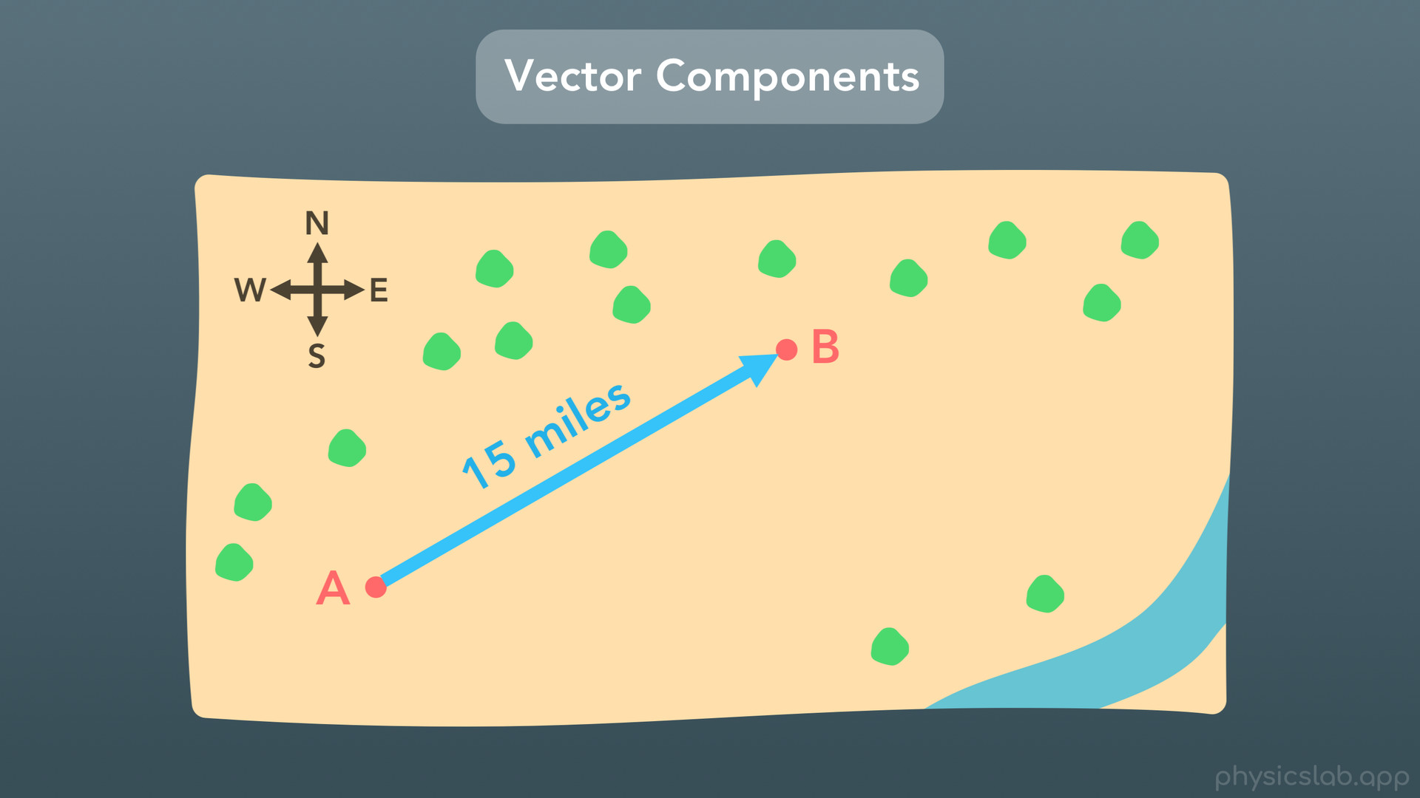
Notes:
Imagine you’re hiking, and you travel from point A to point B in a straight line, which is 15 miles. So now you’re at point B, and you physically hiked 15 miles straight.

Slide 13
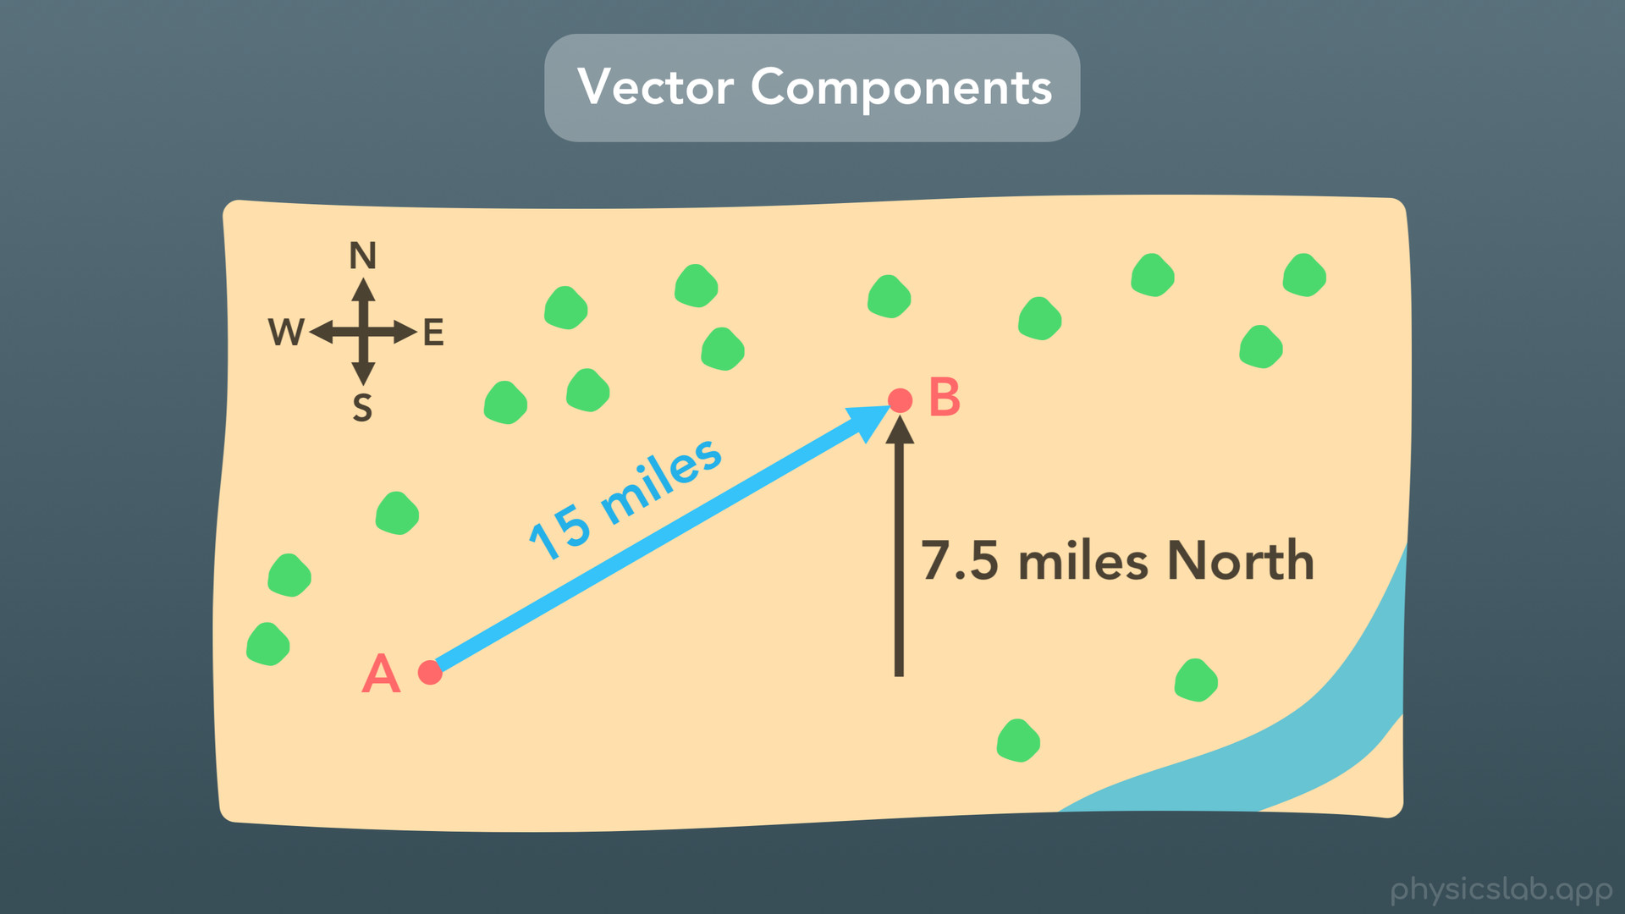
Notes:
But, how far North of point A are you? It turns out that you travelled 7.5 miles North of point A.

Slide 14
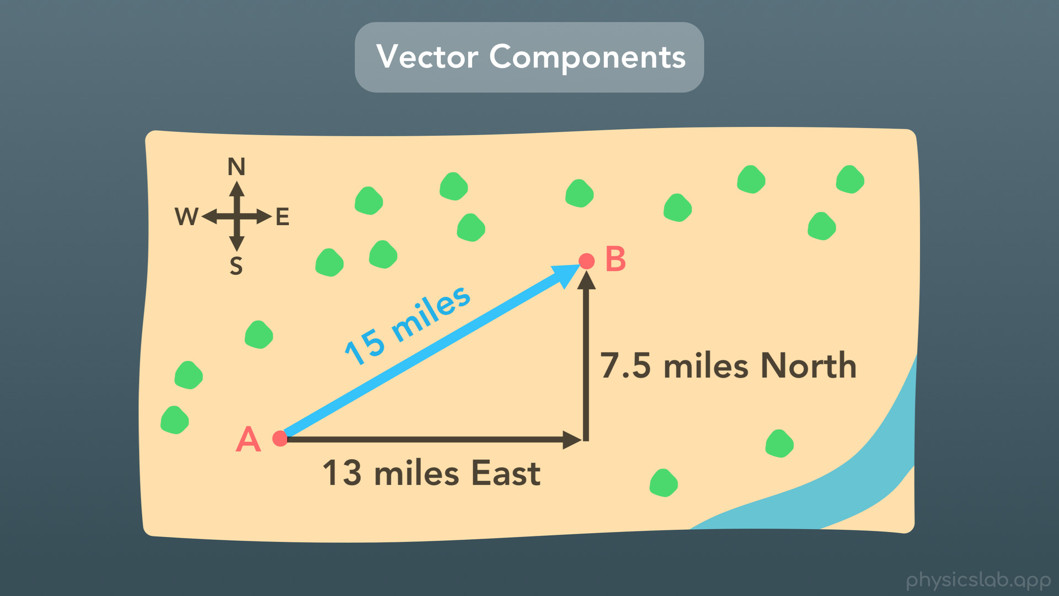
Notes:
And how are East of point A are you? Well you travelled 13 miles East of point A. So if you were lost and you called someone at point A to come find you with a compass, you could tell them to travel 13 miles directly East and then 7.5 miles directly north, and they would take a different path but still end up at point B.

Slide 15
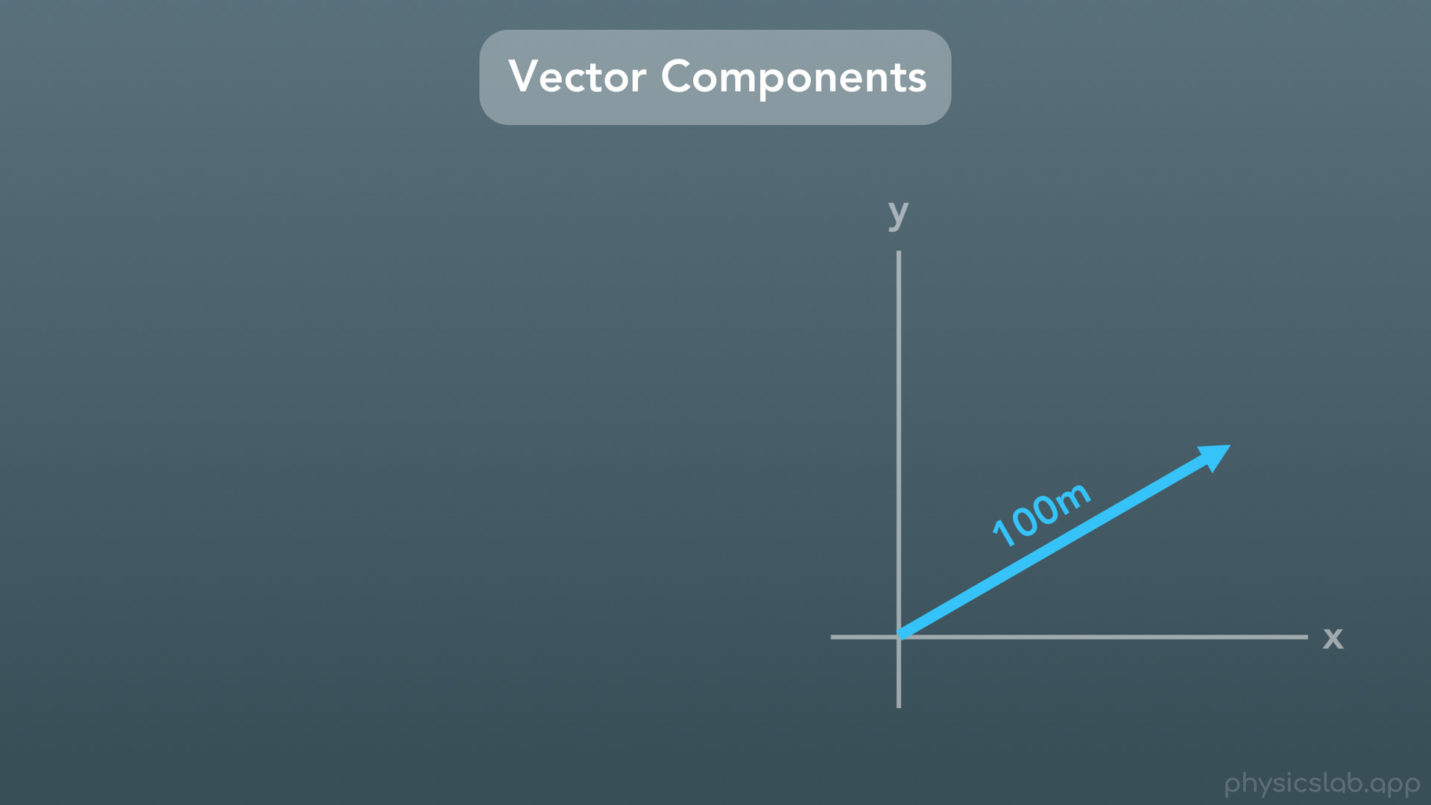
Notes:
Another way to think about components is imagining the shadow that the vector projects onto each axis.

Slide 16
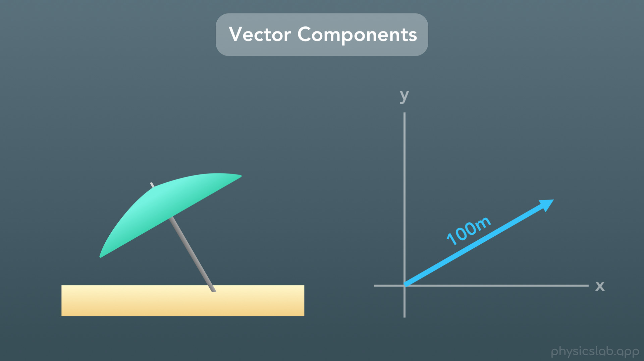
Notes:
If you were at the beach with an umbrella

Slide 17
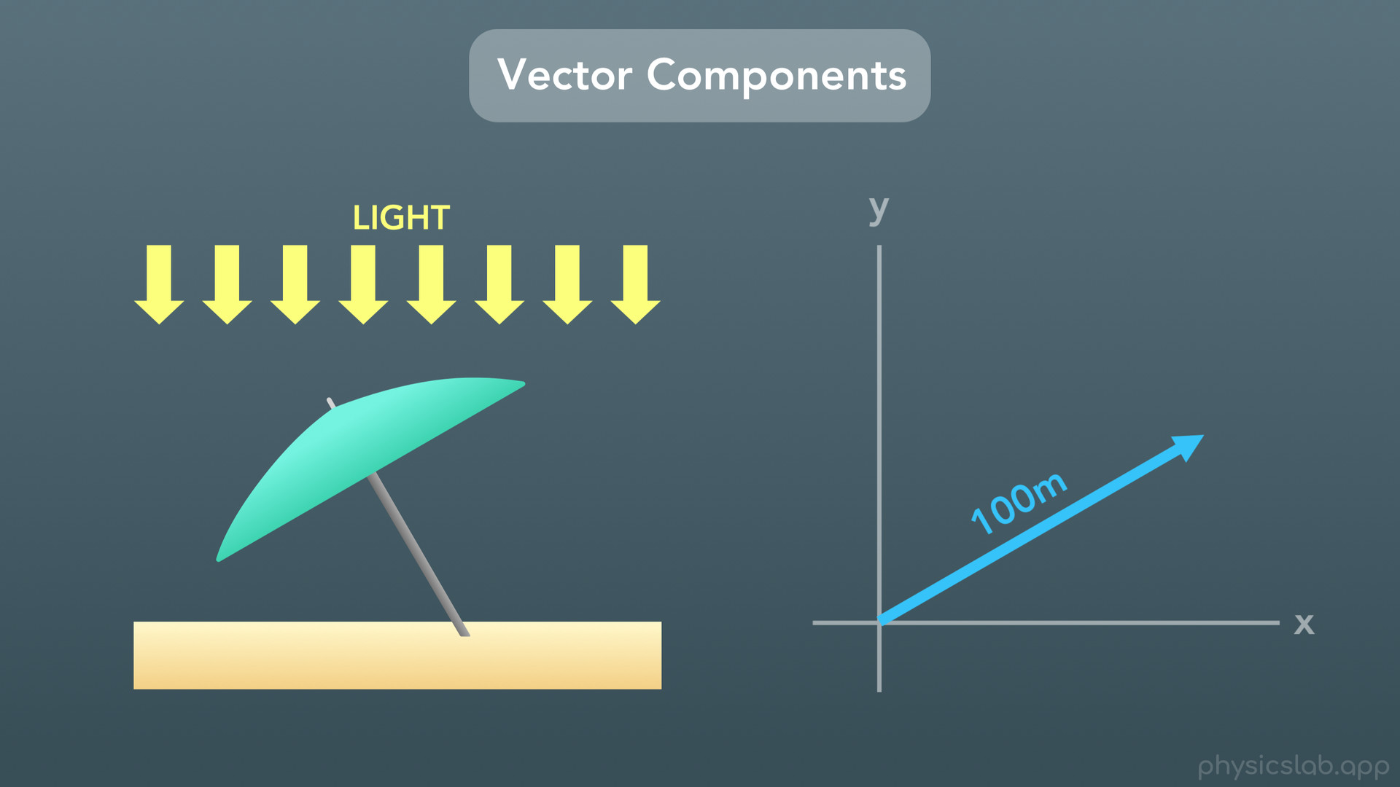
Notes:
and the sun was shining down across the whole beach

Slide 18
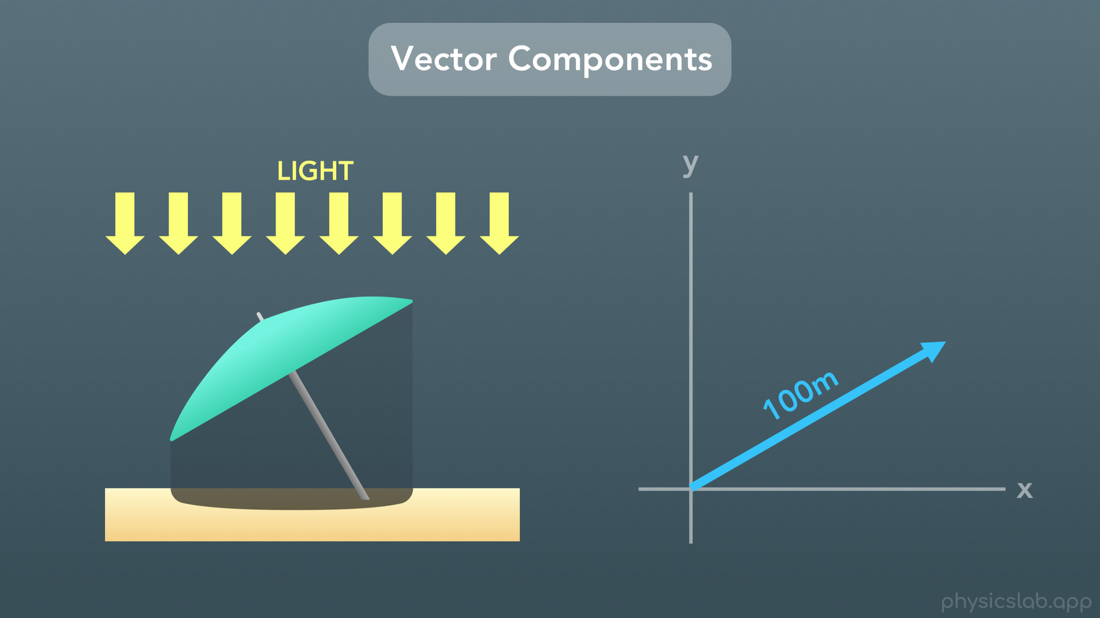
Notes:
your umbrella would create a shadow on the sand. The shadow isn’t the entire length of your umbrella, it’s only the length of the umbrella that is blocking the sun from shining straight downwards and reaching the sand.

Slide 19
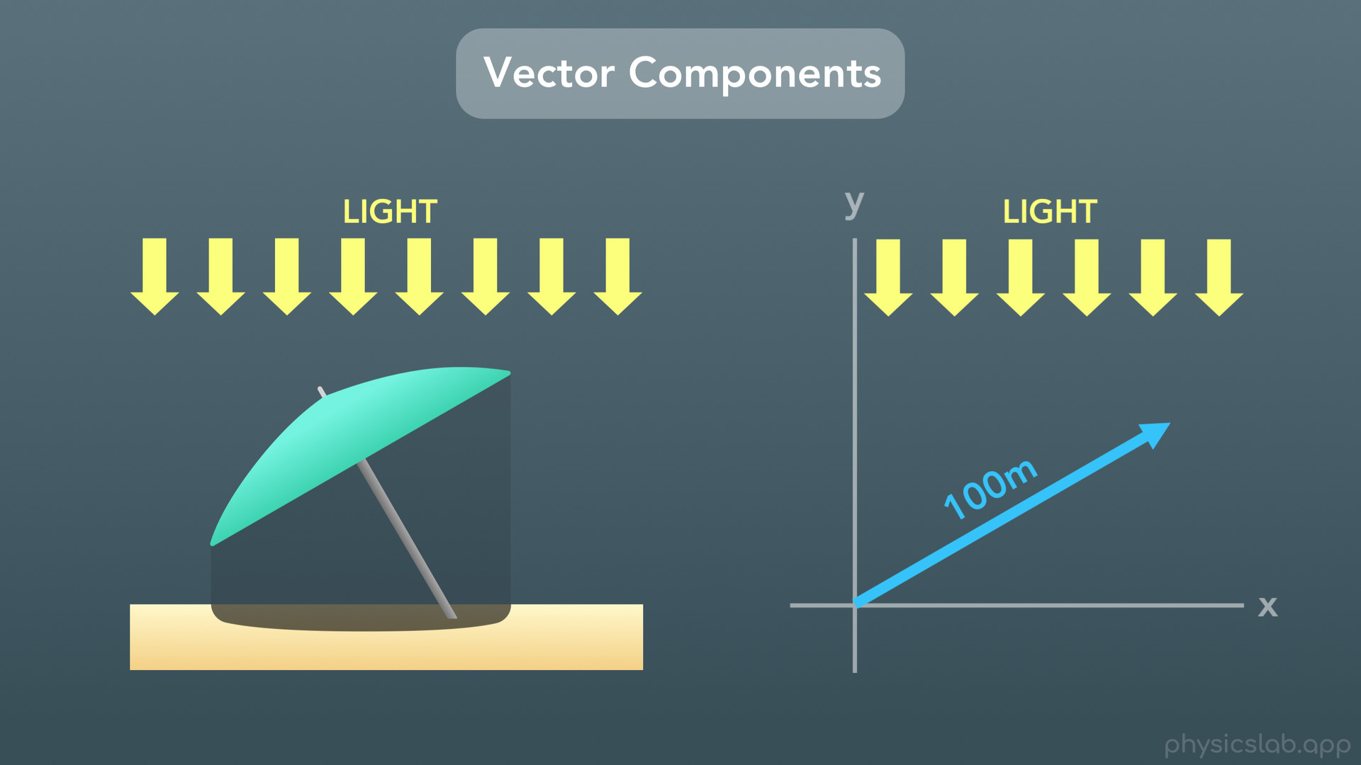
Notes:
The same thing is true for finding components of a vector along the x and y axes.

Slide 20
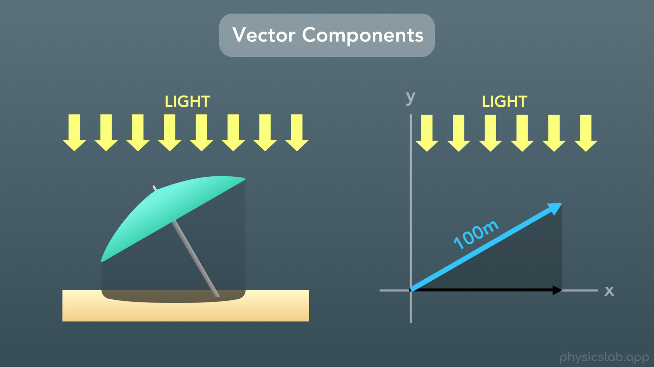
Notes:
If you had light shining down, parallel to the y axis, the vector would cast a shadow onto the x axis.

Slide 21
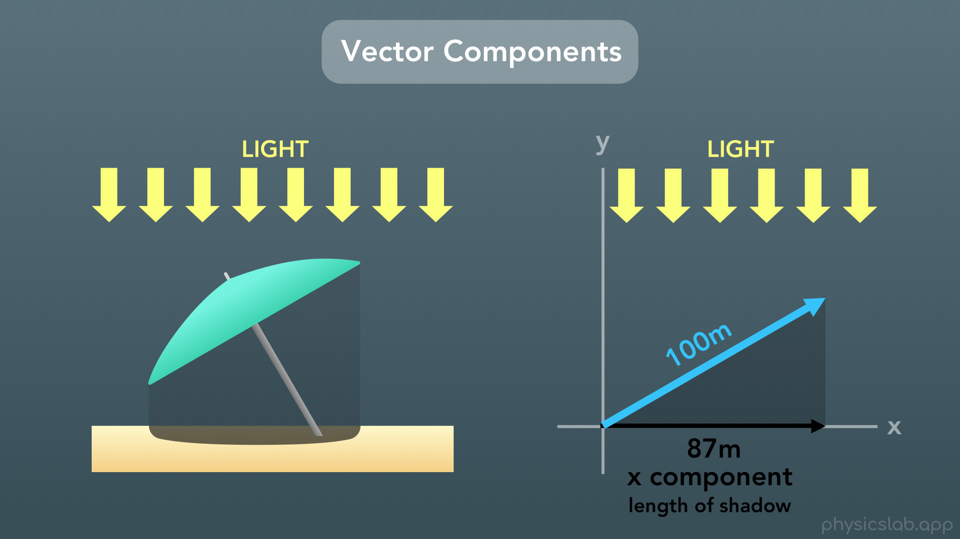
Notes:
The length of this shadow is the vector’s component along the x axis, also known as the x component.

Slide 22
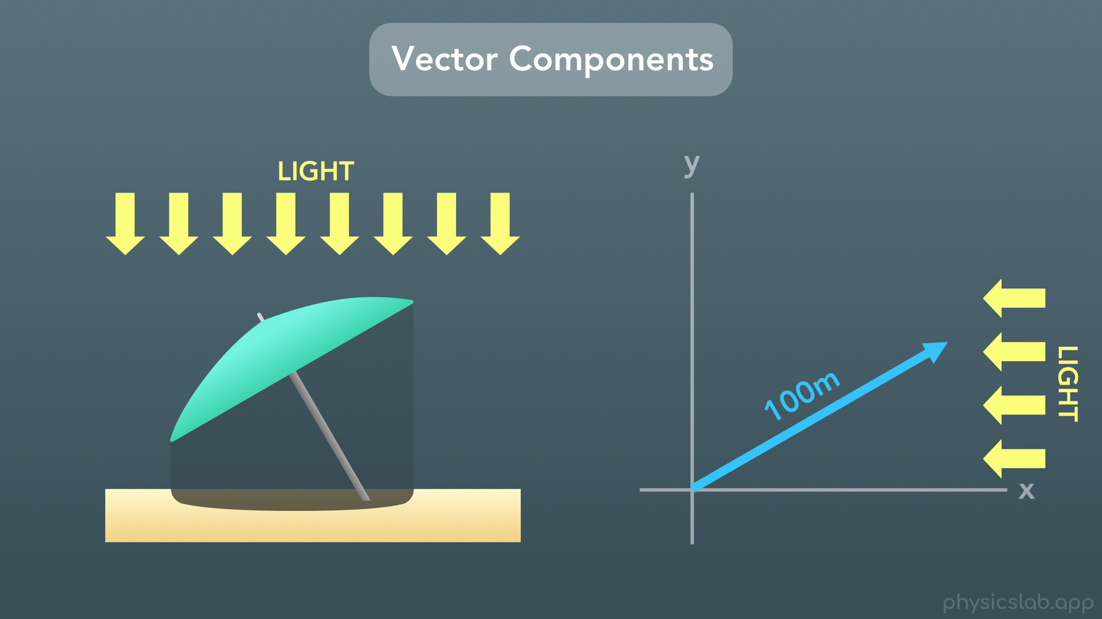
Notes:
And if you shined a light sideways parallel to the x axis

Slide 23
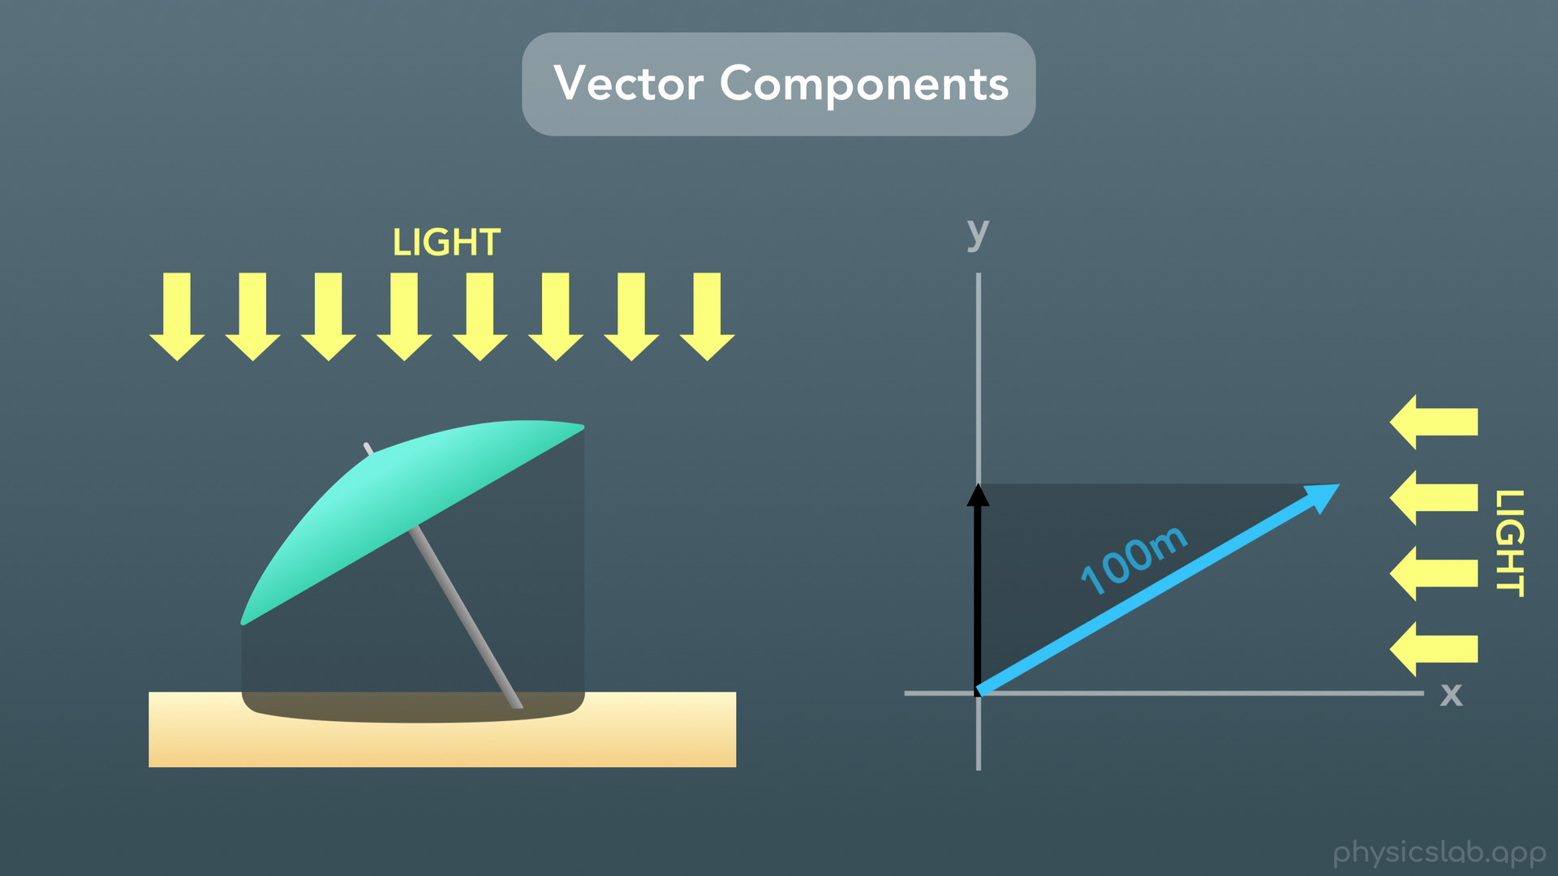
Notes:
the vector would cast a shadow onto the y axis.

Slide 24

Notes:
Again the length of this shadow is the vector’s component along the y axis, also known as the y component.

Slide 25
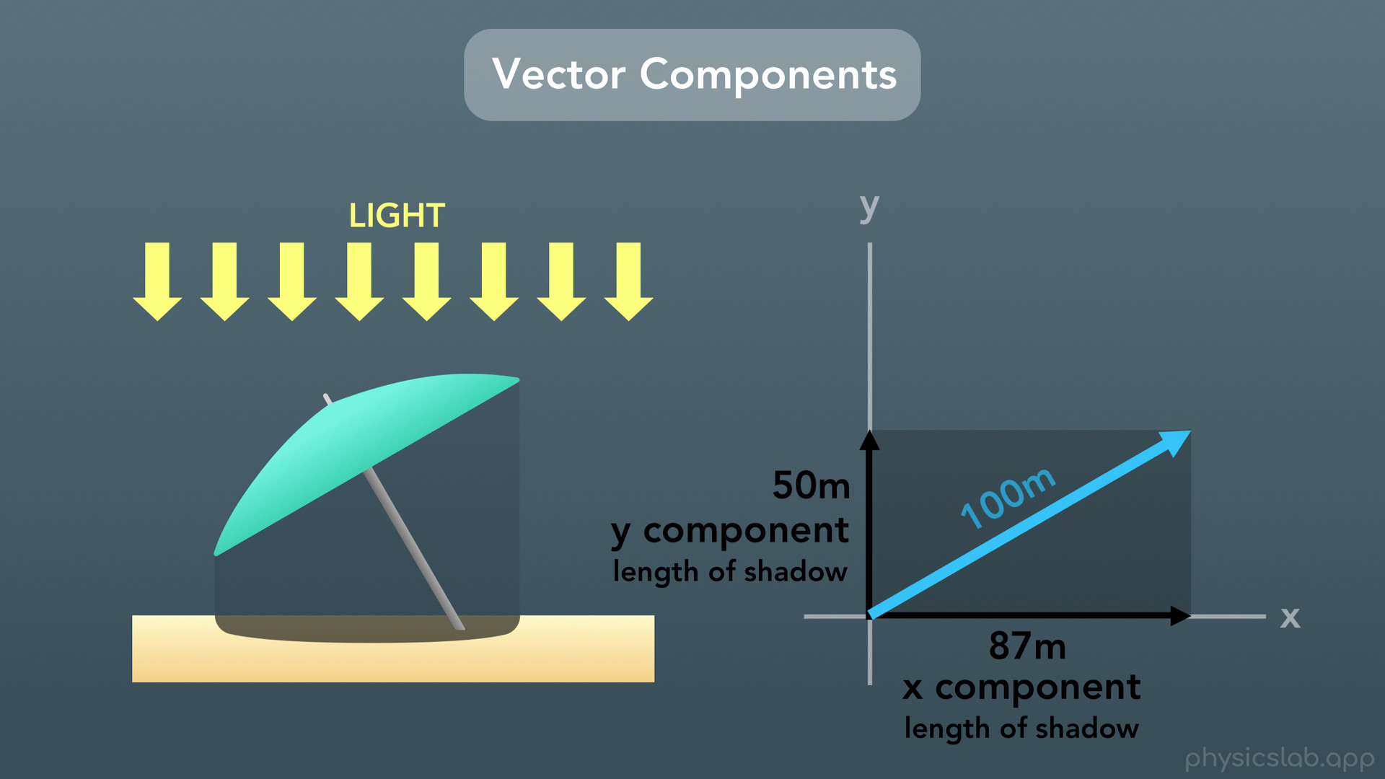

Slide 26
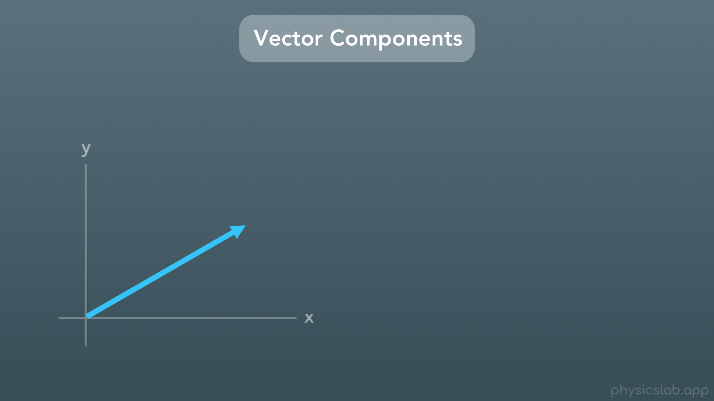
Notes:
So now that we know what components are, how do we actually calculate them?

Slide 27
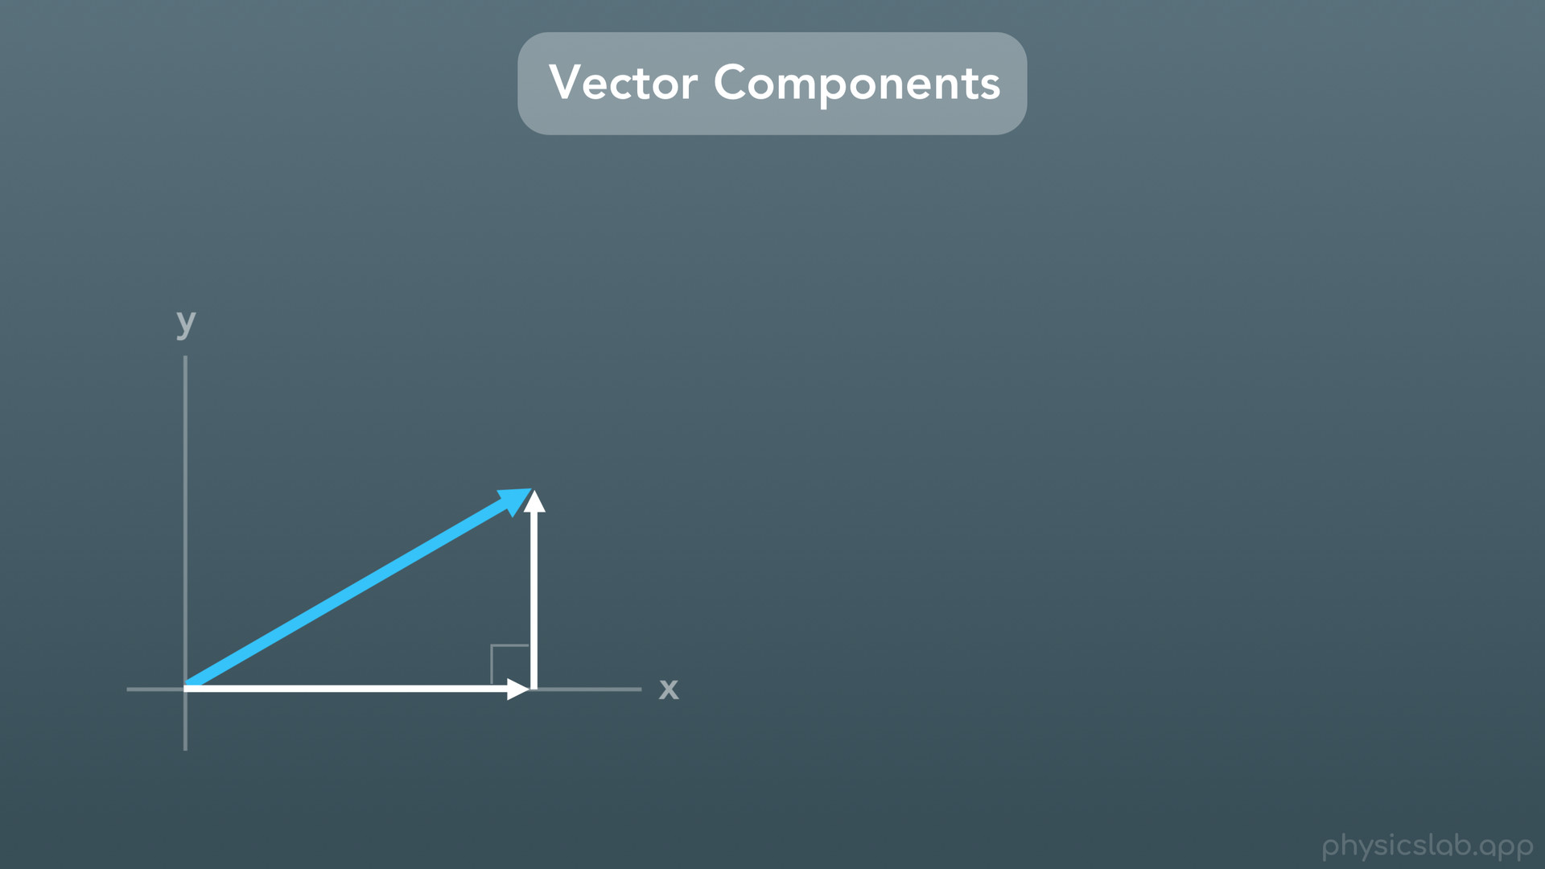
Notes:
This is where you’ll need to know the right triangle trig functions, and we covered this is a previous video.
So every vector and its two components form a right triangle

Slide 28
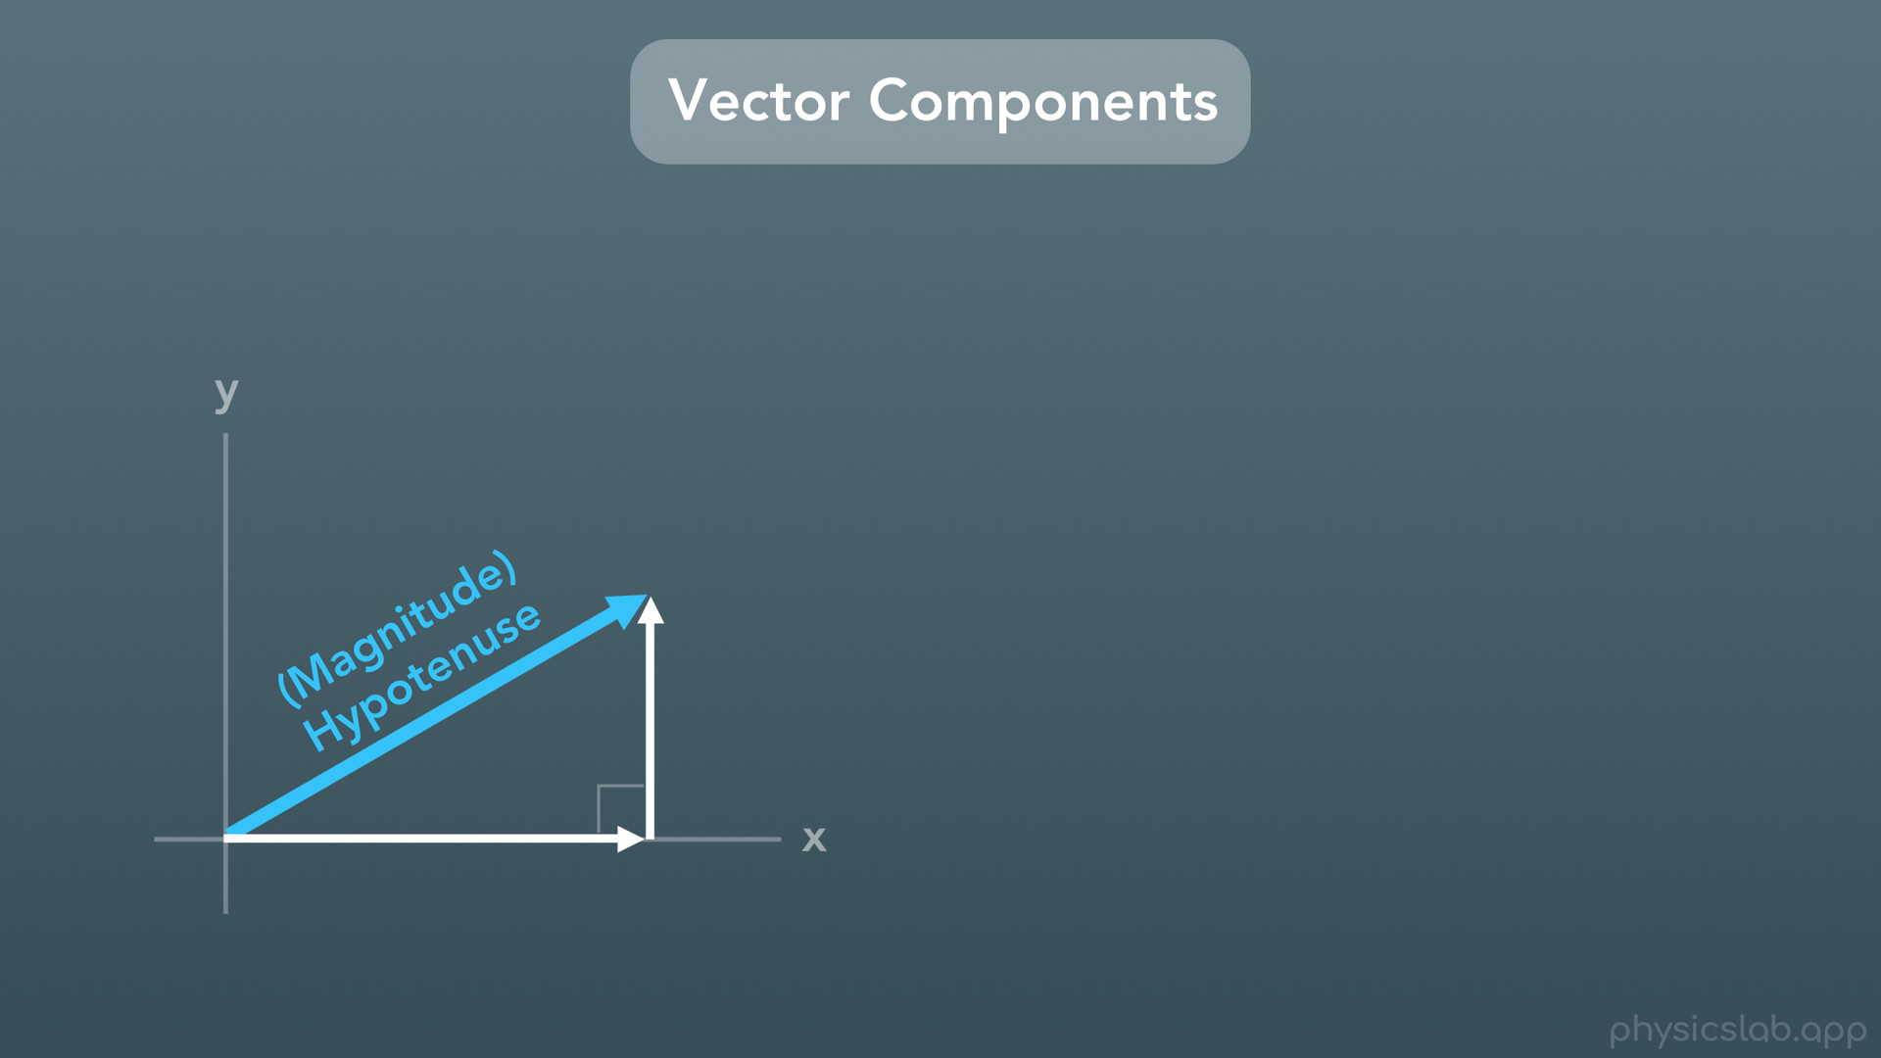
Notes:
where the magnitude of the vector is the length of the hypotenuse.

Slide 29
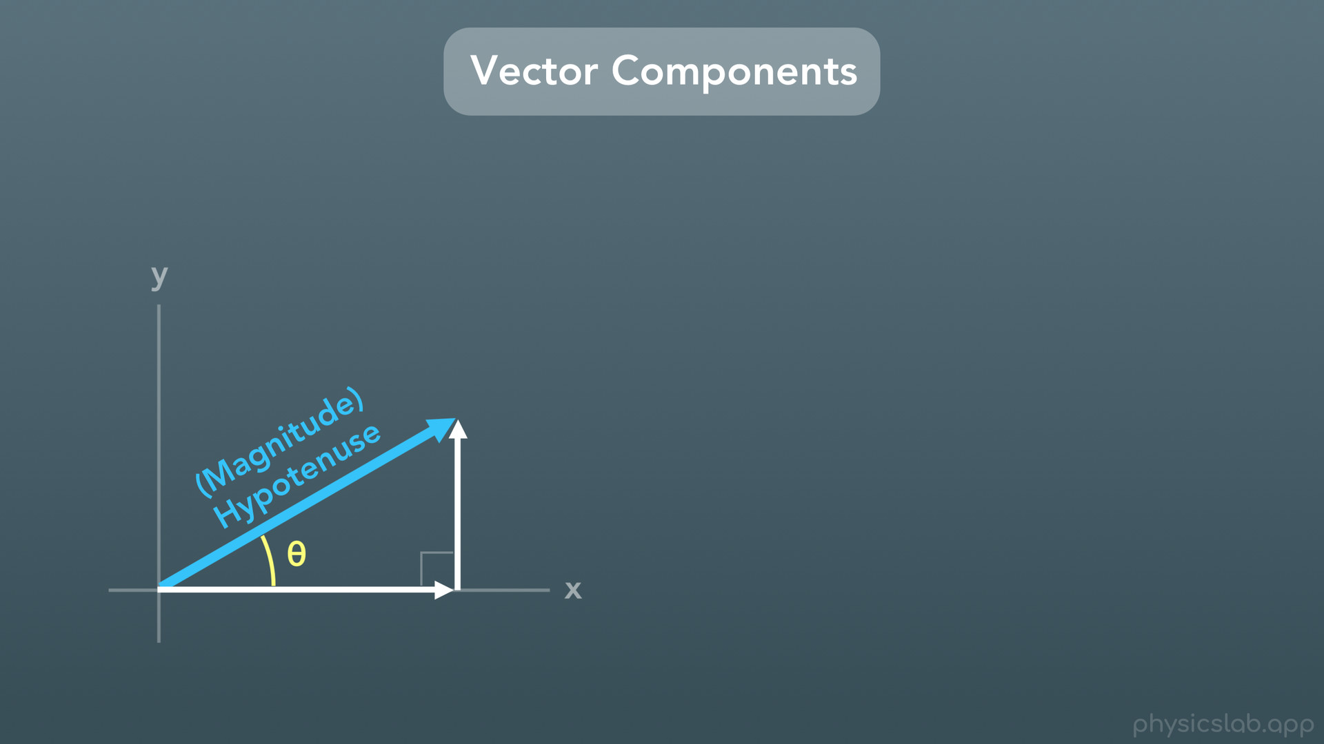
Notes:
To find the lengths of the other two sides, we need to be given an angle.

Slide 30
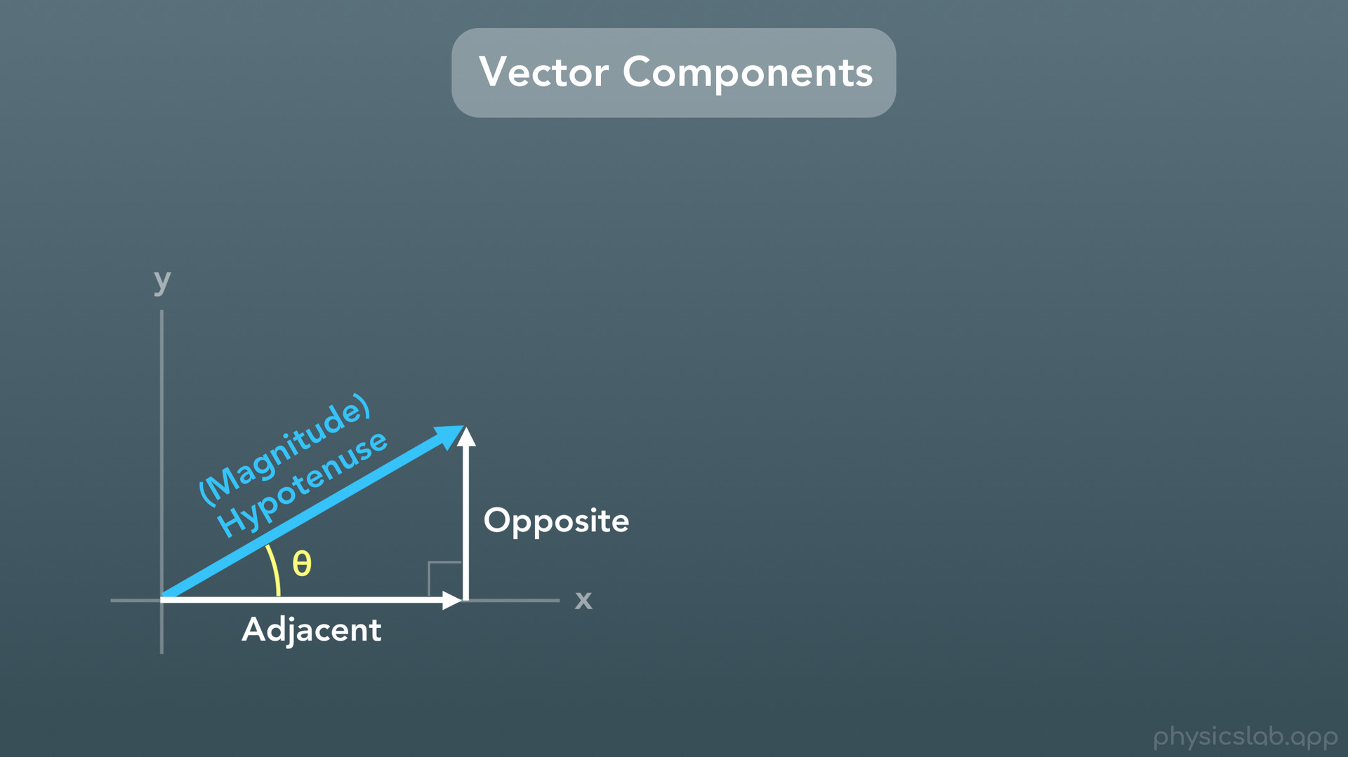
Notes:
If this was the angle, then we would label the adjacent and opposite sides like this.

Slide 31
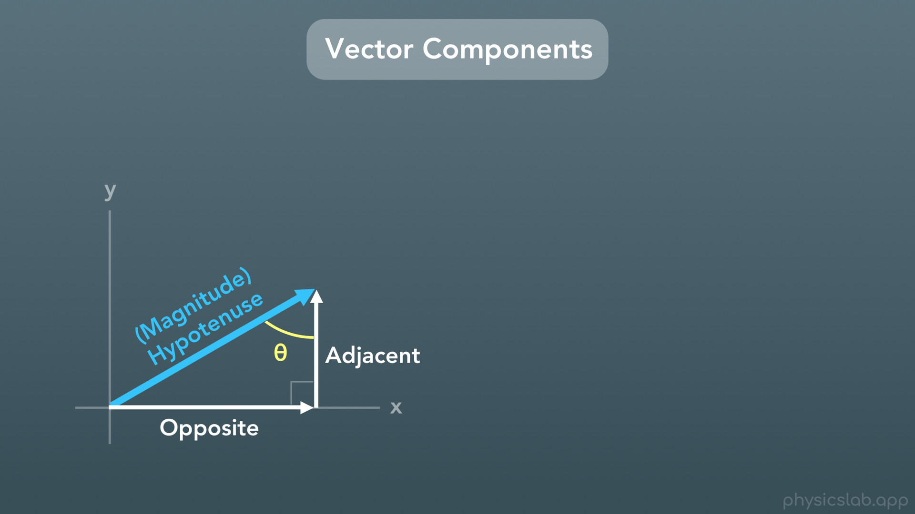
Notes:
And if we were given the other angle, we would flip the adjacent and opposite sides like this. But let’s use the first angle.

Slide 32
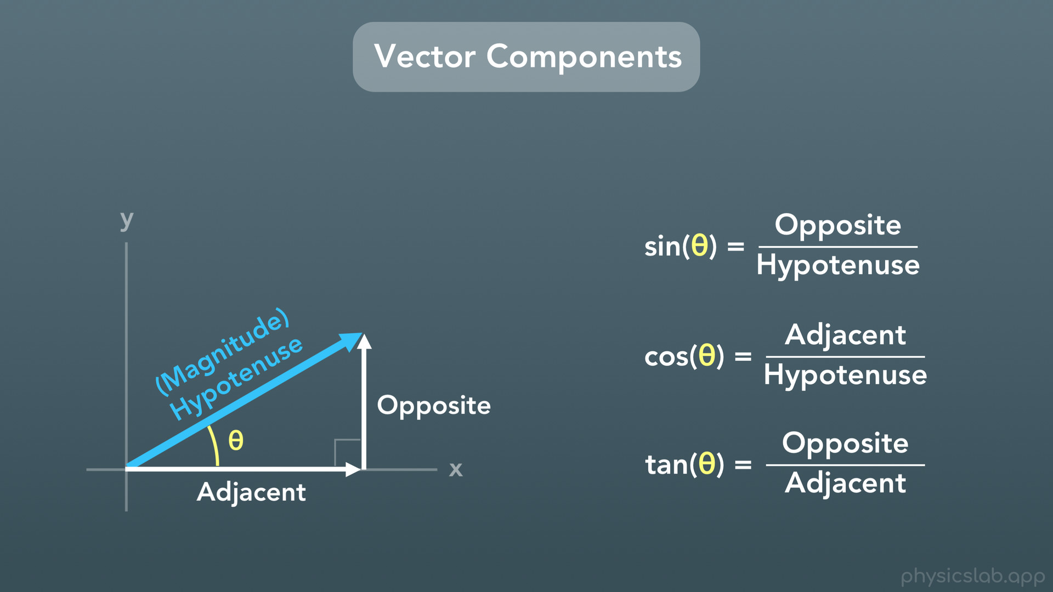
Notes:
So here are the three trig functions that we know: sine, cosine and tangent. We’re given the hypotenuse and an angle, and we want to find the adjacent side and the opposite side. The tangent function doesn’t include the hypotenuse, so it’s easiest if we just use the sine and cosine functions.

Slide 33
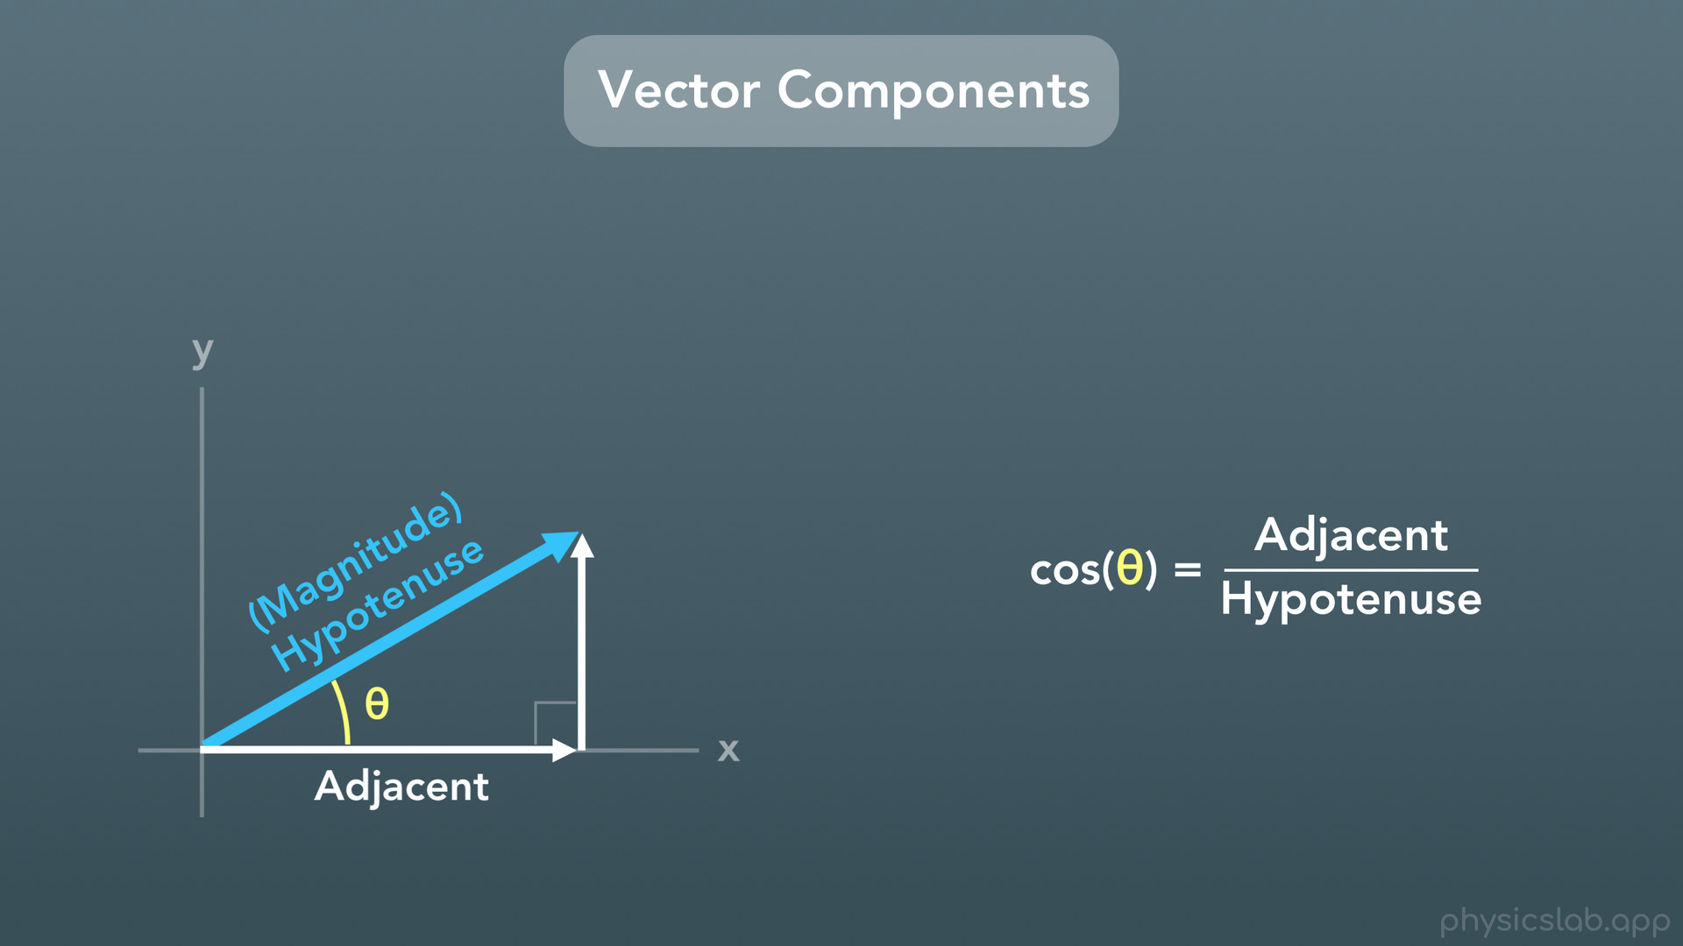
Notes:
First let’s find the adjacent side, so we’ll use the cosine function.

Slide 34
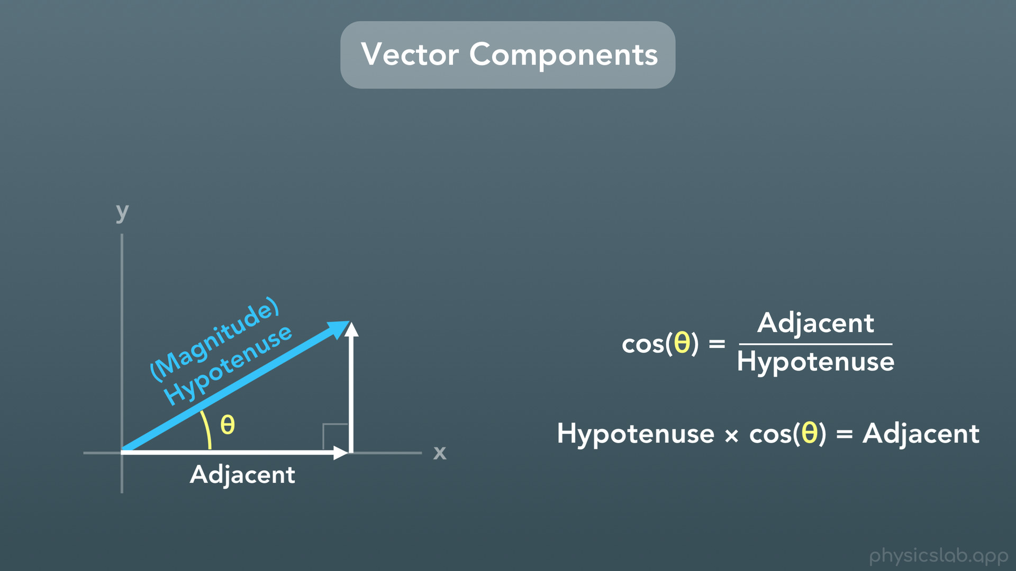
Notes:
If we rearrange this equation by multiplying both sides of the equation by “the hypotenuse”, we get this: the hypotenuse times cosine of theta equals the adjacent side.

Slide 35
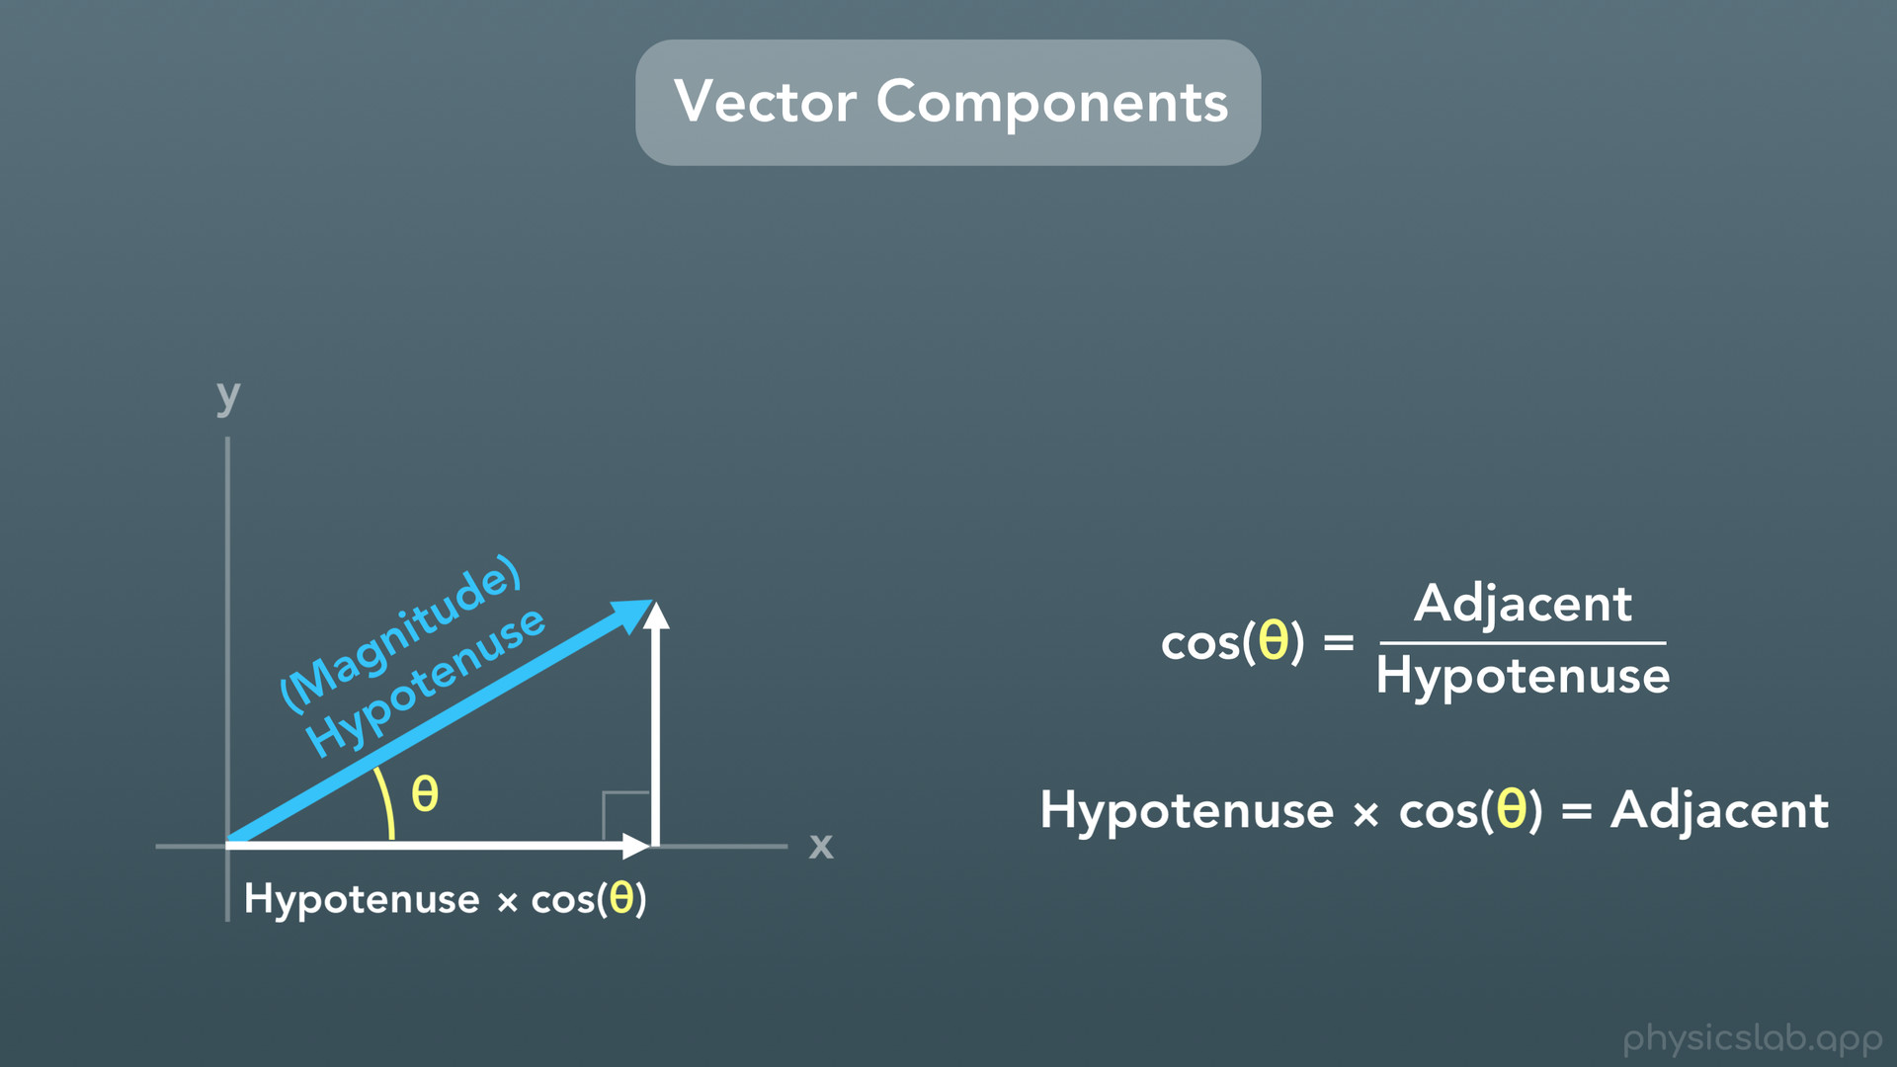
Notes:
So we’ll label the adjacent side with that.

Slide 36
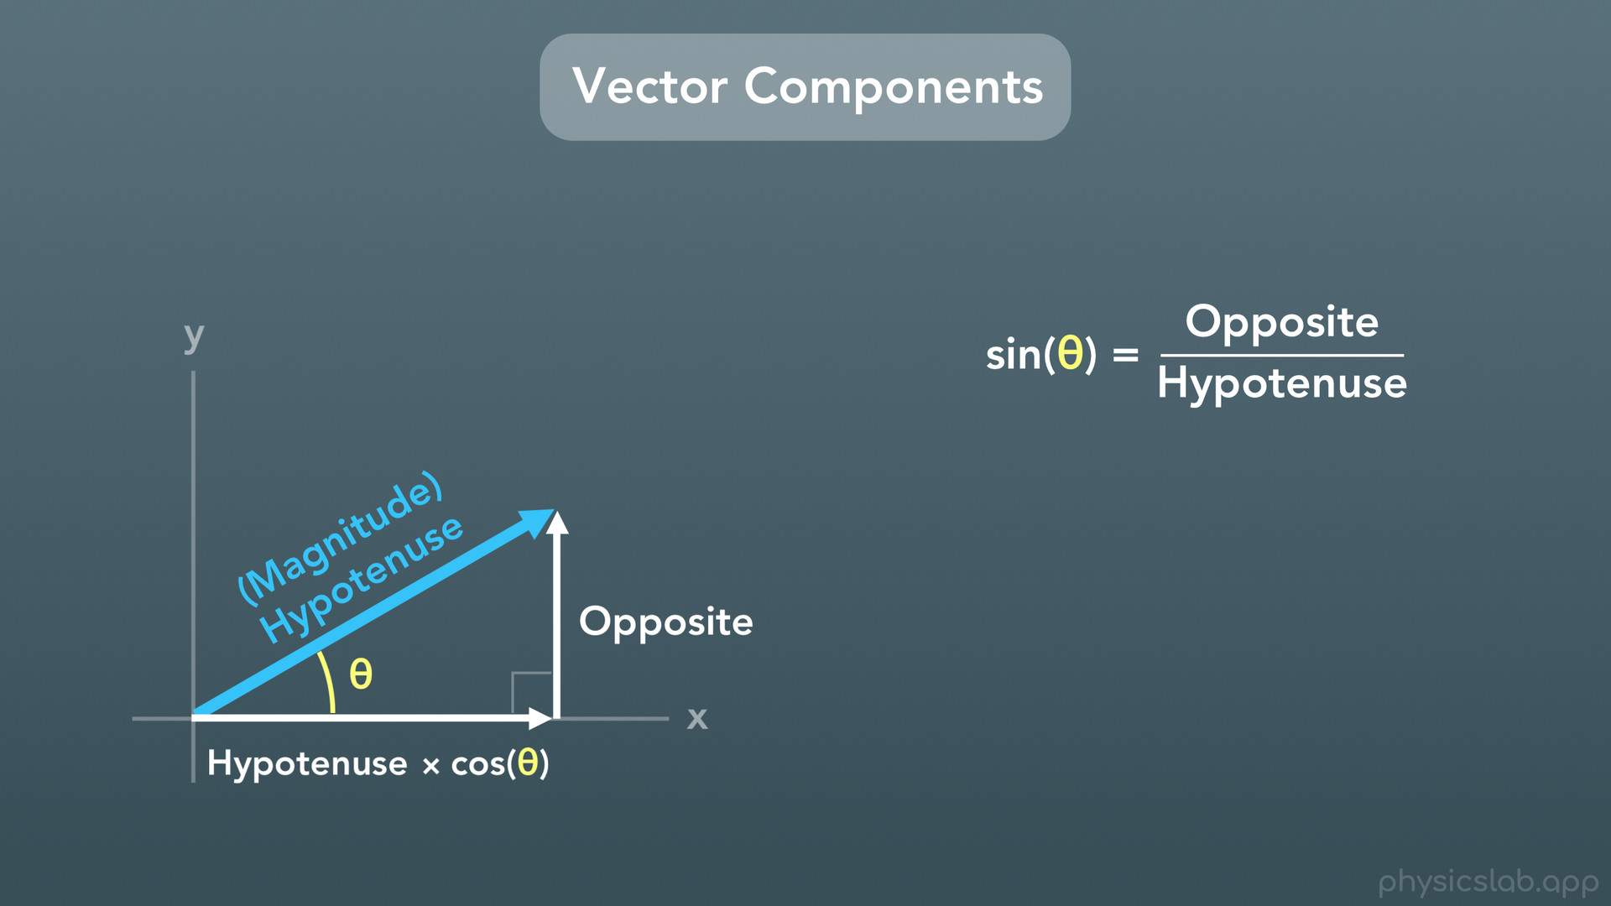
Notes:
Now let’s find the opposite side.

Slide 37
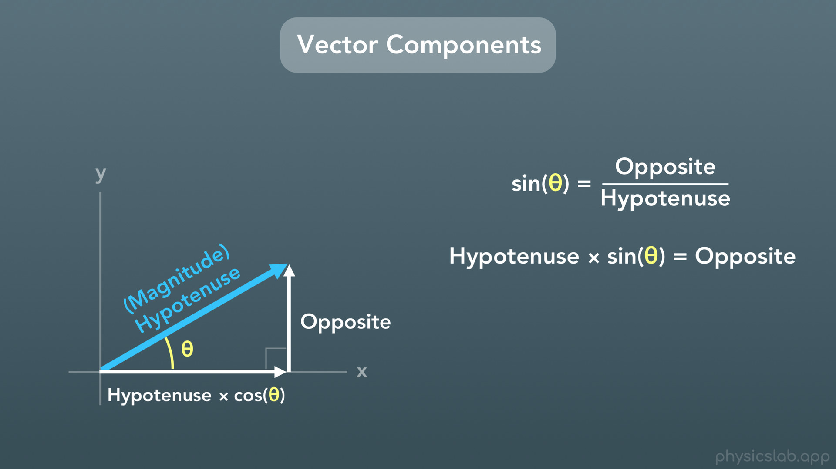
Notes:
Again if we rearrange this equation by multiplying both sides of the equation by “the hypotenuse”, we get this: the hypotenuse times sine of theta equals the opposite side

Slide 38
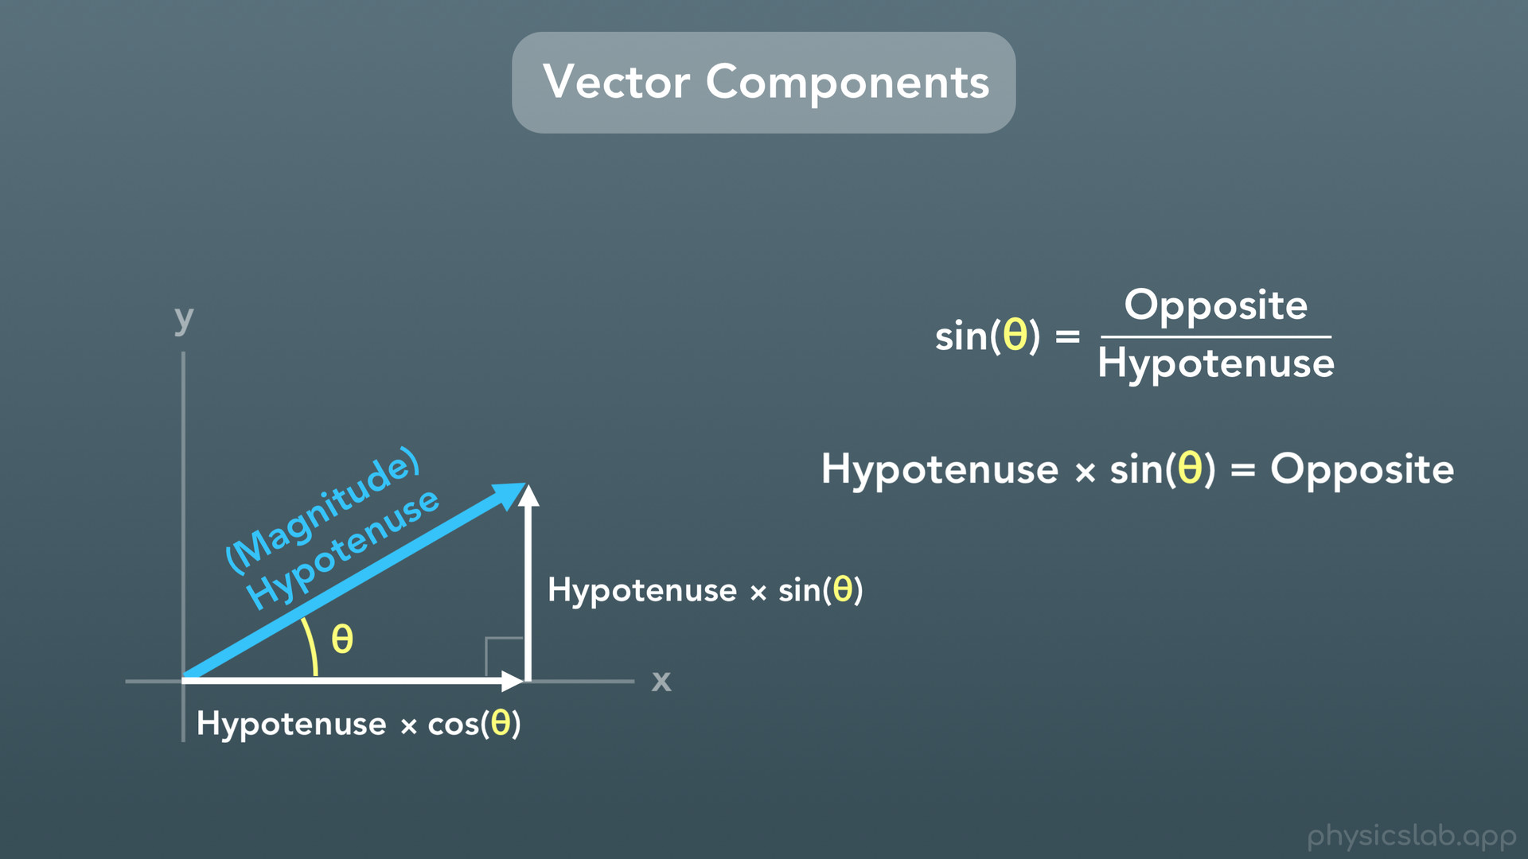
Notes:
and we’ll label the opposite side with that.

Slide 39
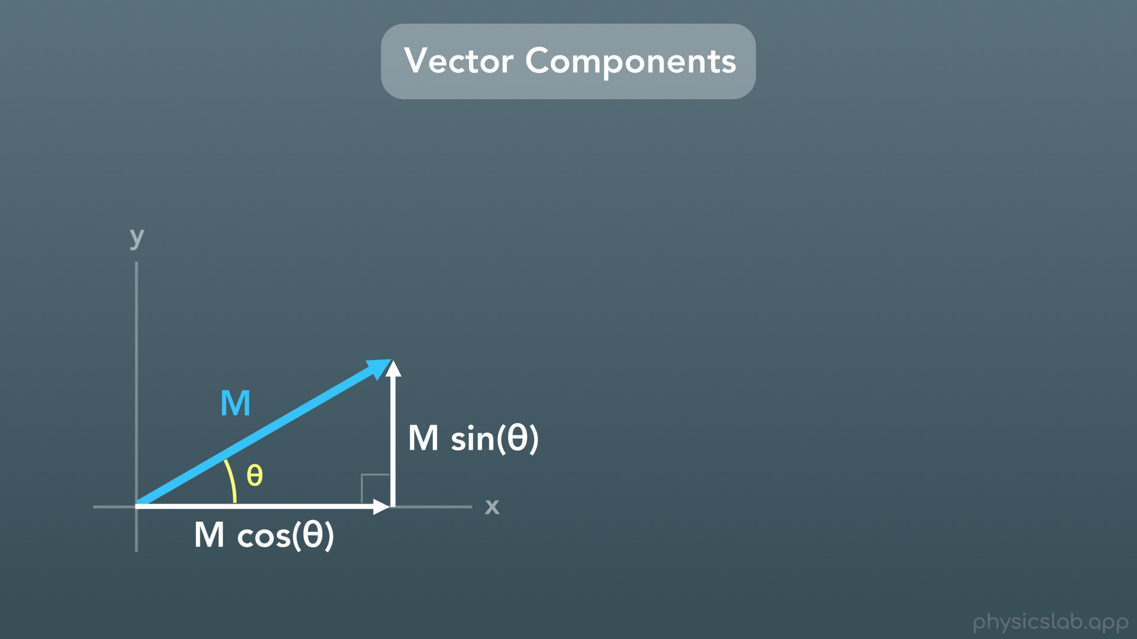
Notes:
To make this simpler, let’s call the hypotenuse M, for the magnitude of the vector. So in this case the x component is M times cosine of theta, and the y component is M times the sine of theta.

Slide 40
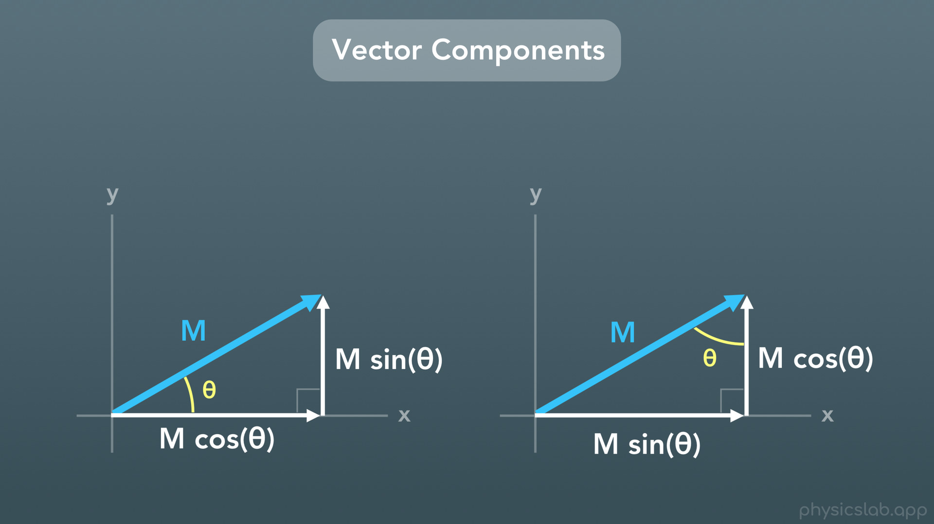
Notes:
However if we were given the other angle, now the x component is M times sine of theta and the y component is M times cosine of theta.

Slide 41
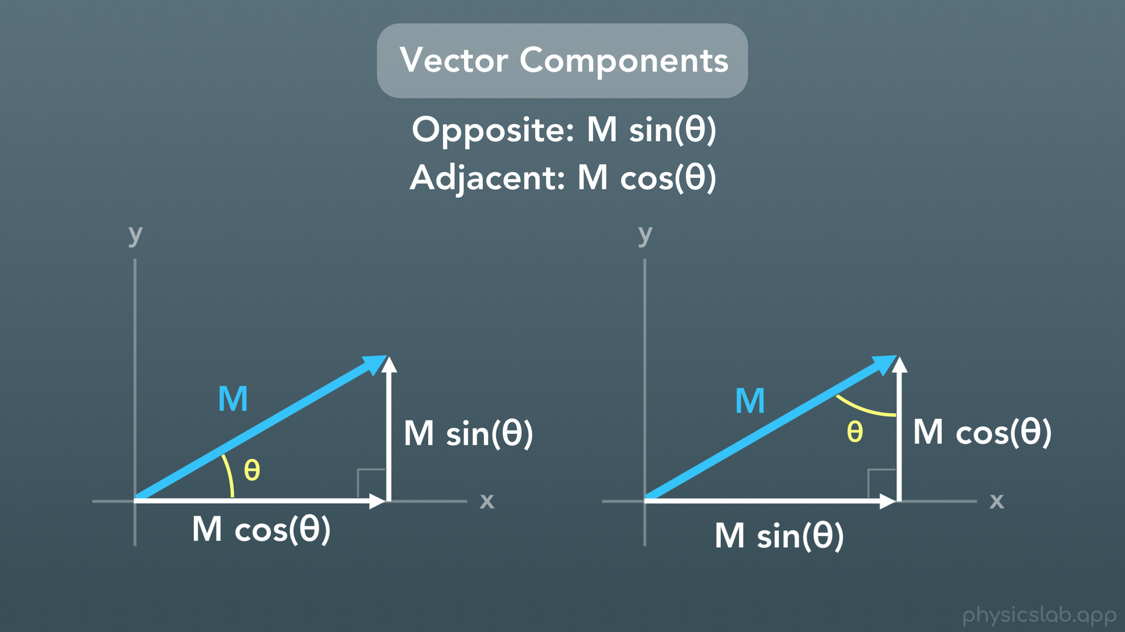
Notes:
All you need to remember are the trig functions, which will tell you which component is which based on the angle you’re given. The opposite side is always M times the sine of theta, and the adjacent side is always M times the cosine of theta.

Slide 42
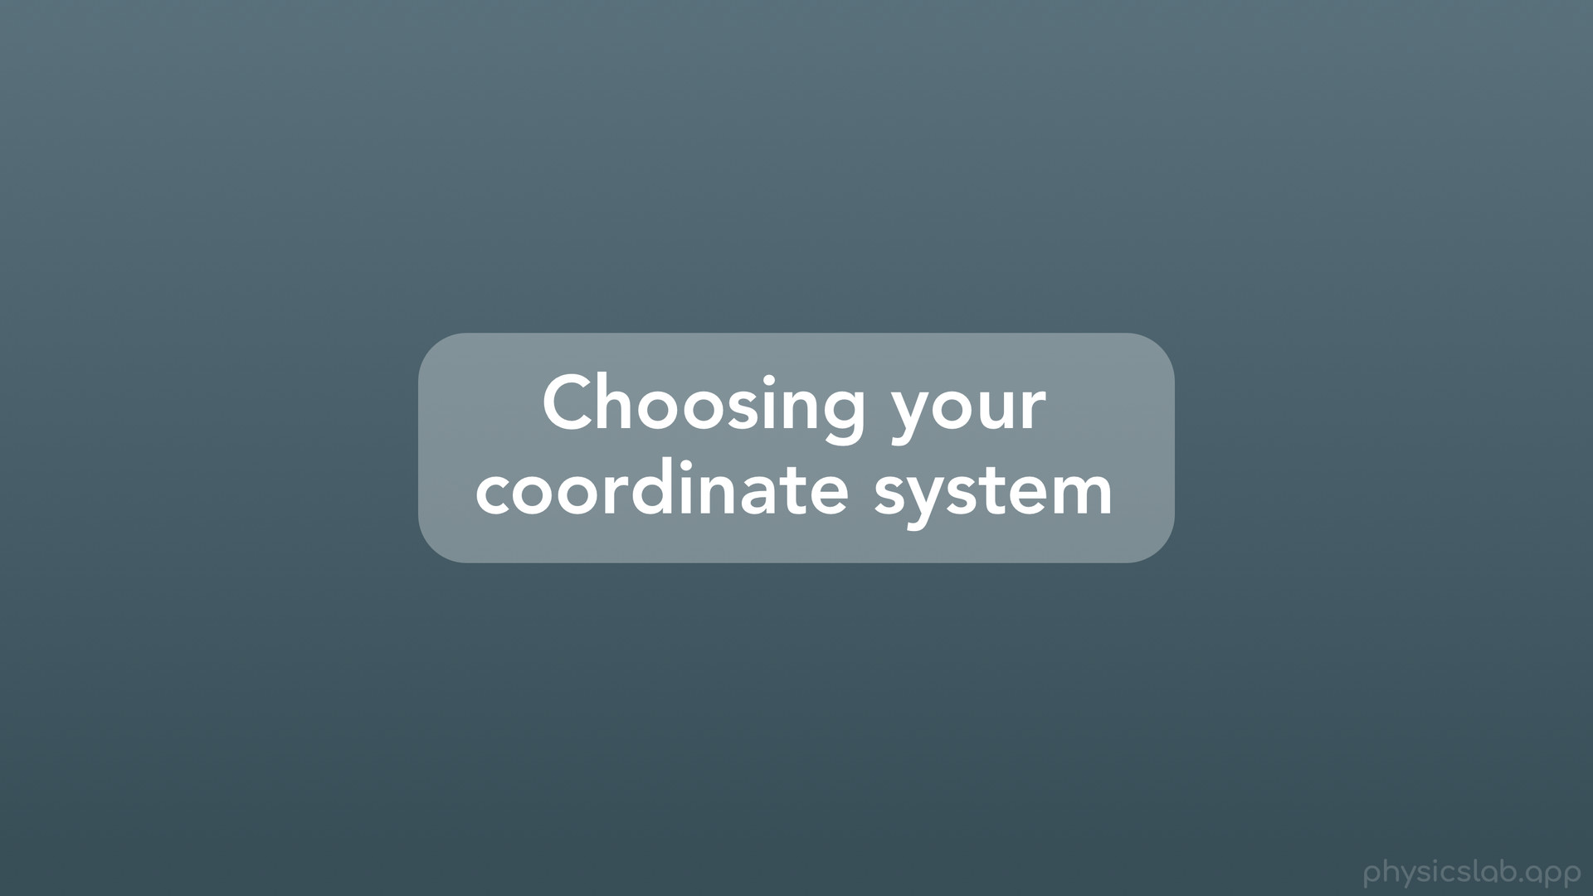
Notes:
The last thing we’ll talk about is choosing your coordinate system when setting up a problem and finding the vector components.

Slide 43
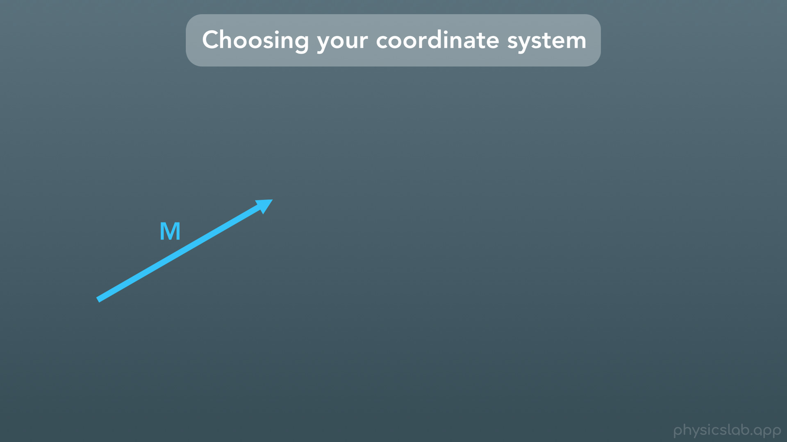
Notes:
Let’s say we’re given this vector with a magnitude of M.

Slide 44
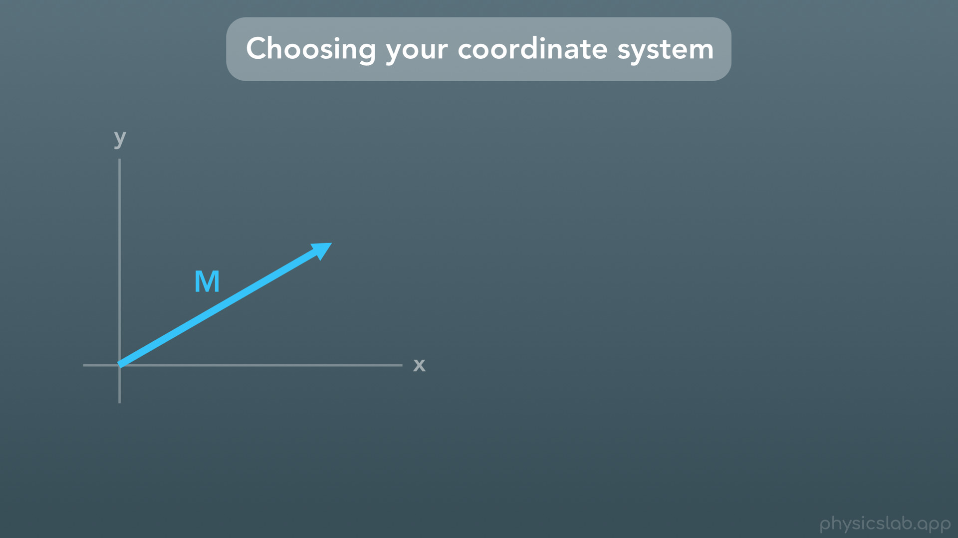
Notes:
We could choose to set up a coordinate system like this.

Slide 45
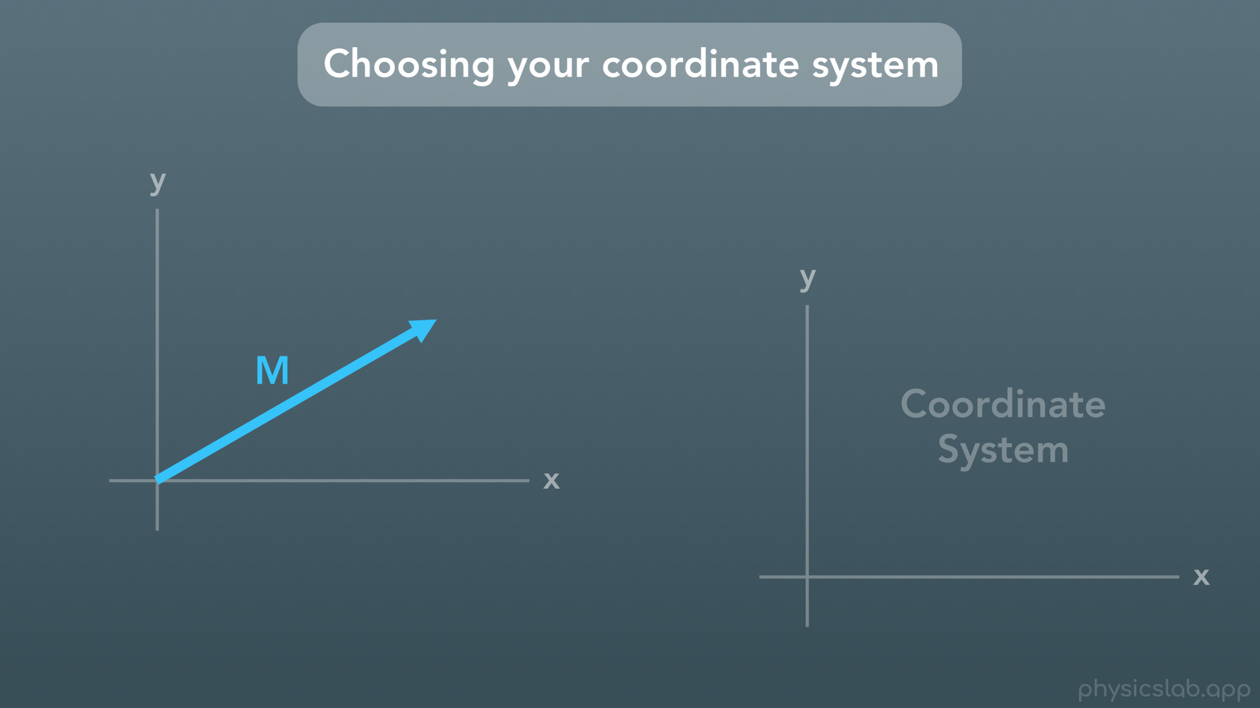
Notes:
The coordinate system is just how we choose to position and orient the x and y axes.

Slide 46
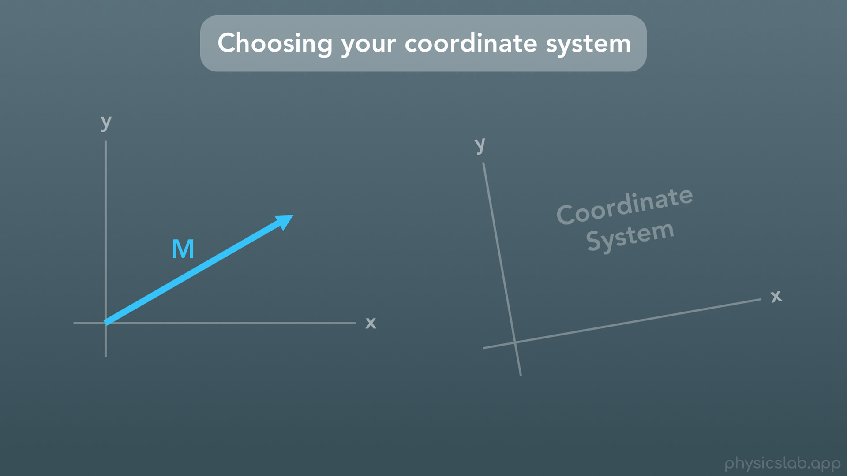

Slide 47
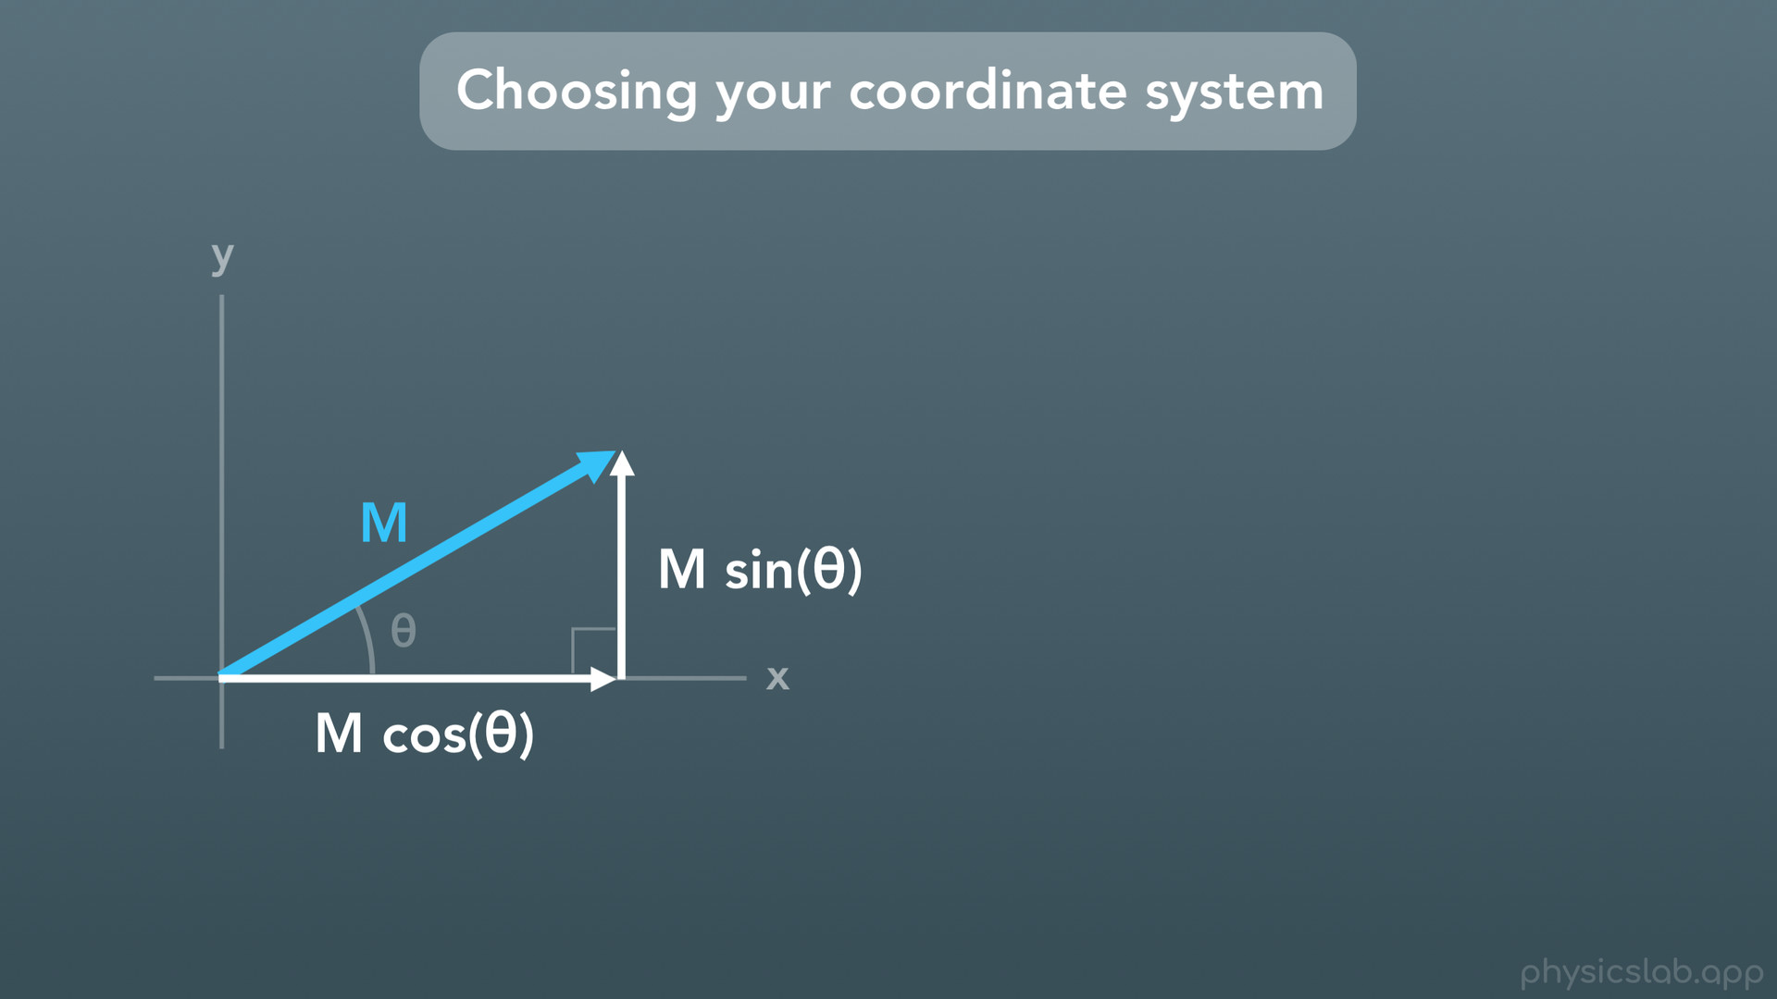
Notes:
So using this coordinate system, the vector components would look like this. One is parallel to the x axis, and the other is parallel to the y axis.

Slide 48
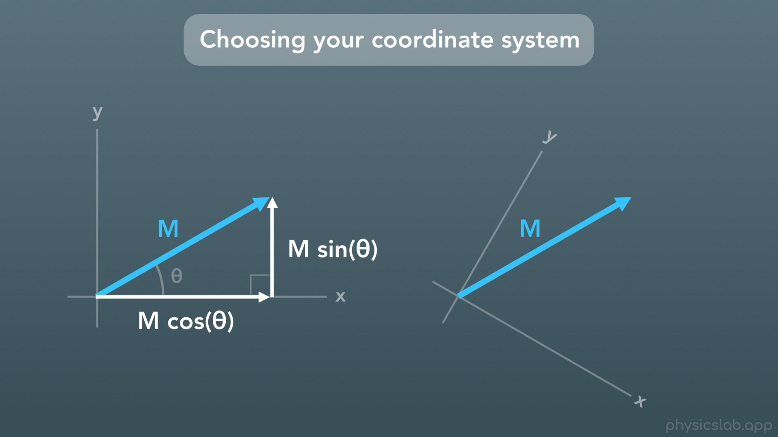
Notes:
But let’s say we’re given the exact same vector, but we choose a rotated coordinate system like this. We’ll see in a minute why we would want to do this.

Slide 49
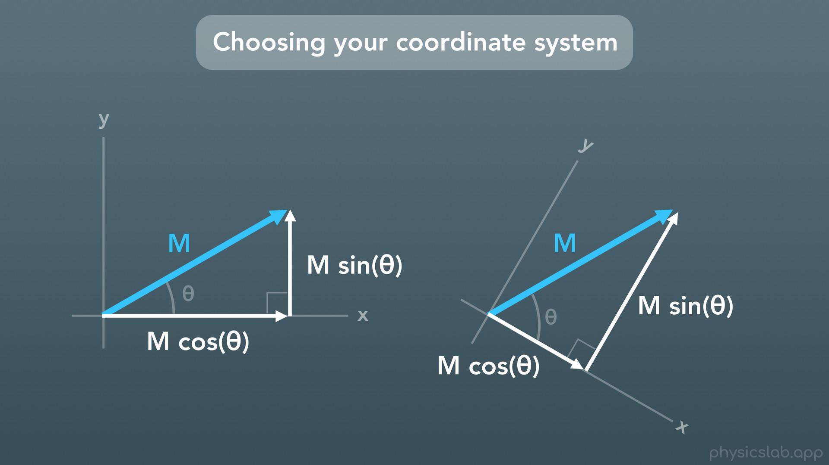
Notes:
Now, the same vector would have components that look like this. Again, one is parallel to the x axis, and the other is parallel to the y axis. The components are different than before, but they create the exact same vector.

Slide 50
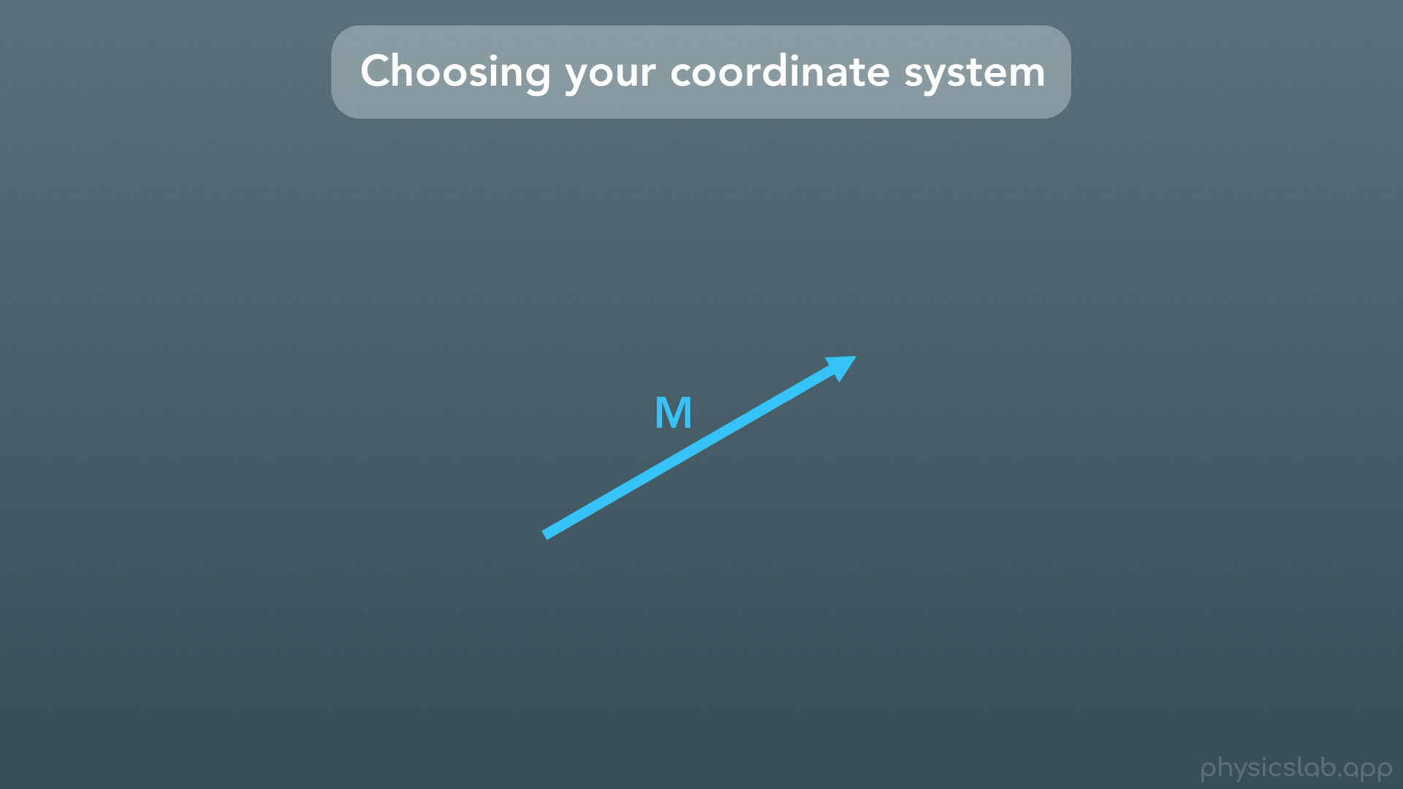

Slide 51
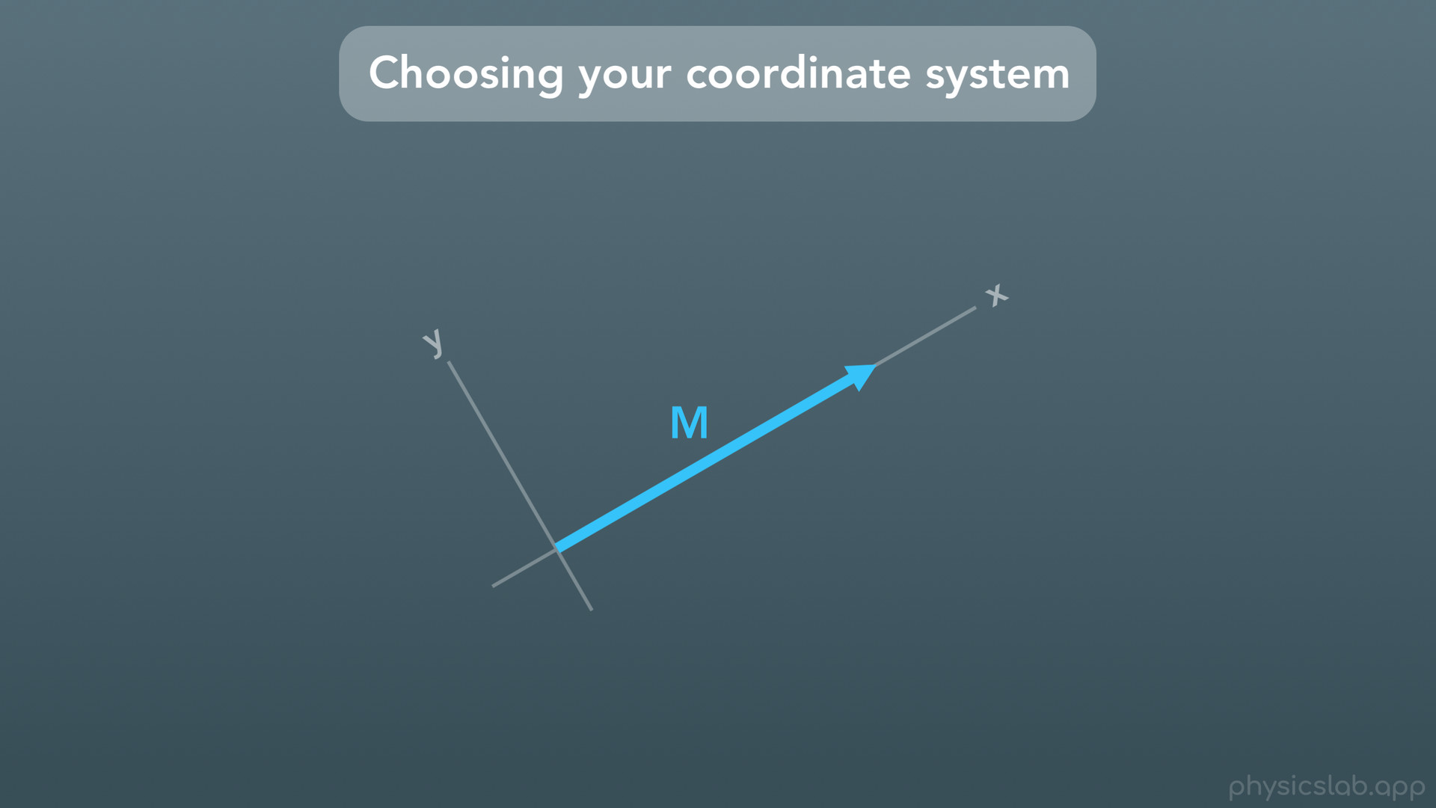
Notes:
So what if we oriented our coordinate system so that the x axis was pointing along the actual vector?

Slide 52

Notes:
Well now, the vector’s component along the x axis is the same length as the vector itself, because the vector is already parallel to the x axis.

Slide 53

Notes:
And the y component of the vector would be zero. No amount of the vector is pointing along the y direction.

Slide 54

Notes:
And the trig functions still work. If we said the angle between the vector M and the x axis is zero degrees, the x component would be M times cosine of zero, and since the cosine of zero is 1, the x component is just M times 1, or M.

Slide 55

Notes:
And the y component would be M times sine of zero, and sine of zero is zero, so the y component is also zero.

Slide 56

Notes:
So why would we choose any of these weird coordinate systems? Well it all depends on the problem we’re working on.

Slide 57

Notes:
The most common setup includes an object on a flat surface with some force vector being applied. Gravity points vertically downwards, the normal forces (which we’ll learn) point vertically upwards, and the motion of the object is usually horizontal.

Slide 58

Notes:
So for this setup, it makes the most sense for us to choose a coordinate system where x and y are in the same direction as the forces. And more importantly, either x or y is in the same direction as the object’s motion.

Slide 59

Notes:
With this coordinate system, the vector’s components look like this.

Slide 60

Notes:
But sometimes, we work with problems where an object is on an incline at some angle. In this case, the normal forces are still perpendicular to the surface, and the object’s motion is still parallel to the surface.

Slide 61

Notes:
So it will be the most useful for us to set up our coordinate system with the x axis parallel to the motion.

Slide 62

Notes:
As a third example, when we deal with forces that create a torque around some pivot point

Slide 63

Notes:
we’re going to break the force into components that are parallel and perpendicular to what we call the “arm”, which in this case is a wrench.
But in general, the coordinate system will be the most useful if one of the axes is in the same direction as the object’s motion. That will make a lot of sense when we learn about free-body-diagrams and adding forces together.

Slide 64

Notes:
So to sum it up, here’s how to find the components of a vector.

Slide 65

Notes:
One: choose your coordinate system that will make your problem the easiest to solve.

Slide 66

Notes:
Two: Draw a right triangle with the vector’s magnitude as the hypotenuse, and one side parallel to the x axis, and one side parallel to the y axis. These other two sides are the components.

Slide 67

Notes:
Three: use the trig functions and the given angle to solve for the components. Remember that we can rearrange our trig functions to find that the adjacent side equals the magnitude times cosine of theta, and the opposite side equals the magnitude times sine of theta.

Slide 68

Notes:
And here’s an important tip: DO NOT memorize if the x or y components go with sine or cosine. It all depends on which angle is given. Just remember you have a right triangle, Opposite goes with sine, and adjacent goes with cosine.

Slide 69

Notes:
Let’s do a quick recap

Slide 70

Notes:
First we learned what vectors are and the different types of vectors we might use.

Slide 71

Notes:
Next, we learned the 2 ways to defiance a vector: either by using the magnitude and the direction, or by using the two components.

Slide 72

Notes:
We talked about why we might choose to orient our coordinate system in different ways based on the problem we’re solving

Slide 73

Notes:
And we walked through and summarized how to find the components of a vector using the right triangle trig functions.

