Slide 1
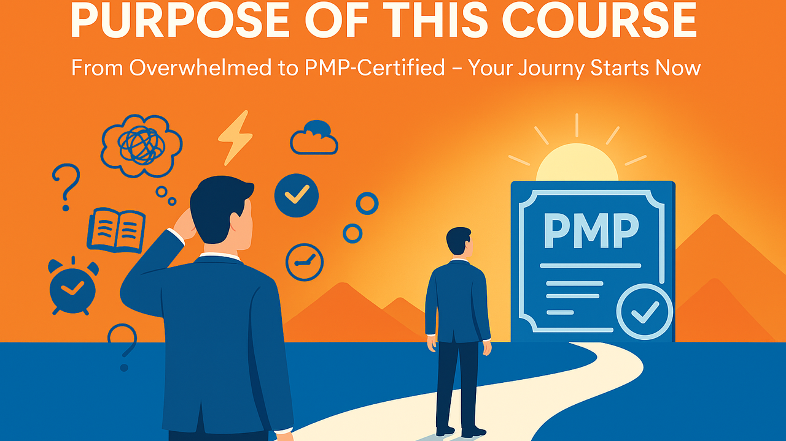

Slide 2


Purpose of This Course
Your Journey
Begins!
Your Research for the
PMP Exam Ends Here!
PMP Exam & Your
Emotional State!

