Slide 1



SAP FI
www.zarantech.com
© Copyright 2026, ZaranTech LLC. All rights reserved.

Slide 2


Disclaimer
This presentation, including examples, images, and references are provided for informational purposes only.
Complying with all applicable copyrights laws is the responsibility of the user.
Without limiting the rights under copyright, no part of this document may be reproduced, stored or introduced into a retrieval system, or transmitted in any form or by any means.
Credits shall be given to the images taken from the open-source and cannot be used for promotional activities.
© Copyright 2026, ZaranTech LLC. All rights reserved.

Slide 3

Agenda
General Ledger Accounting
© Copyright 2026, ZaranTech LLC. All rights reserved.

Slide 4
Introduction Financials
SAP: stands for Systems Application and Products in Data Processing
FI: stands for Financials
CO: stands for Controlling i.e, in normal terminology Costing
First time SAP was released in 1972 in Germany. SAP Head Quarters are in Germany. Version ECC-6.0 is the latest as on 01.07.2009
ECC: stands for ERP Central Component
ERP: stands for Enterprise Resource Planning. It integrates all the systems in one system. It facilitates free flow of data among departments.
© Copyright 2026, ZaranTech LLC. All rights reserved.

Slide 5
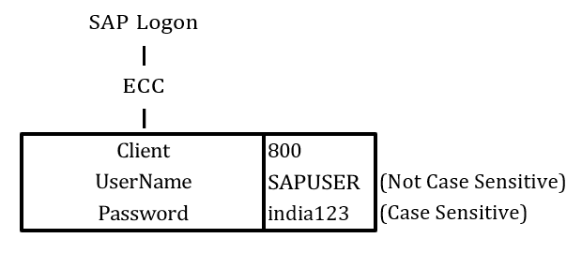
Introduction Financials
Various Types of ERP Packages:
SAP, Oracle-Financials, JD Edwards, BAAN, Peoplesoft are various types of ERP packages available in the Market. Among them SAP is Famous in the World.
Opening of SAP : To open SAP click on the SAP Log on Icon on Desktop
© Copyright 2026, ZaranTech LLC. All rights reserved.

Slide 6
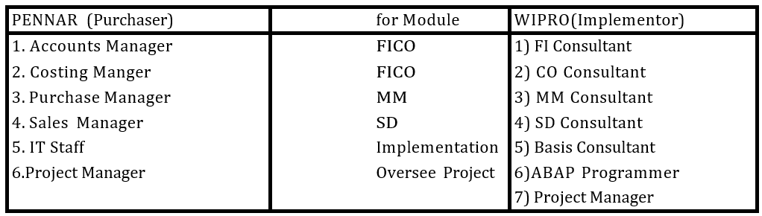
What is Client?
Normally when a Company ( ex., PENNAR) intends to start SAP in its Company, it purchases SAP software from SAP-India.
Price of SAP software is based on the Number of Users. Once company purchased the software, it recruits / engage another Company (ex., WIPRO) for implementation purpose. Both the purchaser and implementor will delegate/ recruit some employees for implementation of SAP. They are called as Core Team Members. Structure of Core Team will be like below:
© Copyright 2026, ZaranTech LLC. All rights reserved.

Slide 7
What is Client?
Core Team from Purchaser analyze the present situation in the Company and prepare the Process Document for SAP Implementation .
Basis Consultant will install or copy the SAP in Server and Create the Client Numbers. There are Minimum 2 type of Clients will be created by Basis Consultant.
1. Development Client > for Customization & Testing purpose
2. Production Client > for Live Data i.e, entering day to day activities
By default SAP-India is allotting 000 (or) 001 (or) 067 (or) 800 as Development Client # Number of Production Client will be given by Basis Consultant after Discussing with Purchaser. There will be Minimum of 2 Clients. Some company's are creating 3 clients.
1. Development Client > for Customization purpose
2. Testing Client > for Testing purpose
3. Production Client > for Live Data i.e, entering day to day activities
© Copyright 2026, ZaranTech LLC. All rights reserved.

Slide 8
What is Client?
After Basic Consultant done the Customization in Development Client , he copy it to Production Client. All the Customization will be done at Development Client only but not at Production Client.
USER NAME: As we discussed earlier, cost of the SAP is based on Number of Users. Major Benefit of Users is it fixes the responsibility of the employee. Who has done what , can be identified. So the responsibility will be fixed on employees. User name is not case Sensitive. We can use either Small Letters or Capital Letters.
PASSWORD: Benefit of Passwords are for restricting the Un-authorized use of Users. Length of the Password can be Minimum 6 and Maximum 40 characters. It is case sensitive. We can use Alphabetics, Numeric, Alphanumeric or Special Characters like " * " or "#" etc.,
© Copyright 2026, ZaranTech LLC. All rights reserved.

Slide 9
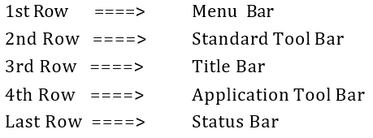
What is Client?
Note 1: It is not possible to change the password morethan once in a Day
Note 2: System will not permit us to use the latest 5 passwords.
Note 3: If we lost Password it can not be restored. Basis Consultant has to allot New Password.
LANGUAGE: Along with package SAP has given 41 languages . If we do not specify the language, by default system will use English ( EN) as language
Once we enter User Name and Password and press enter , system will log on to SAP. On Screen
In 2nd Row there is √ . It is for Enter symbol. Beside+A954 There is one Box called Command
field.
© Copyright 2026, ZaranTech LLC. All rights reserved.

Slide 10
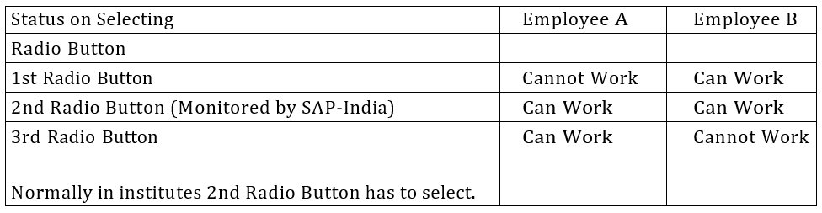
What is Client?
If, any one enter User Name and Password of which some other is logged in SAP system will warn with a message of 3 options. Action will be depending on the option we select.
If any user want to work on different screens at a single time, he can open upto a max of 6 windows or Sessions.
© Copyright 2026, ZaranTech LLC. All rights reserved.

Slide 11
What is Session?
A session is a window or screen where SAP user will do day to day activities. One user can open 6 Sessions at a time.
How to Create New Session:
To create new session path is Menu Bar---->System >Create Session
How to Move From One Session to Another:
Press Alt+Tab to move from One session to another session easily
How to Close Session:
To close one session path is Menu Bar---->System >End Session
© Copyright 2026, ZaranTech LLC. All rights reserved.

Slide 12
What is Transaction Code
Transaction Code is a code number given for each activity . SAP has given some Transaction Codes ( TC's ) which are common in SAP through the world .
If customer / Purchaser want to give their own TC's it should start either with "Y" or "Z". Other Alphabets are not allowed in SAP.
Going Back to Sap Easy Access Screen:
Use /N ( Forward Slash & N) in Command Window . N is not case sensitive. CHANGING SESSION ( WINDOW)
Posting the Document ( F-02) A/c Balance Display ( FS10N)
© Copyright 2026, ZaranTech LLC. All rights reserved.

Slide 13
What is Transaction Code
After Posting the Document in F-02, to change the session and see the account balance display, instead of going back to Easy Access and press new code FS10N in command window, we can type" /NFS10N" to go directly to the new window of FS10N. If we want to change the session we have to give \N before the New Command TC in Command Window.
Use /OFS10N in command window for creating new session directly with New TC
/N ----> for change the session and /O for Creating the session
Activating Transaction Codes in SAP Menu:
Some times TC's will not appear in SAP Easy Access Menu. To activate them path is Menu Bar---->Extras---->Settings >Display Technical Names Check Box and Press Enter
© Copyright 2026, ZaranTech LLC. All rights reserved.

Slide 14
What is Transaction Code
How to Set Start Transaction Window:
Making 1 session as default screen is called Start Transaction. To Set start transaction Menu Bar---->Extras---->Set Start Transaction---->Transaction Code (ex F-02)-->Enter We will get message T F-02 set as start Transaction. From next time onwards when ever SAP is logged in, F-02 session will open directly.
How to Colse SAP: For closing SAP path
Menu Bar---->System--->Log Off > YES for the message Log Off
© Copyright 2026, ZaranTech LLC. All rights reserved.

Slide 15
Unlocking Screens
Tools---->Administration---->Monitor---->Lock Entries(TC=SM12) >List Buttons
Menu Bar---->Lock Entry---->Delet All >Select "YES"Button for the message Delete All Lock Entries.
© Copyright 2026, ZaranTech LLC. All rights reserved.

Slide 16
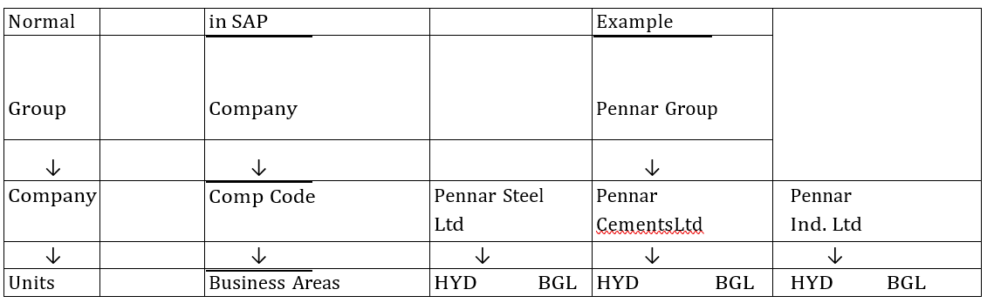
Project Creation
Normal Organization Structure will be as follows
© Copyright 2026, ZaranTech LLC. All rights reserved.

Slide 17
Project Creation
Company Code is the Legal Entity. FICO Consultant will do customization at Company Code Level. Company /Group is only for information purpose.
Consultant will do customization for one company code and copies the customization to including Accounting to other Company Codes and makes modification wherever required.
© Copyright 2026, ZaranTech LLC. All rights reserved.

Slide 18
Customization of Pennar Steel Ltd
Define Company( Group in Normal ): When project is started Group Company Name in SAP Company should be defined. Path for defining Company as in Example Project PENNAR .
TOOLS---->CUSTOMIZING---->IMG(Implementation Guide) >Execute Project (SPRO)-->
SAP Reference IMG Button---->Enterprise Structure---->Definitions---->Financial Acc > Define Company----> Select IMG Activity Button---->Select New Entries Button >
© Copyright 2026, ZaranTech LLC. All rights reserved.

Slide 19
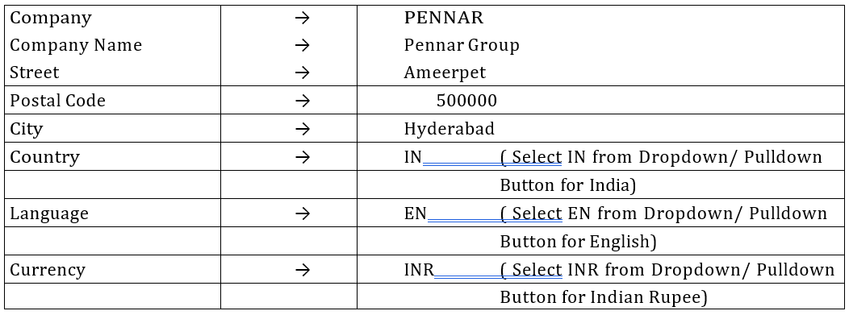
Customization of Pennar Steel Ltd
Define Company( Group in Normal ): When project is started Group Company Name in SAP Company should be defined. Path for defining Company as in Example Project PENNAR .
TOOLS---->CUSTOMIZING---->IMG(Implementation Guide) >Execute Project (SPRO)-->
SAP Reference IMG Button---->Enterprise Structure---->Definitions---->Financial Acc > Define Company----> Select IMG Activity Button---->Select New Entries Button >
© Copyright 2026, ZaranTech LLC. All rights reserved.

Slide 20
Customization of Pennar Steel Ltd
Select Save Button ( or) Ctrl + S Buttons for saving the Company Information.
Once the Company information is saved, SAP will generate one Transport Request. Every time it saves 2 files. One in Client 800 and 2nd one in Transport Request with Key Number.
For Example Project we create 6 requests like below.
Creating Request : Select create request Button
Short Description: FI Basic Settings for Pennar Steels Ltd > press Enter again to save the request. We get message Data Saved.
© Copyright 2026, ZaranTech LLC. All rights reserved.

Slide 21
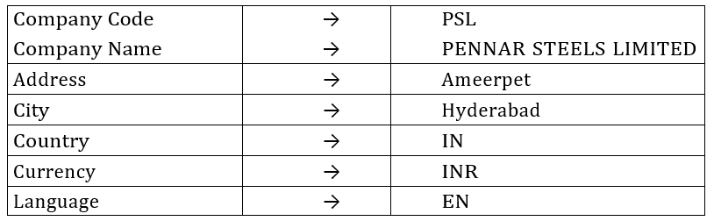
Define Company Code (Pennar Steels Ltd)
SPRO---> to go directly to SAP Reference IMG Button. So whenever we are customizing , no need to give full path upto SPRO. We can give SPRO directly in command field to go directly to SAP reference IMG Button Screen.
SPRO option will be activated only for Consultants . End User Job is without SPRO Option. So Path for defining the Company Code is as follows:
SPRO--->Enterprise Structure----> Definition ----> Financial Accounting >Edit, Copy,
Delete, Check Company Code( Select IMG Activity Button here) >Double click on Edit Company Code Data >Select New Entry Button ( Screen like below will open…)
© Copyright 2026, ZaranTech LLC. All rights reserved.

Slide 22
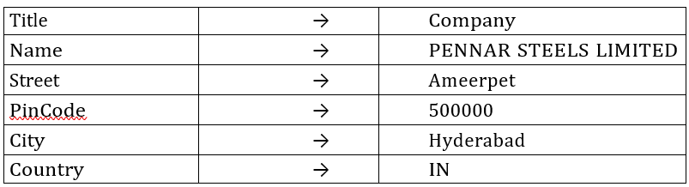
Define Company Code (Pennar Steels Ltd)
Select Save Button or CTRL + S for saving. Once Saved New Screen Will open.
© Copyright 2026, ZaranTech LLC. All rights reserved.

Slide 23
Define Company Code (Pennar Steels Ltd)
Once Completed all the data, press Enter Button. System will generate Transport Request. To Choose our request select it from Drop Down Button. Beside Request# Select your request# .Press enter to save in your request.
Assagin Company Code to Company:--> ( Creating Link between Company Code to Co)
Path to assaign Company Code to Company
SPRO---->Enterprise Structure---->Assaignment---->Financial Accounting >Assaign
Company Code to Company---->Select Position Button >Give Company Code PSL and
Presss Enter .
For Company Code PSL Assaign Company----> Pennnar Steels Limited Select Save Button Press Enter to saving your request.
© Copyright 2026, ZaranTech LLC. All rights reserved.

Slide 24
Define Business Areas
SPRO---->Enterprise Structure---->Definition---->Financial Accounting >Define Business Area--->Select New Entries Button > New Window will open
© Copyright 2026, ZaranTech LLC. All rights reserved.

Slide 25
Define Business Areas
Assigning Business area to Company Code is not required. Reason is explained below. If company is having 2 business areas.
1 in Hyderabad and 2 in Banglore.
PSC
PCL
© Copyright 2026, ZaranTech LLC. All rights reserved.

Slide 26
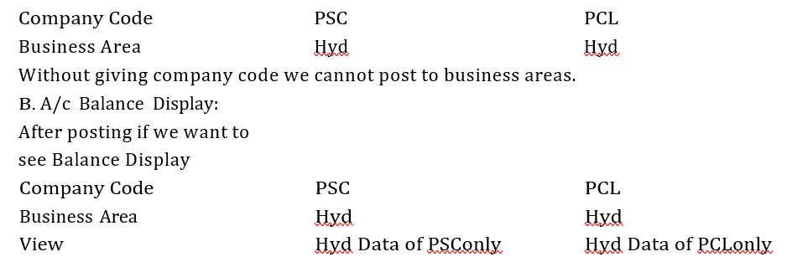
Define Business Areas
A. At the time of Posting :
© Copyright 2026, ZaranTech LLC. All rights reserved.

Slide 27

Define Business Areas
Same Business are can be used for number of Company Codes in Client 800. When we see the report or we want to see the report, we have to give the Combination of company code and business areas.
If Hyderabad incharges wants to see Hyderabad data of all Company Codes, he has to enter like this.
© Copyright 2026, ZaranTech LLC. All rights reserved.

Slide 28
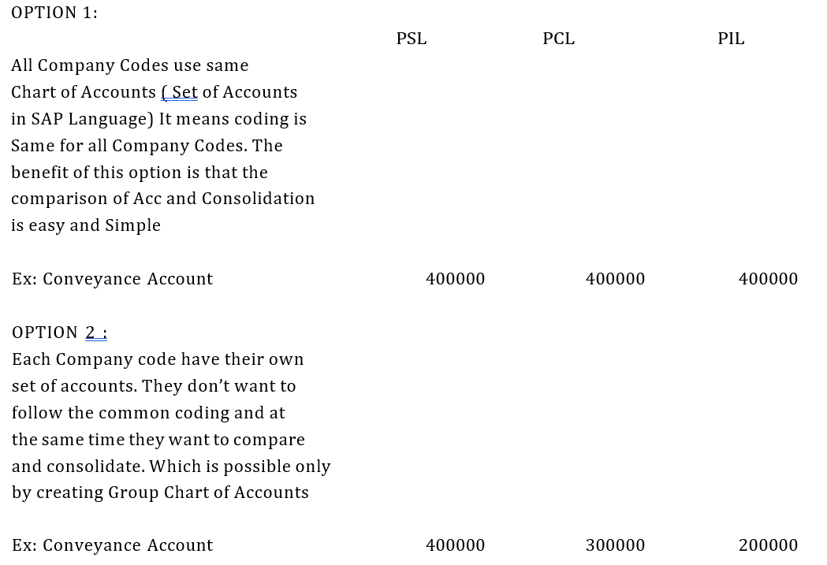
Chart of Accounts
There are two types for creating chart of accounts.
© Copyright 2026, ZaranTech LLC. All rights reserved.

Slide 29
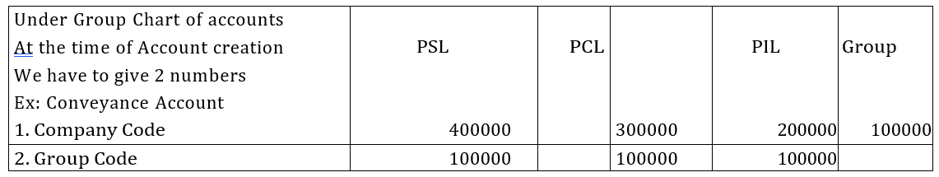
Chart of Accounts
© Copyright 2026, ZaranTech LLC. All rights reserved.

Slide 30
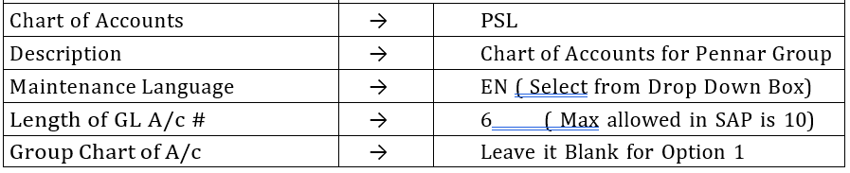
Define Business Areas
Normally all companies will follow option 1 i.e, SAP SET OF ACCOUNTS as consultant will do Customization in 1 company and copy customization along with accounts to all Other Company Codes. It is Easy process.
Process: Chart of Account Codes
Description of Chart of Accounts Weather we are following option 1 or 2. Maintainence Language
Length of account Number---> Normally SAP will allow Max of 10 Digits But we are using 6 digits only.
PATH: SPRO---->Financial Accounting---->General Ledger A/c----> GL Accounts > Master Data---->Preparations---->Edit Chart of Accounts List( TC is OB13) > Select New Entries Button >
© Copyright 2026, ZaranTech LLC. All rights reserved.

Slide 31
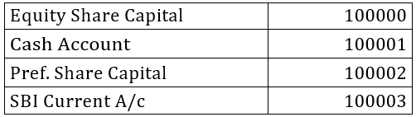
Define Business Areas
Assigning Company Code to Chart of Accounts:
Same path for above ---> Assign Company ( TC-OB62)----> Select Position Button > Company Code == PSL Press Enter Select Save Button or CTRL+S. Press Enter to Save your Request.
Account Groups:
If we create Account Codes without Groups like below
© Copyright 2026, ZaranTech LLC. All rights reserved.

Slide 32
Define Business Areas
If we want to see the Current Assets Balances or Transactions of Current Assets, it is not possible to get directly without Group Creation. We have to verify each and every account and go on adding the respective accounts. In the above example, we have to add 100001 and 100003 which takes much time in practical.
Or
When we prepare Balance Sheet, in the balance sheet we have items like Share Capital, Reserves & Surpluses, Fixed assets, Current Assets etc., We have to verify each and every account and assign to the account to the respective item.
To get the Balances directly or assigning accounts to items easily, SAP has given Account Groups. Structure of Account Groups in SAP will be as under.
© Copyright 2026, ZaranTech LLC. All rights reserved.

Slide 33
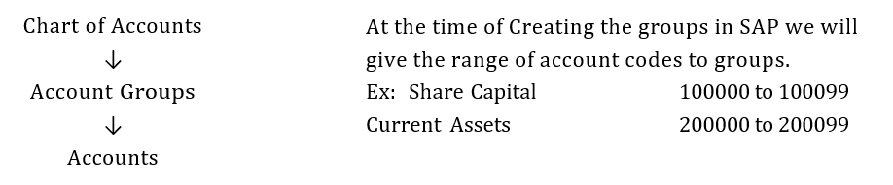
Define Business Areas
© Copyright 2026, ZaranTech LLC. All rights reserved.

Slide 34
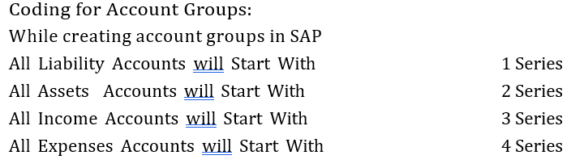
Define Business Areas
When we create Cash Account it can be with any number within Range of 200000 to 200099. When we create SBI C/A , it can be within 200000 to 200099. When we prepare Balance Sheet for Current assets, we give range 200000 to 200099.
In Live Environment, we take the Client's Balance Sheet and Create Account Groups. After Implementation also Client wants to see the Balance Sheet the way he used to get
© Copyright 2026, ZaranTech LLC. All rights reserved.

Slide 35
Define Business Areas
At the time of Posting Document for Expenses by user, he can search all the Expneses accounts by pressing *4 and select the required account from the list of Expenses Accounts. If he typed *4 , only Expenses Accounts List will display , not other groups.
Path:
SPRO----->Financial Accounting---->GL Accounting---->GL Accounts >Master Data---->Preparations >Define A/c Group( Select IMG Activity Button) (TC=OBD4)---->Select New Entries Button >
© Copyright 2026, ZaranTech LLC. All rights reserved.

Slide 36
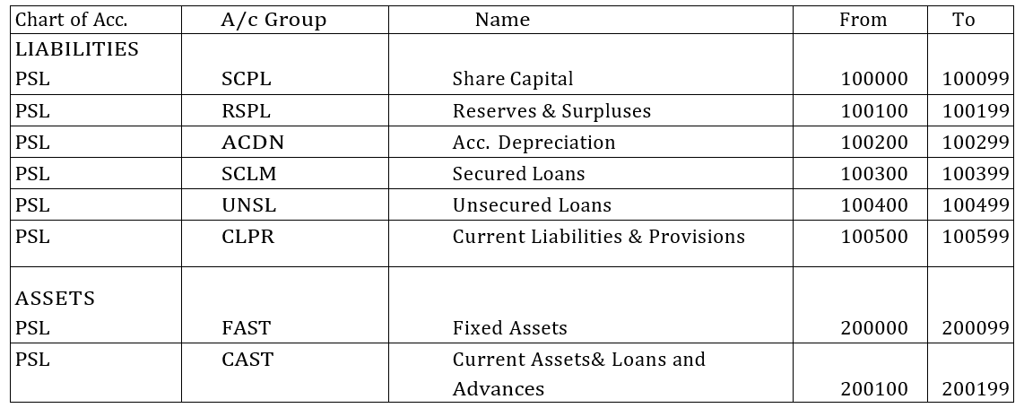
Define Business Areas
© Copyright 2026, ZaranTech LLC. All rights reserved.

Slide 37
Define Business Areas
At the time of Posting Document for Expenses by user, he can search all the Expneses accounts by pressing *4 and select the required account from the list of Expenses Accounts. If he typed *4 , only Expenses Accounts List will display , not other groups.
Path:
SPRO----->Financial Accounting---->GL Accounting---->GL Accounts >Master Data---->Preparations >Define A/c Group( Select IMG Activity Button) (TC=OBD4)---->Select New Entries Button >
© Copyright 2026, ZaranTech LLC. All rights reserved.

Slide 38
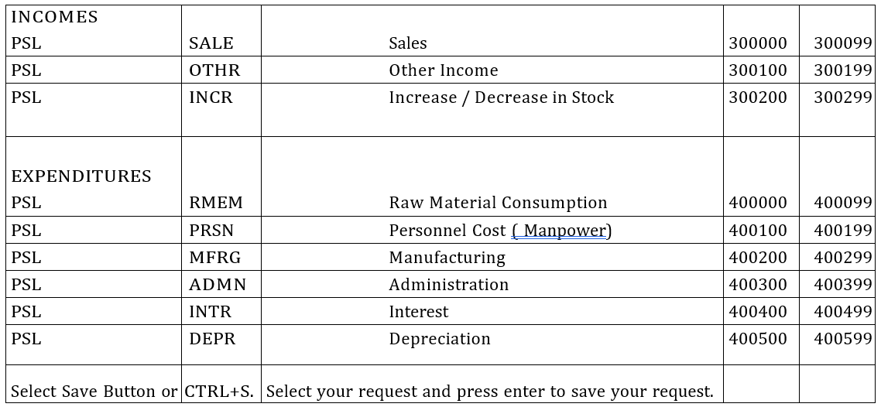
Define Business Areas
© Copyright 2026, ZaranTech LLC. All rights reserved.

Slide 39
Define Business Areas
Reason for Selection of 6 Digits Coding:
If we planned to use 4 digits coding to chart of accounts, it is difficult to create new groups in future. As we are assigning 100 accounts to each group, if any group is completed with 100 accounts, it is difficult to create more group if the account digits is 4.
If account group # is of 10 Digits, it is difficult to remember the account group. So we suggested / recommend to use 6 digits.
If we created Account Groups for Liabilities up to 1599 ( as Liabilities will start with 1 series and coding is 4 digits) , We can not create more than 4 another groups 1999-1599=400/100 ( as we are assigning 100 accounts to each group)
Suppose if we are using 6 digit number for group, we can create 199999-100599=99400/100 994 groups. SO WE SUGGESTED TO GO FOR 6 DIGIT ACCOUNT GROUPS.
© Copyright 2026, ZaranTech LLC. All rights reserved.

Slide 40
Retained Earnings Account
In the Year End, all P& L A/c Balances to be transferred to Surplus in Reserves & Surplus ( Retained Earnings) Account.
All Balance Sheet item balances to be carried forward to Next Year to the same accounts as Opening Balances.
This step is required to do at the end of the year. But in SAP , it has made mandatory at the time of Implementation itself. The reason behind this is Consultant will not be available at the time of Closing the books of accounts for the year. System does not know which account balances to be transferred to "Surplus in Reserves & Surplus" Account and which account balances to be carryforward to next year as opening balances of the same account.
We can specify any Account Number within the Range of Given for Reserves & Surplus i.e., 100100 to 100199. Generally we specify A/c # 100100. When we start crating account the first account to be created is 100100, surplus in P&L Account.
© Copyright 2026, ZaranTech LLC. All rights reserved.

Slide 41
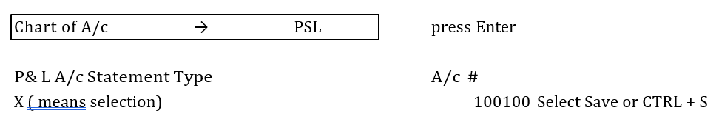
Retained Earnings Account
PATH:
SPRO---->Financial Accounting---->GL Accounting---->GL Accounts >Master Data---->Preparations >Define Retained Earnings A/c ( TC=OB53)
It gives us a warning Message " A/c 100100 not created in chart of Accounts for PSL"
Ignore the warning message and press Enter. It asks for request. Press Enter again to save the request.
© Copyright 2026, ZaranTech LLC. All rights reserved.

Slide 42
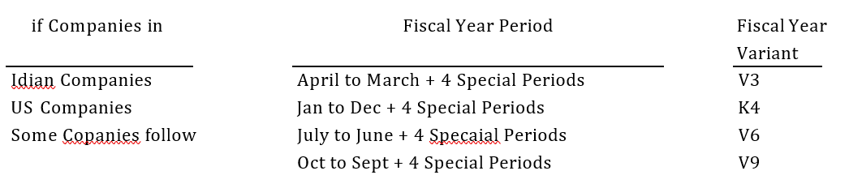
Fiscal Year
If Fiscal Year period is from April '08 to March '09, in SAP it is called as Fiscal Year 2008
If Fiscal Year period is from July 2008 to June 2009, in SAP it is called as Fiscal Year 2008
If Fiscal Year period is from Oct 2008 to Sept 2009, in SAP it is called as Fiscal Year 2009
© Copyright 2026, ZaranTech LLC. All rights reserved.

Slide 43
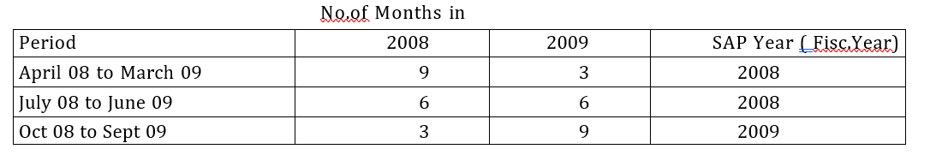
Retained Earnings Account
Logic behind this is based on Number of Months covered in Next Calander Year. If in next Calendar Year Period is above 6 months , call it as Next Year , otherwise call with the same year. So , in above example
© Copyright 2026, ZaranTech LLC. All rights reserved.

Slide 44
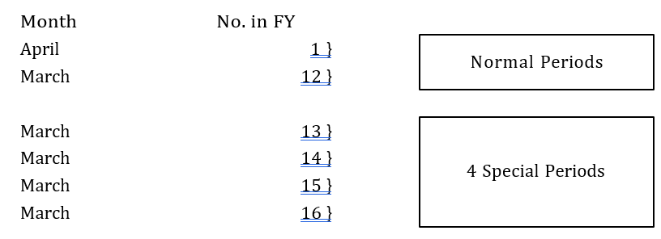
Retained Earnings Account
What are Special Periods
For Fiscal Year 2008 i.e, Accounting period from April 2008 to March 2025, March 2009 will be the last Month. In SAP it has 4 special periods for MARCH 09
Special periods are part of last period in that Fiscal Year. In this example March 2009.
USAGE OF SPECIAL PERIODS IS OPTIONAL
© Copyright 2026, ZaranTech LLC. All rights reserved.

Slide 45
Why Special Periods Required
Date | Status of Accounting
20.03.26 | Accounts department released profitability upto the Feb'26 to the Mgt. Figures upto Feb'26 can not be changed as profitability is finalised upto Feb 26. In that sence, We open period for March 2026 to March 2026 for data entry purpose so as to not to change the previous data by any one. So End user can entere transactions only for the month of March 2026. for Opening March 2026 to March 2026 means open period is 12.2025 to 12.2025
30.03.26 | New accounting year April 2026 to March 2027 ( Fisc. Year 2026) will start after 2 days. So to open the period for Fisc.Year 2026, we have to open period from March 2026 to March 2027 as , for Fisc. Year 2025 B/S is not finalized and still some entries have to make for March 2026. So period to open would be 12.2025 to 12.2026
16.04.26 | Accounts Department has closed the Balance Sheet and declared Profitability for the Fisc. Year 2025 to the Management. Management has suggested to make some adjustments for which adjustment entries hast to be passed by A/c Dept. This Adjustments may be for increase / decrease the profitability.
05.05.26 | Accounts Dept made passed adjustment entries as suggested by the Management . Data entered on 05.05.26 but posting dated will be 31.03.26 so as to updated the 2025 Fisc. Year ledgers.
12.05.26 | Audit has completed and Auditors suggested to make Rectification Entries. These rectification entries were done on 12.05.26 but the posting date will be 31.03.26 so as to update the Fisc.Year 2025 ledgers.
10.07.26 | If Management wants to see the Profitability finalized by the Accounts Department, it is not possible to see as subsequently adjustment entries were made as suggested by the Management and Rectification Entries were made as suggested by the Auditors. All the data was changed.
© Copyright 2026, ZaranTech LLC. All rights reserved.

Slide 46
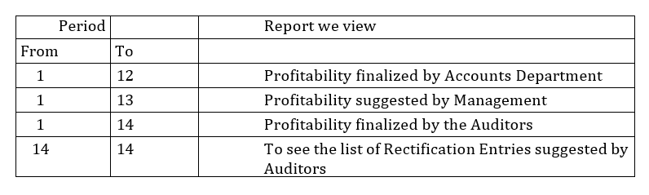
How Special Periods will be useful
Entries made upto the Profitability of Accounts Department will be posted upto period 12. Entries made for Management Adjustments will be in the period 13.
Entries made for Auditors Rectifications will be in the period 14.
When we want to see the Report:
© Copyright 2026, ZaranTech LLC. All rights reserved.

Slide 47
How Special Periods will be useful
How to Convert Calendar Year to Accounting Year Periods:
SAP by default Know only Calendar Year ( Jan - Dec) as Accounting Year ( Fiscal Year) Below is the process to convert the Calendar year to Accounting Year.
© Copyright 2026, ZaranTech LLC. All rights reserved.

Slide 48
How Special Periods will be useful
Conversion for A/c Year from Apr 2026 to March 2027 ( Fisc. Year 2026)
 | Month | Days | Period in SAP | Year Shift
Jan | 1 | 31 | 10 | -1
Feb | 2 | 29 | 11 | -1
Mar | 3 | 31 | 12 | -1
Apr | 4 | 30 | 1 | 0
May | 5 | 31 | 2 | 0
June | 6 | 30 | 3 | 0
July | 7 | 31 | 4 | 0
August | 8 | 31 | 5 | 0
Sept | 9 | 30 | 6 | 0
Oct | 10 | 31 | 7 | 0
Nov | 11 | 30 | 8 | 0
Dec | 12 | 31 | 9 | 0
For Accounting Year 2026-2027, April will be the 1st Month
For April Calender year =2026 For April Fiscal Year = 2026 So, Year Shift is "0" ( 2026-2026)
But for Jan to March , Cal Year =2027 Fiscal Year = 2026
So, Year Shift = "-1" ( 2026-2027)
When we post document for Jan-2027 it should updated the FY. 2026 ledger But not the 2027, so Year shift= -1.
© Copyright 2026, ZaranTech LLC. All rights reserved.

Slide 49
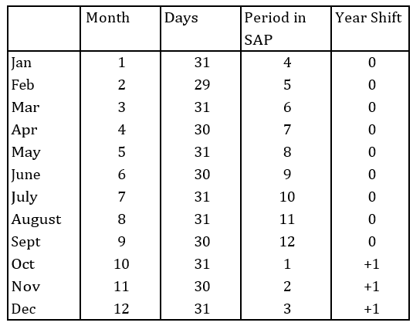
How Special Periods will be useful
Scenario - I I
Conversion for A/c Year from Oct 2026 to Sept 2027 ( Fisc. Year 2027)
For Accounting Year 2026-2027, Oct will be the 1st Month
For Oct Calendar year =2026 For Oct Fiscal Year = 2027
So, Year Shift is "+1" (2027-2026)
But for Jan to Sept, Cal Year =2027 Fiscal Year = 2027
So, Year Shift = "0" (2027-2027)
When we post document for Jan-2027 it should updated the FY. 2027 ledger But not the 2026, so Year shift= 0.
© Copyright 2026, ZaranTech LLC. All rights reserved.

Slide 50
Path for Fiscal Year Conversion
SPRO---->Financial Accounting---->Fin. A/c Global Setting---->Fiscal Year >
Maintain Fiscal Year Variant( Maintain Shortened Fiscal Year TC=OB29) >
Select Position Button Press Enter
Double Click on Period Folder. It will display default Window, If we want to Create our own Variant Pess on New Entries Button
FV Description
1A April to March + 4 special Periods---> Deselect Year Dependent--Deselect Calendar Year Check Box----> No of Posting Periods =12 > No of
Spl. Periods =4 Select Save Button or CTRL+S
© Copyright 2026, ZaranTech LLC. All rights reserved.

Slide 51
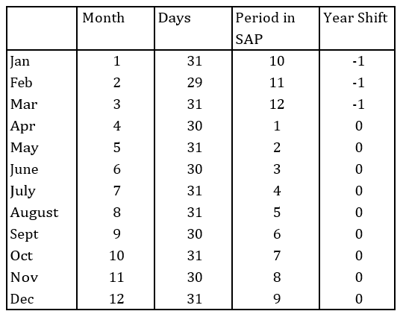
Path for Fiscal Year Conversion
Select F.Year Variant as 1A. Double click on Periods folder > Select New Entries
Press Save Button
© Copyright 2026, ZaranTech LLC. All rights reserved.

Slide 52
Path for Fiscal Year Conversion
Why to De-select Year Dependent Check Box: If we select the Year Dependent Check Box, at the time of Saving , SAP will ask for Which Fiscal Year. If we gave 2026 as FY, Conversion is applicable to that FY only.
We have to do the Same process of Conversion for each and every year. If we de select, conversion is applicable to all the years.
Why to De-select Calendar Year Check Box: If we select this check box, System will consider January as Period 1 in the Fiscal Year and April will be as 4th period. But we require April will be treated as 1st period and January will be 10th in Periods.
© Copyright 2026, ZaranTech LLC. All rights reserved.

Slide 53
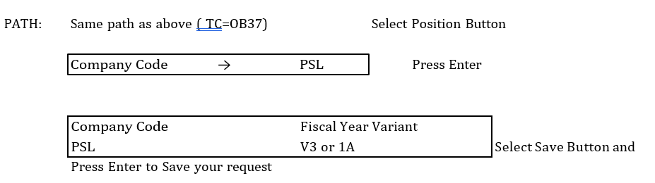
Path for Fiscal Year Conversion
Assigning Company Codes to Fiscal Year Variant:
© Copyright 2026, ZaranTech LLC. All rights reserved.

Slide 54
Path for Fiscal Year Conversion
POSTING PERIODS: Here we define , which periods are to be open for posting purpose. In all other Software’s, Closing of the period is there. Once we selected closing the periods, end user cannot enter any documents before to that period. But in SAP Open period is there. If we open period for entering documents, the periods before to that and after that
periods, end user is not able to enter any document. Once we open the period, automatically other periods will be closed. We can enter any document between the dates of the open periods only.
For example, if we declared profitability upto June'26 and we want to open periods from July '26 to March'2027. In SAP we call it as 4.2026 to 12.2026.
© Copyright 2026, ZaranTech LLC. All rights reserved.

Slide 55
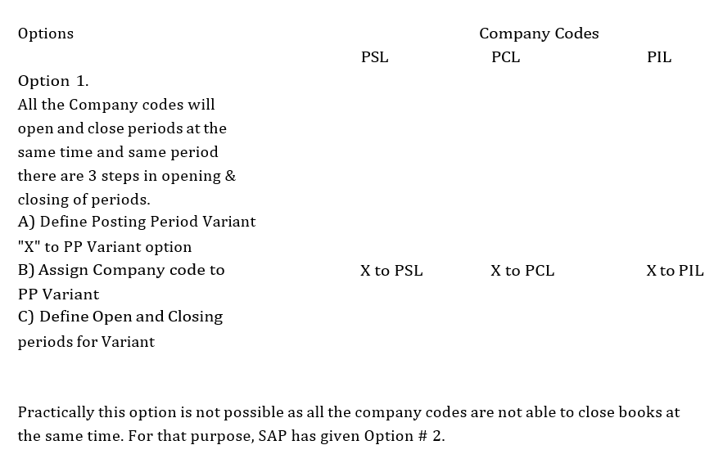
Path for Fiscal Year Conversion
For Opening and Closing of periods we have 2 options in SAP which is explained below
© Copyright 2026, ZaranTech LLC. All rights reserved.

Slide 56
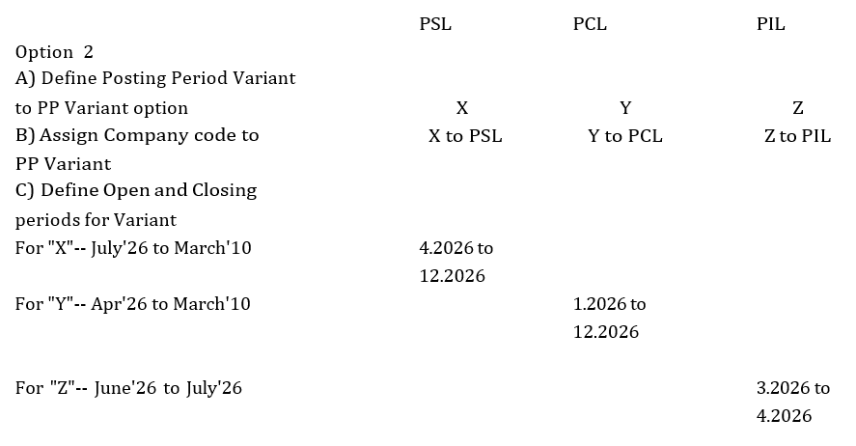
Path for Fiscal Year Conversion
© Copyright 2026, ZaranTech LLC. All rights reserved.

Slide 57
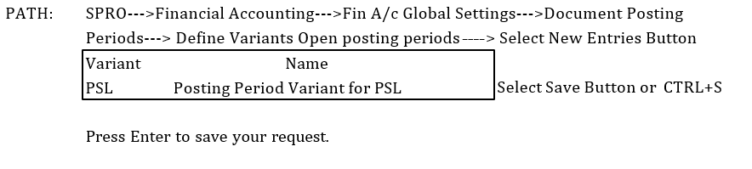
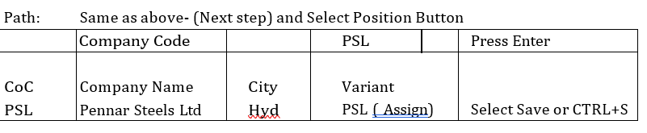
Path for Fiscal Year Conversion
Defining Posting Period Variant
Assigning Posting Period Variant to Company Code:
© Copyright 2026, ZaranTech LLC. All rights reserved.

Slide 58
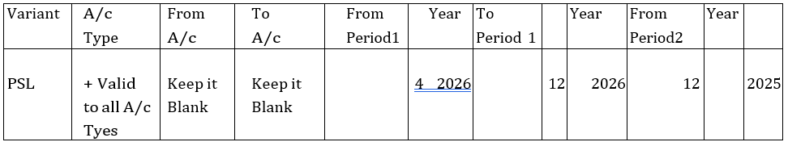
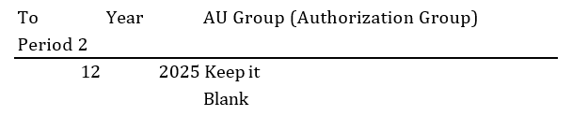
Path for Fiscal Year Conversion
Press Enter to save your request.
Open and Close Posting Periods:
Same Path > Select New Entries Button
© Copyright 2026, ZaranTech LLC. All rights reserved.

Slide 59
Path for Fiscal Year Conversion
At the time of Opening Posting Periods, Authorization Group is kept as Blank. When June Profitability is declared period to be open will be July'26 to March'2027.
After July'26 profitability Period to be open will be Aug'26 to March'10. So Opening and Closing of periods Screen is regularly used in SAP. As this screen is widely used, SAP has given the access of this screen at the End User level also. It may be Misused by End User. To restrict the misuse Authorization Group is Helpful.
Basis Consultant will create Authorization Group Say "X" and assign user ID's say Manager Dy.Manager of Accounts to this Group. Hence these 2 people only can access the screen
and make changes in opening periods.
© Copyright 2026, ZaranTech LLC. All rights reserved.

Slide 60
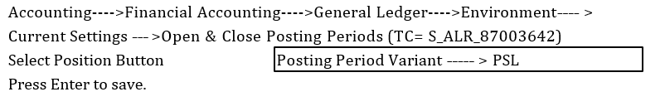
Path for Fiscal Year Conversion
Path for Posting Periods Entry at End User Area:
© Copyright 2026, ZaranTech LLC. All rights reserved.

Slide 61
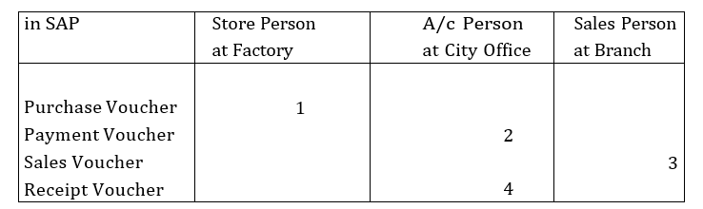
Document Types and Number Range
In Normal Accounting all entries are made by Accounts Persons. So Voucher Number will be continuous.
© Copyright 2026, ZaranTech LLC. All rights reserved.

Slide 62
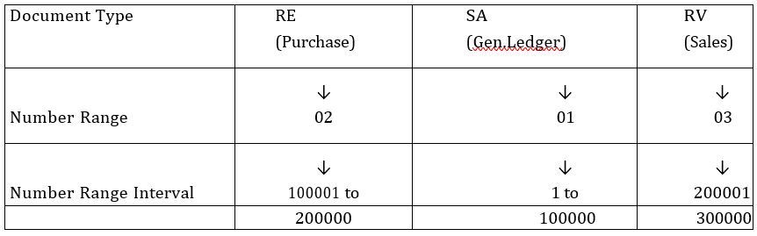
Document Types and Number Range
In the above example , Voucher Number is continuously coming for all the departments. So, which document raised in Which Department or How many Documents raised in One Department is not able to get. To Get document number continuously SAP has given Document Types
© Copyright 2026, ZaranTech LLC. All rights reserved.

Slide 63
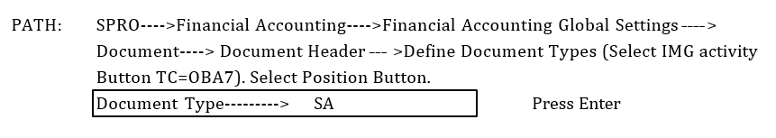
Document Types and Number Range
If we give the Document Number Range like above, we will get Document Number Continuously in Department wise. So, by seeing the Document number itself we can say in which department the Document is generated.
If in any year, 100000 documents are consumed for SA, System will warn with Error Message when we post a new document of SA.
At that time we have to give available Number range to the Number Range Interval. In the above example, available Number is from 300001 to 400000
© Copyright 2026, ZaranTech LLC. All rights reserved.

Slide 64
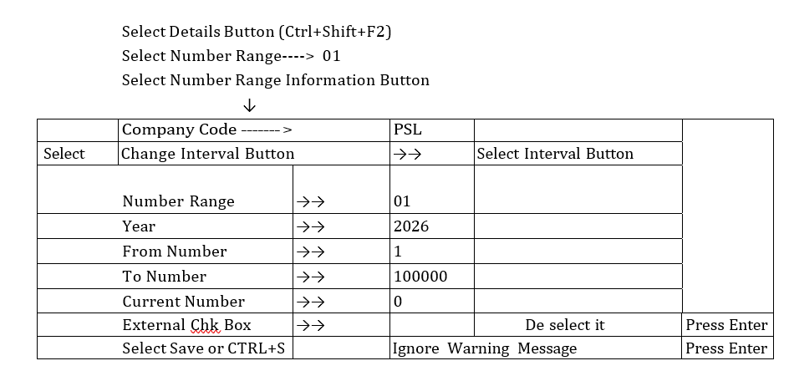
Document Types and Number Range
© Copyright 2026, ZaranTech LLC. All rights reserved.

Slide 65
Document Types and Number Range
Number Range Interval cannot be transported to Production Client. Reasons:
Consultant is outsider. He does not know how many Docs. are required for each type.
All the Department people want to have the number range from 1 to 100000 which is not possible in practical.
IN live environment before going to live Production Clients all Department Heads will sit together and decide the Document Numbering.
Whatever we have given in Client 800 are applicable only for Development Client for testing of documents.
© Copyright 2026, ZaranTech LLC. All rights reserved.

Slide 66
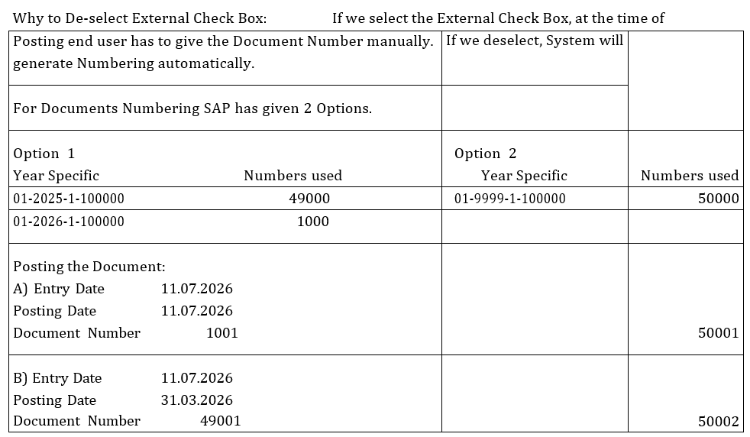
Document Types and Number Range
© Copyright 2026, ZaranTech LLC. All rights reserved.

Slide 67
Document Types and Number Range
In Option 1, last number in 2025 is 49000 and in 2026 is 1000. When we posted document on 11.07.2026 for the date of Posting 11.07.2026 (FY2026) New Document Number will be 1001. If we post the document on 11.07.2026 for Posting Date 31.03.2026, New document number will be the next number of last year’s last number i.e, 49001 only, but not 1001.
In option number 2, Continuous numbering is there, whenever we posted the document and for which Fiscal Year It may relate to. So, in practical, it is difficult to maintain which document relates to which Fiscal Year.
© Copyright 2026, ZaranTech LLC. All rights reserved.

Slide 68
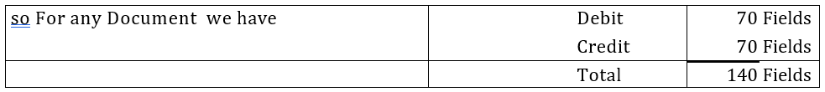
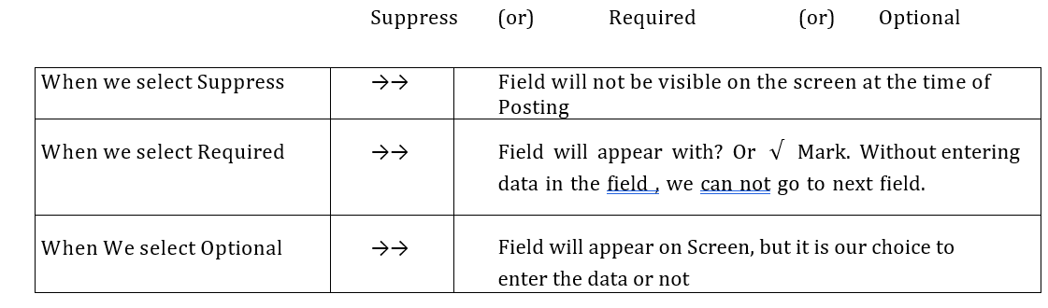
Field Status Variant and Field Status Groups
At the time of Posting in all Screens, we get around 70 Fields for Debit and 70 for Credit.
If we start entering all the 140 fields, it takes so much time to post a document. So SAP has given a chance to make any field
© Copyright 2026, ZaranTech LLC. All rights reserved.

Slide 69
Field Status Variant and Field Status Groups
Field selection is not common to all accounts. It varies Account to Account.
So For Purchase accounts/ Sales Accounts Field "Qty" is required but Not for Equity Share Capital Account. If we have 1000 Accounts in Chart of accounts, We have to create 1000 Scenarios for each account separately. This is very difficult in Practical. To overcome this problem, SAP has given Shortcut method called " Field Status Group"
For Field Status Groups we specify which field is Required/Optional/Suppress.
Field Status Groups will be created under Field Status Variant ( F St.V) and Field Status Variant will be assigned to Company Codes.
In Account Creation we specify Field Status Group
At the time of Posting, when user give the Account #, the Screen will appear based on Field Selection to the Field Status Group which is specified in Account.
© Copyright 2026, ZaranTech LLC. All rights reserved.

Slide 70
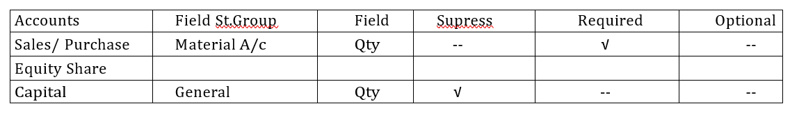
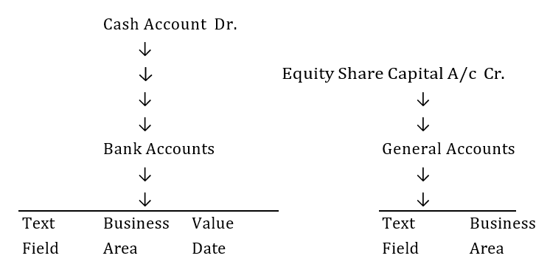
Field Status Variant and Field Status Groups
As an Example we are going to Create Accounts and Post
© Copyright 2026, ZaranTech LLC. All rights reserved.

Slide 71
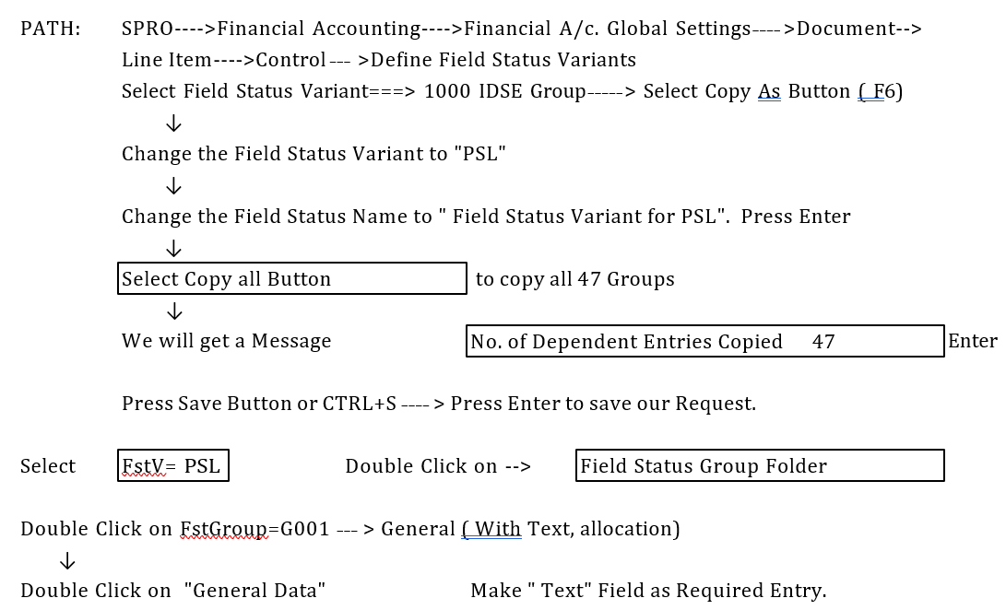
Field Status Variant and Field Status Groups
For the above accounts, we make the above fields are as Compulsory ( REQUIRED) whether client inform to make them compulsory or not . Other fields are based on client information.
© Copyright 2026, ZaranTech LLC. All rights reserved.

Slide 72
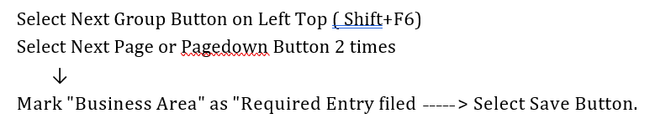
Field Status Variant and Field Status Groups
© Copyright 2026, ZaranTech LLC. All rights reserved.

Slide 73
Field Status Variant and Field Status Groups
Double Click on FstGroup G005= Bank Account(Obligatory, Value Date) Double Click on General Data > Make Text as Required Entry
Select Next Group Button
Select Next Page Button or Page Down 2 times Mark Business Area as Required Entry Field.
Select Next Group Button 2 times
Mark Value Date as Required Entry Field Select Save or CTRL+S
Value Date means Effective Date. Suppose if we took a Loan from IDBI on 11.07.26 Cheque Date of IDBI is 11.07.2026.
On 13.07.2026 we are posting the document and depositing the cheque in Bank. At the time of Posting
Document Date-------> 13.07.26 Once date is entered in Document Dated Posting Date-----------> 13.07.26 and Posting Dated column, it can not be Modifiable. We have to reverse the entry only.
© Copyright 2026, ZaranTech LLC. All rights reserved.

Slide 74
Field Status Variant and Field Status Groups
IDBI Calculate Interest from 11.07.2026, whereas SAP will calculate interest from 13.07.2026 as posting date is 13.07.2026. So In interest amount , there will be a difference between IDBI and Systems calculation. To overcome this problem, SAP has given Effective Date i.e, Value Date ( in SAP Terminology) .
IF we select the Value Date option Compulsory and enter it at the time of posting.
SAP will calculate interest from Value Date entry. Value date can be modifiable if necessary but not Document Date or Posting Date.
© Copyright 2026, ZaranTech LLC. All rights reserved.

Slide 75
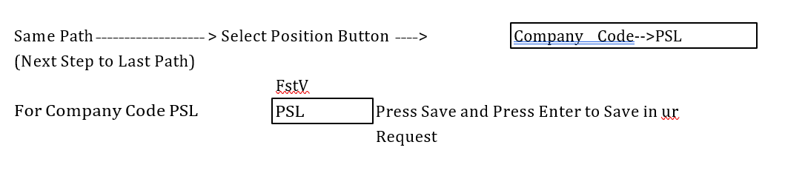
Field Status Variant and Field Status Groups
Assign Filed Status Variant to Company Code:
© Copyright 2026, ZaranTech LLC. All rights reserved.

Slide 76
Field Status Variant and Field Status Groups
Assign Sales Tax Procedure:
in Financials we are going to Cover
1. General Ledger 2. A/c Payable 3. A/c Receivables 4. Asset A/c
Sale Tax is required for Both Accounts Payable and Accounts Receivable. But system will not allow to enter any transactions in India ( for Country Code IN) without Sales Tax Procedures even for General Accounts.
So, we assign some Tax Procedure which is available in system temporarily. Afterwards, when we go for Accounts Payable , or Receivable we make our own Tax Procedures.
For Country IN--> Assign Tax Procedure TaxUS( Sales Tax USA) or TaxINN (Sales Tax India)---> as Temporary assignment.
© Copyright 2026, ZaranTech LLC. All rights reserved.

Slide 77
Field Status Variant and Field Status Groups
Assign Sales Tax Procedure:
in Financials we are going to Cover
1. General Ledger 2. A/c Payable 3. A/c Receivables 4. Asset A/c
Sale Tax is required for Both Accounts Payable and Accounts Receivable. But system will not allow to enter any transactions in India ( for Country Code IN) without Sales Tax Procedures even for General Accounts.
So, we assign some Tax Procedure which is available in system temporarily. Afterwards, when we go for Accounts Payable , or Receivable we make our own Tax Procedures.
For Country IN--> Assign Tax Procedure TaxUS( Sales Tax USA) or TaxINN (Sales Tax India)---> as Temporary assignment.
© Copyright 2026, ZaranTech LLC. All rights reserved.

Slide 78
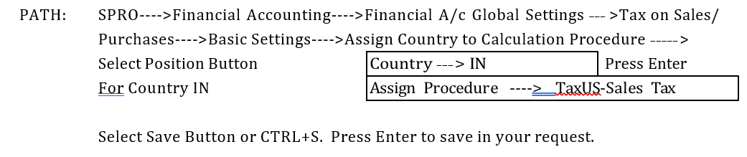
Field Status Variant and Field Status Groups
Assign Sales Tax Procedure:
in Financials we are going to Cover
1. General Ledger 2. A/c Payable 3. A/c Receivables 4. Asset A/c
Sale Tax is required for Both Accounts Payable and Accounts Receivable. But system will not allow to enter any transactions in India ( for Country Code IN) without Sales Tax Procedures even for General Accounts.
So, we assign some Tax Procedure which is available in system temporarily. Afterwards, when we go for Accounts Payable , or Receivable we make our own Tax Procedures.
For Country IN--> Assign Tax Procedure TaxUS( Sales Tax USA) or TaxINN (Sales Tax India)---> as Temporary assignment.
© Copyright 2026, ZaranTech LLC. All rights reserved.

Slide 79
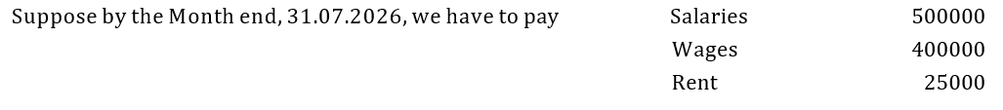
Tolerance Groups
SAP has given 2 types of Tolerance Groups
1. General Ledger Account Tolerance 2. Employee Tolerance
General Ledger Account Tolerance is mandatory in SAP which is applicable in Receipts & Payments. Before understanding Tolerance Groups, we need to know about "Open Item Management".
OPEN ITEM MANAGEMENT: This is used for Vendors/ Customers/Balance Sheet Items where Clearing is required.
© Copyright 2026, ZaranTech LLC. All rights reserved.

Slide 80
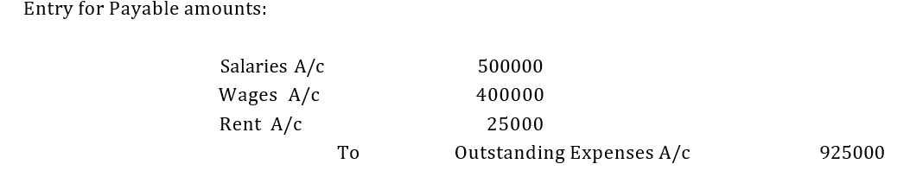
Tolerance Groups
If we see the account in the Month End, we will have Number of Credit items and Number of Debit Items. We don’t know which item is pending and How much is Pending.
In SAP, if we select Open Item Management, at the time of payment , system will ask against which item the payment is made. When we specify the payment is made against Rent that item will be cleared upto the extent we paid.
If we paid 25000 against Rent A/c , We can see accounts in 3 ways.
© Copyright 2026, ZaranTech LLC. All rights reserved.

Slide 81
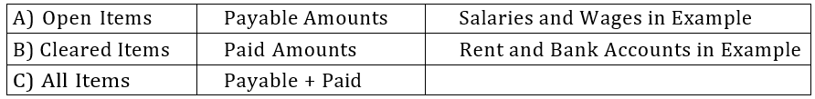
Tolerance Groups
Once we selected Open Item Management, we can see Bill Wise Payable of Vendors, Bill wise Receivables of Customers.
As discussed earlier, SAP has given Tolerance Groups. Tolerance means Payment Difference. It can be " Amount Tolerance" to "Percentage Tolerance". It can be Debit or Credit
© Copyright 2026, ZaranTech LLC. All rights reserved.

Slide 82
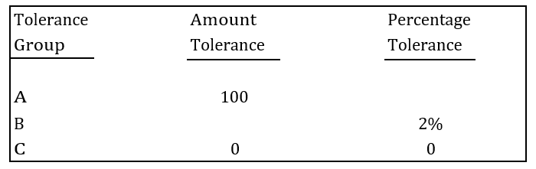
Tolerance Groups
We create Tolerance for Tolerance Groups
© Copyright 2026, ZaranTech LLC. All rights reserved.

Slide 83
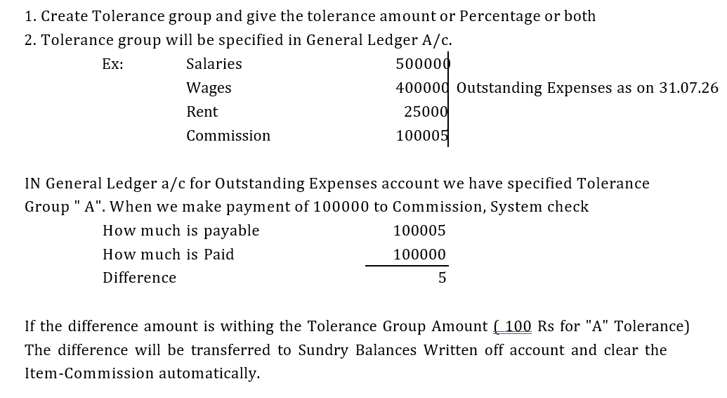
Tolerance Groups
© Copyright 2026, ZaranTech LLC. All rights reserved.

Slide 84
Tolerance Groups
Disadvantages of Tolerance System:
Tolerance group is given at A/c Level and not at Transactions Level.
No Flexibility in Tolerance Groups.
If the Tolerance amount is within the Tolerance Group Limit, system will automatically transfer the Difference amount to Sundry Balances Written Off account. It should ask the end user before Transferring.
In Live Environment, we use Tolerance Group "C" in which Tolerance amount and Tolerance Percentage both are ZERO.
If we specify Tolerance Amount (or) Tolerance Percentage as ZERO, system will show the balance "5" as Outstanding in Account. It the Customer or End-user decision to Pay or not to Pay.
© Copyright 2026, ZaranTech LLC. All rights reserved.

Slide 85


Tolerance Groups
© Copyright 2026, ZaranTech LLC. All rights reserved.

Slide 86

Tolerance Groups
When we create the account, Tolerance Group will be " Blank". System expects we have created Blank Tolerance Group and Assigned in the Account.
© Copyright 2026, ZaranTech LLC. All rights reserved.

Slide 87

Tolerance Group for Employees
Mainly, Tolerance Group for Employees is to restrict/control the users for posting the documents. Here, we give user wise upper limit for posting. We can create Maximum Limit for Tolerance group.
© Copyright 2026, ZaranTech LLC. All rights reserved.

Slide 88

Tolerance Group for Employees
If we have 1000 users we have to create 1000 Scenarios. So SAP has given short cut to Tolerance as Groups. We create 3 Groups "A", "B" & "C" and assign to Users.
If we have following people in Accounts Dept we can assign Tolerance Groups to them like
© Copyright 2026, ZaranTech LLC. All rights reserved.

Slide 89

Tolerance Group for Employees
PATH:
SPRO---->Financial Accounting---->General Ledger Accounting -->Business Transactions---->Open Item Clearing---->Clearing Differences -->Define Tolerance Group for Employees > Select Position Button
Select New Entries Button
© Copyright 2026, ZaranTech LLC. All rights reserved.

Slide 90

Tolerance Group for Employees
Enter Global Parameters:
Path: SPRO---->Financial Accounting---->Financial Accounting---->Company Code >
Enter Global Parameters > Select Position Button
© Copyright 2026, ZaranTech LLC. All rights reserved.

Slide 91
Important Steps in Basic Settings
Following are the steps to follow for completing the Basic Settings in Financials
Step # | Action to be Done | TC
1 | Define Company ( In normal terminology-Group) | /NOX15
2 | Define Company Code ( in normal terminalogy Company in Group) | /NOX02
3 | Assign Company to Company Code | /NOX16
4 | Define Business Area | /NOX03
5 | Define Chart of Accounts | OB13
6 | Assign Company Code to Chart of Accounts | OB62
7 | Define Account Groups with Number Ranges | OBD4
8 | Define Retained Earning Account | OB53
9 | Define Fiscal Year Variant with Fiscal Year Conversion | OB29
10 | Assign Company Code to Fiscal Year Variant | OB37
11 | Define Posting Period Variant | SPRO
12 | Assign company Code to Posting Period Variant | SPRO
13 | Define Open and Close Posting Periods | SPRO
14 | Define Document Types and Number Range | OBA7
15 | Define Field Status Variant | SPRO
16 | Assign Company Code to Field Status Variant | SPRO
17 | Assign Company Code to Sales Tax Procedure | SPRO
18 | Define Tolerance Groups | SPRO
19 | Assign Company Code to Tolerance Groups | SPRO
20 | Check the Global Parameters of Company Code and Enter TDS and PAN Numbers | SPRO
© Copyright 2026, ZaranTech LLC. All rights reserved.

Slide 92

General Ledger Concepts
HOW TO CREATE GENERAL LEDGER MASTERS :
We can create Chart of Accounts at
A) Chart of Accounts Level
B) At Company Code Level
C) Centrally
© Copyright 2026, ZaranTech LLC. All rights reserved.

Slide 93

General Ledger Concepts
© Copyright 2026, ZaranTech LLC. All rights reserved.

Slide 94

General Ledger Concepts
© Copyright 2026, ZaranTech LLC. All rights reserved.

Slide 95

General Ledger Concepts
© Copyright 2026, ZaranTech LLC. All rights reserved.

Slide 96

General Ledger Concepts
© Copyright 2026, ZaranTech LLC. All rights reserved.

Slide 97

General Ledger Concepts
© Copyright 2026, ZaranTech LLC. All rights reserved.

Slide 98
Posting of Transactions
Path: Accounting ---> Financial Accounting ---> General Ledger Accounting > Posting > General Posting(TC=F02)
On screen we get a window For Posting Document
Document Date: Normally Document Date and Posting Date will be same. IN case of Purchases i.e., Document Date will be the Party's Bill Date. For Date we can enter like 16. 07.2026 ( or ) Press F4 to get the calendar and select the date (or) press F2 for current date.
Posting Date: Posting Date comes automatically from Server. Ledger update will be based on Posting Date. Period comes automatically based on the date of posting.
Document Number: IN Document Types and No Ranges we deselected Ext. Chk Box. So Document Number will come automatically after saving the document.
If Ext. Chk Box is selected Document Number should be given by User.
© Copyright 2026, ZaranTech LLC. All rights reserved.

Slide 99

Posting of Transactions
Reference: Party Bill Number in case of Purchases.
SAP has given to differentiate between Debit and Credit 2 Different Posting Keys.
© Copyright 2026, ZaranTech LLC. All rights reserved.

Slide 100
Posting of Transactions
From Menu---->Document--->Simulate (Shift+F9) to post the Document Debit amount will be posted without any Symbol
Credit Amount will be posted with "- " Symbol
Select Save or Ctrl+S. We will get a message "Document 1 was posted in Company Code PSL" Note: IN ONE DOCUMENT WE CAN POST 999 LINE ITEMS
How to View the Latest Posted Document:
Menu---->Document---->Display >Select Display Document Header(F5)
How to Change the Document:
PATH: Accounting---->Financial Accounting---->GL Accounting---->Document >
Change (TC=FB-02)
© Copyright 2026, ZaranTech LLC. All rights reserved.

Slide 101

Posting of Transactions
© Copyright 2026, ZaranTech LLC. All rights reserved.

Slide 102
Posting of Transactions
To View Documents Posted by a Specific User:
Menu---->Edit >Dynamic Selection (Shift+F4)
User Name SAPUSER Select Execute Button or F8 Display Document #1.
To Display Account Balance :
Accounting----> Financial Accounting----> GL A/C > Display Balance (TC=FS10N)
To View Number of Accounts at a time:
Select Right Arrow ( Multiple Selection) Button beside GL Account.
To View Random A/c Transactions:
Under Single Value give account Numbers 100100, 200100 and select copy as (F8)
© Copyright 2026, ZaranTech LLC. All rights reserved.

Slide 103

Posting of Transactions
© Copyright 2026, ZaranTech LLC. All rights reserved.

Slide 104

Posting of Transactions
© Copyright 2026, ZaranTech LLC. All rights reserved.

Slide 105

Posting of Transactions
© Copyright 2026, ZaranTech LLC. All rights reserved.

Slide 106

Posting of Transactions
© Copyright 2026, ZaranTech LLC. All rights reserved.

Slide 107

Sample Document
This is used for Month End Provisions. For this purpose, we create Sample Doc.
Sample Document template will not update the ledger. Every month end we copy the template and change the amount and post the Document.
Advantages of Sample Document:
Sample Document Saves times
When we create Sample Document Template , we will not Forget any provisions
Any Provision in the Template is paid in the same month . No provision is required for that account. So When we copy the template for the month, for that account Enter Amount " ZERO"
© Copyright 2026, ZaranTech LLC. All rights reserved.

Slide 108
Sample Document
Steps to Create Sample Document Template:
Define Number Range Interval for Number Range X2
Creation of Masters.
Creation of Sample Document Template
Display Sample Document Posted
Posting of Transactions by using Sample Document Template (F-02)
© Copyright 2026, ZaranTech LLC. All rights reserved.

Slide 109

Parking of Documents
Parking of Documents are used where approval by Sr. Person is required for the Posted Documents. For Example, if in any company Cashier or Accountant and Accounts Manager/ Sr. Person are there .
© Copyright 2026, ZaranTech LLC. All rights reserved.

Slide 110
Parking of Documents
Parking will not Update the Ledger After Releasing Sr. will send reply to Cashier ← Releasing will be updated the Ledger
Steps to Cover this Topic :
Entering Document and Parking by Cashier/Accountant
Display G L A/c to check whether Ledgers updated or Not.
Sending Message to Senior for Releasing Parked Document
Display Parked Documents, Make Corrections in Amount, Head of Account, Date and Releasing by Sr. Person
Display G L A/c to check whether Ledgers updated or Not.
Sending Message to Cashier regarding the Releasing of Document by Sr. Person
Display changes made by Senior Person in Parked Document for Cashier
© Copyright 2026, ZaranTech LLC. All rights reserved.

Slide 111
Hold Documents
This is used for the purpose of Adjustment Entries. Hold Documents are for Debit and Credit or only Credit also. When we hold the document, it will ask for a Temporary Document Number which can be anything.
We have the option to delete the hold document also. Hold document will not update the ledger until it is posted as normal Document.
If we made Hold document for Cash Account, then Physical Cash Balance will be SAP Balance + Hold Documents amount.
© Copyright 2026, ZaranTech LLC. All rights reserved.

Slide 112
Hold Documents
Steps for Hold Documents
Run Program "RFTMPBLU" for conversion of Hold Documents.
Creation of Hold Document
(A) One document with Debit and Credit Entries
(B) One document with Credit entry only
Display Hold Documents, Delet document ( A) in Point 2, and Complete 2 (B)
© Copyright 2026, ZaranTech LLC. All rights reserved.

Slide 113
Recurring Documents
Recurring Documents are used when date and amount are fixed. Ex: Prepaid Expenses / Hire Purchase Installments.
Steps for Recurring Documents:
Define Number Range Interval for Number Range X1 ( For Recurring Document Template)
Creation of Recurring Document
Posting of Transactions by using Recurring Document Templates by the way of Batch input Session.
© Copyright 2026, ZaranTech LLC. All rights reserved.

Slide 114


Foreign Currency Transactions
There are 3 types of Exchange Rates defined by SAP
© Copyright 2026, ZaranTech LLC. All rights reserved.

Slide 115

Foreign Currency Transactions
Define Translation Ratios for Currency Translation:
© Copyright 2026, ZaranTech LLC. All rights reserved.

Slide 116

Foreign Currency Transactions
Once we follow one Conversion Factor, follow continuously for all the years. Don’t Change in between. If we change in between, it gives wrong Results.
Conversion Factors are given at Client Level but not at Company Code Level.
PATH: Same as above ignore the warning message and press Yes. Select New Entries Button
© Copyright 2026, ZaranTech LLC. All rights reserved.

Slide 117

Create Request Button
Short Description: Foreign Exchange Customization for PSL ENTER 2 times to save in your request.
Enter Exchange Rates: This is called Forex Table. We can enter Foreign Exchange Rates Daily, Weekly, Monthly. For Each Type we can enter only one rate in a day.
PATH: Same Path as above ( Next Step to last Path)
© Copyright 2026, ZaranTech LLC. All rights reserved.

Slide 118

Create Request Button
SAVE and press Enter to save in your request. Indirect Quota is for INR to US$ Rate.
Exchange Rate Entry at End User Area (S_BCE_68000174)
PATH Accounting ---->Financial Accounting---->General Ledger---->Environment > Current Settings > Enter Translation Rates
Select Position Button
© Copyright 2026, ZaranTech LLC. All rights reserved.

Slide 119

Create Request Button
Foreign Currency Postings: There are two typs of options for Foreign currency postings.
It takes the Latest Rate from Table
Ex. on 26.07.26 Rate is 45
on 21.07.26 Rate is 49
If we want to enter document on 20.07.26, system will take the rate of 45 not 49
© Copyright 2026, ZaranTech LLC. All rights reserved.

Slide 120

Create Request Button
To Enter Default Exchange Rate type based on Document Type.
© Copyright 2026, ZaranTech LLC. All rights reserved.

Slide 121

Create Request Button
© Copyright 2026, ZaranTech LLC. All rights reserved.

Slide 122

Month End Provisions
We have 2 options for Month End provisions
Option 1: Accrual / Deferral Document Method
Under option 1 of Accrual / Deferral Document method, on the Month end we make provision and on next month 1st working day, we reverse total provision made. At the time of making payment we will take the actual payment made. For Ex:
© Copyright 2026, ZaranTech LLC. All rights reserved.

Slide 123

Month End Provisions
Option 2: Open Item Management
Under Open Item Management, at the end of the month, we make the provision. At the time of payment, we adjust the provision. If an excess payment is made, the difference between the actual payment and the provision is booked as expenditure for that month. For Ex:
© Copyright 2026, ZaranTech LLC. All rights reserved.

Slide 124
Month End Provisions
In both the options effect will be same. In Option 2 Tracking of Provision Made is important which is not possible in practical live environment.
Note: In Live Environment provisions will be made by Accountant and Payment will be made by Cashier. The cashier at the time of making payment should know the amount of provision and how much he has to clear at the time of payment. Tracing is required in Option 2. In Live Environment Companies follow OPTION-1
© Copyright 2026, ZaranTech LLC. All rights reserved.

Slide 125
Reversals
When we post a Wrong Entry in SAP, we have to go for Reversal or
pass a Rectification Entry. There are so many Types of Reversals allowed in SAP. They are
Individual Document Reversal
Reversal of Reversed Document ( Work Around Method -- Indirect Method)
Mass Reversal
Cleared Items Reversals
Accrual / Deferral Documents Reversal ( Topic covered at Month End Provisions)
© Copyright 2026, ZaranTech LLC. All rights reserved.

Slide 126
Reversals
Type 1: Individual Document Reversal
A) Under This Method, we can reverse one document at a time
B) At the time of Reversal we have to give the Reversal Reason .
C) At the time of Reversal , we have to specify Reversal Date. If we don’t specify reversal date, System will generate reversal Document on Original Document Posting Date. In that case, that Original Document Posting Period should be open at the time of reversing the document.
PATH: Accounting ---->Financial accounting---->General Ledger---->Document >
Reverse >Individual Reversal ( FB08)
© Copyright 2026, ZaranTech LLC. All rights reserved.

Slide 127
Reversals
Reversal of Document # 1
Documnt No : 1 Comp Code: PSL F.Year 2026
Reversal Reason 01 ( Reversal In Current Period) Posting Date: Blank
Select Display Before Reversal Button on Top
Select ← ( Back arrow) and Select Save Button
To See the reversed Document : Menu---> Document > Display
Reversed Document Type : AB
For General Ledger Postings Document Type is SA . Eventhough Reversal Document is part of the GL Documents, System will specify automatically for Reversal Documents Type as AB. Why?
© Copyright 2026, ZaranTech LLC. All rights reserved.

Slide 128

Reversals
Reversal Documents are part of General Ledger Postings. If System generate Document Type SA for reversal Document , as number will come in Serial either for Normal Posting or for Reversal Postings. If I want to see only the Reversal Documents it is not possible if it allots type SA for all Documents. To identify the
Reversal Documents Separately System is allotting Type AB for reversal Documents.
© Copyright 2026, ZaranTech LLC. All rights reserved.

Slide 129
Reversals
Type 2: Reversal of Reversed Document (F-02)
From Menu-----> Document > Post with Reference
Doc # 19 Comp Code: PSL F.Year 2026
Select Generate Reverse Posting Check Box
Select Display Line Items Check Box → Press ENTER 2 Times
Text: Change to Reversal of Document # 19 → ENTER
Text : + Enter , we can see the reversal of Reversed Document SAVE We get the message that Document was Saved.
Menu---> Document > Display to see the Reversed Document.
© Copyright 2026, ZaranTech LLC. All rights reserved.

Slide 130
Reversals
Type 3: Mass Reversal
To reverse more than one document at at time, we use Mass Reversal Method. The documents to be reversed can be contineous numbers or random numbers.
PATH: Accounting ---->Financial Acconting---->General Ledger---->Document > Reverse > Mass Reversal ( F.80)
Comp. Code: PSL To Reverse Random #, Select Right Arrow or Multiple Selection Button, beside Document No.
Under Single Values Give Document # 2 and Document # 4. Select Copy Button Reason for Reversal 01 ( Reversal in Current Period)
Select Test Run Check Box Select Execute Button ( F8) Select Reverse Document Button
We will get message that Document number 2 and document numbe 4 reversed
© Copyright 2026, ZaranTech LLC. All rights reserved.

Slide 131

Reversals
Type 4: Cleared Items Reversal
Step 1: See Open Itemed Managed Account Transactions ( FBL3N)
© Copyright 2026, ZaranTech LLC. All rights reserved.

Slide 132

Reversals
© Copyright 2026, ZaranTech LLC. All rights reserved.

Slide 133

Reversals
PATH: Accounting ----> Financial Accounting---->General Ledger---->Document >
Reset Cleared Items ( FBRA)
Giver Clearing Doc 13
Company Code PSL
F.Year 2026 Select Save or Ctrl +S
Select Resetting and Reverse Button
Reversal Reason 01 → ENTER
It gives message that Clearing 13 was reset → ENTER
It gives message Document was posted → ENTER
Checking: To See Open Item Managed Accounts ( FBL3N)
© Copyright 2026, ZaranTech LLC. All rights reserved.

Slide 134

Interest Calculations
We have two types of interest calculations in SAP.
© Copyright 2026, ZaranTech LLC. All rights reserved.

Slide 135

SAP Methods for Interest Calculation
© Copyright 2026, ZaranTech LLC. All rights reserved.

Slide 136

SAP Methods for Interest Calculation
© Copyright 2026, ZaranTech LLC. All rights reserved.

Slide 137

SAP Methods for Interest Calculation
So If we are Calculating interest of IDBI Rupee term Loan For Symbol 0002 assign A/c # 400401
In the Batch processing select Process Fore Ground Only System Shows the Entry which is going to be posted.
So If we are Calculating interest of IDBI Rupee term Loan For Symbol 0002 assign A/c # 400401
In the Batch processing select Process Fore Ground Only System Shows the Entry which is going to be posted
© Copyright 2026, ZaranTech LLC. All rights reserved.

Slide 138

General Ledger Accounting
‹#›
© Copyright 2026, ZaranTech LLC. All rights reserved.

Slide 139
FOREIGN CURRENCY BALANCES REVALUATION ( FC Balance Revaluation)
Consider we have taken SBI FC Term Loan on 31.07.09 of 100000 US$ which is equal to 48,00,000 INR @ 48/ US$. Consider that Company has not paid the loan upto 31.03.2010.
As per Accounting Standard 11, US GAAP, IFRS it is mandatory to reevaluate the FC Loan Balance as on 31.03.2010. Revaluation of FC Balances is applicable to
all FC Loans/ Export Vendors/Import Customers Balances except for Advances.
If on 31. 03.2010 rate of 1 US$ equals INR 50, Difference of INR 500000
( 100000 US$ x 5 Rs. == 500000). This difference should be transferred to Exchange Loss and charged to P& L Account.
‹#›
© Copyright 2026, ZaranTech LLC. All rights reserved.

Slide 140
FOREIGN CURRENCY BALANCES REVALUATION ( FC Balance Revaluation)
Customization of FC Balance Revaluation:
Step.1 Creation of 3 GL Masters
Account Name Under Group No. Range
A) SBI FC Term Loan A/c Secured Loans 100300 to 100399
B) Exchange Gain A/c Other Income 300100 to 300199
C) Exchange Loss A/c Administration 400300 to 400399
‹#›
© Copyright 2026, ZaranTech LLC. All rights reserved.

Slide 141
FOREIGN CURRENCY BALANCES REVALUATION ( FC Balance Revaluation)
1st A/c
GL A/c# 100301 Comp.Code: PSL F.Year: 2026
Select With Template Button
GL A/c# 100300
Comp.Code: PSL Press Enter
Change Short Text & Long Text to SBI FC Term Loan
Select Control Tab
Change Account Currency to USD
Deselect in Only Balances in Local Currency Checkbox
Select Tab
Remove Interest Indicators and Dates → SAVE
‹#›
Create/Bank/Interest
© Copyright 2026, ZaranTech LLC. All rights reserved.

Slide 142
FOREIGN CURRENCY BALANCES REVALUATION ( FC Balance Revaluation)
2nd A/c
GL A/c# 300100 Comp.Code: PSL F.Year: 2026 Select With Template Button
GL A/c# 400300
Comp.Code: PSL Press Enter
‹#›
© Copyright 2026, ZaranTech LLC. All rights reserved.

Slide 143

FOREIGN CURRENCY BALANCES REVALUATION ( FC Balance Revaluation)
Step 3. Select Tab
Change Account Group to Other Income
Change Short Text & Long Text to Exchange Gain → SAVE
3rd A/c
GL A/c# 400301 Comp.Code: PSL F.Year: 2026
Select With Template Button
GL A/c# 400300
Comp.Code: PSL Press Enter
Change Short Text & Long Text to Exchange Loss → SAVE
‹#›
© Copyright 2026, ZaranTech LLC. All rights reserved.

Slide 144
FOREIGN CURRENCY BALANCES REVALUATION ( FC Balance Revaluation)
Step 2. Define Accounting Principles:
SPRO---->Financial Accounting ( New)---->Financial A/c Global Settings(New)---> Ledgers--->Parallel Accounting--->Define Accounting Principles
Select New Entries Button
A/c Principle P1 (Text field any thing can enter)
Name / Description Of A/c Principle: Indian Accounting Standards SAVE and Press Enter to save in your request.
‹#›
© Copyright 2026, ZaranTech LLC. All rights reserved.

Slide 145
FOREIGN CURRENCY BALANCES REVALUATION ( FC Balance Revaluation)
Step 3. Assign Accounting Principles to Ledger Groups:
Same Path ( Next Level to last path)
Select New Entries Button
A/c Principle : P1
Target: Ledger Group
Select OL for Indian Accounting Standards ( By default all Indian Companies
SAVE and Press Enter to save in your request. IAS is defined by SAP)
‹#›
© Copyright 2026, ZaranTech LLC. All rights reserved.

Slide 146
FOREIGN CURRENCY BALANCES REVALUATION ( FC Balance Revaluation)
Step 4. Define Valuation Methods:
SPRO---->Financial Accounting(New)---->GL A/c ( New)---->Periodic Processing >
evaluate >Define Valuation Methods
Select New Entries Button
Valuation Method PSL1 (Text Field)
Description FC Valuation for PSL (Bank Selling Method) Select Always Evaluate Radio Button
Document Type SA
Ex Rate type for Dr. Balance B (Bank Selling Rate)
Ex Rate type for Cr. Balance B (Bank Selling Rate)
select Determine Exchange Rate Type for A/c Balance Radio Button
→ SAVE → Enter to save in your request.
‹#›
© Copyright 2026, ZaranTech LLC. All rights reserved.

Slide 147
FOREIGN CURRENCY BALANCES REVALUATION ( FC Balance Revaluation)
Step 6. Assign Valuation Areas & Accounting Principles :
Same Path ( Next Line to Old path)
Select New Entries Button Valuation Area : PA
A/c Principles: P1 → SAVE
→ Enter to save in your request.
‹#›
© Copyright 2026, ZaranTech LLC. All rights reserved.

Slide 148
FOREIGN CURRENCY BALANCES REVALUATION ( FC Balance Revaluation)
Step 7. Prepare Automatic Posting for Foreign Currency Valuation:
SPRO---->Financial Accounting(New)---->GL A/c ( New) >Periodic Processing
-----> valuate--->FC Valuation > Prepare Automatic Posting for Foreign
Currency Valuation ( TC=OBA1)
Double Click on Exchange Rate Difference UG Exchange Rate Key
Chart of Accounts : PSL
Select Right Arrow at Down and Change
Valuation Area Button Valuation Area PA → ENTER
‹#›
© Copyright 2026, ZaranTech LLC. All rights reserved.

Slide 149
FOREIGN CURRENCY BALANCES REVALUATION ( FC Balance Revaluation)
\
→ SAVE
→ Enter to save in your request.
Ex.Rate Diff. Key | Expense A/c (Exchange Loss) | Exchange Rate GainA/c
USD ( Text Field) | 400301 | 300100
‹#›
© Copyright 2026, ZaranTech LLC. All rights reserved.

Slide 150
FOREIGN CURRENCY BALANCES REVALUATION ( FC Balance Revaluation)
Step 8. Assign Exchange Rate Difference Key in Loan A/c ( FS00)
GL A/c : 100301
Comp. Code : PSL
From Menu----> GL Account > Change
Select Tab Control Data Tab
Exchange Rate
Difference Key
USD → SAVE
‹#›
© Copyright 2026, ZaranTech LLC. All rights reserved.

Slide 151
END USER AREA FOR FC REVALUATION
{1} | FC Term loan Receipt ( F-02)
 | Doc.Date: 01.08.09 | Comp. Code: | PSL | Currency : USD
 | Post.DT: 01.08.09 | Type : | SA | Rate: 45.00
Post Key: 40 A/c # 200100 → Enter
Ignore Warning Message → Enter
Amount : 100000 USD Buss.Area: PSLH Text: SBI FC
Term Loan Receipt → Enter
Post Key: 50 A/c # 100301 → Enter
Amount : * USD Buss.Area: PSLH
Text: + → Menu----> Document >Simulate and SAVE
‹#›
© Copyright 2026, ZaranTech LLC. All rights reserved.

Slide 152
END USER AREA FOR FC REVALUATION
2) Enter Year End Exchange Rates in Forex Table ( OB08) Select New Entries Button
Ex. Rate Type | Valid From | From Currency | Direct Quot | To Currency
G( Bank Buying Rate) B( Bank Selling Rate) | 31.03.10 31.03.10 | USD USD | 49.50 50.00 | INR INR
‹#›
© Copyright 2026, ZaranTech LLC. All rights reserved.

Slide 153
END USER AREA FOR FC REVALUATION
{3} FC Valuation:
Accounting ----> Financial Accounting---->Gen Ledger---->Periodic Processing >
Closing--->Valuate---> FC Valuation(New) ( TC=FAGL_FC_VAL)
Comp. Code: PSL
Valuation Period: 31.03.10
Valuation Area: PA
Select GL Balance tab
Select Valuate GL A/c Balance Check Box → Execute ( F8)
Select on Postings Button and Select Back Arrow 2 Times
‹#›
© Copyright 2026, ZaranTech LLC. All rights reserved.

Slide 154
END USER AREA FOR FC REVALUATION
There are 2 types of FC Valuations.
1) Month End Valuation
2) Year End Valuation
If we made Month End Valuation, Exchange Gain / Loss will be double unless we reverse in next month. So We will reverse the Exchange Gain/ Loss under Month End Valuation until the Year End. There will be no Reversal on Year End.
‹#›
© Copyright 2026, ZaranTech LLC. All rights reserved.

Slide 155
END USER AREA FOR FC REVALUATION
Procedure for Month End Valuation:
Step 1. Month End Exchange Rates in Forex Table ( OB08)
Enter Month End Exchange Rates then go to FC Valuation Screen
IN FAGL_FC_Val Screen
Comp. Code: PSL Valuation Key Date: 31.08.09 ( Every Month End)
Valuation Area: PA
Select Create Posting Check Box
Post.Date: 31.08.09 Reverse Posting Date: 01.09.09
select Reverse Posting check Box
Select GL Balance Tab
Select valuate GL A/c Balance Check Box
GL A/c: 100301 → Select Execute Button ( F8)
‹#›
© Copyright 2026, ZaranTech LLC. All rights reserved.

Slide 156
END USER AREA FOR FC REVALUATION
Procedure for Year End Valuation:
Step 1. Year End Exchange Rates in Forex Table ( OB08)
Year End Exchange Rates then go to FC Valuation Screen
IN FAGL_FC_Val Screen
Comp. Code: PSL Valuation Key Date: 31.03.10 (F.Y.End Date)
Valuation Area: PA
Select Create Posting Check Box
Post.Date: 31.03.10 Reverse Posting Date: Blank De select Reverse Posting check Box
Select GL Balance Tab
Select valuate GL A/c Balance Check Box
GL A/c: 100301 → Select Execute Button ( F8)
From Menu--->System---->Batch Input > Sessions
‹#›
© Copyright 2026, ZaranTech LLC. All rights reserved.

Slide 157
END USER AREA FOR FC REVALUATION
Session : PSL → Click on Process Button ( F8)
Select Display Errors only Radio Button
Select Process Button → Enter
Business Area: PSLH → Enter
Again Business Area: PSLH → Enter
We will get a message that Processing of Batch Input Session is Completed
Select Exit Batch Input Button
To View the Document Posted ( TC=FB03) → Enter
Double Click on 1st Line Item
We can see the FC Revaluation Document Posted.
‹#›
© Copyright 2026, ZaranTech LLC. All rights reserved.

Slide 158
Some Important Points To be noted in SAP
How to View the steps saved in our Request:
At the time of various Basic Settings and GL a/c Settings, we saved some steps
in our request. What are the points we saved in our request can be seen with the following path
Tools---->ABAP Workbench---->Overview >Transport Organizer ( SE09)
Under client 800
Select Customizing Folder
Select Modifiable Folder
Select GL Customization for PSL Folder
Select Customizing Task Sub Folder
Double Click on Enter Interest Values
Double Click on Enter Interest Values under GL A/c
Select Enter Interest Value Activity
‹#›
© Copyright 2026, ZaranTech LLC. All rights reserved.

Slide 159

Some Important Points To be noted in SAP
HOW TO VIEW PATH
Select Enter Interest Value Activity
‹#›
© Copyright 2026, ZaranTech LLC. All rights reserved.

Slide 160

Accounts Payable
‹#›
© Copyright 2026, ZaranTech LLC. All rights reserved.

Slide 161
Accounts Payable
This is a Sub Ledger ( Subsidiary Ledger). When Material Management ( MM ) is not implemented , this is used for all Purchases i.e., Material purchases as well as for services. When Material Management Module is implemented this is used for Services , where TDS is to be deducted. Ex:- Legal & Professional Charges, Job work Charges.
In Normal Accounting for Raw Material Purchases accounting entry would be like below:
Purchases A/c Dr
To Party A/c ( Supplier Account ) Cr
Where as in SAP Entry would be like below:-
Inventory Raw Material A/c Dr ( General Ledger )
To Party A/c ( Supplier Account ) Cr ( Subsidiary Ledger)
‹#›
© Copyright 2026, ZaranTech LLC. All rights reserved.

Slide 162
Accounts Payable
Basic Settings for Accounts Payable:
1 Creation of Vendor A/c Groups
A) FI Vendors (Service Parties) B) MM Vendors (Material Suppliers)
↓ ↓
Specify Reco A/c Required Specify Reco A/c Required
Entry Field Entry Field
2 Create Number Range for Vendor Account
3 Assign No Range Group to Vendor Account Group
4 Create Tolerance Group for Vendor Account
5 Creation of 2 GL Masters
A) Inventory RM Under Current Assets & Loans and Advances
B) Sundry Creditors for RM Under Liabilities & Provisions
‹#›
© Copyright 2026, ZaranTech LLC. All rights reserved.

Slide 163
Accounts Payable
6 Creation of Vendor Masters
7 Document Types and Number Ranges
KR----> Vendor Invoice
KZ----> Vendor Payment
KA----> Vendor Document for Transfer / Reversals
8 Posting Keys 31 Vendor Credit
25 Vendor Debit
‹#›
© Copyright 2026, ZaranTech LLC. All rights reserved.

Slide 164
Accounts Payable
Step 1. Creation of Vendor Account Groups:
SPRO----> Financial Accounting---->Account Receivable & Accounts Payable >
Vendor Accounts---> Master Data >Preparation for Creating Vendor Master
Data---->Define Account Groups with Screen Lay Out ( Vendors) >
Select New Entries
Account Group → PSL1 (Text Field)
Name → FI Vendors for PSL
Double Click on
Double Click on
Make Reconciliation Account as "Required Entry" Field (Select Radio Button)
Cash Management Group "Suppress" (Select Radio Button)
Company Code Data
‹#›
Account Management
© Copyright 2026, ZaranTech LLC. All rights reserved.

Slide 165
Accounts Payable
Select SAVE or CTRL+S > Select Create Request Button and save in your request.
Short Description : AP Customization for PSL → ENTER
Press Enter to Save in your request.
Select Next Entry Button to create one more Group of MM Vendors for PSL
Account Group → PSL2 (Text Field)
Name → MM Vendors for PSL
Double Click on
Double Click on
Make Reconciliation Account as "Required Entry" Field (Select Radio Button)
Cash Management Group "Suppress" (Select Radio Button)
Select SAVE or CTRL+S
Company Code Data
Account Management
‹#›
© Copyright 2026, ZaranTech LLC. All rights reserved.

Slide 166
Accounts Payable
Step 2. Create Number Range for Vendor Account :
SPRO----> Financial Accounting---->Account Receivable & Accounts Payable >
Vendor Accounts---> Master Data >Preparation for Creating Vendor Master
Data >Create Number Range for Vendor A/c ( TC=XKN1)
Select Change Intervals Button Select Intervals Button
No Range From To
15 4400001 4400100 → ENTER
Select Intervals Button
No Range From To
16 4400101 4400200 → ENTER → SAVE
Ignore Warning Message and Press Enter to SAVE
‹#›
© Copyright 2026, ZaranTech LLC. All rights reserved.

Slide 167
Accounts Payable
Step 3. Assign No Range Group to Vendor Account Group:
SPRO----> Financial Accounting---->Account Receivable & Accounts Payable >
Vendor Accounts---> Master Data >Preparation for Creating Vendor Master
Data---->Assign Number Range for Vendor A/c Select Position Button
Account Group PSL1 → ENTER For Group PSL1 Assign No Range 15
For Group PSL2 Assign No Range 16 → SAVE
→ ENTER to save in your request
‹#›
© Copyright 2026, ZaranTech LLC. All rights reserved.

Slide 168
Accounts Payable
Step 4. Creation of Tolerance Group for Vendors Accounts:
SPRO---->Financial Accounting ---->Accounts Receivable & Accounts Payable >
Business Transactions---->Outgoing Payments---->Manual Outgoing Payments >
Define Tolerances ( Vendors)
Select New Entries button
Company Code: PSL
Tolerance group: Blank
Description : Tolerance Group for PSL
→ SAVE → ENTER to save in your request
‹#›
© Copyright 2026, ZaranTech LLC. All rights reserved.

Slide 169
Accounts Payable
Step 5. Creation of 2 GL Masters( FS00)
1st A/c | GL Account No: Comp. Code: |  | PSL | 200120 | → | Select with Template Button
 | GL A/c Comp. Code |  | PSL | 200100 | → | ENTER
Change Short Text and GL A/c Long Text to "Inventory RM"
Select |  | Create/Bank/Interest |  |  |  | tab
Select |  | Field Status |  |  | G001
De Select Relevant to Cash Flow Checkbox → SAVE
2nd A/c | GL Account No: Comp. Code: |  | PSL | 100501 | → | Select with Template Button
 | GL A/c Comp. Code |  | PSL | 100500 | → | ENTER
‹#›
© Copyright 2026, ZaranTech LLC. All rights reserved.

Slide 170
Accounts Payable
Change Short Text and GL A/c Long Text to "Sundry Creditors for RM"
Select Control Data tab
Select Field Status G001
De Select Only Balances in Local Currencies Checkbox Recon A/c for Account Type: Vendor Deselect Optimum Management Check Box
Sort Key 012 ( Vendor Account Number)
Select Create/Bank/Interest tab
Select Field Status G067 ( Recon A/c ) → SAVE
‹#›
© Copyright 2026, ZaranTech LLC. All rights reserved.

Slide 171

Accounts Payable
Step 6. Creation of Vendor Masters:
PATH: Accounting ----> Financial Accounting ---->Accounts Payable > Master
Records--->Maintain Centrally >Create ( TC=XK01)
Country: IN Communication: EN ( English) Telephone: 66611983
Telephone: 66611983
Select Next Screen Button 3 Times
Reconciliation Account : 100501 ( Sundry Creditors RM A/c) Sort Key : 012 ( Vendor Number)
Select Next Screen Button
Payment Terms: Select 001 ( Payable Immediately Due Net) Tolerance Group: Blank
Check Double Inv: V → SAVE
‹#›
© Copyright 2026, ZaranTech LLC. All rights reserved.

Slide 172

Accounts Payable
Step 7. Document Types and Number Ranges: ( TC=OBA7)
Doc.1 Select Type KR ( Vendor Invoice)
Select Details Button
Number Range 19
Select No Range Information Button
\
Ignore Warning Message and Press Enter .
‹#›
© Copyright 2026, ZaranTech LLC. All rights reserved.

Slide 173

Accounts Payable
Select Back Arrow 3 Times
Doc.2 Select Type KZ ( Vendor Payment) Select Details Button
Number Range 15
Select No Range Information Button
Ignore Warning Message and Press Enter .
‹#›
© Copyright 2026, ZaranTech LLC. All rights reserved.

Slide 174

Accounts Payable
Select Back Arrow 3 Times
Doc.3 Select Type KA ( Vendor Document) Select Details Button
Number Range 17
Select No Range Information Button
Ignore Warning Message and Press Enter .
‹#›
© Copyright 2026, ZaranTech LLC. All rights reserved.

Slide 175
Accounts Payable
HOUSE BANKS
Scenario 1:
SBI Main Branch
↓
A/c Ids C. A/c 1 C. A/c 2 C. A/c 3
Scenario 2:
SBI Main Branch SBI Begumpet Branch
Bank St. Hyd Hyd
↓ ↓
Current A/c #1 Current A/c #1
1 House Bank 1 House Bank
1 A/c Id 1 A/c Id
House Banks will be created Branch wise
‹#›
© Copyright 2026, ZaranTech LLC. All rights reserved.

Slide 176

Accounts Payable
Steps in creating House Banks :
1 Creating of A/c Masters
2 Details of House Bank
3 Creation of Check Lots ( In Normal English Cheque= In SAP Check)
Check From #
Check To #
Step 1. Creation of GL Master( FS00): SBI Current account under Current Assets and Loans and Advances
Change Short Text & Long Text to SBI Current Account and Save
‹#›
© Copyright 2026, ZaranTech LLC. All rights reserved.

Slide 177

Accounts Payable
Step 2 Define House Bank:
SPRO---->Financial Accounting--->Bank A/c >Define House Bank ( TC=FI12)
Comp. Code: PSL
Select New Entries Button
‹#›
© Copyright 2026, ZaranTech LLC. All rights reserved.

Slide 178
Accounts Payable
Double Click on Bank Folder
Select New Entries Button
A/c ID SBI1
Description SBI Current Account #1
Bank A/c # 123456
Currency INR ( INR for Indian Rupees)
GL A/c 200105 → SAVE
‹#›
© Copyright 2026, ZaranTech LLC. All rights reserved.

Slide 179

Accounts Payable
Step 3 Creation of Check Lots:
PATH: Accounting---->Financial Accounting---->Accounts Payable >Periodic
Processing >Payments ( FI10)
From Menu--->Environment---->Check Information >No Range
‹#›
© Copyright 2026, ZaranTech LLC. All rights reserved.

Slide 180
Accounts Payable
Select Non Sequential Check Box
Short Index SBI
Purchase Date 04.08.2009 → SAVE
PAYMENT METHODS :
Manual Payment Method Automatic Payment Method
1 Check Lot can be Sequential or 1 Check Lot should be only Sequential Non Sequential
2 We can issue any cheque any time 2 First Cheque will be 500001 and 2nd
Check should be 500002. It should be In sequential
‹#›
© Copyright 2026, ZaranTech LLC. All rights reserved.

Slide 181

Accounts Payable
END USER AREA:
Step 1. Purchase Invoice Posting :
Accounting ---> Financial Accounting--->Accounts Payable---->Document Entry---> Invoice General ( F-43)
Amount * Buss.Area: PSLH Text : +
Menu---->Document >Simulate and SAVE
‹#›
© Copyright 2026, ZaranTech LLC. All rights reserved.

Slide 182
Accounts Payable
Step 2. How to view Vendor A/c Transactions: ( FBL1N)
PATH: Accounting ---->Financial Accounting ---->Accounts Payable >Account
- >Display/Change Line Items ( FBL1N)
Vendor a/c # 4400001 Comp. Code: PSL
Select Open Items Radio Button
Select Normal Items Check Box → Execute ( F8)
‹#›
© Copyright 2026, ZaranTech LLC. All rights reserved.

Slide 183
Accounts Payable
Step 3. Go and See General Ledger account ( FS10N)
GL A/c # 100501 Comp. Code: PSL F.Year 2026
Buss.Area: PSLH → Execute ( F8)
Double Click on Cum.Balance Amount: 3000 To View Party Wise: Select Change Layout Button
From Hidden Fields Column select Assignment Field
under Column Contents Select Amount in Local Currency
Select Left Arrow Button or Show Selected Fields Button
select Copy Button
While at the time of Creating the Vendor Master, We mentioned Sort Key 012
(Vendor Number). Sort Key update the Assignment Fields Automatically
‹#›
© Copyright 2026, ZaranTech LLC. All rights reserved.

Slide 184

Accounts Payable
Step 4. Outgoing Payment With Clearing ( F-53):
PATH: Accounting---->Financial Accounting--->Accounts Payable >
Document Entry----> Outgoing Payment >Post ( F-53)
Clearing Text: Outgoing Payment
Under Bank Data
A/c # 200105 ( SBI Current A/c) Buss.Area: PSLH
Amount: 3000
Value Dt :05.08.09 Text: Outgoing Payment
‹#›
© Copyright 2026, ZaranTech LLC. All rights reserved.

Slide 185
Accounts Payable
Under Open Item Selection
Account: 4400001 A/c Type: K ( It come by default) ( K stand for Vendors)
Select Process Open Items Button
Double Click on Payable Amount 3000
From Menu---->Document---->Simulate → SAVE
Step 5. Go and see Vendor A/c Transactions: ( FBL1N)
Vendor a/c # 4400001 Comp. Code: PSL
Select Cleared Items Radio Button
Select Normal Items Check Box → Execute ( F8)
‹#›
© Copyright 2026, ZaranTech LLC. All rights reserved.

Slide 186

Accounts Payable
Step 6. Manual Check Creation:
PATH: Accounting---->Financial Accounting--->Accounts Payable--->Environment
Check Information--->Create--->Manual Checks( FCH5)
Step 7. Display Check Register:
PATH: Accounting---->Financial Accounting--->Accounts Payable--->Environment
Check Information--->Display Check Register(FCHN)
Paying Comp. Code: PSL → Execute ( F8)
Double Click on Check 500020
Select Accompanying Documents Button
‹#›
© Copyright 2026, ZaranTech LLC. All rights reserved.

Slide 187
Accounts Payable
Step 8. Check Encashment Date Updation: Here we specify on which date the check
is debited in our Bank Account, Based on Bank Statement .
Advantages:
A) If party says payment was not received , we can say on which date payment
was debited to our account easily.
B) BRS can be done easily
PATH: Accounting---->Financial Accounting--->Accounts Payable--->Environment
Check Information--->Change--->Additional Info / Cash(FCH6)
Paying Comp. Code: PSL House Bank: SBI A/c ID# SBI1
Check No: 500020 > ENTER
Check Encashment Date: 06.08.09 > SAVE
‹#›
© Copyright 2026, ZaranTech LLC. All rights reserved.

Slide 188
Accounts Payable
Go and see Check Register ( FCHN) :
Paying Comp. Code: PSL > Execute ( F8)
We can see Report Showing Check Encashed Date
Step 9. Cancellation of Unissued Checks: While writing checks before issuing to
party, we commit some mistakes. Because of that we cancel checks.
PATH: Accounting---->Financial Accounting--->Accounts Payable >Environment
Check Information--->Void >Unused Checks ( FCH3)
Paying Company Code: PSL House Bank: SBI A/c ID SBI1
Check From 500001
Void Reference 06 ( Destroyed or Unusable- Option given by SAP )
We can define our own Void Reason. Explained Below)
select Void Button → Check will be void
‹#›
© Copyright 2026, ZaranTech LLC. All rights reserved.

Slide 189

Accounts Payable
Go and see Check Register ( FCHN) :
Paying Comp. Code: PSL > Execute ( F8)
We can see Report Showing Check Cancelled
Once the Check Lot is over , Keep the Cursor on Check No From To Select
Sorting Ascending Order Button. We can see all the chek details in Sr. No of Checks
If any check Number is missing in order, it means Check is misused.
Creation of Void Reason Codes:
SPRO---->Financial Accounting--->Accounts Receivable & Accounts Payable >
Business Transactions---->Outgoing Payment >Automatic Outgoing Payments
----->Payment Media---->Check Management >Define void Reason Codes( FCHV)
Select New Entries Button
‹#›
© Copyright 2026, ZaranTech LLC. All rights reserved.

Slide 190

Accounts Payable
Deletion of Encashment Date: Sometimes by Mistake at the time of entering
Encashment Date , Instead of giving to One Check, we will give to some other
Check . For Ex:
So We have to delete the encashed date for Check No 500020 and enter Encashed
Date to Check # 50019 as normal check encashement dated entry.
PATH: Accounting---->Financial Accounting--->Accounts Payable >Environment
Check Information--->Delete > Reset Date ( FCHG)
Paying Company Code: PSL House Bank : SBI
A/c ID: SBI1 Check #: 500020 → Select Reset Cashing Data Radio Button
Select Execute ( F8) Button Select YES to Message
‹#›
© Copyright 2026, ZaranTech LLC. All rights reserved.

Slide 191
Accounts Payable
Go and see Check Register ( FCHN) :
Paying Comp. Code: PSL > Execute ( F8)
We can see Report where Check # 500020 encashement Date is Removed
Cancellation of Issued Checks : Cashed Checks cannot be cancelled.
Steps : 1 Purchase Invoice Posting ( F-43)
2 Outgoing Payment with Clearing ( F-53)
3 Manual Check Creation ( FCH5)
4 Display Check Register ( FCHN)
Before encashment by party, we have given stop payment letter to Bank.
5 Issued Check Cancellation
A} Reset Cleared Items---> To make it as open , Delink the Transaction in
Vendor account
‹#›
© Copyright 2026, ZaranTech LLC. All rights reserved.

Slide 192
Accounts Payable
B} Reverse Transaction
C} Cancel the Check
PATH: Accounting---->Financial Accounting--->Accounts Payable--->Environment
Check Information--->Void > Cancel Payment ( FCH8)
Paying Comp Code :PSL House Bank: SBI A/c ID: SBI1
Check No: 500020 Void Reason: 16
Reversal Reason: 01 → Select Cancel Payment Button
Go and See Vendor A/c Transactions: ( FBL1N)
Vendor A/c # 4400001 Comp. Code: PSL
Select Open Items Radio Button
Select Normal Items Check Box → Execute( F8) Button
‹#›
© Copyright 2026, ZaranTech LLC. All rights reserved.

Slide 193
Accounts Payable
Advance Payment to Vendors( Down Payment to Vendors) :
Steps:
1 Creation of GL Master " Advances to Vendors" under Current Assets , Loans & Adv
2 Link Between Sundry Creditors & Advance to Vendors
Sundry Creditors Advances to Vendors
(Reconciliation Account) ( Alternative Reconciliation Account
tı ↙ or Special GL A/c)
A
( Advance - Special GL Indicator)
A/c # 100501 ( Sundry Creditor Inventory Raw Materials A/c)
A/c # 200150 ( Advances to Vendors A/c)
‹#›
© Copyright 2026, ZaranTech LLC. All rights reserved.

Slide 194
Accounts Payable
At the time of Making Payment, we know the purpose whether it is advance or
against Bill. If payment is made against Bill Number , as we assigned A/c# 100501
in Creditor Account 4400001, it will updated the A/c # 100501.
If we are making payment as advance, while at the time of payment against
Creditor A/c 4400001, we mention "A" for advance. System automatically update
A/c # 200150 ( Advances for Vendors Account) instead of Account # 100501
(Sundry Creditors Inventory Raw Materials Account)
3 Advance Payment Postings
4 Purchase Invoice Posting Agaisnt Advances
5 Transfer of advance from Special GL to Normal By clearing Special GL Items
6 Clearing of Normal Items
Vendor Account will have 2 items 1. Normal Items 2. Special GL Items
‹#›
© Copyright 2026, ZaranTech LLC. All rights reserved.

Slide 195

Accounts Payable
Scenario 1: Advance Amount and Purchase Invoice Amount are Equal
Step 1. Creation of GL Master " Advances to Vendors" A/c :
Change Account Group to Current Assets Loans & Advances
Change Short Text & GL A/c Long Text to Advances to Vendors
→ SAVE
‹#›
© Copyright 2026, ZaranTech LLC. All rights reserved.

Slide 196
Accounts Payable
Step 2. Link Between Sundry Creditors and Advances to Vendors:
PATH: SPRO---->Financial Accounting--->Accounts Receivable & Acc.Payable->
Business Transactions---->Downpayment Made--->Define Alternate
Reconciliation Account for Down Payments ( TC=OBYR)
Double Click on Special GL Indicator "A"
Chart of Accounts ( COA) PSL → ENTER
Recon. A/c Spl.GL A/c
100501 200150 Select Save or Ctrl +S
→ ENTER to save in your request
‹#›
© Copyright 2026, ZaranTech LLC. All rights reserved.

Slide 197
Accounts Payable
Step 3. Advance Payment Posting :
PATH: Accounting ---->Financial Accounting---->Accounts Payable--->
DocumentEntry---->Down Payment >Downpayment ( TC= F-48)
Doc.DT: 07.08.09 TYPE KZ Comp. Code: PSL
Post DT: 07.08.09
Vendor A/c 4400001 Special GL Indicator : A
Bank A/c 200105 ( SBI C/A) Buss. Area: PSLH
Amount 15000
Text: Advance Payment Posting → ENTER
Amount * Buss.Area: PSLH
Text + → Menu → Document → Simulate & Save
‹#›
© Copyright 2026, ZaranTech LLC. All rights reserved.

Slide 198

Accounts Payable
Go and See Vendor Account Transactions ( FBL1N) :
Vendor A/c 44000001 Comp. Code: PSL
Select Open Items Radio Button
Select Special GL Transactions Check Box → Execute ( F8)
We can see report showing Rs. 15,000 as advance payment ( Dr)
Step 4. Purchase Invoice Posting against Advance Amount (F-43):
‹#›
© Copyright 2026, ZaranTech LLC. All rights reserved.

Slide 199
Accounts Payable
Go and See Vendor Account Transactions ( FBL1N) :
Vendor A/c 44000001 Comp. Code: PSL
Select Open Items Radio Button
Select Normal Items Check Box → Execute ( F8)
We can see Purchase Invoice of Rs 15,000 outstanding in Report
Select Back Arrow >Special GL A/c Transactions Check Box along with
Normal Items Check Box → Execute ( F8)
We can see Rs. 15,0000 ( Dr) and Rs. 15,000 ( Cr). Net Effect will be Zero , but
presentation in Balance Sheet will be Wrong. As 15,000 ( Dr.) Balance will appear
on Assets Side and 15,000 Cr will appear on Liabilities Side.
‹#›
© Copyright 2026, ZaranTech LLC. All rights reserved.

Slide 200


Accounts Payable
Step 5. Transfer of Advance from Special GL A/c to Normal by Clearing Special Clearing Items ( F-54):
Doc.Dt: 07.08.09 Comp. Code: PSL Type : KA
Vendor A./c: 4400001 Text: Advance Payment Clearing
Select Process Down Payment Button
Go and See Vendor Account Transactions ( FBL1N) :
Vendor A/c 44000001 Comp. Code: PS
We can see report showing 15,000 Debit and Credit under open items
‹#›
© Copyright 2026, ZaranTech LLC. All rights reserved.

Slide 201
Accounts Payable
Step 6. Clearing of Normal Items ( F-44):
PATH: Accounting---->Financial Accounting ---->Accounts > Clear ( F-44)
A/c # 4400001 Comp. Code: PSL
Double Click on 15000 ( Cr) and 15,000 ( Dr) → SAVE
Go and See Vendor Account Transactions ( FBL1N) :
Vendor A/c 44000001 Comp. Code: PSL
Select Cleared Items Radio Button
Select Normal Items Check Box → Execute ( F8)
We can see report showing 15,000 Debit and Credit under Cleared items
‹#›
© Copyright 2026, ZaranTech LLC. All rights reserved.

Slide 202
Accounts Payable
Scenario 2: Advance Amount is More and Purchase Invoice is Less
Advance =100000 Bill Amount : 25000 Advance may be for 4 Items)
Steps:
1 Advance Payment Posting of Rs. 100,000 ( F-48)
2 Purchase Invoice Posting for Rs. 25,000 ( F-43)
3 Transfer of advance of Rs. 25000 from Special GL A/c to Normal Items ( F-54)
4 Clearing of Normal Items( F-44)
Final Result: Vendor Special GL A/c shows a balance of Rs. 75,000 as Advance to Vendors
Vendor A/c Special GL A/c
↙tı ↙tı
3- 25,000 2-25,000 1-100,000 3-25,000
0 75,000
(Balance) (Balance)
‹#›
© Copyright 2026, ZaranTech LLC. All rights reserved.

Slide 203

Accounts Payable
Scenario-3: Advance Amount is Less and Bill Amount is More
Advance = 8000 ( 10%) Bill Amount =80,000
Step 1. Advance Payment of Rs. 8,000 ( F-48)
2 Purchase Invoice Posting for Rs. 80,000( F-43)
3 Transfer of Advance From Special GL A/c to Normal by clearing Special GL Items(F-54)
4 While we make Balance payment of 72,000 Rs. Double Click on Bill Amount 80,000
and advance amount 8,000. All 3 line items will go to Cleared Iems ( F-53)
‹#›
© Copyright 2026, ZaranTech LLC. All rights reserved.

Slide 204

Accounts Payable
TERMS OF PAYMENT:
PATH: SPRO---->Financial Accounting >Accounts Receivable & Accounts
Payable---->Business Transactions >Incoming Invoices/Credit Memos
- >Maintain Terms of Payment
Select New Entries Button
Payment Terms: PSL1 ( Text Field)
‹#›
© Copyright 2026, ZaranTech LLC. All rights reserved.

Slide 205

Accounts Payable
Term: If we make payment within 10 days we get 3% Cash Discount
If we make payment within 20 days we get 2% Cash Discount
Due within 30 days
Press Enter and See Explanation changes according to our Terms
Save and Press Enter to Save In our request.
** Under Default for Base Line Date There are 4 Options
A. No Default: Number of Purchases during the Month
Terms: 10 days from the Month End 3% C.Discount
20 days from the Month End 2% C.Discount
Due within 30 days from the Month End .
‹#›
© Copyright 2026, ZaranTech LLC. All rights reserved.

Slide 206

Accounts Payable
Base Line Date : Keep Blank (If Enter Month End Date -10/20/30 will
be calculated from Month End)
B. Document Date: Party Bill Date
C. Posting Date: Goods Receipt Date → Select This Option
D. Entry Date: Quality Approval Date
ΩΩΩΩΩ
Cash Discount Received:
Trade Discounts are to be adjusted against Purchases where as Cash Discounts
are to be shown under Other Income
1 Creation of GL Master " Cash Discount Received" under Other Income( FS00)
GL A/c: 300101 Comp Code: PSL Select With Template
→ ENTER
Change Short Text & Long Text to "Cash Discount Received" → SAVE
‹#›
© Copyright 2026, ZaranTech LLC. All rights reserved.

Slide 207
Accounts Payable
2 Assignment of Accounts for Automatic Postings:
PATH: SPRO---->Financial Accounting >Accounts Receivable & Accounts
Payable--->Business Transactions---->Outgoing Payments > Outgoing
Payments Global Settings >Define A/c's for Cash Discounts taken(OBXU)
Chart of Accounts : PSL → ENTER → SAVE
A/c # 300101 ( Cash Discount Received ) → SAVE
→ ENTER to save in your request
‹#›
© Copyright 2026, ZaranTech LLC. All rights reserved.

Slide 208

Accounts Payable
END USER AREA:
1 Purchase Invoice Posting (F-43)
Ignore Warning Message and → ENTER
Post Key: 40 A/c # 200120 → ENTER
Amount: * Buss.Area PSLH Text: +
From Menu → Document→Simulate & SAVE
‹#›
© Copyright 2026, ZaranTech LLC. All rights reserved.

Slide 209
Accounts Payable
2 Go and See Vendor A/c Transactions(FBL1N)
Vendor A/c# 4400001 Comp. Code: PSL
select Open Items Radio Button
Select Normal Items Check Box → Execute(F8)
We can see Rs. 100,000 shows in Open Items
Select Change Layout Button : From Hidden Fields Column Select "
Current Cash Discount Amount"
Select Amount in Local Document in Currency under Column Contents Side
Select Left Arrow or Show Selected Fields Button
Select Copy Button
‹#›
© Copyright 2026, ZaranTech LLC. All rights reserved.

Slide 210
Accounts Payable
3 Outgoing Payment with Clearing ( F-53)
Doc.Date 08.08.09 Type: KZ Comp. Code: PSL
Clearing Text: Outgoing Payment
A/c Under Bank Data:
A/c# 200105 (SBI Current Account)
Bus.Area PSLH
Amount: 97000 (* Amount Paid is 97000 only as 3% CD
Text: Outgoing Payment can be availed as payment is below 10days)
A/c Under Open Item Selection:
A/c# 4400001 (Godrej Steels Limited)
Select Process Open Items Button
Double Click on Payable Amount 100000
From Menu → Document→Simulate & SAVE
Double Click on Blue Font Line Items
Text : + → SAVE
‹#›
© Copyright 2026, ZaranTech LLC. All rights reserved.

Slide 211

Accounts Payable
AUTOMATIC PAYMENT PROGRAMME (APP) :
In Automatic Payment Programme, System will define the Due date for the Bill based on the Payment terms for the Vendors. System will issue Check, Pass Entry and Clear the Party Account. System Will generate Payment Advice . It will Update the Check Register. Everything will be done automatically.
The Checks will be issued from the Lots specified for APP. Check Lot should be Sequential. This APP will be used normally by Cash Rich Companies not by all Companies. They run Every Week (or) 10 days ( or) 15days once. We are not Programmers. We use system Given Payment Programme, Check Format and Payment advice Format.
Before Run we have to give Bank Wise Ranking wit available amounts.
‹#›
© Copyright 2026, ZaranTech LLC. All rights reserved.

Slide 212
Accounts Payable
System will issue checks first from Rank 1 Bank , then it will go to Rank 2. Like that it issues checks based on ranks upto available amount.
When we run the programme. It first give a Proposal . In the proposal it shows for which parties, for which invoices for which amount and from which bank it is going to issued checks. We can Edit the proposal by Blocking some invoices for payment or by changing banks for payment.
Blocking of Invoices Means: If we have funds for payment of 8 Bills , but as per the Programme Payable Bills came 12, we can drill down the gross amount payable to any party and block some bills for payment from that proposal.
Changing of Bank can be done when any Vendor requested to make payment from specific bank, and as per programme, system allotted another bank, we can make changes in Bank for issuance of Check.
‹#›
© Copyright 2026, ZaranTech LLC. All rights reserved.

Slide 213

Accounts Payable
Customization of APP:
Step1. Set up Payment Methods per Country for Payment Transactions:
PATH: SPRO---->Financial Accounting > Accounts Receivable & Accounts
Payable---->Business Transactions--->Outgoing Payment >Automatic
Outgoing payment >Payment Method/Bank Selection for payment
Programme >Set up payment Methods per country for payment transactions
Select New Entries Button
Country : IN
Payment Method : M ( Text Field)
Description : Check
Select Outgoing Payments Radio Button
Select Check Radio Button
‹#›
© Copyright 2026, ZaranTech LLC. All rights reserved.

Slide 214

Accounts Payable
Step2. Set up Payment Methods per Company Code for Payment Transactions:
PATH: SPRO---->Financial Accounting > Accounts Receivable & Accounts
Payable---->Business Transactions--->Outgoing Payment >Automatic
Outgoing payment >Payment Method/Bank Selection for payemnt
Programme >Set up payment Methods per Company Code for
payment transactions
Step2. Set up Payment Methods per Company Code for Payment Transactions:
Select Payment Per Due Date Check Box
Select Form Data Button
Form for Payment Medium F110_PREMIUM_CHECK ( SAP Script)
Drawer on the Form For Pennar Steels Limited
Authorised Signatory
→ SAVE → ENTER to save in your request.
‹#›
© Copyright 2026, ZaranTech LLC. All rights reserved.

Slide 215
Accounts Payable
Step3. Set up all Company Codes for Payment Transactions :
Same Path ( Next Line of Last Path)
Select New Entries button
Company Code: PSL Paying Company Code: PSL
Select Separate Payment for Business Area Check Box
Under Vendors
Spl. GL transactions to be Paid: A ( Select from Dropdown Button )
( A for Advance Payment)
→ SAVE → ENTER to save in your request.
‹#›
© Copyright 2026, ZaranTech LLC. All rights reserved.

Slide 216
Accounts Payable
Step4. Setup paying Company Codes for Payment Transactions
Same Path ( Next Line to last path)
Select New Entries Button
Paying Company Code: PSL
Select Forms Button
Form for the Payment Advice: SAP script F110_D_AVIS
Select Sender Details Button
Text ID: Select ST ( ST stands for Standard Text)
Letter Header: F_0001_Header
Footer: F_0001_Footer
Sender: F_0001_Sender → SAVE
→ ENTER to save in your request.
‹#›
© Copyright 2026, ZaranTech LLC. All rights reserved.

Slide 217
Accounts Payable
Step 5 Creation of Sequential Check Lots ( FCH1)
Paying Comp Code :PSL
House Bank SBI
A/c ID SBI1
select Change Button ( Shift +F5)
Select Create Button
Lot # 2
Check From 800001 { For Sequential Checks Banks will
Check To 801000 give 1000 Numbers not 100)
De-Select Non Sequential Check Box
Sort Information SBI
Purchase Date 10.08.09 {It Means Check Book Issued Date}
→ ENTER & SAVE
‹#›
© Copyright 2026, ZaranTech LLC. All rights reserved.

Slide 218
Accounts Payable
Step 6. Assign Payment Methods in Vendor Masters:
PATH: Accounting ----> Financial Accounting --->Accounts Payable >Master
Records---->Maintain Centrally >Change ( XK02)
Vendor 4400001
Comp. Code PSL
Select Payment Transaction Check Box under Company Code Data
→ ENTER Payment Methods M → SAVE SAP has defined 4 payment Methods in APP Programme :
SAP has defined 4 payment Methods in APP Programme :
I. Payment Block: If we don’t want to issue any cheks in APP, we can select * ( Skip A/c)
Option and Select payment Block
II. Alternative Payee PSL has to pay GSL. GSL has to make payment to XYZ. GSL requested
to issue check in the name of XYZ instead of GSL. Here Clearing Party
will be GSL and check will be issued in the name of XYZ.
‹#›
© Copyright 2026, ZaranTech LLC. All rights reserved.

Slide 219
Accounts Payable
III. House Bank: If PSL and GSL both are having Bank Account in ICICI and GSL
requested to make payment from ICICI then House Bank will be ICICI
IV. Individual Pay: If 5 Bills are due to GSL. System will generate 1 check for all the 5 bills
If GSL asked to issue a separate check for each bill , we select this option.
So System will Generate individual payment
‹#›
© Copyright 2026, ZaranTech LLC. All rights reserved.

Slide 220

Accounts Payable
2. Set up Bank Determinations for Payment Transactions:
Accounting ---->Financial Accounting--->Accounts Payable >Periodic Processing
- > Payments
From Menu--->Environment >Maintain Configuration ( FBZP)
Select Bank Determination Button
Select Company Code PSL Double Click on Ranking Order Folder
Select New Entries Button
→ ENTER to save in your Request
Double Click on Bank Account Folder
‹#›
© Copyright 2026, ZaranTech LLC. All rights reserved.

Slide 221


Accounts Payable
Select New Entries Button
Double Click on Available Amounts Folder
Select New Entries Button
‹#›
© Copyright 2026, ZaranTech LLC. All rights reserved.

Slide 222
Accounts Payable
Automatic Payment Programme Run:
Accounting ---->Financial Accounting--->Accounts Payable >Periodic Processing
- >Payments (F110)
Run Date: 11.08.09 Identification : PSL1
Select Payment Tab Company Code: PSL
Payment Method: M Next Payment Date: 21.08.09 ?
Vendor a/c: 4400001 to 4400100 → SAVE
Select Back Arrow > select Proposal Button
Select Start immediately Check Box Go on pressing Enter until we get the
message ." Payment Proposal has been created"
‹#›
© Copyright 2026, ZaranTech LLC. All rights reserved.

Slide 223
Accounts Payable
? Importance of Next Payment Date:
If purchase Terms of Payment are like below
Within 15 days ----> 3% Cash Discount
More Than 15 days ----> No Discount
If we make payment on 11.08.09 we get 3 % cash Discount
If we make payment on 21.08.09 we get 3% cash discount
So, system will not make payment on 11.08.09 as we are getting same 3% cash
discount on 21.08.09 also . System automatically controlling cash flow.
Select Edit Proposal Button :
Double Click on Values # System Shows outgoing bills details
‹#›
© Copyright 2026, ZaranTech LLC. All rights reserved.

Slide 224
Accounts Payable
To Block One Invoice for Payment:
Double Click on Bill Amount for which payment is to Block.
For Payment Block Select "A" ( Blocked for Payment ) > Enter
To Change the Bank:
Double click on the Bill Amount to which Bank account is to change.
Select Reallocate Button ( F6)
Payment Method M
House Bank SBI
A/c ID SBI1 → SAVE
Save again Select Back Arrow
We get a Message " Payment Proposal has been Edited"
Select Payment Run Button → ENTER
Go on pressing Enter until we get the message "Payment Run has been Carried out"
‹#›
© Copyright 2026, ZaranTech LLC. All rights reserved.

Slide 225

Accounts Payable
For Check Printing:
Select Printout/Data Medium Tab
For Programm: RFFOUS_C Give Variant "X" ( Text Field)
Select Maintain Variants Button
Select For All Selections Fieled Radio Button
Select Contineu Button
‹#›
© Copyright 2026, ZaranTech LLC. All rights reserved.

Slide 226

Accounts Payable
No of Sample Printouts: 0 Select Do not Void any Check Box
select Attributes Button Variant X
Meaning : SBI Check Printing Dated 11.08.09 → SAVE
Select Back Arrow > Save Once again > Select Back Arrow
To View the Check on System: From Menu---->System---->Services >
Output Control Select Execute ( F8)
Select Spool No. Check Box for Title Check
Select Display Contents Button
‹#›
© Copyright 2026, ZaranTech LLC. All rights reserved.

Slide 227
Accounts Payable
Go and See Vendor A/c ( FBL1N):
Vendor A/c No: 4400001 Comp. Code: PSL
Select Cleared Items Radio Button Clearing Date: 11.08.09
Select Normal Items Check Box Select Execute ( F8) Double Click on Type KZ
Select Callup Document Overview Button → ENTER
Menu > Environment >Check Information
Go and See Check Register ( FCHN):
Paying Company Code: PSL → Execute(F8)
We can see that Chck was posted against the outstandign amount
‹#›
© Copyright 2026, ZaranTech LLC. All rights reserved.

Slide 228
Accounts Payable
CREDIT MEMO POSTINGS :
We have purchased Material from GSL. But the Material is not good in quality. We
reduced the price of material or return the material to GSL. In that case in Accounting
Credit Memo will raise on GSL
PSL Raises Debit → OR → GSL Raises Credit
Note on GSL Not of PSL
Document Type: KG ( Credit Memo) KA
Number Range 17 17
As Earlier for Document Type KA, No range defined is 17. So There is no need to
define No range 17 again for Document Type KG
‹#›
© Copyright 2026, ZaranTech LLC. All rights reserved.

Slide 229
Accounts Payable
PATH: Accounting--->Financial Accounting---->Accounts Payable >Document
Entry >Credit Memo General ( F-41)
Doc.Dt: 11.08.09 Type: KG Comp. Code: PSL
Post. Key: 21 ( Vendor Debit) A/c# 4400001 → ENTER
Amount: 1000 Buss.Area: PSLH
Text: Credit Memo Posting
Post Key: 50 A/c# 200120 → ENTER
Amount * Buss.Area: PSLH Text: +
Menu-----> Document-----> Simulate & SAVE
‹#›
© Copyright 2026, ZaranTech LLC. All rights reserved.

Slide 230

Accounts Payable
IMPORTANT TRANSACTION CODES IN GL ACCOUNTING & ACCOUNTS PAYABLE
‹#›
© Copyright 2026, ZaranTech LLC. All rights reserved.

Slide 231

Accounts Payable
IMPORTANT TRANSACTION CODES IN GL ACCOUNTING & ACCOUNTS PAYABLE
‹#›
© Copyright 2026, ZaranTech LLC. All rights reserved.

Slide 232

Accounts Payable
IMPORTANT TRANSACTION CODES IN GL ACCOUNTING & ACCOUNTS PAYABLE
‹#›
© Copyright 2026, ZaranTech LLC. All rights reserved.

Slide 233

Accounts Receivable
‹#›
© Copyright 2026, ZaranTech LLC. All rights reserved.

Slide 234

Accounts Receivable
This is also subledger ( Subsidary Ledger) . This is used when Sales & Distribution Module is not implemented for all types of Sales. Ex: for Product Sales / Scrap Sales/ Asset Sale When SD Module is implementing , this is used for Scrap Sale / Asset Sales, Other than Product Sales. Product Sales will be used in SD Module.
in case of Sales:
‹#›
© Copyright 2026, ZaranTech LLC. All rights reserved.

Slide 235
Accounts Receivable
Basic Settings for Accounts Receivable:
1 Creation of Customer Account Groups
a) FI Customers > for Scrap Sale/ Asset Sale Parties
b) SD Customers > for Product sale parties
In Both the cases, make Reconciliation account required entry field
2 Create Number Ranges for Customer Account
3 Assaign No Ranges to Customer Account Groups
4 Creation of 2 GL Master
a) Sundry Debtors → Under Current Assets, Loans & Advances
b) Sales Account → Under Sales
5 Creation of Customer Masters
‹#›
© Copyright 2026, ZaranTech LLC. All rights reserved.

Slide 236

Accounts Receivable
6 Document Types & Number Ranges
DR → Customer Invoice
DZ → Customer Payment
DA → Customer Document for Transfers/ Reversals
7 Posting Keys → 01 : Customer Debit
15 : Customer Credit
We are testing a Scenario where Vendor is a Customer also
GSL
When we make net payment or when we receive Net amount , we have to clear Vendor as well as Customer Transactions.
‹#›
© Copyright 2026, ZaranTech LLC. All rights reserved.

Slide 237
Accounts Receivable
Customization :
Step 1. Creation of Customer Account Groups
PATH: SPRO---->Financial accounting >Accounts Receivable & Accounts
Payable----> Customer Accounts ---->Master Data >Preparations for
Creating Customer Master Data >Define Account Groups with
Screen Lay Out ( Customers)
Select New Entries Button
Account Group: PSL1 ( Text Field) Name : FI Customers for PSL
Double Click on Company Code Data
Double Click on Account Management
Reconciliation Account Make it Required Entry Field → SAVE
Select Create Request Button
Short Description : AR Customization for PSL → ENTER
Press ENTER to save in your request.
‹#›
© Copyright 2026, ZaranTech LLC. All rights reserved.

Slide 238
Accounts Receivable
Select Next Entry Button
A/c Group: PSL2
Name : SD Customers for PSL
Double Click on Company Code Data
Double Click on Account Management
Reconciliation Account Make it Required Entry Field → SAVE
Step 2. Create Number Ranges for Customer Accoounts:
PATH: SPRO---->Financial accounting >Accounts Receivable & Accounts
Payable----> Customer Accounts ---->Master Data >Preparations for
Creating Customer Master Data >Create No. Ranges for Customers
(TC=XDN1)
Select Change Interval Button
‹#›
© Copyright 2026, ZaranTech LLC. All rights reserved.

Slide 239
Accounts Receivable
Select Change Interval Button
Select Interval Button
No. Range From No To No
35 3000001 3000100 → ENTER
Select Drop Down Button
Select Interval Button
‹#›
© Copyright 2026, ZaranTech LLC. All rights reserved.

Slide 240

Accounts Receivable
Step 3 Assign Number Ranges to Customer Accounts:
PATH: SPRO---->Financial accounting >Accounts Receivable & Accounts
Payable----> Customer Accounts ---->Master Data >Preparations for
Creating Customer Master Data >Assaign Number Ranges to Cust A/c
Select Position Button
→ ENTER to Save in your Request.
‹#›
© Copyright 2026, ZaranTech LLC. All rights reserved.

Slide 241


Accounts Receivable
Step 4 Creation of 2 GL Masters ( FS00)
Change Short text & GL A/c Long Text to : Sundry Debtors
Select Control / Data Tab
Reconciliation for Account type Select Customers
Sork Key: 031 ( Customer No) → SAVE
‹#›
© Copyright 2026, ZaranTech LLC. All rights reserved.

Slide 242
Accounts Receivable
Select Type/ Description Tab
Change Account Group to Sales
Change Short text & GL A/c Long Text to : Sales Accounts → SAVE
Step 5 Creation of Customer Masters:
Accounting ----> Financial Accounting ---->Accounts Receivable > Master
Records----->Maintain Centrally > Create ( XD01)
Account Group: Select FI Customers for PSL
Comp. Code: PSL → ENTER
Title: Company ( Select from Drop Down Button )
Name : Godrej Steel Limited
Country : IN ( India)
Select Control/ Data Tab
Vendor A/c: Select 4400001
‹#›
© Copyright 2026, ZaranTech LLC. All rights reserved.

Slide 243

Accounts Receivable
Select Company Code data button
Recon A/c: 200110 ( Sundry Debtros A/c)
Sort Key: 031 ( Customer Number)
Select Payment Transaction Tab
Terms of Payment : 0001 ( Payable Immediately due net) → SAVE
Step 6 Document Types & Number Ranges ( OBA7)
Select DR Customer Invoice
Select Details Button
Number Range: 18
Select Number Range information Button
Company Code: PSL
‹#›
© Copyright 2026, ZaranTech LLC. All rights reserved.

Slide 244

Accounts Receivable
Ignore Warning Message and Enter Press Back Arrow 3 Times
Select DZ Customer Payment Select Details Button
Number Range: 14
Select Number Range information Button
Company Code: PSL
Ignore Warning Message and Enter Press Back Arrow 3 Times
Select DA Customer Document
‹#›
© Copyright 2026, ZaranTech LLC. All rights reserved.

Slide 245

Accounts Receivable
Select DA Customer Document
Select Details Button
Number Range: 16
Select Number Range information Button
Company Code: PSL
Ignore Warning Message and Enter
‹#›
© Copyright 2026, ZaranTech LLC. All rights reserved.

Slide 246

Accounts Receivable
END USER AREA:
Step1: Sales Invoice Posting :
Accounting ----> Financial Accounting ---> Accounts Receivable >
Doc
ument Entry >Invoice General ( F-22)
Text: Sales Invoice Posting
Post.Key: 50 ( Sales) A/c# 300000 ( Sales A/c) → ENTER
Amount: * Buss. Area: PSLH Text: + From Menu----> Document > Simulate & SAVE
‹#›
© Copyright 2026, ZaranTech LLC. All rights reserved.

Slide 247
Accounts Receivable
Step2: How to view Customer Account Transactions:
Accounting ----> Financial Accounting ---> Accounts Receivable >
Accounting >Display/ Change Line Items ( FBL5N)
Customer A/c # 3000001 Company Code:
Select Open Items Radio Button
Select Normal Items Check Box > Execute ( F8)
We can see report that 200000 receivable . If We select Vendor Items Check Box also
we can see Vendor A/c & Customer transactions Together.
‹#›
© Copyright 2026, ZaranTech LLC. All rights reserved.

Slide 248
Accounts Receivable
Incoming Payment and Clearing Vendor & Customer Transactions:
Step A: Document Type DZ( Customer Payment should allow Vendor Transactions also
We have 5 Account types of Number Ranges.
When we receive Payment from Customer When we made payment to Vendor
Bank A/c Dr Vendor A/c Dr.
To Customer A/c To Bank A/c
A: Assets A: Assets
D: Customers---> Selected D: Customers---> to be Selected
K: Vendors----> to be selected K: Vendors > Selected
M: Materials---> M: Materials >
S: GL Masters---> Selected S: GL Masters > Selected
‹#›
© Copyright 2026, ZaranTech LLC. All rights reserved.

Slide 249
Accounts Receivable
Use TC= OBA7 Select Type: DZ
Select Details Button
Select Vendor Check Box > SAVE
Press Enter to Save in your request.
Step B: Incoming Payment :
Accounting ----> Financial Accounting ---> Accounts Receivable > Doc. Entry
- >Incoming Payment ( F-28)
Doc.Dt: 12.08.09 Type: DZ Comp. Code: PSL
Clearing Text: Incoming Payment
A/c : 200105 ( SBI C/A) Buss.Area: PSLH
Amount: 198000 Text: Incoming Payment
‹#›
© Copyright 2026, ZaranTech LLC. All rights reserved.

Slide 250

Accounts Receivable
Under Open Items Selection
A/c # 3000001 ( GSL)
A/c Type: D ( It come by Default) D Stands for Customer
Select Other A/c Check Box
Select Process Open Items Button
Double Click on all Open Items
Menu----> Document > Simulate & Save
‹#›
© Copyright 2026, ZaranTech LLC. All rights reserved.

Slide 251
Accounts Receivable
Go and See Customer A/c Transactions ( FBL5N):
Cust. A/c: 3000001 Comp. Code PSL
Select Cleared Items Radio Button
Select Noram Items Check Box
Select Vendor Items Check Box > Execute ( F8)
Advance Receipt from Customers ( Down Payments Received ) :
Normally after sales we receive payment from Customer. In this case, we received advance from Customer and after that sales were made.
Step 1. Creation of Advance from Customers under Current Liabilities and Provisions
FS00
GL A/c # 100502
Comp.Code: PSL Select With Template Button
‹#›
© Copyright 2026, ZaranTech LLC. All rights reserved.

Slide 252


Accounts Receivable
Change Account Group to Current Liabilities and Provisions
Change Short Text and GL Account Long Text to Advances from Customers
SAVe
Step 2. Link Between Sundry Debtors & Advances from Customers:
SPRO--->Financial Account---->Accounts Receivable & Accounts Payable >
Business Transactions---> Down Payment Received >Define Reconciliation A/c
for Customer Downpayments ( TC=OBXR)
Double Click on Special GL Indicator "A" ( A for Advance)
→ ENTER to save in your request
‹#›
© Copyright 2026, ZaranTech LLC. All rights reserved.

Slide 253
Accounts Receivable
Step 3 Advance Receipt Posting ( F-29)
Accounting ---->Accounts Receivable---->Document Entry >Down
Payment(F-29)
Doc.Dt: 13.08.09 Type: DZ Comp.Code: PSL
Under Customer :
A/c # 30000001 Spl.GL Indicator: A
Under Bank:
A/c# 200105 Buss. Area: PSLH
Amount: 30000 Text: Advance Receipt Pisting
→ ENTER
Amount : * Buss. Area: PSLH Text : +
Menu----> Document -----> Simulate & SAVE
‹#›
© Copyright 2026, ZaranTech LLC. All rights reserved.

Slide 254
Accounts Receivable
Step 4 Go and See Customer Account Transactions ( FBL5N)
Cust.A/c: 3000001 Comp.Code: PSL
Select Open Items Radio Button
Select Spl.GL Transactions Check Box
select Execute ( F8) Button
We can see Report Showing Advance receipt from Customer
Step 5 Sale Invoice Posting ( F-22)
Doc.Dt: 13.08.09 Type: DR Comp. Code: PSLH
Post. Key: 01 A/c# 3000001 → ENTER
Amount : 30000 Buss. Area: PSLH
Text : Sale Invoice Posting
Menu----> Document -----> Simulate & SAVE
‹#›
© Copyright 2026, ZaranTech LLC. All rights reserved.

Slide 255
Accounts Receivable
Step 6 Go and See Customer Account Transactions ( FBL5N)
Cust.A/c: 3000001 Comp.Code: PSL
Select Open Items Radio Button
Select Normal Items Check Box > Execute ( F8)
We can see Sale Invoice showing as Open Item under Normal Items
Select Back Arrow
Select Spl.GL Transactions Check Box along with Normal Items
select Execute ( F8) Button
We can see Report Showing Advance receipt from Customer and Sale
Invoice under Open Items
‹#›
© Copyright 2026, ZaranTech LLC. All rights reserved.

Slide 256
Accounts Receivable
Step 7 Transfer of Advance from Special GL to Normal by Clearing Special GL Items ( F-39)
Accounting --->Financial Accounting ---->Accounts Receivable >
Document Entry---->Down payment >Clearing ( F-39)
Doc.Dt: 13.08.09 Type: DA Comp.Code: PSL
Cust. a/c: 3000001 Text: Advance Receipt Clearing
Select Process Down Payment Button
Transfer Posting : 30000 → SAVE
Step 8 Go and See Customer Account Transactions ( FBL5N)
Cust.A/c: 3000001 Comp.Code: PSL
Select Cleared Items Radio Button
Select Normal Items Check Box > Execute ( F8)
We can see Sale Invoice and Advance showing as Open Items under
Normal Items
‹#›
© Copyright 2026, ZaranTech LLC. All rights reserved.

Slide 257

Accounts Receivable
Step 9 Clearing of Normal Items: ( F-32)
Accounting --->Financial Accounting ---->Accounts Receivable--->
Accounting ---> Clear ( F-32)
A/c # 3000001 Comp. Code: PSL
Select Process Open Items Button
Double Click on Debit 30000 and Double Click on Credit 30000.
Save. Now Both will go from Open Items and cleared.
If we are purchasing following material from One Supplier :
In F-43 Posting Key will Be 39 and Special GL Indicator "X"
‹#›
© Copyright 2026, ZaranTech LLC. All rights reserved.

Slide 258

Accounts Receivable
BILL DISCOUNTING :
Normally Banks are offering 2 Types of Facilities.
1. Fund Based Banking Facilities
2. Non Fund Based Banking Facilities
We are Discussing with Bill Discounting only Now
‹#›
© Copyright 2026, ZaranTech LLC. All rights reserved.

Slide 259
Accounts Receivable
Suppose PSL Made a sale to one customer on 13.08.09 on 30 days credit payment terms.
If we have Bill Discounting Facilities, We can discount the Invoice with the bank . We receive the Money now itself after deducting the Bank Charges and Interest for 30 days.
On due date, we have 2 scenarios.
if Customer Made the Payment IF Customer does not pay
to Bank to the Bank on Due Date
No Liability to Bank from PSL Liability rises with PSL and Bank will
debit the amount from PSL's Bank C/A
‹#›
© Copyright 2026, ZaranTech LLC. All rights reserved.

Slide 260

Accounts Receivable
Suppose , if we discounted some of bills with the bank. Out of them, some of the bills due date is after the date of Fiscal Year Closing Date. The amount which is outstanding after Fiscal Year Closing date, will be contingent liability of the Customer as , we do not know, whether customer will pay to the bank or not. So we will show that amount as Contingent Liability in Notes to the Balance Sheet as " Bills Discounted with Banks"
‹#›
© Copyright 2026, ZaranTech LLC. All rights reserved.

Slide 261

Accounts Receivable
Presentation of Bills of Exchanges in Balance Sheet:
If we received Bills of Exchange from Customer and discounted in Bank
we have 2 types of presentation in Balance Sheet
{A} We will show Sundry Debtors including the Bills of Exchange Amounts
{B} Some Companies show normal Debtors and Bills Discounting will not
show in B/S. It will be appeared in Notes to B/S under Contingent
Liabilities.
‹#›
© Copyright 2026, ZaranTech LLC. All rights reserved.

Slide 262


Accounts Receivable
Customization:
Step 1. Creation of 2 GL Masters ( FS00)
1st A/c GL A/c: 200111 Comp. Code: PSL
Select With Template Button
→ ENTER
Change short Text to Sundry Dr. B/E
Change Long Text to Sundry Debtors Bills of Exchange
SAVE
2nd A/c
GL A/c: 100302 Comp. Code: PSL
Select With Template Button
→ ENTER
‹#›
© Copyright 2026, ZaranTech LLC. All rights reserved.

Slide 263

Accounts Receivable
Step 2. Link Between Sundry Debtors and Sundry Debtors Bills of Exchange:
PATH: SPRO---> Financial Accounting--->Bank A/c---> Business
Transactions--->Bills of Exchange Transactions >Bills of Exchange
Receivables---> Post Bill of Exchange Receivable >Define Alternative
Reconciliation Account for Bills of Exchange Receivable ( OBYN)
Double Click on Special GL Indicator " W"
→ ENTER to save in your request.
‹#›
© Copyright 2026, ZaranTech LLC. All rights reserved.

Slide 264
Accounts Receivable
Step 3 Define Banks of Sub Accounts:
Upto Bills of Exchange Receivable Path is same > Present Bill of
Exchange Receivable Bank >Define Bank sub Account ( TC=OBYK)
Select New Entries Button
COA Bank A/c Usage SGL Ind Customer Bank Sub A/c
Recon A/c for Liability
PSL 200105 Discountin W 200110 100302
( SBI Bill Discounting A/c)
→ SAVE → ENTER to save in your request
‹#›
© Copyright 2026, ZaranTech LLC. All rights reserved.

Slide 265

Accounts Receivable
END USER AREA:
Step 1 Sales Invoice Posting ( F-22)
Doc.Dt: 14.08.09 Type: DR Comp. Code: PSL
Ignore Warning Message → ENTER
Amount: * Buss. Area: PSLH Text: +
Menu----> Document----> Simulate & SAVE
‹#›
© Copyright 2026, ZaranTech LLC. All rights reserved.

Slide 266
Accounts Receivable
Step 2 Bills of Exchange Payment
Path: Accounting ---->Financial Accounting ---->Accounts Receivable >
Document Entry---->Bills of Exchange >Payment ( F-36)
Special GL Indicator: W X ENTER
Amount: 50000 Buss. Area: PSLH
Text : Bills of Exchange Payment
Due on : 12.09.09 Planned Usage: Select Discounting
Domicile: SBI ( Bank Name in which B/E is discounted)
Central Bank Location: Main Branch, Hyd ( Location of the Bank)
Select Choose Open Items Check Box
select Processs Open Iteme
Double Click on Receivable amount( Rs. 50,000
Menu----> Document----> Simulate & SAVE
‹#›
© Copyright 2026, ZaranTech LLC. All rights reserved.

Slide 267
Accounts Receivable
Step 3 Bills of Exchange Discounting( F-33)
Path: Accounting ----> Financial Accounting ----< Accounts Receivable >
Document Entry----> Bills of Exchange >Discounting ( F-33)
Doc.Dt: 14.08.09 Type: DA Comp. Code: PSL
Bank A/c: 200105 ( SBI C/A) Buss. Area: PSLH
Amount : 48000 Text: SBI Bill Discounting
Post. Key: 40 A/c # 400400 ( Interest A/c) → ENTER
Amount : 2000
Buss. Area: PSLH
Text: Interest on SBI Bill Discounting
Select Bill of Exchange Button
Doc # : 500003
Menu----> Document----> Simulate & SAVE
‹#›
© Copyright 2026, ZaranTech LLC. All rights reserved.

Slide 268
Accounts Receivable
Step 4 Report to View Customer wise, Bill Wise, Due Date Wise and Bank Wise O/s:
Path: Accounting ---> Financial Accounting --->Accounts Receivable ---> Periodic
Processing--->Bills of Exchange Processing --->Korea >B/E Management
( TC= S_ALR_87012213)
COA : PSL GL A/c: 200111 Comp. Code: PSL
Special GL Indicator : W Usage: D ( Discounting )
select Discounted/ Collected Radio Button → Execute ( F8)
Select Change Layout Button
Keep fields Due Date, Doc # , Customer No, Received from, Doc Dt, Domicile,
Amount in Local Currency Select Copy Button
‹#›
© Copyright 2026, ZaranTech LLC. All rights reserved.

Slide 269
Accounts Receivable
REVERSE OF CONTINGENT LIABILITY:
Accounting --->Financial Accounting---->Accounts Receivable > Document
Entry--->Bills of Exchange >Reverse Contingent Liability ( TC=F-20)
Doc.Dt: 11.09.09 Type: DA Comp. Code: PSL
Bills of Exchange Selection
GL A/c : 200111 Usage: Discounting
Customer: 3000001 Due By: 30.09.09
Select Edit Line Items Button → Ignore Warning Message Press ENTER
*** Command: + ( Set Items to Active) → SAVE
MENU----> Document > Display
If the Bill is Dishonour by Customer :
The Contingent Liability Becomes Actual Liability when the Bill is dishonoured by
Customer. We have to Reverse Contingent Liability and Pass
Customer A/c Dr.
To SBI C/A
‹#›
© Copyright 2026, ZaranTech LLC. All rights reserved.

Slide 270

Accounts Receivable
Why to Select "+" in Command Field:
+ set items to active
++ set items in block to active
- set items to inactive
-- set items in block to inactive
If customer paid to Bank for Bill Nos 2,3 & 4, then we can select like below
‹#›
© Copyright 2026, ZaranTech LLC. All rights reserved.

Slide 271

Accounts Receivable
Later If customer made payment for Bill Nos 1 & 5 then
‹#›
© Copyright 2026, ZaranTech LLC. All rights reserved.

Slide 272

Dunning
‹#›
© Copyright 2026, ZaranTech LLC. All rights reserved.

Slide 273
Dunning
Dunning means Reminder. If the customer does not make the payment as per the payment terms, we can issue Dunning ( Reminder) Letter to Customer from SAP.
Dunning Area: Dunning area can be Company Code, as a
whole (or ) Region (or) Location
In Case of Big Companies Separate Marketing Head from Each Region wants to issue Dunning Letters to his Area Customers. In this Case Dunning area will be Region
In Case of Small Companies, One Marketing Head for all the Regions . In this case Dunning area will be Company Code as a whole
Dunning Levels: Dunning Levels means Types of Letters. There are Maximum 9 levels in SAP. But we are using 4 levels.
‹#›
© Copyright 2026, ZaranTech LLC. All rights reserved.

Slide 274

Dunning
Dunning Intervals: Dunning Intervals means Frequency of Letters to be generated
Every 10 days or 15 days
Grace Period: 3 days
Ex: if Sale is made on 17.08.09 and Terms of Payment 0001 ( payable immediately)
Note: Grace Period is calculated only for the 1st Letter but not for all letters.
‹#›
© Copyright 2026, ZaranTech LLC. All rights reserved.

Slide 275
Dunning
Dunning Charges: For Sending the letters we can collect Dunnig Charges from
Customers. Dunning Charges can be a Fixed Amount or Percentage Basis
Amount or Percentage can be based on Levels of Dunning .
Dunning Charges will be levied only in the Letters and will not be posted to
Accounts. It will be Done to Threaten the Customer to make the Payment with in
Due Date. If the Customer paid Dunning Charges in Real, then only posting will
be done to " Dunning Charges A/c " as Other Income.
‹#›
© Copyright 2026, ZaranTech LLC. All rights reserved.

Slide 276
Dunning
CUSTOMIZATION OF DUNNING PROCEDURE:
Step 1. Define Dunning Area: SPRO---->Financial Accounting >Accounts
Receivable & Accounts Payable--->Business Trnsactions---->Dunning > Basic
settings for Dunning > Define Dunning Area
Select New Entries Button
Company Code: PSL Area : Blank (Blank Area is for Creating
Text: Dunning Area for PSL Dunning area at Comp Code Level)
SAVE > Ignore Warning Message and Press Enter
Press Enter to Save in your Request.
‹#›
© Copyright 2026, ZaranTech LLC. All rights reserved.

Slide 277
Dunning
Step 2. Define Dunning Procedure: Upto Dunning Path is same--->Dunning Procedure
---->Define Dunning Procedure( FBMP)
Select New Procedure Button
Dunning Procedure: PSL1 ( Text Field)
Name: Dunning Procedure for PSL Dunning Interval in Days: 10
No. of Dunning Levels: 4
Line Item Grace Period: 3
Interest Indicator 01 ( Standard Item Interest Calculator) Select Standard Transaction Dunning Check Box
Select Dunning Texts Button
Ignore Warning Message and Press Enter
Company Code: PSL
Select Customer Radio Button
Press Enter and Select New Company Code Button
‹#›
© Copyright 2026, ZaranTech LLC. All rights reserved.

Slide 278
Dunning
Company Code: PSL Press Enter
De-select Dunning by Dunning Area Check Box. If Area is Blank.
Select Separate Notice for Dunning Level Check Box
Select Back Arrow 2 times
Select "Yes" Button Press Enter to save in your request.
Select Dunning Texts Button once Again.
Comp Code: PSL
Select Customer Radio Button and Press Enter
Open One More Session with TC = FBMP
Double Click on Procedure 0001
select Dunnint Texts Button
Comp. Code 1000
Select Customer Radio Button → ENTER
‹#›
© Copyright 2026, ZaranTech LLC. All rights reserved.

Slide 279

Dunning
Come to 1st Session
Select Dunning Levels Button
Select Always Dunn Check Box for all the 4 levels
Select Charges Button
Currency : INR → ENTER ( In this section we can give Dunning
Charges to be collected from Customer)
Select Back Arrow
Select Save or Ctrl+S → Ignore Warning Message → ENTER
→ ENTER to save in your request.
‹#›
© Copyright 2026, ZaranTech LLC. All rights reserved.

Slide 280
Dunning
Step3. Assign Dunning Procedure in Customer Master:
Accounting ---->Financial Accounting ---->Accounts Receivable--->Master records
---->Maintain Centrally--->Change ( XD02)
Customer A/c#: 3000001
Comp. Code: PSL → ENTER select Company Code Data Button
Select Correspondence Tab
Dunning Procedure: PSL1 → SAVE
‹#›
© Copyright 2026, ZaranTech LLC. All rights reserved.

Slide 281
Dunning
END USER AREA:
Step1. Sales Invoice Posting ( F-22)
Doc.DT: 10.08.09 Type: DR Comp. Code: PSL Post. Key: 01 Account # 3000001 → ENTER
Amount : 9999 Buss. Area: PSLH
Text: Sales Invoice Posting
Post. Key: 50 Account # 300000 → ENTER
Amount : * Buss. Area: PSLH Text: +
Menu----> Document----> Simulate & SAVE
Step2. Dunning : Accounting --->Financial Accounting ---->Accounts Receivable--->
Periodic Processing >Dunning ( F150)
Run ON : 18.08.09 Identification: PSL1 ( Text Field) Select Payment Tab
Dunning Date( Letter Date): 18.08.09
Documents Posted Upto: 18.08.09
Company Code: PS
‹#›
© Copyright 2026, ZaranTech LLC. All rights reserved.

Slide 282
Dunning
Company Code: PSL
Customer A/c: 3000001 to 3000100 → SAVE
Select Back Arrow
Select Schedule Button
Output Device : LP01 Select Continue Button
Select Start Immediately Check Box
Select Schedule Button
Go and Press Enter till we get message " Dunning Selection is Complete"
Select Dunning Printout Button
Output Device : LP01
Select Continue Button Select Print Button
Go on Press Enter till we get the Message " Dunning Printout is Complete"
‹#›
© Copyright 2026, ZaranTech LLC. All rights reserved.

Slide 283
Dunning
Select Dunning History Button
Comp. Code: PSL → Execute ( F8)
Keep the Cursor on Amount 9999
Select Display Dunning Notice Button
Keep the Cursor on Doc #
Select Print Preview Button ,
Output Device : LP01
Select Continue Button
Go and See Customer Master ( XD02):
Customer A/c # 3000001
Comp. Code: PSL → ENTER Select Comp Code Data Button
Select Correspondence Tab
We can see the Letter to the Customer regarding the Outstanding Payment.
‹#›
© Copyright 2026, ZaranTech LLC. All rights reserved.

Slide 284

Sales Tax
Sales Tax is part of CIN in SAP. CIN mans Country India Version.
If we made Local Purchases or Local Sales i.e., Within State Purchases / Sales
VAT is applicable ( VAT Purchases
/ Vat Sales}
If we made Out of State Purchases/ Sales Central Sales Tax( CST Purchases/ Sales
‹#›
© Copyright 2026, ZaranTech LLC. All rights reserved.

Slide 285
Sales Tax
Note *: will go to VAT Receivable A/c Note ?: Will go to VAT Payable Account
Note **: to be added to Inventory only, No Note??: will go to CSTG Payable Account
adjustment is possible for CST.
VAT payable and VAT Receivable eventhough 2 accounts, every month, we will reconcile these accounts and adusted against other. Net amount only be payable or receivable.
Where as In the case of CST Payable , we cannot able to adjust this amount against other account . CST Receivable can be adjusted against VAT Payable.
‹#›
© Copyright 2026, ZaranTech LLC. All rights reserved.

Slide 286


Sales Tax
Step 1: Define Tax Procedure:
PATH: SPRO---->Financial Accounting ---->Finanial Accounting Global Settings--->
Tax on Sales / Purchases----> Basic Settings--->Check Calculation Procedure
Double Click on Define Procedure
Select New Entries Button
‹#›
© Copyright 2026, ZaranTech LLC. All rights reserved.

Slide 287

Sales Tax
→ ENTER to save in your request.
Select PSL Tax
Double Click on Control Data Folder
Select New Entries Button
→ SAVE
‹#›
© Copyright 2026, ZaranTech LLC. All rights reserved.

Slide 288

Sales Tax
Step 2: Assign Country to Calculation Procedure:
PATH: Upto tax on sales / Purchase Path is same---> Basic Settings--->Assign
Country to Calculation Procedure
Select Position Button
Country : IN ( For India) → ENTER
For Country IN Assaign Procedure PSL Tax → SAVE
→ ENTER to save in your request.
Step 3: Define Tax Codes for Sales and Purchases:
PATH: Upto Tax on Sales / Purchases path is same----> Calculation --->Define
Tax Codes for Sales & Purchases
‹#›
© Copyright 2026, ZaranTech LLC. All rights reserved.

Slide 289

Sales Tax
Tax Type: V ( Input Tax) → ENTER
Tax %
Input Tax 4%
Output Tax Keep cursor on Output tax % and select Deactivate
Button → SAVE
Tax Type: V ( Input Tax) → ENTER
Tax %
Input Tax 0%
Output Tax Keep cursor on Output tax % and select Deactivate Button → SAVE
‹#›
© Copyright 2026, ZaranTech LLC. All rights reserved.

Slide 290

Sales Tax
Tax Code: A1 → ENTER
Description: 12.5% Output Tax
Tax Type A ( Output Tax) → ENTER Tax %
Output Tax 12.5%
Input Tax Keep cursor on InPut tax % and select Deactivate
Button → SAVE
Tax Type: A ( Output Tax) → ENTER
Tax %
Output Tax 0.0%
Input Tax Keep cursor on InPut tax % and select Deactivate
Button → SAVE
‹#›
© Copyright 2026, ZaranTech LLC. All rights reserved.

Slide 291

Sales Tax
Step 4: Assign Tax Codes for Non Taxable Transactions:
PATH: Upto Tax on Sales / Purchases path is same----> Posting >Assign
Tax Codes for Non Taxable Transactions (OBCL)
Select Position Button
→ ENTER
Step 5: Creation of 2 GL Masters:
A} VAT Receivables Under Current Assets Loans & Advances
B} VAT Payable Under Current Liabilities & Provisions
Enter TC=FS00
‹#›
© Copyright 2026, ZaranTech LLC. All rights reserved.

Slide 292

Sales Tax
1st a/c GL A/c : 200155 Comp. Code : PSL Select with template
ENTER
Change Short Text and GL A/c Long Text to " VAT Receivable Account" Select Control Data tab
Tax Category: * ( All Tax types allowed)
select Posting Without Tax Allowed Check Box
select Create/ Bank/ Interest tab
Change Field Status group to G041 ( tax office clearing account )
→ SAVE
‹#›
© Copyright 2026, ZaranTech LLC. All rights reserved.

Slide 293

Sales Tax
‹#›
© Copyright 2026, ZaranTech LLC. All rights reserved.

Slide 294

Sales Tax
PATH: Upto Tax on Sales/ Purchases path is same----> Posting >Define tax
Accounts ( OB40)
Double Click on Transactions VST( Input Tax)
Chart of Accounts: PSL → ENTER → SAVE Account: 200155 ( Vat Receivable) → SAVE
→ ENTER to save in your request.
‹#›
© Copyright 2026, ZaranTech LLC. All rights reserved.

Slide 295
Sales Tax
In Live Environment:
FI Consultants Job: 1. Define Tax Procedure
2. Define Tax Codes
3. Creation of GL Accounts
4. Assign GL Accounts
In MM Module:
Purchase Order Material 1
Vendor 1234
Qty 1 Kg
Rate 100 Rs
Tax Code: V1 ( Input Tax)
‹#›
© Copyright 2026, ZaranTech LLC. All rights reserved.

Slide 296
Sales Tax
Procedure:
Base Amount( 1kg x 100) = 100 Inventory Account
Tax Input V1 ( 4%) = 4 Vat Receivable account
Vendor Credit 104
IN SD Module:
Sales Order Material 1000
Vendor 4567
Qty 1 Kg
Rate 200 RS
Tax Code: A1 (Output Tax)
‹#›
© Copyright 2026, ZaranTech LLC. All rights reserved.

Slide 297
Sales Tax
Procedure:
Base Amount( 1kg x 200) = 200 Sales Account
Tax Input A1 (12.5%) = 25 Vat Payable account
Customer Debit 225
IN FI Module :
Customer A/c Dr. 225
To Sales 225 once we save the entry system will pass entry like below
Customer A/c dr 225
To Sales A/c 200
To VAT Payable 25
These entries will pass automatically when MM Module is activated and documents
posted in MM Module. But for our example Now, we are testing only in FI.
Not in MM Module
‹#›
© Copyright 2026, ZaranTech LLC. All rights reserved.

Slide 298

Sales Tax
END USER AREA:
Amount: 225 Select Calculate Tax Check Box
Buss. Area: PSLH Text: Sales Invoice Posting
Post Key: 50 A/c # 300000 → ENTER
Amount: * Tax Code : A1 ( 12.5% output tax)
Buss. Area: PSLH Text : +
Document -----> Simulate & SAVE
‹#›
© Copyright 2026, ZaranTech LLC. All rights reserved.

Slide 299
With Holding Tax ( TDS)
TDS is part of CIN ( Country India Version)
TDS stands for Tax Deducted at Source
TCS stands for Tax Collected at Source
We collect TDS for Vedor Payments to Services like Legal , Professional charges ,& Job work charges
We collect TCS from Customers of Slaes from Scrap & Waste Sales.
Upto SAP Version 4.7C , SAP has given 2 packages in India. SAP +CIN from Version 4.7EE on wards CIN is part of SAP
There are 2 types of Withholding tax in SAP
Classic Withholding Tax
SAP was released in India in 1995
in 1996 after Finance Budget , For changes in Tax SAP Released
‹#›
© Copyright 2026, ZaranTech LLC. All rights reserved.

Slide 300
With Holding Tax ( TDS)
PATCHES (Programme). Like that Upto year 2000 SAP has released patches and providing along with SAP pack. A new company which purchased SAP in the Year 2000 got SAP+CIN+ Attach of All the Patches from 1996 to 1999.
Extended Withholding Tax
SAP modified existing programme with the changes in all Finance Budgets. Later on in Finance Budgets Surcharge, Education Cess, Higher education Cess was introduced by Govt.of India in Taxes. In the Present Budget for Financial Year 2010, Surcharge, Education Cess and Higher Ed Cess removed.
Earlier we have Annual TDS Return on Contractors a Separate Form 26C Later it changed to Common TDS Form of 26. From Year 2009 Quarterly Return of 26Q was introduced.
Procedure of TDS on Contractors/Interest/Rent/Professional Charges is same except for Salaries. Only Rates are Different. TDS on salaries is part of "Pay Roll Module" which we are not Covering in Training.
‹#›
© Copyright 2026, ZaranTech LLC. All rights reserved.

Slide 301
With Holding Tax ( TDS)
As Procedure is same, we are Testing only " TDS on Contractors" for Testing Purpose ( IT Sec 194C)
1. Status Company/Partnership Firm Individuals
2. Rates Basic 2% 2%
3 TDS is to be deducted at the time of Invoice Posting / Advance Payment Posting whichever is earlier
4. If the Bill amount is less than Rs. 20,000 and the Whole Year Contract Value with the same party is less than 50,000. No TDS to be deducted.
5. If the Contractor does not have taxable income, we can get exemption certificate from Income Tax Department for lower rate of Deduction or NIL Rate of Deduction. In that case we have to deduct TDS at Lower Rate or NIL rate . Income Tax Dept give exemption for each year
6. TDS Deducted should be deposited within 7 days from the month end.
in case of Year End credits, to be deposited within 2 months from the end of the year.
7. If 7th day come on Holiday choice to make payment 1 day before or after.
‹#›
© Copyright 2026, ZaranTech LLC. All rights reserved.

Slide 302
With Holding Tax ( TDS)
Day 01
Month 05( May)
Short Holiday Name: May Day
Long Holiday Name: May Day → ENTER
Ignore Warning Message Select Button → ENTER Select Back Arrow
Select Holiday Calendar Radio Button
Select Change Button
Select Create Button
Calendar ID P2 ( Text Field)
Description : PSL HYD Factory Holiday Calendar Select Assaign Holiday Button
Salect May Day Check Box
Select Assign Public Holiday Button → SAVE
Ignore Warning Message → ENTER
‹#›
© Copyright 2026, ZaranTech LLC. All rights reserved.

Slide 303
With Holding Tax ( TDS)
Select Back Arrow 2 times
Select Factory Calendar Radio Button
Select Change Button
Select Create Button
Calendar ID P3 ( Text Field)
Description : PSL Hyd Factory Calendar
Holiday Calendar ID: P2
Select Monday to Saturday Check Box → SAVE
Ignore Warning Message → ENTER
‹#›
© Copyright 2026, ZaranTech LLC. All rights reserved.

Slide 304
With Holding Tax ( TDS)
Step 2: Check Withholding Tax Countries:
SPRO--->Financial Accounting--->Financial A/c Global Settings--->
Withholding Tax---->Extended Withholding Tax---->Basic Settings--->
Check withholding tax countries
Select New Entries Button
Country : IN
W/Tax Country: IN
Description : India → SAVE
Save in AP Customization Request
Step 3: Define Withholding Tax Keys → Same Path
Country Key: IN → ENTER
Select New Entries Button
‹#›
© Copyright 2026, ZaranTech LLC. All rights reserved.

Slide 305

With Holding Tax ( TDS)
Off. Withold Name
Tax Key
194C TDS on Contractors → ENTER
→ ENTER to save in your request.
Step 4: Define Business Places ( Section Code)
Upto Extended Withholding Tax Path is Same---->Basic Settings >
India >Define Business Places
Select New Entries Button
‹#›
© Copyright 2026, ZaranTech LLC. All rights reserved.

Slide 306
With Holding Tax ( TDS)
Step 5: Assign Factory Calendar to Business Place( Section Code)
Same Path → Select New Entries
Comp. Section Fact. Cal Rule
→ SAVE → ENTER to save in ur request
‹#›
© Copyright 2026, ZaranTech LLC. All rights reserved.

Slide 307
With Holding Tax ( TDS)
Step 6: Define Business Places:
Menu-->System-->Services-->Table Maintenance--->Extended Table Maintenance ( SM30)
Table View: J_1BBRANCV Select Maintain Button
Give Comp. Code: PSL → ENTER Select New Entries Button
Business Place: PSLF
Description: PSL Hyd Factory → SAVE
Name: PSL Hyd Factory
Country: IN
Press Enter to Save in your Request
‹#›
© Copyright 2026, ZaranTech LLC. All rights reserved.

Slide 308

With Holding Tax ( TDS)
Step 7: Assign Section Code to Business Place:
Use TC= SM30
Table/ View : V_SECCODE
Select Maintain Button
‹#›
© Copyright 2026, ZaranTech LLC. All rights reserved.

Slide 309
With Holding Tax ( TDS)
Step 8: Define Withholding Tax Type for Invoice Posting
Upto Extended W/Tax Path is same--->Calculations--->Withhold Tax
Type >Define Withhold Tax Type for Invoice Posting
Country : IN → ENTER
Select New Entries Button
Withhold Tax Type P1
Description : Sec194C Contractors Invoice Posting Under Base Amount
Select Gross Amount Radio Button
Select Withhold Tax Commercial Rounding Radio Button
Select Post Withhold Tax Amount Check Box
Select No Accumulation Radio Button
Save > Press Enter to save in your Request.
‹#›
© Copyright 2026, ZaranTech LLC. All rights reserved.

Slide 310
With Holding Tax ( TDS)
Step 9: Define Withhold Tax Type for Payment Posting ( At Advance)
Same Path( Next Line to Last Price)
Country Key: IN for India → ENTER Select New Entries Button
Withhold Tax Type : PA
Description : Section 194C Contractors Advance Posting
Base Amount: Select Gross Amount Radio Button
Select Withhold Tax Commercial Rounding Radio Button
Select Post Withhold Tax Check Box
Select No Accumulation Radio Button
** Select Central Invoice Proportionate Radio Button
→ SAVE → ENTER to save in your request
‹#›
© Copyright 2026, ZaranTech LLC. All rights reserved.

Slide 311
With Holding Tax ( TDS)
** Importance of Central Invoice Proportionate Radio Button
on 10.07.09 Advance Payemnt Posting ( F-48) Vendor Special GL A/c Dr. 100000
To Bank A/c 98000
To TDS Payable A/c 2000 ( to be paid to Govt before 07.08.09)
** Importance of Central Invoice Proportionate Radio Button
on 10.07.09 Advance Payemnt Posting ( F-48) Vendor Special GL A/c Dr. 100000
To Bank A/c 98000
To TDS Payable A/c 2000 ( to be paid to Govt before 07.08.09)
‹#›
© Copyright 2026, ZaranTech LLC. All rights reserved.

Slide 312
With Holding Tax ( TDS)
Transfer of Advance from Special GL to Normal by Clearing Special GL Items ( F-54)
Vendor A/c Dr. 98000
TDS A/c 2000
To Vendor Special GL A/c 100000
Debit to TDS Account will be done automatically when we select the
Central Invoice Proportionate Radio Button
Effect on 07.09.09 to be paid : 10000 Cr Total to be payable
2000 Dr advance paid
8000 Cr Balance to be paid
‹#›
© Copyright 2026, ZaranTech LLC. All rights reserved.

Slide 313
With Holding Tax ( TDS)
Step10: Define Withholding Tax Codes:
Upto Extended Withholding Tax Path is same--->Calculation >
Withholding Tax >Define Withholding tax codes
Country Key: IN ( For India) → ENTER Select New Entries Button
Withholding Tax Type: P1
Withholding Tax Code: P1
Description : Select 194C Contractors Invoice Posting
Official W/Tax Key: 194C ( Standard Posting : Bank/Vendor/
Customer Line Items Reduced)
Base Amount
Percentage Subject to Tax: 100% Posting Indicator: 1
‹#›
© Copyright 2026, ZaranTech LLC. All rights reserved.

Slide 314
With Holding Tax ( TDS)
Calculation :
Withholding Tax Rate: 2% → SAVE
→ ENTER to save in your request.
Select Back Arrow
Select Withhold Tax Type P1 Select Copy as Button
Change Withhold Tax Type to PA
Change Withhold Tax Code to PA
Description : Sec 194C Contractors Advance Posting
→ ENTER & SAVE
Step11: Check Receipient Types :
Upto Extendted Withholding Tax Path is same--->Basic Settings--->
Check Recipient Types
Country Key: IN ( India) → Enter Select New Entries Button
Withholding Tax Type: P1
‹#›
© Copyright 2026, ZaranTech LLC. All rights reserved.

Slide 315
With Holding Tax ( TDS)
Recipient Type: CO ( Text Field)
Text : Company
2nd : Withholding Tax Type: P2
Recipient Type: CO ( Text Field)
Text : Company
SAVE → Enter to save in your request.
Step12: Maintain Tax Due Dates:
Upto Extended Withholding Tax Path is same---> Basinc settings--->
India--->Maintain Tax Due Dates
Select New Entries Button
Country: IN ( for India)
Official W/tax Key : 194C
‹#›
© Copyright 2026, ZaranTech LLC. All rights reserved.

Slide 316
With Holding Tax ( TDS)
Recipient Type : CO ( Company)
No. of Days Until Tax
Due Date: 777 ( 7 Days from the Month End)
Select SAVE or Ctrl+S → Ente to save in your request.
Step13: Assign Withhold Tax Types to Company Codes:
Upto Extended Withholding Tax Path is same---> Company Code--->
Assign Withhold Tax Types to Company Codes
Select New Entries Button
Company Code: PSL
W/Tax Type: P1
Recipient Type: CO
Select W/Tax Agent Check Box
W/Tax Obligated from : 01.04.09
W/Tax Obligated to : 31.03.09
‹#›
© Copyright 2026, ZaranTech LLC. All rights reserved.

Slide 317
With Holding Tax ( TDS)
Select SAVE or Ctrl+S → Enter to save in your request.
Select back Arrow Button
Select Company Code: PSL Select Copy As Button
Change W/tax type to PA and SAVE
Step14: Activate Extended Withholding Tax
Same Path
select Position Button
Company Code: PSL → Enter
For Comp Code PSL Select Extended W/Tax Check Box SAVE ---> Ignore Warning Message
→ Enter to save in your request.
‹#›
© Copyright 2026, ZaranTech LLC. All rights reserved.

Slide 318
With Holding Tax ( TDS)
Step15: Creation of 2 GL Masters ( FS00)
a) Conversion Charges under Manufacturing Group
b) TDS on Contractors under Current Liabilities & Provisions
FS00 → Enter
1st A/c GL A/c: 400200 Comp.Code: PSL Select With Template
GL A/c: 400100
Comp.Code: PSL → Enter
2nd A/c
GL A/c: 100510 Comp.Code: PSL Select With Template
GL A/c: 100500
Comp.Code: PSL → Enter
Change ST & GL Long Text to " TDS on Contracting" → SAVE
‹#›
© Copyright 2026, ZaranTech LLC. All rights reserved.

Slide 319

With Holding Tax ( TDS)
Step16: Assaignment of Accounts for Automatic Posting
Upto Extended Withhold tax path is same---> Postings--->
A/c for Withhold tax--->Define account for Withhold Tax to be paid over Chart of Accounts: PSL → Enter
Step17: Maintain Company Code Settings
SPRO--->Logistics General----<Tax on Goods Movements---> India-->
Basic Settings--->Maintain Comp. Code Settings
Select New Entries Button Comp.Code: PSL → SAVE
→ Enter to save in your request.
‹#›
© Copyright 2026, ZaranTech LLC. All rights reserved.

Slide 320

With Holding Tax ( TDS)
Step18: Specify Document Types for Remittance Challan:
TDS Challan for Company Contractors---CO
TDS Challan for Individual Contractors---IN
If in TDS on Contractors A/c there are 5 Bills O/s. ( to pay to Govt)
At the time of making payment We seelct receipt type = CO
Bills to select 1,2,4== 7000
Document type we use to enter SA as Debit A/c and Credit A/c
Both are general Ledger Accounts.
‹#›
© Copyright 2026, ZaranTech LLC. All rights reserved.

Slide 321
With Holding Tax ( TDS)
Entry: TDS on Contractors A/c 7000
To Bank A/c 7000
PATH: Upto Extended W/Tax path is same--->Postings---> India--->
Remittance Challans--->Document Types > Specify
Document Types ( A/c Payable)
Select New Entries Button
CoCode RC Doc Type
PSL SA → SAVE
→ Enter to save in your request.
‹#›
© Copyright 2026, ZaranTech LLC. All rights reserved.

Slide 322
With Holding Tax ( TDS)
Step19: Maintain Number Ranges : Same Path
Select Maintain Groups Button
Select Group Without Text Having 005 Check Box
Menu---->Interval >Maintain
Comp. Code: PSL → Enter Select Interval Button
Year From No To No
2009 1 100000 → Enter & SAVE
Ignore Warning Message and Press Enter
Step20: Assign No Group to Business Place:
Use TC= SM30
Table / View == J_1IEWTNUMGR
select maintain button
select new entries button
‹#›
© Copyright 2026, ZaranTech LLC. All rights reserved.

Slide 323

With Holding Tax ( TDS)
Step22 Maintain Numbe Groups & SAP Script Forms( for TDS Certificates)
Upto Extended W/Tax Path is same--->Postings--->India >W/Tax
Certificates for Vendors & Customers >Maintain No. Groups & SAP
Script Forms
Select New Entries Button
Co.Code Sect. Code Off. Key Form
Step23 Assaign Number Ranges to Number Groups:
Same Path
Select New Entries Button
‹#›
© Copyright 2026, ZaranTech LLC. All rights reserved.

Slide 324
With Holding Tax ( TDS)
Step24 Maintain Number Ranges:
Same Path
Select Maintain Groups Button
Select Group W/tax having '004 Check box
Menu--->Internal > Maintain
Comp. Code: PSL → Enter
Select Internal Button
Year From To
2009 100001 200000 → Enter & Save
Ignore Warning Message and Press Enter
Step25 Assaign Tax Codes in Vendor Master:
Accounting --->Financial Accounting--->Accounts Payable >Master
Records--->Maintain Centrally >Change ( XK02)
‹#›
© Copyright 2026, ZaranTech LLC. All rights reserved.

Slide 325
With Holding Tax ( TDS)
Vendor No: 4400001
Comp. Code: PSL
Select Withhold Tax Check Box → Enter
W/Tax Country : IN
W/ Tax Type: P1
W/tax Code: P1
Select Liable Check Box
Recepient Type: CO
W/Tax Type PA
W/tax Code: PA
Select Liable Check Box
Recepient Type: CO
‹#›
© Copyright 2026, ZaranTech LLC. All rights reserved.

Slide 326
With Holding Tax ( TDS)
Select CIN Details
Ignore Warnign Message and Press Enter
Select W/tax Tab
PAN of Vendor : PSL123456C ( Text Field)
Select Back Arrow: Select Save or Ctrl+S
‹#›
© Copyright 2026, ZaranTech LLC. All rights reserved.

Slide 327
With Holding Tax ( TDS)
END USER AREA:
Step1: Posting of Conversion Charges ( F-43)
Doc.Dt: 25.08.09 Type : KR Comp. Code: PSL
Post.DT: 25.08.09
Post Key: 31 A/c# 4400001 → Enter
Amount: 100000 Buss. Area: PSLH
Buss.Place: PSLF Text: Conversion Charges Posting
Post.Key: 40 A/c# 400200 → Enter
(Conversion Chg. A/c)
Remove W/Tax Code: PA → Enter
Amount: * Buss. Area: PSLH Text: +
Menu----> Document > Simulate
Double Click on Blue Font Line item Change Text to +
SAVE
‹#›
© Copyright 2026, ZaranTech LLC. All rights reserved.

Slide 328
With Holding Tax ( TDS)
Regarding TDS following points are important:
Option1 : If the Bill amount is less than 20,000 and in the whole year contracts gross
value is less than 50000, No TDS to be deducted . Remove P1 from PA
Option2 :If the Bill includes Material Value of Rs. 30,000 and Conversion Charges
are Rs. 70,000. TDS should be deducted on 70,000 but not on 100,000.
Withholding Tax Base is 70,000 for P1. and Remove PA
Option3 :If the Bill is only for Conversion charges of Rs. 100,000, TDS should be
deducted on 100,000. Remove PA
Step 2: Create Remittance Challan:
PATH: Accounting ---->Financial Accounting--->Accounts Payable >
W/tax ---->India--->Extended W/tax--->Remittance of W/tax >
Create Remittance Challan (J1INCHLN)
‹#›
© Copyright 2026, ZaranTech LLC. All rights reserved.

Slide 329
With Holding Tax ( TDS)
Comp.Code: PSL
Fiscal Year: 2009
Buss.Place/
Sect Code: PSLF
Posting Date: 01.08.09 to 31.08.09
Section: 194C
Recipient Type CO
Document Dt: 07.09.09
Post. Date: 07.09.09
Bank A/c: 200105 ( SBI C/A)
Buss Area: PSLH → Execute ( F8)
Text : TDS payment for Aug'09
Select Process Open Items Button
‹#›
© Copyright 2026, ZaranTech LLC. All rights reserved.

Slide 330
With Holding Tax ( TDS)
Double Click on all Open Items
Select Document Overview Button
Double Click on SBI C/A Line Item
Amount * → SAVE
Select Clearing Document Button
Select Back Arrow
Step 3: Enter Bank Challan : Same Path ( J1INBANR)
Comp. Code: PSL
Fiscal Year: 2009
Challan Clg. No: Select 31
Once we select Challan Clrg. No Internal Challan No and Internal Challan
Date will be updated Automatically
Bank Challan NO: 567 ( Text Field)
Bank Challan Dt: 07.09.09
Bank Key Select SBI → Execute ( F8)
‹#›
© Copyright 2026, ZaranTech LLC. All rights reserved.

Slide 331

With Holding Tax ( TDS)
Step 4: Print TDS Certificates : Upto Extended W/tax path is same >
Certificates > Print ( J1INCERT)
To View the printout From Menu--->System--->Services >Output Control
→ Execute ( F8)
Select Spool No Check Box
Select Display Contents Button
from 2009 New Quarterly Return ( Form 26Q) introduced which is not in the
learning package for which TC=J1INQEFILE
‹#›
© Copyright 2026, ZaranTech LLC. All rights reserved.

Slide 332

Cash Journal
‹#›
© Copyright 2026, ZaranTech LLC. All rights reserved.

Slide 333
Cash Journal
We can get Daily Cash positions by Opening Balance+Receipts-Payments
Some Companies will use this for Petty Cash purpose
Cash Journal will not accept Negative Cash Balance
Step1: Create GL Masters- Hyderabad City Office Cash Account( FS00)
GL A/c: 200101 Comp. Code: PSL Select With Template
GL A/c: 200100
Comp. Code: PSL → Enter
Change Short Text & GL A/c Long Text to "Hyd City Office Cash A/c"
Select Create/Bank/Interest Tab
Select Post Automatically only Check Box → SAVE
→ Enter to save in your request.
‹#›
© Copyright 2026, ZaranTech LLC. All rights reserved.

Slide 334
Cash Journal
Step2: Define Number Range Intervals for Cash Journal Documents:
SPRO--->Financial Accounting --->Bank Account--->Business Transactions
--->Cash Journal--->Define No Range Interval for --->Cash Journal Doc
Comp. Code: PSL
Select Change Interval Button
Select Interval Button
No Range: 01
From No : 500001 To No: 600000 → Enter & SAVE
Ignore Warning message → Enter
‹#›
© Copyright 2026, ZaranTech LLC. All rights reserved.

Slide 335
Cash Journal
Step3: Set up Cash Journal: Path is same as above Select New Entries Button
Comp. Code: PSL
Cash Journal: 0001
GL A/c 200101
Currency INR
Doc. Type for GL A/c: SA
Doc. Type for Vendor Payment KZ
Doc. Type from Vendor Payment KZ
Doc. Type from Customer Payment DZ
Doc. Type to Customer Payment DZ
Cash Journal Name: PSL Hyd City Office Cash Book
SAVE → Enter to save in your request.
‹#›
© Copyright 2026, ZaranTech LLC. All rights reserved.

Slide 336

Cash Journal
Step 4: Create Change Delete Business Transaction
same Path > Select New Entries Button
Comp. Code: Bus. Tran Type GL A/c Cash Journal
Transactions
i) PSL R( Revenues) 300000 Revenues
Select Account Modifiable Check Box
ii) PSL E ( Expenses) 400100 Expenses
Select Account Modifiable Check Box → SAVE
→ Enter to save in your request.
Note: If I select Account Modifiable, We need not give all Revenue Accounts ( or)
All Expenses Account
IF I don’t Select Account Modifiable Check Box, We need to give for Revenue
and Expenses Account Numbers
‹#›
© Copyright 2026, ZaranTech LLC. All rights reserved.

Slide 337
Cash Journal
Step 5: Set up Print Parameters for Cash Journal: Same Path
CoCode Cash Jrn Report Correspondence
Print Prg Variant
PSL RFCASHOO DEMOEN SAP18 ( Cash Document)
Press Enter and Save
‹#›
© Copyright 2026, ZaranTech LLC. All rights reserved.

Slide 338
Cash Journal
END USER AREA:
Posting to Cash Journal(FBCJ)
Path: Accounting-->Financial Accounting --->General Ledger---> Posting -->
Cash Journal Posting (FBCJ)
From Menu--->Extras--->Change Cash Journal
Comp. Code: PSL
Cash Journal: 0001 → ENTER
Select Today Button
Select Cash Receipts Tab
Business Transactions: Select
Business Amount G/L A/c Text Buss.
Transaction Area
Revenues 5000 3 00000 Cash PSLH
Sales
‹#›
© Copyright 2026, ZaranTech LLC. All rights reserved.

Slide 339
Cash Journal
Select Post Button
Select Print Cash Journal Button
Ignore Warning Message and Press Enter
‹#›
© Copyright 2026, ZaranTech LLC. All rights reserved.

Slide 340

Bank Reconciliation
‹#›
© Copyright 2026, ZaranTech LLC. All rights reserved.

Slide 341
Bank Reconciliation
Check Deposit can be of two types
a) Manual Check Deposit
b) Electronic Check Deposit
Bank Statement can be of two types
a) Manual Statement b) Electronic Statement
We are testing now with Manual Check Deposit/Manual Bank Statement
We have to create 4 GL accounts for each Bank Current Account
A/c No Should
End With
1 Main Bank Account 0
2 Check Issue Account as Open Item 1
3 Check Deposit Account as Open Item 2
4 Clearing Account as Open Item 3
‹#›
© Copyright 2026, ZaranTech LLC. All rights reserved.

Slide 342
Bank Reconciliation
Bank Charges Account to be Created
If we have 100 Bank Current accounts, we have to assaign account 100 times Instead we can assaign account only one time for all 100 Bank Accounts like below.
1 Main Bank Account +++++ ++++0 ( 9 times Plus Symbol)
2 Check Issue Account +++++ ++++1
3 Check Receipt Account +++++ ++++2
4 Clearing Account +++++ ++++3
Always Main Bank account Balance and Bank Statement Balance will be same.
Sales Scenario:
1. Sales Invoice Posting ( F-22)
Customer A/c Dr. 200000
to Sales A/c 200000
‹#›
© Copyright 2026, ZaranTech LLC. All rights reserved.

Slide 343
Bank Reconciliation
2. Check Deposit
A) Bank Key E) Customer Number
B) Bank A/c No F) Ref. Bill No
C) Transactions G) Amount
D) Group
SAVE
IDBI Check Deposit A/c Dr 200000
to Customer A/c with Clrg 200000
‹#›
© Copyright 2026, ZaranTech LLC. All rights reserved.

Slide 344
Bank Reconciliation
3. Enter Manual Bank Statement :
i) If the checks deposited does not appear in Bank Statement, they should be
in IDBI Check Deposit Account as Open Items. In BRS these items will be
called as Checks Deposited but not cleared
ii) If check deposited appear in Bank Statement , then enter a) Bank Key
b) Bank A/c No c) Transaction, d)Ref. Doc No f) Amount and SAVE
Once we saved, Entry will generate like below
IDBI Bank A/c Dr 200000
to IDBI Chq. Dep with Clrg A/c 200000
4. Purchase Invoice Posting ( F-43)
Inventory RM A/c Dr 50000
To Party A/c 50000
‹#›
© Copyright 2026, ZaranTech LLC. All rights reserved.

Slide 345
Bank Reconciliation
5 Outgoing Payment with Clearing ( F-53)
Party A/c Dr 50000
To IDBI Check Issued A/c 50000
6. Creation of Manual Check (FCH5)
Assaing Check No to Payment Document Number
7. Enter Manual Bank Statement
a) If the Check Issued Debit does not appear in the Bank Statement , it will
appear in IDBI Check Issued Account as Open Items. In BRS it will come
under Check Issued but not Cleared
b) If the Check issued Debite appears in Bank Statemetn then Enter
1) Bank Key 2) Bank A/c No 3) Transaction 4) Bank Ref No ( Check No)
5) Amount and SAVE
IDBI Check Issue Dr 50000
to IDBI Bank A/c 50000
‹#›
© Copyright 2026, ZaranTech LLC. All rights reserved.

Slide 346
Bank Reconciliation
8. Bank Charges Direct Debit to Bank Account:
Enter from Manual Bank Statement a) Bank Key b) Bank A/c #
c) Transaction d) Amount and Save
Bank Charges A/c Dr 1000
to IDBI Bank A/c 1000
CUSTOMIZATION FOR BRS:
Step 1: Creation of 4 GL Masters( FS00)
1st a/c GL A/c: 200130 Comp. Code: PSL Select With Template
GL A/c: 200105
Comp. Code: PSL → ENTER
Change ST & LT to IDBI Main Bank A/c → SAVE
‹#›
© Copyright 2026, ZaranTech LLC. All rights reserved.

Slide 347

Bank Reconciliation
Change ST & LT to IDBI Check Issue A/c
Selct Control Data Tab
Select Open Items Management Check Box → SAVE
‹#›
© Copyright 2026, ZaranTech LLC. All rights reserved.

Slide 348
Bank Reconciliation
Select New Entries Button
House Bank : IDBI
Bank Country: IN
Bank Key: PSLIDBI1
Save
Bank Name: IDBI Bank Name
Street: Basheerbagh
City: Hyderabad
Branch: Main Branch → ENTER
→ ENTER to save in your request.
Double Click on Bank Account Folder
Select New Entries Button
A/c ID: IDBI1
Description: IDBI Current A/c # 1
‹#›
© Copyright 2026, ZaranTech LLC. All rights reserved.

Slide 349
Bank Reconciliation
Bank A/c #: IDBI12345 ( Text Field)
Currency: INR
GL A/c : 200130 ( IDBI Main Bank A/c)
SAVE
Step 3: Creation of Check Lots ( FCHI)
Paying Comp. Code: PSL House Bank: IDBI
A/c ID IDBI1
Select Change Button Select Create Button
Lot Number: 1
Check No from : 600001 Check No to : 600100
Select Non Sequention Check Box
Short Information : IDBI Bank
Purchase Dt: 27.08.09 → ENTER & Save
‹#›
© Copyright 2026, ZaranTech LLC. All rights reserved.

Slide 350

Bank Reconciliation
Step 4: Define Posting Keys and Posting Rules for Check Deposit:
SPRO--->Financial Accounting--->Bank Accounting--->Business
Transactions--->Check Deposit--->Define Positng Keysand Posting Rules
for Check Deposits
‹#›
© Copyright 2026, ZaranTech LLC. All rights reserved.

Slide 351
Bank Reconciliation
Double Click on Create Keys for Posting Rules Folder Posting
Rule(TF) Text
PSL1 Check Deposit---> Clear Customer
PSL2 Check Deposit---> Credited in Bank
PSL3 Check Issue > Debited in Bank
PSL4 Bank Charges Direct Debits → SAVE
‹#›
© Copyright 2026, ZaranTech LLC. All rights reserved.

Slide 352

Bank Reconciliation
Double click on Define Posting Rules Folder
Select New Entries Button
‹#›
© Copyright 2026, ZaranTech LLC. All rights reserved.

Slide 353
Bank Reconciliation
Select New Entries Button
Post. Rule : PSL4 Post Area 1 ( Bank a/c)
Doo. Post Key: 40 Cr. Posting Key : 50
DrA/c Symbol PSLD Cr. A/c Symbol" PSLA
Doc. Type: SA
Post Typ:: 1 ( Posting → SAVE
Step 5: Create and Assaign Business Transactions
Upto Business Transactions Path is same---->Check Depsosit >Create &
Assaign Business Transactions
Select New Entries
Transactions +/- Post Rule Text
PSL1 + PSL1 Cheque Deposit Clear Customer
PSL1 - PSL1 Chq. Dep Clear Cust Reversal
‹#›
© Copyright 2026, ZaranTech LLC. All rights reserved.

Slide 354
Bank Reconciliation
Select SAVE or Ctrl+S
Select Cancel Button & Select "YES" Button. Select Save Again
Select your request and save in your request.
Step 6: Define Variants for Check Deposit: Same Path
Select Create Button
Variant: PSL1 (Text Field)
Name: Cheq Deposit Variant for PSL → ENTER
From Possible Fields Column
Double click on Ref. Doc No ( Sel) → ENTER
second Column offset change to 20
From Possible Fields Column
Double click on Customer No ( Sel) → ENTER From Possible Fields Column
‹#›
© Copyright 2026, ZaranTech LLC. All rights reserved.

Slide 355

Bank Reconciliation
Double Click on Business Area → ENTER
→ ENTER to save in your request.
Keep the Cursor on PSL1 and Select Activate Button
Step 7: Create and Assaign Business Transactions for Manual Bank Statement
Upto Business Transactions Path is same--->Payment Transactions >
Manual Bank Statement >Credit and Assaign Business Transactions
Select New Entries Button
© Copyright 2026, ZaranTech LLC. All rights reserved.

Slide 356

Bank Reconciliation
SAVE and Enter to Save in your request.
ZERO Level mean 011- outgoing check. Check no different from Payment Doc. No
3. Creating of Manual Check ( FCH5)
Assign Check No to
Payment Document No
Payment Doc # 200001
Check # 500001
© Copyright 2026, ZaranTech LLC. All rights reserved.

Slide 357
Bank Reconciliation
If we assaign "0" ( ZERO) level System will take payment Doc# and Check # as
different . Otherwise systeme assume payment Document # as Check #
Define Variants for Manual Bank Statement:
Same Path > Selecgt Create Button
Variant PSL (Text Field)
Name Manual Bank Statement Variant for PSL → ENTER
From Possible Fields Column Double click on Ref Doc# ( Selection ) → ENTER
4th Column Offset Change to 36
Double Click on Bank Reference → ENTER
Double Click on Bussiness Area → ENTER → SAVE
→ ENTER to SAVE In Your work bench request.
Keep the Cursor PSL2 and select Activate Button
© Copyright 2026, ZaranTech LLC. All rights reserved.

Slide 358
Bank Reconciliation
To Make Text Field Optional for Field Status Group G-001 and G-005
TC= OBC4 → ENTER
Field Status Variant PSL
Double Click on Field Status Group Folder
Double Click on G-001
Double Click on General Date
Make Text Optional Field → SAVE
→ ENTER to SAVE In Your request.
Double Click on G-005
Double Click on General Date
Make Text Optional Field → SAVE
→ ENTER to SAVE In Your request.
© Copyright 2026, ZaranTech LLC. All rights reserved.

Slide 359
Bank Reconciliation
END USER AREA:
Sales Scenario:
Step 1 Sales Invoice Posting (F-22)
Doc.Dt: 28.08.09 Type: DR Comp. Code: PSL Ref: Bill No 1234
Post Key: 01 A/c # 3000001 → ENTER Amount : 200000
Buss.Area: PSLH Text: Sales Invoice Posting
Post Key: 50 A/c # 300000 → ENTER Amount : *
Buss.Area: PSLH Text: +
Menu----> Document ----> Simulate & SAVE
Step 2 Manual Check Deposit ( FF68)
Accounting ---->Financial Accounting ---->Banks--->Incomings >Check
Deposit >Manual Entry
From Menu---> Settings > Specifications
© Copyright 2026, ZaranTech LLC. All rights reserved.

Slide 360
Bank Reconciliation
Short Variant : PSL1 → ENTER Bank
Key: PSLIDBI1
Bank A/c: IDBI12345
Currency: INR
Group: 1
Transaction : PSL1 ( Check Deposit Clear Customer ) Posting Date: 28.08.09
Value Date: 28.08.09
Currency: INR → ENTER
Amount : 200000
Ref. Doc # 1234
Customer : 3000001
Buss. Area: PSLH → SAVE
SAVE Once again
© Copyright 2026, ZaranTech LLC. All rights reserved.

Slide 361
Bank Reconciliation
Select Session Name : IDBI/IDBI1
Select Process Button
Select Display Errors only Radio Button Select Process Button
Ignore Warning Message Select Exit Batch Input Button
Step 3 Go and See Customer Account Trnasactions ( FBL5N)
Customer A/c: 3000001
Comp. Code: PSL
Select Cleared Items Radio Button
Clearing Date : 28.08.09
Select Normal Items Check Box → Execute ( F8)
Double Click on Type DZ
Select Callup Document Overview Button to see the Entry Posted
© Copyright 2026, ZaranTech LLC. All rights reserved.

Slide 362
Bank Reconciliation
Step 4 Go and See IDBI Check Deposit Account ( FBL3N)
GL A/c : 200132 ( IDBI Check Deposit Account )
Comp. Code: PSL
Select Open Items Radio Button
Select Normal Items Check Box → Execute ( F8)
We can see IDBI Check Deposit Report
Step 5 Enter Manual Bank Statement ( FF67)
Accounting --->Financial Accounting ---->Banks---->Incomings--->Bank
Statement >Manual Entry( FF67)
From Menu---->Settings >Specifications
Short Variant: PSL2 → ENTER
Bank Key: PSLIDBI1
Bank A/c: IDBI12345
© Copyright 2026, ZaranTech LLC. All rights reserved.

Slide 363

Bank Reconciliation
Currency: INR
Settlement No: 1
Statement DT: 28.08.09
Opening Balance: 0
Closing Balance: 200000
Posting Date: 28.08.09 → ENTER
Ignore Warning Message → ENTER
SAVE → SAVE once Again
© Copyright 2026, ZaranTech LLC. All rights reserved.

Slide 364
Bank Reconciliation
Purchase Scenario:
Step 1. Purchase Invoice Posting (F-43)
Doc.Dt: 29.08.09 Type: KR Comp. Code: PSL
Post Key: 31 A/c # 4400001 → ENTER Amount : 50000
Buss.Area: PSLH Text: Purchase Invoice Posting
Post Key: 40 A/c # 200120 → ENTER Remove TDS Codes
Amount : * Buss.Area: PSLH Text: +
Menu----> Document ----> Simulate & SAVE
Step 2. Outgoing Payment with Clearing ( F-53)
Doc.Dt: 29.08.09 Type: KZ Comp. Code: PSL
Clearing Text: Outgoing Payment
Bank Data:
Account : 200131 Buss.Area: PSLH Amount : 50000
© Copyright 2026, ZaranTech LLC. All rights reserved.

Slide 365
Bank Reconciliation
Text : Outgoing Payament
Open Item Selection:
Account :4400001
Select Process Open Items Button
Double Click on Payable Amount 50000
MENU-----> Document >SAVE
Step 3. Creation of Manual Checks ( FCH5)
Give Check No : 600005 → SAVE
Step 4. Enter Manual Bank Statement ( FF67)
Select Overview Button
Keep the Cursor on Company Code PSL- IDBI Bank
© Copyright 2026, ZaranTech LLC. All rights reserved.

Slide 366


Bank Reconciliation
Limited Selecgt New Statement Button
Give Closing Balance : 149000
From MENU---->System--->Services---> Batch Input >Sessions
Select Session Name: IDBI/IDBI1
Select Process Button
Select Display Errors only Radio Button
© Copyright 2026, ZaranTech LLC. All rights reserved.

Slide 367
Bank Reconciliation
Selecgt Process Button → ENTER
→ ENTER Once Again
Ignore the message and select Exit Batch Input Button
Step 5. Go and See Check Issue Account ( FBL3N)
GL A/c: 200131
Comp. Code: PSL
Select Cleared Items Radio Button
Execute( F8)
Step 6. Go and See Main Bank Account ( FS10N)
GL A/c: 200130
Comp. Code: PSL
Fiscal Year: 2009 → Execute(F8)
© Copyright 2026, ZaranTech LLC. All rights reserved.

Slide 368
Bank Reconciliation
Double Click on Cumilative Balance 51000
Double Click on 1000 Cr
Select Column Document Overview Button
We can see Bank Charges Entry
How to View the Bank Statement in SAP (FF67)
Select Overview Button
Double Click on PSL-IDBI Bank Ltd
Double Click on Statement No 2
We can see the Bank Statement in SAP
© Copyright 2026, ZaranTech LLC. All rights reserved.

Slide 369
Asset Accounting
‹#›
© Copyright 2026, ZaranTech LLC. All rights reserved.

Slide 370
Asset Accounting
This is also a Sub Ledger ( Subsidery Ledger)
Chart of Depreciaion: Asset Customization steps will be made for Chart of Depreciation and Chart of Depreciation will be assaigned to Company Code /Comp. Codes.
In SAP we don’t have option of creating the Chart of Depreciation for our own company But SAP has given the option to copy the Existing Chart of Accounts of Germany or Indian. We have to copy either Germany Chart of Depreciation or Indian Chart of Depreciation and make changes according to our company Porocedure.
Depreciation Areas: We have many areas of Depreciation like
1. Book Depreciation
2. Depreciation as per Income Tax Rules
3. Costing Depreciation as mentioned in Schedule 14 of Companies Act
4. Group Depreciation
© Copyright 2026, ZaranTech LLC. All rights reserved.

Slide 371
Asset Accounting
Postings to Books of Accounts will be done only Book Depreciation, others
are for information purpose only.
Depreciation Methods:
There are So many Depreciation methods recognised by SAP. But in India
we use either 1. Straight Line Method ( SLM) 2. Written Down Value ( WDV)
Depreciation Keys: Depreciation Keys are nothing but Rate+ Method say
5% SLM or 5%WDV
Posting Keys: We use the Following Posting Keys in Asset Accounting
Posting Key: 70 for Asset Debit
Posting Key: 75 for Asset Credit
© Copyright 2026, ZaranTech LLC. All rights reserved.

Slide 372
Asset Accounting
Transaction Types:
100 → External Asset Acquisition
110 → In House Production
210 → Retirement with Revenue( Consideration)
Assets can be acquired from Outside Purchases/ InHouse Production/
Inter Unit Transfers/ Inter Company Transfers. So, when we are posting the
Debit Entry, by mentioning the Transaction Type we can come to know what
type to transaction it is.
Asset Accounting is based on 4 Rules:
[A] Sub Asset Master is to be created with reference to the Main Asset Master
[B] Main Asset Master is to be created with Asset Class
[C] Account Determination is specified in Asset Class
[D] For Account Determination we Assaign G L Account based on Nature of Transaction
© Copyright 2026, ZaranTech LLC. All rights reserved.

Slide 373

Asset Accounting
We will create the Accounts and Determine Accounts like below for Asset Accounting Testing Purpose
© Copyright 2026, ZaranTech LLC. All rights reserved.

Slide 374
Asset Accounting
Additions to the Main Asset will be created as Sub Asset Master
Account Determination :- The Items will determine the GL Accounts to be Posted Automatically
Main Asset Will have always Subnumber ZERO
Depreciation will be calculated at the Sub Asset Master Level, from the date of Capitalization of
Sub Assets.
CUSTOMIZATION :
Step1. Copy Reference Chart of Depreciation/ Depreciation Areas:
PATH: SPRO----> Financial Accounting ---->Asset Accounting >Organizational
Structures >Copy Reference Chart of Depreciation / Depreciation Areas
Double Click on Copy Reference Chart of Depreciation (TC= EC08)
Menu----> Organizational Object >Copy Organizational Object
© Copyright 2026, ZaranTech LLC. All rights reserved.

Slide 375

Asset Accounting
From Chart of Dep: ODE ( Max Valuation : Germany)
Select Back Arrow
Double Click on Specify Description of Chart of Depreciation
Select Position Button
Chart of Depreciation PSL → ENTER
Change Description to : Chart of Description for PSL
Select SAVE or CTRL + S → ENTE to save in your request. Select Back Arrow
© Copyright 2026, ZaranTech LLC. All rights reserved.

Slide 376

Asset Accounting
Double Click on Copy / Delet Depreciation Areas
Give Chart of Depreciation PSL → ENTER
Select Depreciation Areas 3,10,15,20,31,32,41 & 51
From MENU---->EDIT >DELET
Ignore Warning Messgae → ENTER
→ ENTER to save in your request.
Step 2. Asaign Chart of Depreciaton to Company Codes :
Same Path (TC=OAOB )
Select Position Button
Company Code: PSL → ENTER
for Company Code PSL Assaign Chart of Dep PSL
Select SAVE or CTRL+S
→ ENTER to save in your request.
© Copyright 2026, ZaranTech LLC. All rights reserved.

Slide 377

Asset Accounting
Step 3. Specify Account Determination
Upto Organizational Structure Path is Same -----> Asset Class >Specify Account
Determination
Select New Entries Button
SAVE → ENTER to save in your request.
© Copyright 2026, ZaranTech LLC. All rights reserved.

Slide 378

Asset Accounting
Step 4. Create Screen Layout rules :
Same Path
Select Layout 1000, 1100,2000,2100,2500,3000
Select Copy as Button
Change Screen Change the Name to
Layout
© Copyright 2026, ZaranTech LLC. All rights reserved.

Slide 379

Asset Accounting
→ ENTER to save in your request.
© Copyright 2026, ZaranTech LLC. All rights reserved.

Slide 380

Asset Accounting
** Select Include Asset and Inventory Data Check Box
Select No AUC or Summary Management of AUC Radio Button
(AUC Stands for Asset Under Construction)
Select SAVE or Ctrl +S → ENTER to save in your request.
Select Next Entry Button
© Copyright 2026, ZaranTech LLC. All rights reserved.

Slide 381


Asset Accounting
2nd Asset: Asset Class: PSL1100 ( Text Field)
Select Include Asset and Inventory Data Check Box
Select No AUC or Summary Management of AUC Radio Button
Select SAVE or Ctrl +S → ENTER to save in your request.
Select Next Entry Button
© Copyright 2026, ZaranTech LLC. All rights reserved.

Slide 382
Asset Accounting
Select Include Asset and Inventory Data Check Box
Select No AUC or Summary Management of AUC Radio Button
Select SAVE or Ctrl +S → ENTER to save in your request.
Select Next Entry Button
4th Asset: Asset Class: PSL2001 ( Text Field)
Description : Dept-B
Short Text: Dept-B
A/c Determination: Select PSL20000 (PLANT & MACHINERY)
Screen Layout Rule: Select PSL3 (PLANT & MACHINERY)
No. Range: 03
Select Include Asset and Inventory Data Check Box
Select No AUC or Summary Management of AUC Radio Button
© Copyright 2026, ZaranTech LLC. All rights reserved.

Slide 383

Asset Accounting
Select SAVE or Ctrl +S → ENTER to save in your request.
Select Next Entry Button
5th Asset: Asset Class: PSL3000 ( Text Field)
Select No AUC or Summary Management of AUC Radio Button
Select SAVE or Ctrl +S → ENTER to save in your request.
Select Next Entry Button
© Copyright 2026, ZaranTech LLC. All rights reserved.

Slide 384

Asset Accounting
6th Asset: Asset Class: PSL3100 ( Text Field)
Select Include Asset and Inventory Data Check Box
Select No AUC or Summary Management of AUC Radio Button
Select SAVE or Ctrl +S → ENTER to save in your request.
Select Next Entry Button
© Copyright 2026, ZaranTech LLC. All rights reserved.

Slide 385

Asset Accounting
7th Asset: Asset Class: PSL4000 ( Text Field)
De-Select Include Asset and Inventory Data Check Box
Select Line Items Settlement Radio Button
Select SAVE or Ctrl +S
© Copyright 2026, ZaranTech LLC. All rights reserved.

Slide 386

Asset Accounting
** WHY WE SELECTED " INCLUDE ASSET INVENTORY" CHECK BOX
Here inventory means Fixed Assets Inventory List. Once we select the Check box,
what ever asset we creat under this asset class, will be included in Fixed Assets
Inventory List
As per Companies Auditors Report Order ( CARO), Auditor should specify in his
report wether the Fixed Assets have been physically verified by the Management or Not
In Big Companies , Physical Verification will be done in a Phased Manner.
When we create an asset master , there is a field called Last Verification date
© Copyright 2026, ZaranTech LLC. All rights reserved.

Slide 387
Asset Accounting
Step7. Select Line Item Settlement for Capital Work in Progress:
on 01.08.09 Machinery Purchased xxxxx
Add: on 05.08.09 Freight Charges paid xxxx
Add: on 31.08.09 Commission Charges paid xxxx
on 02.09.09 Asset Commissioned as Mach. No 1 xxxxx
Settle CWIP to Machine No 1. Line Item Wise
De select Include Asset Check Box under Inventory Data.
Step8. Define Screen Layout for Asset Master Data:
PATH: SPRO---->Financial Accounts---->Asset Accounting---->Master Data >Screen Layout
- >Define Screen Layout for Asset Master Data
Double Click on Define Screen Layout for Asset Master Data
Select Positon Button
© Copyright 2026, ZaranTech LLC. All rights reserved.

Slide 388

Asset Accounting
Give Screen Layout: PSL1 → ENTER
Select PSL1 Land
Double Click on Logical Field Groups Folder
Select 2 Positing Information
Double Click on Field Group Rules Folder
Capitalization Field Required
Select Main No Check Box
Select Sub No Check Box
¥ Select Copy Check Box
Select SAVE or Ctrl +S → ENTER to save in your request.
Select Back Arrow
Select 3 Time Dependent Data
Double Click on Field Group Rules Folder
© Copyright 2026, ZaranTech LLC. All rights reserved.

Slide 389

Asset Accounting
Cost Centre Mate it Optional Entry Field
Select Main No Check Box
Select Sub No Check Box
Select Copy Check Box
Business Area Make it Required Entry Field
Select Main No Check Box
Select Sub No Check Box
Select Copy Check Box
SAVE > Selecgt Back Arrow 2 Times
© Copyright 2026, ZaranTech LLC. All rights reserved.

Slide 390
Asset Accounting
Step 9. Define Screen Layout for Asset Depreciation Areas:
Same Path
Select Screen Layout 2000- Depreciation on Asset Sub No Level
Double Click on Field Group Rules Folder
Dep Key make it Required Entry Field
Deselect Class Check Box
Select Main No Check Box
Select Sub No Check Box
Select Copy Check Box
SAVE > Selecgt Back Arrow 2 Times
© Copyright 2026, ZaranTech LLC. All rights reserved.

Slide 391
Asset Accounting
Step 10. Determine Depreciation Areas in Asset Class:
SPRO---->Financial Accounting ---->Asset Accounting ---->Valuation > Determine
Depreciation Areas in Asset Class
Chart of Dep: PSL → ENTER (TC== OAYZ)
Select Asset Class : PSL1000 (Free Hold Land)
Double Click on Depreciation Areas Folder
De-select De-Activation Check Box for Area 01 ( Book Depreciation)
Area Layout
for 01 Select 2000 ( Dep on Asset Sub No Level)
02 Select 2000
30 Select 2000
Select SAVE or Ctrl +S → ENTER to save in your request.
Select Back Arrow
© Copyright 2026, ZaranTech LLC. All rights reserved.

Slide 392


Asset Accounting
Why we have to De-select Deactivation Check Box for Land and Capital WIP even though
there is no Depreciation on Land and Capital WIP. At the time of Creating Land Master we give
Capitalization Date which would be Purchase Date of Land or Registration Date and Rate of
Depreciation as "0%"
Layout of 2000 - Depreciation on Asset Sub No Level will be like below
© Copyright 2026, ZaranTech LLC. All rights reserved.

Slide 393
Asset Accounting
Sub Number for Main Asset No will always be ZERO. Depreciation will be calculated based on Capitalization Date. Depreciation will be calculated at Sub Number Level.
Step 11. Creation of 15 GL Masters ( FS00)
Create 15 GL Masters as mentioned below under the TC=FS00
© Copyright 2026, ZaranTech LLC. All rights reserved.

Slide 394

Asset Accounting
© Copyright 2026, ZaranTech LLC. All rights reserved.

Slide 395
Asset Accounting
Step 12. Assaignment of Accounts for Automatic Postings:
SPRO---->Financial Accounting ---->Asset accounting >Integration with the
General Ledger >Assaing GL Accounts
Select Position Button (TC==AO90)
Chart of Depreciation : PSL → ENTER
Seelct Chart of Accounts PSL
Double Click on Account Determination Folder
Select Account Determination PSL10000 ( Land )
Double Click on B/S Accounts Folder
A/c to Determine
Acquisition: Acquisition & Production Costs 200000 ( Land)
Loss Made on Asset Retirement w/o Revenue 400303 ( Loss due to Scrap)
Clearing Account Revenue from Asset Sale 300102 ( Asset Sale A/c)
© Copyright 2026, ZaranTech LLC. All rights reserved.

Slide 396
Asset Accounting
Gain from Asset Sale 300103 ( Profit on Asset Sale)
Loss from Asset Sale 400302 ( Loss on Asset Sale)
→ ENTER & SAVE Ignore Warning Message and Press Enter
→ ENTER to save in your request.
Double Click on Account Determination Folder
Select Account Determination PSL11000 ( Buildings )
Double Click on B/S Accounts Folder
A/c to Determine
Acquisition: Acquisition & Production Costs 200005 ( Buildings)
Loss Made on Asset Retirement w/o Revenue 400303 ( Loss due to Scrap)
Clearing Account Revenue from Asset Sale 300102 ( Asset Sale A/c)
Gain from Asset Sale 300103 ( Profit on Asset Sale)
Loss from Asset Sale 400302 ( Loss on Asset Sale)
© Copyright 2026, ZaranTech LLC. All rights reserved.

Slide 397
Asset Accounting
→ ENTER & SAVE Ignore Warning Message and Press Enter
Double Click on Depreciation Folder
Accumulated Dep A/c for Ordinary Depr. 100200 (Acc. Dep Buildings A/c)
Exp. A/c for Ordinary Depreciation 400500 ( Depreciation A/c)
SAVE--> Ignore the Warning Message
Double Click on Account Determination Folder
Select Account Determination PSL20000 (Plant & Machinery )
Double Click on B/S Accounts Folder
© Copyright 2026, ZaranTech LLC. All rights reserved.

Slide 398
Asset Accounting
A/c to Determine
Acquisition: Acquisition & Production Costs 200010 ( Plant & Machinery)
Loss Made on Asset Retirement w/o Revenue 400303 ( Loss due to Scrap)
Clearing Account Revenue from Asset Sale 300102 ( Asset Sale A/c)
Gain from Asset Sale 300103 ( Profit on Asset Sale)
Loss from Asset Sale 400302 ( Loss on Asset Sale)
→ ENTER & SAVE Ignore Warning Message and Press Enter
Double Click on Depreciation Folder
Accumulated Dep A/c for Ordinary Depr. 100205 (Acc. Dep P & M A/c)
Exp. A/c for Ordinary Depreciation 400500 ( Depreciation A/c)
SAVE--> Ignore the Warning Message
© Copyright 2026, ZaranTech LLC. All rights reserved.

Slide 399
Asset Accounting
Double Click on Account Determination Folder
Select Account Determination PSL30000 (Furniture & Fixtures )
Double Click on B/S Accounts Folder
A/c to Determine
Acquisition: Acquisition & Production Costs 200015 ( Furniture & Fixtures)
Loss Made on Asset Retirement w/o Revenue 400303 ( Loss due to Scrap)
Clearing Account Revenue from Asset Sale 300102 ( Asset Sale A/c)
Gain from Asset Sale 300103 ( Profit on Asset Sale)
Loss from Asset Sale 400302 ( Loss on Asset Sale)
→ ENTER & SAVE Ignore Warning Message and Press Enter
© Copyright 2026, ZaranTech LLC. All rights reserved.

Slide 400
Asset Accounting
Double Click on Depreciation Folder
Accumulated Dep A/c for Ordinary Depr. 100210 (Acc. Dep F & F A/c)
Exp. A/c for Ordinary Depreciation 400500 ( Depreciation A/c)
SAVE--> Ignore the Warning Message
Double Click on Account Determination Folder
Select Account Determination PSL31000 (Vehicles )
Double Click on B/S Accounts Folder
A/c to Determine
Acquisition: Acquisition & Production Costs 200020 (Vehicles)
Loss Made on Asset Retirement w/o Revenue 400303 ( Loss due to Scrap)
Clearing Account Revenue from Asset Sale 300102 ( Asset Sale A/c)
© Copyright 2026, ZaranTech LLC. All rights reserved.

Slide 401
Asset Accounting
Gain from Asset Sale 300103 ( Profit on Asset Sale)
Loss from Asset Sale 400302 ( Loss on Asset Sale)
→ ENTER & SAVE Ignore Warning Message and Press Enter
Double Click on Depreciation Folder
Accumulated Dep A/c for Ordinary Depr. 100215 (Acc. Dep Vehicles A/c)
Exp. A/c for Ordinary Depreciation 400500 ( Depreciation A/c)
SAVE--> Ignore the Warning Message
Double Click on Account Determination Folder
Select Account Determination PSL40000 (Capital WIP )
Double Click on B/S Accounts Folder
© Copyright 2026, ZaranTech LLC. All rights reserved.

Slide 402
Asset Accounting
A/c to Determine Acquisition:
Acquisition & Production Costs 200025 (Capital WIP)
Loss Made on Asset Retirement w/o Revenue 400303 ( Loss due to Scrap)
Clearing Account Revenue from Asset Sale 300102 ( Asset Sale A/c)
Gain from Asset Sale 300103 ( Profit on Asset Sale)
Loss from Asset Sale 400302 ( Loss on Asset Sale)
→ ENTER & SAVE Ignore Warning Message and Press Enter
NOTE: No Depreciation for Capital WIP
Step 13. Specify Document Type for posting of Depreciation:
SPRO----->Financial Accounting--->Asset Accounting >Integration with the General
Ledger---->Post Depreciation to the General Ledger > Specify Document Types for
Posting of Depreciation (TC===OBA7)
Double click on Define Document Types
© Copyright 2026, ZaranTech LLC. All rights reserved.

Slide 403

Asset Accounting
Select Type AF ( Depreciation Postings)
Select Details Button
No. Range: 04
Select No Range Information Button Company Code: PSL
Select Change Interval Button Select Interval Button
Ignore Warning Message and Press Enter
© Copyright 2026, ZaranTech LLC. All rights reserved.

Slide 404

Asset Accounting
**** As per ECC 6.0 of SAP Documentation , we should not select External Check Box at the
time of Number Range Intervals. Upto Version 4.7EE selection is required. When we
select the External Check Box, at the time of posting the document , we have to specify
what should be the document number. There is an exception to this for Depreciation
Documents Postings.
IN F-02, when we are posting a Document, We can post one document at a time.
Where as for Depreciation Postings systme will post Number of Documents at a time
based on the Account Determination.
© Copyright 2026, ZaranTech LLC. All rights reserved.

Slide 405
Asset Accounting
Step 14. Specify Intervals and Posting Rules: Same Path (TC== OAYR)
Select Company Code: PSL
Doubel Click on Posting Rules Folder
Select Monthly Posting Radio Button
SAVE → ENTER to save in your request.
Step 15. Specify Rounding Off Net Book Valeu and/ or Depreciation:
PATH: SPRO---->Financial Accounting---->Asset Accounting---->Valuation >
Amount Specifications(Comp.Code/Dep.Area) >Specify Rounding off Net Book
Value and /or Depreciation (TC===OAYO)
Ignore Message and Press Enter
Company Code: PSL
Double Click on Rounding Specifications Folder
© Copyright 2026, ZaranTech LLC. All rights reserved.

Slide 406
Asset Accounting
Select Area: 01 ( Book Depreciation)
Select Details Button
Select Automatically Calculated Depreciation Check Box
Select Rounding Radio Button
SAVE → ENTER to save in your request.
Step 16. Creation of Depreciation Keys:
In Creation of Depreciation Keys we have 5 steps.
Step 1. Define Base Methods
Step 2. Define Declining Balance Method All the 4 steps will be assaigned in Step 5
Step 3. Define Multilevel Methods
Step 4. Maintain Period Control Method
Step 5. Maintain Depreciatio Key 5th Step will be assaigned in Asset Master
Customization of 5 steps is detailed below
© Copyright 2026, ZaranTech LLC. All rights reserved.

Slide 407
Asset Accounting
Step 1. Define Base Methods
SPRO----> Financial Accounting ----> Asset Accounting ---->Depreciation --->Valuation
Methods---->Depreciation Key---->Calculation Methods >Define Base Methods
0014 Ordinary:Explicity Percentage( after end of life)
* Ordinary -- Means Ordinary Depreciation
Explicit Percentage--- We follow percentages specified in Com. Act Schedule 14.
After End of Life No depreciation should be calculated if Net Book Value = ZERO
Step 2. Define Declining Balance Method: Same ath (TC==AFAMD)
Chart of Depreciation : PSL → ENTER
Note Down the Number '001 ( in this Step Nothing to save)
We will mention this number in 5th Step
© Copyright 2026, ZaranTech LLC. All rights reserved.

Slide 408


Asset Accounting
Step 3. Define Multilevel Methods: Same Path (TC==AFAMS) Select New Entries Button
Double Click on Levels Folder
Select New Entries Button
Acquisition Year Period Base Value Percent Year
9999 999 12 01 5 → SAVE
Double Click on Multilevel Method Folder
Select Next Entry Button
© Copyright 2026, ZaranTech LLC. All rights reserved.

Slide 409

Asset Accounting
Acquisition Year Period Base Value Percent Year
9999 999 12 24 5 → SAVE
(N.B.V)
Note: Some of the Fields in above steps are briefed below for information.
Point 1. Validity Start From : Ordinary Depreciation Start Date
Here Ordinary Depreciation Date means , the date from which system should calculate
depreciation. Normally it should be the Capitalization Date. In some Countries it will be
from 1st of Next month of Capitalization .
© Copyright 2026, ZaranTech LLC. All rights reserved.

Slide 410
Asset Accounting
Point 2. Levels
Acquisition Year: 9999 . If we give Acquisition Year as 2009. 5% depreciation
Rate is applicable to only for the assets purchased in 2009. If we mention 9999 , 5% is
applicable to any asset acquired in any year.
Years: 999 (Maximum No. of Years)
If the Depreciation Method is Straight Line Method and Dep Rate is 5% - Life of asset
can be assuemed as 20 Years, if rate is 1% Life would be 100 Years. But in Written
Down value Method Life of the Asset is difficult to calculate as there would always be
some remining value. If we select 999 for Years, it will calculate upto any number of Years.
Period: 12 Means the number of Months
Basic Value: 01 - Acquisition Value-- it is applicable to Straight Line Method.
In SLM, Dep will be calculated always on Acquisition Value
24- Net Book Value-- it is applicable to Written Down Method.
in WDV dep will be calculated on the Net Book value
© Copyright 2026, ZaranTech LLC. All rights reserved.

Slide 411

Asset Accounting
If we are following 5% Dep Rate in Reduction Method, Dep will be calculated
on 99,000 but not on 100,000. In India this method is not applicable.
Rem Life: Depreciation will be calculated in 2 ways. One is Percentage Method
Second One is Useful Life Method. In India at Present 2nd Method is not
using by most of the Companies. For Example. If an Asset is Purchased in
2004 for Rs. 100,000 which is having Useful Life of 20 Years. So Depreciation
Per Anum is Rs. 5,000. If this Company is Implementing SAP from 2009
© Copyright 2026, ZaranTech LLC. All rights reserved.

Slide 412
Asset Accounting
onwards. Already 5years accounting was done in Other Accounting Software.
AT the time of Creation of Asset Master in SAP we should mention like
Acquisiton Value : 100,000 , Acc. Depreciation : 25,000. Select Remaining
Life check Box. System will Know Raining Life of Asset is 15 years.
System will calculate depreciation for 15 years only. This system is applicable
if Depreciation Method is Straight Line Method in which life of asset can be assumed. In WDV it is not possible.
© Copyright 2026, ZaranTech LLC. All rights reserved.

Slide 413
Asset Accounting
Step 4. Maintain Period Control Methods: Same Path (TC== AFAMP)
Chart of Depreciation: PSL → ENTER
Select New Entries Button
Period Description Acq. Additions Retirement Transfers
Control Year
Method
006 PSL Period Control 01 01 01 01
Method ( Prorata at Period Start Date)
SAVE → ENTER to save in your request.
© Copyright 2026, ZaranTech LLC. All rights reserved.

Slide 414

Asset Accounting
Step 5. Maintain Depreciation Keys: Same Path (TC==AFAMA)
Select New Entries Button
Dep. Key : PSL1
Description: 5% Straight Line Method
Double Click on Assaignment of Calculation Methos Folder
Select New Entries Button
Depreciation Type: Ordinary Depreciaton ( Select from Drop Down
Phase: From the Start of Depreciation Button)
Base Method: 0014
Decl.Bal Method: 001
© Copyright 2026, ZaranTech LLC. All rights reserved.

Slide 415

Asset Accounting
Period Control Method: 006
Multilevel Method: P1
Class: Straight Line Depreciation ( Select from DD Button)
SAVE → Select Back Arrow 4 times
Select Depreciation Key: PSL1
Select Activate Button → SAVE
Select New Entries Button
Dep. Key : PSL2
Description: 5% Written Down Value Method
© Copyright 2026, ZaranTech LLC. All rights reserved.

Slide 416
Asset Accounting
Double Click on Assaignment of Calculation Methos Folder
Select New Entries Button
Depreciation Type: Ordinary Depreciaton ( Select from Drop
Down Phase: From the Start of Depreciation Button)
Base Method: 0014
Decl.Bal Method: 001
Period Control Method: 006
Multilevel Method: P2
© Copyright 2026, ZaranTech LLC. All rights reserved.

Slide 417
Asset Accounting
Select Depreciation Key: PSL2
Select Activate Button → SAVE
Select First Page/ Control +Page Up Button on Top Right Side
Select Depreciation Key: 0000 ( No Depreciation & No Interest) and Select
Activate Button
Note: Activation of Depreciation Key '0000 is necessary for Land and Capital WIP as there is no Depreciation on these 2 assets.
© Copyright 2026, ZaranTech LLC. All rights reserved.

Slide 418

Asset Accounting
END USER AREA
© Copyright 2026, ZaranTech LLC. All rights reserved.

Slide 419
Asset Accounting
In Depreciation Run Screen WE have 4 options for Depreciation Calculation( AFAB)
1. Planned Posting Run
Comp. Code: PSL
Fiscal Year : 2009
Posting Period: 02 (May)
Select Planned Posting Run Check Box
Before Executing depreciation run for May and after Eexuting Depreciation Run for
April , if we commissioned New Asset with April Date. Ex: Mach. No 2 dated 25.04.09
if we run Depreciation Programme for May system will calculated Dep like below
For Asset 200001-0: Dep from 01.05.09 to 31.05.09 ( As for Apr dep already calculated)
For Asset 200002-0: Dep from 25.04.09 to 31.05.09 ( As for Apr dep Not calculated)
© Copyright 2026, ZaranTech LLC. All rights reserved.

Slide 420
Asset Accounting
2. Repeat Run :
Instead of Selecting Planned Posting like in Earlier Case for Asset No 200002-0, we can
Select Repeat Run for April. If we selected Repeat Run, System will check the Assets
for which Depreciation is not calculated in April and post the Depreciation in that
Period.
Repeate Run is possible only for the Latest Planned Run i.e, in this case for April only
Before Repeat Run, there should be Planned Posting Run for that Period.
Period for which Repeat Run is going on should be in Open .
In the Present Example. When we Selected Repeat Run System will calculate Depre.
for Machine No 200002-0 from 25.04.09 to 30.04.09 and post in April Month
When we run for May , we have to choose Planned Posting then system will consider
For Asset 200001-0: Dep from 01.05.09 to 31.05.09
For Asset 200002-0: Dep from 01.05.09 to 31.05.09
© Copyright 2026, ZaranTech LLC. All rights reserved.

Slide 421
Asset Accounting
3. Restart :
This Option is useful when we have Scheduled Depreciation Run and because of any Reasons ( Either Technical or Power Problems) the scheduled Job is not Finished, System gives a Message that Job is not Completed. Select the Restart Radio Button
4 Unplanned Posting :
This option is to be selected when the Depreciation Posting is not as per Planned one In Live Environment, monthly we pass a Provisional Entry in F-02 in stead of Running Depreciation Programme in SAP. Entry will be like below
Depreciation Provision A/c Dr
to Accumulated Depreciation Provision Account
Once Audit is over, we will reverse the manual Entries and Run Depreiciation in SAP
© Copyright 2026, ZaranTech LLC. All rights reserved.

Slide 422
Asset Accounting
Comp. Code: PSL
Fiscal Year: 2009
Period : 12 (upto March)
Select Unplanned Posting Run
© Copyright 2026, ZaranTech LLC. All rights reserved.

Slide 423
Asset Accounting
TRANSFER OF ASSET:
We have Asset No 200001-0, we want to transfer this asset from Hyd unit to Bangalore Unit.
In this type of Transfers we have to transfer the Asset at Cost price. There will be
no change in the Life of the Asset as it is transferred within the Company Code Level.
When we are transferring the Asset within 2 units of the same Company Code,there
will be No PROFIT or NO LOSS. We have to transfer both Acquisition Value(Gross
Value) and Accumulated Depreciation on that Asset. Eventhough Dep Programme is
not run, upto the date of transfer depreciation will be considered in sending unit. From
the date of Transfer Depreciation will be considered in Receiving Unit.
© Copyright 2026, ZaranTech LLC. All rights reserved.

Slide 424
Asset Accounting
There are 2 types in Asset Transfers
Two Step Transfer Procedure One Step Transfer Procedure
In this Method first we have to In this method we will create Asset
1 Create Asset Master in Receiving Master and Transfer Values in One
Unit (AS01) Step only
2 Transfer the Asset Values
Two Step Transfer Procedure is followed when we want to Transfer Number of Assets at a Single Time or Asset which is going to Transferred will be the Sub Asset Master in the Receiving Unit.
For Testing Purpose we are Covering One Step Procedure
PATH: Accounting----->Financial Accounting----->Fixed Assets---->Posting > Transfer--->Transfer within Company Code (TC==ABUMN)
© Copyright 2026, ZaranTech LLC. All rights reserved.

Slide 425

Asset Accounting
Select New Asset Radio Button
Description: Machine No 75 ( No of Receiving Unit)
Asset Class: PSL2001 (Dept-B)
Select Master Data Button
Business Area: PSLH
Select Additional Data Button Capitalized on : 01.05.09
Select Depreciation Area Tab
© Copyright 2026, ZaranTech LLC. All rights reserved.

Slide 426

Asset Accounting
SCRAPPING OF ASSET:
We have so many assets, out of that Asset Motor 200000-1 is one Asset. If we are not
able to Use/Sold/Trnasfer the asset, we will Scrap it. The Net Book Value of Asset will
be charged to P& L Account.
As per Accounting Standard 28-Impairment of Assets: If the realisable value of the
assets are less than the Net Book Value, and Future Cash Flows are Negative, then
we have to Impair the Asset.
© Copyright 2026, ZaranTech LLC. All rights reserved.

Slide 427

Asset Accounting
To View Motor Values as on 31.10.2009 ( S_ALR_87011965)
Press All Selections Button
Company Code: PSL
Buss. Area: PSLH
Report Date: 31.10.09
Select Execute Button ( F8)
Double Click on Dept-A
We can see Assets in Dept-A
Scrapping of Asset: PATH :-> Accounting ---->Financial Accounting >Fixed
Assets---->Posting---->Retirement >Asset Retirement by Scrapping (TC=ABAVN)
© Copyright 2026, ZaranTech LLC. All rights reserved.

Slide 428
Asset Accounting
Go and See Document Posted ( FB03)
Doc # 36 ( Last Posted Document Number of Asset Scrapping)
Comp. Code: PSL
F.Year 2009 → ENTER
© Copyright 2026, ZaranTech LLC. All rights reserved.

Slide 429
Data Takeover (LSMW)
© Copyright 2026, ZaranTech LLC. All rights reserved.

Slide 430
Data Takeover (LSMW)
Data Takeover is an important Topic to be concentrated in Implementation Procedure. If any Company which is using some other Software for Accounting purpose is swithching over to SAP, Closing balances in previous Software will be taken as Opening Balances in SAP. For this There should be Cutoff Date in Old Software. During the Process of Data Takeover, it is adviced to practice not to post any transactions in Old Software until the Data Takeover is completed, otherwise confusion will arise or balances may not match.
IN SAP, Data Takeover is of 2 Processes
1. Masters Uploading
2. Balances Uploading
© Copyright 2026, ZaranTech LLC. All rights reserved.

Slide 431

Data Takeover (LSMW)
Masters Uploading:
In Live Environment , if we have Number of Masters it is Difficult to Create in SAP
One by One. So we first Create all Fields in Excel. Flow of Masters Uploading will be like
Below
© Copyright 2026, ZaranTech LLC. All rights reserved.

Slide 432

Data Takeover (LSMW)
To Do this ABAP Prgramming required This is used only for Testing Purpose
But not for Data Uploading
As LSMW is the Job of Functional Consulatant, we are covering this topic for learning purpose
© Copyright 2026, ZaranTech LLC. All rights reserved.

Slide 433
Data Takeover (LSMW)
Procedure for Balances Uploading :
1 Prepare a Statement Showing Each Vendors - Billwise Payables and Advances which should match with the Trial Balance
2 Prepare a Statement Showing Each Customers - Billwise Receivables &Advances which should match with the Trial Balance
3 Prepare a Statement Showing each Sub Assetwise, Purchase Cost, and Accumulated Depreciation and the Total Should match with Trial Balance Fixed Assets Account and Accumulated Depreciation Account.
4 Prepare a Statement showing each material wise Quantity, Rate and Amount, which should match with the Trial Balances Inventory Account.
5 Create 5 Dummy GL Accounts . It can be under any Account Group. Generally we create under Liabilities.
a) GL Clearing A/c b) Vendor Clearing A/c c) Customer Clearing A/c
d) Asset Clearing A/c e) Stock Taking A/c
© Copyright 2026, ZaranTech LLC. All rights reserved.

Slide 434
Data Takeover (LSMW)
6 If Balances Uploaded is Correct, Balances of 5 Dummy Accounts will become ZERO.
If in Any Dummy Account Balance is not become ZERO, it means there is some mistake in uploading that Balances. Balances of the Masters will Upload but with Mistakes.
We have to Check manually the Balances to identify the Mistake and make the Rectification Entry .
7 We should not allow users to enter day to day transactions until the Balances are uploaded.
© Copyright 2026, ZaranTech LLC. All rights reserved.

Slide 435

Data Takeover (LSMW)
Example of Simple Normal Trial Balance
Particulars Debit Credit A/c Type
© Copyright 2026, ZaranTech LLC. All rights reserved.

Slide 436
Data Takeover (LSMW)
Example of Simple Normal Trial Balance
Particulars Debit Credit A/c Type
© Copyright 2026, ZaranTech LLC. All rights reserved.

Slide 437
Closing Procedure
© Copyright 2026, ZaranTech LLC. All rights reserved.

Slide 438

Some Important Topics & Reports in SAP
© Copyright 2026, ZaranTech LLC. All rights reserved.

Slide 439
Some Important Topics & Reports in SAP
Point 1 How to Creat a Folder:
In Live Environment for Generating Reports or Statements is common and Frequently
Required. So it is Difficult to remember or go to the Particular Report through Path or
Remembering the Transaction Codes. So create a Folder and Keep all the Reports
frequently required by Management in that Folder so as to acess them easily.
Keep The Cursor on Favourites
Menu---->Favourites >Insert Folder
Give the Folder Name : FI Reports → ENTER
Point 2 How to Attach the Report to Folder :
Keep the Cursor on FI Reports Folder
Menu---->Favourites >Insert Transactions
Transaction Code : S_ALR_87011965 ( Asset Balances Report) Double click on Asset Balances Report
We can see that System will go Directly to the Asset Balances Report
© Copyright 2026, ZaranTech LLC. All rights reserved.

Slide 440
Some Important Topics & Reports in SAP
Point 3 How to Attach a Report on Desktop:
Go the The Asset Balances Report (Any Report which we want on Desktop)
Select Generate a Shortcut Button On Right Top
Description: Select ECC Server → ENTER
Select OK to the Message --->SAP will Create Desktop Short cut of the Report
Log Off the SAP
Double Click on Asset Balances Icon on Desktop
Give the Login Password → ENTER
We can see that System will Go directly in to the Asset Balances Report.
Point 4 How to View the Chart of Accounts:
Accounting ---->Financial Accounting--->General Ledger--->Information System >
General Ledger Reports----> Master Data--->Chart of Accounts >Chart of Accounts
(TC=S_ALR_87012326)
© Copyright 2026, ZaranTech LLC. All rights reserved.

Slide 441
Some Important Topics & Reports in SAP
Chart of Accounts: PSL
Select Execute Button
We can See the Report of List of Accounts Created
Point 5 How to Generate Trial Balance:
Upto General Ledger Report Path is Same---->Account Balances---->Korea >Trial
Balance South Korea (TC=S_ALR_87012310)
Comp. Code: PSL → EXECUTE
Ignore the Warning Message → ENTER
Select Current Lay Out Button
Keep the Fields GL A/c, GL Long Text, Cl Balances, and Hid other Fields → ENTER
For Trial Balance We have 2 types of Reports
© Copyright 2026, ZaranTech LLC. All rights reserved.

Slide 442
Some Important Topics & Reports in SAP
1st General Report
2nd Korea Repot
It gives all Fields like in General Report but we can Hide the Fields which are not
required. Hiding of Fields is not possible in General Report
Point 6 Exporting Statements to Excel:
From Menu--->Lists--->Export to Spread Sheets
Ignore the Warning Message → ENTER
Select Table Radio Button → ENTER → ENTER Once Again and SAVE
© Copyright 2026, ZaranTech LLC. All rights reserved.

Slide 443
Some Important Topics & Reports in SAP
Point 7 Printing the Ledger:
Accounting ---->Financial Accounting ---->General Ledger---->Periodic Processing >
Closing ---->Document---->Balances Audit Trial---->All Accounts >General Ledger
from Document File (TC=S_ALR_87100205)
Comp. Code: PSL → EXECUTE
Select Current Layout Button
Keep the Fields Doc. No , Post. Date
From Hidden Fields Column Select Text Field
Select Left Arrow
From Hidden Fields Column Select Dr. Amount in Local Currency
Select Left Arrow
from Hidden Fields Column Select Cr. Amount in Local Currency
Select Left Arrow
© Copyright 2026, ZaranTech LLC. All rights reserved.

Slide 444
Some Important Topics & Reports in SAP
Point 8 How to View the Vendors List:
Accounting---->Financial Accounting----->Accounts Payable---->Information System-->
Reports for Accounts Payable Accounting ---->Master Data >Vendors List
(TC=S_ALR_87012086)
Comp. Code: PSL → EXECUTE
Point 9 How to View Vendorwise Purchases Report:
Upto Reports for Accounts Payable Accounting Path is Same----> Vendor Balances >
Vendor Business (TC=S_ALR_87012093)
Comp. Code: PSL → EXECUTE
© Copyright 2026, ZaranTech LLC. All rights reserved.

Slide 445
Some Important Topics & Reports in SAP
Point 10 How to View the Outstanding List of Vendors:
Upto Reports for Accounts Payable Accounting Path is Same--->Vendors Items--->
List of Vendor Open Items for Printing (TC=S_ALR87012083)
Comp. Code: PSL → EXECUTE
Point 11 Agewise Analysis of Vendors:
Upto Reports for Accounts Payable Accounting Path is Same--->Vendors Items--->
Vendor Payment History with Open Items Sorted List (TC=S_ALR_87012085)
Comp. Code: PSL
Summarization Level: 0
Select Days Over Due Sorted List Check Box only but not Other Check Boxes
→ EXECUTE
© Copyright 2026, ZaranTech LLC. All rights reserved.

Slide 446
Some Important Topics & Reports in SAP
Point 12 Vendor Advances Report:
Upto Reports for Accounts Payable Accounting Path is Same--->Vendors Items--->
List of Down Payments Open on Key Data-Vendors (TC=S_ALR_87012105)
Comp. Code: PSL → EXECUTE
Point 13 Vendors Ledger ( Payables + Paid):
Upto Reports for Accounts Payable Accounting Path is Same--->Vendors Items--->
List of Vendor Line Items (TC=S_ALR_87012103)
Comp. Code: PSL → EXECUTE
© Copyright 2026, ZaranTech LLC. All rights reserved.

Slide 447
Some Important Topics & Reports in SAP
Assets Reports
Point 14 Depreciation Forecast:
Accounting --->Financial Accounting --->Fixed Assets---->Information System >
Reports on Asset Accounting ---->Depreciation Forecast >Depreciation on
Capitalized Assets ( Depreciation Simulation ) (TC=S_ALR_87012936)
Comp. Code: PSL
Report Date: 31.03.2012 → EXECUTE
( Report for FY. 2009,2010,2011)
Point 15 Depreciation Schedule as per Schedule VI of Companies Act:
Information Systems--->Accounting ---->Financial Accounting ---->Fixed Assets >
Asset History Sheet ( TC=AR02)
Comp. Code: PSL
Report Date: 31.03.2010
© Copyright 2026, ZaranTech LLC. All rights reserved.

Slide 448
Some Important Topics & Reports in SAP
Select Group Totals Only Radio button → EXECUTE
We can See Report in Schedule VI Format
Select Assets Button
Double Click on Asset Retirements
We can see the Asset Retirement Report
© Copyright 2026, ZaranTech LLC. All rights reserved.

Slide 449

Financial Statement Versions ( F S V )
© Copyright 2026, ZaranTech LLC. All rights reserved.

Slide 450

Financial Statement Versions ( F S V )
CREATION:
In this Chapter we create Format for Balance Sheet and P& L Account . Each Company
had its own Format. In India we have Companies Act Schedule VI format.
In Client 000 for India SAP has given BAIN--- Balance Sheet and P& L A/c format
© Copyright 2026, ZaranTech LLC. All rights reserved.

Slide 451
Financial Statement Versions ( F S V )
By using 0 to 9 lelvels we can get all 3 versions. In Live Environment we create 2 versions.
1st Version > Summary
2nd Version >Schedules
© Copyright 2026, ZaranTech LLC. All rights reserved.

Slide 452

ECC 6.0 New Features
© Copyright 2026, ZaranTech LLC. All rights reserved.

Slide 453
ECC 6.0 New Features
New General Ledger ( Multiple Ledgers): This is the Concept given in ECC6.0 by SAP.
For Indian Companies Financial Year is April to March. If an Indian Company is Registered in
US Stock Exchange, it has to Submit Reports to Stock Exchange according to the Financial Year there
in US ( ie., Jan to Dec). If The Same Company had its Group HeadQuarters in UK, it has
to Submit Reports according to the Financial Year there ( i.e., July to June). So For One Company
we are Creating Reports according to the Financial Year. In India Period of April is 01 but in US
it is '04' and in UK it "10". So When we are posting a Transaction in the Period "04" for the
Fiscal Year Variant V3( which is for India), it has to update the Posting Period '01' for the
Fiscal Year Variant K4 ( for US) and Posting Period '10' for the PP Variant V6(for UK).
© Copyright 2026, ZaranTech LLC. All rights reserved.

Slide 454

ECC 6.0 New Features
Here we have the Concept of Leading Ledger and Non Leading Ledgers.
Example:
Company Location Financial Year FYVariant Ledger Group
When we Create Ledger J1, Automatically Ledger Group J1 will be created and J1 ledger will be
assaigned . At the Time of Posting , if we do not give any Ledger Group it will updates all the Ledgers.
For Example, Gain on FC Revaluation in India and US it will be Trnasferred to P& L A/c as
Other Income. But in UK it will Add to the Fixed Assets and calculate Depreciation Over the Life of Asset.
© Copyright 2026, ZaranTech LLC. All rights reserved.

Slide 455
ECC 6.0 New Features
We create a New Ledger Group J3 and assaign Ledgers 0L and J1. At the Time of Posting When we give Leder Group J3, and Post , it updates Ledgers 0L and J1. In Ledger Group One Ledger will be Representative Ledger and others will be Non Representative Ledgers. We have to Open the Periods in which Posting is done in Representative Ledgers. Eventhough the Periods for Non Representative Ledgers is not open, it will update the records. When the Ledger Group
is Consisiting of Ledgers 0L an J1 always 0L will be the Leading Ledger or Representative Ledger When we Post a Document, System will generate Documents in non leading ledgers. In Live Environment, for All document types we will give only One Number Range for No range interval to post in Non Leading Ledgers.
© Copyright 2026, ZaranTech LLC. All rights reserved.

Slide 456
Thank You
For more informative Videos, Subscribe to our YouTube Channel
www.zarantech.com
© Copyright 2026, ZaranTech LLC. All rights reserved.

