Slide 1
What is A Computer Network?
Dr. Mohammad Adly

Slide 2
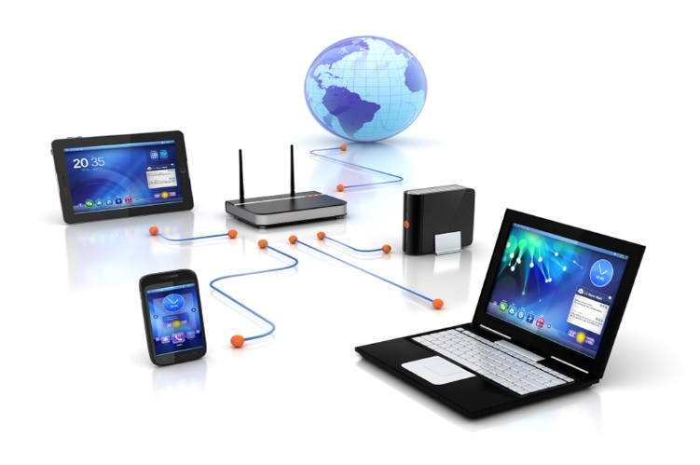
Definition of a Computer Network
A group of computers (hosts/nodes) and computer peripherals connected via a transmission media and connecting devices

Slide 3
Computer Types
Personal Computers (PCs)
  Desktop Computer
Laptops
Tablets
Smart Mobile Phones
Embedded Systems in Machines
  Internet of Things (IoT)

Slide 4
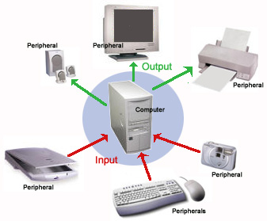
Computer Peripherals
Hardware connected to computer
  Printers
  Scanners
  Storage Media
Cloud Computing and Data Center
  Servers
  Storage Devices
  Managing Terminals
  Offers several types of services

Slide 5
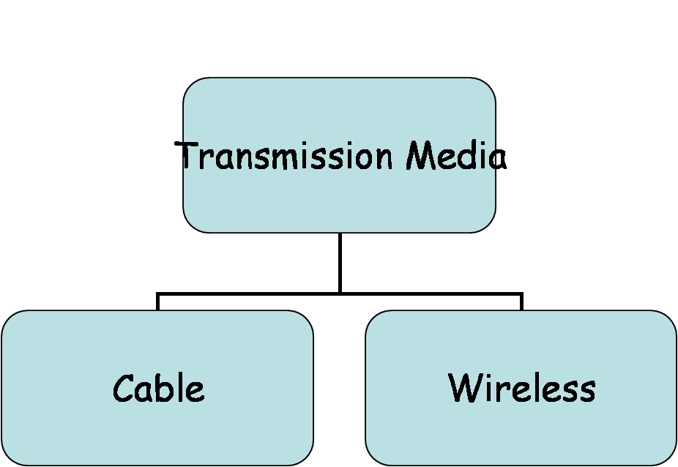
Transmission Media
Wired (Cables)
  Copper
    Coaxial Cables
    Twisted Pair Cables (Shielded/Unshielded)
  Fiber Optic
    Single Mode
    Multi-Mode
Wireless
  Air as Transmission Media
  Frequency Band
  Area of Coverage

Slide 6

Network Benefits and Services
Resources Sharing
  Hardware Resources
    Computer Peripherals
    Storage Media
    Processors
  Software Resources
    File Sharing
    Databases
    Applications
Services
  Browsing and E-mail
  Voice Calls and Video Conferences

Slide 7
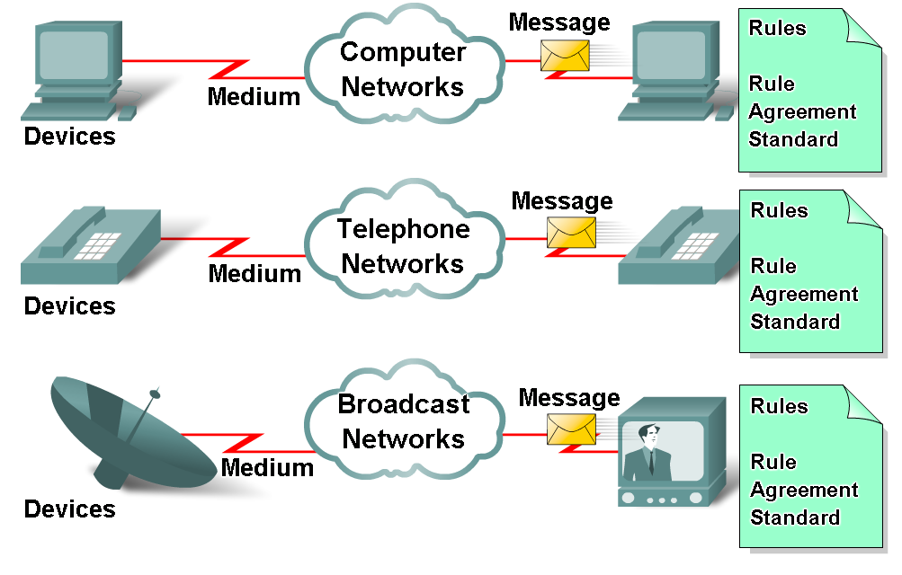
Basic Network Elements
End Devices
  Communicating with each other (Send/Receive)
Connecting Devices
  Switches, Routers, and Access Points
Medium
  How devices connected?
Messages
  Information travelling through network
Protocols
  Rules governing information transfer

Slide 8
Thank you

