Slide 1
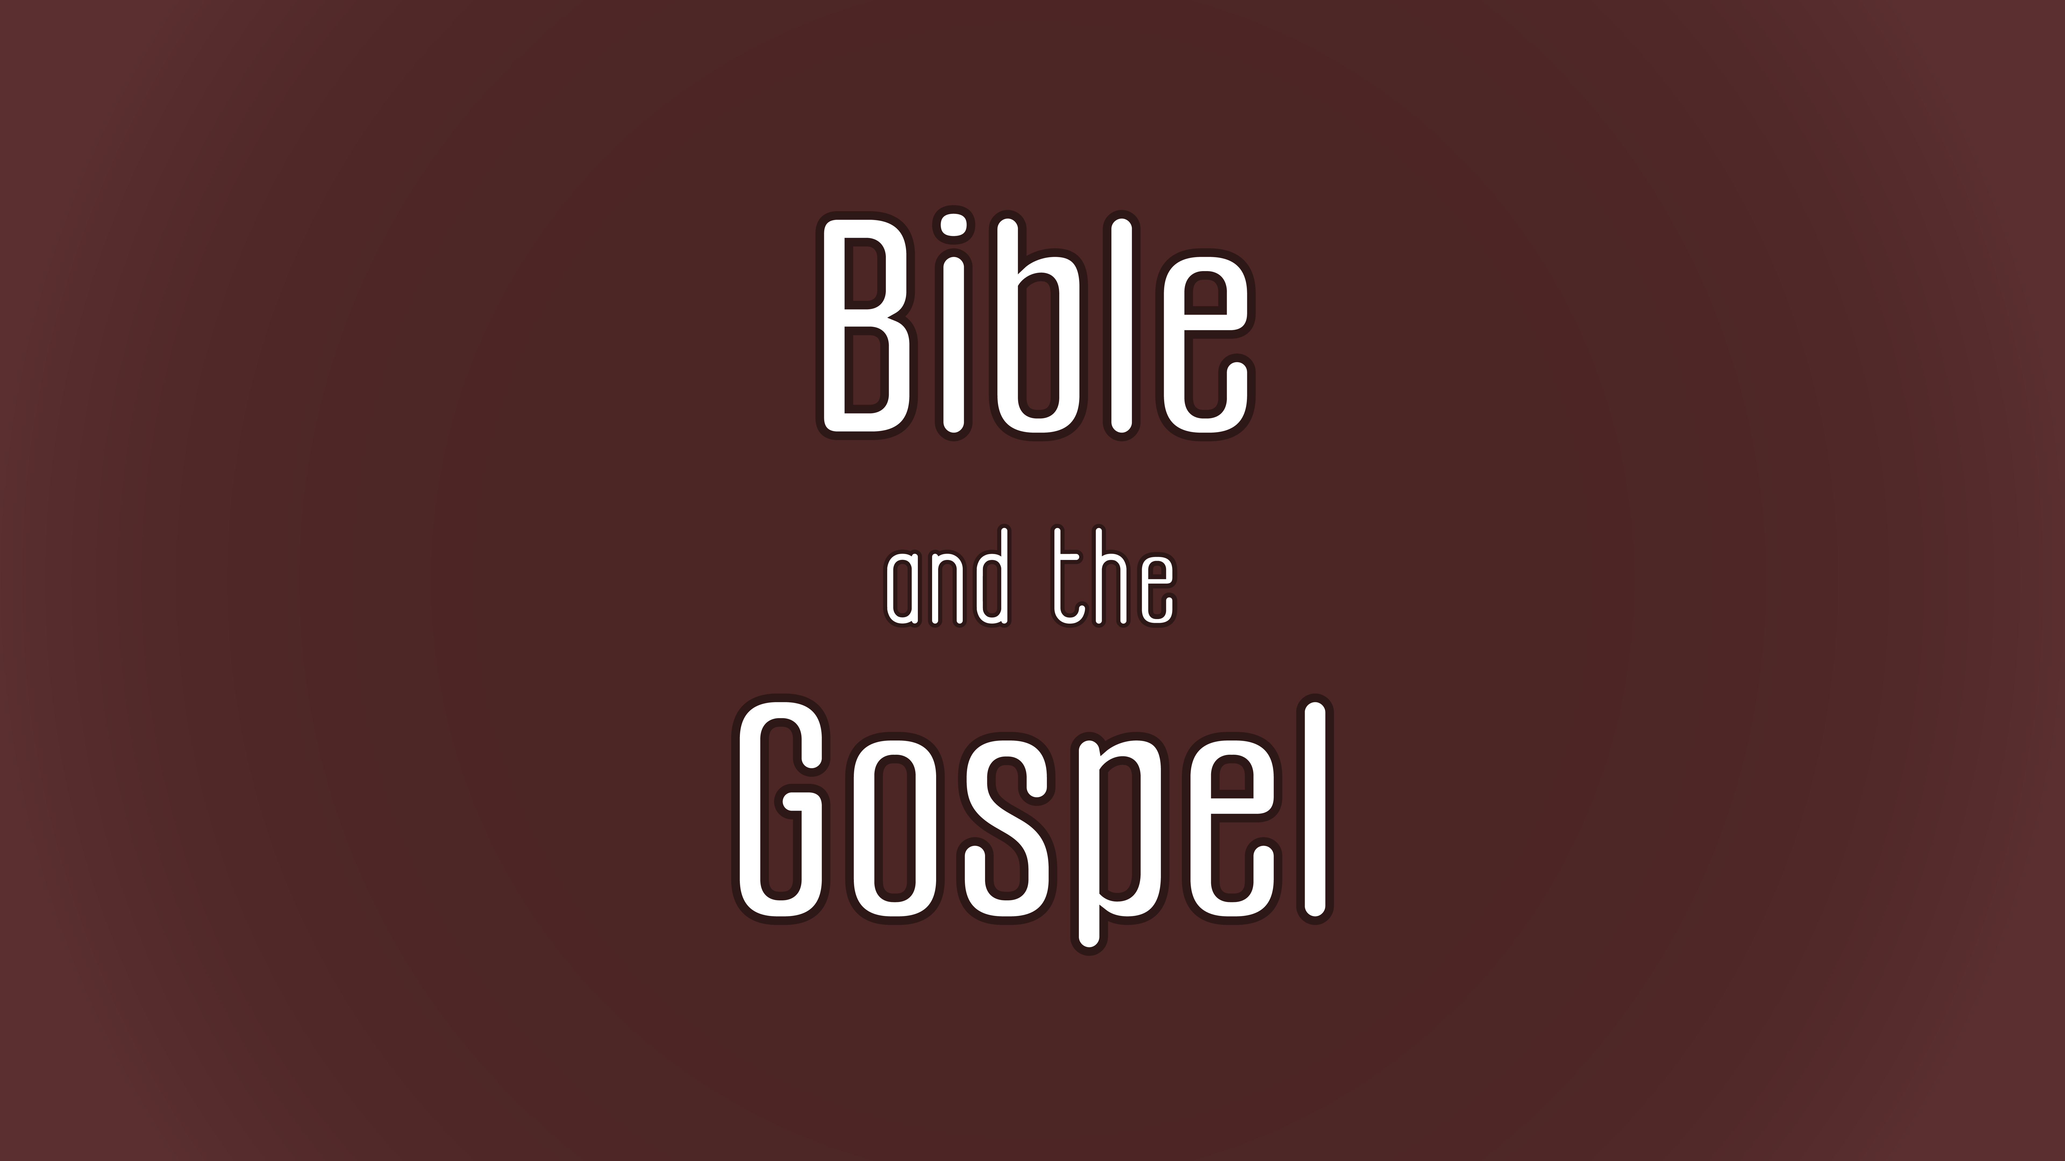

Slide 2
Character and Content of the Bible

Slide 3
What does the Bible claim about itself?

Slide 4

Class Goals:
Know some key texts in the Bible about the Bible.
Articulate a biblical understanding of the Bible.
Notes:
Begin by reinforcing the necessity and beauty of God’s word.
-Tell me some things about God.
-Tell me some things about Jesus.
-Tell me some things about salvation.
Now how do you know all those things? THE BIBLE
“Jesus loves me this I know, for the Bible tells me so” we try to engrain this basic epistemological claim into our kids’ hearts
If I am to know God, embrace Jesus, and be saved by Jesus, then I must do so through his revealed word.
If you were going to begin a book about God, what is the first thing you would say about God? “He exists and creates.” and then what? The Bible says that “And God said…”
-God speaks
-God communicates
-He communicates with us
-He superintended the process of recording that speech so that we can know him
-We were not there, so we are dependent on him to know what happened

Slide 5
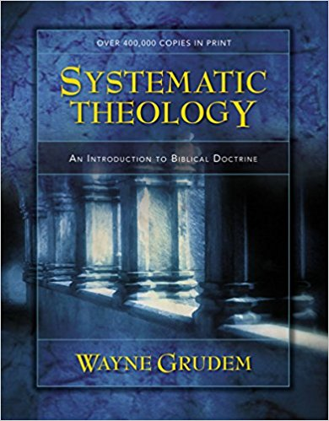
CHARACTER OF THE BIBLE: the Word of God
“FOR THE WORD OF GOD AND THE TESTIMONY OF JESUS CHRIST”
Ways that the “WORD OF GOD” is used in the Bible...
Word of God = the person of Jesus Christ (e.g., John 1:1; Rev 19:13)
Word of God = the direct speech of God (e.g., Gen 1:3; 1:24; Ps 33:6)
Word of God = God’s speech through human lips (e.g., Deut 18:18-20)
Word of God = the written form of the Bible (e.g., Exod 32:16; Josh 24:26)
Notes:
Our focus in this section is on the word of God as the Bible revealed to us.

Slide 6

CHARACTER OF THE BIBLE: an initial definition
How would you define the Bible?
Let’s say that you’re at a coffee shop, someone comes and asks you what are you reading. When you respond “The Bible,” he asks “What is the Bible?” How would you respond?

Slide 7
CHARACTER OF THE BIBLE: CU’s Statement of Faith
Cedarville Statement of Faith: “We believe that God has revealed Himself truthfully to humans through the inspired texts of the Scriptures. These canonical texts, Old and New Testaments, are inerrant, infallible, and reliable in detail and in theological content. The Bible, as the sufficient Word of God, has authority over the church and the Christian's life and thought. As divinely inspired texts, the meaning of the biblical authors is to be discerned through careful, textual interpretation guided by the Spirit.”
Notes:
The doctrinal statement starts with revelation because that is how we can know about God.

Slide 8
CHARACTER OF THE BIBLE: an initial definition
A Definition: The Bible is the Word of God, inspired by the Spirit, written for our understanding and submission. Our access to God the Son (the Word) is through the preaching (word) of the prophets and the apostles as it comes to us in the pages of Scripture.
Some of this is drawn from work by Dr. Jason Lee

Slide 9
CHARACTER OF THE BIBLE: the Bible’s self-testimony
The starting point for discussing the nature of the Bible is the Bible itself because…
  the Bible is God’s self-revelation,
  so hearing what the Bible says about itself is hearing what God says the Bible is.

Slide 10
CHARACTER OF THE BIBLE
What does the Bible say about itself?

Slide 11
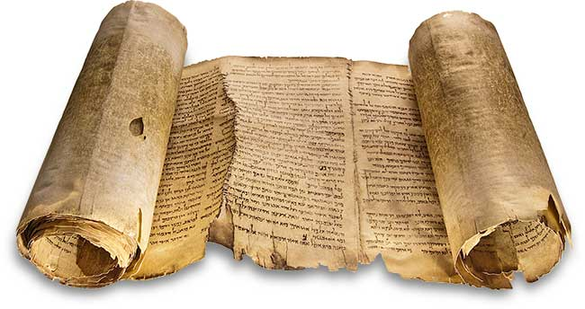
CHARACTER OF THE BIBLE: the Bible’s self-testimony
The law of the Lord is perfect,
reviving the soul;
the testimony of the Lord is sure,
making wise the simple;
⁸ the precepts of the Lord are right,
rejoicing the heart;
the commandment of the Lord is pure,
enlightening the eyes;
⁹ the fear of the Lord is clean,
enduring forever;
the rules of the Lord are true,
and righteous altogether.
¹⁰ More to be desired are they than gold,
even much fine gold;
sweeter also than honey
and drippings of the honeycomb.
¹¹ Moreover, by them is your servant warned;
in keeping them there is great reward. (Psalm 19:7-11)
Notes:
TRUTH AND BEAUTY
Characteristics of the Bible
-later Bible author reflecting on the writing of a previous author
-this is the writing a person who loves God’s word
-he declares it to be true and right
-it is a way of life
Deuteronomy 32:47: For it is no empty word for you, but your very life, and by this word you shall live long in the land that you are going over the Jordan to possess.”

Slide 12
CHARACTER OF THE BIBLE: the Bible’s self-testimony
But, as it is written, “What no eye has seen, nor ear heard, nor the heart of man imagined, what God has prepared for those who love him”— these things God has revealed to us through the Spirit. For the Spirit searches everything, even the depths of God. For who knows a person’s thoughts except the spirit of that person, which is in him? So also no one comprehends the thoughts of God except the Spirit of God. Now we have received not the spirit of the world, but the Spirit who is from God, that we might understand the things freely given us by God. And we impart this in words not taught by human wisdom but taught by the Spirit, interpreting spiritual truths to those who are spiritual. (1 Corinthians 2:9-13 ESV)
Notes:
REVELATION OF GOD HIMSELF
-God reveals his plan and his activity
-Scripture is God’s self-revelation
-Only the Spirit of God can reveal God
-God’s Spirit empowers the apostles to impart infallible spiritual wisdom

Slide 13
CHARACTER OF THE BIBLE: the Bible’s self-testimony
But as for you, continue in what you have learned and have firmly believed, knowing from whom you learned it and how from childhood you have been acquainted with the sacred writings, which are able to make you wise for salvation through faith in Christ Jesus. All Scripture is breathed out by God and profitable for teaching, for reproof, for correction, and for training in righteousness, that the man of God may be complete, equipped for every good work. (2 Timothy 3:16-17 ESV)
Notes:
REVEALING SALVATION
-God reveals himself in Scripture
-God reveals how we can be saved
-breathed-out: the words of the Bible are the very words of God
-the Bible is effective in helping us live rightly
-key verse about inspiration (we’ll return to later)

Slide 14
CHARACTER OF THE BIBLE: the Bible’s self-testimony
And we have the prophetic word more fully confirmed, to which you will do well to pay attention as to a lamp shining in a dark place, until the day dawns and the morning star rises in your hearts, knowing this first of all, that no prophecy of Scripture comes from someone’s own interpretation. For no prophecy was ever produced by the will of man, but men spoke from God as they were carried along by the Holy Spirit. (2 Peter 1:19-21 ESV)
Notes:
GOD IS THE AUTHOR→ SELF-REVELATION
-the origin of the Bible is NOT with humans
-the origin of the Bible is GOD HIMSELF
-it is God’s self-revelation of who he is and what he’s done
-The HS “carried along” these authors in a process called inspiration
--key verse about inspiration (we’ll return to later)

Slide 15
CHARACTER OF THE BIBLE: the Bible’s self-testimony
For Christ did not please himself, but as it is written, “The reproaches of those who reproached you fell on me.” For whatever was written in former days was written for our instruction, that through endurance and through the encouragement of the Scriptures we might have hope. (Romans 15:3-4 ESV)
Notes:
GUIDE FOR LIFE

Slide 16
CHARACTER OF THE BIBLE: the Bible’s self-testimony
For I do not want you to be unaware, brothers, that our fathers were all under the cloud, and all passed through the sea, 2 and all were baptized into Moses in the cloud and in the sea, 3 and all ate the same spiritual food, 4 and all drank the same spiritual drink. For they drank from the spiritual Rock that followed them, and the Rock was Christ. 5 Nevertheless, with most of them God was not pleased, for they were overthrown in the wilderness.
6 Now these things took place as examples for us, that we might not desire evil as they did. 7 Do not be idolaters as some of them were; as it is written, “The people sat down to eat and drink and rose up to play.” 8 We must not indulge in sexual immorality as some of them did, and twenty-three thousand fell in a single day. 9 We must not put Christ to the test, as some of them did and were destroyed by serpents, 10 nor grumble, as some of them did and were destroyed by the Destroyer. 11 Now these things happened to them as an example, but they were written down for our instruction, on whom the end of the ages has come. 12 Therefore let anyone who thinks that he stands take heed lest he fall. 13 No temptation has overtaken you that is not common to man. God is faithful, and he will not let you be tempted beyond your ability, but with the temptation he will also provide the way of escape, that you may be able to endure it. (1 Cor 10:1-13 ESV)
Notes:
RELEVANT GUIDE FOR LIFE
-OT relevant for today
-we understand God’s plan through how he has revealed and interpreted it

Slide 17
CHARACTER OF THE BIBLE: the Bible’s self-testimony
In your groups, read Psalm 119 (assigned by letter of the Hebrew alphabet). Make a list of how the Bible is described. For what is it used?

Slide 18
CHARACTER OF THE BIBLE
What does Jesus say about the Bible?
Notes:
Look at Matthew 12:38-42
Jesus treats the Bible as actual true history
Billy Graham: I would believe the Bible even if it said that Jonah swallowed the whale
ISN’T IT REASONABLE TO CLAIM THAT JESUS UNDERSTOOD THE NATURE OF THE BIBLE BETTER THAN MODERN SKEPTICS AND CRITICS?
CHRIST’S DOCTRINE OF SCRIPTURE SHOULD BE OUR DOCTRINE OF SCRIPTURE

Slide 19
CHARACTER OF THE BIBLE: the testimony of Jesus
31 The Jews picked up stones again to stone him. 32 Jesus answered them, “I have shown you many good works from the Father; for which of them are you going to stone me?” 33 The Jews answered him, “It is not for a good work that we are going to stone you but for blasphemy, because you, being a man, make yourself God.” 34 Jesus answered them, “Is it not written in your Law, ‘I said, you are gods’? 35 If he called them gods to whom the word of God came—and Scripture cannot be broken— 36 do you say of him whom the Father consecrated and sent into the world, ‘You are blaspheming,’ because I said, ‘I am the Son of God’? 37 If I am not doing the works of my Father, then do not believe me; 38 but if I do them, even though you do not believe me, believe the works, that you may know and understand that the Father is in me and I am in the Father.” 39 Again they sought to arrest him, but he escaped from their hands. (Jn 10:31–39 ESV)
Notes:
-the Bible is ENDURING AND AUTHORITATIVE
Niv: 10:34–36 Jesus quotes Ps 82:6 to question their umbrage: “gods” can refer to others than God himself, so if God called humans “gods” and “sons of the Most High” (i.e., sons of God) in some sense, on what Scriptural basis can the Jews charge that Jesus—whom the Father sent—is necessarily guilty of blasphemy when he says that he is God’s Son?
Esv: 10:34 Jesus’ point in quoting Ps. 82:6 is that if human judges (Ps. 82:2–4) can in some sense be called gods (in light of their role as representatives of God), this designation is even more appropriate for the one who truly is the Son of God (John 10:33, 35–36).
Crossway Bibles. (2008). (p. 2044). Crossway Bibles.

Slide 20
CHARACTER OF THE BIBLE: the testimony of Jesus
¹⁷ “Do not think that I have come to abolish the Law or the Prophets; I have not come to abolish them but to fulfill them. ¹⁸ For truly, I say to you, until heaven and earth pass away, not an iota, not a dot, will pass from the Law until all is accomplished. (Matthew 5:17-18)
²⁶ Was it not necessary that the Christ should suffer these things and enter into his glory?” ²⁷ And beginning with Moses and all the Prophets, he interpreted to them in all the Scriptures the things concerning himself. (Luke 24:25-27)
Notes:
-the Bible is CHRISTOCETRIC—that is, it points to Christ as the fulfilment
-Jesus has his own authority to utter God’s words. He is God, so what he says is the very word of God. But he often quotes and explains the Bible? Why? Because Jesus’s words and the OT have the same consistent author: God himself.

Slide 21
CHARACTER OF THE BIBLE: the testimony of Jesus
35 And as Jesus taught in the temple, he said, “How can the scribes say that the Christ is the son of David? 36 David himself, in the Holy Spirit, declared,
“ ‘The Lord said to my Lord,
“Sit at my right hand,
until I put your enemies under your feet.” ’
37 David himself calls him Lord. So how is he his son?” And the great throng heard him gladly. (Mark 12:35–37 ESV)
Notes:
CHRISTOCENTRIC
INSPIRED…the dual authorship of Scripture

Slide 22
CHARACTER OF THE BIBLE: the testimony of Jesus
Then Jesus was led up by the Spirit into the wilderness to be tempted by the devil. ² And after fasting forty days and forty nights, he was hungry. ³ And the tempter came and said to him, “If you are the Son of God, command these stones to become loaves of bread.” ⁴ But he answered, “It is written, “‘Man shall not live by bread alone, but by every word that comes from the mouth of God.’”…Jesus said to him, “Again it is written, ‘You shall not put the Lord your God to the test.’”… Then Jesus said to him, “Be gone, Satan! For it is written, “‘You shall worship the Lord your God and him only shall you serve.’” (Matthew 4:1-11)
Notes:
USEFUL for life

Slide 23
CHARACTER OF THE BIBLE
What is the relationship between the Bible and the gospel?

Slide 24
CHARACTER OF THE BIBLE: an initial definition
A Definition: The Bible is the Word of God, inspired by the Spirit, written for our understanding and submission. Our access to God the Son (the Word) is through the preaching (word) of the prophets and the apostles as it comes to us in the pages of Scripture.
Some of this is drawn from work by Dr. Jason Lee

Slide 25
CHARACTER OF THE BIBLE: the Bible and the Gospel
Paul, a servant of Christ Jesus, called to be an apostle, set apart for the gospel of God, ² which he promised beforehand through his prophets in the holy Scriptures, ³ concerning his Son, who was descended from David according to the flesh ⁴ and was declared to be the Son of God in power according to the Spirit of holiness by his resurrection from the dead, Jesus Christ our Lord, ⁵ through whom we have received grace and apostleship to bring about the obedience of faith for the sake of his name among all the nations, ⁶ including you who are called to belong to Jesus Christ,⁷ To all those in Rome who are loved by God and called to be saints: Grace to you and peace from God our Father and the Lord Jesus Christ. (Romans 1:1-7)
Notes:
-Would it be the gospel if it weren’t the fulfillment of OT prophecies?
-Imagine if the gospel disregarded God’s promises to Israel. Could we trust God to make good on his promises to us if he didn’t make good on his promises to Israel?
-Describe chapters 9-11 in the Book of Romans.

Slide 26
CHARACTER OF THE BIBLE: the Bible and the Gospel
1 Cor 15:3-5:For I delivered to you as of first importance what I also received: that Christ died for our sins in accordance with the Scriptures, that he was buried, that he was raised on the third day pin accordance with the Scriptures, and that he appeared to Cephas, then to the twelve
(first Christian Sermon) Acts 2:14-16: But Peter, standing with the eleven, lifted up his voice and addressed them: “Men of Judea and all who dwell in Jerusalem, let this be known to you, and give ear to my words. For these people are not drunk, as you suppose, since it is only the third hour of the day. But this is what was uttered through the prophet Joel:
The truthfulness of the Bible and sharing the gospel (first 7 minutes): https://www.youtube.com/watch?v=m1mg8hCekn4

Slide 27
CHARACTER OF THE BIBLE: God’s self-revelation
How do we know about God?
Make a truth statement about God. How do you know that truth claim about God?
Notes:
Begin by reinforcing the necessity and beauty of God’s word.
-Tell me some things about God.
-Tell me some things about Jesus.
-Tell me some things about salvation.
Now how do you know all those things? THE BIBLE
“Jesus loves me this I know, for the Bible tells me so” we try to engrain this basic epistemological claim into our kids’ hearts
If I am to know God, embrace Jesus, and be saved by Jesus, then I must do so through his revealed word.
If you were going to begin a book about God, what is the first thing you would say about God? “He exists and creates.” and then what? The Bible says that “And God said…”
-God speaks
-God communicates
-He communicates with us
-He superintended the process of recording that speech so that we can know him
-We were not there, so we are dependent on him to know what happened

Slide 28
What is the character of the Bible…key terms?

Slide 29
Class Goals:
Articulate the doctrine of Scripture.
Know some key texts that describe the character of the Bible.
Explain key theological terms about the Bible (e.g., Inspiration, Inerrancy, Christological Outlook, Sufficiency, Clarity, Authority, Necessity)..

Slide 30
CHARACTER OF THE BIBLE: revelation
Revelation is God’s disclosure of the reality about him.
Why is revelation necessary?
Notes:
God’s infinitude and our finitude makes revelation necessary.
God alone is sufficient to reveal himself.

Slide 31
CHARACTER OF THE BIBLE: God’s self-revelation
Revelation is divine communication.
The Bible begins by telling us that God exists and creates. The way that he creates is through SPEAKING. Our God speaks. God communicates. He reveals himself.

Slide 32
CHARACTER OF THE BIBLE: God’s self-revelation
A common way of thinking about discovery of knowledge, especially knowledge about God: https://www.youtube.com/watch?v=Vn9BUfUCL4I
But what changes if the elephant speaks? What if the elephant can tell the blind men, “I AM AN ELEPHANT.” https://youtu.be/m1mg8hCekn4?t=964

Slide 33

CHARACTER OF THE BIBLE: God’s self-revelation
“But of course there are two enormous problems with the [elephant] analogy. For starters, the whole story is told from the vantage point of someone who clearly knows that the elephant is an elephant. For the story to make its point, the narrator has to have clear and accurate knowledge of the elephant. The second flaw is even more serious. The story is a perfectly good description of human inability in matters of the divine. We are blind and unable to know God by our own devices. But the story never considers this paradigm-shattering question: What if the elephant talks? What if he tells the blind men, ‘That wall-like structure is my side. That fan is really my ear. And that’s not a rope; it’s a tail.’ If the elephant were to say all this, would the six blind men be considered humble for ignoring his word? We must not separate epistemology (that is, our theory of what we know and how we can know it) from the rest of theology. These high-sounding debates about perspicuity and hermeneutics really have to do with the character of God. Is God wise enough to make himself known? Is he good enough to make himself accessible? Is he gracious enough to communicate in ways that are understandable to the meek and lowly? Or does God give us commands we can’t understand and a self-revelation that reveals more questions than answers?”

Slide 34
CHARACTER OF THE BIBLE: inspiration
What do we mean when we say that the Bible is inspired?
Recall that Jesus said, “David himself, in the Holy Spirit, declared [Psalm 110:1]” (Mark 12:36).
Notes:
How does inspiration happen? Does God take over and the human authors became mindless? Do they write as they always would and God puts his stamp on it when they’re done?

Slide 35
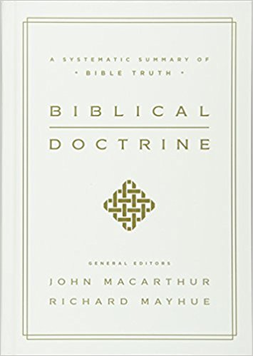
CHARACTER OF THE BIBLE: inspiration
DEFINITION OF INSPIRATION: the supernatural work of the Holy Spirit to speak through human authors, so that what they wrote was what God intended to communicate.
VERBAL-PLENARY INSPIRATION: “God through his Spirit inspired every word penned by the human authors in each of the 66 books of the Bible” (MacArthur and Mayue, Biblical Doctrine, 77).
  Verbal: the very words, not just big ideas
  Plenary: full or every single word

Slide 36
CHARACTER OF THE BIBLE: inspiration
But as for you, continue in what you have learned and have firmly believed, knowing from whom you learned it and how from childhood you have been acquainted with the sacred writings, which are able to make you wise for salvation through faith in Christ Jesus. All Scripture is breathed out by God and profitable for teaching, for reproof, for correction, and for training in righteousness, that the man of God may be complete, equipped for every good work.
(2 Timothy 3:16-17 ESV)
Notes:
-”God-breathed”- GOD IS THE SOURCE OF SCRIPTURE
-the entirety of Scripture is inspired
-the Bible is authoritative for our lives

Slide 37
CHARACTER OF THE BIBLE: inspiration
And we have the prophetic word more fully confirmed, to which you will do well to pay attention as to a lamp shining in a dark place, until the day dawns and the morning star rises in your hearts, knowing this first of all, that no prophecy of Scripture comes from someone’s own interpretation. For no prophecy was ever produced by the will of man, but men spoke from God as they were carried along by the Holy Spirit. (2 Peter 1:19-21 ESV)
Notes:
-GOD IS THE SOURCE OF SCRIPTURE

Slide 38
CHARACTER OF THE BIBLE: inerrancy
Inerrancy: the Bible contains no errors; it does not affirm anything contrary to fact.
When all the facts are known and understood properly in their contexts, the Bible will be proven completely true and never false.
“Inerrancy means the word of God always stands over us and we never stand over the word of God. When we reject inerrancy we put ourselves in judgment over God’s word” (DeYoung, Taking God at His Word, 39).
Inerrancy is grounded in the truthfulness of God. If God is true, his self-revelation is true.
https://www.youtube.com/watch?v=i6zudFtjI4U&feature=youtu.be
Notes:
-inerrancy allows for normal language or idiom (e.g., the sun rises; there are 4,500 students at Cedarville University)
-there is a significant abandonment when someone says “only in matters of faith and practice”

Slide 39
CHARACTER OF THE BIBLE: Christological outlook
Christological Outlook- The Bible is focused on the person and work of Jesus Christ. The OT anticipates his coming, the NT describes his ministry, and the NT anticipates his second coming.
The Bible looks at the cross both prospectively in the OT and retrospectively in the NT.
“The new is in the old concealed; the old is in the new revealed.” –Augustine

Slide 40
CHARACTER OF THE BIBLE: characteristics
Think about your favorite novel. What are some qualities or characteristics of the novel? What makes it your favorite?
What are some characteristics of the Bible? What adjectives would you use to describe it?

Slide 41
CHARACTER OF THE BIBLE: characteristics
What we HAVE COVERED…
Bible’s Self-Description
Self-Revelation
Inspiration
Inerrancy
Christological Outlook
What we WILL cover…
Sufficiency
Clarity
Authority
Necessity
Notes:
I want to commend DeYoung’s book again as a helpful presentation of these concepts.

Slide 42
CHARACTER OF THE BIBLE:
SCAN
What is the sufficiency of Scripture?
  The Bible contains everything we need to know and love God.
What is the clarity (i.e. perspicuity) of Scripture?
  The Bible is understandable.
What is the authority of Scripture?
  The Bible stands over all my thoughts and actions (i.e. the Bible gets the first and the last word).
What is the necessity of Scripture?
  The Bible is essential for us to love and obey God (i.e. we can’t come to personal and saving knowledge of God apart from the Bible).

Slide 43
CHARACTER OF THE BIBLE: sufficiency
Sufficiency- The Bible contains everything we need to know and love God.
Take away: We don’t need any new revelation from God.
“His divine power has granted to us all things that pertain to life and godliness, through the knowledge of him who called us to his own glory and excellence, by which he has granted to us his precious and very great promises, so that through them you may become partakers of the divine nature, having escaped from the corruption that is in the world because of sinful desire.” (2 Peter 1:3-4)
Notes:
Kevin Deyoung, Taking God at His Word:
Practical Sufficiency
1. We keep tradition in its place.
2. We will not add to or subtract from the Word of God.
3. We can expect the Word of God to be relevant to all of life.
4. This doctrine invites us to open our Bibles to hear the voice of God.

Slide 44
CHARACTER OF THE BIBLE: clarity
Clarity- the Bible is understandable
The biblical texts are capable of communicating the meaning that the authors intend.
  "Scripture is clear, but hard." Michael Shepherd, The Textual World of the Bible, 90-92.
  Claiming that something is “unclear” can be an attempt to avoid its authority.
  God is wise enough to make himself known.
Take away: we don’t need a teaching magisterium to explain God’s word (but that does NOT mean we don’t need to study and that we are not benefitted by teachers).
“Then he said to them, “These are my words that I spoke to you while I was still with you, that everything written about me in the Law of Moses and the Prophets and the Psalms must be fulfilled.” Then he opened their minds to understand the Scriptures…” (Luke 24:44-45 ESV)
Notes:
-sometimes theistic evolutionists speak as if no one understood the meaning of Genesis until the 18th century

Slide 45
CHARACTER OF THE BIBLE: authority
Authority-the Bible stands over all my thoughts and actions.
  As God’s inspired Word, the biblical text’s revelation guides the church and the individual believer in all life and thought.
  Inspiration ensures that the Bible is God’s Word and it carries the authority of God himself.
  "[The Bible] carries the same authority as the God who speaks it and so has the right to say what is true and to demand obedience. As Christians we want to live with God in charge of us, and in practice that means living in submission to the words of Scripture. Listening to Jesus’ voice and following him in all that he says is a matter of instinct (Jn 10:27)" (Beynon and Sach, Dig Deeper, 22-23).
  See John 10:27; Luke 6:46
  Adopt a hermeneutic of obedience!
  Be characterized by pervasive biblical authority!
Take away: the Bible trumps all other truth claims. God’s word has the first final word.
Notes:
-

Slide 46
CHARACTER OF THE BIBLE: authority
Statements representing potential threats to biblical authority:
“We’re in Cedarville. Everybody believes in the authority of God’s word.”
“I wish I knew Greek, so I could figure this out.”
“Let’s just focus on the majors.”
“This is so obscure that we shouldn’t worry about it.”
“This isn’t relevant to our lives today” (esp. talking about the OT).
“There are a lot of interpretations, so I’m not sure we can understand it.”
“I feel like this is saying...”
“I know what Paul is saying, but we understand this so much better today.”
“We’re in a totally different context.”
“Paul never could have imagined this…”
“I don’t like it, but if God says it, I guess I’ll do it.”
“We might believe every single detail, but the gist is correct.”
“Do we have to talk about this again? Every chapel speaker references this.”
http://themelios.thegospelcoalition.org/article/subtle-ways-to-abandon-the-authority-of-scripture-in-our-lives
Notes:
-

Slide 47
CHARACTER OF THE BIBLE: necessity
Necessity- we need God’s word for knowing the gospel, knowing God’s will, and spiritual life. General revelation is not sufficient.
  Recall the difference between general and special revelation.
  The gospel is not deduced from the world around us. The gospel is spoken to us through the Bible.
  We are dependent on God to reveal himself. If we are to know him, it is necessary that he reveals himself to us.
  Romans 10:13-17

Slide 48
CHARACTER OF THE BIBLE:
SCAN
Which of these characteristics is most debated or denied today?

Slide 49

CHARACTER OF THE BIBLE: clarity
If authority is the liberal problem, clarity the postmodern problem, and necessity the problem for atheists and agnostics, then sufficiency is the attribute most quickly doubted by rank and file Christians. We can say all the right things about the Bible, and even read it regularly, but when life gets difficult, or just a bit boring, we look for new words, new revelation, and new experiences to bring us closer to God (DeYoung, Taking God at His Word, 45-46)
Notes:
Denial of…
-authority: I am my own master
-clarity: can truth be known? Is there truth? (postmodernism has questions without answers)
-necessity: if there is a God, I can know him from everything around us
-sufficiency:

Slide 50
How does the Bible come to us?
Notes:
-we read a story from Jeremiah about God preserving his word.

Slide 51
Class Goals:
Explain the processes of transmission, canonization, and translation.
Know key terms about the transmission, canonization, and translation of the Bible.

Slide 52
BIBLE AND THE GOSPEL: how the Bible comes to us
I was leading a group of people to do street evangelism for a church plant in Chicago. One of our evangelistic pairs encountered a man eager to talk. After they explained the gospel, and called for a response, he objected, “Why don’t you include the Gospel of Thomas in your Bible?” How would you respond to him?
Notes:
Dating: it is much later that the apostles, making it impossible to be written by an apostle
Christology: the Jesus of GOT is a wise teacher but not a substitute
Orthodoxy: the view of humanity is unbiblical, and here is an example: “(114) Simon Peter said to them, "Mary should leave us, for females are not worthy of life." Jesus said, "See, I am going to attract her to make her male so that she too might become a living spirit that resembles you males. For every female (element) that makes itself male will enter the kingdom of heaven."”

Slide 53
BIBLE AND THE GOSPEL: how the Bible comes to us
Striving for Faithfulness
Inspired Writing
Transmission
Translation
Infallible
Trustworthy
Canonization: recognition of authority
Text Criticism: seeking the original
Re-translation: updating language
Notes:
Canon-the canon (a group of inspired writings) exists because God has spoken. Canonization is the recognition of that reality
Transmission: God preserves his word
Translaton:

Slide 54
BIBLE AND THE GOSPEL: how the Bible comes to us
Canonization
Canon: the 66 books of the Bible comprise one authoritative book from one divine author
canon = a rule of measure that becomes a standard (e.g., yardstick)
Canonicity: the church’s recognition and affirmation of the inspired writings
OT: established before the time of Christ
NT:
  By the time of 2 Peter 3:16 the writings of Paul were known
  Likely recognized early and made explicit by the 4th century
  Bishop Athanasius’s festal letter AD 367 lists all 27 NT books
Notes:
-questions to the faith often force the church to articulate assumed matters of the faith
-e.g., Arius questioned the deity of the Son, and thus the church had to articulate its understanding
-e.g., Marcion rejected the OT and some of the NT, so the church had to articulate its understanding

Slide 55
BIBLE AND THE GOSPEL: how the Bible comes to us
Canonization…Some of the criteria/tests
ORTHODOXY: faithful to the apostolic teaching (i.e. the rule of faith)
APOSTOLICITY: authored by an apostle or someone from the apostolic circle
ANTIQUITY: both old enough to be by an apostle and widely circulated
Christologically centered
Give internal evidence of its unique character as inspired and authoritative
“The church did not establish a canon of its choosing; it is more proper to speak of the church recognizing the books that Christians has always considered to be an authoritative Word from God” (Berding, “NT Canon” in What the New Testament Authors Really Cared About, 318).

Slide 56
BIBLE AND THE GOSPEL: how the Bible comes to us
Striving for Faithfulness
Inspired Writing
Transmission
Translation
Infallible
Trustworthy
Canon: recognition of authority
Text Criticism: seeking the original
Re-translation: updating language

Slide 57
BIBLE AND THE GOSPEL: how the Bible comes to us
HOW THE BIBLE COMES TO US:
  Transmission: the process by which a text is passed down through copying and recopying over the years
  Variant: any difference in wording, spelling, or content among manuscripts
  Text Criticism: “a discipline that tries to restore the original text of a lost document by resolving textual variants among the extant witnesses.” (Meade and Gurry, Scribes and Scripture, 252) It is both a science (with objective data) and an art (involving interpretation).
      Internal evidence: data from the author's argument, context, and writing style
      External evidence: data from comparing and evaluating multiple manuscripts

Slide 58
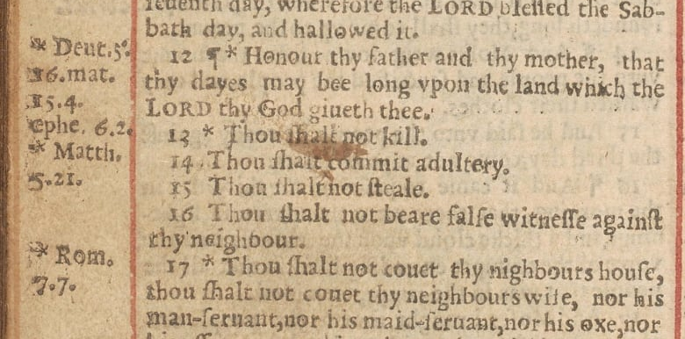
BIBLE AND THE GOSPEL: how the Bible comes to us
Errors can happen…even accidentally
Notes:
Errors: an example of unintentional errors with great consequences
Wikipedia: The Wicked Bible, sometimes called the Adulterous Bible or the Sinners' Bible, is an edition of the Bible published in 1631 by Robert Barker and Martin Lucas, the royal printers in London, meant to be a reprint of the King James Bible. The name is derived from a mistake made by the compositors: in the Ten Commandments in Exodus 20:14, the word "not" was omitted from the sentence "Thou shalt not commit adultery," causing the verse to instead read "Thou shalt commit adultery."

Slide 59

BIBLE AND THE GOSPEL: how the Bible comes to us
Errors can happen…even accidentally
Notes:
Tell the story of Byron and Libby

Slide 60
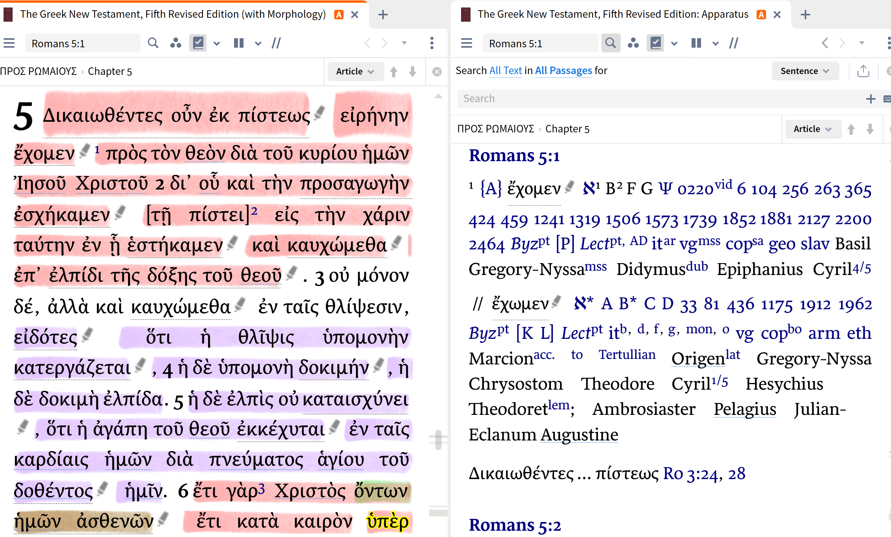

Slide 61
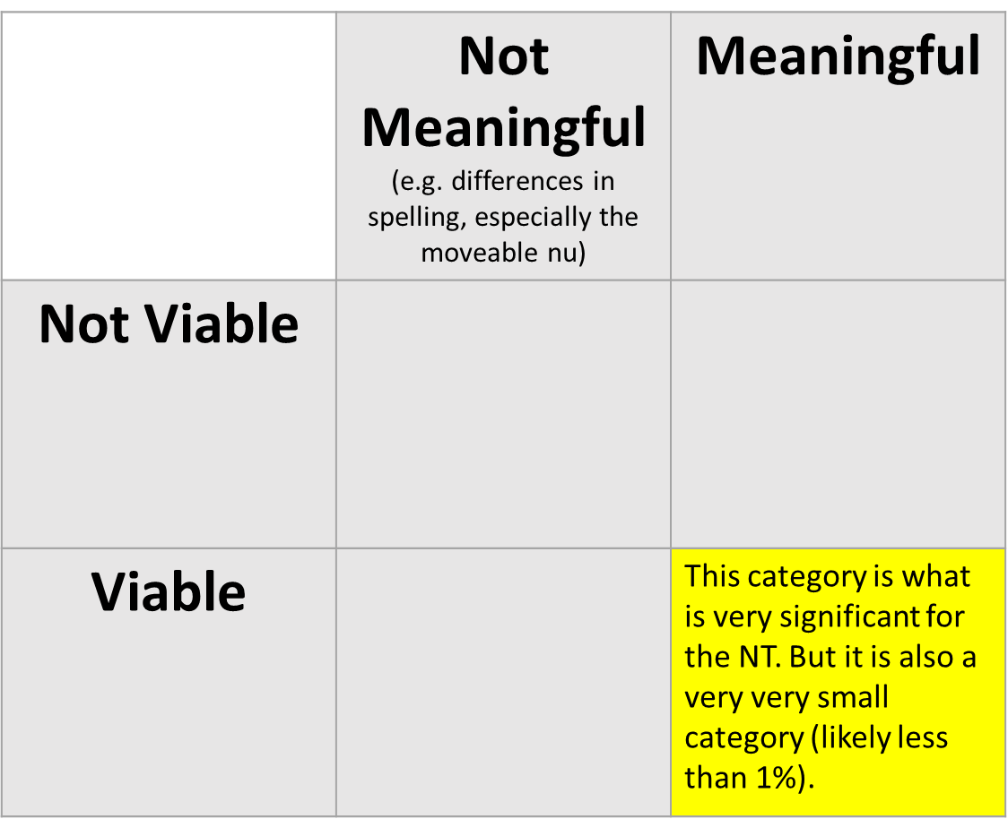
BIBLE AND THE GOSPEL: how the Bible comes to us
Types of variants

Slide 62
BIBLE AND THE GOSPEL: how the Bible comes to us
TEXT CRITICISM: examples of intentional variants
Grammatical “improvements”: Mark 6:29…ἦλθον is substituted in place of ἦλθαν
Liturgical changes: Matt 6:13…ὅτι σοῦ ἐστιν ἡ βασιλεία καὶ ἡ δύναμις καὶ ἡ δόξα εἰς τοὺς αἰῶνας. ἀμήν
Harmonization of parallels (n.b. could be unintentional): Matt 19:17 // Mark 10:18
Elimination of seeming discrepancies / contradictions: Mark 1:2… ἐν τῷ Ἠσαΐᾳ τῷ προφήτῃ for a citation from Malachi 1
Doctrinal changes (n.b. often strengthening): 1 John 5:7-8

Slide 63
BIBLE AND THE GOSPEL: how the Bible comes to us
TEXT CRITICISM: examples of unintentional variants
Incorrect Division of Words (fusion): Mark 10:40…ἀλλʼ οἷς
Incorrect Division of Words (fission): Rom 7:14…οἴδαμεν
Skipping Due to Similar Beginnings or Endings (homoioarkton or homoioteleuton): 1 Jn 2:23 and the omission of the first “τὸν πατέρα ἔχει” in several manuscripts
Single Writing of a Double Letter (haplography): John 1:13…ἐγεννήθησαν
Double Writing of a Single Letter or Word (dittography): Mark 12:27…θεὸς
Change of Place (metathesis): Mark 14:65… ἔλαβον becomes ἔβαλον (struck); John 1:42…Ἰωάννου and Ἰωανᾶ
Confusion of Vowels Sounds (itacism): e.g., Rom 5:1…ἔχομεν
Substitution of similar sounding words (homophony): e.g., Rom 5:1…ἔχομεν
Omissions: Eph 1:1…ἐν Ἐφέσῳ

Slide 64
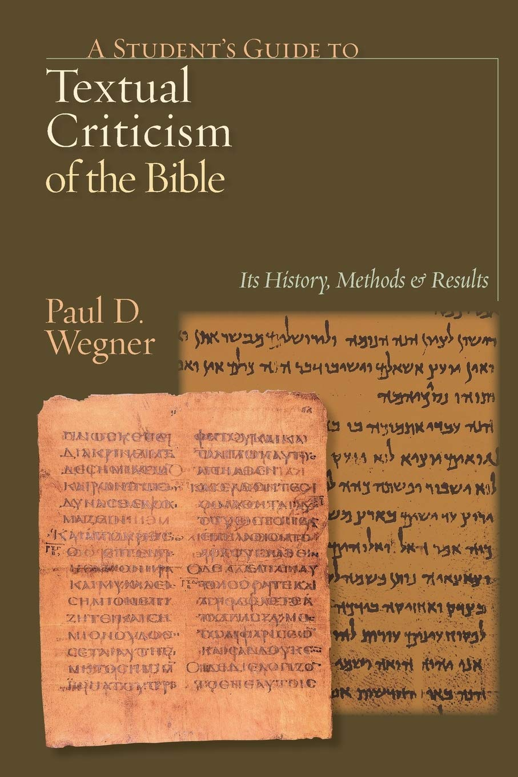
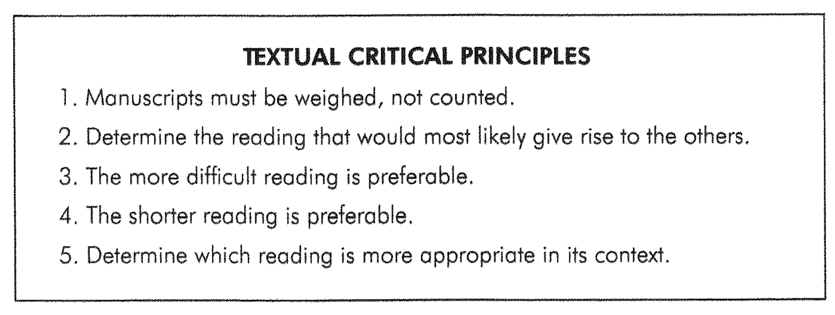

Slide 65
BIBLE AND THE GOSPEL: how the Bible comes to us
Striving for Faithfulness
Inspired Writing
Transmission
Translation
Infallible
Trustworthy
Canon: recognition of authority
Text Criticism: seeking the original
Re-translation: updating language

Slide 66
BIBLE AND THE GOSPEL: how the Bible comes to us
TRANSLATION: some important ideas
Translation necessitates interpretation.
Translation is an ongoing process (in part because receptor languages change).
Readability: the degree to which a work is expressed in common language, often measured by reading level
Translation Committee: group of people (sometimes more or less diverse and skilled) charged with producing a translation.
Translation Theory: The stated approach and objectives of the translator(s) in producing a document.
  Formal Equivalence:
  Functional / Dynamic Equivalence:

Slide 67
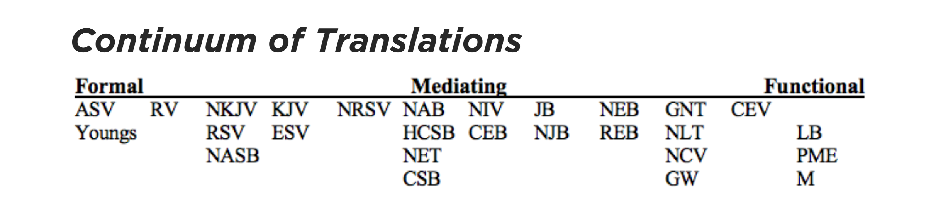
https://www.thegospelcoalition.org/essay/the-bible-in-translation/
Notes:
NOTE: this is from Mark Strauss posted on TGC

Slide 68
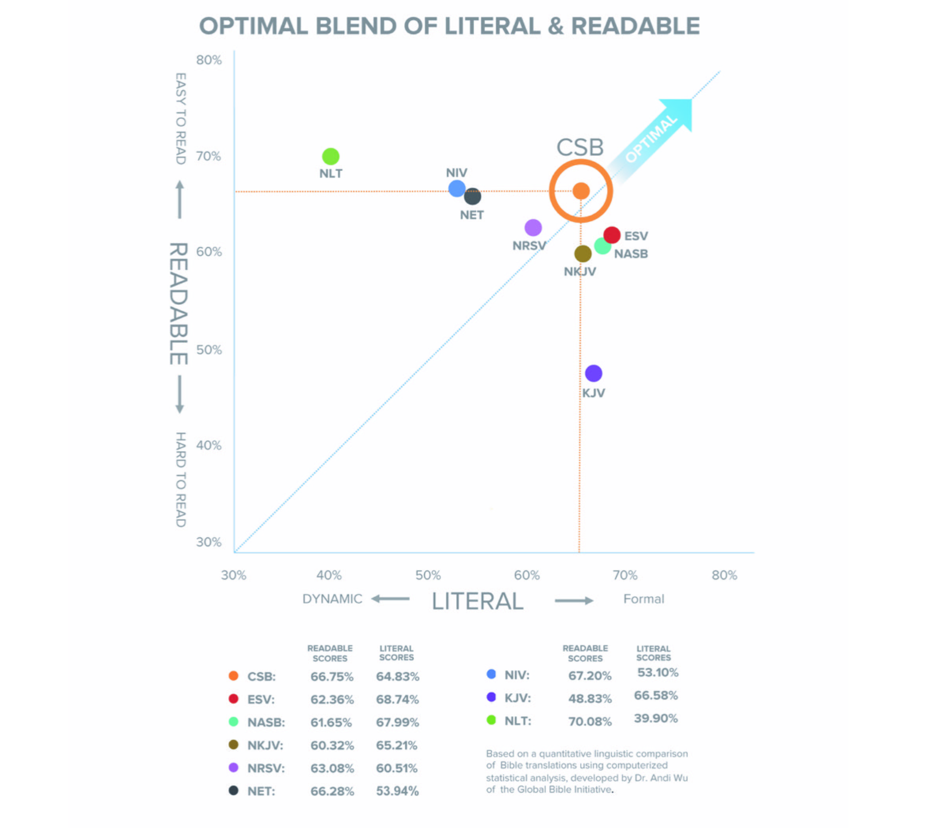
Notes:
NOTE: this is information put out by the CSB to argue for their translation

Slide 69
THE
CONTENT
OF THE BIBLE
The Overarching Story

Slide 70
What is the message of the Bible?

Slide 71
Class Goals:
Articulate the message of the Bible from Genesis to Revelation.
Know key texts in the biblical storyline.
Observe the practice of biblical theology.

Slide 72

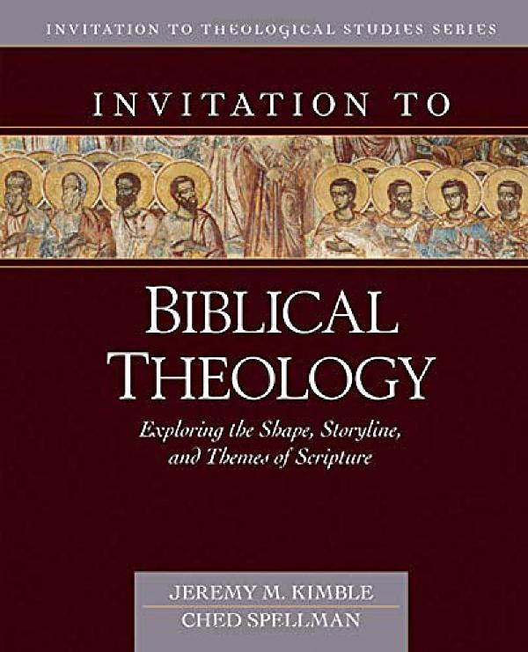
A valuable starting point for doing biblical theology is establishing a comprehensive framework. The building blocks of a solid framework for doing biblical theology can be grouped into three categories: the canon, the covenants, and Christ. (Kimble and Spellman, Invitation to Biblical Theology, 53)
Notes:
Reading the Bible rightly will take notice of these three things:
Christ→ we looked at the Christocentric nature of Scripture
Canon → We will look at the story of Scripture…the story of the canon
Covenant → we will look at the covenants

Slide 73



A valuable starting point for doing biblical theology is establishing a comprehensive framework. The building blocks of a solid framework for doing biblical theology can be grouped into three categories: the canon, the covenants, and Christ. (Kimble and Spellman, Invitation to Biblical Theology, 53)
Notes:
Reading the Bible rightly will take notice of these three things:
Christ→ we looked at the Christocentric nature of Scripture
Canon → We will look at the story of Scripture…the story of the canon
Covenant → we will look at the covenants

Slide 74
CONTENT OF THE BIBLE: overarching story
The Bible is a collection (canon) of inspired books that reveal God and His purposes. Because of the nature of the Scriptures, there are appropriate ways to read and understand these texts.
There is one Christian Bible, comprised of both Old and New Testaments.
It is a whole book characterized by unity not uniformity.
These foundational ideas determine how we approach interpretation:
  Read the parts in light of the whole (Scripture interprets Scripture).
  Focus on the Bible itself. The Bible provides its own textual context.
  Focus on the Bible itself. History can be a help (e.g., philology), a distraction (some of archaeology and socio-cultural studies), or a hindrance (form, source criticisms).
  Focus on the author’s intent, being especially attentive to the book as a whole.
  Keep the whole story in mind when reading any one story.

Slide 75
CONTENT OF THE BIBLE: overarching story
Think about the most engaging novel you’ve ever read. What was the plot? Were there twists in the plot?
Books have plots. Some aren’t that interesting, but the best of them engage us and keep us longing to know the ending.
Notes:
Have you ever read a book once, so you knew the ending, but you wanted to read it again and again?
When you read the book the next time, you discover new things that makes it even more interesting.
You get even more enveloped in the plot the more you re-read it.
Maybe I should have asked about movies.
I think one of the reasons that we get numb to the story of the Bible is because we know how it ends.
Does that make you numb to the story?
I want to suggest that knowing the ending can make it even more interesting.
E.g., Bekah reading the end first; missionary getting Packers games sent but only when they won; watching a prequel when you know the protagonist lives
REALITY IS MORE INTERESTING THAN FICTION

Slide 76
CONTENT OF THE BIBLE: overarching story
Some paradoxes about the Bible…
The Bible has one Author and many authors.
  We have already discussed inspiration.
The Bible is one Book from many books.
  We will learn how to interpret different kinds of books.
The Bible tells one story through many stories.
  We need to understand how the many stories fit together into the one overarching story.

Slide 77
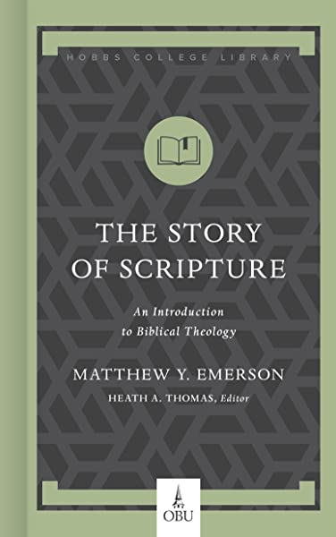
CONTENT OF THE BIBLE: overarching story
What is the overarching story of the Bible? Describe the story of the Bible in one sentence.
Recall your reading.

Slide 78
CONTENT OF THE BIBLE: overarching story
“The whole Bible is one book inspired by one author with one story that culminates in the one person, the God-Man Jesus Christ. Biblical theology is the attempt to read the Bible in this structurally and conceptually unified fashion…Biblical theology, then, helps us to see the end goal of the biblical narrative—Jesus—as well as how its different parts fit into that one main Christological pathway of Scripture” (pp. 16–18).

Slide 79
CONTENT OF THE BIBLE: overarching story
How do these aspects of the Bible fit together?
Adam’s rule in the Garden of Eden
Promise of a serpent-crusher
Abraham and Melchizedek
Abraham’s blessing on Judah
Moses leading God’s people out of the Egypt
Joshua conquering the land
Judges ruling over God’s people
King Saul
King David (Ps 2, Ps 110, 2 Sam 7)
Failure of the kings
Messiah Jesus
Second coming
THE BIBLICAL STORY POINTS TO A KING.
Notes:
Various expressions of prophet, priest, and king pointing to the ONE KING JESUS

Slide 80
CONTENT OF THE BIBLE: overarching story
How do these aspects of the Bible fit together?
Adam
Noah
Abraham
Moses
David
Prophets
Messiah Jesus
Church
Heaven
THE BIBLICAL STORY INVOLVES PEOPLE CALLED BY GOD FOR HIS GLORY

Slide 81
CONTENT OF THE BIBLE: overarching story
How do these aspects of the Bible fit together?
Eden
Canaan
Egypt
Promised Land
Jerusalem
Exile
Return to Jerusalem
Rule by the Romans
Messiah Jesus
New Heavens and New Earth
THE BIBLICAL STORY INVOLVES A SACRED PLACE WHERE GOD DWELLS.

Slide 82
CONTENT OF THE BIBLE: overarching story
21 Then I saw a new heaven and a new earth, for the first heaven and the first earth had passed away, and the sea was no more. 2 And I saw the holy city, new Jerusalem, coming down out of heaven from God, prepared as a bride adorned for her husband. 3 And I heard a loud voice from the throne saying, “Behold, the dwelling place of God is with man. He will dwell with them, and they will be his people, and God himself will be with them as their God. 4 He will wipe away every tear from their eyes, and death shall be no more, neither shall there be mourning, nor crying, nor pain anymore, for the former things have passed away.”
5 And he who was seated on the throne said, “Behold, I am making all things new.” Also he said, “Write this down, for these words are trustworthy and true.” 6 And he said to me, “It is done! I am the Alpha and the Omega, the beginning and the end. To the thirsty I will give from the spring of the water of life without payment. 7 The one who conquers will have this heritage, and I will be his God and he will be my son. (Rev 21:1–7)

Slide 83
CONTENT OF THE BIBLE: overarching story
God enacts his kingdom by bringing his holy people into his perfect place under his righteous rule. It’s focused on God’s King, Jesus. And it unfolds through a series of covenants.
Notes:
-explain each of these concepts
-kingdom: the realm and extend of a King’s rule
-God is King over everything
-he enacts his Kingdom through CREATION and REDEMPTION
-enacting means he exerts his authority over what is already his
-holy people
-perfect place
-righteous rule

Slide 84
The realm in which God’s glory is supremely displayed is referred to as his kingdom, which is “God’s people in God’s place under God’s rule and reign” (Goldsworthy, Goldsworthy Trilogy, 54). Certainly “kingdom” language can be used to convey the activity of God exercising his sovereignty over all things (Deut. 2:5, 9, 30; 4:19; 29:25-26; 32:8; Isa. 45:5-7). Most often, however, God’s kingdom refers to his particular activity of exercising authority over his subjects who, out of their faith in and love for him, serve only him. One could thus identify the kingdom of God as his universal reign and eternal dominion…(Kimble and Spellman, Invitation to Biblical Theology, 271-2)

Slide 85
CONTENT OF THE BIBLE: overarching story
God enacts his kingdom by bringing his holy people into his perfect place under his righteous rule. It’s focused on God’s King, Jesus. And it unfolds through a series of covenants.
Some steps in the story…
Garden
Abraham
Egypt, Moses, Exodus
Tabernacle/Temple
Notes:
Garden: A great pictures of God’s people, in God’s perfect place, under God’s righteous rule. THINGS WERE GOOD.
God’s people: were created pure and without sin.
Good’s place: was amazing because the place was life with God.
BUT God’s people rebelled against his righteous rule.
This resulted in them being removed from God’s perfect place.
This is TRAGIC. We don’t often put much emphasis on the idea of place. But God’s place is God’s presence—it represents life with him.
Apart from the presence of God, terror ensues:
Abraham: God choosing his people, promising his place, under his perfect rule.
God’s people: he chooses through Abraham and his descendants.
God’s place: he promises them Canaan, a land flowing with milk and honey, and well-situated to proclaim his name.
God’s rule: is anticipated as they follow him by faith.
None of this comes true immediately. When we come to the story of Moses, all of these promises seem quite distant.
Egypt, Moses, and the Exodus: God saving his people, bringing them into his place, and giving them instructions about his rule.
God’s people: are oppressed, and he reaffirms his love for them. He has chosen Israel to be his people, not Egypt or any other nation.
God’s place: they are in Egypt and he delivers them from Egypt and leads them in conquest of the Promised Land.
God’s rule: God instructs them about how his rule is to be expressed on earth through the giving of the Law.
Tabernacle/Temple
How can this SINFUL and REBELLIOUS people live with God in his place? They need cleansing from sin.
So God creates a place where his holy presence is known especially, the tabernacle. And the tabernacle is a place of cleansing.
Animal sacrifices, as acts of faith, acknowledge guilt and the consequences of sin, and the death of the animal represents God’s cleansing—to be in presence of God, they had to rely on the provision of God.

Slide 86
CONTENT OF THE BIBLE: overarching story
God enacts his kingdom by bringing his holy people into his perfect place under his righteous rule. It’s focused on God’s King, Jesus. And it unfolds through a series of covenants.
Some steps in the story…
Kings and Prophets
Exile and Return
Jesus
Church
Heaven
Notes:
Kings and Prophets
Holy People: They repeatedly turn to other gods and forsake God.
Perfect Place: The Promised Land with the “holy hill” where God would make his name known…the people were driven out of this land and it was occupied by godless rulers.
Righteous Rule: The psalms and prophets record some of the ways that God’s people continue to rebel against his righteous rule.
These failings create and overwhelming expectation and desire for God to do something new and better.
In the prophets, the promises are ratcheted up, and we have the expectation that God is going to do something BIG.
Transition: We have been asking the question of who can dwell in God’s presence, and we’ve found that no one is worthy. Before God brings his people into his forever place, God makes good on his promises in a different way. They cannot ascend to his holy hill, but he can descend to live with them—God says to his people that “I will dwell among you”
Exile:
-holy people: because of their unholiness they are driven from God’s perfect place
-perfect place: they are driven from God’s place
-righteous rule: they are ruled by foreign leaders
Jesus: Emmanuel, God with us—the climactic step in God’s story of redemption
Jesus makes God’s people holy: Jesus makes his people holy by dealing with their sin decisively and finally at the cross. “For our sake he made him to be sin who knew no sin, so that in him we might become the righteousness of God.” (2 Cor 5:9)
Jesus is God’s perfect place: Jesus is the one “greater than the temple.” Jesus is God really dwelling with his people in an unimaginable way. So the one who “has seen the Son has seen the Father.” God’s place is where Jesus is.
Jesus enacts God’s righteous rule: Submission to God’s rule has been an insurmountable problem for God’s people. The problem has been their hearts. Jesus deals with this problem by making them new from the inside out, and the Holy Spirit indwells believers giving them new motivations and desires.
→ Who can have life with God? Answer: the one who relies on the righteousness of Christ and is made righteous by Christ.
→God answers the question of Psalm 15 decisively in Jesus.
Hope! The final stop in God’s story or bringing his holy people into his perfect place under his righteous rule.
Our present situation is that God’s Spirit indwells us in remarkable ways. But the story doesn’t end there. God is bringing his eternal plan to its perfect fulfillment. This is our secure Christian hope.
God will make his people holy and he will bring them into his perfect place and he will rule over them in righteousness.
Who can dwell with God in his holy place? “Those who have washed their robes in the blood of the lamb”
Revelation 21:3-4

Slide 87
CONTENT OF THE BIBLE: overarching story
God enacts his kingdom by bringing his holy people into his perfect place under his righteous rule. It’s focused on God’s King, Jesus. And it unfolds through a series of covenants.
See also Goldsworthy, Goldsworthy Trilogy, 54 and Schreiner, Kingdom of God, 18
Notes:
-this is an attempt to summarize the scope, themes, and purpose of the Bible into a single sentence
-explain each of these concepts
-kingdom: the realm and extend of a King’s rule
-God is King over everything
-he enacts his Kingdom through CREATION and REDEMPTION
-enacting means he exerts his authority over what is already his
-holy people
-perfect place
-righteous rule

Slide 88
CONTENT OF THE BIBLE: overarching story
God enacts his kingdom by bringing his holy people into his perfect place under his righteous rule. It’s focused on God’s King, Jesus. And it unfolds through a series of covenants.
Let’s look at an example of a biblical author presenting the overarching story of the Bible.
Acts 7:1-53

Slide 89
THE
CONTENT
OF THE BIBLE
The Biblical Covenants
Thanks to Drs. Jason Lee and Thomas Schreiner for some of this material

Slide 90
What role do the covenants play?

Slide 91
Class Goals:
Articulate each of the biblical covenants and their meaning.
Know the key texts for each of the biblical covenants.
Explain the function of each of the covenants in the biblical storyline.

Slide 92
CONTENT OF THE BIBLE: overarching story
God enacts his kingdom by bringing his holy people into his perfect place under his righteous rule. It’s focused on God’s King, Jesus. And it unfolds through a series of covenants.

Slide 93
CONTENT OF THE BIBLE: overarching story
“The fourth important concept that helps us to see the Bible’s structural unity is that of covenant. The whole Bible is tied together through covenants God makes with his people” (p. 14).

Slide 94
We can define a covenant here simply and broadly as a relationship based on a promise. More specifically, a biblical covenant is a relationship in the biblical storyline between God and a group of his created people that is based on a spoken promise. These covenant relationships usually include the formal expectation of blessing for obedience and curses for disobedience. (Kimble and Spellman, Invitation to Biblical Theology, 66)

Slide 95
Four Ideas to Consider
The covenants are embedded.
The covenants are interconnected.
The covenants are directive.
The covenants are comprehensive.
Pages 66-68
Notes:
Four Ideas to Consider
The covenants are embedded: the covenants emerge from the canon itself, so that a canonical reading must be a covenantal reading.
The covenants are interconnected: many of the intertextual connections depend on covenantal connections, so that the covenants give shape to the whole
The covenants are directive: the covenants are markers that direct the readers to important textual feature and the storyline as a whole.
The covenants are comprehensive: the biblical covenants, functioning together, provide the framework for seeing the whole

Slide 96
CONTENT OF THE BIBLE: the biblical covenants
Definition: Covenant: a solemn commitment between two parties, usually with each party having obligations to the other.
Kimble and Spellman: a relationship based on a promise … [which] usually include the formal expectation (Kimble and Spellman, Invitation to Biblical Theology, 66)
Michael Horton: a relationship of oaths and bonds and involves mutual, though not necessarily equal, commitments (God of Promise, 10)
Notes:
-Mention suzerain-vassal treaties
-we want to focus on divine covenants

Slide 97
CONTENT OF THE BIBLE: the biblical covenants
The Six Major Covenants in the Biblical Texts:
Adamic “Covenant” (Gen 1-3; esp. 1:26-31, 2:15-17).
Noahtic Covenant (Gen 6-9; esp. 8:20-9:17).
Abrahamic Covenant (Gen 12-17; esp. 12:1-3).
Mosaic (Sinaitic) Covenant (Exod 19-20, Deut 4:1-8; esp. Ex19:19).
Davidic Covenant (2 Sam 7; esp. 7:8-17; also 1 Chr 17).
New Covenant (Deut 30:6-10; Jer 31:31-34; Ezek 36:22-32; Heb 8-10).
Notes:
Here’s why this matters…
?What did you eat for breakfast this morning or dinner last night?
?What did you do on Saturday, the Sabbath?
Here’s the impact on exegesis…
When Colossians 3 describes there being “neither circumcised nor uncircumcised” this must be a New Covenant declaration.

Slide 98

CONTENT OF THE BIBLE:
the biblical covenants

Slide 99
CONTENT OF THE BIBLE:
Adamic Covenant
Adamic “Covenant” (Gen. 1-3; esp. 1:26-31, 2:15-17).
Though there is no covenant language in these passages, when compared textually with Gen 8-9, it is clear that these passages are covenantal.
Notes:
In Gen 1-2 there is a relationship with God that takes a form which later is described as covenant. By nature of creation, Adam and Eve are in a covenant relationship with God. The covenant stipulation is to not eat of the tree of knowledge, and “to worship and obey” (Gen 2:15). The covenant blessings include, “Be fruitful and multiply”, dominion over creation, peaceful relationship with God and trusting God to determine what is “good”.
The covenant is broken when Adam and Eve’s lack of trust cause them to eat of the tree that will give them their own “knowledge of good and not good.” In the midst of the curses that result from the Fall, a redeemer is promised who will be a descendent (seed) of Eve and will crush the head of the serpent (Gen 3:15).
Genesis 1:26-31
Great King: God
Lesser: created humanity
Charge: dominion; multiply
Obligations: 2:15-17
Curses: “you shall die”

Slide 100
CONTENT OF THE BIBLE:
Noahtic Covenant
Noahtic Covenant (Genesis 6-9; esp. 8:20-9:17).
Humans spiraled downward in evil inclinations. Noah’s faith and obedience are recognized by the Lord. After being delivered from the flood, Noah offers a pleasing (faith-filled) sacrifice. God offers a covenant with the blessings: “Be fruitful and multiply”, dominion over creation, and peace in the relationship with God (The name ‘Noah’ indicates peace). The blessings of the Noahtic Covenant seem to be a reversal of the curse of the fall (that God will no longer curse the ground, and Noah can now be fruitful).
A brief review of the first 2 covenants (first 5 minutes): https://www.desiringgod.org/interviews/a-little-introduction-to-covenants
Notes:
This covenant made with all humans demonstrates that God will withhold his righteous judgment on human sin in order that humans might have the opportunity to worship Him. Note also the presence of sin (drunkenness) and curses following the scene of covenant renewal (Gen 9:20-29).

Slide 101
CONTENT OF THE BIBLE:
Abrahamic Covenant
Abrahamic Covenant (Gen. 12-17; esp. 12:1-3).
Abraham receives the covenant with the Lord by faith (15:6). The covenant blessings include: a great land, a great people, and a blessing to the nations. The promise will be fulfilled in Abraham’s descendant (seed—12:7). Through this promise, the children of Abraham who have the faith of their father will become God’s chosen people. The faith of Abraham’s descendants will allow them to participate in being God’s chosen people.
Notes:
The faith of Abraham is a central part of this covenant. Though it has an unconditional aspect to it, the conditional aspect has to do with enjoying the blessings. The blessings of the Abrahamic covenant come to those living by faith. This covenant is the background (context) for God’s gracious dealings with Israel and for His blessings to be extended to the nations.

Slide 102
CONTENT OF THE BIBLE:
Mosaic Covenant
Mosaic Covenant (Ex. 19-20, Deut. 4:1-8).
The Mosaic Covenant provides a way to live out the Abrahamic Covenant. If Israel fulfills the stipulations of the Mosaic Covenant, then it receives the benefits of the Abrahamic Covenant (i.e., the land, being the people of God: a kingdom of priests). This connection with the Abrahamic Covenant alludes to the requirement of faith for fulfilling the Mosaic Covenant. Here, God presented Moses with the offer for covenant with Israel. The covenant blessings include being God’s chosen people, being God’s representatives among humans and being reserved for God’s purposes.
Notes:
The key stipulation to the covenant was faith-filled obedience to God’s word. Before Israel left Sinai (Ex 32) they had already disobeyed the primary command of the covenant (exclusive worship), and therefore broke the covenant. The Lord revealed Himself as gracious and renewed the covenant (Ex 34) albeit with added stipulations (commands/laws).
The failure of the Mosaic covenant becomes evident through the history of Old Testament Israel. The primary cause of the failure of this covenant is the “heart-problem” of the people. Their hearts are corrupt (they are scoundrels!).

Slide 103
CONTENT OF THE BIBLE:
Davidic Covenant
Davidic Covenant (2 Sam. 7; especially 7:8-17; also 1 Chronicles 17).
The son of David would come and bring the covenant blessings of rest in the land, worship of the Lord (cf. the house of the Lord), an eternal kingdom, eternal dwelling in Jerusalem and the son of David being God’s Son. One of the promises is that this coming son of David will be God’s son.
Notes:
The seed of Abraham that is coming that will provide this great nation is demonstrated to be the son of David. The great nation is formed because of the coming King’s great kingdom (i.e., the son of David). When he reigns, he establishes the blessings that are promised in the Abrahamic Covenant.

Slide 104
CONTENT OF THE BIBLE:
Davdic Covenant
The Davidic Covenant comes in correlation to the previous two (Abrahamic Covenant & Mosaic Covenant). It is important to see the correspondence between these two covenants and the Davidic Covenant. There is the overarching promise of the Abrahamic Covenant, then there is the immediate presentation of the Mosaic Covenant, which allows for an immediate enjoyment of the Abrahamic Covenant dependent on the people’s obedience.
Because there is constant disobedience, there must be a new measure of hope given through another means. This new measure of hope is the Davidic Covenant. In spite of the failure of the Mosaic Covenant (due to the heart of the people), the Davidic Covenant is the means by which the Abrahamic Covenant can be fulfilled.

Slide 105
CONTENT OF THE BIBLE:
Davidic Covenant
Old Testament prophecy looks fervently for this coming Son of David.
The New Testament Gospel writers attempt to demonstrate Jesus as this coming Son of David. It is no wonder, then, that in the genealogy of Matthew 1, Jesus is described as the Son of Abraham, and the Son of David. Matthew is pointing out that Jesus is the fulfillment (coming seed) of both the Abrahamic Covenant and the Davidic Covenant.

Slide 106
CONTENT OF THE BIBLE:
Intro to the New Covenant
Genesis 17:9-14
Colossians 3:9-11
A text’s place in the biblical storyline (i.e. within which covenant it exists) is an important factor in its interpretation.

Slide 107
CONTENT OF THE BIBLE: the New Covenant
The new covenant represents the culmination of God’s saving work among his people. God regenerates his people by his Spirit and renews their hearts so that they obey him. He is their God, and they are his people. The basis for such renewal is the cross and resurrection of Jesus Christ, for by his atoning death and resurrection complete forgiveness of sins is achieved. Hence, a new and bold access to God is obtained which wasn’t available in the old covenant. The covenant with Israel passed away, and now the promise is fulfilled in the restored Israel, which consists of both Jews and Gentiles. Jesus is the last and second Adam who obeys where Adam failed, who brings his people into the new creation so that they can reign with him as priest-kings (cf. Dan. 7: 18, 22, 27; 1 Cor. 6: 2; 1 Pet. 2: 9; Rev. 1: 6; 5: 10; 20: 6).
(Schreiner, Covenant, 118)

Slide 108
CONTENT OF THE BIBLE: the New Covenant
The New Covenant (Deuteronomy 30:6-10; Jeremiah 31:31-34; Ezekiel 36:22-32; Matthew 26:26-29; Hebrews 8-10).
Though the phrase “New Covenant” is used only in Jeremiah 31, the same stipulations and covenant situation are present in the other passages. In this New Covenant, there are significant developments that happen.
→The incarnation, death, and resurrection of Jesus is not something that God conjured up when other things failed. These covenants are preparing for and pointing to Jesus Christ (see esp. Ephesians 1).
Notes:
The New Covenant is promised even in Moses’ last words that there will be a circumcision of the heart.
The failure of the Mosaic Covenant was because of the inability of the people to obey due to their corrupt hearts.
Deuteronomy 30 holds out hope for the people because the people will be able to obey because their hearts will be circumcised. This inward transformation is pictured in Jeremiah 31 as a new heart, and in Ezekiel 36 as a new Spirit. The New Covenant will address even the heart.

Slide 109
CONTENT OF THE BIBLE: the New Covenant
The New Covenant
Hebrews 8-10 speaks about the mediator of this New Covenant.
  The New Covenant is not a renewed version of the Mosaic Covenant.
  The covenant blessings include an internal law (much like Abraham who kept the law through faith though the Sinai laws had not yet been given), being God’s people, God’s glory being known universally, forgiveness and a rebuilt promise land.
  The Old Covenant (i.e., the Mosaic Covenant and not the OT) is rendered obsolete by this New Covenant. The one who made redemption is now the mediator of the New Covenant.
  The New Covenant is the means of bringing the Abrahamic Covenant and the Davidic Covenant into actuality.

Slide 110
CONTENT OF THE BIBLE: understanding the covenants
God enacts his kingdom by bringing his holy people into his perfect place under his righteous rule. It’s focused on God’s King, Jesus. The way the plot unfolds is through a series of covenants.
Six major biblical covenants provide the “big picture” or “big ideas” of the Scripture.
The biblical covenants interrelate, are drawn from the biblical texts and provide rich biblical imagery for other biblical authors.
The biblical covenants can be in the “background”, in the “foreground” or two covenants can interplay.
The biblical covenants provide a Christological reading for all of Scripture.

Slide 111
CONTENT OF THE BIBLE: main thought of each covenant
Adamic Covenant: to establish the relationship between God and humanity; it charges Adam with obedience and rule of the world, and it ultimately points to the seed of the woman.
Noahtic Covenant: to preserve the world so that God’s salvation could come about.
Abrahamic Covenant: to promise descendant(s), land, and blessing to Abraham and those who live by faith in God.
Mosaic Covenant: to instruct about a faith-filled obedience to God.
Davidic Covenant: the people’s unregenerate hearts make the Mosaic Covenant an in impossible fulfillment of the Abrahamic Covenant, so the Davidic Covenant focuses God’s blessings and promises on a particular (R)ruler as God’s (S)son
New Covenant: the fulfillment of all God’s promises in Christ.

Slide 112
CONTENT OF THE BIBLE: covenants point to Christ
Adamic Covenant (Rom 5:12-19): Jesus is the second Adam who is obedient, crushes the serpent, brings about new creation, and rules over the whole world as a garden-temple.
Noahtic Covenant (Isa 53…54:9-10): Jesus brings about new creation and the realization of salvation.
Abrahamic Covenant (Rom 4:13-15 ; Gal 3:15-18): Jesus is the faithful son of Abraham/Judah who reigns over all nations (people) and all the earth (land) and offers salvation to everyone (blessing).
Mosaic Covenant (Heb 8:13; 9:11-15): Jesus is the Son whose sacrifice will cleanse completely and enable obedience
Davidic Covenant (Luke 1:32-33; Rev 19:11-16): Jesus is the true priest and king who will reign forever.

Slide 113
THE
CONTENT
OF THE BIBLE
Some Interpretive Questions
Thanks to Dr. Jason Lee for some of this material

Slide 114
We probably won’t have time to cover these questions in detail. We will work them out in guided practice.

Slide 115
CONTENT OF THE BIBLE:
good interpretive questions
God enacts his kingdom by bringing his holy people into his perfect place under his righteous rule. It’s focused on God’s King, Jesus. The way the plot unfolds is through a series of covenants.
Three Prevailing Questions:
  What is the Bible all about?
  What is this book about?
  What is this passage about?

Slide 117
https://vimeo.com/499637314
A helpful video about what the Bible is…
https://www.youtube.com/watch?v=ak06MSETeo4

