Slide 1
Computer Networks transmission Media
Dr. Mohammad Adly

Slide 2
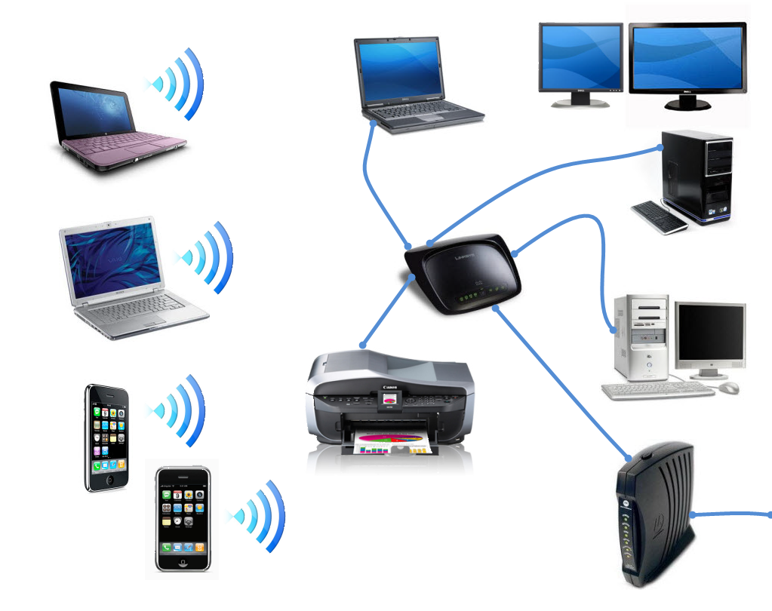
Computer Networks Media types
Wired Media (Cables)
  Copper Cables
    Coaxial cables
    Twisted Pair cables
      Shielded (STP)/Unshielded (UTP)
  Fiber Optic Cables
    Single Mode/Multi-Mode
Wireless Media (Air)

Slide 3
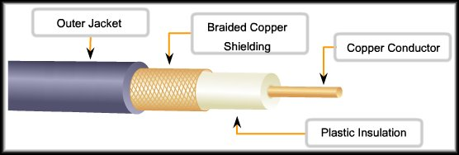
Coaxial Cables
High capacity cables
Used for video transfer
Two types
  Thick coaxial cable (Thicknet)
    ½ inch diameter
    10base5
  Thin coaxial cable (Thinnet)
    ¼ inch diameter
    10base2
Use BNC connector

Slide 4
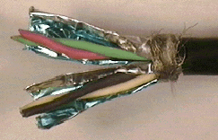
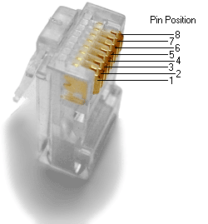
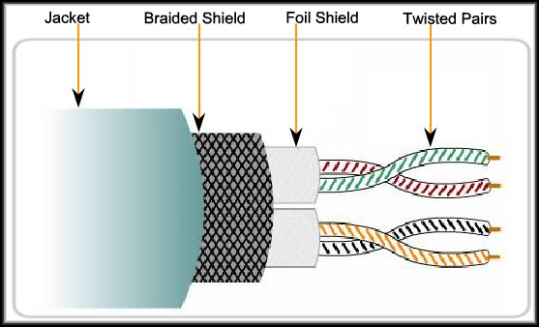

Shielded Twisted Pair (STP) Cables
Protected
Hard to install
RJ45 Connector
Crimper Tool

Slide 5
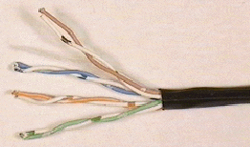
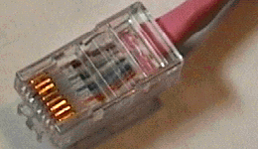
Unshielded twisted Pair (Utp) cables
Most commonly used type
Easy to install
Less expensive
Electromagnetic interference
RJ45 Connector
Crimper Tool

Slide 6
UTP Cables Categories
(a) Category 3 UTP.
(b) Category 5 UTP.

Slide 7
UTP Cables Categories
Type | Use
Category 1 | Voice Only (Telephone Wire)
Category 5 | Data up to 100 Mbps (Fast Ethernet)
Category 5e | Data up to 1 Gbps (Giga Ethernet)
Category 6 | Data: 1 – 10 Gbps (Giga Ethernet)

Slide 8
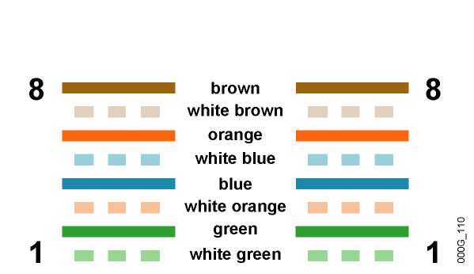
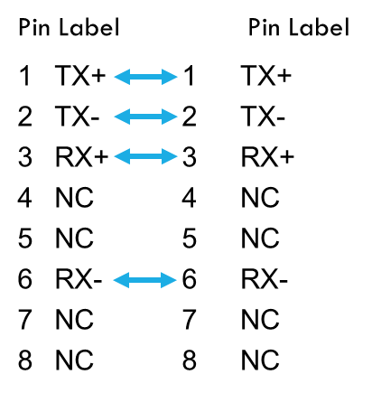
UTP Cables Standard

Slide 9
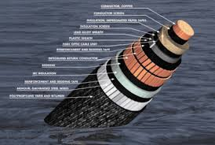
Fiber Optic Cables
Faster than twisted pair and coaxial
Send data as light pulses over glass medium
Free of electromagnetic interference
Expensive
Hard to install
Used in submarine connections
More secure

Slide 10
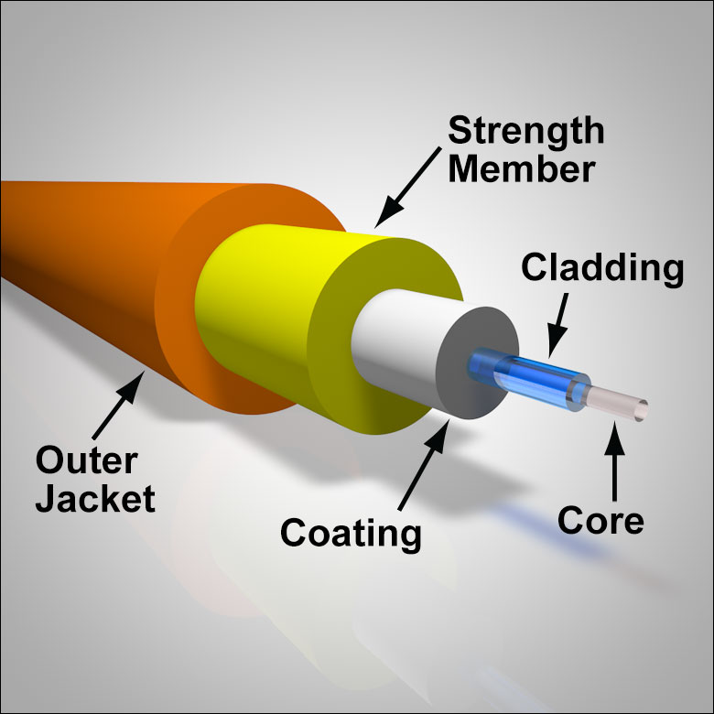
Fiber Optic Cables
Core carries the signals
Core made of plastic or glass
Cladding maintains the signal in the center of the core as the cable bends
Sheathing protects the cladding and the core

Slide 11
Fiber Optic Cables Modes
Type | Description
Single Mode | Transfer data through the core using a single light ray The core diameter is around 9 microns Supports a large amount of data Cable length can extended a great distance
Multi-Mode | Transfers the data through the core using multiple light rays The core diameter is around 50 microns Cable length are limited in distance compared to single mode

Slide 12
Fiber Optic Cables
Advantages | Total immune to the EMI Highly resistance to Eavesdropping Support extremely high data transfer rate Allow grater cable distances without repeater
Disadvantages | Very expensive Difficult to work with

Slide 13
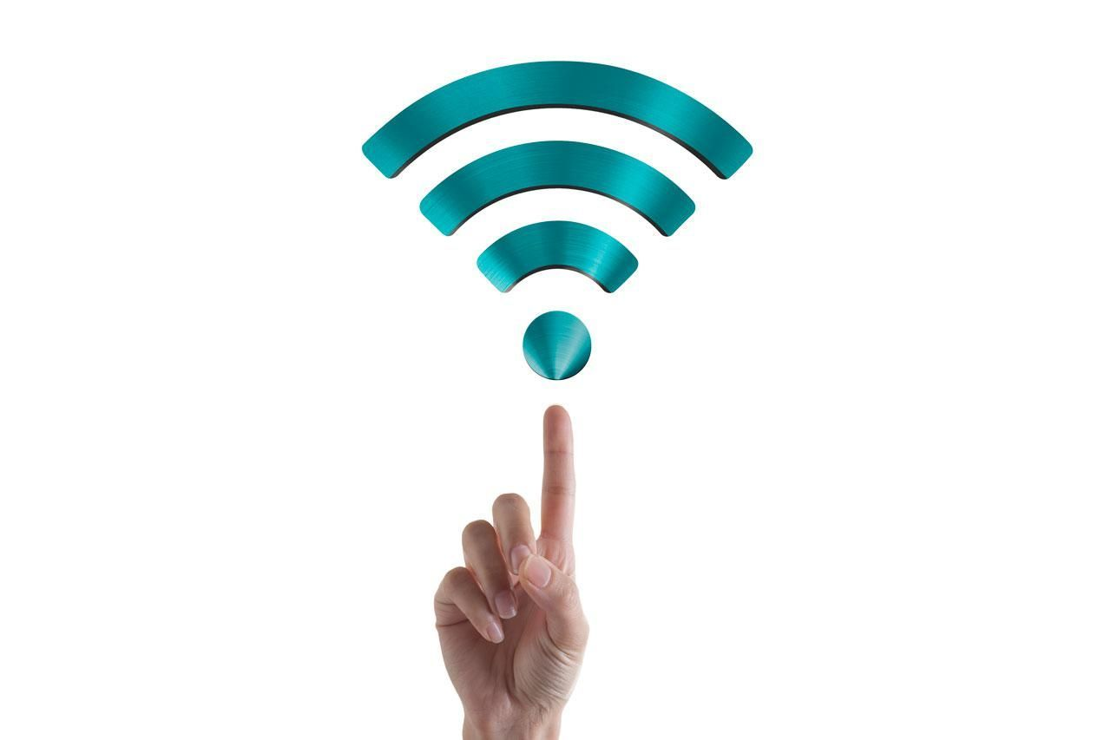
Wireless Media (Air)
Wi-Fi Wireless Fidelity
Uses frequencies 2.4GHz or 5GHz
Standards: a,b,g, and n
Access Point (AP) connecting devices
Mobility
Flexibility
Less secure

Slide 14
Thank you

