Slide 1
Logistic Regression

Slide 2
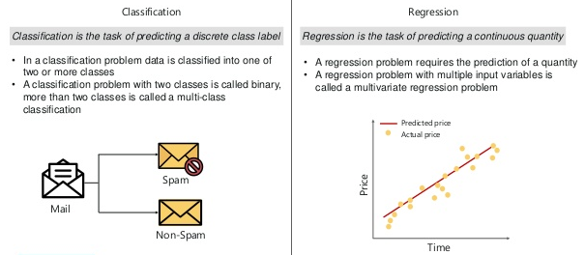
Classification vs Regression

Slide 3
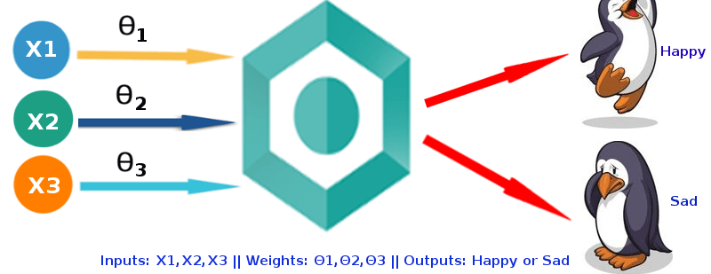
What is Logistic Regression?
Logistic Regression is a classification algorithm used to predict a binary outcome (1 / 0, Yes / No, True / False) given a set of independent variables.

Slide 4
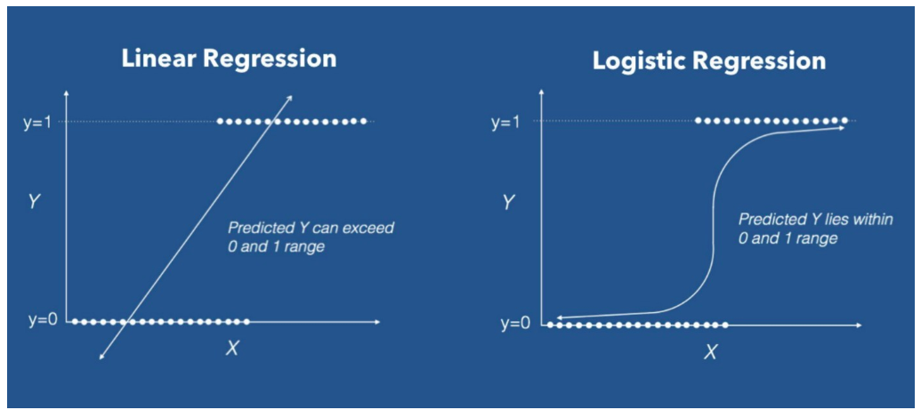
Logistic vs Linear Regression
Linear regression is used when the response variable is continuous in nature, but logistic regression is used when the response variable is categorical in nature.

Slide 5
Logistic vs Linear Regression
Some more differences
Linear regression assumes gaussian (or normal) distribution of dependent variable. Logistic regression assumes binomial distribution of dependent variable.
To perform Linear regression we require a linear relationship between the dependent and independent variables. But to perform Logistic regression we do not require a linear relationship between the dependent and independent variables.
Linear Regression is all about fitting a straight line in the data while Logistic Regression is about fitting a curve to the data.

Slide 6
Why is it called a regression?
Logistic regression is a special case of linear regression where we only predict the outcome in a categorical variable. It predicts the probability of the event using the log function.
Linear regression equation: y = β0 + β1X + E
  Y stands for the dependent variable that needs to be predicted.
  β0 is the Y-intercept, which is basically the point on the line which touches the y-axis.
  β1 is the slope of the line (the slope can be negative or positive depending on the relationship between the dependent variable and the independent variable.)
  X here represents the independent variable that is used to predict our resultant dependent value.

Slide 7
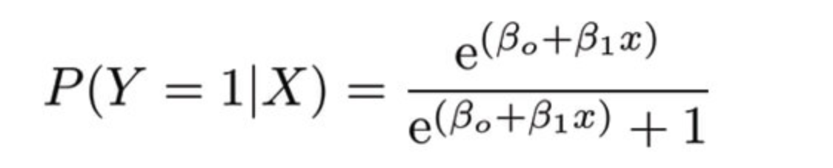
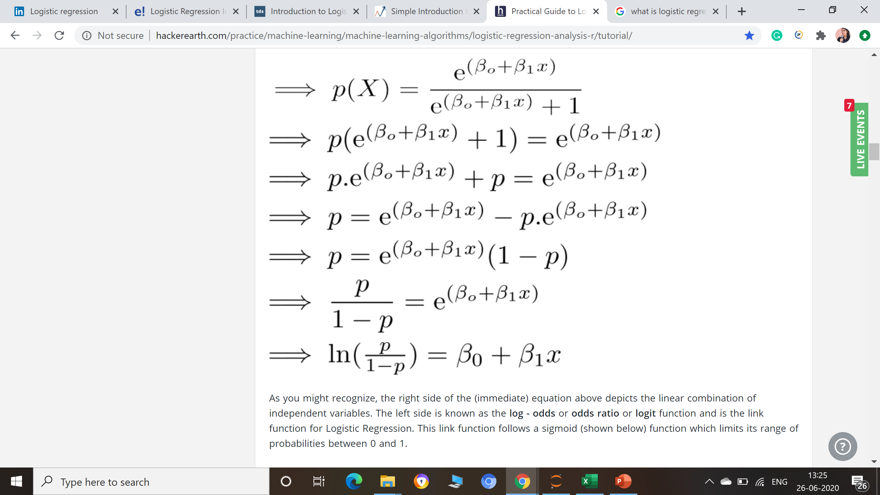
Logit function
In Logistic Regression, we use the same equation but with some modifications made to Y - we calculate probabilities.
This is the logistic function:

Slide 8
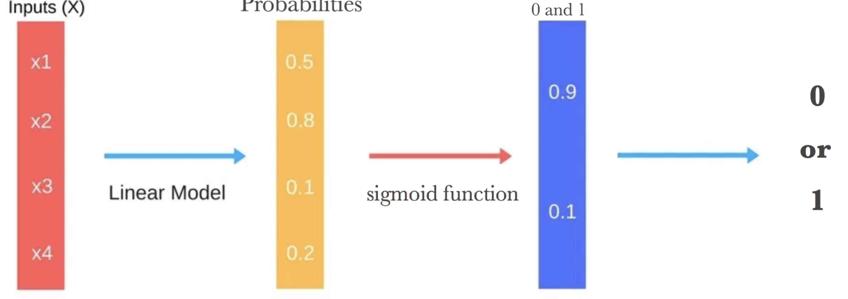
Logit function:
The right side of the (immediate) equation above depicts the linear combination of independent variables. The left side is known as the log - odds or odds ratio or logit function and is the link function for Logistic Regression.

Slide 9
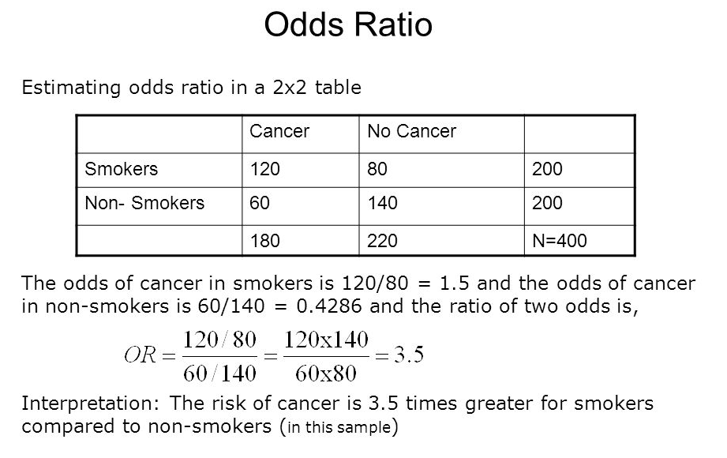
Example:

Slide 10
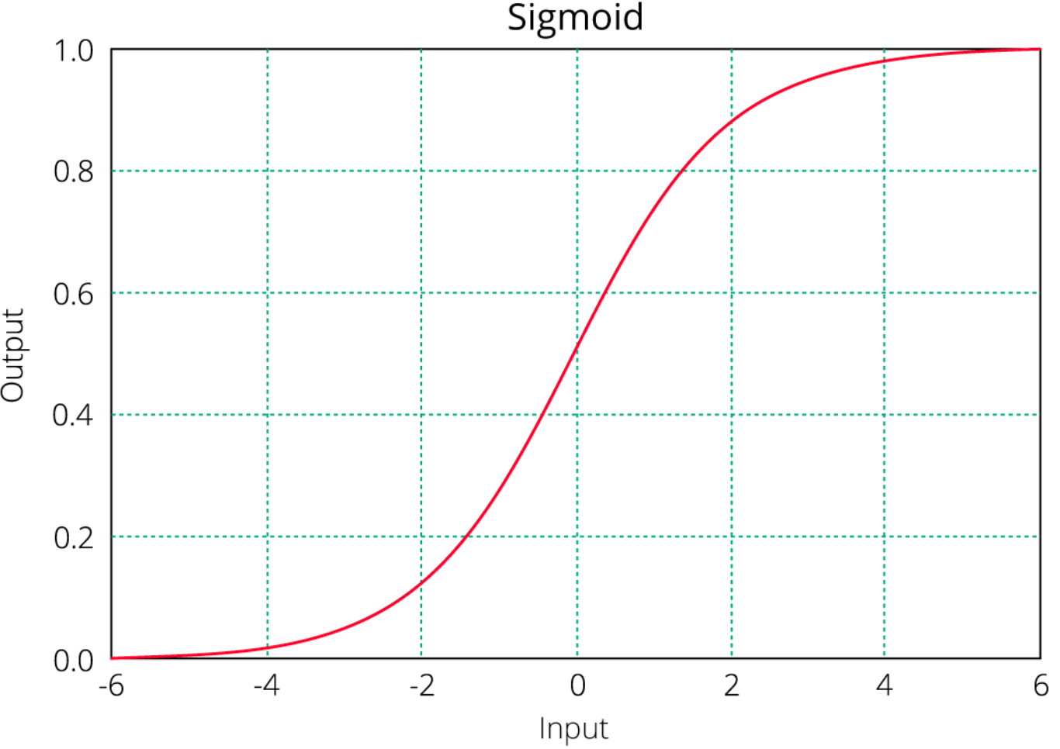
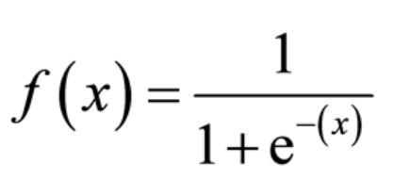
The link function follows a sigmoid function (shown below) which limits its range of probabilities between 0 and 1.
Formula of Sigmoid function:
  f(x) tends towards 1 as x ∞
  f(x) tends towards 0 as x - ∞
  f(x) is always bounded between 0 and 1

Slide 11
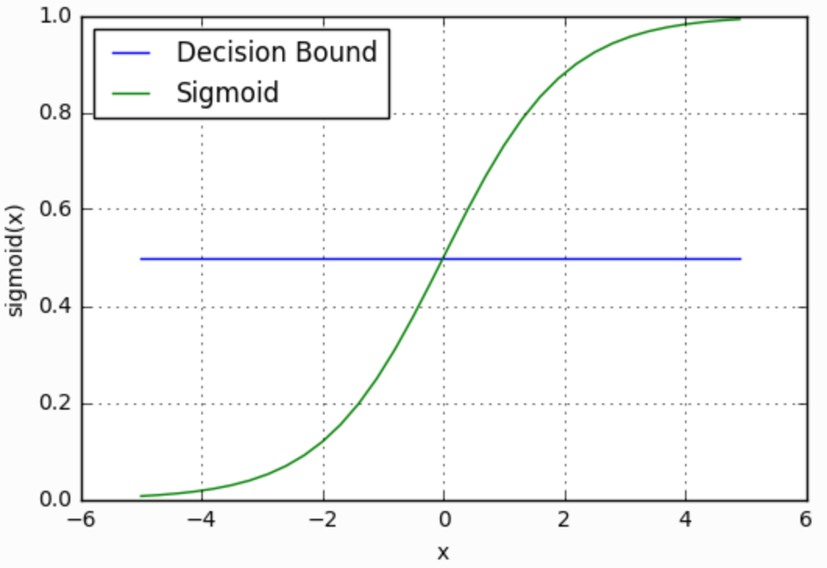
Decision boundary
Our current prediction function returns a probability score between 0 and 1.
In order to map this to a discrete class (true/false, cat/dog), we select a threshold value or tipping point above which we will classify values into class 1 and below which we classify values into class 2.
p≥0.5,class=1
p<0.5,class=0

Slide 12
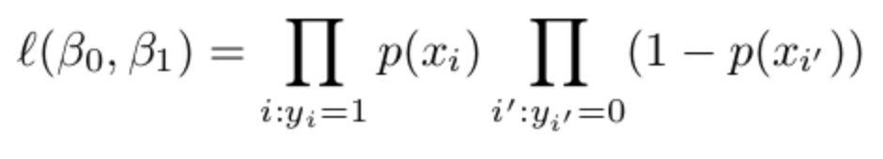
Maximum Likelihood Method (MLE)
In Multiple Regression, we use the Ordinary Least Square (OLS) method to determine the best coefficients to attain good model fit. In Logistic Regression, we use maximum likelihood method to determine the best coefficients and eventually a good model fit.
How it works?
It tries to find the value of coefficients (βo,β1) such that the predicted probabilities are as close to the observed probabilities as possible.

Slide 13
Interpretation of equation
A unit increase in variable x results in multiplying the odds ratio by ε to power β. In other words, the regression coefficients explain the change in log(odds) in the response for a unit change in predictor.
This is contradictory to Linear Regression where, regardless of the value of input feature, the regression coefficient always represents a fixed increase/decrease in the model output per unit increase in the input feature.

Slide 14
Types of Logistic Regression
Binary Logistic Regression:
It is used when the dependent variable is dichotomous.
Example: Spam or Not
Multinomial Logistic Regression:
It is used when the dependent variable has more than two categories.
Example: Predicting which food is preferred more (Veg, Non-Veg, Vegan)

Slide 15
Assumptions
Violates the assumption of Linear Regression!
No assumptions about the distributions of the predictor variables.
Predictors do not have to be normally distributed.
Does not have to be linearly related.
Does not have to have equal variance within each group.
The independent variables should be independent of each other. That is, the model should have little or no multicollinearity.
The independent variables are linearly related to the log odds.
Logistic regression requires quite large sample sizes.

Slide 16
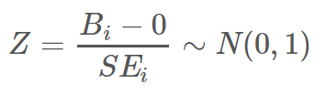
Hypothesis Testing in Logistic
Regression
H0:βi=0, where βi represents the population coefficient on the parameters (including interaction terms) of the logistic regression modeling log(odds) of Vote as a function of log contribution and party.
HA: At least one βi≠0
Test Statistics:

Slide 17
Measures of Accuracy

Slide 18
Measures of Accuracy
Akaike Information Criteria (AIC):
  You can look at AIC as counterpart of adjusted r square in multiple regression and compare two models.
  It follows the rule: Smaller the better.
  the basic formula is defined as: AIC = -2(log-likelihood) + 2K
  Where:
    K is the number of model parameters (the number of variables in the model plus the intercept).
    Log-likelihood is a measure of model fit. The higher the number, the better the fit. This is usually obtained from statistical output.

Slide 19
2. Null Deviance and Residual Deviance:
Deviance of an observation is computed as -2 times log likelihood of that observation.
Null deviance is calculated from the model with no features, i.e.,only intercept. The null model predicts class via a constant probability.
Residual deviance is calculated from the model having all the features.
On comparison with Linear Regression, think of residual deviance as residual sum of square (RSS) and null deviance as total sum of squares (TSS).
The larger the difference between null and residual deviance, better the model.

Slide 20
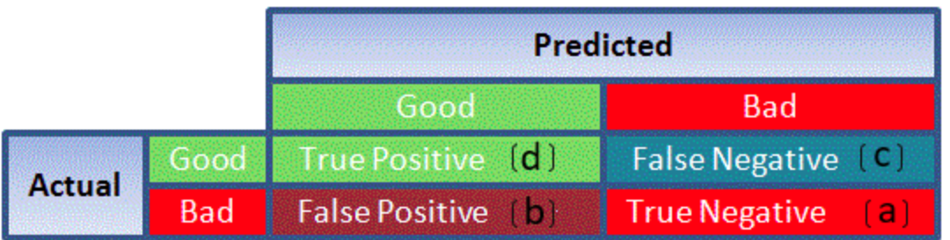
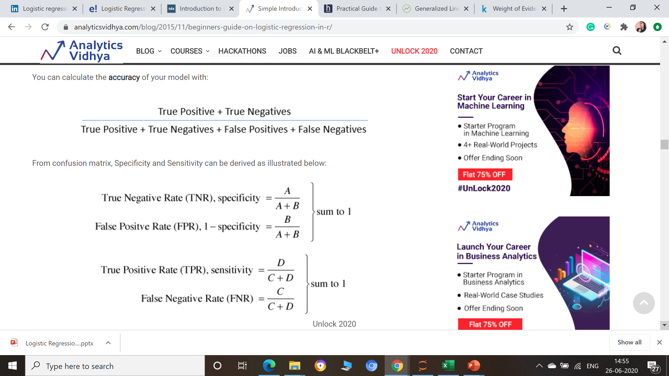
3. Confusion Matrix: Tabular representation of Actual vs Predicted values.
Accuracy of model:
Specificity and Sensitivity:

Slide 21
Accuracy - It determines the overall predicted accuracy of the model.
True Positive Rate (TPR) - It indicates how many positive values, out of all the positive values, have been correctly predicted. It is also known as Sensitivity or Recall.
False Positive Rate (FPR) - It indicates how many negative values, out of all the negative values, have been incorrectly predicted.
True Negative Rate (TNR) - It indicates how many negative values, out of all the negative values, have been correctly predicted.
False Negative Rate (FNR) - It indicates how many positive values, out of all the positive values, have been incorrectly predicted.
Precision: It indicates how many values, out of all the predicted positive values, are actually positive. It is formulated as:(TP / TP + FP)
F Score: F score is the harmonic mean of precision and recall. It lies between 0 and 1. Higher the value, better the model. It is formulated as 2((precision*recall) / (precision+recall)).

Slide 22
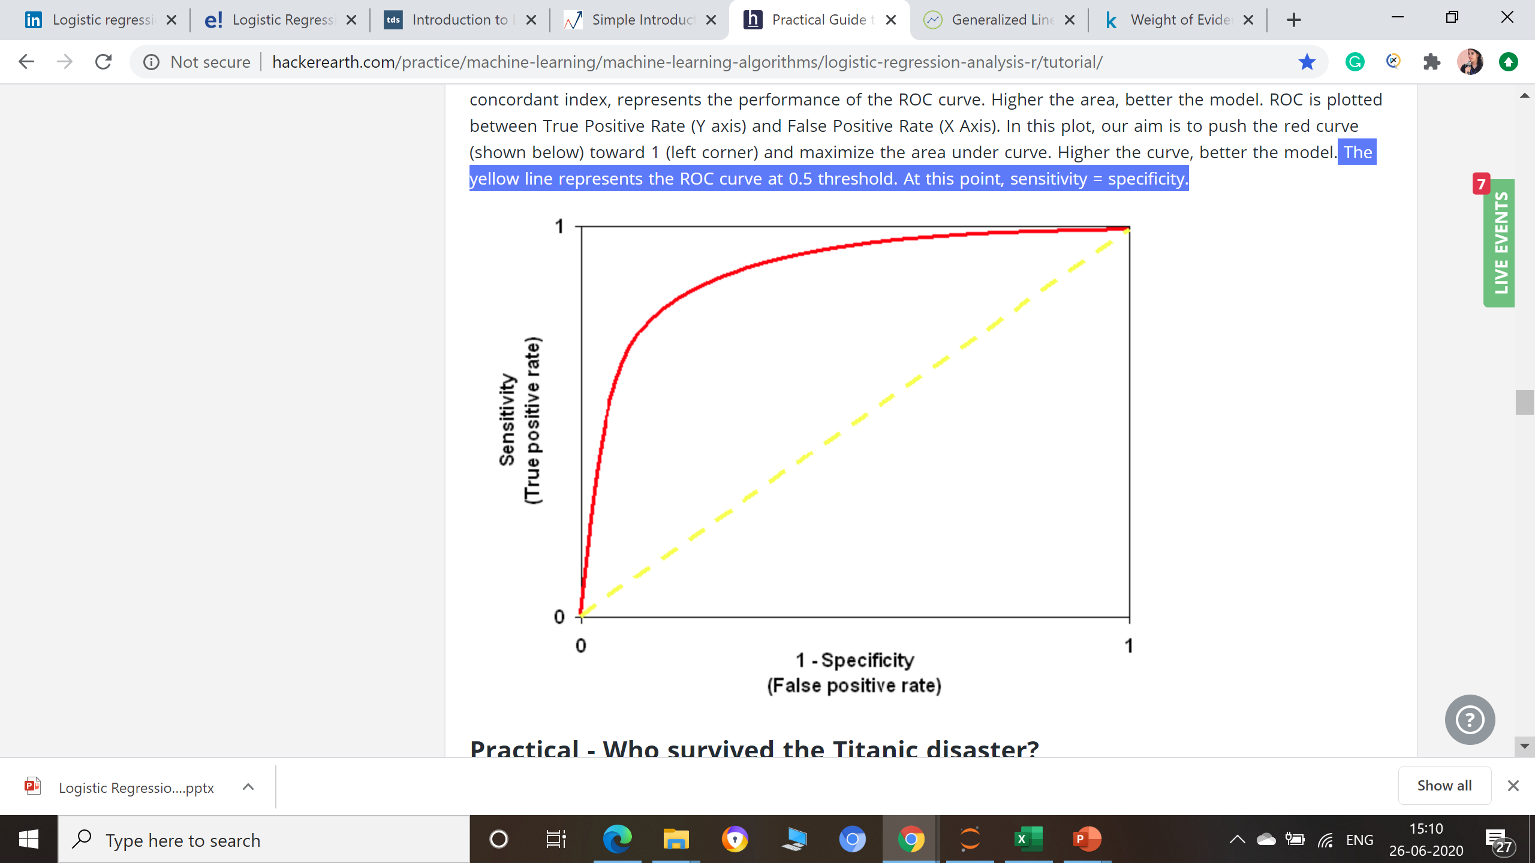
4. Receiver Operator Characteristic (ROC)
ROC is plotted between True Positive Rate (Y axis) and False Positive Rate (X Axis).
It determines the model's accuracy using Area Under Curve (AUC). The area under the curve (AUC), also referred to as index of accuracy (A) or concordant index, represents the performance of the ROC curve. Higher the area, better the model.
The yellow line represents the ROC curve at 0.5 threshold. At this point, sensitivity = specificity.

Slide 23
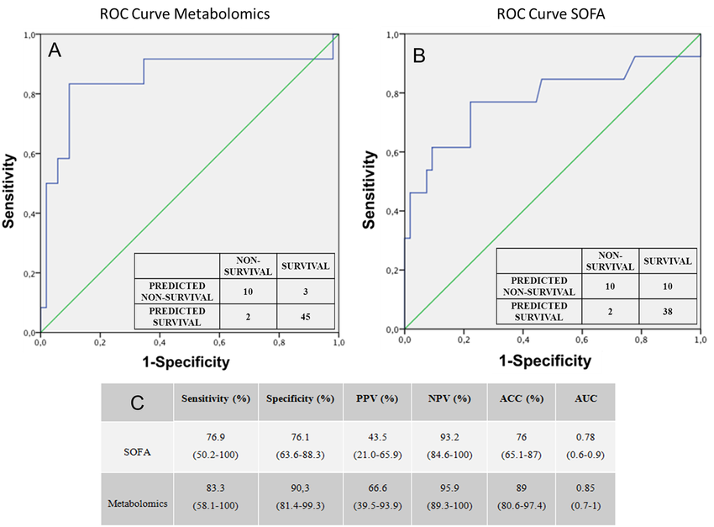
Example of ROC

Slide 24
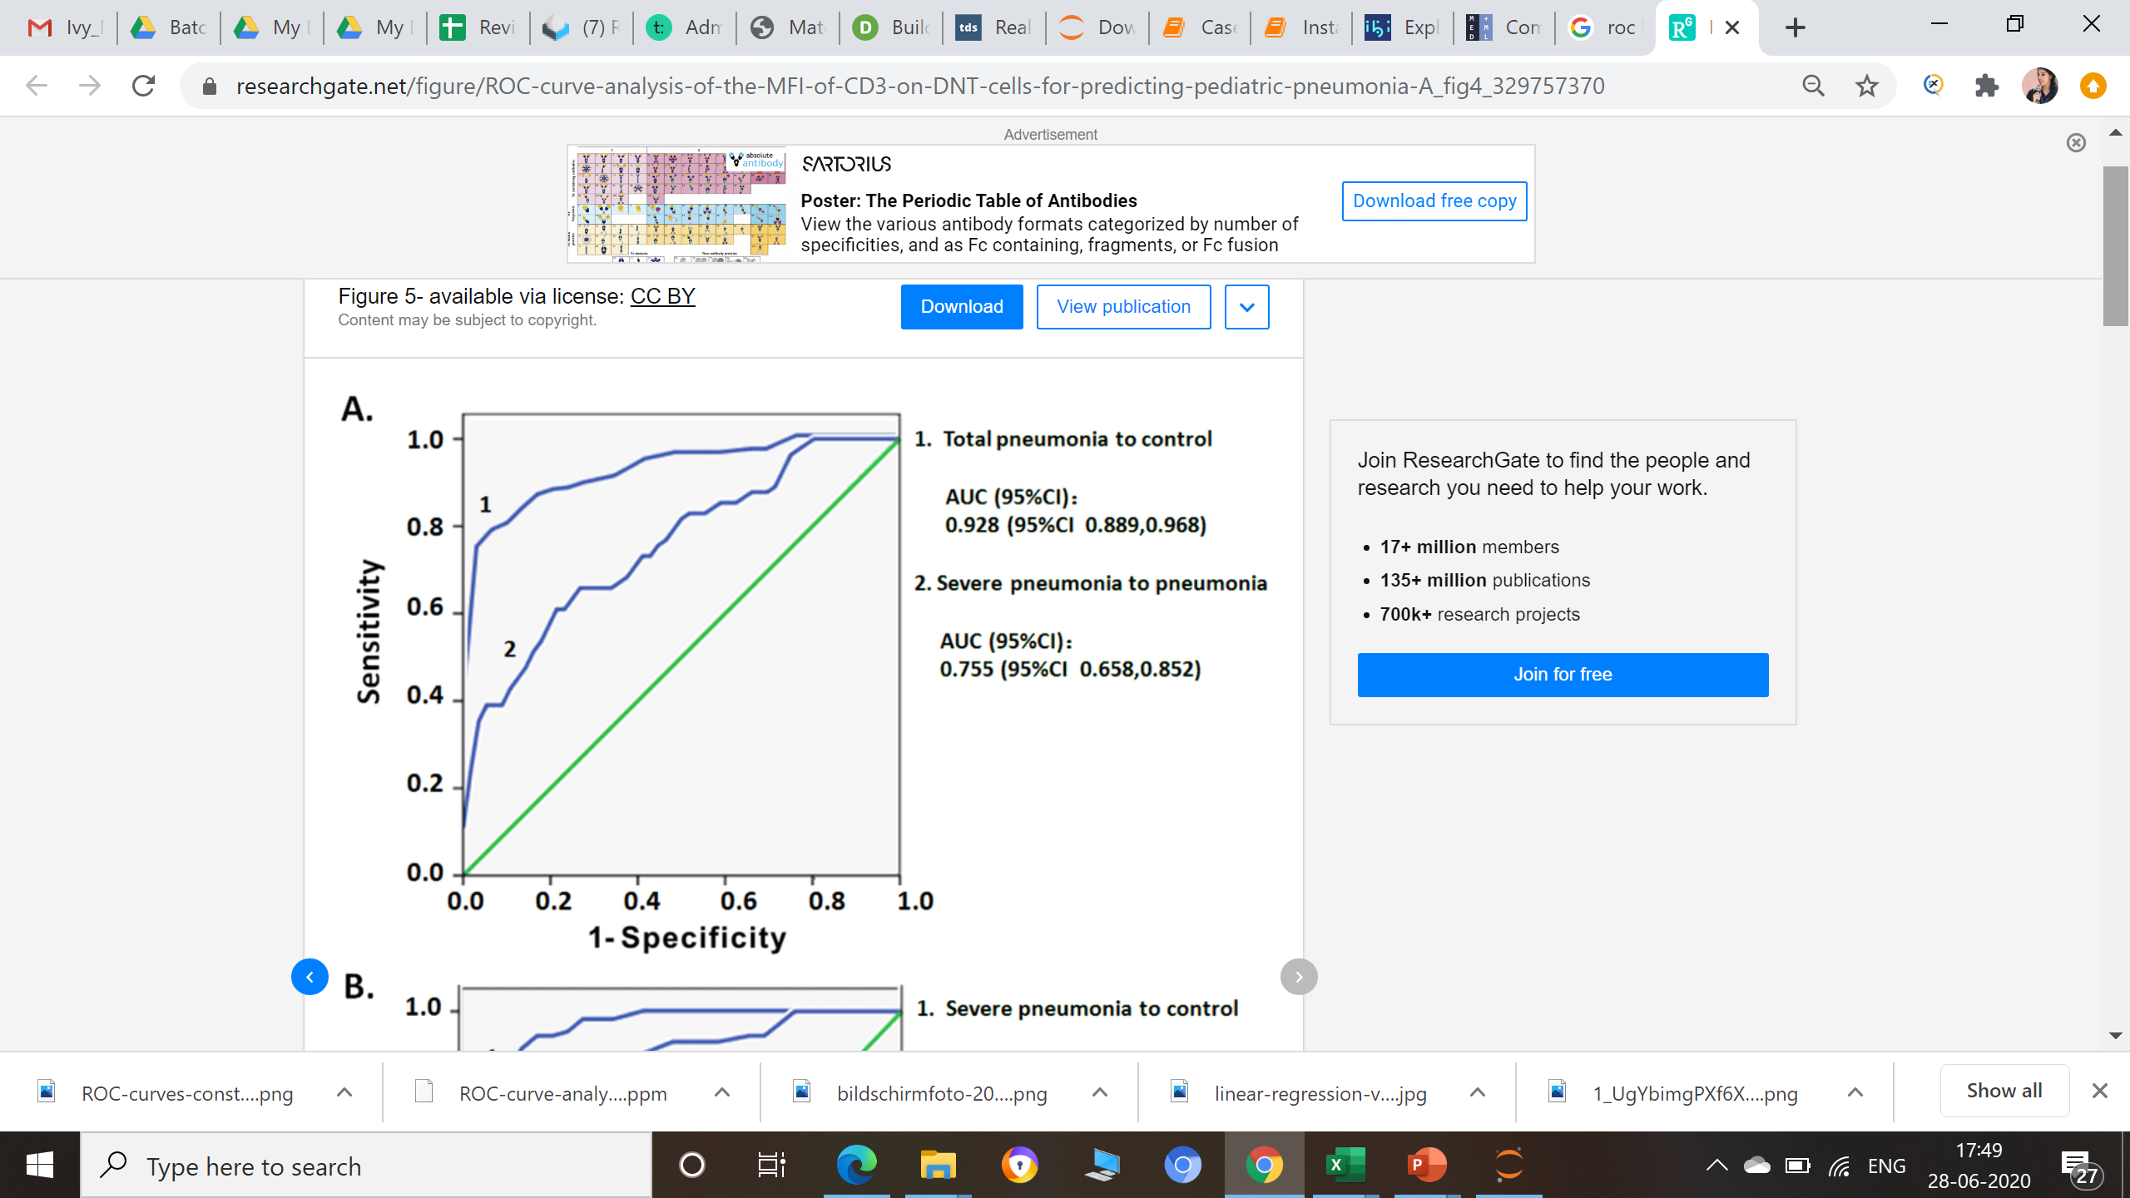
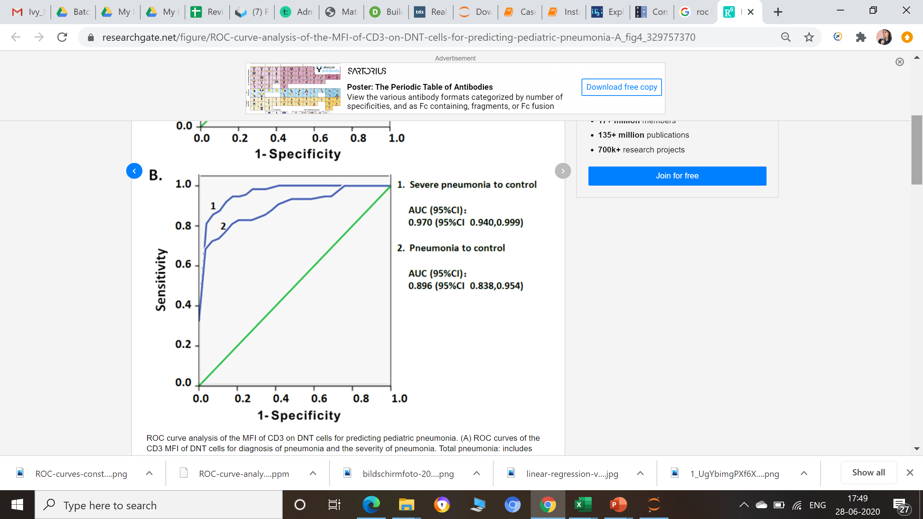
Example of ROC

Slide 25
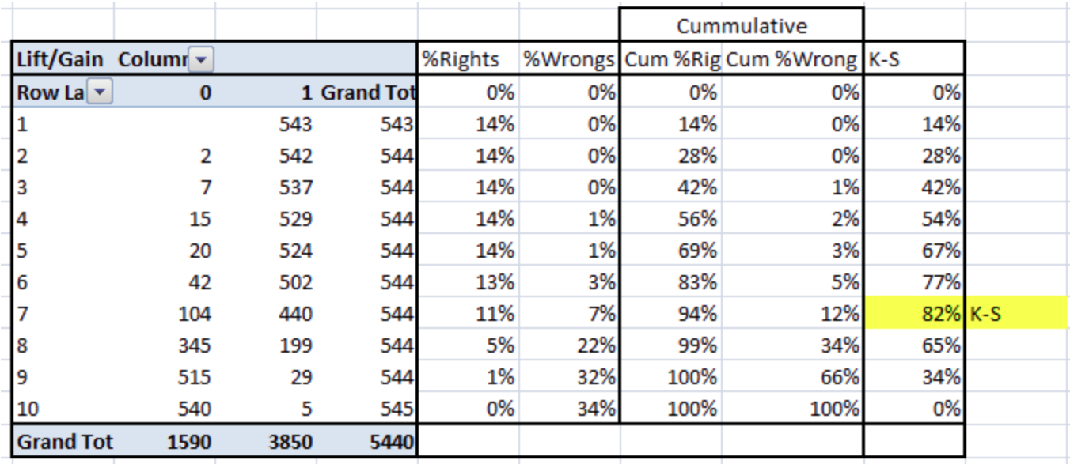
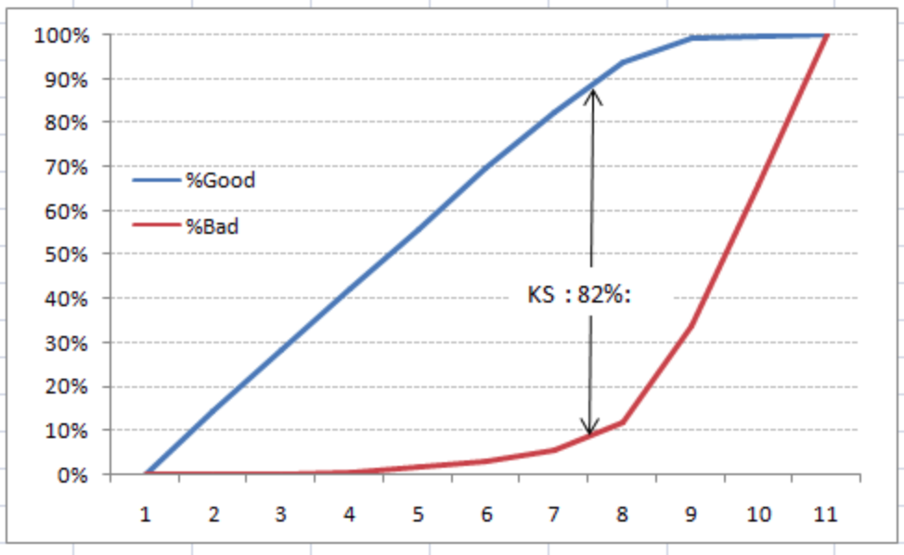
5. Kolomogorov Smirnov (K-S) chart
Measure of the degree of separation between the positive and
negative distributions.
0<= K-S <=100, and that the higher the value the better the model is at separating the positive from negative cases.
The K-S is 100, if the scores partition the population into two separate groups in which one group contains all the positives and the other all the negatives.
If the model cannot differentiate between positives and negatives, then it is as if the model selects cases randomly from the population. The K-S would be 0.

Slide 26
Model Validation Rules : Summary
Same significant variables should come in both the training and validation sample.
The behavior of variables should be same in both the samples (same sign of coefficients)
Beta coefficients should be close in training and validation samples
KS statistics should be in top 3 deciles.
KS statistics should be between 40 and 70. Should not be significantly different from Training KS (more than 10 points in absolute)
Area under Curve (AUC) - Should be more than 0.7.

