Slide 1
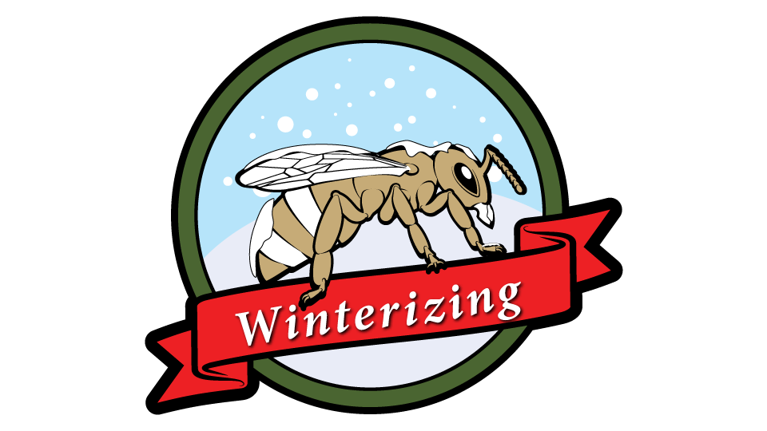

A. B. F. C.
A Bee Friendly Company, Inc.
Cheyenne, WY 82001
ABeeFriendlyCompany@gmail.com
Bees, cold, and Food
The Wintering of honey bees

Slide 2
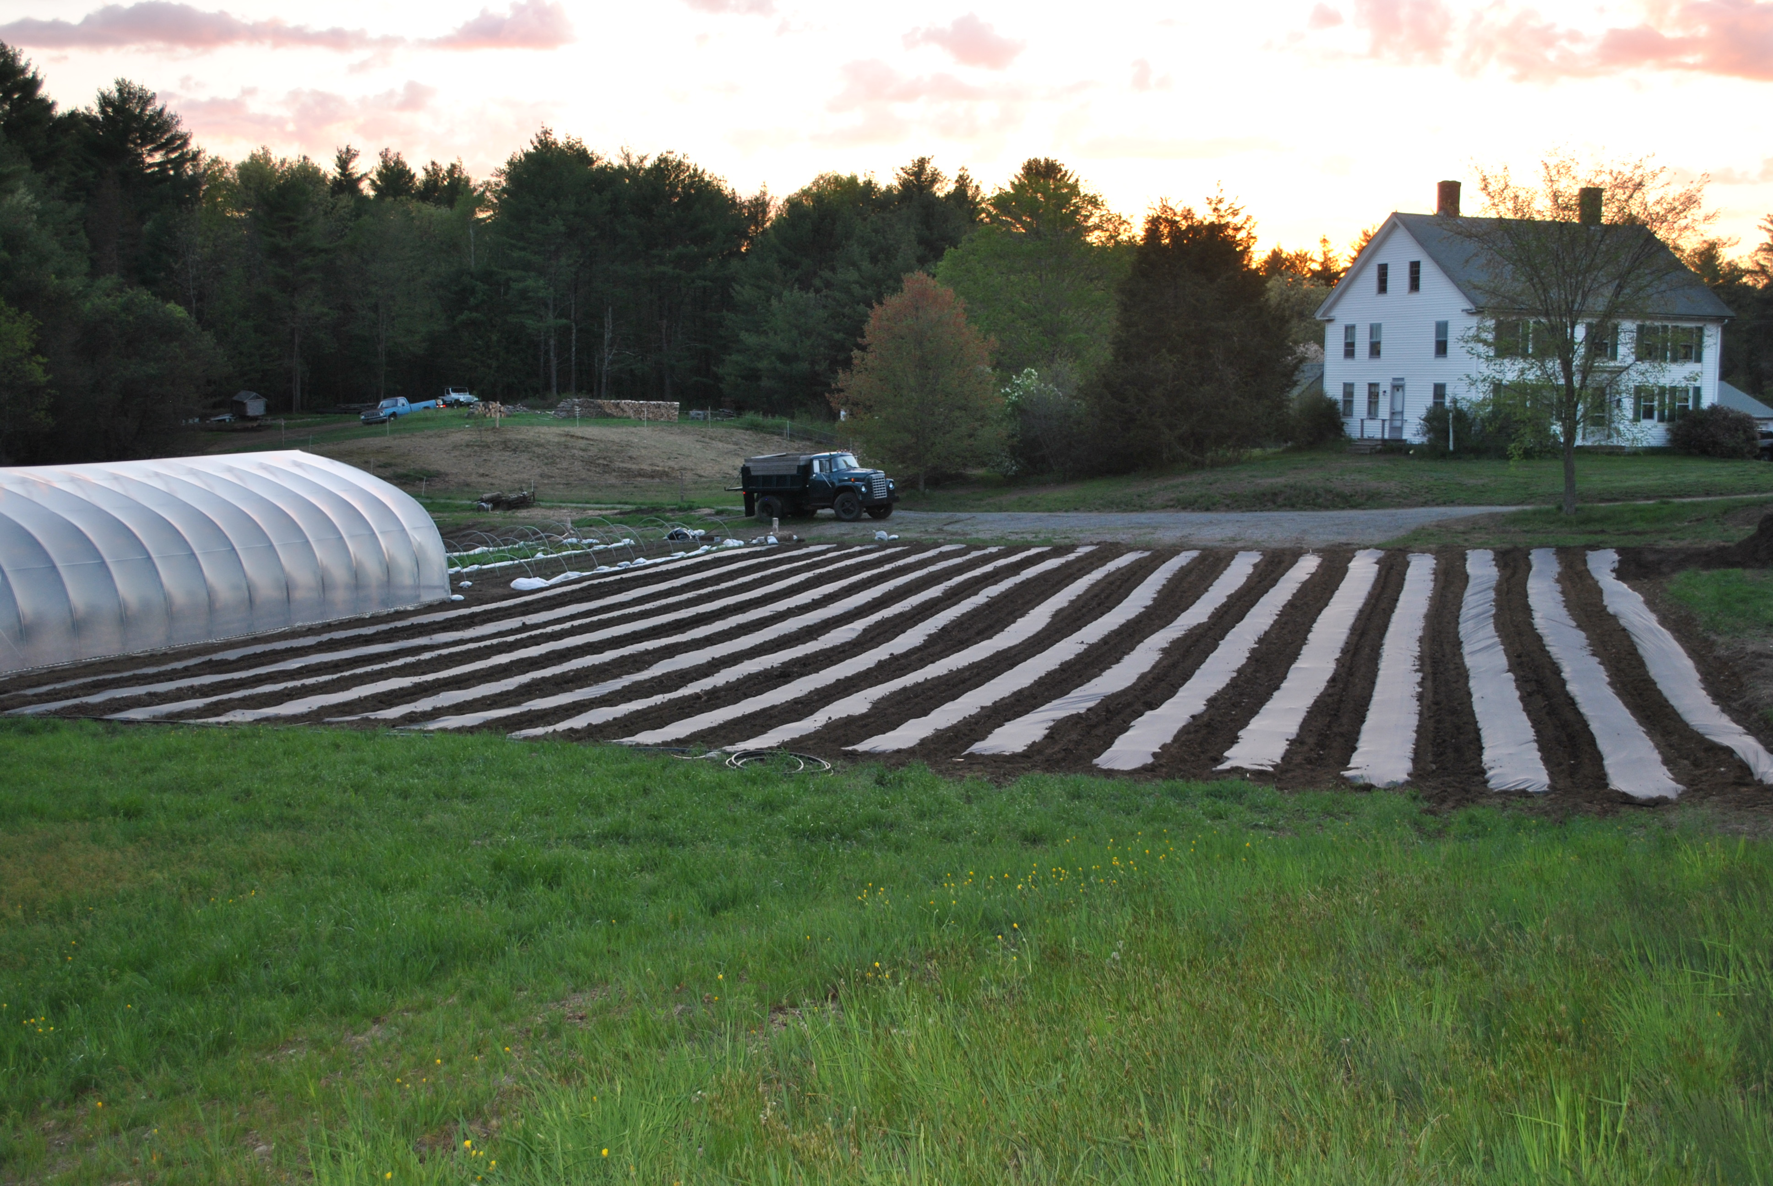
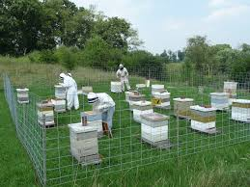
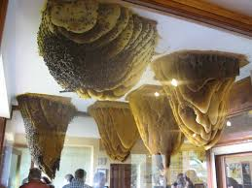
So Why Would I Have To Winter My Hives

Slide 3
The percent of winter kill in the United States for honey bee hives is growing.
This loss is largely due to carelessness or to lack of knowledge among beekeepers-E.F. Phillips 1915. Outdoor Wintering of Bees. USDA Farmers’ Bulletin #695, October 12, 1915 –
STILL TRUE TODAY!!!!
Truly, entire books could be written on this single subject
But where are they??? With so large of loss, This is where you start to make a change in the population in bees.

Slide 4
WE ARE NOT GETTING ANY BETTER
2015-2016 winter season, a preliminary 5,756 beekeepers in the United States provided validated survey responses. Collectively, these beekeepers managed 389,083 colonies in October 2015, representing about 15% of the country’s estimated 2.66 million managed honey producing colonies. An estimated 28.1% of the colonies managed in the United States were lost over the 2015-2016 winter. This represents an increase in losses of 5.8 percentage points compared to the previous 2014-2015 winter, but is close to the 10-year average total winter loss of 28.6%
PEOPLE, WE ARE LOOKING AT 1/3 OF THE HIVES DIEING OVER THE WINTER!

Slide 5
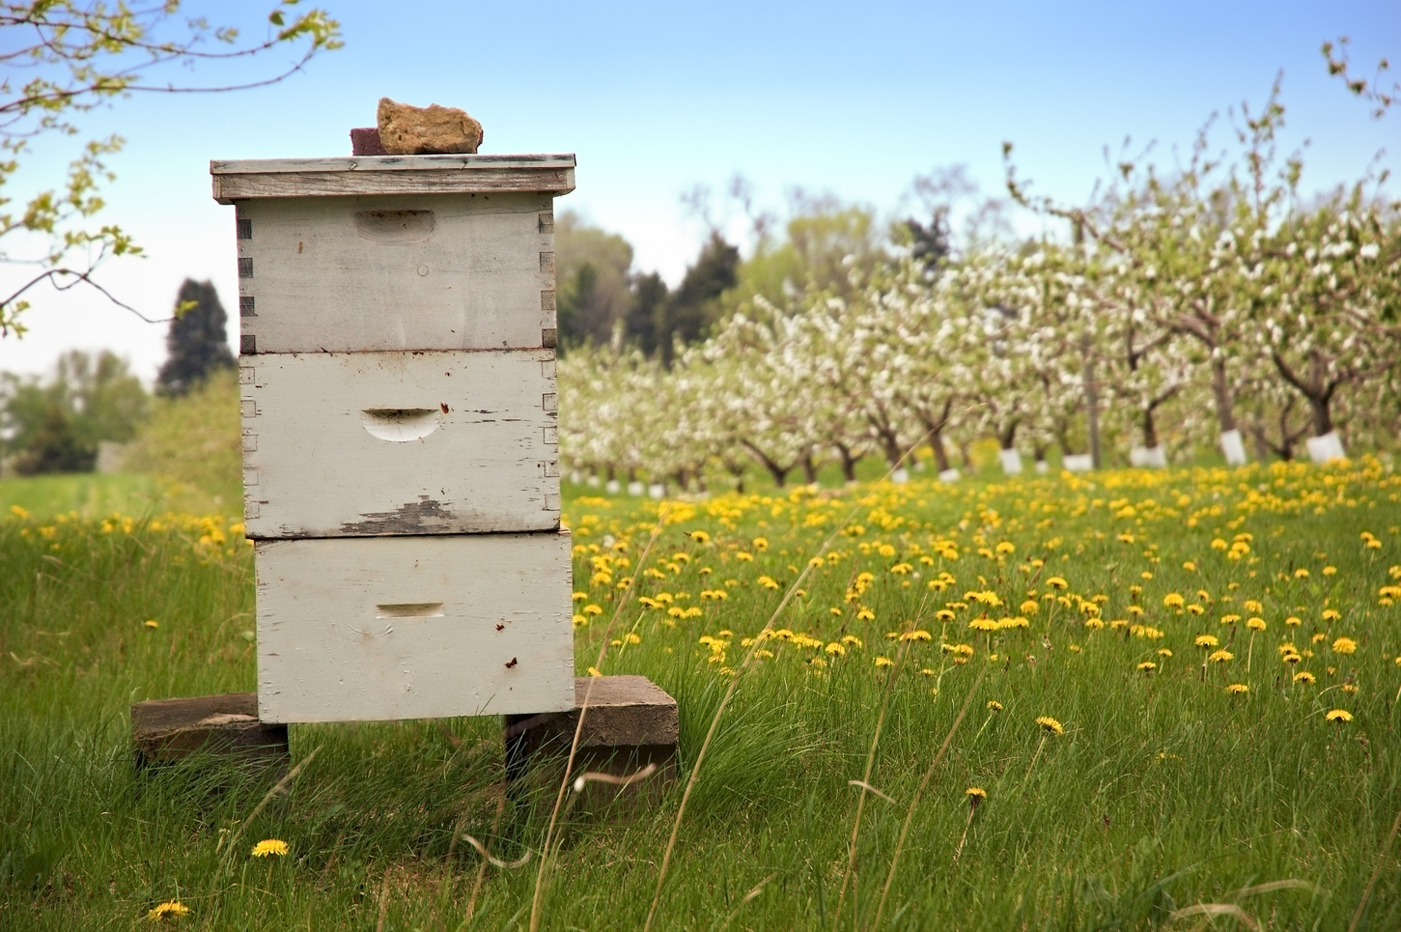
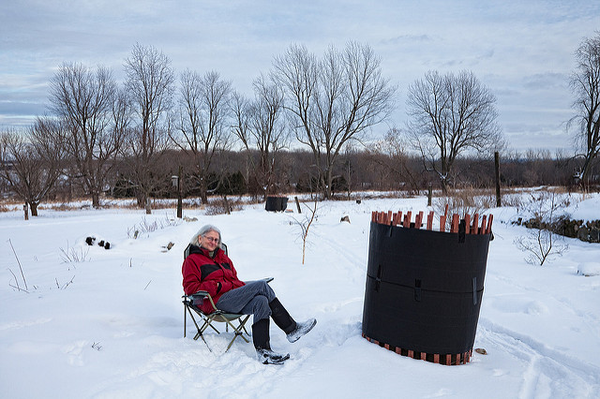
NOT EVERY LOCATION GETS THE SAME THING!

Slide 6
Some places no changes are need.
Winter from the equator out!
The more you move from the mediterranean belt the more you have to do to keep your bee warm over the winter. Not to say, if you do not live where it you have 12 months of summer the more you have to do.
Some places the bees are moved until the location is warm, like Alaska
Just like in the summer we need to cool the girls down, in the winter we need to warm the girls up.
Now it is not always the cold zones that you winter hives.
You have rain, wind, & just no food supply on the fields

Slide 7
Down Sizing Space
What does that mean???
Having the ideal amount of space is a tricky thing to manage but it makes the difference between prosperity and poverty for a honey bee colony. –Michael Bush, The practical beekeeper

Slide 8
Remove Frames, Boxes, and Pests
Take off all honey boxes and queen excluders. The honey boxes take up more space to keep warm and if you lever them with a queen excluder, as the bee go up in the winter to eat and keep warm, the queen is left behind to freeze and starve. One of he biggest reasons for no queens in the spring.
Remove any combs they are not occupying. Remove any combs they have lost control of as evidenced by small hive beetle or wax moth larvae. Do a good check and get things out that will not be managed over the winter. As the bees cluster, they can not get to the whole hive now.
It's like they were living out of control in a place they can not pay to keep warm, safes and starving and now they are in place they can afford by keeping it warm, safe and well feed.
Make the hive smaller for winter control.

Slide 9
Starting Out From The Ground Up
For winter you may have to set up the apiary all over to keep them girls happy.

Slide 10
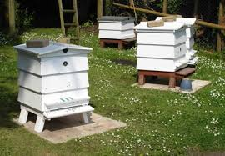
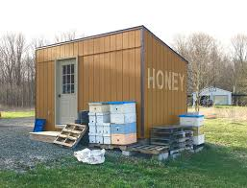
Your Site

Slide 11
Landscape fabric and plastic can help prevent weeds and control erosion by holding the soil in place and keeping weeds from sprouting. It can also keep ant and small pests from moving across the ground to get to the bee hives. You man need start right there. Control the surroundings.
You may need to in to place wind breaks, and hay bails to stop wind and snow from piling up. In location people are even coving the hives in mounds of Dirt to keep them insolated.
Heck some people load up and just move them inside a potato cellar or in a barn.
The location may need to change for the season.

Slide 12
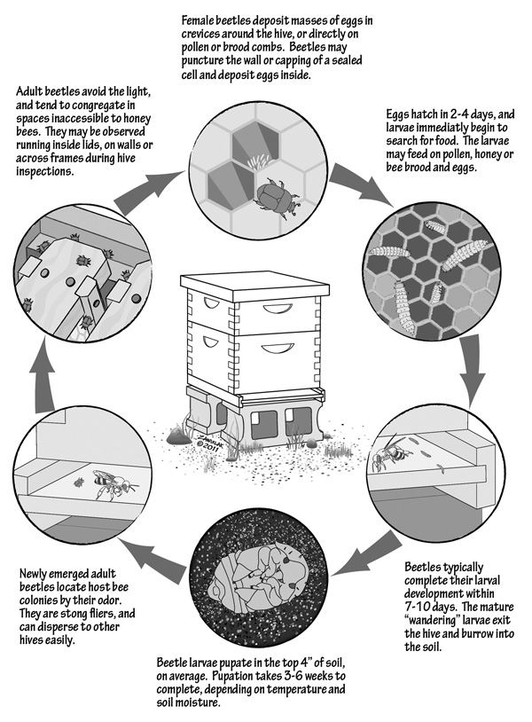

Slide 13
The Winter Hive Check
Some quick things to look for:
Drone Culling
Brood Nest Size
Hive Health – Nosema or Dysentery
PEST CHECK – Mice, Moth, and Mites

Slide 14
Winter Treatments
Now if have seen any problems during your hive check, Address them ASAP. Do not wait till the new year hoping that it cured itself.
As to doing preventive treatment, us the last of the Rhubarb leaves that are dying off. One way mother nature tells us to treat the hives.
Only treat what you see.

Slide 15
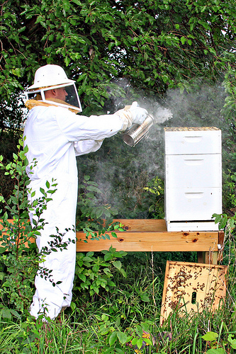

Slide 16
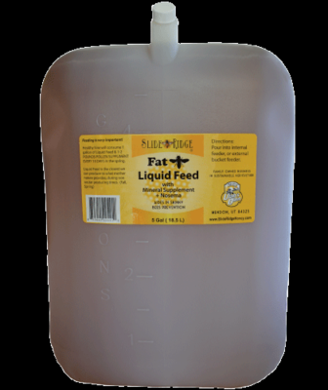
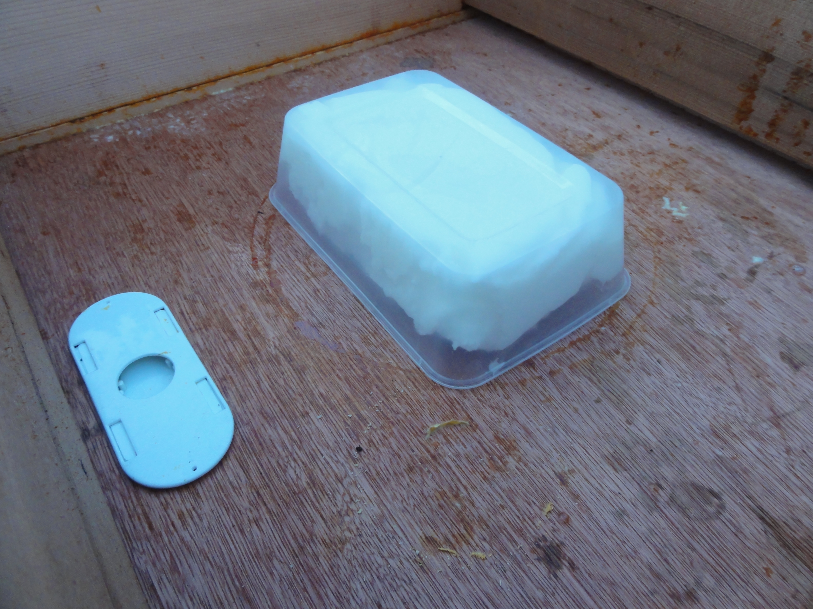
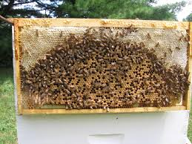
FEEDS For The Bees
Liquid Feed
Fondant cakes
Storage

Slide 17
If Bee Make Honey, Why Feed?
So we have made an investment. $100 plus just for the bees. If you get a dog and pay $100 for it you would want to feed it too.
A Bee hive will need lots of food for storage. So in Times of Darth, or no nectar flow, we feed the bees or they will eat all they have…and it may not be enough.

Slide 18
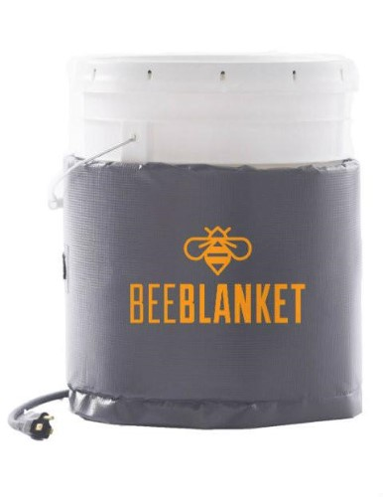
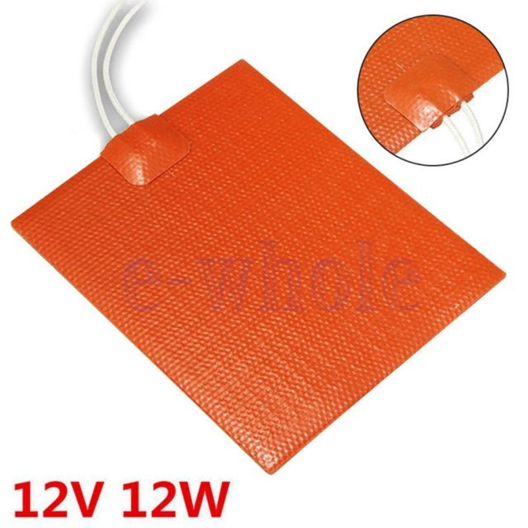
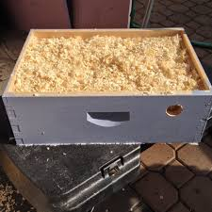
Hive Heaters & The Quilting Box

Slide 19
Hive heaters
Now we make the easy-bake-oven hive bottoms. They work. You can see it in the videos. We sell them. There are many ways to heat the hive.
Heat Box
Heat Pad
Fish tank heater
You want to keep the hive above 40 and under 50. You want the bees to eat, but not so active they eat everything in the hive.

Slide 20
The Quilting Box
I did not know Bees could knit?!?!
Moisture in the hive is a large problem. It freezes the bees in mins.

Slide 21
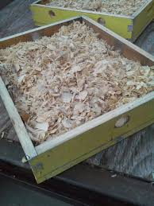
Use Cedar Chips in The Quilting Box
Sitting under the lid, this box is filled with wood chips. It has fine screen or fabric to cover it when it is placed over a hive.
The wood chips absorb the water in the hive so it will not freeze. Letting it dissipate faster out of the hive.
ABFC quilting boxes have feed tubes and vent controls for air flow.

Slide 22
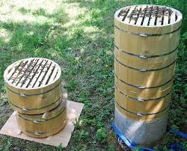
Different hive need different types of winterization. Really look at the system your using

