Slide 1
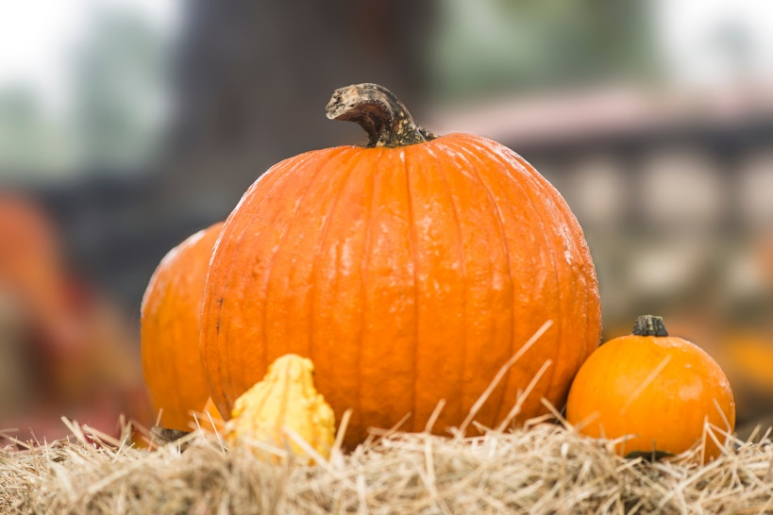
Pumpkins!

Slide 2
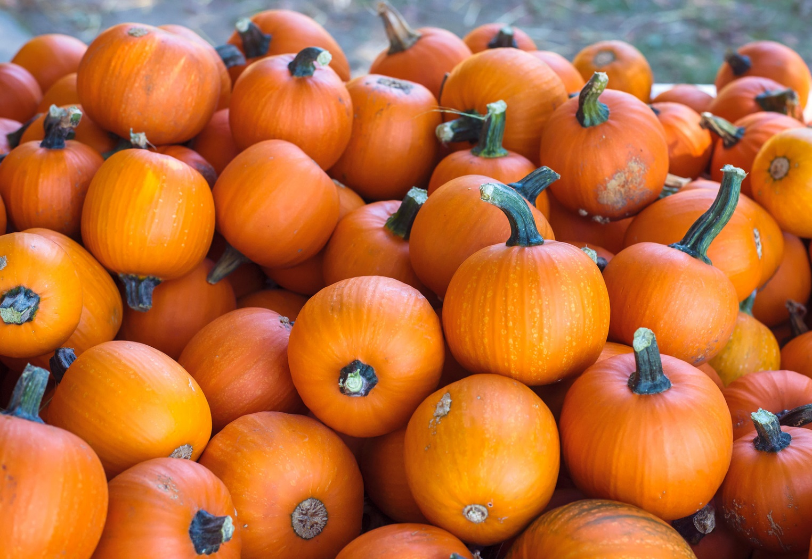
In the fall, we start to see pumpkins.

Slide 3
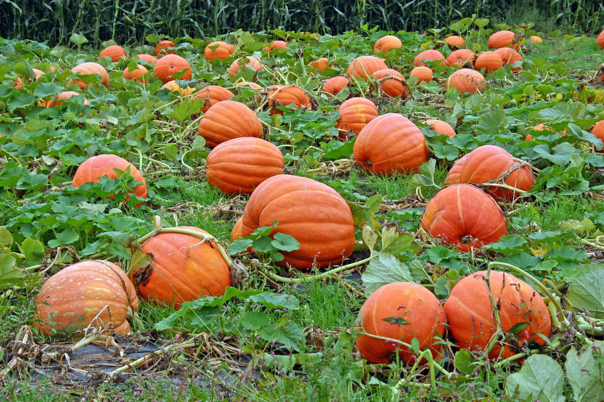
Pumpkins grow in a pumpkin patch.

Slide 4
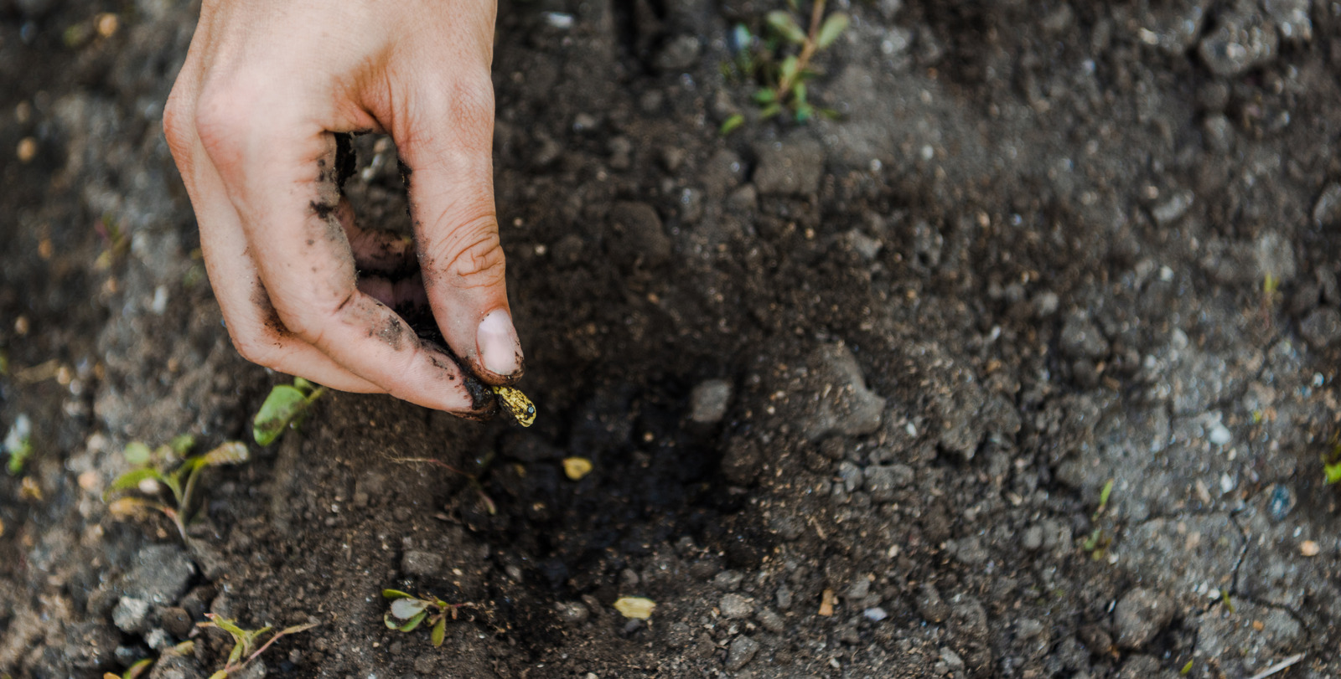
In the spring, the pumpkin seeds are planted.

Slide 5
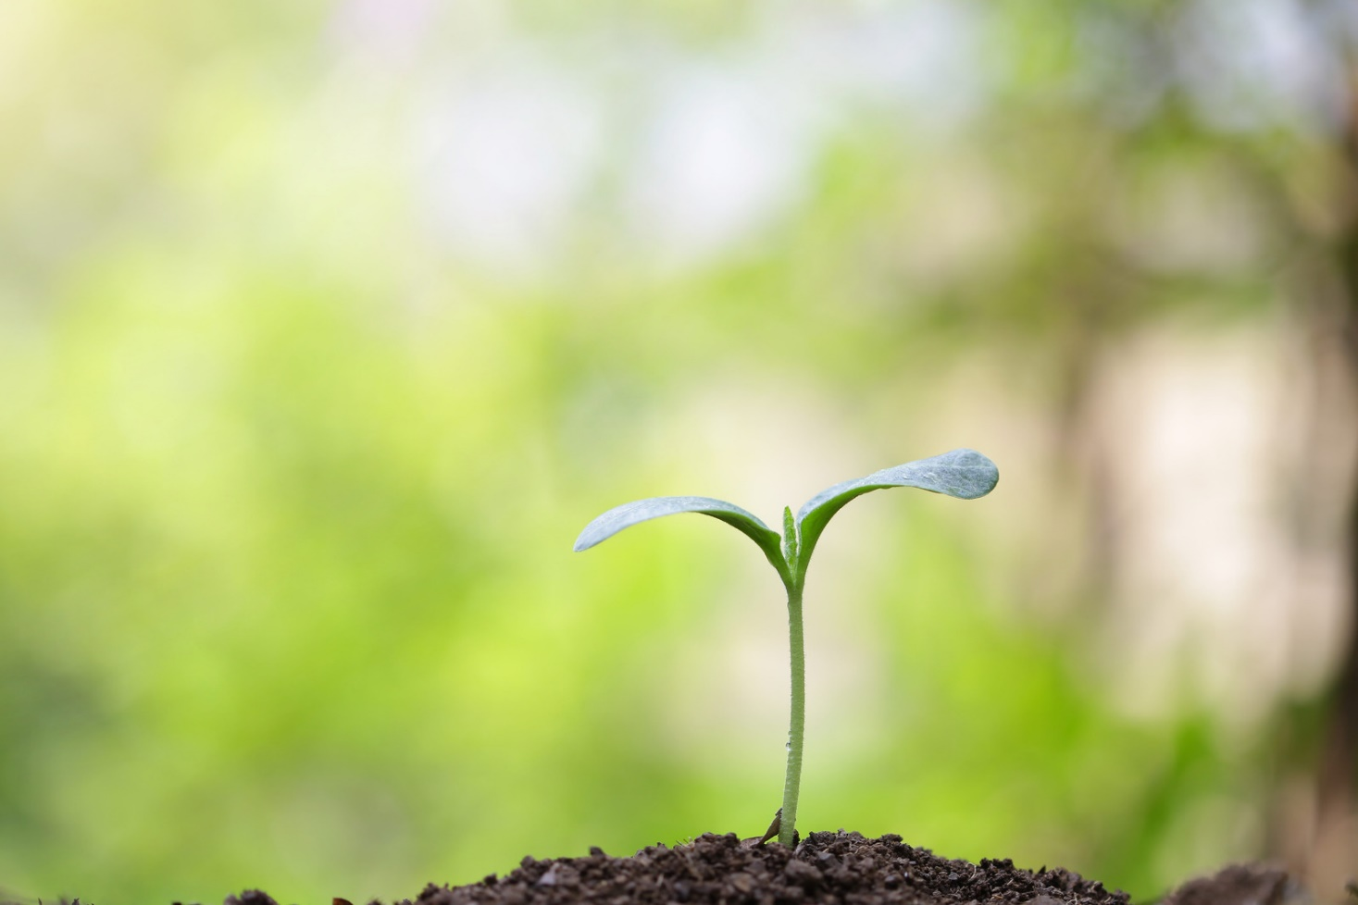
In the summer, the pumpkin plants start to grow.

Slide 6
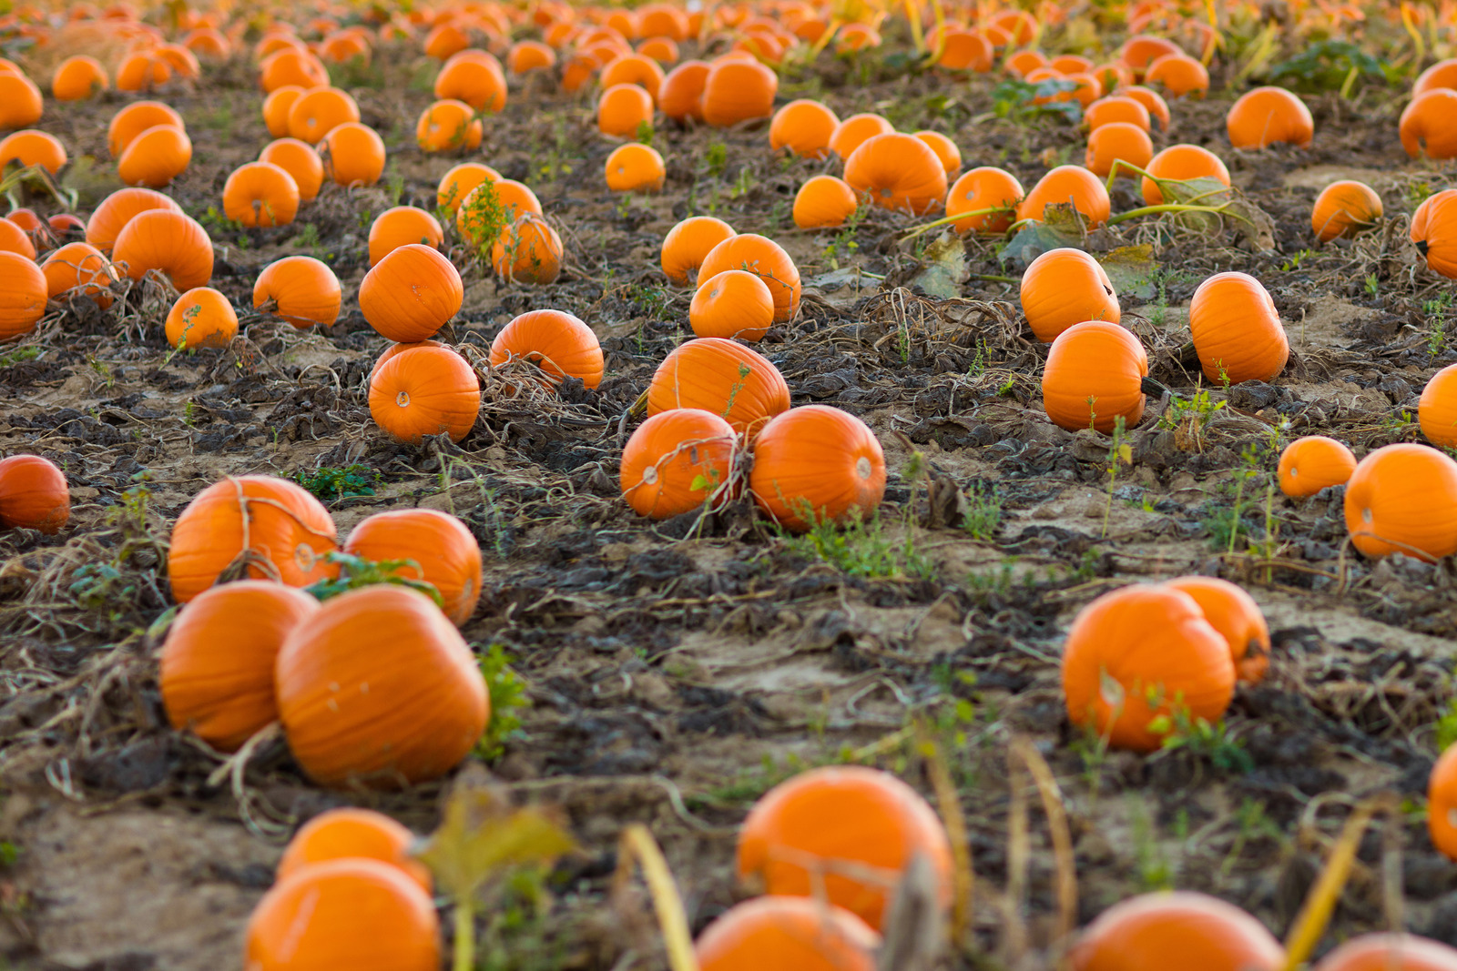
In the fall, the flowers grow into pumpkins.

Slide 7
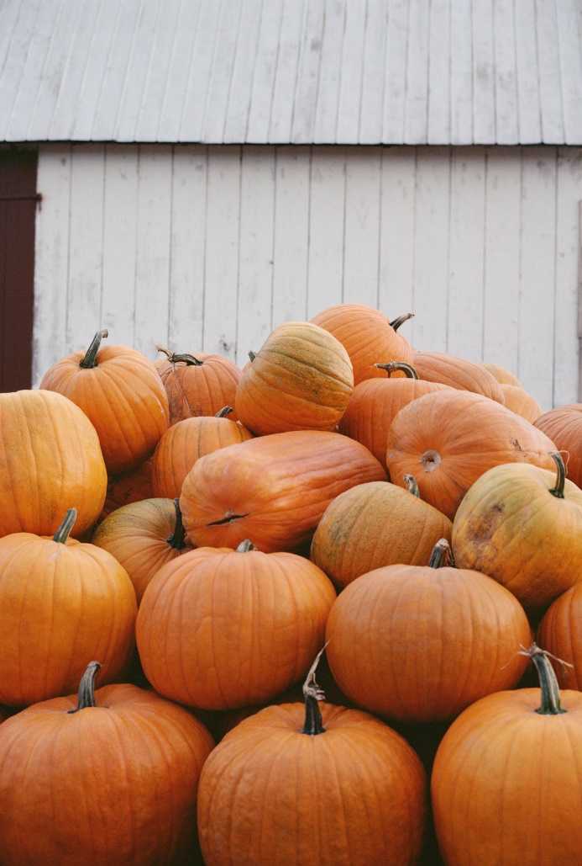
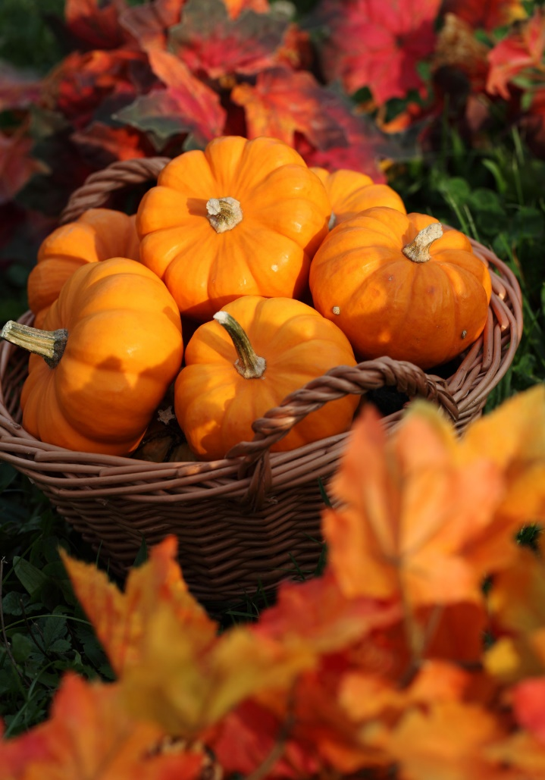
Most pumpkins turn orange.

Slide 8
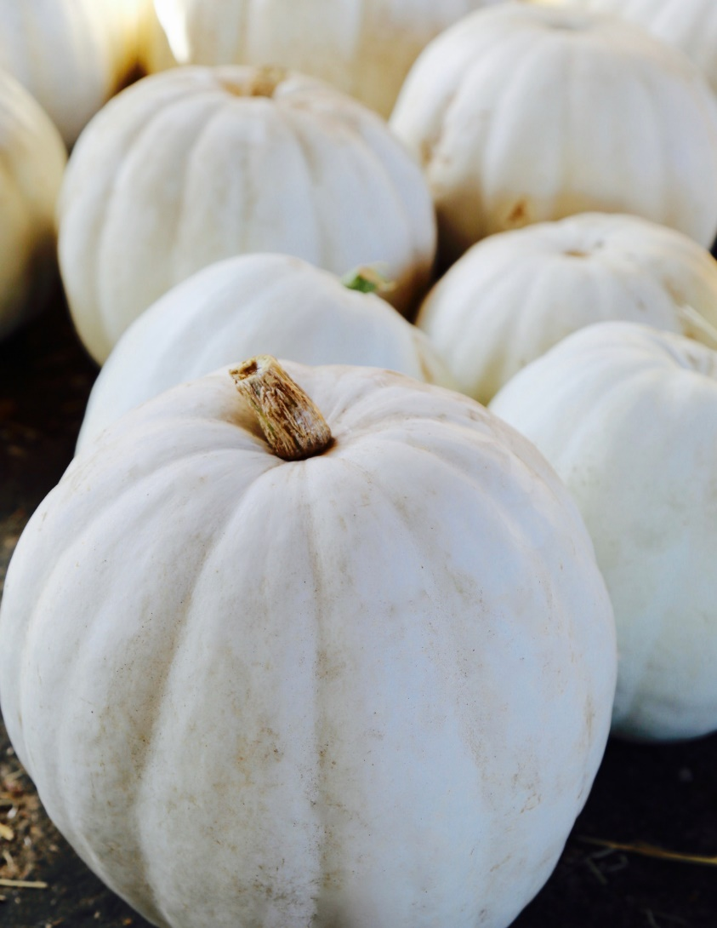
There are white pumpkins.

Slide 9
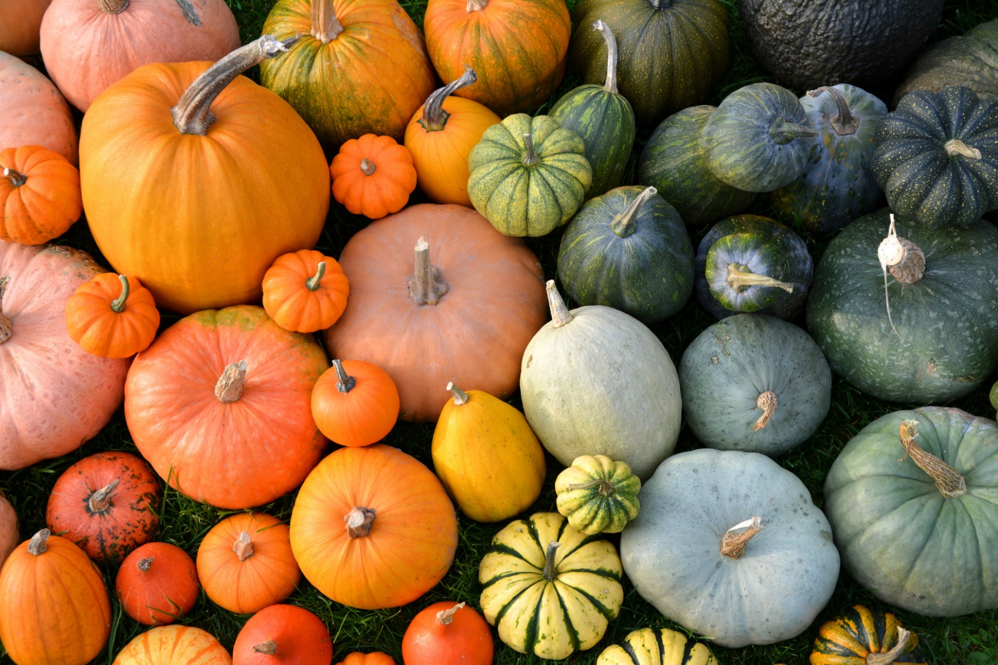
There are also other kinds of pumpkins.

Slide 10
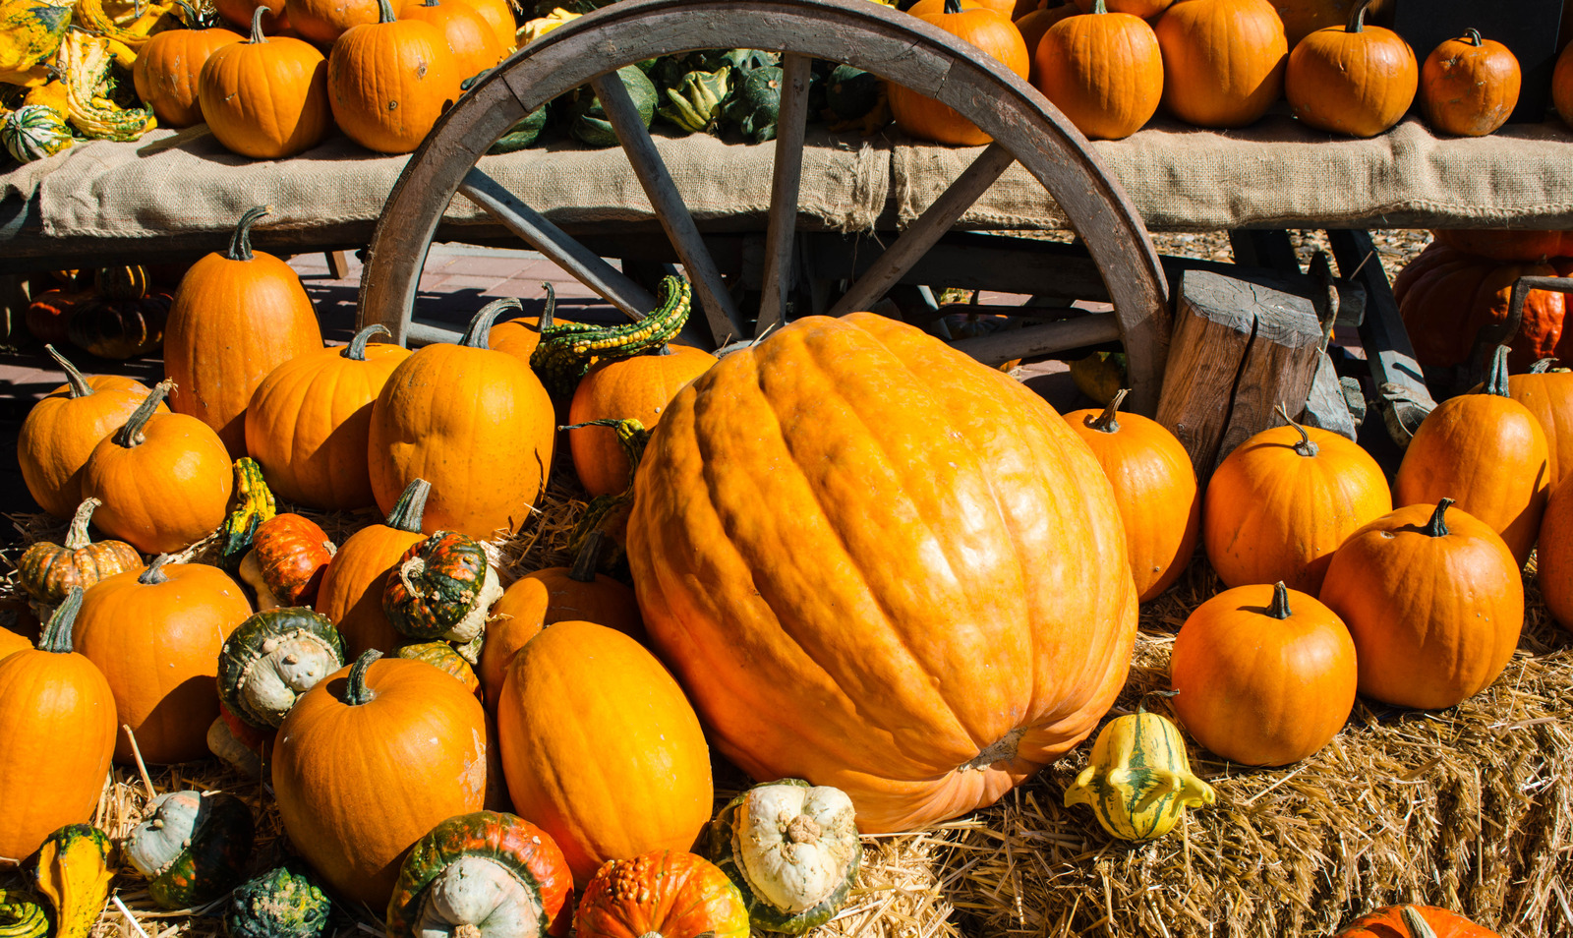
Some pumpkins grow big and some grow small.

Slide 11
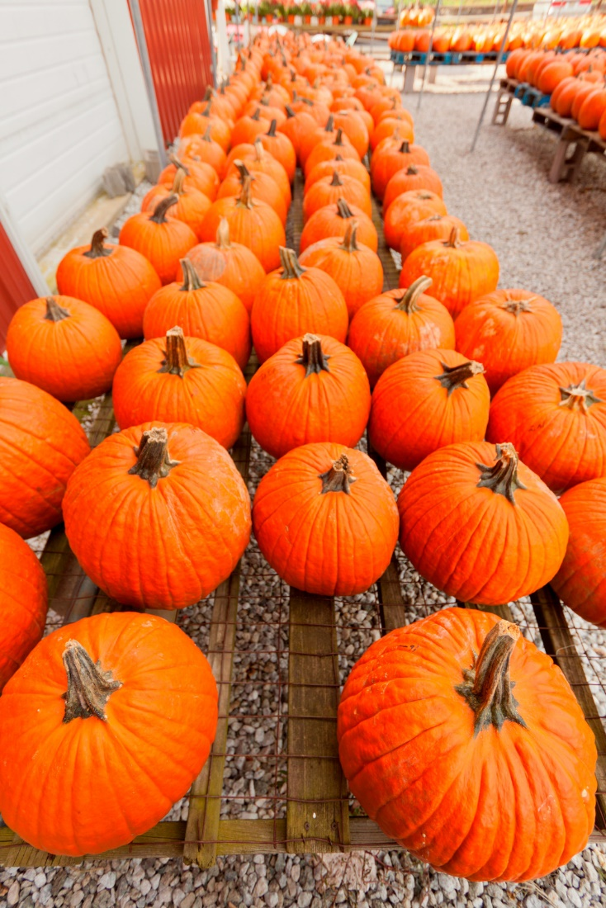
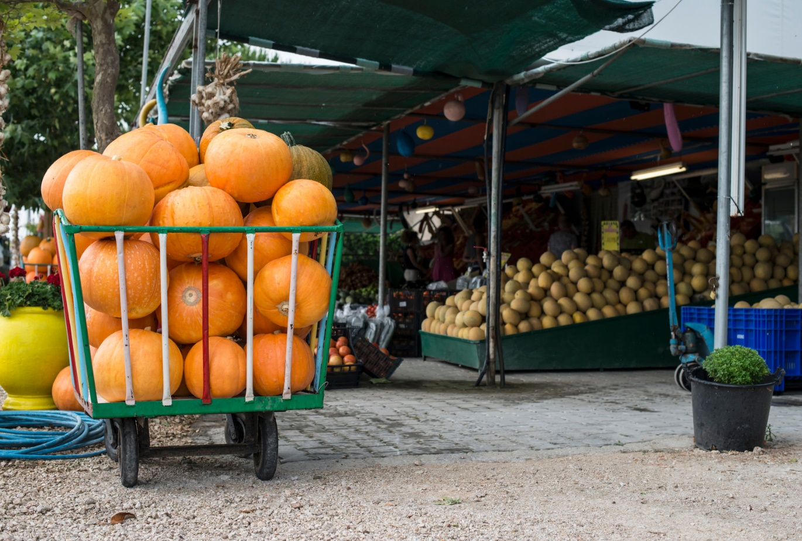
Some pumpkins go to the market place.

Slide 12
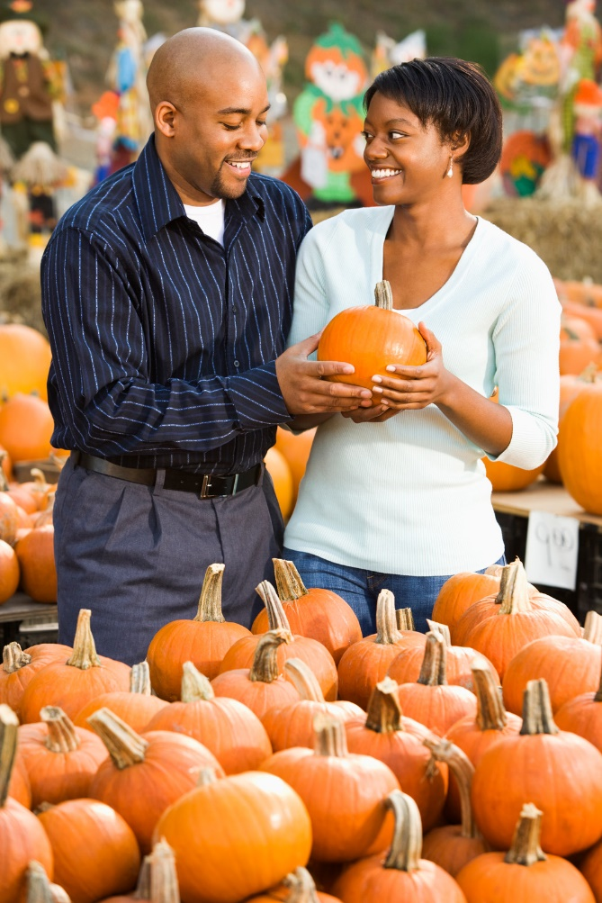
People buy pumpkins and take them home.

Slide 13
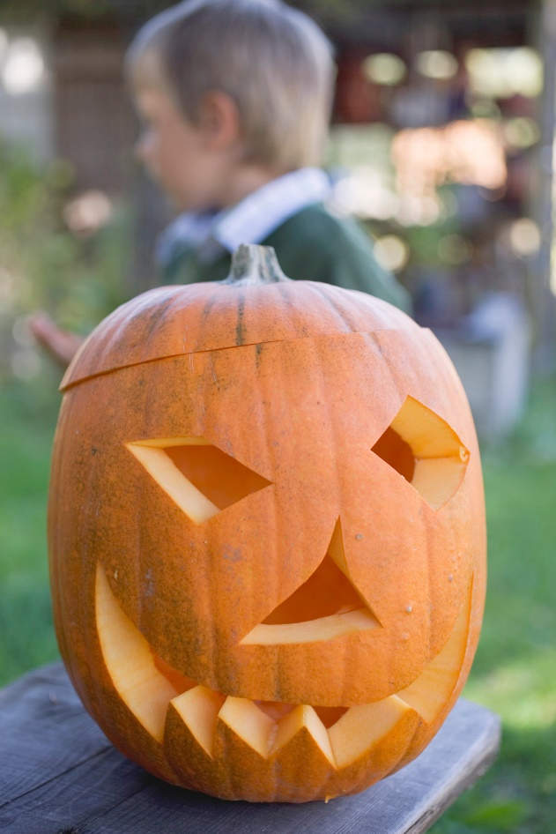
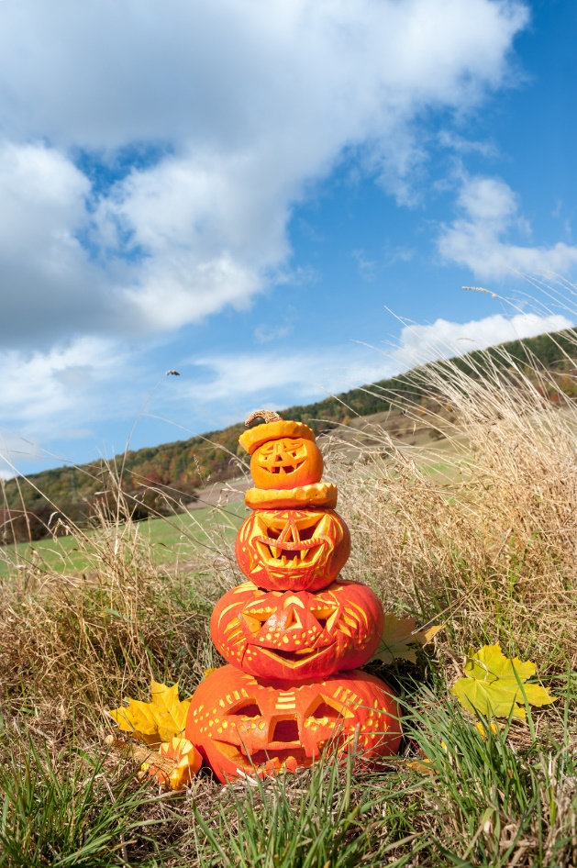
People like to carve pumpkins.

Slide 14
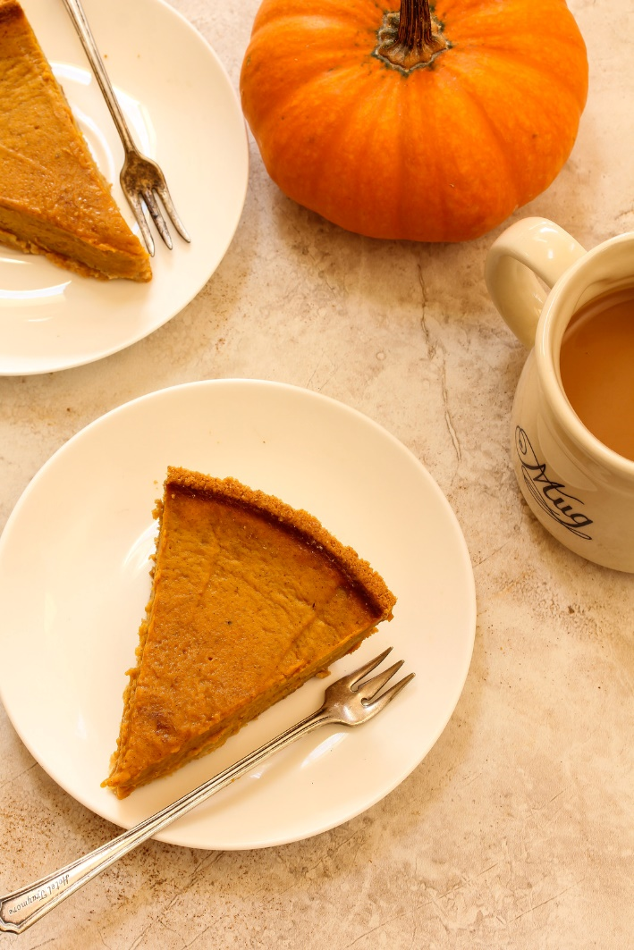
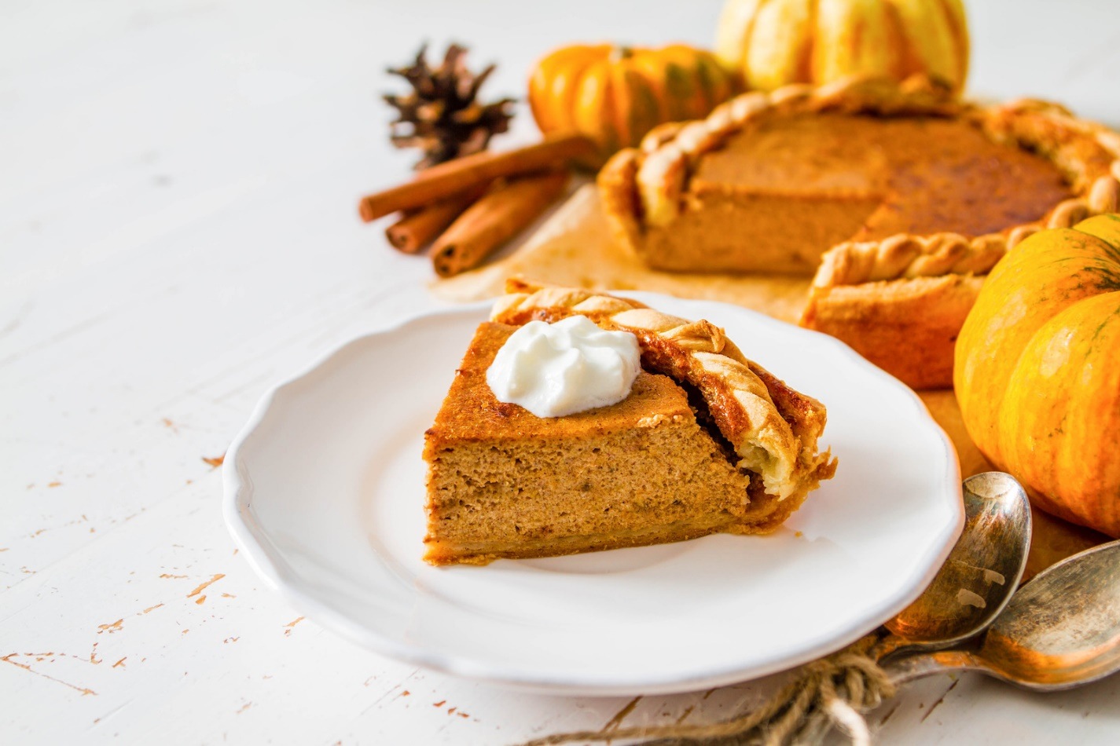
People make pumpkin pie.

Slide 15
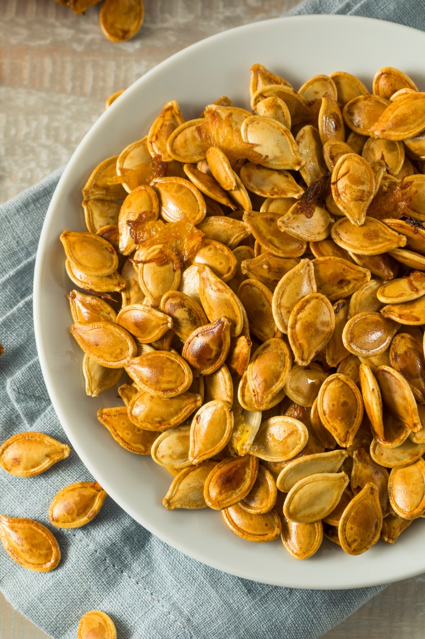
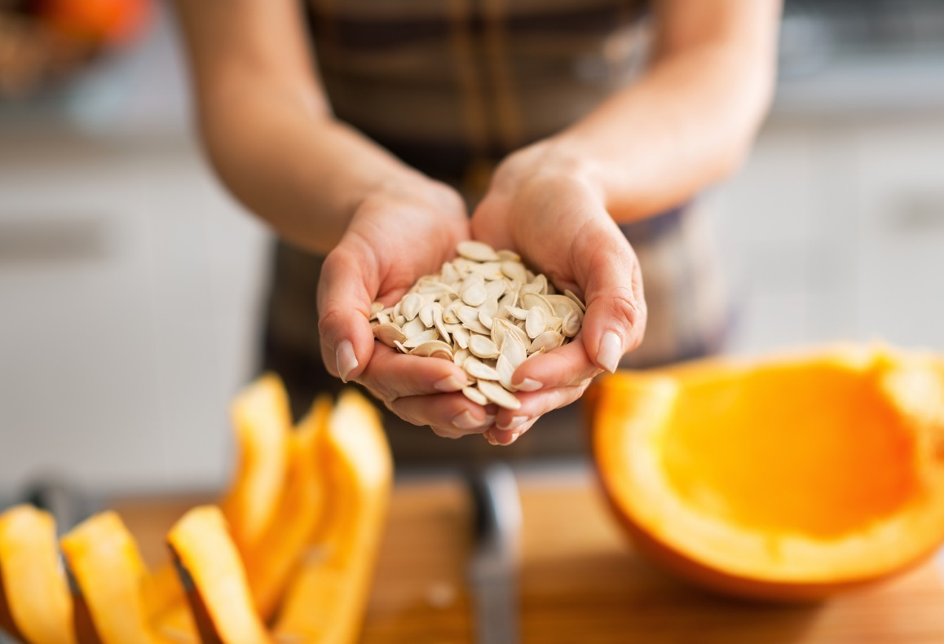
People like to bake the pumpkin seeds and eat them.

Slide 16
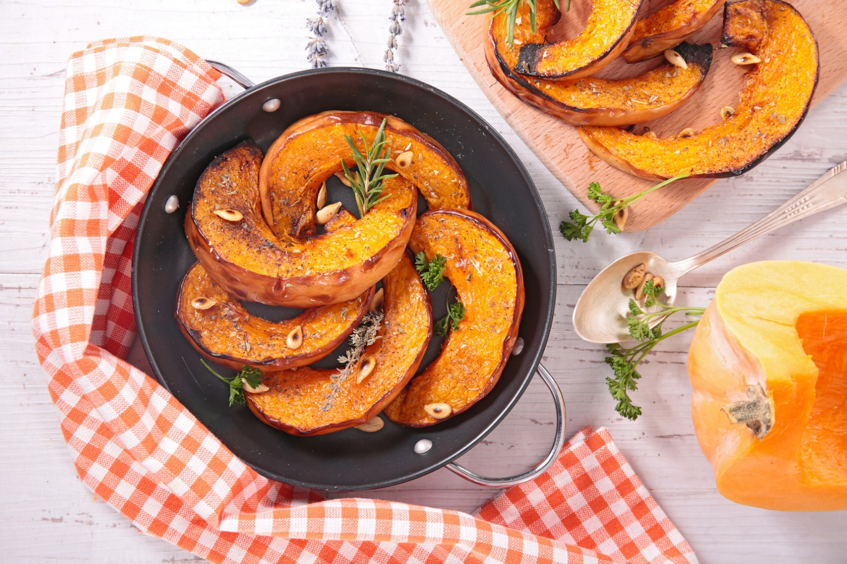
Some people like to eat pumpkin.

Slide 17

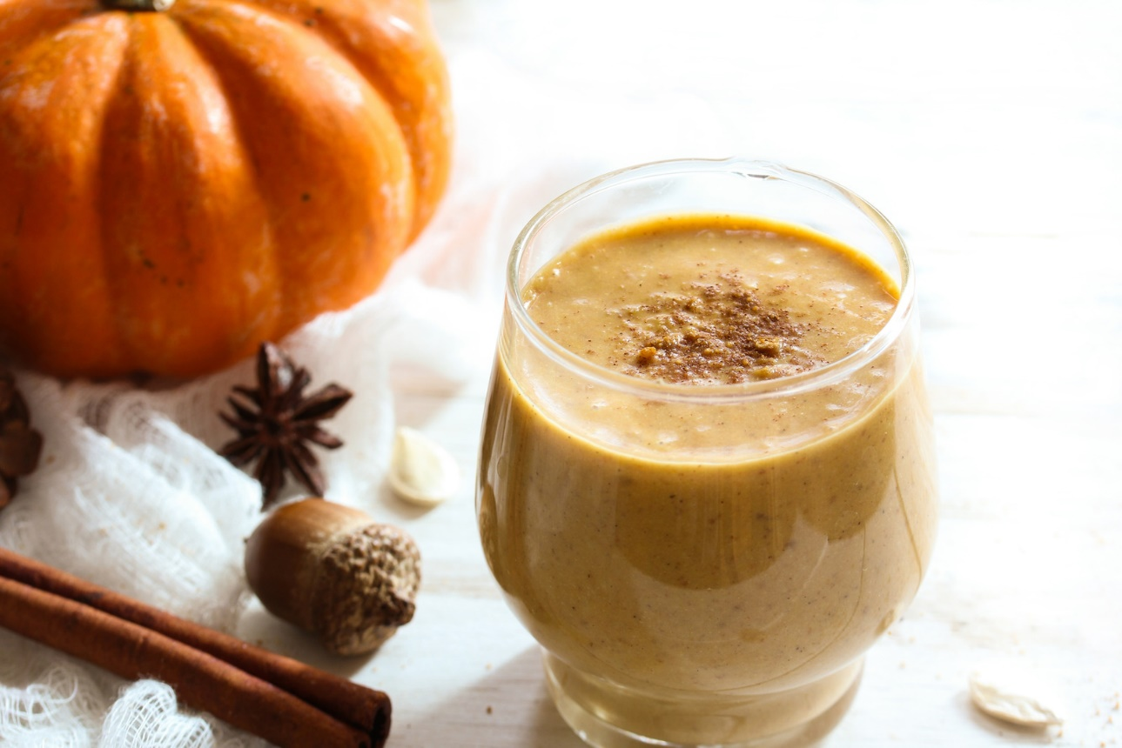
Pumpkins are used for many things, happy pumpkin time!

