Slide 1
ALIGN OBJECTS

Slide 2
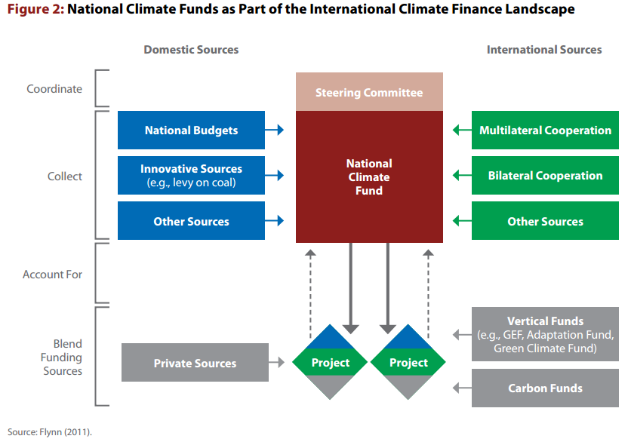
1
Source: UNDP - Blending_Climate_Finance_Through_National_Climate_Funds

Slide 4
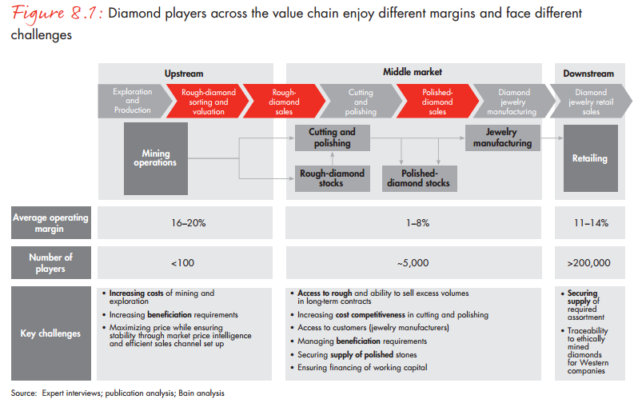
2
Source: BAIN_REPORT_The_global_diamond_report_2013

Slide 5
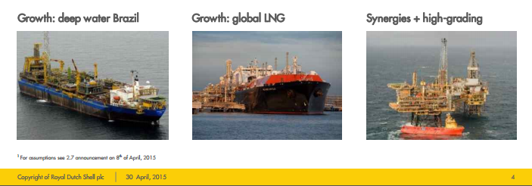
3
Source: q1-shell-q1-2015-analyst-presentation-slides

Slide 6
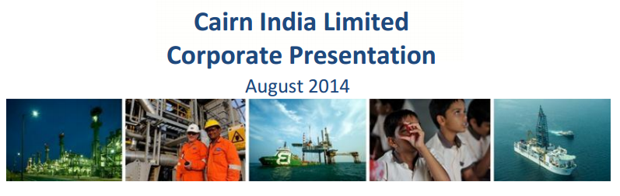
4
Source: Cairn-India-Corporate-Presentation-August-2014

Slide 7
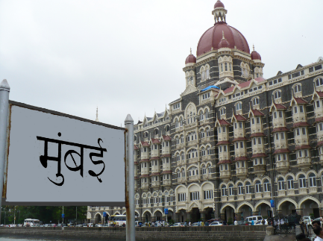


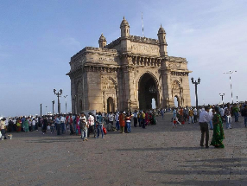
Exercise

Slide 9



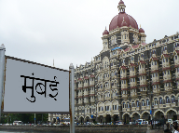

Slide 10

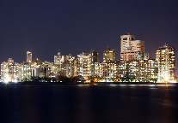


Slide 12



