Slide 1

A framework for your social action project
Young Citizens
Make a Difference Challenge
Notes:
- Would you like a tried and tested structure to underpin your social action project?
- Would you like resources, lesson plans, and suggested activities to help ensure your social action project is child-led?
- Would you like your learning to contribute to your CPD at the same time?
For more than a decade the Young Citizens Make a Difference Challenge has supported teachers across England to deliver quality social action projects with primary aged children. The programme follows a structure which ensures that children lead the project and are at the heart of decision making, whilst teachers are on hand to guide and facilitate their learning.

Slide 2
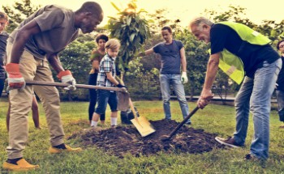
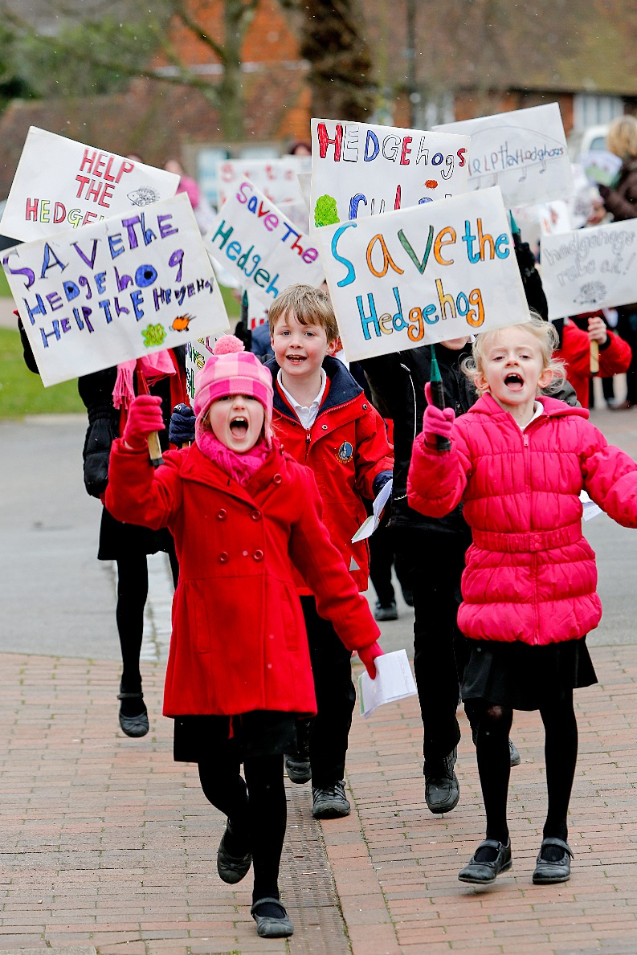
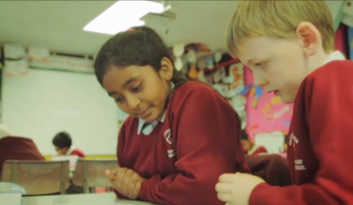
Notes:
Since 2008, hundreds of schools across the UK have taken part in the Make a Difference Challenge, involving thousands of children, and benefitting local, national and international communities.
Children have chosen to make a difference to a wide range of issues, from social problems such as knife crime, social isolation of elderly people, homelessness, speeding cars near schools or period poverty, to environmental issues such as hedgehog conservation, clearing-up graffiti, and planting wild flower gardens to support declining butterfly and bee populations.

Slide 3
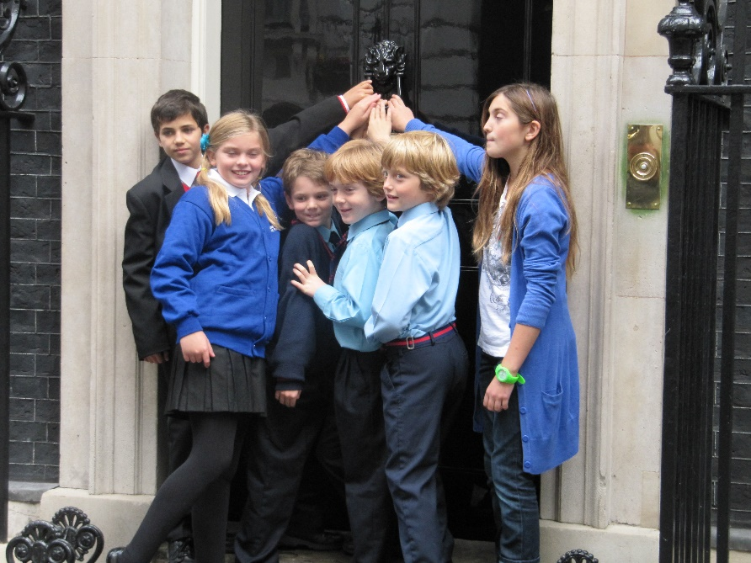
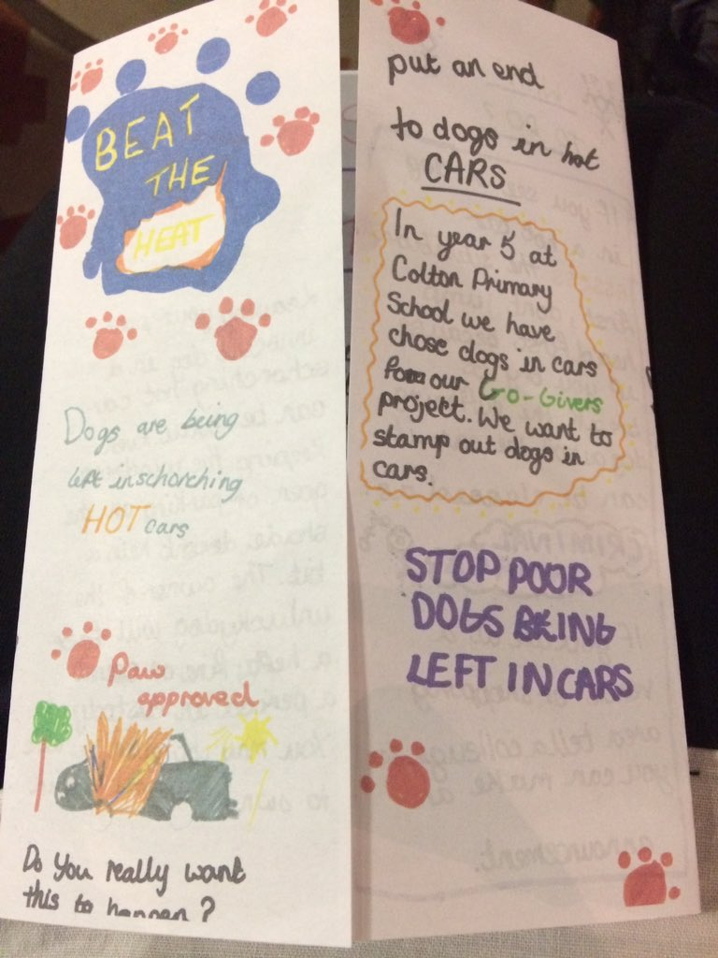
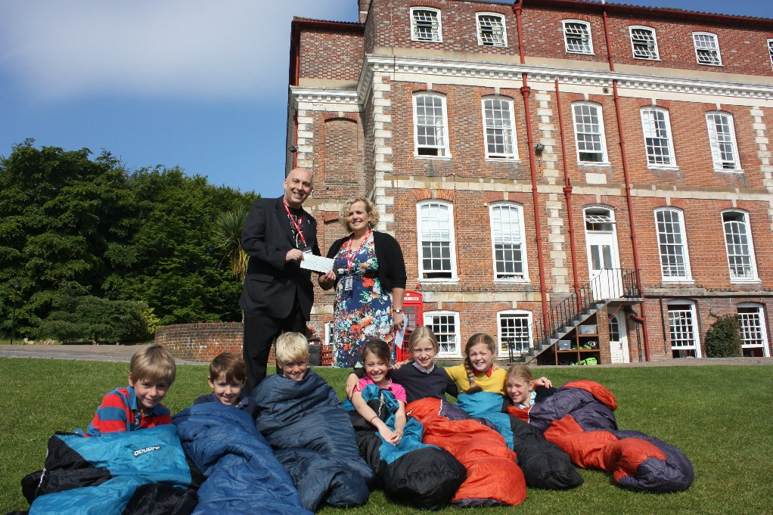
Notes:
Their actions have included:-
protests
writing to their political representatives
raising funds for, or donating items to, local, national and international charities
volunteering, and
raising awareness through poster campaigns, local radio, newspapers and social media

Slide 4
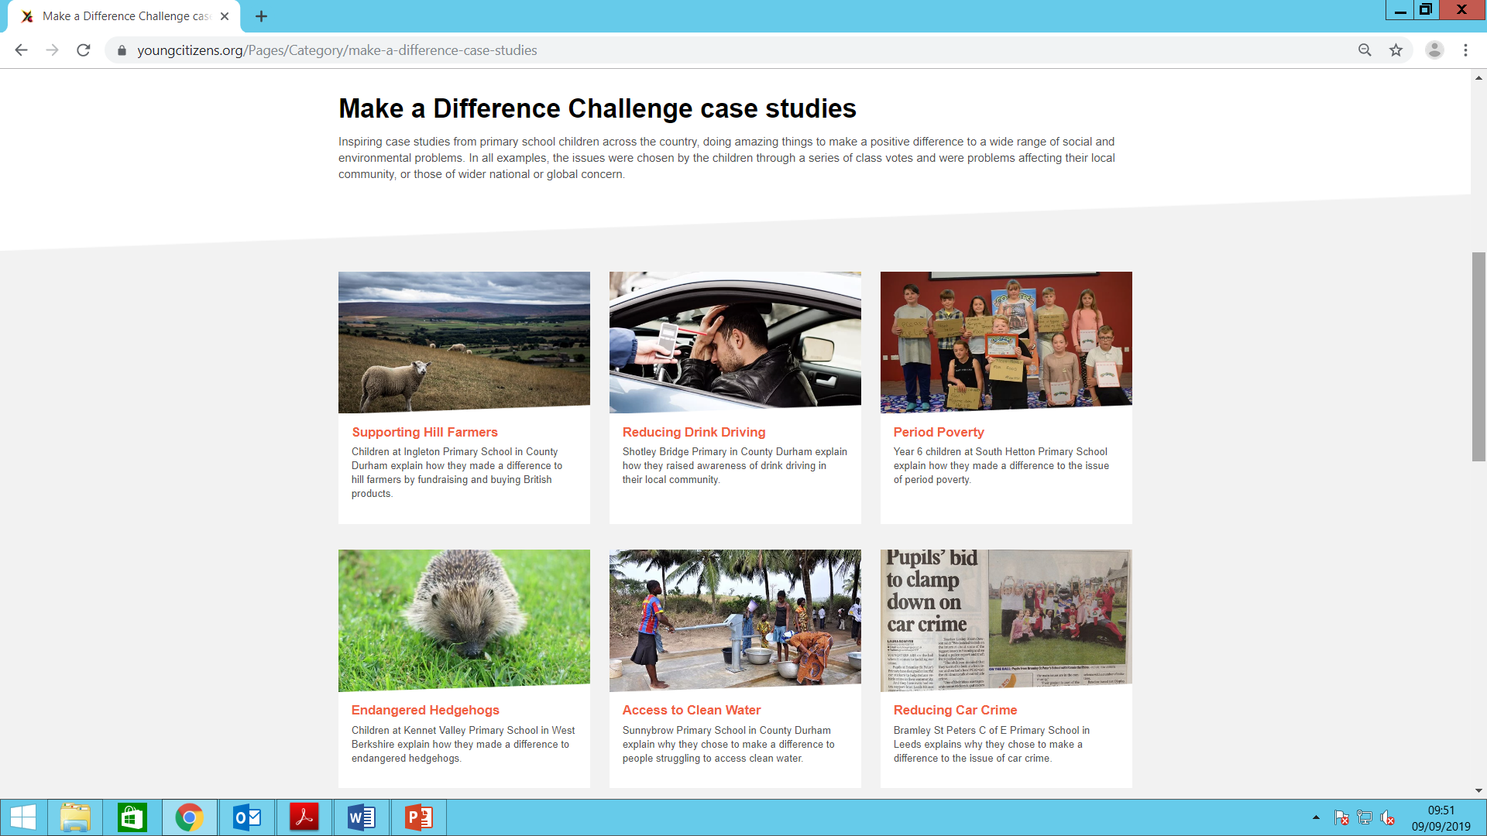
Make a Difference Challenge
Case Studies
Notes:
For other examples and case studies of projects primary schools have developed for their Make a Difference Challenge, visit our website where you will find a whole community of like minded schools supporting hundreds of children around the country to ‘Make a Difference.’
https://www.youngcitizens.org/Pages/Category/make-a-difference-case-studies

Slide 5
How does the Make a Difference Challenge work?
Ongoing support from YC
Children carry out social action project
Children evaluate and celebrate their project
Children research cause and decide on course of action
Teacher training programme: online or face to face
Teacher uses new knowledge and tools to guide and support children in choosing a cause
Notes:
How does the Make a Difference Challenge work?
The programme starts with a comprehensive, CPD certified, training programme for participating teachers. The training introduces teachers to a structured framework, based on the Belle Wallace TASC Wheel, explores the concept of child led learning and provides activities and tools to use back in the classroom.
Once in the classroom, teachers use what they’ve learnt to facilitate the project process with a class or group of children either during curriculum time, or running the project as an extra-curricular activity. Pupils start by exploring and then voting for the social or environmental issue they feel most passionate about.
The children then carry out extensive research into the issue they’ve identified before suggesting potential solutions; these might include actions such as raising awareness, volunteering/practical support, fundraising, social enterprise - or a combination of all of these!
Children take the lead in carrying out their social action over a period of time, with the support and guidance of their teacher.
The teacher can access further support from Young Citizens as it’s needed: this might be advice on how to ensure the pupils’ ideas are achievable and realistic, or help with writing a press release and getting publicity, or simply to check that they’re on the right track.
The social action project is then evaluated and celebrated – perhaps at a special event including key stakeholders, or simply through presentation at a school assembly.

Slide 6
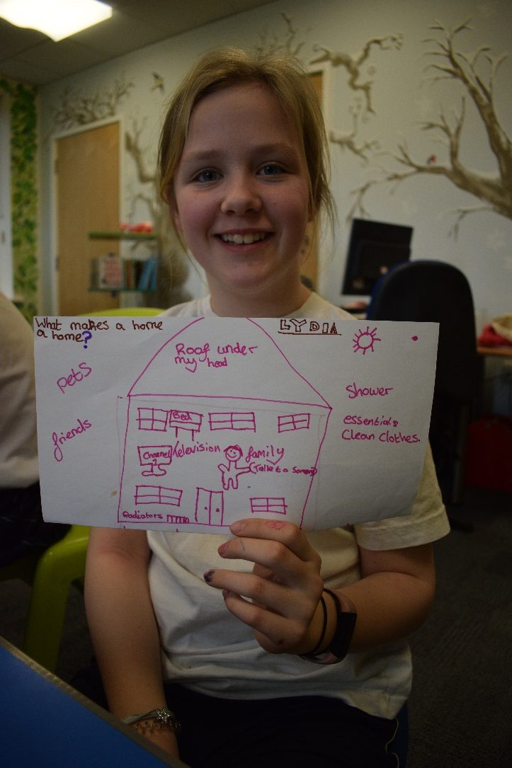
Who is it suitable for?
Whole year group
A class
A few children
Cross curricular topic
After SATS
Extra support or intervention
After school club
School Council
Notes:
The Make a Difference Challenge can be used with a whole year group, a class, or just a few children. We’ve seen it used as a cross-curricular topic focus for a year group – for example as a post-SATS project for Year 6, or in a classroom situation with a group of children who require additional intervention to support them with behavioural or academic needs. In more recent times it’s becoming a popular focus for After School Citizenship-type clubs, or a way to structure the work of the School Council – it really can fit wherever you need it to – as a curricular or extra-curricular activity.
Initially the programme was designed to be used with upper KS2 children, but we also know it has been successfully used with groups of children as young as Reception age.

Slide 7
How can I take part?
Make a Difference Challenge: Annual Licence
Includes online teacher training
Licence to run the MADC Programme
Resources, lesson plans, case studies, certificates and other support materials
£85
For additional teachers
Online training, bite-size chunks
£50
4 hours CPD certified
Face to face training for up to 3 teachers
Tailored to your needs
Includes access to the Annual Licence package
£195
Only available in some areas
Make a Difference Challenge: Teacher Training Course
Make a Difference Challenge: Premium Support Package
Notes:
Until now, the Make a Difference Challenge was only available in selected areas of the country where we were able to deliver the training sessions. Thanks to #iwill and Pears Foundation funding, from September 2019 there will be the option to access this programme online, through via the Teachable platform.
There are 3 packages available to teachers, depending on where you are based and what you need:
Make a Difference Challenge: Annual Licence
This package comprises three main parts: an online teacher training course with CPD accreditation for one person, a licence to run the Make a Difference Challenge in your school (including a digital badge and certificate for your school), and additional resources such as suggested lesson plans, topical issues, case studies, a digital scrapbook and other support materials to use with your children. This package costs £85 with a discount on renewal in year 2.
Make a Difference Challenge: Teacher Training
The online teacher training course is available as a separate package for ‘additional’ teachers who also need to complete the training but whose school already hold an Annual Licence. Comprising a suite of bite-size sessions which guide you through our TASC wheel framework for social action projects, as well as exploring important topics such as child led learning, and safeguarding. The training costs £50 per person and is CPD certified by the CPD Standards Office meaning that students who complete the course receive a certificate and confirmation of having achieved 4 CPD hours.
Make a Difference Challenge: Premium Support Package
In this package the Make a Difference Challenge teacher training is delivered as a face to face course, meaning that it can be tailored to your specific needs (for example if you already have an idea of the kinds of causes that your children will want to champion). Up to 3 teachers per school may attend the training. Post training you will have automatic access to the Annual Licence Package. It costs £195 per school but please take note that this package is only available in certain parts of England – so please get in touch for more details if you are interested in this option.
Please note that all prices quoted are introductory prices correct at Sept 2019 and may be subject to change in subsequent years.

Slide 8
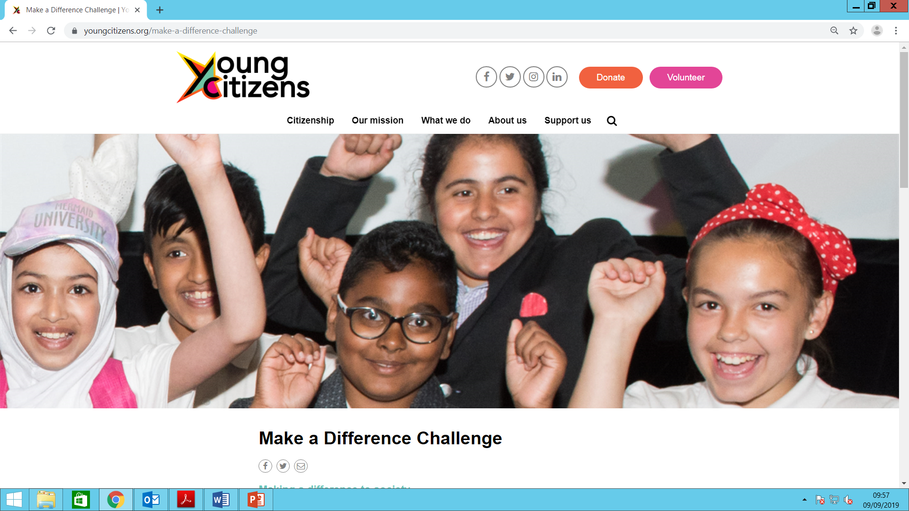
How do I register?
www.youngcitizens.org/make-a-difference-challenge
makeadifferencechallenge@youngcitizens.org
Notes:
To join our community of primary schools delivering the Make a Difference Challenge to children up and down the country visit:
www.youngcitizens.org/make-a-difference-challenge, or email makeadifference challenge@youngcitizens.org with your questions and queries.

Slide 9




Programme Endorsements
Notes:
Don’t take our word for it!
The strength of the Make a Difference Challenge was recently recognised with a grant from the Pears Foundation, a match funder awarding grants on behalf of the #iwill Fund, to expand the number of schools taking part in the programme.
In addition, Young Citizens has been awarded the status of “Impact Partner” by Generation Change - one of the first organisations to be awarded the status which recognises youth social action organisations that are deeply committed to achieving positive outcomes for both young people and communities through social action.
The Make a Difference Challenge was also shortlisted as a finalist in the Children & Young People Now Awards 2017 in the category of ‘Youth Volunteering and Social Action Award’ and shortlisted for the Child Friendly Leeds Awards 2018 in the category of ‘Communities and Schools Working Together’.

Slide 10


Further support?
Over 70 lesson plans
Assembly outlines
Subscription required
www.youngcitizens.org/go-givers
Focused on SMSC provision
Self review tool and verification services
Nationally recognised quality mark: Bronze, Silver, Gold
www.youngcitizens.org/smsc-quality-mark
Notes:
If you’re looking for further support in terms of an SMSC programme that supports PSHE & Citizenship, then why not look at our Go-Givers programme where you will find over 70 lesson plans on different issues and topical problems, together with assembly outlines and other activities to support children’s learning. Access is by subscription. The site address is www.youngcitizens.org/go-givers
And if you’re looking to review and improve your school’s SMSC provision then why not use the Young Citizens SMSC National Quality Mark self-review tool and verification service to help your school implement your vision and improve your delivery of pupils’ SMSC development. Successful verification leads to a nationally recognised quality mark at Bronze, Silver or Gold level standard. For more information on the SMSC quality mark visit www.youngcitizens.org/smsc-quality-mark

