Slide 1
Virtual LANs (VLANS)
Dr. Mohammad Adly

Slide 2
Virtual LANs VLANs
  Segment physical switches into two or more virtual switches
  VLANs can span multiple switches
    Sometimes vendor-specific
  Need some form of routing to tie VLANs together for connectivity
    Router
    Layer 3 Switch

Slide 3
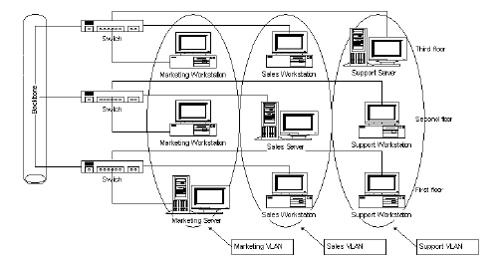
VLANS

Slide 4
Thank you

