Slide 1


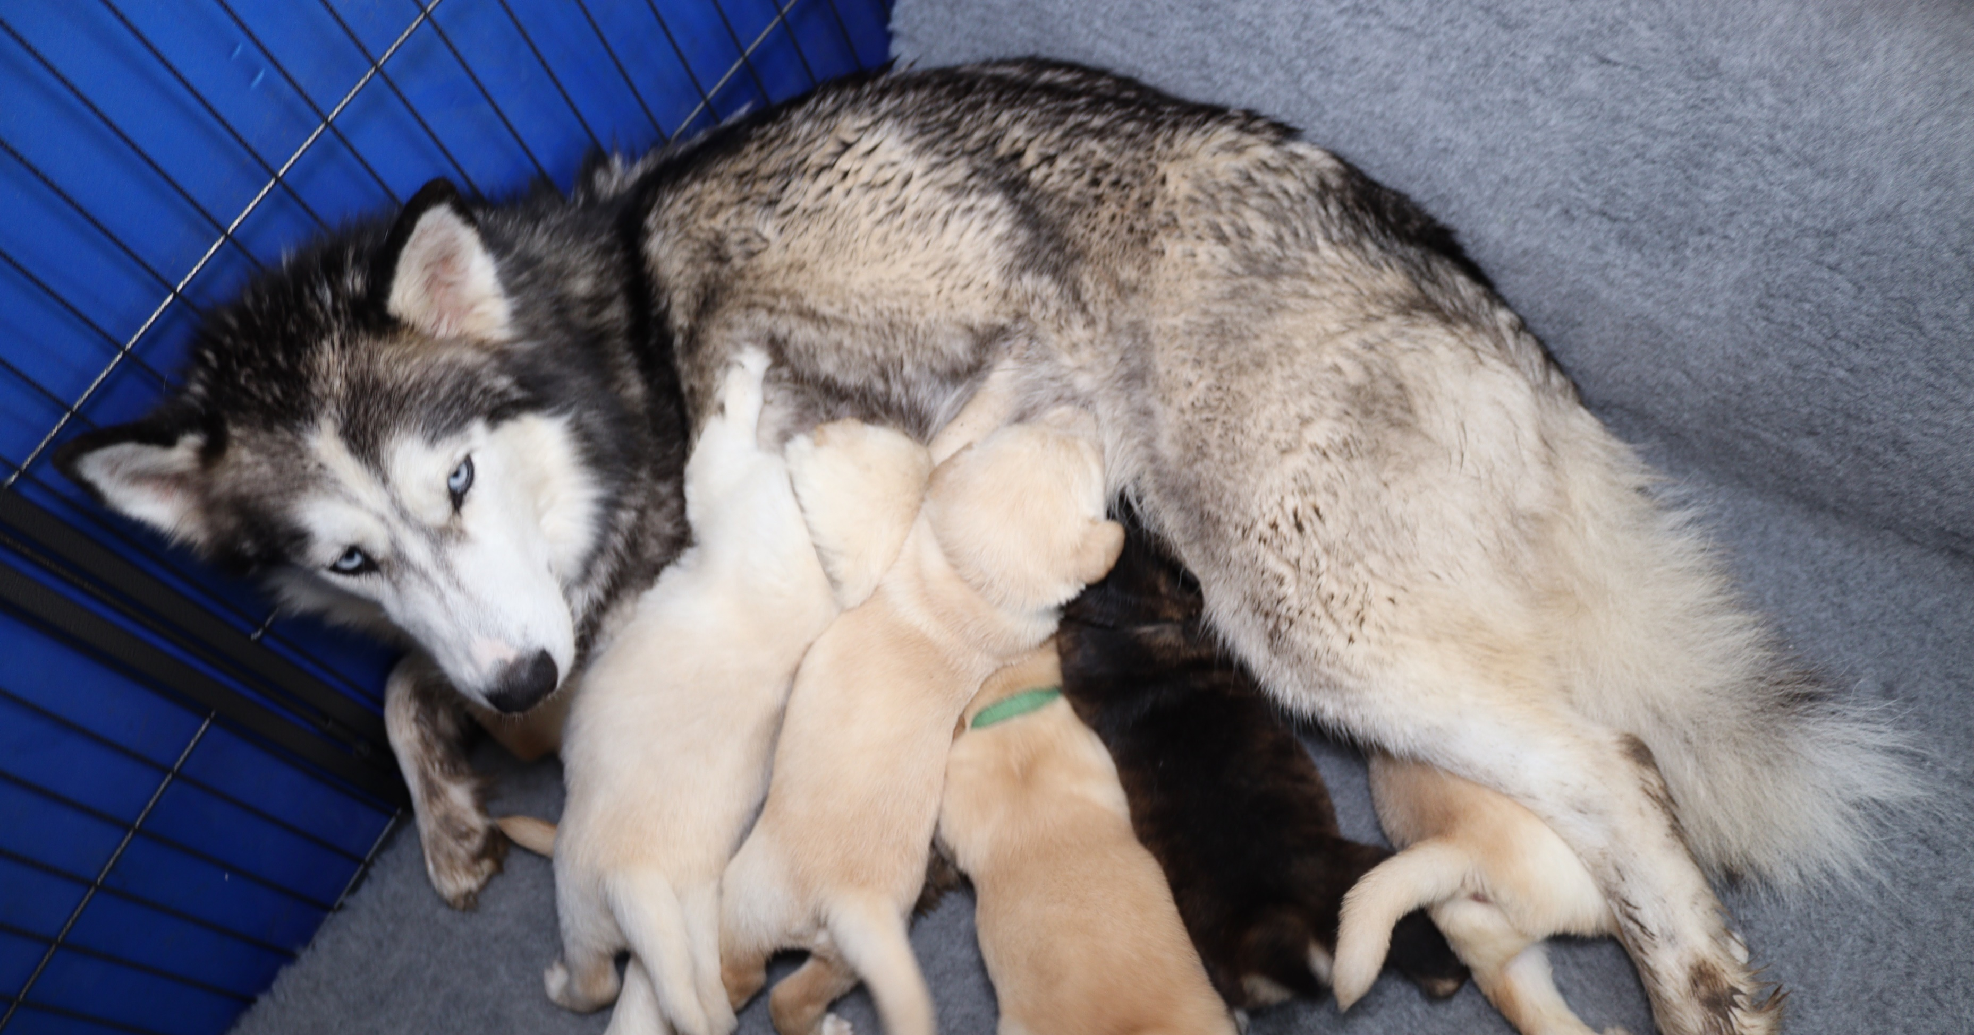
Key Principles for a Brilliant Partnership Lifestyle for you and your puppy.
Presented by Sonia Gager-Tomkinson

Slide 2

Partnership Principles
The partnership principles, if followed diligently, will supercharge your relationship with your puppy.
This approach will be effective with all puppies, no matter their breed.

Slide 3
Key Principles for a True Partnership Lifestyle
Safe, Calm and Happy – for both partners.
Trust.
Communication.
Being intentional and fully present.
Being a loving leader.

Slide 4
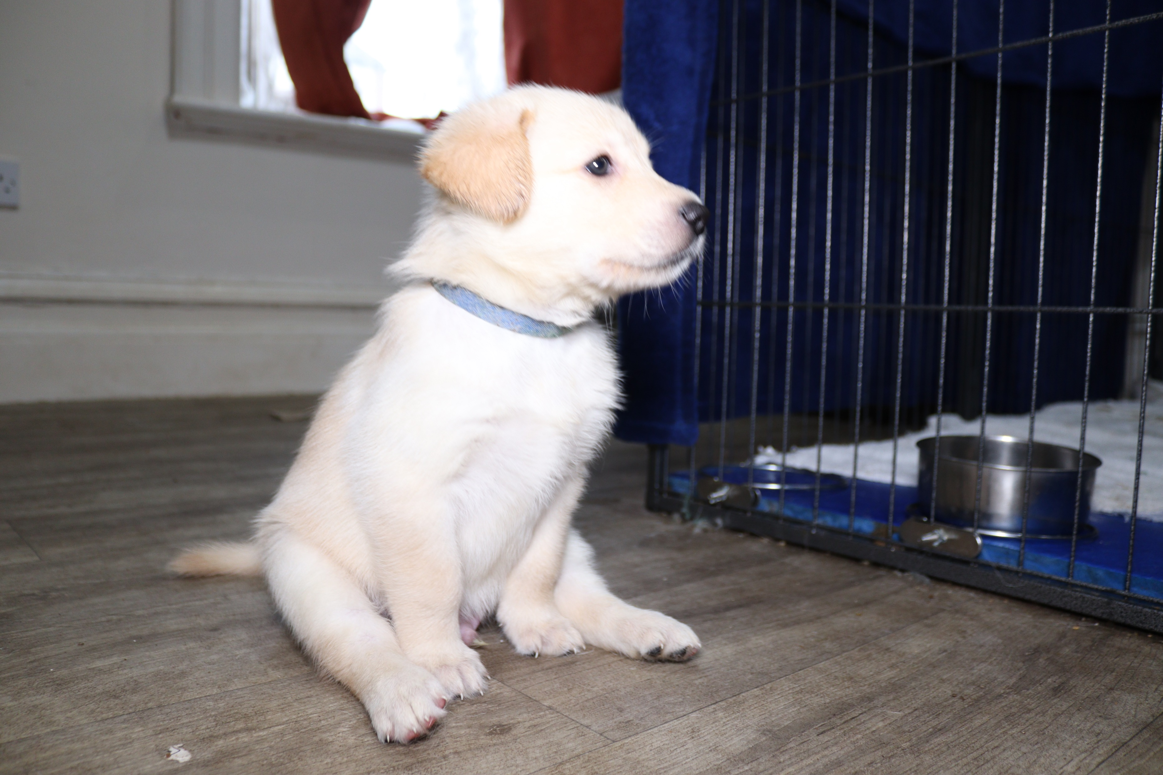
Husky Rescue and Rehoming
Puppies come from a variety of backgrounds, they have all sorts of personalities, ages and energy levels.
My focus to get you started is Safe, Calm and Happy.

Slide 5
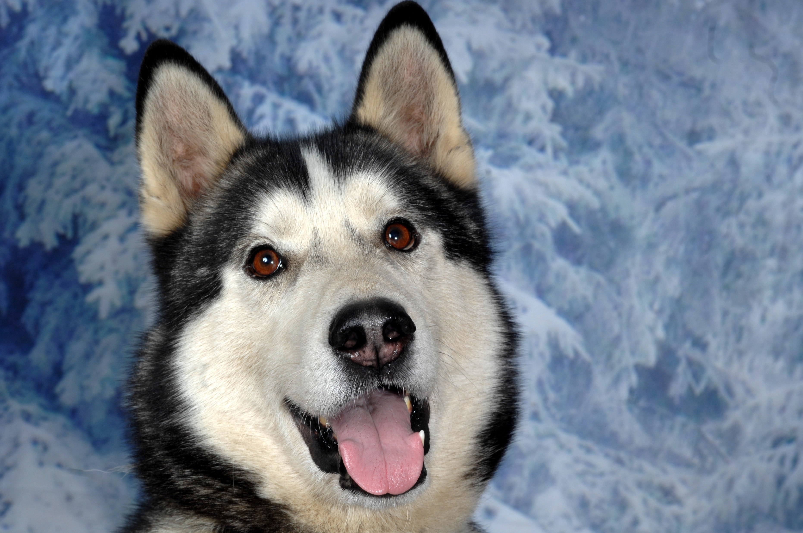
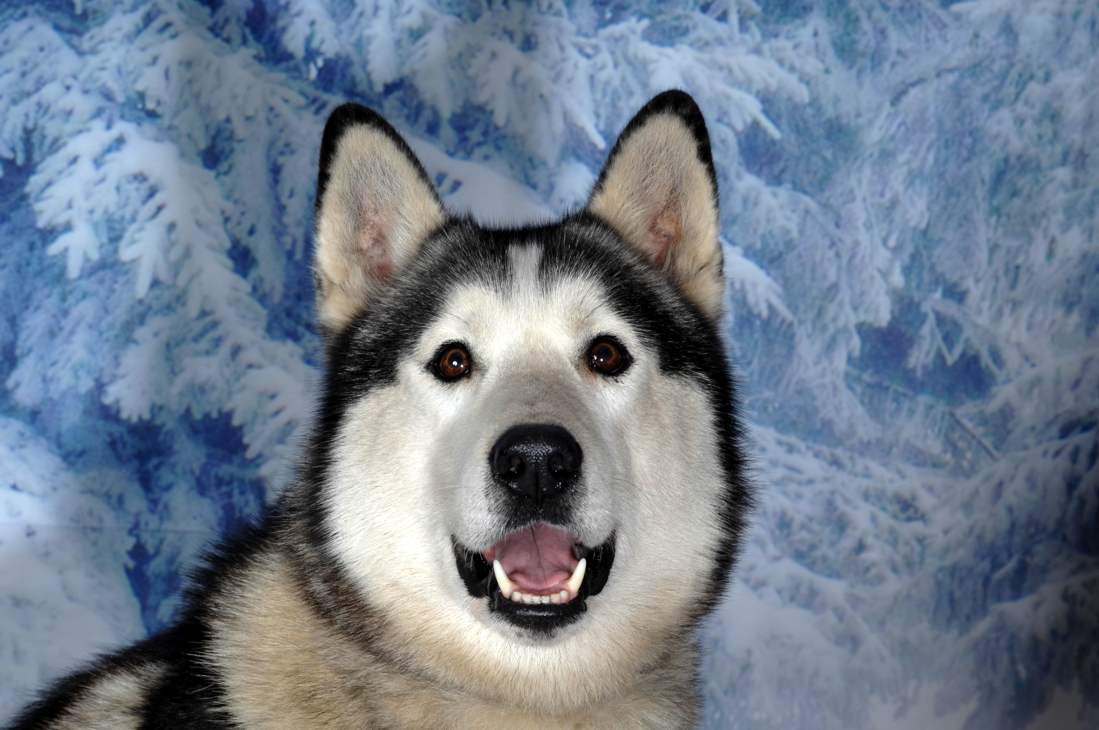
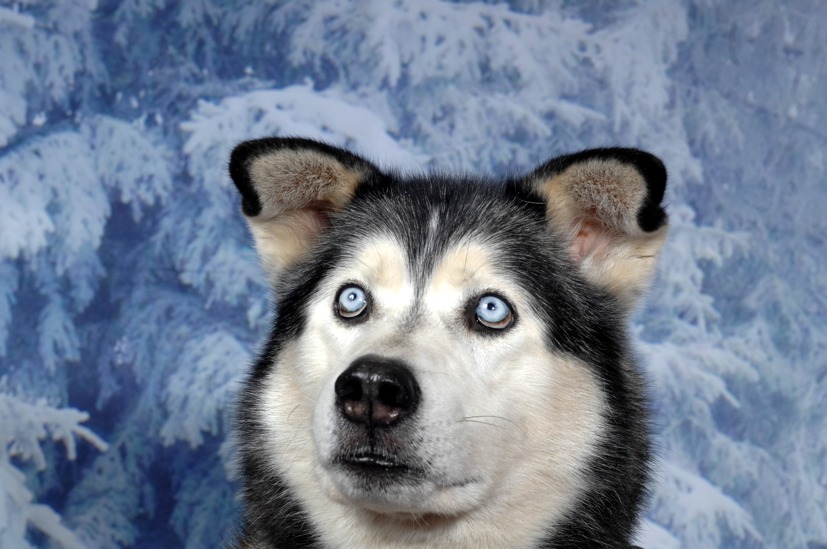
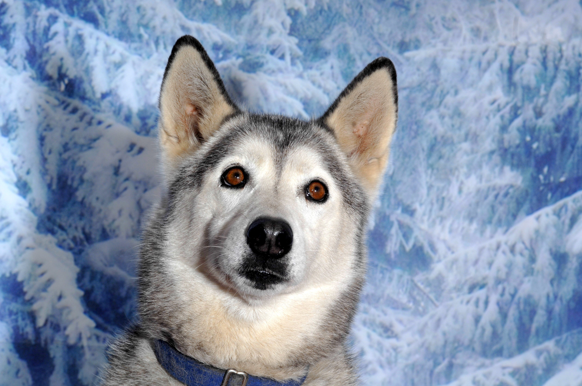
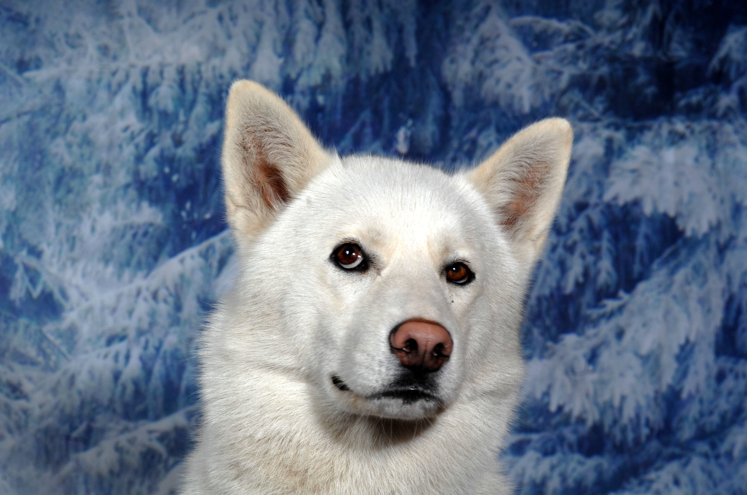
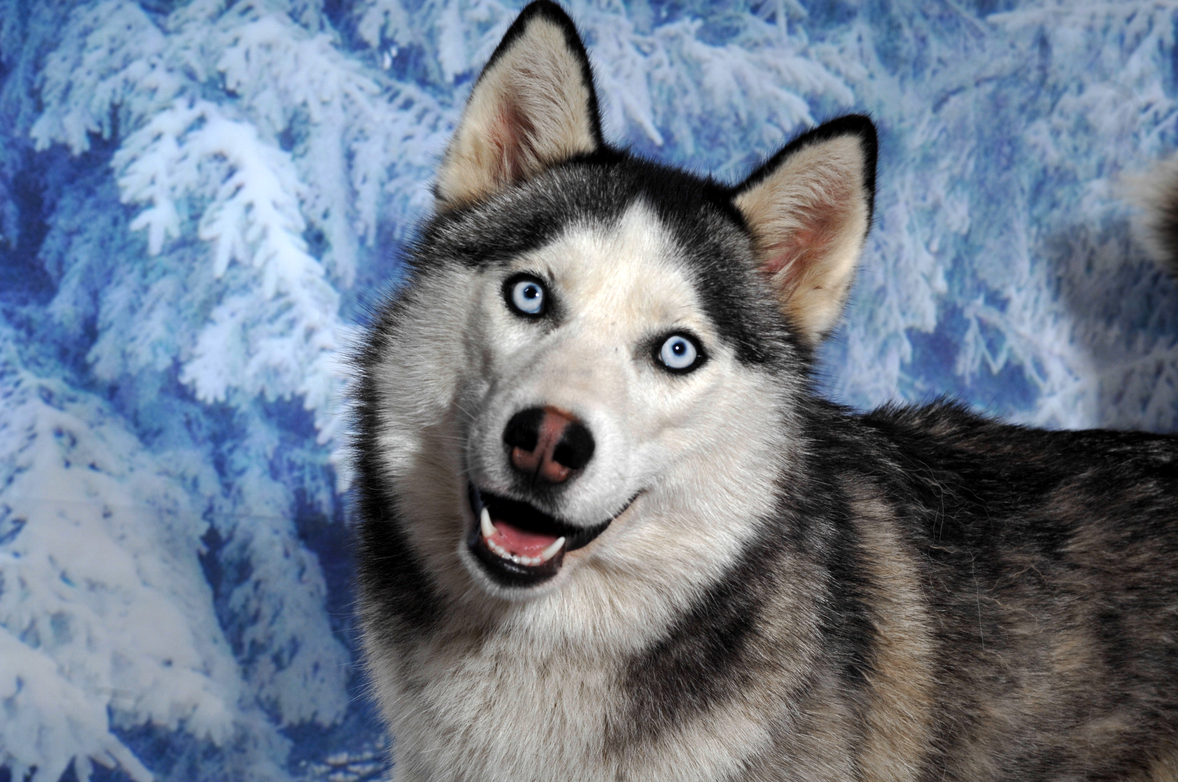
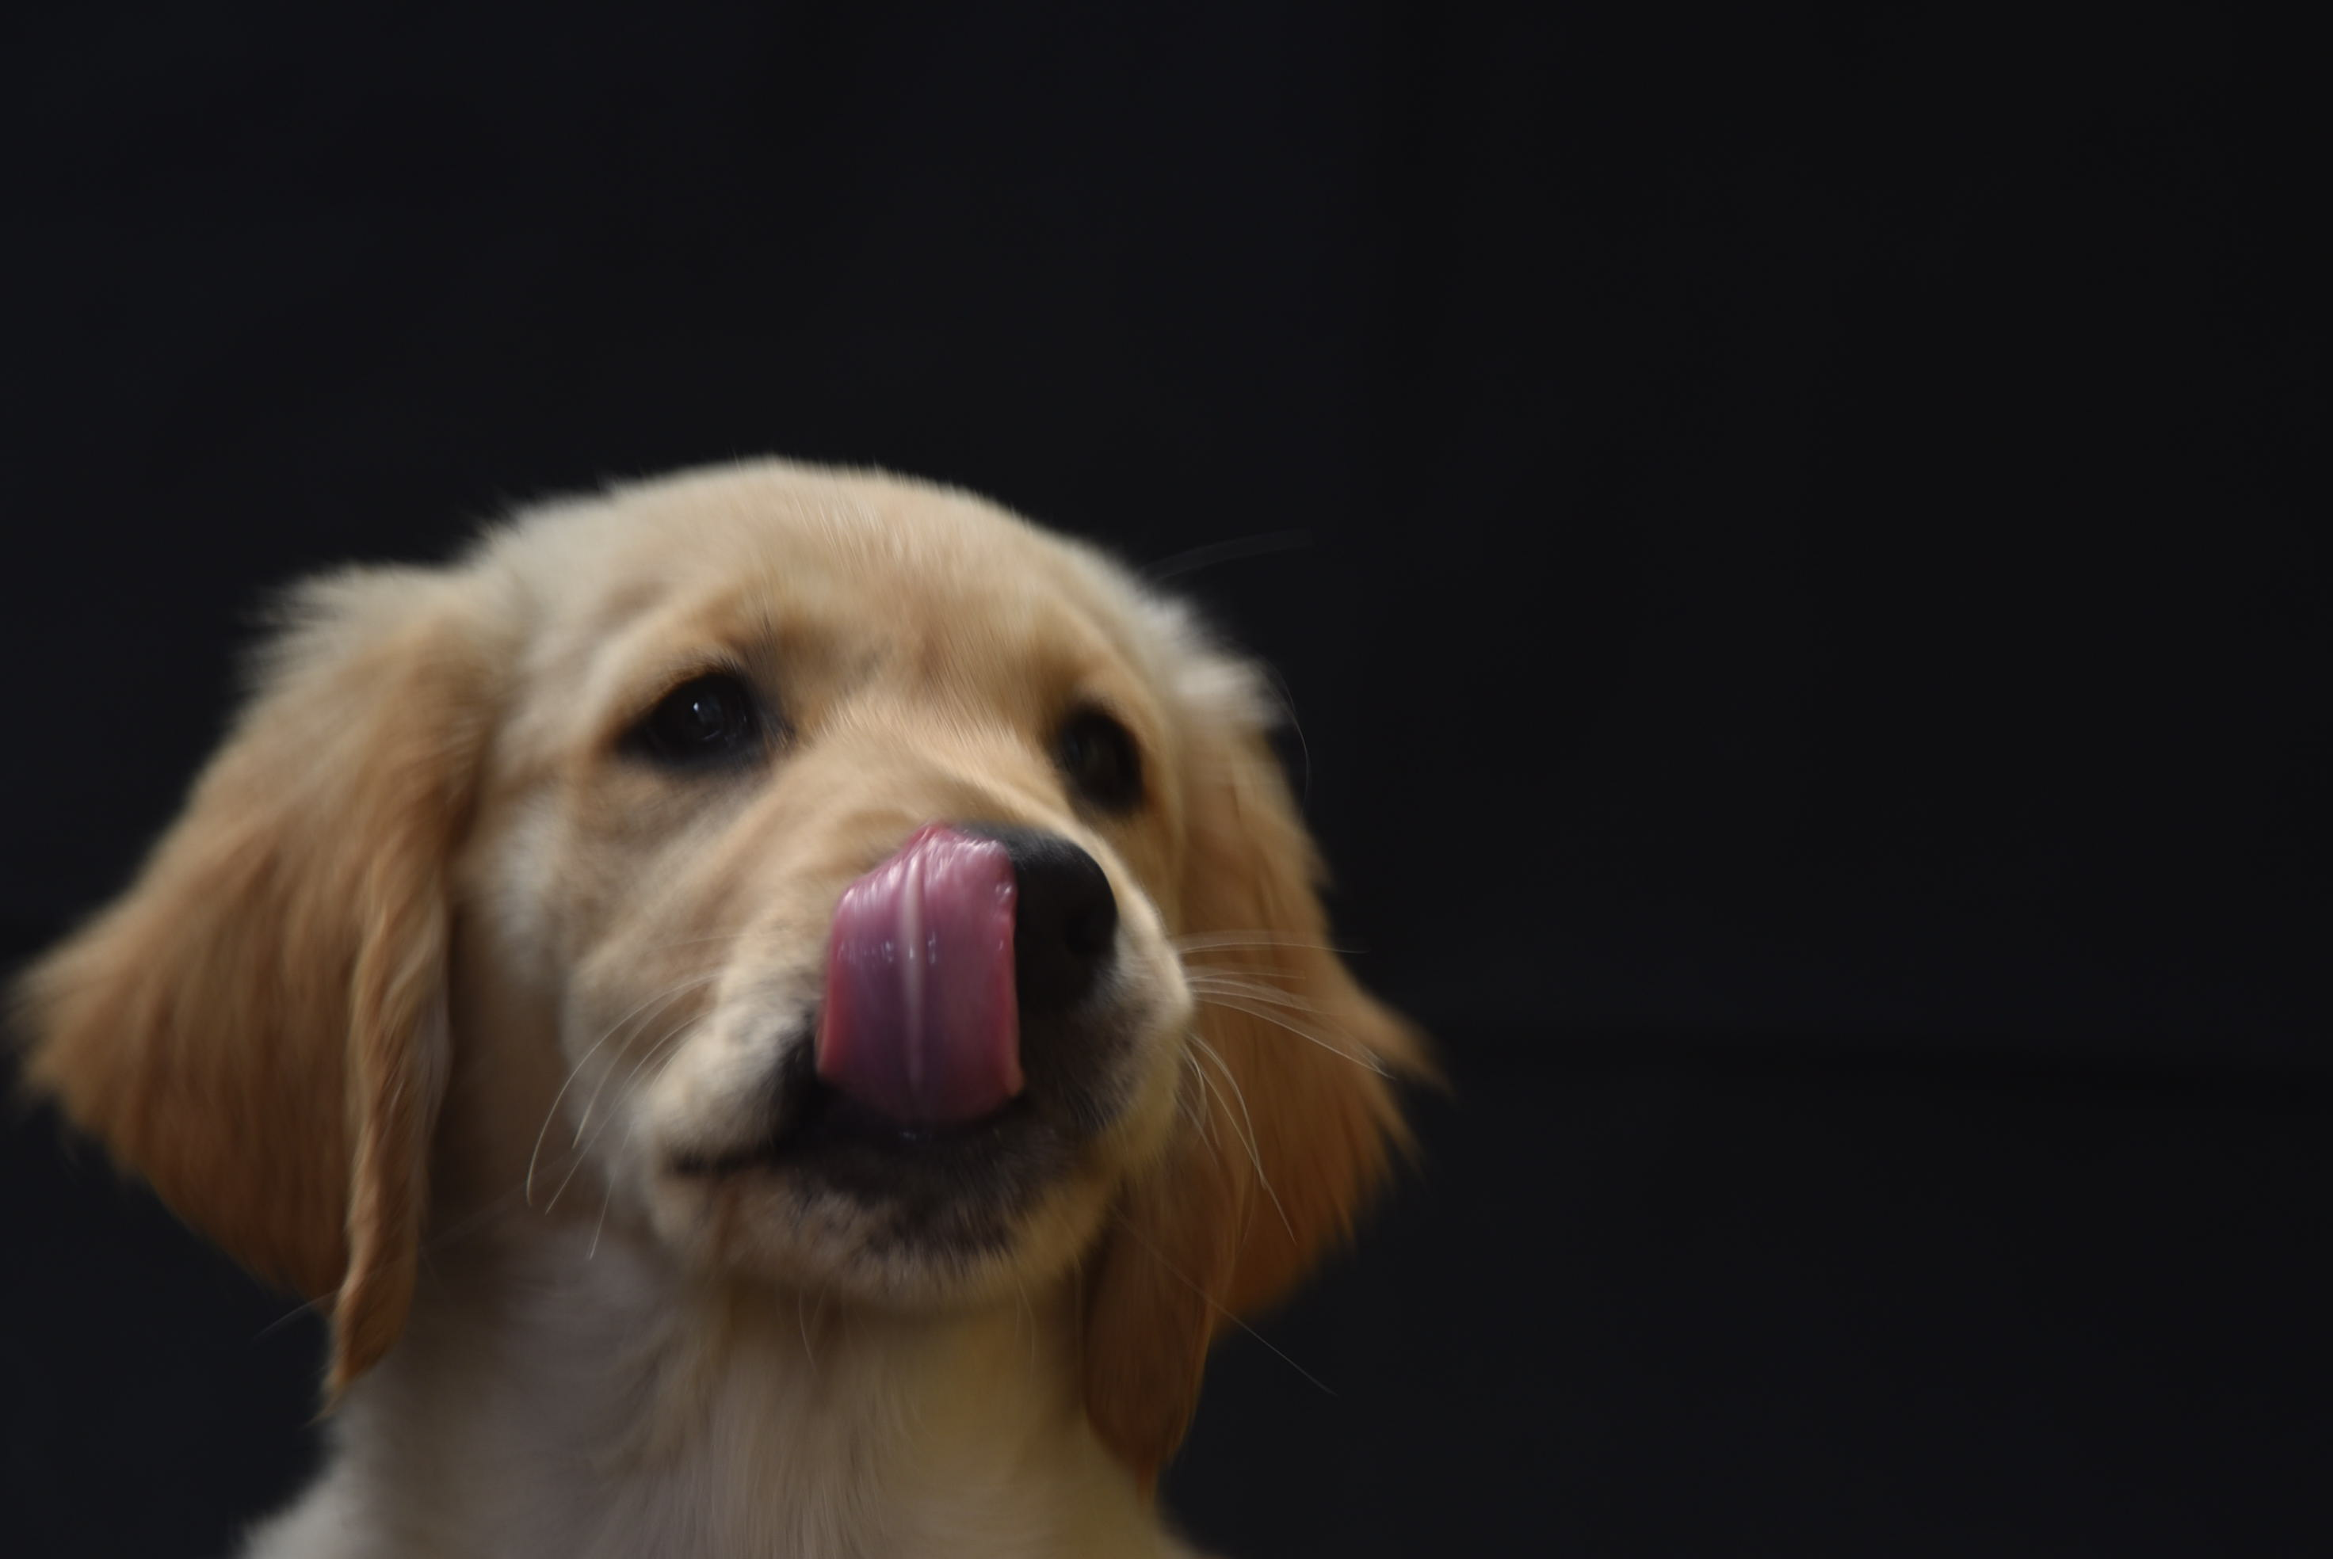

Examples – Litter Siblings
Shadow & Blade
Ice & Luna
Ghost & Mischief
Bella & Sandy

Slide 6
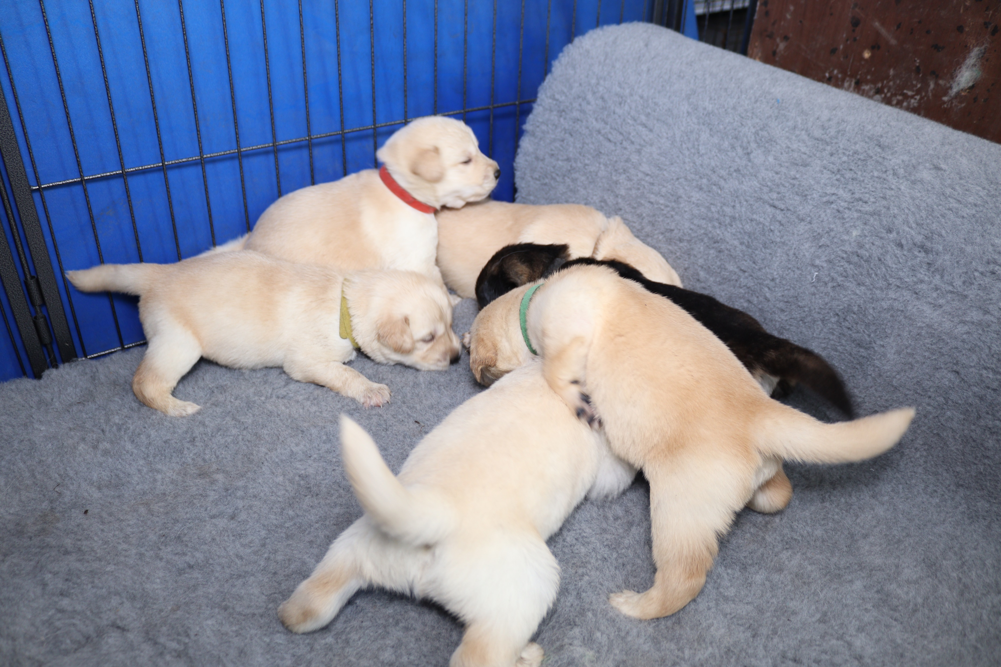
Litter Siblings

Slide 7
SCH Focus – Keeping Safe, Calm and Happy
Where, When and How to walk.
Five minutes per month.
How do you feel about ditching the walks for a while?
We need to work on having our pups used to the harness and leads before we go out walking.

Slide 8
Essentials of Safe, Calm and Happy

Slide 9
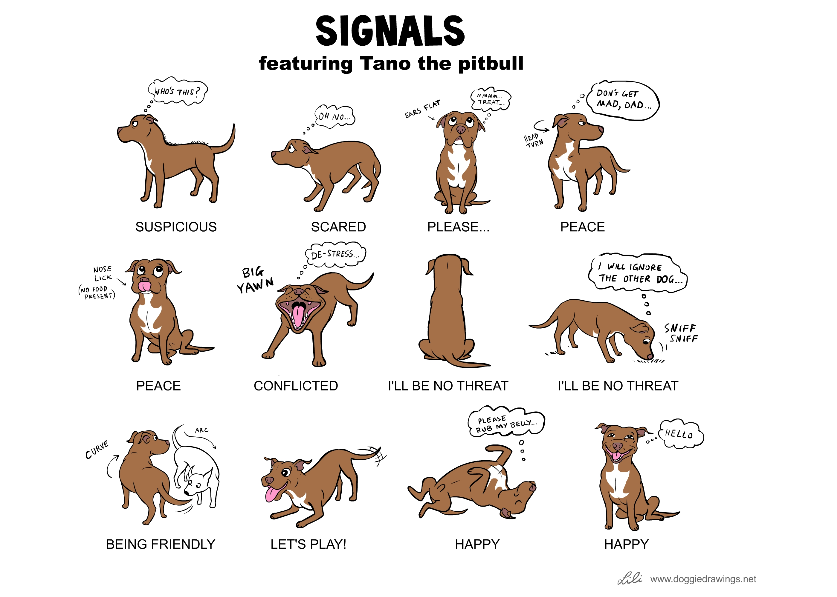
Pay attention to subtle body language
The whispers before the shouting.
Pay attention to our intuition, our gut feeling.

Slide 10
Work with the dog in front of us.
Think about the individual personality of our dog and our own personality.
How may one be affecting the other.
Example: With Bella and Sandy, I need to be very soft with my energy with Bella, keep the pressure off, no expectations, no agenda.

Slide 11
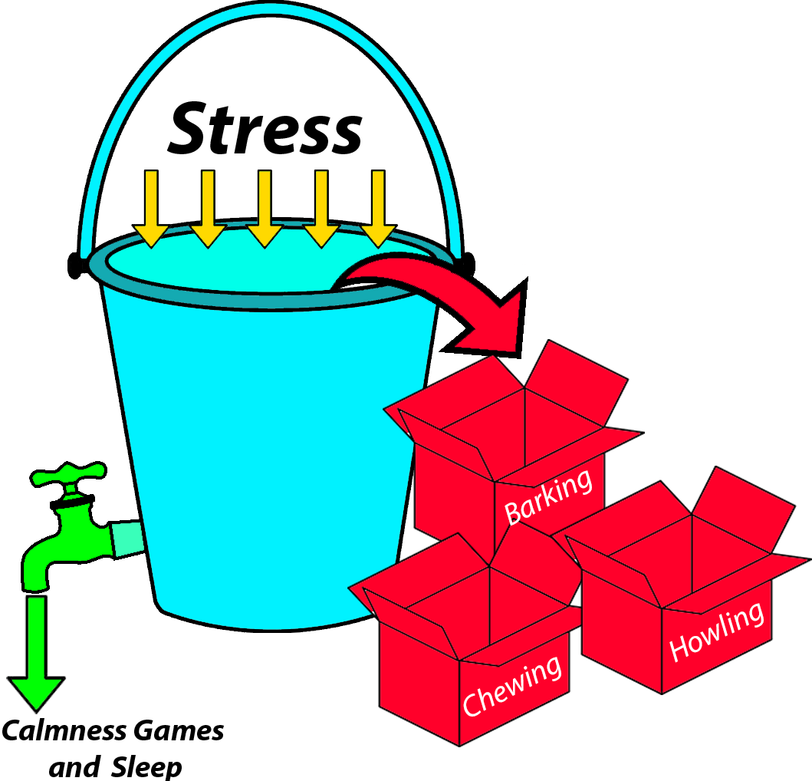
The Stress Bucket
Consider how full is the bucket of stress hormones?
Remember we both need to be SCH. How full is your bucket?
What happened yesterday? The day before? Earlier today?
What other factors could be paying into the bucket?
Diet, Pain, itchiness, Gastro intestinal issues, hormones, calmness and rest.

Slide 12
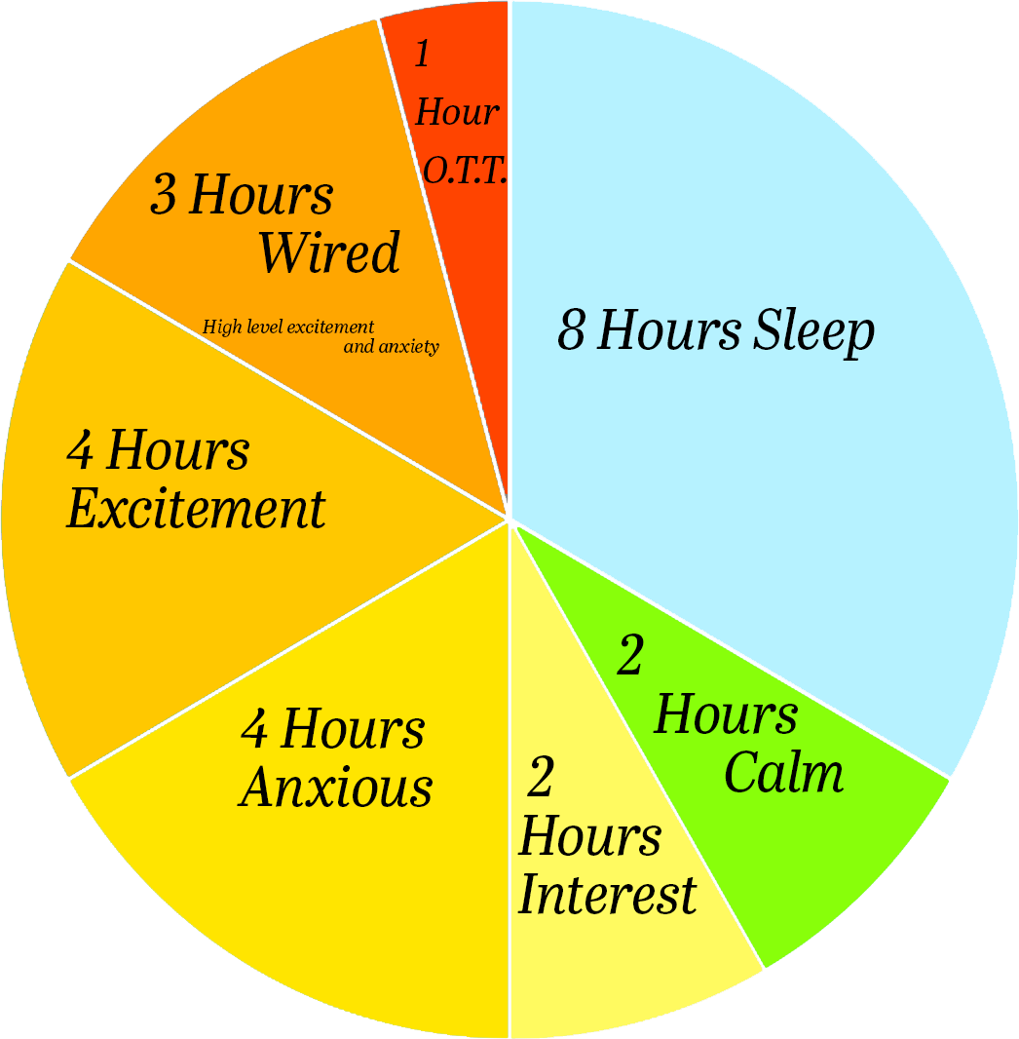
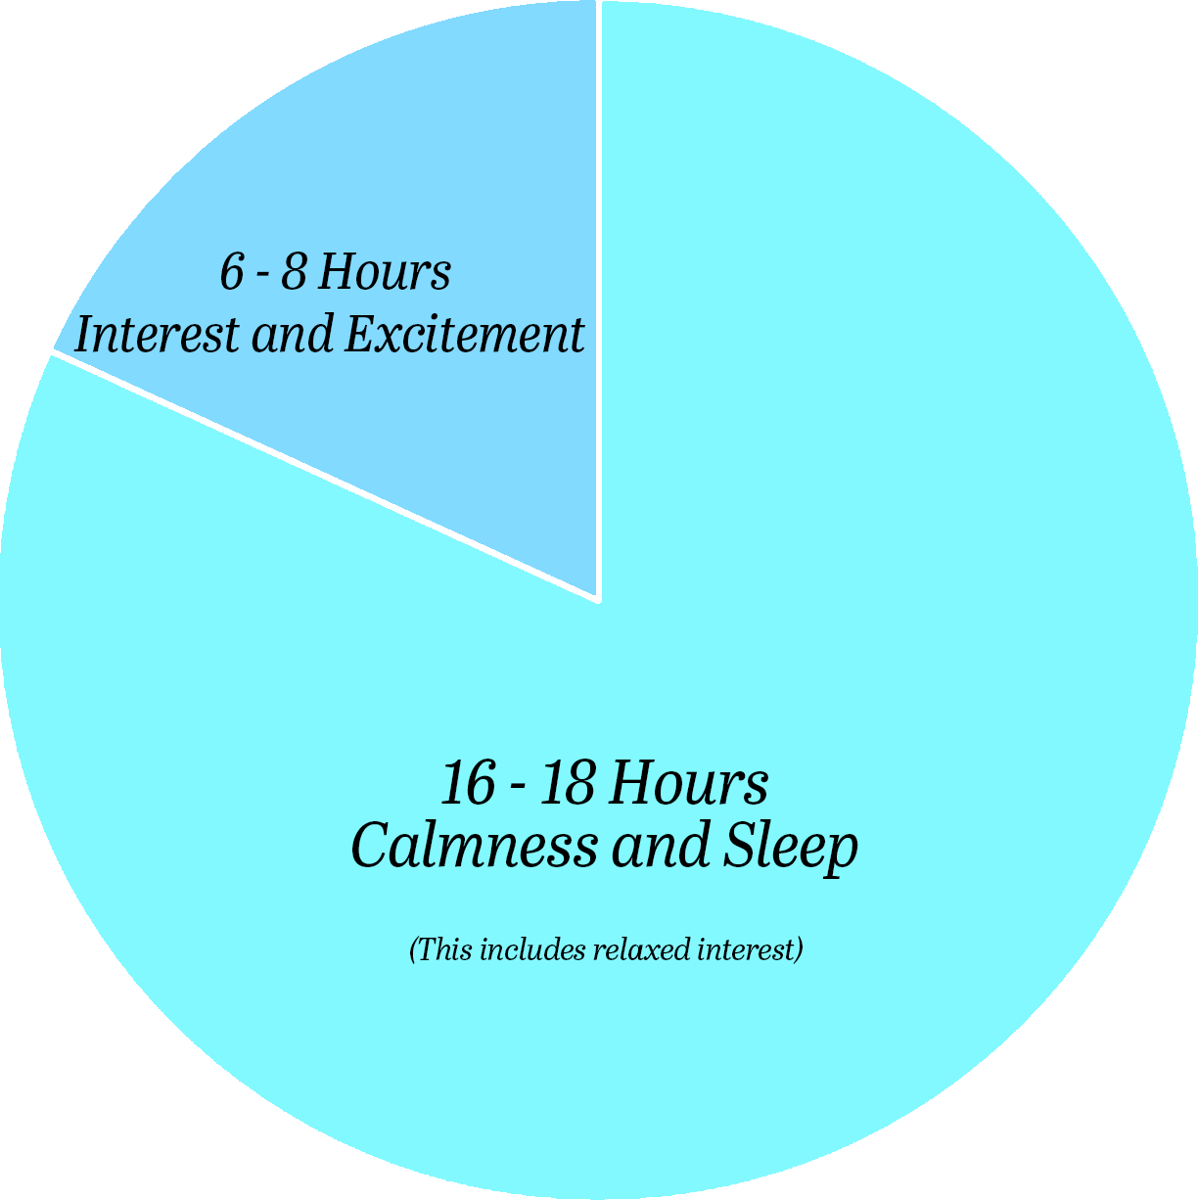
How active is your dog?
What does the Activity Chart look like for your puppy.
Puppies only need one hour of high excitement (orange) activity per day and 20 hours sleep.
We want to avoid the red areas at all costs and really want to stay in the green zone.
VS

Slide 13
Keeping Both Partners SCH
Use of brain games e.g. scent work in place of more exercise.
The value of long leash Sniffaries.
Being fully present and intentional

Slide 14
Keeping SCH
If we keep putting our dogs in situations where they feel uncomfortable (e.g. walks) and feel they need to actively cope and take charge themselves (e.g. lunging and barking) then we will be leaking TRUST from our relationship.
When our dogs behave in this way there is a Trust leak felt by us – we may think our dog needs ‘fixing’, we put labels on them e.g. Reactive, Aggressive, Dominant,
We are likely to be anxious and micro-manage them. We take away their agency.
We have the opportunity with a puppy to start off on the right path and avoid the lunging, barking, spinning or other reactive behaviour.

Slide 15
Mirroring
Our dogs often Mirror our emotions and behaviour.
An essential step is for us to be honest with ourselves, develop self-awareness.

Slide 16
Digging Deeper
As we go through the course, we will come back to some of the principles we have mentioned and dig deeper.
If you have any questions or want to discuss anything during these presentations we can arrange one-to-one coaching calls or even discuss these in the live coaching sessions.

